Slide 1

Additively Manufactured Aerial Drone for Emergency Unmanned Surveillance (HERD-CU)
Test Readiness Review
Customer & Faculty Mentor: Prof. John Mah
Aziz Alwatban (Testing lead)
Mikaela Felix (Manufacturing lead)
Alex Fitzgerald
Ben Gattis
Godwin Gladison
Brady Hogoboom (Systems Engineer)
Amanda Marlow
Ella Mumolo
Devon Paris
Adam Pillari (Safety lead)
Jake Ramsey (CFO)
Linus Schmitz (Program Manager)
Overview
Schedule
Test
Budget
Notes:
Hi everyone and welcome to the CDR for team AMADEUS. Thank you to everyone for coming out today. My name is Linus Schmitz and I am the Program manager for the team and with me are Aziz, Alex, Godwin, Brady, Ella and Adam .
Linus
<15 seconds

Slide 2
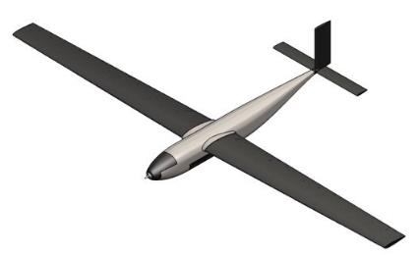
Project Description
The purpose of AMADEUS is to provide a low cost, high endurance, human portable, and rapidly deployable UAS capable of various missions in austere environments.
Missions could include:
Aerial radio/cell repeater
Search and rescue
Reconnaissance
Basic overwatch platform with camera
Use in Fire departments, SAR, Military and other government agencies
Overview
Schedule
Test
Budget
Notes:
Linus
The goal of the project was to create a low cost, high endurance uav. It had to be human portable and rapidly deployed which would allow it to be used in a variety of missions.
<20 seconds

Slide 3
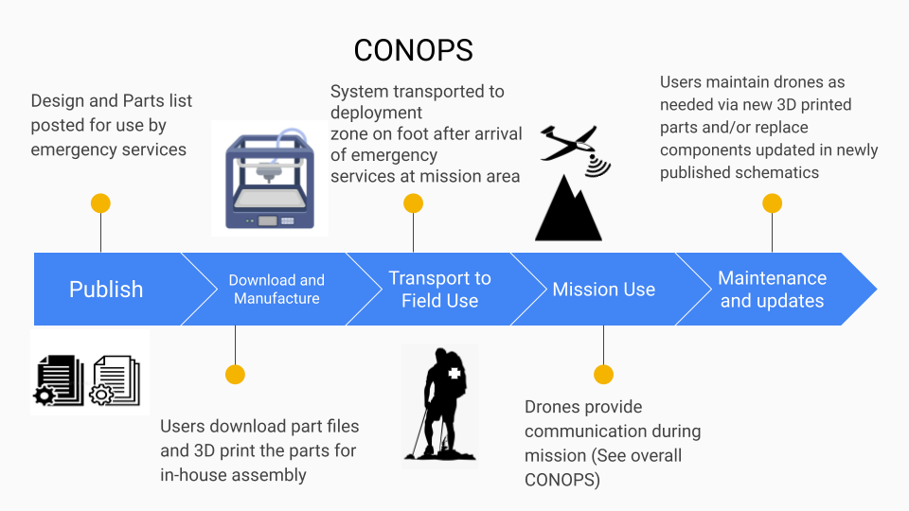
CONOPS
Overview
Schedule
Test
Budget
Notes:
Linus
Our final project objective was to create documentation such that an end user can recreate the aircraft we design using off the shelf goods and additively manufactured methods.
<15 seconds

Slide 4
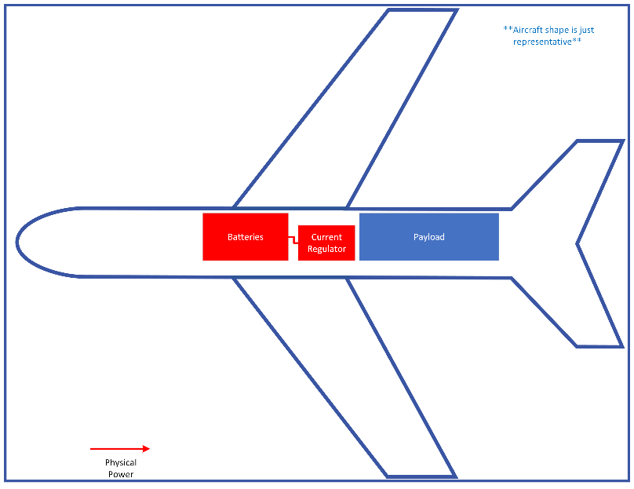
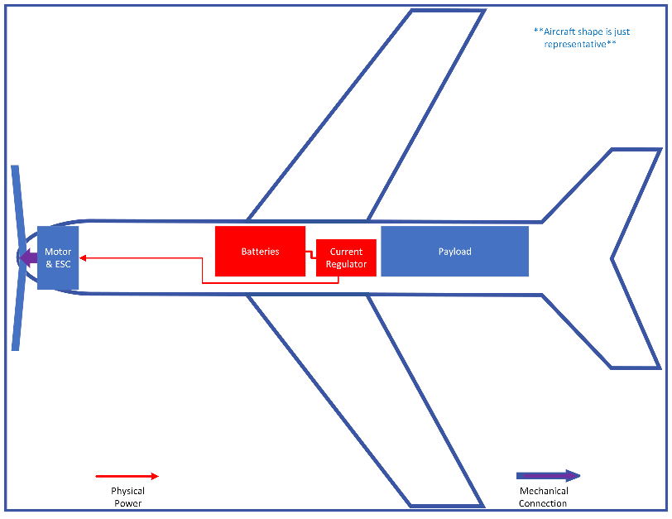
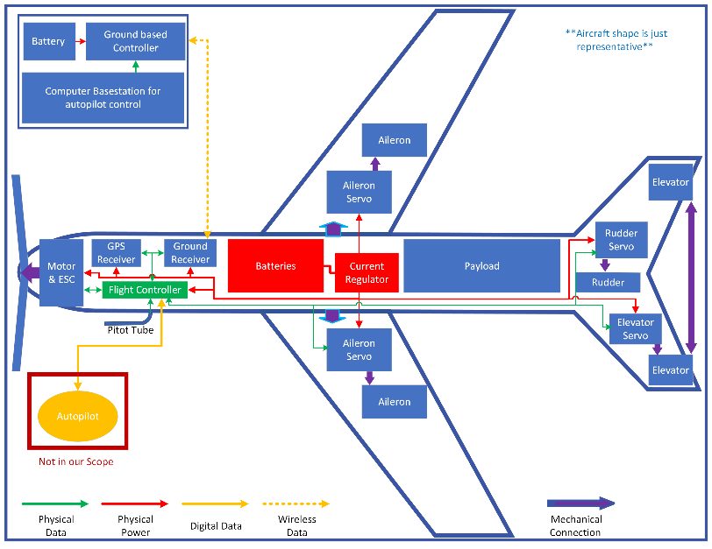
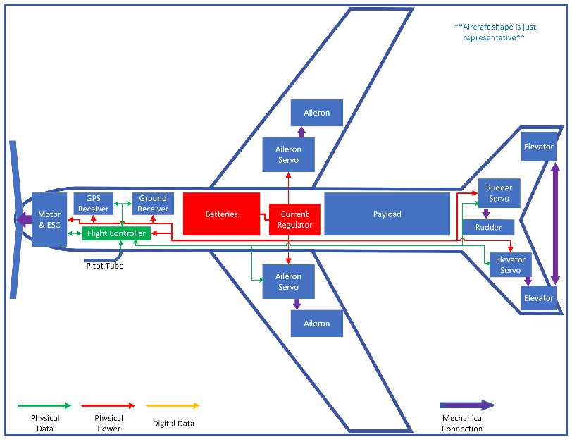
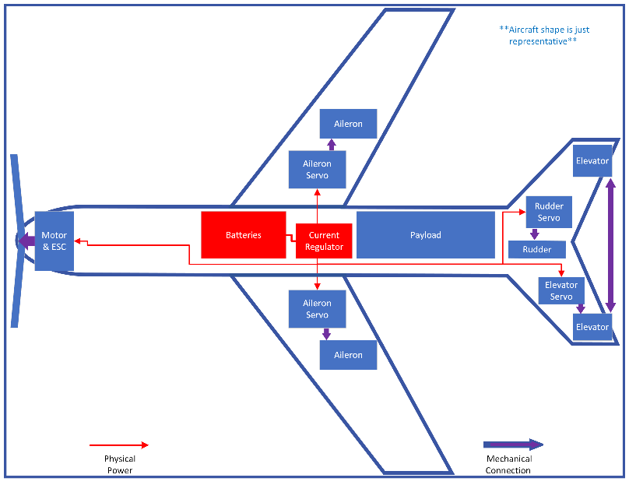
Single battery pack to power all aircraft systems
Payload & battery are the two heaviest items on the aircraft
Motor is largest power draw
Large propeller to maximize efficiency
ESC & BEC built into one
Simple flight surfaces.
Yaw, roll & pitch control
Connected elevators to lessen complexity
Flight computer for autopilot, navigation & control
Pitot tube for more accurate airspeed
GPS & ground controller receivers
Autopilot (COTS) will also help with stability
Ground flight controller
Ground autopilot & computer
Detachable wings
Overview
Schedule
Test
Budget
Notes:
Linus
First and foremost on the aircraft, the batteries payload and aircraft structure (including fuselage, wings and tail) account for the greatest portion of the aircraft weight.
Then of course, the propulsion and electronic speed controller in order to remain aloft.
Next come flight control surfaces that provide roll, pitch and yaw control.
Then comes the brains of the aircraft in the form of a flight controller, which will communicate with all the control surfaces, motor, battery and outside the aircraft. This includes GPS data, guidance data from a ground controller and a pitot tube for more accurate inflight airspeed.
And finally a consumer autopilot will be loaded onto the aircraft and the necessary ground equipment set up to control the uav while in the air.
Linus
~60 seconds

Slide 5

Current Design Solution
Physical characteristics:
Total Aircraft Weight: 12.65 kg
Wingspan: 3.6 m
Length: 1.75 m
Height: 0.534 m
Max Payload: 3 kg
Flight characteristics:
Cruise speed: 21 m/s
Endurance: 0:50 hrs
Construction characteristics:
Light Weight PLA
Carbon Fiber reinforcing spars
Foam (wings as off-ramp/backup)
Additional Components:
Launcher
UAS controller
Autopilot computer
Total Cost for project: $4114.80
Project Targets:
Up 2 hr endurance
3 kg payload
Overview
Schedule
Test
Budget
Notes:
Linus
The overall design of AMADEUS is that of a powered drone with a glider profile. A high wingspan to length ratio will allow for flight at low speeds, while carrying the needed payload for the mission. While this design has an estimated endurance of only 50 min, this is a pessimistic first estimate, and we believe that it may be possible to extend this after initial testing confirms the capabilities of the design. We will be discussing this item in depth later in the presentation. Finally, our current project cost is well under budget at this time, so we are confident that we will be able to continue prototyping and testing in the spring without running into budgetary concerns.

Slide 6
Critical Project Elements
Aerodynamic Efficiency + Performance
FR.2 + FR.6
Interdependent with materials and portability
Structural Support
Materials
Portability
Requirements/scope from iron triangle
FR.1, FR.6 and FR.9
Interdependent with Structural support, materials, and aerodynamic efficiency
FR.1, FR.3 through FR.8
FR.3, FR.5, and FR.8
Interdependent with materials and portability
Scope, cost, and schedule from iron triangle
Interdependent with structures, aerodynamics and portability
Requirements from iron triangle
Cost and requirements from iron triangle
Overview
Schedule
Test
Budget
Notes:
Linus We have identified four Critical project elements, without which the design will not be successful.
First and foremost is the aerodynamics which ties into the requirements for endurance and deployment.
Next is structural design which touches on ALL the requirements except endurance and remote operation.
1: The UAS must have a high aerodynamic efficiency that ensures natural stability, long endurance for minimal orbit swaps, and little energy losses at operation altitudes. Optimizing lift to drag ratio will ensure performance in all mission stages (launch, orbits, landing).
2: UAS structure must support its own weight in addition to modular payload. Structures will accommodate the aerodynamic loading and any other environmental loading without

Slide 7
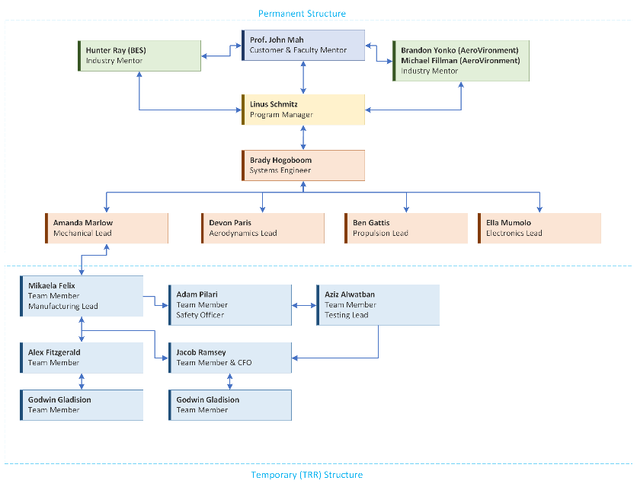
Overview
Schedule
Test
Budget
Notes:
Our Organizational structure has not changed significantly from the PDR structure; however, we foresee that there will be more significant shifts in the spring semester as testing begins and requires different resources.
< 15 seconds

Slide 8
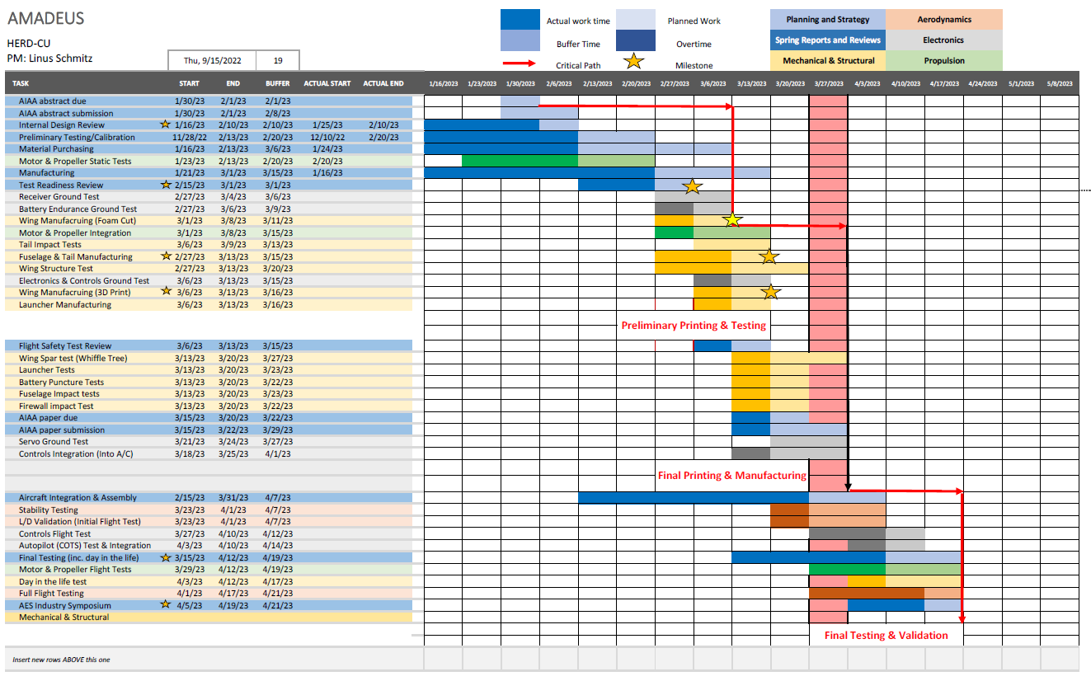
Overview
Schedule
Test
Budget
Notes:
Speaking of project timelines, the Gannt chart again allowed us to highlight the key aspects and milestones of the project. Generally the spring semester is broken down into five sections:
Initial material testing, planning and reviews.
Secondary component testing and the beginning of manufacturing and assembled component testing such as the wings and combined propulsion system.
Design considerations and larger assembly tests as well as launcher and control systems tests.
Then final assembly and full system ground tests which must be completed prior to spring break.
And finally all flight tests and final reviews post spring break.
This last section is one of the most important given that it is required to validate any aerodynamic models and can not be completed until the full aircraft has been assembled.
~65 seconds

Slide 9
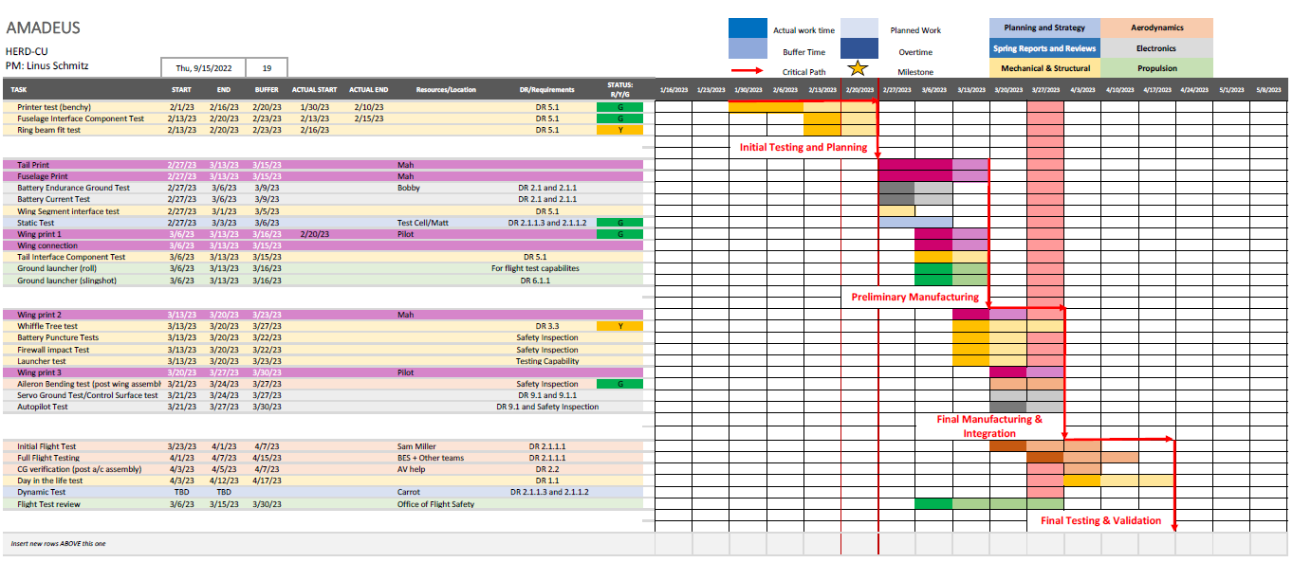

Overview
Schedule
Test
Budget
Notes:
Speaking of project timelines, the Gannt chart again allowed us to highlight the key aspects and milestones of the project. Generally the spring semester is broken down into five sections:
Initial material testing, planning and reviews.
Secondary component testing and the beginning of manufacturing and assembled component testing such as the wings and combined propulsion system.
Design considerations and larger assembly tests as well as launcher and control systems tests.
Then final assembly and full system ground tests which must be completed prior to spring break.
And finally all flight tests and final reviews post spring break.
This last section is one of the most important given that it is required to validate any aerodynamic models and can not be completed until the full aircraft has been assembled.
~65 seconds

Slide 10
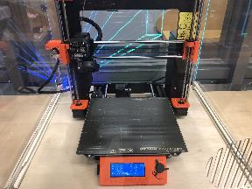
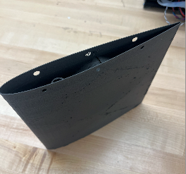
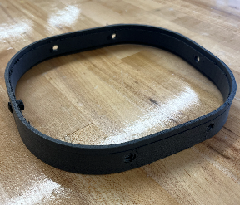
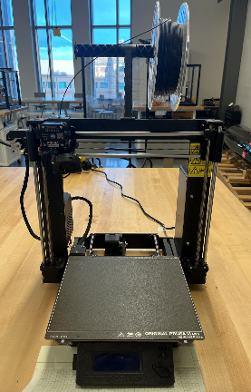
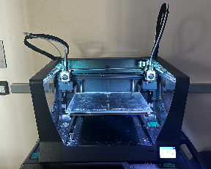
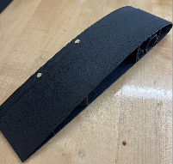
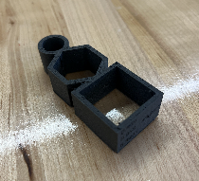
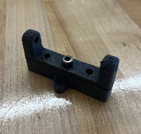
Manufacturing Status
3 printers at BTU Lab at ATLAS
Prusa Wing Section Tip
Fuselage Interface Test
Prusa i3 MK3 in N200
BCN3D in PILOT Lab
BCN3D Wing Section
Ring Beam Test Print
Heat Insert Interface
Overview
Schedule
Test
Budget
Notes:
Aziz
Calibrated BCN3D and Prusa
Changed printing orientation of wing section and will most likely not be needing PVA support in the BCN3D due to printing vertically
Printing sections of the wing and fuselage
Use tools like sand paper and exacto knife to clean the stringing off the prusa prints
Possibly use monokot to wrap around the wing for further protection
Need to look further into whether to print the wings on the prusa or BCN
Checking pieces interface with each other (heat insert, carbon fiber rod fits in a ring like it would in the wing, fuselage interface, screws insert well)

Slide 11
Testing Status
MECHANICAL
Propulsion and Electronics
Tests Completed:
Printer test (benchy)
Fuselage segment interface test
Heat insert interface test
Tests in Progress:
Whiffle Tree Test
Carbon fiber PLA interface tolerance test
Tests Needed:
Battery puncture test
Firewall impact test
Launcher test
Tests in Progress:
Static test
Battery endurance ground test
Battery current test
Aerodynamics
Tests Needed:
Aileron bending test
CG Verification
Gliding
Full flight test
Overview
Schedule
Test
Budget
Notes:
Aziz
Benchy = boat --> good for calibrating and testing print settings due to all the intricacies like overhang, extending beyond the base layers of the print, etc
Tested heat inserts to failure and PLA failed first (good result)

Slide 12
Static Thrust Test
Overview
Schedule
Test
Budget
Notes:
Ben

Slide 13
Deadline: 3/3/23
In Progress
Requirements and Verification
DR 2.1.1.3 - Motor shall produce 21.7N of thrust necessary for climb
Verify measured static thrust with APC datasheet
  Update propeller efficiency in endurance model
Pre-requisite Tests
Transmitter/receiver verification test without propeller attached to motor
  Ensure the motor can be operated safely for test
Overview
Schedule
Test
Budget
Notes:
Ben

Slide 14
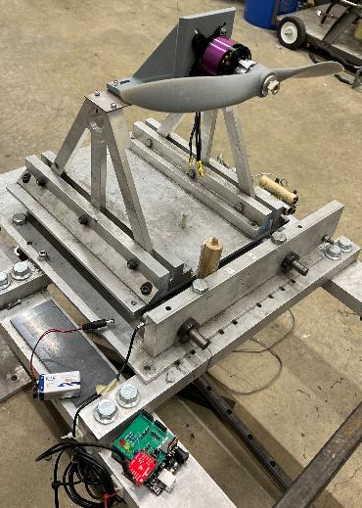
Equipment and Facilities
Need:
Aerospace test cell and static test stand
Load cell and DAC: built into test stand
Have:
Motor
Propeller
Speed controller (ESC)
Battery
Receiver
Transmitter
Propeller mounted to motor mounted to bracket
Load cell
Arduino connected to load cell
Overview
Schedule
Test
Budget
Notes:
Ben

Slide 15
Procedure
Mount motor and propeller on mounting bracket
Connect battery to ESC, power on ESC
Turn Arduino on
Remove everyone from test cell
Start stepping up motor through remote
After test, disconnect battery from ESC
Collect data from SD card, process in Matlab
Propeller mounted to motor mounted to bracket
Load cell
Arduino connected to load cell
Overview
Schedule
Test
Budget
Notes:
Ben

Slide 16
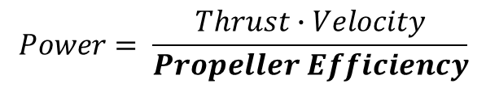
Results Analysis
Risk Reduction:
Proves propulsion system has enough power for climb
Establishes thrust margins to establish flyable flight conditions
Model Validation:
Verifies propulsion system is suitable for aircraft
Verifies/updates propeller efficiency, biggest unknown in endurance model
Expected Results:
Max static thrust 60N at 8000 rpm
Required static thrust achieved between 4000-5000 rpm
APC Test Data
Propeller RPM | Static Thrust
3000 | 7.9 N
4000 | 14 N
5000 | 22.2 N
6000 | 33 N
7000 | 45.4 N
8000 | 60.5 N
$$Power= \frac{Thrust∙Velocity}{Propeller Efficiency}$$
Test | Expected | Pass | Fail
Max Static Thrust | 60 N | >21.7 N | < 21.7 N
Overview
Schedule
Test
Budget

Slide 17
Static Test Safety
Battery Safety
Procedural safety
Battery Storage procedures to be maintained
Battery connector will only be connected/disconnected while system is verified OFF
In the event of Battery fire, test cell safety procedures will be followed
Power will be disconnected while work is being performed on the motor and/or propeller
Test will not begin until all personnel have cleared the room
Test room will not be re-entered until system is verified to be safe
Overview
Schedule
Test
Budget
Notes:
Adam

Slide 18
Whiffle Tree Test
Overview
Schedule
Test
Budget
Notes:
Jake takes stage switch slide

Slide 19
Deadline: 3/20/23
In progress
Requirements and Verification
DR 3.3 - The UAV shall support wing loading of up to W/S = 137.9 [N/m²] with a minimum factor of safety of FOS = 1.3
½ Span will support a loading up to P = 89.91 N with no perceivable failure
Total deflection Δ ≤ 0.286 m at a loading of P = 89.91 N
Verify ANSYS Strength Model and subsequent Deflection Analysis
Pre-requisite Tests
Steel Cable Tensile Strength Testing
Crimped Aluminum Ferrule Shear Strength Testing
Wing Build Quality Inspection
Overview
Schedule
Test
Budget
Notes:
Jake

Slide 20
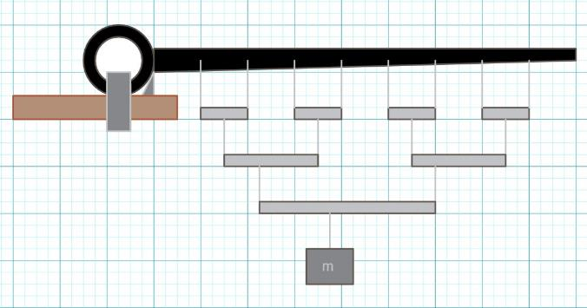
Procedure
Manufacturing:
Tubing cut to size with Miter Saw
Holes Bored out on Drill Press
Steel Cable cut to size with heavy shears
Assembly:
Cable fed through holes on tubing
Ferrules used as strong stops for Cable
Canvas Straps attached to Cable by
looping through punched, heat-sealed
holes
Testing:
Safety Sand used as weight in bucket
Quasistatic loading in small increments
Equilibrium attained before recording tip
Deflection
Overview
Schedule
Test
Budget
Notes:
Jake

Slide 21
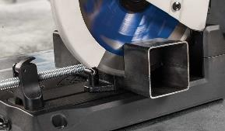
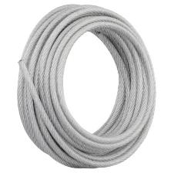
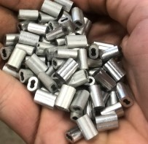
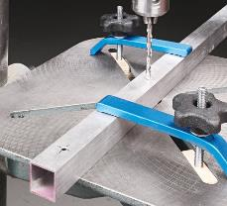
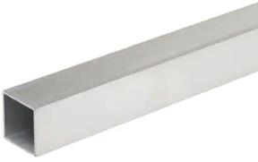
Equipment and Facilities
Aircraft Component:
½ Span
Fuselage Section
Appropriate Fastners
Whiffletree Materials:
Aluminum Square Tubing
Vinyl Coated Steel wire rope
Aluminum Crimp Fasteners
Heavy Duty Canvas Straps
Krylon Spray Tack
Tools:
Chop saw
Drill Press
Hand Tools
Location:
Cutting/Drilling in AES Wood and Composite Shop
Assembly/Testing in Project Room N254
Overview
Schedule
Test
Budget
Notes:
Jake

Slide 22
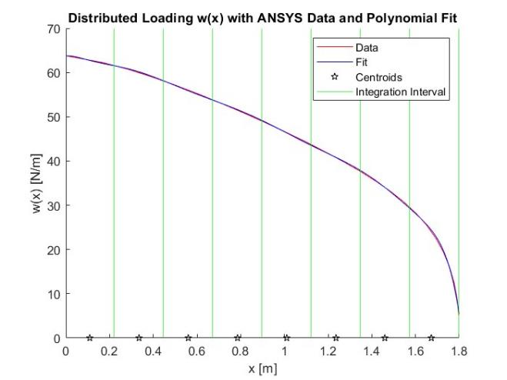
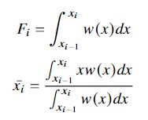
Distributed Loading and Discretization
DR 3.3- The UAV shall support wing loading of up to [137.9 [N/m^2]] with a safety factor of 1.3
Maximum loading on ½ span
  F = 81.91 N
Numerically calculated with ANSYS
Tenth degree polynomial fit
Discretized 8 point loads
ERROR IN FIT = 0.05 %
Point Loads,
Centroids,
Overview
Schedule
Test
Budget
Notes:
Mikaela
Equations
Find area under curve for each interval to represent point loads

Slide 23
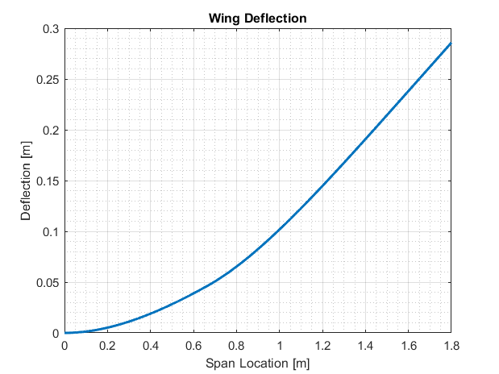
Wing Bending Model
DR 3.3- The UAV shall support wing loading of up to [137.9 [N/m^2]] with a safety factor of 1.3
Factor of safety (FOS) based on Bending Stress
  Wing Shell FOS = 1.3
  Long Spar FOS = 19.6
  Min Short Spar FOS = 27.3
Wing Shell FOS limits design
Predicted Max Wing Deflection Δ = 28.6 cm
Overview
Schedule
Test
Budget
Notes:
-Mikaela
From CDR that shows wing deflection based on maximum load.
Old PDR notes
From the distributed load we integrated to get the shear force along the wing span. Integrating the shear we then got the moment. From the moment we were able to get the curvature of the beam. Since the geometry of the beam changes at 0.667 m we see a jump in the curvature at that point. Since curvature is related to the stress due to bending using the equation sigma = youngs modulus * distance from the center * curvature we want to minimize the max curvature to minimize the max stress by either increasing the size of the spar or by increasing the length to which the short spar goes. With the chosen spar beams and wing shell material we get a minimum factor of safety of 1.3 which occurs in the wing shell. Other important parameters are the slope and deflection itself. To get these values along the span we first set boundary conditions where the beam has zero displacement and zero slope at the root and at 0.667m the deflection and slope of both cross-sections corresponding to I_1+I_2 and I_2 are equal. We then integrate the curvature to get slope and slope to get deflection for both cross sections and solve for the constants of integration using the boundary conditions. With our choosen spars we get a maximum deflection of 28.5 cm.

Slide 24
Results Analysis
DR 3.3- The UAV shall support wing loading of up to [137.9 [N/m^2]] with a safety factor of 1.3
Model Validation:
Distributed Loading model
Wing Bending Model
Risk Reduction:
Verify wing + fuselage connections will support expected loading
Expected Results:
½ Span will endure a load of P = 89.91 N, for a factor of safety of FOS = 1.3
Test | Expected | Pass | Fail
Load at Failure | 89.91 N | ≥ 89.91 N | < 89.91
Tip Deflection | 28.6 cm | within 10%
Overview
Schedule
Test
Budget
Notes:
Mikaela
Verify wing and intersection/connection points can support loading
Validate model for distributed load
1st – pass fail
2nd – criteria to pass

Slide 25
Whiffletree Safety
Minimal two-person team required for construction and testing to ensure safety
Work gloves (except during use of power tools), closed-toe shoes, and safety glasses shall be worn during construction and during testing
All sharp edges resulting from cutting/drilling will be deburred during construction
Controlled test environment to avoid outside interference (blocked off from public)
Test procedure checklist to keep testing consistent
Overview
Schedule
Test
Budget
Notes:
Mikaela
Minimal two-person team required for construction and testing to ensure safety
Work gloves (except during use of power tools), closed-toe shoes, and safety glasses shall be worn during construction and during testing
All sharp edges resulting from cutting/drilling will be deburred during construction
Controlled test environment to avoid outside interference (blocked off from public)
Test procedure checklist to keep testing consistent

Slide 26
Full Flight Test
Overview
Schedule
Test
Budget

Slide 27
Requirements
Deadline: 4/17/23
Waiting
DR 2.1.1 Endurance of [1.5] hours as a threshold, [4] hours as a goal
DR 2.1.1.2 Propulsive power no greater than [700] Wh throughout flight
DR 2.2 Lateral and longitudinal static and dynamic stability
DR 2.1.2 Operate at a max of 6000 ft MSL altitude at constant speed of [21] m/s
DR 2.1.1.1 Parasite drag coefficient less than [0.05]
Overview
Schedule
Test
Budget

Slide 28
Pre-requisite Tests
Launcher test
Whiffle Tree test
Battery endurance ground test
Autopilot test
Initial flight tests
  Gliding test: low speed and weight, thrown from a hill
  Low speed taxi test: practicing 90, 180, 360 degree turns
  High speed taxi test: determine aircraft's high-speed handling and braking
Overview
Schedule
Test
Budget

Slide 29
Equipment
Variables | Sensors | Unit
Linear acceleration rotation rate | IMU | ZOHD KOPILOT
Position Altitude | IMU GPS Magnetometer
True airspeed angle of attack | 5-hole probe | Air Data Computer
Control surface deflection angle | Magnet sensor Rotor sensor | HS-125 MG Servo
Full Aircraft
Battery safety components
Disaster plan and equipment
Pilot
Controller
Launcher
Overview
Schedule
Test
Budget

Slide 30
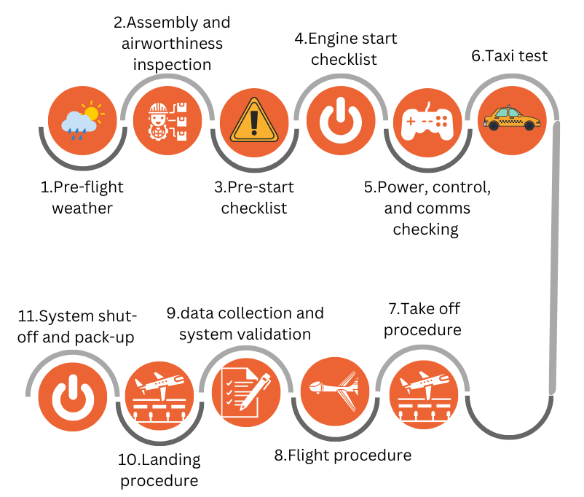
Procedure
Follows military testing standards
Overview
Schedule
Test
Budget

Slide 31
Full Flight Test Checklists
Battery safety
Assembly
Airworthiness inspection
Pre-start
Engine start
Control and communication
Take off procedure
Flight procedure
Landing procedure
Emergency procedures
Sources:
Military testing standards: "Test Operations Procedure (TOP) TOP 7-4-020 Flight Test Techniques"
"Amateur-Built Aircraft and Ultralight Flight Testing Handbook "
Overview
Schedule
Test
Budget

Slide 32
Results
Lift: equals weight in steady horizontal flight, use density and velocity measurement to get CL
Use five-hole probe to measure α, synchronize the measurements, then plot CL-α
Verify parasite drag
  Using CD and CL from a zero thrust sink test
  X intercept is parasite drag
Stability performance
Pilot feedback is important
Overview
Schedule
Test
Budget

Slide 33
Results
Test | Expected | Pass | Fail | Reasons for failure | Probability
Endurance | ~ 50 min Endurance model | >90 min | < 90 min | Unstable aircraft | Medium
Speed | 21 m/s | = 21 m/s | < 21 m/s | Low thrust | low
Parasite drag coefficient | ~ 0.012 From XFLR and ANSYS models | < 0.05 | >0.05 | Prop flow and surface smoothness | low
Overview
Schedule
Test
Budget

Slide 34


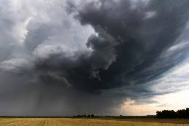

Pre-Flight Safety - Weather
The full flight test will not take place if weather is not conducive to test safety. No-go conditions include but not are not limited to;
Non-VFR Flight Conditions
High Winds
(>15 mph)
Precipitation
Red Flag Warning
Overview
Schedule
Test
Budget
Notes:
Adam

Slide 35
Pre-Flight Safety - Logistics
Battery check and vehicle transportation safety procedures
Airworthiness inspection of AMADEUS vehicle
Boulder Fire Department shall be notified of the test at least 24 hours in advance per AES Special Flight Request documentation
Check for final clearance of test at flight location
Overview
Schedule
Test
Budget
Notes:
Adam

Slide 36

Pre-Flight Safety - Airfield
Prior to takeoff, the following risks will be evaluated, and actions will be taken to mitigate each, per the requirements of the Aerospace Engineering Sciences Special Flight Release documentation (AES SFR)
Bystanders not involved in the test
Flight path
Crash response readiness
Overview
Schedule
Test
Budget
Notes:
Adam

Slide 37
Test Flight Safety
Per the AES SFR
In case of a subsystem failure, the pilot will attempt to use the autopilot return to home option
Military standards for flight tests will be followed (see pdf documents)
If significant control difficulty is encountered during the flight, the test will be ended
Full flight checklist procedures and battery checklist procedures will be followed.
Final details regarding the full flight test will be established during the final flight test review
Overview
Schedule
Test
Budget
Notes:
Adam

Slide 38
Budget Update
Overview
Schedule
Test
Budget

Slide 39
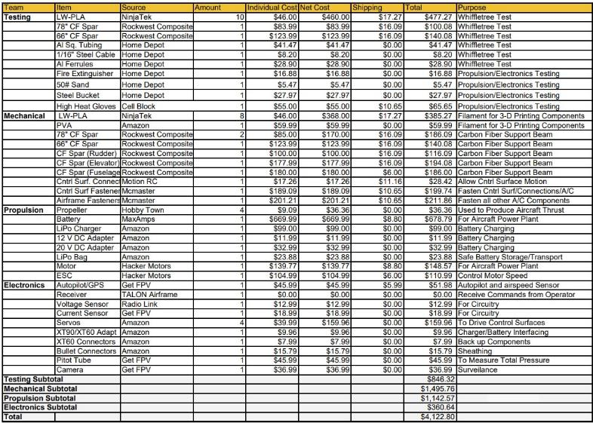
Updated Cost Plan
Modifications due to:
EEF Mini Decision
  Full Award = $2414
  Updated Budget = $6414
Unforeseen costs
  Electronic Accessories
  Testing Hardware & Accessories
  Inflation
  Inconsistent shipping estimates
  Underestimated Filament Requirements
Updated Total = $4,122.80
Overview
Schedule
Test
Budget

Slide 40
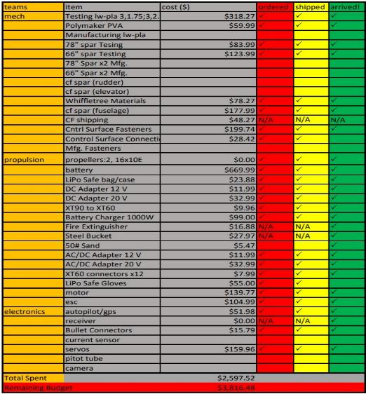
Purchase History and Spending to Date
Initial purchases primarily test components and testing accessories
Spending to Date = $2597.52
Remaining Budget = $3816.48
Completed Purchases
  By Dollar = 64.43%
  By Order = 30 of 38
Overview
Schedule
Test
Budget

Slide 41
Projected v. Actual Team Spending
Team | Projected Total ($) | Actual Total ($) | Discrepancy ($)
Testing | 346.33 | 846.32 | 499.99
Mechanical | 1384.03 | 1487.76 | 103.73
Propulsion | 1007.34 | 1152.57 | 145.23
Electronics | 320.91 | 360.64 | 39.73
Total | 2878.28 | 4,122.80 | 1,244.52
Projected Margin = 43.35%
Actual Margin = 64.28%

Slide 42
TRR Slide Toc
Project Purpose & Objectives
Purpose & Objectives (2)
CONOPS (3)
FBD (4)
Design Solution (5)
CPEs & Org Chart (6-7)
Schedule
High Level Gantt Chart ()
Testing Gantt Chart ()
Manufacturing Status ()
Testing Status ()
Test Readiness
Static Thrust
Requirements & Verification
Equipment & Facilities
Procedure
Results Analysis
Static Test Safety
Whiffle Tree Test
Requirements & Verification
Procedure
Equipment & Facilities
Distributed Loading
Wing Bending Model
Results Analysis
Whiffletree Safety
Full Flight Test
Requirements
Pre-requisite Tests
Equipment
Procedure
Full Flight Test Checklist
Results
Results
Endurance Model
Pre-Flight Safety: Weather
Pre-Flight Safety: Logistics
Pre-Flight Safety: Airfield
Flight Test Safety
Budget
Updated Cost Plan
Purchase History
Projected vs. Actual Spending
Overview
Schedule
Test
Budget

Slide 43
CDR Slide Reference
Purpose and Objectives
Purpose & Objectives (2)
CONOPS (3)
Mission Profile (4)
Design Solution
Functional Requirements (5)
Design Requirements (6)
Functional Block Diagram (7)
Design Solution – Aerodynamics (8)
Design Solution – Airframe (9-10)
Design Solution – Propulsion (11)
Design Solution – Electronics (12)
Design Solution – Battery (13)
Design Solution - Launch System (14)
Mass Budget (15)
Design Solution – Summary (16)
Critical Project Elements & Risks
CPEs (17)
Risk Analysis + Mitigation (18)
Aircraft Stall Limits (19)
Risk Matrix (20)
Design Requirements Satisfaction
Endurance Model (22)
Aerodynamic Characterization (23)
Endurance Model Equations (24)
Wing Bending Model: Assumptions (25)
Wing Bending Model: Deflection (26)
Wing Bending Model: Spar (27)
Wing Bending Model: Choices (28)
Verification and Validation
Whiffletree Test: Objectives (30)
Whiffletree Test: Equipment (31)
Whiffletree Test: Measurements (32)
Motor Static Test: Objectives (33)
Motor Static Test: Measurements (34)
Motor Static Test: Equipment (35)
Full Flight Test: Objectives (36)
Full Flight Test: Equipment (37)
Safety Concerns (38)
Project Planning
WBS (39)
Gantt Chart (40)
Manufacturing & Testing Plans (41)
Cost Plan (42)
Organizational Chart (43)
Overview
Design
Risks
Require
V & V
Plans

Slide 44
CDR & PDR Backup Slide Reference
Purpose and Objectives
Mission Profile Animation Breakdown
Design Solution
Design Requirements - 1,2 & 3
FBD Animation Breakdown
FBD Electronic Components
FBD Electronics Connections
Launch System Animation Breakdown -1 & 2
Launch System Math -1, 2 & 3
Launch System Video
Critical Project Elements and Risks
CPEs - 1 & 2
Risk Matrix – Scoring
System Risk Analysis - 1 to 5
Design Requirements Satisfaction
Natural Stability Requirements
Static Margin Model
Endurance Model – Aerodynamics
Endurance: Optimizing Propulsion System
Additively Manufacturing
Endurance Model #2 - 1 & 2
Fuselage-Tail Structure – Durability
Horizontal-Tail Structure – Durability
Human Portability
Aircraft Selection
Planning
Gannt Chart Animation Breakdown
PDR Backup Slides
Structures Trades
Wing Trades
Firewall Trades
Materials Trades
Props Trades
Aero Trades
Design Space
Backups
Overview
Design
Risks
Require
V & V
Plans

Slide 45
Begin Backup Slides

Slide 46
Battery Safety
Due to our design requiring a Lithium-Ion battery, safety procedures have been developed for the following scenarios regarding use of the battery.
Storage
Charging/Discharging
General test usage
Transportation by vehicle
Overheating/Fire

Slide 47
Battery Storage
Prior to storage, the battery shall be examined for damage to outer casing, cables, and connectors.
Prior to storage, the battery shall be tested to ensure that it is at a safe storage level. The battery may be at full charge if testing is to occur within 24 hours
After inspection and testing, the battery shall be sealed within the approved fire-proof carrying case, and then shall be stored within the appropriate battery locker at the Smead Aerospace

Slide 48
Battery Charging/Discharging
Prior to charging, battery and leads shall be inspected for damage.
At least two people will be present during charging sequence
Charging or discharging begins
At least one person will be monitoring battery for puffing, smoke, or other signs of overheating.
Battery will remain in container during charging, and will be stored in container for storage until used.

Slide 49
General Battery Usage Procedure
Prior to use, battery and leads will be inspected for damage.
If the battery cannot remain within its container due to testing or usage requirements, it will be secured in such a manner as to prevent damage
Verify system OFF before connecting or disconnecting battery
Perform tests in accordance with procedure
During test, monitor battery for signs of overheating or electrical problems.
After test, battery will be returned to container and stored in accordance with procedures

Slide 50
Vehicle Travel Procedures
Prior to transportation, battery and leads will be inspected for damage, then container will be sealed for duration of transport.
The battery will be secured within the vehicle in a manner that prevents shifting, damage, or direct impact during a sudden stop
Upon arrival at testing location, battery will remain within container until needed, and will not be left unattended in the vehicle.
After use during testing, the battery will be returned to its container for transport back to Smead Aerospace
If a sudden stop causes physical shock to the battery, it will not be used until inspected for damage.
In the event of an emergency that requires evacuation of the vehicle, the battery will be removed if safe to do so. If not, attending emergency personnel will be informed of the presence of a LiPo battery in the vehicle.

Slide 51
Vehicle Travel Procedures
Prior to transportation, battery and leads will be inspected for damage, then container will be sealed for duration of transport.
The battery will be secured within the vehicle in a manner that prevents shifting, damage, or direct impact during a sudden stop
Upon arrival at testing location, battery will remain within container until needed, and will not be left unattended in the vehicle.
After use during testing, the battery will be returned to its container for transport back to Smead Aerospace
If a sudden stop causes physical shock to the battery, it will not be used until inspected for damage.
In the event of an emergency that requires evacuation of the vehicle, the battery will be removed if safe to do so. If not, attending emergency personnel will be informed of the presence of a LiPo battery in the vehicle.

Slide 52
Battery Emergency procedure: Overheating
If the battery shows evidence of overheating, such as puffing up, smoke, or being hot to the touch;
If the battery is within the fire-proof container, the container will be sealed, using fire resistant gloves for protection
If the battery is not within the fire-proof container, if safe to do so it will be transferred to and sealed within the container via fire resistant gloves
After sealing the container, one person will monitor the container for further anomaly, while a second alerts Smead Aerospace staff

Slide 53
Battery Emergency procedure: Fire
All procedures following will only be attempted if possible, without undue personal risk, and if a clear escape route is present. This procedure is superseded by any test specific procedure for fires that permit greater safety
If the battery is within the fire-proof container, the container will be sealed, using fire resistant gloves for protection
If the battery is not within the fire-proof container, it will be transferred via shovel to a bucket of sand to burn out safely
Appropriate handheld firefighting equipment will be used to attempt extinguishing of any surrounding fire.
If none of the above are possible without undue personal risk, the area will be evacuated, and the nearest alarm system will be activated
Any personnel not involved in mitigating the fire will evacuate and alert Smead Aerospace staff and emergency services as needed

Slide 54
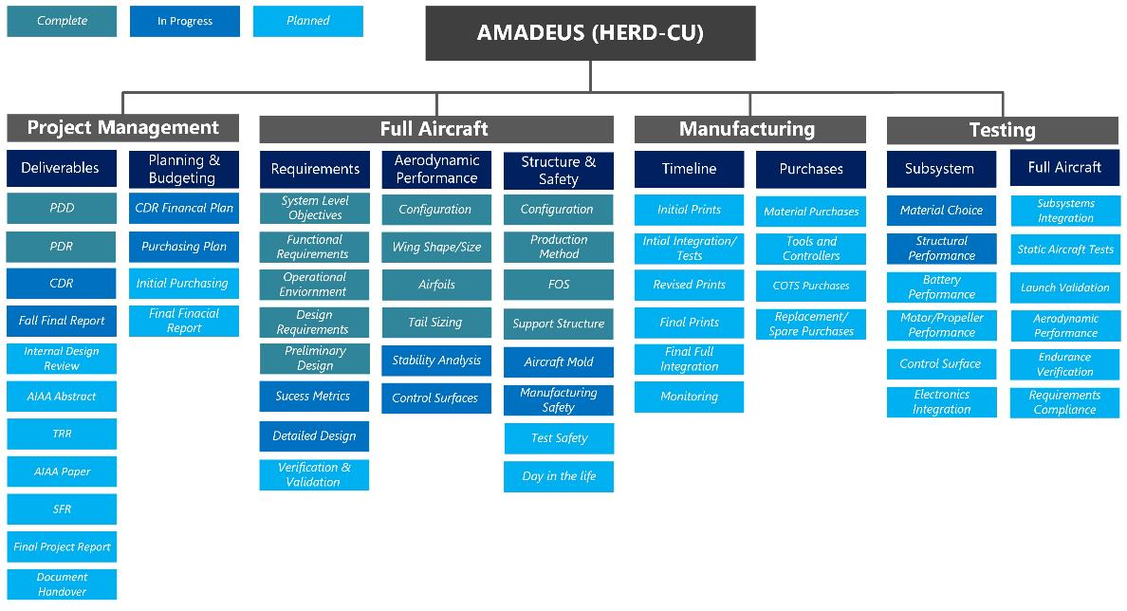
Overview
Design
Risks
Require
V & V
Plans
Notes:
The project work breakdown was structured on the different stages and subteams within the full team. This allowed us to isolate and keep track of each team’s responsibilities and current progress throughout the course of the project
Linus
< 20 seconds

Slide 55
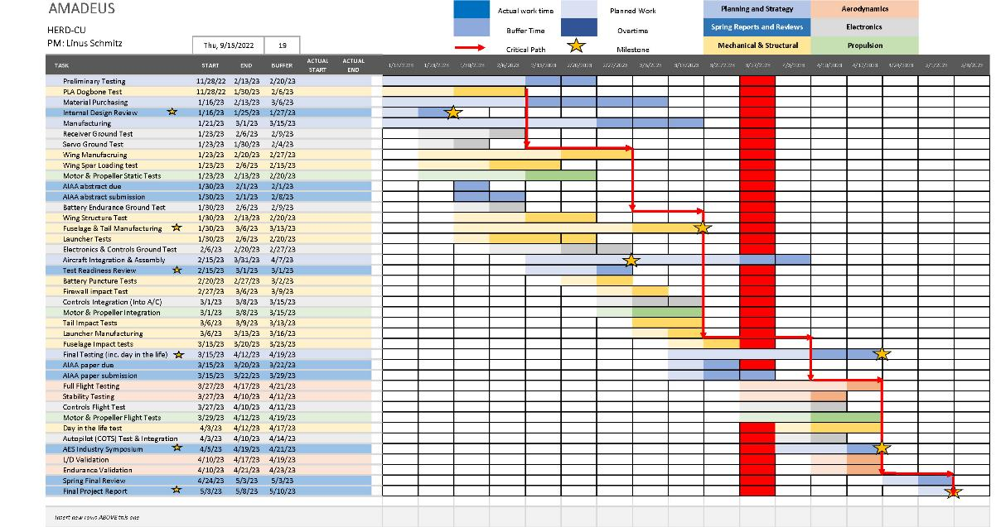
Overview
Design
Risks
Require
V & V
Plans
Notes:
Speaking of project timelines, the Gannt chart again allowed us to highlight the key aspects and milestones of the project. Generally the spring semester is broken down into five sections:
Initial material testing, planning and reviews.
Secondary component testing and the beginning of manufacturing and assembled component testing such as the wings and combined propulsion system.
Design considerations and larger assembly tests as well as launcher and control systems tests.
Then final assembly and full system ground tests which must be completed prior to spring break.
And finally all flight tests and final reviews post spring break.
This last section is one of the most important given that it is required to validate any aerodynamic models and can not be completed until the full aircraft has been assembled.
~65 seconds

Slide 56
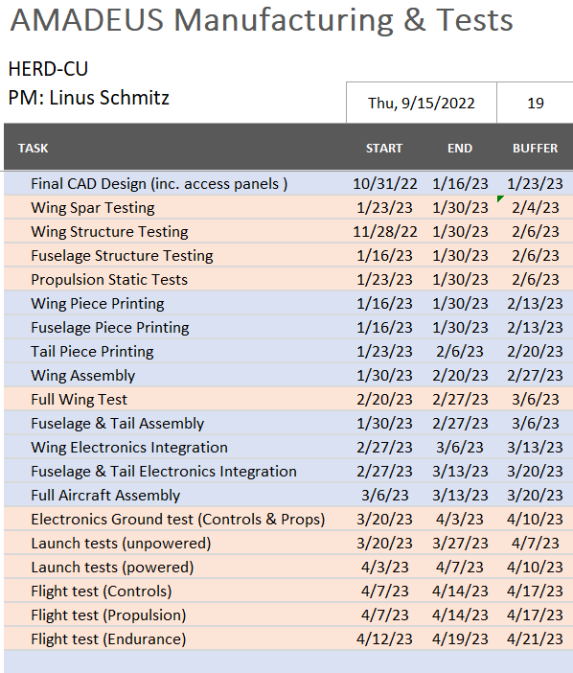
Test | Special Facilities + Equipment
Flight Time Battery Test | N/A
Servo Functionality Test | N/A
Thrust + Efficiency Test | - DBF Static Test Stand - Load cells and data acquisition device
Electronics Ground Test | N/A
Whiffle Tree Test | Whiffle Tree equipment; in contact with Prof. Schwartz
Launch Velocity Test | - Open space
Full Flight Test | - FAA certified drone pilot; BES customer. - Open space
Overview
Design
Risks
Require
V & V
Plans
Notes:
20 sec

Slide 57
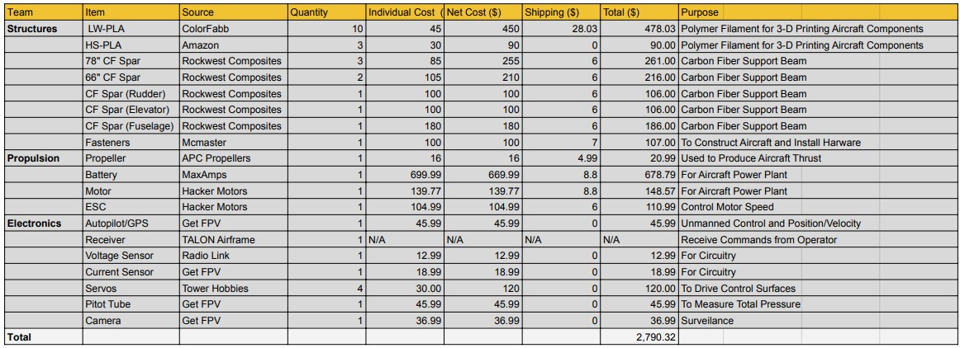
Cost Plan
Structural Total: $1550.03
Propulsion Total: $959.34
Electronics Total: $280.95
Current Margin (may Decrease): 43.35% ($1209.68)
Awaiting EEF Mini Approval
EEF Mini Funding Request: $2413.54
Overview
Design
Risks
Require
V & V
Plans
Notes:
Our cost plan now is very high level and accounts only for the known expenses that we will have, including those needed for testing that will be pushed to failure. We do however have a large margin (nearly one thirds of our total provided budget). The plan is that this will provide enough of a buffer for any unexpected expenses due to components breaking or needing replacement.
< 30 sec

Slide 58
Question?
* Any slides with animations are included in the backup slides as individuals for later reference*

Slide 59
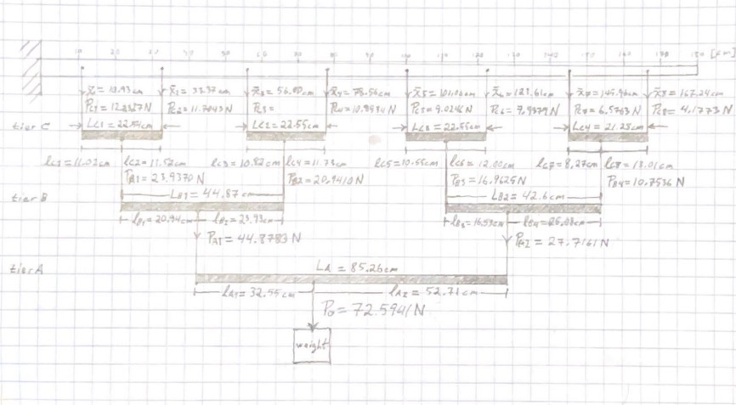
Whiffle Tree Manufacturing
Prerequisite Testing
3D Printer Test
Wing Build Quality
Equipment
Wing
Wing-fuselage connection
1 in x 1 in, 1/20 in thickness Aluminum Square Tubing
1/16 in. x 20 ft Vinyl Coated Steel wire rope
1/16 in. Aluminum Ferrule Crimp Fasteners
Dewalt Clamps
Vinyl Straps
Digital Tape Measure

Slide 60
I*alpha = 0 = l1*p1 – l1*P2
L1 = p2/p1*l b/c l2 = L-l1

Slide 61
Whiffle Tree Manufacturing
Two-person team for construction
Beam lengths cut on chop saw to the nearest millimeter
Cable receivers drilled ¼ inch from ends of beam on center on top side with drill press and clamps for firm placement
Cable receivers drilled at origin on center on bottom side
Cable fed through receiver holes, pulled through beam, attached to ferrules and pulled back into place
Due to ferrules being permanent and geometry of origin receiver, whiffletree constructed from bottom tier up
Visual aids here

Slide 62
Procedures
Inspect Wing/Fuselage for Structural Integrity
Mark loading centroid locations on top of the wing
Lay whiffletree over worktable, ensure it is untangled, and inspect all connections for integrity
Clamp fuselage section to worktable
Fit vinyl connector loops over wing over at centroid locations
Apply sticky tack to underside of loops and replace to centroid locations to ensure immobility
Gradually fill bucket with sand for quasistatic loading, allowing the wing to reach equilibrium between increments
Record loading and deflection between hanging whiffletree and each increment of additional loading.
After working load and deflection are achieved and logged, continue loading increments until catastrophic failure is achieved.
Carefully inspect failed wing and fuselage section and record failure modes and any phenomena of interest

Slide 63
Results
Flight Condition Loading
Maximum Shear Strength
Factor of Safety
Flight Condition Tip deflection
Maximum* Tip Deflection
Failure point and mode
Verify wing strength and wing bending models

Slide 64
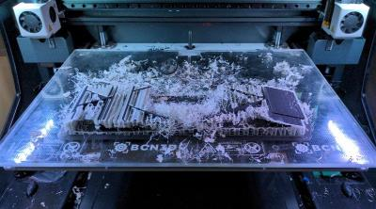
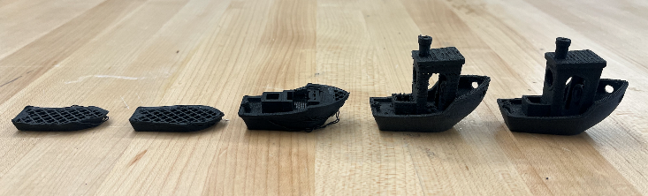
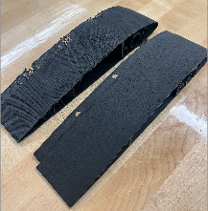
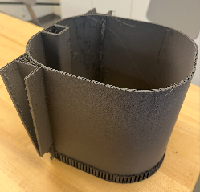
More Test Prints
Failed BCN3D Wing Section
Calibration Tests for LWPLA on BCN3D using Benchy model
Horizontally printed (top) vs. vertical print (bottom) on BCN3D
Fuselage section on Prusa

Slide 65
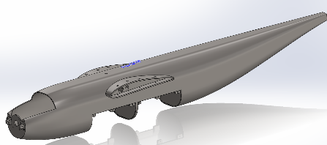
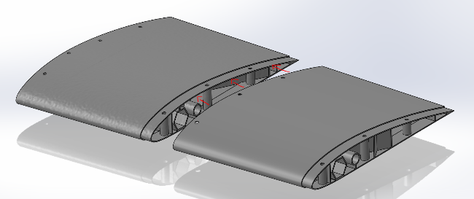
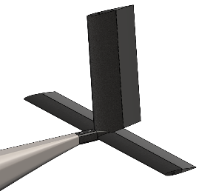
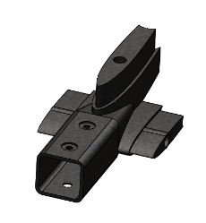
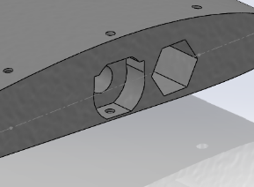
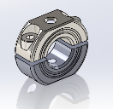
Design Updates

Slide 66
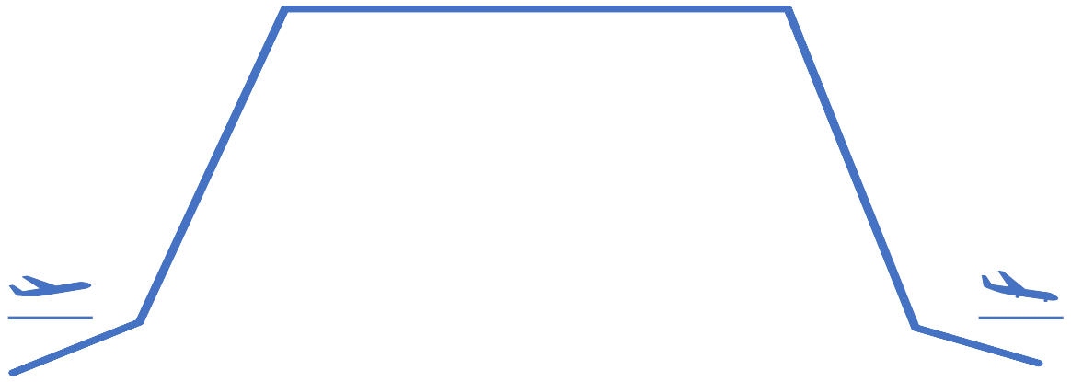
Mission Profile
3. Orbit/Operation
Descent
152.4 meters of descent
Density modeled as constant [1.007] kg/m^3
Power requirement assumed to be the same as climb
Orbit/Operation
Steady, level, unaccelerated flight (SLUF)
No turn performance considered
2000 meters ASL ~ 6500 ft ASL
Trim Angle: 2.44 degrees
Velocity: 21 m/s
Takeoff
Slingshot launcher
[902] newtons of force experienced
Minimum change in velocity [~19] m/s
Climb
Unaccelerated climb at flight speed of [21] m/s
Density constant using operational altitude value of [1.007] kg/m^2
152.4 meters of climb
2. Climb
Landing
Glide into landing, no capture mechanism or runway.
Power requirement equal to takeoff.
4. Descent
1. Takeoff
5. Landing
Notes:
Our functional requirements, flow down from the mission statement
where our top three are human portability, endurance and operability in austere environments.
Next we have the customer focused requirements
which include the modular payload, low maintenance cost and rapid deployment.
Finally the last three requirements are geared towards design and manufacturing
which include legal restrictions, design cost requirements and remote operation.
Brady

Slide 67
Functional Requirements
FR.1: The UAS shall be human portable.
FR.2: The UAS shall support 12 hours of continuous coverage/operation.
FR.3: The UAS shall be durable to support structural loading and environmental conditions.
FR.4: The UAS shall support a modular payload.
FR.5: The UAS shall be low cost to produce and repair for user.
FR.6: The UAS shall be rapidly deployable.
FR.7: The UAS shall obey guidelines and regulations set forth by FAA and MIL-F-8785C.
FR.8: The total costs for development and technology shall not exceed $4000.
FR.9: The UAS shall be controllable by remote user.
Overview
Design
Risks
Require
V & V
Plans
Notes:
Our functional requirements, flow down from the mission statement
where our top three are human portability, endurance and operability in austere environments.
Next we have the customer focused requirements
which include the modular payload, low maintenance cost and rapid deployment.
Finally the last three requirements are geared towards design and manufacturing
which include legal restrictions, design cost requirements and remote operation.
Brady

Slide 68
Driving Design Requirements
DR 1.2: Wingspan shall not exceed [3.6] meters.
  From portability and structural support (FR. 1).
DR 1.3: Aircraft shall have detachable wings.
  From portability and manufacturing (FR. 1 and FR. 5)
DR 2.1.1: The UAV shall have an operational endurance of [1.5] hours as a threshold, [4] hours as a goal.
  From aerodynamic efficiency and performance (FR. 2).
DR 7.1: Aircraft airborne weight shall not exceed [20] kg as a threshold, [12] kg as a goal.
  Defined by ability for users to carry and FAA restrictions (FR. 7)
Overview
Design
Risks
Require
V & V
Plans
Notes:
Our functional requirements, flow down from the mission statement
where our top three are human portability, enduranceH and operability in austere environments.
Next we have the customer focused requirements
which include the modular payload, low maintenance cost and rapid deployment.
Finally the last three requirements are geared towards design and manufacturing
which include legal restrictions, design cost requirements and remote operation.
Brady – Previous 3 slides are 1:10 seconds currently

Slide 69
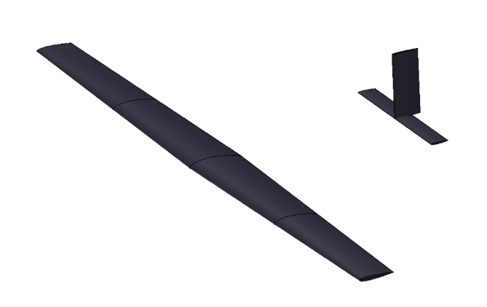
Design Solution - Aerodynamics
Root Characteristics
  NACA 4412
  0.3 meter chord
Tip Characteristics
  NACA 0012
  0.2 meter chord
Wingspan: 3.6 meters
  Limited by structural spar beam size
Horizontal Tail (NACA 0012)
  Chord Length: 0.1 m
  Tip to Tip Span: 0.814 m
Vertical Tail (NACA 0012)
  Chord Length: 0.15 m
  Height: 0.36 m
Overview
Design
Risks
Require
V & V
Plans
Notes:
Putting this before battery because these things contribute to power needs and that leads to battery chosen
Aziz
85 sec
Now 58 sec

Slide 70





Design Solution - Airframe
Materials and Components
Off-the-shelf carbon fiber beams
  Hex Fabric Tube 22 mm OD
  Pultruded Unidirectional Rod 12 mm OD
  Square Fabric Tube 22x25 mm
  Pultruded Unidirectional Rod 7.9 mm OD
All other structures will be additively manufactured
BCN3D/Prusa - dual extrusion FFM 3D printer
  Light Weight PLA
    Density can be adjusted using nozzle temperature to optimize strength and mass distribution
Overview
Design
Risks
Require
V & V
Plans
Notes:
putting this before battery because these things contribute to power needs and that leads to battery chosen
Alex
1 min 15 sec
The major structural components of our airframe consist of 6 carbon fiber beams picked for their rigidity, high strength, and low density. These beams are available commercial off the shelf. A total of 3 carbon fiber spars will support the wings. 1 that is centered on the fuselage and reaches roughly a third of the way through each wing. 2 that goes from the center of the fuselage to the tip of each wing. 1 used to provide structure to the fuselage and connect the tail. 1 for the horizontal tail and 1 for the vertical tail. All other stuctures including the wing shell and fuselage will be constructed out of 3d printed light weight pla due to its low density combined with its moderate strength. By adjusting the print temperature we are able to control the density of the lwpla so certain parts can have increased strength if necessary. We plan to use the Pilot labs BCN3D dual extrusion printer in order to print at an orientation that maximizes the print strength without increasing print complexity by using a water soluable support filament in the second extruder.

Slide 71




Design Solution - Airframe
Overview
Design
Risks
Require
V & V
Plans
Notes:
putting this before battery because these things contribute to power needs and that leads to battery chosen
Alex
1 min 15 sec
Amanda's suggestions on points to hit
Outer mold line of the Fuselage was defined with the maximum dimensions of example payload and desired battery + space for wing stucture (width 170mm height 190mm)
Front cone planned to accommodate motor selected
Length built to have 500mm of straight usable space to have plenty of margin to adjust the battery and payload position for ideal center of gravity.
Tail made to be <20 degree slope to avoid flow separation
Wing has ribs at 60 degree angles to optimize strength/stiffness of the shell (I would avoid saying the overhang angle is for printing because we want to print in xy not z)
The wing harness is made so wings can be removed for human portability spars slide
Secured by spars slotting into fusilage/wings and the using fasteners that go through the wings and wing harness outer structure (idk how to refer to all these pieces sorry)
Tail slides onto beam that extents length wise through the fuselage and is secured with small fasteners with minimum threading to maintain carbon fiber an pla integrity
Shown is a CAD model of our aircraft showing where we plan to locate key components such as the battery shown in blue and the payload shown in red. The outer mold line of our fuselage was defined using the maximum dimensions of the example payload and the desired battery along with space for our wing and fuselage beams. The transition from the main fuselage body to the tail was made to be less than 20 degrees to avoid flow separation. The tail section is designed to slide onto the center fuselage beam and be secured using small fasteners. Similarly the wings are designed to be detachable for human portability. They will slide onto the thick wing spar that will be permanently attached to the fuselage and be secured using fasteners through the exterior wing harness. The wing shell will be 3d printed in sections and will include thin ribs in order to transfer stress onto the wing spars. The wing sections will be connected together using fasteners in a similar fashion to the tail.

Slide 72


Design Solution - Propulsion
Motor – HackerMotors A50
  Max Power: 1250 W
  520 kv
  5S battery req – 18.5 V
  Max draw < 70 A
Propeller – APC 16x14
  84% efficiency @ orbit conditions
Speed Controller – HackerMotors MasterBasic 70SB
  Supports 70A, 6-26V continuous draw
  5.5V Switching BEC
Overview
Design
Risks
Require
V & V
Plans
Notes:
Ella
~36 seconds

Slide 73




Design Solution - Electronics
MATEKSYS Digital Airspeed Sensor
Hitec HS-125MG Thin Metal
Wing Servo
Foxeer Falkor 3 Micro FPV Camera
KOHD KOPILOT Lite Autopilot System
Overview
Design
Risks
Require
V & V
Plans
Notes:
Ella
~43 seconds

Slide 74

Design Solution – Battery
Battery Spec | Value
Nominal Voltage | 18.5 V
Nominal Capacity | 23,000 mAh
Usable Capacity | 20,700 mAh
C Rating (Discharge rate) | 25 C
Total Energy | 425.5 Wh
Total Usable Energy | 382.95 Wh
Mass | 2.071 kg
LiPo 23000 5S 18.5v Battery Pack
Overview
Design
Risks
Require
V & V
Plans
Notes:
Ella
~50 seconds

Slide 75


Design Solution - Launch System
Elastic Energy Model:
Assume friction with table/support negligible.
Fundamental Model:
K = 40.1 N/m (for 3m unstretched cord)
Max Force experienced: 902 [N]
Minimum velocity = Stall Velocity * (1.2)
  = 18.72 m/s
Launcher Construction:
Kent Elastomer surgical latex tubing
  Internal Diameter: 3/4 inch
  Width: 1/8 inch
Two 3/4 inch steel posts to hold elastic
Basic picnic table or something similar
Overview
Design
Risks
Require
V & V
Plans
Notes:
Adam: 0:50
Due to the mass of AMADEUS, it was determined that a hand launched design was not feasible. Because this, our design will use a catapult launch system to accelerate the aircraft to a takeoff velocity of 18.72 m/s. This will be accomplished via 3 meter elastic tubing, stretched to almost 8m in length to impart the needed kinetic energy to the aircraft. This tubing will be anchored via steel posts driven into the ground, and the launch platform will be a suitably flat surface such as a portable table. This system has legacy heritage, so we are confident that it is practical and feasible for our needs.

Slide 76
Mass Budget - UAV
Payload + Propulsion | Mass (kg)
Payload | 3
Motor (A50-14 XS V4 kv520 ) | 0.347
Propeller | 0.051
Airframe/Structure | Mass (kg)
Fuselage | 2
Wing Spars | 0.823
Fuselage Beam | 0.36
Wing Shell | 1.2
Horizontal Tail Spar | 0.0306
Vertical Tail Spar | 0.0306
Tail Shell | 0.61095
Avionics + Electronics | Mass (kg)
Battery (LiPo 23000 5S 18.5V Battery Pack) | 2.1
Camera (Foxeer Falkor 3 Micro 1200TVL M12 1.7mm) | 0.25
ESC (YEP 100A Brushless ESC) | 0.08
Autopilot (ZOHD KOPILOT Lite) | 0.02
Servos (HS-125MG Servo) | 0.096
Subsystem | Mass (kg)
Propulsion | 0.398
Payload | 3
Airframe/Structure | 5.05
Electronics | 2.55
Total | 10.99
Margin | 1.65
Total Mass + Margin of 15% to account for adhesive, wiring, etc. | 12.65
Overview
Design
Risks
Require
V & V
Plans
Notes:
Adam: 0:35
The mass budget for AMADEUS follows guidelines and assumptions for general aircraft design (Raymer Textbook). Key points include a payload percentage of approximately 25% aircraft mass, and a margin of error of 15% to account for things like adhesive, wiring, and other components not included in the high level design. These numbers were estimated via CAD modeling and known material densities for the fuselage components, and from datasheets for the off the shelf components. An effort has been made throughout the design to keep our mass budget as low as feasibly possible, both for the functional requirement of being human portable, as well as for practical aerodynamic requirements.

Slide 77
Risk Analysis + Mitigation
Risk | If/Then Statement | Probability | Consequence | Mitigation Strategy
Aircraft Stall (8) | If the UAV encounters stall conditions and recovery is not possible, then system will crash. | 4 | 5 | Increase margins between operational and stall conditions - Velocity: 15.6 vs. 21 m/s - Angle of attack: 2.44 vs. 10 degrees
Modular Assembly (4) | If the system is modular and assembled in the field, then connection between wing and fuselage introduces stress concentration. | 4 | 4 | "Wing box" design - 2 separate spar beams that connect fuselage and wing - Continuous spars, not modular.
Manufacturing Time (14) | If the system is to be 3D printed, then prints (components, elements, etc.) will have to be printed several times to account for deficiencies, testing, and design adjustments. | 4 | 3 | Advance Planning - Begin prints for testing early January - Account for extra printing material in cost plan
Overview
Design
Risks
Require
V & V
Plans
Notes:
Brady

Slide 78

Aircraft Stall Limits
Simulated stall conditions over aircraft main wing
Main wing stall causes loss of aerodynamic lifting
Low Reynold's Number effects increases the stall risk
Main wing stall occurs at ~10 degrees angle of attack
Aircraft main wing pressure contours with increasing angle of attack
Overview
Design
Risks
Require
V & V
Plans
Notes:
Brady

Slide 79
Risk Matrix
Consequence
 | 1 | 2 | 3 | 4 | 5
5
4 |  | #12 | #14 | #4 | #8
3 |  | #1,3 | #7, 13
2 |  |  | #9 | #11 | #2
1 |  | #10 | #5 | #6
Orbit Swapping
Engine Damage
Motor Failure
Modular Assembly
Control Communications
Factor of Safety (Wing Loading)
Aerodynamic Efficiency
Aircraft Stall
Battery Performance
Aircraft Stability
Launch Mechanism
Launch Pilot Training
Control Software Integration
Manufacturing Time
Probability of Occurrence
Overview
Design
Risks
Require
V & V
Plans
Notes:
Brady – Previous 4 slides are ~ 3 minutes

Slide 80
Design Requirements Satisfaction
Overview
Design
Risks
Require
V & V
Plans
Notes:
Aziz

Slide 81

Endurance Model
DR 2.1.1 UAV shall have an operational endurance of [1.5] hours as a threshold, [4] hours as a goal.
Assumptions:
Motor efficiency = 0.8
Propeller efficiency = 0.84
Climb occurring at fixed speed
Operational velocity of 21 m/s
Span efficiency factor: e = 0.4
Zero lift angle = ${CL}_{0}$ = -2.885
Method:
Found energy required for takeoff, climb, orbit, descent, and landing
Compared various models for climb and orbit, then took maximum energy requirement from those
Used this to determine necessary specs for battery and power system
Overview
Design
Risks
Require
V & V
Plans
Notes:
Aziz

Slide 82


Aerodynamic Characterization
Aircraft Coefficient of Lift Curve vs. Angle of Attack
Aircraft Drag Polar
Overview
Design
Risks
Require
V & V
Plans
Notes:
Be sure to mention the trim candidates on the graph
Aziz
~Slides 21, 22, 23: 235 sec

Slide 83



Endurance Model
DR 2.1.1 UAV shall have an operational endurance of [1.5] hours as a threshold, [4] hours as a goal.
Mission Energy = Takeoff + Climb + Orbit/Operation + Descent + Landing
= 298 ~ 488 Wh
Battery Energy = 425.5 Wh
For orbit/operation:
Endurance =
Predicted flight time = 0.8339 hours = 50 minutes
Rt = battery hour rating [hours]
V = volts
C = battery capacity [Amp-hours]
U = velocity
S = reference area
W = weight
n = discharge parameter
= total efficiency
= density
= zero lift drag
Overview
Design
Risks
Require
V & V
Plans
Notes:
- battery finalized then operation velocity, among other things, changed which is why the mission energy is higher than that of the battery
had to remain within size requirements and this was the closest we could get
Ella
1:30

Slide 84





Wing Bending Model
DR 3.3: The UAV shall support wing loading of up to [13.33 ] with a safety factor of [1.3]
Assumptions:
Distributed load
Fixed at Fuselage
Small Bending Approximation
All load is applied to spar beams
Wing Structure deforms with the spar beams
Dimensions
  Constraints
    Airfoil size given by aero
    Available beams produced by Rockwest
    Direct effect on mass
Overview
Design
Risks
Require
V & V
Plans
Notes:
- Alex
- 1min
The wing spars are an essential part of our aircraft as they provide necessary structure to the wings. The primary forces that the wing spars take are due to lift which result in the wing bending upward. This bending results in stress both in the spars as well as in the wing shell. To ensure that our wings meet DR 3.3, are strong enough to fly at our desired 21m/s with 20 mph wing gusts with a factor of safety of 1.3 while also minimizing mass we preformed a wing bending analysis. In our model we assumed a parabolic distributed load shown in orange using this equation that closely mimics the actual expected lift shown in blue. We also modeled our 2 spar setup as a single variable geometry cantilever beam fixed at the root shown here where I_1 is the moment of inertia of the short beam and I_2 is the moment of inertia of the long beam.

Slide 85


Wing Bending Model
DR 3.3: The UAV shall support wing loading of up to [13.33 ]
with a safety factor of [1.3]
Curvature (k) can be related to the stress in the individual spars and the wing shell via the equation:
where E is Young's Modulus and y is distance from cross section centroid.
Min Wing Shell FOS = 1.3
Min Long Spar FOS = 19.6
Min Short Spar FOS = 27.3
Max Wing Deflection = 28.5 cm
Overview
Design
Risks
Require
V & V
Plans
Notes:
-Alex
- 1 min 20 sec
From the distributed load we integrated to get the shear force along the wing span. Integrating the shear we then got the moment. From the moment we were able to get the curvature of the beam. Since the geometry of the beam changes at 0.667 m we see a jump in the curvature at that point. Since curvature is related to the stress due to bending using the equation sigma = youngs modulus * distance from the center * curvature we want to minimize the max curvature to minimize the max stress by either increasing the size of the spar or by increasing the length to which the short spar goes. With the chosen spar beams and wing shell material we get a minimum factor of safety of 1.3 which occurs in the wing shell. Other important parameters are the slope and deflection itself. To get these values along the span we first set boundary conditions where the beam has zero displacement and zero slope at the root and at 0.667m the deflection and slope of both cross-sections corresponding to I_1+I_2 and I_2 are equal. We then integrate the curvature to get slope and slope to get deflection for both cross sections and solve for the constants of integration using the boundary conditions. With our choosen spars we get a maximum deflection of 28.5 cm.

Slide 87
Wing Bending Model
DR 3.3: The UAV shall support wing loading of up to [13.33 ] with a safety factor of [1.3]
Dimensions
  Max diameter/height = 2.94 cm
Cross-Section Shape (Short Spar)
  Hollow Circle
  Hollow Square/Rectangle
  Hollow Hexagon
  Oval/Circle
Parabolic distributed load
Changed from one beam to two beams
Short Spar Performance:
The Hollow Hexagon geometry was chosen due to:
Provided most support to the wing root
Low cost
Flat surfaces for potential fastening
Shape | Factor of Safety (Wing Shell) | Factor of Safety (CF Spar)
Hollow Circle | 1.45 | 27.35
Hollow Square | 1.35 | 25.32
Hollow Hexagon | 1.46 | 27.35
Filled Circle | 0.74 | 13.91
Above results were calculated based off of existing COTS spars with similar masses that met sizing constraints.
Overview
Design
Risks
Require
V & V
Plans
Notes:
- Alex
- 35 seconds
In order to actually determine what spars we wanted we ran our model to find the optimal cross sectional geometry. We tried a number of geometries including a hollow circle, hollow square, hollow hexagon, and solid circle. For the short spar, the resulting minimum factor of safety for each spar cross section geometry controlled to have similar overall weights is shown. The hollow circle and hollow hexagon performed best but we ultimately chose the hollow hexagon as it's flat surface would work best for potential fastening.

Slide 88


Wing Bending Model
DR 3.3: The UAV shall support wing loading of up to [13.33 ] with a safety factor of [1.3]
Long Spar
Short Spar
Geometry:
OD: 1.198 cm
Length: 1.8m
Weight: 0.315 kg each
Quantity: 2 total (1 per wing)
Geometry:
OD: 2.197 cm
ID: 1.905 cm
Length: 0.667 m
Weight: 0.191 kg
Quantity: 1 total
Overview
Design
Risks
Require
V & V
Plans
Notes:
- Alex
- 30 seconds
A similar analysis was performed for the long spar however due to a smaller maximum allowable diameter it was found that a solid cylinder carbon fiber spar was necessary to reach a FOS of 1.3. The chosen wing spars are 2 solid unidirectional carbon fiber spars 1 per each wing each and 1 hollow hexagon carbon fiber weave reaching 0.667 m into each wing.

Slide 89
Verification and Validation
Overview
Design
Risks
Require
V & V
Plans

Slide 90

Whiffletree Test
Objective
  Show that the wing can withstand expected worst case loading
  Determine if the wing behaves in a way consistent with model
Requirement Verified
  DR 3.3: The UAV shall support wing loading of up to 13.33 kg/m^2 with a safety factor of 1.3
Overview
Design
Risks
Require
V & V
Plans
Notes:
Helps to verify system efficiency for endurance requirement
Godwin
We will be using a whiffle tree test to determine if our wing will behave consistent with our model. We expect our wing to undergo the worst case loading in the test. We will need the wing to support the loading of 13.3 kg/m^2 with our 1,3 safety factor

Slide 91

Whiffletree Test
*Representative whiffletree not actual configuration
Equipment necessary
  Whiffle tree bars provided by Professor Schwartz
  Clamps
  Container + weights to fill it with
  50 lb fishing line
  Slow motion cell phone camera with steady mount
  Ruler
Plan/method:
  Calculate distances to approximate expected aerodynamic
  load distribution
    Apply 16 point loads over the 1.8m
    Account for weight of the bars themselves
  Print a fuselage section and wing to test to failure along with an extra set of wing spars
  Clamp fuselage in place upside-down & attach wing
  Load weights incrementally into container until failure
Overview
Design
Risks
Require
V & V
Plans
Notes:
Godwin
We will be in contact with Professor Schwartz to obtain the equipments for our whiffle tree test. We will be applying a 16 point load over the wing to approxiamate the aerodynamic load as shown in the previous slide. We are going to print a fuselange section with wing test to failure with the extra set of wing spar.

Slide 92
Whiffletree Test
*Representative whiffletree not actual configuration
Measurements to collect
  Total deflection
    Use camera and ruler
  Load applied at failure
    Count weights
Pass Criteria:
  Wing holds 16.7 kg with no perceivable failure (meets requirements)
  Total deflection below 0.286 m with a load of 16.7 kg (behaves as predicted)
Overview
Design
Risks
Require
V & V
Plans
Notes:
Godwin
We are measuring the total deflection and the weight for the wing to fail. We expect the wing to pass the following set criteria and behave as predicted to the model

Slide 93
Motor Static Test
Objective: Obtain thrust data from chosen motor and propeller
Measurements to collect: Thrust at various RPM -> system efficiency
Requirement(s) Verified:
  DR 2.1.1.4: The UAV propulsion system shall provide a minimum of 10.41 [N] of thrust in orbit.
  The motor can obtain desired RPM for climb and orbit
  Motor is compatible with the battery voltage and current output
Overview
Design
Risks
Require
V & V
Plans
Notes:
Godwin

Slide 94

Motor Static Test
Plan/method:
  Thrust setup will be placed on a static test stand
  Load cells will be used to measure the force the propeller outputs from the RPM
Pass Criteria:
  The motor and propeller setup will output desired thrust force at a reasonable RPM
  Voltage and current draw from the battery is within model limits
Similar setup to Talon Static test stand
Overview
Design
Risks
Require
V & V
Plans
Notes:
Godwin

Slide 95
Motor Static Test
Materials needed:
  Static test stand
  Load cells and data acquisition device
  Motor and propeller
Facilities necessary: DBF Static Test Stand (In Contact)
  Wind tunnel for accurate thrust measurements
Blockers and/or safety concerns:
  Propeller and motor would need to be compatible
  Durability of the motor with multiple runs
Overview
Design
Risks
Require
V & V
Plans
Notes:
Godwin

Slide 96

Full Flight Test
Plan/method
  Glide at different angles of attack
  Back out lift to drag ratio from flight data
  Return lift and drag separately to verify model accuracy
Pass Criteria
  Model accuracy matches experimental results within 10%
  Aircraft maintains flight and stability during test
Overview
Design
Risks
Require
V & V
Plans
Notes:
Adam 0:30
The culmination of testing in the Spring will be a full flight test of the AMADEUS prototype. While wind tunnel testing was considered, it was determined that we do not have the resources, nor the time to conduct this kind of testing during the spring in a way that would be meaningful. Specific test needs include obtaining real world data for different glide angles, as well as confirming our lift and drag calculations. This test will be considered successful if we are able to match our model calculations within 10%, as well as the overall requirement that the aircraft remains stable and controllable during flight.

Slide 97

Full Flight Test
Materials needed
  Full aircraft needs to be built and inspected for safety
Facilities necessary
  Large open area with free airspace for safe operation
Safety Considerations and Possible Obstacles
  Requires an FAA certified drone pilot
    Likely will be from the potential customer, BES
  Required to follow all FAA operating procedures for unmanned aerial systems under 14 CFR Part 107
  Lithium-Ion batteries can pose a large danger in any system failure
    Fire extinguishers and other safety measures must be readily available
  Requires a clear weather window and a low risk of wildfires
Overview
Design
Risks
Require
V & V
Plans
Notes:
Adam 0:45
To accomplish the full flight test, the following goals will need to be met. First, the full scale prototype must be built, and it must be inspected for safety. It will also be necessary to obtain access to a large open area with free airspace for the operation of the drone. This test will require a drone operator that has been certified by the FAA, and the CFR requirements for drone operating procedures will need to be followed. In addition to these requirements, safety must be kept in mind. Whether an aircraft is powered by combustion or via electricity, fire is always a risk, so the appropriate precautions must be taken in the event of an anomaly. There is also the unfortunate possibility that we will not be able to test, if weather conditions, particularly those related to wildfire season, are not ideal for a flight test.

Slide 98
Safety Concerns
The following tests will require procedures to ensure safety
Launch system
Materials Testing
Flight Testing
Battery Endurance
Human Portability
Other safety concerns
Battery Charging procedures
System Operation and Storage Procedures
Overview
Design
Risks
Require
V & V
Plans
Notes:
Adam 0:40
While we have not begun any of the testing for our design, as mentioned on the prior slide, it is never too early to talk about safety. To ensure that there are no injuries to personnel or damage to facilities, the following tests will require the development of safety procedures. This is due to the presence of factors such as large amounts of stored potential energy, fire risks, as well as athletic stresses in the case of human portability. This list is preliminary, and more items will be added if needed. It will also be necessary to develop the correct safety procedures for charging of the lithium ion batteries, as well as establish protocols to maintain system integrity during operation and storage of AMADEUS.

Slide 99
Mission Profile
3. Orbit/Operation
2. Climb
Takeoff
Slingshot launcher
[902] newtons of force experienced
Total change in velocity [~19] m/s
4. Descent
1. Takeoff
5. Landing
Overview
Design
Risks
Require
V & V
Plans
Notes:
Our functional requirements, flow down from the mission statement
where our top three are human portability, endurance and operability in austere environments.
Next we have the customer focused requirements
which include the modular payload, low maintenance cost and rapid deployment.
Finally the last three requirements are geared towards design and manufacturing
which include legal restrictions, design cost requirements and remote operation.

Slide 100
Mission Profile
3. Orbit/Operation
2. Climb
Climb
Unaccelerated climb at flight speed of [21] m/s
Density constant using operational altitude value of [1.007] kg/m^2
152.4 meters of climb
4. Descent
1. Takeoff
5. Landing
Overview
Design
Risks
Require
V & V
Plans
Notes:
Our functional requirements, flow down from the mission statement
where our top three are human portability, endurance and operability in austere environments.
Next we have the customer focused requirements
which include the modular payload, low maintenance cost and rapid deployment.
Finally the last three requirements are geared towards design and manufacturing
which include legal restrictions, design cost requirements and remote operation.

Slide 101
Mission Profile
3. Orbit/Operation
2. Climb
Orbit/Operation
Steady, level, unaccelerated flight (SLUF)
No turn performance considered
2000 meters ASL ~ 6500 ft ASL
Trim Angle: 2.44 degrees
Velocity: 21 m/s
4. Descent
1. Takeoff
5. Landing
Overview
Design
Risks
Require
V & V
Plans
Notes:
Our functional requirements, flow down from the mission statement
where our top three are human portability, endurance and operability in austere environments.
Next we have the customer focused requirements
which include the modular payload, low maintenance cost and rapid deployment.
Finally the last three requirements are geared towards design and manufacturing
which include legal restrictions, design cost requirements and remote operation.

Slide 102
Mission Profile
3. Orbit/Operation
2. Climb
Descent
152.4 meters of descent
Density modeled as constant [1.007] kg/m^3
Power requirement assumed to be the same as climb
4. Descent
1. Takeoff
5. Landing
Overview
Design
Risks
Require
V & V
Plans
Notes:
Our functional requirements, flow down from the mission statement
where our top three are human portability, endurance and operability in austere environments.
Next we have the customer focused requirements
which include the modular payload, low maintenance cost and rapid deployment.
Finally the last three requirements are geared towards design and manufacturing
which include legal restrictions, design cost requirements and remote operation.

Slide 103
Mission Profile
3. Orbit/Operation
2. Climb
Landing
Glide into landing, no capture mechanism or wheels
Power requirement equal to takeoff
4. Descent
1. Takeoff
5. Landing
Overview
Design
Risks
Require
V & V
Plans
Notes:
Our functional requirements, flow down from the mission statement
where our top three are human portability, endurance and operability in austere environments.
Next we have the customer focused requirements
which include the modular payload, low maintenance cost and rapid deployment.
Finally the last three requirements are geared towards design and manufacturing
which include legal restrictions, design cost requirements and remote operation.

Slide 104
Design Requirements
DR 5.1.4: Root chord length shall not exceed [0.3] meters
  From materials and structural support. Limited by printer capabilities (FR. 5).
DR 5.1.5: Tip chord length shall not exceed [0.2] meters
  From materials and structural support. Limited by printer capabilities (FR. 5).
DR 3.3: The UAS shall support wing loading of [13.3] kg/m² with a minimum safety factor of [1.5].
DR 5.1: 90% of UAS shall be additively manufactured or purchased off the shelf.
  From materials and users (FR. 5).
Overview
Design
Risks
Require
V & V
Plans
Notes:
Our functional requirements, flow down from the mission statement
where our top three are human portability, endurance and operability in austere environments.
Next we have the customer focused requirements
which include the modular payload, low maintenance cost and rapid deployment.
Finally the last three requirements are geared towards design and manufacturing
which include legal restrictions, design cost requirements and remote operation.

Slide 105
Design Requirements
DR 1.1 | The combined UAS system elements shall be carried/set up by [5] people (threshold), carried/set up by [1] person (goal).
DR 1.1.1 | The amount of weight carried by a single individual shall not exceed [20] kg.
DR 1.2 | Wingspan shall not exceed 3.6 meters
DR 1.3 | The aircraft shall have detachable wings
DR 2.1 | The UAS shall have [12] orbit swaps as a threshold, [3] as a goal.
DR 2.1.1 | The UAV itself shall have an endurance of [1.5] hours as a threshold, [4] hours as a goal.
DR 2.1.1.2 | The UAV's parasite drag coefficient shall be less than [.05].
DR 2.1.1.3 | The UAV shall use propulsive power no greater than [700] Watt-hours throughout mission.
DR 2.1.1.4 | The UAV propulsion system shall provide a minimum of 10.41 [N] of thrust in orbit.
DR 2.1.2 | The UAV shall operate at 6000 feet MSL altitude at constant speed [21 m/s] in its orbits.
DR 2.2 | The UAV shall have static and dynamic longitudinal and lateral-directional stability naturally.
DR 3.1 | UAS shall operate in light, dark, rain, and snow.
DR 3.1.1 | UAS shall operate in the range of -20 degrees Fahrenheit to 120 degrees Fahrenheit.
DR 3.1.2 | Structure shall withstand discrete wind gust loads for sharp-edged vertical gusts of 30 ft/s (9.15 m/s) throughout flight envelope.
DR.3.1.2.1 | Structure shall withstand lifting force determined by CL properties with a velocity of the nominal flight velocity [21 m/s] plus [9.15 m/s] due to gusts
DR 3.2 | Service life of airframe shall be a minimum of 1000 hours.
DR 3.3 | The UAS shall support wing loading of up to [13.3] kg/m^2 with a minimum safety factor of [1.3].
Overview
Design
Risks
Require
V & V
Plans
Notes:
Our functional requirements, flow down from the mission statement
where our top three are human portability, endurance and operability in austere environments.
Next we have the customer focused requirements
which include the modular payload, low maintenance cost and rapid deployment.
Finally the last three requirements are geared towards design and manufacturing
which include legal restrictions, design cost requirements and remote operation.

Slide 106
Design Requirements
DR 4.1 | The aircraft shall support a payload of 1.5 kg (threshold) - 3 kg (goal)
DR 4.2 | The aircraft shall have field accessible payload bay.
DR 4.2.1 | The payload shall be swappable in the field.
DR 4.3 | The payload shall receive 12 Volts and 10 W of power during operational time.
DR 5.1 | 90% of UAS shall be 3D printable of purchasable off the shelf.
DR 5.1.1 | 90% of UAS shall be repairable/manufactured by user.
DR 5.1.2 | UAS printable or repairable parts shall cost no more than [1000] $.
DR 5.1.3 | Largest printable size must fit within 11 x 9 x 9 inches
DR 5.1.4 | Max root chord length = 0.3 m
DR 5.1.5 | Max tip chord length = 0.2 m
DR 6.1 | UAS shall maintain 100 % standby posture.
DR 6.1.1 | UAS shall be airborne within [15] minutes of arrival destination.
DR 7.1 | Aircraft airborne weight shall not exceed 20 kg.
DR 9.1 | The UAV shall be controlled by a user on the ground within line of sight to the aircraft.
DR 9.1.1 | The aircraft/controller shall receive signals at a minimum of [500] meters away.
Overview
Design
Risks
Require
V & V
Plans
Notes:
Our functional requirements, flow down from the mission statement
where our top three are human portability, endurance and operability in austere environments.
Next we have the customer focused requirements
which include the modular payload, low maintenance cost and rapid deployment.
Finally the last three requirements are geared towards design and manufacturing
which include legal restrictions, design cost requirements and remote operation.

Slide 107

Single battery pack to power all aircraft systems
Payload & battery are the two heaviest items on the aircraft
Overview
Design
Risks
Require
V & V
Plans
Notes:
The functional block diagram outlines the physical dependency of all systems with the structural design.
Furthermore, it outlines the connection of communications and control with nearly every system to provide a single coherent aircraft.
The propulsion system for instance communicates with the control system during flight, however is a key determinant in the design process as it will dictate the climb rate at launch and the cruise performance once at altitude.

Slide 108

Motor is largest power draw
Large propeller to maximize efficiency
ESC & BEC built into one
Overview
Design
Risks
Require
V & V
Plans
Notes:
The functional block diagram outlines the physical dependency of all systems with the structural design.
Furthermore, it outlines the connection of communications and control with nearly every system to provide a single coherent aircraft.
The propulsion system for instance communicates with the control system during flight, however is a key determinant in the design process as it will dictate the climb rate at launch and the cruise performance once at altitude.

Slide 109

Simple flight surfaces.
Yaw, roll & pitch control
Connected elevators to lessen complexity
Overview
Design
Risks
Require
V & V
Plans
Notes:
The functional block diagram outlines the physical dependency of all systems with the structural design.
Furthermore, it outlines the connection of communications and control with nearly every system to provide a single coherent aircraft.
The propulsion system for instance communicates with the control system during flight, however is a key determinant in the design process as it will dictate the climb rate at launch and the cruise performance once at altitude.

Slide 110

Flight computer for autopilot, navigation & control
Pitot tube for more accurate airspeed
GPS & ground controller receivers
Overview
Design
Risks
Require
V & V
Plans
Notes:
The functional block diagram outlines the physical dependency of all systems with the structural design.
Furthermore, it outlines the connection of communications and control with nearly every system to provide a single coherent aircraft.
The propulsion system for instance communicates with the control system during flight, however is a key determinant in the design process as it will dictate the climb rate at launch and the cruise performance once at altitude.

Slide 111

Autopilot (COTS) will also help with stability
Ground flight controller
Ground autopilot & computer
Detachable wings
Overview
Design
Risks
Require
V & V
Plans
Notes:
The functional block diagram outlines the physical dependency of all systems with the structural design.
Furthermore, it outlines the connection of communications and control with nearly every system to provide a single coherent aircraft.
The propulsion system for instance communicates with the control system during flight, however is a key determinant in the design process as it will dictate the climb rate at launch and the cruise performance once at altitude.

Slide 112

Connections
Servos:
ground and power cables to battery
signal wire connects to Flight Controller (FC)
ESC:
ground and power cables to battery
3 wires connecting to motor
receiver lead that connects to receiver
Flight Controller:
connects directly to servos
connects directly to receiver
Pitot Tube:
outputs I2C that connects to FC
Overview
Design
Risks
Require
V & V
Plans

Slide 113

Overview
Design
Risks
Require
V & V
Plans

Slide 114

Launch System
Elastic Energy Model:
Assume friction with table/support negligible.
Fundamental Model:
K = 40.1 N/m (for 3m unstretched cord)
Max Force experienced: 902 [N]
Minimum velocity = Stall Velocity * (1.2)
  = 18.72 m/s
Launcher Construction:
Kent Elastomer surgical latex tubing
  Internal Diameter: 3/4 inch
  Width: 1/8 inch
Two 3/4 inch steel posts to hold elastic
Basic picnic table or something similar
Overview
Design
Risks
Require
V & V
Plans

Slide 115
Launch System
Elastic Energy Model:
Assume friction with table/support negligible.
Fundamental Model:
K = 40.1 N/m (for 3m unstretched cord)
Max Force experienced: 902 [N]
Minimum velocity = Stall Velocity * (1.2)
  = 18.72 m/s
Launcher Construction:
Kent Elastomer surgical latex tubing
  Internal Diameter: 3/4 inch
  Width: 1/8 inch
Two 3/4 inch steel posts to hold elastic
Basic picnic table or something similar
Overview
Design
Risks
Require
V & V
Plans

Slide 116
Launch System
Kent Elastomer surgical latex tubing
  Internal Diameter: 3/4 inch
  Width: 1/8 inch
Energy Model:
  Drag (D) calculated to be 9 [N] in takeoff/climb
  X is displacement and k is spring constant approximated using manufacturer specs.
  M is mass and V is velocity imparted to aircraft.
Overview
Design
Risks
Require
V & V
Plans
Notes:
Our functional requirements, flow down from the mission statement
where our top three are human portability, endurance and operability in austere environments.
Next we have the customer focused requirements
which include the modular payload, low maintenance cost and rapid deployment.
Finally the last three requirements are geared towards design and manufacturing
which include legal restrictions, design cost requirements and remote operation.

Slide 117


Launch System
K = 40.12 N/m (for a 3 meter unstretched cord)
D = 9 [N]
Max force experienced: 902.7 [N]
5 cords used
Overview
Design
Risks
Require
V & V
Plans
Notes:
Our functional requirements, flow down from the mission statement
where our top three are human portability, endurance and operability in austere environments.
Next we have the customer focused requirements
which include the modular payload, low maintenance cost and rapid deployment.
Finally the last three requirements are geared towards design and manufacturing
which include legal restrictions, design cost requirements and remote operation.

Slide 118


Launch System
Overview
Design
Risks
Require
V & V
Plans

Slide 119

* Curtesy of IRISS
Overview
Design
Risks
Require
V & V
Plans

Slide 120
Critical Project Elements
Element Number | Element | Associated Functional Requirements | Interdependent with
1 | Aerodynamic Efficiency + Performance | FR.2 FR.6 IRON Triangle --> Requirements/Scope | -Materials -Portability
2 | Structural Support | FR.1 FR.3 FR.4 FR.5 FR.6 FR.7 FR.8 IRON Triangle --> Requirements/Scope + Cost + Schedule | -Materials -Portability
Overview
Design
Risks
Require
V & V
Plans
Notes:
We have identified four Critical project elements, without which the design will not be successful.
First and foremost is the aerodynamics which ties into the requirements for endurance and deployment.
Next is structural design which touches on ALL the requirements except endurance and remote operation.
1: The UAS must have a high aerodynamic efficiency that ensures natural stability, long endurance for minimal orbit swaps, and little energy losses at operation altitudes. Optimizing lift to drag ratio will ensure performance in all mission stages (launch, orbits, landing).
2: UAS structure must support its own weight in addition to modular payload. Structures will accommodate the aerodynamic loading and any other environmental loading without significant yielding or deformation.

Slide 121
Critical Project Elements
Element Number | Element | Associated Functional Requirements | Interdependent with
3 | Materials | FR.3 FR.5 FR.8 IRON Triangle --> Cost and requirements/scope | -Aerodynamic Efficiency -Structural Support -Portability
4 | Portability | FR.1 FR.6 FR.9 IRON Triangle --> Requirements | -Aerodynamic Efficiency -Structural Support -Materials
Overview
Design
Risks
Require
V & V
Plans
Notes:
Materials and material choice is one of our most important elements as it plays a roll in every CPE.
It is based on the operations, costs requirements for the project.
Finally portability stems from the requirement specifying that it must be transportation, rapid deployment and remote control requirements.
Similar to material choice it is has interdependencies with all three other CPEs.
3: Design must incorporate additive manufacturing or off the shelf materials while maintaining the lightest possible airframe. Poses challenges for aerodynamics as materials used influence efficiency and structures as these materials have stress/strength limitations.
4: For use in austere environments, UAS must be lightweight to be carried by user to launch site. If feasible, design to be modular and assembled in field or before use.

Slide 122
Risk Matrix - Scoring
Consequence – To performance, schedule, safety, or budget
1 | Minor Concern
2 | Slightly Concerning
3 | Concerning
4 | Very Concerning
5 | Mission Ending
Probability of Occurrence
1 | Not Likely: P < 20%
2 | Low Likelihood: 20% < P < 40%
3 | Likely: 40% < P < 60%
4 | Highly Likely: 60%< P < 80%
5 | Near certainty: P > 80%
Overview
Design
Risks
Require
V & V
Plans

Slide 123
System Risk Analysis
 | 4 | 5
5
4 | Aircraft Stall
3
2
Mitigating risk:
Introduce greater margin between stall velocity and all operational velocities. Aircraft will fly faster and power requirement increases as a result.
Introduce margin between angle of attack and stall angle during all phases of flight.
Overview
Design
Risks
Require
V & V
Plans

Slide 124
System Risk Analysis
 | 4 | 5
5
4
3 |  | Structural Failure
2
Mitigating risk:
Factor of safety set at 1.3
Aircraft flight restricted such that conditions never exceed worst case;
  Vertical wind gust maximum of 30 [m/s]
  Temperature range: -20 to 120 degrees Fahrenheit.
b
Overview
Design
Risks
Require
V & V
Plans

Slide 125
System Risk Analysis
Number | Subteam | Title | Risk Statement [If, by, then] | Score Justification / Notes | Probability | Consequence | Score
1 | Aero/Prop | Orbit swapping + Endurance time | If user must swap the orbiting aircraft more than [3] times in the 12 hour mission, then risk of failed launch due to fatigue and increased number of launches (that each have a risk of failing) | Swapping between launches will be a well-documented process, and fatigue will be limited by replaceable parts (battery, etc.). | 3 | 2 | 6
2 | Structures/Prop | Engine Damage | If aircraft crashes, then engine (battery) could puncture and start a fire. | A structural concern, associated with design and loading. Limited early on by firewall design. | 2 | 5 | 10
3 | Prop | Motor | If motor fails for any reason (loss of power, damage, etc.), then aircraft will crash without the ability to maintain lift. | Motor failure has a low probability, and if so, aircraft should still achieve some glide. Glide capabilities to be flushed out in testing. | 2 | 3 | 6
4 | Structures | Modular Assembly | If the system is modular and constructed in the field, then connection between wing and fuselage introduces stress concentration. | Structural concerns from design and manufacturing. No succuss can be claimed if structure breaks. | 4 | 4 | 16
5 | Electrical | Control communications | If the UAV cannot receive signals from operator, aircraft may fail without control and crash. | Should not be a concern as UAV should remain in line of sight to satisfy FAA regulations. | 1 | 3 | 3
Overview
Design
Risks
Require
V & V
Plans

Slide 126
System Risk Analysis
6 | Structures | Wing Loading | If UAS cannot support the weight of payload + system itself then structural support in wing could fail. | Design and trade studies are using worst case weight scenarios such that this risk is low. | 1 | 4 | 4
7 | Aerodynamics | Efficiency | If the UAV is not aerodynamically efficient the endurance of the system will be minimal, climb will be difficult, and risks posed by engine failure will be compounded. | System needs to be aerodynamically efficient to succeed in mission objectives. | 3 | 3 | 9
8 | Aerodynamics | Stall | If the UAV hits stall conditions and recovery is not possible, then system will crash. | If a stall condition is obtained, and we are unable to recover the mission will fail and the aircraft could be damaged. Currently, very low margins exist between stall and operational performance. | 4 | 5 | 20
9 | Electrical | Battery performance | If the system battery does not perform as theorized/modeled, system endurance will be far lower. | If endurance is lower, then system will require more orbit swaps. | 2 | 3 | 6
10 | Aerodynamics | Stability | If the UAV cannot exhibit natural stability, then DR 2.2 will go unsatisfied. | Some mission success can still be achieved but will require constant pilot correction in flight to maintain stability. | 1 | 2 | 2
Overview
Design
Risks
Require
V & V
Plans

Slide 127
System Risk Analysis
11 | All teams | Launch mechanism | If the UAV cannot achieve desired launch velocity, aircraft will not reach operation. | Probability will be low because of design. Consequence should also be ranked low as continuous iteration should result in an effective launch. | 2 | 4 | 8
12 | All teams | Launch Training | If the UAV is to launched, then pilot/operator must learn when/how to activate throttle in launch as the table will block propellers from operation. | Probability here will be very high as there are no alternate ways to launch with our current mass. Consequence will be low however as this merely adds time and training but should not damage or alter mission. | 4 | 2 | 8
13 | All teams | Control Software Integration | If control software integration is not trivial, then time could be added to schedule which would include work beyond the scope of our project. This work could involve adjusting software, writing software, and hardware changes as well. | Probability is medium, COTS control software research and heritage show that integration should be simple. Consequence is high as this is a limitation to flight. | 3 | 3 | 9
14 | All teams | Manufacturing Time | If various testing is to be done on printed components, then program could be delayed if construction/printing exceeds expected timelines. | Since we want to fully test components/elements and not use them again, we will have to print several times. This will increase our time it takes to prepare for a test as we also have to construct after printing. This further impacts budgeting, materials needed, and labor hours. | 4 | 3 | 12
Overview
Design
Risks
Require
V & V
Plans

Slide 128

Natural Stability Requirements
BACKUP SLIDE
Pitch Stability Requirement
  Pitching moment must tend to counteract aircraft motion
  Restores aircraft to its natural trim position
  Center of gravity balance and static margin limitations
  Horizontal tail to provide pitching moment balance
Yaw Stability Requirement
  Vertical tail weathervane effect to keep aircraft flying true straight
Roll Stability Requirement
  Natural restoration to level flight trim
  Ability to hold roll angle through turn maneuvers
Overview
Design
Risks
Require
V & V
Plans

Slide 129


Static Margin Model
BACKUP SLIDE
SM = (XNP-XCG)/MAC = %14.2 (with payload)
SM = %16.99 (no payload)
Overview
Design
Risks
Require
V & V
Plans

Slide 130
ANSYS Fluent Modelling
Computational Fluid Dynamics solver ANSYS Fluent
Used to compare theoretical results and capture complex effects like aircraft stall
Solved wing, tail and fuselage flow fields separately and added force contributions
Shear Stress Transport (SST-k) viscous equations
Low Reynold's number corrected model
Overview
Design
Risks
Require
V & V
Plans

Slide 131

Lift Contributions
Contributions to lifting force (N) from components providing significant lift
Theoretical aerodynamics models compared to ANSYS SST-k Low Reynold's
Overview
Design
Risks
Require
V & V
Plans

Slide 132

Drag Contributions
Contributions to drag force (N) from components
Theoretical aerodynamics models compared to ANSYS SST-k Low Reynold's
Overview
Design
Risks
Require
V & V
Plans

Slide 133

Lift to Drag Ratio
Lift to Drag ratio of the entire aircraft
Generally used to measure aircraft efficiency
Comparison of theoretical aerodynamics modelling to ANSYS Fluent SST-k Low Reynold's model
Overview
Design
Risks
Require
V & V
Plans

Slide 134


Stabilizer and Control Surface Sizing
Vertical Stabilizer
Surface area
Horizontal Stabilizer
Surface area
Aileron Sizing and Location Guidelines
From 50-90% of single span
25% wing MAC
Elevator Sizing and Location Guidelines
From 90-100% of horizontal stabilizer span
43% Horizontal stabilizer MAC
Rudder Sizing and Location Guidelines
From 90-100% of vertical stabilizer height
40% Horizontal stabilizer MAC
Overview
Design
Risks
Require
V & V
Plans

Slide 135

Stability Surface Size and Placement
Wing Placement
  Nose to Wing Leading Edge: 0.4 m
  Nose to Tail Leading Edge: 1.2 m
Horizontal Tail (NACA 0012)
  Chord Length: 0.1 m
  Tip to Tip Span: 0.814 m
Vertical Tail (NACA 0012)
  Chord Length: 0.15 m
  Span: 0.36 m
Overview
Design
Risks
Require
V & V
Plans

Slide 136
Maybe BACKUP SLIDE
Endurance Model – Aerodynamics
DR 2.1.1 UAV shall have an operational endurance of [1.5] hours as a threshold, [4] hours as a goal.
Exploration of trim conditions to maximize endurance
  Minimum Power Required
    Induced drag is 3x parasite drag
    Trim location would be past stall limits
  Maximum Lift to Drag
    Tangent line from origin to drag polar
    Very small margin between stall and trim
  Selected Trim Condition
    Fly near maximum efficiency to safely avoid aircraft stall
    Keep velocity as low as possible to avoid excess power drain
    At xx m/s at -- angle
Overview
Design
Risks
Require
V & V
Plans

Slide 137


Endurance: Optimizing Propulsion System
Maybe BACKUP SLIDE
Goals: Optimize motor and propeller for cruise flight conditions
-From aerodynamics: Velocity = 21m/s, Drag = 8.81 N
-Cruise power required: 275 W
-Climb power required: 400 W
Propeller Solution: 16x14 APC Prop
-> @4000rpm, 21m/s, 9.8 N of thrust with 84% efficiency
Motor Solution: HackerMotors A50
-> Max power 1250W, 520 kv, 5S 18.5V battery required
Overview
Design
Risks
Require
V & V
Plans
Notes:
Think about wind tunnel thrust efficiency test instead of static. Static is very different than forward flight

Slide 138
BACKUP SLIDE
Additive Manufacturing
Durability (FR.3) + Manufacturing (FR.5) cont.
DR 3.3: The UAV shall support wing loading of up to [13.33 ] with a safety factor of [1.3]
Dual extrusion for printing wings
Print one section at a time
  Use PVA, a water soluble support material, to easily and safely remove once wing is printed without causing damage
Temperature
  Strength decreases with increasing temperature
  Density decreases with increasing temperature up to 250 °C.
  Choice
    Print at 250 °C
    Up to a 67% reduction in density due to active foaming
Direction
  XY
    Requires more supporting material
    Harder to print (without support material)
    More strength
  Z
    Requires less supporting material
    Easier to print
    Less strength
  Choice
    XY-direction
    Higher strength to ensure no structural failure in wing shell
Overview
Design
Risks
Require
V & V
Plans

Slide 139
Endurance Model #2
DR 2.1.1 UAV shall have an operational endurance of [1.5] hours as a threshold, [4] hours as a goal.
Assumptions:
Battery specific energy density = Eb = 205.46 Wh/kg
Velocity = V = 21 m/s
Battery mass = Mb = 2.1 kg
Total mass = M = 10.54
System efficiency = n = 0.6
Endurance = (3.6 * (CL/CD) * (n/V) * (Mb/M) * (Eb/g)) / 3600
= 2.94 hours
Overview
Design
Risks
Require
V & V
Plans
Notes:
Motor test will give actual efficiency, same test along with battery will give actual endurance

Slide 140


Endurance Model #2
DR 2.1.1 UAV shall have an operational endurance of [1.5] hours as a threshold, [4] hours as a goal.
Overview
Design
Risks
Require
V & V
Plans

Slide 141



BACKUP SLIDE
Fuselage-Tail Structure - Durability (FR.3)
DR 3.3: The UAV shall support wing loading of up to [13.33 ] with a safety factor of [1.3]
Assumptions:​
Point Loading​ (22N*1.5 FOS)
Fixed at Root Quarter Chord
Small Bending Approximation​
Linear Elastic
Carbon Fiber Rod Dimensions | Value
Length | 1.45 m
Height / Width | 2.413 cm
Thickness | 0.1016 cm
Mass | 0.222 kg
Property | Value
Spar FOS | 41.04
Max Deflection | 6.098 cm
Max Stress in CF Spar | 119.41 MPa
Overview
Design
Risks
Require
V & V
Plans

Slide 142



BACKUP SLIDE
Horizontal Tail Structure - Durability (FR.3)
DR 3.3: The UAV shall support wing loading of up to [] with a safety factor of [1.5]
Assumptions:​
Point Loading​ (11N*1.5 FOS)
Fixed at Root Quarter Chord
Small Bending Approximation​
Linear Elastic
Carbon Fiber Rod Dimensions | Value
Length | 0.407 m
Radius | 0.396 cm
Mass | 0.031 kg
Property | Value
Spar FOS | 35.7
Wing Shell FOS | 1.47
Max Deflection | 1.67 cm
Max Stress in CF Spar | 137 MPa
Max Stress in lwPla wing shell | 2.93 MPa
Overview
Design
Risks
Require
V & V
Plans

Slide 143


BACKUP SLIDE
Human Portability (FR.1)
DR1....
Overview
Design
Risks
Require
V & V
Plans

Slide 144

Aircraft Selection
Standard Fixed wing Scores Highest overall
Simplicity of design a major concern for mission success
Airship will either require ropes or an onboard compressor
Quad Rotor requires highest Thrust for Operation
Overview
Design
Risks
Require
V & V
Plans

Slide 145
Overview
Design
Risks
Require
V & V
Plans

Slide 146
Structures/Material Selection Space
Purpose:
Explore options to meet
  FR.3 - durable
  FR.4 - modular payload (up to 3 kg)
  FR.5 - low cost to produce and repair
    DR.5.1 - 90% COTS or additively manufactured by user
Refine the design space by modeling worst case loading scenarios on the most critical structural elements
Choose an ideal manufacturing method and identify top candidate materials for each critical structural element
Overview
Trades
Design
Next Steps
Notes:
The driving factors behind our structures and materials research were our functional requirements for durability, supporting a 3 kg payload, and keeping costs low – specifically by using primarily COTS and 3D printed parts.
We wanted to refine the design space by modeling worst case loading conditions on the most critical structural elements. We also looked into the best material and manufacturing methods for each of these elements.

Slide 147



Wing Loading Assumptions
Mass = 15 kg (Mass budget in appendix)
L = Lift = Weight = 147.15 N
F = Force applied at wing tips to overestimate worst case scenario without relying on specific lift distribution and keeping the model simple
Overview
Trades
Design
Next Steps
Notes:
The first element we looked at were the wings.
We had to start with some assumptions to do this analysis. First of all, we decided to use a total lifting force equal to the weight of the plane. We also assumed loads were applied at the tips, so that we did not have to rely on a certain lift distribution from the aerodynamics team. When looking at torsion over the wing, we assumed a pretty long chord length for this sized plane and a rectangular wing so the chord length is uniform. We chose to apply the lifting force at the quarter chord to get the moment arm as this is about where the aerodynamic center is on most fixed wings.

Slide 148





Wing Bending
Cantilever Beam Analysis
Trends along the wing stay the same for all cross sections but max and min stress differ
Max Shear
Overview
Trades
Design
Next Steps
Notes:
We modeled the bending moment on the wing with a cantilever beam meaning it is completely fixed at the fusilage. The top of the wing will be in compression and the bottom in tension with a plane of shear stress that transitions between the two.
You can see the trends along the wing in these plots with the most extreme tensile stress at the root and uniform shear stress over the span.

Slide 149


Wing Bending
Hollow Cylinder
Approximates a structural spar beam
Easily constructed with COTS components
Hollow Rectangular Cross Section
Approximates a wing shell with no other structural elements
Best with additive manufacturing
Tensile Stress:
Max σ = 104.4 MPa
Tensile Stress: Max σ = 2.701 MPa
Shear Stress: Max τ = 0.27 MPa
Shear Stress:
Max τ = 0.0098 MPa
Overview
Trades
Design
Next Steps
Notes:
For wing bending we primarily looked at two cross section shapes. The hollow cylinder is meant to approximate a spar beam. The hollow rectangle is meant to be close to the shape of an airfoil with a representative length and thickness. The tensile stress was pretty high on the hollow cylinder, but a spar beam would be pretty easy to make with COTS components that have higher strengths. The tensile stress on the rectangle was lower, and shear stress was higher. The increased shear stress here is something to keep an eye on, since this is meant to approximate an airfoil shape we would want to 3D print and shear strength is highly dependent on printing techniques.

Slide 150


Wing Torsion
Hollow Thick-Walled Cylinder
Approximates a structural spar beam
Max τ = 2.22 MPa
Best with OTS Components
  Aluminum
  Steel
  Carbon Fiber
Open Thin-Walled Ellipse
Approximates a wing shell with no other structural elements
Max τ = 0.987 MPa
Best with Additive Manufacturing
  Extruded Filaments
  SLS Plastics
Overview
Trades
Design
Next Steps
Notes:
Similar to our bending calculations, we looked at two cross sections. A hollow cylinder is still used to approximate the spar beam, but this time we used an open thin wall ellipse to approximate an airfoil shell. We used these results as the max shear stress a material must withstand.

Slide 151
Wing Conclusions
Manufacturability [FR.5]
  Wing Surface should be additively manufactured to get ideal airfoil shape
  Spar beam can utilize COTS components
Strength/Durability [FR.3]
  Stress, particularly shear, is high enough that a spar beam made of a stronger material is recommended to ensure the additively manufactured wings do not fail
    3D printed materials have largely unknown shear strengths because it is so dependent on printing technique and other outside factors
*Elaborated on in materials trade study
Overview
Trades
Design
Next Steps
Notes:
Overall, we concluded that the shear stress could be of great enough concern to combine a spar beam made of a strong, material and a 3D printed outer airfoil shape in order to meet our requirements for manufacturing and durability.

Slide 152




Firewall - Assumptions
Generic firewall geometry where motor transfers impact force axially onto firewall.
Primarily Shear Stress
Distributed load acting on center only.
High stresses compared to material strength
Primarily Compressive Stress
Distributed load acting on outside cylinder only.
Lower stresses compared to material strength
F is force due to impact
Overview
Trades
Design
Next Steps
Notes:
The next critical structural element we looked at was a firewall. A firewall is what the engine is mounted to and it is the primary structure that absorbs forces due to impact. We looked at various impact angles using an upper bound on the expected airspeed of 18 m/s. In our first model, we assumed the firewall was constructed in a way that the force of the impact was primarily transferred into shear stress. There were really no materials that could withstand this. So instead, we changes how me were envisioning the configuration so the major force is compression as shown in the top and bottom figures. We found that this is actually how most firewalls are constructed.
Alex's Notes: The firewall is an important airframe component that supports the motor. Due to its placement directly behind the motor it will experience large stresses during any hard landings. The firewall was analyzed in order to determine the best possible material to use in its manufacturing in order to improve the durability of the aircraft. The firewall was first analyzed as a disk attached to a hollow cylinder where the primary forces act on the disk. In this geometry the most severe stresses are shear stresses at the connection between the disk and the cylinder. Upon the completion of this analysis it was determined that few or no materials had the necessary shear strength to survive impacts at relatively low impact angles given reasonable geometry. Further research was done into firewalls in order to find out how other similarly sized uav's solved this issue. It was found that most firewalls actually have additional supports behind the motor mount generally taking the form of a L-bracket or cylinder. For simplicity the firewall was then modeled as a cylinder shown in the top image where the major stress is compression in the cylinder.

Slide 153






Firewall Feasibility
Compressive Stress (sigma) in the firewall cylinder calculation using work-energy principle:
Equation can be rewritten to solve for a relationship between material properties sigma (Compressive Stress) and E (Young's Modulus):
Assumptions: v = 18 m/s, m = 15 kg, geometry given in previous slide
IMAGE: https://en.wikipedia.org/wiki/Stiffness
http://hyperphysics.phy-astr.gsu.edu/hbase/impulse.html
Overview
Trades
Design
Next Steps
Notes:
Using the geometry given in the last slide compressive stress was determined using the work-energy principle. The spring constant, k, is determined using the young's modulus of the material. The stiffer the material, the more force will act upon the firewall since the impact is taking place over a shorter time period. This equation can be rearranged to isolate the material properties on one side resullting in the useful ratio between the compressive strength and the square root of the young's modulus of the material. The plot on the right shows the maximum compressive stress vs the young's modulus of the material.
Alex's Notes: Using the geometry given in the last slide where the force of an impact, F, is transfered onto the firewall as a distributed load on the hollow cylinder the maximum compressive stress and therefore necessary material compressive strength was determined. The impact force was determined using the work-energy principle where k, spring constant, is determined using the young's modulus of the firewall material. The stiffer the material, the more force will act upon the firewall since the impact is taking place over a shorter time period. The force is then divided by the cross-sectional area of the firewall cylinder in order to get the maximum compressive stress. This equation can be rearranged to isolate the material properties on one side resullting in the useful ratio between the compressive strength and the square root of the young's modulus of the material. For a specific velocity and impact angle an angle can be determined This ratio will be used to determine if a material is feasible for the firewall. A plot of the maximum compressive stress vs the young's modulus of the material is shown to the right.

Slide 154
Firewall Conclusions
Minimum material ratio required w/ 20% margin
Takeaway:
Reasonable impact angle must be assumed for firewall to survive crash.
Firewall should use material with high sigma/sqrt(E) value such as Acrylic. [FR.3]
Firewall should be additively manufactured to accommodate potentially complex geometry. [FR.5]
Compressive Strength vs. sqrt(E)
Impact Angle θ​ | sigma/sqrt(E)​
90°​ | 2853.4​
60°​ | 2140.1​
45°​ | 1426.7​
30°​ | 856.0​
15°​ | 191.1​
5°​ | 21.7​
Material | sigma/sqrt(E)
PC | 1646.77
PLA | 1468.03
ABS | 1300.00
PETG | 763.76
Acrylic | 2105.15
Nylon | 2173.52
316L SS | 386.96
Carbon Fiber | 1819.92
Al. 6061 T-6 | 952.42
Assumptions: v = 18 m/s, m = 15 kg, geometry given in previous slide
Overview
Trades
Design
Next Steps
Notes:
The conclusions we can draw from the firewall analysis is that the material should have a high strength to youngs modulus ratio to meet our durability requirement. We also determined that the shape needed to would be best to 3D print to meet our manufacturability requirement. On the right you can see tables of the strength ratios, but I'm going to hand it over to Mikaela to go more in-depth on materials.
Alex's notes: The table in the center shows the minimum required compressive strength per square root of young's modulus depending on the impact angle. These values were determined using an assumed aircraft mass of 15kg and velocity of 18 m/s. A list of prospective materials is tabulated to the right including their ratio of sigma over sqrt of E. As shown, given reasonable geometry no material is able to survive a 90 degree impact however given a more reasonable impact angle the list of feasible materials increases.

Slide 155
Material Trade Study Weighting
Metric | Description | Weight | Rationale
Density | Affects overall weight of structure | 0.3 | Most critical aspect Affects flight characteristics Must be lightweight to be human portable
Strength | Maintain structure from applied loads | 0.15 | Handle strong loads Wind gusts at least 30 ft/s
Durability | Resistance to damage from forces over time | 0.1 | Endure flight forces 12 hour duration
Overview
Trades
Design
Next Steps
Notes:
Density is the most vital for ensuring the aircraft is lightweight enough to be human portable
Strength and durability so the aircraft can endure high wind gusts and complete a long duration flight without losing structure

Slide 156
Material Trade Study Weighting
Metric | Description | Weight | Rationale
Cost | Cost per kg of filament | 0.1 | Affordable Additive manufacturing generally cheaper – smaller weight
Manufacturability | Ease of manufacturing | 0.2 | Minimal to no expertise Materials easy to use Minimal errors during construction
Heritage | Material usage in related applications | 0.05 | Lower weight Take into consideration other aircraft using this material
Weathering | Ability of material to withstand poor weather | 0.1 | UAS must travel in poor weather conditions during emergencies
Overview
Trades
Design
Next Steps
Notes:
Cost was given lower weight due to additive manufacturing generally being cheaper
Manufacturability had a higher weight since another big aspect was requiring little expertise for manufacturing so anybody could build it
Heritage - using examples of other applications

Slide 157

Material Trade Study
*Varies by type
**Low density offsets cost/kg
Overview
Trades
Design
Next Steps
Notes:
Broke down into further selections since each structure has different ideal metrics than others

Slide 158
Material Comparison – Spar Beam
Materials | Carbon Fiber | Stainless Steel | Aluminum
Density (g/cm^3) | 1.3 | 7.91 | 1.54
Tensile Strength (MPa) [Worst Case 104.4 MPa] | 1035 | 590 | 460
Heritage | High | Mid | Mid
Cost ($/kg) | 30-80 | 100 - Varies | 100 - Varies
Overview
Trades
Design
Next Steps
Notes:
Use COTS components and all would support the hollow cylinder as a spar beam
Carbon fiber most ideal due to high heritage and high strength while being much lighter than other materials and much more affordable

Slide 159
Material Comparison – Wing Surface
Materials | Lightweight PLA | PLA | ABS | Nylon
Density (g/cm^3) | 0.8 | 1.24 | 1.04 | 1.06-1.14
Tensile Strength (MPa) [Worst Case 2.7 MPa) | 23 (To be tested) | 65 | 40 | 40-85
Manufacturability | (FDM) Easy | (FDM) Easy | (FDM) Medium | (FDM) Difficult
Cost ($/kg) | 37* | 15-20 | 21 | 40-60
Overview
Trades
Design
Next Steps
Notes:
Most important here was choosing a light material that still would have a strength that could be support
Lightweight PLA appeared to be great due to having a low density but will need to be tested strength wise

Slide 160
Material Comparison – Firewall
Materials | Carbon Fiber | PLA | PC | Nylon | Acrylic
Density (g/cm^3) | 1.3 | 1.24 | 1.20 | 1.06-1.14 | 1.24
Compressive Strength ratio (sigma/sqrt(E)) | 1819.92 | 1468.03 | 1646.77 | 2173.52 | 2105.15
Manufacturability | (COTS or FDM) Medium | (FDM) Easy | (FDM) Medium | (FDM) Difficult | (FDM or COTS) Medium
Cost ($/kg) | 30-80 | 15-20 | 95 | 40-60 | 50
Overview
Trades
Design
Next Steps
Notes:
Compressive strength ended up being most vital so those with higher ratios like nylon and acrylic tended to be more
Higher the strength rating the larger the impact angle that the firewall can survive. Nylon appears to be the obvious choice however, due to its low weatherability it should be avoided for extended outdoor use. The next two options are Acrylic and Polycarbonate (PC) which both have good strength to young's modulus ratios. Acrylic beats PC due to its lower cost.

Slide 161
Materials Summary
Aerodynamic Surfaces
  PLA or LW-PLA
  Mostly favorable characteristics of light weight and ease of use
  Disadvantages in strength can be compensated for via internal structure.
  Internal Structure
  Carbon fiber
  High strength-to-weight ratio compared to steel and aluminum, strong heritage
  Firewall
  PC, Nylon, or Acrylic
  High strength ratio
  Performs well in harsh environment (weatherability)
Overview
Trades
Design
Next Steps

Slide 162


Propulsion – Motor Selection Space
Purpose:
  Identify power and energy needs to satisfy [FR.2] (endurance) while also satisfying performance characteristics (climb + headwind)
Motor choices:
  What type? Electric or gas?
Overview
Trades
Design
Next Steps

Slide 163

Propulsion – Power Requirements
Assumptions
Propeller Efficiency ƞ = 50% (40%-90% range)
Steady Level Unaccelerated Flight (SLUF)
Velocity = 12m/s
AR = 10
Wing Area = 0.8 m²
Span Efficiency = 0.85
Weight = 15 kg = 147.15 N
Altitude = 7500ft
Power Requirements
Drag = 10.5 N
10.5 N = Thrust Needed for SLUF
Takeaways
Drag = Required Thrust = 10.5N
Power = 252 W
1008 Wh Energy needs
7kg of batteries for 15kg plane
$$P= \frac{T}{\text{ƞ}}×V=\frac{10.5}{0.5}×12=252 W$$
$$252 W×4 hours=1008 Wh Battery$$
Common Battery COTS: 4S Lithium
14.8 V
5000 mAh
0.5 kg
= 74 Wh
Need 14 batteries in parallel = 7kg of batteries
Feasible for 15kg plane -> scalable to smaller, lighter plane
Overview
Trades
Design
Next Steps

Slide 164



Propulsion – Power Requirements
Takeaways
Required Thrust = 31 N, 44 N
Power = 921, 1300 W
35, 25 Wh Energy needs
0.25kg of batteries for 15kg plane
Assumptions:
V = 15 m/s (Faster speed for faster climb)
ROC = 1.3 m/s, 2.6 m/s
Angle of attack = 2°
Climb 600ft = 183m
Power Requirements
$$T=D+W×\sin\left(θ\right)$$
$$T=12.8N+147N×sin⁡(7°, 12°)$$
T =30.7N, 43.4N
$$P= \frac{T}{\text{ƞ}}×V$$
P = 921W, 1302W
Time = 183m/ROC
Time = 140s, 70s
wH = 35wH, 25wH
Battery = 0.25 kg for climb
Faster climb uses less energy, but requires a greater max power and therefore larger engine
15m
1.3m
𝛾 = 5°
$$θ= γ+α=7°, 12°$$
Overview
Trades
Design
Next Steps

Slide 165
Motor Type – Electric vs Gas
Metric | Description | Weight | Rationale
Safety | How safe is it to operate in environment? | 35% | Motor/engine must not cause unnecessary risks
Endurance | Weight of motor and fuel energy density | 25% | Must have energy density to meet FR.2
Reliability | How simple is it to maintain and fly | 20% | Engine should require minimal maintenance between flights
Prep Time | How much prep time is needed to be flight ready | 20% | Plane should be flyable in minimal time upon arrival
Totals |  | 100%
Overview
Trades
Design
Next Steps

Slide 166
Motor Type – Electric vs Gas
Materials | Electric | Gas
Usable Energy Density (Wh/kg) | 150 Wh/kg | 400 Wh/kg
Safety | Hazards Unlikely | Hazards Possible
Reliability | Minimal Maintenance | High Maintenance
Prep Time | <5 Minutes | 5-20 Minutes
Electric is preferred: Not as energy dense, but much safer and far easier to maintain and operate
Overview
Trades
Design
Next Steps

Slide 167
Propulsion – Summary
Optimal Design: One electric motor in a pull configuration
Motor Selection Space and Next Steps:
To maximize weight and energy efficiency, the motor should have little thrust overhead
4-hour endurance goal is feasible
  More battery research is necessary
Next step is to establish a better power model
  Testing may be needed to establish propeller efficiency
Overview
Trades
Design
Next Steps

Slide 168
Aerodynamic Efficiency Study
Overall Purpose
Maximizing the aerodynamic efficiency will allow for longer endurance missions [FR.2]
Analyze characteristics at SLUF (Steady Level Unaccelerated Flight)
Important Quantities
Lift to Drag ratio is generally considered as the standard measure for aircraft efficiency
  Maximize Lift
  Minimize Drag (Parasitic and Lift Induced)
Overview
Trades
Design
Next Steps
Notes:
Within the aerodynamics team, we have been investigating how to maximize the aerodynamic efficiency of the vehicle design to meet the long endurance standards of the mission referenced in functional requirement 2. A standard measure for efficiency is the lift to drag ratio. This quantity can be improved by increasing the lift while decreasing the drag. In our case, there will be two main sources of drag, parasitic associated with the form of the aircraft and lift induced from three dimensional effects. At low speeds, induced drag is usually the main contributor.

Slide 169


Evaluation of Aerodynamic Efficiency
Evaluation Methods
Risk Matrix Evaluations
  Ranking options with quantified metrics
OpenVSP
  Parasite drag on wing shape, placement, and tail configurations
Prandtl Lifting Line Theory
  Span efficiency on simple wings
XFLR5
  Span efficiency on complex wings
OpenVSP test configurations
Prandtl Lifting Line Theory Finite Wing
Overview
Trades
Design
Next Steps
Notes:
Within the trade studies, we used these four methods to quantify and assess our options. The risk matrices were the main factor in making final decisions by ranking a list of options in different categories with higher priority placed on important categories like endurance and manufacturability. OpenVSP was used to evaluate the parasite drag of different configurations. Prandtl Lifting Line Theory and XFLR5 were used to investigate the span efficiency factor, a direct measure of how large the effects of induced drag will be. PLLT was used for simpler finite wing planforms to narrow the airfoil selection space with XFLR5 being used for higher complexity geometries such as the use of winglets to lower induced drag.

Slide 170
Study Methodology
Designing for aerodynamic efficiency requires insight into multiple design parameters
  UAV Configuration
  Wing Planform Shape and Location
  Tail and Stability Configuration
  Airfoil Design Selection
These trade studies reveal defining factors of the early design space
  Parasitic (zero lift), Induced, and Total Drag [FR.2]
  Control Configuration [FR.9]
  Approximate Sizing [FR.1]
Overview
Trades
Design
Next Steps
Notes:
In order to characterize the efficiency of the aerodynamic design, we had to investigate a multitude of design parameters, the UAV configuration, the shape and location of the main wing planform, the configuration of the stabilizing tail and control surfaces, and the airfoil selection of the main wing. Investigating these fields revealed some important baseline quantities in the preliminary design space. First, an estimate for the total amount of drag on the vehicle broken into its components which allowed for an early estimate of required power at trim and total endurance tying back to FR2. Next, the control scheme for the UAV which allows for the fulfillment of the controllability of FR9. And finally, the approximate sizing of the aircraft so that it remains human portable as specified by FR1.

Slide 171

UAV Configuration
General Purpose
Classify vehicle configuration to suite the requested mission profile
Overview
Trades
Design
Next Steps
Notes:
The UAV configuration study aimed to select which platform type would be best suited to the mission profile. The risk matrix is shown and considers the manufacturability, endurance, payload capacity, weight, stability, and take off characteristics for our design candidates. Emphasis was placed on the manufacturing and endurance capability of the system to satisfy the customer needs

Slide 172



UAV Configuration Results
Selection
Fixed Wing UAV
  Proven flight heritage in similar missions
  Provides high efficiency [FR.2] and stability [FR.1]
  Supports wide variety of payload options [FR.4]
Other Considerations
Multi-rotor, Single-rotor, and Hybrid VTOL
Fixed Wing Configuration
Hybrid VTOL Configuration
Quad-rotor Drone Configuration
Overview
Trades
Design
Next Steps
Notes:
The result of this study narrowed our design space to a fixed wing UAV. This was chosen because of its proven flight heritage in closely related missions, a high potential for long endurance, natural aircraft stability, and an easy implementation of varying payloads. Considerations were made for multi and single rotor drone and a hybrid VTOL system. These fell short in their capabilities for endurance when compared to the fixed wing UAV and did not provide enough meaningful advantage to be worth the loss.

Slide 173

Wing Planform
General Purpose
Greatly influences all aerodynamic forces and natural stability
Overview
Trades
Design
Next Steps
Notes:
The wing planform study aimed to set the general shaping of the main aircraft wing which will provide most of the lift needed for the aircraft to remain aloft. This decision has a large influence over the baseline performance of the aircraft. The included risk matrix investigates 8 unique planform shapes and ranks them in categories of stability, parasite drag, induced drag, mission fitness, strength, weight, and manufacturability. The most important were the mission fitness, and both sources of drag.

Slide 174


Wing Planform Results
Top Choices
Straight Tapered Wing or Delta Tapered Wing
  Near elliptical lifting distribution [FR.2]
  Lower parasite drag than elliptical wing [FR.2]
  Easy to manufacture [FR.5], low weight [FR.1], high strength [FR.3]
Other Considerations
High AR Glider Wing: Better induced drag, worse parasite drag and strength
Blended Wing Body: Excellent parasite drag, not fit to mission profile
Straight vs Delta Tapered Wing
Overview
Trades
Design
Next Steps
Notes:
The top choices for the wing planform are between the straight tapered and delta tapered wing style shown on the right. The shape of these wings provide a very similar performance and clear advantages over others. They can closely approximate an elliptical lifting distribution which is ideal for lowering induced drag without the larger parasite drag associated with a true elliptical wing. They also provide an easy customer manufacturing and implementation process, have a lower weight than other options, and a relatively high strength compared to other designs. Other close considerations were made for a high aspect ratio glider wing which is commonly used for long endurance nonpowered vehicles. While providing excellent lift induced drag characteristics, the baseline parasite drag would be much higher and they may lack the strength to support a fully loaded vehicle. The blended wing body is becoming more popular in modern aircraft design for its greatly reduced parasite drag characteristics, but it does not support the profile of our mission and lacks the flight heritage in any similar missions.

Slide 175

Tail and Stability
General Purpose
Provide natural stability and control without significant efficiency loss
Overview
Trades
Design
Next Steps
Notes:
The selection of the tail configuration is mostly related to the stability and control design for the aircraft; however, it can still have significant effects on the overall endurance of the aircraft. An unnecessarily large or poorly configured tail can greatly increase the drag on the vehicle. The risk matrix shown evaluates 8 tail configurations for their stability, drag, weight, manufacturability, strength, and compatibility to the controls team. The most highly weighted is drag, followed by the stability and manufacturability

Slide 176


Tail and Stability Results
Selection
Conventional Tail
  Naturally stable, highly controllable, suits basic flight controllers [FR.9]
  Relatively high strength with low weight [FR.1,3]
Other Considerations
T-Tail: Better drag profile, requires higher weight due to low strength
Canards and Vertical Tail: Best drag characteristics, naturally unstable
Overview
Trades
Design
Next Steps
Notes:
This study yielded the choice of a conventional aircraft tail. This is an incredibly common choice for UAV and piloted systems because of its natural stability, high controllability and ability to implement into most basic flight controllers. It also has very high strength, low weight, and would be the easiest to manufacture. While it may not have the best drag characteristics, its excellence in all other categories makes this the best option. The T-Tail was not chosen despite having a reduced drag profile due to the possibility of breakage in flight and the extra weight needed to support its more complex loading. Canards and a vertical tail provided the best drag characteristics, but this configuration is not naturally stable and requires specially written, high complexity flight controllers to make constant adjustments to control surface deflections.

Slide 177


Airfoil Design Selection
Design Selection
NACA XXXX series airfoils considered. Highly dependable with sufficient subsonic performance
Minimal Induced Drag [FR.2], with sufficient Lift for SLUF
Configuration
Tapered wing with b = 3.05 (m), c_{r} = 0.457 (m), & c_{t} = 0.152 (m)
Cambered at root, reducing to symmetrical at tips (aerodynamic twist)
Geometric twist of 1º at root to zero at tips. AoA = 0
Variance of 1-8% camber and 1-24% thickness with p = 40%
Theory and Analysis Parameters
Vortex Panel Method used for 2-dimensional airfoil characteristics
Prandtl Lifting Line Theory used for Lift and Induced Drag Coefficient calculations
Overview
Trades
Design
Next Steps

Slide 178


Airfoil Design Selection
Coefficients of Lift and Induced Drag
Required Lift L = 147.15 (N) for SLUF. Estimated required Lift Coefficient C_{L} = 0.353
Desired Induced Drag D < 4.46 (N). Estimated Induced Drag Coefficient C_{D,i} < 0.0107
Assessment
Acceptable Induced Drag Coefficient for camber at 1-8% with thickness from 1-24%, varying by camber
Coefficient of Lift is a limiting factor. Acceptable camber at 4-8% with thickness from 1-19% and 22-24%, varying by camber
Overview
Trades
Design
Next Steps

Slide 179


Airfoil Design Selection
Span Efficiency and Lift to Induced Drag Ratio
Increasing Span efficiency e reduces Induced Drag
Lift to Induced Drag ratio L/D_{i} is a measure of the overall aerodynamic efficiency of the wing.
Assessment
Design space bounded by Lift and Induced Drag requirements at e = 0.69-0.71.
Potential configurations with highest L/D_{i} values will have the highest aerodynamic efficiency.
Overview
Trades
Design
Next Steps

Slide 180
Airfoil Design Selection
Airfoil Design Space
35 candidate configurations with C_{L} = 0.353 ± 10% & C_{D,i} < 0.0107
7 configurations of NACA 44XX
21 configurations of NACA 54XX
4 configurations of NACA 64XX
2 configurations of NACA 74XX
1 configuration of NACA 84XX
Conclusion
5 highest L/Di values for NACA 44XX series airfoils. Most aerodynamically efficient wing root airfoil is NACA 4412 with L/D_{i} = 69.34
Increasing camber decreases the AoA at which stall occurs. Lowest possible camber is preferable to decrease the risk of stall during ascent
Overview
Trades
Design
Next Steps

Slide 181
Aerodynamic Efficiency Summary
Fixed-wing Aircraft
  Straight or delta tapered wing
  Conventional aircraft tail
NACA 4-series Airfoil
  Aerodynamic twist reducing to zero at tips
    4-8% camber to symmetrical
  Geometric twist reducing to zero at tips
  10-24% airfoil thickness
  Top candidates NACA 44XX
    Thickness t = 12,13,14,15,&23
    All top candidates with L/D_{i} > 66
Overview
Trades
Design
Next Steps

Slide 182
Structures Design Space
Highest loading at wing root and firewall highest risk
Recommended design:
  3D Printed wing shell
    Best option to keep ideal aerodynamic shape and skin friction while balancing manufacturability requirements (FR.5)
  Spar Beam is needed to support wing loading
    Could be made stronger with COTS components like carbon fiber tubing rather than weaker plastics for 3D printing (FR.3)
  Firewall should be built to transfer force in compression primarily to best absorb impact (FR.3)
    Best materials are acrylic and PC
Overview
Trades
Design
Next Steps

Slide 183

Propulsion Design Space
Recommended Motor Configuration:
  One electric motor at the front of the fuselage “pulling” the aircraft
    Pull configuration provides natural stability
    One motor can provide the needed thrust
  Motor needs approximately 1300 W of max power
  Batteries required will make up roughly half of total aircraft weight
Overview
Trades
Design
Next Steps

Slide 184

Aerodynamics Design Space
Configuration
Fixed-wing Aircraft
  Straight or delta tapered wing
  Conventional aircraft tail
NACA 4 series Airfoil
  Aerodynamic twist reducing to zero at tips
    4-8% camber to symmetrical
  Geometric twist reducing to zero at tips
  10-24% airfoil thickness
ANSYS Fluent Cylinder Vortex Shedding
Overview
Trades
Design
Next Steps

Slide 185
Next Steps - Structures
Modeling
  Implement loading conditions more accurate to what the aerodynamics team results.
  More structural elements than the 3 critical ones we started with.
Prototype scaled down wings
  Get a better idea of how 3D printing method affects material properties
    Most filament materials don't list shear strengths, so we need to verify these numbers
Think about interfaces between COTS and additively manufactured components, engines, electronics, and payload
Overview
Trades
Design
Next Steps

Slide 186
Next Steps - Propulsion
Modeling:
  Refine assumptions with entire team so models reflect aircraft better.
  Refine models to include more real-world flight conditions.
  Find optimal battery now that energy needs are defined
Prototyping:
  Test propellers on motors to get better efficiency numbers.
Overview
Trades
Design
Next Steps

Slide 187
Next Steps - Aerodynamics
Communicate with sub teams to refine ideal space
  Discuss trade study results
  Assess how decisions narrow other aspects of space
    Materials and structures decisions influence feasibility of aerodynamic designs.
Follow up trade studies
  Wing planform sizing (aspect ratio, taper ratio)
  Finite wing geometric twist
  SLUF characteristics
  Fuselage shaping
  Tail location and control surfaces
  Material characterization (skin friction)
Overview
Trades
Design
Next Steps

Slide 188
Thank you
Any Questions?

Slide 189
Backup Slides After This

Slide 190
Mass Budget
Subsystem | Item | Mass | Rational
NA | Modular Payload | 3 kg | Max payload mass
Structures | All Structures | 6.6 kg | Mass of Talon * 1.5 for margin
Propulsion | Engine | 0.347 kg | Sample typical small UAS engine
Electronics | Batteries | 4 kg | Most research points to ~3 kg needed but overestimated for margin
 | Total | =13.947 | *Use 15 kg as an easy number to start from that is a worst case / overestimate

Slide 191


Cantilever Beam Calculations

Slide 192


Torsion Calculations

Slide 193
3D Printed Material Qualities
Materials | Lightweight PLA | PLA | ABS
Advantages | Very lightweight Easy to work with | Easy to work with Readily available Strong heritage | Lightweight
Disadvantages | Less strength than normal PLA Can be sensitive to UV exposure | Somewhat heavy Can be sensitive to UV exposure | Difficult for inexperienced users Needs careful temperature control Prone to layer separation
Possible use | Control and Aerodynamic thin wall surfaces | Outer structures | Control and aerodynamic thin wall structures
Overview
Trades
Design
Next Steps

Slide 194
3D Printed Material Qualities
Materials | Carbon Fiber | PETG | ASA
Advantages | Very strong | Flexible More impact resistance | Lightweight Impact, heat, and UV resistant
Disadvantages | Expensive Wears out printer nozzles quickly Heavy Can become brittle | Somewhat heavy Can shrink, leading to layer separation | Difficult for inexperienced users Fumes during printing Somewhat Expensive
Possible use | Fire wall or other internal structures | Engine mounts or landing gear struts | Control surfaces and aerodynamic thin wall parts
Overview
Trades
Design
Next Steps

Slide 195
3D Printed Material Qualities
Materials | Nylon | Resin | Metal Filament
Advantages | lightweight Good impact resistance | Strong impact resistance | Very strong
Disadvantages | Prone to warping Sensitive to humidity Wide variety of characteristics; may be difficult to substitute | Can be brittle Many are not compatible with FDM | Difficult for inexperienced users Heavy
Possible use | Control and Aerodynamic thin wall surfaces | Not a good material candidate | Not a good material candidate
Overview
Trades
Design
Next Steps

Slide 196
Trade Study Rationale (Quantitative)
Materials | LW PLA | PLA | ABS | Carbon Fiber | PETG | ASA | Nylon | Resin | Aluminum | Stainless Steel
Ultimate Strength (MPa) | 23 | 65 | 40 | 45 | 40-53 (Dependent on type) | 55 | 60 | 45 | Unknown | Unknown
Density (g/cm^3) | <0.8 | 1.24 | 1.04 | 1.3 | 1.23 | 1.07 | 1.06-1.14 | Varies | 1.48 | 3.5
Cost ($/kg) | 37 | 15-20 | 21 | 40-60 | 20-60 | 40 | 25-65 | 40-75 | 148 | ~300

Slide 197
Propulsion – Number of Motors
Metric | Description | Weight | 1 | 3 | 1 Motor | 2 Motors
Thrust | How much total thrust available? | 30% | Less Thrust | More Thrust | 1 | 3
Mounting Simplicity | How easy is it to build and maintain? | 20% | Motors will require intricate placement | Motors will be simple to install | 3 | 1
Reliability | Will loss of a motor result in loss of flight? | 10% | Failure results in Loss of thrust | Motor failure doesn't result in loss of thrust | 1 | 3
Efficiency | How heavy and power efficient? | 40% | Heavier, power hungrier | Less heavy, less power required | 3 | 1
Totals |  | 100% |  |  | 2.2 | 1.8

Slide 198
Propulsion – Push vs Pull Configuration
Metric | Description | Weight | 1 | 2 | Pull | Push
Efficiency | Aerodynamic efficiency | 55% | Less aerodynamic | More aerodynamic | 2 | 1
Stability | Does the motor placement encourage stable flight? | 20% | Plane is naturally less stable | Plane is naturally stable | 2 | 1
Durability | How easily will motor/propeller break? | 25% | More likely to break | Less likely to break | 1 | 2
Totals |  | 100% |  |  | 1.75 | 1.25

Slide 199
UAV Configuration
General Purpose
Choosing the correct UAV configuration that suits the customer mission
Categories
Manufacturability (30%): Is the configuration easy to build and supports additive manufacturing?
Endurance (30%): Is the configuration able to meet the endurance requirements?
Payload capacity (10%): Does the configuration allow enough space for our payload?
Stability/Safety (10%): Does the configuration cause any stability issues?
Weight (5%): Is the configuration heavy for the customer’s use?
Take off/Landing (5%): Is it easy to land and take off the UAV?
Overview
Trades
Design
Next Steps

Slide 200

UAV Configuration Trade Studies Results
Overview
Trades
Design
Next Steps

Slide 201
UAV Configuration Choice Rationale
Top Choices
Fixed Wing
  Have great flight heritage compared to single-rotor and the hybrid
  Provides the best endurance
  Stable in high winds
  Unlike single rotor and hybrid, it does not have complex structure and supports additive manufacturing
Hybrid Wing VTOL
  Similar advantages as the traditional fixed wing but is better in takeoff and landing
  Structure is complex due to motor placement so it is difficult to manufacture
  Additional weight of motors and structure will make the UAV heavy and less convenient
Other Consideration
Multi Rotor
  Easy manufacturing without complex geometry such as airfoil
  Simple takeoff and landing
  Suffers from low endurance
  Unstable in high winds compared to fixed wing design, which is the environment it will be tested in
Overview
Trades
Design
Next Steps

Slide 202
Wing Planform Shape
General Purpose
Wing planform shape greatly influences the properties of an aircraft and depends heavily on the goals of the mission
Categories
Stability (10%): Does the wing planform cause any stability issues?
Parasite Drag (15%): Will there be avoidable form drag added due to the planform shape?
Induced Drag (15%): How efficiently does the wing planform create lift?
Mission Fitness (20%): Has this planform been used in similar missions? Will there be any sacrifices of mission requirements due to the subsequent design choices?
Strength (10%): Does the planform shape make it more fragile during operation?
Weight (10%): Does the wing add excess weight to the vehicle?
Manufacturability (20%): Is the wing planform easy for the user to build and implement?
Overview
Trades
Design
Next Steps

Slide 203
Wing Planform Shape Results
Overview
Trades
Design
Next Steps

Slide 204
Wing Planform Shape Design Space Rationale
Top Choices
Straight Tapered Wing
  Provides advantages of near elliptical lift distribution for lifting efficiency
  Slightly lower parasite drag compared to rectangular, greatly decreased from elliptical
  Easy manufacture, relatively lower weight, and high stability
Delta Tapered Wing
  Provides the same advantages as the straight tapered wing
  Both types of taper provide a compromise between the high parasite drag of a true elliptical wing and lower lifting efficiency of a rectangular wing
Other Considerations
High AR Glider Wing
  Generally used for endurance missions due to high lift efficiency with low weight
  Parasite drag and strength become major limiting factors in the design
Blended Wing Body
  Provides incredible parasite drag numbers due to less need for a large wing
  Disrupts mission requirements with complex payload integration and difficult manufacturing process
Overview
Trades
Design
Next Steps

Slide 205
Tail Type
General Purpose
Define common tail configurations and determine which type best fits the mission parameters
Categories
Stability (20%): Will the tail provide naturally stable flight?
Drag (30%): Does the tail significantly affect the endurance with added drag?
Weight (10%): Will the tail weight require higher lifting and hence higher drag forces?
Manufacturability (20%): Is the tail easy to manufacture and add working control surfaces?
Strength (10%): What is the probability of failure during flight operations?
Control Compatibility (10%): Does the tail add unnecessary complexity to the flight controller design?
Overview
Trades
Design
Next Steps

Slide 206
Tail Type Results
Overview
Trades
Design
Next Steps

Slide 207
Tail Type Design Space Rationale
Best Choice
Conventional Aircraft Tail
  Provides great stability with natural implementation of flight controller
  Easy to manufacture and link surface actuators
  Reliably strong with low structural weight
  Optimizes overall performance and customer implementation while only trading slightly increased drag profile
Other Considerations
T-Tail
  Provides better drag characteristics due to horizontal tail in clean air
  Lower stability and higher weight to to horizontal tail balancing
  Compatible with controller, but tougher to actuate control surfaces
Canards and Vertical Tail
  Best drag characteristics of all tail types considered
  Inherently unstable requiring active controls
Overview
Trades
Design
Next Steps
Notes:
Why did you end up with the your top choice?
What other considerations are there to make outside of this study?

Slide 208
Parasite Drag
General Purpose
Quantifying predictions of parasite drag on UAS vehicle configurations
  First order estimations of drag force on the vehicle
  Required thrust force for SLUF and battery endurance
Considerations
HIstorical data of similar UAS vehicles
Calculations of parasite drag on arbitrary geometries in OpenVSP
Usage
First order estimation of vehicle drag at zero lift
Using drag polar equations and SLUF assumptions (Lift = Weight, Thrust = Drag) to find the drag coefficient at trim
Data to be communicated to the propulsion and power team for investigations of required thrust and battery endurance
Overview
Trades
Design
Next Steps

Slide 209
Parasite Drag: OpenVSP
Surface Material: Lightweight PLA
Approximate Sizing:
Fuselage: Length 1.2-2.5 meters
Wing: NACA 0010, Chord 0.25-0.5 meters, Span 2-4 meters
Horizontal Tail: NACA 0010, Chord 0.15-0.3 meters, Span 0.75-3 meters
Vertical Tail: NACA 0010, Chord 0.1-0.2 meters, Height 0.4-0.75 meters
Approximate Flight Scenarios:
Trim Velocity: 5, 10, 15, 20 m/s
Flight Altitude: 7500 ft
OpenVSP Results:
Initial sizing has a large effect on parasite drag
Higher trim speeds have a lower coefficient, but overall higher drag force
5 m/s CD0 = 0.03 – 10 m/s CD0 = 0.026 – 15 m/s CD0 = 0.0235 – 20 m/s CD0 = 0.0226
Overview
Trades
Design
Next Steps

Slide 210

Parasite Drag: OpenVSP Findings
Important Remarks
Thicker airfoils quickly increase parasite drag
Adding more complex features will increase parasite drag
  Wings above CG
  Dihedral Angle
  Twist Angle
  Tapered Wings
  Winglets
Aircraft Evolution through OpenVSP Runs
Overview
Trades
Design
Next Steps

Slide 211

Parasite Drag OpenVSP to Drag Polar
To form a first estimate drag polar, assumptions will be
Trim speed of 10 m/s
Parasite drag of 0.0312
  Increased 20% from OpenVSP model to account for material imperfections, modular connections, and other outer surface design choices such as control servo locations
Zero lift angle of attack at zero degrees
Aspect ratio of 10
Span Efficiency Factor of 0.85
To find lift and drag required at trim
SLUF (Steady Level Unaccelerated Flight)
Operating at 7500 ft
Weight of 20 kg
Overview
Trades
Design
Next Steps

Slide 212
STOL Strategy
General Purpose
Provide a strategy so that the aircraft can quickly climb to clear obstacles in an unknown environment
Categories
Time to Operation (10%): How long is the time from deployment to operation?
Drag (25%): Does the STOL system add increased drag?
Required Power (25%): Will the STOL require large amounts of power to succeed?
Weight (10%): How much weight is needed to accommodate the STOL system?
TOL Clearance (20%): Can the STOL clear objects in a short vicinity?
Manufacturability (10%): Is the STOL system easy to build and implement?
Overview
Trades
Design
Next Steps

Slide 213

STOL Strategy Results
Overview
Trades
Design
Next Steps

Slide 214
STOL Strategy Design Space Rationale
Best Choices
No Special Additions
  Best drag and weight characteristics which translates directly into endurance
  Normal fixed wing climb is not highly power intensive
  Tough to clear obstacles with stall characteristics determining the max climb
Vortex Generators
  Delayed stall on wings allows for higher climbs for obstacle clearance
  No additional manufacturing complications
  Small amount of additional form drag from less smooth wing surfaces
Worst Choices
Slat and Flap Control Surfaces
  Provides high lift for fast, stable climb
  Added complexity, weight, and power consumption for additional control surfaces
  No delay of stall characteristics
VTOL Propeller
  Provides best obstacle clearance and time to operational altitude
  Consumes a large amount of power
  Adds a large amount of weight, drag, and manufacturing complexity
Overview
Trades
Design
Next Steps

Slide 215
Wing Dihedral
General Purpose
Some aircraft use a wing dihedral/anhedral to natural roll stability
Can save power by natural restoration of trim from roll perturbations
Categories
Stability (20%): Will the dihedral angle enhance or detract from the aircraft’s natural stability?
Lift to Drag Ratio (40%): Does the dihedral angle affect the aerodynamic efficiency?
Weight (20%): Is there any added weight due to the dihedral angle?
Manufacturability (10%): Does implementation of the angle complicate the build process?
Strength (10%): Is failure more likely to occur due to the dihedral angle?
Overview
Trades
Design
Next Steps

Slide 216

Wing Dihedral Results
Best Choice
No Dihedral/Straight Wings
  No increase of parasitic drag profile
  No complex additions to customer manufacture process
Other Considerations
Positive Dihedral Angle
  Increased natural roll stability of the aircraft
  Slight decrease in lift and ~1% increase in parasite drag
Overview
Trades
Design
Next Steps

Slide 217
Wing Placement
General Purpose
The placement height of the wings relative to the z-axis center of gravity can affect the aircraft’s natural roll and pitch stability
Categories
Stability (20%): Will the wing placement enhance or detract from the aircraft’s natural stability?
Lift to Drag Ratio (40%): Does the wing placement affect the aerodynamic efficiency?
Weight (20%): Is there any added weight due to the wing placement?
Manufacturability (10%): Does implementation of the wing placement complicate the build process?
Strength (10%): Is failure more likely to occur due to the wing placement?
Overview
Trades
Design
Next Steps

Slide 218

Wing Placement Results
Above Z-Axis CG
Provides additional stability to roll and pitch
No losses of efficiency or strength
At Z-Axis CG
No natural stability increases
Complex to manufacture due to payload and power systems near mounting point
Below Z-Axis CG​
Not as much added roll and pitch control​
Slightly decreased lift to drag ratio due to dirtier flow at tail section​
Overview
Trades
Design
Next Steps

Slide 219
Induced Drag
General Purpose
See the effects of varying AR, TR, twist angle, and adding a winglet on the induced drag of the UAV’s wing
Considerations
No tail or body for simplicity
Use fixed-lift analysis when estimating the effect of Aspect Ratio and Taper Ratio for fair comparison (since lift contributes to induced drag)
XFLR5 Analysis
Airfoil: NACA 0012, Chord 0.3 meters, Span 2-4 meters
Flight Altitude: 9800 ft
Velocity: 18 m/s
Overview
Trades
Design
Next Steps

Slide 220
Airfoil Selection
NACA XXXX series airfoils analyzed
Airfoil selection based on minimizing Induced Drag with sufficient lift implied
Cambered at root with linear regression to symmetric at wing tips
Geometric twist of AoA = 1 [deg] at wing root reducing linearly to AoA = 0 [deg] at wing tip
Variance of 1-8 % camber
Variance of 1-24 % thickness
Analysis Parameters
Lift Slope and Zero Lift Angle of Attack calculated with Vortex Panel Method
Coefficients of Lift and Induced Drag calculated with Prandtl Lifting Line Theory
Lift and Drag considered for b = 10 [ft], c_{root}= 1.5 [ft], c_{tip}= 0.5 [ft]
Velocity V = 100 [ft/s] for all calculations at 8,000 [ft] Standard Atmosphere (slightly greater than half maximum altitude for desired flight regime)
Overview
Trades
Design
Next Steps

Slide 221

Coefficient of Lift
Non-dimensionalized lift applicable to multiple configurations and flight regimes
Strength of Lift must be considered in conjunction with minimal Induced Drag values
Optimal values from 6 % camber and up
Overview
Trades
Design
Next Steps

Slide 222

Coefficient of Induced Drag
Considerations
Non-dimensionalized Induced Drag applicable to multiple configurations and flight conditions
Drag must be considered for values coinciding with sufficient lift
Optimal values between 6-7%
Overview
Trades
Design
Next Steps

Slide 223

Lift over Induced Drag Ratio
Considerations
Highest values of lift over drag not realistic for design requirements
Optimal range of L/D between 45 and 60
Trend suggest camber between 6-7%
Overview
Trades
Design
Next Steps

Slide 224
Airfoil Preliminary Design Space
Results
NACA XXXX series airfoil
Maximum camber m = 6-7%
Maximum thickness t = 12-18%
Immediate modeling with NACA 7414
Overview
Trades
Design
Next Steps

Slide 225
Aspect Ratio and Taper Ratio Influence on Induced Drag
Analysis parameters
For this analysis, we are using constant lift and assuming a 20 kg aircraft
For TR analysis, we are using a chord of 0.3 m
Results
AR: as we increase the aspect ratio, it decreases induced drag
TR: as we decrease the taper ratio, it decreases the overall induced drag, although it becomes higher at the wing root
Overview
Trades
Design
Next Steps

Slide 226


Aspect Ratio and Taper Ratio Influence on Induced Drag Figures
Overview
Trades
Design
Next Steps

Slide 227
Sources
Raymer, D. P., Aircraft design: A conceptual approach, Reston: American Institute of Aeronautics and Astronautics, 2021.
https://www.simplify3d.com/support/materials-guide/properties-table/
https://www.matterhackers.com/
https://www.eclipson-airplanes.com/optimized-design
https://colorfabb.com/rc-planes
https://3dlabprint.com/faq/materials-for-3d-printing-planes/#lwasa
https://www.cnckitchen.com/blog/colorfabb-lw-pla-testing-foaming-pla
https://www.eclipson-airplanes.com/plavspetg
ASEN 3112 PDFs (Prof. Carlos Felippa & Prof. Kurt Maute)
http://www.epi-eng.com/propeller_technology/selecting_a_propeller.htm#:~:text=Propeller%20efficiency%20is%20defined%20as,power%20applied%20(engine%20power).&text=In%20case%20you%20are%20wondering,equation%20(8th%20grade%20algebra).

Slide 228
Sources
https://www.simplify3d.com/support/materials-guide/properties-table/?highlight=nylon
https://formlabs.com/blog/3d-printing-materials/
https://markforged.com/resources/learn/design-for-additive-manufacturing-metals/metal-additive-manufacturing-introduction/3d-printing-metal-filaments-powders
https://4dfiltration.com/resources/3d/resin-vs-filament-strength-quality-cost.html
https://all3dp.com/2/3d-printer-metal-filament-for-real-metal-parts/
https://imaterialise.helpjuice.com/materials/density

Slide 229

Well done! You made it through 160 some odd slides. Now marvel at our concept art/ initial design: Aero-plan

