Slide 1

Additively Manufactured Aerial Drone for Emergency Unmanned Surveillance (HERD-CU)
Critical Design Review
Customer & Faculty Mentor: Prof. John Mah
Aziz Alwatban
Mikaela Felix
Alex Fitzgerald
Ben Gattis
Godwin Gladison
Brady Hogoboom (Systems Engineer)
Amanda Marlow
Ella Mumolo
Devon Paris
Adam Pillari
Jake Ramsey
Linus Schmitz (Program Manager)
Overview
Design
Risks
Require
V & V
Plans
Notes:
Hi everyone and welcome to the PDR for team AMADEUS. Thank you to everyone for coming out today. My name is Linus Schmitz and I am the Program manager for the team and with me are Amanda, Mikaela, Ben, Devon and Jake.

Slide 2
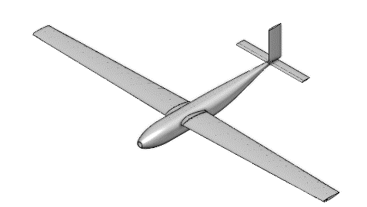
Project Description
The purpose of AMADEUS is to provide a low cost, high endurance, human portable, and rapidly deployable UAS capable of various missions in austere environments.
Missions could include:
Arial radio/cell repeater
Search and rescue
Reconnaissance
Basic overwatch platform with camera
Use in Fire departments, SAR, Military and other government agencies
Overview
Design
Risks
Require
V & V
Plans
Notes:
The mission statement for Team AMADEUS was to provide a low cost, high endurance, UAV capable of operating in austere environments under a variety of missions.
It must be transported, launched and flown by a single operator.
Additionally, it must be constructed out of additively manufactured materials and consumer off the shelf components.
The final deliverable, will be design documentation for organizations, to reproduce and operate the aircraft with minimal additional work.

Slide 3
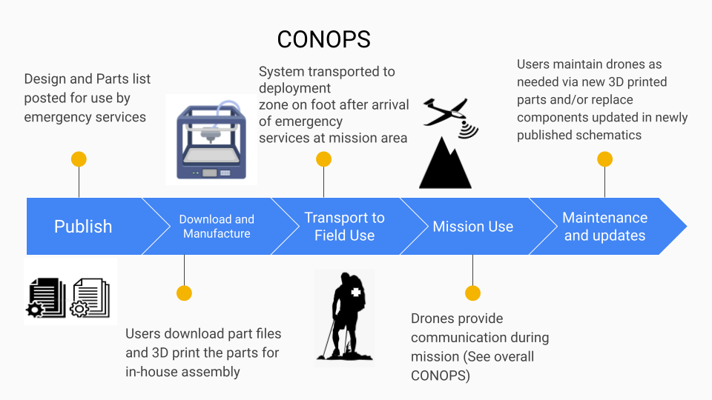
CONOPS
Overview
Design
Risks
Require
V & V
Plans
Notes:
Our CONOPS highlights the key attributes of our project including the documentation, fabrication, mission use and continued maintenance and upkeep of the UAV throughout it's lifecycle.

Slide 4
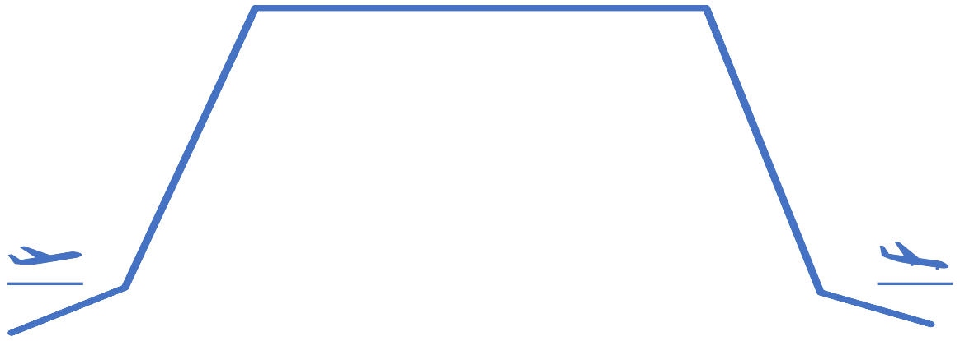
Mission Profile
3. Orbit/Operation
Landing
Glide into landing, no capture mechanism or runway.
Power requirement equal to takeoff.
Orbit/Operation
Steady, level, unaccelerated flight (SLUF)
No turn performance considered
2000 meters ASL ~ 6500 ft ASL
Trim Angle: 2.44 degrees
Velocity: 21 m/s
Descent
152.4 meters of descent
Density modeled as constant [1.007] kg/m^3
Power requirement assumed to be the same as climb
Takeoff
Slingshot launcher
[902] newtons of force experienced
Minimum change in velocity [~19] m/s
2. Climb
Climb
Unaccelerated climb at flight speed of [21] m/s
Density constant using operational altitude value of [1.007] kg/m^2
152.4 meters of climb
4. Descent
1. Takeoff
5. Landing
Overview
Design
Risks
Require
V & V
Plans
Notes:
Our functional requirements, flow down from the mission statement
where our top three are human portability, endurance and operability in austere environments.
Next we have the customer focused requirements
which include the modular payload, low maintenance cost and rapid deployment.
Finally the last three requirements are geared towards design and manufacturing
which include legal restrictions, design cost requirements and remote operation.

Slide 5
Functional Requirements
FR.1: The UAS shall be human portable.
FR.2: The UAS shall support 12 hours of continuous coverage/operation.
FR.3: The UAS shall be durable to support structural loading and environmental conditions.
FR.4: The UAS shall support a modular payload.
FR.5: The UAS shall be low cost to produce and repair for user.
FR.6: The UAS shall be rapidly deployable.
FR.7: The UAS shall obey guidelines and regulations set forth by FAA and MIL-F-8785C.
FR.8: The total costs for development and technology shall not exceed $4000.
FR.9: The UAS shall be controllable by remote user.
Overview
Design
Risks
Require
V & V
Plans
Notes:
Our functional requirements, flow down from the mission statement
where our top three are human portability, endurance and operability in austere environments.
Next we have the customer focused requirements
which include the modular payload, low maintenance cost and rapid deployment.
Finally the last three requirements are geared towards design and manufacturing
which include legal restrictions, design cost requirements and remote operation.

Slide 6
Driving Design Requirements
DR 1.2: Wingspan shall not exceed [3.6] meters.
  From portability and structural support (FR. 1).
DR 1.3: Aircraft shall have detachable wings.
  From portability and manufacturing (FR. 1 and FR. 5)
DR 2.1.1: The UAV shall have an operational endurance of [1.5] hours as a threshold, [4] hours as a goal.
  From aerodynamic efficiency and performance (FR. 2).
DR 7.1: Aircraft airborne weight shall not exceed [20] kg as a threshold, [12] kg as a goal.
  Defined by ability for users to carry and FAA restrictions (FR. 7)
Overview
Design
Risks
Require
V & V
Plans
Notes:
Our functional requirements, flow down from the mission statement
where our top three are human portability, endurance and operability in austere environments.
Next we have the customer focused requirements
which include the modular payload, low maintenance cost and rapid deployment.
Finally the last three requirements are geared towards design and manufacturing
which include legal restrictions, design cost requirements and remote operation.

Slide 7
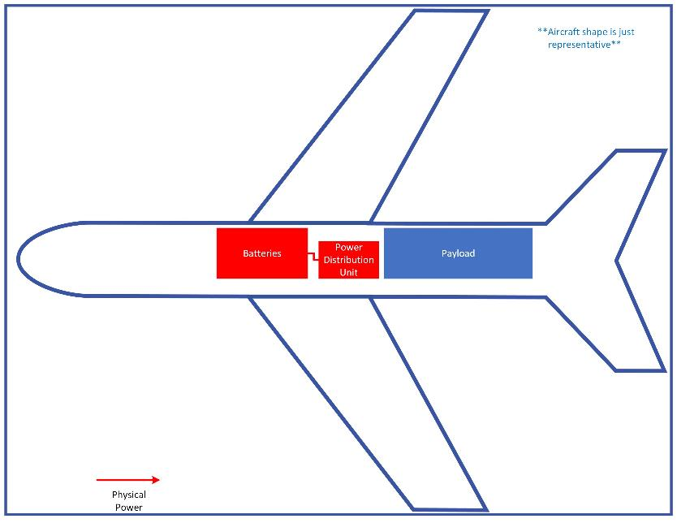
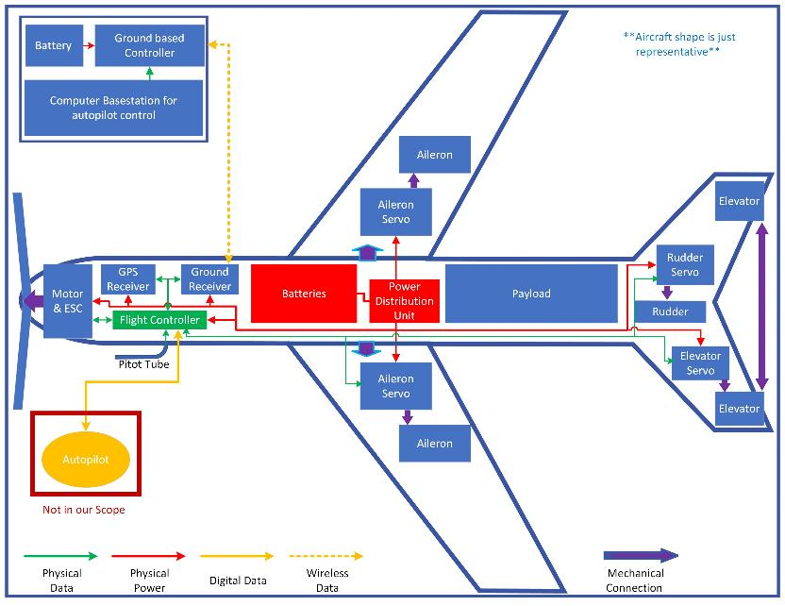
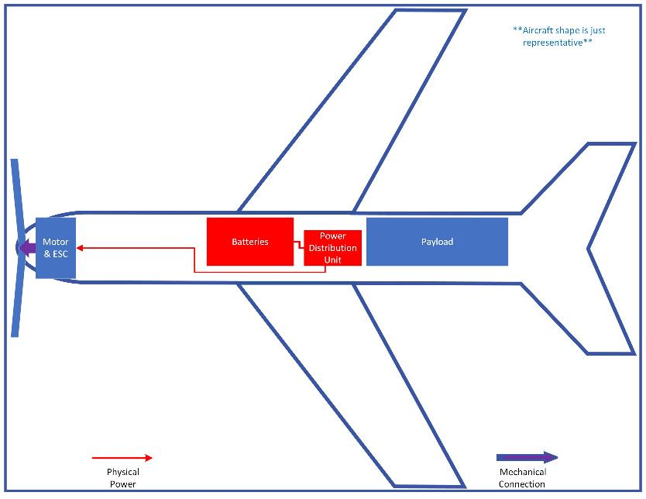
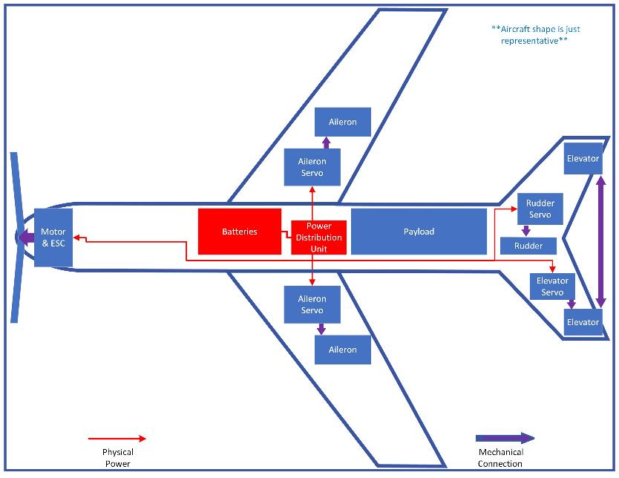
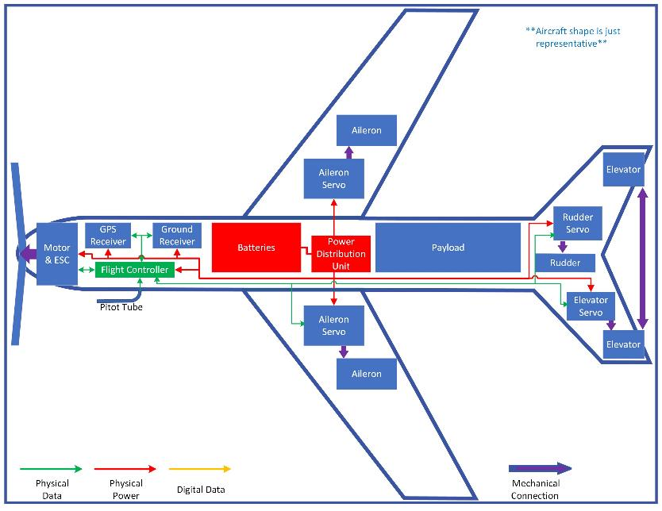
Single battery pack to power all aircraft systems
Payload & battery are the two heaviest items on the aircraft
Motor is largest power draw
Large propeller to maximize efficiency
ESC & BEC built into one
Simple flight surfaces.
Yaw, roll & pitch control
Connected elevators to lessen complexity
Flight computer for autopilot, navigation & control
Pitot tube for more accurate airspeed
GPS & ground controller receivers
Autopilot (COTS) will also help with stability
Ground flight controller
Ground autopilot & computer
Detachable wings
Overview
Design
Risks
Require
V & V
Plans
Notes:
The functional block diagram outlines the physical dependency of all systems with the structural design.
Furthermore, it outlines the connection of communications and control with nearly every system to provide a single coherent aircraft.
The propulsion system for instance communicates with the control system during flight, however is a key determinant in the design process as it will dictate the climb rate at launch and the cruise performance once at altitude.

Slide 8
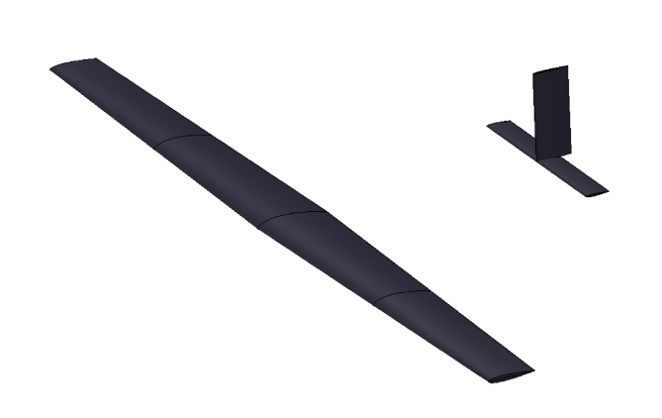
Design Solution - Aerodynamics
Root Characteristics
  NACA 4412
  0.3 meter chord
Tip Characteristics
  NACA 0012
  0.2 meter chord
Wingspan: 3.6 meters
  Limited by structural spar beam size
Horizontal Tail (NACA 0012)
  Chord Length: 0.1 m
  Tip to Tip Span: 0.814 m
Vertical Tail (NACA 0012)
  Chord Length: 0.15 m
  Height: 0.36 m
Overview
Design
Risks
Require
V & V
Plans
Notes:
- putting this before battery because these things contribute to power needs and that leads to battery chosen

Slide 9
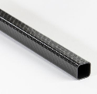
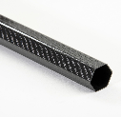
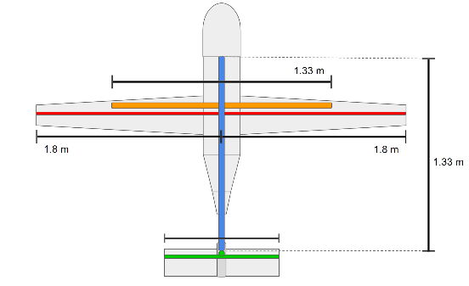
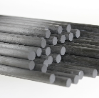
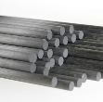
Design Solution - Airframe
Materials and Components
Off-the-shelf carbon fiber beams
  Hex Fabric Tube 22 mm OD
  Pultruded Unidirectional Rod 12 mm OD
  Square Fabric Tube 22x25 mm
  Pultruded Unidirectional Rod 7.9 mm OD
All other structures will be additively manufactured
BCN3D/Prusa - dual extrusion FFM 3D printer
  Light Weight PLA
    Density can be adjusted using nozzle temperature to optimize strength and mass distribution
Overview
Design
Risks
Require
V & V
Plans
Notes:
- putting this before battery because these things contribute to power needs and that leads to battery chosen

Slide 10
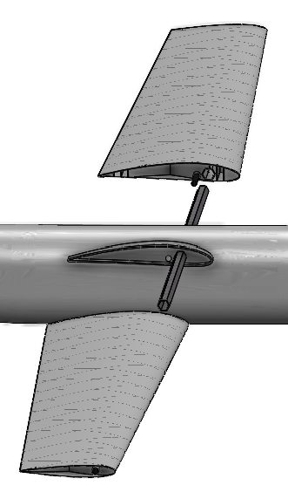
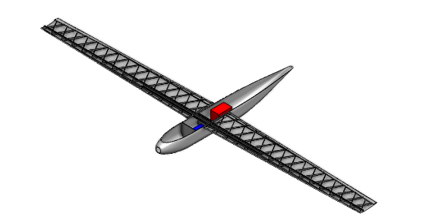

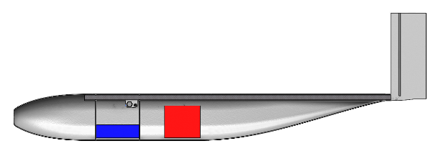
Design Solution - Airframe
Overview
Design
Risks
Require
V & V
Plans
Notes:
- putting this before battery because these things contribute to power needs and that leads to battery chosen

Slide 11
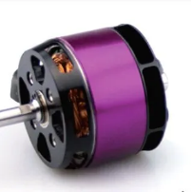
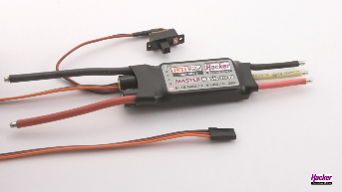
Design Solution - Propulsion
Motor – HackerMotors A50
  Max Power: 1250 W
  520 kv
  5S battery req – 18.5 V
  Max draw < 70 A
Propeller – APC 16x14
  84% efficiency @ orbit conditions
Speed Controller – HackerMotors MasterBasic 70SB
  Supports 70A, 6-26V continuous draw
  5.5V Switching BEC
Overview
Design
Risks
Require
V & V
Plans

Slide 12
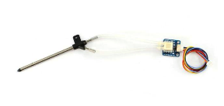
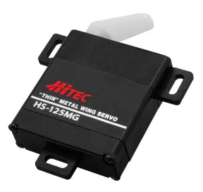
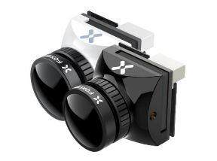
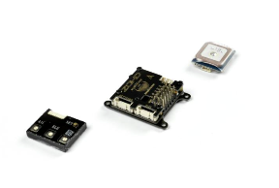
Design Solution - Electronics
MATEKSYS Digital Airspeed Sensor
Hitec HS-125MG Thin Metal
Wing Servo
Foxeer Falkor 3 Micro FPV Camera
KOHD KOPILOT Lite Autopilot System
Overview
Design
Risks
Require
V & V
Plans
Notes:
- putting this before battery because these things contribute to power needs and that leads to battery chosen

Slide 13

Design Solution – Battery
Battery Spec | Value
Nominal Voltage | 18.5 V
Nominal Capacity | 23,000 mAh
Usable Capacity | 20,700 mAh
C Rating (Discharge rate) | 25 C
Total Energy | 425.5 Wh
Total Usable Energy | 382.95 Wh
Mass | 2.071 kg
LiPo 23000 5S 18.5v Battery Pack
Overview
Design
Risks
Require
V & V
Plans
Notes:
Possible specs to include: nominal voltage, nominal capacity, continuous discharge rate, C rating, power capability, total energy, mass, configuration
Have somewhere discussion of why this battery was picked and how it supports other components
- supports 18.5V requirement of motor
- is within the mass budget
- provides necessary current/voltage for ESC, servos, and all other components
- maximizes capacity available given all of those requirements

Slide 14
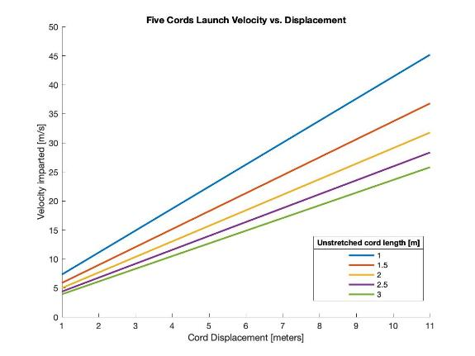
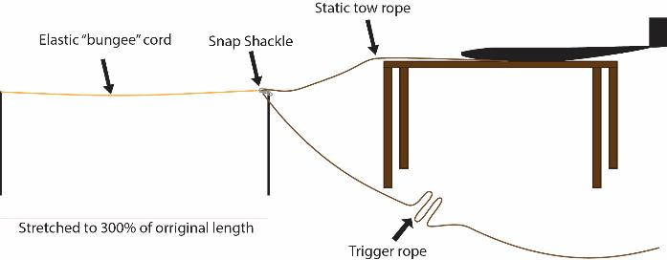
Design Solution - Launch System
Elastic Energy Model:
Assume friction with table/support negligible.
Fundamental Model:
K = 40.1 N/m (for 3m unstretched cord)
Max Force experienced: 902 [N]
Minimum velocity = Stall Velocity * (1.2)
  = 18.72 m/s
Launcher Construction:
Kent Elastomer surgical latex tubing
  Internal Diameter: 3/4 inch
  Width: 1/8 inch
Two 3/4 inch steel posts to hold elastic
Basic picnic table or something similar
Overview
Design
Risks
Require
V & V
Plans

Slide 15
Mass Budget - UAV
Payload + Propulsion | Mass (kg)
Payload | 3
Motor (A50-14 XS V4 kv520 ) | 0.347
Propeller | 0.051
Airframe/Structure | Mass (kg)
Fuselage | 2
Wing Spars | 0.823
Fuselage Beam | 0.36
Wing Shell | 1.2
Horizontal Tail Spar | 0.0306
Vertical Tail Spar | 0.0306
Tail Shell | 0.61095
Avionics + Electronics | Mass (kg)
Battery (LiPo 23000 5S 18.5V Battery Pack) | 2.1
Camera (Foxeer Falkor 3 Micro 1200TVL M12 1.7mm) | 0.25
ESC (YEP 100A Brushless ESC) | 0.08
Autopilot (ZOHD KOPILOT Lite) | 0.02
Servos (HS-125MG Servo) | 0.096
Subsystem | Mass (kg)
Propulsion | 0.398
Payload | 3
Airframe/Structure | 5.05
Electronics | 2.55
Total | 10.99
Margin | 1.65
Total Mass + Margin of 15% to account for adhesive, wiring, etc. | 12.65
Overview
Design
Risks
Require
V & V
Plans

Slide 16

Design Solution - Summary
Physical characteristics:
Total Aircraft Weight: 12.65 kg
Wingspan: 3.6 m
Length: 1.75 m
Height: 0.534 m
Max Payload: 3 kg
Flight characteristics:
Cruise speed: 21 m/s
Endurance: 0:50 hrs
Additional Components:
Launcher
UAS controller
Autopilot computer
Total Cost for project: $2790.32
Overview
Design
Risks
Require
V & V
Plans

Slide 17
Critical Project Elements
Aerodynamic Efficiency + Performance
FR.2 + FR.6
Interdependent with materials and portability
Structural Support
Materials
Portability
Requirements/scope from iron triangle
FR.1, FR.6 and FR.9
Interdependent with Structural support, materials, and aerodynamic efficiency
FR.1, FR.3 through FR.8
FR.3, FR.5, and FR.8
Interdependent with materials and portability
Scope, cost, and schedule from iron triangle
Interdependent with structures, aerodynamics and portability
Requirements from iron triangle
Cost and requirements from iron triangle
Overview
Design
Risks
Require
V & V
Plans
Notes:
We have identified four Critical project elements, without which the design will not be successful.
First and foremost is the aerodynamics which ties into the requirements for endurance and deployment.
Next is structural design which touches on ALL the requirements except endurance and remote operation.
1: The UAS must have a high aerodynamic efficiency that ensures natural stability, long endurance for minimal orbit swaps, and little energy losses at operation altitudes. Optimizing lift to drag ratio will ensure performance in all mission stages (launch, orbits, landing).
2: UAS structure must support its own weight in addition to modular payload. Structures will accommodate the aerodynamic loading and any other environmental loading without significant yielding or deformation.

Slide 18
Risk Analysis + Mitigation
Risk | If/Then Statement | Probability | Consequence | Mitigation Strategy
Aircraft Stall (8) | If the UAV encounters stall conditions and recovery is not possible, then system will crash. | 4 | 5 | Increase margins between operational and stall conditions - Velocity: 15.6 vs. 21 m/s - Angle of attack: 2.44 vs. 10 degrees
Modular Assembly (4) | If the system is modular and assembled in the field, then connection between wing and fuselage introduces stress concentration. | 4 | 4 | "Wing box" design - 2 separate spar beams that connect fuselage and wing - Continuous spars, not modular.
Manufacturing Time (14) | If the system is to be 3D printed, then prints (components, elements, etc.) will have to be printed several times to account for deficiencies, testing, and design adjustments. | 4 | 3 | Advance Planning - Begin prints for testing early January - Account for extra printing material in cost plan
Overview
Design
Risks
Require
V & V
Plans

Slide 19
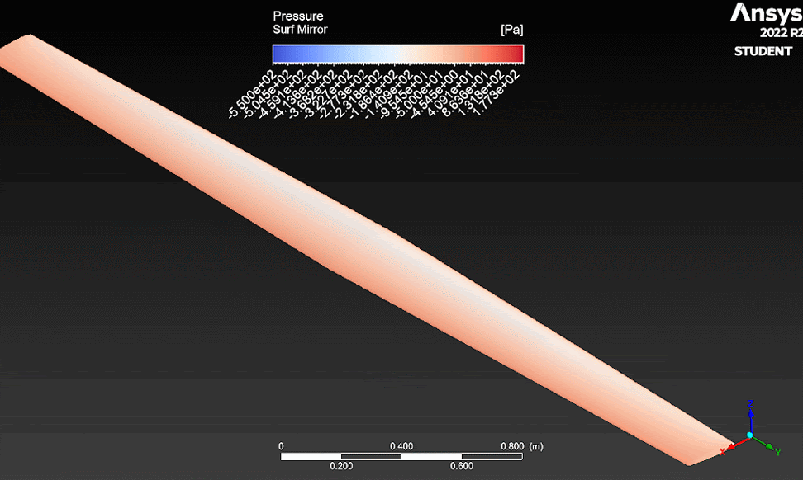
Aircraft Stall Limits
Simulated stall conditions over aircraft main wing
Main wing stall causes loss of aerodynamic lifting
Low Reynold's Number effects increases the stall risk
Main wing stall occurs at ~10 degrees angle of attack
Aircraft main wing pressure contours with increasing angle of attack
Overview
Design
Risks
Require
V & V
Plans

Slide 20
Risk Matrix
Consequence
 | 1 | 2 | 3 | 4 | 5
5
4 |  | #12 | #14 | #4 | #8
3 |  | #1,3 | #7, 13
2 |  |  | #9 | #11 | #2
1 |  | #10 | #5 | #6
Orbit Swapping
Engine Damage
Motor Failure
Modular Assembly
Control Communications
Factor of Safety (Wing Loading)
Aerodynamic Efficiency
Aircraft Stall
Battery Performance
Aircraft Stability
Launch Mechanism
Launch Pilot Training
Control Software Integration
Manufacturing Time
Probability of Occurrence
Overview
Design
Risks
Require
V & V
Plans

Slide 21
Design Requirements Satisfaction
Overview
Design
Risks
Require
V & V
Plans

Slide 22
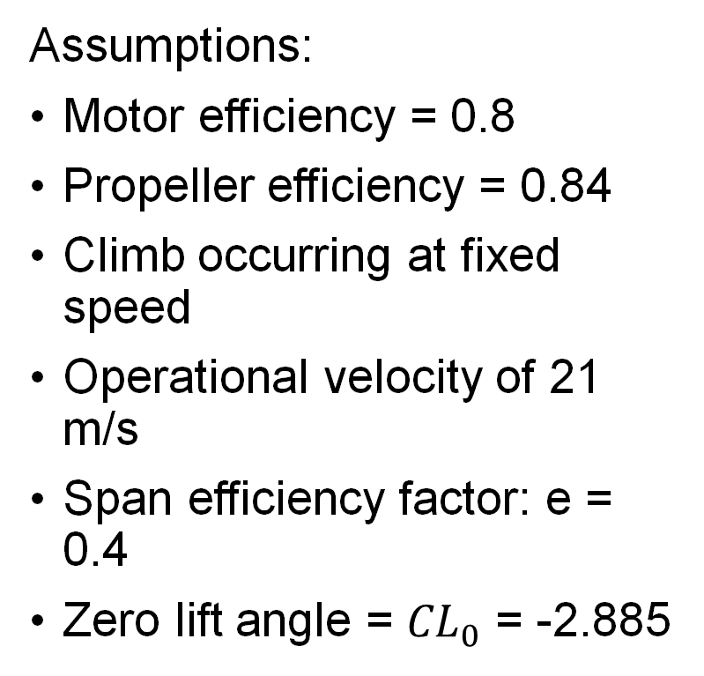
Endurance Model
DR 2.1.1 UAV shall have an operational endurance of [1.5] hours as a threshold, [4] hours as a goal.
Assumptions:
Motor efficiency = 0.8
Propeller efficiency = 0.84
Climb occurring at fixed speed
Operational velocity of 21 m/s
Span efficiency factor: e = 0.4
Zero lift angle = ${CL}_{0}$ = -2.885
Method:
Found energy required for takeoff, climb, orbit, descent, and landing
Compared various models for climb and orbit, then took maximum energy requirement from those
Used this to determine necessary specs for battery and power system
Overview
Design
Risks
Require
V & V
Plans

Slide 23
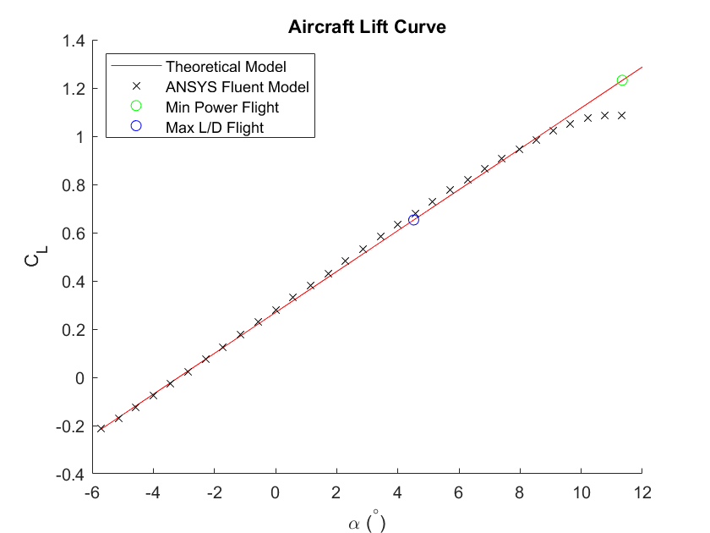
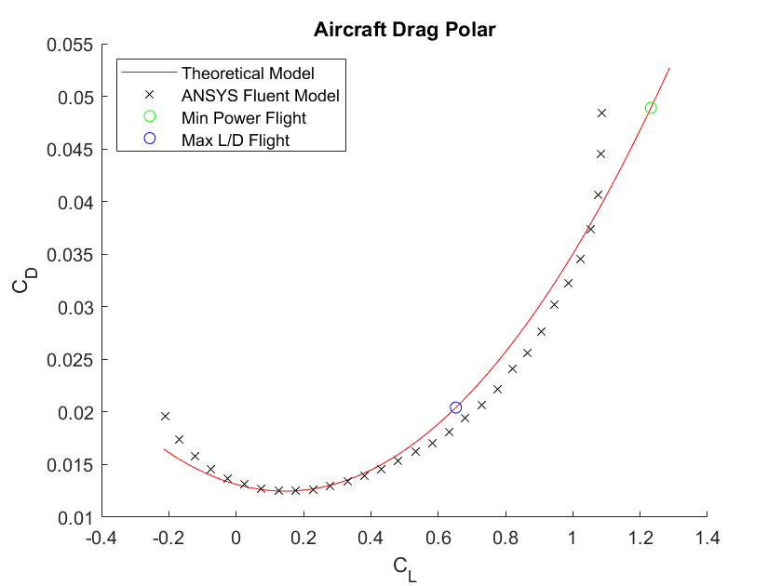
Aerodynamic Characterization
Aircraft Coefficient of Lift Curve vs. Angle of Attack
Aircraft Drag Polar
Overview
Design
Risks
Require
V & V
Plans
Notes:
Be sure to mention the trim candidates on the graph

Slide 24
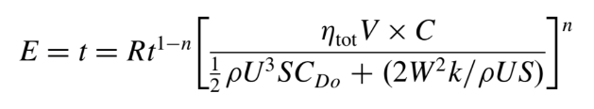


Endurance Model
DR 2.1.1 UAV shall have an operational endurance of [1.5] hours as a threshold, [4] hours as a goal.
Mission Energy = Takeoff + Climb + Orbit/Operation + Descent + Landing
= 298 ~ 488 Wh
Battery Energy = 425.5 Wh
For orbit/operation:
Endurance =
Predicted flight time = 0.8339 hours = 50 minutes
Rt = battery hour rating [hours]
V = volts
C = battery capacity [Amp-hours]
U = velocity
S = reference area
W = weight
n = discharge parameter
= total efficiency
= density
= zero lift drag
Overview
Design
Risks
Require
V & V
Plans
Notes:
- battery finalized then operation velocity, among other things, changed which is why the mission energy is higher than that of the battery
- had to remain within size requirements and this was the closest we could get

Slide 25
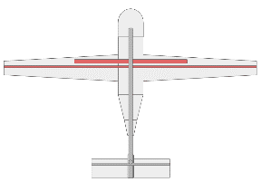



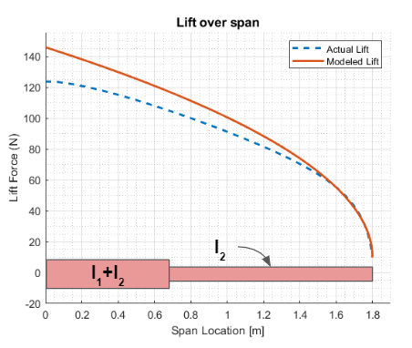
Wing Bending Model
DR 3.3: The UAV shall support wing loading of up to [13.33 ] with a safety factor of [1.3]
Assumptions:
Distributed load
Fixed at Fuselage
Small Bending Approximation
All load is applied to spar beams
Wing Structure deforms with the spar beams
Dimensions
  Constraints
    Airfoil size given by aero
    Available beams produced by Rockwest
    Direct effect on mass
Overview
Design
Risks
Require
V & V
Plans

Slide 26
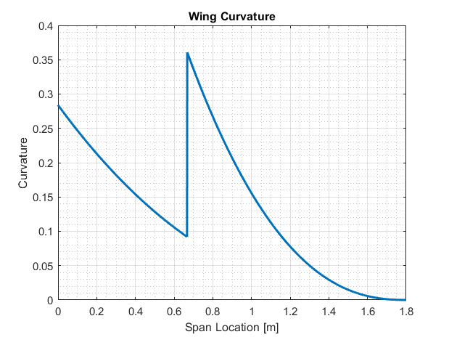
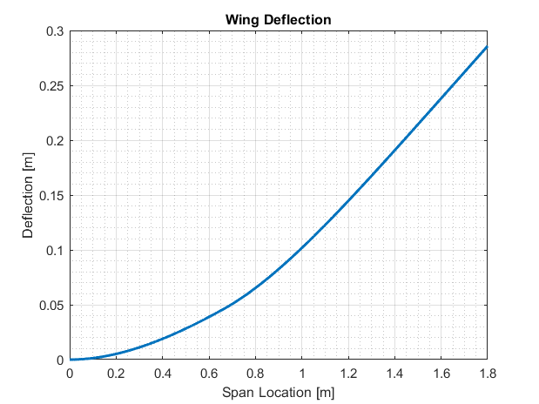

Wing Bending Model
DR 3.3: The UAV shall support wing loading of up to [13.33 ]
with a safety factor of [1.3]
Curvature (k) can be related to the stress in the individual spars and the wing shell via the equation:
where E is Young's Modulus and y is distance from cross section centroid.
Min Wing Shell FOS = 1.3
Min Long Spar FOS = 19.6
Min Short Spar FOS = 27.3
Max Wing Deflection = 28.5 cm
Overview
Design
Risks
Require
V & V
Plans

Slide 27
Wing Bending Model
DR 3.3: The UAV shall support wing loading of up to [13.33 ] with a safety factor of [1.3]
Dimensions
  Max diameter/height = 2.94 cm
Cross-Section Shape (Short Spar)
  Hollow Circle
  Hollow Square/Rectangle
  Hollow Hexagon
  Oval/Circle
Parabolic distributed load
Changed from one beam to two beams
Short Spar Performance:
The Hollow Hexagon geometry was chosen due to:
Provided most support to the wing root
Low cost
Flat surfaces for potential fastening
Shape | Factor of Safety (Wing Shell) | Factor of Safety (CF Spar)
Hollow Circle | 1.45 | 27.35
Hollow Square | 1.35 | 25.32
Hollow Hexagon | 1.46 | 27.35
Filled Circle | 0.74 | 13.91
Above results were calculated based off of existing COTS spars with similar masses that met sizing constraints.
Overview
Design
Risks
Require
V & V
Plans

Slide 28

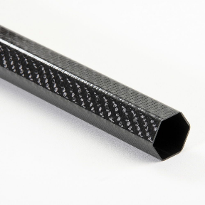
Wing Bending Model
DR 3.3: The UAV shall support wing loading of up to [13.33 ] with a safety factor of [1.3]
Long Spar
Short Spar
Geometry:
OD: 1.198 cm
Length: 1.8m
Weight: 0.315 kg each
Quantity: 2 total (1 per wing)
Geometry:
OD: 2.197 cm
ID: 1.905 cm
Length: 0.667 m
Weight: 0.191 kg
Quantity: 1 total
Overview
Design
Risks
Require
V & V
Plans

Slide 29
Verification and Validation
Overview
Design
Risks
Require
V & V
Plans

Slide 30
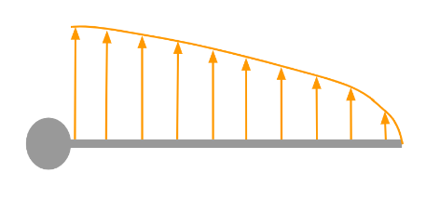
Whiffletree Test
Objective
  Show that the wing can withstand expected worst case loading
  Determine if the wing behaves in a way consistent with model
Requirement Verified
  DR 3.3: The UAV shall support wing loading of up to 13.33 kg/m^2 with a safety factor of 1.3
Overview
Design
Risks
Require
V & V
Plans
Notes:
Helps to verify system efficiency for endurance requirement

Slide 31
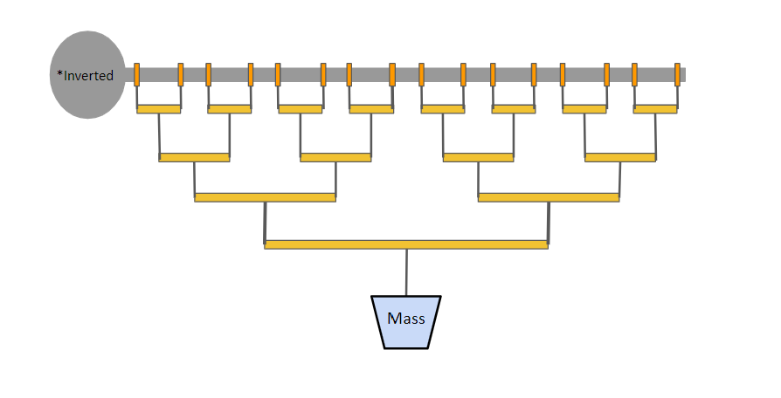
Whiffletree Test
*Representative whiffletree not actual configuration
Equipment necessary
  Whiffle tree bars provided by Professor Schwartz
  Clamps
  Container + weights to fill it with
  50 lb fishing line
  Slow motion cell phone camera with steady mount
  Ruler
Plan/method:
  Calculate distances to approximate expected aerodynamic
  load distribution
    Apply 16 point loads over the 1.8m
    Account for weight of the bars themselves
  Print a fuselage section and wing to test to failure along with an extra set of wing spars
  Clamp fuselage in place upside-down & attach wing
  Load weights incrementally into container until failure
Overview
Design
Risks
Require
V & V
Plans

Slide 32
Whiffletree Test
*Representative whiffletree not actual configuration
Measurements to collect
  Total deflection
    Use camera and ruler
  Load applied at failure
    Count weights
Pass Criteria:
  Wing holds 16.7 kg with no perceivable failure (meets requirements)
  Total deflection below 0.286 m with a load of 16.7 kg (behaves as predicted)
Overview
Design
Risks
Require
V & V
Plans

Slide 33
Motor Static Test
Objective: Obtain thrust data from chosen motor and propeller
Measurements to collect: Thrust at various RPM -> system efficiency
Requirement(s) Verified:
  DR 2.1.1.4: The UAV propulsion system shall provide a minimum of 10.41 [N] of thrust in orbit.
  The motor can obtain desired RPM for climb and orbit
  Motor is compatible with the battery voltage and current output
Overview
Design
Risks
Require
V & V
Plans

Slide 34
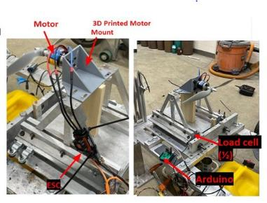
Motor Static Test
Plan/method:
  Thrust setup will be placed on a static test stand
  Load cells will be used to measure the force the propeller outputs from the RPM
Pass Criteria:
  The motor and propeller setup will output desired thrust force at a reasonable RPM
  Voltage and current draw from the battery is within model limits
Similar setup to Talon Static test stand
Overview
Design
Risks
Require
V & V
Plans

Slide 35
Motor Static Test
Materials needed:
  Static test stand
  Load cells and data acquisition device
  Motor and propeller
Facilities necessary: DBF Static Test Stand (In Contact)
  Wind tunnel for accurate thrust measurements
Blockers and/or safety concerns:
  Propeller and motor would need to be compatible
  Durability of the
Overview
Design
Risks
Require
V & V
Plans

Slide 36
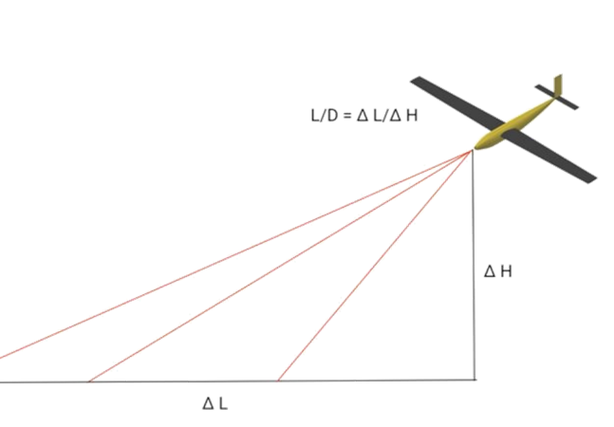
Full Flight Test
Plan/method
  Glide at different angles of attack
  Back out lift to drag ratio from flight data
  Return lift and drag separately to verify model accuracy
Pass Criteria
  Model accuracy matches experimental results within 10%
  Aircraft maintains flight and stability during test
Overview
Design
Risks
Require
V & V
Plans

Slide 37

Full Flight Test
Materials needed
  Full aircraft needs to be built and inspected for safety
Facilities necessary
  Large open area with free airspace for safe operation
Safety Considerations and Possible Obstacles
  Requires an FAA certified drone pilot
    Likely will be from the potential customer, BES
  Required to follow all FAA operating procedures for unmanned aerial systems under 14 CFR Part 107
  Lithium-Ion batteries can pose a large danger in any system failure
    Fire extinguishers and other safety measures must be readily available
  Requires a clear weather window and a low risk of wildfires
Overview
Design
Risks
Require
V & V
Plans

Slide 38
Safety Concerns
The following tests will require procedures to ensure safety
Launch system
Materials Testing
Flight Testing
Battery Endurance
Human Portability
Other safety concerns
Battery Charging procedures
System Operation and Storage Procedures
Overview
Design
Risks
Require
V & V
Plans

Slide 39
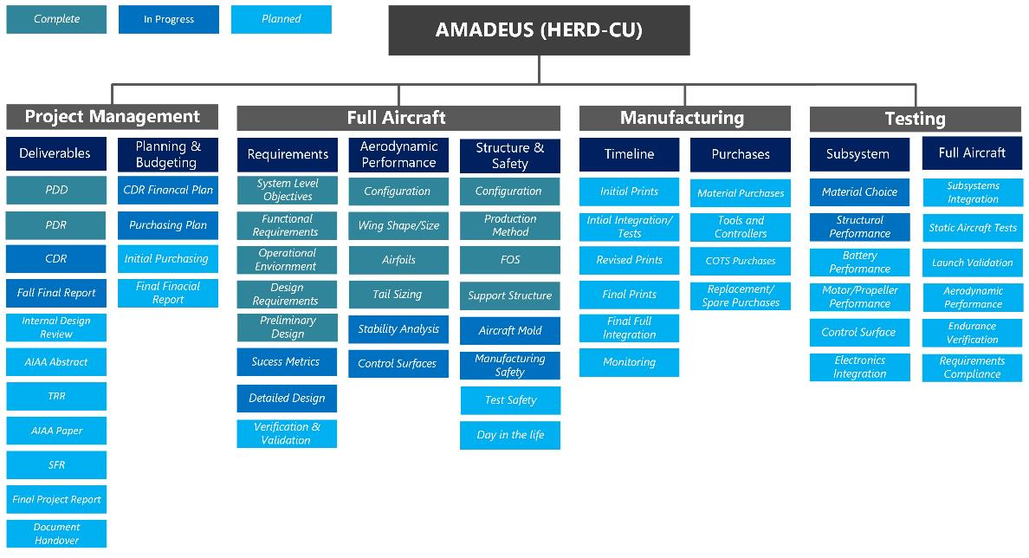
Overview
Design
Risks
Require
V & V
Plans

Slide 40
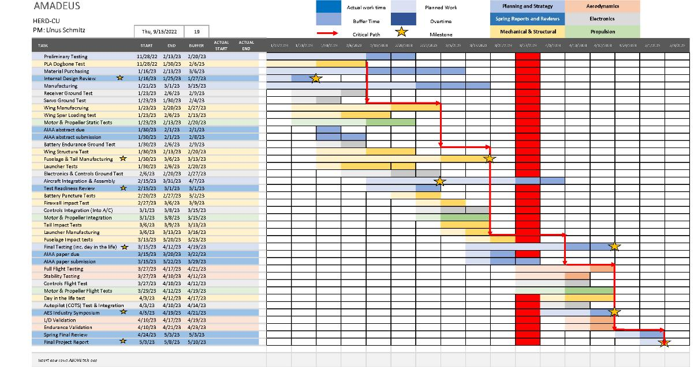
Overview
Design
Risks
Require
V & V
Plans

Slide 41
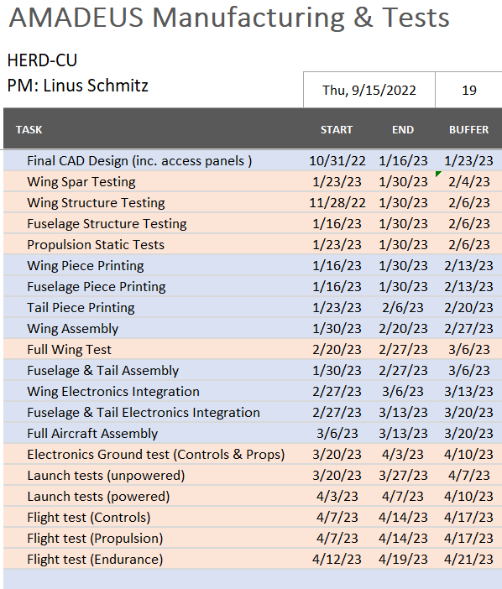
Test | Special Facilities + Equipment
Flight Time Battery Test | N/A
Servo Functionality Test | N/A
Thrust + Efficiency Test | - DPF Static Test Stand - Load cells and data acquisition device
Electronics Ground Test | N/A
Whiffle Tree Test | Whiffle Tree equipment; in contact with Prof. Schwartz
Launch Velocity Test | - Open space
Full Flight Test | - FAA certified drone pilot; BES customer. - Open space
Overview
Design
Risks
Require
V & V
Plans

Slide 42
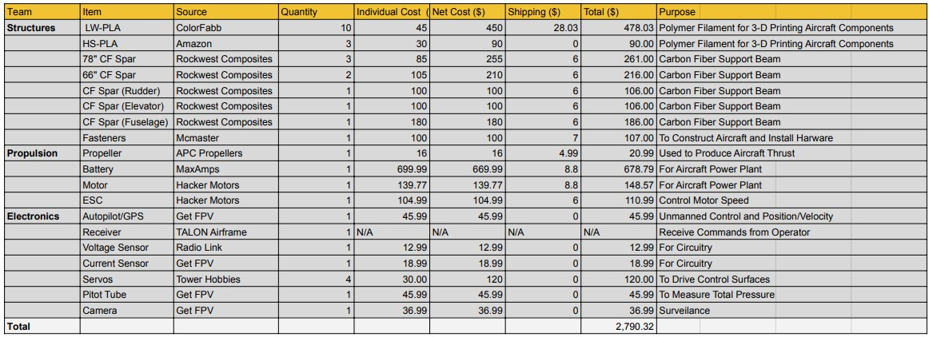
Cost Plan
Structural Total: $1550.03
Propulsion Total: $959.34
Electronics Total: $280.95
Current Margin (may Decrease): 43.35% ($1209.68)
Awaiting EEF Mini Approval
EEF Mini Funding Request: $2413.54
Overview
Design
Risks
Require
V & V
Plans

Slide 43
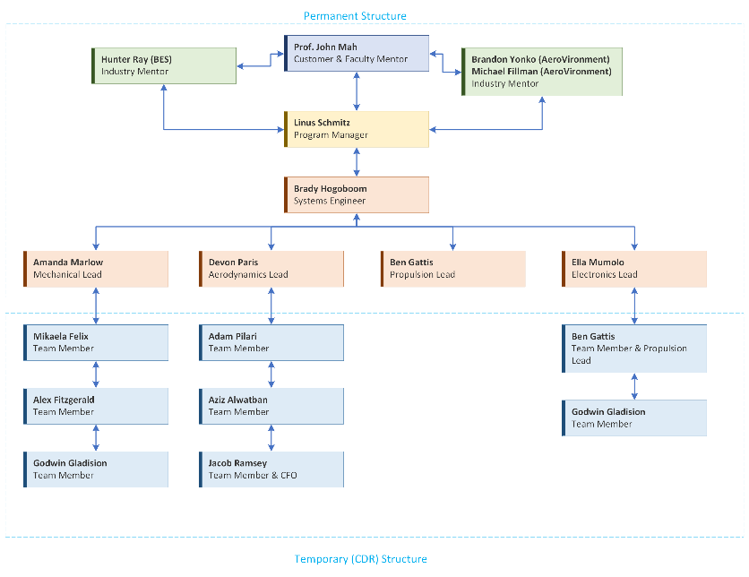
Overview
Design
Risks
Require
V & V
Plans

Slide 44
Question?
* Any slides with animations are included in the backup slides as individuals for later reference*

Slide 45
Main Slide Reference
Purpose and Objectives
Purpose & Objectives (2)
CONOPS (3)
Mission Profile (4)
Design Solution
Functional Requirements (5)
Design Requirements (6)
Functional Block Diagram (7)
Design Solution – Aerodynamics (8)
Design Solution – Airframe (9-10)
Design Solution – Propulsion (11)
Design Solution – Electronics (12)
Design Solution – Battery (13)
Design Solution - Launch System (14)
Mass Budget (15)
Design Solution – Summary (16)
Critical Project Elements & Risks
CPEs (17)
Risk Analysis + Mitigation (18)
Aircraft Stall Limits (19)
Risk Matrix (20)
Design Requirements Satisfaction
Endurance Model (22)
Aerodynamic Characterization (23)
Endurance Model Equations (24)
Wing Bending Model: Assumptions (25)
Wing Bending Model: Deflection (26)
Wing Bending Model: Spar (27)
Wing Bending Model: Choices (28)
Verification and Validation
Whiffletree Test: Objectives (30)
Whiffletree Test: Equipment (31)
Whiffletree Test: Measurements (32)
Motor Static Test: Objectives (33)
Motor Static Test: Measurements (34)
Motor Static Test: Equipment (35)
Full Flight Test: Objectives (36)
Full Flight Test: Equipment (37)
Safety Concerns (38)
Project Planning
WBS (39)
Gantt Chart (40)
Manufacturing & Testing Plans (41)
Cost Plan (42)
Organizational Chart (43)
Overview
Design
Risks
Require
V & V
Plans

Slide 46
CDR Backup Slide Reference
Purpose and Objectives
Mission Profile Animation Breakdown
Design Solution
Design Requirements - 1,2 & 3
FBD Animation Breakdown
FBD Electronic Components
FBD Electronics Connections
Launch System Animation Breakdown -1 & 2
Launch System Math -1, 2 & 3
Launch System Video
Risks
Physical Design Parameters
Mass Budget
Digital Design Parameters
Functional Block Diagram
ANSYS Fluent Modelling
Lift and Drag Component Breakdown
Critical Project Elements & Risks
Risk Matrix Scoring Analysis (47)

Slide 47
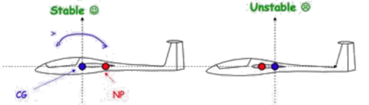
Natural Stability Requirements
BACKUP SLIDE
Pitch Stability Requirement
  Pitching moment must tend to counteract aircraft motion
  Restores aircraft to its natural trim position
  Center of gravity balance and static margin limitations
  Horizontal tail to provide pitching moment balance
Yaw Stability Requirement
  Vertical tail weathervane effect to keep aircraft flying true straight
Roll Stability Requirement
  Natural restoration to level flight trim
  Ability to hold roll angle through turn maneuvers
Overview
Design
Risks
Require
V & V
Plans

Slide 48
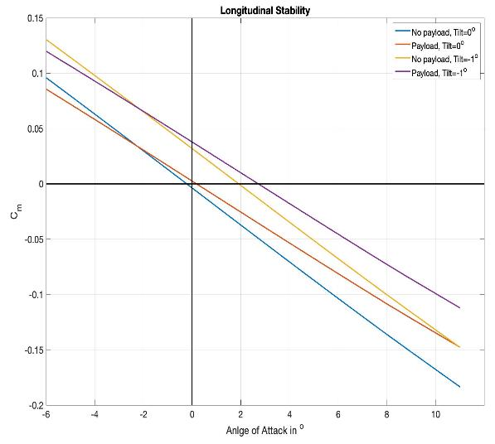
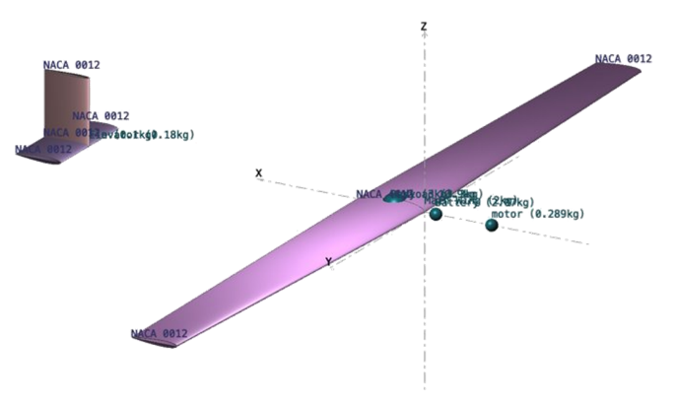
Static Margin Model
BACKUP SLIDE
SM = (XNP-XCG)/MAC = %14.2 (with payload)
SM = %16.99 (no payload)
Overview
Design
Risks
Require
V & V
Plans

Slide 49
Maybe BACKUP SLIDE
Endurance Model – Aerodynamics
DR 2.1.1 UAV shall have an operational endurance of [1.5] hours as a threshold, [4] hours as a goal.
Exploration of trim conditions to maximize endurance
  Minimum Power Required
    Induced drag is 3x parasite drag
    Trim location would be past stall limits
  Maximum Lift to Drag
    Tangent line from origin to drag polar
    Very small margin between stall and trim
  Selected Trim Condition
    Fly near maximum efficiency to safely avoid aircraft stall
    Keep velocity as low as possible to avoid excess power drain
    At xx m/s at -- angle
Overview
Design
Risks
Require
V & V
Plans

Slide 50
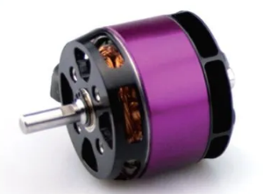
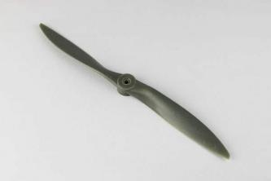
Endurance: Optimizing Propulsion System
Maybe BACKUP SLIDE
Goals: Optimize motor and propeller for cruise flight conditions
-From aerodynamics: Velocity = 21m/s, Drag = 8.81 N
-Cruise power required: 275 W
-Climb power required: 400 W
Propeller Solution: 16x14 APC Prop
-> @4000rpm, 21m/s, 9.8 N of thrust with 84% efficiency
Motor Solution: HackerMotors A50
-> Max power 1250W, 520 kv, 5S 18.5V battery required
Overview
Design
Risks
Require
V & V
Plans
Notes:
Think about wind tunnel thrust efficiency test instead of static. Static is very different than forward flight

Slide 51
BACKUP SLIDE
Additive Manufacturing
Durability (FR.3) + Manufacturing (FR.5) cont.
DR 3.3: The UAV shall support wing loading of up to [13.33 ] with a safety factor of [1.3]
Dual extrusion for printing wings
Print one section at a time
  Use PVA, a water soluble support material, to easily and safely remove once wing is printed without causing damage
Temperature
  Strength decreases with increasing temperature
  Density decreases with increasing temperature up to 250 °C.
  Choice
    Print at 250 °C
    Up to a 67% reduction in density due to active foaming
Direction
  XY
    Requires more supporting material
    Harder to print (without support material)
    More strength
  Z
    Requires less supporting material
    Easier to print
    Less strength
  Choice
    XY-direction
    Higher strength to ensure no structural failure in wing shell
Overview
Design
Risks
Require
V & V
Plans

Slide 52
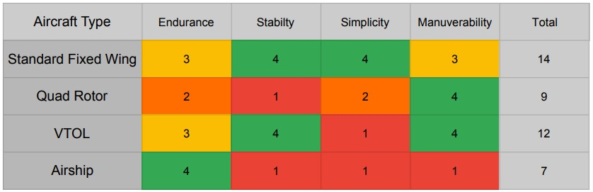
Aircraft Selection
Standard Fixed wing Scores Highest overall
Simplicity of design a major concern for mission success
Airship will either require ropes or an onboard compressor
Quad Rotor requires highest Thrust for Operation

Slide 53



BACKUP SLIDE
Fuselage-Tail Structure - Durability (FR.3)
DR 3.3: The UAV shall support wing loading of up to [13.33 ] with a safety factor of [1.3]
Assumptions:​
Point Loading​ (22N*1.5 FOS)
Fixed at Root Quarter Chord
Small Bending Approximation​
Linear Elastic
Carbon Fiber Rod Dimensions | Value
Length | 1.45 m
Height / Width | 2.413 cm
Thickness | 0.1016 cm
Mass | 0.222 kg
Property | Value
Spar FOS | 41.04
Max Deflection | 6.098 cm
Max Stress in CF Spar | 119.41 MPa
Overview
Design
Risks
Require
V & V
Plans

Slide 54



BACKUP SLIDE
Horizontal Tail Structure - Durability (FR.3)
DR 3.3: The UAV shall support wing loading of up to [] with a safety factor of [1.5]
Assumptions:​
Point Loading​ (11N*1.5 FOS)
Fixed at Root Quarter Chord
Small Bending Approximation​
Linear Elastic
Carbon Fiber Rod Dimensions | Value
Length | 0.407 m
Radius | 0.396 cm
Mass | 0.031 kg
Property | Value
Spar FOS | 35.7
Wing Shell FOS | 1.47
Max Deflection | 1.67 cm
Max Stress in CF Spar | 137 MPa
Max Stress in lwPla wing shell | 2.93 MPa
Overview
Design
Risks
Require
V & V
Plans

Slide 55


BACKUP SLIDE
Human Portability (FR.1)
DR1....
Overview
Design
Risks
Require
V & V
Plans

Slide 56
Mission Profile
3. Orbit/Operation
2. Climb
Takeoff
Slingshot launcher
[902] newtons of force experienced
Total change in velocity [~19] m/s
4. Descent
1. Takeoff
5. Landing
Overview
Design
Risks
Require
V & V
Plans
Notes:
Our functional requirements, flow down from the mission statement
where our top three are human portability, endurance and operability in austere environments.
Next we have the customer focused requirements
which include the modular payload, low maintenance cost and rapid deployment.
Finally the last three requirements are geared towards design and manufacturing
which include legal restrictions, design cost requirements and remote operation.

Slide 57
Mission Profile
3. Orbit/Operation
2. Climb
Climb
Unaccelerated climb at flight speed of [21] m/s
Density constant using operational altitude value of [1.007] kg/m^2
152.4 meters of climb
4. Descent
1. Takeoff
5. Landing
Overview
Design
Risks
Require
V & V
Plans
Notes:
Our functional requirements, flow down from the mission statement
where our top three are human portability, endurance and operability in austere environments.
Next we have the customer focused requirements
which include the modular payload, low maintenance cost and rapid deployment.
Finally the last three requirements are geared towards design and manufacturing
which include legal restrictions, design cost requirements and remote operation.

Slide 58
Mission Profile
3. Orbit/Operation
2. Climb
Orbit/Operation
Steady, level, unaccelerated flight (SLUF)
No turn performance considered
2000 meters ASL ~ 6500 ft ASL
4. Descent
1. Takeoff
5. Landing
Overview
Design
Risks
Require
V & V
Plans
Notes:
Our functional requirements, flow down from the mission statement
where our top three are human portability, endurance and operability in austere environments.
Next we have the customer focused requirements
which include the modular payload, low maintenance cost and rapid deployment.
Finally the last three requirements are geared towards design and manufacturing
which include legal restrictions, design cost requirements and remote operation.

Slide 59
Mission Profile
3. Orbit/Operation
2. Climb
Descent
152.4 meters of descent
Density modeled as constant [1.007] kg/m^3
Power requirement assumed to be the same as climb
4. Descent
1. Takeoff
5. Landing
Overview
Design
Risks
Require
V & V
Plans
Notes:
Our functional requirements, flow down from the mission statement
where our top three are human portability, endurance and operability in austere environments.
Next we have the customer focused requirements
which include the modular payload, low maintenance cost and rapid deployment.
Finally the last three requirements are geared towards design and manufacturing
which include legal restrictions, design cost requirements and remote operation.

Slide 60
Mission Profile
3. Orbit/Operation
2. Climb
Landing
Glide into landing, no capture mechanism or wheels
Power requirement equal to takeoff
4. Descent
1. Takeoff
5. Landing
Overview
Design
Risks
Require
V & V
Plans
Notes:
Our functional requirements, flow down from the mission statement
where our top three are human portability, endurance and operability in austere environments.
Next we have the customer focused requirements
which include the modular payload, low maintenance cost and rapid deployment.
Finally the last three requirements are geared towards design and manufacturing
which include legal restrictions, design cost requirements and remote operation.

Slide 61
Design Requirements
DR 5.1.4: Root chord length shall not exceed [0.3] meters
  From materials and structural support. Limited by printer capabilities (FR. 5).
DR 5.1.5: Tip chord length shall not exceed [0.2] meters
  From materials and structural support. Limited by printer capabilities (FR. 5).
DR 3.3: The UAS shall support wing loading of [13.3] kg/m² with a minimum safety factor of [1.5].
DR 5.1: 90% of UAS shall be additively manufactured or purchased off the shelf.
  From materials and users (FR. 5).
Overview
Design
Risks
Require
V & V
Plans
Notes:
Our functional requirements, flow down from the mission statement
where our top three are human portability, endurance and operability in austere environments.
Next we have the customer focused requirements
which include the modular payload, low maintenance cost and rapid deployment.
Finally the last three requirements are geared towards design and manufacturing
which include legal restrictions, design cost requirements and remote operation.

Slide 62
Design Requirements
DR 1.1 | The combined UAS system elements shall be carried/set up by [5] people (threshold), carried/set up by [1] person (goal).
DR 1.1.1 | The amount of weight carried by a single individual shall not exceed [20] kg.
DR 1.2 | Wingspan shall not exceed 3.6 meters
DR 1.3 | The aircraft shall have detachable wings
DR 2.1 | The UAS shall have [12] orbit swaps as a threshold, [3] as a goal.
DR 2.1.1 | The UAV itself shall have an endurance of [1.5] hours as a threshold, [4] hours as a goal.
DR 2.1.1.2 | The UAV's parasite drag coefficient shall be less than [.05].
DR 2.1.1.3 | The UAV shall use propulsive power no greater than [700] Watt-hours throughout mission.
DR 2.1.1.4 | The UAV propulsion system shall provide a minimum of 10.41 [N] of thrust in orbit.
DR 2.1.2 | The UAV shall operate at 6000 feet MSL altitude at constant speed [21 m/s] in its orbits.
DR 2.2 | The UAV shall have static and dynamic longitudinal and lateral-directional stability naturally.
DR 3.1 | UAS shall operate in light, dark, rain, and snow.
DR 3.1.1 | UAS shall operate in the range of -20 degrees Fahrenheit to 120 degrees Fahrenheit.
DR 3.1.2 | Structure shall withstand discrete wind gust loads for sharp-edged vertical gusts of 30 ft/s (9.15 m/s) throughout flight envelope.
DR.3.1.2.1 | Structure shall withstand lifting force determined by CL properties with a velocity of the nominal flight velocity [21 m/s] plus [9.15 m/s] due to gusts
DR 3.2 | Service life of airframe shall be a minimum of 1000 hours.
DR 3.3 | The UAS shall support wing loading of up to [13.3] kg/m^2 with a minimum safety factor of [1.3].
Overview
Design
Risks
Require
V & V
Plans
Notes:
Our functional requirements, flow down from the mission statement
where our top three are human portability, endurance and operability in austere environments.
Next we have the customer focused requirements
which include the modular payload, low maintenance cost and rapid deployment.
Finally the last three requirements are geared towards design and manufacturing
which include legal restrictions, design cost requirements and remote operation.

Slide 63
Design Requirements
DR 4.1 | The aircraft shall support a payload of 1.5 kg (threshold) - 3 kg (goal)
DR 4.2 | The aircraft shall have field accessible payload bay.
DR 4.2.1 | The payload shall be swappable in the field.
DR 4.3 | The payload shall receive 12 Volts and 10 W of power during operational time.
DR 5.1 | 90% of UAS shall be 3D printable of purchasable off the shelf.
DR 5.1.1 | 90% of UAS shall be repairable/manufactured by user.
DR 5.1.2 | UAS printable or repairable parts shall cost no more than [1000] $.
DR 5.1.3 | Largest printable size must fit within 11 x 9 x 9 inches
DR 5.1.4 | Max root chord length = 0.3 m
DR 5.1.5 | Max tip chord length = 0.2 m
DR 6.1 | UAS shall maintain 100 % standby posture.
DR 6.1.1 | UAS shall be airborne within [15] minutes of arrival destination.
DR 7.1 | Aircraft airborne weight shall not exceed 20 kg.
DR 9.1 | The UAV shall be controlled by a user on the ground within line of sight to the aircraft.
DR 9.1.1 | The aircraft/controller shall receive signals at a minimum of [500] meters away.
Overview
Design
Risks
Require
V & V
Plans
Notes:
Our functional requirements, flow down from the mission statement
where our top three are human portability, endurance and operability in austere environments.
Next we have the customer focused requirements
which include the modular payload, low maintenance cost and rapid deployment.
Finally the last three requirements are geared towards design and manufacturing
which include legal restrictions, design cost requirements and remote operation.

Slide 64
Single battery pack to power all aircraft systems
Payload & battery are the two heaviest items on the aircraft
Overview
Design
Risks
Require
V & V
Plans
Notes:
The functional block diagram outlines the physical dependency of all systems with the structural design.
Furthermore, it outlines the connection of communications and control with nearly every system to provide a single coherent aircraft.
The propulsion system for instance communicates with the control system during flight, however is a key determinant in the design process as it will dictate the climb rate at launch and the cruise performance once at altitude.

Slide 65
Motor is largest power draw
Large propeller to maximize efficiency
ESC & BEC built into one
Overview
Design
Risks
Require
V & V
Plans
Notes:
The functional block diagram outlines the physical dependency of all systems with the structural design.
Furthermore, it outlines the connection of communications and control with nearly every system to provide a single coherent aircraft.
The propulsion system for instance communicates with the control system during flight, however is a key determinant in the design process as it will dictate the climb rate at launch and the cruise performance once at altitude.

Slide 66
Simple flight surfaces.
Yaw, roll & pitch control
Connected elevators to lessen complexity
Overview
Design
Risks
Require
V & V
Plans
Notes:
The functional block diagram outlines the physical dependency of all systems with the structural design.
Furthermore, it outlines the connection of communications and control with nearly every system to provide a single coherent aircraft.
The propulsion system for instance communicates with the control system during flight, however is a key determinant in the design process as it will dictate the climb rate at launch and the cruise performance once at altitude.

Slide 67
Flight computer for autopilot, navigation & control
Pitot tube for more accurate airspeed
GPS & ground controller receivers
Overview
Design
Risks
Require
V & V
Plans
Notes:
The functional block diagram outlines the physical dependency of all systems with the structural design.
Furthermore, it outlines the connection of communications and control with nearly every system to provide a single coherent aircraft.
The propulsion system for instance communicates with the control system during flight, however is a key determinant in the design process as it will dictate the climb rate at launch and the cruise performance once at altitude.

Slide 68
Autopilot (COTS) will also help with stability
Ground flight controller
Ground autopilot & computer
Detachable wings
Overview
Design
Risks
Require
V & V
Plans
Notes:
The functional block diagram outlines the physical dependency of all systems with the structural design.
Furthermore, it outlines the connection of communications and control with nearly every system to provide a single coherent aircraft.
The propulsion system for instance communicates with the control system during flight, however is a key determinant in the design process as it will dictate the climb rate at launch and the cruise performance once at altitude.

Slide 69

Connections
Servos:
ground and power cables to battery
signal wire connects to Flight Controller (FC)
ESC:
ground and power cables to battery
3 wires connecting to motor
receiver lead that connects to receiver
Flight Controller:
connects directly to servos
connects directly to receiver
Pitot Tube:
outputs I2C that connects to FC
Overview
Design
Risks
Require
V & V
Plans

Slide 70

Overview
Design
Risks
Require
V & V
Plans

Slide 71

Launch System
Elastic Energy Model:
Assume friction with table/support negligible.
Fundamental Model:
K = 40.1 N/m (for 3m unstretched cord)
Max Force experienced: 902 [N]
Minimum velocity = Stall Velocity * (1.2)
  = 18.72 m/s
Launcher Construction:
Kent Elastomer surgical latex tubing
  Internal Diameter: 3/4 inch
  Width: 1/8 inch
Two 3/4 inch steel posts to hold elastic
Basic picnic table or something similar
Overview
Design
Risks
Require
V & V
Plans

Slide 72
Launch System
Elastic Energy Model:
Assume friction with table/support negligible.
Fundamental Model:
K = 40.1 N/m (for 3m unstretched cord)
Max Force experienced: 902 [N]
Minimum velocity = Stall Velocity * (1.2)
  = 18.72 m/s
Launcher Construction:
Kent Elastomer surgical latex tubing
  Internal Diameter: 3/4 inch
  Width: 1/8 inch
Two 3/4 inch steel posts to hold elastic
Basic picnic table or something similar
Overview
Design
Risks
Require
V & V
Plans

Slide 73
Launch System
Kent Elastomer surgical latex tubing
  Internal Diameter: 3/4 inch
  Width: 1/8 inch
Energy Model:
  Drag (D) calculated to be 9 [N] in takeoff/climb
  X is displacement and k is spring constant approximated using manufacturer specs.
  M is mass and V is velocity imparted to aircraft.
Overview
Design
Risks
Require
V & V
Plans
Notes:
Our functional requirements, flow down from the mission statement
where our top three are human portability, endurance and operability in austere environments.
Next we have the customer focused requirements
which include the modular payload, low maintenance cost and rapid deployment.
Finally the last three requirements are geared towards design and manufacturing
which include legal restrictions, design cost requirements and remote operation.

Slide 74


Launch System
K = 40.12 N/m (for a 3 meter unstretched cord)
D = 9 [N]
Max force experienced: 902.7 [N]
5 cords used
Overview
Design
Risks
Require
V & V
Plans
Notes:
Our functional requirements, flow down from the mission statement
where our top three are human portability, endurance and operability in austere environments.
Next we have the customer focused requirements
which include the modular payload, low maintenance cost and rapid deployment.
Finally the last three requirements are geared towards design and manufacturing
which include legal restrictions, design cost requirements and remote operation.

Slide 75


Launch System
Overview
Design
Risks
Require
V & V
Plans

Slide 76

* Curtesy of IRISS
Overview
Design
Risks
Require
V & V
Plans

Slide 77
Critical Project Elements
Element Number | Element | Associated Functional Requirements | Interdependent with
1 | Aerodynamic Efficiency + Performance | FR.2 FR.6 IRON Triangle --> Requirements/Scope | -Materials -Portability
2 | Structural Support | FR.1 FR.3 FR.4 FR.5 FR.6 FR.7 FR.8 IRON Triangle --> Requirements/Scope + Cost + Schedule | -Materials -Portability
Overview
Design
Risks
Require
V & V
Plans
Notes:
We have identified four Critical project elements, without which the design will not be successful.
First and foremost is the aerodynamics which ties into the requirements for endurance and deployment.
Next is structural design which touches on ALL the requirements except endurance and remote operation.
1: The UAS must have a high aerodynamic efficiency that ensures natural stability, long endurance for minimal orbit swaps, and little energy losses at operation altitudes. Optimizing lift to drag ratio will ensure performance in all mission stages (launch, orbits, landing).
2: UAS structure must support its own weight in addition to modular payload. Structures will accommodate the aerodynamic loading and any other environmental loading without significant yielding or deformation.

Slide 78
Critical Project Elements
Element Number | Element | Associated Functional Requirements | Interdependent with
3 | Materials | FR.3 FR.5 FR.8 IRON Triangle --> Cost and requirements/scope | -Aerodynamic Efficiency -Structural Support -Portability
4 | Portability | FR.1 FR.6 FR.9 IRON Triangle --> Requirements | -Aerodynamic Efficiency -Structural Support -Materials
Overview
Design
Risks
Require
V & V
Plans
Notes:
Materials and material choice is one of our most important elements as it plays a roll in every CPE.
It is based on the operations, costs requirements for the project.
Finally portability stems from the requirement specifying that it must be transportation, rapid deployment and remote control requirements.
Similar to material choice it is has interdependencies with all three other CPEs.
3: Design must incorporate additive manufacturing or off the shelf materials while maintaining the lightest possible airframe. Poses challenges for aerodynamics as materials used influence efficiency and structures as these materials have stress/strength limitations.
4: For use in austere environments, UAS must be lightweight to be carried by user to launch site. If feasible, design to be modular and assembled in field or before use.

Slide 79
Risk Matrix - Scoring
Consequence – To performance, schedule, safety, or budget
1 | Minor Concern
2 | Slightly Concerning
3 | Concerning
4 | Very Concerning
5 | Mission Ending
Probability of Occurrence
1 | Not Likely: P < 20%
2 | Low Likelihood: 20% < P < 40%
3 | Likely: 40% < P < 60%
4 | Highly Likely: 60%< P < 80%
5 | Near certainty: P > 80%
Overview
Design
Risks
Require
V & V
Plans

Slide 80
System Risk Analysis
 | 4 | 5
5
4 | Aircraft Stall
3
2
Mitigating risk:
Introduce greater margin between stall velocity and all operational velocities. Aircraft will fly faster and power requirement increases as a result.
Introduce margin between angle of attack and stall angle during all phases of flight.
Overview
Design
Risks
Require
V & V
Plans

Slide 81
System Risk Analysis
 | 4 | 5
5
4
3 |  | Structural Failure
2
Mitigating risk:
Factor of safety set at 1.3
Aircraft flight restricted such that conditions never exceed worst case;
  Vertical wind gust maximum of 30 [m/s]
  Temperature range: -20 to 120 degrees Fahrenheit.
b
Overview
Design
Risks
Require
V & V
Plans

Slide 82
System Risk Analysis
Number | Subteam | Title | Risk Statement [If, by, then] | Score Justification / Notes | Probability | Consequence | Score
1 | Aero/Prop | Orbit swapping + Endurance time | If user must swap the orbiting aircraft more than [3] times in the 12 hour mission, then risk of failed launch due to fatigue and increased number of launches (that each have a risk of failing) | Swapping between launches will be a well-documented process, and fatigue will be limited by replaceable parts (battery, etc.). | 3 | 2 | 6
2 | Structures/Prop | Engine Damage | If aircraft crashes, then engine (battery) could puncture and start a fire. | A structural concern, associated with design and loading. Limited early on by firewall design. | 2 | 5 | 10
3 | Prop | Motor | If motor fails for any reason (loss of power, damage, etc.), then aircraft will crash without the ability to maintain lift. | Motor failure has a low probability, and if so, aircraft should still achieve some glide. Glide capabilities to be flushed out in testing. | 2 | 3 | 6
4 | Structures | Modular Assembly | If the system is modular and constructed in the field, then connection between wing and fuselage introduces stress concentration. | Structural concerns from design and manufacturing. No succuss can be claimed if structure breaks. | 4 | 4 | 16
5 | Electrical | Control communications | If the UAV cannot receive signals from operator, aircraft may fail without control and crash. | Should not be a concern as UAV should remain in line of sight to satisfy FAA regulations. | 1 | 3 | 3
Overview
Design
Risks
Require
V & V
Plans

Slide 83
System Risk Analysis
6 | Structures | Wing Loading | If UAS cannot support the weight of payload + system itself then structural support in wing could fail. | Design and trade studies are using worst case weight scenarios such that this risk is low. | 1 | 4 | 4
7 | Aerodynamics | Efficiency | If the UAV is not aerodynamically efficient the endurance of the system will be minimal, climb will be difficult, and risks posed by engine failure will be compounded. | System needs to be aerodynamically efficient to succeed in mission objectives. | 3 | 3 | 9
8 | Aerodynamics | Stall | If the UAV hits stall conditions and recovery is not possible, then system will crash. | If a stall condition is obtained, and we are unable to recover the mission will fail and the aircraft could be damaged. Currently, very low margins exist between stall and operational performance. | 4 | 5 | 20
9 | Electrical | Battery performance | If the system battery does not perform as theorized/modeled, system endurance will be far lower. | If endurance is lower, then system will require more orbit swaps. | 2 | 3 | 6
10 | Aerodynamics | Stability | If the UAV cannot exhibit natural stability, then DR 2.2 will go unsatisfied. | Some mission success can still be achieved but will require constant pilot correction in flight to maintain stability. | 1 | 2 | 2
Overview
Design
Risks
Require
V & V
Plans

Slide 84
System Risk Analysis
11 | All teams | Launch mechanism | If the UAV cannot achieve desired launch velocity, aircraft will not reach operation. | Probability will be low because of design. Consequence should also be ranked low as continuous iteration should result in an effective launch. | 2 | 4 | 8
12 | All teams | Launch Training | If the UAV is to launched, then pilot/operator must learn when/how to activate throttle in launch as the table will block propellers from operation. | Probability here will be very high as there are no alternate ways to launch with our current mass. Consequence will be low however as this merely adds time and training but should not damage or alter mission. | 4 | 2 | 8
13 | All teams | Control Software Integration | If control software integration is not trivial, then time could be added to schedule which would include work beyond the scope of our project. This work could involve adjusting software, writing software, and hardware changes as well. | Probability is medium, COTS control software research and heritage show that integration should be simple. Consequence is high as this is a limitation to flight. | 3 | 3 | 9
14 | All teams | Manufacturing Time | If various testing is to be done on printed components, then program could be delayed if construction/printing exceeds expected timelines. | Since we want to fully test components/elements and not use them again, we will have to print several times. This will increase our time it takes to prepare for a test as we also have to construct after printing. This further impacts budgeting, materials needed, and labor hours. | 4 | 3 | 12
Overview
Design
Risks
Require
V & V
Plans

Slide 85
Overview
Design
Risks
Require
V & V
Plans

Slide 86
Endurance Model #2
DR 2.1.1 UAV shall have an operational endurance of [1.5] hours as a threshold, [4] hours as a goal.
Assumptions:
Battery specific energy density = Eb = 205.46 Wh/kg
Velocity = V = 21 m/s
Battery mass = Mb = 2.1 kg
Total mass = M = 10.54
System efficiency = n = 0.6
Endurance = (3.6 * (CL/CD) * (n/V) * (Mb/M) * (Eb/g)) / 3600
= 2.94 hours
Notes:
Motor test will give actual efficiency, same test along with battery will give actual endurance

Slide 87


Endurance Model #2
DR 2.1.1 UAV shall have an operational endurance of [1.5] hours as a threshold, [4] hours as a goal.

Slide 88
Structures/Material Selection Space
Purpose:
Explore options to meet
  FR.3 - durable
  FR.4 - modular payload (up to 3 kg)
  FR.5 - low cost to produce and repair
    DR.5.1 - 90% COTS or additively manufactured by user
Refine the design space by modeling worst case loading scenarios on the most critical structural elements
Choose an ideal manufacturing method and identify top candidate materials for each critical structural element
Overview
Trades
Design
Next Steps
Notes:
The driving factors behind our structures and materials research were our functional requirements for durability, supporting a 3 kg payload, and keeping costs low – specifically by using primarily COTS and 3D printed parts.
We wanted to refine the design space by modeling worst case loading conditions on the most critical structural elements. We also looked into the best material and manufacturing methods for each of these elements.

Slide 89



Wing Loading Assumptions
Mass = 15 kg (Mass budget in appendix)
L = Lift = Weight = 147.15 N
F = Force applied at wing tips to overestimate worst case scenario without relying on specific lift distribution and keeping the model simple
Overview
Trades
Design
Next Steps
Notes:
The first element we looked at were the wings.
We had to start with some assumptions to do this analysis. First of all, we decided to use a total lifting force equal to the weight of the plane. We also assumed loads were applied at the tips, so that we did not have to rely on a certain lift distribution from the aerodynamics team. When looking at torsion over the wing, we assumed a pretty long chord length for this sized plane and a rectangular wing so the chord length is uniform. We chose to apply the lifting force at the quarter chord to get the moment arm as this is about where the aerodynamic center is on most fixed wings.

Slide 90





Wing Bending
Cantilever Beam Analysis
Trends along the wing stay the same for all cross sections but max and min stress differ
Max Shear
Overview
Trades
Design
Next Steps
Notes:
We modeled the bending moment on the wing with a cantilever beam meaning it is completely fixed at the fusilage. The top of the wing will be in compression and the bottom in tension with a plane of shear stress that transitions between the two.
You can see the trends along the wing in these plots with the most extreme tensile stress at the root and uniform shear stress over the span.

Slide 91


Wing Bending
Hollow Cylinder
Approximates a structural spar beam
Easily constructed with COTS components
Hollow Rectangular Cross Section
Approximates a wing shell with no other structural elements
Best with additive manufacturing
Tensile Stress:
Max σ = 104.4 MPa
Tensile Stress: Max σ = 2.701 MPa
Shear Stress: Max τ = 0.27 MPa
Shear Stress:
Max τ = 0.0098 MPa
Overview
Trades
Design
Next Steps
Notes:
For wing bending we primarily looked at two cross section shapes. The hollow cylinder is meant to approximate a spar beam. The hollow rectangle is meant to be close to the shape of an airfoil with a representative length and thickness. The tensile stress was pretty high on the hollow cylinder, but a spar beam would be pretty easy to make with COTS components that have higher strengths. The tensile stress on the rectangle was lower, and shear stress was higher. The increased shear stress here is something to keep an eye on, since this is meant to approximate an airfoil shape we would want to 3D print and shear strength is highly dependent on printing techniques.

Slide 92


Wing Torsion
Hollow Thick-Walled Cylinder
Approximates a structural spar beam
Max τ = 2.22 MPa
Best with OTS Components
  Aluminum
  Steel
  Carbon Fiber
Open Thin-Walled Ellipse
Approximates a wing shell with no other structural elements
Max τ = 0.987 MPa
Best with Additive Manufacturing
  Extruded Filaments
  SLS Plastics
Overview
Trades
Design
Next Steps
Notes:
Similar to our bending calculations, we looked at two cross sections. A hollow cylinder is still used to approximate the spar beam, but this time we used an open thin wall ellipse to approximate an airfoil shell. We used these results as the max shear stress a material must withstand.

Slide 93
Wing Conclusions
Manufacturability [FR.5]
  Wing Surface should be additively manufactured to get ideal airfoil shape
  Spar beam can utilize COTS components
Strength/Durability [FR.3]
  Stress, particularly shear, is high enough that a spar beam made of a stronger material is recommended to ensure the additively manufactured wings do not fail
    3D printed materials have largely unknown shear strengths because it is so dependent on printing technique and other outside factors
*Elaborated on in materials trade study
Overview
Trades
Design
Next Steps
Notes:
Overall, we concluded that the shear stress could be of great enough concern to combine a spar beam made of a strong, material and a 3D printed outer airfoil shape in order to meet our requirements for manufacturing and durability.

Slide 94




Firewall - Assumptions
Generic firewall geometry where motor transfers impact force axially onto firewall.
Primarily Shear Stress
Distributed load acting on center only.
High stresses compared to material strength
Primarily Compressive Stress
Distributed load acting on outside cylinder only.
Lower stresses compared to material strength
F is force due to impact
Overview
Trades
Design
Next Steps
Notes:
The next critical structural element we looked at was a firewall. A firewall is what the engine is mounted to and it is the primary structure that absorbs forces due to impact. We looked at various impact angles using an upper bound on the expected airspeed of 18 m/s. In our first model, we assumed the firewall was constructed in a way that the force of the impact was primarily transferred into shear stress. There were really no materials that could withstand this. So instead, we changes how me were envisioning the configuration so the major force is compression as shown in the top and bottom figures. We found that this is actually how most firewalls are constructed.
Alex's Notes: The firewall is an important airframe component that supports the motor. Due to its placement directly behind the motor it will experience large stresses during any hard landings. The firewall was analyzed in order to determine the best possible material to use in its manufacturing in order to improve the durability of the aircraft. The firewall was first analyzed as a disk attached to a hollow cylinder where the primary forces act on the disk. In this geometry the most severe stresses are shear stresses at the connection between the disk and the cylinder. Upon the completion of this analysis it was determined that few or no materials had the necessary shear strength to survive impacts at relatively low impact angles given reasonable geometry. Further research was done into firewalls in order to find out how other similarly sized uav's solved this issue. It was found that most firewalls actually have additional supports behind the motor mount generally taking the form of a L-bracket or cylinder. For simplicity the firewall was then modeled as a cylinder shown in the top image where the major stress is compression in the cylinder.

Slide 95






Firewall Feasibility
Compressive Stress (sigma) in the firewall cylinder calculation using work-energy principle:
Equation can be rewritten to solve for a relationship between material properties sigma (Compressive Stress) and E (Young's Modulus):
Assumptions: v = 18 m/s, m = 15 kg, geometry given in previous slide
IMAGE: https://en.wikipedia.org/wiki/Stiffness
http://hyperphysics.phy-astr.gsu.edu/hbase/impulse.html
Overview
Trades
Design
Next Steps
Notes:
Using the geometry given in the last slide compressive stress was determined using the work-energy principle. The spring constant, k, is determined using the young's modulus of the material. The stiffer the material, the more force will act upon the firewall since the impact is taking place over a shorter time period. This equation can be rearranged to isolate the material properties on one side resullting in the useful ratio between the compressive strength and the square root of the young's modulus of the material. The plot on the right shows the maximum compressive stress vs the young's modulus of the material.
Alex's Notes: Using the geometry given in the last slide where the force of an impact, F, is transfered onto the firewall as a distributed load on the hollow cylinder the maximum compressive stress and therefore necessary material compressive strength was determined. The impact force was determined using the work-energy principle where k, spring constant, is determined using the young's modulus of the firewall material. The stiffer the material, the more force will act upon the firewall since the impact is taking place over a shorter time period. The force is then divided by the cross-sectional area of the firewall cylinder in order to get the maximum compressive stress. This equation can be rearranged to isolate the material properties on one side resullting in the useful ratio between the compressive strength and the square root of the young's modulus of the material. For a specific velocity and impact angle an angle can be determined This ratio will be used to determine if a material is feasible for the firewall. A plot of the maximum compressive stress vs the young's modulus of the material is shown to the right.

Slide 96
Firewall Conclusions
Minimum material ratio required w/ 20% margin
Takeaway:
Reasonable impact angle must be assumed for firewall to survive crash.
Firewall should use material with high sigma/sqrt(E) value such as Acrylic. [FR.3]
Firewall should be additively manufactured to accommodate potentially complex geometry. [FR.5]
Compressive Strength vs. sqrt(E)
Impact Angle θ​ | sigma/sqrt(E)​
90°​ | 2853.4​
60°​ | 2140.1​
45°​ | 1426.7​
30°​ | 856.0​
15°​ | 191.1​
5°​ | 21.7​
Material | sigma/sqrt(E)
PC | 1646.77
PLA | 1468.03
ABS | 1300.00
PETG | 763.76
Acrylic | 2105.15
Nylon | 2173.52
316L SS | 386.96
Carbon Fiber | 1819.92
Al. 6061 T-6 | 952.42
Assumptions: v = 18 m/s, m = 15 kg, geometry given in previous slide
Overview
Trades
Design
Next Steps
Notes:
The conclusions we can draw from the firewall analysis is that the material should have a high strength to youngs modulus ratio to meet our durability requirement. We also determined that the shape needed to would be best to 3D print to meet our manufacturability requirement. On the right you can see tables of the strength ratios, but I'm going to hand it over to Mikaela to go more in-depth on materials.
Alex's notes: The table in the center shows the minimum required compressive strength per square root of young's modulus depending on the impact angle. These values were determined using an assumed aircraft mass of 15kg and velocity of 18 m/s. A list of prospective materials is tabulated to the right including their ratio of sigma over sqrt of E. As shown, given reasonable geometry no material is able to survive a 90 degree impact however given a more reasonable impact angle the list of feasible materials increases.

Slide 97
Material Trade Study Weighting
Metric | Description | Weight | Rationale
Density | Affects overall weight of structure | 0.3 | Most critical aspect Affects flight characteristics Must be lightweight to be human portable
Strength | Maintain structure from applied loads | 0.15 | Handle strong loads Wind gusts at least 30 ft/s
Durability | Resistance to damage from forces over time | 0.1 | Endure flight forces 12 hour duration
Overview
Trades
Design
Next Steps
Notes:
Density is the most vital for ensuring the aircraft is lightweight enough to be human portable
Strength and durability so the aircraft can endure high wind gusts and complete a long duration flight without losing structure

Slide 98
Material Trade Study Weighting
Metric | Description | Weight | Rationale
Cost | Cost per kg of filament | 0.1 | Affordable Additive manufacturing generally cheaper – smaller weight
Manufacturability | Ease of manufacturing | 0.2 | Minimal to no expertise Materials easy to use Minimal errors during construction
Heritage | Material usage in related applications | 0.05 | Lower weight Take into consideration other aircraft using this material
Weathering | Ability of material to withstand poor weather | 0.1 | UAS must travel in poor weather conditions during emergencies
Overview
Trades
Design
Next Steps
Notes:
Cost was given lower weight due to additive manufacturing generally being cheaper
Manufacturability had a higher weight since another big aspect was requiring little expertise for manufacturing so anybody could build it
Heritage - using examples of other applications

Slide 99

Material Trade Study
*Varies by type
**Low density offsets cost/kg
Overview
Trades
Design
Next Steps
Notes:
Broke down into further selections since each structure has different ideal metrics than others

Slide 100
Material Comparison – Spar Beam
Materials | Carbon Fiber | Stainless Steel | Aluminum
Density (g/cm^3) | 1.3 | 7.91 | 1.54
Tensile Strength (MPa) [Worst Case 104.4 MPa] | 1035 | 590 | 460
Heritage | High | Mid | Mid
Cost ($/kg) | 30-80 | 100 - Varies | 100 - Varies
Overview
Trades
Design
Next Steps
Notes:
Use COTS components and all would support the hollow cylinder as a spar beam
Carbon fiber most ideal due to high heritage and high strength while being much lighter than other materials and much more affordable

Slide 101
Material Comparison – Wing Surface
Materials | Lightweight PLA | PLA | ABS | Nylon
Density (g/cm^3) | 0.8 | 1.24 | 1.04 | 1.06-1.14
Tensile Strength (MPa) [Worst Case 2.7 MPa) | 23 (To be tested) | 65 | 40 | 40-85
Manufacturability | (FDM) Easy | (FDM) Easy | (FDM) Medium | (FDM) Difficult
Cost ($/kg) | 37* | 15-20 | 21 | 40-60
Overview
Trades
Design
Next Steps
Notes:
Most important here was choosing a light material that still would have a strength that could be support
Lightweight PLA appeared to be great due to having a low density but will need to be tested strength wise

Slide 102
Material Comparison – Firewall
Materials | Carbon Fiber | PLA | PC | Nylon | Acrylic
Density (g/cm^3) | 1.3 | 1.24 | 1.20 | 1.06-1.14 | 1.24
Compressive Strength ratio (sigma/sqrt(E)) | 1819.92 | 1468.03 | 1646.77 | 2173.52 | 2105.15
Manufacturability | (COTS or FDM) Medium | (FDM) Easy | (FDM) Medium | (FDM) Difficult | (FDM or COTS) Medium
Cost ($/kg) | 30-80 | 15-20 | 95 | 40-60 | 50
Overview
Trades
Design
Next Steps
Notes:
Compressive strength ended up being most vital so those with higher ratios like nylon and acrylic tended to be more
Higher the strength rating the larger the impact angle that the firewall can survive. Nylon appears to be the obvious choice however, due to its low weatherability it should be avoided for extended outdoor use. The next two options are Acrylic and Polycarbonate (PC) which both have good strength to young's modulus ratios. Acrylic beats PC due to its lower cost.

Slide 103
Materials Summary
Aerodynamic Surfaces
  PLA or LW-PLA
  Mostly favorable characteristics of light weight and ease of use
  Disadvantages in strength can be compensated for via internal structure.
  Internal Structure
  Carbon fiber
  High strength-to-weight ratio compared to steel and aluminum, strong heritage
  Firewall
  PC, Nylon, or Acrylic
  High strength ratio
  Performs well in harsh environment (weatherability)
Overview
Trades
Design
Next Steps

Slide 104


Propulsion – Motor Selection Space
Purpose:
  Identify power and energy needs to satisfy [FR.2] (endurance) while also satisfying performance characteristics (climb + headwind)
Motor choices:
  What type? Electric or gas?
Overview
Trades
Design
Next Steps

Slide 105

Propulsion – Power Requirements
Assumptions
Propeller Efficiency ƞ = 50% (40%-90% range)
Steady Level Unaccelerated Flight (SLUF)
Velocity = 12m/s
AR = 10
Wing Area = 0.8 m²
Span Efficiency = 0.85
Weight = 15 kg = 147.15 N
Altitude = 7500ft
Power Requirements
Drag = 10.5 N
10.5 N = Thrust Needed for SLUF
Takeaways
Drag = Required Thrust = 10.5N
Power = 252 W
1008 Wh Energy needs
7kg of batteries for 15kg plane
$$P= \frac{T}{\text{ƞ}}×V=\frac{10.5}{0.5}×12=252 W$$
$$252 W×4 hours=1008 Wh Battery$$
Common Battery COTS: 4S Lithium
14.8 V
5000 mAh
0.5 kg
= 74 Wh
Need 14 batteries in parallel = 7kg of batteries
Feasible for 15kg plane -> scalable to smaller, lighter plane
Overview
Trades
Design
Next Steps

Slide 106



Propulsion – Power Requirements
Takeaways
Required Thrust = 31 N, 44 N
Power = 921, 1300 W
35, 25 Wh Energy needs
0.25kg of batteries for 15kg plane
Assumptions:
V = 15 m/s (Faster speed for faster climb)
ROC = 1.3 m/s, 2.6 m/s
Angle of attack = 2°
Climb 600ft = 183m
Power Requirements
$$T=D+W×\sin\left(θ\right)$$
$$T=12.8N+147N×sin⁡(7°, 12°)$$
T =30.7N, 43.4N
$$P= \frac{T}{\text{ƞ}}×V$$
P = 921W, 1302W
Time = 183m/ROC
Time = 140s, 70s
wH = 35wH, 25wH
Battery = 0.25 kg for climb
Faster climb uses less energy, but requires a greater max power and therefore larger engine
15m
1.3m, 2.6m
𝛾 = 5°, 10°
$$θ= γ+α=7°, 12°$$
Overview
Trades
Design
Next Steps

Slide 107
Motor Type – Electric vs Gas
Metric | Description | Weight | Rationale
Safety | How safe is it to operate in environment? | 35% | Motor/engine must not cause unnecessary risks
Endurance | Weight of motor and fuel energy density | 25% | Must have energy density to meet FR.2
Reliability | How simple is it to maintain and fly | 20% | Engine should require minimal maintenance between flights
Prep Time | How much prep time is needed to be flight ready | 20% | Plane should be flyable in minimal time upon arrival
Totals |  | 100%
Overview
Trades
Design
Next Steps

Slide 108
Motor Type – Electric vs Gas
Materials | Electric | Gas
Usable Energy Density (Wh/kg) | 150 Wh/kg | 400 Wh/kg
Safety | Hazards Unlikely | Hazards Possible
Reliability | Minimal Maintenance | High Maintenance
Prep Time | <5 Minutes | 5-20 Minutes
Electric is preferred: Not as energy dense, but much safer and far easier to maintain and operate
Overview
Trades
Design
Next Steps

Slide 109
Propulsion – Summary
Optimal Design: One electric motor in a pull configuration
Motor Selection Space and Next Steps:
To maximize weight and energy efficiency, the motor should have little thrust overhead
4-hour endurance goal is feasible
  More battery research is necessary
Next step is to establish a better power model
  Testing may be needed to establish propeller efficiency
Overview
Trades
Design
Next Steps

Slide 110
Aerodynamic Efficiency Study
Overall Purpose
Maximizing the aerodynamic efficiency will allow for longer endurance missions [FR.2]
Analyze characteristics at SLUF (Steady Level Unaccelerated Flight)
Important Quantities
Lift to Drag ratio is generally considered as the standard measure for aircraft efficiency
  Maximize Lift
  Minimize Drag (Parasitic and Lift Induced)
Overview
Trades
Design
Next Steps
Notes:
Within the aerodynamics team, we have been investigating how to maximize the aerodynamic efficiency of the vehicle design to meet the long endurance standards of the mission referenced in functional requirement 2. A standard measure for efficiency is the lift to drag ratio. This quantity can be improved by increasing the lift while decreasing the drag. In our case, there will be two main sources of drag, parasitic associated with the form of the aircraft and lift induced from three dimensional effects. At low speeds, induced drag is usually the main contributor.

Slide 111


Evaluation of Aerodynamic Efficiency
Evaluation Methods
Risk Matrix Evaluations
  Ranking options with quantified metrics
OpenVSP
  Parasite drag on wing shape, placement, and tail configurations
Prandtl Lifting Line Theory
  Span efficiency on simple wings
XFLR5
  Span efficiency on complex wings
OpenVSP test configurations
Prandtl Lifting Line Theory Finite Wing
Overview
Trades
Design
Next Steps
Notes:
Within the trade studies, we used these four methods to quantify and assess our options. The risk matrices were the main factor in making final decisions by ranking a list of options in different categories with higher priority placed on important categories like endurance and manufacturability. OpenVSP was used to evaluate the parasite drag of different configurations. Prandtl Lifting Line Theory and XFLR5 were used to investigate the span efficiency factor, a direct measure of how large the effects of induced drag will be. PLLT was used for simpler finite wing planforms to narrow the airfoil selection space with XFLR5 being used for higher complexity geometries such as the use of winglets to lower induced drag.

Slide 112
Study Methodology
Designing for aerodynamic efficiency requires insight into multiple design parameters
  UAV Configuration
  Wing Planform Shape and Location
  Tail and Stability Configuration
  Airfoil Design Selection
These trade studies reveal defining factors of the early design space
  Parasitic (zero lift), Induced, and Total Drag [FR.2]
  Control Configuration [FR.9]
  Approximate Sizing [FR.1]
Overview
Trades
Design
Next Steps
Notes:
In order to characterize the efficiency of the aerodynamic design, we had to investigate a multitude of design parameters, the UAV configuration, the shape and location of the main wing planform, the configuration of the stabilizing tail and control surfaces, and the airfoil selection of the main wing. Investigating these fields revealed some important baseline quantities in the preliminary design space. First, an estimate for the total amount of drag on the vehicle broken into its components which allowed for an early estimate of required power at trim and total endurance tying back to FR2. Next, the control scheme for the UAV which allows for the fulfillment of the controllability of FR9. And finally, the approximate sizing of the aircraft so that it remains human portable as specified by FR1.

Slide 113

UAV Configuration
General Purpose
Classify vehicle configuration to suite the requested mission profile
Overview
Trades
Design
Next Steps
Notes:
The UAV configuration study aimed to select which platform type would be best suited to the mission profile. The risk matrix is shown and considers the manufacturability, endurance, payload capacity, weight, stability, and take off characteristics for our design candidates. Emphasis was placed on the manufacturing and endurance capability of the system to satisfy the customer needs

Slide 114



UAV Configuration Results
Selection
Fixed Wing UAV
  Proven flight heritage in similar missions
  Provides high efficiency [FR.2] and stability [FR.1]
  Supports wide variety of payload options [FR.4]
Other Considerations
Multi-rotor, Single-rotor, and Hybrid VTOL
Fixed Wing Configuration
Hybrid VTOL Configuration
Quad-rotor Drone Configuration
Overview
Trades
Design
Next Steps
Notes:
The result of this study narrowed our design space to a fixed wing UAV. This was chosen because of its proven flight heritage in closely related missions, a high potential for long endurance, natural aircraft stability, and an easy implementation of varying payloads. Considerations were made for multi and single rotor drone and a hybrid VTOL system. These fell short in their capabilities for endurance when compared to the fixed wing UAV and did not provide enough meaningful advantage to be worth the loss.

Slide 115

Wing Planform
General Purpose
Greatly influences all aerodynamic forces and natural stability
Overview
Trades
Design
Next Steps
Notes:
The wing planform study aimed to set the general shaping of the main aircraft wing which will provide most of the lift needed for the aircraft to remain aloft. This decision has a large influence over the baseline performance of the aircraft. The included risk matrix investigates 8 unique planform shapes and ranks them in categories of stability, parasite drag, induced drag, mission fitness, strength, weight, and manufacturability. The most important were the mission fitness, and both sources of drag.

Slide 116


Wing Planform Results
Top Choices
Straight Tapered Wing or Delta Tapered Wing
  Near elliptical lifting distribution [FR.2]
  Lower parasite drag than elliptical wing [FR.2]
  Easy to manufacture [FR.5], low weight [FR.1], high strength [FR.3]
Other Considerations
High AR Glider Wing: Better induced drag, worse parasite drag and strength
Blended Wing Body: Excellent parasite drag, not fit to mission profile
Straight vs Delta Tapered Wing
Overview
Trades
Design
Next Steps
Notes:
The top choices for the wing planform are between the straight tapered and delta tapered wing style shown on the right. The shape of these wings provide a very similar performance and clear advantages over others. They can closely approximate an elliptical lifting distribution which is ideal for lowering induced drag without the larger parasite drag associated with a true elliptical wing. They also provide an easy customer manufacturing and implementation process, have a lower weight than other options, and a relatively high strength compared to other designs. Other close considerations were made for a high aspect ratio glider wing which is commonly used for long endurance nonpowered vehicles. While providing excellent lift induced drag characteristics, the baseline parasite drag would be much higher and they may lack the strength to support a fully loaded vehicle. The blended wing body is becoming more popular in modern aircraft design for its greatly reduced parasite drag characteristics, but it does not support the profile of our mission and lacks the flight heritage in any similar missions.

Slide 117

Tail and Stability
General Purpose
Provide natural stability and control without significant efficiency loss
Overview
Trades
Design
Next Steps
Notes:
The selection of the tail configuration is mostly related to the stability and control design for the aircraft; however, it can still have significant effects on the overall endurance of the aircraft. An unnecessarily large or poorly configured tail can greatly increase the drag on the vehicle. The risk matrix shown evaluates 8 tail configurations for their stability, drag, weight, manufacturability, strength, and compatibility to the controls team. The most highly weighted is drag, followed by the stability and manufacturability

Slide 118


Tail and Stability Results
Selection
Conventional Tail
  Naturally stable, highly controllable, suits basic flight controllers [FR.9]
  Relatively high strength with low weight [FR.1,3]
Other Considerations
T-Tail: Better drag profile, requires higher weight due to low strength
Canards and Vertical Tail: Best drag characteristics, naturally unstable
Overview
Trades
Design
Next Steps
Notes:
This study yielded the choice of a conventional aircraft tail. This is an incredibly common choice for UAV and piloted systems because of its natural stability, high controllability and ability to implement into most basic flight controllers. It also has very high strength, low weight, and would be the easiest to manufacture. While it may not have the best drag characteristics, its excellence in all other categories makes this the best option. The T-Tail was not chosen despite having a reduced drag profile due to the possibility of breakage in flight and the extra weight needed to support its more complex loading. Canards and a vertical tail provided the best drag characteristics, but this configuration is not naturally stable and requires specially written, high complexity flight controllers to make constant adjustments to control surface deflections.

Slide 119


Airfoil Design Selection
Design Selection
NACA XXXX series airfoils considered. Highly dependable with sufficient subsonic performance
Minimal Induced Drag [FR.2], with sufficient Lift for SLUF
Configuration
Tapered wing with b = 3.05 (m), c_{r} = 0.457 (m), & c_{t} = 0.152 (m)
Cambered at root, reducing to symmetrical at tips (aerodynamic twist)
Geometric twist of 1º at root to zero at tips. AoA = 0
Variance of 1-8% camber and 1-24% thickness with p = 40%
Theory and Analysis Parameters
Vortex Panel Method used for 2-dimensional airfoil characteristics
Prandtl Lifting Line Theory used for Lift and Induced Drag Coefficient calculations
Overview
Trades
Design
Next Steps

Slide 120


Airfoil Design Selection
Coefficients of Lift and Induced Drag
Required Lift L = 147.15 (N) for SLUF. Estimated required Lift Coefficient C_{L} = 0.353
Desired Induced Drag D < 4.46 (N). Estimated Induced Drag Coefficient C_{D,i} < 0.0107
Assessment
Acceptable Induced Drag Coefficient for camber at 1-8% with thickness from 1-24%, varying by camber
Coefficient of Lift is a limiting factor. Acceptable camber at 4-8% with thickness from 1-19% and 22-24%, varying by camber
Overview
Trades
Design
Next Steps

Slide 121


Airfoil Design Selection
Span Efficiency and Lift to Induced Drag Ratio
Increasing Span efficiency e reduces Induced Drag
Lift to Induced Drag ratio L/D_{i} is a measure of the overall aerodynamic efficiency of the wing.
Assessment
Design space bounded by Lift and Induced Drag requirements at e = 0.69-0.71.
Potential configurations with highest L/D_{i} values will have the highest aerodynamic efficiency.
Overview
Trades
Design
Next Steps

Slide 122
Airfoil Design Selection
Airfoil Design Space
35 candidate configurations with C_{L} = 0.353 ± 10% & C_{D,i} < 0.0107
7 configurations of NACA 44XX
21 configurations of NACA 54XX
4 configurations of NACA 64XX
2 configurations of NACA 74XX
1 configuration of NACA 84XX
Conclusion
5 highest L/Di values for NACA 44XX series airfoils. Most aerodynamically efficient wing root airfoil is NACA 4412 with L/D_{i} = 69.34
Increasing camber decreases the AoA at which stall occurs. Lowest possible camber is preferable to decrease the risk of stall during ascent
Overview
Trades
Design
Next Steps

Slide 123
Aerodynamic Efficiency Summary
Fixed-wing Aircraft
  Straight or delta tapered wing
  Conventional aircraft tail
NACA 4-series Airfoil
  Aerodynamic twist reducing to zero at tips
    4-8% camber to symmetrical
  Geometric twist reducing to zero at tips
  10-24% airfoil thickness
  Top candidates NACA 44XX
    Thickness t = 12,13,14,15,&23
    All top candidates with L/D_{i} > 66
Overview
Trades
Design
Next Steps

Slide 124
ANSYS Fluent Modelling
Computational Fluid Dynamics solver ANSYS Fluent
Used to compare theoretical results and capture complex effects like aircraft stall
Solved wing, tail and fuselage flow fields separately and added force contributions
Shear Stress Transport (SST-k) viscous equations
Low Reynold's number corrected model

Slide 125

Lift Contributions
Contributions to lifting force (N) from components providing significant lift
Theoretical aerodynamics models compared to ANSYS SST-k Low Reynold's

Slide 126

Drag Contributions
Contributions to drag force (N) from components
Theoretical aerodynamics models compared to ANSYS SST-k Low Reynold's

Slide 127

Lift to Drag Ratio
Lift to Drag ratio of the entire aircraft
Generally used to measure aircraft efficiency
Comparison of theoretical aerodynamics modelling to ANSYS Fluent SST-k Low Reynold's model

Slide 128


Stabilizer and Control Surface Sizing
Vertical Stabilizer
Surface area
Horizontal Stabilizer
Surface area
Aileron Sizing and Location Guidelines
From 50-90% of single span
25% wing MAC
Elevator Sizing and Location Guidelines
From 90-100% of horizontal stabilizer span
43% Horizontal stabilizer MAC
Rudder Sizing and Location Guidelines
From 90-100% of vertical stabilizer height
40% Horizontal stabilizer MAC

Slide 129

Stability Surface Size and Placement
Wing Placement
  Nose to Wing Leading Edge: 0.4 m
  Nose to Tail Leading Edge: 1.2 m
Horizontal Tail (NACA 0012)
  Chord Length: 0.1 m
  Tip to Tip Span: 0.814 m
Vertical Tail (NACA 0012)
  Chord Length: 0.15 m
  Span: 0.36 m
Overview
Design
Risks
Require
V & V
Plans

Slide 130

Static Margin Model
  Positive static margin is required for pitch stability
  Balance of tail surfaces and location of heavy parts
XNP = 0.147 m
XCG = 0.135 m
MAC = 0.253 m
SM = (XNP-XCG)/MAC = 4.74%
Overview
Design
Risks
Require
V & V
Plans

Slide 131
Structures Design Space
Highest loading at wing root and firewall highest risk
Recommended design:
  3D Printed wing shell
    Best option to keep ideal aerodynamic shape and skin friction while balancing manufacturability requirements (FR.5)
  Spar Beam is needed to support wing loading
    Could be made stronger with COTS components like carbon fiber tubing rather than weaker plastics for 3D printing (FR.3)
  Firewall should be built to transfer force in compression primarily to best absorb impact (FR.3)
    Best materials are acrylic and PC
Overview
Trades
Design
Next Steps

Slide 132

Propulsion Design Space
Recommended Motor Configuration:
  One electric motor at the front of the fuselage “pulling” the aircraft
    Pull configuration provides natural stability
    One motor can provide the needed thrust
  Motor needs approximately 1300 W of max power
  Batteries required will make up roughly half of total aircraft weight
Overview
Trades
Design
Next Steps

Slide 133

Aerodynamics Design Space
Configuration
Fixed-wing Aircraft
  Straight or delta tapered wing
  Conventional aircraft tail
NACA 4 series Airfoil
  Aerodynamic twist reducing to zero at tips
    4-8% camber to symmetrical
  Geometric twist reducing to zero at tips
  10-24% airfoil thickness
ANSYS Fluent Cylinder Vortex Shedding
Overview
Trades
Design
Next Steps

Slide 134
Next Steps - Structures
Modeling
  Implement loading conditions more accurate to what the aerodynamics team results.
  More structural elements than the 3 critical ones we started with.
Prototype scaled down wings
  Get a better idea of how 3D printing method affects material properties
    Most filament materials don't list shear strengths, so we need to verify these numbers
Think about interfaces between COTS and additively manufactured components, engines, electronics, and payload
Overview
Trades
Design
Next Steps

Slide 135
Next Steps - Propulsion
Modeling:
  Refine assumptions with entire team so models reflect aircraft better.
  Refine models to include more real-world flight conditions.
  Find optimal battery now that energy needs are defined
Prototyping:
  Test propellers on motors to get better efficiency numbers.
Overview
Trades
Design
Next Steps

Slide 136
Next Steps - Aerodynamics
Communicate with sub teams to refine ideal space
  Discuss trade study results
  Assess how decisions narrow other aspects of space
    Materials and structures decisions influence feasibility of aerodynamic designs.
Follow up trade studies
  Wing planform sizing (aspect ratio, taper ratio)
  Finite wing geometric twist
  SLUF characteristics
  Fuselage shaping
  Tail location and control surfaces
  Material characterization (skin friction)
Overview
Trades
Design
Next Steps

Slide 137
Thank you
Any Questions?

Slide 138
Backup Slides After This

Slide 139
Mass Budget
Subsystem | Item | Mass | Rational
NA | Modular Payload | 3 kg | Max payload mass
Structures | All Structures | 6.6 kg | Mass of Talon * 1.5 for margin
Propulsion | Engine | 0.347 kg | Sample typical small UAS engine
Electronics | Batteries | 4 kg | Most research points to ~3 kg needed but overestimated for margin
 | Total | =13.947 | *Use 15 kg as an easy number to start from that is a worst case / overestimate

Slide 140


Cantilever Beam Calculations

Slide 141


Torsion Calculations

Slide 142
3D Printed Material Qualities
Materials | Lightweight PLA | PLA | ABS
Advantages | Very lightweight Easy to work with | Easy to work with Readily available Strong heritage | Lightweight
Disadvantages | Less strength than normal PLA Can be sensitive to UV exposure | Somewhat heavy Can be sensitive to UV exposure | Difficult for inexperienced users Needs careful temperature control Prone to layer separation
Possible use | Control and Aerodynamic thin wall surfaces | Outer structures | Control and aerodynamic thin wall structures
Overview
Trades
Design
Next Steps

Slide 143
3D Printed Material Qualities
Materials | Carbon Fiber | PETG | ASA
Advantages | Very strong | Flexible More impact resistance | Lightweight Impact, heat, and UV resistant
Disadvantages | Expensive Wears out printer nozzles quickly Heavy Can become brittle | Somewhat heavy Can shrink, leading to layer separation | Difficult for inexperienced users Fumes during printing Somewhat Expensive
Possible use | Fire wall or other internal structures | Engine mounts or landing gear struts | Control surfaces and aerodynamic thin wall parts
Overview
Trades
Design
Next Steps

Slide 144
3D Printed Material Qualities
Materials | Nylon | Resin | Metal Filament
Advantages | lightweight Good impact resistance | Strong impact resistance | Very strong
Disadvantages | Prone to warping Sensitive to humidity Wide variety of characteristics; may be difficult to substitute | Can be brittle Many are not compatible with FDM | Difficult for inexperienced users Heavy
Possible use | Control and Aerodynamic thin wall surfaces | Not a good material candidate | Not a good material candidate
Overview
Trades
Design
Next Steps

Slide 145
Trade Study Rationale (Quantitative)
Materials | LW PLA | PLA | ABS | Carbon Fiber | PETG | ASA | Nylon | Resin | Aluminum | Stainless Steel
Ultimate Strength (MPa) | 23 | 65 | 40 | 45 | 40-53 (Dependent on type) | 55 | 60 | 45 | Unknown | Unknown
Density (g/cm^3) | <0.8 | 1.24 | 1.04 | 1.3 | 1.23 | 1.07 | 1.06-1.14 | Varies | 1.48 | 3.5
Cost ($/kg) | 37 | 15-20 | 21 | 40-60 | 20-60 | 40 | 25-65 | 40-75 | 148 | ~300

Slide 146
Propulsion – Number of Motors
Metric | Description | Weight | 1 | 3 | 1 Motor | 2 Motors
Thrust | How much total thrust available? | 30% | Less Thrust | More Thrust | 1 | 3
Mounting Simplicity | How easy is it to build and maintain? | 20% | Motors will require intricate placement | Motors will be simple to install | 3 | 1
Reliability | Will loss of a motor result in loss of flight? | 10% | Failure results in Loss of thrust | Motor failure doesn't result in loss of thrust | 1 | 3
Efficiency | How heavy and power efficient? | 40% | Heavier, power hungrier | Less heavy, less power required | 3 | 1
Totals |  | 100% |  |  | 2.2 | 1.8

Slide 147
Propulsion – Push vs Pull Configuration
Metric | Description | Weight | 1 | 2 | Pull | Push
Efficiency | Aerodynamic efficiency | 55% | Less aerodynamic | More aerodynamic | 2 | 1
Stability | Does the motor placement encourage stable flight? | 20% | Plane is naturally less stable | Plane is naturally stable | 2 | 1
Durability | How easily will motor/propeller break? | 25% | More likely to break | Less likely to break | 1 | 2
Totals |  | 100% |  |  | 1.75 | 1.25

Slide 148
UAV Configuration
General Purpose
Choosing the correct UAV configuration that suits the customer mission
Categories
Manufacturability (30%): Is the configuration easy to build and supports additive manufacturing?
Endurance (30%): Is the configuration able to meet the endurance requirements?
Payload capacity (10%): Does the configuration allow enough space for our payload?
Stability/Safety (10%): Does the configuration cause any stability issues?
Weight (5%): Is the configuration heavy for the customer’s use?
Take off/Landing (5%): Is it easy to land and take off the UAV?
Overview
Trades
Design
Next Steps

Slide 149

UAV Configuration Trade Studies Results
Overview
Trades
Design
Next Steps

Slide 150
UAV Configuration Choice Rationale
Top Choices
Fixed Wing
  Have great flight heritage compared to single-rotor and the hybrid
  Provides the best endurance
  Stable in high winds
  Unlike single rotor and hybrid, it does not have complex structure and supports additive manufacturing
Hybrid Wing VTOL
  Similar advantages as the traditional fixed wing but is better in takeoff and landing
  Structure is complex due to motor placement so it is difficult to manufacture
  Additional weight of motors and structure will make the UAV heavy and less convenient
Other Consideration
Multi Rotor
  Easy manufacturing without complex geometry such as airfoil
  Simple takeoff and landing
  Suffers from low endurance
  Unstable in high winds compared to fixed wing design, which is the environment it will be tested in
Overview
Trades
Design
Next Steps

Slide 151
Wing Planform Shape
General Purpose
Wing planform shape greatly influences the properties of an aircraft and depends heavily on the goals of the mission
Categories
Stability (10%): Does the wing planform cause any stability issues?
Parasite Drag (15%): Will there be avoidable form drag added due to the planform shape?
Induced Drag (15%): How efficiently does the wing planform create lift?
Mission Fitness (20%): Has this planform been used in similar missions? Will there be any sacrifices of mission requirements due to the subsequent design choices?
Strength (10%): Does the planform shape make it more fragile during operation?
Weight (10%): Does the wing add excess weight to the vehicle?
Manufacturability (20%): Is the wing planform easy for the user to build and implement?
Overview
Trades
Design
Next Steps

Slide 152
Wing Planform Shape Results
Overview
Trades
Design
Next Steps

Slide 153
Wing Planform Shape Design Space Rationale
Top Choices
Straight Tapered Wing
  Provides advantages of near elliptical lift distribution for lifting efficiency
  Slightly lower parasite drag compared to rectangular, greatly decreased from elliptical
  Easy manufacture, relatively lower weight, and high stability
Delta Tapered Wing
  Provides the same advantages as the straight tapered wing
  Both types of taper provide a compromise between the high parasite drag of a true elliptical wing and lower lifting efficiency of a rectangular wing
Other Considerations
High AR Glider Wing
  Generally used for endurance missions due to high lift efficiency with low weight
  Parasite drag and strength become major limiting factors in the design
Blended Wing Body
  Provides incredible parasite drag numbers due to less need for a large wing
  Disrupts mission requirements with complex payload integration and difficult manufacturing process
Overview
Trades
Design
Next Steps

Slide 154
Tail Type
General Purpose
Define common tail configurations and determine which type best fits the mission parameters
Categories
Stability (20%): Will the tail provide naturally stable flight?
Drag (30%): Does the tail significantly affect the endurance with added drag?
Weight (10%): Will the tail weight require higher lifting and hence higher drag forces?
Manufacturability (20%): Is the tail easy to manufacture and add working control surfaces?
Strength (10%): What is the probability of failure during flight operations?
Control Compatibility (10%): Does the tail add unnecessary complexity to the flight controller design?
Overview
Trades
Design
Next Steps

Slide 155
Tail Type Results
Overview
Trades
Design
Next Steps

Slide 156
Tail Type Design Space Rationale
Best Choice
Conventional Aircraft Tail
  Provides great stability with natural implementation of flight controller
  Easy to manufacture and link surface actuators
  Reliably strong with low structural weight
  Optimizes overall performance and customer implementation while only trading slightly increased drag profile
Other Considerations
T-Tail
  Provides better drag characteristics due to horizontal tail in clean air
  Lower stability and higher weight to to horizontal tail balancing
  Compatible with controller, but tougher to actuate control surfaces
Canards and Vertical Tail
  Best drag characteristics of all tail types considered
  Inherently unstable requiring active controls
Overview
Trades
Design
Next Steps
Notes:
Why did you end up with the your top choice?
What other considerations are there to make outside of this study?

Slide 157
Parasite Drag
General Purpose
Quantifying predictions of parasite drag on UAS vehicle configurations
  First order estimations of drag force on the vehicle
  Required thrust force for SLUF and battery endurance
Considerations
HIstorical data of similar UAS vehicles
Calculations of parasite drag on arbitrary geometries in OpenVSP
Usage
First order estimation of vehicle drag at zero lift
Using drag polar equations and SLUF assumptions (Lift = Weight, Thrust = Drag) to find the drag coefficient at trim
Data to be communicated to the propulsion and power team for investigations of required thrust and battery endurance
Overview
Trades
Design
Next Steps

Slide 158
Parasite Drag: OpenVSP
Surface Material: Lightweight PLA
Approximate Sizing:
Fuselage: Length 1.2-2.5 meters
Wing: NACA 0010, Chord 0.25-0.5 meters, Span 2-4 meters
Horizontal Tail: NACA 0010, Chord 0.15-0.3 meters, Span 0.75-3 meters
Vertical Tail: NACA 0010, Chord 0.1-0.2 meters, Height 0.4-0.75 meters
Approximate Flight Scenarios:
Trim Velocity: 5, 10, 15, 20 m/s
Flight Altitude: 7500 ft
OpenVSP Results:
Initial sizing has a large effect on parasite drag
Higher trim speeds have a lower coefficient, but overall higher drag force
5 m/s CD0 = 0.03 – 10 m/s CD0 = 0.026 – 15 m/s CD0 = 0.0235 – 20 m/s CD0 = 0.0226
Overview
Trades
Design
Next Steps

Slide 159

Parasite Drag: OpenVSP Findings
Important Remarks
Thicker airfoils quickly increase parasite drag
Adding more complex features will increase parasite drag
  Wings above CG
  Dihedral Angle
  Twist Angle
  Tapered Wings
  Winglets
Aircraft Evolution through OpenVSP Runs
Overview
Trades
Design
Next Steps

Slide 160

Parasite Drag OpenVSP to Drag Polar
To form a first estimate drag polar, assumptions will be
Trim speed of 10 m/s
Parasite drag of 0.0312
  Increased 20% from OpenVSP model to account for material imperfections, modular connections, and other outer surface design choices such as control servo locations
Zero lift angle of attack at zero degrees
Aspect ratio of 10
Span Efficiency Factor of 0.85
To find lift and drag required at trim
SLUF (Steady Level Unaccelerated Flight)
Operating at 7500 ft
Weight of 20 kg
Overview
Trades
Design
Next Steps

Slide 161
STOL Strategy
General Purpose
Provide a strategy so that the aircraft can quickly climb to clear obstacles in an unknown environment
Categories
Time to Operation (10%): How long is the time from deployment to operation?
Drag (25%): Does the STOL system add increased drag?
Required Power (25%): Will the STOL require large amounts of power to succeed?
Weight (10%): How much weight is needed to accommodate the STOL system?
TOL Clearance (20%): Can the STOL clear objects in a short vicinity?
Manufacturability (10%): Is the STOL system easy to build and implement?
Overview
Trades
Design
Next Steps

Slide 162

STOL Strategy Results
Overview
Trades
Design
Next Steps

Slide 163
STOL Strategy Design Space Rationale
Best Choices
No Special Additions
  Best drag and weight characteristics which translates directly into endurance
  Normal fixed wing climb is not highly power intensive
  Tough to clear obstacles with stall characteristics determining the max climb
Vortex Generators
  Delayed stall on wings allows for higher climbs for obstacle clearance
  No additional manufacturing complications
  Small amount of additional form drag from less smooth wing surfaces
Worst Choices
Slat and Flap Control Surfaces
  Provides high lift for fast, stable climb
  Added complexity, weight, and power consumption for additional control surfaces
  No delay of stall characteristics
VTOL Propeller
  Provides best obstacle clearance and time to operational altitude
  Consumes a large amount of power
  Adds a large amount of weight, drag, and manufacturing complexity
Overview
Trades
Design
Next Steps

Slide 164
Wing Dihedral
General Purpose
Some aircraft use a wing dihedral/anhedral to natural roll stability
Can save power by natural restoration of trim from roll perturbations
Categories
Stability (20%): Will the dihedral angle enhance or detract from the aircraft’s natural stability?
Lift to Drag Ratio (40%): Does the dihedral angle affect the aerodynamic efficiency?
Weight (20%): Is there any added weight due to the dihedral angle?
Manufacturability (10%): Does implementation of the angle complicate the build process?
Strength (10%): Is failure more likely to occur due to the dihedral angle?
Overview
Trades
Design
Next Steps

Slide 165

Wing Dihedral Results
Best Choice
No Dihedral/Straight Wings
  No increase of parasitic drag profile
  No complex additions to customer manufacture process
Other Considerations
Positive Dihedral Angle
  Increased natural roll stability of the aircraft
  Slight decrease in lift and ~1% increase in parasite drag
Overview
Trades
Design
Next Steps

Slide 166
Wing Placement
General Purpose
The placement height of the wings relative to the z-axis center of gravity can affect the aircraft’s natural roll and pitch stability
Categories
Stability (20%): Will the wing placement enhance or detract from the aircraft’s natural stability?
Lift to Drag Ratio (40%): Does the wing placement affect the aerodynamic efficiency?
Weight (20%): Is there any added weight due to the wing placement?
Manufacturability (10%): Does implementation of the wing placement complicate the build process?
Strength (10%): Is failure more likely to occur due to the wing placement?
Overview
Trades
Design
Next Steps

Slide 167

Wing Placement Results
Above Z-Axis CG
Provides additional stability to roll and pitch
No losses of efficiency or strength
At Z-Axis CG
No natural stability increases
Complex to manufacture due to payload and power systems near mounting point
Below Z-Axis CG​
Not as much added roll and pitch control​
Slightly decreased lift to drag ratio due to dirtier flow at tail section​
Overview
Trades
Design
Next Steps

Slide 168
Induced Drag
General Purpose
See the effects of varying AR, TR, twist angle, and adding a winglet on the induced drag of the UAV’s wing
Considerations
No tail or body for simplicity
Use fixed-lift analysis when estimating the effect of Aspect Ratio and Taper Ratio for fair comparison (since lift contributes to induced drag)
XFLR5 Analysis
Airfoil: NACA 0012, Chord 0.3 meters, Span 2-4 meters
Flight Altitude: 9800 ft
Velocity: 18 m/s
Overview
Trades
Design
Next Steps

Slide 169
Airfoil Selection
NACA XXXX series airfoils analyzed
Airfoil selection based on minimizing Induced Drag with sufficient lift implied
Cambered at root with linear regression to symmetric at wing tips
Geometric twist of AoA = 1 [deg] at wing root reducing linearly to AoA = 0 [deg] at wing tip
Variance of 1-8 % camber
Variance of 1-24 % thickness
Analysis Parameters
Lift Slope and Zero Lift Angle of Attack calculated with Vortex Panel Method
Coefficients of Lift and Induced Drag calculated with Prandtl Lifting Line Theory
Lift and Drag considered for b = 10 [ft], c_{root}= 1.5 [ft], c_{tip}= 0.5 [ft]
Velocity V = 100 [ft/s] for all calculations at 8,000 [ft] Standard Atmosphere (slightly greater than half maximum altitude for desired flight regime)
Overview
Trades
Design
Next Steps

Slide 170

Coefficient of Lift
Non-dimensionalized lift applicable to multiple configurations and flight regimes
Strength of Lift must be considered in conjunction with minimal Induced Drag values
Optimal values from 6 % camber and up
Overview
Trades
Design
Next Steps

Slide 171

Coefficient of Induced Drag
Considerations
Non-dimensionalized Induced Drag applicable to multiple configurations and flight conditions
Drag must be considered for values coinciding with sufficient lift
Optimal values between 6-7%
Overview
Trades
Design
Next Steps

Slide 172

Lift over Induced Drag Ratio
Considerations
Highest values of lift over drag not realistic for design requirements
Optimal range of L/D between 45 and 60
Trend suggest camber between 6-7%
Overview
Trades
Design
Next Steps

Slide 173
Airfoil Preliminary Design Space
Results
NACA XXXX series airfoil
Maximum camber m = 6-7%
Maximum thickness t = 12-18%
Immediate modeling with NACA 7414
Overview
Trades
Design
Next Steps

Slide 174
Aspect Ratio and Taper Ratio Influence on Induced Drag
Analysis parameters
For this analysis, we are using constant lift and assuming a 20 kg aircraft
For TR analysis, we are using a chord of 0.3 m
Results
AR: as we increase the aspect ratio, it decreases induced drag
TR: as we decrease the taper ratio, it decreases the overall induced drag, although it becomes higher at the wing root
Overview
Trades
Design
Next Steps

Slide 175


Aspect Ratio and Taper Ratio Influence on Induced Drag Figures
Overview
Trades
Design
Next Steps

Slide 176
Sources
Raymer, D. P., Aircraft design: A conceptual approach, Reston: American Institute of Aeronautics and Astronautics, 2021.
https://www.simplify3d.com/support/materials-guide/properties-table/
https://www.matterhackers.com/
https://www.eclipson-airplanes.com/optimized-design
https://colorfabb.com/rc-planes
https://3dlabprint.com/faq/materials-for-3d-printing-planes/#lwasa
https://www.cnckitchen.com/blog/colorfabb-lw-pla-testing-foaming-pla
https://www.eclipson-airplanes.com/plavspetg
ASEN 3112 PDFs (Prof. Carlos Felippa & Prof. Kurt Maute)
http://www.epi-eng.com/propeller_technology/selecting_a_propeller.htm#:~:text=Propeller%20efficiency%20is%20defined%20as,power%20applied%20(engine%20power).&text=In%20case%20you%20are%20wondering,equation%20(8th%20grade%20algebra).

Slide 177
Sources
https://www.simplify3d.com/support/materials-guide/properties-table/?highlight=nylon
https://formlabs.com/blog/3d-printing-materials/
https://markforged.com/resources/learn/design-for-additive-manufacturing-metals/metal-additive-manufacturing-introduction/3d-printing-metal-filaments-powders
https://4dfiltration.com/resources/3d/resin-vs-filament-strength-quality-cost.html
https://all3dp.com/2/3d-printer-metal-filament-for-real-metal-parts/
https://imaterialise.helpjuice.com/materials/density

Slide 178

Well done! You made it through 160 some odd slides. Now marvel at our concept art/ initial design: Aero-plan

