Slide 1
TEAM SEVEN Critical Design Review
Advisors
Professor Mah
Professor Rafi
Hunter Ray
Sponsor
Mr. John Mah
TEAM SEVEN
Ty Banach, Maklen Estrada, Max Gerber, Sam Hatton, Alex Hubben, Collin Hudson, Mike Miller, Kevin Pipich, Bennett Spengler, Ethan Temby, Alessandro Villain, Jacob Wilson

Slide 2

Agenda
Project Purpose
Design Solution
Critical Project Elements and Risks
01
02
03
Design Requirements and Their Satisfaction
Verification and Validation
Project Planning
04
05
06
Project Purpose
Design Solution
Critical Elements and Risk
Design Requirements
Verification and Validation
Project Planning

Slide 3

Project Purpose

Slide 4
Project Overview
Problem
TEAM SEVEN Objectives
Program (HERD-CU)
Develop energy management solution based on mission trajectory
Establish communications in remote areas
Lack of low-cost, energy efficient unmanned ariel systems (UAS)
Limited emergency personnel
Improve mission endurance
Reduce user workload by providing an optimized flight path
Project (TEAM SEVEN)
Enable trajectory solution via attitude control
COTS autopilot/ground station software not tailored for long endurance missions
Upgrade the native autopilot to fly a control architecture more optimal for this type of mission
Project Purpose
Design Solution
Critical Elements and Risk
Design Requirements
Verification and Validation
Project Planning

Slide 5
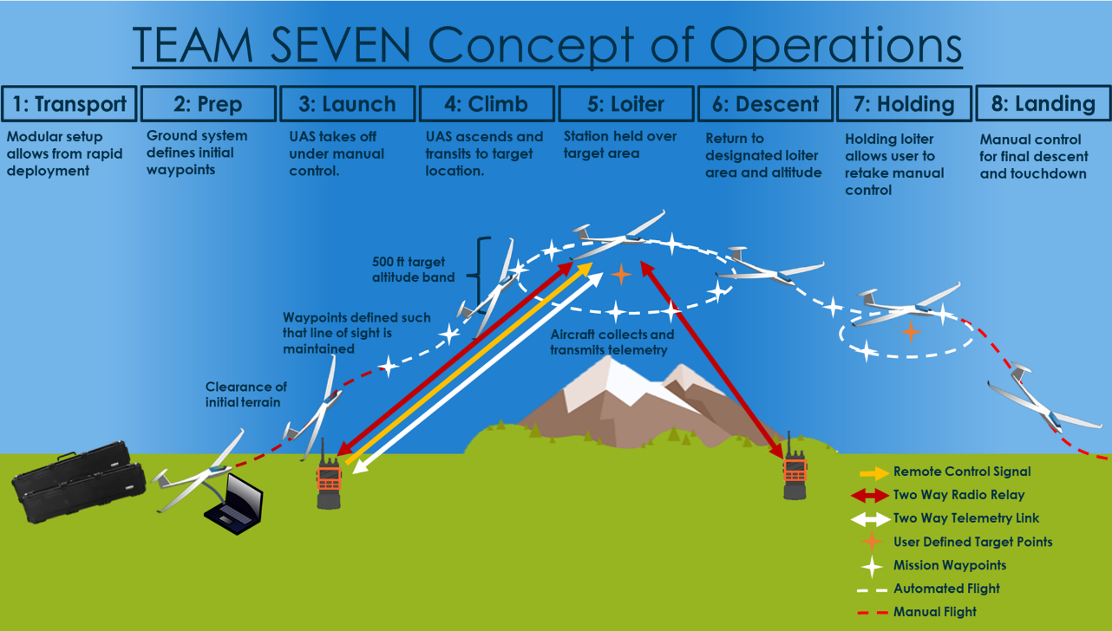
5
Project Purpose
Design Solution
Critical Elements and Risk
Design Requirements
Verification and Validation
Project Planning

Slide 6

Design Solution

Slide 7
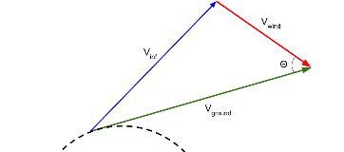
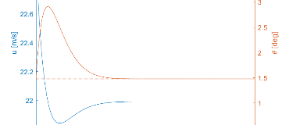
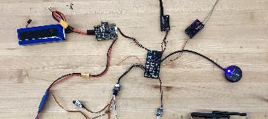
Subsystems & Major Project Elements
Mission Management
Flight Controls
Hardware
Flight Trajectory Based on Energy State
Development of Stability Augmentation System
Flight Hardware and Communications
Simulink/MAVLINK/ROS 2
Ground Station
Custom Algorithms
On-Board Computer
ROS 2 Integration with PX4
  2nd Level Controls using LQR
Pixhawk Flight Controller
Airframe – Phoenix 2400
Battery/ESC/Servos/Wires
Transmitter/Receiver
Motor/Propellor
Project Purpose
Design Solution
Critical Elements and Risk
Design Requirements
Verification and Validation
Project Planning

Slide 8
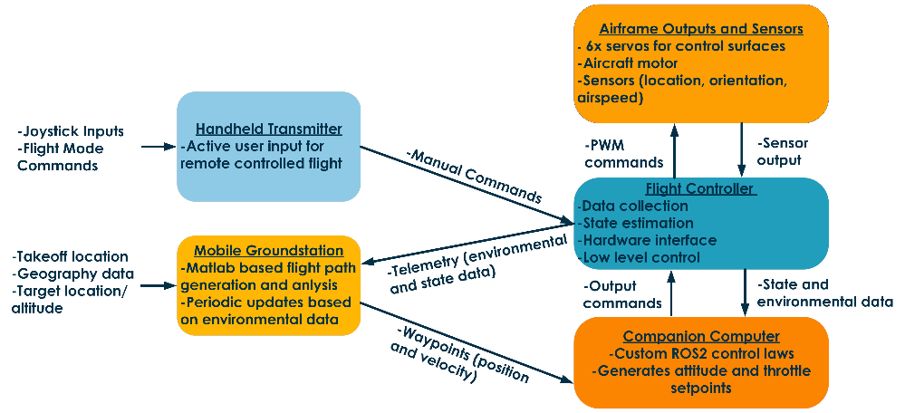
High Level Systems Architecture
Project Purpose
Design Solution
Critical Elements and Risk
Design Requirements
Verification and Validation
Project Planning

Slide 9
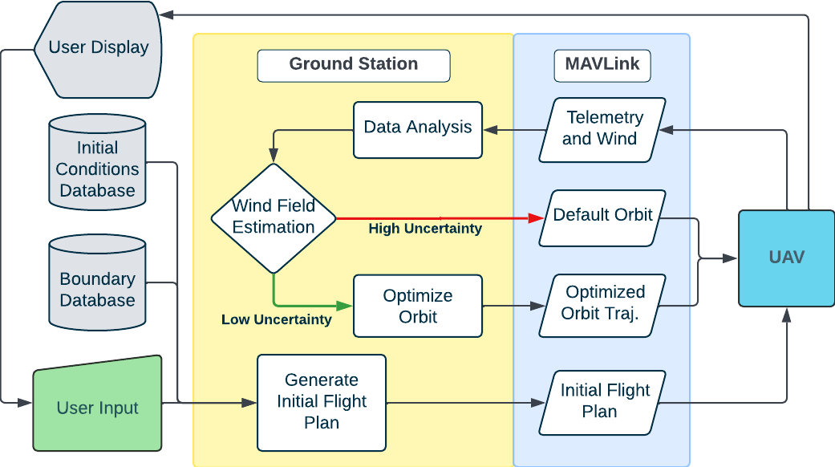
Mission management P.F.D.
9
Project Purpose
Design Solution
Critical Elements and Risk
Design Requirements
Verification and Validation
Project Planning
Notes:
Bennett
Colors (backgrounds, blocks, idk it's your choice)
Starting location (user input) --> color this differently? Maybe green or sumthin
"Good Wind Field" blcok --> "Wind Field Estimation" block
"Yes" --> low uncertainty in speed and direction
"No" --> high uncertainty in speed and direction

Slide 10
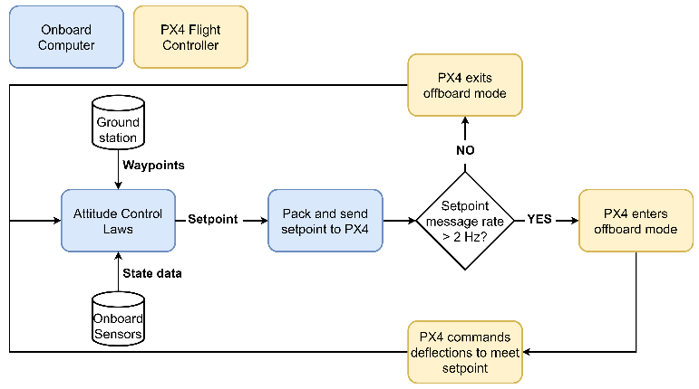
Flight controls Diagram
Setpoint
(attitude and thrust)
Waypoint
(position and velocity)
10
Project Purpose
Design Solution
Critical Elements and Risk
Design Requirements
Verification and Validation
Project Planning
Notes:
Our flight controls system defines the attitude and thrust of the aircraft between waypoints via setpoint messages. These messages are generated by our control loops implemented in the Robot Operating System (ROS2) software, using inputs from our onboard sensors and ground station and sent to the PX4 flight controller at a minimum rate of 2 Hz as required by the messaging protocol. The PX4 will command control surface deflections to meet the received setpoints.
Must mention that ROS2 is on the Onboard computer, as ROS2 is mentioned in the risks section. The MAVROS protocol will be used to send the setpoints to PX4. The waypoints will be received using MAVLINK

Slide 11
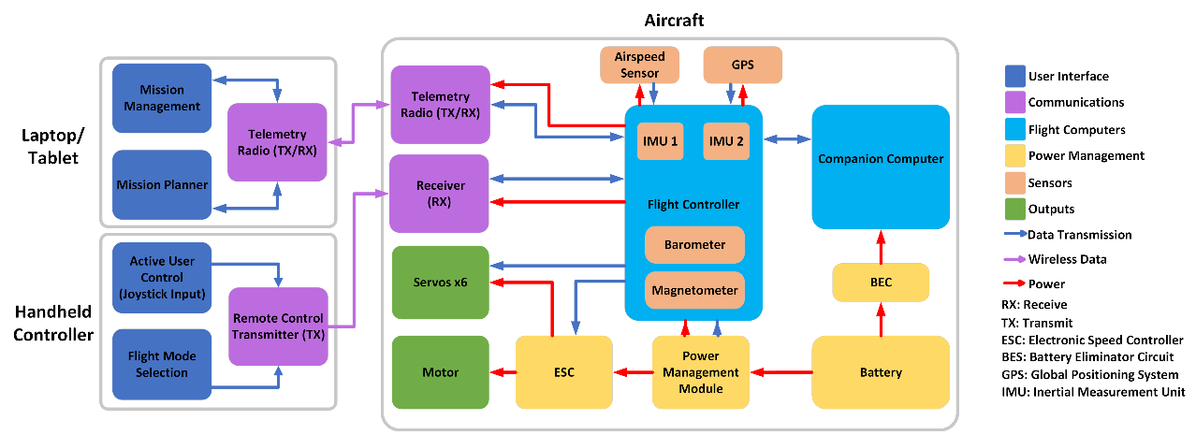
Hardware FBD
11
Project Purpose
Design Solution
Critical Elements and Risk
Design Requirements
Verification and Validation
Project Planning

Slide 12
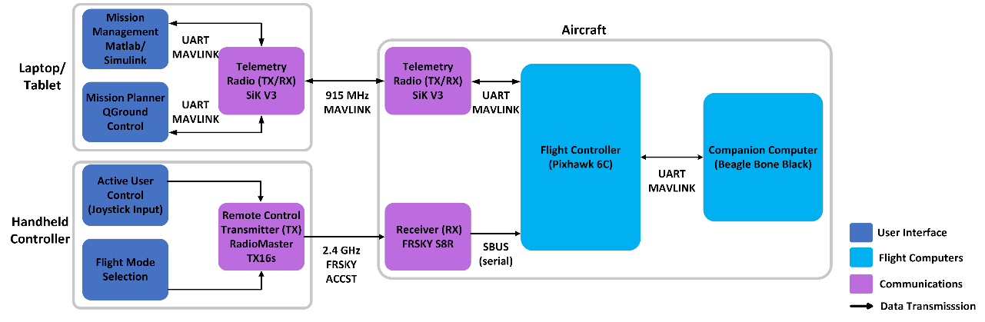
Communication Links
12
Project Purpose
Design Solution
Critical Elements and Risk
Design Requirements
Verification and Validation
Project Planning

Slide 13
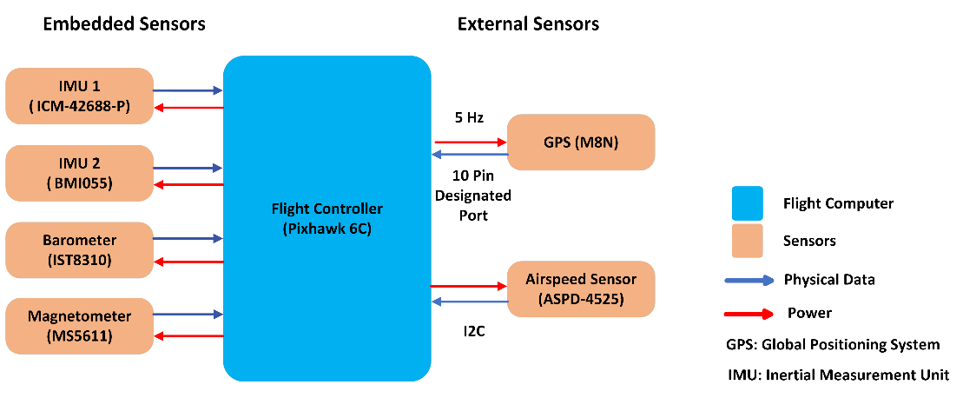
Airframe Sensor Suite
13
Project Purpose
Design Solution
Critical Elements and Risk
Design Requirements
Verification and Validation
Project Planning

Slide 14
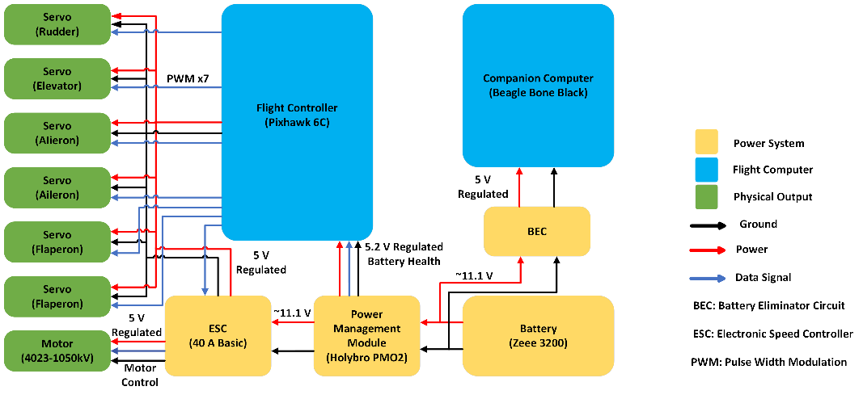
Power Management
14
Project Purpose
Design Solution
Critical Elements and Risk
Design Requirements
Verification and Validation
Project Planning

Slide 15
Critical Project Elements and Risks

Slide 16
*Functional Requirements are in backup slides
Critical Project Elements
Energy
Management
Stability Augmentation System
Flight
Boundaries
Wind
Measurements
FR 2 | FR 3 | FR 6
FR 3 | FR 4 | FR 6
FR 1 | FR 4 | FR 5
FR 1 | FR 3 | FR 5
Primary goal of the mission
Considered in each subsystem
Necessary for implementing flight trajectory
Simplifies user input and improves safety
Necessary safety consideration
Preserve LOS, ensure safe flight by not crashing
Measuring wind is complex
Optimization is wind dependent
Critical to success of mission
16
Project Purpose
Design Solution
Critical Elements and Risk
Design Requirements
Verification and Validation
Project Planning

Slide 17
Risk summary
Risk 1
Risk 2
Risk 3
ROS2 Control Law Implementation
Flight Condition Execution
Predominant Wind Estimation
If ROS2 control laws cannot be implemented interfaced with existing PX4 code,
Then there will be significant design rework involved in restructuring PX4 code.
If the waypoints commanded by mission management includes added parameters,
Then flight control laws will have to be developed to meet these additional constraints.
If reliable wind estimates cannot be obtained,
Then flight condition optimization may result in limited improvement in terms of energy consumption.
17
Project Purpose
Design Solution
Critical Elements and Risk
Design Requirements
Verification and Validation
Project Planning

Slide 18
Risk Scoring
Probability: 2
R2: Flight Condition Execution
Probability: 2
R3: Predominant Wind Estimation
Probability: 3
Cost: 1
Technical: 3
Total: 6
Schedule: 1
Cost: 1
Technical: 4
Schedule: 3
Total: 8
Cost: 1
Technical: 3
Schedule: 2
Total: 9
R1: ROS2 Control Law Implementation
Impact | 4 | 8 | 12 | 16
 | 3 | 6 | 9 | 12
 | 2 | 4 | 6 | 8
 | 1 | 2 | 3 | 4
 | Probability
R2
R1
R3
*Overall impact score is determined by the maximum of cost/technical/schedule
Project Purpose
Design Solution
Critical Elements and Risk
Design Requirements
Verification and Validation
Project Planning

Slide 19

Design Requirements and their satisfaction
Notes:
Bennett

Slide 20
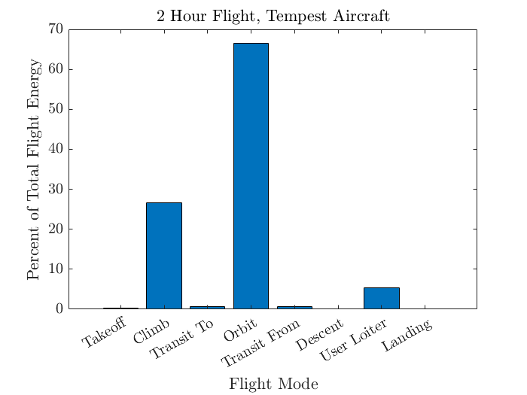
Design Aspects: outer loop
Purpose
Live path optimization
  Update path characteristics while in flight
    Desired velocity and shape
    Based on wind speed and direction
20
Project Purpose
Design Solution
Critical Elements and Risk
Design Requirements
Verification and Validation
Project Planning
Notes:
Bennett

Slide 21
Key design requirements: outer loop
Design Requirement | 1.6 | 2.1 | 2.2 | 2.3 | 6.1
Description | Ground station capable of transmitting flight plan to UAS | 20% increase in endurance compared to baseline flight profile | Generate set of waypoints for a given UAS mission | Utilize downlinked telemetry to develop optimized flight plan | Utilized existing off-the-shelf and natively developed software
21
Project Purpose
Design Solution
Critical Elements and Risk
Design Requirements
Verification and Validation
Project Planning
Notes:
Bennett

Slide 22
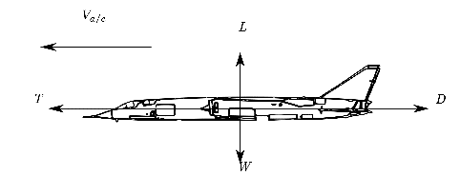
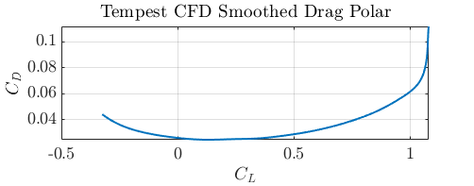
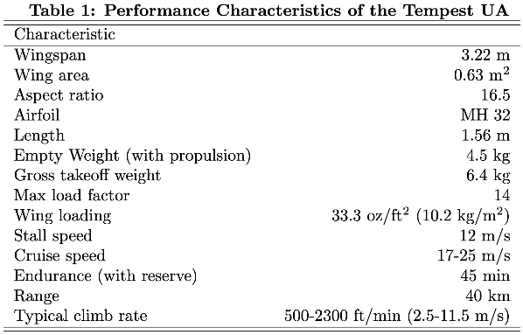
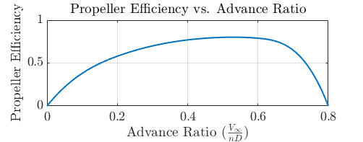
Tempest Power & energy model
Aircraft Performance: General
DR 2.1
22
Project Purpose
Design Solution
Critical Elements and Risk
Design Requirements
Verification and Validation
Project Planning
Notes:
Bennett

Slide 23
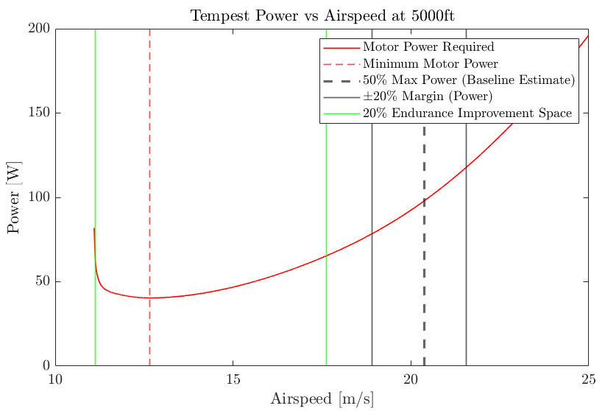




Tempest Power & energy model
Aircraft performance: Power curves
DR 2.1
(from drag polar)
propeller efficiency
+ 20% endurance
Assumptions:
Baseline flight: SLUF @ 50% throttle
15° pitch propeller (typical efficiency curve)
23
Project Purpose
Design Solution
Critical Elements and Risk
Design Requirements
Verification and Validation
Project Planning
Notes:
Bennett

Slide 24
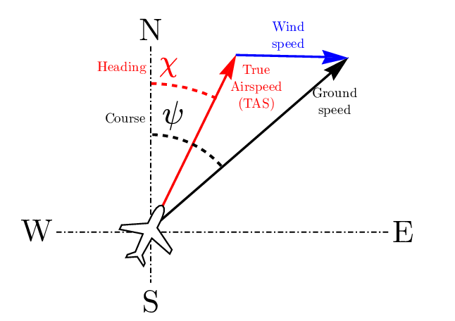
Tempest Power & energy model
Aircraft performance: wind
DR 2.1
24
Project Purpose
Design Solution
Critical Elements and Risk
Design Requirements
Verification and Validation
Project Planning
Notes:
Bennett

Slide 25
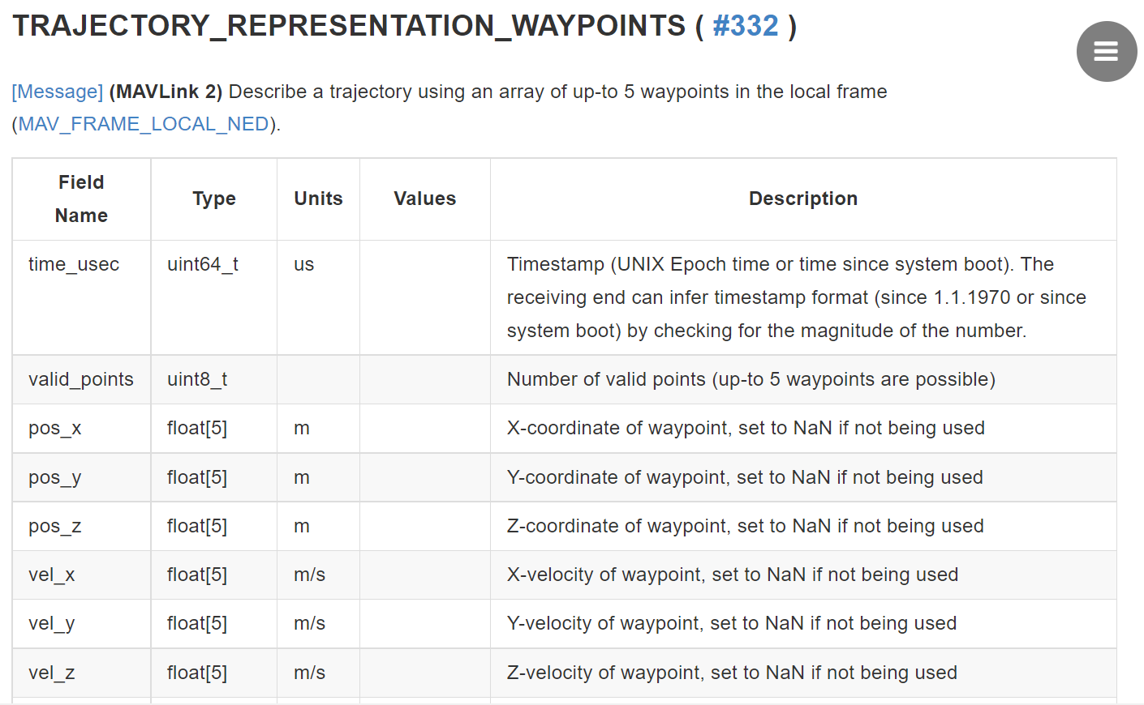
PX4 MAVLink protocol constraint
DR 1.6
DR 6.1
25
Project Purpose
Design Solution
Critical Elements and Risk
Design Requirements
Verification and Validation
Project Planning
Notes:
Bennett

Slide 26
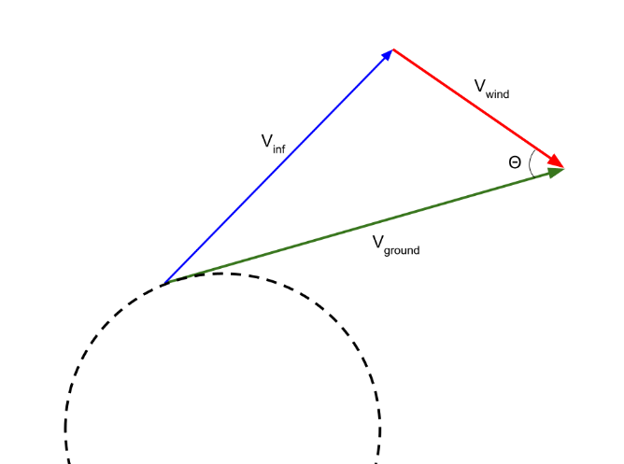
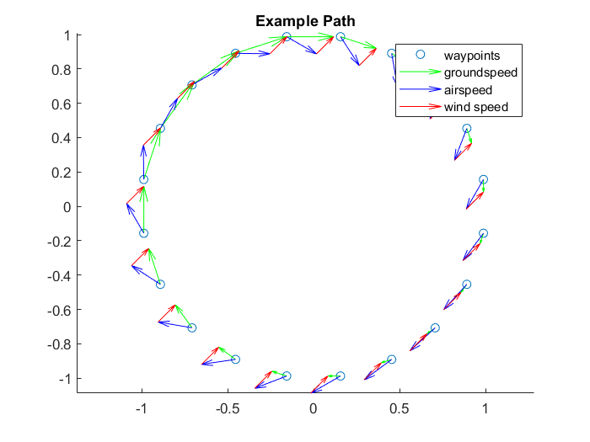
Optimization design choice
Wind Triangle and Ground Speed
DR 2.2
Goal:
Command ground speed such that airspeed is constant
Full derivation in backup slides
26
Project Purpose
Design Solution
Critical Elements and Risk
Design Requirements
Verification and Validation
Project Planning
Notes:
Bennett

Slide 27
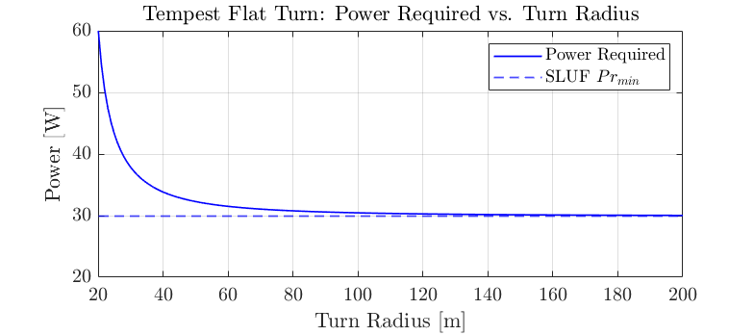
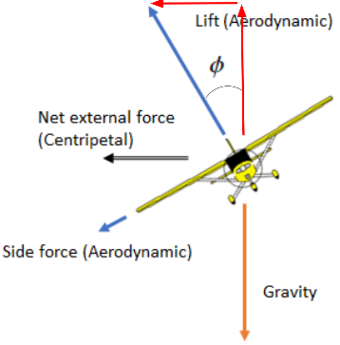
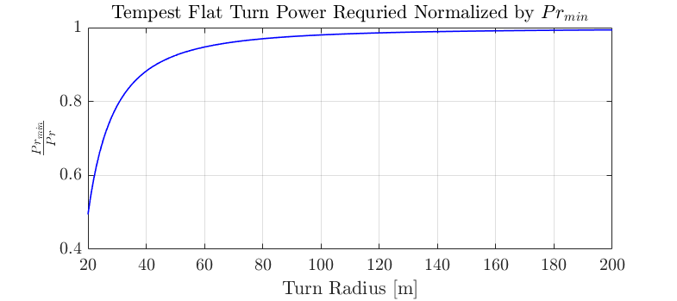

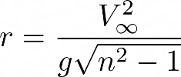

Path modeling
Maximize Turn Radius
27
Project Purpose
Design Solution
Critical Elements and Risk
Design Requirements
Verification and Validation
Project Planning
Notes:
Sam
Sam – So, what path?
Primarily wanna max time in SLUF
This means:
-Maximize Turn Radius (an aircraft performance model)
-Minimize Number of Turns
-Fly Parallel to Wind
Bennett's plots
Some equations

Slide 28
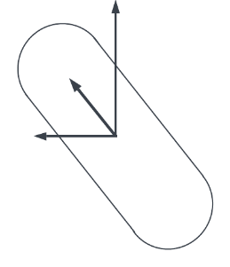



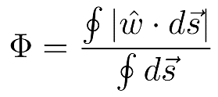

path modeling
Flying Parallel to the Wind
Flying parallel to the wind decreases risk:
Lower control surface demand
Lower flight controller uncertainty
Lower impact from wind changes
Goal: Avoid side-slip and crab flight!
f
28
Project Purpose
Design Solution
Critical Elements and Risk
Design Requirements
Verification and Validation
Project Planning
Notes:
Sam: Justifying qualitatively why we are minimizing crab/side slip
We "can" fly at any crab angle, theoretically, sidesliping so that our air relative velocity is constant
But we can't really:
Me and ty's graph?
Graph shows HOW to maximize time parallel to wind: orient orbit to be parallel:
Should we say that our advisors recommend it or that we have engineering judgement to prove it.

Slide 29
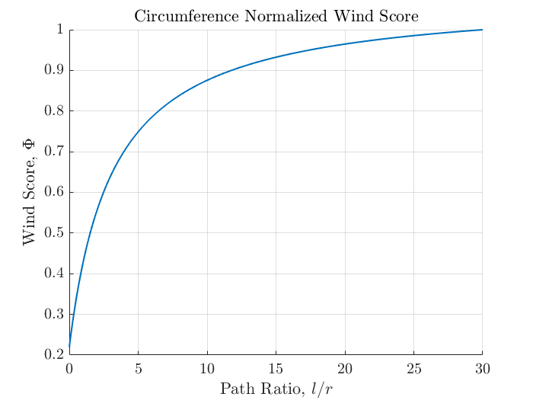
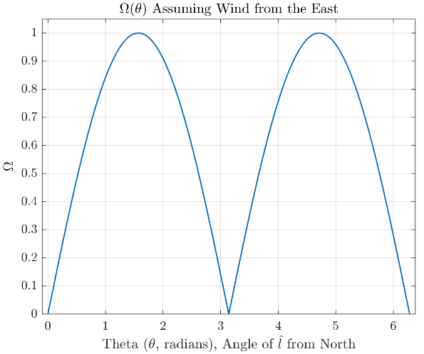
Path modeling
Flying Parallel to the Wind
29
Project Purpose
Design Solution
Critical Elements and Risk
Design Requirements
Verification and Validation
Project Planning
Notes:
Sam: Justifying qualitatively why we are minimizing crab/side slip
We "can" fly at any crab angle, theoretically, sidesliping so that our air relative velocity is constant
But we can't really:
Me and ty's graph?
Graph shows HOW to maximize time parallel to wind: orient orbit to be parallel:

Slide 30
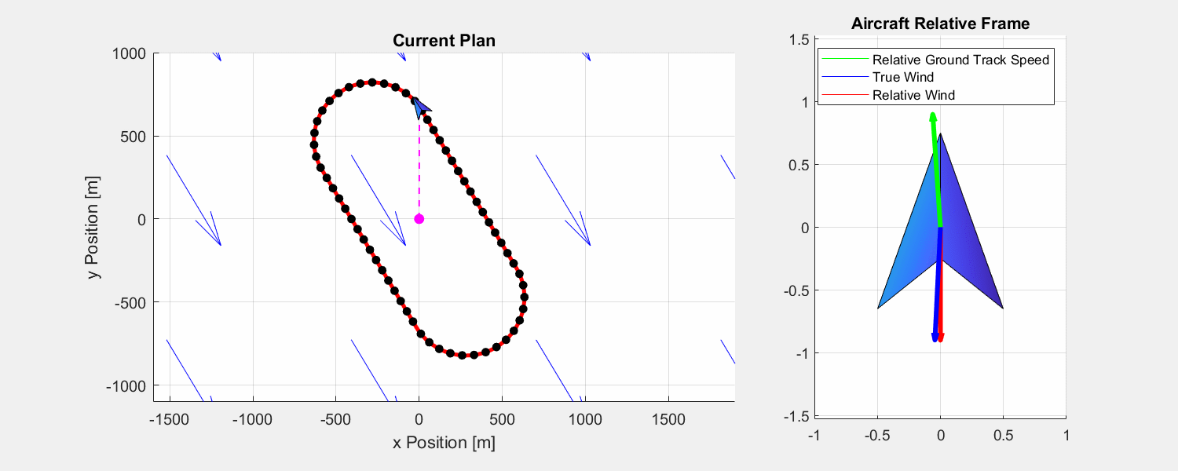
Optimization design choice
Wind triangle flight & path Modifications
DR 2.2
DR 2.3
DR 6.1
30
Project Purpose
Design Solution
Critical Elements and Risk
Design Requirements
Verification and Validation
Project Planning
Notes:
Alessandro

Slide 31
Design Aspects: Inner loop
Purpose
Setpoint
(attitude and thrust)
Efficient execution of
waypoint path
  Generate attitude setpoints throughout flight
    Replace existing PX4 loops
    ROS2 compatibility with PX4
Waypoint
(position and velocity)
31
Project Purpose
Design Solution
Critical Elements and Risk
Design Requirements
Verification and Validation
Project Planning
Notes:
The inner loop of our flight control system is focused on generating attitude setpoints between our defined waypoints. This will be accomplished by replacing existing PX4 control loops with our own.

Slide 32
KEY DESIGN REQUIREMENTS: Inner LOOP
Design Requirement | 2.1 | 3.1 | 5.3 | 6.1
Description | 20% increase in endurance compared to baseline flight profile | Autonomous flight for all phases of flight except launch and landing. | Follow a set of predefined waypoints. | Utilize existing off-the-shelf and natively developed software
32
Project Purpose
Design Solution
Critical Elements and Risk
Design Requirements
Verification and Validation
Project Planning

Slide 33
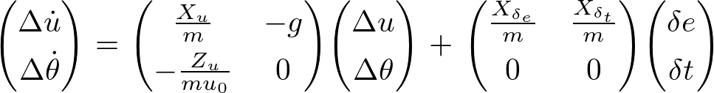
Control Architecture Model
Goal
Assumptions
To inform our control architecture trade, and evaluate what we can control
The state of the aircraft experiencing a disturbance from SLUF can be modelled by a 2nd order approximation of aircraft modes.
The aircraft state is characterized by the inertial velocity vector in the body x direction u^{E} , and the pitch angle theta.
2nd Order Phugoid Approximation
33
Project Purpose
Design Solution
Critical Elements and Risk
Design Requirements
Verification and Validation
Project Planning
Notes:
To support our control architecture trade and define the level of control we were able to implement, we created a reduced order model of the modes of the Tempest aircraft with different control architecture implementations in Simulink and evaluated their performance in varied conditions.

Slide 34
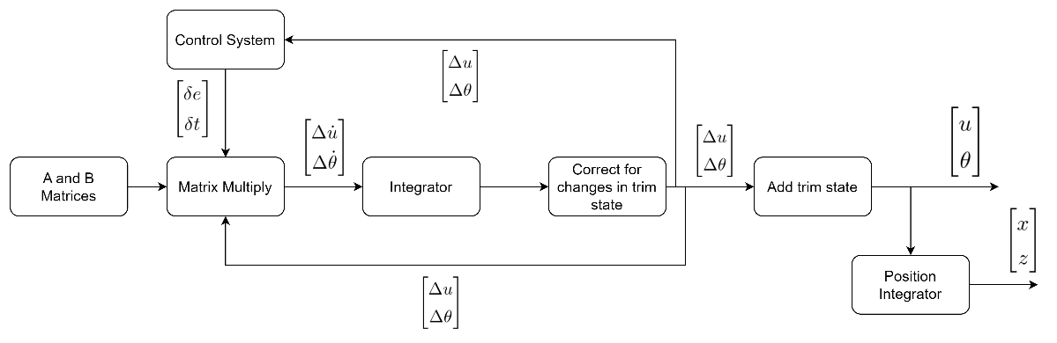
Control Architecture Model
34
Project Purpose
Design Solution
Critical Elements and Risk
Design Requirements
Verification and Validation
Project Planning

Slide 35
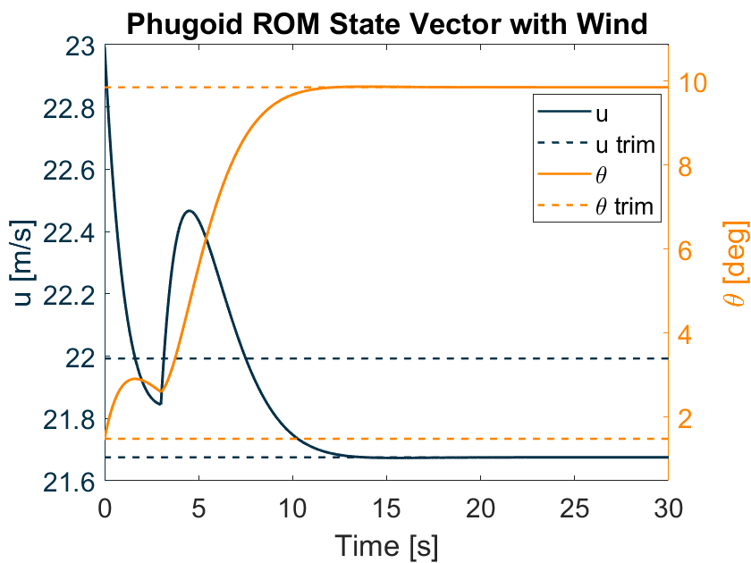
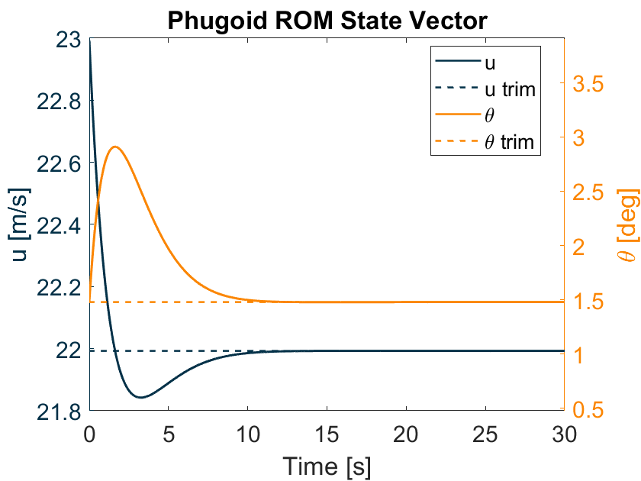
Control Architecture Model
Outcomes
Model and architecture trade reduced design space, with
Linear-Quadratic Regulator (LQR)
being our chosen architecture.
Successfully controlled changes in state and rejected disturbances using LQR
Better suited for setpoint control
35
Project Purpose
Design Solution
Critical Elements and Risk
Design Requirements
Verification and Validation
Project Planning
Notes:
We were able to successfully control perturbations and changes in aircraft trim state with several architectures, but the LQR architecture proved to be well suited for our use case, as it enables us to optimize our setpoint control based on the energy cost and effectiveness of each maneuver.

Slide 36
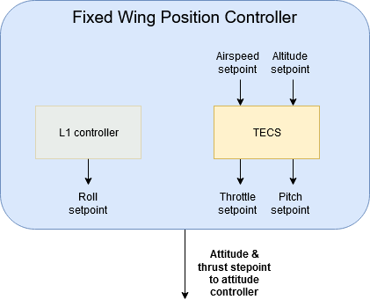
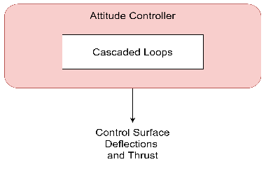
PX4 Position Controller
Fixed Wing Position Controller
Position commands to attitude and thrust commands using PID
Calculates KE and PE of aircraft and attempts to remain at a specific energy level (KE + PE)
Attitude Controller
Attitude and thrust to control surface deflection commands
Handles turn coordination and mode damping
36
Project Purpose
Design Solution
Critical Elements and Risk
Design Requirements
Verification and Validation
Project Planning
Notes:
The control system we will replace is the PX4 TECS position controller. Currently, the PX4 generates attitude and thrust setpoints using a complex control architecture based around the total energy of the aircraft. These setpoints are then sent to a set of cascaded PID loops which calculate the necessary control surface deflections and thrust to meet the setpoints.

Slide 37
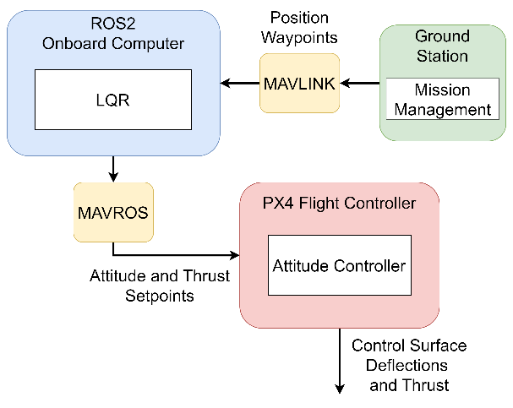

Inner Loop: Design Choice
Replace Position Controller
Replace TECS control architecture with LQR controller
  TECS controls for unwanted factors, wasting energy
  LQR can optimize for model
  converting waypoints to setpoints
  More impactful energy savings
LQR controller implemented on
ROS2 onboard computer
37
Project Purpose
Design Solution
Critical Elements and Risk
Design Requirements
Verification and Validation
Project Planning
Notes:
Our design solution involves substituting the position controller with an LQR control architecture running on an external onboard computer running ROS2. The current system controls for a few unwanted factors, so replacing it with our own enables us to save energy and create a more responsive system for our use case. The setpoints will be sent using the integrated ROS2 to PX4 communication protocol MAVROS, with the PX4 running in offboard mode.

Slide 38
Verification and Validation

Slide 39
PX4 WIND ESTIMATION
CHARACTERIZATION TEST
Test Objective
Design Validation/CPE
Pass/Fail Criteria
Estimate North-East wind velocity from PX4
Validate PX4 wind measurements against NOAA GFS (Global Forecast System) wind data
Validation of method to use wind to fly at P_{r,min} and align path with wind direction
Testing CPE 4 (Wind Measurements)
Pass: Error between PX4 wind speed measurements and GFS wind speed is within +/- 2 m/s & within +/- 22.5°
Fail: Error tolerances not met
Project Purpose
Design Solution
Critical Elements and Risk
Design Requirements
Verification and Validation
Project Planning
Notes:
Alessandro

Slide 40
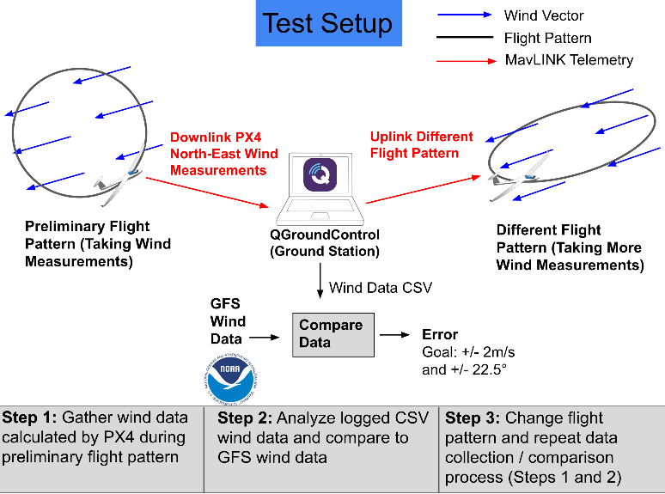
Px4 wind estimation
40
Project Purpose
Design Solution
Critical Elements and Risk
Design Requirements
Verification and Validation
Project Planning
Notes:
Alessandro

Slide 41

Px4 wind estimation
Measurements and key issues
Measurements
Key Issues
PX4 estimates the state of the aircraft using Extended Kalman Filtering (EKF)
Velocity is used to determine Equivalent Airspeed (EAS)
EAS data used to estimate North-East Wind Velocity
Loss of Data
  Sensor unable to return data
Large State Prediction Discrepancy
  Could cause EKF to attempt a reset of the states with the sensor observations
Project Purpose
Design Solution
Critical Elements and Risk
Design Requirements
Verification and Validation
Project Planning
Notes:
Alessandro

Slide 42
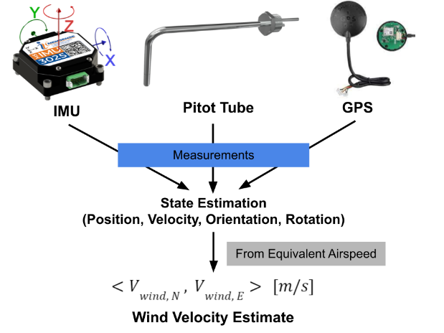
Px4 wind estimation Test readiness
Test Readiness
IMU (Inertial Measurement Unit)
  Measures angular (rotation) rates and acceleration in aircraft body axis
Pitot Tube
  Measures differential pressure to determine true airspeed
GPS (Global Positioning System)
  Measures position (latitude, longitude, altitude) [deg, deg, meters]
Ground Station Logging
  Saves flight logs to CSV on ground station computer
Project Purpose
Design Solution
Critical Elements and Risk
Design Requirements
Verification and Validation
Project Planning
Notes:
Alessandro

Slide 43

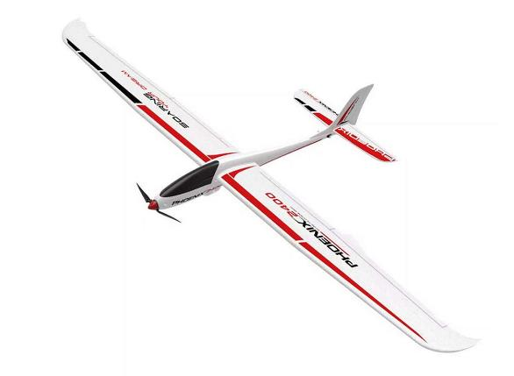
Test Readiness -- Phoenix 2400
  2.4 M Wingspan
  ABS Plastic Hull
  4023-1050kV Brushless Motor
  Readily Available
  Legacy – Free for us
43
Project Purpose
Design Solution
Critical Elements and Risk
Design Requirements
Verification and Validation
Project Planning

Slide 44
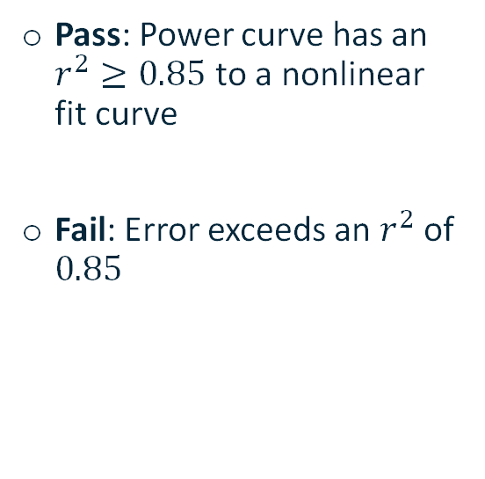
Phoenix 2400 Power Curve characterization test
Test Objective
Design Validation/CPE
Pass/Fail Criteria
Determine power curve and minimum power required airspeed
Verify power curve model (no drag polar available for the Phoenix 2400)
Use ideal airspeed to reduce power in flight to extend endurance
Testing CPE 1 (Energy Management)
Pass: Power curve has an $r^{2}≥0.85$ to a nonlinear fit curve
Fail: Error exceeds an $r^{2}$ of $0.85$
Project Purpose
Design Solution
Critical Elements and Risk
Design Requirements
Verification and Validation
Project Planning
Notes:
Alessandro
We don't have a drag polar or propeller efficiency data for the Phoenix 2400 aircraft, so we need to design a test to determine what the power curve looks like, as well as what the Pr_min airspeed is.
Verify if the power curve for the Phoenix resembles a typical aircraft's power curve (like the Tempest)
Validate if using an ideal airspeed as a means of extending the aircrafts endurance will work
Testing CPE1: energy management critical project element
Pass if looks like a typical power curve??? --> is this enough of a pass/fail criteria???

Slide 45
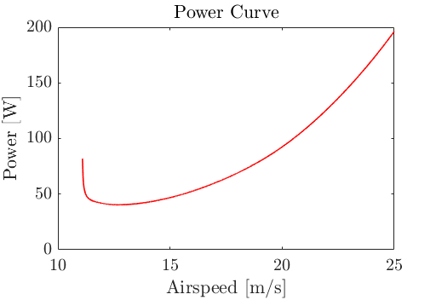
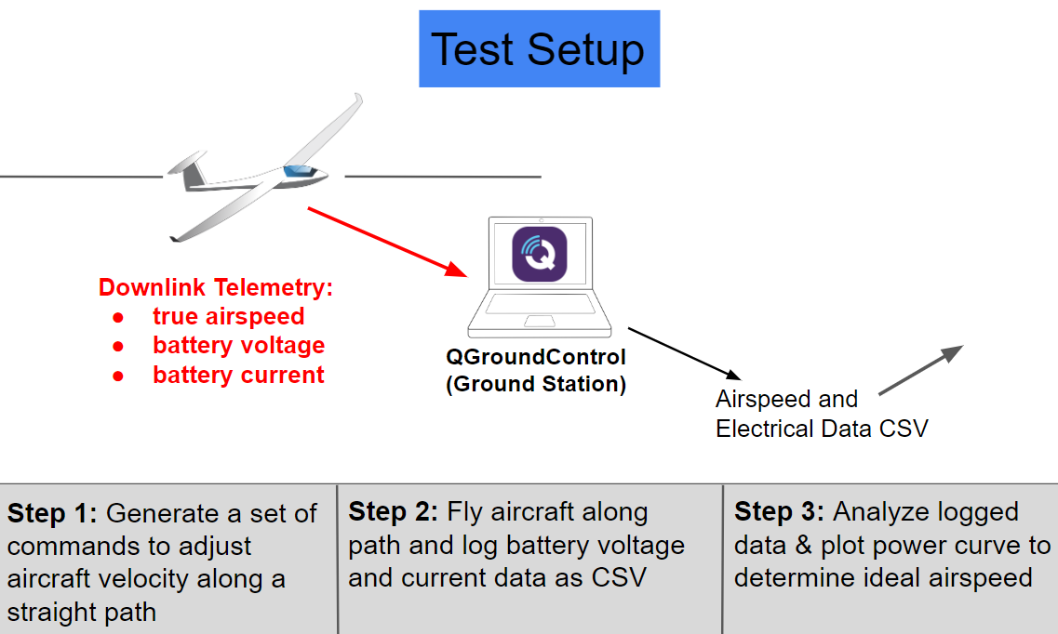
Phoenix 2400 power curve estimation Process
45
Project Purpose
Design Solution
Critical Elements and Risk
Design Requirements
Verification and Validation
Project Planning
Notes:
Alessandro
The power curve that we get from this will essentially be the aircraft power required curve already accounting for the prop efficiency. This measuring system power. Therefore, we will not be able to extract a drag polar without modeling the propeller. We won't need the drag polar anyway if we have this.
Design mission with QGC to fly at SLUF for a while (might turn here and there and just take data from straightaways) --> increment aircraft velocity along flight
Fly aircraft --> log data with ground station
Analyze logged data (this will be a time series over the course of the flight) --> we need to get data from just the straight sections, and make a scatter plot or something of airspeed vs power (battery voltage x battery current)

Slide 46
Phoenix 2400 power curve estimation
Measurements and key issues
Measurements
Key Issues
PX4 Telemetry
  True airspeed
  Battery voltage
  Battery current draw
Wind gusts or sudden changes in wind direction may yield unwanted test results
  Ideally testing on calm day
Project Purpose
Design Solution
Critical Elements and Risk
Design Requirements
Verification and Validation
Project Planning
Notes:
Alessandro

Slide 47
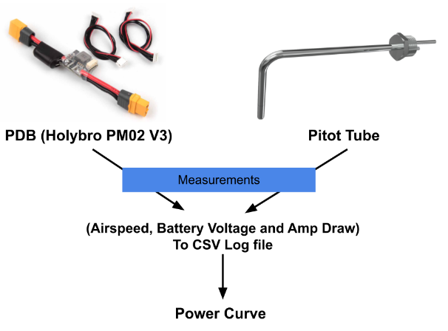
Pheonix 2400 Power Curve estimation
Test readiness
Test Readiness
PDB (Power Distribution Board)
  Measures voltage and current draw from the battery
  Most power will be used by the ESC/motor
Pitot Tube
  Measures differential pressure to determine true airspeed
Ground Station Logging
  Saves flight logs to CSV on ground station computer
Project Purpose
Design Solution
Critical Elements and Risk
Design Requirements
Verification and Validation
Project Planning
Notes:
Alessandro
PDB: Can send battery current and voltage over standard telemetry
Pitot Tube: Can send true airspeed over telemetry
MAVLink: Telemetry downlink to ground station
Ground Station (QGC or MP): Records and logs telemetry to CSV file on ground station computer – data rates and frequency isn't really up to us

Slide 48
Px4 wind estimation and Phoenix Power curve
Safety Risks
Unpredictable Winds
Environmental Safety
While taking measurements in flight, strong wind gust are possible
May compromise flight safety and lead to a crash
Battery ejection could cause fires in environment near test flight location
Safety Risk Mitigation Plans
Safety Risk Mitigation Plans
Fly at lower altitude to closely monitor flight status (< 6500ft MSL)
Avoid flying in extremely turbulent weather on test day
Fly in areas with steady winds
Develop protective housing for battery
Confirm with advisor and other faculty members the safety of the power management systems prior to flight
Project Purpose
Design Solution
Critical Elements and Risk
Design Requirements
Verification and Validation
Project Planning
Notes:
Alessandro

Slide 49
Simulation CHARACTERIZATION TEST
Test Objective
Design Validation/CPE
Pass/Fail Criteria
Send attitude setpoints and pre-defined waypoints to PX4
Verify if aircraft reaches pre-defined waypoints within a selected range
Validating:
  Messaging reliability
  Guidance level loop fidelity
Testing CPE 2 (Stability Augmentation System)
Pass: Aircraft reaches all waypoints within a 20-meter range
Fail: Aircraft does not reach all waypoints and/or does not come within 20-meter range
Project Purpose
Design Solution
Critical Elements and Risk
Design Requirements
Verification and Validation
Project Planning

Slide 50
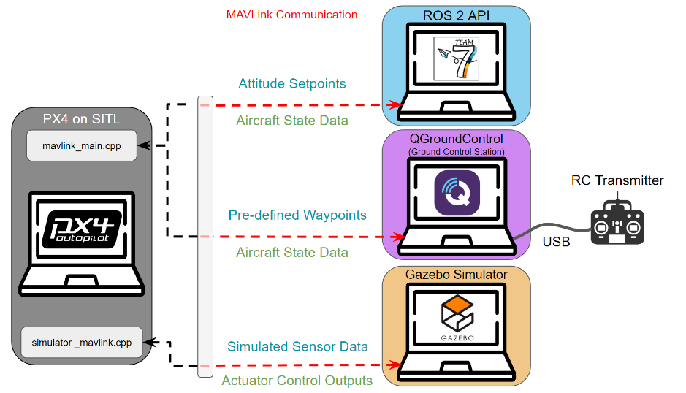
Simulation Test Set up
Output
Input
MAVLink
50
Project Purpose
Design Solution
Critical Elements and Risk
Design Requirements
Verification and Validation
Project Planning

Slide 51
GAZEBO SIMULATION MEASUREMENTS
AND KEY ISSUES
Measurements
Key Issues
Safety Risks
State Stream Data
  Planned waypoints
  Simulated aircraft state
Motor and Actuator outputs
PX4 Mode
  Running in offboard mode
Limited computer resources
  Computer must run several programs which may be resource intensive.
No environmental safety risks
  Test is only on a computer
No equipment risks
  Testing software only
Project Purpose
Design Solution
Critical Elements and Risk
Design Requirements
Verification and Validation
Project Planning

Slide 52
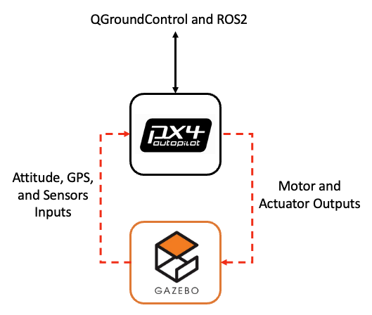
Simulation
Test readiness
Test Readiness
Gazebo
  Full-function simulator to provide all necessary inputs
  Generates simulated sensor data
QGroundControl
  Sends waypoints to PX4 using MAVLink protocol communication
ROS2
  Send setpoints to PX4 using MAVLink protocol communication
Project Purpose
Design Solution
Critical Elements and Risk
Design Requirements
Verification and Validation
Project Planning

Slide 53
Project Planning

Slide 54
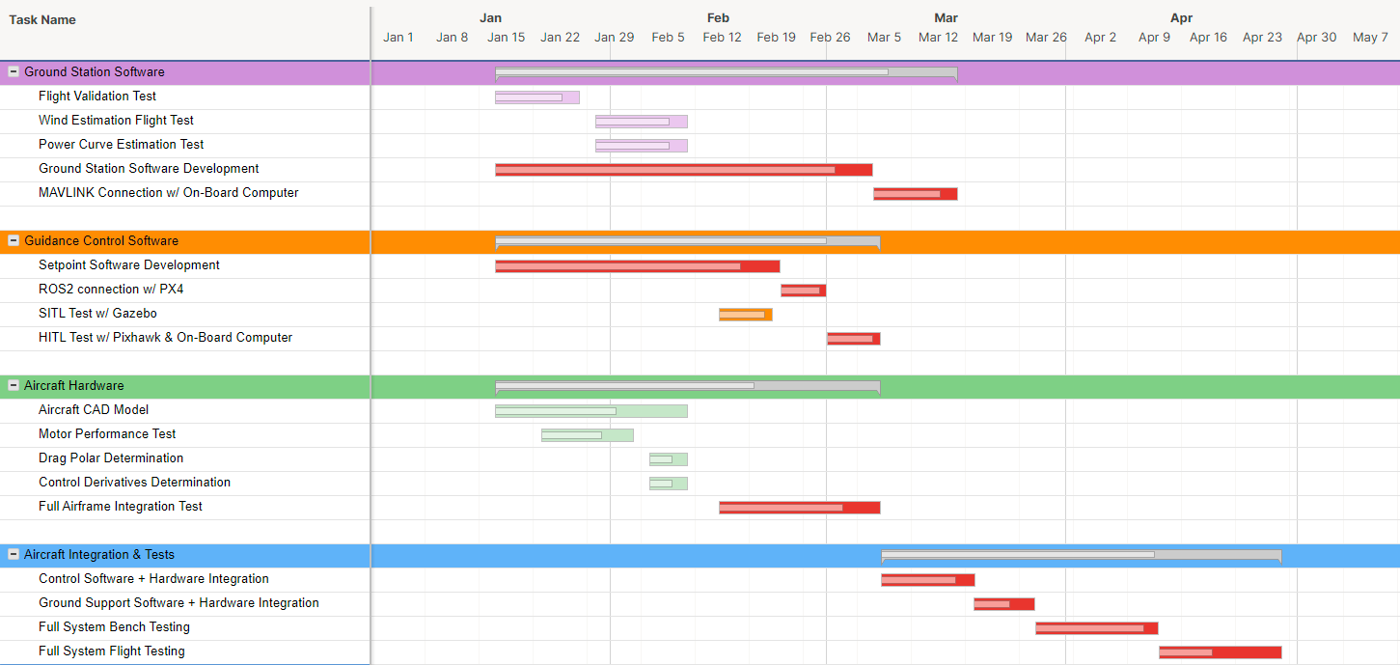
*Dark Colors Represent Margin
TEAM SEVEN Work Plan
= Deliverable
Internal Design Review
AIAA Conference Paper
Test Readiness Review
Spring Final Review
AES Industry Symposium
Project Final
Report
54
Project Purpose
Design Solution
Critical Elements and Risk
Design Requirements
Verification and Validation
Project Planning

Slide 55
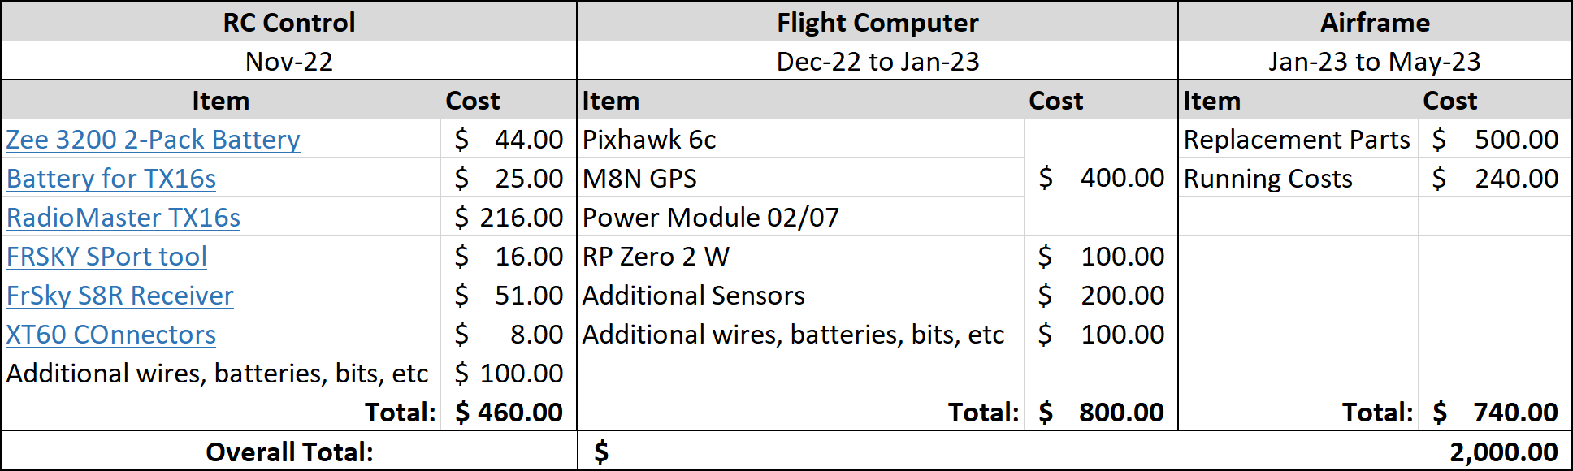
Cost Plan
55
Project Purpose
Design Solution
Critical Elements and Risk
Design Requirements
Verification and Validation
Project Planning

Slide 56
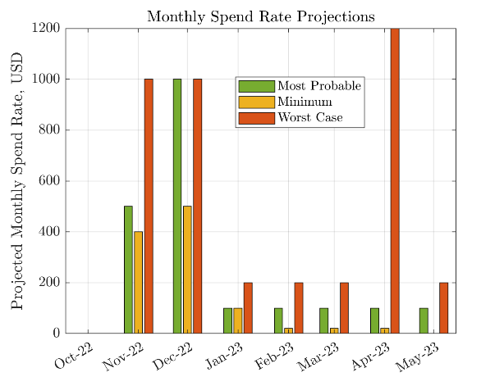
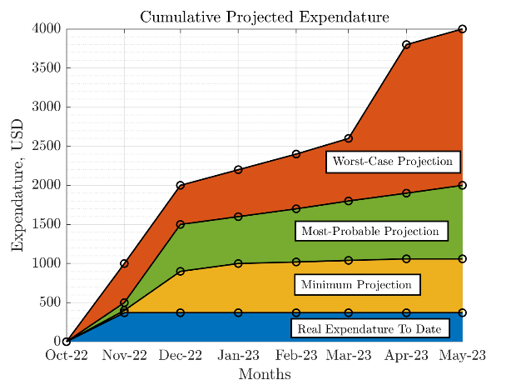
Cost Plan
56
Project Purpose
Design Solution
Critical Elements and Risk
Design Requirements
Verification and Validation
Project Planning

Slide 57
Test Plan
Bench Test 1
Bench Test 2
Controls Test
Bench Test 3
Base Hardware Functionality
Motor, RC, Control Surfaces
Sensor Input
Communication Between Ground Station, Flight Computer and Beagle Bone
Prove Flight Safety
Software in the Loop Test
Ensure Control Deflections Work as Intended
Hardware in the Loop Controls Test
Prove Flight Safety
Mission Planning
Flight Test 1
Flight Test 2
Wind Estimation Validation
Power Curve Estimation Validation
Validate Sensors and Control Laws
Gather Wind Data
Gather Power Data
Mission Profile Generated by M.M. Software
On board computer generates setpoints
Full System Test
57
Project Purpose
Design Solution
Critical Elements and Risk
Design Requirements
Verification and Validation
Project Planning

Slide 58
Questions

Slide 59
Table of Contents
Project Purpose
DRs and Their Satisfaction
Verification and Validation
Project Overview
CONOPS
Mission Management Model
Wind Measurement
Power Curve
Simulation
Key Requirements
Power & Energy Model
Constraints
Path Model
Design Choice
Design Solution
Project Planning
Subsystems & Major Elements
High Level Systems Architecture
Mission Management Diagram
Flight Controls Diagram
Hardware FBDs
Work Plan
Cost Plan
Test Plan
Flight Controls Model
Design Aspect
Key Requirements
Control Architecture Model
Design Choice
Critical Project Elements & Risks
Critical Project Elements
Risk Summary
Risk Matrix
59

Slide 60
Table of Contents (Additional Slides)
Risk Description
Miscellaneous
ROS2 Control Law Implementation
Flight Condition Execution
Wind Estimation
Wind Triangle Derivation
Functional Requirements
Hardware Selections
Airframe
Flight Controller
Companion Computer
Power Management Module
Battery
ESC
Digital Airspeed Sensor
GPS
Transmitter
Receiver
Telemetry Radios
60

Slide 61
Additional Slides

Slide 62
RISKS

Slide 63
Risk Scoring

Slide 67
Hardware Selections

Slide 68

Airframe: Volantex Phoenix 2400
2.4 M Wingspan
ABS Plastic Hull
EPO Foam Wings
4023-1050kV brushless outrunner motor
Rudder, elevator, aileron, and flaperon control surfaces
6x 9g servos

Slide 69

Flight Controller: Pixhawk 6c
Clock speed of up to 480 MHz
Supports both PX4 and ArduPilot
Integrated barometer, magnetometer, and two vibration isolated IMU’s
Input voltage of 5.0 ±0.25 V
84.8 x 44 x 12.4 mm
Integrated package with support for up to 16 PWM outputs
I2C, GPS, CAN, Telemetry (Serial), and Debug Ports

Slide 70

Companion Computer: Beagle Bone Black
1 GHz processor
Input voltage of 5 ±0.25 V
512 Mb RAM
4 Gb onboard flash storage
3.4” by 2.1” PCB
Can be loaded with ROS2 using either Ubuntu Linux or preinstalled Ångström Linux distribution
Ethernet, USB, HDMI, and 2 headers of 46 general purpose input/ output pins
GPIO pins can be configured for I2C, SPI, or UART protocols.

Slide 71

Power Management Module: PM02
Provides regulated 5.2V to flight controller
Input voltage 7-51V
Rated current of 60 A
Outputs batter voltage to ESC
Outputs current and voltage measurements to flight controller

Slide 72

Battery: Zeee 11.1V 3200mAh
11.1 V
3200 mAh
50 C discharge
XT-60 will be soldered on for power module interface

Slide 73

ESC: 40A ESC w/ 5V UBEC
Provides regulated 5V power to motor and servos through UBEC output
Interfaces with power distribution module through XT-60 Connection
3A UBEC to power servos
6.4V-16.8V input voltage
3x bullet plugs for motor connection

Slide 74

Digital Airspeed Sensor
HolyBro Airspeed
UART Connection
Resolution < 1Pa
= .1m/s@10m/s or .06m/s @ 20m/s
Max pressure 6800Pa ~ 100 m/s

Slide 75

GPS: Holybro M8N
2.5 m position accuracy
0.05 m/s speed accuracy
GPS, GLONASS, and Galileo support
Input voltage 4.7-5.2 V
Direct integration with Pixhawk 6C through designated port
Can be purchased as bundle with Pixhawk 6C

Slide 76

Transmitter: RadioMaster TX16S Mark II
Multi protocol support
16 inputs, visual interface
Telemetry enabled
Completely customizable outputs and mixing
Ramps for changing input sensitivity
Open source software
Module port on back for TBS Crossfire or alternative protocol/antennas
LUA scripting for any future needs.

Slide 77

Receiver: FrSky S8R
16 Channel Receiver
Interface with flight controller though Serial Bus
Allows one wire to communicate all channels
Optional Flight stabilization modes with in-flight gain tuning through channel 9
Uses FRSKY ACCST protocol

Slide 78

Telemetry Radios: HolyBro SiK V3
Two frequency options (915 MHz and 433 MHZ)
Powered directly through Pixhawk
MAVLINK Protocol Framing
28 x 53 x 10.7mm (without antenna)

Slide 79

Wind Triangle derivation

Slide 80
Functional Requirements
FR # | Requirement
1 | The UAS shall be capable of receiving commands and transmitting telemetry to and from a controller
2 | The UAS shall manage aircraft trajectory based on energy state and specified mission parameters to improve flight endurance
3 | Flight operation shall minimize user workload and need for active user input throughout its entire mission profile
4 | The UAS shall adhere to all relevant guidelines and implement measures to protect the safety of the UAS itself as well as people and objects in the surrounding area
5 | The UAS shall be fully operational in austere environments with the ability to adapt to varied conditions and remain in a continual standby posture when unused
6 | The initial cost and complexity for users to assemble, configure, operate, and maintain the UAS system shall be minimized and shall seek to significantly undercut prices of existing long endurance drone systems

Slide 81
Inner Loop: Design Choice
Communication
Send waypoint data via MAVLINK protocol
  Native support with ROS2
Send attitude setpoints via
MAVROS from onboard computer
  Native support with PX4
  Frequency of setpoint transmission must be greater than 2 Hz
81
Project Purpose
Design Solution
Critical Elements and Risk
Design Requirements
Verification and Validation
Project Planning

