Slide 1
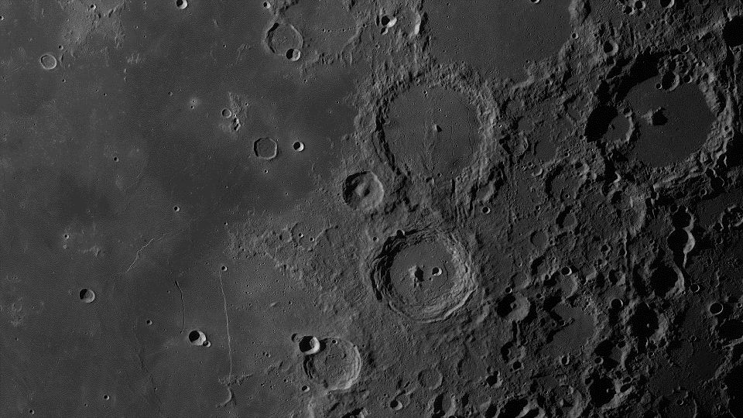
CTHREEPIO
Test Readiness Review
March 8, 2023
ASEN 4028 Team 6
Team Advisor: Dr. Allie Anderson
Team Sponsor: Blue Origin
Presenters: Hannah Blanchard Obolsky, Nick Bottieri, Luca Bonarrigo, Andrew Czekay, Autumn Martinez, Sarah Martinez, Nathaniel Shiba
Other team members: Lily Allen, Skylar Edwards, Geoff Lord, Thomas O’Connor, Elijah Stubbs
Notes:
Presenters: Andrew, Autumn, Nick, Nathan, Luca, Hannah, Sarah

Slide 2
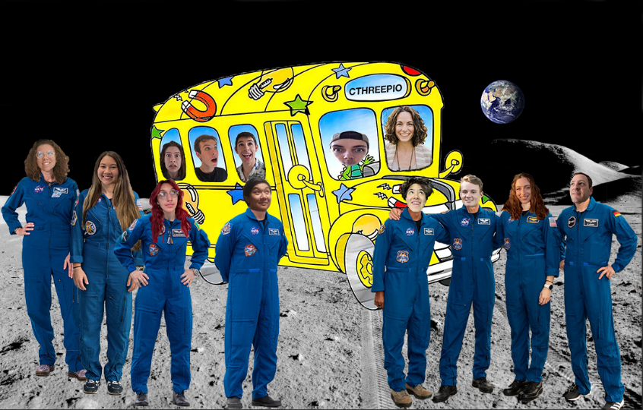
Capabilities Training in Hybrid Reality Extraterrestrial Environments in Preparation for Interplanetary Operations

Slide 3
Outline
Overview
Schedule
Test Readiness
Budget
Nathan, Luca
Andrew, Luca
Nick, Autumn, Hannah, Sarah, Andrew
Nathan

Slide 4
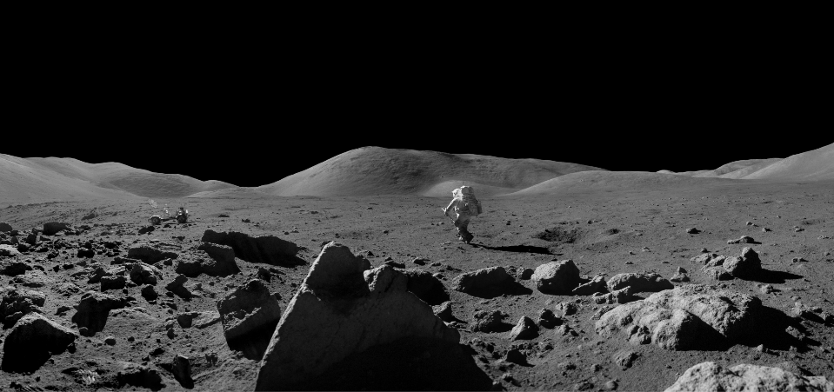
Overview
I: Overview
IV: Schedule
V: Test Readiness
VI: Budget

Slide 5
Nomenclature
VR = Virtual Reality
HR = Hybrid Reality
EVA = Extravehicular Activity
LSP = Lunar South Pole
LRO = Lunar Reconnaissance Orbiter
MSSQ = Motion Sickness Susceptibility Questionnaire
SSQ = Simulator Sickness Questionnaire
ROM = Range of Motion
I: Overview
IV: Schedule
V: Test Readiness
VI: Budget
Notes:
The software that “will” be developed

Slide 6
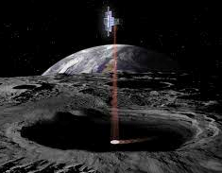
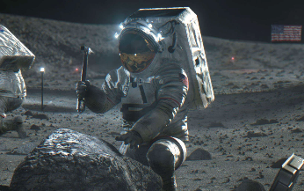
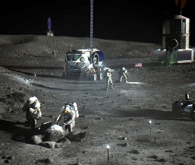
Project Definition
To develop a virtual reality lunar surface environment incorporating hybrid reality interactions and embedded environmental constraints specifically focused on the lunar south pole (LSP) region.
I: Overview
IV: Schedule
V: Test Readiness
VI: Budget

Slide 7
Primary Objectives
Level I: Threshold | Level II: Target
Display the simulation at an average frame rate of at least 72 frames per second and maximum latency of 120 ms | Display the simulation at an average frame rate of at least 90 frames per second with maximum latency of 48 ms
Accurately map position and motion of 4 pieces of HR equipment to corresponding VR objects with a margin of 4 cm | Accurately map position and motion of 7 pieces of HR equipment to corresponding VR objects with a margin of 4 cm
Simulate environmental lighting conditions by including a lighting contrast ratio of 10.0 and a solar lighting angle no greater than 5° | Simulate environmental lighting conditions by including a lighting contrast ratio of 16.0 and a lighting angle no greater than 1.5°
Accurately model LSP topography within a 100 m/px resolution | Accurately model LSP topography within a 5 m/px resolution
Operate simulation continuously for 20 minutes | Operate simulation continuously for 1 hour
I: Overview
IV: Schedule
V: Test Readiness
VI: Budget

Slide 8
High Level Functional Requirements
 | Functional Requirement
F1 | The VR environment shall simulate the south polar region of the lunar surface.
F2 | The training simulation shall include physical, real-world objects.
F3 | The training simulation shall accurately portray interactions with physical objects in the VR environment.
F4 | To accurately simulate EVA activities on the lunar surface, the training simulation shall portray spacesuit features and small scale lunar objects.
F5 | The training simulation, including the VR environment and all physical aspects, shall keep the user, operator, and itself safe from harm.
F6 | The training simulation shall be appropriate for a laboratory environment.
I: Overview
IV: Schedule
V: Test Readiness
VI: Budget
Notes:
Levels of success → specific quantitative objectives?

Slide 9
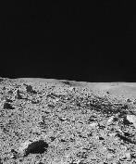
Concept of Operations
Tasks Inside the Simulation
1
2
3
Training Setup
Exiting the Simulation
Biometrics Readout
Survey Environment
Obtain Sampling Tools
4
5
6
Clean and turn on equipment
Select desired training
Mission briefing and setup
User dons hardware and enters simulation
User doffs all hardware
Evaluate user experience and provide feedback
Small Sample Collection
Large Sample Collection
Place Samples on Rover
Notes:
1) Read out biometric data to mission control
2) Survey the environment, locate sampling areas
3) Navigate to rover, obtain proper equipment
4) Regolith and small pebble collection
5) Large rock sample collection
6) Bring box to rover for transport
Above steps are related to the user task outline, (see this document)
I know Jasmine said maybe to remove the setup and exiting the sim panels, however if I recall correctly, when making the first ConOps for PDR, Dr. Anderson explicitly told me to include the full user experience, including taking on and off the hardware. I think it could be a good idea to run this version of the ConOps by Dr. Anderson and get her input before we start consolidating the panels too much, because I want to make sure that we show our distinct built in capabilities in this ConOps.

Slide 10
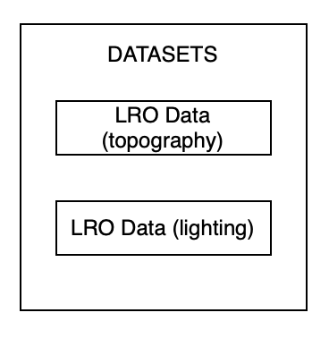
I: Overview
IV: Schedule
V: Test Readiness
VI: Budget

Slide 11
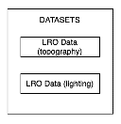
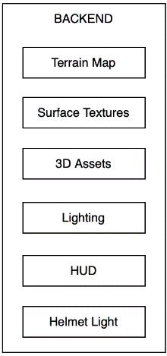
I: Overview
IV: Schedule
V: Test Readiness
VI: Budget

Slide 12
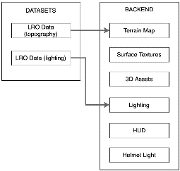
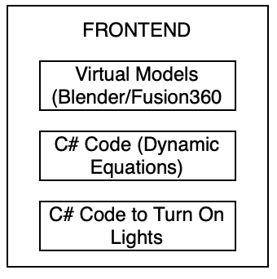
)
I: Overview
IV: Schedule
V: Test Readiness
VI: Budget

Slide 13
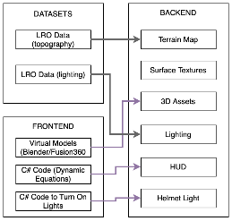
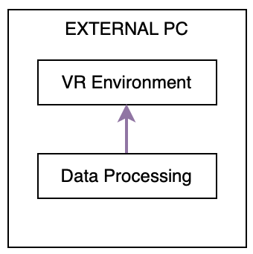
)
I: Overview
IV: Schedule
V: Test Readiness
VI: Budget

Slide 14
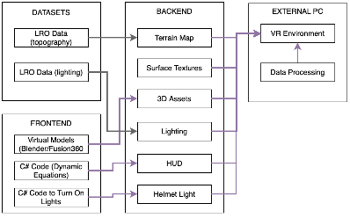
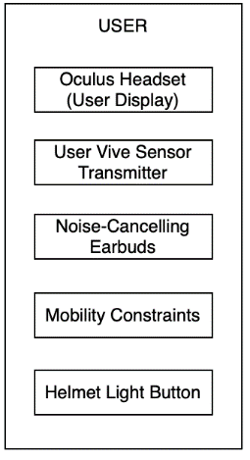
)
I: Overview
IV: Schedule
V: Test Readiness
VI: Budget

Slide 15
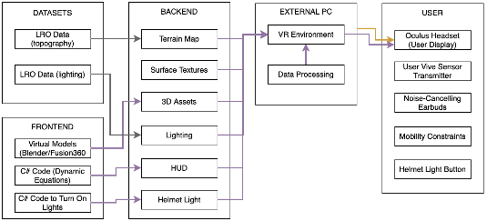
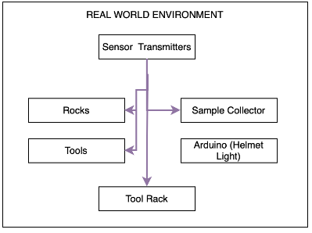
)
I: Overview
IV: Schedule
V: Test Readiness
VI: Budget

Slide 16
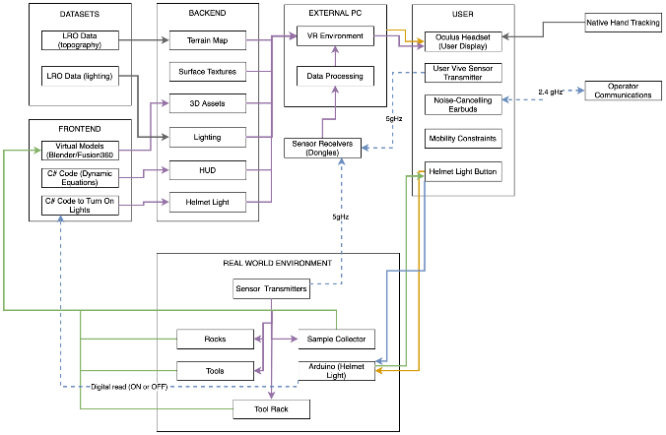
)
I: Overview
IV: Schedule
V: Test Readiness
VI: Budget

Slide 17
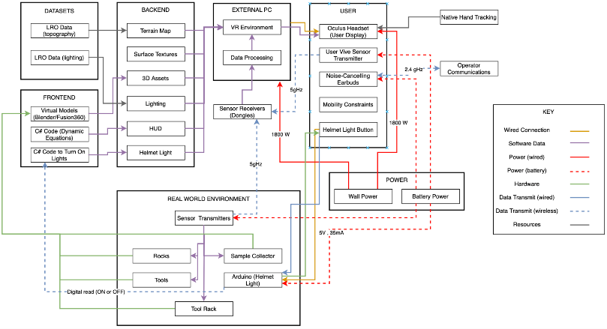
Functional Block Diagram
I: Overview
IV: Schedule
V: Test Readiness
VI: Budget

Slide 18
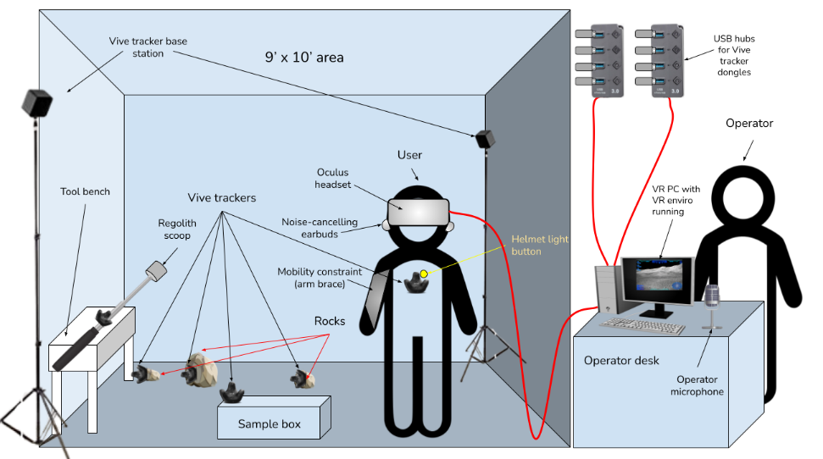
Design Diagram - Physical World
Notes:
Major changes to design: none yet. Revising the integratability of 7 different tracked objects and whether they will all run together

Slide 19
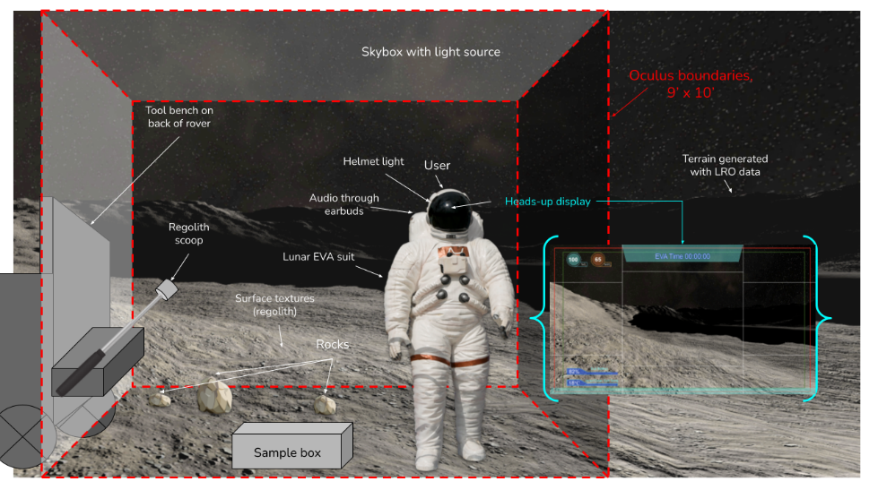
Design Diagram - Virtual World
Notes:
Changes to design: specifically set on peak near shackleton

Slide 20
Design Solution Updates
 | Major Design Updates
Virtual World | No longer incorporating bags for regolith collection HUD no longer includes heart rate or EVA menu
Real World | No updates since CDR
Safety Considerations | One arm brace worn by user Helmet light button on chest rather than head
I: Overview
IV: Schedule
V: Test Readiness
VI: Budget

Slide 21
Critical Project Elements
 | Element | Major Components
E1 | Virtual Environment | LRO-derived terrain and lighting of LSP Heads-up display with simulated biometrics
E2 | User-Associated Equipment | Arm motion constraint Visual and auditory interfaces (including operator-user comms)
E3 | Hybrid Reality (HR) Support Equipment | Hand tracking and tool/equipment tracking Low-fidelity, real world geology tool/equipment models
E4 | Testing | Accessible, intuitive, and operable by human user Human-in-the-loop testing procedures
E5 | Safety | Must not cause any physical or mental harm to users or operators Must not cause any physical harm to equipment
E6 | Financial | Total cost of the simulation must not exceed $4900*
* $900 extra funds provided by University of Colorado Boulder Engineering Excellence Fund
I: Overview
IV: Schedule
V: Test Readiness
VI: Budget
Notes:
HR support equipment shall track user actions/interactions with utilized tools and integrate with virtual reality instruments
User-associated equipment shall integrate such that all equipment does not impede on overall functionality or safety
Training simulation will utilize a virtual environment that is recognizable by the user as a lunar surface and must integrate with the real-world equipment

Slide 22
Schedule
I: Overview
IV: Schedule
V: Test Readiness
VI: Budget

Slide 23
Order of Testing: Inspections
Inspections - V&V of requirements of binary nature with little to no active procedure
Tests - V&V of requirements involving complex procedural tests
 | Inspections | Deadline | Status
1 | Environment Realism (ENV) | 3/13/2023 | In Progress
2 | Heads-Up Display (HUD) | 3/13/2023 | In Progress
3 | Hybrid Reality Integration (HRI) | 3/17/2023 | Not Started
4 | Mobility and Collapsibility (MC) | 3/22/2023 | Not Started
5 | Simulation Space Boundary (SSB) | 3/24/2023 | Not Started
6 | Safety Inspection (SI) | 4/3/2023 | Not Started
I: Overview
IV: Schedule
V: Test Readiness
VI: Budget

Slide 24
Order of Testing: Tests
 | Tests | Deadline | Status
1 | Object Pairing & Tracking (OPT) | 3/17/2023 | In Progress
2 | Equipment & Object Weigh-In (EOWI) | 3/22/2023 | Not Started
3 | System Battery Life (SBL) | 3/24/2023 | Not Started
4 | Tracker Sensitivity (TSens) | 3/24/2023 | Not Started
5 | Arm Brace Comfort & Range of Motion (ABC-ROM) | 4/3/2023 | Not Started
6 | System Computational Performance (SCP) | 4/3/2023 | Not Started
7 | Full System Test (FST) | 4/19/2023 | Not Started
I: Overview
IV: Schedule
V: Test Readiness
VI: Budget
Notes:
Map of tests to requirements can be found in backup slides

Slide 25
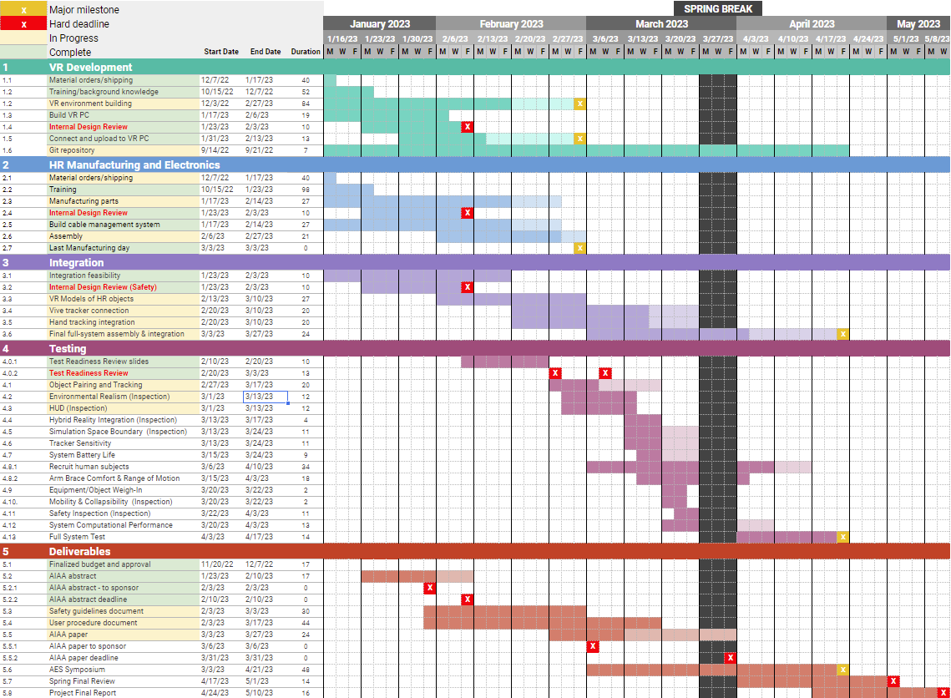
Gantt
Chart
VR development
Critical path
Current date
Manufacturing
Integration
Testing
Final product
Notes:
Major changes: none, we are currently on track.

Slide 26
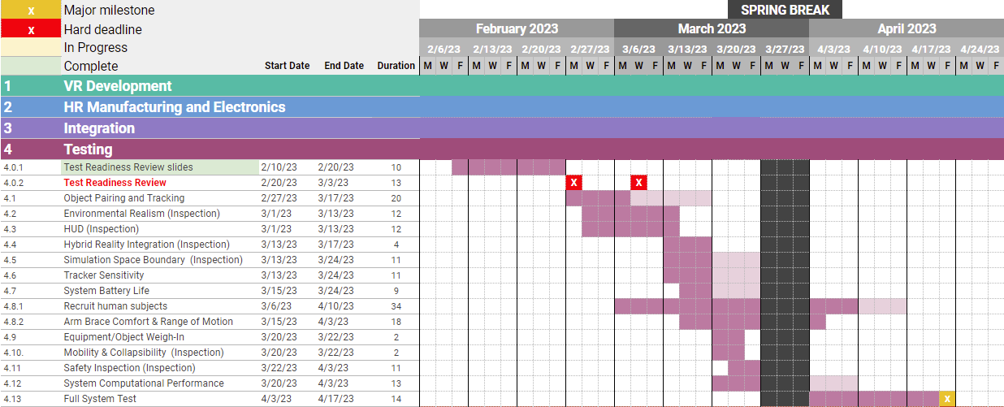
Gantt Chart - Testing
Lighter color = margin
Critical path
Current date
Prelim Inspections
Human Subject Testing
Full System Validation
I: Overview
IV: Schedule
V: Test Readiness
VI: Budget
Notes:
Wip (needs replacing)

Slide 27
Test Schedule
Week | Monday | Wednesday | Friday
2/27 | OPT | OPT ENV/HUD
3/6 | ENV/HUD OPT | TRR (no test)
3/13 | ENV/HUD HRI SSB TSens | SBL TSens ABC-ROM | OPT HRI
3/20 | EOWI MC ABC-ROM SCP | ABC-ROM SCP EOWI MC | SI TSens SSB SBL
3/27 | SPRING BREAK
4/3 | ABC-ROM SCP SI | FST
4/10 | FST | FST
4/17 | FST | FST | SYMPOSIUM!
TEST
DEADLINE
OPT = Object Pairing and Tracking
ENV = Environmental Realism
HUD = Heads-Up Display
HRI = Hybrid Reality Integration
SSB = Simulation Space Boundary
SBL = System Battery Life
TSens = Tracker Sensitivity
ABC-ROM = Arm Brace Comfort &
Range of Motion
EOWI = Equipment & Object Weigh-In
SCP = System Computational Performance
SI = Safety Inspection
FST = Full System Test
I: Overview
IV: Schedule
V: Test Readiness
VI: Budget

Slide 28
Test Readiness
I: Overview
IV: Schedule
V: Test Readiness
VI: Budget

Slide 29
Major Test Overview
Name | Description | FR
System Computational Performance (SCP) | Ensure simulation will meet key requirements for mitigating motion sickness with the addition of HR/VR objects (i.e., VIVE Trackers) | 2, 5
Full System Test (FST) | Day-In-The-Life (DITL) test that ensures satisfactory integration of all subsystems and components while implementing effective motion sickness screenings | ALL
I: Overview
IV: Schedule
V: Test Readiness
VI: Budget

Slide 30
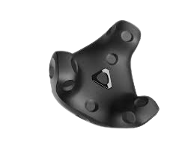
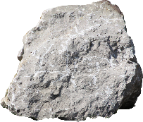
System Computational Performance (SCP)

Slide 31
System Computational Performance
DRIVERS AND ASPECTS
Focus | Ensure that running the built environment within the Oculus along with tracker use will meet key requirements for mitigating motion sickness
Driving CPEs | C5: VR Environment will keep user safe
Driving risks | Degraded computational performance decreases immersion | Motion Sickness from VR Headset/Display
Key aspects | CPU usage GPU usage RAM consumption | Latency Framerate
I: Overview
IV: Schedule
V: Test Readiness
VI: Budget
Notes:
AM

Slide 32
System Computational Performance
DRIVING REQUIREMENTS
DR # | Requirement
5.1.1.1 | Shall implement a maximum 48 ms latency
5.1.1.2 | Shall implement a minimum 90 fps frame rate
5.5.1.1 | The PC GPU usage shall not exceed 95%
5.5.1.2 | The PC CPU usage shall not exceed 85%
5.5.1.4 | During the simulation, the PC RAM usage shall not exceed 80%
F5
I: Overview
IV: Schedule
V: Test Readiness
VI: Budget
Notes:
AM

Slide 33
System Computational Performance
PRE-REQUISITE TESTING
Test/Inspection | Description |  | Status
Environmental Realism | Verifying requirements for accurate depiction of environment (incl. lighting, terrain, shaders, and surface textures). |  | In Progress
HUD | Verifying requirements for heads-up display are met. |  | In Progress
Object Pairing & Tracking | Verifying that trackers properly track objects and appear in the VR world simultaneously. |  | In Progress
I: Overview
IV: Schedule
V: Test Readiness
VI: Budget
Notes:
Pre-requisite test plans/data that indicate this test can be successful
AM

Slide 34
System Computational Performance
TEST DESIGN
Test fixtures | PC setup, Base stations, Oculus Connection, VIVE Trackers
Sensors & data acquisition | Task manager, Oculus debug tool
Test facilities & equipment
Virtual Reality | Hybrid Reality | Other
PC Oculus Base Stations | Trackers | Senior Projects work space Sanitation equipment
I: Overview
IV: Schedule
V: Test Readiness
VI: Budget
Notes:
AM

Slide 35
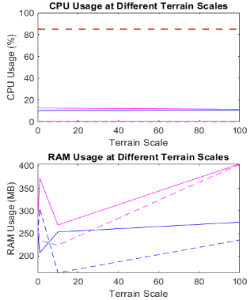
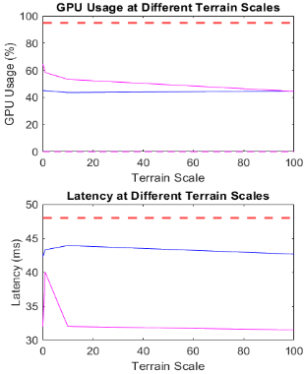
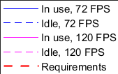
System Computational Performance
CDR PERFORMANCE MODEL VERIFICATION
I: Overview
IV: Schedule
V: Test Readiness
VI: Budget
Notes:
Talk about how these are test based results

Slide 36
System Computational Performance
TEST PROCEDURE
Setup
Data Collection
Set up (PC, Base Stations, VR simulation)
Insert a VR Object (.obj)
Attach VIVE Tracker to a VR Object
Connect Oculus headset to PC via Oculus App
Run the simulation in Unity through the Oculus headset
Repeat process adding a new VIVE Tracker
Have user look and move around the simulation and collect performance measurements
Leave the simulation idle and collect performance measurements
Data acquisition:
CPU, GPU, and RAM consumption = Windows Task Manager
Frame rate and latency information = Oculus debug tool
Test CPU: AMD Ryzen 5 5600X
Test GPU: NVIDIA Gigabyte 2080 Super
Test RAM: 16 GB
36
I: Overview
IV: Schedule
V: Test Readiness
VI: Budget
Notes:
Look at jasmins TRR to create a visual for this

Slide 37
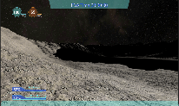
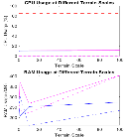
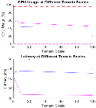
System Computational Performance
TEST PROCEDURE
Systems Computational Performance Test
Evaluating Performance
.obj file
Imported into sim
Link Vive Tracker to Obj
Vive Tracker is now seen as a rock to the user
User interacts with vive tracker and changes orientation
Load HR object (.obj) into the simulation
Assign vive tracker to HR object in simulation
Run simulation and interact with the added trackers
37
I: Overview
IV: Schedule
V: Test Readiness
VI: Budget
Notes:
Look at jasmins TRR to create a visual for this

Slide 38
System Computational Performance
PASS/FAIL CRITERIA
Success Level | 5.5.1.2: CPU Usage | 5.5.1.1: GPU Usage | 5.5.1.4: RAM Consumption |  | 5.1.1.1: Latency
Level 1 | < 85%¹ | < 95%² | < 80%³ |  | < 48ms⁴
Level 2 | ~ | ~ | ~ |  | < 120ms⁵
Failure | > 85% | > 95% | > 80% |  | > 120ms
I: Overview
IV: Schedule
V: Test Readiness
VI: Budget

Slide 39
System Computational Performance
BUYING DOWN RISK- Degraded Computational Performance
Risk: Degraded Computational Performance decreases immersion
(High Risk Level (5), High Likelihood (5))
Likelihood | Very Likely (5)
 | Likely (4)
 | Possible (3)
 | Unlikely (2)
 | Very Unlikely (1)
 |  | Negligible (1) | Minor (2) | Moderate (3) | Significant (4) | Severe (5)
 |  | Impact
How does the SCP buy down risk?
Adding VR objects and VIVE trackers to monitor change in performance measurements
Verify performance measurements remain within range of success criteria
Maintaining passable performance measurements reduces risk of decreased immersion
I: Overview
IV: Schedule
V: Test Readiness
VI: Budget
Notes:
Lily

Slide 40
System Computational Performance
BUYING DOWN RISK- Degraded Computational Performance
Risk: Degraded Computational Performance decreases immersion
(High Risk Level (5), High Likelihood (5))
Likelihood | Very Likely (5)
 | Likely (4)
 | Possible (3)
 | Unlikely (2)
 | Very Unlikely (1)
 |  | Negligible (1) | Minor (2) | Moderate (3) | Significant (4) | Severe (5)
 |  | Impact
 | Baseline (CDR Model) | Expected Results
Latency | 40.1 ms | ~96 ms*
CPU | 12.6% | ~40-70%
GPU | 58.4% | ~70%
RAM | 372.4 MB (2%) | <10%
*IEEE study⁶ found VIVE tracker latency on average to be ~56 ms
I: Overview
IV: Schedule
V: Test Readiness
VI: Budget

Slide 41
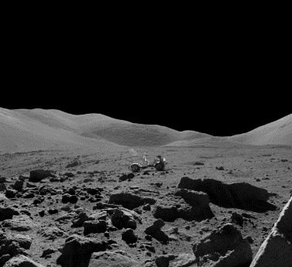
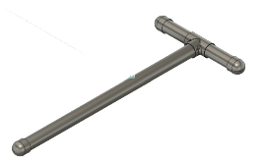
Full System Test (FST)

Slide 42
Full System Test
DRIVERS AND ASPECTS
Focus | Ensure that the full system will meet the six functional requirements while simultaneously putting emphasis on Human-in-the-Loop (HITL) Testing
Driving CPEs | E1-E5: Virtual Environment, User Equipment, HR Support Equipment, Testing, and Safety
Driving risks | User safety and all other major risks
Key aspects | South Pole Environment Simulation Physical, Real-World Objects Accurate Portrayal of Physical Objects in VR Spacesuit Features and Small Lunar Objects Keep User Safe Appropriate for Lab
I: Overview
IV: Schedule
V: Test Readiness
VI: Budget
Notes:
Thomas - Thomas(test2):What is being tested and why: rationale for performing the test in terms of reqs to be verified or mission objectives to be validated

Slide 43
Full System Test
PRE-REQUISITE TESTING
All planned tests should be successfully completed before this test is carried out to ensure the success of the FST
However, some tests are flagged as fundamental sub-system prerequisites and must be successfully completed before the FST:
Test/Inspections | Description |  | Status
Object Pairing & Tracking | Verifying requirements that define the project’s hybrid reality capabilities |  | In Progress
System Computational Performance | Verifying our design solution by ensuring that tracker integration does not prevent the simulation from operating properly |  | Not Started
I: Overview
IV: Schedule
V: Test Readiness
VI: Budget
Notes:
Andrew

Slide 44
Full System Test
TEST DESIGN
Test fixtures | VR PC, Base stations, Oculus Connection, VIVE Trackers
Sensors & data acquisition | Motion Sickness Susceptibility Questionnaire (MSSQ)⁷, Virtual Reality Sickness Questionnaire (SSQ)⁸, feedback surveys, Bishop-Corlett Discomfort Survey⁹, & Oculus Headset
Test facilities & equipment
Test & safety procedures | Risk Mitigation Strategy: TACO Test Procedure: Human-in-the-Loop (HITL) Flow
Virtual Reality | Hybrid Reality | Other
Oculus PC VIVE Trackers | Tools, Button Bench Rocks | Sanitation Supplies Arm Constraint 9’x10’ space (TBD)
I: Overview
IV: Schedule
V: Test Readiness
VI: Budget
Notes:
Geoff/Hannah

Slide 45
Full System Test
DRIVING REQUIREMENTS
DR # | Requirement
1.1 | Shall incorporate accurate location characteristics that resemble the south polar region of the lunar surface
2.1.1 | Physical training object(s)/equipment shall be user compatible
2.2.1.1 | User motion sensor(s) shall not inhibit user mobility
2.2.2.2 | Object motion sensor(s) shall not inhibit object handling
5.1 | Shall implement proper methods to avoid causing simulation sickness in user
5.3.1 | Shall maintain two-way communication with the user throughout the entire simulation
6.1.1 | All hybrid reality equipment/objects shall fit within the physical training environment
I: Overview
IV: Schedule
V: Test Readiness
VI: Budget
Notes:
Geoff
Presenter → reminder that the first number is the functional requirement the derived requirement falls under

Slide 46
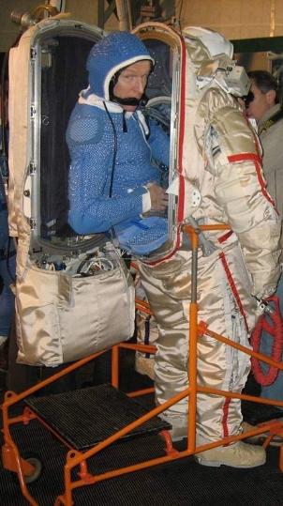
Human-in-the-Loop Testing (HITL)
What is it?
Fundamental Human Factors Analysis
Human evaluation of design through testing
Helps engineers see what they might have overlooked
Helps engineers improve efficiency, effectiveness of desired purpose of device
Why is it needed?
Most effective way to verify + validate our requirements
Required in industry for human-centric devices to ensure user safety, comfort, accomodation, and useability
Spacesuits are tight fits even for the humans they are designed for
I: Overview
IV: Schedule
V: Test Readiness
VI: Budget
Notes:
What is it?
Human in the Loop (HITL) testing is a form of testing prototypes by having humans evaluate specific qualities of the prototype.
By providing feedback on these metrics, engineers can better refine their prototype so that is more efficient and effective at its desired purpose

Slide 47
Human-in-the-Loop Test Flow
Briefing by team member
Verbal confirmation of understanding
Test Begins
Conduct evaluation via survey at predetermined checkpoints [dependendent on test]
Debrief after testing
In the event that a participant needs to exit the simulation, there will be a
Procedure to End the Simulation
This includes nominal, off-nominal, and emergency situations
All HITL will be done with at least two members of CTHREEPIO present
Goal: 10 participants¹⁰
Testing will include the administration of surveys to verify and validate requirements
Tests that require HITL Testing:
Arm Brace Comfort and Range of Motion
Full System Test
I: Overview
IV: Schedule
V: Test Readiness
VI: Budget

Slide 48
Understanding TACO
Training
Awareness
Communication
Off-ramps
SME-consultation
Comprehensive for procedures, emergency action plans
Pass/Fail Evaluations by Safety Officer
One team member observing the user
Clear boundaries, minimized set up
Slow and steady
Inspect items before use
Briefing before and after each test
Written and printed procedures
Clear acknowledgement of understanding
Procedure to Exit Simulation
Team member observing will help with ingress/egress
Proceed with scalability plan if V&V fails
I: Overview
IV: Schedule
V: Test Readiness
VI: Budget

Slide 49
Full System Test
TEST PROCEDURE
STAGE 1:
Human Subject Recruitment
Pre-Screening with MSSQ (Must be 95th percentile or below)
STAGE 2:
Pre-Test
1. Set up simulation, play area, and trackers
2. Brief subject on procedure
3. Don equipment
4. Comfort test (Corlett-Bishop)
5. Audio check
6. Baseline SSQ (16 questions)
STAGE 3
Test
1. Start CTHREEPIO simulation
2. Instruct subject to complete tasks described by mission control
3. Administer modified SSQ intermittently (5 min)
STAGE 4
Post-Test
1. Administer final full SSQ
2. Doff equipment
3. End-of-Test surveys
STAGE 5
Clean-Up
1. Disassemble play area, simulation, trackers, and base stations
2. Sanitize all equipment for next user
Test Time: 20 min
I: Overview
IV: Schedule
V: Test Readiness
VI: Budget
Notes:
Geoff to add audio

Slide 50
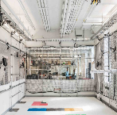
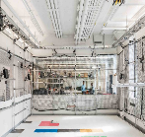
Full System Test
TEST PROCEDURE
Iterative Testing Loop
Stage 2
Stage 4/5
Equipment Setup
Exiting the Simulation
Safety Briefing
User dons equipment
Comfort test/baseline SSQ
Set up simulation, play area, and trackers
User doffs equipment
End-of-Test surveys
Sanitize all equipment & clean up
20-min sim interaction; SSQ every 5 min
Final SSQ
Stage 3
Stage 4
Notes:
1) Read out biometric data to mission control
2) Survey the environment, locate sampling areas
3) Navigate to rover, obtain proper equipment
4) Regolith and small pebble collection
5) Large rock sample collection
6) Bring box to rover for transport
Above steps are related to the user task outline, (see this document)
I know Jasmine said maybe to remove the setup and exiting the sim panels, however if I recall correctly, when making the first ConOps for PDR, Dr. Anderson explicitly told me to include the full user experience, including taking on and off the hardware. I think it could be a good idea to run this version of the ConOps by Dr. Anderson and get her input before we start consolidating the panels too much, because I want to make sure that we show our distinct built in capabilities in this ConOps.

Slide 51
Full System Test
PASS/FAIL CRITERIA (1/2)
 | 1.1: Accurate location characteristics - south polar region of lunar surface | 5.1: Proper avoidance of user simulation sickness |  | 5.3.1: Shall maintain two-way communication with the user throughout the entire simulation
Level 1 | Average of 8 or higher on 1-10 scale | Final SSQ score is ⩽ 10 greater than baseline SSQ in ⩽ 20% of participants |  | Communication does not cease for more than 10 seconds
Level 2 | Average of 7 or higher on 1-10 scale | Final SSQ is ⩽ 15 greater than baseline SSQ in ⩽ 20% of participants |  | ~
Failure | Average of 6 or lower on 1-10 scale | Final SSQ is > 15 greater than SSQ in > 20% of participants* |  | Communication gap lasts more than 10 seconds
* OR > 20% of participants must end sim before 20 min mark due to excessive motion sickness.
I: Overview
IV: Schedule
V: Test Readiness
VI: Budget

Slide 52
Full System Test
PASS/FAIL CRITERIA (2/2)
 | 2.1.1: Physical training object(s)/equipment shall be user compatible* | 2.2.1.1: User motion sensor(s) shall not inhibit user mobility* | 2.2.2.2: Object motion sensor(s) shall not inhibit object handling* | 6.1.1: All hybrid reality equipment shall fit within the physical training environment
Level 1 | Average of 8 or higher on 1-10 scale | Average of 8 or higher on 1-10 scale | Average of 8 or higher on 1-10 scale | All components fit within training environment
Level 2 | Average of 7 or higher on 1-10 scale | Average of 7 or higher on 1-10 scale | Average of 7 or higher on 1-10 scale | ~
Failure | Average of 6 or lower on 1-10 scale | Average of 6 or lower on 1-10 scale | Average of 6 or lower on 1-10 scale | Some or all components do not fit within training environment
* Results will be based on the accumulated and averaged End-of-Test survey responses of participants
I: Overview
IV: Schedule
V: Test Readiness
VI: Budget

Slide 53
Full System Test
BUYING DOWN RISK- User Motion Sickness
Risk: Simulation causes user to experience motion sickness
(High Risk Level (5), Moderate Likelihood (3))
Likelihood | Very Likely (5)
 | Likely (4)
 | Possible (3)
 | Unlikely (2)
 | Very Unlikely (1)
 |  | Negligible (1) | Minor (2) | Moderate (3) | Significant (4) | Severe (5)
 |  | Impact
How does the FST buy down risk?
Pre-screening with MSSQ filters subjects with high susceptibility to motion sickness
Periodic administering of SSQ during the test prevents severe progression of motion sickness symptoms that the user may experience
I: Overview
IV: Schedule
V: Test Readiness
VI: Budget
Notes:
Lily

Slide 54
Full System Test
BUYING DOWN RISK- User Motion Sickness
Risk: Simulation causes user to experience motion sickness
(High Risk Level (5), Moderate Likelihood (3))
Likelihood | Very Likely (5)
 | Likely (4)
 | Possible (3)
 | Unlikely (2) |  |  | #2
 | Very Unlikely (1)
 |  | Negligible (1) | Minor (2) | Moderate (3) | Significant (4) | Severe (5)
 |  | Impact
Due to the subjective nature of human testing, the best way to predict results is through careful analysis of simulator sickness data and by designing to human safety & comfort
Analysis of prior SSQ studies¹¹ indicates that we will be able to meet our requirements
I: Overview
IV: Schedule
V: Test Readiness
VI: Budget
Notes:
Lily- At this point, we will have verified that the environment looks like the moon, has real world objects incorporated, EVA parameters via the HUD all through inspection. The most important risk that test 2 will cover is motion sickness which is likely caused by lag and similar variables. Thus, a HITL will tie together the safety requirements- not that we just met latency/frame rate values, but with a human, they are at acceptable values. Presenter should discuss that this is a critical project element and failure to implement all aspects without motion sickness will result in failure of project as a whole

Slide 55
Budget
I: Overview
IV: Schedule
V: Test Readiness
VI: Budget

Slide 56
Budget
Item Name | Status | Date Ordered | Date Arrived | Price Spent
PC Components | Acquired | 1/17 | 1/24 | $1,450
Meta Quest 2 Headset | Acquired | 1/21 | 1/21 | $400
Vive Motion Trackers | Acquired | 1/19 | 1/31 | $909
Vive Base Station 2.0s | Acquired | 1/26 | 2/7 | $860
Base Station Tripods | Acquired | 1/28 | 2/7 | $45
USB Cable for Headset | Acquired | 1/23 | 2/7 | $15
USB 4 Port Hubs | Acquired | 1/28 | 2/1 | $29
Transceiver Modules | Acquired | 10/29 | 11/21 | $8
Arduino #1 | Acquired | 10/29 | 11/21 | $25
Arduino #2 | Acquired | 2/3 | 2/9 | $25
9V Batteries + Battery Clips | Acquired | 2/1 | 2/24 | $10
PVC Pipe Parts for Shovel | Acquired | 1/23 | 1/23 | $87
Velcro Straps | Acquired | 1/23 | 1/23
Wood Planks for Bench | Acquired | 1/23 | 1/23
Sample Container | Acquired | 2/13 | 2/13 | $10
Arm Braces | Shipping | 2/5 | -- | $120
Sanitation Equipment | Not Yet Ordered | -- | -- | $30
Virtual Assets | Not Yet Ordered | -- | -- | $25
 |  |  | Total: | $4900
 |  |  | Remaining: | $872
Essential VR Hardware
VR Accessories
Electronics
Equipment
Other Expenses
I: Overview
IV: Schedule
V: Test Readiness
VI: Budget

Slide 57
Budget
Budget Updates:
Remaining margin: $872
$660 used from originally allocated margin
$200 additional spent on PC components
$460 additional spent on Base Stations
Procurement Summary:
Nearly all project components acquired or in transit
Final major components will be virtual assets and sanitation equipment
Part Replacement Plan
At Risk Components | Price Per Unit | # of Units | Total
HTC Vive Base Station | $440 | 1 | $440
HTC Vive Motion Trackers | $130 | 2 | $260
Arduino Nanos | $25 | 1 | $50
Arm Brace | $60 | 1 | $60
 |  | Final Total: | $810
I: Overview
IV: Schedule
V: Test Readiness
VI: Budget
Notes:
Feedback from Anderson: Show part replacement plan for trackers/base stations

Slide 58
Acknowledgements
We would like to thank our team advisor and sponsor, Dr. Anderson, our Blue Origin sponsors, Christine Reilly and Tim Lloyd, as well as Dr. Wingate, Professor Muldrow, and the ASEN 4028 teaching fellows for their assistance in completing this Test Readiness Review.

Slide 59
Questions

Slide 60
References
Diamond Lobby (2023). CPU Usage When Gaming. DiamondLobby, https://diamondlobby.com/tech-guides/what-should-cpu-usage-be-when-gaming/
Hicks, J. (2022). How Much GPU Usage is Normal for Gaming? Device Tests, https://devicetests.com/how-much-gpu-usage-is-normal-for-gaming
(2023). How Much Ram Usage is Normal. The Healthy Journal, https://www.thehealthyjournal.com/faq/how-much-ram-usage-is-normal
Golding, J. F. (2006). Motion sickness susceptibility. Autonomic Neuroscience, 129(1-2), 67-76.
Meehan, M., Razzaque, S., Whitton, M. C., & Brooks, F. P. (2003, March). Effect of latency on presence in stressful virtual environments. In IEEE Virtual Reality, 2003. Proceedings. (pp. 141-148). IEEE.
J. -P. Stauffert, F. Niebling and M. E. Latoschik, "Simultaneous Run-Time Measurement of Motion-to-Photon Latency and Latency Jitter," 2020 IEEE Conference on Virtual Reality and 3D User Interfaces (VR), Atlanta, GA, USA, 2020, pp. 636-644.
Golding, J. F. (1998). Motion sickness susceptibility questionnaire revised and its relationship to other forms of sickness. Brain research bulletin, 47(5), 507-516.
Kennedy, R. S., Lane, N. E., Berbaum, K. S., & Lilienthal, M. G. (1993). Simulator sickness questionnaire: An enhanced method for quantifying simulator sickness. The international journal of aviation psychology, 3(3), 203-220.
Corlett, E. N., & Bishop, R. P. (1976). A technique for assessing postural discomfort. Ergonomics, 19(2), 175-182.
(2022). Human-in-the-Loop (HITL) Test Subject Sample Sizes. NASA-STD-3001 Technical Brief.
Kennedy, R., Drexler, J., Compton, D., Stanney, K., Lanham, D., & Harm, D. (2003). Conﬁgural scoring of simulator sickness, cybersickness and space adaptation syndrome: similarities and differences. Virtual and adaptive environments: Applications, implications, and human performance issues, 247.

Slide 61
Backup Slides

Slide 62
Table of Contents - TRR Slides
Outline
Overview
Nomenclature
Project Definition
Objectives & HLFR
CONOPS
FBD
Design Diagrams
Critical Project Elements
Schedule
Test Readiness
Test Overview
System Computational Performance
Full System Test
HITL Testing
Budget

Slide 63
Table of Contents - Backup Slides
Background Information
Nomenclature
Motivation
Full Requirements
V&V (Tests and Inspections)
Supplemental Equipment Details
Master Equipment List
HR Object Details
Risks (Full)
Safety & Human Testing
Developmental and Functional Pipelines

Slide 64
Background Information
Nomenclature
Motivation
Full Requirements

Slide 65
Complete Nomenclature List
Virtual Reality (VR): The software developed to virtually recreate a lunar environment
Back End: The Unity and other software development tools used to create the infrastructure for the software
Front End: The rendering software used to visualize the data and software infrastructure - what the user will actually see and interact with
Hybrid Reality (HR): The physical tools and sensors used to track interactions between the user, real life and virtual objects
Training Simulation (CTHREEPIO): The project as a whole - the combination of virtual environment and hybrid reality
Extravehicular Activity (EVA): This is the official term for any activity that an astronaut conducts outside of a safe habitat/vehicle.
Lunar South Pole (LSP): Primary landing site for Artemis III mission and where on the moon CTHREEPIO is trying to replicate
Derived Requirement (DR): A lower level requirement under a high level functional requirement (FR). DRs can be found in backup slides.
Blender → creates the things we see in the virtual environment
Unity → the engine that “powers” the virtual environment and everything happening in it
SteamVR → the bridge between what’s happening in Unity and the virtual reality devices (Oculus, VIVE trackers, VIVE base stations)
GitHub → software storage system that allows for open access and version control
Fusion360 → creates the things we want to understand the mechanics of or develop into a 3D printable object
Meta Quest App → the app used to access the oculus headset
VIVE Input Utility → Unity plugin that allows manipulation of VIVE tracker data
Mobility Constraint ↔ Physical Constraint → The physical device(s) that are used to constrict the movement of the user the same way that an actual spacesuit would.
Arm Brace ↔ Elbow Brace → The physical device(s) that are used to constrict the movement of the user’s elbow the same way that an actual spacesuit would.
Hard Upper Torso (HUT) → A device used in spacesuit design to provide structural support and one of the main components that lead to mobility constriction within a spacesuit
NASA - STD - 3001 → NASA Spaceflight Human-System Standard Volume 2, Rev C → The requirement(s) standard set for by NASA for all human spaceflight projects and the standard we use for all CTHREEPIO development

Slide 66
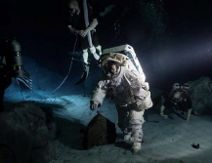
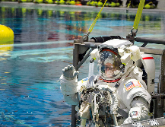
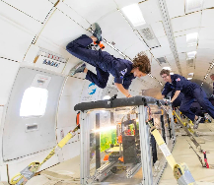
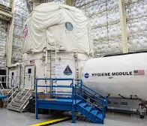
Background - Lunar/Astronaut Training
Increased interest in lunar operations comes with an increased need for operational training.
Current training methods include (not limited to):
Neutral Buoyancy Lab¹
Field Simulations (Analogs)²
Parabolic flight³
These methods are costly and operate on strict time schedules.

Slide 67
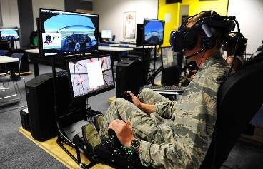
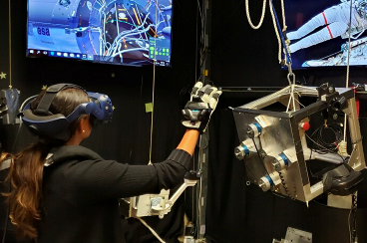
Background - VR
VR systems have been successfully applied to training exercises across many fields:
Aviation Training/Maintenance⁴
Surgical/Medical Training⁵
This technology allows for:
Complicated visual environments
Flexibility
Immersiveness
Simulated gravity in an altered way
…all at a much lower cost than other operational training methods
Notes:
1 pic - (Jennifer Spradlin/Air Force Academy)
2nd pic - https://spacecenter.org/how-nasa-uses-virtual-reality-to-train-astronauts/

Slide 68
CTHREEPIO Requirements
FR | L1 | L2 | L3 | Requirement | V&V | Level | Predicted Compliance
F1 |  |  |  | The VR environment shall simulate the South Polar region of the lunar surface. |  | Level 0
 | 1.1 |  |  | Shall incorporate accurate location characteristics that resemble the south polar region of the lunar surface | FST | Level 1: System | C
 |  | 1.1.1 |  | Shall accurately portray lighting characteristics one would experience on the south polar region of the lunar surface | Bottom-up | Level 2: Subsystem | C
 |  |  | 1.1.1.1 | Shall accurately portray a suit-mounted flashlight with an intensity of 108 Lux (+-10 Lux) | ENV | Level 3: Component | C
 |  |  | 1.1.1.2 | Shall accurately portray high-contrast lighting conditions with a contrast ratio of 16.0 (+-2). | ENV | Level 3: Component | C
 |  |  | 1.1.1.3 | Shall accurately portray low-angle solar lighting conditions with an elevation angle of no greater than 1.5 Degrees | ENV | Level 3: Component | PC
 |  | 1.1.2 |  | Shall accurately generate lunar topographical and geographical features | Bottom-up | Level 2: Subsystem | C
 |  |  | 1.1.2.1 | Shall generate topographical and geographical features with raw lunar scan data. | ENV | Level 3: Component | C
 |  |  | 1.1.2.2 | Shall ensure the texture of the lunar surface in the simulation is visually indicative of lunar regolith | ENV | Level 3: Component | PC

Slide 69
F2 |  |  |  | The training simulation shall include physical, real-world objects. |  | Level 0
 | 2.1 |  |  | Shall include necessary physical object(s)/equipment that represent training utilities used in the VR simulation | Bottom-up | Level 1: System | C
 |  | 2.1.1 |  | Physical training object(s)/equipment shall be user compatible | FST | Level 2: Subsystem | C
 |  |  | 2.1.1.1 | Physical model(s) of VR tools shall have a simulated weight (ie, 1/6 the weight they would nominally have on Earth) | EOWI | Level 3: Component | C
 |  |  | 2.1.1.2 | Physical model(s) of VR tools shall be mechanically illustrative of VR counterpart | HRI | Level 3: Component | C
 |  |  | 2.1.1.3 | Physical model(s) of VR environment shall be relevant to training simulation | HRI | Level 3: Component | C
 |  |  | 2.1.1.4 | Physical model(s) of VR equipment shall be mechanically illustrative of VR counterpart | HRI | Level 3: Component | C
 |  |  | 2.1.1.5 | Physical model(s) of VR equipment shall be relevant to a Lunar training environment | HRI | Level 3: Component | C
 |  |  | 2.1.1.6 | Physical model(s) of the VR spacesuit shall recreate elbow extension/flexion range of motion (from 0 degrees to 120 degrees) | ABC-ROM | Level 3: Component | C
 |  |  | 2.1.1.7 | Physical model(s) of the VR spacesuit shall be non-invasive | FST | Level 3: Component | C
 |  |  | 2.1.1.8 | Physical model(s) of the VR spacesuit shall be user adjustable | FST | Level 3: Component | C
 |  |  | 2.1.1.9 | Physical model(s) of the VR spacesuit shall be able to house any HR support hardware | HRI | Level 3: Component | C
 | 2.2 |  |  | Shall include physical hardware designed to support VR and user actions | Bottom-up | Level 1: System | C
 |  | 2.2.1 |  | Physical hardware shall include sensor(s) to track user(s) activities and motions | Bottom-up | Level 2: Subsystem | C
 |  |  | 2.2.1.1 | User motion sensor(s) shall not inhibit user mobility | FST | Level 3: Component | PC
 |  |  | 2.2.1.2 | User motion sensor(s) shall have. 4cm sensitivity | TSens | Level 3: Component | TBD
 |  |  | 2.2.1.3 | User motion sensor(s) shall be able to track object and stream data within the training area | TSens | Level 3: Component | C
 |  |  | 2.2.1.4 | User motion sensor(s) shall be able to operate continously for a minimum of 1 hour | SBL | Level 3: Component | C
 |  | 2.2.2 |  | Physical hardware shall include sensor(s) to track object(s) motions | Bottom-up | Level 2: Subsystem | C
 |  |  | 2.2.2.1 | Object motion sensor(s) shall have the ability to track objects with minimum dimension of 4cm | OBT | Level 3: Component | C
 |  |  | 2.2.2.2 | Object motion sensor(s) shall not inhibit object handling | FST | Level 3: Component | PC
 |  |  | 2.2.2.3 | Object motion sensor(s) shall have a 4cm sensitivity | TSens | Level 3: Component | TBD
 |  |  | 2.2.2.4 | Object motion sensor(s) shall be scalable to spacial augmentation of the physical training environment | OBT | Level 3: Component | C

Slide 70
F3 |  |  |  | The training simulation shall accurately portray interactions with physical objects in the VR environment. |  | Level 0
 | 3.1 |  |  | Shall include auditory feedback for user interactions | Design-To | Level 1: System | C
 | 3.2 |  |  | Shall include visual feedback for user interactions | Design-To | Level 1: System | C
 | 3.3 |  |  | Shall include virtual assets representing the physical training elements | Bottom-Up | Level 1: System | C
 |  | 3.3.1 |  | Shall include virtual representations of rocks and geological objects | ENV | Level 2: Subsystem | C
 |  | 3.3.2 |  | Shall include virtual representations of tools and equipment used | ENV | Level 2: Subsystem | C
F4 |  |  |  | To accurately simulate EVA activities on the lunar surface, the training simulation shall portray spacesuit features and small scale lunar objects. |  | Level 0
 | 4.1 |  |  | Shall include an accurate visual representation of the user's hands within the simulation | ENV | Level 1: System | PC
 |  | 4.1.1 |  | Shall include a realistic visual of current astronaut gear | ENV | Level 2: Subsystem | C
 |  |  | 4.1.1.1 | Shall include a horizontal field-of-view of at least 80 Degrees | ENV | Level 3: Component | C
 |  | 4.1.2 |  | Shall be able to see shadows of user | ENV | Level 2: Subsystem | PC
 | 4.2 |  |  | Shall integrate the capability to display simulated data with a Heads Up Display | HUD | Level 1: System | PC
 |  | 4.2.1 |  | Shall be able to dynamically simulate human health parameters based on user input | HUD | Level 2: Subsystem | NC
 |  |  | 4.2.1.1 | Shall be able to view simulated heart rate | HUD | Level 3: Component | NC
 |  |  | 4.2.1.2 | Shall be able to view simulated blood pressure | HUD | Level 3: Component | NC
 |  | 4.2.2 |  | Shall be able to dynamically simulate space suit parameter | HUD | Level 2: Subsystem | PC
 |  |  | 4.2.2.1 | Shall be able to view simulated O₂ levels | HUD | Level 3: Component | PC
 |  |  | 4.2.2.2 | Shall be able to view simulated CO₂ levels | HUD | Level 3: Component | PC
 |  |  | 4.2.2.3 | Shall be able to view simulated inner and outer space suit temperatures | HUD | Level 3: Component | PC
 |  |  | 4.2.2.4 | Shall be able to view Battery/Power left | HUD | Level 3: Component | PC
 |  | 4.2.3 |  | Shall be able to dynamically simulate mission/simulation parameter | HUD | Level 2: Subsystem | PC
 |  |  | 4.2.3.1 | Shall be able to view simulated EVA Total Time | HUD | Level 3: Component | PC
 |  |  | 4.2.3.2 | Shall be able to view simulated distance back to start point (airlock) | HUD | Level 3: Component | PC
 |  |  | 4.2.3.3 | Shall be able to view a topographical map of the lunar simulated surface | HUD | Level 3: Component | NC

Slide 71
 |  |  | The training simulation, including the VR environment and all physical aspects, shall keep the user, operator, and itself safe from harm. |  | Level 0
5.1 |  |  | Shall implement proper methods to avoid causing simulation sickness in user | FST | Level 1: System | C
 | 5.1.1 |  | Shall implement proper depth perception and scaling. | Bottom-Up | Level 2: Subsystem | C
 |  | 5.1.1.1 | Shall implement a maximum 48 ms latency | SCP | Level 3: Component | C
 |  | 5.1.1.2 | Shall implement a minimum 90 fps frame rate | SCP | Level 3: Component | C
 |  | 5.1.1.3 | Shall implement a minimum 80 Hz refresh rate | Design-To | Level 3: Component | C
5.2 |  |  | The VR environment shall have boundaries that match the physical boundaries of the training space | SSB | Level 1: System | C
5.3 |  |  | Shall keep the user physically safe | Bottom-Up | Level 1: System | C
 | 5.3.1 |  | Shall maintain two-way communication with the user throughout the entire simulation | FST | Level 2: Subsystem | C
 | 5.3.2 |  | Shall have a procedure for user to quickly exit or terminate simulation | Design-To/FST | Level 2: Subsystem | C
 | 5.3.3 |  | The user shall have guidance on how to complete the task | Design-To/FST | Level 2: Subsystem | C
 | 5.3.4 |  | The simulation shall have the ability to control auditory environment within the headset via flight operator | Design-To/FST | Level 2: Subsystem | C
 | 5.3.5 |  | The training simulation shall have a 70 decibel limit | Design-To/FST | Level 2: Subsystem | C
 | 5.3.6 |  | Equipment used shall be adjustable to accommodate different user anthropometry ranging from the 10th to 90th percentiles | ABC-ROM | Level 2: Subsystem | C
 | 5.3.7 |  | The total weight of the user's training simulation equipment shall not exceed 22.7 kg (50 lbs) | EOWI | Level 2: Subsystem | C
5.4 |  |  | Shall have tools/equipment that are safe to operate | Bottom-Up | Level 1: System | C
 | 5.4.1 |  | Tools/Equipment shall be modified to prevent injury | Bottom-Up | Level 2: Subsystem | C
 |  | 5.4.1.1 | Tools and equipment shall not have sharp corners or edges | SI | Level 3: Component | C
 |  | 5.4.1.2 | The physical representation of the tool rack shall be safe to handle and shall not pose a risk to the user or other equipment at any time during the simulation | SI | Level 3: Component | C

Slide 72
 | 5.5 |  |  | The training equipment shall not be damaged during the training simulation | Bottom-Up | Level 1: System | C
 |  | 5.5.1 |  | The VR computer shall be robust enough to safely run the training simulation for the entire duration | Bottom-Up | Level 2: Subsystem | C
 |  |  | 5.5.1.1 | The PC GPU usage shall not exceed 95% | SCP | Level 3: Component | C
 |  |  | 5.5.1.2 | The PC CPU usage shall not exceed 85% | SCP | Level 3: Component | C
 |  |  | 5.5.1.3 | The PC shall have a minimum of 16 GB RAM | Design-To | Level 3: Component | C
 |  |  | 5.5.1.4 | During the simulation the PC RAM usage shall not exceed 80% | SCP | Level 3: Component | C
F6 |  |  |  | The training simulation shall be appropriate for a laboratory environment. |  | Level 0
 | 6.1 |  |  | The physical training environment shall be no larger than 2.74 m x 3.05 m (9ft by 10ft) | SSB | Level 1: System | C
 |  | 6.1.1 |  | All hybrid reality equipment/objects shall fit within the physical training environment | FST | Level 2: Subsystem | C
 |  | 6.1.2 |  | All hybrid reality equipment/objects shall be appropriately scaled to match realistic sizes | HRI | Level 2: Subsystem | C
 | 6.2 |  |  | The physical training environment shall be designed such that it will not damage its occupied space | SI | Level 1: System | C
 | 6.3 |  |  | The physical training environment shall not be a permanent installation | MC | Level 1: System | C
 |  | 6.3.1 |  | All individual physical equipment shall be movable by one person | MC | Level 2: Subsystem | C
 |  |  | 6.3.1.1 | Hybrid reality components that need to be vertically lifted shall be no more than 22.7 kg (50 lbs) weight | EOWI | Level 3: Component | C

Slide 73
V&V (Tests and Inspections)

Slide 74
Validation and Verification Breakdown
A “flow-up” approach by verifying and validating our requirements from the bottom to the top
Chosen V&V methods reflect the presented P&M and Risks
6.1 |  |  | The physical training environment shall be no larger than 2.74 m x 3.05 m (9ft by 10ft)
 | 6.1.1 |  | All hybrid reality equipment/objects shall fit within the physical training environment
 | 6.1.2 |  | All hybrid reality equipment/objects shall be appropriately scaled to match realistic sizes
6.2 |  |  | The physical training environment shall be designed such that it will not damage its occupied space
6.3 |  |  | The physical training environment shall not be a permanent installation
 | 6.3.1 |  | All individual physical equipment shall be movable by one person
 |  | 6.3.1.1 | Hybrid reality components that need to be vertically lifted shall be no more than 22.7 kg (50 lbs) weight

Slide 75
Order of Testing: Inspections
Inspections
Environment Realism (ER)
Heads-Up Display (HUD)
Hybrid Reality Integration (HRI)
Simulation Space Boundary (SSB)
Mobility and Collapsibility (MC)
Safety Inspection (SI)

Slide 76
Order of Testing: Tests
Tests
Object Pairing & Tracking (OPT)
System Battery Life (SBL)
Arm Brace Comfort & Range of Motion (ABC-ROM)
Equipment & Object Weigh-In (EOWI)
Tracker Sensitivity (TSens)
System Computational Performance (SCP)
Full System Test (FST)

Slide 77
Environmental Realism (ENV)
Verifying/Validating:
User-mounted lighting (1.1.1.1)
Solar lighting (1.1.1.2, 1.1.1.3)
Accurate topography (1.1.2.1)
Surface texture (1.1.2.2)
Virtual assets related to physical training elements (3.3.1, 3.3.2)
User body/hands (4.1, 4.1.1)
User shadows (4.1.2)
Horizontal FOV (4.1.1.1)
Driving CPEs: E1
Driving risks: MINOR
Prerequisites: VR environment must be fully built and uploaded to Oculus.
Test procedures: Tests will be done through an analysis of the environment within the headset and VR PC view of the environment in Unity, using relative luminance and contrast ratio calculations, as well as verification using built-in Unity platform abilities and objective visual inspection while in the Oculus.
Notes:
Procedures and pass/fail criteria

Slide 78
Environmental Realism (ENV)
Pass Criteria: (bottom-up pass for higher-level requirements)
1.1.1.1: user-mounted light intensity must be verified by inspection in Unity editor to be 108+/-10 Lux
1.1.1.2: lit/shadowed region contrast ratio must be calculated to 16.0+/-2
1.1.1.3: elevation angle must be verified by inspection in Unity
1.1.2.1: environmental surface seen within the headset must not have any glitches, sudden and/or visible drop-offs, or hard shadows indicative of a rendering error. Because we don’t have any images to compare to of the actual LSP, this requirement must be verified by process of elimination.
1.1.2.2: the environmental surface seen within the headset is textured
3.3.1: virtual representations of rocks appear within the simulation
3.3.2: virtual representations of tools & equipment appear within the simulation
4.1: user hands must appear within the simulation
4.1.1: user hands must appear with rendered astronaut gloves on
4.1.1.1: verified by VR headset specs
4.1.2: user shadows must appear within simulation and must not have jagged edges
Notes:
Procedures and pass/fail criteria

Slide 79
Heads-Up Display (HUD)
Verifying/Validating:
HUD capabilities (4.2 and sub-requirements)
Driving CPEs: E1
Driving risks: MINOR
Prerequisites: ER, HUD must be fully built with all C# scripts integrated. Arduino must also be integrated.
Test procedures: Tests will be run with an operator wearing the Oculus and with the simulation running for 20 minutes. Verification that code runs correctly will be done by objective inspection with binary (yes-or-no) criteria. For battery/power: must test turning on/off VR flashlight.
Extra testing includes changing variables of the HUD and rerunning the simulation to ensure that the changing of variables will change the biometrics (e.g, to simulate an O₂ depletion emergency).

Slide 80
Heads-Up Display (HUD)
Pass Criteria: (bottom-up pass for higher-level requirements)
4.2.1.1: simulated heart rate is visible, understandable, and fluctuates while remaining in nominal range
4.2.1.2: simulated BP is visible, understandable, and fluctuates while remaining in nominal range
4.2.2.1: simulated O₂ level is visible, understandable, and fluctuates while remaining in nominal range
4.2.2.2: simulated CO₂ level is visible, understandable, and fluctuates while remaining in nominal range
4.2.2.3: simulated temperatures are visible, understandable, and fluctuates while remaining in nominal range
4.2.2.4: simulated battery level is visible, understandable, and decreases at correct rates (higher when light on)
4.2.3.1: EVA time is visible, understandable, and increments at same rate as realtime
4.2.3.2: simulated distance to airlock is visible, understandable, and fluctuates while remaining in nominal range
4.2.3.3: simulated lunar map is visible, understandable, and moves in accordance with user movement

Slide 81
Hybrid Reality Integration (HRI)
Verifying/Validating:
VR and HR tool/equipment visual matching (2.1.1.2, 2.1.1.4, 2.1.1.9)
Properly scaled in VR (6.1.2)
VR/HR tool/equipment relevance (2.1.1.3, 2.1.1.5)
Driving CPEs:
Driving risks: MINOR
Prerequisites: VR tool/equipment asset integration in VR environment. HR tools must be built.
Test procedures: Tests will be objective inspections with binary (yes-or-no) criteria.

Slide 82
Hybrid Reality Integration (HRI)
Pass Criteria: (bottom-up pass for higher-level requirements)
2.1.1.2: HR and VR tools must match in size, model, and mechanism
2.1.1.3: HR and VR tools must be relevant to lunar missions
2.1.1.4: HR and VR equipment must match in size, model, and mechanism
2.1.1.5: HR and VR equipment must be relevant to lunar missions

Slide 83
Simulation Space Boundary (SSB)
Verifying/Validating:
VR and HR boundaries match (5.2)
Simulation space size (6.1)
Driving CPEs: E4
Driving risks: MINOR
Pass Criteria: (bottom-up pass for higher-level requirements)
5.2: averaged distance must not exceed 4 cm
6.1: space taken up must not exceed 9’ x 10’

Slide 84
Mobility and Collapsibility (MC)
Verifying/Validating:
Collapsibility (6.3)
Mobility (6.3.1)
Driving CPEs: E4, E5
Driving risks: MINOR
Prerequisite tests: None
Test procedures: Have one person set up the system by themselves, then take it down. Time how long it takes to do both. Have one person move all individual equipment a distance of at least 15 feet.
Pass Criteria: (bottom-up pass for higher-level requirements)
6.3: one person can set up/take down each within 20 minutes
6.3.1: one person can move each piece of equipment at least 15 feet without having to set equipment down in between.

Slide 85
Safety Inspection (SI)
Verifying/Validating:
Safety of equipment (5.4.1.1, 5.4.1.2, 6.2)
Driving CPEs: E5
Driving risks: MAJOR

Slide 86
Object Pairing and Tracking (OPT)
Verifying/Validating:
Tracker range scalability (2.2.2.4)
Tracker dimension scale (object minimum 4 cm) (2.2.2.1)
Driving CPEs: E3
Driving risks: MAJOR
Prerequisites: VR environment must be fully built and uploaded to Oculus
Test procedures: Tests will be done through the headset and VR PC view of the environment in Unity. Several movements and manipulations/orientations of the trackers will be used to test the effectiveness of the object tracking and pairing.

Slide 87
System Battery Life (SBL)
Verifying/Validating:
1 hour minimum requirement (2.2.1.4)
Driving CPEs: E4
Driving risks: MINOR
Prerequisites: All VIVE trackers must be integrated with the completed VR simulation. Inspections 1, 2, 3, and Test 1 must be completed.
Test procedures: Run simulation until at least one component’s battery dies.
Pass Criteria: (bottom-up pass for higher-level requirements)
2.2.1.4: whole system can run for at least an hour continuously without any components needing recharging

Slide 88
Arm Brace Comfort and Range of Motion (ABC-ROM)
Verifying/Validating:
ROM (2.1.1.6)
User anthropometry range (5.3.6)
Driving CPEs: E2
Driving risks: INTERMEDIATE
Prerequisites: none
Test procedures: Tests will be done with HITL testing, instructing the user to flex/extend elbow and measure limits to range of motion. Additionally, continuous inquiry regarding the subject’s comfort level.

Slide 89
Equipment and Object Weigh-In (EOWI)
Verifying/Validating:
Simulated weights of HR tools/equipment (2.1.1.1)
Total weight of user-associated equipment (5.3.7)
HR component vertical lift weight (6.3.1.1)
Driving CPEs: E2, E3, E5
Driving risks: MINOR
Prerequisite tests: none
Test procedures: weigh all objects separately and document weights.
Pass Criteria: (bottom-up pass for higher-level requirements)
2.1.1.1: all HR tool/object weights must be between ⅙ and ⅓ expected Earth weight
5.3.7: weight of all user-associated equipment must not total more than 50 lbs
6.3.1.1: all vertically lifted components must weigh less than 50 lbs each

Slide 90
Tracker Sensitivity (TSens)
Prerequisite tests: HRI, OTP
Test procedures: One operator will wear the Oculus and will point with their fingers to the location of objects in-game. An external operator will measure and document the distance between the end of their pointer finger and the closest point of the VIVE tracker corresponding to the object they are pointing at. This should be repeated at least 5 times to average sensitivities, and should be done with all VIVE trackers integrated in the simulation.
Pass Criteria: (bottom-up pass for higher-level requirements)
2.2.1.2: averaged distance must not exceed 4 cm
2.2.2.3: averaged distance must not exceed 4 cm
Verifying/Validating:
User motion tracker sensitivity (2.2.1.2)
Object motion tracker sensitivity (2.2.2.3)
Driving CPEs: E3
Driving risks: MAJOR

Slide 91
System Computational Performance (SCP)
Verifying/Validating:
Latency/frame rate (5.1.1.1, 5.1.1.2)
CPU/GPU/RAM usage (5.5.1.1, 5.5.1.2, 5.5.1.4)
Driving CPEs: E1, E3, E5
Driving risks: MAJOR
See slides in TRR for procedure, pre-reqs, pass/fail criteria

Slide 92
Full System Test (FST)
Verifying/Validating:
Visual immersivity (1.1)
Motion sickness avoidance (5.1)
Audio and communication (5.3.1)
Usability of HR/VR tools and equipment (2.1.1, 2.2.1.1, 2.2.2.2)
Simulation space setup (6.1.1)
Driving CPEs: ALL
See slides in TRR for procedure, pre-reqs, pass/fail criteria

Slide 93
Equipment Details
Master Equipment List (MEL)
HR Object Modeling Processes

Slide 94
Master Equipment List
Subteam Owner | Component Name | Quantity | Technology/Design Decision | Inputs | Outputs | Cost p/ Unit | Total Cost | Power | Product Links | Shipping Time
IT/VR | Oculus Quest 2 headset | 1 |  |  |  | $400 | $400 | 3.85V Rechargable Battery | Meta
 | VR PC |  |  |  |  |  |  |  |  | 6 Days (free)
IT | CPU: AMD Ryzen 5 5600X | 1 |  |  |  | $160 |  | Standard 120V Supply |  | 6 Days (free)
 | GPU: Gigabyte 2080 Super | 1 |  |  |  | $440 |  |  |  | 6 Days (free)
 | Motherboard: Gigabyte B550 w/ Bluetooth + Wifi | 1 |  |  |  | $170 |  |  |  | 6 Days (free)
 | RAM: G.Skill Ripjaws V series 16GB | 1 |  |  |  | $54 |  |  |  | 6 Days (free)
 | Storage: Samsung 980 Pro 500GB | 1 |  |  |  | $80 |  |  |  | 6 Days (free)
 | CORSAIR RMx Series (2021) RM750x 750 W | 1 |  |  |  | $110 |  |  |  | 6 Days (free)
 | Case: Corsair 4000D | 1 |  |  |  | $101 |  |  |  | 6 Days (free)
 |  |  |  |  |  |  | $1,115

Slide 95
 |  |  | HR Physical Models and Prototypes
Subteam Owner | Component Name | Quantity | Technology/Design Decision | Inputs | Outputs | Cost p/ Unit | Total Cost | Power | Product Links
HR | Rock | 1 | 3D Printed |  |  |  | 0 | N/A
HR | PLA | 1 |  |  |  | 15.19 | 15.19 |  | Amazon
HR | Scoop | 1 | Build from COTs |  |  |  | 0 | N/A
HR | PVC Pipe | 4.16 | Purchase - Home Depot |  |  | $4.44 | $18.47 | N/A | Home Depot
HR | PVC T Connector | 1 | Purchase - Home Depot |  |  | $4.95 | $4.95 | N/A | Home Depot
HR | PVC End Caps | 3 | Purchase - Home Depot |  |  | $2.61 | $7.83 | N/A | Home Depot
HR | 1/4 Bolt | 1 | Purchase - Home Depot |  |  | $0.19 | $0.19 | N/A | Home Depot
HR | Tennis Ball | 1 | Obtain from Autumns stash |  |  | $0 | $0 | N/A
HR | Sample Container | 1 | Purchase - Target |  |  | $10 | $10 | N/A | Home Depot
HR | Velcro Strips | 8 | Purchase - Amazon |  |  | $1.12 | $8.99 | N/A | Amazon
HR | Arduino Nano | 2 | Purchase - Arduino |  |  | $24.90 | $49.80 | N/A | Arduino
HR | NRF24L01 | 4 | Purchase - Amazon |  |  | $1.97 | $7.89 | N/A | Amazon
HR | Prototyping Wires | 1 | Purchase - Sparkfun |  |  | $6.50 | $6.50 | N/A | SparkFun
HR | Electrolytic Capacitor | 4 | Purchase - Sparkfun |  |  | $0.50 | $2.00 | N/A | SparkFun
HR | Resistors | ~ | Personal Item
HR | Breadboard | 1 | Personal Item
HR | Prototyping Button | 1 | Personal Item
HR | Final Button/Switch | 2 | ~
HR | PCB/Perfboard | 2 | ~
HR | Final Wires | ~ | ~
HR | Tool Interface- 2x4 wood plank | 3 | Purchase - Home Depot |  |  | $9.22 | $27.66 | 173.73
HR | Tool Interface- 4x4 wood plank | 1 | Purchase - Home Depot |  |  | $14.27 | $14.27 | N/A

Slide 96
 |  |  | HR Virtual Assets
Subteam Owner | Component Name | Quantity | Technology/Design Decision | Inputs | Outputs | Cost p/ Unit | Total Cost | Power | Product Links
HR/VR | Rock- Virtual Model | 1 | Custom Built |  |  | 0 | 0 | N/A
HR/VR | Scoop- Virtual Model | 1 | Custom Built or pulled from NASA 3D object library |  |  | 0 | 0
HR/VR | Sample Container- Virtual Model | 1 | Purchase- Unity Asset Store |  |  | $5.99 | $5.99 | N/A | Unity
HR/VR | Tool Interface- Virtual Model | 1 | Lunar Rover- Purchase on Turbosquid |  |  | $15 | $15 | N/A | TurboSquid
IT | Operator microphone | 1 | Undecided
IT | Noise Cancelling Headphones | 1 | Airpods |  |  |  | $119 | N/A | Apple
HR/VR | Ice Spectrometer Gun- Virtual Model | 1 | VR Model will need to be custom built, Physical Model should be able to be crafted from a COTS product (i.e. Drill) |  |  |  | 0 | N/A
HR | Ice Spectrometer Gun- Real World Object | 1 | VR Model will need to be custom built, Physical Model should be able to be crafted from a COTS product (i.e. Drill) |  |  |  | 0 | N/A
HR | HTC VIVE Trackers | 9 |  |  |  | $130 | $1,170
HR | Button- Helmet Lights, Real World Object | 1 |  |  | RF Signal |  | 0
HR | Button- Camera, Real World Object | 1 |  |  |  |  | 0
IT | Elbow Brace | 2 |  |  |  | $85 | $170 | N/A
IT | VIVE Tracker Base Stations | 2 |  | Tracker Info(?) | Tracker Information(?) | $200 | $400 | Native Battery
IT | Tripod Support for Base Stations | 2 |  | Box | Up | $20 | $40 | N/A | Amazon
IT | 15 ft USB 3.0 to USB C cable | 1 |  | User Inputs + Headset Info |  | $16 | $16 | N/A | Amazon
IT | USB 4-Port Hub | 2 |  | VIVE Dongles |  | $18 | $36 | N/A | Amazon
VR | User suit (Virtual model) | 1 | Undecided |  |  |  | 0 | N/A
VR | Boundaries for game | 1 | Built into Oculus | N/A | N/A | 0 | $0 | N/A

Slide 97
Subteam Owner | Component Name | Quantity | Technology/Design Decision | Inputs | Outputs | Cost p/ Unit | Total Cost | Power | Product Links
 |  |  | Heads-up Display
VR | Task list (HUD) | 1 | Custom build | HUD Scripts with fake data | Represented in the Env | 0 | 0 | N/A
VR | Biometrics lvl 1 (HUD) | 1 | Custom build | HUD Scripts with fake data | Represented in the Env | 0 | 0 | N/A
VR | Biometrics lvl 2 (HUD) | 1 | Custom build | HUD Scripts with fake data | Represented in the Env | 0 | 0 | N/A
VR | Time counter (HUD) | 1 | Custom build | HUD Scripts with fake data | Represented in the Env | 0 | 0 | N/A
 |  |  | VR Environment
VR | Terrain | 1 | Custom build | LRO topography data | Represented in the Env | 0 | 0 | N/A
VR | Surface Textures | 1 | Undecided | Terrain Sample Asset Pack | Represented in the Env | 0 | 0 | N/A | Unity Store
VR | Lighting (Sun) | 1 | Unity Skybox built-in | Can use auto generated skybox | Represented in the Env | 0 | 0 | N/A
VR | Lighting (helmet on user) | 1 | Undecided | All aspects are included in unity. | Represented in the Env | 0 | 0 | N/A
VR | Stars | 1 | Unity Skybox built-in | Can use auto generated skybox | Represented in the Env | 0 | 0 | N/A | YouTube

Slide 98
Hybrid Reality Objects
Overview
HR Objects:
Lunar Bench
Lunar Regolith Scoop
Lunar Sample Container
Lunar Rock
Arduino Controller

Slide 99
Hybrid Reality Objects
GENERAL REQUIREMENTS
DR # | Requirement | V&V Method
2.1 | Shall include necessary physical object(s)/equipment that represent training utilities used in the VR simulation | Demonstration
2.1.1 | Physical training object(s)/equipment shall be user compatible | Demonstration
2.1.1.2 | Physical model(s) of VR tools shall be mechanically illustrative of VR counterpart | Demonstration
2.1.1.3 | Physical model(s) of VR tools shall be relevant to training simulation | Demonstration
5.3 | Shall keep the user physically safe | Test / Analysis
5.4.1.2 | The physical representation of the tool interface shall be safe to handle and shall not pose a risk to the user or other equipment at any time during the simulation | Demonstration

Slide 100
Hybrid Reality Objects
GENERAL REQUIREMENTS
DR # | Requirement | V&V Method
6.1.1 | All hybrid reality equipment/objects shall fit within the physical training environment | Inspection
6.2 | The physical training environment shall be designed such that it will not damage its occupied space | Inspection
6.3 | The physical training environment shall not be a permanent installation | Inspection
6.3.1 | All individual physical equipment shall be movable by one person | Demonstration
6.1.1 | All hybrid reality equipment/objects shall fit within the physical training environment | Inspection

Slide 101
Lunar Bench
DRIVERS & VARIABLES
Focus: To demonstrate the mitigation of user safety risk when interacting with the bench in the real world
Driving CPEs and risks:
CPEs:
C2: Integration of equipment will not impede on overall safety (or functionality)
C5: Must not cause any physical harm to user
Risks:
User may potentially hit or trip on the bench
User and/or objects may tip the bench over
Key Aspects:
Bench supports the initial configuration of tools so that they are not laying randomly on the floor (real world) or moon (VR)
Design based on virtual Lunar Rover Blender model
The simulation will begin with the assumption that the astronaut (user) has navigated to EVA location, removed tools from a secure location on the rover, and they are placed on the back of the rover until use
I: Objectives
II: Design Soln.
III: Risks
IV: Requirements
V: V&V
VI: Proj. Planning

Slide 102
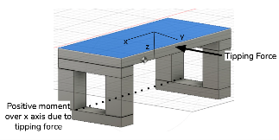
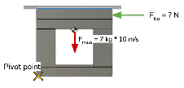
Lunar Bench
MODELING PROCESS
MODELING PROCESS & RESULTS
Find the CG of the bench
Determine where tipping force is likely to be applied
Sum the moments about the pivot point
Solve for the tipping force
2
I: Objectives
II: Design Soln.
III: Risks
IV: Requirements
V: V&V
VI: Proj. Planning

Slide 103
Lunar Regolith Scoop
DRIVERS & VARIABLES
Focus: To aid in the demonstration of object tracking and user interaction with the HR assets
Driving CPEs and risks:
CPEs:
E2, E3
Risks:
Scoop may not track correctly
Scooping motion may be difficult for the tracker to follow
Key Aspects:
Demonstrates tracking capabilities of HR Objects
Demonstrate similar scoop motion used during apollo missions

Slide 104
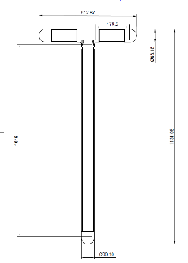
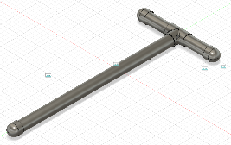
Lunar Regolith Scoop
MODELING PROCESS
Modeling - Manufacturing process: COTs and the in-house built
33.175 cm
113.1 cm
Scalability:
Level 1: No moving parts
Level 2: Retractable handle
Level 3: Adding in an adjustable angle scoop head
Level 4: Haptic feedback

Slide 105
Lunar Sample Return Container
DRIVERS & VARIABLES
Focus:
Driving CPEs and risks:
CPEs:
E3
Risks:
Tracked lid and body may have meshing issues
Container may impede rock sensor
May be challenges in keeping other VR assets inside container during transit
Key Aspects:
Demonstrates capability to track a physical object with mechanical features (hinged lid) in VR
Is of similar volume to the Apollo Lunar Sample Return Container, ALSRC (<±25%)
Stores physical rock model and VR regolith samples

Slide 106
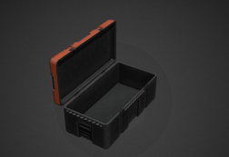
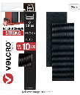
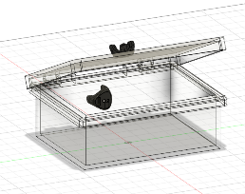
Lunar Sample Return Container
MODELING PROCESS
Additional Requirements:
Transparent material (for rock sample tracker)
Modeling/Prototyping: COTS

Slide 107
Lunar Rock
DRIVERS & VARIABLES
Focus: To demonstrate the ability of the mobility constraints through sample collection of lunar rock
Driving CPEs and risks:
CPEs:
CPE 3
Risks:
Location of sensor may impede ability to handle rock
Key Aspects:
Weight and size reflect ⅙ gravity on moon

Slide 108
Lunar Rock
MODELING PROCESS
Manufacturing Method: 3D Printing using standard PLA
Split rock model in half and 3D print each half separately

Slide 109
Lunar Rock
MODELING PROCESS
Scalability:
Level 1: 1 Rock and a Sensor; 1 Material
Level 2: 1 Rock; 1 Sensor; hollow for weight modification (multiple materials)
Level 3: Level 2 + other rocks with sensors

Slide 110
Lunar Rock
MODELING PROCESS
Vive Tracker Integration:
Create plane cut in one of half of split model for mounting surface for Vive tracker

Slide 111
Arduino Controller
DRIVERS & VARIABLES
Focus: To demonstrate both the ability to wirelessly communicate a user button/switch input and input that output signal, live, into the simulation
Driving CPEs and risks:
CPEs:
E3
E5 - Will be addressed post prototype testing
Risks:
RF Interference
Unity/Live Integration
Meeting Latency Requirement (48 ms of latency)
Key Aspects:
Demonstrate the capability to use in-house electronics to produce a unique controller for in game immersion
Located on TBD headset location to simulate helmet mounted utilities
Scalability: can scale the number of controller inputs

Slide 112
Arduino Controller
PROTOTYPING PROCESS
Initial Button-LED Design and Verification

Slide 113
Arduino Controller
PROTOTYPING PROCESS
Initial TX Code - Ready to Test

Slide 114
Arduino Controller
PROTOTYPING PROCESS
Initial PCB Layout (without power supply):

Slide 115
Risks (Full)

Slide 116
Risk Metrics
Likelihood
Value | Level
5 | Very likely
4 | Likely
3 | Possible
2 | Unlikely
1 | Very Unlikely
Impact
Value | Level | Description
5 | Severe | Failure of CPE(s)
4 | Significant | Extreme impact to project success without CPE failure
3 | Moderate | DR failure
2 | Minor | Possible failure of DR
1 | Negligible | No impact on project success
Notes:
Simulation must be accessible, intuitive, and operable by a human user and must have the ability to test, validate, and verify requirements as set forth in the PDD and in future documents
The training simulation must not cause any physical or mental harm to any user or operator

Slide 117
Risks
Risk No. | Subteam | Risk | Risk Mitigation Strategy | CPE | Risk Level | Likelihood | Score | After Mitigation
1 | HR | Sensors breaking due to impacts with floor or other objects | Attatch Ninja-Flex bumpers on the sensors that would | E3, E5 | 5 | 3 | 8 | 4
2 | HR | 3D-printed physical objects breaking due to impacts with floor and other objects | Use Ninja-Flex as the printing material | E2, E3, E5 | 3 | 3 | 6 | 4
3 | HR | Battery failure due to fatigue/freak occurances | Check battery level of headset before each use, manage charging to avoid overcharging | E4 | 4 | 1 | 5 | 4
4 | HR | Tool rack falling | Fasten tool rack to a wall, widen base to avoid risk of tipping, load weight towards the base to lower position of the center of mass | E2, E5 | 2 | 2 | 4 | 3
5 | HR | Tool rack harming user | "Baby proof" the physical model of the tool rack, eliminate sharp edges, sand any wood to avoid splinters | E2, E5 | 2 | 1 | 3 | 3

Slide 118
Risks
6 | HR | Physical tools harming user | "Baby proof" the physical model of the tools, eliminate sharp edges, sand any wood to avoid splinters | E2, E5 | 2 | 1 | 3 | 3
7 | HR | Lack of communication from sensors due to physical interference | Minimize physical barriers between sensors and the receivers | E3 | 4 | 3 | 7 | 4
8 | HR | Obstructing RF interference between the dongles | Ensure the dongles are far enough apart to minimize impact | E2, E3 | 4 | 4 | 8 | 6
9 | VR | Unknowns with Vive tracker integration. (quantity of Vive trackers may reduce simulatiuon performance, Accurcy of trackers will cause misallignment with the physical obejct and the virtual one, Computational Load, Compatability with the oculus, number of trackers unity can support. ) | Reduce the number of used sensors to prevent major performance declinations; try to realisitically maximize object sizes such that the misalignment is not as impactful to the user during object interactions in the training simulation | E1 | 5 | 5 | 10 | 6
10 | VR | Deltas in physical object location and vr sim presentation of the physical objects location. | Ensure that objects are initially in place before starting the simulation, following pre-marked locations that match up in the VR display, additionally maximize object sizes such that the deltas are a lower percent of total object size | E1 | 1 | 4 | 5 | 4

Slide 119
Risks
11 | VR | Motion Sickness caused by the VR headset/display. | Pre-screen users with a survey to determine user susceptibility to motion sickness; by staying above our requirement-stated FPS, we can minimize the probability that the user will suffer motion sickness; constant communication available between user and simulation team to stop simulation before severe motion sickness occurs | E2, E5 | 3 | 3 | 6 | 4
12 | VR | Wire-tripping and equipment damage due to integration methods between system components | Effective wire management, as well as a "shadowing" person to hold the trailing wires to ensure that they do not get caught around other aspects of the simulation, and additionally ensures that the user does not trip over the wires | E2. E4, E5 | 2 | 4 | 6 | 3
13 | VR | User harm during initial testing for carrying out V&V methods | Carefully follow V&V method procedures to eliminate as much risk to the user's health as possible; V&V without user whenever possible, until effects of test are known | E4 | 5 | 2 | 7 | 5
14 | VR | Poor communication between the user and the training team supervising the simulation | Establish a short list of code words/safe words to ensure quick action during any emergency situations | E4 | 3 | 2 | 5 | 2
15 | VR | User tripping over objects in the play area. | By having the physical objects in the positions that are mirrored through the VR display, we can eliminate tripping over other physical objects; additionally, the spotter aforementioned holding tee user's trailing wires can warn the user | E5 | 3 | 3 | 6 | 3

Slide 120
Risks
16 | IT | The headset hand tracking and Vive trackers/IMUs do not work simultaneously during simulation. | An external PC will leverage SteamVR for integration of various tracking methods; or exploit flight heritage resources: Reference Dr. Anderson’s previous work utilizing a headset/Vive tracker/IMU combination. | E2, E3, E4 | 5 | 3 | 8 | 5
17 | IT | Users are unable to perform tasks due to interference between mobility constraint devices (elbow brace) and tools/objects. | Chosen arm brace is adjustable in length and circumference, allowing for slight non-invasive alterations to the mobility constraint device to allow for interactions between the user and tools/objects | E4 | 1 | 1 | 2 | 2
18 | IT | Non-realistic range of motion for a lunar exploration suit (EVA suit) | Choose an arm brace to inhibit user motion surrounding their elbow joint that lists in its specifications a range of motion that is comparable to what we desire | E1, E4 | 1 | 3 | 4 | 3
19 | IT | The user’s movements may be exaggerated, “choppy”/”jerky”, under representative, or otherwise visually inaccurate such that the user’s sense of presence is damaged and the accuracy of their task completion is impacted This could result in damage to the user (trying to compensate), damage to the equipment (due to user error), and damage to overall training integrity by impacting the effectiveness of other components of the training simulation | Rigorous testing regimes will be needed to ensure that this bug is addressed early on and throughout the design process. Documentation of resources utilized (ie: web tutorials, SMEs, online forms, etc) combined with documentation of development process will help streamline debugging while also minimizing the chance of recurrence by creating a transparent and traceable trail from the first test to the finished result. This combined with an IPQ score from the users can inform and coordinate debugging efforts, streamlining the process. | E1, E4, E5 | 5 | 3 | 8 | 5
20 | IT | The mobility constraint device(s) harms the user and/or the simulation equipment | The chosen elbow brace is to be highly rated for its safety and comfort to the user; and ensure that sharp edges are removed to prevent catching onto wires/harming the user/hitting simulation equipment and damaging them | E2, E5 | 5 | 2 | 7 | 3

Slide 121
Safety & Human Testing
Internal versus External Review
Disclaimers & Rights
Oculus Headset Safety Summary
Screening Standards for Motion Sickness
Human in the Loop: MS Comfort
Why Constrain?
Elbow Brace Safety Summary
Human in the Loop: Comfort
Human in the Loop: Range of Motion
Full Table of Documentation
Required Training + Relevant Expertise
Summary of Requirements
Survey Summary
SSQ
User Safety for V+V
User Safety Examples
EHS Procedure Recommendation
Scalability Plan
Procedure to Put on / Take off Arm Constraint
Procedure to Test Comfort
Procedure to Test Range of Motion
Procedure to Exit Simulation
Equipment Management
Sanitation
Emergency Action Plan

Slide 122
Internal or External Recruitment?
Internal
“Does it work?”
Does not require advisor approval
Non-proceduralized, informal
Data collected mostly internal use (refinement)
Required before external recruitment
External
“Does it verify and validate our requirements?”
Requires advisors approval
Must follow procedure, formal
Data collected for external use (AIAA, presentations, symposium)

Slide 123
Disclaimers & Rights
All recruited participants will be read consent, data collection, safety, and COVID disclaimers prior to testing
All CTHREEPIO participants will be informed of their rights by the safety lead before testing
Physical copies will be made available for participants
Consent will be taken verbally and continuously
These disclaimers will be approved by Dr. Anderson before any testing begins
Disclaimers will be adapted to fit the specific requirements/needs of each test
The motion sickness data collection disclaimer will not be the same as the arm constraint data collection disclaimer
Disclaimers and rights have been written based on CITI training and IRB protocols

Slide 124
The Oculus Headset
Primary test
Motion Sickness Comfort
Secondary tests (optional)
Perceived realism
Workload
Main risk
VR-Induced Motion Sickness
Main mitigation strategies - MSSQ, SSQ, TACO

Slide 125
Screening Standards for Motion Sickness
Computer Performance Metrics
Motion Sickness Susceptibility Score
Simulator Sickness Score
Latency: < 48 ms
Frame Rate: > 90fps
Visual inspection of virtual environment (to check for bugs)
Greater than 95th percentile, do not proceed with human subject testing
Checkpoints every 5 min
If subject gives a ‘moderate’ score for nausea, up frequency to once every 2 min
If 2 ‘moderate’ scores for nausea in a row, follow Procedure to Exit Simulation

Slide 126
Human in the Loop Test: MS Comfort
Necessary to verify and validate requirement 5.1
Shall implement proper methods to avoid causing simulation sickness in user
Only done after MSSQ is completed by the test subject
User comfort and safety will still be monitored (communication inside the simulation)
Notes:
Insert Testing Set Up CONOPS
Verify frame rate and latency values are within threshold
Administer the MSSQ to the user
– use MSQ (full - 28 questions) every 5 min and shortened MSQ (general discomfort & nausea) every 1 min from 1 to 20 min
– cancellation: if 2 ‘moderate’s (or above) in a row for nausea symptom, terminate simulation
After 10 subjects are tested, analyze the MSSQ results of the subjects and determine a MSSQ percentile cutoff that would refuse subjects above this line

Slide 127
Why Constrain?
Geological task depends on use of hands, shoulders, arms, legs
Legs are too dangerous to constrain → balance
Simple tasks (picking up, pulling, lifting) are all done with joints (shoulders, elbows)
Elbows are the easiest to integrate into a head-mounted headset set up
Easier to non-invasively take measurements at joints like elbow
Constraining only one arm in order to protect user + equipment

Slide 128
The Brace Direct Post-Operation Elbow Brace
Two primary HITL tests
Comfort
Range of Motion
Main risks
Short term injury (ex: pinching)
Long term injury (ex: chafing)
Main mitigation strategy - TACO

Slide 129
Human in the Loop Test 1: Comfort
Three Parts
Outside of simulation
Within simulation
During simulation
Necessary to verify and validate requirements
Non Invasive (2.1.1.7)
User Adjustable (2.1.1.8)
User Safety (5.3)
User accommodation (5.3.6)

Slide 130
Human in the Loop Test 2: Range of Motion
Only one part, outside of simulation
If it’s true outside, it will be within
Necessary to verify and validate requirements
elbow extension/flexion range of motion, 0 to 120 degrees (2.1.1.6)
Only done after comfort test is fully completed
User comfort and safety will still be monitored

Slide 131
Procedure to Put on / Take off Arm Constraint
Undo the velcro straps
Place user’s arm in the open brace
Extend/shorten sizer if needed
Loosely tighten top and bottom velcro straps around the user’s arm
Loosely tighten the remaining inner two velcro straps
TACO
Training: Operator trained on exiting simulation and putting on arm constraint
Awareness: Operator will brief and observe subject throughout test
Communication: Operator will check in with subject at each new interval
Off-Ramps: Procedure to exit simulation
Brace Direct Instructional Video for Elbow Brace
Adapt as necessary with experience using arm constraint

Slide 132
Procedure to Test Comfort
Once the arm brace is loosely bound to the user’s arm, instruct the user to extend and flex elbow as well as picking up a small object and rotating wrist/forearm
If no discomfort, tighten straps further and repeat above step
Continue until the user reports discomfort or when the arm brace is snugly attached to the user’s arm
If the user reports discomfort, loosen the straps slightly and repeat motion testing to confirm comfort form the user
TACO
Training: Operator trained on exiting simulation and putting on arm constraint
Awareness: Operator will brief and observe subject throughout test
Communication: Operator will check in with subject at each new interval
Off-Ramps: Procedure to exit simulation
Corlett-Bishop
Modified by Dr. Anderson

Slide 133
Procedure to Test Range of Motion
Brief subject on test purpose and procedure
Set the elbow brace to the desired constraint angle
Help subject put elbow constraint on
Have subject lie down in a supine (face up) position
Use goniometer to measure angle of extension
Have subject bend elbow until they can no longer do so easily
Use goniometer to measure angle of flexion
Repeat from step 2 with new constraint angle
TACO
Training: Operator trained on exiting simulation and putting on arm constraint
Awareness: Operator will brief and observe subject throughout test
Communication: Operator will check in before and after measurements
Off-Ramps: Procedure to Exit Simulation
CDC Range of Motion Elbow Extension and Flexion

Slide 134
Procedure to Exit Simulation
General Example
Nominal
Have user put down equipment
Help user take off headset
Guide user over to chair
Help user take off arm constraint
Mission Control Operator: save data, sanitize equipment Guide Operator: debrief user
Off-Nominal
Guide Operator helps user remove main source of discomfort or alerts them to off-nominal event (depending)
If not serious: follow normal exit strategy, include what went wrong in debrief
If serious: follow emergency action plan
Once user is safe / debriefed, work to locate and mitigate error
Emergency → Follow Emergency Action Plan
TACO
Training: All operators will receive this training
Awareness: Both operators during simulation and testing will assist in exiting simulation
Communication: Subjects will be briefed before the simulation begins on the procedure to exit simulation
Off-Ramps: Procedure will be modified as needed for different tests

Slide 135
Equipment Management
Electrical Equipment
Minimum electrocution danger
Wire management done by second operator
Materials
Design to minimize sharp corners, edges
Remove burrs, snags, injury-prone areas
Choose low-risk materials (plastics, wood)
Physical Equipment
Demonstrate and observe use of tools
Check for ergonomic, accommodation, useability

Slide 136
Sanitation
Equipment
Will wipe down with sanitation wipes after each use
Clean glass of VR goggles with microfiber cloth
COVID
Will have masks on hand in case people want
Will screen before testing
Emergency
Will train operators on what to do in case of broken glass, bodily fluids, and other hazards
Caution, body isolation, alerting EHS

Slide 137
Emergency Action Plan
Two Key Roles:
“Mission Control” Operator: In charge of data collection, running the computer/simulation, making sure there are no interruptions
“Guide” Operator: In charge of briefing, assisting subject, running the test
With each test, these two roles will vary in their scope and complexity
Both will be trained by safety officer
Isolate / Stop Danger
Record Incident
Identify & Provide Treatment
Alert the Instructional Team
Mission Control: stops simulation, helps get supplies, helps get equipment out of the way
Guide: Helps person out of simulation / arm constraint
Mission Control: determine what happened
Guide: treat subject using first aid kit or provide psychological first aid
Mission Control: If not severe, email Dr. Anderson, Dr. Wingate, and Dr. Muldrow
Mission Control: If severe, go seek immediate assistance in building
Both: get contact information from subject and follow up as needed. Record incident in data collection and follow instructions form senior projects staff as needed

Slide 138
Full Table of Documentation
 | Procedures | Trainings | Surveys | Data Collected
Arm Constraint: Comfort | put on/take off arm constraint | put on/take off arm constraint | Corlett-Bishop Discomfort | Arm length, medical history with arm injuries
Arm Constraint Range of Motion | put on/take off arm constraint, CDC measurement of extension/flexion | put on/take off arm constraint | Corlett-Bishop Discomfort | Arm length, medical history with arm injuries
Motion Sickness: Comfort | exit/enter simulation, MS comfort test | exit/enter simulation, MS comfort test | MSSQ, MSQ | MSSQ/MSQ relevant data
Motion Sickness: Perceived Realism + Workload | exit/enter simulation, MS PRWL test | exit/enter simulation, MS PRWL test | MSSQ, NASA TLX, IPQ | MSSQ/MSQ relevant data, past experience with video games
Universal | Emergency Action Plan | Emergency Action Plan, Participant Rights | N/A | COVID pre-screening

Slide 139
Required Training + Relevant Expertise
CTHREEPIO: Training + Evaluation of operators by safety lead
Safety Lead: Hannah Obolsky – 2+ years experience in human subject research, currently enrolled in Medicine in Space class, CITI certified for Biomedical Research and Research Code of Conduct
Project Manager: Luca Bonarrigo – 1+ years experience in human subject research, WFA certified (2022), CITI certified for Biomedical Research and Research Code of Conduct
Evaluation will be a practice run with Hannah to see that the operators know how to brief the subjects and how to help guide them through the simulation.
Recommended training for CTHREEPIO: CITI Research Code of Conduct
Notes:
Internal goalpost before moving external goalpost

Slide 140
Safety Requirements Summary | HITL Testing? | Compliant?
Shall implement a maximum 48 ms latency | No | Ongoing
Shall implement a minimum 90 fps frame rate | No | Ongoing
Shall implement a minimum 80 Hz refresh rate | No | Ongoing
Tools and equipment shall not have sharp corners or edges | No | Yes
Tool rack (bench) shall be safe to handle | Yes - in-house, non formal | TBD (not built yet)
Physical model(s) of the VR spacesuit shall recreate elbow extension/flexion range of motion (from 0 degrees to 120 degrees) | Yes - Range of Motion | TBD (not tested yet)
Physical model(s) of the VR spacesuit shall be non-invasive | Yes - Comfort | TBD (not tested yet)
Physical model(s) of the VR spacesuit shall be user adjustable | Yes - Comfort | Yes
Equipment used shall be adjustable to accommodate different user anthropometry ranging from the 10th to 90th percentiles | Yes - Comfort | TBD (not tested yet)
Shall have a procedure for user to quickly exit or terminate simulation | No | Yes
The user shall have guidance on how to complete the task | No | Yes
Procedure to take on and take off arm constraint | No | Yes

Slide 141
Survey Summary
# | Survey Title | Verification / Validation Case | Timing | Planned Date of Test | Location of Test | Expected Duration
1 | Corlett-Bishop Discomfort Scale | Physical Tools | During use |  | Senior Projects Room | 1 hour
2 | Corlett-Bishop Discomfort Scale | Mobility Constraint Comfort | Before, during use, after use |  | Senior Projects Room | 1 hour
3 | Motion Sickness Susceptibility Questionnaire (MSSQ) | User Safety, Motion Sickness | Before testing |  | Senior Projects Room | 1 hour
4 | Simulator Sickness Questionnaire (SSQ) | User Safety, Motion Sickness | During simulation |  | Senior Projects Room | 1 hour
Corlett-Bishop Discomfort Scale
Two 1-10 Scale Questions
Discomfort, Control
Used by Dr. Anderson
MSSQ
Several 0-3 Questions
Recent versus historical motion sickness in different scenarios
Used by Dr. Clark
SSQ
Long and short form
16 questions (long)
Based on MSQ, plenty of use in VR studies (incl. with Dr. Clark)

Slide 142
Simulator Sickness Questionnaire - SSQ
Designed by Kennedy et. al¹, based off of the Motion Sickness Questionnaire (28 questions) reduced to 16 questions
4-point Likert Scale
Used in various motion sickness, VR sickness/cybersickness studies²
Typically look at difference in pre- and post- test scores
Maximum score 300, 3 categories (Nausea, Oculomotor, and Disorientation)
SSQ Motion Sickness Indicators:³

Slide 143
SSQ References
¹Kennedy, R. S., Lane, N. E., Berbaum, K. S., & Lilienthal, M. G. (1993). Simulator sickness questionnaire: An enhanced method for quantifying simulator sickness. The international journal of aviation psychology, 3(3), 203-220.
²Kourtesis, P., Linnell, J., Amir, R., Argelaguet, F., & MacPherson, S. E. (2023, March). Cybersickness in Virtual Reality Questionnaire (CSQ-VR): A Validation and Comparison against SSQ and VRSQ. In Virtual Worlds (Vol. 2, No. 1, pp. 16-35). Multidisciplinary Digital Publishing Institute.
³Kennedy, R., Drexler, J., Compton, D., Stanney, K., Lanham, D., & Harm, D. (2003). Conﬁgural scoring of simulator sickness, cybersickness and space adaptation syndrome: similarities and differences. Virtual and adaptive environments: Applications, implications, and human performance issues, 247.

Slide 144
User Safety Considerations for Verification + Validation
Area of Concern | Concern | Mitigation Strategy
Software Development | Motion Sickness | Administer MSSQ to determine if tester has a high chance of becoming motion sick Verify latency, frame, refresh rate before other V+V Limit duration of exposure to simulation
Physical Object | User Injury Pinching, scratching, scraping, etc | Visually inspect objects before use to look for potential injury areas Have a clear procedure for use of objects Only develop tools made of lightweight and low-impact materials Minimize movements (slow+controlled) Model before building
Wearable Device | User Injury (short term) User Injury (long term) | Have clear procedure for putting on / taking off devices Have clear rules of communication Continually check in with user using User Comfort Survey (developed in house) Model before building

Slide 145
User Safety Considerations Go-No-Go’s Example
Area of Concern | Concern | Mitigation Go / No Go Examples
Software Development | Motion Sickness | Latency is at 40 ms → go for testing MSSQ score is high → no go for testing Duration is capped at 1 hr → go for testing (with caution)
Physical Object | User Injury Pinching, scratching, scraping, etc | Visual Inspection of handle reveals no sharp edges → go for testing Procedure for tool use is not reviewed verbally or acknowledged → no go for testing Tool is comprised of metal components → go for testing (with caution) Structural Loading allows for max weight → go for testing
Wearable Device | User Injury (short term) User Injury (long term) | Verbal discussion and clear acknowledgement about device use, expectations, and procedure → go for testing User Comfort Survey low score → no go for testing

Slide 146
EHS Procedure Recommendations

Slide 147
Scalability Plan
Arm Brace
Development
Off Ramp Options
Range of Motion Measures
HITL Development
User Comfort + Safety Reqs.
Design Analysis
SME Consultation
Purchase
Modify purchased arm brace
Develop Testing Plan
We are here
Switch to cheaper arm brace
User Test
Readapt use in simulation
Integrate Sensors
Test ROM
Model in Blender

Slide 148
Development and Functional Pipelines
Software Development
Hybrid Reality
Tracking
Wire Management

Slide 149
Software Development Pipeline
So What?
The purely virtual components of the project can be developed completely in Unity before being passed on to Steam VR
This simplifies the development process since the majority of the work is done within one software program that has a well-documented and well-developed base
Unity
Topographic dataset pulled from LRO database
Terrain Map
Surface Texture
Virtual models pulled from Blender/Fusion360
3D Assets
VR Environment
LRO lighting data
Lighting
Oculus headset
(user display)
C# code with dynamic equations for HUD variables
Heads Up Display

Slide 150
Hybrid Reality Pipeline
Physical Object Reference Image
Physical Object Modeled in Fusion 360
Physical Object Recreated with Low Fidelity Physical Object
Physical Object Modeled in Fusion 360 &/or Blender
Vive tracker attached to the physical model of object
Blender Model uploaded to Unity Environment
Motion data from Vive tracker recreates motion of physical model in Unity environment
Unity Environment Streamed to Oculus Headset using SteamVR

Slide 151
Tracking
Infrared signals from the base stations
Hand tracking data is sent from Oculus sensors to SteamVR
Sensors on the tracker detect IR signals and triangulate position
Hand tracking and object tracking data both sent through SteamVR from computer to the Oculus, displaying motion of objects and hands in realtime
Positional data is sent to SteamVR via dongle

Slide 152
Wire Management Plan
Utilize Master Equipment List (MEL) to track
What is wired
What type of wire
What length of wire
When Equipment is bought
Tag wires with packing tape
Keep wires stored with relevant equipment + in a way to mitigate tangles
Oculus Pwr
Oculus Pwr
Power Cable for Oculus
USB-A to USB-c wire
10ft

