Slide 1
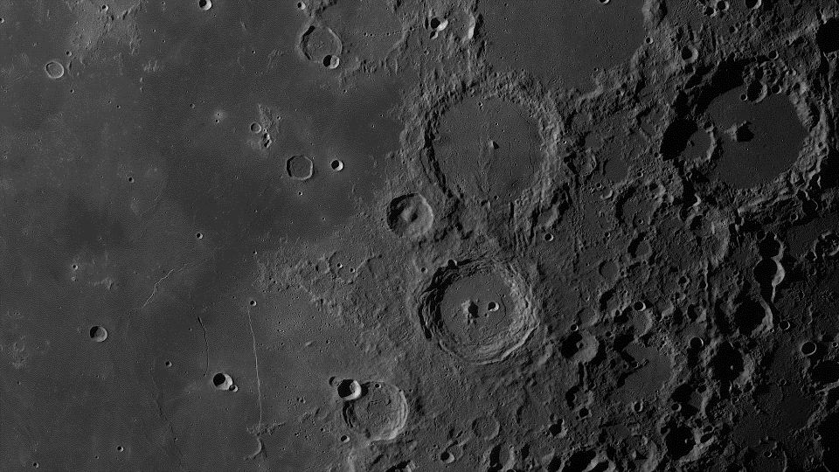
CTHREEPIO
Critical Design Review
November 30, 2022
ASEN 4018 Team 6
Team Advisor: Dr. Allie Anderson
Team Sponsor: Blue Origin
Presenters: Luca Bonarrigo, Nick Bottieri, Andrew Czekay, Skylar Edwards, Autumn Martinez, Sarah Martinez, Thomas O’Connor
Other team members: Lily Allen, Geoff Lord, Hannah Obolsky, Nathaniel Shiba, Elijah Stubbs

Slide 2
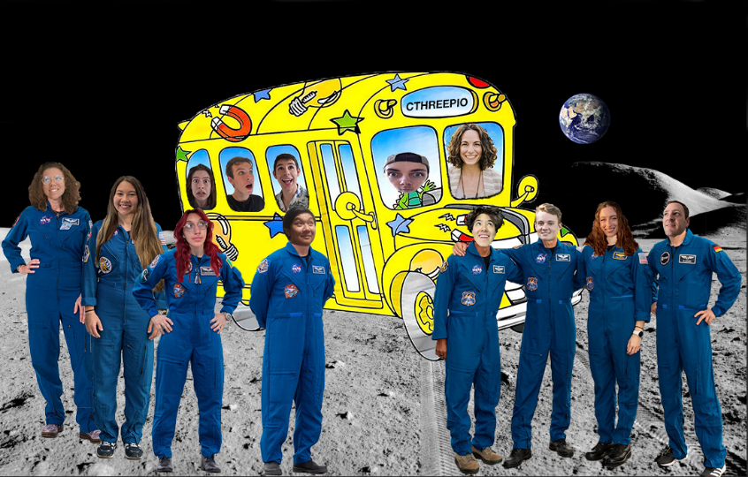
Capabilities Training in Hybrid Reality Extraterrestrial Environments in Preparation for Interplanetary Operations

Slide 3
Outline
PROJECT PURPOSE & OBJECTIVES
DESIGN SOLUTION
CRITICAL PROJECT ELEMENTS & RISKS
DESIGN REQUIREMENTS
VERIFICATION AND VALIDATION
PROJECT PLANNING
Nick
Sarah, Autumn
Andrew
Skylar, Luca
Thomas, Luca
Andrew, Luca
I: Objectives
II: Design Soln.
III: Risks
IV: Requirements
V: V&V
VI: Proj. Planning

Slide 4
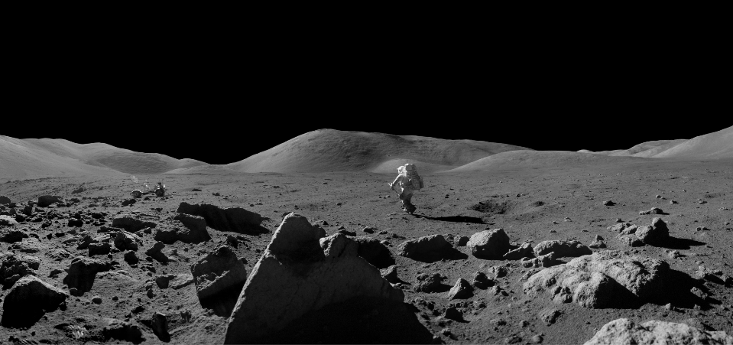
Project Purpose and Objectives
I: Objectives
II: Design Soln.
III: Risks
IV: Requirements
V: V&V
VI: Proj. Planning

Slide 5
Nomenclature
Virtual Reality (VR): The software developed to virtually recreate a lunar environment
Hybrid Reality (HR): The physical tools and sensors used to track interactions between the user, real life and virtual objects
Training Simulation (CTHREEPIO): The project as a whole - the combination of virtual environment and hybrid reality
Extravehicular Activity (EVA)
Lunar South Pole (LSP)
Lunar Reconnaissance Orbiter (LRO)
Commercial Off-The-Shelf (COTS)
I: Objectives
II: Design Soln.
III: Risks
IV: Requirements
V: V&V
VI: Proj. Planning
Notes:
The software that “will” be developed

Slide 6
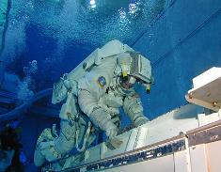
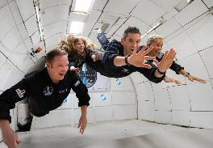
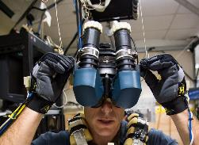
Pre-Existing Training Analogs
Neutral Buoyancy Laboratory
Parabolic Flights
Virtual Reality
I: Objectives
II: Design Soln.
III: Risks
IV: Requirements
V: V&V
VI: Proj. Planning

Slide 7
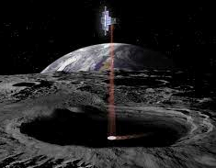
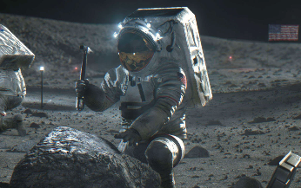
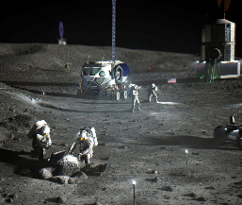
Project Definition - Objective
To develop a virtual reality lunar surface environment incorporating hybrid reality interactions and embedded environmental constraints specifically focused on the lunar south pole (LSP) region.
I: Objectives
II: Design Soln.
III: Risks
IV: Requirements
V: V&V
VI: Proj. Planning

Slide 8
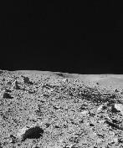
Concept of Operations
Tasks Inside the Simulation
1
2
3
Training Setup
Exiting the Simulation
Biometrics Readout
Survey Environment
Obtain Sampling Tools
4
5
6
Clean and turn on equipment
Select desired training
Mission briefing and setup
User dons hardware and enters simulation
User doffs all hardware
Evaluate user experience and provide feedback
Small Sample Collection
Large Sample Collection
Place Samples on Rover
Notes:
1) Read out biometric data to mission control
2) Survey the environment, locate sampling areas
3) Navigate to rover, obtain proper equipment
4) Regolith and small pebble collection
5) Large rock sample collection
6) Bring box to rover for transport
Above steps are related to the user task outline, (see this document)
I know Jasmine said maybe to remove the setup and exiting the sim panels, however if I recall correctly, when making the first ConOps for PDR, Dr. Anderson explicitly told me to include the full user experience, including taking on and off the hardware. I think it could be a good idea to run this version of the ConOps by Dr. Anderson and get her input before we start consolidating the panels too much, because I want to make sure that we show our distinct built in capabilities in this ConOps.

Slide 9
Design Solution
I: Objectives
II: Design Soln.
III: Risks
IV: Requirements
V: V&V
VI: Proj. Planning

Slide 10
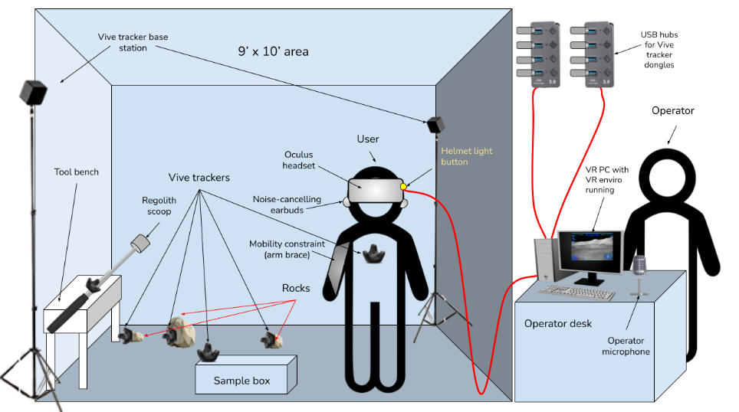
Design Diagram - Physical World

Slide 11
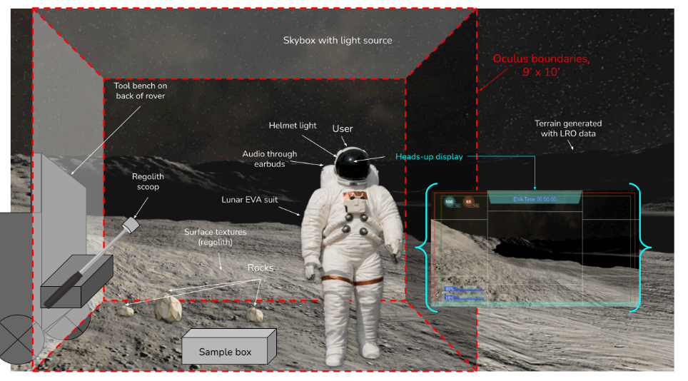
Design Diagram - Virtual World

Slide 12
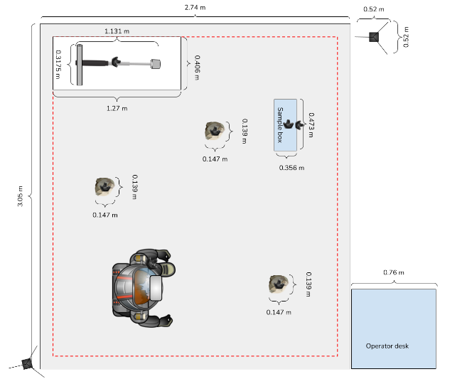
Design Diagram - Top-Down View

Slide 13
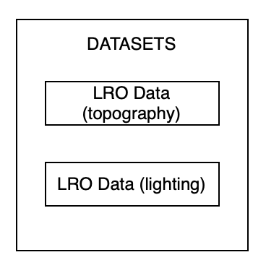
I: Objectives
II: Design Soln.
III: Risks
IV: Requirements
V: V&V
VI: Proj. Planning

Slide 14
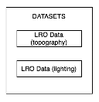
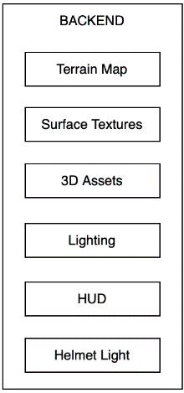
I: Objectives
II: Design Soln.
III: Risks
IV: Requirements
V: V&V
VI: Proj. Planning

Slide 15
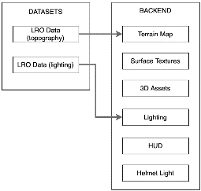
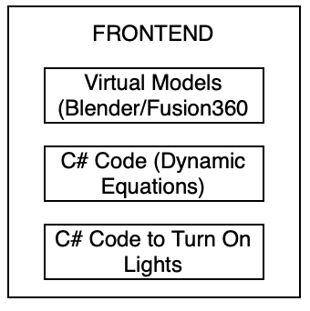
)
I: Objectives
II: Design Soln.
III: Risks
IV: Requirements
V: V&V
VI: Proj. Planning

Slide 16
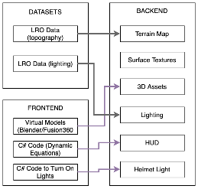
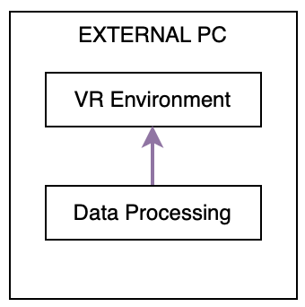
)
I: Objectives
II: Design Soln.
III: Risks
IV: Requirements
V: V&V
VI: Proj. Planning

Slide 17
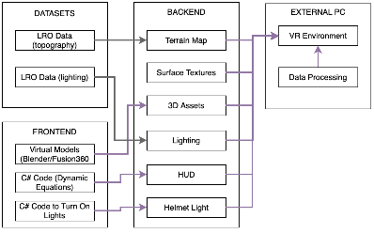
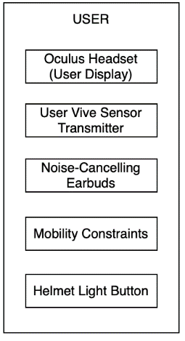
)
I: Objectives
II: Design Soln.
III: Risks
IV: Requirements
V: V&V
VI: Proj. Planning

Slide 18
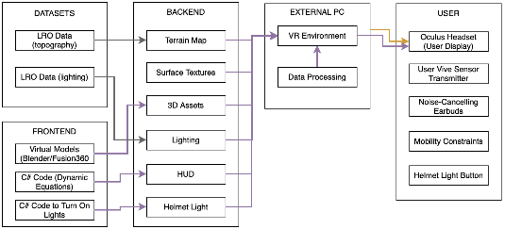
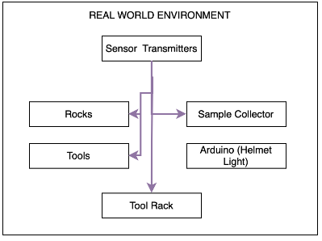
)
I: Objectives
II: Design Soln.
III: Risks
IV: Requirements
V: V&V
VI: Proj. Planning

Slide 19
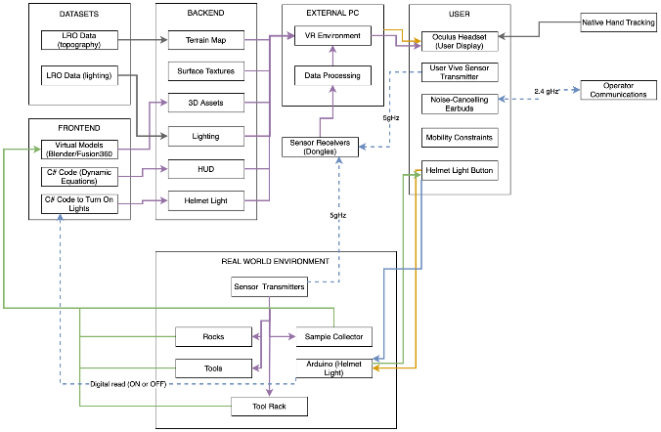
)
I: Objectives
II: Design Soln.
III: Risks
IV: Requirements
V: V&V
VI: Proj. Planning

Slide 20
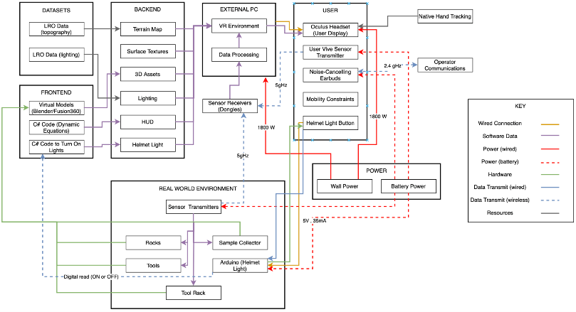
Functional Block Diagram
I: Objectives
II: Design Soln.
III: Risks
IV: Requirements
V: V&V
VI: Proj. Planning

Slide 21
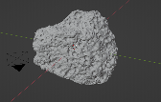
Hybrid Reality Objects/Equipment
Tool | Mass (kg) | Dimensions (meters) | Purpose | Real World Component | VR Component
Scoop* | 2.3 | 1.131 x 0.3175 x 0.068 | Gather regolith (fine particles) in the VR simulation | Manufactured out of PVC piping | IN PROGRESS
Rocks* (x3) | 1.4 | 0.061 x 0.139 x 0.147 | Collected by the user and placed in the sample container (in both VR and real world) | 3D Printed
* Includes Vive Tracker 3.0 weight (0.075 kg) ** Includes Base Station Weight (0.320 kg)
I: Objectives
II: Design Soln.
III: Risks
IV: Requirements
V: V&V
VI: Proj. Planning
Notes:
Autumn Script - https://docs.google.com/document/d/1Bm-yQSAt_C8HoFdT7HQEt11KLd97oww_yfHIwxsFn7s/edit?usp=sharing

Slide 22
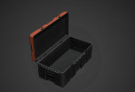
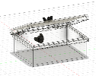
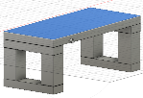
Hybrid Reality Objects/Equipment
Tool | Mass (kg) | Dimensions (meters) | Purpose | Real World Component | VR Component
Lunar Sample Return Container* | 1 | 0.473 x 0.356 x 0.187 | Store ‘samples’ (rocks in VR and real world, and regolith just in VR) | COTS - Sterilite 20qt Container
Staging Bench | 6.8 | 1.27 x 0.464 x 0.356 | For the initial configuration of the simulation, the tools will be lying horizontally on the bench in the real world but on the back of a lunar rover in VR. The motive for doing so was so that tools are not laying randomly in the play space | Wood Manufacturing (2x4s and 4x4s) | Lunar Rover model
* Includes Vive Tracker 3.0 weight (0.075 kg) ** Includes Base Station Weight (0.320 kg)
127 cm
40.64 cm
35.6 cm
I: Objectives
II: Design Soln.
III: Risks
IV: Requirements
V: V&V
VI: Proj. Planning

Slide 23
Hybrid Reality Objects/Equipment
Tool | Mass (kg) | Dimensions (meters) | Purpose | Real World Component | VR Component
VR Headlamp & Head Mounted Camera | Est. <1 | N/A | The button/switch mechanism* on the helmet will be used to operate the user’s helmet-mounted camera and headlamp | Arduino-controlled wireless controller* | N/A
Base Station Tripod | 1.5 | 2.29 x 0.52 x 0.52 | The tripod will be used to elevate the tracker base station so that all the trackers can be seen in the training area. |  | N/A
* Specifics are outlined in the backup slides
I: Objectives
II: Design Soln.
III: Risks
IV: Requirements
V: V&V
VI: Proj. Planning

Slide 24
Hybrid Reality Objects
Tool | Mass (kg) | Dimensions (meters) | Purpose | Real World Component | VR Component
Elbow Brace | 0.50 | Max length: 0.33 Min Length: 0.43 | Restricts the user’s elbow joint flexion and extension angle range to recreate mobility constriction that would be experienced while wearing spacesuit | Brace Direct ROM Post Op Elbow Brace | EVA Spacesuit Unity Asset
I: Objectives
II: Design Soln.
III: Risks
IV: Requirements
V: V&V
VI: Proj. Planning
Notes:
8 ounces
13”-17”

Slide 25
Critical Project Elements and Risks
I: Objectives
II: Design Soln.
III: Risks
IV: Requirements
V: V&V
VI: Proj. Planning

Slide 26
Critical Project Elements
 | Element | Summary Description
E1 | Virtual Environment | Recognizable as the moon Integratable with real-world equipment
E2 | User-Associated Equipment | Integration of equipment will not impede on overall functionality or safety
E3 | Hybrid Reality (HR) Support Equipment | Tracks user’s interaction/actions Integrates with VR instruments
E4 | Testing | Accessible, intuitive, and operable by human user Possess the ability to test, validate, and verify requirements
E5 | Safety | Must not cause any physical or mental harm to user
E6 | Financial* | Total cost of the simulation must not exceed $4000
*Applied for $900 extra funds from University of Colorado Boulder Engineering Excellence Fund
I: Objectives
II: Design Soln.
III: Risks
IV: Requirements
V: V&V
VI: Proj. Planning
Notes:
HR support equipment shall track user actions/interactions with utilized tools and integrate with virtual reality instruments
User-associated equipment shall integrate such that all equipment does not impede on overall functionality or safety
Training simulation will utilize a virtual environment that is recognizable by the user as a lunar surface and must integrate with the real-world equipment

Slide 27
Risk Metrics
Likelihood
Value | Level
5 | Very likely
4 | Likely
3 | Possible
2 | Unlikely
1 | Very Unlikely
Impact
Value | Level | Description
5 | Severe | Failure of CPE(s)
4 | Significant | Extreme impact to project success without CPE failure
3 | Moderate | DR failure
2 | Minor | Possible failure of DR
1 | Negligible | No impact on project success
I: Objectives
II: Design Soln.
III: Risks
IV: Requirements
V: V&V
VI: Proj. Planning
Notes:
Simulation must be accessible, intuitive, and operable by a human user and must have the ability to test, validate, and verify requirements as set forth in the PDD and in future documents
The training simulation must not cause any physical or mental harm to any user or operator

Slide 28
Major Risks - Before Mitigation
 | Description | CPE | Likelihood | Impact | Score
Likelihood | Very Likely (5) |  |  |  |  | #1
 | Likely (4) |  |  | #3
 | Possible (3) |  |  |  | #4 | #2
 | Unlikely (2) |  |  |  | #5
 | Very Unlikely (1)
 |  | Negligible (1) | Minor (2) | Moderate (3) | Significant (4) | Severe (5)
 |  | Impact
#1 | Object misalignment | E1 | 5 | 5 | 10
#2 | Motion sickness | E2, E5 | 3 | 5 | 8
#3 | Tracking methods do not work together | E2, E3, E4 | 4 | 3 | 8
#4 | RF interference | E2, E3 | 3 | 4 | 7
#5 | Wire-tripping hazard | E2. E4, E5 | 2 | 4 | 6
I: Objectives
II: Design Soln.
III: Risks
IV: Requirements
V: V&V
VI: Proj. Planning

Slide 29
Major Risks - After Mitigation
 | Mitigation Strategy | After Mitigation
Likelihood | Very Likely (5)
 | Likely (4)
 | Possible (3) |  |  | #1
 | Unlikely (2) |  | #3 | #2
 | Very Unlikely (1) | #5 | #4
 |  | Negligible (1) | Minor (2) | Moderate (3) | Significant (4) | Severe (5)
 |  | Impact
#1 | Reduce number of trackers; realistically maximize object sizes | 6
#2 | Motion sickness susceptibility questionnaire; adhere to FPS and latency requirements | 5
#3 | Utilize SteamVR and prior research for integration of various tracking methods | 4
#4 | Spread out dongles | 3
#5 | Effective wire management; shadowing operator | 2
I: Objectives
II: Design Soln.
III: Risks
IV: Requirements
V: V&V
VI: Proj. Planning

Slide 30
Design Requirements and Satisfactions
I: Objectives
II: Design Soln.
III: Risks
IV: Requirements
V: V&V
VI: Proj. Planning

Slide 31
High Level Functional Requirements
 | Functional Requirement
F1 | The VR environment shall simulate the south polar region of the lunar surface.
F2 | The training simulation shall include physical, real-world objects.
F3 | The training simulation shall accurately portray interactions with physical objects in the VR environment.
F4 | To accurately simulate EVA activities on the lunar surface, the training simulation shall portray spacesuit features and small scale lunar objects.
F5 | The training simulation, including the VR environment and all physical aspects, shall keep the user, operator, and itself safe from harm.
F6 | The training simulation shall be appropriate for a laboratory environment.
I: Objectives
II: Design Soln.
III: Risks
IV: Requirements
V: V&V
VI: Proj. Planning

Slide 32
Prototyping and Modeling Overview
 | Name | Description | FR | Type of Model
P&M 1 | VR Environment | Demonstrates VR capabilities to create desired lunar environment, complete with proper terrain, textures, lighting, and a HUD. | F1, F4 | Feasibility
P&M 2 | Computing Performance | Predicting ability to properly, safely run CTHREEPIO using external PC with variable VR environment and HR objects. | F5 | Performance
Requirement Compliance Key | C (Compliant) | PC (Partially Compliant) | NC (Non-Compliant)
I: Objectives
II: Design Soln.
III: Risks
IV: Requirements
V: V&V
VI: Proj. Planning

Slide 33
P&M 1: VR Environment
DRIVERS & VARIABLES
Focus | To demonstrate feasibility creating a VR environment that is high-fidelity, immersive, and accurate to what would be experienced by an astronaut on a lunar EVA
Driving CPEs | C1: High-fidelity virtual simulation of an LSP EVA site C4: Accessible and intuitive interface for user
Driving risks | Inability to integrate various aspects of lunar environment in VR User difficulty with interpreting and interacting with VR environment (HUD)
Key aspects | Terrain creation using Lunar Reconnaissance Orbiter (LRO) topography data Lighting simulation Creation of surface textures Implementation of HUD with dynamic biometrics and other data visuals
I: Objectives
II: Design Soln.
III: Risks
IV: Requirements
V: V&V
VI: Proj. Planning

Slide 34
P&M 1: VR Environment
MODELING PROCESS
Select Artemis III landing site
Access and parse LRO data using MATLAB
Insert LRO data into Unity as a terrain map
Paint surface textures onto terrain map
Add environment effects
Add lighting source from Sun into Unity skybox
Add lighting source from user helmet lights
Write C# code for HUD elements
Add HUD elements
Terrain building
Lighting
VR Environment
Surface textures
HUD
I: Objectives
II: Design Soln.
III: Risks
IV: Requirements
V: V&V
VI: Proj. Planning

Slide 35
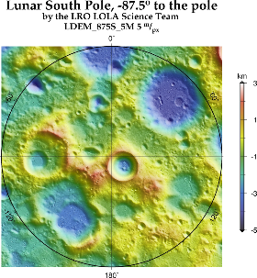
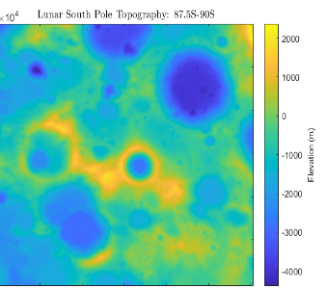
P&M 1: VR Environment
MODELING PROCESS: TERRAIN
Select Artemis III landing site
Access and parse LRO data using MATLAB
1.1.2.1 | Shall generate topographical and geographical features with raw lunar scan data. | C
Site 007
Examined 13 potential Artemis III landing sites
Selected Site 007: a 15km x 15km site within the Peak near Shackleton area
I: Objectives
II: Design Soln.
III: Risks
IV: Requirements
V: V&V
VI: Proj. Planning

Slide 36
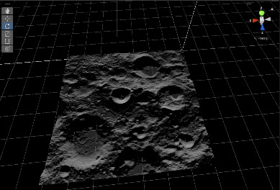
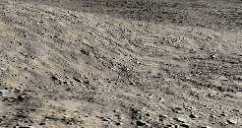
P&M 1: VR Environment
MODELING PROCESS: TERRAIN
Insert LRO data into Unity as a terrain map
Paint surface textures onto terrain map
Add environment effects
1.1.2.2 | Shall ensure the texture of the lunar surface in the simulation is visually indicative of lunar regolith | C
Feasibility was assessed by integrating LRO data and surface textures into the unity scene to provide a high fidelity lunar surface for the user.
Without Surface Textures
Site 007
With Surface Textures
I: Objectives
II: Design Soln.
III: Risks
IV: Requirements
V: V&V
VI: Proj. Planning

Slide 37
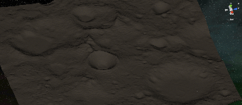
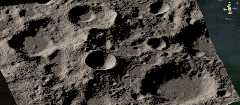
P&M 1: VR Environment
MODELING PROCESS: LIGHTING
Add lighting source from Sun into Unity skybox
Add lighting source from user helmet lights
1.1.1.1 | Shall accurately portray suit-mounted lighting | C
1.1.1.2 | Shall portray accurate solar lighting conditions. | C
Without user flashlight & low-angle solar light
Two forms of lighting were tested:
A user-mounted flashlight representative of what an astronaut may use on a EVA.
Low-angle, high-contrast solar light for accurate portrayal of LSP shadows.xx
1
2
With user flashlight & low-angle solar light
1
2
I: Objectives
II: Design Soln.
III: Risks
IV: Requirements
V: V&V
VI: Proj. Planning

Slide 38
P&M 1: VR Environment
MODELING PROCESS: HUD
Write C# code for HUD elements
Add HUD elements
4.2.1 | Shall be able to dynamically simulate human health parameters | PC
4.2.2 | Shall be able to dynamically simulate space suit parameter | C
4.2.3 | Shall be able to dynamically simulate mission/simulation parameter | C
Measure Type | Level 1 Metrics | Level 2 Metrics
Suit | O₂ → Health Bar (as a %) CO₂→ Health Bar (as a %) Inner/Outer Suit Temps → Space Suit Icon Battery/Power → bar | Integrity → Only display a “warning” if the integrity is breached
Human | Heart Beat → BPM | H₂O → Health Bar Blood Pressure → fraction numbers
Mission | EVA Total Time → Timer Menu - EVA procedures | Distance to Airlock - Metric
I: Objectives
II: Design Soln.
III: Risks
IV: Requirements
V: V&V
VI: Proj. Planning

Slide 39
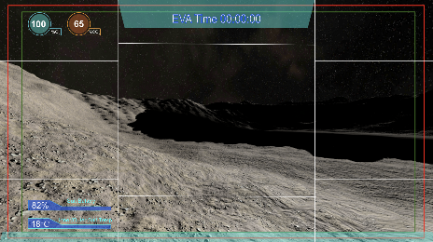
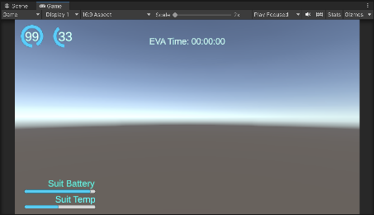
P&M 1: VR Environment
MODELING PROCESS: HUD
Write C# code for HUD elements
Add HUD elements
I: Objectives
II: Design Soln.
III: Risks
IV: Requirements
V: V&V
VI: Proj. Planning

Slide 40
P&M 1: VR Environment
REQUIREMENTS
DR # | Requirement | Met?
1.1.1.1 | Shall accurately portray suit-mounted lighting | C
1.1.1.2 | Shall portray accurate solar lighting conditions. | C
1.1.1.3 | Shall accurately portray high-contrast lighting conditions similar to those seen on the south polar region of the lunar surface. | C
1.1.1.4 | Shall accurately portray low-angle lighting conditions similar to those seen on the south polar region of the lunar surface. | C
1.1.2.1 | Shall generate topographical and geographical features with raw lunar scan data. | C
1.1.2.2 | Shall ensure the texture of the lunar surface in the simulation is visually indicative of lunar regolith | C
F1
I: Objectives
II: Design Soln.
III: Risks
IV: Requirements
V: V&V
VI: Proj. Planning

Slide 41
P&M 1: VR Environment
REQUIREMENTS
DR # | Requirement | Met?
4.2.1.1 | Shall be able to view simulated heart rate | PC
4.2.1.2 | Shall be able to view simulated blood pressure | PC
4.2.2.1 | Shall be able to view simulated O2 levels | C
4.2.2.2 | Shall be able to view simulated Co2 levels | C
4.2.2.3 | Shall be able to view simulated inner and outer space suit temperatures | C
4.2.2.4 | Shall be able to view Battery/Power left | C
4.2.3.1 | Shall be able to view simulated EVA Total Time | PC
4.2.3.2 | Shall be able to view simulated distance back to start point (airlock) | PC
4.2.3.3 | Shall be able to view a topographical map of the lunar simulated surface | PC
F4
I: Objectives
II: Design Soln.
III: Risks
IV: Requirements
V: V&V
VI: Proj. Planning

Slide 42
P&M 1: VR Environment
RESULTS
I: Objectives
II: Design Soln.
III: Risks
IV: Requirements
V: V&V
VI: Proj. Planning
Notes:
There are multiple ways to track objects within the simulation, the one used in the video is just an example.
Should be noted that the lag seen in the virtual environment is a result of the screen capture method and NOT a result of the environment itself

Slide 43
Hybrid Reality Feasibility - Next Steps
PROCESS
Feasibility for F2, F3: hybrid and real-world side of CTHREEPIO
Preliminary feasibility determination of higher-risk HR components
Develop procedures for testing feasibility with HR once components are available
Acquire Vive trackers using early access funds
Integrate HR on small scale to determine feasibility
Complete
In progress
I: Objectives
II: Design Soln.
III: Risks
IV: Requirements
V: V&V
VI: Proj. Planning
Notes:
Due to budget and equipment constraints, we were not able to integrate the hybrid and real-world parts of CTHREEPIO into our feasibility model. Since two of our six high level functional requirements are related to the hybrid side, we plan to address feasibility for those aspects in the coming weeks and at the beginning of next semester. We have already determined using online documentation for the Vive trackers and created models using fusion 360 for the HR tools that the HR will integrate well with VR. As part of this, we also assessed potential risks with integration from online documentation and determined mitigation strategies for them, details of which can be found in our backup slides. We developed procedures to integrate and test the trackers with the VR side, and purchased the Vive trackers using early access. As soon as the trackers arrive, we plan to use our previously made procedures to integrate HR on a small scale and determine feasibility before we begin building the full product.

Slide 44
P&M 2: Computing Performance
DRIVERS & VARIABLES
Focus | Ensure environment will meet key requirements for mitigating motion sickness
Driving CPEs | C5: VR environment will keep user safe
Driving risks | Risk #2: Motion Sickness from VR Headset/Display
Key variables | CPU usage GPU usage RAM consumption Latency Framerate
I: Objectives
II: Design Soln.
III: Risks
IV: Requirements
V: V&V
VI: Proj. Planning
Notes:
Focus:
Driving requirements and risks
Key Variables

Slide 45
P&M 2: Computing Performance
MODELING PROCESS
Create VR environment (see P&M 1)
Select scaling factor to apply to terrain
Insert LRO data into Unity as a terrain map
Connect Oculus headset to PC via Oculus App
Run the simulation in Unity through the Oculus headset
Repeat process selecting a new scaling factor
Have user look and move around the simulation and collect performance measurements
Leave the simulation idle and collect performance measurements
Test CPU: AMD Ryzen 5 1400 Quad-Core Processor
Test GPU: NVIDIA GeForce GTX 1060
Test RAM: 16 GB
CPU, GPU, and RAM consumption measured in Windows task manager
Frame rate and latency information from Oculus debug tool
I: Objectives
II: Design Soln.
III: Risks
IV: Requirements
V: V&V
VI: Proj. Planning

Slide 46
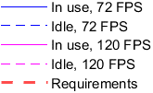
P&M 2: Computing Performance
RESULTS
I: Objectives
II: Design Soln.
III: Risks
IV: Requirements
V: V&V
VI: Proj. Planning
Notes:
Latency appeared consistent across all size tests, all within our maximum allowable delay of 48 ms

Slide 47
P&M 2: Computational Performance
REQUIREMENT(S)
DR # | Requirement | Predicted Compliance
5.1.1.1 | Shall implement a maximum 48 ms latency | C
5.1.1.2 | Shall implement a minimum 90 fps frame rate | C
5.5.1.1 | The PC GPU usage shall not exceed 95% | C
5.5.1.2 | The PC CPU usage shall not exceed 85% | C
5.5.1.4 | During the simulation, the PC RAM usage shall not exceed 80% | C
F5
I: Objectives
II: Design Soln.
III: Risks
IV: Requirements
V: V&V
VI: Proj. Planning
Notes:
(30-40 seconds)
After discussing V&V for the environment, its important that we address the performance based requirements the simulation must abide by.
Those are …

Slide 48
P&M 2: Computing Performance
LIMITATIONS
Were not able to test computing performance with:
Hybrid reality components in the VR environment
Vive trackers connected
These gaps will be addressed through Verification & Validation plans
I: Objectives
II: Design Soln.
III: Risks
IV: Requirements
V: V&V
VI: Proj. Planning

Slide 49
Verification and Validation Processes
I: Objectives
II: Design Soln.
III: Risks
IV: Requirements
V: V&V
VI: Proj. Planning

Slide 50
V&V 1: Computational Performance
REQUIREMENT(S)
DR # | Requirement | Predicted Compliance
5.1.1.1 | Shall implement a maximum 48 ms latency | C
5.1.1.2 | Shall implement a minimum 90 fps frame rate | C
5.5.1.1 | The PC GPU usage shall not exceed 95% | C
5.5.1.2 | The PC CPU usage shall not exceed 85% | C
5.5.1.4 | During the simulation, the PC RAM usage shall not exceed 80% | C
F5
I: Objectives
II: Design Soln.
III: Risks
IV: Requirements
V: V&V
VI: Proj. Planning
Notes:
(30-40 seconds)
After discussing V&V for the environment, its important that we address the performance based requirements the simulation must abide by.
Those are …

Slide 51
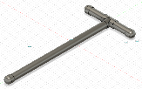
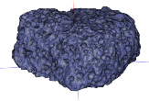
V&V 1: Computational Performance
METHOD
Run simulation with full VR environment and one tracker
II. User moves and interacts with each HR object
Repeat until computer or tracker limits
are met
III. Monitor CPU, GPU, RAM, Latency, and Framerate
IV. Monitor latency & frame rate through Oculus debugging tool
V. Increase number of trackers by one
I: Objectives
II: Design Soln.
III: Risks
IV: Requirements
V: V&V
VI: Proj. Planning
Notes:
Based on the requirements we observed, it is important that we have a solid method of verifying and validating those.
So let me walk you through the approach we will take to verify that the simulation is compliant with those requirements
After connecting the headset, making sure the settings are set to 120 FPS, making sure the environment is to the 100% scale, beginning the stream, and finally checking to make sure the Oculus debugging tool is ready, we can begin the process seen on screen.
Step 1. Run the simulation with the LRO based topography and the assets, HUD, biometrics, and a VIVE Tracker
Step 2. Have the user stress the system. Have them move, Have them pick up and use the HR object with the tracker. Have them look around and do things that anyone may do in the sim. And simultaneously conduct step 3.
Which is to monitor the CPU, the GPU, the RAM, latency, and framerate and get a benchmark. And at the same time, through step 4. We can gather the results from the Oculus debugging tool, which tell us if the latency and framerate of the streamed headset match up with the computer.
And Step 5. Complete the same process but with increased number of trackers, meaning increased number of hybrid reality components.
And through this we can collect comprehensive results that illustrate whether our computer holds up to our simulation needs and we can predict the limit.

Slide 52
V&V 1: VR Computational Performance
EQUIPMENT
VR Equipment
PR Equipment
Custom Built PC – COTS
Oculus Headset – COTS
Vive Trackers – COTS
Bench – In-House Built
Scoop – In-House Built
Rock – In-House Built
I: Objectives
II: Design Soln.
III: Risks
IV: Requirements
V: V&V
VI: Proj. Planning
Notes:
After discussing the approach we will take to verify and validate the system as a whole, this visual demonstrates that there are a lot of components in our design that rely on one another.
The PC is our bread and butter. Every VIVE trackers sends their position to it, even the simulation is ran 100% by the PC. The PC performance has to be exceptional because that performance is then streamed to the Oculus headset and any problems there would only become worse in the headset. Without a robust VR side, none of the low fidelity physical reality equipment can be brought to life in the VR
And so, it only makes sense for this VR computational test to include every element when assessing the performance

Slide 53
V&V 2: VR Environment Realism
REQUIREMENT(S)
DR # | Requirement | Predicted Compliance
1.1.1.1 | Shall accurately portray suit-mounted lighting | C
1.1.1.2 | Shall portray accurate solar lighting conditions. | C
1.1.1.3 | Shall accurately portray high-contrast lighting conditions similar to those seen on the south polar region of the lunar surface. | C
1.1.1.4 | Shall accurately portray low-angle lighting conditions similar to those seen on the south polar region of the lunar surface. | C
1.1.2.2 | Shall ensure the texture of the lunar surface in the simulation is visually indicative of lunar regolith | C
F1
I: Objectives
II: Design Soln.
III: Risks
IV: Requirements
V: V&V
VI: Proj. Planning

Slide 54
V&V 2: VR Environment Realism
METHOD
I. Development of Perceived Terrain Realism Metric (PTRM) Survey¹
II. Find human subjects + administer Motion Sickness Susceptibility Questionnaire (MSSQ)²
Human-in-the Loop (HITL) Testing
III. 5-minute exploration of VR environment
*NASA recommends a minimum of 10 subjects for most HITL testing³
IV. Administer + Score PTRM Survey
V. Analyze Results from PTRM Survey
VI. Incorporate feedback to improve fidelity
VII. Repeat until compliant with requirements
I: Objectives
II: Design Soln.
III: Risks
IV: Requirements
V: V&V
VI: Proj. Planning

Slide 55
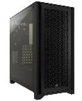
V&V 2: VR Environment Realism
EQUIPMENT
Custom Built PC – COTS
Oculus Headset – COTS
PTRM Survey – In-House Developed
I: Objectives
II: Design Soln.
III: Risks
IV: Requirements
V: V&V
VI: Proj. Planning

Slide 56
Project Planning
I: Objectives
II: Design Soln.
III: Risks
IV: Requirements
V: V&V
VI: Proj. Planning

Slide 57
Budget
$4,000 Budget
Components | Total
Dedicated VR PC* | $1,114
Oculus Quest 2 VR Headset | $400
9 HTC Vive 3.0 Trackers | $1,170
2 HTC Vive Base Station 2.0s | $400
Base Station Tripods | $40
Tool Manufacturing Materials* | $106
Electronics* | $118
Elbow Braces | $170
Premade Virtual Assets | $21
Remaining Margin | $461
Preliminary Purchase Plan
Dedicated VR PC* | $1,114
3 HTC Vive 3.0 Trackers | $390
2 HTC Vive Base Station 2.0s | $400
Arduino Nano | $25
NRF24L01+ Transceiver Modules | $8
Wire for Prototyping | $7
TOTAL | $1,944
Pending EEF Application for funds to help cover PC component costs
Extra funds freed up from EEF Application will go to headset accessories (battery packs, improved head mounted strap) and to improving simulation audio (noise cancelling earbuds)
Remaining margin for shipping expenses, part repair/replacement
*Additional detail for these items provided in backup slides
I: Objectives
II: Design Soln.
III: Risks
IV: Requirements
V: V&V
VI: Proj. Planning

Slide 58
Order of Testing
 | Test Name | Testing Location | Date
1 | VR & HR Congruence & Sensitivity | Senior Projects Room | February 2023
2 | Computing Performance | Senior Projects Room | February 2023
3 | Safety Testing | Senior Projects Room | March 2023
4 | Mobility Constraint | Senior Projects Room | March-April 2023
5 | Environmental Realism | Senior Projects Room | March-April 2023
6 | Full System Test | Client-Provided Space | April 2023
I: Objectives
II: Design Soln.
III: Risks
IV: Requirements
V: V&V
VI: Proj. Planning

Slide 59
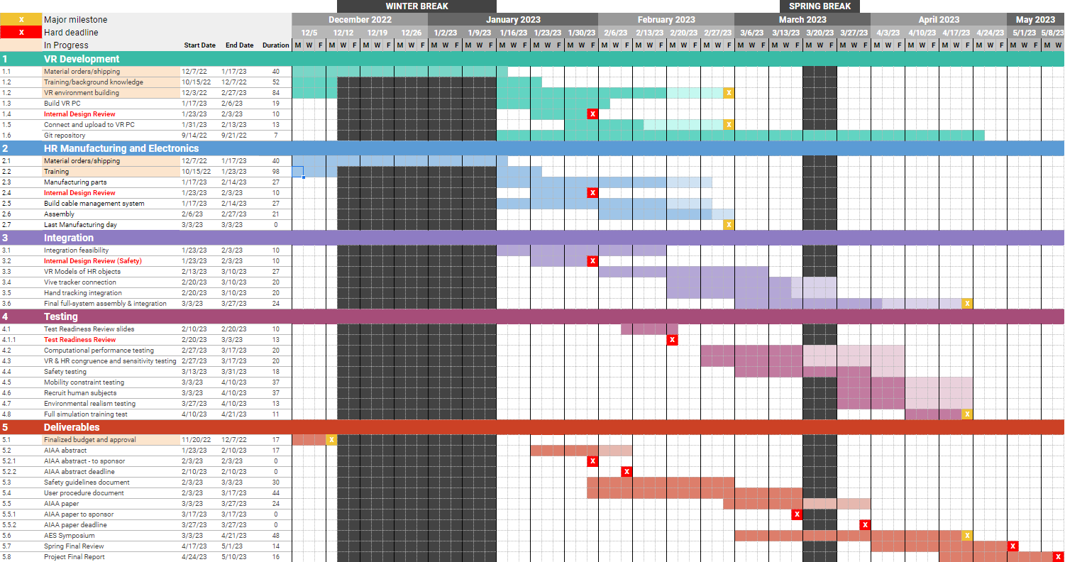
Gantt Chart
Lighter color = margin
Critical path
VR development
Manufacturing
Integration
Testing
Final product

Slide 60
Acknowledgements
We would like to thank our team advisor and sponsor, Dr. Anderson, our Blue Origin sponsors, Christine Reilly and Tim Lloyd, as well as Dr. Wingate, Professor Muldrow, and the ASEN 4018 teaching fellows for their assistance in completing this Critical Design Review.

Slide 61
Questions

Slide 62
References
Rajasekaran, S. D., Kang, H., Čadík, M., Galin, E., Guérin, E., Peytavie, A., ... & Benes, B. (2022). PTRM: Perceived Terrain Realism Metric. ACM Transactions on Applied Perceptions (TAP).
Golding, J. F. (1998). Motion sickness susceptibility questionnaire revised and its relationship to other forms of sickness. Brain research bulletin, 47(5), 507-516.
(2022). Human-in-the-Loop (HITL) Test Subject Sample Sizes. NASA-STD-3001 Technical Brief.

Slide 63
Backup Slides

Slide 64
Table of Contents - CDR Slides
Outline
Project Purpose and Objectives
Nomenclature
Project Definition
CONOPS
Design Solution
FBD
Objects/Equipment
Design Diagrams
Critical Project Elements and Risks
Design Requirements and Satisfactions
P&M Overview
P&M 1: VR Environment
P&M 2: Computing Performance
V&V Processes
V&V 1: Computing Performance
V&V 2: VR Environment Realism
Project Planning

Slide 65
Table of Contents - Backup Slides
Background Information
Nomenclature
Motivation
High-Level Use Cases
Full Requirements
Critical Project Elements
Mission Objectives
Trade Studies
Supplemental Budget Information
P&M Process Details
Supplemental Equipment Details
Master Equipment List
HR Object Details
Risks (Full)
V&V (Full)
Safety Guidelines
Developmental and Functional Pipelines

Slide 66
Background Information
Nomenclature
Motivation
High Level Use Cases
Full Requirements
Critical Project Elements
Specific Mission Objectives

Slide 67
Complete Nomenclature List
Virtual Reality (VR): The software developed to virtually recreate a lunar environment
Back End: The Unity and other software development tools used to create the infrastructure for the software
Front End: The rendering software used to visualize the data and software infrastructure - what the user will actually see and interact with
Hybrid Reality (HR): The physical tools and sensors used to track interactions between the user, real life and virtual objects
Training Simulation (CTHREEPIO): The project as a whole - the combination of virtual environment and hybrid reality
Extravehicular Activity (EVA): This is the official term for any activity that an astronaut conducts outside of a safe habitat/vehicle.
Lunar South Pole (LSP): Primary landing site for Artemis III mission and where on the moon CTHREEPIO is trying to replicate
Derived Requirement (DR): A lower level requirement under a high level functional requirement (FR). DRs can be found in backup slides.
Blender → creates the things we see in the virtual environment
Unity → the engine that “powers” the virtual environment and everything happening in it
SteamVR → the bridge between what’s happening in Unity and the virtual reality devices (Oculus, VIVE trackers, VIVE base stations)
GitHub → software storage system that allows for open access and version control
Fusion360 → creates the things we want to understand the mechanics of or develop into a 3D printable object
Meta Quest App → the app used to access the oculus headset
VIVE Input Utility → Unity plugin that allows manipulation of VIVE tracker data
Mobility Constraint ↔ Physical Constraint → The physical device(s) that are used to constrict the movement of the user the same way that an actual spacesuit would.
Arm Brace ↔ Elbow Brace → The physical device(s) that are used to constrict the movement of the user’s elbow the same way that an actual spacesuit would.
Hard Upper Torso (HUT) → A device used in spacesuit design to provide structural support and one of the main components that lead to mobility constriction within a spacesuit
NASA - STD - 3001 → NASA Spaceflight Human-System Standard Volume 2, Rev C → The requirement(s) standard set for by NASA for all human spaceflight projects and the standard we use for all CTHREEPIO development

Slide 68
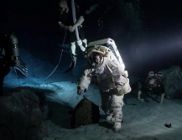
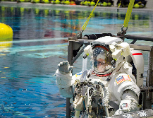
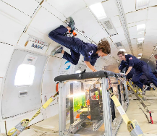
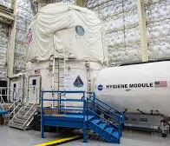
Background - Lunar/Astronaut Training
Increased interest in lunar operations comes with an increased need for operational training.
Current training methods include (not limited to):
Neutral Buoyancy Lab
Field Simulations (Analogs)
Parabolic flight
These methods are costly and operate on strict time schedules.

Slide 69
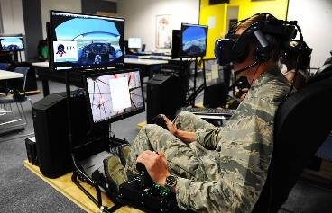
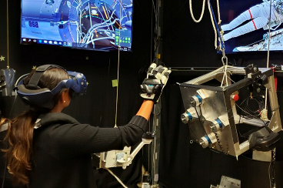
Background - VR
VR systems have been successfully applied to training exercises across many fields:
Aviation Training/Maintenance
Surgical/Medical Training
This technology allows for:
Complicated visual environments
Flexibility
Immersiveness
Simulated gravity in an altered way
…all at a much lower cost than other operational training methods
Notes:
1 pic - (Jennifer Spradlin/Air Force Academy)
2nd pic - https://spacecenter.org/how-nasa-uses-virtual-reality-to-train-astronauts/

Slide 70
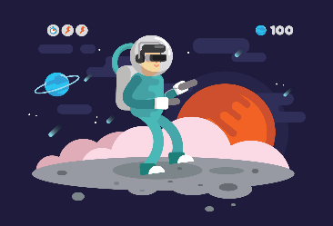
CTHREEPIO High-Level Use Cases
Classroom Education
CTHREEPIO Training
Hardware Evaluation
Supplement knowledge with hands-on experience
Test astronaut adaptation to environmental constraints
Run mission tasks with hybrid reality objects
Evaluate new hardware and mission protocols

Slide 71
CTHREEPIO Requirements
FR | L1 | L2 | L3 | Requirement | Verification/Validation | Level | Predicted Compliance
F1 |  |  |  | The VR environment shall simulate the South Polar region of the lunar surface. |  | Level 0
 | 1.1 |  |  | Shall incorporate accurate location characteristics that resemble the south polar region of the lunar surface | Demonstration | Level 1: System | C
 |  | 1.1.1 |  | Shall accurately portray lighting characteristics one would experience on the south polar region of the lunar surface | Demonstration | Level 2: Subsystem | C
 |  |  | 1.1.1.1 | Shall accurately portray suit-mounted lighting | Demonstration | Level 3: Component | C
 |  |  | 1.1.1.2 | Shall portray accurate solar lighting conditions. | Demonstration | Level 3: Component | C
 |  |  | 1.1.1.3 | Shall accurately portray high-contrast lighting conditions similar to those seen on the south polar region of the lunar surface. | Demonstration | Level 3: Component | PC
 |  |  | 1.1.1.4 | Shall accurately portray low-angle lighting conditions similar to those seen on the south polar region of the lunar surface. | Demonstration | Level 3: Component | C
 |  | 1.1.2 |  | Shall accurately generate lunar topographical and geographical features | Demonstration | Level 2: Subsystem | C
 |  |  | 1.1.2.1 | Shall generate topographical and geographical features with raw lunar scan data. | Demonstration | Level 3: Component | C
 |  |  | 1.1.2.2 | Shall ensure the texture of the lunar surface in the simulation is visually indicative of lunar regolith | Demonstration/Analysis | Level 3: Component | PC

Slide 72
F2 |  |  |  | The training simulation shall include physical, real-world objects. |  | Level 0
 | 2.1 |  |  | Shall include necessary physical object(s)/equipment that represent training utilities used in the VR simulation | Demonstration/Inspection | Level 1: System | C
 |  | 2.1.1 |  | Physical training object(s)/equipment shall be user compatible | Demonstration/Inspection | Level 2: Subsystem | C
 |  |  | 2.1.1.1 | Physical model(s) of VR tools shall have a simulated weight (ie, 1/6 the weight they would nominally have on Earth) | Demonstration/Inspection | Level 3: Component | C
 |  |  | 2.1.1.2 | Physical model(s) of VR tools shall be mechanically illustrative of VR counterpart | Demonstration/Inspection | Level 3: Component | C
 |  |  | 2.1.1.3 | Physical model(s) of VR environment shall be relevant to training simulation | Demonstration/Inspection | Level 3: Component | C
 |  |  | 2.1.1.4 | Physical model(s) of VR equipment shall be mechanically illustrative of VR counterpart | Demonstration/Inspection | Level 3: Component | C
 |  |  | 2.1.1.5 | Physical model(s) of VR equipment shall be relevant to a Lunar training environment | Demonstration/Inspection | Level 3: Component | C
 |  |  | 2.1.1.6 | Physical model(s) of the VR spacesuit shall recreate elbow extension/flexion range of motion (from 0 degrees to 120 degrees) | Demonstration/Inspection | Level 3: Component | C
 |  |  | 2.1.1.7 | Physical model(s) of the VR spacesuit shall be non-invasive | Demonstration/Inspection | Level 3: Component | C
 |  |  | 2.1.1.8 | Physical model(s) of the VR spacesuit shall be user adjustable | Demonstration/Inspection | Level 3: Component | C
 |  |  | 2.1.1.9 | Physical model(s) of the VR spacesuit shall be able to house any HR support hardware | Demonstration/Inspection | Level 3: Component | C
 | 2.2 |  |  | Shall include physical hardware designed to support VR and user actions | Test/Inspection/Analysis | Level 1: System | C
 |  | 2.2.1 |  | Physical hardware shall include sensor(s) to track user(s) activities and motions | Test/Inspection | Level 2: Subsystem | C
 |  |  | 2.2.1.1 | User motion sensor(s) shall not inhibit user mobility | Test/Inspection | Level 3: Component | PC
 |  |  | 2.2.1.2 | User motion sensor(s) shall have. 4cm sensitivity | Test/Analysis | Level 3: Component | TBD
 |  |  | 2.2.1.3 | User motion sensor(s) shall be able to track object and stream data within the training area | Test/Analysis | Level 3: Component | C
 |  |  | 2.2.1.4 | User motion sensor(s) shall be able to operate continously for a minimum of 1 hour | Test/Inspection | Level 3: Component | C
 |  | 2.2.2 |  | Physical hardware shall include sensor(s) to track object(s) motions | Test/Inspection | Level 2: Subsystem | C
 |  |  | 2.2.2.1 | Object motion sensor(s) shall have the ability to track objects with minimum dimension of 4cm | Test | Level 3: Component | C
 |  |  | 2.2.2.2 | Object motion sensor(s) shall not inhibit object handling | Test/Inspection | Level 3: Component | PC
 |  |  | 2.2.2.3 | Object motion sensor(s) shall have a 4cm sensitivity | Test/Analysis | Level 3: Component | TBD
 |  |  | 2.2.2.4 | Object motion sensor(s) shall be scalable to spacial augmentation of the physical training environment | Test/Analysis | Level 3: Component | C

Slide 73
F3 |  |  |  | The training simulation shall accurately portray interactions with physical objects in the VR environment. |  | Level 0
 | 3.1 |  |  | Shall include auditory feedback for user interactions | Test/Demonstration | Level 1: System | C
 | 3.2 |  |  | Shall include visual feedback for user interactions | Test/Demonstration | Level 1: System | C
 | 3.3 |  |  | Shall include virtual assets representing the physical training elements | Demonstration/Inspection | Level 1: System | C
 |  | 3.3.1 |  | Shall include virtual representations of rocks and geological objects | Demonstration/Inspection | Level 2: Subsystem | C
 |  | 3.3.2 |  | Shall include virtual representations of tools and equipment used | Demonstration/Inspection | Level 2: Subsystem | C
F4 |  |  |  | To accurately simulate EVA activities on the lunar surface, the training simulation shall portray spacesuit features and small scale lunar objects. |  | Level 0
 | 4.1 |  |  | Shall include an accurate visual representation of the user's hands within the simulation | Demonstration | Level 1: System | PC
 |  | 4.1.1 |  | Shall include a realistic visual of current astronaut gear | Demonstration | Level 2: Subsystem | C
 |  |  | 4.1.1.1 | Shall include realistic spacesuit features (Mobility Constraints / FOV) | Demonstration | Level 3: Component | C
 |  |  | 4.1.1.2 | Shall include a field-of-view constraint closely resembling current astronaut gear. | Demonstration | Level 3: Component | C
 |  | 4.1.2 |  | Shall be able to see shadows of user | Demonstration | Level 2: Subsystem | PC
 | 4.2 |  |  | Shall integrate the capability to display simulated data with a Heads Up Display | Demonstration | Level 1: System | PC
 |  | 4.2.1 |  | Shall be able to dynamically simulate human health parameters based on user input | Demonstration | Level 2: Subsystem | PC
 |  |  | 4.2.1.1 | Shall be able to view simulated heart rate | Demonstration | Level 3: Component | PC
 |  |  | 4.2.1.2 | Shall be able to view simulated blood pressure | Demonstration | Level 3: Component | PC
 |  | 4.2.2 |  | Shall be able to dynamically simulate space suit parameter | Demonstration | Level 2: Subsystem | PC
 |  |  | 4.2.2.1 | Shall be able to view simulated O2 levels | Demonstration | Level 3: Component | PC
 |  |  | 4.2.2.2 | Shall be able to view simulated Co2 levels | Demonstration | Level 3: Component | PC
 |  |  | 4.2.2.3 | Shall be able to view simulated inner and outter space suit temeperatures | Demonstration | Level 3: Component | PC
 |  |  | 4.2.2.4 | Shall be able to view Battery/Power left | Demonstration | Level 3: Component | PC
 |  | 4.2.3 |  | Shall be able to dynamically simulate mission/simulation parameter | Demonstration | Level 2: Subsystem | PC
 |  |  | 4.2.3.1 | Shall be able to view simulated EVA Total Time | Demonstration | Level 3: Component | PC
 |  |  | 4.2.3.2 | Shall be able to view simulated distance back to start point (airlock) | Demonstration | Level 3: Component | PC
 |  |  | 4.2.3.3 | Shall be able to view a topographical map of the lunar simulated surface | Demonstration | Level 3: Component | PC

Slide 74
 |  |  | The training simulation, including the VR environment and all physical aspects, shall keep the user, operator, and itself safe from harm. |  | Level 0
5.1 |  |  | Shall implement proper methods to avoid causing simulation sickness in user | Test/Analysis | Level 1: System | C
 | 5.1.1 |  | Shall implement proper depth perception and scaling. | Test/Analysis | Level 2: Subsystem | C
 |  | 5.1.1.1 | Shall implement a maximum 48 ms latency | Test/Inspection/Analysis | Level 3: Component | C
 |  | 5.1.1.2 | Shall implement a minimum 90 fps frame rate | Test/Inspection/Analysis | Level 3: Component | C
 |  | 5.1.1.3 | Shall implement a minimum 80 Hz refresh rate | Test/Inspection/Analysis | Level 3: Component | C
5.2 |  |  | The VR environment shall have boundaries that match the physical boundaries of the training space | Test/Demonstration | Level 1: System | C
5.3 |  |  | Shall keep the user physically safe |  | Level 1: System | C
 | 5.3.1 |  | Shall maintain two-way communication with the user throughout the entire simulation | Demonstration/Inspection | Level 2: Subsystem | C
 | 5.3.2 |  | Shall have a procedure for user to quickly exit or terminate simulation | Inspection | Level 2: Subsystem | C
 | 5.3.3 |  | The user shall have guidance on how to complete the task | Demonstration/Inspection | Level 2: Subsystem | C
 | 5.3.4 |  | The simulation shall have the ability to control auditory environment within the headset via flight operator | Demonstration/Inspection | Level 2: Subsystem | C
 | 5.3.5 |  | The training simulation shall have a 70 decibel limit | Test/Inspection | Level 2: Subsystem | C
 | 5.3.6 |  | Equipment used shall be adjustable to accommodate different user anthropometry ranging from the 10th to 90th percentiles | Demonstration/Analysis | Level 2: Subsystem | C
 | 5.3.7 |  | The total weight of the user's training simulation equipment shall not exceed 22.7 kg (50 lbs) | Test | Level 2: Subsystem | C
5.4 |  |  | Shall have tools/equipment that are safe to operate | Inspection | Level 1: System | C
 | 5.4.1 |  | Tools/Equipment shall be modified to prevent injury | Inspection/Demonstration/Test | Level 2: Subsystem | C
 |  | 5.4.1.1 | Tools and equipment shall not have sharp corners or edges | Inspection/Demonstration/Test | Level 3: Component | C
 |  | 5.4.1.2 | The physical representation of the tool rack shall be safe to handle and shall not pose a risk to the user or other equipment at any time during the simulation | Demonstration/Test | Level 3: Component | C

Slide 75
 | 5.5 |  |  | The training equipment shall not be damaged during the training simulation | Demonstration/Test | Level 1: System | C
 |  | 5.5.1 |  | The VR computer shall be robust enough to safely run the training simulation for the entire duration | Demonstration/Test | Level 2: Subsystem | C
 |  |  | 5.5.1.1 | The PC GPU usage shall not exceed 95% | Demonstration/Test | Level 3: Component | C
 |  |  | 5.5.1.2 | The PC CPU usage shall not exceed 85% | Demonstration/Test | Level 3: Component | C
 |  |  | 5.5.1.3 | The PC shall have a minimum of 16 GB RAM | Demonstration/Test | Level 3: Component | C
 |  |  | 5.5.1.4 | During the simulation the PC RAM usage shall not exceed 80% | Demonstration/Test | Level 3: Component | C
F6 |  |  |  | The training simulation shall be appropriate for a laboratory environment. |  | Level 0
 | 6.1 |  |  | The physical training environment shall be no larger than 2.74 m x 3.05 m (9ft by 10ft) | Inspection | Level 1: System | C
 |  | 6.1.1 |  | All hybrid reality equipment/objects shall fit within the physical training environment | Inspection | Level 2: Subsystem | C
 |  | 6.1.2 |  | All hybrid reality equipment/objects shall be appropriately scaled to match realistic sizes | Test/Inspection | Level 2: Subsystem | C
 | 6.2 |  |  | The physical training environment shall be designed such that it will not damage its occupied space | Inspection | Level 1: System | C
 | 6.3 |  |  | The physical training environment shall not be a permanent installation | Inspection | Level 1: System | C
 |  | 6.3.1 |  | All individual physical equipment shall be movable by one person | Demonstration | Level 2: Subsystem | C
 |  |  | 6.3.1.1 | Hybrid reality components that need to be vertically lifted shall be no more than 22.7 kg (50 lbs) weight | Test | Level 3: Component | C

Slide 76
Critical Project Elements - Full
CPE | Element | Description
E1 | Hybrid Reality (HR) Support Equipment | The HR support equipment must be able to track user actions and interactions with utilized tools. The equipment shall integrate with the virtual reality instruments to provide visual cues that match user motion. Oversight would lead to integration challenges and obstacles that may impede on the overall immersiveness and quality of the training simulation.
E2 | User-Associated Equipment | The user-associated equipment shall integrate such that all equipment does not impede on overall functionality. The user-associated equipment must follow the prescribed safety requirements. Oversight could impair HR effectiveness or result in person/equipment damage.
E3 | Virtual Environment | The training simulation will utilize a virtual environment that is recognizable by the user as a lunar surface. This virtual environment must integrate with the real-world equipment such that the user’s actions are paralleled in the virtual environment . Failure to successfully integrate the virtual environment will impede the ability of astronauts to have a high-fidelity and safe training experience.

Slide 77
Critical Project Elements - Full
CPE | Element | Description
E4 | Testing | The simulation must be accessible, intuitive, and operable by a human user. The simulation must have the ability to test, validate, and verify requirements as set forth in the PDD and in future documents. Failure to have a user-friendly simulation would impede the training capability and may put the users at greater risk. Failure to have a simulation that can test, validate, and verify requirements would impede the ability for this project to be considered a success by the customer.
E5 | Safety | The training simulation must not cause any physical or mental harm to any user or operator. Precautions will be employed to ensure that while in the simulation, hazards are minimized to user, operator, and equipment.
E6 | Financial | The total cost of the simulation equipment, integration system, and testing, along with any costs from research and development processes, must not exceed $4000. Extra funds may be secured from the University of Colorado Boulder College of Engineering if necessary. To stay within budget, the cost and time for the project will be carefully managed and balanced by a team Chief Financial Officer.

Slide 78
Specific Mission Objectives
Level I:
VR Environment
Provide a realistic virtual representation of the lunar surface
Model high-fidelity VR objects for physical objects
Level II:
VR Environment
Include accurate lighting & topography
Create specific mission objectives utilizing HR objects
Hybrid Integration
Utilize object tracking during simulation
Represent physical interactions in the VR environment
Hybrid Integration
Allow user to interact with the physical objects of individual objects

Slide 79
Specific Mission Objectives
Level I:
Usability/Adaptability
Provide user-friendly interface along with an outlet for feedback
Level II:
Usability/Adaptability
Compact and mobile
Act as a framework for creating various training exercises
Human Constraints
Safely incorporate variables that would impact an astronaut during an EVA
Human Constraints
Address human factors limitations, such as mobility constraints
Display EVA information to user from a virtual display

Slide 80
Trade Studies

Slide 81
Trades Performed
 | Trade Space | Parent FRs | Related CPEs
0 | Virtual Reality Display | F2, F3, F5, F6 | E1, E2, E4, E5, E6
1 | Virtual Reality Headset | F3, F5 | E1, E2, E4, E5, E6
3 | Lunar Data | F1 | E3
5 | Unity Templates | F1 | E3, E6
2 | Object Tracking | F2 | E1, E2, E4, E6
4 | Physical Constraints | F2 | E2, E4, E5, E6
6 | Manufacturing of Physical Objects | F2, F3 | E1, E2, E5, E6
7 | Microcontroller | F2, F3 | E2, E5, E6
8 | Wireless Transmitter/Receiver | F2, F3 | E2, E5, E6
VR
HR

Slide 82
Trade 0 - Virtual Reality Display
DESIGN METRICS AND WEIGHTINGS
Design Metric | Weight | Reasoning
User Immersion | 60% | As CTHREEPIO aims to provide a highly immersive, high-fidelity and realistic environment, user immersion and overall immersivity is a key metric for the VR display system.
Portability | 25% | As per F6, CTHREEPIO must be appropriate for a laboratory environment, and part of this requirement is portability. The VR display system must be easily portable and fit within volume constraints provided.
Cost | 15% | While some displays might have excellent capabilities in regards to the previous metrics, they may be prohibitively expensive (outside of budget options will be removed due to noncompliance).

Slide 83
Trade 0 - Virtual Reality Display
TRADE MATRIX
 |  | Virtual Reality Headsets | Augmented Reality Glasses | Projector Displays | Mounted Screen Displays
Metric | Weight | WT | WT | WT | WT
Immersion | 60% | 5.4 | 4.2 | 2.4 | 1.2
Portability | 25% | 2.0 | 2.0 | 0.25 | 1
Cost | 15% | 1.05 | 0.75 | 0.6 | 0.75
Total (0-10) | 100% | 8.45 | 6.95 | 3.25 | 2.95
Final Selection
*WT = Weighted Total Score
Uncertainty:
Variety among VR Headsets in cost and quality (trade space)
Potential physical discomfort and motion sickness

Slide 84
Trade 1 - VR Headset
DESIGN METRICS AND WEIGHTINGS
Design Metric | Weight | Reasoning
External PC Required (yes/no) | 25% | The hindrance of an external PC outweighs the benefit of additional computing power.
Cost ($400-$1400) | 20% | One of the project’s largest expenses, so this metric is weighed heavily. Prices ranged from $400 to $1400 for basic headset packages.
Refresh Rate (60-144 Hz) | 15% | Higher refresh rate reduces motion blur and makes movement and action clearer. The most common refresh rates for computer screens vary between 60 and 144Hz.
Horizontal FOV (100°-130°) | 15% | Maximizing FOV helps mitigate the “screen door effect”. Minimum FOV of all headsets was 100° and FOV for a human’s dual eye overlap region is 130°.
Resolution per Eye | 15% | Higher number of pixels per eye increases virtual fidelity of simulation.
Weight | 10% | Minimizing weight on head reduces user fatigue.
Notes:
Should this be a backup slide?

Slide 85
Trade 1 - VR Headset
TRADE MATRIX
Final Selection
 |  | Oculus Quest 2 | HTC Vive Focus 3 | HP Reverb G2 | HTC Vive Pro 2 | Sony Playstation VR | Valve Index VR Kit
Metric | Weight | WT | WT | WT | WT | WT | WT
Requires External PC | 25% | 2.5 | 2.5 | 0.3 | 0.3 | 0.3 | 0.3
Cost [$] | 20% | 1.4 | 0.1 | 1.3 | 0 | 1.5 | 0.2
Resolution [per eye] | 15% | 0.8 | 1.5 | 1.1 | 1.5 | 0 | 0.4
Refresh Rate [Hz] | 15% | 0.5 | 0.5 | 0.5 | 1.1 | 1.1 | 1.1
Horizontal FOV [°] | 15% | 0.2 | 1 | 0.7 | 1 | 0 | 1
Weight [lb] | 10% | 1 | 0.2 | 0.9 | 0 | 0.7 | 0.1
Total (0-10) | 100% | 6.4 | 5.9 | 4.8 | 3.8 | 3.6 | 3.0
*WT = Weighted Total Score

Slide 86
Trade 2 - Object Tracking
DESIGN METRICS AND WEIGHTING
Design Metric | Weight | Reasoning
Per Unit Cost ($20 - $300) | 35% | Potentially another hefty expense; in combination with the VR headset, object tracking hardware could create risk for being over budget.
Ease of Integration (0.5 - 1) | 25% | Integrability is key; less integratable object-tracking sensors may institute an additional learning curve associated with integration software.
Battery life (2hrs - 8hrs) | 20% | A longer battery life enables multiple users to use the equipment/training simulation without having to charge or replace batteries.
Size (50mm - 90mm) | 10% | The size can affect the VR experience should it get in the user’s way, and would decrease the realistic feel of the object. It could also potentially affect the manufacturability of the object.
Weight (0g - 100g) | 10% | Similar to size, a large weight on an object because of a tracker affects the realistic feel of the object.
Notes:
Lily
Design Metrics
Risks
Engineering Analyses
Weightings

Slide 87
Trade 2 - Object Tracking
FULL TRADE MATRIX
 |  | VIVE Tracker (3.0) |  |  | Manus Pro Tracker |  |  | IMU (6DOF MPU 6050) |  |  | Xbox Kinect Sensor
Metric | Weight | Value | Score | WT | Value | Score | WT | Value | Score | WT | Value | Score | WT
Cost [$] | 35% | 129.99 | 6.072 | 2.125 | 289.73 | 0.367 | 0.128 | 50 | 8.929 | 3.125 | 60 | 8.571 | 3
Ease of Integration | 25% | 1 | 10 | 2.5 | 1 | 10 | 2.5 | 0.6 | 2 | 0.5 | 0.6 | 2 | 0.5
Battery Life [hrs] | 20% | 7.5 | 9.167 | 1.833 | 4.5 | 4.167 | 0.833 | 5 | 5 | 1 | n/a | 0 | 0
Size [mm] | 10% | 79 | 2.75 | 0.275 | 75 | 3.75 | 0.375 | 55 | 8.75 | 0.875 | n/a | 0 | 0
Weight [g] | 10% | 75 | 2.5 | 0.25 | 62 | 3.8 | 0.38 | 20 | 8 | 0.8 | n/a | 0 | 0
Total (0-10) | 100% |  |  | 6.983 |  |  | 4.216 |  |  | 6.425 |  |  | 3.5
Final Selection
*WT = Weighted Total Score

Slide 88
Trade 3 - Scoring Techniques
Design Metric | Scoring | Weight | Reasoning
Data resolution (0 - 500 meters/pixel) | S = 10 - 0.01*V 0 m/px → S = 10 500 m/px → S = 0 | 45% | This is perhaps the most important metric for data, as we need very high resolution data to be able to create something that realistically resembles the lunar surface.
Dataset size (0 - 100k products available) | S = 10*(1-1/50^2)*(V-50)^2 0, 100k prod → S = 0 50k prod → S = 10 | 30% | Too much data will be difficult to parse, but too little will not give enough data to create a simulation.
Relevance (0 - 2, ranked on % of data around lunar south pole) | S = 5*V 0 → S = 0 2 → S = 10 | 25% | Needs to include lunar south pole data for Artemis III location relevance.

Slide 89
Trade 3 - Lunar Data
FULL TRADE MATRIX
Final Selection
 |  | Lunar Reconnaissance Orbiter (2009-pres) |  |  | Lunar Orbiters (1960s) |  |  | Clementine (1994) |  |  | Kaguya (2007-pres)
Evaluation Criteria | Weight | Value | Score | WT | Value | Score | WT | Value | Score | WT | Value | Score | WT
Resolution (m/px) | 45% | 0.5 | 9.99 | 4.4955 | 60 | 8.8 | 3.96 | 118 | 7.64 | 3.438 | 474 | 0.52 | 0.234
Dataset size (1000s of products) | 30% | 89.766 | 3.674 | 1.102 | 0.021 | 0.0083 | 0.0025 | 0.084 | 0.0335 | 0.0100 | 10.384 | 3.722 | 1.116
Relevance (0,1,2) | 25% | 2 | 10 | 2.5 | 1 | 5 | 1.25 | 1 | 5 | 1.25 | 1 | 5 | 1.25
Total (0-10) | 100% |  |  | 8.098 |  |  | 5.213 |  |  | 4.698 |  |  | 2.601
*WT = Weighted Total Score

Slide 90
Trade 4 - Physical Constraints
DESIGN METRICS AND WEIGHTINGS
Design Metric | Weight | Reasoning
Safety | 20% | Safety is the most important aspect of the mobility constraint This is the go/no-go criteria first and foremost
Compatibility (user) | 15% | Compatibility with user ensures (1) safety, (2) mission fidelity, and (3) direct measures of success
Compatibility (senors + equipment) | 12% | The constraint is an important part of our senior project, but it isn’t as important as making sure everything else works -- if this isn’t compatible, it isn’t feasible for this project
Risk | 12% | The constraint is an important part of our senior project, but it isn’t as important as making sure everything else works

Slide 91
Trade 4 - Physical Constraints
DESIGN METRICS AND WEIGHTINGS
Design Metric | Weight | Reasoning
Complexity | 10% | The constraint is an important part of our senior project, but it isn’t as important as making sure everything else works
Durability + Maintenance | 10% | Ties directly into cost, risk, safety The less time we spend on repairing, the more time we spend optimizing
Cost | 10% | Limited money, limited ability to develop constraint Also ties into complexity, maintenance
Mission Fidelity | 6% | This allows us to train the astronaut in a way that will better help them be prepared for the lunar environment
Size | 5% | Limited space leads to limited design space Ties into risk, safety, complexity, cost

Slide 92
Trade 4 - Physical Constraints
TRADE MATRIX
 |  | Hard Upper Torso | Arm Brace | Costume | Pool Noodles
Metric | Weight | WT | WT | WT | WT
Safety | 20% | 1.2 | 1.55 | 1.8 | 1
Compatibility (user) | 15% | 1.13 | 1.25 | 1.08 | 0.95
Risk | 12% | 0.78 | 0.9 | 0.66 | 0.63
Compatibility (senors + equipment) | 12% | 0.84 | 0.91 | 0.60 | 0.62
Complexity | 10% | 0.7 | 0.81 | 0.76 | 0.46
Durability + Maintenance | 10% | 0.64 | 0.5 | 0.62 | 0.66
Mission Fidelity | 10% | 0.50 | 0.77 | 0.5 | 0.83
Cost | 6% | 0.54 | 0.348 | 0.24 | 0.264
Size | 5% | 0.36 | 0.5 | 0.35 | 0.28
Total (0-10) | 100% | 6.7 | 7.5 | 6.6 | 5.69
Final Selection

Slide 93
Trade 4 - Physical Constraints
TRADE MATRIX - ARM BRACE TYPE
 |  |  | Brace Direct |  | Ergo-Brace |  | Mueller |  | AliMed
Criteria | Weight |  | WT |  | WT |  | WT |  | WT
Safety | 28% |  | 1.87 |  | 1.87 |  | 1.9525 |  | 1.87
Compatibility (user) | 21% |  | 1.26 |  | 1.26 |  | 0.75 |  | 1.26
Risk | 19% |  | 1.05 |  | 1.05 |  | 1.05 |  | 1.05
Durability + Maintenance | 17% |  | 0.72 |  | 0.72 |  | 0.624 |  | 0.72
Cost | 15% |  | 0.57 |  | 0.50 |  | 0.89 |  | 0.00
Total | 100% |  | 5.47 |  | 5.40 |  | 5.27 |  | 4.90
Final Selection

Slide 94
Trade 5 - Unity VR Templates
DESIGN METRICS AND WEIGHTINGS
Design Metric | Scoring | Weight | Reasoning
Supported Build Targets | Weight*Score = Weighted Total value → S = 10 value → S = 0 | 25 | Base template must be compatible with all VR headset types
License | Weight*Score = Weighted Total value → S = 10 value → S = 0 | 10 | License must allow for IP to be transferred to our customer
Existing Documentation | Weight*Score = Weighted Total value → S = 10 value → S = 0 | 15 | Documentation greatly increases the rate at which we can develop.
Ease of Development | Weight*Score = Weighted Total value → S = 10 value → S = 0 | 25 | Aids in our ability to develop rapidly.
Opportunity for Customization | Weight*Score = Weighted Total value → S = 10 value → S = 0 | 25 | Allows for greater flexibility

Slide 95
Trade 5 - Unity VR Templates
FULL TRADE MATRIX
 |  | Custom Built Template |  |  | Unity Base VR Template |  |  | Fist Full of Shrimp Template
Metric | Weight | Value | Score | WT | Value | Score | WT | Value | Score | WT
Supported Build Targets | 25% | 1 | 1 | 0.25 | 3 | 6.4 | 1.6 | 3 | 6.4 | 1.6
License | 10% | MIT | 10 | 1 | Student Unity License | 10 | 1 | MIT | 10 | 1
Documentation | 15% | 0 | 0 | 0 | 10 | 10 | 1.5 | 9.5 | 9.5 | 1.425
Ease of Development | 25% | 5 | 5 | 1.25 | 9 | 9 | 2.25 | 10 | 10 | 2.5
Opportunity for Customization | 25% | 10 | 10 | 2.5 | 9 | 9 | 2.25 | 9 | 9 | 2.25
Total (0-10) | 100% |  |  | 5 |  |  | 8.6 |  |  | 8.775
*WT = Weighted Total Score
Final Selection

Slide 96
Trade 6 - Manufacturing of Physical Objects
DESIGN METRICS AND WEIGHTINGS
Design Metric | Weight | Reasoning
Material Durability | 20% | Durability is one of the most important metrics for manufacturing. The object should be able to hold its initial durability quality for multiple uses.
Design Complexity | 15% | Complexity is also very important, this will rule out which manufacturing method we want to use for each object. EX: Could take days to make a drill model out of wood/foam where it could be an hour or so with COTS/ 3d printing.
Manufacturing Time | 15% | Time is very important in manufacturing, weeks can't be allocated to manufacturing a small support asset when that time could be allocated to a more important aspect of the simulation.

Slide 97
Trade 6 - Manufacturing of Physical Objects
FULL TRADE MATRIX
 |  | COTS |  |  | 3D Printing |  |  | Laser Cutting |  |  | Gen. Manufacturing
Metric | Weight | Value | Score | WT | Value | Score | WT | Value | Score | WT | Value | Score | WT
Material Durability | 20% | 75 | 3.75 | 0.75 | 75 | 3.75 | 0.75 | 65 | 3.25 | 0.65 | 85 | 4.25 | 0.85
Design Complexity | 15% | 10 | 4.5 | 0.675 | 25 | 3.75 | 0.562 | 75 | 1.25 | 0.187 | 85 | 0.75 | 0.112
Manufacturing Time | 15% | 72 | 4.28 | 0.642 | 12 | 4.88 | 0.732 | 3 | 4.97 | 0.745 | 336 | -11.8 | -1.77
Total (0-10) | 100% |  |  | 2.067 |  |  | 2.0445 |  |  | 1.583 |  |  | -.8075
*WT = Weighted Total Score
Final Selection

Slide 98
Trade 7 - Microcontroller
DESIGN METRICS & WEIGHTINGS
Focus: Create a system using a microcontroller in which a real world switch will activate a light in the simulation
Constraints:
Must be compatible with Unity
Must be able to communicate wirelessly
INSERT IMAGE(S)
FR: | CPE:

Slide 99
Trade 7 - Microcontroller
DESIGN METRICS AND WEIGHTINGS
Design Metric | Weight | Reasoning
Price | 20 | The need for multiple microcontrollers may create the risk for going over budget, especially when there are many additional hefty costs required for he simulation
Operating Voltage | 15 | Operating voltage is important in terms of the power source that will be required to power the system, especially in the case that a battery pack will be used
Size | 20 | Size is important since the microcontroller will be mounted on the user, and should not impede the user in anyway
Flash Memory | 10
Processor | 15
Power Consumption | 20 | Power consumption is important in terms of the power source that will be required to power the system, especially in the case that a battery pack will be used

Slide 100
Trade 7 - Microcontroller
FULL TRADE MATRIX
 |  | Option 1 |  |  | Option 2 |  |  | Option 3 |  |  | Option 4
Metric | Weight | Value | Score | WT | Value | Score | WT | Value | Score | WT | Value | Score | WT
Price | 20% | 24.9 | 5.1 | 1.02 | 27.5 | 2.5 | 0.5 | 24.9 | 5.1 | 1.02 | 27.6 | 2.4 | 0.48
Operating Voltage | 15% | 5 | 9 | 1.35 | 3.3 | 7 | 1.05 | 5 | 9 | 1.35 | 5 | 9 | 1.35
Size | 20% | 45 | 6.25 | 1.25 | 35 | 8.75 | 1.75 | 48 | 5.5 | 1.1 | 68.6 | 0.35 | 0.07
Flash Memory | 10% | 32 | 4 | 0.4 | 256 | 10 | 1 | 28 | 3.8 | 0.38 | 32 | 4 | 0.4
Processor | 15% | ATMega328 | 8 | 1.2 | Cortex-M4 72 MHz | 8 | 1.2 | ATMega32U4 | 6 | 0.9 | ATMega328p | 9 | 1.35
Power Consumption | 20% | 19 | 9.35 | 1.87 | 100 | 3.5 | 0.7 | 50 | 7.14 | 1.428 | 50 | 7.14 | 1.428
Total (0-10) | 100% |  |  | 6.07 |  |  | 5.7 |  |  | 5.158 |  |  | 4.598
Final Selection
*WT = Weighted Total Score

Slide 101
Trade 8 - Wireless Transmitter/Receiver
FULL TRADE MATRIX
 |  | nrf24l01 |  |  | 1597-1223-ND |  |  | XBee Pro
Metric | Weight | Value | Score | WT | Value | Score | WT | Value | Score | WT
Frequency (GHz) | 25% | 2.4 | 9.55 | 2.3875 | 0.433 | 0.8 | 0.2 | 2.4 | 9.55 | 2.3875
Data Rate (kbps) | 15% | 250 | 10 | 1.5 | 10 | 0.04 | 0.006 | 250 | 10 | 1.5
Power Consumption (mA) | 15% | 250 | 1.6 | 0.24 | 5.5 | 9.9 | 1.485 | 215 | 2.8 | 0.42
Price | 10% | 14.19 | 7.4 | 0.74 | 8.79 | 8.9 | 0.89 | 37.95 | 0.5 | 0.05
Range (m) | 25% | 60 | 5.56 | 1.39 | 100 | 10 | 2.5 | 60 | 5.56 | 1.39
Size (mm) | 10% | 29 | 6 | 0.6 | 30 | 5 | 0.5 | 34 | 1 | 0.1
Total (0-10) | 100% |  |  | 6.8757 |  |  | 5.581 |  |  | 5.8475
Final Selection
*WT = Weighted Total Score

Slide 102
Supplemental Budget Information
VR PC Parts & Budget Breakdown
Physical Constraint Budget Breakdown

Slide 103
PC Parts List
CPU: AMD Ryzen 5 5600X $160
GPU: Gigabyte 2080 Super (refurbished) $440
Motherboard:Gigabyte B550 w/ Bluetooth + Wifi $170
RAM: G.Skill Ripjaws V series 16GB $54
Storage: Samsung 980 Pro 500GB SSD $80
PSU: Corsair RM750x 750 Watt $110
Case: Corsair 4000D $101
OS: Windows 10 (unregistered) $0
TOTAL: $1115
* Monitor, Keyboard, and Mouse supplied by CU Boulder

Slide 104
Detailed Budget Breakdown - PC Components
Item Description | Cost per Unit | # of Units | Total Cost
CPU: AMD Ryzen 5 5600X | $159.99 | 1 | $159.99
GPU: Gigabyte 2080 Super | $439.00 | 1 | $439.00
Motherboard: Gigabyte B550 | $169.99 | 1 | $169.99
RAM: G.Skill Ripjaws V series 16GB | $53.99 | 1 | $53.99
Storage: Samsung 980 Pro 500GB | $79.99 | 1 | $79.99
PSU: CORSAIR RMx Series (2021) RM750x 750 W | $109.99 | 1 | $109.99
Case: Corsair 4000D | $100.99 | 1 | $100.99
Total: $1,113.94

Slide 105
Detailed Budget Breakdown - Manufacturing Materials
Item Description | Cost per Unit | # of Units | Total Cost
PLA Filament | $15.19 | 1 | $15.19
2x4’ Wooden Plank | $9.22 | 3 | $27.66
4x4’ Wooden Plank | $14.27 | 1 | $14.27
PVC Pipe | $4.44 | 4 | $17.76
PVC T Connector | $4.95 | 1 | $4.95
PVC End Caps | $2.61 | 3 | $7.83
Sample Container | $10.00 | 1 | $10.00
Set of 8 Velcro Strips | $8.99 | 1 | $8.99
Total: $106.65

Slide 106
Detailed Budget Breakdown - Electronics
Item Description | Cost per Unit | # of Units | Total Cost
Arduino Nano | 24.90 | 2 | $49.80
4 Pc NRF24L01 Transceiver Module | $7.89 | 1 | $7.89
Prototyping Wire | $6.50 | 1 | $6.50
4 Pc Electrolytic Capacitor | $2.00 | 1 | $2.00
15 ft USB 3.0 to USB C cable | $15.99 | 1 | $15.99
USB 4-Port Hub | $17.99 | 2 | $35.98
Total: $118.16

Slide 107
CPU Specs
AMD Ryzen 5 5600X
6 core, 12 threads
Socket AM4
Operating Frequency: 3.7 GHz
Max Turbo Frequency: 4.6 GHz
Manufacturing Tech: 7 nm
Memory Types: DDR4 3200
Thermal Design Power: 65 W
32MB L3 Cache
3MB L2 Cache
Wraith Stealth Cooler

Slide 108
GPU Specs
Gigabyte GeForce RTX 2080 Super (refurbished)
Version: Gaming OC
Chipset Manufacturer: NVIDIA
Memory size: 8 GB
Memory type: GDDR6
Interface: PCIe 3.0 x16
Cooler: Triple fans
Multi Monitor, VR Ready

Slide 109
Motherboard Specs
Gigabyte B550 AORUS ELITE AX2 V2
Supports AMD Ryzen 5000 Series
Dual Channel ECC/Non-ECC Unbuffered DDR4, 4 DIMMs
Dual Ultra-Fast NVMe PCIe 4.0/3.0 x4 M.2 with Dual Thermal Guards
Onboard Intel WiFi 6 802.11ax 2T2R & BT5 with AORUS Antenna
Front USB 3.2 Gen1 Type-C and DisplayPort & HDMI for Multiple Display
Advanced Thermal Design with Enlarged Surface Heatsinks
Ultra Durable PCIe 4.0 x16 Slot

Slide 110
Alternative GPU Options
GTX 1080ti 11GB - $400
https://www.newegg.com/p/1FT-001K-004U0?Description=1080ti&cm_re=1080ti-_-1FT-001K-004U0-_-Product&quicklink=true
RTX 3070 8GB - $530
https://www.newegg.com/gigabyte-geforce-rtx-3070-gv-n3070vision-oc-8gd/p/N82E16814932450?Description=3070&cm_re=3070-_-14-932-450-_-Product

Slide 111
Additional Fan Option
Corsair AF Series 120mm case fans, 3-pack
$34 for pack of 3
RPM: 1400
Air Flow: 52 CFM
Noise Level: 26 dBA
Power Connector: 3 pin
Compatible with Corsair 4000D Case

Slide 112
Windows 10 Unregistered Restrictions
No premium features (such as Dark Mode)
No security updates
No bug fixes & patches
Limited Personalization Settings
Default Wallpaper, lock screen, fonts, start menu, taskbar
Default colors for taskbar & applications
Default theme (OS’s color, background, cursor, sound)
Activate Windows Watermark in bottom corner
Persistent notifications to activate Windows 10

Slide 113
Computer Power Wattage
CPU: Max 97 W
Motherboard: Max 135 W
GPU: Max 250 W
RAM: 6 W
SSD: 5 W
120mm Fan: 3 W (per fan)
Total: 499 - 508 Watts

Slide 114
Physical Constraint - In-House versus COTS?
Availability
Arm Brace: Dozens of braces that have already been designed to constrain movement
HUT: Very few avenues to get a HUT and would likely need an expensive custom order
Learning Opportunities
Arm Brace: Here the NASA standards (3001 document) is the biggest learning opportunity (what NASA uses to build all of their human spaceflight projects)
HUT: full engineering process, from design to build to testing to deployment
Cost
Arm Brace: Relatively cheap
HUT: more expensive, but with plenty of scaling down options
Virtual Resources
Both: Using Spacesuit design from NASA 3D Resources

Slide 115
Physical Constraint - Budget Breakdown
Arm Brace can scale down if needs to be replaced but sufficient funds unavailable
Item Description | $ per Unit | # Units | $ Amount
HTC Vive Tracker (3.0) | $130 | 9 | $1,170
Dedicated Desktop | $1,155 | 1 | $1,155
Prototyping & Manufacturing Materials | $200 | - | $500
Asset Manufacturing Expenses | $200 | - | $500
Oculus Quest 2 VR Headset | $400 | 1 | $400
HTC Vive Steam VR Base Station (2.0) | $200 | 2 | $400
Motion Inhibiting Equipment | $300 | - | $250
Noise Canceling Headphones / Earbuds | $150 | 1 | $150
Shipping | $150 | - | $150
Reserve Funds | $300 | - | $225
 |  | Total: | $4,900
Arm Brace: $70-$140
(depends on quantity, includes tax/shipping)
Assets: Free
(in-house built)
HUT: TBD
(depends on available funds + material chosen)
Arm Brace will be COTS
Assets will not be COTS
HUT will not be COTS
Current budget includes EEF

Slide 116
Manufacturing + Prototyping Scalability Plan
Hard Upper Torso Initial Design
Off Ramp Options
Arm Brace Initial Trade Study
Research current design
Switch to cheaper arm brace
Range of Motion
Cost
User Comfort + Safety
Switch focus to only arm brace
Performance Modeling
Initial Drawing (Fusion 360)
Purchase
Redesign HUT
SME Consultation
User Test
Modify arm brace + HUT
Scaled Model (3D print)
Integrate Sensors
Test ROM
Model in Blender

Slide 117
Requirements
2.1.1.7 | Physical model(s) of the VR spacesuit shall recreate elbow extension/flexion range of motion (from 0 degrees to 120 degrees) as listed in the NASA Spaceflight Human System Standard Volume 2 Rev C
2.1.1.8 | Physical model(s) of the VR spacesuit shall be non-invasive
2.1.1.9 | Physical model(s) of the VR spacesuit shall be user adjustable
2.1.1.10 | Physical model(s) of the VR spacesuit shall be able to house any HR support hardware
This requirement is specifically for the elbow brace
The elbow brace will be required, the hard upper torso will be a goal

Slide 118
Prototyping & Modeling Process Details
Lunar Data Integration
HUD Integration

Slide 119
Lunar Data Integration - P&M Process
Determine Artemis III Landing Site
Download lunar topographical data focused on those coordinates
Implement data into Unity

Slide 120
STEP 1: Pick Landing Site
Artemis III Landing Site Candidates
Faustini Rim A
Peak near Shackleton
Connecting Ridge
Connecting Ridge Extension
de Gerlache Rim 1
de Gerlache Rim 2
de Gerlache-Kocher Massif
Haworth
Malapert Massif
Leibnitz Beta Plateau
Nobile Rim 1
Nobile Rim 2
Amundsen Rim

Slide 121
STEP 1: Pick Landing Site
Research: Study of 2 Sites
A 2022 study examined the tradeoffs between 2 of the 13 potential Artemis III landing sites:
Site 007: a 15km x 15km site within the Peak near Shackleton area
Site 011: a 15km x 15km site within the de Gerlache Rim 1 area
Looked at 5 metrics:
Topography → for ease of landing and navigation for both walking and rover EVAs
Walking EVAs require slopes of <15º
Rover EVAs require slopes of <25º
Lighting → for access to solar power
Permanently Shadowed Regions (PSRs) → for scientific objective interest (volatiles and lunar ice potential within PSRs)
Temperatures → for variability during lunar seasons
Geological Diversity → including boulder distribution and lunar ejecta patterns for geological-based EVAs
Proposed 10 sampling sites for each of the two sites

Slide 122
STEP 1: Pick Landing Site
Research: Site 007 vs 011 Results
 | 007 (within Peak near Shackleton) |  | 011 (within de Gerlache Rim 1)
Topography | Mostly <25º slopes Majority <15º Smoother terrain |  | Some >25º slopes Majority >15º slopes Rougher terrain
Lighting | Entire 10km radius area is lit during 3 windows of lunar summer |  | Only 1 of 3 portions of area are lit at a time during the lunar summer
Permanently Shadowed Regions (PSRs) | 2 km radius: 0.0396 km² small PSRs | 10 km radius: 7.3 km² PSR on the floor of unnamed crater (water ice directly detected there!) | 2 km radius: 0.108 km² small PSRs (PSR in de Gerlache is inaccessible) | 10 km radius: 6.05 km² small PSRs
Temperatures | Lower temp variations Same amount of sunlight as 011 |  | Higher variations both in the 2 km and 10 km radius More temp fluctuations within PSRs
Geological Diversity | 3204 boulders* within 10 km radius, high density in unnamed crater |  | 3774 boulders** within 10 km radius, high density on de Gerlache rim
*boulders range 0.7m to 14m in size, average of 2.8m **boulders range 0.7m to 27m in size, average of 3m

Slide 123
STEP 1: Pick Landing Site
Research: Site 007 & 011 Figures
Topography
Temperature
Boulders
Site 007
Site 011

Slide 124
STEP 1: Pick Landing Site
Research: Site 007 & 011 Proposed Sampling Sites
The proposed sampling sites were chosen for:
Geological interest (PSRs, water, high boulder density, volatiles, and ejecta)
Accessibility (all accessible by rover or walking, <25º slopes, avoiding rough topography)
Within 2 km (walking) or 10 km (rover) radius
Site 007
Site 011

Slide 125
STEP 1: Pick Landing Site
Landing Site & Sampling Site Selection
Chosen site: Site 007 (Peak near Shackleton)
Chosen sampling site: C3
Coordinates: 88.71ºS, 133.15ºW

Slide 126
STEP 2: Access LRO Data
Lunar Topographical Data
Data was accessed and downloaded via the NASA Planetary Data System
Hosted by the Washington University in St. Louis
Data used: LRO LOLA Gridded Data Record Shape Map (GDRDEM)
87.5ºS-90ºS, 5m/px resolution (highest possible resolution)

Slide 127
STEP 2: Access LRO Data
Haworth
Shoemaker
Shackleton
de Gerlache
Sverdrup

Slide 128
STEP 2: Access LRO Data
Processing Data
The topographical data was imported into MATLAB through a .jp2 file
Once parsed using imread(), the image was replotted using image()
The resulting image (right) was exported for use in a Unity terrain map
Original
MATLAB

Slide 129
STEP 2: Access LRO Data
Haworth
Shoemaker
011
de Gerlache
Shackleton
007
Sverdrup

Slide 130
STEP 3: Import into Unity
Convert image to greyscale

Slide 131
STEP 3: Import into Unity
Importing Data into Unity
Inserted MATLAB image into height map (full color vs grayscale)
Using MATLAB image (full color) as height map
Using MATLAB image (greyscale) as height map
Shackleton Crater
Site 007

Slide 132
STEP 3: Import into Unity
Unity Camera POV Pictures at Site 007
Stark shadow/light contrast
Semi-realistic lunar surface appearance
Taken from approximate chosen sampling location (site 007)
Will be combined with accurate surface textures and more complex skybox

Slide 134
Top Left - Highly visible area
High-Level Menus
Health and Stats
Top - Easy to register area while maintaining focus
Compass Maps
Timers
Top Right - Secondary information
Navigation (Waypoints)
Left - Menu Lists and Notifications
Try to preserve this area for users view and only use to display popups
Center Focus
Do not want to obstruct the users view
Display only Emergencies (ie. Suit Integrity Issues)
Right
Try to preserve this area for users view and only use to display popups
Bottom Left
High-Level Menus
Inventory Stats
Bottom Right
Buttons for various functions
Bottom - Secondary Information that supports the menus

Slide 135
HUD Integration - P&M Process

Slide 136
P&M 1: VR Environment
USER INTERFACE DESIGN AND EVA INTERACTION PROCESS
I: Objectives
II: Design Soln.
III: Risks
IV: Requirements
V: V&V
VI: Proj. Planning

Slide 137
Equipment Details
Master Equipment List (MEL)
HR Object Modeling Processes

Slide 138
Master Equipment List
Subteam Owner | Component Name | Quantity | Technology/Design Decision | Inputs | Outputs | Cost p/ Unit | Total Cost | Power | Product Links | Shipping Time
IT/VR | Oculus Quest 2 headset | 1 |  |  |  | $400 | $400 | 3.85V Rechargable Battery | Meta
 | VR PC |  |  |  |  |  |  |  |  | 6 Days (free)
IT | CPU: AMD Ryzen 5 5600X | 1 |  |  |  | $160 |  | Standard 120V Supply |  | 6 Days (free)
 | GPU: Gigabyte 2080 Super | 1 |  |  |  | $440 |  |  |  | 6 Days (free)
 | Motherboard: Gigabyte B550 w/ Bluetooth + Wifi | 1 |  |  |  | $170 |  |  |  | 6 Days (free)
 | RAM: G.Skill Ripjaws V series 16GB | 1 |  |  |  | $54 |  |  |  | 6 Days (free)
 | Storage: Samsung 980 Pro 500GB | 1 |  |  |  | $80 |  |  |  | 6 Days (free)
 | CORSAIR RMx Series (2021) RM750x 750 W | 1 |  |  |  | $110 |  |  |  | 6 Days (free)
 | Case: Corsair 4000D | 1 |  |  |  | $101 |  |  |  | 6 Days (free)
 |  |  |  |  |  |  | $1,115

Slide 139
 |  |  | HR Physical Models and Prototypes
Subteam Owner | Component Name | Quantity | Technology/Design Decision | Inputs | Outputs | Cost p/ Unit | Total Cost | Power | Product Links
HR | Rock | 1 | 3D Printed |  |  |  | 0 | N/A
HR | PLA | 1 |  |  |  | 15.19 | 15.19 |  | Amazon
HR | Scoop | 1 | Build from COTs |  |  |  | 0 | N/A
HR | PVC Pipe | 4.16 | Purchase - Home Depot |  |  | $4.44 | $18.47 | N/A | Home Depot
HR | PVC T Connector | 1 | Purchase - Home Depot |  |  | $4.95 | $4.95 | N/A | Home Depot
HR | PVC End Caps | 3 | Purchase - Home Depot |  |  | $2.61 | $7.83 | N/A | Home Depot
HR | 1/4 Bolt | 1 | Purchase - Home Depot |  |  | $0.19 | $0.19 | N/A | Home Depot
HR | Tennis Ball | 1 | Obtain from Autumns stash |  |  | $0 | $0 | N/A
HR | Sample Container | 1 | Purchase - Target |  |  | $10 | $10 | N/A | Home Depot
HR | Velcro Strips | 8 | Purchase - Amazon |  |  | $1.12 | $8.99 | N/A | Amazon
HR | Arduino Nano | 2 | Purchase - Arduino |  |  | $24.90 | $49.80 | N/A | Arduino
HR | NRF24L01 | 4 | Purchase - Amazon |  |  | $1.97 | $7.89 | N/A | Amazon
HR | Prototyping Wires | 1 | Purchase - Sparkfun |  |  | $6.50 | $6.50 | N/A | SparkFun
HR | Electrolytic Capacitor | 4 | Purchase - Sparkfun |  |  | $0.50 | $2.00 | N/A | SparkFun
HR | Resistors | ~ | Personal Item
HR | Breadboard | 1 | Personal Item
HR | Prototyping Button | 1 | Personal Item
HR | Final Button/Switch | 2 | ~
HR | PCB/Perfboard | 2 | ~
HR | Final Wires | ~ | ~
HR | Tool Interface- 2x4 wood plank | 3 | Purchase - Home Depot |  |  | $9.22 | $27.66 | 173.73
HR | Tool Interface- 4x4 wood plank | 1 | Purchase - Home Depot |  |  | $14.27 | $14.27 | N/A

Slide 140
 |  |  | HR Virtual Assets
Subteam Owner | Component Name | Quantity | Technology/Design Decision | Inputs | Outputs | Cost p/ Unit | Total Cost | Power | Product Links
HR/VR | Rock- Virtual Model | 1 | Custom Built |  |  | 0 | 0 | N/A
HR/VR | Scoop- Virtual Model | 1 | Custom Built or pulled from NASA 3D object library |  |  | 0 | 0
HR/VR | Sample Container- Virtual Model | 1 | Purchase- Unity Asset Store |  |  | $5.99 | $5.99 | N/A | Unity
HR/VR | Tool Interface- Virtual Model | 1 | Lunar Rover- Purchase on Turbosquid |  |  | $15 | $15 | N/A | TurboSquid
IT | Operator microphone | 1 | Undecided
IT | Noise Cancelling Headphones | 1 | Airpods |  |  |  | $119 | N/A | Apple
HR/VR | Ice Spectrometer Gun- Virtual Model | 1 | VR Model will need to be custom built, Physical Model should be able to be crafted from a COTS product (i.e. Drill) |  |  |  | 0 | N/A
HR | Ice Spectrometer Gun- Real World Object | 1 | VR Model will need to be custom built, Physical Model should be able to be crafted from a COTS product (i.e. Drill) |  |  |  | 0 | N/A
HR | HTC VIVE Trackers | 9 |  |  |  | $130 | $1,170
HR | Button- Helmet Lights, Real World Object | 1 |  |  | RF Signal |  | 0
HR | Button- Camera, Real World Object | 1 |  |  |  |  | 0
IT | Elbow Brace | 2 |  |  |  | $85 | $170 | N/A
IT | VIVE Tracker Base Stations | 2 |  | Tracker Info(?) | Tracker Information(?) | $200 | $400 | Native Battery
IT | Tripod Support for Base Stations | 2 |  | Box | Up | $20 | $40 | N/A | Amazon
IT | 15 ft USB 3.0 to USB C cable | 1 |  | User Inputs + Headset Info |  | $16 | $16 | N/A | Amazon
IT | USB 4-Port Hub | 2 |  | VIVE Dongles |  | $18 | $36 | N/A | Amazon
VR | User suit (Virtual model) | 1 | Undecided |  |  |  | 0 | N/A
VR | Boundaries for game | 1 | Built into Oculus | N/A | N/A | 0 | $0 | N/A

Slide 141
Subteam Owner | Component Name | Quantity | Technology/Design Decision | Inputs | Outputs | Cost p/ Unit | Total Cost | Power | Product Links
 |  |  | Heads-up Display
VR | Task list (HUD) | 1 | Custom build | HUD Scripts with fake data | Represented in the Env | 0 | 0 | N/A
VR | Biometrics lvl 1 (HUD) | 1 | Custom build | HUD Scripts with fake data | Represented in the Env | 0 | 0 | N/A
VR | Biometrics lvl 2 (HUD) | 1 | Custom build | HUD Scripts with fake data | Represented in the Env | 0 | 0 | N/A
VR | Time counter (HUD) | 1 | Custom build | HUD Scripts with fake data | Represented in the Env | 0 | 0 | N/A
 |  |  | VR Environment
VR | Terrain | 1 | Custom build | LRO topography data | Represented in the Env | 0 | 0 | N/A
VR | Surface Textures | 1 | Undecided | Terrain Sample Asset Pack | Represented in the Env | 0 | 0 | N/A | Unity Store
VR | Lighting (Sun) | 1 | Unity Skybox built-in | Can use auto generated skybox | Represented in the Env | 0 | 0 | N/A
VR | Lighting (helmet on user) | 1 | Undecided | All aspects are included in unity. | Represented in the Env | 0 | 0 | N/A
VR | Stars | 1 | Unity Skybox built-in | Can use auto generated skybox | Represented in the Env | 0 | 0 | N/A | YouTube

Slide 142
Hybrid Reality Objects
Overview
HR Objects:
Lunar Bench
Lunar Regolith Scoop
Lunar Sample Container
Lunar Rock
Arduino Controller

Slide 143
Hybrid Reality Objects
GENERAL REQUIREMENTS
DR # | Requirement | V&V Method
2.1 | Shall include necessary physical object(s)/equipment that represent training utilities used in the VR simulation | Demonstration
2.1.1 | Physical training object(s)/equipment shall be user compatible | Demonstration
2.1.1.2 | Physical model(s) of VR tools shall be mechanically illustrative of VR counterpart | Demonstration
2.1.1.3 | Physical model(s) of VR tools shall be relevant to training simulation | Demonstration
5.3 | Shall keep the user physically safe | Test / Analysis
5.4.1.2 | The physical representation of the tool interface shall be safe to handle and shall not pose a risk to the user or other equipment at any time during the simulation | Demonstration

Slide 144
Hybrid Reality Objects
GENERAL REQUIREMENTS
DR # | Requirement | V&V Method
6.1.1 | All hybrid reality equipment/objects shall fit within the physical training environment | Inspection
6.2 | The physical training environment shall be designed such that it will not damage its occupied space | Inspection
6.3 | The physical training environment shall not be a permanent installation | Inspection
6.3.1 | All individual physical equipment shall be movable by one person | Demonstration
6.1.1 | All hybrid reality equipment/objects shall fit within the physical training environment | Inspection

Slide 145
Lunar Bench
DRIVERS & VARIABLES
Focus: To demonstrate the mitigation of user safety risk when interacting with the bench in the real world
Driving CPEs and risks:
CPEs:
C2: Integration of equipment will not impede on overall safety (or functionality)
C5: Must not cause any physical harm to user
Risks:
User may potentially hit or trip on the bench
User and/or objects may tip the bench over
Key Aspects:
Bench supports the initial configuration of tools so that they are not laying randomly on the floor (real world) or moon (VR)
Design based on virtual Lunar Rover Blender model
The simulation will begin with the assumption that the astronaut (user) has navigated to EVA location, removed tools from a secure location on the rover, and they are placed on the back of the rover until use
I: Objectives
II: Design Soln.
III: Risks
IV: Requirements
V: V&V
VI: Proj. Planning

Slide 146
Lunar Bench
MODELING PROCESS
MODELING PROCESS & RESULTS
Find the CG of the bench
Determine where tipping force is likely to be applied
Sum the moments about the pivot point
Solve for the tipping force
2
I: Objectives
II: Design Soln.
III: Risks
IV: Requirements
V: V&V
VI: Proj. Planning

Slide 147
Lunar Regolith Scoop
DRIVERS & VARIABLES
Focus: To aid in the demonstration of object tracking and user interaction with the HR assets
Driving CPEs and risks:
CPEs:
E2, E3
Risks:
Scoop may not track correctly
Scooping motion may be difficult for the tracker to follow
Key Aspects:
Demonstrates tracking capabilities of HR Objects
Demonstrate similar scoop motion used during apollo missions

Slide 148
Lunar Regolith Scoop
MODELING PROCESS
Modeling - Manufacturing process: COTs and the in-house built
33.175 cm
113.1 cm
Scalability:
Level 1: No moving parts
Level 2: Retractable handle
Level 3: Adding in an adjustable angle scoop head
Level 4: Haptic feedback

Slide 149
Lunar Sample Return Container
DRIVERS & VARIABLES
Focus:
Driving CPEs and risks:
CPEs:
E3
Risks:
Tracked lid and body may have meshing issues
Container may impede rock sensor
May be challenges in keeping other VR assets inside container during transit
Key Aspects:
Demonstrates capability to track a physical object with mechanical features (hinged lid) in VR
Is of similar volume to the Apollo Lunar Sample Return Container, ALSRC (<±25%)
Stores physical rock model and VR regolith samples

Slide 150
Lunar Sample Return Container
MODELING PROCESS
Additional Requirements:
Transparent material (for rock sample tracker)
Modeling/Prototyping: COTS

Slide 151
Lunar Rock
DRIVERS & VARIABLES
Focus: To demonstrate the ability of the mobility constraints through sample collection of lunar rock
Driving CPEs and risks:
CPEs:
CPE 3
Risks:
Location of sensor may impede ability to handle rock
Key Aspects:
Weight and size reflect ⅙ gravity on moon

Slide 152
Lunar Rock
MODELING PROCESS
Manufacturing Method: 3D Printing using standard PLA
Split rock model in half and 3D print each half separately

Slide 153
Lunar Rock
MODELING PROCESS
Scalability:
Level 1: 1 Rock and a Sensor; 1 Material
Level 2: 1 Rock; 1 Sensor; hollow for weight modification (multiple materials)
Level 3: Level 2 + other rocks with sensors

Slide 154
Lunar Rock
MODELING PROCESS
Vive Tracker Integration:
Create plane cut in one of half of split model for mounting surface for Vive tracker

Slide 155
Arduino Controller
DRIVERS & VARIABLES
Focus: To demonstrate both the ability to wirelessly communicate a user button/switch input and input that output signal, live, into the simulation
Driving CPEs and risks:
CPEs:
E3
E5 - Will be addressed post prototype testing
Risks:
RF Interference
Unity/Live Integration
Meeting Latency Requirement (48 ms of latency)
Key Aspects:
Demonstrate the capability to use in-house electronics to produce a unique controller for in game immersion
Located on TBD headset location to simulate helmet mounted utilities
Scalability: can scale the number of controller inputs

Slide 156
Arduino Controller
PROTOTYPING PROCESS
Initial Button-LED Design and Verification

Slide 157
Arduino Controller
PROTOTYPING PROCESS
Initial TX Code - Ready to Test

Slide 158
Arduino Controller
PROTOTYPING PROCESS
Initial PCB Layout (without power supply):

Slide 159
Hybrid Reality Objects
GENERAL REQUIREMENTS
DR # | Requirement | V&V Method | Predicted Compliance
2.1.1 | Physical training object(s)/equipment shall be user compatible | Demonstration | TBD
2.1.1.2 | Physical model(s) of VR tools shall be mechanically illustrative of VR counterpart | Demonstration | PNV
2.1.1.3 | Physical model(s) of VR tools shall be relevant to training simulation | Demonstration | Y
5.3 | Shall keep the user physically safe | Test / Analysis | PNV
5.4.1.2 | The physical representation of the tool interface shall be safe to handle and shall not pose a risk to the user or other equipment at any time during the simulation | Demonstration | TBD
6.1.1 | All hybrid reality equipment/objects shall fit within the physical training environment | Inspection | Y
6.2 | The physical training environment shall be designed such that it will not damage its occupied space | Inspection | PNV
6.3 | The physical training environment shall not be a permanent installation | Inspection | Y
6.3.1 | All individual physical equipment shall be movable by one person | Demonstration | PNV

Slide 160
Risks (Full)

Slide 161
Risks
Risk No. | Subteam | Risk | Risk Mitigation Strategy | CPE | Risk Level | Likelihood | Score | After Mitigation
1 | HR | Sensors breaking due to impacts with floor or other objects | Attatch Ninja-Flex bumpers on the sensors that would | E3, E5 | 5 | 3 | 8 | 4
2 | HR | 3D-printed physical objects breaking due to impacts with floor and other objects | Use Ninja-Flex as the printing material | E2, E3, E5 | 3 | 3 | 6 | 4
3 | HR | Battery failure due to fatigue/freak occurances | Check battery level of headset before each use, manage charging to avoid overcharging | E4 | 4 | 1 | 5 | 4
4 | HR | Tool rack falling | Fasten tool rack to a wall, widen base to avoid risk of tipping, load weight towards the base to lower position of the center of mass | E2, E5 | 2 | 2 | 4 | 3
5 | HR | Tool rack harming user | "Baby proof" the physical model of the tool rack, eliminate sharp edges, sand any wood to avoid splinters | E2, E5 | 2 | 1 | 3 | 3

Slide 162
Risks
6 | HR | Physical tools harming user | "Baby proof" the physical model of the tools, eliminate sharp edges, sand any wood to avoid splinters | E2, E5 | 2 | 1 | 3 | 3
7 | HR | Lack of communication from sensors due to physical interference | Minimize physical barriers between sensors and the receivers | E3 | 4 | 3 | 7 | 4
8 | HR | Obstructing RF interference between the dongles | Ensure the dongles are far enough apart to minimize impact | E2, E3 | 4 | 4 | 8 | 6
9 | VR | Unknowns with Vive tracker integration. (quantity of Vive trackers may reduce simulatiuon performance, Accurcy of trackers will cause misallignment with the physical obejct and the virtual one, Computational Load, Compatability with the oculus, number of trackers unity can support. ) | Reduce the number of used sensors to prevent major performance declinations; try to realisitically maximize object sizes such that the misalignment is not as impactful to the user during object interactions in the training simulation | E1 | 5 | 5 | 10 | 6
10 | VR | Deltas in physical object location and vr sim presentation of the physical objects location. | Ensure that objects are initially in place before starting the simulation, following pre-marked locations that match up in the VR display, additionally maximize object sizes such that the deltas are a lower percent of total object size | E1 | 1 | 4 | 5 | 4

Slide 163
Risks
11 | VR | Motion Sickness caused by the VR headset/display. | Pre-screen users with a survey to determine user susceptibility to motion sickness; by staying above our requirement-stated FPS, we can minimize the probability that the user will suffer motion sickness; constant communication available between user and simulation team to stop simulation before severe motion sickness occurs | E2, E5 | 3 | 3 | 6 | 4
12 | VR | Wire-tripping and equipment damage due to integration methods between system components | Effective wire management, as well as a "shadowing" person to hold the trailing wires to ensure that they do not get caught around other aspects of the simulation, and additionally ensures that the user does not trip over the wires | E2. E4, E5 | 2 | 4 | 6 | 3
13 | VR | User harm during initial testing for carrying out V&V methods | Carefully follow V&V method procedures to eliminate as much risk to the user's health as possible; V&V without user whenever possible, until effects of test are known | E4 | 5 | 2 | 7 | 5
14 | VR | Poor communication between the user and the training team supervising the simulation | Establish a short list of code words/safe words to ensure quick action during any emergency situations | E4 | 3 | 2 | 5 | 2
15 | VR | User tripping over objects in the play area. | By having the physical objects in the positions that are mirrored through the VR display, we can eliminate tripping over other physical objects; additionally, the spotter aforementioned holding tee user's trailing wires can warn the user | E5 | 3 | 3 | 6 | 3

Slide 164
Risks
16 | IT | The headset hand tracking and Vive trackers/IMUs do not work simultaneously during simulation. | An external PC will leverage SteamVR for integration of various tracking methods; or exploit flight heritage resources: Reference Dr. Anderson’s previous work utilizing a headset/Vive tracker/IMU combination. | E2, E3, E4 | 5 | 3 | 8 | 5
17 | IT | Users are unable to perform tasks due to interference between mobility constraint devices (elbow brace) and tools/objects. | Chosen arm brace is adjustable in length and circumference, allowing for slight non-invasive alterations to the mobility constraint device to allow for interactions between the user and tools/objects | E4 | 1 | 1 | 2 | 2
18 | IT | Non-realistic range of motion for a lunar exploration suit (EVA suit) | Choose an arm brace to inhibit user motion surrounding their elbow joint that lists in its specifications a range of motion that is comparable to what we desire | E1, E4 | 1 | 3 | 4 | 3
19 | IT | The user’s movements may be exaggerated, “choppy”/”jerky”, under representative, or otherwise visually inaccurate such that the user’s sense of presence is damaged and the accuracy of their task completion is impacted This could result in damage to the user (trying to compensate), damage to the equipment (due to user error), and damage to overall training integrity by impacting the effectiveness of other components of the training simulation | Rigorous testing regimes will be needed to ensure that this bug is addressed early on and throughout the design process. Documentation of resources utilized (ie: web tutorials, SMEs, online forms, etc) combined with documentation of development process will help streamline debugging while also minimizing the chance of recurrence by creating a transparent and traceable trail from the first test to the finished result. This combined with an IPQ score from the users can inform and coordinate debugging efforts, streamlining the process. | E1, E4, E5 | 5 | 3 | 8 | 5
20 | IT | The mobility constraint device(s) harms the user and/or the simulation equipment | The chosen elbow brace is to be highly rated for its safety and comfort to the user; and ensure that sharp edges are removed to prevent catching onto wires/harming the user/hitting simulation equipment and damaging them | E2, E5 | 5 | 2 | 7 | 3

Slide 165
Risk # | Risk Description | Mitigation Strategy | CPE(s) | Likelihood | Impact | Score | After Mitigation
#1 | Obstructing RF interference between the dongles | Ensure the dongles are far enough apart to minimize impact | E2, E3 | 4 | 4 | 8 | 6
#2 | Unknowns with Vive tracker integration. (Vive trackers may reduce simulation performance, tracker accuracy may cause misalignment between physical and virtual objects, compatibility with oculus, number of trackers unity can support. ) | Reduce the number of used sensors to prevent major performance declinations; try to realistically maximize object sizes such that the misalignment is not as impactful to the user during object interactions in the training simulation | E1 | 5 | 5 | 10 | 6
#3 | Motion Sickness caused by the VR headset/display. | Pre-screen users with a survey to determine user susceptibility to motion sickness; by staying above our requirement-stated FPS, we can minimize the probability that the user will suffer motion sickness; constant communication available between user and simulation team to stop simulation before severe motion sickness occurs | E2, E5 | 3 | 3 | 6 | 4
#4 | Wire-tripping and equipment damage due to integration methods between system components | Effective wire management, as well as a "shadowing" person to hold the trailing wires to ensure that they do not get caught around other aspects of the simulation, and additionally ensures that the user does not trip over the wires | E2. E4, E5 | 2 | 4 | 6 | 3
#5 | The headset hand tracking and Vive trackers/IMUs do not work simultaneously during simulation. | An external PC will leverage SteamVR for integration of various tracking methods; or exploit flight heritage resources: Reference Dr. Anderson’s previous work utilizing a headset/Vive tracker/IMU combination. | E2, E3, E4 | 5 | 3 | 8 | 5
I: Objectives
II: Design Soln.
III: Risks
IV: Requirements
V: V&V
VI: Proj. Planning

Slide 166
Risk # | Risk Description | Mitigation Strategy | CPE(s) | Likelihood | Impact | Score | After Mitigation
#1 | Obstructing RF interference between the dongles | Ensure the dongles are far enough apart to minimize impact | E2, E3 | 3 | 4 | 7 | 3
#2 | Unknowns with Vive tracker integration. (Vive trackers may reduce simulation performance, tracker accuracy may cause misalignment between physical and virtual objects, compatibility with oculus, number of trackers unity can support. ) | Reduce the number of used sensors to prevent major performance declinations; try to realistically maximize object sizes such that the misalignment is not as impactful to the user during object interactions in the training simulation | E1 | 5 | 5 | 10 | 6
#3 | Motion Sickness caused by the VR headset/display. | Pre-screen users with a survey to determine user susceptibility to motion sickness; by staying above our requirement-stated FPS, we can minimize the probability that the user will suffer motion sickness; constant communication available between user and simulation team to stop simulation before severe motion sickness occurs | E2, E5 | 3 | 5 | 8 | 5
#4 | Wire-tripping and equipment damage due to integration methods between system components | Effective wire management, as well as a "shadowing" person to hold the trailing wires to ensure that they do not get caught around other aspects of the simulation, and additionally ensures that the user does not trip over the wires | E2. E4, E5 | 2 | 4 | 6 | 2
#5 | The headset hand tracking and Vive trackers do not work simultaneously during simulation. | An external PC will leverage SteamVR for integration of various tracking methods; or exploit flight heritage resources: Reference Dr. Anderson’s previous work utilizing a headset/Vive tracker/IMU combination. | E2, E3, E4 | 5 | 3 | 8 | 4
I: Objectives
II: Design Soln.
III: Risks
IV: Requirements
V: V&V
VI: Proj. Planning

Slide 167
Risk Matrix
Likelihood | Very Likely (5) | 6 | 7 | 8 | 9 | 10
 | Likely (4) | 5 | 6 | 7 | 8 | 9
 | Possible (3) | 4 | 5 | 6 | 7 | 8
 | Unlikely (2) | 3 | 4 | 5 | 6 | 7
 | Very Unlikely (1) | 2 | 3 | 4 | 5 | 6
 |  | Negligible (1) | Minor (2) | Moderate (3) | Significant (4) | Severe (5)
 |  | Impact
Notes:
Simulation must be accessible, intuitive, and operable by a human user and must have the ability to test, validate, and verify requirements as set forth in the PDD and in future documents
The training simulation must not cause any physical or mental harm to any user or operator

Slide 168
Risks Post-Mitigation
Likelihood | Very Likely (5) |  |  |  |  | 1
 | Likely (4) |  |  | 4 | 2
 | Possible (3) |  |  | 5 |  | 3, 6
 | Unlikely (2)
 | Very Unlikely (1) |  | 5 | 2, 4, 6 | 3 | 1
 |  | Negligible (1) | Minor (2) | Moderate (3) | Significant (4) | Severe (5)
 |  | Impact

Slide 169
V&V (Full)

Slide 170
Validation and Verification Breakdown
A “flow-up” approach by verifying and validating our requirements from the bottom to the top
Chosen V&V methods reflect the presented P&M and Risks
6.1 |  |  | The physical training environment shall be no larger than 2.74 m x 3.05 m (9ft by 10ft)
 | 6.1.1 |  | All hybrid reality equipment/objects shall fit within the physical training environment
 | 6.1.2 |  | All hybrid reality equipment/objects shall be appropriately scaled to match realistic sizes
6.2 |  |  | The physical training environment shall be designed such that it will not damage its occupied space
6.3 |  |  | The physical training environment shall not be a permanent installation
 | 6.3.1 |  | All individual physical equipment shall be movable by one person
 |  | 6.3.1.1 | Hybrid reality components that need to be vertically lifted shall be no more than 22.7 kg (50 lbs) weight

Slide 171
Test Number | Requirement | Subteam | V&V Method | V&V Procedure
1 | 1.1.1.1 | VR Team | Demonstration | Verify through visual confirmation by the user within the simulation
2 | 1.1.1.2 | VR Team | Demonstration | V and V will be addressed via the use of the PTRM: Perceived Terrain Realism Metric. https://dl.acm.org/doi/full/10.1145/3514244
2 | 1.1.1.2.1 | VR Team | Demonstration | V and V will be addressed via the use of the PTRM: Perceived Terrain Realism Metric. https://dl.acm.org/doi/full/10.1145/3514244
2 | 1.1.1.2.2 | VR Team | Demonstration | V and V will be addressed via the use of the PTRM: Perceived Terrain Realism Metric. https://dl.acm.org/doi/full/10.1145/3514244
2 | 1.1.2.1 | VR Team | Demonstration | V and V will be addressed via the use of the PTRM: Perceived Terrain Realism Metric. https://dl.acm.org/doi/full/10.1145/3514244
2 | 1.1.2.2 | VR Team | Demonstration/Analysis | V and V will be addressed via the use of the PTRM: Perceived Terrain Realism Metric. https://dl.acm.org/doi/full/10.1145/3514244
2 | 1.1.3.1 | VR Team | Demonstration | V and V will be addressed via the use of the PTRM: Perceived Terrain Realism Metric. https://dl.acm.org/doi/full/10.1145/3514244
2 | 1.1.3.2 | VR Team | Demonstration | V and V will be addressed via the use of the PTRM: Perceived Terrain Realism Metric. https://dl.acm.org/doi/full/10.1145/3514244

Slide 172
Test Number | Requirement | Subteam | V&V Method | V&V Procedure
3 | 2.1.1.1 | HR Team | Demonstration/Inspection | Use user comfort metric/survey to validate tools are easily held
4 | 2.1.1.2 | HR Team | Demonstration/Inspection | Verify by comparing physical model silhouette to VR model
5 | 2.1.1.3 | HR Team | Demonstration/Inspection | Verify the VR Lunar environment objects are similar to Apollo mission site photograph through comparison and observation
6 | 2.1.1.4 | HR Team | Demonstration/Inspection | Verify user can use handle the equipment detachted and without hard integration with user
7 | 2.1.1.5 | HR Team | Demonstration/Inspection | Verify by comparing physical model silhouette to VR model
8 | 2.1.1.6 | HR Team | Demonstration/Inspection | Verify tool use is in the detailed operation procedure for the traning scenario
9 | 2.1.1.7 | HR Team | Demonstration/Inspection | Set the desired limits on the elbow brace and then measure the actual angles of the extension/flexsion of user's elbow to ensure we have the desired range of motion
10 | 2.1.1.8 | HR Team | Demonstration/Inspection | Verify user can wear/don detachted and without hard integration with user
11 | 2.1.1.9 | HR Team | Demonstration/Inspection | Have users with varying anthropometry to don the equiptment to verify the physical model's adjustability
12 | 2.1.1.10 | HR Team | Demonstration/Inspection | Validate access for HR support hardware by implementing a mock dock to ensure ability to integrate additional hardware

Slide 173
Test Number | Requirement | Subteam | V&V Method | V&V Procedure
13 | 2.2.1.1 | HR Team | Test/Inspection | Validate by avoiding user sensor placement on joints
14 | 2.2.1.2 | HR Team | Test/Analysis | Measure difference between user physical hand position and user hand position in VR
15 | 2.2.1.3 | HR Team | Test/Analysis | Verify by moving sensors to the furthest distance away that is still within the 9x10 foot area to ensure that they are picked up and accurately track
16 | 2.2.1.4 | HR Team | Test/Inspection | Verify by running simulation on a fully charged system until battery depletion, and measure time taken
17 | 2.2.2.4 | HR Team | Test | Sensor Integration Verify user can see object in virtual world Verify object is to scale Verify object moves the way user moves it Scoop- rotate 90 degrees Rock- pick up and move over 2 ft? Tool interface- sensor mapping location of scoop mount is found in vr (if this is necessary) Sample Container - lid rotates as is physically done Verify object movement doesn’t lag more than XXX ms Verify object location is accurately portrayed with placement/movement of object in physical/virtual space
 | 2.2.2.5 | HR Team | Test/Inspection | N/A
 | 2.2.2.6 | HR Team | Test/Analysis | N/A

Slide 174
Test Number | Requirement | Subteam | V&V Method | V&V Procedure
 | 2.2.2.7 | HR Team | Test/Analysis | N/A
18 | 3.1 | IT Team | Test/Demonstration | Run simulation with user wearing headphones and have them verify they can hear, understand, and apply auditory feedback as outlined in user task outline
19 | 3.2 | IT Team | Test/Demonstration | Run simulation with objects and check the latency, refresh rate, position accuracy, orientation accuracy, and newtonian physics accuracy
20 | 3.3.1 | IT Team | Demonstration/Inspection | Visual Inspection within Unity and within Oculus
 | 3.3.2 | IT Team | Demonstration/Inspection | Visual Inspection within Unity and within Oculus
 | 4.1.1.1 | VR Team/HR | Demonstration | N/A
 | 4.1.1.2 | VR Team | Demonstration | N/A
2 | 4.1.2 | VR Team | Demonstration | V and V will be addressed via the use of the PTRM: Perceived Terrain Realism Metric. https://dl.acm.org/doi/full/10.1145/3514244
21 | 4.2.1.1 | VR Team | Inspection | HUD Checklist
21 | 4.2.1.2 | VR Team | Inspection | Inspect the HUD
21 | 4.2.2.1 | VR Team | Inspection | Inspect the HUD
21 | 4.2.2.2 | VR Team | Inspection | Inspect the HUD
21 | 4.2.2.3 | VR Team | Inspection | Inspect the HUD
21 | 4.2.1.4 | VR Team | Inspection | Inspect the HUD
21 | 4.2.1.1 | VR Team | Inspection | Inspect the HUD

Slide 175
Test Number | Requirement | Subteam | V&V Method | V&V Procedure
21 | 4.2.1.2 | VR Team | Inspection | Inspect the HUD
21 | 4.2.2.1 | VR Team | Inspection | Inspect the HUD
21 | 4.2.2.2 | VR Team | Inspection | Inspect the HUD
21 | 4.2.2.3 | VR Team | Inspection | Inspect the HUD
21 | 4.2.1.4 | VR Team | Inspection | Inspect the HUD
21 | 4.2.1.1 | VR Team | Inspection | Inspect the HUD
21 | 4.2.1.2 | VR Team | Inspection | Inspect the HUD
21 | 4.2.2.1 | VR Team | Inspection | Inspect the HUD
21 | 4.2.2.2 | VR Team | Inspection | Inspect the HUD
21 | 4.2.2.3 | VR Team | Inspection | Inspect the HUD
21 | 4.2.2.4 | VR Team | Inspection | Inspect the HUD
21 | 4.2.3.1 | VR Team | Inspection | Inspect the HUD
21 | 4.2.3.2 | VR Team | Inspection | Inspect the HUD
21 | 4.2.3.3 | VR Team | Inspection | Inspect the HUD
2 | 4.3 | VR Team | Inspection | V and V will be addressed via the use of the PTRM: Perceived Terrain Realism Metric. https://dl.acm.org/doi/full/10.1145/3514244
22 | 5.1.1.1 | IT/VR Team | Test/Inspection/Analysis | Verify through performance models carried out that measurre and track the latency value through the training simulation

Slide 176
Test Number | Requirement | Subteam | V&V Method | V&V Procedure
22 | 5.1.1.2 | IT/VR Team | Test/Inspection/Analysis | Verify through performance models carried out that measurre and track the frame rate value through the training simulation
22 | 5.1.1.3 | IT/VR Team | Test/Inspection/Analysis | Verify through performance models carried out that measurre and track the refresh rate value through the training simulation
23 | 5.2 | IT Team | Test/Demonstration | Demonstrate that as a user walks near boundaries in simulation, a red X or red wall appears to warn of leaving designated area.
24 | 5.3.1 | IT Team | Demonstration/Inspection | Demonstrate selected earbuds allow for two-way communication with flight operator.
25 | 5.3.2 | IT Team | Demonstration | Demonstrate exiting the VR simulation environment and removing all equiptment by following the provided exit procedure
26 | 5.3.3 | IT Team | Demonstration/Inspection | Demonstrate HUD has tasks displayed. Additionally, one person shall act as flight operator to walk user through tasks.
27 | 5.3.4 | IT Team | Demonstration/Inspection | Auditory control demonstrated by simulation supervisor
28 | 5.3.5 | IT Team | Test/Inspection | Check maximum decibel of earbuds is no greater than 70 decibels
29 | 5.3.6 | IT Team | Demonstration/Analysis | Check wide range of user compatibility by having Elijah and Autumn demonstrate they can don the wearable components

Slide 177
Test Number | Requirement | Subteam | V&V Method | V&V Procedure
30 | 5.3.7 | IT Team | Test | Weigh all components to be worn by user together and verify it does not total greater than 60 lbs.
31 | 5.4.1.1 | HR Team | Inspection/Demonstration/Test | Inspect for sharp points and edges on tools and eliminate if necessary
32 | 5.4.1.2 | HR Team | Demonstration/Test | Ensure that the tipping force is outside the range of common applied forces during the simulation
33 | 6.1.1 | HR Team | Inspection | Setup simulation and ensure all objects/equipment are within confined space
34 | 6.1.2 | HR Team | Test/Inspection | Compare HR object dimensions to real object dimensions as well as VR object dimensions
35 | 6.2 | HR Team | Inspection/Demonstration | Visually inspect that our training equiptment is not damaging, and construct a 2-3 foot cleeared boundary surrounding the 9x10 foot area
36 | 6.3.1.1 | HR Team | Demonstration/Test | Weigh individual components to verify none are greater than 50 lbs.

Slide 178
Safety Guidelines
User Safety Considerations
Equipment Safety Considerations
Human-in-the-loop Test Flow
Survey Development

Slide 179
User Safety Considerations for Verification + Validation
Area of Concern | Concern | Mitigation Strategy
Software Development | Motion Sickness | Administer MSSQ to determine if tester has a high chance of becoming motion sick Verify latency, frame, refresh rate before other V+V Limit duration of exposure to simulation
Physical Object | User Injury Pinching, scratching, scraping, etc | Visually inspect objects before use to look for potential injury areas Have a clear procedure for use of objects Only develop tools made of lightweight and low-impact materials Minimize movements (slow+controlled) Model before building
Wearable Device | User Injury (short term) User Injury (long term) | Have clear procedure for putting on / taking off devices Have clear rules of communication Continually check in with user using User Comfort Survey (developed in house) Model before building

Slide 180
Equipment Safety Considerations for Verification + Validation
Area of Concern | Concern | Mitigation Strategy
Software Development | Overloading computer hardware Overloading computer software | Gradually ramp up to desired specifications Utilize provided documentation and available subject matter experts Have a clear procedure laid out for software development
Physical Object | Damage to other equipment Damage to itself | Visually inspect objects before use to look for potential injury areas Have a clear procedure for use of objects Only develop tools made of lightweight and low-impact materials Minimize movements (slow+controlled) Model before building
Wearable Device | Damage to other equipment Damage to itself | Have clear procedure for putting on / taking off devices Have clear rules of communication Continually check in with user using User Comfort Survey (developed in house) Model before building

Slide 181
Human in the Loop Test Flow
Briefing by team member
Verbal confirmation of understanding
Test Begins
Checkpoint One by teammember
Checkpoint TBD as needed
Debrief after testing
In the event that a participant needs to exit the simulation, the team will develop a
Procedure to End the Simulation
Including:
exiting the simulation nominally
exiting the simulation in the event of an emergency
All human in the loop testing will be done with at least two members of CTHREEPIO present
Testing will include the administration of surveys
to verify and validate requirements
CTHREEPIO will not require IRB approval:
Testing falls under hardware evaluation
CTHREEPIO will not require IRB approval:
Testing falls under hardware evaluation

Slide 182
Survey Development
Survey Title | Use | Creator | Number of Questions
Corlett-Bishop Discomfort Scale (CBDS) | Measuring User Discomfort | Corlett-Bishop Modified by Dr. Anderson | 2
Perceived Terrain Realism Metric (PTRM) | Measuring Perceived Realism | Benes et. al | 1
iGroup Presence Questionnaire (IPQ) | Measuring Perceived Presence | igroup | 14
NASA Task Load Index (TLX) | Measuring Workload | NASA | 6
Motion Sickness Susceptibility Questionnaire (MSSQ) | Measuring likelihood of getting motion sick | Reason & Brand | 15
Survey Title | Verification / Validation Case | Number of participants | Planned Date of Administration | Location of Administration | Expected Duration
Corlett-Bishop Discomfort Scale | Physical Tools | 10 | Early Spring 2023 | Senior Projects Room | 1 hour
Corlett-Bishop Discomfort Scale | Mobility Constraint | 10 | Early Spring 2023 | Senior Projects Room | 1 hour

Slide 183
Development and Functional Pipelines
Software Development
Hybrid Reality
Tracking
Wire Management

Slide 184
Software Development Pipeline
So What?
The purely virtual components of the project can be developed completely in Unity before being passed on to Steam VR
This simplifies the development process since the majority of the work is done within one software program that has a well-documented and well-developed base
Unity
Topographic dataset pulled from LRO database
Terrain Map
Surface Texture
Virtual models pulled from Blender/Fusion360
3D Assets
VR Environment
LRO lighting data
Lighting
Oculus headset
(user display)
C# code with dynamic equations for HUD variables
Heads Up Display

Slide 185
Hybrid Reality Pipeline
Physical Object Reference Image
Physical Object Modeled in Fusion 360
Physical Object Recreated with Low Fidelity Physical Object
Physical Object Modeled in Fusion 360 &/or Blender
Vive tracker attached to the physical model of object
Blender Model uploaded to Unity Environment
Motion data from Vive tracker recreates motion of physical model in Unity environment
Unity Environment Streamed to Oculus Headset using SteamVR

Slide 186
Tracking
Infrared signals from the base stations
Hand tracking data is sent from Oculus sensors to SteamVR
Sensors on the tracker detect IR signals and triangulate position
Hand tracking and object tracking data both sent through SteamVR from computer to the Oculus, displaying motion of objects and hands in realtime
Positional data is sent to SteamVR via dongle

Slide 187
Wire Management Plan
Utilize Master Equipment List (MEL) to track
What is wired
What type of wire
What length of wire
When Equipment is bought
Tag wires with packing tape
Keep wires stored with relevant equipment + in a way to mitigate tangles
Oculus Pwr
Oculus Pwr
Power Cable for Oculus
USB-A to USB-c wire
10ft

