Slide 1
Critical Design Review
THE ICEBOX
Lewis bittner, Willy gettinger, collin hayes,
reina krumvieda, Alayna Lauffer, ZaK reichenbach,
fabrizio roberts, Andrew sapuppo, Amir tillis
SPONSORS: LOCKHEED MARTIN, AEROSPACE CORPORATION, BALL AEROSPACE
1

Slide 2
Project Purpose and Objectives
1
2
3
Project Description
Project Purpose
CONOPS
Purpose
Solution
CPE & Risks
Requirements
Verification & Validation
Planning
2
2

Slide 3
Project Scope
Concept
Deliverables
- 3 High Level Objectives
- Architecture in the cislunar regime
- Systems of systems infrastructure
- Multi-objective analysis
- Software analysis of system
- Hardware demonstration
Project Scope
Project Definition
Project Description
CONOPS
3
Notes:
Our objective is to create a cost-effective way to supply fuel and refined byproducts for lunar missions better than current methods (launching fuel from Earth)

Slide 4
Project Definition
Problem
Solution
- Need for fuel and resources on the Moon
- Sustain long term missions
- Cost-effective supply of fuel and refined byproducts for lunar missions
- More cost effective and timely to lunar customers than current methods
Project Scope
Project Definition
Project Description
CONOPS
4
Notes:
Problem
There is a need for fuel and resources on the Moon to sustain long term missions (> a few weeks)
Solution:
Our objective is to create a cost-effective way to supply fuel and refined byproducts for lunar missions better than current methods (launching fuel from Earth)

Slide 5
Project Description: Systems of Systems Analysis
High Level Objectives
Specific Objectives
Fuel mining, production, and storage logistics and services
Space-based power logistics and services
Return on investment
Generate fuel and other resources to sustain lunar missions and sell to customers
Receiving enough power to operate the infrastructure with some margin
Reduce cost of resources, and supply/sell additional power to customers
Project Scope
Project Definition
Project Description
CONOPS
5

Slide 6
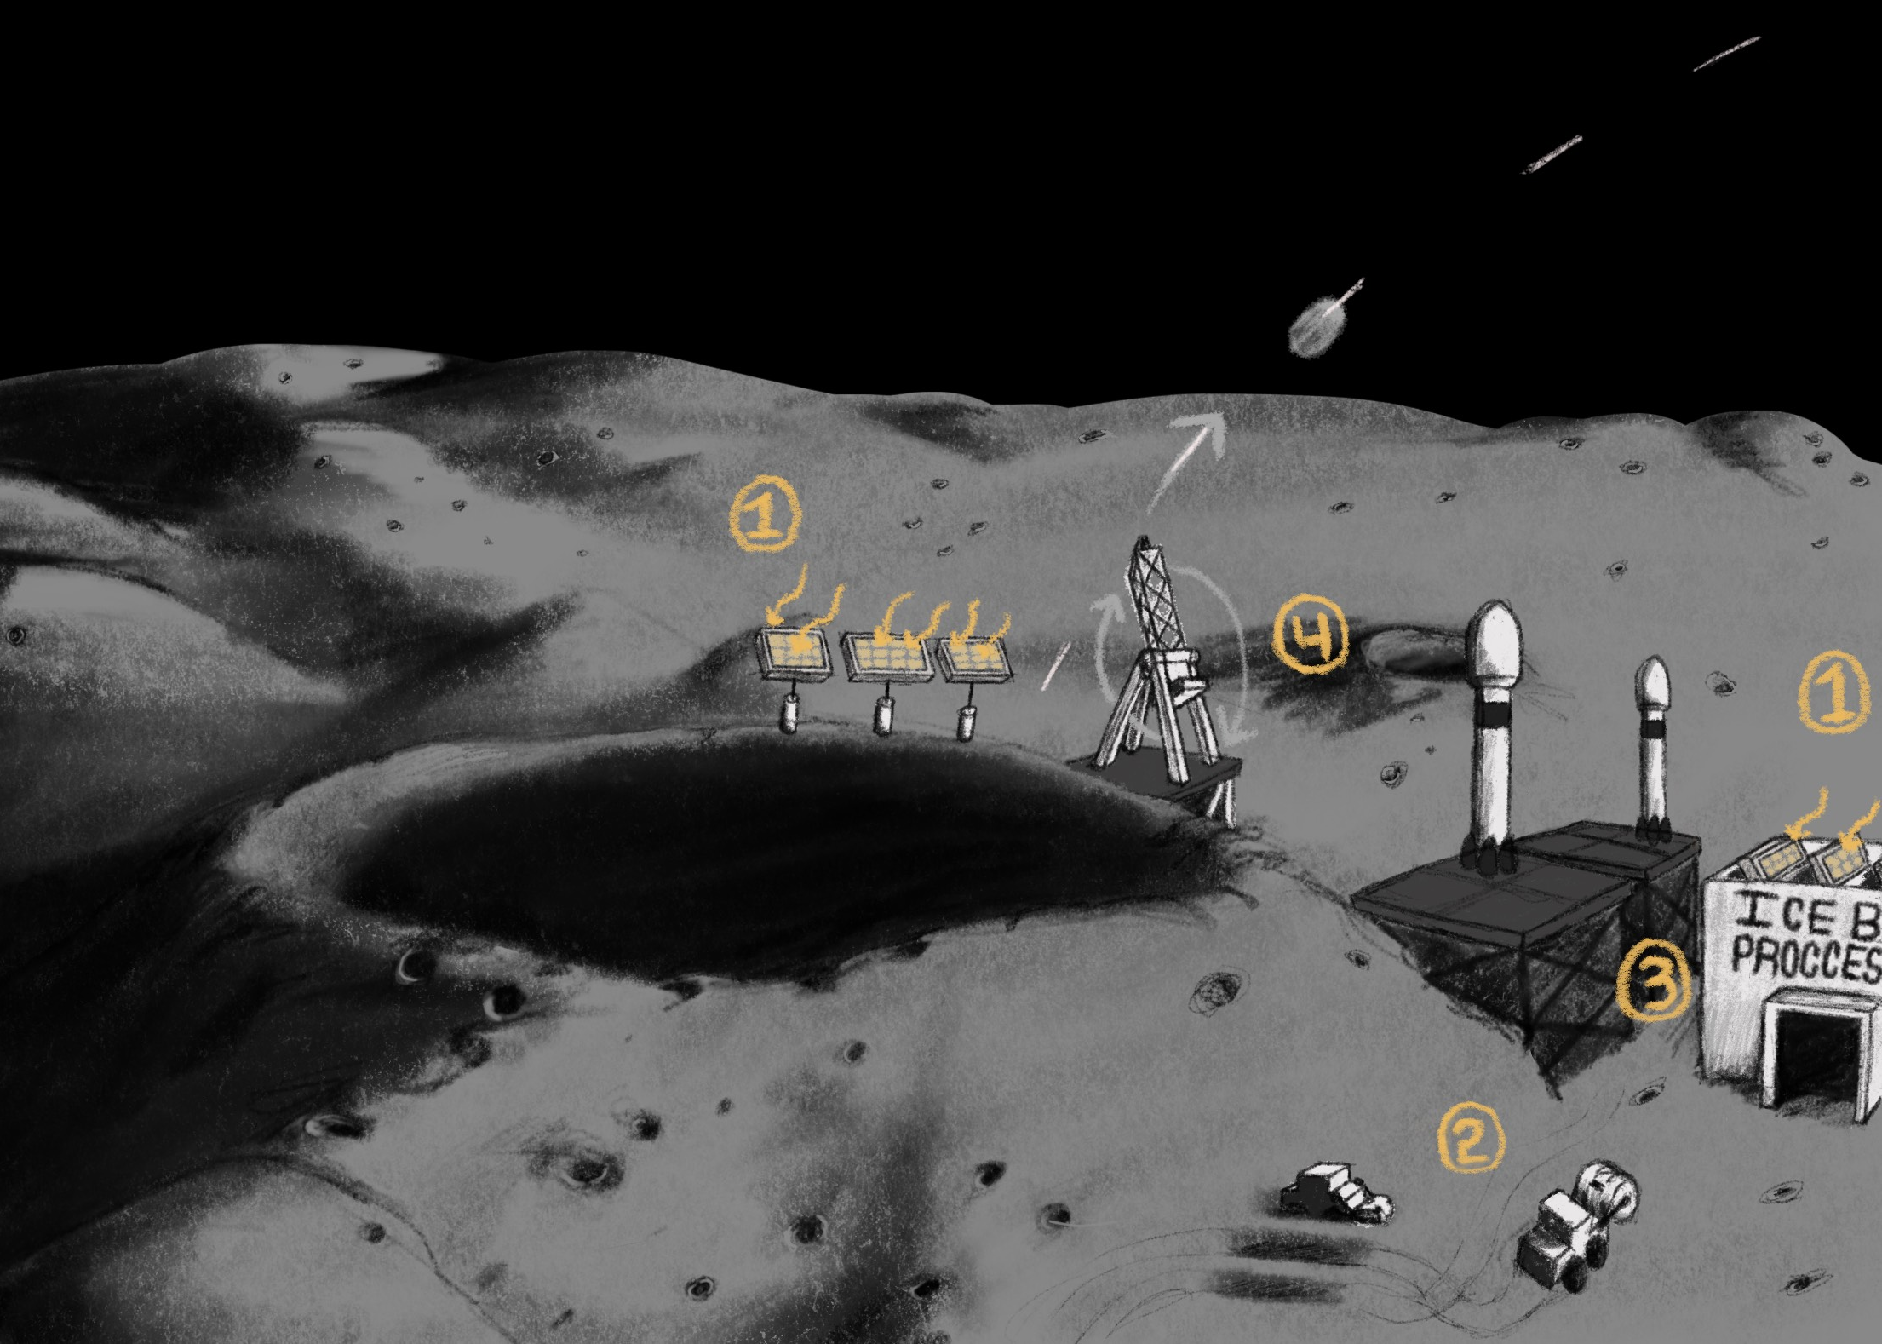
CONOPS: The Icebox Lunar Refueling Infrastructure (Size is not to scale)
1. Collect solar energy to charge flywheels and supply power to infrastructure
2. Collect regolith from surface with drum excavator rover
3. Process regolith using hydrogen reduction and water electrolysis
4. Supply customers on surface, or transport to orbit to supply orbital missions via kinetic launch system
Shackleton crater (NOT TO SCALE)
Project Scope
Project Definition
Project Description
CONOPS
6

Slide 7
Design Solution
1
2
3
Functional Block Diagrams
Pareto Frontier
Chosen Architecture
Purpose
Solution
CPE & Risks
Requirements
Verification & Validation
Planning
7

Slide 8
Functional Block Diagram Legend
Start
Option
Input; output
Model; Process; Function
Transition; Organization
FBD
Pareto Frontier
Architecture
8

Slide 9
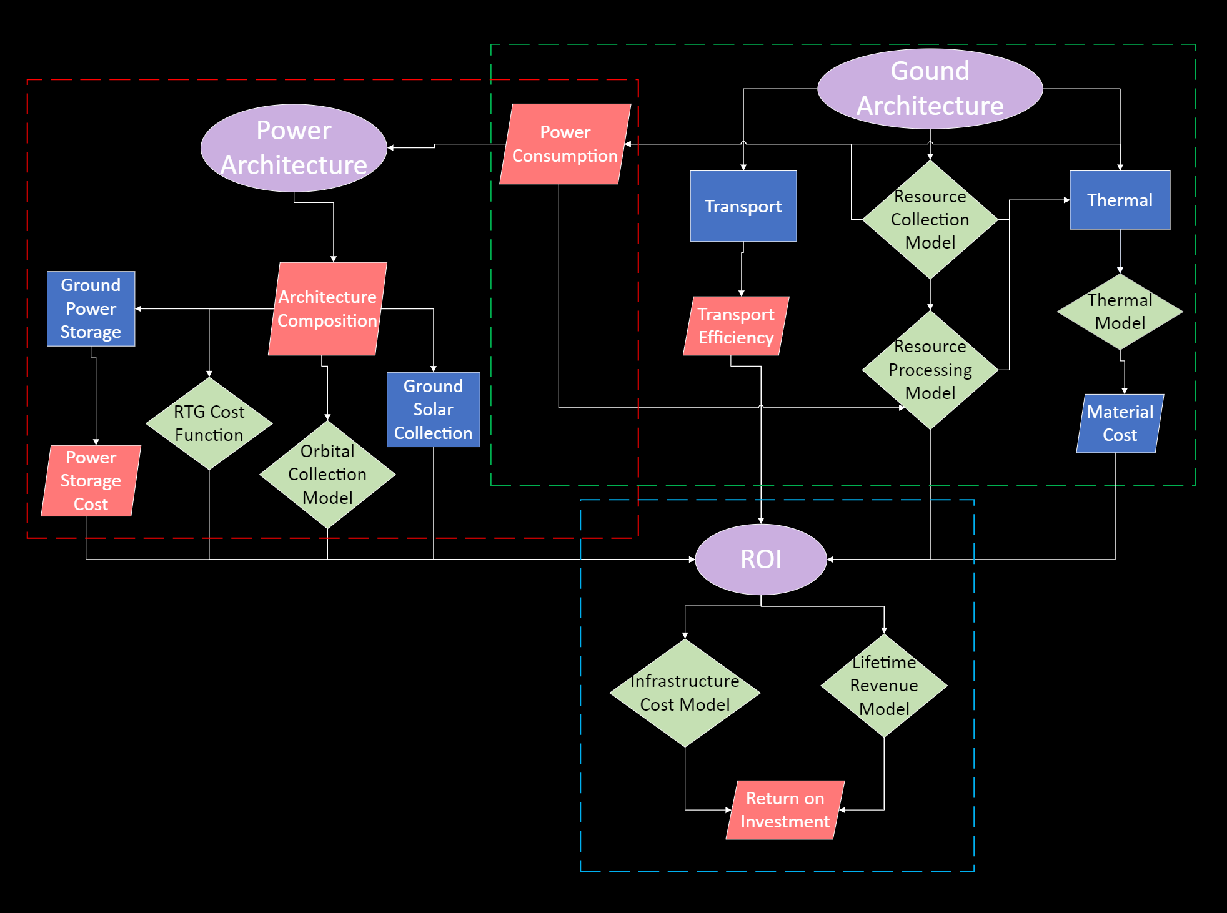
9

Slide 10
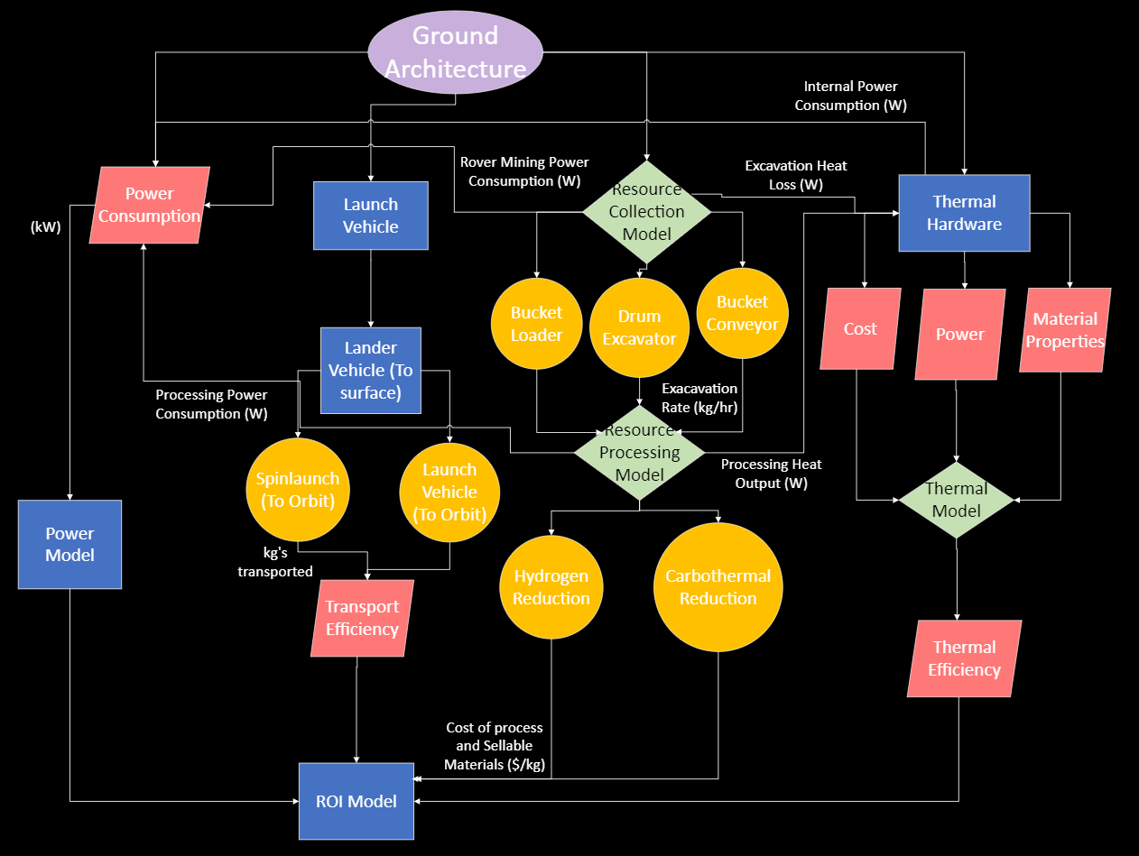
10

Slide 11
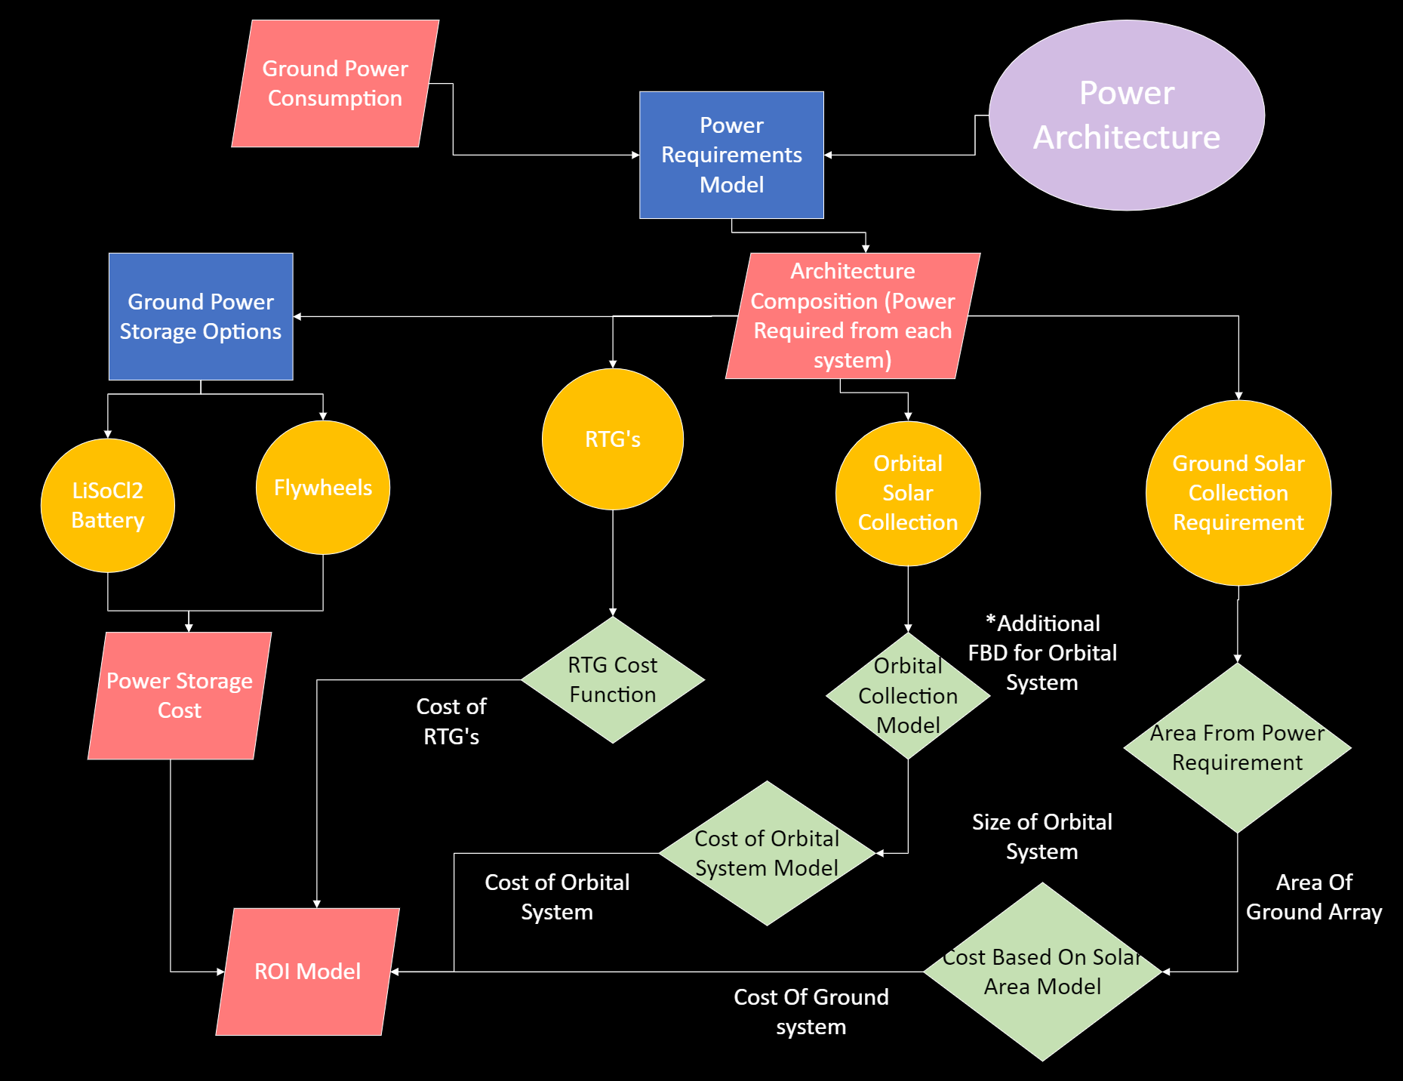
11

Slide 12
Pareto Frontier Model
- Developed model to iterate through technology trade space of each sub-systems
- Model operated by calculating material through put in kg/hr and power consumption in kW primarily in addition in each of these categories:
- Efficiency - Cost
- Lifetime
- Scores were then summed respectively between all subsystems, to create a final array infrastructure score.
- 2304 different infrastructure options from varying the models
FBD
Pareto Frontier
Architecture
12
Notes:
Collin

Slide 13
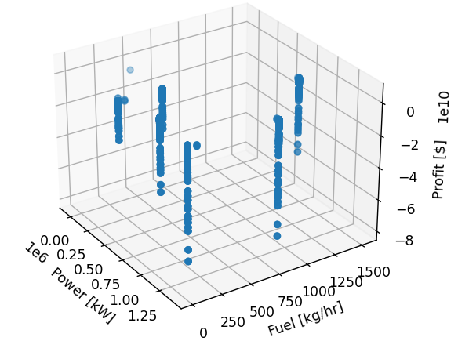
Pareto Infrastructure Objectives
All Possible Infrastructure Scores
Objective Space Infrastructure Scores
FBD
Pareto Frontier
Architecture
13
13
Notes:
Collin

Slide 14
Objective Space: Decision
Most Profitable
Maximize Fuel Production
Select Most Profitable Model
Maximum Fuel Production
FBD
Pareto Frontier
Architecture
14
Notes:
Collin

Slide 15
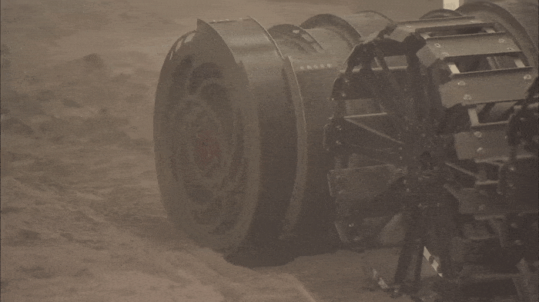
What - Chosen Architecture
Solution
The best working architecture provided from the Pareto Frontier
- Drum excavator style rover
- Hydrogen reduction with water electrolysis
- All ground-based power from solar arrays - Flywheel energy storage
- Spin launch delivery
FBD
Pareto Frontier
Architecture
15
Notes:
Collin
Ground based power: (Orbital was deemed too expensive)

Slide 16
Critical Project Elements and Risks
1
1
2
CPEs
Architecture
Risks
Purpose
Solution
CPE & Risks
Requirements
Verification & Validation
Planning
16
Notes:
Holzinger feedback:
ID 4-6 specific risks and mitigation strategy for each of those risks
- can go through with test inspection or analysis and verify we are meeting level 2 reqs
Next Semester
- Hardware demonstration for Level 2 Requirements

Slide 17
Critical Project Elements "Level 0 Requirements"
CPE​ | Description​
Land Rights and Policy​ | Minimum policy to make infrastructure possible​
Fuel Mining, Processing, and Storage System​ | Mining system, transportation system, processing system, storage system, method of distribution​
Space Based Power System​ | Power collection, power storage, power transmission to other systems​
Return on Investment​ | Cost, necessity, value​
Multi-level Objective Analysis​ | Model inputs, outputs, constraints​
Risk Reduction Hardware Demonstration​ | Assess and mitigate infrastructure risk​
CPE - Level 0
Risk Matrix
Risk Mitigation
17
Notes:
F – mention policy

Slide 18
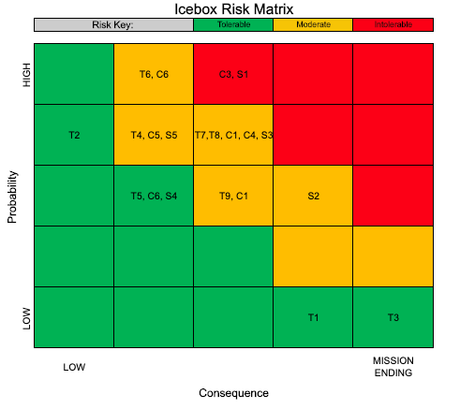
Risk Matrix
CPE - Level 0
Risk Matrix
Risk Mitigation
18
Notes:
F – note main risks

Slide 19
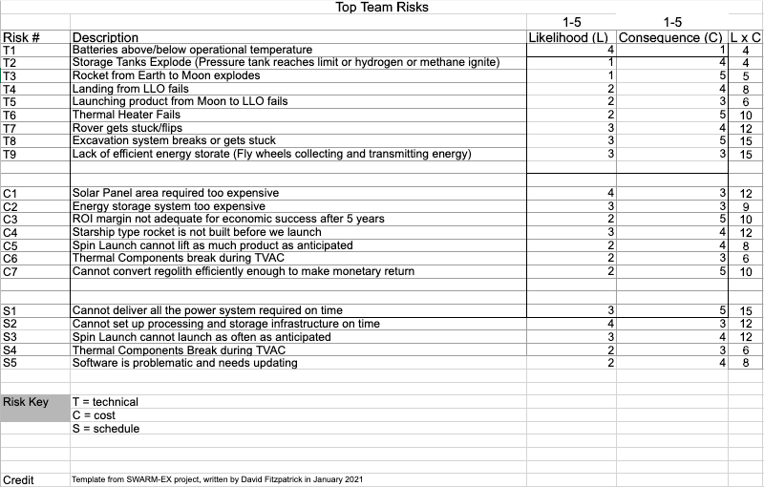
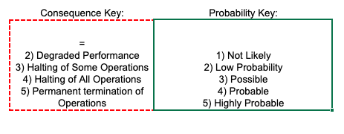
Risk Matrix
19
Notes:
F

Slide 20
Risk Mitigation
RISKS
MITIGATION STRATEGY
T9: Lack of efficient energy storage
T8: Excavation system breaks
T7: Rover flips or gets stuck
Create flywheel for storing energy instead of chemical batteries → *most feasible*
Have repair robots or send astronaut technicians → high cost, inefficient
CPE - Level 0
Risk Matrix
Risk Mitigation
20
Notes:
F

Slide 21
Design Requirements and their Satisfaction
1
2
Requirements
Models
Purpose
Solution
CPE & Risks
Requirements
Verification & Validation
Planning
21

Slide 22
Level 1 Requirements
Requirements
Justification
Must provide...
~1000 kg of fuel per hour
power operation architecture
Must...
profit over lifespan of the system
- Meaningful amount of fuel to customers
- Architecture requires specific power requirements
- Business must be profitable throughout lifetime
Level 1
Architecture
Models
Level 2
22
Notes:
F - Afterwards, remind why we chose what architecture we did based on these

Slide 23
Why - Chosen Architecture ~ Ground System ~
Drum excavator for maximizing fuel production
- simpler and less expensive than other options (robotic arm, astronaut miners, pareto tested mining methods)
- most efficient & profitable
Hydrogen reduction
- minimizes weight of needed reactant therefore reducing processing cost
Spin launch for delivery
- minimizes amount of fuel to sell to customers
- substitute for using rocket fuel for launches
Level 1
Architecture
Models
Level 2
23
Notes:
Description of what is most important to success of the project and why these elements were chosen to focus on in this presentation
Convey your understanding of how the system works and what design features, attributes, or characteristics are most important to that functionality

Slide 24
Why - Chosen Architecture ~ Power System ~
Ground based solar arrays
- solar panels reliable and used in nearly all space applications
- cheaper and more feasible (solar arrays for satellites size of ISS)
Flywheel energy storage system
- High specific energy (storage)
- higher temperature operating range than conventional batteries
- longer lasting than batteries since no discharge efficiency
- Moon surface vacuum → less friction and higher efficiency
Level 1
Architecture
Models
Level 2
24
Notes:
Collin
Description of what is most important to success of the project and why these elements were chosen to focus on in this presentation
Convey your understanding of how the system works and what design features, attributes, or characteristics are most important to that functionality

Slide 25
Ground: Excavation Model
Assumptions:
- Size limitation from "Over the Dusty Moon" Challenge
- Lunar dust smaller than 20 microns
- 1 of 3 typical mining tools compared at a time
- Constant motor RPM between conveyor and drum style methods
- Reasonable estimates for excavation rate based of size and rates from other company and industry listings
Level 1
Architecture
Models
Level 2
25

Slide 26
Ground: Excavation Model
Inputs
- Regolith Properties
- Excavator Properties
-
Outputs:
- Excavator productivity
- Bucket, Drum, Conveyor
-
Level 1
Architecture
Models
Level 2
26

Slide 27
Ground: Processing Model
Assumptions:
- 500 kg loss from storage 1 to 2
- Regolith starting at lunar surface temp at Equator during day: 260 K
- Ideal stoichiometry & reaction conditions
- No slag or excess CO2 produced
- Perfect Scaling
- No surface film
- Adiabatic containers
Level 1
Architecture
Models
Level 2
27
Notes:
F

Slide 28
Ground: Processing Model
Carbothermal Reduction:
- Methane Reduction
- Carbon Monoxide Reduction
- Water Electrolysis
Overall: Faster, Requires less Power
Hydrogen Reduction:
- Hydrogen Reduction
- Water Electrolysis
Overall: Cheaper, More Efficient
Level 1
Architecture
Models
Level 2
28
Notes:
F

Slide 29
ROI: Introduction
Definition: Return on Investment (ROI) is a key measure of the profit derived from any investment.
Model Goal: To calculate the ROI for different infrastructure models, technology combinations, and products to find the infrastructure that will be the most profitable.
Level 1
Architecture
Models
Level 2
29

Slide 30
ROI: Integration
ROI is dependent on the integration of all subsystems
Each sub-system has cost associated with it, such as operating cost, development cost, and other extraneous cost.
Level 1
Architecture
Models
Level 2
30

Slide 31
ROI Model Assumptions:
There is a limited time span in which the infrastructure will be able to operate.
Lifetime Revenue is calculated based on the value of kilograms of resources mined over the lifetime of the infrastructure.
Lifetime Revenue is independent of customer demand over time.
This is due to the predicted demand to be on the moon.
A Depot/Reserve style operation in which customers can buy when they arrive.
Level 1
Architecture
Models
Level 2
31

Slide 32
Business Model
Motto: "Mine, Store, Deliver“
Model: Business to Consumer via Depot/Reserve Business Model
Customer Demand: Increasing over time as Mission Increase to moon.
Lifetime Profit: ~1.1 Billion USD
Annualized ROI: Variable and Dependent on Customer Use
Level 1
Architecture
Models
Level 2
32

Slide 33
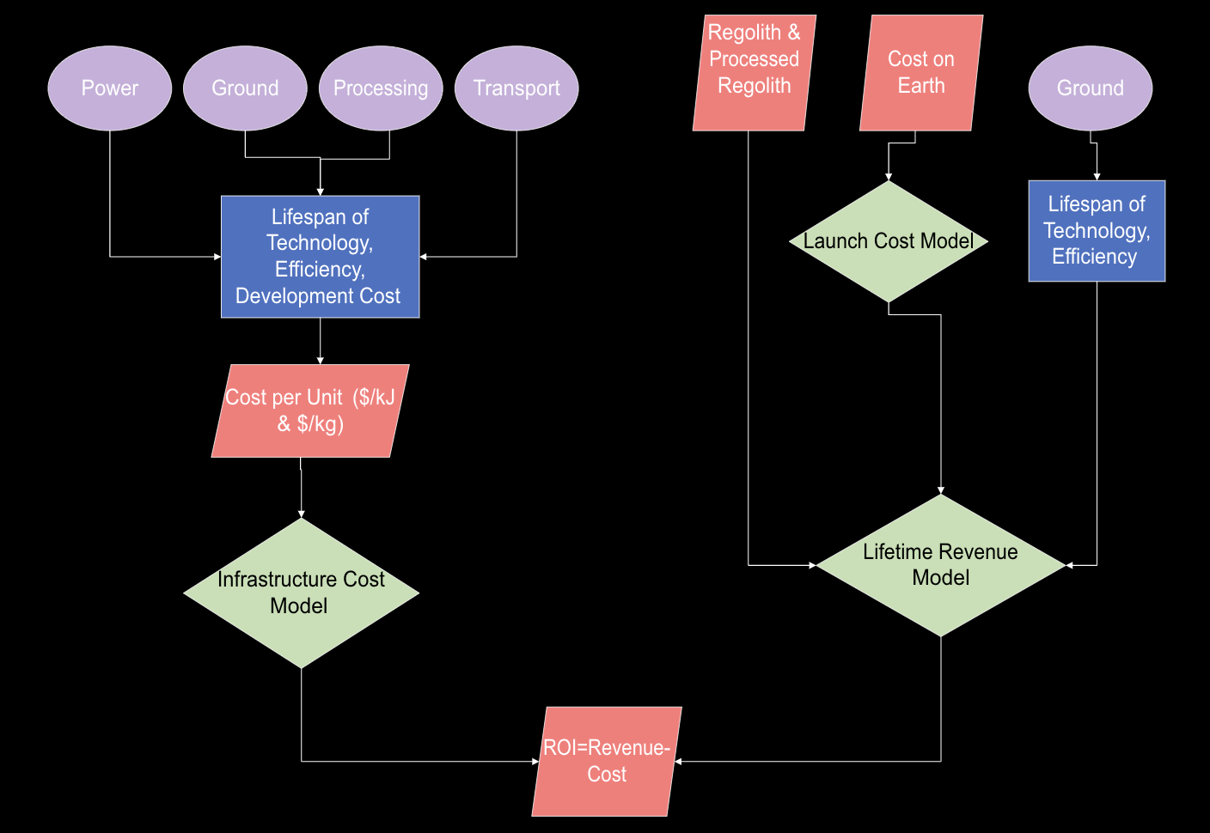
Level 1
Architecture
Models
Level 2
33

Slide 34
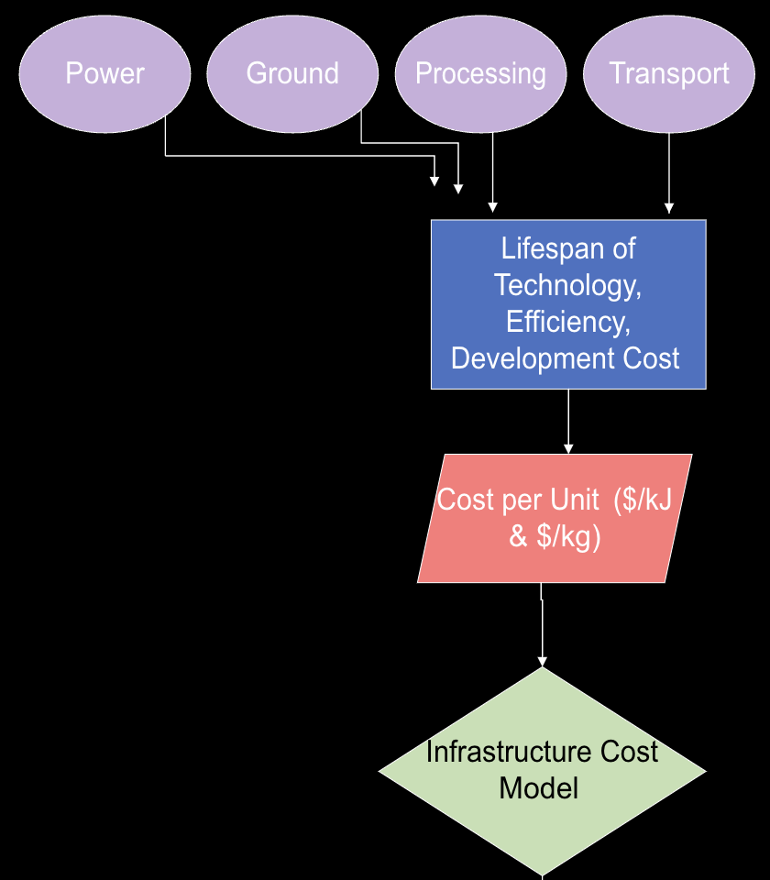
Infrastructure Cost Model
Ground Subsystems:
Mining, Processing, & Transport Cost/kg
Ground Technology Lifespan
Power: Cost/kJ
Conversion
Conversion
Ground Technology Output
Power Technology Lifespan
Power Output
Level 1
Architecture
Models
Level 2
34
Notes:
Lewis- Initial cost to moon
Fabrizio- Processing and Initial
Andrew- Cost to get customer

Slide 35
ROI: Code Integration
Due to a lack of experience, planning, communication, and varying assumptions. The integration of different subsystems did not go as expected.
This created a delay and hardships when attempting to create the pareto. The attempt to standardized the code took time and went subsystem by subsystem.
Unfortunately, ROI was the last system to be integrated. With the given timeframe, the Infrastructure Cost model developed was unable to be integrated due to time and complexity.
Level 1
Architecture
Models
Level 2
35

Slide 36
ROI: Outcome
The outcome of this is a non-standardized cost considerations for each sub-system, with limited consistency between systems.
The cost does not factor in key variables such as system lifespan and cost per operating unit. (Ex: $/kg)
The cost passed through do considering Development, Launch, and other major cost excursions.
Overall, we feel that the cost we considered, are of such a magnitude and scale, that the error is still within an acceptable range.
Level 1
Architecture
Models
Level 2
36

Slide 37
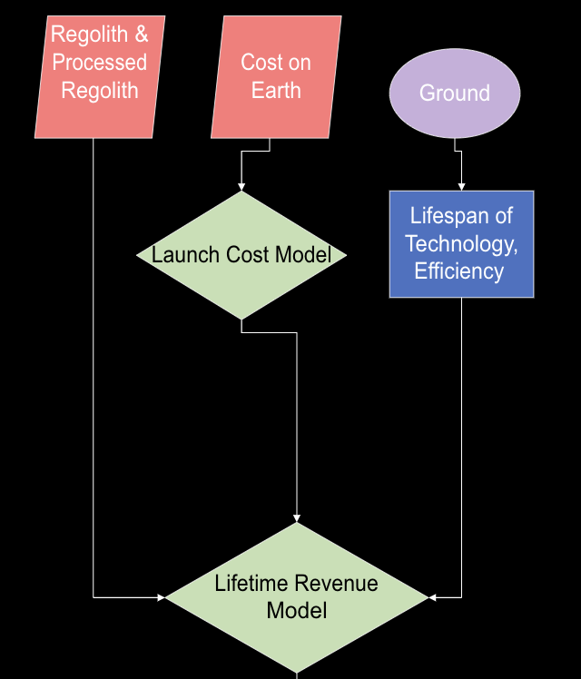
Lifetime Revenue Model
Launch Cost Model
Ground Technology Output
Conversion
Resource Abundance on Moon
Ground Technology Lifespan
Level 1
Architecture
Models
Level 2
37

Slide 38
Launch Cost Model
Purpose: Finding the selling price of products, by comparing the cost of getting resources to the moon via launching.
Product Cost = Launch Cost + Guestimate Mass *(Product Cost on Earth)
Falcon 9 Launch Cost
Maximum Payload
Product Cost on Earth based on Market
Level 1
Architecture
Models
Level 2
38

Slide 39
Level 2 Requirements
Requirements
Justification
Rover must collect 16200 kg of regolith per hour
Processing must be able to process all the regolith collected by the rover
Power systems must provide habitat with continuous power to operate (28kW or more)
Power system must store enough energy for processing system (805402.79 Watts)
This is the capability of our processing model, and running the processing plant always will be optimal for the architecture
This will drive processing scale
Habitat needs 28kW to run, otherwise people die
The processing system runs in waves, and will require power storage so that it can begin to run one cycle
Level 1
Architecture
Models
Level 2
39
Notes:
Note on rover collection
- requirement of fuel is diff from requirement of regolith

Slide 40
Level 2 Requirements
Requirements
Justification
Power system must be able to store enough power to operate spin launch (3x10^9 Joules)
Power system must be able to store 3-4 days-worth of reserve power for contingency purposes
Spin launch must be able to send 1000* kg of fuel in a single launch
Full return on investment before architecture components must be replaced
Power is required for spin launch to operate
Provide a safety buffer for the crew in the event of an emergency
Spin launch structure and dynamics must be capable of sending significant amounts of fuel
If we need to replace components before we make a profit, profit isn't feasible
Level 1
Architecture
Models
Level 2
40
Notes:
From Holzinger:
- our Level 2 Reqs are similar to other team's level 1 ( we need less detail)
- overall performance reqs
- Showing verification: thing we designed meets particular performance value (quantifiable) necessary for whole system to work
- show this with test inspection or analysis

Slide 41
Verification and Validation
1
2
Analysis of System
Hardware Demonstration
Purpose
Solution
CPE & Risks
Requirements
Verification & Validation
Planning
41

Slide 42
Analysis of System
Detailed Analysis
- Optimize architecture
- Refine detail
- Develop CONOPS to outline architecture operations
- Develop hardware demonstration for high-risk component
Analysis of System
Power Analysis
Hardware Demonstration
42
Notes:
Collin
Now with a chosen architecture, we can begin to analyze it in detail

Slide 43
Power Analysis
Flywheel for Energy Storage
PROS
- Constant Power Output
- High Efficiency
- Long Life
(no chemical battery degradation)
(no temperature variability)
- High Energy and Power Density
CONS
- More Expensive
- Requires More Space
- Heavier
Analysis of System
Power Analysis
Hardware Demonstration
43
Notes:
Collin

Slide 44
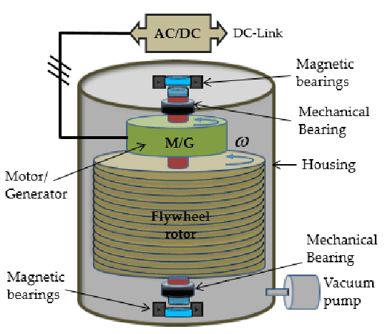
Hardware Demonstration
Fly Wheel Components:
- Rotor
- Axle
- Motor
- Generator
- Magnetic Bearings
- AC to DC converter
Analysis of System
Power Analysis
Hardware Demonstration
44
Notes:
Holzinger feedback
- solar one doesn't help with reduction of risk
- spin launch too dangerous and hard (and how many times could we test it? Is it easy? )
- flywheel sounds the best (detailed dynamical models talking about what important parameters are – how good are bearings (to make sure doesn't lose energy, magnetic?)

Slide 45
Project Planning
1
2
3
4
Test Plan
Cost Plan
Work Plan
Lessons Learned
Purpose
Solution
CPE & Risks
Requirements
Verification & Validation
Planning
45

Slide 46
Test Plan
Test 1: Motor Spins Up Rotor
- Can it maintain angular velocity needed to hold enough power during the moon's night cycle?
Test 2: Recover Energy with Generator
- How much energy can we recover?
Test 3: Optimize Design to Maximize Efficiency
- Can it store energy longer than a conventional battery at sub-freezing temperatures?
Plans
Lessons Learned
46

Slide 47
Cost Plan
- 24V Solar Panel: $125
- 24V DC motor: $250
- High power magnets: $60
- Brake rotor: $50
- 24V to 5V step-down voltage converter: $30
- Mounting Infrastructure: ~$400
- Total Price: ~ $1000
Plans
Lessons Learned
47

Slide 48
Work Plan
Hardware demo schedule:
- Buy...
(1) Solar panel to power motor to spin axle
(2) Disk break or mill a heavy aluminum disk
- Attach...
(1) Disk to milled or bought axle and levitate with magnets
(2) Magnets and coiled wire housing to axle to generate electricity
Plans
Lessons Learned
48

Slide 49
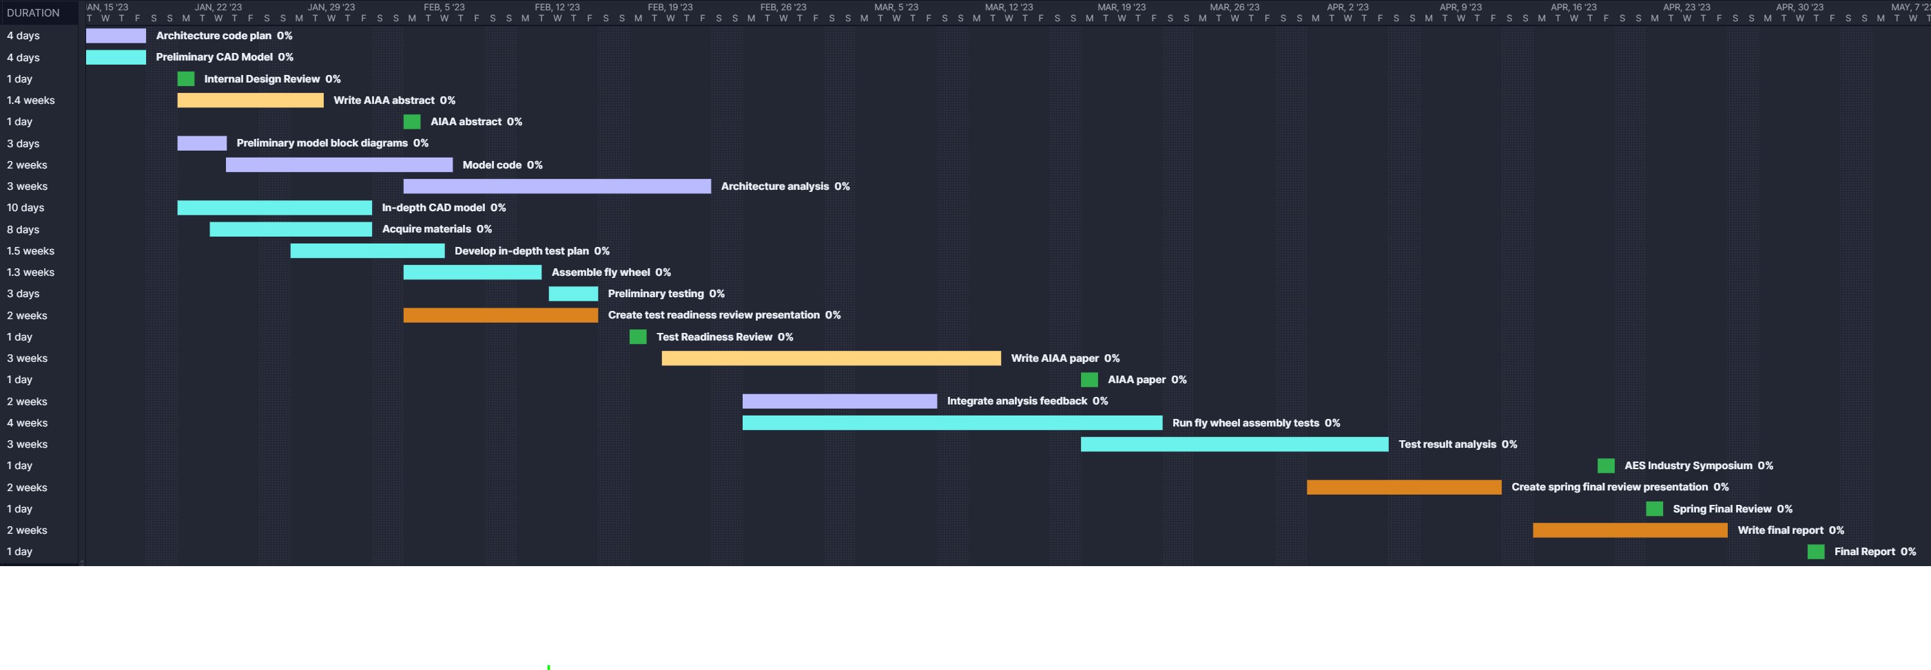
Overall Work Plan
Key:
Hardware
Software
AIAA
Projects
Deadlines
Plans
Lessons Learned
49

Slide 50
Overall Work Plan
Plans
Lessons Learned
50

Slide 51
Overall Work Plan
Plans
Lessons Learned
51

Slide 52
Lessons Learned
- Poor Initial Integration of Various Subsystem Pareto's
Massive assumptions
Different coding structure/organization across models
- Team Communication
Coordination and Planning
Plans
Lessons Learned
52

Slide 53
Thank you. Questions?
53

Slide 54
Backup Slides
54

Slide 55
Hardware Demo Feedback from Wingate
Fly Wheel:
How easy is it to make or buy?
How much time would that take?
If it takes too long or too much work, then might be out of scope
Talk to Bobby or Rhode to discuss feasibility of testing within the time given next semester
Spin Launch:
Gravity is different on earth
What variable are we analyzing (velocity?)
Are we launching a liquid or a solid?
If a liquid, it will be too difficult to imitate the dynamics
If launching a solid this this might be doable
If this is doable on earth and the dynamics will be the same – good relations between earth and space – we could probably do this

Slide 56
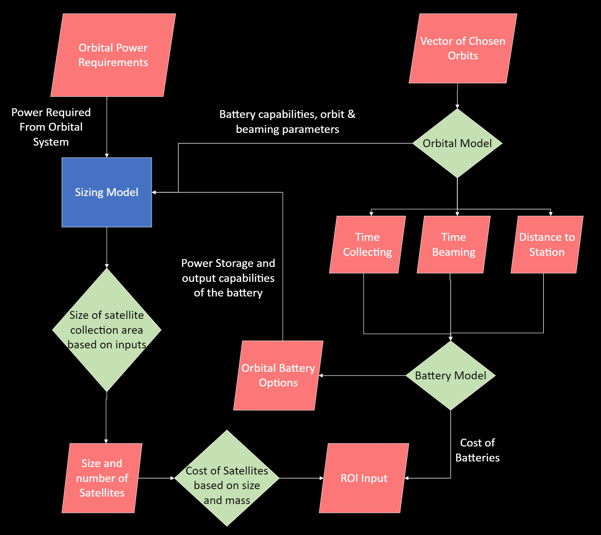
56
Notes:
Collin

Slide 57
Power: Orbit Model
Assumptions:
Circular restricted 3 body problem
Lunar Synodic Period = 29.53 days
Length Unit (LU) = 389703 km, Time Unit (TU) = 382981 s, Moon Radius = 1737.1 km
Inputs:
Initial state vector
Orbital period
Output:
Array of orbit state vector over time
57

Slide 58
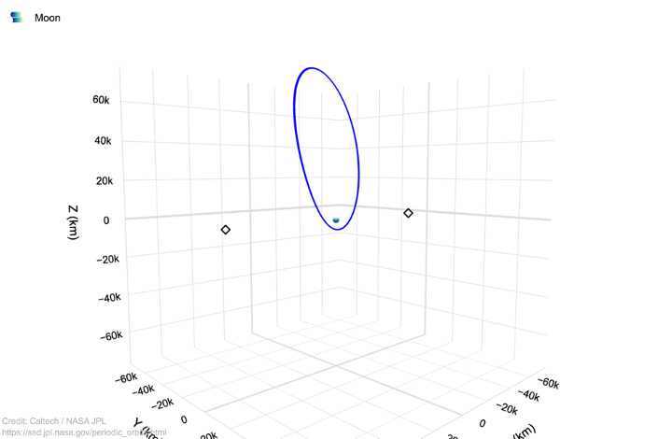
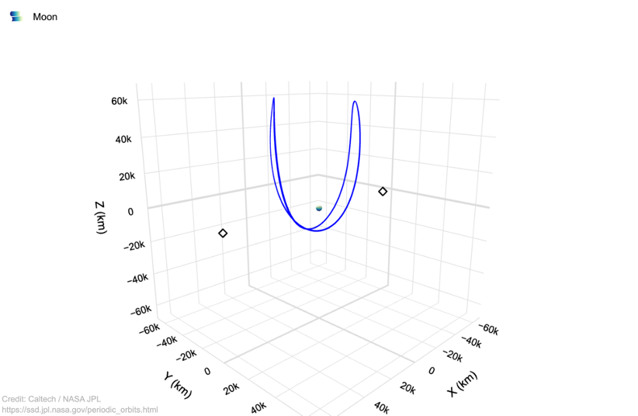
Power: Orbit Model
Used Cislunar Toolkit and JPL three body orbit resource:
Found orbits with synodic based periods
Used single shooter to find exact initial state
Butterfly orbit
Period=14.7 days
Half of moons synodic orbit
Halo orbit, L2 centered, Northern
Period = 7.38 days
quarter of moons synodic orbit
58

Slide 59
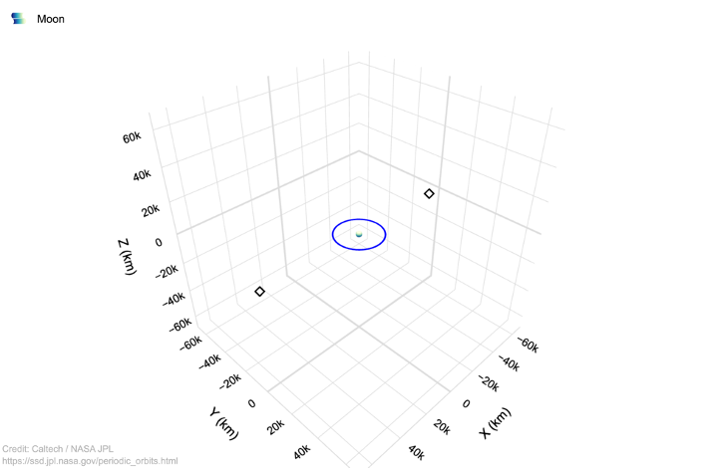
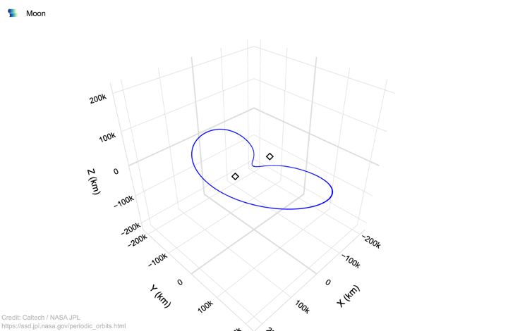
Power: Orbit Model
Distant Prograde orbit, P2 centered
P = 1.845 days
1/8 of moons synodic orbit
Lyapunov Orbit, L2 centered
Period = 29.53 days-synodic orbit
59

Slide 60
Power: Orbital Storage
Battery:
Scaled based on EaglePicher Technologies LP341000 due to high discharge rate
Very high-power density, lithium-ion cell
30% discharge to conserve battery and prevent degradation
Supercapacitor:
Scaled based on in-orbit demonstration of super capacitors in Acta Astronautica [1]
98% discharge, cyclable for much longer than batteries
No risk of explosion
Inputs:
Energy Required
Outputs:
Cost
Mass
Discharge Time
[1] Gonzalez-Llorente, Jesus, et al. “In-Orbit Feasibility Demonstration of Supercapacitors for Space Applications.” Acta Astronautica, vol. 174, 2020, pp. 294–305., https://doi.org/10.1016/j.actaastro.2020.05.007.
60

Slide 61
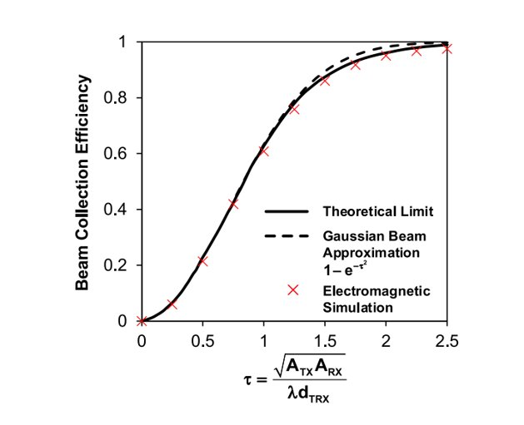
Power: Beaming Model
Assumptions:
Microwave Power Beaming
Circular transmitter and receiving apertures
Largely scalable
No atmospheric loss
61

Slide 62
Power: Solar Model
Assumptions:
Dimensions and masses of solar panels are similar to the ISS’ solar panels
Final solar panel efficiency will be closer to maximum laboratory efficiencies (40%)
Time in eclipse negligible
Inputs: Power needed to sustain satellite alone
Outputs: Req'd solar array area --> use this for reasonable estimates of how much more power can be used for energy transmission
62

Slide 63
Ground: Thermal Model
Assumptions:
- All surface area is covered by analyzed thermal hardware
- Utilizing same thermal hardware values as the Polar Ice Explorer (PIE)
- Thermal Balance: Qrad - Q_IR - Qalbedo - Qsolar - Pdisp
63

Slide 64
Ground: Thermal Model
Inputs:
- Thermal Hardware Properties
- Costs
- Power
Outputs
- Efficiency
- Thermal Balance
64

Slide 65
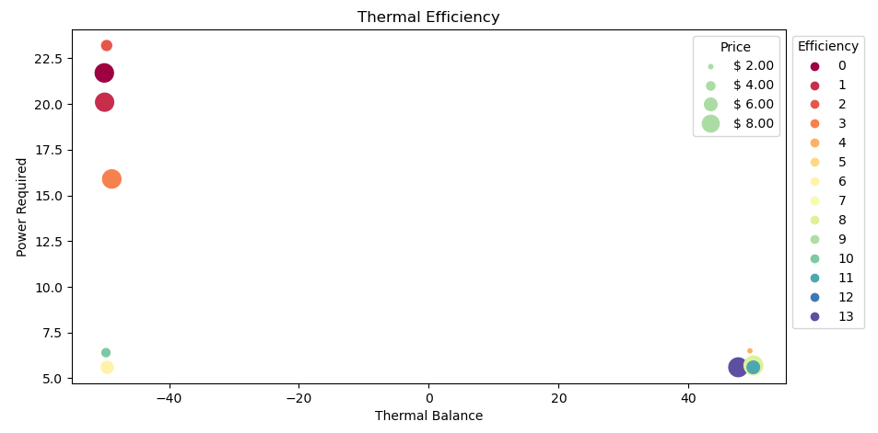
Ground: Thermal Model
0: SSM
1: White Paint
3: AgTeflon
4: Heat Switch
5: Louvre
65
Notes:
1 : SSM Efficiency: 2.138417574608068, Thermal Balance: -49.92390737899452, Max SA: 4.200000000003538
2 : White Paint Efficiency: 2.302860265033709, Thermal Balance: -49.61128773090717, Max SA: 3.7000000000035396
3 : AgTeflon Efficiency: 2.48377648651714, Thermal Balance: -49.972067751231485, Max SA: 10.55000000000356
4 : Heat Switch Efficiency: 3.070699432660468, Thermal Balance: -48.82412097930145, Max SA: 3.4000000000035406
5 : Louvre Efficiency: 7.607039503496532, Thermal Balance: 49.922932736462684, Max SA: 5.850000000003532
6 : Lourvre + Heat Switch Efficiency: 7.768097591729311, Thermal Balance: 47.641170445705654, Max SA: 0.25000000000354433
7 : Deployable Radiator (Black Paint) Efficiency: 8.507351865304582, Thermal Balance: 49.8994421823287, Max SA: 5.800000000003532
8 : Deployable Radiator (Solar Cell) Efficiency: 8.755686999344068, Thermal Balance: 49.249396727272384, Max SA: 0.3500000000035443
9 : Deployable Radiator (MLI) Efficiency: 8.768649783703593, Thermal Balance: 49.981303767110475, Max SA: 5.250000000003534
10 : Deployable Radiator (White Paint) Efficiency: 8.794535129870068, Thermal Balance: -49.90741589626119, Max SA: 12.300000000003585
11 : Deployable Radiator (White Paint + Heat Switch) Efficiency: 8.843352471006511, Thermal Balance: 49.964136347394025, Max SA: 6.150000000003531
12 : Deployable Radiator (MLI) Efficiency: 8.91061467541584, Thermal Balance: -49.52277383763646, Max SA: 5.550000000003533
13 : Deployable Radiator (MLI) Efficiency: 8.914809417225479, Thermal Balance: 49.44575677272746, Max SA: 1.350000000003545
14 : Deployable Radiator (MLI + Heat Switch) Efficiency: 8.92216720489179, Thermal Balance: -49.715824587067594, Max SA: 3.7500000000035394

Slide 66
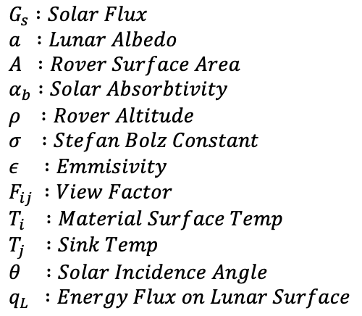
Ground: Thermal Model
Equations:
-
-
-
-
Variables:
66

Slide 67
Ground: Transportation
Assumptions:
(1) Costs does not account for building/developing vehicles or infrastructure
(2) To account for Moon's gravity assume we can multiply the amount of mass spin lauch can lauch into orbit on Earth by this ratio to get moon equilvalent g/gm
Deliverables:
(1) Extra cost for The Ice Box per sale [$]
(2) Extra ONE TIME cost for The Ice Box [$]
(3) Extra cost for customer per sale [$]
(4) Extra ONE TIME cost for customer [$]
(5) Amount of product that can be transported per sale [kg]
(6) If method of getting product to orbit is reusbale how much [kg]'s of fuel
# or [J]'s of energy needed per sale
67

Slide 68
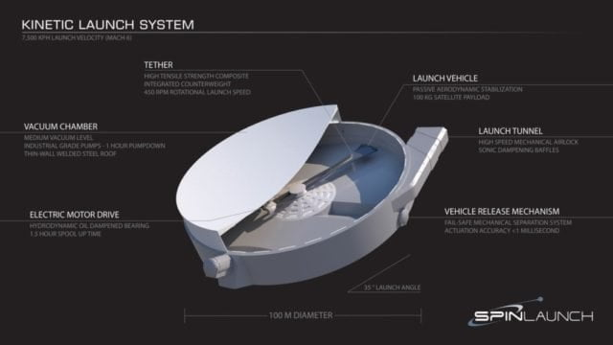
Ground: Transportation
Calculations
Price to bring 1 kg to moon's surface:
- Using Saturn V / SLS
- Using Falcon Heavy
- Using Starship
Kg per hour and ROI of system:
- Using Apollo 11/Blue Origin Lunar lander
- Using Straship Lunar lander
- Using spin launch system
68

