Slide 1
Test Readiness Review
The Icebox
LEWIS BITTNER, WILLY GETTINGER, COLLIN HAYES,
REINA KRUMVIEDA, ALAYNA LAUFFER, ZAK REICHENBACH,
FABRIZIO ROBERTS, ANDREW SAPUPPO, AMIR TILLIS

Slide 2
Overview
Overview
Schedule
Test Readiness
Budget

Slide 3
Project
Last Semester
This Semester
Systems of Systems architecture in cislunar regime
3 High Level Objectives
Fuel mining
Space-based power
ROI
Multi-Objective Optimization
Pareto surface
Risk mitigation
Hardware demonstration
Demonstrating the feasibility of a Flywheel Energy Storage System and mitigating the risk around energy storage capabilities.
Hardware Demonstration – Flywheel
Design and assembly
Testing
Goal: prove this is a valid option for energy storage and mitigate risk
Software Analysis
Does our chosen architecture meet our level 2 requirements and models?

Slide 4
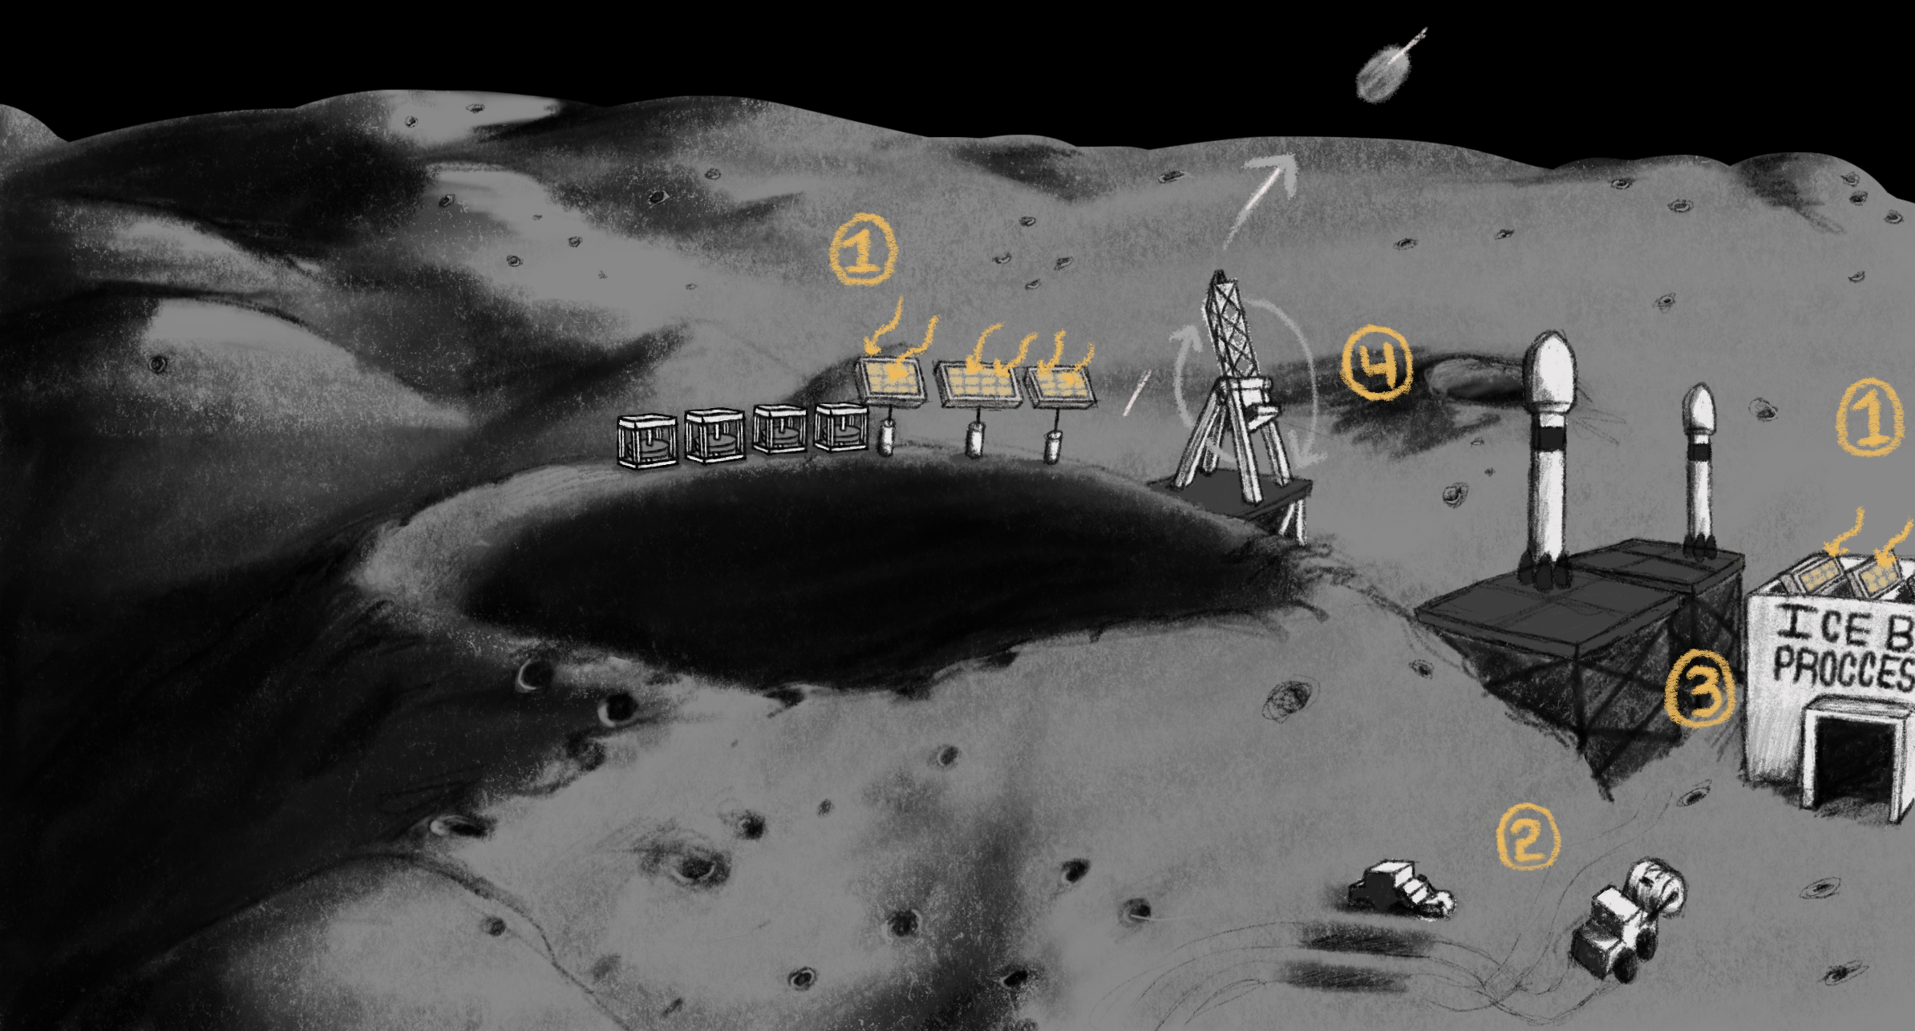
CONOPs
1. Collect solar energy to charge flywheels and supply power to infrastructure
2. Collect regolith from surface with drum excavator rover
3. Process regolith using hydrogen reduction and water electrolysis
4. Supply customers on surface, or transport to orbit to supply orbital missions via kinetic launch system
Shackleton crater (NOT TO SCALE)
4
Notes:
Maybe add a flywheel to this CONOPs?

Slide 5
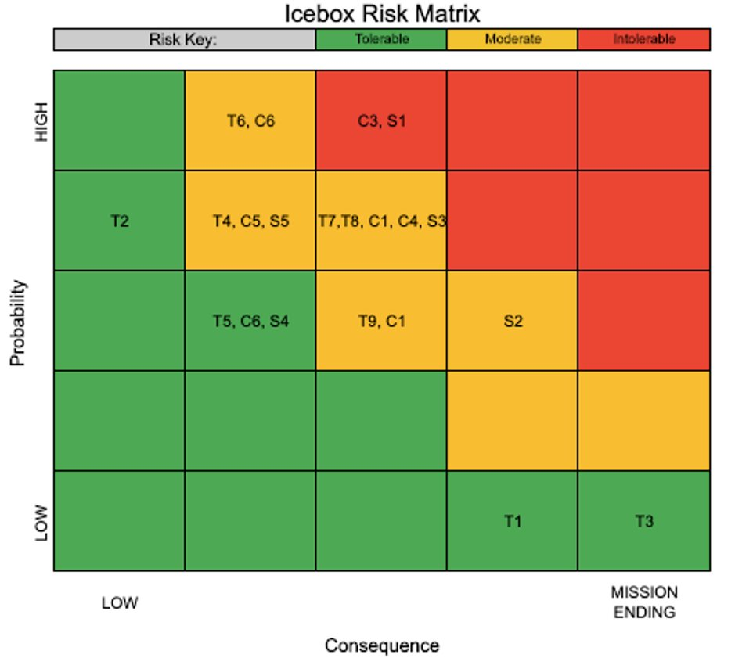
Risk Matrix
C3 = ROI margin not adequate for economic success
S1 = Cannot deliver all the power system required on time
Risk Mitigation:
T9 = Lack of efficient energy storage
Hardware demonstration:
Build a flywheel
Test efficiency and storage capacity of flywheel
5

Slide 6
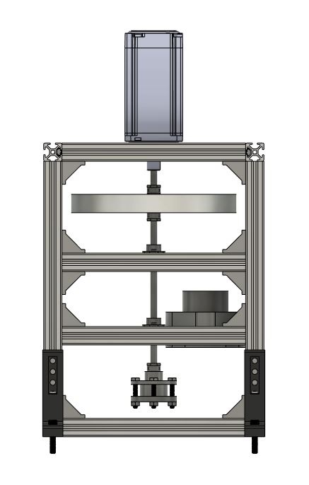
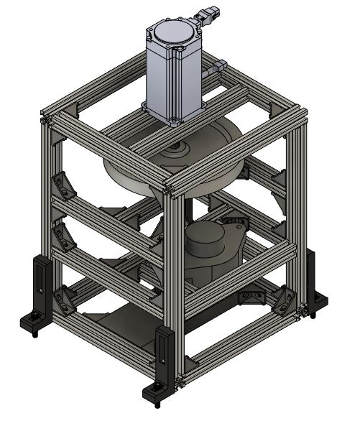
Baseline Design
Goal: Flywheels as an alternative to batteries for power storage
Main System Components
Motor to spin up Flywheel
Flywheel on axle to store energy via rotational kinetic energy
Alternator to turn the mechanical energy into electrical energy
Magnetic levitation system
Polycarbonate shielding for safety (not shown for clarity)
1.
2.
3.
4.
Notes:
Have call outs with arrows as to where things are
CONOPs for test = how does test work
Recognize a lot has changed since CDR – the nature of our project is different

Slide 7
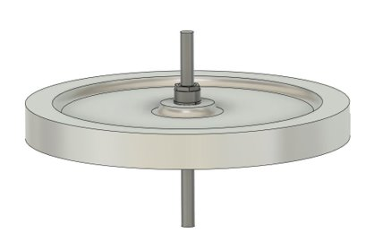
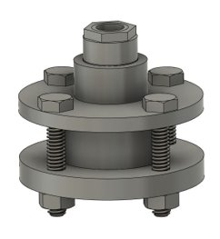
Key Mechanical Systems
Flywheel
Maximum of 9” diameter and 1” thick
Secured to the 3/8” axle via 2 keyless bushings
Stores the energy in the form of rotational kinetic energy
Flywheel Energy Storage Capacity: ~ 1800 J
Magnetic Levitation
Two Neodymium Magnets used to levitate the flywheel to reduce friction
Secured Between two plates
Magnet weight capacity
Total: 54.9 kg (when in contact)
Required: 3 kg

Slide 8
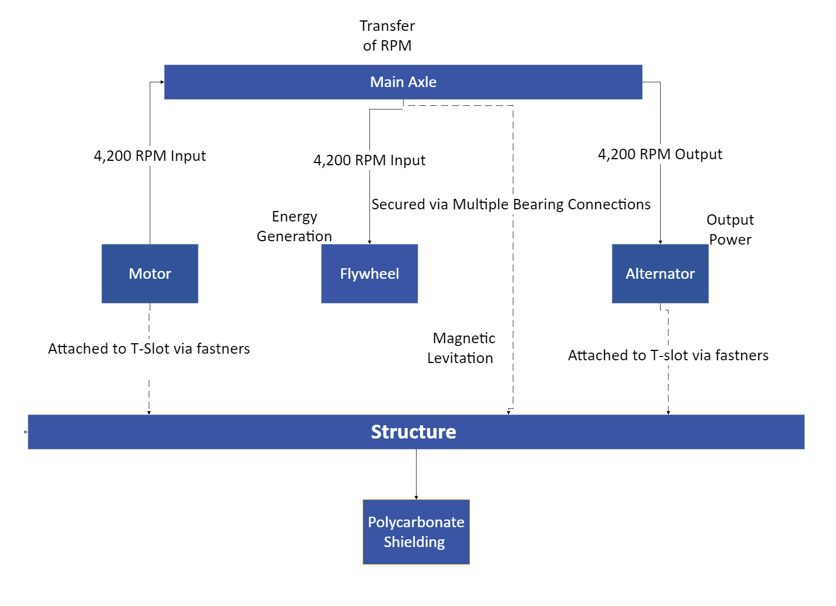
Mechanical FBD

Slide 9
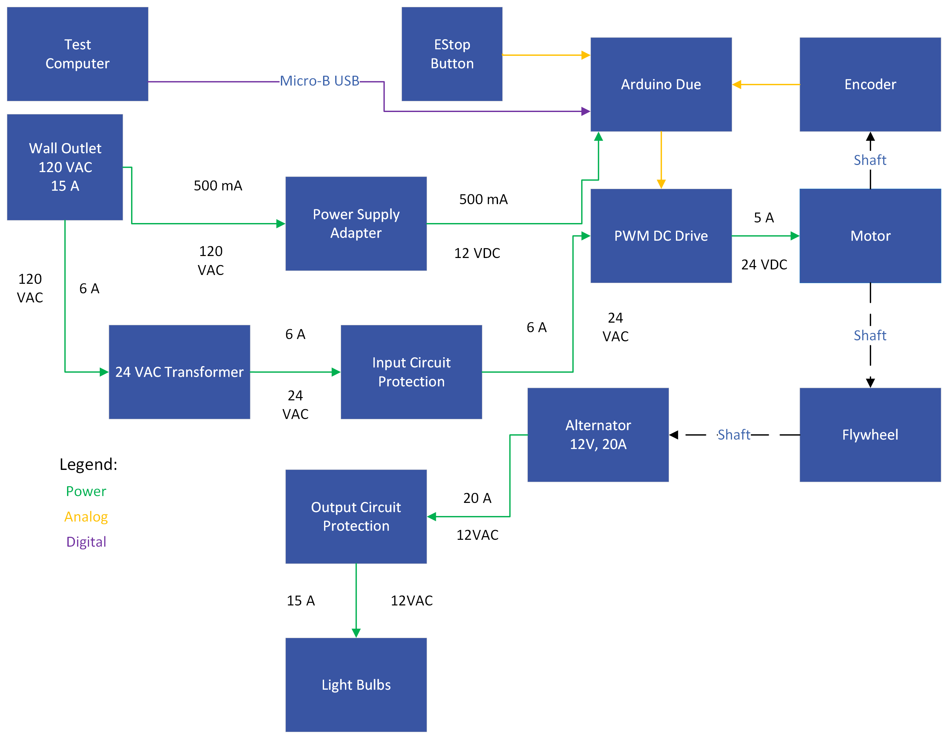
Electrical FBD
Notes:
Standardize coloring for all FBDs
Highlight where arduino is

Slide 10
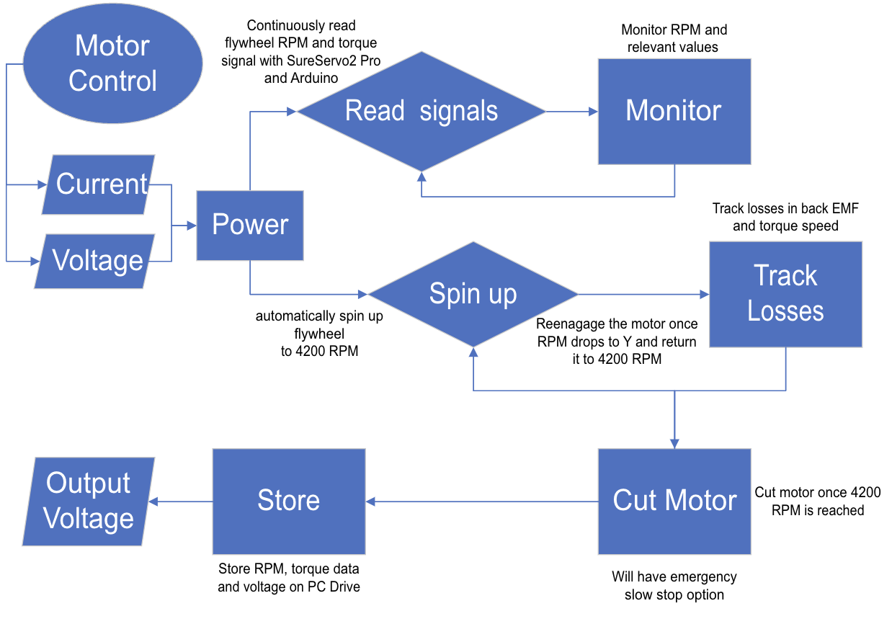
Software FBD
SureServo Speed Control Bandwidth: Max 3.1 kHz (closed loop)

Slide 11
Level 2 Requirements and CPEs
Overall Project
Level 2 Requirements (whole system)
Land Rights and Policy
Fuel Mining, Processing, and Storage
Space Based Power
Return on Investment
Multi-level Objective Analysis
Risk Reduction Hardware Demonstration
Power systems must provide habitat with continuous power to operate (28kW or more)
Energy system must store enough energy for processing system (2.34*10^10 J)
Energy system must store enough energy for spin launch system (3*10^9 J)
Power system must be able to store 3 days' worth of reserve power for contingency purposes
Notes:
Relate and describe difference between CDR requirements and our hardware demonstration specific requirements.

Slide 12
Level 2 and Level 3 Requirements
Level 2 Requirements
Level 3 Requirements
Power systems must provide habitat with continuous power to operate (28kW or more)
Energy system must store enough energy for processing system (2.34*10^10 J)
Energy system must store enough energy for spin launch system (3*10^9 J)
Power system must be able to store 3 days' worth of reserve power for contingency purposes
Flywheel shall reach 4200 rpm
Flywheel system shall store ~1800 J of kinetic energy
Flywheel energy output shall have an efficiency of at least 70%
Flywheel shall be able to free spin for 2 mins before coming to a complete stop

Slide 13
Hardware Demo Requirements
Requirements
Verification
Flywheel shall be able to free spin for 2 mins before coming to a complete stop
Flywheel power output shall have an efficiency of 70%
Flywheel shall reach 4200 rpm
Flywheel system shall store ~1800 J of kinetic energy
Test energy dissipation
Investigate frictional losses in the system
Test efficiency
Investigate energy input vs output over varied intervals of time

Slide 14
Schedule
Overview
Schedule
Test Readiness
Budget

Slide 15
Tests
Preliminary Component Testing
Alternator
Output Circuit
Sensor
Motor Characterization
Motor/Software Test
Determine Back EMF and Torque Constant for Motor
Mechanical Testing
Brake Test
Loose Hand Testing
Alternator Engage
Axle/Magnet Test
Post-Testing Model Validation
Energy Dissipation Test
Efficiency Test
Notes:
Noticed naming of tests isn't consistent as of now.
Add slide with EVERY test

Slide 16
Gantt Chart
Notes:
Add critical path to Gantt chart and maybe relate this schedule

Slide 17
Gantt Chart: Assembly and Testing
Notes:
Add critical path to Gantt chart and maybe relate this schedule

Slide 18
Test Readiness
Overview
Schedule
Test Readiness
Budget

Slide 19
Major Test #1

Slide 20
Major Test #1 – Energy Dissipation Test
What: Spin Flywheel up to 4,200 RPM, record how long it takes to come to rest.
Why: To understand the energy dissipation of our system, without a load. This allows us to better understand the friction of our system and allows us to compare our systems to other technologies. We can also scale this test, to understand our system at a larger scale implementation. In addition, this also will allow us to understand areas of improvement for our system.
Pre-req tests: Electro-Mechanical Test, Integrated Mechanical Test.
Notes:
Maybe rename test?

Slide 21
Energy Dissipation Test – Overview
1.
Energy Dissipation Test, will encompass and require entire system architecture
Motor Starts and Flywheel Spins Up
Flywheel Spins up to 4,200 RPM and then coast to stop
2.

Slide 22
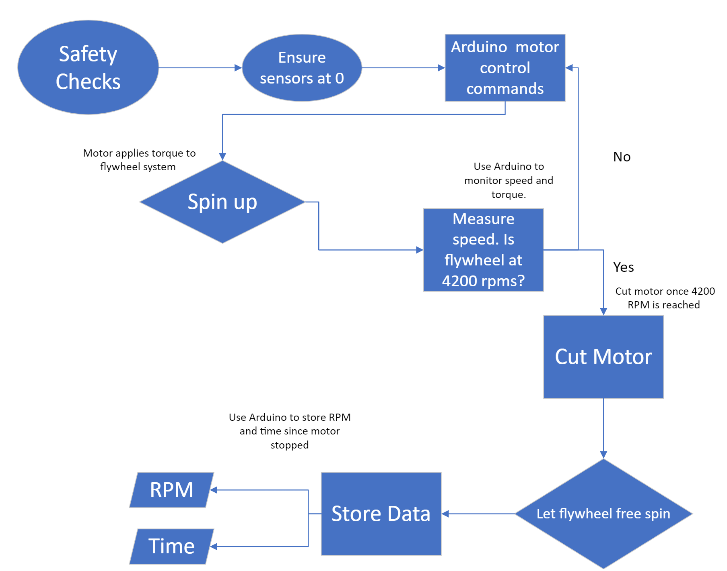
Energy Dissipation Test - FBD

Slide 23
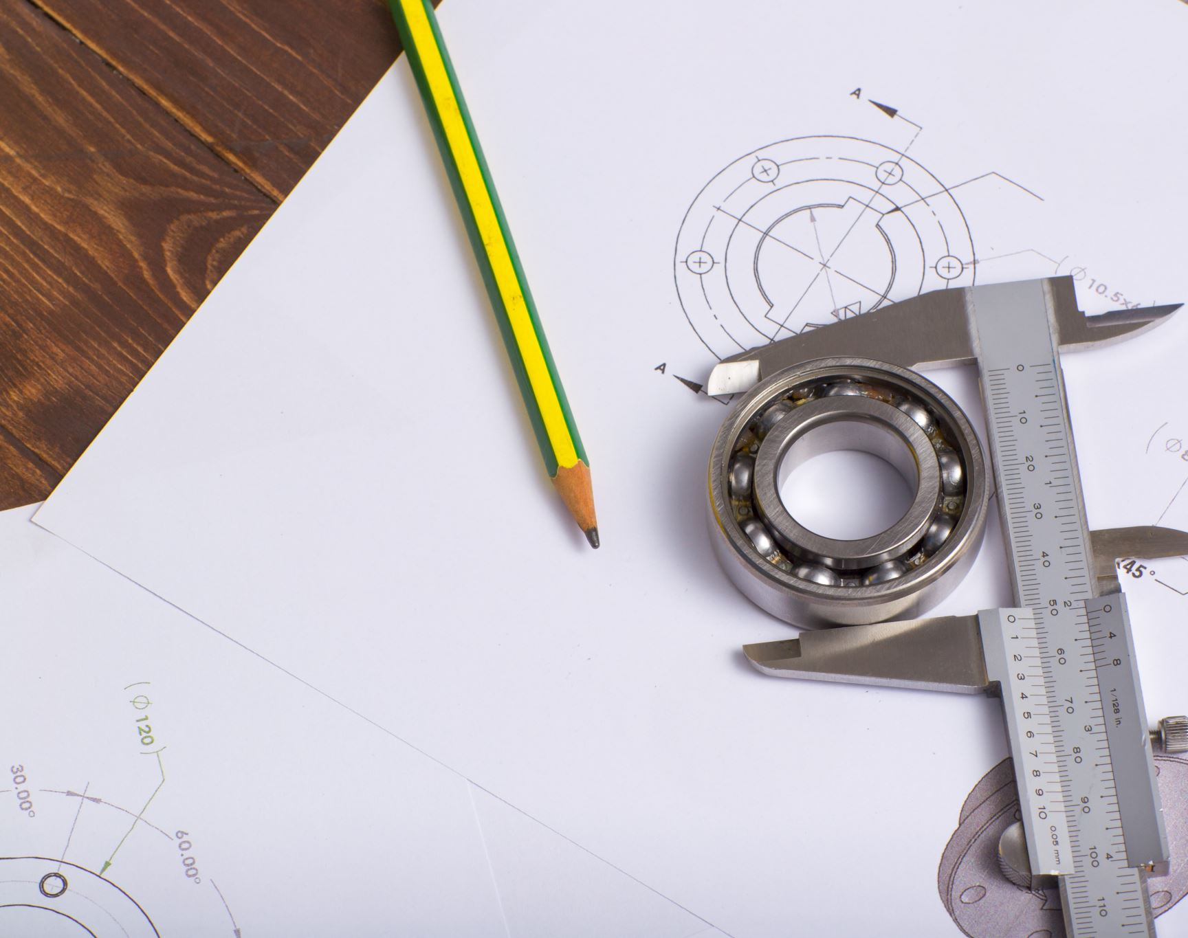
Energy Dissipation Test – Plans
Test Fixtures: Assembled Flywheel System
Sensors: RPM sensor (already included in system)
Data Acquistion: Use measured time, and system knowns, to back out Friction, Energy Dissipation over time, and Average Start to Stop Time.

Slide 24
Energy Dissipation Test– Facilites
Facilities: Test Cell
Equipment: Timer and data from RPM sensor, Ardiuno
Notes:
Probably consolidate this slide with plans

Slide 25
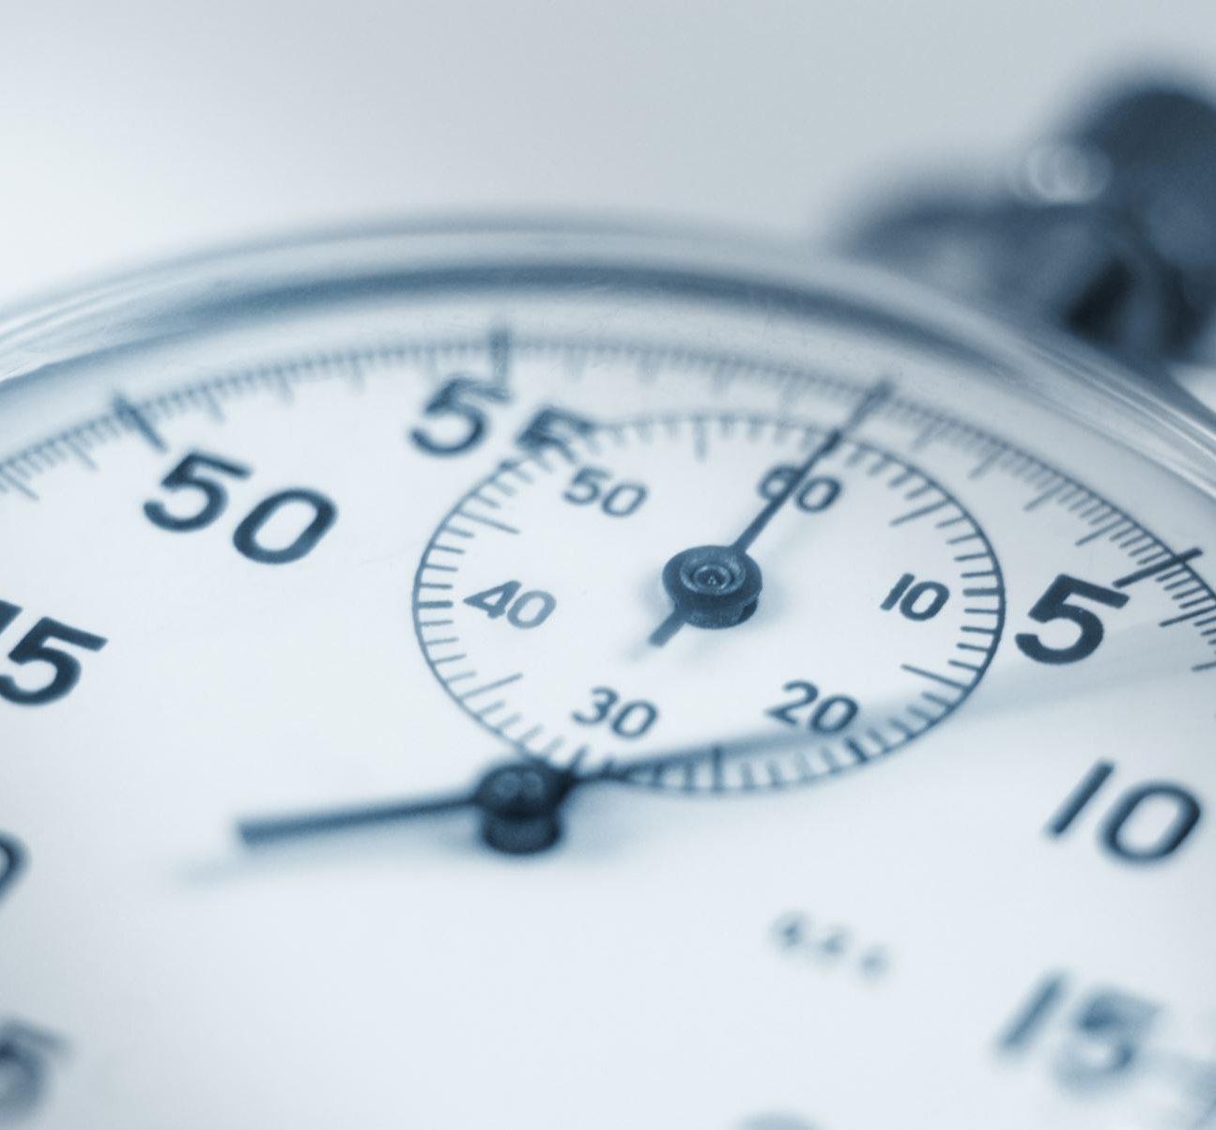
Energy Dissipation Test– Procedures
Test Procedures
Ensure that Flywheel is Assembled, and ready for operation.
Ensure that Polycarbonate covering is in position.
Start the Flywheel motor
Run motor till, rpm sensor calls out 4,200 rpm
Disengage motor
Begin data storage: store time and angular speed
Record data until rpm sensor calls out 0 rpm
Repeat Steps 1-8, at minimum 10 times
End Test
Analyze data to obtain angular acceleration and frictional torque
Notes:
Mention safety, very similar safety procedures as first test

Slide 26
Energy Dissipation Test - Validation
Pass/Fail Criteria
Pass
System can spin for minimum of 2 minutes
System can start and reach within 20% of 4,200 rpm .
System comes to a stop.
Fail
System stops before 2 minutes has passed
System is unable to start.
System is unable to reach within 20% of 4,200 rpm.
System deconstructs itself during operation.
Simulation Baseline
RPM: 4,200
Estimated Start to stop Time: 124 seconds
Estimated Friction: 0.053 Nm
Notes:
Talk about requirements

Slide 27
Major Test #2

Slide 28
Major Test #2 – System Efficiency
What: efficiency [%] = Energy Output [J] / Energy Input [J]
Why: determine if the flywheel can effectively provide our architecture with energy as modelled in our multi-objective analysis
Pre-req tests: system is entirely built up and functioning
Component Tests
Motor Characterization Tests
Mechanical Testing

Slide 29
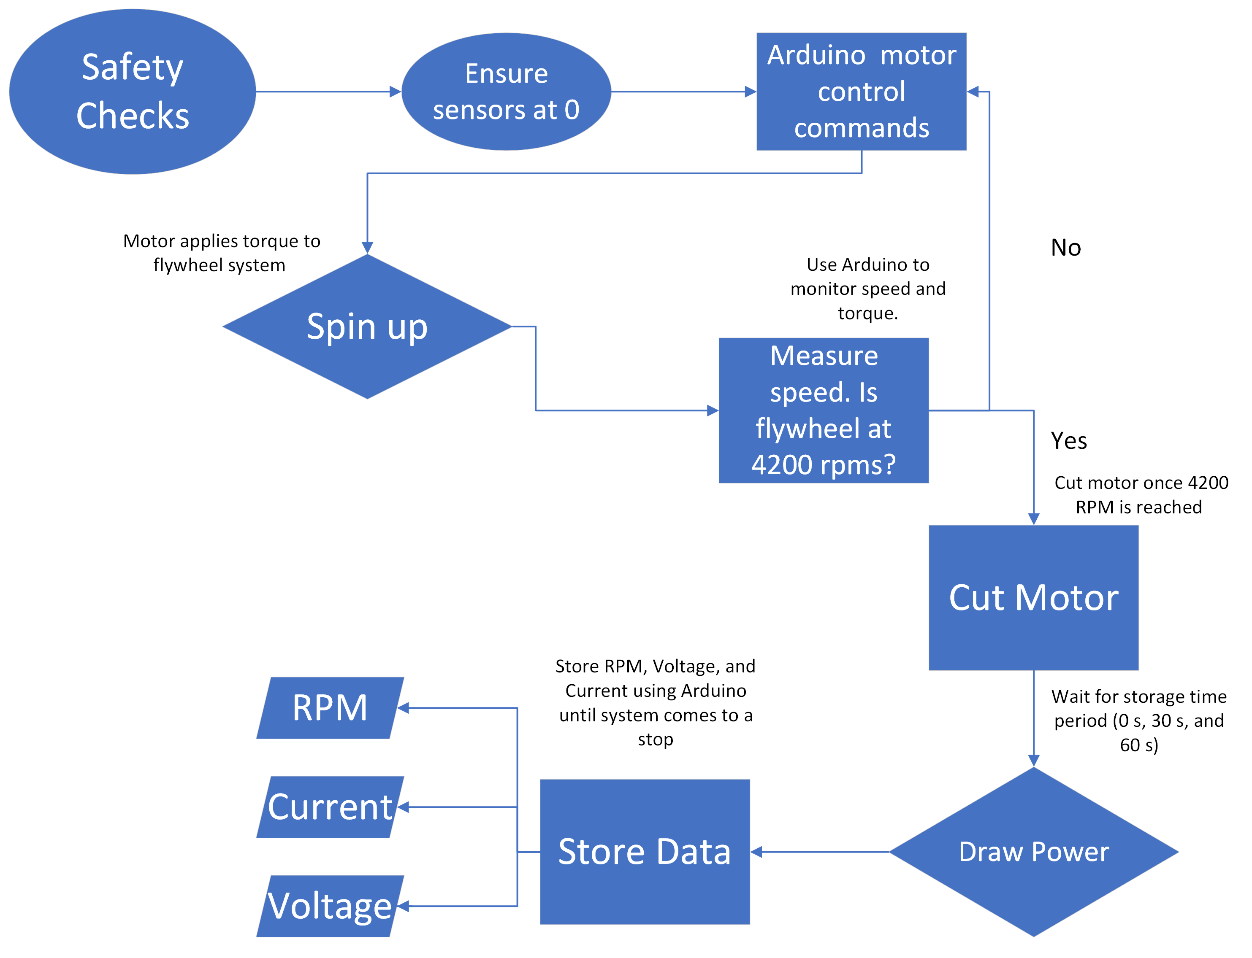
System Efficiency Test - FBD

Slide 30
System Efficiency Test – Plans
Test fixtures: Arduino motor control and data collection program
Sensor Selection: Multimeter, Encoder (motor and optical), Oscilloscope
Calibration of sensors: Voltmeter and current clamp on alternator output, encoders, and oscilloscope outputs stored using Arduino
DAQ: Sample above Nyquist frequency
F_sampling ≥ 2*F_max
F_sampling = 1500 Hz
Facilities: Test Cell – Aero Machine Shop
Storage Times: None, 30 seconds, and 60 seconds
Notes:
Test fixtures, selection, calibration of sensors, data acquisition plans
DAQ greater than or equal to

Slide 31
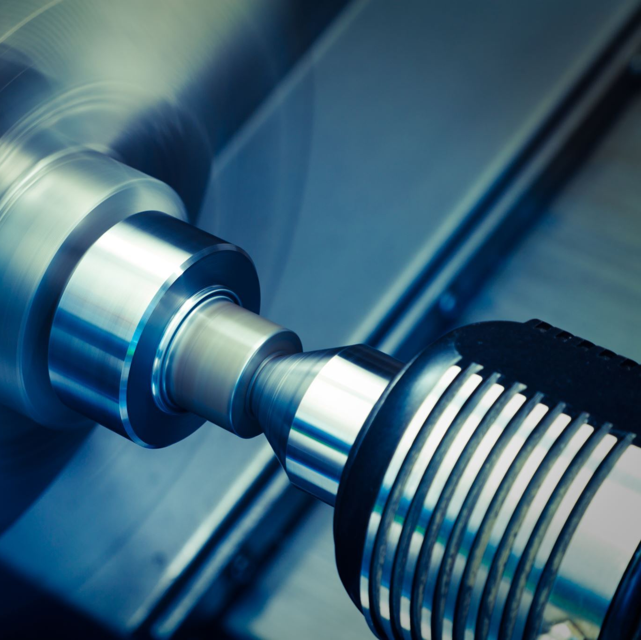
System Efficiency Test – Procedures
Test Procedures:
Ensure that Flywheel is Assembled, and ready for operation.
Ensure that Polycarbonate covering is in position.
Turn system on and ensure nominal voltage, current draw, and operation.
Send spin up commands to motor
Run motor until rpm sensor reads flywheel spinning at 4,200 rpm (within 20% of 4,200 also acceptable)
Disengage motor
Wait for storage period (0 sec, 30 sec, 60 sec)
Engage alternator and begin to draw power to output circuit
Read telemetry on rpm sensors, voltmeter, current clamp and record data
Continue to draw power until flywheel stops, confirm sensors are at 0
Repeat Steps 1-8, a minimum 10 of times for each storage period and make sure adequate data is obtained
End Test
Analyze data to obtain system efficiency
Notes:
Mention safety, very similar safety procedures as first test

Slide 32
System Efficiency Test - Validation
Passing this test will prove we can quickly provide power, show discrepancies in our model, and reduce the risk by showing efficient energy storage.
Pass/fail criteria:
Able to receive accurate readings from sensors and compare all sensor readings to find an average accuracy of over 95%
Efficiency of 75.81% after 30 seconds and 51.61% efficiency after 60 seconds.
System must lose 15.39 J or energy or less per second
Notes:
Talk about requirments

Slide 33
Budget
Overview
Schedule
Test Readiness
Budget

Slide 34
Bill of Materials
Parts | Cost | Date ordered/Expected | Date Delivered/Expected
Pilot Tools Deposit | $200 | ~ | ~
SMAD Textbook | $57.22 | 9/28/2023 | 10/10/2023
Brackets to hold down our structure | $127.84 | 2/13/2023 | 2/15/2023
nuts, bolts, and disks of aluminum | $975.65 | 2/13/2023 | 2/15/2023
Aluminum bars to support our structure | $389.95 | 2/14/2023 | 2/22/2023
2 cylindrical Magnets | $135.45 | 2/15/2023 | 2/19/2023
Alternator | $61.50 | 2/20/2023 | 2/22/2023
Motor and Electronics | $238 | 2/22/2023 | 2/24/2023
RPM sensor | $18.99 | 2/22/2023 | 2/24/2023
clamps | $79.71 | 2/23/2023 | 3/2/2023
pulley system | $65.99 | 2/23/2023 | 2/24/2023
Bullet Proof Glass | $117.43 | 2/24/2023 | 3/3/2023
Shaft Coupler | $13.98 | 2/24/2023 | 3/3/2023
Light Sockets/Transformer | $41.15 | 2/26/2023 | 2/28/2023
Outlet Breakers | $49.00 | 2/26/2023 | 3/1/2023
Current Total Costs: $2571.84
Current Remaining Budget: $1428.16
Remaining Costs: $0
Final Remaining Budget: $1428.16
Notes:
Mention that there is more to the motor and electronics kit. Not just one singular item that could break

Slide 35
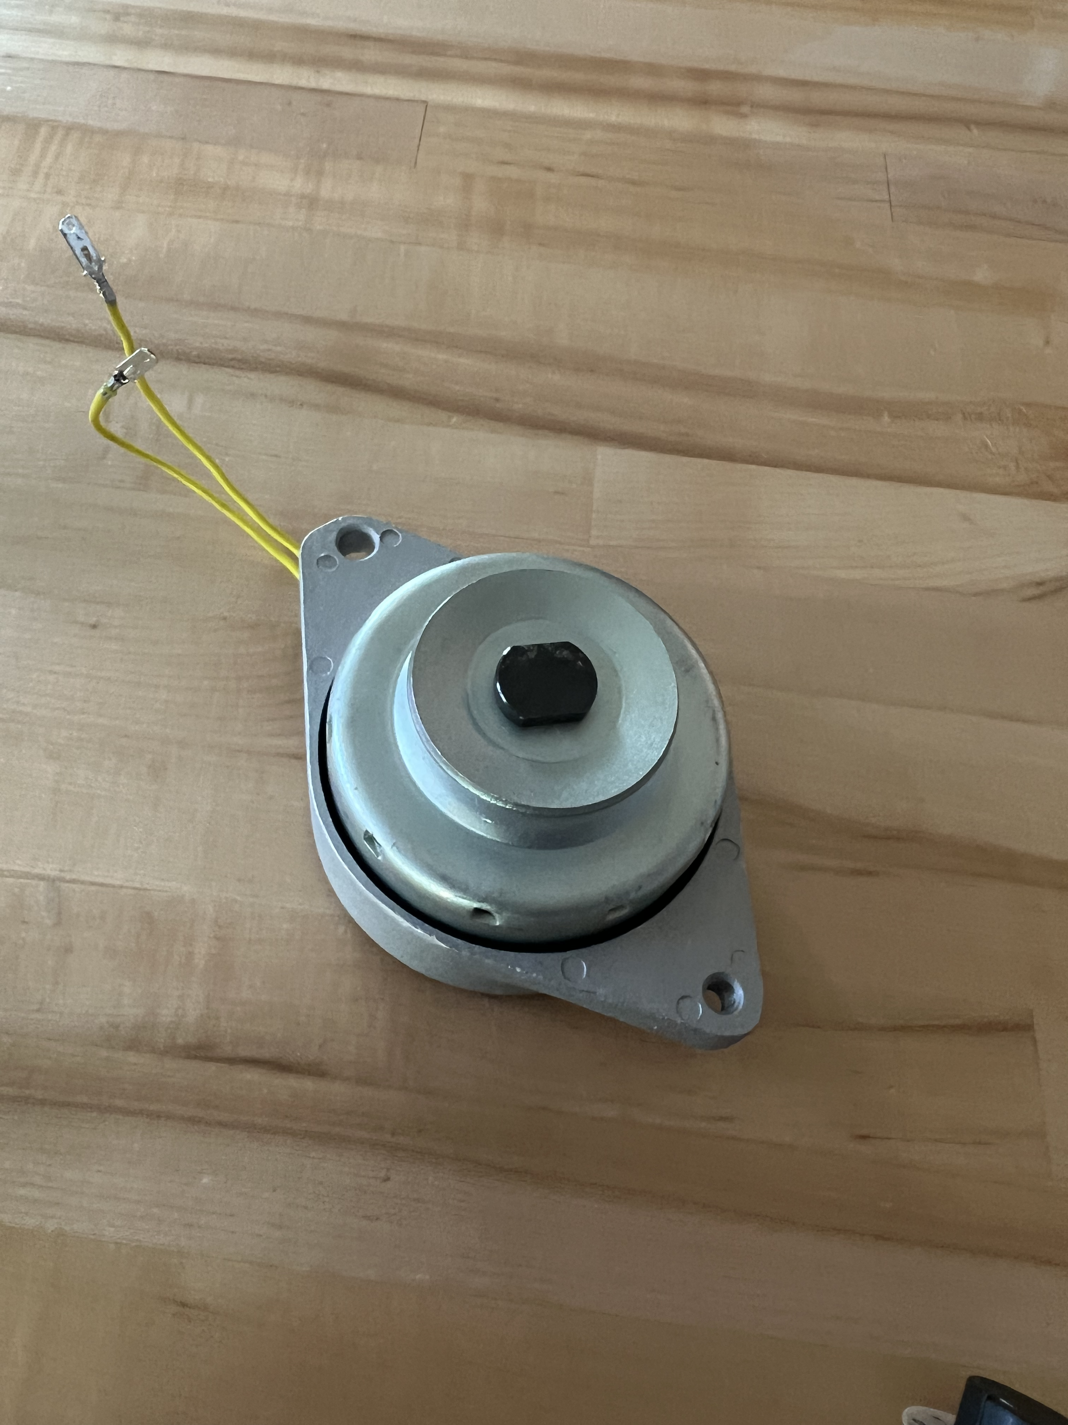
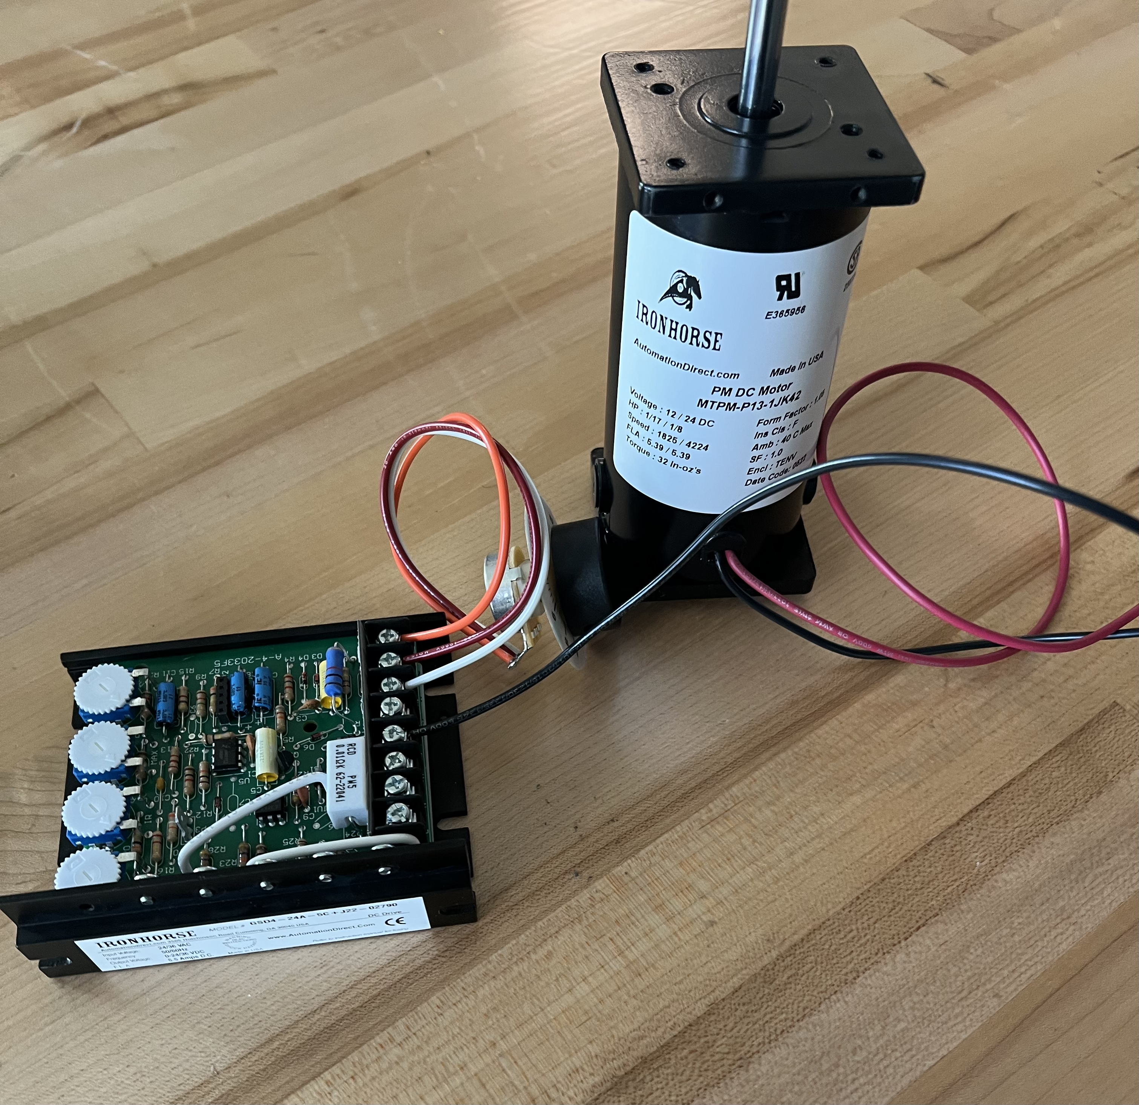
Current Progress
Frame is mostly manufactured
The rest of the mechanical components have arrived
Initial alternator testing

Slide 36
What’s Next?
Initial Motor testing
Finalize component tests
Machine required parts
Final mechanical assembly
Add full electronic system to the frame
Conduct efficiency test
Conduct energy dissipation test

Slide 37
Backup Slides

Slide 39
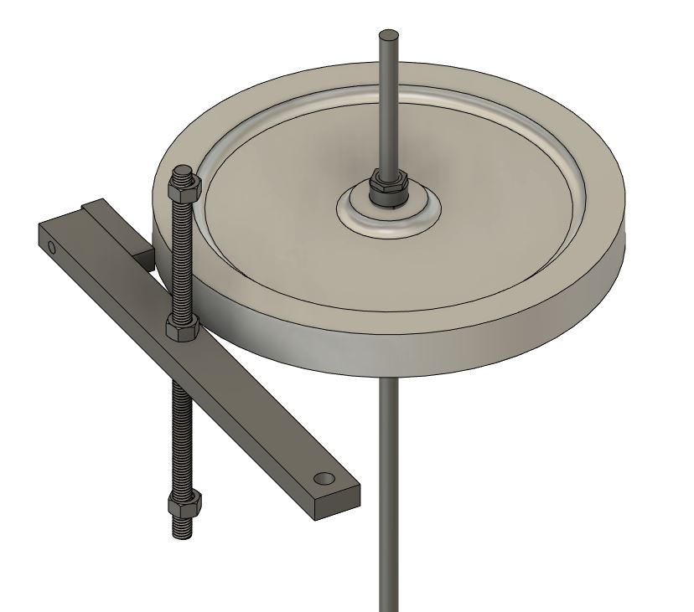
Key Mechanical Systems
Brake
Used for emergency stops
Uses a metal bar on a rod to turn and apply a frictional force onto the flywheel with a bike brake pad

Slide 40
Potential Brake System
If we have the capability/space in the test cell, we can mechanically brake the flywheel
Bike brake on a lever

Slide 41
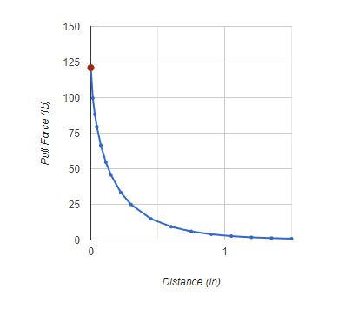
Magnet Characteristics
Axle system weighs just under 3kg or under 7lbs
Magnets support 9lbs at a distance of 0.6 in (need at minimum 0.2 in)
Source: K&J Magnetics

Slide 42
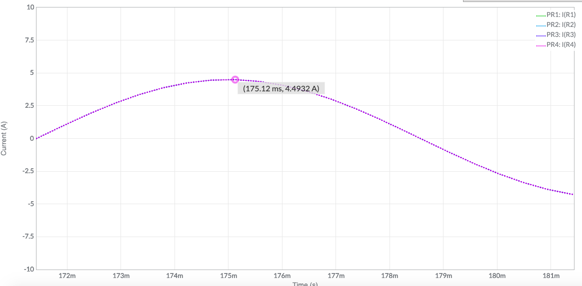
Output Circuit
We can power up to four 60W lightbulbs
Given: Vin=12V, Iin=18A
Current draw of each bulb
P=IV → I=P/V = 60W/12V = 5A/bulb
Resistance of each bulb
P=V^2/R → R=144V/60W = 2.5Omhs/bulb
How many bulbs we can power
18A/5A/bulb = 3.6bulbs → 4bulbs
Check math
1/Rtot = (½.4)*4 → Rtot = 0.6Ohms
V=IR → V=18A(0.6Ohms) = 10.8V <=12V

Slide 43
Assumptions for Calculations
Disk spins at constant 4200rpm
Alternator provides max voltage and current rated
No losses due to friction from disc to alternator shaft
Resistances and power usage rounded up (to assume max case)

Slide 44
Machine flywheel
Manufacture central bore for 10 10 crossbeams
Mount central shaft and bearings
Cut polycarbonate
Machine magnet holder
Assemble magnet holder
Assemble full axle
Mount the motor
Mount alternator
Attach flywheel to axle
Attach magnet holder to axle
Connect electronics
Manufacture bottom magnet holder
Full assembly

Slide 47
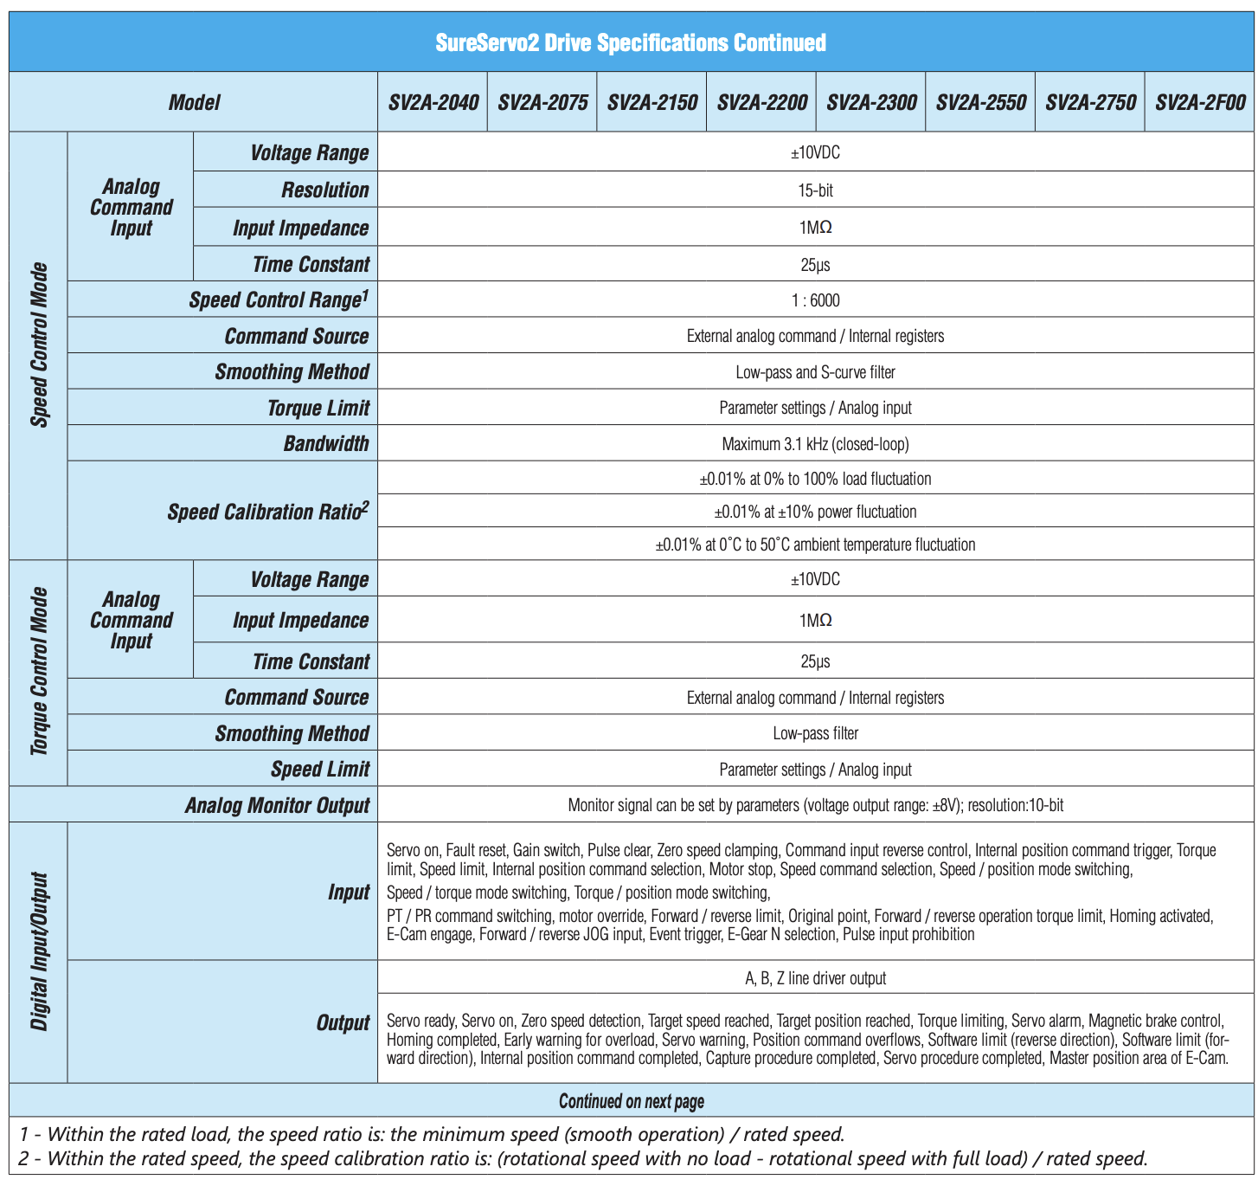

Slide 48
