Slide 1
GAINS
General Atomics Inertial Navigation System
Presenters:
Ben McHugh, Tucker Peyok, Alfredo Restrepo, Kaylie Rick, Brian Trybus, Addison Woodard
Team Members:
Bennet Grow, Cannon Palmer, Alex Pichler, Derek Popich, Jason Popich, Ross White
Sponsor:
General Atomics (GA)
Faculty Advisor:
Dr. Dale Lawrence
Test Readiness Review
March 6, 2023

Slide 2
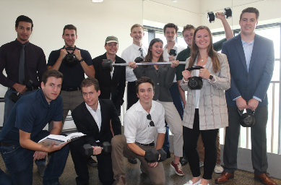
Agenda
Project Overview
Project Updates
Schedule
Test Readiness
Environmental Temperature Test
Controlled Positioning Test
Budget

Slide 3
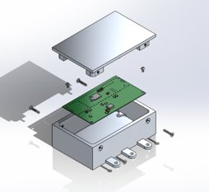
Project Overview
Notes:
Recap the project descriptions that appeared in the PDD, CDD, and PDR. It should be a concise overview that assumes the review board has not just reviewed these earlier documents. That is, the CDR should stand alone as a description of the project from concept through design solution. Typically, this overview will include a CONOPS, updated to help explain the project purpose and specific objectives as quickly and clearly as possible.

Slide 4
Mission Statement
Project GAINS aims to develop an Inertial Navigation System (INS) prototype for installation on cube-satellites in cislunar applications. The GAINS prototype will be developed to maximize accuracy of estimated position and velocity with the aid of external error corrections.
Notes:
Addi
Say what INS is: Sensor suite with computations
Cislunar = orbit trajectory between the Earth and Moon

Slide 5
Mission Objectives
1
Provide accurate inertial position and velocity to a CubeSat in a cislunar orbit with an INS, outside of GPS range
2
Modularity, such that the system can be installed in a variety of standardized General Atomics CubeSats
3
Ground segment to receive INS data and display trajectory in a Graphical User Interface (GUI)
Notes:
Addi
*2. Modularity such that the size and power provide a standardize

Slide 6
Full Mission CONOPS
In Scope
3. INS activation
2. Lunar orbit
1. Launch
4b. Ground station contacts, every 2 hours
4a. INS based position maintenance and navigation
KEY
Ground station
Uplink/Downlink
Trajectory
24 hrs
6 hrs of contact
2 hrs Loss of Contact
6 hrs of contact
2 hrs LoC
6 hrs of contact
2 hrs LoC
Notes:
Addi

Slide 7
GAINS Project CONOPS
Attitude Drift Corrections @ 10Hz
Star Tracker
Parent Cubesat
Downlink computed AD data package
Satellite polling @ 100Hz
(Position and velocity calculations)
GAINS
Measurement
Positional Drift Corrections
GS Contact Maintained
Computed AD solution and data
Computation
GS Contact Achieved (send all storage)
Storage
In Scope
Positional Drift Corrections, maximum 2 hours LOC
Truth Data & Communication emulation for testing
In Scope
Ground Station
Overview
Notes:
Addi

Slide 8
Critical Project Elements
Critical Element | Constraint Rationale
E1: Accuracy | The GAINS system should have a peak position error of no more than 1 km and peak velocity error of no more than 0.4 m/s.
E2: Calculation | The GAINS system will estimate its inertial position and velocity in real time using measurements from its integrated sensors.
E3: Communication | The GAINS system must have uplink and downlink capabilities with the ground station, as well as data transmission to the parent satellite.
E4: Display | The GAINS ground station must include a Graphical User Interface (GUI) with a real time status, trajectory, and power on/off switches.
E5: Integration | The GAINS system must have flanges for mounting to the parent satellite.
E6: Testing | The GAINS system shall be tested to ensure project elements fulfill customer mission objectives.

Slide 9
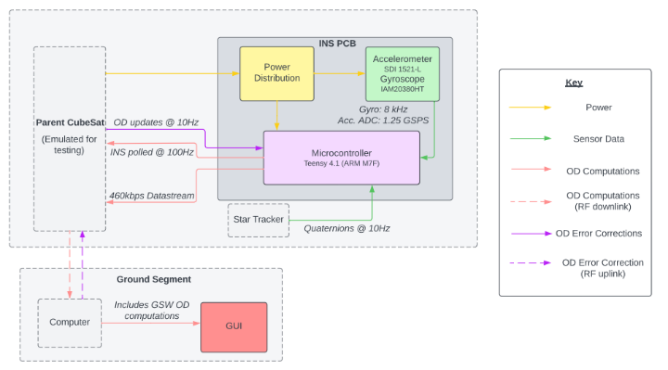
System FBD

Slide 10
Project Updates
Notes:
20%
• Provide a chart of ALL tests that have or will be performed. Indicate which ones have been completed.
• Review the whole project schedule in the form of the Gantt chart, showing overall progress toward goals. In this case, the status should be described with an emphasis on testing. Highlight any major changes in the project schedule since CDR, and indicate shifts in critical path or margins.

Slide 11
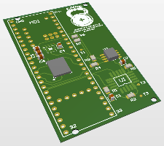
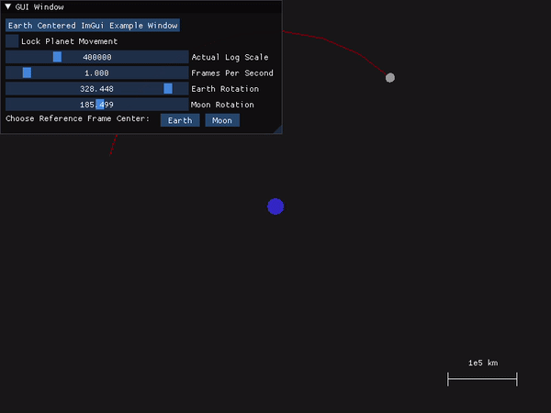
Baseline Design Progress
GAINS Enclosure
GAINS PCB
GAINS GUI
*Orbital mode shown, testing and symposium view also in development
Notes:
Addi
*2. Modularity such that the size and power provide a standardize

Slide 12
Schedule
Notes:
20%
• Provide a chart of ALL tests that have or will be performed. Indicate which ones have been completed.
• Review the whole project schedule in the form of the Gantt chart, showing overall progress toward goals. In this case, the status should be described with an emphasis on testing. Highlight any major changes in the project schedule since CDR, and indicate shifts in critical path or margins.

Slide 13
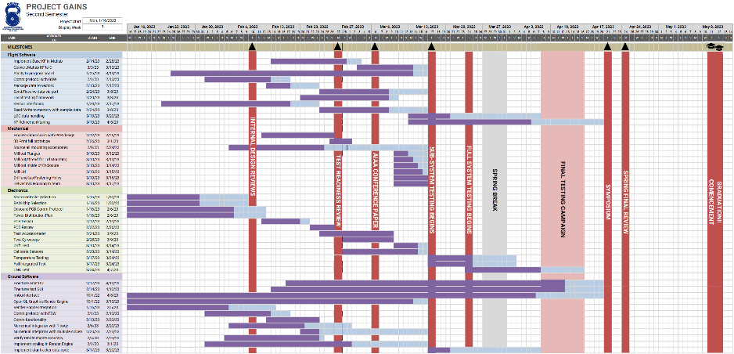
Gantt Chart
TODAY
KEY
Milestone
Subsystem Critical Path
Dependency

Slide 14
All Test Overview
 | Test Name | Model/ Reference | Requirements Verified | Equipment/ facilities | Status
Unit/Device | Component Checks | Datasheets | 1.2.1 | Multimeter, Power Supply | In progress
 | Flight software functionality test | Matlab Kalman Filter | 1.2.2, 1.2.3, 1.2.4 | N/A | In progress
 | GUI Functionality Test | GUI Concept | 1.3 | N/A | Start date: 3/10
Subsystem | Electronic Circuit Functionality | Altium Model | 1.2.1 | Breadboard, Power Supply, Multimeter | In progress
 | Flight Software and Electronics Integration | Computation Speed Model | 1.2.7 | N/A | Start date: 3/10
 | Mechanical and Electronics Integration | CAD Model | 1.2.1 | Ruler, Scale, Multimeter | In progress
 | Flight Software and Ground Software Communication | Data rate, Packet loss | 1.2.3, 1.2.7, 1.3.1 | N/A | Start date: 3/10
System | Next Slide...

Slide 15
All Test Overview
 | Test Name | Model/ Reference | Requirements Verified | Equipment/ facilities | Status
System | Tabletop Calibration | Bias Drift, Velocity Random Walk Model, Repeatability | 1.2.1, 1.2.3, 1.2.4 | Table, Computer | Start date: 3/10
 | Environmental Temperature | Bias Drift with Temperature Model, Datasheets | 1.2.1, 1.2.3, 1.2.4 | Oven + Freezer or General Atomics Thermal Chamber | Start date: 3/17
 | Controlled Positioning | Bias Drift, VRW, Temperature | 1.2.1, 1.2.3, 1.2.4, 1.2.7 | 3-axis CNC | Start date: 3/24
Requirements available
in Backup Slides
*No test is completed just yet. Components are just now arriving, and unit testing will begin March 1st.

Slide 16
Test Readiness
Notes:
60%
Select two to three major tests that will be performed. These should be tests that are verifying top level driving requirements or validating high level mission objectives, buying down operational risk, or closing the loop on a model. Typically this involves tests that integrate multiple subsystems and are at the system level of testing. Ensure that you can measure the performance of your design- (how fast, what range, what current, what latency, etc) as opposed to measuring a simple binary outcome.
For these two to three tests, cover:
• What is being tested and why: your rationale for performing the test in terms of requirements to be verified or mission objectives to be validated.
• Highlight critical pre-requisite tests planned/completed that will or do demonstrate this test will be successful. (For example, the components are operating within datasheet ranges, signals could be sent and received, etc) This should not be a deep dive, but rather a quick summary that can be completed in 1 to 2 minutes.
• Describe the scope of the testing tasks in the project specifically:
o the design of the test fixtures, selection and calibration of sensors, data acquisition plans
o test equipment and/or facilities are needed
o an overview of the test and safety procedures
• Describe how the test(s) will reduce risk to meeting requirements, expected results, and how models will be validated. Include clear pass/fail criteria ALONG with expected performance measurements.

Slide 17
Environmental Temperature Test
Notes:
60%
Select two to three major tests that will be performed. These should be tests that are verifying top level driving requirements or validating high level mission objectives, buying down operational risk, or closing the loop on a model. Typically this involves tests that integrate multiple subsystems and are at the system level of testing. Ensure that you can measure the performance of your design- (how fast, what range, what current, what latency, etc) as opposed to measuring a simple binary outcome.
For these two to three tests, cover:
• What is being tested and why: your rationale for performing the test in terms of requirements to be verified or mission objectives to be validated.
• Highlight critical pre-requisite tests planned/completed that will or do demonstrate this test will be successful. (For example, the components are operating within datasheet ranges, signals could be sent and received, etc) This should not be a deep dive, but rather a quick summary that can be completed in 1 to 2 minutes.
• Describe the scope of the testing tasks in the project specifically:
o the design of the test fixtures, selection and calibration of sensors, data acquisition plans
o test equipment and/or facilities are needed
o an overview of the test and safety procedures
• Describe how the test(s) will reduce risk to meeting requirements, expected results, and how models will be validated. Include clear pass/fail criteria ALONG with expected performance measurements.

Slide 18
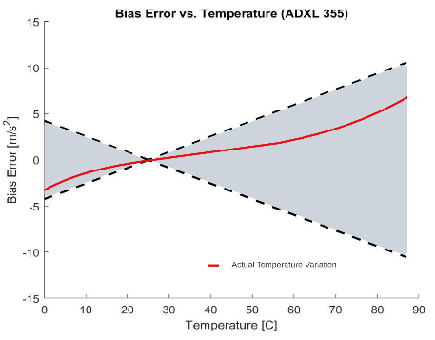
Environmental Temperature Test
Start Date: 3/17
C.9 | INS environment shall be in a temperature range of 0-60 degrees Celsius
Overview:
Characterize SDI 1521-L accelerometer bias with respect to accelerometer temperature sensor
Calibrate out bias error to minimize position and velocity error for all operational temperatures (0°C to 60 °C)
Verify internal temperature does not exceed 125°C and harm microprocessor
Bias Error vs. SDI 1521-L Temperature
Cooling test
Heating test
Datasheet defined potential bias error bounds
Ambient Temperature
Bias Error [m/s²]
Sample (uncalibrated) bias error curve
SDI 1521-L Temperature (°C)

Slide 19
Environmental Temperature Test
Rationale/Motivation:
Accelerometer bias is the dominant error source in final position and velocity accuracy
Characterizing this bias will allow the Kalman Filter to more accurately compute the INS position and velocity

Slide 20
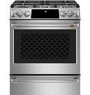
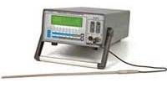
Environmental Temperature Test
Prerequisite Tests:
Individual sensor operation verification
Temperature sensor calibration
Flight/Ground software communication
Full PCB sub-system test
Test chamber temperature control baseline
Test Needs:
Hot temperature chamber (oven at 60°C)
Cold temperature chamber (freezer at 0°C)
External temperature measurement device (precision thermocouple, ±0.015 °C accuracy)
Two thermocouples
Completed GAINS product
Home Oven
Team member's house
Home Freezer
Team member's house
AΣΛ F150
Borrowed from AES Electronics shop
2 Thermocouples
Borrowed from AES Electronics shop
Notes:
Mention accuracy of thermocouple (0.001 deg C idk), mention calibration of thermocouple

Slide 21
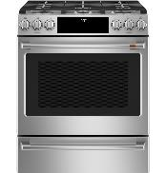
Environmental Temperature Test
High-Level Test Procedure:
Set environmental chamber to minimum/maximum of requirement range
Validate temperature with thermometer
Place GAINS in chamber, begin collecting data
Keep in environment until thermal equilibrium, finish collecting data
Remove GAINS and thermometer, analyze results
Generate bias change in temperature curve, integrate with Kalman filter
Re-run test with temperature calibration
Repeat for each axis of the accelerometer
0 °C
(32 °F)
Ground Station
GAINS
Precision Thermometer
(AΣΛ F150)
60 °C
(140 °F)
Safety Considerations:
Handle GAINS with oven mitts after hot temperature test
Abort test if internal GAINS temperature exceeds allowable component temperatures
GAINS

Slide 22
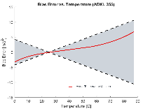
Environmental Temperature Test
Expected Results:
Prior to Calibration: Bias error to increase positively under hot conditions, and increase negatively under cold conditions
Post Calibration: Decreased Biases for 0°C to 60°C range, more accurate final INS position and velocity prediction
GAINS Acceleration of Gravity Measurement
GAINS Acceleration of Gravity Measurement
Bias Error vs. SDI 1521-L Temperature
Cooling test
Heating test
Acceleration (g)
Acceleration (g)
Bias Error [m/s²]
1
1
SDI 1521-L Temperature (°C)
0 60
0 60
Temperature (°C)
Temperature (°C)

Slide 23
Environmental Temperature Test
Validation Criteria:
Pass: GAINS accelerometer bias drift does not exceed 0.4mg after temperature calibration, internal temperature does not exceed 125°C
Largest possible bias = 20mg
Max allowable velocity error = 0.39 m/s
Minimum calibration = 0.4 mg or 0.004 m/s
Fail: GAINS bias drift exceeds 0.4mg, internal temperature exceeds 125°C, test chamber fails to reach temperature thresholds, corrupt data
Risk reduction of requirement satisfaction:
Post calibration, accelerometer accuracy will increase
Accelerometer temperature bias will be characterized for expected thermal environment

Slide 24
Controlled Positioning Test
Notes:
60%
Select two to three major tests that will be performed. These should be tests that are verifying top level driving requirements or validating high level mission objectives, buying down operational risk, or closing the loop on a model. Typically this involves tests that integrate multiple subsystems and are at the system level of testing. Ensure that you can measure the performance of your design- (how fast, what range, what current, what latency, etc) as opposed to measuring a simple binary outcome.
For these two to three tests, cover:
• What is being tested and why: your rationale for performing the test in terms of requirements to be verified or mission objectives to be validated.
• Highlight critical pre-requisite tests planned/completed that will or do demonstrate this test will be successful. (For example, the components are operating within datasheet ranges, signals could be sent and received, etc) This should not be a deep dive, but rather a quick summary that can be completed in 1 to 2 minutes.
• Describe the scope of the testing tasks in the project specifically:
o the design of the test fixtures, selection and calibration of sensors, data acquisition plans
o test equipment and/or facilities are needed
o an overview of the test and safety procedures
• Describe how the test(s) will reduce risk to meeting requirements, expected results, and how models will be validated. Include clear pass/fail criteria ALONG with expected performance measurements.

Slide 25
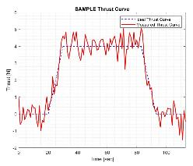
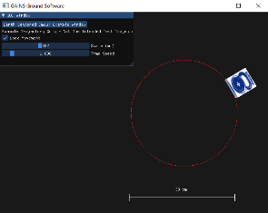
Controlled Positioning Test
Start Date: 3/24
E1: Accuracy | The GAINS system should have a peak position error of no more than 1 km and peak velocity error of no more than 0.4 m/s.
Overview:
Position and velocity accuracy estimation of the GAINS with simulated ground station contact, and loss of contact periods
Real time trajectory plotting of the GAINS on the GUI

Slide 26
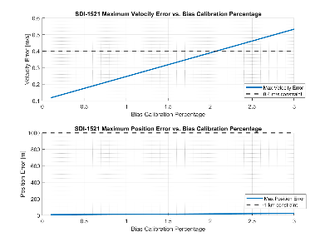
Controlled Positioning Test
E1: Accuracy | The GAINS system should have a peak position error of no more than 1 km and peak velocity error of no more than 0.4 m/s.
Rationale/Motivation:
Accurate position and velocity estimation is critical to mission success, and a top-level requirement by the customer
Characterize the effect of error sources in the electronics on position and velocity accuracy (i.e. Bias Calibration, Velocity Random Walk, Scale Factor, Repeatability)

Slide 27
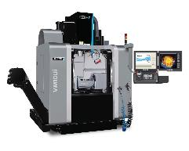
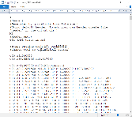
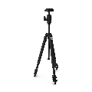
Controlled Positioning Test
Prerequisite Tests:
All other component, subsystem, and system tests
Test Needs:
5 axis CNC Machine
Pre-coded path (G-code)
Programming language used in CNC machines to control movements and operations
Camera to record revolution time
Completed GAINS product
Hurco VM10Ui
ITLL
G-coded Path
Team member written
Video Camera on Fixed Structure
Team member provided

Slide 28
Controlled Positioning Test
Methodology:
CNC trajectory will follow a circular path to impart a constant acceleration on the INS, simulating the Themis Satellite's Hydrazine gas thrusters
Assumed ΔV required for lunar maintenance burn = 10 m/s
Typical burn duration = 73 sec
Centripetal Acceleration Magnitude = 0.137 m/s²
Test Specifications:
5-Axis CNC Hurco VM10Ui:
Max feed rate = 28 m/min
Minimum Bed Dimension (Y): 0.406 m
Test Trajectory:
Tangential Velocity: 8.604 m/min
Trajectory Diameter: 0.3 m
Revolutions: 11.108
0.533 m
0.406 m
0.15 m
GAINS

Slide 29
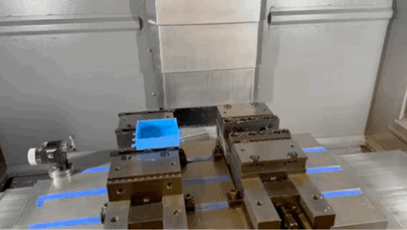
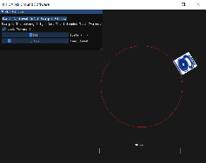
Controlled Positioning Test
High-Level Test Procedure:
Import pre-coded path to Ground Software for plotting and comparison to INS readings
Place the GAINS in CNC
Run coded path
Simulate positional changes in 2 axes (spacecraft thrusting)
Use video recording to correlate time with CNC start and stop
Monitor GUI trajectory plot, simulate loss of contact
Path ends, remove GAINS, analyze data
Repeat for each body axis of interest
Safety Considerations:
Secure GAINS onto CNC fixture
Training and qualification to operate CNC
Implement measures to ensure the proper organization and routing of GAINS cables to prevent entanglement

Slide 30
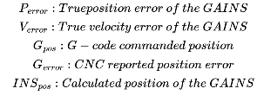
Controlled Positioning Error Analysis
Error Analysis:
The GAINS calculated position will be compared to the commanded position of the CNC
CNC error in that commanded position will be added generate our final positional error.
The time derivative of our positional error throughout the test will yield the velocity error
G_{pos}
G_{pos}
G_{error}
G_{error}
P_{error}
P_{error}
INS_{pos}
INS_{pos}
$$P_{error}=\left|{INS}_{pos}−{CNC}_{pos}\right|+{CNC}_{error}$$
$$V_{error}=\frac{{dP}_{error}}{dt}$$
Notes:
Mention CDR velocity measurement concern in script

Slide 31
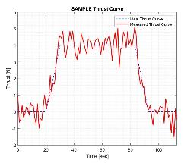
Controlled Positioning Test
Expected Results:
Position and velocity measurements accurate under various acceleration scenarios
Relative to the path defined by the CNC input G-Code
Characterize the effect of various error sources
Bias Calibration, Velocity Random Walk, Scale Factor, and Repeatability
Final position and velocity accuracy value
Integrated into expected bias of the Kalman Filter as a function of time
GAINS Test Acceleration
0.137
Acceleration (m/s²)
0
0 120
Time (s)

Slide 32
Controlled Positioning Test
Validation Criteria:
Pass: Satisfy mission accuracy requirements of the INS
Position error less than 1 km
Velocity error less than 0.4 m/s
Fail: Corrupt data, incomplete test, accuracy requirement not met
Revisit tabletop test to insure proper calibration of INS
Investigate test set up for potential error sources
Monitor test in real-time to detect any unexpected behavior or deviations from the programmed path
Risk reduction of requirement satisfaction:
Kalman Filter will be minimizing error through simulated thrusting period, error will be within customer requirements.

Slide 33
Budget
Notes:
10%
• Provide an update on all project expenses including status of parts/materials procurement and the financial budget.

Slide 34
Budget
Part Type | Part Name | Qty | Cost/unit | Total Cost | Purchased? | Received?
3-axis Accelerometer | SDI 1521-L | 5 | $180 | $900 | Yes | Yes
3-axis Gyroscope | IAM-20380HT | 10 | $11.91 | $119.10 | Yes | No
Microcontroller | Teensy 4.1 w/ Ethernet Hat | 4 | $41.50 | $166 | Yes | Yes
PCB | “GAINS PCB” | 3 | ~ $30 | $90 | No | No
Flash Memory | GD5F1GQ4UFYIGR | 2 | $4.84 | $9.68 | No | No
Dev-Boards | Accel/Gyro Dev | 2 | ~ $30 | $60 | No | No
Housing Material | Aluminum 6061 (1.25” x 12” x 12”) | 180 in³ | $127.52 | $127.52 | Yes | Yes
Misc. (cables, ports, shipping, etc) | Various | - | ~ $200 | $200 | No | No
Total Projected Cost: |  |  |  | $1662.62
TOTAL | $4000
SPENT: | $1312.62 | 33%
REMAINING: | $2687.38 | 67%
*Purchased/Received statuses may change between submission and presentation.

Slide 35
Backup

Slide 36
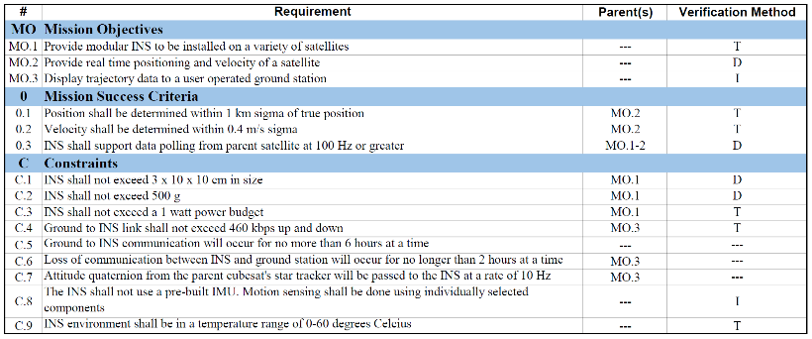
Top Level Requirements

Slide 37
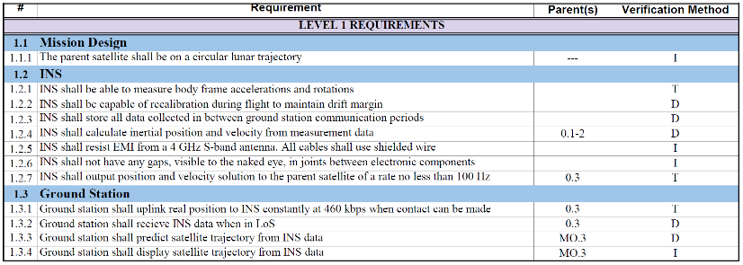
Level 1 Requirements

Slide 38
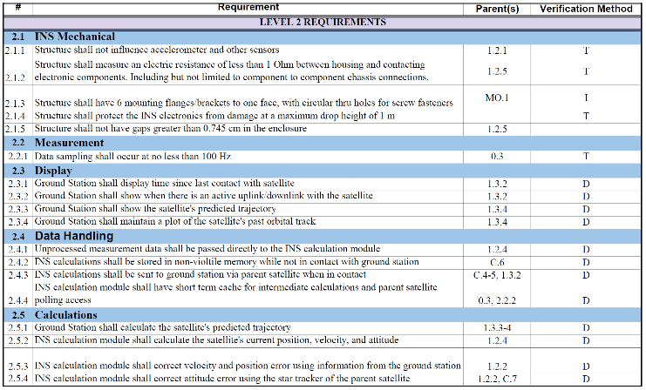
Level 2 Requirements

Slide 39
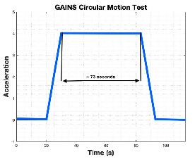
Centripetal Motion vs. Linear Motion
Centripetal Motion
Simulate the acceleration effects of Themis Satellite's Hydrazine gas thrusters
Typical burn duration: ~ 73 seconds
Relevant position and velocity approximations
Subjected to an extended duration of acceleration for relevant testing
Enable various acceleration scenarios
centripetal acceleration
An illustrative representation aimed at depicting the projected acceleration trend corresponding to the described motion.
t > 0 [s]
t >> 0 [s]
Body _{x-axis}
a_{c}
GAINS
GAINS
a_{c}
Body _{x-axis}

Slide 40
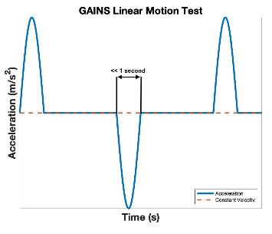
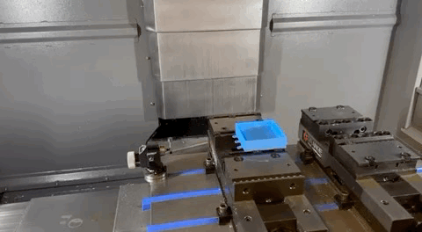
Centripetal Motion vs. Linear Motion
Linear Motion
INS exhibits linear reciprocating motion
Short-duration, high-amplitude acceleration events
Discrepancy between the expected trajectory of the INS during thrusting periods
An illustrative representation aimed at depicting the projected acceleration trend corresponding to the described motion.

Slide 41
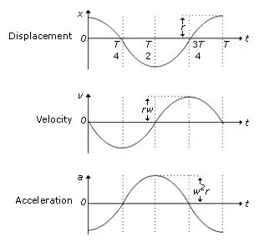
CNC Trajectory Math
Body frame force vector rotates around the z-axis
Feed-rate required to meet required a_{c} :
$$a_{centripetal}=\frac{10 m/s}{73 sec}=0.137 m/s^{2}$$
$$a_{centripetal}=\frac{v^{2}}{r}→v=\sqrt{a_{c}r}$$
$$v_{feed}=0.1434\frac{m}{s}=8.604 m/min$$
$$Revolutions= \frac{t_{total}}{2∗πr}$$

Slide 42
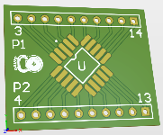
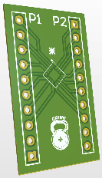
PCB and Breakout Boards
Accelerometer Breakout Board
PCB Design
Gyroscope Breakout Board

Slide 43
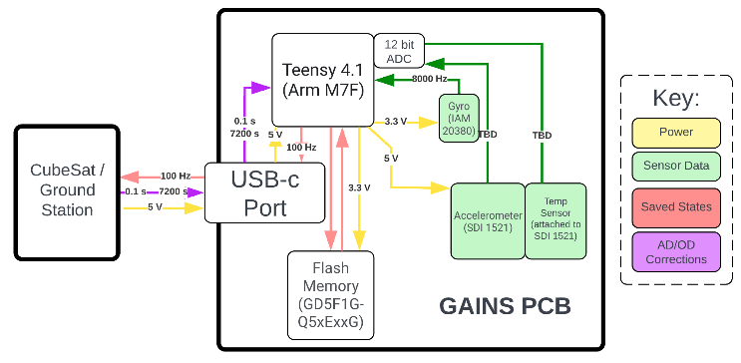
Electronics FBD

Slide 44
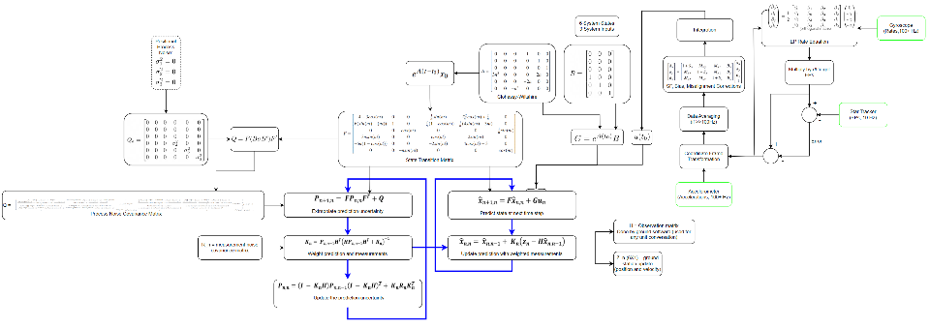
Flight Software FBD

Slide 45
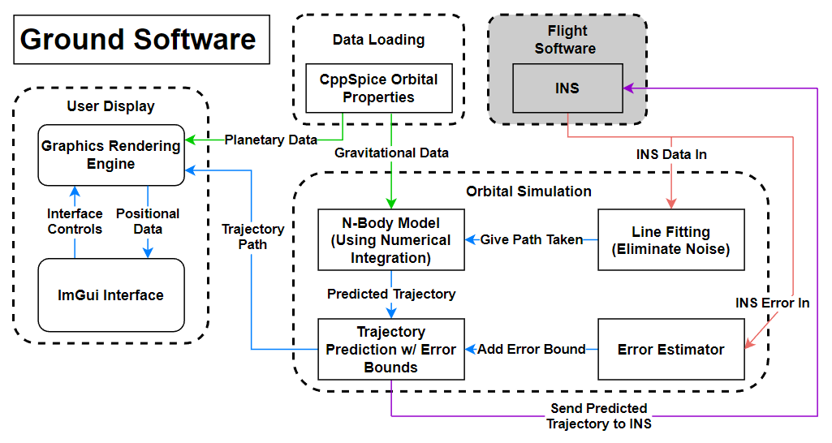
Ground Software FBD

Slide 46
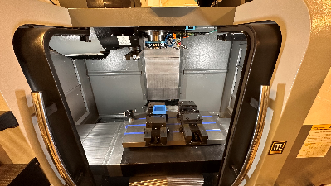
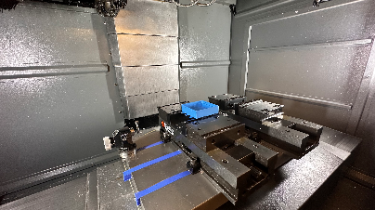
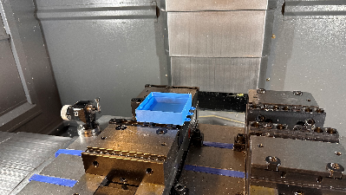
Mounting for CNC Testing

Slide 47
Mounting for CNC Testing
*Not moving in anticipated path
Generalized illustration purposes only

