Slide 1
GAINS
General Atomics Inertial Navigation System
Presenters:
Bennett Grow, Cannon Palmer, Tucker Peyok, Alfredo Restrepo, Kaylie Rick, Ross White, Addison Woodard
Team Members:
Ben McHugh, Alex Pichler, Derek Popich, Jason Popich, Brian Trybus
Sponsor:
General Atomics (GA)
Faculty Advisor:
Dr. Dale Lawrence
Critical Design Review
December 7, 2022

Slide 2
Agenda
Project Overview
Change of Scope
Design Solutions
Critical Project Elements
Project Risk
Design Requirements/Satisfaction
Verification & Validation
Project Planning

Slide 3
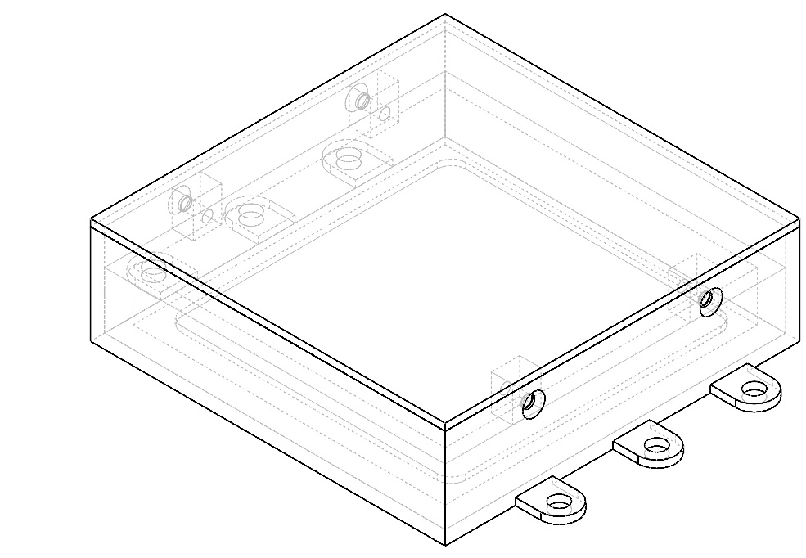
Project Overview

Slide 4
Mission Statement
Project GAINS aims to develop an Inertial Navigation System (INS) prototype for installation on cube-satellites in cislunar applications. The GAINS prototype will be developed to maximize accuracy of estimated position and velocity with the aid of external error corrections.

Slide 5
Mission Objectives
1
Provide accurate inertial position and velocity to a CubeSat in a cislunar orbit with an INS, outside of GPS range
2
Modularity, such that the system can be installed in a variety of standardized General Atomics cubesats
3
Ground segment to receive INS data and display trajectory in a Graphical User Interface (GUI)

Slide 6
Full Mission CONOPS
In Scope
3. INS activation
2. Cislunar orbit
1. Launch
4b. Ground station contacts, every 2 hours
4a. INS based position maintenance and navigation
KEY
Ground station
Uplink/Downlink
Trajectory
24 hrs
6 hrs of contact
2 hrs Loss of Contact
6 hrs of contact
2 hrs LoC
6 hrs of contact
2 hrs LoC

Slide 7
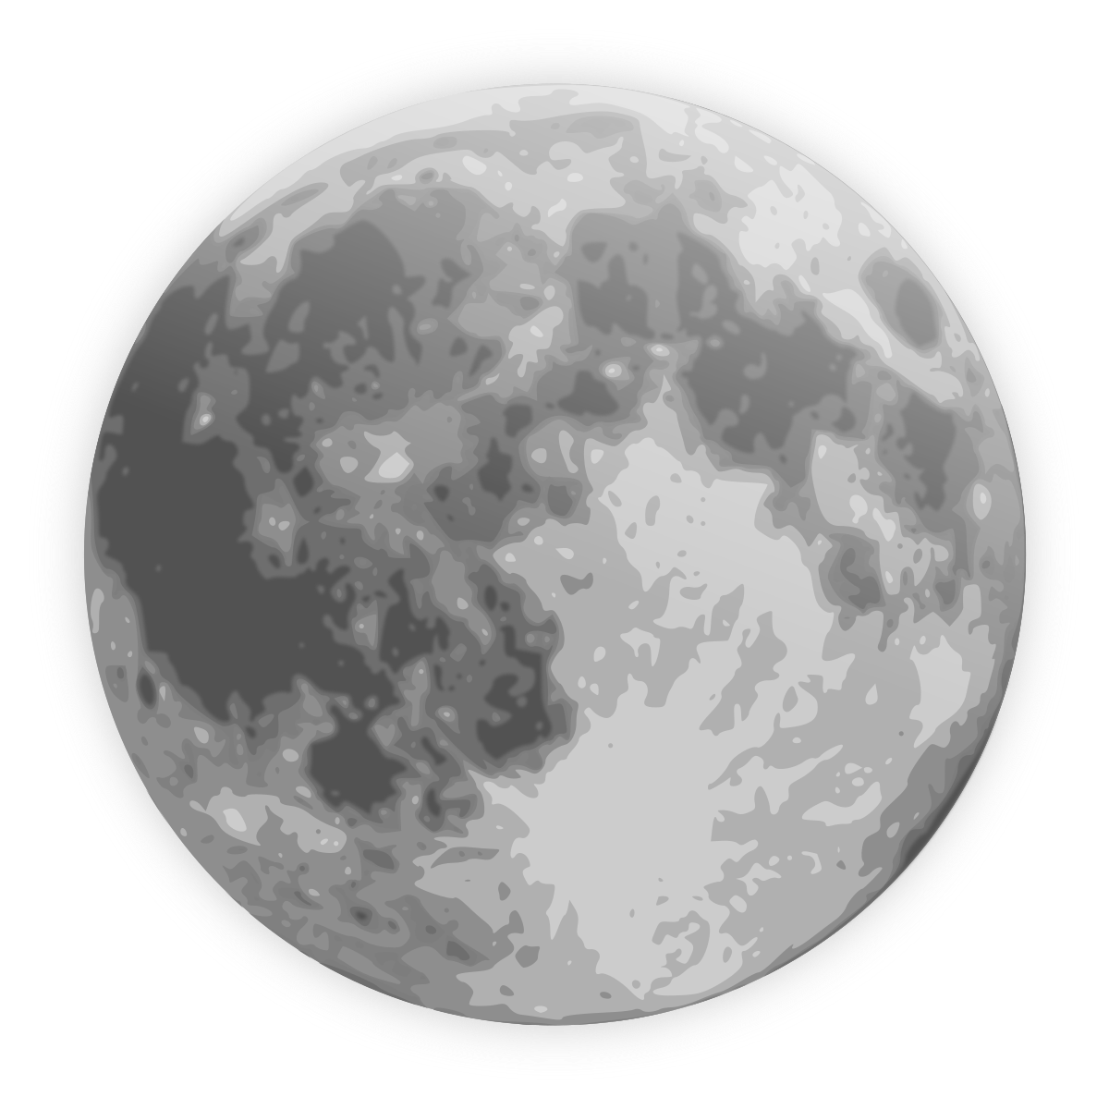
GAINS Project CONOPS
Attitude Drift Corrections @ 10Hz
Star Tracker
Parent Cubesat
Downlink computed AD data package
Satellite polling @ 100Hz
(Position and velocity calculations)
GAINS
Measurement
Positional Drift Corrections
GS Contact Maintained
Computed AD solution and data
Computation
GS Contact Achieved (send all storage)
Storage
In Scope
Positional Drift Corrections, maximum 2 hours LOC
Truth Data & Communication emulation for testing
In Scope
Ground Station
Overview
Design
CPE/Risk

Slide 8
GAINS Change of Scope
Sensor Selection
Unable to find sensors that meet customer’s position/velocity requirements through the 2 hour loss-of-contact window
Called multiple vendors to discuss sensors not available on websites
Completed studies on increasing the number of sensors to improve accuracy
Multiplicative Extended Kalman Filter (MEKF) for a 6 Degree of Freedom system in a cislunar trajectory
Determined to be over-complicated for meeting adjusted customer requirements
Cislunar Orbit
Changed to circular lunar orbit for modeling/dynamic accuracy

Slide 9
Design Solution

Slide 10
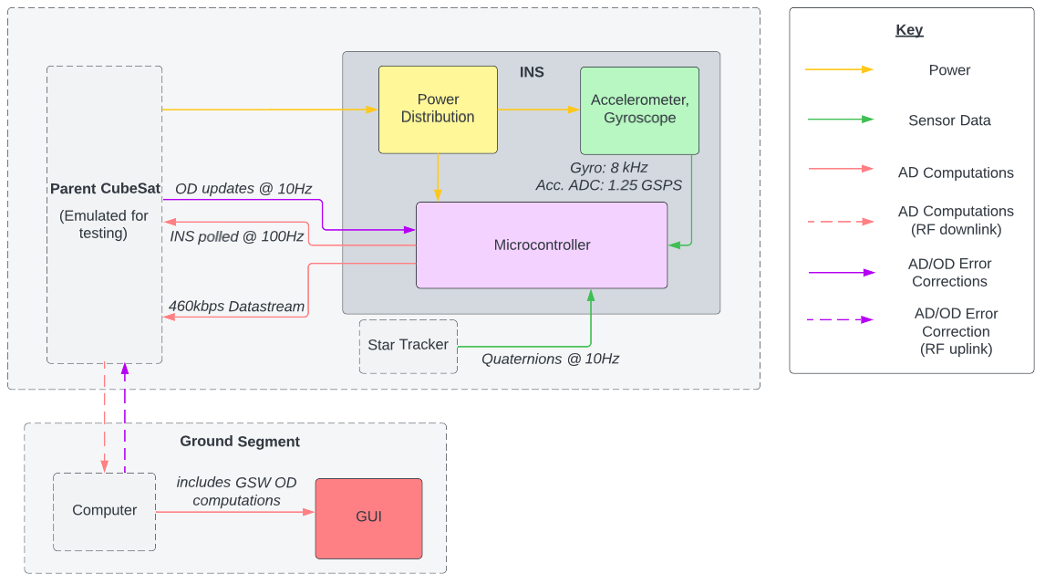
System Functional Block Diagram

Slide 11
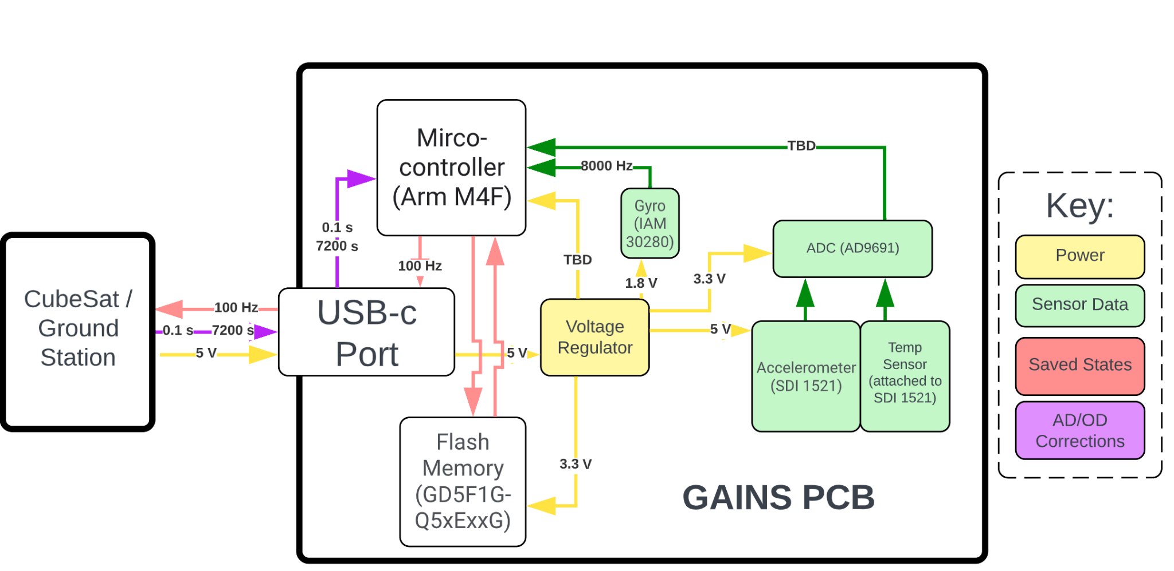
Electronics Design - PCB Functional Block Diagram

Slide 12
Electronics Design - Sensors
Accelerometer | Gyroscope
Due to 7200 seconds between updates, we are unable to find an accelerometer with all of the following specs required to meet accuracy constraints: Bias (0g offset) ≤ 0.55 mg Velocity Random Walk ≤ 1 mm/sec/Hr Scale Factor ≤ 1% Bias Repeatability ≤ 0.1 mg Using the following 2 accelerometers for modelling: ADXL 355 from Analog Devices Inc. Dimensions = 6mm x 6mm x 2.05 mm SDI 1521 from Silicon Devices Inc. Dimensions = 8.9mm x 8.9mm x 4.2mm | Error not as significant due to 10Hz attitude corrections from star tracker Selected: IAM 20380 from TDK InvenSense Bias (0g offset) = 10 deg/s Noise Spectral Density = 0.010 deg/s/√Hz Dimensions = 3mm x 3mm x 0.75mm

Slide 13
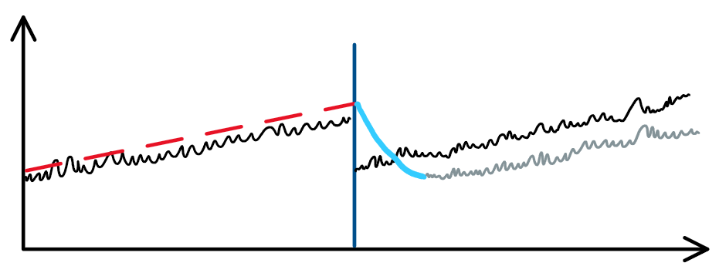
Flight Software Design
Kalman Filter
Combine weighted prediction and measurement to estimate position and velocity at 100 Hz
Written in C for bare-metal flashing and speed
Sensor Data
Kalman Filter
Predict
Measure
𝛿velocity
Error Correction
Weight P & M
Kalman Filtered Error Correction
Upward trending random walk-off
Final Estimate
0.4 m/s
Parent CubeSat
Ground Station
Time
2 hrs

Slide 14
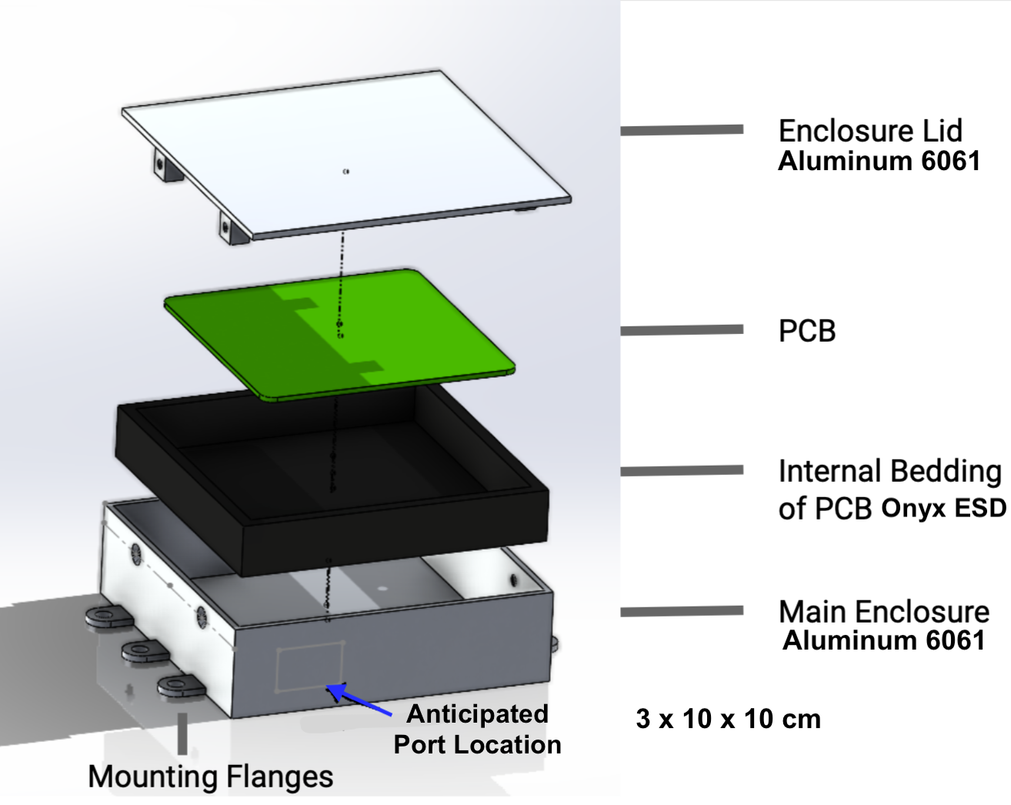
Mechanical Concept Design
Estimate Housing Maximum Weight = 217 g
Aluminum 6061
Shielding Effective Material
2 mm Al Sheet Brazed Together
Estimated Clean Weight: 172 grams
Onyx ESD
Ideal Material Resistance Range: 10⁵ -10⁷ Ω
Prevents Discharge to PCB via Human Contact
3D Printed
Estimated Clean Weight: 45 grams
Mounting Flanges
Mountable on Both GA Spacecraft and for Testing
Not Required to Fit in 3x10x10 cm Envelope
Driving Requirement
C.1 | INS shall not exceed 3 x 10 x 10 cm in size
C.2 | INS shall not exceed 500 g
1.2.5 | Structure shall resist EMI from a 4 GHz S-band antenna using gaps smaller than 7.45 mm
2.1.4 | Structure shall have 6 mounting flanges/brackets

Slide 15
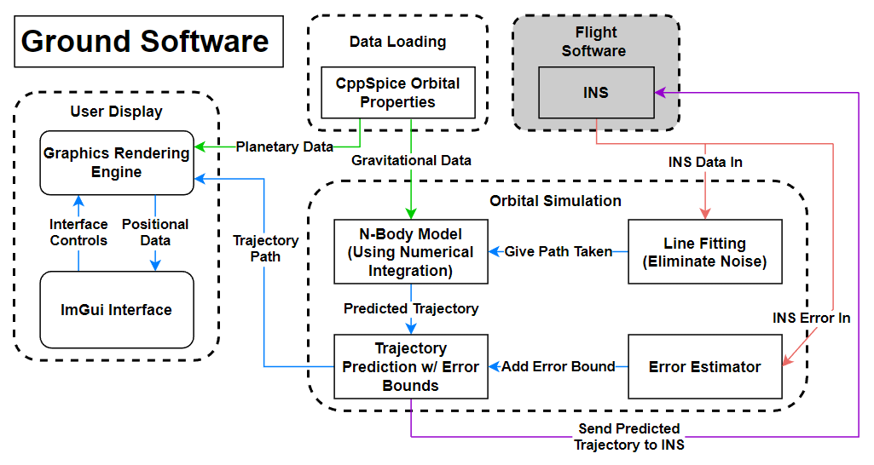
Ground Software - GS Flowchart

Slide 16
Critical Projects Elements/Project Risk

Slide 17
Critical Project Elements
Critical Element | Constraint Rationale
E1: Accuracy | The GAINS system should have a peak position error of no more than 1 km and peak velocity error of no more than 0.1 0.4 m/s.
E2: Calculation | The GAINS system will have to calculate estimate its inertial position and velocity in real time using measurements from its integrated sensors.
E3: Communication | The GAINS system must have uplink and downlink capabilities with the ground station, as well as data transmission to the parent satellite.
E4: Display | The GAINS ground station must include a Graphical User Interface (GUI) with a real time status, trajectory, and power on/off switches.
E5: Integration | The GAINS system must be compatible with a variety of GA’s satellite bus structures have flanges for mounting to the parent satellite.
E6: Testing | The GAINS system shall be tested to ensure project elements fulfill customer mission objectives.

Slide 18
CPE 1
E1: Accuracy | The GAINS system should have a peak position error of no more than 1 km and peak velocity error of no more than 0.4 m/s.
Critical to deliver states with high accuracy to General Atomics
Sensor calibration using accuracy error and sensor bias models
Kalman Filter (KF)
Sensor error (bias, repeatability, VRW) is mitigated through the KF
Weighting sensor measurements with ground station updates allows for improved state estimates
KF development researched and computational requirements modelled
Trajectory modeling on the ground provides predictions for KF error correction during LOC periods

Slide 19
CPE 2
E2: Calculation | The GAINS system will estimate its inertial position and velocity at 100 Hz using measurements from its integrated sensors.
Critical to provide parent satellite with 100 Hz state updates
Kalman Filter
Non-linear position determination (MEKF equations, out of scope)
Utilize Clohessy-Wiltshire equations to model a circular lunar orbit
Accelerometer measurements and ground station update inputs
Utilizing Dr. Holzinger & PhD students for support
Developed code outline in C for testing on dev. boards to estimate computational requirements

Slide 20
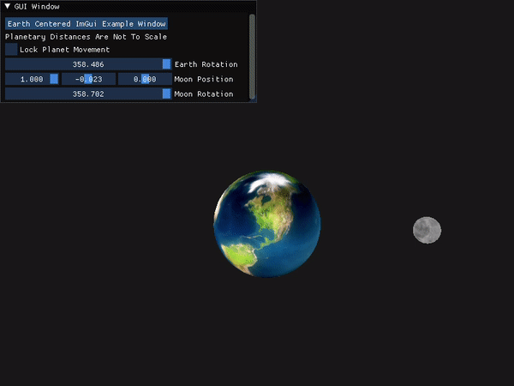
CPE 4
E4: Display | The GAINS ground station must include a Graphical User Interface (GUI) with a real time status, trajectory, and power on/off switches.
Critical to display relevant trajectory information to General Atomics’ engineers
NASA JPL CppSpice Data gives planet locations and gravitational effects
GUI displays live data and enables live control of the simulation
GUI will control connection activity and enable different control modes to be activated
*This is only an initial model intended to show functionality of the Graphics Render Engine, Gui, and CppSpice Orbital Data Implementation

Slide 21
Risk Matrix (New Scope)
Very Likely |  |  | Lack of Kalman Filter expertise | Accelerometer drift/uncertainty
Likely
Possible
Unlikely |  |  |  | Part lead time/delivery
Very Unlikely |  |  | Budget |  | Part availability
 | Negligible | Minor | Moderate | Significant | Severe
Risk Level
Acceptable
Concerning
Unacceptable
Probability
Impact/Consequence

Slide 22
Design Requirements/Satisfaction

Slide 23
Electronics - Accuracy Model
Velocity Error Derivation
Position Error Derivation

Slide 24
Electronics - Velocity Accuracy Model Derivation
Velocity error at calibration
Velocity Random Walk
Angle Random Walk
Scale Factor
Accelerometer Bias
Gyro Bias
KEY
Total change in velocity felt over time interval
t = 0.1 s
t = 2 hr

Slide 25
Electronics - Position Accuracy Model Derivation
Position error at calibration
Velocity error at calibration
Velocity Random Walk
Angle Random Walk
Scale Factor
Accelerometer Bias
Gyro Bias
KEY
Total change in position felt over time interval
t = 0.1 s
t = 2 hr

Slide 26
Electronics - Dominant Error Source
Accelerometer | Velocity Error (m/s) | Calibration Error Term (m/s) | Sensitivity (Scale Factor) Term (m/s) | Accelerometer Bias Term (m/s) | Velocity Random Walk Term (m/s) | Attitude Terms (m/s)
SDI 1521 | 8.706 | 0 | 0.00017 | 8.7 | 0.0058 | 1.8e-8

Slide 27
Electronics - Dominant Error Source
Accelerometer | Velocity Error (m/s) | Calibration Error Term (m/s) | Sensitivity (Scale Factor) Term (m/s) | Accelerometer Bias Term (m/s) | Velocity Random Walk Term (m/s) | Attitude Terms (m/s)
SDI 1521 | 8.706 | 0 | 0.00017 | 8.7 | 0.0058 | 1.8e-8
Accelerometer | Position Error (m) | Calibration Error Term (m) | Sensitivity (Scale Factor) Term (m) | Calibration error Term (m) | Accelerometer Bias Term (m) | Velocity Random Walk Term (m) | Attitude Terms (m)
SDI 1521 | 31029.2 | 0 | 1.2 | 0 | 31000 | 28 | 7.3e-10

Slide 28
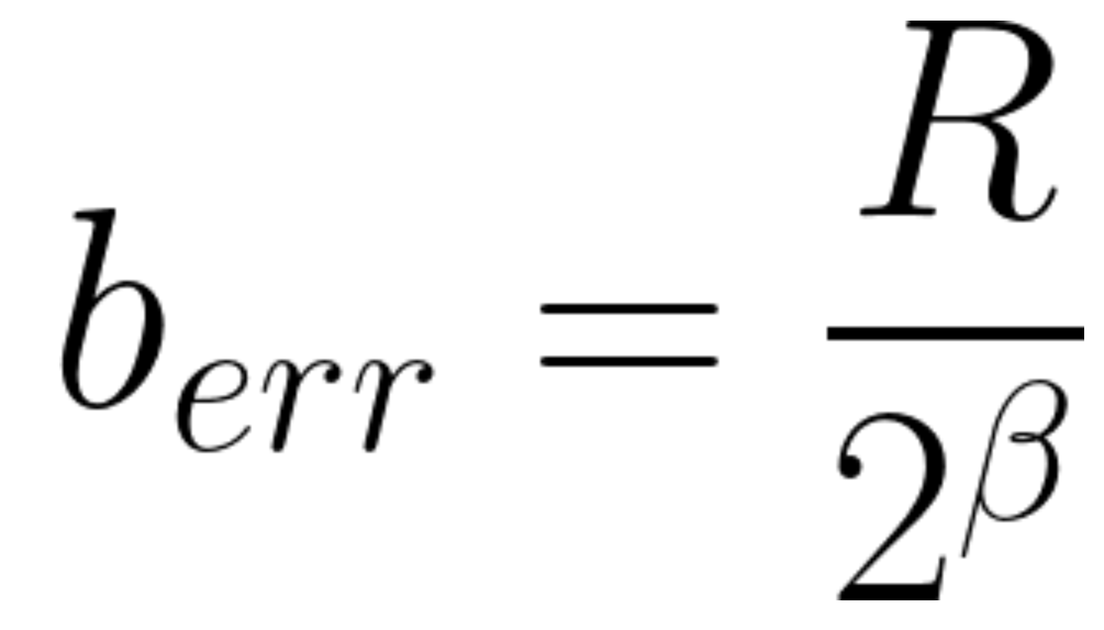
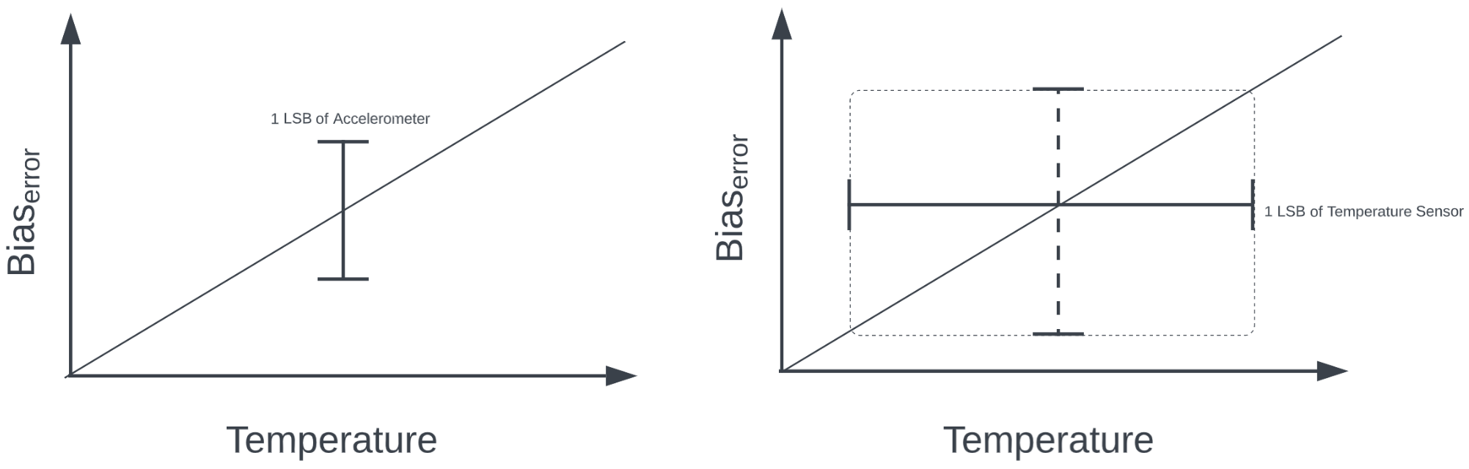
Electronics - Bias Calibration Model
Assuming that we can calibrate the bias to the physical limit of the ADC (1 LSB), we can reduce the bias error as follows:
Where R is the range of the sensor (accel. or temp.) and β is the number of bits in the ADC

Slide 29
Electronics - Lifetime Drift (Repeatability)
After a sensor is calibrated, it drifts roughly with the square root of time.
Unlike temperature calibrations, these drift calibrations cannot be made mid flight.
The model used for repeatability was suggested by the ADXL355 datasheet:
Where D is the sensor lifetime drift and t is time since calibration

Slide 30
Electronics - Model Results
0.0019% Best Bias Estimation possible
(within 1 LSB of the ADC)
Drifts out of requirement after 64 seconds
x10⁴
0.61% Bias Estimation (Calibration of accelerometer done by a team of doctoral graduates)
- Source: “Estimation of Deterministic and Stochastic IMU Error Parameters” by Derya Unsal and Kerim Demirbas
8.7 m/s, and 31 km error at calibration (out of requirement)

Slide 31
FSW- Kalman Filter Model
Kalman filters estimate state using multiple sources of measurements and their uncertainty
Predict state at next time step
Extrapolate prediction uncertainty
Determine Kalman gain - weight prediction and measurements
Update prediction with weighted measurements
Update the prediction uncertainty
Predict
Update

Slide 32
FSW - Multiplicative Extended Kalman Filter
The following capabilities would require a Multiplicative Extended Kalman Filter (MEKF):
3 axis accelerometer
3 axis gyroscope
Coupled, nonlinear system
The state vector would need 19 variables:
The full MEKF is not required to meet adjusted customer requirements

Slide 33
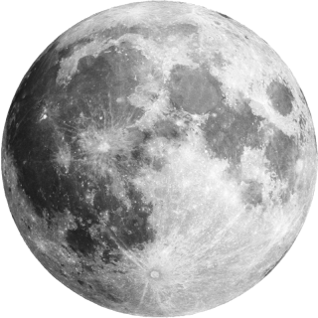
GAINS Change of Scope Recap
Inertially measured trajectory change
Expected Trajectory
Re-scoped orbit
Computed AD solution and data
THRUST
Positional Drift Corrections
Parent S/C
INS
Known Trajectory

Slide 34
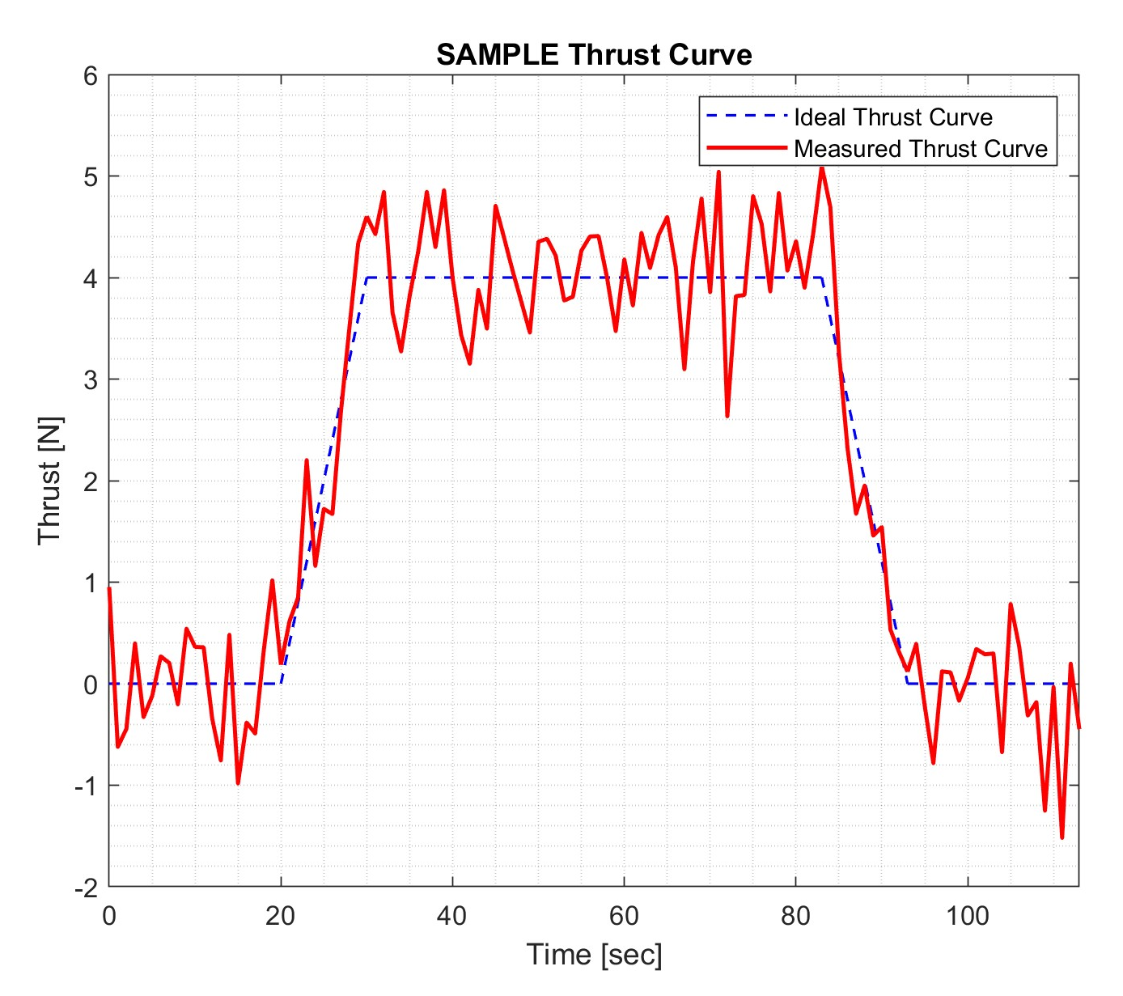
Thrust Addition Benefits
Integrating noise for entire 2 hour LOC produces error values exceeding the customer requirements.
Integrating for thrusting period only results in error values below customer requirements.
Sensor repeatability has less time to drift

Slide 35
Electronics - Model Results (New Scope)
Modeled after THEMIS Satellites: 4 Monopropellant Hydrazine Cold Gas Thrusters
Assumed ΔV required for lunar maintenance burn = 10 m/s
Typical burn duration of 73 seconds
Repeatability value at calibration now within customer requirements!

Slide 36
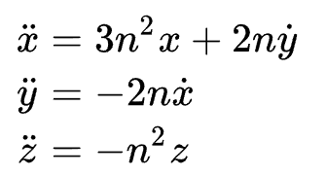
FSW - New Scope
Modelling as a circular orbit allows use of the Clohessy–Wiltshire equations. (This avoids implementing a full non-linear MEKF)
Allows our Kalman Filter state vector to be reduced to 6 variables:
Attitude information is provided from star tracker at 10 Hz

Slide 37
FSW - Compute Time Estimates
Testing on Arduino Due (Atmel SAM3X8E ARM Cortex M3, 84 MHz)
Full MEKF test with 25 variable state vector:
0.1882 seconds/cycle (~5 Hz [100 Hz required])
Compilation size: 30 kB
SRAM usage: 47 kB (floats not doubles)
Testing rescoped model with 6 variable state vector on same Arduino Due:
0.006 seconds/cycle (~166 Hz)
Compilation size: 30 kB
SRAM usage: 8 kB (floats not doubles)
Only tests Kalman filter equations,
excludes I/O, memory operations, communications, sensor interactions, state transition matrix calculations

Slide 38
Verification & Validation

Slide 39
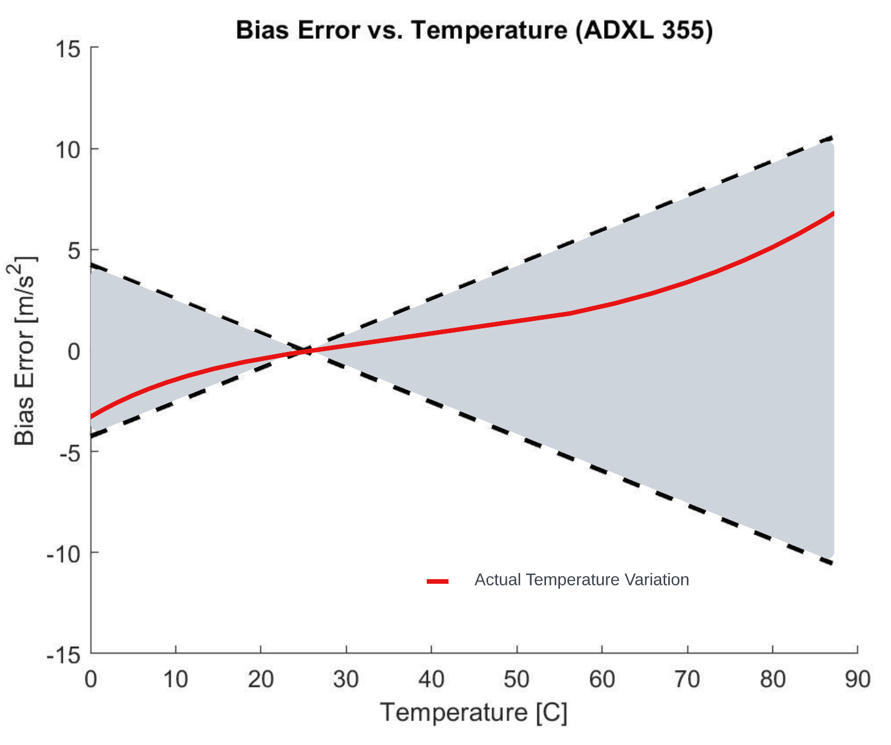
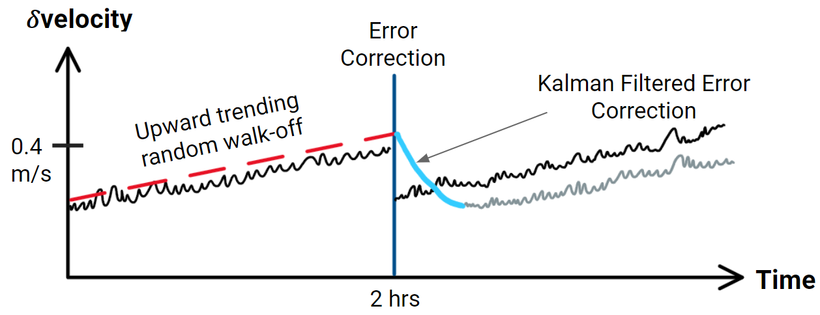
Tabletop Test - Models
Velocity Random Walk | Temperature Calibration | Repeatability
Kalman Filter uses this value to establish discrete error bounds in weighting process | Calibration of bias error change over various temperatures will greatly reduce the accuracy estimates | Understand how the accelerometer will drift between calibrations Verify accuracy is within customer requirements

Slide 40
Tabletop Test
Purpose | Description
Baseline accelerometer Velocity Random Walk (VRW) value, and characterize sensor specific uncertainties to increase accuracy Quantify accelerometer Repeatability value through testing runs with power cycles between | Secure INS on static surface for two hours on each axis at a constant temperature Process data to determine VRW Same test procedure to be followed with Temperature Variation Test in order to determine associated dependence
Success Criteria: Baseline VRW values established for each axis for incorporation in software.
Ground Station
INS
F_{g}

Slide 41
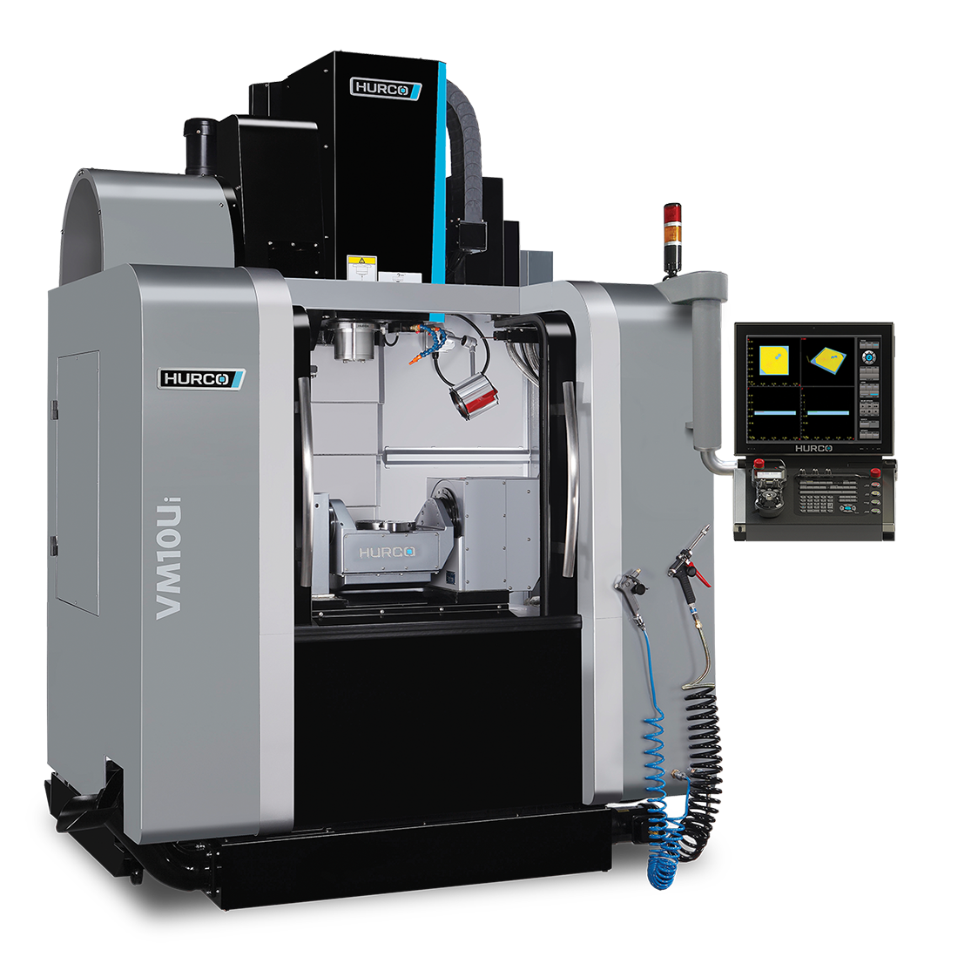
5-Axis CNC Test
Purpose:
Determine sensor misalignment, scale factor, and bias for software-sensor calibration
Characterize accuracy of position and velocity estimation by comparing to known values of the CNC machine
INS
Ground Station
Success Criteria: Scale factor, misalignment properties, and bias for software calibration obtained along with sensor accuracy.
Hurco VM10U_{i} (ITLL Model)

Slide 42
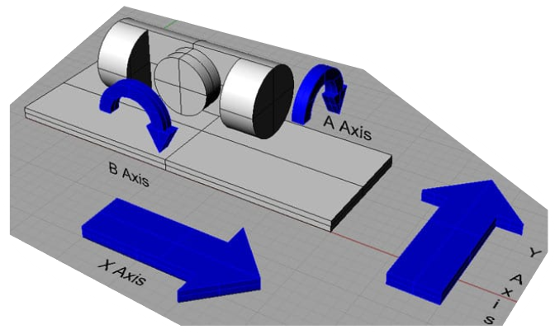
5-Axis CNC Test - Description
Description:
Mount INS to CNC fixture plate
Measure accelerations and rotational velocities through pre-coded path
Perform data uplink and downlink with the ground station
Remove INS and compare measured trajectory to true motions of the CNC
Test bed range of motion is sufficient for GAINS to be rotated and translated along each axis of the accelerometer

Slide 43
Project Planning

Slide 44
WBS
KEY: Completed Work In Work Future Work
GAINS
Management
INS
Housing
Ground Station
Deliverables
Budget
Flight Software
PCB
Requirements definition
Accessibility method
EMI characterization
ESD characterization
Material requirement definition
PCB thermal analysis
Material selection
Prototyping
Fabrication
Hardware integration
Test mounting fabrication
Tabletop Test
5 Axis CNC Test
Basic GUI design
Planetary model incorporation
Render engine development
Orbital simulation
Thrust modeling
Compatibility testing
Simulation Integration
Real time testing
GUI refinement
Data exchange testing
PDD
PDR
CDR
Fall Final Report
IDR
AIAA Abstract
AIAA Submission
TRR
AES Industry Symposium
SFR
Spring Final Report
Sr. Symposium!
Initial mass allocation
Initial power allocation
Finalize Bill of Materials
P-Card approval
Purchase plan finalization
Ordering
KF creation
Star tracker data fabrication
KF tuning
Real time Testing
Data exchange testing
Accelerometer selection
Gyroscope selection
Error characterization
Altium PCB design
PCB review
PCB fabrication
Component testing
Component calibration
Integrated testing

Slide 45
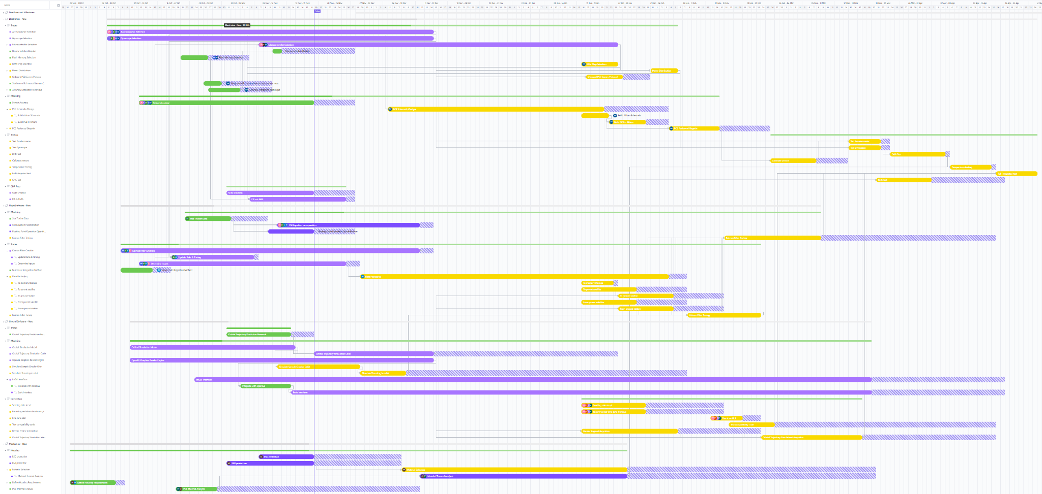
Updated Work Plan
CDR
FFR
IDRs
TRR
AIAA Paper
SFR
Component Selection
PCB Fabrication/Testing
Testing Campaign
Fall Break
Winter Break
Symposium!
Spring Break
Kalman Filter Development/Tuning
GUI/Truth Orbit Development
Housing Fabrication

Slide 46
Cost Plan
Part Type | Part Name | Qty | Cost/unit | Total Cost
3-axis Accelerometer | SDI 1521 | 2 | $450 | $900
3-axis Gyroscope | IAM-20380 | 2 | $14.93 | $29.86
Microcontroller | TBD | 2 | < $25 | $50
PCB | TBD | 3 | ~ $30 | $90
Flash Memory | GD5F1GQ4UFYIGR | 2 | $4.84 | $9.68
Dev-Board | TBD | 1 | < $100 | $100
Housing Material | Aluminum 6061/ Onyx ESD | 64 ㎤/ 10.1 ㎤ | < $30/ $35 | $65
Testing Supplies | Various, TBD | - | ~ $100 | $100
Misc. (fasteners, ports, shipping, etc) | Various | - | ~ $200 | $200
Total projected cost Electronics: |  |  |  | $1479.54
Total projected cost Mechanical: |  |  |  | $135
Subsystem | Allocated Budget | Remaining Budget | Budget margin
Electronics | $2480 | $1250.46 | 50.42%
Mechanical | $1200 | $1135 | 94.6%
Shipping | $320 | $170 | 53%
Total: | $4000 | $2555.46 | 63.9%
*All components were determined to be available with feasible lead times for next semester

Slide 47
Major Test Overview
Test | Facilities Required | Access?
Tabletop Test | Static surface, undisturbed for 2 hours | Yes
5-Axis CNC Test | 5-Axis CNC machine, mounting hardware | Yes - Team member is an ITLL machine shop employee
Temperature Variation Test | Temperature controlled environment, ability to monitor/record temperature and sensor readings, static surface, undisturbed for 2 hours | Yes, same facility as Tabletop Test. Still evaluating Temperature Control methods
*All other tests will be component level tests, achieved with Aerospace Electronics Lab facilities

Slide 48
Questions?

Slide 49
Backup

Slide 50
Mechanical Backup Slides

Slide 51
Mechanical - Overview
GAINS Enclosures Anticipated Environment
Closed in Spacecraft
Assuming the use of an S-Band antenna, the requirement would be to reduce the interference of Electromagnetic radiation in the range of 2GHz - 4GHz.
Distance of S-Band assumed to be less than 1 meter
Ambient Temperature = 0°C to 60°C
Flat point of contact with spacecraft is assumed to follow given constraint
Ambient Temperature = 0°C- 60°C
S-Band Antenna
INS
Illustration of anticipated environment described by General Atomics
Notes:
Basic illustration of…
the heat produced by our PCB
The exact set up
Hence mounted inside the spacecraft and not exposed to space
where the ambient temperature takes place
Aka where our initial heat transfer is coming from akaa we are given the assumption that the surface point of contact with SC will also be the same temp
our mounting on the GA satellite
The “S-band antenna” producing 2 GHz to 4GHz emitted towards the INS (doesn’t have to be an s-band but show that their is radiated interference by an antenna on SC

Slide 52
Mechanical Design
Key Features:
3 Pieces
Aluminum Base
Aluminum Lid
Onyx ESD Bedding
Base and Lid Hozintonally Bolted Together
Bedding for PCB Mounting
PCB Screwed On
Bedding held flat via Lid
Mounting Flanges
Mountable on Spacecraft
Mountable for Testing Requirement
Featured Illustration on Testing Section
PCB Board Accessible
Access PCB via Removable Top
PCB and Bedding Fully Removable
Shielded Connectors
Notes:
Backup

Slide 53
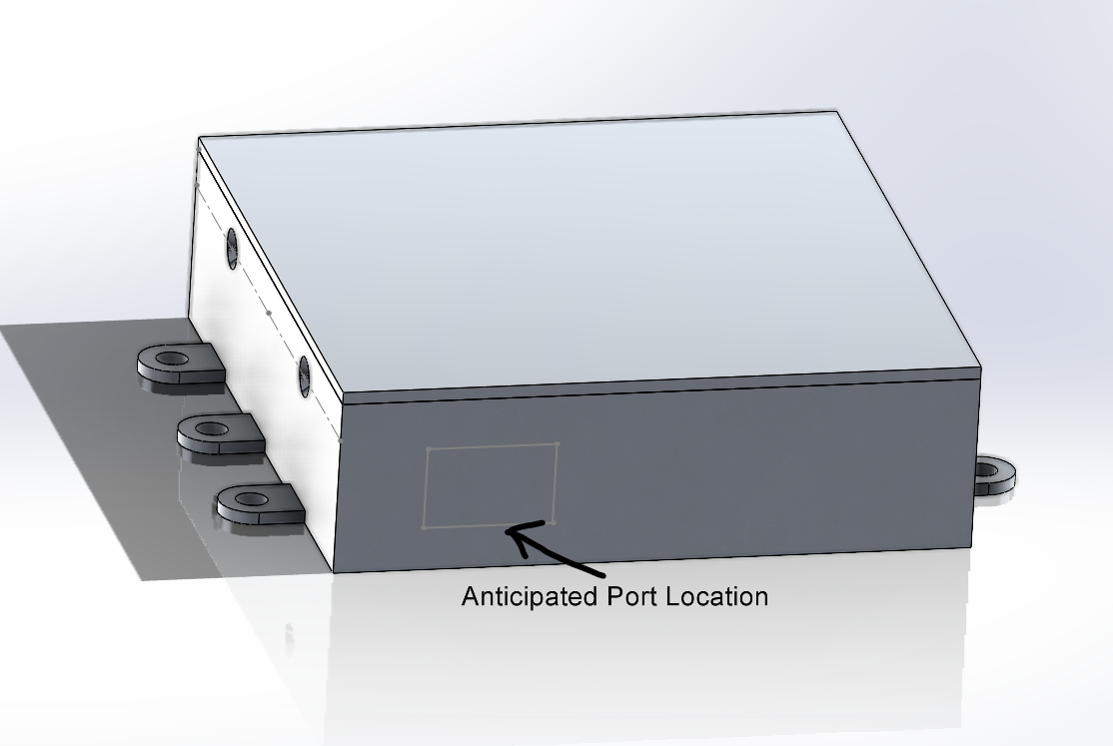
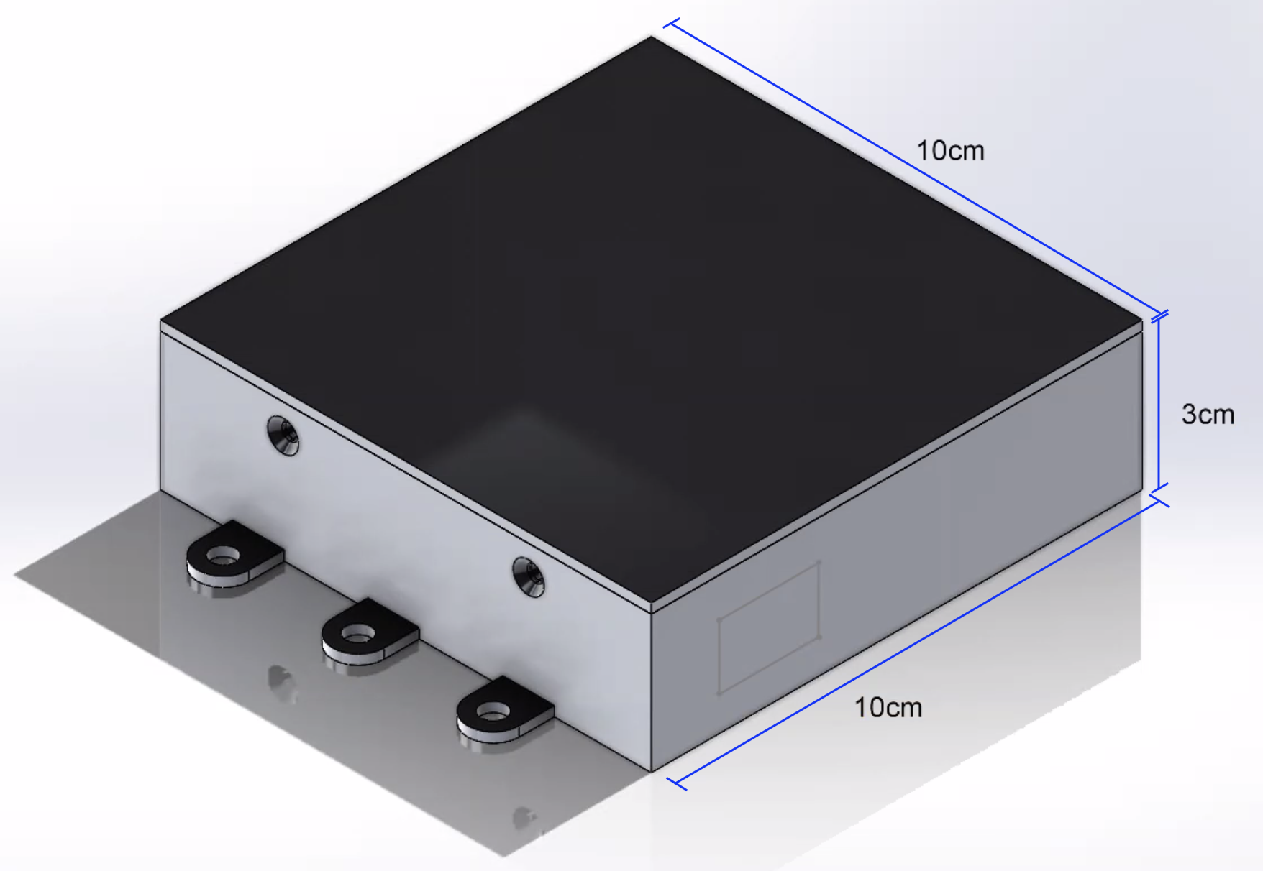
Mechanical Design- Additional CAD
e

Slide 54
Mechanical - Electromagnetic Compatibility
Customer Requirement: “Assuming the use of an S-Band antenna, the requirement would be to reduce the interference of Electromagnetic radiation in the range of 2GHz - 4GHz.”
“Electromagnetic Compatibility (EMC) is the ability of electrical or electronic equipment/systems to function in the intended operating environment without causing or experiencing performance degradation due to unintentional Electromagnetic Interference (EMI).”
INS instruments affected by EMI:
MEMS Accelerometer (ADXL355 - 3-axis Accelerometer)
MEMS Gyroscopes (IAM-20380 - 3-axis Gyroscope)
EMI Shielding Rule of Thumb: To prevent signal transmission, holes need to be no larger than 1/10 of the wavelength
Wavelength: 0.1499 m and 0.07495 m respectively
Maximum allowable gap: 10% of wavelength
1.49 cm at 2 GHz
0.745 cm at 4 GHz
Concept design feature no holes, hence protectant EMI Gaskets will be decided upon possible manufacturing imperfections
Wavelength:
c = speed of light
f = frequency
Source: https://www.radioing.com/eengineer/intro.html
Notes:
Source of definition: https://www.radioing.com/eengineer/intro.html
“Assuming the use of an S-Band antenna, the requirement would be to reduce the interference of Electromagnetic radiation in the range of 2Ghz- 4Ghz.”
One rule of thumb often used for Faraday cages to prevent transmission is that the holes need to be no larger than 1/10 of the wavelength of the signal.

Slide 55
Mechanical - Shielding Effectiveness Setup
Shield Effectiveness (SE): An enclosure ability to diminish the exposed electromagnetic field
The Required Attenuation Shield Effectiveness [dB]:
= The radiated field strength received without barrier
= The radiated field strength received with barrier
S-Band Antenna radiated field strength: XXX [v/m]
Acceptable Field Strength of MEMS Gyroscope: XXXX [v/m]
Minimum Shielding Effectiveness Required: XX [dB]
Near field application
At frequencies from 30 to 100 MHz, aluminum foil provides at least 85 dB of shielding effectiveness.
Higher frequency requires higher shield thickness
Source: T.L. Clark, M.B. McCollum, D.H. Trout,
and K. Javor: Marshall Space Flight Center Electromagnetic
Compatibility Design and Interference Control
(MEDIC) Handbook

Slide 56
Mechanical - Designed Shielding Effectiveness
Four Types of possible EMI:
Conduction - Electric Current
Radiation - Electromagnetic Field
Capacitive Coupling - Electric Field
Inductive Coupling - Magnetic Field
Total Shielding Effectiveness of Designed Enclosure increases:
Thickness of the shield
Conductivity of the shield
Permeability of the shield
Joints and apertures will degrade shielding effectiveness (SE) of the material
Source: R.W. Evans, Design Guidelines for Shielding Effectiveness,
Current Carrying Capability, and the Enhancement
of Conductivity of Composite Materials

Slide 57
Mechanical - Shielding Effectiveness
Attenuation due to absorption factor:
Loss due to reflection factor (Negative Number):
Near-field re-reflection correction factor:
Total Shield Effectiveness:
Incident Wave
Reflection
Transmitted Wave
Re-Reflection
Reflected wave
Outside
Inside
Enclosure
Source: R.W. Evans, Design Guidelines for Shielding Effectiveness,
Current Carrying Capability, and the Enhancement
of Conductivity of Composite Materials
Notes:
Explain the meaning of each term (possibly backup slide)
Source: “Design Guidelines for Shielding Effectiveness,
Current Carrying Capability, and the Enhancement
of Conductivity of Composite Materials PDF”
Possibly make nomenclature

Slide 58
Mechanical - Electrostatic Discharge (ESD)
Electrostatic Discharge (ESD) Damage: The discharge of build up of electrostatic charge between two components
Electrostatic discharge improperly disperse towards components in attempt to reach ground
Fatal towards vulnerable components
Sensitivity of components may vary
Main Concern:
Discharge while in physical contact (testing) with the INS Housing
Build-up of electrostatic charge in human body
ESD Standard Practices:
Grounded wrist straps
Handle with anti-static gloves
Notes:
Intended to be a back up slide

Slide 59
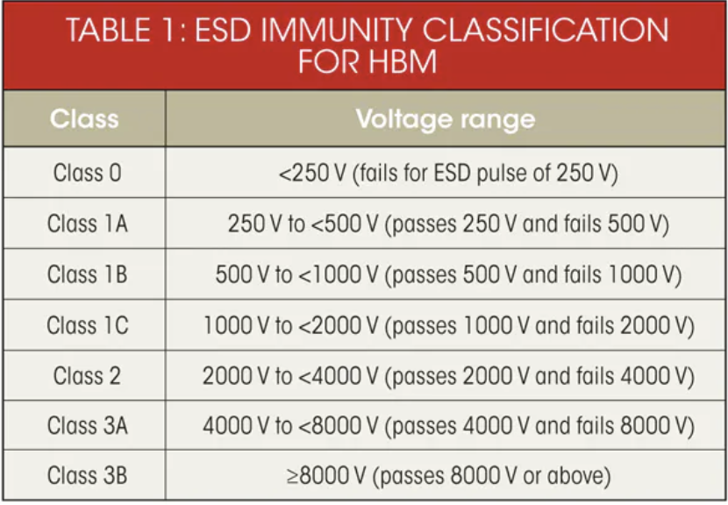
Mechanical - Electrostatic Discharge Vulnerability
GAINS Components Vulnerability:
ADXL355 - 3-axis Accelerometer
Class 1C (HBM)
Damage at 2000 Volts
Moderately Sensitive
IAM-20380 - 3-axis Gyroscope
Class 1C (HBM)
Damage at 2000 Volts
Moderately Sensitive
Flash Memory - GD5F1GQ4UFYIGR
Class 3B (HBM)
No concern
“Human Body Model (HBM): Model imitating the susceptibility of an electronic device from ESD caused by a human touch”
Source: electronicdesign.com
Notes:
Intended to be a back up slide

Slide 60
Mechanical - Electrostatic Discharge Protection
ESD Shielding Material of the Housing
Insulative Material (Undesirable)
Enable electrostatic to build up
Attempts to discharge at random
Fatal
Difficult to ground
Conductive Material (Acceptable)
Enable electrostatic charges to discharge towards ground
Low resistance leads to unsafe discharge
Connect enclosure to ground enable discharge
Dissipative Material (Desirable)
Materials with surface resistivity 10^2 ohms to 10^7 ohms disperse static charge
Connect enclosure to ground to enable safer discharge
Source: terrauniversal.com

Slide 61
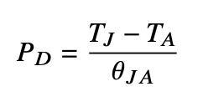
Mechanical - Thermal Analysis Setup
Thermal Analysis conducted to have an understanding of thermal implications on design
Customer constraints on Design
Maximum Power Usage is 1 Watt
Ambient Temperature is 0°C to 60°C
10x10x3 Cubic Centimeter Volume
Analysis Assumptions
STM32F21xxx - LQFP144 processor
Power dissipated is 0.7 Watts
0.5 Watts for microcontroller; 0.2 Watts for everything else
Still air convection
Air - Wall - Air Thermal Resistance System
2 mm enclosure wall thickness
Governing Equations:
Source: Nikhil Seshasayee, Understanding Thermal Dissipation and Design of a
Heatsink PDF
Notes:
For EMI and ESD shielding, shielding diminishes with any apertures, hence the thermal model will assume a closed enclosure. Will explain more in the respective slides

Slide 62
Mechanical - Thermal Analysis Results
Initial model results were promising!
Maximum Allowed Junction Temperature from Microprocessor Specs: 125°C
Minimum Estimated Junction Temperature (@ 0°C): 28°C
Maximum Estimated Junction Temperature (@ 60°C): 88°C
Estimated Heat Energy Flow: ~0.35 Watts
Notes:
Reminder that this was used to estimate worst case!
70% of power going into processor assumed lost
Effects are vertical through 10 x 10 squared centimeter area. No provisions were made for added conduction benefits through PCB and bottom of enclosure
Minimum junction temperature would be 0°C with no power dissipation!
Care should be taken to minimize power dissipation of electronics but there is 37°C buffer to work with
Notes:
For EMI and ESD shielding, shielding diminishes with any apertures, hence the thermal model will assume a closed enclosure. Will explain more in the respective slides

Slide 63
Mechanical - Thermal Analysis Setup (Backup Slide)
Before INS turns on:
Spacecraft
Ambient Temperature = 0°C- 60°C
Enclosure
Ambient Temperature = 0°C- 60°C
PCB
After INS turns on:
Spacecraft
Ambient Temperature = 0°C- 60°C
Estimated Heat Energy Flow: ~0.35 Watts
Enclosure
Max. Temperature = 88°C
PCB
1 Watt

Slide 64
Planned Evaluation Criteria Weight Justification
Feasible: This criterion refers to the total amount of equipment required to execute the plan, availability, and manufacturability.
EMI Shielding: This criterion refers material’s raw resistance to Electromagnetic Interference (EMI). Note: Alternatives are available.
ESD Shielding: This criterion refers material’s raw dispersion of Electrostatic Discharge (ESD). Note: Alternatives are available.
Density: This criterion refers estimated mass in the concept design.
Cost: Total cost of the material.
Notes:
Repeatability: This criterion refers to the ease of re-manufacturing various prototypes. (debating on it because i feel like feasible section takes care of it)

Slide 65
Mechanical - Planned Material Trade Matrix
Evaluation Criteria | Weight | Onyx ESD | Aluminum 6061 | Nylon 12 | ABS
Feasible | 30% | 3 | 3 | 2 | 2
EMI Shielding | 15% | 1 | 3 | 1 | 1
ESD Shielding | 15% | 3 | 2 | 2 | 1
Density | 20% | 3 | 2 | 3 | 3
Cost | 20% | 3 | 3 | 3 | 3
Total |  | 2.7 | 2.65 | 2.25 | 2.1
Trade Matrix Scale
3: Desirable
2: Acceptable
1: Undesirable
Trades
Notes:
Tried to keep this color neutral
Nylon 12 required coating for ESD dissipation
ABS Plastic: Acrylonitrile butadiene styrene
ABS was considered to due being a common material for PCB enclosures

Slide 66
Flight Software Backup Slides

Slide 67
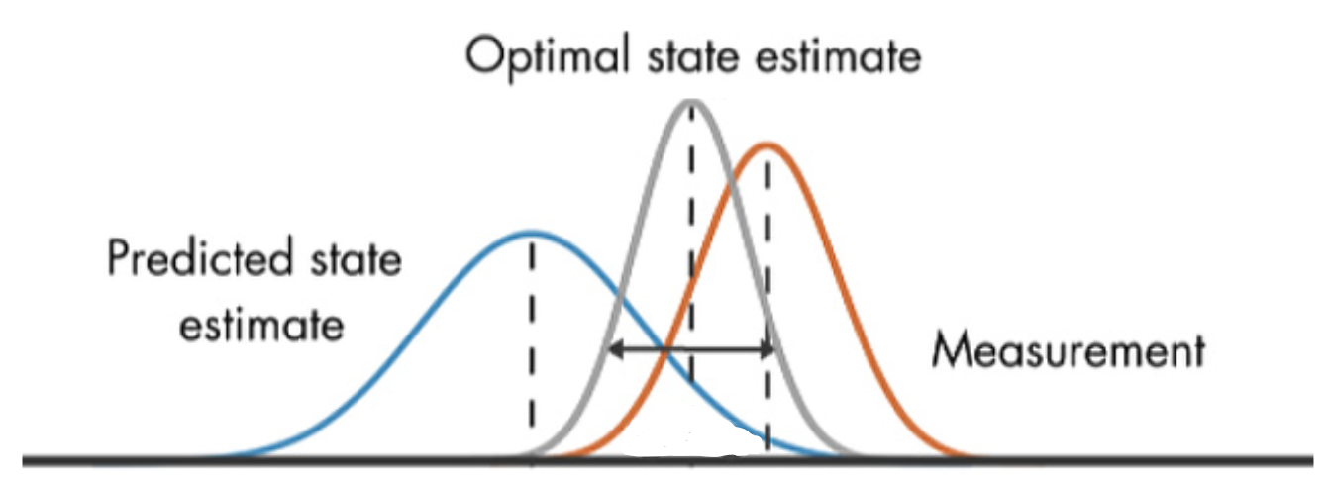
Flight Software Design
Sensor Data
Kalman Filter
Combine weighted prediction and measurement to estimate position and velocity at 100 Hz
Written in C for bare-metal flashing and speed
Kalman Filter
Predict
Measure
Weight P & M
Final Estimate
Parent CubeSat
Ground Station
∬a
(Sensor readings)
Error in prediction
Measurements
(GND updates)
Notes:
Square root filtering? Look into this

Slide 68
FSW - Kalman Filter Model
Driving Requirement
0.1 | Position shall be determined within 1 km sigma of true position
0.2 | Velocity shall be determined within 0.4 m/s sigma
0.3 | INS shall support data polling from parent satellite at 100 Hz or greater
What is a Kalman Filter?
Kalman filtering is an iterative mathematical process to quickly estimate a value such as your velocity or position using some model and measurements in “real-time”.
Initial Estimate ± Error
Value
KF Estimate
Actual Value
Sensor Measurements
t, time

Slide 69
FLOPS
Floating Point Operations Per Second
Assuming 25 variable state vector, 6 measurements
Hand calculated 13,757,200 FLOPS
Does not take into account:
External libraries
I/O interfacing
Reading/writing from memory
Rescoped model, 6 state, 6 measurements
Hand calculated 468,600 FLOPS (~30x smaller)

Slide 70
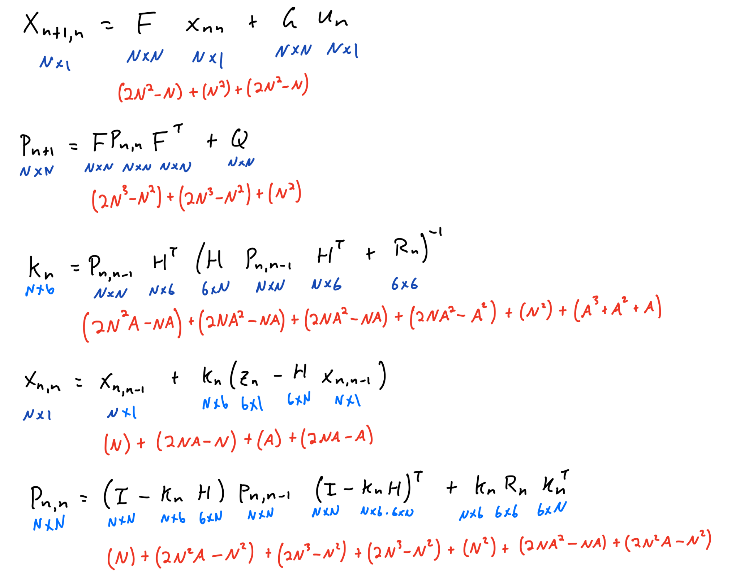
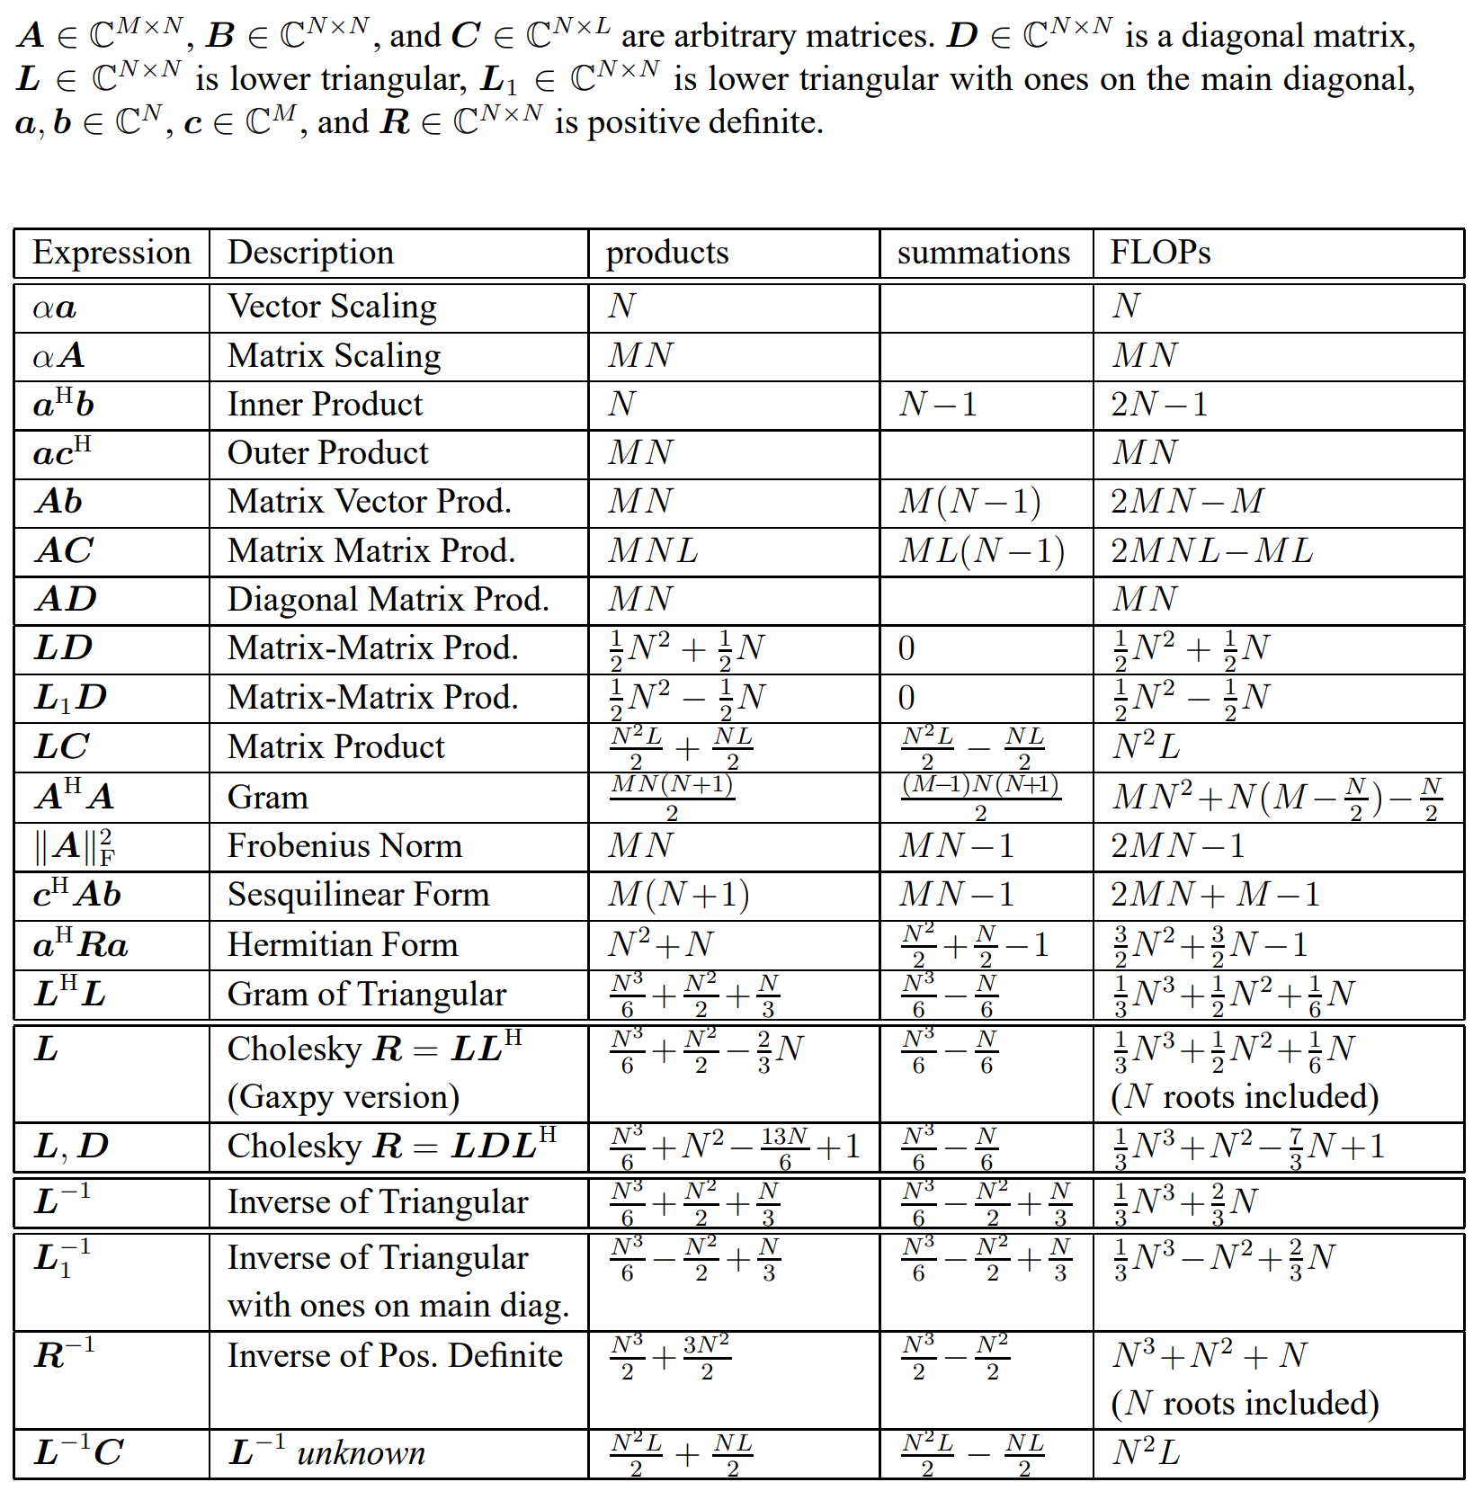
FLOPS
https://mediatum.ub.tum.de/doc/625604/625604

Slide 71
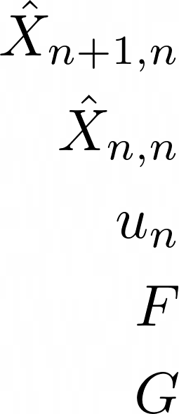
State Extrapolation Equation
The state extrapolation equation will give a prediction of the state one step in time forward using the current state vector estimate and system inputs.
= Predicted system state vector at time step n+1
= Estimated system state vector at time step n
= Control vector (or input vector), essentially a measurable deterministic input to the system
= State Transition Matrix
= Control Matrix, or the Input Transition Matrix

Slide 72
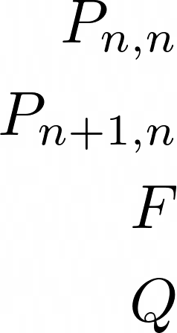
Covariance Extrapolation Equation
The covariance extrapolation equation is a measure of how uncertain are we about that prediction for the state one step in time forward that we just calculated in the State Extrapolation Equation.
= The uncertainty of the last estimate - covariance matrix of the current state
= The uncertainty estimate of the prediction - covariance matrix for the next state
= State Transition Matrix
= Process Noise Matrix

Slide 73
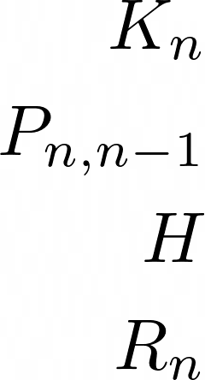
Kalman Gain Equation
The Kalman Gain is the weight given to the measurements and the current-state estimate. Essentially, the higher the kalman gain the more weight the measurements have on the outcome of the estimate or the more impact that the measurement will have on the next state prediction as opposed to the state prediction from the State Extrapolation Equation. The lower the Kalman Gain, the less the measurements influence the estimate and the more that the prediction from the State Extrapolation equation influences.
= The Kalman Gain
= The prior estimate uncertainty (covariance) matrix of the current state (predicted at the previous step)
= The Observation Matrix
= The Measurement Uncertainty (Measurement Noise Covariance Matrix)

Slide 74
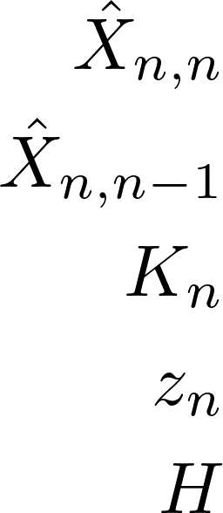
State Update Equation
The State Update Equation is the actual state estimate based on the predicted system state vector and the measurements weighted by the Kalman Gain.
= The Estimated System state vector at time step n
= The Predicted system state vector at time step n - 1
= The Kalman Gain
= The Measurement Vector
= The Observation Matrix

Slide 75
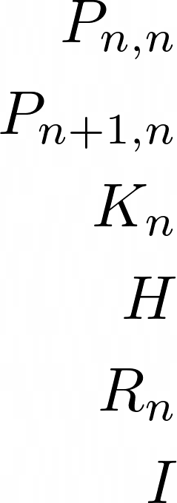
Covariance Update Equation
The covariance update equation is a measure of how uncertain are we about the estimate we just calculated with the State Update Equation.
= The estimate uncertainty (covariance) matrix of the current state estimate
= The prior estimate uncertainty (covariance) matrix of the current state (predicted at the previous state)
= The Kalman Gain
= The Observation Matrix
= The Measurement Uncertainty (Measurement Noise Covariance Matrix)
= The Identity Matrix

Slide 76
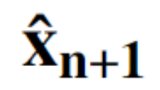
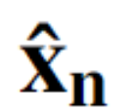
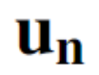
FSW - Time Prediction (New Scope)
Single axis accelerometer decoupled model
Kinematics
Scale Factor
Bias Instability

Slide 77
FSW - Process Noise Covariance Matrix

Slide 78
Electronics Backup Slides

Slide 79
Microcontroller Trade - Overview
Microcontrollers (MCUs) have the most promising CPU profile to fulfil our requirements:
Complex matrix calculations at 100Hz
Power constraint of 1W
Microprocessors are not a viable option as they draw too much power, FPGAs are too complex to use and whole integrated boards are too big and have unnecessary peripherals.
Notes:
Jasmin comments:
Get something concrete in here

Slide 80
Microcontroller Trade - Approach
Our research showed that a regular, trade-matrix based approach to part selection was not viable, as the most important characteristics (processing power and power consumption) are incredibly difficult to accurately quantify.
We thus used the quantifiable part values, such as size, number of I/O pins, comm. protocols etc. to establish a group of MCUs that work for our purpose.
Among different MCUs, ARM Cortex M architecture chips have come out on top when considering our requirements and system needs, as they are purpose-designed for low power consumption and high performance and check all other boxes.

Slide 81
Microcontroller - Testing
In order to gauge if the ARM cortex M chips have enough processing power to fulfil requirements, we performed testing on the Arduino DUE, which uses an ARM M3 MCU, to establish a baseline for obtainable computing power.
This was accomplished by writing a script in C to represent the KF-computations needed to achieve our requirements.
The test shows that even with an ARM M3 chip, we are able to meet requirements, and have a large margin of error as we will use an ARM M4 chip, which our research shows has a calculation speed 5 times faster than the M3. The exact test results can be found on slide “FSW - Compute Time Estimates”
We will move from estimates to definitive numbers are we obtain a ARM M4 chip MCU with a dev-board to test it on.

Slide 82
Electronics - Microcontroller Trade
Evaluation Criteria | STM32F3 (ARM M4) | STM32L4+ (ARM M4) | LCP1800 (ARM M3) | Arduino Due (ARM M3) | Necessity
Clock Speed (MHz) | 72 | 120 | 180 | 84 | -
Op. Voltage (V) | 2 - 3.6 | 1.7 - 3.6 | 1.8 - 3.6 | 3.3 | -
Max. Power Consumption (mW) | 38.8 | 64.8 | 75 | 1270 | < 850
FPU | Yes | Yes | No | No | -
Connectivity / I/O pins | I2C, SPI / 24 - 80 | I2C, SPI / 28 - 136 | I2C, SPI / 49 - 164 | I2C, SPI / 42 | I2C, SPI / >20
Flash memory / SRAM (KB) | 32 - 512 / 16 - 80 | 512 - 2048 / 320 - 640 | 128 - 1024 / 136 - 200 | 512 / 96 | > 30 / > 47
Dev board available? | Yes | Yes | No | Yes | Yes

Slide 83
Electronics - Weighted Flash Memory Trade Matrix
Evaluation Criteria | Weight | GD5F1GQ5xExxG | W25Q02JV-DTR | S35ML04G3 | TC58BVG2S0HBAI6
Storage | 0.2 | 1 | 2 | 3 | 3
Cost (dollars) | 0.08 | 3 | 2.5 | 3 | 3
Max Power Consumption (W) | 0.18 | 3 | 1 | 2 | 2.5
Erase Time (ms) | 0.08 | 3 | 1 | 2 | 3
Comms Protocol | 0.1 | 3 | 3 | 3 | 1
Type | 0.18 | 3 | 1 | 3 | 3
Operating Voltage (V) | 0.18 | 3 | 2 | 2 | 2
Weighted Total: |  | 2.60 | 1.70 | 2.56 | 2.53
($6.27)
Notes:
Mention we have the math available in a backup slide!!
Into detail why analog vs digital

Slide 84
Electronics - Accelerometer Trade
Evaluation Criteria | Weight | SDI 1521 | SDI 1527 | ADXL355 | ADXL357
Dimensions (cm) | 0.1 | 0.89 x 0.89 x 0.42 | 0.89 x 0.89 x 0.42 | 0.6 x 0.56 x 0.22 | 0.6 x 0.56 x 0.22
Power (mW) | 0.2 | 32.5 | 25 | 0.72 | 0.72
Cost (dollars) | 0.1 | $465 | $650 | $36.38 | $70.85
Bias (mg) | 0.1 | 5 | 4 | 25 | 125
Bias Repeatability (m/s^2) | 0.3 | 0.03924 | 0.04905 | 0.24525 | 1.22625
Noise Spectral Density (µg / √Hz) | 0.1 | 7 | 10 | 22.5 | 75
Output Type | 0.1 | Analog | Analog | I²C, SPI | I²C, SPI
Total |  | 2.5 | 2.5 | 2.4 | 2

Slide 85
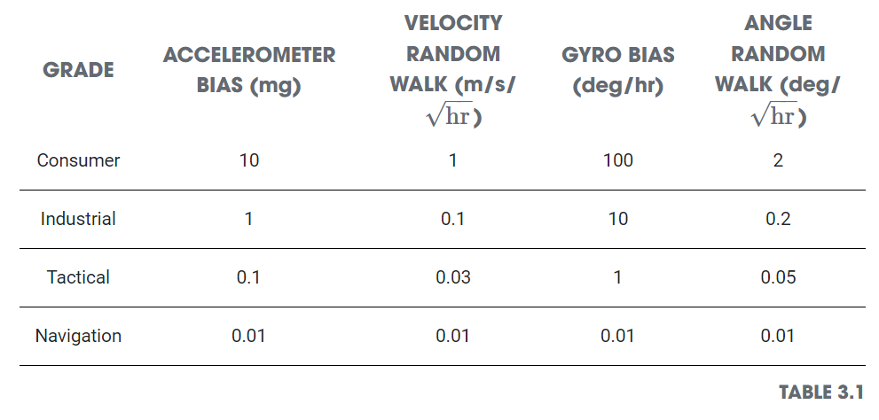
Electronics - Accuracy Model General Feasibility
VectorNav provided general values for each sensor grade
Project only feasible for navigation grade
Only sensor available to us are consumer and some industrial
Notes:
Done - Backup

Slide 86
Electronics - Bias Term Calibration
Bias change with Temperature Subtraction
Base Bias Subtraction
Raw Accelerometer Data
Base Calibrated Data
Temperature Calibrated Data
Calibrated Data vs Lifetime plot
Notes:
Done - Backup

Slide 87
Electronics - Temperature Variations
We assume that the kalman filter can estimate the temperature variation of variables to the same degree (within 1 LSB of temperature sensor) at all temperatures. Therefore, a temperature control design solution is not necessary.
Notes:
Done - Backup

Slide 88
Electronics - Best Possible Calibration Accuracy
Notes:
Done - Backup

Slide 89
Electronics - Realistic Calibration Accuracy
Notes:
Done - Backup

Slide 90
Electronics - “Realistic Calibration”
A table top calibration of accelerometers and gyroscopes was done by a team of doctoral graduates. “Estimation of Deterministic and Stochastic IMU Error Parameters” by Derya Unsal and Kerim Demirbas
Accelerometer Bias Calibration Error Average | Gyro Bias Calibration Error Average
0.6187 % | 0.0478 %
Notes:
Done - Backup

Slide 91
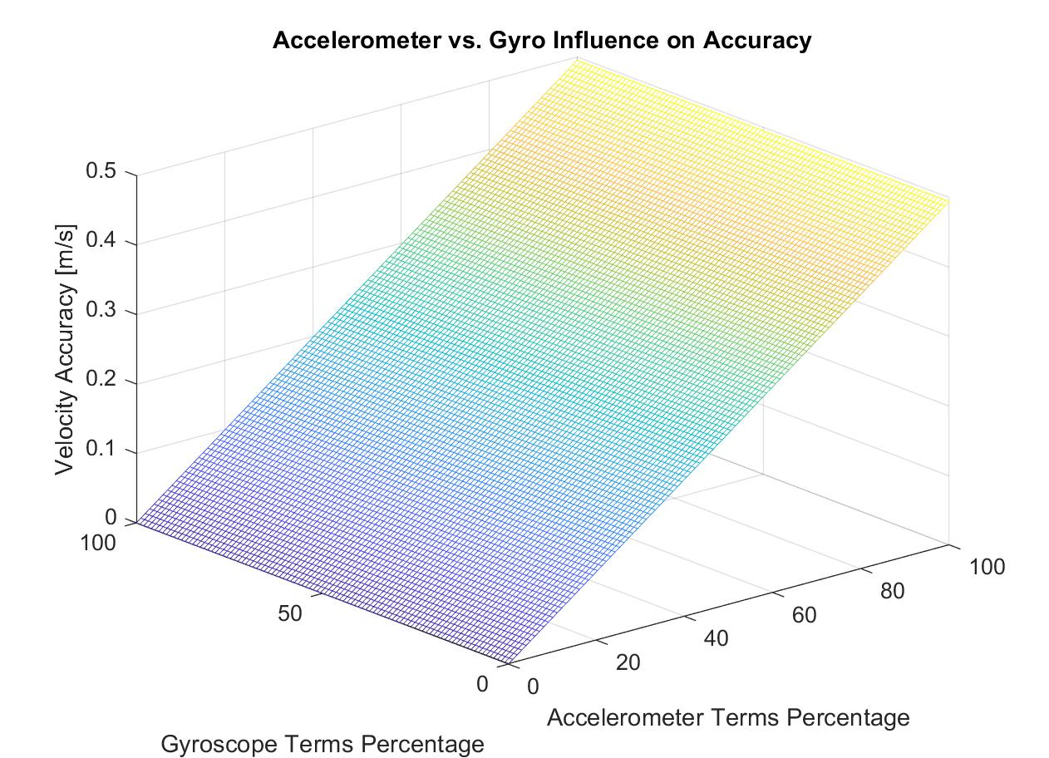
Electronics - Accelerometer vs Gyro Influence
Because we get attitude updates from the star tracker every 0.1 seconds while we get telemetry updates every 2 hours, the gyroscope contributions to accuracy error is negligible compared to the accelerometer contribution to accuracy error.
Notes:
Done - Backup

Slide 92
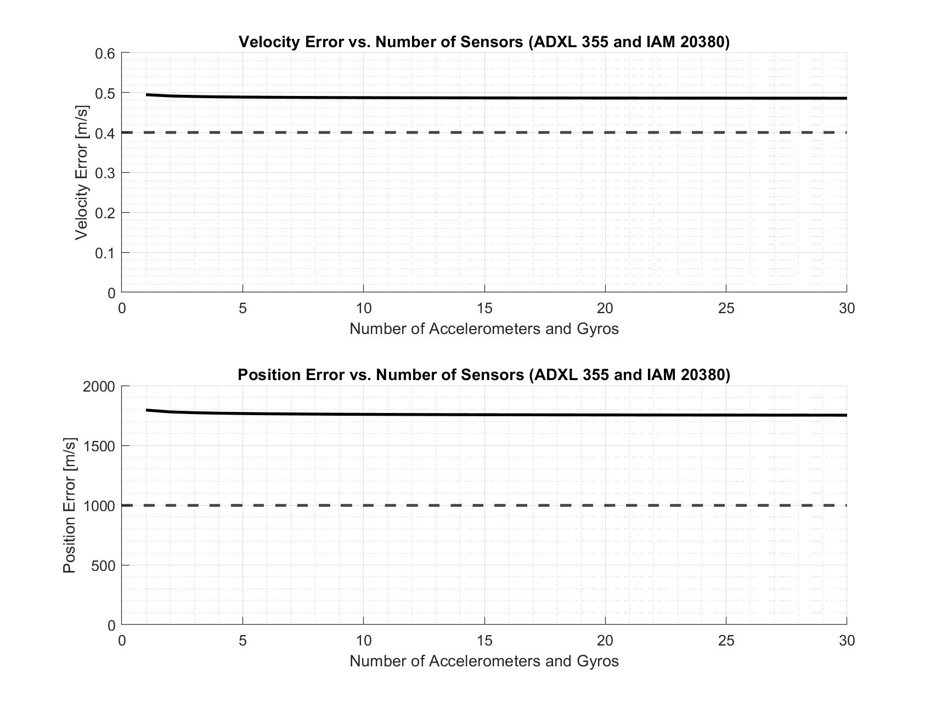
Electronics - Number of Sensors
Only the velocity random walk and angle random walk terms (random noise terms) are reduced by 1/sqrt(N) with multiple sensors, therefore, including multiple sensors is not a feasible design solution
Notes:
Done - Backup

Slide 93
Electronics - Single vs Multi-axis Sensors
Complexities
Alignment calibration, 3 different boards, Sample overlapping, more IO pins
Accelerometer | Number of Axes | Range (g) | Noise Density (μg/sqrt(Hz)
ADXL 103 | 1 | 3.4 | 110
ADXL 355 | 3 | 4 | 22.5
SDI 2012 | 1 | 4 | 10
SDI 1521 | 3 | 4 | 7
Notes:
Not Done - Backup. If we want to expand to 3 axis then we can, Power consumption shouldn’t be an issue.

Slide 94
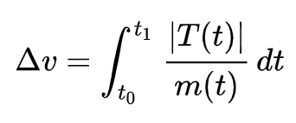
Electronics - Thrusting Model
Modelled after the Themis Satellites:
Mass = 128 kg
4 Monopropellant hydrazine thrusters at 4.4 N each = 17.6 N
ΔV required for lunar maintenance orbit = 10 m/s
Using the ΔV equation, this leads to a burn time of 73 seconds
Assuming constant mass and thrust
Sources: https://www.eoportal.org/satellite-missions/themis#spacecraft
https://ntrs.nasa.gov/api/citations/20070035736/downloads/20070035736.pdf
https://en.wikipedia.org/wiki/Delta-v#:~:text=Delta%2Dv%20is%20produced%20by,%2C%20delta%2Dv%20sums%20linearly
Notes:
Done - Backup

Slide 95
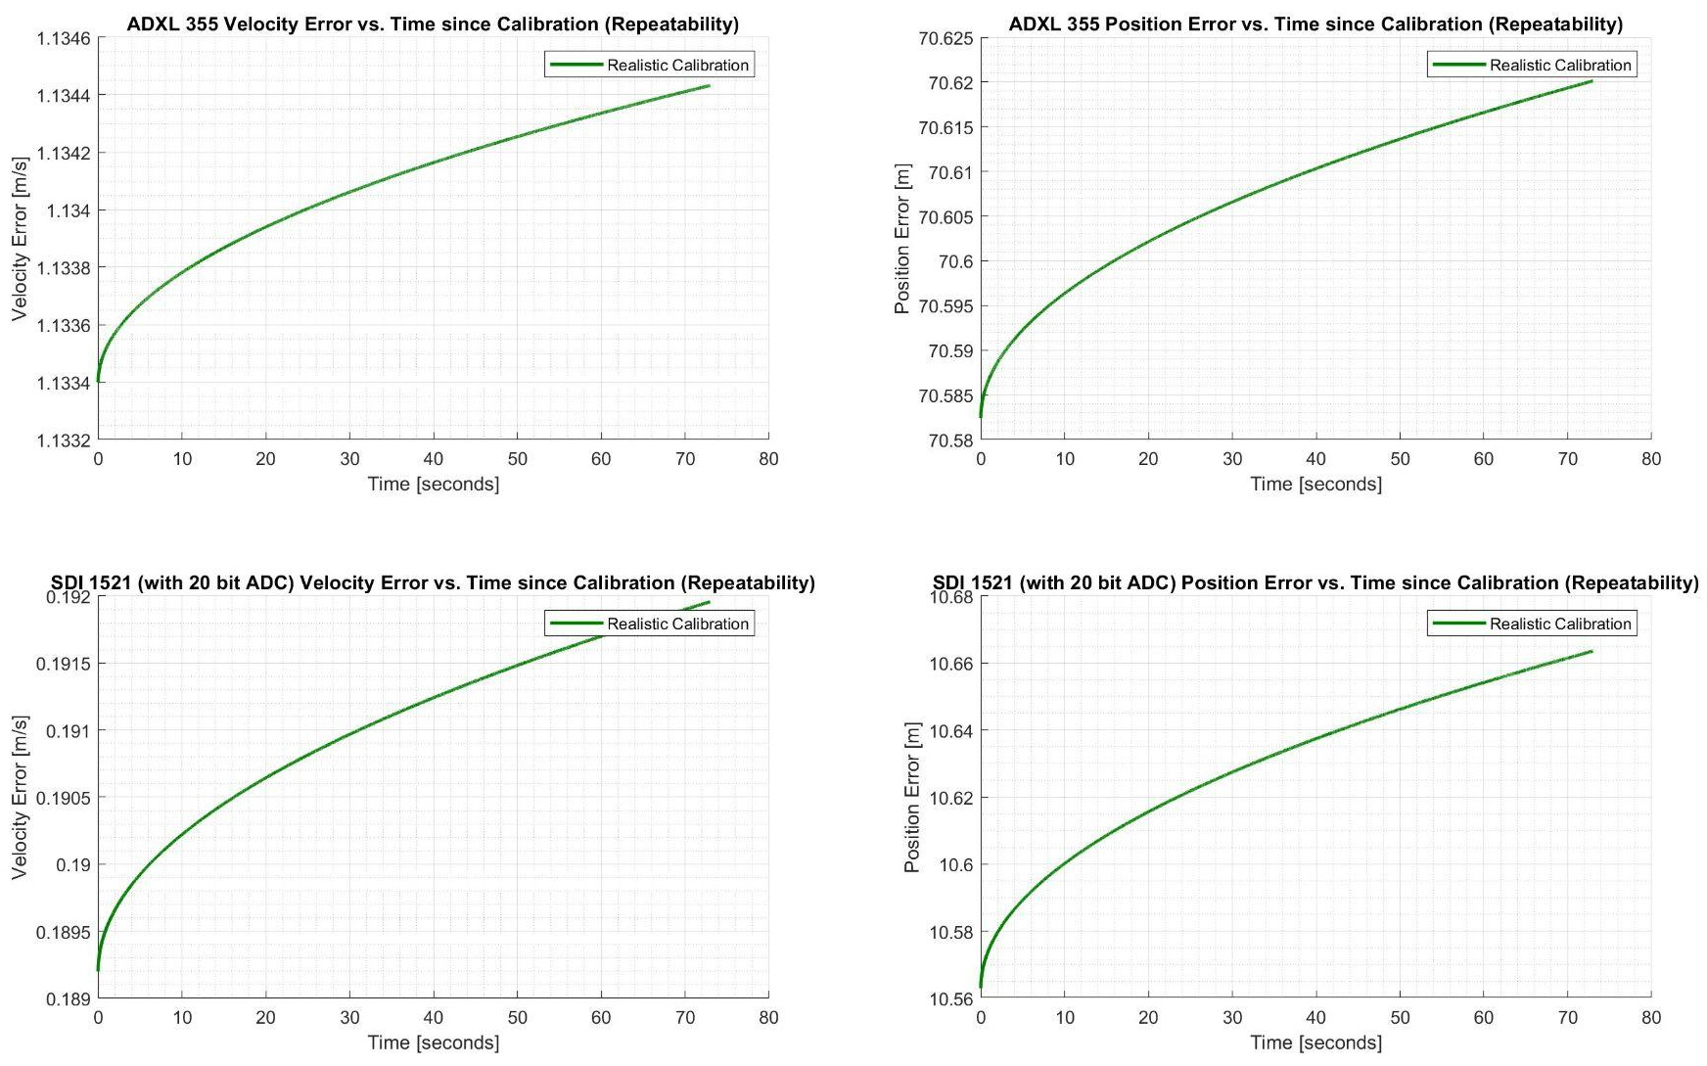
Electronics - Accuracy Model with Thrusting
The descope will assume that the INS is only on during the duration of the burn
Notes:
Done - Backup

Slide 96
Error Verification Using Allan Variance
Allan Variance is a statistical approximation found using consecutive data points over a specific period of time σ²
This variance is related to quantization noise, angle random walk (or velocity random walk), bias instability, rate random walk, and rate ramp
Quantization Noise
Angle Random Walk
Bias Instability
Rate Random Walk
Drift Rate Ramp
Notes:
Done - Verification

Slide 97
Electronics - Allan Variance Computation
Using N consecutive data points with a sample time of t₀
Form consecutive clusters of size n (n < N/2) with time
Cluster Average:
Next Cluster Average:
Allan Variance:
Notes:
Done - Backup

Slide 98
Ground Software Backup Slides

Slide 99
Ground Software - FSW / GS Communications
E3: Communication | The GAINS system must have uplink and downlink capabilities with the ground station, as well as data transmission to the parent satellite.
(p,v,a) = (position, velocity, acceleration) | (θ,⍵,⍺) = angular (p,v,a)
Data Downlink: [timestamp, (p,v,a,θ,⍵,⍺), kalman uncertainties (p,v,a,θ,⍵,⍺)] = 1 + 9 + 9 + 18 = 37 states
Data Uplink: [timestamp, (p,v,a,θ,⍵,⍺), sigma error values (p,v,a,θ,⍵,⍺), operation mode] = 1 + 9 + 9 + 18 + 1 = 38 states
Data Rate: 460 kbps Full Duplex
38 states * 8 bytes per double * 7200 seconds * 100 Hz / 460000 bps = ~8 minutes of upload / download time

Slide 100
Ground Software - FSW / GS Communications
Evaluation Criteria | Weight | USB-C | USB 3 | USB 2 | Ethernet (Cat 6) | HDMI
Average Data Bit Rate (Gbit/s) | 0.3 | 10 | 5 | 0.5 | 2 | 5
C++ Integration Complexity | 0.2 | Simple | Simple | Simple | Medium | Difficult
Max Length (meters) | 0.1 | 2 | 3 | 5 | 100 | 13
Duplex | 0.2 | Full | Full | Half | 4 2-way channels | Full
Microcontroller Support | 0.2 | On Board | Through Adapter | Through Adapter | Through Adapter | Through Adapter
Negligible Properties: Price, Power Supplied, Packets Supported

Slide 101
Ground Software - FSW / GS Communications
Evaluation Criteria | Weight | USB-C | USB 3 | USB 2 | Ethernet (Cat 6) | HDMI
Average Data Bit Rate (Gbit/s) | 0.3 | 3 | 3 | 2 | 3 | 3
C++ Integration Complexity | 0.2 | 3 | 3 | 3 | 2 | 1
Max Length (meters) | 0.1 | 2 | 2 | 3 | 3 | 3
Duplex | 0.2 | 3 | 3 | 1 | 3 | 3
Microcontroller Support | 0.2 | 3 | 2 | 2 | 2 | 2
Sum (0-3) | 1 | 2.9 | 2.7 | 2.1 | 2.6 | 2.4
Negligible Properties: Price, Power Supplied, Packets Supported

Slide 102
Ground Software - N-Body Model
The N-Body Model is a dynamic simulation of particles under influences by external forces
Will take in Acceleration, Velocity, and Position Vectors at a final point from onboard INS computed calculations
Acceleration vector will be modified to reflect gravitational acceleration
The model then propagates with an integrator for the next 24 hours
New trajectory X, Y, Z position estimations are then sent to graphical user interface
Model will use ephemeris data from the NAIF SPICE data
Validation of model will come from NASA GMAT comparisons
NASA General Mission Analysis Tool useful to design orbital trajectories and missions

Slide 103
Ground Software - N-Body Model
GAINS Ground Software will use N-Body Naive Propagation (particles only affected by force of gravitation)
Gravitational Acceleration of Body is then found by dividing by mass of spacecraft.
When the gravitational acceleration vector is found, the gravitational vector is added to initial acceleration vector of SC to get a final acceleration vector for state propagation

Slide 104
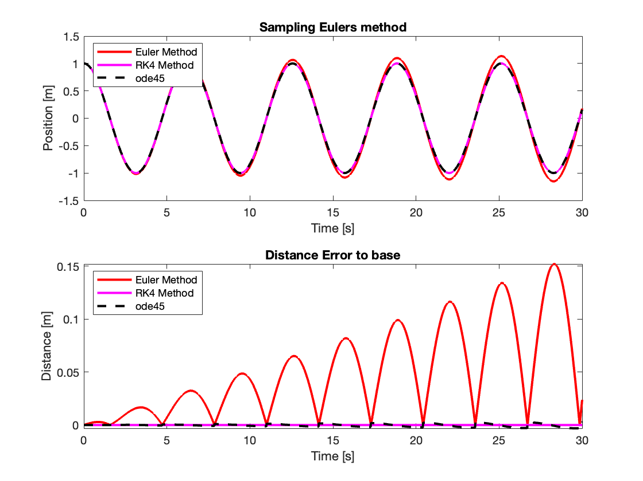
Ground Software - Numerical Integration
Model of 2nd Order Differential Equation: Spring Mass System
Timestep: 0.1 seconds over 30 seconds
Approximate position
Verify accuracy with INS

Slide 105
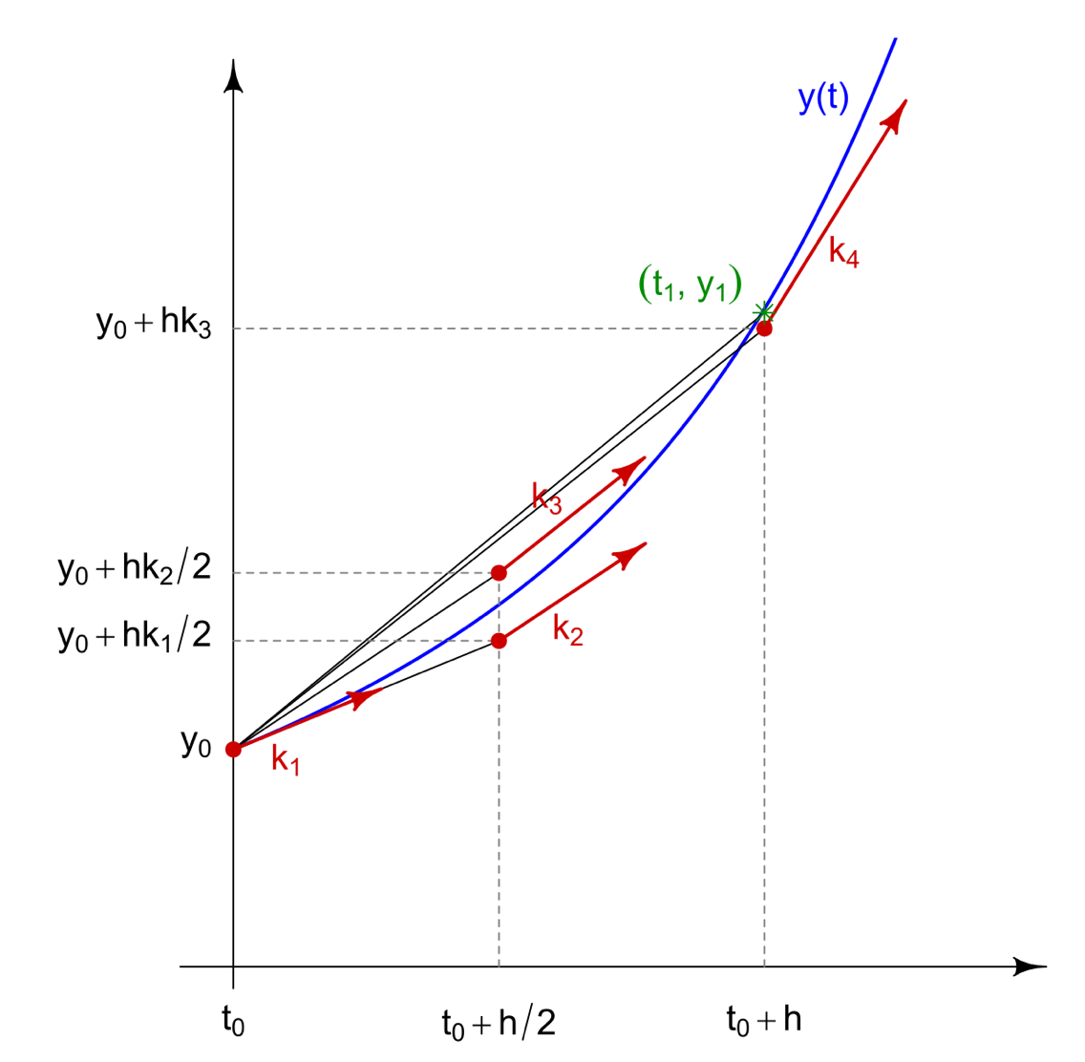
Ground Software - Numerical Integration
RK4 works to average four slopes from two consecutive timesteps to approximate the next point.
Customizable and compatible with C++ (No ode45 on c++)
Implements the linear multistep method - “Adam-Bashforth” Method

Slide 106
Admin Backup Slides

Slide 107
Human Resources
Professor Dale Lawrence
Trudy Schwartz
Sebastian Wankmuller
Professor Eric Bogatin
Professor Marcus Holzinger
Samuel Fedeler
Professor Penina Axelrad
Matt Rhode
Professor Katherine Wingate
Notes:
Ahmed and McMahon

Slide 108
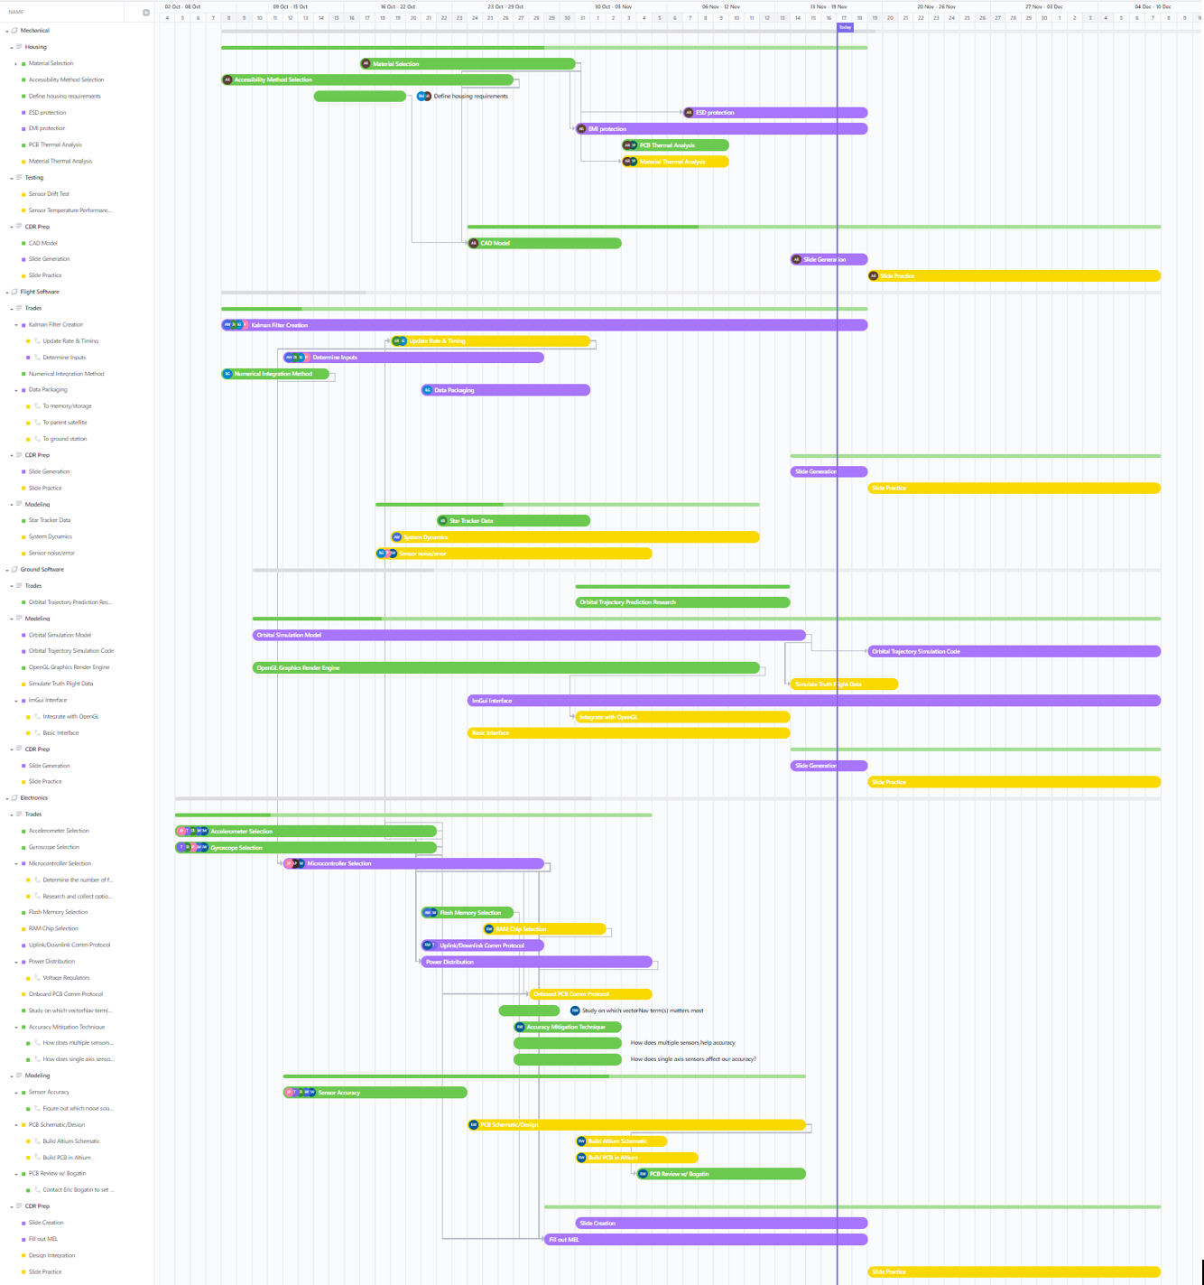
Old Work Plan
Mechanical
Flight Software
Ground Software
Electronics

Slide 109
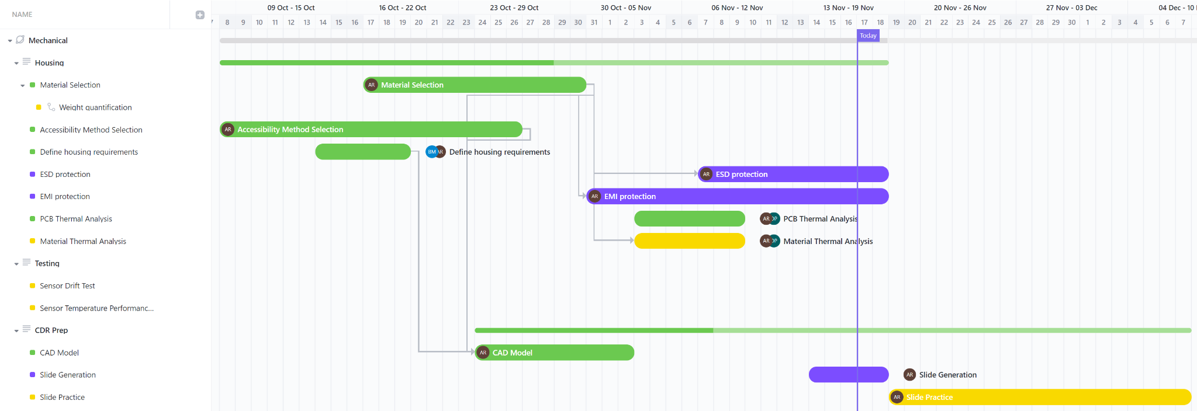
Old Gantt - Mechanical

Slide 110
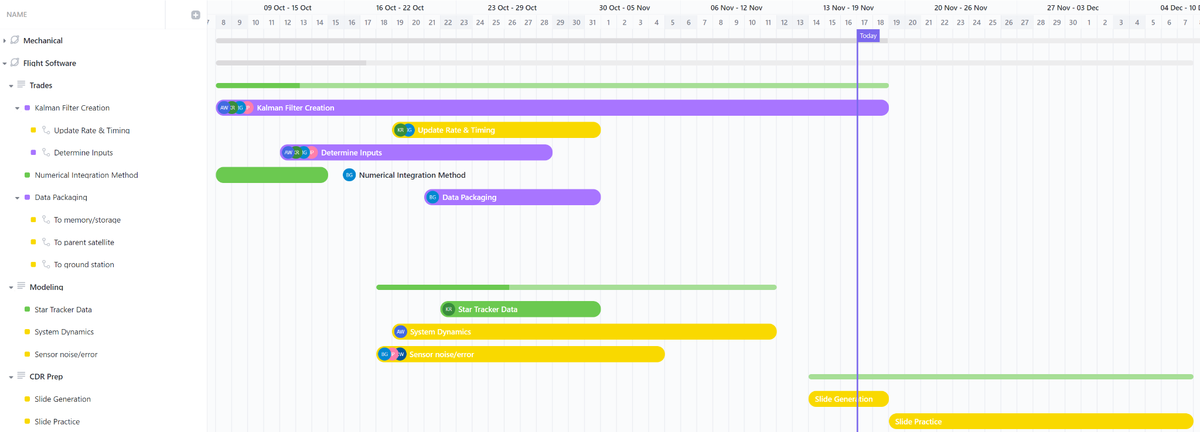
Old Gantt - Flight Software

Slide 111
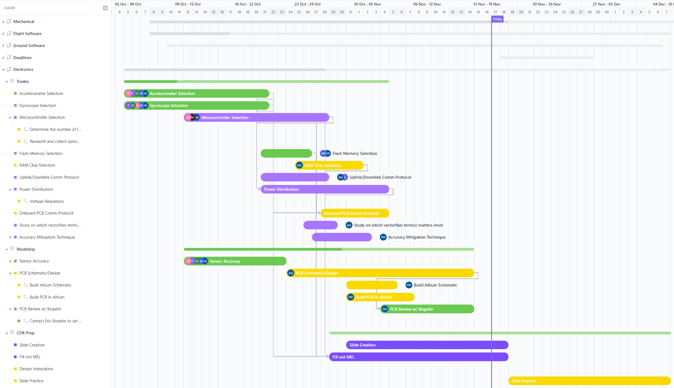
Old Gantt - Electronics

Slide 112
Old Gantt - Ground Software

Slide 113
Timeline (Path Taken)
Models tie customer requirements to sensor specs
Customer Requirements
Mathematical models
Sensor Specs
Customer Requirements | Mathematical Models | Sensor Specs
1 km position accuracy, 0.4 m/s velocity accuracy 1 W power budget >=100 Hz computation output | Accuracy Model Kalman filter computation estimate Allan Variance Bias Calibration Model | ADC bits 0g bias Random Noise Repeatability Clock speed

Slide 114
Risk Matrix (Old)
Very Likely |  |  | Lack of expertise | Sensor drift, sensor uncertainty
Likely
Possible |  |  |  |  | Part availability
Unlikely |  | Testing safety |  | Schedule
Very Unlikely |  |  | Budget
 | Negligible | Minor | Moderate | Significant | Severe
Risk Level
Acceptable
Concerning
Unacceptable
Probability
Impact/Consequence

