Slide 1
Test Readiness Review
Bi-Functional On-Orbit Space Transfers (BOOST)
By: Tycho Cinquini, Riana Gagnon, Avery Gillespie, Wesley Gilliam, Luca Herlein, Chieri Kamada, Colton Massic, Rishi Mayekar, Zach Rochman
Customer/Sponsor: Marcus Holzinger | Mentor: Ball Aerospace
Notes:
Chieri

Slide 2
Overview
1
Notes:
Chieri

Slide 3
Project Purpose
The Bi-Functional On Orbit Space Transfer (BOOST) Team developed cost-effective space-based transportation infrastructure capable of providing spacecraft with the ability to conduct orbit transfers and provide navigation services in the cislunar domain
Notes:
Chieri

Slide 4
Specific Objectives
Performance
Energy Transfer
Level 1 | The infrastructure shall provide users with the capability of transferring/navigating to Trajectories of Interest (TOI) in low lunar orbit (LLO) and the lunar corridor
Level 2 | The infrastructure shall provide users with the capability of moving bidirectionally between two TOI
Level 1 | The infrastructure shall provide the necessary ΔV for transfer between the desired TOI
ff | The infrastructure shall facilitate the storage/transfer of the kinetic, potential, and/or chemical energy required for transfers between the desired TOI
Level 2 | The infrastructure shall facilitate the minimum energy transfer between the desired TOI within the max time specified by the customer
Notes:
Chieri
Mention it’s high level

Slide 5
Specific Objectives Con.
Return on Investment (ROI)
Navigation Services
Level 1 | The infrastructure shall have an annualized internal compounded ROI of 5% percent over a total of 20 Earth years
Level 2 | The infrastructure shall have an initial cost of no more than 100 Billion in real 2023 USD
Level 1 | The infrastructure shall provide navigation services to customer spacecraft within the lunar corridor and LLO
ff | The infrastructure shall provide customers with position and time measurements with up to 100 m and 1 ms respectively
Level 2 | The system shall provide service for at least 10 years
ff | The infrastructure shall prevent service blackouts from disrupting more than 99 percent of full system coverage
 | The infrastructure shall provide at least 75 percent coverage of the determined regions
Notes:
Chieri

Slide 6
Notes:
Chieri

Slide 7
Notes:
Chieri

Slide 8
Critical Project Elements
CPE # | CPE | Rationale
1 | Navigation | Corresponds to one of the high-level objectives Low TRL - need to mature the technology (LIDAR/longer range optical systems) Must use it in a configuration that will meet our accuracy and coverage requirements
2 | Fuel Station | Corresponds to one of the high-level objectives Risk associated with station maintenance/refueling cost; must verify the feasibility
3 | Customer Interface | For mechanical and signal transmission Risk associated with customer not being able to use our service due to incompatibility
4 | Return on Investment | Corresponds to one of the high-level objectives Must ensure that we meet customer's needs Must verify that the business model results in overall positive ROI
Notes:
Chieri – 6 Slides of Content
Briefly summarize each CPE

Slide 9
CDR Risk matrix
Negligible
Low
Medium
High
Critical
Risk | Description
1 | User vehicle can’t interface with system
2 | System does not work in a time-effective manner
3 | Navigation system has blackout periods
4 | Navigation and power system not compatible
5 | Low TRL for navigation system
6 | User vehicle too massive for transport vehicle
7 | System hardware failure
8 | Low return on investment (ROI)
9 | Positive ROI in more than 25 years
10 | System can’t achieve enough thrust for desired orbit
11 | Navigation system can’t function in Cislunar domain
12 | Low TRL for power system
13 | Optimized system does not exist
14 | Power system can’t function in Cislunar domain
 | 1
 | 2 | 3 | 4
 | 5 |  | 6 | 7
 | 8 | 9 | 10 | 11
 | 12 |  | 13 | 14
Very Likely
Likely
Possible
Unlikely
Very Unlikely
Notes:
Tycho

Slide 10
Risks Addressed in Hardware Demo
#​ | Risk​ | Risk Level | Mitigation​
3​ | Navigation system has blackout periods​ | Medium: Likelihood: High Severity: Medium | Test multiple transmitters to test the accuracy of the model/system and the effects of blackout in providing position data​
4​ | SNR too low​ | High: Likelihood: High Severity: High | [Stretch Goal]: Artificially add noise to simulate low SNR
5​ | Low TRL for navigation system​ | Medium: Likelihood: Medium Severity: High | Prove the feasibility of the navigation concept of operation and software by demonstrating it in a relevant environment on ground (TRL ~5)​
Notes:
Tycho

Slide 11
(Hardware Demo) Requirements
#​ | Hardware Requirement​ | Corresponding System Req. #
1​ | The system shall output the receiver position. ​ | 2
1.1​ | The error in calculated receiver position shall not exceed 50 m.​ | 2.2
1.1.1​ | The errors in transmitter positions (measured with a range finder or provided from GPS) shall not exceed 0.1 m.​ | 2.2
1.2 | The transmitter and receiver clock bias shall not exceed 150 ns. | 2.3
1.2.1​ | The transmitter and receiver clock drift shall not exceed 5 seconds per hour. | 2.3
1.3 | The system shall calculate the receiver's position at a frequency of 5 Hz. | 2.4
1.4​ | The signal frequency shall not have a noise of more than 30 dB. | 2.2
2​ | The transmitters and receiver shall operate in the outdoor testing environment.​ | 4
2.1​ | The system shall operate in a temperature range of -5°C and 38°C.​ | 4.1
2.2​ | The hardware shall achieve an IP level of 03.​ | 4.1
2.3​ | The hardware shall operate without any external power source (e.g. power outlets).​ | 4.4
3​ | The system shall comply with the regulations and safety measures.​ | 5.1
Notes:
Tycho
Mention table of original requirements in appendix

Slide 12
Algorithm
Overview
$$D_{1}+δD_{1}$$
$$T_{2}$$
$$D_{1}−δD_{1}$$
$$D_{1}$$
$$T_{1}$$
$$D_{2}−δD_{2}$$
$$R$$
$$Δx={\left(H^{T}H\right)}^{−1}H^{T}Δr$$
$$T_{4}$$
$$D_{2}+δD_{2}$$
$$H=\left[\begin{matrix}\frac{x−x_{1}}{R_{1}} & \frac{y−y_{1}}{R_{1}} & \begin{matrix}\frac{z−z_{1}}{R_{1}} & 1\end{matrix} \\ ⋮ & ⋮ & \begin{matrix}⋮ & ⋮\end{matrix} \\ \frac{x−x_{i}}{R_{i}} & \frac{y−y_{i}}{R_{i}} & \begin{matrix}\frac{z−z_{i}}{R_{i}} & 1\end{matrix}\end{matrix}\right]$$
$$T_{3}$$
$$D_{3}−δD_{3}$$
$$D_{4}−δD_{4}$$
$$D_{3}+δD_{3}$$
$$D_{4}+δD_{4}$$
Model derivation from: Li, Dempster, and Wang
Notes:
Tycho

Slide 13
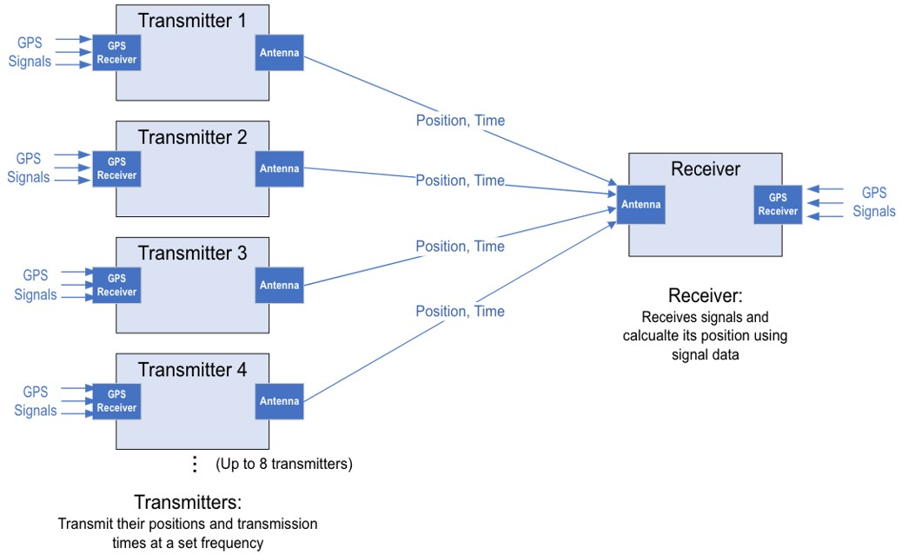
Hardware Demo FBD
Notes:
Ri – General FBD of how our whole system is going to work. 4 transmitters is the minimum number of transmitters we could have and may go up to 8 to mimic our system . We purchased 2 extras to be safe. Receiver will receive position and time data from the transmitters while both components are receiving truth data from GPS.

Slide 14
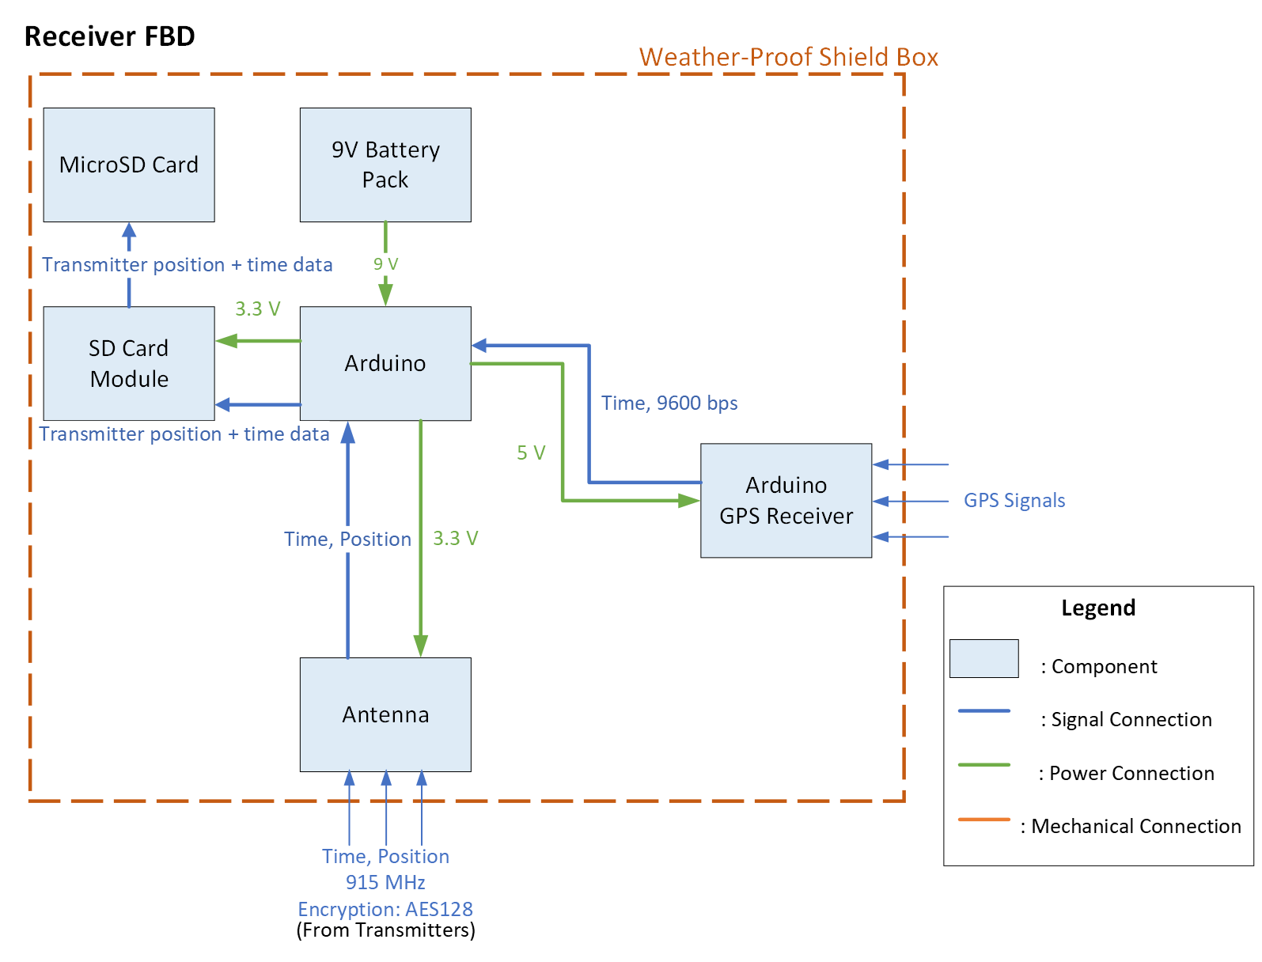
Receiver FBD
Notes:
Ri: So specifically for our receiver FBD we will have a weatherproof shield box around each of the components listed in the FBD. Our Arduino will be powered by a 9V battery. The Arduino will be receiving GPA data from the GPS receiver and time and position data from the transmitter at 915 MHz to the antenna. The received data will then be stored in the SD card module to a microSD card

Slide 15
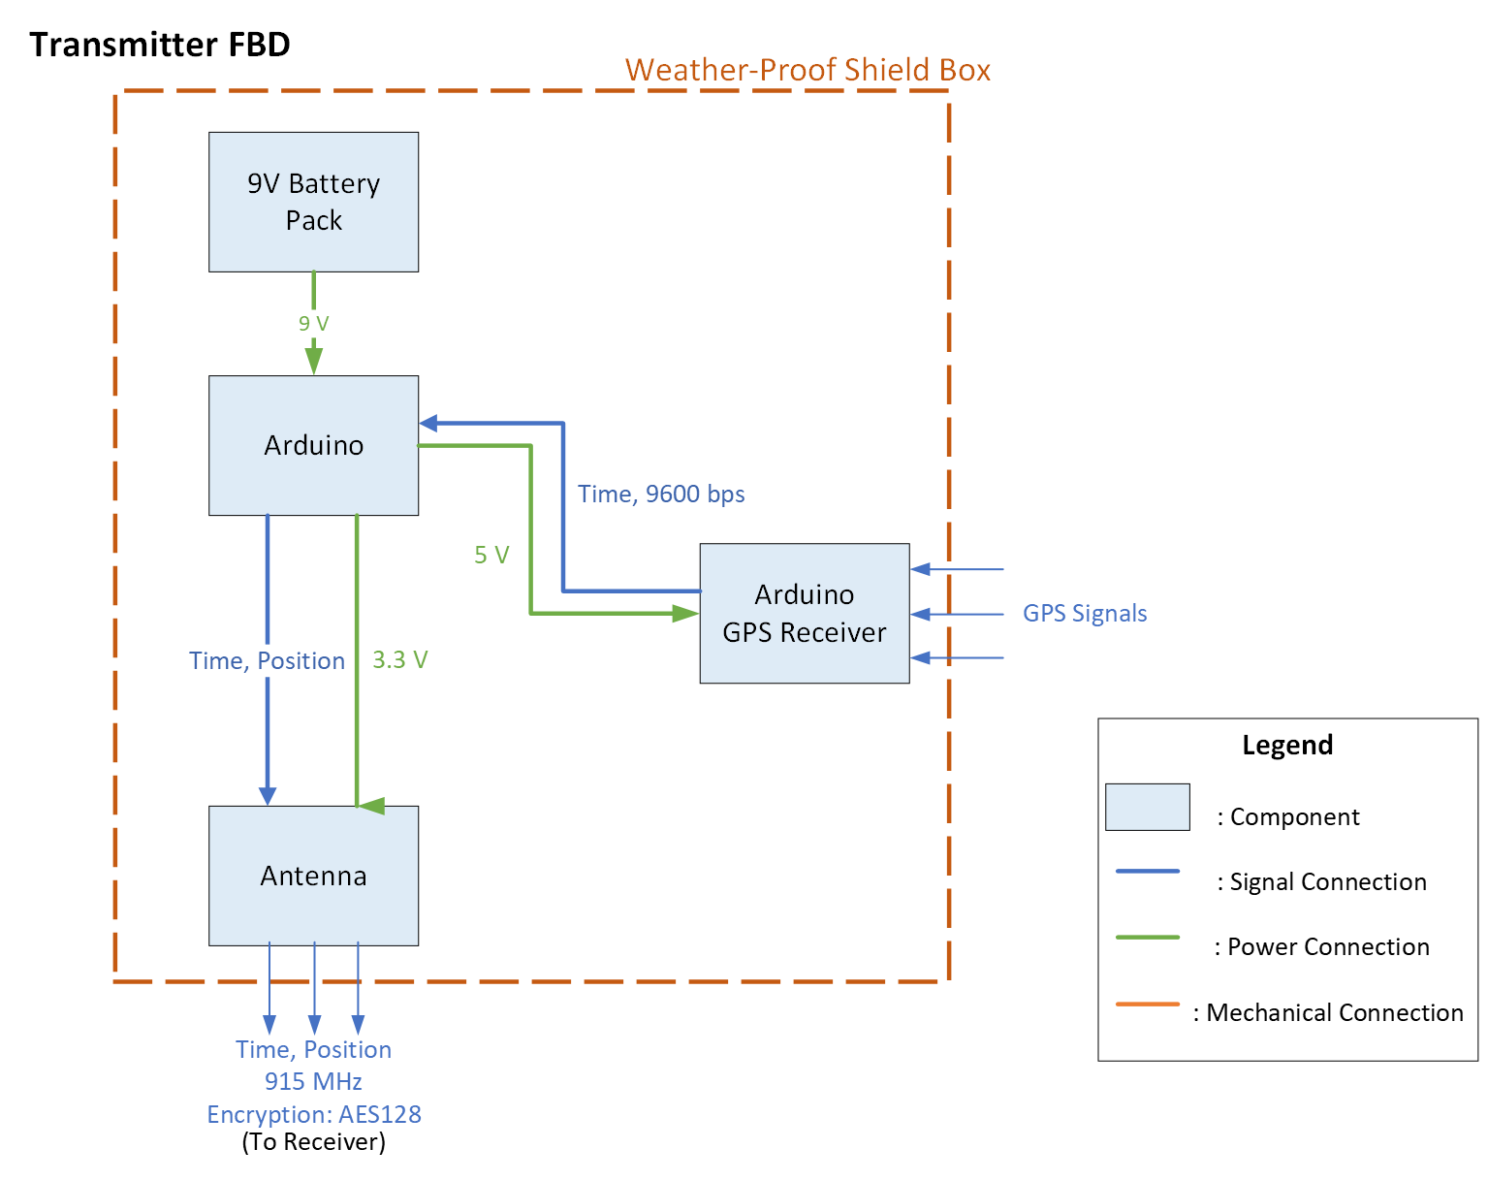
Transmitter FBD
Notes:
Ri: Similarly for the transmitter. We have a weather proof shield box around our components when were testing outside. Again, the Arduino is powered by a 9V battery pack that is receiving GPS signals for truth data and transmitting time and position data from the antenna ay 915 MHz

Slide 16
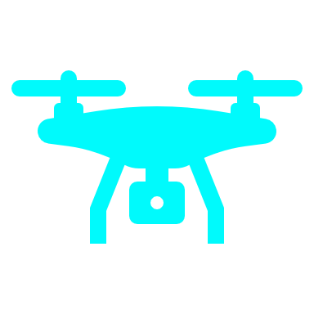
Major Changes From CDR
Drone removed from planned tests
Detail added to testing plan
Pass criteria adjusted for time constraints
Test algorithm using simulated signals
Notes:
Ri

Slide 17
Schedule
2
Notes:
Colton

Slide 18
Testing Overview
8,9,10,11
# | Test | Completed?
Electrical Unit Tests
1 | Antenna (Transceiver) | Y
2 | GPS Module | Y
3 | Data Logging (SD Card) | Y
Manufacturing Unit Tests
4 | Ingress Protection (IP) | N
5 | RF Transparency | N
Software Unit Tests
6 | Unit Deviation | N
7 | Algorithm Convergence | Y
System Tests
8 | Benchtop Link | N
9 | 1D | N
10 | Planar 2D | N
11 | Outdoor 3D | N
4,5
2
3
1,6
Notes:
Colton

Slide 19
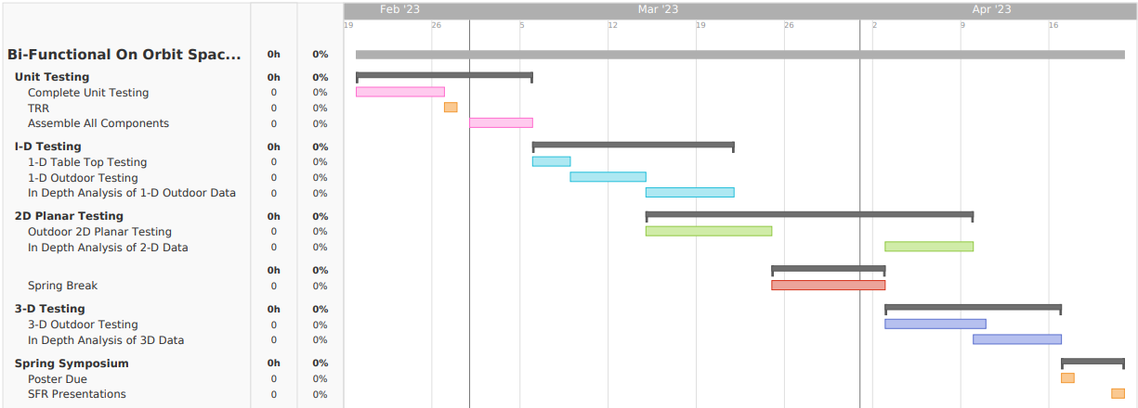
Gantt Chart
Notes:
Colton

Slide 20
Critical path Shift
Beginning of system testing shifted by a week
No flight testing needed
System of systems model refinement completed
Addition of 3D Test planned
Addition of noise, time delays, offsets and blackout periods now a stretch goal.
Notes:
Colton
Idk about saying “we just got our stuff ordered” we’d have placed our first order 3 weeks ago as of TRR day

Slide 21
Test Readiness
3
Notes:
Luca

Slide 22
Test 1 – Outdoor 1D
Prerequisite Tests
Benchtop link test
Component testing
Testing Steps
Two transmitters set up 200m apart with a receiver aligned between them collinearly
Move receiver back and forth between two ends
Test at 25, 50, 75, 100, 125, 150, 175m
Calculate distance and time-of-flight from transmitters to receivers
Assess position and timing solution uncertainties
Pass/Fail Criteria
Test has passed when functional data is achieved and basic linear position and clock bias is calculated to accuracies less than or equal to calculated error bounds
Rationale for Test
Raise TRL with in-house tests for custom system
Verify the TDOA problem can be solved
Quantify how RF noise and attenuation affects our system
Adding another dimension of complexity from benchtop unit test
Scope of Testing Tasks
Component design - Talked about previously with transmitter design
Facilities – Outdoor testing area of some kind, previously discussed aerospace lawn
Safety Procedures – N/A
Using a class 1 (non-dangerous) laser as part of the rangefinder
Notes:
Luca

Slide 23
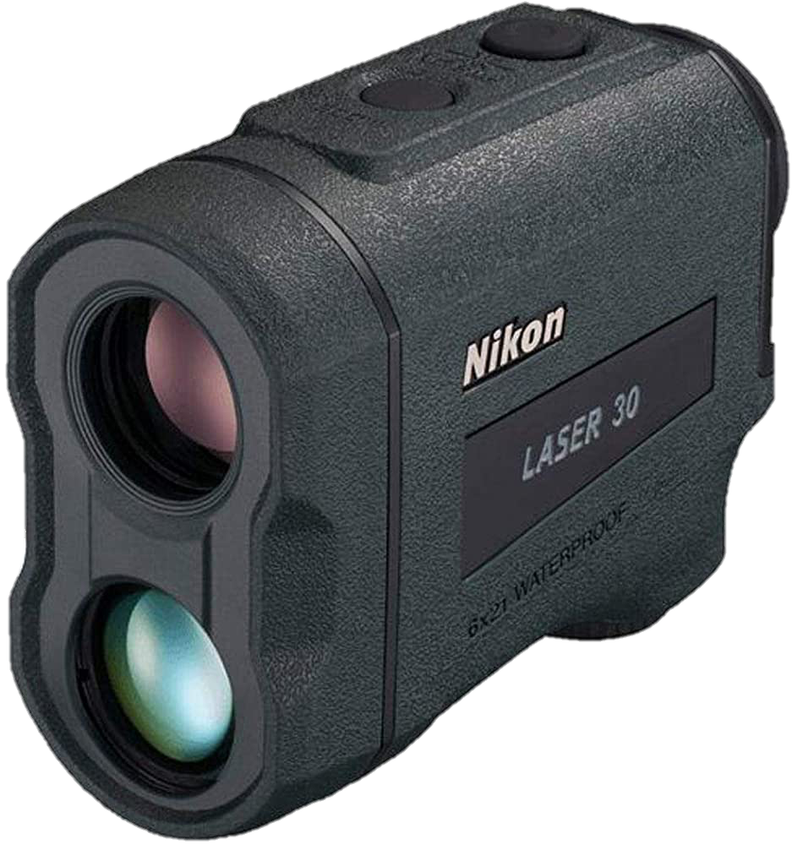
Sys Test 1 (1D) CONOPS
① Place transmitters and receiver in testing configuration using laser range finder
② Obtain “true” positions and times of transmitters and receiver from GPS
③ Transmitters transmit
position + time signal
Transmitter Unit 2
Receiver Unit
Transmitter Unit 1
⑤ Signal data is saved to SD card, and used to calculate receiver’s position and time
Local Coordinate Origin
⑥ Compare calculated and true positions and time
④ Receiver receive/process
position + time signals
⑦ Repeat with varying distance between transmitters and receiver
Notes:
Luca

Slide 24
Sys Test 1 (1D) CONOPS
⑦ Repeat with varying distance between transmitters and receiver
Transmitter Unit 1
100 m
Receiver Unit
100 m
Transmitter Unit 2
175 m
25 m
150 m
50 m
125 m
75 m
Notes:
Luca

Slide 25
Test 1 Error model
Key Details:
From Prof. Akos:
$δ_{s,x},δ_{s,y},δ_{s,z}=25$ m
$δ_{τ}=\frac{\sqrt{δ_{s,x}^{2}+δ_{s,y}^{2}+δ_{s,z}^{2}}}{c}=144.3$ ns
1D geometry of test allows Newton’s Method (algorithm) to approximate solution exactly → $δ_{t}=0$
Numbers >> machine epsilon ($ε_{M}$) → $δ_{r}=0$
$$δ=δ_{s}+δ_{t}+δ_{r}$$
Total Error in Each Variable
Error From Sensor Measurements
Truncation Error (From Algorithm)
Roundoff Error (From Computer)
Predicted Error Bounds:
$δ_{x}=25+0+0=25 \text{m}$
$δ_{τ}=144.3+0+0=144.3 \text{ns}$
Notes:
Tycho
- Re-emphasis that we validate models by comparing errors from tests and make sure they are less than error bounds

Slide 26
Test 2 – Outdoor 2D
Prerequisite Tests:
Outdoor 1-D Test
Testing Steps
Set up transmitters at boundary of test area
Perform test in local coordinate system
Set up square test area with transmitters at corners
Sample map on next slide
Move receiver around test area and collect data at various positions
Calculating all 3 coordinates and time
Z-coordinate should be consistent across all measurements
Convert position into ECEF coordinate system (and LLH?)
Compare data to manual measurements from Tx locations with rangefinder as well as to GPS “truth” data from receiver module
Pass/Fail Criteria
Test has passed when functional data is achieved and basic linear position and clock bias is calculated to accuracies less than or equal to calculated error bounds
Rationale for Test
First complex test of location calculation
Quantify error in position calculations and tune receiver algorithm
Scope of Testing Tasks
Component design – Mentioned previously in transmitter design
Facilities
Outdoor area with minimal obstructive buildings
Ideally 500m x 500m
Aerospace Building to LASP
Flatirons Golf Course (Pre-season) – pending permission
Safety Procedures – N/A
Notes:
Luca

Slide 27
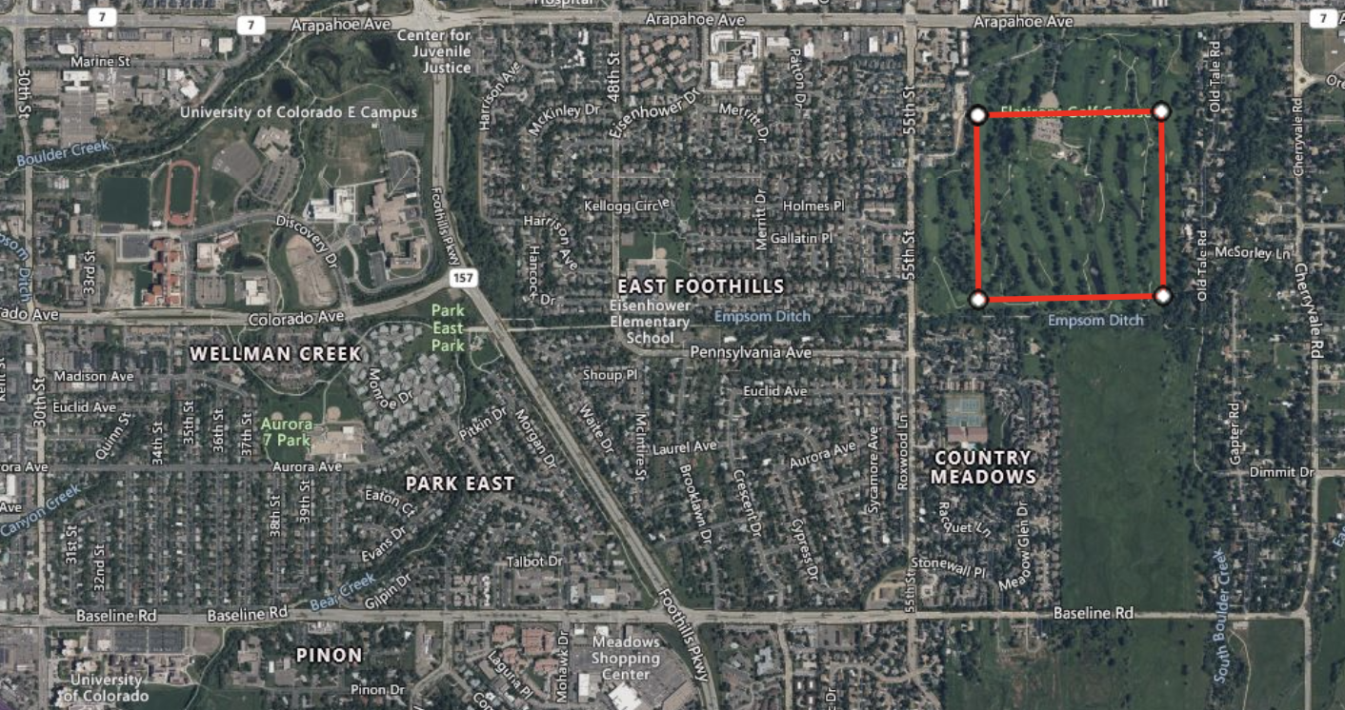
500m
500m
Notes:
Luca

Slide 28
Sys Test 2 (2D) CONOPS
② Obtain “true” positions and times of transmitters and receiver from GPS
① Place transmitters and receiver in testing configuration using laser range finder
③ Transmitters transmit
position + time signal
Transmitter Unit 2
Transmitter Unit 3
Transmitter Unit 1
Receiver Unit
Local Coordinate Origin
⑤ Signal data is saved to SD card, and used to calculate receiver’s position and time
⑥ Compare calculated and true positions and time
④ Receiver receive/process
position + time signals
Transmitter Unit 4
⑦ Repeat with varying distance between transmitters and receiver
Notes:
Luca

Slide 29
Test 2 Error model
Key Details:
From Prof. Akos:
$δ_{s,x},δ_{s,y},δ_{s,z}=25$ m
$δ_{τ}=\frac{\sqrt{δ_{s,x}^{2}+δ_{s,y}^{2}+δ_{s,z}^{2}}}{c}=144.3$ ns
2D geometry of test allows Newton’s Method (algorithm) to approximate solution exactly → $δ_{t}=0$
Numbers >> machine epsilon ($ε_{M}$) → $δ_{r}=0$
$$δ=δ_{s}+δ_{t}+δ_{r}$$
Total Error in Each Variable
Error From Sensor Measurements
Truncation Error (From Algorithm)
Roundoff Error (From Computer)
Predicted Error Bounds:
$δ_{x}=25+0+0=25 \text{m}$
$δ_{y}=25+0+0=25$ m
$δ_{τ}=144.3+0+0=144.3 \text{ns}$
Notes:
Tycho
- Re-emphasis that we validate models by comparing errors from tests and make sure they are less than error bounds

Slide 30
Test 3 – outdoor 3d
Prerequisite Tests: Testing begins after the completion of the planar 2D tests
Testing Steps
Set up transmitters at boundary of test area
Perform test in local coordinate system
Use same vertices as test 2, however add a transmitter with height.
Move receiver around test area and collect data at various positions
Calculating all three coordinate measurements plus time
Convert position into ECEF coordinate system (and LLH?)
Compare data to manual measurements as well as to GPS “truth” data from receiver module
Pass/Fail Criteria
Test has passed when functional data is achieved and basic linear position and clock bias is calculated to accuracies less than or equal to calculated error bounds
Rationale for Test
Final system test, designed to verify the location problem can be solved in three dimensions. The algorithm for location estimation changes slightly in three dimensions and therefore must be tested again. Also moving transmitters will have more of an effect in three dimensions as there are more degrees of freedom, so this test will evaluate how movement in transmitters will affect the data
Scope of Testing Tasks
Component design - Talked about previously with transmitter design
Facilities – Outdoor testing area of some kind, previously discussed aerospace lawn, building roof
Safety Procedures – N/A
Notes:
Luca

Slide 31
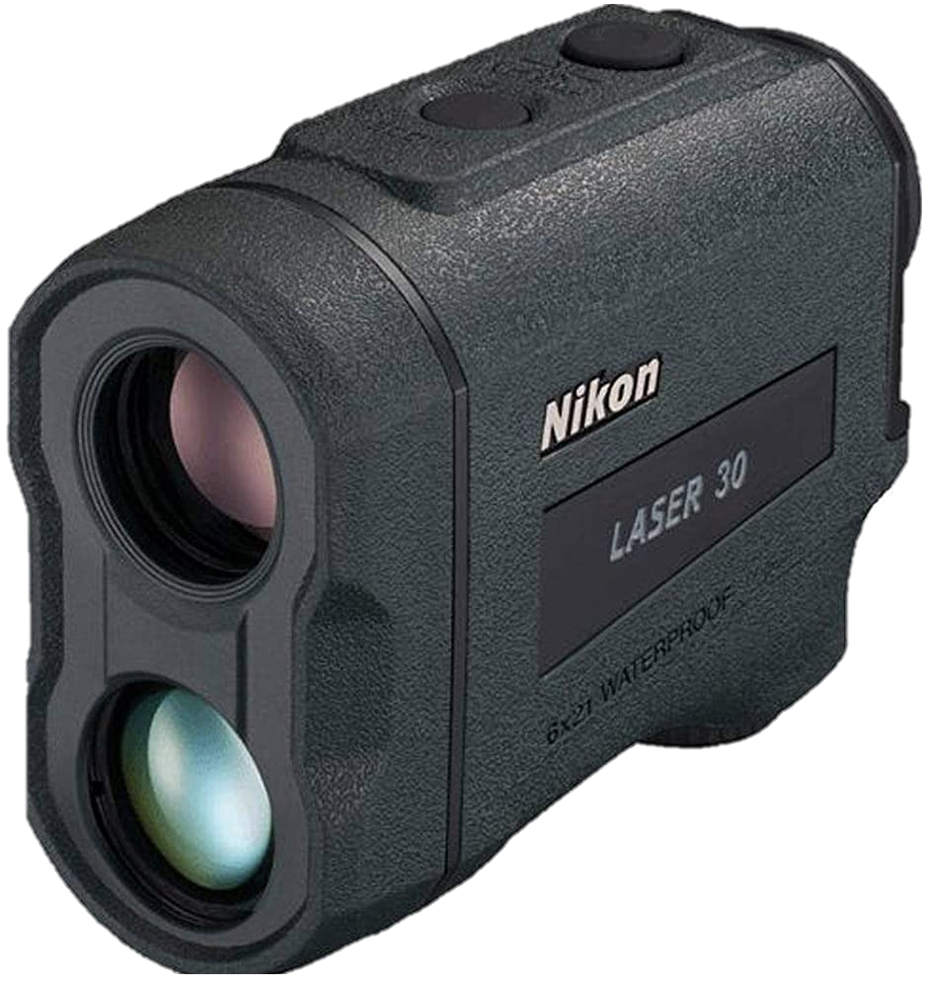
Sys Test 3 (3D) CONOPS
② Obtain “true” positions and times of transmitters and receiver from GPS
① Place transmitters and receiver in testing configuration using laser range finder
Transmitter Unit 2
③ Transmitters transmit
position + time signal
Transmitter Unit 1
Receiver Unit
Transmitter Unit 3
Local Coordinate Origin
⑤ Signal data is saved to SD card, and used to calculate receiver’s position and time
⑥ Compare calculated and true positions and time
④ Receiver receive/process
position + time signals
Transmitter Unit 4
⑦ Repeat with varying distance between transmitters and receiver
Notes:
Luca

Slide 32
Test 3 Error model
Key Details:
From Prof. Akos:
$δ_{s,x},δ_{s,y},δ_{s,z}=25$ m
$δ_{τ}=\frac{\sqrt{δ_{s,x}^{2}+δ_{s,y}^{2}+δ_{s,z}^{2}}}{c}=144.3$ ns
Numbers >> machine epsilon ($ε_{M}$) → $δ_{r}=0$
$$δ=δ_{s}+δ_{t}+δ_{r}$$
Total Error in Each Variable
Error From Sensor Measurements
Truncation Error (From Algorithm)
Roundoff Error (From Computer)
Predicted Error Bounds:
$δ_{x}=25+0.884+0=25.88\text{4} \text{m}$
$δ_{y}=25+0.884+0=25.884$ m
$δ_{z}=25+0.884+0=25.884$ m
$δ_{τ}=144.3+0.884+0=145.\text{184} \text{ns}$
Notes:
Tycho
- Re-emphasis that we validate models by comparing errors from tests and make sure they are less than error bounds

Slide 33
Budget
4
Notes:
Colton

Slide 34
Budget
Project Expenses
Ordered all expected materials and equipment necessary to build and test hardware demo. Total Budget remaining after these expenses is $1591.09
Status of Parts and Materials
All equipment and supplies have been received or are expected within the next few days to arrive to BOOST's project space.
All equipment and supplies necessary for initial component testing have been received and the team is finishing testing on these components in preparation for our first system test.
Notes:
Colton

Slide 35
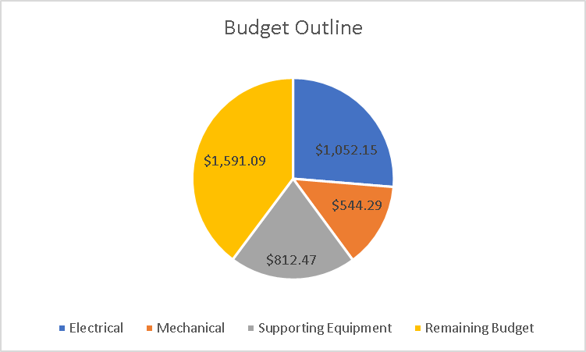
Current Project Expenses
After procurement of all sub team components and equipment, current Project expenses total to $2408.91
Remaining Budget as of now is $1591.09
Notes:
Colton

Slide 36
Questions?
?

Slide 37
Appendices
5

Slide 38
Hardware Demo Overview
For RF navigation system, the following were identified as risks in our architecture design:
Low TRL
Blackout periods
Low Signal-to-Noise Ratio (SNR)
Hardware demo as proof of concept
Create a scale model of RF navigation to address those risks
Multiple transmitters and 1 receiver for GPS-like triangulation model
Attempt to Model in-space environment through noise addition and force blackouts.
Notes:
Ri

Slide 39
Hardware Risks
Risks | Severity | Mitigation Strategy
Error in transmitters positions provided by GPS | High | Measure accurate positions with laser distance measurer
Non-negligible time delays in computation | Medium | Develop a model that does not require real-time computation, verify the spec of processor​
Errors in timestamps provided by GPS​ | Med​ | Include clock bias in position calculation model​
Hardware (transmitters and receiver) damage due to weather | Medium | Use weather-proof casing and appropriate shielding
Hardware not complying with the regulations | Medium | Verify that hardware meets the signal transmission standards, confirm with faculty member
Required components being unavailable​ | Low | Check the availability and price before finalizing the hardware design
Difficulties in assembling hardware (e.g.: not enough space in the box to use required tools) | Low | Create a CAD drawing with components before assembling to make sure there is enough space

Slide 40
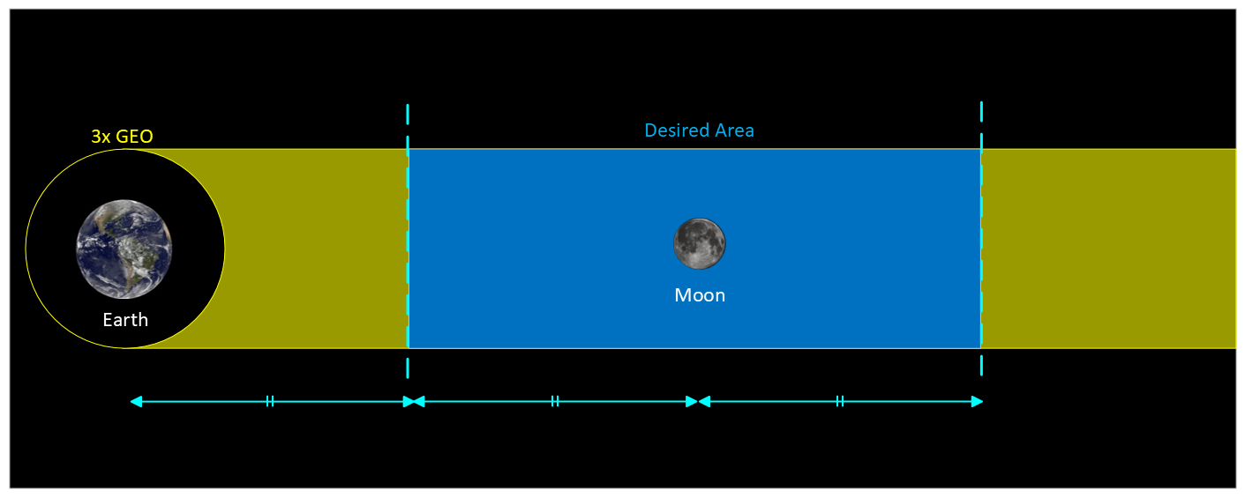
CDR Requirements
Requirement ID | Requirement
1 (Power) | The system shall provide the user with positive ΔV to transfer between the Trajectories of Interest (ToI).
1.1 | The system shall be capable of providing the transfer service to at least 4 customer spacecraft simultaneously.
1.1.1 | The system shall provide the user with minimum ΔV of 3.95 km/s.
1.2 | The system shall store energy to be transferred to the user spacecraft.
1.2.1 | The system shall have a tank size of 10000 cubic meters.
1.3 | The system shall provide fuel to the user via fuel station vehicle.
2 (Navigation) | The system shall provide the user with navigation service.
2.1 | The system shall have the RF navigation coverage of 75% of desired area in the Earth-Moon corridor (shown in Figure below).
2.2 | The navigation service shall achieve the position accuracy of at least 1 km.
2.3 | The navigation service shall achieve the time accuracy of at least 10 ms.
2.4 | The navigation service shall have an availability of at least 99%.
2.5 | The system shall transmit navigation data to customer at a data rate compatible with customer spacecraft.
2.6 | The system shall be capable of providing the navigation service to at least 8 customer spacecraft simultaneously.

Slide 41
CDR Requirements (continued)
3 (ROI) | The system shall have a net positive Return on Investment (ROI).
3.1 | The system shall have an initial cost of no more than 100 Billion dollars.
3.2 | The system shall have a positive ROI in 25 Earth years.
4 (Operational) | The system shall operate in Cislunar space.
4.1 | The system shall retain its full functionality for at least 25 years in Cislunar region.
4.2 | The system's mean time between maintenance (including re-stocking of resources) shall be greater than 3 years.
4.3 | The system shall achieve an overall factor of safety of at least 1.4.
4.4 | The system shall be self-sufficient in producing the power required for operation.
4.4.1 | Each spacecraft shall have a maximum energy consumption of 4000 W.
5 (Other)
5.1 | The system shall comply with applicable space laws and policies.
5.1.1 | The system shall comply with the Outer Space Treaty.
5.1.2 | The system shall comply with NASA's sustainable policy.
5.1.3 | The system shall comply with the Artemis Accords.
5.2 | The system shall meet the sizing and mass requirements of launching vehicle.
5.2.1 | The system shall have a maximum mass of 21000 kg.
5.2.2 | The system shall have a maximum outer dimensions of 46 m height and 5.4m diameter at launch.

Slide 42
Unit Tests - Receiver
Goal is to verify each 'unit', or component in the FBD, will successfully integrate into the system as a whole. These tests will be performed in parallel with manufacturing, and will consist of basic uplink and part tests. For example, when installing the SD card module, run a test where dummy data is printed to the SD card. Verifying that data can be accurately added to the SD card will complete the test, and eliminate the SD card as a failure point down the road.
Because these tests are very similar and relatively straightforward, each one will not be discussed. However we will be vigilant in ensuring that each unit and subunit manufactured is tested and verified before system testing begins.

Slide 43
Subsystem Expenses

Slide 44
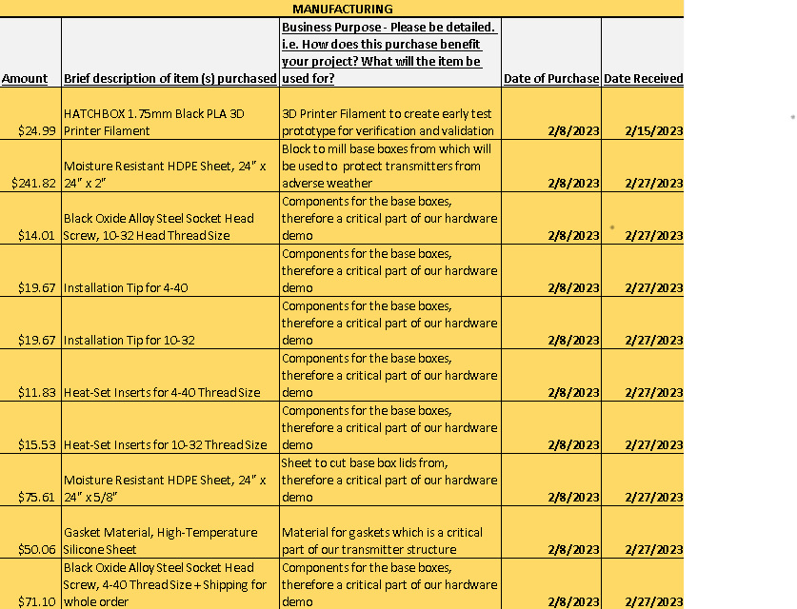
Expenses by Sub-team
Subsystem Expenses

Slide 45
Expenses by Sub-team
Subsystem Expenses

Slide 46
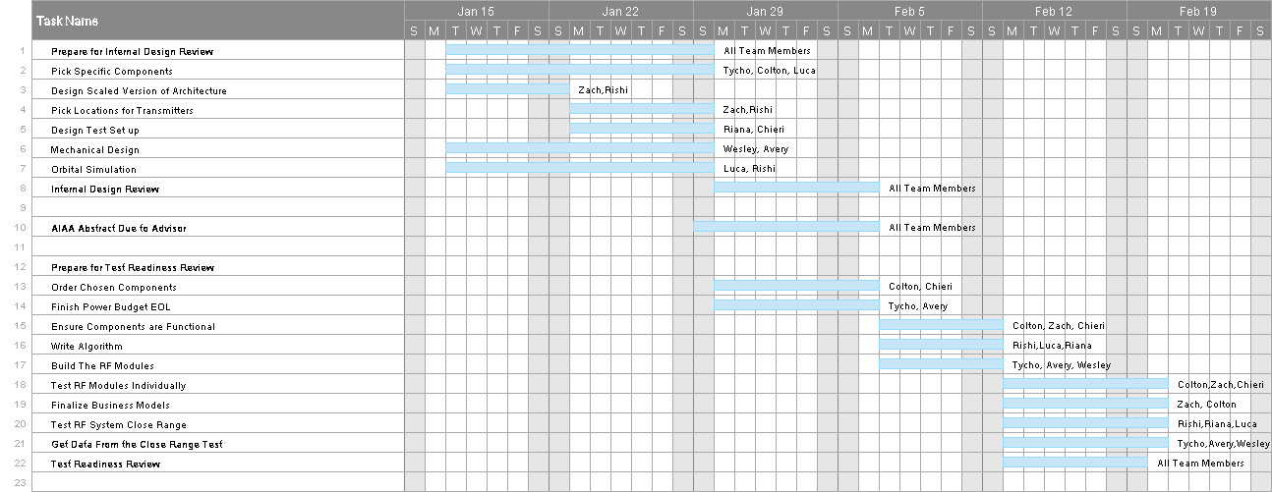
CDR Gantt Chart

Slide 47
CDR Gantt Chart Continued

Slide 48
RF Transparency Testing Procedure
Control:
Set up one receiver and one transmitter via breadboard
Keeping transmitter stationary, move receiver in a circle at constant radius (1ft)
Quantify radial distance uncertainty
Measure signal strength as a function of radial position
HDPE Transparency
Set up one receiver and one transmitter, both contained within HDPE housing
Repeat same process as control, moving in a 1ft-radius circle
Measure signal strength as a function of radial position
Compare results to estimate losses from material spatial permittivity

Slide 49
IP (Ingress Protection) Testing Procedure
IP Rating | Solid Particle Protection | Liquid Ingress Protection
X | No available data | No available data
0 | No protection against contact and ingress of objects | No protection against ingress of water
1 | >50 mm | Dripping water
2 | >12.5 mm | Dripping water when tilted at 15 degrees
3 | >2.5 mm | Spraying water
4 | >1 mm | Splashing of water
5 | Dust protected | Water jets
6 | Dust-tight | Powerful water jets
7 | -- | Immersion, up to 1m depth
8 | -- | Immersion, >1m depth
9 | -- | Powerful, high-temperature water jets
IP Rating consists of two criteria:
First digit represents the amount of solid material that can pass through a surface or seal
Second indicates how much liquid can pass through
For general weatherproofing (sealed electronics against snow, rain, light dew), requirements for IP rating were set at IP04
Since solid particle permittivity is irrelevant, testing will be limited to IP0

Slide 50
IP (Ingress Protection) Testing Procedure
IP Rating | Test Duration | Water Volume | Pressure
X | --
0 | --
1 | 10 minutes | 1mm rain/min
2 | 2.5 minutes for every direction of tilt | 3mm rain/min
3 | 1 minute per square meter for at least 5 minutes | 10 L/min
4 | 10 minutes
5 | 1 minute per square meter for at least 3 minutes | 12.5 L/min | 30 kPa at 3m
6 | 1 minute per square meter for at least 3 minutes | 100 L/min | 100 kPa at 3m
7 | 30 minutes
8 | Agreement with manufacturer
9 | 30 seconds in 4 angles | 14-16 L/min | 8-10 MPa at 0.1-0.15 m
IPX1: Dripping water (vertically falling drops) shall have no unsafe effect on the specimen when mounted in an upright position onto a turntable and rotated at 1 RPM.
IPX2: Vertically dripping water shall have no harmful effect when the enclosure is tilted at an angle of 15° from its normal position. A total of four positions are tested within two axes.
IPX3: Water falling as a spray at any angle up to 60° from the vertical shall have no harmful effect, utilizing either: a) an oscillating fixture, or b) A spray nozzle with a counterbalanced shield.
test a) is conducted for 5 minutes, then repeated with the specimen rotated horizontally by 90° for the second 5-minute test. Test b) is conducted (with shield in place) for 5 minutes minimum.
IPX4: Water splashing against the enclosure from any direction shall have no harmful effect, utilizing either:
a) an oscillating fixture, or b) A spray nozzle with no shield. Test a) is conducted for 10 minutes. b) is conducted (without shield) for 5 minutes minimum.

Slide 51
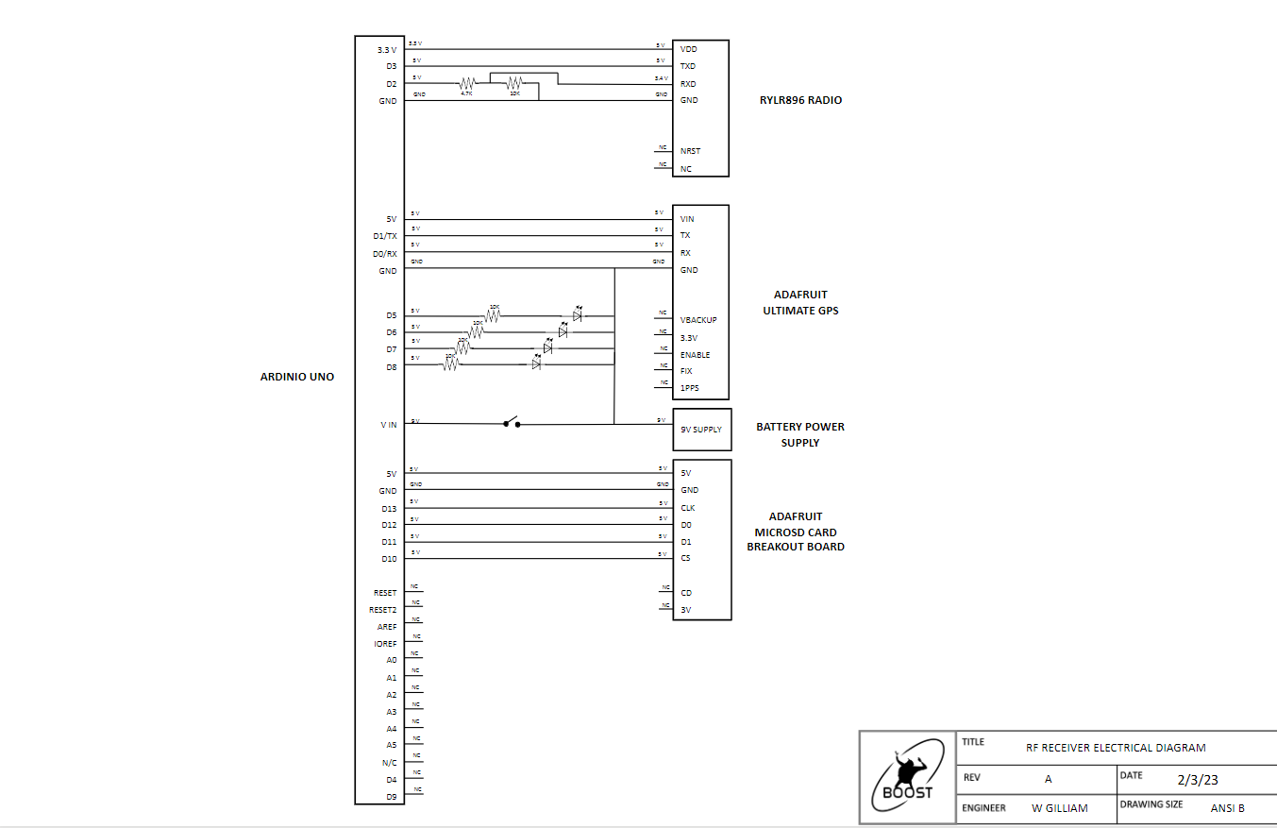
Wiring Diagram - Receiver

Slide 52
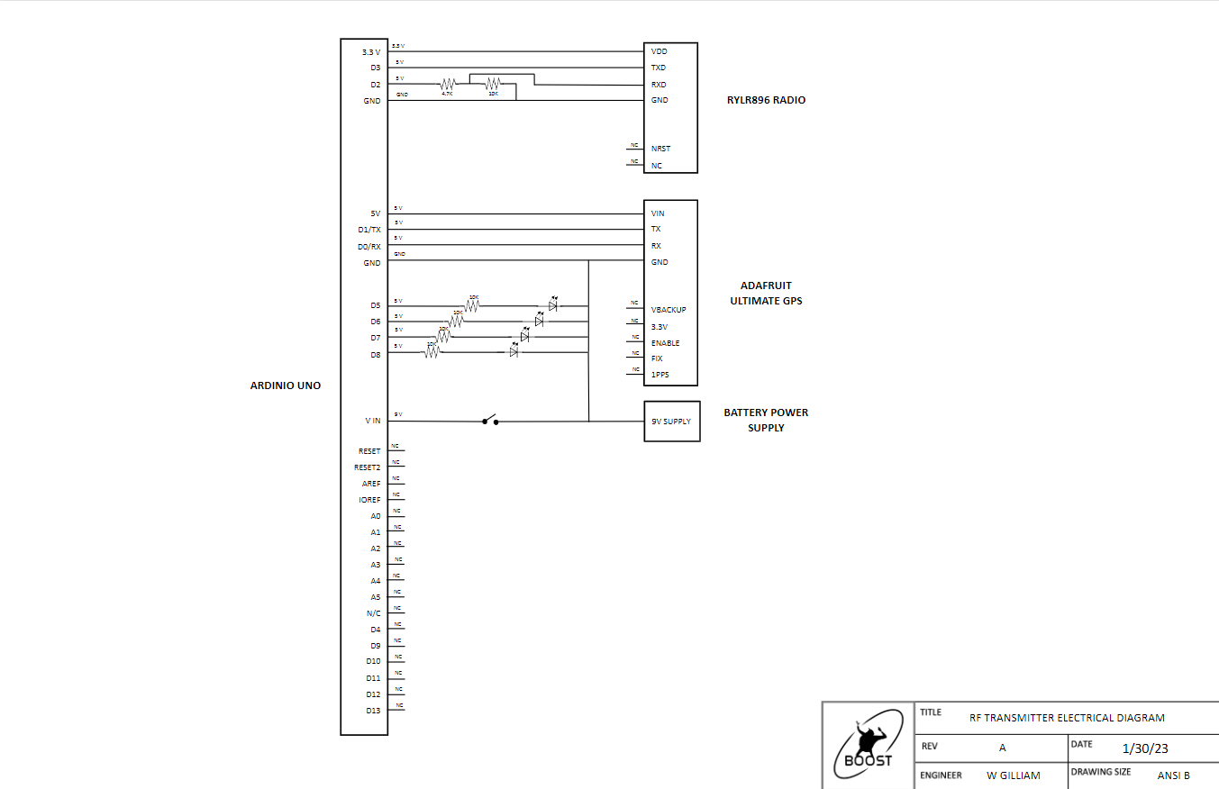
Wiring diagram - Transmitter

Slide 53
COMPONENT Test – REYAX RYLR896
Prerequisite Tests: None
Testing Steps
Use provided schematics and components to build the transmitter and receiver circuits
Connect the Arduinos to the computer(s) and load up the transmitter/receiver script.
Run both scripts
Ensure that the message sent by the transmitter is displayed on the serial monitor of the receiver.
Vary the message to ensure it still works
Pass/Fail Criteria
Test has passed when a variety of messages sent by the transmitter code is received by the receiver without any inconsistencies
Rationale for Test
Ensure that the RYLR896 is capable of both transmitting data and receiving it.
Requirements are met for the hardware demo and project specifications
Scope of Testing Tasks
Component design – Follows transmitter receiver schematics
Facilities – Indoor testing facilities, the electronics shop or senior projects space
Safety Procedures – N/A
Results and Conclusion
Simplistic and cost-effective way of communication
Notes:
Luca

Slide 54
COMPONENT Test – ADAFRUIT GPS BREAKOUT
Prerequisite Tests: None
Testing Steps
Using a breadboard, connect the TX and RX channels of the Adafruit to digital Arduino pins.
Ensure the power and ground is connected to the 5V power supply and ground pins.
Connect the Arduinos to the computer(s) and load up the GPS echo and parsing test scripts from the Adafruit GPS library
Run the script and compare output values to known values about time and location
Pass/Fail Criteria
Test has passed when sensible data can be viewed in the serial monitor
Some output data may be more accurate than provided comparisons
Rationale for Test
Ensure that the Adafruit GPS can obtain relevant data for the demonstration.
The component meets the requirements highlighted for the project scope.
Scope of Testing Tasks
Component design – Follows transmitter receiver schematics
Facilities – Indoor testing facilities, the electronics shop or senior projects space
Safety Procedures – N/A
Results and Conclusion
Accurate and useful data can be obtained at a reasonable frequency
Millisecond time accuracy can be achieved
Notes:
Luca

Slide 55
COMPONENT Test – SD Card Reader
Prerequisite Tests: Reyax RYLR896 Component Test
Testing Steps
Follow the steps required to set up a REYAX RYLR896 transmitter-receiver pair
Connect the SD card data logger as described by documentation to the receiver circuit.
Run the provided Arduino code with the data-logging functionality.
Once the code has run, disconnect the power source and eject the SD card to read it using a valid device
Pass/Fail Criteria
Test has passed when the received data has been logged exactly as intended on the card
Rationale for Test
Ensure that any data collected by the receiver can be collected and stored for post-processing.
The component meets the requirements highlighted for the project scope.
Scope of Testing Tasks
Component design – Follows updated receiver schematics
Facilities – Indoor testing facilities, the electronics shop or senior projects space
Safety Procedures – N/A
Results and Conclusion
Useful data was logged in a readable file format (FAT32)
Notes:
Luca

Slide 56
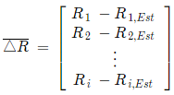
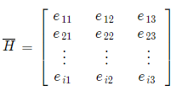
Solving TDOA – No Error
Begin with initial conditions: estPos
Find range from estPos to each receiver
Compare estimated range to true range, create deltaRange matrix
Create line of sight matrix using estPos
Solve for deltaPos, or the position estimate iteration
Iterate

Slide 57
Truncation Error Calculation
Algorithm uses Newton’s Method → Derived from 1st order multivariate Taylor series → Truncation error = 1st order multivariate Taylor expansion remainder:
For 3D: f
Recall pseudo-range equation: $R_{i}=\sqrt{{\left(x−x_{i}\right)}^{2}+{\left(y−y_{i}\right)}^{2}+{\left(z−z_{i}\right)}^{2}}+τ$ w/ partial derivatives:
Then:
And $\max_{}\left[D^{2}R_{i}(x,y,z,τ)\right]=1.768$ so $δ_{t}=0.884$
To get error for 2D and 1D, remove z (2D) and y & z (1D) from equations
$$δ_{t}=\frac{1}{2}\max_{}\left[D^{2}R_{i}(x,y,z,τ)\right]$$
$$R_{xx}=\frac{1}{\sqrt{{\left(x−x_{i}\right)}^{2}+{\left(y−y_{i}\right)}^{2}+{\left(z−z_{i}\right)}^{2}}}−\frac{{\left(x−x_{i}\right)}^{2}}{{\left({\left(x−x_{i}\right)}^{2}+{\left(y−y_{i}\right)}^{2}+{\left(z−z_{i}\right)}^{2}\right)}^{3/2}}$$
$$R_{xy}=−\frac{\left(x−x_{i}\right)\left(y−y_{i}\right)}{{\left({\left(x−x_{i}\right)}^{2}+{\left(y−y_{i}\right)}^{2}+{\left(z−z_{i}\right)}^{2}\right)}^{3/2}}$$
$$R_{ττ}=0$$
$$R_{xτ}=0$$
$$R_{yτ}=0$$
$$R_{zτ}=0$$
$$R_{yy}=\frac{1}{\sqrt{{\left(x−x_{i}\right)}^{2}+{\left(y−y_{i}\right)}^{2}+{\left(z−z_{i}\right)}^{2}}}−\frac{{\left(y−y_{i}\right)}^{2}}{{\left({\left(x−x_{i}\right)}^{2}+{\left(y−y_{i}\right)}^{2}+{\left(z−z_{i}\right)}^{2}\right)}^{3/2}}$$
$$R_{xz}=−\frac{\left(x−x_{i}\right)\left(z−z_{i}\right)}{{\left({\left(x−x_{i}\right)}^{2}+{\left(y−y_{i}\right)}^{2}+{\left(z−z_{i}\right)}^{2}\right)}^{3/2}}$$
$$R_{zz}=\frac{1}{\sqrt{{\left(x−x_{i}\right)}^{2}+{\left(y−y_{i}\right)}^{2}+{\left(z−z_{i}\right)}^{2}}}−\frac{{\left(z−z_{i}\right)}^{2}}{{\left({\left(x−x_{i}\right)}^{2}+{\left(y−y_{i}\right)}^{2}+{\left(z−z_{i}\right)}^{2}\right)}^{3/2}}$$
$$R_{yz}=−\frac{\left(y−x_{i}\right)\left(y−z_{i}\right)}{{\left({\left(x−x_{i}\right)}^{2}+{\left(y−y_{i}\right)}^{2}+{\left(z−z_{i}\right)}^{2}\right)}^{3/2}}$$
$$D^{2}R_{i}\left(x,y,z,τ\right)=δ_{r,x}^{2}R_{xx}+δ_{r,y}^{2}R_{yy}+δ_{r,z}^{2}R_{zz}+δ_{r,τ}^{2}R_{ττ}+2δ_{r,x}δ_{r,y}R_{xy}+2δ_{r,x}δ_{r,z}R_{xz}+2δ_{r,x}δ_{r,τ}R_{xτ}+2δ_{r,y}δ_{r,z}R_{yz}+2δ_{r,y}δ_{r,τ}R_{yτ}+2δ_{r,z}δ_{r,τ}R_{zτ}$$

