Slide 1
Critical Design Review
Bi-Functional On-Orbit Space Transfers (BOOST)
By: Tycho Cinquini, Riana Gagnon, Avery Gillespie, Wesley Gilliam, Luca Herlein, Chieri Kamada, Colton Massic, Rishi Mayekar, Zach Rochman
Customer/Sponsor: Marcus Holzinger | Mentor: Ball Aerospace

Slide 2
Overview
Project Purpose and Objective
Design Solution
Critical Project Elements and Risks
Design Requirements and Satisfaction
Verification and Validation
Project Planning

Slide 3
Project Purpose and Objective
1

Slide 4
Mission Statement
The Bi-Functional On Orbit Space Transfer (BOOST) Team will be developing cost-effective space-based transportation infrastructure capable of providing spacecraft with the ability to conduct orbit transfers and provide navigation services in the Cislunar regime.​

Slide 5
Specific Objectives
Performance
Energy Transfer
Level 1 | The infrastructure shall provide users with the capability of transferring/navigating to Trajectories of Interest (TOI) in low lunar orbit (LLO) and the lunar corridor
Level 2 | The infrastructure shall provide users with the capability of moving bidirectionally between two TOI
Level 1 | The infrastructure shall provide the necessary ΔV for transfer between the desired TOI
 | The infrastructure shall facilitate the storage/transfer of the kinetic, potential, and/or chemical energy required for transfers between the desired TOI
Level 2 | The infrastructure shall facilitate the minimum energy transfer between the desired TOI within the max time specified by the customer

Slide 6
Specific Objectives Con.
Return on Investment (ROI)
Navigation Services
Level 1 | The infrastructure shall have an annualized internal compounded ROI of at least 5% over a total of 25 Earth years
Level 2 | The infrastructure shall have an initial cost of no more than 100 Billion in 2022 USD
Level 1 | The infrastructure shall provide navigation services to customer spacecraft within the lunar corridor and LLO
 | The infrastructure shall provide customers with position and time measurements with accuracies of at least 100 m and 1 ms respectively
Level 2 | The system shall provide service for at least 10 years
 | The infrastructure shall prevent service blackouts from disrupting more than 99% percent of full system coverage
 | The infrastructure shall provide at least 75% percent coverage of the determined regions

Slide 7
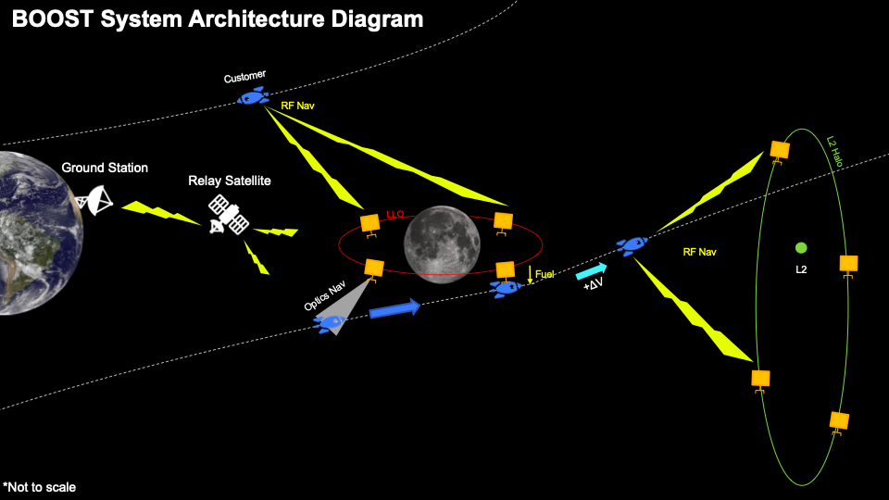
system CONOPS

Slide 8
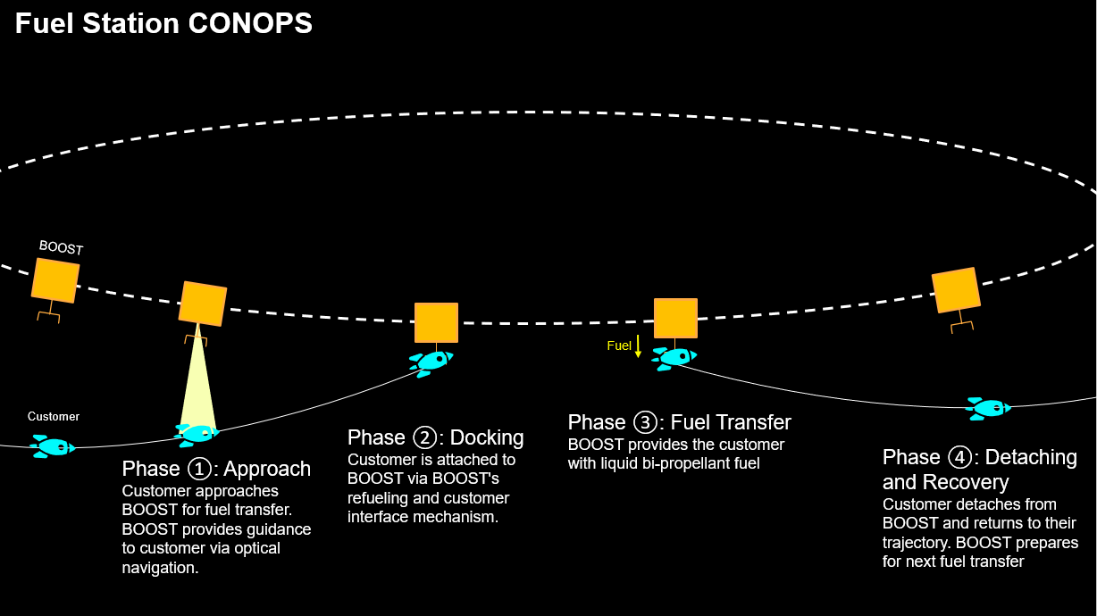
Fuel Station CONOPS

Slide 9
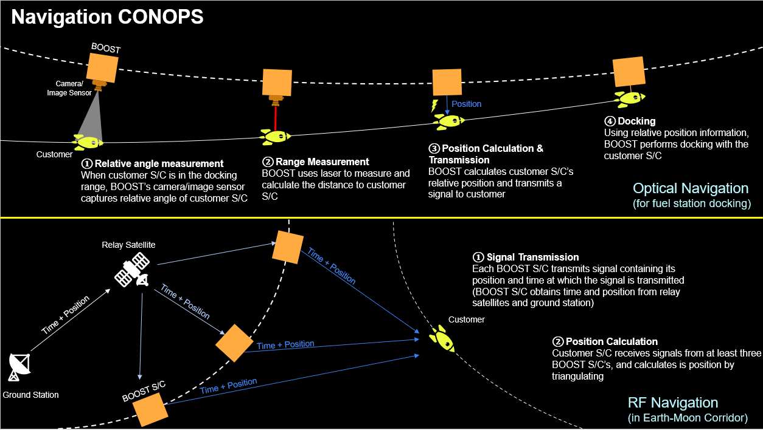
Navigation CONOPS

Slide 10
Design Solution
2

Slide 11
Design Solution
Infrastructure Design
Orbit Period: 7 Days
Orbit Family: L2 Halo and LLO
Navigation System: Camera, LiDAR, RF
Vehicle: Fuel Station
Fuel Type: Liquid Propellant
Business Model: Invoice
Spacecraft Design
Estimated Required Power: 3036.7 W
Optics/RF System: Camera, LiDAR, RF
Received Power Margin: 0.864 dBW
Navigation Services Data Rate: 2 Mbps
Supplied Fuel: LOX/LH2
Annual Return: 14%
Notes:
Mention that this was chosen based on MOO and trades

Slide 12
High Level Functional Block Diagram
Perform Relative Navigation with Customer Spacecraft
Perform Rendezvous with Customer Spacecraft
Customer Docks with BOOST
Boost Spacecraft
Customer Fuels Needed Amount of Propellant for Mission
Customer Continues Mission with Needed Fuel
Provide Long Range Navigation Services to Cislunar Domain
Customer Must Wait to be On Desired Point in Orbit

Slide 13
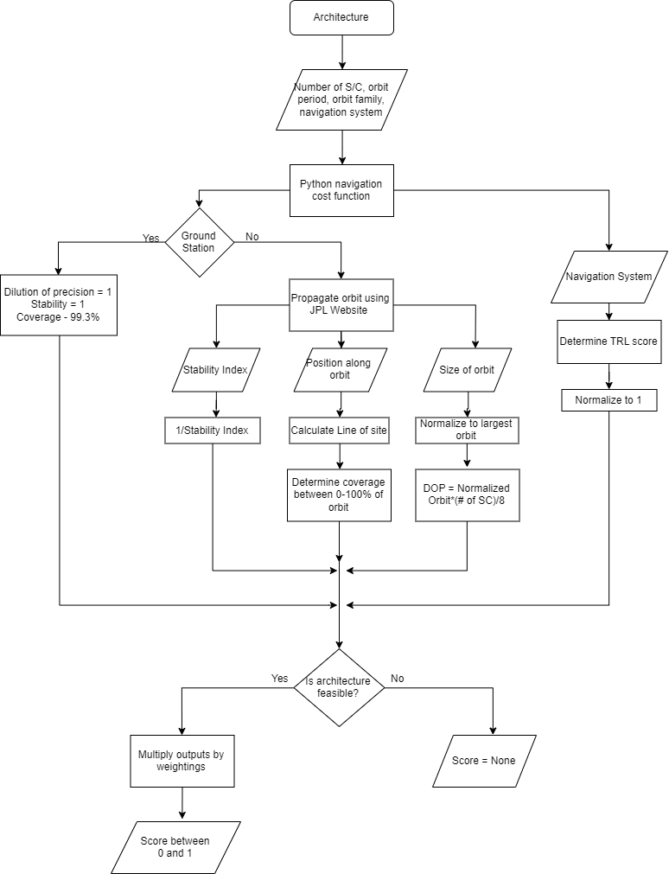
Nav MOO FBD
Yes
No
Yes
No

Slide 14
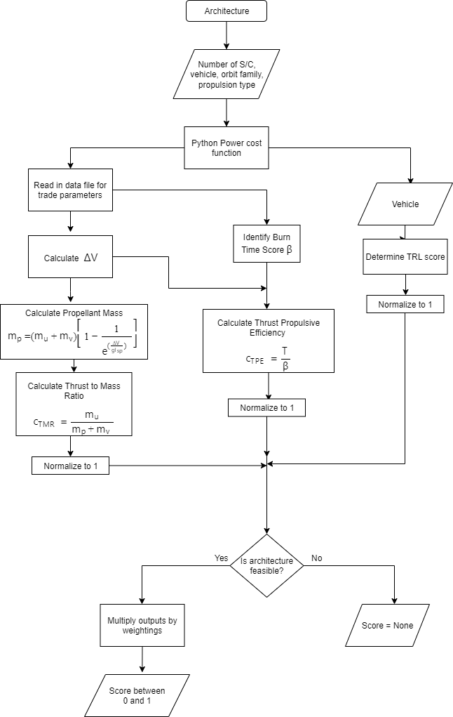
Vehicle MOO FBD
Yes
No

Slide 15
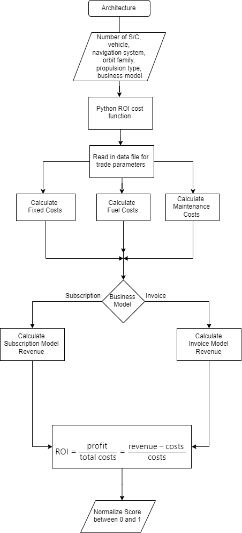
ROI MOO FBD

Slide 16
Critical Project Elements and Risks
3

Slide 17
Critical Project Elements
CPE # | CPE | Rationale
1 | Optical Navigation | Corresponds to one of high-level objectives Technology is mature Must design configuration that meets accuracy and coverage requirements
2 | Fuel Station | Corresponds to one of the high-level objectives Risk associated with station maintenance/refueling cost Must verify feasibility
3 | Customer Interface | For mechanical and signal transmission Risk associated with interfacing not being possible due to incompatibility
4 | Return on Investment (ROI) | Corresponds to one of the high-level objectives Must verify that the business model results in positive ROI
5 | Policy | Verify compliance with all current space policy

Slide 18
Architecture Risk Matrix
Negligible
Low
Medium
High
Critical
 | 1
 | 2 | 3 | 4
 | 5 |  | 6 | 7
 | 8 | 9 | 10 | 11
 | 12 |  | 13 | 14
Very Likely
Risk | Description
1 | User vehicle can’t interface with system
2 | System does not work in a time-effective manner
3 | Navigation system has blackout periods
4 | Navigation and power system not compatible
5 | Low TRL for navigation system
6 | User vehicle too massive for transport vehicle
7 | System hardware failure
8 | Low return on investment (ROI)
9 | Positive ROI in more than 25 years
10 | System can’t achieve enough thrust for desired orbit
11 | Navigation system can’t function in Cislunar domain
12 | Low TRL for power system
13 | Optimized system does not exist
14 | Power system can’t function in Cislunar domain
Likely
Possible
Unlikely
Very Unlikely

Slide 19
Component Design Risk Matrix
Negligible
Low
Medium
High
Critical
 | 1 | 4
 | 8 | 3, 14 | 9 | 11
 |  | 12 | 13 | 5
 |  |  | 10 | 7
 |  | 2 | 6 | 15
Risk | Description
1 | Navigation system can’t service multiple spacecraft
2 | System does not work in a time-effective manner
3 | Navigation system has blackout periods
4 | SNR too low
5 | Low TRL for navigation system
6 | User vehicle too massive for transport vehicle
7 | System hardware failure
8 | Customer can’t dock with BOOST spacecraft
9 | Unable to maintain system temperature
10 | System can’t achieve enough thrust for desired orbit
11 | Low factor of safety
12 | Low number of customers
13 | Customer not compatible with BOOST spacecraft
14 | Low return on investment
15 | BOOST system does not align with space policy
Very Likely
Likely
Possible
Unlikely
Very Unlikely
Notes:
I moved the location of 14 Mention that the bolded risks are the risks we will addressing mitigation strategies for

Slide 20
Mitigation Strategy: Risk 1
Negligible
Low
Medium
High
Critical
Very Likely
 | 1
1
Risk Description | Navigation system can’t service multiple spacecraft
Mitigation Strategy | Satellite-design trade study concluded with the addition of an RF component to our navigation system
CPEs | CPE 1, CPE 3, CPE 4
Likely
Possible
Unlikely
Very Unlikely
Notes:
Quickly brief that these correspond to the component design risks

Slide 21
Mitigation Strategy: Risk 3
Negligible
Low
Medium
High
Critical
Very Likely
 |  | 3
3
Risk Description | Navigation system has blackout periods
Mitigation Strategy | Hardware demo will investigate effect on accuracy of provided navigation data when blackout periods are introduced
CPEs | CPE 1, CPE 4
Likely
Possible
Unlikely
Very Unlikely

Slide 22
Mitigation Strategy: Risk 4
Negligible
Low
Medium
High
Critical
Very Likely
 |  | 4
 |  | 4
Risk Description | Signal-to-noise ratio (SNR) too low
Mitigation Strategy | Hardware demo will involve creating a RF system with a high enough SNR
CPEs | CPE 1, CPE 3
Likely
Possible
Unlikely
Very Unlikely

Slide 23
Mitigation Strategy: Risk 5
Negligible
Low
Medium
High
Critical
Very Likely
 |  |  |  | 5
 |  |  | 5
Risk Description | Low TRL for navigation system
Mitigation Strategy | Hardware demo will be focused around proving ability of an RF system to deliver accurate position data in Cislunar Space
CPEs | CPE 1
Likely
Possible
Unlikely
Very Unlikely

Slide 24
Mitigation Strategy: Risk 14
Negligible
Low
Medium
High
Critical
Very Likely
 |  | 14
 |  | 14
Risk Description | Low return on investment (ROI)
Mitigation Strategy | Adjust business models to optimize our ROI and ensure positive net income; conduct in-depth research to ensure accuracy of ROI models
CPEs | CPE 4
Likely
Possible
Unlikely
Very Unlikely

Slide 25
Mitigation Strategy: Risk 15
Negligible
Low
Medium
High
Critical
Very Likely
15 |  |  |  | 15
Risk Description | System does not align with space policy
Mitigation Strategy | Conduct research on current space laws; adjust design if necessary
CPEs | All → system isn’t viable if it doesn’t comply with existing space policy
Likely
Possible
Unlikely
Very Unlikely

Slide 26
Design Requirements and Satisfaction
4

Slide 27
Functional Requirements
ID | Requirement | Verification Method* | Slide Number
1 (Power) | The system shall provide the user with positive ΔV to transfer between the Trajectories of Interest (TOI)
1.1 | The system shall be capable of providing the transfer service to at least 4 customer spacecraft simultaneously | A | 31
1.2 | The system shall store energy to be transferred to the user spacecraft | I | 44
1.2.1 | The system shall have a maximum tank size of 10000 cubic meters | I | 80
1.3 | The system shall provide fuel to the user via fuel station vehicle | I | 44
1.3.1 | The system shall provide the user with a minimum ΔV of 3.95 km/s | A | 63
2 (Navigation) | The system shall provide the user with navigation services
2.1 | The system shall have the RF navigation coverage of at least 80% of the desired area in the Earth-moon corridor (See Appendix) | A | 37
2.2 | The navigation service shall achieve the position accuracy of at least 1 km | A, T | 37
*I: Inspection, A: Analysis, D: Demonstration, T: Test

Slide 28
Functional Requirements Con
ID | Requirement | Verification Method* | Slide Number
2.3 | The navigation service shall achieve the time accuracy of at least 10 ms | A, T | 36
2.4 | The navigation service shall have an availability of at least 99% | A | 67
2.5 | The system shall transmit navigation data to customer at a data rate compatible with customer spacecraft. | I | 86
2.6 | The system shall be capable of providing navigation services to at least 8 customer spacecraft simultaneously | A | 36
3 (ROI) | The system shall have a net positive return on investment (ROI)
3.1 | The system shall have an initial cost of no more than $100 Billion | I | 38
3.2 | The system shall have a positive ROI in 20 Earth years | A | 38-39
4 (Operational) | The system shall operate in Cislunar space
4.1 | The system shall retain its full functionality for at least 20 years in the Cislunar region | A | 45
4.2 | The system’s mean time between maintenance (including restocking of resources) shall be greater than 3 years. | A | 83
*I: Inspection, A: Analysis, D: Demonstration, T: Test

Slide 29
Functional Requirements Con
ID | Requirement | Verification Method* | Slide Number
4.3 | The system shall achieve an overall factor of safety of at least 1.4 | A | 82
4.4 | The system shall be self-sufficient in producing the power required for operation | I | 84
4.4.1 | Each spacecraft shall have a maximum energy consumption of 4000 W | I | 85
5 (Other)
5.1 | The system shall comply with applicable space laws and policies | I | 41
5.1.1 | The system shall comply with the Outer Space Treaty | I | 41
5.1.2 | The system shall comply with NASA’s sustainable policy | I | 41
5.1.3 | The system shall comply with the Artemis Accords | I | 41
5.2 | The system shall meet the sizing and mass requirements of the launching vehicle | I | 33
5.2.1 | The system shall have a maximum mass of 21000 kg. | A | 33
5.2.2 | The system shall have a maximum outer dimensions of 46 m height and 5.4m diameter at launch. | A | 33
*I: Inspection, A: Analysis, D: Demonstration, T: Test

Slide 30
Architecture Design Model

Slide 31
Pareto Surface
Modeled in Python
Generated all possible solutions
Three chosen performance metrics: energy, navigation, and ROI
Each ROI surface differentiated by spacecraft solution (Tugs, Tethers, Fuel Stations)
A single solution optimized for all three metrics was approached
Notes:
Mention the separated plots in the appendix

Slide 32
Component Design Models

Slide 33
Mass Budget Model - Constraints
Limiting factors imposed from launch vehicle and tank pressure
Mass Limitation
Derived from Ariane V (ECA)
Max. LEO payload of 21,000 kg (46,000 lbf)
Volume Limitation
Derived from Ariane V (ECA)
Outer dimensions of 46-52m height, 5.4m diameter
Used 90% of maximum values as upper limit
Pressure Limits
For liquid oxygen (oxidizer): P = 2.41 MPa
For compressed hydrogen gas (fuel): P = 30 MPa

Slide 34
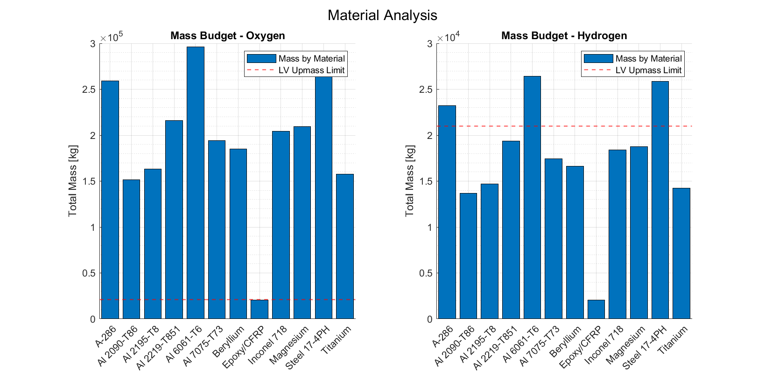
Mass Budget Model - Material Selection
From TWPVA:
Thin-Walled PVA
Extrapolate Material Volume
Evaluate System Mass

Slide 35
Mass Budget Model - Launch Masses
Fuel: Liquid Hydrogen (LH2)
Cryogenic storage to reduce required pressure from 30 MPa to 101 kPa
Constrained volumetrically by launch vehicle payload size
Oxidizer: Liquid Oxygen (LOx)
Tank volume reduced from maximum values to 25m height
Constrained by launch vehicle upmass limit
 | Tank Mass [kg] | Propellant Mass [kg] | Total Mass [kg] | Propellant Volume [L]
LH2 | 1,377 | 688 | 2,065 | 9.71e6
LOx | 15,481 | 5,221 | 20,703 | 4.58e6

Slide 36
Navigation Component Trade Matrix
Configuration | ROI [$] | Coverage Area [%] | Position Accuracy Score 50k-100k [km] | Position Accuracy Score 1k-50k [km] | Position Accuracy Score 100-1k [km] | Position Accuracy Score 0-100[km] | Time Accuracy [s/year] | Required Mass | Required Power | Number of S/c | Max Data Rate to Customer | Customer S/c Required Mods
LIDAR | 1.7M | 0 | 0 | 0 | 1 | 7 | 6e-11 | < 10 kg | 200 W | 1 | 10 Gbps | Low- substantial
Camera | 100k-5M | 0 | 0 | 0 | 1 | 8 | 6e-11 | < 10 kg | 10 W | Any in range | 0 bps | None
LIDAR + Camera | 1.7M-5M | 0 | 0 | 0 | 7.5 | 10 | 6e-11 | < 20 kg | 210 W | 1 | 10 Gbps | Low- substantial
RF + Camera | 382k-5M | 8 | 5 | 9 | 10 | 8 | 6e-11 | < 20 kg | 12 W | Any in range | 2.4 Kbps | None-low
RF + Camera + LIDAR | 2M-5M | 8 | 5 | 9 | 10 | 10 | 6e-11 | < 30 kg | 212 W | Any in range | 10 Gps | Low- substantial

Slide 37
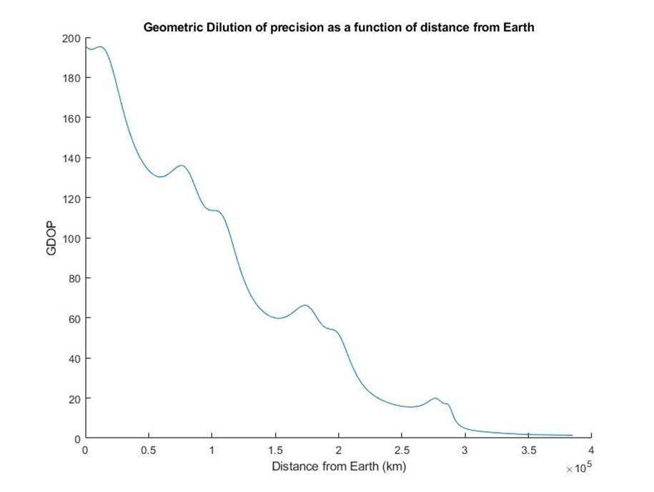
Geometric Dilution of Precision (GDOP) Model
Notes:
Make sure to define GDOP before presenting results

Slide 38
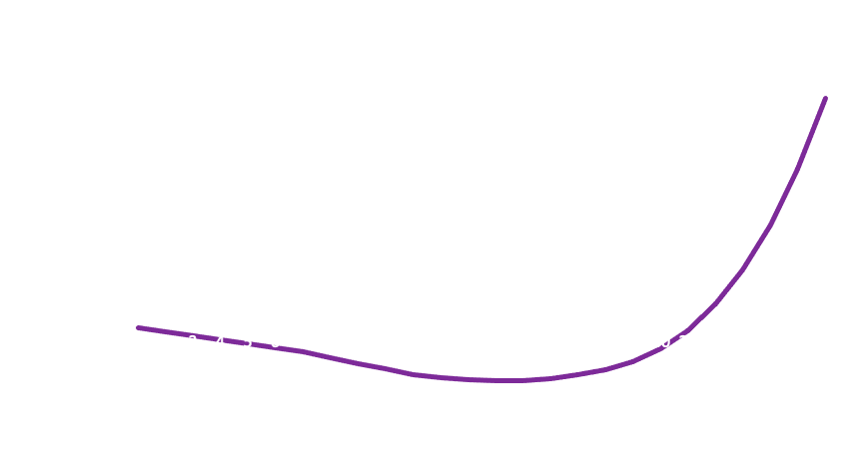
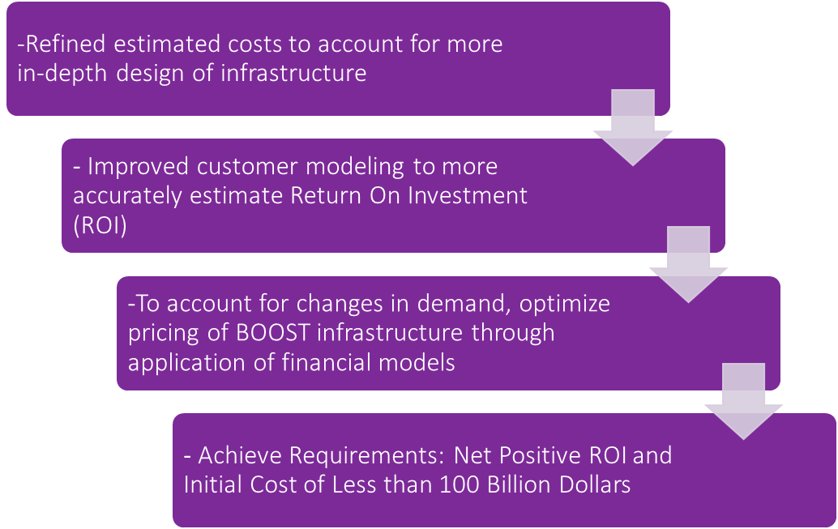
Predictive Financial Model

Slide 39
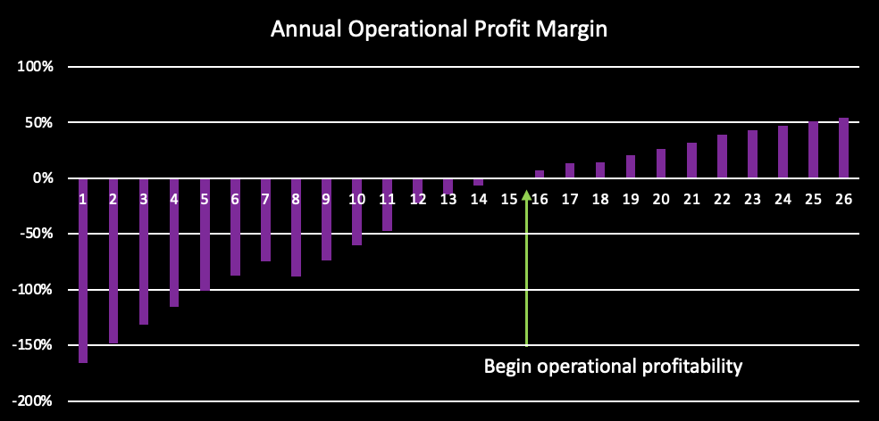
Breakdown of Annualized ROI

Slide 40
Results From Other Models
Model | Result
Power Source | Fuel Cell (See Appendix)
Power Budget | 3036.7 W (See Appendix)
Link Budget | 0.864 dBW (See Appendix)

Slide 41
Space Laws & Policy
To improve infrastructure and access to the Cislunar domain and beyond for companies everywhere, BOOST intends to implement its system in compliance with the following current space policy:
Outer Space Treaty
Requires that the exploration and use of space be for the benefit of all mankind BOOST will comply with all statements in the Outer Space Treaty as well as expansions on this treaty BOOst will create an infrastructure that improves access to space for companies who wish to benefit others
NASA’s Sustainability Policy
Execute mission without compromising our planet’s resources so that future generations can meet their needs BOOST intends to follow standards set by NASA through the safe transfer of customer spacecraft to prevent additional space debris BOOST intends to use greener fuels and employ efficient use of that fuel
The Artemis Accords
There shall be freedom of scientific research and exploration and use on the Moon by any party without discrimination Lunar resources shall be used with an equitable sharing by all state parties in the benefits derived from those resources BOOST will be improving access to lunar space for various companies BOOST will not discriminate in terms of which companies have access to our service as long as they also comply with space and lunar policy

Slide 42
Verification and Validation
5

Slide 43
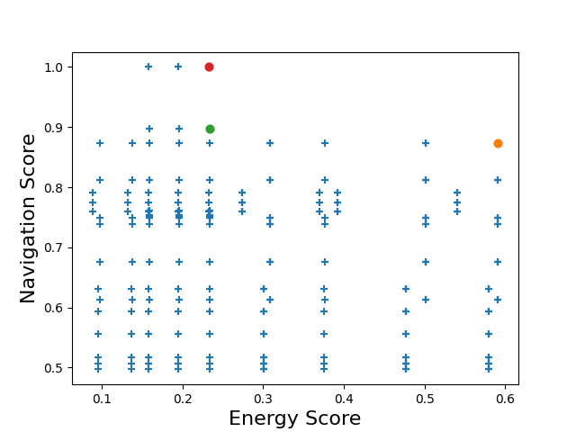
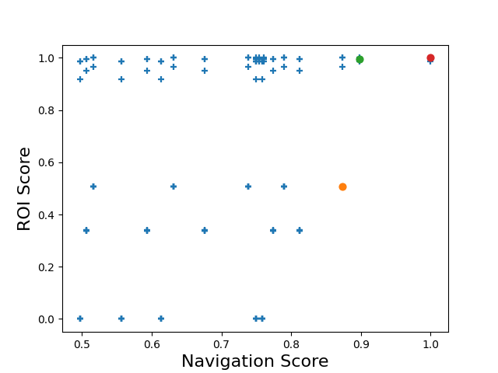
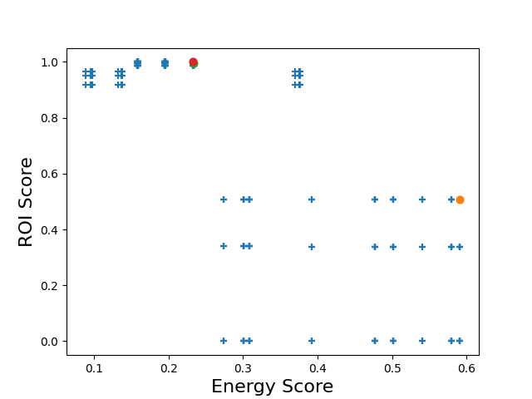
System Architecture Verification
Notes:
Use as segue

Slide 44
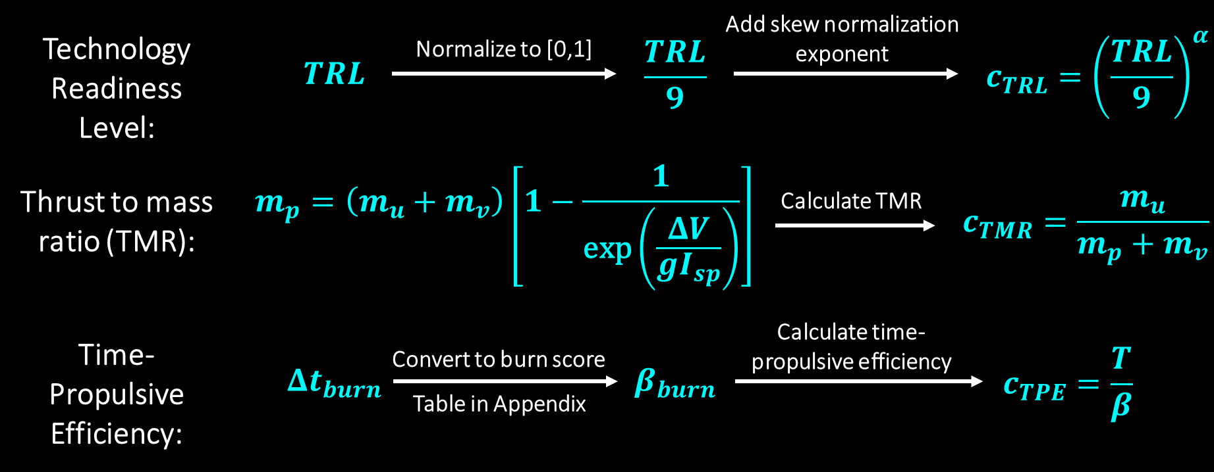
Vehicle Cost Function Verification
Burn Time | 1+ years | 182.5+ days | 1+ days | 12+ hours | 1+ hours | 30+ minutes | 1+ minutes | 30+ seconds | <30 seconds
Score (β) | 9 | 8 | 7 | 6 | 5 | 4 | 3 | 2 | 1

Slide 45
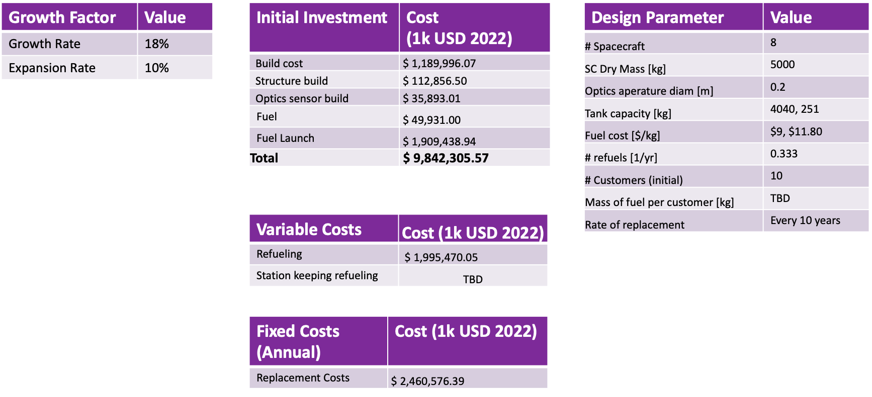
Business Model Verification
Annualized Internal ROI | 14.257%
Total Return on Investment | 3098.3%

Slide 46
Navigation Cost Function Verification
TRL | Dilution of Precision | Stability | Coverage
Based off NASA’s TRL (1-9) Low TRL = high risk TRL score normalized to 1 TRL level provided from research of similar systems | Computation of error based on geometric properties of the system Compounded analysis factoring in orbit family, orbit period, and number of spacecraft Scores of 1 assigned to largest orbit path, and highest number of spacecraft | Calculated stability index score [1-inf] of the orbit Stability index of 1 = stable Higher the index, the less stable Stability = 1/stability index Stability index provided by JPL | Numeric quantification of the system’s ability to provide navigation to the customer s/c within an orbital volume (0-100%) Based on line-of-sight calculations with selective weighting based on subsystem needs Coverage region designated as the lunar corridor and low lunar orbit

Slide 47
Power and Link Budget Verification
Power Budget:
Values compared to tables and graphs of approximate expected values from Space Mission Analysis and Design (SMAD) textbook
Values also compared to example mission (FireSat) from SMAD
Link Budget:
Values compared to EIRP and loss values from existing GPS constellations
Values compared to FireSat mission from SMAD

Slide 48
Propellant Trade
Weight [%] |  | 27% | 27% | 18% | 18% | 9%
Fuel | Oxidizer | Vacuum Isp | Average Bulk Density | Propellant Cost | Safety and Volatility | Storability | Overall Score
RP-1 | LOx | 77.8 | 81.6 | 61.5 | 72.3 | 85.0 | 75.5
LH2 | LOx | 100.0 | 100.0 | 50.2 | 52.4 | 70.0 | 79.6
MMH | N2O4 | 74.7 | 78.9 | 64.6 | 49.0 | 85.0 | 70.3
N2H4 | F2 | 94.4 | 77.8 | 58.7 | 62.0 | 85.0 | 76.6
N2H4 | ClF5 | 77.8 | 75.7 | 58.7 | 72.5 | 100.0 | 74.8
B2H6 | OF2 | 95.6 | 83.1 | 33.2 | 25.0 | 85.0 | 67.0

Slide 49
GDOP Verification
Define distance from each BOOST s/c to customer s/c
Define approximate location of target s/c
Calculate the line of sight unit vector from each BOOST s/c to the target
Find the geometry matrix of the signal-sending s/c
Calculate GDOP
Notes:
ratio of position error to range error

Slide 50
Further Verifications To Be Completed
Orbital Simulation: Test how our system performs while in orbit. Ensure all our predictive models are correct.
Use Orbital STK
See the long term effects of the stability of chosen orbits
Mechanical Design: Study the feasibility of our chosen design through a CAD model of 1 BOOST spacecraft
Use SolidWorks
Verify Dimensions
Policy Research: A 2 page report on our research of Space Policy will be provided to ensure our system is allowed to be deployed
Business Model: Refine our Business Models as our design becomes verified

Slide 51
Hardware Component
Create a scale model of our RF communication of positioning system
Determine the subsystem design and time accuracy as it relates to the geometric layout of our spacecraft
Add artificial delays to simulate relative geometries
Add receiver to drone to emulate trajectories of customer spacecraft for long distance trajectory corrections
Notes:
If the PAB asks why we don’t have a FBD say “Our sponsor told us this expectation 16 hours before the presentation was due.”

Slide 52
Hardware Component Risks
Risk 3 Navigation System has Blackout Periods: We will use 6 Transmitters to test the accuracy of our system. We will study the effects of lowering the number of transmitters to test the severity of a satellite blackout
Risk 4 Signal-to-Noise Ratio too Low: Add noise to simulate bad SNR which is likely for our design
Risk 5 Low TRL: Currently no RF communication system in Cislunar space. We aim to prove the feasibility of our proposed architecture. Will add delays to simulate a realistic scenario.
Notes:
Show a slide with our risk matrix or just bring it up when talking?

Slide 53
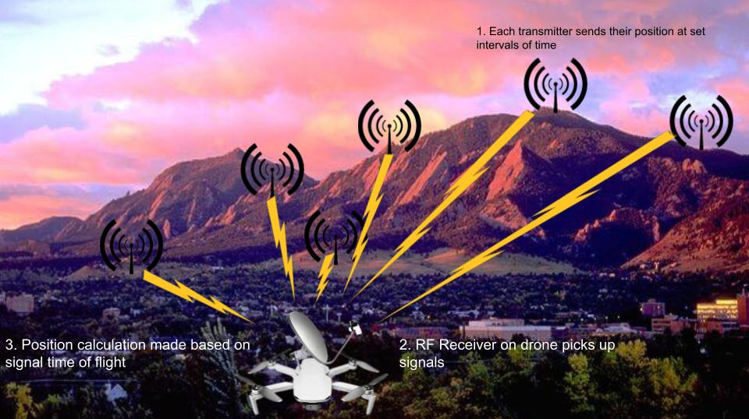
Final Test Set-up

Slide 54
Testing Requirements
Facilities:
ASPEN Lab for testing close range
Outdoors for medium and long range
Equipment:
Drone
Breadboard
Antennas
GPS
Arduino
Safety Concerns:
None

Slide 55
Project Planning
6

Slide 56
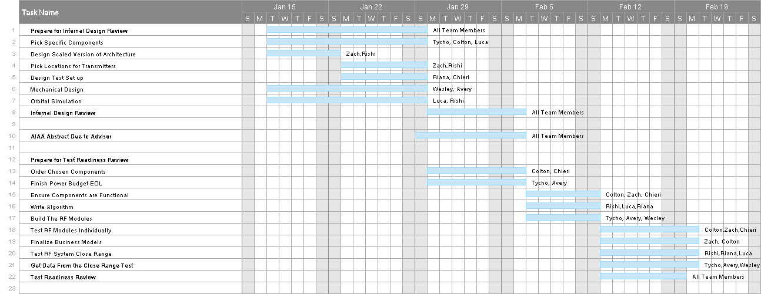
Work Plan

Slide 57
Work Plan Con.

Slide 58
Cost Breakdown
Due to the nature of our project and direction from our sponsor, our hardware demo will be designed and implemented next semester. As a result, the following cost breakdown is approximate
Component | Cost
Drone | $200-$1000
Antennas (x6) | $324-$600
Arduino & Breadboard | $10-$50
GPS Modules | $10-$50
Total Cost: | $544-$1700
Budget: | $4000
Surplus: | $2300-$3456

Slide 59
Major Tests To Be Conducted
Test individual components for RF modules
Test each RF module for its functionality
Test all RF modules in close range
Add artificial delays and blackout periods to simulate relative geometries in Cislunar region
Keep increasing the range to test the limit
Add a receiver to the drone and collect data
Notes:
Test the functionality of our individual components
Test a single built RF module
Test all six in close range
Test limits of system
Continue to increase the range between the transmitters and the receivers
Add a receiver to the drone and measure data
Add artificial delays and blackout periods to simulate relative geometries and system behavior

Slide 60
Presentation Contents
Mission Statement
Specific Objectives
System Architecture CONOPS
Fuel Station CONOPS
Navigation CONOPS
Design Solution
High-Level FBD
Navigation MOO FBD
Vehicle MOO FBD
ROI MOO FBD
CPEs
Architecture Risk Matrix
Component Design Risk Matrix
Risk Mitigation
Functional Requirements
Pareto Surface
Mass Budget – Constraints
Mass Budget – Material Selection
Mass Budget – Launch Masses
Navigation Trade Matrix
GDOP Model
Predictive Financial Model
Annualized ROI
Space Laws & Policy
System Architecture Verification
Vehicle Cost Function Verification
Business Model Verification
Nav Cost Function Verification
Power and Link Budget Verification
Propellant Model Verification
GDOP Verification
Hardware Component Overview
Hardware Component Testing
Work Plan
Cost Breakdown
Testing Plan
ΔV Rationale
Desired System coverage
BOOST Spacecraft Architecture
Pareto Projections
Line of Sight Coverage Verification
Risk Measurement
Propellant Appendices
Power Trade & Budget
Link Budget

Slide 61
Appendices
7

Slide 62
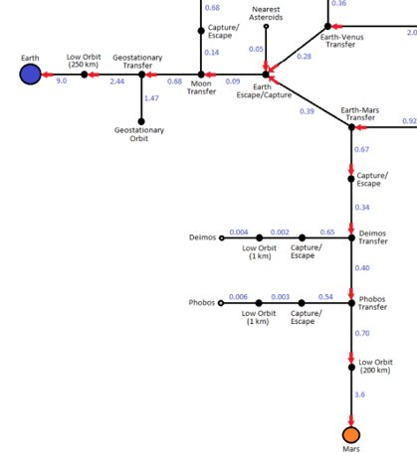
ΔV Rationale
LEO-LLO: 3.84 km/s
Earth-Lunar Surface: 14.66 km/s
LEO-L2: 3.47 km/s
L2-LLO: 0.64 km/s
LEO-LMO: 5.72 km/s
L2-LMO: 2.94 km/s

Slide 63
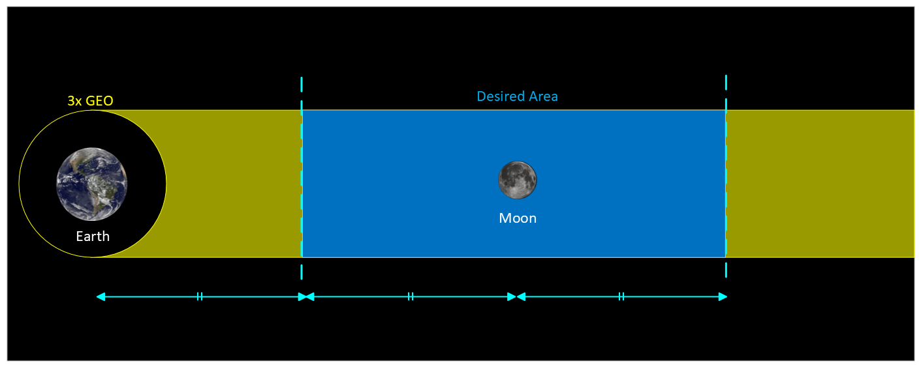
Desired System Coverage

Slide 64
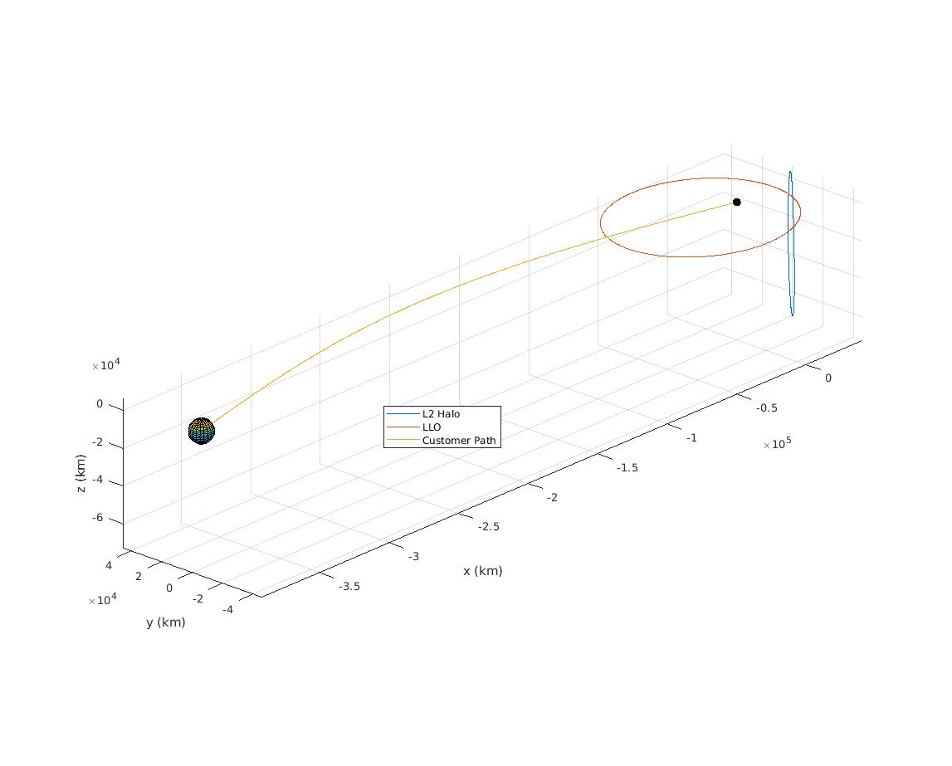
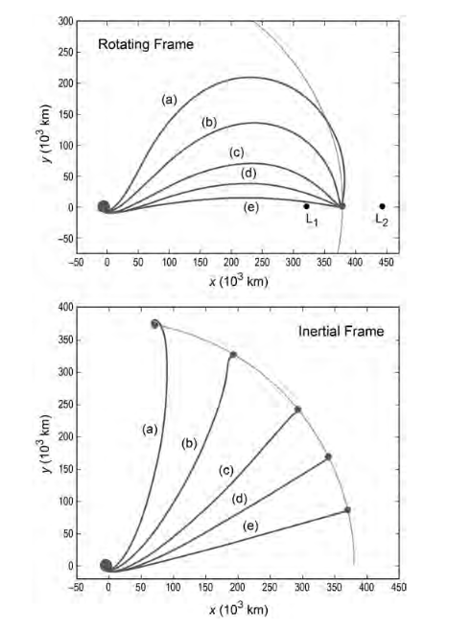
BOOST Spacecraft Architecture
Earth-Moon transfer based on JPL official direct Lunar transfer documentation

Slide 65
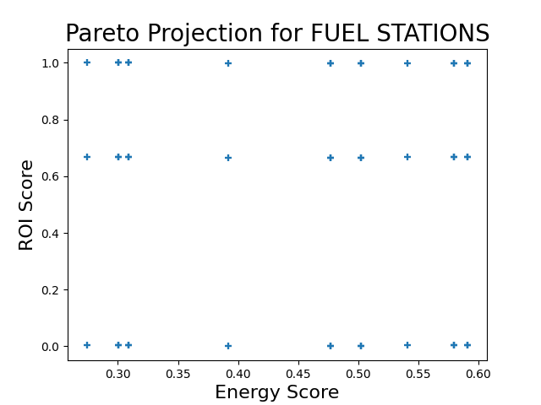
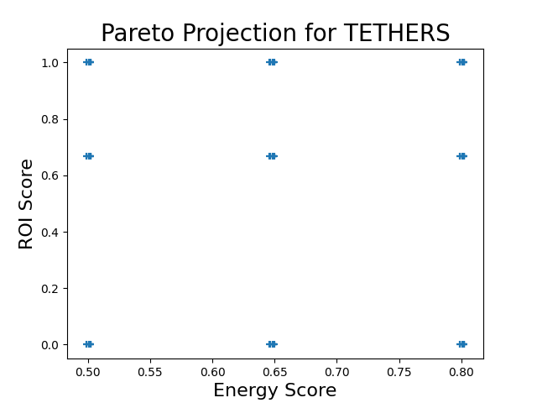
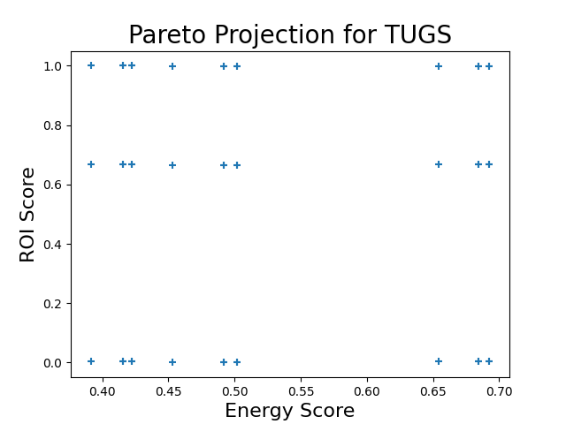
Pareto Projections for individual vehicles

Slide 66
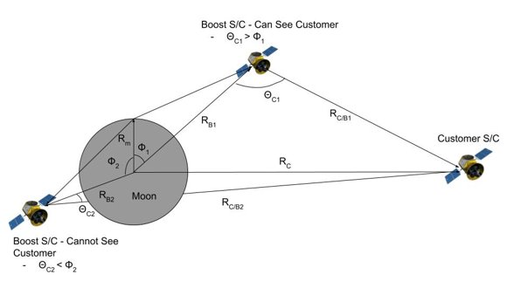
Line of Sight Coverage Verification
Only object blocking line of sight is moon
Critical lunar angle determined from moon radius and distance from moon

Slide 67
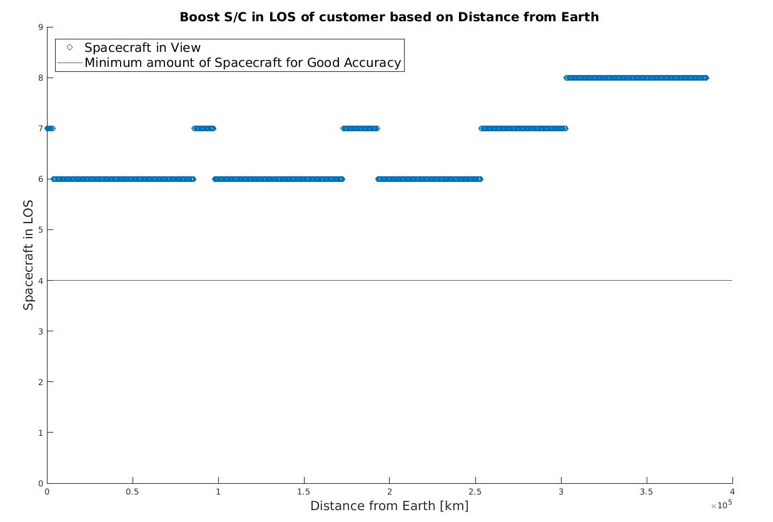
Line of Sight Coverage Verification

Slide 68
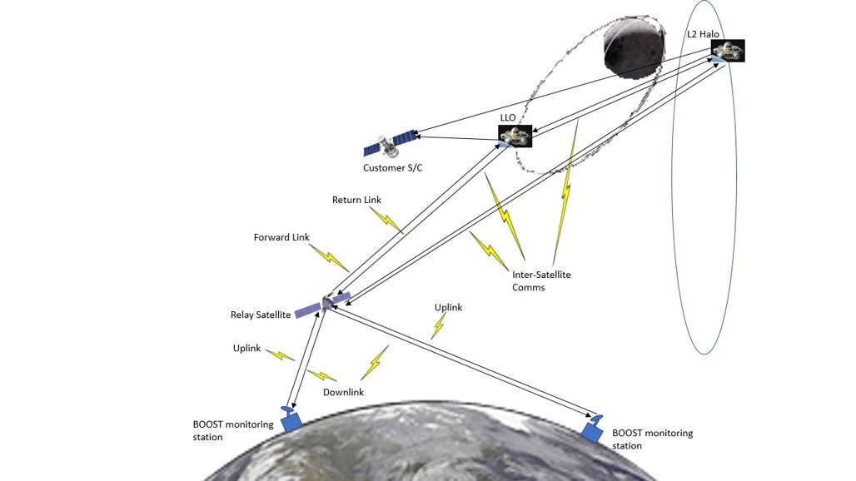
Communications Architecture

Slide 69
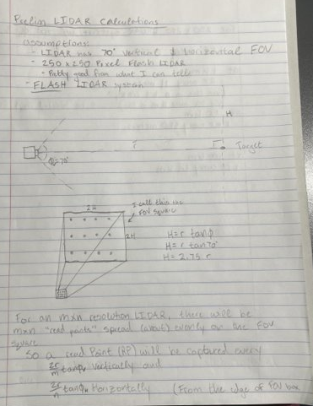
Flash Lidar Detection Derivation/Calculation

Slide 70
Risk Measurement
Severity
Likelihood
Level | Description
Negligible | Little to no impact on system performance
Low | Slightly reduces system performance
Medium | Impairs performance of system but doesn’t cause system failure
High | Likely causes system failure
Critical | Highly likely that it causes system failure
Level | Description
Very Unlikely | Little to no probability of occurring during system lifespan
Unlikely | Low probability of occurring during system lifespan
Possible | Medium probability of occurring a couple of times during system lifespan
Likely | High probability of occurring multiple times during system lifespan
Very Likely | High probability of occurring regularly during system lifespan

Slide 71
Propellant Architecture Rationale
Monopropellant Hydrazine:
Heritage: used in existing fueling stations (OrbitFab)
Can provide services to smaller satellites as well as larger systems
Customer can stock additional oxidizer and still use biprop system
Isp = 228 s
Density = 1.004 g/cm3
Makes it more volume efficient far less weight efficient
Monoprop: ~85% propellant/wt
Bipropellant LOX/LH2:
Used for higher ΔV operations (SLS, ULA, Ariane V)
Isp = 460 s (x2)
Density = 0.188 (~20%)
Unit prop mass provides 3.05 km/s of ΔV per user mass
Hydrazine has 1.55 km/s
Launch costs per m/s of ΔV are about 10x as efficient
Biprop: ~92-96% propellant/wt

Slide 72
Propellant Trade Verification
Isp: raw average values for propellant type, feature scaled (% of maximum)
Density:
Fuel & oxidizer density
Used optimal (stoichiometric) equivalence ratio for O/F ratio
Computed propellant density
Negative normalized, log scaled, then feature scaled (% of maximum)
Cost:
Values gathered in $/kg
Log scaled and negative normalized
NOTE: no value for ClF5, eliminated from trade study
Storage:
Cryogenic or complicated lowers score by 15
Scaled from 100

Slide 73
Propellant Trade Verification Cont.
Boiling Point [K] | Score
0-50 | 0
51-100 | 1
101-150 | 2
151-200 | 3
201-250 | 4
251-300 | 5
301-350 | 6
351-400 | 7
401-450 | 8
451-500 | 9
>500 | 10
Safety:
Characterized with GHS (Globally Harmonized System of Classification and Labelling of Chemicals) hazard statements
Human toxicity not considered
Volatility measured using chemical compound boiling point, and assigned a point on the scale below
Volatility and GHS subscore averaged to obtain the safety score and normalized to 100
Safety Hazard
H220 | Extremely flammable gas
H225 | Highly flammable liquid and vapor
H226 | Flammable liquid and vapor
H270 | May cause or intensify fire
H280 | May explode if heated

Slide 74
Propellant Trade - Isp
Fuel | Oxidizer | Isp [s] | Feature Scaled [%]
RP-1 | LOx | 350 | 77.77777778
LH2 | LOx | 450 | 100
MMH | N2O4 | 336 | 74.66666667
N2H4 | F2 | 425 | 94.44444444
N2H4 | ClF5 | 350 | 77.77777778
B2H6 | OF2 | 430 | 95.55555556

Slide 75
Propellant Trade - Density
Propellant |  | Bulk Density [g/cc] |  | O/F Ratio | % by wt |  | Propellant Density | Negative Normalized | Log Scaled- base 2 | Feature Scaled [%]
Fuel | Oxidizer | Fuel | Oxidizer |  | Fuel | Oxidizer
RP-1 | LOx | 0.8 | 1.14 | 2.56 | 0.280898876 | 0.719101124 | 1.018419072 | 98.19140548 | 6.617524848 | 81.56137289
LH2 | LOx | 0.0708 | 1.14 | 6 | 0.142857143 | 0.857142857 | 0.361058282 | 276.9635954 | 8.113552548 | 100
MMH | N2O4 | 0.86 | 1.43 | 2.16 | 0.316455696 | 0.683544304 | 1.182068378 | 84.59747494 | 6.402542697 | 78.91170556
N2H4 | F2 | 1 | 1.5 | 1.64 | 0.378787879 | 0.621212121 | 1.261146497 | 79.29292929 | 6.309120319 | 77.76026939
N2H4 | ClF5 | 1 | 1.9 | 1.64 | 0.378787879 | 0.621212121 | 1.416949153 | 70.57416268 | 6.141068202 | 75.68901742
B2H6 | OF2 | 0.44 | 1.5 | 3 | 0.25 | 0.75 | 0.936170213 | 106.8181818 | 6.739013423 | 83.05872653

Slide 76
Propellant Trade - Cost
Propellant |  | Cost [$/kg] |  | O/F Ratio | Total Cost | Log Scaled- base 9 | Negative Normalized
Fuel | Oxidizer | Fuel | Oxidizer
RP-1 | LOx | 5.5 | 11.8 | 2.56 | 35.708 | 1.627223175 | 61.45438531
LH2 | LOx | 9 | 11.8 | 6 | 79.8 | 1.993207044 | 50.17040267
MMH | N2O4 | 17 | 6 | 2.16 | 29.96 | 1.547344406 | 64.62685334
N2H4 | F2 | 9.4 | 20 | 1.64 | 42.2 | 1.703248844 | 58.7113271
N2H4 | ClF5 | 9.4 | 20 | 1.64 | 42.2 | 1.703248844 | 58.7113271
B2H6 | OF2 | 742.11 | 0.60364 | 3 | 743.92092 | 3.009221182 | 33.23118972

Slide 77
Propellant Trade - Safety
Chemical / Compound | Boiling Point [K] | Volatility Score | Hazard Statements | Hazard Score | Compound Subscore
RP-1 | 500 | 9 | -- | 10 | 9.5
LOx | 90.188 | 1 | -- | 10 | 5.5
LH2 | 20.271 | 0 | -- | 10 | 5
MMH | 360.65 | 7 | H225 | 5 | 6
N2O4 | 294.84 | 5 | H270 H280 | 3 | 4
N2H4 | 387 | 7 | H226 | 7 | 7
F2 | 85.04 | 1 | -- | 10 | 5.5
ClF5 | 260 | 5 | -- | 10 | 7.5
OF2 | 128.4 | 2 | H270 H280 | 3 | 2.5
B2H6 | 180.66 | 3 | H220 H280 | 2 | 2.5

Slide 78
Propellant Trade - Storage
Fuel | Oxidizer | Score | Comments
RP-1 | LOx | 85 | complicated
LH2 | LOx | 70 | cryogenic, complicated
MMH | N2O4 | 85 | complicated
N2H4 | F2 | 85 | complicated
N2H4 | ClF5 | 100
B2H6 | OF2 | 85 | complicated

Slide 79
Propellant Model Verification
Selected propellant combination: Liquid Oxygen and Cryogenically Compressed Hydrogen (LOx/LH2)
Rationale: highest performing in the most important categories (Isp and density), with relatively efficient cost
Notes:
Talk about how cost of propellant was included in MOO but these are costs of the specific types of liquid bi prop
this comes from post MOO (1st level trade), the ROI is a dependent variable on propellant cost: choosing a different prop won’t change our ROI model, so we should just optimize based on propellant

Slide 80
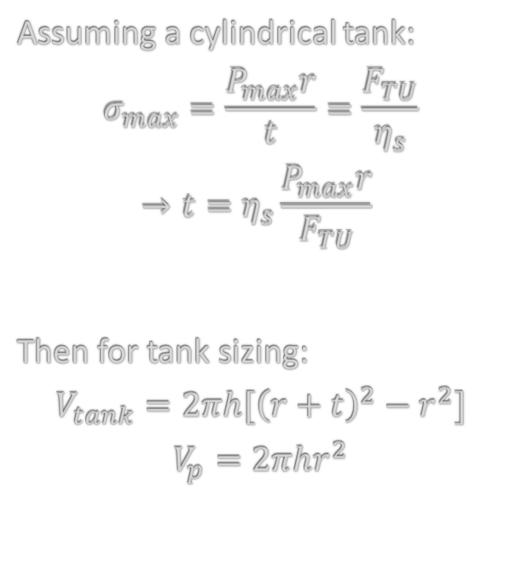
Thin-Walled Pressure Vessel Analysis
Further analysis in pressure vessel design could describe the tank as two hemispheres and a cylindrical casing
Pressure vessel analysis does not take into account effects of thermal cooling needed for the storage of cryogenic hydrogen, which may reduce the tensile strength of materials like carbon fiber/epoxy

Slide 81
Material Properties
Material | Density [g/cc] | Tensile Strength [MPa] | Tank Thickness (LOx) [mm]
Epoxy/CFRP | 1.75 | 3500 | 5.21
Al 2219 | 2.85 | 420 | 43.43
Al 2195 | 3.0 | 590 | 30.92
Al 2090 | 2.59 | 550 | 33.17
Al 6061 | 2.71 | 290 | 62.90
Al 7075 | 2.80 | 460 | 39.66
Steel 17-4PH | 7.86 | 860 | 21.21
A-286 | 7.94 | 970 | 18.81
Inconel 718 | 8.22 | 1280 | 14.25
Magnesium | 1.77 | 270 | 67.56
Titanium | 4.43 | 900 | 20.27
Beryllium | 1.85 | 320 | 57.01
The following properties were primarily compiled from Table 11-52 in SMAD
Data for Al 2195, Al 2090, and Epoxy/CFRP were added later, due to their applications in gas tank construction
all values were additionally given a FoS of 1.4 as an additional safety margin
Tank thickness is a derived value for the high-pressure oxygen storage

Slide 82
Material Selection Justification
CFRP (Carbon-Fiber Reinforced Plastic) was selected as material of choice, due to high tensile strength, relatively low density, and very low thickness
Article by ESA (European Space Agency) details flight-readiness of CFRP tanks conducted by MT Aerospace in Germany
In past, common tanks were made from Al 2090 & Al 2195 alloys
Common concerns for the technology are mitigated:
leak proof with liquid hydrogen and LOX
doesn’t require heavy metal interior lining
no composite overwrap
cheap to manufacture
resisted cryogenic temperatures, pressure cycling, and reactive substance testing
MT Aerospace hardware has demonstrated nearly flight-ready TRL on Phoebus mission with 3.5m diameter hydrogen and oxygen tanks (2023)

Slide 83
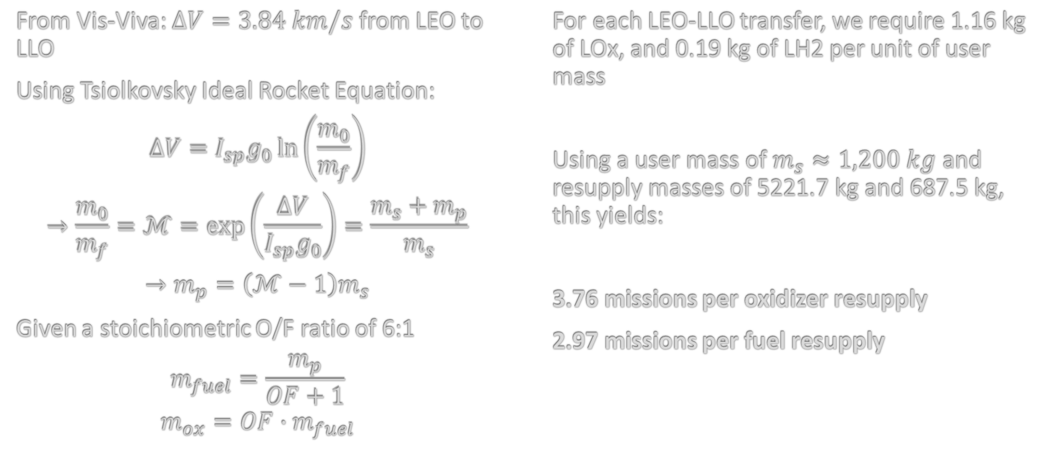
Fuel and Resupply Requirements

Slide 84
Power Source Trade
Attribute | Weighting | Power Source
 |  | Solar Panel Array | Surface-Mounted Solar Panel | Solar Thermal Dynamic | Radio-Isotope | Nuclear Reactor | Fuel Cell
Specific Power [W/kg] | 0.15 | 9.289 | 9.289 | 4.747 | 5.252 | 6.467 | 9.847
Specific Cost [$/kg] | 0.15 | 4.906 | 4.906 | 4.736 | 2.623 | 0.17 | 8.245
Maneuverability | 0.1 | 2 | 6 | 5 | 10 | 8 | 10
Degradation Over Life | 0.2 | 5 | 5 | 5 | 9 | 9 | 7
Use Time | 0.3 | 6 | 4 | 4 | 10 | 10 | 10
Vulnerability | 0.1 | 2.5 | 2.875 | 7 | 10 | 10 | 7
Weighted Score |  | 5.37925 | 5.21675 | 4.82245 | 7.98125 | 7.59555 | 8.8138

Slide 85
Beginning of Life Power Budget
Subsystem | Required Power [W] | Assumptions | Source
Fuel Transfer System | 2000 | For cryogenically cooling fuel | Research
Communication (Customer Nav.) | 861.2 |  | Link Budget
GNC | 45 | FireSat used as baseline | SMAD
Command and Data Handling | 18 | ‘Typical’ system (from SMAD), communicating over X-band | SMAD
Telemetry, Tracking, and Command | 57.5 | ‘Typical’ system (from SMAD) | SMAD
Propulsion | 0 | Chemical propulsion | SMAD
Thermal | 5 |  | SMAD
Power | 50 |  | SMAD
Total BOL Power | 3036.7

Slide 86
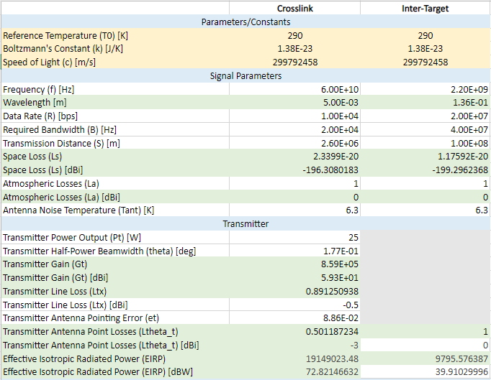
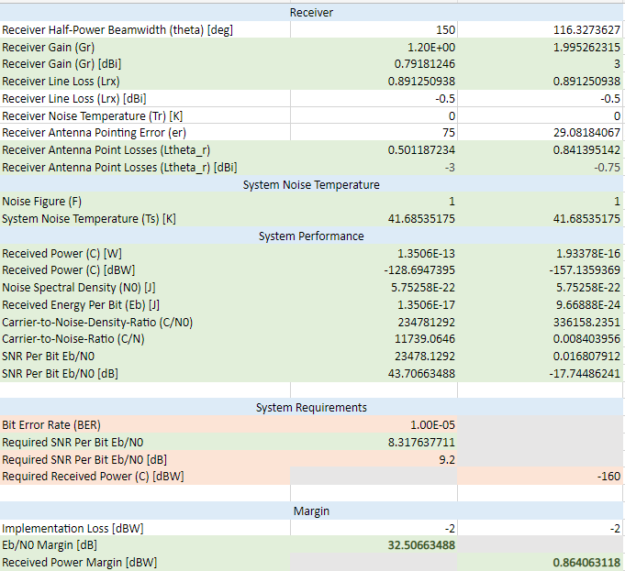
Link Budget

Slide 87
Bibliography

Slide 88
Sources
[1] “2195 (2195-T8) Aluminum,” MakeItFrom Available: https://www.makeitfrom.com/material-properties/2195-2195-T8-Aluminum.
[2] Aerojet Rocketdyne, “Bipropellant in-space propulsion,” Bipropellant In-Space Propulsion | Aerojet Rocketdyne Available: https://www.rocket.com/space/space-power-propulsion/bipropellant-space-propulsion#:~:text=Aerojet%20Rocketdyne%20has%20bipropellant%20in,thrust%20to%206%2C000-lbf%20thrust.
[3] Air Liquide, “Storing Hydrogen,” Air Liquide Energies Available: https://energies.airliquide.com/resources-planet-hydrogen/how-hydrogen-stored.
[4] “Ammonium perchlorate 1kg,” ChemDirect Available: https://www.chemdirect.com/p/ChemD-27-213010-1KG-7790-98-9/ammonium-perchlorate-1kg-14828?gclid=Cj0KCQjwteOaBhDuARIsADBqRegLrnNV45WxJbnQWAd4oOCxTziRy8D1FB19XjdmltKHFGna70FTdYwaAhD8EALw_wcB.
[5] “Approach: Optical navigation experiment,” NASA Available: https://mars.nasa.gov/mro/mission/timeline/mtapproach/approachopticalnav/.
[6] Bradley, N., Laboratory, J. P., Olikara, Z., Bhaskaran, S., Young, B., S., B., R., W. R. and M., R., W., J., T. D., T., E., S., B., N., B., Tuckness D. G. and Young S.-Y., K., H., G., H. S., Hosken R. W. and Wertz J. R., S., H.-D., D., M., A., C. J., V., F., S., M., Christian J. A. and Lightsey E. G., B., T., B., M., E., B., D., H. M., G., S., S., T., S., E., M., M., A., N., W., K., P., A., Al., E., Scheeres, D. L. and D. J., McKee, P. D., and Christian, S. H. J. A., “Cislunar navigation accuracy using optical observations of natural and artificial targets,” Journal of Spacecraft and Rockets Available: https://arc.aiaa.org/doi/abs/10.2514/1.A34694.
[7] Caldwell, S., “4.0 in-space propulsion,” NASA Available: https://www.nasa.gov/smallsat-institute/sst-soa/in-space-propulsion#4.5.
[8] Chen, C.-S., Chiu, Y.-J., Lee, C.-T., and Lin, J.-M., “Calculation of weighted geometric dilution of precision,” Journal of Applied Mathematics Available: https://www.hindawi.com/journals/jam/2013/953048/.

Slide 89
Sources
[9] Christian, J. A., and Cryan, S., “A survey of LIDAR technology and its use in spacecraft relative navigation,” NTRS.NASA.gov Available: https://ntrs.nasa.gov/api/citations/20140000616/downloads/20140000616.pdf.
[10] Collins, L., “A wake-up call on green hydrogen: The amount of wind and solar needed is immense,” Recharge News Available: https://www.rechargenews.com/transition/a-wake-up-call-on-green-hydrogen-the-amount-of-wind-and-solar-needed-is-immense/2-1-776481.
[11] Department of Energy, “Hydrogen Storage,” Energy.gov Available: https://www.energy.gov/eere/fuelcells/hydrogen-storage#:~:text=Storage%20of%20hydrogen%20as%20a,pressure%20is%20%E2%88%92252.8%C2%B0C.
[12] Dragonfly Aerospace, “Satellite cameras,” Dragonfly Aerospace Available: https://dragonflyaerospace.com/satellite-cameras/.
[13] EnduroSat, “Commercial S-band Patch Antenna,” CubeSat by EnduroSat Available: https://www.endurosat.com/cubesat-store/cubesat-antennas/s-band-antenna-commercial/.
[14] EnduroSat, “S-band transmitter - cubesat communication module,” CubeSat by EnduroSat Available: https://www.endurosat.com/cubesat-store/cubesat-communication-modules/s-band-transmitter/.
[15] European Space Agency, “Lidar-based relative navigation, guidance and Control Technologies,” ESA Available: https://www.esa.int/Science_Exploration/Human_and_Robotic_Exploration/Exploration/Lidar-based_relative_navigation_guidance_and_control_technologies.
[16] European Space Agency, “Rocket tanks made of lightweight carbon fiber proven possible,” SciTechDaily Available: https://scitechdaily.com/rocket-tanks-made-of-lightweight-carbon-fiber-proven-possible/.

Slide 90
Sources
[17] Fall Semester Accomplishments: Optical Navigation | Cislunar Explorers says: “Optical navigation,” Cislunar Explorers Available: https://cislunarexplorers.wordpress.com/spacecraft-design/optical-navigation/.
[18] “Hydrogen economy,” Wikipedia Available: https://en.wikipedia.org/wiki/Hydrogen_economy#:~:text=As%20of%202020%20green%20hydrogen,at%20%241%E2%80%931.80%2Fkg.
[19] Iridium NEXT, “Hydrazine - toxic for humans, but satellites love it.,” Iridium Satellite Communications Available: https://www.iridium.com/blog/hydrazine-toxic-for-humans-but-satellites-love-it/.
[20] Keysight, “Modulation Schemes for Satellite Communications,” Keysight Blogs Available: https://blogs.keysight.com/blogs/tech/rfmw.entry.html/2020/08/24/modulation_schemesf-6MpZ.html.
[21] “Lox/LH2,” Astronautix Available: http://www.astronautix.com/l/loxlh2.html#:~:text=Propellant%20Formulation%3A%20LOX%2FLH2.,Density%3A%200.28%20g%2Fcc.
[22] MatWeb, “ Overview of materials for Epoxy/Carbon Fiber Composite,” MatWeb Available: https://www.matweb.com/search/datasheet_print.aspx?matguid=39e40851fc164b6c9bda29d798bf3726.
[23] MatWeb, “Aluminum 2090-T83,” MatWeb Available: https://www.matweb.com/errorUser.aspx?msgid=2&ckck=nocheck.
[24] Perez, E., “Ariane 5 - User's Manual,” Internet archive: Wayback Machine Available: https://archive.org/web/.

Slide 91
Sources
[25] Pescea, V., Opromollab, R., Sarnoc, S., Lavagnaa, M., Grassib, M., Opromolla, R., Wold, S., Pesce, V., Sharma, S., Canny, J., Felicetti, L., Zhang, L., Pinard, D., Alepuz, J. P., Wang, X., Ambrose, R., Starek, J. A., Mauro, G. D., Clerc, X., Volpe, R., Shi, J., Lowe, D. G., Rublee, E., Augenstein, S., Yuan, J., D'Amico, S., Naasz, B. J., and David, P., “Autonomous relative navigation around uncooperative spacecraft based on a single camera,” Aerospace Science and Technology Available: https://www.sciencedirect.com/science/article/abs/pii/S1270963818317346.
[26] Shiozawa, B., “The cost of CO2-free ammonia,” The Cost of CO2-free Ammonia Available: https://www.ammoniaenergy.org/articles/the-cost-of-co2-free-ammonia/.
[27] techcrunch, “Startup battlefield: Session 3 - orbit fab,” YouTube Available: https://www.youtube.com/watch?v=ASWvao0IFMY&ab_channel=TechCrunch.
[28] Wang, T., Ruff, C., Block, B., and McKague, D. S., “Characterization of GPS L1 EIRP: Transmit power and antenna gain pattern,” Resarch Gate Available: https://www.researchgate.net/publication/329576218_Characterization_of_GPS_L1_EIRP_Transmit_Power_and_Antenna_Gain_Pattern.
[29] Zeng, T., Wang, H., Cheng, H., Zheng, C. L., Feng, X. Y., Shan, W., L., L., M., G. S., B., C., M., R., A., D. L., F., X. D., and Y., Y., “Four-channel Lidar Relative Navigation System for Rocket First Stage Recovery at Sea,” Computer Communications Available: https://www.sciencedirect.com/science/article/abs/pii/S0140366421001882.

