Slide 1
DAISy Cam
(Docking Arm Integration System for Scoutcam Camera)
Test Readiness Review
March 6, 2023
ASEN 4028 - Team 19
Company Sponsor
Astroscale
Faculty Advisor
Dr. Melvin Rafi
Presenters
Mohammed Alnasser, Kiley Beckwith, Peyton Early, Lucas House, and Jacob Moncada
Notes:
Presenter:

Slide 2
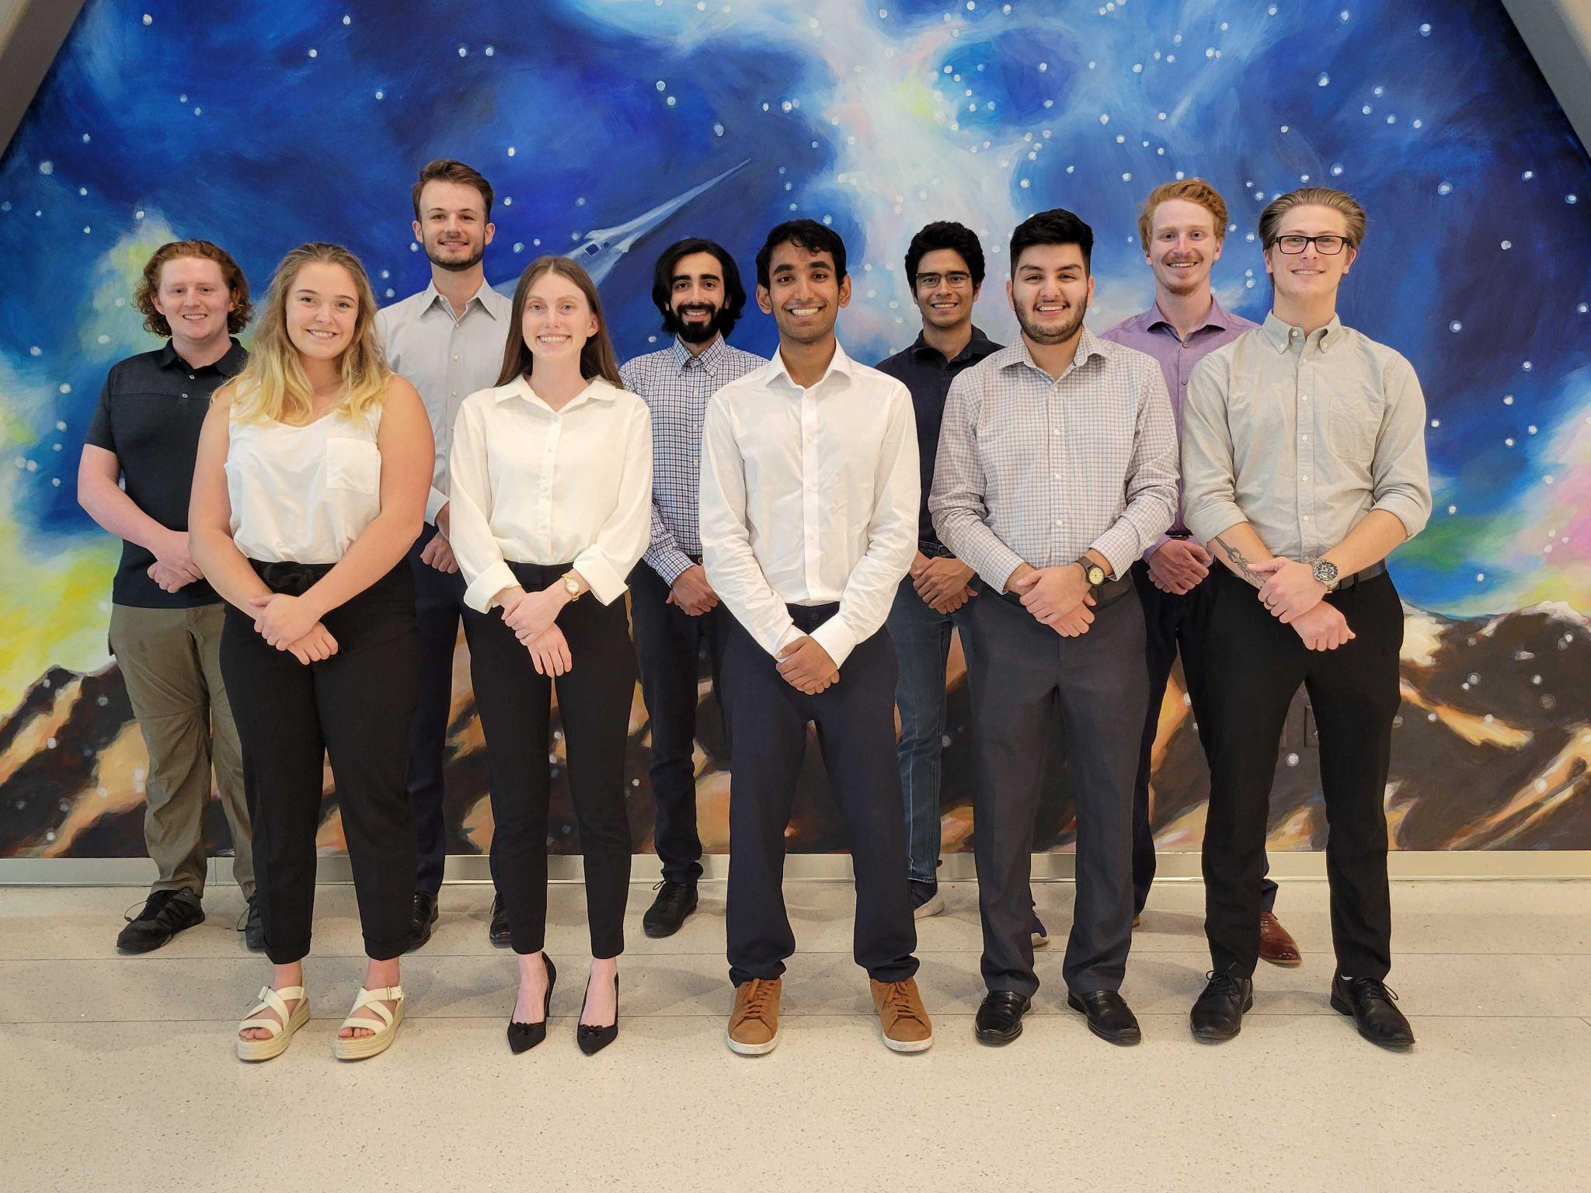
The Team
Front Row (left-to-right)
Abby Durell
(Mechanical Lead)
Kiley Beckwith
(Project Manager)
Ketan Kamat
(Electrical Lead)
Jacob Moncada
(Electrical Sub/CFO)
Peyton Early
(Software Lead)
Back Row (left-to-right)
Lucas House
(Manufacturing Lead)
Mason Lemler
(Electrical Lead)
Mohammed Alnasser
(Testing Lead)
Nate Sanchez
(Mechanical Sub)
Samuel Barrette
(Systems Engineer)
Notes:
Presenter: Each introduce themselves
Rafi’s feedback: Add who is doing what

Slide 3
Presentation Outline
Overview
Schedule
Test Readiness
Budget
Notes:
Presenter:

Slide 4
Project Overview
Notes:
Presenter:

Slide 5
Project Definition
DAISy Cam will integrate a Scoutcam micro-camera into a model of one of LEXI vehicle’s four docking arms, and develop a video card solution to support multiple cameras to assist LEXI in its final stages of docking with a client satellite.
1. Overview
2. Schedule
3. Test Readiness
4. Budget
Notes:
Presenter: Kiley
MENTION ASTROSCALE

Slide 6
Mission Objectives
Objective | Description
Video Data | Ensure correct video data is received and the system is capable of video compression
Radiation Hardened Video Card | Provide information about a solution for a radiation hardened video card that can withstand the temperature and radiation hazards of a geostationary orbit (GEO)
Camera System Harnessing | Provide a harnessing method that integrates a Scoutcam Camera to one of four LEXI docking arms that does not interfere with docking arm actions
Docking Arm Model | Develop a model of the LEXI docking arm that replicates its kinematic motion in order to test harnessing system of integrated Scoutcam camera
1. Overview
2. Schedule
3. Test Readiness
4. Budget
Notes:
Presenter:

Slide 7
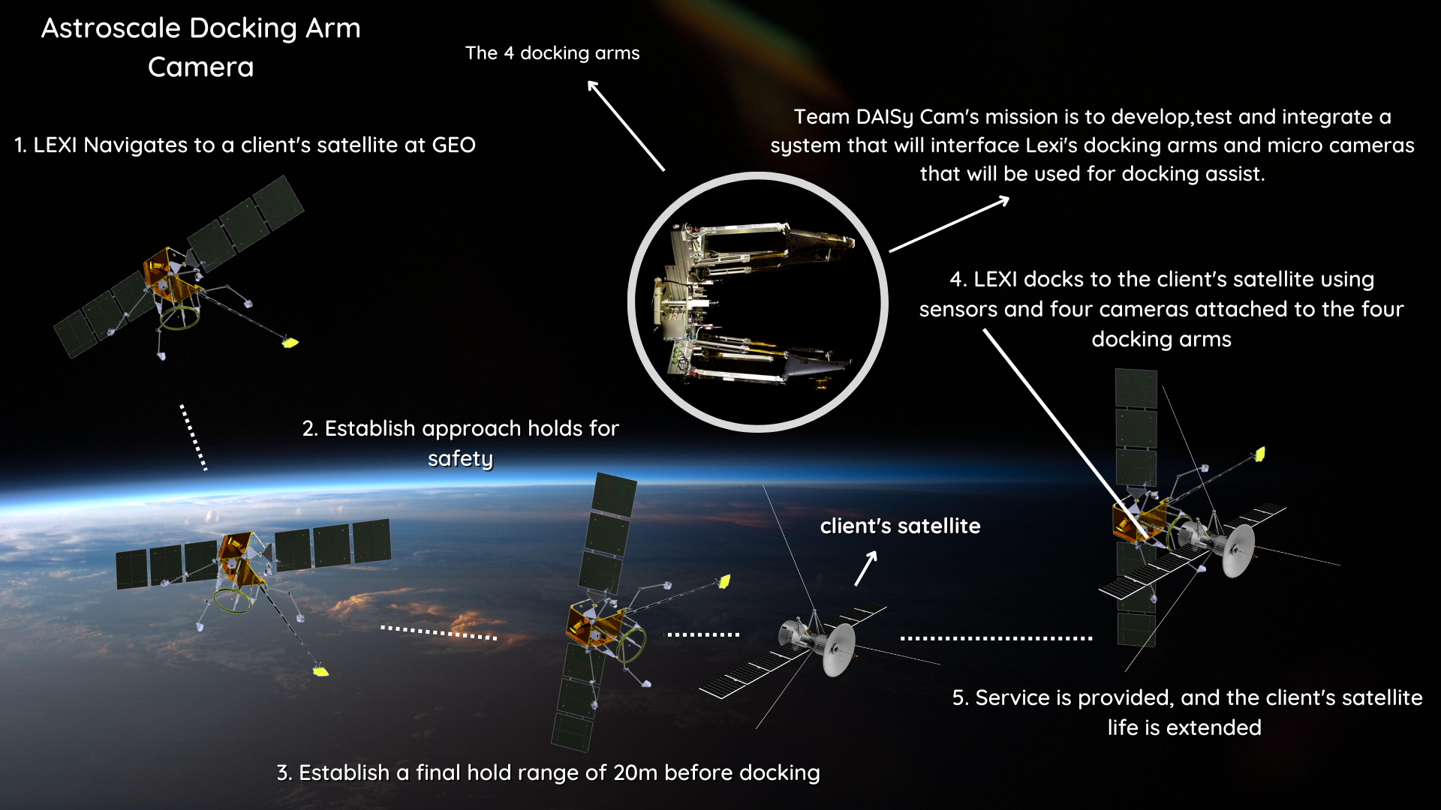
High Level ConOps
1. Overview
2. Schedule
3. Test Readiness
4. Budget
Notes:
Presenter:
(Say what LEXI stands for)

Slide 8
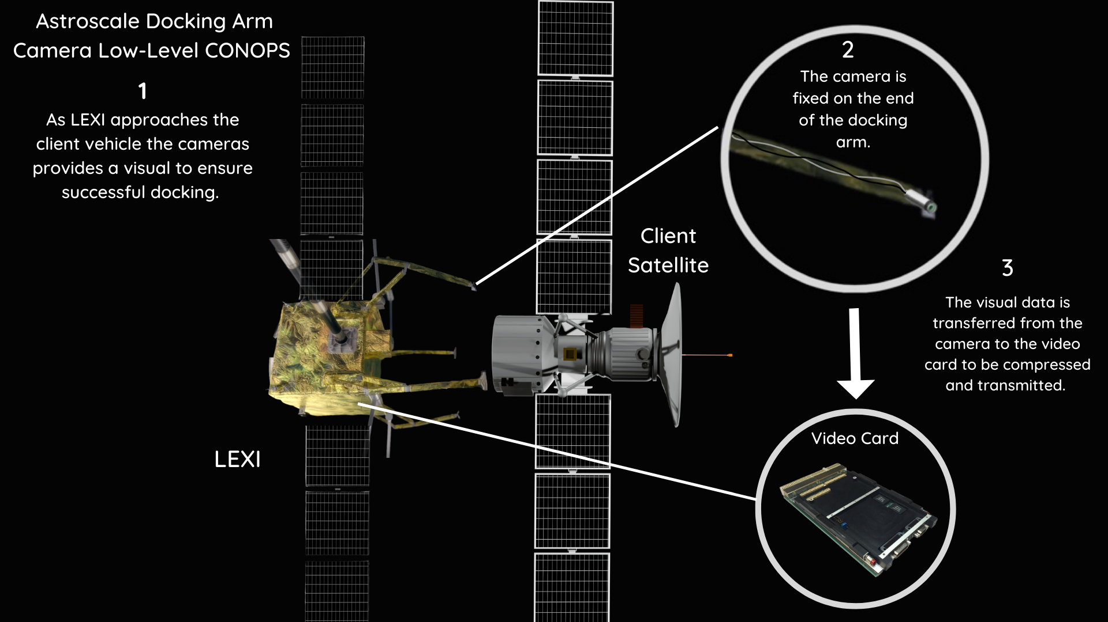
Low Level ConOps
1. Overview
2. Schedule
3. Test Readiness
4. Budget
Notes:
Presenter:

Slide 9
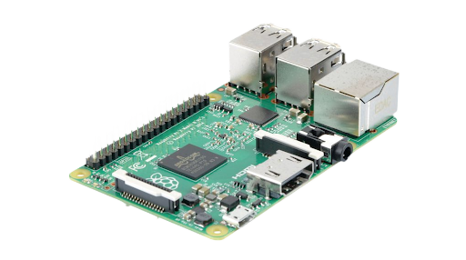
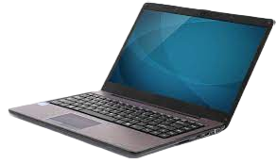
Functional Block Diagram
1. Overview
2. Design Solution
3. CPEs
4. DR Satisfaction
5. Risks
6. V&V
7. Project Planning
Notes:
Presenter:

Slide 10
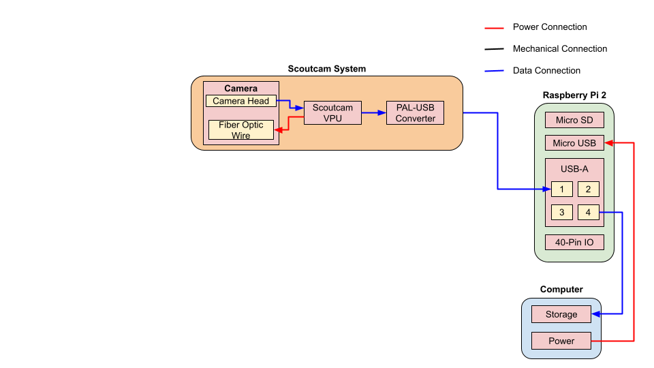
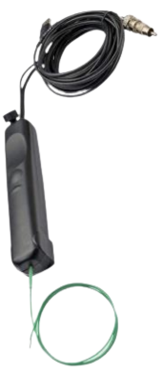
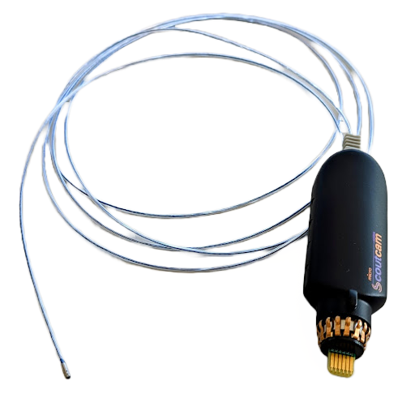
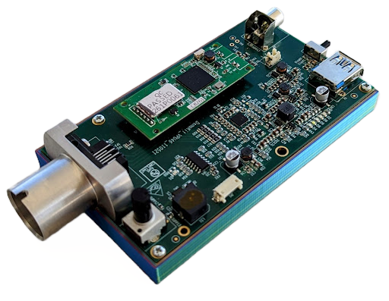
Functional Block Diagram
1. Overview
2. Design Solution
3. CPEs
4. DR Satisfaction
5. Risks
6. V&V
7. Project Planning
Notes:
Presenter:

Slide 11
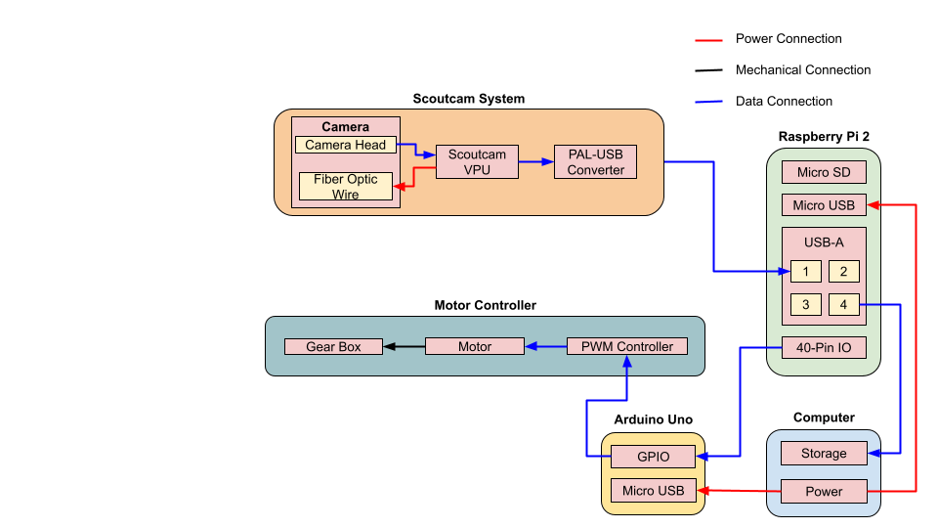
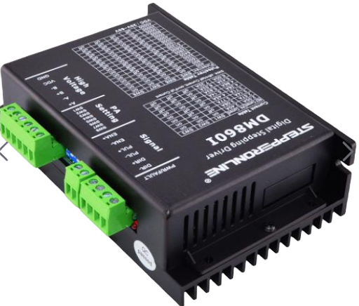
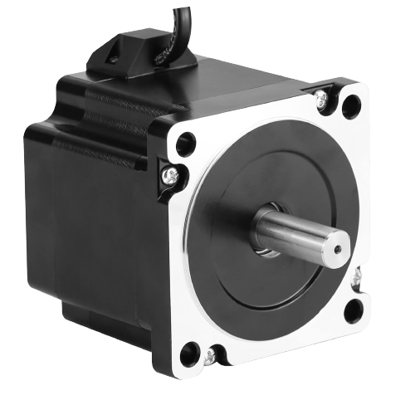
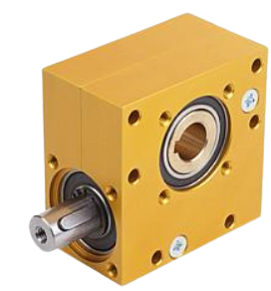
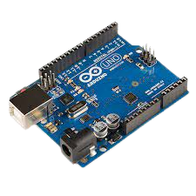
Functional Block Diagram
1. Overview
2. Design Solution
3. CPEs
4. DR Satisfaction
5. Risks
6. V&V
7. Project Planning
Notes:
Presenter: Peyton
Don’t mention a wooden base, just say it connects to a base
Update Pico with Arduino Uno

Slide 12
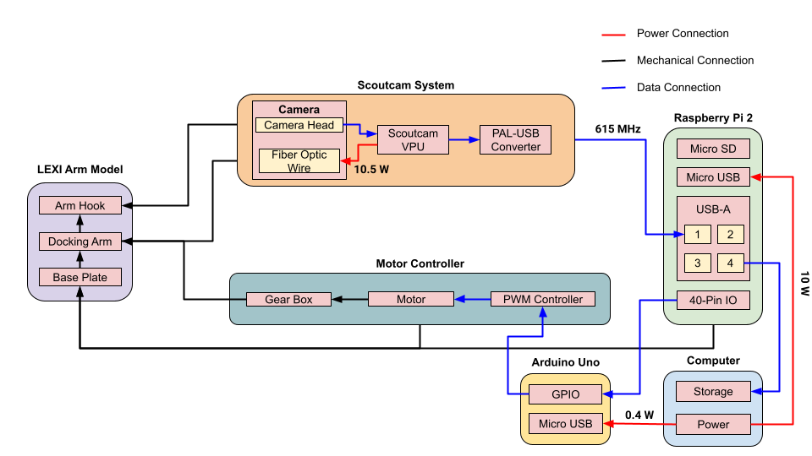
Functional Block Diagram
1. Overview
2. Design Solution
3. CPEs
4. DR Satisfaction
5. Risks
6. V&V
7. Project Planning
Notes:
Presenter: Peyton

Slide 13
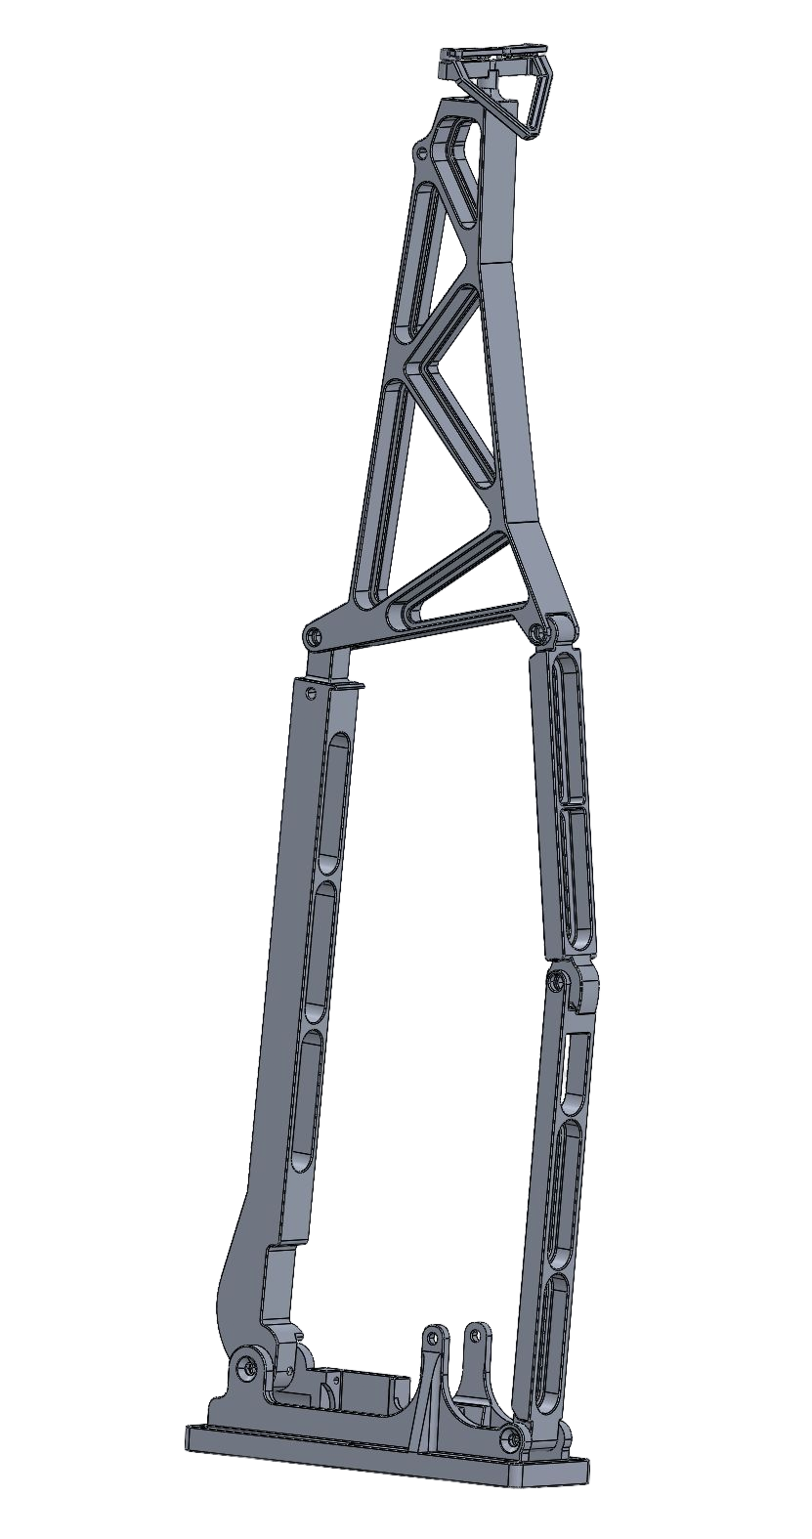
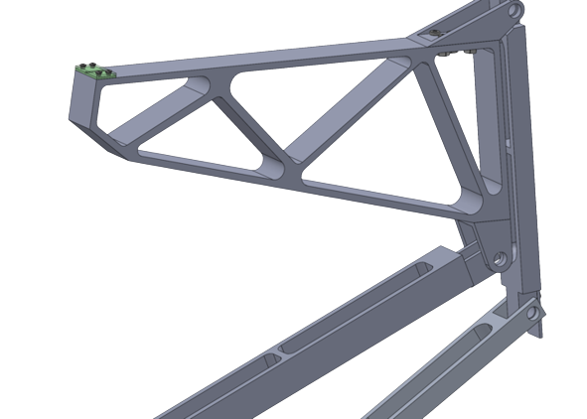
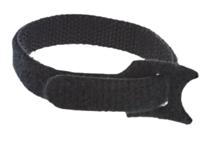
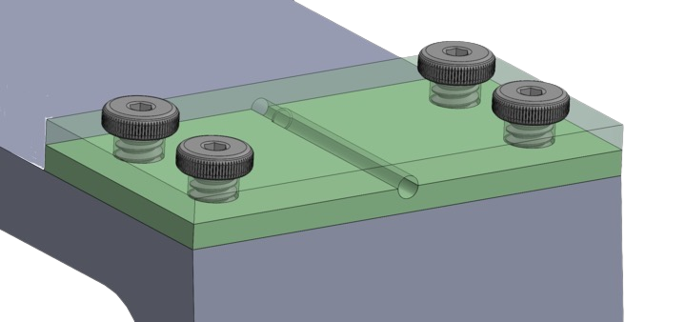
Baseline Design
Docking Arm Model
Harnessing Attachment
Velcro Straps
Gearbox drive system
13:1 worm gear drive
Arm Hook
Camera Head
Location
Stepper motor connection
12mm to 14mm coupler
Motor Driver
Digital stepper driver
1.15 m
Motor Connection
Base
Scoutcam Camera Attachment
1. Overview
2. Schedule
3. Test Readiness
4. Budget
Notes:
Changes Since CDR:
No longer using hose clamps, now velcro straps

Slide 14
Baseline Design
ScoutCam Camera
ScoutCam VPU
Arduino Uno
Nema 34 Stepper Motor 14mm
Raspberry Pi 2
Laptop (OBC stand-in)
1. Overview
2. Schedule
3. Test Readiness
4. Budget
Notes:
Changes Since CDR:
No longer using hose clamps, now velcro straps

Slide 15
Critical Project Elements
Identifier | Critical Project Element | Related FR
CPE 1 | Practical video card receives viewable image | FR 1
CPE 2 | The compression algorithm functions properly | FR 2
CPE 3 | Radiation hardened video card can operate in GEO under radiation and thermal loads | FR 3
CPE 4 | Harnessing does not restrict arm mobility | FR 5
CPE 5 | Camera receives power after initial stowage of harnessing | FR 4,6
CPE 6 | Docking arm model replicates motion of one of LEXI’s docking arms | FR 7
1. Overview
2. Schedule
3. Test Readiness
4. Budget
Notes:
Speaker:
3 months stowage

Slide 16
Schedule
Notes:
Presenter:

Slide 17
Test Overview
 | Test Name | Motivation | Completed (Y/N)
 | Environment Test | Use dry ice to determine how long we can hold desired temp range for thermal test and ensure temp monitoring system works as expected. | Yes
 | Thermal Test | Observe how cold temperature and variation in bend radii affects the Scoutcam wire’s structural integrity and electrical capability. | Yes
 | Motor Test | Determine that the motor outputs the desired torque to move the docking arm model. | Yes
 | Scoutcam Camera Functionality | Ensure that the Scoutcam camera works. | Yes
 | Raspberry Pi Functionality | Ensure the raspberry pi functions as expected | Yes
 | Video Compression Q.C.Test | Testing that the compression algorithm works properly with the full system for use in later performance tests. | No
Component Tests
1. Overview
2. Schedule
3. Test Readiness
4. Budget
Notes:
Presenter: Kiley
MAX 3 months stowed

Slide 18
Test Overview
 | Test Name | Motivation | Completed (Y/N)
 | Video Compression Performance Test | Compare different compression methods and report results to Astroscale. | No
 | Kinematics Test | Determine that the docking arm model replicates kinematic motion of the actual LEXI docking arm via repeated deployments and motion capture. | No
 | Harnessing Test | Determine the best harnessing route for the Scoutcam camera wire that does not allow for any bend to exceed the minimum bend radii. | No
 | Full System “Day in the life” Test | Determine that the docking arm model, with the Scoutcam camera attached and running can survive 3-5 long-duration deployments. | No
Sub-System Tests
System Tests
1. Overview
2. Schedule
3. Test Readiness
4. Budget
Notes:
Presenter: Kiley

Slide 19
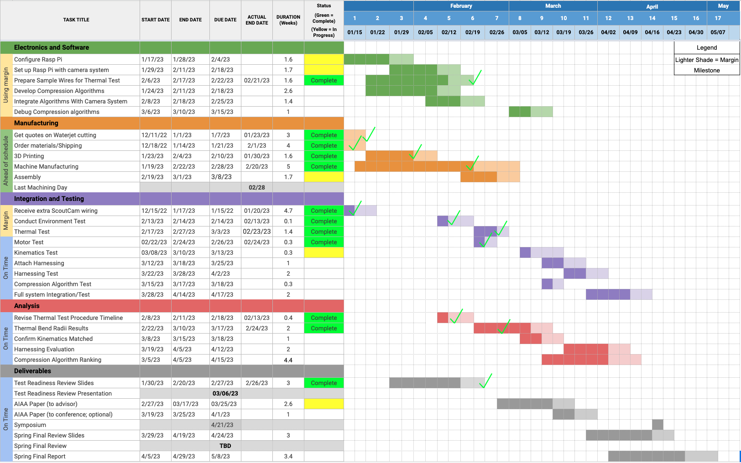
Overall Schedule
Machine Parts
Finish Assembly
Kinematics Test
Harnessing Test
Full System Test
Finish Testing and Analysis in preparation for Expo and SFR
1. Overview
2. Schedule
3. Test Readiness
4. Budget
Notes:
Presenter: Kiley
Will update as we get closer to submitting slides

Slide 20
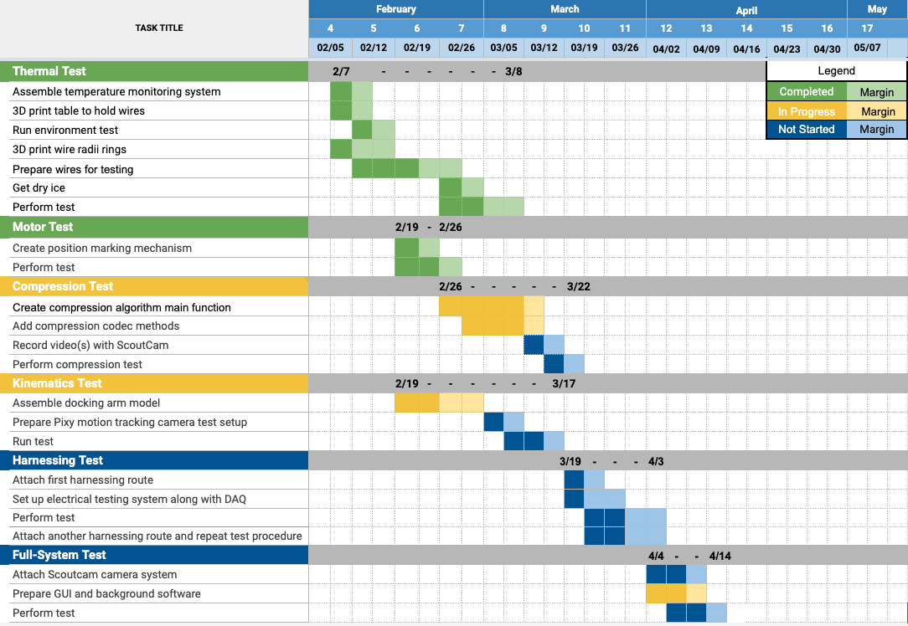
Test Schedule
Completed 2/23
Completed 2/24
3/22
3/17
4/03
4/14
1. Overview
2. Schedule
3. Test Readiness
4. Budget
Notes:
Presenter: Kiley
MAX 3 months stowed

Slide 21
Test Readiness
Notes:
Presenter:

Slide 22
Video Compression Test
Deadline: March 22nd
FR 2 | Shall develop a compression algorithm for video data
DR 2.1 | The decompressed video shall be of sufficient quality as to be viewable
DR 2.2 | The compression algorithm shall drop no more than 5% of frames
Rationale/Motivation:
Determine which compression method is preferable with regards to storage efficiency and speed.
Ensure that the video output is of sufficient frame rate and resolution to be viewable.
Will allow for transmitted video to be used in aiding with docking process.
Prerequisite Tests:
Scoutcam camera functionality validation: Completed
Raspberry Pi functionality validation: Completed
1. Overview
2. Schedule
3. Test Readiness
4. Budget
Notes:
Presenter: Peyton

Slide 23
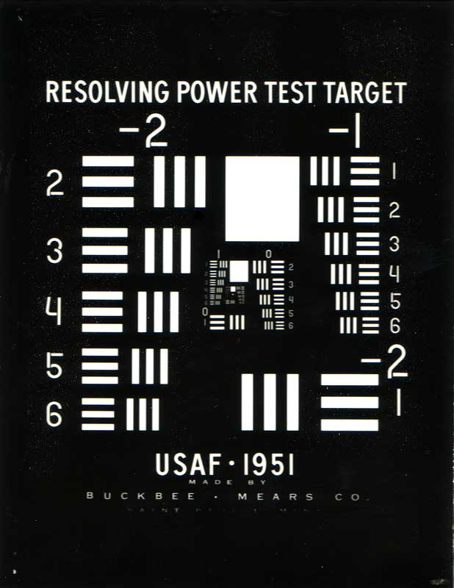
Video Compression Test Model Validation
Risk Reduction:
Testing will reduce likelihood of the camera system producing unusable video by validating the compression process ahead of time.
Validation Method:
Both compressed and uncompressed videos will be saved by the algorithm so decompressed video can be viewed side-by-side with original video.
Track lost frames using watchdog timers.
Test three different lossless compression algorithms.
Image quality scored with USAF resolution test from 1 meter.
1. Overview
2. Schedule
3. Test Readiness
4. Budget
Notes:
Presenter: Peyton

Slide 24
Video Compression Test
Expected Performance:
Not expected to see a large difference between compression algorithms and between compressed/uncompressed file sizes.
Pass/Fail Criteria:
Compression Algorithm drops less than 5% of frames (DR 2.2)
Compressed video passes visual test from USAF resolution test (Y/N) (DR 2.1)
Image from the Scoutcam Camera
1. Overview
2. Schedule
3. Test Readiness
4. Budget
Notes:
Presenter: Peyton

Slide 25
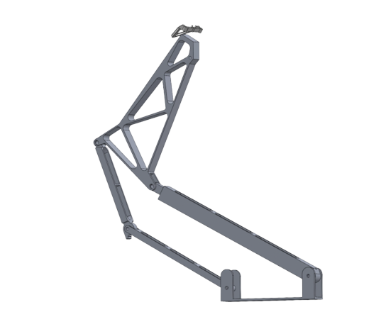
Harnessing Test
Deadline: April 3rd
FR 4 | The harnessing route shall provide power to the camera in deployed position
FR 5 | The harnessing route shall allow for full range of motion of the arm model
Rationale/Motivation:
Find a harnessing route that does not:
Interfere with mobility of the arm
Get damaged by the movement of the arm
Induce any wire bends that exceed the minimum bend radius
Significantly affect electrical capabilities of the wire
1. Overview
2. Schedule
3. Test Readiness
4. Budget
Notes:
Presenter: Mo

Slide 26
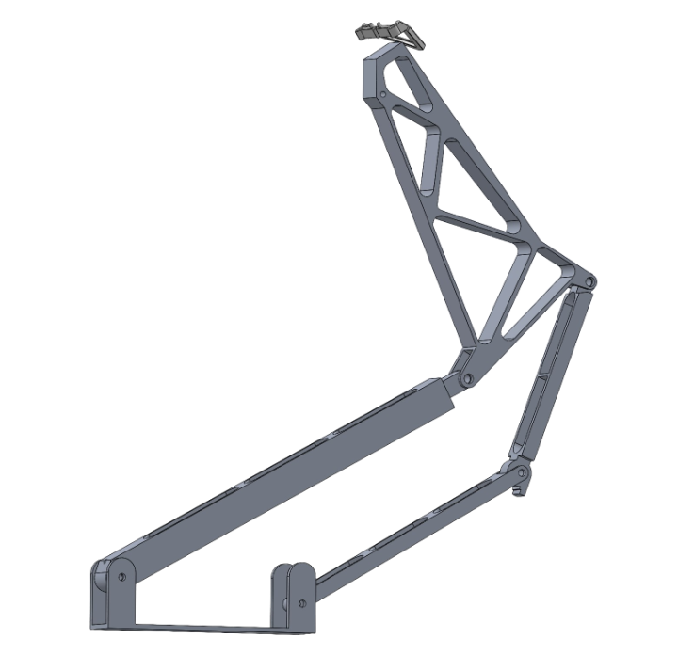
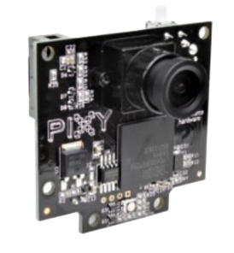
Harnessing Test Prerequisite Tests
Thermal Test: Completed
Learn how cold temperatures affect performance of wires at various bend radii (DR 6.1, 6.2)
Motor Test: Completed
Verified that the motor performs expected movement based on driving code (DR 7.2.1)
Kinematics Test: Not Completed
Verify arm kinematics match the deployment of the actual LEXI arm as close as possible (FR 7, DR 7.2)
Use motion capture to track movement and compare to Solidworks deployment model
Pixy Motion Tracking Camera
1. Overview
2. Schedule
3. Test Readiness
4. Budget
Notes:
Presenter: Mo

Slide 27
Harnessing Test Procedure
Utilize Pixy camera to monitor kinematic motion
Pixy camera connects to arduino with open source code
Attach colored markers to arm joints to be monitored by camera as it deploys
Compare to kinematic test (arm motion without harnessing)
Note any changes
Measure bends throughout deployment
Ensure none surpass the minimum bend radius
R ≥ 30 mm
Measure resistance of a comparable wire when the arm is deployed
1. Overview
2. Schedule
3. Test Readiness
4. Budget
Notes:
Presenter: Mo
MAX 3 months stowed

Slide 28
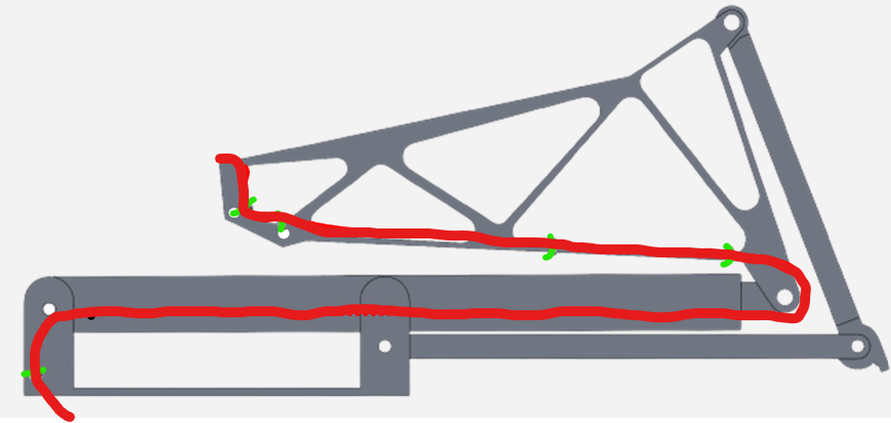
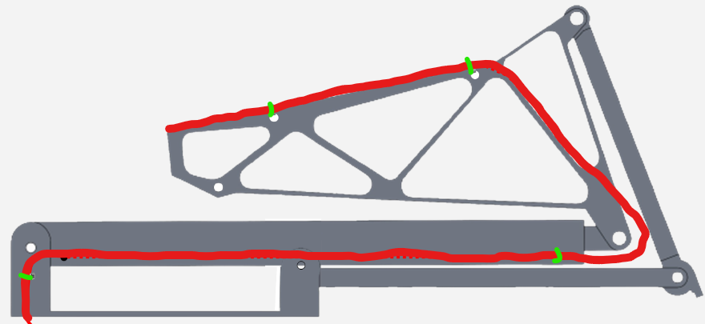
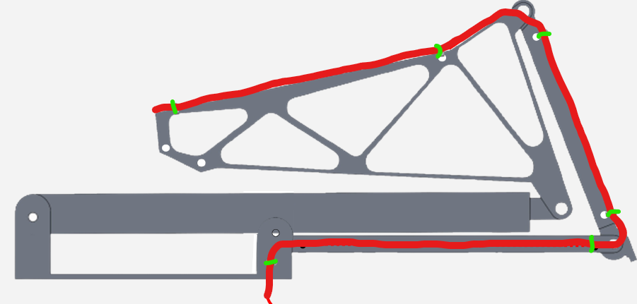
Harnessing Test Procedure
Route 1
Route 2
Route 3
Harnessing Attachment:
Velcro Straps
Cable Bend Limitations: 30mm radius
1. Overview
2. Schedule
3. Test Readiness
4. Budget
Notes:
Presenter: Lucas
Potentially use velcro straps instead

Slide 29
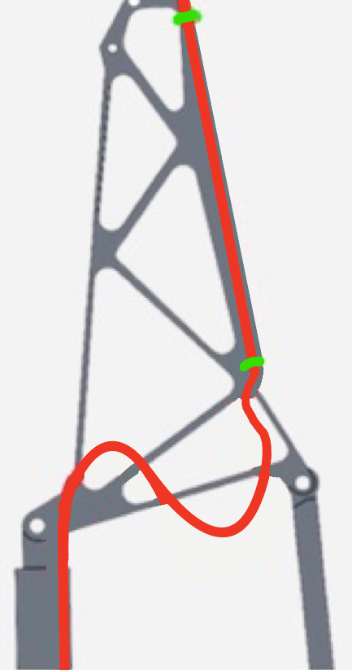
Harnessing Test
Risk Reduction
Reduce risk to breaking the real camera wire
Reduce possibility of harnessing interfering with arm mobility
Model Validation
Validate kinematic motion model
Show that with the harnessing the motion does not change
Expected Performance
Route 3 will maintain a minimum bend radius above 30 mm and leaves enough slack for free motion of the arm
Pass/Fail Criteria
Bend radii at all points of deployment are greater than 30 mm (FR 6)
Does wire get caught in arm joints during deployment? (FR 5)
Bend angles at joints does not differ from model by more than 2º (DR 7.2)
Resistance of wire does not change by more than +/- 5% of original resistance (FR 4)
r ≥ 30 mm
1. Overview
2. Schedule
3. Test Readiness
4. Budget
Notes:
Presenter: Lucas

Slide 30
Full-System “Day in the life” Test
Deadline: April 14th
Mission Obj. 3: Provide a harnessing method that integrates a Scoutcam Camera to one of four LEXI docking arms that does not interfere with docking arm actions
FR 1 | Shall develop a video card solution compatible with a ScoutCam micro camera
FR 4 | The harnessing route shall provide power to the camera in deployed position
Rationale/Motivation
Determine that the docking arm model, with the Scoutcam camera attached and running can survive 3-5 deployments
Prerequisite Tests
All other tests should be completed at this stage
Risk Reduction
This test will allow us to verify our full system such that changes can be made if necessary before expo
1. Overview
2. Schedule
3. Test Readiness
4. Budget
Notes:
Presenter: Mo

Slide 31
Full-System “Day in the life” Test
Validation Method
Arm shall be deployed with actual camera attached 3-5 times with each deployment occurring over 10 minutes
Camera will be run with compression during each deployment
After each iteration camera and compression performance will be assessed
Potential harnessing route for full system test
1. Overview
2. Schedule
3. Test Readiness
4. Budget
Notes:
Presenter: Mo

Slide 32
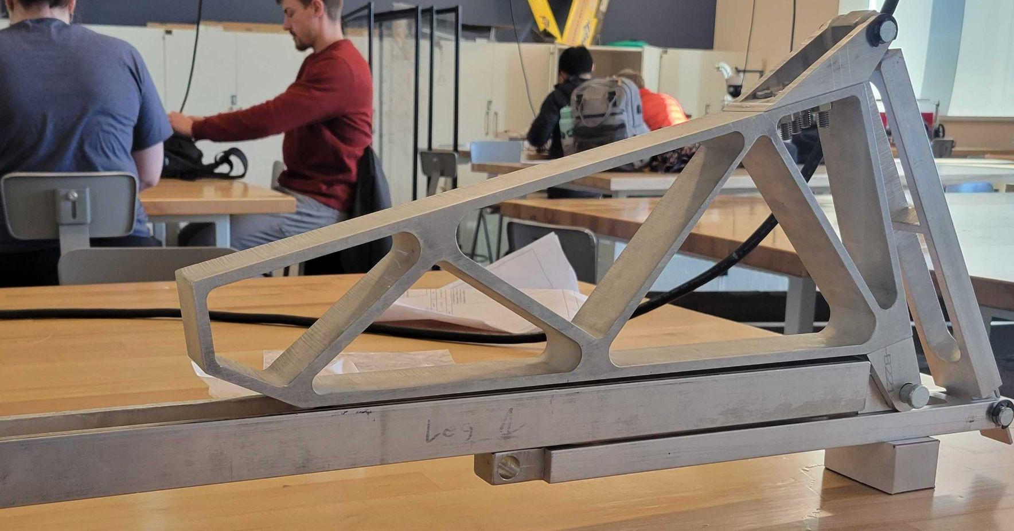
Full-System “Day in the life” Test
Expected Performance
We expect the arm to deploy in a similar manner to the harnessing test
We expect the camera to capture video and run compression in the same way as the compression test
Pass/Fail Criteria
Compressed video drops no more than 5% of frames (DR 2.2)
Camera remains undamaged after at least three tests (Obj. 3)
1. Overview
2. Schedule
3. Test Readiness
4. Budget
Notes:
Presenter: Mo

Slide 33
Budget
Notes:
Presenter:

Slide 34
Purchased and Received Items
Price | Item
$48.99 | Stepper Motor Driver
$44.99 | Stepper Motor
$184.93 | Various fasteners and screws
$903.00 | Water-Jetting
$231.93 | Power Supply
$31.87 | Fasteners and Wooden board
$232.83 | Aluminum Stock
$9.99 | Motor Mounting Bracket
$236.00 | Gearbox
Price | Item
$12.29 | Ethernet and HDMI cables
$12.99 | USB Power Meter
$13.59 | Raspberry Pi Pico
$73.69 | Raspberry Pi 2 Model B
$31.98 | 2 Micro SD Cards
$5.37 | Clear Heat shrink
$16.10 | Dry Ice
Electrical
Mechanical
Testing
Total Spent: $2,698.66
1. Overview
2. Schedule
3. Test Readiness
4. Budget
Notes:
Presenter: Jacob
Additional Planned Expenditures:
Pixy Camera
Raspberry Pi wire harness

Slide 35
Items To Be Purchased
Price | Item
$73.94 | Motion Tracking Camera
$9.82 | Reflective Tape
$11.29 | Velcro Straps
$18.99 | Spool of Wire
Testing
Longest lead time is for motion tracking camera
7-14 business days
All other lead times: 2-4 business days
Estimated Remaining Expenditures: $114.04
Total Budget Remaining: $1,301.34
1. Overview
2. Schedule
3. Test Readiness
4. Budget
Notes:
Presenter: Jacob
Additional Planned Expenditures:
Pixy Camera
Raspberry Pi wire harness

Slide 36
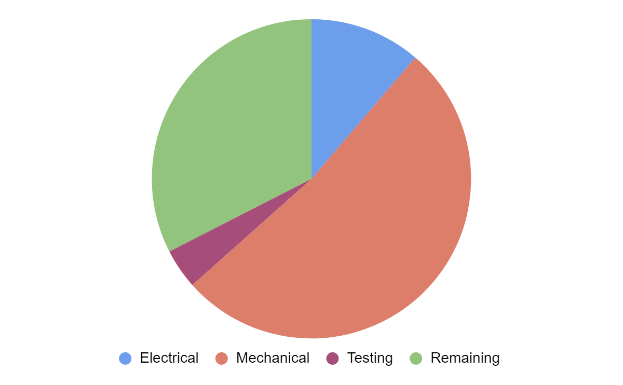
Cost Plan
11.3%
$450.80
32.5%
$1,301.34
52.1%
$2,085.36
4.1%
$162.50
1. Overview
2. Schedule
3. Test Readiness
4. Budget
Notes:
Presenter: Jacob
MAX 3 months stowed

Slide 37
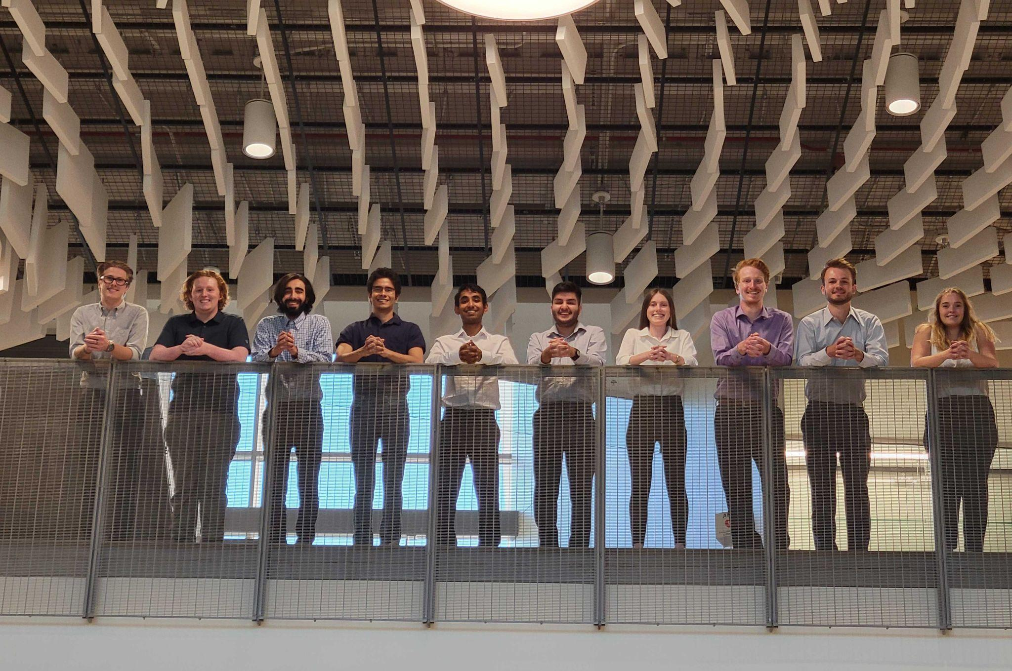
Acknowledgements
Advisors
Dr. Melvin Rafi
Dr. Kathryn Wingate
Dr. Chris Muldrow
CU Professors
Prof. Trudy Schwartz
Prof. Bobby Hodgkinson
Prof. Josh Mellin
Sponsors
Astroscale
Rebeca Griego
Jon Buschur
Teaching Fellows
Andreas Brecl
Jasmin Chadha
Gina Staimer
Notes:
Presenter: Kiley

Slide 38
Questions?

Slide 39
References
[1] Zhang, Huakai & Fritts, Jason. (2004). EBCOT coprocessing architecture for JPEG2000. 10.1117/12.527160.
[2] “Image Compression: How Math Led to the JPEG2000 Standard - JPEG 2000”. Why Do Math.https://www.whydomath.org/node/wavlets/jpeg2000.html
[3] “Image Compression: How Math Led to the JPEG2000 Standard - Wavelet Transformation”. Why Do Math. https://www.whydomath.org/node/wavlets/wavelettransforms.html
[4] Staples, Rob. (2021). “Key Capabilities of our Life Extension In-orbit (LEXI) Servicer”. Astroscale. https://astroscale-us.com/lexi-life-extension-capabilities/
[5] “Scoutcam Starter Kit Probe - 1.8mm”. ScoutCam Data Sheet.
Notes:
Presenter:

Slide 40
Backup Slides

Slide 41
Functional Requirements
Identifier | Functional Requirement
FR 1 | Shall develop a video card solution compatible with a ScoutCam micro camera
FR 2 | Shall develop a compression algorithm for video data
FR 3 | The radiation hardened video card recommendation shall operate at a geostationary orbit (GEO)
FR 4 | The harnessing route shall provide power to the camera in deployed position
FR 5 | The harnessing route shall allow for full range of motion of the arm model
FR 6 | The harnessing shall withstand three months in fully stowed position
FR 7 | The docking arm model shall replicate one of the LEXI vehicle’s docking arms
1. Overview
2. Schedule
3. Test Readiness
4. Budget
Notes:
Presenter: Kiley
MAX 3 months stowed

Slide 42
Raspberry Pi Main/GUI Thread
Pi 2 Power Loop
GUI (Main Loop)
Transmit Flag Logic
Language Used: Python
Notes:
Presenter:

Slide 43
Compression Test Design
Frame Saving
Compression
Transmission
Notes:
Presenter:

Slide 44
Laptop OBC Simulation
Ground Station
Notes:
Presenter:

Slide 45
Thermal Survivability Verification
Purpose
Docking arms stored in closed position for 2 months before initial deployment
Determine how cold temperature affects the brittleness and power capabilities of cables
Guiding Requirements
DR 6.1: Harnessing needs to withstand temperatures from -65ºC to 130ºC
DR 6.2: The bend radius shall be no smaller than 30 mm
Plan
Conduct testing on samples of the camera wire
Vary bend radii
Use dry ice to reach cold temperatures
Hold temperature environment for 4-6 hours
Use thermocouples to observe temperature hold
Pass Criteria
P/F: Wire does not break
The resistance of the wire is within 5% of original measurement
Limitations
Cannot control external temperature
Cannot conduct thermal cycles
Only testing lower end of temp range
Restricted by temperature of dry ice
Cannot conduct accelerated life test
Instead observing initial effect of cold temperature on wires
Sample wire does not include fiber optics portion of camera wire
Notes:
Presenter: Mason
During the mission, the docking arms and its attached harnessing will be in a stowed position for at least 2 months
We will be testing if the extreme cold temperatures at GEO orbit combined with a bent harness will impact the functionality of the wire itself.
For the test, we will vary the bend radius of the wire samples from a 30 mm minimum pre-determined by Scoutcam to a 100 mm maximum
The camera’s manufacturer had provided samples of the camera wire, which is identical to the camera wire we will actually be using.
We will then place the samples in a chilled environment chilled by dry ice for up to 24 hours. This duration may vary depending on the results of an environment test in which we will determine the length of time we can successfully hold the desired temperatures
Throughout the test we will monitor the temperature using a sub-zero thermometer.
Upon completion, we will remove each wire, and while still cold unbend them and test if they can still provide power and are not broken.
Note that we cannot simulate 2 months of chilled temperatures, so we are only able to conduct the first step which is a survivability test.

Slide 46
Kinematic Motion Verification
Purpose
Replicating kinematic motion is necessary to test the wire harnessing
Ensure motor will deploy arm at constant rate over many iterations
Guiding Requirement
DR 7.2: The docking arm model shall replicate kinematic motion of LEXI’s docking arm
Plan
Use Pixy motion capture camera to film deployment repeated times
Measure joint angles of docking arm model using Pixy Camera and included software
Compare tests to CAD motion analysis
Pass Criteria
Bend angles at joints does not differ from model by more than 2º
Prerequisite Component Test
Motor Test:
Ensure the motor runs as expected
Notes:
Presenter: Mo
Notes
Points that I will talk about:
State the purpose of the kinematic motion verification: replicate LEXI’s docking arm and make sure that motor setting will deploy arm in constant rate.
Talk about our plan to do this verification: use motion capture, measure joint angles, and compare test to make sure that the motion is the same throughout.
State the guiding requirement for this verification: Functional requirement 7.
Finally, state the pass criteria: average angle error between computer model and actual deployment is < 5%

