Slide 1
DAISy Cam
(Docking Arm Integration System for Scoutcam Camera)
Critical Design Review
December 5, 2022
ASEN 4018 - Team 19
Company Sponsor
Astroscale
Faculty Advisor
Dr. Melvin Rafi
Presenters
Mohammed Alnasser, Sam Barrette, Kiley Beckwith,
Abby Durell, Peyton Early, and Mason Lemler
Notes:
Presenter:

Slide 2
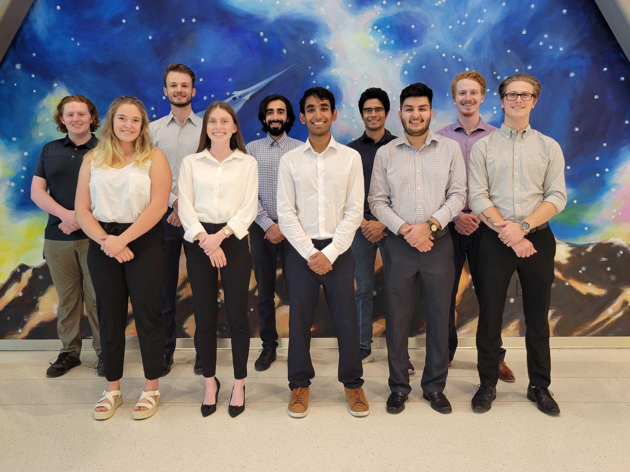
The Team
Front Row (left-to-right)
Abby Durell
(Mechanical Lead)
Kiley Beckwith
(Project Manager)
Ketan Kamat
(Electrical Lead)
Jacob Moncada
(Electrical Sub/CFO)
Peyton Early
(Software Lead)
Back Row (left-to-right)
Lucas House
(Manufacturing Lead)
Mason Lemler
(Electrical Lead)
Mohammed Alnasser
(Testing Lead)
Nate Sanchez
(Mechanical Sub)
Samuel Barrette
(Systems Engineer)
Notes:
Presenter: Each introduce themselves
Rafi’s feedback: Add who is doing what

Slide 3
Presentation Outline
Project Overview
Design Solution
Critical Project Elements
Risks
Design Requirement Satisfaction
Verification and Validation
Project Planning
Notes:
Presenter:

Slide 4
Project Overview
Notes:
Presenter:

Slide 5
Project Definition
DAISy Cam will integrate a Scoutcam micro-camera into a model of one of LEXI vehicle’s four docking arms, and develop a video card solution to support multiple cameras to assist LEXI in its final stages of docking with a client satellite.
1. Overview
2. Design Solution
3. CPEs
4. DR Satisfaction
5. Risks
6. V&V
7. Project Planning
Notes:
Presenter: Kiley
MENTION ASTROSCALE

Slide 6
Mission Objectives
Objective | Description
Video Data | Ensure correct video data is received and the system is capable of video compression
Radiation Hardened Video Card | Provide information about a solution for a radiation hardened video card that can withstand the temperature and radiation hazards of a geostationary orbit (GEO)
Camera System Harnessing | Provide a harnessing method that does not interfere with docking arm actions to integrate Scoutcam Camera to one of four LEXI docking arms
Docking Arm Model | Develop a model of the LEXI docking arm that replicates its kinematic motion in order to test harnessing system of integrated Scoutcam camera
1. Overview
2. Design Solution
3. CPEs
4. DR Satisfaction
5. Risks
6. V&V
7. Project Planning
Notes:
Presenter: Kiley

Slide 7
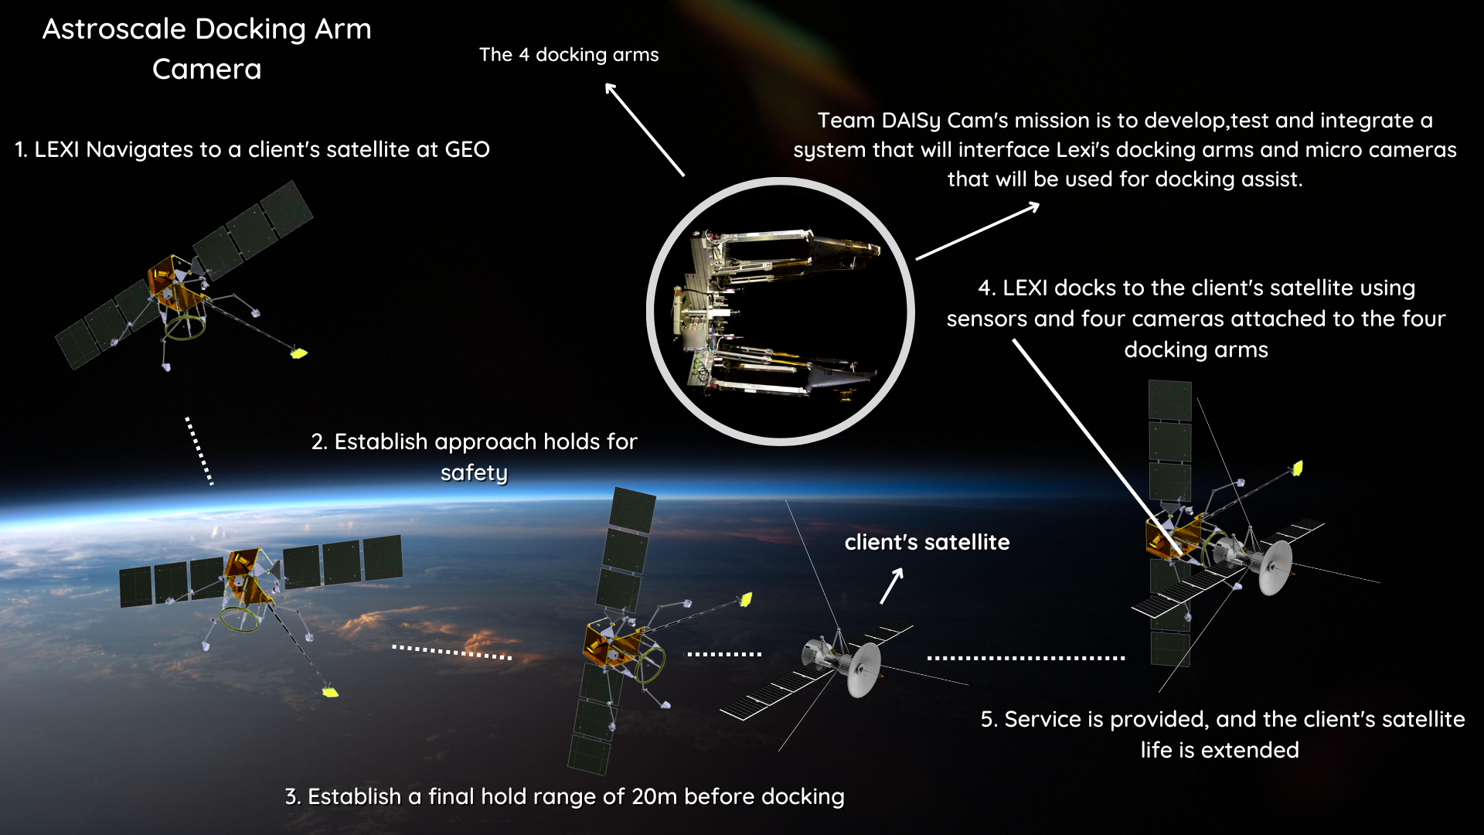
High Level ConOps
1. Overview
2. Design Solution
3. CPEs
4. DR Satisfaction
5. Risks
6. V&V
7. Project Planning
Notes:
Presenter: Kiley
(Say what LEXI stands for)

Slide 8
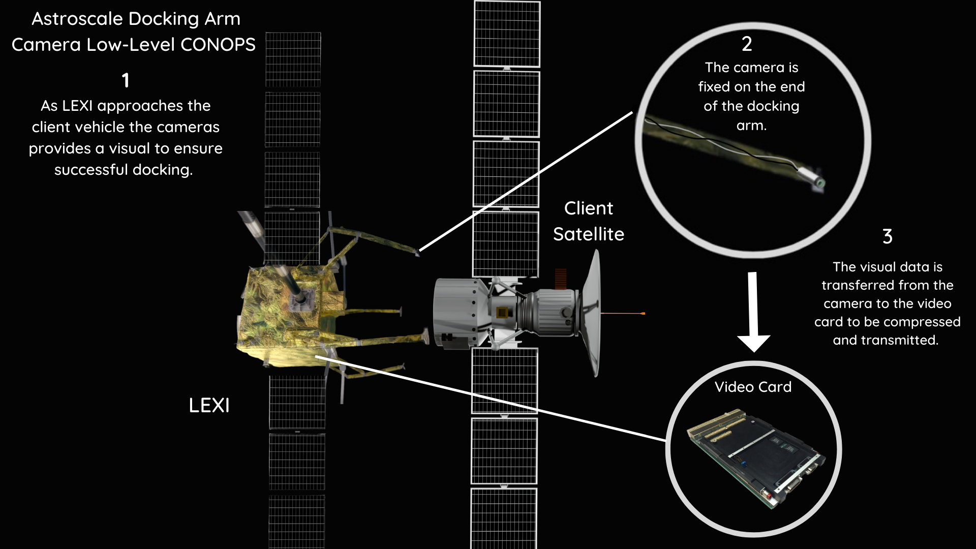
Low Level ConOps
1. Overview
2. Design Solution
3. CPEs
4. DR Satisfaction
5. Risks
6. V&V
7. Project Planning
Notes:
Presenter: Kiley

Slide 9
Functional Requirements
Identifier | Functional Requirement
FR 1 | Shall develop a video card solution compatible with a ScoutCam micro camera
FR 2 | Shall develop a compression algorithm for video data
FR 3 | The radiation hardened video card recommendation shall operate at a geostationary orbit (GEO)
FR 4 | The harnessing route shall provide power to the camera in deployed position
FR 5 | The harnessing route shall allow for full range of motion of the arm model
FR 6 | The harnessing shall withstand three months in fully stowed position
FR 7 | The docking arm model shall replicate one of the LEXI vehicle’s docking arms
1. Overview
2. Design Solution
3. CPEs
4. DR Satisfaction
5. Risks
6. V&V
7. Project Planning
Notes:
Presenter: Kiley

Slide 10
Design Solution
Notes:
Presenter:
This section outlines what our design is, and how it works. Not why we chose what we did.

Slide 11
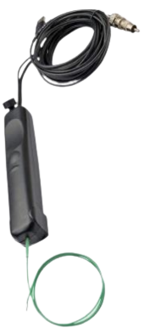
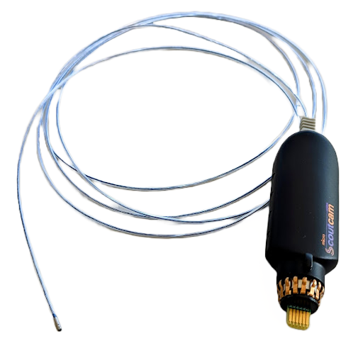
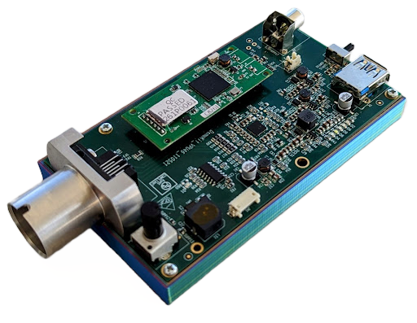
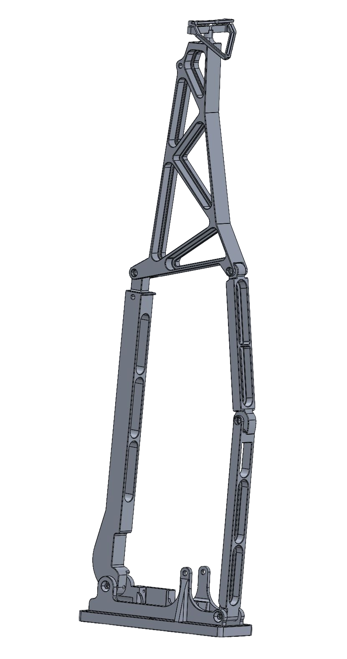
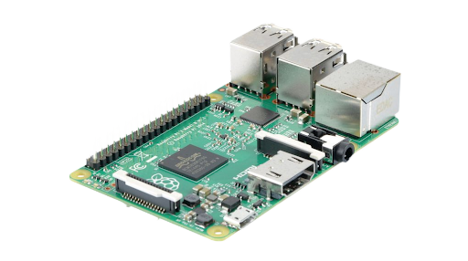
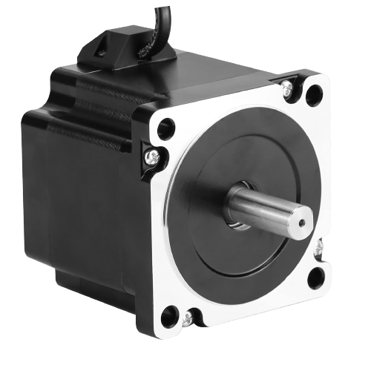
Project Components
ScoutCam Camera
ScoutCam VPU
Docking Arm Model
Camera Head
Location
Arm Hook
Truss
Leg 2b
Nema 34 Stepper Motor 14mm
Raspberry Pi 2
1.15 m
Leg 1
Leg 2a
Motor Connection
Base
1. Overview
2. Design Solution
3. CPEs
4. DR Satisfaction
5. Risks
6. V&V
7. Project Planning
Notes:
Presenter: Sam

Slide 12
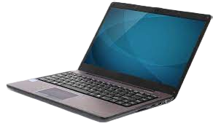
Functional Block Diagram
1. Overview
2. Design Solution
3. CPEs
4. DR Satisfaction
5. Risks
6. V&V
7. Project Planning
Notes:
Presenter:

Slide 13
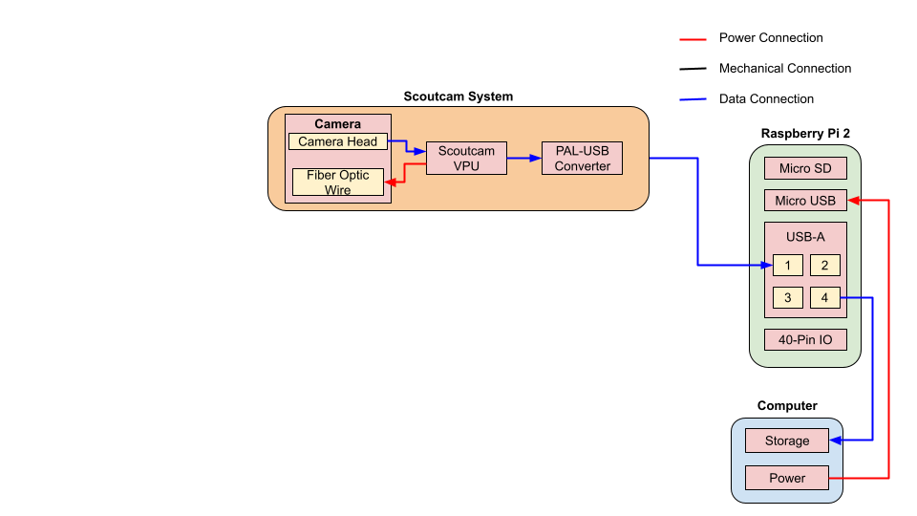
Functional Block Diagram
1. Overview
2. Design Solution
3. CPEs
4. DR Satisfaction
5. Risks
6. V&V
7. Project Planning
Notes:
Presenter:

Slide 14
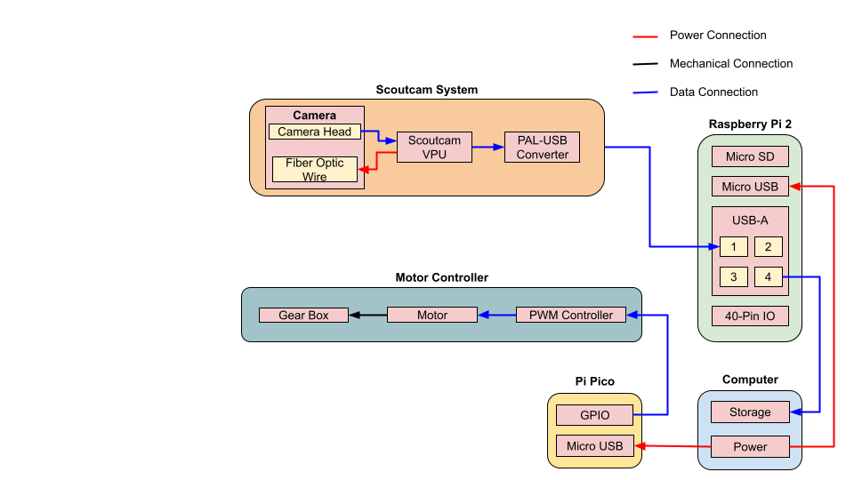
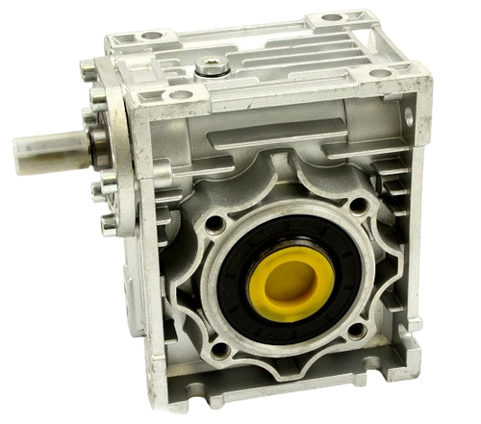
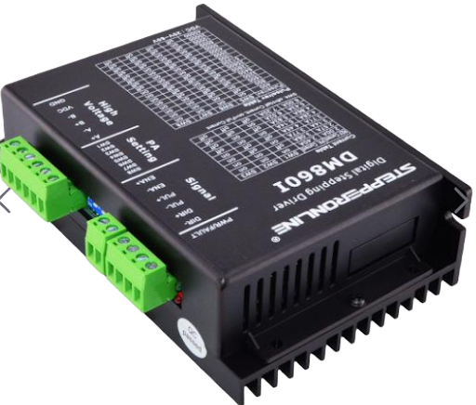
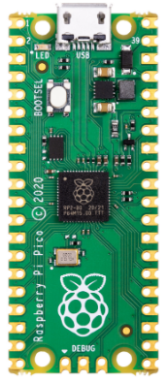
Functional Block Diagram
1. Overview
2. Design Solution
3. CPEs
4. DR Satisfaction
5. Risks
6. V&V
7. Project Planning
Notes:
Presenter:

Slide 15
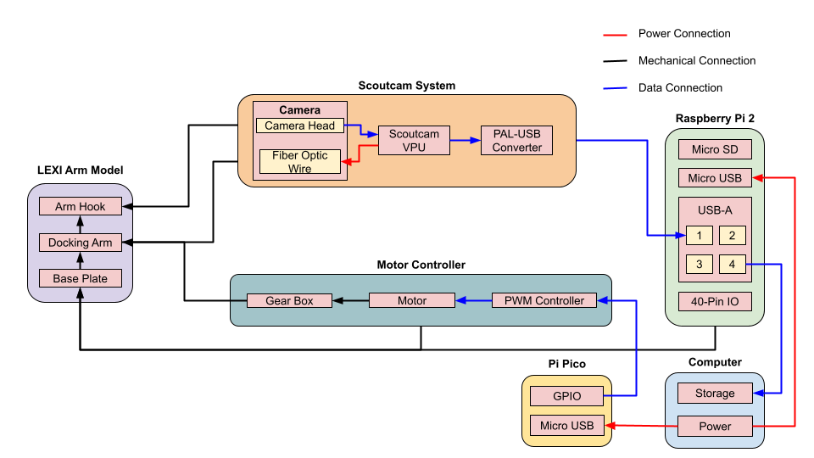
Functional Block Diagram
1. Overview
2. Design Solution
3. CPEs
4. DR Satisfaction
5. Risks
6. V&V
7. Project Planning
Notes:
Presenter:

Slide 16
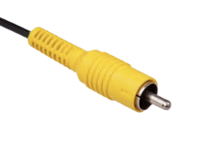
ScoutCam Micro-Camera Specs
Voltage | 2.1 V
Current Draw | 5 A
Power Draw | 10.5 W
Resolution | 160 kpx
Frame Rate | 30 fps
Camera Head Length | 6.0 mm
Camera Head Diameter | 1.8 mm
Cable Length | 2.0 m
Output | PAL composite video
Operating Temp Range | -20C to 70C
* Penny for scale
1. Overview
2. Design Solution
3. CPEs
4. DR Satisfaction
5. Risks
6. V&V
7. Project Planning
Notes:
Speaker: Mason
EMPHASIZE THAT WE DID NOT CHOOSE THIS CAMERA IT WAS GIVEN TO US BY ASTROSCALE
On the right you can see key specs of the provided ScoutCam Micro-Camera, which is on LEXI’s docking arm
Some key specs that are important to our designs
10.5 W power draw
Diameter of 1.8 mm
Frame rate of 30 fps, resolution of 160 kpx, around 360 p
Output is a PAL composite video

Slide 17
Practical Video Card Solution
Raspberry Pi 2 B
Power draw: 10 W
Voltage: 5 V
Current: 2 A
Connections: USB,Ethernet,HDMI
ScoutCam system
Power draw: 10.5 W
Voltage: 5 V
Current: 2.1 A
Connections: proprietary USB,USB,HDMI
Video Card System Power Constraint
Power Budget: 68 W
Consumed Power: 20.5 W
f_{s} = 3.2
Raspberry Pi 2 B
ScoutCam PCB
1. Overview
2. Design Solution
3. CPEs
4. DR Satisfaction
5. Risks
6. V&V
7. Project Planning
Notes:
Speaker: Mason

Slide 18
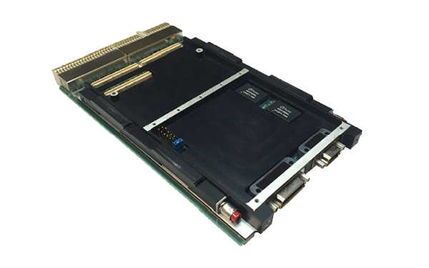
Rad-Hard Video Card Solution
MPC8548E
ARM Cortex-A7
AiTech SP0-S
Radiation hardened for GEO Orbit
Power: <12.5 W
Weight: 350 g
Dimensions: Standard 3U cPCI Slot
Slot: 100 x 160 x 1.6 mm
Constraints: 254 x 165.1 x 27.94 mm
CPU: MPC8548E PowerQUICC®III
FPGA: Rad-tolerant Actel RTAX
3 Async Serial RS422 Ports
Typical Speed [MHz] | 1333 | 900
MIPS / MHz | 2.299 | 1.9
MIPS | 3065 | 1710
1. Overview
2. Design Solution
3. CPEs
4. DR Satisfaction
5. Risks
6. V&V
7. Project Planning
Notes:
Speaker: Mason

Slide 19
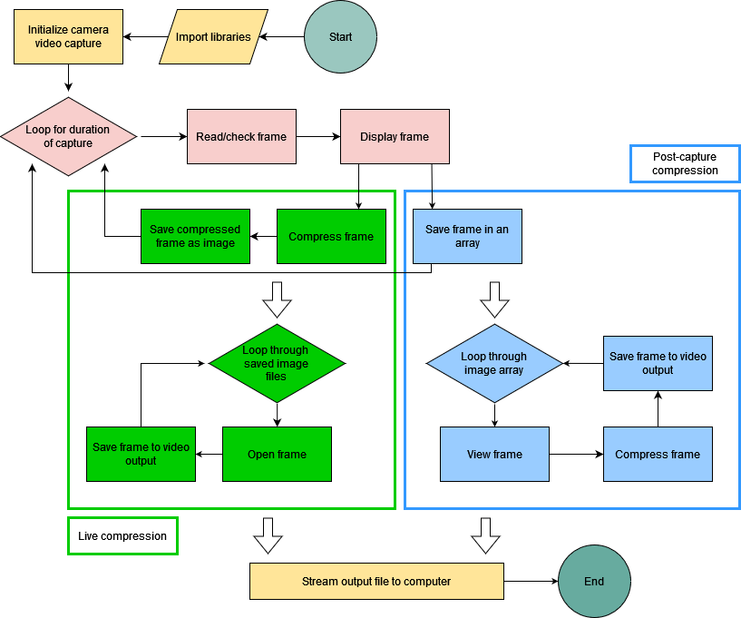
Software Solution
Based in Python and Raspberry Pi OS
Lossless compression format(s)
JPEG2000
Testing for functionality and performance, not trying to deliver optimal solution
Image clarity
Dropped frames
Algorithm runtime
Buffer overhead and storage needs
Power consumption
1. Overview
2. Design Solution
3. CPEs
4. DR Satisfaction
5. Risks
6. V&V
7. Project Planning
Notes:
Speaker: Peyton
Our software solution will run off of the Raspberry Pi OS and will be written with Python. We are focusing on lossless compression formats, notably the JPEG2000 standard format, which was specifically requested by Astroscale. Lossless compression provides more accurate video when uncompressed, making it more desirable than lossy compression. It is important to note that our software solution will actually be a range of compression techniques and algorithm structures in order to fully test the capabilities of the camera system, rather than providing a single solution.
On the right is a high-level overview of our software functional block diagram. You’ll notice the green and blue boxes, which represent the different algorithm methods: green being live compression of each frame as it is read, and blue being the storage of frames for compression after the video capture has ended. Moving from top to bottom, the general structure of the algorithm is consistent, starting with video initialization and moving to the reading of each video frame until the video capture ends. Next is the reconstruction of the compressed video from the captured frames. This reconstructed video is then sent to the on-board computer for storage.

Slide 20
Docking Arm Model
Material | 6061 Aluminum
Size | 1.15 m tall
Deployment Time | 45 seconds
FR 7 | The docking arm model shall replicate one of the LEXI vehicle’s docking arms
DR 7.1 | Full scale replica
1. Overview
2. Design Solution
3. CPEs
4. DR Satisfaction
5. Risks
6. V&V
7. Project Planning
Notes:
Speaker: Abby
Discuss full scale
6061 Aluminum
Deploys over 45 seconds rather than 10 minutes
Waterjeting main components
Replicates motion and geometry

Slide 21
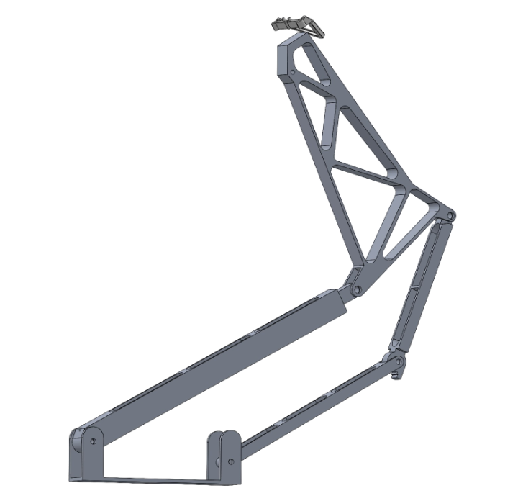
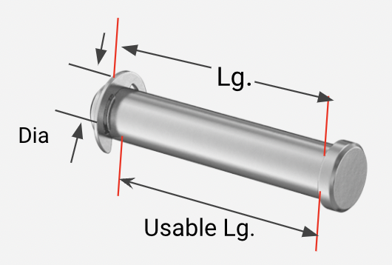
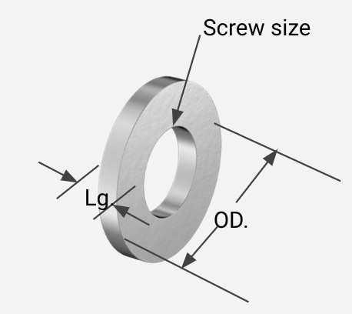
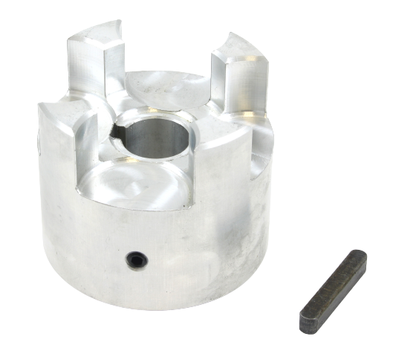
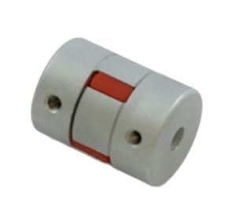
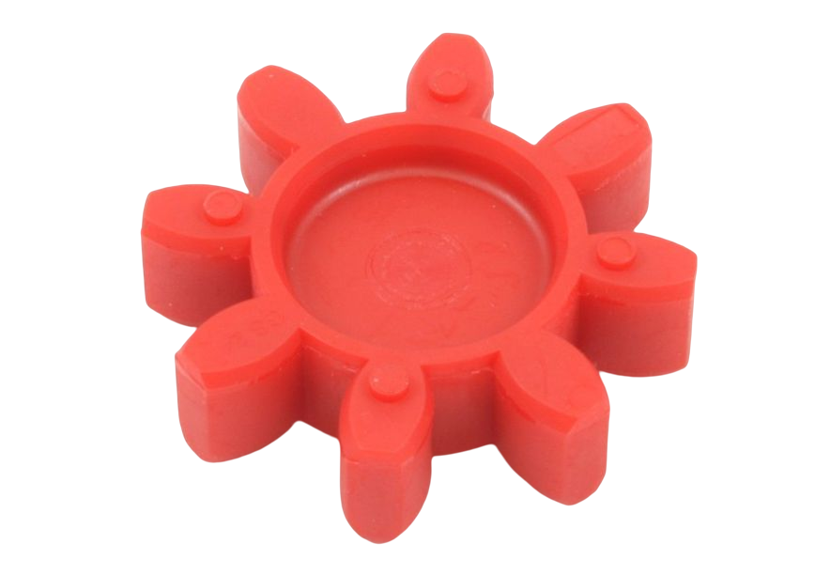
Docking Arm Model Connections
Steel Retaining Pins:
1004-1045 Carbon Steel
3 at Pins A : 2.5’’ x 0.5” (Usable Lg x Dia)
1 at Pin B : 2.0’’ x 0.5” (Usable Lg x Dia)
Aluminum spacers:
6 Joint spacers A: 3/32” x 0.5” ( Lg x Screw size)
2 Joint spacers B: 0.125” x 0.5”( Lg x Screw size)
Jaw couplings series 24, 14mm:
Aluminum
Uses jaw coupling spider series 24
To connect two jaw couplings in series
Pins A
Pin B
Motor connection
1. Overview
2. Design Solution
3. CPEs
4. DR Satisfaction
5. Risks
6. V&V
7. Project Planning
Notes:
Speaker: Mo

Slide 22
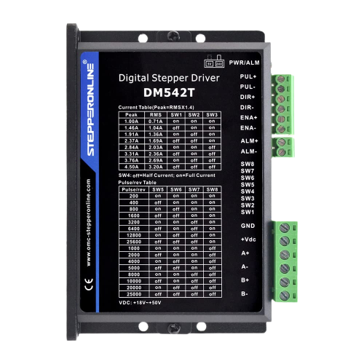
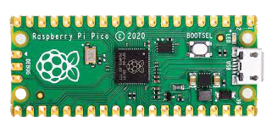
Docking Arm Model:
Raspberry Pi Pico RP 2040:
5 V, 93 mA, 0.465 W
Nema 34 Stepper Motor 14mm:
4.8N-m Holding torque
30-60v 6A
Nema 34 Stepper Motor CNC Drive
Controlled Through Pico
Worm Gearbox 50 Series 30:1
Max Torque 85 N-m
25mm and 14mm keyed shafts
5 ⅝”
3 ⅜”
5 ¼”
1. Overview
2. Design Solution
3. CPEs
4. DR Satisfaction
5. Risks
6. V&V
7. Project Planning
Notes:
Speaker: Mo

Slide 23
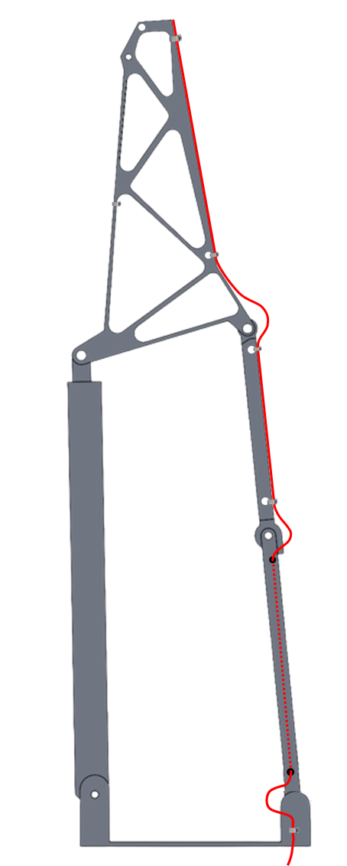
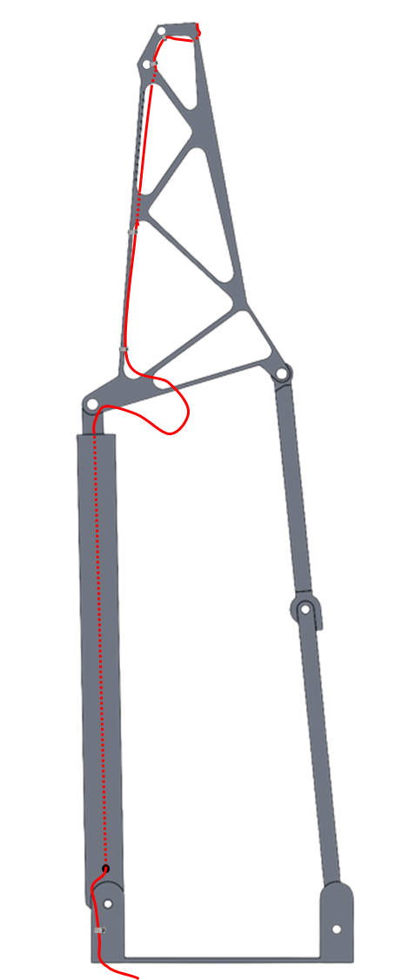
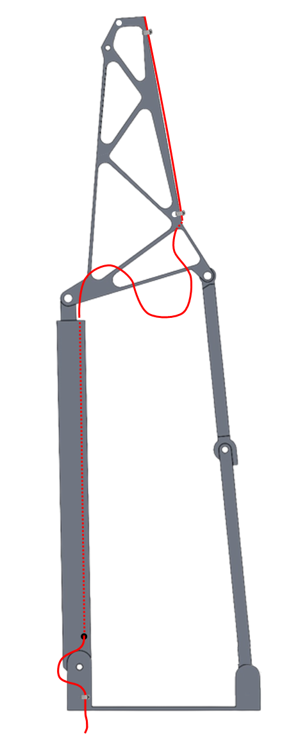
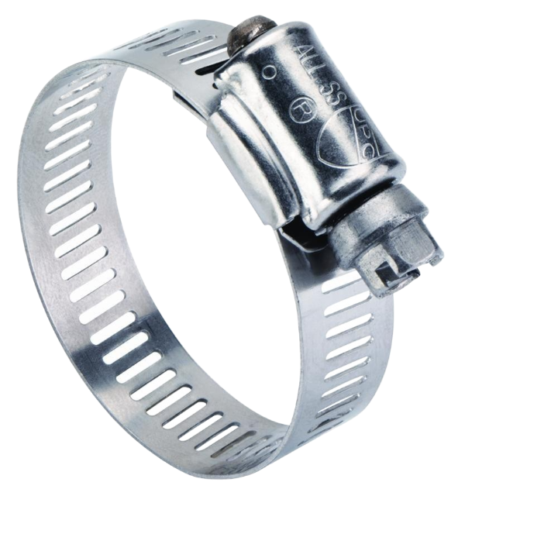
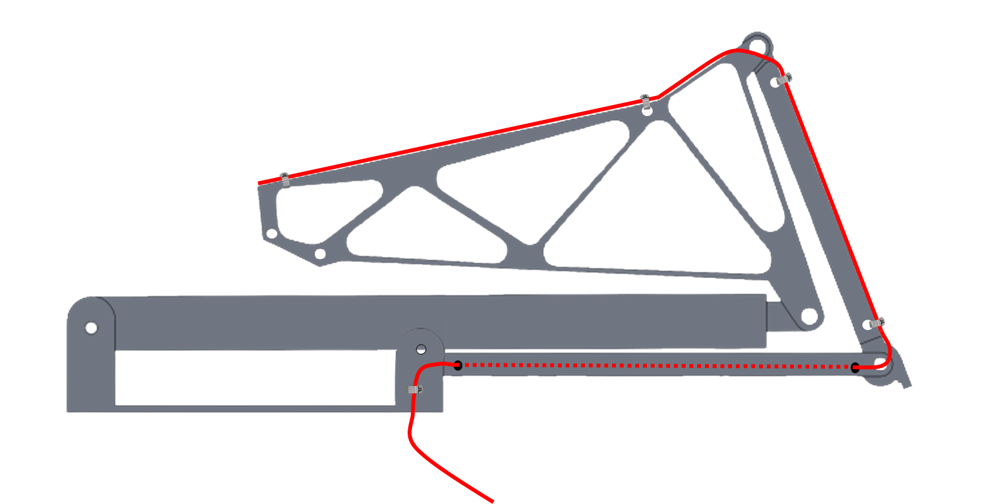
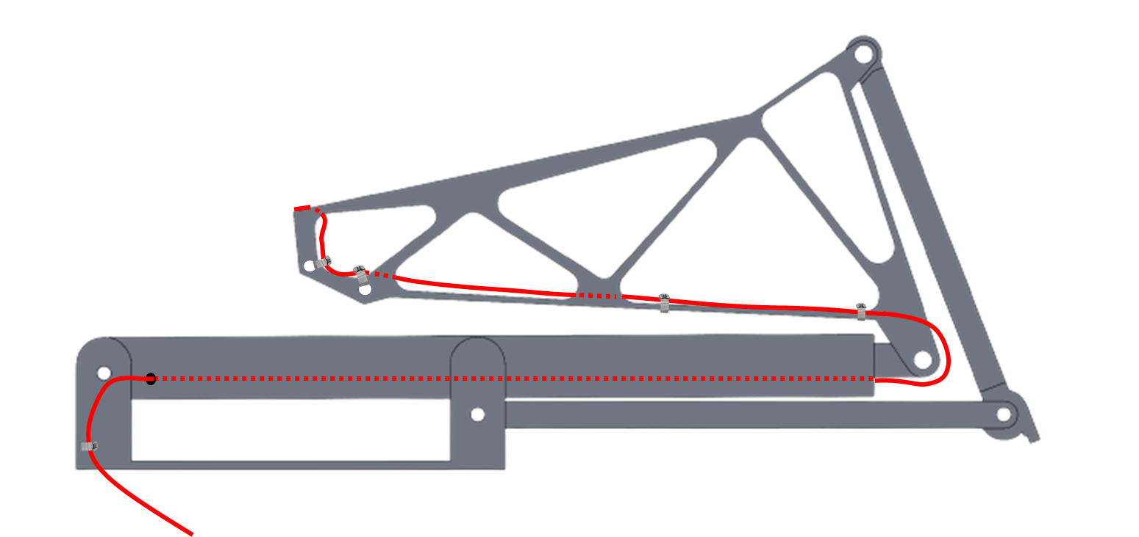
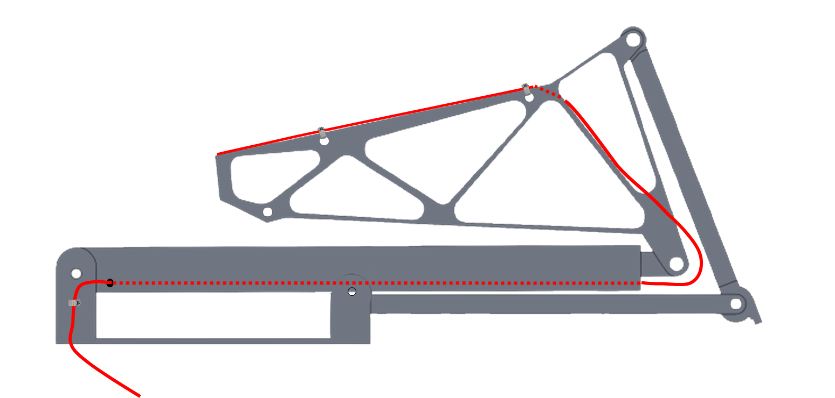
Scoutcam Harnessing Layout
Route 1
Route 2
Route 3
Harnessing Attachment:
Hose Clamp
Stainless Steel
8-44 mm dia
Cable Bend Limitations: 30mm radius
1. Overview
2. Design Solution
3. CPEs
4. DR Satisfaction
5. Risks
6. V&V
7. Project Planning
Notes:
Presenter: Abby
Here are three potential harnessing routes our team has discussed. As previously mentioned, the camera cable is 2 meters and the model stands 1.15 meters tall when fully deployed, which leaves us with 0.85 meters of extra slack to work with, and so the extra slack depicted here is not necessarily the exact amount that would be leftover when fully deployed. The dashed line in each of the diagrams indicates the cable tunneling through the leg rather than being attached externally. The team plans to drill holes through the truss in order to keep the cable in the correct path, and use Kapton tape as padding and hose clamps to secure the wire from translating during deployment and stowage.
We are leaning towards route three because it has the largest bend radius with the minimum number of joints. Route 1 has the largest bend radius for each required bend, however, it would need the cable to wrap around two joints, introducing more locations of pinching and wear-and-tear.

Slide 24
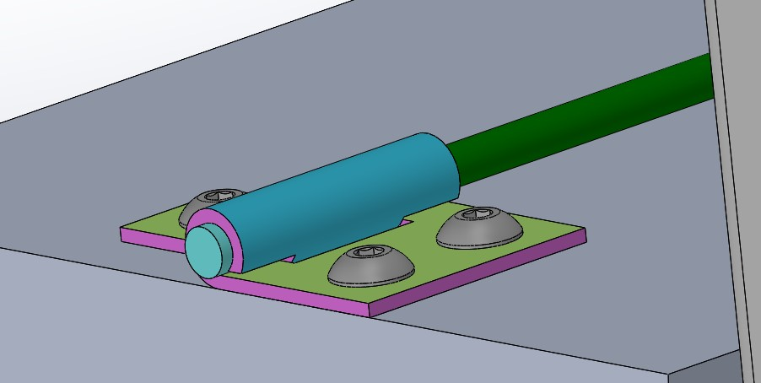
Scoutcam - LEXI Model Interface
Truss
Camera
Interface
1. Overview
2. Design Solution
3. CPEs
4. DR Satisfaction
5. Risks
6. V&V
7. Project Planning
Notes:
Abby

Slide 25
Critical Project Elements
Notes:
Presenter:

Slide 26
Critical Project Elements
Identifier | Critical Project Element | Related FR
CPE 1 | Practical video card receives viewable image | FR 1
CPE 2 | The compression algorithm functions properly | FR 2
CPE 3 | Radiation hardened video card can operate in GEO under radiation and thermal loads | FR 3
CPE 4 | Harnessing does not restrict arm mobility | FR 5
CPE 5 | Camera receives power after initial stowage of harnessing | FR 4, 6
CPE 6 | Docking arm model replicates motion of one of LEXI’s docking arms | FR 7
1. Overview
2. Design Solution
3. CPEs
4. DR Satisfaction
5. Risks
6. V&V
7. Project Planning
Notes:
Speaker:
On the right you can see key specs of the provided ScoutCam Micro-Camera, which is on LEXI’s docking arm
Some key specs that are important to our designs
10.5 W power draw
Diameter of 1.8 mm
Frame rate of 30 fps, resolution of 160 kpx, around 360 p
Output is a PAL composite video

Slide 27
Risks
Notes:
Presenter:

Slide 28
Risk Breakdown
Risk | Description
R1 | Camera wire fatigues at joints and breaks in mobility testing
R2 | Harnessing solution interferes with arm mobility
R3 | Provided camera PCB breaks
R4 | Camera mounting location interferes with the range of motion of LEXI’s hand
R5 | Motor cannot extend arm at the desired rate
R6 | Manufacturing error leads to need to re-manufacture model part
1. Overview
2. Design Solution
3. CPEs
4.Risks
5. DR Satisfaction
6. V&V
7. Project Planning
Notes:
Presenter:

Slide 29
Risk Matrix
Very Likely
Likely
Possible |  |  |  | R6 | R1
Unlikely |  |  |  |  | R2, R3
Very Unlikely |  |  |  |  | R4, R5
 | Negligible | Minor | Moderate | Significant | Severe
Risk | Description
R1 | Harnessing solution interferes with arm mobility
R2 | Camera wire fatigues at joints and breaks in mobility testing
R3 | Provided camera PCB breaks
Probability
Impact/Consequence
Risk Level
Acceptable | Watch | Unacceptable
1. Overview
2. Design Solution
3. CPEs
4.Risks
5. DR Satisfaction
6. V&V
7. Project Planning
Notes:
Presenter:

Slide 30
Mitigated Risk Matrix
Risk | Mitigation Strategy
R1 | Conduct thermal accelerated life testing on comparable wire in spring semester to determine thermal capabilities of camera wire
R2 | Conduct mobility testing on multiple harnessing paths using string or comparable wire
R3 | Create structure around PCB to protect it from damage
Very Likely
Likely
Possible |  |  |  | R6 | R1
Unlikely |  |  | R6 |  | R1 R2,R3
Very Unlikely |  |  |  |  | R2.R3, R4, R5
 | Negligible | Minor | Moderate | Significant | Severe
Probability
Impact/Consequence
Risk Level
Acceptable | Watch | Unacceptable
1. Overview
2. Design Solution
3. CPEs
4.Risks
5. DR Satisfaction
6. V&V
7. Project Planning
Notes:
Presenter:

Slide 31
Design Requirement
Satisfaction
Notes:
Presenter:
This section outlines WHY we chose what we did and how it meets our requirements

Slide 32
Scoutcam System:
DR 1.1 | The practical video card shall support at least one (1) Scoutcam camera | CPE 4
Number of clock cycles | 2,100,000
Image size [px] | 128 x 128
Clock cycles per pixel | 128.1738
Image size [px] | 400 x 400
Cycles per image | 20,507,812.5
Cycles per second [MHz] | 615.2344
Data per frame [B] | 480,000
Data per hour [GB] | 51.84
Compressed data per hour [GB] | 15.552
Research Paper
Processing Estimates
Storage Estimates
DRs Satisfied | Yes
1. Overview
2. Design Solution
3. CPEs
4.Risks
5. DR Satisfaction
6. V&V
7. Project Planning
Notes:
Speaker: Peyton
To verify that our hardware solution will be powerful enough to handle the incoming video and satisfy design requirement 1.1, a model was made based on a research paper that measured the performance of the JPEG2000 compression algorithm. Using the total number of clock cycles and the image resolution from the research paper (top section), an average value of clock cycles per pixel was calculated and applied to our video solution (middle section). We determined that for a single frame the algorithm would need approximately 20.5 million cycles, and when run at 30 frames per second would translate to 615 million cycles per second, approximately 2/3 of the processing power of our selected Raspberry Pi solution.
Also calculated in the model was the predicted storage requirement of the solution, as well as the predicted compressed storage requirement at a compression ratio of 30%. These values will referred to during testing as a form of validation for our solution.

Slide 33
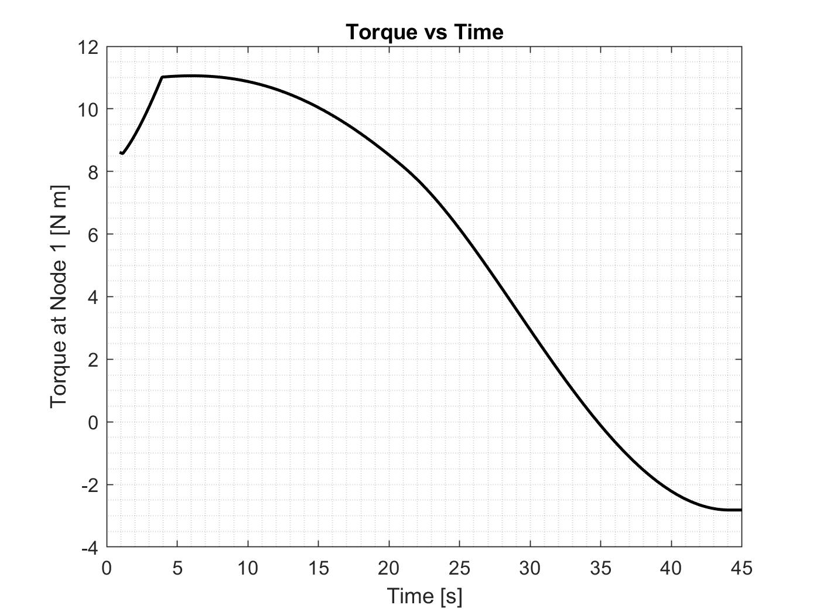
Docking Arm Model - Torque Analysis
DR 7.2 | The docking arm model shall replicate the kinematic motion of LEXI’s docking arm | CPE 6
DR 7.2.1 | The docking arm model shall deploy in less than 1 minute | CPE 6
i = seconds
j = part #
Max torque: 11.06 N m
DRs Satisfied | Yes
1. Overview
2. Design Solution
3. CPEs
4.Risks
5. DR Satisfaction
6. V&V
7. Project Planning
Notes:
Speaker: Abby
In order to accurately determine the torque required by the motor to open and hold the LEXI arm replica, we conducted a solidworks motion analysis using specified geometry and material properties in order to calculate the location of each component’s COG. For simplification purposes, we assumed that the moment the motor would feel is based on center of gravity location rather than the joint locations. It is important to note that this model does not incorporate the mass of the harnessing, but because the components we are working with are so small, it was determined that those masses are negligible compared to the masses of each component of the arm.

Slide 34
Verification and Validation
Notes:
Presenter:

Slide 35
Thermal Survivability Verification
Purpose
Docking arms stored in closed position for 2 months before initial deployment
Determine how cold temperature affects the brittleness and power capabilities of cables
Guiding Requirements
DR 6.1: Harnessing needs to withstand temperatures from -65ºC to 130ºC
DR 6.2: The bend radius shall be no smaller than 30 mm
Plan
Conduct testing on samples of the camera wire
Vary bend radii
Use dry ice to reach cold temperatures
Hold temperature environment for up to 24 hours
Use sensors to observe temperature hold
Pass Criteria
P/F: Wire does not break
P/F: Wire can still provide power
1. Overview
2. Design Solution
3. CPEs
4. Risks
5. DR Satisfaction
6. V&V
7. Project Planning
Notes:
Presenter: Mason

Slide 36
Compression Algorithm Validation
Purpose
Ensure that the video output is of sufficient frame rate and resolution to be viewable
Will allow for transmitted video to be used in aiding with docking process
Guiding Requirement
DR 2.1: The compressed video shall be of sufficient quality as to be viewable
DR 2.2: The compression algorithm shall drop no more than 5% of frames
Plan
Watchdog timer will compute estimated time for completion and calculate frame loss
Will inform when and where frames are being lost
Visual acuity test will be conducted at the end of compression to ensure video is still viewable
Track runtime, transfer bitrate, storage requirement, and power consumption throughout algorithm
Create comprehensive test score based on above factors to evaluate algorithm performance
1. Overview
2. Design Solution
3. CPEs
4. RIsks
5. DR Satisfaction
6. V&V
7. Project Planning
Notes:
Presenter: Peyton
The compression algorithm will be verified by measuring various performance factors throughout each test. Based on design requirement 2.2, the algorithm will use one or more watchdog timers to track any lost frames and where they occurred.
Based on design requirement 2.2, we define viewability based on various measures of performance. Viewability is based primarily on how much detail can be seen in the compressed and uncompressed videos, and will be tested based on a standard vision test such as a Snellen eye chart or the Stanford Acuity Test. Secondary factors include algorithm runtime, transfer bitrate, storage needs, and power consumption, which can be measured by the algorithm itself during each test. A comprehensive test score will be made based on these factors, which weights to-be-determined after analyzing test results.

Slide 37
Kinematic Motion Verification
Purpose
Replicating kinematic motion is necessary to test the wire harnessing
Ensure motor will deploy arm at constant rate over many iterations
Guiding Requirement
FR 7: The docking arm model shall replicate kinematic motion of LEXI’s docking arm
Plan
Use motion capture to film deployment repeated times
Measure joint angles of docking arm model
Compare tests to verify motion is the same throughout
Pass Criteria
Average joint angle error between computer model and actual deployment is less than 5%
1. Overview
2. Design Solution
3. CPEs
4. Risk
5. DR Satisfaction
6. V&V
7. Project Planning
Notes:
Presenter: Mo

Slide 38
Harnessing Validation
Purpose
Find a harnessing route that does not interfere with mobility of the arm or get damaged by the movement of the arm
Guiding Requirement
FR 4: The harnessing route shall provide power to the camera in the deployed position
FR 5: The harnessing route shall allow for full range of motion of the arm model
Plan
Conduct repeated deployments with various harnessing routes
Pass Criteria
P/F: Does the kinematics of the arm model change with harnessing attached?
P/F: Does the harnessing experience any pinching, kinking, etc.?
P/F: Does it transmit power through deployment process?
1. Overview
2. Design Solution
3. CPEs
4. Risks
5. DR Satisfaction
6. V&V
7. Project Planning
Notes:
Presenter: Abby

Slide 39
Project Planning
Notes:
Presenter:
Will be doing half-scale 3D printed model, and then a full scale hand out of 6061 aluminum, look into requirements for this section

Slide 40
Test Plan
Test Name | CPE Addressed | Location | Anticipated Date | Hazards or Challenges
Thermal Survivability | CPE 5 | TBD | February 2023 | Dry ice
Compression | CPE 1, 2 | Projects Room | March 2023 | N/A
Kinematic Motion | CPE 6 | Projects Room | March 2023 | N/A
Harnessing | CPE 4 | Projects Room | April 2023 | N/A
1. Overview
2. Design Solution
3. CPEs
4. RIsks
5. DR Satisfaction
6. V&V
7. Project Planning
Notes:
Presenter: Kiley

Slide 41
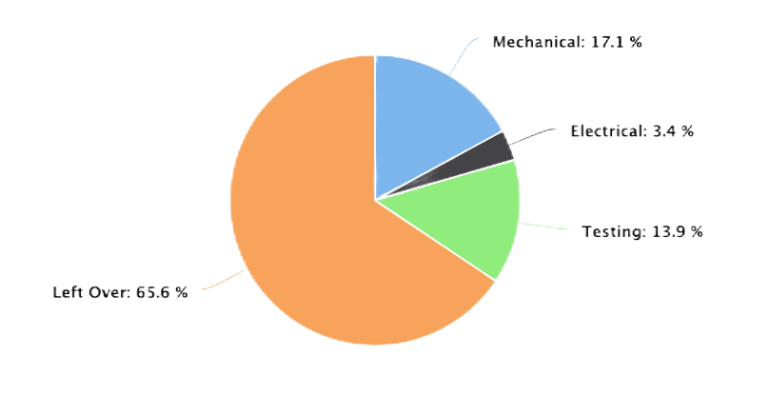
Finance Budget
Subsystem | Items | Price
Mechanical | Aluminum, Manufacturing Services, Motor | $721.04
Electrical | Raspberry Pi 2, Micro SD Card | $143.34
Testing | Dry ice, Thermometer, Insulated box | $585.88
Total: |  | $1231.82
Remaining: |  | $2768.18
Budget Breakdown
1. Overview
2. Design Solution
3. CPEs
4. RIsks
5. DR Satisfaction
6. V&V
7. Project Planning
Notes:
Presenter: Kiley

Slide 42
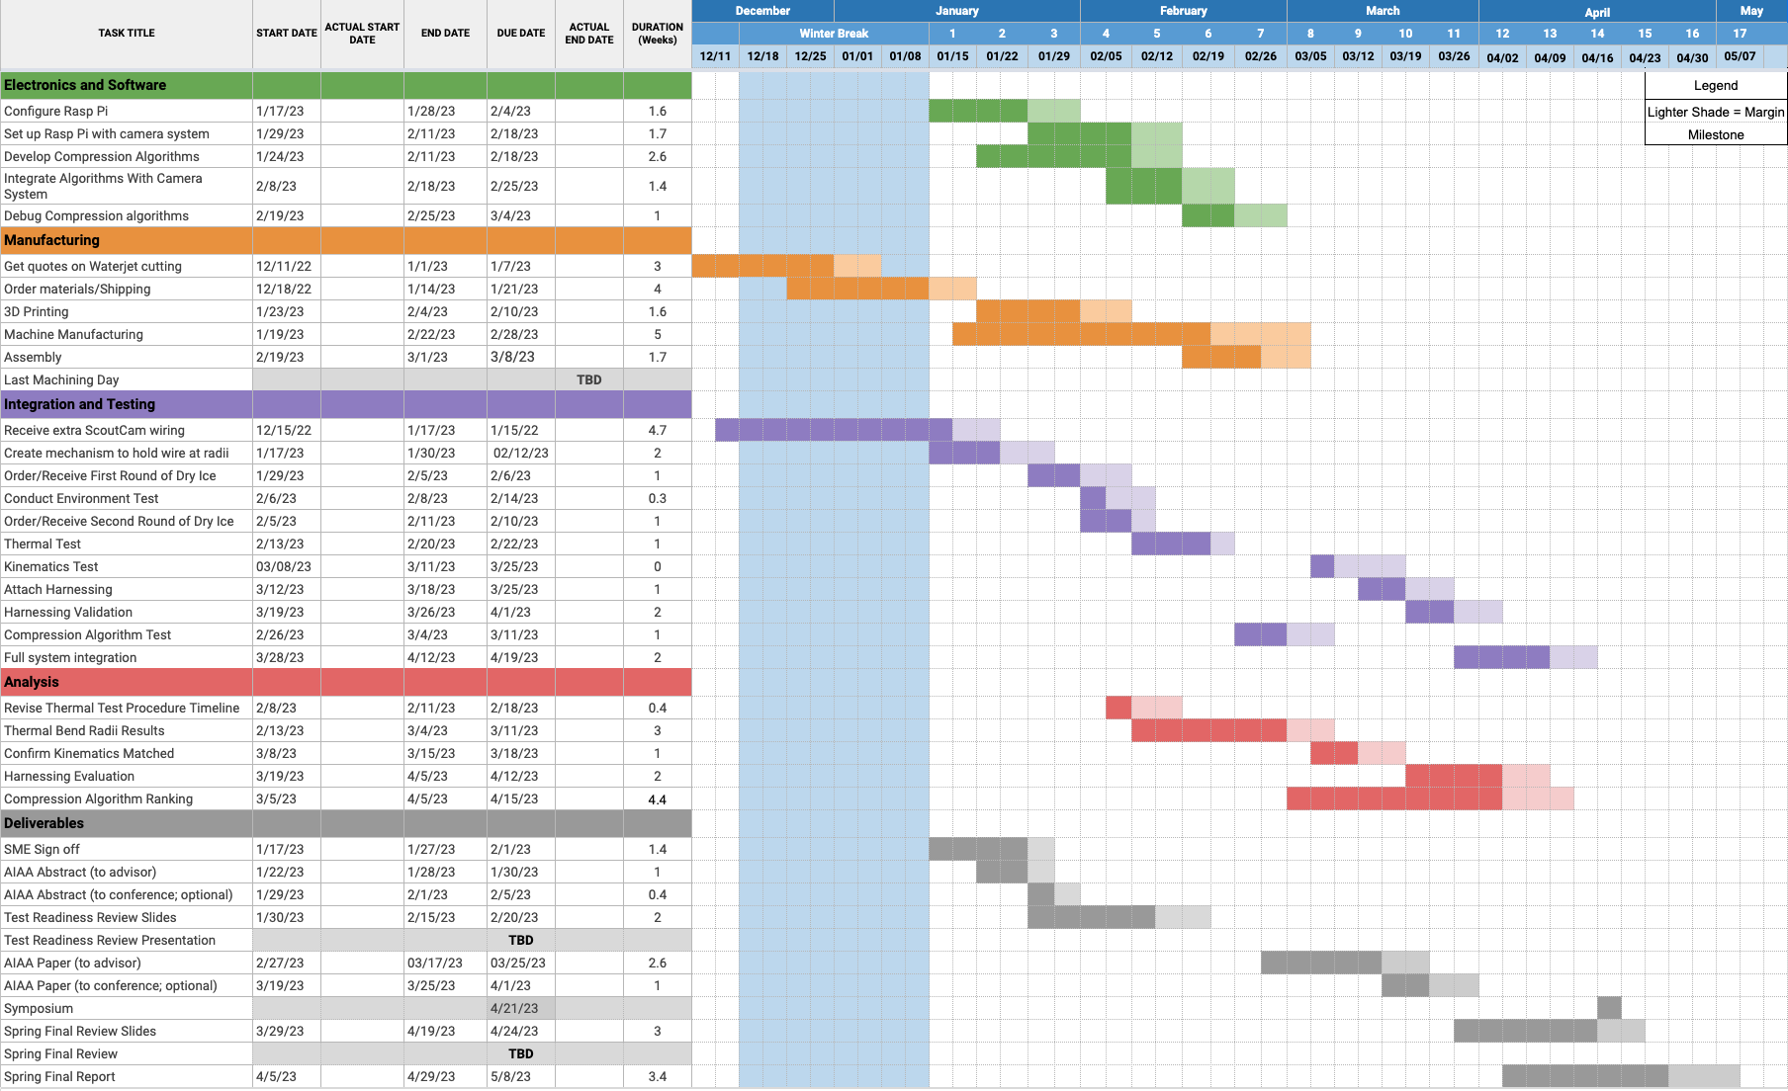
Spring Schedule
Software Development
Manufacturing Timeline
Testing System
Integration
Final Design
1. Overview
2. Design Solution
3. CPEs
4. RIsks
5. DR Satisfaction
6. V&V
7. Project Planning
Notes:
Presenter: Kiley

Slide 43
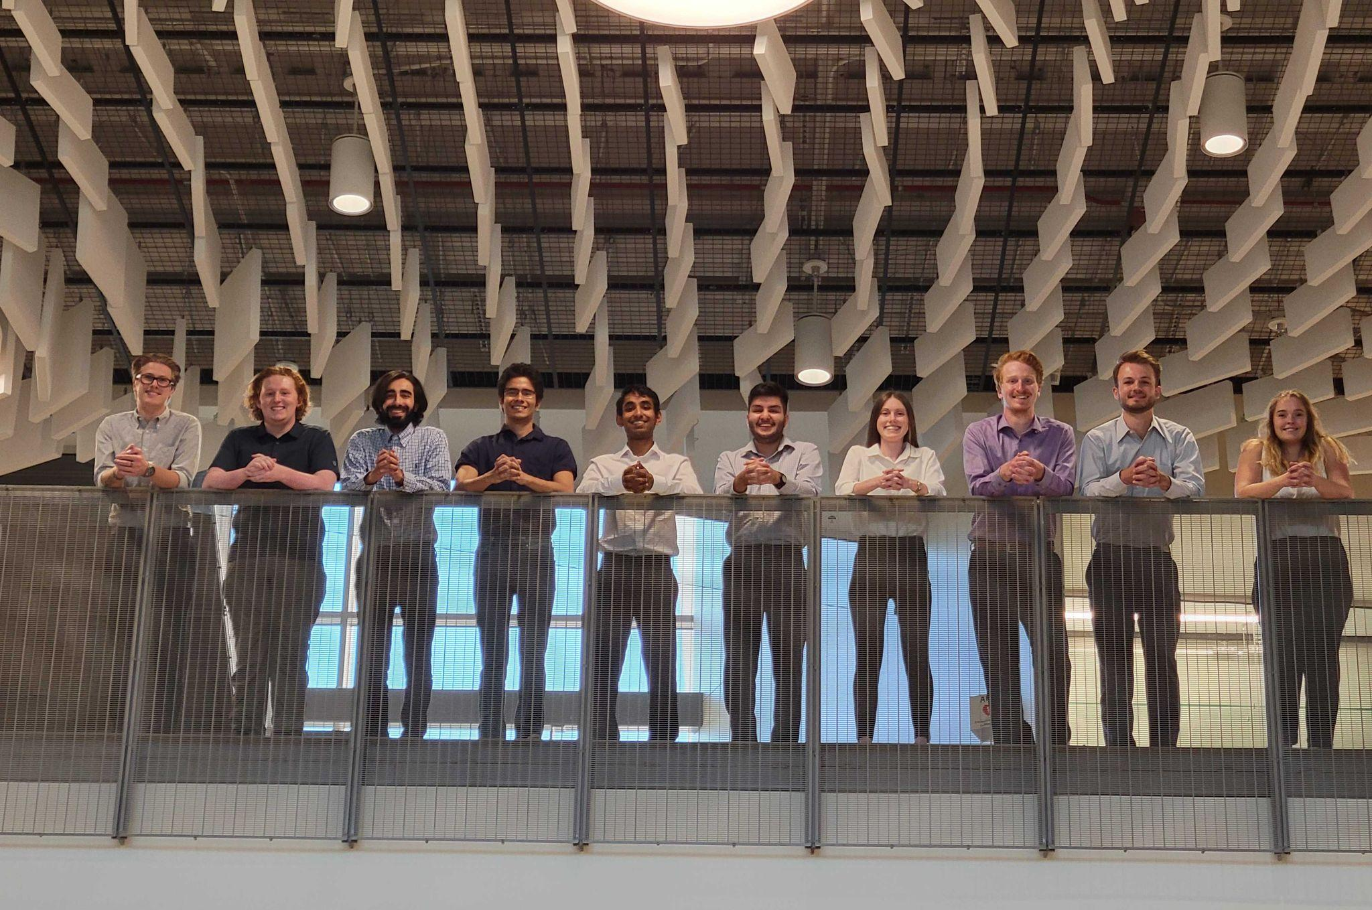
Acknowledgements
Advisors
Dr. Melvin Rafi
Dr. Kathryn Wingate
Dr. Chris Muldrow
CU Professors
Prof. Trudy Schwartz
Prof. Bobby Hodgkinson
Prof. Nabity
Sponsors
Astroscale
Rebeca Griego
Jon Buschur
Teaching Fellows
Andreas Brecl
Jasmin Chadha
Gina Staimer
Notes:
Presenter: Kiley

Slide 44
Questions?

Slide 45
References
[1] Zhang, Huakai & Fritts, Jason. (2004). EBCOT coprocessing architecture for JPEG2000. 10.1117/12.527160.
[2] “Image Compression: How Math Led to the JPEG2000 Standard - JPEG 2000”. Why Do Math.https://www.whydomath.org/node/wavlets/jpeg2000.html
[3] “Image Compression: How Math Led to the JPEG2000 Standard - Wavelet Transformation”. Why Do Math. https://www.whydomath.org/node/wavlets/wavelettransforms.html
[4] “Aluminum 6061-T6; 6061-T651”. ASM Material Data Sheet. https://asm.matweb.com/search/SpecificMaterial.asp?bassnum=ma6061t6
[5] Staples, Rob. (2021). “Key Capabilities of our Life Extension In-orbit (LEXI) Servicer”. Astroscale. https://astroscale-us.com/lexi-life-extension-capabilities/
[6] “Scoutcam Starter Kit Probe - 1.8mm”. ScoutCam Data Sheet.
[7] “SP0-S 3U cPCI Radiation Tolerant PowerPC SBC”. Aitech.
[8] “STEPPERONLINE Nema 34 Stepper Motor 4.8Nm 6.0A 14mm Key-Way Shaft with 1m Cable”. Amazon. https://www.amazon.com/STEPPERONLINE-Stepper-Motor-679-87oz-Key-Way/dp/B091C83HWF/ref=asc_df_B091C83HWF/?tag=hyprod-20&linkCode=df0&hvadid=564776331281&hvpos=&hvnetw=g&hvrand=7922558747980942348&hvpone=&hvptwo=&hvqmt=&hvdev=c&hvdvcmdl=&hvlocint=&hvlocphy=1014448&hvtargid=pla-1481763760527&psc=
Notes:
Presenter:

Slide 46
Backup Slides

Slide 47
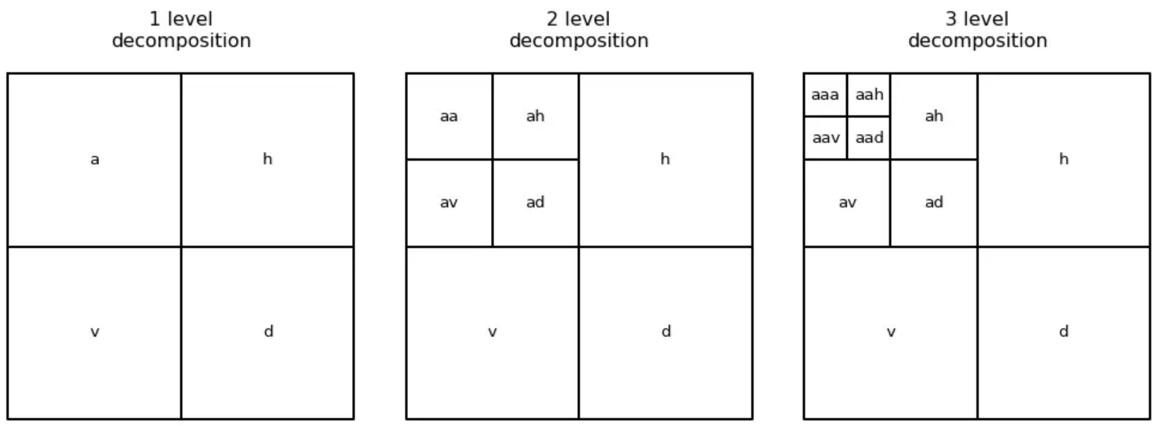
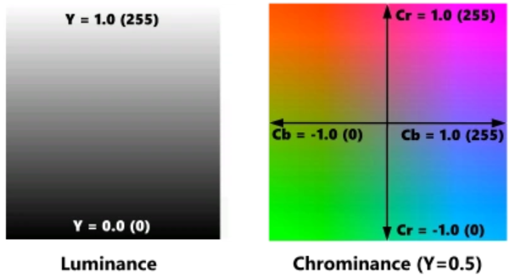
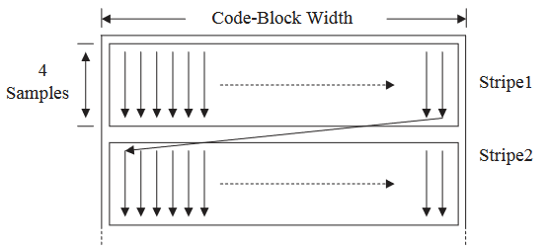
JPEG2000 Algorithm _{[3]}
1 - Preprocessing
Convert to YC_{b}C_{r} color space and center.
2 - Transformation
2-3 iterations of a discrete wavelet transformation (DWT). _{[4]}
3 - Quantization (Skipped for lossless compression)
Color values are quantized toward zero and converted to integers.
4 - Encoding
Embedded Block Coding with Optimized Truncation (EBCOT) encoding
Notes:
Presenter: Kiley

Slide 48
Compression Algorithm Validation Cont.
Testing Criteria Factors
Image viewability
Power consumption
Percentage of frames dropped
Storage needed to store compressed video
Frame Loss
The key is to find the minimum number of frames before the understanding/quality of the video is no longer acceptable
A current estimate of this is 5% of the total frames obtained
Success criteria will be further refined as Scoutcam is further studied (e.g. consecutively lost frames, randomly ordered lost frames)
1. Overview
2. Design Solution
3. CPEs
4. RIsks
5. DR Satisfaction
6. V&V
7. Project Planning
Notes:
Presenter: Peyton

Slide 49
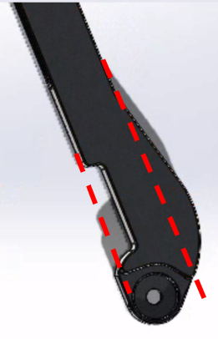
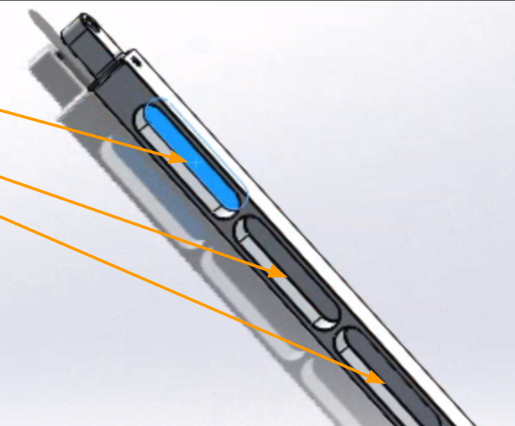
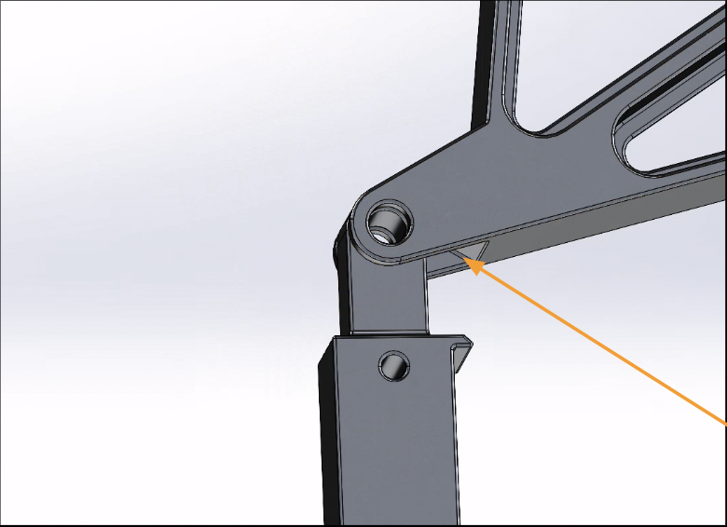
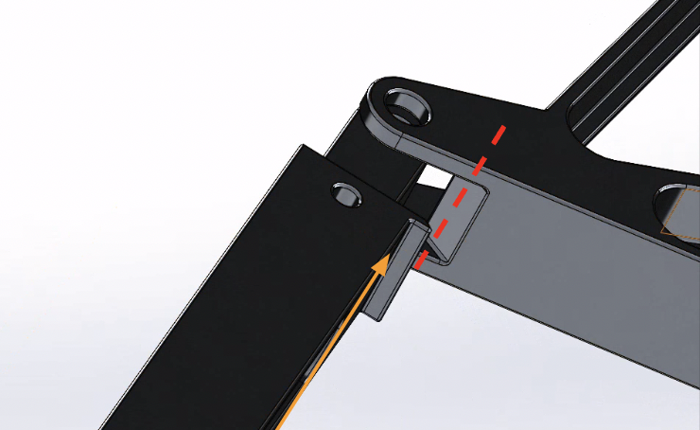
LEXI Arm Modifications
Notes:
Presenter: Abby

Slide 50
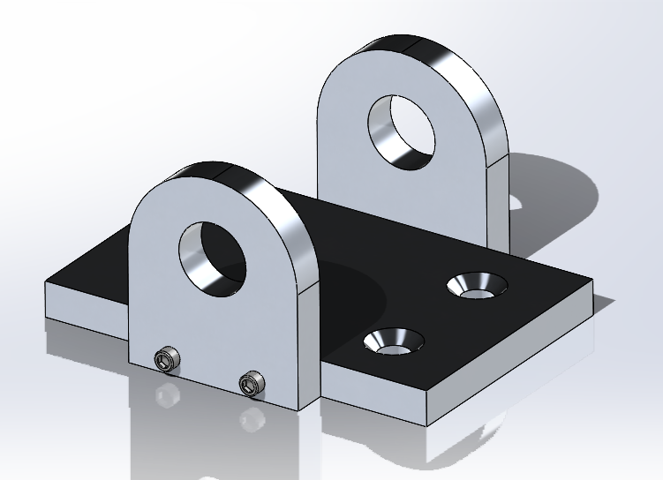
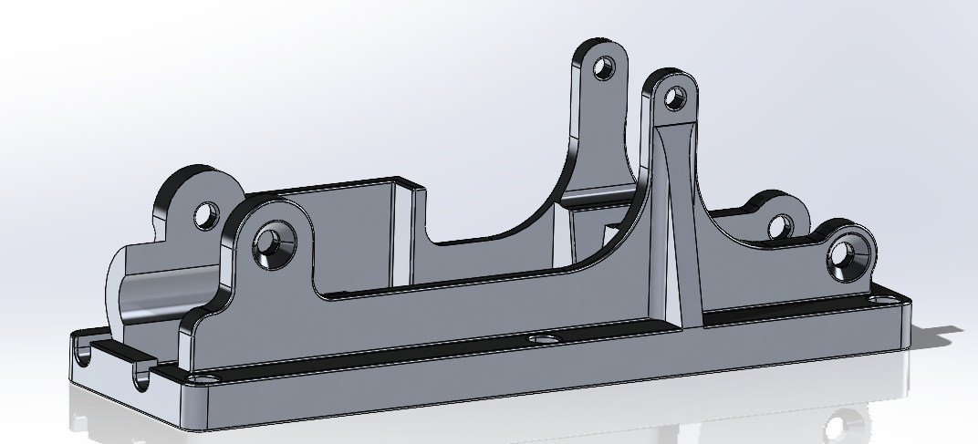
LEXI Arm Modifications Cont.
1. Project Overview
2. Trade - Video Card
3. Trade - Model
4. Design Space
5. Modeling Plan
Notes:
Presenter: Abby

Slide 51
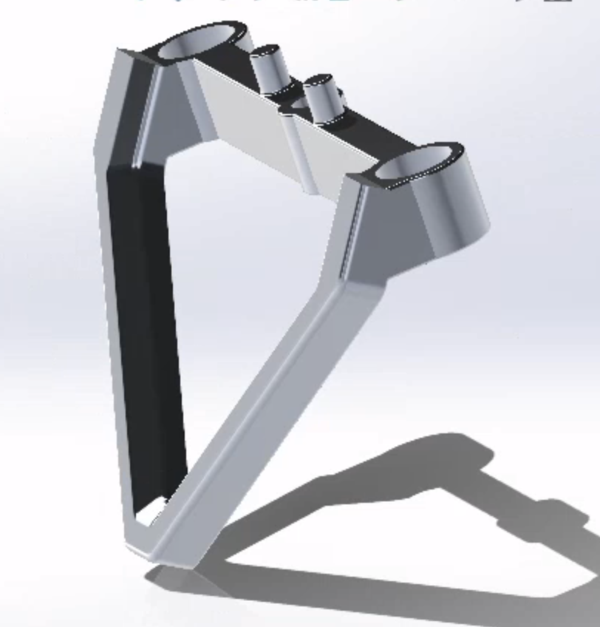
Manufacturing Plan
Water Jet Cutting and Machining: 6061 Aluminum
3D Printing: PLA
Notes:
Speaker: Abby

Slide 52
Radiation Hardened Video Card
DR 3.1 | The rad hard video card can withstand at least 100 krad/year. | CPE 5
DR 3.2 | The rad hard video card must operate between 0-50 deg C | CPE 5
DR 3.3 | The rad hard video card shall support spacewire connection to on-board computer (OBC)
DR 3.5 | The rad hard video card must be smaller than 10”x1.1”x6.5” | CPE 5
All rad-hard video card requirements are satisfied by the specs sheet of the SP0-S
1. Overview
2. Design Solution
3. CPEs
4.Risks
5. DR Satisfaction
6. V&V
7. Project Planning
Notes:
Speaker:

Slide 53
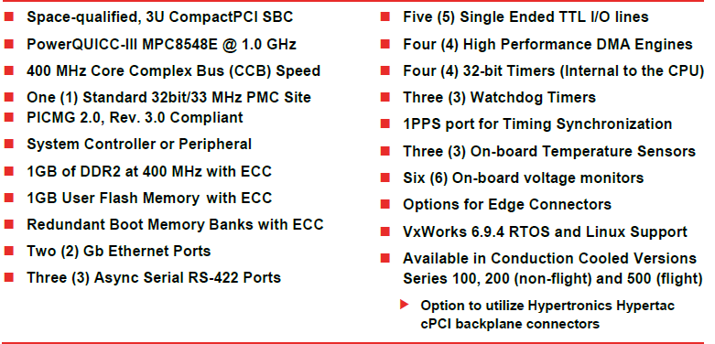
Radiation Hardened Videocard Data Sheet
1. Project Overview
2. Trade - Video Card
3. Trade - Model
4. Design Space
5. Modeling Plan
Notes:
Presenter: Kiley

Slide 54
Radiation Hardened Videocard Data Sheet
1. Project Overview
2. Trade - Video Card
3. Trade - Model
4. Design Space
5. Modeling Plan
Notes:
Presenter: Kiley

Slide 55
Test Procedure for Thermal Wire Testing
Materials:
Dry ice
Styrofoam box
Below 0C Thermometer
Gloves
Wiring
Mechanisms to hold wires at various radii
Pliers
Timer
LED
Thermal Wire Fatigue Test Procedures
Attach wires to bend radii mechanisms
Set up styrofoam box
Place thermistors inside styrofoam box
Place wires and mechanisms inside styrofoam box
Place 30lb block of dry ice in styrofoam box
Let sit for time frame determined by Environmental Hold Test.
Don gloves
Unattach wires from mechanisms
Using pliers slowly unbend wires
Observe if wire breaks or not
Record outcome
If the wire does not break: Run current through wire
See if the cable can light up a small LED
Environmental Hold Test Procedure:
Set up styrofoam box
Place thermistors inside thermos
Place 30lb block of dry ice in box
Record temperature data
Determine how long we can hold the environment below -30 C.
Notes:
Speaker: Mason

Slide 56
Raspberry Pi 2B Data Sheet

Slide 57
Raspberry Pi Pico RP2040 Data Sheet

Slide 58
STEPPERONLINE Nema 34 Stepper Motor Datasheet
Notes:
Mo

Slide 59
STEPPERONLINE Digital Stepper Driver
Notes:
Mo

Slide 60
Additional Risks
Risk | Description
R7 | Camera harnessing detaches from the arm during testing
R8 | Video compression encounters error and corrupts video
R9 | Video processing can’t save output file properly
R10 | Camera harnessing detaches from the arm during testing
R11 | Video compression algorithm is too slow and bottleneck forms
R12 | Motor cannot extend arm at the desired rate
Notes:
Presenter: Kiley

Slide 61
Additional Risks Matrix
Very Likely
Likely
Possible |  | R10,R11 | R8,R9
Unlikely |  |  | R12 | R7
Very Unlikely
 | Negligible | Minor | Moderate | Significant | Severe
Probability
Impact/Consequence
Risk Level
Acceptable | Watch | Unacceptable
1. Overview
2. Design Solution
3. CPEs
4.Risks
5. DR Satisfaction
6. V&V
7. Project Planning
Notes:
Presenter:

Slide 62
Bill of Materials - Mechanical
Water Jet Estimate:
~$500 in addition
Notes:
Presenter: Mo

Slide 63
Bill of Materials - Electrical
Notes:
Presenter: Mo

Slide 64
Bill of Materials - Testing
Notes:
Presenter: Mo

