Slide 1





ABSTRACT: Automated Battery System For Testing Reliability And Continuity Tool
Test Readiness Review
6 March 2023
Customer: EnerSys / ABSL
Presenters:
Jeffrey Azuma
Nick Dembiczak
Hrithik Hiranandani
Alex Miceli
Andrew Peterson
Additional Members:
Haotian Chen
Jack Davis
Ryan Gao
Ryan Sievers
Advisor:
Matt Rhode

Slide 2

Presentation Outline
Overview
Schedule
Test Readiness – Accuracy
Test Readiness – Timing
Budget
Overview
Schedule
Test Readiness – Accuracy
Test Readiness – Timing
Budget
Backup Slides

Slide 3
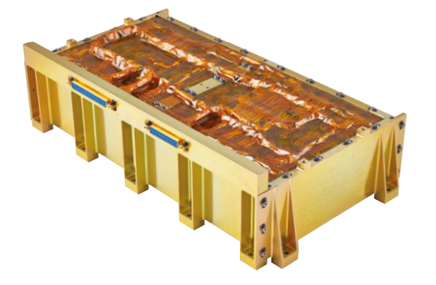
Problem & Need
Battery is manufactured
Battery’s performance is hand-tested by technician
Battery hand-off to customer
ABSTRACT will automate the battery performance testing
Overview
Schedule
Test Readiness – Accuracy
Test Readiness – Timing
Budget
Backup Slides

Slide 4
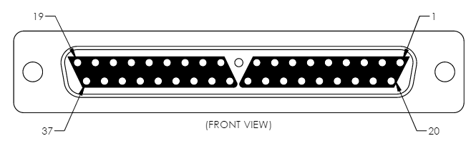
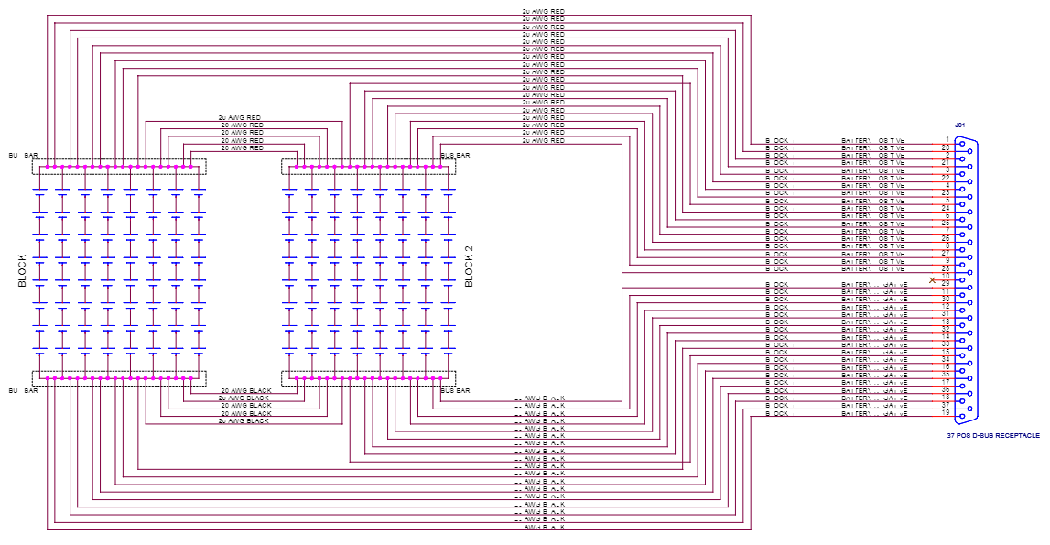
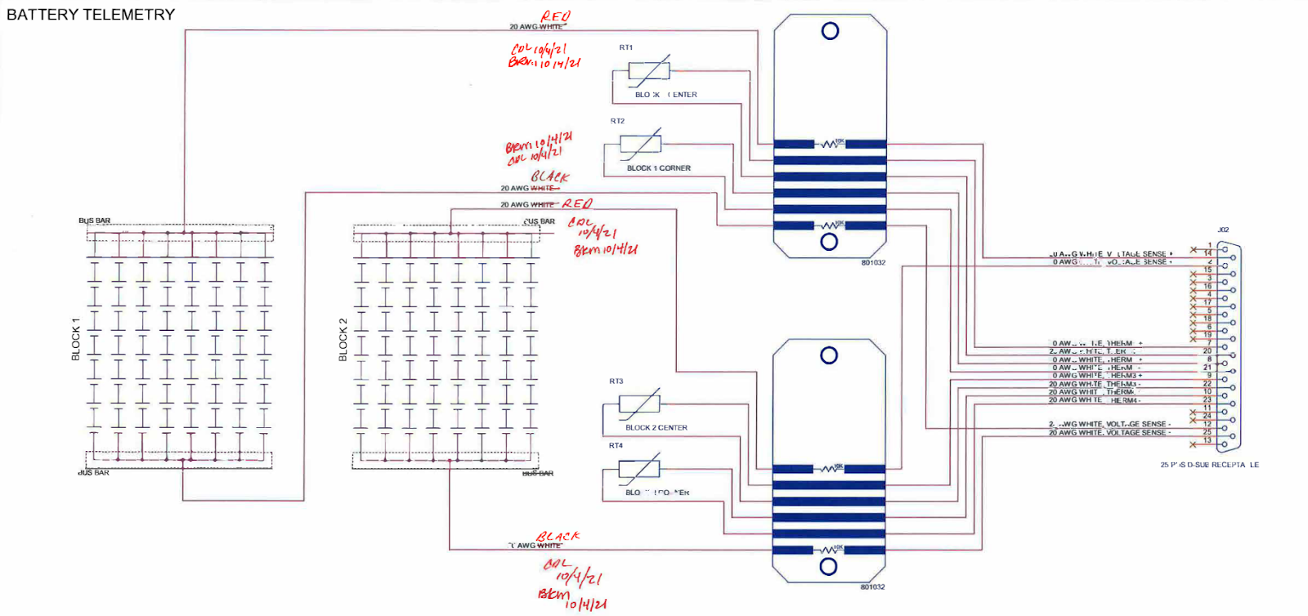
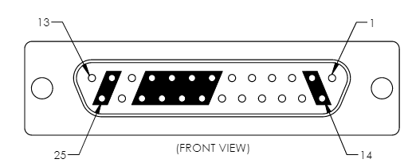
Battery
Overview
Schedule
Test Readiness – Accuracy
Test Readiness – Timing
Budget
Backup Slides

Slide 5
Mission Statement
Team ABSTRACT shall provide EnerSYS with a system that can interface with their 8s16p battery, autonomously test the battery for continuity, resistance, voltage, isolation, and insulation, and provide data to verify whether or not the battery is qualified for space-flight.
Overview
Schedule
Test Readiness – Accuracy
Test Readiness – Timing
Budget
Backup Slides

Slide 6
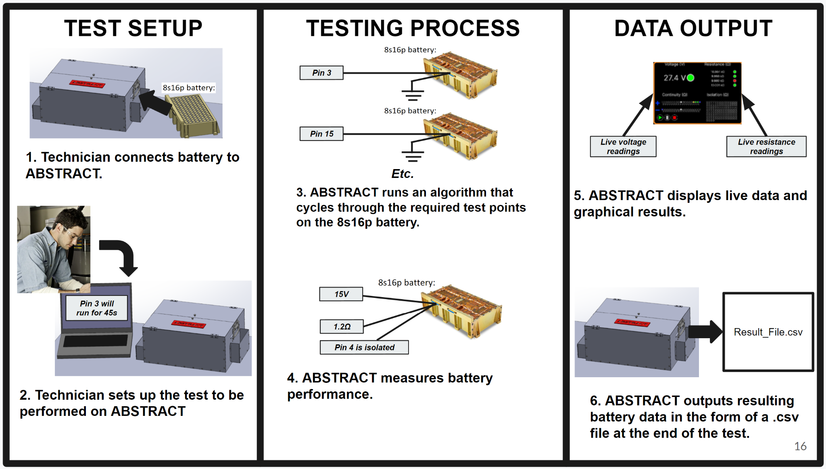
CONOPS
Overview
Schedule
Test Readiness – Accuracy
Test Readiness – Timing
Budget
Backup Slides

Slide 7
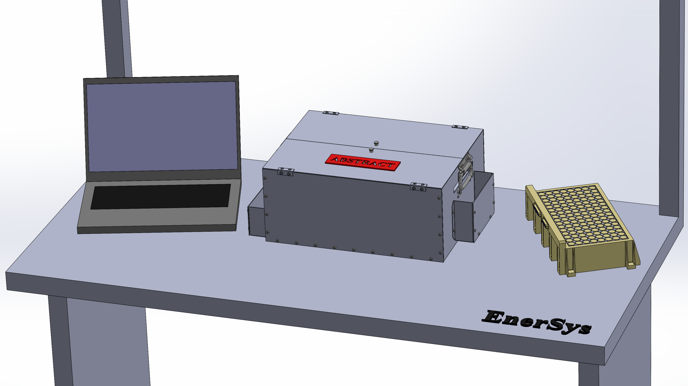
Baseline Design
Overview
Schedule
Test Readiness – Accuracy
Test Readiness – Timing
Budget
Backup Slides
Notes:
I would love updated cad models

Slide 8
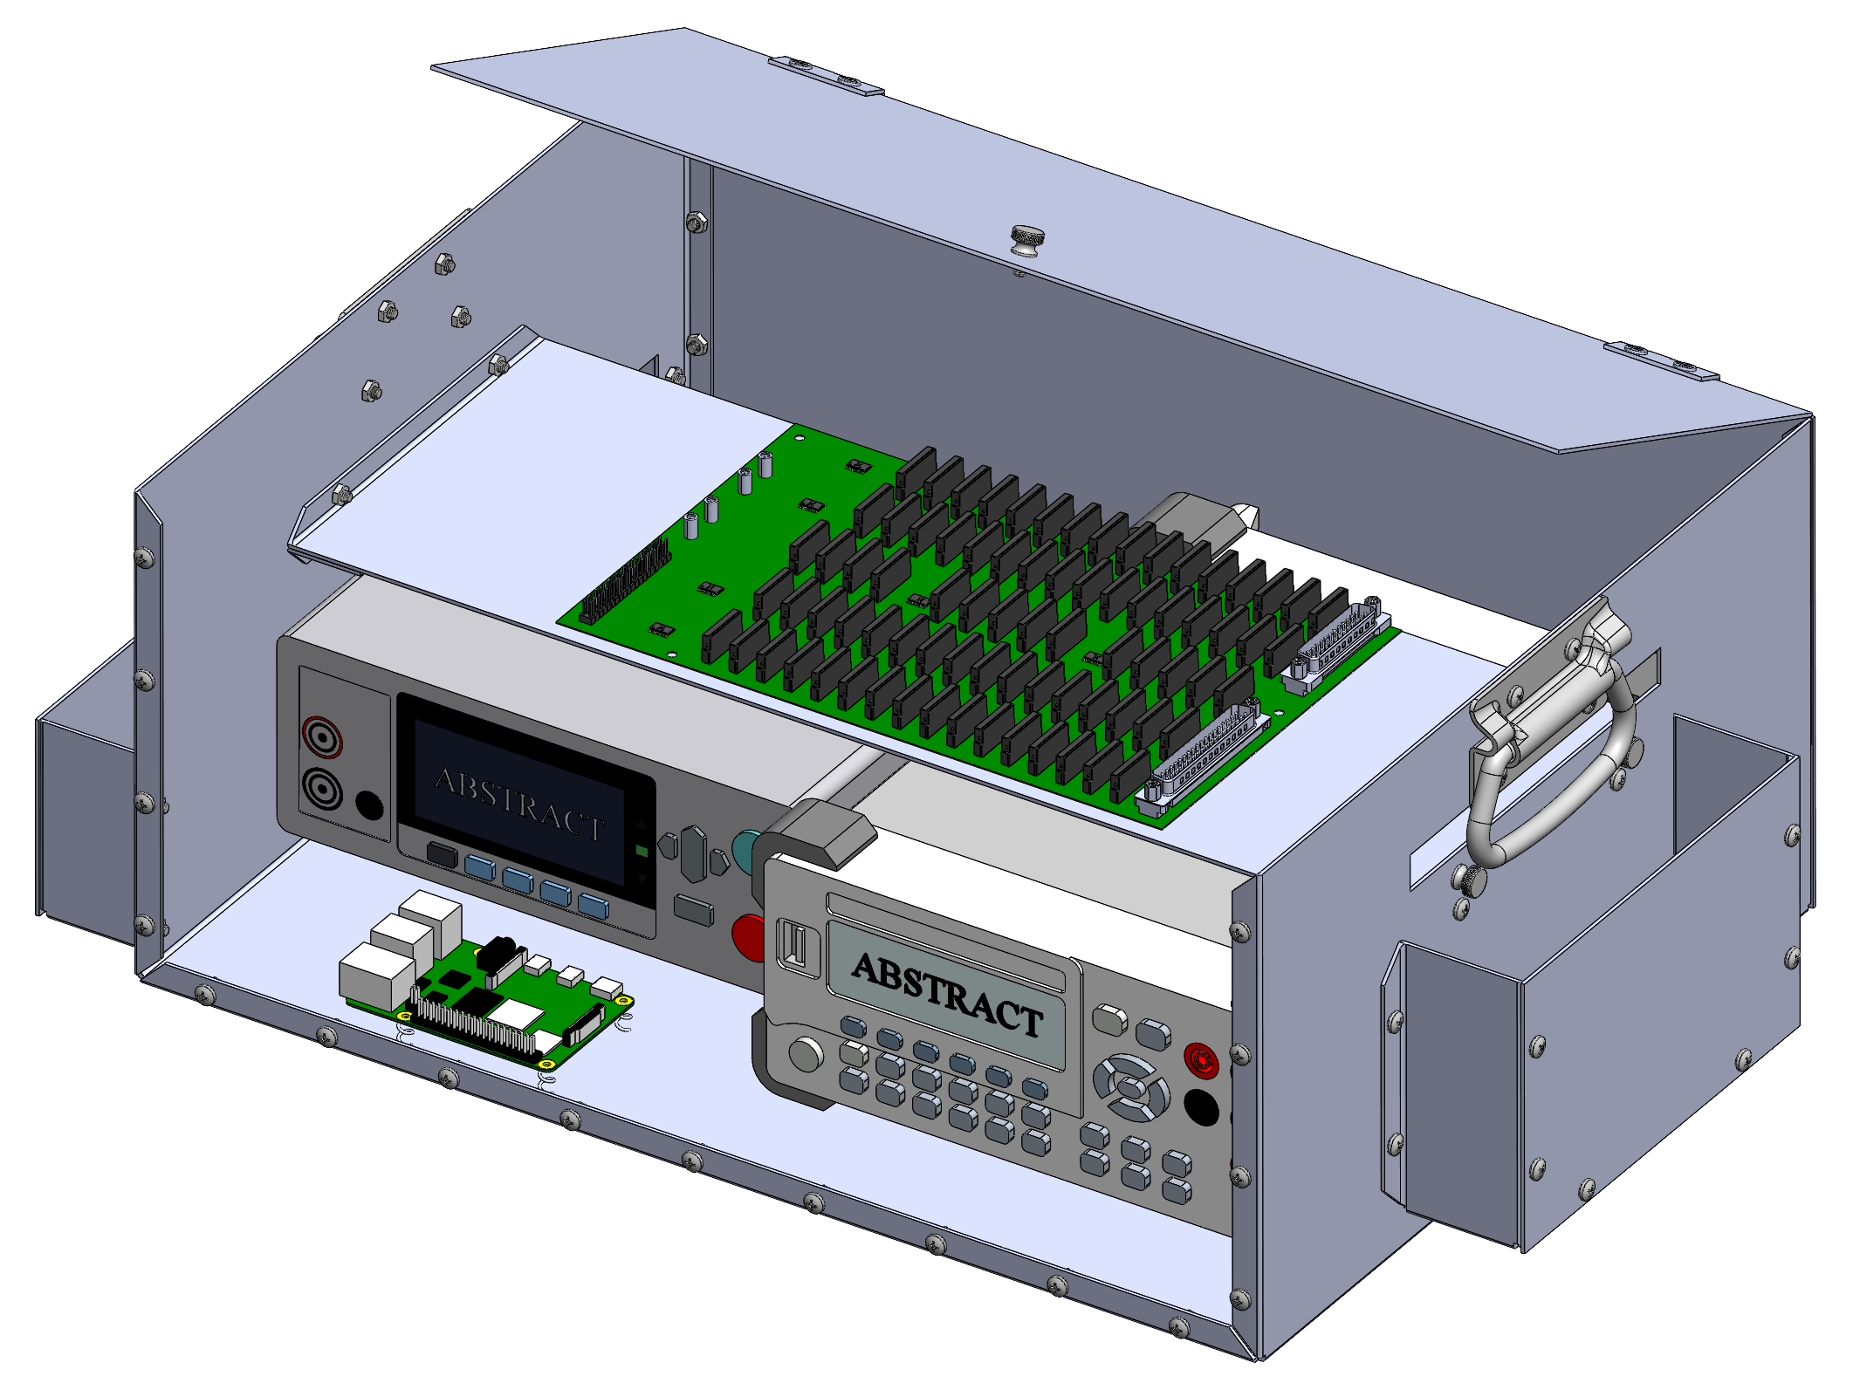
Baseline Design
Overview
Schedule
Test Readiness – Accuracy
Test Readiness – Timing
Budget
Backup Slides
Notes:
I would love updated cad models

Slide 9
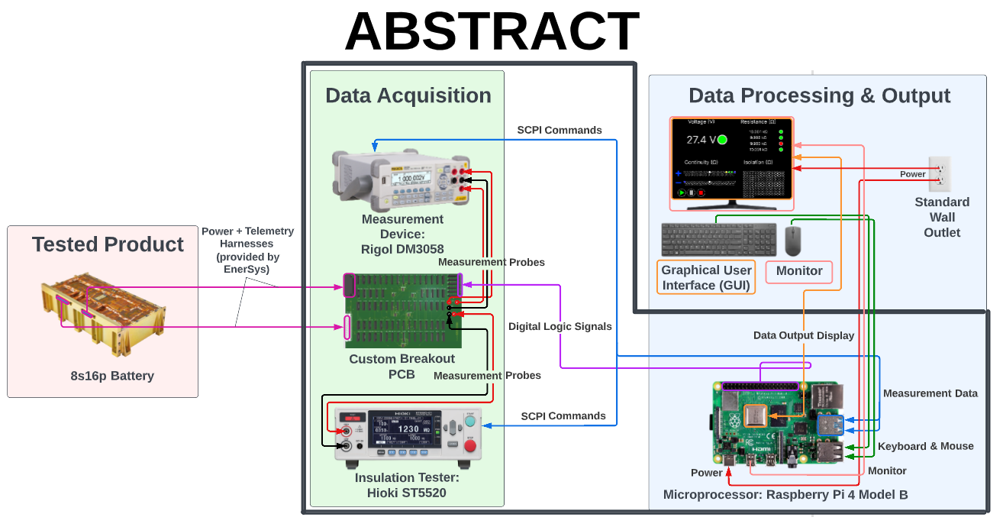
Functional Block Diagram
Overview
Schedule
Test Readiness – Accuracy
Test Readiness – Timing
Budget
Backup Slides
Notes:
Narrate how it works, this will be the biggest design solution part
Could potetntially benefit from zoomed in version of the PCB

Slide 10
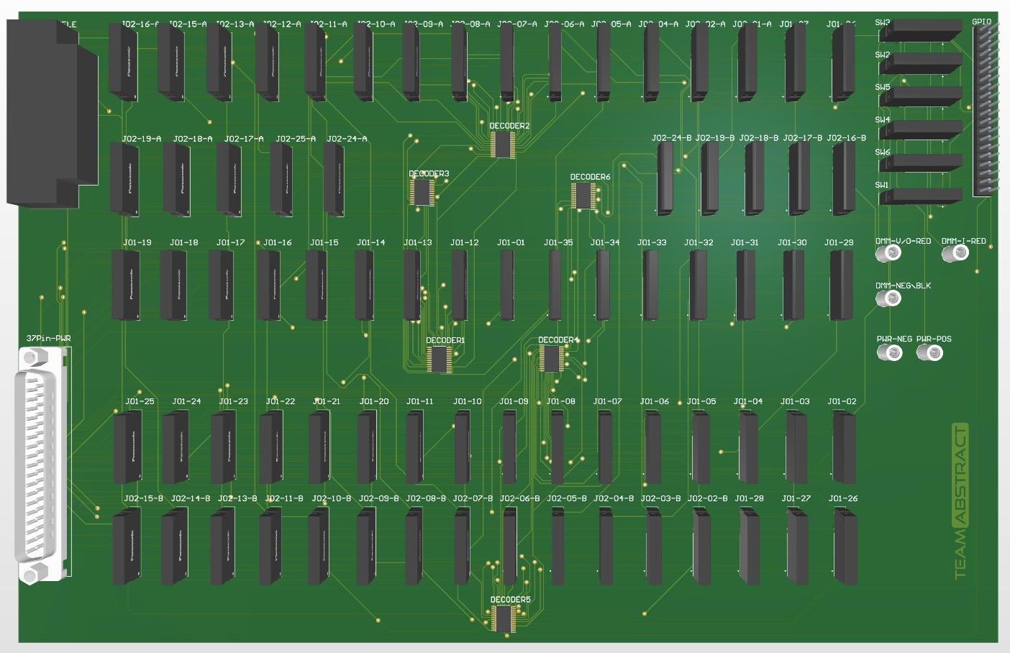
Printed Circuit Board (PCB)
Overview
Schedule
Test Readiness – Accuracy
Test Readiness – Timing
Budget
Backup Slides
Notes:
Potentially add more to this slide?

Slide 11
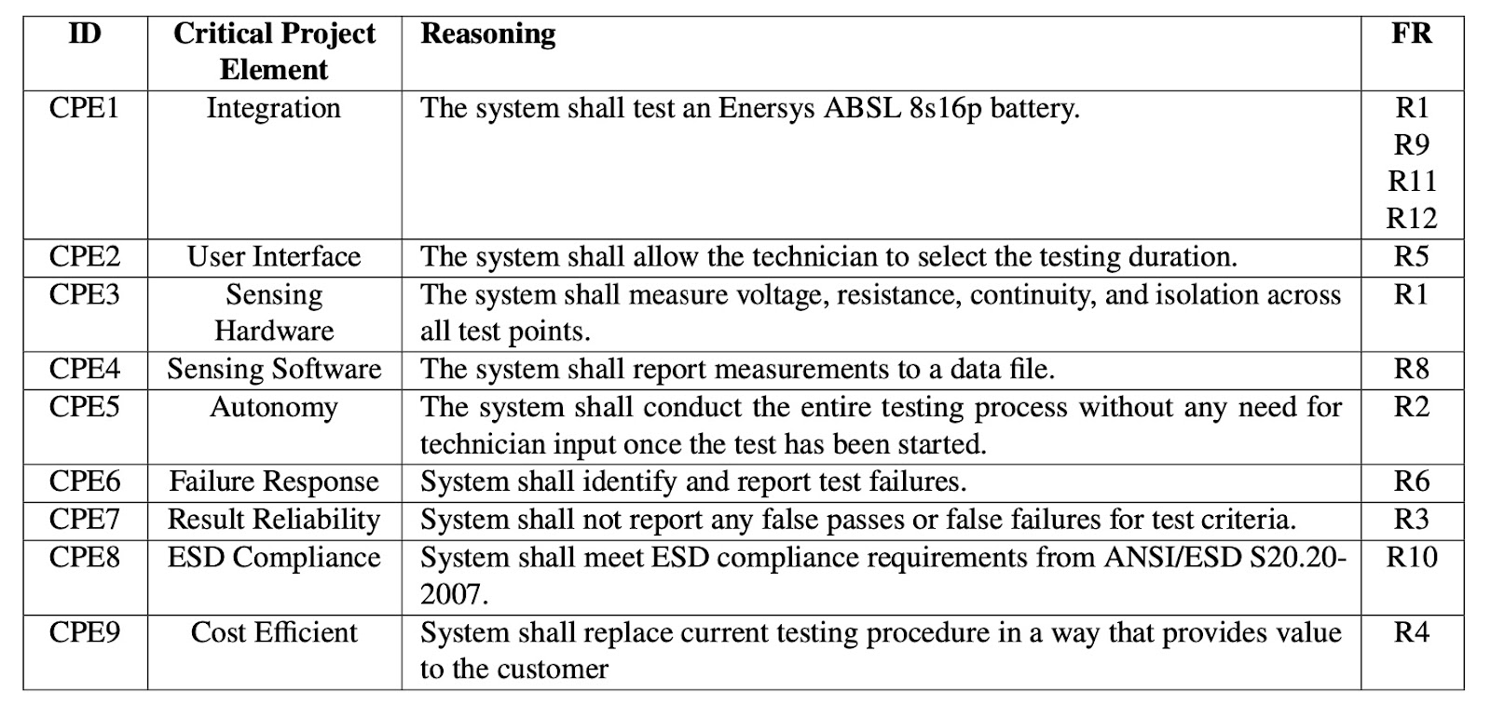
Critical Project Elements (CPEs)
Overview
Schedule
Test Readiness – Accuracy
Test Readiness – Timing
Budget
Backup Slides

Slide 12
Levels of Success
 | Level 1 | Level 2
Hardware | ABSTRACT interfaces with an 8s16p battery through the required test points for battery testing | ABSTRACT is modular and flexible in design, which enables it to interface with multiple batteries or different kinds of batteries
 | ABSTRACT measures voltage, continuity, resistance, and isolation from each required test point of a 8s16p battery
 | ABSTRACT features a form factor capable of fitting on a standard workbench used by Enersys for battery testing | ABSTRACT’s design is finalized to the point that it has the potential of being a commercialized device
Software | ABSTRACT will start/stop/pause a test under the command of a technician
 | ABSTRACT collects the measured data on voltage, continuity, resistance, isolation, and abnormal/faulty readings, from an 8s16p battery, to enable a technician to judge the flight readiness of the tested battery | ABSTRACT not only collects and measures data on voltage, continuity, resistance, isolation, and abnormal/faulty readings, from an 8s16p battery, but ABSTRACT can also autonomously verify the flight readiness of the tested battery
 | ABSTRACT displays live data acquired during testing in the form of graphs/plots
 | ABSTRACT outputs the results of the battery test in a .csv file | ABSTRACT has the ability to output a result file in any format the user requests
Overview
Schedule
Test Readiness – Accuracy
Test Readiness – Timing
Budget
Backup Slides
Notes:
We’ll see if this is really needed. Left open spot for now

Slide 13
Schedule
Overview
Schedule
Test Readiness – Accuracy
Test Readiness – Timing
Budget
Backup Slides

Slide 14
Prerequisite Testing
Subsystem | Test | Goals | Dates | Testing Location | Equipment | Progress
Electronics | PCB Continuity Test | Determine resistance to be able to calculate R_{eq} | Mid Feb | Aero 150 | PCB, DMM | Completed
Electronics | SSR On-Resistance Test | Determine resistance to be able to calculate R_{eq} | Late Feb / Early March | Aero 150 | SSR, DMM | In Progress
Electronics | Binary Decoder Performance Test | Verify data sheets | Late Feb / Early March | Aero 150 | Decoders, DMM | In Progress
Electronics | GPIO Current Output Characterization Test | Determine output capabilities of Raspberry Pi | Late Feb / Early March | Aero 150 | PCB, GPIO, DMM | In Progress
Electronics | SSR Functionality Test | Ensure SSR is operational | Early Feb | Aero 150 | SSR, DMM | Completed
Software | SSR Spec Verification | Verify data sheets | Late Feb / Early March | Aero 150 | SRR, DMM | In Progress
Software | Measurement Circuit Rise Time | Determine rise times to verify data sheets | Early March | Aero 150 | Oscilloscope, electrical components | In Progress
Software | Raspberry Pi Communication Test | Determine communication abilities with Pi | Early Feb | Aero 150 | Raspberry Pi, DMM, Insulation Tester, GUI, Binary Decoder, PCB | Completed
Overview
Schedule
Test Readiness – Accuracy
Test Readiness – Timing
Budget
Backup Slides
Notes:
Alex!

Slide 15
Major Testing
Subsystem | Test | Goals | Dates | Testing Location | Equipment | Progress
Electronics | Component On-Resistance Test | Determine resistance to be able to calculate R_{eq} | Early March | Aero 150 | DMM, Power supply, SSRs, Raspberry Pi, GPIO, Decoders, Contact probes | To - Do
Electronics | PCB Trace Resistance Test | Determine resistance to be able to calculate R_{eq} | Early March | Aero 150 | DMM, Power supply, SSRs, Raspberry Pi, GPIO, Decoders, Contact probes | To - Do
Electronics | Drive Current Test | Ensure system can be operated | March | Aero 150 | DMM, Power supply, SSRs, Raspberry Pi, GPIO, Decoders, Contact probes | To - Do
Software | Timing Model Test | Determine total time to hit requirements | March | Aero 150 | Raspberry Pi, PCB, DMM, Insulation Tester, Oscilloscope, Cables, Computer | To - Do
Integration | Integration Test | Begin integration for success of project | Late March | Aero 150 | Raspberry Pi, PCB, DMM, Insulation Tester, Oscilloscope, Cables, Computer | To - Do
Overview
Schedule
Test Readiness – Accuracy
Test Readiness – Timing
Budget
Backup Slides
Notes:
Alex!

Slide 16
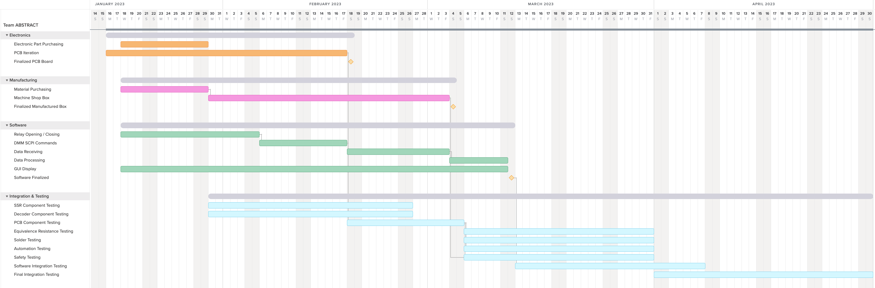
Gantt Chart - Old
Today
Critical Path
Overview
Schedule
Test Readiness – Accuracy
Test Readiness – Timing
Budget
Backup Slides
Notes:
Alex! – currently messing with the gantt chart to accurately reflect the new schedule we have

Slide 17

Gantt Chart - Status
Today
Critical Path
Overview
Schedule
Test Readiness – Accuracy
Test Readiness – Timing
Budget
Backup Slides
Notes:
Put in new gantt chart

Slide 18
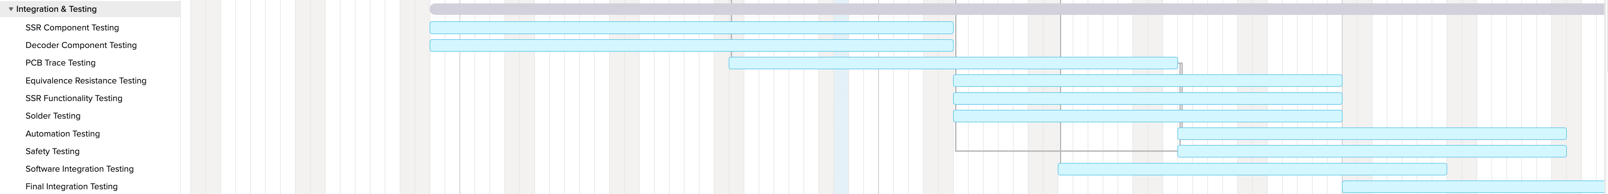
Gantt Chart – Integration & Testing
Overview
Schedule
Test Readiness – Accuracy
Test Readiness – Timing
Budget
Backup Slides
Notes:
Put in the part that is just focusing on integration and testing

Slide 19
Test Readiness - Accuracy
Overview
Schedule
Test Readiness – Accuracy
Test Readiness – Timing
Budget
Backup Slides

Slide 20
What & Why
Test Objective:
Test component resistance
Verify component integration
Rationale:
Prove that the accuracy requirements are met
  As accurate or better than current test solution
Replace the human in the loop
  Automation of the system
Components:
Split into
  Component On-Resistance
  PCB Trace resistance
  Drive current
Overview
Schedule
Test Readiness – Accuracy
Test Readiness – Timing
Budget
Backup Slides

Slide 21
Requirement Verification
CPE 3
Sensing Hardware
Measure: Voltage, Resistance, Continuity, Isolation, Insulation
FR 1
Testing Performance
System shall test the battery for electrical performance
DR 1
Voltage
System shall measure voltage across test points (designated in the functional test template) for values in the range of [24.01V - 33.59V]
DR 2
Continuity
System shall measure resistance across test points (designated in the functional test template) for values < 1 Ω
DR 3
Resistance
System shall measure resistance across test points (designated in the functional test template) for a value of 10 kΩ ± 7 Ω
DR 4
Isolation
System shall measure resistance across test points (designated in the functional test template) for values > 10.025 MΩ
DR 5
Insulation
System shall measure resistance across test points (designated in the functional test template) for values > 10 MΩ while applying +100 V across the test points for 60 seconds or until resistance measurement is stable (minimum 10 seconds)
Overview
Schedule
Test Readiness – Accuracy
Test Readiness – Timing
Budget
Backup Slides
Notes:
Are there any fr that relate to traces? Could be important to tie that to requirements

Slide 22
Prerequisite Tests
Planned Tests:
SSR something
Binary Decoder performance
GPIO Current output characterization
Completed Tests:
PCB Continuity Trace
SSR functionality test
Overview
Schedule
Test Readiness – Accuracy
Test Readiness – Timing
Budget
Backup Slides
Notes:
fill out to make sure all completed, all planned, no floating things (i guess), throw in a picture?

Slide 23
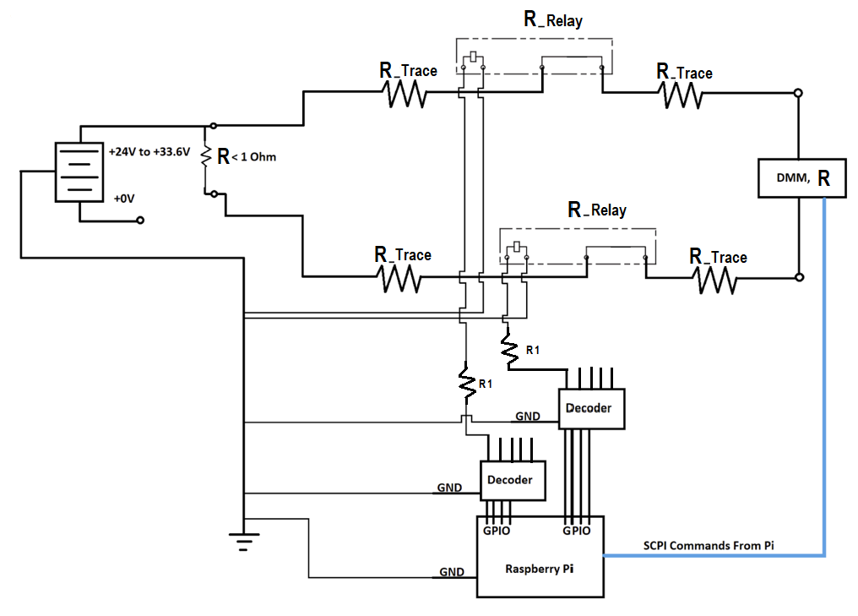
Accuracy Model – Continuity
R_{True} = R_{Meas} - R_{Eq}
R_{Eq} = R_{Trace} + 4*R_{Relay}
R_{Eq} = 0.1 Ω + 4*0.7 Ω
R_{Eq} = 2.81Ω
Max Test Current: 1 mA
SSR Relay rated for 1 A
Overview
Schedule
Test Readiness – Accuracy
Test Readiness – Timing
Budget
Backup Slides

Slide 24
Accuracy Model – Continuity - SSR
R_{True} = R_{Meas} - R_{Eq}
R_{Eq} = R_{Trace} + 4*R_{Relay}
R_{Eq} = 0.1 Ω + 4*0.7 Ω
R_{Eq} = 2.81Ω
Max Test Current: 1 mA
SSR Relay rated for 1 A
Overview
Schedule
Test Readiness – Accuracy
Test Readiness – Timing
Budget
Backup Slides

Slide 25
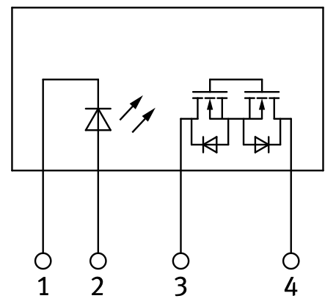
Accuracy Model – SSR On-Resistance Characterization
Characterizing On-Resistance:
Measure on-resistance across contacts 3 & 4
Measure for input current and voltage provided by decoder
Data Sheet Specifications:
Single point specs
On-Resistance = 0.7 Ω
  For I_{forward} = 10.0 mA
Pass Criteria:
On-Resistance cannot exceed 50 Ω
Number of Tests: 78
Overview
Schedule
Test Readiness – Accuracy
Test Readiness – Timing
Budget
Backup Slides
Notes:
I think it may be relevant to take out some information as to not confuse the PAB with “too much too early”

Slide 26
Accuracy Test – Procedure – SSR
Test Procedure:
Configure Setup
  Set DMM to resistance mode
  Connect power supply to input terminals
Provide Current and Voltage
  Expected from the 4:16 Decoder
Measure On-Resistance
  Via DMM
  Across FET / Output terminals of SSR
Overview
Schedule
Test Readiness – Accuracy
Test Readiness – Timing
Budget
Backup Slides
Notes:
Do we want to show a circuit here? There is a already drawn one on slide 34 hidden, if we want, just make some changes to that circuit and paste to here
Configure DMM
-Switch DMM to resistance mode
Build circuit
Plug in wires into DMM
- Connect positive and negative test leads to the Load side (pin 3 and 4) of relay and measure resistance
Activate the SSR
Apply 3.3V voltage between pin 2 and 1 with a limiting resistor in series
Read R_load

Slide 27
Accuracy Model – Continuity – Trace Wires
R_{True} = R_{Meas} - R_{Eq}
R_{Eq} = R_{Trace} + 4*R_{Relay}
R_{Eq} = 0.1 Ω + 4*0.7 Ω
R_{Eq} = 2.81Ω
Max Test Current: 1 mA
SSR Relay rated for 1 A
Overview
Schedule
Test Readiness – Accuracy
Test Readiness – Timing
Budget
Backup Slides

Slide 28
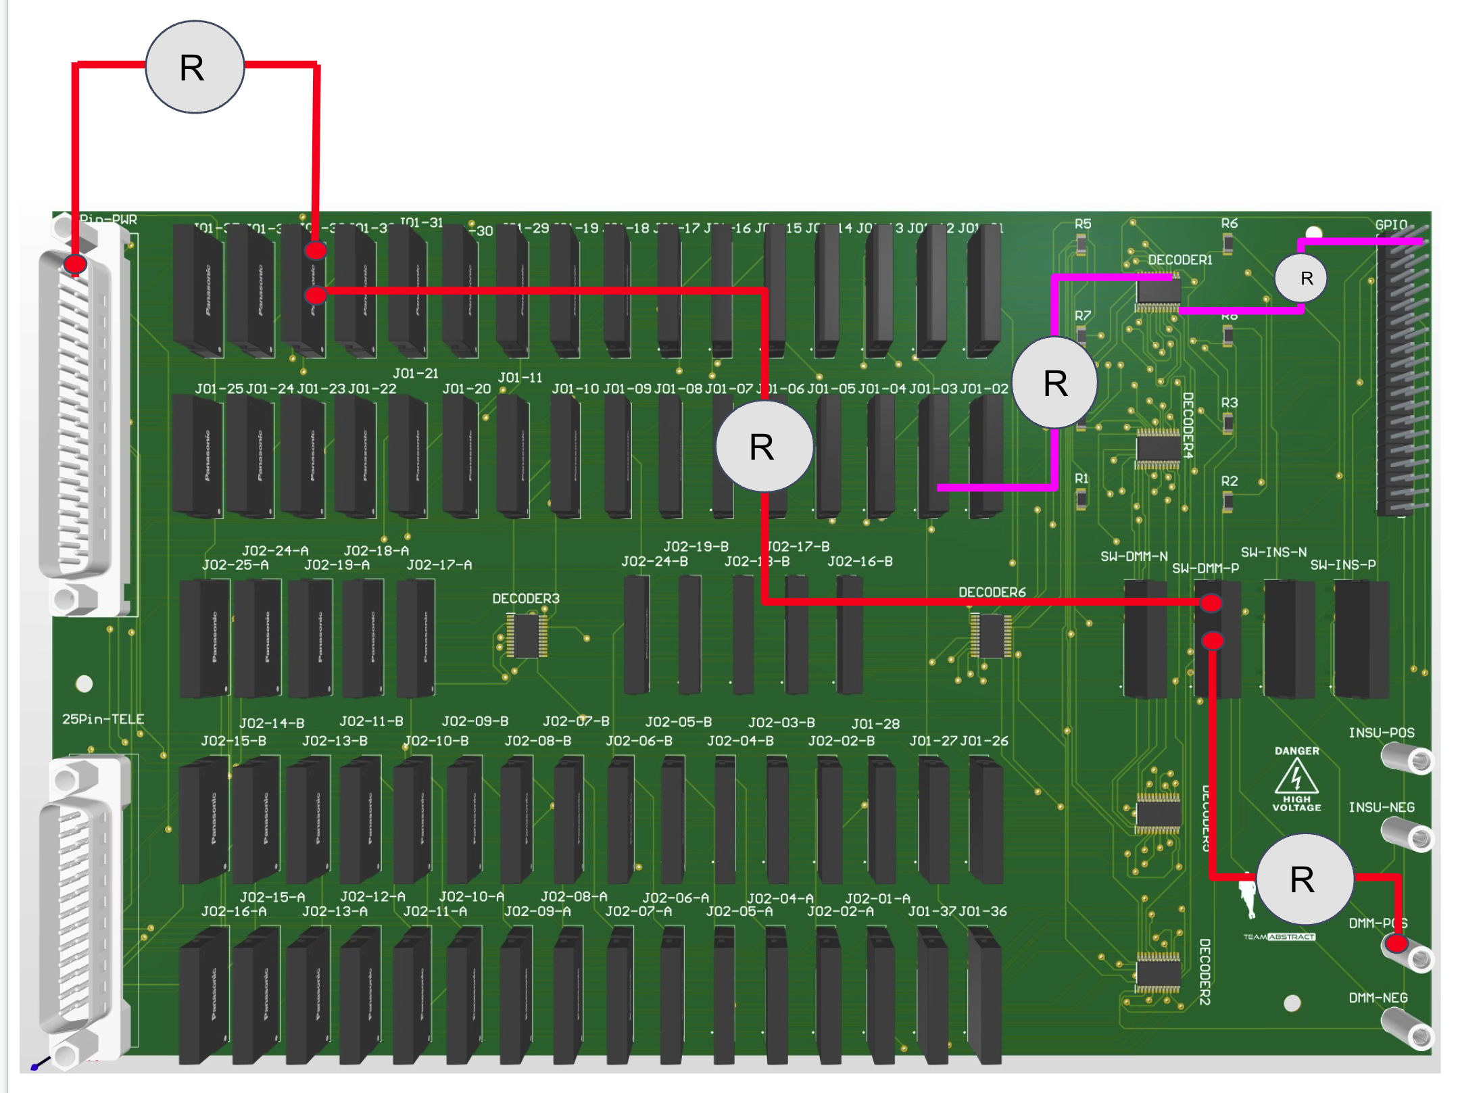
Accuracy Model – PCB Trace Resistance Test
Pass Criteria:
- R < 0.05 Ω for every single trace
Number of Tests:
Red: Testing Circuit
  234 tests
    78 for 3 parts
Pink: GPIO Circuit
  40 tests
Overview
Schedule
Test Readiness – Accuracy
Test Readiness – Timing
Budget
Backup Slides
Notes:
talk about whether or not we take the numerical measurement, this leads into are we making an actual test slide?

Slide 29
Accuracy Test – Procedure – Trace Wires
Test Procedure:
Configure Setup
  Set DMM to resistance mode
Measure Resistance Across Traces
  Use contact probes to do so
Overview
Schedule
Test Readiness – Accuracy
Test Readiness – Timing
Budget
Backup Slides
Notes:
Switch DMM to resistance mode
Plug in wires to DMM
Connect positive and negative test leads to PCB trace and measure resistance

Slide 30
Accuracy Model – Continuity – Decoders
R_{True} = R_{Meas} - R_{Eq}
R_{Eq} = R_{Trace} + 4*R_{Relay}
R_{Eq} = 0.1 Ω + 4*0.7 Ω
R_{Eq} = 2.81Ω
Max Test Current: 1 mA
SSR Relay rated for 1 A
Overview
Schedule
Test Readiness – Accuracy
Test Readiness – Timing
Budget
Backup Slides

Slide 31
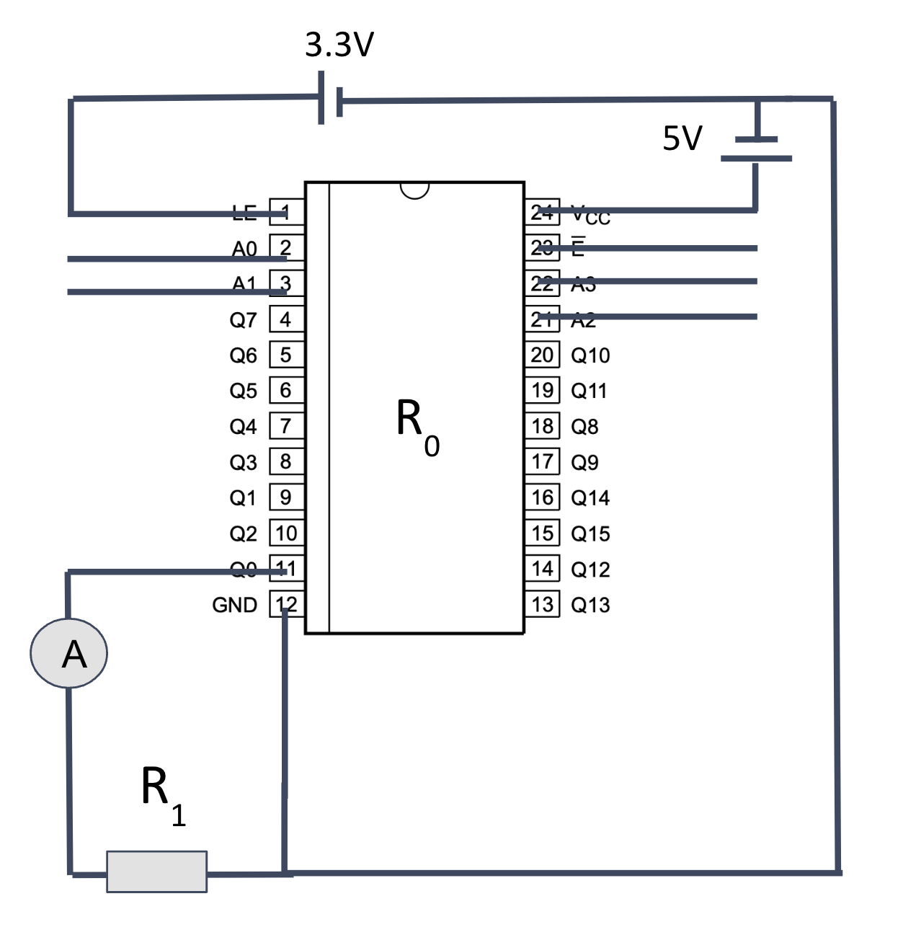


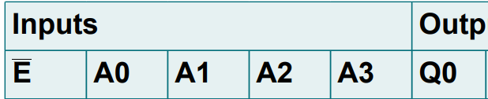

Accuracy Model – Binary Decoders
4:16 Binary Decoder Requirements:
R₀ = 4:16 decoder on-resistance
R₁ = Limiting resistor
Pass Criteria:
125 Ω ± 10 Ω
Number of Tests: 6
Overview
Schedule
Test Readiness – Accuracy
Test Readiness – Timing
Budget
Backup Slides
Notes:
Hey Nick, do we need to SSR in this slide since we will just be using an ammeter to measure the current from the decoder. The next slide is when we integrate everything and test the LED, so maybe we don’t need it here. If you think it is good just for reference though I am okay with it

Slide 32
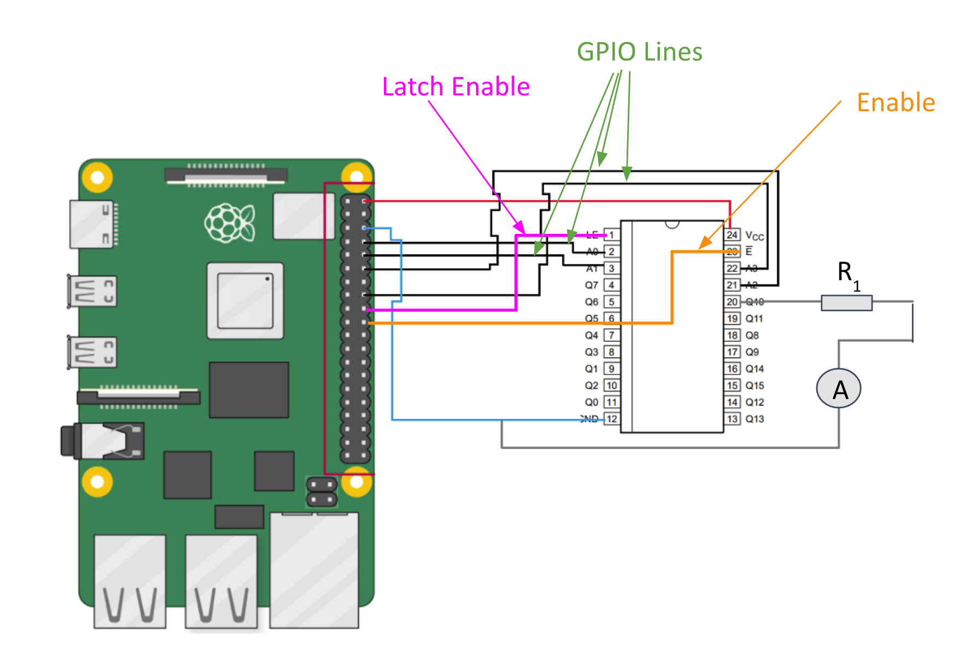
Accuracy Model – Decoder Verification
Pass Criteria:
I_{output, minimum} = 1.0 mA - 3.0 mA
I_{output, ideal} = 3.0 mA – 15.0 mA
I_{output, max} = 50.0 mA
Number of Tests: 6
Overview
Schedule
Test Readiness – Accuracy
Test Readiness – Timing
Budget
Backup Slides

Slide 33
Accuracy Model – SSR On-Resistance Characterization
Characterizing On-Resistance:
Measure on-resistance across contacts 3 & 4
Measure for input current and voltage provided by decoder
Data Sheet Specifications:
Single point specs
On-Resistance = 0.7 Ω
  For I_{forward} = 10.0 mA
Pass Criteria:
On-Resistance cannot exceed 50 Ω
Number of Tests: 78
Overview
Schedule
Test Readiness – Accuracy
Test Readiness – Timing
Budget
Backup Slides
Notes:
Nick, I do not think this is necessarily a function of input current. While input current is variable, there is a certain amount of current the pi can output and if we have the same set up for every test (with respect to binary decoders and SSRs that create the load seen by the pi) which we will, the pi should output roughly the same current every test. This means that once we determine the current given by the pi, we should be able to calculate our component resistances just by testing each SSR with the current that it will see. With respect to how the coding will work, each discrete resistance needs to be known and coded, not a range based on possible output currents from the pi
is this in the right place?

Slide 34
Accuracy Test – Procedure – Decoders
Test Procedure:
Build Circuit
  Place DMM in series between decoder output and ground
Verify Circuit
Configure DMM
  Place DMM in current mode
Run Test
  Use Raspberry Pi code to send high signal
    33 Volts LE
    5V V_{cc} of the decoder
  Record DMM measurement
Overview
Schedule
Test Readiness – Accuracy
Test Readiness – Timing
Budget
Backup Slides
Notes:
Build circuit
Place DMM in series between decoder output and ground
Verify circuit with multiple team members
Configure DMM
Place in current mode
Run Test
Turn on power supply
Record DMM measurement

Slide 35
Accuracy Model – Continuity – Integration
R_{True} = R_{Meas} - R_{Eq}
R_{Eq} = R_{Trace} + 4*R_{Relay}
R_{Eq} = 0.1 Ω + 4*0.7 Ω
R_{Eq} = 2.81Ω
Max Test Current: 1 mA
SSR Relay rated for 1 A
Overview
Schedule
Test Readiness – Accuracy
Test Readiness – Timing
Budget
Backup Slides

Slide 36
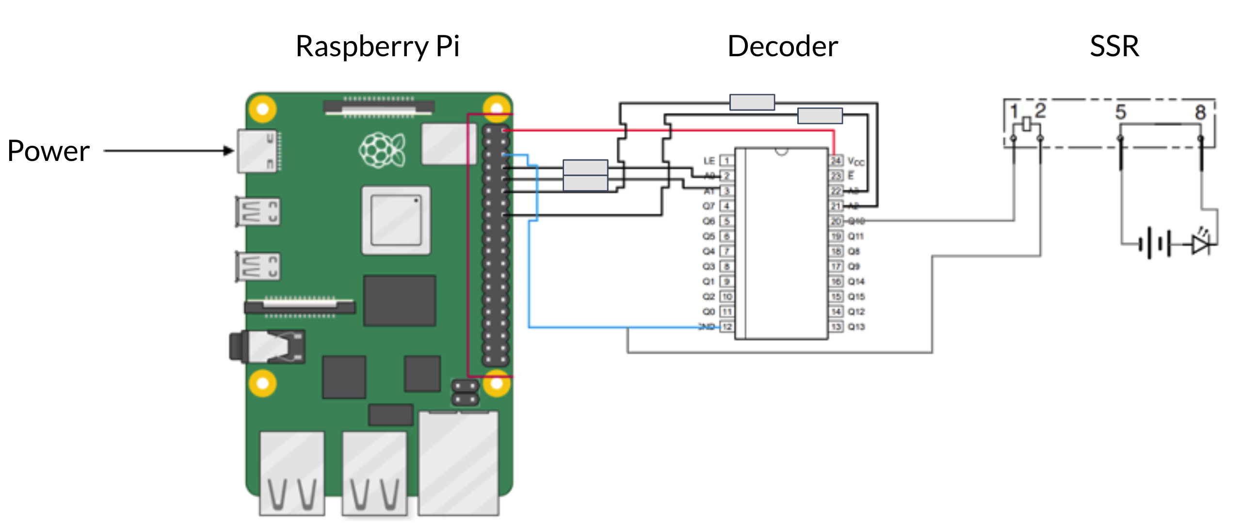
Accuracy Model – Integration
Pass Criteria:
LED lights up
  Ensure the current flow on the output terminal
Number of Tests:
18
Overview
Schedule
Test Readiness – Accuracy
Test Readiness – Timing
Budget
Backup Slides
Notes:
adding a bit more text to this could help - put an ammeter in series and say the pass criteria is led lights up therefore current measure of 1mA

Slide 37
Accuracy Test – Procedure – Integration
Test Procedure:
Set Up Test
  Connect GPIO pins to board via harness
  Connect single SSR to PCB
  Connect SSR output terminals to a breadboard
    With 1mA LED connected in series to the output terminals of SSR
Send Out Signals
  Send High / Low signals to decoder via Raspberry Pi
  Send to SSR of interest
Determine LED Status
  a) Verify LED turns on (~1 mA) when GPIOs are commanded by software
Overview
Schedule
Test Readiness – Accuracy
Test Readiness – Timing
Budget
Backup Slides
Notes:
Build circuit
Place DMM in series between decoder output and ground
Verify circuit with multiple team members
Configure DMM
Place in current mode
Run Test
Use Pi code to send high signal to 3.3V LE and 5V Vcc of the decoder
Record DMM measurement
help w renaming the thin

Slide 38
Accuracy Test – Test Equipment & Facilities
Test Equipment:
Digital Multimeter
Insulation Tester
Power Supply
Raspberry Pi
Facilities:
Electronics Shop in Ann & H.J. Smead Department of Aerospace Engineering Sciences
Overview
Schedule
Test Readiness – Accuracy
Test Readiness – Timing
Budget
Backup Slides
Notes:
Fill this out please

Slide 39
Accuracy Test – Safety Procedures
Personal Risks:
Wear insulating gloves
  Don’t: touch battery, ABSTRACT’s circuity, or probes during test
In the event of battery fire and/or outgassing:
  Pull fire alarm and evacuate room
  Call 911, EHS, and building manager
Hardware Risks:
Battery must be grounded at all times
  ABSTRACT must be grounded during test
Battery safety harness must be attached at all times
Operate ABSTRACT in ESD-protected environment
Remove dust and debris from ABSTRACT’s PCB
  Attach dust covers to battery ports when not in use
Overview
Schedule
Test Readiness – Accuracy
Test Readiness – Timing
Budget
Backup Slides
Notes:
Rest is fine

Slide 40
Risk Reduction
Biggest Risk:
Incorrect component specifications
  Manufacturer specs can be incorrect
  Verify this to prevent false positives or false negatives (CPE 7, FR 3)
Other Risks:
Incorrect circuits created
Damaged battery
Harm to test engineer
Risk Reduction:
Ensure tests are taken at proper instances
Verify all test circuitry with electronics shop faculty
Ensure protective harness is connected to battery
Overview
Schedule
Test Readiness – Accuracy
Test Readiness – Timing
Budget
Backup Slides
Notes:
Were good

Slide 41
Test Readiness - Timing
Overview
Schedule
Test Readiness – Accuracy
Test Readiness – Timing
Budget
Backup Slides

Slide 42
What & Why
Test Objective:
Estimate the time required for each type of measurement
Rationale:
Predict total test duration
Ensure proper software phasing with electrical components
Overview
Schedule
Test Readiness – Accuracy
Test Readiness – Timing
Budget
Backup Slides
Notes:
Make sure this is conversational
Don’t get too technical so you don’t lose the PAB
Mention reqs -> leads into next slide

Slide 43
Requirement Verification
FR 4
Customer Value
System shall provide value to the customer
DR 2
Time Elapsed
System shall not take more total elapsed time compared to the current solution of 4 hours
CPE 7
Result Reliability
System shall not report any false passes or false failures for test criteria
FR 3
Reliability
System shall not report any false positives or false negatives
Overview
Schedule
Test Readiness – Accuracy
Test Readiness – Timing
Budget
Backup Slides
Notes:
Look at rhode notes doc for comments, slide looks good

Slide 44
Prerequisite Tests
Planned Tests:
SSR Time Spec Verification (w/ Datasheet)
Measurement Circuit Rise Time (w/ Oscilloscope)
Completed Tests:
PCB Functional Test
DMM ⬄ Pi Interfacing (SCPI)
Insulation Tester ⬄ Pi Interfacing (SCPI)
Pi ⬄ GUI (Displaying Values)
Pi ⬄ Binary Decoder Resistor Verification
Pi ⬄ Devices Calibration (Data Sampling Rate)
Overview
Schedule
Test Readiness – Accuracy
Test Readiness – Timing
Budget
Backup Slides
Notes:
Check rhode notes doc for comments, seems like he like this, but wants to use fbd in next slide

Slide 45
Functional Block Diagram
Overview
Schedule
Test Readiness – Accuracy
Test Readiness – Timing
Budget
Backup Slides

Slide 46
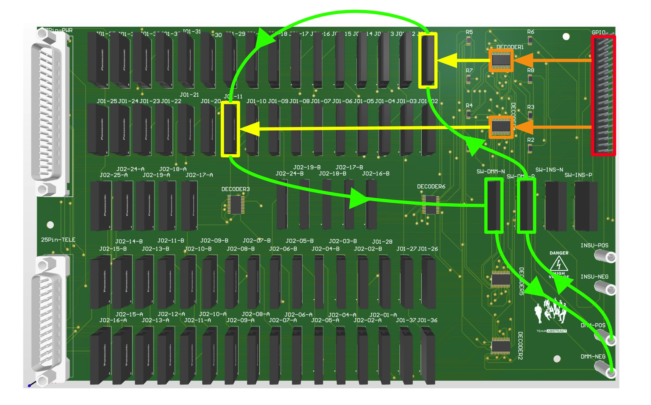
Functional Block Diagram – In Depth
Overview
Schedule
Test Readiness – Accuracy
Test Readiness – Timing
Budget
Backup Slides
Notes:
Make a more FBD of just the timing model (so lots of PCB stuff)

Slide 47
Timing Model – Circuitry
Circuit for Testing: Continuity
Overview
Schedule
Test Readiness – Accuracy
Test Readiness – Timing
Budget
Backup Slides

Slide 48
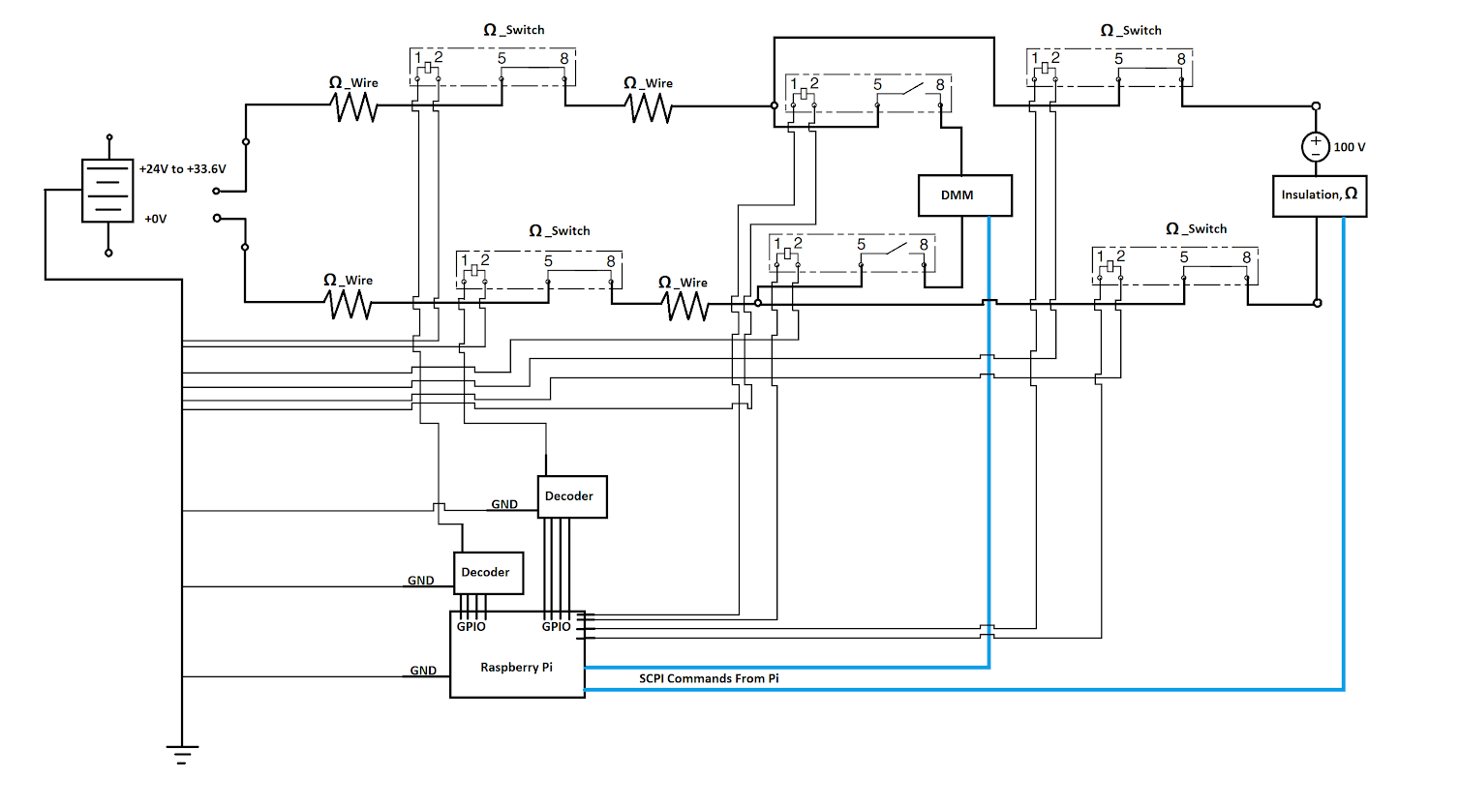
Timing Model – Circuitry
Circuit for Testing: Insulation
Overview
Schedule
Test Readiness – Accuracy
Test Readiness – Timing
Budget
Backup Slides
Notes:
Make sure these make sense to have

Slide 49
Timing Model
Component | Timing Delay (Maximum)
Binary Decoder Activation | 0.0049 ms
SSRs Close Circuit | 5 ms
DMM Measurement | ~ 0.5 s
Insulation | 10 – 60 s
Binary Decoder Deactivation | 0.0007 ms
SSRs Open Circuit | 5 ms
Overview
Schedule
Test Readiness – Accuracy
Test Readiness – Timing
Budget
Backup Slides
Notes:
Throw in new FBD on left side as well

Slide 50
Timing Model
Mathematical Model:
For all measurements:
Time Req. per Meas. = 2*(Binary Decoder Activate) + 2*(SSR Close) + (Measurement) +
2*(Binary Decoder Deactivate) + 2*(SSR Open)
Total time for all measurements
Total Time = (Time Req. per Volt. measurement) x (# of Volt. measurements)
+ (Time Req. per Res. measurement) x (# of Res. measurements)
+ (Time Req. per Cont. measurement) x (# of Cont. measurements)
+ (Time Req. per Iso. measurement) x (# of Iso. measurements)
+ (Time Req. per Ins. measurement) x (# of Ins. measurements)
Overview
Schedule
Test Readiness – Accuracy
Test Readiness – Timing
Budget
Backup Slides
Notes:
I think this would be a good thing to have ? Use this idea, go off of it. I think it would be nice

Slide 51
Timing Model – Volt./Res./Cont./Iso.
Mathematical Model:
For Volt./Res./Cont./Iso. measurements:
Time Req. per Meas. = 2*(Binary Decoder Activate) + 2*(SSR Close) + (Measurment) +
2*(Binary Decoder Deactivate) + 2*(SSR Open)
Time Req. per Meas. = 2*(0.0049 ms) + 2*(5 ms) + (0.5 s) + 2*(0.0007 ms) + 2*(5 ms)
Time Req. per Meas. = 510.0056 ms → 0.51 s
Time Req. for all Volt./Res./Cont./Iso. measurements:
Total Time = (Time Req. per Meas.) x (# of measurements)
Total Time = (0.51 s) x (193) = 98.43 s → 1 min 38 s
Overview
Schedule
Test Readiness – Accuracy
Test Readiness – Timing
Budget
Backup Slides
Notes:
I think this would be a good thing to have ? Use this idea, go off of it. I think it would be nice

Slide 52
Timing Model – Insulation – Slowest
Mathematical Model:
For Insulation measurement (Slowest):
Time Req. per Meas. = 2*(Binary Decoder Activate) + 2*(SSR Close) + (Insulation Meas.) +
2*(Binary Decoder Deactivate) + 2*(SSR Open)
Time Req. per Meas. = 2*(0.0049 ms) + 2*(5 ms) + (60 s) + 2*(0.0007 ms) + 2*(5 ms)
Time Req. per Meas. = 60010.0056 ms → 60.01 s
Time Req. for all Insulation measurements (Slowest):
Total Time = (Time Req. per Meas.) x (# of measurements)
Total Time = (60.01 s) x (154) = 9241.54 s → 2 hr 34 min 2 s
Overview
Schedule
Test Readiness – Accuracy
Test Readiness – Timing
Budget
Backup Slides
Notes:
I think this would be a good thing to have ? Use this idea, go off of it. I think it would be nice

Slide 53
Timing Model – Insulation – Fastest
Mathematical Model:
For Insulation measurement (Fastest):
Time Req. per Meas. = 2*(Binary Decoder Activate) + 2*(SSR Close) + (Insulation Meas.) +
2*(Binary Decoder Deactivate) + 2*(SSR Open)
Time Req. per Meas. = 2*(0.0049 ms) + 2*(5 ms) + (10 s) + 2*(0.0007 ms) + 2*(5 ms)
Time Req. per Meas. = 10010.0056 ms → 10.01 s
Time Req. for all Insulation measurements (Fastest):
Total Time = (Time Req. per Meas.) x (# of measurements)
Total Time = (10.01 s) x (154) = 1541.54 s → 25 min 42 s
Overview
Schedule
Test Readiness – Accuracy
Test Readiness – Timing
Budget
Backup Slides
Notes:
I think this would be a good thing to have ? Use this idea, go off of it. I think it would be nice

Slide 54
Timing Model – Total – Slowest
Mathematical Model:
Total time for all measurements (Slowest)
Total Time = (Time Req. per Volt. measurement) x (# of Volt. measurements)
+ (Time Req. per Res. measurement) x (# of Res. measurements)
+ (Time Req. per Cont. measurement) x (# of Cont. measurements)
+ (Time Req. per Iso. measurement) x (# of Iso. measurements)
+ (Time Req. per Ins. measurement) x (# of Ins. measurements)
Total Time = (1 min 38 s) + (2 hr 34 min 2 s) = 2 hr 35 min 40 s
Slowest Total Elapsed Time: 2 hr 34 min 2 s < 4 hr (DR 4.2)
DR 4.2
Overview
Schedule
Test Readiness – Accuracy
Test Readiness – Timing
Budget
Backup Slides
Notes:
I think this would be a good thing to have ? Use this idea, go off of it. I think it would be nice

Slide 55
Timing Model – Total – Fastest
Mathematical Model:
Total time for all measurements (Fastest)
Total Time = (Time Req. per Volt. measurement) x (# of Volt. measurements)
+ (Time Req. per Res. measurement) x (# of Res. measurements)
+ (Time Req. per Cont. measurement) x (# of Cont. measurements)
+ (Time Req. per Iso. measurement) x (# of Iso. measurements)
+ (Time Req. per Ins. measurement) x (# of Ins. measurements)
Total Time = (1 min 38 s) + (25 min 42 s) = 27 min 20 s
Fastest Total Elapsed Time: 27 min 20 s < 4 hr (DR 4.2)
DR 4.2
Overview
Schedule
Test Readiness – Accuracy
Test Readiness – Timing
Budget
Backup Slides
Notes:
I think this would be a good thing to have ? Use this idea, go off of it. I think it would be nice

Slide 56
Timing Test - Procedure
Test Procedure:
Sensor Calibration / Data Acquisition – Measurement Device Settings
  Data bits
  Synchronization bits
  Parity Bits
  Baud Rate
Build Circuit
Run Software
  Start a timer
  Execute test code
    Close circuit
    Command measurement
    Display to GUI
  Stop timer
Compare Actual Time to Model Time
Overview
Schedule
Test Readiness – Accuracy
Test Readiness – Timing
Budget
Backup Slides
Notes:
Yall update when possible

Slide 57
Timing Test – Test Equipment & Facilities
Test Equipment:
Raspberry Pi
PCB (populated for 1 circuit)
DMM
Insulation Tester
Monitor
Keyboard / Mouse
Oscilloscope
Test Software in Thonny Python IDE
Cables
  40 pin Ribbon
  USB to RS232 (x2)
  Micro-HDMI to HDMI
  15 W USB-C Power Supply
  DMM Power Supply
  Insulation Tester Power Supply
  Measurement Probes (Banana / Clip) (x2)
  BNC Coaxial Cables (x2)
Facilities:
Electronics Shop in Ann & H.J. Smead Department of Aerospace Engineering Sciences
Overview
Schedule
Test Readiness – Accuracy
Test Readiness – Timing
Budget
Backup Slides
Notes:
Rhode said potentially throw fbd / image in empty space

Slide 58
Timing Test – Safety Procedures
Personal Risks:
Wear insulating gloves
  Don’t: touch battery, ABSTRACT’s circuity, or probes during test
In the event of battery fire and/or outgassing:
  Pull fire alarm and evacuate room
  Call 911, EHS, and building manager
Hardware Risks:
Battery must be grounded at all times
  ABSTRACT must be grounded during test
Battery safety harness must be attached at all times
Operate ABSTRACT in ESD-protected environment
Remove dust and debris from ABSTRACT’s PCB
  Attach dust covers to battery ports when not in use
Overview
Schedule
Test Readiness – Accuracy
Test Readiness – Timing
Budget
Backup Slides
Notes:
Idk if this is good? Could change around. Empty slide, needs filling out

Slide 59
Risk Reduction
Biggest Risk:
Incorrect component specifications
  Manufacturer specs can be incorrect
  Verify this to prevent false positives or false negatives (CPE 7, FR 3)
Other Risks:
Incorrect circuits created
Damaged battery
Harm to test engineer
Risk Reduction:
Ensure tests are taken at proper instances
Verify all test circuitry with electronics shop faculty
Ensure protective harness is connected to battery
Overview
Schedule
Test Readiness – Accuracy
Test Readiness – Timing
Budget
Backup Slides
Notes:
Unsure if this is necessary

Slide 60
Budget
Overview
Schedule
Test Readiness – Accuracy
Test Readiness – Timing
Budget
Backup Slides

Slide 61
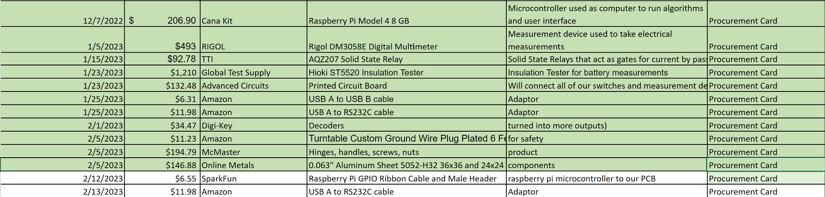
Purchased Items
All listed items have been purchased and received by ABSTRACT
Overview
Schedule
Test Readiness – Accuracy
Test Readiness – Timing
Budget
Backup Slides

Slide 62
Remaining Purchases
All listed items are remaining purchases
Overview
Schedule
Test Readiness – Accuracy
Test Readiness – Timing
Budget
Backup Slides

Slide 63
Remaining Purchases
Current budget spent: $2759.35
Current budget remaining: $1240.65
Current budget planning on being spent: $760
Current budget margin: $480
Overview
Schedule
Test Readiness – Accuracy
Test Readiness – Timing
Budget
Backup Slides

Slide 64
Questions?
Overview
Schedule
Test Readiness – Accuracy
Test Readiness – Timing
Budget
Backup Slides

Slide 65
Backup Slides
Overview
Schedule
Test Readiness – Accuracy
Test Readiness – Timing
Budget
Backup Slides

Slide 66
Altium Design Schematic
Overview
Schedule
Test Readiness – Accuracy
Test Readiness – Timing
Budget
Backup Slides

Slide 67
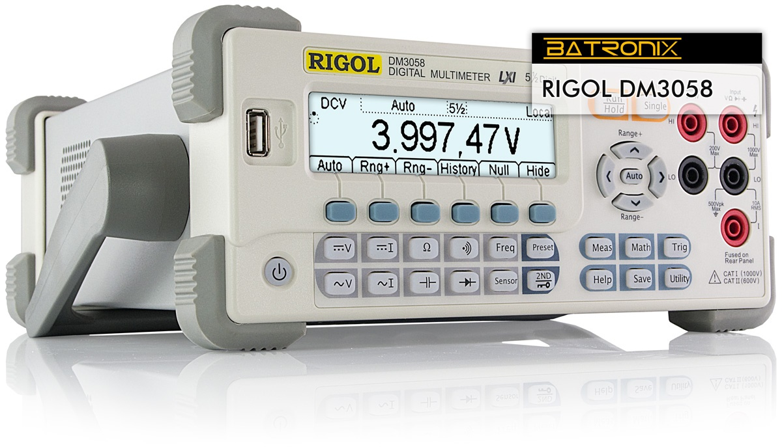
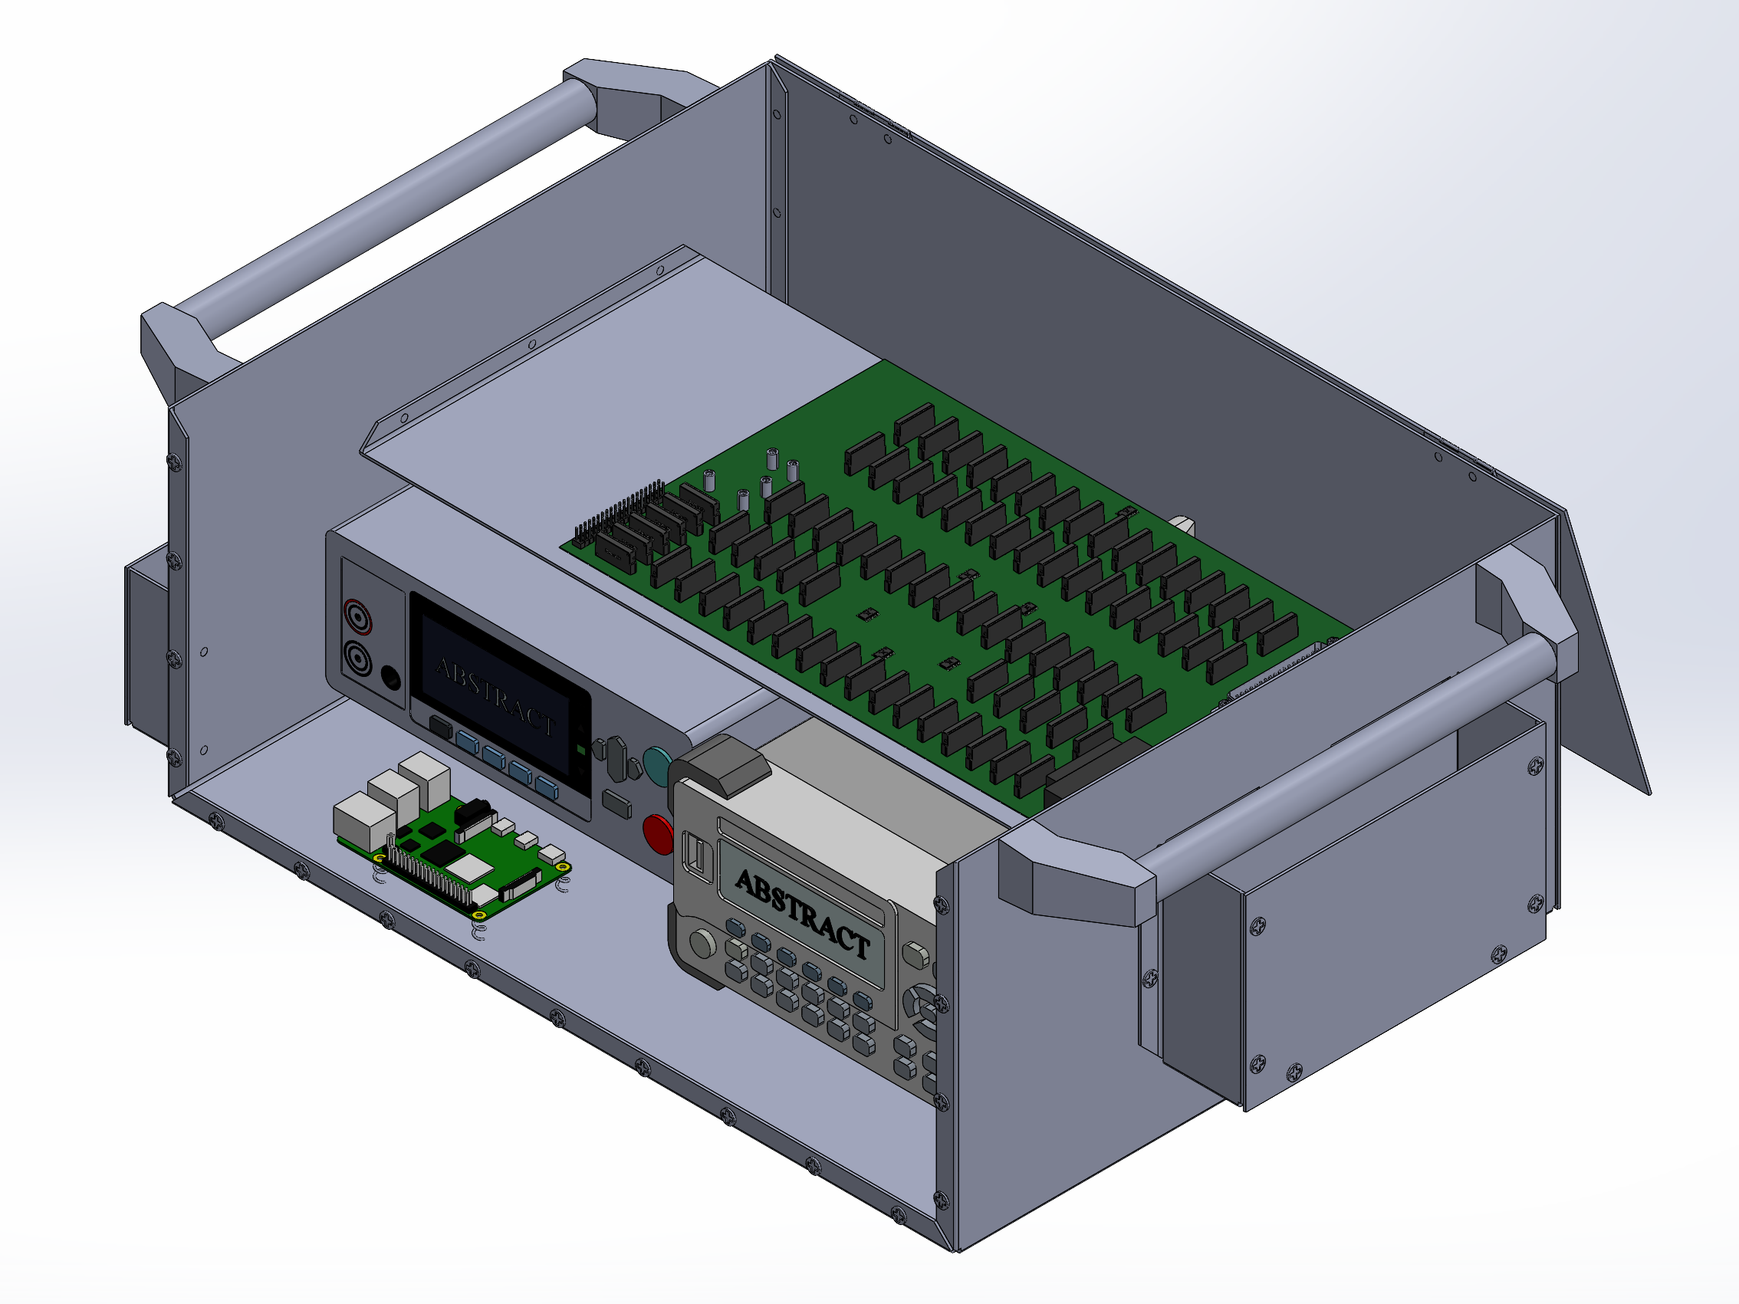
Digital Multimeter
Sizing Dimensions:
10.7 cm x 23.2 cm x 29.1 cm
Weight:
2.50 kg
Accuracy:
Discussed in design requirements
5.5 digit Resolution
Overview
Schedule
Test Readiness – Accuracy
Test Readiness – Timing
Budget
Backup Slides

Slide 68

Insulation Tester
Sizing Dimensions:
21.5 cm x 8.0 cm x 16.6 cm
Weight:
1.10 kg
Accuracy:
Discussed in design requirements
1 V Resolution
Overview
Schedule
Test Readiness – Accuracy
Test Readiness – Timing
Budget
Backup Slides

Slide 69
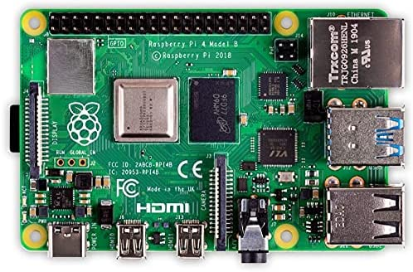
Raspberry Pi
Sizing Dimensions:
8.56 cm x 5.65 cm
Coding:
IDLE IDE
  Python language
Model:
Raspberry Pi 4 Model B
8 GB of ram
Overview
Schedule
Test Readiness – Accuracy
Test Readiness – Timing
Budget
Backup Slides

Slide 70
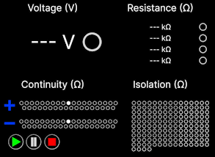
Graphical User Interface (GUI)
Coding:
IDLE IDE
  Python language
TKinter
  GUI toolbox
  Compatible with Python
Standard Commands for Programmable Instruments (SCPI)
  Compatible with DMM
  Compatible with Insulation Tester
Overview
Schedule
Test Readiness – Accuracy
Test Readiness – Timing
Budget
Backup Slides

Slide 71
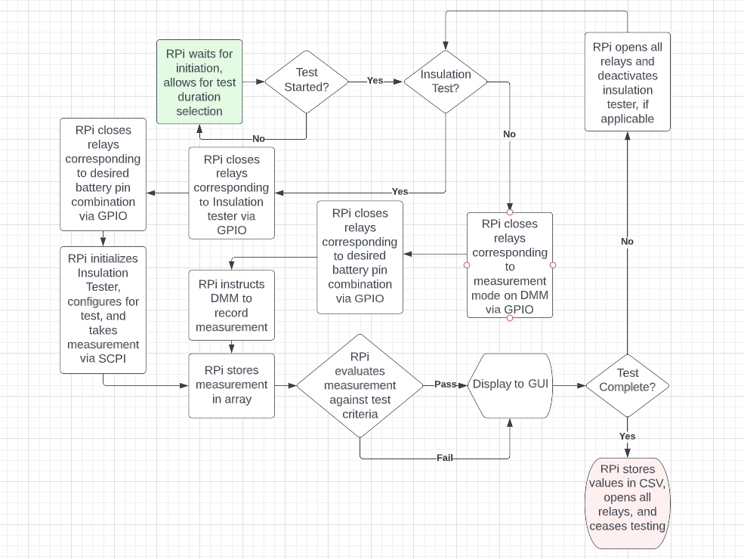
Software Code Flowchart
Overview
Schedule
Test Readiness – Accuracy
Test Readiness – Timing
Budget
Backup Slides

Slide 72
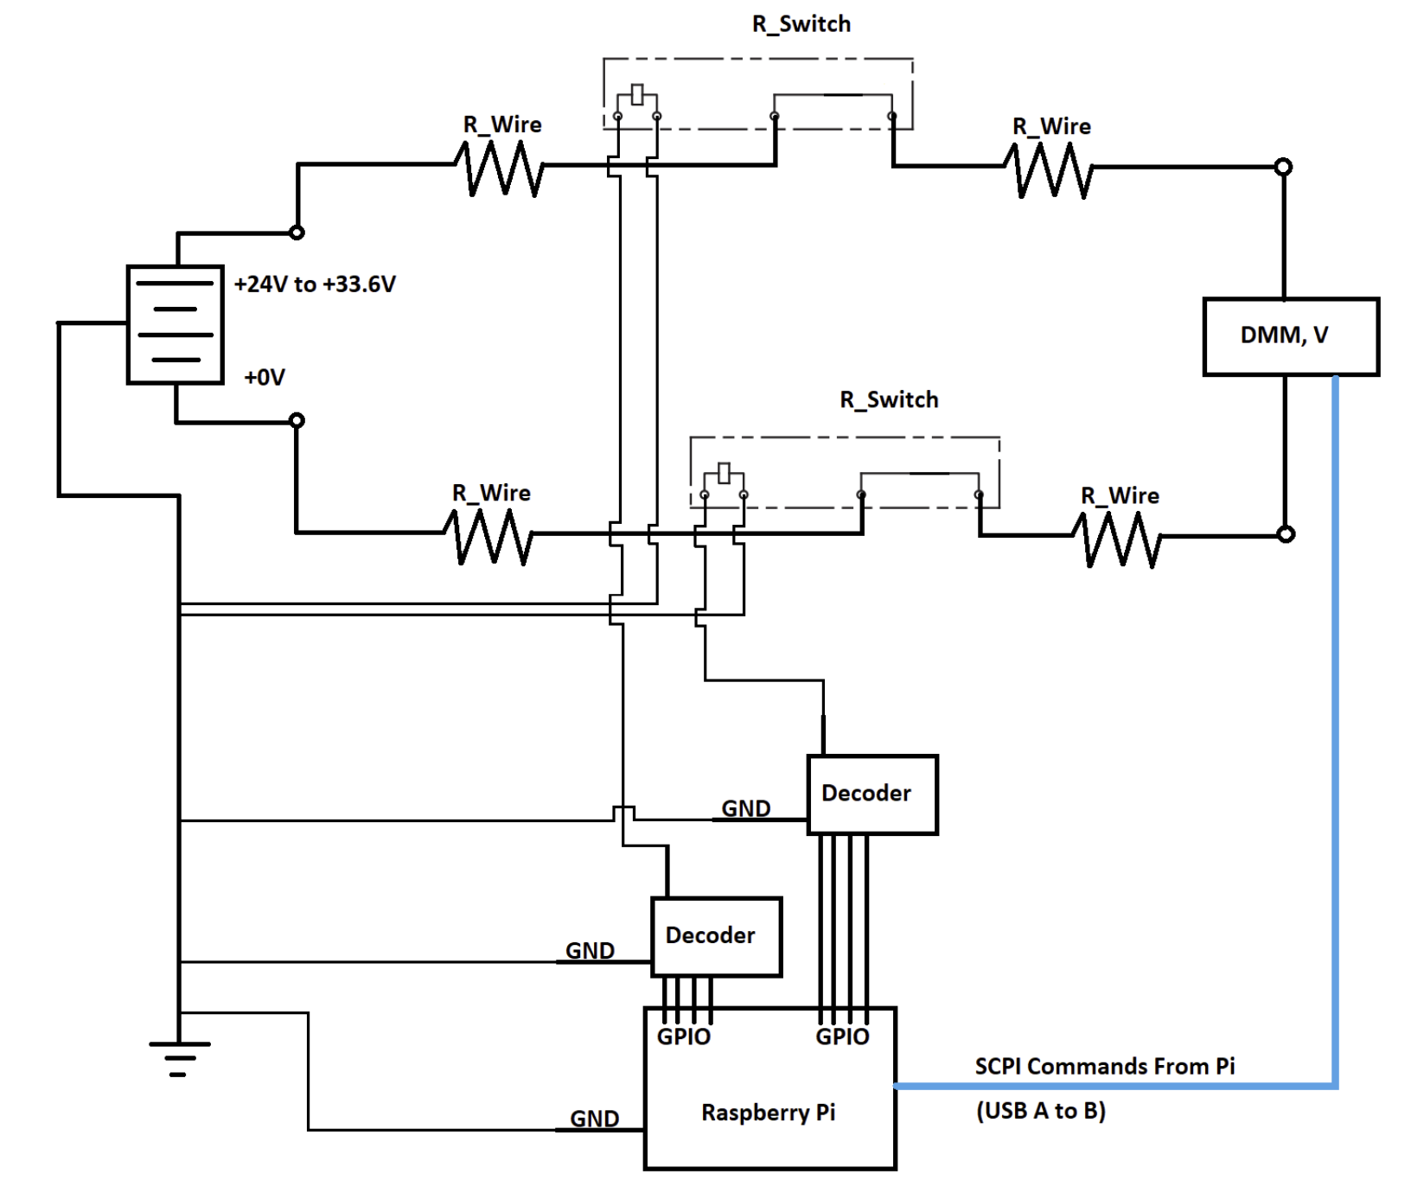
Accuracy Model – Voltage
V_{True} = V_{Meas} + V_{Drop}
V_{Drop} = I_{Batt} * R_{Eq}
I_{Batt} = V_{Batt} / R_{DMM} = 2.9 µA
R_{Eq} = R_{Wire} + 2*R_{Switch}
R_{Eq} = 0.01Ω + 1.4Ω = 1.41Ω
V_{Drop} = 4.1 µV
Overview
Schedule
Test Readiness – Accuracy
Test Readiness – Timing
Budget
Backup Slides

Slide 73
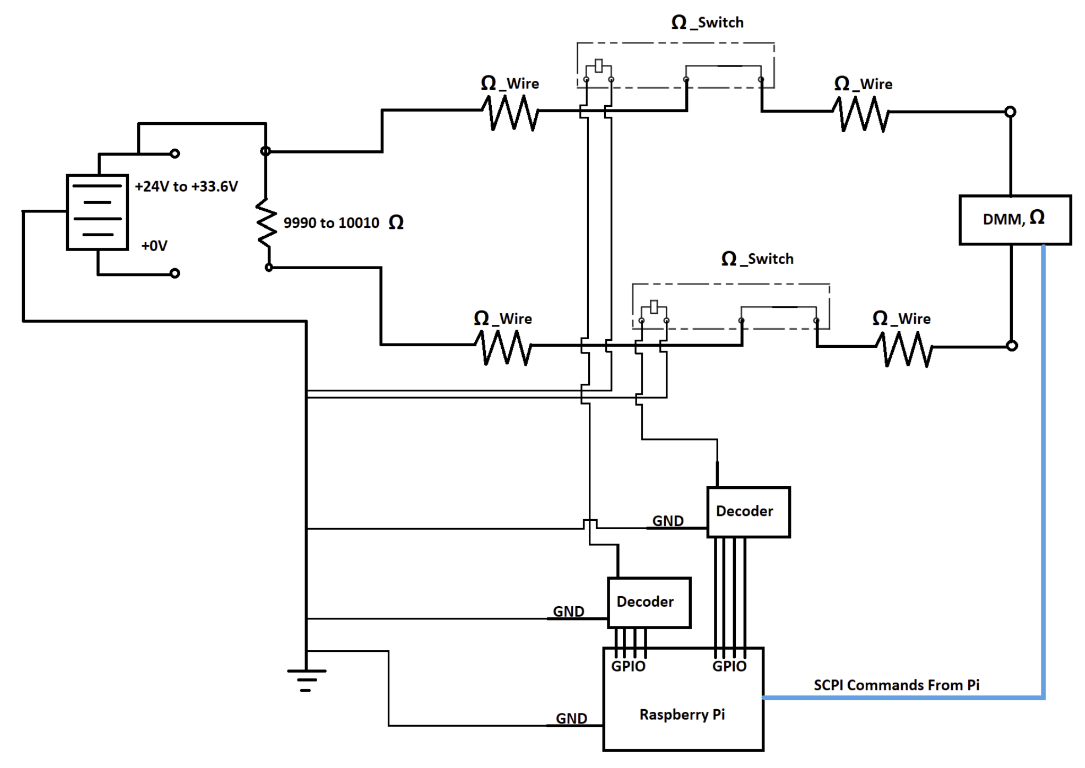
Accuracy Model – Resistance
R_{True} = R_{Meas} - R_{Eq}
R_{Eq} = R_{Wire} + 2*R_{Switch}
R_{Eq} = 1.41Ω
Max Test Current: 100 µA
SSR Relay rated for 1 A
Overview
Schedule
Test Readiness – Accuracy
Test Readiness – Timing
Budget
Backup Slides

Slide 74
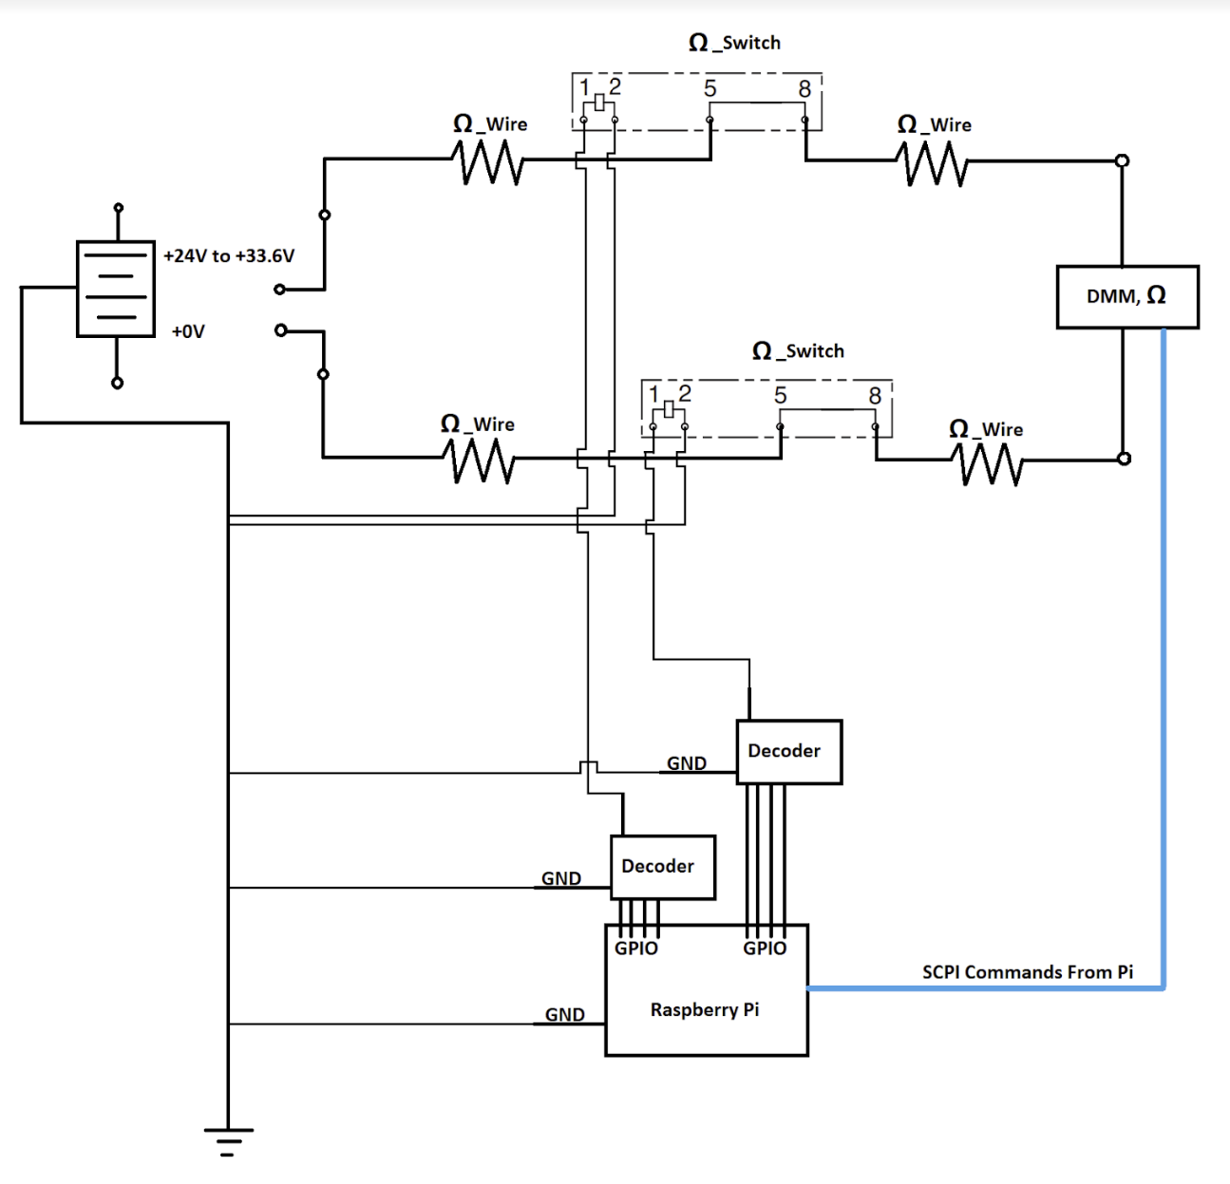
Accuracy Model – Isolation
R_{True} = R_{Meas} - R_{Eq}
R_{Eq} = R_{Wire} + 2*R_{switch}
R_{Eq} =1.41Ω
Max Test Current: 200 nA
SSR Relay rated for 1 A
Overview
Schedule
Test Readiness – Accuracy
Test Readiness – Timing
Budget
Backup Slides

Slide 75
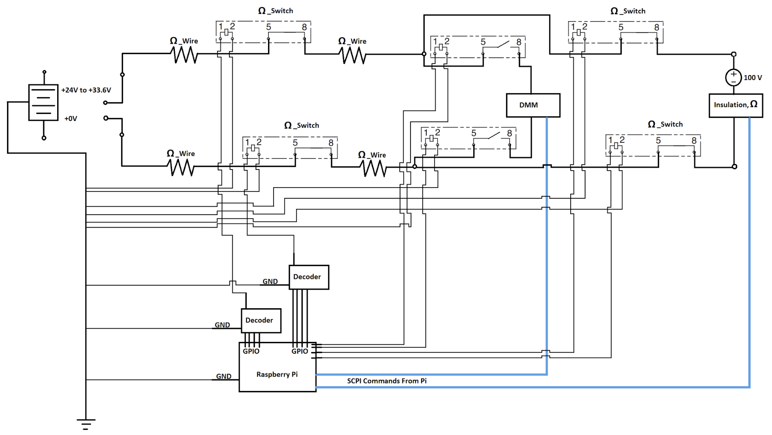
Accuracy Model – Insulation
R_{True} = R_{Meas} - R_{Eq}
R_{Eq} = R_{Wire} + 2*R_{switch}
R_{Eq} =1.41Ω
Max Test Current: 1 mA
SSR Relay rated for 1 A
Overview
Schedule
Test Readiness – Accuracy
Test Readiness – Timing
Budget
Backup Slides

Slide 76
Battery Layout
8s16p Battery – Power Circuit
Overview
Schedule
Test Readiness – Accuracy
Test Readiness – Timing
Budget
Backup Slides

Slide 77
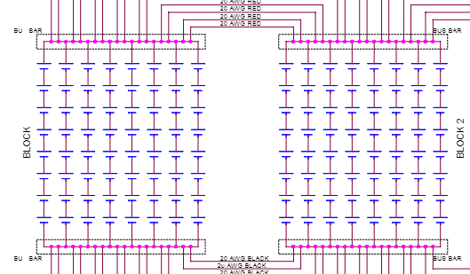
Battery Layout
8s16p Battery – Cell Layout
8s:
8 cells in series
Boxed in red
16p:
16 cells in parallel
Boxed in Blue
Overview
Schedule
Test Readiness – Accuracy
Test Readiness – Timing
Budget
Backup Slides

Slide 78
Battery Layout
8s16p Battery – Bus Bar
Bus Bars:
Positive End
  Boxed in red
Negative End
  Boxed in blue
Cells are connected to these bus bars
Overview
Schedule
Test Readiness – Accuracy
Test Readiness – Timing
Budget
Backup Slides

Slide 79
Battery Layout
8s16p Battery – Power Connector
Power Connector:
Voltage outputs of the positive and negative bus bars are split into 37 pin connector
Positive pins boxed in red
Negative pins boxed in blue
Single blank pin
Overview
Schedule
Test Readiness – Accuracy
Test Readiness – Timing
Budget
Backup Slides

Slide 80
Battery Layout
8s16p Battery – Telemetry Circuit
Overview
Schedule
Test Readiness – Accuracy
Test Readiness – Timing
Budget
Backup Slides

Slide 81
Battery Layout
8s16p Battery – Voltage Sense
Voltage Sense:
Used by payload to monitor the voltage output of the 8s16p battery
4 voltage sense pins
  2 positive (red)
  2 negative (blue)
Voltage sense pins are connected to 10 kOhm resistor
  Payload does not need high voltage to read battery output
Overview
Schedule
Test Readiness – Accuracy
Test Readiness – Timing
Budget
Backup Slides

Slide 82
Battery Layout
8s16p Battery – Blank Pins
Blank Pins:
There are blank pins
White pins (no black)
No electrical connection to battery
Overview
Schedule
Test Readiness – Accuracy
Test Readiness – Timing
Budget
Backup Slides

Slide 83
PCB Board
What’s Included:
79 solid state relays for testing circuit
4 solid state relays for insulation circuit
Panasonic AQZ207
6 decoders
Nexperia 74HC4514
1 37-pin power connector
Amphenol L717TSCH37POL2RM8
1 25-pin telemetry connector
Amphenol L717TSBH25POL2RM8
1 GPIO connector
PRT-14275
4 Banana cable connectors
105-0852-001
Overview
Schedule
Test Readiness – Accuracy
Test Readiness – Timing
Budget
Backup Slides

Slide 84
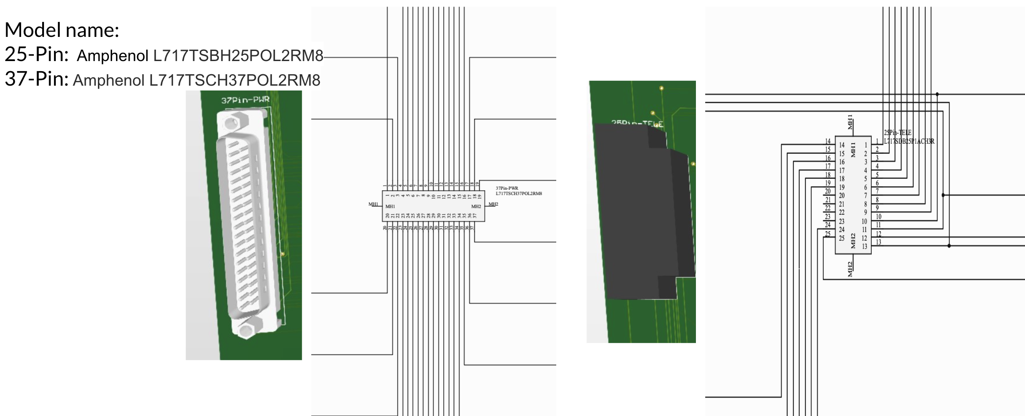
PCB Board – Connection to Battery
Overview
Schedule
Test Readiness – Accuracy
Test Readiness – Timing
Budget
Backup Slides

Slide 85
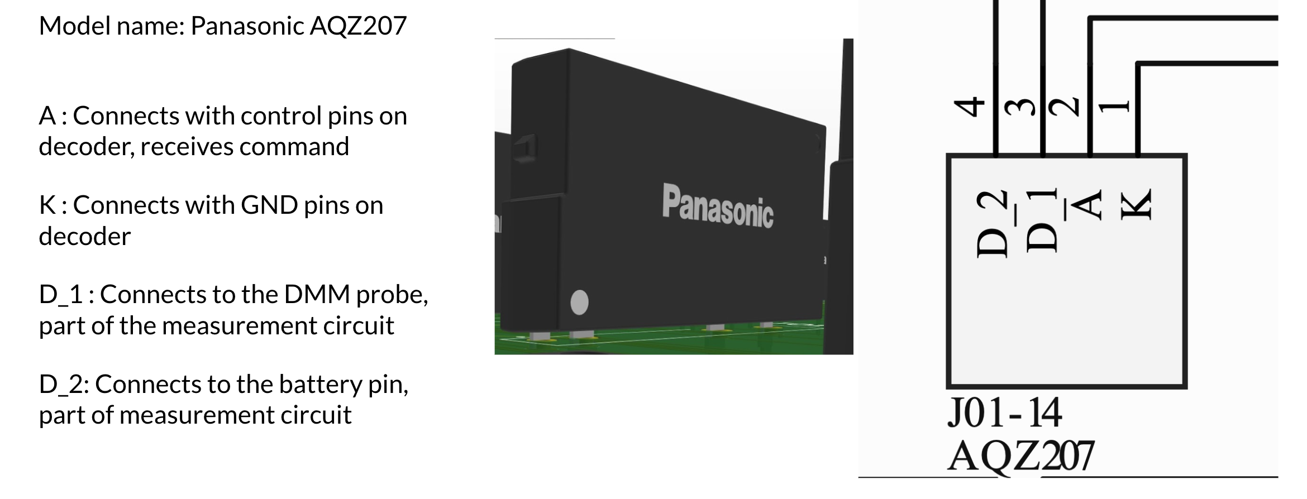
PCB Board – Solid State Relays
Overview
Schedule
Test Readiness – Accuracy
Test Readiness – Timing
Budget
Backup Slides

Slide 86
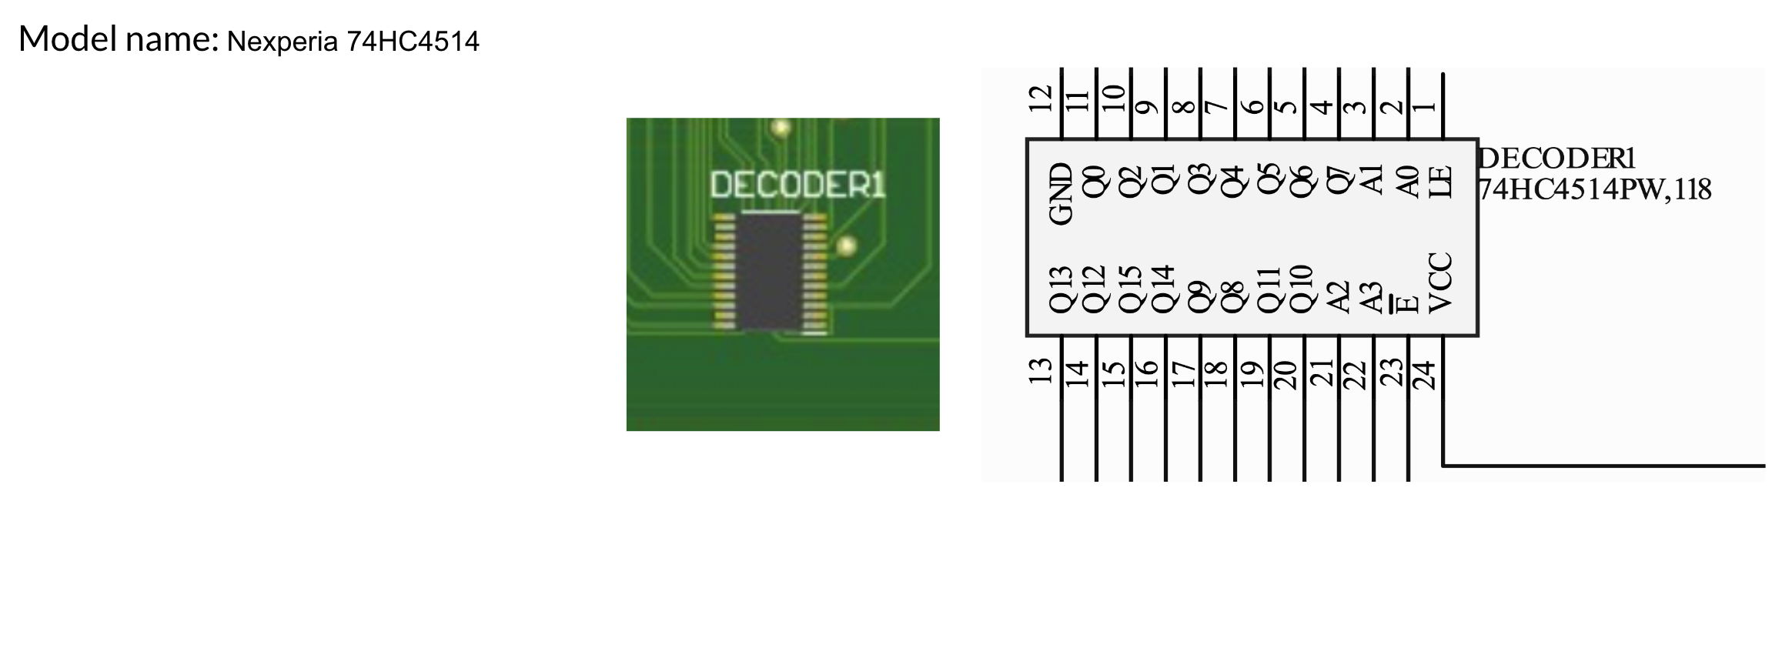
PCB Board – Decoder
Overview
Schedule
Test Readiness – Accuracy
Test Readiness – Timing
Budget
Backup Slides

Slide 87
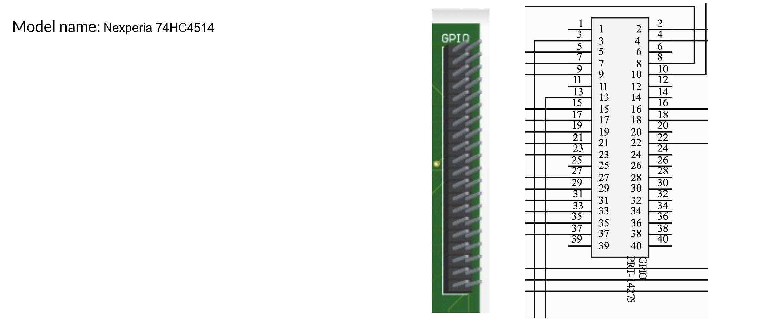
PCB Board – GPIO Connector
Overview
Schedule
Test Readiness – Accuracy
Test Readiness – Timing
Budget
Backup Slides

Slide 88
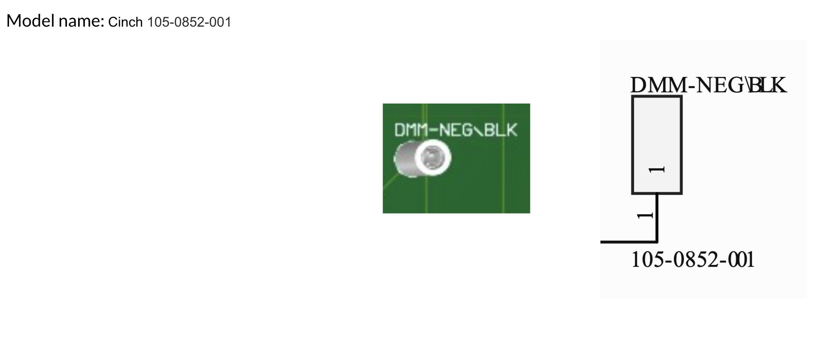
PCB Board – Banana Jack Cables
Overview
Schedule
Test Readiness – Accuracy
Test Readiness – Timing
Budget
Backup Slides

Slide 89
Full Requirement Flowdown
FR | DR | DR | DR | Requirement
1 |  |  |  | System shall test the battery for electrical performance
 | 1.1 |  |  | System shall test for positive continuity
 |  | 1.1.1 |  | System shall measure resistance across test points (designated in the functional test template) for values < 1 Ohm
 |  |  | 1.1.1.1 | System shall measure continuity with an uncertainty of ± 25 % of reading
 |  |  | 1.1.1.2 | System shall measure resistance across test points within 5 ms (based on resistance measurement settling time of PXI DMM datasheet with factor of safety of 5)
 | 1.2 |  |  | System shall test for negative continuity
 |  | 1.2.1 |  | System shall measure resistance across test points (designated in the functional test template) for values < 1 Ohm
 |  |  | 1.2.1.1 | System shall measure continuity with an uncertainty of ± 25 % of reading
 |  |  | 1.2.1.2 | System shall measure resistance across test points within 5 ms (based on resistance measurement settling time of PXI DMM datasheet with factor of safety of 5)
Overview
Schedule
Test Readiness – Accuracy
Test Readiness – Timing
Budget
Backup Slides

Slide 90
Full Requirement Flowdown
FR | DR | DR | DR | Requirement
 | 1.3 |  |  | System shall test for voltage
 |  | 1.3.1 |  | System shall measure voltage across test points (designated in the functional test template) for values in the range of [24.01 V - 33.59 V]
 |  |  | 1.3.1.1 | System shall measure voltage with an uncertainty of ± 0.025 % of reading
 |  |  | 1.3.1.2 | System shall measure voltage across test points within 5 ms (based on voltage measurement settling time of PXI DMM datasheet with factor of safety of 5)
 | 1.4 |  |  | System shall test for isolation
 |  | 1.4.1 |  | System shall measure resistance across test points (designated in the functional test template) for values > 10.025 MOhms
 |  |  | 1.4.1.1 | System shall measure resistance with an uncertainty of ± 0.25 % of reading
 |  |  | 1.4.1.2 | System shall measure resistance across test points for 10 seconds
 | 1.5 |  |  | System shall test for insulation
 |  | 1.5.1 |  | System shall measure resistance across test points for values > 10 MOhms while applying + 100 V across the test points for 60 seconds or until resistance measurement is stable (minimum 10 seconds)
 |  |  | 1.5.1.1 | System shall measure resistance with an uncertainty of ± 3 % of reading
Overview
Schedule
Test Readiness – Accuracy
Test Readiness – Timing
Budget
Backup Slides

Slide 91
Full Requirement Flowdown
FR | DR | DR | DR | Requirement
 | 1.6 |  |  | System shall test for resistance
 |  | 1.6.1 |  | System shall measure resistance across test points (designated in the functional test template) for a value of 10 kOhm ± 7 Ohm
 |  |  | 1.6.1.1 | System shall measure resistance with an uncertainty of ± 0.025 % of reading
 |  |  | 1.6.1.2 | System shall measure resistance across test points within 25 ms (based on resistance measurement settling time of PXI DMM datasheet with factor of safety of 5)
2 |  |  |  | System shall test the battery automatically
 | 2.1 |  |  | System shall test continuity without technician input after test has been started
 |  | 2.1.1 |  | System shall access the required test points (designated in the functional test template)
 |  |  | 2.1.1.1 | System shall send a command signal to the proper switches corresponding to the proper test points
 |  |  | 2.1.1.2 | System shall verify the proper test points are accessed
 |  | 2.1.2 |  | System shall send a command signal to the digital multimeter to measure resistance across the proper test points
 |  |  | 2.1.2.1 | System shall take the resistance measurement at the measurement circuit output
 |  |  | 2.1.2.2 | System shall store the resistance measurement value
 |  | 2.1.3 |  | System shall cease to access the required test points
 |  |  | 2.1.3.1 | System shall send a command signal to the proper switches corresponding to the proper test points
Overview
Design Solution
Critical Project Elements
Design Requirements
Project Risks
Verification & Validation
Project Planning

Slide 92
Full Requirement Flowdown
FR | DR | DR | DR | Requirement
 | 2.2 |  |  | System shall test voltage without technician input
 |  | 2.2.1 |  | System shall access the required test points (designated in the functional test template)
 |  |  | 2.2.1.1 | System shall send a command signal to the proper switches corresponding to the proper test points
 |  |  | 2.2.1.2 | System shall verify the proper test points are accessed
 |  | 2.2.2 |  | System shall send a command signal to the digital multimeter to measure voltage across the proper the proper test points
 |  |  | 2.2.2.1 | System shall take the voltage measurement at the measurement circuit output
 |  |  | 2.2.2.2 | System shall store the voltage measurement value
 |  | 2.2.3 |  | System shall cease to access the required test points
 |  |  | 2.2.3.1 | System shall send a command signal to the proper switches corresponding to the proper test points
Overview
Schedule
Test Readiness – Accuracy
Test Readiness – Timing
Budget
Backup Slides

Slide 93
Full Requirement Flowdown
FR | DR | DR | DR | Requirement
 | 2.3 |  |  | System shall test isolation without technician input
 |  | 2.3.1 |  | System shall access the required test points (designated in the functional test template)
 |  |  | 2.3.1.1 | System shall send a command signal to the proper switches corresponding to the proper test points
 |  |  | 2.3.1.2 | System shall verify the proper test points are accessed
 |  | 2.3.2 |  | System shall send a command signal to the digital multimeter to measure resistance across the proper test points
 |  |  | 2.3.2.1 | System shall take the resistance measurement value at the measurement circuit output
 |  |  | 2.3.2.2 | System shall store the resistance measurement value
 |  | 2.3.3 |  | System shall cease to access the required test points
 |  |  | 2.3.3.1 | System shall send a command signal to the proper switches corresponding to the proper test points
Overview
Schedule
Test Readiness – Accuracy
Test Readiness – Timing
Budget
Backup Slides

Slide 94
Full Requirement Flowdown
FR | DR | DR | DR | Requirement
 | 2.4 |  |  | System shall test resistance without technician input
 |  | 2.4.1 |  | System shall access the required test points (designated in the functional test template)
 |  |  | 2.4.1.1 | System shall send a command signal to the proper switches corresponding to the proper test points
 |  |  | 2.4.1.2 | System shall verify the proper test points are accessed
 |  | 2.4.2 |  | System shall send a command signal to the digital multimeter to measure resistance across the proper test points
 |  |  | 2.4.2.1 | System shall take the resistance measurement value at the measurement circuit output
 |  |  | 2.4.2.2 | System shall store the resistance measurement value
 |  | 2.4.3 |  | System shall cease to access the required test points
 |  |  | 2.4.3.1 | System shall send a command signal to the proper switches corresponding to the proper test points
Overview
Schedule
Test Readiness – Accuracy
Test Readiness – Timing
Budget
Backup Slides

Slide 95
Full Requirement Flowdown
FR | DR | DR | DR | Requirement
3 |  |  |  | System shall not report any false positives or false negatives
 | 3.1 |  |  | System shall follow accuracy requirements outlined in R.0.1
 | 3.2 |  |  | System shall have calibration of measurement instruments
 |  | 3.2.1 |  | System shall have proper calibration as instructed in user manual
 | 3.3 |  |  | System shall provide feedback on given/executed commands
 |  | 3.3.1 |  | System shall verify the switches corresponding to test points of interest have received open/close command signal
 |  | 3.3.2 |  | System shall verify the proper measurement type is selected
Overview
Schedule
Test Readiness – Accuracy
Test Readiness – Timing
Budget
Backup Slides

Slide 96
Full Requirement Flowdown
FR | DR | DR | DR | Requirement
4 |  |  |  | System shall provide value to the customer
 | 4.1 |  |  | System complete test without user supervision
 |  | 4.1.1 |  | System shall not require manual operation after starting test
 |  | 4.1.2 |  | System shall deliver explicit test result to technician
 | 4.2 |  |  | System shall not take more total elapsed time compared to the current solution 4 hours
5 |  |  |  | System shall be able to respond to failures in real time
 | 5.1 |  |  | System shall have Data Acquisition System failure response
 | 5.2 |  |  | System shall have Graphical User Interface failure response
Overview
Schedule
Test Readiness – Accuracy
Test Readiness – Timing
Budget
Backup Slides

Slide 97
Full Requirement Flowdown
FR | DR | DR | DR | Requirement
6 |  |  |  | System shall have a graphical user interface (GUI)
 | 6.1 |  |  | System shall allow user to manage testing using the GUI
 |  | 6.1.1 |  | System shall allow user to start test using the GUI
 |  | 6.1.2 |  | System shall allow user to pause test using the GUI
 |  |  | 6.1.2.1 | System shall meet safety requirements when pausing test
 |  |  | 6.1.2.2 | System shall remain on measurement when test was paused
 |  | 6.1.3 |  | System shall allow user to resume test using the GUI
 |  |  | 6.1.3.1 | System shall meet safety requirements when resuming test
 |  |  | 6.1.3.2 | System shall repeat paused measurement when test is resumed
 |  | 6.1.4 |  | System shall allow user to stop test using the GUI
 |  |  | 6.1.4.1 | System shall meet safety requirements when stopping test
 |  |  | 6.1.4.2 | System shall end test and meet data output and display
Overview
Schedule
Test Readiness – Accuracy
Test Readiness – Timing
Budget
Backup Slides

Slide 98
Full Requirement Flowdown
FR | DR | DR | DR | Requirement
 | 6.2 |  |  | System shall allow user to observe testing using the GUI
 |  | 6.2.1 |  | System shall display continuity measurements using the GUI
 |  |  | 6.2.1.1 | System shall display continuity measurement during continuity tests
 |  |  | 6.2.1.2 | System shall display all continuity measurement verifications
 |  | 6.2.2 |  | System shall display voltage measurement using the GUI
 |  |  | 6.2.2.1 | System shall display voltage measurement during voltage test
 |  |  | 6.2.2.2 | System shall display voltage measurement verification
 |  | 6.2.3 |  | System shall display isolation measurements using the GUI
 |  |  | 6.2.3.1 | System shall display isolation measurement during isolation tests
 |  |  | 6.2.3.2 | System shall display all isolation measurement verifications
 |  | 6.2.4 |  | System shall display resistance measurements using the GUI
 |  |  | 6.2.4.1 | System shall display resistance measurement during isolation tests
 |  |  | 6.2.4.2 | System shall display all isolation measurement verifications
Overview
Schedule
Test Readiness – Accuracy
Test Readiness – Timing
Budget
Backup Slides

Slide 99
Full Requirement Flowdown
FR | DR | DR | DR | Requirement
 |  | 6.2.5 |  | System shall display elapsed time of test
 |  | 6.2.6 |  | System shall display estimated time remaining of test
 |  | 6.2.7 |  | System shall display estimate time remaining of present measurement
7 |  |  |  | System shall provide test data for each test
 | 7.1 |  |  | System shall collect test data
 |  | 7.1.1 |  | System shall take measurements that meet measurement accuracy requirements
 | 7.2 |  |  | System shall save test data
 |  | 7.2.1 |  | System shall store measurement data for each test
 | 7.3 |  |  | System shall organize test data
 |  | 7.3.1 |  | System shall process measurement data for each test
 |  | 7.3.2 |  | System shall prepare measurement data for .csv file for each test
 | 7.4 |  |  | System shall output test data
 |  | 7.4.1 |  | System shall provide an output .csv file of measurement data for each test
Overview
Schedule
Test Readiness – Accuracy
Test Readiness – Timing
Budget
Backup Slides

Slide 100
Full Requirement Flowdown
FR | DR | DR | DR | Requirement
8 |  |  |  | System shall be compatible with the lab environment
 | 8.1 |  |  | Form factor
 |  | 8.1.1 |  | System shall be able to fit on a standard technician workbench
 |  |  | 8.1.1.1 | System shall not exceed 76.2 cm xx 76.2 cm xx 76.2 cm in size
 |  |  | 8.1.1.2 | The system shall weigh no more than 113 kg
 | 8.2 |  |  | Power compatibility
 |  | 8.2.1 |  | System shall include a three-prong power plug that be compatible with the standard 120V socket
 |  | 8.2.2 |  | System shall have ground plugs that be compatible with the ground slot of standard 120V socket
 | 8.3 |  |  | Environment adaptability
 |  | 8.3.1 |  | System shall have an operating temperature of [10°C - 35°C]
 |  | 8.3.2 |  | System shall have an operating humidity of [20% - 60%]
 | 8.4 |  |  | ESD compliance
 |  | 8.4.1 |  | The system shall comply the ANSI/ESD S20.20-2021 standard published by the ESD Association
Overview
Schedule
Test Readiness – Accuracy
Test Readiness – Timing
Budget
Backup Slides

Slide 101
Full Requirement Flowdown
FR | DR | DR | DR | Requirement
 | 8.5 |  |  | Friendly for work area
 |  | 8.5.1 |  | System shall have a container that cover all exposed electrical interface and does not leave any parts on the workbench
 |  | 8.5.2 |  | System should have a container with a cushioned bottom shell to protect the workbench surface while still providing enough stability
 |  | 8.5.3 |  | System shall have a container with electrical insulation
 |  | 8.5.4 |  | System shall not generate temperatures exceeding 40°C
9 |  |  |  | System shall provide safety to the battery and user
 | 9.1 |  |  | System shall be safe for the user to operate, maintain, and monitor
 |  | 9.1.1 |  | System shall be ESD compliant according to the ANSI/ESD S.20.20 guidelines
 |  | 9.1.2 |  | System shall not have any exposed parts that may cause harm to the user
 |  |  | 9.1.2.1 | System shall have no loose fasteners
 |  |  | 9.1.2.2 | System shall have all wires secured and properly insulated
 |  | 9.1.3 |  | System shall have safe system operation described in the user guide
 |  | 9.1.4 |  | System shall be labeled properly to ensure user safety during inspection/maintenance
Overview
Schedule
Test Readiness – Accuracy
Test Readiness – Timing
Budget
Backup Slides

Slide 102
Full Requirement Flowdown
FR | DR | DR | DR | Requirement
 | 9.2 |  |  | System shall protect the battery
 |  | 9.2.1 |  | System shall prevent shorts in the battery
 |  |  | 9.2.1.1 | System shall have fuses in the harnessing that break before any shorts occur in the battery
 |  | 9.2.2 |  | System shall not overheat the battery or any other electrical components in the system
 |  |  | 9.2.2.1 | System shall have wires in the proper gauge such that they do not overheat when in use
 |  |  | 9.2.2.2 | System shall use proper insulation and cooling where necessary to ensure that all components remain within operating temperature
10 |  |  |  | System shall have a user guide / manual
 | 10.1 |  |  | System shall have a comprehensive software / GUI guide
 |  | 10.1.1 |  | System shall have a guide to explain how to properly use the GUI
 | 10.2 |  |  | System shall have a comprehensive physical set up guide
 |  | 10.2.1 |  | System shall have a guide to explain how to properly connect the battery
 |  | 10.2.2 |  | System shall have a guide to explain how to operate ABSTRACT
Overview
Schedule
Test Readiness – Accuracy
Test Readiness – Timing
Budget
Backup Slides

Slide 103
SCPI Commands
Command | Purpose | Tested?
CONFigure:CONTinuity, VOLTage:DC,RESistance,CURRent:DC | Configure the DMM for a measurement (continuity, voltage, resistance, DC current | Tested successfully
MEASure:CONTinuity, VOLTage:DC, RESistance, CURRent:DC | Configures the DMM for a measurement, and triggers the measurement | Tested successfully, further testing required to compare usefulness with CONF command.
SENSe: | Sets the range for a measurement | Not yet tested, essential for meeting accuracy requirements
Overview
Schedule
Test Readiness – Accuracy
Test Readiness – Timing
Budget
Backup Slides

Slide 104
Safety Document Information
Battery & ABSTRACT SAFETY
Ensure battery is constantly grounded
Consider an electronic kill switch for ABSTRACT
Ensure battery is not moved from designated area
Ensure battery is connected to battery safety harness
Ensure battery has dust caps when not in use
Ensure battery is not discharged to very low levels (unlikely)
  If battery is discharged to low levels, contact EnerSys and have them pick up the battery to recharge
Ensure ABSTRACT is grounded during testing
Use an analog of the battery when testing ABSTRACT
If battery is in a shipping/humidity blocking bag, DO NOT REMOVE
Overview
Schedule
Test Readiness – Accuracy
Test Readiness – Timing
Budget
Backup Slides

Slide 105
Safety Document Information
USER SAFETY
Wear insulating gloves when handling battery and/or ABSTRACT
AT LEAST TWO PEOPLE must monitor the battery and ABSTRACT during operation
Wear a grounding strap when handling battery and/or ABSTRACT
Clean battery and ABSTRACT of dust or other contaminants (procedure for this pending)
  Check if connectors are free of dust or debris
  Buy and use pin connector dust covers (assuming they exist)
Clean ABSTRACT’s PCB (air duster?) when noticeably dusty
Remove jewelry or other metallic objects from body
BATTERY OUTGASSING/FIRE & EVACUATION
Battery outgassing/fire is extremely dangerous but highly unlikely
Evacuate room battery is housed
Pull the fire alarm(?)
Call 911
Call EHS: 303-492-6025, ehs@colorado.edu
Call Building Manager: Sam Miller, samuel.w.miller@colorado.edu, 303-735-0034, Aero 245
(outgassing can lead to poisonous chemicals leaking into the ventilation system)
Overview
Schedule
Test Readiness – Accuracy
Test Readiness – Timing
Budget
Backup Slides

