Slide 1





ABSTRACT: Automated Battery System For Testing Reliability And Continuity Tool
Critical Design Review
28 November 2022
Customer: EnerSys / ABSL
Presenters:
Haotian Chen
Jack Davis
Ryan Gao
Alex Miceli
Ryan Sievers
Additional Members:
Jeffrey Azuma
Nick Dembiczak
Hrithik Hirnanandani
Andrew Peterson
Advisor:
Matt Rhode

Slide 2

Presentation Outline
Overview
Design Solution
Critical Project Elements (CPEs)
Project Risks
Design Requirements
Verification and Validation
Project Planning
Overview
Design Solution
Critical Project Elements
Project Risks
Design Requirements
Verification & Validation
Project Planning
Backup Slides

Slide 3
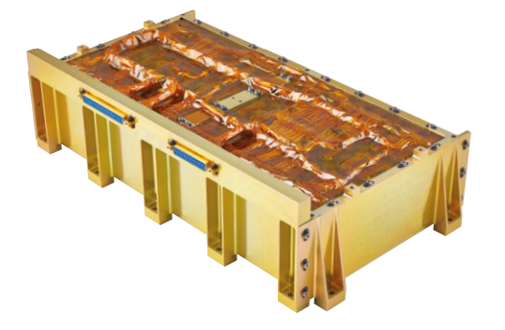
Problem & Need
Battery is manufactured
Battery’s performance is hand-tested by technician
Battery hand-off to customer
ABSTRACT will automate the battery performance testing
Overview
Design Solution
Critical Project Elements
Project Risks
Design Requirements
Verification & Validation
Project Planning
Backup Slides
Notes:
Maybe have a better picture of it so I am doing less narrating and instead have those pictures help tell the story

Slide 4
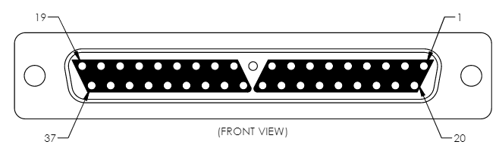
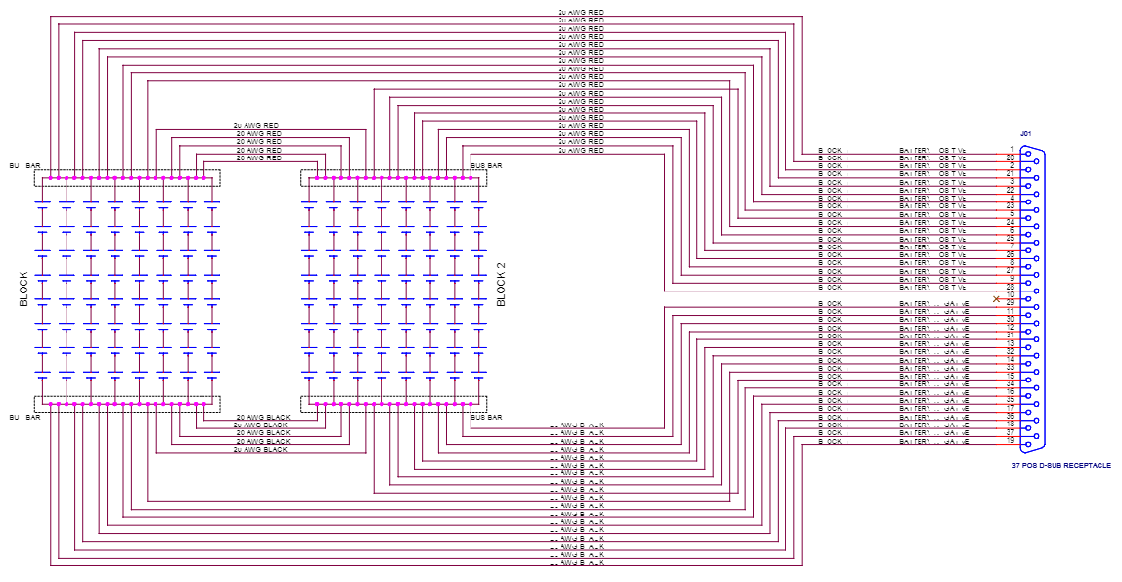
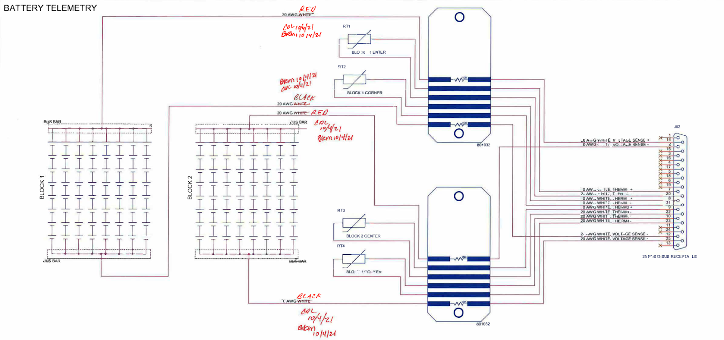
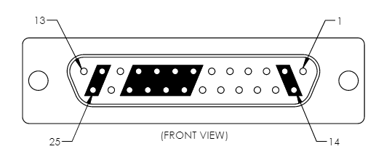
Battery
Overview
Design Solution
Critical Project Elements
Project Risks
Design Requirements
Verification & Validation
Project Planning
Backup Slides
Notes:
Maybe have a better picture of it so I am doing less narrating and instead have those pictures help tell the story

Slide 5
Mission Statement
Team ABSTRACT shall provide EnerSYS with a system that can interface with their 8s16p battery, autonomously test the battery for continuity, resistance, voltage, isolation, and insulation, and provide data to verify whether or not the battery is qualified for space-flight.
Overview
Design Solution
Critical Project Elements
Project Risks
Design Requirements
Verification & Validation
Project Planning
Backup Slides

Slide 6
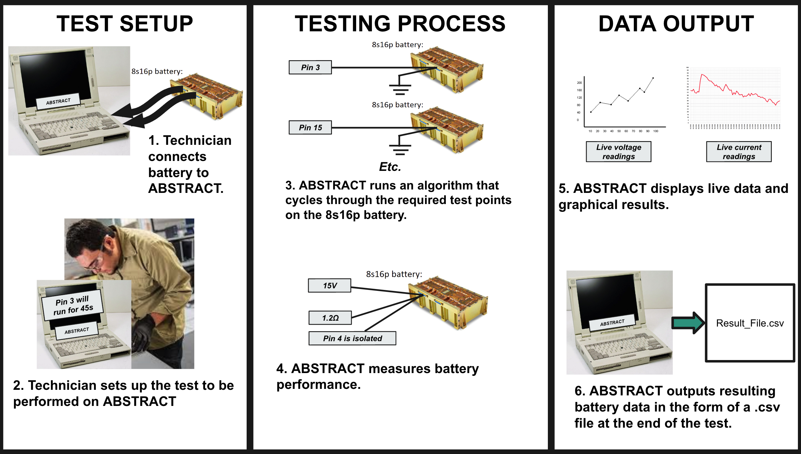
CONOPS
Overview
Design Solution
Critical Project Elements
Project Risks
Design Requirements
Verification & Validation
Project Planning
Backup Slides
Notes:
Look into throwing specific objectives here or after the design solution

Slide 7
Design Solution
Overview
Design Solution
Critical Project Elements
Project Risks
Design Requirements
Verification & Validation
Project Planning
Backup Slides

Slide 8
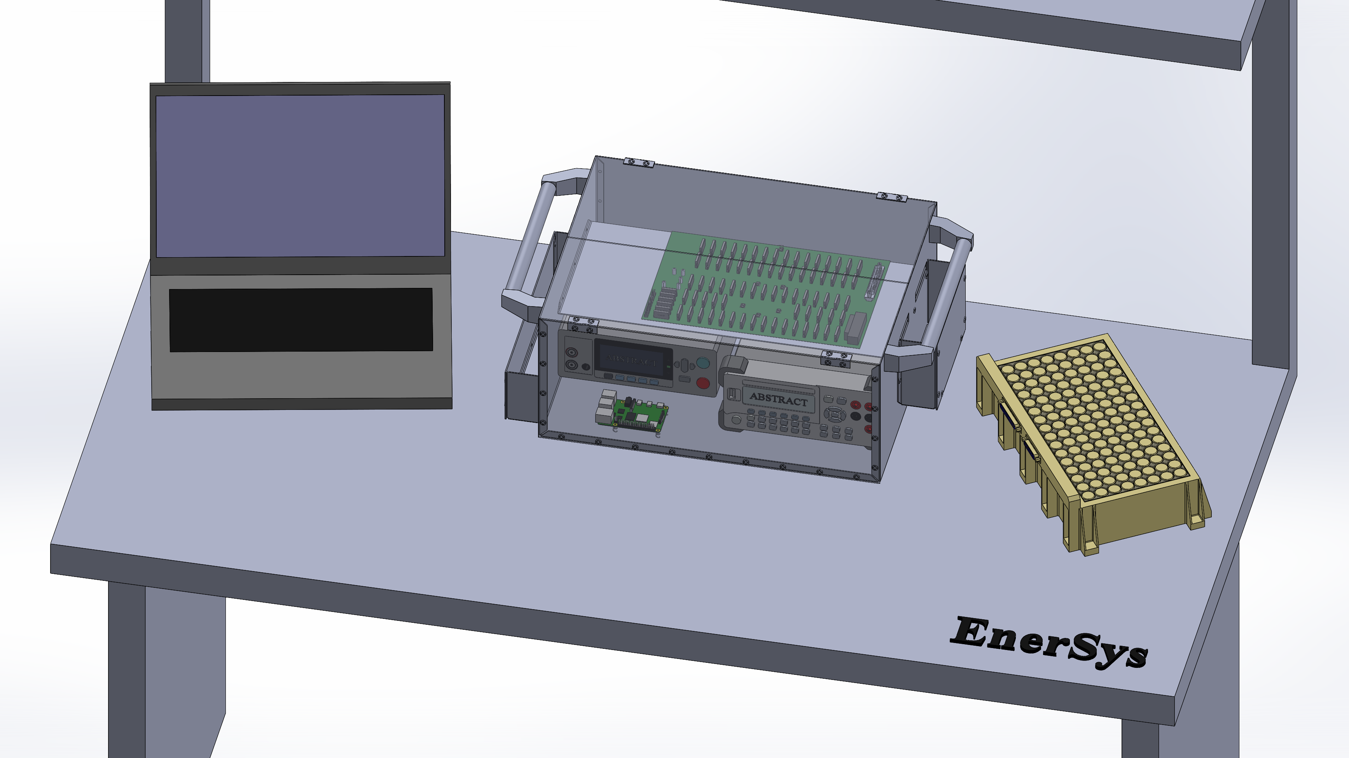
CAD - Workbench View
Overview
Design Solution
Critical Project Elements
Project Risks
Design Requirements
Verification & Validation
Project Planning
Backup Slides
Notes:
Crop & fix

Slide 9
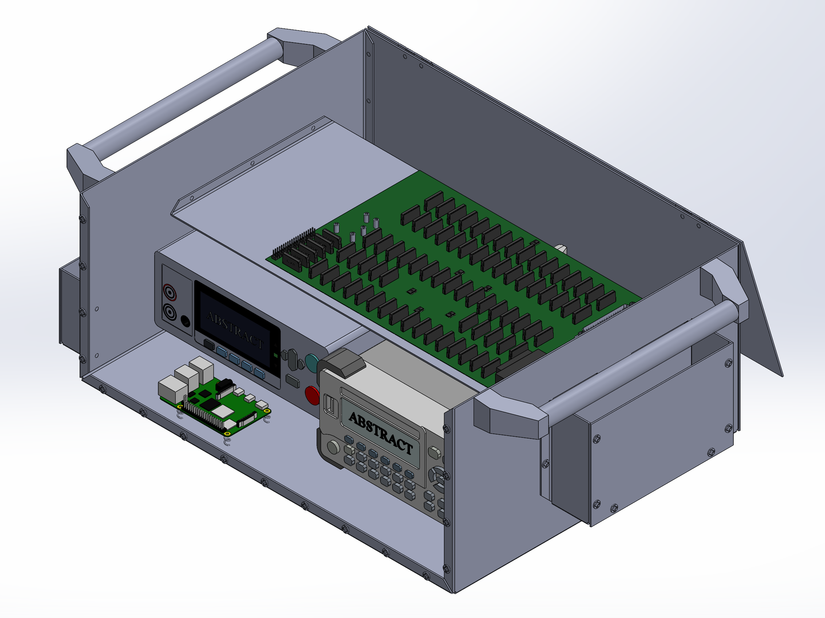
CAD – ABSTRACT View
Overview
Design Solution
Critical Project Elements
Project Risks
Design Requirements
Verification & Validation
Project Planning
Backup Slides

Slide 10
Altium Design Schematic
Overview
Design Solution
Critical Project Elements
Project Risks
Design Requirements
Verification & Validation
Project Planning
Backup Slides
Notes:
Worth having to give confidence that we are doing the work – do not go into depth

Slide 11
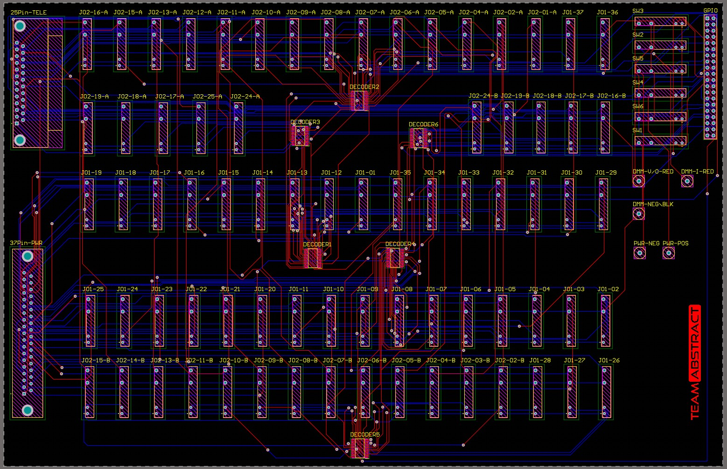
Printed Circuit Board (PCB)
Overview
Design Solution
Critical Project Elements
Project Risks
Design Requirements
Verification & Validation
Project Planning
Backup Slides

Slide 12
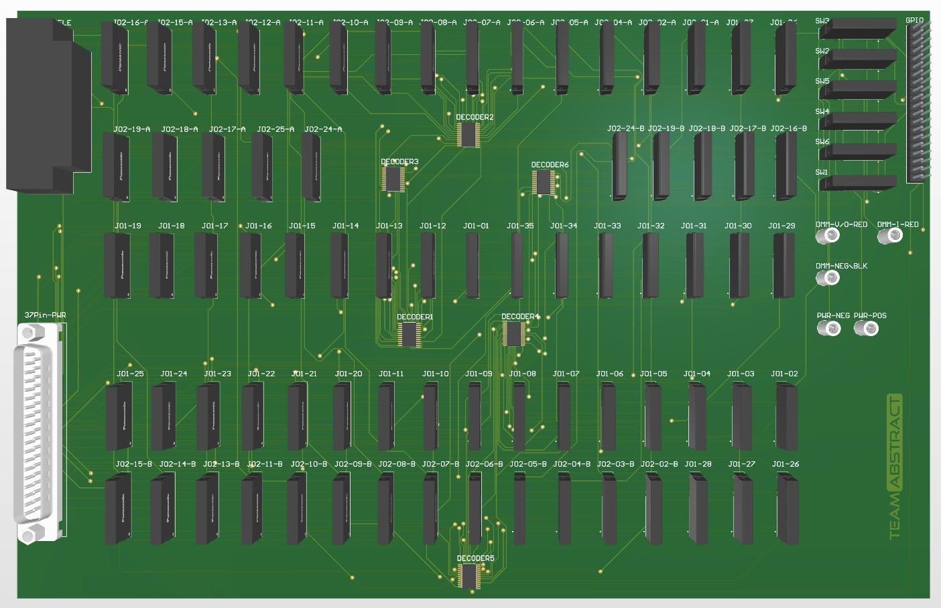
Printed Circuit Board (PCB)
Sizing Dimensions:
29.62 cm x 19.09 cm
Area:
565.32 cm²
Material:
FR4
Spacing:
0.2 mm
Trace Width:
Preferred: 0.254 mm
Min: 0.25 mm
Max: 0.26 mm
Meets IPC-2221B
Overview
Design Solution
Critical Project Elements
Project Risks
Design Requirements
Verification & Validation
Project Planning
Backup Slides
Notes:
Tell what this does rather than get bogged down into the details of the things – narrate what it does, allow the users to read the specific information

Slide 13
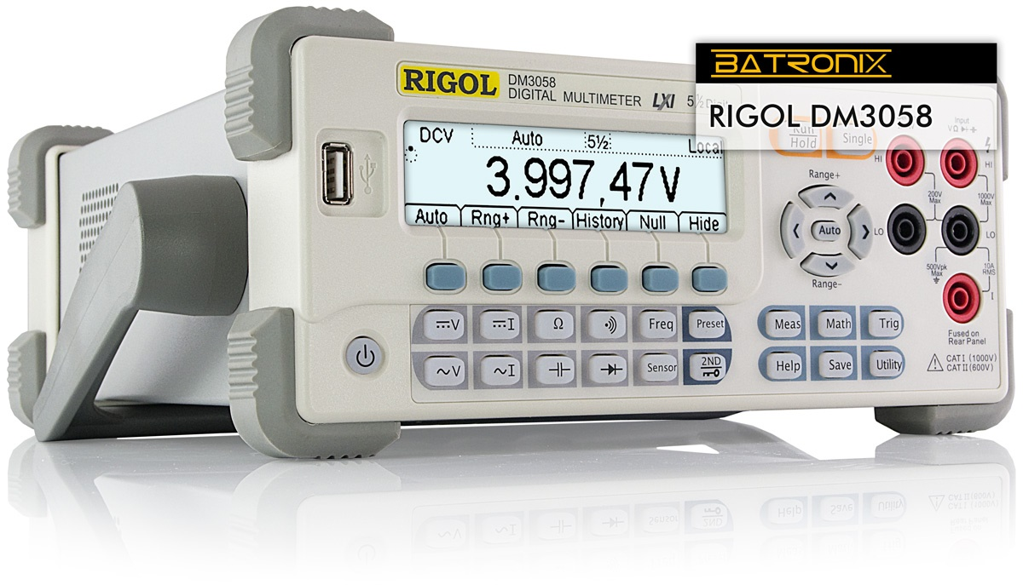
Digital Multimeter
Sizing Dimensions:
10.7 cm x 23.2 cm x 29.1 cm
Weight:
2.50 kg
Accuracy:
Discussed in design requirements
5.5 digit Resolution
Overview
Design Solution
Critical Project Elements
Project Risks
Design Requirements
Verification & Validation
Project Planning
Backup Slides

Slide 14

Insulation Tester
Sizing Dimensions:
21.5 cm x 8.0 cm x 16.6 cm
Weight:
1.10 kg
Accuracy:
Discussed in design requirements
1 V Resolution
Overview
Design Solution
Critical Project Elements
Project Risks
Design Requirements
Verification & Validation
Project Planning
Backup Slides

Slide 15
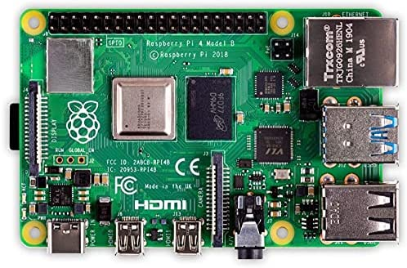
Raspberry Pi 4
Sizing Dimensions:
8.56 cm x 5.65 cm
Coding:
IDLE IDE
  Python language
Model:
Raspberry Pi 4 Model B
8 GB of ram
Overview
Design Solution
Critical Project Elements
Project Risks
Design Requirements
Verification & Validation
Project Planning
Backup Slides

Slide 16
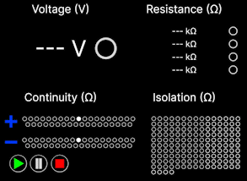
Graphical User Interface (GUI)
Coding:
IDLE IDE
  Python language
TKinter
  GUI toolbox
  Compatible with Python
Standard Commands for Programmable Instruments (SCPI)
  Compatible with DMM
  Compatible with Insulation Tester
Overview
Design Solution
Critical Project Elements
Project Risks
Design Requirements
Verification & Validation
Project Planning
Backup Slides
Notes:
Working prototype of gui, how does it communicate

Slide 17
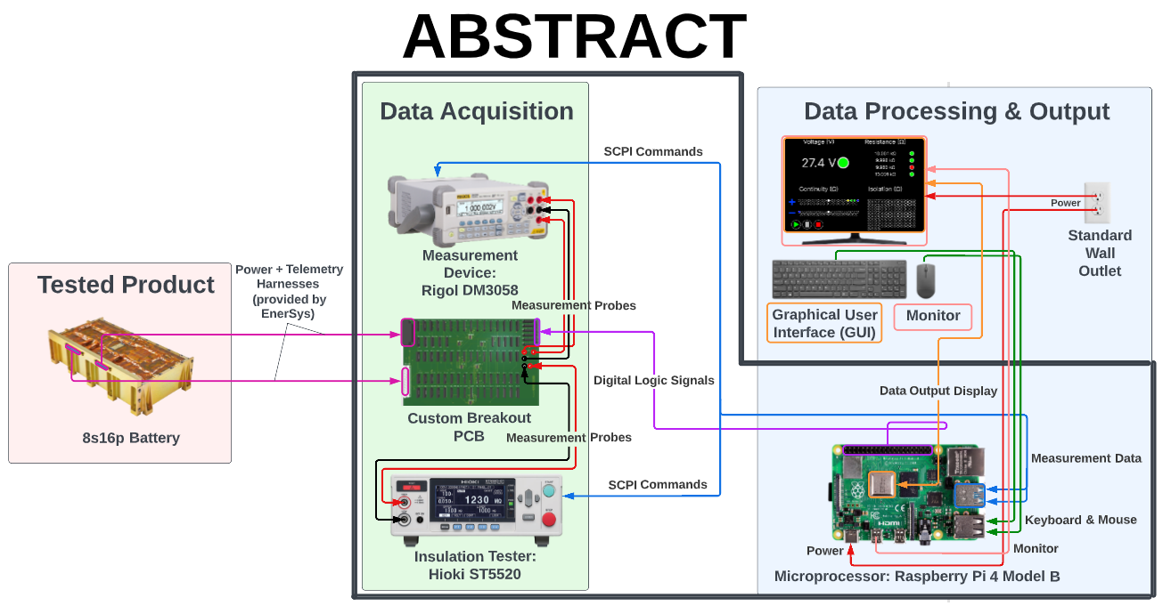
Functional Block Diagram
Overview
Design Solution
Critical Project Elements
Project Risks
Design Requirements
Verification & Validation
Project Planning
Backup Slides
Notes:
Make it all high level
Make the black box around abstract more obvious

Slide 18
Critical Project Elements (CPEs)
Overview
Design Solution
Critical Project Elements
Project Risks
Design Requirements
Verification & Validation
Project Planning
Backup Slides

Slide 19
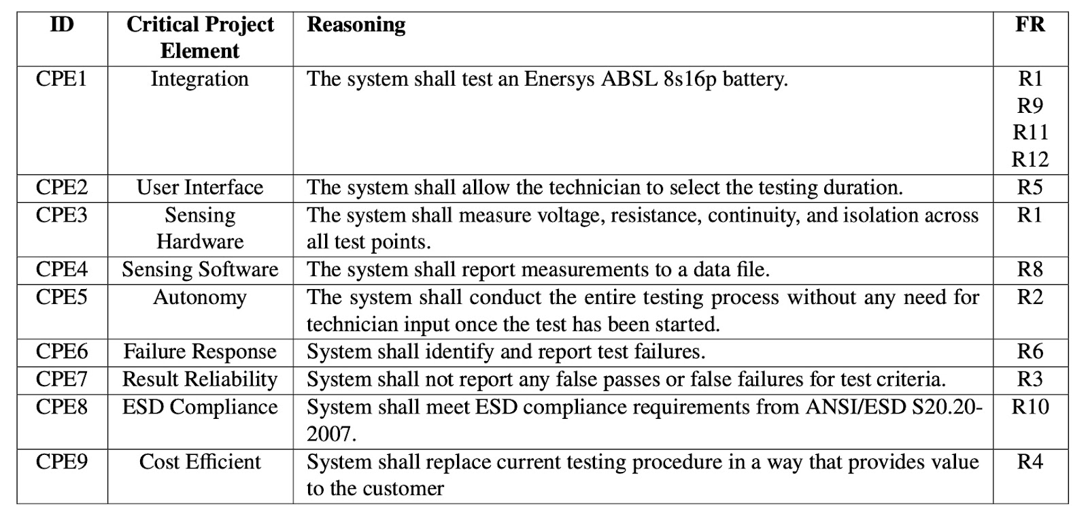
Critical Project Elements - Overview
Overview
Design Solution
Critical Project Elements
Project Risks
Design Requirements
Verification & Validation
Project Planning
Backup Slides
Notes:
I’ll update this slide ugh

Slide 20
Risk
Overview
Overview
Design Solution
Design Solution
Critical Project Elements
Critical Project Elements
Verification & Validation
Project Planning
Backup Slides
Design Requirements
Project Risks
Verification & Validation
Project Planning
Project Risks
Design Requirements
20

Slide 21
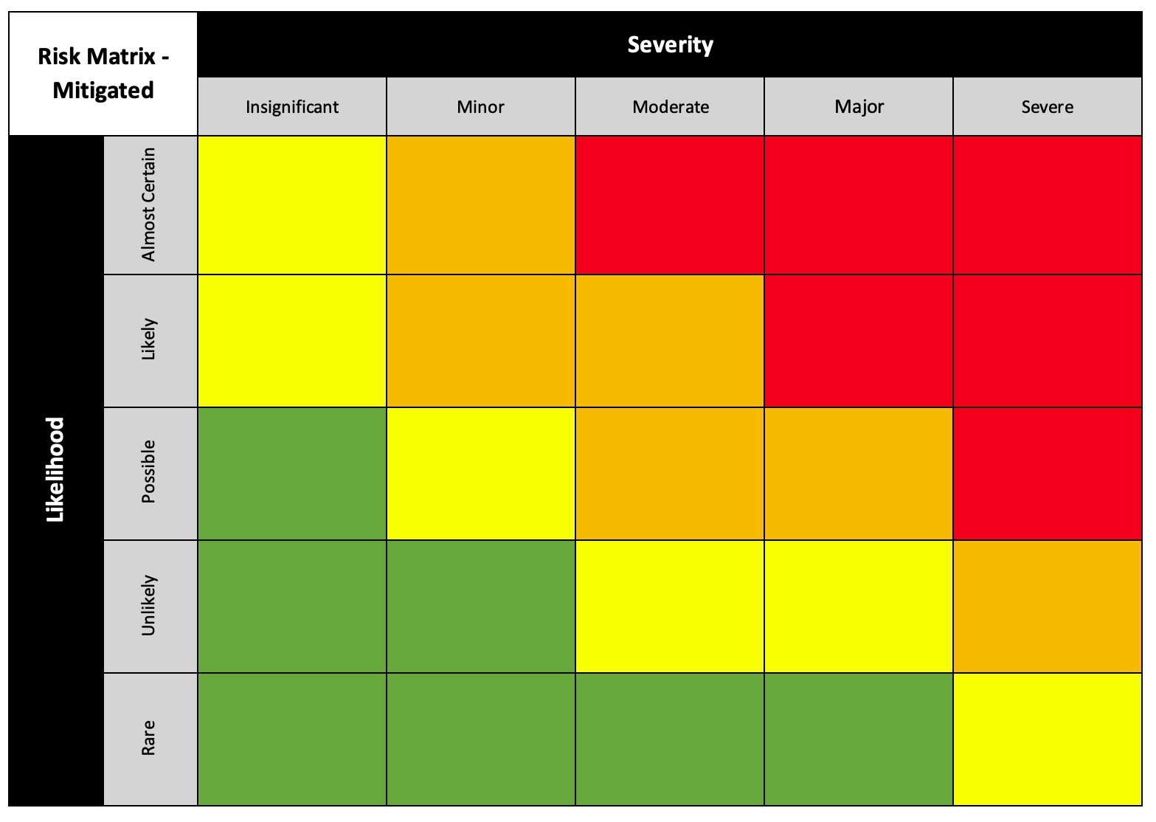
Risk Matrix - Unmitigated
Dominant Risks:
Timing & Sending Proper Signals:
Raspberry Pi limited IO pins
Shift registers/Decoder decision
Signals to incorrect relays
Battery damage
False Positives & False Negatives:
Inaccurate readings
Incorrect pin readings
Component Errors:
Components breaking
Overheating:
No heat drain
Relays producing heat
Timing & Sending Proper Signals
Component Errors
False Positives & False Negatives
Overheating
Overview
Overview
Overview
Design Solution
Design Solution
Design Solution
Critical Project Elements
Critical Project Elements
Critical Project Elements
Project Planning
Verification & Validation
Project Planning
Backup Slides
Project Risks
Project Planning
Project Risks
Verification & Validation
Design Requirements
Verification & Validation
Design Requirements
Project Risks
Design Requirements
21
21
Notes:
I feel like “unable to command the devices” like DMM or insulation tester is also a major risk, likelihood might be possible and severity is severe. It will be something similar to the false positive &false negatives – incorrect pins →

Slide 22
Risk Matrix – Timing & Sending Proper Signals
Risk: Timing & Sending Proper Signals
Mitigation Strategy
Decoders
V&V Testing
Outcome
Use of decoders rather than shift registers
Decrease in likelihood
Timing & Sending Proper Signals
Timing & Sending Proper Signals
Overview
Overview
Overview
Design Solution
Design Solution
Design Solution
Critical Project Elements
Critical Project Elements
Critical Project Elements
Project Planning
Verification & Validation
Project Planning
Backup Slides
Project Risks
Project Planning
Project Risks
Verification & Validation
Design Requirements
Verification & Validation
Design Requirements
Project Risks
Design Requirements
22
22

Slide 23
Risk Matrix – False Positives & False Negatives
Risk: False Positives & False Negatives
Mitigation Strategy
Modeling
Switch selection
Verification & Validation
Outcome
Yet to reduce risk
Should reduce the likelihood
Switch selection
False Positives & False Negatives
False Positives & False Negatives
Overview
Overview
Overview
Design Solution
Design Solution
Design Solution
Critical Project Elements
Critical Project Elements
Critical Project Elements
Project Planning
Verification & Validation
Project Planning
Backup Slides
Project Risks
Project Planning
Project Risks
Verification & Validation
Design Requirements
Verification & Validation
Design Requirements
Project Risks
Design Requirements
23
23

Slide 24
Risk Matrix - Mitigated
False Positives & False Negatives
Overheating
Component Errors
Timing & Sending Proper Signals
Overview
Overview
Overview
Design Solution
Design Solution
Design Solution
Critical Project Elements
Critical Project Elements
Critical Project Elements
Project Planning
Verification & Validation
Project Planning
Backup Slides
Project Risks
Project Planning
Project Risks
Verification & Validation
Design Requirements
Verification & Validation
Design Requirements
Project Risks
Design Requirements
24
24

Slide 25
Design Requirement Satisfaction
Overview
Overview
Overview
Design Solution
Design Solution
Design Solution
Critical Project Elements
Critical Project Elements
Critical Project Elements
Project Planning
Verification & Validation
Project Planning
Backup Slides
Project Risks
Project Planning
Project Risks
Verification & Validation
Design Requirements
Verification & Validation
Design Requirements
Project Risks
Design Requirements
25
25

Slide 26
Key Requirements
CPE 3
Sensing Hardware
Measure: Voltage, Resistance, Continuity, Isolation, Insulation
CPE 4
Sensing Software
System shall report measurements to a data file
FR 8
Lab Compatibility
System shall be compatible with the lab environment
CPE 5
Autonomy
System shall conduct the entire test process without any need for technician input
Overview
Overview
Overview
Overview
Design Solution
Design Solution
Design Solution
Design Solution
Critical Project Elements
Critical Project Elements
Critical Project Elements
Critical Project Elements
Project Planning
Project Planning
Verification & Validation
Project Planning
Backup Slides
Project Risks
Project Planning
Project Risks
Project Risks
Verification & Validation
Verification & Validation
Design Requirements
Verification & Validation
Design Requirements
Design Requirements
Project Risks
Design Requirements
26
26
26

Slide 27
CPE 3: Sensing Hardware
CPE 3
Sensing Hardware
Measure: Voltage, Resistance, Continuity, Isolation, Insulation
FR 1
Testing Performance
System shall test the battery for electrical performance
DR 1
Voltage
System shall measure voltage across test points (designated in the functional test template) for values in the range of [24.01V - 33.59V]
DR 2
Continuity
System shall measure resistance across test points (designated in the functional test template) for values < 1 Ω
DR 3
Resistance
System shall measure resistance across test points (designated in the functional test template) for a value of 10 kΩ ± 7 Ω
DR 4
Isolation
System shall measure resistance across test points (designated in the functional test template) for values > 10.025 MΩ
DR 5
Insulation
System shall measure resistance across test points (designated in the functional test template) for values > 10 MΩ while applying +100 V across the test points for 60 seconds or until resistance measurement is stable (minimum 10 seconds)
Overview
Overview
Overview
Design Solution
Design Solution
Design Solution
Critical Project Elements
Critical Project Elements
Critical Project Elements
Project Planning
Verification & Validation
Project Planning
Backup Slides
Project Risks
Project Planning
Project Risks
Verification & Validation
Design Requirements
Verification & Validation
Design Requirements
Project Risks
Design Requirements
27
27

Slide 28

CPE 3: Sensing Hardware - Voltage
DR 1
Voltage
System shall measure voltage across test points (designated in the functional test template) for values in the range of [24.01V - 33.59V]
DR 1.2
Accuracy
System shall measure voltage with an uncertainty of ± 0.025% of reading
EnerSys Pass Criteria:
Between 24.0 V – 33.6 V
Our Measurement Requirements:
Must measure between [24.01 V – 33.59 V]
Uncertainty ± 0.025 % of reading
0.01 V
DMM Specs:
Scale
  EnerSys: 100 V
  ABSTRACT: 200 V
EnerSys: Uncertainty = 0.0018 % + 0.0006 % = [0.001 V, 0.001 V]
ABSTRACT: Uncertainty = 0.015 % + 0.003 % = [0.01 V, 0.01 V]
Uncertainty Difference = [0.01 V, 0.01 V]
Hand Testing
Voltage range
  [24.0 V, 24.01V]
  [33.59V, 33,6V]
DR 1
Overview
Overview
Overview
Design Solution
Design Solution
Design Solution
Critical Project Elements
Critical Project Elements
Critical Project Elements
Project Planning
Verification & Validation
Project Planning
Backup Slides
Project Risks
Project Planning
Project Risks
Verification & Validation
Design Requirements
Verification & Validation
Design Requirements
Project Risks
Design Requirements
28
28
Notes:
Talk about defining uncertainty (one slide – circuit does not need to be on this)

Slide 29
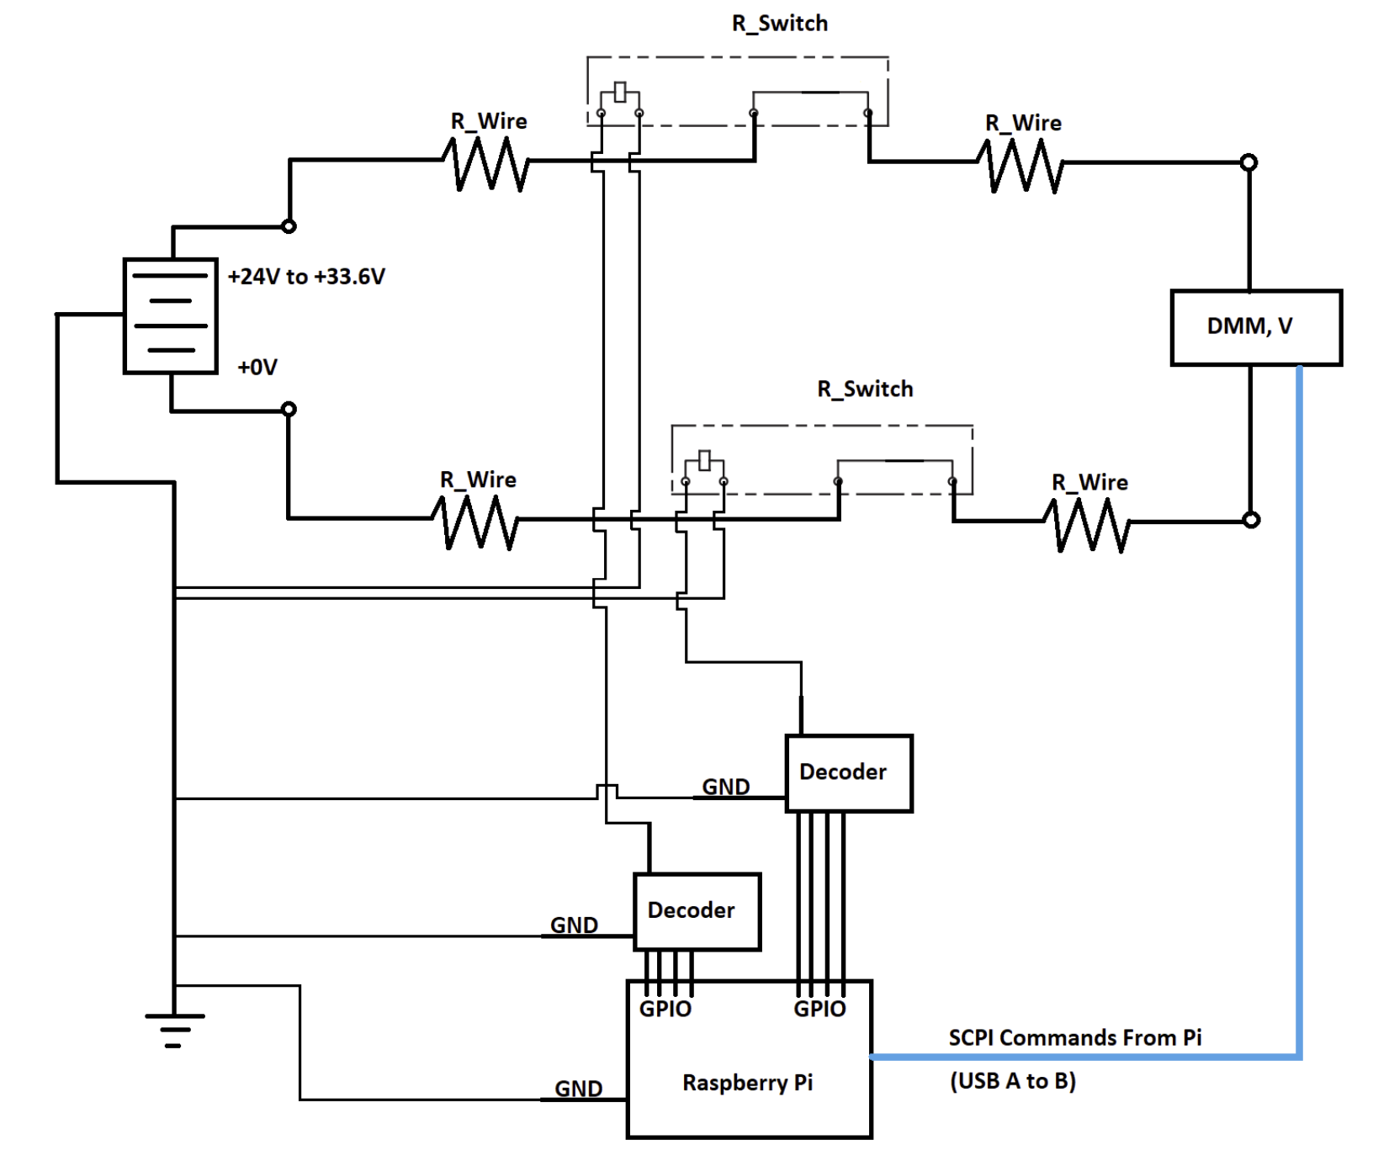
CPE 3: Sensing Hardware - Voltage
V_{True} = V_{Meas} - V_{Drop}
V_{Drop} = I_{Batt} * R_{Eq}
I_{Batt} = V_{Batt} / R_{DMM} = 2.9 µA
R_{Eq} = R_{Wire} + 2*R_{Switch}
R_{Eq} = 0.01Ω + 1.4Ω = 1.41Ω
V_{Drop} = 4.1 µV
DR 1
Overview
Overview
Overview
Design Solution
Design Solution
Design Solution
Critical Project Elements
Critical Project Elements
Critical Project Elements
Project Planning
Verification & Validation
Project Planning
Backup Slides
Project Risks
Project Planning
Project Risks
Verification & Validation
Design Requirements
Verification & Validation
Design Requirements
Project Risks
Design Requirements
29
29
Notes:
Talk about defining uncertainty (one slide – circuit does not need to be on this)

Slide 30
CPE 3: Sensing Hardware - Continuity
DR 2
Continuity
System shall measure resistance across test points (designated in the functional test template) for values < 1 Ω
DR 2.2
Accuracy
System shall measure continuity with an uncertainty of ± 25 % of reading
EnerSys Pass Criteria:
Must measure < 1 Ω
Average: 0.39 Ω
High: 0.530 Ω
50% Factor of Safety on highest value: 0.80 Ω
Our Measurement Requirements:
Must measure < 1 Ω
Uncertainty ± 25 % of reading
0.2 Ω
DMM Specs:
Scale
  ABSTRACT: 200 Ω
Uncertainty: ± 0.03% + 0.005% = 0.010 Ω
Hand Testing
None required
DR 2
Overview
Overview
Overview
Design Solution
Design Solution
Design Solution
Critical Project Elements
Critical Project Elements
Critical Project Elements
Project Planning
Verification & Validation
Project Planning
Backup Slides
Project Risks
Project Planning
Project Risks
Verification & Validation
Design Requirements
Verification & Validation
Design Requirements
Project Risks
Design Requirements
30
30

Slide 31
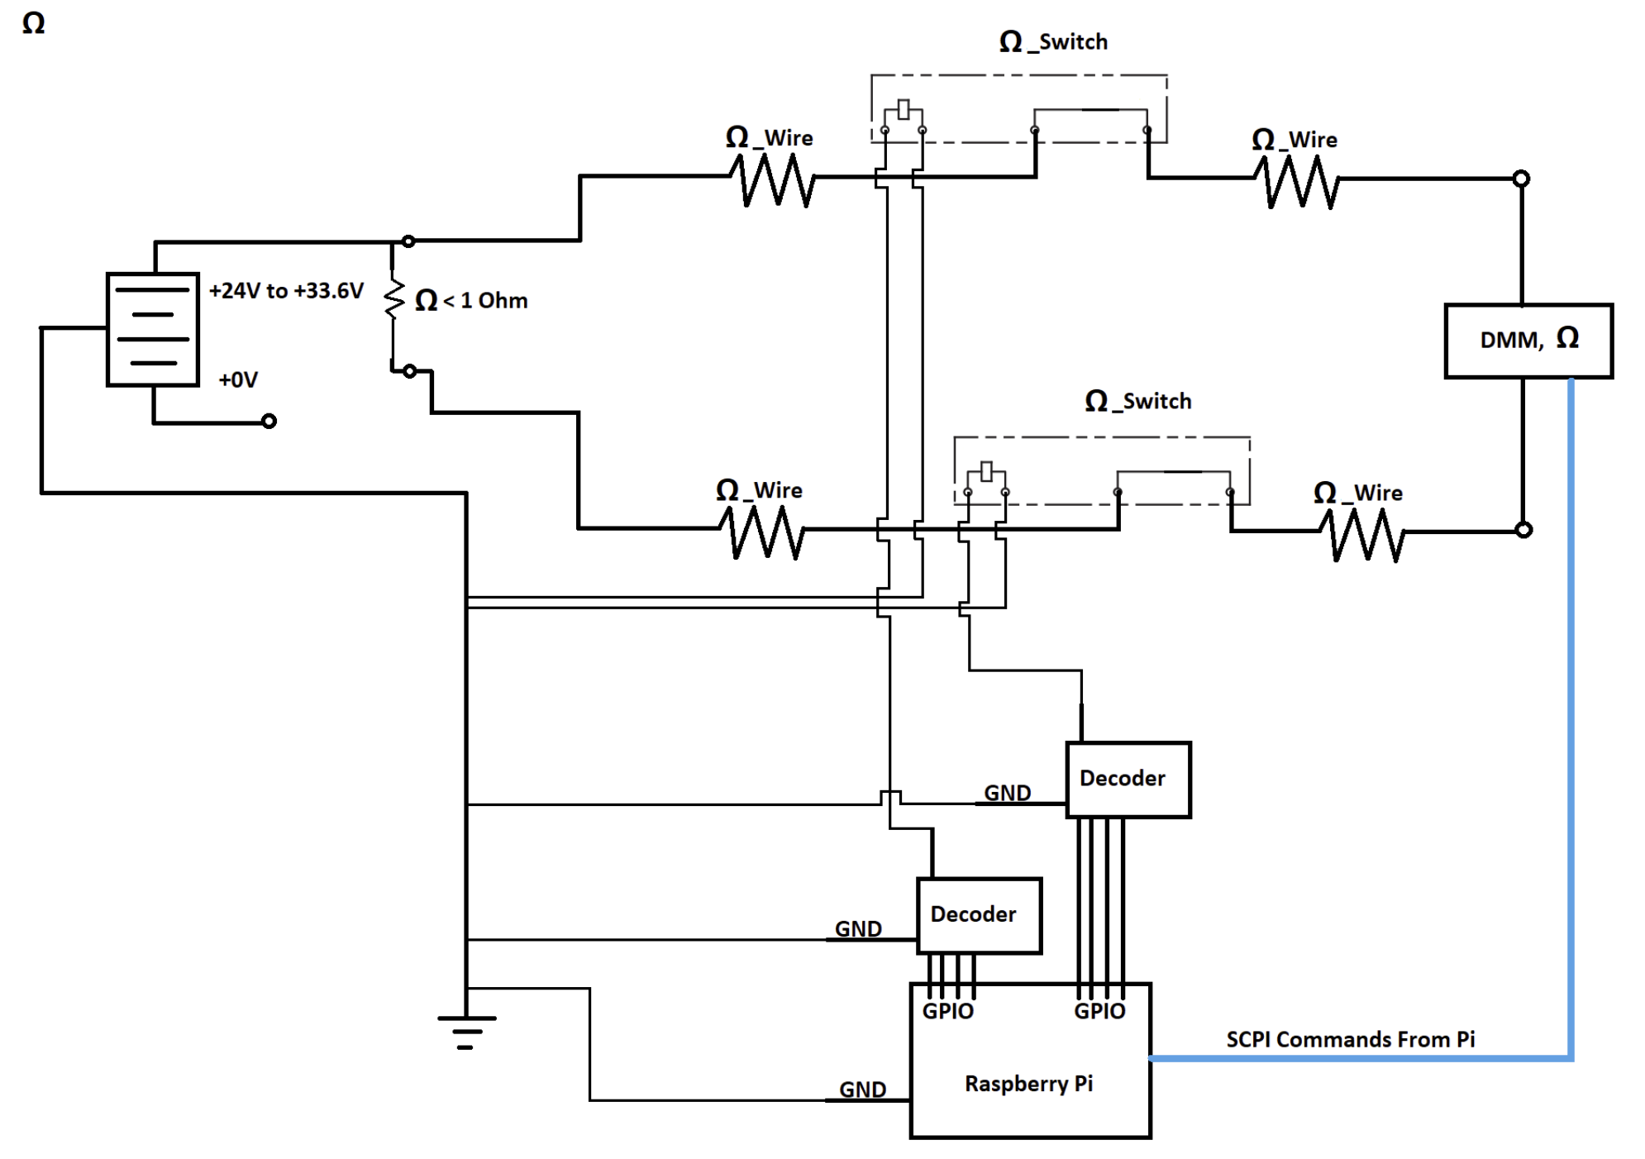
CPE 3: Sensing Hardware - Continuity
R_{True} = R_{Meas} - R_{Eq}
R_{Eq} = R_{Wire} + 2*R_{Switch}
R_{Eq} = 1.41Ω
Max Test Current: 1 mA
SSR Relay rated for 1 A
DR 2
Overview
Overview
Overview
Design Solution
Design Solution
Design Solution
Critical Project Elements
Critical Project Elements
Critical Project Elements
Project Planning
Verification & Validation
Project Planning
Backup Slides
Project Risks
Project Planning
Project Risks
Verification & Validation
Design Requirements
Verification & Validation
Design Requirements
Project Risks
Design Requirements
31
31

Slide 32
CPE 3: Sensing Hardware - Resistance
DR 3
Resistance
System shall measure resistance across test points (designated in the functional test template) for a value of 10 kΩ ± 7 Ω
DR 3.2
Accuracy
System shall measure resistance with an uncertainty of ± 0.025 % of reading
EnerSys Pass Criteria:
10 kΩ ± 10 Ω
Our Measurement Requirements:
Must measure between [9993 Ω – 10007 Ω]
Uncertainty ± 0.025 % of reading
3 Ω
DMM Specs:
Scale
  EnerSys: 10 kΩ
  ABSTRACT: 20 kΩ
EnerSys: Uncertainty = 0.002% + 0.0005% = [0.25 Ω, 0.25 Ω]
ABSTRACT: Uncertainty = 0.02% + 0.003% = [3 Ω, 3 Ω]
Uncertainty Difference = [3 Ω, 3 Ω]
Hand Testing
Resistance range
  [9990 Ω, 9993 Ω]
  [10007 Ω, 10010 Ω]
DR 3
Overview
Overview
Overview
Design Solution
Design Solution
Design Solution
Critical Project Elements
Critical Project Elements
Critical Project Elements
Project Planning
Verification & Validation
Project Planning
Backup Slides
Project Risks
Project Planning
Project Risks
Verification & Validation
Design Requirements
Verification & Validation
Design Requirements
Project Risks
Design Requirements
32
32

Slide 33
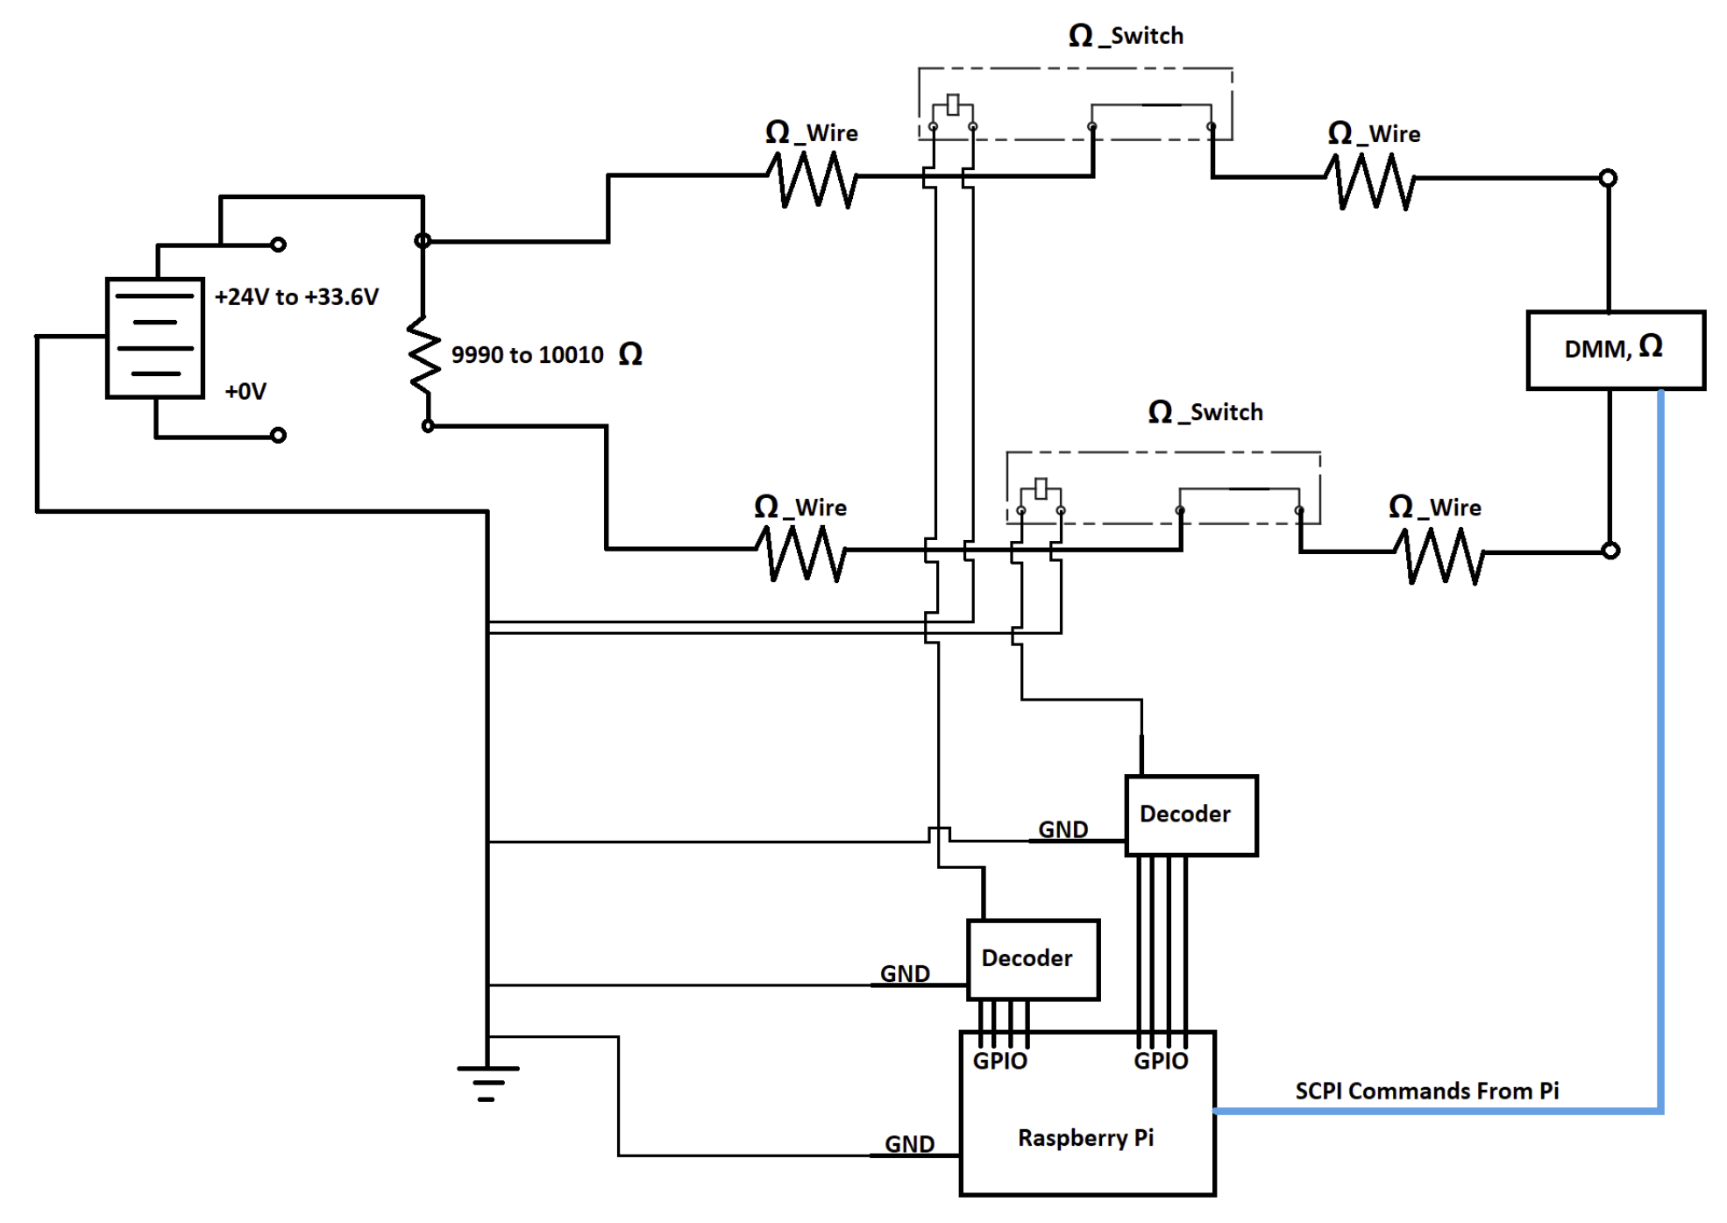
CPE 3: Sensing Hardware - Resistance
R_{True} = R_{Meas} - R_{Eq}
R_{Eq} = R_{Wire} + 2*R_{Switch}
R_{Eq} = 1.41Ω
Max Test Current: 100 µA
SSR Relay rated for 1 A
DR 3
Overview
Overview
Overview
Design Solution
Design Solution
Design Solution
Critical Project Elements
Critical Project Elements
Critical Project Elements
Project Planning
Verification & Validation
Project Planning
Backup Slides
Project Risks
Project Planning
Project Risks
Verification & Validation
Design Requirements
Verification & Validation
Design Requirements
Project Risks
Design Requirements
33
33

Slide 34
CPE 3: Sensing Hardware - Isolation
DR 4
Isolation
System shall measure resistance across test points (designated in the functional test template) for values > 10.025 MΩ
DR 4.2
Accuracy
System shall measure resistance with an uncertainty of ± 0.25 % of reading
EnerSys Pass Criteria:
> 10 MΩ
Our Measurement Requirements:
Must measure > 10.025 MΩ
Uncertainty ± 0.25 % of reading
25 kΩ
DMM Specs:
Scale: 10 MΩ
EnerSys: Accuracy = 0.015 % + 0.001 % = 1.6 kΩ
ABSTRACT: Accuracy = 0.25 % + 0.003 % = 25 kΩ
Accuracy Difference = 23 kΩ
Hand Testing
Resistance range
  [10 MΩ, 10.025 MΩ]
DR 4
Overview
Overview
Overview
Design Solution
Design Solution
Design Solution
Critical Project Elements
Critical Project Elements
Critical Project Elements
Project Planning
Verification & Validation
Project Planning
Backup Slides
Project Risks
Project Planning
Project Risks
Verification & Validation
Design Requirements
Verification & Validation
Design Requirements
Project Risks
Design Requirements
34
34

Slide 35
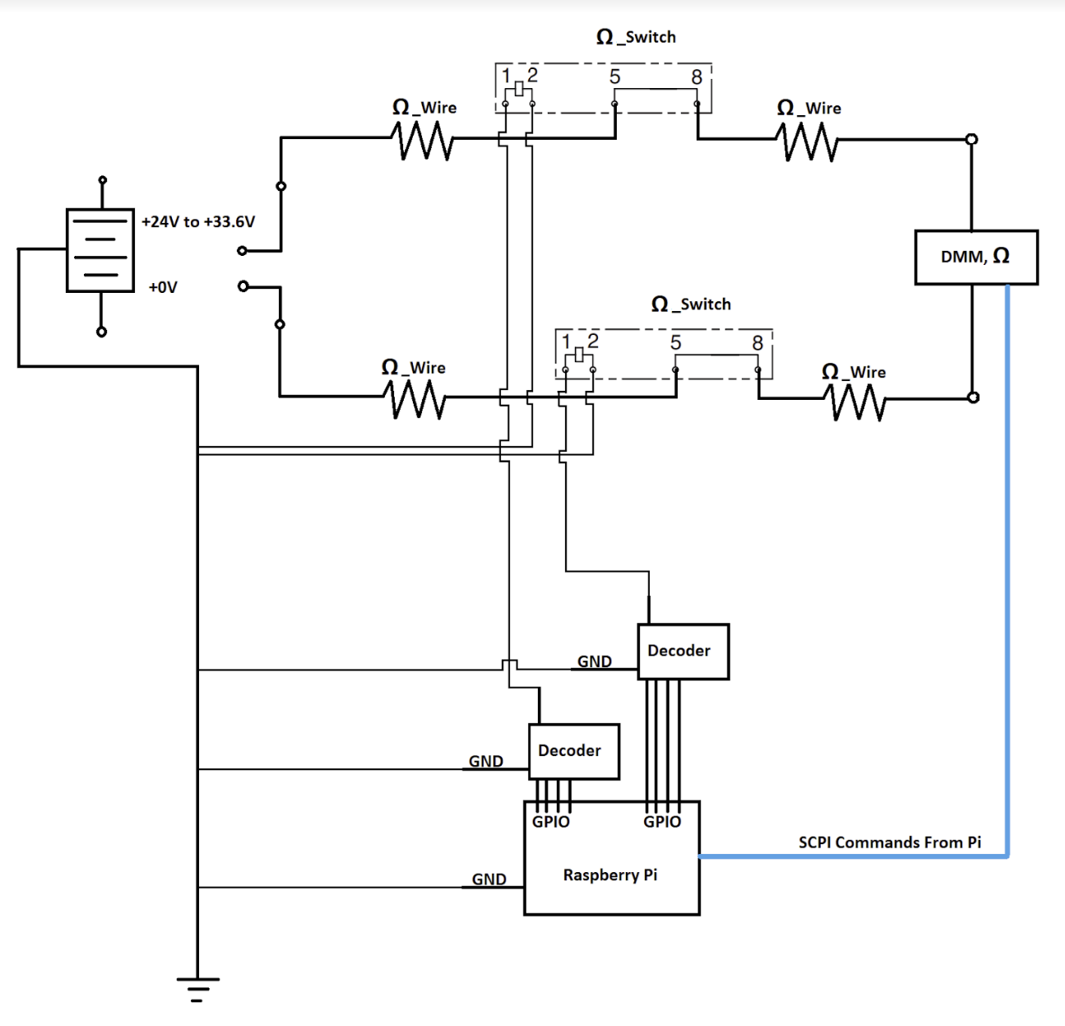
CPE 3: Sensing Hardware - Isolation
R_{True} = R_{Meas} - R_{Eq}
R_{Eq} = R_{Wire} + 2*R_{switch}
R_{Eq} =1.41Ω
Max Test Current: 200 nA
SSR Relay rated for 1 A
DR 4
Overview
Overview
Overview
Design Solution
Design Solution
Design Solution
Critical Project Elements
Critical Project Elements
Critical Project Elements
Project Planning
Verification & Validation
Project Planning
Backup Slides
Project Risks
Project Planning
Project Risks
Verification & Validation
Design Requirements
Verification & Validation
Design Requirements
Project Risks
Design Requirements
35
35

Slide 36
CPE 3: Sensing Hardware - Insulation
DR 5
Insulation
System shall measure resistance across test points (designated in the functional test template) for values > 10 MΩ while applying +100 V across the test points for 60 seconds or until resistance measurement is stable (minimum 10 seconds)
DR 5.2
Accuracy
System shall measure resistance with an uncertainty of ± 3 % of reading
EnerSys Pass Criteria:
> 10 MΩ
Our Measurement Requirements:
Must measure > 10 MΩ
Uncertainty ± 3 % of reading
0.3 MΩ
DMM Specs:
Scale: 20 MΩ
EnerSys: Accuracy = 3 % = 0.3 MΩ
ABSTRACT: Accuracy = 2% = 0.2 MΩ
Hand Testing
Not required
DR 5
Overview
Overview
Overview
Design Solution
Design Solution
Design Solution
Critical Project Elements
Critical Project Elements
Critical Project Elements
Project Planning
Verification & Validation
Project Planning
Backup Slides
Project Risks
Project Planning
Project Risks
Verification & Validation
Design Requirements
Verification & Validation
Design Requirements
Project Risks
Design Requirements
36
36

Slide 37
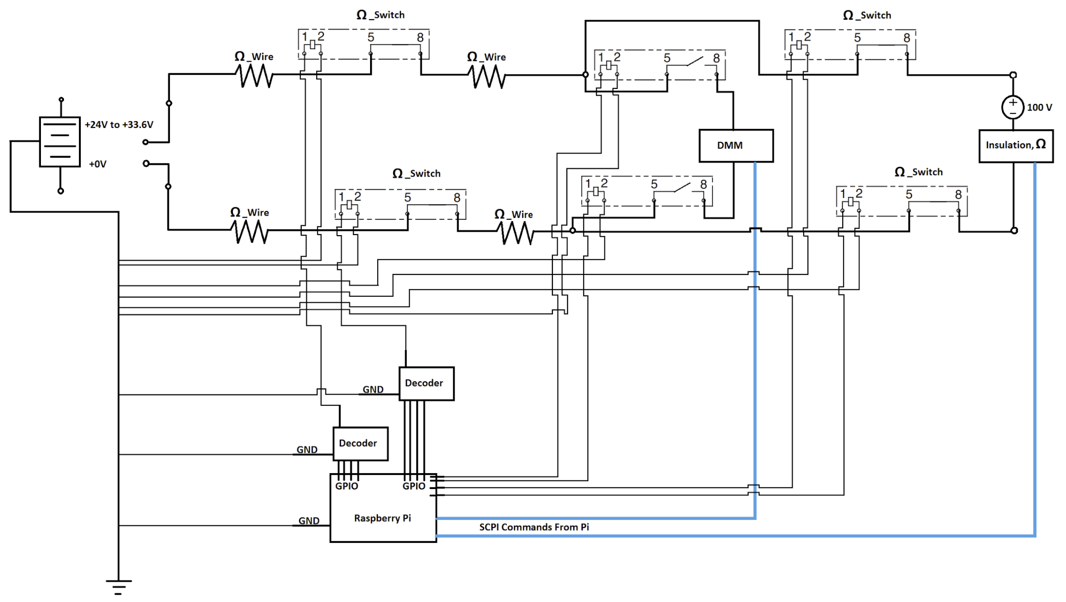
CPE 3: Sensing Hardware - Insulation
R_{True} = R_{Meas} - R_{Eq}
R_{Eq} = R_{Wire} + 2*R_{switch}
R_{Eq} =1.41Ω
Max Test Current: 1 mA
SSR Relay rated for 1 A
DR 5
Overview
Overview
Overview
Design Solution
Design Solution
Design Solution
Critical Project Elements
Critical Project Elements
Critical Project Elements
Project Planning
Verification & Validation
Project Planning
Backup Slides
Project Risks
Project Planning
Project Risks
Verification & Validation
Design Requirements
Verification & Validation
Design Requirements
Project Risks
Design Requirements
37
37

Slide 38
CPE 3: Sensing Hardware
CPE 3
Sensing Hardware
Measure: Voltage, Resistance, Continuity, Isolation, Insulation
FR 1
Testing Performance
System shall test the battery for electrical performance
DR 1
Voltage
System shall measure voltage across test points (designated in the functional test template) for values in the range of [24.01V - 33.59V]
DR 2
Continuity
System shall measure resistance across test points (designated in the functional test template) for values < 1 Ohm
DR 3
Resistance
System shall measure resistance across test points (designated in the functional test template) for a value of 10 kΩ ± 7 Ω
DR 4
Isolation
System shall measure resistance across test points (designated in the functional test template) for values > 10.025 M Ohms
DR 5
Insulation
System shall measure resistance across test points (designated in the functional test template) for values > 10 MΩ while applying +100 V across the test points for 60 seconds or until resistance measurement is stable (minimum 10 seconds)
Overview
Overview
Overview
Design Solution
Design Solution
Design Solution
Critical Project Elements
Critical Project Elements
Critical Project Elements
Project Planning
Verification & Validation
Project Planning
Backup Slides
Project Risks
Project Planning
Project Risks
Verification & Validation
Design Requirements
Verification & Validation
Design Requirements
Project Risks
Design Requirements
38
38

Slide 39
FR 8: Lab Compatibility
FR 8
Lab Compatibility
System shall be compatible with the lab environment
DR 8.1
Form Factor
System shall fit on a standard technician workbench
DR 8.1.1
Form Factor
The footprint of the system shall be smaller than 76 cm x 76 cm x 76 cm.
The weight of the system shall not exceed 113 kg
DR 8.6
Heat Dissipation
System shall not overheat the battery or any other electrical components in the system
DR 8.6
Safety
System shall include ground chassis
Overview
Overview
Overview
Design Solution
Design Solution
Design Solution
Critical Project Elements
Critical Project Elements
Critical Project Elements
Project Planning
Verification & Validation
Project Planning
Backup Slides
Project Risks
Project Planning
Project Risks
Verification & Validation
Design Requirements
Verification & Validation
Design Requirements
Project Risks
Design Requirements
39
39
Notes:
I need to do this.

Slide 40
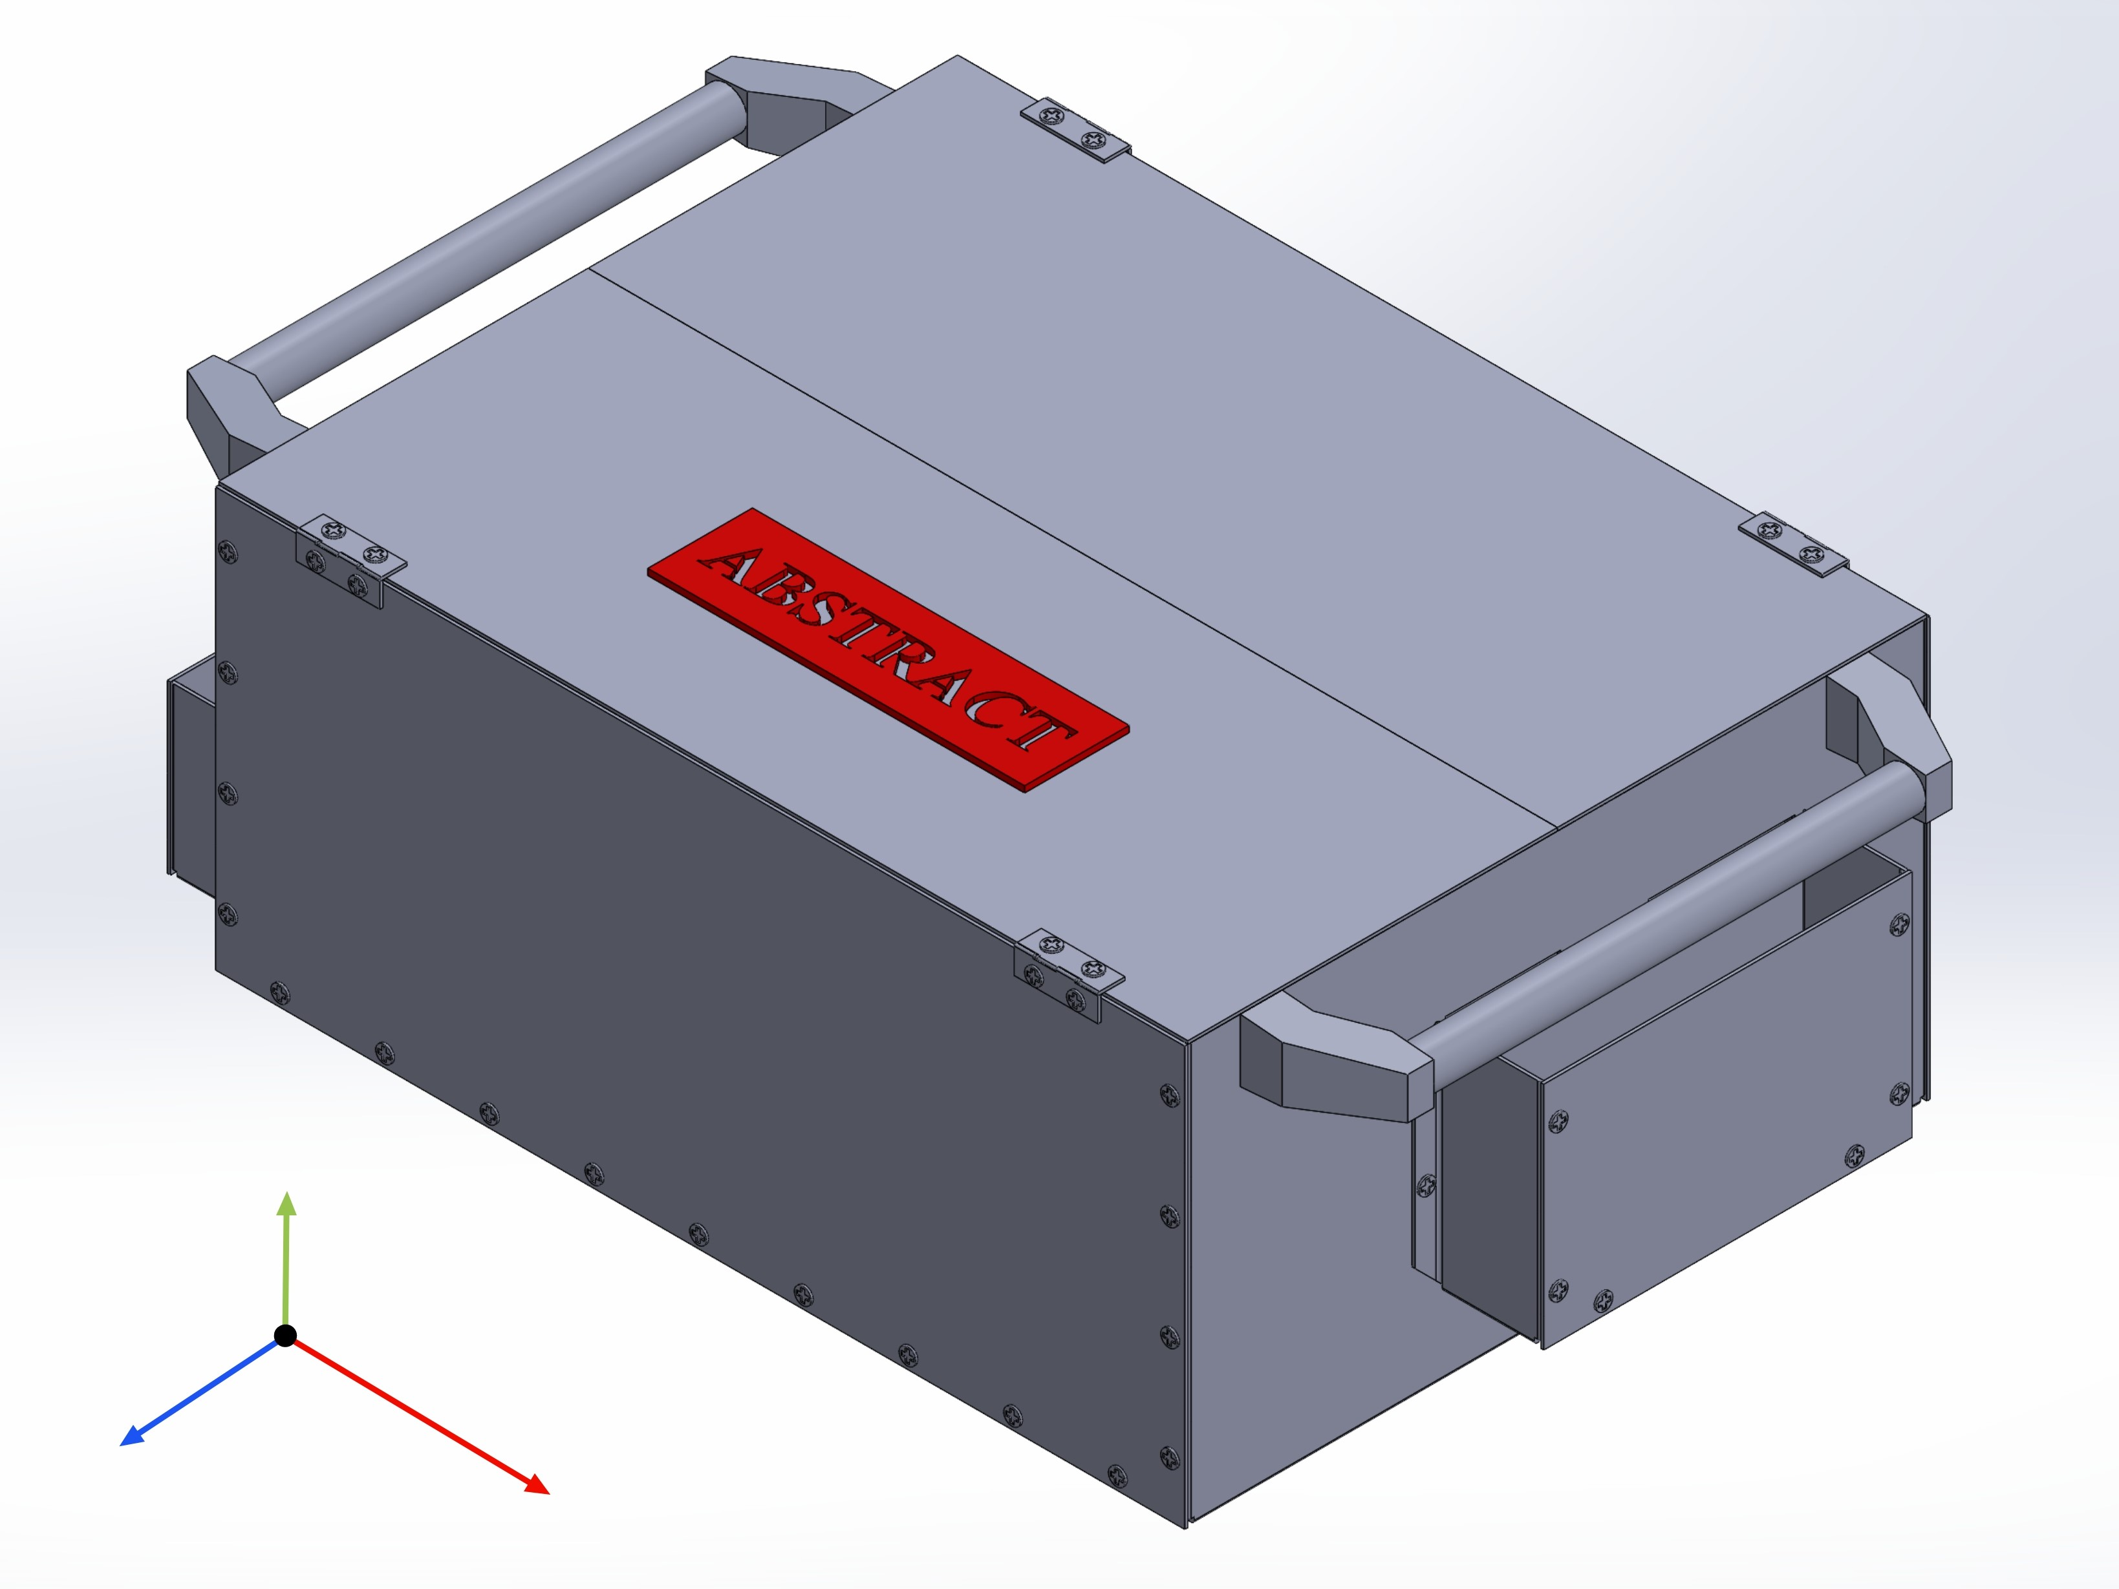
FR 8: Lab Compatibility
DR 8.1
Form Factor
The footprint of the system shall be smaller than 76 cm x 76 cm x 76 cm.
The weight of the system shall not exceed 113 kg
L: 35 cm W: 56cm H: 20cm
Weight: about 11 kg Material: 5052-H32 Aluminum
20 cm
35 cm
56 cm
Overview
Overview
Overview
Design Solution
Design Solution
Design Solution
Critical Project Elements
Critical Project Elements
Critical Project Elements
Project Planning
Verification & Validation
Project Planning
Backup Slides
Project Risks
Project Planning
Project Risks
Verification & Validation
Design Requirements
Verification & Validation
Design Requirements
Project Risks
Design Requirements
40
40

Slide 41
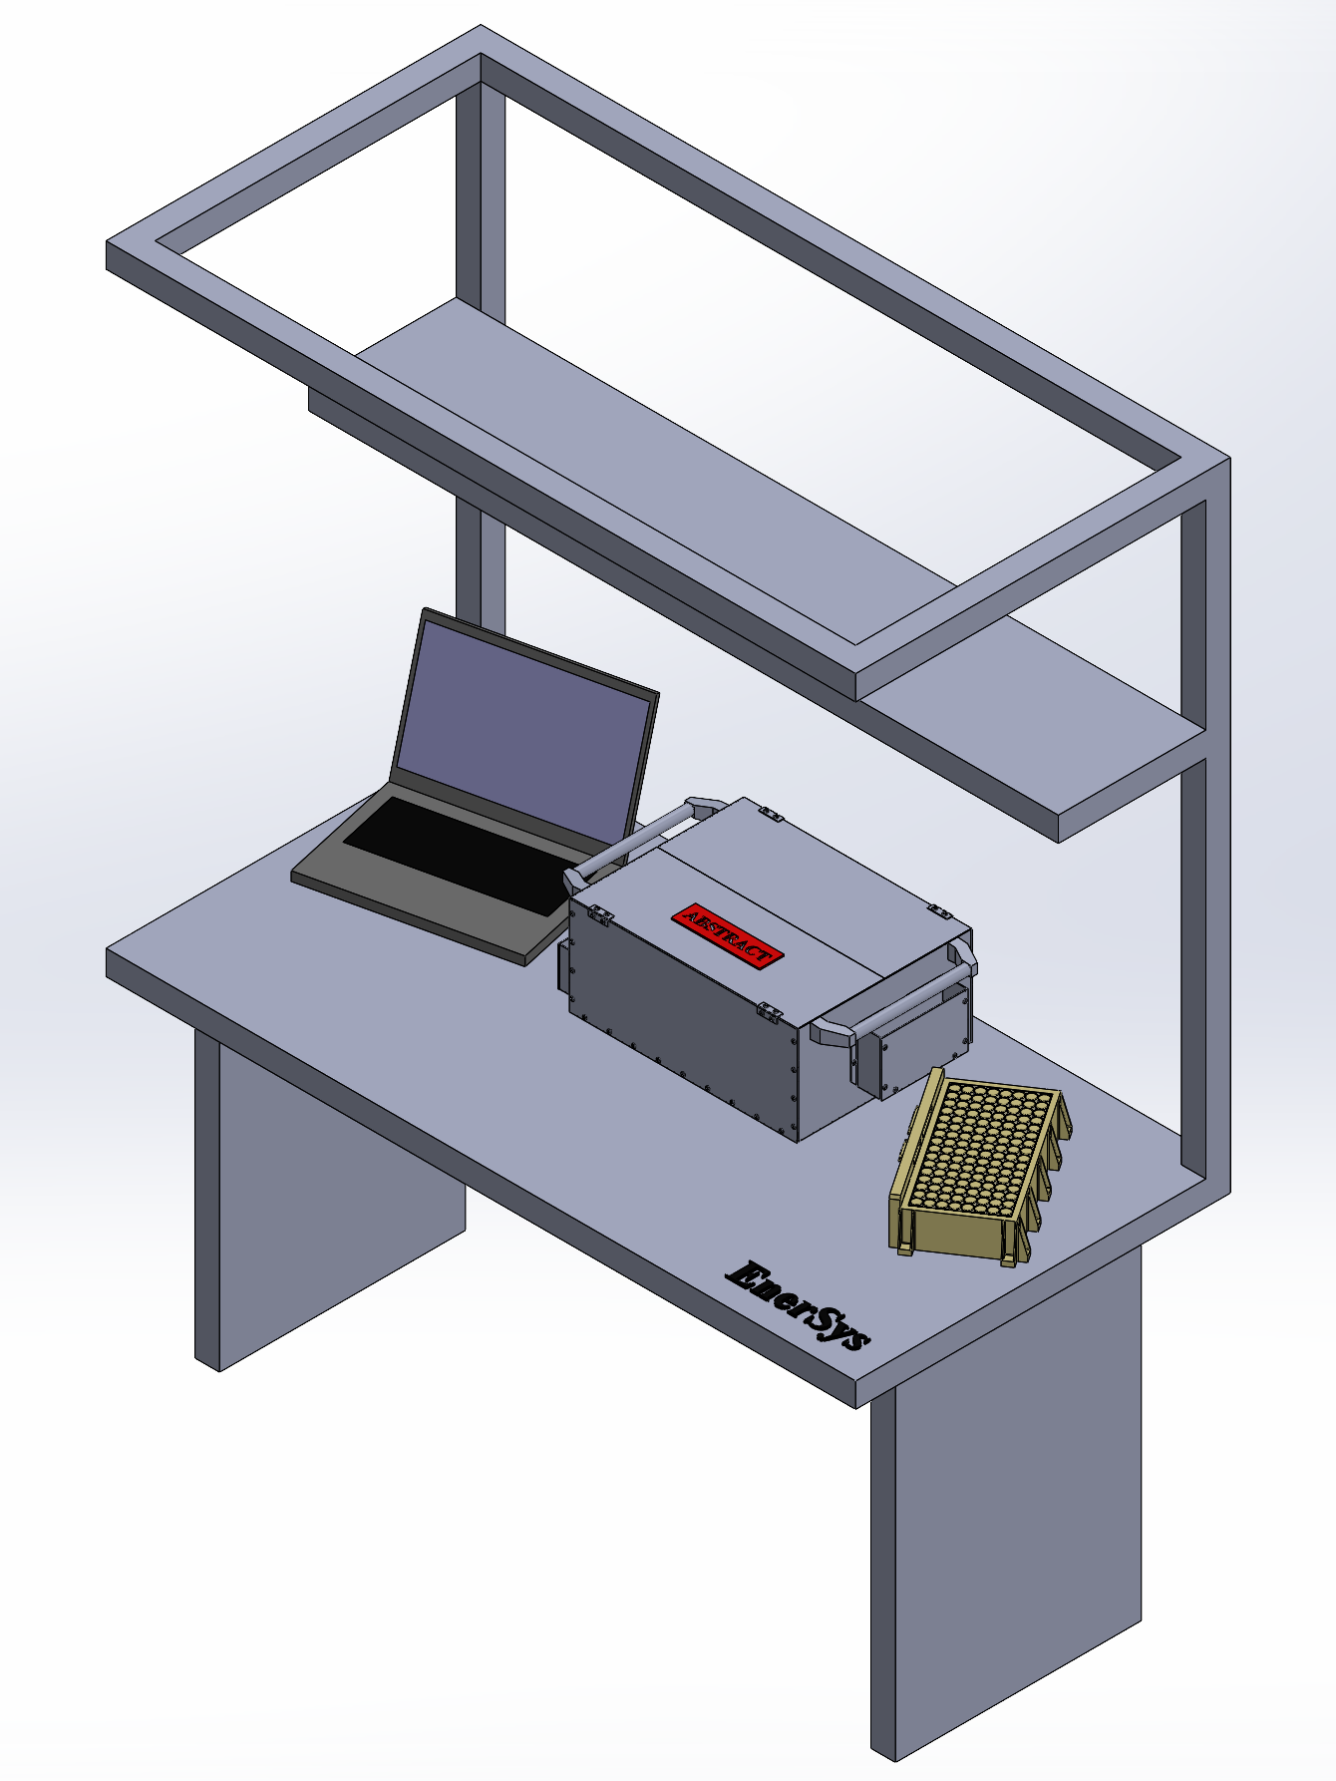
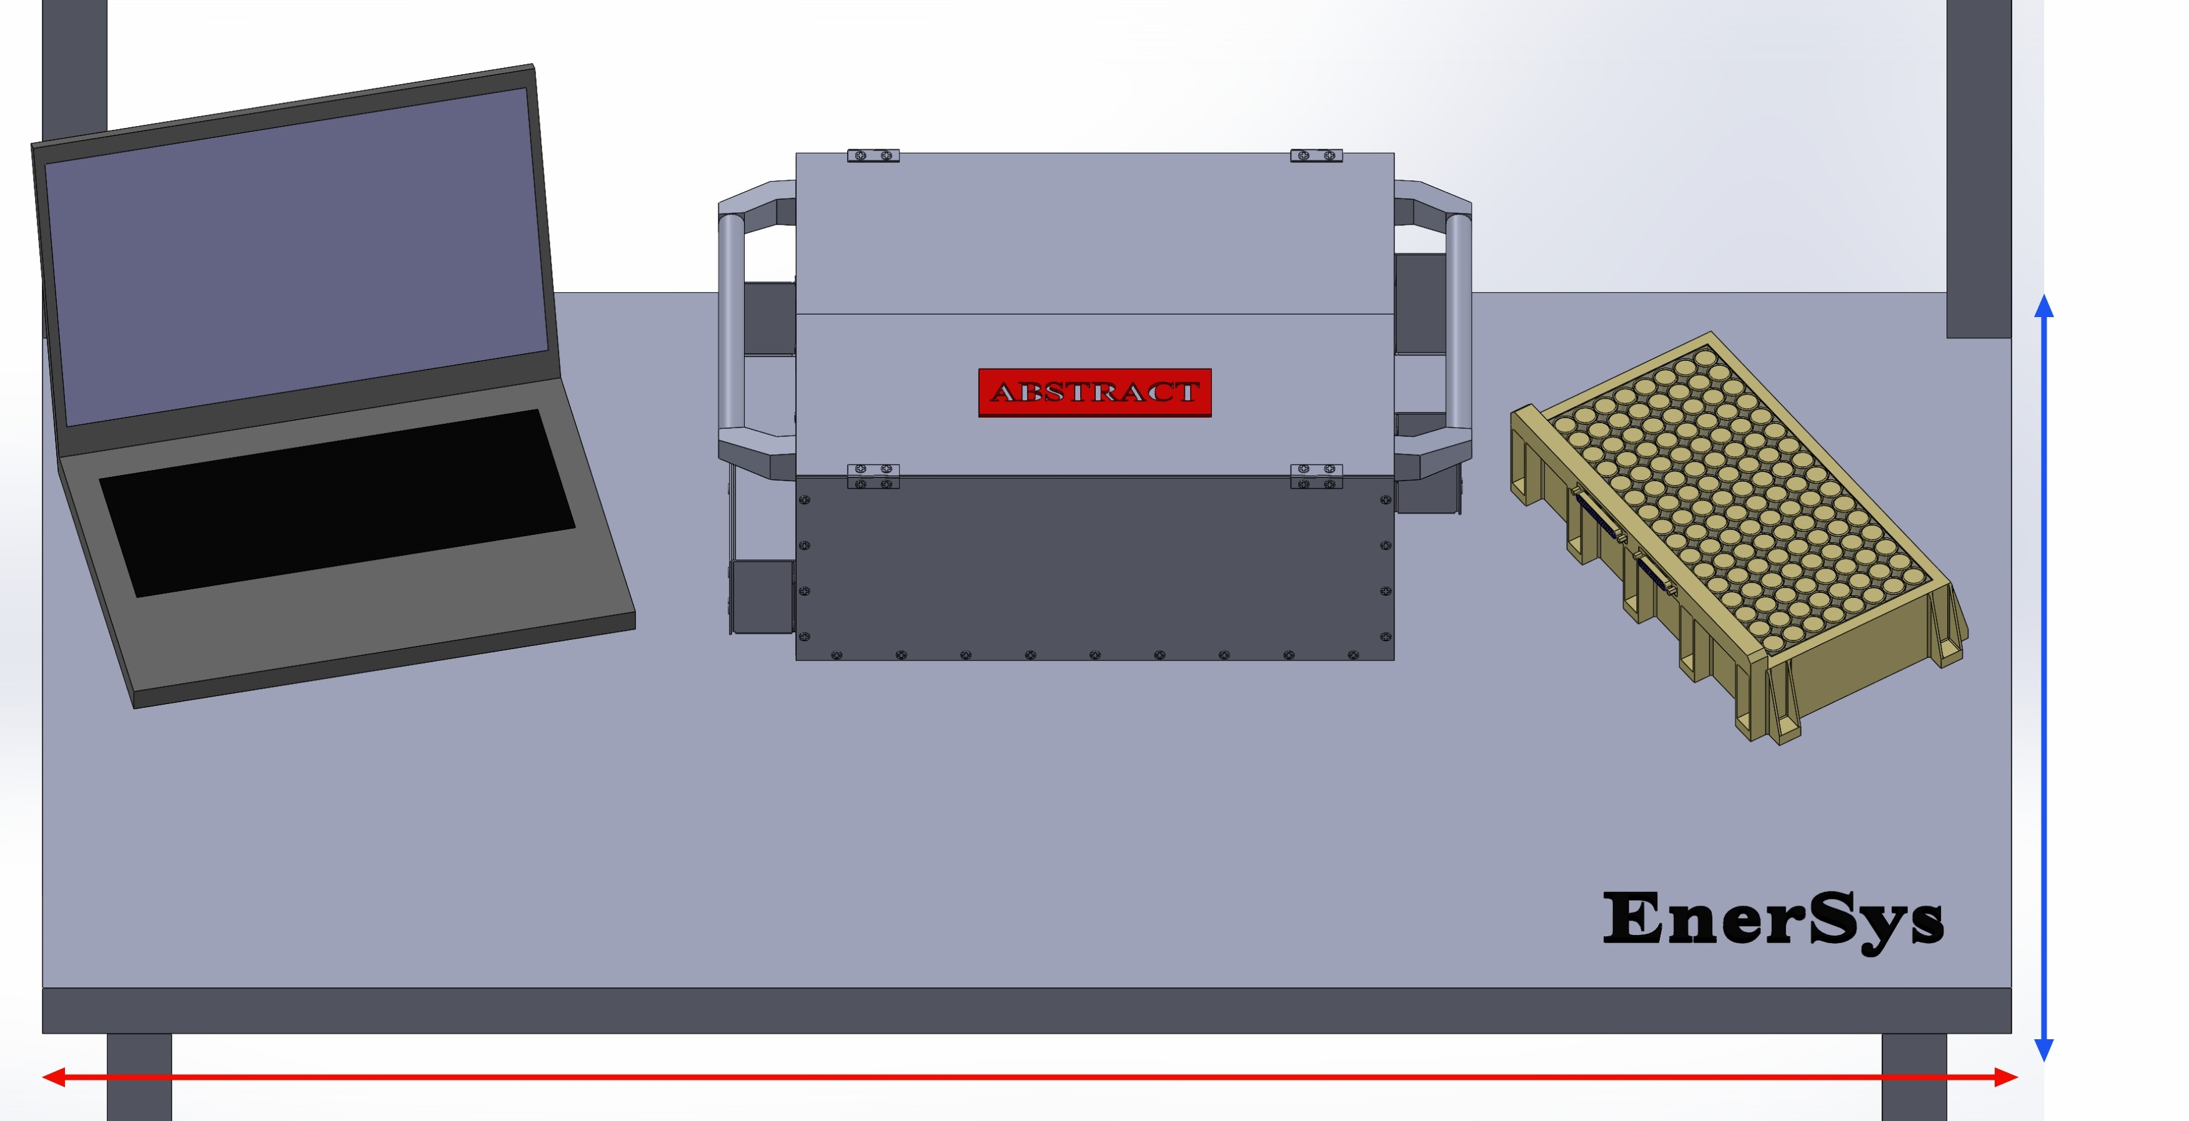
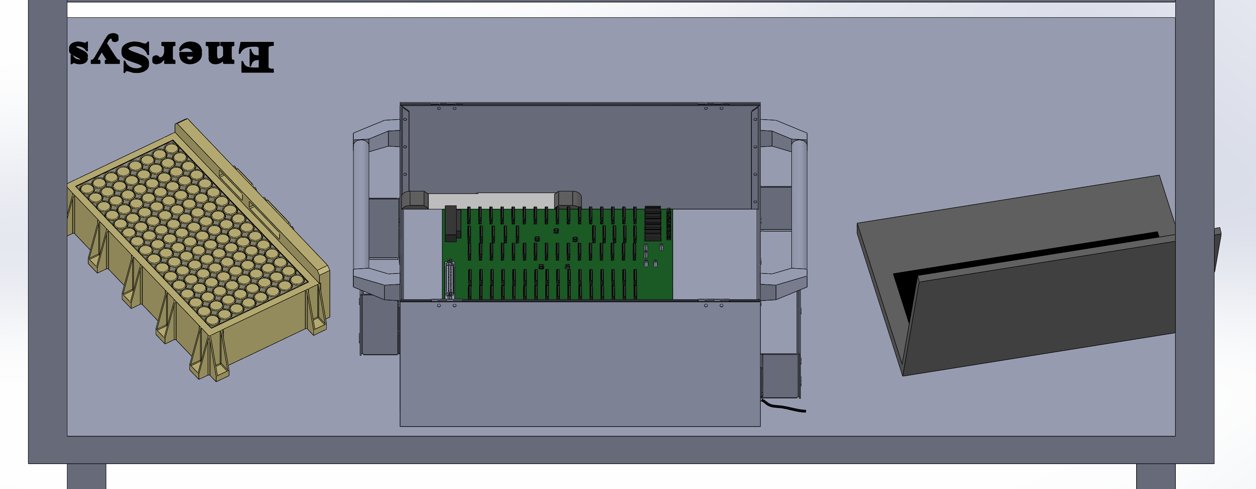
FR 8: Lab Compatibility
DR 8.1
Form Factor
The footprint of the system shall be smaller than 76 cm x 76 cm x 76 cm.
The weight of the system shall not exceed 113 kg
75 cm
150 cm
Overview
Overview
Overview
Design Solution
Design Solution
Design Solution
Critical Project Elements
Critical Project Elements
Critical Project Elements
Project Planning
Verification & Validation
Project Planning
Backup Slides
Project Risks
Project Planning
Project Risks
Verification & Validation
Design Requirements
Verification & Validation
Design Requirements
Project Risks
Design Requirements
41
41

Slide 42
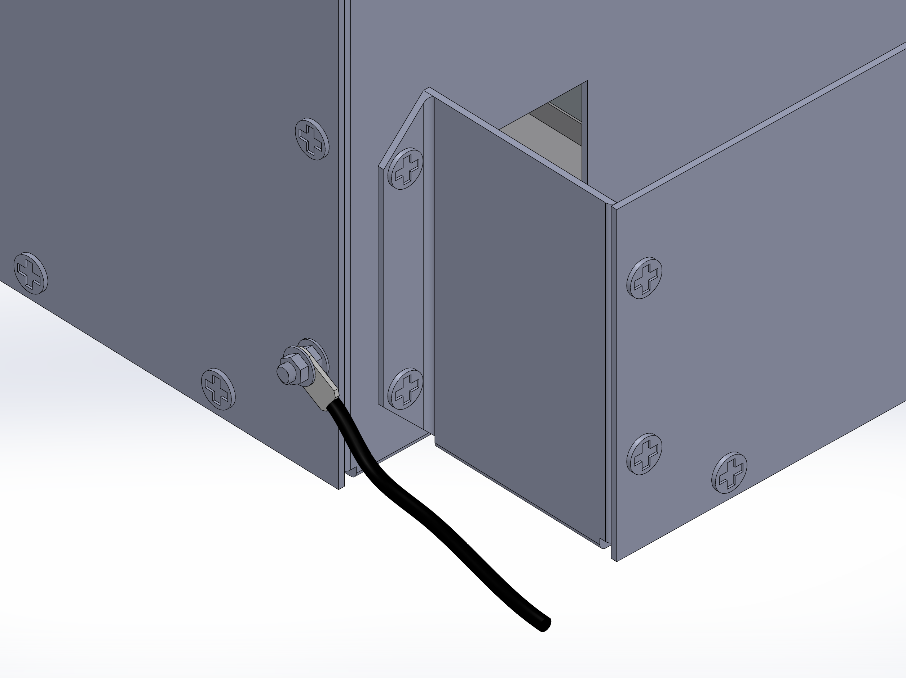
FR 8: Lab Compatibility
DR 8.7
Safety
System shall include ground chassis
Overview
Overview
Overview
Design Solution
Design Solution
Design Solution
Critical Project Elements
Critical Project Elements
Critical Project Elements
Project Planning
Verification & Validation
Project Planning
Backup Slides
Project Risks
Project Planning
Project Risks
Verification & Validation
Design Requirements
Verification & Validation
Design Requirements
Project Risks
Design Requirements
42
42

Slide 43
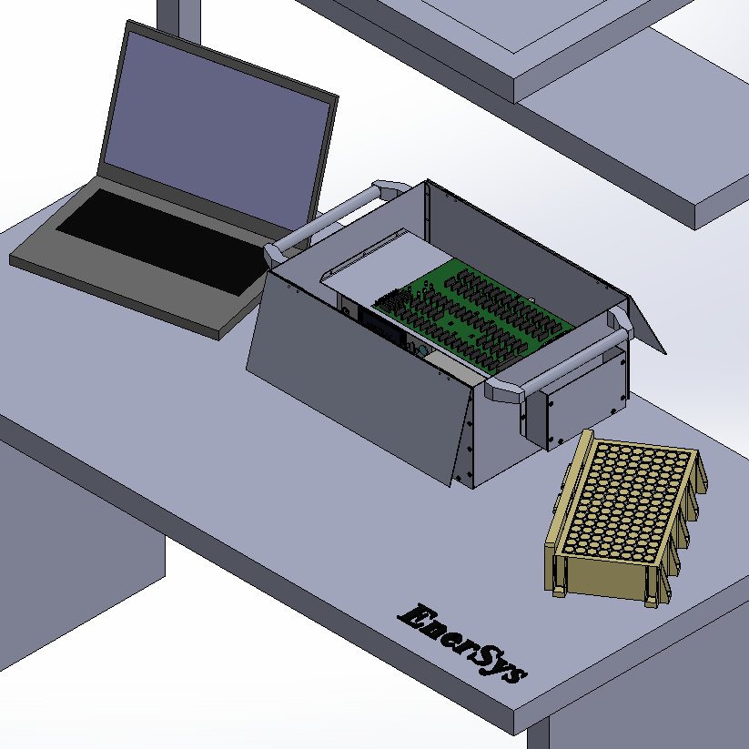
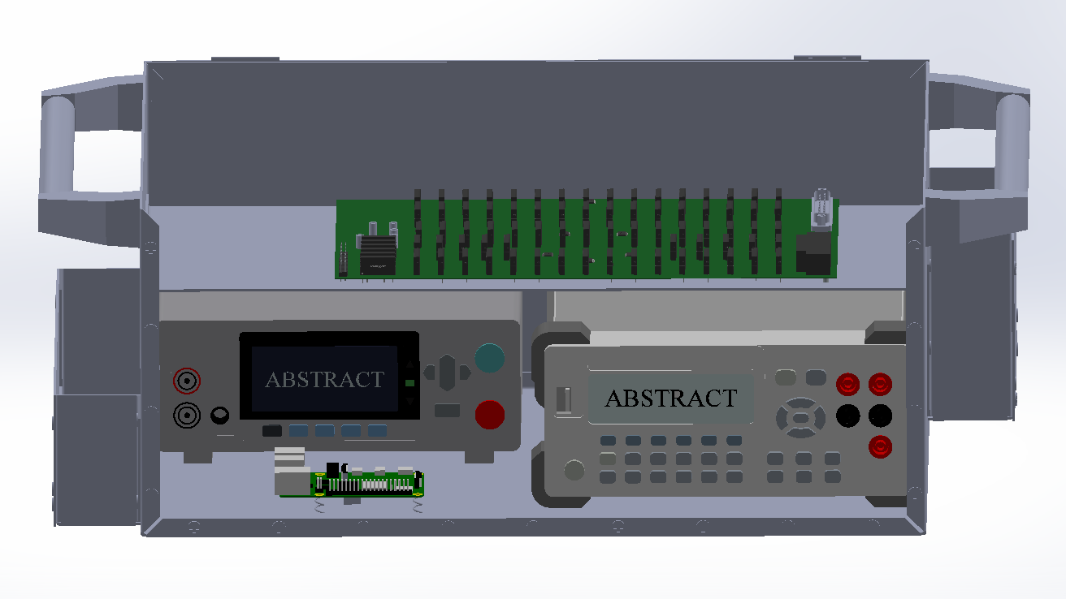
FR 8: Lab Compatibility
DR 8.6
Heat Dissipation
System shall not overheat the battery or any other electrical components in the system
Airflow convection Metal conduction
Overview
Overview
Overview
Design Solution
Design Solution
Design Solution
Critical Project Elements
Critical Project Elements
Critical Project Elements
Project Planning
Verification & Validation
Project Planning
Backup Slides
Project Risks
Project Planning
Project Risks
Verification & Validation
Design Requirements
Verification & Validation
Design Requirements
Project Risks
Design Requirements
43
43

Slide 44
FR 8: Lab Compatibility
FR 8
Lab Compatibility
System shall be compatible with the lab environment
DR 8.1
Form Factor
System shall fit on a standard technician workbench
DR 8.1.1
Form Factor
The footprint of the system shall be smaller than 76 cm x 76 cm x 76 cm.
The weight of the system shall not exceed 113 kg
DR 8.6
Heat Dissipation
System shall not overheat the battery or any other electrical components in the system
DR 8.6
Safety
System shall include ground chassis
Overview
Overview
Overview
Design Solution
Design Solution
Design Solution
Critical Project Elements
Critical Project Elements
Critical Project Elements
Project Planning
Verification & Validation
Project Planning
Backup Slides
Project Risks
Project Planning
Project Risks
Verification & Validation
Design Requirements
Verification & Validation
Design Requirements
Project Risks
Design Requirements
44
44
Notes:
I need to do this.

Slide 45
CPE 4: Sensing Software
CPE 4
Sensing Software
System shall report measurements to a data file
CPE 5
Autonomy
System shall conduct the entire test process without any need for technician input
FR 6
GUI
System shall have a graphical user interface (GUI)
DR 6.1
Management
System shall allow the user to manage testing using the GUI
FR 2
Automatic Testing
System shall test the battery automatically
DR 2.1.1.2
Data Acquisition
System shall store the voltage measurement value
Overview
Overview
Overview
Design Solution
Design Solution
Design Solution
Critical Project Elements
Critical Project Elements
Critical Project Elements
Project Planning
Verification & Validation
Project Planning
Backup Slides
Project Risks
Project Planning
Project Risks
Verification & Validation
Design Requirements
Verification & Validation
Design Requirements
Project Risks
Design Requirements
45
45

Slide 46
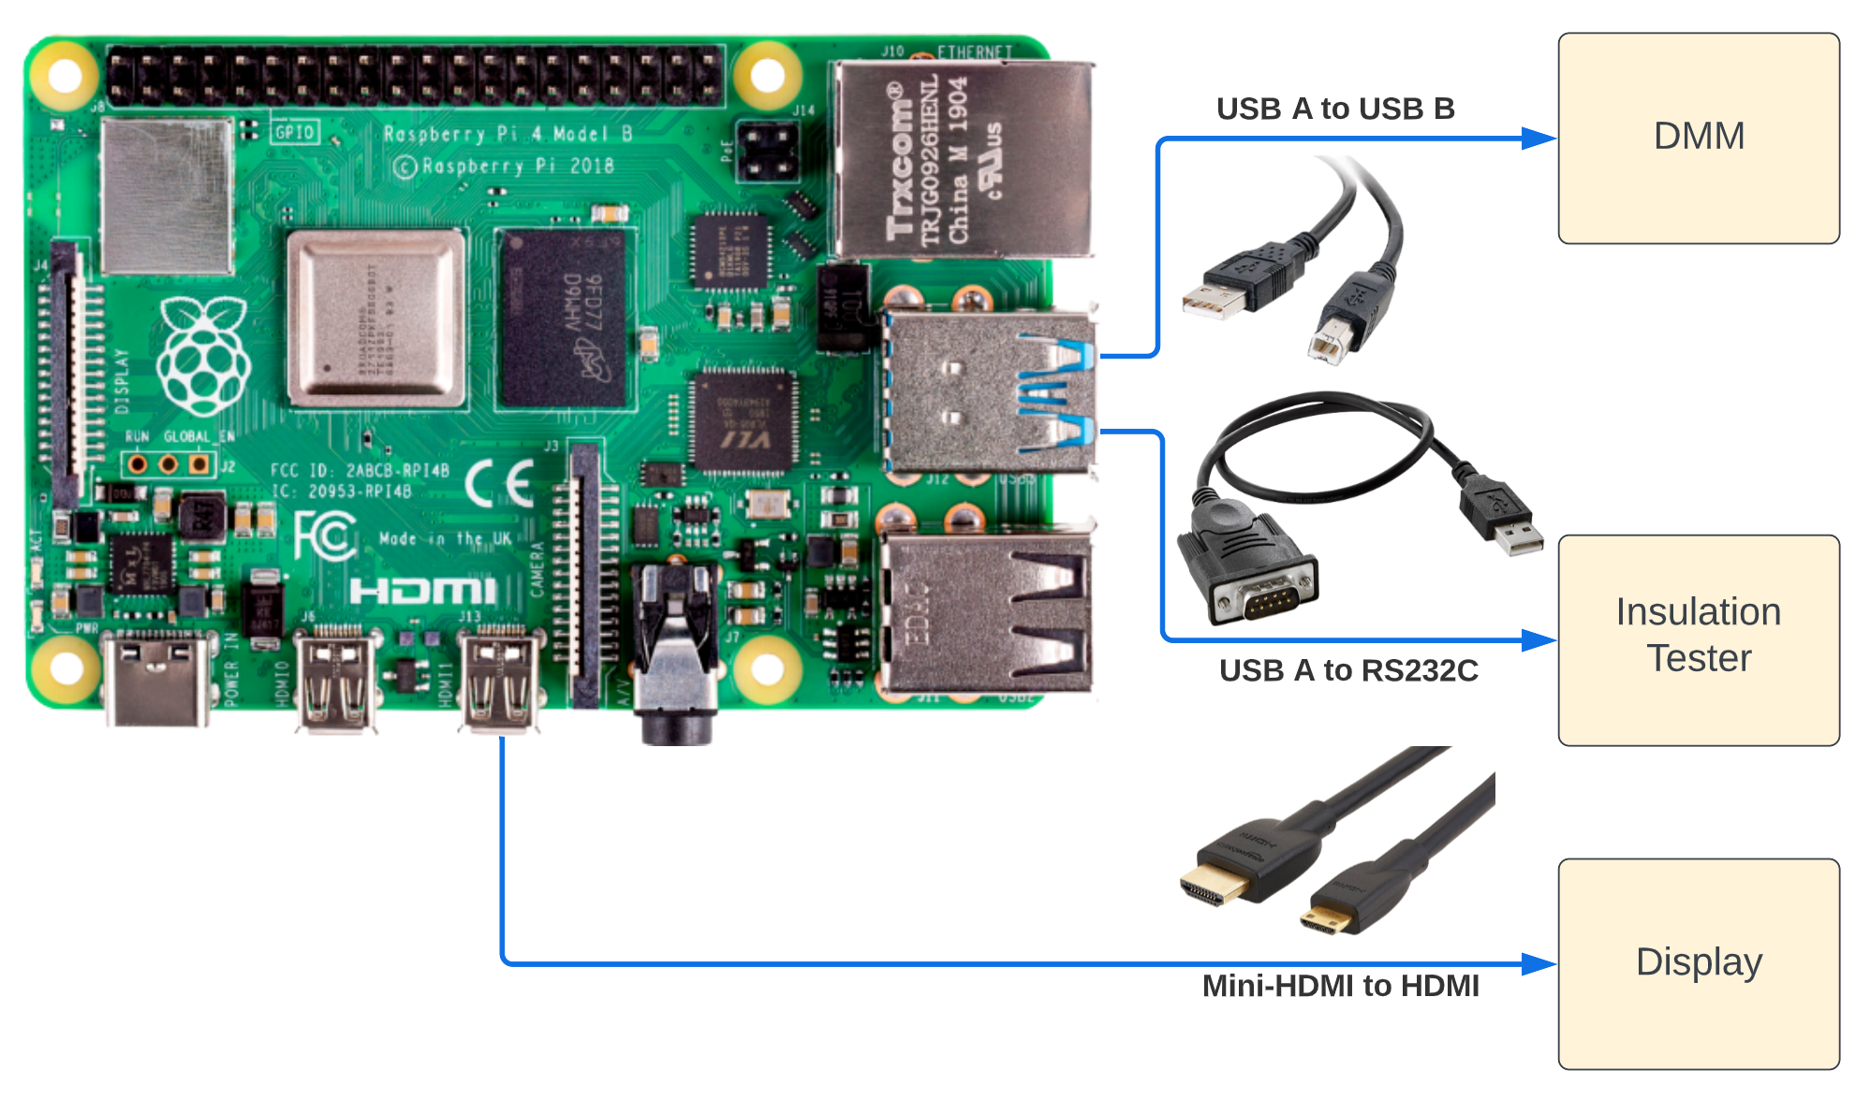
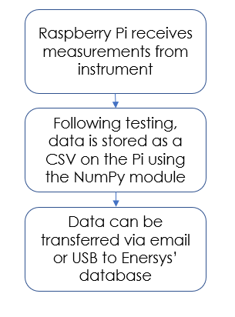
CPE 4: Sensing Software – Communication and Data Storage
Overview
Overview
Overview
Design Solution
Design Solution
Design Solution
Critical Project Elements
Critical Project Elements
Critical Project Elements
Project Planning
Verification & Validation
Project Planning
Backup Slides
Project Risks
Project Planning
Project Risks
Verification & Validation
Design Requirements
Verification & Validation
Design Requirements
Project Risks
Design Requirements
46
46

Slide 47
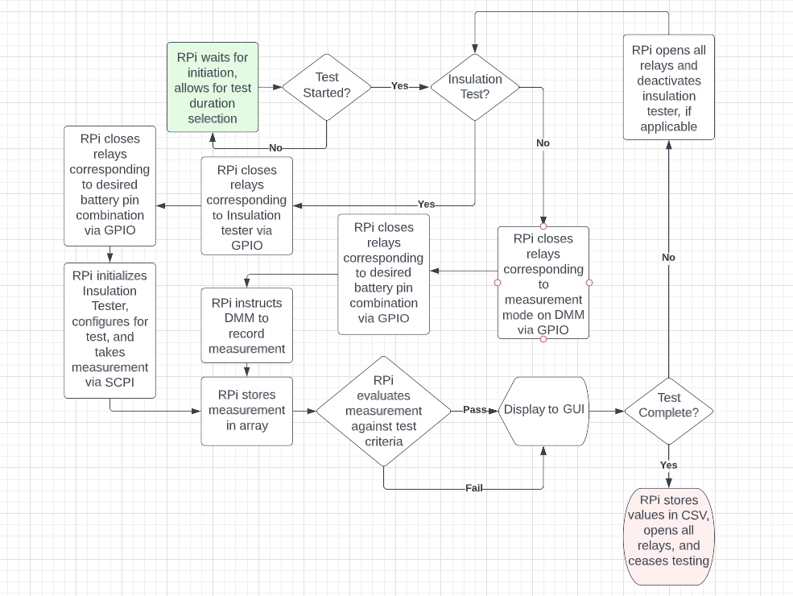
CPE 4: Sensing Software – Code Flowchart
FR 2
FR 6
DR 6.1

Slide 48
CPE 4: Sensing Software
CPE 4
Sensing Software
System shall report measurements to a data file
CPE 5
Autonomy
System shall conduct the entire test process without any need for technician input
FR 6
GUI
System shall have a graphical user interface (GUI)
DR 6.1
Management
System shall allow the user to manage testing using the GUI
FR 2
Automatic Testing
System shall test the battery automatically
DR 2.1.1.2
Data Acquisition
System shall store the voltage measurement value
Overview
Overview
Overview
Design Solution
Design Solution
Design Solution
Critical Project Elements
Critical Project Elements
Critical Project Elements
Project Planning
Verification & Validation
Project Planning
Backup Slides
Project Risks
Project Planning
Project Risks
Verification & Validation
Design Requirements
Verification & Validation
Design Requirements
Project Risks
Design Requirements
48
48

Slide 49
Verification & Validation
Overview
Overview
Overview
Design Solution
Design Solution
Design Solution
Critical Project Elements
Critical Project Elements
Critical Project Elements
Project Planning
Verification & Validation
Project Planning
Backup Slides
Project Risks
Project Planning
Project Risks
Verification & Validation
Design Requirements
Verification & Validation
Design Requirements
Project Risks
Design Requirements
49
49

Slide 50
Verification and Validation – Electrical Components
Objective | Prove that components meet their requirements and performance expectations
Description | SSR: Test on resistance, leakage current for each component Decoders: Test decoders with Raspberry Pi GPIO and SSRs to verify proper voltage and current are supplied PCB: Ensure continuity between pads before soldering
Model Comparison | Component data sheets
Pass / Fail Criteria | SSR: On resistance <= 1.1 Ω, leakage current <= 10 μA, Decoders: 3 mA < Output Current < 50 mA, Output voltage ~= 5V, maximum 5.5V PCB: Continuity between pads (negligible resistance)
Measurements | SSR: On-resistance, leakage current Decoders: Output current, voltage PCB: Resistance
Validation Against FRs | FR 3 (no false positives/negatives)
Overview
Overview
Overview
Overview
Design Solution
Design Solution
Design Solution
Design Solution
Critical Project Elements
Critical Project Elements
Critical Project Elements
Critical Project Elements
Project Planning
Project Planning
Verification & Validation
Project Planning
Backup Slides
Project Risks
Project Planning
Project Risks
Project Risks
Verification & Validation
Verification & Validation
Design Requirements
Verification & Validation
Design Requirements
Design Requirements
Project Risks
Design Requirements
50
50
50

Slide 51
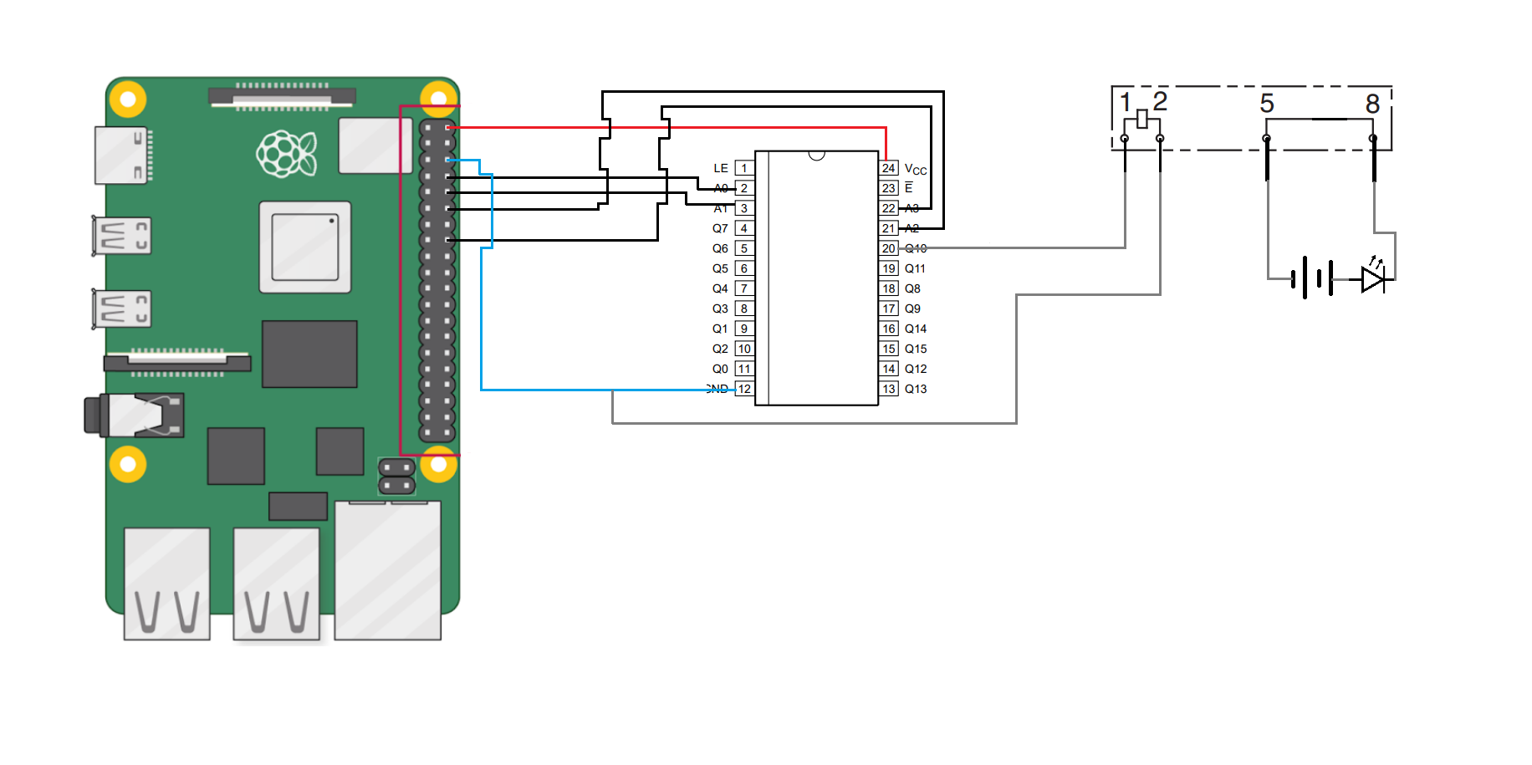
Verification and Validation – Electrical Components
Decoder Test: measuring supply current and voltage to the SSR
Raspberry Pi
Decoder
SSR
Power
Ammeter
Voltmeter
Overview
Overview
Overview
Overview
Design Solution
Design Solution
Design Solution
Design Solution
Critical Project Elements
Critical Project Elements
Critical Project Elements
Critical Project Elements
Project Planning
Project Planning
Verification & Validation
Project Planning
Backup Slides
Project Risks
Project Planning
Project Risks
Project Risks
Verification & Validation
Verification & Validation
Design Requirements
Verification & Validation
Design Requirements
Design Requirements
Project Risks
Design Requirements
51
51
51

Slide 52
Verification and Validation – PCB Performance
Objective | Prove that the custom PCB is manufactured and designed properly and test for its performance compared to the measurement requirements provided by the customer for each set of tests. Additionally, test for model accuracy within system integration
Description | Equivalent Resistance: Solder components onto PCB, measure equivalent resistance, compare to model, for all components Solder Tests: Test all components after soldering to ensure connections are complete Automation Tests: Ensure Raspberry Pi can execute selection of pins and collection of measurements automatically Safety During Testing: Use of rubber insulating gloves, sleeves, ESD mats In the Electronics shop
Model Comparison | Measurement Accuracy Model
Pass / Fail Criteria | Measured equivalent resistance does not exceed DMM measurement range, complete execution of code, components function after soldering
Measurements | Resistance, voltage
Validation Against FRs | FR 2 (automatic testing), FR 3 (no false positives/negatives), FR 9 (battery and user safety)
Overview
Overview
Overview
Overview
Design Solution
Design Solution
Design Solution
Design Solution
Critical Project Elements
Critical Project Elements
Critical Project Elements
Critical Project Elements
Project Planning
Project Planning
Verification & Validation
Project Planning
Backup Slides
Project Risks
Project Planning
Project Risks
Project Risks
Verification & Validation
Verification & Validation
Design Requirements
Verification & Validation
Design Requirements
Design Requirements
Project Risks
Design Requirements
52
52
52
Notes:
Use test batteries connected to our system in order to make measurements and verify that the integration of the components on our PCB satisfy the design requirements. Apply voltage to the circuit (what circuit ... PCB ? A different one? ), use the raspberry pi and ensure that the decoder works as intended, measuring voltage and current at outputs. Test with SSRs to ensure that they can be opened and closed ad the proper test points are accessed (how can we prove this? Maybe by using LEDs – I think that would work). I DON’T THINK WE NEED TO WORRY ABOUT MEASUREMENTS TAKEN FOR RASP PI IS IMPORTANT FOR THIS V&V.
Nick says we test (BASIL LAB – heat camera to check for hot spots in addition (heat testing)). Nick says perform an integration test to see if PCB works and to compare it to the truth values

Slide 53
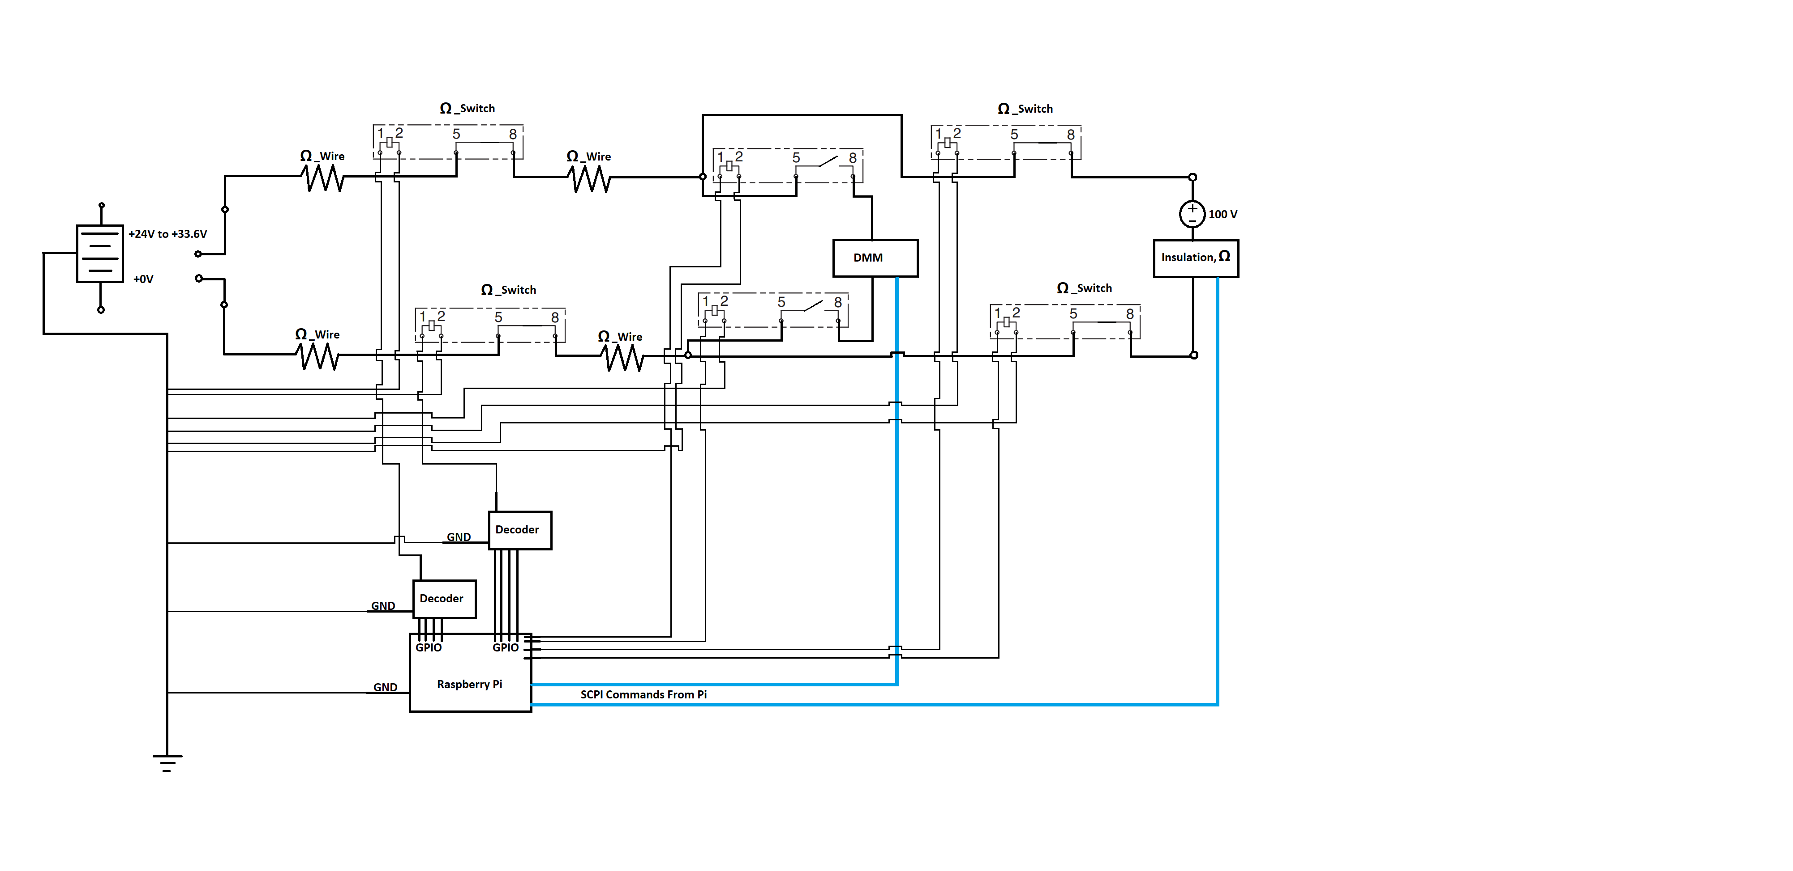
Verification and Validation – Electrical Components
Overview
Design Solution
Critical Project Elements
Design Requirements
Project Risks
Verification & Validation
Project Planning

Slide 54
Project Planning
Overview
Overview
Overview
Overview
Design Solution
Design Solution
Design Solution
Design Solution
Critical Project Elements
Critical Project Elements
Critical Project Elements
Critical Project Elements
Project Planning
Project Planning
Verification & Validation
Project Planning
Backup Slides
Project Risks
Project Planning
Project Risks
Project Risks
Verification & Validation
Verification & Validation
Design Requirements
Verification & Validation
Design Requirements
Design Requirements
Project Risks
Design Requirements
54
54
54

Slide 55
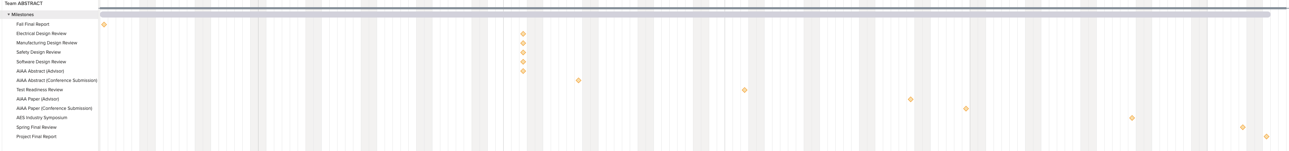
Gantt Chart - Milestones
Overview
Overview
Overview
Overview
Design Solution
Design Solution
Design Solution
Design Solution
Critical Project Elements
Critical Project Elements
Critical Project Elements
Critical Project Elements
Project Planning
Project Planning
Verification & Validation
Project Planning
Backup Slides
Project Risks
Project Planning
Project Risks
Project Risks
Verification & Validation
Verification & Validation
Design Requirements
Verification & Validation
Design Requirements
Design Requirements
Project Risks
Design Requirements
55
55
55

Slide 56
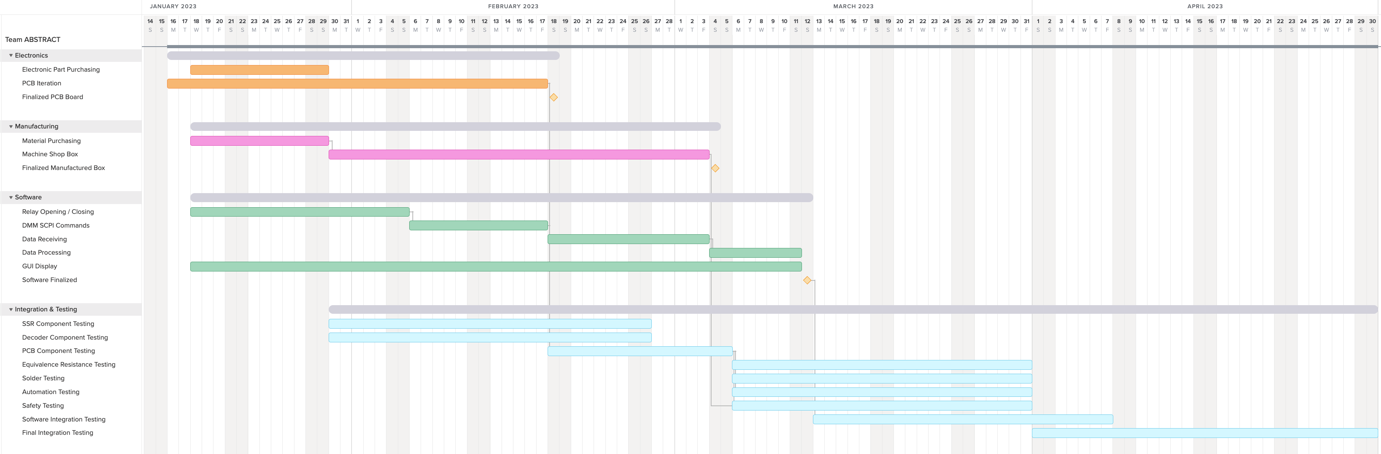
Gantt Chart – Overall
Critical Path
Overview
Overview
Overview
Overview
Design Solution
Design Solution
Design Solution
Design Solution
Critical Project Elements
Critical Project Elements
Critical Project Elements
Critical Project Elements
Project Planning
Project Planning
Verification & Validation
Project Planning
Backup Slides
Project Risks
Project Planning
Project Risks
Project Risks
Verification & Validation
Verification & Validation
Design Requirements
Verification & Validation
Design Requirements
Design Requirements
Project Risks
Design Requirements
56
56
56

Slide 57
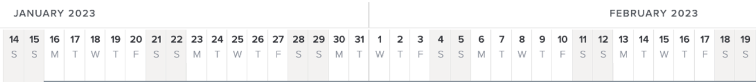
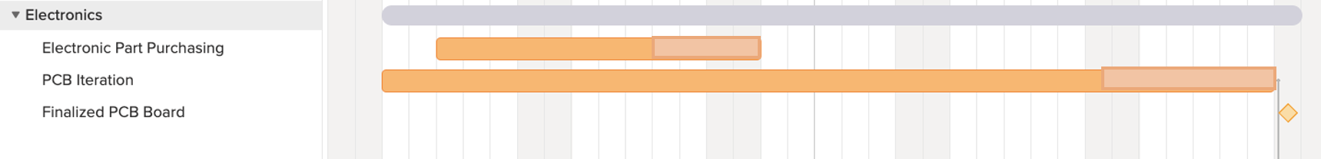
Gantt Chart – Electronics
Overview
Overview
Overview
Overview
Design Solution
Design Solution
Design Solution
Design Solution
Critical Project Elements
Critical Project Elements
Critical Project Elements
Critical Project Elements
Project Planning
Project Planning
Verification & Validation
Project Planning
Backup Slides
Project Risks
Project Planning
Project Risks
Project Risks
Verification & Validation
Verification & Validation
Design Requirements
Verification & Validation
Design Requirements
Design Requirements
Project Risks
Design Requirements
57
57
57

Slide 58
Gantt Chart – Manufacturing
Overview
Overview
Overview
Overview
Design Solution
Design Solution
Design Solution
Design Solution
Critical Project Elements
Critical Project Elements
Critical Project Elements
Critical Project Elements
Project Planning
Project Planning
Verification & Validation
Project Planning
Backup Slides
Project Risks
Project Planning
Project Risks
Project Risks
Verification & Validation
Verification & Validation
Design Requirements
Verification & Validation
Design Requirements
Design Requirements
Project Risks
Design Requirements
58
58
58

Slide 59
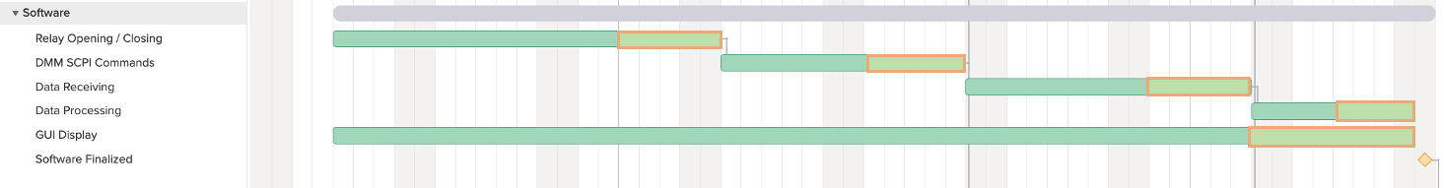
Gantt Chart – Software
Overview
Overview
Overview
Overview
Design Solution
Design Solution
Design Solution
Design Solution
Critical Project Elements
Critical Project Elements
Critical Project Elements
Critical Project Elements
Project Planning
Project Planning
Verification & Validation
Project Planning
Backup Slides
Project Risks
Project Planning
Project Risks
Project Risks
Verification & Validation
Verification & Validation
Design Requirements
Verification & Validation
Design Requirements
Design Requirements
Project Risks
Design Requirements
59
59
59

Slide 60
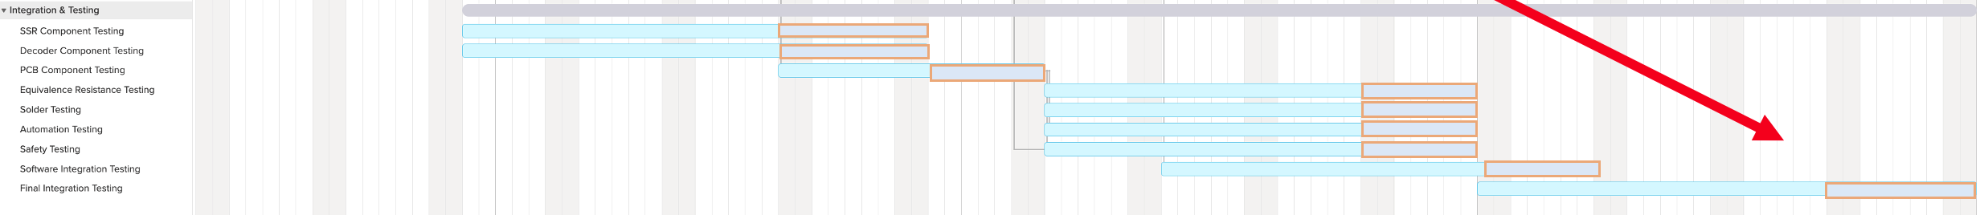
Gantt Chart – Integration & Testing
Overview
Overview
Overview
Overview
Design Solution
Design Solution
Design Solution
Design Solution
Critical Project Elements
Critical Project Elements
Critical Project Elements
Critical Project Elements
Project Planning
Project Planning
Verification & Validation
Project Planning
Backup Slides
Project Risks
Project Planning
Project Risks
Project Risks
Verification & Validation
Verification & Validation
Design Requirements
Verification & Validation
Design Requirements
Design Requirements
Project Risks
Design Requirements
60
60
60

Slide 61
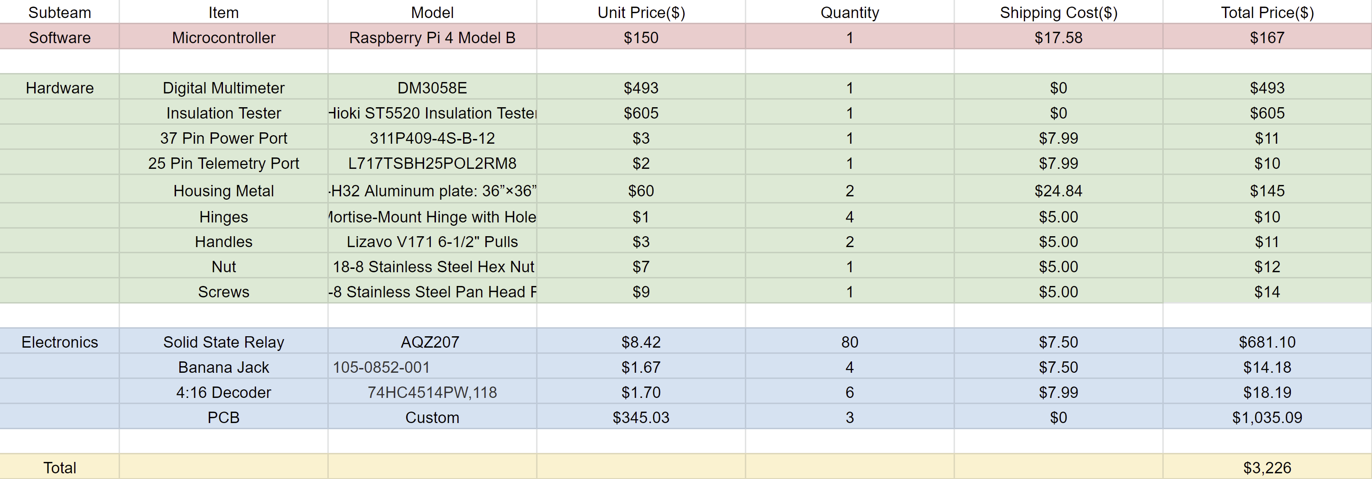
Cost Plan - Budget
Overview
Overview
Overview
Overview
Design Solution
Design Solution
Design Solution
Design Solution
Critical Project Elements
Critical Project Elements
Critical Project Elements
Critical Project Elements
Project Planning
Project Planning
Verification & Validation
Project Planning
Backup Slides
Project Risks
Project Planning
Project Risks
Project Risks
Verification & Validation
Verification & Validation
Design Requirements
Verification & Validation
Design Requirements
Design Requirements
Project Risks
Design Requirements
61
61
61

Slide 62
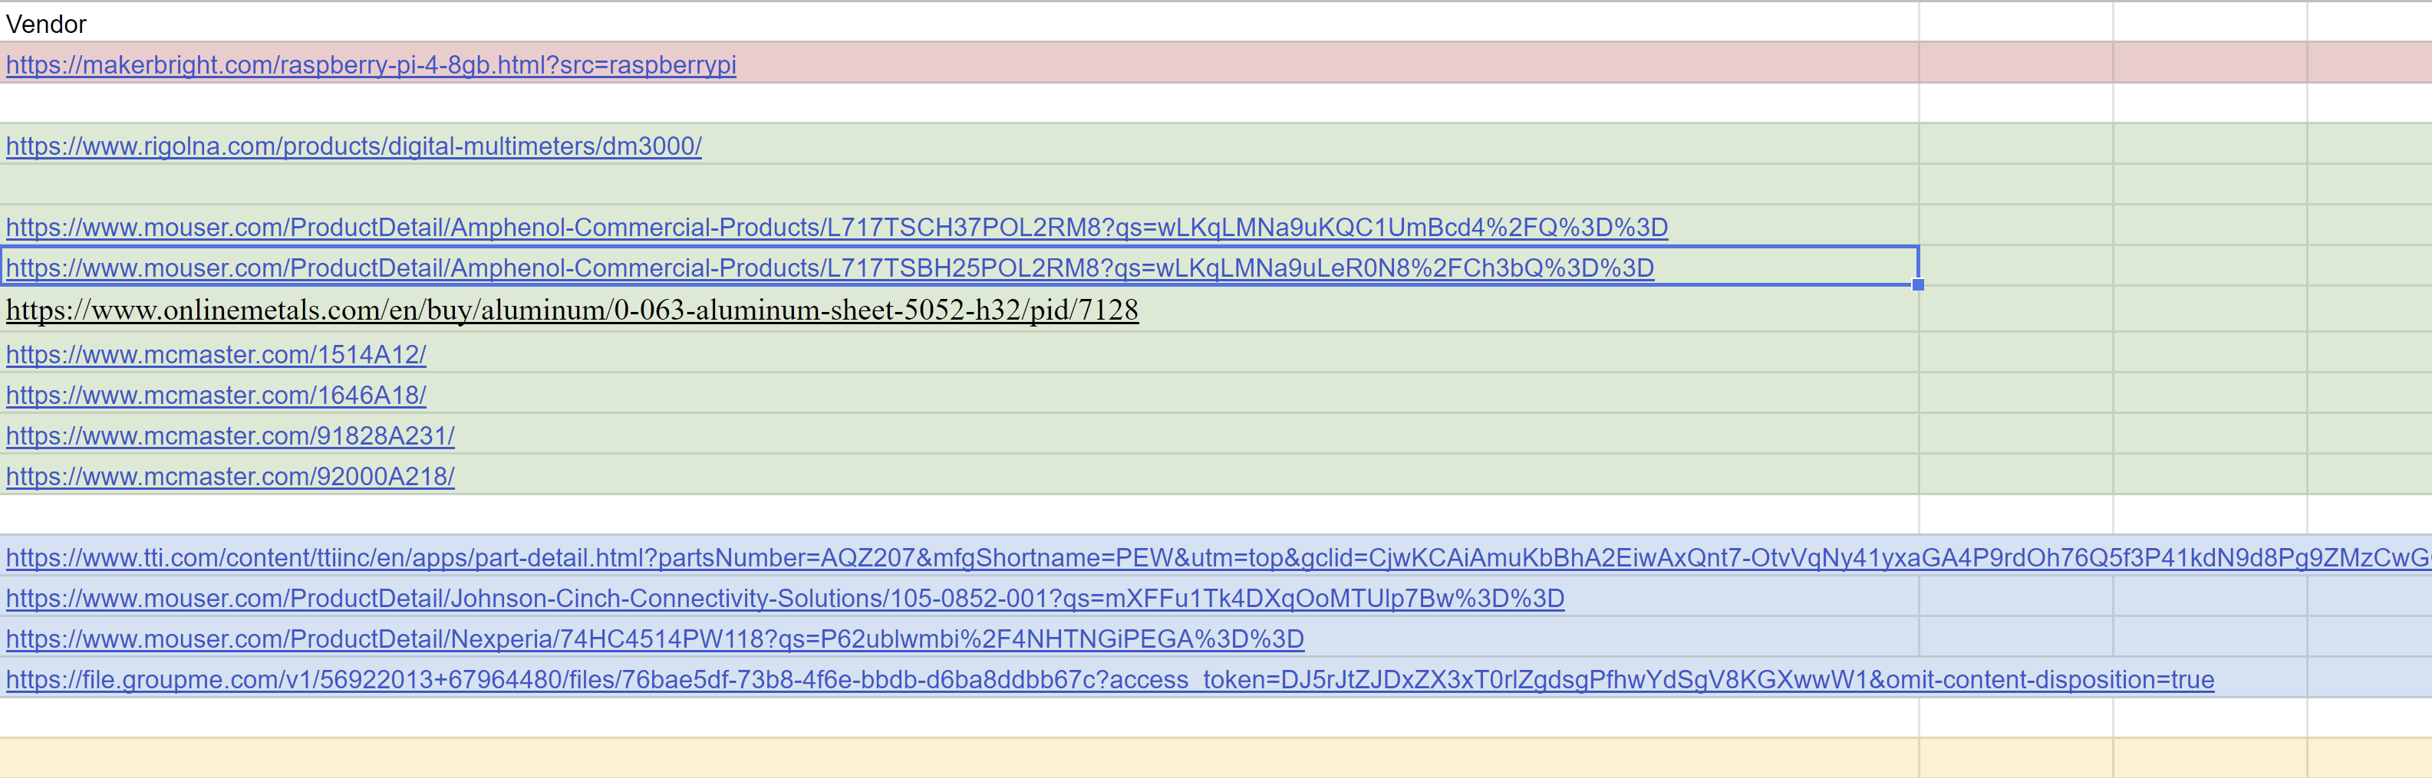
Cost Plan - Budget
Overview
Overview
Overview
Overview
Design Solution
Design Solution
Design Solution
Design Solution
Critical Project Elements
Critical Project Elements
Critical Project Elements
Critical Project Elements
Project Planning
Project Planning
Verification & Validation
Project Planning
Backup Slides
Project Risks
Project Planning
Project Risks
Project Risks
Verification & Validation
Verification & Validation
Design Requirements
Verification & Validation
Design Requirements
Design Requirements
Project Risks
Design Requirements
62
62
62

Slide 63
Future Testing
Future Testing
Subsystem | Test | Goals | Dates | Testing Location | Equipment | Safety
SSR | Component Test | Verify that the on-resistance measurement meets the requirements Test for Leakage current Test voltage tolerance | Feb - Mar | Aerospace Building –Electronics Shop | Ammeter Voltmeter Decoder Raspberry Pi | Use of rubber insulating gloves, sleeves, ESD mats In the Electronics shop
Decoder | Component Test | Verify proper voltage and current is supplied to drive the SSR | Feb - Mar | Aerospace Building - Electronics Shop | Ammeter Voltmeter SSR Raspberry Pi | Use of rubber insulating gloves, sleeves, ESD mats In the Electronics shop
PCB | Breadboard Integration and prototyping | Verify equivalent Resistance Ensure connections are complete after soldering Ensure Raspberry Pi can execute selection of pins Ensure measurements are within uncertainty requirements | Feb - Mar | Aerospace Building - Electronics Shop | Benchtop DMM Test Batteries Raspberry Pi Computer Harnesses | Use of rubber insulating gloves, sleeves, ESD mats In the Electronics shop
Overview
Overview
Overview
Overview
Design Solution
Design Solution
Design Solution
Design Solution
Critical Project Elements
Critical Project Elements
Critical Project Elements
Critical Project Elements
Project Planning
Project Planning
Verification & Validation
Project Planning
Backup Slides
Project Risks
Project Planning
Project Risks
Project Risks
Verification & Validation
Verification & Validation
Design Requirements
Verification & Validation
Design Requirements
Design Requirements
Project Risks
Design Requirements
63
63
63

Slide 64
Questions?
Overview
Overview
Overview
Overview
Overview
Design Solution
Design Solution
Design Solution
Design Solution
Design Solution
Critical Project Elements
Critical Project Elements
Critical Project Elements
Critical Project Elements
Critical Project Elements
Project Planning
Project Planning
Project Planning
Verification & Validation
Project Planning
Backup Slides
Project Risks
Project Planning
Project Risks
Project Risks
Project Risks
Verification & Validation
Verification & Validation
Verification & Validation
Design Requirements
Verification & Validation
Design Requirements
Design Requirements
Design Requirements
Project Risks
Design Requirements
64
64
64
64

Slide 65
Backup Slides
Overview
Overview
Overview
Overview
Overview
Design Solution
Design Solution
Design Solution
Design Solution
Design Solution
Critical Project Elements
Critical Project Elements
Critical Project Elements
Critical Project Elements
Critical Project Elements
Project Planning
Project Planning
Project Planning
Verification & Validation
Project Planning
Backup Slides
Project Risks
Project Planning
Project Risks
Project Risks
Project Risks
Verification & Validation
Verification & Validation
Verification & Validation
Design Requirements
Verification & Validation
Design Requirements
Design Requirements
Design Requirements
Project Risks
Design Requirements
65
65
65
65

Slide 66
Battery Layout
8s16p Battery – Power Circuit
Overview
Overview
Overview
Overview
Overview
Design Solution
Design Solution
Design Solution
Design Solution
Design Solution
Critical Project Elements
Critical Project Elements
Critical Project Elements
Critical Project Elements
Critical Project Elements
Project Planning
Project Planning
Project Planning
Verification & Validation
Project Planning
Backup Slides
Project Risks
Project Planning
Project Risks
Project Risks
Project Risks
Verification & Validation
Verification & Validation
Verification & Validation
Design Requirements
Verification & Validation
Design Requirements
Design Requirements
Design Requirements
Project Risks
Design Requirements
66
66
66
66

Slide 67
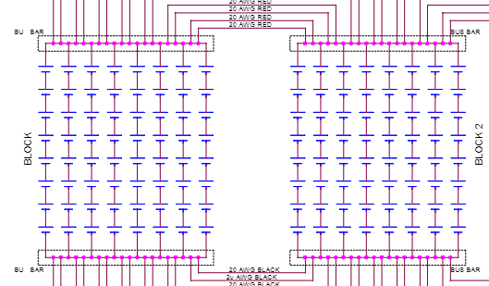
Battery Layout
8s16p Battery – Cell Layout
8s:
8 cells in series
Boxed in red
16p:
16 cells in parallel
Boxed in Blue
Overview
Overview
Overview
Overview
Overview
Design Solution
Design Solution
Design Solution
Design Solution
Design Solution
Critical Project Elements
Critical Project Elements
Critical Project Elements
Critical Project Elements
Critical Project Elements
Project Planning
Project Planning
Project Planning
Verification & Validation
Project Planning
Backup Slides
Project Risks
Project Planning
Project Risks
Project Risks
Project Risks
Verification & Validation
Verification & Validation
Verification & Validation
Design Requirements
Verification & Validation
Design Requirements
Design Requirements
Design Requirements
Project Risks
Design Requirements
67
67
67
67

Slide 68
Battery Layout
8s16p Battery – Bus Bar
Bus Bars:
Positive End
  Boxed in red
Negative End
  Boxed in blue
Cells are connected to these bus bars
Overview
Overview
Overview
Overview
Overview
Design Solution
Design Solution
Design Solution
Design Solution
Design Solution
Critical Project Elements
Critical Project Elements
Critical Project Elements
Critical Project Elements
Critical Project Elements
Project Planning
Project Planning
Project Planning
Verification & Validation
Project Planning
Backup Slides
Project Risks
Project Planning
Project Risks
Project Risks
Project Risks
Verification & Validation
Verification & Validation
Verification & Validation
Design Requirements
Verification & Validation
Design Requirements
Design Requirements
Design Requirements
Project Risks
Design Requirements
68
68
68
68

Slide 69
Battery Layout
8s16p Battery – Power Connector
Power Connector:
Voltage outputs of the positive and negative bus bars are split into 37 pin connector
Positive pins boxed in red
Negative pins boxed in blue
Single blank pin
Overview
Overview
Overview
Overview
Overview
Design Solution
Design Solution
Design Solution
Design Solution
Design Solution
Critical Project Elements
Critical Project Elements
Critical Project Elements
Critical Project Elements
Critical Project Elements
Project Planning
Project Planning
Project Planning
Verification & Validation
Project Planning
Backup Slides
Project Risks
Project Planning
Project Risks
Project Risks
Project Risks
Verification & Validation
Verification & Validation
Verification & Validation
Design Requirements
Verification & Validation
Design Requirements
Design Requirements
Design Requirements
Project Risks
Design Requirements
69
69
69
69

Slide 70
Battery Layout
8s16p Battery – Telemetry Circuit
Overview
Overview
Overview
Overview
Overview
Design Solution
Design Solution
Design Solution
Design Solution
Design Solution
Critical Project Elements
Critical Project Elements
Critical Project Elements
Critical Project Elements
Critical Project Elements
Project Planning
Project Planning
Project Planning
Verification & Validation
Project Planning
Backup Slides
Project Risks
Project Planning
Project Risks
Project Risks
Project Risks
Verification & Validation
Verification & Validation
Verification & Validation
Design Requirements
Verification & Validation
Design Requirements
Design Requirements
Design Requirements
Project Risks
Design Requirements
70
70
70
70

Slide 71
Battery Layout
8s16p Battery – Voltage Sense
Voltage Sense:
Used by payload to monitor the voltage output of the 8s16p battery
4 voltage sense pins
  2 positive (red)
  2 negative (blue)
Voltage sense pins are connected to 10 kOhm resistor
  Payload does not need high voltage to read battery output
Overview
Overview
Overview
Overview
Overview
Design Solution
Design Solution
Design Solution
Design Solution
Design Solution
Critical Project Elements
Critical Project Elements
Critical Project Elements
Critical Project Elements
Critical Project Elements
Project Planning
Project Planning
Project Planning
Verification & Validation
Project Planning
Backup Slides
Project Risks
Project Planning
Project Risks
Project Risks
Project Risks
Verification & Validation
Verification & Validation
Verification & Validation
Design Requirements
Verification & Validation
Design Requirements
Design Requirements
Design Requirements
Project Risks
Design Requirements
71
71
71
71

Slide 72
Battery Layout
8s16p Battery – Blank Pins
Blank Pins:
There are blank pins
White pins (no black)
No electrical connection to battery
Overview
Overview
Overview
Overview
Overview
Design Solution
Design Solution
Design Solution
Design Solution
Design Solution
Critical Project Elements
Critical Project Elements
Critical Project Elements
Critical Project Elements
Critical Project Elements
Project Planning
Project Planning
Project Planning
Verification & Validation
Project Planning
Backup Slides
Project Risks
Project Planning
Project Risks
Project Risks
Project Risks
Verification & Validation
Verification & Validation
Verification & Validation
Design Requirements
Verification & Validation
Design Requirements
Design Requirements
Design Requirements
Project Risks
Design Requirements
72
72
72
72

Slide 73
PCB Board
What’s Included:
79 solid state relays for testing circuit
4 solid state relays for insulation circuit
Panasonic AQZ207
6 decoders
Nexperia 74HC4514
1 37-pin power connector
Amphenol L717TSCH37POL2RM8
1 25-pin telemetry connector
Amphenol L717TSBH25POL2RM8
1 GPIO connector
PRT-14275
4 Banana cable connectors
105-0852-001
Overview
Overview
Overview
Overview
Overview
Design Solution
Design Solution
Design Solution
Design Solution
Design Solution
Critical Project Elements
Critical Project Elements
Critical Project Elements
Critical Project Elements
Critical Project Elements
Project Planning
Project Planning
Project Planning
Verification & Validation
Project Planning
Backup Slides
Project Risks
Project Planning
Project Risks
Project Risks
Project Risks
Verification & Validation
Verification & Validation
Verification & Validation
Design Requirements
Verification & Validation
Design Requirements
Design Requirements
Design Requirements
Project Risks
Design Requirements
73
73
73
73

Slide 74
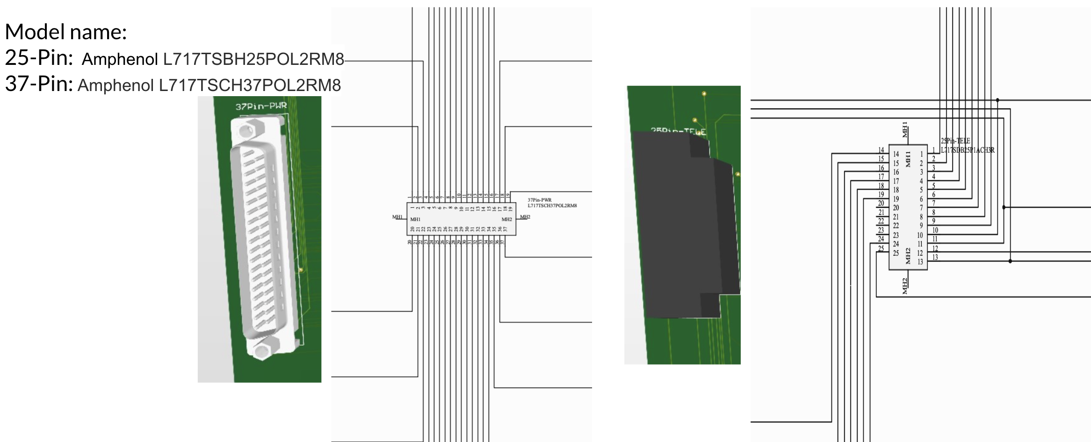
PCB Board – Connection to Battery
Overview
Overview
Overview
Overview
Overview
Design Solution
Design Solution
Design Solution
Design Solution
Design Solution
Critical Project Elements
Critical Project Elements
Critical Project Elements
Critical Project Elements
Critical Project Elements
Project Planning
Project Planning
Project Planning
Verification & Validation
Project Planning
Backup Slides
Project Risks
Project Planning
Project Risks
Project Risks
Project Risks
Verification & Validation
Verification & Validation
Verification & Validation
Design Requirements
Verification & Validation
Design Requirements
Design Requirements
Design Requirements
Project Risks
Design Requirements
74
74
74
74

Slide 75
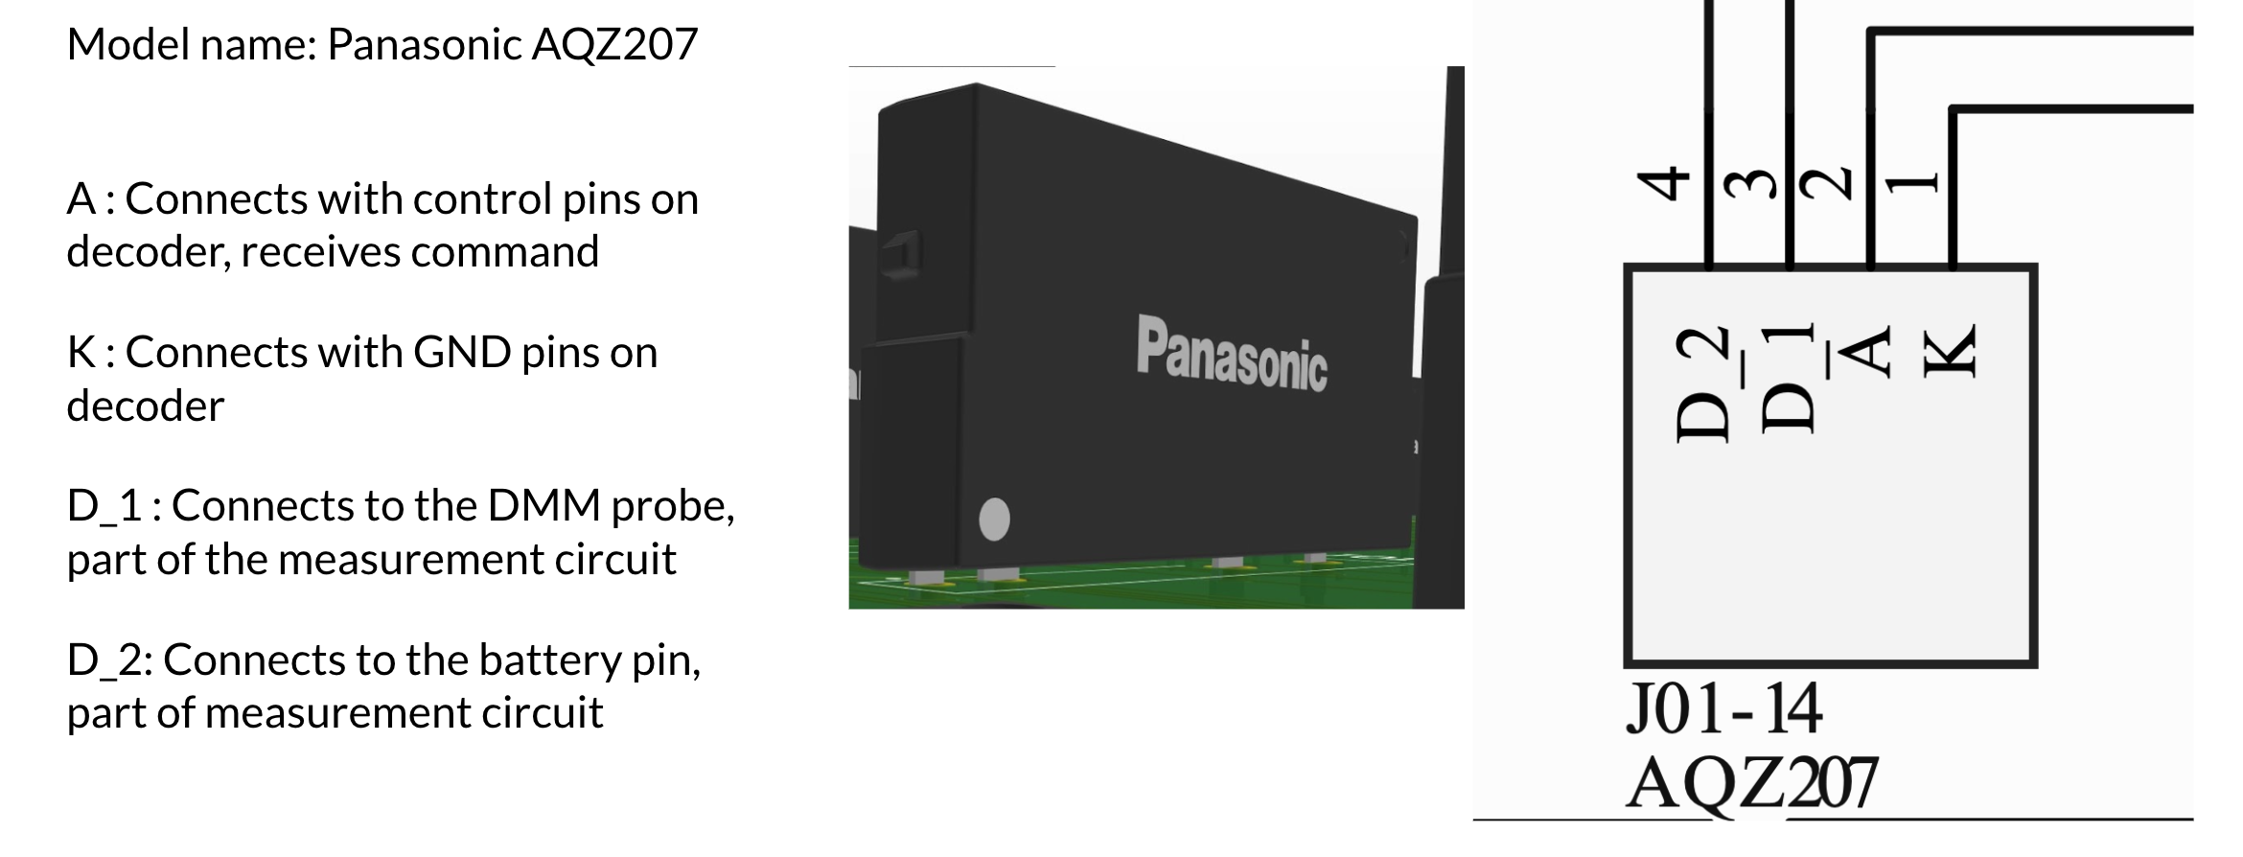
PCB Board – Solid State Relays
Overview
Overview
Overview
Overview
Overview
Design Solution
Design Solution
Design Solution
Design Solution
Design Solution
Critical Project Elements
Critical Project Elements
Critical Project Elements
Critical Project Elements
Critical Project Elements
Project Planning
Project Planning
Project Planning
Verification & Validation
Project Planning
Backup Slides
Project Risks
Project Planning
Project Risks
Project Risks
Project Risks
Verification & Validation
Verification & Validation
Verification & Validation
Design Requirements
Verification & Validation
Design Requirements
Design Requirements
Design Requirements
Project Risks
Design Requirements
75
75
75
75

Slide 76
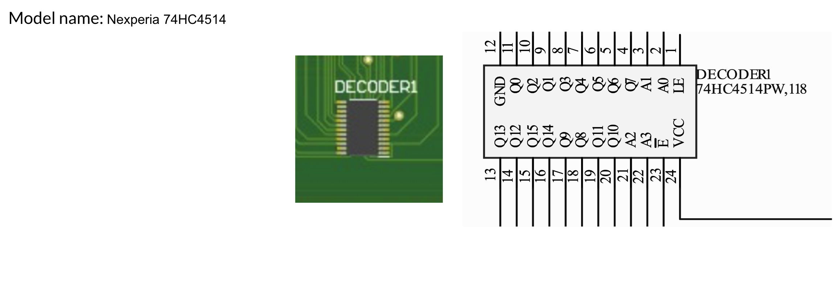
PCB Board – Decoder
Overview
Overview
Overview
Overview
Overview
Design Solution
Design Solution
Design Solution
Design Solution
Design Solution
Critical Project Elements
Critical Project Elements
Critical Project Elements
Critical Project Elements
Critical Project Elements
Project Planning
Project Planning
Project Planning
Verification & Validation
Project Planning
Backup Slides
Project Risks
Project Planning
Project Risks
Project Risks
Project Risks
Verification & Validation
Verification & Validation
Verification & Validation
Design Requirements
Verification & Validation
Design Requirements
Design Requirements
Design Requirements
Project Risks
Design Requirements
76
76
76
76

Slide 77
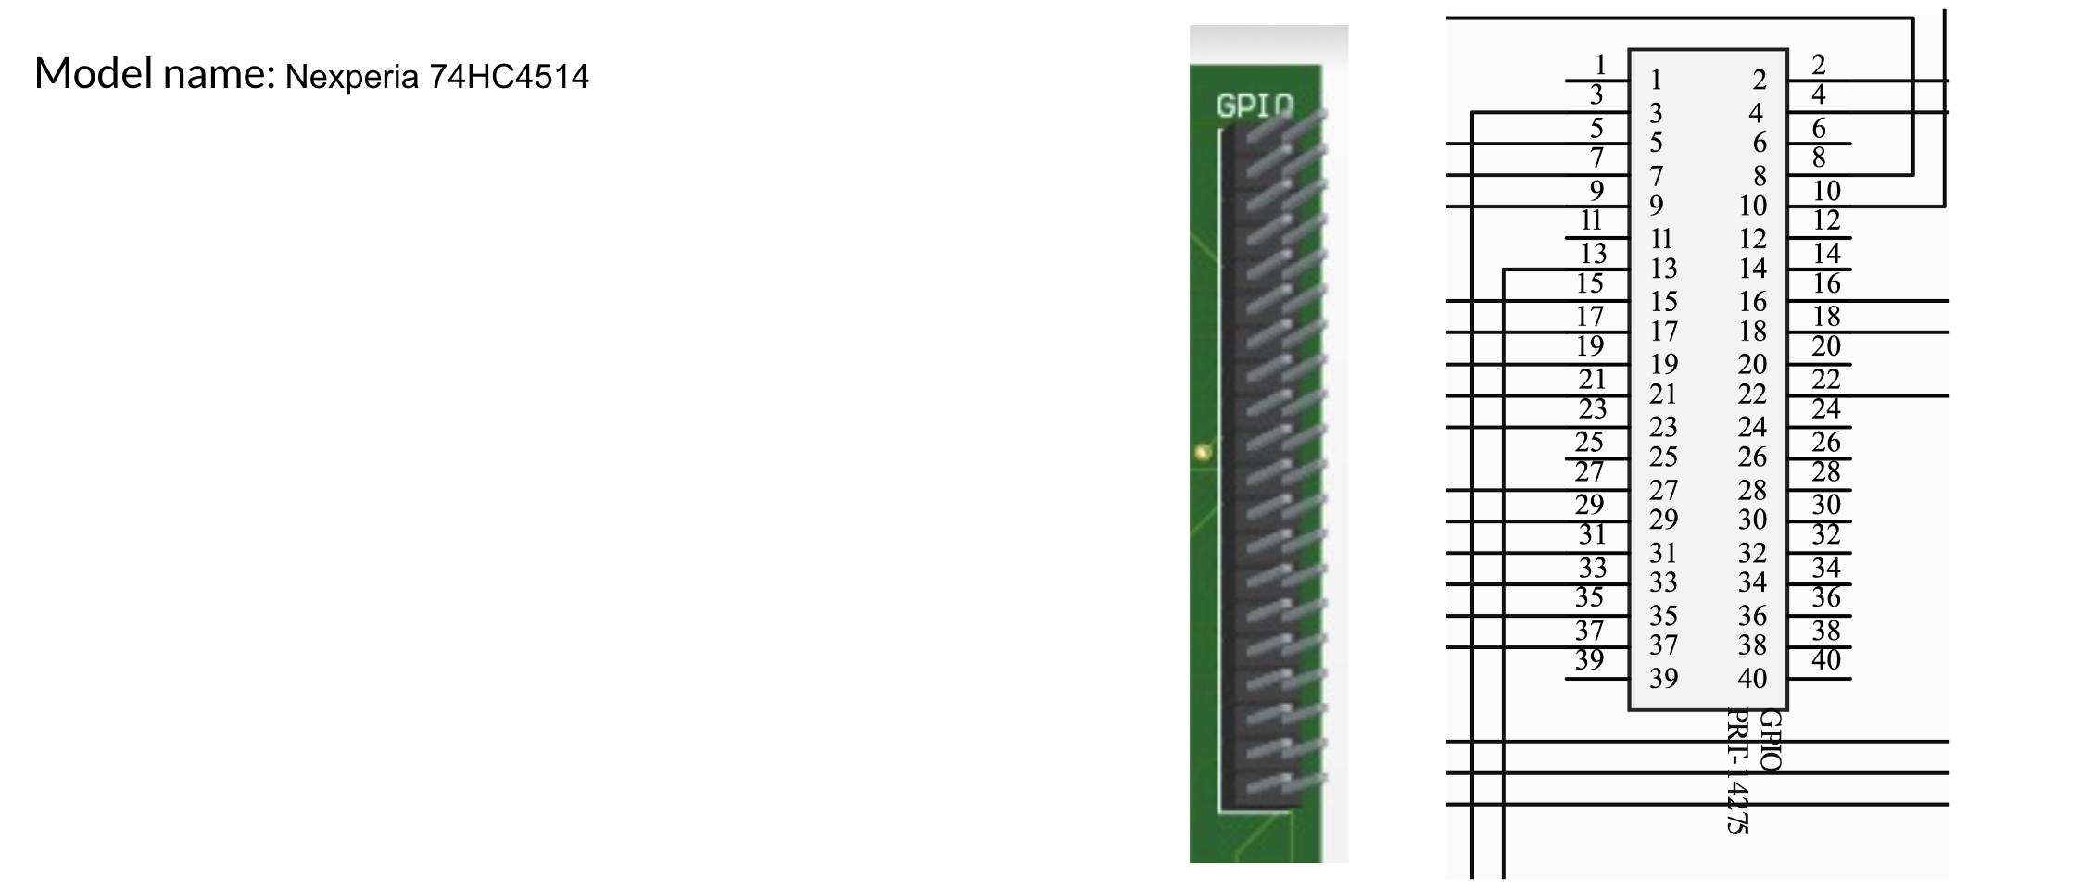
PCB Board – GPIO Connector
Overview
Overview
Overview
Overview
Overview
Design Solution
Design Solution
Design Solution
Design Solution
Design Solution
Critical Project Elements
Critical Project Elements
Critical Project Elements
Critical Project Elements
Critical Project Elements
Project Planning
Project Planning
Project Planning
Verification & Validation
Project Planning
Backup Slides
Project Risks
Project Planning
Project Risks
Project Risks
Project Risks
Verification & Validation
Verification & Validation
Verification & Validation
Design Requirements
Verification & Validation
Design Requirements
Design Requirements
Design Requirements
Project Risks
Design Requirements
77
77
77
77

Slide 78
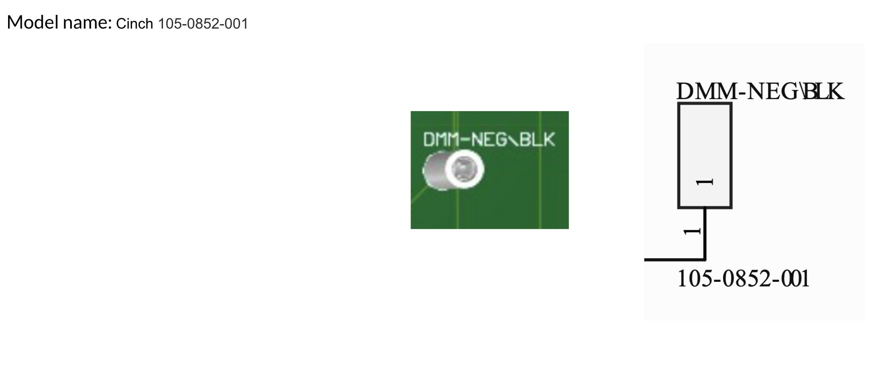
PCB Board – Banana Jack Cables
Overview
Overview
Overview
Overview
Overview
Design Solution
Design Solution
Design Solution
Design Solution
Design Solution
Critical Project Elements
Critical Project Elements
Critical Project Elements
Critical Project Elements
Critical Project Elements
Project Planning
Project Planning
Project Planning
Verification & Validation
Project Planning
Backup Slides
Project Risks
Project Planning
Project Risks
Project Risks
Project Risks
Verification & Validation
Verification & Validation
Verification & Validation
Design Requirements
Verification & Validation
Design Requirements
Design Requirements
Design Requirements
Project Risks
Design Requirements
78
78
78
78

Slide 79
Full Requirement Flowdown
FR | DR | DR | DR | Requirement
1 |  |  |  | System shall test the battery for electrical performance
 | 1.1 |  |  | System shall test for positive continuity
 |  | 1.1.1 |  | System shall measure resistance across test points (designated in the functional test template) for values < 1 Ohm
 |  |  | 1.1.1.1 | System shall measure continuity with an uncertainty of ± 25 % of reading
 |  |  | 1.1.1.2 | System shall measure resistance across test points within 5 ms (based on resistance measurement settling time of PXI DMM datasheet with factor of safety of 5)
 | 1.2 |  |  | System shall test for negative continuity
 |  | 1.2.1 |  | System shall measure resistance across test points (designated in the functional test template) for values < 1 Ohm
 |  |  | 1.2.1.1 | System shall measure continuity with an uncertainty of ± 25 % of reading
 |  |  | 1.2.1.2 | System shall measure resistance across test points within 5 ms (based on resistance measurement settling time of PXI DMM datasheet with factor of safety of 5)
Overview
Overview
Overview
Overview
Overview
Design Solution
Design Solution
Design Solution
Design Solution
Design Solution
Critical Project Elements
Critical Project Elements
Critical Project Elements
Critical Project Elements
Critical Project Elements
Project Planning
Project Planning
Project Planning
Verification & Validation
Project Planning
Backup Slides
Project Risks
Project Planning
Project Risks
Project Risks
Project Risks
Verification & Validation
Verification & Validation
Verification & Validation
Design Requirements
Verification & Validation
Design Requirements
Design Requirements
Design Requirements
Project Risks
Design Requirements
79
79
79
79

Slide 80
Full Requirement Flowdown
FR | DR | DR | DR | Requirement
 | 1.3 |  |  | System shall test for voltage
 |  | 1.3.1 |  | System shall measure voltage across test points (designated in the functional test template) for values in the range of [24.01 V - 33.59 V]
 |  |  | 1.3.1.1 | System shall measure voltage with an uncertainty of ± 0.025 % of reading
 |  |  | 1.3.1.2 | System shall measure voltage across test points within 5 ms (based on voltage measurement settling time of PXI DMM datasheet with factor of safety of 5)
 | 1.4 |  |  | System shall test for isolation
 |  | 1.4.1 |  | System shall measure resistance across test points (designated in the functional test template) for values > 10.025 MOhms
 |  |  | 1.4.1.1 | System shall measure resistance with an uncertainty of ± 0.25 % of reading
 |  |  | 1.4.1.2 | System shall measure resistance across test points for 10 seconds
 | 1.5 |  |  | System shall test for insulation
 |  | 1.5.1 |  | System shall measure resistance across test points for values > 10 MOhms while applying + 100 V across the test points for 60 seconds or until resistance measurement is stable (minimum 10 seconds)
 |  |  | 1.5.1.1 | System shall measure resistance with an uncertainty of ± 3 % of reading
Overview
Overview
Overview
Overview
Overview
Design Solution
Design Solution
Design Solution
Design Solution
Design Solution
Critical Project Elements
Critical Project Elements
Critical Project Elements
Critical Project Elements
Critical Project Elements
Project Planning
Project Planning
Project Planning
Verification & Validation
Project Planning
Backup Slides
Project Risks
Project Planning
Project Risks
Project Risks
Project Risks
Verification & Validation
Verification & Validation
Verification & Validation
Design Requirements
Verification & Validation
Design Requirements
Design Requirements
Design Requirements
Project Risks
Design Requirements
80
80
80
80

Slide 81
Full Requirement Flowdown
FR | DR | DR | DR | Requirement
 | 1.6 |  |  | System shall test for resistance
 |  | 1.6.1 |  | System shall measure resistance across test points (designated in the functional test template) for a value of 10 kOhm ± 7 Ohm
 |  |  | 1.6.1.1 | System shall measure resistance with an uncertainty of ± 0.025 % of reading
 |  |  | 1.6.1.2 | System shall measure resistance across test points within 25 ms (based on resistance measurement settling time of PXI DMM datasheet with factor of safety of 5)
2 |  |  |  | System shall test the battery automatically
 | 2.1 |  |  | System shall test continuity without technician input after test has been started
 |  | 2.1.1 |  | System shall access the required test points (designated in the functional test template)
 |  |  | 2.1.1.1 | System shall send a command signal to the proper switches corresponding to the proper test points
 |  |  | 2.1.1.2 | System shall verify the proper test points are accessed
 |  | 2.1.2 |  | System shall send a command signal to the digital multimeter to measure resistance across the proper test points
 |  |  | 2.1.2.1 | System shall take the resistance measurement at the measurement circuit output
 |  |  | 2.1.2.2 | System shall store the resistance measurement value
 |  | 2.1.3 |  | System shall cease to access the required test points
 |  |  | 2.1.3.1 | System shall send a command signal to the proper switches corresponding to the proper test points
Overview
Design Solution
Critical Project Elements
Design Requirements
Project Risks
Verification & Validation
Project Planning

Slide 82
Full Requirement Flowdown
FR | DR | DR | DR | Requirement
 | 2.2 |  |  | System shall test voltage without technician input
 |  | 2.2.1 |  | System shall access the required test points (designated in the functional test template)
 |  |  | 2.2.1.1 | System shall send a command signal to the proper switches corresponding to the proper test points
 |  |  | 2.2.1.2 | System shall verify the proper test points are accessed
 |  | 2.2.2 |  | System shall send a command signal to the digital multimeter to measure voltage across the proper the proper test points
 |  |  | 2.2.2.1 | System shall take the voltage measurement at the measurement circuit output
 |  |  | 2.2.2.2 | System shall store the voltage measurement value
 |  | 2.2.3 |  | System shall cease to access the required test points
 |  |  | 2.2.3.1 | System shall send a command signal to the proper switches corresponding to the proper test points
Overview
Overview
Overview
Overview
Overview
Design Solution
Design Solution
Design Solution
Design Solution
Design Solution
Critical Project Elements
Critical Project Elements
Critical Project Elements
Critical Project Elements
Critical Project Elements
Project Planning
Project Planning
Project Planning
Verification & Validation
Project Planning
Backup Slides
Project Risks
Project Planning
Project Risks
Project Risks
Project Risks
Verification & Validation
Verification & Validation
Verification & Validation
Design Requirements
Verification & Validation
Design Requirements
Design Requirements
Design Requirements
Project Risks
Design Requirements
82
82
82
82

Slide 83
Full Requirement Flowdown
FR | DR | DR | DR | Requirement
 | 2.3 |  |  | System shall test isolation without technician input
 |  | 2.3.1 |  | System shall access the required test points (designated in the functional test template)
 |  |  | 2.3.1.1 | System shall send a command signal to the proper switches corresponding to the proper test points
 |  |  | 2.3.1.2 | System shall verify the proper test points are accessed
 |  | 2.3.2 |  | System shall send a command signal to the digital multimeter to measure resistance across the proper test points
 |  |  | 2.3.2.1 | System shall take the resistance measurement value at the measurement circuit output
 |  |  | 2.3.2.2 | System shall store the resistance measurement value
 |  | 2.3.3 |  | System shall cease to access the required test points
 |  |  | 2.3.3.1 | System shall send a command signal to the proper switches corresponding to the proper test points
Overview
Overview
Overview
Overview
Overview
Design Solution
Design Solution
Design Solution
Design Solution
Design Solution
Critical Project Elements
Critical Project Elements
Critical Project Elements
Critical Project Elements
Critical Project Elements
Project Planning
Project Planning
Project Planning
Verification & Validation
Project Planning
Backup Slides
Project Risks
Project Planning
Project Risks
Project Risks
Project Risks
Verification & Validation
Verification & Validation
Verification & Validation
Design Requirements
Verification & Validation
Design Requirements
Design Requirements
Design Requirements
Project Risks
Design Requirements
83
83
83
83

Slide 84
Full Requirement Flowdown
FR | DR | DR | DR | Requirement
 | 2.4 |  |  | System shall test resistance without technician input
 |  | 2.4.1 |  | System shall access the required test points (designated in the functional test template)
 |  |  | 2.4.1.1 | System shall send a command signal to the proper switches corresponding to the proper test points
 |  |  | 2.4.1.2 | System shall verify the proper test points are accessed
 |  | 2.4.2 |  | System shall send a command signal to the digital multimeter to measure resistance across the proper test points
 |  |  | 2.4.2.1 | System shall take the resistance measurement value at the measurement circuit output
 |  |  | 2.4.2.2 | System shall store the resistance measurement value
 |  | 2.4.3 |  | System shall cease to access the required test points
 |  |  | 2.4.3.1 | System shall send a command signal to the proper switches corresponding to the proper test points
Overview
Overview
Overview
Overview
Overview
Design Solution
Design Solution
Design Solution
Design Solution
Design Solution
Critical Project Elements
Critical Project Elements
Critical Project Elements
Critical Project Elements
Critical Project Elements
Project Planning
Project Planning
Project Planning
Verification & Validation
Project Planning
Backup Slides
Project Risks
Project Planning
Project Risks
Project Risks
Project Risks
Verification & Validation
Verification & Validation
Verification & Validation
Design Requirements
Verification & Validation
Design Requirements
Design Requirements
Design Requirements
Project Risks
Design Requirements
84
84
84
84

Slide 85
Full Requirement Flowdown
FR | DR | DR | DR | Requirement
3 |  |  |  | System shall not report any false positives or false negatives
 | 3.1 |  |  | System shall follow accuracy requirements outlined in R.0.1
 | 3.2 |  |  | System shall have calibration of measurement instruments
 |  | 3.2.1 |  | System shall have proper calibration as instructed in user manual
 | 3.3 |  |  | System shall provide feedback on given/executed commands
 |  | 3.3.1 |  | System shall verify the switches corresponding to test points of interest have received open/close command signal
 |  | 3.3.2 |  | System shall verify the proper measurement type is selected
Overview
Overview
Overview
Overview
Overview
Design Solution
Design Solution
Design Solution
Design Solution
Design Solution
Critical Project Elements
Critical Project Elements
Critical Project Elements
Critical Project Elements
Critical Project Elements
Project Planning
Project Planning
Project Planning
Verification & Validation
Project Planning
Backup Slides
Project Risks
Project Planning
Project Risks
Project Risks
Project Risks
Verification & Validation
Verification & Validation
Verification & Validation
Design Requirements
Verification & Validation
Design Requirements
Design Requirements
Design Requirements
Project Risks
Design Requirements
85
85
85
85

Slide 86
Full Requirement Flowdown
FR | DR | DR | DR | Requirement
4 |  |  |  | System shall provide value to the customer
 | 4.1 |  |  | System complete test without user supervision
 |  | 4.1.1 |  | System shall not require manual operation after starting test
 |  | 4.1.2 |  | System shall deliver explicit test result to technician
 | 4.2 |  |  | System shall not take more total elapsed time compared to the current solution 4 hours
5 |  |  |  | System shall be able to respond to failures in real time
 | 5.1 |  |  | System shall have Data Acquisition System failure response
 | 5.2 |  |  | System shall have Graphical User Interface failure response
Overview
Overview
Overview
Overview
Overview
Design Solution
Design Solution
Design Solution
Design Solution
Design Solution
Critical Project Elements
Critical Project Elements
Critical Project Elements
Critical Project Elements
Critical Project Elements
Project Planning
Project Planning
Project Planning
Verification & Validation
Project Planning
Backup Slides
Project Risks
Project Planning
Project Risks
Project Risks
Project Risks
Verification & Validation
Verification & Validation
Verification & Validation
Design Requirements
Verification & Validation
Design Requirements
Design Requirements
Design Requirements
Project Risks
Design Requirements
86
86
86
86

Slide 87
Full Requirement Flowdown
FR | DR | DR | DR | Requirement
6 |  |  |  | System shall have a graphical user interface (GUI)
 | 6.1 |  |  | System shall allow user to manage testing using the GUI
 |  | 6.1.1 |  | System shall allow user to start test using the GUI
 |  | 6.1.2 |  | System shall allow user to pause test using the GUI
 |  |  | 6.1.2.1 | System shall meet safety requirements when pausing test
 |  |  | 6.1.2.2 | System shall remain on measurement when test was paused
 |  | 6.1.3 |  | System shall allow user to resume test using the GUI
 |  |  | 6.1.3.1 | System shall meet safety requirements when resuming test
 |  |  | 6.1.3.2 | System shall repeat paused measurement when test is resumed
 |  | 6.1.4 |  | System shall allow user to stop test using the GUI
 |  |  | 6.1.4.1 | System shall meet safety requirements when stopping test
 |  |  | 6.1.4.2 | System shall end test and meet data output and display
Overview
Overview
Overview
Overview
Overview
Design Solution
Design Solution
Design Solution
Design Solution
Design Solution
Critical Project Elements
Critical Project Elements
Critical Project Elements
Critical Project Elements
Critical Project Elements
Project Planning
Project Planning
Project Planning
Verification & Validation
Project Planning
Backup Slides
Project Risks
Project Planning
Project Risks
Project Risks
Project Risks
Verification & Validation
Verification & Validation
Verification & Validation
Design Requirements
Verification & Validation
Design Requirements
Design Requirements
Design Requirements
Project Risks
Design Requirements
87
87
87
87

Slide 88
Full Requirement Flowdown
FR | DR | DR | DR | Requirement
 | 6.2 |  |  | System shall allow user to observe testing using the GUI
 |  | 6.2.1 |  | System shall display continuity measurements using the GUI
 |  |  | 6.2.1.1 | System shall display continuity measurement during continuity tests
 |  |  | 6.2.1.2 | System shall display all continuity measurement verifications
 |  | 6.2.2 |  | System shall display voltage measurement using the GUI
 |  |  | 6.2.2.1 | System shall display voltage measurement during voltage test
 |  |  | 6.2.2.2 | System shall display voltage measurement verification
 |  | 6.2.3 |  | System shall display isolation measurements using the GUI
 |  |  | 6.2.3.1 | System shall display isolation measurement during isolation tests
 |  |  | 6.2.3.2 | System shall display all isolation measurement verifications
 |  | 6.2.4 |  | System shall display resistance measurements using the GUI
 |  |  | 6.2.4.1 | System shall display resistance measurement during isolation tests
 |  |  | 6.2.4.2 | System shall display all isolation measurement verifications
Overview
Overview
Overview
Overview
Overview
Design Solution
Design Solution
Design Solution
Design Solution
Design Solution
Critical Project Elements
Critical Project Elements
Critical Project Elements
Critical Project Elements
Critical Project Elements
Project Planning
Project Planning
Project Planning
Verification & Validation
Project Planning
Backup Slides
Project Risks
Project Planning
Project Risks
Project Risks
Project Risks
Verification & Validation
Verification & Validation
Verification & Validation
Design Requirements
Verification & Validation
Design Requirements
Design Requirements
Design Requirements
Project Risks
Design Requirements
88
88
88
88

Slide 89
Full Requirement Flowdown
FR | DR | DR | DR | Requirement
 |  | 6.2.5 |  | System shall display elapsed time of test
 |  | 6.2.6 |  | System shall display estimated time remaining of test
 |  | 6.2.7 |  | System shall display estimate time remaining of present measurement
7 |  |  |  | System shall provide test data for each test
 | 7.1 |  |  | System shall collect test data
 |  | 7.1.1 |  | System shall take measurements that meet measurement accuracy requirements
 | 7.2 |  |  | System shall save test data
 |  | 7.2.1 |  | System shall store measurement data for each test
 | 7.3 |  |  | System shall organize test data
 |  | 7.3.1 |  | System shall process measurement data for each test
 |  | 7.3.2 |  | System shall prepare measurement data for .csv file for each test
 | 7.4 |  |  | System shall output test data
 |  | 7.4.1 |  | System shall provide an output .csv file of measurement data for each test
Overview
Overview
Overview
Overview
Overview
Design Solution
Design Solution
Design Solution
Design Solution
Design Solution
Critical Project Elements
Critical Project Elements
Critical Project Elements
Critical Project Elements
Critical Project Elements
Project Planning
Project Planning
Project Planning
Verification & Validation
Project Planning
Backup Slides
Project Risks
Project Planning
Project Risks
Project Risks
Project Risks
Verification & Validation
Verification & Validation
Verification & Validation
Design Requirements
Verification & Validation
Design Requirements
Design Requirements
Design Requirements
Project Risks
Design Requirements
89
89
89
89

Slide 90
Full Requirement Flowdown
FR | DR | DR | DR | Requirement
8 |  |  |  | System shall be compatible with the lab environment
 | 8.1 |  |  | Form factor
 |  | 8.1.1 |  | System shall be able to fit on a standard technician workbench
 |  |  | 8.1.1.1 | System shall not exceed 76.2 cm xx 76.2 cm xx 76.2 cm in size
 |  |  | 8.1.1.2 | The system shall weigh no more than 113 kg
 | 8.2 |  |  | Power compatibility
 |  | 8.2.1 |  | System shall include a three-prong power plug that be compatible with the standard 120V socket
 |  | 8.2.2 |  | System shall have ground plugs that be compatible with the ground slot of standard 120V socket
 | 8.3 |  |  | Environment adaptability
 |  | 8.3.1 |  | System shall have an operating temperature of [10°C - 35°C]
 |  | 8.3.2 |  | System shall have an operating humidity of [20% - 60%]
 | 8.4 |  |  | ESD compliance
 |  | 8.4.1 |  | The system shall comply the ANSI/ESD S20.20-2021 standard published by the ESD Association
Overview
Overview
Overview
Overview
Overview
Design Solution
Design Solution
Design Solution
Design Solution
Design Solution
Critical Project Elements
Critical Project Elements
Critical Project Elements
Critical Project Elements
Critical Project Elements
Project Planning
Project Planning
Project Planning
Verification & Validation
Project Planning
Backup Slides
Project Risks
Project Planning
Project Risks
Project Risks
Project Risks
Verification & Validation
Verification & Validation
Verification & Validation
Design Requirements
Verification & Validation
Design Requirements
Design Requirements
Design Requirements
Project Risks
Design Requirements
90
90
90
90

Slide 91
Full Requirement Flowdown
FR | DR | DR | DR | Requirement
 | 8.5 |  |  | Friendly for work area
 |  | 8.5.1 |  | System shall have a container that cover all exposed electrical interface and does not leave any parts on the workbench
 |  | 8.5.2 |  | System should have a container with a cushioned bottom shell to protect the workbench surface while still providing enough stability
 |  | 8.5.3 |  | System shall have a container with electrical insulation
 |  | 8.5.4 |  | System shall not generate temperatures exceeding 40°C
9 |  |  |  | System shall provide safety to the battery and user
 | 9.1 |  |  | System shall be safe for the user to operate, maintain, and monitor
 |  | 9.1.1 |  | System shall be ESD compliant according to the ANSI/ESD S.20.20 guidelines
 |  | 9.1.2 |  | System shall not have any exposed parts that may cause harm to the user
 |  |  | 9.1.2.1 | System shall have no loose fasteners
 |  |  | 9.1.2.2 | System shall have all wires secured and properly insulated
 |  | 9.1.3 |  | System shall have safe system operation described in the user guide
 |  | 9.1.4 |  | System shall be labeled properly to ensure user safety during inspection/maintenance
Overview
Overview
Overview
Overview
Overview
Design Solution
Design Solution
Design Solution
Design Solution
Design Solution
Critical Project Elements
Critical Project Elements
Critical Project Elements
Critical Project Elements
Critical Project Elements
Project Planning
Project Planning
Project Planning
Verification & Validation
Project Planning
Backup Slides
Project Risks
Project Planning
Project Risks
Project Risks
Project Risks
Verification & Validation
Verification & Validation
Verification & Validation
Design Requirements
Verification & Validation
Design Requirements
Design Requirements
Design Requirements
Project Risks
Design Requirements
91
91
91
91

Slide 92
Full Requirement Flowdown
FR | DR | DR | DR | Requirement
 | 9.2 |  |  | System shall protect the battery
 |  | 9.2.1 |  | System shall prevent shorts in the battery
 |  |  | 9.2.1.1 | System shall have fuses in the harnessing that break before any shorts occur in the battery
 |  | 9.2.2 |  | System shall not overheat the battery or any other electrical components in the system
 |  |  | 9.2.2.1 | System shall have wires in the proper gauge such that they do not overheat when in use
 |  |  | 9.2.2.2 | System shall use proper insulation and cooling where necessary to ensure that all components remain within operating temperature
10 |  |  |  | System shall have a user guide / manual
 | 10.1 |  |  | System shall have a comprehensive software / GUI guide
 |  | 10.1.1 |  | System shall have a guide to explain how to properly use the GUI
 | 10.2 |  |  | System shall have a comprehensive physical set up guide
 |  | 10.2.1 |  | System shall have a guide to explain how to properly connect the battery
 |  | 10.2.2 |  | System shall have a guide to explain how to operate ABSTRACT
Overview
Overview
Overview
Overview
Overview
Design Solution
Design Solution
Design Solution
Design Solution
Design Solution
Critical Project Elements
Critical Project Elements
Critical Project Elements
Critical Project Elements
Critical Project Elements
Project Planning
Project Planning
Project Planning
Verification & Validation
Project Planning
Backup Slides
Project Risks
Project Planning
Project Risks
Project Risks
Project Risks
Verification & Validation
Verification & Validation
Verification & Validation
Design Requirements
Verification & Validation
Design Requirements
Design Requirements
Design Requirements
Project Risks
Design Requirements
92
92
92
92

Slide 93
SCPI Commands
Command | Purpose | Tested?
CONFigure:CONTinuity, VOLTage:DC,RESistance,CURRent:DC | Configure the DMM for a measurement (continuity, voltage, resistance, DC current | Tested successfully
MEASure:CONTinuity, VOLTage:DC, RESistance, CURRent:DC | Configures the DMM for a measurement, and triggers the measurement | Tested successfully, further testing required to compare usefulness with CONF command.
SENSe: | Sets the range for a measurement | Not yet tested, essential for meeting accuracy requirements
Overview
Overview
Overview
Overview
Overview
Design Solution
Design Solution
Design Solution
Design Solution
Design Solution
Critical Project Elements
Critical Project Elements
Critical Project Elements
Critical Project Elements
Critical Project Elements
Project Planning
Project Planning
Project Planning
Verification & Validation
Project Planning
Backup Slides
Project Risks
Project Planning
Project Risks
Project Risks
Project Risks
Verification & Validation
Verification & Validation
Verification & Validation
Design Requirements
Verification & Validation
Design Requirements
Design Requirements
Design Requirements
Project Risks
Design Requirements
93
93
93
93

Slide 94
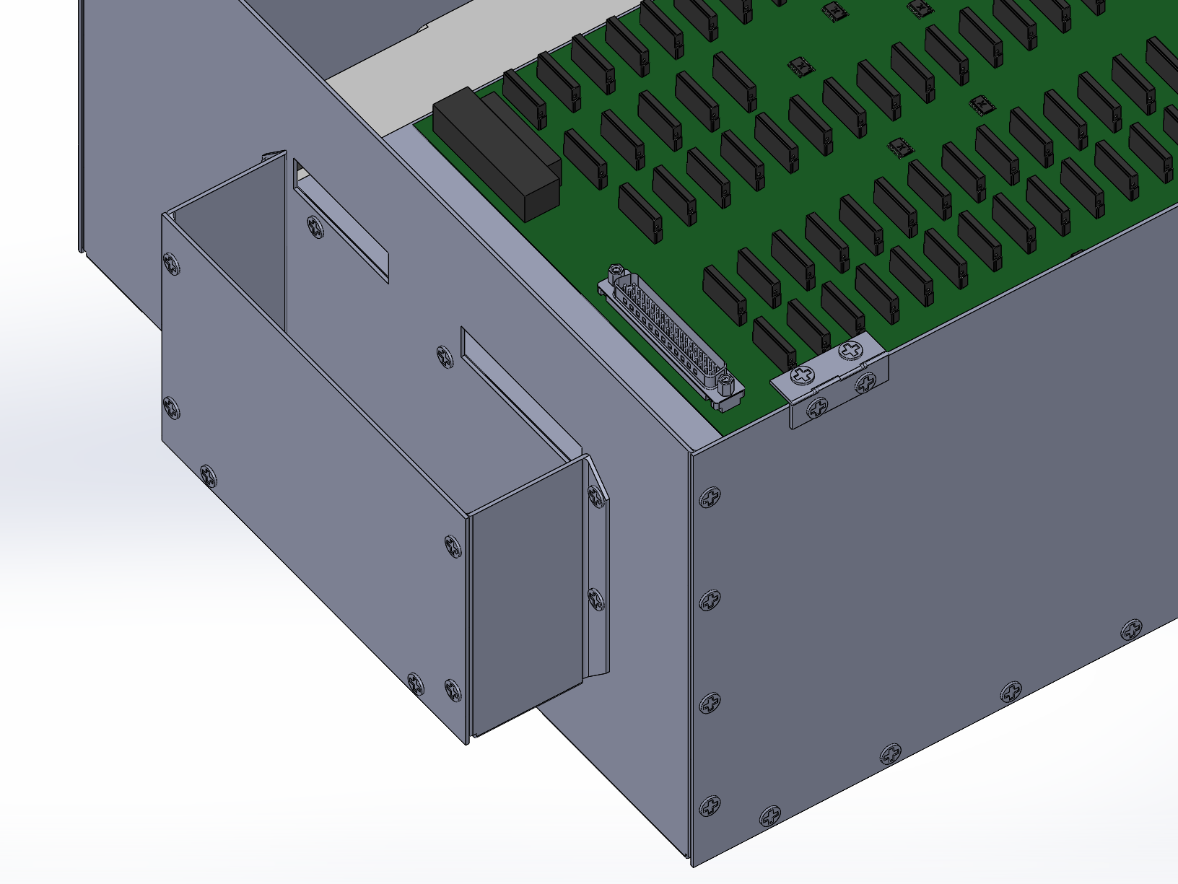
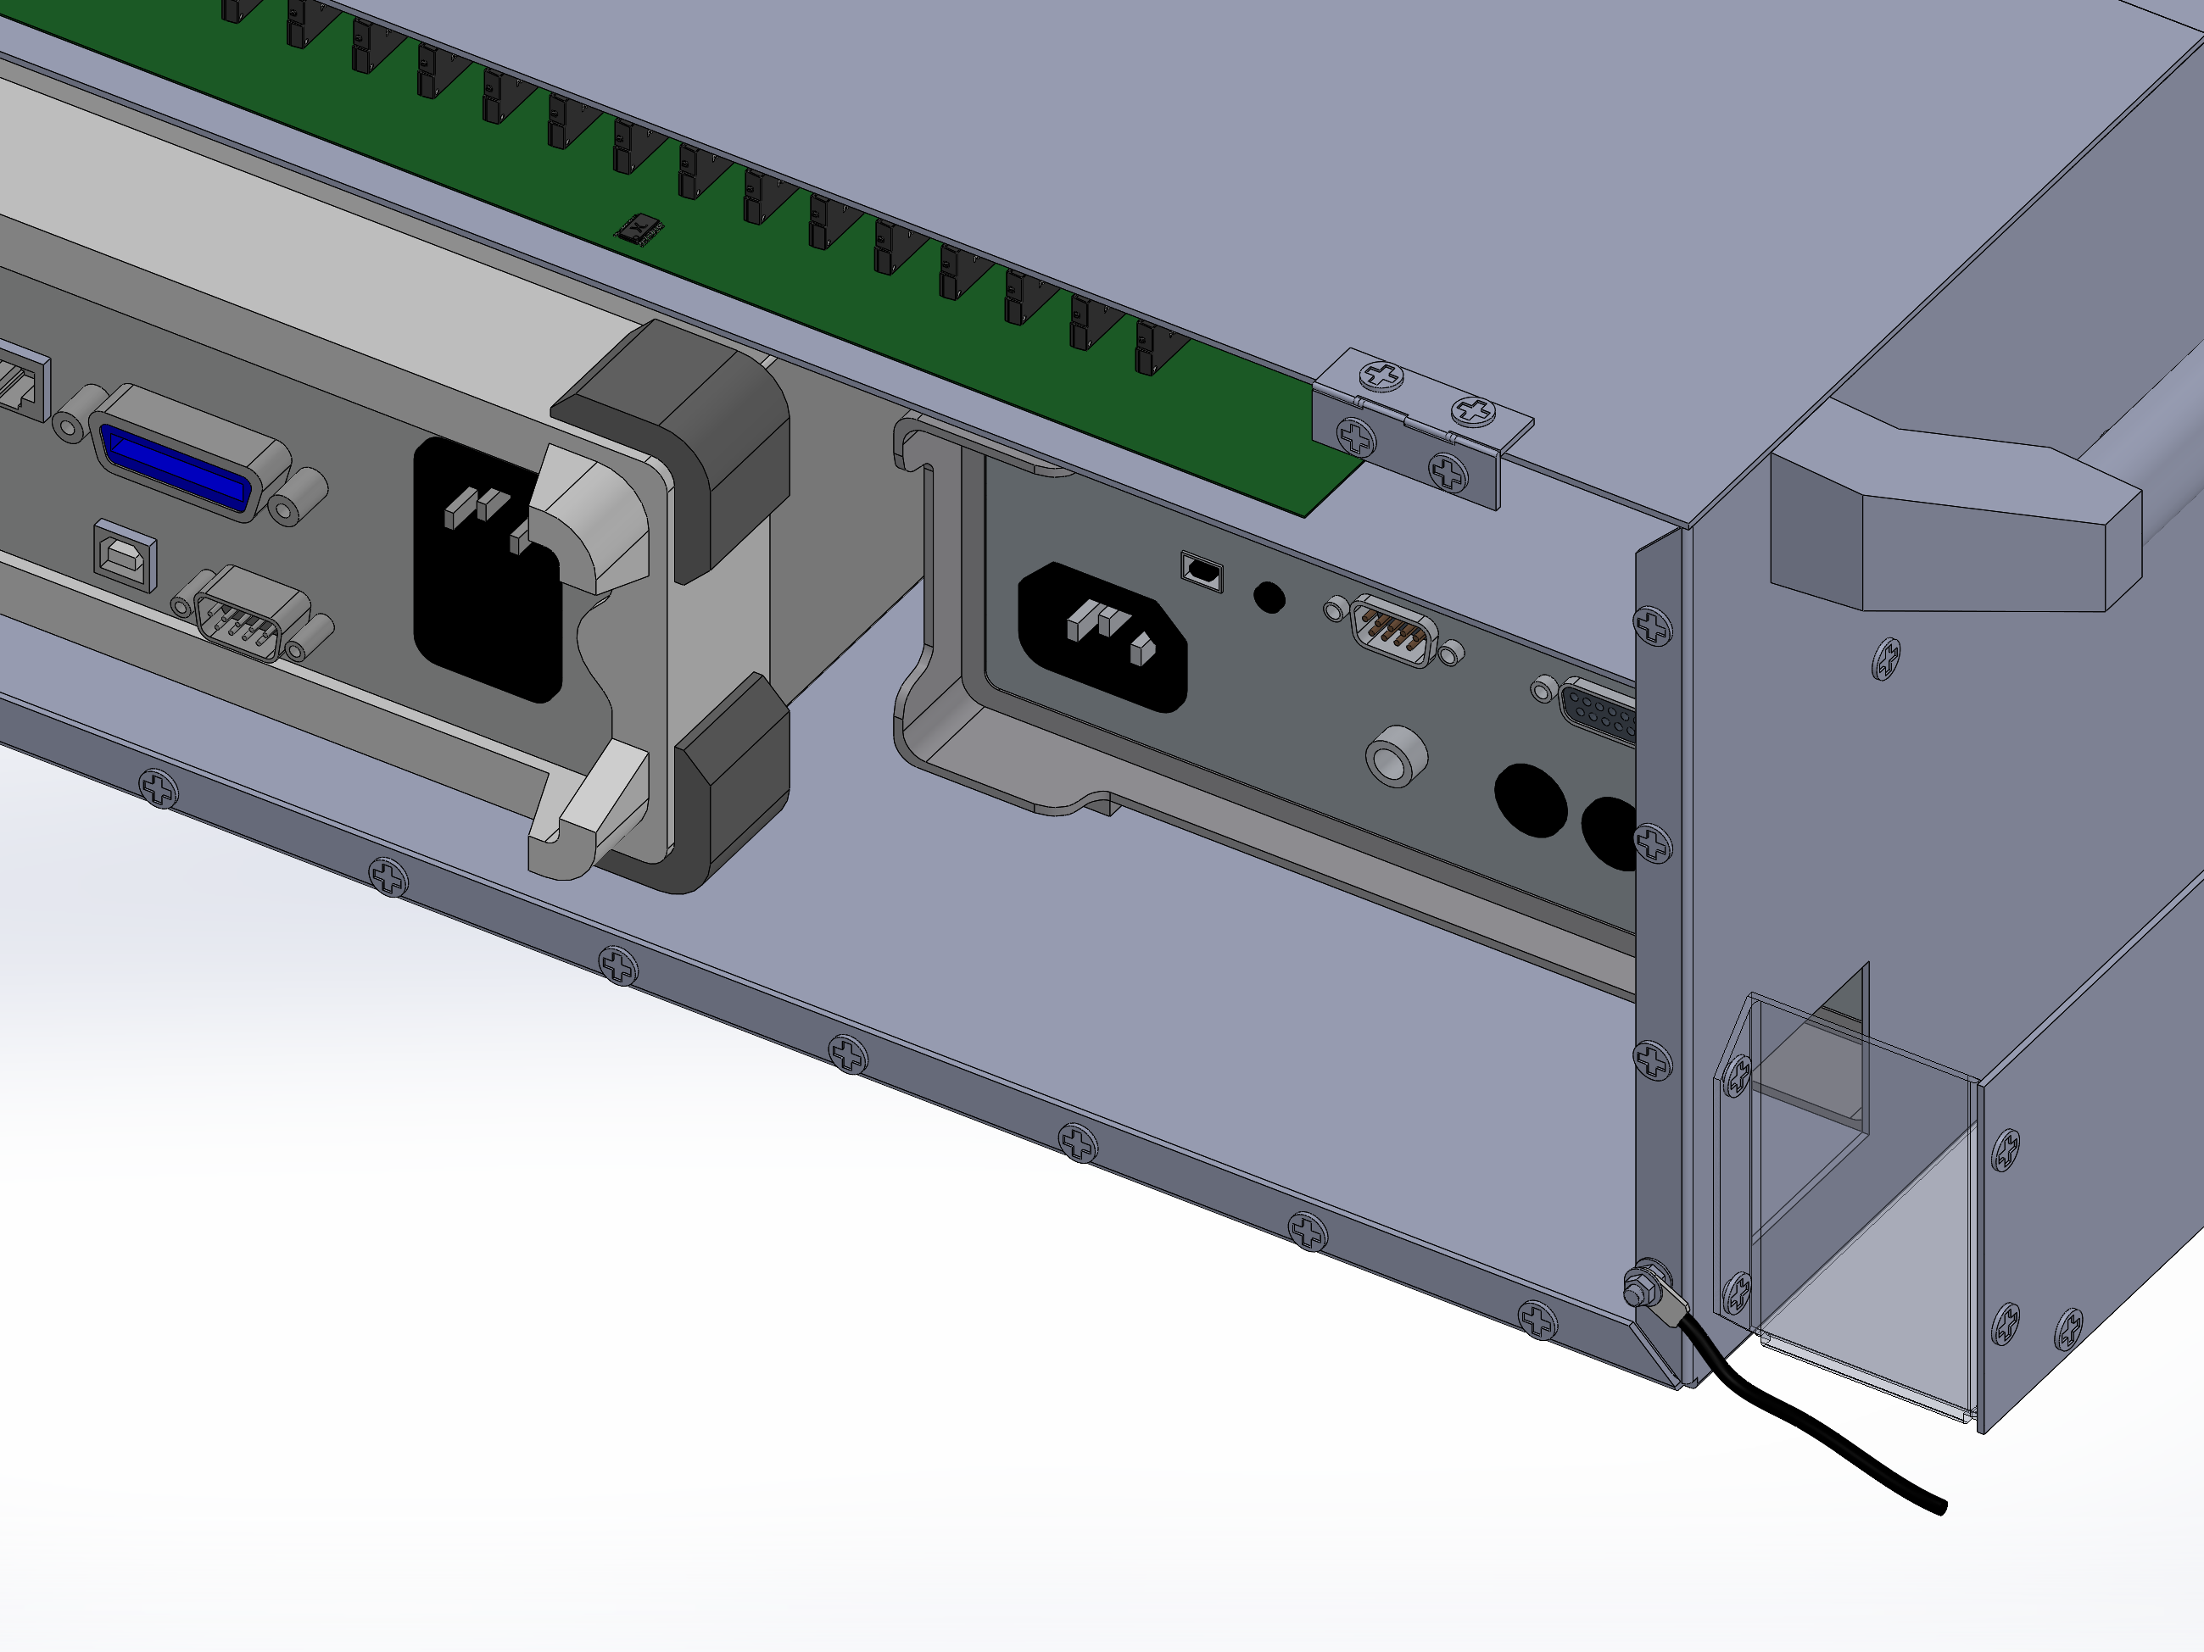
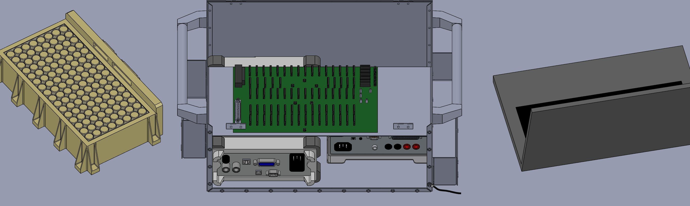
FR 8: Lab Compatibility
DR 8.8
Cable Management
System shall be more operator-friendly in terms of cable layout for testing
Battery
Power
USB communication
Overview
Overview
Overview
Overview
Overview
Design Solution
Design Solution
Design Solution
Design Solution
Design Solution
Critical Project Elements
Critical Project Elements
Critical Project Elements
Critical Project Elements
Critical Project Elements
Project Planning
Project Planning
Project Planning
Verification & Validation
Project Planning
Backup Slides
Project Risks
Project Planning
Project Risks
Project Risks
Project Risks
Verification & Validation
Verification & Validation
Verification & Validation
Design Requirements
Verification & Validation
Design Requirements
Design Requirements
Design Requirements
Project Risks
Design Requirements
94
94
94
94

Slide 95
Steady State Temperature Model
Power Dissipated through electrical components:
SSR: P_{D} = i²R = 6.3x10⁻⁶ W
  At most, 4 SSRs are active
Decoder: P_{D} = i²R = 3.78x10⁻⁵ W
GPIO: On-resistance is effectively zero, so we assume no power dissipation
C_{p}air = 1.00kJ/kgK
m_{air}=density_{air}*V_{air}
Q_{in}= m_{air}* C_{p}air*(T-T_{a})
Taking the worst case scenario of
  4 SSRs active
  All Decoders active
  Time active = 60 seconds (insulation test)
(T-T_{a}) = 0.23C → So no active cooling is necessary
Q_{in}
PCB
Overview
Overview
Overview
Overview
Overview
Design Solution
Design Solution
Design Solution
Design Solution
Design Solution
Critical Project Elements
Critical Project Elements
Critical Project Elements
Critical Project Elements
Critical Project Elements
Project Planning
Project Planning
Project Planning
Verification & Validation
Project Planning
Backup Slides
Project Risks
Project Planning
Project Risks
Project Risks
Project Risks
Verification & Validation
Verification & Validation
Verification & Validation
Design Requirements
Verification & Validation
Design Requirements
Design Requirements
Design Requirements
Project Risks
Design Requirements
95
95
95
95

