Slide 1
Programmable Battery Examiner: TRR
Andruss Black, Qihan Cai, Alex Cheng, Ruize Liu, Joe Moser,
Z Oginsky, Walker Tiffany, Bartek Wardega, Zhixing Yao

Slide 2
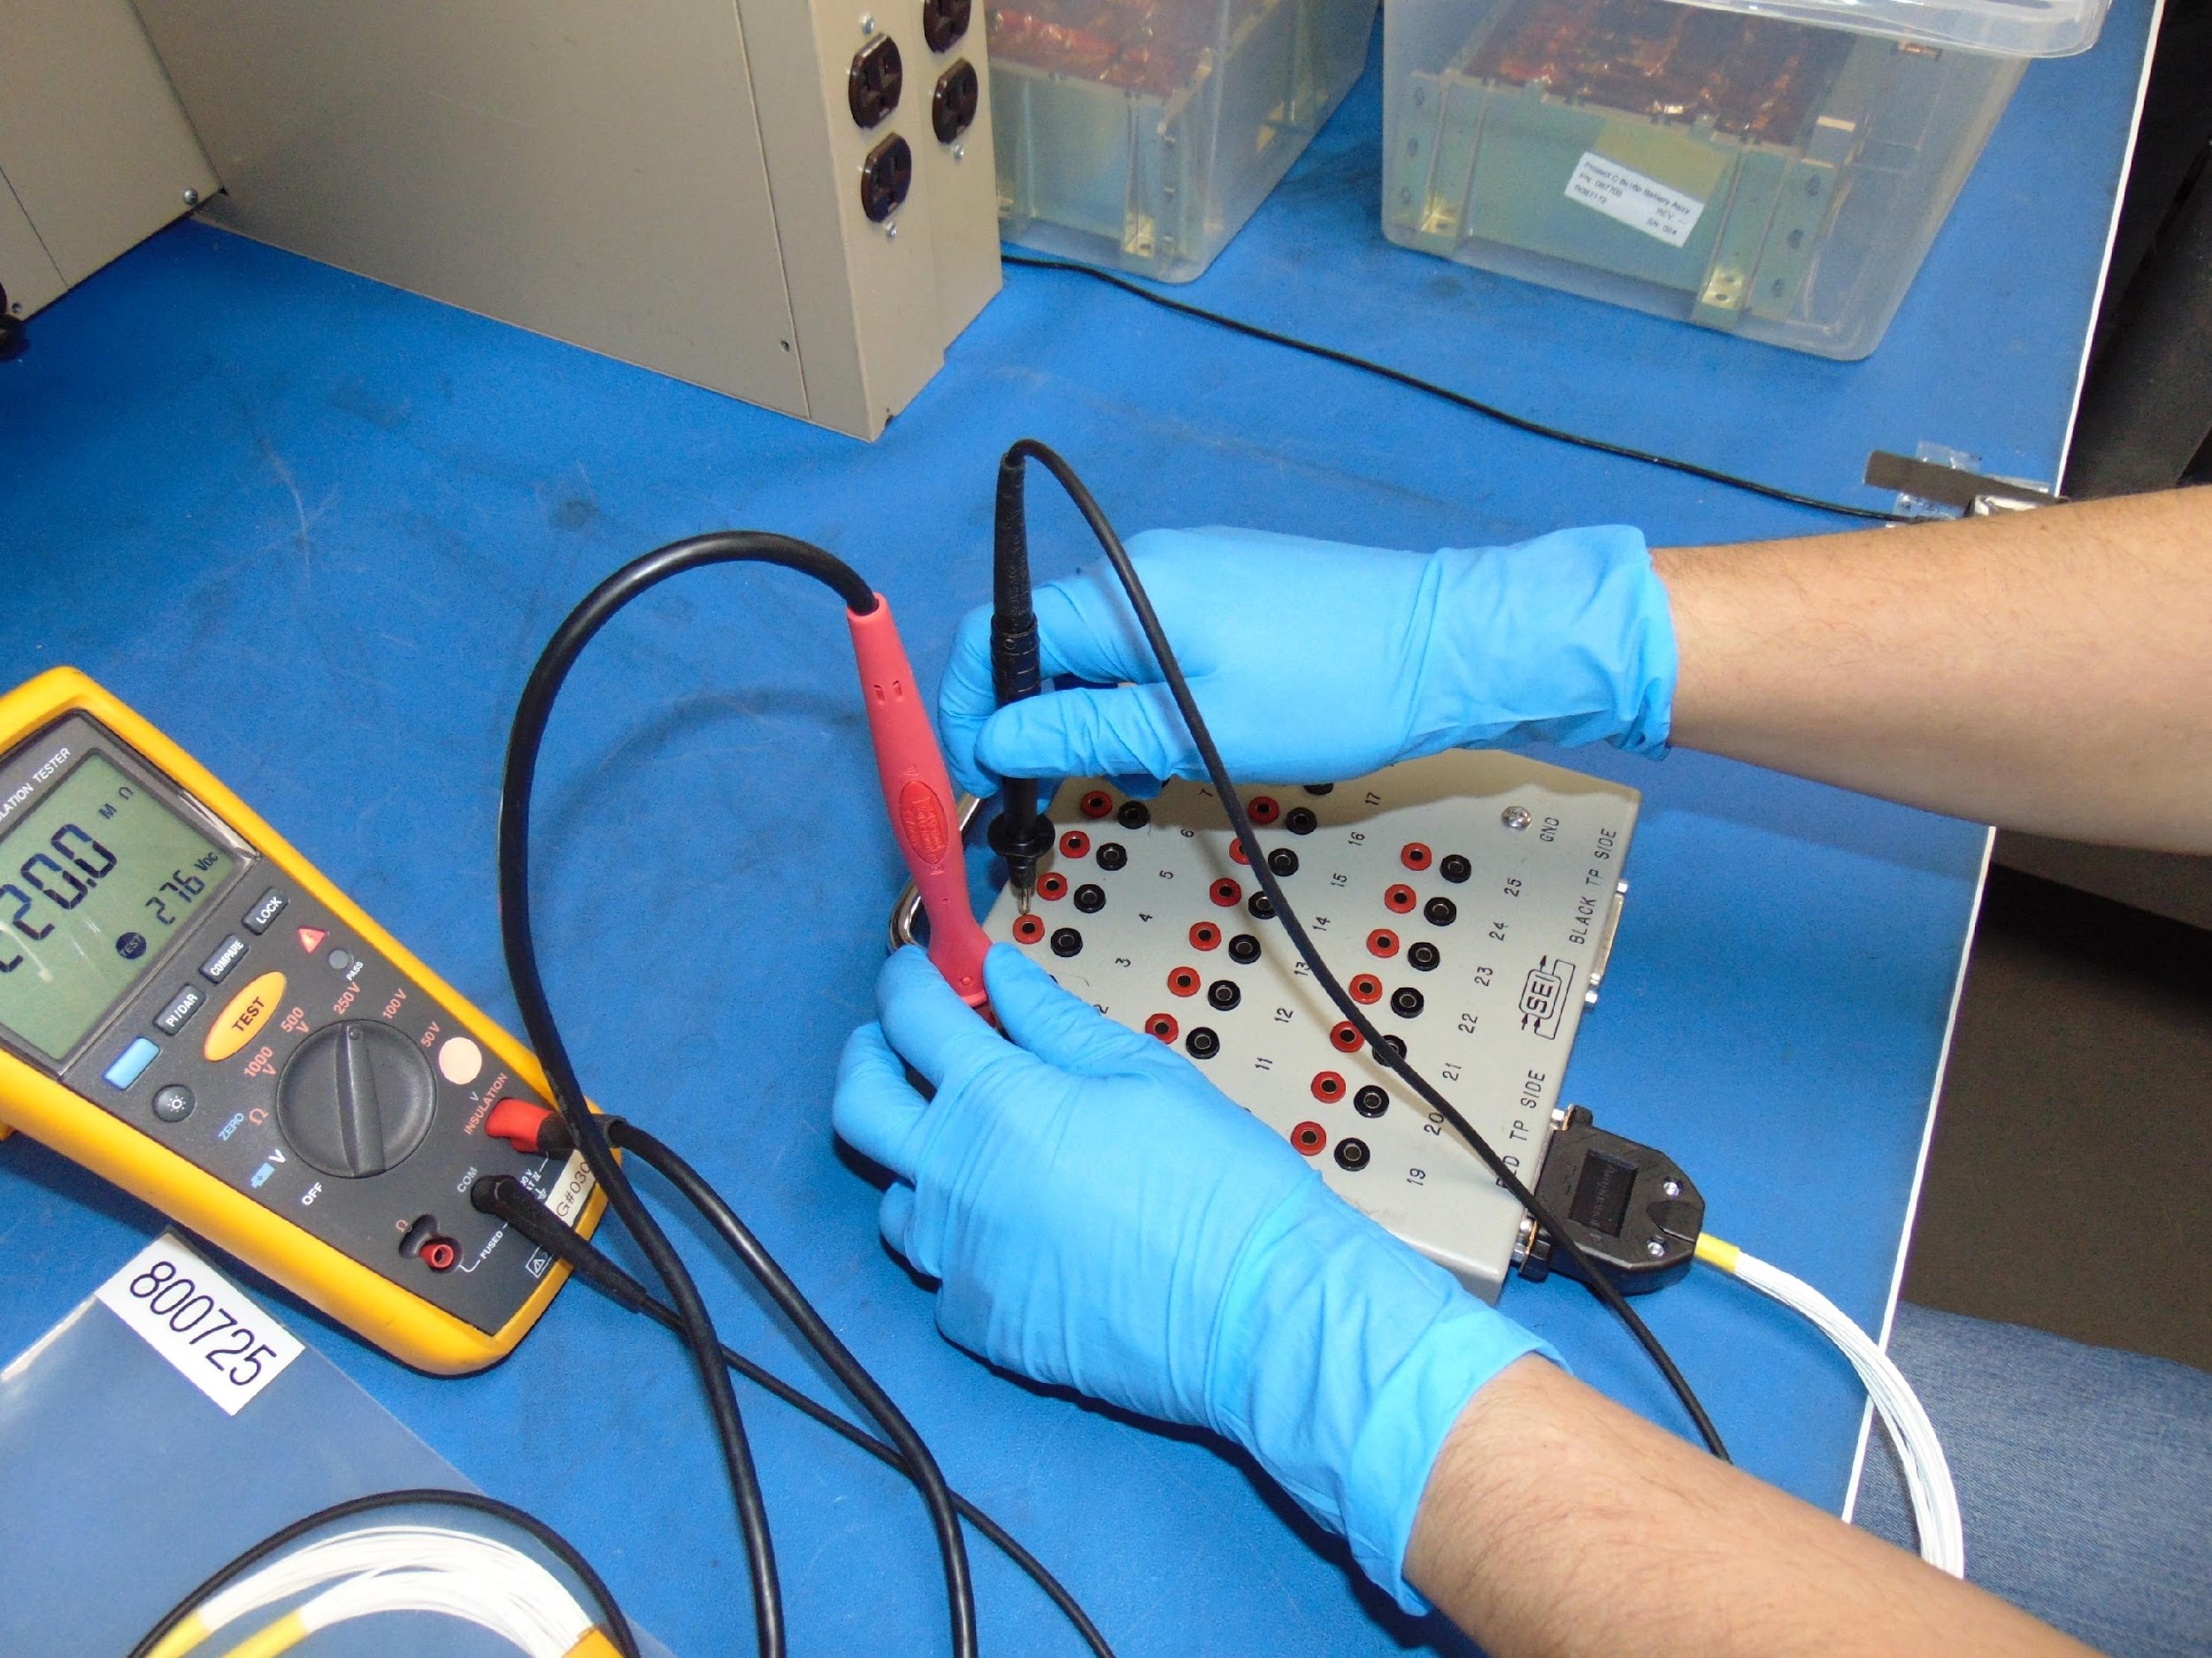
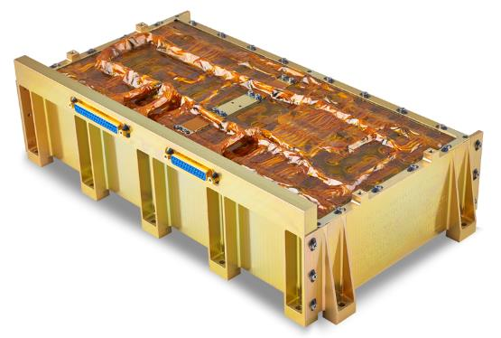
Motivation for Project:
Customer: EnerSys ABSL
Global leader in stored energy solutions with a large impact in Aerospace industries [1].
8s16p Battery is their most popular model.
Current flight-readiness testing is done manually.
EnerSys 8s16p Lithium-ion Battery

Slide 3
Mission Statement:
“ProBe exists to automate the current industry readiness test implemented by EnerSys for the 8s16p Battery.”

Slide 4
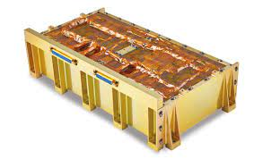
CONOPS:
Phase 1: Set up | Phase 2: Configuration | Phase 3: DMM Test | Phase 4: Insulation Test | Phase 5: Report | Phase 6: Storage | Phase 7: Shutdown
Open the GUI and make required connections. | In the GUI select the configuration of the test to be run. Initialize the test. | Software app directs ProBE for DMM measurement portion of test. | Manually switch connections from DMM to insulation tester. Continue test. | When the test is complete the GUI displays the results of the test. | Upon user command the test results are saved and exported to a .csv file. | Disconnect devices and power them off.
05.5000Vdc
05.5000Vdc
05.5000Vdc
3.001 06.09
3.001 06.09
ProBE
ProBE

Slide 5
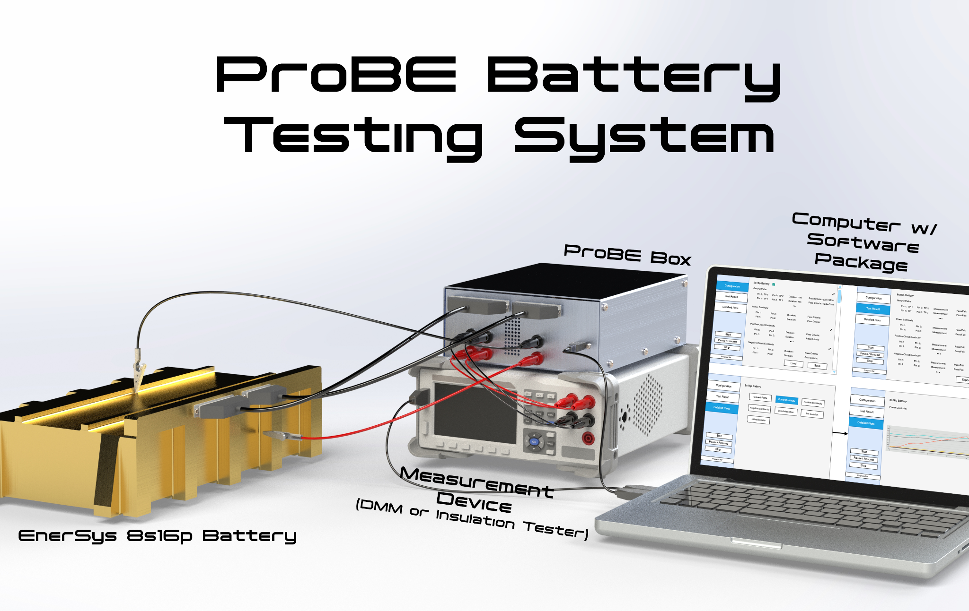
Overall Design:
Overall System
Our Design
Software Application
ProBE Box
Measurement Devices
DMM & Insulation Tester
Customer Provides
Computer
Battery
Fused D-Sub Harnesses

Slide 6
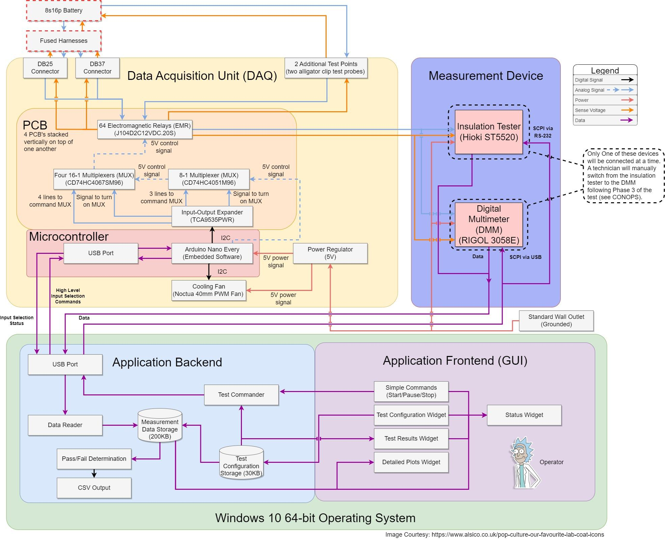
FBD:
For greater PCB detail: See Slides 42 & 43

Slide 7
Schedule
Full Testing Schedule

Slide 8
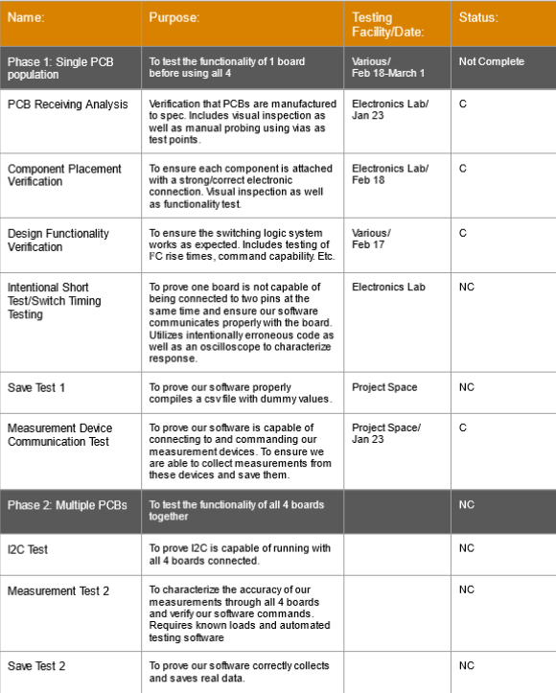
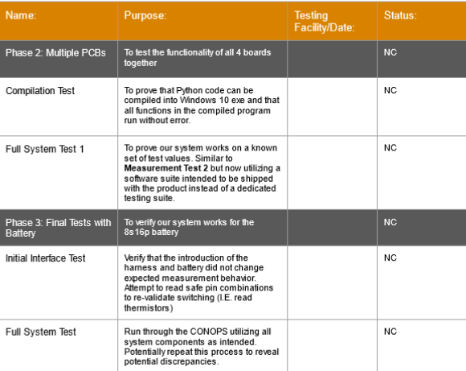
In Summary: Full Testing Plan

Slide 9
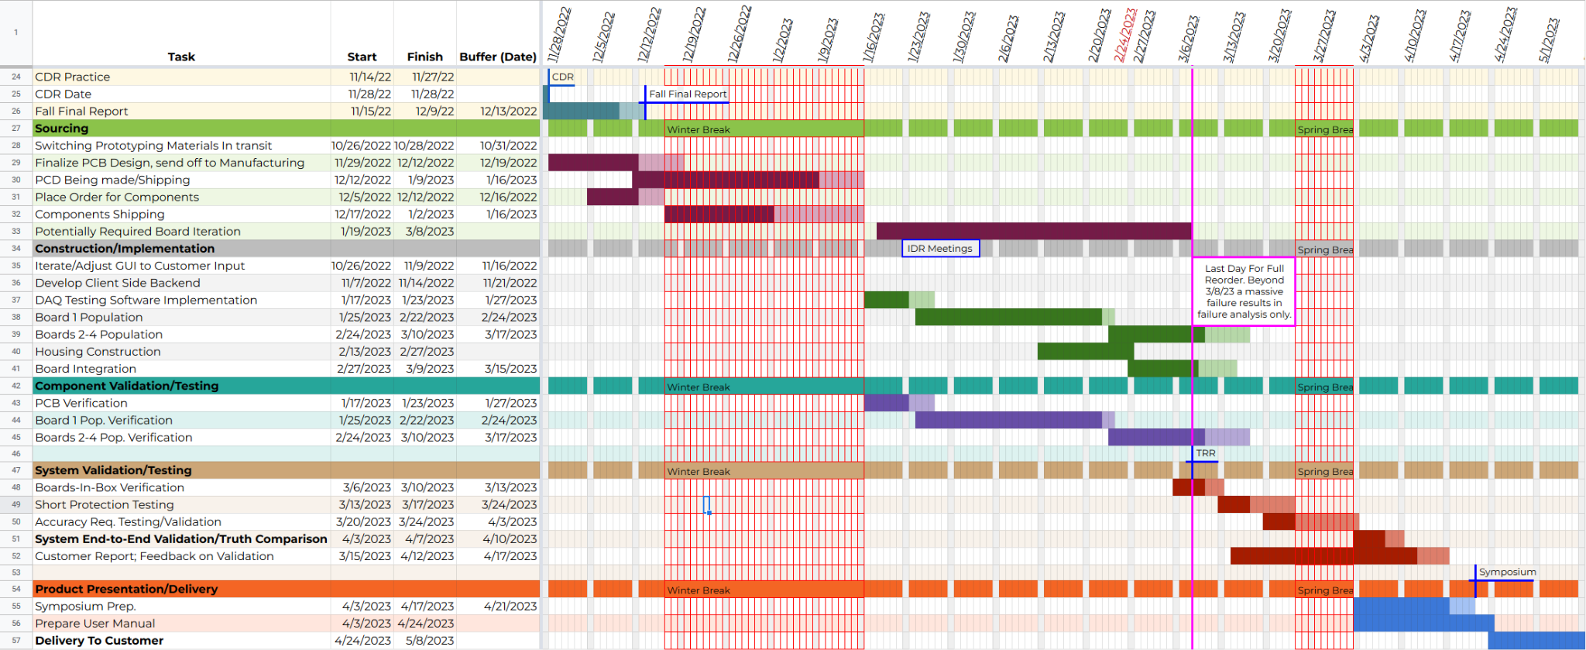
Testing Schedule

Slide 10
Test Readiness
Short Protection, Accuracy, and System End to End Tests in Depth

Slide 11
Test 1
Internal Shorting Test
ProBE shall not introduce risk of shorting battery power pins.

Slide 12
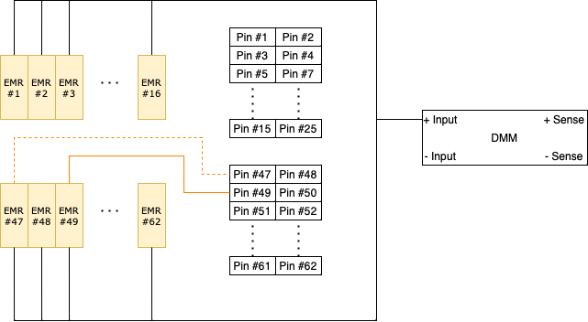
Internal Short Test 1: Purpose
A normal battery test require switching ~200 pin combinations:
Accuracy: exactly 1 pin switched on per PCB
Verify design and timing model

Slide 13
Internal Short Test 1: Switching Timing Model
 |  | Operation | Clock Cycles | Delay (ms) |  | I2C Bus Freq. (kHz)
Switch Off Previous Pin | Relay Off Command Sequence | Device Address Command | 10 | 0.025 |  | 400
 |  | Register Address Command | 9 | 0.0225
 |  | I/O Change Command | 10 | 0.025
 | Relay Response Delay | Output Port Transition Delay |  | 0.0002
 |  | Relay Off Delay |  | 0.5
 |  | uC Software Delay |  | 1
Switch On New Pin | Relay On Command Sequence | Device Address Command | 10 | 0.025
 |  | Register Address Command | 9 | 0.0225
 |  | I/O Change Command | 10 | 0.025
 | Relay Response Delay | Output Port Transition Delay |  | 0.0002
 |  | Relay On Delay |  | 0.35
 |  |  |  | 1.9954

Slide 14
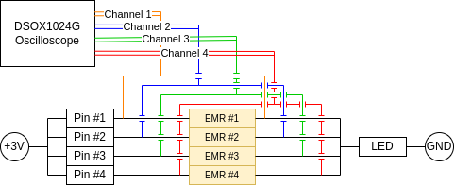
Internal Short Test 1: Test Plan
1. Worst-case test:
2. Regular test:
Pin 1 On
Switch On Pin 2
Pin 1 On
Switch Off Pin 1
Switch On Pin 2
Internal Short Test Checklist
Randomly select 4 pins.
Connect oscilloscope channels to end of EMRs.
Connect +3V power source.
Command 200 sequential switching.
Export and save oscilloscope channel data.
Analyze data with MATLAB script: generate statistics to occurrences of multiple closed circuits.

Slide 15
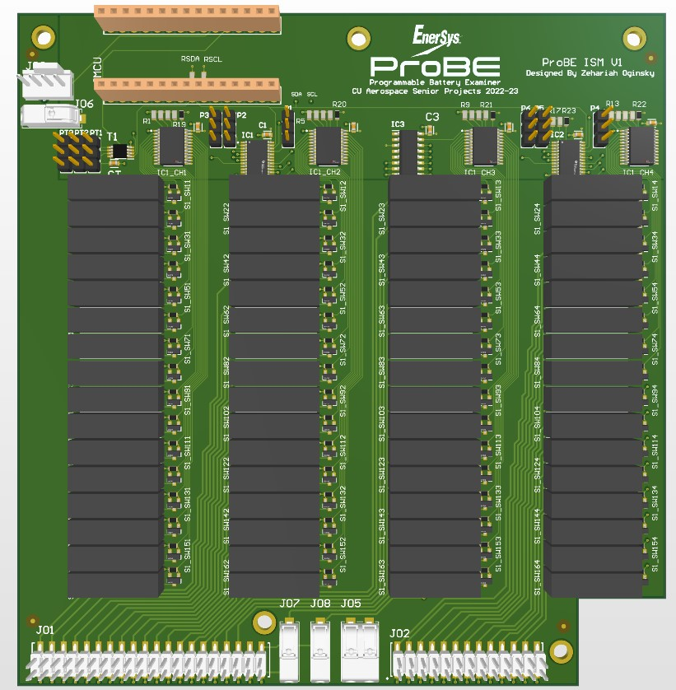
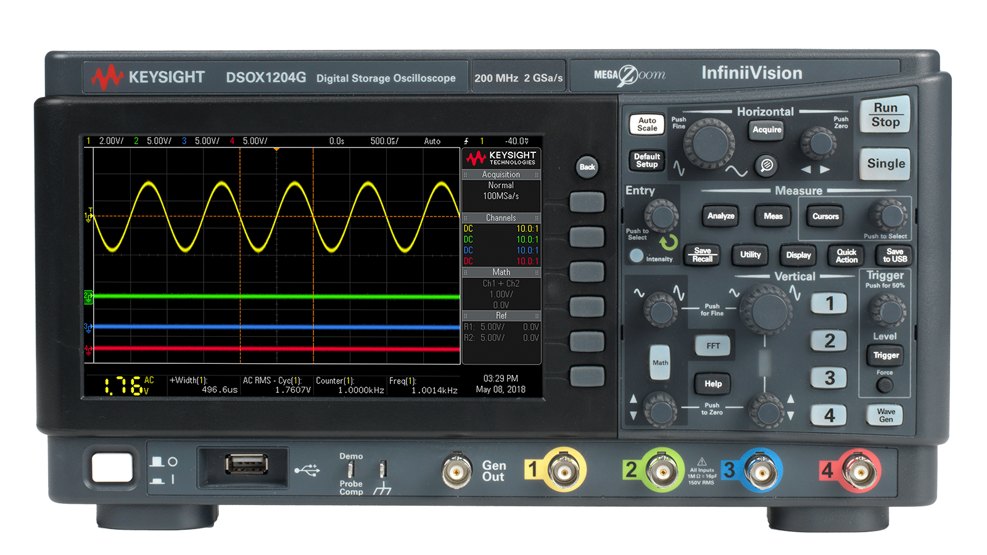
Internal Short Test 1: Test Plan
Start: March 13, 2023
End: March 17, 2023
Equipments: Keysight DSOX1204G oscilloscope, ProBE PCBx4
Location: AERO 150

Slide 16
Internal Short Test 1: Pass Criteria
FR 1.1.4: Shall not short battery power pins: 0 tolerance on shorting
Saved readings from oscilloscope:
Test passes if number of closed circuits ≤ 1 at all times
Test fails if otherwise
Possible mitigation:
Increase software delay between pin switches
Look for failing electrical components

Slide 17
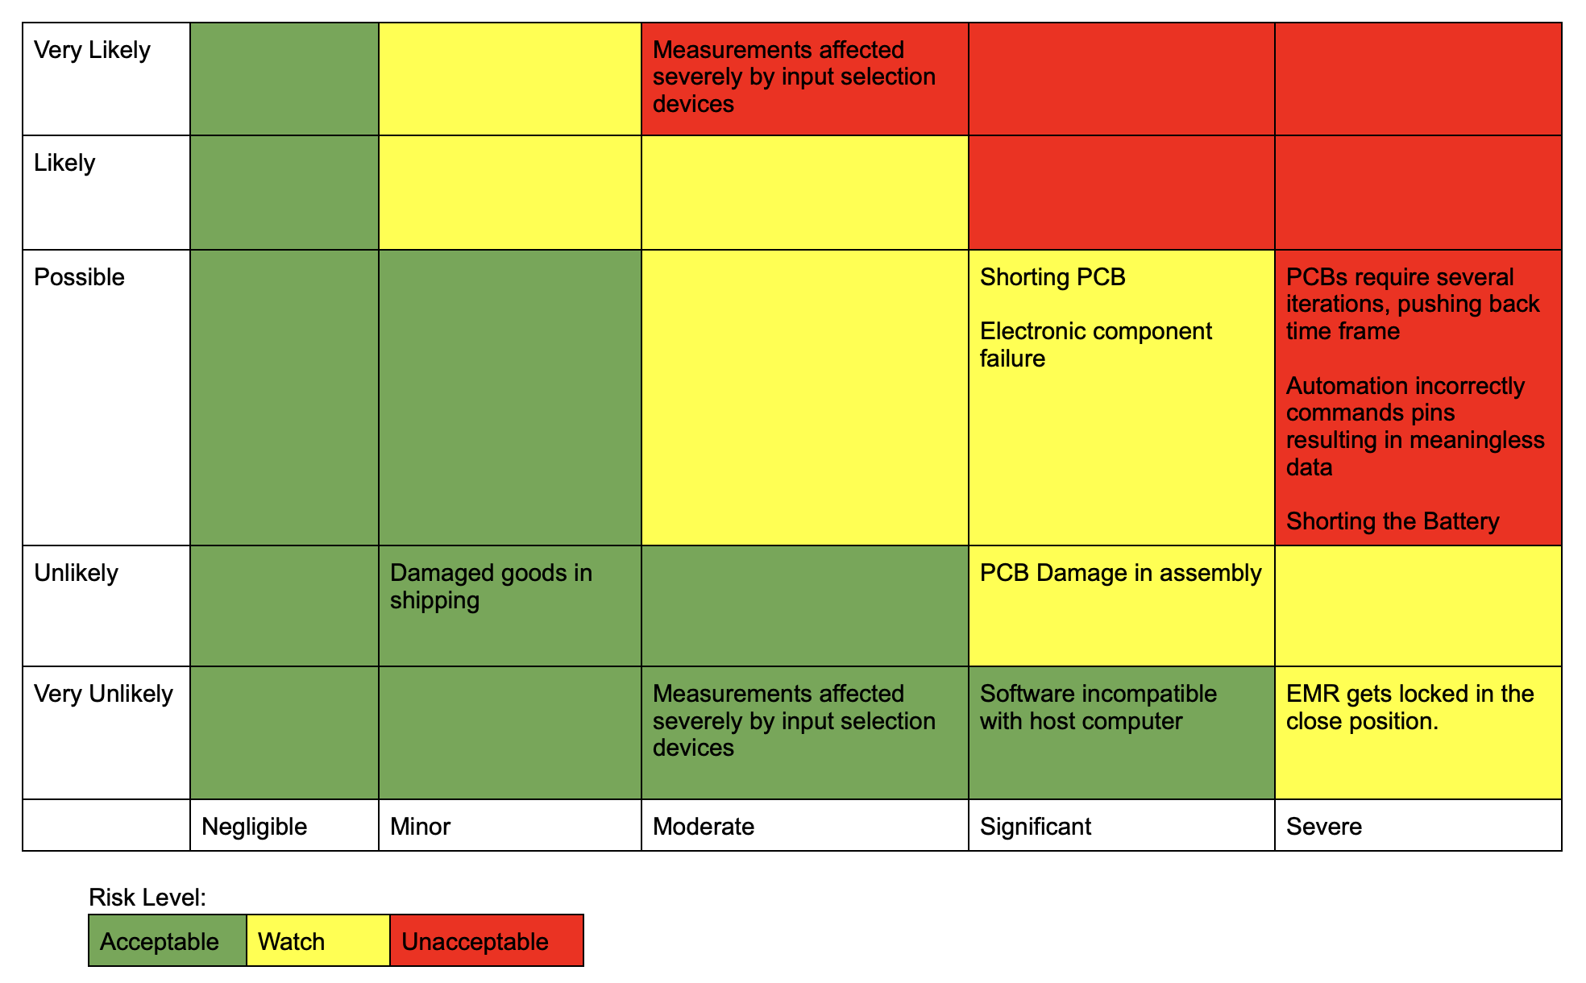
Internal Short Test 1: Risk

Slide 18
Test 2
Measurement Accuracy
ProBE shall provide testing capabilities with accuracies as good or better than current instruments/procedures.

Slide 19
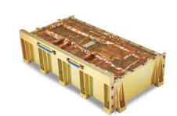
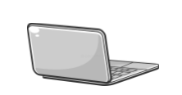
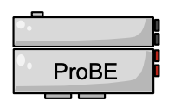
Measurement Accuracy Test 2: Purpose
??
Requirements:
Voltage
Continuity
Isolation
Accuracy | Resolution
±12.5 mV | 10 mV
Accuracy | Resolution
±250 mΩ | 10 mΩ
Accuracy | Resolution
±0.3 MΩ | 0.1 MΩ

Slide 20
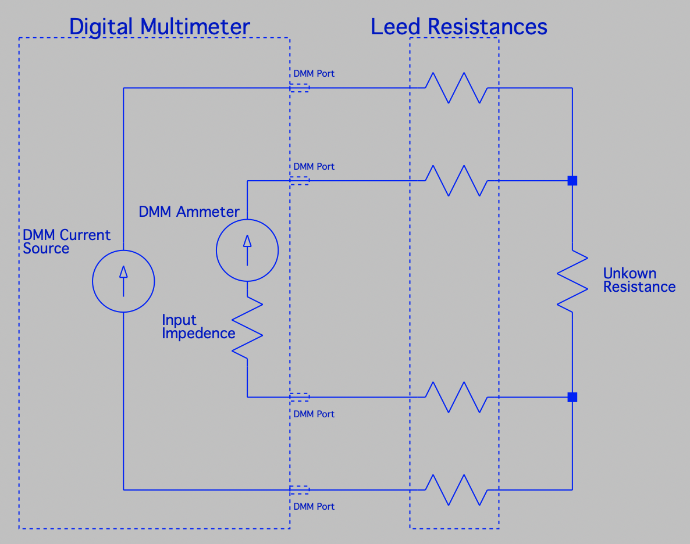
Measurement Accuracy Test 2: How it works
Lead Resistances
Probe Port
Probe Port
Probe Port
Probe Port
Probe
Probe Port
Probe Port
Probe Port
Probe Port

Slide 21
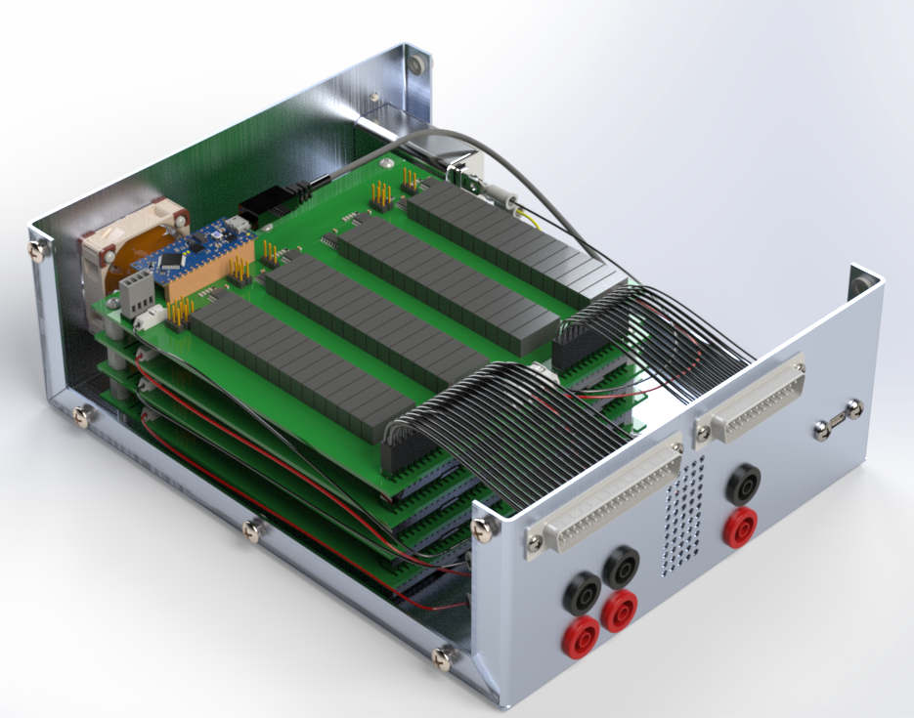
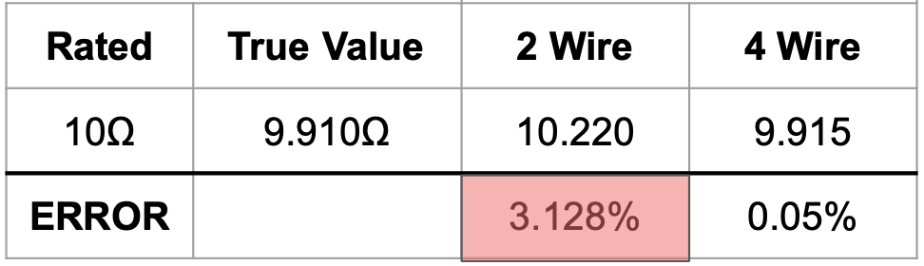
Measurement Accuracy Test 2: Background
Prerequisite Work
This Test
Materials Required
Model
- Probe system
- DMM, Insulation tester, PSU
- 0.5Ω, 10MΩ Resistors
- 4 Banana Cables
- DMM probes w/ alligator clips
- Breadboard, 6 headers.
- USB A to USB C cable
- USB A to Rs232 cable
- Laptop with test scripts
Physical Test
All 4 pin switching boards in the enclosure using finalized connections
Lab Space Required
- All tests will be run in the senior project design space.
Note: Full test setup in next slides.
X
Short Protection Testing!
Notes:
We need to run this test on an actual battery, so the short protection test must be completed and passed before we hook up to the battery.
The main prerequisite task was to run a physical test with a DMM that we had access to in the lab through our EMRs to measure a resistor. As you can see the error is 0.05%, which is still within our measurement requirements.

Slide 22
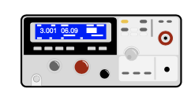
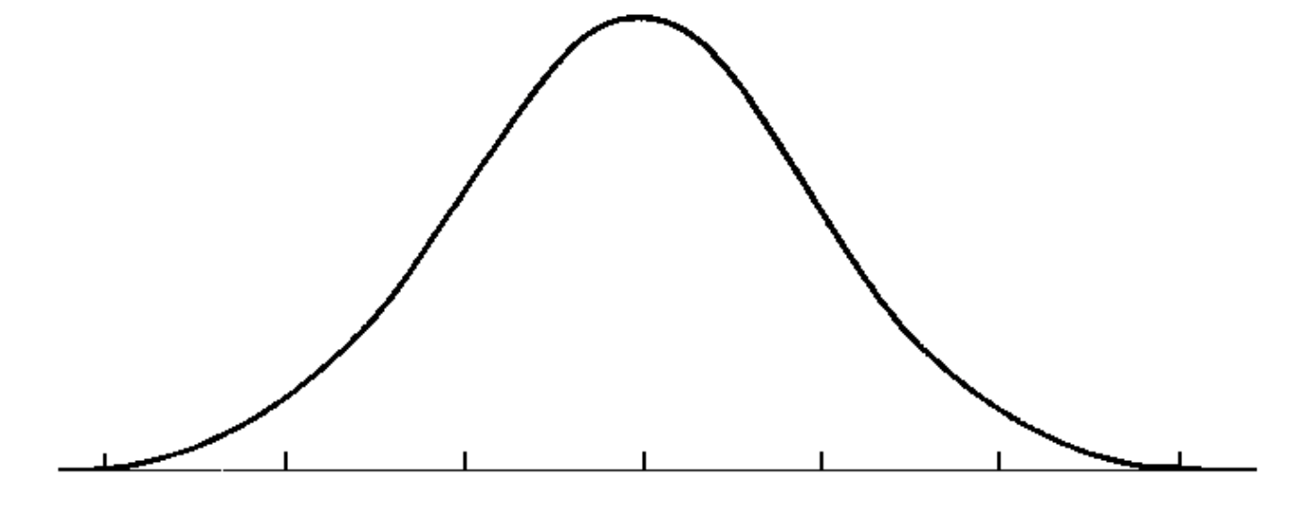
Measurement Accuracy Test 2: Voltage Test
Obtain True Voltage Value
4. Run Data Analysis
Power Supply
Alligator Clips
DMM
10V - 12.5mV
10V + 12.5mV
Banana cables
2. Hook up Probe switching system
Power Supply
DMM
10V
USB-A to USB-C
99.9% Confidence Interval
USB-A to rs232
3. Run Test Script
Pass/Fail Criteria
Accuracy | Resolution
±12.5 mV | 10 mV

Slide 23
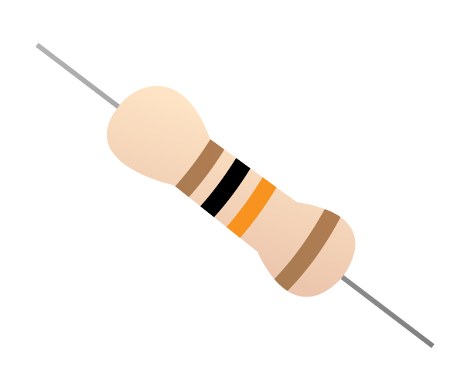
Measurement Accuracy Test 2: Continuity Test
Obtain True Resistance Value
4. Run Data Analysis
DMM
0.5Ω - 250 mΩ
0.5Ω + 250 mΩ
2. Hook up Probe switching system
DMM
0.5 Ω
99.9% Confidence Interval
3. Run Test Script
Pass/Fail Criteria
Accuracy | Resolution
±250 mΩ | 10 mΩ

Slide 24
Measurement Accuracy Test 2: Isolation Test
Obtain True Resistance Value
4. Run Data Analysis
Insulation Tester
10 MΩ - 0.3 MΩ
10 MΩ + 0.3 MΩ
2. Hook up Probe switching system
Insulation Tester
10 MΩ
99.9% Confidence Interval
3. Run Test Script
Pass/Fail Criteria
Accuracy | Resolution
±0.3 MΩ | 0.1 MΩ

Slide 25
Measurement Accuracy Test 2: Risk

Slide 26
Automation Test
ProBE shall automate battery testing procedures without introducing inaccuracies or uncertainties.

Slide 27
Automation Test: Purpose
Purpose:
Automated Commanding:
ProBE’s software package is capable of automating the commands to the Automated Pin Selection System.
ProBE’s software automates commanding of type and duration for measurements taken by the measurement device.
Automated Data Reception:
ProBE’s software automates the proper receiving of data from the measurement device.
ProBE’s software automates the accurate displaying and storage of data.
Driving Requirements:
CPE 1: Measurement Device Interface
ProBE shall be capable of controlling, receiving data from, and taking readings from a measurement device.
CPE 2: Automated Pin Selection System (APSS)
ProBE shall automatically run tests on all required pin permutations while providing protection against damage to the battery.
CPE 5: Data Capture
Signal information shall be stored and exported to a csv file accessible by external systems.

Slide 28
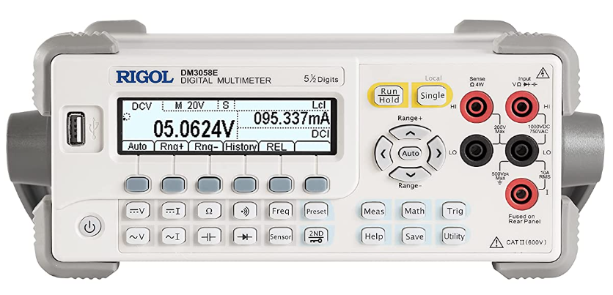
Automation Test: Automated Commanding
String of characters
4 analog high/low signals
Arduino Nano Every
I2C Com. Protocol
IO Expander
Prerequisite Tests:
Design Functionality Test: Verifies Pin Selection Model.
I2C Test: Verifies use of I2C when all four boards are connected.
Measurement Device Communication Test: Verifies use of Standard Commands for Programmable Instruments (SCPI) to control with our measurement device.
5 analog high/low signals
8:1 Multiplexer
5V
5V
16:1
Multiplexer
EMR
5V
See Slide 43
SCPI

Slide 29
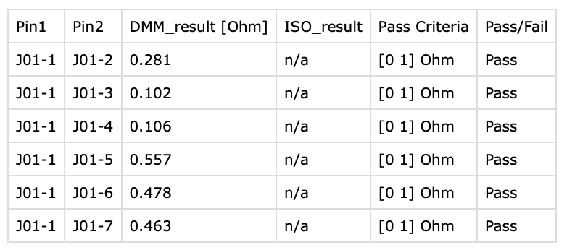
Automation Test: Automated Data Reception
Prerequisite Tests:
Measurement Accuracy Test 2: Verifies our system’s ability to take accurate measurements
Save Test 2: Verifies our software’s ability to accurately collect and save real data.
Measurement Device Communication Test: Verifies ability to receive accurate data from our measurement device.
DMM
Collected Data
.csv
Measurement Data

Slide 30
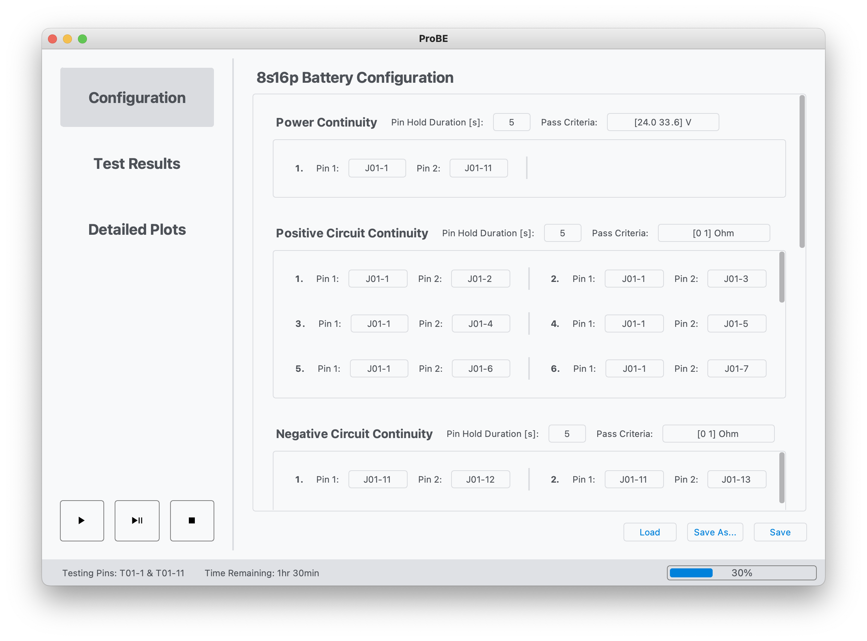
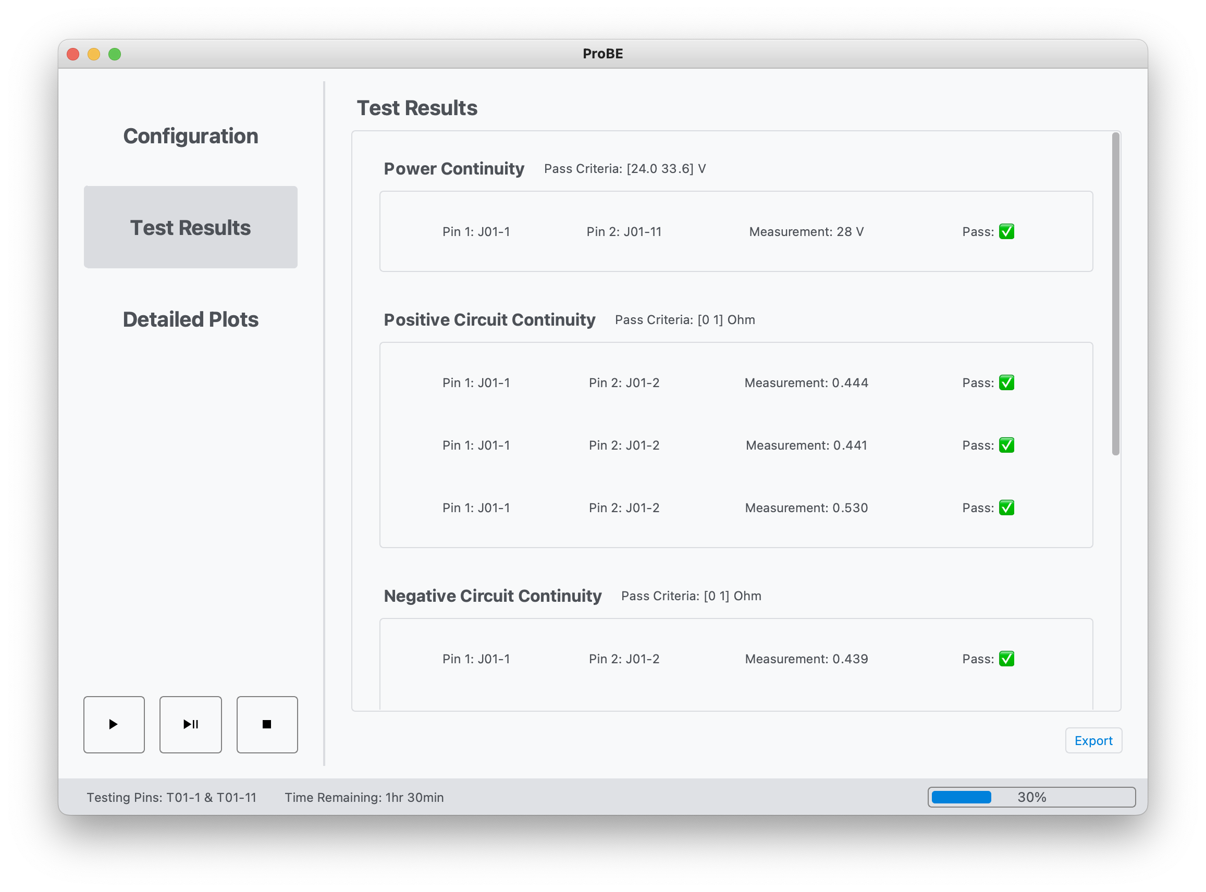
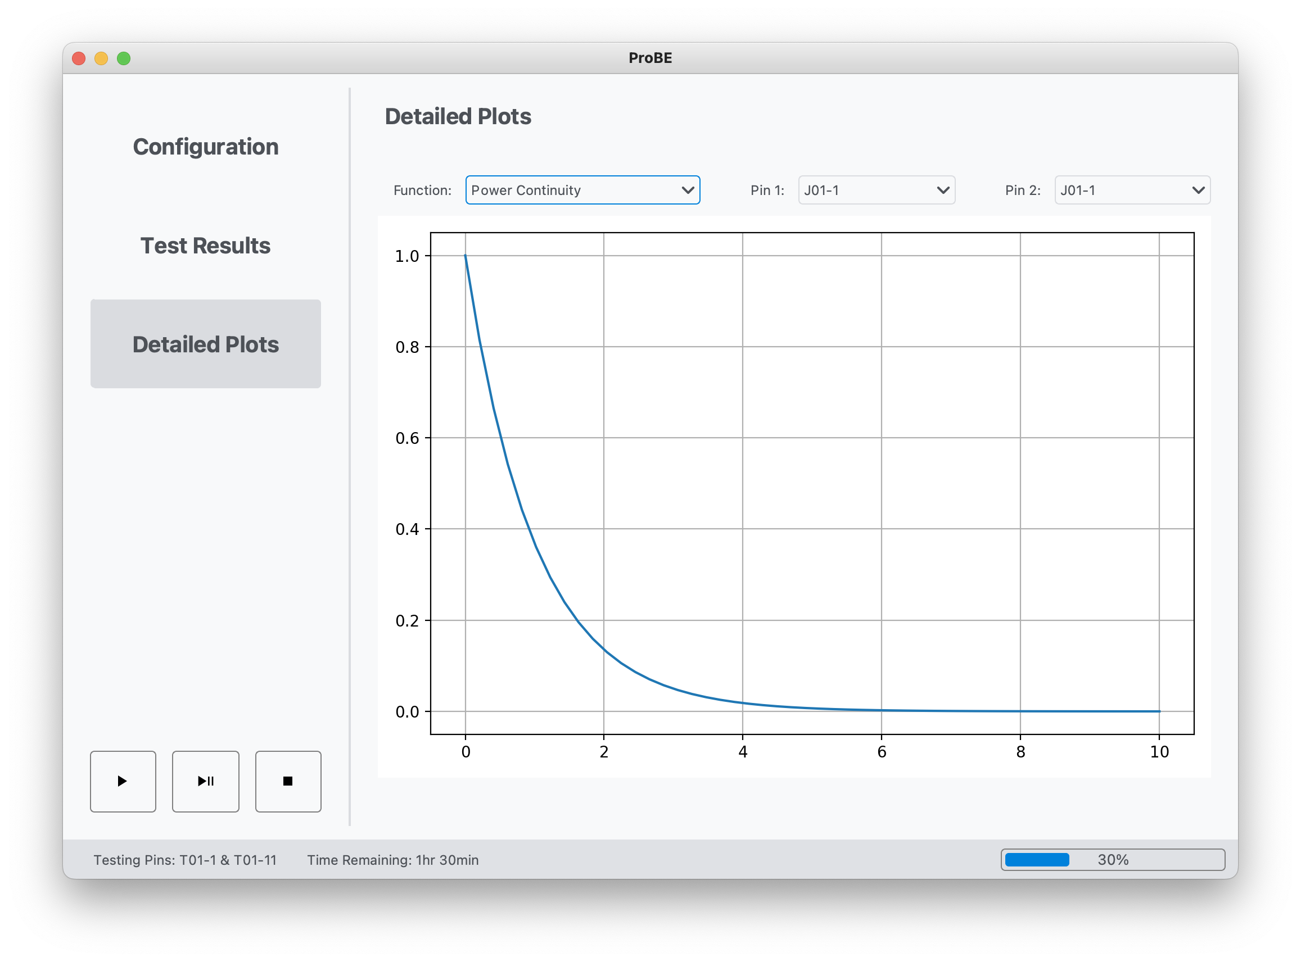
Automation Test: Model Validation
Test: Power Continuity [V] Measurement: 28
.csv

Slide 31
Automation Test: Set up
Phase 1:
Directly measure true values of resistance for a set 8 resistors.
Phase 2:
Set up all 8 unique resistors on a breadboard.
Connect pin pairings 1-2, 9-10, 17-18, 25-26, 3-11, 19-27, 4-20, and 12-28 to one resistor of known value on the breadboard.
Connect the Computer to the DMM and ProBE Box.
Connect the DMM to the ProBE Box.
DMM
Alligator Clips
Banana Cables
DMM
USB A to USB C
USB A to rs232

Slide 32
Automation Test: Procedure (Phase 1)
Phase 1 Checklist
True Resistance Table (kΩ)
Set up the DMM.
Connect the banana cables with alligator clips to the “HI” and “LO” ports of the DMM.
Set the DMM to the resistance setting.
Select 8 resistors of unique value.
Measure the true resistance of the resistor to
given resolution of our DMM in that range.
Record the label value of the resistor, the true value of the resistor and the pin pair it will be connected to in the “True Resistance Table”
Pin 1 | Pin 2 | Label | True
J01-1 | J01-2 | 10 | 10.1
J01-17 | J01-18 | 20 | 20.3
J01-33 | Jo1-34 | 30 | 29.4
… | … | … | …

Slide 33
Automation Test: Procedure (Phase 2)
Live Resistance Table (kΩ)
Phase 2 Checklist
Set up and connect all required devices to one another.
Connect resistors on breadboard to the required pins on the ProBE Box
In GUI load in the Test Configuration and run the test.
While the test is running compare the resistance values displayed by the GUI with the true resistance values for each pin selection.
When the test save data to a .csv file.
Compare the Test Results page, the “True Resistance Table”, the “Live Resistance Table”,
the Detailed Plots page and the .csv file.
Record any unexpected discrepancies in the
“Discrepancies Table”.
Pin 1 | Pin 2 | Live | True
J01-1 | J01-2 | 10.2 | 10.1
J01-17 | J01-18 | 19.1 | 20.3
… | … | … | …
Discrepancies Table (kΩ)
Pin 1 | Pin 2 | Live | .csv | Test Results | Detailed Plots | True
J01-1 | J01-2 | 10.2 | 10.2 | 10.2 | 10.2 | 10.1
… | … | … | … | … | … | …

Slide 34
Automation Test: Results
Recorded Results:
“True Resistance Table”
“Live Resistance Table”
“Test Results” Page on GUI
“Detailed Plots” Page on GUI
.csv file
“Discrepancies Table”
Expected Results:
Error of no more than ±10% between the “True Resistance” and the “Live Resistance” Tables.
No discrepancies between the “Live Resistance” Table, “Test Results” Page, “Detailed Plots” Page, and .csv file.
Test: Power Continuity [V] Measurement: 28

Slide 35
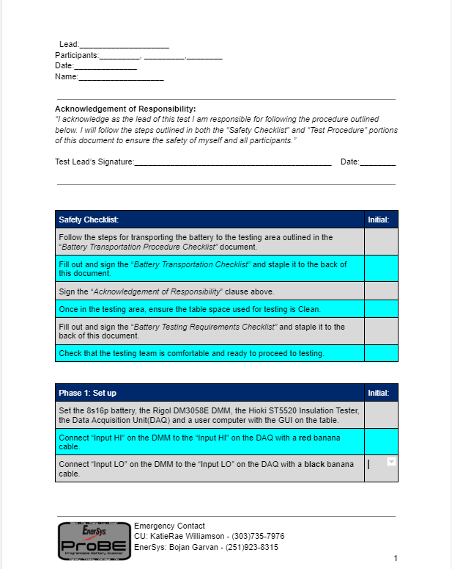
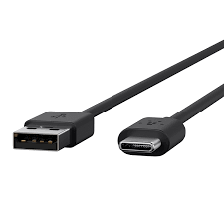
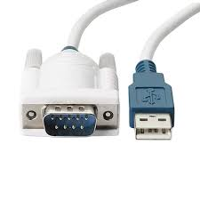
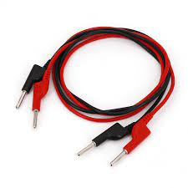
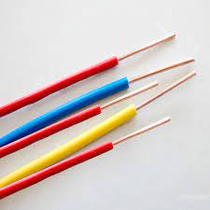
Automation Test: Test Plan
Date: Finishing of Measurement Accuracy Test - 3/24/2023
Facility: Electronics Lab
Equipment: DMM, Computer with ProBE GUI, 8 unique resistors, Data Acquisition Unit, required cables for connection(banana cables, USB cables and alligator wire), bread board and test procedure document.

Slide 36
Automation Test: Risk

Slide 37
Budget
Budget Overview

Slide 38
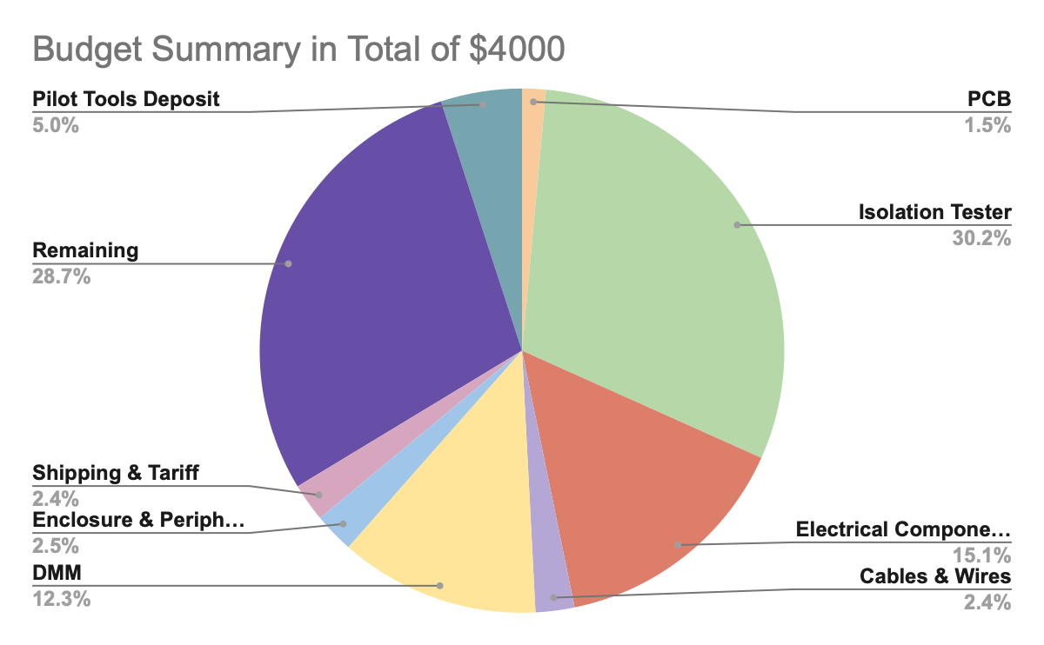
Budget - Summary
Total Budget
$4000
Total Cost
$2853.32
Remaining Budget
$1146.68

Slide 39
Budget - Completed Expenses
Items | Original Budget | Current Cost | Status | Margin
PCB | $500 | $58.34 | Completed | $441.66
Electrical Components | $1000 | $602.93 | Completed | $397.07
Isolation Tester | $1200 | $1210 | Completed | -$10
DMM | $500 | $493 | Completed | $7
Enclosure & Peripherals | $200 | $98.9 | Completed | $101.1
Cables & Wires | $200 | $95.95 | Completed | $104.05

Slide 40
Budget - Overview
Team is under budget of with almost all electrical materials.
Estimated $15 of powder coat yet to be purchased with a current $1146.68 of budget left.
Uncertainty & Risk
Redesigning and manufacturing PCB

Slide 41
Backup Slides

Slide 42
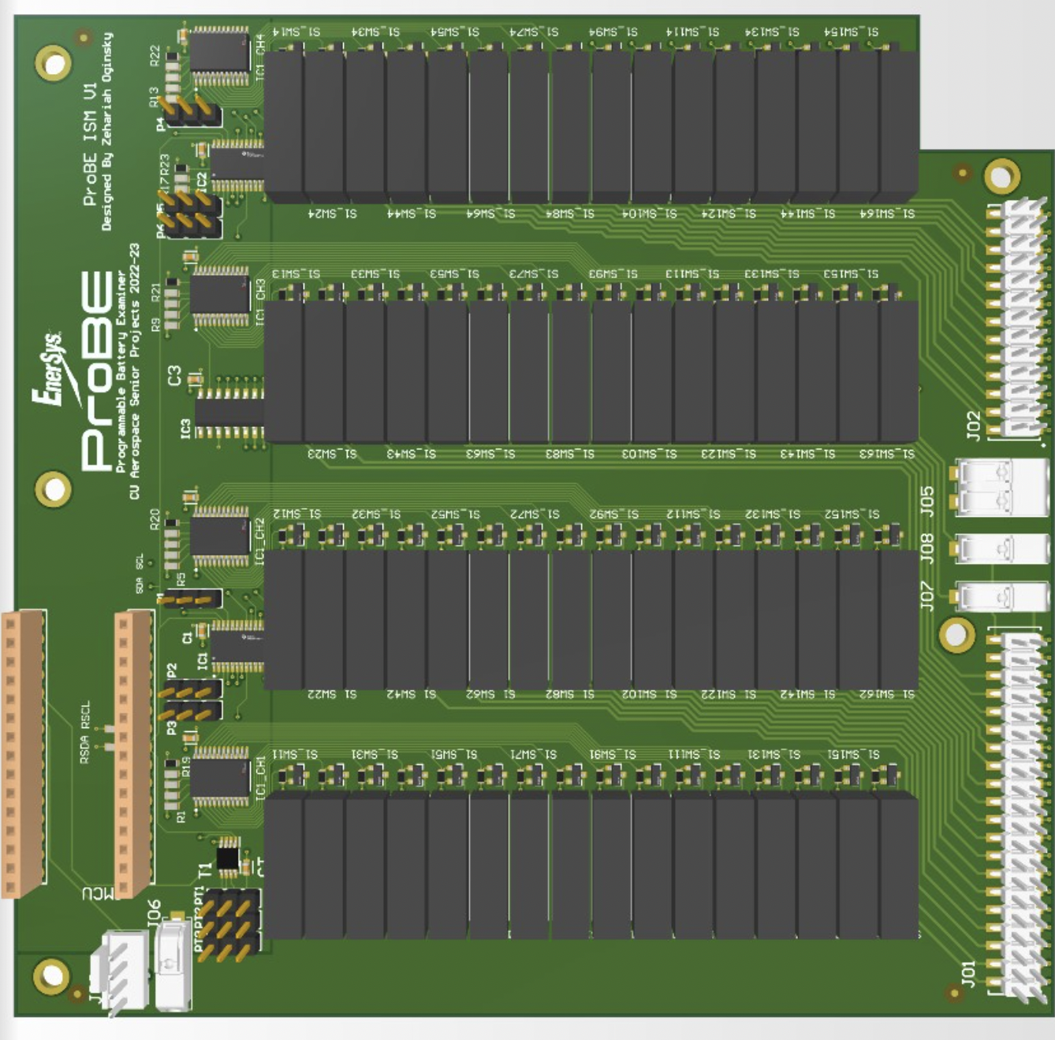
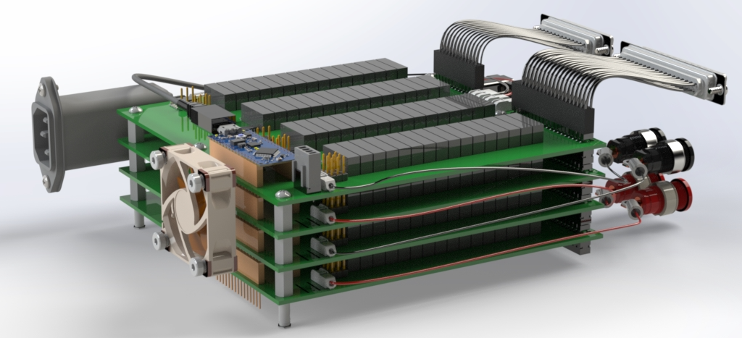
PCB Design/ 4 Stacked Boards

Slide 43
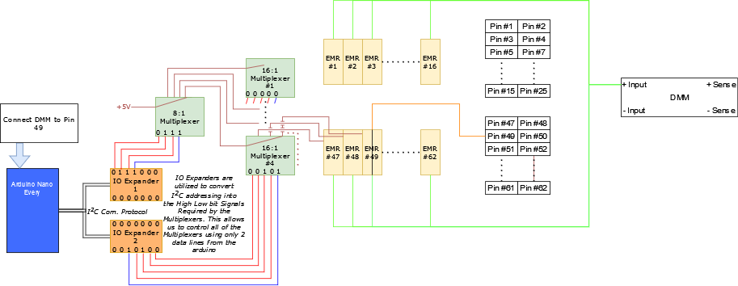
Pin Selection Model

Slide 44
Measurement Accuracy Test 2: Plan/Procedure
Pre-Setup Checklist
Pass/Fail Requirements
Acquire test kit (breadboard, resistors, leads, headers, probes)
Acquire Probe, DMM, insulation tester, and laptop.
Establish safe testing area in senior project design space.
Inspect Probe, DMM, insulation tester for damage.
Voltage
Accuracy | Resolution
±12.5 mV | 10 mV
Setup Checklist
Continuity
Connect laptop to DMM and Probe via USB.
Open up test software suite.
Set test kit hardware out.
Set Probe to disconnect all EMRs.
Accuracy | Resolution
±250 mΩ | 10 mΩ
Test Process Checklist
Isolation
Run DMM Voltage Test Procedure and Script.
Run Continuity Test Procedure and Script.
Disconnect DMM and connect Insulation Tester
Run Isolation Test Procedure and Script.
Accuracy | Resolution
±0.3 MΩ | 0.1 MΩ
Notes:
We know our DMM meets these requirements, so this test is to verify that our system does not introduce error that would push the bounds of our measurement accuracy/resolution outside of requirements.

Slide 45
Measurement Accuracy Test 2: Voltage Test
Test Procedure Checklist
Data Analysis Script
Setup breadboard up for Voltage Test.
Install 4 headers on 2 nodes on BB. (2 per node)
Attach each power supply input to 1 node’s header.
Set power supply to 10V.
Use DMM to measure exact voltage value.
Attach each APSS board lead to remaining headers.
Run Test
Hook up DMM to Probe using banana cables.
Run voltage test script.
Run analysis on data.
Run Z-Distribution with 99.9% Confidence Interval
Record number of data points. (n)
Calculate mean of data. (x)
Calculate standard deviation of data. (σ)
Calculate Z-Score. Z = 3.2905σ (Z)
Calculate Confidence Interval (CI)
Pass: Max and min of CI are within reqs
DMM Voltage Script
Pin 1 (Probe EQ) | Pin 2 (Probe EQ) | Expected Measurement
JO1-1 | JO1-11 | 10V ± 12.5mV
Note: expected measurement mean will be exact voltage value measured by DMM

Slide 46
Measurement Accuracy Test 2: Resistance Test
Test Procedure Checklist
Resistance Test Script
Setup breadboard up for Resistance Test.
Install 4 headers on 2 nodes on BB. (2 per node)
Attach each 10kΩ resistor end into each node.
Use DMM to measure exact resistance value.
Attach each APSS ± sense board lead to ±
headers.
Attach each APSS ± board lead to ± headers.
Run Test
Hook up DMM to Probe using banana cables.
Run Resistance test script.
Run analysis on data.
Pin 1 (Probe EQ) | Pin 2 (Probe EQ) | Expected Measurement
J01-1 | J02-2 | 10kΩ ± 25Ω
J01-1 | J02-14 | 10kΩ ± 25Ω
J01-11 | J02-12 | 10kΩ ± 25Ω
J01-11 | J02-25 | 10kΩ ± 25Ω
… | … | …
Note: expected measurement mean will be exact voltage resistance measured by DMM.

Slide 47
Measurement Accuracy Test 2: Isolation Test
Test Procedure Checklist
Insulation Script
Setup breadboard up for Isolation Test.
Connect Insulation Tester to Probe with banana cables.
Install 2 headers on 2 nodes on BB. (1 per node)
Attach each 20MΩ resistor end into each node.
Use DMM to measure exact resistance value.
Attach each APSS board lead to remaining headers.
Run Test
Hook up DMM to Probe using banana cables.
Run Resistance test script.
Run analysis on data.
Pin 1 | Pin 2 | Pass Criteria
TP1 | J01-1 | 10MΩ ± 0.3MΩ
TP1 | J01-10 | 10MΩ ± 0.3MΩ
TP1 | J02-1 | 10MΩ ± 0.3MΩ
J01-1 | J01-10 | 10MΩ ± 0.3MΩ
J01-1 | J02-07 | 10MΩ ± 0.3MΩ
J01-1 | J01-08 | 10MΩ ± 0.3MΩ
… | … | …
Note: expected measurement mean will be exact resistance resistance measured by DMM

Slide 48
Measurement Accuracy Test 2: Continuity Test
Test Procedure Checklist
Continuity Test Script
Setup breadboard up for Continuity Test.
Install 4 headers on 2 nodes on BB. (2 per node)
Attach each end of 0.5Ω resistor directly into a node.
Use DMM to measure exact resistance value.
Attach each APSS ± sense board lead to ± headers.
Attach each APSS ± board lead to ± headers.
Run Test
Hook up DMM to Probe using banana cables.
Run Continuity test script.
Run analysis on data.
Pin 1 | Pin 2 | Expected Measurement
J01-1 | J01-2 | 0.5 ± .01Ω
J01-1 | J01-3 | 0.5 ± .01Ω
J01-1 | J01-4 | 0.5 ± .01Ω
J01-11 | J01-12 | 0.5 ± .01Ω
J01-11 | J01-13 | 0.5 ± .01Ω
J01-11 | J01-14 | 0.5 ± .01Ω
… | … | …
Note: expected measurement mean will be exact resistance resistance measured by DMM

