Slide 1
Programmable Battery Examiner: CDR
Andruss Black, Qihan Cai, Alex Cheng, Ruize Liu, Joe Moser,
Z Oginsky, Walker Tiffany, Bartek Wardega, Zhixing Yao
With Many Thanks to Our Advisor: Matt Rhode

Slide 2
Presentation Overview:
Project Purpose and Objectives
Design Solution
Critical Project Elements (CPEs)
Risk Management
Design Requirements and Satisfaction
Verification and Validation
Project Planning
Acknowledgement and Questions

Slide 3
Project Purpose and Objectives
Motivation for Project
Mission Statement
Expected Deliverables
CONOPS

Slide 4
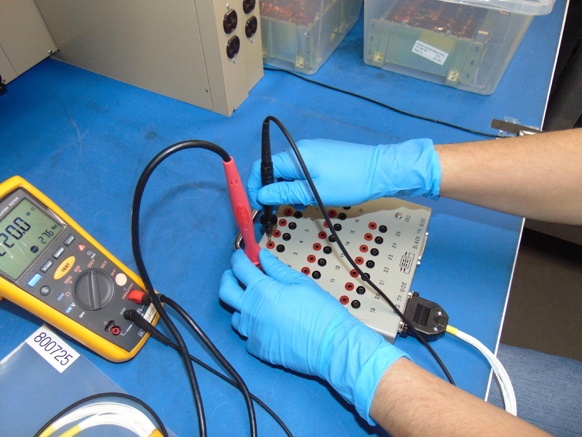
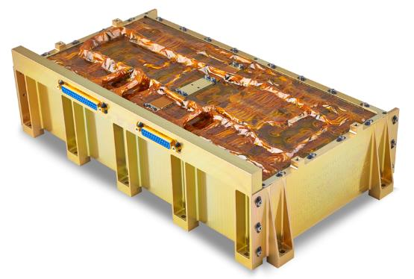
Motivation for Project:
Customer: EnerSys ABSL
Global leader in stored energy solutions with a large impact in Aerospace industries [1].
8s16p Battery is their most popular model.
Current flight-readiness testing is done manually.
EnerSys 8s16p Lithium-ion Battery

Slide 5
Motivation for Project:
Notes:
Explain battery here

Slide 6
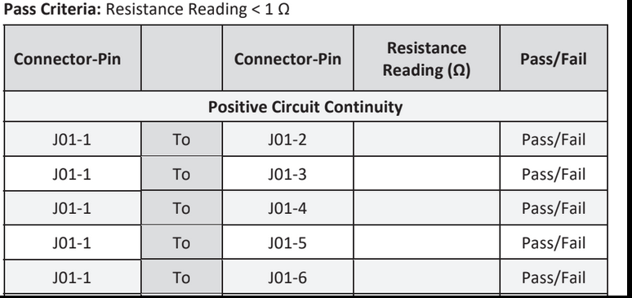
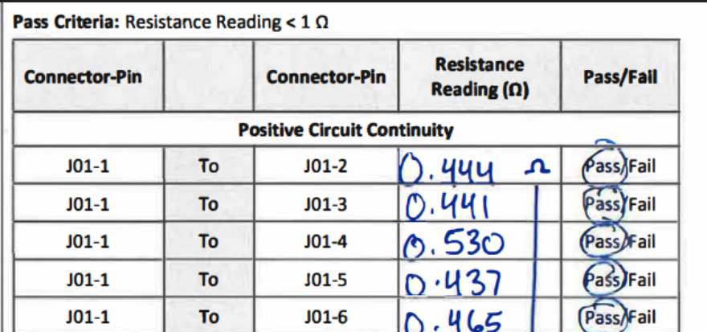
Motivation for Project:
4 Key Measurements:
Voltage (24.0 → 33.6 V || 1mV res. || .025% acc.)
Resistance (9,990 Ω → 10,010 Ω || 1Ω res. || .05% acc.)
Continuity (<1Ω || 10mΩ res. || .05% acc.)
Isolation (>10MΩ || .1MΩ res. || 3% acc.)
More detail on backup slides 55 → 61

Slide 7
Mission Statement:
“ProBe exists to automate the current industry readiness test implemented by EnerSys for the 8s16p Battery.”

Slide 8
Expected Deliverables:
EnerSys has requested:
Functional prototype of automated testing unit:
Automated pin selection system
Automated measurement acquisition logic
Enclosed unit
Graphical User Interface (GUI):
Test configuration
Test data storage
Automated test results report
User guide:
Explain the functionality of the prototype and GUI
Procedure for using the prototype and GUI
Safety guidelines

Slide 9
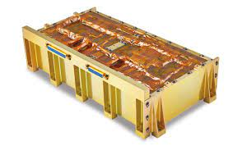
CONOPS:
Phase 1: Set up | Phase 2: Configuration | Phase 3: DMM Test | Phase 4: Insulation Test | Phase 5: Report | Phase 6: Storage | Phase 7: Shutdown
Open the GUI and make required connections. | In the GUI select the configuration of the test to be run. Initialize the test. | Software app directs ProBE for DMM measurement portion of test. | Manually switch connections from DMM to insulation tester. Continue test. | When the test is complete the GUI displays the results of the test. | Upon user command the test results are saved and exports to a .csv file. | Disconnect devices and power them off.
05.5000Vdc
05.5000Vdc
05.5000Vdc
3.001 06.09
3.001 06.09
ProBE
ProBE

Slide 10
Design Solution
Overall Setup
Pin Switching
FBD

Slide 11
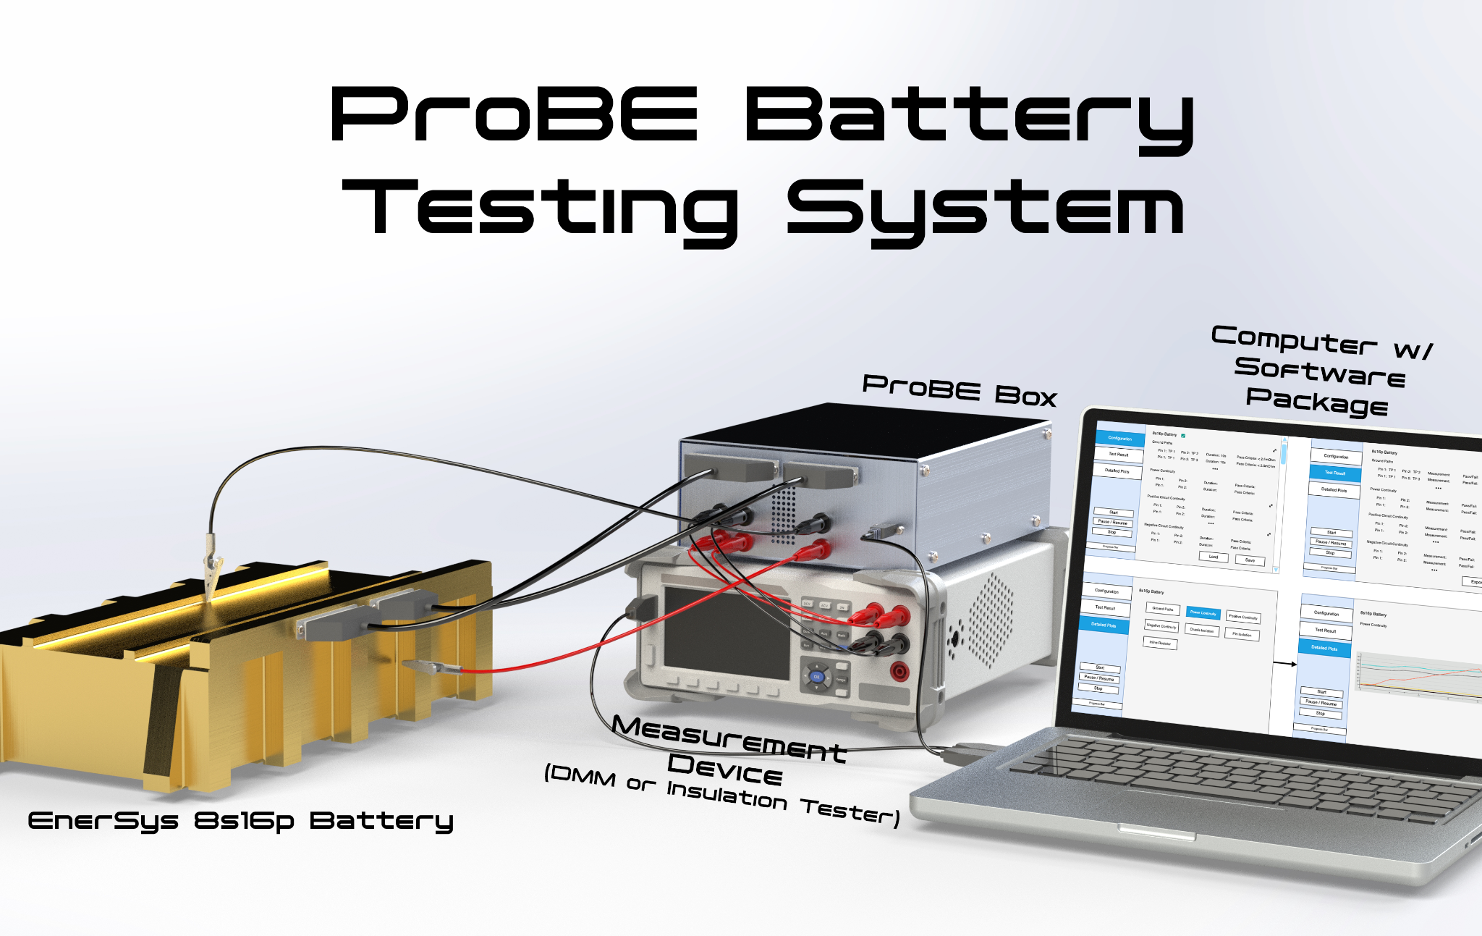
Overall Design
Overall System
Our Design
Software Application
ProBE Box
Measurement Devices
DMM & Insulation Tester
Customer Provides
Computer
Battery
Fused D-Sub Harnesses

Slide 12
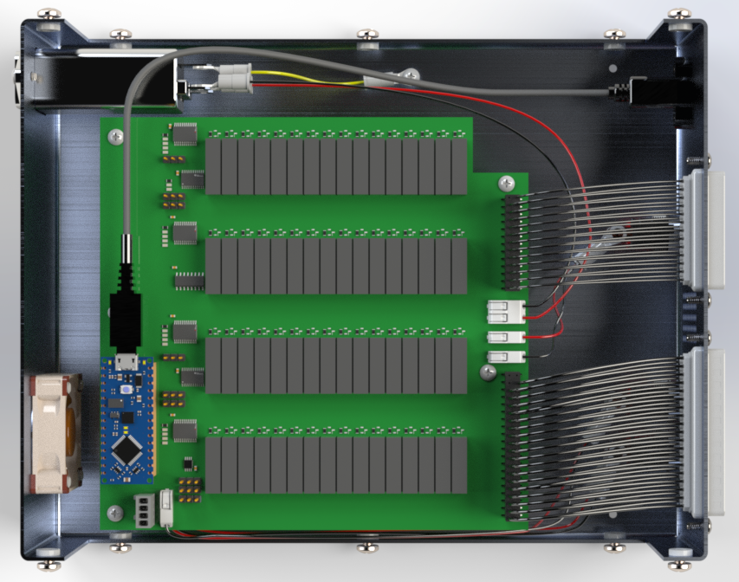
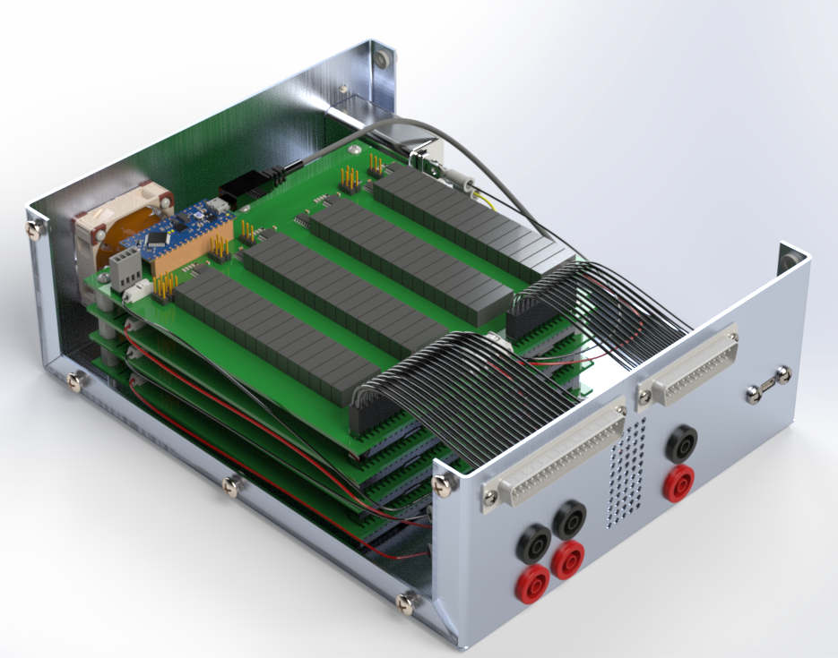
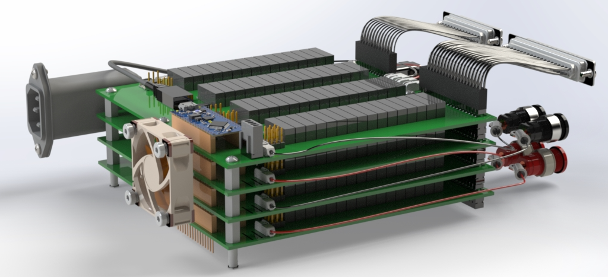
Automated Pin Selection System (APSS)
APSS
1 board per banana port
All 62 pins connected to each board
Banana ports are connected to measurement device via banana cables
7 in
9 ini

Slide 13
Functional Block Diagram

Slide 14
CPEs:
 | CPE |  | Description
CPE1 | Measurement Device Interface | E | ProBE shall be capable of controlling, receiving data from, and taking readings from a measurement device.
CPE2 | Automated Pin Selection System (APSS) | E | ProBE shall automatically run tests on all required pin permutations while providing protection against damage to the battery.
CPE3 | Hardware Containment Unit | P | The APSS shall be enclosed in a manor complaint with EnerSys requirements and ESD standards
CPE4 | Graphical User Interface | S | The user shall be able to interact with the system to manage tests and configurations, as well as export data.
CPE5 | Data Capture | S | Signal information shall be stored and exported to a csv file accessible by external systems.

Slide 15
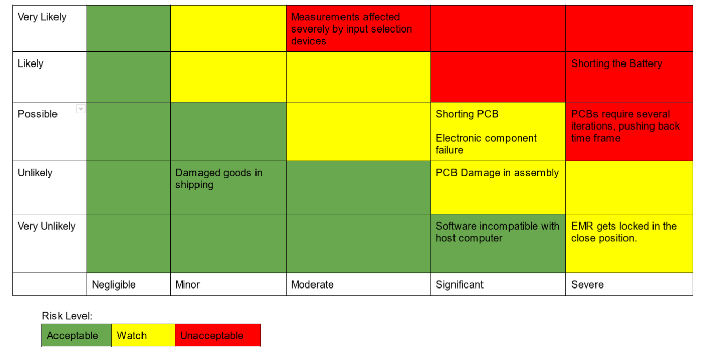
Risk Matrix

Slide 16
Measurement Device Interface
CPE 1
Collect accurate measurements with SCPI command and control

Slide 17
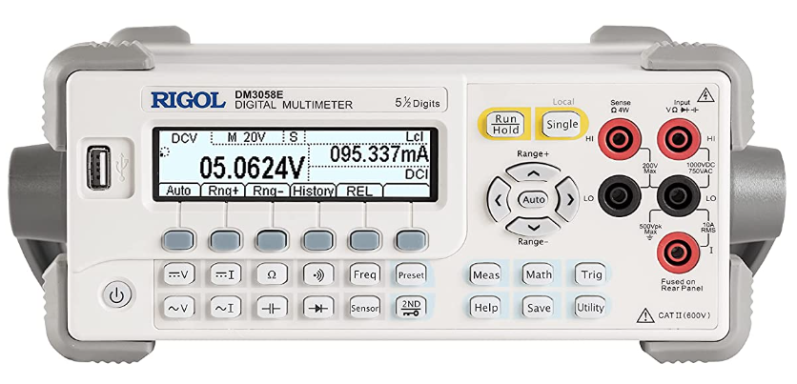
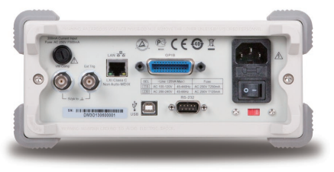
Measurement Devices: DMM
Digital Multimeter
Rigol DM3058E
Cost: $493.00
5.5 Digit Resolution
SCPI Compatibility
Voltage Requirement: 24 - 33.6 V || 1mV res. || 0.025% acc.
Rigol DM3058E: 20V || 1 mV res || 0.015% acc.
Resistance Requirement: 10kΩ ± 20 Ω || 1Ω res. || 0.05% acc.
Rigol DM3058E: 20kΩ || 1Ω res || 0.02% acc.
Continuity Requirement: <1Ω || 10mΩ res. || 0.05% acc.
Rigol DM3058E: 200 Ω || 10 mΩ res || 0.03% acc.

Slide 18
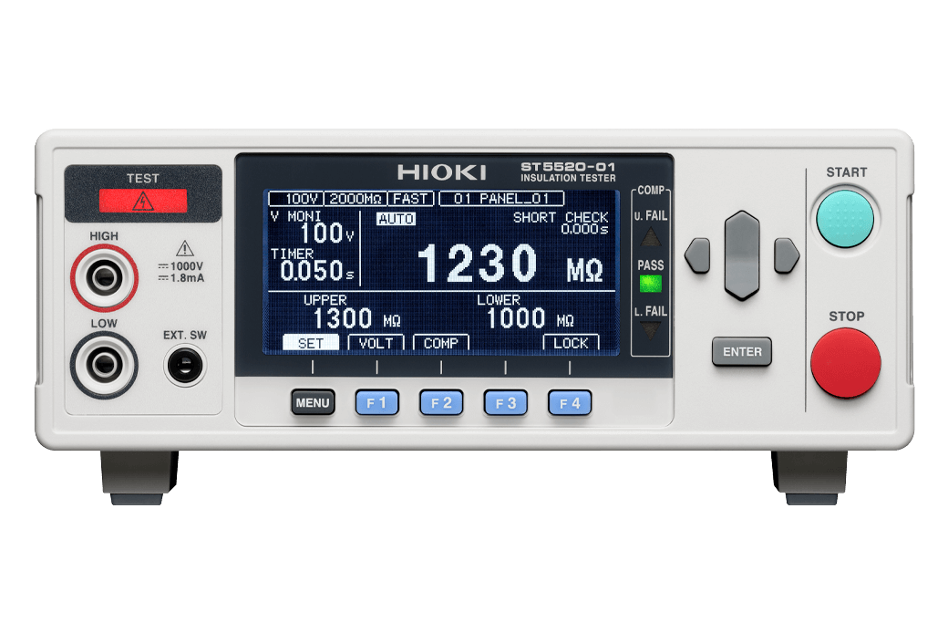
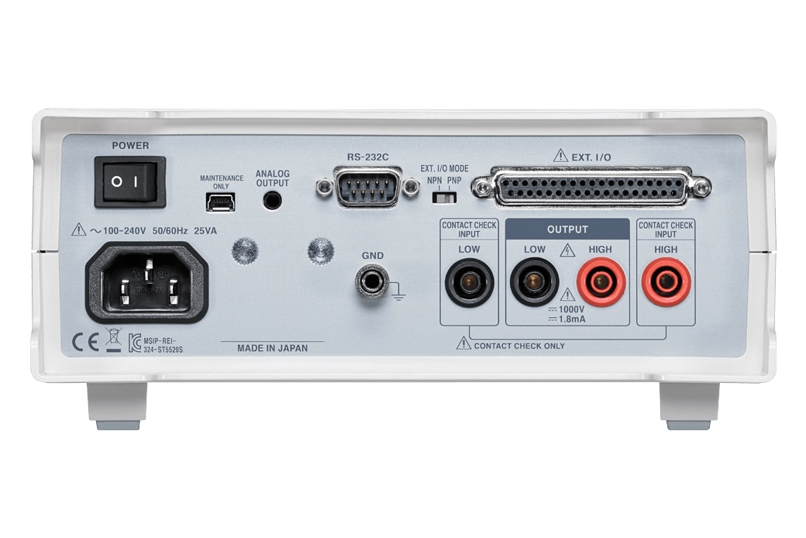
Measurement Devices: Insulation Tester
Insulation Tester
Hioki ST5520
Cost: $1210.00
Configurable Voltage
SCPI Compatibility
Isolation Requirement: >10MΩ || .1MΩ res. || 3% acc.
Hioki ST5520: 20MΩ || 0.01MΩ res || 2% acc.

Slide 19
Automated Pin Selection System (APSS)
CPE 2
Selectively switch between pins for each Measurement Device Connection without introducing shorting risk

Slide 20
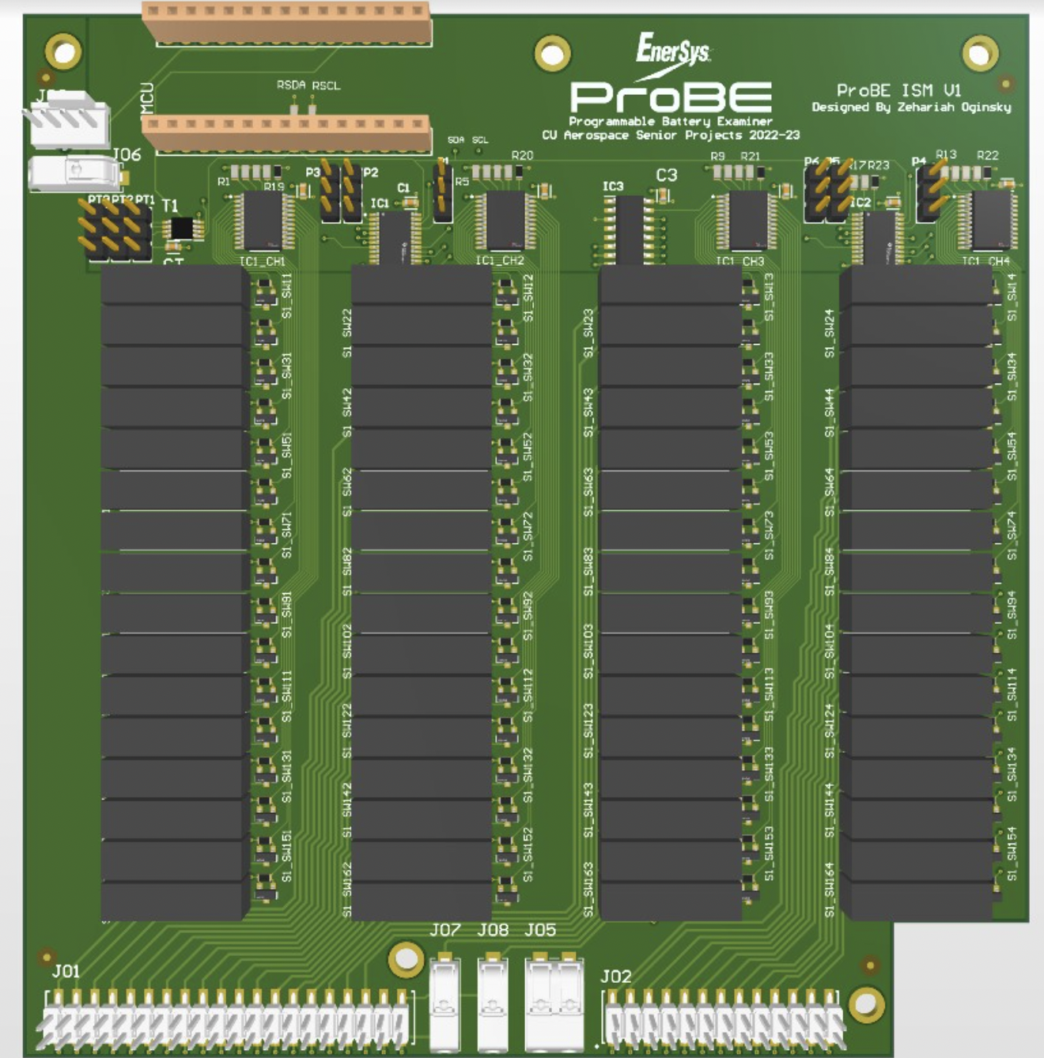
APSS

Slide 21
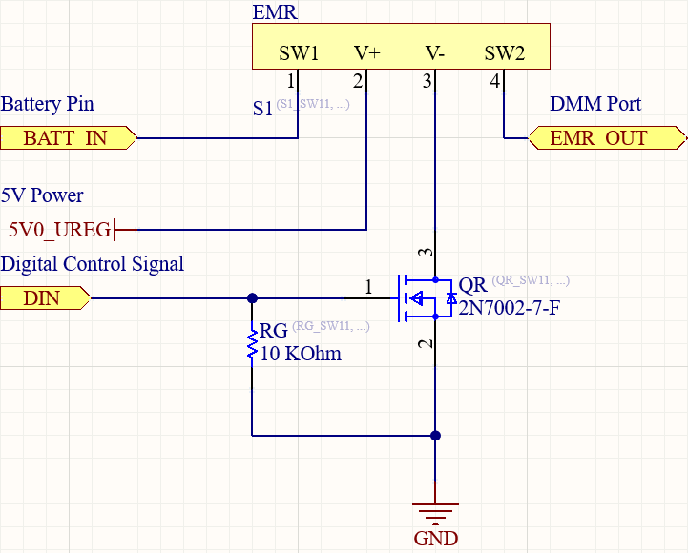
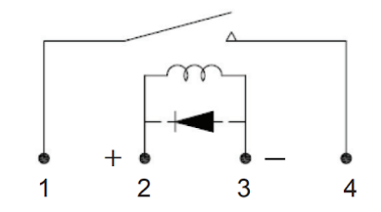
EMR Circuit Diagram

Slide 22
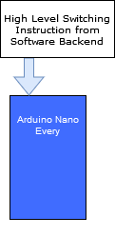
PCB Design
Microcontroller

Slide 23
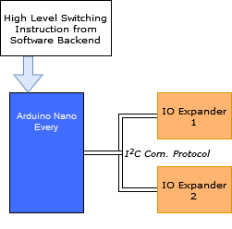
PCB Design
IO Expanders

Slide 24
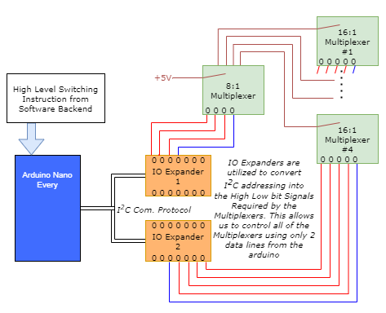
PCB Design
Multiplexers

Slide 25
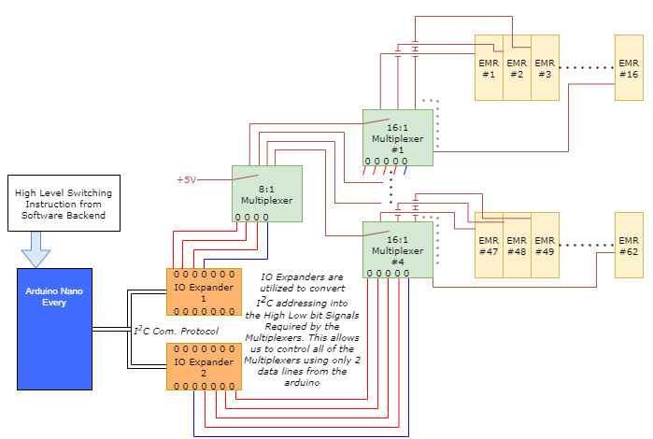
PCB Design
Electromechanical Relays (EMRs)

Slide 26
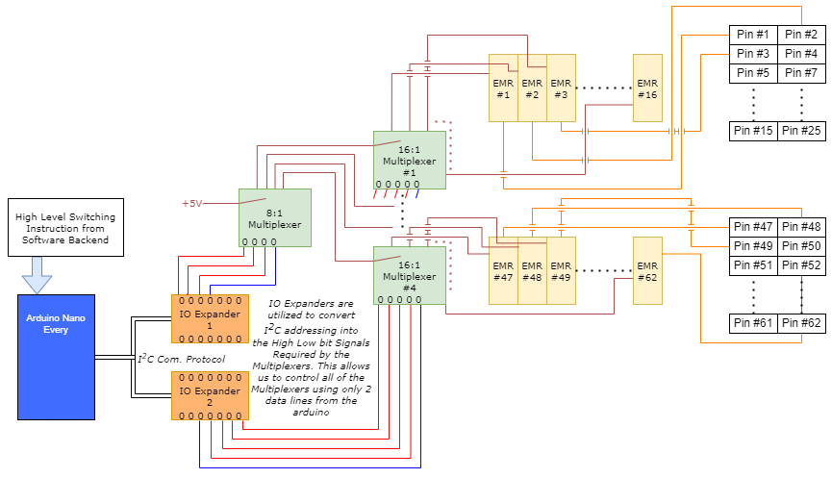
PCB Design
Pins on PCB Board

Slide 27
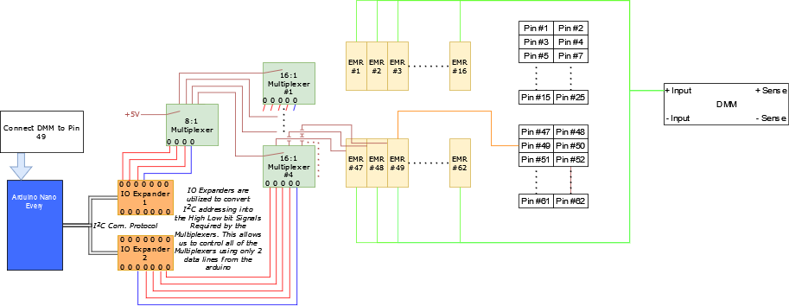
PCB Design
How an instruction is executed
Notes:
First the high level instruction comes to the Arduino

Slide 28
PCB Design
How an instruction is executed
Notes:
The Arduino addresses the IO expanders as prescribed to pass high lows to the Multiplexers that signify which connection is to be made.

Slide 29
PCB Design
How an instruction is executed
Notes:
The arduino than addresses the ‘valid bits’ of the Multiplexers, allowing them to actually complete the connection prescribed.

Slide 30
PCB Design
How an instruction is executed
Notes:
The passes the 5V signal to the FET device controlling the EMRs, making the prescribed connection.

Slide 31
PCB Design
How an instruction is executed
Notes:
In essence, the high level switching signal successfully connected the DMM + to Pin #49 on the battery. This would hypothetically be done 3 more times with the other 3 connections to the DMM, where the +Sense may be connected to Pin #49 as well, and the negative side of the DMM to some other pin (in example).

Slide 32
PCB Design

Slide 33
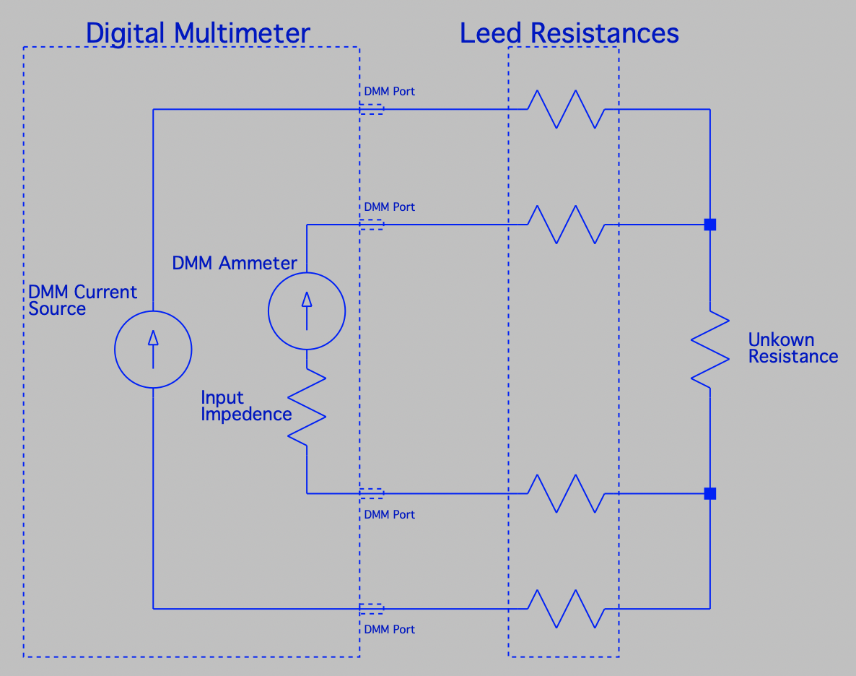
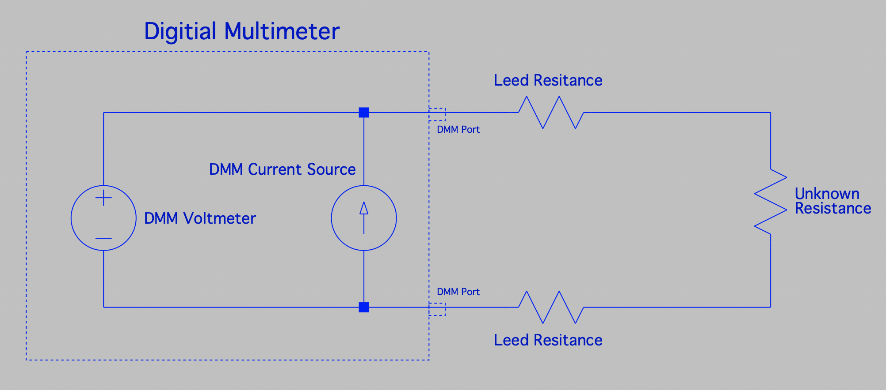
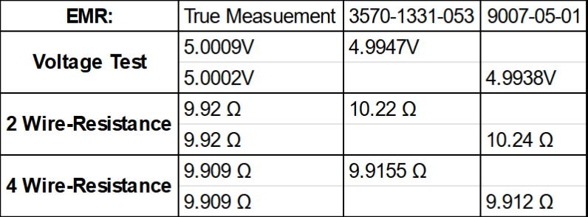
PCB Design
4 Wire Measurement Method
Measurement Accuracy Requirement
Limited by: Continuity test
(<1Ω || 10mΩ res. || .05% accuracy)
3.125% error
.048% error
More detail on backup slides 57 → 59

Slide 34
PCB Design

Slide 35
Hardware Containment Unit
CPE 3
ESD Compliant Hardware Enclosure

Slide 36
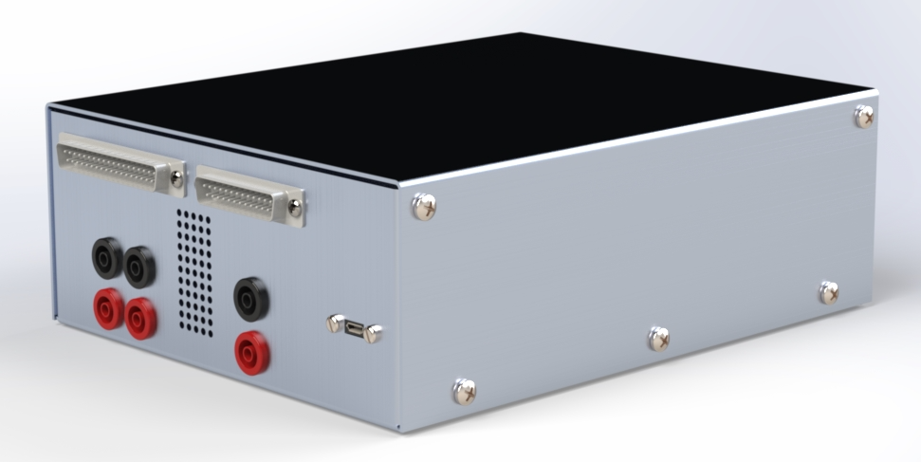
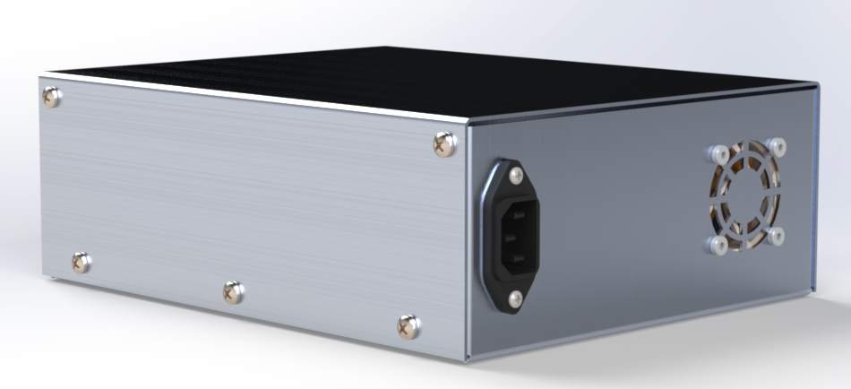
Hardware Containment Unit
Design Considerations
ESD Compliance
Footprint
Ease of Manufacturing
Ease of Component Access
Cost
Solution:
Folded Aluminum 5052 Sheet Metal
Grounded Chassis
7” x 9” x 3”
Removable Lid

Slide 37
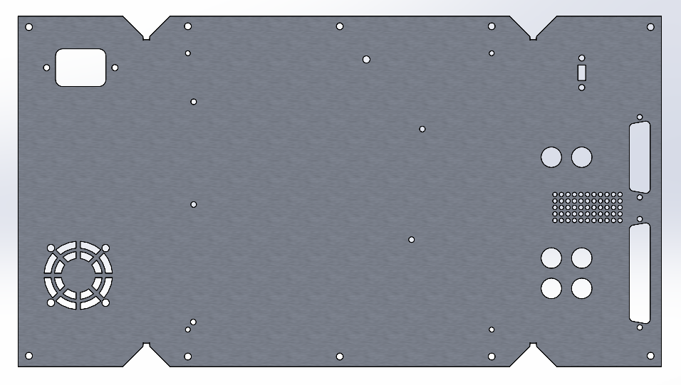
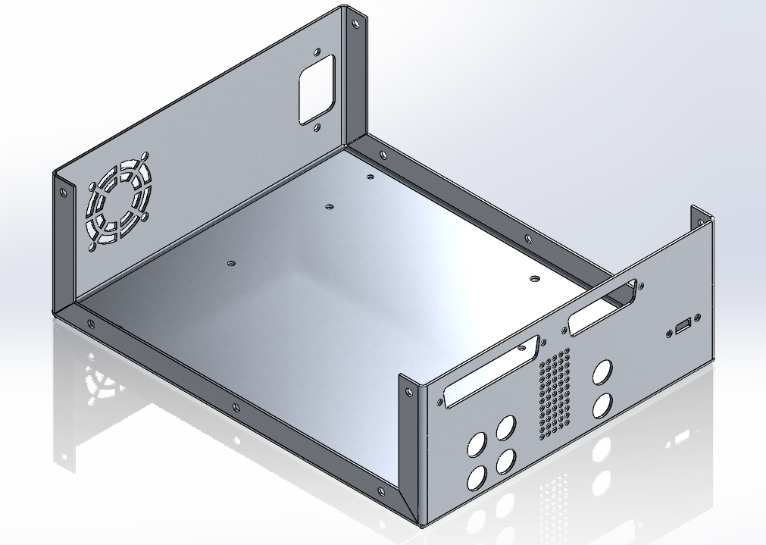
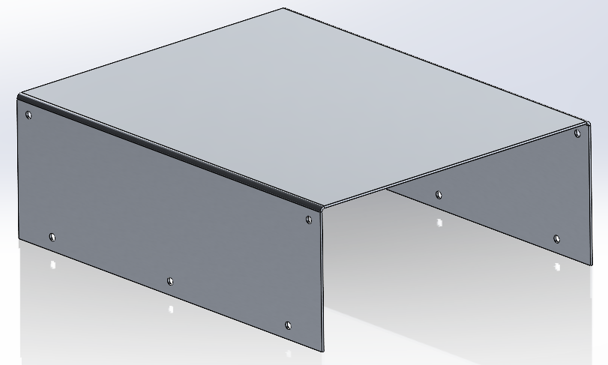
Enclosure Manufacturing
ENCLOSURE
Sheet Metal: Aluminum 5052
Size: 16” x 14”
Thickness: 0.050”
Folded Size: 7” x 9” x 3”
Manufacturing Techniques:
Shears
2-axis CNC & Water Jet
Assembly:
Press Break
Machine Screws & Captive Fasteners

Slide 38
GUI and Data Capture
CPE 4-5

Slide 39
Requirement Satisfaction: CPE 4-5
CPE 4: Graphical User Interface
Edit Test Configuration Page
Test Results Page
Detailed Plots Page
CPE 5: Data Capture
Configuration Storage and Measurement Storage
Pin Switching and Hold
DMM and ISO SCPI Interfaces

Slide 40
Software Package
GUI code ✅
Backend
Edit Test Configuration Page
Test Configuration Storage
Arduino
DMM / ISO
Test Results Page
Data Capture
Detailed Plots Page
Measurement Data Storage
python ➡️ probe.exe

Slide 41
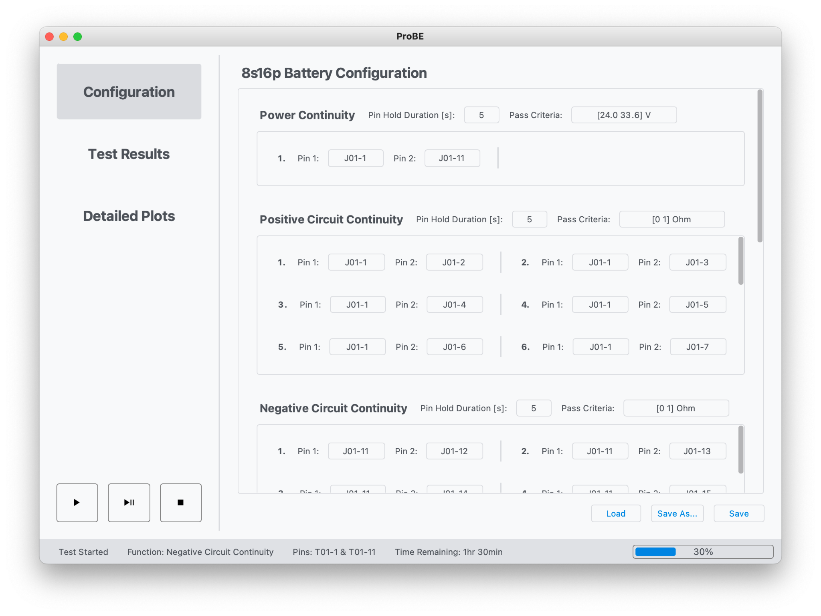
Graphical User Interface
Edit Test Configuration Page
Test Configuration Storage

Slide 42
Software Package
GUI
Backend
Edit Test Configuration Page
Test Configuration Storage
Arduino
DMM / ISO
Test Results Page
Data Capture
Detailed Plots Page
Measurement Data Storage

Slide 43
Data Capture
Arduino
{“duration”: 10,
“i2c-write”: [
{“addr”: io-expander-address1, “data”: mux-data-pin1},
{“addr”: io-expander-address2, “data”: mux-data-pin2}, ...
]}
Arduino Nano Serial Port
Test Configuration Storage
writeI2C(addr,data)
sleep(duration)
Function: Power Continuity
Pin 1: J01-1
Pin 2: J01-11
Hold Duration: 10s
Pass Criteria: [24.0 33.6] V
Wait for ACK
ACK Backend
Reset IO Expanders
DMM: “:MEASure:VOLTage:DC?”
Measurement Data Storage

Slide 44
Data Capture: Verification
Randomly Select Pin Combination
Apply 30 V across pin, reading should be 30 ± 0.0075 V
Connect 0.5 Ohm across pin, reading should be 0.5 ± 0.025 Ohm
Connect 100 MOhm across pin, reading should be 100 ± 3 MOhm
All readings correctly stored in measurement data storage
Backend
Test Configuration Storage
Arduino
DMM / ISO
Data Capture
Measurement Data Storage

Slide 45
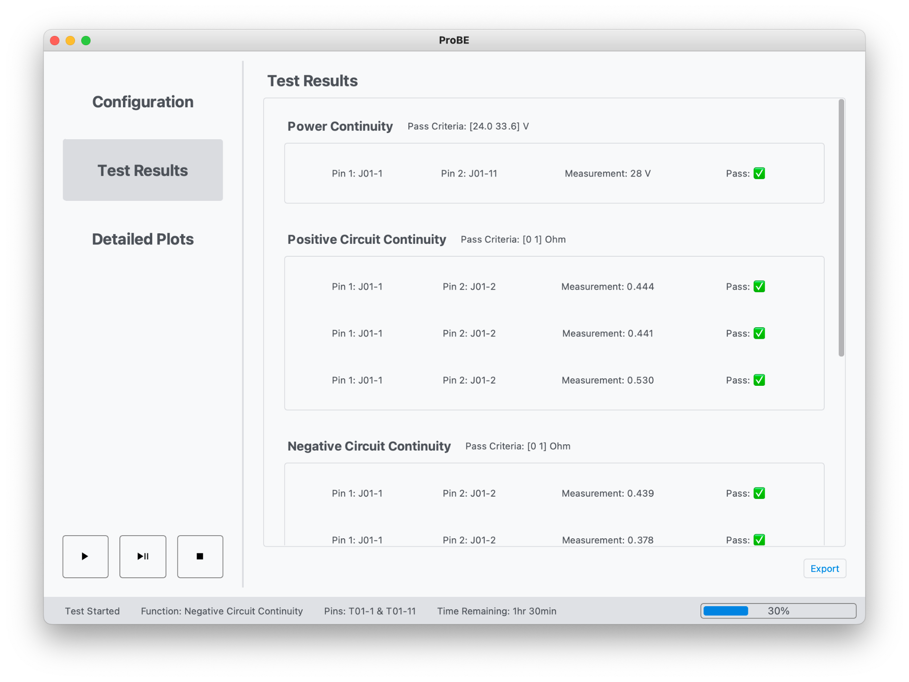
Graphical User Interface
Measurement Data Storage
Test Results Page

Slide 46
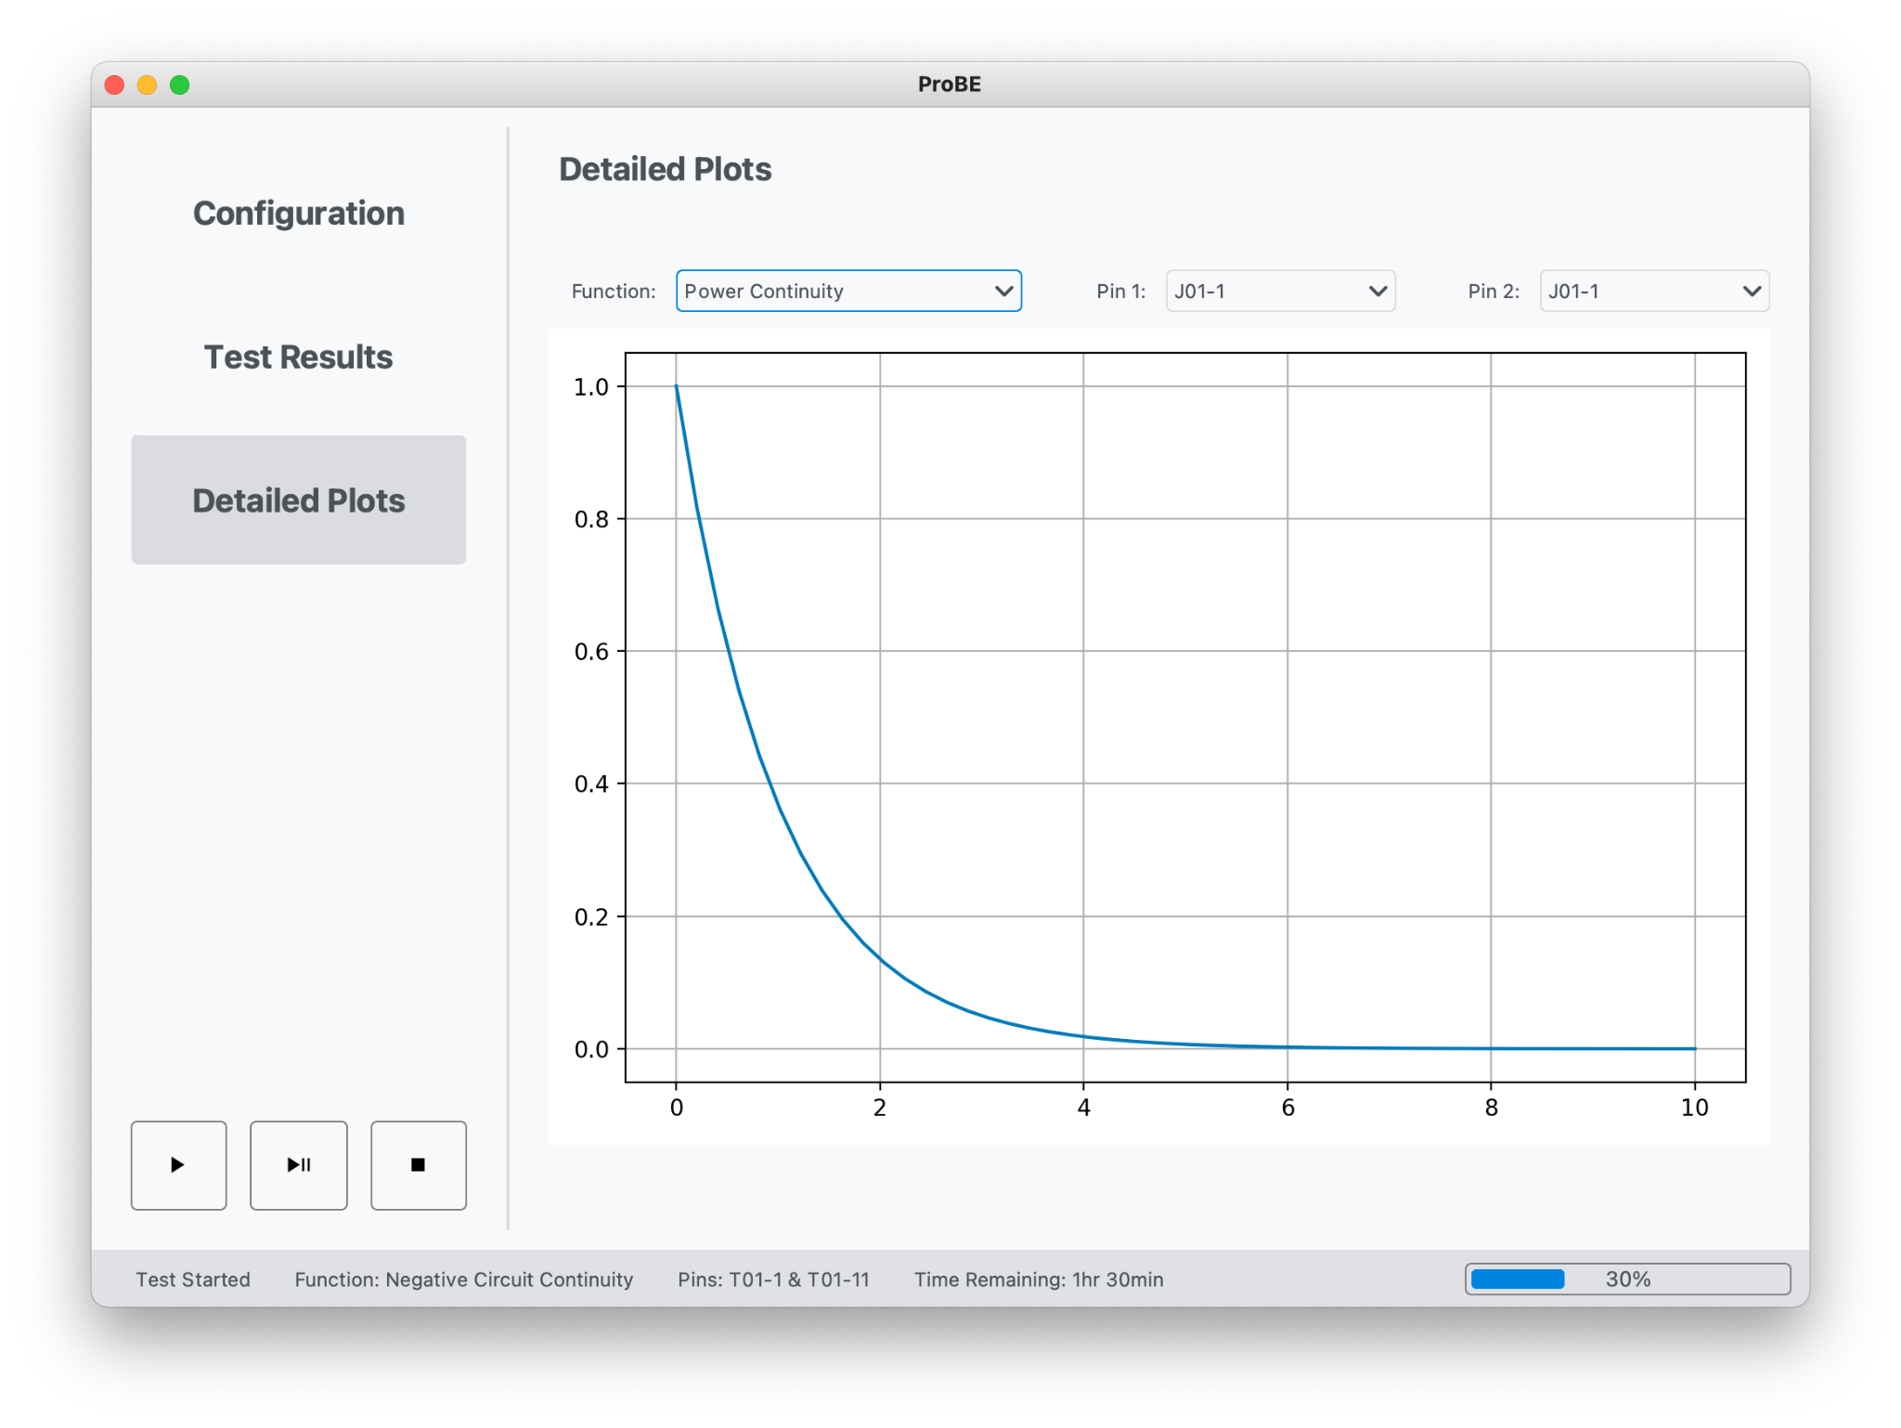
Graphical User Interface
Measurement Data Storage
Detailed Plots Page

Slide 47
Work and Cost Plans
Looking into Spring

Slide 48
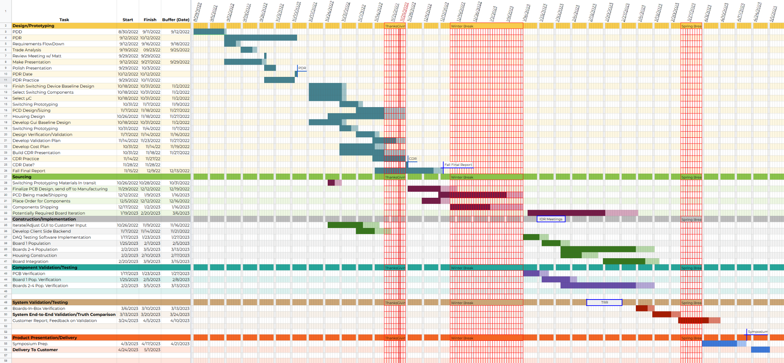
Work Planning
Notes:
Here is the work plan we can see in the upper left of the Design work we’ve done to date.
And we are here, at CDR. Our plans for the rest of the semester are to complete our final report as well as place orders for our construction materials. (next slide)

Slide 49
Work Planning
Notes:
Here we’ve just zoomed in to the bottom right of the whole chart. You can see where the Final report is as well as the part ordering I just mentioned.
In the Spring we plan on beginning with PCB Verification, where we will begin to ensure that our design was A) manufactured properly and B) functions as expected.
In orange here, we have planned for the possibility that we will need to revision the PCB design, this is an ‘alternative’ critical path and is also the reason why we’ve allocated so much time for board verification and population.
You’ll also note that the planned critical path ‘splits’ here. This is only to indicate that these tasks necessarily happen in parallel. We will be verifying our work as we populate the PCB which allows us to catch potential problems as soon as possible.
Once we reach the end of board integration into its housing, we plan on beginning system tests, including end-to-end tests, as well as v&v test in comparisons to truth data. EnerSys has offered to send us a battery to run verification tests on, and we’ll ask as well that they have a technician run a test in the current format and use that as truth data to compare our test against. We expect that a few things may differ slightly, for example the battery voltage may have sunk slightly, but this provided battery along with the current test will serve as a baseline to which we will verify our test run.
Finally, upon completion of the system tests, we’ll be spending time for product delivery.

Slide 50
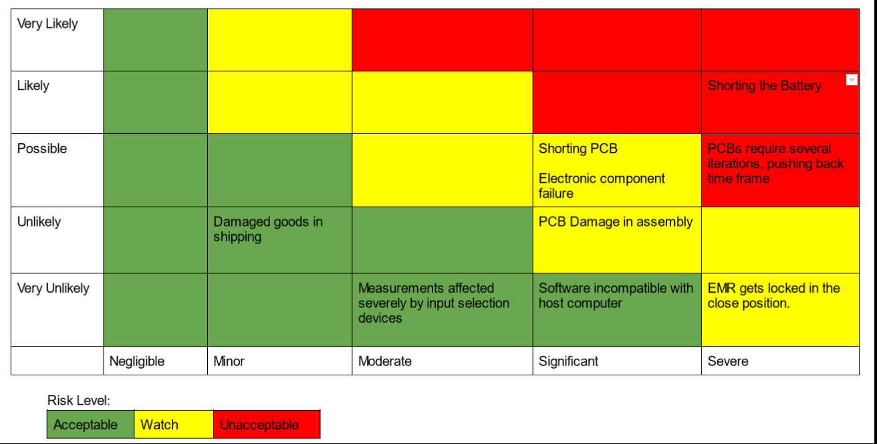
Work Planning
Notes:
By expecting the need to iterate PCB design, and allowing ample time to do so, we’ve effectively bought down the risk that puts us severely behind schedule. An iteration on the design would remain a nuisance, but is unlikely to adversely affect the outcome of the project.
With this, we’ve effectively bought down all risks we’ve declared as unacceptable.

Slide 51
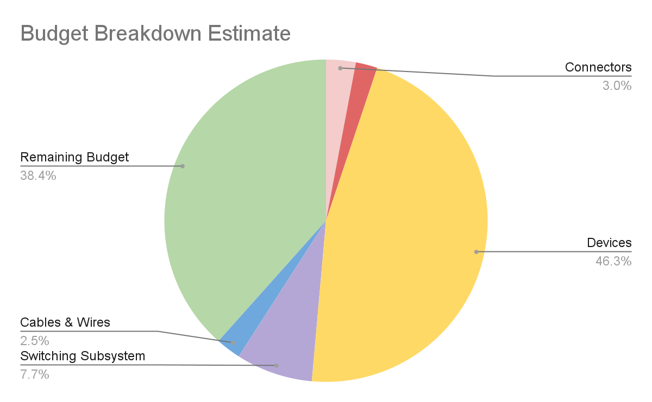
Cost Plan
Early funding approved.
PCB order over winter break.
Splitting isolation tester with other team.
Connectors | $118.48
Enclosure+Peripherals | $86.45
Devices | $1846.71
Switching Subsystem | $306.56
Cables & Wires | $100.09
TOTAL COST | $2392.15
Notes:
Next we have our budget planned as shown, the total cost we have decided is up 2400 dollars. Because our team are buying off the shelf devices including off the shelf digital multimeter and isolation tester, which makes up most of our budget. However, after negotiate with our sponsor and the other Enersys team, we have plan on splitting the cost for isolation tester, which will bring down our budget about 600 dollars. As we can see in the green part of the pie chart, the large margin remaining can be used in PCB reiteration, electrical risk test or any unexpected plan comes up.
Lastly, With the early funding being approved, our team is planning on ordering the PCB boards over the winter break to stay on top of our schedule.

Slide 52
Thank You to the PAB, EnerSys, and our advisor Matt Rhode
We will now take questions

Slide 53
Backup

Slide 54
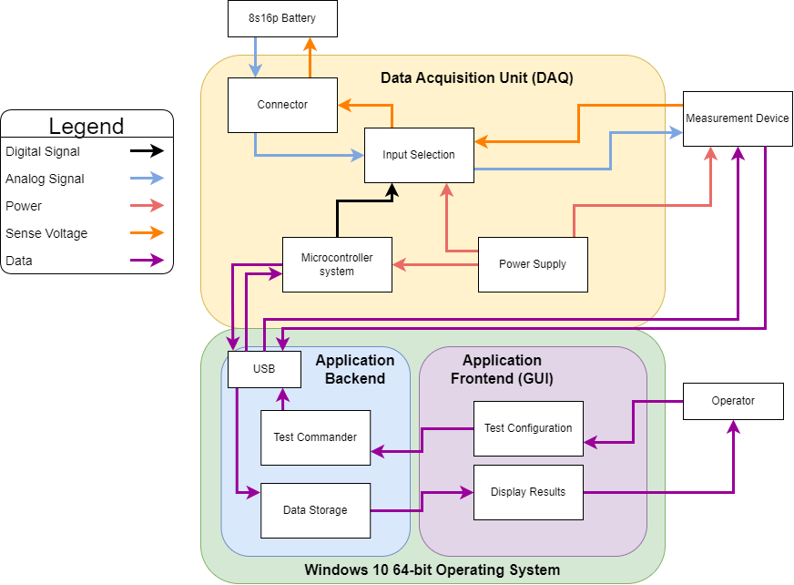
Functional Block Diagram: Simplified

Slide 55
Voltage Test
Requirements:
Voltage Range (expected): [24.0 → 33.6 V]
Resolution: 1mV
Accuracy: .025%
SCPI Compatibility
DMM Specifications:
.015% acc. up to 1000V || 5.5 digit resolution (mV res @ expected range)
Comments:
Input resistance of DMM = 10MΩ, in line resistance of PCB + EMRs
~1.3Ω, voltage drop across DAQ unit negligibly affects measurement.
A voltage test is used simply to measure the voltage of the Battery. Example DMM connections are shown to the right.
DMM +
DMM -

Slide 56
Continuity Test
Requirements:
Resistance Range (expected): <1Ω
Resolution: 10 mΩ
Accuracy: .05%
DMM Specifications:
.03% acc. up to 200Ω (2 or 4 wire measurement)
Comments:
Please refer to the next 2 slides for background on why 4 wire resistance
measurement method was chosen. High level, it was chosen to preserve
the listed accuracy of the DMM even when measurements are taken through the DAQ.
A ‘continuity test’ is used to verify that two pins that are meant to be shorted together, are. For example pins 1 and 2 (shown right) are expected to be
electrically connected internal to the battery
Sense +
DMM +
DMM -
Sense -

Slide 57
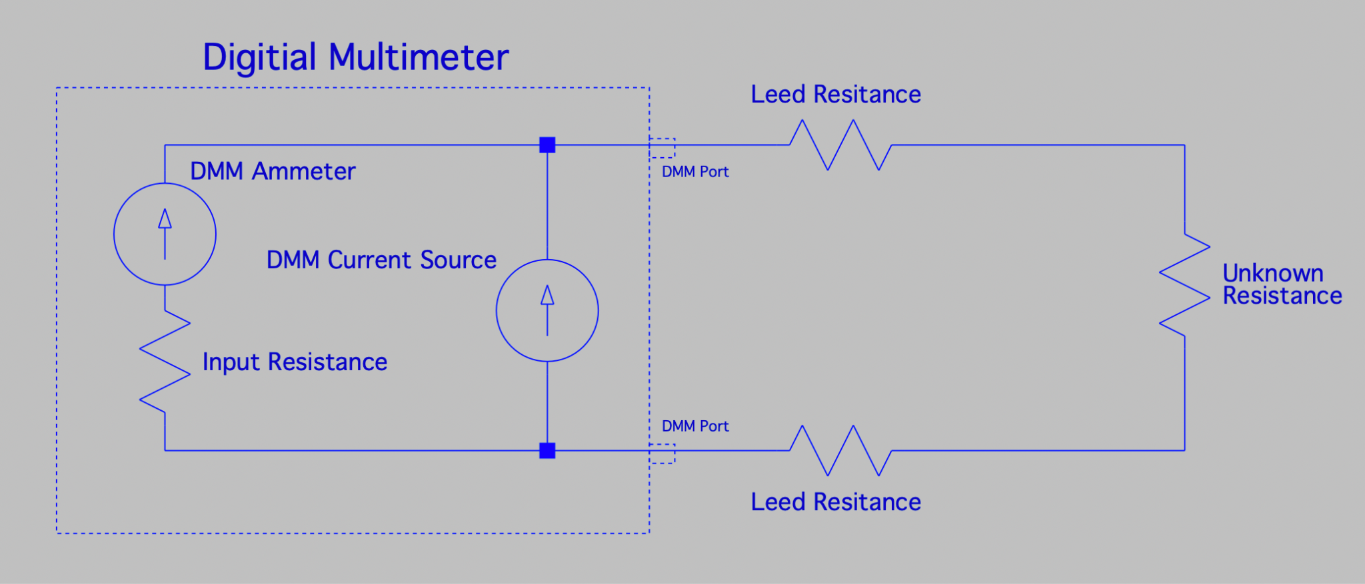
2 Wire Measurement Error Analysis
Note:
1. Ideal Voltmeter is an open circuit.
2. Lead Resistance is summed total resistance of leads and all circuitry between DMM ports and resistor.
Voltmeter model
A
In our case:

Slide 58
4 Wire Measurement Error Analysis
Ideal Voltmeter:
Non-Ideal Voltmeter:
A
Core Principle:
By separating the current that produces a voltage drop across the unknown resistor from the voltmeter’s loop, no significant voltage drop occurs across lead resistances in series with the voltmeter.
Note:
1. DMM Voltmeter is Ammeter + Input Resistance
2. Leed Resistance Includes ALL Series Resistances

Slide 59
4 Wire Measurement Error Analysis cont.
In our case:
A

Slide 60
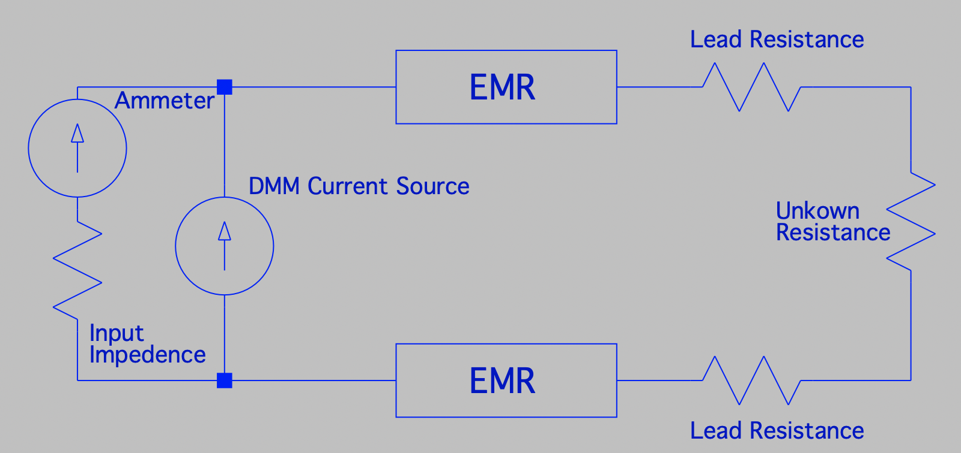
2/4 Wire Measurement Requirement Satisfaction
Requirements:
2.3.3 | Continuity | Up to 1Ω ± 0.05%
2.3.4 | Isolation | Up to 100MΩ ± 3%
A
2.3.3 Prototyping Results
 |  | Measurements taken through EMRs as it would be in the DAQ
Rated | True Value | 2 Wire | 4 Wire
10Ω | 9.910Ω | 10.220 | 9.915
ERROR |  | 3.128% | 0.05%
2 Wire Test Setup
2 Wire FAIL

Slide 61
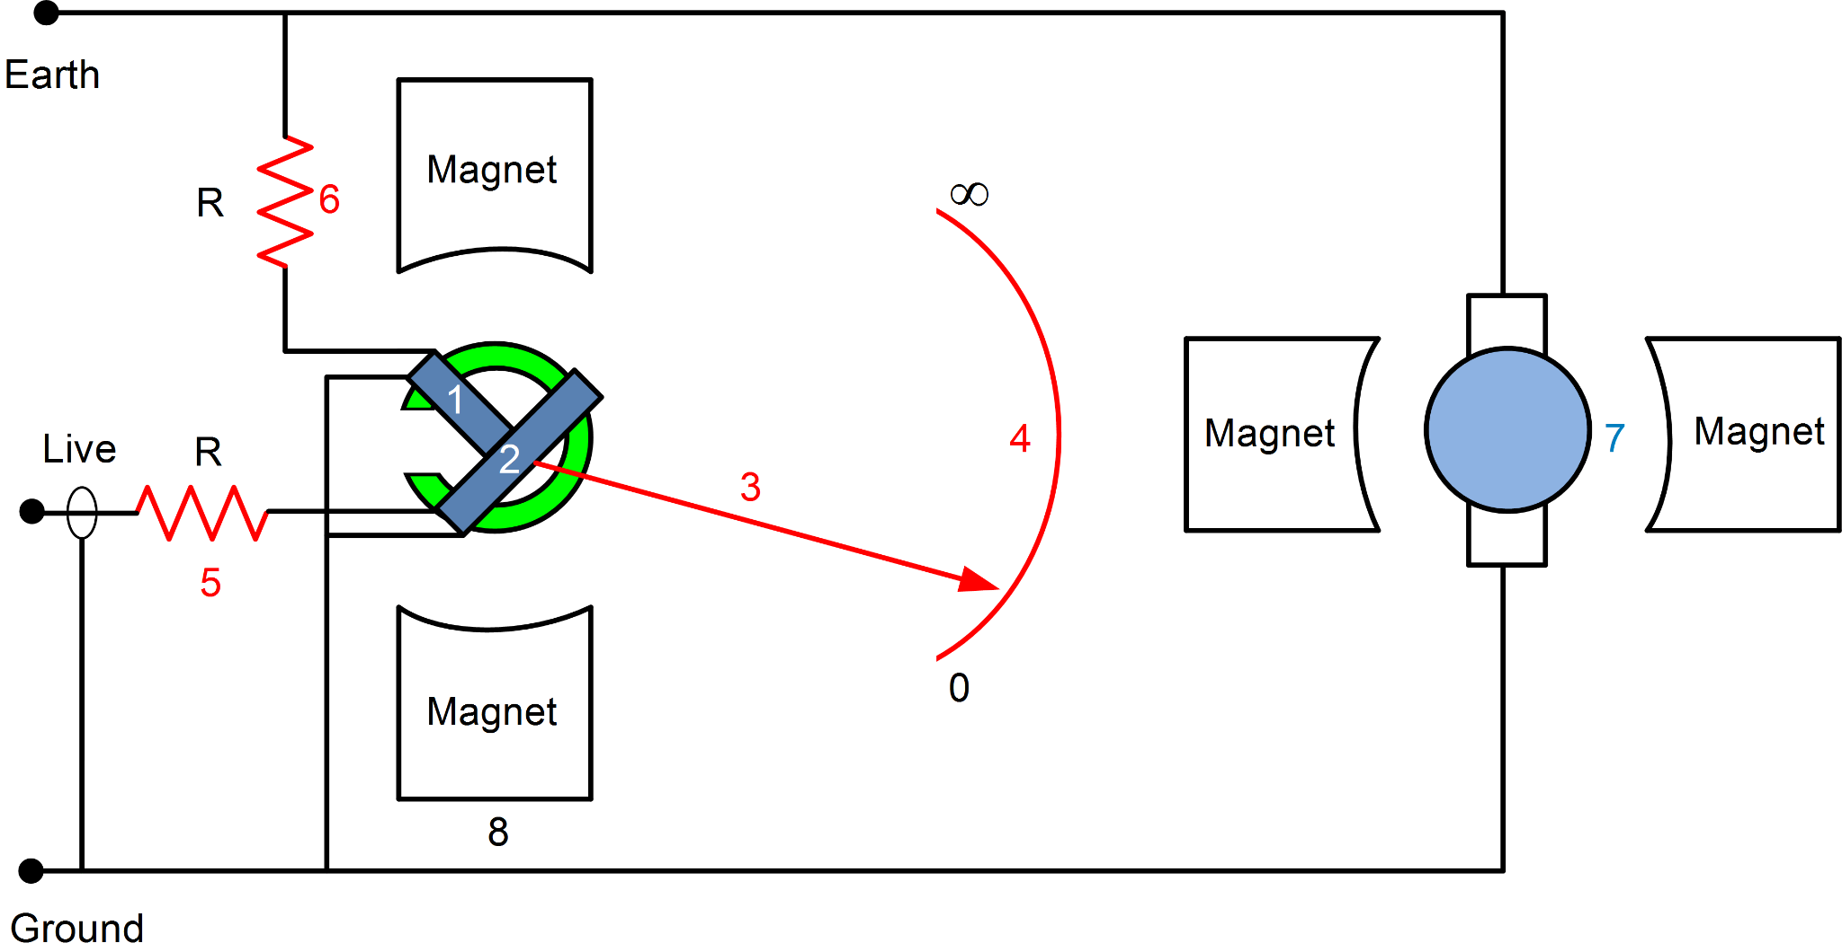
Isolation Test
Megohmmeter Insulation Test
Non-destructive insulation analysis test
High resistance ohmmeter with a DC generator. High voltage creates a small current over the insulation.
Ensures no dielectric breakdown in the insulation occurs at high voltages.

Slide 62
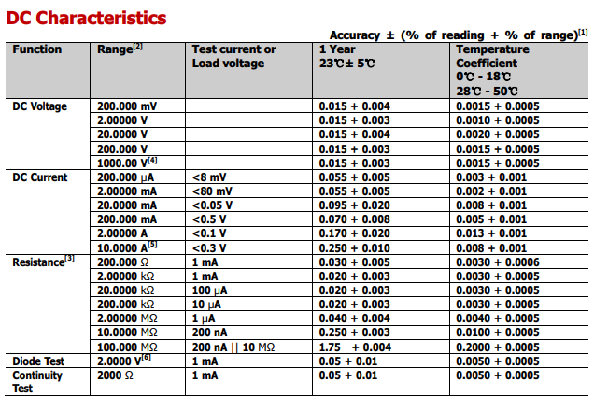
Rigol 3508E Datasheet

Slide 63
Hioki ST5520 Datasheet

Slide 64
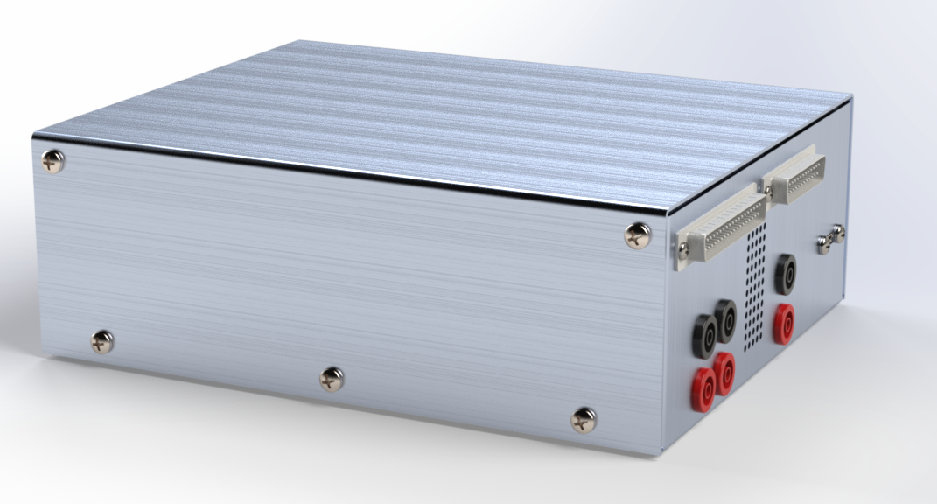
ProBE Enclosure Overview
ProBE Box
7” x 9” x 3” Aluminum Case
DB37 Connector
DB25 Connector
4x Output Banana Jacks
2x Test Probe Jacks
5V Grounded Power Supply (5W)
Micro-USB Port
4x Automated Pin Selection System (APSS) PCBs
Arduino Nano Every
5V 40mm Fan
7 in
9 ini

Slide 65
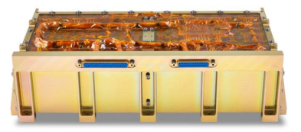
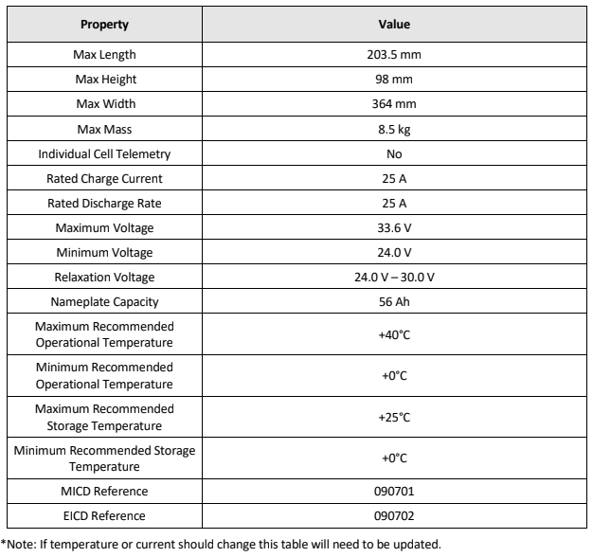
8s16p Battery Overview
Technical Specifications
Overview:
Most Popular Li-Ion Battery for Satellite and Spacecraft
Manufactured by EnerSys/ABSL in Longmont, CO

Slide 66
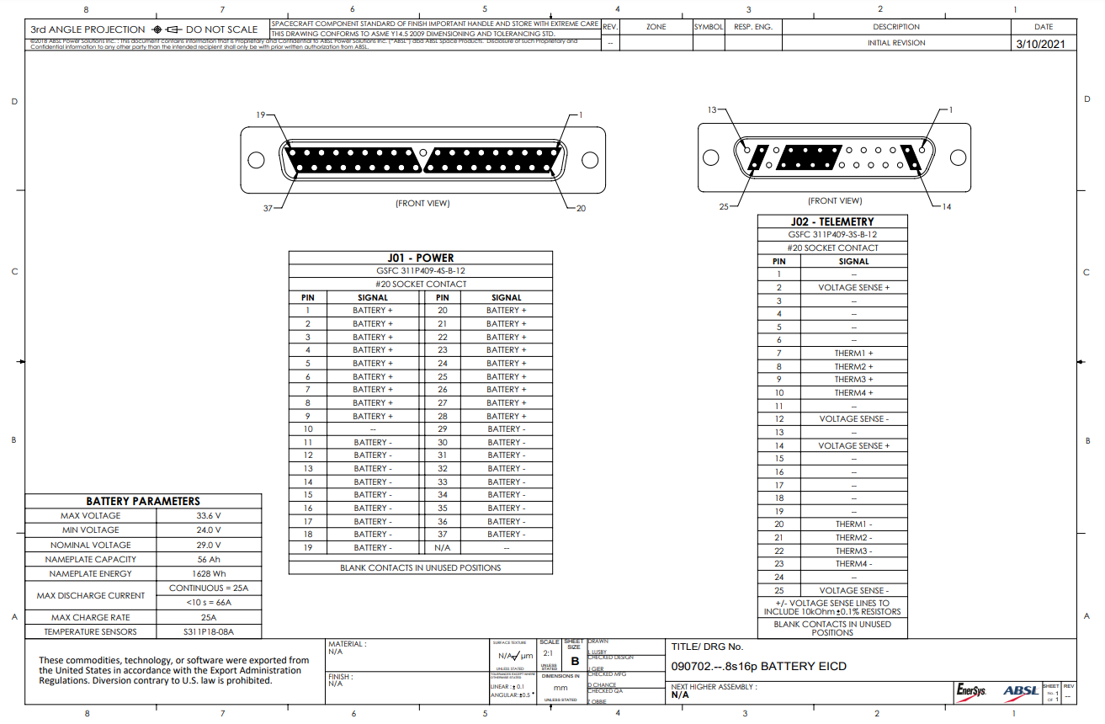
8s16p Battery Pinout

Slide 67
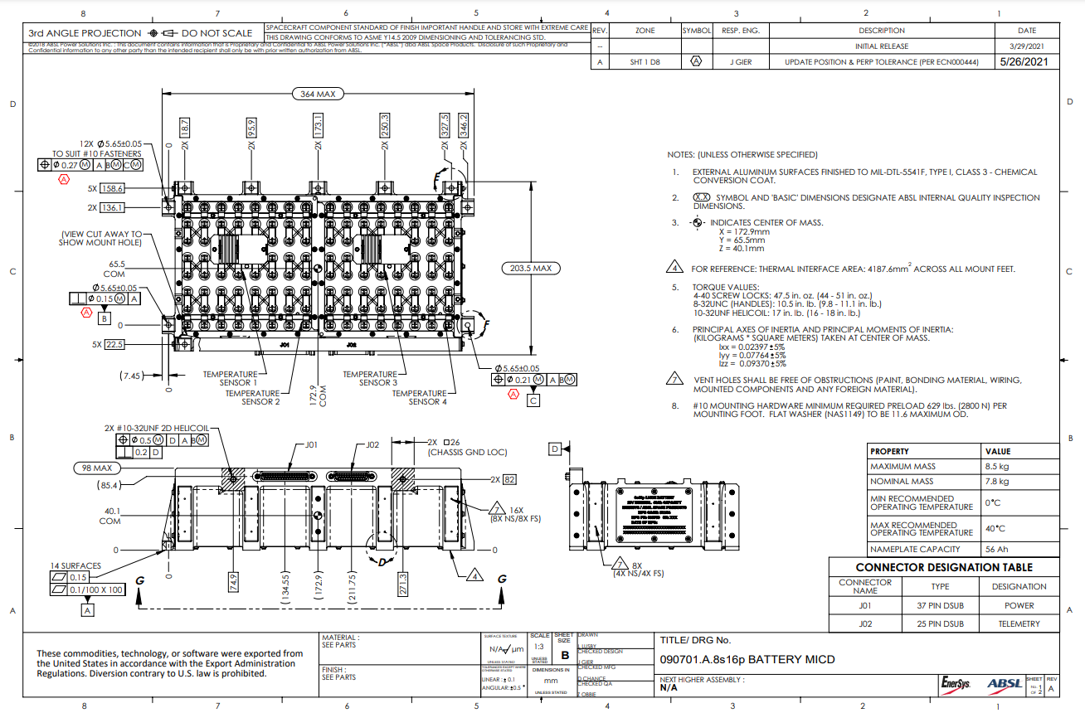
8s16p Battery Drawing

Slide 68
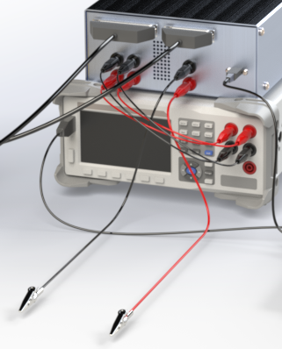
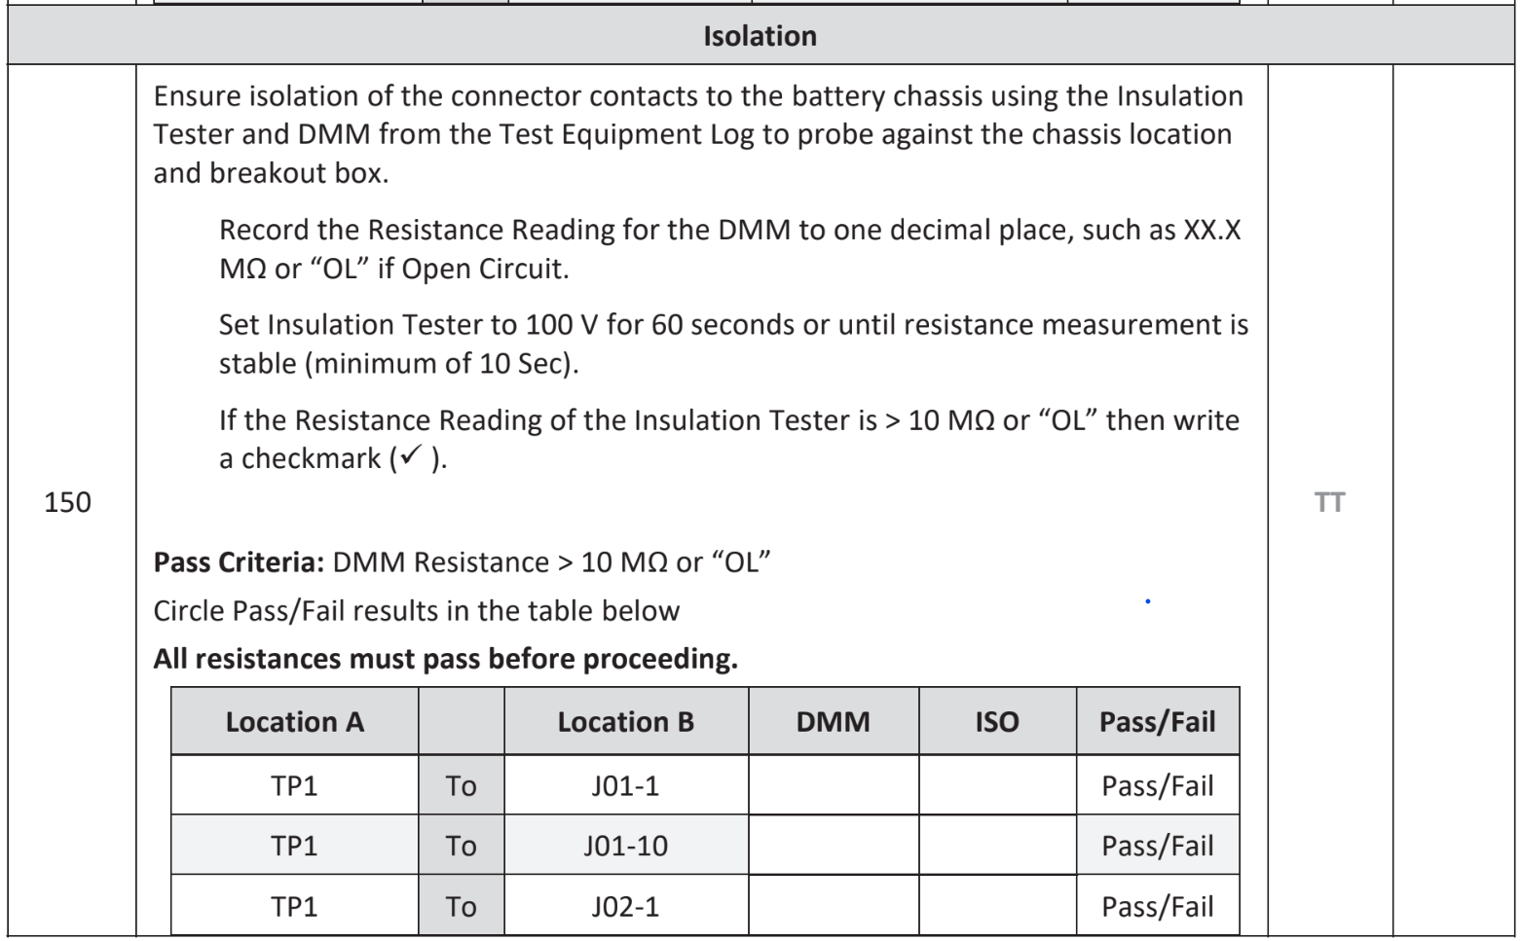
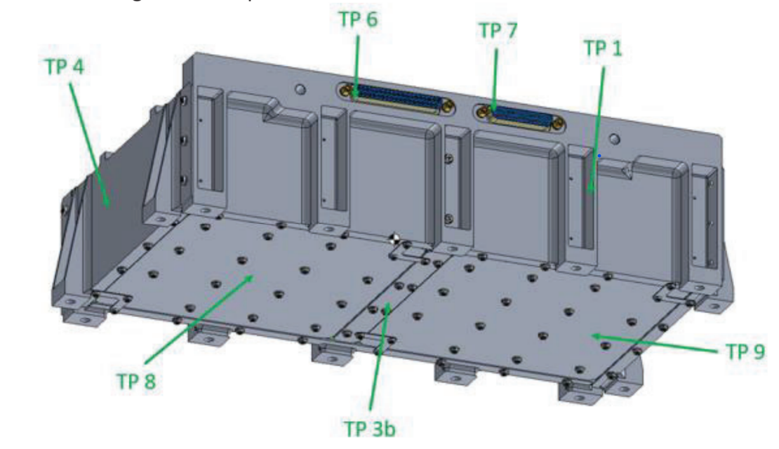
Additional Test Points: Alligator Clips
Most test points (TP) are used in the ground paths test.
TP 1 is used in the isolation test.
Alligator clips allow connection to this TP
They are switched to in the same way a battery pin is. (See J07 & J08 on PCB)

Slide 69
Battery External Test Points

Slide 70
Additional Test Points: PCB

Slide 71
Additional Test Points: Hardware

Slide 72
EMR Comus 3570 1331 053: Data
Source: Comus-intel [1]

Slide 73
Comus 3570 1331 053: Schematic
Source: Comus-intel [1]

Slide 74
EMR Proximity Test
Reason: Due to the magnetic field from the inductor in the EMR, it is theoretically possible to activate an adjacent EMR.
Test: Activation of EMR was tested with an adjacent EMR w/ PCB spacing turned on and turned off. Voltage was gradually increased until switch operated, then decreased until release
Result: Tested EMR did not activate and remained within spec for turn on/off voltage.
Adjacent EMR Status | Off |  | On
EMR | Turn on | Turn off | Turn on | Turn off
Comus 3570-1331-053 | 2.25 V | 1.65 V | 2.58 V | 1.94 V

Slide 75
Multiplexer Layout

Slide 76
Power Supply: RAC05-K/C14
Features:
AC-DC Regulated Power Converter
Standard C14 Connection
80% Efficiency
5W Max Power Draw

Slide 77
Thermal Analysis
Thermal Budget
Thermal Dissipation Analysis
Case Conduction
K = 225.94 W/mK, A = 0.143 m^2, d = 0.00127 m
Heat transfer per degree difference: 25440.5 (W/K)
Internal Convection
h=12.5 W/(m^2*K), A = 0.0195 m^2
Heat Transfer per degree = 0.244 (W/K) (Per PCB board)
Worst case scenario - natural convection is not quite enough. So a fan is beneficial.

Slide 78
Timing Model

Slide 79
Software Package Flowchart

Slide 80
Manual Test Template vs GUI

Slide 81
Requirements Flowdown

Slide 90
Cost Plan - Connectors

Slide 91
Cost Plan - Enclosure+Peripherals

Slide 92
Cost Plan - Devices

Slide 93
Cost Plan - Switching Subsystem

Slide 94
Cost Plan - Cable & Wires

