Slide 1
Critical Design Review
NanoSAM-IV
Nano-Stratospheric Aerosol Measurement
11/30/2022
12:40 PM-1:30 PM
Industry Sponsor: Ball Aerospace
Industry Advisors: Jaykob Velasquez, Jim Baer, Patrick Wessels
Faculty Advisor: Matt Rhode
Team CU-LATR
Presenting:
Gerald Yoho CJ Kennedy
Lucio Murillo David Hightower
Jade Babcock-Chi Lucca Trapani
Benji Brandenburger
Not Presenting:
Abdoulaye Diallo
Garrett Bell
Notes:
Introduce team and people who are presenting before diving in

Slide 2
Critical Design Review Outline
Project Purpose & Objectives
Design Solutions
Software
Electronics
Mechanical
Verification & Validation
Planning & Project Management
Purpose & Objective
Purpose
Design Solution
Design Solution
Software
Software
Electronics
Electronics
Mechanical
Verification/Validation
Testing
Planning
Planning
Notes:
What were going to do and how were going to do it (scope)/ (cad models)
How well it has to work - high level requirements, what is critical, how did this drive design?
Next is up to team - go subteam by subteam? Go from model to design? Design space is large so explain how we approached it, certain decisions narrowed the design space? Go over governing models, SNR model, orbital model, optics model?
What were were gonna do
How were gonna do
Gerald: Intro & slides 1-8
Lucio: slides 8- 16
Lucca: slides 17- 22
Abdoulaye: slides 23- 27
Jade: slides 28 - 31
Garrett: slides 32-37

Slide 3
Project Purpose & Objectives
Purpose & Objective
Purpose
Design Solution
Design Solution
Software
Software
Electronics
Electronics
Mechanical
Verification/Validation
Testing
Planning
Planning
Notes:
Begin by debriefing the project description

Slide 4
SAM and NanoSAM
Na
n
o
Reduce the SAM instrument form factor to a 0.5 U cubesat and put in orbit.
S
A
M
Scientific instrument to measure and characterize aerosols and particles present in Earth’s stratosphere for atmospheric science.
tratospheric
erosol
easurement
Purpose & Objective
Purpose
Design Solution
Design Solution
Software
Software
Electronics
Electronics
Mechanical
Verification/Validation
Testing
Planning
Planning
Notes:
Begin by debriefing the project description

Slide 5
The SAM Principle: Solar Occultation
Baseline calibration at full signal, un-attenuated light
Optics Bench
Optics Bench
Photodiode
Aperture, pinhole, filters, etc
Aperture, pinhole, filters, etc
Photodiode Analog Signal
Sunlight
Photodiode Analog Signal
Sunlight
Purpose
Design Solution
Software
Electronics
Mechanical
Testing
Planning

Slide 6
The SAM Principle: Solar Occultation
As aerosol density in the instruments field of view increases, the photodiode analog signal magnitude decreases
Optics Bench
Optics Bench
Photodiode
Aperture, pinhole, filters, etc
Aperture, pinhole, filters, etc
Photodiode Analog Signal
Sunlight
Photodiode Analog Signal
Sunlight
Aerosol Particles
Purpose
Design Solution
Software
Electronics
Mechanical
Testing
Planning

Slide 7
The SAM Principle: Solar Occultation
Referencing the photodiode signal to the baseline allows scientists to determine the presence and density of aerosols
Optics Bench
Optics Bench
Photodiode
Aperture, pinhole, filters, etc
Aperture, pinhole, filters, etc
Photodiode Analog Signal
Sunlight
Photodiode Analog Signal
Sunlight
Aerosol Particles
Purpose
Design Solution
Software
Electronics
Mechanical
Testing
Planning

Slide 8
The NanoSAM Mission
NanoSAM Orbit
(ISS Orbit, ~92 minute period)
NanoSAM Cubesat
Stratosphere
Purpose
Design Solution
Software
Electronics
Mechanical
Testing
Planning
Notes:
Begin by debriefing the project description

Slide 9
The NanoSAM Mission
417 km Orbit Altitude
150 km
Collection period
8 km
Purpose
Design Solution
Software
Electronics
Mechanical
Testing
Planning
Notes:
Begin by debriefing the project description

Slide 10
The NanoSAM Mission
Receiving full un-attenuated light
150 km
Receiving attenuated light due to aerosols
8 km
Purpose
Design Solution
Software
Electronics
Mechanical
Testing
Planning
Notes:
Begin by debriefing the project description

Slide 11
The NanoSAM-IV Mission Statement
The NanoSAM-IV team will create a laboratory simulation of the Ball Aerospace SAM program missions focusing specifically on collecting and processing simulated solar irradiance data at zero aerosol attenuation (full signal) in an automated fashion.
Purpose
Design Solution
Software
Electronics
Mechanical
Testing
Planning

Slide 12
Design Solutions
Purpose
Design Solution
Software
Electronics
Mechanical
Testing
Planning
Notes:
Begin by debriefing the project description

Slide 13
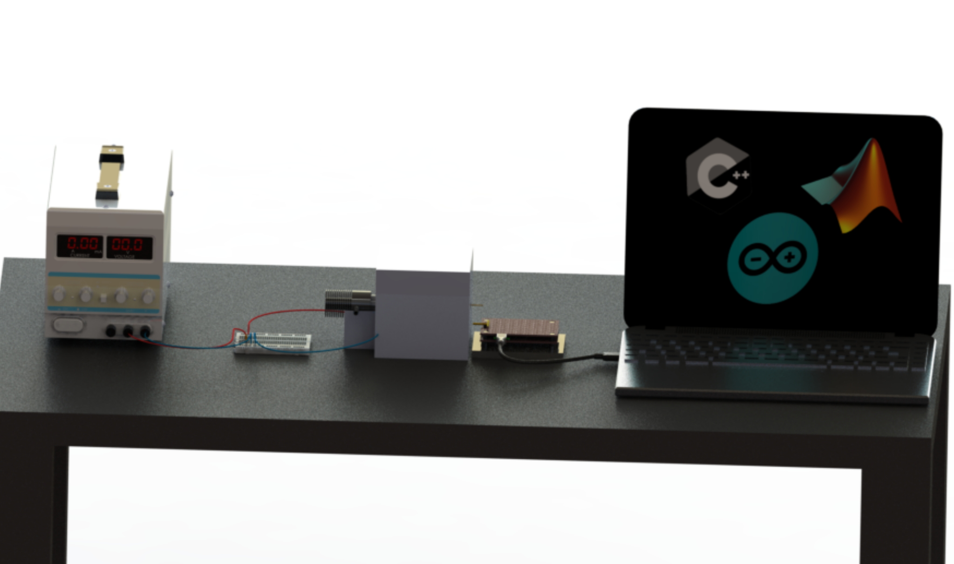
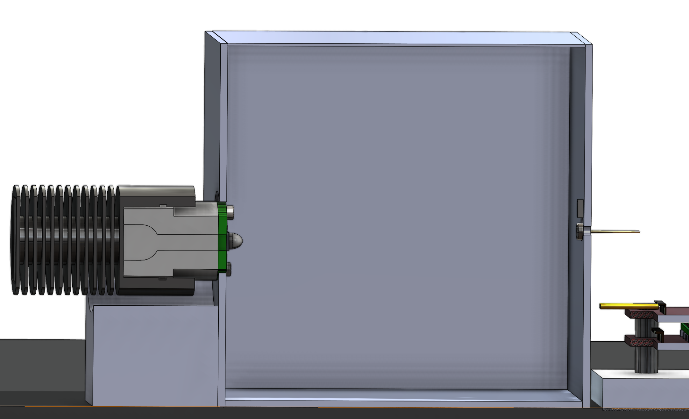
The NanoSAM-IV Design
DC Benchtop Power
Aluminum 661
Computer running software and storing data
LED Mount Plate
Optical Test Bench
Analog and Digital Boards
LED Heat Sink
Light source electronics
12 mm
Entire OTS product, not our design
LED
Thermistor
Previous years manufactured boards, not our design
Photodiode
Purpose
Design Solution
Software
Electronics
Mechanical
Testing
Planning
Notes:
Put design

Slide 14
The NanoSAM-IV FBD
Light Source Electronics:
-Linear Regulator
-Low Pass Filter
-Potentiometer
DC Bench Power
Linear Regulator 5V
Linear Regulator 3.3V
Analog Board
Amp
Filter
Computer
Optical Testing Bench
Thermistor
Data Parsing
/Processing
Orbital Model
Light at ~680 nm
Light source
Photodiode
ADC
Digital
Board
Local Storage
Power
DigitalData
Teensy
Microprocessor
Commands to Teensy
Software Commands
USB Protocol
Current
Purpose
Design Solution
Software
Electronics
Mechanical
Testing
Planning
Notes:
Begin by debriefing the project description
Low pass filter
Potentiometer

Slide 15
The NanoSAM-IV is Required To…
Total board power draw of at most 8 W
Light Source Electronics:
-Linear Regulator
-Low Pass Filter
-Potentiometer
Create an orbital model in software to automate data collection and implement software to detect when signal is below threshold.
Digitize photodiode signal and store as data along with housekeeping (temperature, current, timing)
DC Bench Power
Linear Regulator 5V
Linear Regulator 3.3V
Analog Board
Amp
Filter
Computer
Optical Testing Bench
Thermistor
Data Parsing
/Processing
Orbital Model
Light at ~680 nm
Light source
Photodiode
ADC
Digital
Board
Local Storage
Achieve an SNR of at
least 200 at ADC
Generate an analog signal from the photodiode of .857 microamps
Teensy
Microprocessor
Commands to Teensy
USB Protocol
Purpose
Design Solution
Software
Electronics
Mechanical
Testing
Planning
Notes:
Begin by debriefing the project description
Low pass filter
Potentiometer

Slide 16
CPE’s Based on Requirements
Most critical project element is the electronics boards
Software is critical to the mission of actually collecting and storing data and controlling collection times.
Light Source Electronics:
-Linear Regulator
-Low Pass Filter
-Potentiometer
DC Bench Power
Linear Regulator 5V
Linear Regulator 3.3V
Analog Board
Amp
Filter
Computer
Optical Testing Bench
Thermistor
Data Parsing
/Processing
Orbital Model
Light at ~680 nm
Light source
Photodiode
ADC
Digital
Board
Local Storage
Because of the photodiode signal requirement, the choice and performance of the light source is critical to enabling this signal.
Teensy
Microprocessor
Commands to Teensy
USB Protocol
Purpose
Design Solution
Software
Electronics
Mechanical
Testing
Planning
Notes:
Begin by debriefing the project description
Low pass filter
Potentiometer

Slide 17
Software
Purpose & Objective
Purpose
Design Solution
Design Solution
Software
Software
Electronics
Electronics
Mechanical
Verification/Validation
Testing
Planning
Planning
Notes:
Begin by debriefing the project description

Slide 18
Software Role in NanoSAM-IV
SOFTWARE
Purpose & Objective
Purpose
Design Solution
Design Solution
Software
Software
Electronics
Electronics
Mechanical
Verification/Validation
Testing
Planning
Planning
Notes:
Begin by debriefing the project description

Slide 19
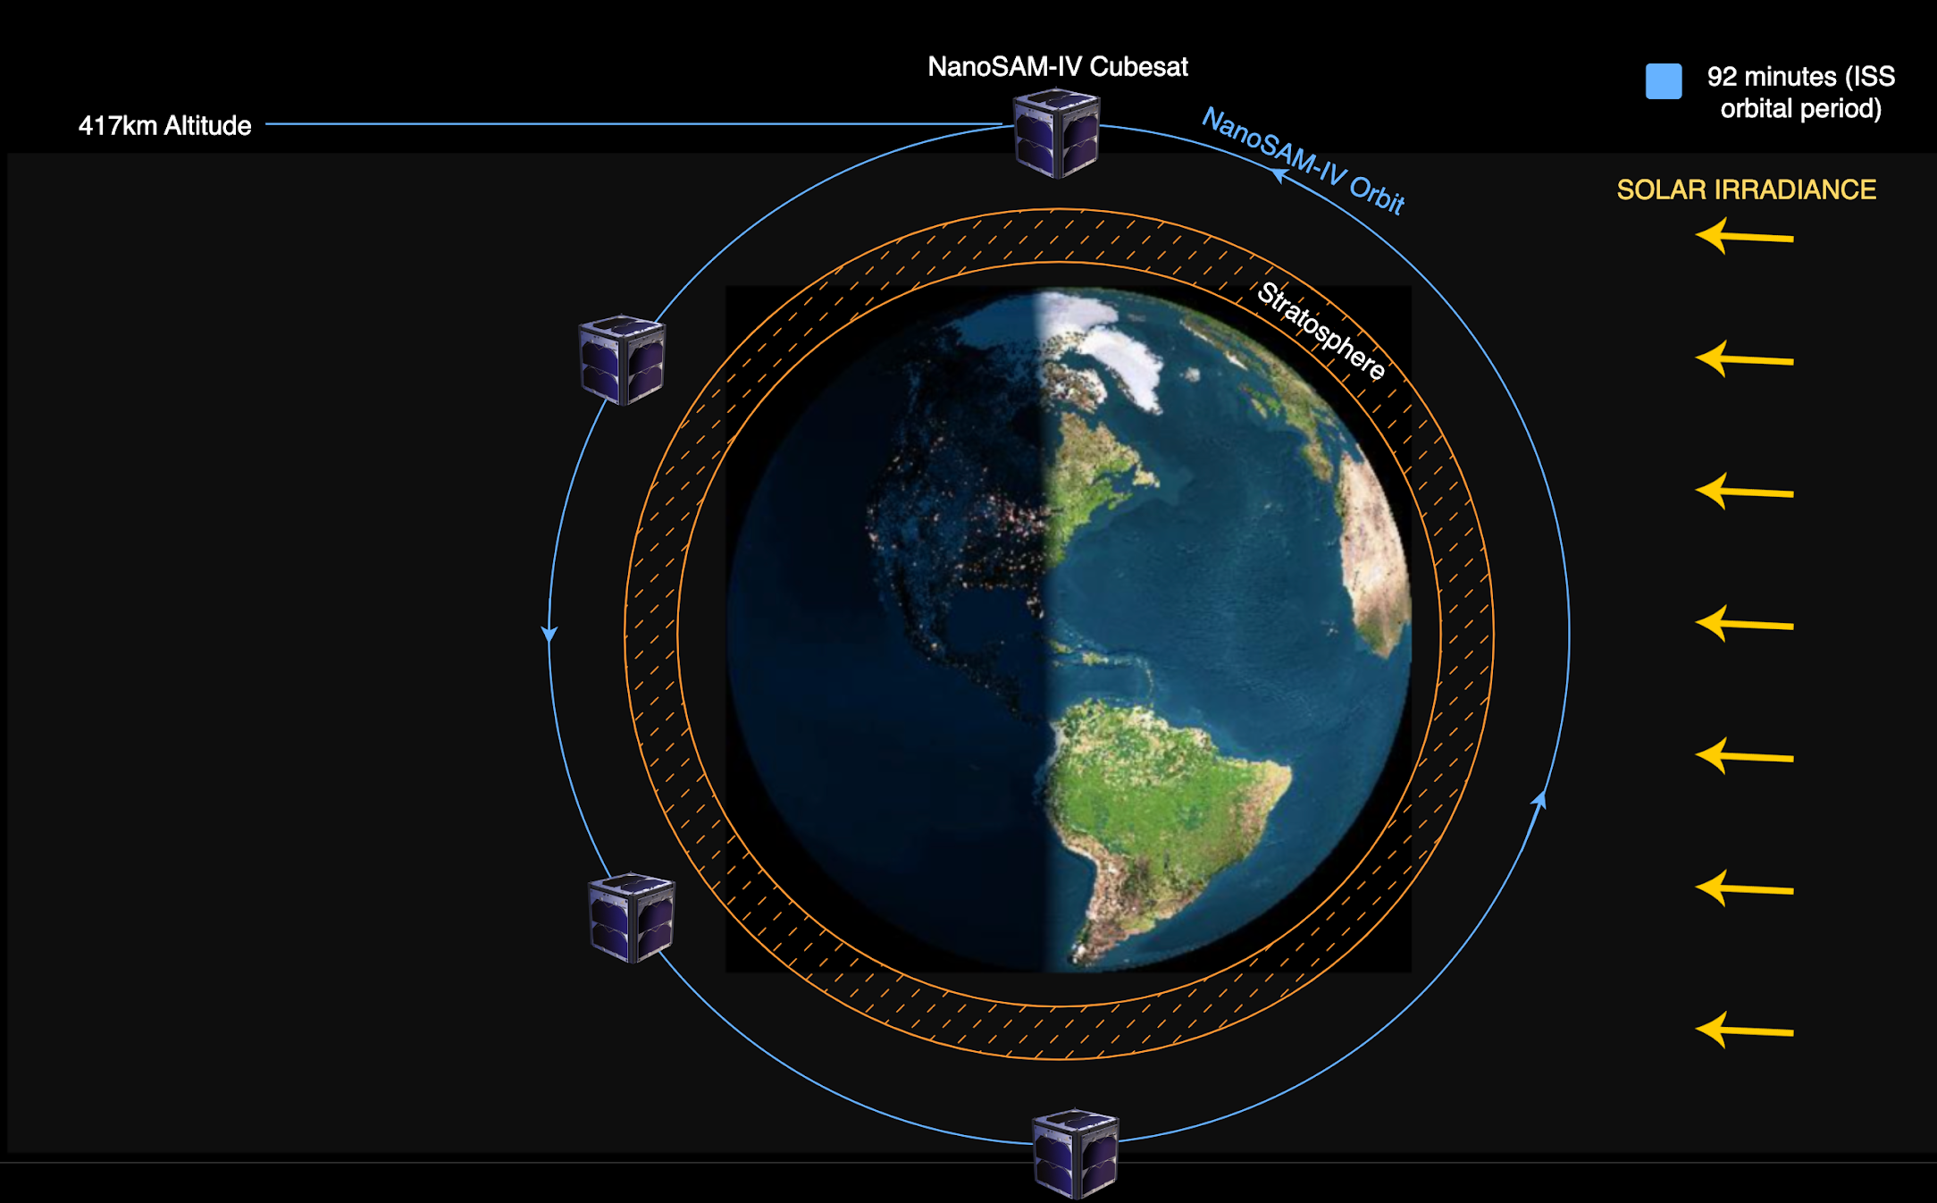
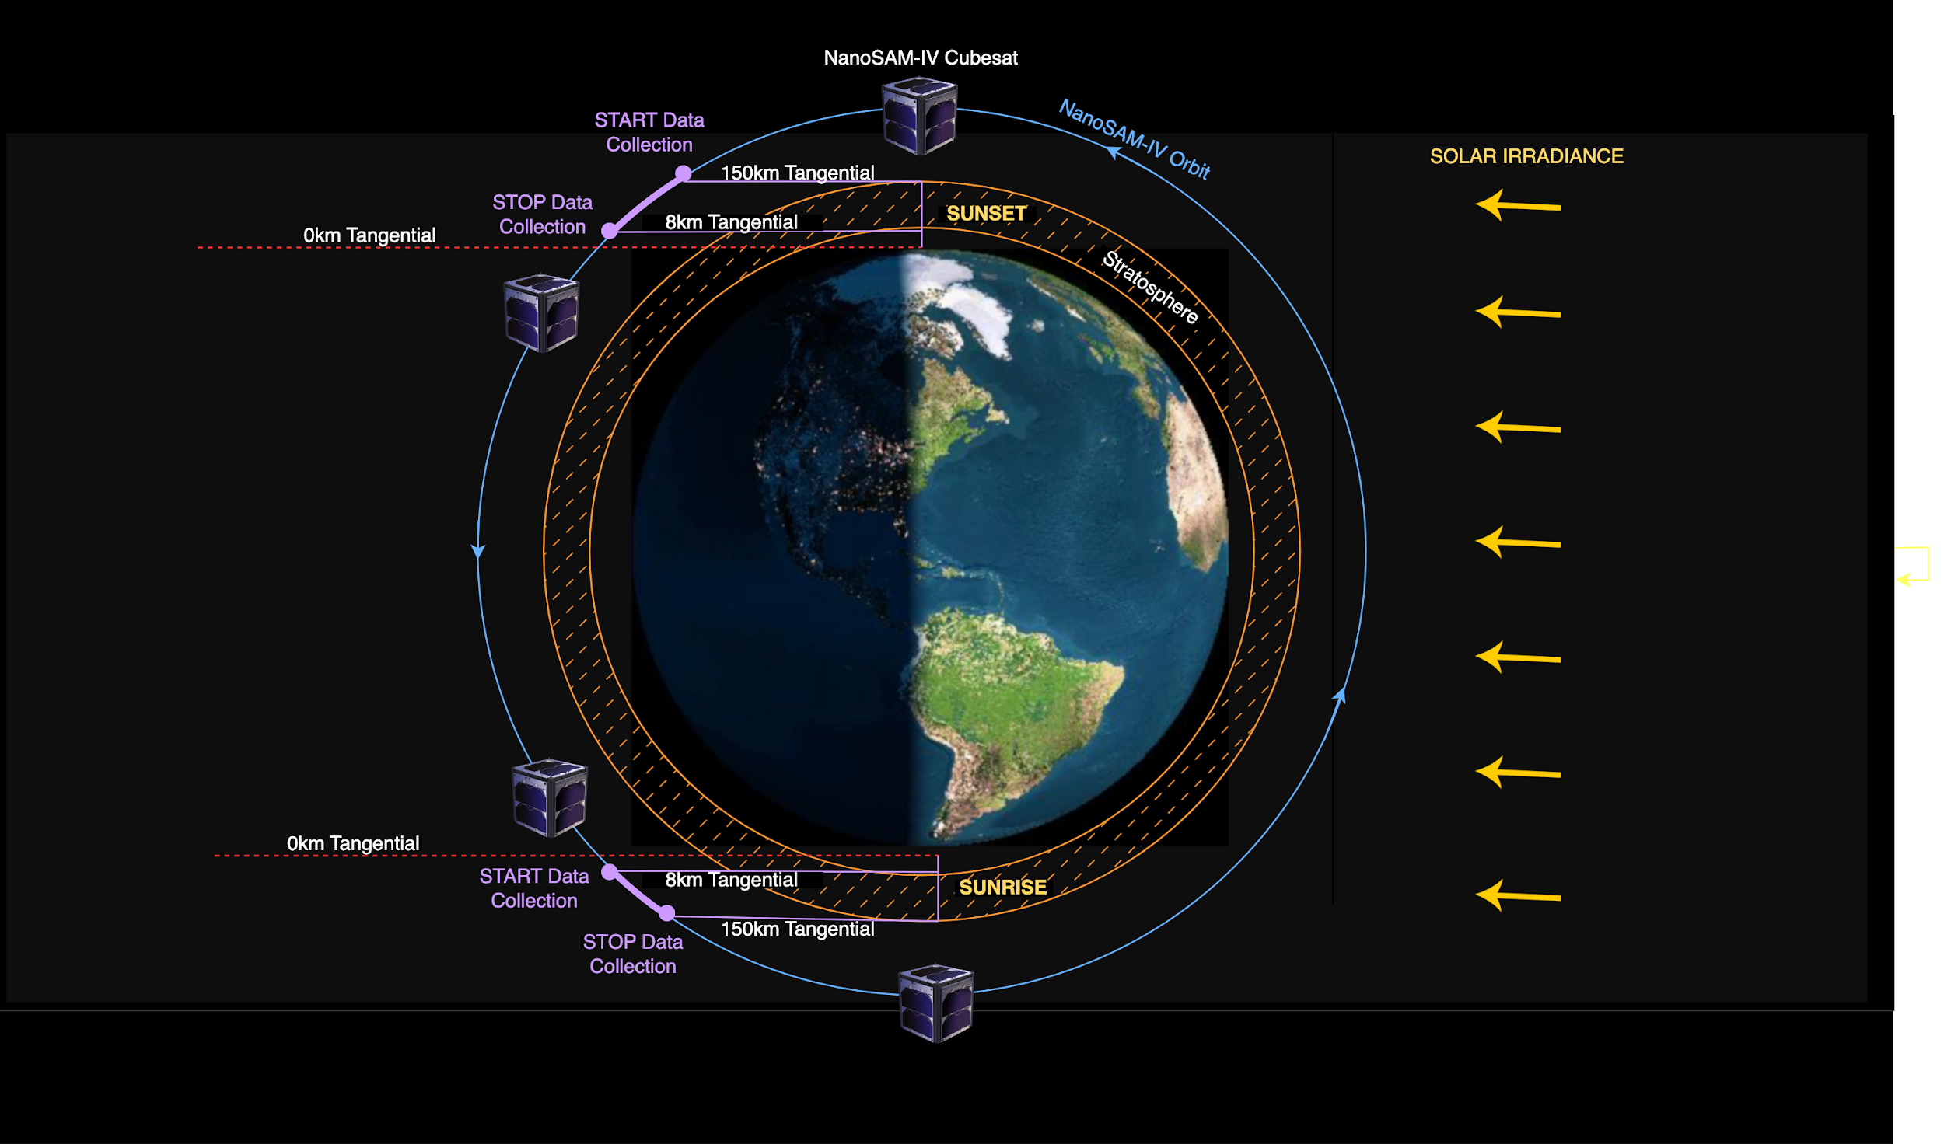
Orbit Timing Diagram
Purpose & Objective
Purpose
Design Solution
Design Solution
Software
Software
Electronics
Electronics
Mechanical
Verification/Validation
Testing
Planning
Planning
Notes:
Begin by debriefing the project description

Slide 20
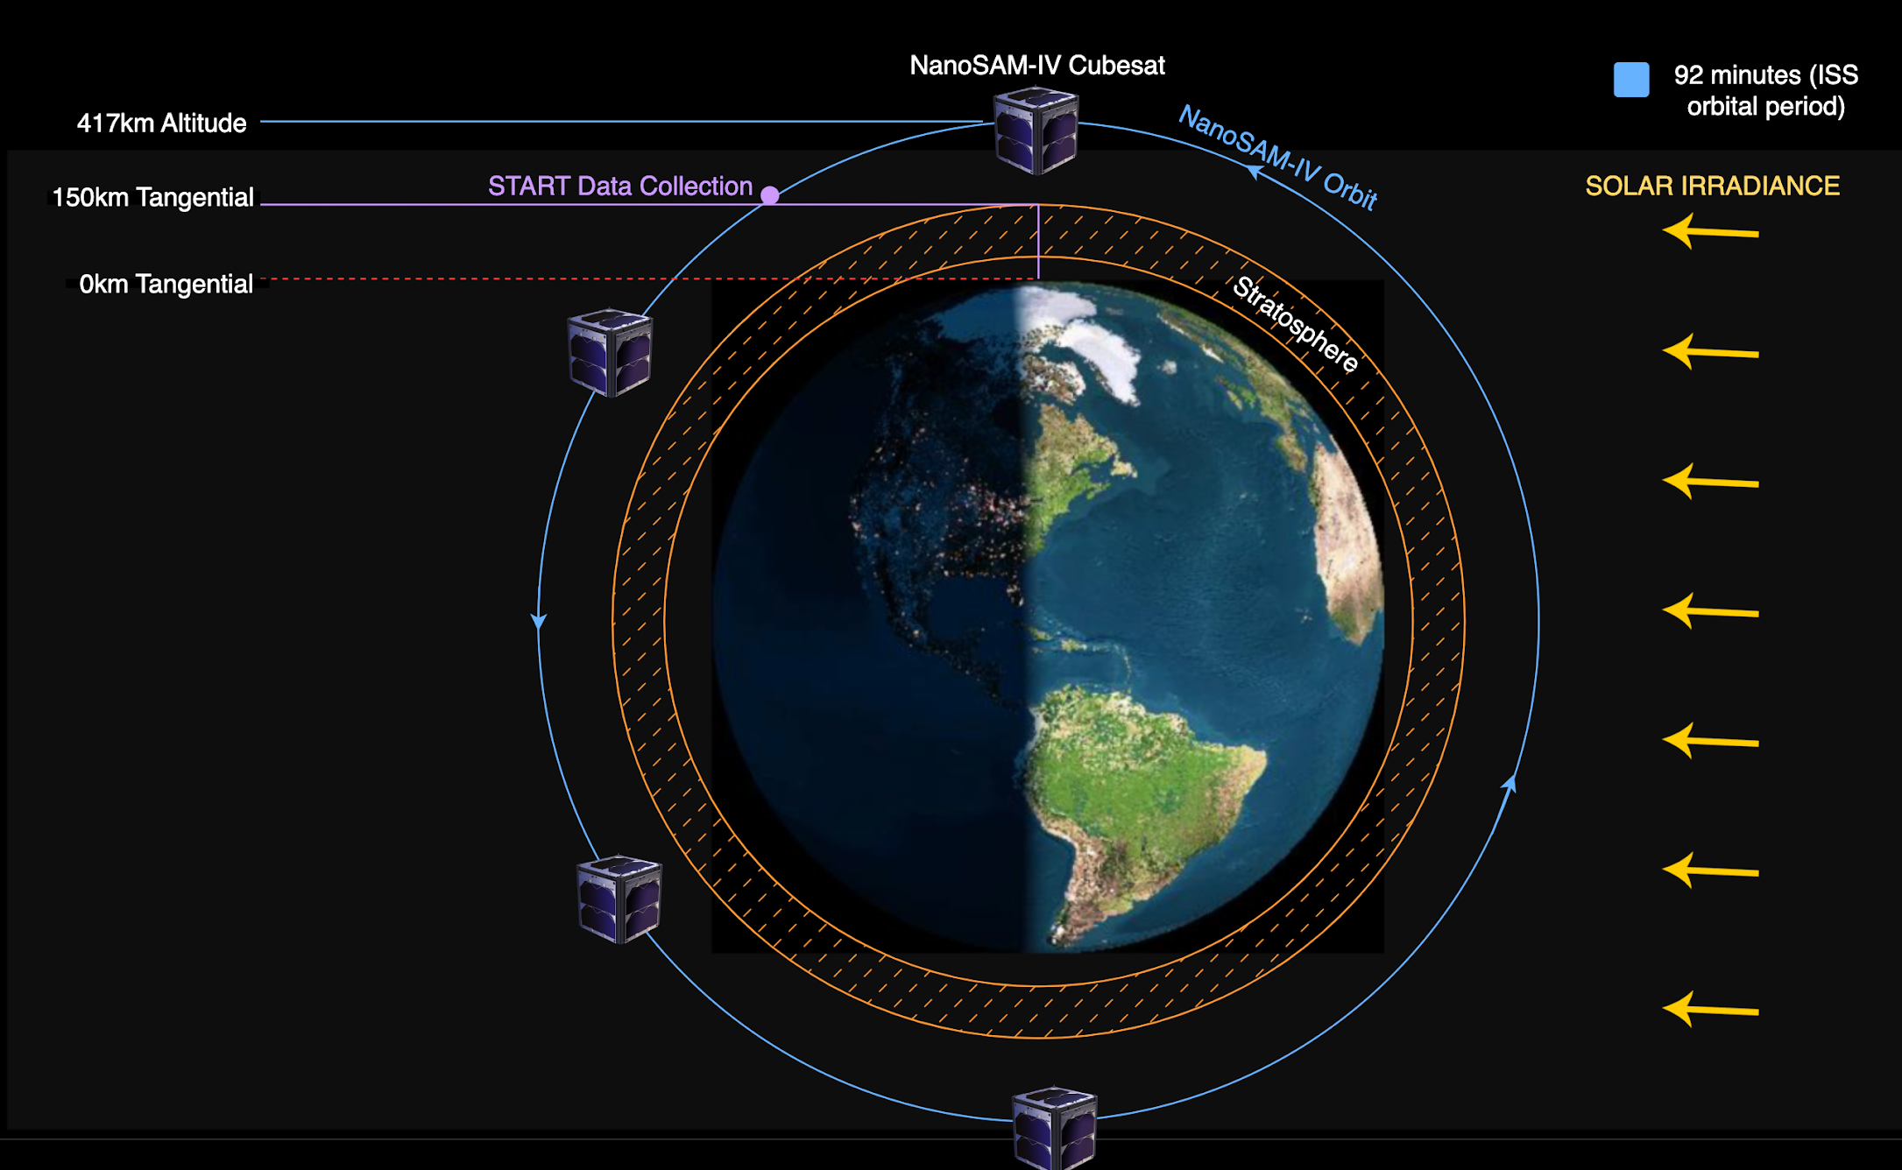
Orbit Timing Diagram
Purpose & Objective
Purpose
Design Solution
Design Solution
Software
Software
Electronics
Electronics
Mechanical
Verification/Validation
Testing
Planning
Planning
Notes:
Begin by debriefing the project description

Slide 21
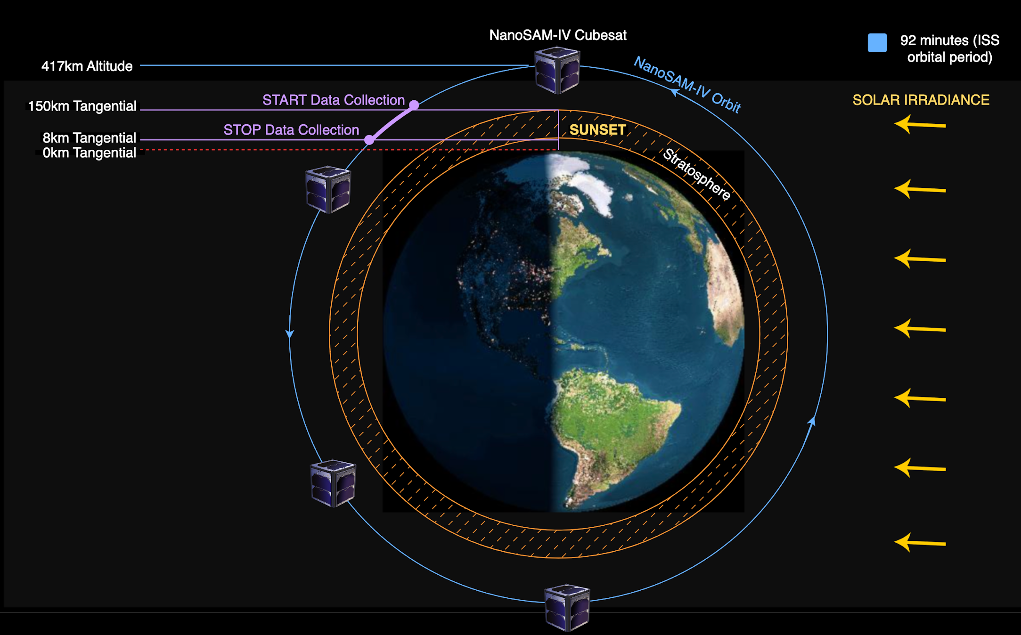
Orbit Timing Diagram
Purpose & Objective
Purpose
Design Solution
Design Solution
Software
Software
Electronics
Electronics
Mechanical
Verification/Validation
Testing
Planning
Planning
Notes:
Begin by debriefing the project description

Slide 22
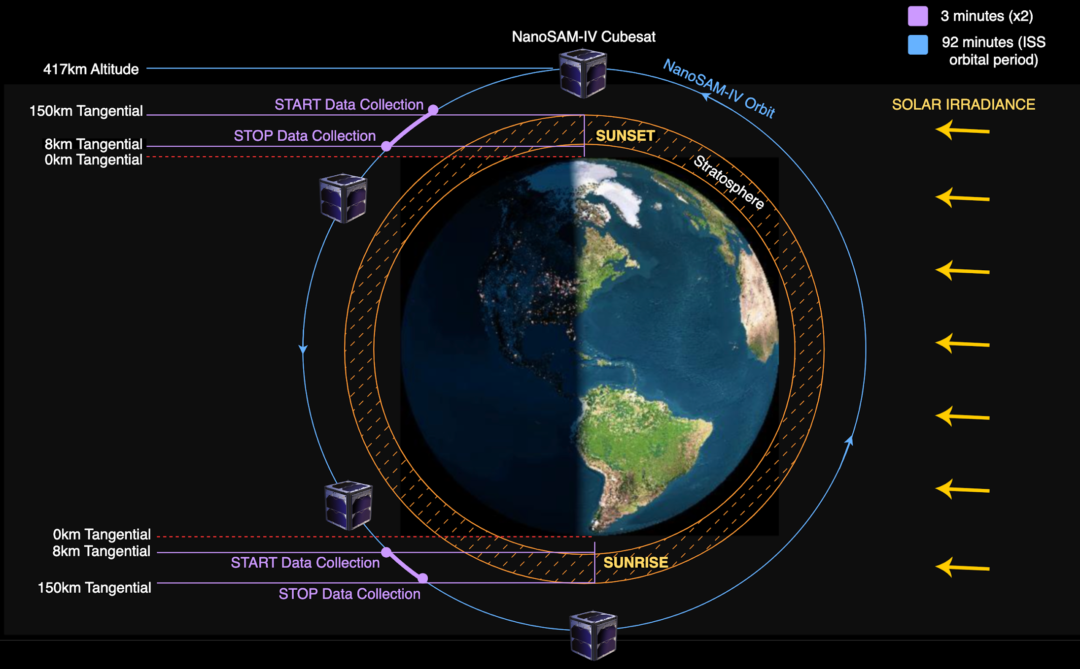
Orbit Timing Diagram
Purpose & Objective
Purpose
Design Solution
Design Solution
Software
Software
Electronics
Electronics
Mechanical
Verification/Validation
Testing
Planning
Planning
Notes:
Begin by debriefing the project description

Slide 23
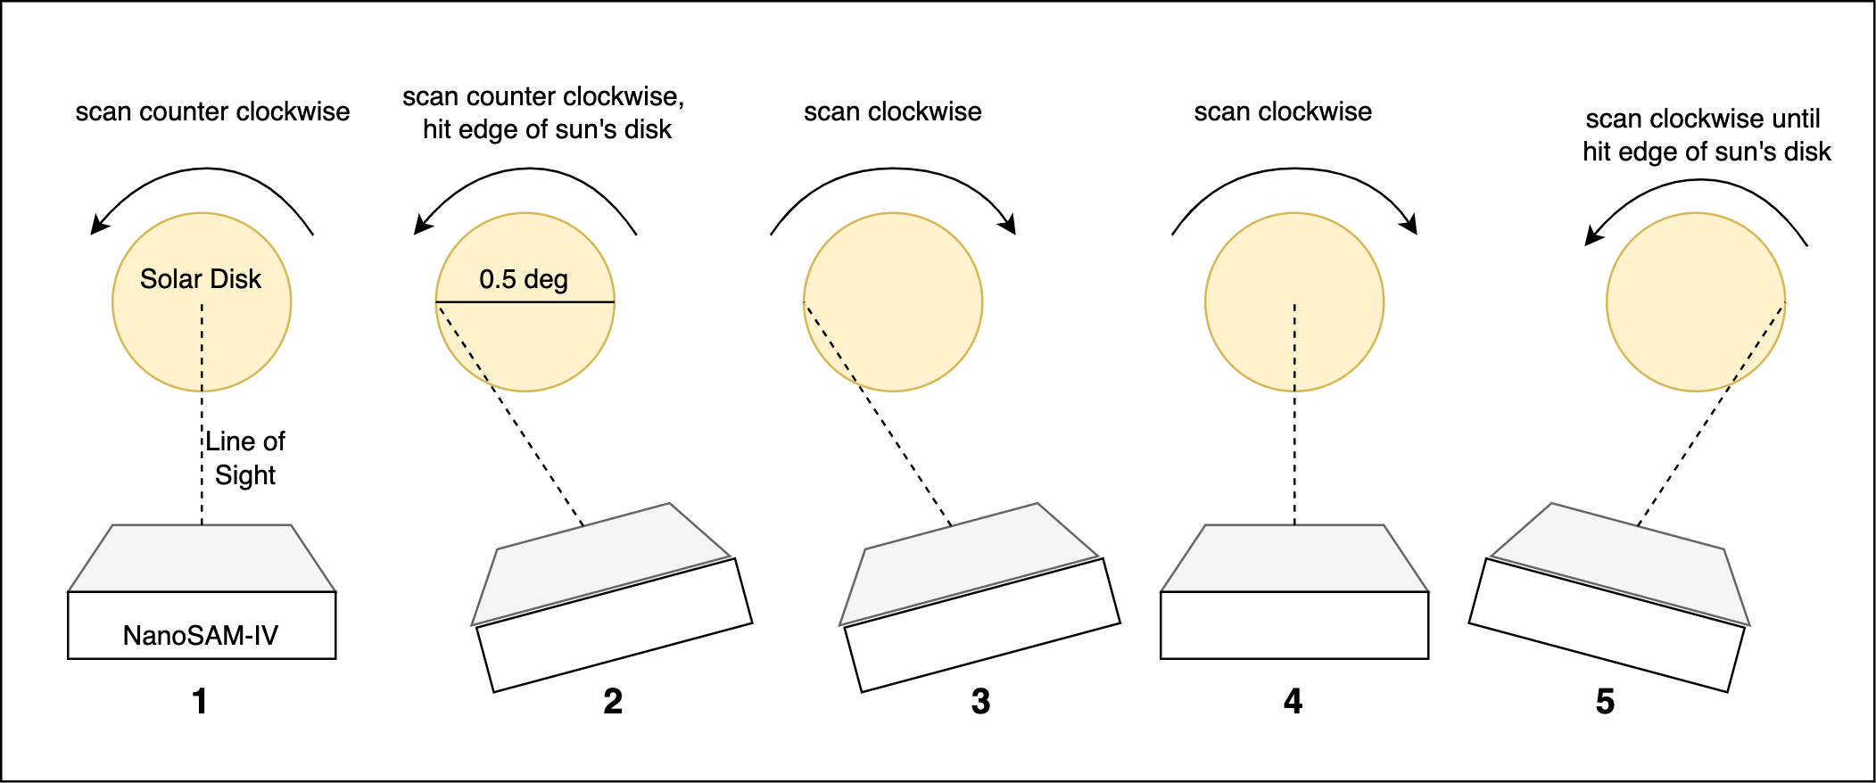
Irradiance Threshold
NanoSAM on Orbit
Purpose & Objective
Purpose
Design Solution
Design Solution
Software
Software
Electronics
Electronics
Mechanical
Verification/Validation
Testing
Planning
Planning
Notes:
Really Explain what the scanning is, and what specifically we have to do in terms of the scanning

Slide 24
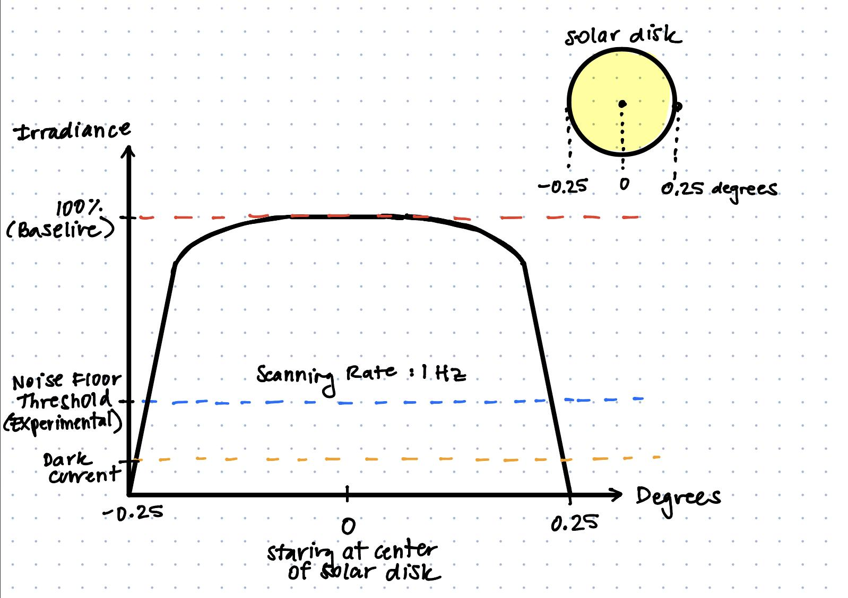
Irradiance Threshold
NanoSAM on Orbit
Purpose & Objective
Purpose
Design Solution
Design Solution
Software
Software
Electronics
Electronics
Mechanical
Verification/Validation
Testing
Planning
Planning
Notes:
If we are below threshold for more than 2 sec, then we know that we can no longer see the sun (the earth may be obscuring the sun)
If we are below threshold the cubesat will change its attitude to scan the other direction. If the irradiance does not go above threshold in less than 2 sec after starting scan in the other direction the

Slide 25
Software Design Objectives
Start and stop data collection
NanoSAM simulated orbital position
Threshold irradiance
Detect when we are below an irradiance threshold
Edge of solar disk during scanning
Facilitate transfer of data through the entire system
NanoSAM on Orbit
Purpose & Objective
Purpose
Design Solution
Design Solution
Software
Software
Electronics
Electronics
Mechanical
Verification/Validation
Testing
Planning
Planning
Notes:
Begin by debriefing the project description

Slide 26
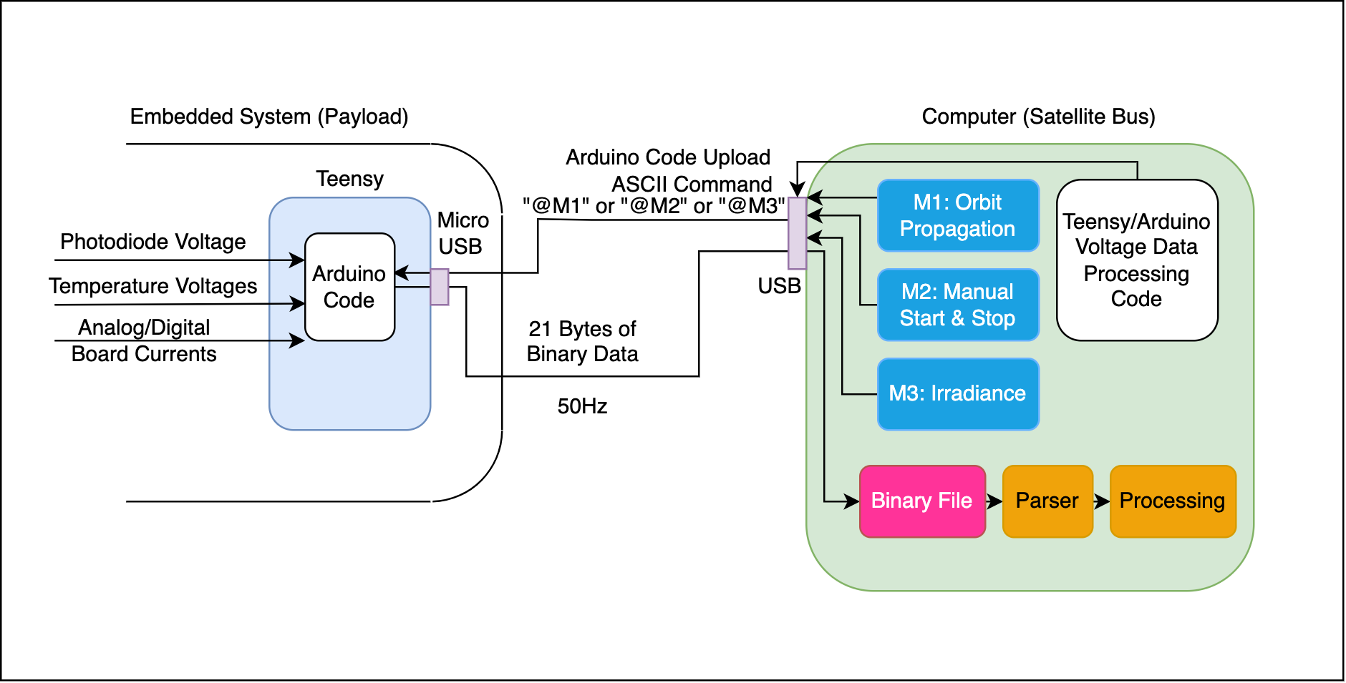
Software FBD
CJ
Jade
50 Hz
20
Purpose & Objective
Purpose
Design Solution
Design Solution
Software
Software
Electronics
Electronics
Mechanical
Verification/Validation
Testing
Planning
Planning
Notes:
Begin by debriefing the project description

Slide 27
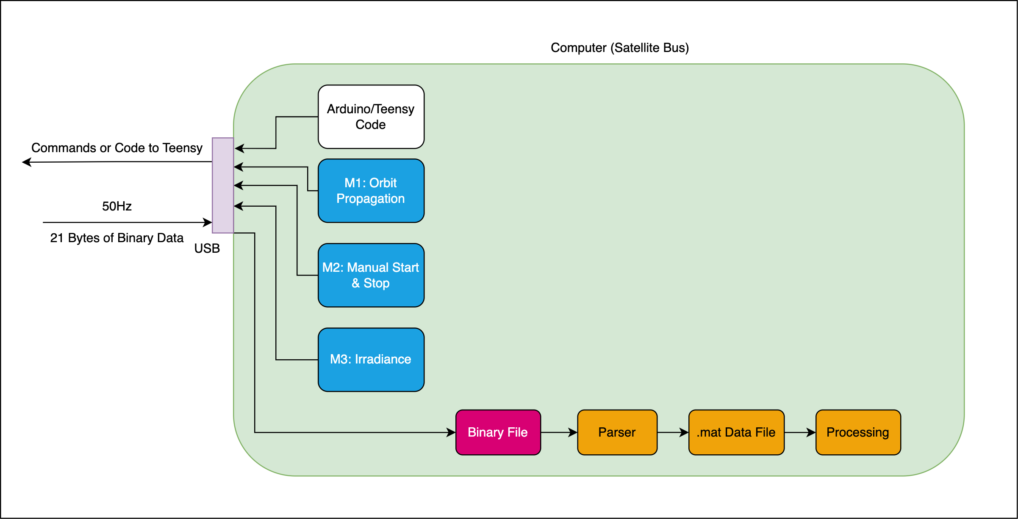
Computer Interface & Satellite Bus
Purpose & Objective
Purpose
Design Solution
Design Solution
Software
Software
Electronics
Electronics
Mechanical
Verification/Validation
Testing
Planning
Planning
Notes:
Begin by debriefing the project description

Slide 28
TEENSY CODE
COMMANDS
DATA STORAGE
POST-PROCESSING
Computer Interface & Satellite Bus
TEENSY CODE
20 Bytes of Data:
(1 byte) Header
(4 byte) Time
(2 byte) Irradiance Data
(1 byte) Threshold Flag
(1 byte) Sun Flag
(2 byte) Photodiode Temperature
(2 byte) Analog Board Temperature
(2 byte) Digital Board Temperature
(2 byte) Analog Board Current
(2 byte) Digital Board Current
(1 byte) End of Message
DATA STORAGE
POST-PROCESSING
COMMANDS
& READ DATA
Purpose & Objective
Purpose
Design Solution
Design Solution
Software
Software
Electronics
Electronics
Mechanical
Verification/Validation
Testing
Planning
Planning
Notes:
Begin by debriefing the project description

Slide 29
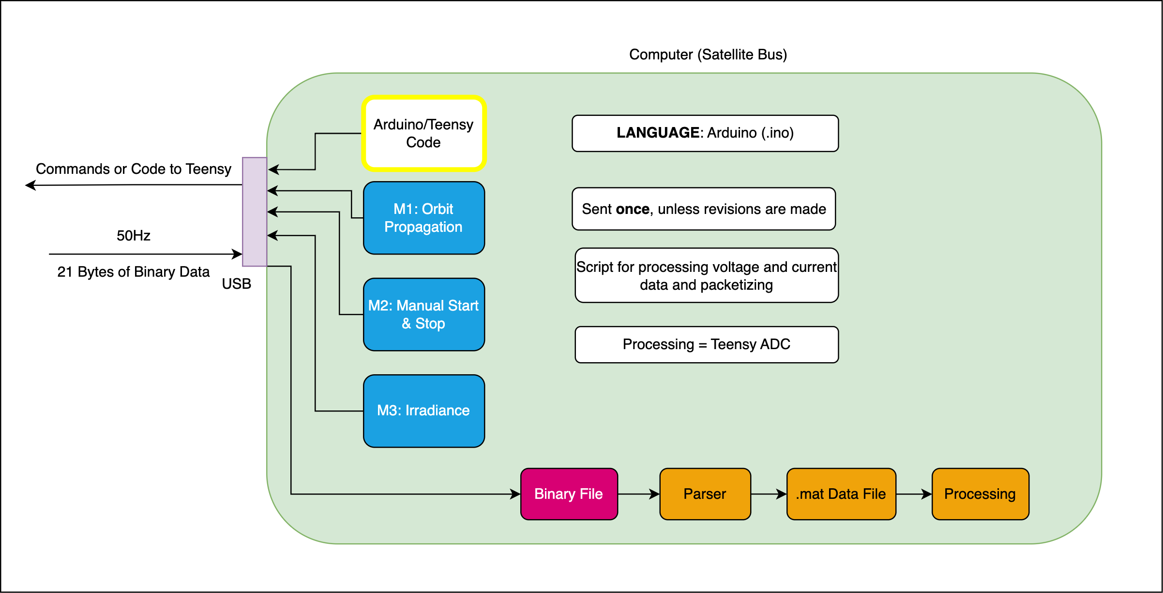
Computer Interface & Satellite Bus
Purpose & Objective
Purpose
Design Solution
Design Solution
Software
Software
Electronics
Electronics
Mechanical
Verification/Validation
Testing
Planning
Planning
Notes:
Begin by debriefing the project description

Slide 30
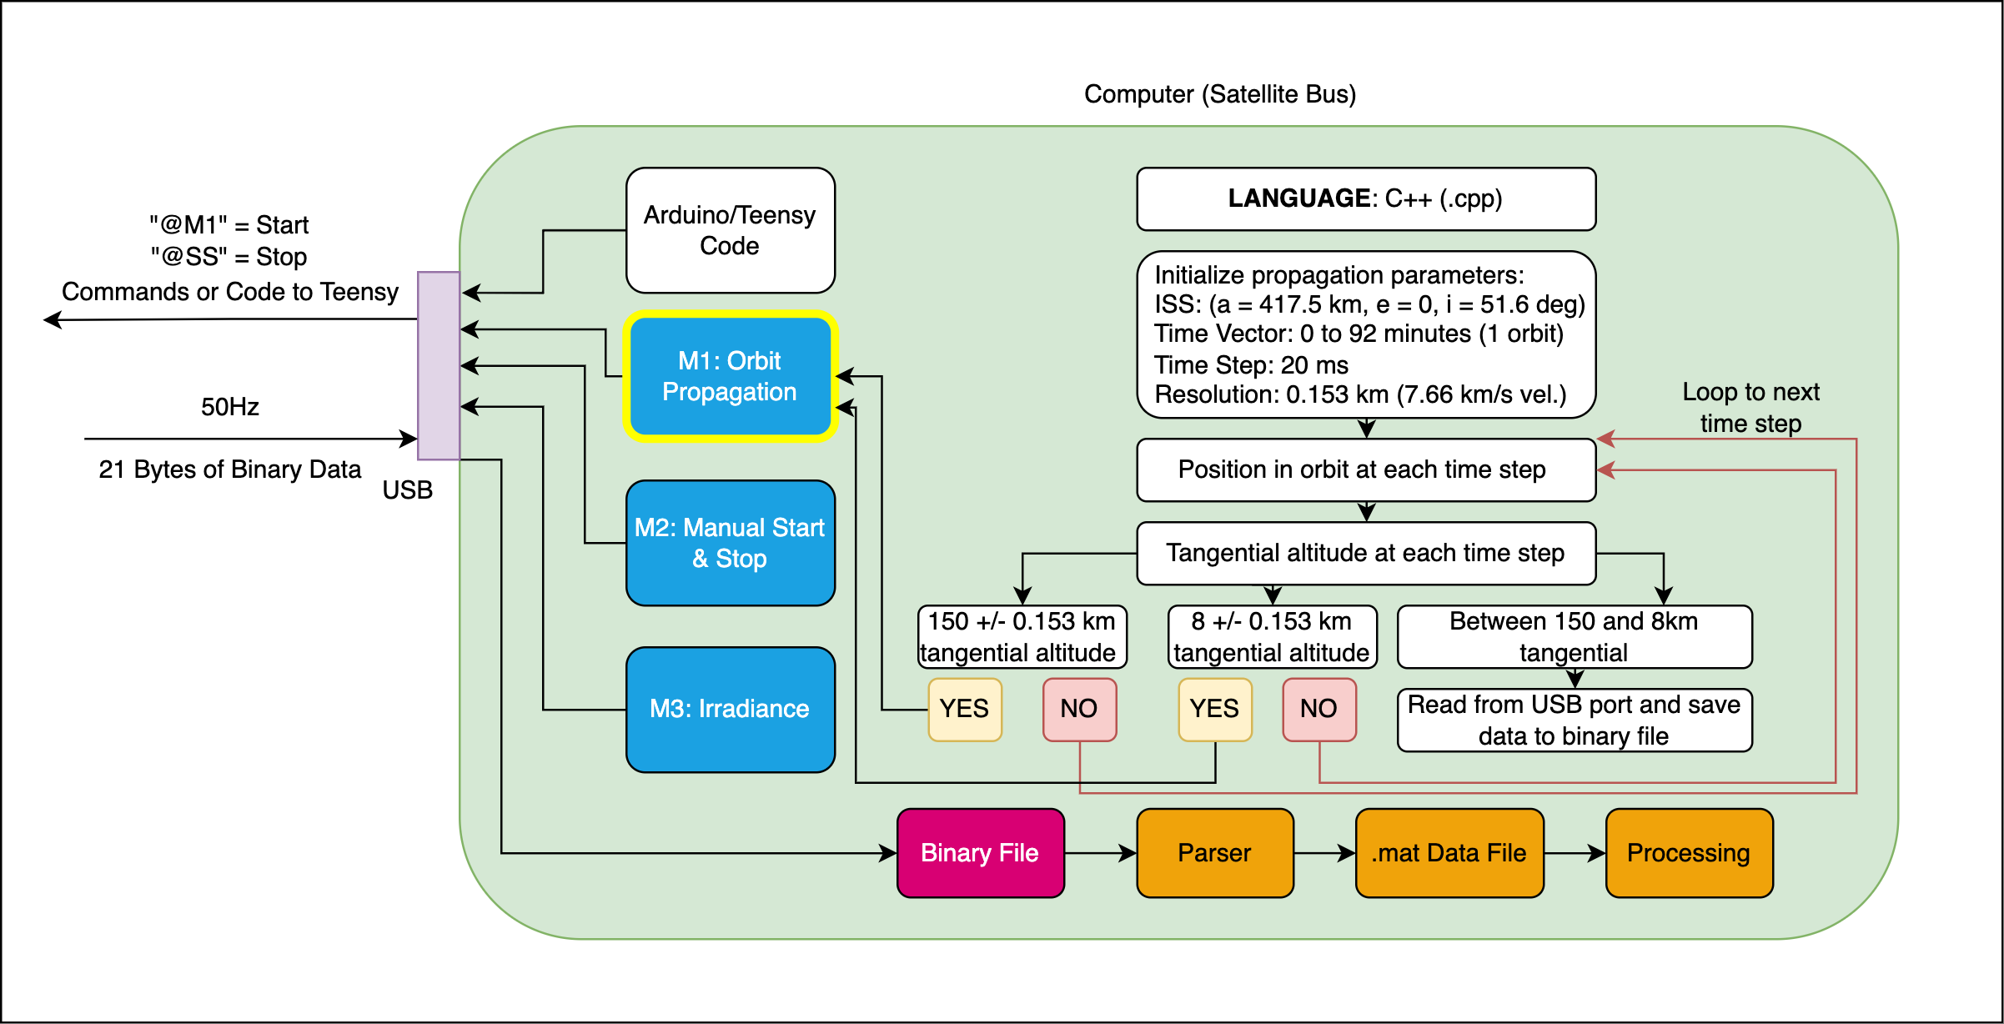
Computer Interface & Satellite Bus
“M1” = Start
“S “ = Stop
Purpose & Objective
Purpose
Design Solution
Design Solution
Software
Software
Electronics
Electronics
Mechanical
Verification/Validation
Testing
Planning
Planning
Notes:
Begin by debriefing the project description

Slide 31
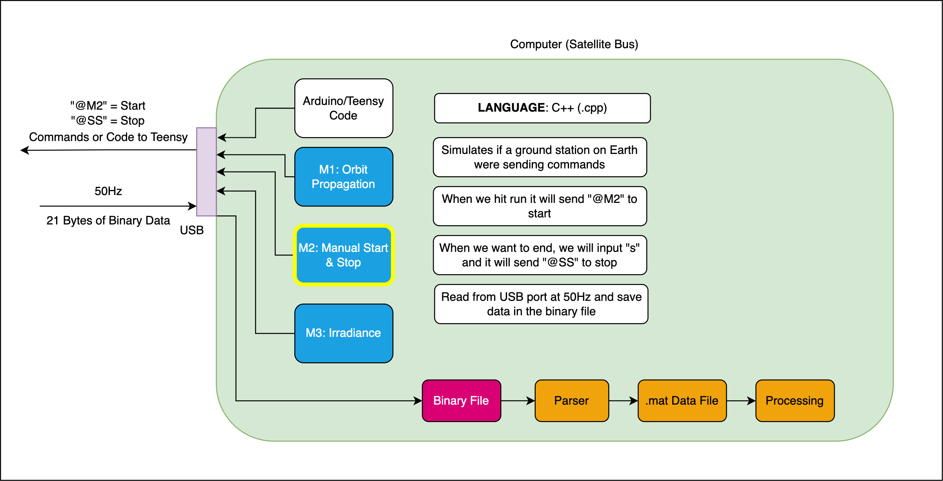
Computer Interface & Satellite Bus
Purpose & Objective
Purpose
Design Solution
Design Solution
Software
Software
Electronics
Electronics
Mechanical
Verification/Validation
Testing
Planning
Planning
Notes:
Begin by debriefing the project description

Slide 32
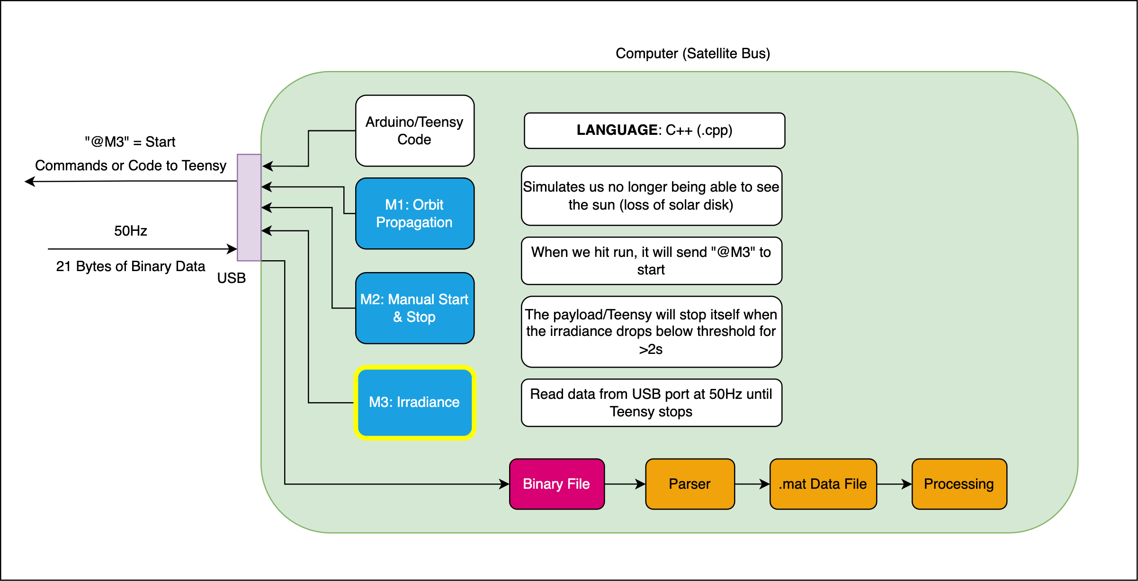
Computer Interface & Satellite Bus
Purpose & Objective
Purpose
Design Solution
Design Solution
Software
Software
Electronics
Electronics
Mechanical
Verification/Validation
Testing
Planning
Planning
Notes:
Begin by debriefing the project description

Slide 33
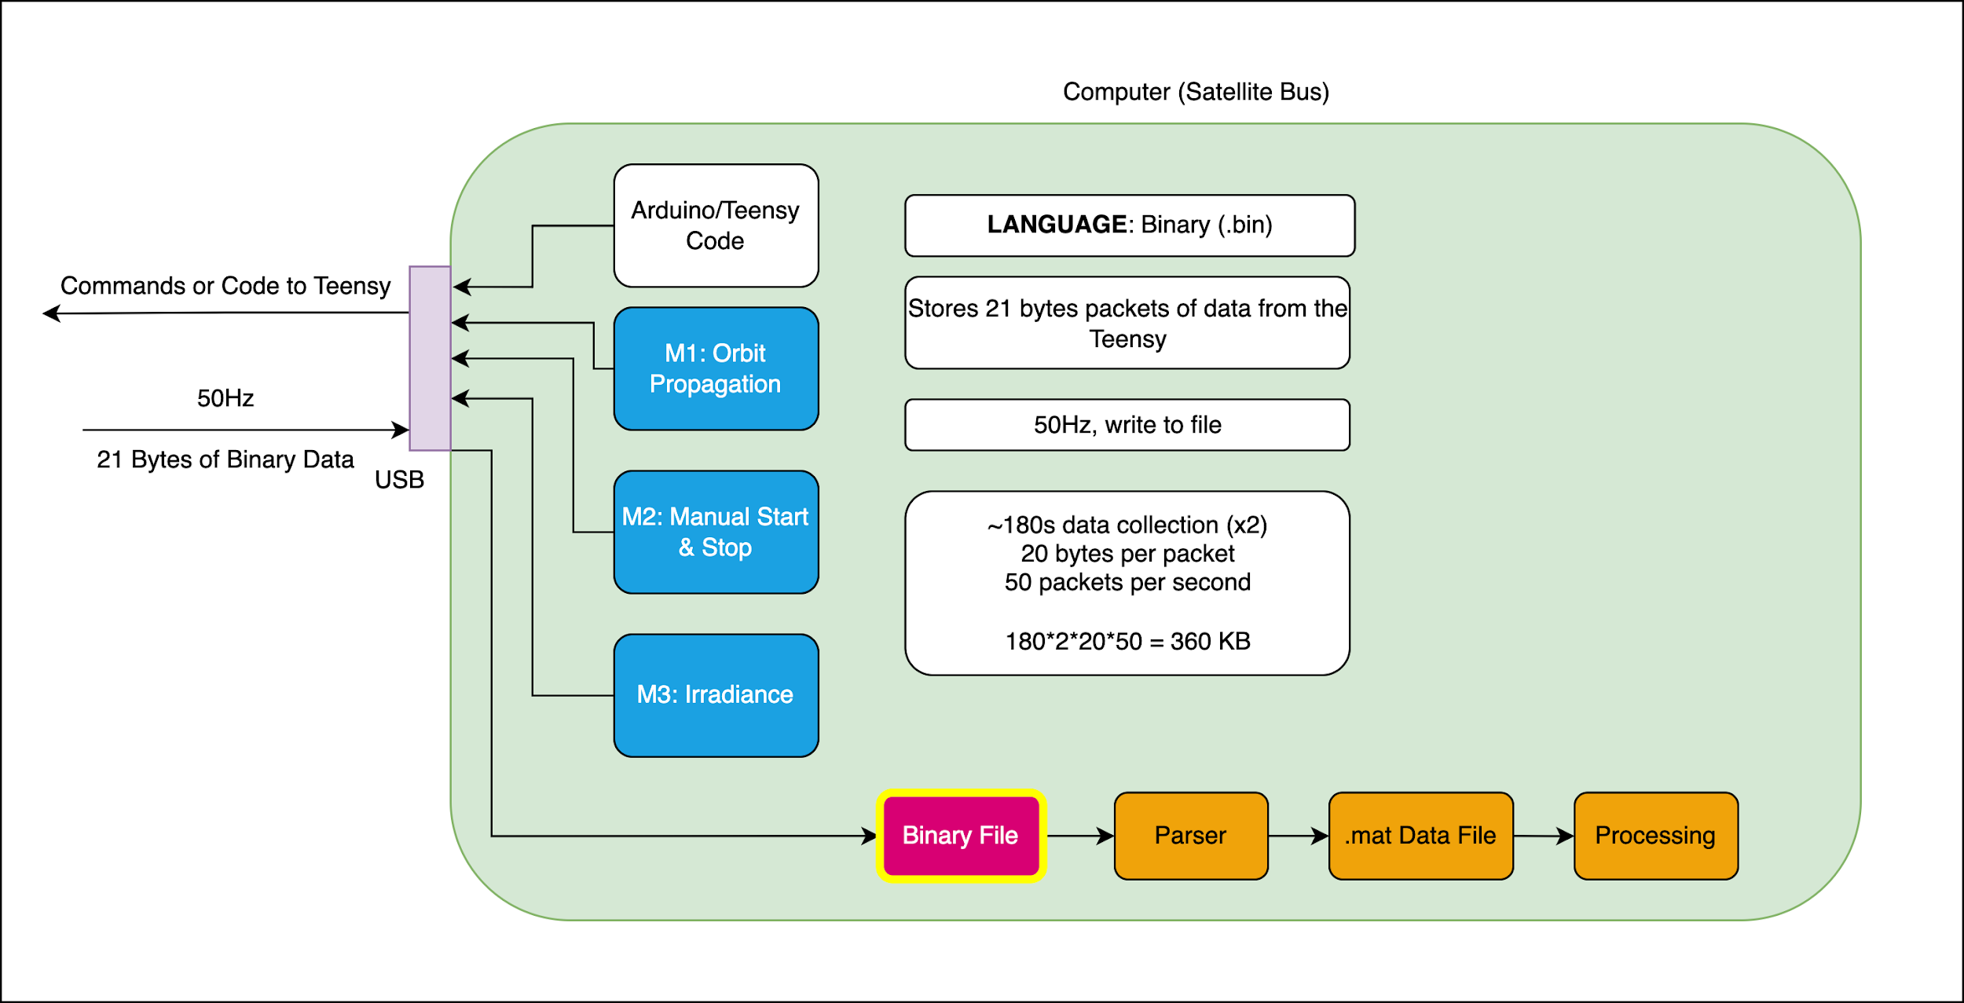
Computer Interface & Satellite Bus
Purpose & Objective
Purpose
Design Solution
Design Solution
Software
Software
Electronics
Electronics
Mechanical
Verification/Validation
Testing
Planning
Planning
Notes:
Begin by debriefing the project description

Slide 34
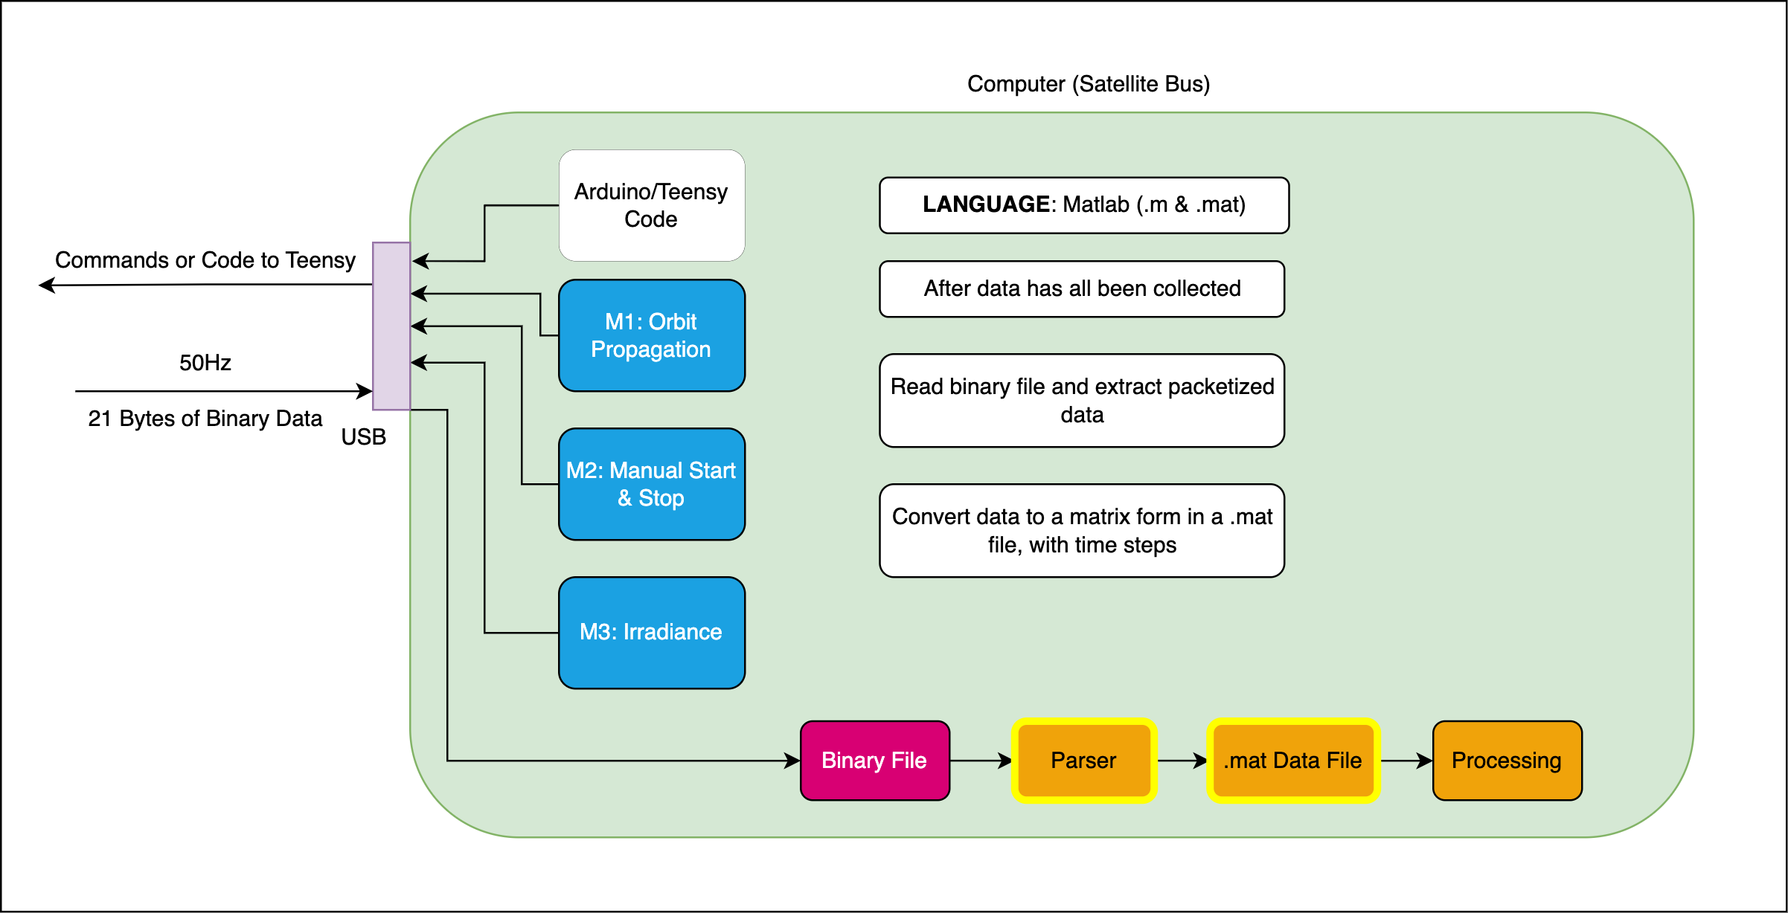
Computer Interface & Satellite Bus
Purpose & Objective
Purpose
Design Solution
Design Solution
Software
Software
Electronics
Electronics
Mechanical
Verification/Validation
Testing
Planning
Planning
Notes:
Begin by debriefing the project description

Slide 35
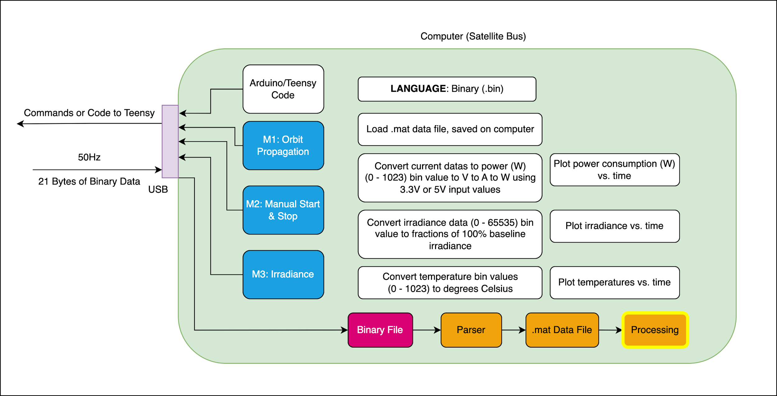
Computer Interface & Satellite Bus
Purpose & Objective
Purpose
Design Solution
Design Solution
Software
Software
Electronics
Electronics
Mechanical
Verification/Validation
Testing
Planning
Planning
Notes:
Begin by debriefing the project description

Slide 36
Software FBD
Ben
50 Hz
Purpose & Objective
Purpose
Design Solution
Design Solution
Software
Software
Electronics
Electronics
Mechanical
Verification/Validation
Testing
Planning
Planning
Notes:
Begin by debriefing the project description

Slide 37
Electronics
Purpose
Design Solution
Software
Electronics
Mechanical
Testing
Planning
Notes:
Begin by debriefing the project description

Slide 38
Electrical & Optical Requirements
Light Source Circuit
Optical Box
Two Revised NanoSAM- II Boards
Thermistor
LED
12 mm
Photodiode
Light Source Requirements:
29 mW < P_{LED,Output}< 586 mW
Photodiode Requirements:
0.118 µW < P_{PD}< 2.37 µW
53.3 nA < I_{PD}< 1.07 µA
Board Requirements:
Power Draw < 8W
Signal Processing SNR > 200
Purpose
Design Solution
Software
Electronics
Mechanical
Testing
Planning
Notes:
The electronics team is chiefly concerned with the design of a light source circuit and the revision of the NanoSAM-2 boards.
The Light Source is required to output an optical power out of 29 miliwatts to 586 milliwatts
The photodiode must have an incident power corresponding to the optical power of 0.118 microwatts to 2.37 microwatts, and a current response between 53.3 nanoamps and 1.07 microamps. Requirement to model the NanoSAM-2’s instrument signal on orbit.
The revised NanoSAM-II board must not draw more more then 8 Watts of power, an must process the photodiode current, convert it to a voltage and amplify it and input it into the onboard ADC to be digitized all while achieving an SNR of greater then 200. To satisfy the the 8W power requirement due to the satellite bus power output and the SNR to allow for meaningful science data.

Slide 39
Electrical & Optical FBD
Photodiode Requirements:
0.118 µW < P_{PD}< 2.37 µW
53.3 nA < I_{PD}< 1.07 µA
Board Requirements:
Power Draw < 8W
Signal Processing SNR > 200
0.165 V < V_{Input,ADC} < 3.3 V
Light Source Requirements:
29 mW < P_{LED,Output}< 586 mW
Purpose
Design Solution
Software
Electronics
Mechanical
Testing
Planning
Notes:
Looking at the Functional Block Diagram the light source radiometric signal will pass through the photodiode into the revised NanoSAM 2 analog board where the signal is processes and passed to the digital board ot be digitized, before being uploaded to our lab computer. I will detail the design of the lightsource and the Revisions of the NanoSAM 2 boards in subsequent slides.

Slide 40
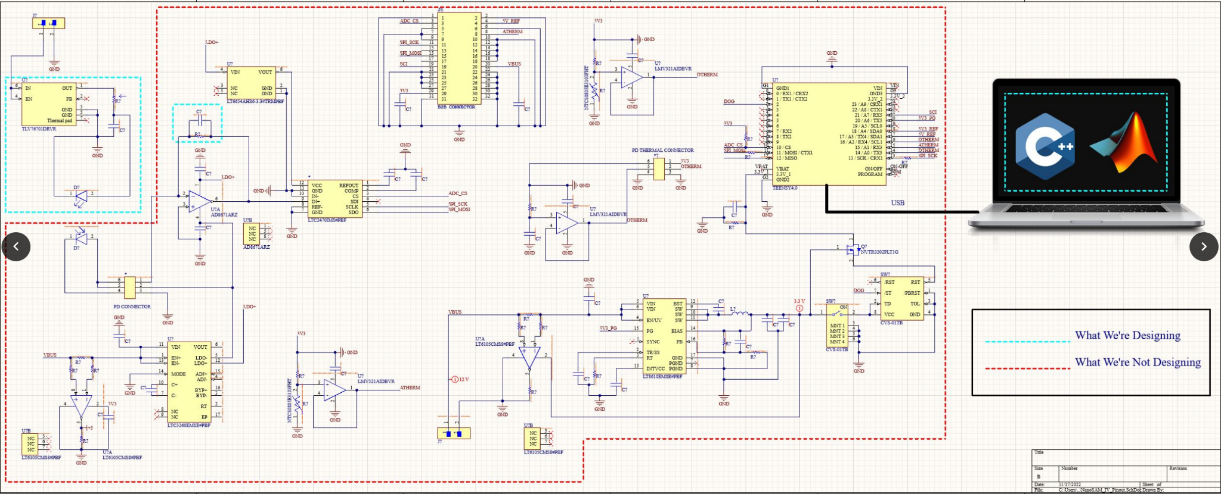
Electrical Design
Revisions
Light Source Design
Analog Board
Digital Board
Purpose
Design Solution
Software
Electronics
Mechanical
Testing
Planning
Notes:
Given this electrical diagram of the entire electrical system, the dotted green box represents the light source circuit, and the dotted blue box represents the revisions that we will do on the NanoSAM 2 board. We will have to change the feedback resistor and capacitor on the opAmp, for the NanoSam 2 team expected a different photodiode signal then we are required to have. Lastly after testing all the components on the boards it was identified that the OpAmp is broken and must be replaced.

Slide 41
Detailed Light Source FBD
Viewing Angle: 20 deg
Wavelength: 680 nm
I_{NanoSAM-IV} = 600 mA
I_{Low} = 82 mA
I_{high} = 1674 mA
P_{NanoSAM-IV} = 210 mW
P_{Low} = 29 mW
P_{High} = 586 mW
Purpose
Design Solution
Software
Electronics
Mechanical
Testing
Planning
Notes:
Detailing the light source design we first started from the NanoSAM - 4 expected power on its orbit of 210 miliWatts and the bounds of 29 miliWatts and 586 miliWatts.
From these optical power requirements the mechanical and optical team selected a distance to place the the LED from the photodiode that they will talk about later. As part of our design and optical output model we selected, given the distance, the LED was selected based on its output angle of 20 deg, wavelength of 680 nm and optical power output driven by the output requirements defined for the LED.
With the Thorlabs M680L4 the electronics team defined the voltage of 2.5 V and 600 mA to be supplied to the LED.
In order to stay well within our optical power bound the power supply to the LED was regulated with a linear regulator, reducing the 10 milivolt ripple to 60 micro volts, and then a passive lowpass RC filter was used to eliminate extraneous frequencies outputted by the linear regulator.

Slide 42
Light Source Electrical Diagram
V_{Power,Supply}
3 V +/- 10 mV
V_{Linear,Regulator}
2.5 V +/- 60 uV
P_{NanoSAM-IV} = 210 mW
P_{Low} = 29 mW
P_{High} = 586 mW
V_{Filter}
2.5 V +/- 60 uV
I_{NanoSAM-IV} = 600 mA
I_{Low} = 82 mA
I_{high} = 1674 mA
R₁ = 0.9 KΩ
C₁ = 18 nF
Purpose
Design Solution
Software
Electronics
Mechanical
Testing
Planning
Notes:
To meet our optical power requirement bounds a stable power supply had to be designed
This design (Here is how we did it)
Once the voltages and current requirements were defined. We were able to size the R1 resistor and C1 capacitor to drive the LED within nominal bounds
The values are given as 0.9 kilo Ohm and 18 nanofarads
Lastly a potentiometer will be used to vary the LED’s power input and optical output shown in Yellow

Slide 43
Detailed Instrument FBD
V_{NanoSAM-IV} = 2.640 V
V_{Low} = 0.165 V
V_{high} = 3.3 V
P_{NanoSAM-IV} = 1.903 μW
P_{Low} = 0.1184 μW
P_{high} = 2.379 μW
I_{NanoSAM-IV} = 0.857 μA
I_{Low} = 0.0533 μA
I_{high} = 1.07 μA
Purpose
Design Solution
Software
Electronics
Mechanical
Testing
Planning
Notes:
After the optical output has been engineered I will now detail how the signal passes through the revised NanoSAM-2 boards.
The expected incident optical power on the photodiode on orbit is given as 1.903 microwatts with bounds of .118 microwatts and 2.379 microwatts.
This incident optical power corresponds to a photodiode response of 0.857 microamps with bounds of 0.0533 microamps and 1.07 microamps respectively.
This Current will then be passed into a transimpedence amp to convert and the current to a voltage and amplify it. The signal is then passed into a lowpass filter to match the voltage bounds 0.165 V and 3.3V and frequency input requirements of the ADC such that the ADC can discern the signal.
The voltage is inputted into the ADC with a expected voltage of 2.640 Volts and a lower bound of 0.165 Volts corresponding to our 200 SNR requirement, and an upper bound of 3.3 volts corresponding to the reference voltage of the ADC.
Looking at the Power requirement of 8 W the instrument will be monitoring the power draw of both of the boards with current monitors on the outputs of the linear regulators.
Lastly there will also be thermal monitoring devices on the photodiode and the two boards to ensure we are within nominal operating temperature, for if the temperature fluctuates by +/- 5 degrees celsius our SNR Model will be invalidated, that I will detail in subsequent slides.
The software team will talk about what happens to the digital signal outputted from the ADC in subsequent slides.

Slide 44
Instrument Electrical Diagram
V_{OpAmp,NanoSAM-IV} = 2.640 V
V_{OpAmp,Low} = 0.165 V
V_{OpAmp,High} = 3.3 V
P_{PD,NanoSAM-IV} = 1.903 µW
P_{PD,Low} = 0.1184 µW
P_{PD,High} = 2.379 µW
Bin_{NanoSAM-IV} = 52428
Bin_{Low} = 3277
Bin_{High} = 65536
I_{PD,NanoSAM-IV} = 0.857 µA
I_{PD,Low} = 0.0533 µA
I_{PD,High} 1.07 µA
LSB = 5.04*10⁻⁵ (V/Bin)
SNR_{NanoSAM-IV} = 3231
SNR_{Low} = 200
SNR_{High} = 4042
R₂ = 3.08 MΩ
C₂ = 408 pF
Purpose
Design Solution
Software
Electronics
Mechanical
Testing
Planning
Notes:
Now that I have detailed the operation of the instrument, and the required signal bounds at each given component, the team was able to revise the sizing of the feedback resistor and capacitor based on the ADC input, we knew its voltage range is from 0.165 volts to satisfy the SNR requirement, and 3.3 Volts max to match its reference voltage, then we sized the capacitor based on the ADC’s sampling rate of 208 hz making the nyquist frequency of 104 Hz resulting prevent aliasing the ADC.
The resistor is to be 3.75 Mega ohms and 408 picoFarads respectively completing the redesign of the analog signal processing board.
With the Resistor and capacitor sized the team was able to model the SNR of the system.

Slide 45
SNR Equation
V_{Signal,Digitized,Min}(V)
SNR_{Min} =
V_{Noise,Max}(V)
V_{Signal,Digitized} = I_{PD}R_{F} (V+ Grounded)
I_{PD} = R P_{Incident,PD}
R = 0.456 Responsivity (Given 680nm and 20.5C)
P_{Incident,PD} = Power Incident on Photodiode Area
R_{F} = 3.75(MΩ) Feedback Resistor
Purpose
Design Solution
Software
Electronics
Mechanical
Testing
Planning
Notes:
The SNR of the system is defined by the Digitized voltage signal taken at the ADC and the subsequent sum of noise to get to that point.
Responsivity is given by the LED average output wavelength of 680nm and the temperature of the senior projects room of 20.5 degrees celsius where we plan on conducting our tests

Slide 46
SNR Equation
V_{Signal,Digitized,Min}(V)
SNR_{Min} =
V_{Noise,Max}(V)
V_{Noise} = V²_{Shot,PD} + V²_{Dark,PD} + V²_{Johnson} + V²_{OpAmp}+ V²_{ADC}
V²_{Shot,PD}= 1.59*10⁻¹³ V (Expected Max)
V²_{Dark,PD}= 1.37*10⁻¹² V (Max @ 20.5 +/- 5 C)
V²_{Johnson}= 2.86*10⁻⁶ V (Max @ 20.5 +/- 5 C)
V²_{OpAmp}= 4.0*10⁻⁸ V (Expected Max)
V²_{ADC} = 2.10*10⁻¹⁰ V (Datasheet @ 20.5 +/- 5 C)
Purpose
Design Solution
Software
Electronics
Mechanical
Testing
Planning
Notes:
The temperature is set to 20.5 +/- 5 C due to the fact that we can reasonable control this within our lab area (Senior Projects Room) without the need for thermal control, and again this temperature is monitored to ensure that we will stay within this nominal temperature. After running a thermal sensitivity analysis we were able to ensure that these temperature bounds will not blow our SNR bounds

Slide 47
Electronics Design Space
PD SATURATION 0.54 mA
P
D
C
U
R
R
E
N
T
I_{PD}
PD
S
A
T
U
R
A
T
I
O
N
MAX CURRENT 1.07 µA
SNR = 4042
NanoSAM IV CURRENT 0.857 µA
SNR = 3231
D
E
S I R E D
P
O W E R
2.37 µW
MIN CURRENT @ 200 SNR 53.3 nA `
1.90 µW
0.118 µW
Power Incident on PD
P_{Incident,PD}
1 mW
Purpose
Design Solution
Software
Electronics
Mechanical
Testing
Planning
Notes:
Begin by debriefing the project description

Slide 48
Detailed Instrument FBD
V_{NanoSAM-IV} = 2.640 V
V_{Low} = 0.165 V
V_{high} = 3.3 V
P_{NanoSAM-IV} = 1.903 μW
P_{Low} = 0.1184 μW
P_{high} = 2.379 μW
I_{NanoSAM-IV} = 0.857 μA
I_{Low} = 0.0533 μA
I_{high} = 1.07 μA
Purpose
Design Solution
Software
Electronics
Mechanical
Testing
Planning
Notes:
Begin by debriefing the project description

Slide 49
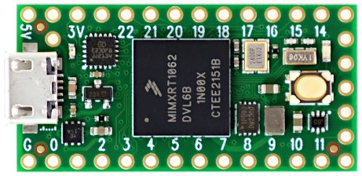
Teensy Inputs and Outputs
Connected to Thermistors
Analog Input. Voltage data of temperature.
Connected to Regulators
SCK
Analog Input. Voltage data of current from analog and digital regulators.
SPI Connection. Voltage data of irradiance from ADC.
USB 2.0 “High-Speed” Connection
Connected to Laptop
Input:
CMD (3 Bytes)
Output:
@50 Hz
Start
Byte
Data (18 Bytes)
Stop
Byte
Teensy: Clock Speed = 600 MHz
Flash = 1983 K
Ram = 1024 K
Connected to ADC
CS
MISO
Purpose
Design Solution
Software
Electronics
Mechanical
Testing
Planning

Slide 50
Teensy Loop Diagram
Run Every Loop
Run in Data Collection Mode
Serial Check:
Buffer Input String
Process Command
SPI Sample
Threshold Check
5 Analog Reads
Send 20-Byte Buffer
20 ms
Time
Sample
Loop
Start
Command Handling
50 x
Time
Science Data
Housekeeping Data
Data Buffering
and Sending
Delay
Loop End
Mode 1 Laptop Code Diagram
Code
Start
Initiate Orbit Parameters and Sim
Propagate Until Start Position
Send Start Command
Collect Data
Propagate 20 ms
Send Stop Command
Continue
Propagation
End Propagation
CodeEnd
Data Collection Loop.
Continue Orbital Propagation.
Check For Stop Position.
Purpose
Design Solution
Software
Electronics
Mechanical
Testing
Planning
Notes:
Begin by debriefing the project description

Slide 51
USB Communication
Simplified USB Data “Packet”
Arduino “Serial Write”
uint16 data;
SYNC
PID
DATA
CRC16
buf[0] = (data & 0xFF);
buf[1] = ((data >> 8) & 0xFF);
Serial.write(buf, len);
8-Bit Variable
Unsigned 32-Bit Variable
Unsigned 16-Bit Variable
Start
Byte
Time
Photodiode Sample
Threshold
Flag
Sun
Flag
Photodiode Thermister
Digital
Board Thermister
Analog
Board Thermister
Analog Regulator Current
Digital
Regulator Current
Stop
Byte
1 Packet Total
Bytes: 20
Bits: 160
1 Second Total (50 Hz)
Bytes: 160
Bits: 8000 (Min. Baud)
1 Collection Total (2*180 s)
Megabytes: 0.36 (MB)
USB 2.0 “High Speed”
Offered Speeds: 60 MB/s
Tested Speeds*: 8800 bits/s
Purpose
Design Solution
Software
Electronics
Mechanical
Testing
Planning
Notes:
Begin by debriefing the project description

Slide 52
Mechanical
Purpose
Design Solution
Software
Electronics
Mechanical
Testing
Planning
Notes:
Begin by debriefing the project description

Slide 53
Mechanical/CAD Design
Mechanical Design
Purpose
Design Solution
Software
Electronics
Mechanical
Testing
Planning
Notes:
Here highlighted in the Red box on the screen is the section of the NanoSAM-IV design that the mechanical team has had the opportunity to design, as you can see from a high level view, the Left side which contains the LED is connected to a breadboard with a voltage regulator that will allow the system to receive precise power, and on the right side, where the photodiode resides, connects to our two electronics boards

Slide 54
Mechanical/CAD Design
Aluminum 6061 Cube
M680L4 LED
Thermistor
12 mm (-.8 mm, + 35mm)
FD11A
Photodiode
10cm x 10cm
x12mm
Purpose
Design Solution
Software
Electronics
Mechanical
Testing
Planning
Notes:
Here we have an internal view of the mechanical system
First, we have the M680 LED purchased from thorlabs, secured to the Aluminum 6061 cube with loctite epoxy and supported by a aluminum 6061 block underneath that is attached directly to our cube.
Second, the Aluminum 6061 Cube, which will be spray painted with Vanta Black paint which will dramatically reduce reflections of light inside by 98%. We will be manufacturing the system to not be opened once it is manufactured, this is to remove any excess light from outside of the testing apparatus.
Third, we have our FD11A Photodiode that will be used to take light from the LED and turn it into electrical current, this will also be secured with loctite epoxy to ensure that there will not be any alignment fluctuations or stray light that may impact data collection
Lastly, we have a thermistor next to the photodiode that will collect temperature data to make sure that the phototiode does not exceed our maximum temperature limits at any point during the test cycle
The primary governing equation we are using in this design is the inverse square law that takes into account the angle of the light emitted from the LED. We are able to use this equation due to three factors
1. The inside of the cube will be painted with paint that removes 98.2 % of reflections from light
2. The cube is much larger than the active area of the photodiode which allows the light more time to dissipate light
LED output power was determined by the electrical team and we were able to design the distance and alignment so that we can achieve the optical power requirements of 29-586mW
In order to achieve the required photodiode signal determined by the system’s electronics we have determined that the distance between the photodiode and LED should be 12 mm apart with a ability to move 0.8 mm closer, or 35 mm further away to satisfy our requirements

Slide 55
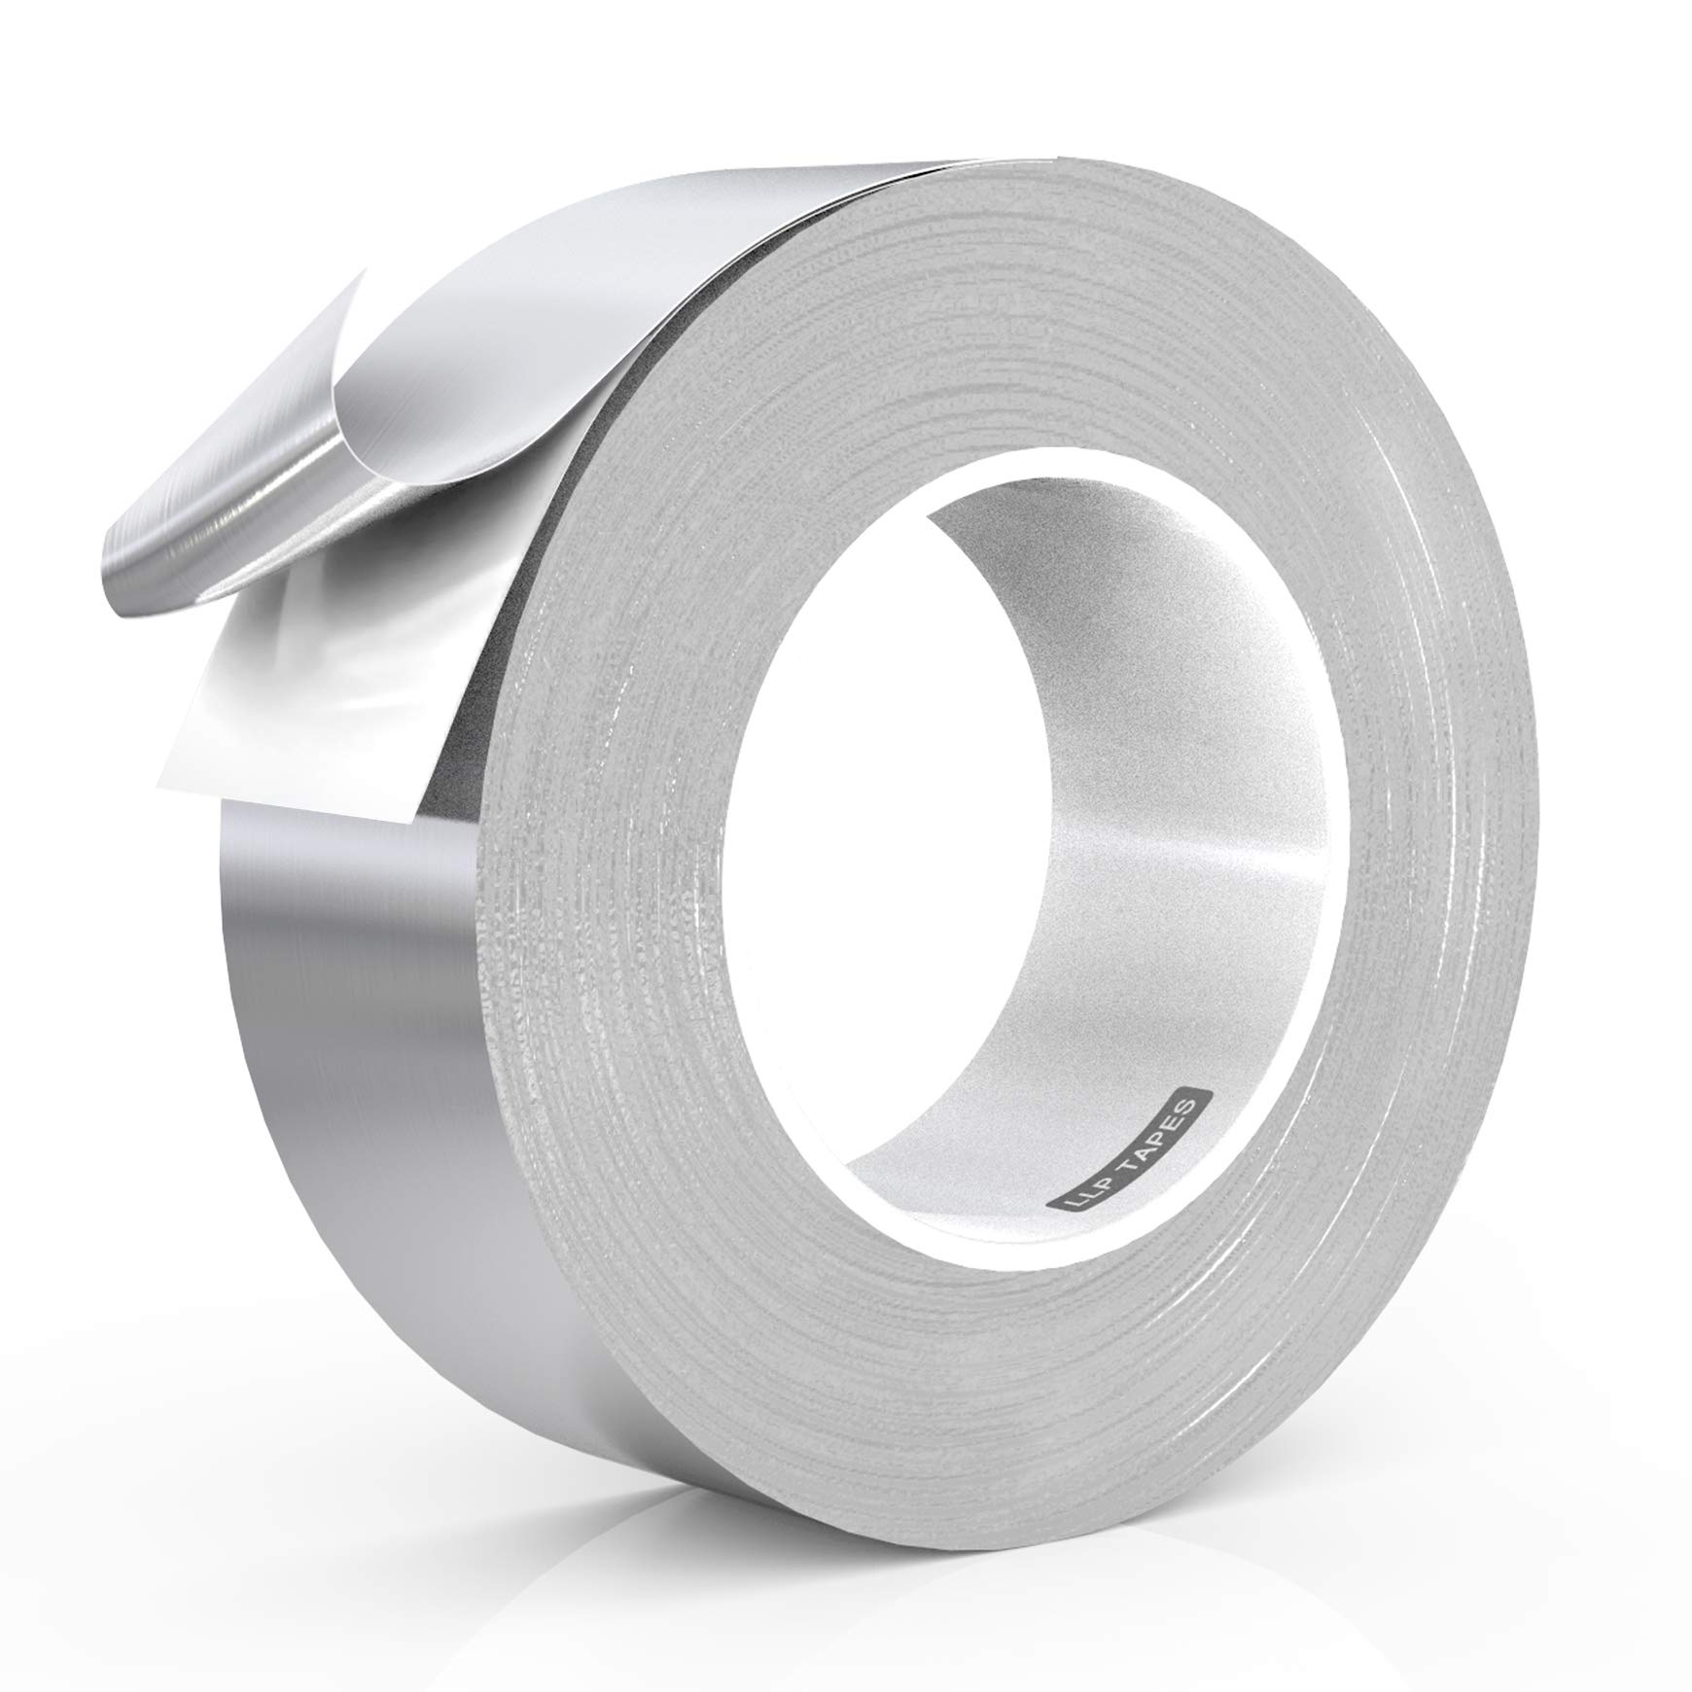
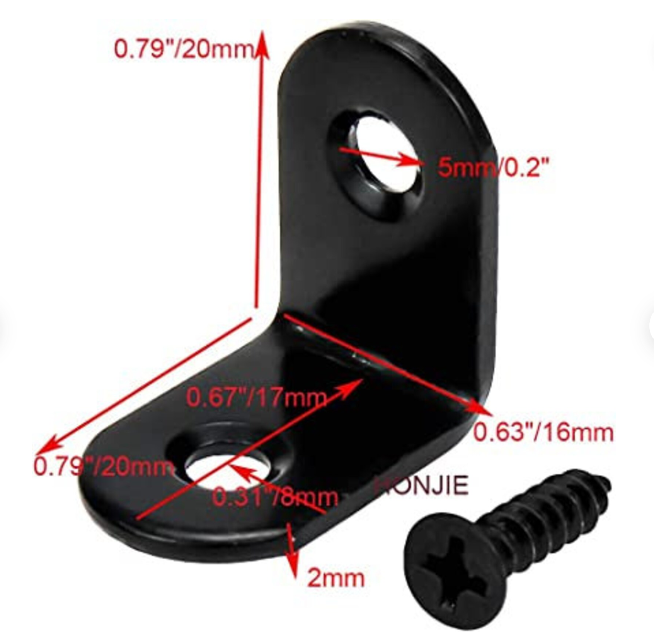
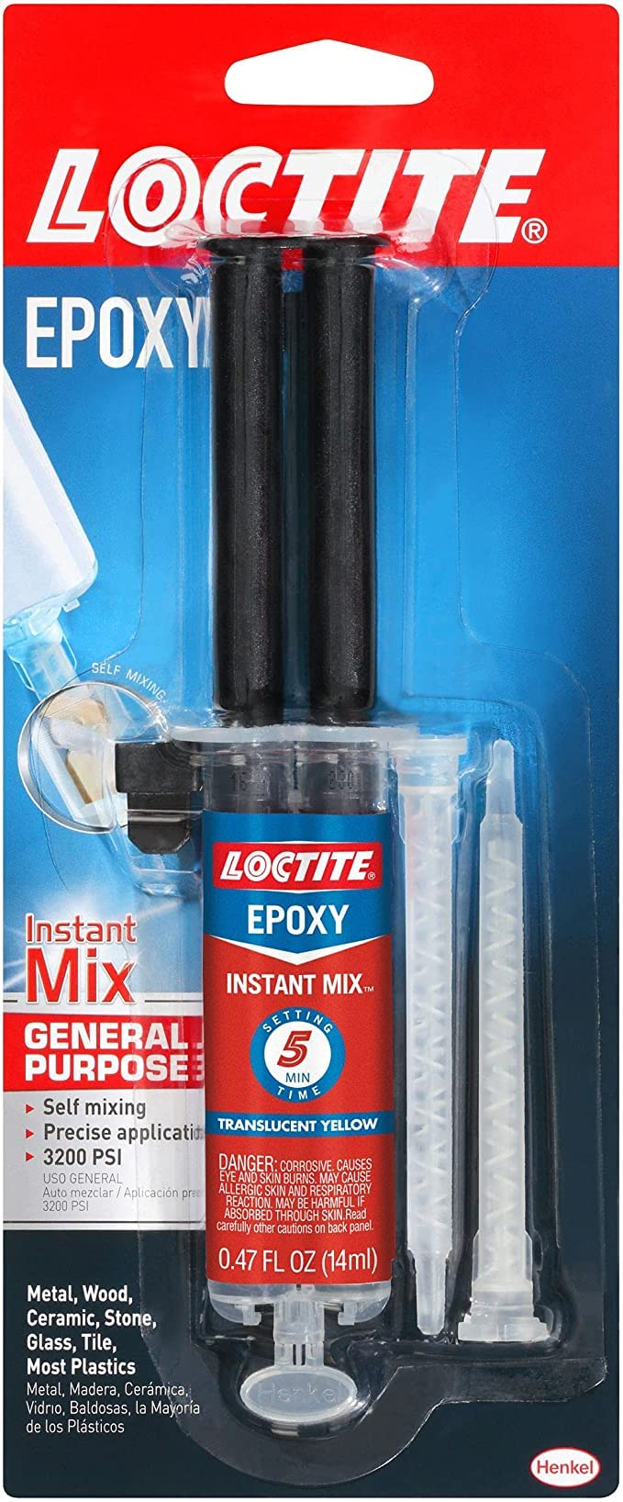
Manufacturing
Purpose
Design Solution
Software
Electronics
Mechanical
Testing
Planning
Notes:
We will be using aluminum tape around edges to block ambient light from entering into the cube
To manufacture the cube and keep alignment under appropriate bounds, we will be securing the LED and photodiode in Loctite epoxy,
This will form a high strength bond that sets in 10-20 minutes
To secure the sides to each other, we will be using four L-brackets on each side of our cube
As one last manufacturing step, we will be spraying the inside of our cube with Vantablack paint, this will absorb 98.2% of the light within the cube

Slide 56
Alignment Tolerances
Governing Equation: Right Triangle
r = Distance between LED and
Photodiode
Photodiode Active Area
1.1x1.1 mm
10 cm
10 cm
Θ = Allowable Viewing Angle
Θ=19°
AM
AM = Allowable Movement, Distance Opposite the Viewing Angle
r=12mm
1.1mm
AM
Θ=19°
1.1mm
AM = 12tan(19°) = 4.13 mm
Purpose
Design Solution
Software
Electronics
Mechanical
Testing
Planning
Notes:
We have determined the tolerance for alignment that is possible for the system that is dictated by the SNR. Using our signal estimation code
We have found that the allowable viewing angle to achieve this SNR is at 19 degrees
We used right triangle equations to calculate the allowable movement for the photodiode and LED, given the viewing angle of our chosen LED
We have reached 4.13 mm as our maximum allowable movement
Alignment concerns have been modelled and verified through accelerometer test in lab that recorded, the worst case vibration
forces were then simulated in ANSYS Simulation software to show that we have a deformation of 10^-9 meter which is well within our bounds

Slide 57
Verification and Validation
Purpose
Design Solution
Software
Electronics
Mechanical
Testing
Planning
Notes:
Begin by debriefing the project description

Slide 58
Mission Objectives
MO-01 | Generate light signal that will simulate expected on-orbit, un-attenuated signal in order to test embedded system (photodiode, signal cond., ADC, microcontroller)
MO-02 | Integrate embedded system design from NanoSAM II (Analog and Digital PCB’s) to collect data with an SNR of 200 or greater
MO-03 | Autonomous control of data collection process through timing that matches predicted orbital data collection windows
MO-04 | Instrument must be appraised of when intensity of light source falls below a threshold
Purpose
Design Solution
Software
Electronics
Mechanical
Testing
Planning
Notes:
In order to validate our design the NanoSAM IV team will need to verify that the system can satisfy the following mission objectives
Firstly, the system needs to generate a response from PD that simulates the expected, on orbit, un-attenuated signal of the current NanoSAM II optics design
The system must collect and digitize the irradiance data at an SNR of 200 or greater
The system’s data collection must be autonomously controlled to match predicted orbital data collection windows
Lastly, the system must be appraised of when light intensity falls below a threshold corresponding to an SNR of 200

Slide 59
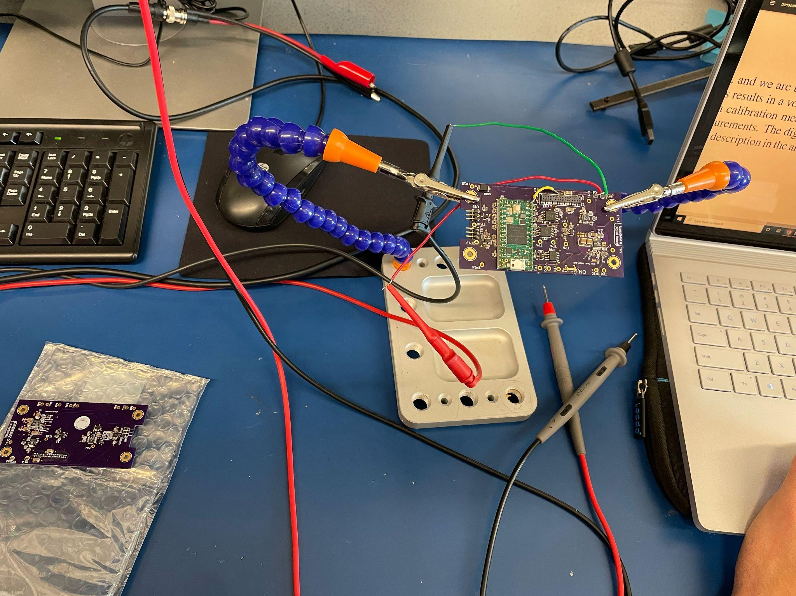
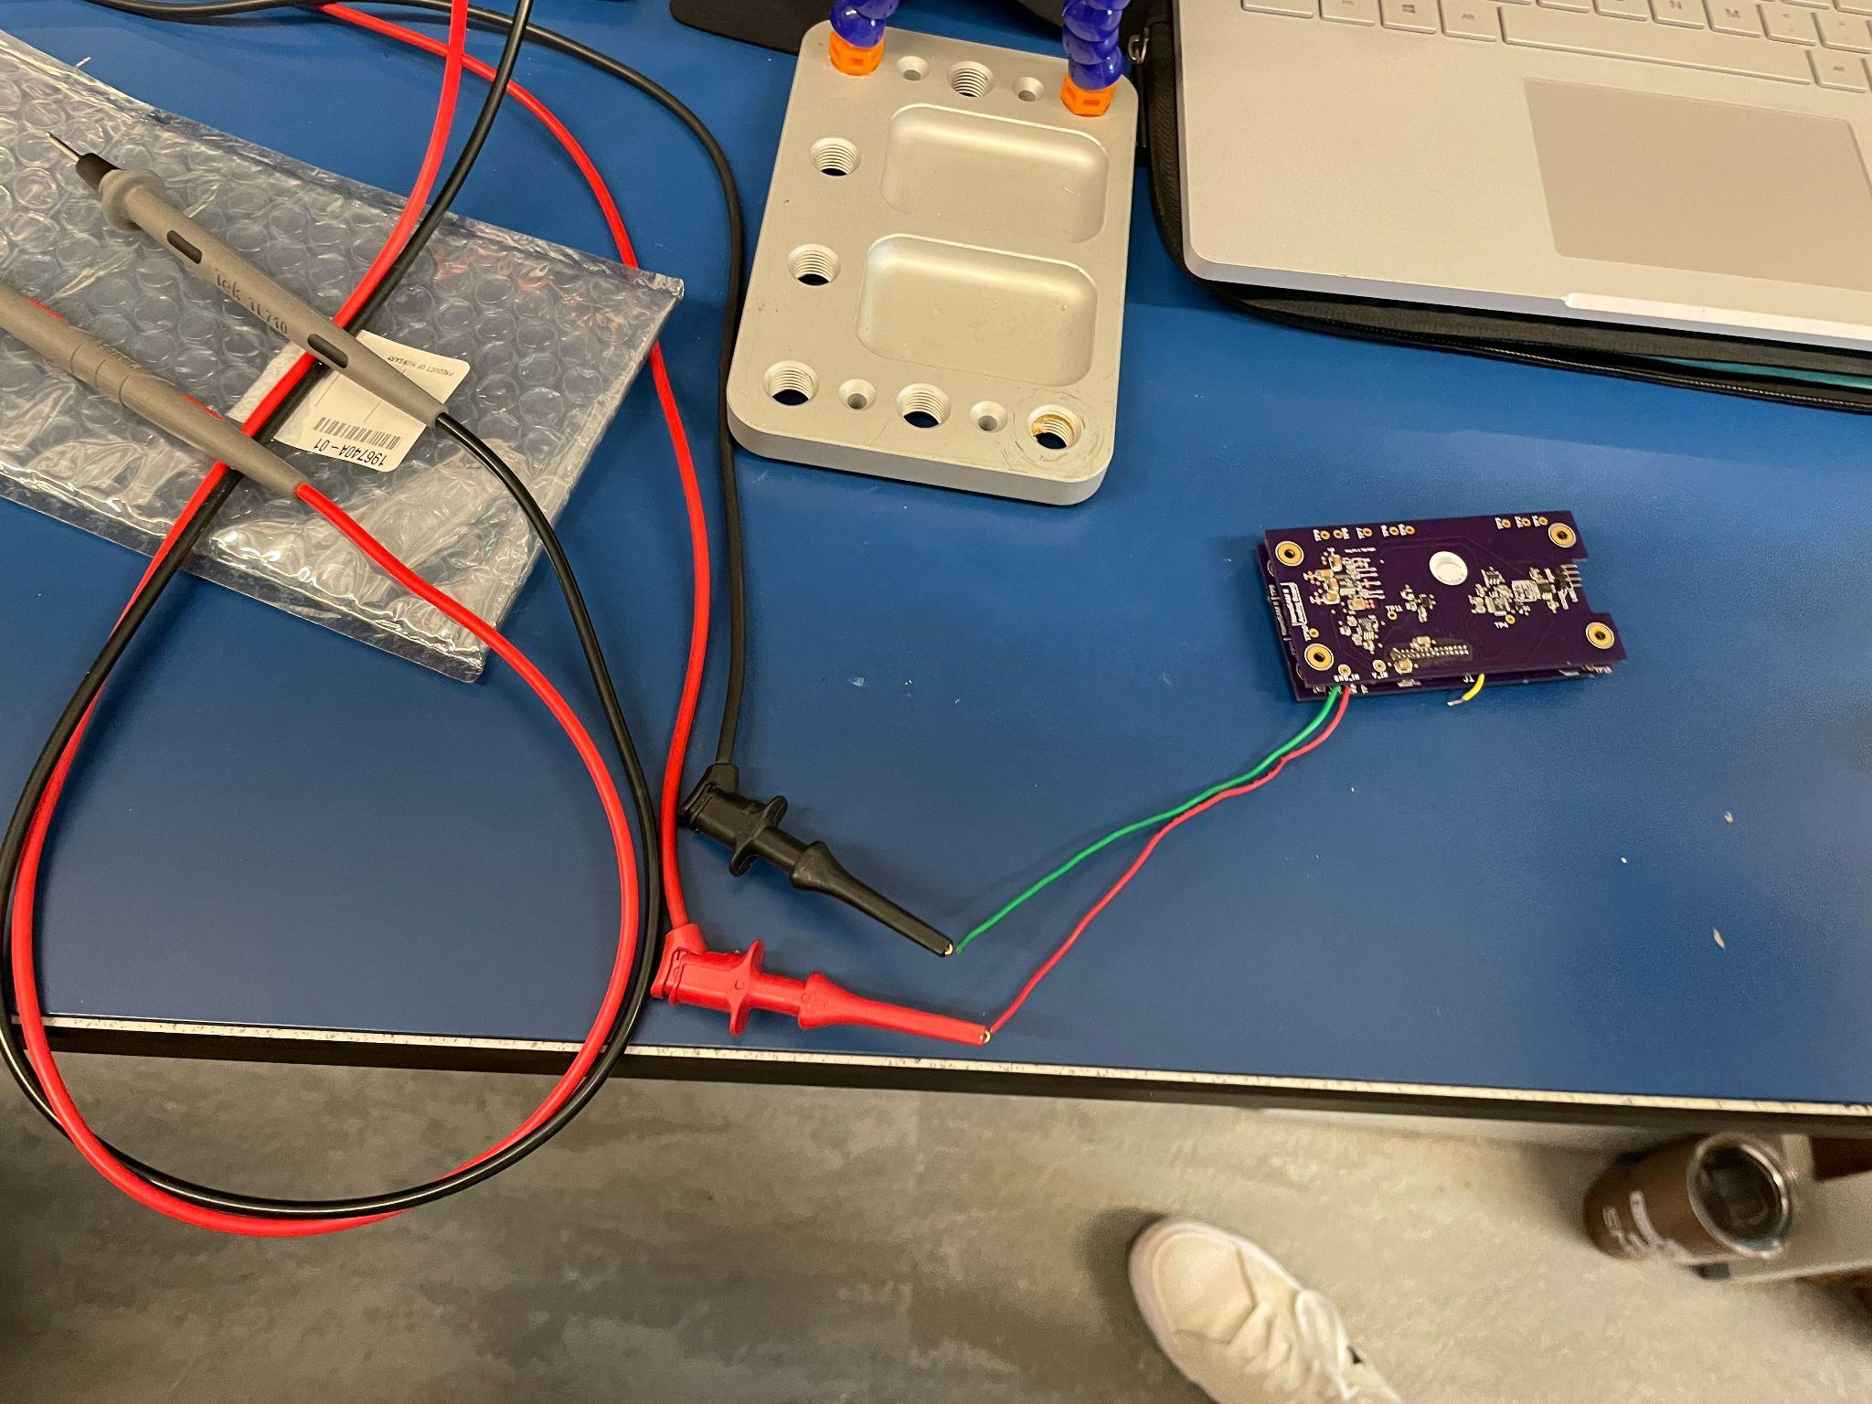
Testing Already Performed
Purpose
Design Solution
Software
Electronics
Mechanical
Testing
Planning
Notes:
The team has begun testing of the NSII PCB’s because they are critical to electronics and software testing
Objective - Verify Functionality of NanoSAM II PCB’s
Results - Microcontroller input voltage was low, due to software errors, which the team has since fixed
Moving Forward - make alterations to board (replace opamp, switch SPI pins) and start working on new rev PCB’s that fix these SPI errors

Slide 60
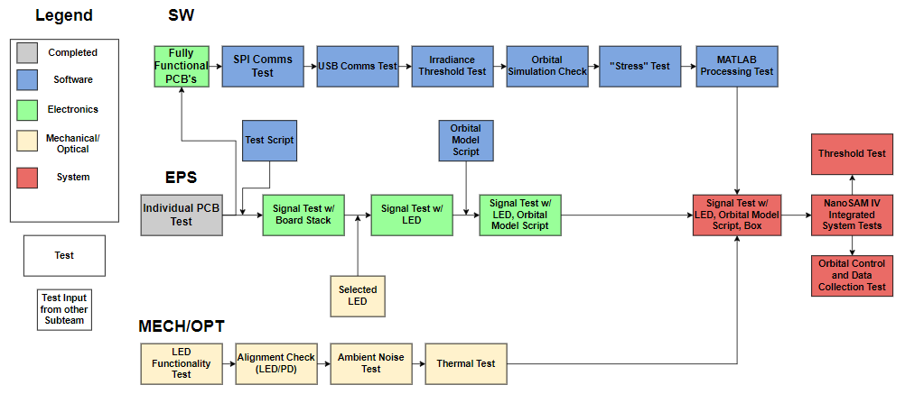
Future Testing Plan
Purpose
Design Solution
Software
Electronics
Mechanical
Testing
Planning
Notes:
In order to work towards achieving our mission objectives, each subteam will semi-independently work through a series of tests and integration tasks to very functional requirements derived from the mission objectives.
After each subteam completes these tests, they will be ready to be integrated into the system

Slide 61
Software Testing Plan
Test Number | Test Objective | Related MO
Test 1 | Verify SPI communications with ADC functions properly | N/A
Test 2 | Verify USB connection functions properly | N/A
Test 3 | Show that irradiance threshold check functions properly | MO-04
Test 4 | Verify position and timing data from orbital model | MO-03
Test 5 | Verify that Teensy can handle multiple orbital testing cycles (data handling and comms) | MO-03
Test 6 | Verify all software has been integrated properly | N/A
Purpose
Design Solution
Software
Electronics
Mechanical
Testing
Planning
Notes:
The software team will verify the functionality of the communications between the ADC and microprocessor as well as the microprocessor and computer
After verifying this functionality, the software team can begin testing features of the software that relate to the mission objectives: being the irradiance threshold, the orbital position and timing data, and that the microprocessor can handle multiple rounds of testing.
Lastly, they will integrate all the code into a single loop and check that it is integrated properly, before being integrated into the system

Slide 62
Electrical Testing Plan
Test Number | Test Objective | Related MO
Test 1 | Verify PCBs are functional | N/A
Test 2 | PCB’s are capable of achieving ≧ 200 SNR | MO-02
Test 3 | LED is capable of producing desired signal | MO-01
Test 4 | Data collection is controlled by orbital model | MO-03
Purpose
Design Solution
Software
Electronics
Mechanical
Testing
Planning
Notes:
The electronics team has tested the NSII PCB’s so that they can conduct data collection tests with them once they are fixed, and also to allow software to verify communications.
Once the boards are fully functional, the electronics team will conduct a series of tests that collect data from the photodiode in order to verify the SNR of the system meets the greater than 200 requirement, as well as verify the system can collect and output this irradiance data at all.
The first signal test will use a power supply in place of the photodiode to simulate the signal before the LED is in our possession
Once we have the LED, we will perform this test again with the photodiode generating the signal this time.
Lastly, once software has verified the orbital model position and timing values are correct, the test will be ran again, this time being autonomously controlled by the orbital model software

Slide 63
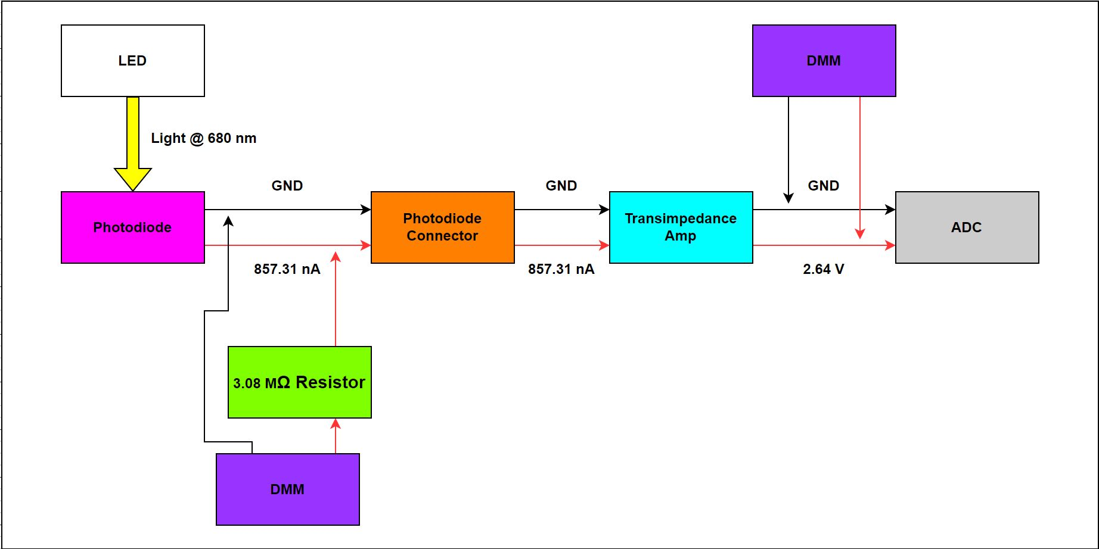
SNR Model Verification
V_{Signal,Digitized,Min}(V)
SNR_{Min} =
V_{Noise,Max}(V)
Equipment: | ESD Wrist Strap, Power Supply, 3.08 MΩ Resistor, Breadboard, Analog Board, DMM
Risk: | ESD, Over-voltage/current
Purpose
Design Solution
Software
Electronics
Mechanical
Testing
Planning
Notes:
An important model the team needs to verify is the SNR modeled by the equation in the bottom right corner of the image above. The model is important to verify because SNR defines how useful the data we collect is.
In order to verify this model, we will perform a data collection test using the LED, PD, and Opamp
While collecting data we will monitor the uncertainty in the voltage output of the opamp as well photodiode
Some risks associated with the test is damaging the electronics by ESD or overvoltaging
To mitigate this this the team will follow a strict procedure to prevent overvoltaging and wear ESD wrsitstrap at all times

Slide 64
Mechanical Testing Plan
Test Number | Test Objective | Related MO
Test 1 | Verify LED functions as expected | N/A
Test 2 | Verify PD and LED are aligned within tolerances to meet ≧ 200 SNR | MO-02
Test 3 | Characterize ambient noise that determines irradiance threshold | MO-04
Test 4 | Verify PD and LED temperatures do not fall outside of tolerances to meet ≧ 200 SNR | MO-02
Purpose
Design Solution
Software
Electronics
Mechanical
Testing
Planning
Notes:
The mechanical team will need to verify that the LED functions as expected
While this is going on they will also be working on fabrication of the LED and photodiode housing
Once fabrication is complete the LED and photodiode will be aligned and attached to the housing
Lastly, they will find the steady state temperature of the LED and Photodiode to ensure that the temp dependent noise doesn’t cause the SNR to fall below 200

Slide 65
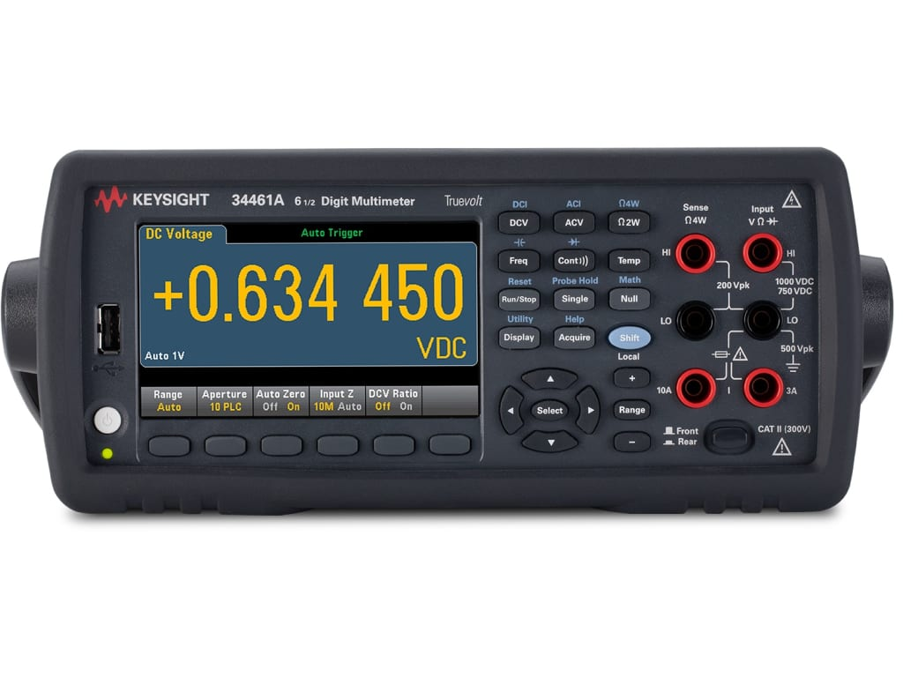
Inverse Square Law Model Verification
Equipment: | LED, LED Power Supply, Testing Box, Photodiode, Photodiode Power Supply, Multimeter, Electrical Boards, Breadboard, 3.08 MΩ Resistor, Supports, Clamp
Risk: | No risk to personnel, Incorrect alignment will impact SNR
Purpose
Design Solution
Software
Electronics
Mechanical
Testing
Planning
Notes:
Another important model to verify of the model that predicts how far the LED must be from the PD as well as how much one can move with respect to the other at that distance in order to induce the desired current of 0.857 uA.
The test will involve hooking the photodiode output pins up to a DMM with a 3.75 Mohm resistor in series similar to the SNR verification test, fixing the LED in place, turning it on, and measuring the photodiode output.
The photodiode will then be adjusted until the DMM shows the correct value for the desired output current, at which point epoxy will be applied to the diode sealing it into place.

Slide 66
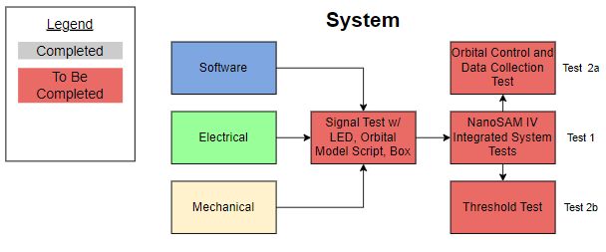
Future Testing Plan
Test 1
Test Number | Test Objective | Related MO
Test 1 | Integrated system capable of collecting desired data controlled by orbital model at SNR ≧ 200 | MO-01,02,03
Test 2a | Collect data for multiple orbital periods with integrated system | MO-03
Test 2b | Demonstrate irradiance threshold check with integrated system | MO-04
Purpose
Design Solution
Software
Electronics
Mechanical
Testing
Planning
Notes:
Once each subsystem has completed their independent testing and integration tasks, the hardware and software will be integrated into the full system to perform final testing that will verify all mission objectives are met
The first test will make sure that the integration process didn’t cause anything to break
The second test will be broken into 2 independent parts that will test the autonomous control of data collection with the integrated system and that the integrated system can detect when the irradiance falls below the 200 SNR equivalent threshold
These tests will provide valuable data for Ball and for future NanoSAM teams, and with the completion of these tests all mission objectives will be satisfied which means we will have achieved mission success.

Slide 67
Planning & Project Management
Purpose
Design Solution
Software
Electronics
Mechanical
Testing
Planning
Notes:
Begin by debriefing the project description

Slide 68
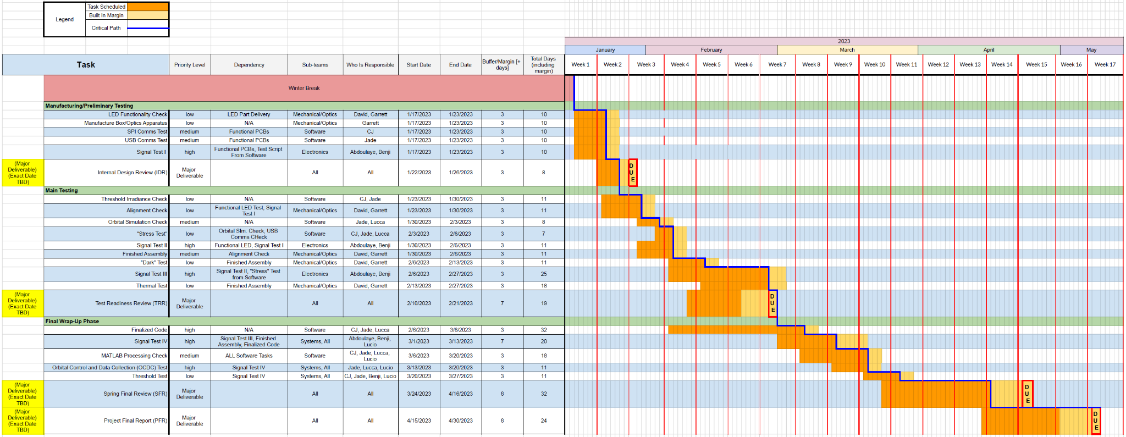
Work Plan/Schedule
Purpose
Design Solution
Software
Electronics
Mechanical
Testing
Planning
Notes:
This shows a big picture view of our Gantt Chart and critical path.
Obviously this graphic is difficult to actually see detail, but we want to illustrate that the team DOES have a schedule in place for the testing that will take place next semester.
NEXT SLIDE

Slide 69
Work Plan/Schedule
Signal Testing (High Risk) = Test Early!
1st Iteration by Jan. 23
Purpose
Design Solution
Software
Electronics
Mechanical
Testing
Planning
Notes:
Our schedule is broken down into greater detail on our end.
This slide is a breakdown for the Manufacturing & Preliminary Testing phase specifically; each of the 3 phases are broken down similarly as backup slides
Since many of the tasks can be completed in parallel, we kept the margins small in an attempt to keep tasks ahead of major deliverables.
CLICK ANIMATION
Before moving forward I want to point out that the functionality of our electronics boards is high risk to the project and drives our critical path to success.
We are attempting to mitigate the risk by testing early and by breaking the testing into a series of 4 total iterations throughout the project.
NEXT SLIDE

Slide 70
Work Plan/Schedule
Higher demand tasks drive the project’s critical path:
Signal (electronics board) separated into 4 shorter iterations
Finalization of code/software occurs over a long period of time
February 6 - March 6
Purpose
Design Solution
Software
Electronics
Mechanical
Testing
Planning
Notes:
The 1st phase “Manufacturing & Preliminary Testing” is a relatively short phase in preparation for Internal Design Review.
The mechanical/optics team will be testing the functionality of the LED/light source while simultaneously having the LED/Photodiode box manufactured.
Software will be testing the USB & SPI comms in parallel.
Electronics focuses on their 1st iteration of signal testing independently.
Notice that we have this first level of testing early; this is because the signal testing is very important to the rest of the project & subteams.
In phase two, we prepare for the Test Readiness deliverable with our “Main Testing”tasks.
Mechanical/Optics will be aligning and finalizing their manufactured assembly from phase one and moving on to a “Dark Test” as well as a Thermal Test.
Software turns their attention to a Threshold Irradiance Check, Orbital Simulation, and a “Stress Check”
Electronics continues with their 2nd & 3rd iterations of Signal Testing
The 3rd and final phase is where we wrap up any loose ends in preparation for the SFR & PFR deliverables.
Software will be finalizing their code as well as doing a MATLAB processing check. They will also work with the Systems Engineer to integrate their Orbital Model & Data Collection.
Electronics will work very closely with the team Systems Engineer to complete the 4th and final iteration of signal testing.
We expect that during this phase it may be necessary to move people from other sub-teams to reallocate help where it is needed.
Each of these phases are broken into individual backup slides with greater detail if anyone wishes to see them broken down more clearly during Q&A.
NEXT SLIDE
Mention critical path
A lot of our tasks depend on the electronics Boards being be functional. The critical path is strongly dependent on getting a signal (even a simulated signal)
Really relies on getting a reliable signal to pass through our boards
Whats risky: making sure boards are functional, signal conditioning
**try to spend like 2 minutes total on my section

Slide 71
Risk Matrix
 | Insignificant | Negligible | Moderate | Extensive | Significant
Near Certain |  |  |  |  | Previous electronic boards do not function properly
Likely
Possible |  |  | Photodiode temp changes (affects SNR) | Disfunctional or unresolvable software/code
Unlikely |  |  | Computational cost of orbit propagation is too long
Improbable |  |  | USB communication with Teensy is too slow | Structure fails due to vibration in testing environment
Previous electronic boards do not function properly
Disfunctional or unresolvable software/code
Purpose
Design Solution
Software
Electronics
Mechanical
Testing
Planning
Notes:
Our risk matrix depicts that the functionality of the board is a high risk with significant impact to the outcome of the project.
The functionality of the code is also weighted to have a high impact.
CLICK ANIMATION
The team anticipates that the boards’ risk will be reduced by swapping new components into the old boards while at the same time having new boards manufactured with minor adjustments.
Testing the boards over 4 separate iterations should also help to aid the electronics team in mitigating unforeseen issues.
The software team has been scheduled for an entire month dedicated to finalizing & debugging their code, which should help reduce the possibility of detrimental failure.
Now I’ll hand things over to Benji to finish up with our Financial Cost Plan.

Slide 72
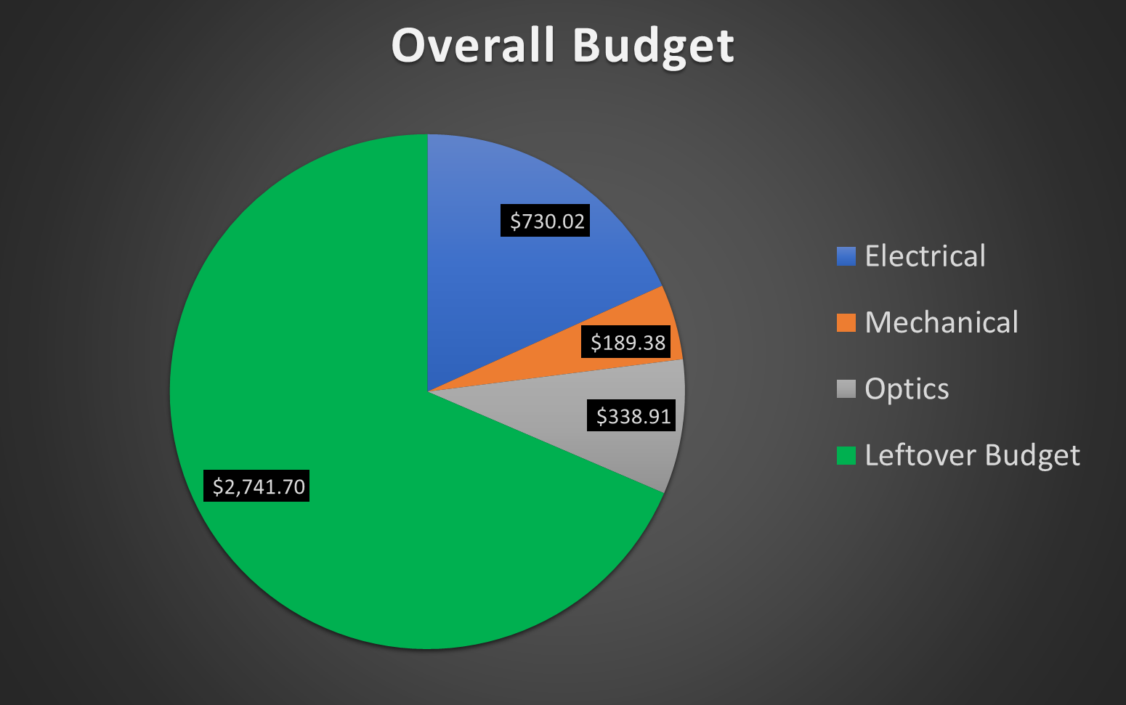
Finances
Purpose
Design Solution
Software
Electronics
Mechanical
Testing
Planning
Notes:
The electronics team will be spending around 730 dollars purchasing 3 times the electrical components, and will be able to replace all components on the boards, and light source circuit.
The mechanical team will will use around 189 dollars, for the inhouse mechanical construction of the whole project.
The optics team will be us around 338 dollars on the purchasing of the LED, and required cables to power it.
Looking at a left over budget of 2741 dollars that allows the team to expedite shipping if required to buy new parts on the fly
We will also have the budget to outsource the population of the electronics boards, mitigating electronics manufacturing risks.
With a budget utilization of around 32% the team is confident that we will not be financially constrained and will have room to outsource manufacturing and expedite shipping if necessary, and all of the parts are available and ready for shipment

Slide 73
Questions?
Notes:
Begin by debriefing the project description

Slide 74
Backup Slides
Notes:
Begin by debriefing the project description

Slide 75
Project Purpose & Objectives
Backup
Purpose & Objective
Purpose
Design Solution
Design Solution
Software
Software
Electronics
Electronics
Mechanical
Verification/Validation
Testing
Planning
Planning
Notes:
Begin by debriefing the project description

Slide 76
Design Solution
Backup
Purpose & Objective
Purpose
Design Solution
Design Solution
Software
Software
Electronics
Electronics
Mechanical
Verification/Validation
Testing
Planning
Planning
Notes:
Begin by debriefing the project description

Slide 77
Software
Backup
Purpose & Objective
Purpose
Design Solution
Design Solution
Software
Software
Electronics
Electronics
Mechanical
Verification/Validation
Testing
Planning
Planning
Notes:
Begin by debriefing the project description

Slide 78
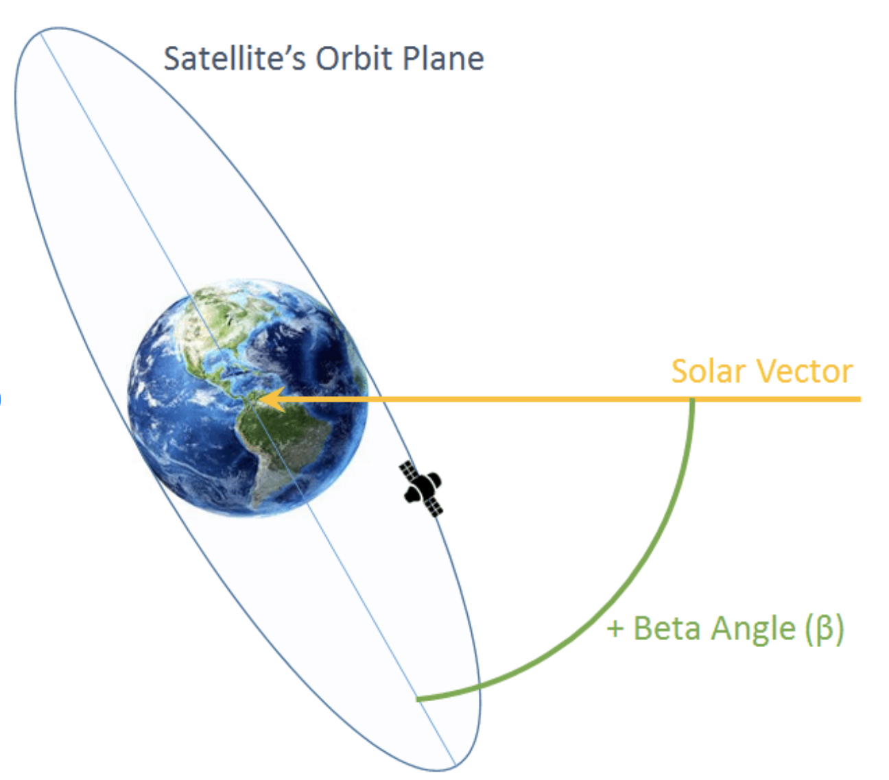
Beta Angle Definition
NanoSAM on Orbit
Purpose & Objective
Purpose
Design Solution
Design Solution
Software
Software
Electronics
Electronics
Mechanical
Verification/Validation
Testing
Planning
Planning
Notes:
Begin by debriefing the project description

Slide 79
Beta = 0 Case: Sun Vector in Orbit Plane
NanoSAM on Orbit
Purpose & Objective
Purpose
Design Solution
Design Solution
Software
Software
Electronics
Electronics
Mechanical
Verification/Validation
Testing
Planning
Planning
Notes:
Begin by debriefing the project description

Slide 80
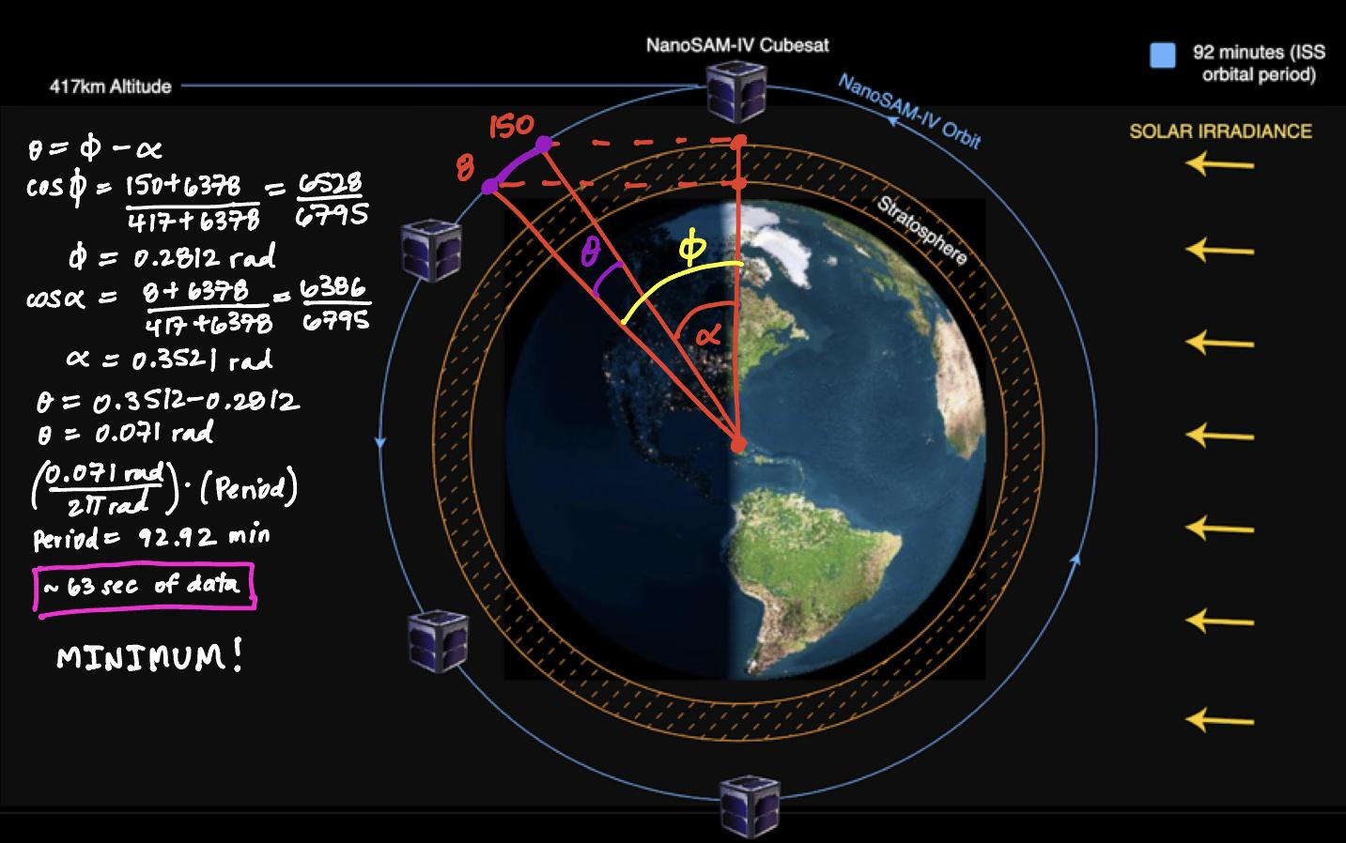
Beta = 0 Case: Sun Vector in Orbit Plane
NanoSAM on Orbit
Purpose & Objective
Purpose
Design Solution
Design Solution
Software
Software
Electronics
Electronics
Mechanical
Verification/Validation
Testing
Planning
Planning
Notes:
Begin by debriefing the project description

Slide 81
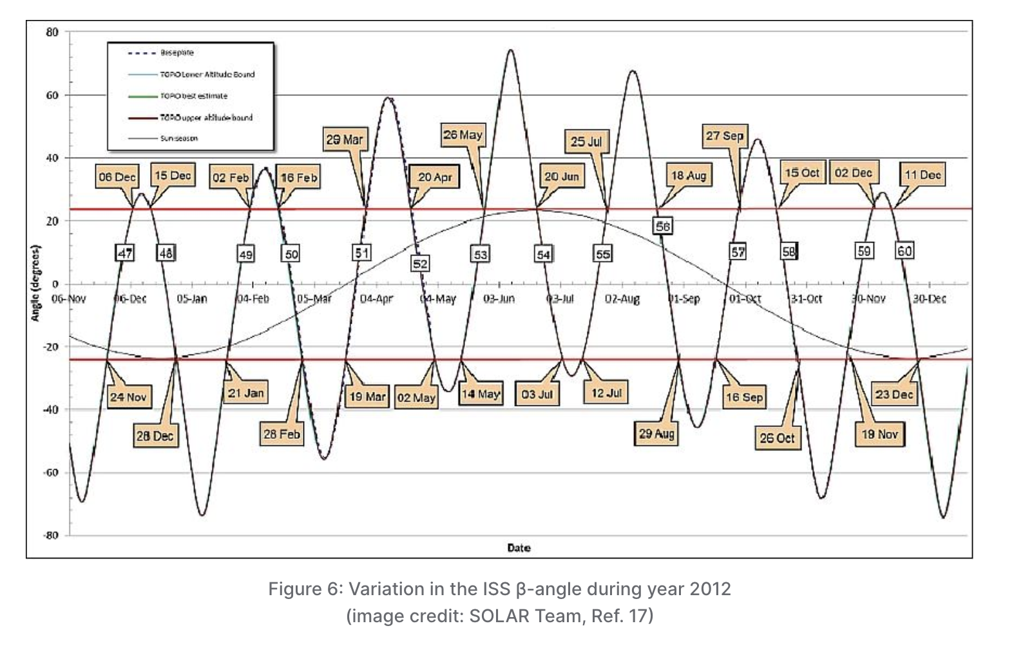
ISS Beta Angle Over 1 Year
Beta Angle: +/- 75.1 over the course of a year (+/-51.6 +/- 23.5 deg)
Orbit Precession: ~50 days
NanoSAM on Orbit
https://www.eoportal.org/satellite-missions/iss-solar#solar-solar-monitoring-observatory-sovim-solspec-solaces
Purpose & Objective
Purpose
Design Solution
Design Solution
Software
Software
Electronics
Electronics
Mechanical
Verification/Validation
Testing
Planning
Planning
Notes:
Begin by debriefing the project description

Slide 82
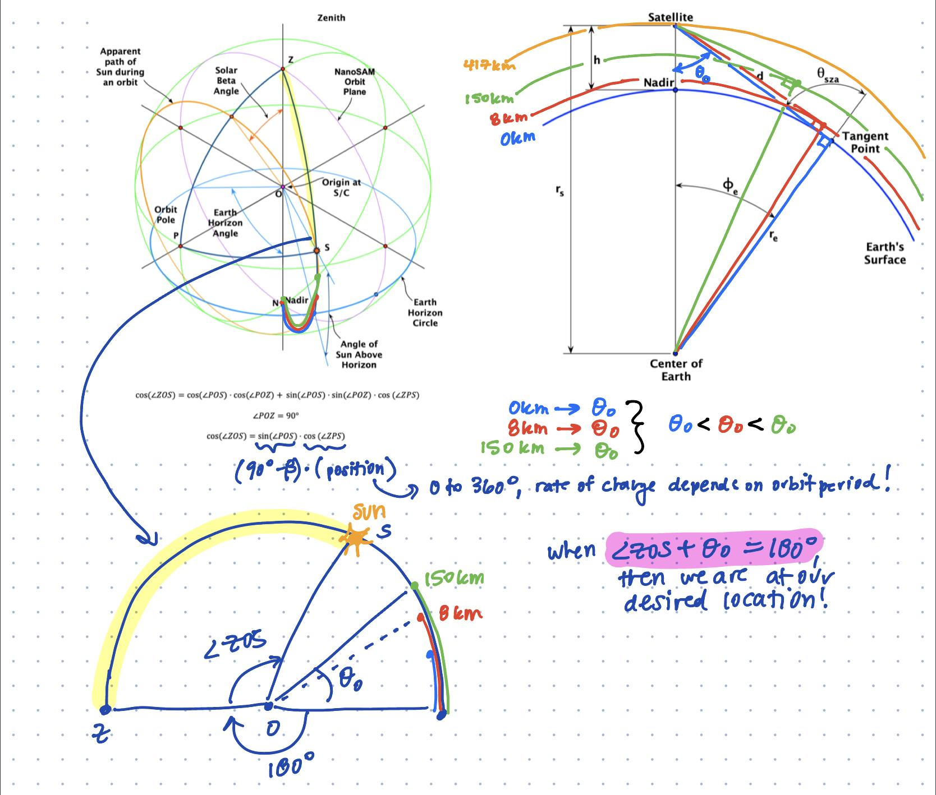
Finding Tangential Altitude for Beta ≠ 0
NanoSAM on Orbit
Purpose & Objective
Purpose
Design Solution
Design Solution
Software
Software
Electronics
Electronics
Mechanical
Verification/Validation
Testing
Planning
Planning
Notes:
Begin by debriefing the project description

Slide 83
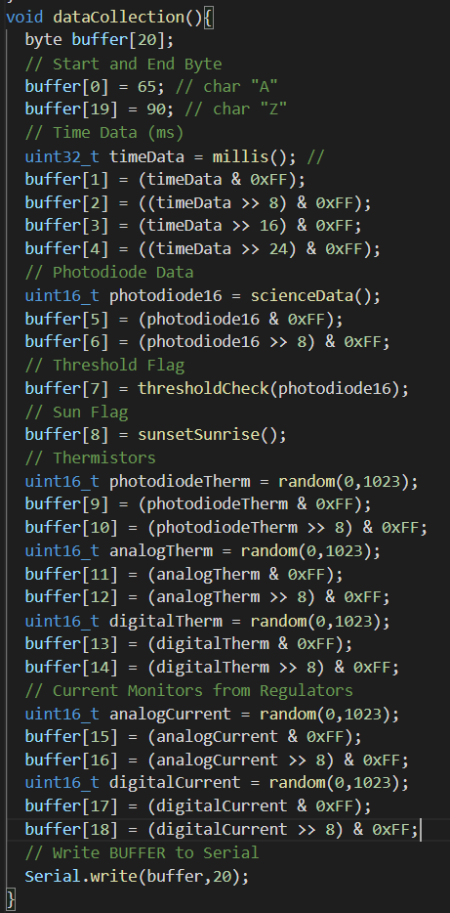
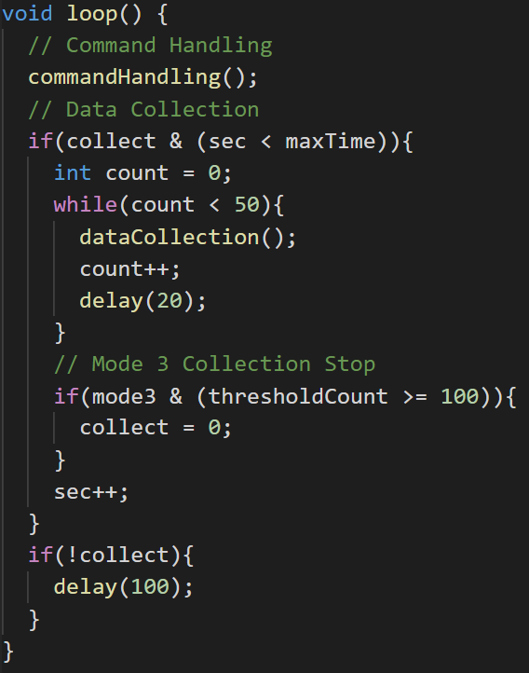
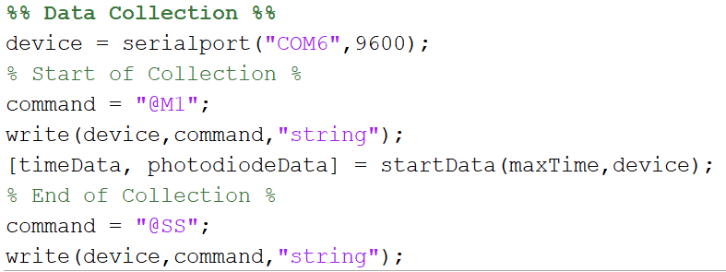
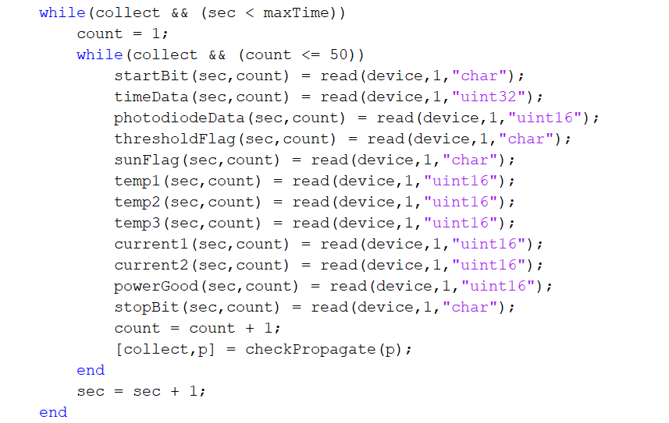
Preliminary USB Teensy Test
Teensy:
MATLAB:
0.5% Flash Memory
7.2% RAM1
2.41% RAM2
Purpose
Design Solution
Software
Electronics
Mechanical
Testing
Planning
Notes:
Teensy Usage:
0.5% Flash Memory Used
7.2% RAM1 Used
2.41% RAM2 Used

Slide 84
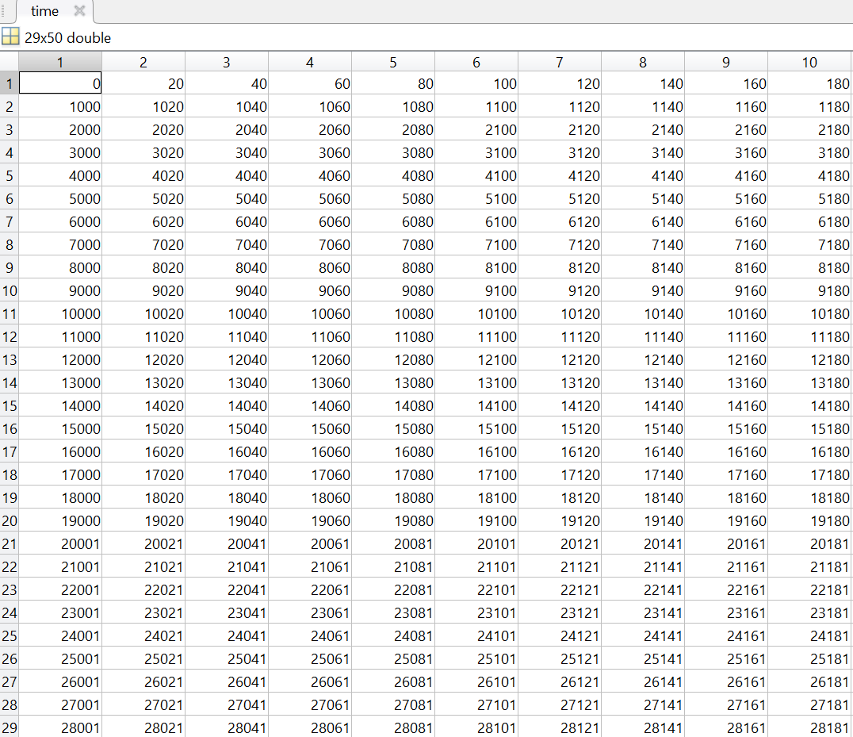
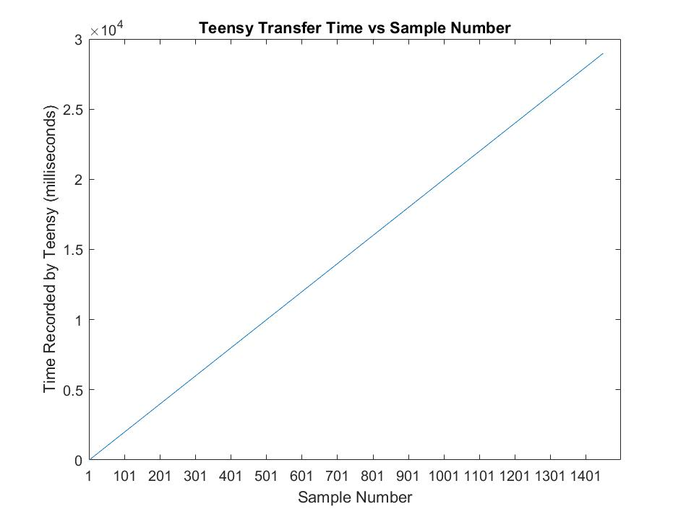
Preliminary USB Teensy Test
Purpose
Design Solution
Software
Electronics
Mechanical
Testing
Planning
Notes:
Begin by debriefing the project description

Slide 85
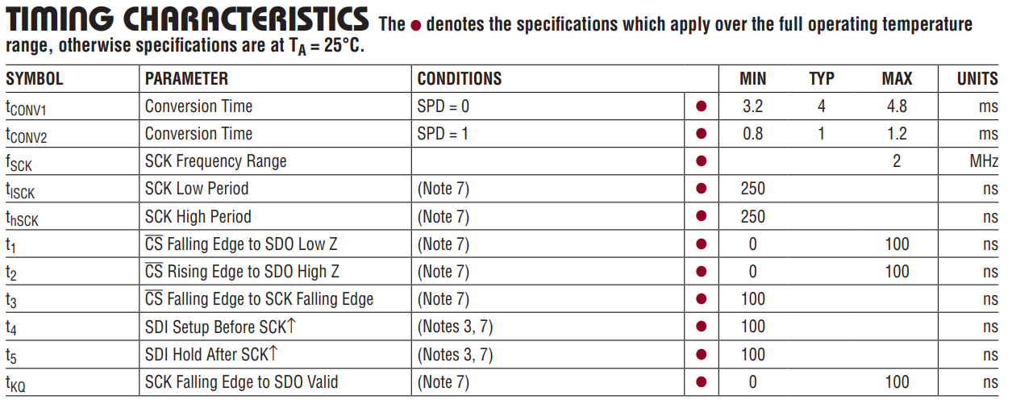
Teensy Timing Testing
and Estimation
~120 ns (invalid cmd)
~290 ns (valid cmd)
~117 ns (no serial read)
~5 ns
~4 ns + SPI Time
~0.102 ms
~700 ns
Command Handling
Time
Science Data
Housekeeping Data
Data Buffering
and Sending
Delay
0.1021 ms (w/o SPI)
Estimated Data Loop Time:
~0.12 ms
Estimated Delay:
delay(19); // milliseconds
delayMicroseconds(880);
Estimated SPI Time
Send: t₁+ 16t_{lSCK}+ 16t_{hSCK} + t₂ = 0.0082 ms
Receive: t₁+ 16t_{lSCK}+ 16t_{hSCK} + t₂ = 0.0082 ms
Purpose
Design Solution
Software
Electronics
Mechanical
Testing
Planning
Notes:
Timed 1000000 Iterations for Each Block
Calculated Average Runtime
Determine Data Loop Time
Still Need to Time SPI Sample

Slide 86
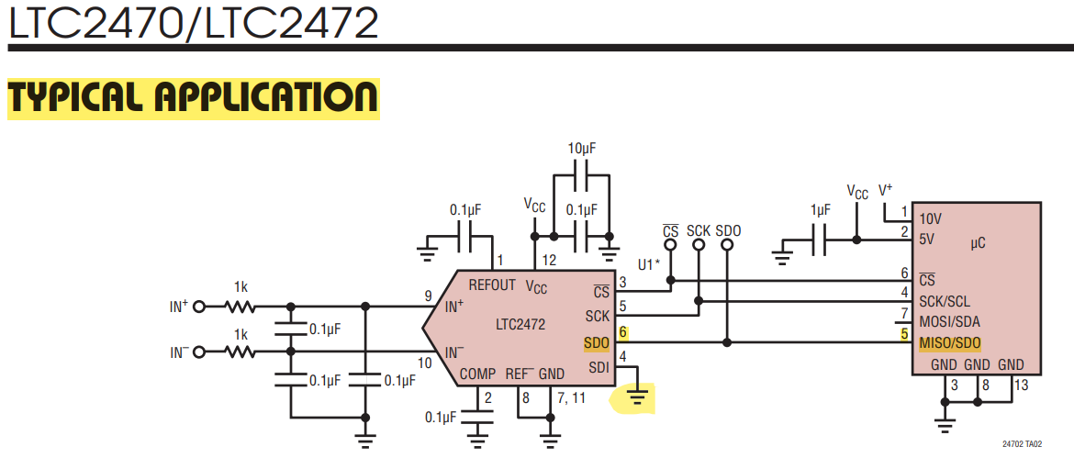
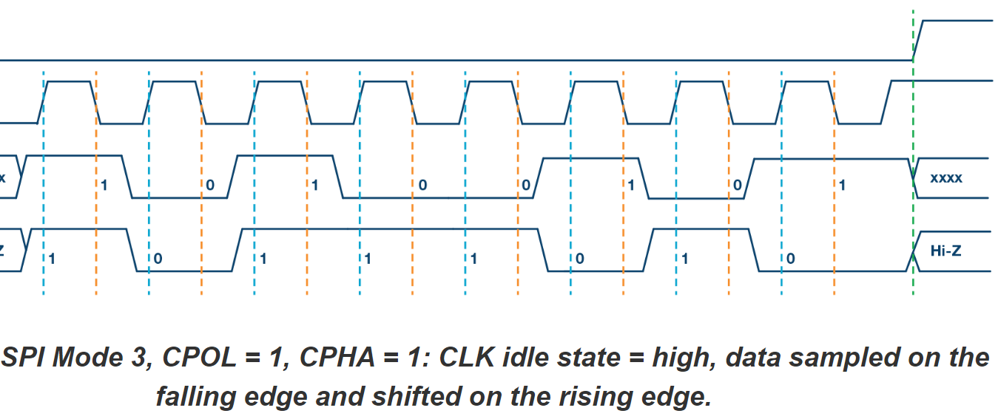
SPI Communications
uint16_t scienceData() {
SPI.begin();
pinMode(ADC_CS, OUTPUT);
uint16_t photodiode16;
SPI.beginTransaction(SPISettings(ADC_MAX_SPEED, MSBFIRST, SPI_MODE3));
digitalWrite(ADC_CS, LOW);
photodiode16 = SPI.transfer16(0x0000);
digitalWrite(ADC_CS, HIGH);
SPI.endTransaction();
SPI.end();
return photodiode16;
}
SPI:
3 Pin Max Sampling Rate: 208 samples/second
ADC Max Speed = 2 MHz
MSB First
CPOL = 1 (Idle High)
Purpose
Design Solution
Software
Electronics
Mechanical
Testing
Planning

Slide 87
Electronics
Backup
Purpose & Objective
Purpose
Design Solution
Design Solution
Software
Software
Electronics
Electronics
Mechanical
Verification/Validation
Testing
Planning
Planning
Notes:
Begin by debriefing the project description

Slide 88
Electrical & Optical Requirements
SHow the system and two things we have to do
Light source circuit (We have to model the response of the photodiode to a selected light source and that model will yield an expected power incident on the photodiode driving a current similar to that of what it would be on orbit
Revise nanosam-2 Previous NS2 board need to be tuned to change the gains of the op-Amp as NS2 had different power expected
Purpose
Design Solution
Software
Electronics
Mechanical
Testing
Planning
Notes:
Begin by debriefing the project description

Slide 89
Electrical & Optical Requirements
Light source must resemble “SAM II” signal
This means that the current from the photodiode, when exposed to the light source, should be 8.57*10^-7 A with a low of 5.33 *10 ^-8 A and a high of 1.07 *10^-6 A (customer requirement)
Light Source must be radiometrically stable and within the visible spectrum
Can not vary intensity incident on the photodiode outside of acceptable and +/- 1*10^-6 Optical W
Embedded System must achieve SNR of NanoSAM II (200) or greater
Embedded System = {Light Source, Photodiode, Signal Conditioning, ADC}
Payload must stay under 8 W power usage
Notes:
Begin by debriefing the project description

Slide 90
Electrical & Optical FBD
Notes:
Begin by debriefing the project description

Slide 91
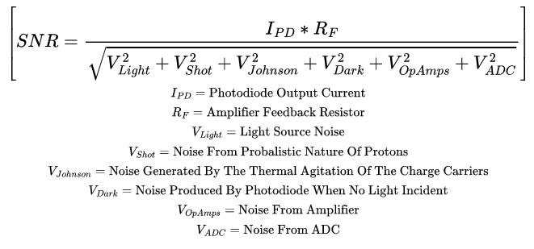
SNR Equation
Notes:
Write actual noise values, and define what I_pd is, and how the feedback resistor was sized.

Slide 92
SNR Equation
V_{Signal}
Notes:
Write actual noise values, and define what I_pd is, and how the feedback resistor was sized.

Slide 93
SNR Equation
V_{Signal}(V)
SNR =
V_{Noise}(V)
V_{Signal} = I_{PD}R_{F}
I_{PD} = R W_{Incident} = 0.857 (µA) (SAM II)
R = 0.451(Light Source and Temp)
W_{Incident} = 1.90 (µW) (Light Source)
R_{F} = (Constant) = 3.75 (MΩ)
Notes:
Write actual noise values, and define what I_pd is, and how the feedback resistor was sized.

Slide 94
SNR Equation
V_{Signal,Digitized} = R W_{Incident}R_{F} (V)
SNR =
V_{Noise}(V)
I_{PD} = R W_{Incident} = 0.857 (µA)
R = 0.451 (680 nm @ 20.5 +/- 5 C)
W_{Incident} = 1.90 (µW)
R_{F} = 3.75 (MΩ)
V_{Noise} = 2.16*10⁻⁴ (V)
SNR = 3231
Temperature:
20.5 +/- 5 C
Notes:
Write actual noise values, and define what I_pd is, and how the feedback resistor was sized.

Slide 95
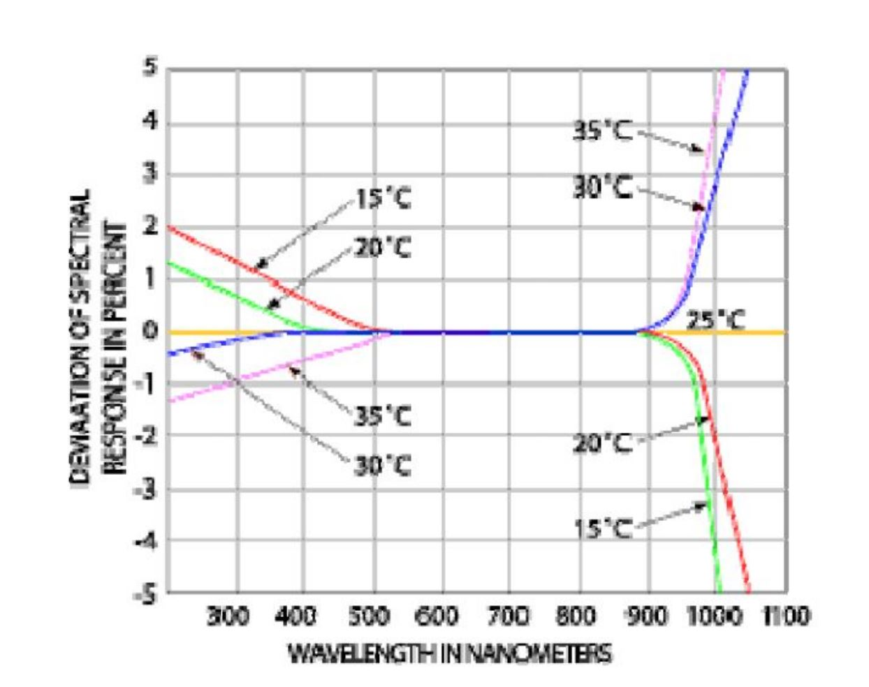
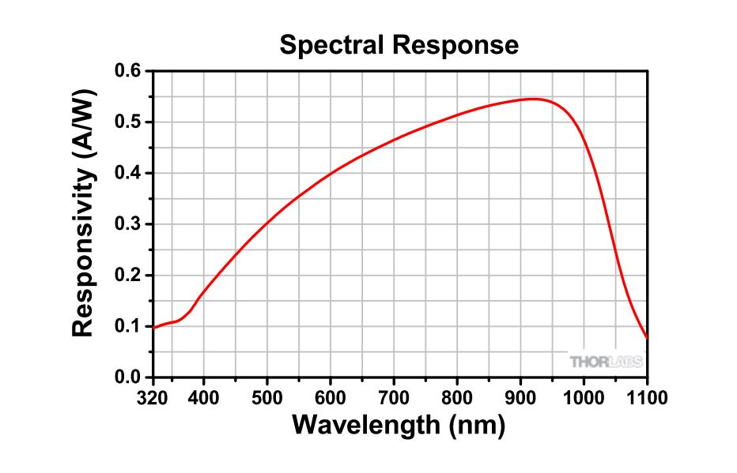
Photodiode Response
600-700 nm = optimal range
Choose wavelength close to 700 nm – best responsivity within visible regime and no temp. dependence!
0.45
680
Notes:
Begin by debriefing the project description

Slide 96
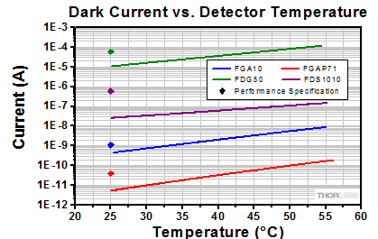
Photodiode Thermal Dependance
Notes:
Begin by debriefing the project description

Slide 97
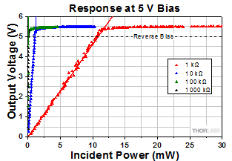
Photodiode Saturation
Notes:
Begin by debriefing the project description

Slide 98
LED Trade
Critical functionality: Nominal LED wavelength should be 700[nm] +/- 5[nm].
Metric | Weight | Driving requirements | Rationale
Spectrum | 0.3 | OPT-02.01 | Light emitted by the LED will be visible during experiments
Temperature dependence | 0.3 | OPT-01.02, OPT-02 | Reduce fluctuations in the photocurrent
Viewing angle | 0.2 | OPT-01 | Limit the ricochet of LED light in the optic apparatus
Cost | 0.05 | Finances | Maximize cost-efficiency
Purpose
Design Solution
Software
Electronics
Mechanical
Testing
Planning
Notes:
Begin by debriefing the project description

Slide 99
Linear Voltage Regulator Trade
Critical functionality: Deliver up to 600[mA] of output current at 2.5[V].
Metric | Weight | Rationale
Power Supply Ripple Rejection (PSSR) | 0.9 | Reject ripple coming from the power-supply input at various frequencies
Cost | 0.1 | Maximize cost-efficiency
Selected Linear Voltage Regulator: TLV767
PSSR | 70[dB] at 1kHz
Cost | $0.92
Purpose
Design Solution
Software
Electronics
Mechanical
Testing
Planning
Notes:
Begin by debriefing the project description

Slide 100
LED Trade Flowdown
Mounted LED
Lower Temperature Dependence
Warm visible
Spectrum range: [590-730] nm
M680L4
Selected LED
Peak wavelength at 680[nm]
Viewing angle | 18 [degrees]
Cost | $225.94
Purpose
Design Solution
Software
Electronics
Mechanical
Testing
Planning
Notes:
Begin by debriefing the project description

Slide 101
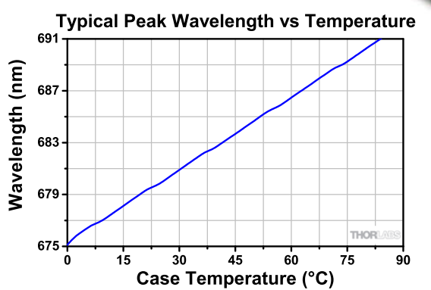
LED Temperature Response
Spectrum range: [590-730] nm
Temperature Dependence
Peak wavelength at 680[nm]
Purpose
Design Solution
Software
Electronics
Mechanical
Testing
Planning
Notes:
Begin by debriefing the project description

Slide 102
LED Power Input Response
Optical Power Output = 0.18*V_Input*I_Input
Purpose
Design Solution
Software
Electronics
Mechanical
Testing
Planning
Notes:
Begin by debriefing the project description

Slide 103
Overall electrical FBD
Purpose
Design Solution
Software
Electronics
Mechanical
Testing
Planning
Notes:
Begin by debriefing the project description

Slide 104
Analog Board (½)
Notes:
Begin by debriefing the project description

Slide 105
Analog Board (2/2)
Notes:
Begin by debriefing the project description

Slide 106
Digital Board (½)
Notes:
Begin by debriefing the project description

Slide 107
Digital Board (2/2)
Notes:
Begin by debriefing the project description

Slide 108
NanoSAM-II PCB Design
Analog Board
Digital Board
Notes:
Begin by debriefing the project description

Slide 109
Design Space
Metric | Lower bound | Desired value | Upper bound
Signal voltage [V] | 0.1642 | 2.64 | 3.3
SNR | 201 | 3232.1 | 4040.2
Photocurrent [A] | 5.33e-08 | 8.57e-07 | 1.07e-06
Light incident power [W] | 1.18e-07 | 1.9e-06 | 2.38e-06
Metric | Value
Feedback resistor [Mohm] | 3.080513
ADC Reference voltage [V] | 3.3
Purpose
Design Solution
Software
Electronics
Mechanical
Testing
Planning

Slide 110
Design Space Flowdown
ADC reference voltage of 3.3 [V]
80% of ADC reference voltage
Signal voltage bounds
1
Performance requirements provided by customer
SNR bounds
2
Purpose
Design Solution
Software
Electronics
Mechanical
Testing
Planning

Slide 111
Design Space Flowdown (cont.)
Photocurrent bounds
3
Incident Light Power bounds
4
Purpose
Design Solution
Software
Electronics
Mechanical
Testing
Planning

Slide 112
Power Budget
Notes:
Don’t say emulate the orbit, talk about filtering, it is not connected to the orbit

Slide 113
How Electronics Boards Work
Show boards and label individual components.
Narrate how the boards work
Include both/all boards (maybe on two separate slides)
Equations used (maybe a different slide)
Purpose
Design Solution
Software
Electronics
Mechanical
Testing
Planning
Notes:
Begin by debriefing the project description

Slide 114
How Electronics Boards Work
Answer the question of how these boards achieve our goals and why we are using them
SNR modeling, sensitivity analysis, thermal, etc.
Show flow of current from photodiode to boards, introduce the photodiode in context of larger NanoSAM 4 embedded system
Photodiode must give us an analog signal to be digitized
Discuss photodiode, show how it achieves our goals
This is where photodiode signal requirement will come in
Purpose
Design Solution
Software
Electronics
Mechanical
Testing
Planning
Notes:
Begin by debriefing the project description

Slide 115
Mechanical
Backup
Purpose & Objective
Purpose
Design Solution
Design Solution
Software
Software
Electronics
Electronics
Mechanical
Verification/Validation
Testing
Planning
Planning
Notes:
Begin by debriefing the project description

Slide 116
Mechanical
Backup
Purpose & Objective
Purpose
Design Solution
Design Solution
Software
Software
Electronics
Electronics
Mechanical
Verification/Validation
Testing
Planning
Planning
Notes:
Begin by debriefing the project description

Slide 117
Mechanical
Backup
Purpose & Objective
Purpose
Design Solution
Design Solution
Software
Software
Electronics
Electronics
Mechanical
Verification/Validation
Testing
Planning
Planning
Notes:
Begin by debriefing the project description

Slide 118
Mechanical
Backup
Purpose & Objective
Purpose
Design Solution
Design Solution
Software
Software
Electronics
Electronics
Mechanical
Verification/Validation
Testing
Planning
Planning
Notes:
Begin by debriefing the project description

Slide 119
Thermal Verification
Governing Equation: Radiation Heat Transfer Equation solved for time
Assumptions:
Q_rad produces the anticipated energy output on provided spec sheet (ThorLabs)
Photodiode active area with absorptivity of 𝛼 = 0.65
Derived change in time and solved to achieve the time until the photodiode will reach a heat of 25.5℃
Time to Heat = ̴66 Minutes continuous operation
Purpose & Objective
Purpose
Design Solution
Design Solution
Software
Software
Electronics
Electronics
Mechanical
Verification/Validation
Testing
Planning
Planning
Notes:
Are able to assume LED as a blackbody because LED’s

Slide 120
Light Intensity Calculations
The Inverse Square Law:
Purpose
Design Solution
Software
Electronics
Mechanical
Testing
Planning
Notes:
To satisfy our optical requirement for the signal to noise ratio, there is a range of incident power that needs to be seen by the photodiode
To determine this we used the Inverse square law as our first governing equation
Where I, W/mm^2, is the intensity of the light at a certain distance r, mm, and source power S,Watts.
42.5(?)
To calculate the power the LED outputs we used Power = Current*Voltage as our second governing equation
Where V is voltage in Watts, and I is current in Amps

Slide 121
On-orbit Signal Calculations
Purpose & Objective
Purpose
Design Solution
Design Solution
Software
Software
Electronics
Electronics
Mechanical
Verification/Validation
Testing
Planning
Planning
Notes:
Begin by debriefing the project description

Slide 122
Photodiode
P = I_0*(I_1*dA_1 + I_2*dA_2 +...+ I_n*dA_n)
Output Current = P/Response
dA
I_…
I_1
I_2
I_3
I_n
Active Area
Purpose
Design Solution
Software
Electronics
Mechanical
Testing
Planning

Slide 123
Verification & Validation
Backup
Purpose & Objective
Purpose
Design Solution
Design Solution
Software
Software
Electronics
Electronics
Mechanical
Verification/Validation
Testing
Planning
Planning
Notes:
Begin by debriefing the project description

Slide 124
Test Name: | Alignment Test
Subteam: | Mechanical
Test Objectives:
Insure the LED and Photodiode are aligned
Requirements Test Will Satisfy: | Description:
MECH-01 | The relative position of the light source and photodiode can not fluctuate more than - 0.8 mm and + 35mm in distance, and 4.13mm in vertical alignment
Equipment and Training Needed:
Equipment:
LED, LED power supply, Testing box, Photodiode, Photodiode power supply, multimeter
Training:
Risks:
No safety risks to personnel, improper alignment will affect SNR
Expected Results: | Actual Results:
The proper current signal of 0.857 uA
Purpose & Objective
Purpose
Design Solution
Design Solution
Software
Software
Electronics
Electronics
Mechanical
Verification/Validation
Testing
Planning
Planning

Slide 125
Test Name: | Ambient Noise Test
Subteam: | Mechanical
Test Objectives:
Show that Test box is sufficiently closed and external ambient light does not affect output signal from photodiode
Requirements Test Will Satisfy: | Description:
OPT-01.01 | The current that the photodiode produces can not exceed the bounds of 0.0533 - 1.07 μA
Equipment and Training Needed:
Equipment:
LED, Testing box, Photodiode, Photodiode power supply, multimeter
Training:
Risks:
No safety risks to personnel, to much ambient noise will affect the signal and thus the SNR
Expected Results: | Actual Results:
Dark Current of 1.00*10^-9 A
Purpose & Objective
Purpose
Design Solution
Design Solution
Software
Software
Electronics
Electronics
Mechanical
Verification/Validation
Testing
Planning
Planning

Slide 126
Planning & Project Management
Backup
Purpose & Objective
Purpose
Design Solution
Design Solution
Software
Software
Electronics
Electronics
Mechanical
Verification/Validation
Testing
Planning
Planning
Notes:
Begin by debriefing the project description

Slide 127
Work Plan/Schedule
Purpose
Design Solution
Software
Electronics
Mechanical
Testing
Planning
Notes:
Our schedule is broken down into greater detail on our end with specific tasks, the tasks which they depend upon, start & end dates, and margins.
This slide is a breakdown for the Manufacturing & Preliminary Testing phase specifically and Each phase is broken down similarly as backup slides
CLICK ANIMATION
Before moving forward I want to point out that the functionality of our electronics boards is high risk to the project and drives our critical path to success.
We are attempting to mitigate the risk by testing early and by breaking the testing into a series of 4 total iterations throughout the project.
NEXT SLIDE
Mention how margins were selected for tasks

Slide 128
Work Plan/Schedule
Purpose
Design Solution
Software
Electronics
Mechanical
Testing
Planning
Notes:
Main Testing & Wrap up Phases

Slide 129
Work Plan/Schedule
Manufacturing/Prelim. Testing
Internal Design Review
Main Testing
Test Readiness Review
Wrap-Up
Spring Final Review
Project Final Report
Purpose
Design Solution
Software
Electronics
Mechanical
Testing
Planning

Slide 130
Work Plan/Schedule
Purpose
Design Solution
Software
Electronics
Mechanical
Testing
Planning
Notes:
Phase 1: Manufacturing/Prelim. Testing

Slide 131
Work Plan/Schedule
Purpose
Design Solution
Software
Electronics
Mechanical
Testing
Planning
Notes:
Phase 2: Main Testing

Slide 132
Work Plan/Schedule
Purpose
Design Solution
Software
Electronics
Mechanical
Testing
Planning
Notes:
Phase 3: Wrap Up

