Slide 1
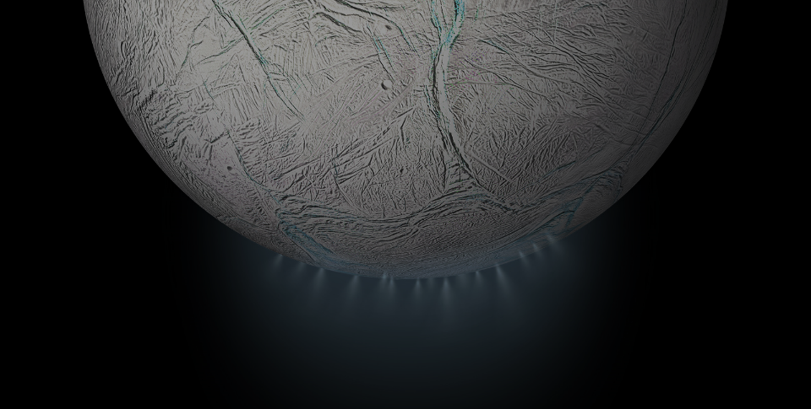
HoMIE
Holographic Microscope Investigating Enceladus
Test Readiness Review
Notes:
Bre

Slide 2
The Holographic Microscope Investigating Enceladus
HoMIE
Notes:
Bre

Slide 3
The Holographic Microscope Investigating Enceladus
Nick
Patricio
HoMIE
Bre
Nick
Eric
Presenters
Notes:
Bre

Slide 4
Agenda
01
02
03
Project
Overview
Design Updates
Schedule Progress
04
05
06
Test Readiness
Budget
Questions
Notes:
Bre

Slide 5
Project Overview
Presenter: Brianna Gagliardi
Notes:
Bre

Slide 6
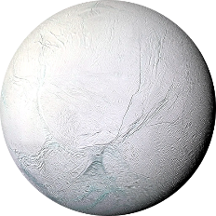
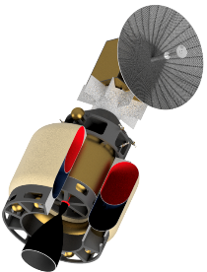
Project Description
Low-cost astrobiology mission to Enceladus (icy moon of Saturn)
Objective:
Design, build, and test a flight-like Digital Inline Holographic microscope to support the detection and characterization of life from melted ice grain samples collected from the plumes from Enceladus
Flight-like:
Design needs to be able to pass basic flight testing (vacuum, thermal, g-loading, etc.), but some aspects of the design will prevent it from being flyable
Enceladus
Encelascope + Transfer Stage
*Not to scale
Notes:
Bre

Slide 7
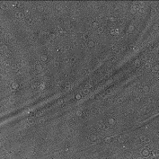
Digital Inline Holographic Microscope (DIHM)
Collimating Lens
Focusing Lens
Imaging Volume
Image Sensor
Laser
Interference Pattern Hologram
Reconstructed Image
*Not to scale
Notes:
Here we have a simple DIHM and to highlight what makes this different from a regular 2D microscope is with this set up, you are able to image and view all of the 3D information of your sample VOLUME, rather than just looking down on a singular 2D plane. So as the light passes through the lenses and sample volume, you receive an interference pattern as shown here on the image sensor, and through software that gets reconstructed into the desired image format where you can then analyze various slides of the 3D sample volume

Slide 8
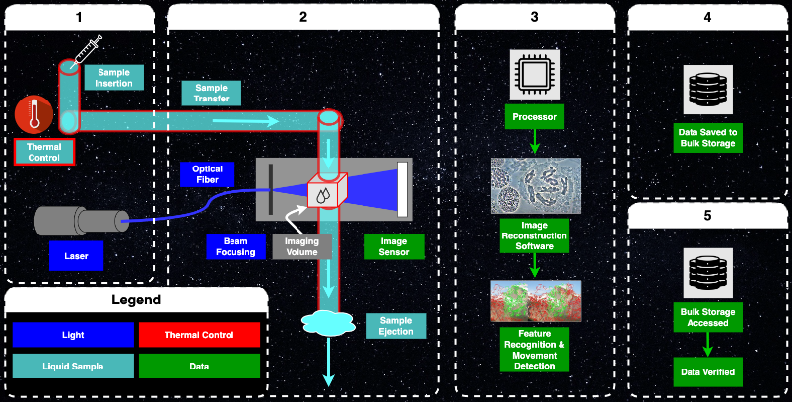
Project CONOPS
Notes:
Bre

Slide 9
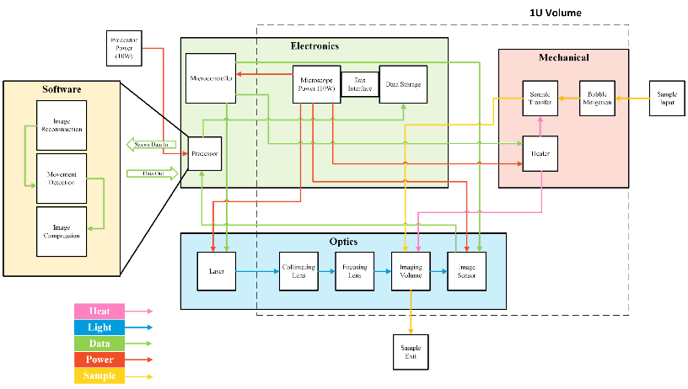
Functional Block Diagram
Notes:
Bre

Slide 10
Critical Project Elements
CPE Number | Name | Challenge
CPE1 | Optical Train | The optical train design must minimize wasted light to meet the resolution requirement.
CPE2 | Sample Heating | The sample must be maintained in a liquid state.
CPE3 | S.W.A.P. | The microscope is limited by flight-like size, weight, and power criteria.
CPE4 | Environment | The microscope must survive flight-like launch and operational conditions.
CPE5 | Hologram Reconstruction Algorithm | The interference patterns captured by the image sensor carries minimal relevant information prior to its reconstruction.
CPE6 | Movement Detection Algorithm | Movement Detection Algorithm must be employed to autonomously search for non-Brownian motion.
CPE7 | Downlink | Meaningful data transmission is limited by the number of bits per second.
Notes:
Bre:
For our project, our team worked together to find the seven most important elements for delivering a successful product to our customer and their corresponding functional requirements. The ones we decided on were:
Microscope Functionality
The basis of our whole project, and arguably the most important aspect of the microscope. In order for the image reconstruction and detection algorithms to work, the microscope must be functional to the point where it can take accurate hologram data from the samples.
Microscope Core Interfaces
This entails the ability for the microscope to handle the interface with the sample collector mechanism at the necessary flow rate for timely material processing. Every bit of water that we are able to process increases the likelihood of detecting Brownian motion and eliminates wasted energy and material.
Spacecraft Interfaces
This one is pretty self explanatory. The microscope needs to fit within the satellite body and send stored data from the microscope bulk storage to the main processing unit on the bus.
Reconstruction Algorithm
The reconstruction algorithm is what brings the holographic microscope its special capabilities. This will allow for 3-Dimensional imaging which gives us the ability to more accurately distinguish items within the fluid volume and determine if they are of any interest to us
Detection Algorithm
Detection is the next step after reconstruction where the computer program will be able to analyze a series of reconstructed images and automatically determine if there are any regions of interest in the sample volume. This reduces the need for high bandwidth downlinks to Earth.
Power
Finally, the spacecraft only has a limited amount of power that it can generate and distribute through each subsystem. Maintaining a proper power budget not only ensures that the microscope assembly will stay powered, but also protects other essential parts of the spacecraft from losing power in space

Slide 11
Design Overview
Presenter: Patricio Ramos
Notes:
Bre

Slide 12
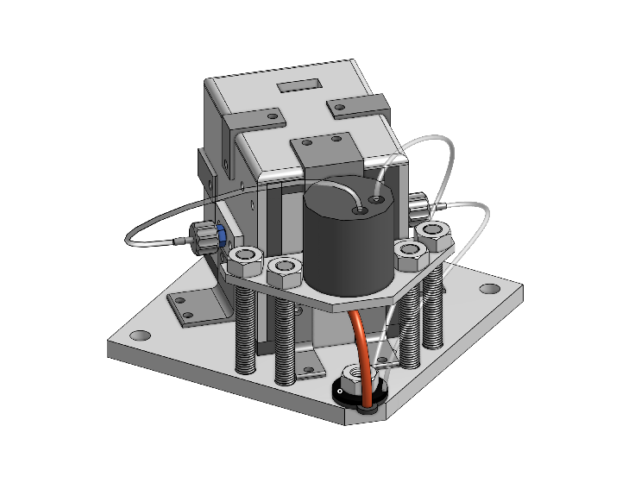
Design Overview Microscope w/ Baseplate
Optical Train Housing
Insulation
Baseplate

Slide 13
Design Overview Microscope w/ Baseplate
Sample Transfer Tubing
Sample Transfer Tubing Adapters
Sample Bubble Trap

Slide 14
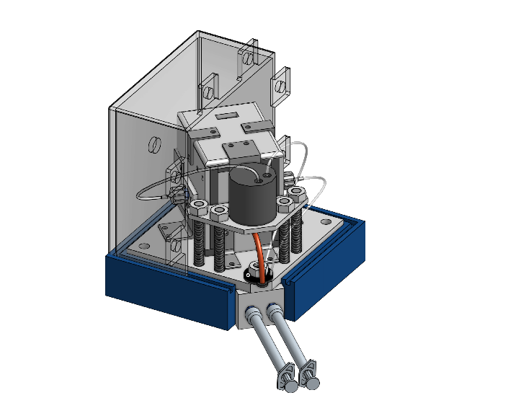
Design Overview GSE
3D printed casing
(1 out of 2 displayed)
3D printed stand
Sample insertion/extraction syringes

Slide 15
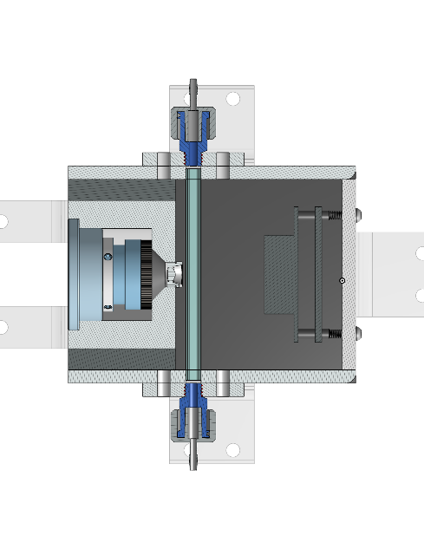
Design Overview Optical Housing
Sample Tube
Image Sensor
Lens Array
Collimating Lens Adapter
Tubing Adapters

Slide 16
Schedule Progress
Presenter: Brianna Gagliardi
Notes:
Bre

Slide 17
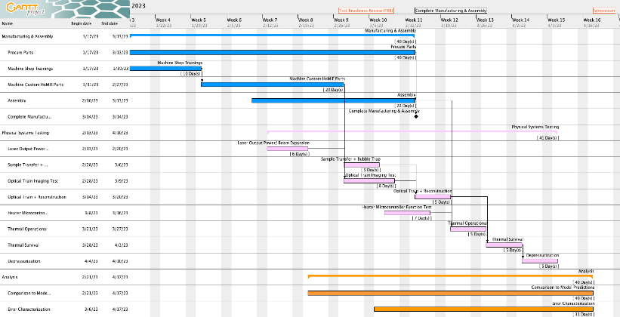
Full Project Schedule

Slide 18
Full Project Schedule
Current Date

Slide 19
Full Project Schedule
Critical Path
Current Date

Slide 20
Full Project Schedule
Progress
Current Date

Slide 21
Testing Progress
Current Date

Slide 22
Testing Progress
Current Date

Slide 23
Testing Scope
CPE | Test | Model V&V | Equipment/Facilities
Optical Train | Laser Output Power and Beam Expansion | Irradiance Model | Laser and Image Sensor/ Laser safe room
 | Reconstructed Resolution Test | Resolution Model | All Optical Components/ Laser safe room
Sample Heating/Environment | Heater Microcontroller Function | PID Feedback Control Software Flow Chart | Electronics Lab
 | Sample Transfer Tubing Test | N/A | N/A
 | Thermal Survival Bounds - Sample Temperature and Thermal Control system | Thermal Pathway and Resistance Model | Insulating chamber, oven, scrap aluminum, dry ice
 | Thermal Operation Bounds - Sample Temperature and Thermal Control system | Thermal Pathway and Resistance Model | Insulating chamber, oven, scrap aluminum, dry ice
SWAP | Microscope Power Consumption | Power Budget | Multimeter / Electronics Lab
 | Full Assembly Weight | Mass Budget | Scale
 | Processor Power Consumption | Power Budget | Multimeter / Electronics Lab
Hologram Reconstruction Algorithm​ | Reconstruction Speed | FLOPs calculation | Raspberry Pi, USB drive, Laptop
 | Reconstruction Methods | N/A | Raspberry Pi, USB drive, Laptop
Movement Detection Algorithm | Features of interest | generateDHMHologram2D | Raspberry Pi, USB drive, Laptop
Downlink | Data Package Output Size | N/A | Raspberry Pi, USB drive, Laptop

Slide 24
Test Readiness
Presenters: Brianna Gagliardi, Nick Iwanicki, Eric Dean

Slide 25
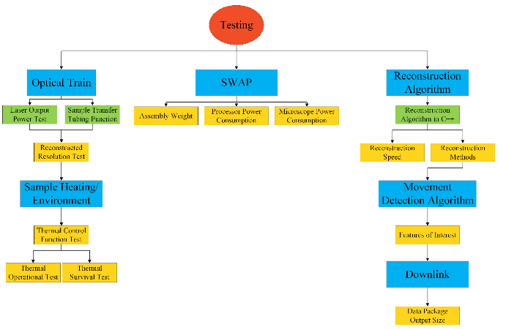
Testing Scope
Notes:
Bre

Slide 26
Reconstructed Resolution Test
R-DIHM-PERF-3: | The microscope shall provide a reconstruction resolution of < 0.8μm in the x and y directions, and < 2μm in the z-direction. ​
R-DIHM-PERF-4.1: | The microscope shall provide an instantaneous imaging volume > 2μL.
R-DIHM-PERF-4.2: | Reconstruction of the full 3D imaging volume from one frame or one difference stack shall take less than 12,000 seconds at the required reconstruction resolution.
R-DIHM-FUNC-1.4: | Raw Storage: The software shall provide a method to reconstruct specified z-slices for a difference stack.
R-DIHM-FUNC-1.9: | The software shall support saving all raw hologram data to the bulk storage device.
Deadline: 3/20
Status: Not Started
Rationale
Characterize the reconstructed resolution and processor speed
Compare optical train performance to our predictive models
Model V&V
Resolution Model
FLOPs model
Notes:
Bre

Slide 27
Reconstructed Resolution Test: System Overview
Notes:
Bre

Slide 28
Reconstructed Resolution Test: System Overview
Notes:
Bre

Slide 29
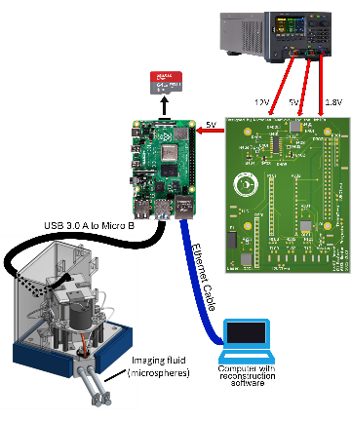
Reconstructed Resolution Test: Test Set Up
Equipment
Benchtop power supply
Raspberry Pi & custom HAT PCB
Micro SD card for OS and data storage
Ethernet cable to communicate with computer
USB A to micro B for communication with the image sensor
Microsphere imaging fluid
Laser Safety Goggles
Wires/Banana Clips for power supply connection
Facilities
AERO 169: Hazardous Test Cell
Notes:
Nick from electronics

Slide 30
Reconstructed Resolution Test: Pre-Requisites
Notes:
Nick from electronics

Slide 31
Reconstructed Resolution Test: Pre-Requisites
Notes:
Nick from electronics

Slide 32
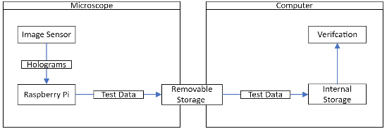
Reconstructed Resolution Test: Data Acquisition
Want to characterize the reconstruction speed and resolution at varying number of z-slices
Test data will be saved to removable storage device (SD Card or removable USB)
Reconstructed images = PNG
Raw holograms = PNG
Reconstruction time = CSV
Post Test Data analysis
Storage device will be removed, and data will be analyzed on secondary computer
Notes:
Nick from electronics

Slide 33
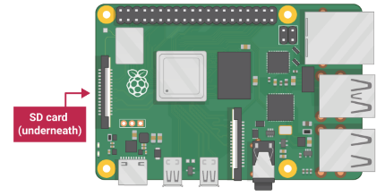
Reconstructed Resolution Test: Data Acquisition
SD Card can be swapped between devices to transfer data acquired during the test
Notes:
Nick from electronics

Slide 34
Reconstructed Resolution Test: Laser Safety Procedures
Step | Procedure | Expected Result | Complete (Y/N)
1 | Assign bouncer to guard the outside of the testing room door. | Prevent any and all unauthorized persons from entering
2 | Lock door | Prevent any and all unauthorized persons from entering
3 | Ensure all occupants are wearing proper eye protection. | Avoid any and all personal injury.
4 | Verify optical housing lid is fully sealed. | No laser light leaks from lid.
5 | Verify interlock system has continuity. | Safe testing conditions established.
6 | Proceed with desired test.
Notes:
Bre

Slide 35
Reconstructed Resolution Test: Testing Procedures
Step | Procedure | Expected Result | Complete (Y/N)
1 | Reference laser safety documentation | Safe test operation.
2 | Connect USB storage to Raspberry Pi | This gives the Raspberry Pi somewhere to store output images.
3 | Connect Raspberry Pi to power | Pi LED turns on.
4 | Connect laptop to Pi via SSH | Display to control the Raspberry Pi appears on monitor.
5 | Load test sample into imaging volume | Full imaging volume.
6 | Plug into power supply | Electronics power on.
7 | Press Play button on PI IDE | "Starting" will be printed to output.
8 | Laser GPIO is pulled high | “Laser ON” will be printed to output.
Notes:
Bre

Slide 36
Reconstructed Resolution Test: Testing Procedures
Step | Procedure | Expected Result | Complete (Y/N)
9 | Camera is triggered by software | “Capturing holograms” will be printed to output.
10 | Laser GPIO is brought low | “Laser OFF” will be printed to output.
11 | Raw Hologram frames are loaded onto the PI | “Loading Hologram” will be printed to output.
12 | Difference Stack is computed | “Computing Difference Stack” will be printed to output.
13 | Reconstruction Starts | “Reconstructing” will be printed to output.
14 | Reconstruction Ends | “Reconstruction Completed” will be printed to output.
15 | Hologram Saved to USB | “Saving Reconstructed Hologram” will be printed to output.
16 | Transfer USB to a computer | Reconstructed images for resolution verification available.
Notes:
Bre

Slide 37
Reconstructed Resolution Test: Levels of Success
Requirement | Level 2 | Level 1 | Failure
R-DIHM-PERF-3: | Reconstructed resolution is less < 0.5μm in the x and y directions, and < 1μm in the z-direction. | Reconstructed resolution is less < 0.8μm in the x and y directions, and < 2 μm in the z-direction. | Reconstructed resolution is less > 0.8 μm in the x and y directions, and > 2μm in the z-direction.
R-DIHM-PERF-4.1: | The instantaneous imaging volume of the microscope is 2.5μL. | The instantaneous imaging volume of the microscope is 2 μL. | The instantaneous imaging volume of the microscope is < 2μL.
R-DIHM-PERF-4.2: | Reconstruction of all difference stack z-slices takes 8,000 seconds. | Reconstruction of all difference stack z-slices takes 12,000 seconds. | Reconstruction of all difference stack z-slices takes more than 12,000 seconds.
R-DIHM-FUNC-1.4: | N/A | The software reconstructs the specified z-slices for a difference stack. | The software does not reconstruct the specified z-slices for a difference stack.
R-DIHM-FUNC-1.9: | N/A | The software supports saving all raw hologram data to the bulk storage device. | The software does not support saving all raw hologram data to the bulk storage device.
Notes:
Bre

Slide 38
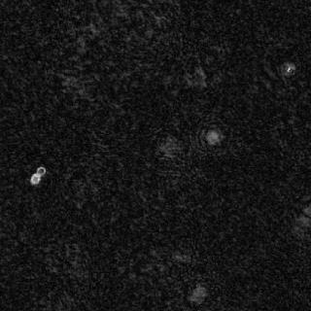
Reconstructed Resolution Test: Measuring Resolution
Reconstructed image example
Manually selecting a line of pixels of the sample (cross section)
Notes:
Eric

Slide 39
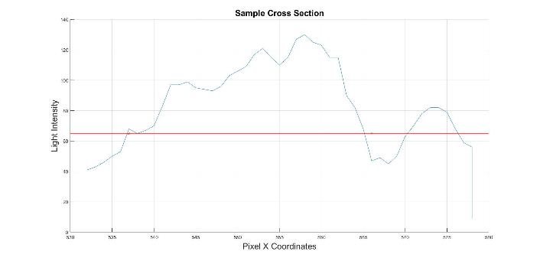
Reconstructed Resolution Test: Measuring Resolution
FWHM = Full Width Half Max = The ability to distinguish between two peaks (features)
Cross section intensity variation
Reconstructed resolution = Known Object Size - FWHM
Notes:
Eric

Slide 40
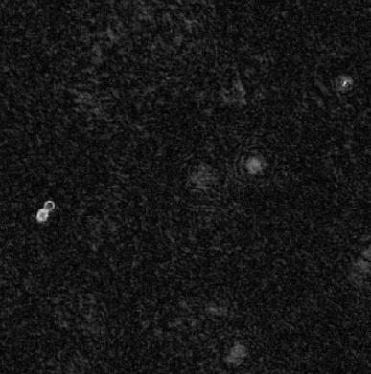
Reconstructed Resolution Test: Measuring Resolution
3 cross sections per object within an image
Calculate the reconstructed resolution for each cross section
Compute the average, and standard deviation among these resolutions
µ = Mean
N = # of resolutions
X_{i} = Resolution
σ = Standard Deviation
Final Reconstructed Resolution = µ + σ
Notes:
Eric

Slide 41
Reconstructed Resolution Test: Measuring Resolution
3 cross sections per object within an image
Calculate the reconstructed resolution for each cross section
Compute the average, and standard deviation among these resolutions
µ = Mean
N = # of resolutions
X_{i} = Resolution
σ = Standard Deviation
Final Reconstructed Resolution = µ + σ
Notes:
Eric

Slide 42
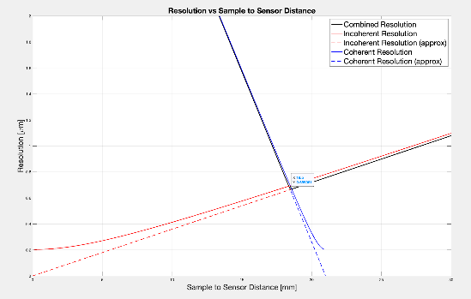
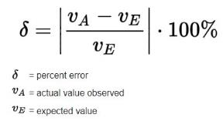
Reconstructed Resolution Test: Model Validation
Expected Resolution: 0.7 µm
Notes:
Eric

Slide 43
Full System Thermal Operational Test
R-DIHM-PHYS-4.7: | The microscope shall operate over temperatures ranging from -15C to +40C. ​
R-DIHM-PHYS-7.5: | The microscope shall not heat the sample by more than +5 degrees C relative to the baseplate temperature, except when the sample heater is activated.
R-DIHM-PHYS-7.6: | "The microscope shall provide a method to actively heat the sample by a configurable amount relative to the baseplate temperature, with 1 degree C resolution and 1 degree C accuracy.
Deadline: 3/27
Status: Not Started
Rationale
Characterize the behavior of our thermal control system as the system is cooled and heated.
Compare our experimental results against our analytical models.
Model V&V
Thermal Resistance Model
Power Budget
Notes:
Bre

Slide 44
Thermal Operation Test: System Overview
Notes:
Bre

Slide 45
Thermal Operation Test: System Overview
Notes:
Bre

Slide 46
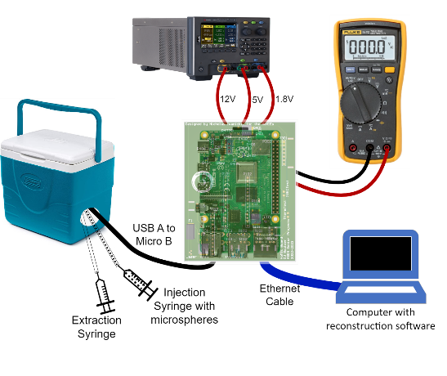
Thermal Operation Test: Test Set Up Diagram
Equipment:
Microscope Assembly
Cooler
Oven
Dry Ice/Heat Source (scrap metal)
Benchtop Power Supply (12V,5V,1.8V)
Size Standard Microspheres
Laser Safety Goggles
Wires/Banana Clips
Facilities:
Hazardous Test Cell, AERO 169
Notes:
Nick from electronics

Slide 47
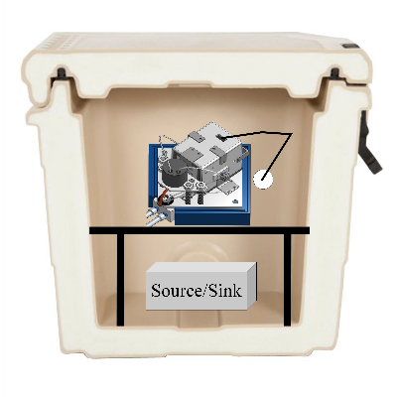
Thermal Operation Test: Test Set Up Diagram
Equipment:
Microscope Assembly
Cooler
Oven
Dry Ice/Heat Source (scrap metal)
Benchtop Power Supply (12V,5V,1.8V)
Size Standard Microspheres
Laser Safety Goggles
Wires/Banana Clips
Facilities:
Hazardous Test Cell, AERO 169
Notes:
Nick from electronics

Slide 48
Thermal Operation Test: Pre-Requisites
Notes:
Nick from electronics

Slide 49
Thermal Operation Test: Pre-Requisites
Notes:
Nick from electronics

Slide 50
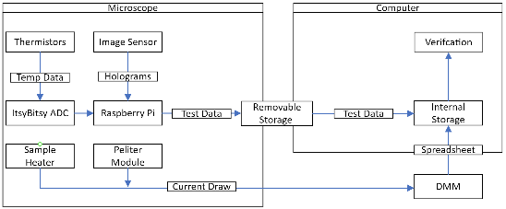
Thermal Operation Test: Data Acquisition
Want to characterize system behavior across temperature range
Heater/Cooler power consumption
Temperatures of baseplate and sample
Test data will be saved to removable storage device (SD Card & removable USB)
Reconstructed images = PNG
Raw holograms = PNG
Temperature readings = CSV
Manual data capture
Heater and Peltier current draw
Measured with a DMM
Recorded manually at 1 minute intervals on an excel spreadsheet
Notes:
Nick from electronics

Slide 51
Thermal Operation Test: Sensor Placement
Thermistors NTC 10KOHM 3950K
Notes:
Nick from electronics

Slide 52
Thermal Operation Test: Sensor Placement
TEG GENERATOR 40.13X40.13X3.91MM Peltier Module
Notes:
Nick from electronics

Slide 53
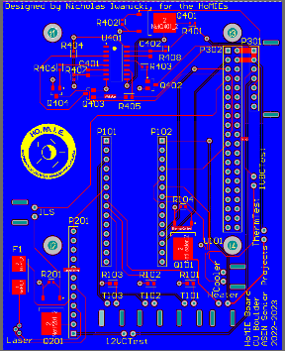
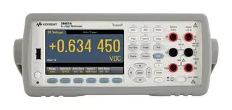
Thermal Operation Test: Sensor Placement
PCB features test pins to measure current
A multimeter can be connected in series with these pins, allowing for current to flow and be measured
When not in use, a jumper can be placed across the pins completing the circuit
Peltier Current Test Pins
Resistance Wire Current Test Pins
Peltier Pins
Heater Pins
Notes:
Nick from electronics

Slide 54
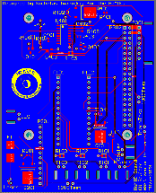
Thermal Operation Test: Sensor Placement
Manually recorded data is saved in a spreadsheet
SD Card can be swapped between devices to transfer data acquired during the test
Notes:
Nick from electronics

Slide 55
Thermal Operation Test: Testing Procedures, COLD
Step | Procedure | Expected Result | Complete (Y/N)
1 | Reference the laser safety document. | Safe test operation.
2 | Follow reconstructed resolution test procedures, steps 2-6 for microscope start up.
3 | Place stand in cooler. | Stand seated securely in cooler.
4 | Place microscope assembly on stand. | Microscope assembly seated securely on stand.
5 | Thread sample tubes through port in cooler and connect with syringes | Sample tubes connect to microscope assembly and run out of the cooler to liquid syringes.
6 | Pass liquid sample through microscope, verify no leaks exist. | Samples passes from input syringe, through microscope assembly, to extraction syringe. No liquid is present outside of tube via visual inspection.
7 | Press Play button on PI IDE | Hologram is saved to bulk storage and is verified against known results. Nominal baseline established.
8 | Extract liquid sample from microscope. | Liquid is removed to extraction syringe; no liquid remains in microscope assembly via visual inspection.
9 | Using thermal PPE, place dry ice inside cooler. Close cooler to seal environment. | Dry ice is seated securely on bottom of cooler. Cooler lid provides tight seal from external environment.
Notes:
Bre

Slide 56
Thermal Operation Test: Testing Procedures, COLD
Step | Procedure | Expected Result | Complete (Y/N)
10 | Using IR thermometer, verify internal cooler temperature and payload baseplate temperatures are ≤-15°C. | IR thermometer reads ≤-15°C.
11 | Using thermal PPE, remove dry ice from cooler and quickly seal. | Cooler is free of dry ice and only contains microscope assembly and stand.
12 | Pass liquid sample through microscope. | Sample passes from input syringe, through microscope assembly.
13 | Press Play button on PI IDE | Hologram is saved to bulk storage and is verified against known results.
14 | Extract liquid sample from microscope. | Liquid is removed to extraction syringe; no liquid remains in microscope assembly.
15 | Open cooler and allow room temperature thermal equilibrium to be reached. | Cooler lid is opened, and external environmental temperature is allowed to enter.
16 | Verify safe handling temperature with IR thermometer | IR thermometer reads room temperature.
17 | Remove microscope assembly from cooler. | Cooler contains only the stand.
18 | Remove stand from cooler. | Cooler is empty.
Notes:
Bre

Slide 57
Thermal Operation Test: Levels of Success
Requirement | Level 2 | Level 1 | Failure
R-DIHM-PHYS-4.7: | At < -15°C AND > 40°C, sample remains liquid at 2.5°C with ±1°C temperature control, hologram is generated successfully. | At < -15°C OR > 40°C, sample remains liquid between 0°C and 5°C with ±1°C temperature control, hologram is generated successfully. | Sample temperature strays outside the 0°C - 5°C, sample temperature bounds.
R-DIHM-PHYS-7.5: | The sample is heated by ≤ 2.5°C relative to the baseplate temperature | The sample is heated by ≤5°C relative to the baseplate temperature | The sample exceeds 5°C relative temperature to the baseplate when it is not actively heated.
R-DIHM-PHYS-7.6: | The Microscope can actively heat the sample with a 1°C resolution AND 1°C accuracy. | The Microscope can actively heat the sample with a 1°C resolution OR 1°C accuracy. | The Microscope can NEITHER actively heat the sample with a 1°C resolution or1°C accuracy.
Notes:
Bre

Slide 58
Thermal Operation Test: Model Validation Housing
Insulation
Glass
Fluid
Thermal Control of Top Plate
1
1
Aluminum
Ins1
4
2
3
4
2.5°C
Ins3
Ins2
6
Ins4
Ins4
Ins4
5
5
Front View
Side View
-15°C or 40°C
*Not to scale
Notes:
Bre

Slide 59
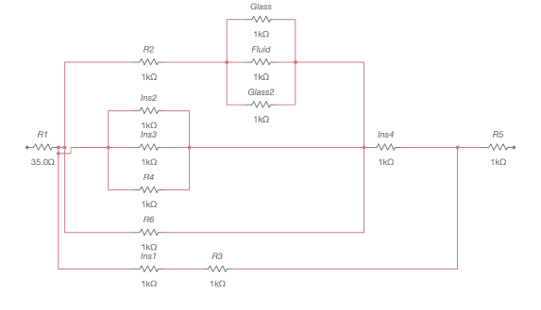
Thermal Operation Test: Model Validation Housing
Assumptions
Vacuum – no convection
Does not account for radiation
Ignores presence of fasteners and epoxy
Model Verification Points
Required Max Heat Input (Cold case): 0.1 W
Required Max Heat Removal (Hot case): 0.6W
Sample Temperature: 2.5°C
Notes:
Bre

Slide 60
Thermal Operation Test: Model Validation PTFE Tubing
*Not to scale
Resistance Wire
Fluid
2.5°C
PTFE Tube
Assumptions
Vacuum – no convection
Ignores presence of Teflon tape for wire attachment
Resistance Wire
Resistance wire wrapped around tubing to provide heating
Wire to be secured with tape
Notes:
Bre

Slide 61
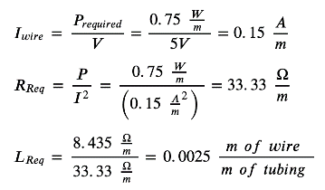
Thermal Operation Test: Model Validation PTFE Tubing
*Not to scale
Resistance Wire
Fluid
2.5°C
PTFE Tube
Notes:
Bre

Slide 62
Thermal Operation Test: Model Validation PTFE Tubing
*Not to scale
Resistance Wire
Fluid
2.5°C
PTFE Tube
Notes:
Bre

Slide 63
Budget
Presenter: Nick Aichholz

Slide 64
Financial Budget Breakdown
Project Area | Allocated Budget | Requested Budget | Actual Expenditure
Mechanical | $1000.00 | $559.63 | $527.47
Electronics | $2000.00 | $2516.63 | $2,170.83
Optics | $600.00 | $479.60 | $788.84
Testing | $200 | $132 | $142.00
Pilot Tools | $200 | $200
Total Spent | $4000.00 | $3613 | $3,829.14
Total Remaining |  |  | $170.86
Notes:
CFO Nick

Slide 65
Parts in Queue
Part | Supplier | Arrival Date | Applicable Test | Test Date
Image Sensor | Pixelink | 3/1 | Reconstructed Resolution | 3/15
Microspheres | Magsphere | ~ | Reconstructed Resolution, Thermal Operation | 3/20 & 3/27
Notes:
CFO Nick

Slide 66
BACKUP SLIDES
Notes:
Bre

Slide 67
Thermal Operation Test: Failure Analysis Plans
Single‐Stage Thermoelectric Generator(TG12‐6)
Qmax @ Th = 0.9W @ 50 °C
Excess available to increase heat removal/addition
RESISTANCE WIRE 26AWG 100’
Comes in 30.5 m
Extreme excess wire length to add for additional heating
Analysis Plans
Verify proper assembly and operation of thermal control systems
Add convection losses to thermal analysis and adjust heater/cooler outputs
Explore SolidWorks thermal simulations
Notes:
Bre

Slide 68
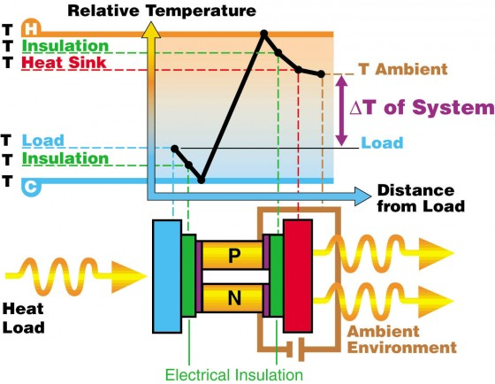
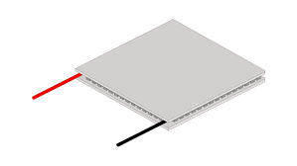
Thermal Operational Test: Peltier Module
Used as a heat pump to maintain optimal sample temperature
Current determines maximum possible ΔT
Polarity can be switched to change which side is being cooled
Utilizes scrap metal as a heat sink

Slide 69
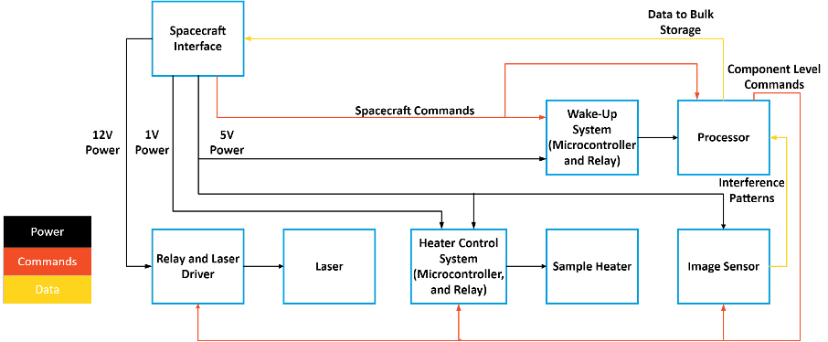
Electronics Functional Block Diagram
Notes:
Nick from electronics
Here we see a functional block diagram for the electrical subsystem
In the top left we have the spacecraft interface, where we have several different voltages coming out, as well as commands for the microscope.
Power is provided to all the different components as needed, and the commands are sent to the processor, which then sends component level commands as needed
We also have a data output from the image sensor, which is processed before being sent back to the spacecraft for bulk storage
Not show is how these components interface with other subsystems, as this is simply an electronics block diagram. This is expanded upon in the full FBD

Slide 70
Reconstruction Algorithm

Slide 71
Overview

Slide 72
Inputs to the Reconstruction Algorithm
Holographic image
Any of the three types
Reference wave (calculated)
Uses microscope geometry and laser properties
Effect of coherent light source with no interference
Template wave (calculated)
Contains frequency data corresponding to objects interfering with the reference wave at a specified distance
Used in a convolution to isolate a focal depth

Slide 73
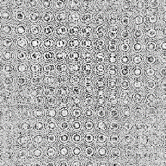
Difference Stack Algorithm
A
B
C
D
Difference Stack = (B-A)+(D-C)

Slide 74
Reconstruction
Unprocessed Difference Stack
Reconstructed Difference Stack
Reconstruction Algorithm

Slide 75
Thermal Operation: Testing Procedures, HOT
Step | Procedure | Expected Result | Complete (Y/N)
1 | Reference the laser safety document. | No one gets injured
2 | Follow reconstructed resolution test procedures, steps 2-6 for microscope start up.
3 | Place stand in cooler. | Stand seated securely in cooler.
4 | Place microscope assembly on stand. | Microscope assembly seated securely on stand.
5 | Thread sample tubes through port in cooler and connect with syringes | Sample tubes connect to microscope assembly and run out of the cooler to liquid syringes.
6 | Pass liquid sample through microscope, verify no leaks exist. | Samples passes from input syringe, through microscope assembly, to extraction syringe. No liquid is present outside of tube via visual inspection.
7 | Press Play button on PI IDE | Hologram is saved to bulk storage and is verified against known results.
8 | Extract liquid sample from microscope. | Liquid is removed to extraction syringe; no liquid remains in microscope assembly via visual inspection.
9 | Using thermal PPE, place a 40°C chunk of aluminum inside cooler. Close cooler to seal environment. | Dry ice is seated securely on bottom of cooler. Cooler lid provides tight seal from external environment.

Slide 76
Thermal Operation: Testing Procedures, HOT
Step | Procedure | Expected Result | Complete (Y/N)
10 | Using IR thermometer, verify internal cooler temperature and payload baseplate temperatures are > 40°C. | IR thermometer reads > 40°C.
11 | Using thermal PPE, remove hot aluminum from cooler and quickly seal. | Cooler is free of dry ice and only contains microscope assembly and stand.
12 | Pass liquid sample through microscope. | Sample passes from input syringe, through microscope assembly.
13 | Press Play button on PI IDE | Hologram is saved to bulk storage and is verified against known results.
14 | Extract liquid sample from microscope. | Liquid is removed to extraction syringe; no liquid remains in microscope assembly.
15 | Open cooler and allow room temperature thermal equilibrium to be reached. | Cooler lid is opened, and external environmental temperature is allowed to enter.
16 | Verify safe handling temperature with IR thermometer | IR thermometer reads room temperature.
17 | Remove microscope assembly from cooler. | Cooler contains only the stand.
18 | Remove stand from cooler. | Cooler is empty.

Slide 77
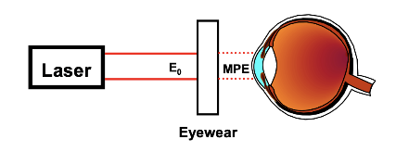
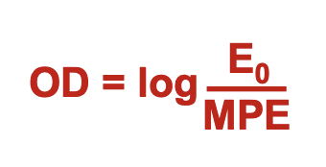
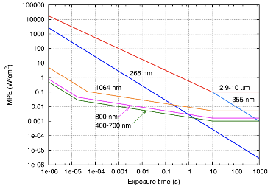
Safety Goggle Optical Density Calculation
OD = Optical Density
E0 = Laser Output Power / Pupil Area
MPE = Maximum Permissible Exposure
Exposure time = 100s
Wavelength = 405 nm
E0 = (3 * 10^-3)/(0.4cm^2)
Assumes eye pupil at enlarged expansion due to low lit environment
MPE = 0.001 W/cm^2
OD = 0.875
Notes:
Derived from ANSI standards (American National Standards Institute)
https://ehs.missouri.edu/sites/ehs/files/pdf/Forms/eyeprotection.pdf
http://www.focustechnologies.us/wp-content/uploads/2013/12/Laser-safety-Wikipedia-Maximum-Exposure-Limits.pdf
Bre

Slide 78
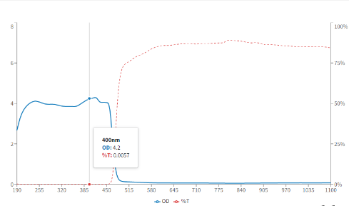
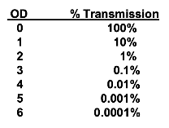
Safety Goggle Optical Density Calculation
Assumptions
100s of continuous viewing of the laser
405 nm continuous wave
Selected safety goggles: OD = 4 at 405nm
Minimum required optical density (OD): 0.875
Factor of safety = 4+
Notes:
Bre

Slide 79
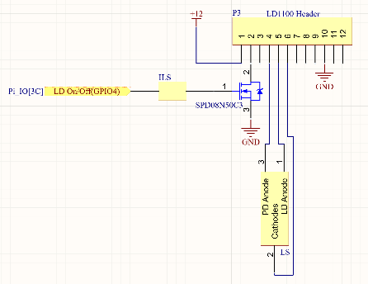
Laser Interlock System
Laser Interlock System
Normally open switch wired between gate of MOSFET and Raspberry Pi GPIO 4
Normally open switch (ILS) will be mounted at the top of the optical enclosure, where it will be depressed when the top access panel is attached
Laser circuit cannot be operated when the top access panel is removed unless the interlock switch is held down manually
Notes:
TESS

Slide 80
Fuse
62 mA fast blow fuse on LD Anode
Prevents max operating current on the laser diode from being exceeded
Add a pull-down resistor to the FET drain to prevent it from floating
Notes:
TESS

Slide 81
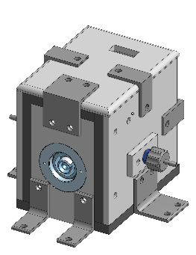
Laser Interlock System
Interlock attached to interior of lid and side panel
Full Assembly
Optical Housing
Notes:
Tess
All sides will be unremovable minus the top lid
Wont be connected to power when doing maintenance for an extra layer of safety

Slide 82
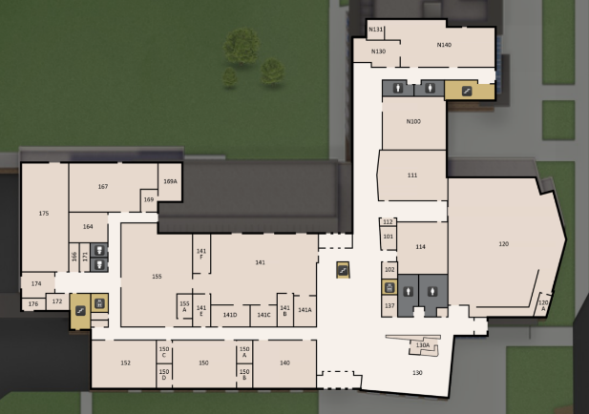
Test Location
AERO 169
“Hazardous testing room”

Slide 83
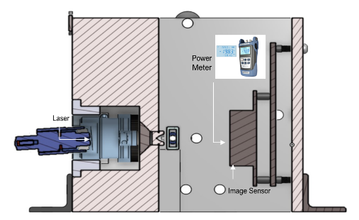
Laser Test
Expected:
Input Voltage = 5V
Input Power = 0.175 W
Output Power = 3mW

Slide 84
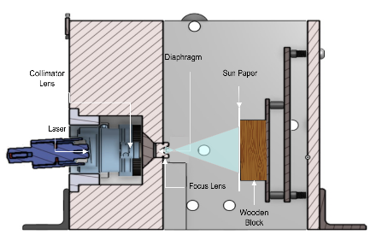
Laser Test
y: imprint radius on sun paper
Beam Divergence and Irradiance Test
θ
z: distance between laser and sun paper
Divergence: θ = tan⁻¹(y/z)
Expected Divergence: θ = 0.1304 rads

Slide 85
Optical Distances
Sample to Image Sensor Distance
18.5 mm
Laser to Collimator Distance
7.5 mm
4.5 mm
Focus Point to Detector
Focus Lens to Sample Distance
21mm

Slide 86
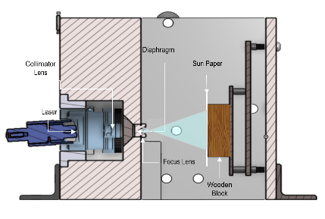
Lens Test
w_{z}: Waist
Divergence Test
θ
z: Axial Distance
Expected Divergence: θ = 30º
Divergence: θ = 2tan⁻¹(w_{z}/z)

Slide 87
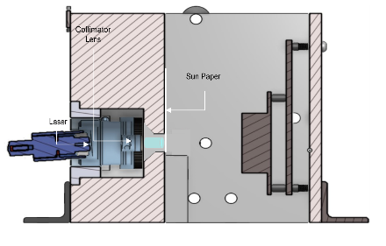
Lens Test
Collimated Diameter
Collimation Diameter Test
Expected Collimated Diameter: 1.96 mm

