Slide 1
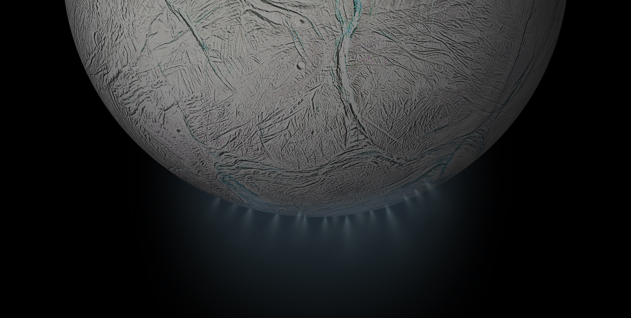
HoMIE
Holographic Microscope Investigating Enceladus
Critical Design Review
Notes:
Bre

Slide 2
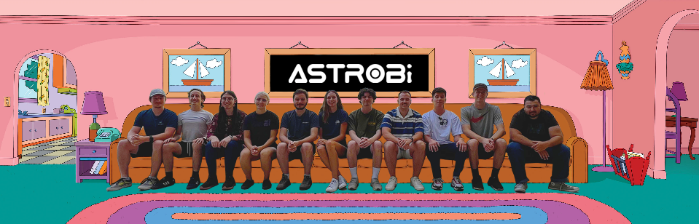
The Holographic Microscope Investigating Enceladus
HoMIE
Notes:
Bre

Slide 3
The Holographic Microscope Investigating Enceladus
Nick
Patricio
Bre
HoMIE
Eric
Ryan
Nick
Kellen
Freddy
Presenters
Notes:
Bre

Slide 4
Agenda
01
02
03
04
Project
Overview
Design Solution
CPE's & Risk
Design
Requirements & Satisfaction
05
06
07
Verification & Validation
Spring Planning
Questions
Notes:
Bre

Slide 5
Project Overview
Presenter: Brianna Gagliardi
Notes:
Bre

Slide 6
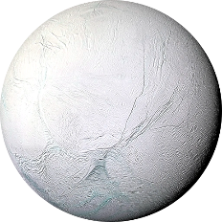
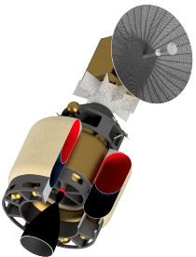
Project Description
Low-cost astrobiology mission to Enceladus (icy moon of Saturn)
Objective:
  Design, build, and test a flight-like Digital Inline Holographic microscope to support the detection and characterization of life from melted ice grain samples collected from the plumes from Enceladus
Flight-like:
  Design needs to be able to pass basic flight testing (vacuum, thermal, g-loading, etc.), but some aspects of the design will prevent it from being flyable
Enceladus
Encelascope + Transfer Stage
*Not to scale
Notes:
Bre

Slide 7
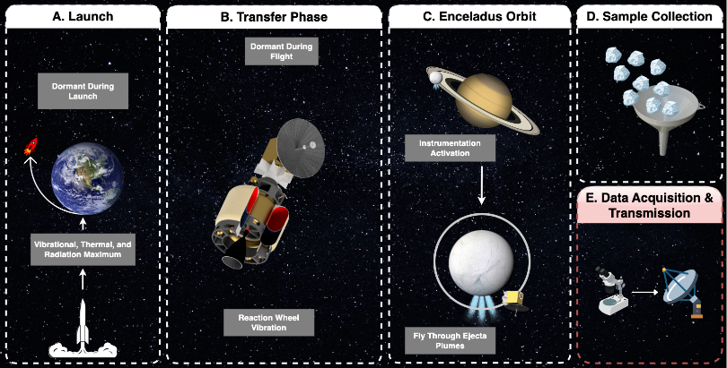
Mission CONOPS
Notes:
Bre

Slide 8
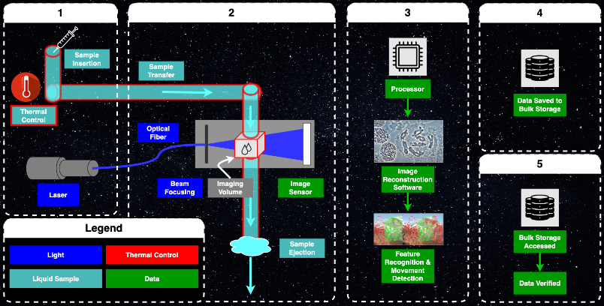
Project CONOPS
Notes:
Bre

Slide 9
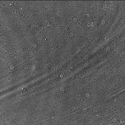
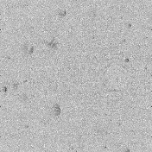
Digital Inline Holographic Microscope (DIHM)
Collimating Lens
Focusing Lens
Imaging Volume
Image Sensor
Laser
Interference Pattern Hologram
Reconstructed Image
*Not to scale
Notes:
Bre

Slide 10
Design Solution
Presenters: Patricio Ramos, Nick from Electronics, Nick from Software, Brianna Gagliardi
Notes:
Patricio

Slide 11
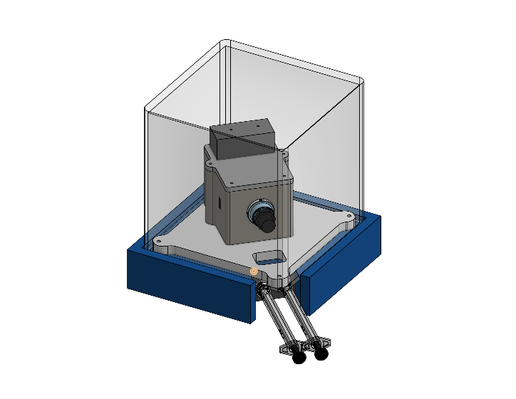
Full Assembly
10cm
10cm
Optical Train Housing
45mm x 57 mm, 142g, 6061 Aluminum
Total weight
(without stand and casing): <500g
Fastener points to spacecraft
10cm
Usable 1U Volume
Through Hole in Baseplate and Stand
16 mm by 20 mm
Baseplate: ¼” thickness, 140g, 6061 Aluminum
Microscope Stand
(Ground only)
Notes:
Patricio
Our proposed solution is housed inside a ground assembly, used to keep dust off of our sensitive equipment, and provides a nice base to comfortable route cables and tubings through the metal baseplate hole

Slide 12
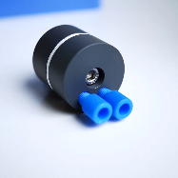
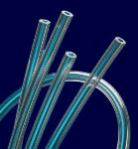
Full Assembly
Bubble trap used for preventing air build-up inside tubing
Microfluidic PTFE tubing used to transport fluid to optical train housing
Epoxy used for gluing the microfluidic tubing to the baseplate
Syringes used for manual sample insertion and extraction
Resistance wire wraps around PTFE tubing for sample heating
Notes:
Patricio

Slide 13
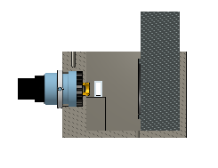
Full Assembly
10cm
Image Sensor
10cm
Borosilicate Sample Tubing
10cm
Optical Train Housing Cross Section
Optical Train Housing
Laser Diode Source
Glass Fiber
Notes:
Patricio: Our proposed solution is housed inside a ground assembly, used to keep dust off of our sensitive equipment, and provides a nice base to comfortable route cables and tubings through the metal baseplate hole

Slide 14
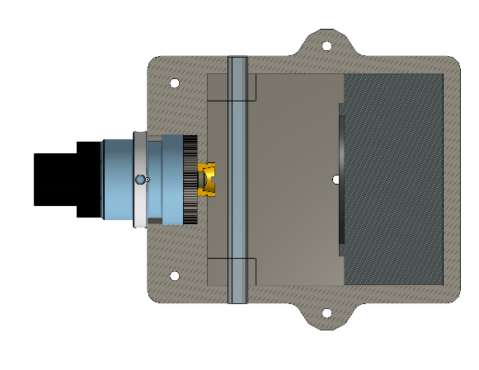


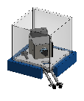
Optical Train
Borosilicate Sample Housing
Top-Down View
Fastener points to baseplate
Image Sensor
Lens Stack
57 mm
Notes:
Patricio

Slide 15
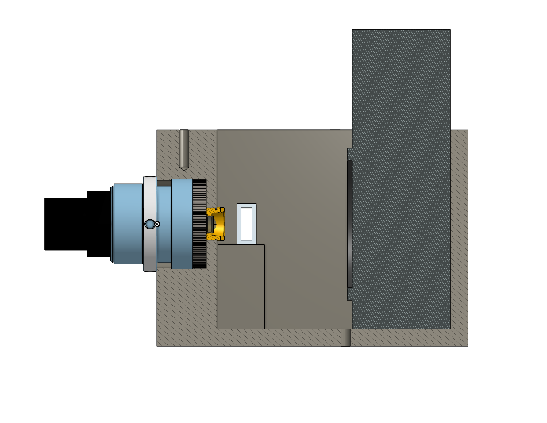
Optical Train
Borosilicate Sample Housing
Cross-Sectional View
Aperture
Laser Fiber Input
Image Sensor
Focusing Lens
Collimating Lens
57 mm
Notes:
Patricio

Slide 16
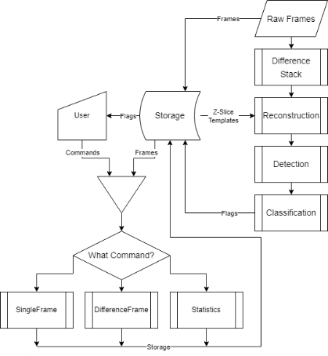
Software Flow Chart
Notes:
Ryan

Slide 17
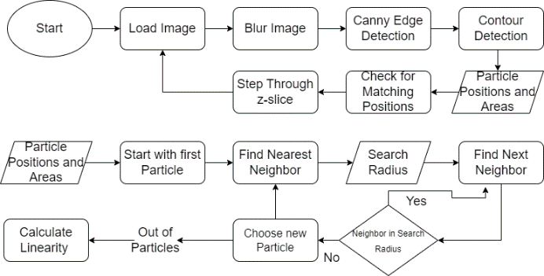
Movement Detection Algorithm Flow Chart
Notes:
Kellen

Slide 18
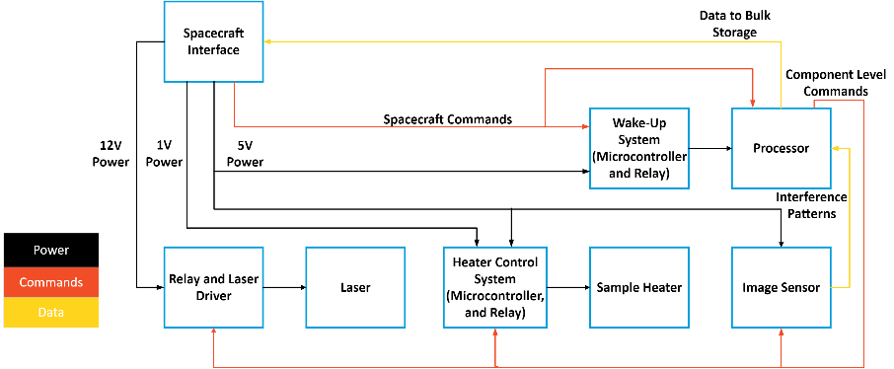
Electronics Functional Block Diagram
Notes:
Nick from electronics

Slide 19
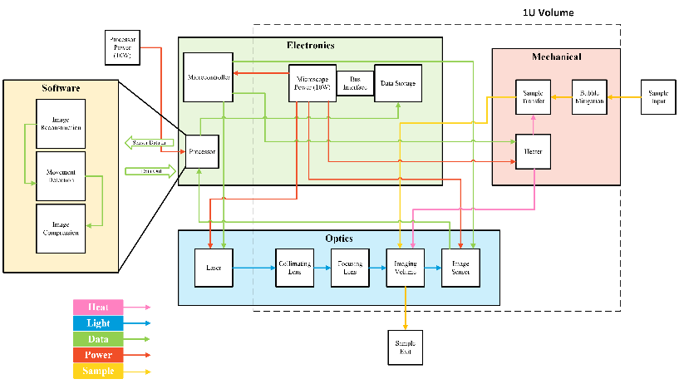
Functional Block Diagram
Notes:
Bre

Slide 20
Risk Reduction
Presenters: Brianna Gagliardi
Notes:
Bre

Slide 21
Critical Project Elements
CPE Number | Name | Challenge
CPE1 | Optical Train | The optical train design must minimize wasted light to meet the resolution requirement.
CPE2 | Sample Heating | The sample must be maintained in a liquid state.
CPE3 | S.W.A.P. | The microscope is limited by flight-like size, weight, and power criteria.
CPE4 | Environment | The microscope must survive flight-like launch and operational conditions.
CPE5 | Hologram Reconstruction Algorithm | The interference patterns captured by the image sensor carries minimal relevant information prior to its reconstruction.
CPE6 | Movement Detection Algorithm | Movement Detection Algorithm must be employed to autonomously search for non-Brownian motion.
CPE7 | Downlink | Meaningful data transmission is limited by the number of bits per second.
Notes:
Bre:
For our project, our team worked together to find the six most important elements for delivering a successful product to our customer and their corresponding functional requirements. The ones we decided on were:
Microscope Functionality
The basis of our whole project, and arguably the most important aspect of the microscope. In order for the image reconstruction and detection algorithms to work, the microscope must be functional to the point where it can take accurate hologram data from the samples.
Microscope Core Interfaces
This entails the ability for the microscope to handle the interface with the sample collector mechanism at the necessary flow rate for timely material processing. Every bit of water that we are able to process increases the likelihood of detecting Brownian motion and eliminates wasted energy and material.
Spacecraft Interfaces
This one is pretty self explanatory. The microscope needs to fit within the satellite body and send stored data from the microscope bulk storage to the main processing unit on the bus.
Reconstruction Algorithm
The reconstruction algorithm is what brings the holographic microscope its special capabilities. This will allow for 3-Dimensional imaging which gives us the ability to more accurately distinguish items within the fluid volume and determine if they are of any interest to us
Detection Algorithm
Detection is the next step after reconstruction where the computer program will be able to analyze a series of reconstructed images and automatically determine if there are any regions of interest in the sample volume. This reduces the need for high bandwidth downlinks to Earth.
Power
Finally, the spacecraft only has a limited amount of power that it can generate and distribute through each subsystem. Maintaining a proper power budget not only ensures that the microscope assembly will stay powered, but also protects other essential parts of the spacecraft from losing power in space

Slide 22
Critical Project Elements
CPE Number | Name | Challenge
CPE1 | Optical Train | The optical train design must minimize wasted light to meet the resolution requirement.
CPE2 | Sample Heating | The sample must be maintained in a liquid state.
CPE3 | S.W.A.P. | The microscope is limited by flight-like size, weight, and power criteria.
CPE4 | Environment | The microscope must survive flight-like launch and operational conditions.
CPE5 | Hologram Reconstruction Algorithm | The interference patterns captured by the image sensor carries minimal relevant information prior to its reconstruction.
CPE6 | Movement Detection Algorithm | Movement Detection Algorithm must be employed to autonomously search for non-Brownian motion.
CPE7 | Downlink | Meaningful data transmission is limited by the number of bits per second.
Notes:
Bre:
For our project, our team worked together to find the six most important elements for delivering a successful product to our customer and their corresponding functional requirements. The ones we decided on were:
Microscope Functionality
The basis of our whole project, and arguably the most important aspect of the microscope. In order for the image reconstruction and detection algorithms to work, the microscope must be functional to the point where it can take accurate hologram data from the samples.
Microscope Core Interfaces
This entails the ability for the microscope to handle the interface with the sample collector mechanism at the necessary flow rate for timely material processing. Every bit of water that we are able to process increases the likelihood of detecting Brownian motion and eliminates wasted energy and material.
Spacecraft Interfaces
This one is pretty self explanatory. The microscope needs to fit within the satellite body and send stored data from the microscope bulk storage to the main processing unit on the bus.
Reconstruction Algorithm
The reconstruction algorithm is what brings the holographic microscope its special capabilities. This will allow for 3-Dimensional imaging which gives us the ability to more accurately distinguish items within the fluid volume and determine if they are of any interest to us
Detection Algorithm
Detection is the next step after reconstruction where the computer program will be able to analyze a series of reconstructed images and automatically determine if there are any regions of interest in the sample volume. This reduces the need for high bandwidth downlinks to Earth.
Power
Finally, the spacecraft only has a limited amount of power that it can generate and distribute through each subsystem. Maintaining a proper power budget not only ensures that the microscope assembly will stay powered, but also protects other essential parts of the spacecraft from losing power in space

Slide 23
Risk Measurement
Impact/Consequence
Level | Description
Negligible | No Impact on Microscope Functionality
Minor | Little Impact on Microscope Functionality
Moderate | Negative Impact on Microscope Functionality
Significant | Negative Impact on Microscope Functionality with Isolated Failure
Severe | Negative Impact on Microscope Functionality with Cascading Failures
Probability
Level | Description
Very Unlikely | No Probability of Occurring During Microscope Operation
Unlikely | Low Probability of Occurring During Microscope Operation
Possible | Medium Probability of Occurring During Microscope Operation
Likely | High Probability of Occurring During Microscope Operation
Very Likely | Highest Probability of Occurring During Microscope Operation
Risk Level:
Acceptable | Watch | Unacceptable
Notes:
Bre:
Here is our chart for the determined high-risk items on our project. We settled seven of what we deemed the most critical parts.
ACCEPTABLE
False positive from detection algorithm
Likely, but not bad. Can be addressed with human review back on Earth
FOD from spacecraft bus
Unlikely given the care taken to prevent FOD in satellite manufacturing/assembly.
Could interfere with our optics system
FOD in sample collection
Very unlikely, but if something that wasn’t ice or on a microscopic scale were to be introduced into the collector, it could potentially clog or damage the microfluidic tubing and sample imaging
WATCH
Detection algorithm fails to detect motion
Very likely due to our inexperience as a team with motion detection code on spacecraft processing platforms
Minor impact, we can update the detection code remotely or downlink all of our data
Misaligned optical assembly
Unlikely with proper design and testing
Severe impact and could ruin the mission for the microscope
Perforation in tubing
Very unlikely to happen at such a scale
Severe impact with the possibility of fluid transfer being immobilized
UNACCEPTABLE
Radiation damage to electronics
Not a worry for our senior projects
Likely to happen with our electronics choice and radiation environment near Saturn
Significant impact on the reliability and capability of our reconstruction and detection systems

Slide 24
Critical Project Risk 1
Impact/Consequence
Risk Description | Detection Algorithm Fails to Detect More than 50% of Motion
Mitigation Strategy | Test and improve movement detection algorithm (detailed previously)
Related Subsystem | Software
CPE Effected | CPE5: Movement Detection Algorithm
 | Negligible | Minor | Moderate | Significant | Severe
Very Likely |  |  |  | 1
Likely
Possible |  |  |  | 1
Unlikely
Very Unlikely
Probability
Risk Level:
Acceptable | Watch | Unacceptable
Notes:
Kellen:
Here is our chart for the determined high-risk items on our project. We settled seven of what we deemed the most critical parts.
ACCEPTABLE
False positive from detection algorithm
Likely, but not bad. Can be addressed with human review back on Earth
FOD from spacecraft bus
Unlikely given the care taken to prevent FOD in satellite manufacturing/assembly.
Could interfere with our optics system
FOD in sample collection
Very unlikely, but if something that wasn’t ice or on a microscopic scale were to be introduced into the collector, it could potentially clog or damage the microfluidic tubing and sample imaging
WATCH
Detection algorithm fails to detect motion
Very likely due to our inexperience as a team with motion detection code on spacecraft processing platforms
Minor impact, we can update the detection code remotely or downlink all of our data
Misaligned optical assembly
Unlikely with proper design and testing
Severe impact and could ruin the mission for the microscope
Perforation in tubing
Very unlikely to happen at such a scale
Severe impact with the possibility of fluid transfer being immobilized
UNACCEPTABLE
Radiation damage to electronics
Not a worry for our senior projects
Likely to happen with our electronics choice and radiation environment near Saturn
Significant impact on the reliability and capability of our reconstruction and detection systems

Slide 25
Critical Project Risk 2
Impact/Consequence
Risk Description | Unknown Composition of Sample from Enceladus Requiring More Heat for The Sample
Mitigation Strategy | 1.647 Watts Available to Increase Heater Output to Ensure Sample Remains Liquid
Related Subsystem | Mechanical, Optical
CPE Effected | CPE1: Optics Train, CPE2: Environment
 | Negligible | Minor | Moderate | Significant | Severe
Very Likely
Likely |  |  |  | 2
Possible |  |  | 2
Unlikely
Very Unlikely
Probability
Risk Level:
Acceptable | Watch | Unacceptable
Notes:
Bre:
Here is our chart for the determined high-risk items on our project. We settled seven of what we deemed the most critical parts.
ACCEPTABLE
False positive from detection algorithm
Likely, but not bad. Can be addressed with human review back on Earth
FOD from spacecraft bus
Unlikely given the care taken to prevent FOD in satellite manufacturing/assembly.
Could interfere with our optics system
FOD in sample collection
Very unlikely, but if something that wasn’t ice or on a microscopic scale were to be introduced into the collector, it could potentially clog or damage the microfluidic tubing and sample imaging
WATCH
Detection algorithm fails to detect motion
Very likely due to our inexperience as a team with motion detection code on spacecraft processing platforms
Minor impact, we can update the detection code remotely or downlink all of our data
Misaligned optical assembly
Unlikely with proper design and testing
Severe impact and could ruin the mission for the microscope
Perforation in tubing
Very unlikely to happen at such a scale
Severe impact with the possibility of fluid transfer being immobilized
UNACCEPTABLE
Radiation damage to electronics
Not a worry for our senior projects
Likely to happen with our electronics choice and radiation environment near Saturn
Significant impact on the reliability and capability of our reconstruction and detection systems

Slide 26
Critical Project Risk 3
Impact/Consequence
Risk Description | Thermal Damage to Sample and the Electronics Resulting in Component Death
Mitigation Strategy | Thermal Network Modeling to Prevent Heat Buildup
Related Subsystem | Mechanical, Electrical, Optical, Software
CPE Effected | All
 | Negligible | Minor | Moderate | Significant | Severe
Very Likely
Likely
Possible |  |  |  |  | 3
Unlikely
Very Unlikely |  |  |  | 3
Probability
Risk Level:
Acceptable | Watch | Unacceptable
Notes:
Bre:
Here is our chart for the determined high-risk items on our project. We settled seven of what we deemed the most critical parts.
ACCEPTABLE
False positive from detection algorithm
Likely, but not bad. Can be addressed with human review back on Earth
FOD from spacecraft bus
Unlikely given the care taken to prevent FOD in satellite manufacturing/assembly.
Could interfere with our optics system
FOD in sample collection
Very unlikely, but if something that wasn’t ice or on a microscopic scale were to be introduced into the collector, it could potentially clog or damage the microfluidic tubing and sample imaging
WATCH
Detection algorithm fails to detect motion
Very likely due to our inexperience as a team with motion detection code on spacecraft processing platforms
Minor impact, we can update the detection code remotely or downlink all of our data
Misaligned optical assembly
Unlikely with proper design and testing
Severe impact and could ruin the mission for the microscope
Perforation in tubing
Very unlikely to happen at such a scale
Severe impact with the possibility of fluid transfer being immobilized
UNACCEPTABLE
Radiation damage to electronics
Not a worry for our senior projects
Likely to happen with our electronics choice and radiation environment near Saturn
Significant impact on the reliability and capability of our reconstruction and detection systems

Slide 27
Critical Project Risk 4
Impact/Consequence
Risk Description | Sample Housing Becomes Misaligned During Launch Vibrational Environment by 0.5 mm
Mitigation Strategy | 1. Vibrations Simulations & Redesign 2. Fixed Sample Housing Mount in Z-Direction
Related Subsystem | Mechanical, Optical
CPE Effected | All
 | Negligible | Minor | Moderate | Significant | Severe
Very Likely
Likely
Possible
Unlikely |  |  |  |  | 4
Very Unlikely |  |  |  |  | 4
Probability
Risk Level:
Acceptable | Watch | Unacceptable
Notes:
Eric:
Here is our chart for the determined high-risk items on our project. We settled seven of what we deemed the most critical parts.
ACCEPTABLE
False positive from detection algorithm
Likely, but not bad. Can be addressed with human review back on Earth
FOD from spacecraft bus
Unlikely given the care taken to prevent FOD in satellite manufacturing/assembly.
Could interfere with our optics system
FOD in sample collection
Very unlikely, but if something that wasn’t ice or on a microscopic scale were to be introduced into the collector, it could potentially clog or damage the microfluidic tubing and sample imaging
WATCH
Detection algorithm fails to detect motion
Very likely due to our inexperience as a team with motion detection code on spacecraft processing platforms
Minor impact, we can update the detection code remotely or downlink all of our data
Misaligned optical assembly
Unlikely with proper design and testing
Severe impact and could ruin the mission for the microscope
Perforation in tubing
Very unlikely to happen at such a scale
Severe impact with the possibility of fluid transfer being immobilized
UNACCEPTABLE
Radiation damage to electronics
Not a worry for our senior projects
Likely to happen with our electronics choice and radiation environment near Saturn
Significant impact on the reliability and capability of our reconstruction and detection systems

Slide 28
Critical Project Risk 5
Impact/Consequence
Risk Description | Edge Effects of Focusing Lens are Larger Than Anticipated
Mitigation Strategy | Inclusion of 2 mm Circular Aperture Prior to Focusing Lens to Block Edge Effects
Related Subsystem | Optical
CPE Effected | CPE 1: Optical Train
 | Negligible | Minor | Moderate | Significant | Severe
Very Likely
Likely
Possible |  |  | 5
Unlikely |  | 5
Very Unlikely
Probability
Risk Level:
Acceptable | Watch | Unacceptable
Notes:
Eric:
Here is our chart for the determined high-risk items on our project. We settled seven of what we deemed the most critical parts.
ACCEPTABLE
False positive from detection algorithm
Likely, but not bad. Can be addressed with human review back on Earth
FOD from spacecraft bus
Unlikely given the care taken to prevent FOD in satellite manufacturing/assembly.
Could interfere with our optics system
FOD in sample collection
Very unlikely, but if something that wasn’t ice or on a microscopic scale were to be introduced into the collector, it could potentially clog or damage the microfluidic tubing and sample imaging
WATCH
Detection algorithm fails to detect motion
Very likely due to our inexperience as a team with motion detection code on spacecraft processing platforms
Minor impact, we can update the detection code remotely or downlink all of our data
Misaligned optical assembly
Unlikely with proper design and testing
Severe impact and could ruin the mission for the microscope
Perforation in tubing
Very unlikely to happen at such a scale
Severe impact with the possibility of fluid transfer being immobilized
UNACCEPTABLE
Radiation damage to electronics
Not a worry for our senior projects
Likely to happen with our electronics choice and radiation environment near Saturn
Significant impact on the reliability and capability of our reconstruction and detection systems

Slide 29
Critical Project Risk 6
Impact/Consequence
Risk Description | Glass Sample Volume Shatters Under Vibrational Environment
Mitigation Strategy | Mechanical Vibrations Simulations & Redesign
Related Subsystem | Mechanical, Optical
CPE Effected | CPE1: Optical Train, CPE4: Reconstruction Algorithm, CPE5: Movement Detection Algorithm
 | Negligible | Minor | Moderate | Significant | Severe
Very Likely
Likely
Possible |  |  |  |  | 6
Unlikely |  |  |  |  | 6
Very Unlikely
Probability
Risk Level:
Acceptable | Watch | Unacceptable
Notes:
Patricio:
Here is our chart for the determined high-risk items on our project. We settled seven of what we deemed the most critical parts.
ACCEPTABLE
False positive from detection algorithm
Likely, but not bad. Can be addressed with human review back on Earth
FOD from spacecraft bus
Unlikely given the care taken to prevent FOD in satellite manufacturing/assembly.
Could interfere with our optics system
FOD in sample collection
Very unlikely, but if something that wasn’t ice or on a microscopic scale were to be introduced into the collector, it could potentially clog or damage the microfluidic tubing and sample imaging
WATCH
Detection algorithm fails to detect motion
Very likely due to our inexperience as a team with motion detection code on spacecraft processing platforms
Minor impact, we can update the detection code remotely or downlink all of our data
Misaligned optical assembly
Unlikely with proper design and testing
Severe impact and could ruin the mission for the microscope
Perforation in tubing
Very unlikely to happen at such a scale
Severe impact with the possibility of fluid transfer being immobilized
UNACCEPTABLE
Radiation damage to electronics
Not a worry for our senior projects
Likely to happen with our electronics choice and radiation environment near Saturn
Significant impact on the reliability and capability of our reconstruction and detection systems

Slide 30
Risk Matrix Summary
Impact/Consequence
Risk Number | Risk Description
1 | Detection Algorithm Fails to Detect Motion
2 | Unknown Composition of Sample
3 | Thermal Damage to Sample and the Electronic Components
4 | Sample Housing Becomes Misaligned During Launch Vibrational Environment
5 | Edge Effects of Focus Lenses are Larger Than Anticipated
6 | Glass Sample Volume Shatters Under Vibrational Environment
 | Negligible | Minor | Moderate | Significant | Severe
Very Likely |  |  |  | 1
Likely |  |  |  | 2
Possible |  |  | 2,5 | 1 | 3,6
Unlikely |  | 5 |  |  | 4,6
Very Unlikely |  |  |  | 3 | 4
Probability
Risk Level:
Acceptable | Watch | Unacceptable
Notes:
Bre:
Here is our chart for the determined high-risk items on our project. We settled seven of what we deemed the most critical parts.
ACCEPTABLE
False positive from detection algorithm
Likely, but not bad. Can be addressed with human review back on Earth
FOD from spacecraft bus
Unlikely given the care taken to prevent FOD in satellite manufacturing/assembly.
Could interfere with our optics system
FOD in sample collection
Very unlikely, but if something that wasn’t ice or on a microscopic scale were to be introduced into the collector, it could potentially clog or damage the microfluidic tubing and sample imaging
WATCH
Detection algorithm fails to detect motion
Very likely due to our inexperience as a team with motion detection code on spacecraft processing platforms
Minor impact, we can update the detection code remotely or downlink all of our data
Misaligned optical assembly
Unlikely with proper design and testing
Severe impact and could ruin the mission for the microscope
Perforation in tubing
Very unlikely to happen at such a scale
Severe impact with the possibility of fluid transfer being immobilized
UNACCEPTABLE
Radiation damage to electronics
Not a worry for our senior projects
Likely to happen with our electronics choice and radiation environment near Saturn
Significant impact on the reliability and capability of our reconstruction and detection systems

Slide 31
Design Requirements & Satisfaction
Presenter: Brianna Gagliardi, Eric Dean, Alfredo Bautista, Ryan Jones

Slide 32
Driving Requirements
Number | Name | Driving Requirement
CPE1 | Optical Train | The microscope shall provide a reconstruction resolution of < 0.8μm in the x and y directions, and < 2μm in the z-direction. Note that reconstruction resolution may be a configurable parameter.
CPE2 | Sample Heating | The microscope shall have a liquid water interface for receiving and expelling samples under expected operating conditions.
CPE3 | S.W.A.P. | The microscope payload shall fit within a 1U SWAP (size, weight, and power) allocation.
CPE4 | Environment | The microscope shall survive launch and operational thermal, acceleration, depressurization, and vibrational simulations, requirements
CPE5 | Hologram Reconstruction Algorithm | The microscope’s processor and reconstruction algorithm shall be fast enough to keep up with the rate of material collection.
CPE6 | Movement Detection Algorithm | The software shall provide a method to characterize detected regions and output the characterization as a compact description.
CPE7 | Downlink | The microscope shall support meeting the mission requirements under a 1 kbps downlink constraint.
Notes:
Bre

Slide 33
Driving Requirements
Number | Name | Driving Requirement
CPE1 | Optical Train | The microscope shall provide a reconstruction resolution of < 0.8μm in the x and y directions, and < 2μm in the z-direction. Note that reconstruction resolution may be a configurable parameter.
CPE2 | Sample Heating | The microscope shall have a liquid water interface for receiving and expelling samples under expected operating conditions.
CPE3 | S.W.A.P. | The microscope payload shall fit within a 1U SWAP (size, weight, and power) allocation.
CPE4 | Environment | The microscope shall survive launch and operational thermal, acceleration, depressurization, and vibrational simulations, requirements
CPE5 | Hologram Reconstruction Algorithm | The microscope’s processor and reconstruction algorithm shall be fast enough to keep up with the rate of material collection.
CPE6 | Movement Detection Algorithm | The software shall provide a method to characterize detected regions and output the characterization as a compact description.
CPE7 | Downlink | The microscope shall support meeting the mission requirements under a 1 kbps downlink constraint.
Notes:
Bre

Slide 34
Optical Train
R-DIHM-PERF-3: | The microscope shall provide a reconstruction resolution of < 0.8μm in the x and y directions, and < 2μm in the z-direction.
R-DIHM-PERF-3.1: | The image sensor shall have a minimum pixel resolution of 2048²
R-DIHM-PERF-3.1.1: | The minimum light intensity at the image sensor shall be 7.663e-05 [mW/mm²].
R-DIHM-PERF-3.1.2: | The laser shall have a minimum output power of 2mW and an input voltage of 5V.
Input Voltage: 5V
Imaging Volume
Image Sensor
Collimating Lens
Focusing Lens
Laser
Minimum Output Power: 2mW
Minimum Pixel Resolution: 2048²
Minimum Light Intensity: 7.663e-05 [mW/mm²]
*Not to scale
Notes:
Fred

Slide 35
Optical Train
Collimating Lens
Collimator/Focus Lens Distance (mm)
2x Divergence Angle
(deg)
Focusing Lens
Imaging Volume
Image Sensor
Laser
s
f
Sample to detector distance (mm)
Collimator lens effective focal length (mm)
Focus lens effective focal length (mm)
Focus point to detector
distance(mm)
*Not to scale
Notes:
fred

Slide 36
Optical Train
Collimating Lens
Collimator/Focus Lens Distance (mm)
2x Divergence Angle
(deg)
Focusing Lens
Imaging Volume
Image Sensor
Laser
s
f
Sample to detector distance (mm)
Collimator lens effective focal length (mm)
Focus lens effective focal length (mm)
Focus point to detector
distance(mm)
*Not to scale
Notes:
fred

Slide 37
Optical Train: Image Sensor Pixel Resolution
R-DIHM-PERF-3.1: | The image sensor shall have a minimum pixel resolution of 2048²
Sample to Detector Distance [mm]
Imaging volume
s
Image sensor
Focus Point to Detector Distance [mm]
f
*Not to scale
Notes:
fred

Slide 38
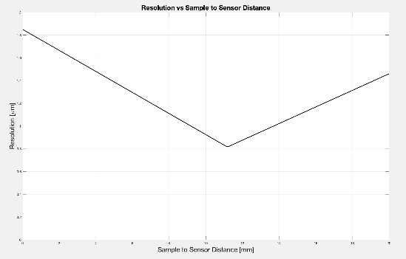
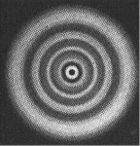
Optics Train: Resolution Model
Detector resolves Fresnel Fringes and acts as an incoherent beam
Fresnel Diffraction
Pixels can't resolve circular Fresnel fringes at detector
array’s periphery
Best Resolution occurs at Turning Point
Notes:
fred

Slide 39
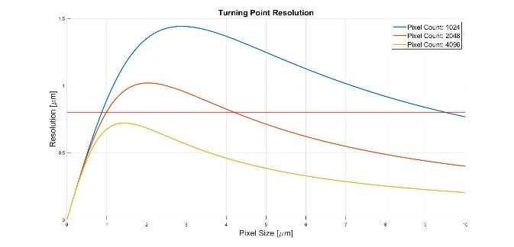


Optical Train: Image Sensor Pixel Resolution
R-DIHM-PERF-3.1: | The image sensor shall have a minimum pixel resolution of 2048²
Turning Point Resolution:
$λ$ = 405nm
f = 21mm
Notes:
eric

Slide 40
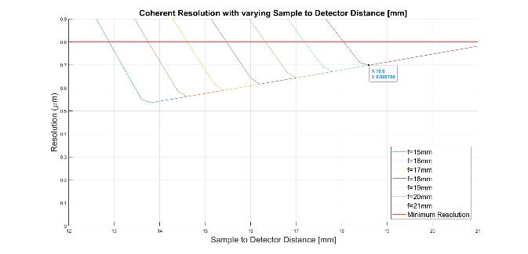


Optical Train: Image Sensor Pixel Resolution
R-DIHM-PERF-3.1: | The image sensor shall have a minimum pixel resolution of 2048²
Coherent
Resolution:
N =2048
p = 5.5 µm
Notes:
eric

Slide 41
Optical Train: Image Sensor Pixel Resolution
R-DIHM-PERF-3.1: | The image sensor shall have a minimum pixel resolution of 2048²
S= 18.6 mm
Sample to detector distance (mm)
Imaging volume
Image sensor
f = 21 mm
Focus point to detector
distance(mm)
*Not to scale
Notes:
eric

Slide 42
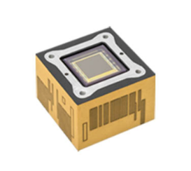
Optical Train: Space-Grade Image Sensor
R-DIHM-PERF-3.1: | The image sensor shall have a minimum pixel resolution of 2048²
11.3 mm
11.3 mm
5.5 µm
3D-Plus 4 Megapixel CMOS Space Camera 3DCM734-1
*Not to scale
Notes:
eric
This sensor was brought to our attention by our customer as a design point. Our customer wants parts that have space grade equivalents, with the important parameters for us to match being resolution and pixel size

Slide 43
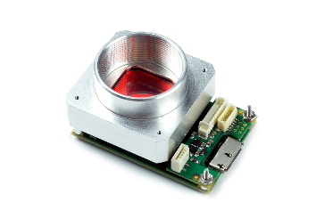
Optical Train: Prototype Image Sensor
R-DIHM-PERF-3.1: | The image sensor shall have a minimum pixel resolution of 2048²
11.3 mm
Manufacturer can send it to us without lens mount
Maximum Frame Rate: 90.3 FPS
Exposure Time: 28 us to 5s
Power Consumption: 2.88 W
Operating Temperature: 0 to 50 C
Price: $1600
11.3 mm
5.5 µm
5.5µm
Pixelink PL-D734MU-BL
*Not to scale
Notes:
eric

Slide 44
Sample Heating
R-DIHM-PHYS-7: | The microscope shall have a liquid water interface for receiving and expelling samples under expected operating conditions.
R-DIHM-PHYS-7.5: | The microscope shall not heat the sample by more than +5º Celsius relative to the baseplate temperature, except when the sample heater is activated.
R-DIHM-PHYS-7.6: | The microscope shall provide a method to actively heat the sample by a configurable amount relative to the baseplate temperature, with 1º Celsius resolution and 1º Celsius accuracy.
R-DIHM-PHYS-7.6.1: | The sample temperature shall remain between 0º Celsius and 5º Celsius .
R-DIHM-PHYS-4: | The microscope shall survive launch and operational environmental conditions.
R-DIHM-PHYS-4.6: | The microscope shall survive temperatures from -50C to +100C.
R-DIHM-PHYS-4.7: | The microscope shall operate over temperatures ranging from -15C to +40C. ​
Notes:
Bre

Slide 45
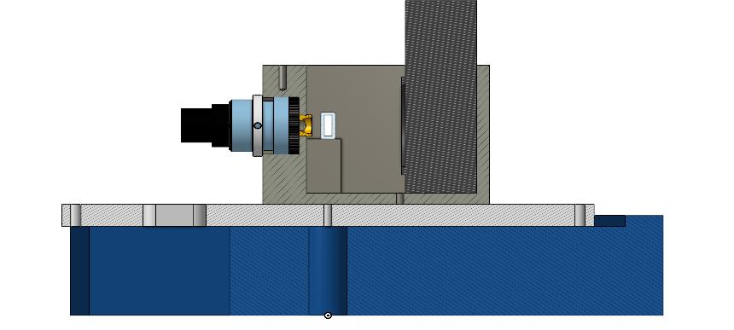
Sample Heating: Thermal Diagram
R-DIHM-PHYS-7.6.1: | The sample temperature shall remain between 0 degrees C and 5 degrees C.
Conduction from heater
Sample and sample housing
Radiation from laser
Radiation from image sensor
Optical housing
Payload baseplate
*The Spacecraft baseplate temperature can be set to our desired temperature in order to meet our sample heating requirements
Conduction from spacecraft baseplate
Spacecraft baseplate*
Instrument cross-section
Notes:
Bre

Slide 46





Sample Heating: Model
R-DIHM-PHYS-7.6.1: | The sample temperature shall remain between 0 degrees C and 5 degrees C.
Governing Principles | Assumptions | Governing Equations
1st Law of Thermodynamics
Conservation of Mass
Conservation of Momentum | V = 0
 | Heat transfer is instantaneous
Notes:
Bre

Slide 47





Sample Heating: Survival-Max Temperature Case
R-DIHM-PHYS-7.6.1: | The sample temperature shall remain between 0 degrees C and 5 degrees C.
R-DIHM-PHYS-4.6: | The microscope shall survive temperatures from -50C to +100C.
No laser, image sensor radiation
Sample temperature = 2.5 deg C
  Environment hotter than sample
  Heat needs to be conducted away from sample by baseplate
  Sample heater INACTIVE
  Heat radiated out into space
$$Q_{radiation}=Q_{cond,baseplate}$$
$$Aεσ(T_{sample}^{4}−T_{max, surrounding}^{4})=Q_{cond,baseplate}$$
$$(0.00068 m^{2})(0.92)(5.67∗{10}^{−8}\frac{W}{m^{2}K^{4}})(\left(2.5+273.15 {K)}^{4}−{\left(100+273.15 K\right)}^{4}\right)= Q_{cond,baseplate}$$
$Q_{cond,baseplate}$ = 1.4574 W
$$Q_{cond,baseplate}=ΔT/R_{aluminum}$$
$T_{baseplate}=$ 2.4743 C
Notes:
Bre

Slide 48



Sample Heating: Survival-Min Temperature Case
R-DIHM-PHYS-7.6.1: | The sample temperature shall remain between 0 degrees C and 5 degrees C.
R-DIHM-PHYS-4.6: | The microscope shall survive temperatures from -50C to +100C.
No laser, image sensor radiation
Sample temperature = 2.5 deg C
  Environment is colder than sample temperature
  NO baseplate conduction
  Sample heater ACTIVE
  Heat radiated out into space
$$Q_{radiation}=Q_{heater}$$
$$Aεσ(T_{sample}^{4}−T_{min, environment}^{4})=Q_{heater}$$
$T_{min,environment}$ = -50 + 273.15 K
$Q_{heater}$ = 0.3526 W
2 W available for use
Notes:
Bre

Slide 49


Sample Heating: Operational-Max Temperature Case
R-DIHM-PHYS-7.6.1: | The sample temperature shall remain between 0 degrees C and 5 degrees C.
R-DIHM-PHYS-4.7: | The microscope shall operate over temperatures ranging from -15C to +40C. ​
Sample temperature = 2.5 deg C
  Heat needs to be conducted away from sample by baseplate
  Sample heater INACTIVE
  Heat radiated out into space
  Heat absorbed from image sensor and laser
$$Q_{laser}+Q_{sensor}+Q_{rad, environment}=Q_{cond,baseplate}$$
$$Q_{laser}+Q_{sensor}+Aεσ(T_{sample}^{4}−T_{max,environment}^{4})=Q_{cond,baseplate}$$
$Q_{cond,baseplate}$ = 0.4081 W
$$Q_{cond,baseplate}=ΔT/R_{aluminum}$$
$T_{baseplate}=$ 2.4928 C
Notes:
Bre

Slide 50

Sample Heating: Operational-Min Temperature Case
R-DIHM-PHYS-7.6.1: | The sample temperature shall remain between 0 degrees C and 5 degrees C.
R-DIHM-PHYS-4.7: | The microscope shall operate over temperatures ranging from -15C to +40C. ​
Sample temperature = 2.5 deg C
  NO baseplate conduction
  Sample heater ACTIVE
  Heat radiated out into space
  Heat absorbed from image sensor and laser
$$Q_{laser}+Q_{sensor}+Q_{heater}=Q_{radiation}$$
$$Q_{laser}+Q_{sensor}+Q_{heater}=Aεσ(T_{sample}^{4}−T_{min, surrounding}^{4})$$
$Q_{heater}$ = 0.1393 W
2 W available for use
Notes:
Bre

Slide 51
Sample Heating: Future Work
Sample Tubing
Insulation
Thermal Desktop Modeling
    More accurate
    Will be able to better account for interactions with aluminum optical housing and glass sample housing
    Predicting it to show we need to add insulation to sample and increase heater output
      Insulation option:
        PVC
Sample
Notes:
Bre

Slide 52
Verification
& Validation
Presenters: Patricio Ramos

Slide 53
Optical Train Verification
Plan | Place size standard microspheres in imaging volume Capture images with image sensor Reconstruct images Verify reconstructed resolution with software
Driving Requirements | R-DIHM-PERF-3: The microscope shall provide reconstruction resolution of < 0.8μm in the x and y directions, and < 2μm in the z-direction.
Required Items | Laser, collimator lens, focus lens, sample housing, image sensor, image processor.
Notes:
Patricio

Slide 54
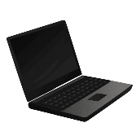
Optical Train Verification: Test Setup
Collimating Lens
Size Standard Microspheres
Focusing Lens
Image Sensor
Laser
Processor
Data Storage
Data Storage Accessed for Reconstructed Resolution Verification
*Not to scale
Notes:
Patricio

Slide 55
Sample Heating Verification
Plan | Place thermocouple before, on, and after assembled sample volume Allow thermal equilibrium to be reached for minimum operational temperature bounds Verify heater output and temperature of sample volume Allow thermal equilibrium to be reached for maximum operational temperature bounds Verify heater output and temperature of sample volume Repeat 1-6 for survival temperature bounds
Driving Requirements | R-DIHM-PHYS-7.5: The microscope shall not heat the sample by more than +5 degrees Celsius relative to the baseplate temperature, except when the sample heater is activated. R-DIHM-PHYS-7.6: The microscope shall provide a method to actively heat the sample by a configurable amount relative to the baseplate temperature, with 1 degree Celsius resolution and 1 degree Celsius accuracy.
Required Sensors | Thermistors - NTC 10KOHM 3976K Bead Multimeter – PILOT Lab
Notes:
Patricio

Slide 56
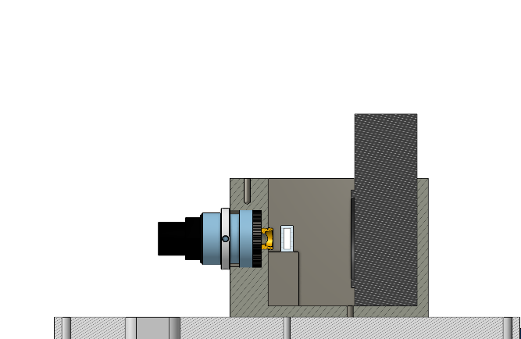
Sample Heating Verification
Multimeter
Air temperature reading from environmental condition
Sample & baseplate temperature reading from thermistors
Compare
Imaging volume
Sample heater power output
Expected sample temperature reading at steady state
Heater
Microcontroller
Thermistors
Instrument Cross-Section View
Notes:
Patricio

Slide 57
Movement Detection Verification
Plan | Use 'test_DHM_2D' to generate test data sets with various classifications of movement Use detection algorithm on test data set to classify data sets Compare classification results of detection algorithm with the known manual classifications of generated data
Driving Requirements | R-DIHM-FUNC-1.5: The software shall provide a method to detect features-of-interest in a single frame reconstruction. R-DIHM-FUNC-1.6: The software shall provide a method to detect features-of-interest in a difference frame reconstruction. R-DIHM-FUNC-1.7: The software shall provide a method to detect features-of-interest in a difference stack reconstruction.
Required Items | Human manual verification
Notes:
Ryan

Slide 58
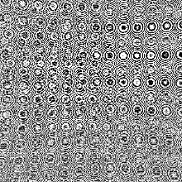
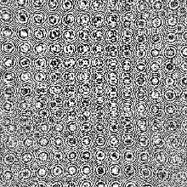
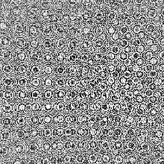
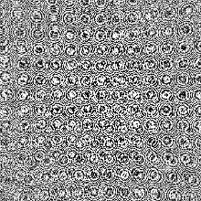
Generated Data
A
B
C
D
Notes:
Ryan

Slide 59


Movement Detection Verification
Known Classifications
Algorithmically
Determined
Classifications
?
Generated Data
Reconstructed Data
Movement
Detection
Algorithm
test_DHM_2D
Reconstruction Algorithm
1. Use function to generate test data that follows a specific type of classification
2. Run the test data through the motion detection algorithm
3. See how the algorithm performs in comparison to what we know the classification to be
Notes:
Ryan

Slide 60
Spring Planning
Presenters: Brianna Gagliardi
Notes:
Bre

Slide 61
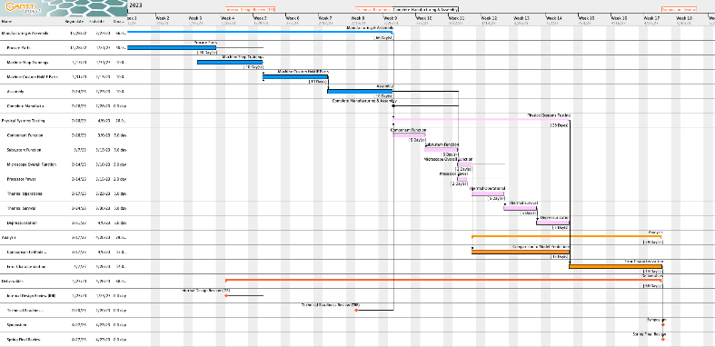
Master Schedule
Manufacturing & Assembly
Systems Testing
Analysis
Deliverables
Notes:
Bre

Slide 62
Master Schedule
Start
Manufacturing & Assembly
Critical Path
Systems Testing
Analysis
Deliverables
Finish
Notes:
Bre

Slide 63
Major Testing Dates
Test | Goal Date | Testing Location
Overall Function | 3/14 | AERO
Thermal Operation | 3/17 | BIOSERVe
Thermal Survival | 3/24 | BIOSERVe
Depressurization | 3/31 | AERO
Notes:
Bre

Slide 64
Financial Budget Breakdown
Project Area | Allocated Budget | Requested Budget | Margin
Mechanical | $1000.00 | $832 | $168
Electronics | $2000.00 | $2043 | -$43
Optics | $600.00 | $530 | $70
Testing | $400 | $300 | $100
Total | $4000.00 | $3505 | $495
Notes:
Bre

Slide 65
Questions?
Notes:
Bre

Slide 66
Backup Slides

Slide 67
General assembly: Manufacturing Methods
Optical components are sourced from 3rd parties
½ in 6061 Aluminum plate from McMaster-Carr,
machined @ AERO
6061 Aluminum, CNC’d by 3rd party (Xometry)
Steel fasteners and hex nuts from McMaster-Carr
Baseplate heater (for testing only)

Slide 68
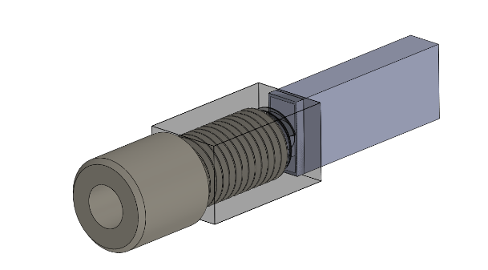
Fluid Connector
Sample housing
Machined block of Acrylic/Polycarbonate
1/16” OD to ¼”-28 adapter
Epoxy sealant around edges

Slide 69
Design Requirements & Satisfaction

Slide 70




Optics Train: Design
Coherent Resolution Approximation:
Corrected Coherent Resolution:
Turning Point Resolution Approximation:
Source Plane Resolution:

Slide 71
Optical Train: Light Intensity
R-DIHM-PERF-3.1.1: | The minimum light intensity at the image sensor shall be 7.663e-05 [mW/mm²].
Divergence Angle (rad)
Initial waist 'w₀' (mm)
Divergence Angle:
θ = asin(NA)
Collimating Lens
Focusing Lens
Laser
θ
Collimated Radius:
Rc = EFL_{c} tan(θ)
w₀
R_{c}
EFL_{c}
EFL_{f}
Initial Waist at the
Focus Point (mm):
w₀ = λEFL_{f}/(πR_{c})
Collimator focal length (mm)
Collimated
radius (mm)
Focus lens focal length (mm)
*Not to scale

Slide 72
Optical Train: Light Intensity
R-DIHM-PERF-3.1.1: | The minimum light intensity at the image sensor shall be 7.663e-05 [mW/mm²].
Collimating Lens
Focusing Lens
Transmission Efficiencies:
Collimating Lens: 0.9 ???
Focusing Lens: 0.95
Sample Housing: 0.9225
Laser
P0 = 3mW
Power at the detector = P0*0.9*0.95*0.9225 = 2.36 mW
*Not to scale

Slide 73



Optical Train: Light Intensity
R-DIHM-PERF-3.1.1: | The minimum light intensity at the image sensor shall be 7.663e-05 [mW/mm²].
Irradiance (mW/mm²):
Sample Volume
Image Sensor
Beam Waist (mm):
Initial Waist 'w₀' (mm)
z
Rayleigh Range (mm):
Sample Axial Distance 'z_{s}' (mm)
Detector Axial Distance 'z_{d}' (mm)
Initial Irradiance (mW/mm²):
I₀ = P₀ / (πw₀²)
*Not to scale

Slide 74
Optical Train: Light Intensity
R-DIHM-PERF-3.1.1: | The minimum light intensity at the image sensor shall be 7.663e-05 [mW/mm²].
Image Sensor Size: 5.64 x 5.64 mm
Min waist at detector = 5.64 mm
Influenced by:
Collimated radius
Focus lens focal length
Detector axial distance
Image Sensor
Sample Volume
Initial Waist 'w₀' (mm)
z
Sample Axial Distance 'z_{s}' (mm)
Detector Axial Distance 'z_{d}' (mm)
*Not to scale

Slide 75
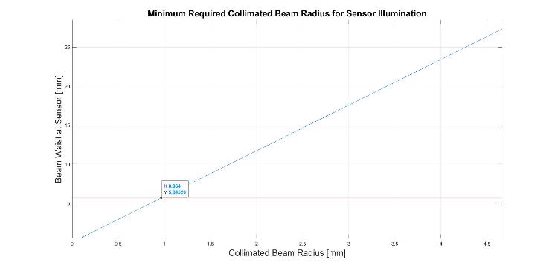
Optical Train: Light Intensity
R-DIHM-PERF-3.1.1: | The minimum light intensity at the image sensor shall be 7.663e-05 [mW/mm²].

Slide 76
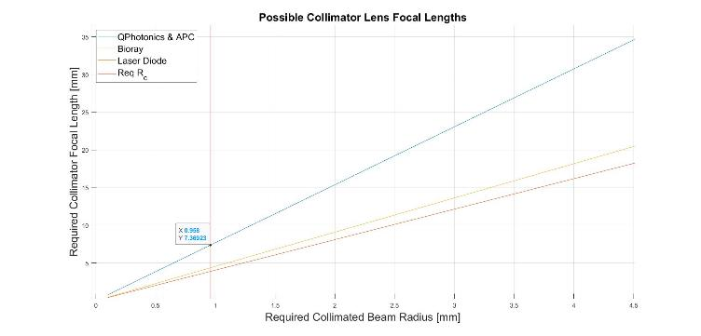
Optical Train: Light Intensity
R-DIHM-PERF-3.1.1: | The minimum light intensity at the image sensor shall be 7.663e-05 [mW/mm²].

Slide 77
Optical Train: Sensor Saturation
R-DIHM-PERF-3.1.1: | The minimum light intensity at the image sensor shall be 7.663e-05 [mW/mm²].

Slide 78
Optical Train: Sensor Saturation
R-DIHM-PERF-3.1.1: | The minimum light intensity at the image sensor shall be 7.663e-05 [mW/mm²].

Slide 79
Optical Train: Light Intensity
R-DIHM-PERF-3.1.1: | The minimum light intensity at the image sensor shall be 7.663e-05 [mW/mm²].
Waist Radius at the Detector 'w_{d}' (mm]
Power at Detector:
P_{d} = I_{d} x A_{d} (mW)
Power Loss:
P_{Loss} = I_{d}πw_{d}² - P_{d} (mW)
Waist Radius at the Detector 'w_{d}' (mm)
Detector Area 'A_{d}' (mm²)
*Not to scale

Slide 80
Optical Train: Focus Lens Focal Length
R-DIHM-PERF-3.1.1: | The minimum light intensity at the image sensor shall be 7.663e-05 [mW/mm²].
Radius
θ = asin(NA_laser) = asin(0.13)
Radius = f_col*tan(θ)*1000 = 7.5*tan(θ)*1000
NA_min = resolution/(0.61*lambda) = 0.4
ENA = sin(atan(radius/f_focus))
Plots on next page show max f_focus (decision for focus lens)
θ
Collimating Lens
Focusing Lens
The ENA grows with decreasing focal length & decreasing focusing lens diameter.

Slide 81
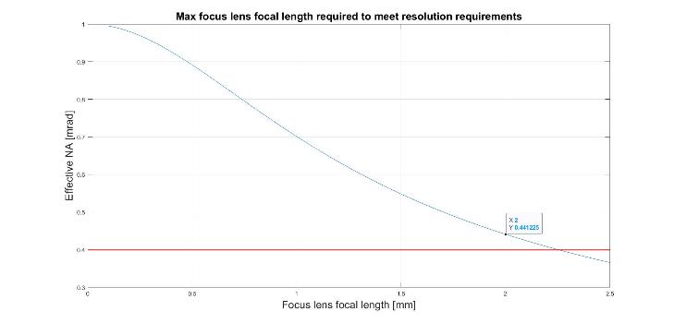
Optical Train: Focus Lens Focal Length

Slide 82
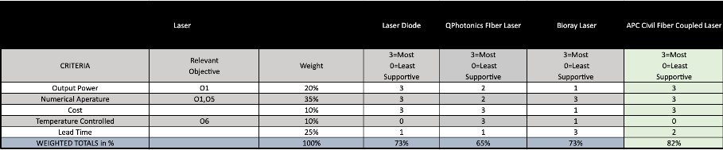
Optical Train: Laser Trade Studies

Slide 83
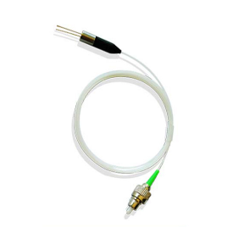
Optical Train: Laser
R-DIHM-PERF-3.1.2: | The laser shall have a minimum output power of 2mW and an input power of 5V.
Wavelength: 405 nm
Power Output: 3 mW
Numerical Aperture: 0.13
Cost: $109
FP SM Coaxial Laser Diode Blue-Violet Fiber Laser

Slide 84
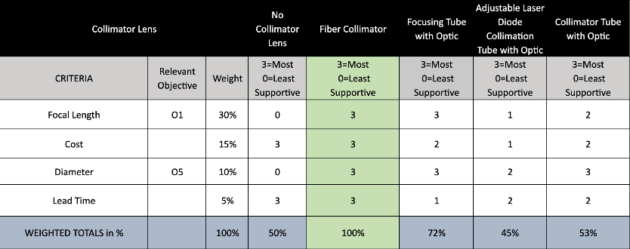
Optical Train: Collimator Trade Studies

Slide 85
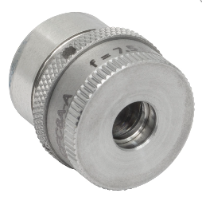
Optical Train: Collimator
FC/APC Adjustable Aspheric Collimator CFC8A-A
Focal Length: 7.5 mm
Diameter: 4.5 mm
Numerical Aperture: 0.5
Transmission Rate: 0.9
Cost: $360.55

Slide 86
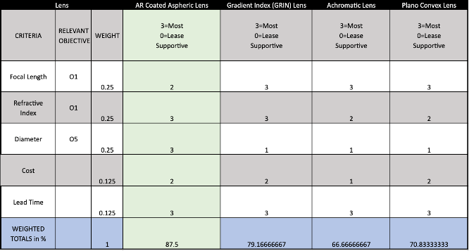
Optical Train: Focus Lens Trade Studies

Slide 87
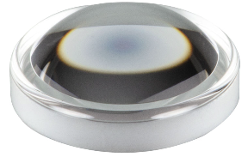
Optical Train: Focus Lens
V-Coated Aspheric Lens 357775-405
Focal Length: 4.0 mm
Numerical Aperture: 0.6
Diameter: 4.80 mm
Transmission Rate: 0.95
Cost: $162.65

Slide 88
Optical Train: Image Sensor Pixel Resolution
Sample to detector distance (mm)
Collimating Lens
Collimator/Focus Lens Distance (mm)
Numerical Aperture
(mrad)
Focusing Lens
Imaging Volume
18.6 mm
Image Sensor
Laser
21 mm
Collimator lens effective focal length
Focus lens effective focal length (mm)
Focus point/detector
distance
*Not to scale
Notes:
eric

Slide 89
Optical Train
Collimator/Focus Lens Distance (mm) - 1mm
CA= 4.5mm
2x Divergence Angle
Collimating Lens
Focusing Lens
Imaging Volume
Image Sensor
Laser
NA = 0.5
Collimator lens effective focal length (mm) 7.5 mm
Focus lens effective focal length (mm) - 2mm
Focus point/detector
distance 'f ‘ (mm) 21 mm
Sample/detector distance 's' (mm) 18.5 mm

Slide 90
Environment
R-DIHM-PHYS-4: | The microscope shall survive launch and operational environmental conditions.
R-DIHM-PHYS-4.1 | The microscope shall survive typical launch random vibration simulations up to specified values.
R-DIHM-PHYS-4.2 | The microscope shall operate and meet all performance requirements in the presence of vibration simulations from the orbiter’s reaction wheels.
R-DIHM-PHYS-4.3 | The microscope shall survive a simulated Overall Sound Pressure Level (OASPL) up to 135dB.
R-DIHM-PHYS-4.4 | The microscope shall simulated survive shock loads up to 1000g.
R-DIHM-PHYS-4.5 | The microscope shall survive continuous g-forces of up to 8g on any axis.
R-DIHM-PHYS-4.6 | The microscope shall survive temperatures from -50C to +100C.
R-DIHM-PHYS-4.7 | The microscope shall operate over temperatures ranging from -15C to +40C.
R-DIHM-PHYS-4.8 | The microscope shall survive depressurization at a rate of 0.5 psi/s.
R-DIHM-PHYS-4.9 | The microscope should not employ any materials with outgassing properties that could contaminate any optics or instruments onboard the orbiter, including optics within the microscope.

Slide 91
Environment: Launch Vibrations Simulations
R-DIHM-PHYS-4.1 | The microscope shall survive typical launch random vibration simulations up to specified values.
Frequency (Hz) | PSD (g²/Hz)
20 | 0.013
50 | 0.030
800 | 0.030
2000 | 0.013
Method
Run SOLIDWORKS random vibration simulation with the given PSD curve.
Multiply maximum stresses in key areas by 3.
Evaluate whether the 3sigma stress is less than the yield strength.
Z
Y
X

Slide 92
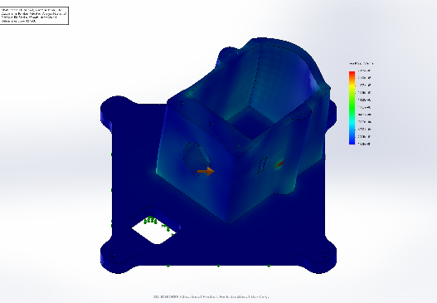
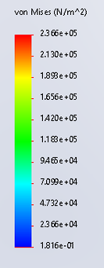
Environment: Operational Vibrations Simulations
R-DIHM-PHYS-4.2 | The microscope shall operate and meet all performance requirements in the presence of vibration simulations from the orbiter’s reaction wheels.
X-Axis Excitation
Z
Y
X

Slide 93
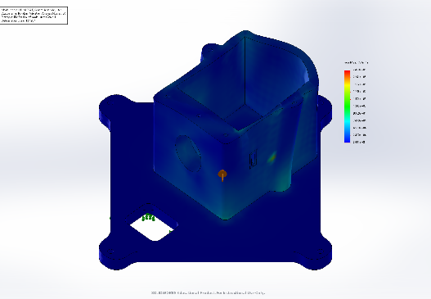
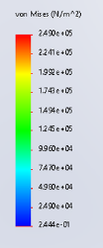
Environment: Operational Vibrations Simulations
R-DIHM-PHYS-4.2 | The microscope shall operate and meet all performance requirements in the presence of vibration simulations from the orbiter’s reaction wheels.
Y-Axis Excitation
Z
Y
X

Slide 94
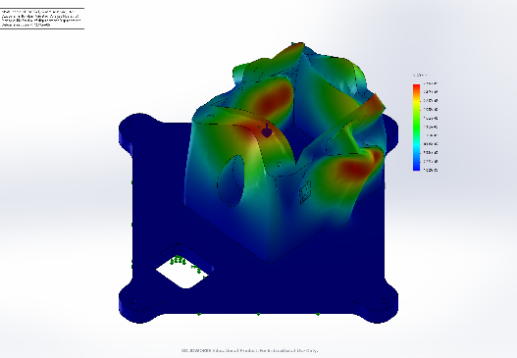
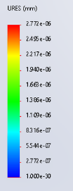
Environment: Operational Vibrations Simulations
R-DIHM-PHYS-4.2 | The microscope shall operate and meet all performance requirements in the presence of vibration simulations from the orbiter’s reaction wheels.
Z-Axis Excitation
Z
Y
X

Slide 95
SWAP
R-DIHM-PHYS-3: | The microscope payload shall fit within a 1U SWAP (size, weight, and power) allocation that provides all interfaces with the spacecraft.
R-DIHM-PHYS-3.1: | The microscope shall fit within a 1U payload volume.
R-DIHM-PHYS-3.2: | The microscope shall weigh less than 2 kg.
R-DIHM-PHYS-3.3: | The microscope shall consume less than 10 watts active, and 0.5 watts inactive.
R-DIHM-PHYS-3.4: | The processor shall consume less than 10 watts active, and .5 watts inactive.
R-DIHM-PHYS-3.5: | The microscope processor and laser shall not be included in the 1U volume constraint.

Slide 96
SWAP: Active Power
R-DIHM-PHYS-3.3: | The microscope shall consume less than 10 watts active, and 0.5 watts inactive.
R-DIHM-PHYS-3.4: | The processor shall consume less than 10 watts active, and 0.5 watts inactive.
Chosen components represent ~95% of power consumption
  Some small components have not been chosen, but will not be an issue
MICROSCOPE POWER BUDGET
Component | Power [W]
Image Sensor | 2.8
Laser | 0.3
Laser Driver | 0.392
Sample Heaters | 2
Heater Controller | 0.0325
Total Power | 5.5245
PROCESSOR POWER BUDGET
Component | Power [W]
Processor | 7.5
Wake-Up System | 0.0325
Total Power | 7.5325
Notes:
Active power consumption is not a concern for microscope or processor, as can be seen
Some components not chosen or accounted for such as the relays. These will not increase power consumption in any impactful way
Inactive power not a concern for microscope, can be completely shut down
Inactive power for processor is a concern, processor will need to be shut down completely, and a secondary, low power system will need to be on standby to reactivate it when necessary

Slide 97

SWAP: Inactive Power
R-DIHM-PHYS-3.3: | The microscope shall consume less than 10 watts active, and 0.5 watts inactive.
R-DIHM-PHYS-3.4: | The processor shall consume less than 10 watts active, and 0.5 watts inactive.
Secondary low power circuit (0.5 W allocated) to wake up the processor.
  Low power microcontroller* will be monitoring input signals for a wake-up sequence
  Upon receipt, the microcontroller will activate a relay, powering up the processor
    From this point, the main processor will take over and begin waking up the microscope
*ATTiny85 used as reference
Notes:
This is our plan to lower inactive power consumption to below 0.5 W.
Low power microcontroller will be monitoring input signals, and wake up the processor when required
From that point forward, the main processor will take over
Shown in the figure is a mockup of what this may look like. We used an ATTiny85 for a reference pinout. At this point we plan on using the Teensy LC, as we will be purchasing one for a different system, allowing for hardware familiarity.

Slide 98
Hologram Reconstruction Algorithm
R-DIHM-PERF-4: | The microscope’s processor and reconstruction algorithm shall be fast enough to keep up with the rate of material collection.
R-DIHM-PERF-4.1: | The microscope shall provide an instantaneous imaging volume > 2μL.
R-DIHM-PERF-4.2: | Reconstruction of the full 3D imaging volume from one frame or one difference stack shall take less than 12,000 seconds at the required reconstruction resolution.
R-DIHM-PERF-4.2.1: | The processor speed shall be in excess of 0.983 GFLOPS, to allow for sufficient power to execute commands and run the detection algorithm.
Interference Pattern Hologram
Reconstructed Image
Reconstruction Algorithm

Slide 99

Hologram Reconstruction Algorithm
R-DIHM-PERF-4.1: | The microscope shall provide an instantaneous imaging volume > 2μL.

Slide 100
Hologram Reconstruction Algorithm
R-DIHM-PERF-4.2: | Reconstruction of the full 3D imaging volume from one frame or one difference stack shall take less than 12,000 seconds at the required reconstruction resolution.
R-DIHM-PERF-4.2.1: | The processor speed shall be in excess of 0.983 GigaFLOPS, to allow for sufficient power to execute commands and run the detection algorithm.
Method:
  Use MATLAB function to compute number of FLOPs to perform full reconstruction
  Divided by time of reconstruction (t = 12,000s)
Results:
  Number of FLOPs = 1.18E13 FLOPs
Speed = (FLOPs/time) = (1.1796*10^13/12000) = 0.983 * 10 ^9 FLOPS = 0.983 GigaFLOPS
Processor Research
  Weaver Computer Engineering Research Group at the University of Maine
    Compiled computing power in GFLOPS of various popular processors and SBCs
Notes:
https://web.eece.maine.edu/~vweaver/group/machines.html

Slide 101
Hologram Reconstruction Algorithm: Processor Choice
Processor/Controller |  |  |  | Jetson Nano Developer Kit | Raspberry Pi 4B | Raspberry Pi 3B | BeagleBone Black Industrial | DragonBoard
CRITERIA | Relevant Objective | Weight | SCALE
Max Power Consumption | PHYS-3.4 | 20% | 3=Most Supportive, 0=Least Supportive | 0 | 2 | 2 | 3 | 2
Computational Power | PERF-4.2.1 | 25% |  | 3 | 2 | 1 | 0 | 1
Thermal Operation and Survival | PHYS-4.6, PHYS-4.7 | 15% |  | 2 | 2 | 2 | 3 | 1
RAM |  | 15% |  | 2 | 3 | 1 | 0 | 1
Cost |  | 10% |  | 0 | 1 | 3 | 2 | 2
Lead Time/Availability |  | 15% |  | 1 | 1 | 3 | 2 | 1
WEIGHTED TOTALS in % |  | 100% |  | 50% | 63% | 62% | 52% | 43%
Notes:
https://web.eece.maine.edu/~vweaver/group/machines.html

Slide 102

Hologram Reconstruction Algorithm: Processor Choice
Winner was Raspberry Pi 4B, but due to supply chain issues, Raspberry Pi 3B will be used for initial prototyping
  Team already owns a Raspberry Pi 3B, and Raspberry Pi 4Bs are not being sold at retail price
  Team will purchase a Pi 4B when available
Notes:
https://web.eece.maine.edu/~vweaver/group/machines.html
Several options were considered, including the NVIDIA Jetson Nano, the Raspberry Pi 3 and 4, the BeagleBone Black Industrial, and more, but ultimately the Pi 4 won. Its relatively easy to acquire, has a plethora of resources and support available, and exceeds our requirements.
One thing to note, is that we will begin our prototyping using a Pi 3, as the team currently already owns one, and Pi 4s are not easy to get at retail price currently. We will transition to a Pi 4 when we are able to acquire one

Slide 103

Hologram Reconstruction Algorithm Flow Chart
1. Subtract intensity of reference wave
2. Take fast fourier transform
3. Over sample
7. Take result from step 3 and multiply by the reference wave

Slide 104

Hologram Reconstruction Algorithm Flow Chart
5. Multiply result of step 4 with the apodizer and shift to frequency domain
6. Multiply template wave with the apodizer and shift to frequency domain
7. Multiply results of step 5 and 6 and shift to time domain to get the final image of specified z-slice

Slide 105


Reconstructed Z-Slices

Slide 106


Frame A
Timestep 1

Slide 107


Frame B
Timestep 2

Slide 108


Frame C
Timestep 3

Slide 109


Frame D
Timestep 4

Slide 110
Difference Stack Algorithm
A
B
C
D
Difference Stack = (B-A)+(D-C)

Slide 111

Reconstruction
Unprocessed Difference Stack
Reconstructed Difference Stack
Reconstruction Algorithm

Slide 112
Verification and Validation

Slide 113

Environment: G-Loading Verification
Plan | 15 g/tons Centrifuge, CIEST Lab located on Main Campus Max volume: 45.72cm x 44.45 cm x 58.42 cm Will ensure physical design matches simulated predictions
Driving Requirements | R-DIHM-PHYS-4.6: The microscope shall survive continuous g-forces of up to 8g on any axis. R-DIHM-PHYS-4.6.1: The microscope shall survive 8g's for 24 seconds.
Required Sensors | Accelerometers
CIEST 15 g/ton Centrifuge

Slide 114
Environment: Thermal Verification
Plan | Utilize BIOSERVe oven and freezers Place assembly in oven/freezer Allow thermal equilibrium to be reached Pull microscope out of freezer Operate with control sample and test sample immediately and verify outputs
Driving Requirements | R-DIHM-PHYS-4.6: The microscope shall survive temperatures from -50C to +100C. R-DIHM-PHYS-4.7: The microscope shall operate over temperatures ranging from -15C to +40C.
Required Sensors | thermocouples

Slide 115
Spring Planning

Slide 116
Financial Budget Breakdown
Mechanical | Mechanical
Item | Cost
Thermistor(split with other team) | $200.00
Optical housing | $150
Optical Housing Endplate | $100
1U Baseplate | $11.70
Sample Heater (split with other team) | $10.00
Epoxy | $20
Sample housing | $0
Syringes | $10
Tubing | $60
Bubble Trap | $120
Sample Housing - Tubing Adapter | $100
Teflon Tape | $5.00
Total | $832
Electronics | Mechanical
Item | Cost
Image Sensor | $1,600
Processor | $80
Camera GPIO Connector | $1.25
Laser Driver | $106.28
Laser | $120
PCB, Misc Components | $75
Teensy LC x2 | $35
Relays | 25
Total | $2043

Slide 117
Financial Budget Breakdown
Optics | Mechanical
Item | Cost
Collimator Lens | $361
Focusing Lens | $104
Aperture | $65
Total | $530
Testing | Mechanical
Item | Cost
Safety Equiptment | $200
Size Standard Microspheres | $100
Total | $300

Slide 118
Data Downlink
R-DIHM-FUNC-1 | The microscope shall support meeting the mission requirements under a 1 kbps downlink constraint.
Using the motion detection algorithm, descriptors and regions of interest will be transmitted via text and JSON files
Researchers can choose to have reconstructed images transmitted of these regions of interest, greatly reducing the image size.
Images requested can be compressed by a ratio of 10:1 to further reduce file size while maintaining image integrity.

