Slide 1
ETNA Test Readiness Review
Team 14
Presenters: Jake Starkel, Srija Boddeda, Ania Miecznik, Ace Stratton, Izaak Beusmans, Atkin Arnstein, Lucas Allen
Additional Members: Anna Jonsen, Hayden Fuller, Max Martinez, Bart Kubiak, Devin Davis
Company Costumer: ASTROBi
Faculty Advisor: Prof. Lawrence

Slide 2
Agenda
Overview
Schedule
Test Readiness
Budget
CONOPS
FBD
CPEs
Design
Gantt Chart
All tests
Thermal Survival
Detection of Life
Day in the Life
Subsystem breakdown

Slide 3
Overview
Overview
Schedule
Testing
Budget

Slide 4
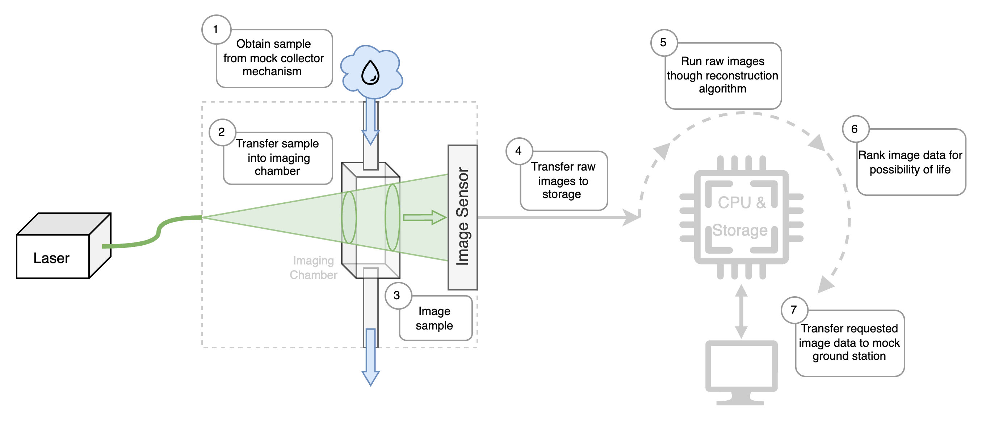
CONOPS: Etna
Overview
High Level
CPEs
Design

Slide 5
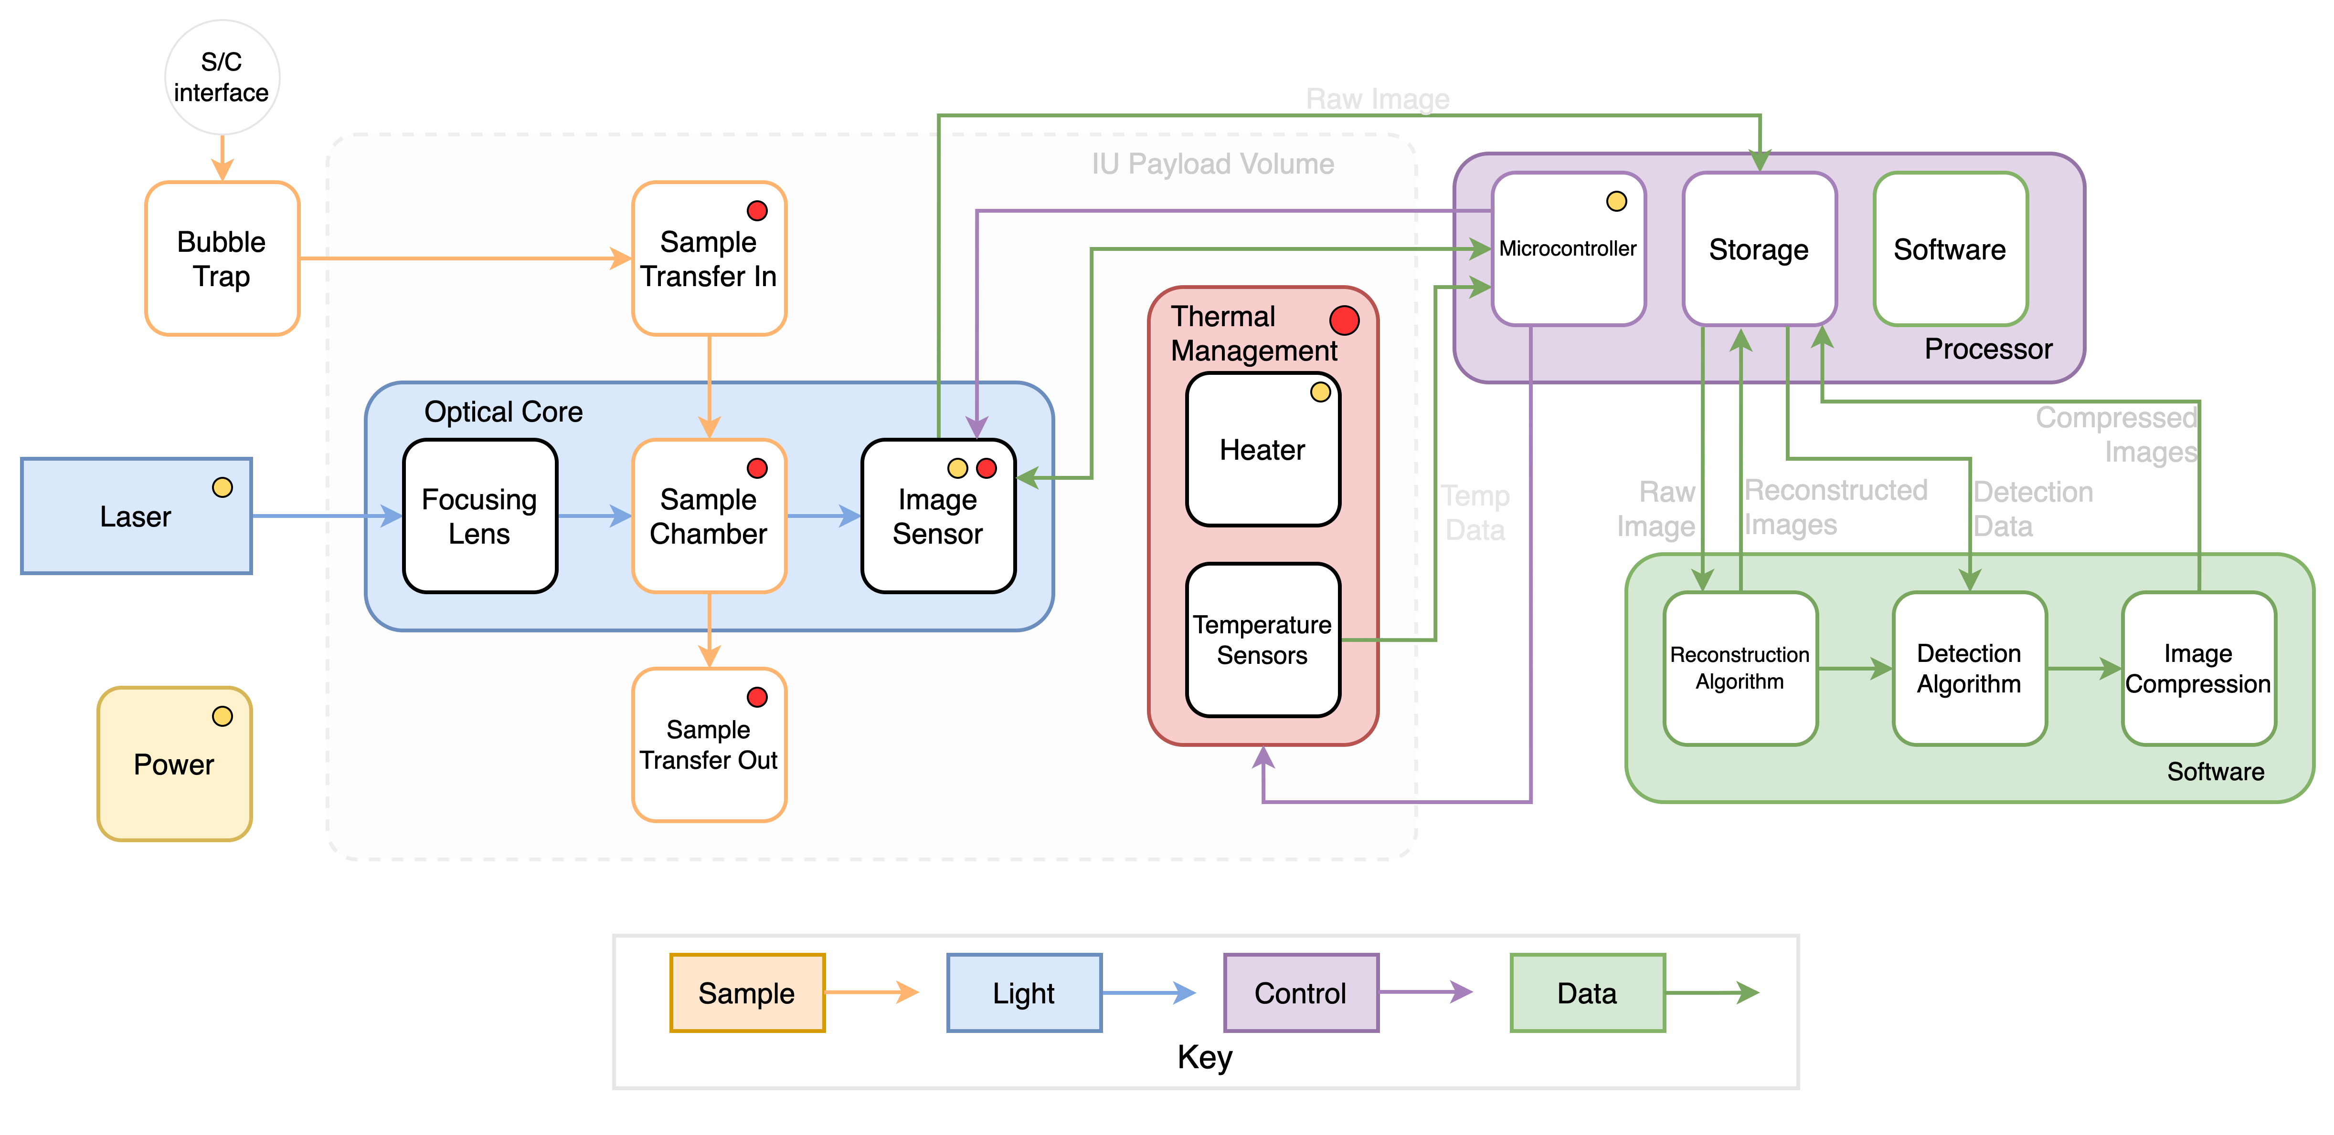
System Functional Block Diagram
Overview
High Level
CPEs
Design

Slide 6
Critical Project Elements
CPE | Description
E1: Structural Survival | Payload shall survive vibrations, g-force, and pressure it would experience throughout the mission
E2: Thermal Survival | Payload shall survive thermal ranges it would experience throughout the mission
E3: Sample Handling | Payload shall be able interface with mock spacecraft to intake and expel saltwater samples
E4: Optical Design | Payload shall be able image sample volume using laser, lenses, and image sensor
E5: Data Reconstruction | Images shall be reconstructed such that a particle and its movement can be identified
E6: Particle Detection | Particle movement shall be identified and ranked by their possibility of life
E7: Communication | Software shall control payload components and recognize results between algorithms.
E8: Power Consumption | Payload and processor shall have sperate maximum active and inactive power consumption
Overview
High Level
CPEs
Design
Notes:
Color boxes more, maybe shade boxes so its obvious
Just saying reasons is clear

Slide 7
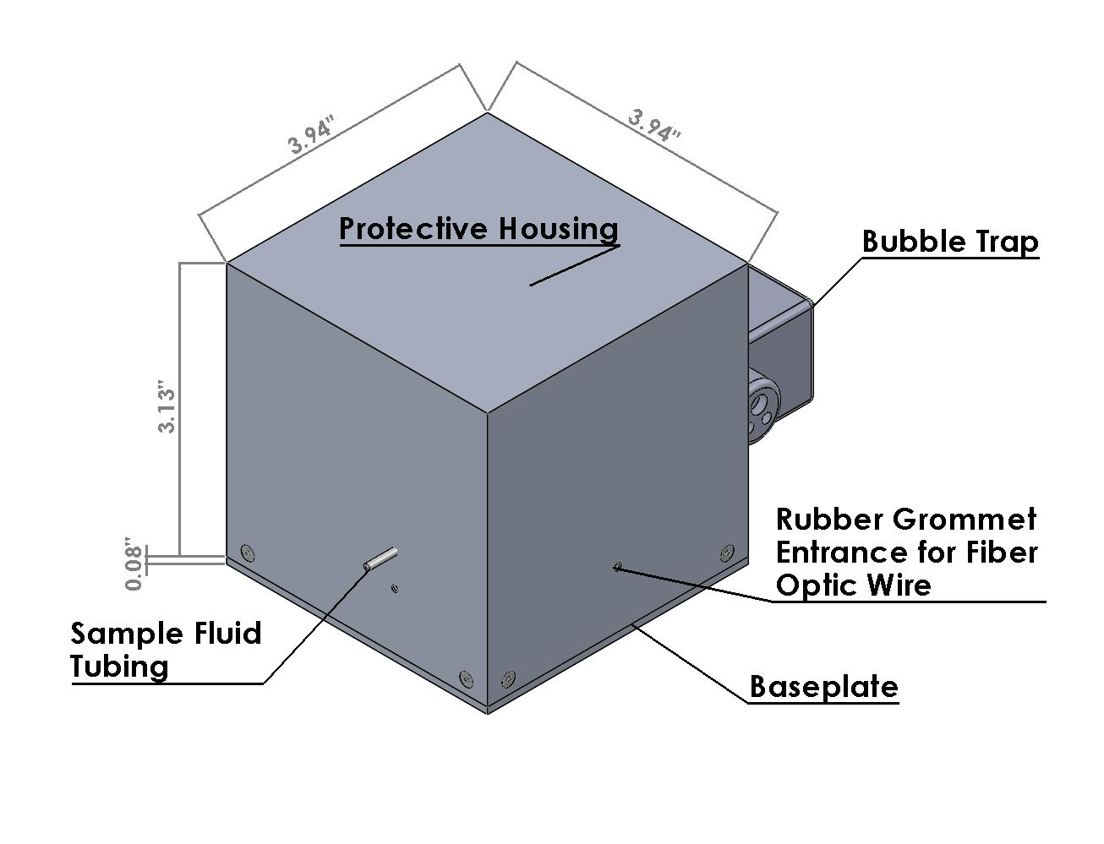
CAD Design: Enclosure and Bubble Trap
3.94” = 10cm
Y-axis
Z-axis
X-axis
Overview
High Level
CPEs
Design

Slide 8
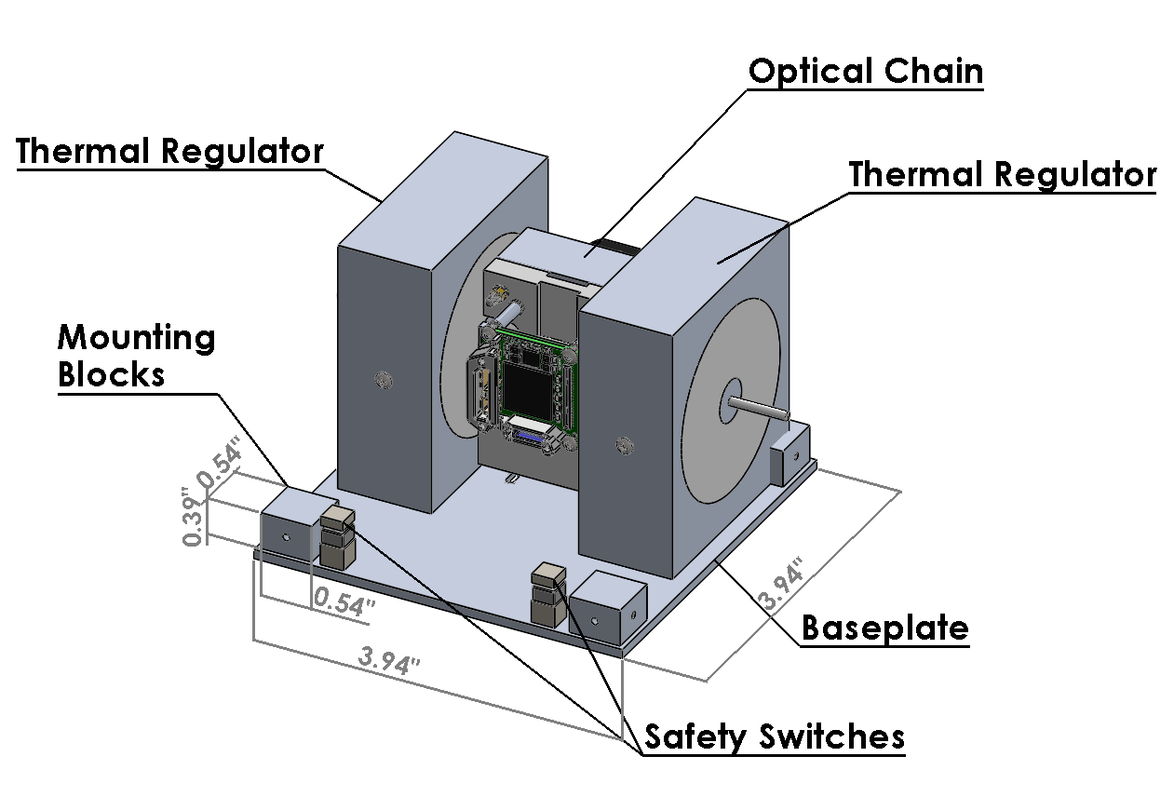
CAD Design: Open Box Assembly
Y-axis
Z-axis
X-axis
Overview
High Level
CPEs
Design

Slide 9
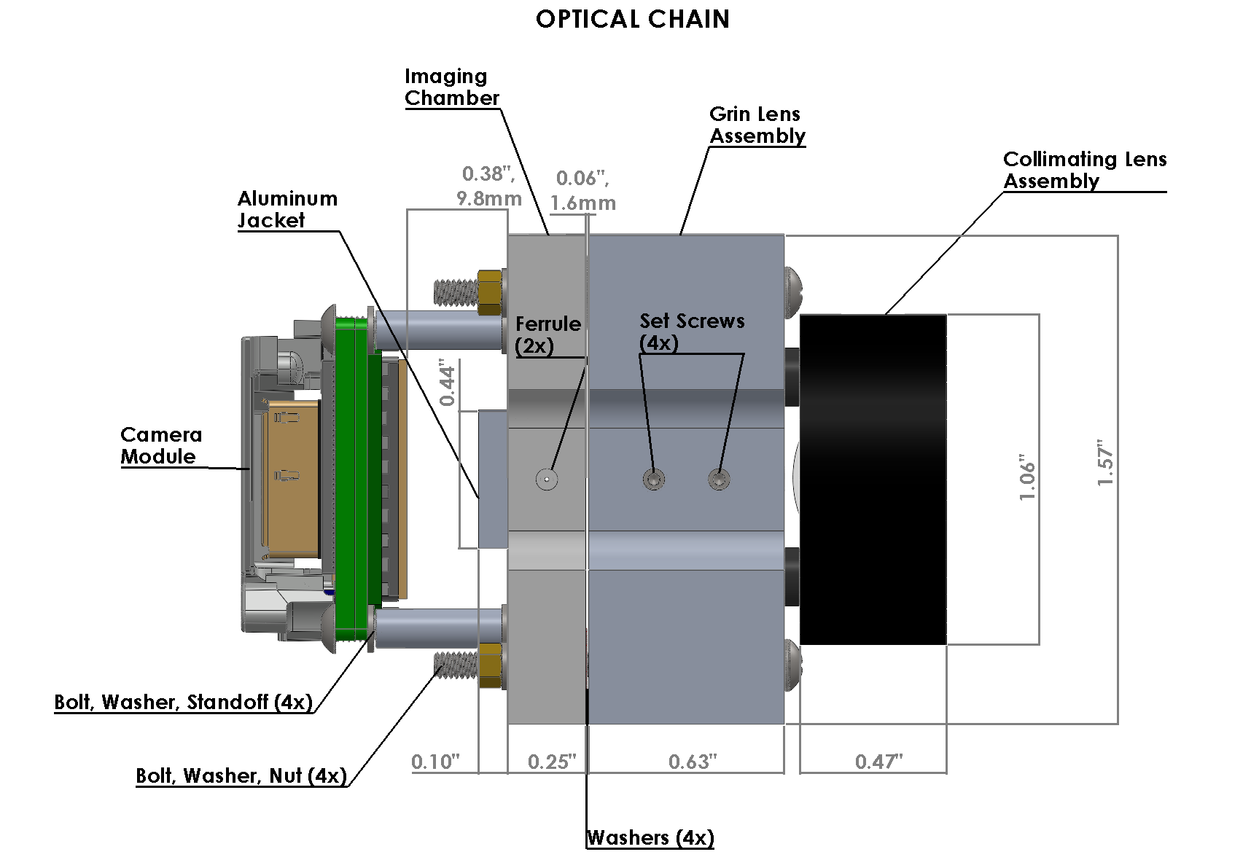
CAD Design: Optical Chain
Side View
Y-axis
Z-axis
Overview
High Level
CPEs
Design

Slide 10
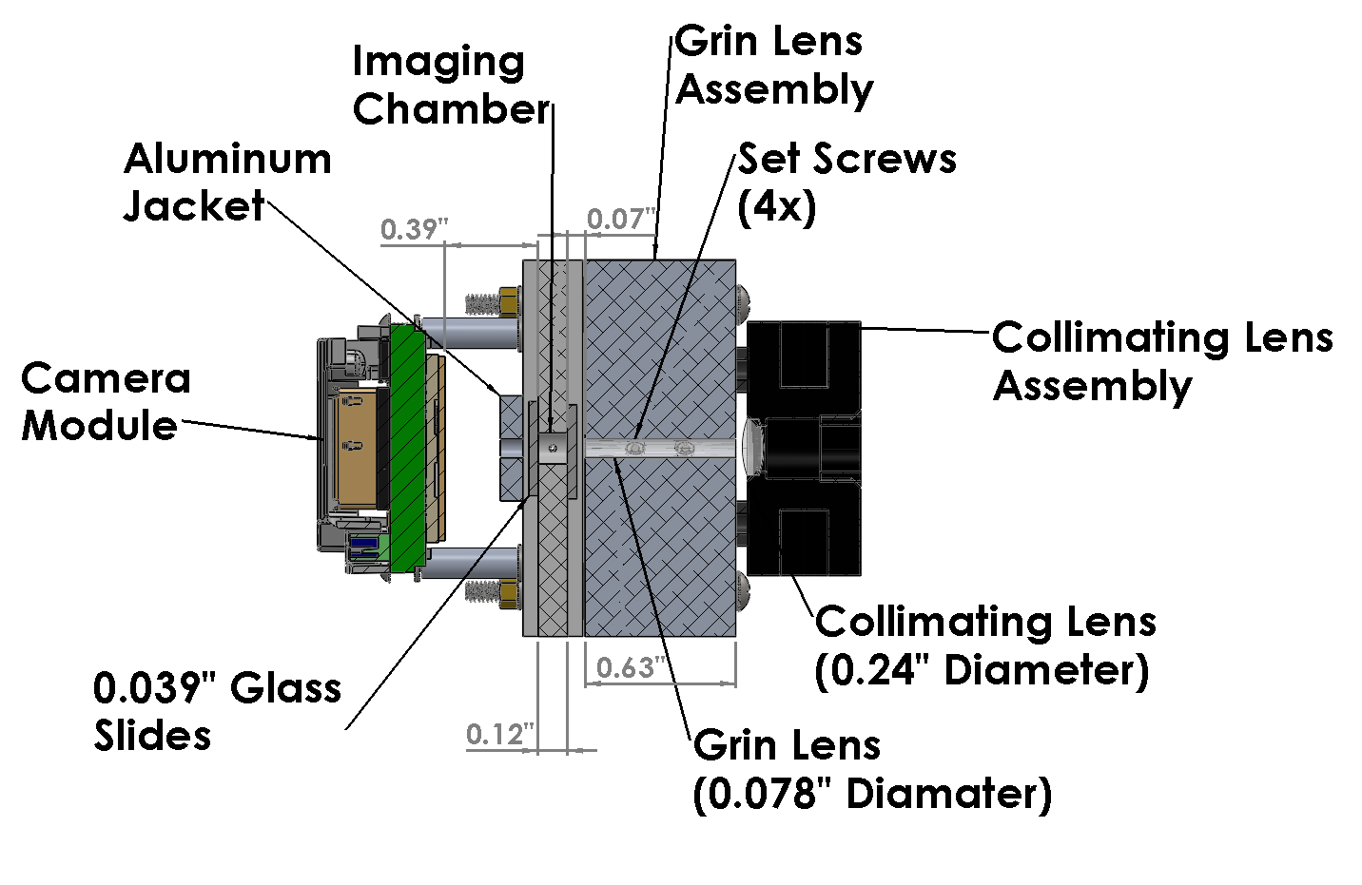
CAD Design: Optical Chain
Side Section View
Wavelength = 520 nm
Sensor Face .
Y-axis
Z-axis
Overview
High Level
CPEs
Design

Slide 11
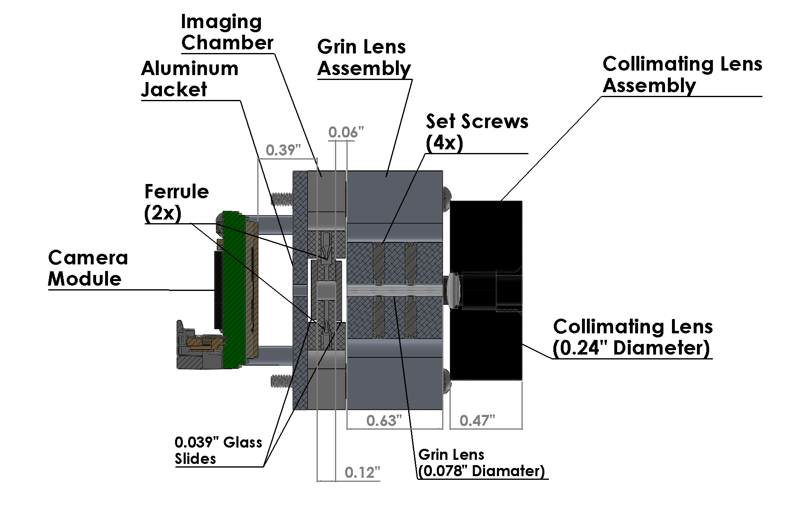
CAD Design: Optical Chain Top Section View
Fluid In
Wavelength = 520 nm
Sensor Face .
X-axis
Fluid Out
Z-axis
Overview
High Level
CPEs
Design

Slide 12
Schedule
Overview
Schedule
Testing
Budget

Slide 13
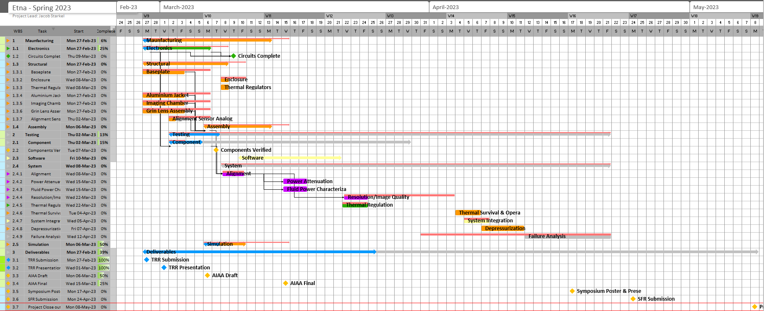
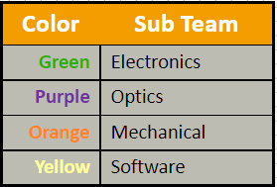
Gantt Chart: Overview
Testing Complete
Critical Path
Overview
Schedule
Testing
Budget

Slide 14
Gantt Chart: Manufacturing
Overview
Schedule
Testing
Budget

Slide 15
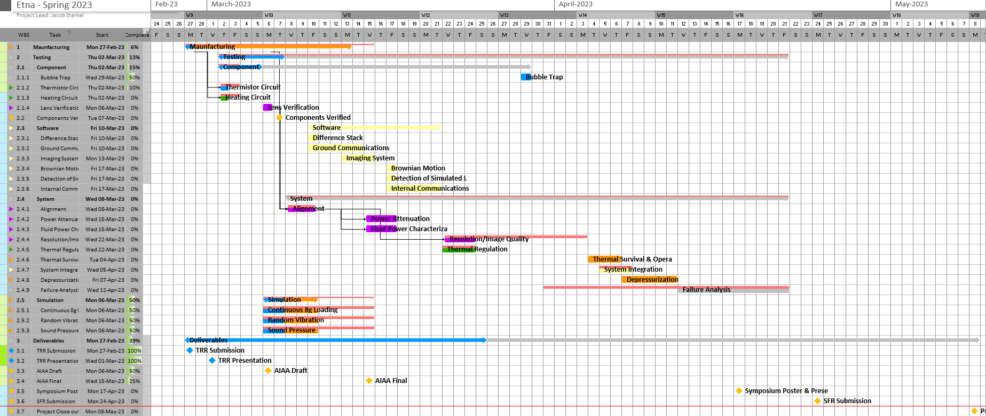
Gantt Chart: Testing
Overview
Schedule
Testing
Budget

Slide 16
All Tests
Optics
CPE | Test | Date (week)
E4 | Lens Verification | 3/5
E4 | Alignment | 3/5
E4 | Power Attenuation | 3/12
E4 | Sample Chamber Fluid Power Characterization | 3/12
E4 | Light Bouncing | 3/12
E4 | Resolution & Image Quality | 3/19
Electrical
CPE | Test | Date (week)
E2 | Thermistor Circuit | 2/26
E2 | Heating Circuit | 2/26
Software
CPE | Test | Date (week)
E7 | Ground Communications | 3/10
E7 | Internal Communications | 3/17
E6 | Brownian Motion | 3/17
E6 | Detection of Life & Reconstruction | 3/17
E5 | Difference Stack | 3/10
E7 | Imaging System | 3/12
Mechanical
CPE | Test | Date (week)
E3 | Bubble Trap | 3/27
E2 | Thermal Regulator | 3/12
E1 | Continuous 8g Simulation | 2/26
E1 | Random Vibration Simulation | 2/26
E1 | Sound Pressure Simulation | 2/26
E1 | Depressurization | 3/26
E2 | Thermal Survival | 3/19
Full system
CPE | Test | Date (week)
All | Day In The Life | 3/16
E2 – E4, | Thermal Operational | 3/19
Overview
Schedule
Testing
Budget

Slide 17
Testing
Overview
Schedule
Testing
Budget

Slide 18
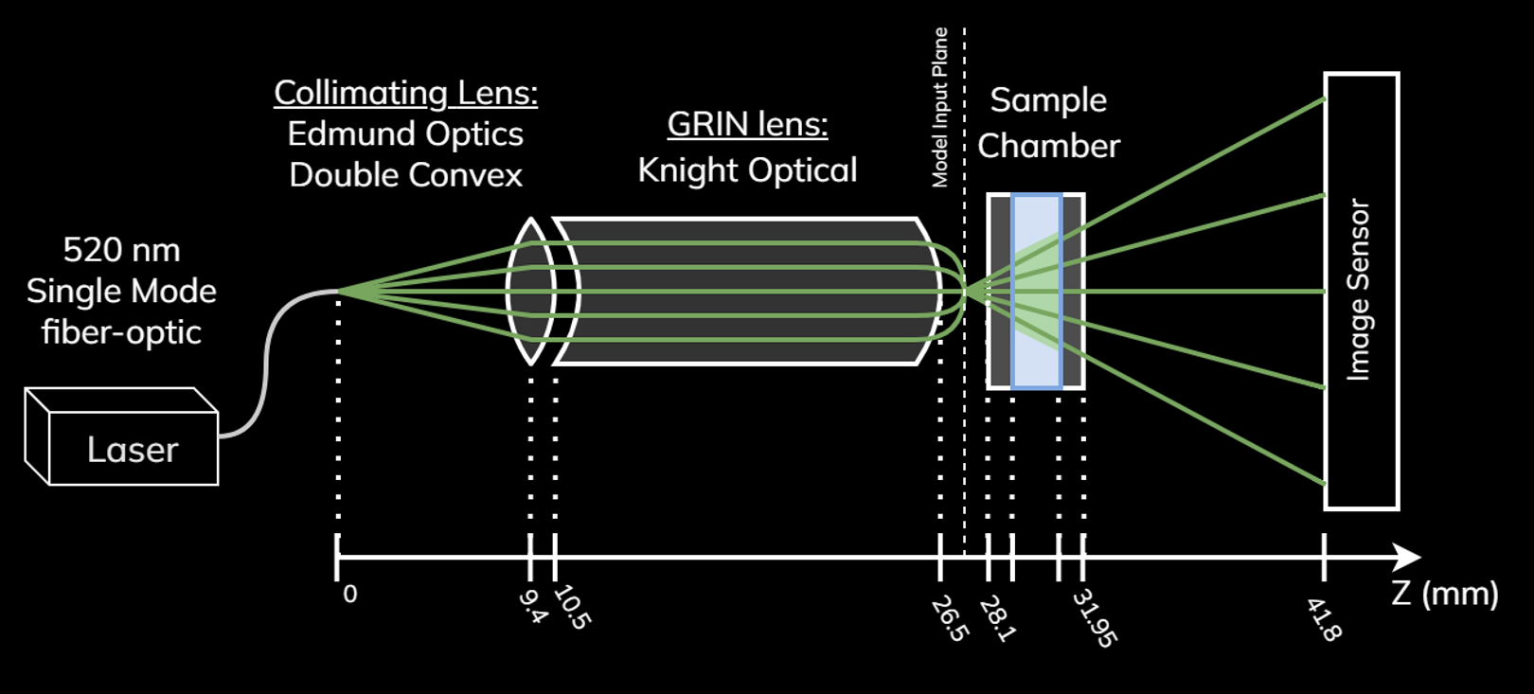
Thermal Survival Overview
Testing that the optical alignment doesn’t change drastically when exposed to extreme temperature ranges, like those experienced through launch and space travel.
CPE 2 | 2.1.5 Thermal | The microscope shall survive temperatures from -15C to +60C
CPE 4 | 3.4.2 Lenses | Microscope lenses shall control provided laser light with a combination of converging and diverging lenses to ensure the most light can contact the optical sensor
Sensitive alignments with ~1mm position difference until image resolution no longer meets requirements
Thermal
Overview
Testing
Comp. & Data
Success
Notes:
Thermal survival test focuses on making sure that our optical alignment doesn't change much when the payload is exposed to space-like temperatures.
This test satisfies our requirements which are focused on thermal survival between –15 and 60 C as well as maintaining proper alignment
Concerns in this test include the components expanding and contracting when exposed to these high and low temperatures. While we are expecting expansion or contraction in response to the temperature, our concern is that the components won't return back to their initial state. This could either damage components like the lenses or cause the system to become misaligned, impacting the image quality.
To address this concern we designed the optical chain with ~ 1mm flexibility in either axis to allow expansions or contraction without affecting the alignment

Slide 19
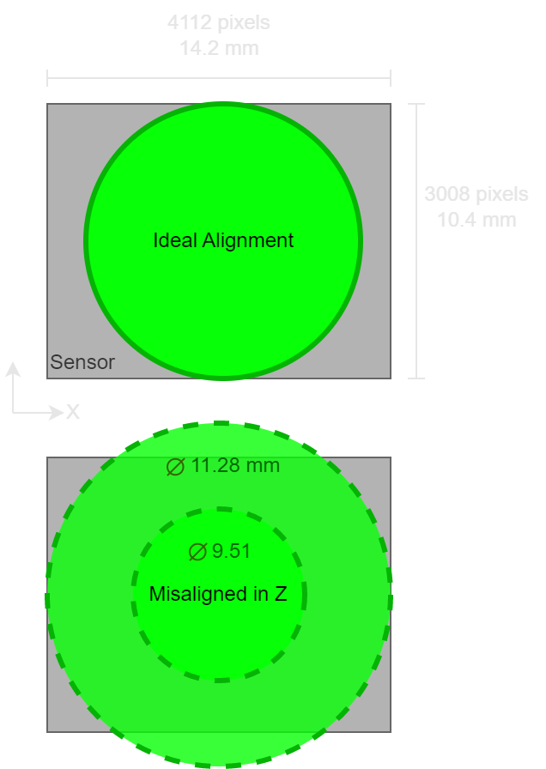
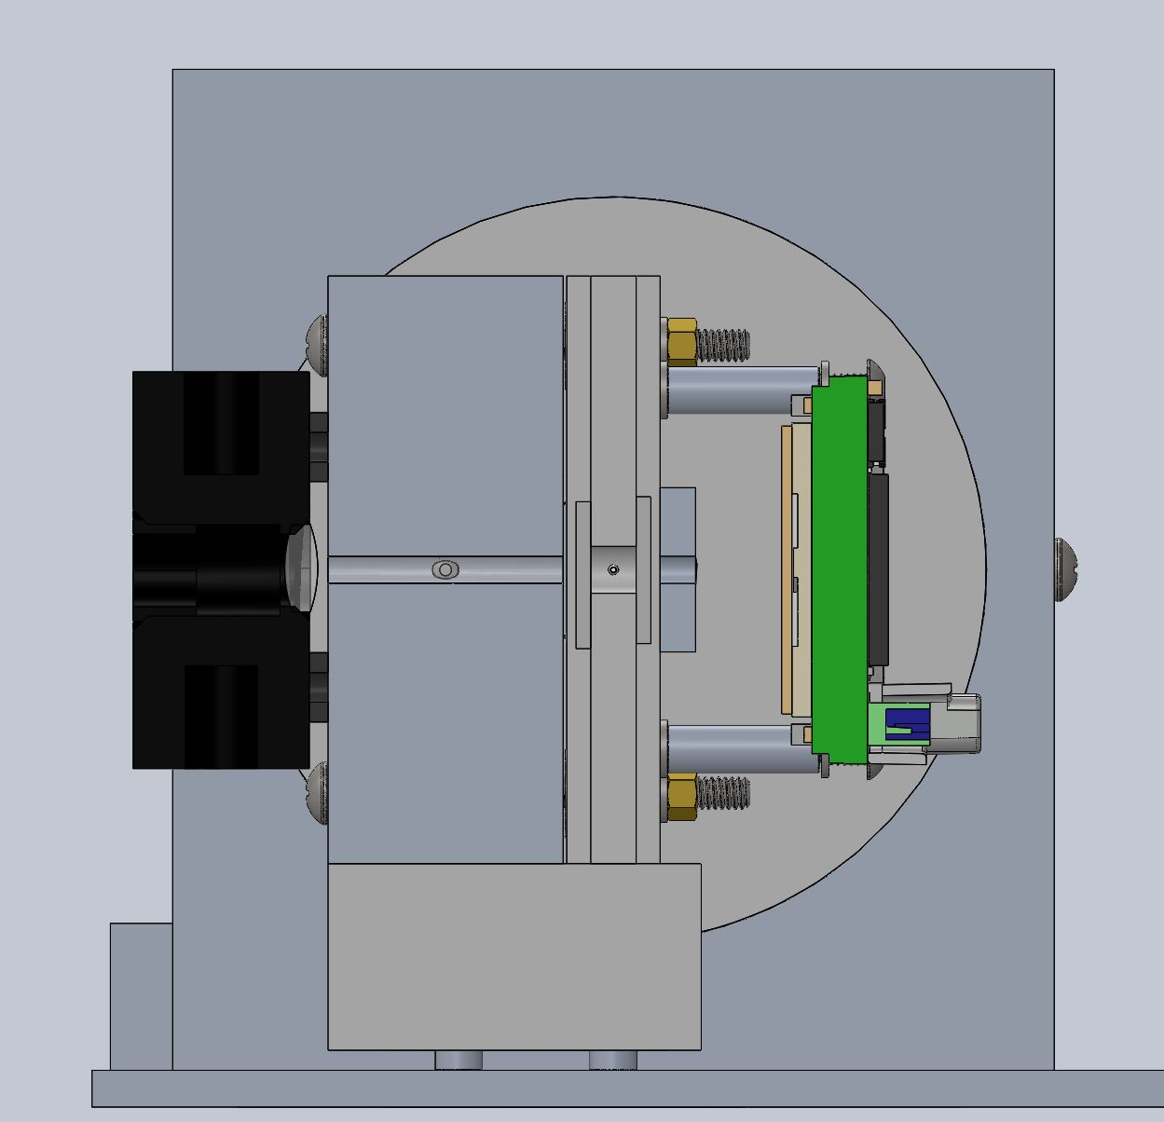
Thermal Survival Alignment Prerequisite
Z location for the image sensor is controlled with the standoffs in relation to the sample chamber.
Z location for lenses and sample chamber is controlled with the screws at the bottom of the payload.
Image Sensor
Standoffs
Alignment Screws
Z axis
Thermal
Overview
Testing
Comp. & Data
Success

Slide 20
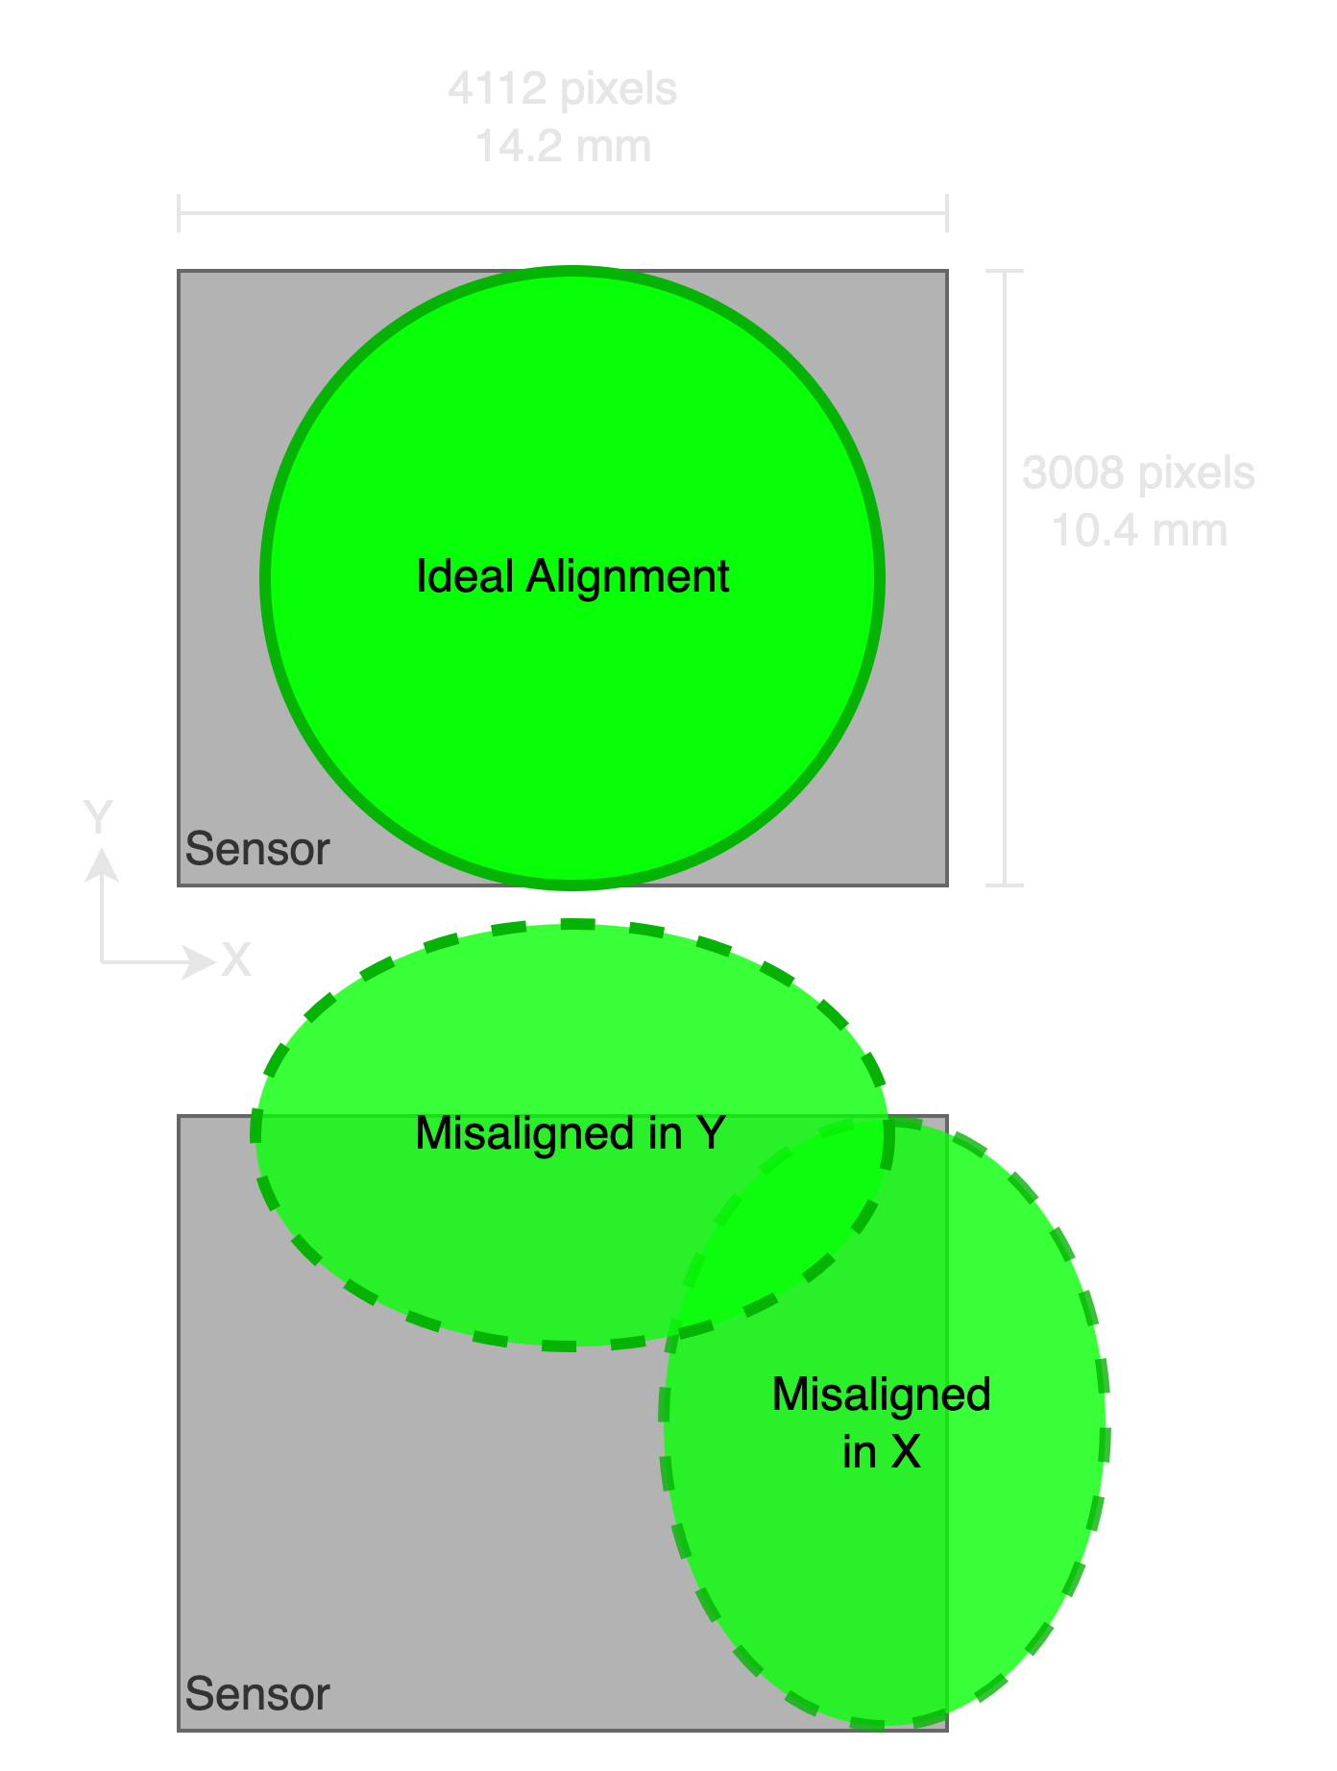
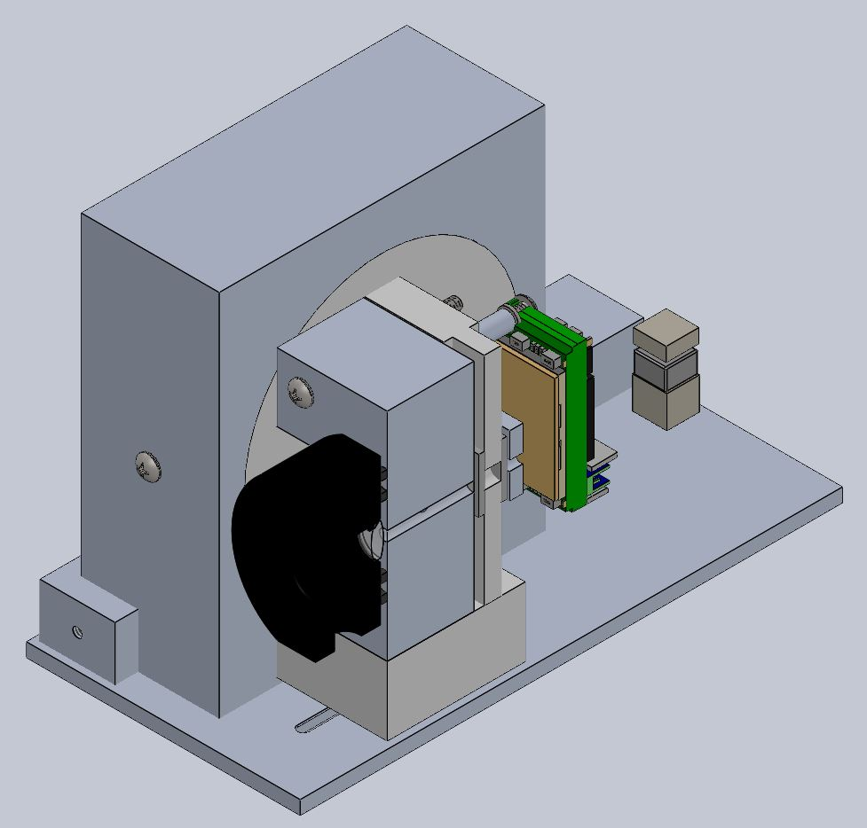
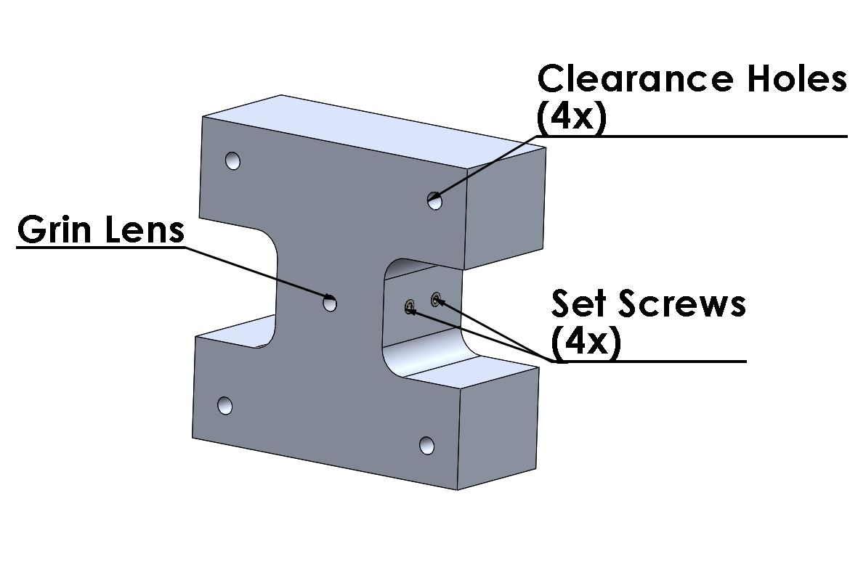
Thermal Survival Alignment Prerequisite
Y axis
X axis
Set screws mirrored on other side
Y axis is controlled with the screws at the bottom of the payload
X axis for each lens is controlled using the set screws holding the lens to its mount.
*Grin lens example above
Thermal
Overview
Testing
Comp. & Data
Success

Slide 21
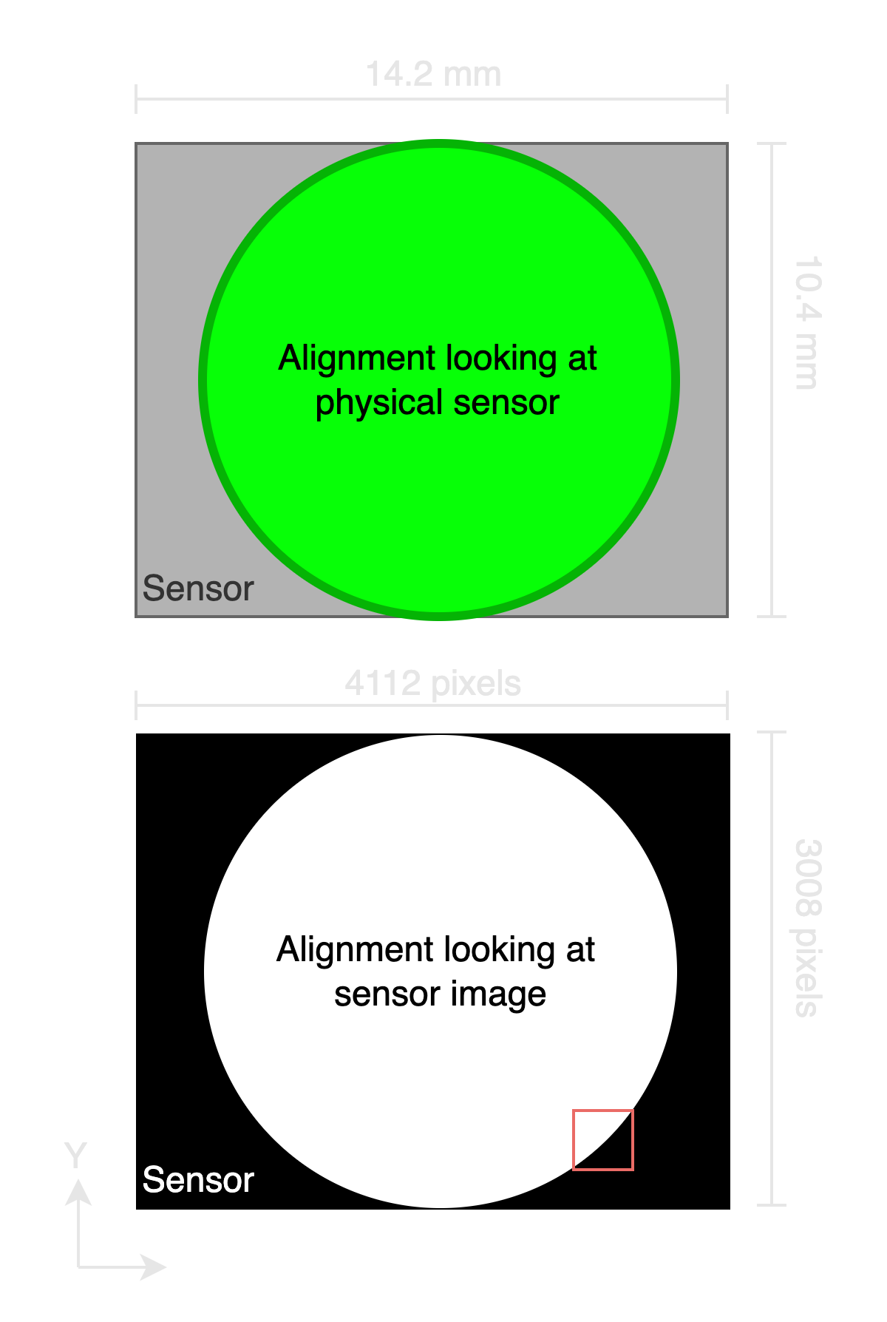
Thermal Survival Testing
Step | Action | Notes
Pre | Initial Alignment procedure
Set up | Set up equipment in testing room (Hazardous Test Cell, room 169) | *laser & PPE , payload, portenta for imaging, computer
1 | Verify alignment w/ low power and image sensor in room 169 | *w/ moving payload and human error, verify alignment and realign as necessary
2 | Move payload to BioServe -bring bricks and cooler | *use cart *BioServe 3rd floor aero
3 | Heat payload and bricks to 60C
4 | Measure temperature until payload is at equilibrium | -IR thermometer(exterior) -Thermistors(interior)
5 | Place bricks and payload carefully in cooler
6 | Move to back to room 169 | *use cart
7 | Remove payload from cooler and place on testing table
8 | Let payload cool to room temp.
9 | Check post alignment w/ low power and image sensor | *save data
Because of the estimated time of the sensor arrival, initial alignment can be done w/ image sensor stand in once assembly is complete.
Post thermal survival check will be done with sensor in order to minimize human error bumping anything while removing payload housing
Thermal
Overview
Testing
Comp. & Data
Success
Notes:
Here is the general procedure for the test. Highlighted are the key steps. These include heating the payload, measuring temp until equilibrium, and checking post alignment with low power laser and image sensor.
The estimated arrival of our sensor is far out so in order to do this test in a timely manner, the initial alignment test will be performed in with a stand in image sensor.
Alignment check can be done by looking at the physical sensor or the sensor image. To prevent any bumping from physically inspecting the sensor, we will instead looking at the sensor image which displays the light intensities.

Slide 22
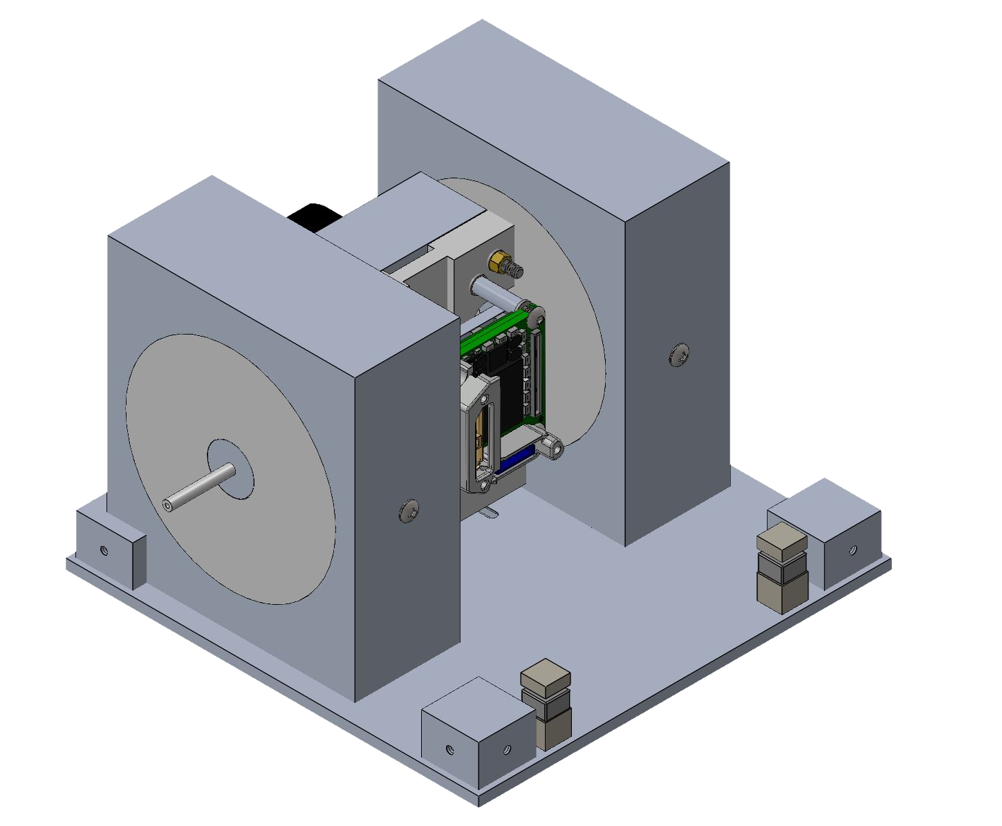
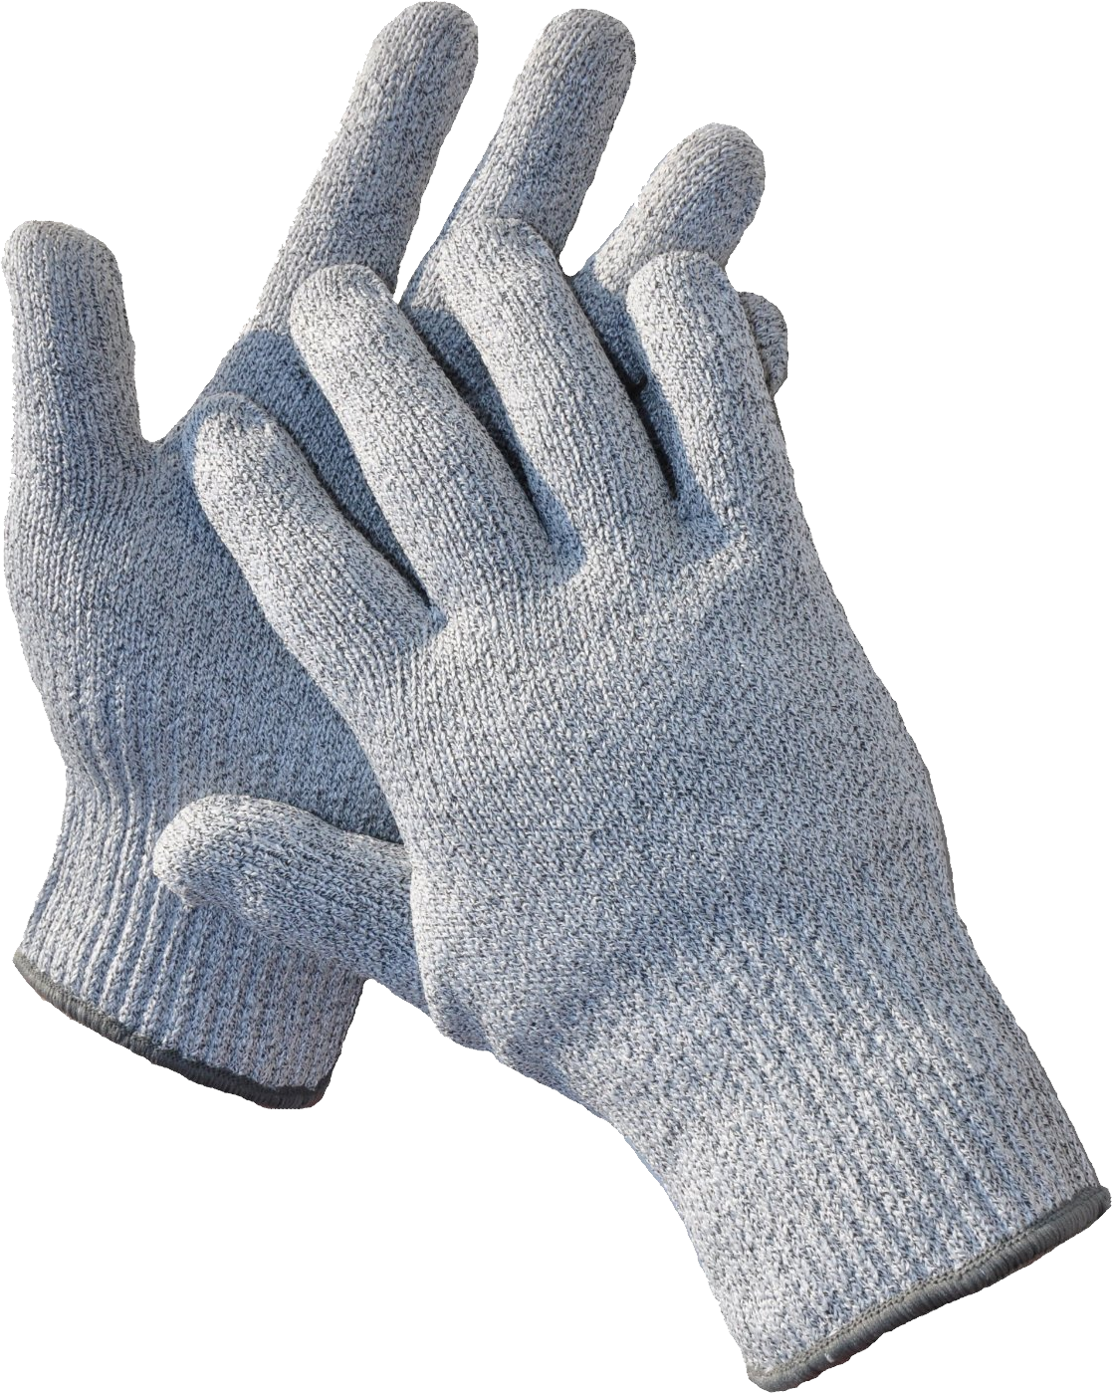
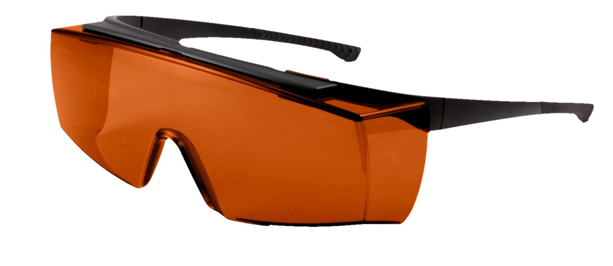
Thermal Survival Testing Safety
Laser Dangers @ < 5mw:
Safe for extended beam exposure to eyes and skin
Hot & Cold Payload:
Burns
Laser Safety Glasses
Insulated Gloves
Momentary Switches (wired in series)
Laser
Operational Checklists Signed by Operator and Observer
Manual Safety Interlock
Thermal
Overview
Testing
Comp. & Data
Success
Notes:
There are some safety concerns regarding the laser usage and hot and cold cases of this test
Thermal survival test will use our low power laser (less than 5 mw) which is considered safe for exposure to eyes and skin. However, the laser has the capability for higher power which could cause damage so we will be following the high power laser safety procedures.
First line of defense: operational checklists (ensure safety even if the procedures are messed up)
Last line of defense: laser safety glasses which will protect your eyes even at the max laser power
In order for the laser to be turned on, the baseplate has built in switches which must be triggered. We will be manually depressing these switches. These switches are incorporated to prevent accidentally turning on the laser
Thermal mitigations: use insulated gloves to prevent hot or cold burns

Slide 23
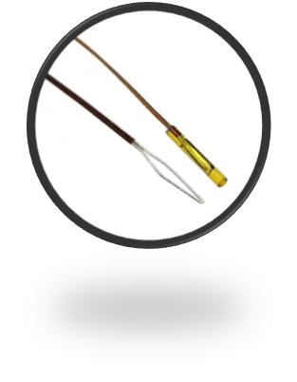
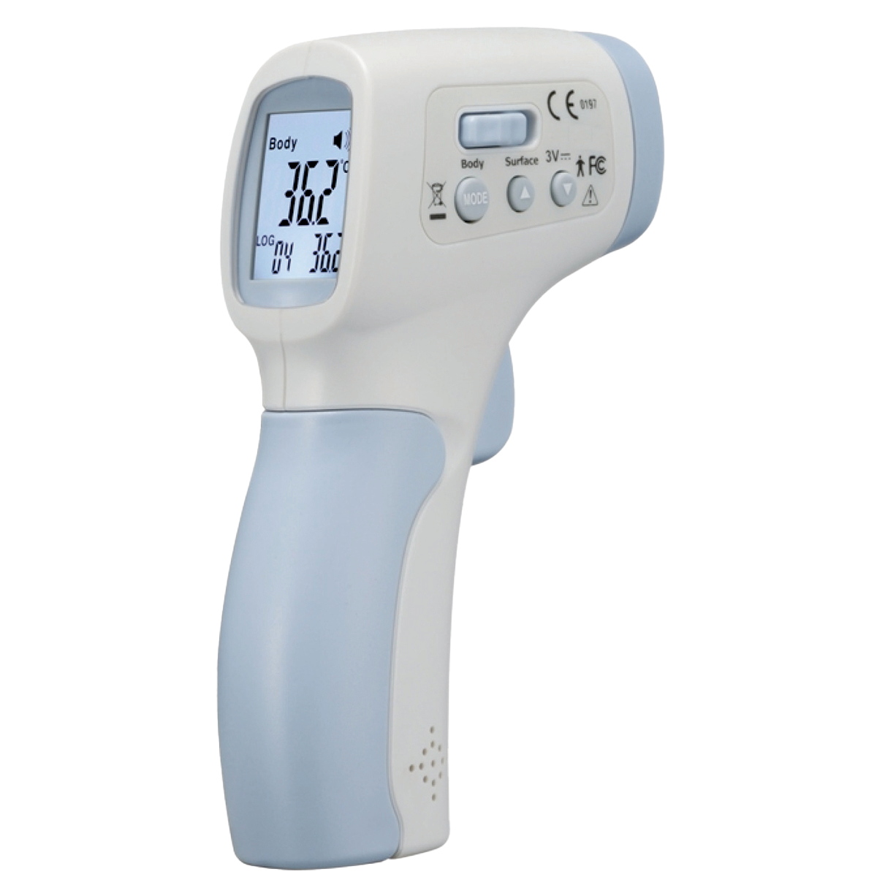
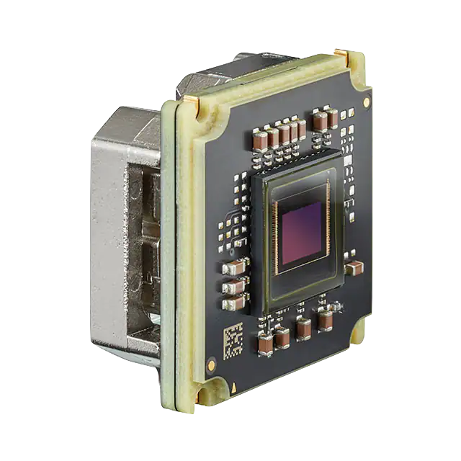
Thermal Survival Components and Data
Image Sensor(alignment)
Taking image pre and post survival temp.
Can look at image live and save as PNG
Internal Temp: NTC Thermistors
Calibrated* to measure ±1°C accuracy
Live temp and save txt file
External Temp: Laser thermometer
Live temp
Also used to confirm oven temp.
Sensor Plane
*Details of calibration provided in the backup slides
Thermal
Overview
Testing
Comp. & Data
Success
Notes:
-image sensor for alignment: pre and post reaching our survival temperatures. The data output is a live image saved as a PNG
Thermistors to measure our internal temperatures: which will be calibrated to + - 1 C accuracy, this data is saved live as a txt file
To measure our external temps, we will be using a laser read thermometer: live temp readings. This will also be used to confirm our oven temperatures

Slide 24
Thermal Survival Alignment Success
Model prediction
The beam spreading calculations show that the light spot should fill our electronics sensor. (~10.4 cm)
Success criteria
The light circle is inscribed with-in the square of the sensor.
CPE 2 | 2.1.5 Thermal | The microscope shall survive temperatures from -15C to +60C
CPE 4 | 3.4.2 Lenses | Microscope lenses shall control provided laser light with a combination of converging and diverging lenses to ensure the most light can contact the optical sensor
Thermal
Overview
Testing
Comp. & Data
Success

Slide 25
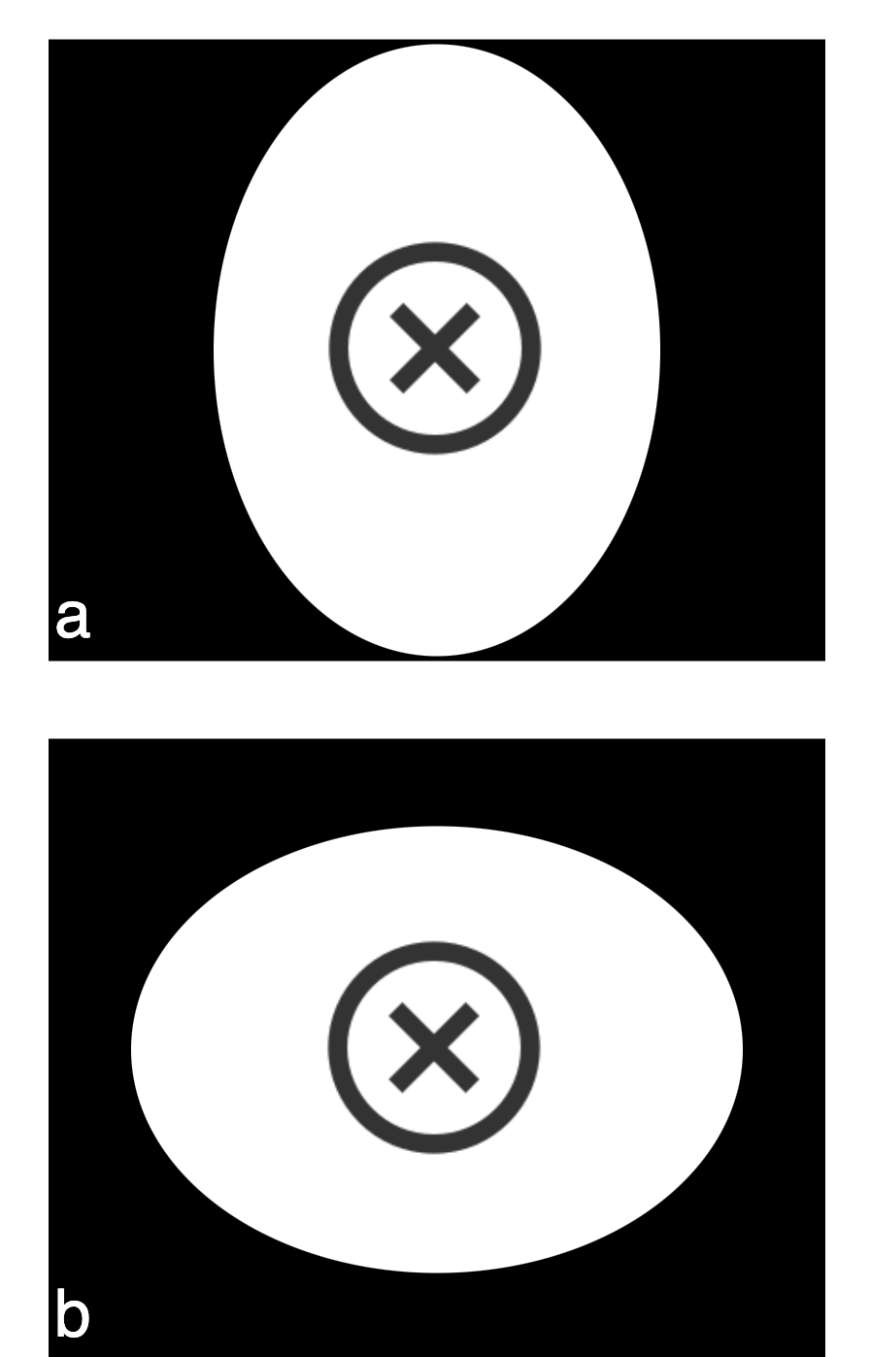
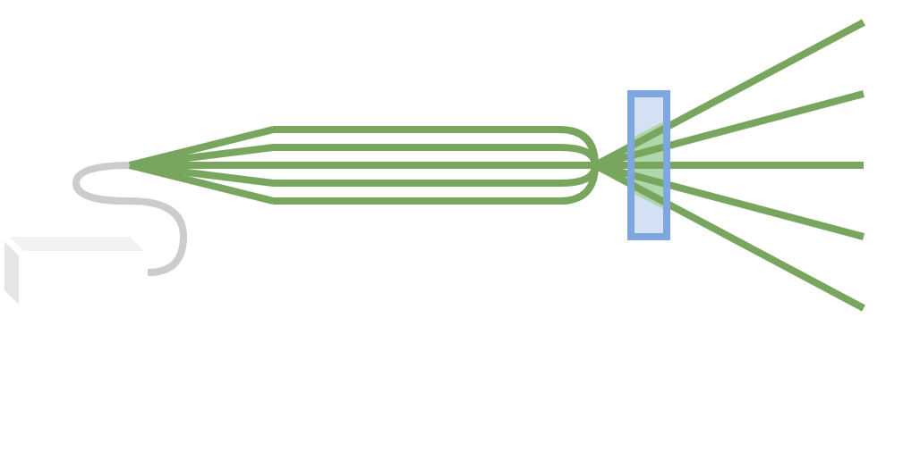
Thermal Survival Alignment Success
Success Post Survival Temp.
dZ | Light Diameter | Light Area on Sensor
0 | 10.4 mm | 340 mm²
-1 mm | 11.3 mm | 398 mm²
+1mm | 9.5 mm | 284 mm²
Failure Post Survival Temp.
a and b are distorted, even though centered
Over or underfilling past success range
Thermal
Overview
Testing
Comp. & Data
Success

Slide 26
Motion Detection Overview
CPE 6 | Particle movement shall be identified and ranked by their possibility of life
 | Provide method to detect features of interest in single frame reconstruction
 | Provide method to detect features of interest in reconstructed difference frame
Brownian motion is a particle with random movement
Non-Brownian motion is a particle moving under its own volition
Example Brownian: Pollen in the air
Example Non-Brownian: Bugs flying through the air
Mission objective is to detect micro-organisms
Our team doesn’t have the experience, budget, or facilities to work with real life
Simulated organisms based on research is the next best thing
Motion Detection
Overview
Testing
Comp. & Data
Success

Slide 27
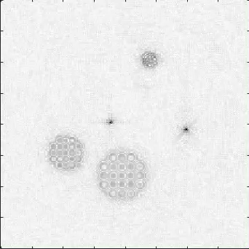
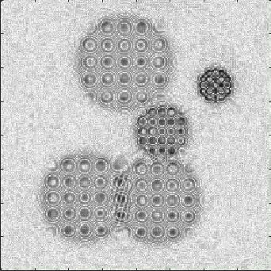
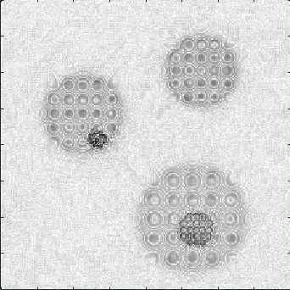
Motion Detection Overview
CPE 6 | Particle movement shall be identified and ranked by their possibility of life
 | Provide method to detect features of interest in single frame reconstruction
 | Provide method to detect features of interest in reconstructed difference frame
Clear Non-Brownian Motion
Clear Movement across significant portion of sensor
Possibly Non-Brownian Motion
Movement but not across a large portion of the sensor
Clear Brownian Motion
Movement but just bouncing around in same relative area
Motion Detection
Overview
Testing
Comp. & Data
Success

Slide 28
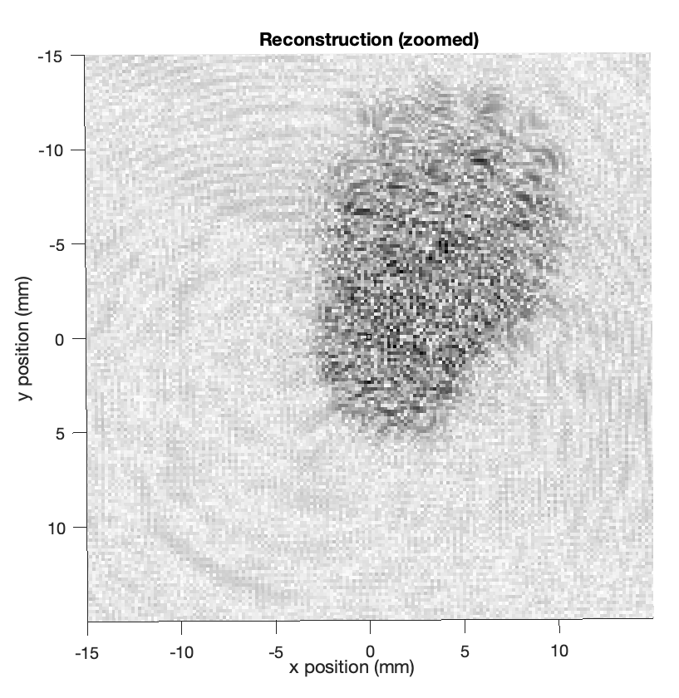
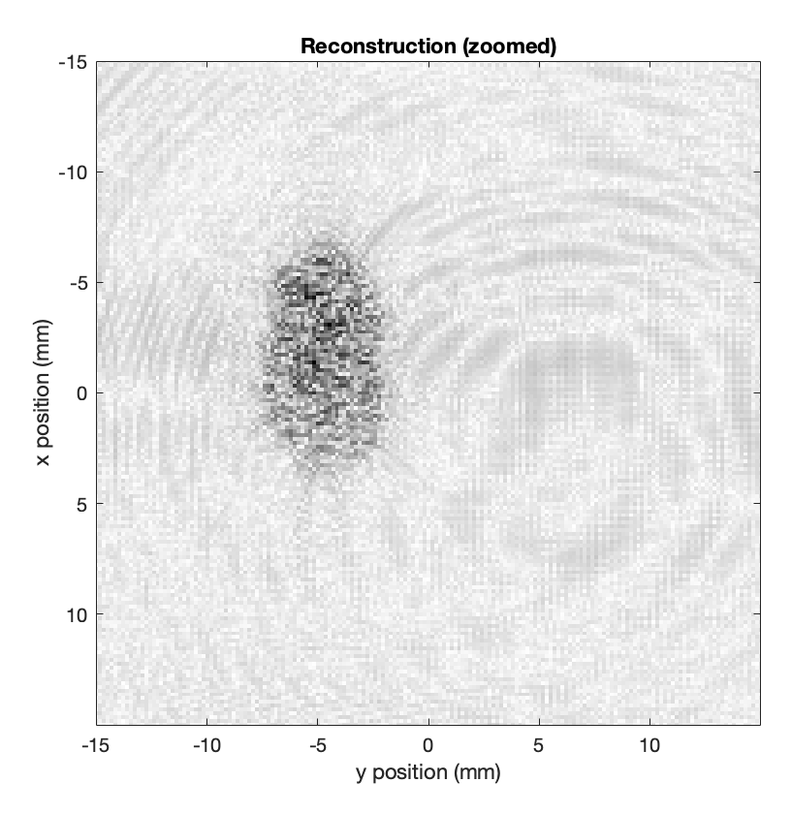
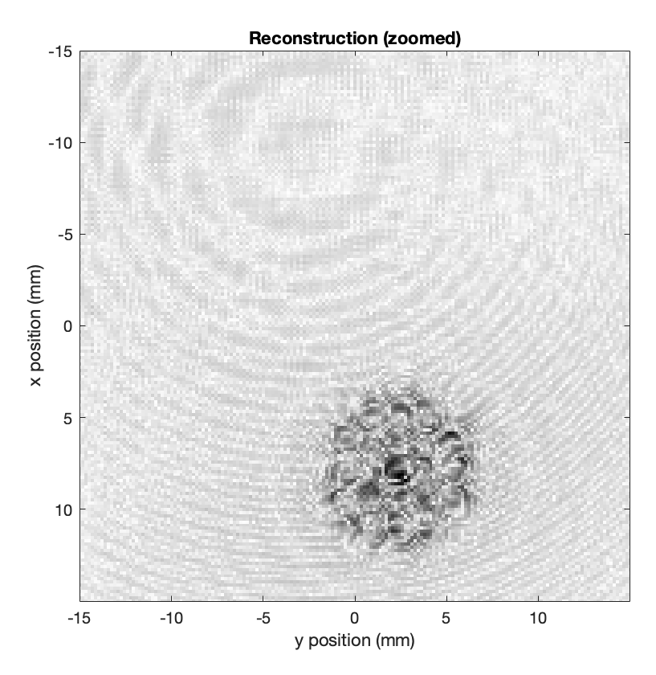
Motion Detection Overview
CPE 6 | Particle movement shall be identified and ranked by their possibility of life
 | Provide method to detect features of interest in single frame reconstruction
 | Provide method to detect features of interest in reconstructed difference frame
Clear Non-Brownian Motion
Clear Movement across significant portion of sensor
Possibly Non-Brownian Motion
Movement but not across a large portion of the sensor
Clear Brownian Motion
Movement but just bouncing around in same relative area
Motion Detection
Overview
Testing
Comp. & Data
Success

Slide 29
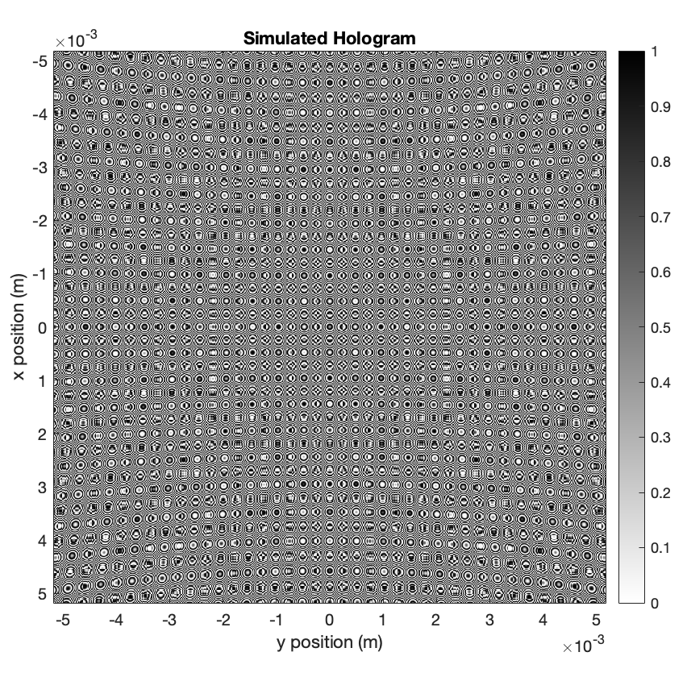
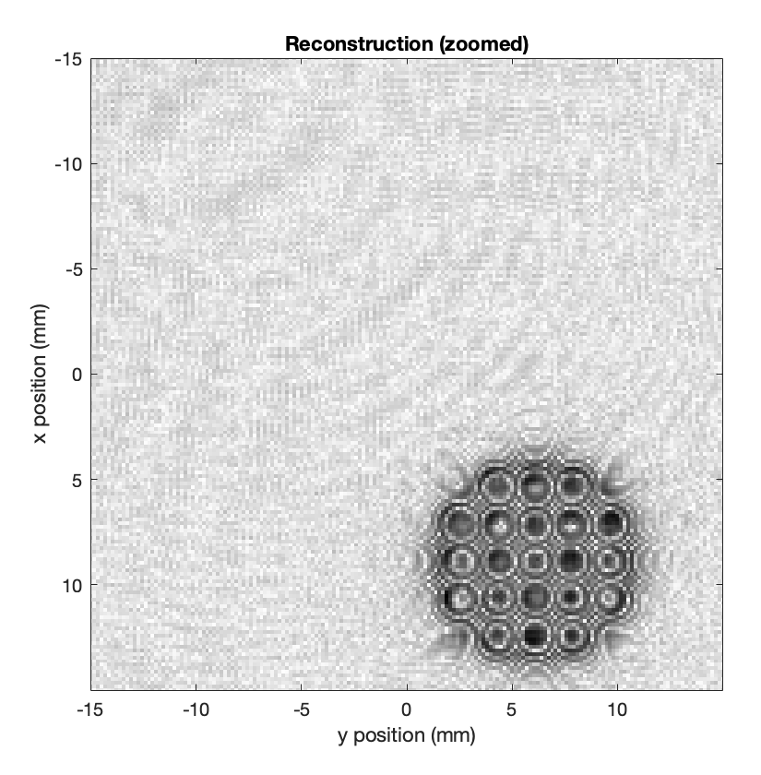
Motion Detection Reconstruction Prerequisite
Detection on a raw hologram doesn’t really work
Raw Hologram
Reconstructed Hologram
Motion Detection
Overview
Testing
Comp. & Data
Success

Slide 30
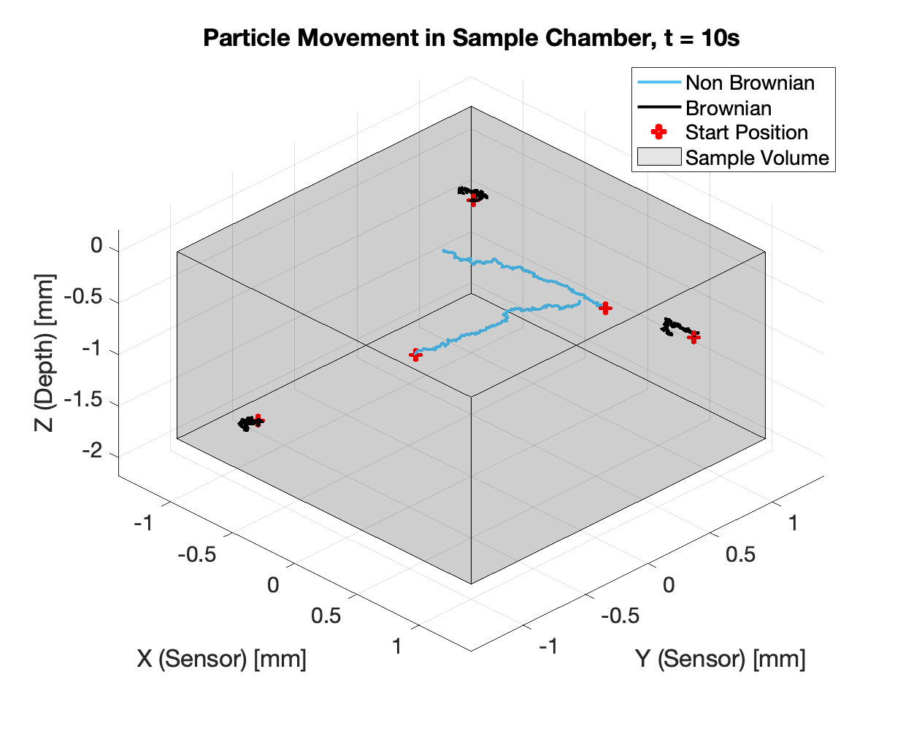
Motion Detection Simulating Particles
Feed detection algorithm simulated particles with known rank and get back a similar rank
Sample chamber depth = 1.18 mm
Sample chamber diameter = 2.36 mm
Min speed = 2 μm/s
Max speed = 200 μm/s
-Choose start position w/in sample chamber (r₀)
-Choose “bias” velocity based on input rank(v₀)
Rank = 1, v₀ = 2-20 μm/s
Rank = 10, v₀ = 180-200 μm/s
-Choose random(Brownian) velocity(v_{r})
v_{r} = 2-400 μm/s
For i = 1: #sec
r_{i} = r_{i-1} + (v₀ + v_{r})* Dt
Output:
(r_{x}, r_{y}, r_{z})
Motion Detection
Overview
Testing
Comp. & Data
Success

Slide 31
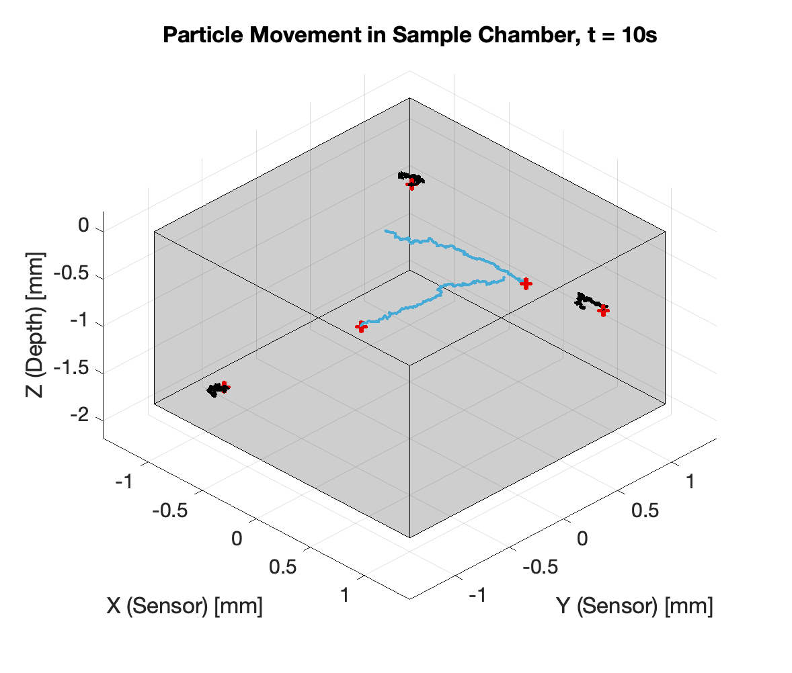
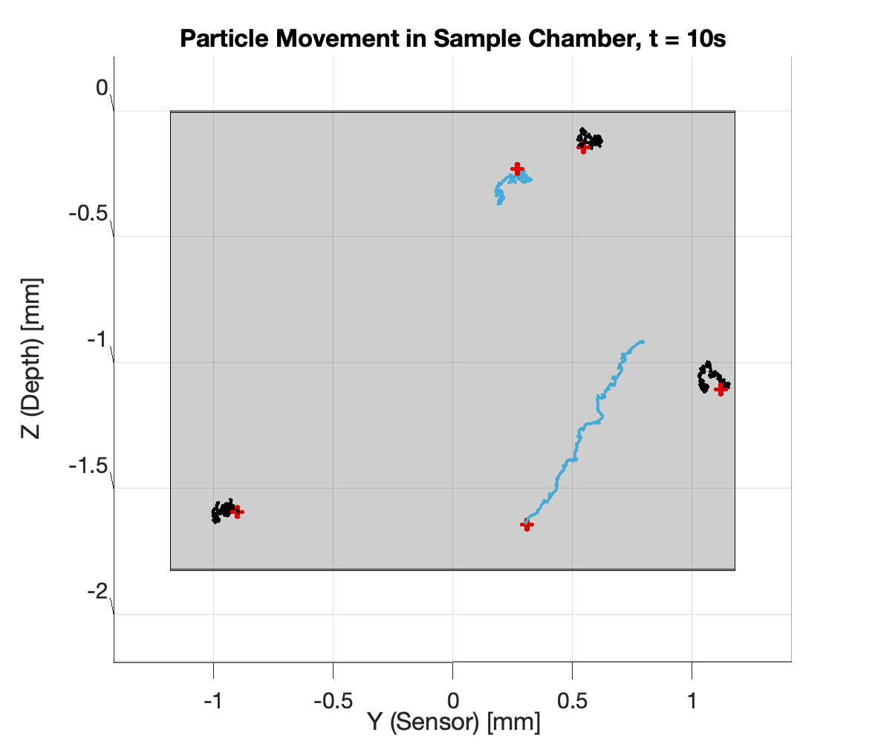
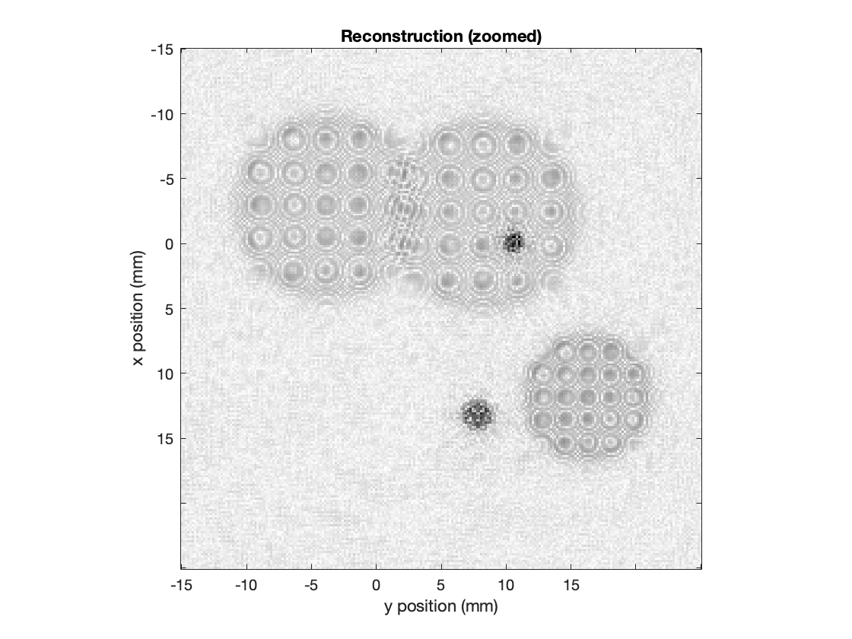
Motion Detection Simulating Particles
3D Sample Chamber Volume
5 particles, 2 Moving
View of Depth
(Z vs Y position)
Closer to Sensor
Further form Sensor
Motion Detection
Overview
Testing
Comp. & Data
Success
Notes:
Verbally say that the reconstructed hologram is a prerequisite instead of putting it on slide, slide will get a little to cluttered

Slide 32
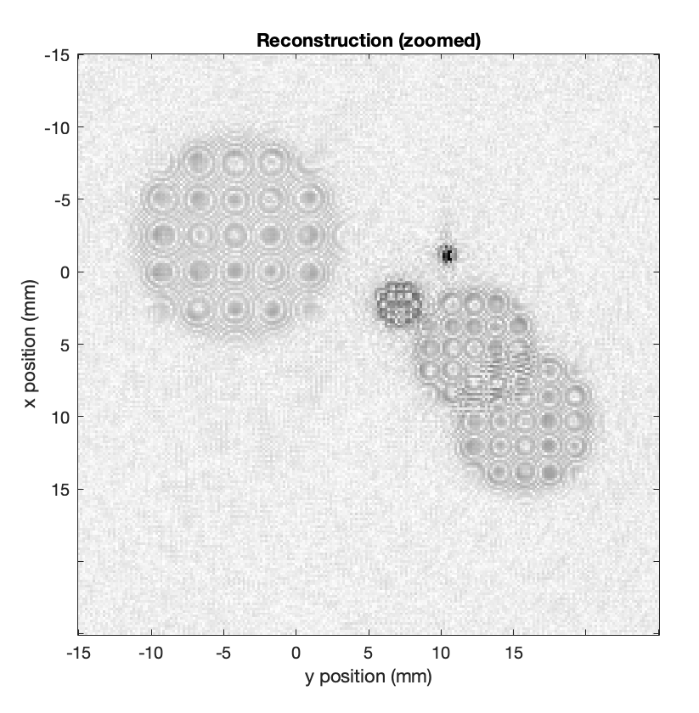
Motion Detection Simulating Particles
Particle 1:
Starts closer to sensor
Moves in –x and +y
First Frame
Particle 2:
Starts further from sensor
Moves in +y, +x and +z
3D Sample Chamber Volume
5 particles, 2 Moving
Image every 23 frames
(1 per sec)
Last Frame
Motion Detection
Overview
Testing
Comp. & Data
Success
Notes:
Verbally say that the reconstructed hologram is a prerequisite instead of putting it on slide, slide will get a little to cluttered

Slide 33
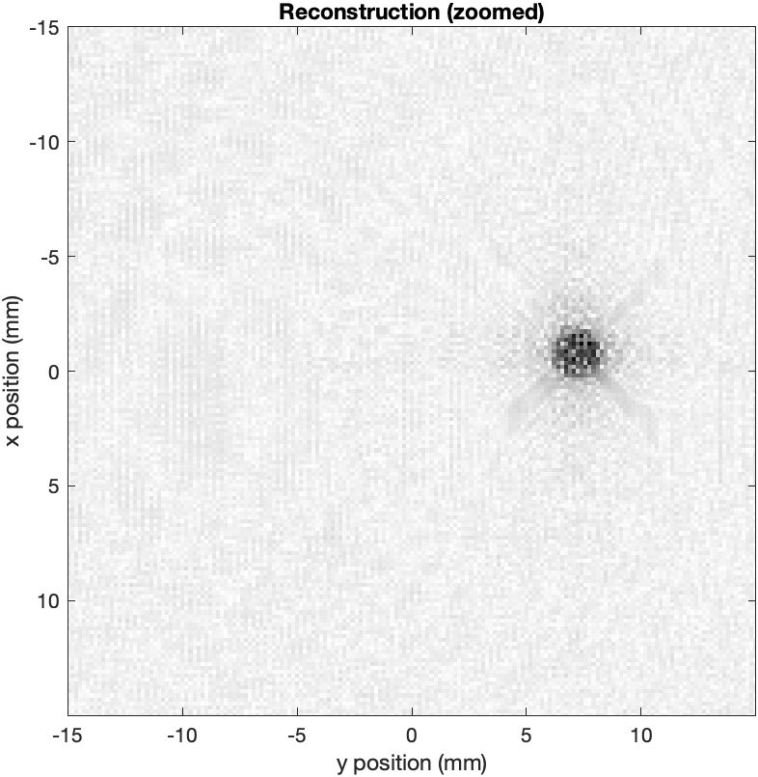
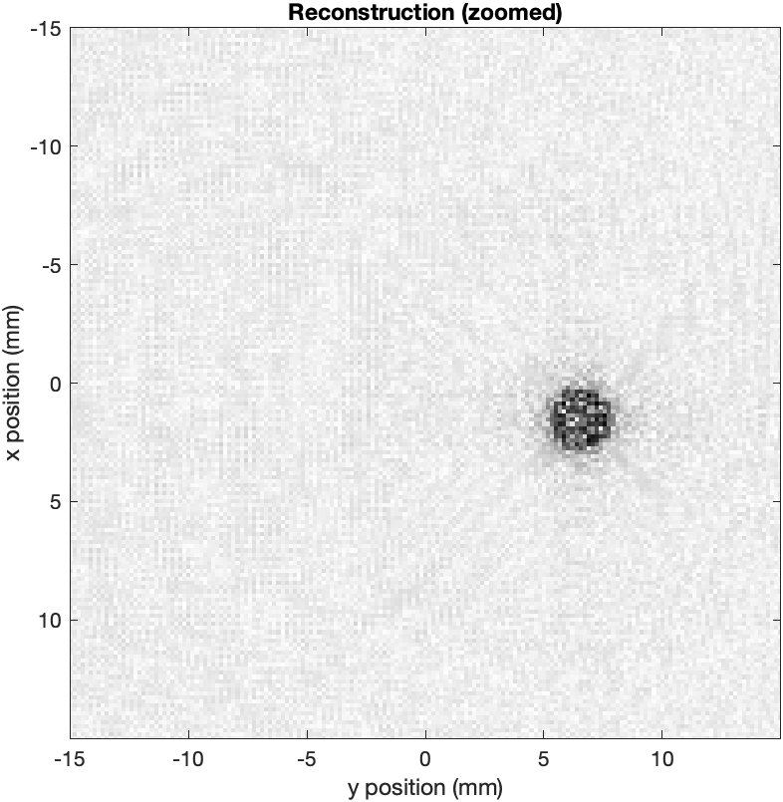
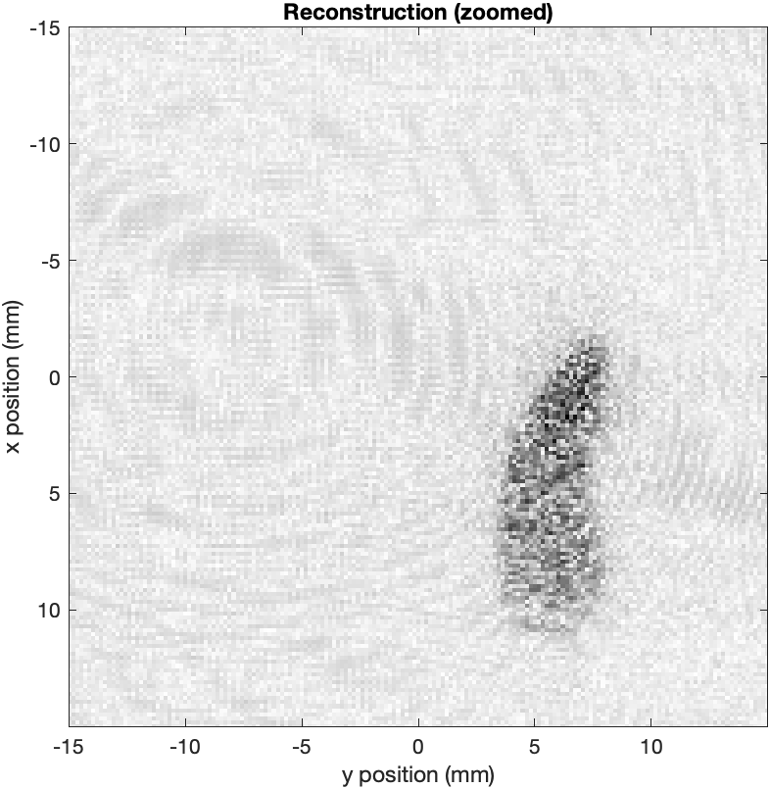
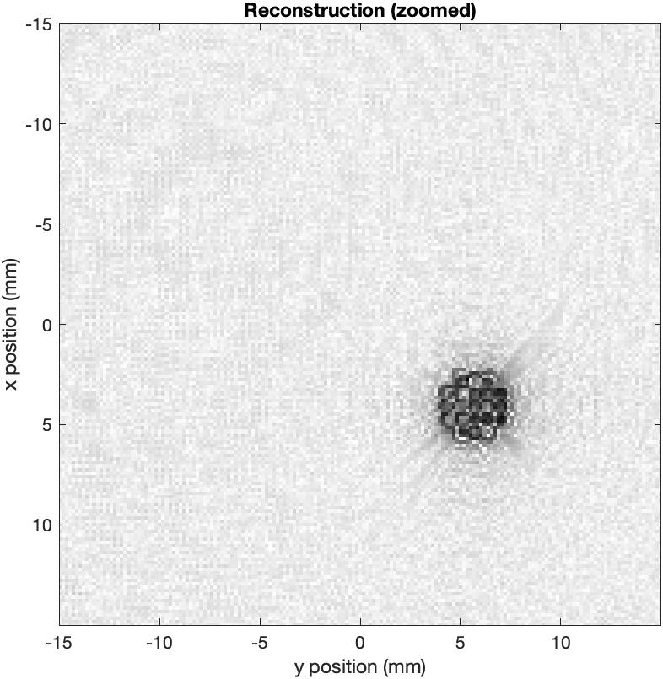
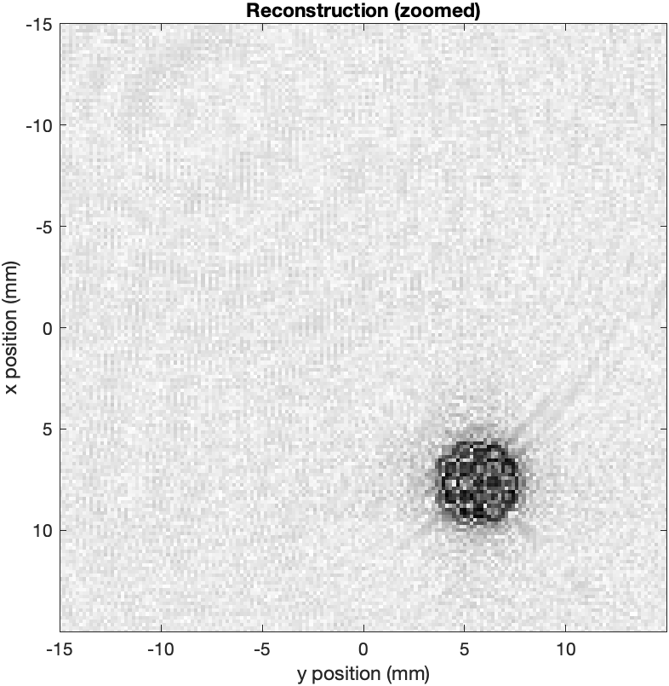
Motion Detection Simulating Particles: Difference Frame
Frame 1
Frame 2
Frame 3
Frame 4
Difference Frame
Motion Detection
Overview
Testing
Comp. & Data
Success

Slide 34
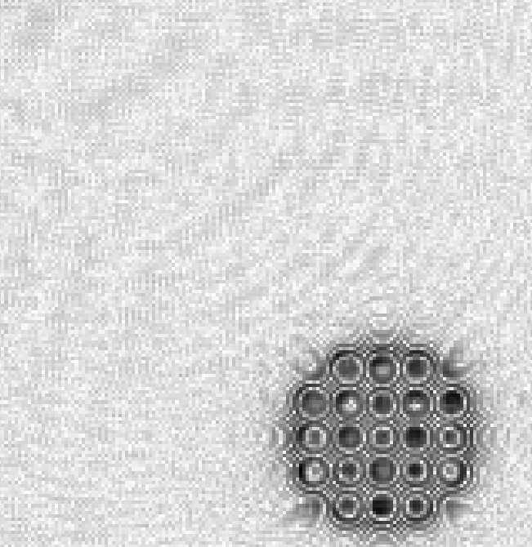
Motion Detection Components and Data
Matlab
Simulated particles and reconstructed holograms
Output PNG files of individual frames and difference frame
Python
Detection of Particle
Outputs PNG files of individual frames and difference frame
Packages: NumPy, OpenCV
Currently on laptops
Detection will eventually go on the portenta
Motion Detection
Overview
Testing
Comp. & Data
Success

Slide 35
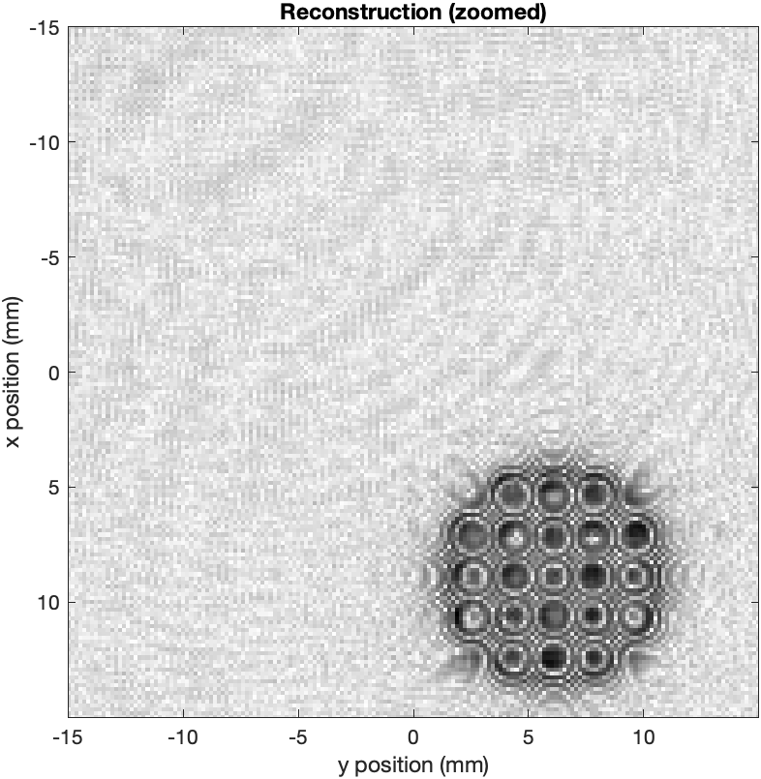
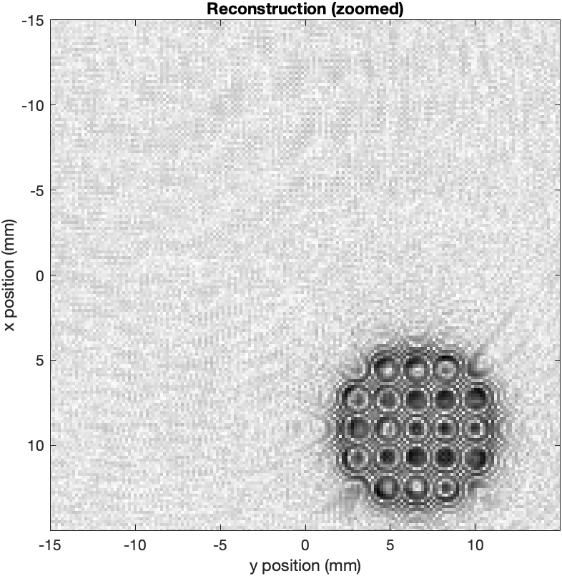
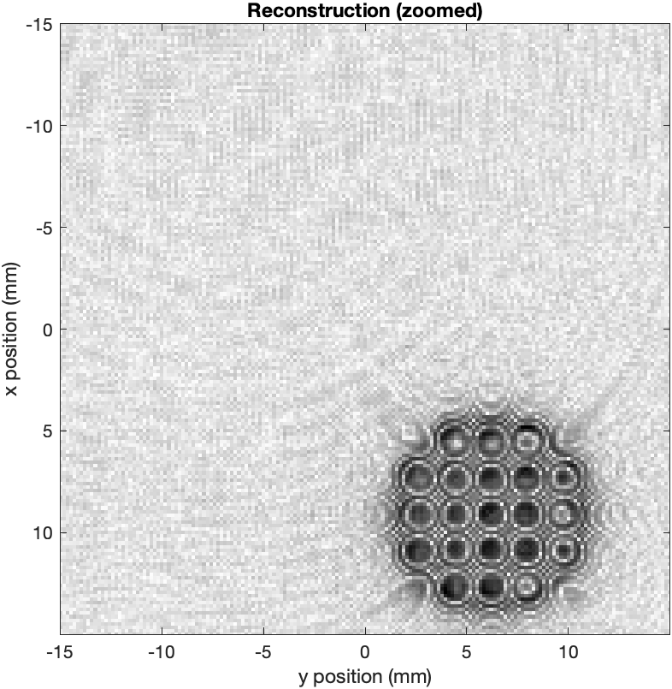
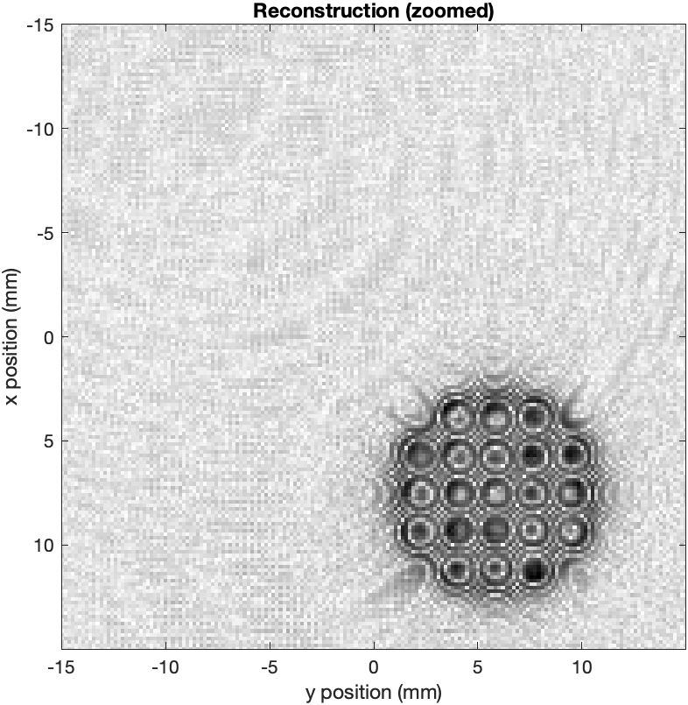
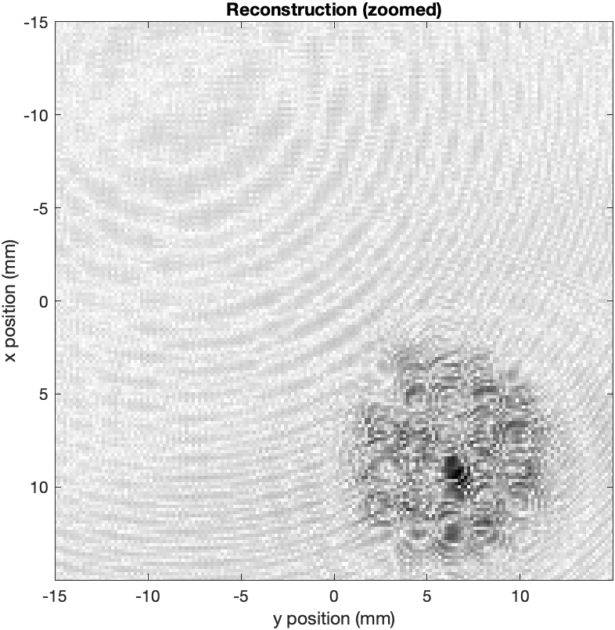
Motion Detection Detect Z Motion
Frame 1
Frame 2
Frame 1
Frame 2
Average Area of Particle
= (1/#frames) * Σ_{frames} (area dark)
Frame 3
Frame 4
Frame 3
Frame 4
Area of Particle Difference Frame
= Area Dark
Average Area of Particle
Area of Particle Difference Frame
Difference Frame
Difference Frame
Motion Detection
Overview
Testing
Comp. & Data
Success

Slide 36
Motion Detection Detect Z Motion
Frame 1
Frame 2
Frame 1
Frame 2
Average Area of Particle
= (1/#frames) * Σ_{frames} (area dark)
Frame 3
Frame 4
Frame 3
Frame 4
Area of Particle Difference Frame
= Area Dark
Average Area of Particle
Area of Particle Difference Frame
Difference Frame
Rank 10
Difference Frame
Rank 1
Rank | Area fraction (avg. per fame/difference)
1 | > 65%
10 | < 25%
Motion Detection
Overview
Testing
Comp. & Data
Success

Slide 37
Motion Detection X Y Velocity
Rank 10:
Rank 1:
Frame 1: t₁
Frame 4: t₄
Frame 1 : t₁
Frame 4 : t₄
dx²+dy²=dr²
dt=t₄-t₁
V_{xy} = dr/dt
dx
dx
Frame 4
Frame 4
Rank | Velocity in XY
1 | 2-20 μm/s
10 | 180-200 μm/s
dy
dy
Motion Detection
Overview
Testing
Comp. & Data
Success

Slide 38
Motion Detection Success
Def | Rank | Velocity X Y (μm/s) | Area Fraction
Likely Brownian Motion | 1 | Min move 2 - 20 | >65%
 | 2 | 20 - 40 | 60% - 65%
 | 3 | 40 - 60 | 55% - 60%
 | 4 | 60 - 80 | 50% - 55%
 | 5 | 80 - 100 | 45% - 50%
Likely Non-Brownian Motion | 6 | 100 - 120 | 40% - 45%
 | 7 | 120 - 140 | 35% - 40%
 | 8 | 140 - 160 | 30% - 35%
 | 9 | 160 - 180 | 25% - 30%
Totally life | 10 | Lots of move 180-200+ | <25%
Final Rank of the simulated particle will be the average of the Velocity rank and the Area Fraction rank
Simulated Input Rank | Output Success Range | Notes
8 | 7 – 10 | Likely Non-Brownian
5 | 4 – 7 | Ground can look for false positive
3 | 2 – 5 | Likely Brownian
Motion Detection
Overview
Testing
Comp. & Data
Success
Notes:
Explicitaly say Simulated particle is what we are testing against

Slide 39
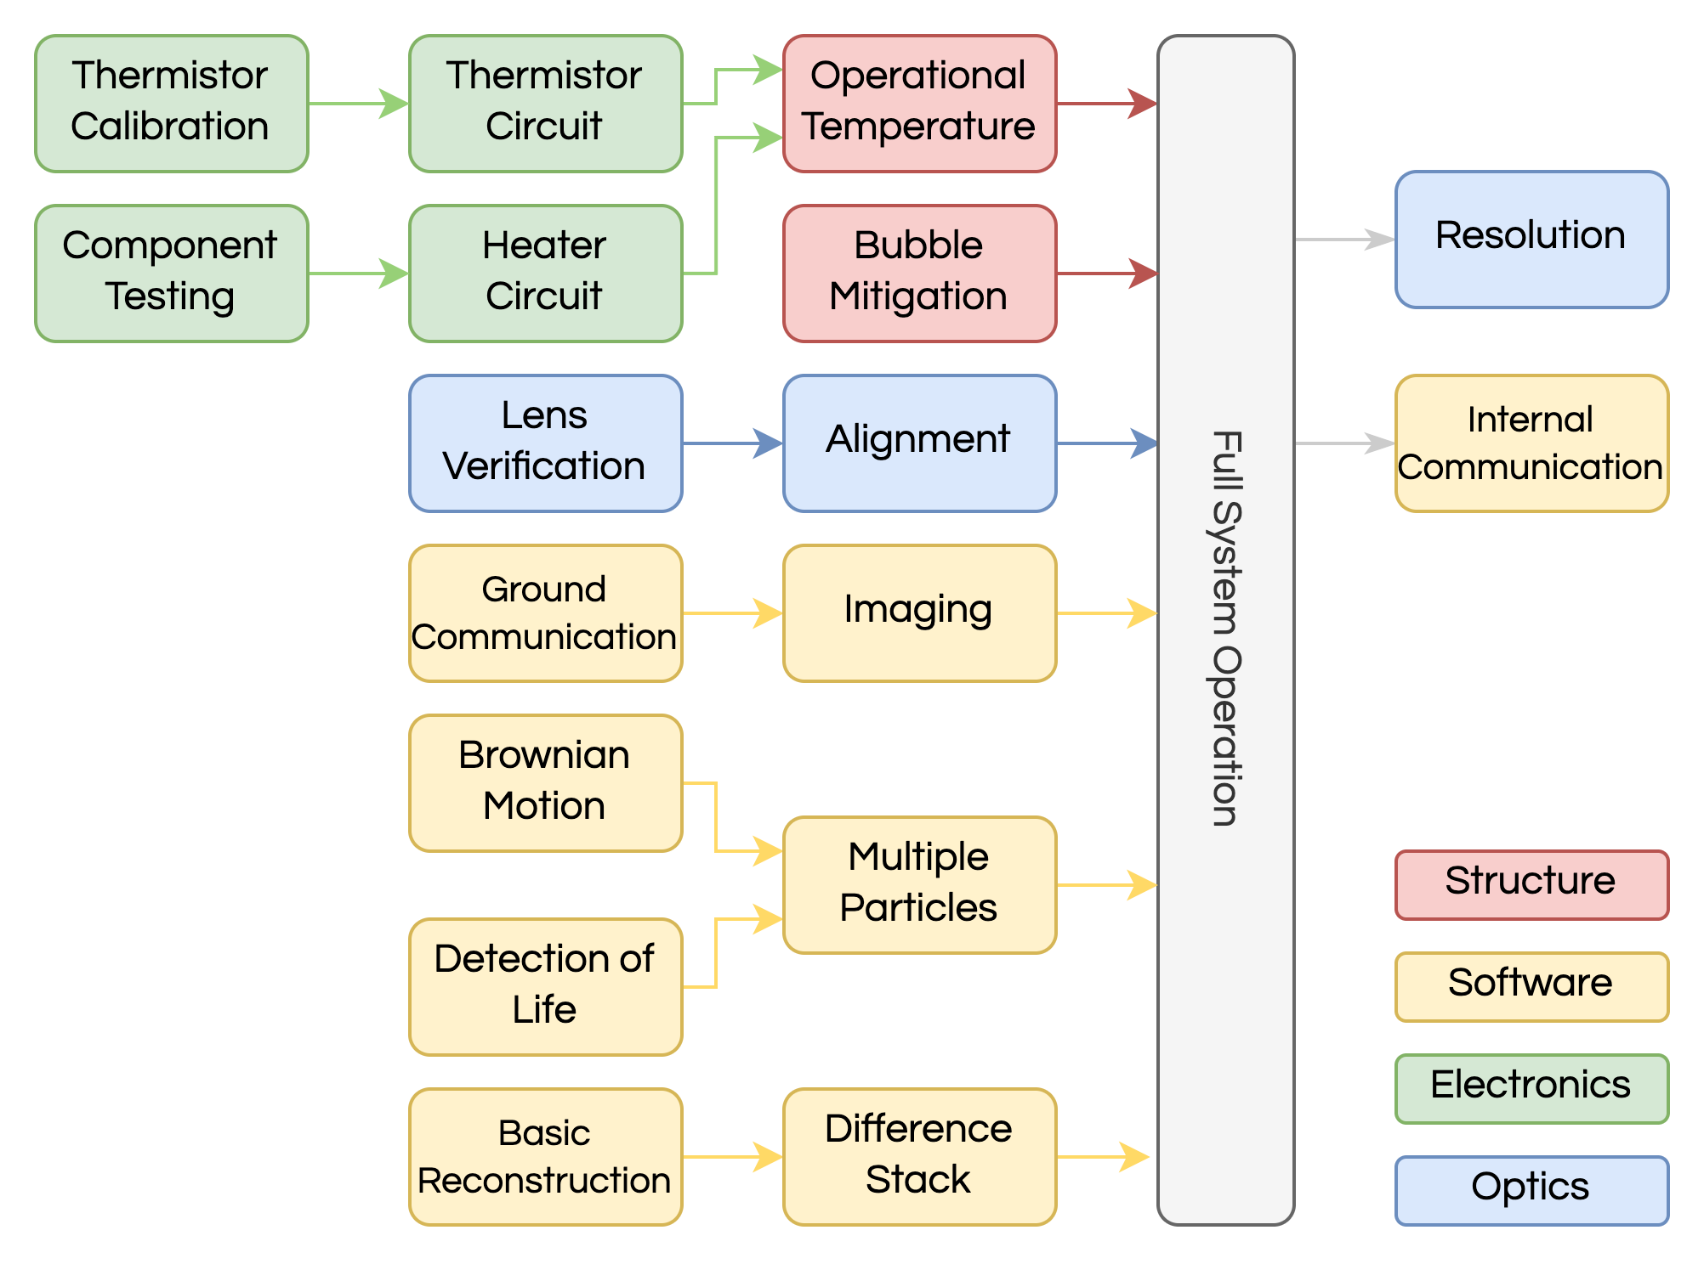
Day in the Life Overview
3.3.1 | Optical sensor shall support a resolution of < 0.8 um in the X and Y directions
3.3.2 | Optical sensor shall support a resolution of < 2 um in the Z direction
2.5.5 | The software shall provide a method to estimate the amount of compression achievable for a specified item of output data
2.5.8 | The software shall provide a method to output raw image frames from the image sensor
2.5.9 | The software shall acknowledge the receipt of commands and provide informative responses when relevant
2.5.10 | The software shall provide a method to retrieve and optionally process requested data from the bulk storage device
DITL
DITL
Thermal
Success
Testing
Optics
Key Tests
Comp. & Data
Overview
Notes:
Focus: image resolution and internal communication integration.
Why important: we will be verifying the resolution as required by our sponsor and we will be using real unsimulated particles to test our software functionality in terms of detection of life, as compared to using simulations of particles in our earlier tests
Prerequisites: this is a culmination of all of our previous tests

Slide 40
Day in the Life Testing
Step | Action | Notes
Set up | Set up equipment in testing room (Hazardous Test Cell, room 169) | *laser & PPE , payload, fluid, portenta for imaging, computer
1 | Run fluid with different dilutions of particles through the payload
2 | Fluid runs through bubble trap | *removal of bubbles is critical for image resolution
3 | Thermal control of fluid | *calibrated thermistors
4 | Laser light through optical chain and fluid in imaging chamber, terminated by camera sensor
5 | Command to take image, 100 frames
6 | Image tests resolution and detection of life & reconstruction functionality | *save data
DITL
Overview
Testing
Comp. & Data
Success
Notes:
Here is the general procedure for our DITL test, highlighted are the key steps which iclude running fluid through the system with different dilutions of particles, the light path of the laser through the optical chain, through the imaging chamber , and hitting the sensor, and our image will test our resolution and detection of life & reconstruction functionality

Slide 41
Day in the Life Testing Safety
Physical Safety Interlock
Laser at High Power, 10mW
Dangers Class 3b:
Retinal Damage
Skin Damage
Laser Safety Glasses
Operational Checklists Throughout & Signage at Entrance
Warning signs outside testing room
Laser
DITL
Overview
Testing
Comp. & Data
Success
Notes:
Since this test also uses a laser, our testing safety will be similar to what we covered in the thermal survival test. However, this test will use the high power laser which creates a larger safety concern. The difference in our safety procedures is that the momentary switches in the cad model will be triggered by placing the encolsure over the payload, and not triggered by hand. -> we want payload to be fully closed at all times for extra layer of protection

Slide 42
Day in the Life Fluid Intake
Filtered water
0.99 g/cm³
Saltwater(Earth)
1.02 g/cm³
Saltwater(Enceladus)
1.03 g/cm³
Particle density comparable to fluid density- float
Particle density less than fluid density- raise
Particle density greater than fluid density- sink
Microspheres:
1um in diameter
1 g/cm³
*Change salinity of fluid and we can simulate Non-Brownian motion without life.
DITL
Overview
Testing
Comp. & Data
Success

Slide 43
Day in the Life Thermal Control – Requirements and Hardware
Sample Tubing and Heater:
Thermal Requirements​ | Detailed Thermal Requirements​
2.1.2 | Sample target temperature no more than 30 °C above baseplate​
2.1.3 | Sample temperature shall be controlled to within 1°C​
2.1.4 | Thermal control shall operate alongside image capture​
2.1.6 | Baseplate temp between 5°C and 40°C​
NTC Thermistor
Calibrated* to measure
± 1°C accuracy
*Details of calibration in the backup slides
DITL
Overview
Testing
Comp. & Data
Success

Slide 44
Day in the Life Thermal Control – Con Ops
Feedback Control Loop
Determine Success
Standard deviation of temperature must lie within 1°C of 30°C
Thermal control software must operate in parallel with imaging software.
Activate
thermal feedback control
Compare to target temp (30 °C)
Store
thermistor
data
Bring baseplate to ambient temp (~20 °C)
Calculate temp from thermistor voltage signal
Set heater power proportional to error
DITL
Overview
Testing
Comp. & Data
Success

Slide 45
Day in the Life Imaging
Data Collection
Step 1: Move fluid to sample chamber
Step 2: Turn on camera
Step 3: Turn on Laser (Illuminate sample)
Step 4: Take images of sample
Image Raw Hologram
Take images at ~22 fps for 100 frames
Portenta Interface
Save data for further analysis
Data will be analyzed and monitored via Laptop
DITL
Overview
Testing
Comp. & Data
Success

Slide 46
Day in the Life Optical Success - Resolution
CPE 4 | 3.3.1: Image Sensor | Optical sensor shall support a resolution of < 0.8 micrometer in the X and Y directions
CPE 4 | 3.3.2: Image Sensor | Optical sensor shall support a resolution of < 2 micrometer in the Z direction
CPE 4 | 2.6.2: Sample Handling | The sample volume shall be greater than 2μL (instantaneous imaging volume), while satisfying the resolution requirements.
Model prediction:
XY resolution = 0.60 um
Z resolution = 1.5 um
Success criteria:
XY Resolution < 0.80 um
Z Resolution < 2 um
DITL
Overview
Testing
Comp. & Data
Success

Slide 47
Day in the Life Testing Software Command & Control
CPE 7 | 1.1.3: Data Relay | Shall relay data to the spacecraft
 | 1.1.4: System Interface | Shall interface with the spacecraft system
 | 2.5.8: Raw Image Output | The software shall provide a method to output raw image frames from the image sensor
 | 2.5.9: Command Acknowledgment | The software shall acknowledge the receipt of commands and provide informative responses when relevant
CPE 4 | 2.5.10: Selective Data Requests | The software shall provide a method to retrieve and optionally process requested data from the bulk storage device
CPE 4 | 3.1: Communication | Control all microscope hardware from ground station, monitor hardware data, and output data at 1 kbps
DITL
Overview
Testing
Comp. & Data
Success

Slide 48
Day in the Life Testing Software: Ground Station – Module Communication
Tests:
Communication: Ground station - Etna Module
Verification:
Send command array to Etna and receive corresponding status messages
DITL
Overview
Testing
Comp. & Data
Success

Slide 49
Day in the Life Testing Software: Local System
Tests:
Communication: Etna Module Local System
Verification:
Send command packet and receive verification file from all folders in storage
DITL
Overview
Testing
Comp. & Data
Success

Slide 50
Budget
Overview
Schedule
Testing
Budget

Slide 51
Overall Budget
System​ | Electrical | Optics | Mech. | Testing | Reserves | Pilot Costs | EEF?
Sub-Total​ | $2,259 | ​$532.00 | $606.08 | $325.43​ | $77.58 | $200 | $3000
Margin​ | $180 | $50 | $50​ | - | - | - | -​
Usage​ | 57%​ | 13%​ | 15%​ | 8%​ | 2% | 5%​ | -​
EEF Funding – March 22nd
Overview
Schedule
Testing
Budget

Slide 52
Backup Slides

Slide 53
Imaging Sensor

Slide 54
Processor: Portenta X8
CPU:
4x ARM® Cortex-A53 (1.8 GHz)
1x ARM® Cortex® M4 (400 MHz)
Microcontroller:
1x ARM® Cortex-M7 (480 MHz)
1x ARM® Cortex-M4 (240 MHz)
4000 mW Maximum Power Consumption
200 mW Low Power Mode
Component and assembly efficiency
User Friendly
Language Choice / Compatibility
Linux OS preloaded onboard
Arduino driven microcontroller
High Safety Factor

Slide 55
Camera Power

Slide 56
Electronics Functional Block Diagram

Slide 57
Thermistor Calibration
Accuracy Requirement: ±1°C
(Thermal 2.1.3)
Thermocouple Accuracy: ± 0.015°C
(F150 Precision Thermometer)
Steinhart–Hart Equation:
Calibration Points
Thermal
Overview
Comp. & Data
Success
Testing

Slide 58
Thermistor Calibration

Slide 59
Thermal Control Success
Levels of Success
Pass: Std of our signal < Pass/fail boundary
Ideal: Both V_pp (or T_pp) and std of our signal < Pass/fail boundary
Failure:
Fail: Std of our signal > Pass/fail boundary
Fail: Both V_pp (or T_pp) and std of our signal > Pass/fail boundary
Voltage vs Time:
Temperature vs Time:

Slide 61
Temperature Control Circuitry

Slide 62
Thermistor Testing Setup
Bench 1
Bench 2
Thermocouple
Meter
Thermocouple
100C or 0C water
Arduino Uno
Thermistor

Slide 63
Thermal Survival Light Area Math
No movement in Z:
A = π*10.4²
+1mm movement
A = π*9.5²
-1mm movement
A = π*11.3² – 2*A_{missing}
A_{missing} = r²acos(1-h/r)- (r-h)sqrt(2rh-h²)
dZ | Light Diameter | Light Area on Sensor
0 | 10.4 mm | 340 mm²
-1 mm | 11.3 mm | 398 mm²
+1mm | 9.5 mm | 284 mm²
A_{missing}
h
r
h_{sensor}

Slide 64
Detection Classification

Slide 65
Motion Detection Testing – Reconstruction Prerequisite
Test Success:
Test reconstruction of one full simulated image set using the Portenta
Produce one stack of z slice images matching the input of the hologram generator
Meet time requirement
12,000 Sec. Requirement
As modeled for CDR (R3.7.1)
Notes:
Just wanted to put some stuff on the slide for now-Izaak

Slide 66
Motion Detection Simulating Particles
Bibliographic Entry | Result (μm/s)
Tortora, Funke, & Case. Microbiology: An Introduction. Redwood City, CA: Benjamin Cumming, 1995: 275 | 50
"Bacteria." The World Book Encyclopedia. Chicago: Field Enterprises, 1973: 18. | 50
Pleczar & Chan. Microbiology. 4th edition. New York: McGraw Hill, 1977: 86. | 50 200
"Bacterial motility." McGraw-Hill Encyclopedia of Science and Technology. New York: McGraw Hill, 1960: 63. | 200 (Vibrio) 20 (Salmonella) 50 (Spirillum) 2 (Beggiatoa)
Guinness Book of World Records. New York: Bantam. 1991: 128. | 100
Sample Chamber Dimensions:
depth = 1.18 mm
diameter = 2.36 mm
Min speed = 2 μm/s
Max speed = 200 μm/s
Max fps = 23
Dt = 1/23
-Randomly choose starting position w/in sample chamber (r₀)
-Choose “bias” velocity based on rank(v₀)
Rank = 1, v₀ = 2-20 μm/s
Rank = 10, v₀ = 180-200 μm/s
-Choose random(Brownian) velocity at each timestep
v_{r} = 2-400 μm/s
r = (r_{x}, r_{y}, r_{z})
r = (v_{x}, v_{y}, v_{z})
For i = 1: #sec
r_{i} = r_{i-1} + (v₀ + v_{r})* Dt
Output (r_{x}, r_{y}, r_{z})
Elert, G. (n.d.). Speed of a Bacterium - The Physics Factbook.

Slide 67
Day in the Life Software

Slide 68
Day in the Life Software Success
Model prediction:
Detection Flags Received
Reconstruction time <12k sec.
Responses to command array
Success criteria:
Procedure/Test-Packet details
*add specific requirements that this is meeting
Key Requirements Satisfied:
Communication
3.1.1 - 3.1.4
Reconstruction
3.7.1
Detection
3.8.7
Storage
3.9.1 - 3.9.2

Slide 69
DITL software
Verifying functionality
Is everything outputting right?
*** add another test for verifying reconstruction and detection?
CPE 5 | Data Reconstruction | Images shall be reconstructed such that a particle and its movement can be identified
CPE 6 | Particle Detection | Particle movement shall be identified and ranked by their possibility of life
CPE 7 | Storage | Shall store raw and reconstructed images, as well as detection data
CPE 8 | Power Consumption | Payload and processor shall have sperate maximum active and inactive power consumption

Slide 70
DITL software: Electronics Connection
Sensor Interfacing Test
Using the GUI send a desired resolution to the sensor
Verified if correct resolution is output
Laptop and Portenta Connection
Does the laptop receive data from the Portenta
Do commands successfully get sent to the Portenta
Notes:
Really just a brain storm slide that's why it is hidden

Slide 71
DITL software: Software Communications
File Sharing Test
Testing the connection of all the individual parts of the software and the file sharing system
If given an input hologram will it show up as a output of the detection code
A inputted hologram make it through the imaging process, Reconstruction and finally Detection Code and output into the detection output folder
Commands
Can a Shut off command be sent and executed
Can a request for data be accepted
Data is successfully sent to the laptop
Can other commands be sent to the Etna Module
Ie: FPS, Exposure time, and Resolution
Notes:
Really just a brain storm slide that's why it is hidden

Slide 72
CAD Breakdown

Slide 73
CAD Design: Optical Chain
Side Section View
Light Path
X-axis
Z-axis

Slide 74
CAD Design: Optical Chain

Slide 75
CAD DESIGN: Open Box

Slide 76
CAD DESIGN: Top Section View of Full Assembly
Fluid In
Light Path
Fluid Out

Slide 77
CAD DESIGN: Collimating Lens Assembly

Slide 78
CAD DESIGN: Grin Lens Assembly

Slide 79
CAD DESIGN: Imaging Chamber

Slide 80
CAD DESIGN: Aluminum Jacket

Slide 81
CAD DESIGN: Thermal Regulators

Slide 82
CAD DESIGN: Baseplate

Slide 83
Budget Breakdown - Components

Slide 84
Electronics Budget
Component | Qty | Qty Margin | Cost/Item | Cost Margin | Total Cost | Total Margin
Image Sensor | 1 | 0 | $ 1,725.00 | $ 0 | $ 1,725.00 | $ 1,725.00
USB3.0 Cable | 1 | 0 | $ 27.50 | $ 0 | $ 27.50 | $ 27.50
Portenta X8 Processor + Breakout Board | 1 | 0 | $ 294.20 | $ 0 | $ 294.20 | $ 294.20
Thermistor | 5 | 0 | $ 31.41 | $ 0 | $ 31.41 | $ 41.41
MOSFET | 2 | 0 | $ 0.53 | $ 0 | $ 1.06 | $ 1.06
33k Resistors | 3 | 0 | $ 0.71 | $ 0 | $ 1.42 | $ 1.42
Resistive Wire | 1 | 0 | $ 13.51 | $ 0 | $13.51 | $13.51
0.39 um Capacitor | 3 | 0 | $ 0.49 | $ 0 | $ 1.47 | $ 1.47
Protoboard | 1 | 0 | $ 8.95 | $ 0 | $ 8.95 | $ 8.95
Circuit Wire | 1 | 00 | $ 6.99 | $ 0 | $ 6.99 | $ 6.99
10 W Power Supply | 1 | 0 | $ 9.00 | $ 0 | $ 9.00 | $ 9.00

Slide 85
Mechanical Budget
 | Component | Qty | Qty Margin | Cost/Item | Cost Margin | Total Cost | Total Margin
Microfluidics | CapTite One-Piece Fitting (Ferrule) | 2 |  | $ 12.00 |  | $ 24.00 | $ –
 | Syringe | 1 | 1 | $ 5.00 | $ 5.00 | $ 5.00 | $ 10.00
 | CapTite Luer Lock Adapter Assembly | 2 |  | $ 47.00 |  | $ 94.00 | $ –
 | 360 um Tubing | 1 | 1 | $ 15.00 |  | $ 15.00 | $ 15.00
 | Sleeves for tubing -> bubble trap | 1 |  | $ 30.00 |  | $ 30.00 | $ –
 | Bubble Trap | 1 |  | $ 160.00 |  | $ 160.00 | $ –
 | PVC Sheet | 1 |  | $ 25 |  | $ 25 | $ –
Thermal | Aluminium Alloy 6061-T6 Square Bar for Thermal Regulator Blocks (1.5x1.5x6in) | 1 |  | $ 15.75 |  | $ 15.75 | $ –
 | PVC Tubing | 1 |  | $ 12.59 |  | $ 12.59 | $ –
 | Thermal Grease | 3 |  | $ 5.53 |  | $ 16.59 | $ –
Structural | Aluminum Alloy 6061-T6 Sheet (0.1" cut to size) (baseplate) | 1 | 1 | $ 11.59 |  | $ 11.59 | $ 11.59
 | Aluminum Alloy 6061-T6 Sheet (0.063" cut to size) (enclosure) | 1 |  | $ 63.32 |  | $ 63.32 | $ –
 | Aluminum Pipes for Mounting (5/64" diameter x 1ft) | 3 |  | $ 2.22 |  | $ 6.66 | $ –
 | Aluminum Alloy 6061-T6511 Square Bar (Back plate for sensor and Lens Casing- 1.375x1.375x12in) | 1 |  | $ 24.68 |  | $ 24.68 | $ –
 | Aluminum Alloy 6061-T6511 Square Bar (Blocks for Mounting 5/8x5/8x6in) | 1 |  | $ 5.05 |  | $ 5.05 | $ –
 | Screws, Standoffs, and all other mounting necessities | 1 |  | $ 100 |  | $ 100 | $ –
 | L-brackets | 1 |  | $ 8.98 |  | $ 8.98 | $ –

Slide 86
Optics Budget
Component | Qty | Qty Margin | Cost/Item | Cost Margin | Total Cost | Total Margin
Laser | 1 | 0 | $ – | $ – | $ – | $ –
GRIN Lens | 1 | 1 | $ 25.92 | $ 20.00 | $ 25.92 | $ 45.92
GRIN Lens Holder | 1 | 0 | $ 20.00 | $ 5.00 | $ 20.00 | $ 5.00
Fiber Optic Wire | 1 |  | $ - | $ - | $ - | $ -
Collimating lens | 1 |  | $ 37.57 | $ 10.00 | $ 37.57 | $ 10.00
Sample Holder | 1 |  | $ 50.00 | $ – | $ 50.00 | $ –
Laser Safety Glasses | 1 |  | $ 200.00 | $ – | $ 200.00 | $ –
Sample Chamber Slide | 1 | 0 | $ 11.86 | $ 10.00 | $ 11.86 | $ 10.00
Collimating Lens Holder | 1 | 0 | $ 26.00 | $ 5.00 | $ 26.00 | $ 5.00
Image Sensor |  |  |  |  | $ – | $ –
Laser Safety Training | 1 | 0 | $ 25 | $ – | $ 25 | $ –

Slide 87
Testing Budget
Component | Qty | Qty Margin | Cost/Item | Cost Margin | Total Cost | Total Margin
Grey Polyethylene Microspheres 1.00g/cc 10-45um - 10g | 1 | 0 | $ 310 | $ – | $ 310 | $ –
Latex-Free Gloves | 1 | 0 | $ 8.99 | $ – | $ 8.99 | $ -
Kimtex Science Wipes | 1 | 0 | $ 6.44 | $ – | $ 6.44 | $ -

Slide 88
Requirements

Slide 89
Level 0
MO | Mission Objectives
MO.1 | Shall support the detection of microorganisms
MO.2 | Shall be able to image and process saltwater samples
MO.3 | Shall be able to satisfy requests for data
MO.4 | Shall be as flight like as possible
SC | Success Criteria
SC.1 | Shall have an imaging volume of 2 microliters
SC.2 | Shall detect objects moving independent of Brownian motion
SC.3 | Shall be able to process an infinite number of samples
SC.4 | Shall be able to store and send raw, reconstructed, and life detected sample images
C | Constraints
C.1 | Shall be a lenesless digital inline holographic microscope(DIHM)
C.2 | Shall not employ materials with outgassing properties
D | Deliverables
D.1 | Operational holographic microscope
D.2 | Associated electronics and cables
D.3 | Software
D.4 | Final report

Slide 90
Level 1
1.1 | Mission Design | TEST
1.1.1 | Shall withstand simulated launch and operational conditions
1.1.2 | Shall detect possible living objects in collected samples
1.1.3 | Shall relay data to the spacecraft | Ground Station ("Etna Link")
1.1.4 | Shall interface with the spacecraft system
1.1.5 | Shall receive and expel liquid sample
1.2 | Science
1.2.1 | Shall provide 3D time history of objects of interest
1.2.2 | Shall have adequate specifications for detecting life
1.2.3 | Shall image an infinite amount of viable samples
1.2.4 | Shall have adequate power for software and storage
1.3 | Survival
1.3.1 | Shall survive thermal ranges during launch and operation | freezer survival, oven survival
1.3.2 | Shall survive simulated vibration frequencies and amplitudes during launch and operation
1.3.3 | Shall survive simulated pressure from launch and operation
1.4 | Payload
1.4.1 | The payload shall be a lensless DIHM consisting of an optional collimating lens, a beam-spreading lens, an optional pinhole, a sample chamber, and an image sensor
1.4.2 | The microscope payload shall fit within a 1U
1.4.3 | The microscope payload shall weight less than 2kg
1.4.4 | The microscope payload should not employ any materials with outgassing properties that could contaminate any optics or instruments onboard the orbiter
1.4.5 | Shall have adequate power for all components | Day in the Life

Slide 91
Level 2
2.1 | Thermal
2.1.1 | The microscope shall mate with a flat, temperature-controlled, aluminum baseplate, sized to accommodate 1U payloads
2.1.2 | Shall not heat the sample by more than +5 degrees C relative to the baseplate temperature, except when the sample heater is activated | Thermistor Circuit
2.1.3 | Shall provide a method to actively heat the sample by a configurable amount relative to the baseplate temperature, with 1 degree C resolution and 1 degree C accuracy | Heater Circuit, thermistor circuit
2.1.4 | Processor shall not impact microscope's thermal performance
2.1.5 | The microscope shall survive temperatures from -15C to +40C | freezer survival, oven survival
2.1.6 | The microscope shall operate over temperatures ranging from 5C to +40C | freezer operating, oven operating
2.2 | Structures
2.2.1 | The microscope shall survive random simulated vibration up to the values in table T1. Log-linear interpolation is to be used to interpolate between values | random vibe simulation
2.2.2 | The microscope shall survive continuous g-forces of up to 8g on any axis | continuous 8g simulation
2.2.3 | The microscope shall survive depressurization at a rate of 0.5 psi/s | depressurization
2.2.4 | The microscope shall survive an Overall Sound Pressure Level (OASPL) up to 135dB | sound pressure simulation
2.3 | Power
2.3.1 | The microscope core shall consume less than 10 watts active -should consume less than 5 watts active | Day in the Life
2.3.2 | The microscope core shall consume less than 0.5 watts inactive -should consume less than .1 watts active | Day in the Life
2.3.3 | The processor shall consume less than 10 watts active -should consume less than 5 watts active | Day in the Life
2.3.4 | The processor shall consume less than 0.5 watts inactive -should consume less than .1 watts active | Day in the Life

Slide 92
Level 2 (cont.)
2.4 | Optics
2.4.1 | The microscope shall support a configurable framerate in 1 FPS increments able to detect non Brownian motion
2.4.2 | The microscope shall output its digital data via the orbiter's science data downlink
2.4.3 | The optical assembly shall be free of debris and contamination that could affect the light path
2.4.4 | Microscope sensor shall support a resolution able to detect particles in the sample volume | alignment test
2.5 | Software
2.5.1 | Shall support configurable exposure times from 0.1ms to 1 second, with an accuracy of 0.01ms, 2-sigma | imaging system
2.5.2 | Shall support configurable sensor gain over the range supported by the image sensor | imaging system
2.5.3 | The processor and reconstruction algorithm shall be fast enough to keep up with the rate of material collection | sim. reconst., sim. reconstruction difference stack
2.5.4 | Shall provide a reconstruction resolution able to detect particles in the sample volume | sim. reconst., sim. reconstruction difference stack
2.5.5 | The software shall provide a method to estimate the amount of compression achievable for a specified item of output data
2.5.6 | The software shall provide a method to compress data prior to output
2.5.7 | The software shall support the detection of microbes larger than 0.8μm in size | detection of life test, multiple organisms test
2.5.8 | The software shall provide a method to output raw image frames from the image sensor | imaging system
2.5.9 | The software shall acknowledge the receipt of commands and provide informative responses when relevant | Ground Station ("Etna Link")
2.5.10 | The software shall provide a method to retrieve and optionally process requested data from the bulk storage device | Ground Station ("Etna Link"), Etna Main
2.6 | Sample Handling
2.6.1 | The microscope shall have a liquid water interface for receiving and expelling samples
2.6.2 | The sample volume shall be greater than 2μL (instantaneous imaging volume), while satisfying the resolution requirements

Slide 93
Level 3
3.1 | Communication
3.1.1 | The microscope shall be controllable via commands from ground control | Ground Station ("Etna Link")
3.1.2 | Shall be able to control all hardware | Ground Station ("Etna Link")
3.1.3 | The CPU shall be able to receive data from all hardware | Ground Station ("Etna Link"), Etna Main
3.1.4 | Shall output data at 1 kbps | Ground Station ("Etna Link")
3.2 | Laser
3.2.1 | Microscope laser shall provide a light intensity compatible with the optical sensor | Power Attenuation Test
3.2.2 | Microscope laser shall have a consistent wavelength with minimal fluctuation | Power Attenuation Test
3.2.3 | Microscope laser shall have a wavelength which is optically transparent to the sample volume material | Power Attenuation Test
3.3 | Image Sensor
3.3.1 | Optical sensor shall support a resolution of < 0.8micrometer in the X and Y directions | DITL
3.3.2 | Optical sensor shall support a resolution of < 2micrometer int the Z direction | DITL
3.4 | Microscope Lenses
3.4.1 | The optical lens environment shall purge contaminants using dry nitrogen to maintain cleanliness of the lens during testing
3.4.2 | Microscope lenses shall control provided laser light with a combination of converging and diverging lenses to ensure the most light is able to make contact with the optical sensor | alignment test
3.5 | Microfluids
3.5.1 | The microscope should prevent bubbles from entering the sample chamber | bubble trap
3.5.2 | The microscope shall provide a method for mitigating bubbles in the imaging chamber | bubble trap

Slide 94
Level 3 (cont.)
3.6 | Reconstruction Algorithm
3.6.1 | Reconstruction of the full 3D imaging volume from one frame or one difference stack shall take less than 12,000 seconds at the required reconstruction resolution | sim. reconst., sim. reconstruction difference stack
3.6.2 | The software shall provide a method to compute an average frame | ^^
3.6.3 | The software shall provide a method to reconstruct specified z-slices for a single frame, and provide the option to subtract out an average frame prior to reconstruction | ^^
3.6.4 | The software shall provide a method to reconstruct specified z-slices for the difference between two frames | ^^
3.6.5 | The software shall provide a method to reconstruct specified z-slices for a difference stack | ^^
3.6.6 | The software shall provide a method to output average frames, averaged over a configurable subset of stored frames | ^^
3.6.7 | The software shall provide a method to output cleaned frames, which are computed as follows: clean_frame = raw_frame - avg_frame | ^^
3.6.8 | The software shall provide a method to output the difference between two frames | ^^
3.6.9 | The software shall provide a method to output a difference stack, which is the sum over multiple frame differences | ^^
3.7 | Detection Algorithm
3.7.1 | The software shall provide a method to detect features-of-interest in a single frame reconstruction | detection of life test, multiple organisms test
3.7.2 | The software shall provide a method to detect features-of-interest in a difference stack reconstruction | ^^
3.7.3 | The software shall provide a method to output detected regions from a reconstructed frame | ^^
3.7.4 | The software shall provide a method to output detected regions from a reconstructed difference frame | ^^
3.7.5 | The software shall provide a method to output detected regions from a reconstructed difference stack | ^^
3.7.6 | The software shall provide a method to characterize detected regions, and output the characterization as a compact description | ^^
3.7.7 | The software shall provide a method to compute and output statistics over a subset of detection descriptors | ^^
3.8 | Storage
3.8.1 | The software shall support saving processed data to a non-volatile bulk storage device, operating as a FIFO | Etna Main
3.8.2 | The software shall support saving all raw hologram data to the bulk storage device | Etna Main

