Slide 1
ETNA
Critical Design Review
Team 14
Presenters: Jake Starkel, Anna Jonsen, Srija Boddeda, Hayden Fuller, Bart Kubiak, Max Martinez, Ace Stratton
Additional Members: Lucas Allen, Atkin Arnstein, Izaak Beusmans, Devin Davis, Ania Miecznik
Company Costumer: ASTROBi
Faculty Advisor: Prof. Lawrence

Slide 2
Agenda
Project Purpose
Design Solution
CPEs and Risk
Design Requirements
Verification and Validation
Project Planning
Mission
Definitions
CONOPS
CAD model
Parameters
Function Block Diagram
Software
CPEs
Risks and Mitigation
Optical Architecture
Sample Transfer Heating
Temperature Control
Electronics
Thermal
Structure
Optical
Work plan
Gantt chart
Budget

Slide 3
Project Purpose
Project Purpose
Design Solution
CPEs and Risk
Design Requirements
Verification and Validation
Project Planning

Slide 4
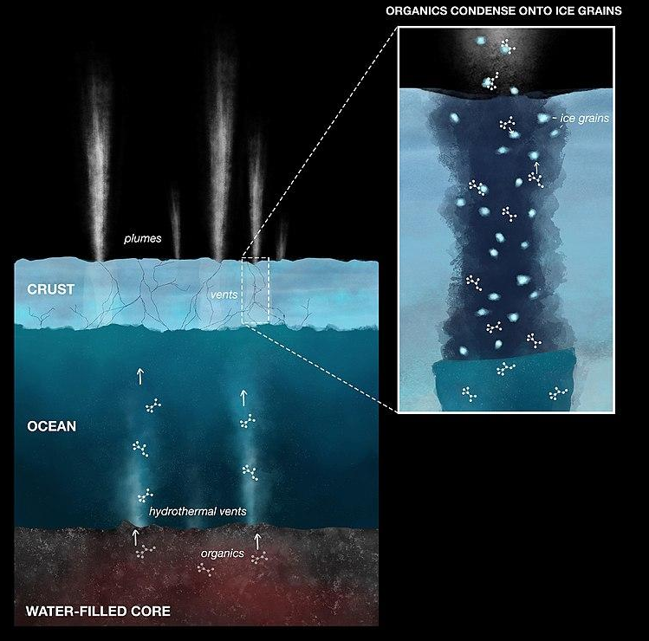
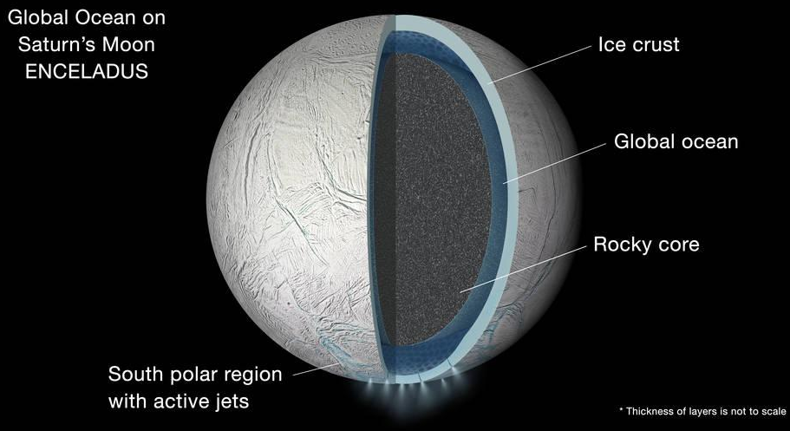
ASTROBi Foundation’s Mission
Dedicated to the search for life outside of Earth
Primary interested Enceladus
Mission
CONOPS
Changes
since PDR
Notes:
Maybe replace with just con ops

Slide 5
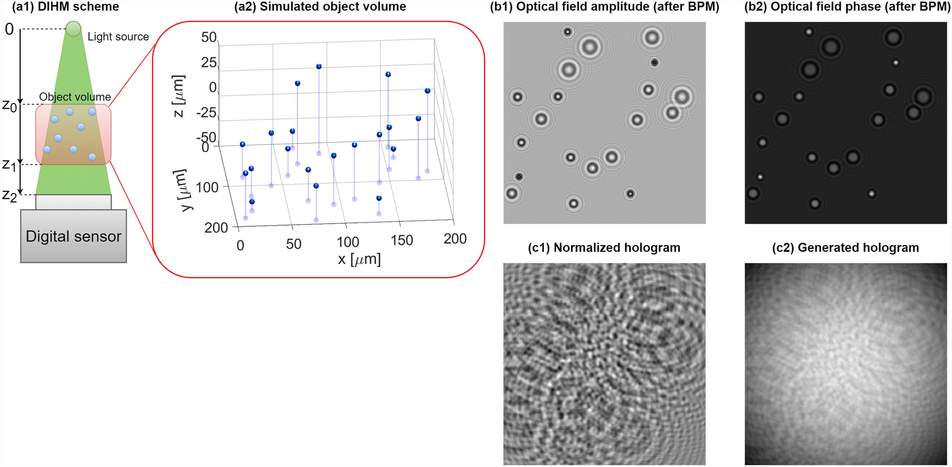
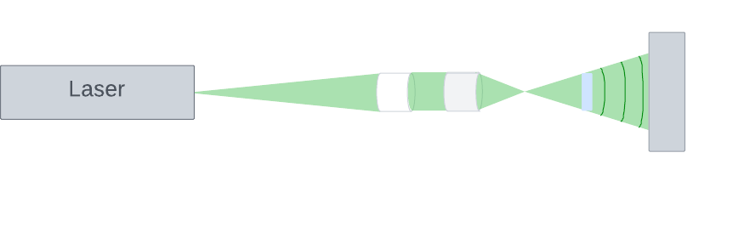
Etna’s Mission
Design, build, and test a proof-of-concept an 1U Digital Inline Holographic Microscope(DIHM)
Image and categorize microbes in mock water samples from the plumes of Enceladus
Raw Hologram
Normalized Hologram
Final Image
Mission
CONOPS
Changes
since PDR
Notes:
Switch 1U to be more readable, con ops is better

Slide 6
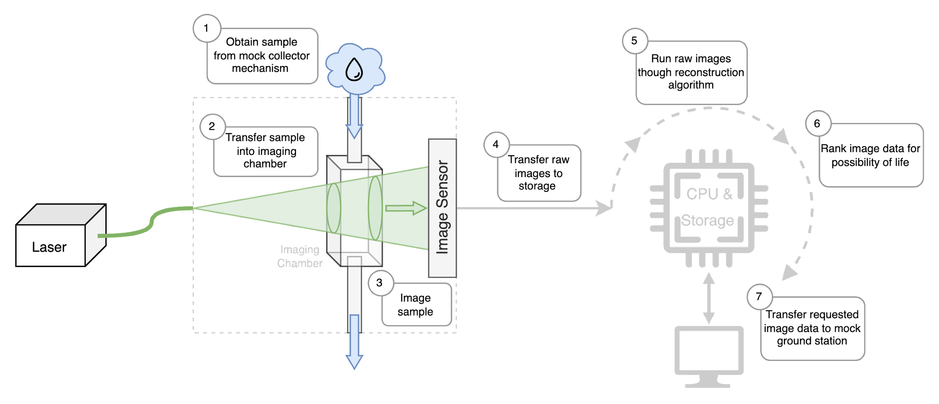
CONOPS: Etna
Mission
Definitions
CONOPS
Notes:
Not orbiting enceladus, Use this for astrobi, show mock sample chamber for etna con ops
Be as specific as we can

Slide 7
Design Solution
Project Purpose
Design Solution
CPEs and Risk
Design Requirements
Verification and Validation
Project Planning

Slide 8
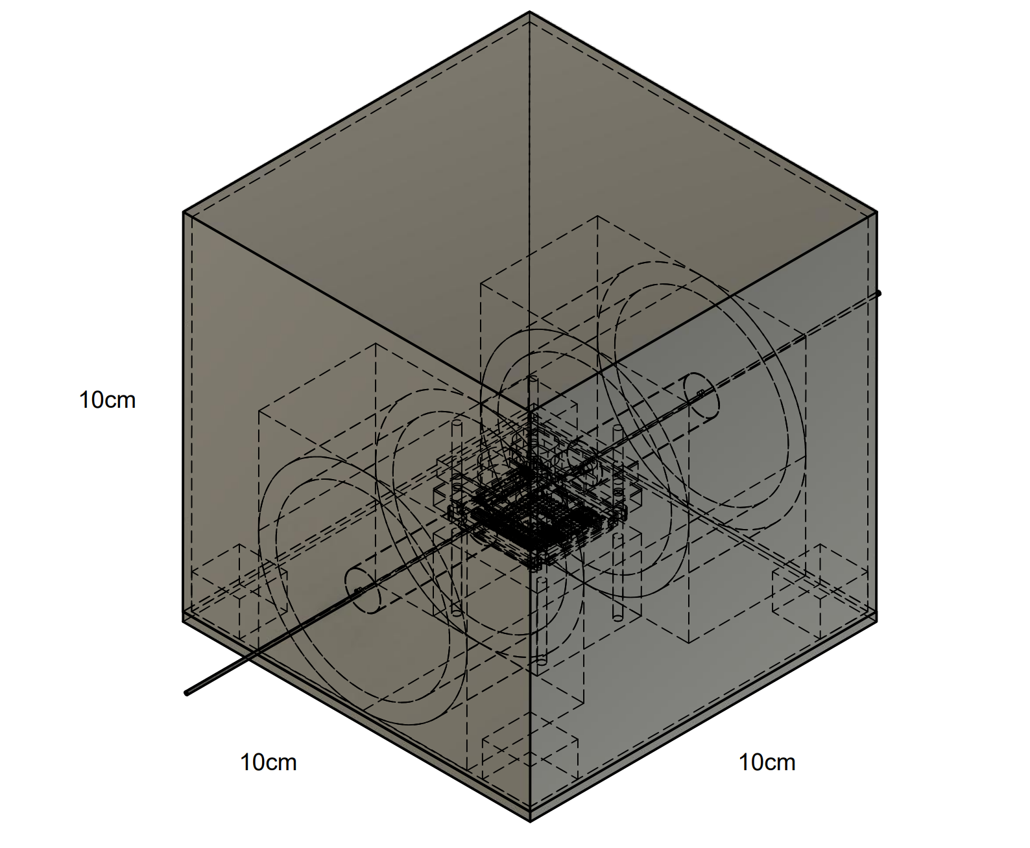
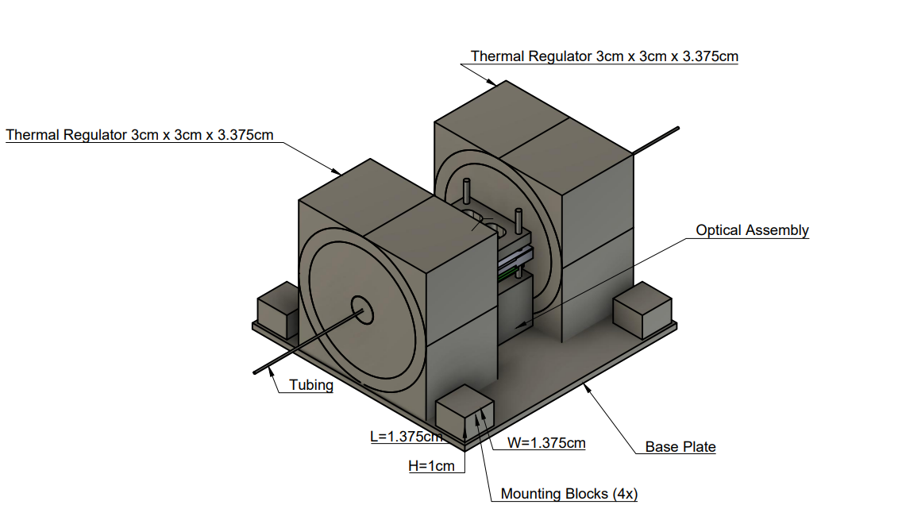
Payload
CAD Model
Parameters
Functional Block Diagram
Software
Notes:
Cant see anything with this view

Slide 9
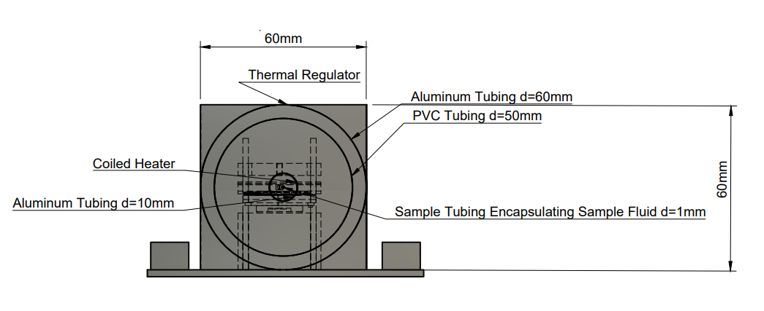
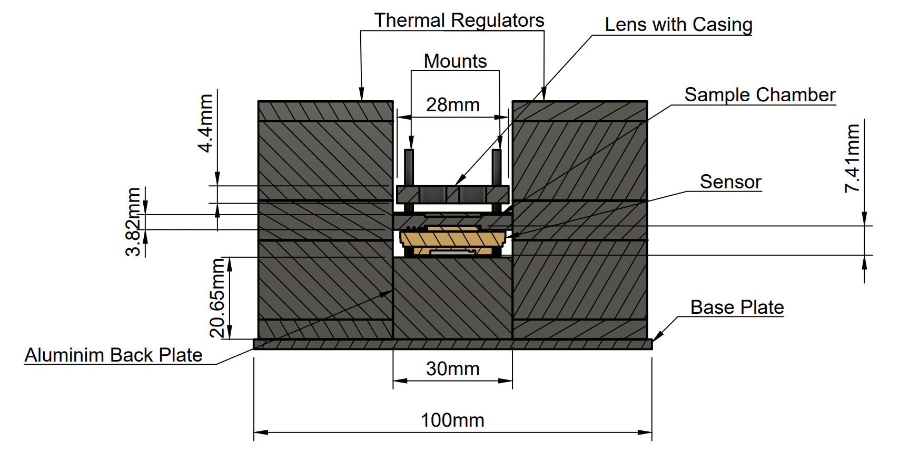
Transfer and Imaging System
CAD Model
Parameters
Functional Block Diagram
Software

Slide 10
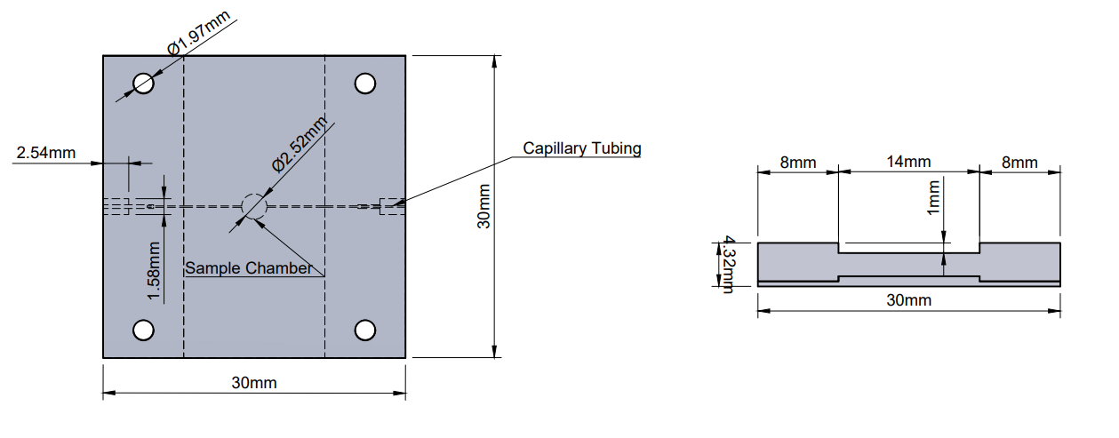
Sample Chamber
CPE 3: Sample Handling | 2.6.2 Sample Handling | The sample volume shall be greater than 2μL (instantaneous imaging volume) | ✓
 | 3.2.3 Laser | Shall have a wavelength which is optically transparent to the sample volume material | ✓
 | 3.6.2 Microfluids | The microscope shall provide a method for mitigating bubbles in the imaging chamber. | ✓
CAD Model
Parameters
Functional Block Diagram
Software

Slide 11
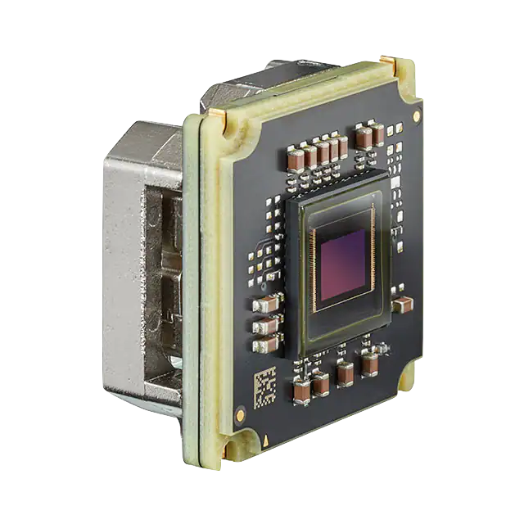
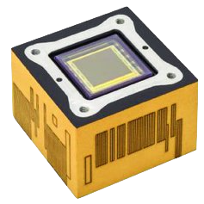
Image Sensor
Space: 3D Plus 12 MP CMOS Space Camera
Ours: Alvium 1800 U-1236m
Pixel Size: 3.45 μm × 3.45 μm
Resolution: 4112 (H) × 3008 (V)
Operating Temp: -20 to +65 °C
Spectral Range: 300 – 1100 nm
  Our laser's wavelength: 520 nm
Dimensions: 38×29×29 mm
Pixel Size: 3.45 μm × 3.45 μm
Resolution: 4096 (H) × 3000 (V)
Operating Temp: -40 to +70 °C
Spectral Range: 400 – 1000 nm
Dimensions: 30x40x40 mm
CAD Model
Parameters
Functional Block Diagram
Software

Slide 12
Power Budgets
CPE 8: Power Consumption | 2.3.1 Power | The microscope core shall consume less than 10 watts active | ✓
 | 2.3.2 Power | The microscope core shall consume less than 0.5 watts inactive. | ✓
 | 2.3.3 Power | The processor shall consume less than 10 watts active | ✓
 | 2.3.4 Power | The processor shall consume less than 0.5 watts inactive. | ✓
Processor – Active
Available | 10 W
Processor(Max) | 4 W
Left over | 6 W
Payload – Active
Available | 10W
Image Sensor | 3.1 W
Fluid Transfer Heater | 0.9W
Sample Chamber Heater | 0.05 W
Left over | 5.95 W
Processor – Inactive
Available | 0.5 W
Processor(Low) | 0.2 W
Left over | 0.3 W
CAD Model
Parameters
Functional Block Diagram
Software
Notes:
Put budgets in here

Slide 13
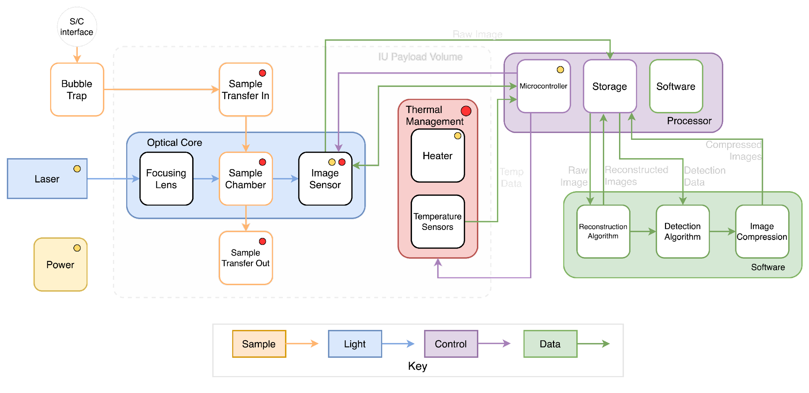
System Functional Block Diagram
CAD Model
Parameters
Functional Block Diagram
Software

Slide 14
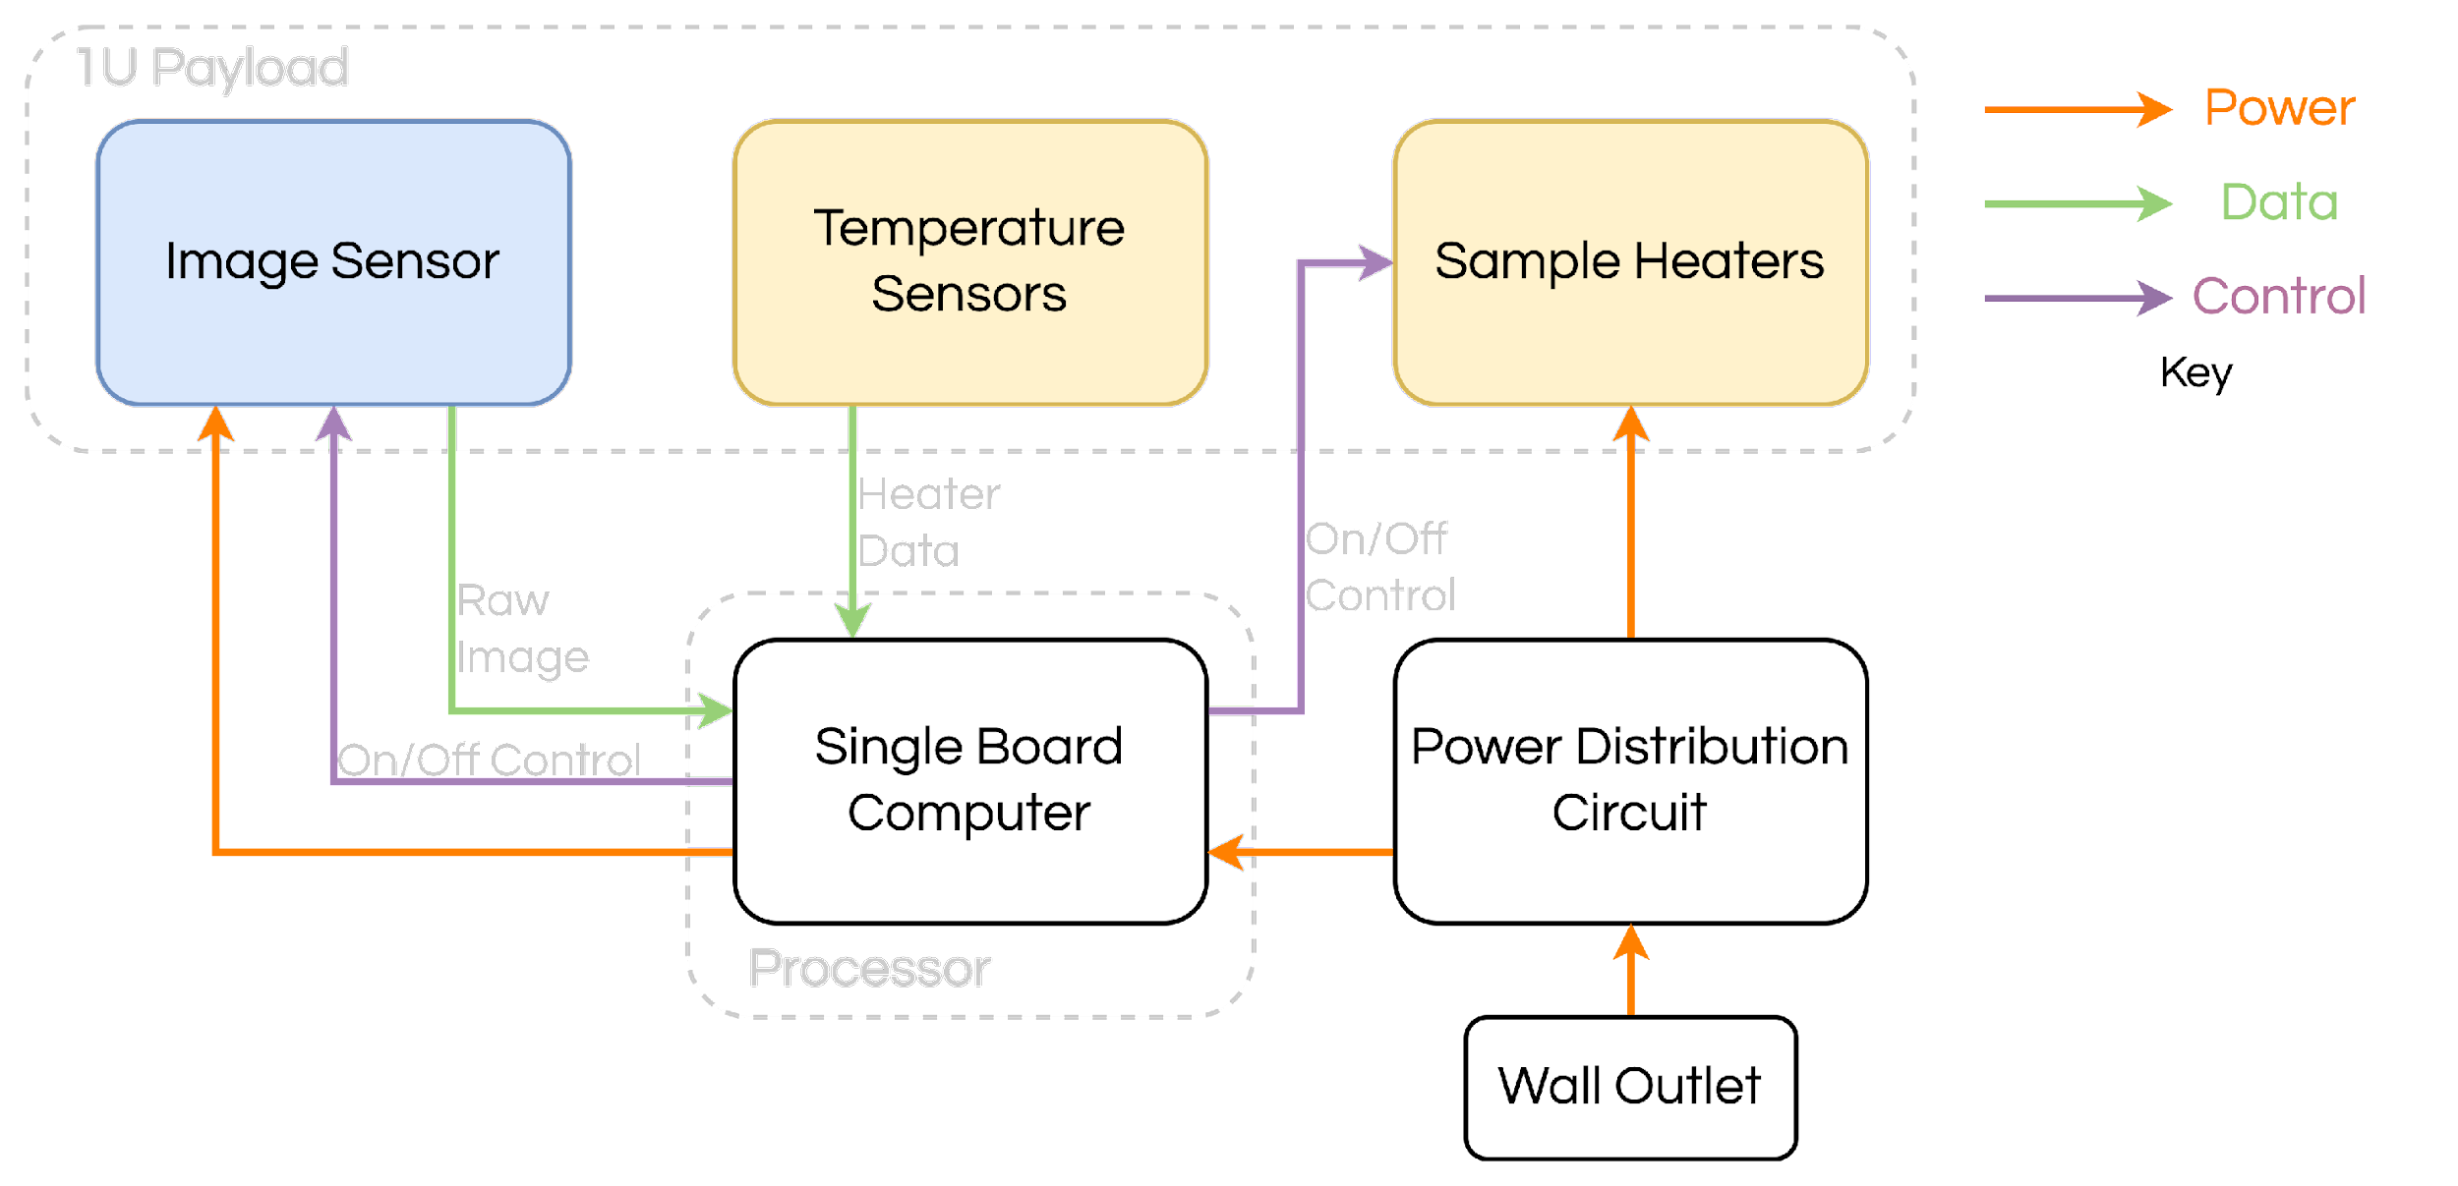
Electronics Functional Block Diagram
CAD Model
Parameters
Functional Block Diagram
Software

Slide 15
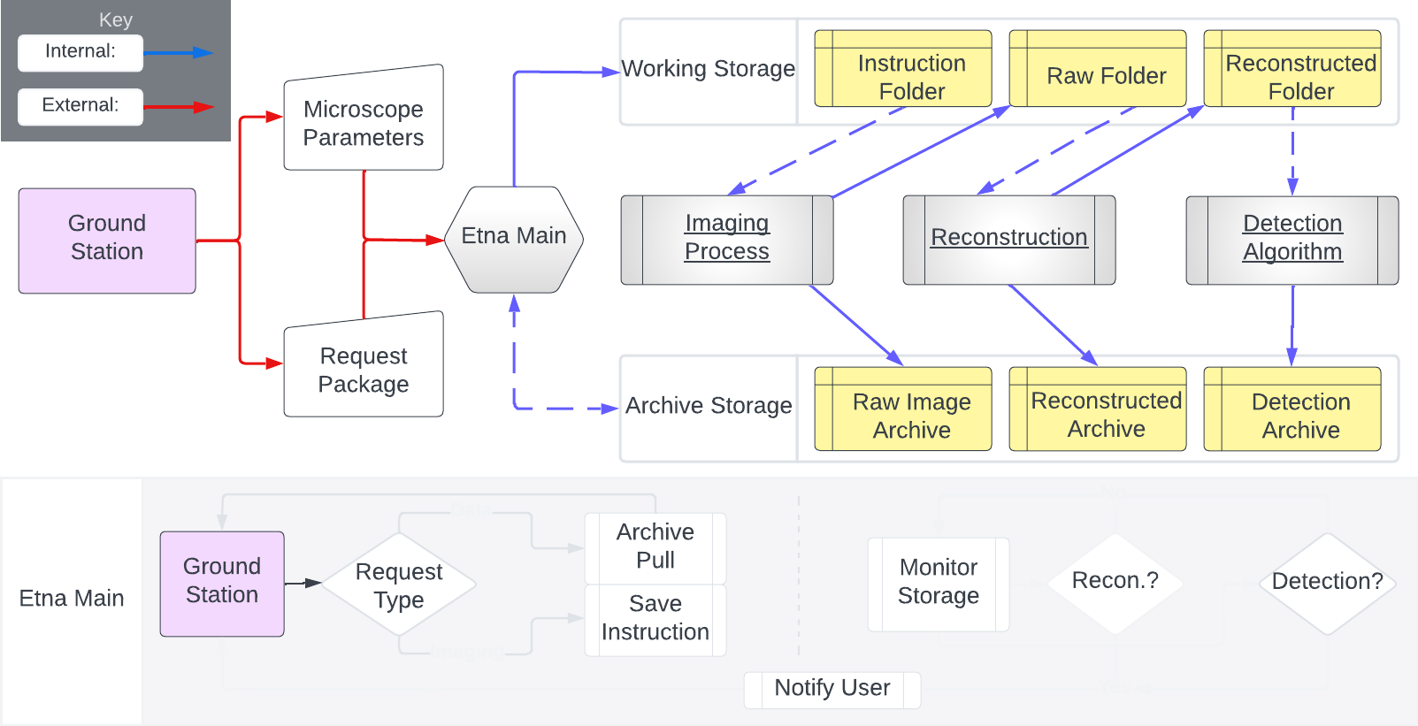
General Software System Flowchart
CAD Model
Parameters
Functional Block Diagram
Software

Slide 16
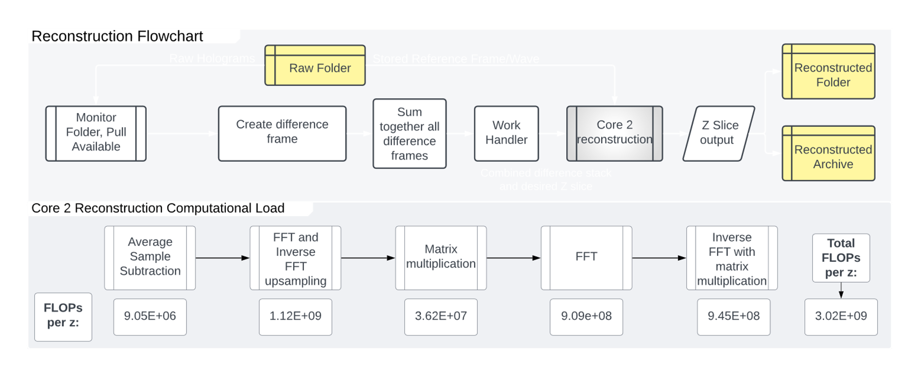
Reconstruction, Flowchart, and Flop Analysis
Should consume < 5W, shall consume < 10W when active
Should consume < 0.1W, shall consume < 0.5W when inactive
12,000 seconds time limit for reconstruction
FFT: FLOPs = 4N²×log₂(4N²)
Inverse FFT: FLOPs = N²×log₂(N²)
Matrix Multiplication: FLOPs = 4N²
CAD Model
Parameters
Functional Block Diagram
Software

Slide 17
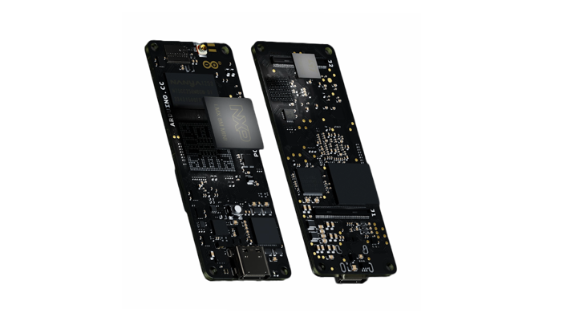
Processor: Portenta X8
CPU:
  4x ARM® Cortex-A53 (1.8 GHz)
  1x ARM® Cortex® M4 (400 MHz)
Microcontroller:
  1x ARM® Cortex-M7 (480 MHz)
  1x ARM® Cortex-M4 (240 MHz)
4000 mW Maximum Power Consumption
200 mW Low Power Mode
Component and assembly efficiency
User Friendly
Language Choice / Compatibility
  Linux OS preloaded onboard
  Arduino driven microcontroller
High Safety Factor
CAD Model
Parameters
Functional Block Diagram
Software

Slide 18
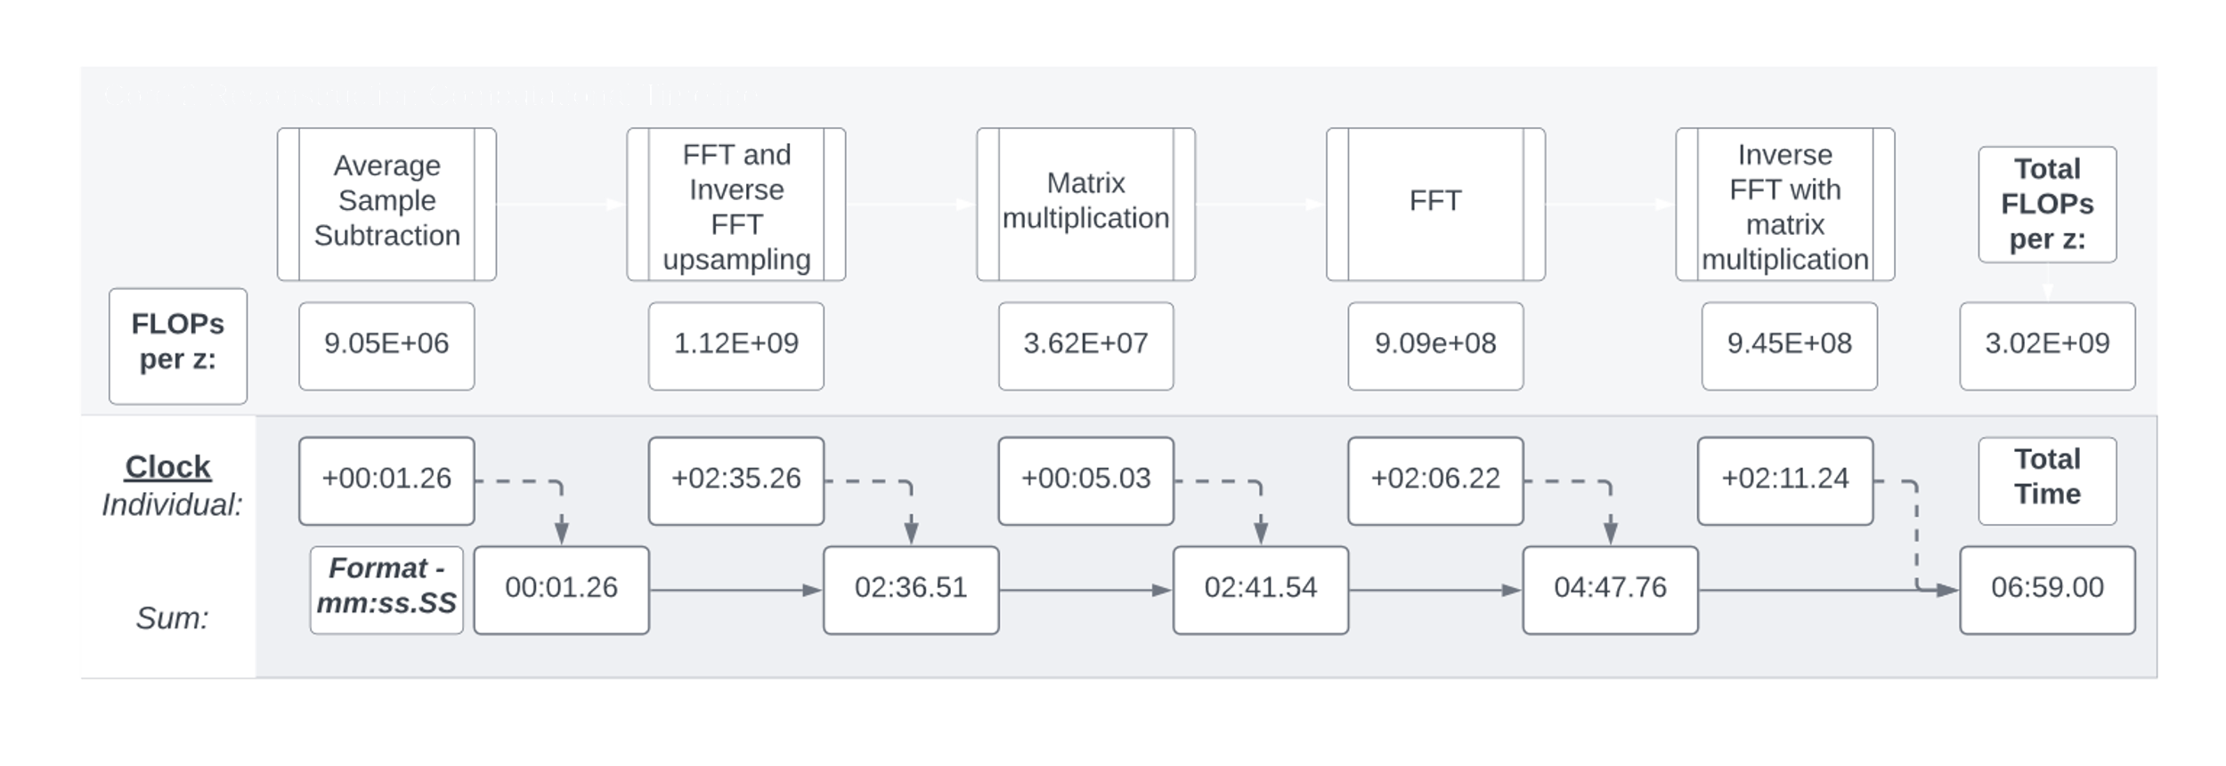
Computational Timeline
FLOPs : Total FLOPs
  total FLOPs per z * 2000 (z-slices)
  F: FLOPs per Clock Cycle
  8 32-bit FLOPS/Hz on the Cortex-A53
  G: Clock Speed
  (1.8 GHz)
Time = FLOPs ÷ (F×G)
CAD Model
Parameters
Functional Block Diagram
Software

Slide 19
CPEs and Risk
Project Purpose
Design Solution
CPEs and Risk
Design Requirements
Verification and Validation
Project Planning

Slide 20
Critical Project Elements
CPE | Description
E1: Structural Survival | Payload shall survive vibrations, g-force, and pressure it would experience throughout the mission
E2: Thermal Survival | Payload shall survive thermal ranges it would experience throughout the mission
E3: Sample Handling | Payload shall be able interface with mock spacecraft to intake and expel saltwater samples
E4: Optical Design | Payload shall be able image sample volume using laser, lenses, and image sensor
E5: Data Reconstruction | Images shall be reconstructed such that a particle and its movement can be identified
E6: Particle Detection | Particle movement shall be identified and ranked by their possibility of life
E7: Storage | Shall store raw and reconstructed images, as well as detection data
E8: Power Consumption | Payload and processor shall have sperate maximum active and inactive power consumption
Critical Project Elements
Risk Matrix
Notes:
Color boxes more, maybe shade boxes so its obvious
Just saying reasons is clear

Slide 21
Risk Matrix
Likelihood | High 5
 | 4
 | 3 |  | 3 | 2 |  | 1
 | 2
 | Low 1
 |  | Low 1 | 2 | 3 | 4 | High 5
 |  | Consequence
# | Risk | Key Mitigation
1 | Injury from laser | Laser safety protocol
2 | Reconstruction Failure: Time Constraint | Processor choice
3 | Bubbles accumulating in the sample chamber | Sample chamber design
Critical Project Elements
Risk Matrix

Slide 22
Injury from Laser
Likelihood | High 5
 | 4
 | 3 |  |  |  |  | 1
 | 2
 | Low 1
 |  | Low 1 | 2 | 3 | 4 | High 5
 |  | Consequence
Class 3b Laser: 5–500mW
Ours: 15 mW
Effect
Eye damage
Burned skin
Critical Project Elements
Risk Matrix
Notes:
Spell out LSO: Laser safety officer
High 5 is same as laser and optics

Slide 23
Injury from Laser: Mitigation
Likelihood | High 5
 | 4
 | 3 |  |  |  |  | 1-Old
 | 2
 | Low 1 |  |  |  |  | 1-New
 |  | Low 1 | 2 | 3 | 4 | High 5
 |  | Consequence
Laser Safety Plan following ANSI Z136.1 Standard
Laser safety officer trained on team observer
Faculty PI who will be present at tests with powered laser
Glasses and skin protection for all testing personnel
Protective housing for laser
Restricted access to room laser testing room
Critical Project Elements
Risk Matrix

Slide 24
Reconstruction Failure: Time Constraint
Likelihood | High 5
 | 4
 | 3 |  |  | 2-Old
 | 2
 | Low 1 | 2-New
 |  | Low 1 | 2 | 3 | 4 | High 5
 |  | Consequence
Effect
Reconstruction not completed in time
Sample backlog
Power limit reached
Mitigation
Large processor safety factor
Parallelized software architecture
Critical Project Elements
Risk Matrix
Notes:
Maybe Consequence is too high? If we get 50% detection for our project that is still good.
How do we test for life detection ?

Slide 25
Bubbles Accumulating in Sample Chamber
Likelihood | High 5
 | 4
 | 3 |  | 3-Old
 | 2
 | Low 1 |  | 3-New
 |  | Low 1 | 2 | 3 | 4 | High 5
 |  | Consequence
Effect
Failure in imaging
Too many bubbles or too large of a bubble for detection
Mitigation
Bubble trap at fluid intake
Shape of sample chamber
Tubing material
Critical Project Elements
Risk Matrix
Notes:
Want to add more verbal explanation given on this slide
Add bubble trap, add shape of sample chamber? No hard edges etc.
Bubble in chamber causes no image, maybe put it at 4?

Slide 26
Risk Matrix: New
Likelihood | High 5
 | 4
 | 3 |  | 3 | 2 |  | 1
 | 2
 | Low 1 | 2 | 3 |  |  | 1
 |  | Low 1 | 2 | 3 | 4 | High 5
 |  | Consequence
# | Risk | Key Mitigation
1 | Injury from laser | Laser safety protocol
2 | Reconstruction Failure: Time Constraint | Processor choice
3 | Bubbles accumulating in the sample chamber | Sample chamber design
Critical Project Elements
Risk Matrix

Slide 27
Design Requirements
Project Purpose
Design Solution
CPEs and Risk
Design Requirements
Verification and Validation
Project Planning

Slide 28
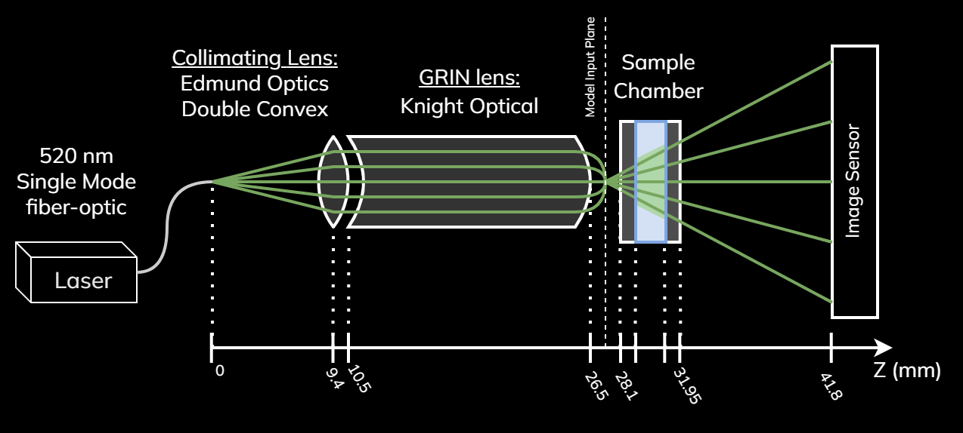
Optical Architecture
CPE 4 | 1.4.1: Payload | The payload shall be a lensless Digital Inline Holographic Microscope(DIHM) consisting of an optional collimating lens, a beam-spreading lens, an optional pinhole, a sample chamber, and an image sensor. | ✓
Optical Architecture
Thermal System
Notes:
Input Design Requirements and functional requirements in beginning

Slide 29
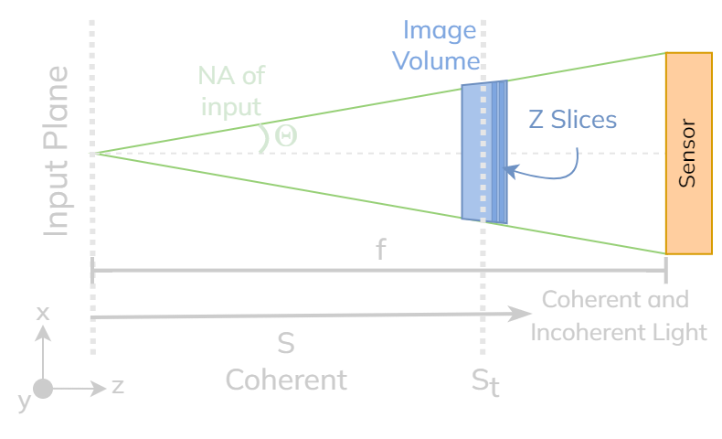
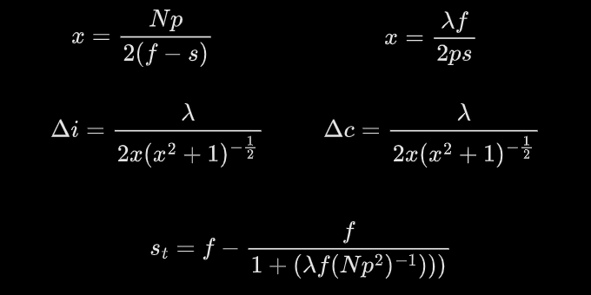
Resolution Model Inputs
CPE 4 | 3.3.1: Image Sensor | Optical sensor shall support a resolution of < 0.8 micrometer in the X and Y directions
 | 3.3.2: Image Sensor | Optical sensor shall support a resolution of < 2 micrometer in the Z direction
 | 2.6.2: Sample Handling | The sample volume shall be greater than 2μL (instantaneous imaging volume), while satisfying the resolution requirements.
Incoherent Eq:
Coherent Eq:
Laser: Wavelength (λ) = 520 nm
Sensor: Width of pixel (p) = 3.45 um
  Number of Pixels (N) = 3008
Optical Architecture
Thermal System

Slide 30
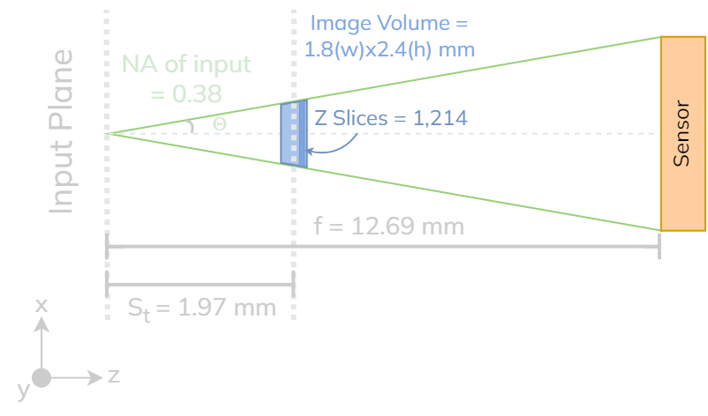
Resolution Model Outputs
CPE 4 | 3.3.1: Image Sensor | Optical sensor shall support a resolution of < 0.8 micrometer in the X and Y directions | ✓
 | 3.3.2: Image Sensor | Optical sensor shall support a resolution of < 2 micrometer in the Z direction | ✓
 | 2.6.2: Sample Handling | The sample volume shall be greater than 2μL (instantaneous imaging volume), while satisfying the resolution requirements. | ✓
Best resolution = 0.60 um
Resolution FOS = 1.3
Z slices = 1,214
Minimum chamber dimensions:
  Radius = 1.18 mm
  Depth = 1.82 mm
Optical Architecture
Thermal System
Notes:
Best resolution is at St (just day this, not on the slide)

Slide 31
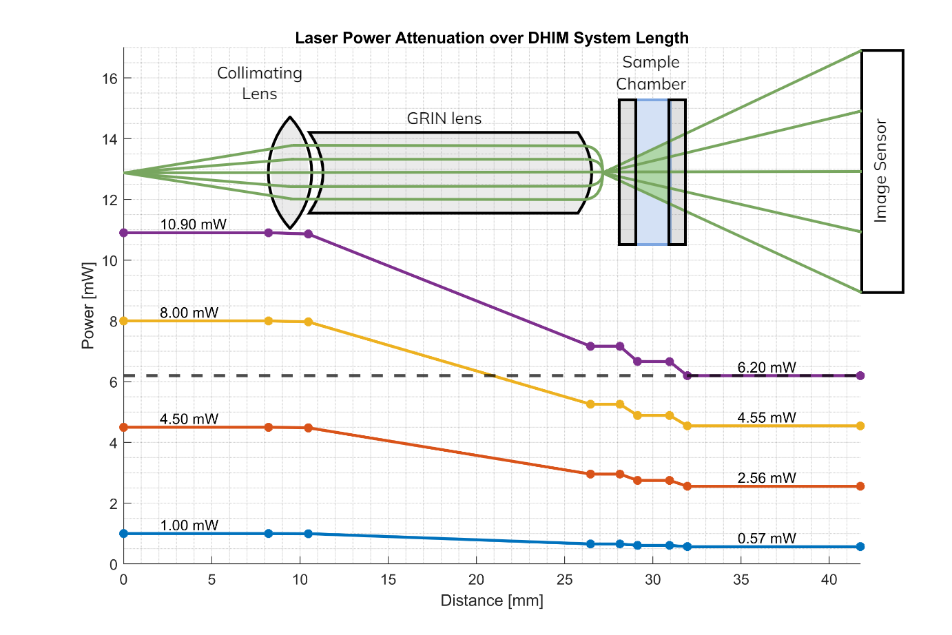
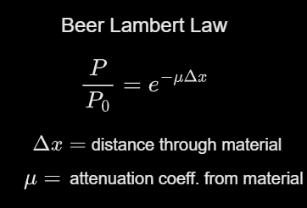
Attenuation Model
CPE 4 | 3.2.1 Laser | Microscope laser shall provide a light intensity compatible with the optical sensor | ✓
Required laser power = 10.3 mW
Required power at sensor = 6.20 mW
Optical Architecture
Thermal System

Slide 32
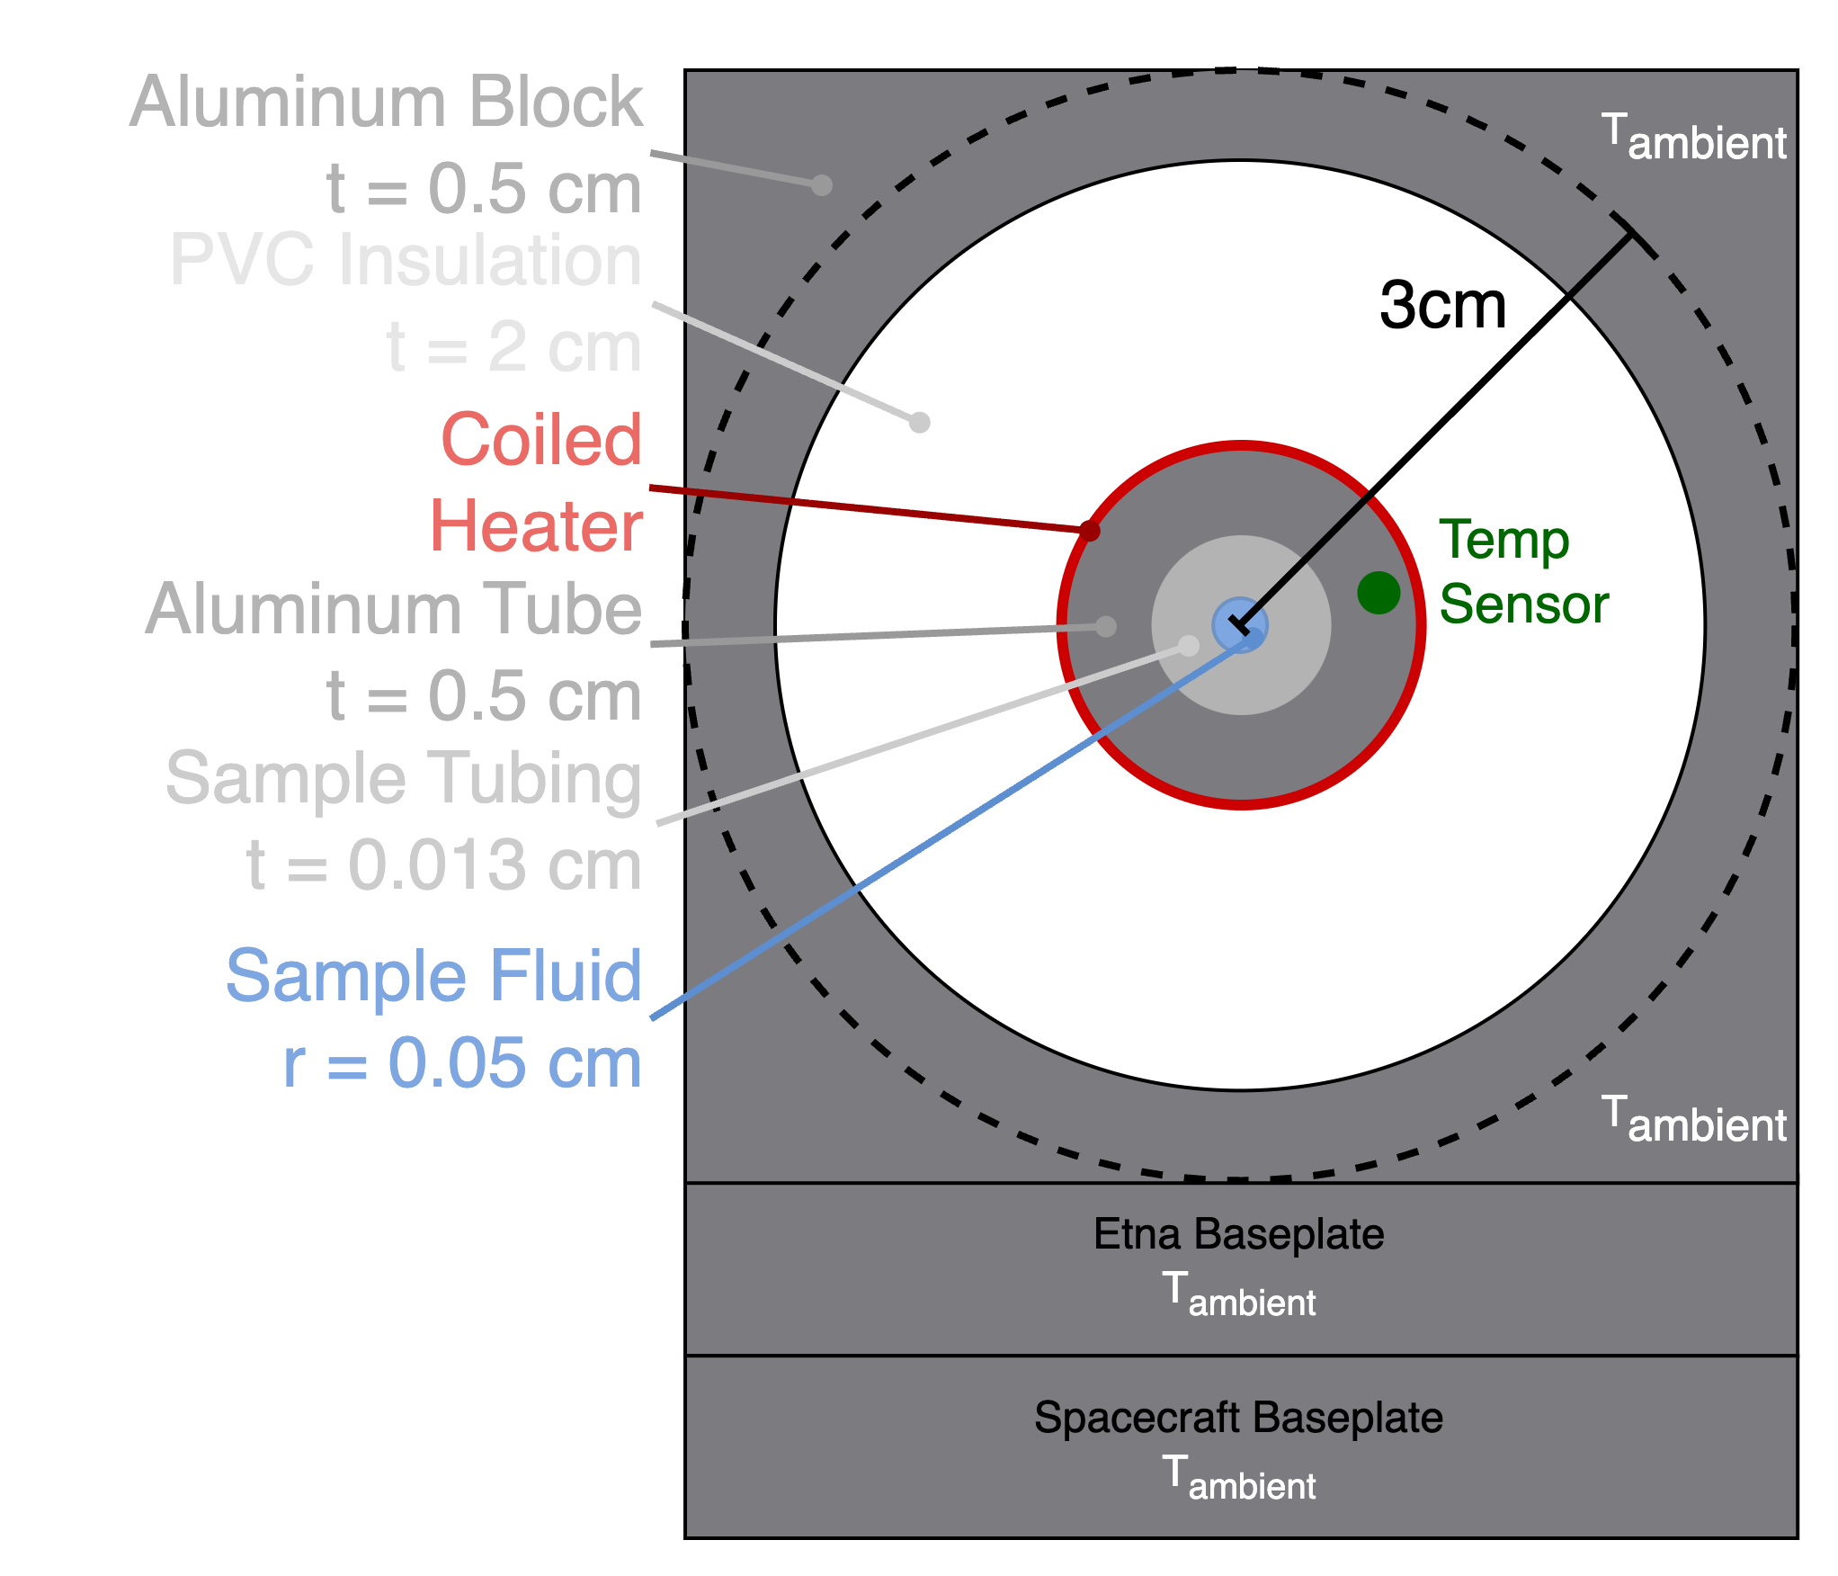
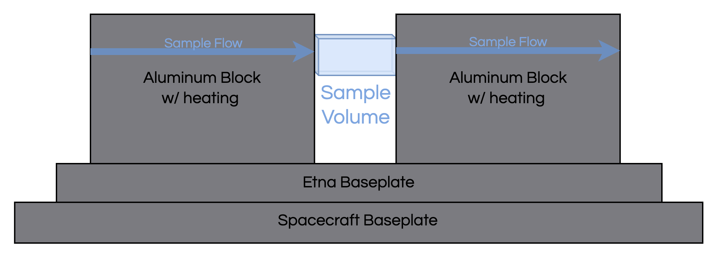
Thermal System
CPE 3 | 2.1.2 Thermal | Shall not heat the sample by more than +5 degrees C relative to the baseplate temperature, except when the sample heater is activated.
 | 2.1.3 Thermal | Shall provide a method to actively heat the sample by a configurable amount relative to the baseplate temperature, with 1 degree C resolution and 1 degree C accuracy.
Axial View
Side view
Note: Thermal grease between each layer
Optical Architecture
Thermal System

Slide 33
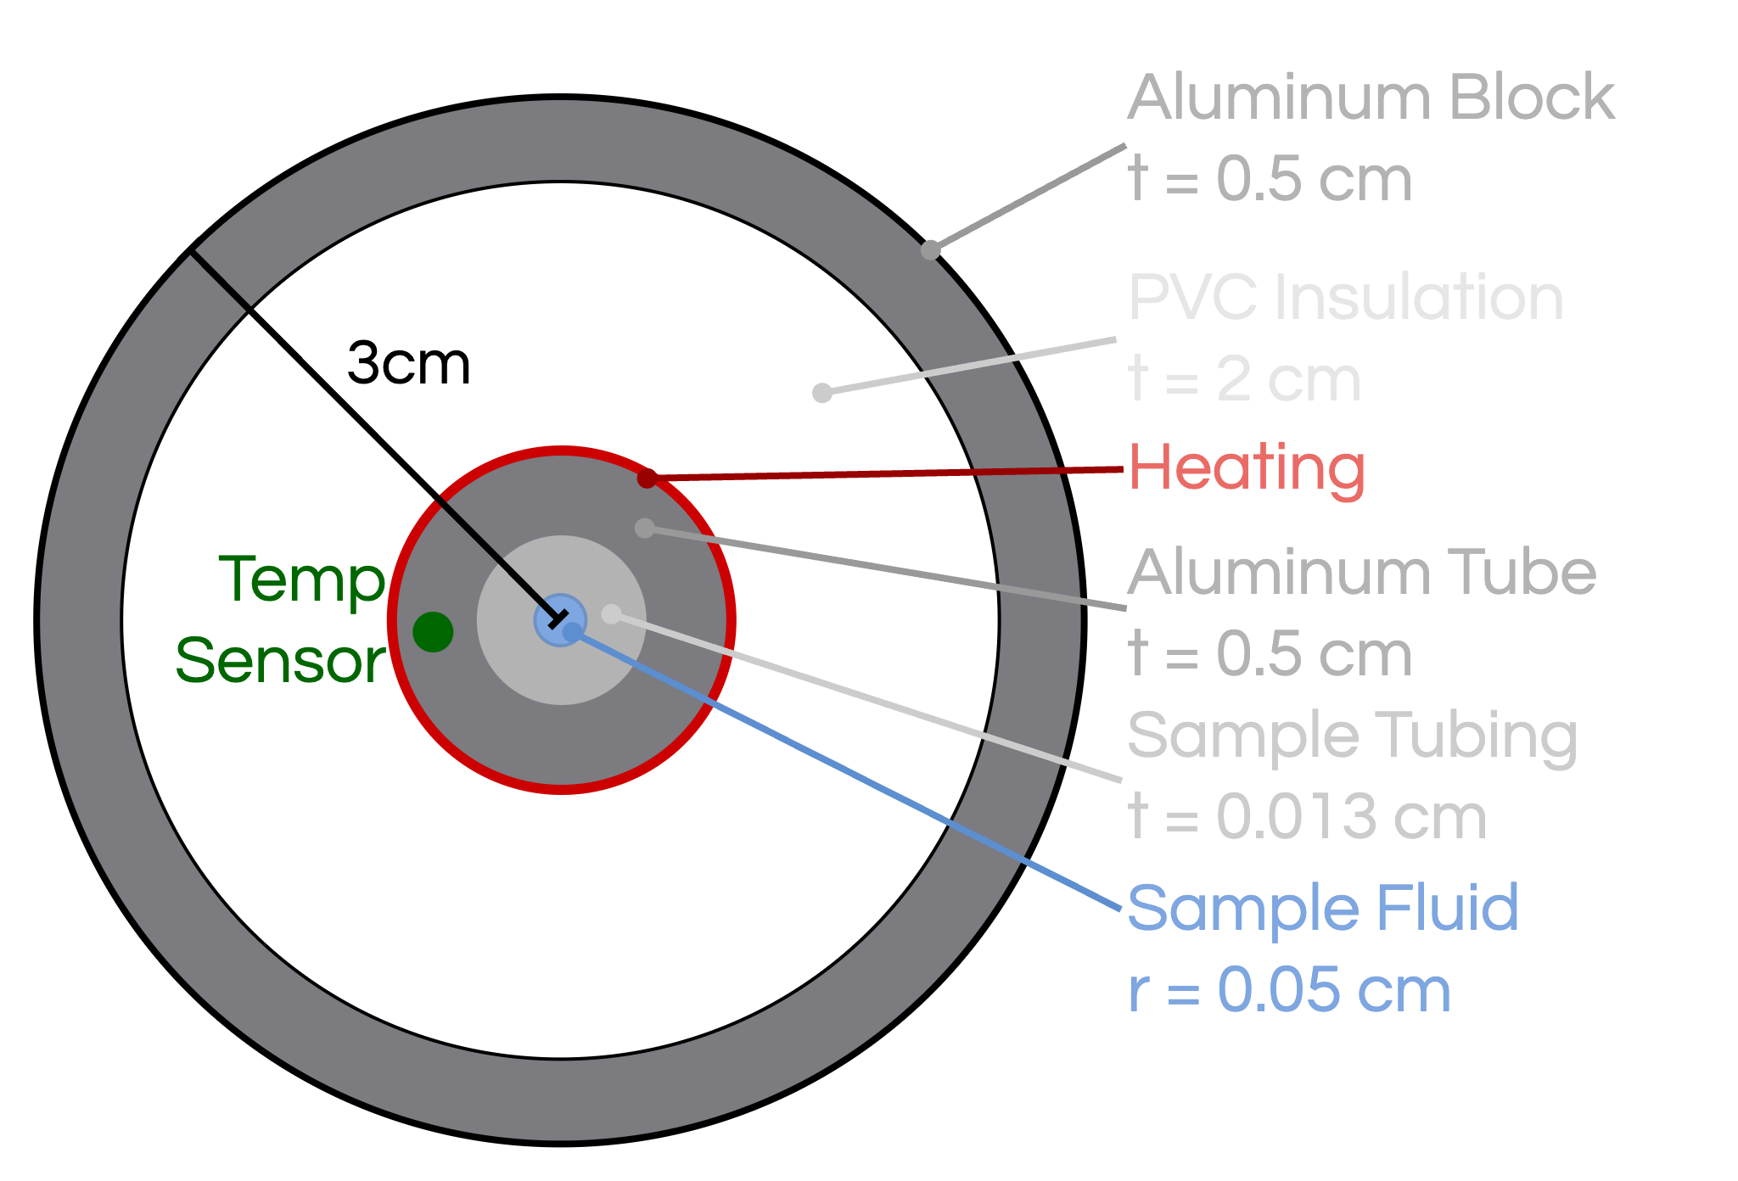
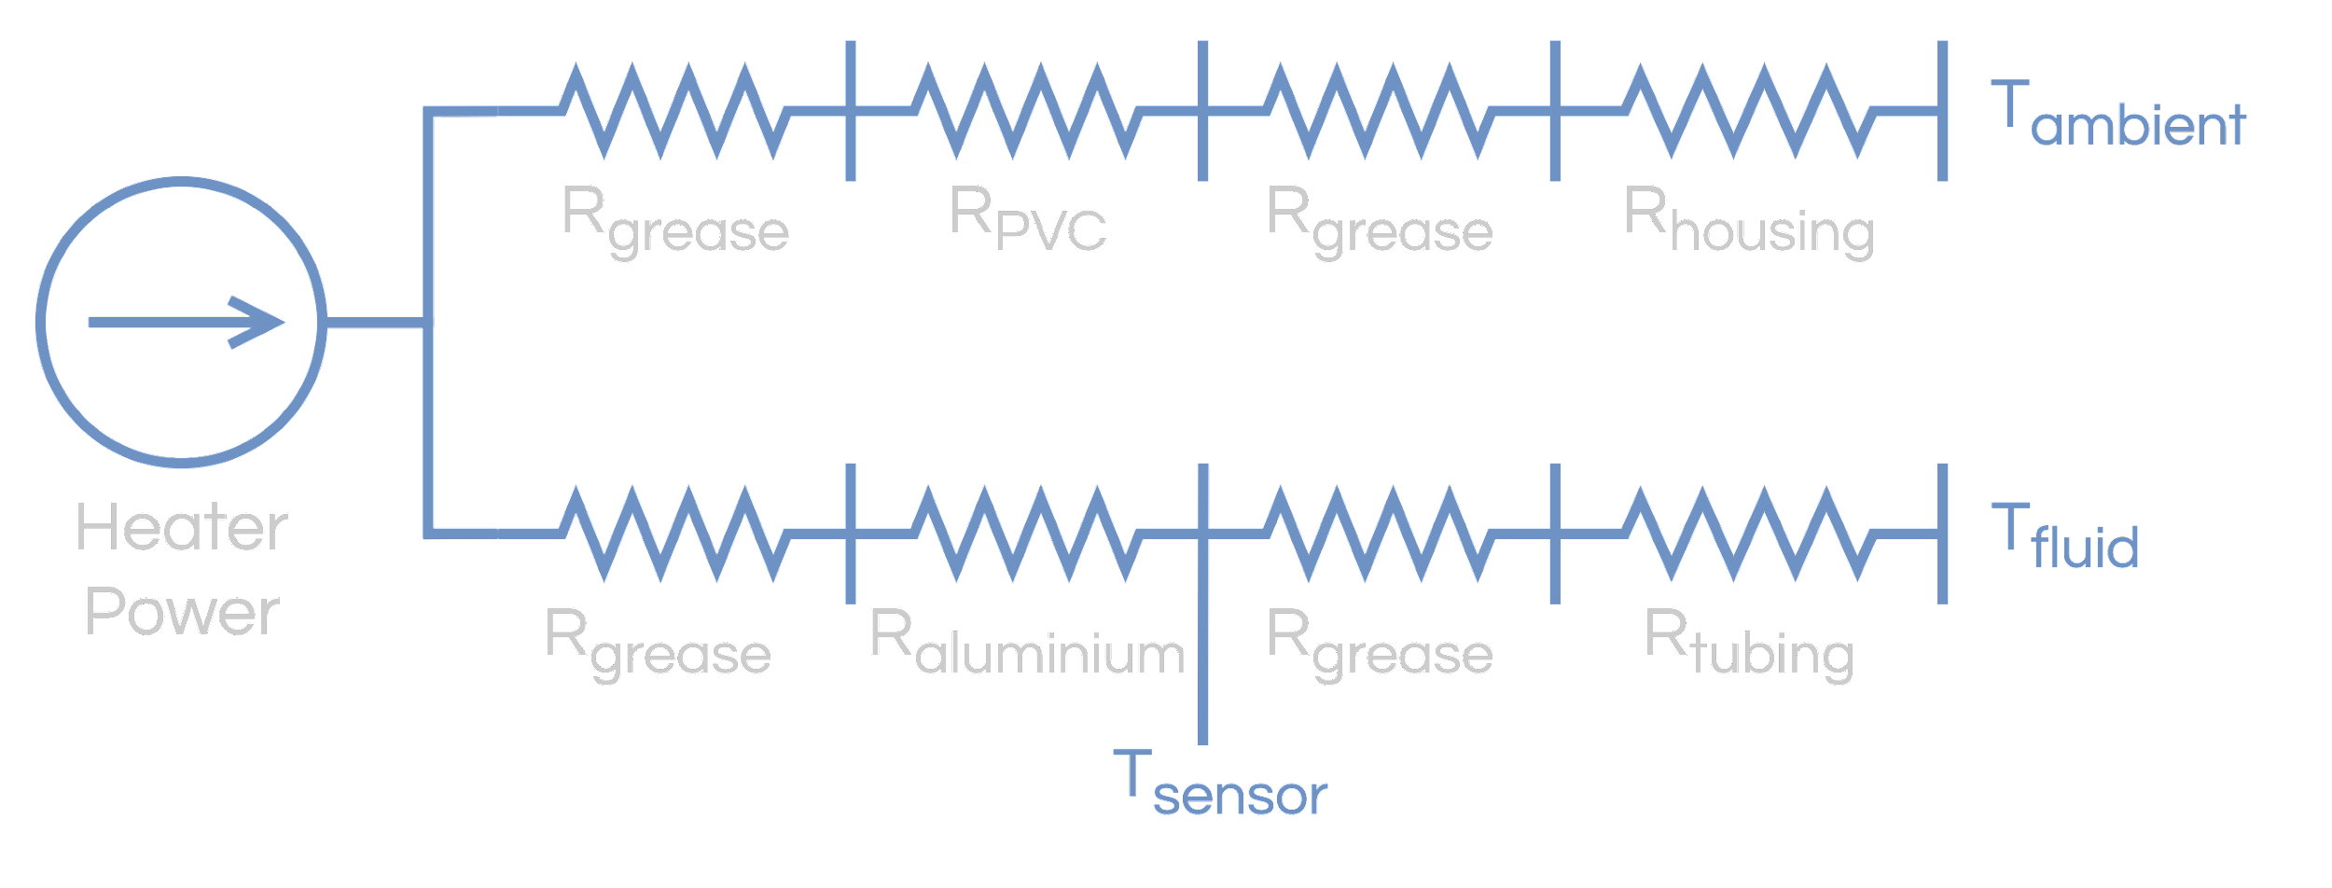
Thermal Analysis
CPE 3 | 2.1.2 Thermal | Shall not heat the sample by more than +5 degrees C relative to the baseplate temperature, except when the sample heater is activated.
 | 2.1.3 Thermal | Shall provide a method to actively heat the sample by a configurable amount relative to the baseplate temperature, with 1 degree C resolution and 1 degree C accuracy.
Simplifying Assumptions:
The temperature at the surface of the outer circle is held at ambient temperature
The heat transfer is radial, with no deviations through the length
Note: Thermal grease between each layer
Optical Architecture
Thermal System

Slide 34
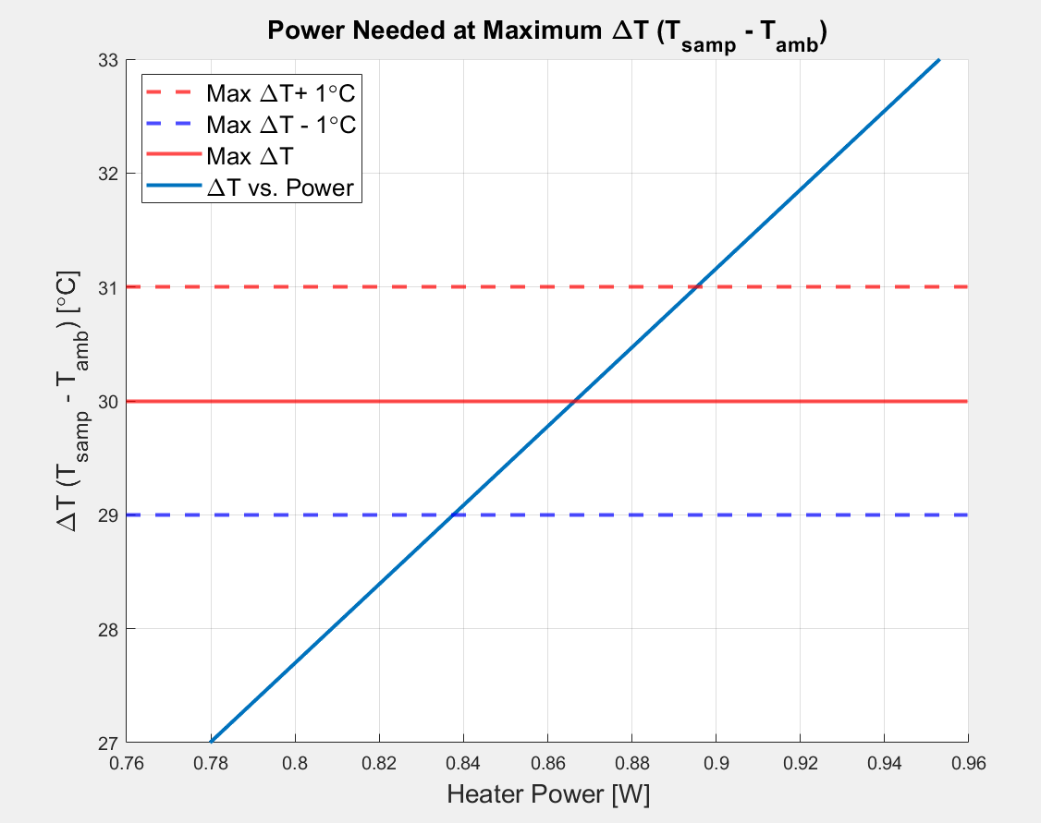
Thermal Analysis Results
CPE 3 | 2.1.2 Thermal | Shall not heat the sample by more than +5 degrees C relative to the baseplate temperature, except when the sample heater is activated. | ✓
 | 2.1.3 Thermal | Shall provide a method to actively heat the sample by a configurable amount relative to the baseplate temperature, with 1 degree C resolution and 1 degree C accuracy. | ✓
Maximum Power Required: 0.84 - 0.9 W
Power Budget: 0.9 W of 6 W
Mass of Aluminum Block Heating System: 0.17 kg
Optical Architecture
Thermal System

Slide 35
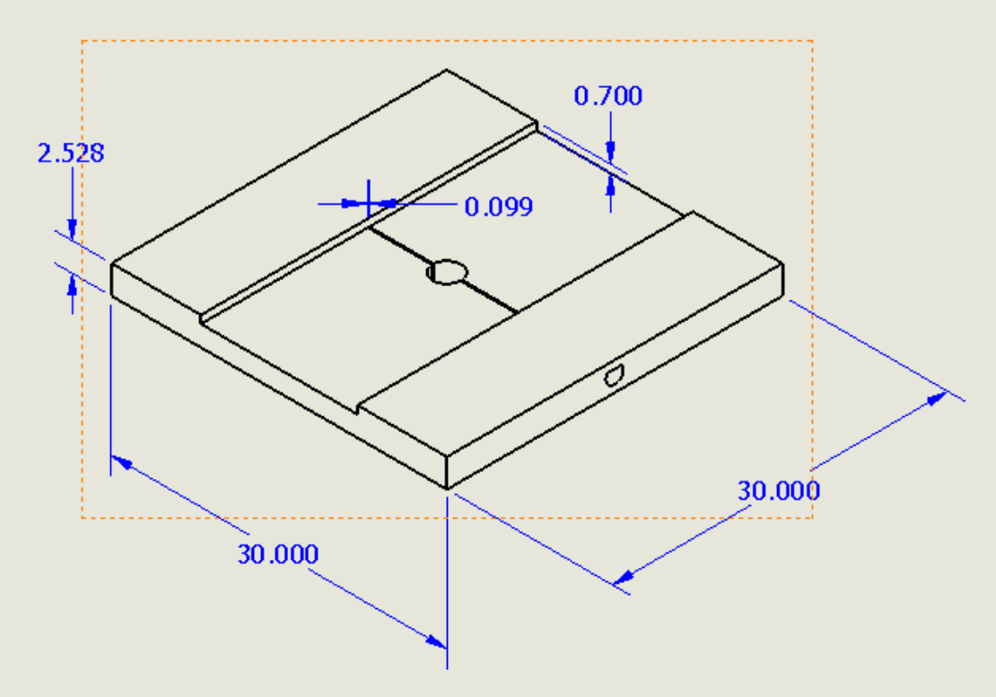
Imaging Chamber Temperature Control
CPE 3 | 2.1.2 Thermal | Shall not heat the sample by more than +5 degrees C relative to the baseplate temperature, except when the sample heater is activated. | ✓
 | 2.1.3 Thermal | Shall provide a method to actively heat the sample by a configurable amount relative to the baseplate temperature, with 1 degree C resolution and 1 degree C accuracy. | ✓
The temperature behavior of the sample when flowing will be modeled and reported in the Spring
When fluid is not flowing, the regulator must hold the sample temperature to above 1 degree C
Two coiled wire heaters will be used to keep the sample liquid
Maximum Heater Power needed: 50 mW
Temperature Probe
Coiled Wire
Heaters
Coiled Wire Heaters
Measurement Units: mm
Optical Architecture
Thermal System

Slide 36
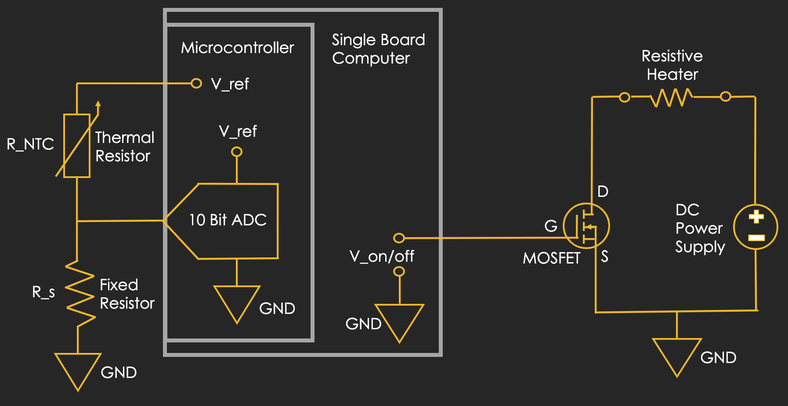
Temperature Measurement Circuitry
Thermistor Circuit
Resistive Heater Circuit
Label | Definition
V_ref | Output voltage of the Microcontroller
V_on/off | Output voltage of the General Purpose In-Out (GPIO) pin of the SBC
R_NTC | Thermal resistor
R_s | Resistor which dictates the sensitivity of our measurements within a certain temperature range
* There will be 5 NTC thermistors and 3 resistive heating elements
Optical Architecture
Thermal System

Slide 37
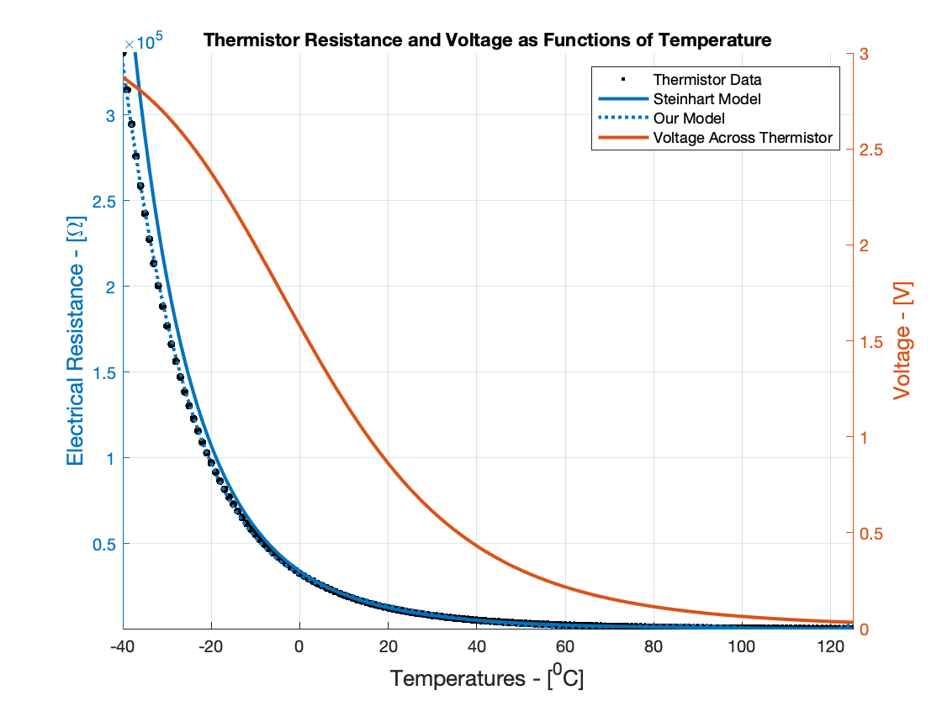
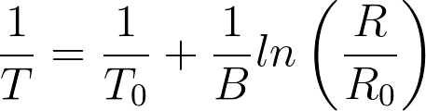
Temperature Measurements
Step 1: Measure the voltage across the fixed value resistor
Step 2: Calculate the voltage across the thermal resistor
Step 3: Calculate the electrical resistance of the thermistor
Step 4: Calculate the temperature of the sensor
Steinhart Equation:
The microcontroller will then determine if the heater needs to be on or off
* Values used in model: 3.1 V, fixed resistor = 10 kOhm, thermistor = 10 kOhm @ 25 degC
Optical Architecture
Thermal System

Slide 38
Verification and Validation
Project Purpose
Design Solution
CPEs and Risk
Design Requirements
Verification and Validation
Project Planning

Slide 39
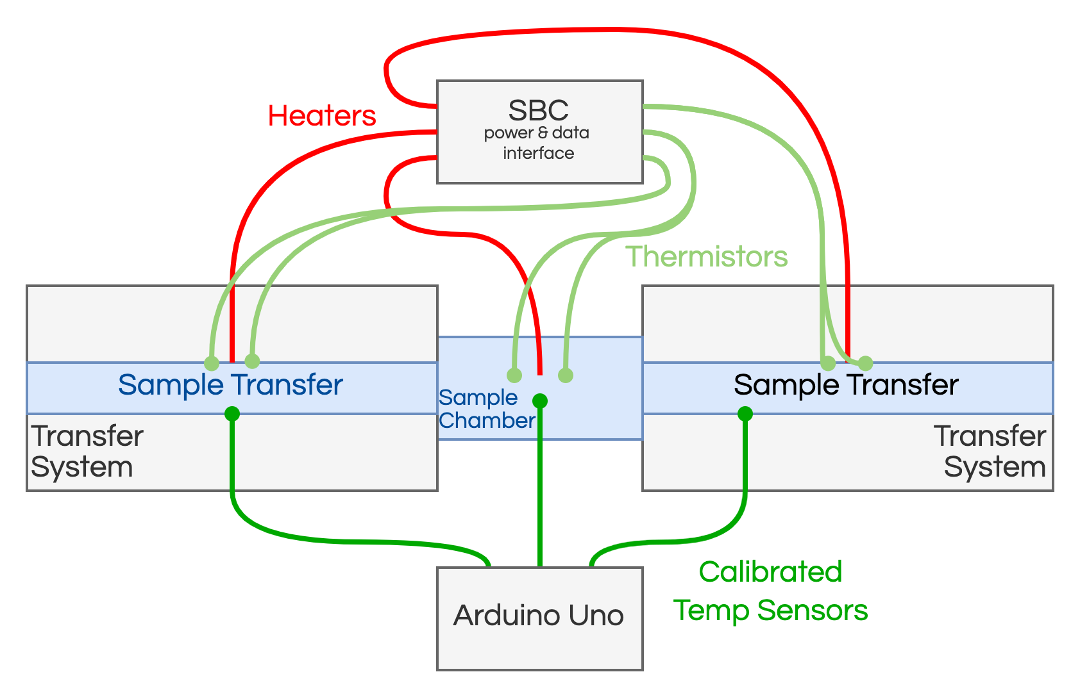
Electrical Testing
2.1.3 Thermal | Shall provide a method to actively heat the sample by a configurable amount relative to the baseplate temperature, with 1 degree C resolution and 1 degree C accuracy.
Objective
Test accuracy of temperature measurements
Plan
Use a calibrated temperature probe and compare the calibrated temperature measurements to the thermistor values
Measurements
Temp. from thermistor
Temp. from calibrated temp sensor
Pass Criteria
Thermistor measurement of fluid within 1°C
Electrical
Thermal
Structural
Optical

Slide 40
Thermal Operation
2.1.6 Thermal | The microscope shall operate over temperatures ranging from -15C to +40C
Objective
Test that the microscope(optical components) can operate at -15C and +40C
Plan
Place payload into oven/freezer until the required temperature is met
After temp is reached, remove payload and test microscope operations
Measurements
Multiple sensors reading temp throughout the payload
Pass Criteria
Microscope can function after experiencing min/max survival temps
Electrical
Thermal
Structural
Optical

Slide 41
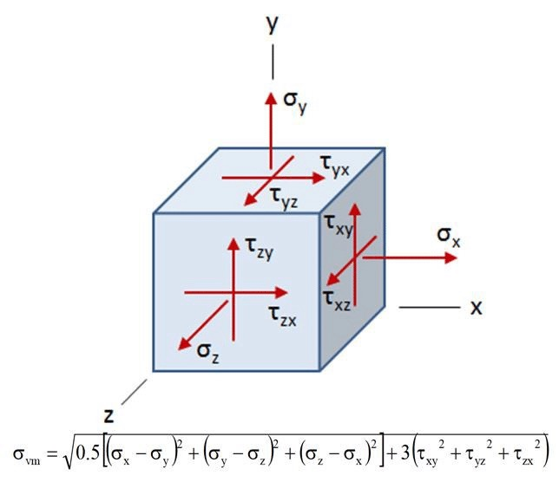
Structure Survival
2.2.1 Structure | The microscope shall survive random simulated vibration with frequency and power spectral densities(PSD).
Objective
Use Solid Works to simulate vibrations
Plan
Simulate vibration of payload
Measurements
Measure stress and displacement of payload components
Pass Criteria
Modelled optical chain is still aligned
Payload doesn’t deform
Frequency [Hz] | PSD [g²/Hz]
20 | 0.013
50 | 0.03
800 | 0.03
2000 | 0.013
Electrical
Thermal
Structural
Optical

Slide 42
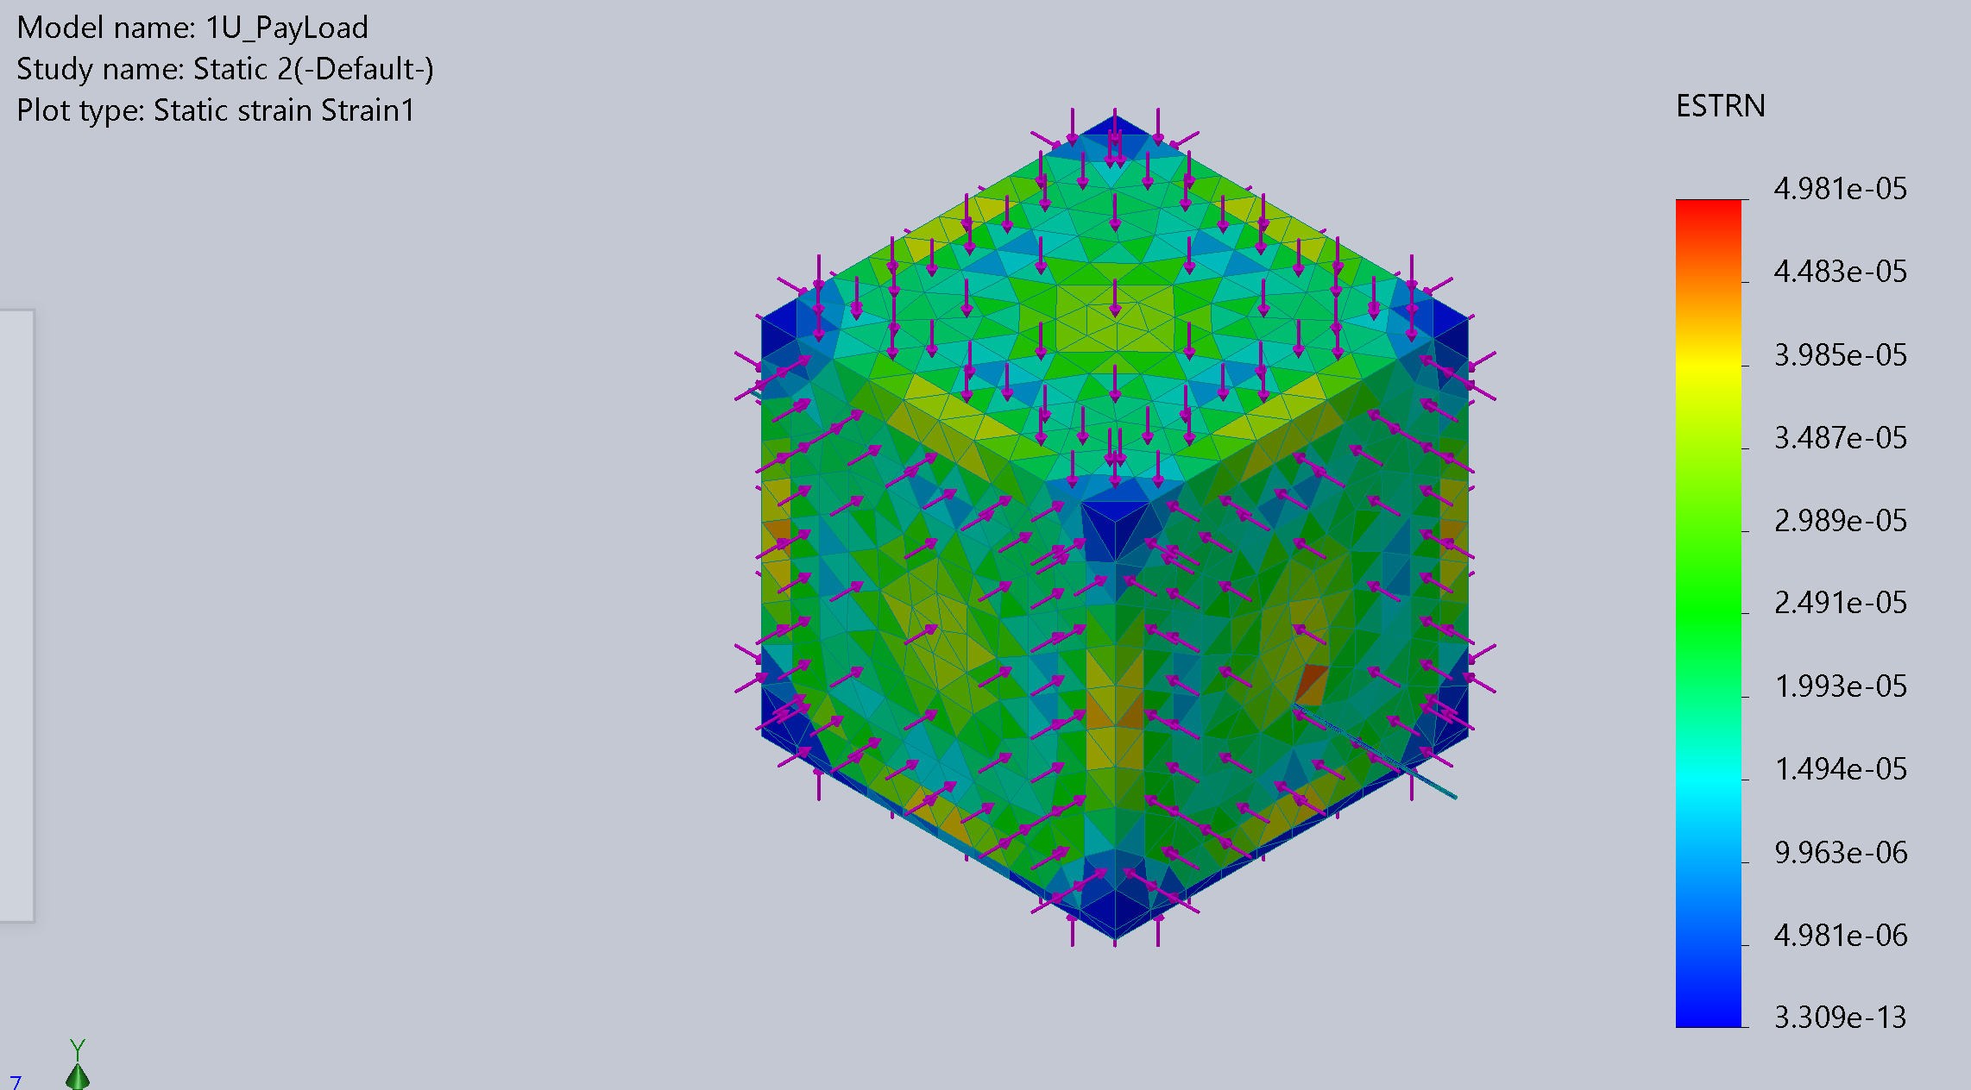
Structure Survival
2.2.2 Structure | The microscope shall survive simulated continuous g-forces of up to 8g on any axis.
Objective
Use Solid Works and Fusion 360 to simulate continuous g forces
Plan
Simulate g force on payload
Measurements
Measure deformation and movement of components
Pass Criteria
Modelled optical chain is still aligned
Payload doesn’t deform
Electrical
Thermal
Structural
Optical

Slide 43
Work Requiring Laser Use
Activity | Description | Purpose
Final optical chain placement | Initial alignment of optical chain | Prerequisite to all optical testing Placement of components(lenses, sensor, fiber cable)
Power at sensor test | Amount of light hitting the sensor with no particles | Baseline of the power at sensor Comparison for images
Baseline optical test | Full optical chain with standard sized microspheres | Resolution and reconstruction
Pre/Post optical test | Test optical chain functionality prior to and post all other testing | Effect of testing on optical chain Compare to baseline
Software integration | Intermittent software functionality testing | Software development
System functionality test | Test of all microscope features commanded by software | Software functionality test
Electrical
Thermal
Structural
Optical

Slide 44
Project Planning
Project Purpose
Design Solution
CPEs and Risk
Design Requirements
Verification and Validation
Project Planning

Slide 45
Budget
System | Optics | Electrical | Mechanical | Reserves
Sub-Total | $571.35 | $2,290.48 | $656.20 | $252.11
Margin | $85.92 | $107.35 | $36.59 | –
Usage | 16.43% | 59.95% | 17.32% | 6.30%
Budget
Work Plan
Gantt chart

Slide 46
Budget
Work Plan
Gantt chart

Slide 47
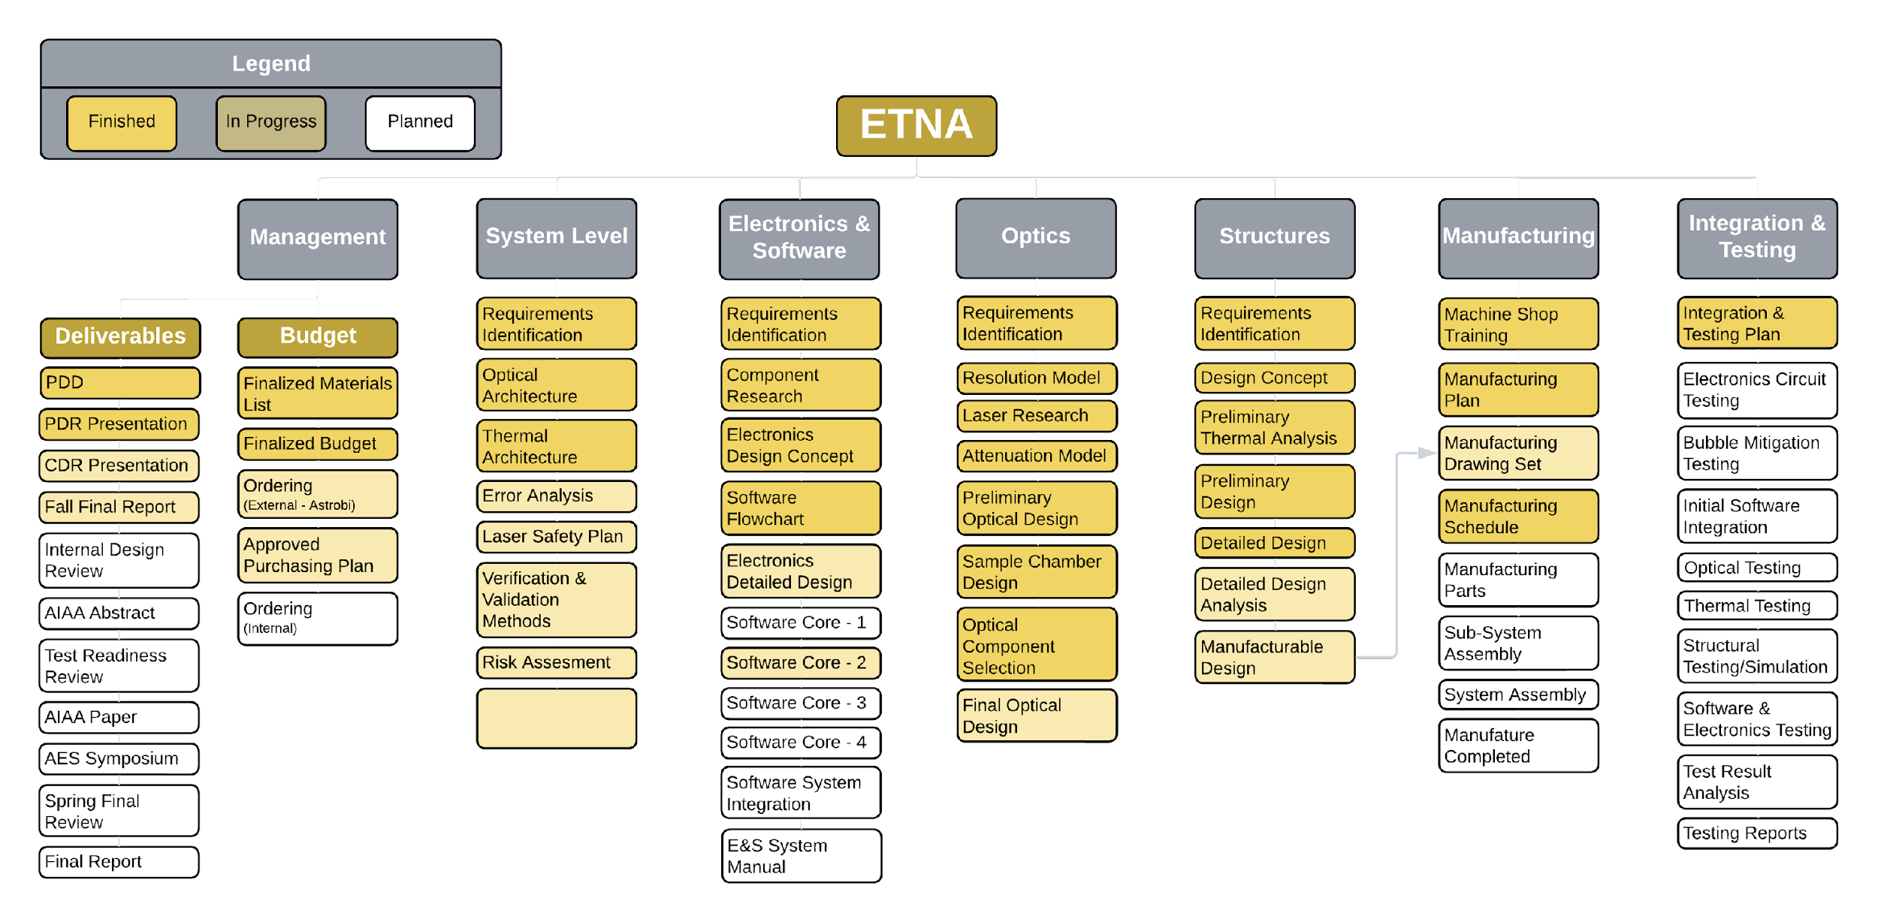
Budget
Work Plan
Gantt chart

Slide 48
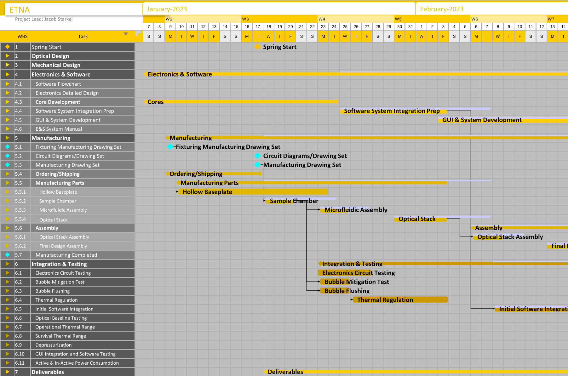
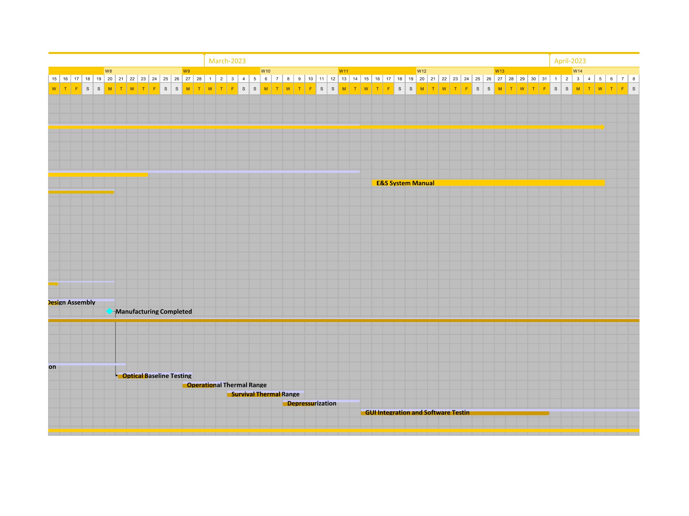
March 2nd
Critical Path
Budget
Work Plan
Gantt chart

Slide 49
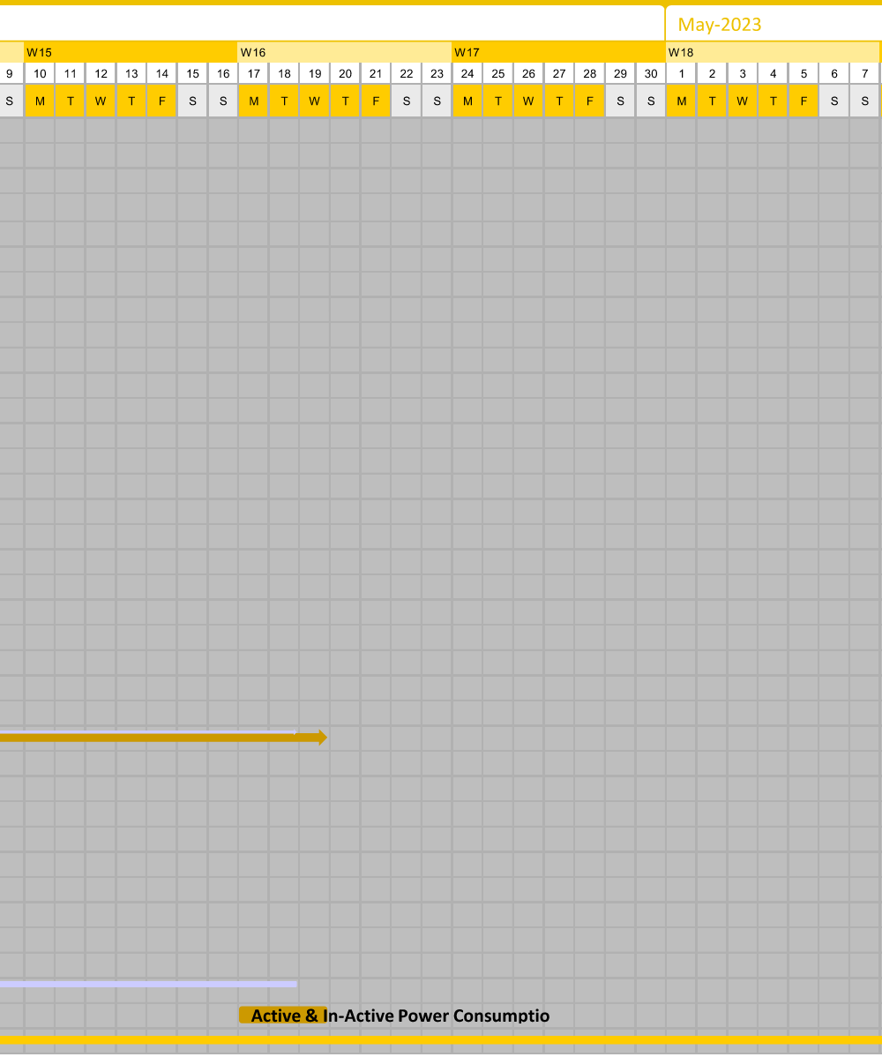
Electronics & Software Cont.
March 2nd
GUI & System Development Cont.
Semester End
Integration & Testing Cont.
Testing Complete
Operational Thermal Range
Critical Path
Budget
Work Plan
Gantt chart

Slide 50
Questions?

Slide 51
Acknowledgements
Dr. Shu-Wei Huang (Laser expert, Laser selection)
Grant Berland (PhD candidate optical instrument design, attenuation model verification)
Dr. Kevin Stenson (Light physics expert, attenuation model verification)
Knight Optical (Tech expert, Lens choice verification for purpose)
Giselle Koo (Electronics expert, sensor power requirement verification)

Slide 52
Acknowledgements(cont.)
Josh Mellin (Aerospace and research software engineer)
Alexandra Le Moine (Thermal analysis help)
KatieRae Williamson (Sample chamber and Prototyping)
Matt Rhode (Prototyping and Manufacturing assistance)
Thomas Schibli (Atomic and optical Physics Professor)
Trudy Schwartz (Temperature control electronics help)
Bobby Hodgkinson (Temperature control electronics help)
Margaret Ashton, RRPT (Radiation Safety Officer)
Kenneth Barat (Laser Safety Consultant)

Slide 53
References
Optics:
Optical Model Equation Source
Europa In Depth - NASA
Seawater Optical Properties - Britannica
Mech:
Stress Strain Calculations
Laser Safety:
CU Laser Safety
Laser Institute Guidlines

Slide 54
Backup Slides

Slide 55
Order of Backup Slides
Laser and Laser Safety (Slides 56-66)
Components (Slides 67-71)
Testing (Slides 72-82)
Risk Matrices (Slides 83-87)
Budget Breakdown (Slides 88-92)
CAD Breakdown (Slides 93-97)
Optics Further Details (Slides 98-110)
Mechanical Further Details (Slides 111-112)
Electronics Further Details (Slides 113-115)
Software Further Details (Slides 116-120)
Requirements (Slides 126-149)

Slide 56
Laser & Laser Safety

Slide 57
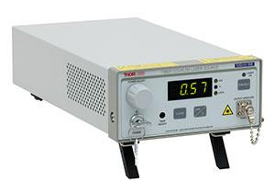
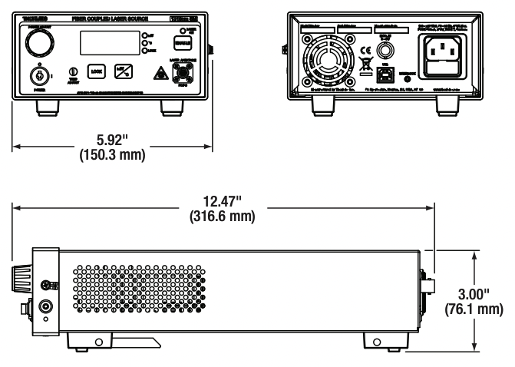
Laser
Power:
  Min: 13 mW
  Typical: 15 mW
Wavelength: 520 nm ± 10 nm
Temperature ranges:
  Operation: 15C – 35C
  Storage: 0C – 50C
Class: 3B
Cost: $ 3,757.10

Slide 58
Laser Safety: Classifications
Class 3b lasers:
Output between 5-500 mW for continuous wave
< 0.125 J within 0.25 second for a pulsed laser.
Serious eye hazard from viewing the direct beam or specular reflections
May be hazardous under direct and specular reflection viewing conditions, but is normally not a fire hazard, diffuse reflection hazard, nor a laser generated air contaminant (LGAC) production hazard.

Slide 59
Laser Safety: Control Measures
Engineering
Must | Should
Protective housing | Key control
Interlocks on removable housing | Area warning device
Collecting optics | Laser radiation emission warning
Nominal Hazard Zone(NHZ) analysis: fully open, limited open, or enclosed beam path | Protective barriers and curtains
Administrative and Procedural
Must | Should
Education and training | Standard Operating Procedures(SOPs)
Authorized personnel | Output emission limitations(LSO determinations)
Indoor laser-controlled area | Service personnel(LSO determination
Alignment procedures
Special Considerations and Warning
Must | Should
Laser optical fiber transmission systems | Laser robotic automated installations (NHZ analysis)
Laser controlled area warning signs
Personal Protective Equipment(PPE)
Must | Should
Laser eye protection | Skin protection
 | Protective clothing

Slide 60
Laser Controlled Area (CU)
Restricted access to the area
Control of the beam to prevent the beam and reflections from extending beyond the area
Removal of reflective materials in and near the beam path
Appropriate laser eye protection if there is a possibility of exposure to laser radiation above the MPE
A warning sign posted outside the area
Only personnel trained in the operation of the laser and laser safety should be permitted to operate the laser or laser system
An individual knowledgeable in laser safety needs to directly supervise the laser-controlled area
The area should be posted with appropriate warning signs
Access should be restricted to the laser controlled area.
The beam should be controlled to prevent any misdirected beams or reflections
Eye protection should be provided for all personnel working in the laser-controlled area
Cover all windows and other openings to prevent laser radiation from extending beyond the laser-controlled area

Slide 61
Laser Safety: Protective Housing(CU)
Protective housings shall limit the accessible laser radiation below the MPE
Protective housings shall prevent access to the laser during normal operations
Protective housings shall be equipped with safety interlocks wherever the protective housing can be opened, removed or displaced
The safety interlocks shall be designed to prevent access to laser radiation above the MPE. (For example, the interlock may be electrically or mechanically interfaced to a shutter that interrupts the beam when the protective housing is opened or removed.)
The safety interlock shall be fail-safe. The use of redundant electrical series connected interlocks would fulfill this requirement.
Adjustments or procedures during service shall not cause the interlocks to be inoperative when the laser is placed back in operation.
The protective housing shall be labeled in accordance with ANSI Z136.1-2000
The embedded laser shall be labeled in accordance with ANSI Z136.1-2000

Slide 62
Laser Safety: Bio-Effects
Eye
  Retinal injury
  Thermal, acoustic, or photochemical
Skin
  Photosensitive reactions
  Skin burning
Baseline eye examinations
  Ocular history
  Visual acuity
  Amsler grid test
  Color vision

Slide 63
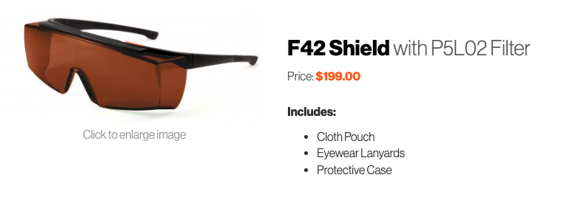
Laser Safety: Eyewear
Need at least 2 sets of glasses because we will NEVER have only one person testing
  Probably need 3 so its 2 team members and the PI
Laser Vision and Laser Institute are recommended vendors from CU
Min Optical Density based on power and wavelength is 4.2
P5L02, P5E01
  OD 6+ @ 315-532 nm
Various models of the goggles, with the same filter

Slide 64
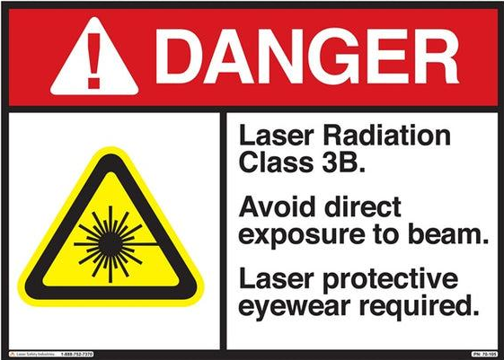
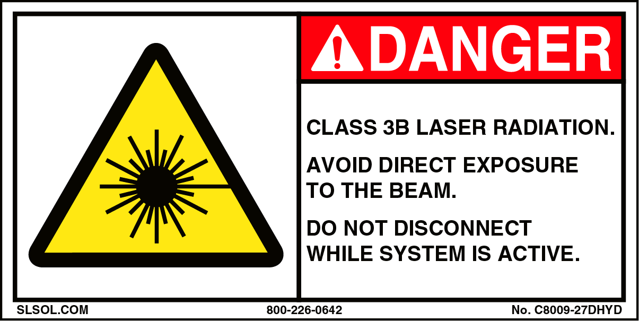
Laser Safety:
Warning Signs
Danger – Laser Radiation
Include: power, wavelength, class, protective actions, and PPE required
Signs on doors and on protective laser housing and storage

Slide 65
Laser Safety
Beam Control
Ensure the beam height is not at the normal eye position of a person in a standing or seated position
Position the laser so that the beam is not directed toward doorways or aisles
Securely mount the laser system to maintain the beam in a fixed position during operation and limit beam movements during adjustments.
Ensure beam path is well defined and controlled.
Terminate the beam at the end of its useful path
Confine beams and reflections to the optical table. The addition of beam-stopping panels to the sides of the optical table is recommended
If the beam path extends beyond the optical table, a physical barrier needs to be used to prevent accidental exposure
Where feasible, have only diffusely reflecting materials in or near the beam path
Absorb unwanted reflections. Scatter should not be permitted.
Standard Operating Procedures(SOPs)
Data and information about the specific laser in use
Contact information for Principal Investigator, Laser Safety Officer, and others
Control measures for the unit
Personal protective equipment required or recommended
Start up and shut down procedures
Experimental procedures
Emergency procedures
Non-beam hazards present in the laboratory

Slide 66
Laser Safety: CU Personnel Responsibilities
PI responsibility
Supervising laser use in the laboratory.
Enforcing the safety recommendations and requirements
Enforcing Standard Operating Procedures (SOPs) for the laboratory.
Providing laser operators with hands-on training in operating, administrative, and alignment procedures.
Ensuring that all lasers in the laboratory are properly classified and labeled.
Ensuring that the proper signs are posted at the entrance(s) to the laboratory.
Registering all lasers with the CU Radiation Safety Office.
Completing approved laser safety training.
Notifying CU Radiation Safety immediately in the event of an exposure to a Class 3b or Class 4 laser beam or reflection.
Providing adequate medical surveillance for laser users under their purview.
Laser Operator Responsibility
Following laboratory Standard Operating Procedures (SOPs).
Informing the Principal Investigator of any departure from the SOPs.
Notifying the Principal Investigator in the event of an exposure incident.
Attending laser safety training.
Laser Safety Officer(LSO) Responsibilities
Conducting periodic safety audits of laser laboratories.
Helping in evaluating and controlling hazards.
Updating the Laser Safety Manual.
Maintaining records of registered lasers and laser safety training by campus personnel.
Conducting laser safety training for all personnel working with lasers.
Participating in accident investigations involving lasers.

Slide 67
Components

Slide 68
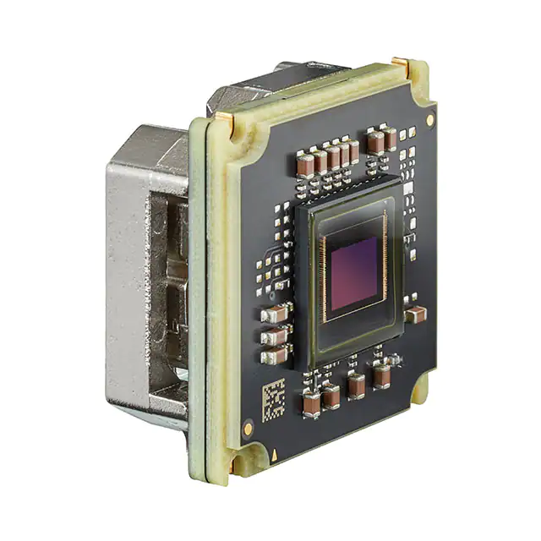
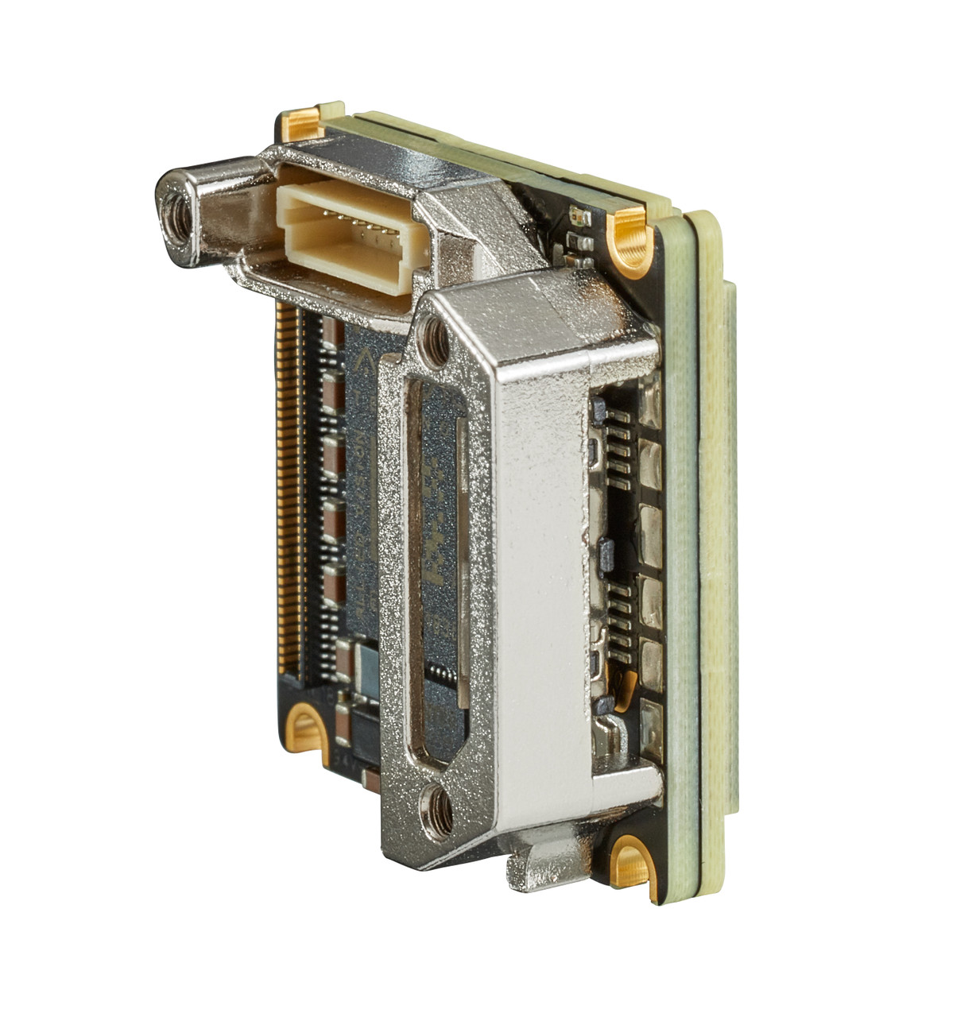
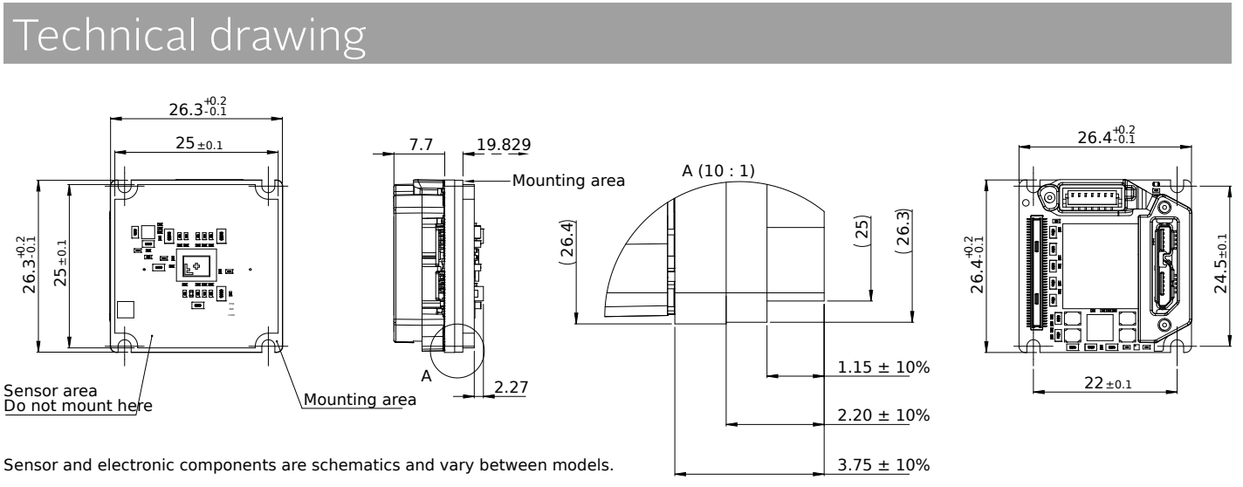
Optical Sensor
* Units are in mm
Alvium 1800 U-1236m
  Resolution: 4112(H) x 3008 (V)
  Frame Rate: 23 [FPS]
  Power Consumption: 3.1[W]
  Pixel Size: 3.45 [um]
Price: $1,725
Monochromatic
Global Shutter

Slide 69
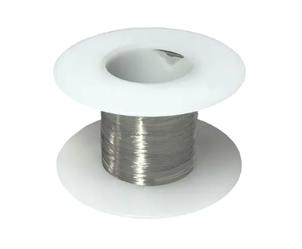
Heaters
Tube Heater | Slide Heater
0.425W | 0.05W
58.2 Ohms | 500 Ohms
5V | 5V
Resistance Wire:
111 Ohms/ft
44 Guage
Stainless Steel
To find Resistance of heater:
R = V²/P

Slide 70
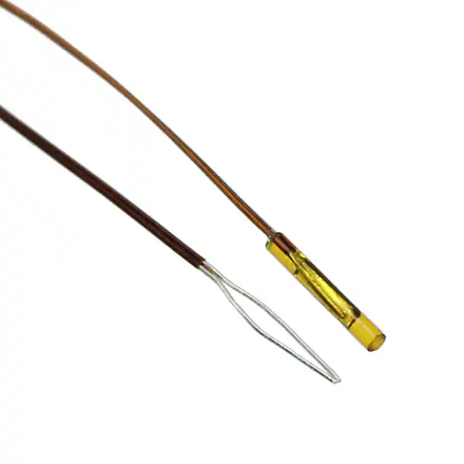

Temperature sensors
GA10K3MCD1
Negative Temperature Coefficient (NTC) Thermal Resistor (Thermistor)
$ 31.99
Resistive tolerance: ± 0.2 °C
Operating Temperature: -40 °C – 125 °C

Slide 71



3.3/(2^10) = 0.0032 Volts per bin
3.3: Voltage
10: Number of bits of the ADC

Slide 72
Testing

Slide 73
Etna Organizational Chart – Spring 2023
Financial Officer &
Prototyping Lead
- Srija Boddeda
Project Manager
- Jacob Starkel
Systems Engineer
- Anna Jonsen
Testing Lead
- Ania Miecznik
Safety Lead
- Devin Davis
Budget
Work Plan
Gantt chart

Slide 74
Major Test Plan
Test | Associated CPE(s) | Scheduling
 |  | Location(s) | Anticipated Date | Hazards
Software Functionality | CPE 5, 6, 7 | TBD | March - April | Laser Safety
Baseline Resolution | CPE 3, 4, 5 | TBD | February | Laser Safety
Thermal Survival | CPE 2 | BioServe | March | High Temperatures
Structural | CPE 1 | Simulation | February | N/A
Thermal Control | CPE 2, 8 | TBD | January - February | High Temperature Components
Bubble Mitigation & Flushing | CPE 3 | TBD | January - February | N/A
Power Consumption | CPE 8 | TBD | April | Laser Safety

Slide 75
Bubble Mitigation and Flushing Testing
3.6.1-2 Microfluids | The microscope should prevent bubbles from entering the sample chamber. The microscope shall provide a method for mitigating bubbles in the imaging chamber.
Objective
Ensuring that bubbles are removed from sample fluid tubing
Plan
Use a Syringe filled with pond water to simulate sample fluid and pass the sample fluid through the bubble trap
Measurements
Look through sample with a microscope for bubbles in sample after bubble trap
Pass Criteria
Ensure that there are no bubbles visually

Slide 76


Structural – Random Vibration Testing X-Axis
Stress
Displacement

Slide 77


Structural – Random Vibration Testing Y-Axis
Stress
Displacement

Slide 78


Structural – Random Vibration Testing Z-Axis
Stress
Displacement

Slide 79

Structural – Static G-Force Loading (8Gs all axes)

Slide 80

Structural – Static G-Force Loading
(8Gs all axes)

Slide 81
Structural – Static G-Force Loading
(8Gs all axes)

Slide 82
Further Structural Testing
Random vibe and g force for all components within the payload
Movement and deformation of the optical components
  Make sure that they are within the sensitivity of the optical resolution
All simulation with Solid Works and Fusion360

Slide 83
Risk Matrices

Slide 84
ROC Matrix: Optics
Likelihood | High 5 | 1 | 2
 | 4 |  |  |  | 4 | 6
 | 3 |  |  | 3 | 5
 | 2 | 1 | 2 |  | 4 | 6
 | Low 1 | 3 | 5
 |  | Low 1 | 2 | 3 | 4 | High 5
 |  | Consequence
# | Risk | Mitigation
1 | Non-optimal optical spacing | Manufacturing precision
2 | Non-optimal optical alignment | Manufacturing precision
3 | FOD in optical path | Clean workspace during testing Clean before/after tests w/ pressurized air
4 | FOD between laser and fiber cable | Protection over connectors while not in use(on box and laser)
5 | Variation in wavelength | Temperature regulation
6 | Damaging or losing optical component | Second set of eyes while any components are being handled/tested

Slide 85
ROC Matrix: Mechanical
Likelihood | High 5
 | 4 | 1
 | 3 |  | 2 |  |  | 3
 | 2 | 1 |  |  |  | 4
 | Low 1 | 2 |  | 3 |  | 4
 |  | Low 1 | 2 | 3 | 4 | High 5
 |  | Consequence
# | Risk | Mitigation
1 | Bubble in fluid | Bubble trap
2 | Inability to completely remove sample | Flushing Loose some sample
3 | Bad connection to tubing | Sealant + screw connectors Move electrical
4 | Heater failure | Don’t max out heating Monitor power

Slide 86
ROC Matrix: Software
Likelihood | High 5 | 1
 | 4 | 2 | 3
 | 3 |  | 4 |  | 4
 | 2 | 1, 2
 | Low 1 |  | 3
 |  | Low 1 | 2 | 3 | 4 | High 5
 |  | Consequence
# | Risk | Mitigation
1 | Downlink limitation | Image compression optimization Compromise storage to downlink
2 | False positive detection | Detection algorithm optimization Compromise ”missed positive live”
3 | Storage limitation | Overestimate need w/ processor choice
4 | Missed positive detection | Detection rank padding Compromise ”false positive detection”

Slide 87
ROC Matrix: Electrical
Likelihood | High 5
 | 4 |  |  |  |  | 1
 | 3 |  |  | 2
 | 2 | 2 |  | 3 | 5 | 6
 | Low 1 | 4 | 5 | 4 3,6 |  | 1
 |  | Low 1 | 2 | 3 | 4 | High 5
 |  | Consequence
# | Risk | Mitigation
1 | Component lead time | Order early Choose components w/ smaller lead times
2 | Temp sensor reads incorrect value | Accurate temp sensors Calibration on sensors Multiple sensors for redundancy
3 | Components consume more than 10W active | Split component power/control between processor and payload
4 | Components consume more than .5W inactive | Processor with a “low power mode”
5 | Connection between components failure | Locking components(no “fit to connect” )
6 | Heating circuit takes too long to respond | Buffer trigger temperature of the heating

Slide 88
Budget Breakdown

Slide 89
Optics Budget
Component | Qty | Qty Margin | Cost/Item | Cost Margin | Total Cost | Total Margin
Laser | 1 | 0 | $ – | $ – | $ – | $ –
GRIN Lens | 1 | 1 | $ 25.92 | $ 20.00 | $ 25.92 | $ 45.92
GRIN Lens Holder | 1 | 0 | $ 20.00 | $ 5.00 | $ 20.00 | $ 5.00
Fiber Optic Wire | 1 |  | $ 50.00 | $ 10.00 | $ 50.00 | $ 10.00
Collimating lens | 1 |  | $ 37.57 | $ 10.00 | $ 37.57 | $ 10.00
Sample Holder | 1 |  | $ 50.00 | $ – | $ 50.00 | $ –
Laser Safety Glasses | 1 |  | $ 200.00 | $ – | $ 200.00 | $ –
Sample Chamber Slide | 1 | 0 | $ 11.86 | $ 10.00 | $ 11.86 | $ 10.00
Collimating Lens Holder | 1 | 0 | $ 26.00 | $ 5.00 | $ 26.00 | $ 5.00
Image Sensor |  |  |  |  | $ – | $ –
Laser Safety Training | 1 | 0 | $ 150 | $ – | $ 150 | $ –

Slide 90
Electronics Budget
Component | Qty | Qty Margin | Cost/Item | Cost Margin | Total Cost | Total Margin
Sensor | 1 | 0 | $ 1,725.00 | $ 0 | $ 1,725.00 | $ 1,725.00
Sensor Cable | 1 | 0 | $ 54.54 | $ 0 | $ 54.54 | $ 54.54
Main Thermistor | 4 | 2 | $ 31.99 | $63.98 | $ 127.96 | $ 191.94
Sample Thermistor | 1 | 1 | $ 33.00 | $33.00 | $ 33.00 | $ 66.00
MOSFET | 3 | 1 | $ 0.53 | $ 0.53 | $ 1.59 | $ 2.12
Resistors 33k | 4 | 2 | $ 0.71 | $ 1.42 | $ 2.84 | $ 4.26
Gate Resistors | 3 | 2 | $ 0.71 | $ 1.42 | $ 2.13 | $ 3.55
Resistor for Sample thermistor | 1 | 2 | $ 0.71 | $ 1.42 | $ 0.71 | $ 2.13
Heater Wire | 1 | 0 | $ 13.51 | $ 0 | $ 13.51 | $ 13.51
Circuit Wire | 1 | 00 | $ 10.00 | $ 0 | $ 10.00 | $ 10.00
5V Converter | 1 | 0 | $ 22.00 | $ 0 | $ 22.00 | $22.00
Protoboard | 1 | 0 | $ 3.00 | $ 0 | $ 3.00 | $ 3.00
Portenta X8 Arduino Processor + Breakout Board | 1 | 0 | $ 294.20 | $ 0 | $ 294.20 | $ 294.20

Slide 91
Mechanical Budget
 | Component | Qty | Qty Margin | Cost/Item | Cost Margin | Total Cost | Total Margin
Microfluidics | CapTite One-Piece Fitting (Ferrule) | 2 |  | $ 12.00 |  | $ 24.00 | $ –
 | Syringe | 1 | 1 | $ 5.00 | $ 5.00 | $ 5.00 | $ 10.00
 | CapTite Luer Lock Adapter Assembly | 2 |  | $ 47.00 |  | $ 94.00 | $ –
 | 360 um Tubing | 1 | 1 | $ 15.00 |  | $ 15.00 | $ 15.00
 | Sleeves for tubing -> bubble trap | 1 |  | $ 30.00 |  | $ 30.00 | $ –
 | Bubble Trap | 1 |  | $ 160.00 |  | $ 160.00 | $ –
 | Clear Resin | 1 |  | $ 150.00 |  | $ 150.00 | $ –
Thermal | Aluminium Alloy 6061-T6 Square Bar for Thermal Regulator Blocks (1.5x1.5x6in) | 1 |  | $ 15.75 |  | $ 15.75 | $ –
 | PVC Tubing | 1 |  | $ 12.59 |  | $ 12.59 | $ –
 | Thermal Grease | 3 |  | $ 5.53 |  | $ 16.59 | $ –
Structural | Aluminum Alloy 6061-T6 Sheet (0.1" cut to size) (baseplate) | 1 | 1 | $ 11.59 |  | $ 11.59 | $ 11.59
 | Aluminum Alloy 6061-T6 Sheet (0.063" cut to size) (enclosure) | 1 |  | $ 63.32 |  | $ 63.32 | $ –
 | Aluminum Pipes for Mounting (5/64" diameter x 1ft) | 3 |  | $ 2.22 |  | $ 6.66 | $ –
 | Aluminum Alloy 6061-T6511 Square Bar (Back plate for sensor and Lens Casing- 1.375x1.375x12in) | 1 |  | $ 24.68 |  | $ 24.68 | $ –
 | Aluminum Alloy 6061-T6511 Square Bar (Blocks for Mounting 5/8x5/8x6in) | 1 |  | $ 5.05 |  | $ 5.05 | $ –
 | Standoffs | 1 |  | $ 12.99 |  | $ 12.99 | $ –
 | L-brackets | 1 |  | $ 8.98 |  | $ 8.98 | $ –

Slide 92
CAD Breakdown

Slide 93

Optical Chain

Slide 94

Grin Lens with Casing

Slide 95

Sample Chamber

Slide 96

Sensor

Slide 97

Thermal Regulator

Slide 98
Optics Further Detail

Slide 99



Collimating Lens
Edmund Optics 6mm Dia. x 9mm FL, VIS 0° Coated, Double-Convex Lens - $37.75

Slide 100



GRIN Lens
Knight Optical Rod Lens 2mmdia x 16mm x 1.6mm F.L.
- $22.55

Slide 101


Sample Chamber Slides
UQG Optics UV Fused Silica Plates PFS-551 Spectrosil 2000
- $12.09

Slide 102






Required Power Calculation

Slide 103

Optical Model Code

Slide 104
Resolution Model Drivers
Optical:
Attenuation model for power requirements,
Resolution Requirements,
Choice of lenses
Outputs:
  System sizes:
    Total system length (f) * *
    Distance for image volume to sensor (s_t) * *
    Numerical aperture (NA)
    Number of z slices
    Depth and height of sample chamber * *
  Requirements:
    Best possible resolution
    Factor of Safety on Resolution * *
Software:
Z slices for timing and computational requirements
Mechanical:
Sizing constraints and modeling
Electrical
Reaffirming sensor choice
Software Algorithms
Optical Architecture
Thermal System

Slide 105

findOptimalf Function

Slide 106

findConicalCylinder Function

Slide 107


Conical Cylinder Math

Slide 108

Attenuation Model Code

Slide 109

Power Values

Slide 110
Sensitivity
Sensitivity | Value | How far we can be off
Placement of sample chamber vs resolution | 0.25 um/mm | 0.8 mm
Placement of Sensor vs resolution | 0.2 um/mm | 1 mm
Power attenuation factor vs sample chamber depth | 1.04 e –4 /mm | ~

Slide 111
Mechanical Further Detail

Slide 112


Microfluidics

Slide 113
Electronics Further Detail

Slide 114
Analog Pins
Ground
R_s
Fixed Resistor
+
GPIO Pins
+ -
-
DC
Power Supply
3.3V
R_NTC
Thermal Resistor
Power Terminals
G
+ -
USB Port
D
Image
Sensor
G
Microcontroller
+ -
S
D
G
R_t
Fixed Resistor
+ -
D
Resistive
Heater
Mosfet
DC
Power Supply
Ground
Notes:
Check 3.3V, check pwm vs gpio

Slide 115

Potential Thermistors

Slide 116
Software Further Detail

Slide 117
Test Run Scaling
CPU used for testing: 4.3 GHz (~4.8 GFLOPS/core)
0.68 sec/z slice theoretically
7.8 sec/z slice experimentally
Error factor: ~12
Determining computation time is far more complex than simple FLOP scaling, need large factor of safety
  (Other operations, memory management, etc)
Time = FLOPs ÷ (F×G)
  F: FLOPs per Clock Cycle
  G: Clock Speed
CAD Model
Parameters
Functional Block Diagram
Software

Slide 118
Scenario List
Startup >
  Boot Sequence
Shutdown >
  Sleep command > Wait for all processes to stop > Enter low-power mode
  Emergency stop > stop all processes > clear most recent folders > Enter low-power mode
    2.3.4
    3.5.2
Imaging request >
  Compile Instructions > Image > Reconstruct > Ready next > Detect > wait
    2.5.1-2
    3.1.1-6
    3.7.1-9
    3.8.1-7
    3.9.1-3
Data Request >
  Detection Data > Main accesses Archive > Send back > Line busy
  Specific Reconstruction > Grab images from archive > reconstruct > return
  All files from day(s) > select all files > grab folders form corresponding imaging period from archive
  Certain files from day(s) > select files > grab folders from corresponding folders for certain day in archive
    3.9-3.93

Slide 119

Detection Flowchart

Slide 120

Imaging Process Flowchart

Slide 121
Base Requirements

Slide 122
Mission
Objectives
Shall support the detection of microorganisms
Shall be able to image and process water sample from Enceladus plume
Shall be able to satisfy requests for data

Slide 123
Success Criteria
Shall have an imaging volume of 2 microliters
Shall detect objects moving independent of Brownian motion
Shall be able to process an infinite number of samples
Shall be able to store and send raw, reconstructed, and life detected sample images

Slide 124
Constraints
Shall be a lenesless digital inline holographic microscope(DIHM)
Shall not employ materials with outgassing properties

Slide 125
Deliverables
Operational holographic microscope
Associated electronics and cables
Software
Final Report

Slide 126
Level 1 Requirements

Slide 127
1.1:
Mission Design
1. Shall withstand simulated launch and operational conditions
2. Shall detect possible living objects in collected samples
3. Shall relay data to the spacecraft
4. Shall interface with the spacecraft system
5. Shall receive and expel liquid sample

Slide 128
1.2: Science
1. Shall provide 3D time history of objects of interest
2. Shall have adequate specifications for detecting life
3. Shall image an infinite amount of viable samples
4. Shall have adequate power for software and storage

Slide 129
1.3: Survival
Operational holographic microscope
Associated electronics and cables
Software

Slide 130
1.4: Payload
1. The payload shall be a lensless DIHM consisting of an optional collimating lens, a beam-spreading lens, an optional pinhole, a sample chamber, and an image sensor.
2. The microscope payload shall fit within a 1U
3. The microscope payload shall weight less than 2kg
4. The microscope payload should not employ any materials with outgassing properties that could contaminate any optics or instruments onboard the orbiter
5. Shall have adequate power for all components

Slide 131
Level 2 Requirements

Slide 132
2.1: Thermal
1. The microscope shall mate with a flat, temperature-controlled, aluminum baseplate, sized to accommodate 1U payloads.
2. Shall not heat the sample by more than +5 degrees C relative to the baseplate temperature, except when the sample heater is activated.
3. Shall provide a method to actively heat the sample by a configurable amount relative to the baseplate temperature, with 1 degree C resolution and 1 degree C accuracy.
4. Processor shall not impact microscope's thermal performance
5. The microscope shall survive temperatures from -50C to +100C.
6. The microscope shall operate over temperatures ranging from -15C to +40C

Slide 133
2.2: Structures
1. The microscope shall survive random simulated vibration up to the values in table T1. Log-linear interpolation is to be used to interpolate between values.
2. The microscope shall survive continuous g-forces of up to 8g on any axis.
3. The microscope shall survive depressurization at a rate of 0.5 psi/s.
4. The microscope shall survive an Overall Sound Pressure Level (OASPL) up to 135dB.

Slide 134
2.3: Power
1. The microscope core shall consume less than 10 watts active
2. The microscope core shall consume less than 0.5 watts inactive
3. The processor shall consume less than 10 watts active
4. The processor shall consume less than 0.5 watts inactive

Slide 135
2.4: Optics
1. The microscope shall support a configurable framerate in 1 FPS increments able to detect non-Brownian motion
2. The microscope shall output its digital data via the orbiter's science data downlink
3. The optical assembly shall be free of debris and contamination that could affect the light path.
4. Microscope sensor shall support a resolution able to detect particles in the sample volume

Slide 136
2.5: Software
1. Shall support configurable exposure times from 0.1ms to 1 second, with an accuracy of 0.01 ms, 2-sigma
2. Shall support configurable sensor gain over the range supported by the image sensor
3. The processor and reconstruction algorithm shall be fast enough to keep up with the rate of material collection
4. Shall provide a reconstruction resolution able to detect particles in the sample volume
5. The software shall provide a method to estimate the amount of compression achievable for a specified item of output data.
6. The software shall provide a method to compress data prior to output.

Slide 137
2.6: Sample Handling
1. The microscope shall have a liquid water interface for receiving and expelling samples
2. The sample volume shall be greater than 2μL (instantaneous imaging volume), while satisfying the resolution requirements.

Slide 138
Level 3 Requirements

Slide 139
3.1: Communication
1. The microscope shall be controllable via commands from ground control
2. The microscope shall be able to control all hardware
3. The CPU shall be able to reveice data from all hardware
4. The microscope shall output data at 1 kbps
5. The software shall acknowledge the receipt of commands and provide informative responses when relevant.
6. The software shall provide a method to output raw image frames from the image sensor.

Slide 140
3.2: Laser
1. Microscope laser shall provide a light intensity compatible with the optical sensor
2. Microscope laser shall have a consistent wavelength with minimal fluctuation
3. Microscope laser shall have a wavelength which is optically transparent to the sample volume material

Slide 141
3.3: Image Sensor
1. Optical sensor shall support a resolution of < 0.8 micrometer in the X and Y directions
2. Optical sensor shall support a resolution of < 2 micrometer int the Z direction

Slide 142
3.4: Microscope Lenses
1. The optical lens environment shall purge contaminants using dry nitrogen to maintain cleanliness of the lens during testing.
2. Microscope lenses shall control provided laser light with a combination of converging and diverging lenses to ensure the most light can contact the optical sensor

Slide 143
3.5 Processor
1. Processor should use < 5W active
2. Processor should use < .1W inactive

Slide 144
3.6: Microfluids
1. The microscope should prevent bubbles from entering the sample chamber.
2. The microscope shall provide a method for mitigating bubbles in the imaging chamber.

Slide 145
3.7: Reconstruction Algorithm
1. Reconstruction of the full 3D imaging volume from one frame or one difference stack shall take less than 12,000 seconds at the required reconstruction resolution.
2. The software shall provide a method to compute an average frame.
3. The software shall provide a method to reconstruct specified z-slices for a single frame, and provide the option to subtract out an average frame prior to reconstruction.
4. The software shall provide a method to reconstruct specified z-slices for the difference between two frames.

Slide 146
3.7: Reconstruction Algorithm(cont.)
5. The software shall provide a method to reconstruct specified z-slices for a difference stack.
6. The software shall provide a method to output average frames, averaged over a configurable subset of stored frames.
7. The software shall provide a method to output cleaned frames, which are computed as follows: clean_frame = raw_frame - avg_frame
8. The software shall provide a method to output the difference between two frames.
9. The software shall provide a method to output a difference stack, which is the sum over multiple frame differences.

Slide 147
3.8: Detection Algorithm
1. The software shall provide a method to detect features-of-interest in a single frame reconstruction.
2. The software shall provide a method to detect features-of-interest in a difference stack reconstruction.
3. The software shall provide a method to output detected regions from a reconstructed frame.

Slide 148
3.8: Detection Algorithm(cont.)
4. The software shall provide a method to output detected regions from a reconstructed difference frame.
5. The software shall provide a method to output detected regions from a reconstructed difference stack.
6. The software shall provide a method to characterize detected regions and output the characterization as a compact description.
7. The software shall provide a method to compute and output statistics over a subset of detection descriptors.

Slide 149
3.9: Storage
1. The software shall support saving processed data to a non-volatile bulk storage device, operating as a FIFO.
2. The software shall support saving all raw hologram data to the bulk storage device.
3. The software shall provide a method to retrieve and optionally process requested data from the bulk storage device.

