Slide 1
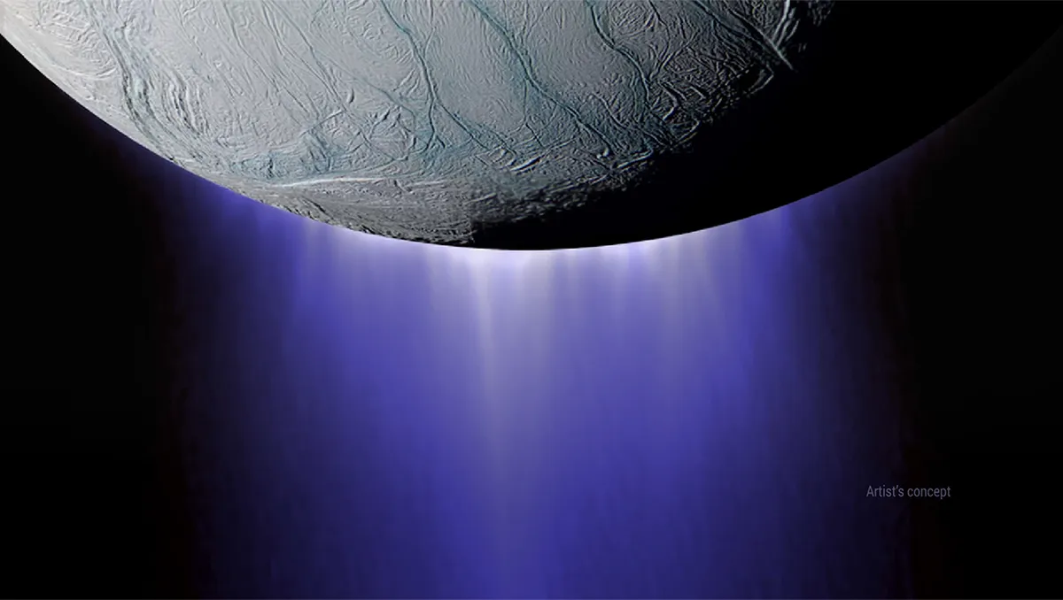
Micro-resolution Unidirectional Sensor for Ice Collisions - M.U.S.I.C.
Test Readiness Review

Slide 2
Project Overview
Image courtesy of NASA https://solarsystem.nasa.gov/resources/17737/enceladus-plume/
Notes:
• Brief top level overview of your project purpose and specific, quantitative objectives (levels of
success), including a brief overview of the project CONOPS and FBD.
• Brief review of the baseline design with respect to CDR. Describe major changes to the design.
• Review of the critical project elements, along with any updates on critical issues from CDR, FFR,
IDR, etc.
Grading Rubric:
Clear what the project is about and what it must accomplish to be successful. Describe all
major elements of the project and how the baseline design works. (9-10 pts)

Slide 3
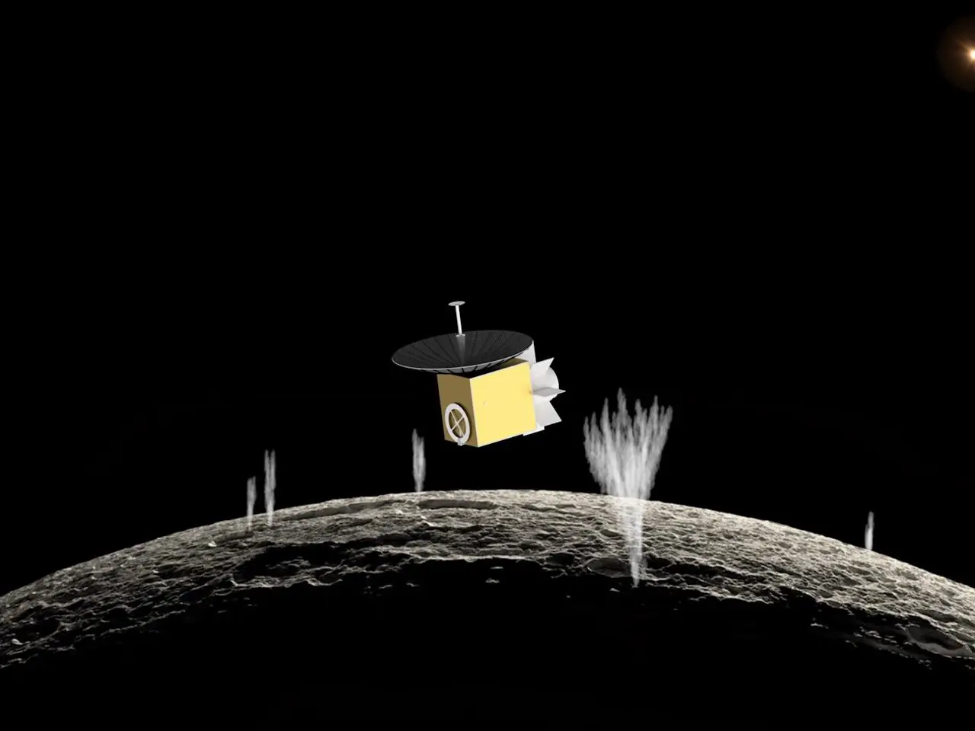
ASTROBi Mission Profile
ASTROBi wants to take samples of the plumes of Enceladus to be viewed with a microscope
Proper positioning within the plume is critical to obtain the correct sample
Particles of interest
Roughly spherical shape
Size Range: 0.5 μm to 4 μm
Mass Range: 6 x 10⁻¹⁷ kg to 3 x 10⁻¹⁴ kg

Slide 4
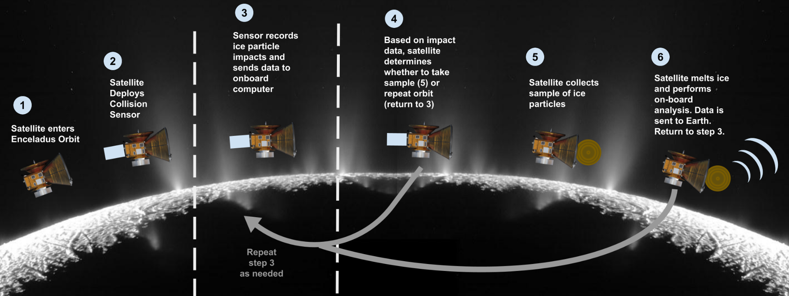
CONOPS - Mission

Slide 5
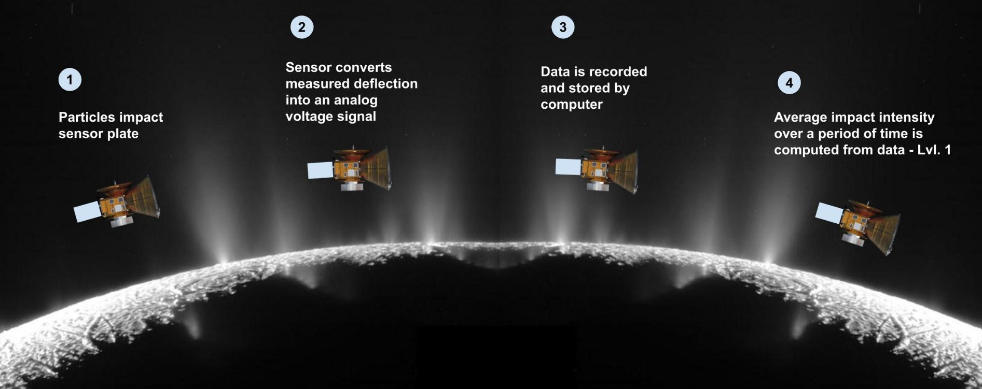
CONOPS - Specific Scope for Sensor

Slide 6
Objectives
Simulate expected deflection from particle impacts
Detect the presence of small particles
Process the data from the impacts for:
Plume density
Particle sizes
Particle velocities

Slide 7
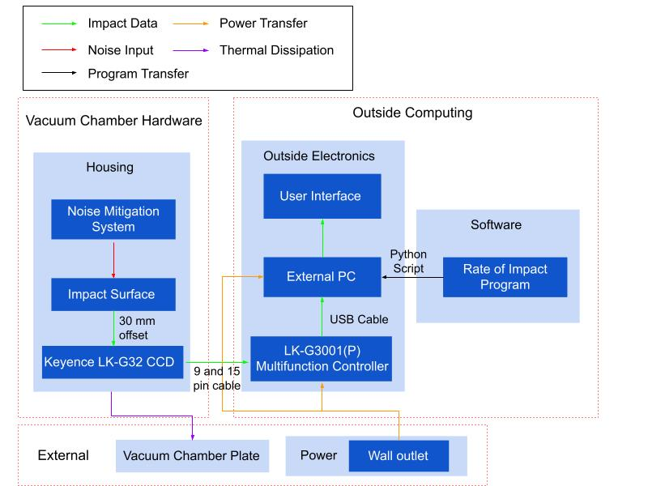
Functional Block Diagram
Notes:
Check with Trudy in regards to amount of detail

Slide 8
Critical Project Elements (CPEs)
Critical Project Element | Reasoning
Sensor | Necessary for data collection
Data Analysis | Noise reduction, impact data processing
Testing/Simulation Software | Assisting/predicting testing results
*No changes to these since CDR

Slide 9
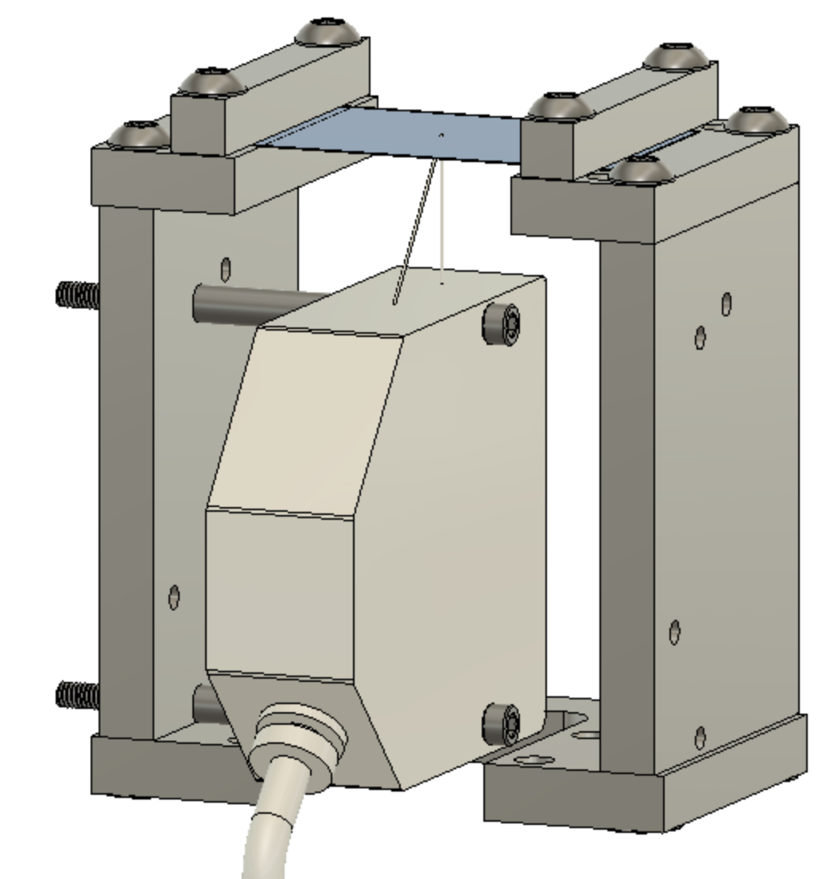
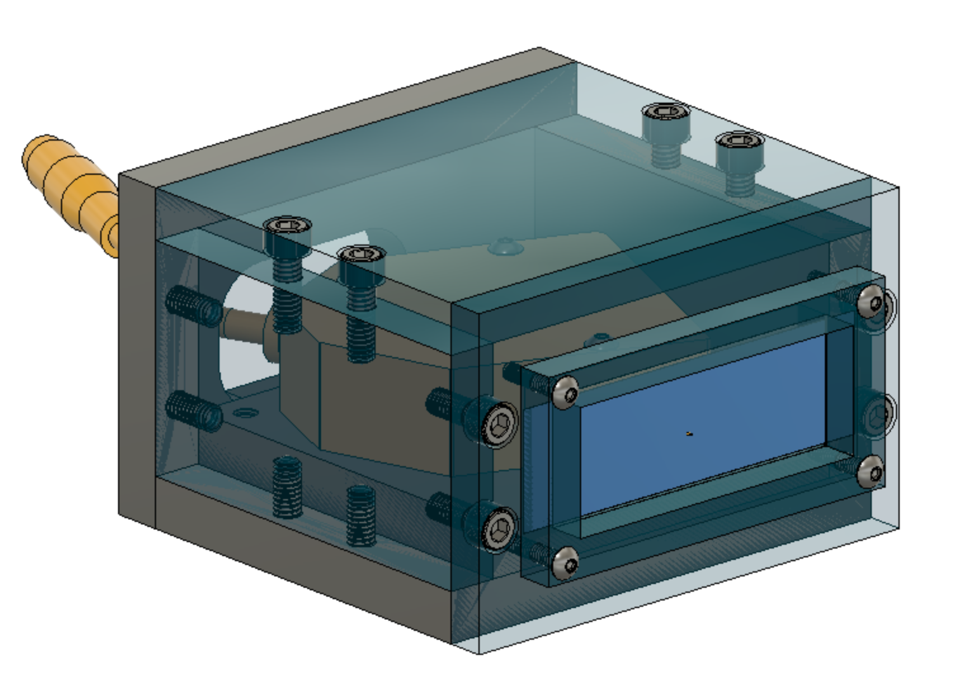
Updated Housing

Slide 10
Levels of Success
Level 1
Survive 100-1000 repeated particle impacts
Detect plate deflections of 3-30 µm in a laboratory setting
Survive vacuum conditions (25 - 10⁻⁹ Torr)
Quantify vacuum chamber noise
Level 2
Detect plate deflections of 3-30 µm in a vacuum chamber
Level 3
Automatically collect data and process in real time

Slide 11
Testing
Test | Requirements/Level of Success Fulfilled
Tabletop Testing | Level 1: Survive repeated impacts and detect plate deflections of 3-30 µm (F2, F4, F7,F8, F9, F11, F12)
Vacuum Chamber Testing | Level 1: Survive vacuum conditions and quantify noise (F1, F3, F6, F9, F10)
Full Functionality Testing | Level 2: Detect plate deflections of 3-30 µm in a vacuum condition (F1, F3, F7, F8, F9, F11, F12)

Slide 12
Schedule
Image courtesy of NASA https://solarsystem.nasa.gov/resources/17737/enceladus-plume/
Notes:
• Provide a chart of ALL tests that have or will be performed. Indicate which ones have been
completed.
• Review the whole project schedule in the form of the Gantt chart, showing overall progress toward
goals. In this case, the status should be described with an emphasis on testing. Highlight any major
changes in the project schedule since CDR, and indicate shifts in critical path or margins.
Grading Rubric:
A comprehensive project schedule was presented for the spring semester that describes all
major tasks especially with respect to Test Readiness, milestones and relates the critical path.
Tasks potentially needing to use margin were described. (17-20 pts)

Slide 13
Project Testing
Test | Completion Status
Preliminary Testing @ Keyence | Complete
Tabletop Testing | In Progress
Software Testing | In Progress
Housing Vibration Testing | Incomplete
Vacuum Chamber Test | Incomplete
Full Functionality Testing | Incomplete
Notes:
May add color coding legend which signifies associated risk, as with following slide as well

Slide 14
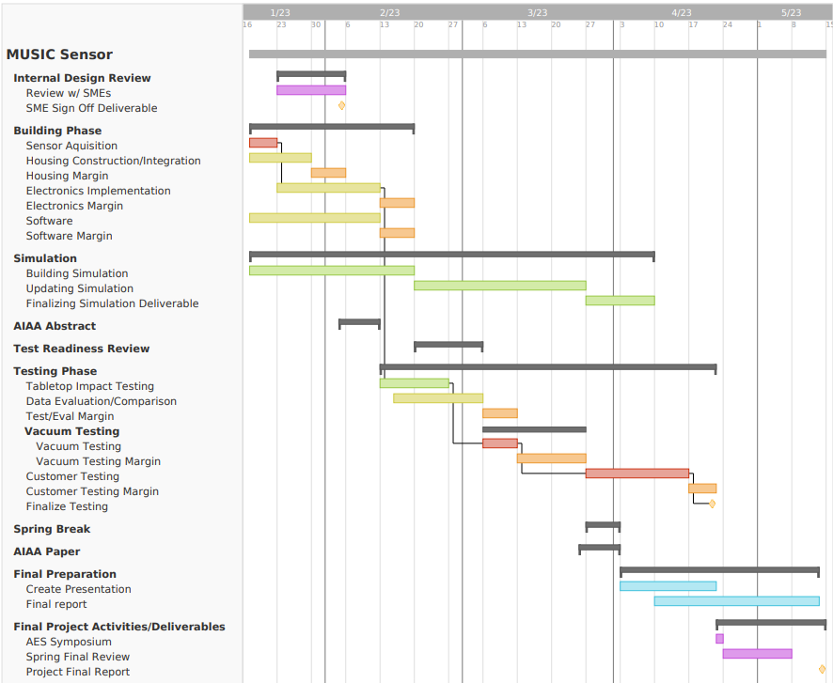
GANTT Chart
Legend
High Risk
Med Risk
Low Risk
Margin
Deliverable
Final Work
Critical Path
Notes:
Still to be updated overall, and to have red line representing critical path

Slide 15
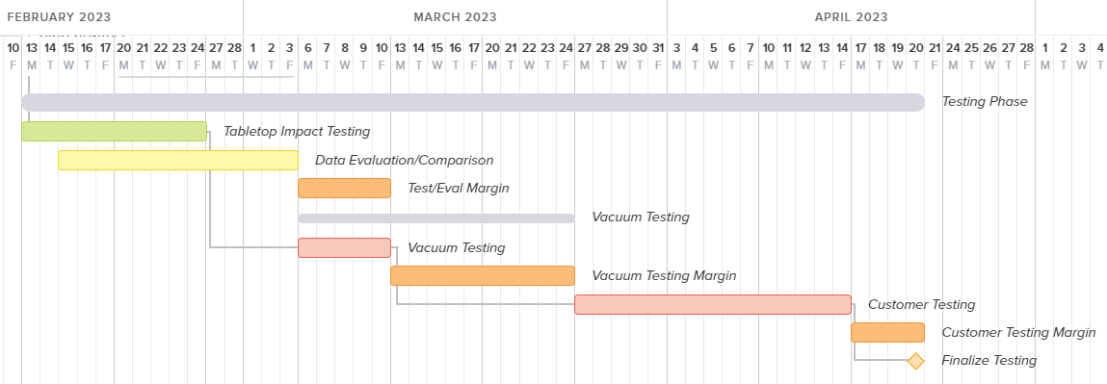
Gantt Chart (Testing Phase)
Actual Tabletop Testing start date: February 8th
Current date
Notes:
NOTE: Does not yet include sending to Cali for customer testing

Slide 16
Schedule Updates
*Margin
Objective | Planned Milestone | Actual Milestone/Current Plan
Tabletop Testing (Data Eval.) | March 3 (March 10*) | February 24 (March 3*)
Vibration Testing | Not Planned | Week of March 6 (March 13*)
Vacuum Survivability | March 10 (March 24*) | March 20 (March 24*)
Full Functionality Testing (RadMet) | Mar. 27 - Apr. 14 (April 20*) | Mar. 27 - Apr. 14 (April 20*)

Slide 17
Test Readiness
Image courtesy of NASA https://solarsystem.nasa.gov/resources/17737/enceladus-plume/
Notes:
For these two to three tests, cover:
• What is being tested and why: your rationale for performing the test in terms of requirements to be
verified or mission objectives to be validated.
• Highlight critical pre-requisite tests planned/completed that will or do demonstrate this test will be
successful. (For example, the components are operating within datasheet ranges, signals could be
sent and received, etc) This should not be a deep dive, but rather a quick summary that can be
completed in 1 to 2 minutes.
• Describe the scope of the testing tasks in the project specifically:
o the design of the test fixtures, selection and calibration of sensors, data acquisition plans
o test equipment and/or facilities are needed
o an overview of the test and safety procedures
• Describe how the test(s) will reduce risk to meeting requirements, expected results, and how models
will be validated. Include clear pass/fail criteria ALONG with expected performance measurements.
Grading Rubric:
(52-60 pts) Clearly presented two to three critical tests with necessary engineering detail to
convey:
- Tests will utilize correct hardware, software, data acquisition plans, and facilities
- Presented pre-requisite test plans/data which indicate this test can be successful
- Tests selected will either verify critical requirements or validate mission objectives.
Measurements of design performance can be successful, pass/fail criteria are directly
tied to requirements and/or mission objectives
- Tests reduce key risks to design operation
- At least one test will allow for validation of key models presented at CDR

Slide 18
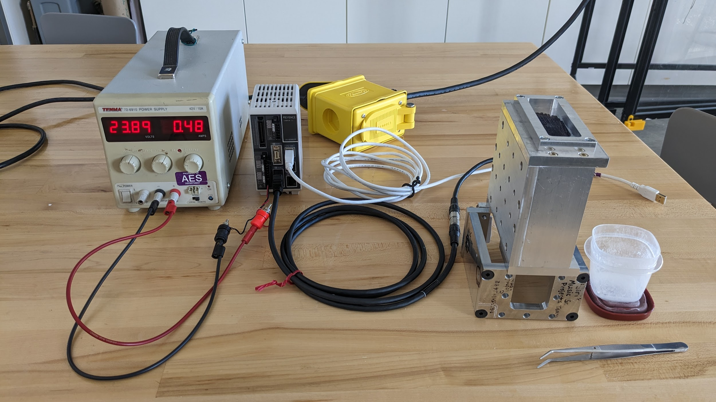
Major Tests
Tabletop Impact Testing
Impact Testing
Verify sensor capabilities and limits
Decreasing particle momentum to expected values
Various film materials
Software Testing
Verify impact calculating algorithm
CU AVS Vacuum Survivability Testing
Validate sensor and housing survivability:
Quantify vacuum chamber noise
Radmet Vacuum Testing with Particle Impacts
RadMet facility
Verify Full Functionality

Slide 19
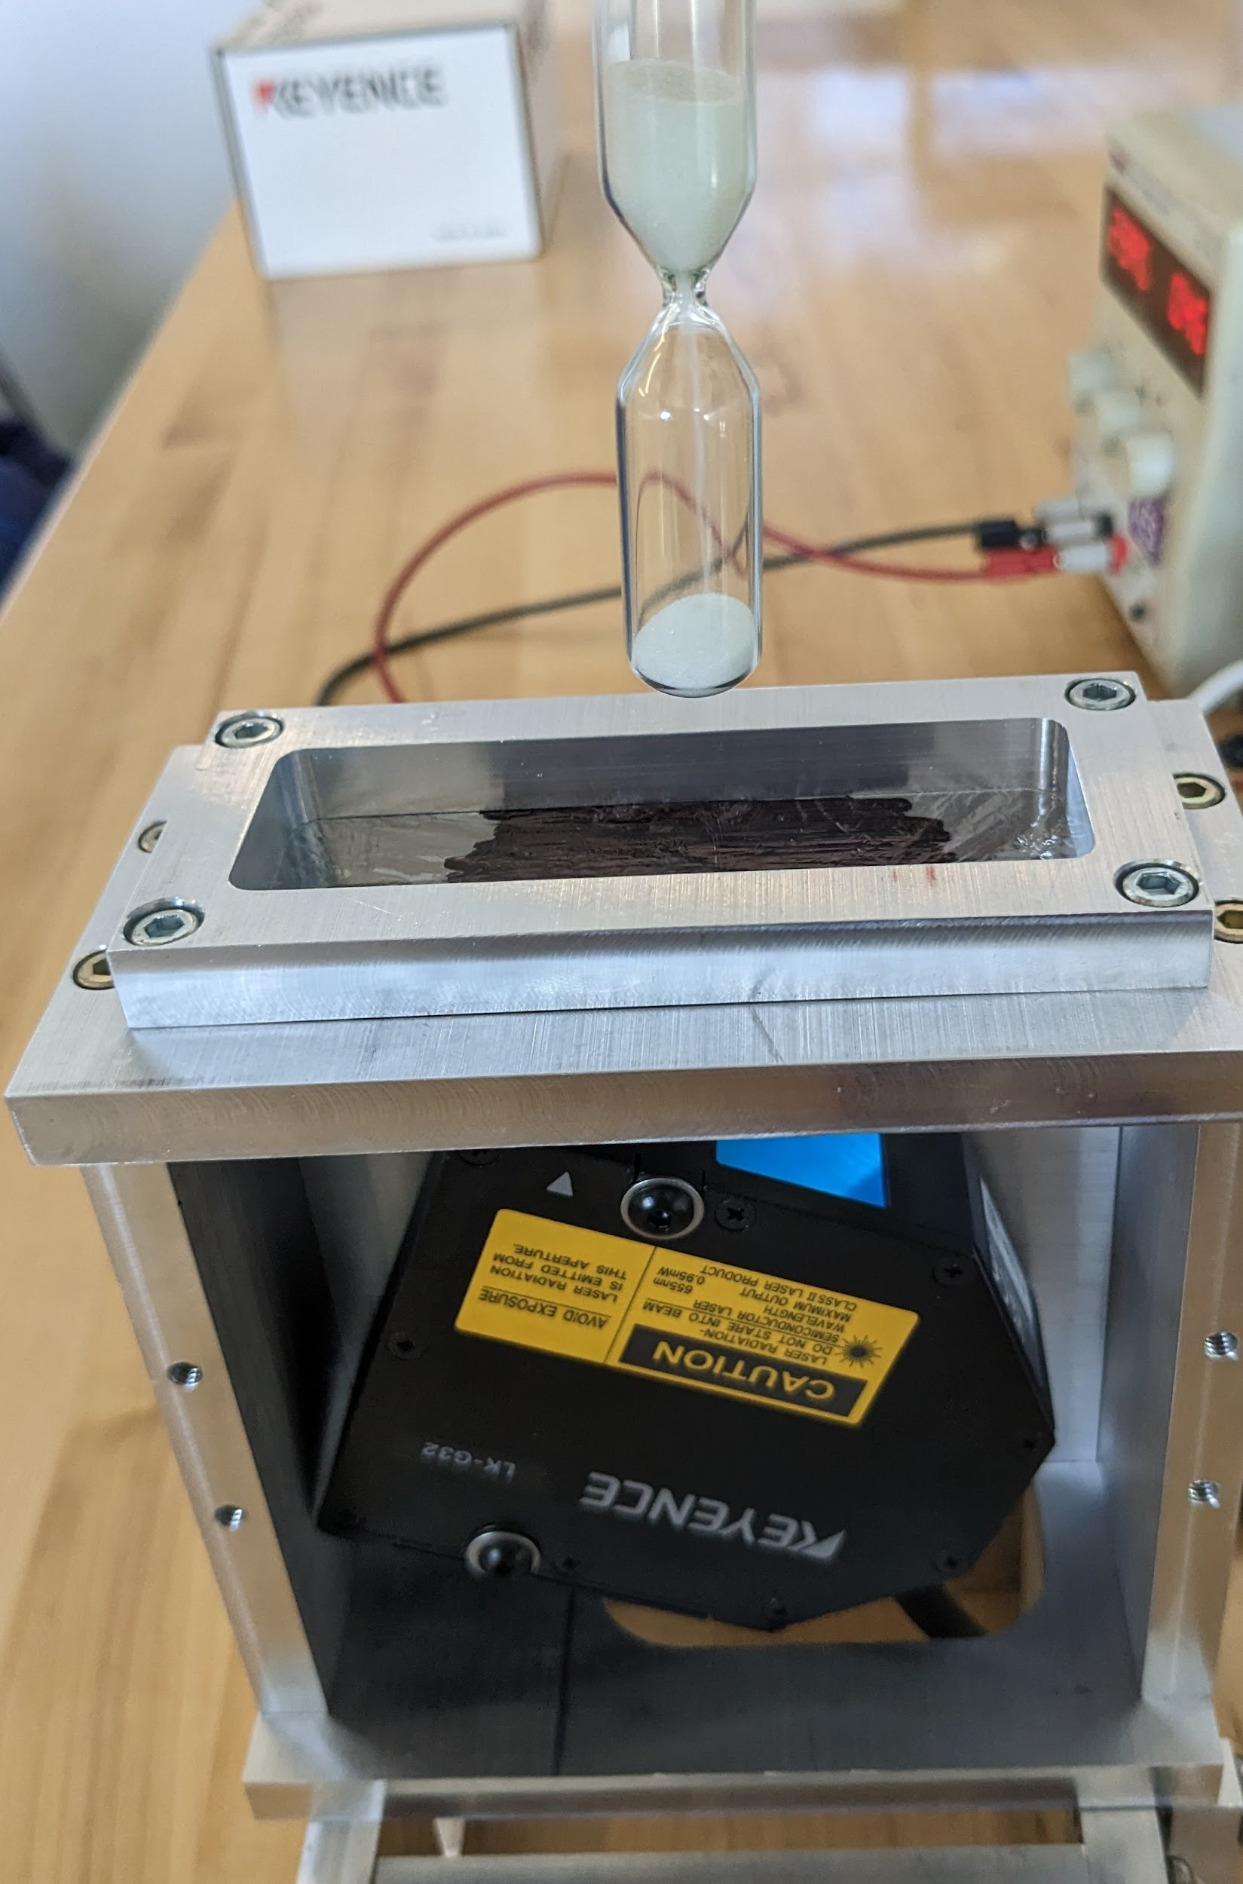
Test I - Tabletop Testing
Mechanical
Systems Integration
Film Selection
Particle Detection Tests
Lowering particle momentum
Multiple impacts
Software
LK-Navigator
Controller and Data Storage settings
Python Code
Post-processing calibration
Comparison with computational models

Slide 20
Test I: Requirements Verified
F2 - Capable of operating at laboratory bench conditions (~760 Torr and 20 °C)
F4 - Survive repeated impacts from small ice particles (100-1000 impacts)
F7 - Detect impacts with similar momentum to ice particles (equivalent momentum #)
F8 - Detect distinct impacts in cases of multiple impacts
F11 - Determine the rate of impacts
Notes:
* in terms of project requirements and objectives

Slide 21
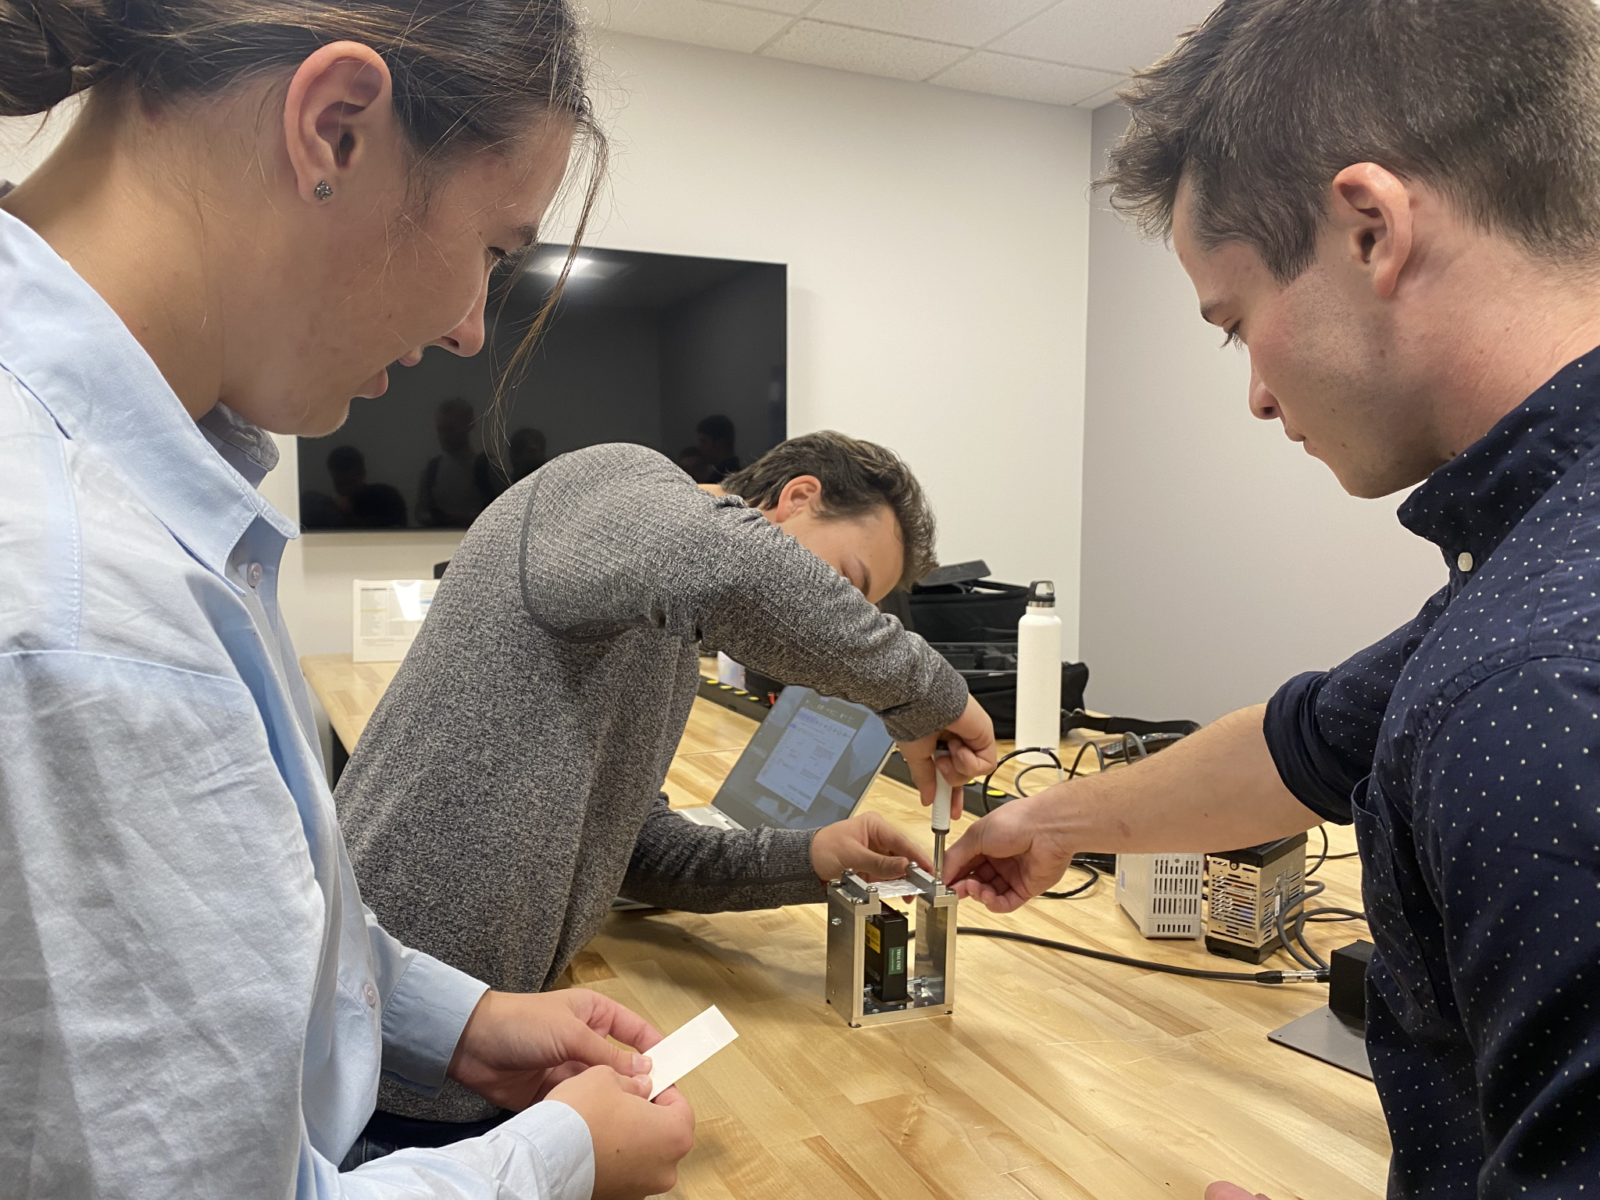
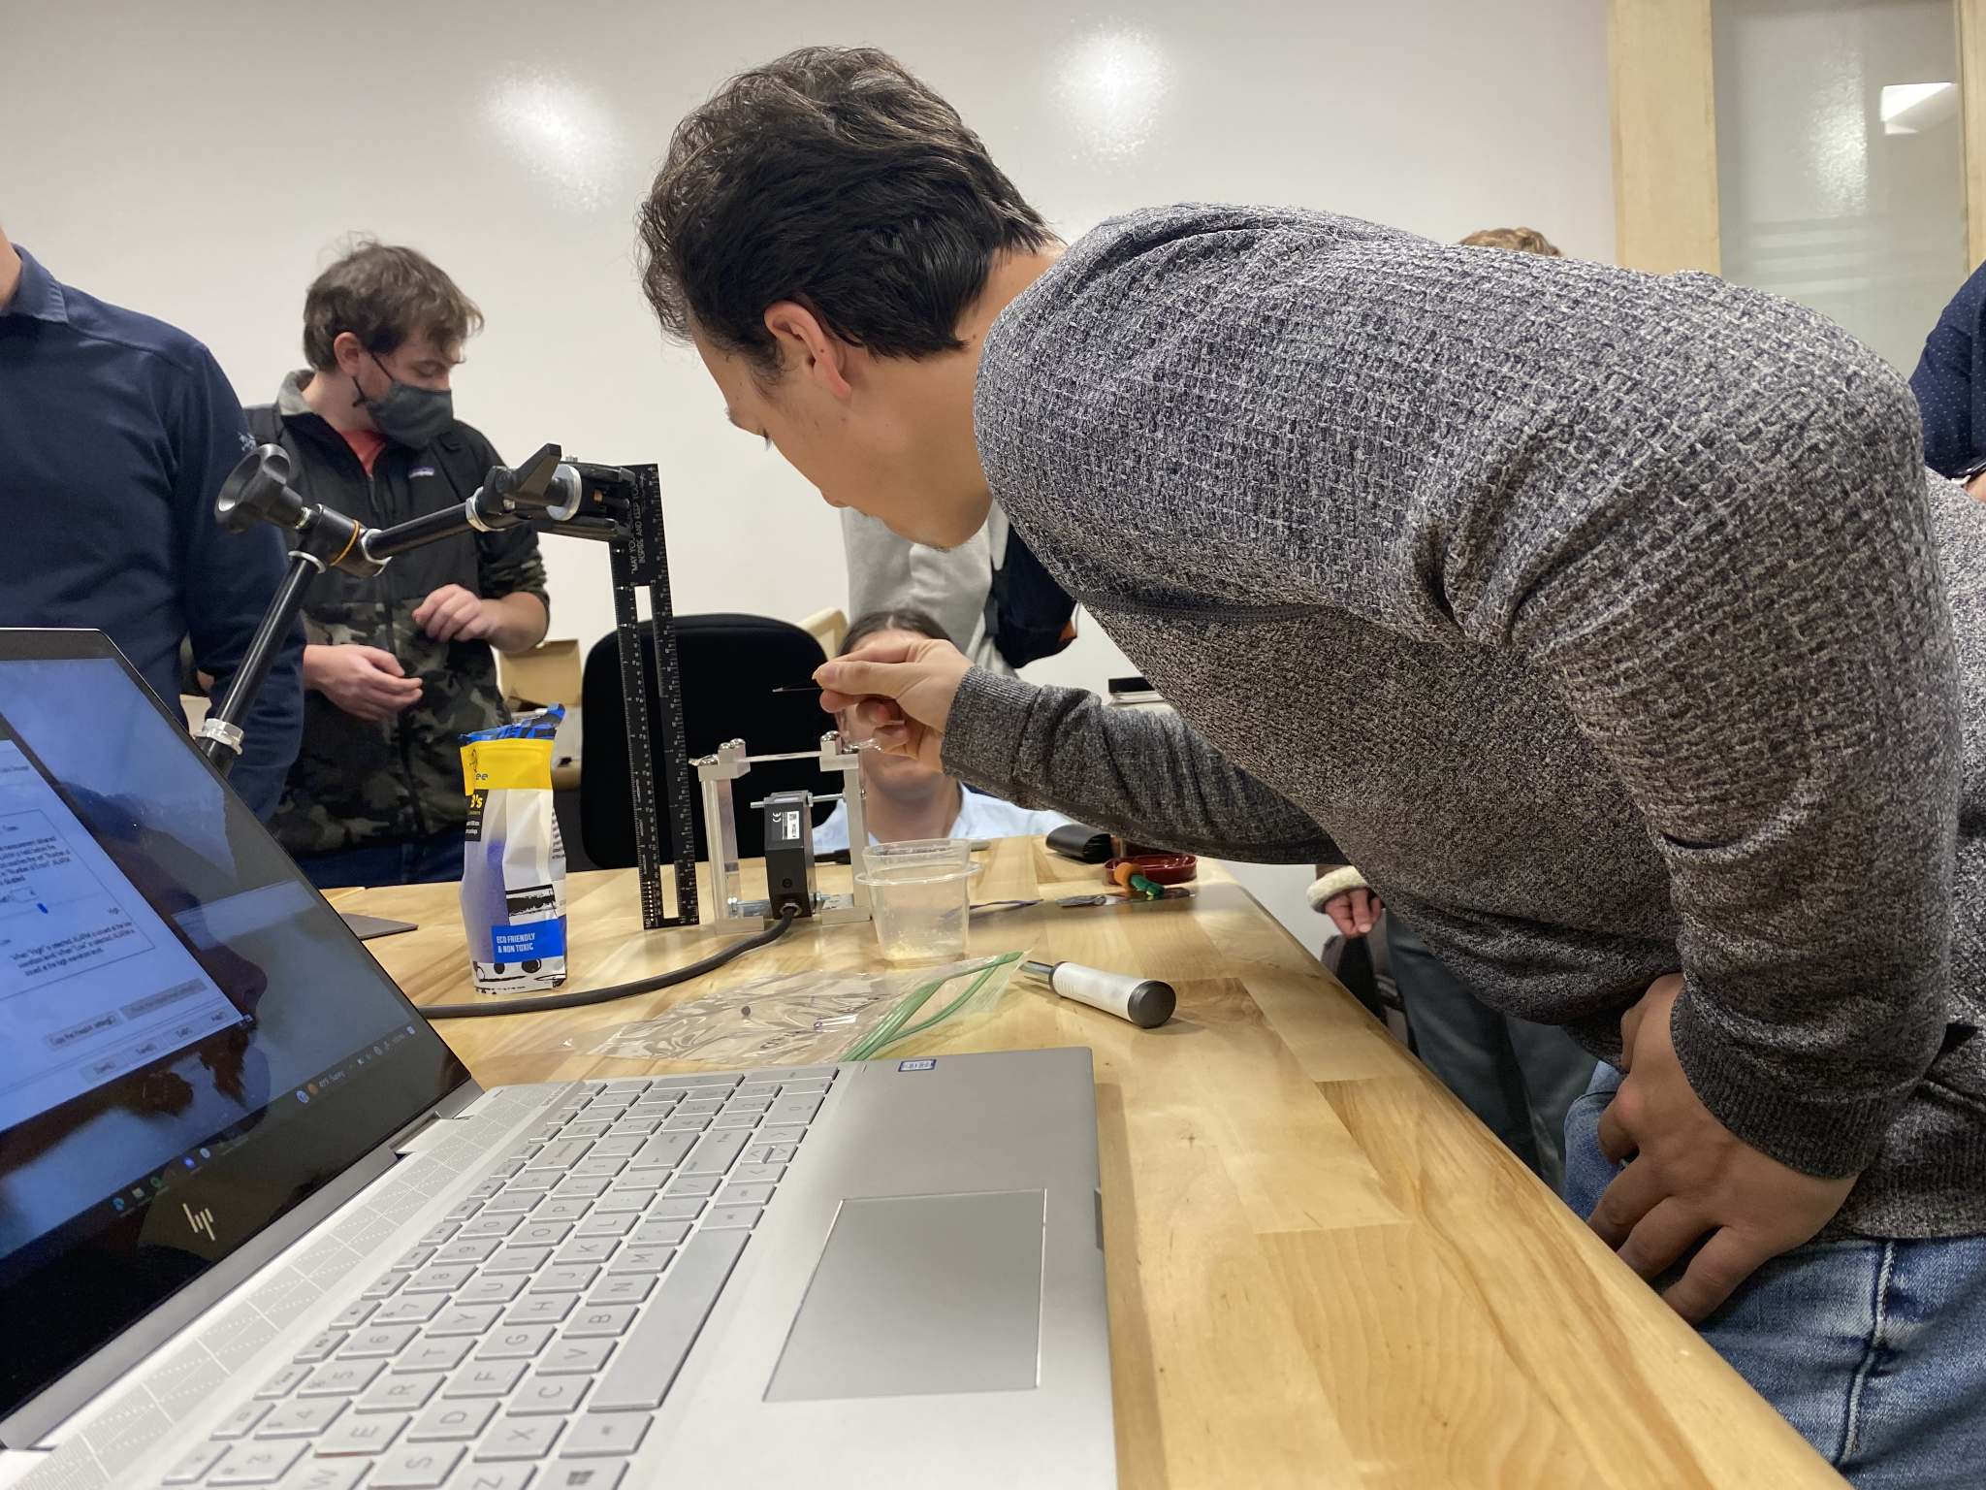
Test I: Prerequisite Testing
Preliminary Testing at Keyence
Completed December 7 @ Keyence’s Denver facility
Prototype housing used
Decreasing equivalent momentums
Test Data recorded at Keyence last semester
LK-Navigator software introduction

Slide 22
Test I: Scope
Location: CU Boulder Senior Projects room
Required Equipment:
LK-G32 Sensor and LK-3001 Controller
Manufactured housing
Power supply
Film Materials
Particle Materials
Test Procedure:
Connect all hardware
Turn on power supply
Start LK-Navigator software
Open Measurement Value and Data Capture windows
Zero Head-A
Start data storage
Drop particle/s
Save to file
Analyze and plot in python script
Notes:
Describe the scope of the testing tasks in the project specifically:
o the design of the test fixtures, selection and calibration of sensors, data acquisition plans
o test equipment and/or facilities are needed
o an overview of the test and safety procedures

Slide 23
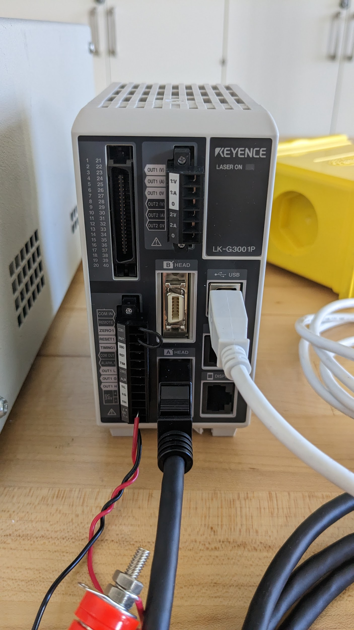
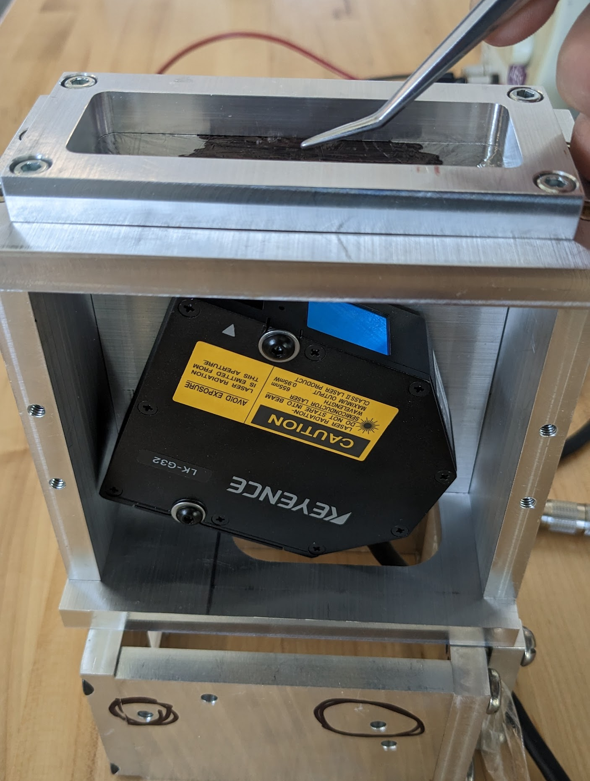
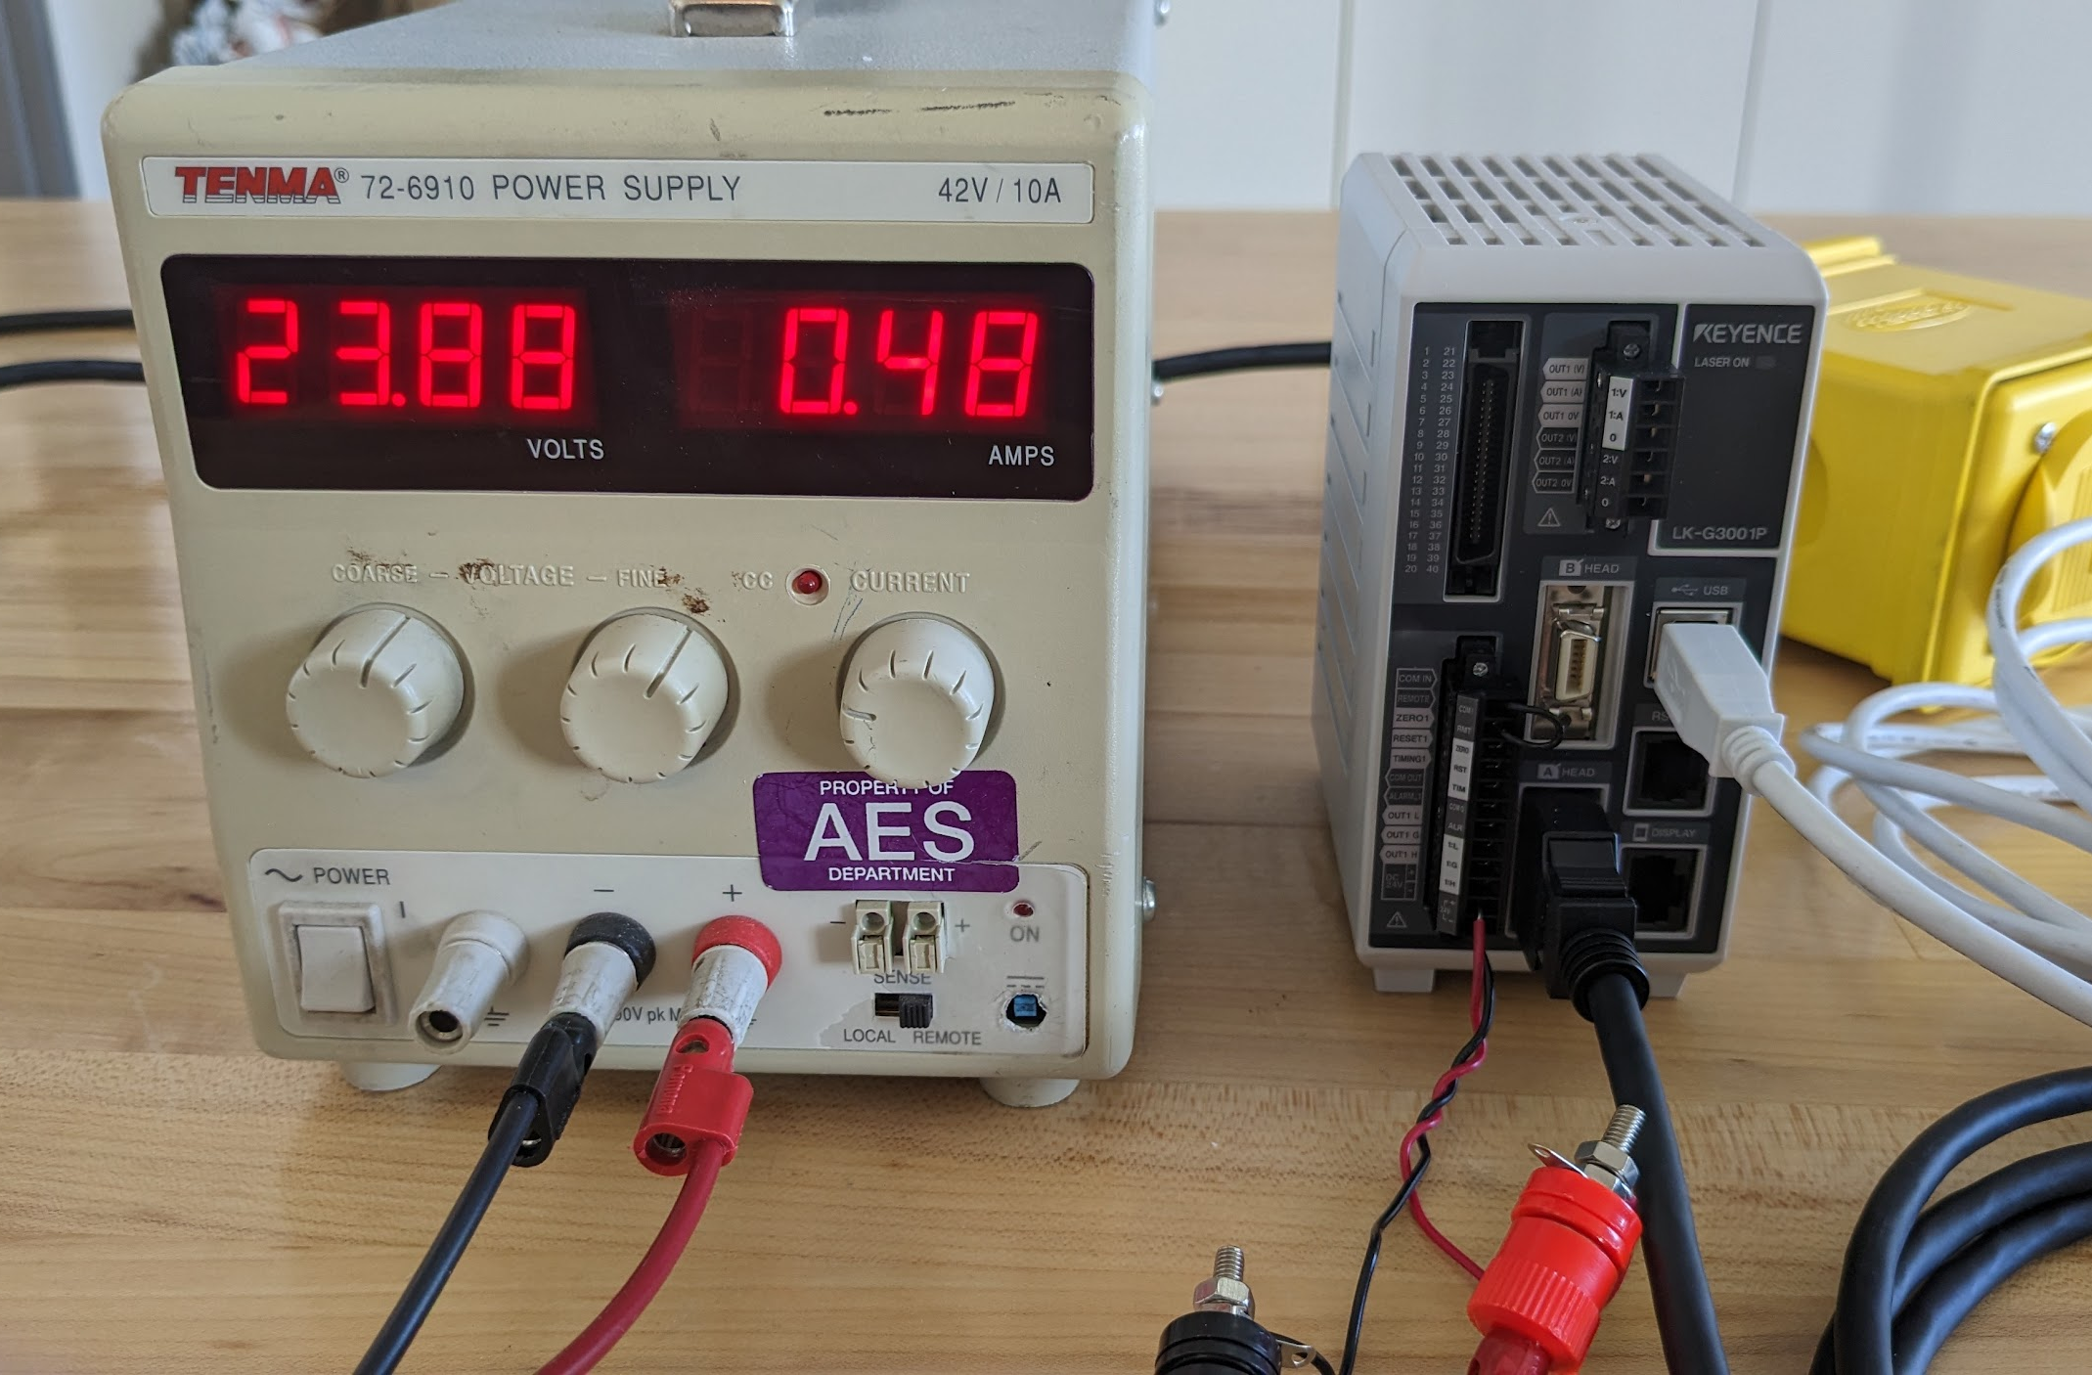
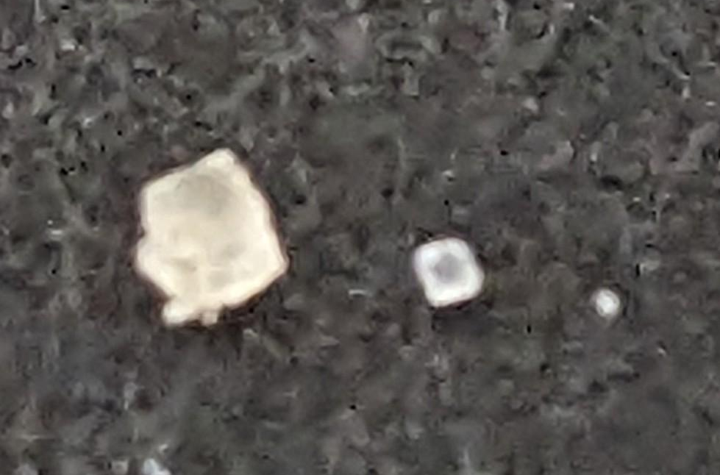
Test I: Procedure
Smallest Particles
D = 20-30um
Notes:
Describe the scope of the testing tasks in the project specifically:
o the design of the test fixtures, selection and calibration of sensors, data acquisition plans
o test equipment and/or facilities are needed
o an overview of the test and safety procedures

Slide 24
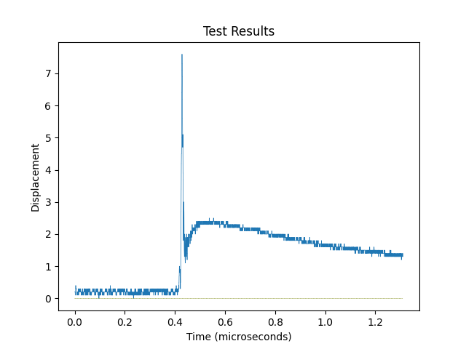
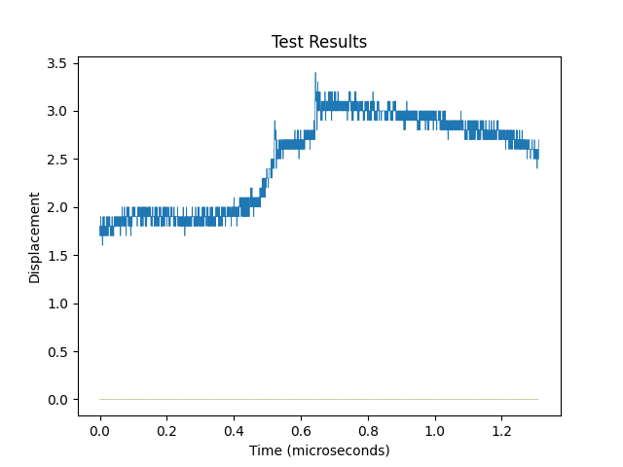
Test I: Results
Large grain of salt ≈ 300 microns
Small grains of salt ≈ 24 microns

Slide 25
Test I: Risk Reduction
Pass/Fail Criteria: Sensor and python script work in tandem to produce impact results from an equivalent momentum impact test.
Risk | Reduction
Sensitivity of sensor | Decreasing particle size to prove sensor detection limits
Data processor failure | Failure modes and bugs should be found and can be corrected
Power over 1W | Verify power consumption is at expected levels

Slide 26
Test 1: Pass/Fail Criteria
Requirements | Pass | Fail | Grade
F2 | Operable | Non-operable | P
F4 | Film Intact and Not Deformed | Pierced/Deformed Film | TBD
F7 | Detect ≤ 1x10⁻¹¹ kg*m/s | Detect ≥ 1x10⁻¹¹ kg*m/s | TBD
F8 | Repeatable | Non-Repeatable | TBD
F11 | Repeatable | Non-Repeatable | TBD

Slide 27
Test II - Vacuum Testing
AVS Lab
AERO 446
March 20-24
Verification of vacuum chamber systems integration
Characterization of vacuum chamber noise environment
Operation at near-vacuum conditions of < 25 Torr

Slide 28
Test II: Requirements Verified
F3 - The detection hardware shall be capable of operating in a vacuum.
F6 - The sensor shall mitigate vibrations inside the vacuum chamber.
F9.1 - The data shall be transferred through standard 9 and 15 pin data cables
from the sensor outside of the vacuum chamber.
F9.2 - The data shall be displayed to an outside computer using the user program.
F10 - The system shall be able to measure the noise floor and be able to take this
into account when measuring impacts

Slide 29
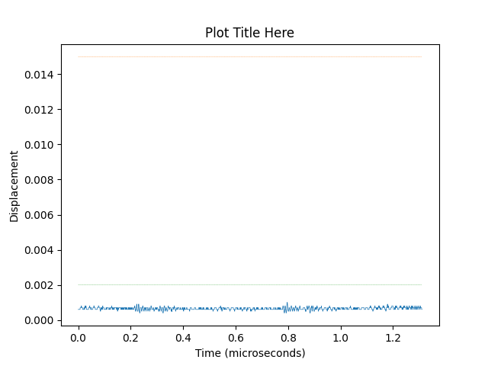
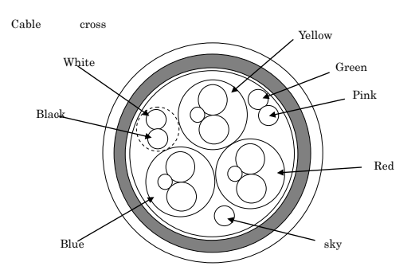
Test II: Prerequisite Testing
Spectrogram recording of vacuum chamber to characterize pump vibration
Assumed constant throughout data capture period
Sensor-to-Controller cable splicing
Required for vacuum chamber passthrough
Tabletop testing
Mitigation of tabletop noise environment
Projects Room Noise Floor

Slide 30
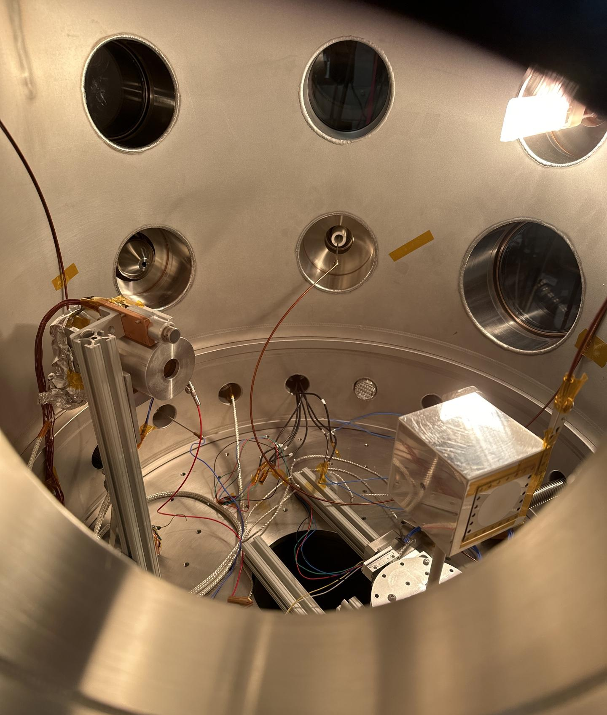
Test II: Scope
Location: AVS Lab, AERO 446
Required Equipment:
LK-G32 Sensor and LK-3001 Controller
Manufactured housing
Power supply
Spliced cables
Procedure
Connect all equipment, with spliced cable through feedthrough
Conduct recording as described for tabletop testing
Allow up to 24 hours to get to lowest pressure condition of 20 Torr
Record during pump operation and at lowest pressure condition
Allow 30 minutes for chamber to return to atmospheric pressure
Disconnect and store all equipment
Notes:
Describe the scope of the testing tasks in the project specifically:
o the design of the test fixtures, selection and calibration of sensors, data acquisition plans
o test equipment and/or facilities are needed
o an overview of the test and safety procedures
Mention email suggestion - mounting directly to table outside chamber and running both pumps

Slide 31
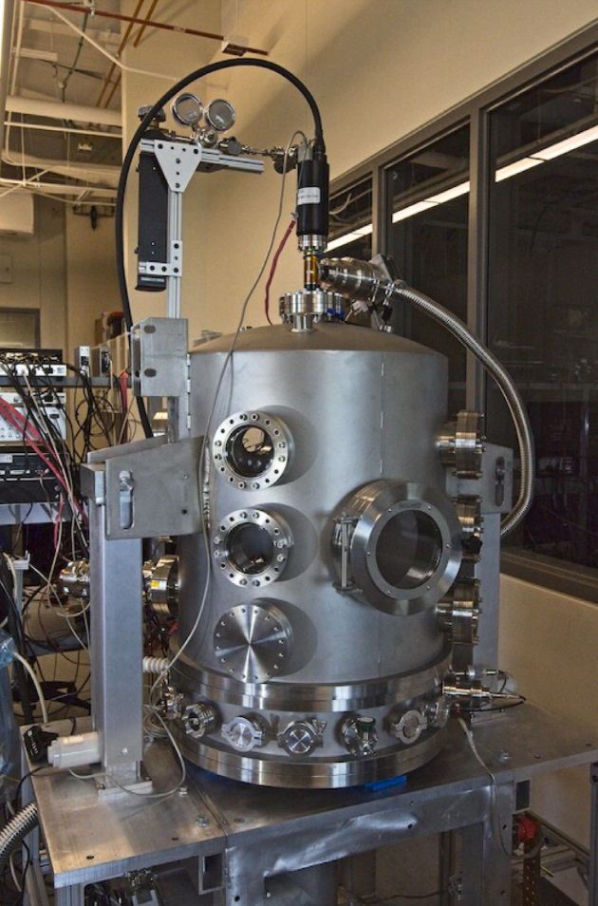
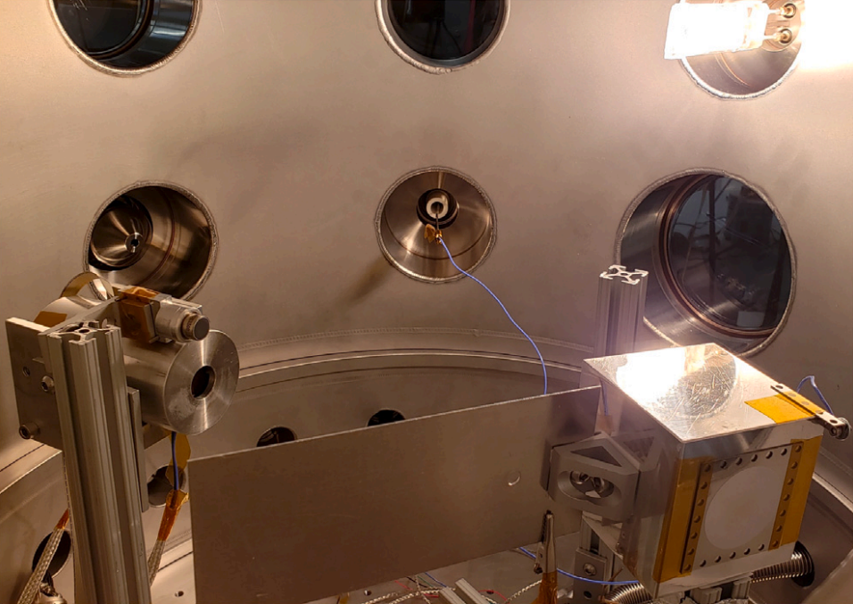
Photographs of AVS Lab research vacuum chamber

Slide 32
Test II: Risk Reduction
Pass/Fail Criteria: The sensor and housing suite do not structurally or electrically fail, and produces a noise floor sample of the vacuum chamber.
Risk | Reduction
Can’t survive vacuum chamber | AVS Lab survivability will verify vacuum survivability requirement
Data processor failure | Noise floor sample will improve data processing ability

Slide 33
Test II: Pass/Fail Criteria
Requirements | Pass | Fail | Grade
F3 | < 25 Torr | > 25 Torr | TBD
F6 | <= 1 μm | > 1 μm | TBD
F9.1 | Data Transfer | No Data Transfer | TBD
F9.2 | Data Display | No Data Display | P
F10 | Recording of Chamber Noise | No Recording of Chamber Noise | TBD
Notes:
Regarding F9.1 and F9.2: We have shown that data display is possible, given that data transfer is working properly.

Slide 34
Budget
Image courtesy of NASA https://solarsystem.nasa.gov/resources/17737/enceladus-plume/
Notes:
• Provide an update on all project expenses including status of parts/materials procurement and the
financial budget.
Grading Rubric:
The team presented an update on status of all expenses including parts received, pending and
planned with emphasis on long-lead and most important parts to project success. An updated
Cost Plan (CP) was presented, in the form of a financial budget, for all major items in the
project, highlighting uncertainties and corresponding budget margins. (9-10 pts)

Slide 35
Budget
Items: | Price/Part: $/# | Quantity: # | Budgeted Price: $ | Actual Cost: $ | Acquired:(Y/N)
Keyence LK-G32 Sensor | $ 3,000.00 | 1 | $ 3,000.00 | $3,119.25 | Y
Converter cables (roughly 3) | $ 15.00 | 3 | $ 45.00 | $6.29 so far | Partly
Film/Deflection Plate (2 materials to test) | $ 50.00 | 2 | $ 100.00 |  | N
Fasteners | $ 3.00 | 18 | $ 54.00 | $27.44 | Y
Housing Construction Materials | $ 30.00 | 3 | $ 90.00 | $91.81 | Y
Power Supply | $ 20.00 | 1 | $ 20.00 | $9.49 | Y
Overhead | $ 200.00 |  | $200.00 |  | N/A
 |  | TOTAL Costs: | $ 3,489.00 | TOTAL Spent: | $3,254.28
 |  | Leftover Budget: | $511.00 | Actual Leftover: | $745.72
Notes:
Cost Plan (CP), in the form of a financial budget, for all major items in the project,
Highlighting uncertainties and corresponding budget margins. (0-5 pts)

Slide 36
Thank you for watching!

Slide 37
Backup Slides

Slide 38
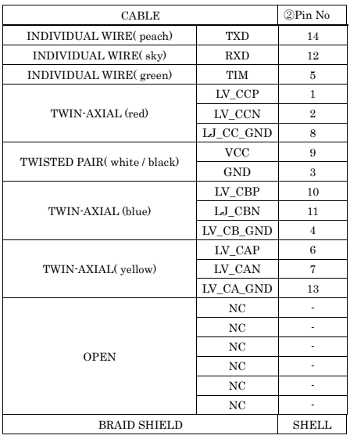
Keyence Sensor-to-Controller Cable Additional information

