Slide 1
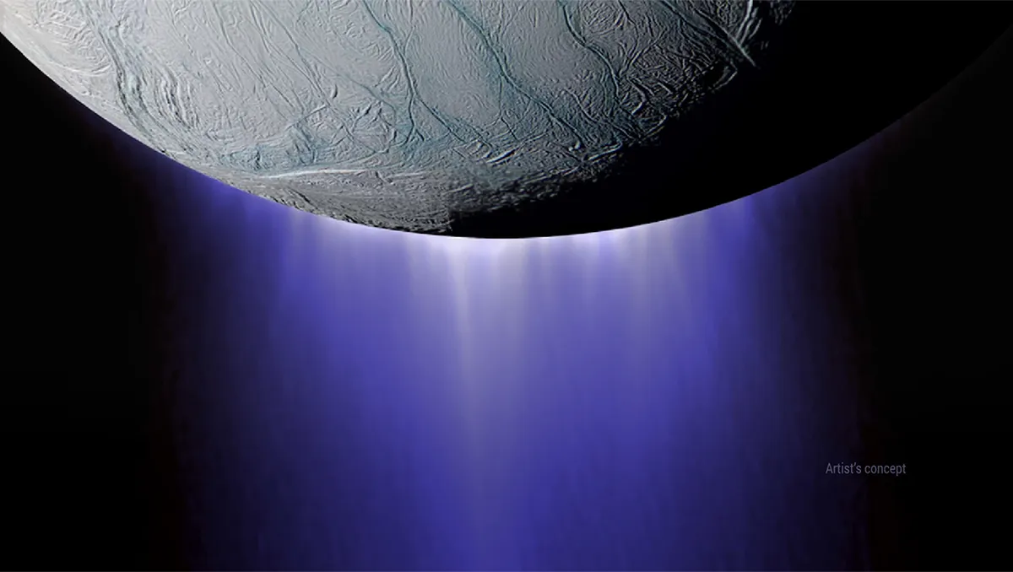
Micro-resolution Unidirectional Sensor for Ice Collisions - M.U.S.I.C.
Critical Design Review

Slide 2
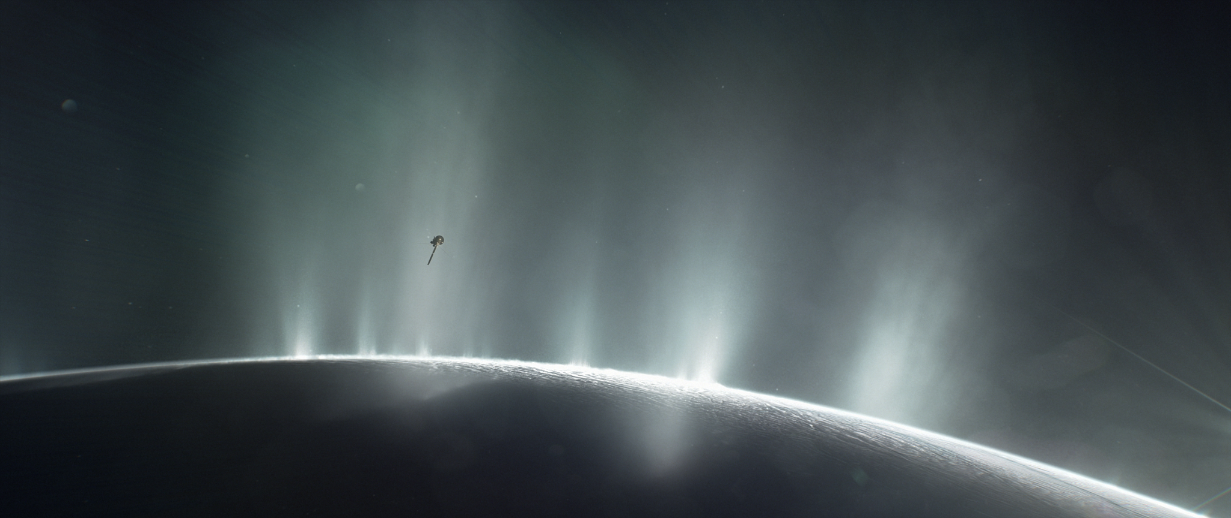
Project Overview
Image courtesy of NASA https://solarsystem.nasa.gov/resources/17737/enceladus-plume/

Slide 3
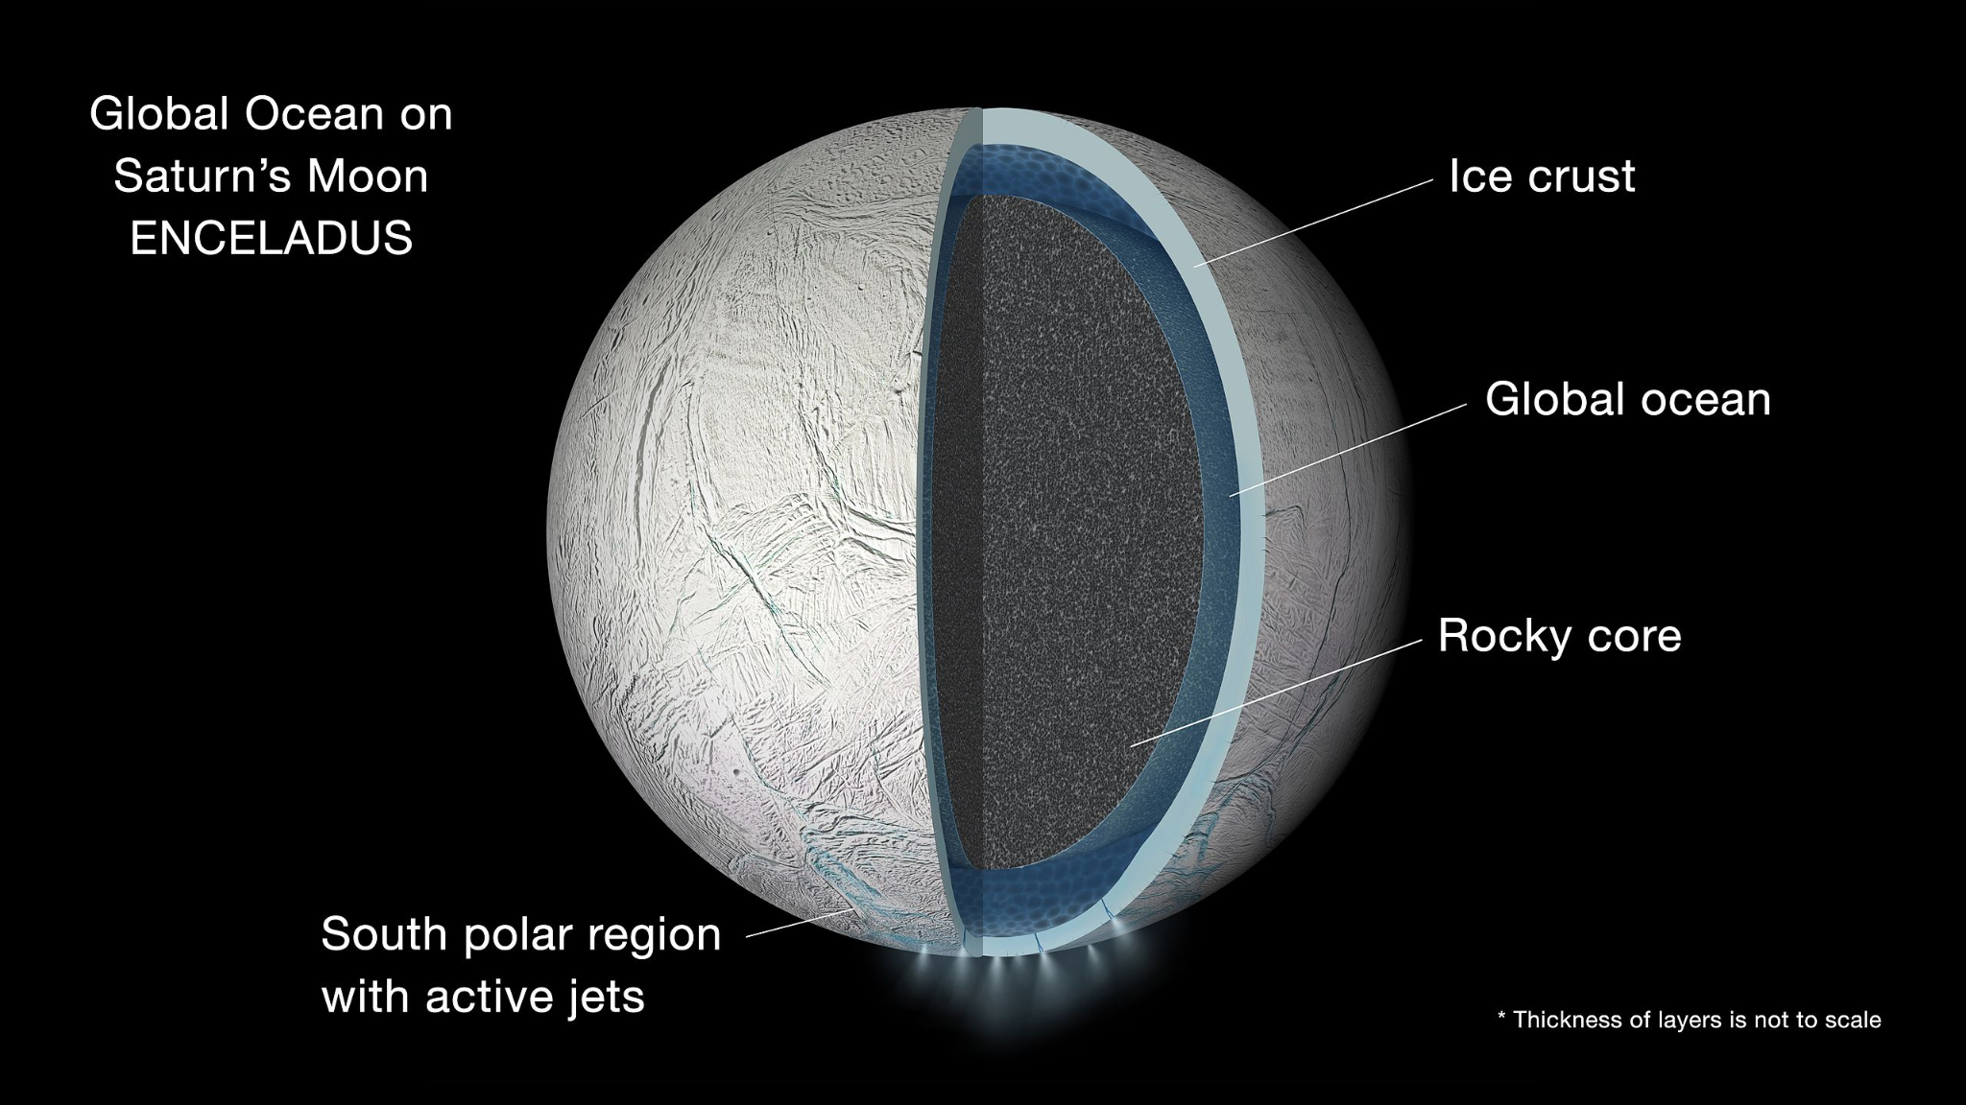
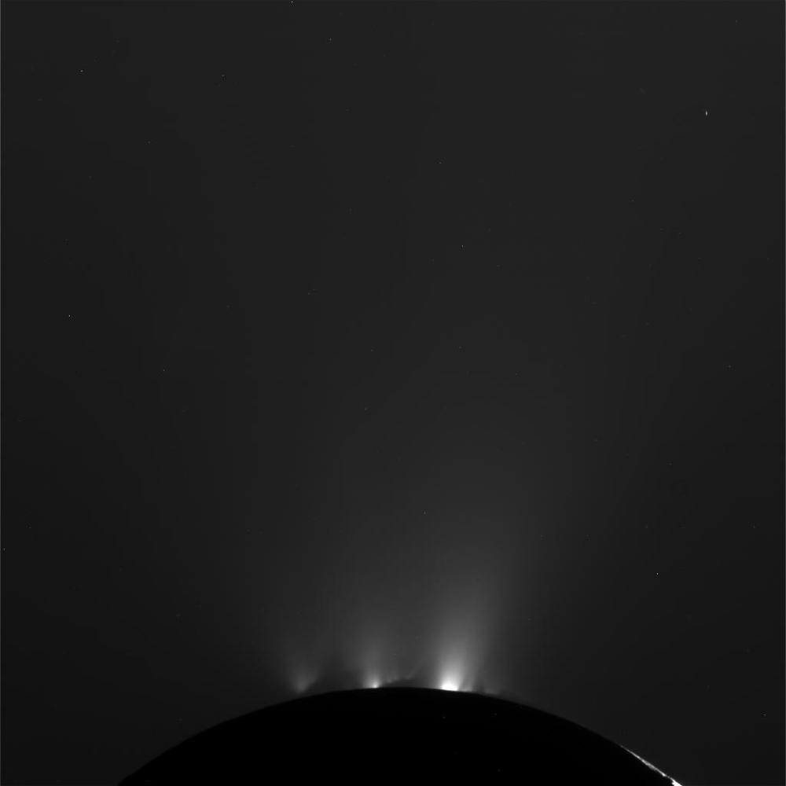
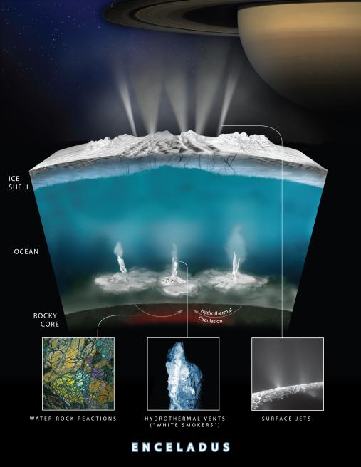
Enceladus and Plumes
Moon of Saturn with water under a surface of ice
Tidal heating causes water to escape in the form of geysers
Geyser particles may contain organics
Enceladus Images and Diagrams courtesy of NASA JPL Photojournal: https://photojournal.jpl.nasa.gov/figures/PIA19656_fig1.jpg https://photojournal.jpl.nasa.gov/jpegMod/PIA21442_modest.jpg https://photojournal.jpl.nasa.gov/jpegMod/PIA14858_modest.jpg
Notes:
Explicitly state particle size and speed range
0.5 - 4.0 microns
100-300 m/s

Slide 4
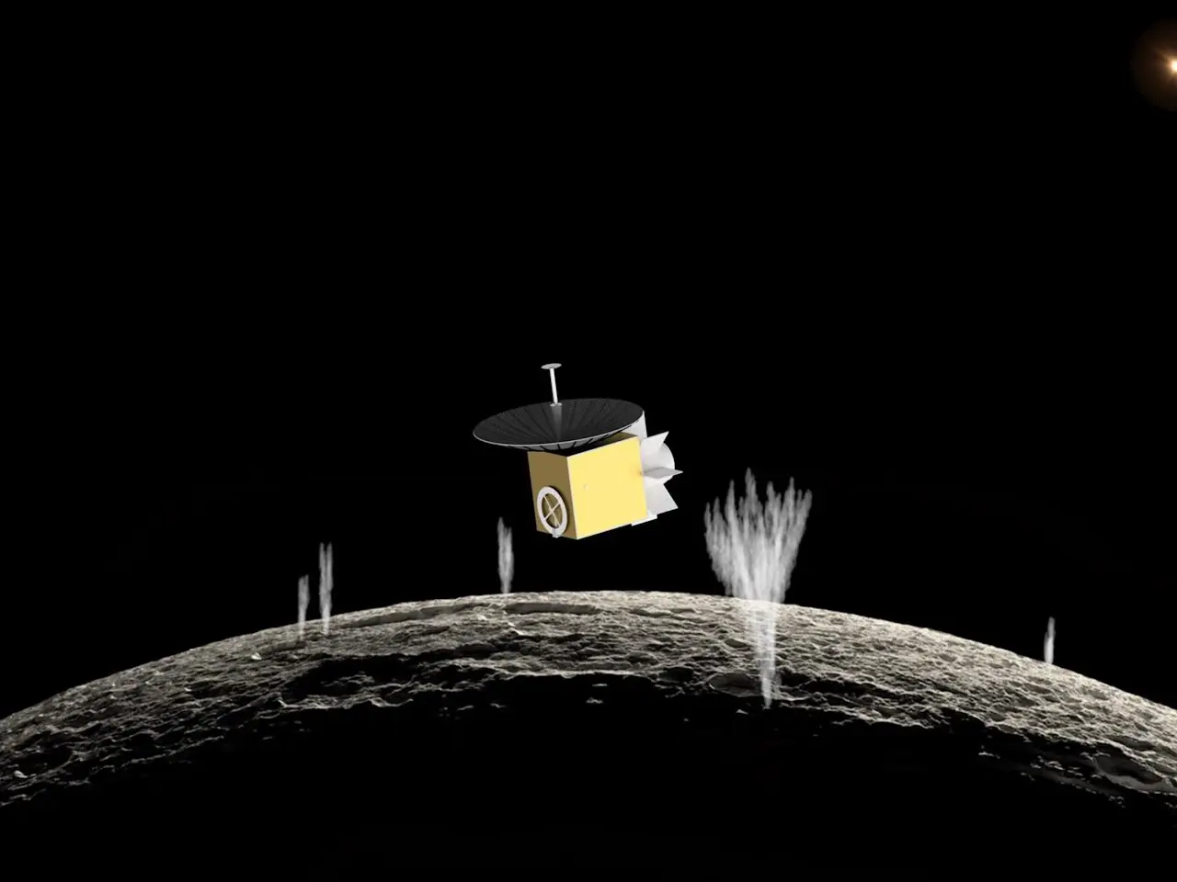
ASTROBi Mission Profile
ASTROBi wants to take samples of the plumes of Enceladus to be viewed with a microscope
Proper positioning within the plume is critical to obtain the correct sample

Slide 5
Particles of Interest
Smallest Particles
Roughly spherical shape
Size Range: 0.5 μm to 4 μm
Mass Range: 6 x 10⁻¹⁷ kg to 3 x 10⁻¹⁴ kg
Equivalent Momentum: A grain of salt dropped from a height of 4.6 mm
0.5 μm
4 μm
Notes:
*Maybe add estimated momentum of actual particles
Equivalent momentum is for largest particle at highest speed
Salt grain is 0.05 mg

Slide 6
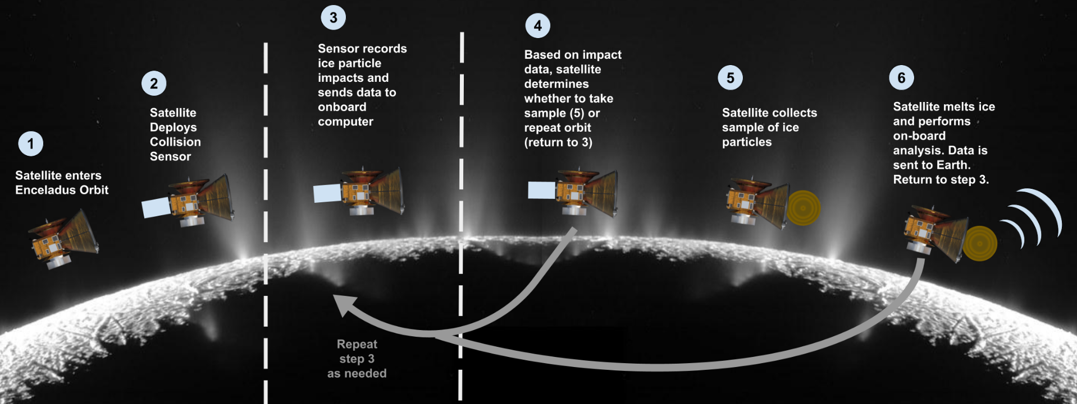
CONOPS - Mission

Slide 7
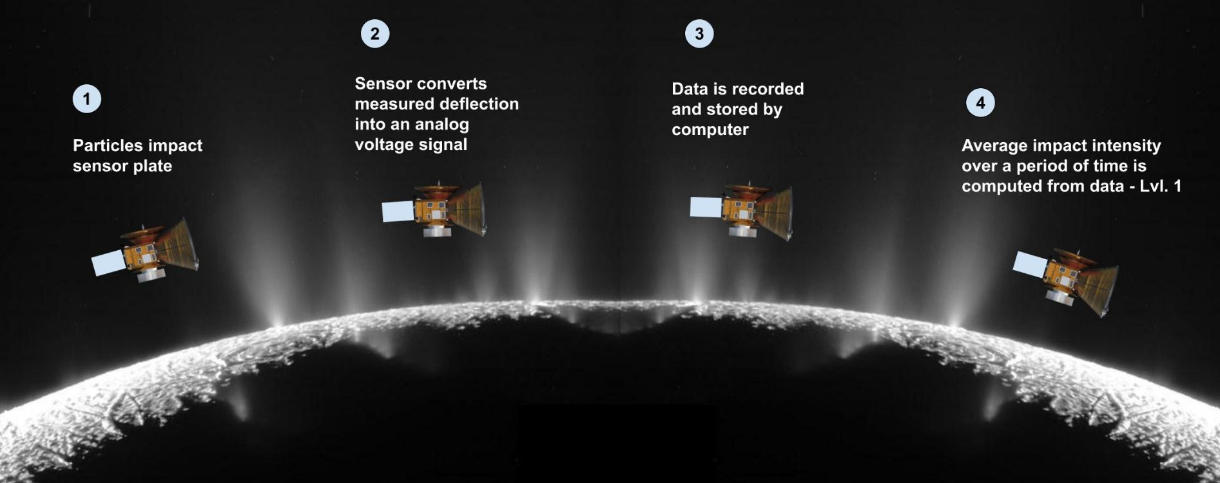
CONOPS - Specific Scope for Sensor

Slide 8
Objectives
Simulate expected deflection from particle impacts
Detect the presence of small particles
Process the data from the impacts for:
Plume density
Particle sizes
Particle velocities

Slide 9
Level 1 Functional Requirements
Provide impact data over given window of time
5 second intervals
Survive repeated impacts from small particles
100-1000 impacts
Operational in bench conditions
~760 Torr and 20°C

Slide 10
Design Solution
Image courtesy of NASA https://solarsystem.nasa.gov/resources/17737/enceladus-plume/

Slide 11
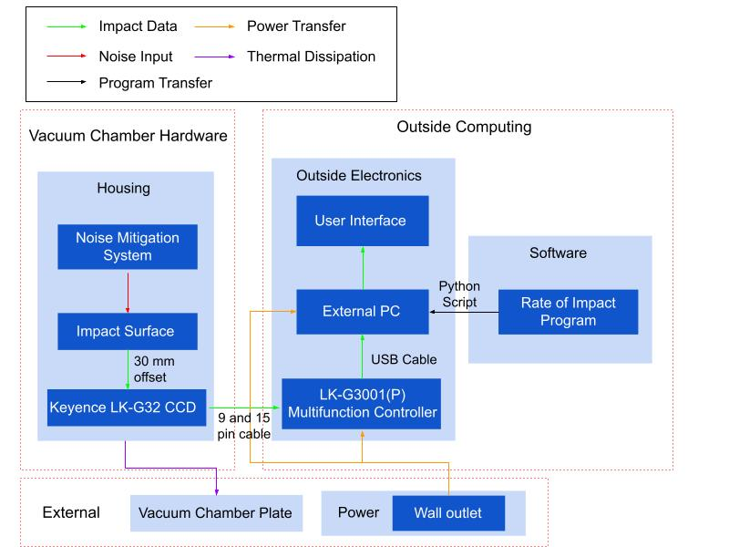
Functional Block Diagram
Notes:
Check with Trudy in regards to amount of detail

Slide 12
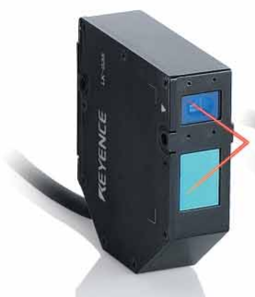
Keyence LK-G32 CCD Laser Displacement Sensor
LI-CCD laser sensor
50 nm sensitivity
50 kHz sample rate
Operable in vacuum

Slide 13
LK-G3001(P) Multifunction Controller
Automatically interprets sensor signals
Self-contained noise reduction algorithms
Analog voltage output for real time data
Notes:
Look into how much it can input / tech specs

Slide 14
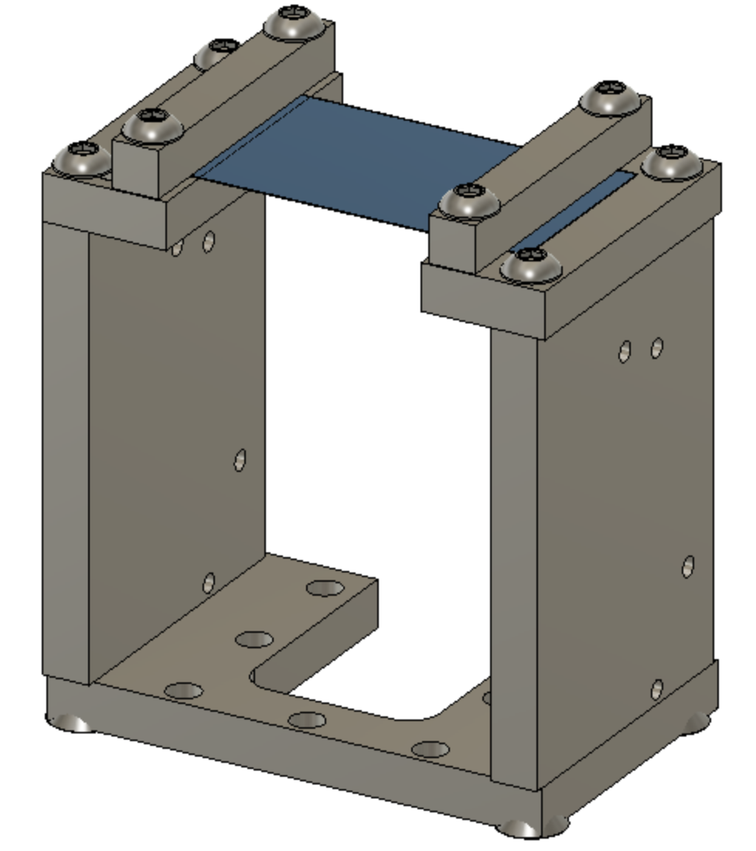
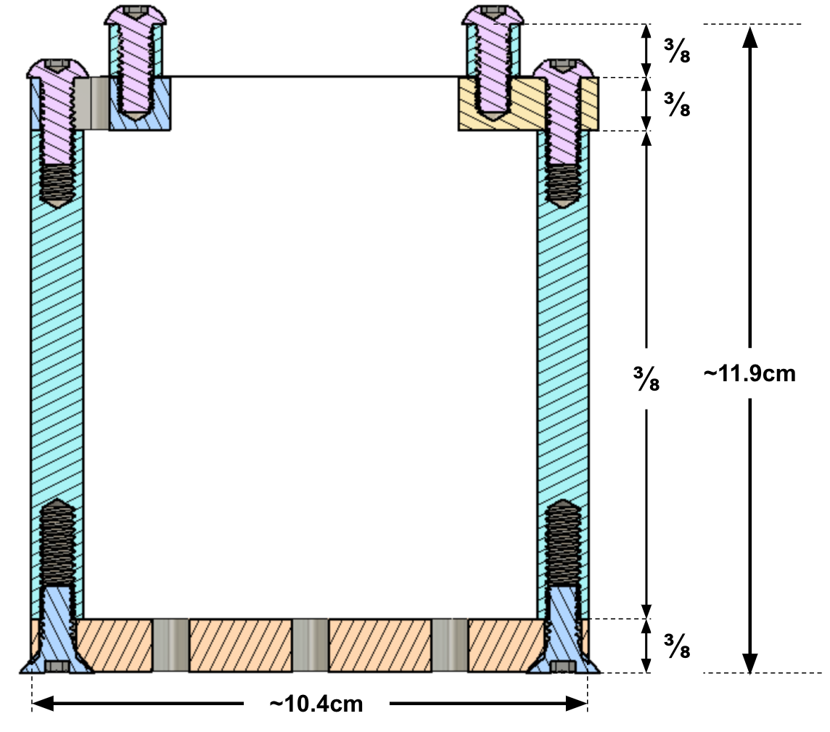
Solution - Benchtop Overview (Housing)
Impact Surface
Units in inches unless otherwise specified
Mounting Plate
Sensor Mounting Holes

Slide 15
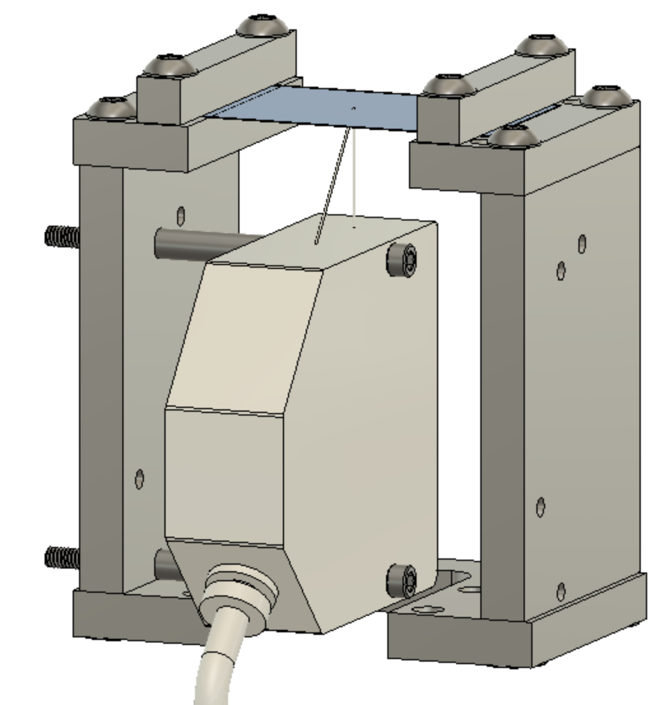
Solution - Benchtop Overview
LK-G32
Notes:
Arrows pointing out what specific parts are and dimensions. Add mention of testing different materials for plate

Slide 16
Critical Project Elements and Risks
Image courtesy of NASA https://solarsystem.nasa.gov/resources/17737/enceladus-plume/

Slide 17
Critical Project Elements (CPEs)
Critical Project Element | Reasoning
Sensor | Necessary for data collection
Data Analysis | Noise reduction, impact data processing
Testing/Simulation Software | Assisting/predicting testing results
Notes:
Relate to functional requirements in a 3rd column

Slide 18
Preliminary Risk Assessment
Risk Matrix
Very Likely (5)
Likely
Possible |  |  |  |  | 1
Unlikely |  | 3 | 5 |  | 2 & 4
Very Unlikely (1)
 | Insign. (1) | Minor | Mod. | Major | Severe (5)
Sensitivity of sensor (15)
Data processor failure (10)
Power over 1W (4)
Cost over budget (10)
Can’t survive vacuum (6)
L
i
k
e
l
i
h
o
o
d
Risk = Likelihood * Consequence
Consequence
Notes:
*Mention noise in processing
Jarrett :)
Possible points of error/margin for chosen sensor
Show legend for number choice
TALK TO HOW TO MITIGATE THESE RISKS

Slide 19
Risk Mitigation Assessment
Risk | Mitigation Method
Sensitivity of sensor (15) | Preliminary sensor testing Tabletop impact testing
Data processor failure (10) | Software output tests Noise testing inside and outside vacuum chamber
Cost over budget (10) | Margins built into budget Extra budget after margins
Notes:
Better articulate what and when for mitigation methods. Focus on most critical (Yellow and Red). Other risks: particle sizes, noise proof

Slide 20
Satisfaction of Design Requirements
Image courtesy of NASA https://solarsystem.nasa.gov/resources/17737/enceladus-plume/
Notes:
***Requirements -> Models -> Analysis -> Results***

Slide 21
Keyence LK-G32 CCD Laser Displacement Sensor
Level | Requirement: | Met by:
1 | The sensor shall be able to detect impacts with similar momentum to ice particles prior to vacuum chamber testing. | Repeatability: 0.05 μm
1 | The vacuum portion of the sensor shall not use more than 1W of power. | Light source Output: 0.3 mW
1 | The detection hardware shall be capable of operating at laboratory bench conditions (~760 Torr and 20 °C). | Enclosure rating: IP67 (IEC60529)
2 | The detection hardware shall be capable of operating in a vacuum (~25 - 1*10⁻⁹ Torr and -150 °C to 150 °C).
Notes:
Some visual color coding would be helpful

Slide 22
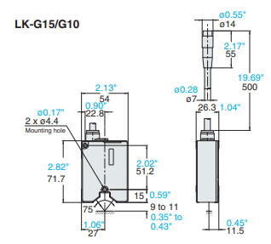
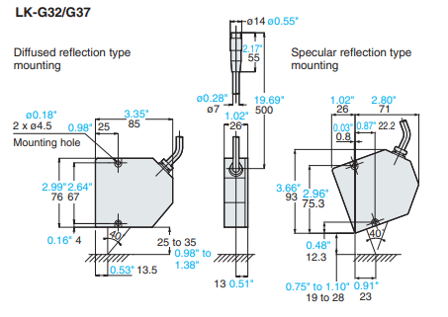
Keyence LK-G32 CCD Laser Displacement Sensor
Level | Requirement: | Met by:
1 | The sensor shall fit inside a 10x10x10 cm volume. | LK-G32 Dimensions: 7.6 x 8.5 x 2.6 cm (10.6 x 8.5 x 2.6 with offset)
7.6 x 8.5 x 2.6 cm
(10.6 x 8.5 x 2.6 w/ offset)
7.17 x 5.4 x 2.63 cm
(8.17 x 5.4 x 2.63 w/ offset)
Notes:
Maybe move bottom picture to next slide, busy slide
Or make table one slide and the two pictures separate

Slide 23
LK-G3001(P) Multifunction Controller
Level | Requirement: | Met by:
1 | The system shall be able to provide data over a given window of time to the user. | Five types of I/O: USB, Binary, Analog, I/O, RS-232C Output at 50 kHz
1 | The system shall be able to measure the noise floor and be able to take this into account when measuring impacts. | Functions: Filtering and Auto Zeroing
Notes:
Take info from SS and put into table
***Most of these tables need another slide specifically showing factors related to that analysis

Slide 24
Housing and Impact Surface
Level | Requirement: | Met by:
1 | The sensor shall mitigate vibrations inside the vacuum chamber. | Film mechanically clamped at two ends
1 | The sensor shall be able to survive repeated impacts from small ice particles. | Non-penetrable film
Notes:
***Needs much more analysis. Prioritize important factors over attempting to fit everything in***
What should be met, not what will be necessarily for now
Maybe more stuff on risk and mitigation of noise
Need to know output of sensor and other various factors

Slide 25
Plate Deflection Analysis
Level | Requirement:
2 | The sensor design shall be based in a computational model of the impacts.
Matlab Models
Constant force
Transient model
Ansys Models
Explicit dynamics impact simulation

Slide 26
MATLAB Spring Mass Model
Plate treated as “spring-mass system”
System of Differential Equations
Use plate bending theory to determine “k” for the spring analogy
Spring-mass parameters are time-dependent
Initial deflection only few nm
Becomes inaccurate quickly
Transitions to bending moment energy
Models are much more complex with higher order ODEs
Notes:
***Outline specific design requirements before this**** - How do the design requirements meet the functional requirements?
Plate bending theory: many assumptions, hard to verify, but gives rough idea
Plate under load
Load is transient, plate won’t reach max deflection from load
Spring Mass Model
Plate treated as “spring mass system” for time in transience (ns)
System of Differential Equations
Initial deflection only few nm, but as more plate becomes available oscillations grow
Becomes inaccurate quickly
Transitions to bending moment energy
Models are much more complex and involve higher order ODEs

Slide 27
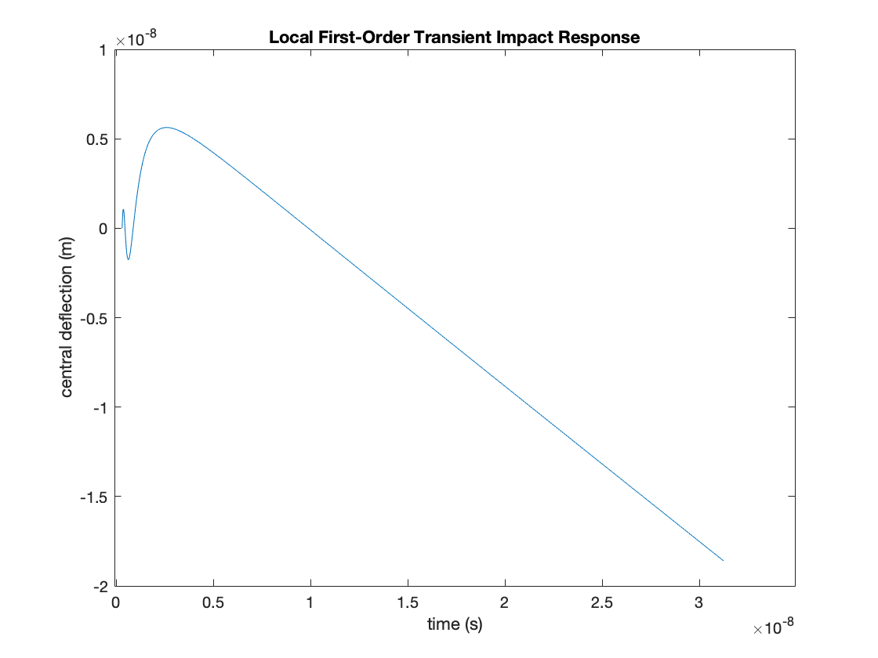
MATLAB Spring Mass Results
Extremely small initial displacement
Displacement grows as wave propagates and plate relaxes
If we extrapolate (likely inaccurate) deflections are ~10 microns
Notes:
Labels will be added plus discussion

Slide 28
MATLAB Simulations
Plate Dimensions: 8x6cm, 17μm thick
Material: Al6061
Load: 1.3mN applied at center of plate
Matlab Partial Differential Equations Toolbox
Dynamic Transient and Static Simulations
Notes:
Max static displacement: Center of plate
Create a mesh structure (can be imported from CAD file)
Assign material
Define load

Slide 29
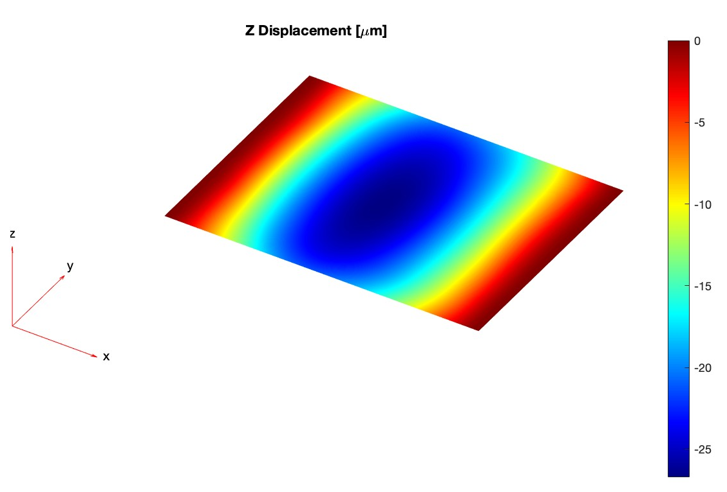
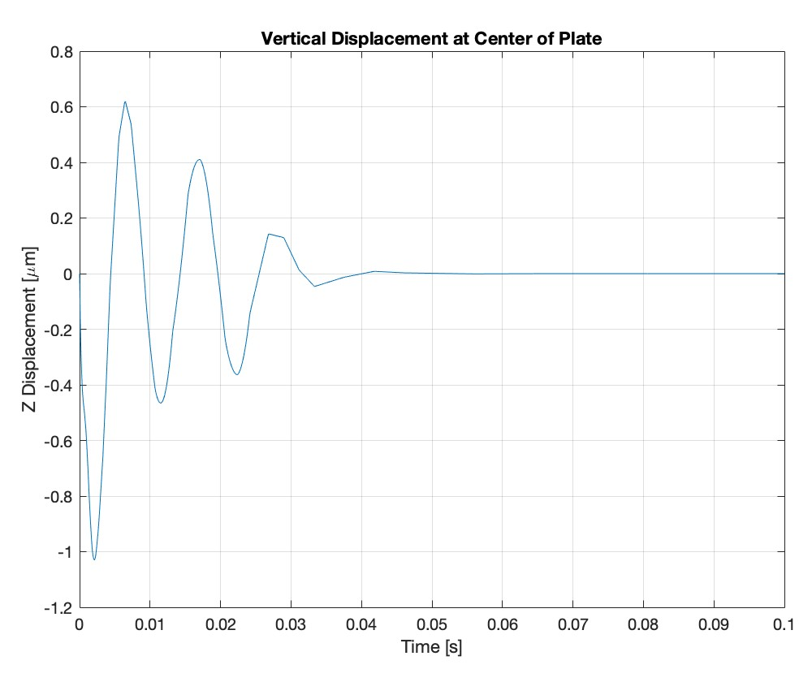
MATLAB Simulation: Results
Static Simulation: Max Displacement = -27um at Center
Transient Simulation
Notes:
Max static displacement: Center of plate: ~27um

Slide 30
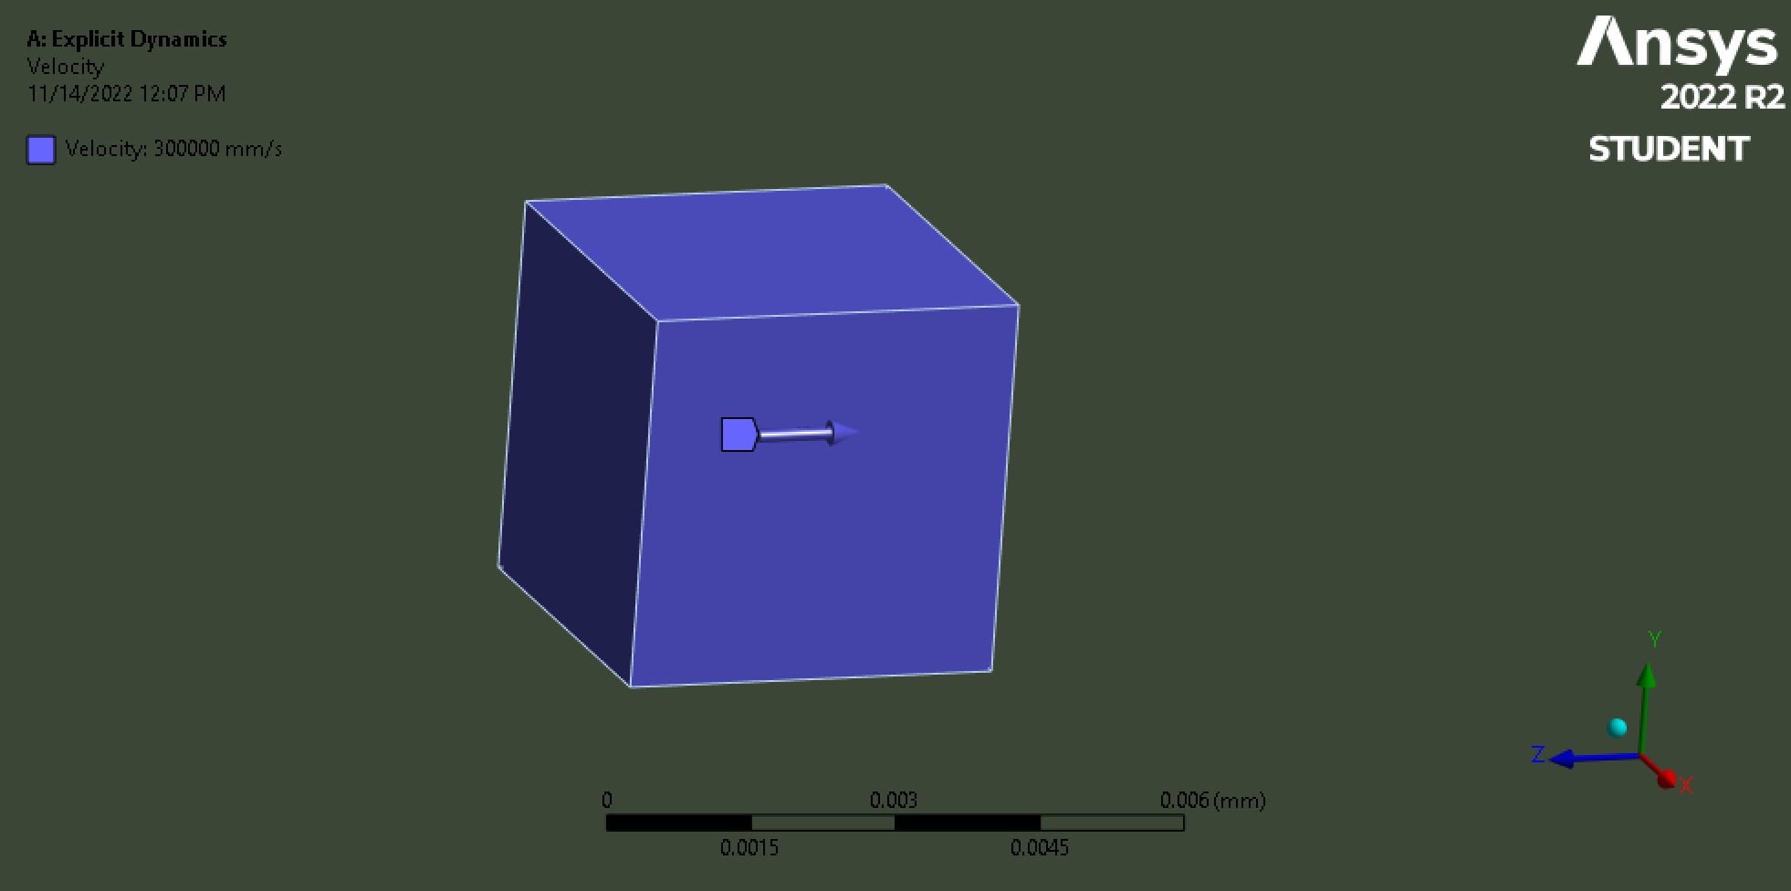
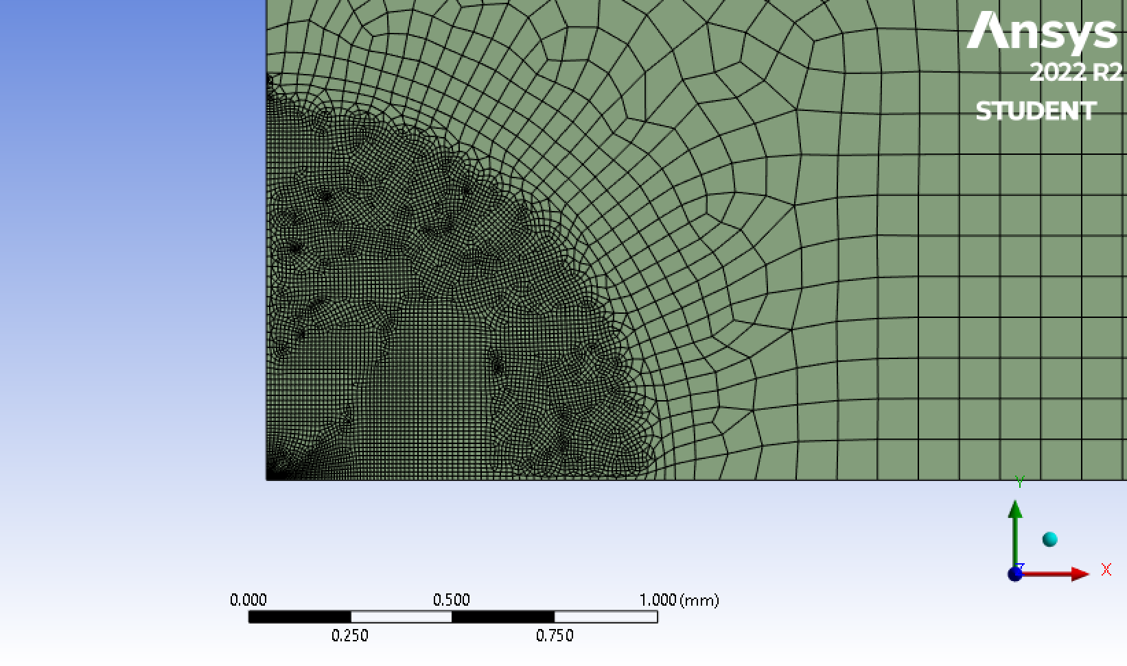
Ansys Simulation: Setup
Aluminum 5086 Plate: 10 x 10 cm, 17 micron thick
4 micron particle at 300 m/s
¼ Symmetry Simulation
37,000 Nodes:

Slide 31
Ansys Simulation: Explicit Dynamics Results
Maximum Deflection: 0.0037 microns
Notes:
*More to be added, Tyler is working on animation. Add material type (thickness and such)

Slide 32
Thermodynamic Models
Radiation Heat Transfer
Interaction between sensor and chamber walls
Heat Conduction
Metal construction
Test stand contact
Stable Environment
Level | Requirement: | Met By:
1 | The detection hardware shall be capable of operating in a vacuum | Stable environment
Notes:
*Define model and object, and show results

Slide 33
Python and User Interface
Level | Requirement: | Met by:
1 | The software shall be able to use data received to calculate the rate of impacts. | Python programming libraries
2 | The sensor should be able to detect distinct impacts in cases of multiple impacts.
Notes:
*This requirement is you noted Dr. Knudsen is worded the same as from the req flow down. It means that if there are multiple impacts the sensor can separate and measure them separately
The last point will be if we can determine individual impacts, the software will have to be the thing that pulls that out of the data
Same note as last slide

Slide 34
Verification and Validation
Image courtesy of NASA https://solarsystem.nasa.gov/resources/17737/enceladus-plume/

Slide 35
V & V Testing Plan
1. Preliminary sensor testing
2/3. Tabletop impact testing
2/3. Software output testing
4. Vacuum chamber survivability testing
5. Final product testing
Notes:
Note none of these tests have inherent safety risks aside from maybe the cu vacuum testing which will be alongside the PH students

Slide 36
Preliminary Sensor Laboratory Testing
Keyence Corporation of America in Denver
Objectives
Characterize overall sensitivity and impact response
Test film materials
Test increasingly smaller particles
Req ID | (Brief) Requirement:
F7 | Ability to detect several particle impacts with expected momentums
F9 | Ability to provide data over a given window of time to the user
F10 | Ability to mitigate noise from the system in the data
Acceptance Criteria
Keyence sensor within prototype housing detects particle impacts with momentum from 1.146E-14 kgm/s to 1.761E-11 kgm/s
Notes:
***Maybe add func reqs expected to be verified***
Displacement data exported as .xls file for further analysis

Slide 37
Tabletop Impact Testing
Smead Aerospace lab space
Objectives
Validate Matlab and Ansys models
Verify survivability of chosen film
Characterization of particle impacts
Conducted in parallel with software testing
Req ID | (Brief) Requirement:
F4 | Ability for the system to survive ongoing particle impacts
F5 | Ability for the vacuum portion of sensor to not use more than 1W of power
F8 | Ability of the sensor to detect multiple distinct impacts
Acceptance Criteria
Receive repeated impact data in alignment with computational models at momentum from 1.146E-14 kgm/s to 1.761E-11 kgm/s
Notes:
***Maybe add func reqs expected to be verified***
Displacement data exported as .xls file for further analysis

Slide 38
Software Output Testing
Smead Aerospace Pilot lab
Objectives
Create expected output from preliminary test .xls
Integrate output from controller into program
Conducted in parallel with impact testing
Req ID | (Brief) Requirement:
F11 | Ability to determine the rate and average magnitude of impacts
F10 | Ability to mitigate noise within the system in the data
F13 | Ability to determine individual impact characterizations
Acceptance Criteria
User output created from preliminary test data and repeatable for tabletop testing
Notes:
Displacement data exported as .xls file for further analysis

Slide 39
Vacuum Testing Plans
CU Autonomous Vehicle Systems (AVS) Lab
Dr. Schaub’s Testing Facility
Survivability and noise testing
Approximately a week of access
RadNet Medical Imaging
Customer side of testing performed in California
Simulate particle impacts within vacuum space

Slide 40
Project Planning
Image courtesy of NASA https://solarsystem.nasa.gov/resources/17737/enceladus-plume/

Slide 41
Major Tests
Impact Testing
Verify sensor capabilities
Decreasing particle momentum to expected values
Various film materials
Software Testing
Validate program functionality with:
Preliminary test data
Computational models
Vacuum Testing
AVS Laboratory
Radnet facility

Slide 42
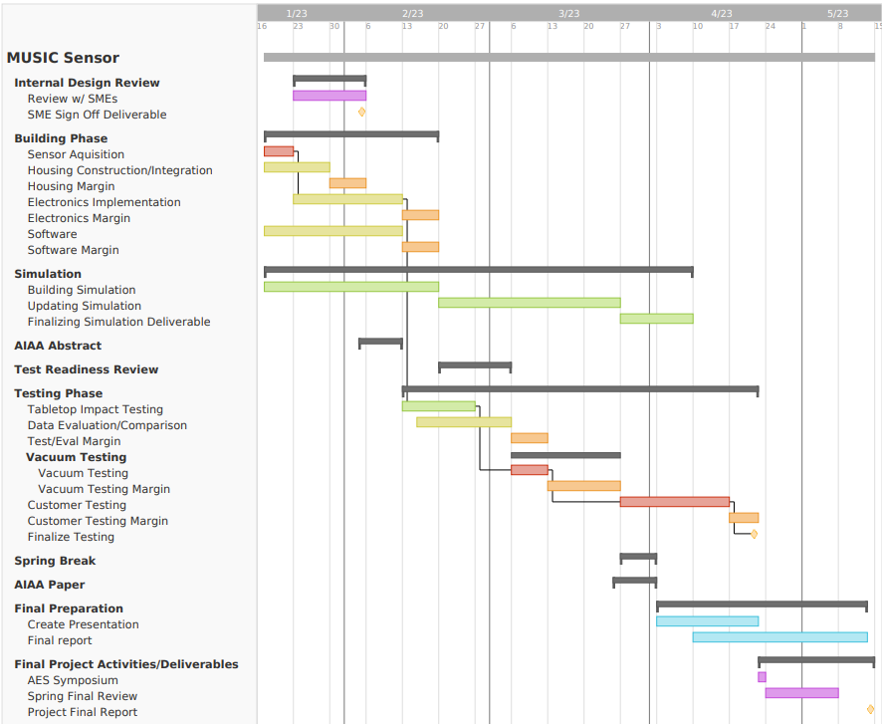
GANTT Chart
Legend
High Risk
Med Risk
Low Risk
Margin
Deliverable
Final Work
Critical Path
Notes:
Still to be updated overall, and to have red line representing critical path

Slide 43
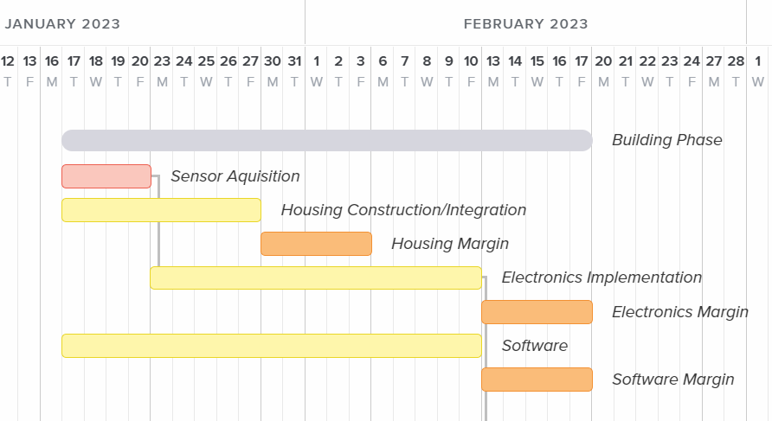
Gantt Chart (Building Phase)
Notes:
May add color coding legend which signifies associated risk, as with following slide as well

Slide 44
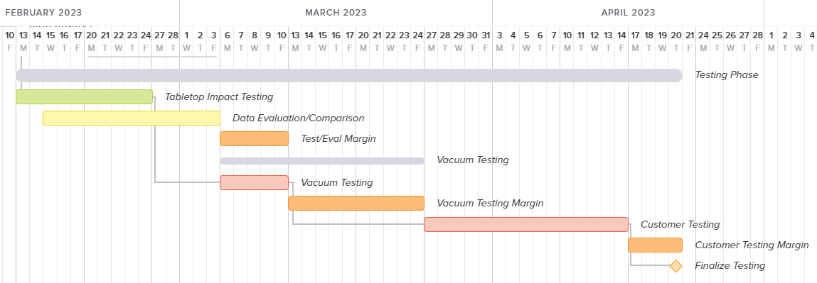
Gantt Chart (Testing Phase)
Notes:
NOTE: Does not yet include sending to Cali for customer testing

Slide 45
Budget
Items: | Price/Part: $/# | Quantity: # | Total Price: $
Converter cables (roughly 3) | $ 15.00 | 3 | $ 45.00
Film/Deflection Plate (2 materials to test) | $ 50.00 | 2 | $ 100.00
Fasteners | $ 3.00 | 18 | $ 54.00
Housing Construction Materials | $ 30.00 | 3 | $ 90.00
Overhead | $ 200.00 | 1 | $ 200.00
Keyence LK-G32 Sensor | $ 3,000.00 | 1 | $ 3,000.00
 |  | TOTAL Costs: | $ 3,489.00
 |  | Leftover Budget: | $511.00
Notes:
Cost Plan (CP), in the form of a financial budget, for all major items in the project,
Highlighting uncertainties and corresponding budget margins. (0-5 pts)

Slide 46
Thank you for watching!

Slide 47
Backup Slides

Slide 48
Design Solution Backup Slides

Slide 49
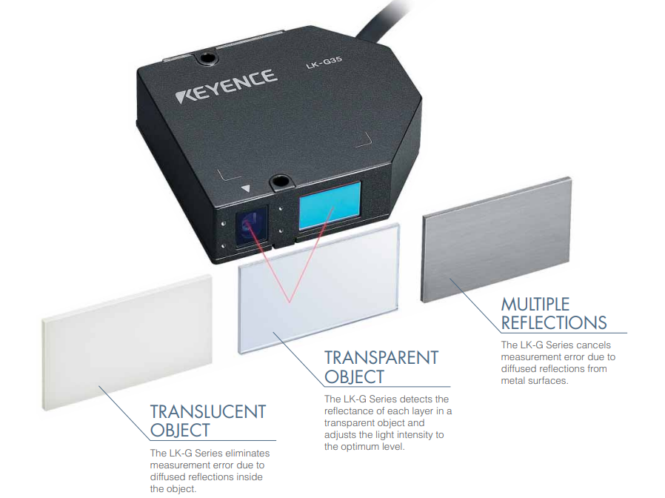
Reflectivity of different materials with sensor

Slide 50
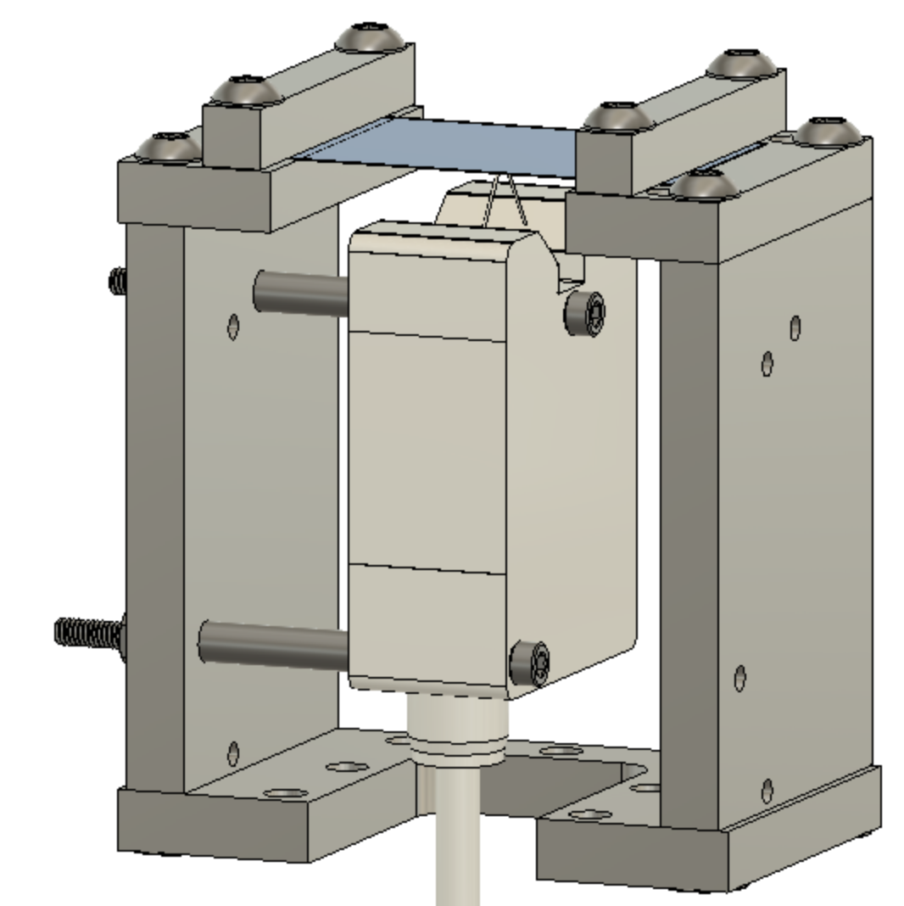
Prototype Housing Sensor Flexibility
LK-G10
LK-G32
Notes:
Arrows pointing out what specific parts are and dimensions. Add mention of testing different materials for plate

Slide 51
Design Requirements Backup Slides

Slide 52
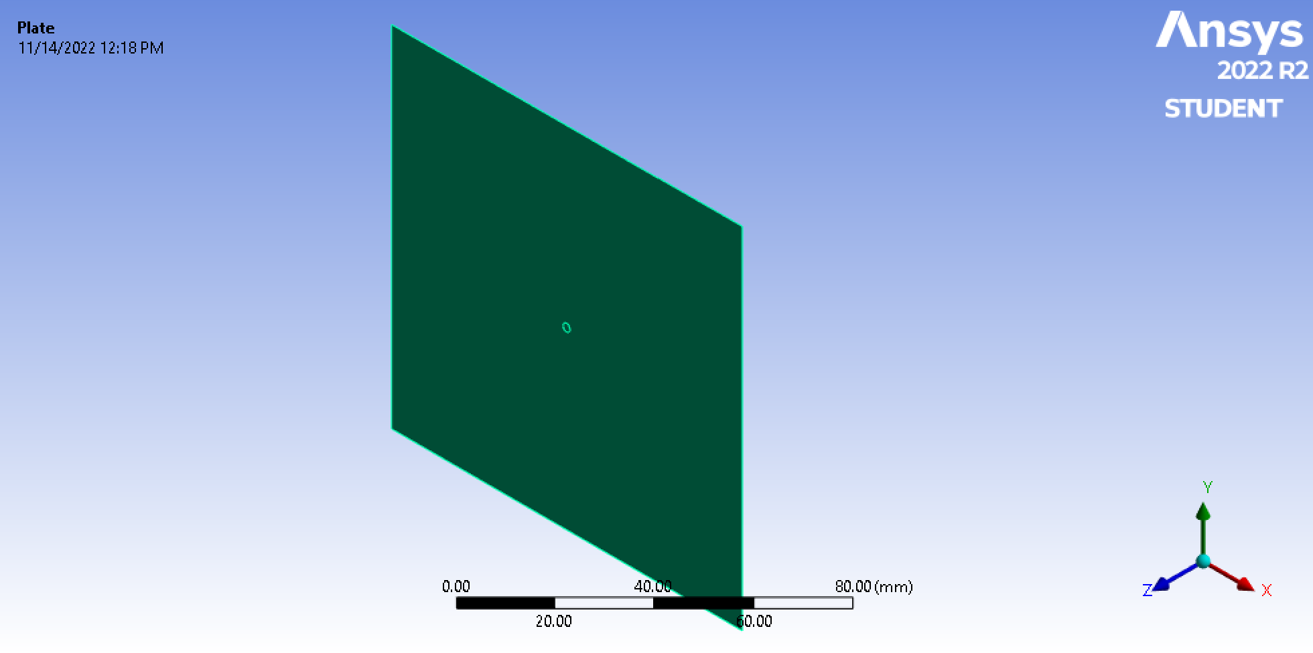
ANSYS Setup

Slide 53
Matlab Model Equations
deflection w = PR²/16πD
where D = Et³/12(1-ν)²
m(T)*w’’ = K(T)*w

Slide 54
Heat Transfer Analysis
Radiation Heat Transfer
Vacuum Chamber Heat Sources:
Emitted Laser Power (0.3mW)
Sensor Components (3mW)
Radiation Heat Transfer (Variable)
Sensor Areas of Heat Loss
Radiation Heat Transfer
Test Stand Conduction
Test Stand Thermal Reservoir
J = σ(T)⁴
Q_{s→c,GBR}= A_{s,e}J_{s}F_{s→c}– A_{c}J_{c}F_{c→s}
Q_{s→c,ESB}= A_{s,e}σε_{s}(T_{s}⁴–T_{c}⁴)
Conduction
Q_{s→ts}= [kA_{s,c}(T_{s}– T_{ts} )]/Δx
Q_{s→ts}: Heat Transfer from housing to test stand
Q_{s→c,GBR}: Heat transfer from housing to chamber, grey body radiation
Q_{s→c,ESB}: Heat transfer from housing to chamber, enclosed small body
J: Radiative power per unit area
F: View factor
A_{s,e}/A_{s,c}: Area housing, exposed / Area housing, contact with test stand
T_{S}: Temperature of housing
T_{c}: Temperature of vacuum chamber
T_{ts}: Temperature of test stand
ε_{s}: Emissivity of housing
k: Thermal conductivity of test stand
σ: Stefan-Boltzmann constant

Slide 55
CAD Backup Slides–Simulation

Slide 56
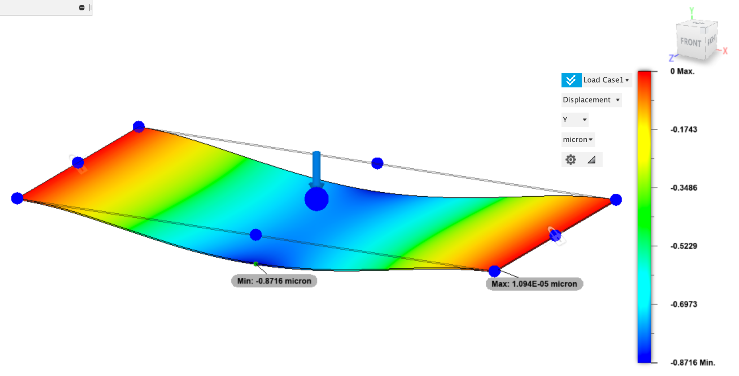
Static Simulation for an 8x4cm plate with Point Load=1.3mN at Center

Slide 57
CAD Backup Slides–Drawings

Slide 58
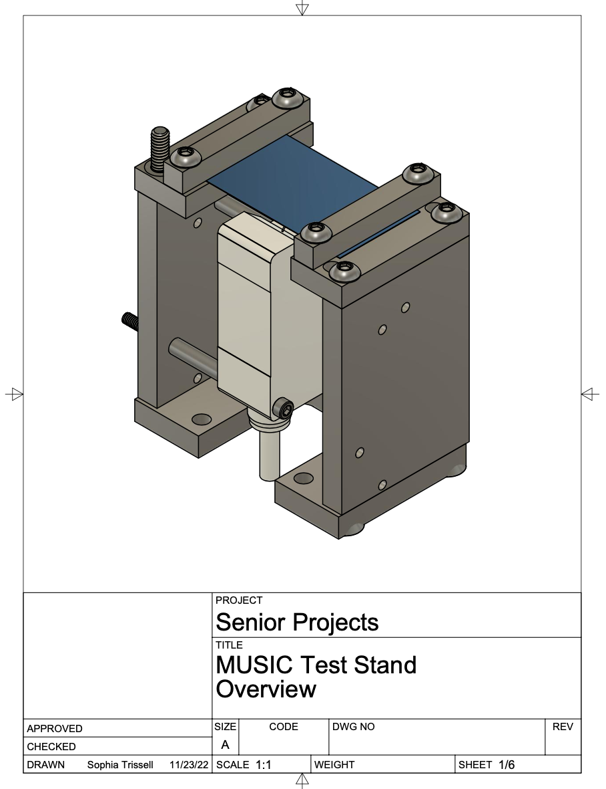
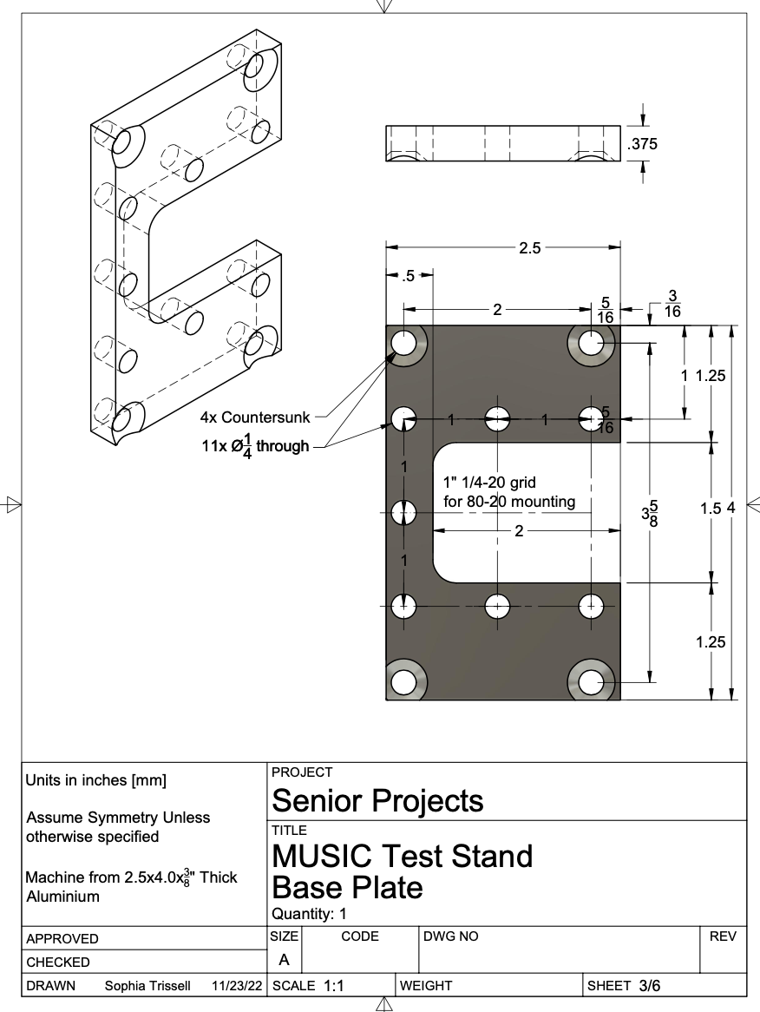
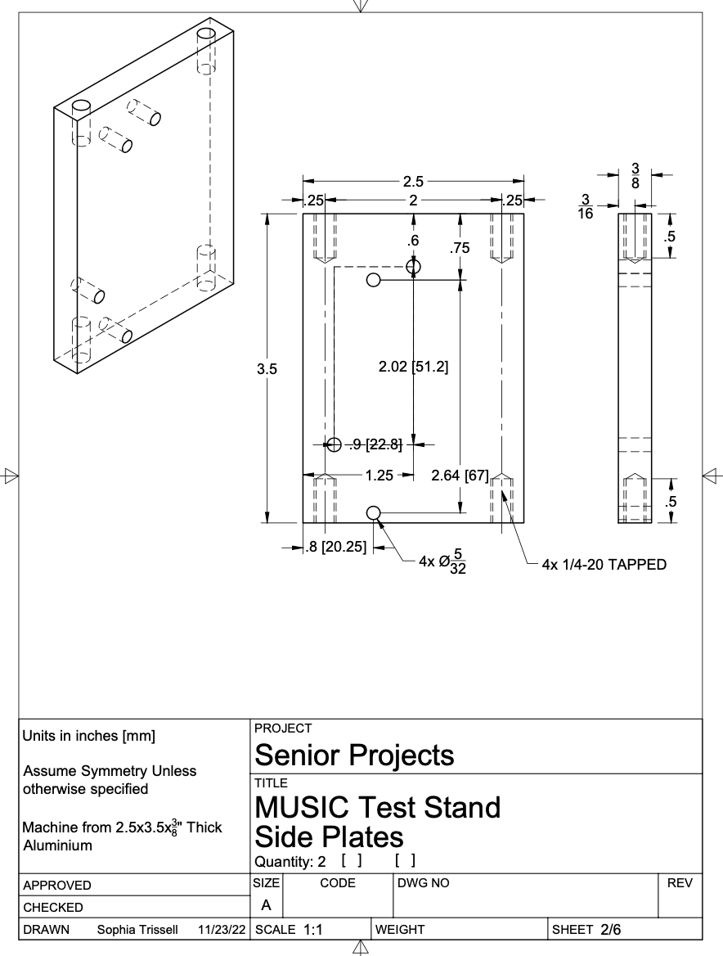

Slide 59
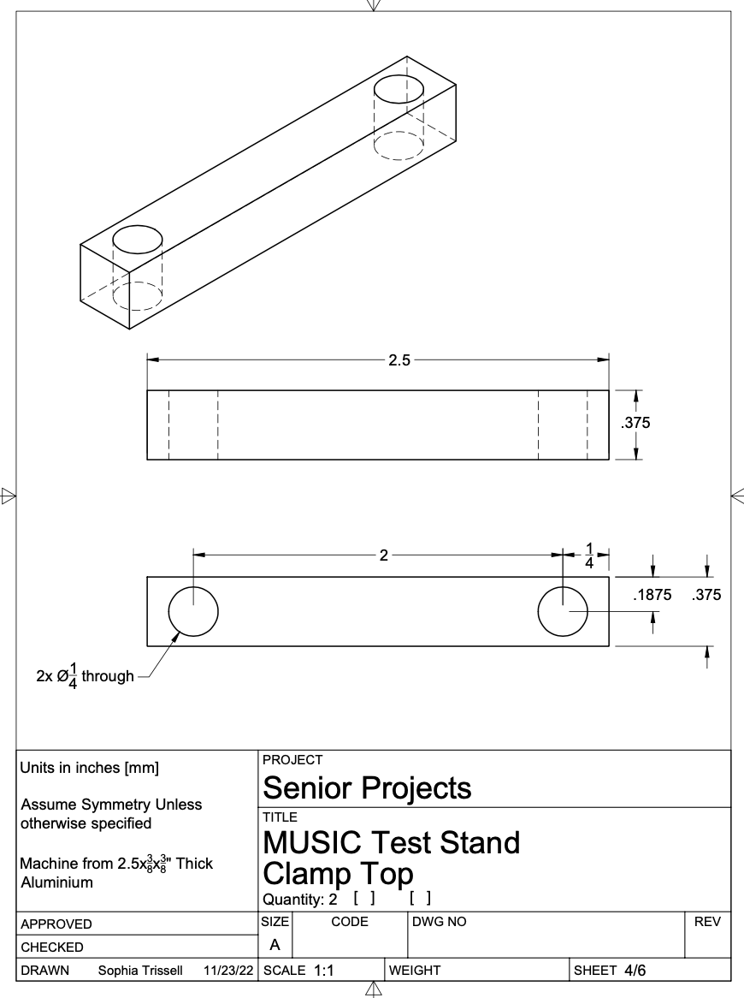
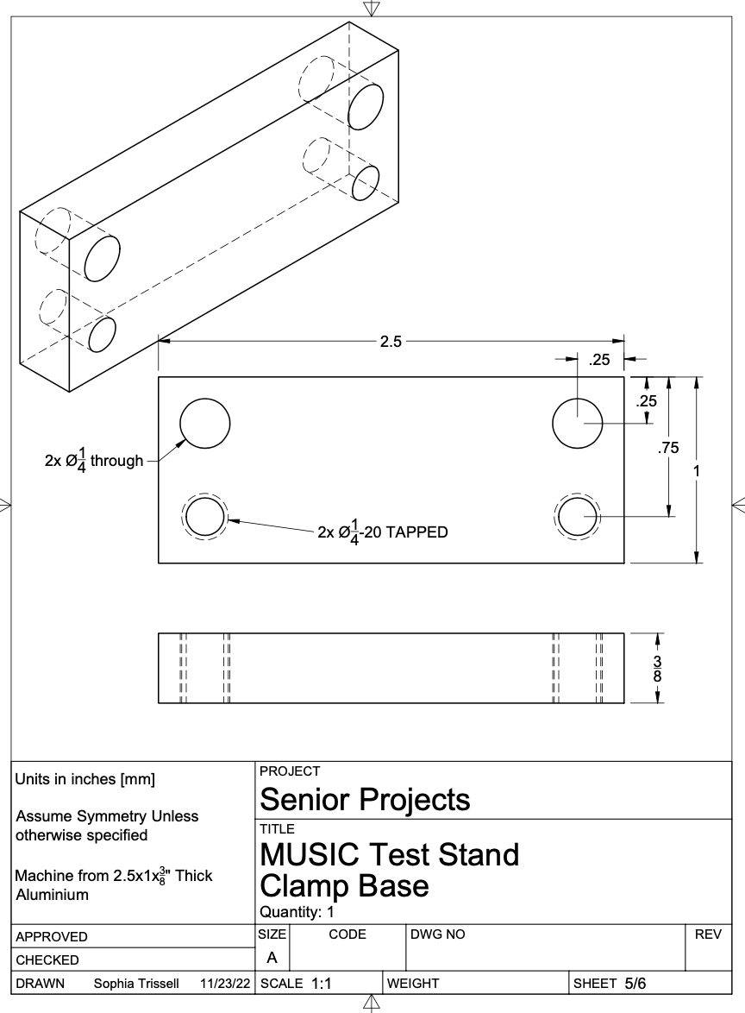
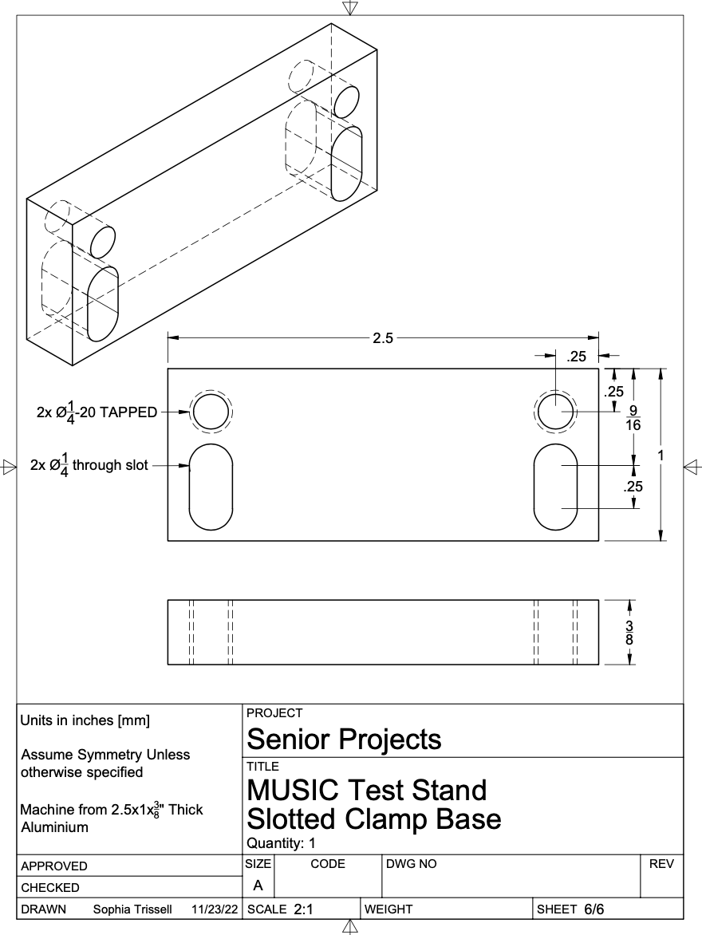

Slide 60
V & V Backup Slides

Slide 61
Preliminary Sensor Laboratory Requirements V & V
Level | Requirement validated
1 | The sensor shall be able to detect impacts with similar momentum to ice particles prior to vacuum chamber testing.
1 | The detection hardware shall be capable of operating at laboratory bench conditions.

Slide 62
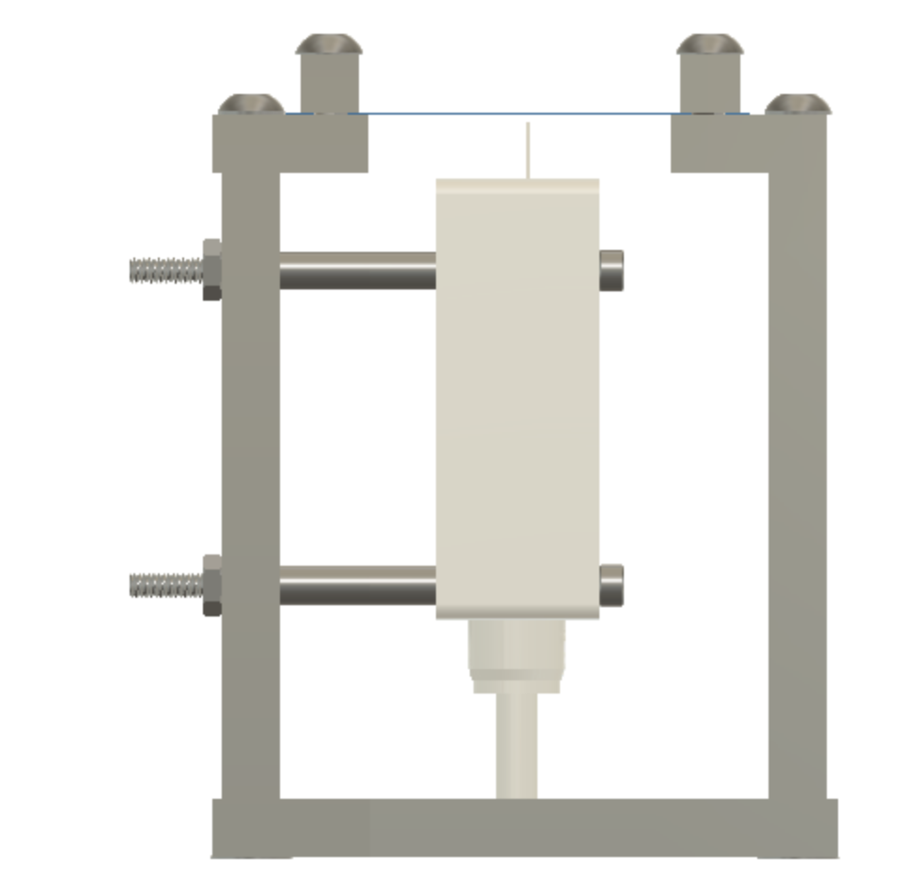
Preliminary Sensor Laboratory Testing Setup
4.6 mm
40°

Slide 63
Tabletop Impact Testing Requirement V & V
Level | Requirement validated
1 | The sensor shall be able to repeat tests of 100-1000 particle impacts.
1 | The sensor shall be able to withstand more than one particle impact at once.
1 | The system shall be able to measure the noise floor and be able to take this into account when measuring impacts.
2 | The sensor design shall be based in a computational model of the impacts.

Slide 64
Software Output Testing Requirement V & V
Level | Requirement validated
1 | The software shall be able to remove noise before analyzing data from impacts.
1 | The software shall be able to use data received to calculate the rate of impacts.
1 | The data will be displayed to an outside computer using the user program.
1 | The display shall show the rate of impacts over a 5 second time interval of received data.

Slide 65
Vacuum Chamber Survivability Testing
CU Autonomous Vehicle Systems (AVS) Lab
Objectives
Verify survivability and functionality in vacuum environment
Validate software noise reduction
Equipment
AVS vacuum chamber
Keyence sensor and controller unit
MUSIC housing
Python script
Acceptance Criteria
Vacuum chamber hardware remains intact and provides noise data output
Notes:
Displacement data exported as .xls file for further analysis

Slide 66
Final Product Testing
RadNet Medical Imaging
Objectives
Test full mission functionality with:
Vacuum chamber
Particle accelerator
Provide testing procedures
Equipment
Radnet vacuum chamber
Particle accelerator
Keyence sensor and controller unit
MUSIC housing
Python script
Test procedure documents
Acceptance Criteria
100% of level 1 requirements and 88% of level 2 requirements are achieved
Notes:
Displacement data exported as .xls file for further analysis
Move to backup(?)

Slide 67
Equipment for Different Testings
Equipment for Keyence Testing
Keyence sensor (provided)
MUSIC housing prototype
Test films
Aluminum foil
Saran wrap
Test particles
BB pellets
Salt
Sand
Equipment for Tabletop Testing
Keyence sensor
MUSIC housing
Test film
Test particles
BB pellets
Salt
Sand

Slide 68
Vacuum Chamber Survivability Testing Requirement V & V
Level | Requirement validated
2 | The sensor shall be able to operate in a near zero pressure environment (from about 25 - 1*10-9 Torr).
2 | The hardware shall connect to standard 9 and 15 pin data transfer cables.
1 | The software shall be able to remove noise before analyzing data from impacts.

Slide 69
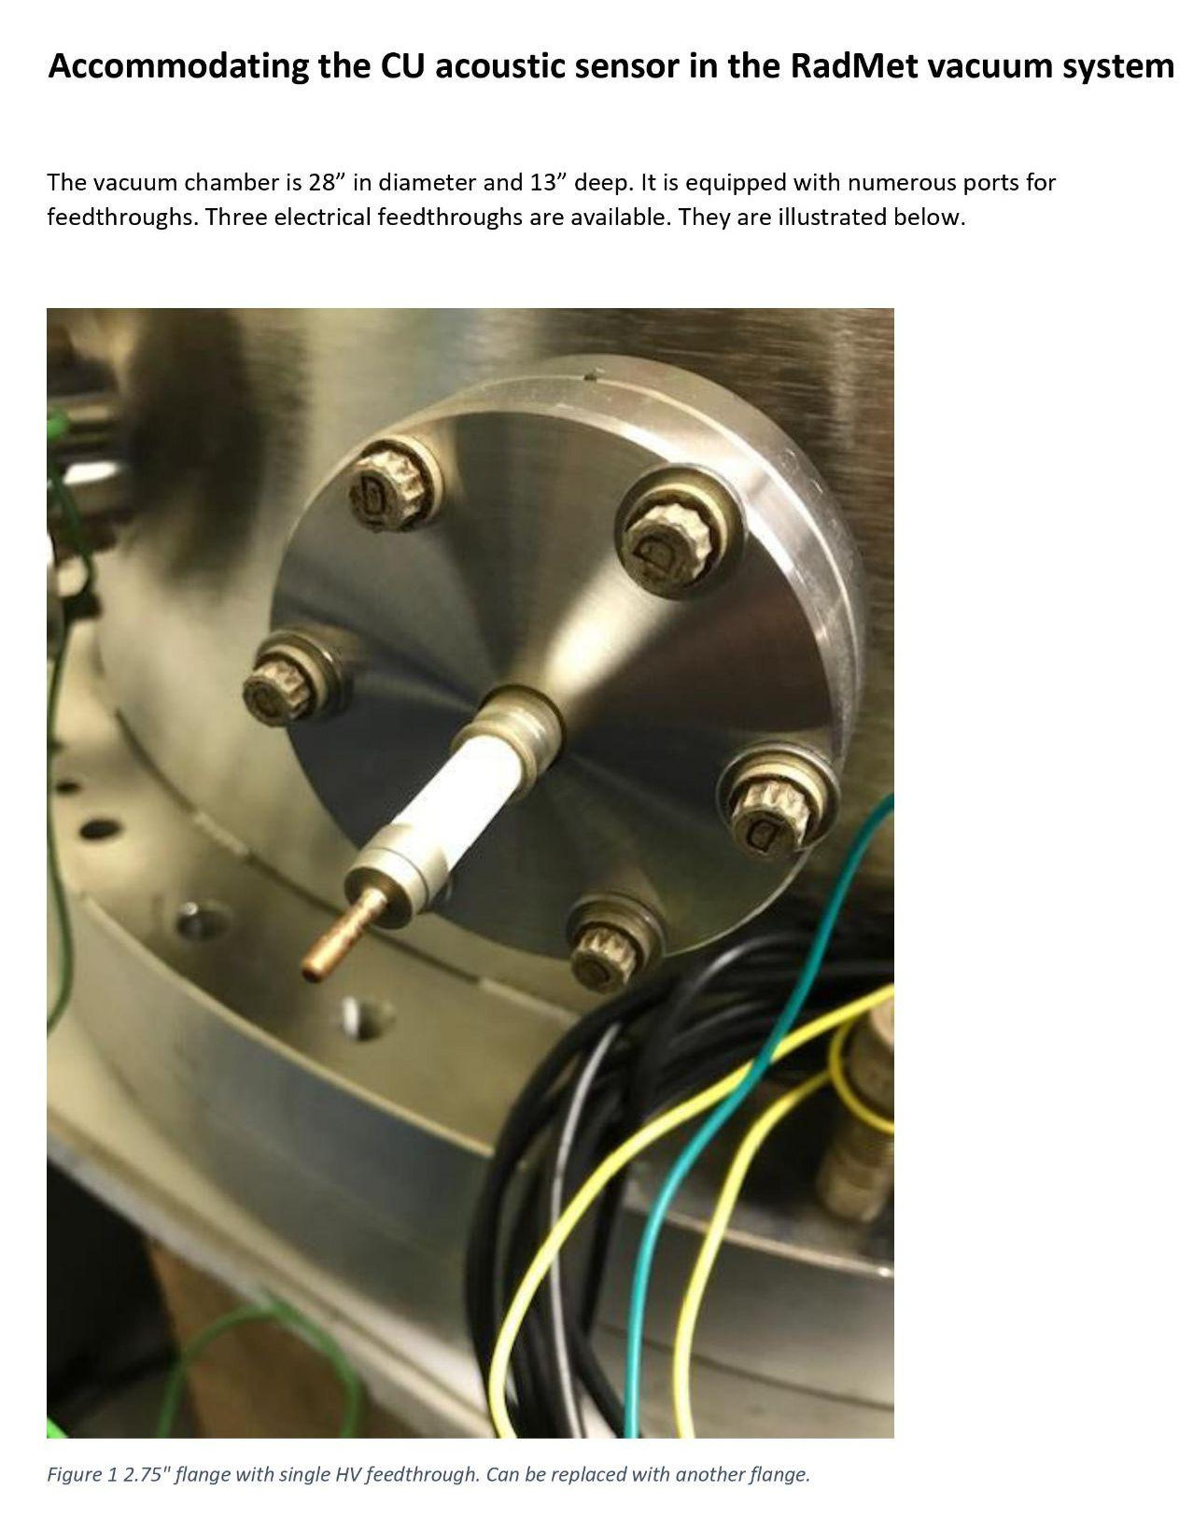
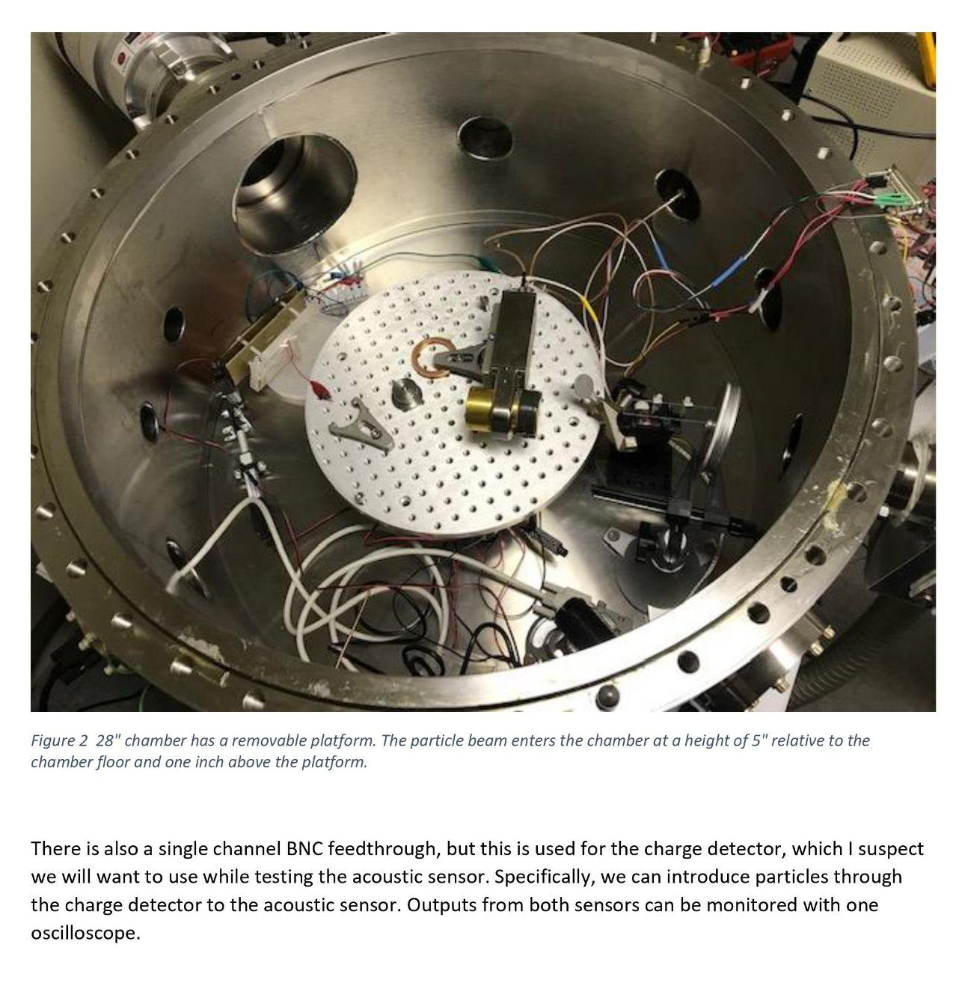
Customer Supplied Vacuum Chamber Testing Information

Slide 70
RadNet Vacuum Chamber Testing Information (cont.)

