Slide 1
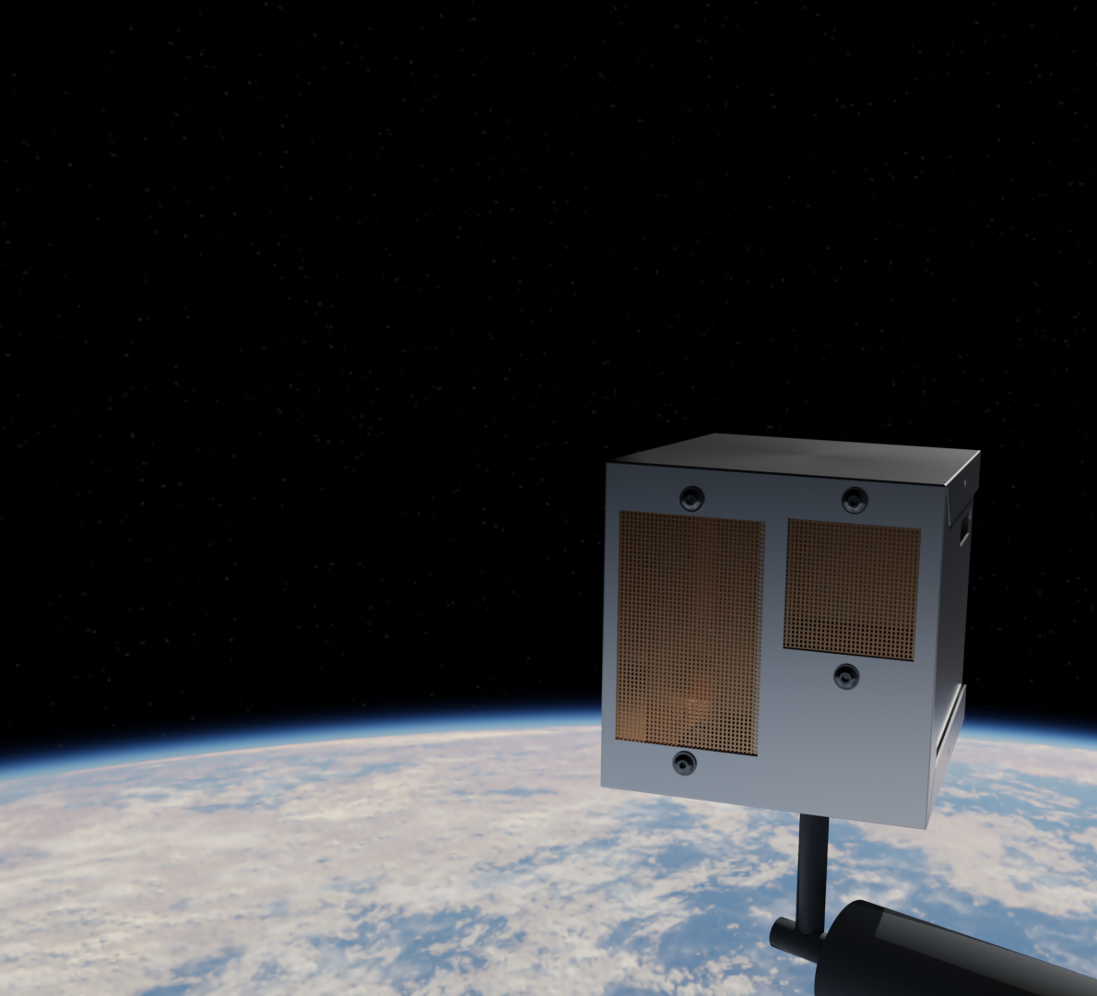
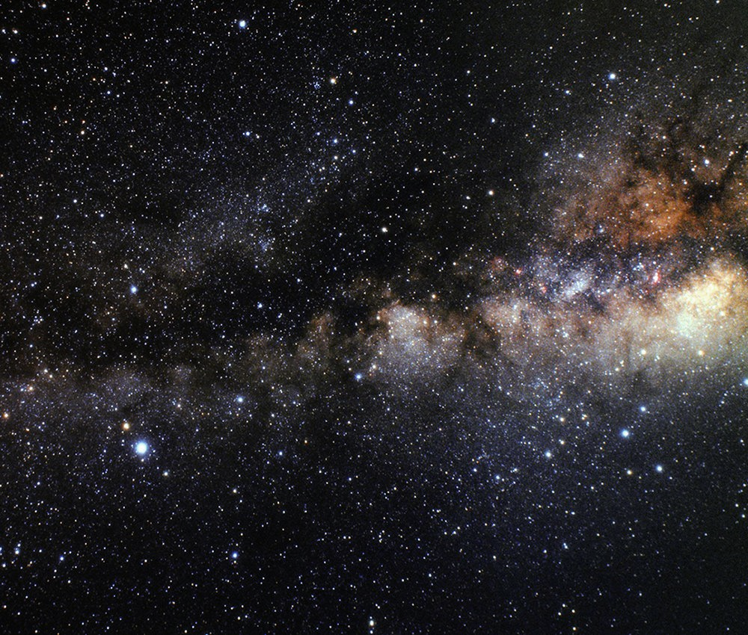

I²CE TRR
Group 12
Sponsored by: ASTROBi
Notes:
Brady Kopec, Kate Boykin, Lila Monprode, Reid Schneckenburger, Joe Miserlian, Jack Huston, Skylar Clark, Ben Esser, Ryan Bennett
Stuff the PDR needs to address:
• What is the purpose of the project and what are its specific objectives (measures of success)?
• What is the proposed design solution, and how does it work?
• What are the critical project elements for meeting the success criteria?
• What are the associated design requirements and how does the design satisfy them? Note: requirements at this time should have discrete values; for example ‘The spacecraft shall operate at a 44 gHz uplink.’ Or ‘The end of the robot arm shall deflect no more than 3 mm in the negative xdirection’
• What are the remaining risks and their mitigations?
• How will the design be verified and validated?
• How is the remaining work organized?

Slide 2
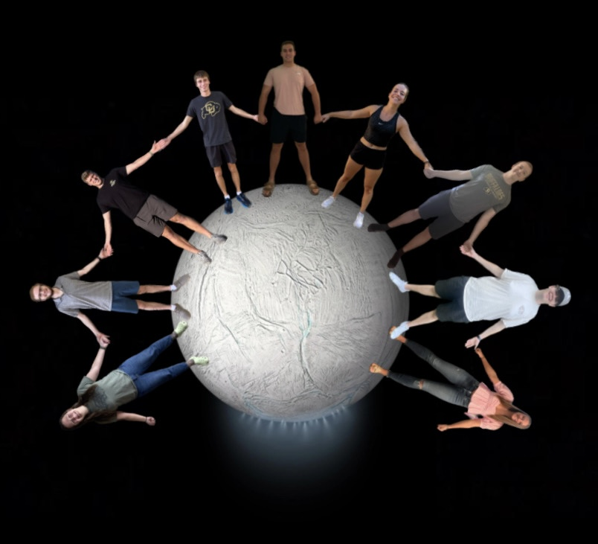
Skylar Jack Reid Joe Brady Kate Ben Ryan Lila
Overview
Schedule
Test Readiness
Budget

Slide 3
Overview

Slide 4
Project Definition
This project is to design and fabricate a proof-of-concept sensor capable of measuring the plume density of ice particles around Enceladus
Overview
Schedule
Test Readiness
Budget

Slide 5
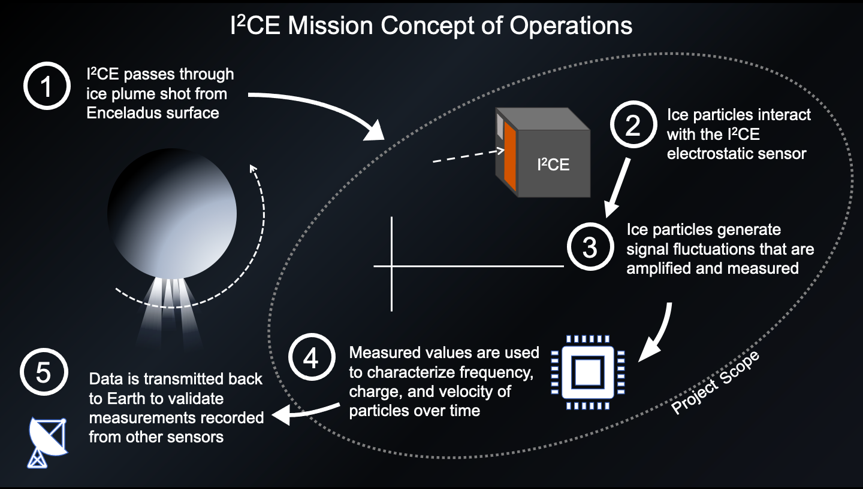

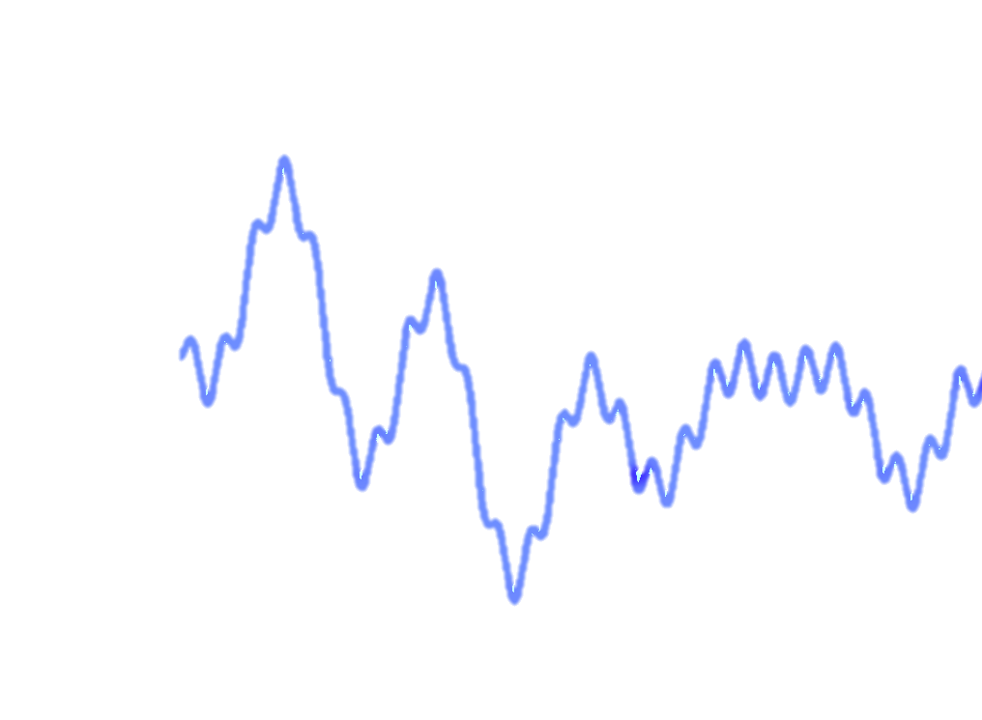
Overview
Schedule
Test Readiness
Budget

Slide 6
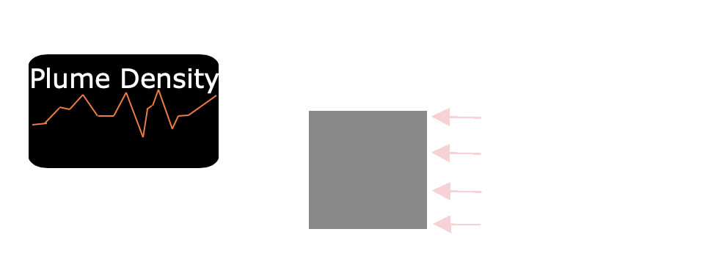
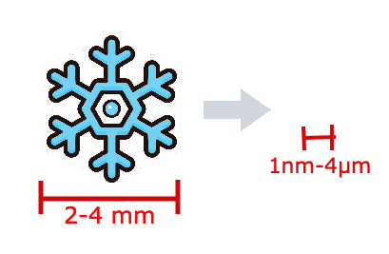
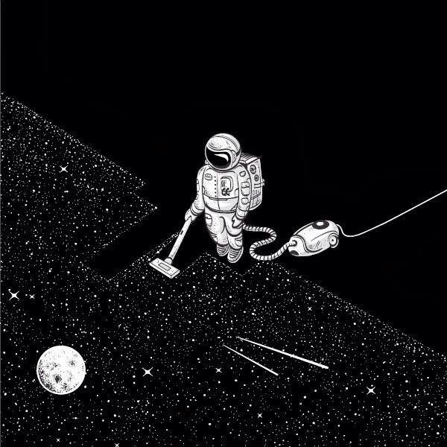
Primary Objectives
Measure incident particle flux over time
2) Detect particles from 0.5 μm to 4 μm in radius​
~1,000 – 1,000,000 times smaller
3) Operate in vacuum conditions
4) Develop Parametric Model to predict sensor performance
Overview
Schedule
Test Readiness
Budget
Notes:
Kate

Slide 7






Higher Level Objectives
Measure the speed and charge of particles of radius > 0.5 μm
$$v= ?$$
$$r$$
$$q= ?$$
60$°$
60$°$
Measure particles with an incidence angle of 60$°$ from sensor opening (120$°$ total FOV)
I²CE
Overview
Schedule
Test Readiness
Budget
Notes:
Kate

Slide 8
CPEs
Geyser Density Detection
  Measure particles per second incident to the spacecraft
  Used to prove that the spacecraft is flying through ice plume
Noise Mitigation
  Must reduce external noise
  Maximize usable data
Simulation
  Must quantitatively model the sensor response to incident ice particles
Overview
Schedule
Test Readiness
Budget
Notes:
Kate

Slide 9
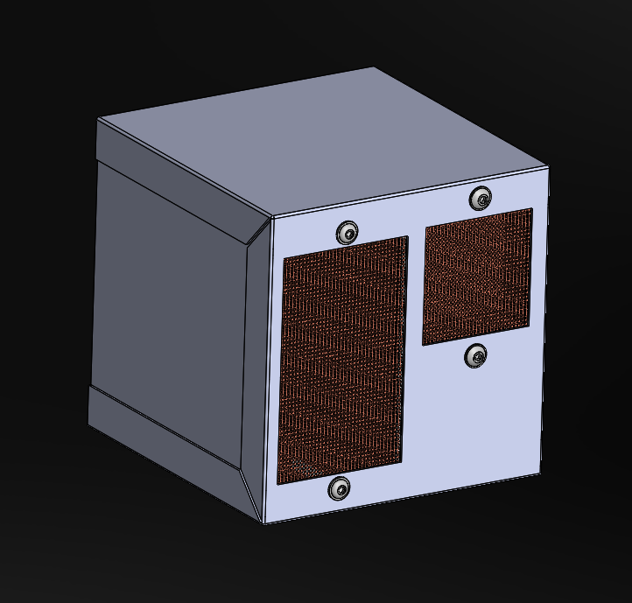
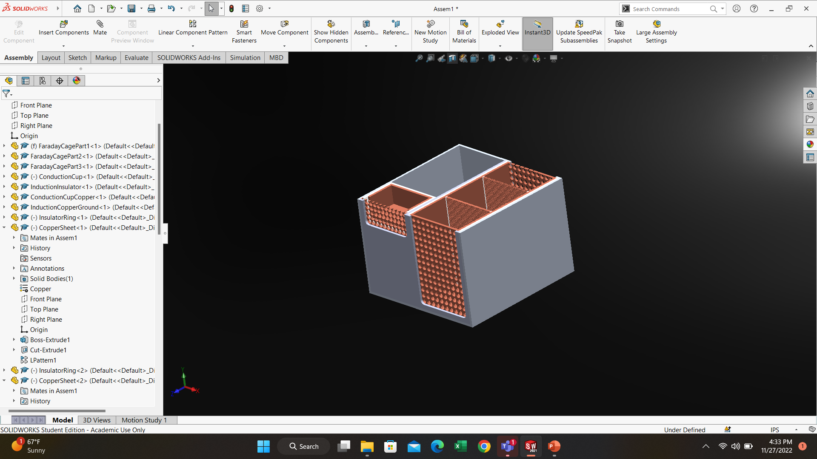
Final Design Solution
Copper Mesh
-Good electrical properties
Copper Wool
-Captures incident particles
ICE Particles
Insulating Material
-Prevents shorting of sensor
-Provides isolation
Aluminum
-Creates faraday cage
Overview
Schedule
Test Readiness
Budget
Notes:
10x10x10 cm
- we broke up our sensor into two main components- an electrostatic conduction and electrostatic induction apperatus.
-Copper wool is essentially steel wool made out of copper. This helps capture the incident particles. The mesh will be soldered on to the faraday cup.
-The aluminum case and external copper meshes (entry and exit of sensors) will create a faraday cage that isolates the electrical circuit and sensing grids within the box from external electrical noise.
-0.5-4 micrometers

Slide 10
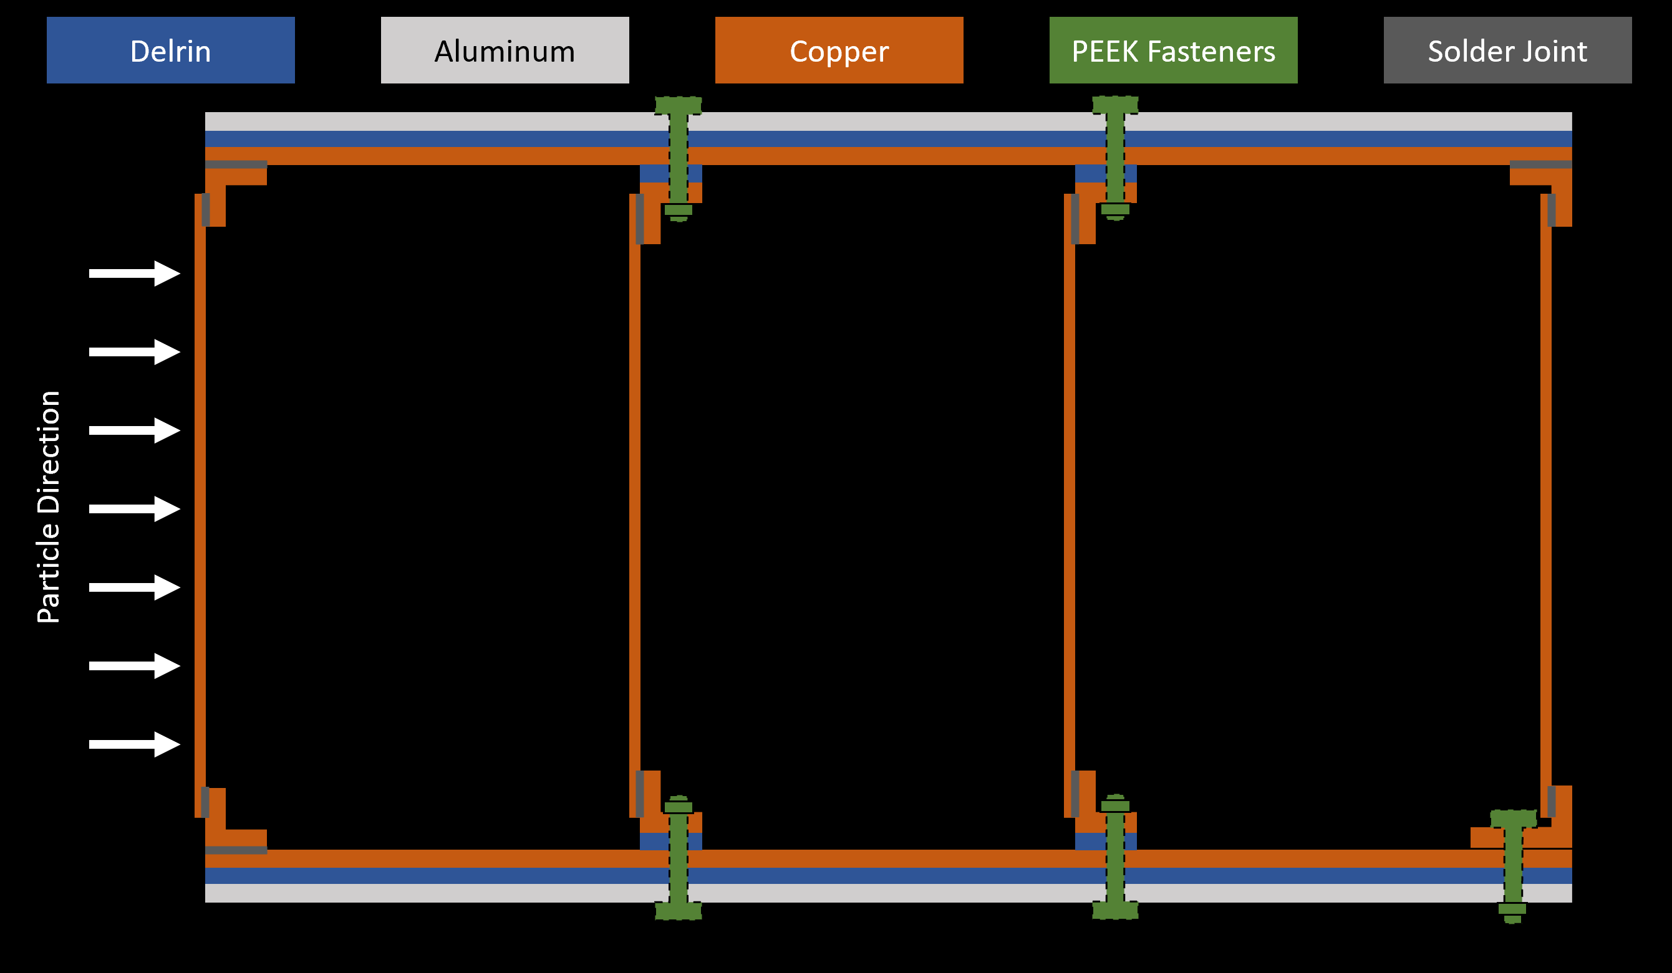
Design Updates from CDR
Major
  New induction sensing grid attachment method
  Updated grid mesh density
Minor
  New electrical components
    Resistors, capacitors, etc.
Overview
Schedule
Test Readiness
Budget

Slide 11
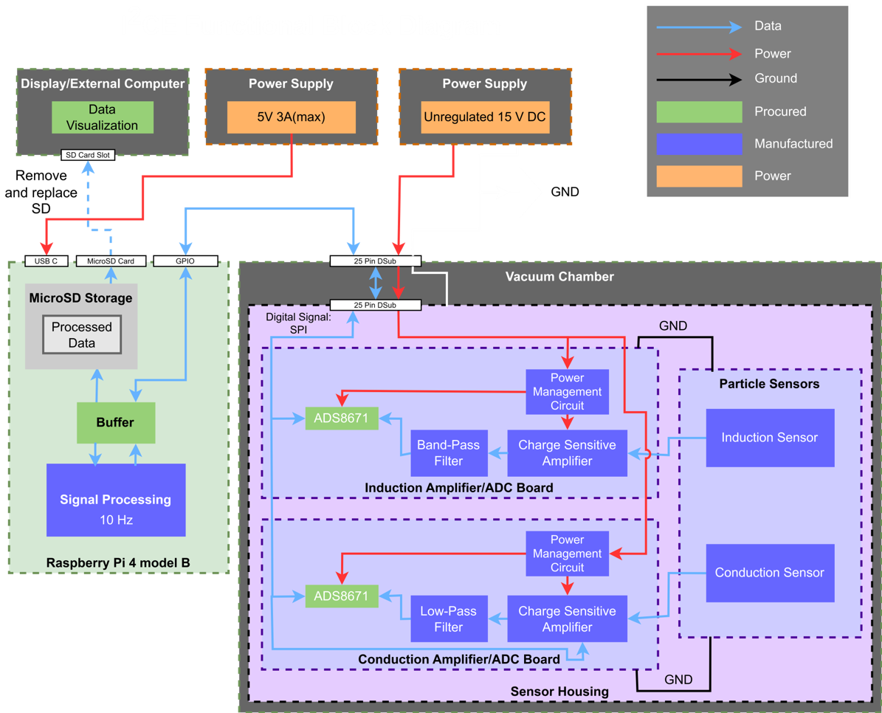
Overview
Schedule
Test Readiness
Budget

Slide 12
Schedule
Overview
Schedule
Test Readiness
Budget

Slide 13
Tests to be Performed
 | Complete Tests | Incomplete Tests
Component | ADC testing Manufacturing capability Electronics component verification
Subsystem | Convolution with accurate timing Direct charge on Breadboard ADC ←→ Raspberry Pi communications test PCB functional verification | Faraday cage verification Thermal assurance test Vacuum compatibility
System | Direct charge injection Open Air Induction PCB Vacuum Conduction PCB | Direct charge injection Open air test Vacuum chamber test (day in the life)
Overview
Schedule
Test Readiness
Budget
Notes:
Kate

Slide 14
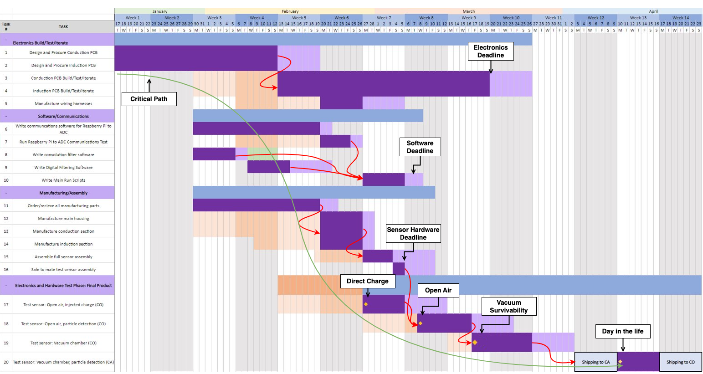
Semester Schedule
Overview
Schedule
Test Readiness
Budget

Slide 15
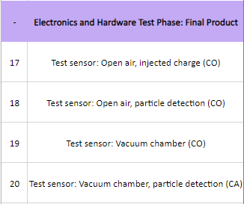
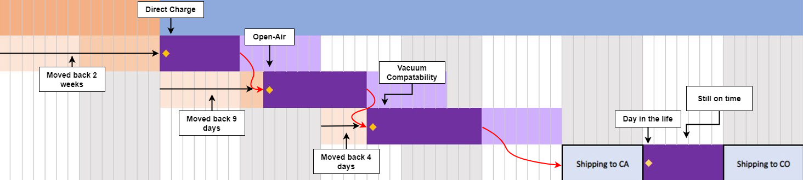
Test Schedule
Overview
Schedule
Test Readiness
Budget

Slide 16
Test Readiness
Overview
Schedule
Test Readiness
Budget

Slide 17
Test #1: Direct Charge Application
Overview
Schedule
Test Readiness
Budget

Slide 18
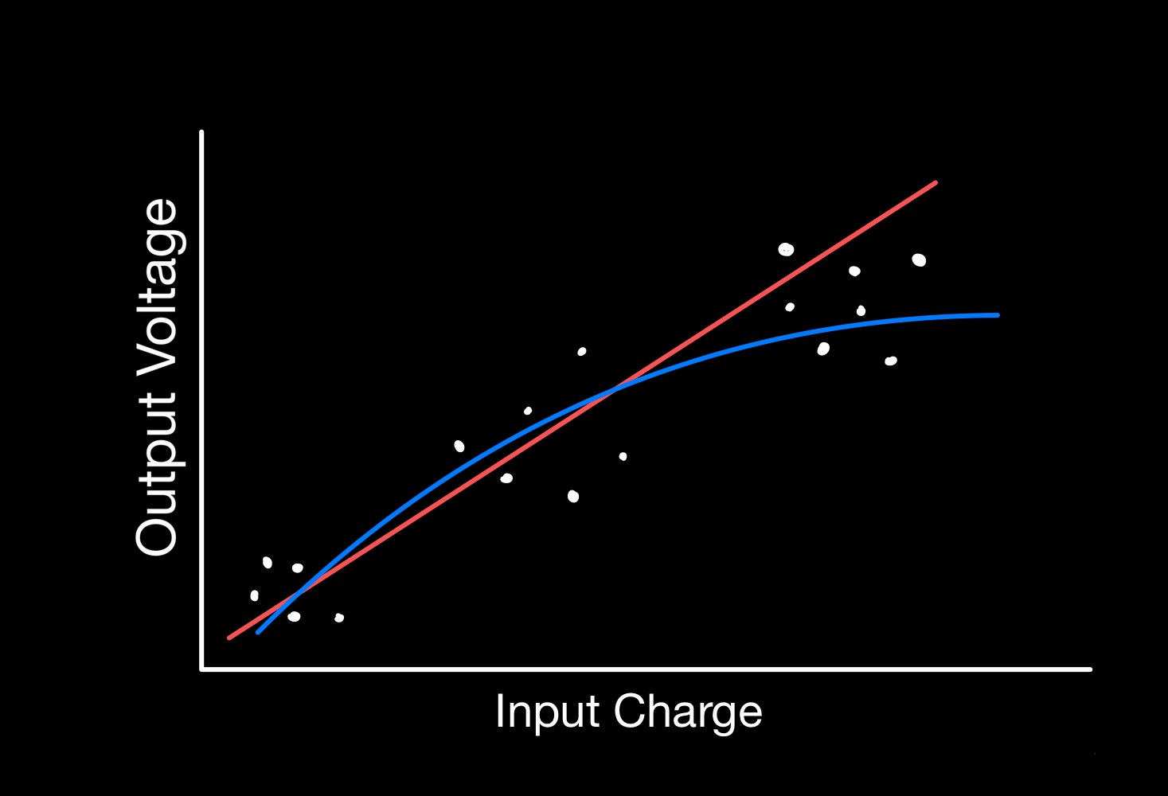
Testing Overview
Purpose
  Test the basic functionality of each PCB
  Create a calibration curve relating charge/voltage
Overview
  Expected charge is directly injected into the PCB via function generator
    Applying voltage across capacitor gives specified amount of charge
  Variation: Oscilloscope / Integrated System DAQ
    ADC and Raspberry Pi functionality
Overview
Schedule
Test Readiness
Budget

Slide 19

Testing Rationale – Requirements to be Verified
MO.3 : Minimize effects of noise
Electronics
Data Acquisition
2.2.4: System shall be capable of detecting and measuring transducer output
1.2.1: Shall filter out external noise
1.2.2: Shall send data in useable packets to human readable format
1.2.4: Sensor sampling rate shall be sufficient to capture required frequencies
Overview
Schedule
Test Readiness
Budget
Notes:
Define what we mean by SNR and noise

Slide 20


Critical Pre-requisite Testing
Electronics
Component
Verification
Breadboard
Direct
Charge
ADC & Raspberry Pi
Communications Test
PCB
Functional Verification
Overview
Schedule
Test Readiness
Budget

Slide 21
Definition of Success
Pass/Fail Criteria
  Success:
    Receive a signal out
    Detect events
  Failure:
    Sensor output does not react to input charge
    Output voltages are not unique for a given input charge
    System SNR is too low for valid testing
Expected Performance Results
 | Open Air - Conduction | Open Air - Induction | Vacuum - Conduction | Vacuum - Induction
Input Charge | 86 pC / s | 18pC | 86 pC / s | 0.5fC
Voltage Output | 4V | 2V | 4 V | 4V
Overview
Schedule
Test Readiness
Budget

Slide 22

Model Validation
t₁
Expected relationship between input charge and output voltage
  same shape as the input charge
Can compare expected signal with measured signal
t₂
t₃
t₄
charge
time
Overview
Schedule
Test Readiness
Budget

Slide 23
Model Validation
Overview
Schedule
Test Readiness
Budget

Slide 24
Model Validation
Calculate speed for particle with known speed
  Use shape and edges of signal
Compare calculated vs. input
Actual | 1 m/s
Calculated | 0.962 m/s
Percent Error | 3.8%
Overview
Schedule
Test Readiness
Budget

Slide 25



Scope – Test Setup
Equipment
Data Acquisition
  With integrated DAQ
    Digital signal output as .csv file
  Without integrated DAQ
    PCB probed at test point
    Routed to oscilloscope and saved to .csv or equivalent
  Power Supply
  Wave Generator
  Oscilloscope
  Grounded Faraday Cage
  ESD mat and wrist strap
Overview
Schedule
Test Readiness
Budget

Slide 26
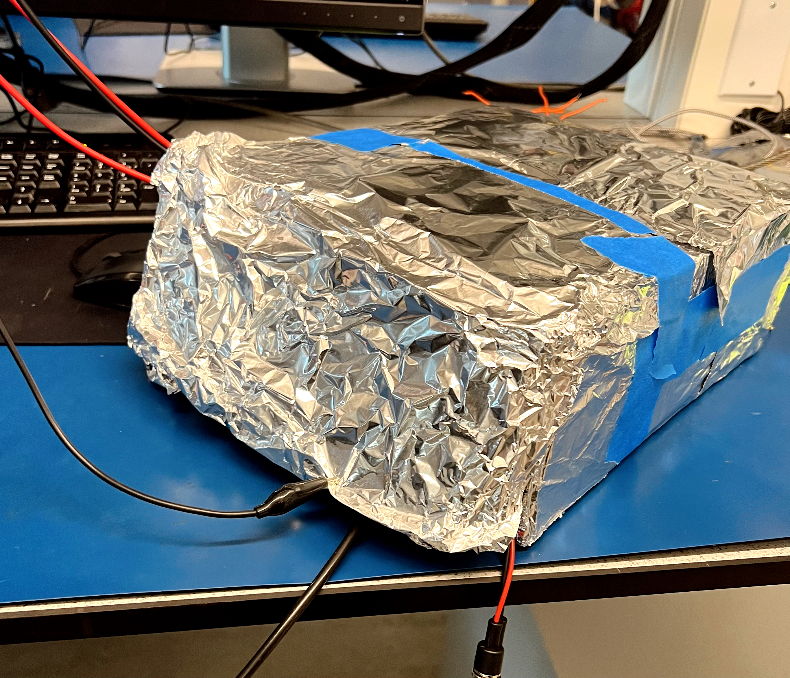
Scope – General Test Procedure
Connect PCB to
  Power Supply
  Wave Generator
  Oscilloscope / Raspberry Pi
Place PCB inside of grounded faraday cage
Verify connections and grounds
Input desired charge signal
Collect Analog / Digital Data
Remove that
Overview
Schedule
Test Readiness
Budget

Slide 27
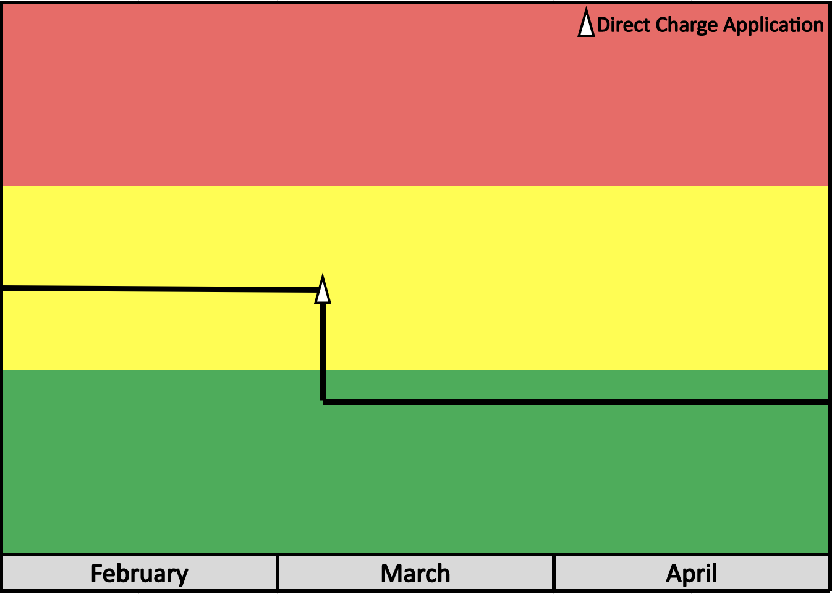
Reducing Risk
Signal to Noise Ratio Too Low
High
Before Direct Charge Application
Risk Level
After Direct Charge Application
Low
Overview
Schedule
Test Readiness
Budget
Notes:
After performing test, SNR will be meaningful enough to get significant, accurate data -> defined by pass criteria of test

Slide 28
Test #2: Open Air Test
Overview
Schedule
Test Readiness
Budget

Slide 29
Testing Overview
Purpose
  Verify intersystem compatibility
    Mechanical system relays signal to the open-air PCB
    Digital signal is recorded via Raspberry Pi
  Verify velocity estimation algorithm
Overview
  Small water droplets are released above the sensor
    Variation of heights / velocities
    Test does not depend on droplet size
  Droplets transfer charge to sensor
  Electronics will amplify and convert this charge to a voltage
Overview
Schedule
Test Readiness
Budget
Notes:
Qualitative not quantitative verification

Slide 30
Testing Rationale
MO.1: Sensor shall detect particles
Test Design
Data Acquisition
1.1.1.1: Sensor shall detect presence of incident charged particles
3.1.2: Conduction section shall detect particles from 0 to 60 degrees incident angle
1.2.1: Shall filter out external noise
1.2.2: Shall send data in useable packets to human readable format
3.5.1: Shall receive data from sensor and perform input signal analyses to determine particle characteristics at 10 Hz
Overview
Schedule
Test Readiness
Budget

Slide 31

Critical Pre-requisite Testing
Direct Charge Pre-Reqs
Direct Charge Injection
Faraday Cage Verification
Overview
Schedule
Test Readiness
Budget

Slide 32

Definition of Success
Pass/Fail Criteria
Success:
  Signal output shape matches model
  Sensor accepts all particles within 60$°$ incident angle
Failure:
  No signal detected
  Results do not meet expected performance
Expected Performance Results
  Conduction: Stair Step / Linear Increase
  Induction: Trapezoid
Overview
Schedule
Test Readiness
Budget
Notes:
Whoever does this slide needs to understand how/why the expected results are the same but for a different reason
Not directly imputing a trapezoid, but assuming that’s what the result of a particle impact should owlook like
Happens because of physics (charge induction and charge transfer for conduction)

Slide 33





Scope – Test Setup
Equipment
Data Acquisition
  Pipette
  Clamps
  Water
  Ruler
  Video recording device
  Raspberry Pi
    Connected to sensor via D-Sub
    Connected to master computer via ethernet
  Computer
Overview
Schedule
Test Readiness
Budget
Notes:
LOGGER PRO!!!!!

Slide 34

Scope – Test Procedure
Mount sensor and pipette
Set up camera to record water falling
Drop water droplets into sensor
  Induction: Five testing heights, ten drops each
  Conduction: Five testing heights, ten drops each, test angles at ±60° in two axes of rotation
Record data via Raspberry Pi
Overview
Schedule
Test Readiness
Budget

Slide 35
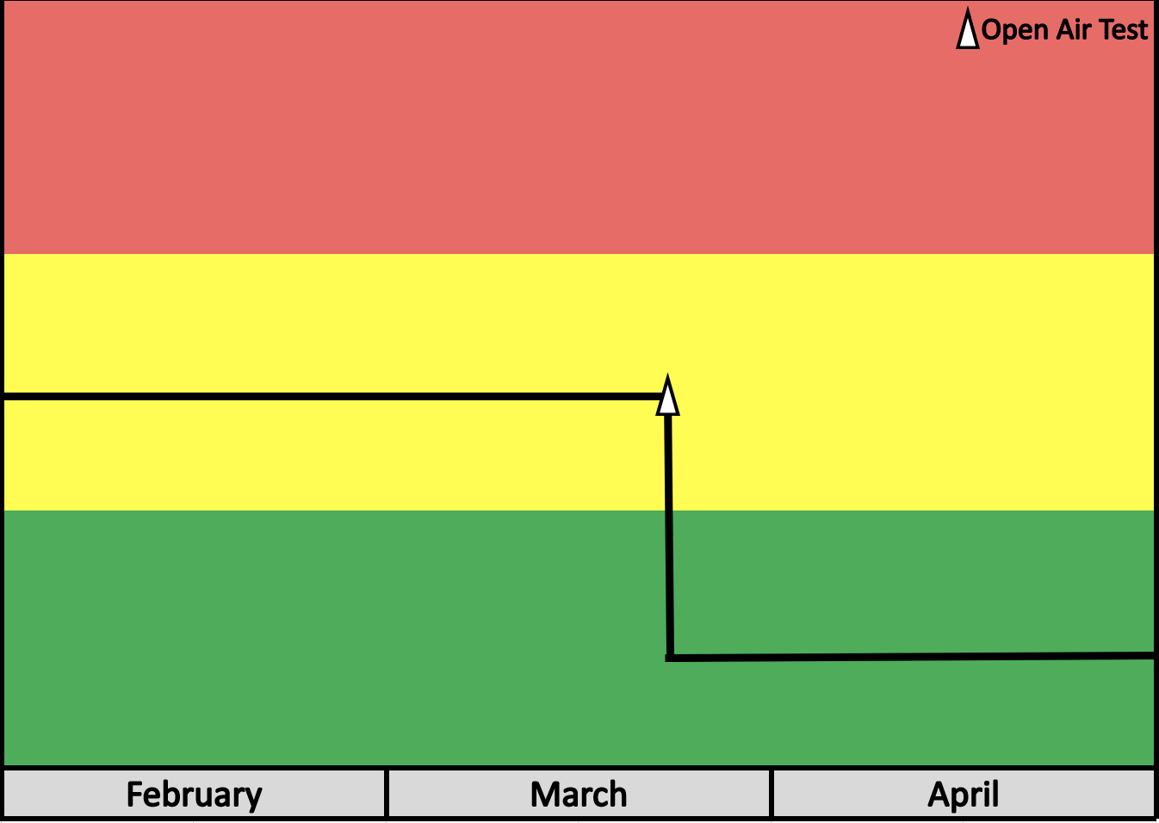
Reducing Risk
Cannot Detect Individual Particles
High
Before Open Air Test
Risk Level
Low
After Open Air Test
Overview
Schedule
Test Readiness
Budget

Slide 36
Test #3: Vacuum Chamber Test
(Day in the Life)
Overview
Schedule
Test Readiness
Budget

Slide 37
Testing Overview
Purpose
  Verify sensor can detect particles with similar charge and speed like those found around Enceladus
Overview
  Particles will be given a charge equivalent to particles around Enceladus
  Particle launcher will be used to accelerate particles at induction and conduction sensors
  Results will be read and processed by the Raspberry Pi outside the vacuum chamber
Overview
Schedule
Test Readiness
Budget

Slide 38
Testing Rationale
MO.4: Perform vacuum chamber test
Vacuum Compatibility
Enceladus Environment
1.1.3: Shall be electrically compatible to the vacuum chamber
1.1.4: Shall be physically compatible to the vacuum chamber
1.1.5: Shall be able to dissipate all heat that is generated
1.1.1.2: Sensor shall detect presence of incident charged particles of sizes 0.5 to 4 micrometers
1.1.2: Sensor shall react to incident particles with relative velocities from 100 to 300 m/s
Overview
Schedule
Test Readiness
Budget

Slide 39
Critical Pre-requisite Testing
Open Air Test
Thermal Assurance Test
Vacuum Compatibility
Overview
Schedule
Test Readiness
Budget

Slide 40
Definition of Success
Pass/Fail Criteria
Success:
  Sensor reacts to particle flux
Failure:
  Sensor does not react to particle flux
  PCBs overheats/fails
Expected Performance Results
Induction Sensor: Detects charge and speed of particles within +/- 10%
Conduction Sensor: Detects charge flux of particles within +/- 10%
Overview
Schedule
Test Readiness
Budget

Slide 41


Scope – Test Setup
Equipment
Data Acquisition
  Raspberry Pi
    Connected to sensor via D-Sub
    Connected to master computer via ethernet
  Computer
Completed sensor
Vacuum Chamber & Particle Launcher
Power Supply
Wire Harnesses & Cables
Overview
Schedule
Test Readiness
Budget

Slide 42
Scope – Test Procedure
Confirm safe arrival of components
Place the sensor within the vacuum chamber
Assemble & connect wire harnesses
Ensure conduction sensor is aligned with particle launcher
Power on Raspberry Pi and confirm communication with sensor
Pull vacuum and begin particle launch procedure with data collection
Repeat steps 4-7 for induction sensor
Overview
Schedule
Test Readiness
Budget

Slide 43
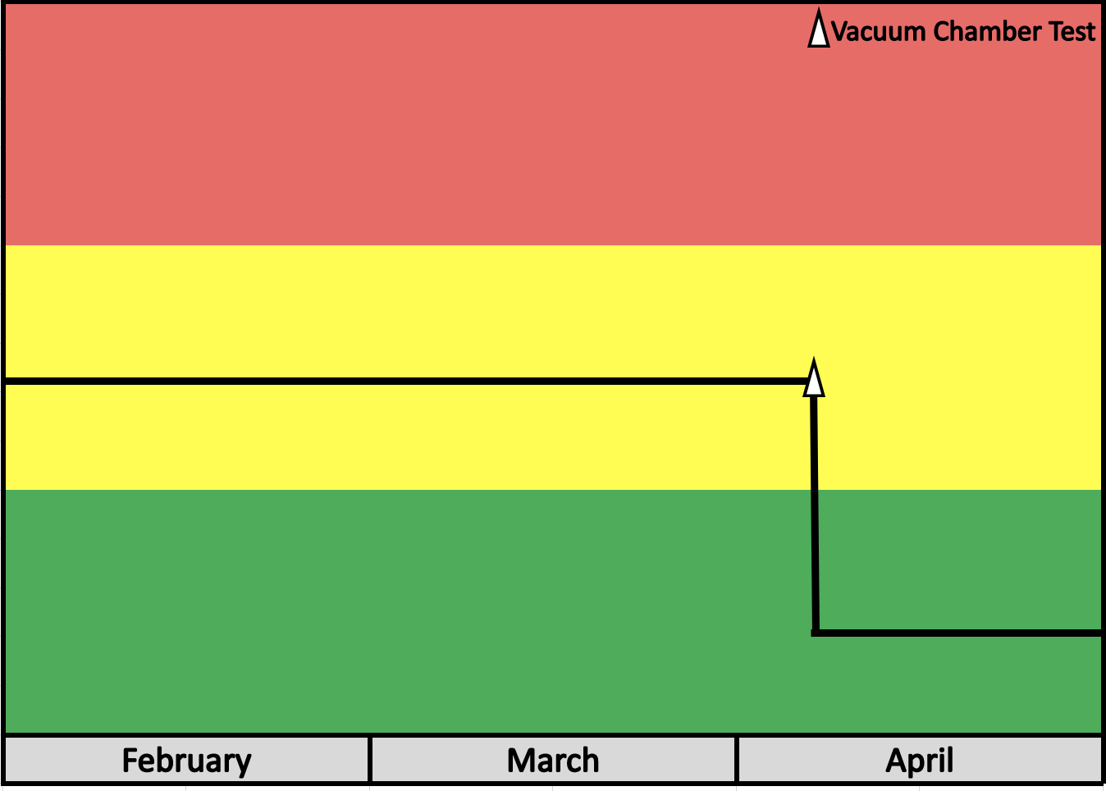
Reducing Risk
Cannot Detect Particles of Expected Charge
High
Risk Level
Before Vacuum Chamber Test
Low
After Vacuum Chamber Test
Overview
Schedule
Test Readiness
Budget

Slide 44
Budget
Overview
Schedule
Test Readiness
Budget

Slide 45
Budget Overview
Total Budget | + $4000.00
CU Toolbox Safety Deposit | - $200.00
Previous Project Spending | -$1871.34
Future Spending | -$1030.00
Remaining Margin | +$898.66
Overview
Schedule
Test Readiness
Budget

Slide 46
Previous Spending
Mechanical
$578.61
30.9%
Subsystem | Amount
Electronics | $1005.80
Computing | $286.93
Mechanical/Manufacturing | $578.61
Total Spent | $1871.34
Electronics
$1005.80
53.7%
Computing
$286.93
15.3%
Overview
Schedule
Test Readiness
Budget

Slide 47
Future Spending & Margin
PCB Iterations
$430.00
22.3%
Items | Amount :
PCB Iterations (5) | -$430
Electronics Margin | -$200
Shipping & Insurance | -$400
Total | -$1030
Margin
$898.66
46.6%
Elec. Margin
$200.00
10.4%
Shipping & Insurance
$400.00
20.7%
Undesignated Remainder: | $898.66
Overview
Schedule
Test Readiness
Budget

Slide 48
Final Budget
Electronics
$1005.80
25.1%
CU Safety Deposit
$200
5%
Future Electronics
$630
15.8%
Shipping & Insurance
$400
10%
Computing
$286.93
7.2%
Overview
Schedule
Test Readiness
Budget

Slide 49
Thank you for listening!
Special thanks to:
Advisor: Dr. Erik Knudsen
Sponsor: Erik Buehler & ASTROBi Foundation
Course Coordinators: Dr. Kathryn Wingate & Chris Muldrow
Lab Directors: Trudy Schwartz, Bobby Hodgkinson, Matt Rhode, Nate Coyle
Dr. Zoltan Sternovsky
The Senior Project Advisory Board

Slide 50
Backup Slides

Slide 51
Functional Requirements
1.1: The sensor shall detect amplitude of incident ice particles over time.
1.2: The sensor shall relate amplitude to particle size for a given speed.
1.3: The sensor shall operate in near perfect vacuum conditions.
1.4: The sensor shall dissipate no more than 10W power.
1.5: The sensor shall determine the average impact rate of ice particles.
1.6: The sensor shall determine individual particle charge.
1.7: The sensor shall fit within the provided vacuum chamber.
1.8: The team shall develop a parametric model for predicting the real response of the ice particle impact dynamics on the incident surface

Slide 52
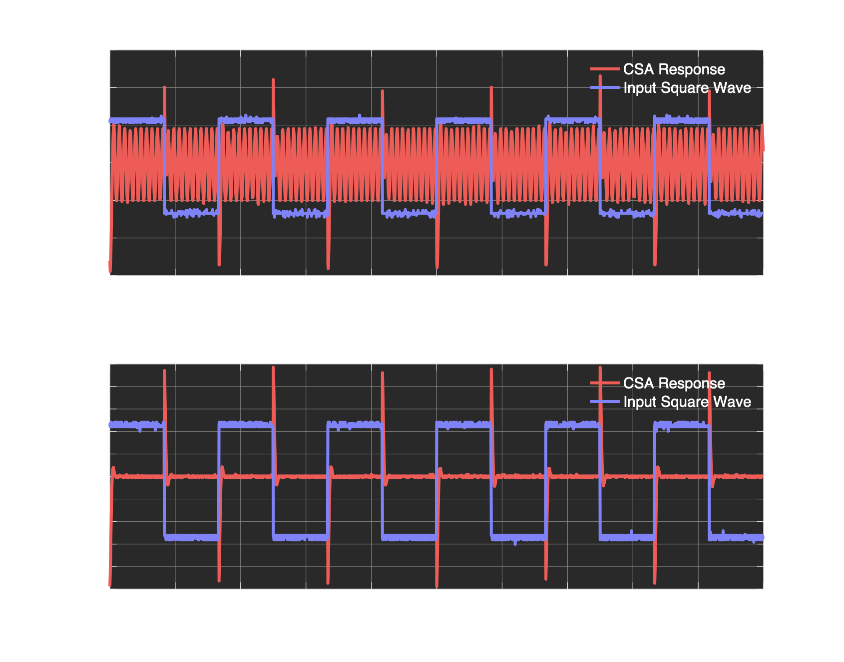
CSA – Impact of Faraday Cage
Noise Mitigation Implementation

Slide 53
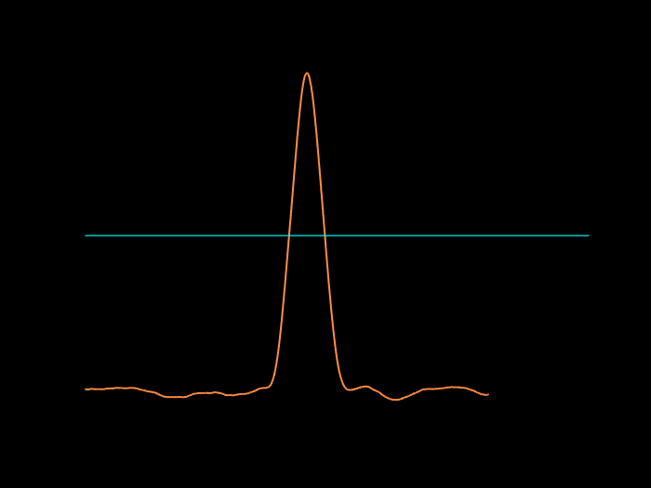
Event Detection - Convolution
Threshold
Notes:
Joe

Slide 54
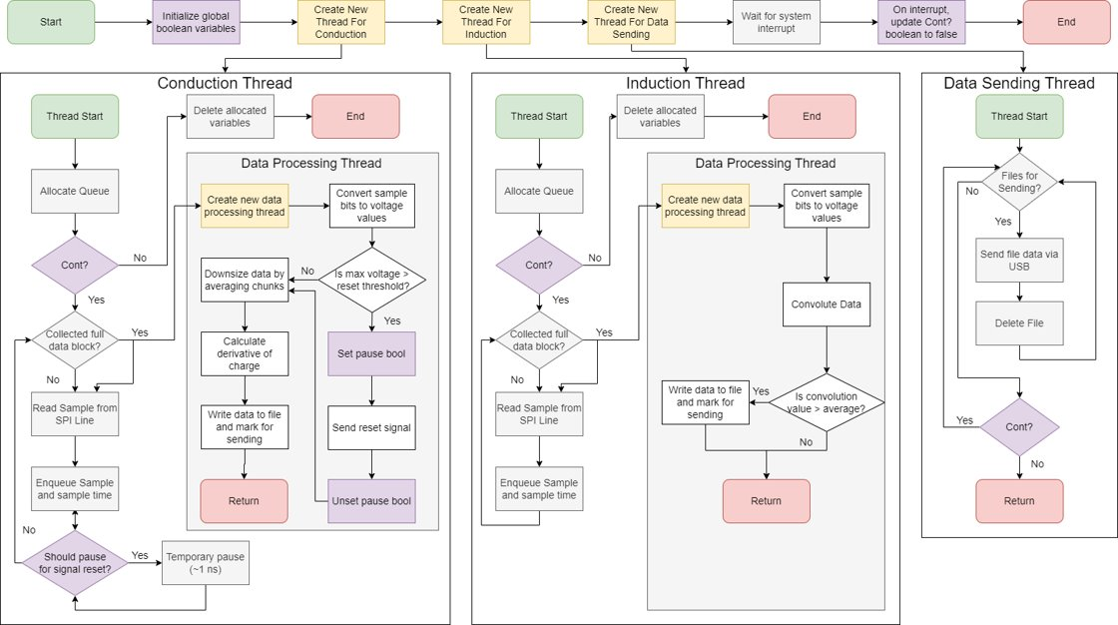

Slide 55
Charge Based Sensing
Particles have an inherent, measurable charge
Combination of two charge detection methods:
Electrostatic Conduction | Induction
Best for bulk charge Heritage: Parker Solar Probe, Cassini | Best for large, individual particles Heritage: Cassini
Purpose & Objectives
Design Solution
CPE's & Risks
Requirements & Satisfaction
Verification & Validation
Project Planning
Notes:
Detailed discussion on differences between Conduction and Induction sensing?
Why are we using induction if conduction meets our requirements? It helps us characterize the velocity and size of the larger particles we encounter. This is important as larger particles will be more likely to contain frozen single cell organisms that Astrobi is concerned with.

Slide 56
Charge Based Sensing - Conduction
Conduction Based – Faraday’s Cup
Incident particles impact sensor face, some charge is transferred
Sensor face is discharged periodically
Cannot measure individual particles
  Measures total charge density
Conduction
Ice Particles
Purpose & Objectives
Design Solution
CPE's & Risks
Requirements & Satisfaction
Verification & Validation
Project Planning

Slide 57
Charge Based Sensing - Induction
Induction Based – Mesh Grid
  Negatively charged particles fly through a conductive wire grid
  Particles induce a charge in the grid
  Measurements of integrated electrons show particle charge
Measures speed
Purpose & Objectives
Design Solution
CPE's & Risks
Requirements & Satisfaction
Verification & Validation
Project Planning
Notes:
Do not talk about induced current, talk about induced charge in the mesh grid. This is what the charge sensitive amplifier measures.
-Talk aobut electrostatic physics
-Why do we car about

Slide 58
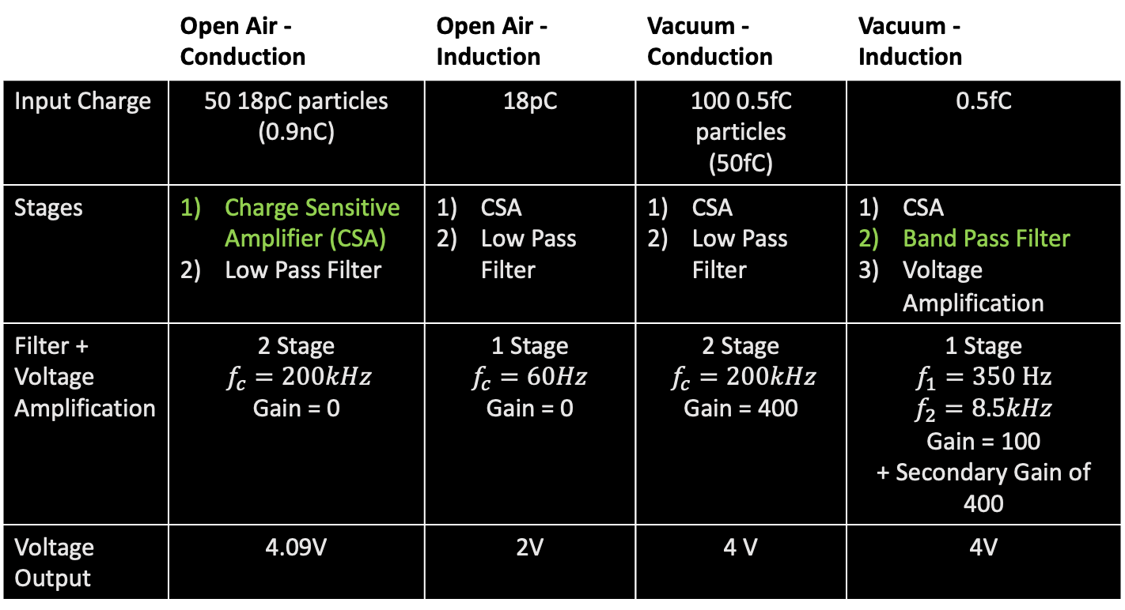
Circuit Specifications
 | Open Air - Conduction | Open Air - Induction | Vacuum - Conduction | Vacuum - Induction
Input Charge | 50 18pC particles (0.9nC) | 18pC | 100 0.5fC particles (50fC) | 0.5fC
Stages | Charge Sensitive Amplifier (CSA) Low Pass Filter | CSA Low Pass Filter | CSA Low Pass Filter | CSA Band Pass Filter Voltage Amplification
Filter + Voltage Amplification | 2 Stage $f_{c}=200kHz$ Gain = 0 | 1 Stage $$f_{c}=60Hz$$ Gain = 0 | 2 Stage $f_{c}=200kHz$ Gain = 400 | 1 Stage $$f_{1}=350 Hz$$ $$f_{2}=8.5kHz$$ Gain = 100 + Secondary Gain of 400
Voltage Output | 4.09V | 2V | 4 V | 4V
Notes:
FOCUS on the differences without going into detail on each box
Difference between Open Air and Vacuum tests to be detailed later

Slide 59
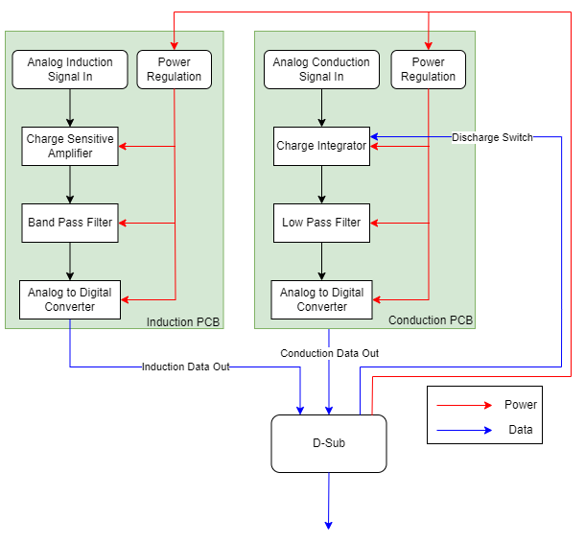
PCB Functional Block Diagram
Two PCBs inside the vacuum chamber
D-Sub leads to and from the Raspberry Pi
Each PCB will have a Vacuum and Open-Air Design
  4 total PCBs designed

Slide 60
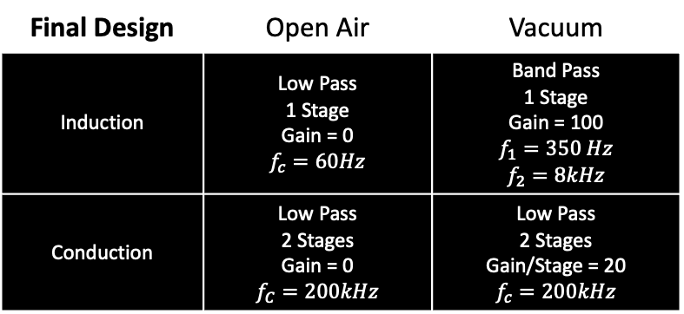
Filter Creation
Final Design | Open Air | Vacuum
Induction | Low Pass 1 Stage Gain = 0 $$f_{c}=60Hz$$ | Band Pass 1 Stage Gain = 100 $$f_{1}=350 Hz$$ $$f_{2}=8kHz$$
Conduction | Low Pass 2 Stages Gain = 0 $$f_{C}=200kHz$$ | Low Pass 2 Stages Gain/Stage = 20 $$f_{c}=200kHz$$
Anti-Aliasing / Lab Noise filtering

Slide 61
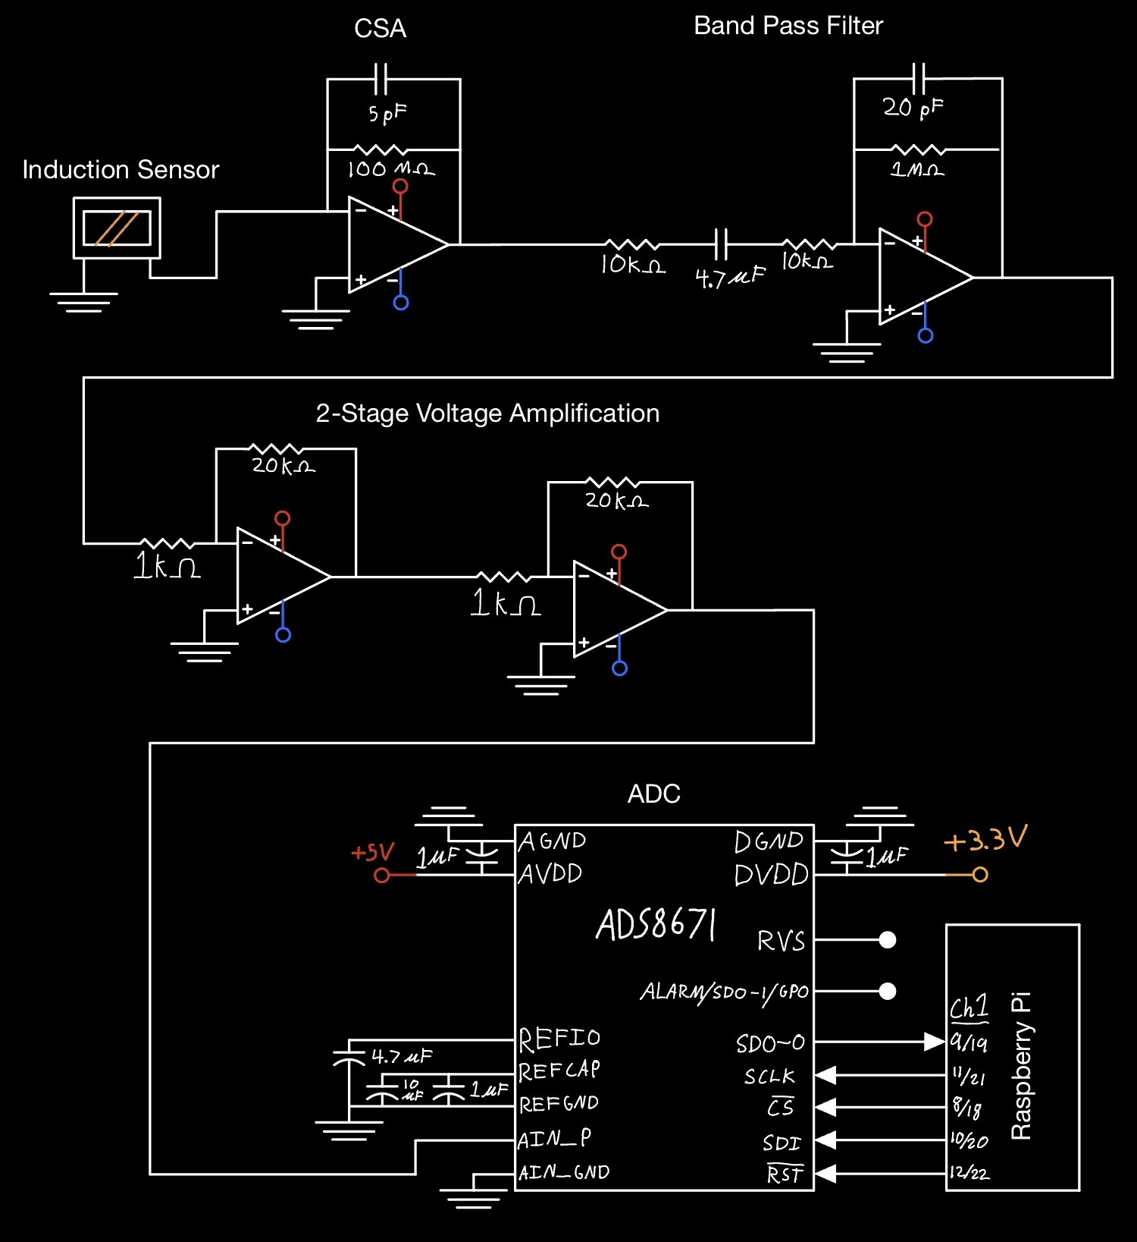
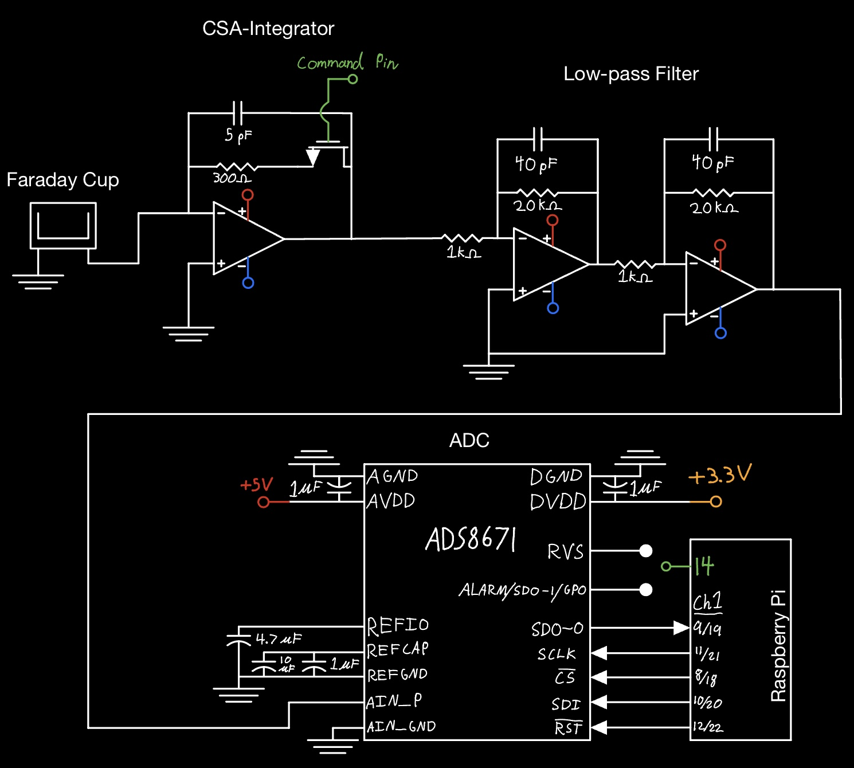
Vacuum Circuit Schematics
Induction Circuit
Conduction Circuit
Note: All grounds are tied
Notes:
Have only CSA circuit (everything else in backup), have conduction and induction side by side on same slide

Slide 62
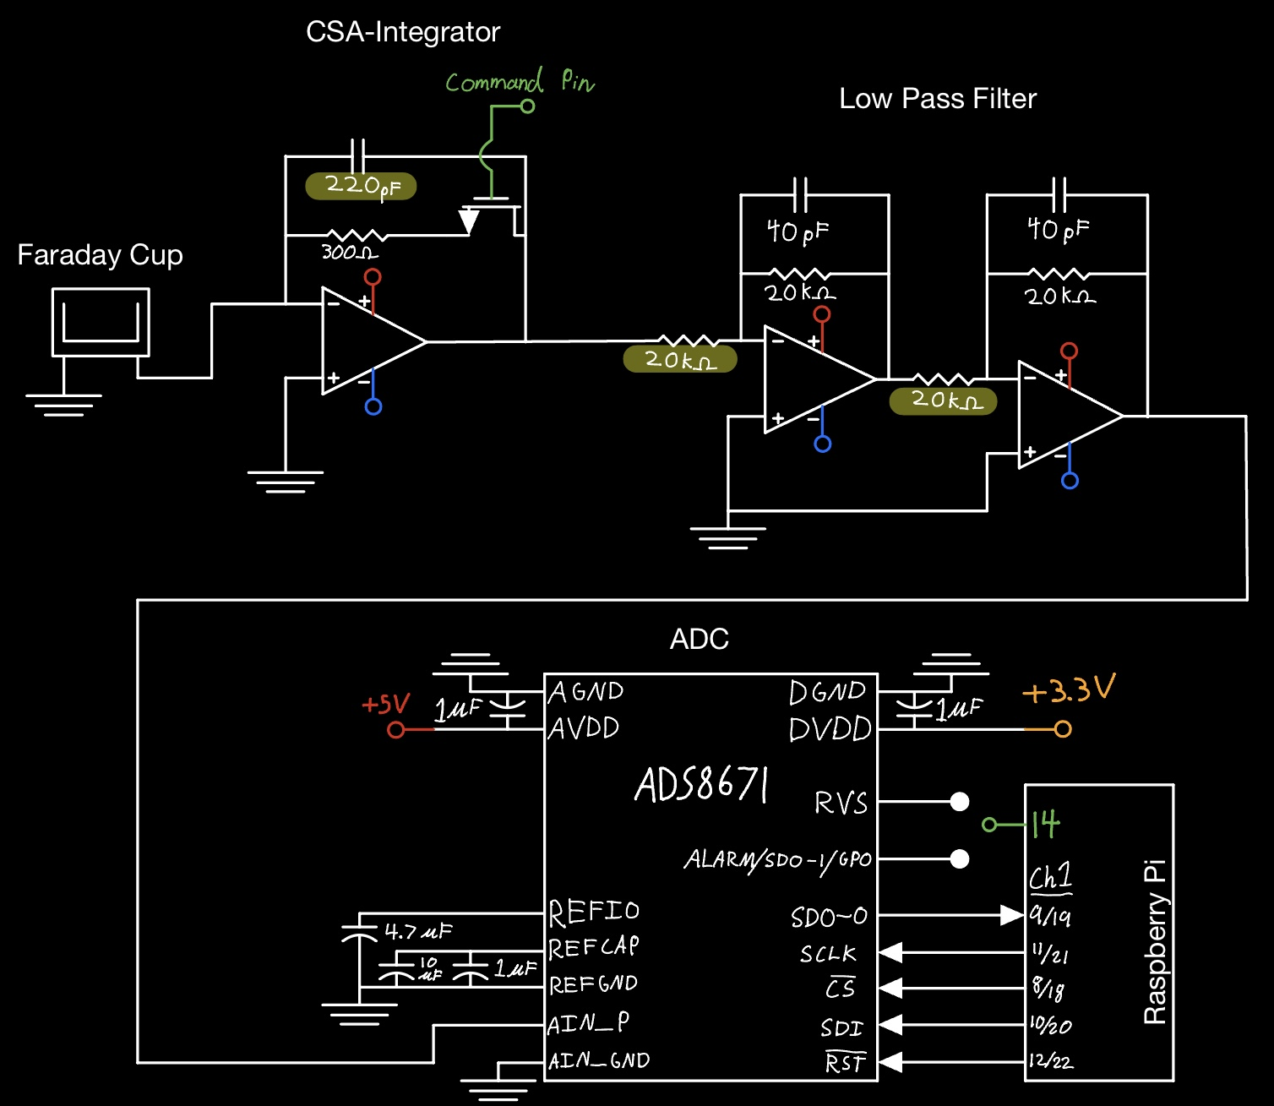
Open Air Test - Conduction Circuit
Note: All grounds are tied

Slide 63
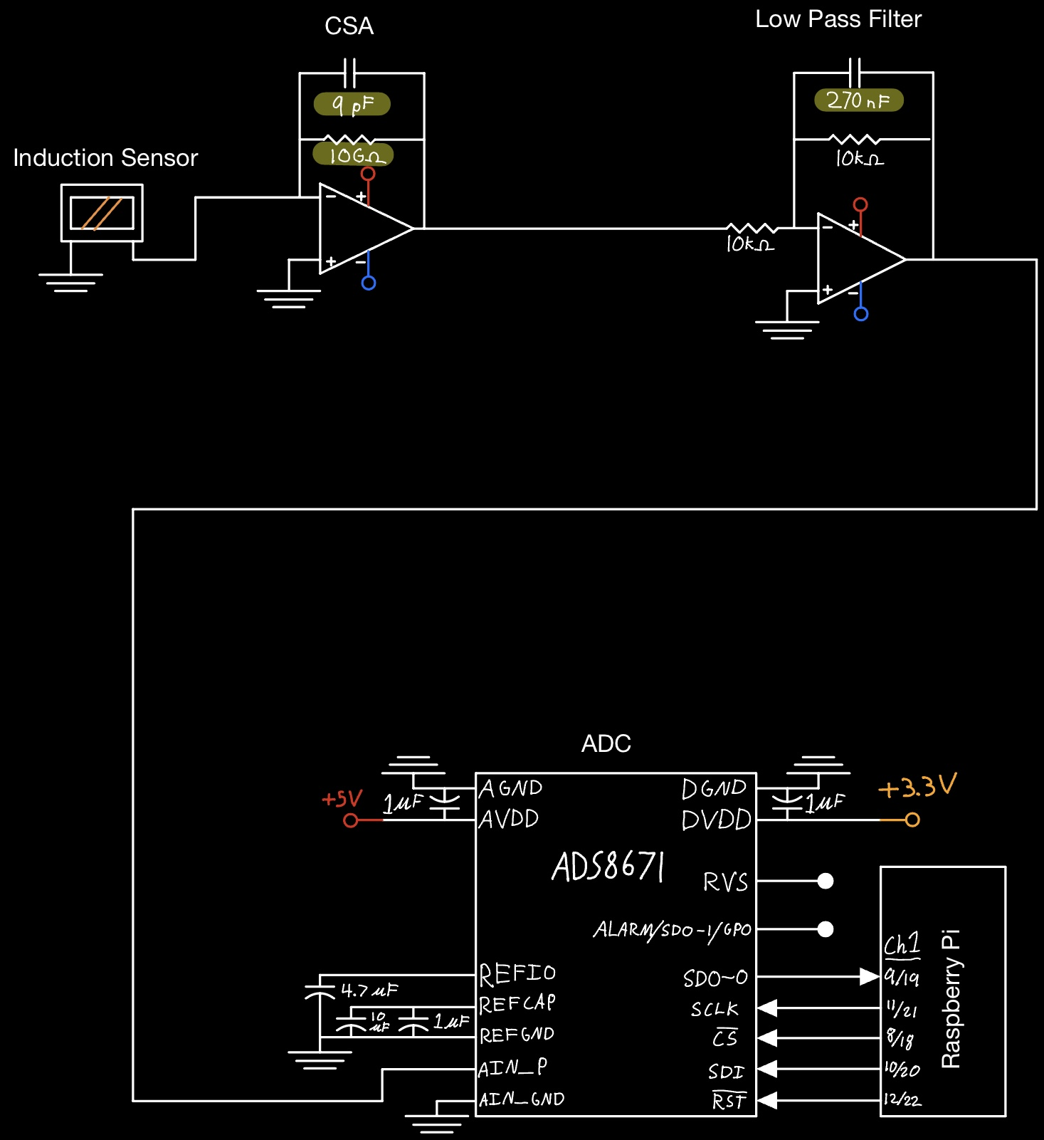
Open Air Test - Induction Circuit
Note: All grounds are tied

Slide 64
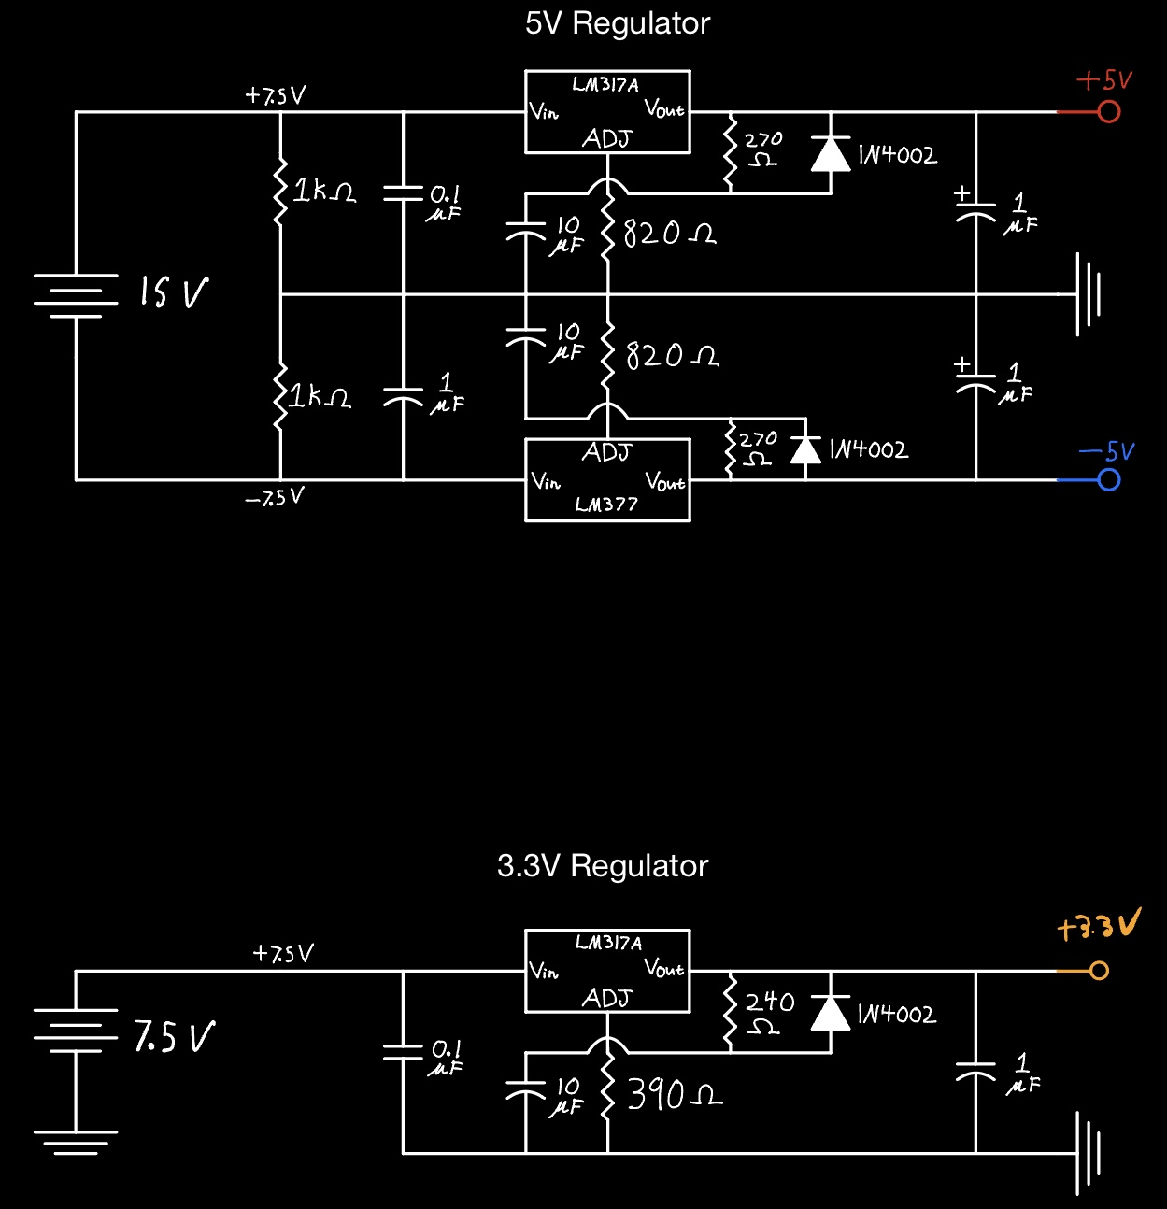

Power Regulation Circuits
Identical Power Regulation on all PCBs
3.3V Regulator
  7.5V input from voltage divider stage of $±$5V regulator

Slide 65
Electronics Testing

Slide 66
CSA Testing- Component Information
Circuit Values
Vin | 1 V
R | 120 kΩ
C1 | 1 μF
C2 | 22.5 μF
Circuit Values
Vin | 50 mV
R | 220 MΩ
C1 | 10pF
C2 | 10pF
Circuit Values​
Vin​ | 5 mV​
R​ | 220 MΩ​
C1​ | 10 pF ​
C2​ | 10 pF ​
Trial 1 - 1 μC
Trial 2 – 0.5pC
Trial 3 – 50fC

Slide 67
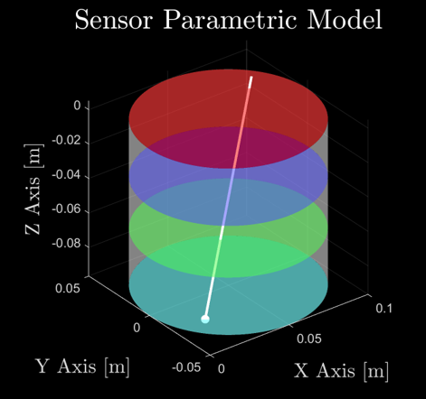
Mesh Grid
More sensitive to smaller particles than individual electrodes
  Less sensitive than tube
Wide range of impact angles
Flight Heritage - Cassini

Slide 68
Key Requirement: Incident Angle
Sensor shall detect particles with incident angles between 0 and 60 degrees
  0 degrees is defined as perpendicular to the sensor plate
Conduction section geometry will capture all particles in this range
0.693 in.
60°
1.2 in.

Slide 69
Sampling Frequency Models

Slide 70

Sensor Stray Capacitance
Capacitance of sensor relates to sensor noise
  Should be less than 8 pF according to Dr. Zoltan Sternovsky who has designed similar detectors
Sensor acts as two capacitors in parallel
Due to Miller Effect this capacitance is virtually grounded and does not affect measurement, just contributes to noise
3 cm
Per Sensing Plane: $C_{i}= \frac{ε_{0}⋅A}{d}=1.474⋅{10}^{−12} F=1.47pF$
3 cm
Total: $C_{t}=2⋅C_{i}=2.95 pF<8 pF$

Slide 71
Risk Matrix Criteria - Probability
What is the Probability the Risk Will Happen?
Level 1 | Not Likely | Avoid or mitigate risk with standard practices
Level 2 | Low Likelihood | Create plan to mitigate risk with minimal oversight
Level 3 | Likely | Workarounds must be applied to mitigate associated risk
Level 4 | Highly Likely | Cannot mitigate this type of risk, different approach may be successful
Level 5 | Near Certainty | Cannot mitigate this type of risk, no workarounds available

Slide 72
Risk Matrix Criteria - Impact
Given the Risk is Realized, what would be the Magnitude of Impact?
Level | Technical | Schedule | Cost
1 | Minimal or no impact | Minimal or no impact | Minimal or no impact
2 | Slight alterations required | Minor slip in schedule, remains within margin | Slight increase in budget
3 | Components must be altered or added | Additional activities required to recover | Serious impact on budget plans
4 | Unacceptable, but workarounds available | Impact on program critical path | Little to no margin remaining in budget
5 | Unacceptable, no alternatives exist | Cannot meet major program milestone | Budget exceeds allowable amount

