Slide 1
Testing Readiness Review
Weightless Integrated Instrument for Ground-based Laboratory Sensing
March 06, 2023
ASEN 4018 – 012, Team 11
Company Customers:
Francisco Lopez Jimenez & Yasara Dharmadasa
Faculty Advisor:
Erik Knudsen
Presenters:
Madison Ritsch, Alex Bergemann, Anabel de Montebello, Matthew Pabin, Victoria Lopez
Additional Team Members:
Gerardo Romero, Olivia Epstein, Céu Gómez, Tristan Workman
Notes:
Notes:
left video brighter
fix conops
tabulate subteams drs and cpes

Slide 2
Presentation Outline
Overview
Schedule
Test Readiness
Budget
Appendix
Overview
Test Readiness
Schedule
Appendix
Budget

Slide 3
Project Overview
Alex Bergemann

Slide 4
Mission Statement
Our mission is to create a modular Weightless Integrated Instrument for Ground-based Laboratory Sensing (WIIGLS) to characterize the motion of a deployable panel structure.
Overview
Test Readiness
Schedule
Appendix
Budget

Slide 5
Mission Objectives
1
Estimate the dynamics of a deployment to define a sensing range
2
Manufacture a sensor package to measure deployment dynamics without interference
3
Conduct a ground-based prototype deployment test to validate data collection
Overview
Test Readiness
Schedule
Appendix
Budget

Slide 6
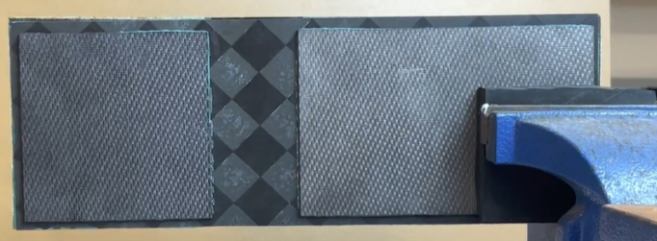
Client Panel & Deployment
Carbon Fiber Enforcement
Hinge
Accuracy of panel manufacturing is out-of-scope
Will be prototyping for sensor testing
Customer provided carbon fiber
Beyond the customer requirements, but the manufacturing its within schedule and budget.
Honeycomb Panel
Client Panel: Basis for the prototype panel
Overview
Test Readiness
Schedule
Appendix
Budget
Notes:
Mention that it snaps and swing
We are manufacturing the panel to make sure our sensor suite integrates well.
There are no requirements for the panel, we used engineering judgement to design it.
What worked best for our timeline

Slide 7
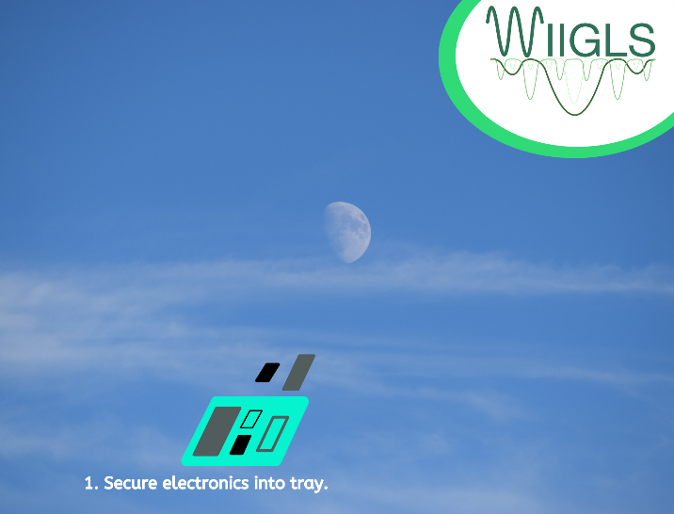
Concept of Operations: Project Level
Overview
Test Readiness
Schedule
Appendix
Budget
Notes:
ADD DEATIL ABOUT HOW SENSORS ARE SECURED
Maybe change space background lol

Slide 8
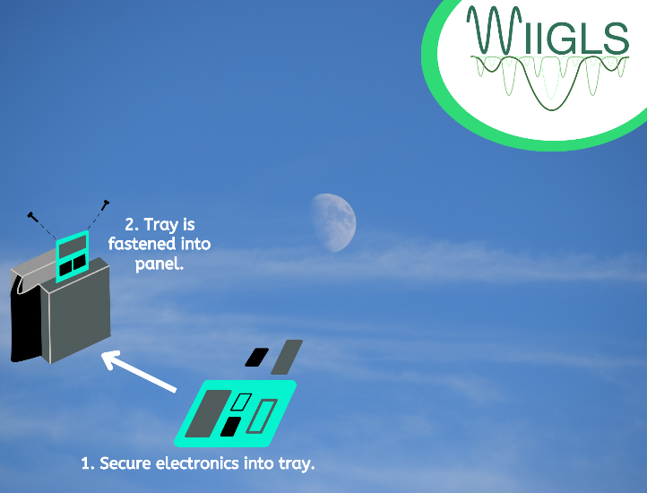
Concept of Operations: Project Level
Overview
Test Readiness
Schedule
Appendix
Budget
Notes:
ADD DETAIL HERE ABOUT INSERTION

Slide 9
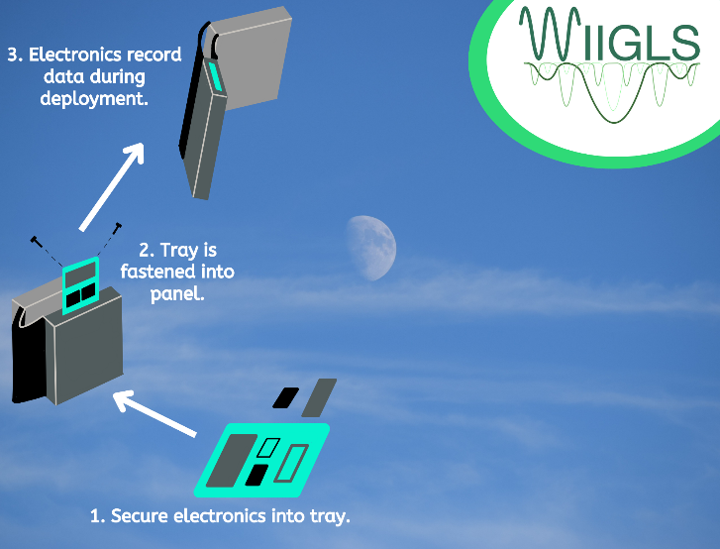
Concept of Operations: Project Level
Overview
Test Readiness
Schedule
Appendix
Budget

Slide 10
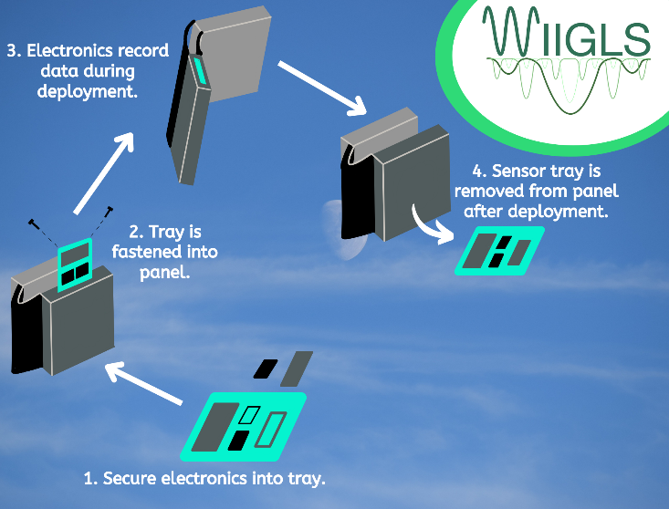
Concept of Operations: Project Level
Overview
Test Readiness
Schedule
Appendix
Budget

Slide 11
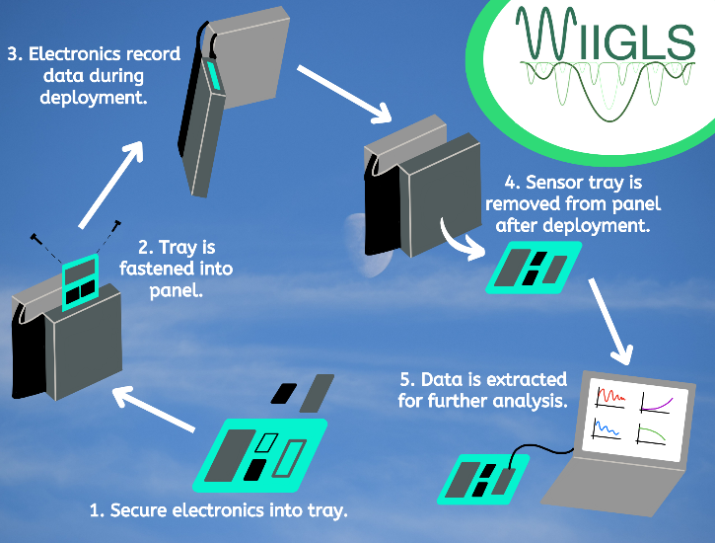
Concept of Operations: Project Level
Overview
Test Readiness
Schedule
Appendix
Budget

Slide 12
Levels of Success
Objective | Success Level 1 | Success Level 2
Data Collection | Record total deployment time and characterize two linear accelerations and one rotational deployment. | Record total deployment time and characterize three linear accelerations and three rotational accelerations during deployment as well as during the resonance period.
Endurance | One hour of active data collection and one hour of standby. | Two hours of active data collection and one hour of standby.
Physical Attributes | Less than 10 mm thick, 40 cm x 20 cm. Weighs less than 300g. MOI is known. | Less than 5 mm thick, 20 cm x 20 cm. Weighs less than 150 g. MOI is known.
Cost | Less than $750 for a single unit. | Less than $500 for a single unit.
Testing | Sensors will capture inputted frequencies and loads within 10% accuracy. Sensors will survive testing with no functional damage. | Tray with sensors will capture inputted frequencies and loads within 10% accuracy with no functional damage. Tray with sensors is integrated securely into a panel and easily removed.
Ease of Use | Instrument can be easily installed and uninstalled without damage to sensor package or structure. | Instrument can be easily installed and uninstalled in less than 5 minutes and without damage to sensor package or structure.
Overview
Test Readiness
Schedule
Appendix
Budget
Notes:
Just talk abt testing?

Slide 13
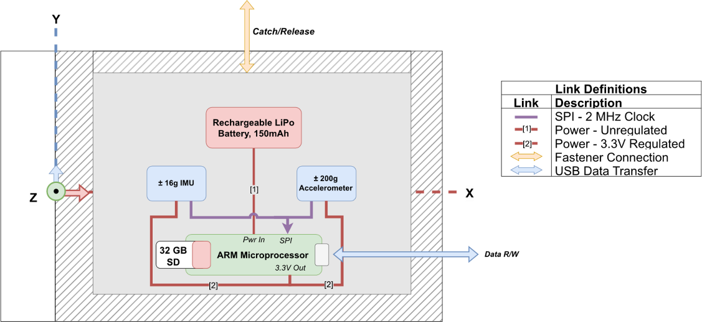
Functional Block Diagram
Overview
Test Readiness
Schedule
Appendix
Budget

Slide 14
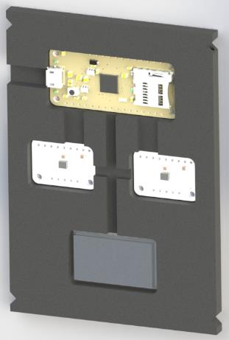
Current Design
1
Sensor Selection & Software – Accelerometer, IMU, Microprocessor, & Battery
Adafruit Featherlogger M0
48 MHz (maximum)
Current 6.3 mA
LM6DSOX IMU
Range: ± 16G
ORD: 6666 Hz
Current: 0.55 mA
ADXL375 Accelerometer
Range: ± 200G
ORD: 800 Hz
Current: 0.14 mA
Battery
Capacity: 150 mAh
LiPo
SPI
1.1.1
System shall maintain a signal-to-noise ratio of greater than 20 dB throughout deployment
Extensive libraries and documentation for SPI communication provided by Adafruit for Arduino IDE
1.3.1
System shall endure a shock up to 16 Gs without structural damage
5.1
System shall be able to record data for up to an hour with an additional hour of standby
Overview
Test Readiness
Schedule
Appendix
Budget
Notes:
Nothing has changed from CDR, go fast

Slide 15
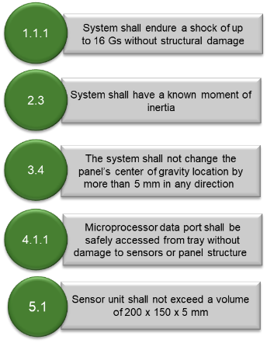
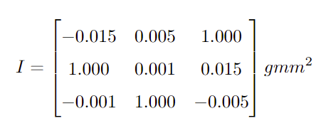
Current Design
2
Sensor Tray – Contains the Accelerometer, IMU, Microprocessor, and Battery
82 mm
Size: 112 x 82 x 5 mm
Tray Mass: 32 Grams
Electronic Mass: 17 Grams
CG: [-0.094, -0.241, 0.376] mm (X,Y,Z) from geometric center
MOI =
112 mm
Delrin Tray
5 mm
Overview
Test Readiness
Schedule
Appendix
Budget
Notes:
Nothing has changed from CDR, go fast
Add?
Mass breakdown
How we got CG and how we'll verify?

Slide 16
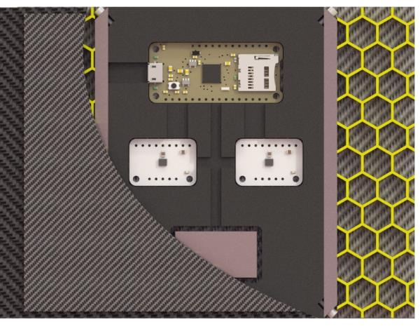
Current Design
3
Client Panel – Alterations made to secure sensor tray using rails and fasteners
2-56 Fasteners
Black Oxide Steel
Guide Rails
Aluminum 6061
2-56 Heli-coils (imbedded)
Installed in tray
Panel Integration and Alteration
Manufacture prototype panel using client provided design and materials
Guide rails epoxied into panel for tray slip fit
2.2
Sensor unit installation method shall not interfere with deployment
3.2
Sensor tray shall be fastened securely to mounting rails to minimize data noise and prevent resonance induced inaccuracies
3.3
Mounting rails shall be securely adhered to panel interior to minimize data noise and prevent resonance induced inaccuracies
Overview
Test Readiness
Schedule
Appendix
Budget
Notes:
Just making the panel for testing – panel agnostic
Fasteners are not different sizes

Slide 17
Design Solution
Overview
Test Readiness
Schedule
Appendix
Budget
Notes:
Hold up a sensor tray model

Slide 18
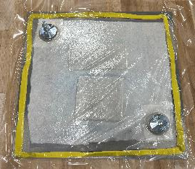
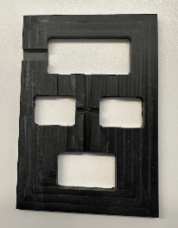
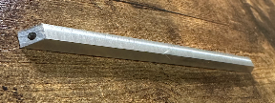
Updates from CDR
Design Changes:
Delrin housing wire routing design changed
Battery
Was using: 600mAh 1C LiPo ultra-thin battery
Now using: 150mAh 1C LiPo ultra-thin battery
Manufacturing Progress:
Machining & Electronics manufacturing in progress
Moving forward with coupon testing
Client provided prepreg carbon fiber
Overview
Test Readiness
Schedule
Appendix
Budget

Slide 19
Critical Project Elements*
CPE #: | Title: | Description:
CPE1 | Accelerations | Must be able to record linear accelerations to within 10% of optically tracked motion
CPE2 | Frequencies | Sensor tray must record frequencies within 10% accuracy of measured input motion
CPE3 | Integration | Sensor tray must be integrated in a fashion that allows for full range of deployment
CPE4 | Power Source | Battery must be able to remain independently powered for 2 hours
*No major changes from CDR
Overview
Test Readiness
Schedule
Appendix
Budget
Notes:
No major changes since CDR

Slide 20
Schedule
Matt Pabin
Notes:
Model development is appropriate, experiments to verify the design and validate model are clearly described, and characterization test objectives and methods are well-defined. Safety risks are understood. (26-30 pts)
Describe how the design will be validated against functional requirements and overall project success criteria. Give two or more examples of how the design will be verified against predictive models through characterization testing. Use diagrams to convey the test set up, the facilities and equipment needed, and how the test works. Describe the measurements to be made, and key measurement issues (resolution, sampling rate, etc.) Show how the selected sensors, instruments, data acquisition, test fixtures, etc. provide the required capabilities. Identify if any testing may result in safety risks.

Slide 21
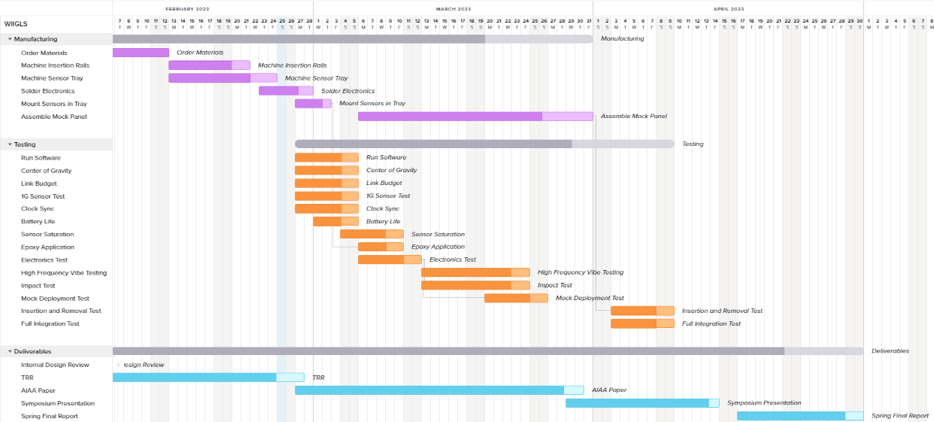
Semester Overview & Critical Path
Legend
Milestone
Lighter Shade - Margin
In progress
Critical Path
Dependencies
Manufacturing
Prerequisite Testing
Level 1 testing
System testing
Delivery
Overview
Test Readiness
Schedule
Appendix
Budget

Slide 22
Testing
✓
3/1
✓
3/1
Legend
Completed
In-Progress
Not Started
✓
3/3
✓
✓
3/3
✓
3/3
✓
3/3
❌
❌
❌
❌
❌
❌
Overview
Test Readiness
Schedule
Appendix
Budget

Slide 23
Test Plan
Legend
Completed
In-Progress
Not Started
✓
Level | Test Name | Goal | Start | End | Location
Component | Run Software | Check that code compiles | 27-Feb | 1-Mar | AERO N200
 | Center of Gravity | Ensure CG location is within requirements | 27-Feb | 1-Mar | AERO N200
 | Link Budget | Verify data is collected as expected | 27-Feb | 3-Mar | AERO N200
 | 1G Sensor Test | Verify sensor calibration | 27-Feb | 3-Mar | AERO N200
 | Battery Life | Remains powered for 2 hours | 1-Mar | 3-Mar | AERO N200
 | Sensor Saturation | Sensors record data at input rate | 4-Mar | 10-Mar | AERO N200
Subsystem | Clock Sync | Sensors experience shock at same time | 27-Feb | 3-Mar | AERO N200
 | Electronics Test | Check full electronics system | 6-Mar | 10-Mar | AERO N200
 | Epoxy Application | Survives high impact | 6-Mar | 10-Mar | AERO N200
 | Vibe Test | Induce high frequencies and low Gs | 13-Mar | 24-Mar | AERO 141
 | Impact Test | Induce high Gs and low frequencies | 13-Mar | 24-Mar | AERO 155
 | Mock Deployment Test | Simulate a panel deployment | 20-Mar | 24-Mar | AERO 310A
System | Integrated Deployment Test | Check fully integrated system | 3-Apr | 7-Apr | AERO 310A
 | Insertion/Removal Test | Verify no damage is caused | 3-Apr | 7-Apr | AERO N200
✓
✓
✓
✓
✓
✓
Overview
Test Readiness
Schedule
Appendix
Budget

Slide 24
Test Readiness
Madison Ritsch, Anabel de Montebello, Victoria Lopez
Notes:
Model development is appropriate, experiments to verify the design and validate model are clearly described, and characterization test objectives and methods are well-defined. Safety risks are understood. (26-30 pts)
Describe how the design will be validated against functional requirements and overall project success criteria. Give two or more examples of how the design will be verified against predictive models through characterization testing. Use diagrams to convey the test set up, the facilities and equipment needed, and how the test works. Describe the measurements to be made, and key measurement issues (resolution, sampling rate, etc.) Show how the selected sensors, instruments, data acquisition, test fixtures, etc. provide the required capabilities. Identify if any testing may result in safety risks.

Slide 25
Testing Flow Chart
Component Level
1G Sampling
Link Budget
Software Compile
Battery Life
Sensor Saturation
Center of Gravity
Subsystem Level
Electronics System
Clock Sync
Impact Test
Vibe Test
Mock Deployment
Epoxy Application
System Level
Integrated Deployment
Insertion/Removal
Overview
Test Readiness
Schedule
Appendix
Budget
Notes:
- little validation bc we made our own DRs
- verification against our own models
- none of our tests require serious safety mitigations

Slide 26
Impact Test
DR 3.1: System shall survive deployment forces without damage
DR 3.1.2: Sensors shall remain secure when exposed to deployment forces
CPE1: Must be able to record linear accelerations to within 10% of optically tracked motion
Deadline: March 24
Not Started
What:
Swinging a pendulum for impact measurements
Why:
Verify the sensors' ability to record the initial shock on deployment (sampling rate)
Ensure sensors remain secure in the tray following an impact
Test Facility:
AERO N200: Senior Project Space
Test Equipment:
Manufactured pendulum stand
String
Electronics suite
Teardrop accelerometer
Camera
Fasteners & eye hooks
Pre-requisite Tests:
Accelerometer/IMU calibration test (IMU)
Link budget test
Software DAQ test
Overview
Test Readiness
Schedule
Appendix
Budget

Slide 27
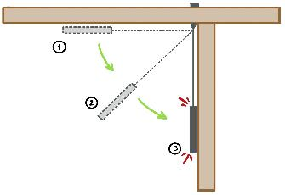
Impact Test
DR 3.1: System shall survive deployment forces without damage
DR 3.1.2: Sensors shall remain secure when exposed to deployment forces
CPE1: Must be able to record linear accelerations to within 10% of optically tracked motion
Deadline: March 24
Not Started
Test Fixture Design:
Actively record data while sensor suite is dropped and follows a circular path until it impacts a wall at 30/60/90 degrees from initial position
String length: 40"
Sensor Selection and Calibration
Optical Tracking Setup
Calibrate distance w/ known length of panel
IMU-LM6DSOX
Accelerometer - ADXL375
Epoxied into tray
Teardrop Accelerometer
Attached to tray with wax
DAQ Plans
Collect live data from IMU, accelerometer, optical tracker, and teardrop accelerometers
Wooden frame
Eye hooks on tray
Sensor tray
Overview
Test Readiness
Schedule
Appendix
Budget

Slide 28
Impact Test
DR 3.1: System shall survive deployment forces without damage
DR 3.1.2: Sensors shall remain secure when exposed to deployment forces
CPE1: Must be able to record linear accelerations to within 10% of optically tracked motion
Deadline: March 24
Not Started
Test procedure:
Attach strings to sensor tray
Turn on the sensor suite with outside auxiliary power
Attach teardrop accelerometers to sensor tray
Ensure sensor tray hangs level
Raise sensor tray to predetermined 30°, 60°, and 90° heights
Drop from each height while recording data
Compare recorded data to teardrop, optically tracked, and mathematical data
Safety procedure:
Remove the LiPo battery from the sensor tray
Add a similar weight in place of the battery
Run the sensor suite with hard power
Overview
Test Readiness
Schedule
Appendix
Budget

Slide 29
Impact Test
DR 3.1: System shall survive deployment forces without damage
DR 3.1.2: Sensors shall remain secure when exposed to deployment forces
CPE1: Must be able to record linear accelerations to within 10% of optically tracked motion
Deadline: March 24
Not Started
Test Setup Parts List
Test Setup Manufacturing Plan
Machine wooden test stand in AERO wood shop
Integrate sensor suite immediately prior to test
Part | Quantity | Procurement | Cost
2"x4"x8' Wood | 2 | HD 058449 | $7.70
Wood Screws | 1 | HD 100173447 | $10.47
Eye Hooks | 1 | Amazon | $9.00
String | 1 | Amazon | $6.99
OT Camera | 1 | AMReC | -
Teardrop Acc | 1 | AMReC | -
Total | - | - | $34.16
Overview
Test Readiness
Schedule
Appendix
Budget

Slide 30
Impact Test
DR 3.1: System shall survive deployment forces without damage
DR 3.1.2: Sensors shall remain secure when exposed to deployment forces
CPE1: Must be able to record linear accelerations to within 10% of optically tracked motion
Deadline: March 24
Not Started
Risk Reduction:
Tray will be externally powered to prevent battery fire
Structural failure under impact mitigated by epoxy application test
Model Validation:
Optical tracking
Teardrop accelerometer truth data
Fail Criteria
Does not match truth data with 10% accuracy
Damage or displacement
Epoxy is damaged
Pass Criteria
Matches the truth data with 10% accuracy
No damage or displacement
Epoxy is undamaged
Expected Result
PASS
Overview
Test Readiness
Schedule
Appendix
Budget

Slide 31
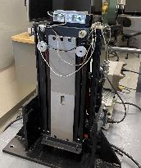
Vibe Test
DR 3.1: Sensors shall be mounted to sensor tray securely
DR 3.1.2: Sensors shall record vibration frequencies to within 10% of measured input
CPE1: Must be able to record linear accelerations to within 10% of optically tracked motion
CPE2: Sensor tray must record frequencies within 10% accuracy of measured input motion
Deadline: March 24
Not Started
What:
Sine sweep 2-1500Hz on Vibe Table, fixed acceleration
Why:
Ensure sensors record high frequencies within 10% accuracy of inputted motion (CPE2)
Ensure sensors record low accelerations within 10% accuracy (CPE1)
Ensure epoxy survives sweep
Understand how screw tightness impacts recorded dynamics
Test Equipment:
Vibe Table
Tray with epoxied sensors
Rails to bolt to table
Teardrop accelerometers
Wax
Test Facility:
AERO 141: PILOT Lab
Pre-requisite Tests:
Accelerometer/IMU calibration test (IMU)
Link budget test
Software DAQ test
Overview
Test Readiness
Schedule
Appendix
Budget

Slide 32
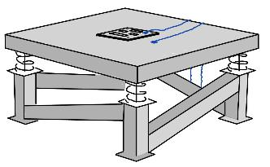
Vibe Test
DR 3.1: Sensors shall be mounted to sensor tray securely
DR 3.1.2: Sensors shall record vibration frequencies to within 10% of measured input
CPE1: Must be able to record linear accelerations to within 10% of optically tracked motion
CPE2: Sensor tray must record frequencies within 10% accuracy of measured input motion
Deadline: March 24
Not Started
Test Fixture Design
Attach sensor suite using ¼-20 fasteners through rails
Attach 2 teardrop accelerometers with wax
1 on the table, 1 on the tray
Sensor Selection and Calibration
IMU- LM6DSOX
Accelerometer – ADXL375
Teardrop Accelerometers
Used to calibrate vibe table
DAQ plans
Collect live data from IMU, accelerometer, and teardrop accelerometers
Process IMU and accelerometer data and save to CSV file
Tray Teardrop
Fastened to table
Tray with Sensors
Reference teardrop
Vibe Table
Overview
Test Readiness
Schedule
Appendix
Budget

Slide 33
Vibe Test
DR 3.1: Sensors shall be mounted to sensor tray securely
DR 3.1.2: Sensors shall record vibration frequencies to within 10% of measured input
CPE1: Must be able to record linear accelerations to within 10% of optically tracked motion
CPE2: Sensor tray must record frequencies within 10% accuracy of measured input motion
Deadline: March 24
Not Started
Test procedure:
Turn on the sensor suite with outside auxiliary power
Secure sensor suite on Vibe table
Run the software to begin recording data
Run the Vibe table at several frequencies raging from 2-1500 Hz
Remove sensor suite from table
Verify the data gathered with the truth data from the Vibe table
Safety procedure:
Remove the LiPo battery from the sensor tray
Add a similar weight in place of the battery
Run the sensor suite with outside power
Overview
Test Readiness
Schedule
Appendix
Budget

Slide 34
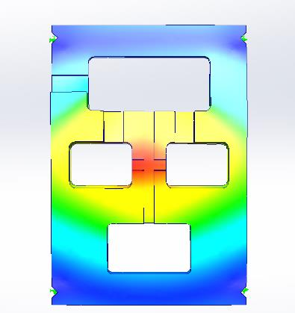
Vibe Test
DR 3.1: Sensors shall be mounted to sensor tray securely
DR 3.1.2: Sensors shall record vibration frequencies to within 10% of measured input
CPE1: Must be able to record linear accelerations to within 10% of optically tracked motion
CPE2: Sensor tray must record frequencies within 10% accuracy of measured input motion
Deadline: March 24
Not Started
Resonance Frequencies:
1st: 528 Hz
3rd: 1164 Hz
5th: 1849 Hz
Model:
Model does account for weight of electronics
Not properly distributed
Sensors modeled as fixed connections
Does not accurately represent epoxy bonds
Fixed at all four corners
For Testing:
Sweep up to 1500 Hz to capture more than one resonance
Looking for see 1st resonance to be ± 500 Hz
Overview
Test Readiness
Schedule
Appendix
Budget

Slide 35
Vibe Test
DR 3.1: Sensors shall be mounted to sensor tray securely
DR 3.1.2: Sensors shall record vibration frequencies to within 10% of measured input
CPE1: Must be able to record linear accelerations to within 10% of optically tracked motion
CPE2: Sensor tray must record frequencies within 10% accuracy of measured input motion
Deadline: March 24
Not Started
Risk Reduction:
Structural failure under vibration risk mitigated by epoxy application test
Modal vibrations existing outside of sensing capability is unlikely due to the sensors' high pulling rate and the expected resonate frequencies range
Tray will be externally powered to prevent battery fire
Model Validation:
Validate the data gathered with the sensor suite with the vibe table's truth data
SolidWorks frequency simulation comparison
Compare resonate frequencies of model to truth data
Compare relative displacements of model to truth data
Fail Criteria
Does not match truth data with 10% accuracy
Damage or displacement
Epoxy is damaged
Pass Criteria
Matches the truth data with 10% accuracy
No damage or displacement
Epoxy is undamaged
Expected Result
PASS
Overview
Test Readiness
Schedule
Appendix
Budget

Slide 36
Mock Deployment
CPE1: Must be able to record linear accelerations to within 10% of optically tracked motion
CPE2: Sensor tray must record frequencies within 10% accuracy of measured input motion
Deadline: March 30
Not Started
What:
Predictable Mock Deployment on test setup
Why:
Subject sensor suite to predictable quasi-deployment loading
Verify sensing tolerances (CPE1)(CPE2)
Test Facility:
AERO 310A: AMReC Lab
Test Equipment:
Mock panel structure
Tray with epoxied sensors
Rails to bolt into panel
Teardrop accelerometers
Optical tracking camera
Pre-requisite Tests:
Accelerometer/IMU calibration test (IMU)
Link budget test
Software DAQ test
Overview
Test Readiness
Schedule
Appendix
Budget

Slide 37
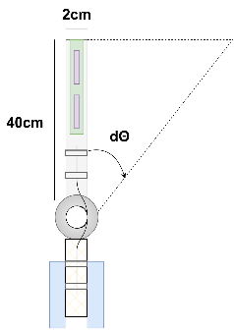
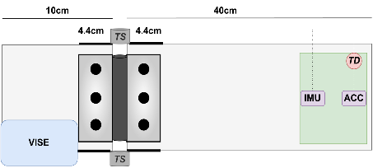
Mock Deployment Test
CPE1: Must be able to record linear accelerations to within 10% of optically tracked motion
CPE2: Sensor tray must record frequencies within 10% accuracy of measured input motion
Deadline: March 30
Not Started
Test Fixture Design
Sensor Selection & Calibration
Optical Tracking camera
Calibrate distance w/ known length of panel
1x Teardrop
Sensor Tray
DAQ plans
Teardrop DAQ provided
Camera recording to internal SD
WIIGLS recording to onboard flash
Overview
Test Readiness
Schedule
Appendix
Budget

Slide 38
Mock Deployment Test
CPE1: Must be able to record linear accelerations to within 10% of optically tracked motion
CPE2: Sensor tray must record frequencies within 10% accuracy of measured input motion
Deadline: March 30
Not Started
Test procedure:
Set up optical tracker & teardrop accelerometers
Integrate and secure sensor suite
Begin recording
Deflect hinge to 90 degrees manually
Release system
Compare data
Safety Procedure:
All team members will be wearing safety goggles
Overview
Test Readiness
Schedule
Appendix
Budget

Slide 39
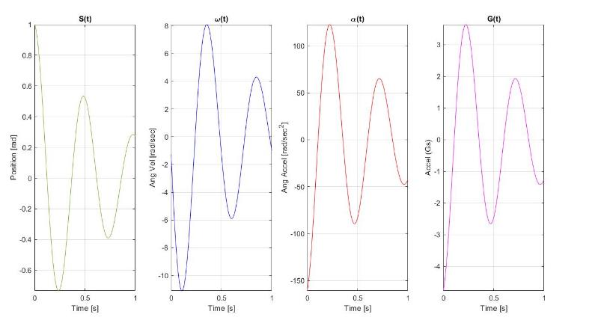
Mock Deployment Test
CPE1: Must be able to record linear accelerations to within 10% of optically tracked motion
CPE2: Sensor tray must record frequencies within 10% accuracy of measured input motion
Deadline: March 30
Not Started
Expected System Response
Model:
Unforced, underdamped harmonic oscillator
1d system solved analytically using MATLAB symbolics
Fit model to captured teardrop data (RM)
Initial displacement: π/2 rad
Predicted maximum loading, : 3.63 g
Overview
Test Readiness
Schedule
Appendix
Budget

Slide 40
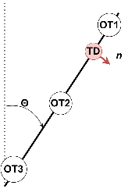
Mock Deployment Test - Derivation
Known System Parameters:
Θ₀ = π/2 rad
ω₀ = 0 rad/sec
α₀ = 0 rad/s²
Τ_{max_spring} = 5.08 nm
I_{sys_hinge} = 0.126 kg/m²
Assumptions:
1D Underdamped Harmonic Oscillator
Linear Spring
Proportional damping (neglecting drag)
K_{eff} = 1.6184 n-m/rad
ζ_{init} = 0.1
EOM
Analytical Solution - Underdamped
Data Rotation Matrix – Optical to Teardrop
Farlow, J., Hall, J. E., McDil, J. M., & West, B. H. (2018). Differential equations & Linear Algebra. Pearson.
Bedford, A., & Fowler, W. (2008). Engineering mechanics: Dynamics. Pearson.
Overview
Test Readiness
Schedule
Appendix
Budget

Slide 41
Mock Deployment Test
CPE1: Must be able to record linear accelerations to within 10% of optically tracked motion
CPE2: Sensor tray must record frequencies within 10% accuracy of measured input motion
Deadline: March 30
Not Started
Test Setup Parts List
Test Setup Manufacturing Plan
Machine Delrin in AERO machine shop
Rail installation & hinge assembly in machine shop
Integrate sensor suite immediately prior to test
Part | Quantity | Procurement | Cost
Delrin Panel | 1 | MMC 8573K21 | $103.14
Spring | 2 | MMC 9271K119 | $8.22
Hinge | 1 | MMC 1798A914 | $15.26
Routing Clamp | 2 | MMC 9434T11 | $5.53
Clamp | 1 | AMReC | -
OT Camera | 1 | AMReC | -
Teardrop Acc | 1 | AMReC | -
Total | - | - | $128.04
Overview
Test Readiness
Schedule
Appendix
Budget

Slide 42
Mock Deployment Test
DR 3.1: Sensors shall be mounted to sensor tray securely
CPE1: Must be able to record linear accelerations to within 10% of optically tracked motion
Deadline: March 30
Not Started
Risk Reduction:
Multiple sensing methods to assess validity of data
Classically predictable system such that data validation will be intuitive
Test conducted in AMReC, with sandbags at hand for emergencies
Model Validation:
Assess damping ratio from initial rise time (truth data)
Apply effective damping to simulation and calculate system response
Compare to all three measured quantities and validate
Fail Criteria
>10% error from TD in sensor suite data
Pass Criteria
<10% error from TD in sensor suite data
Expected Result
PASS
Overview
Test Readiness
Schedule
Appendix
Budget

Slide 43
Testing Status
Component Level
1G Sampling
Link Budget
Software Compile
Battery Life
Sensor Saturation
Center of Gravity
Subsystem Level
Electronics System
Clock Sync
Impact Test
Vibe Test
Mock Deployment
Epoxy Application
System Level
Integrated Deployment
Insertion/Removal
Completed
In Progress
Not Started
Overview
Test Readiness
Schedule
Appendix
Budget
Notes:
- little validation bc we made our own DRs
- verification against our own models
- none of our tests require serious safety mitigations

Slide 44
Budget
Matt Pabin
Notes:
Model development is appropriate, experiments to verify the design and validate model are clearly described, and characterization test objectives and methods are well-defined. Safety risks are understood. (26-30 pts)
Describe how the design will be validated against functional requirements and overall project success criteria. Give two or more examples of how the design will be verified against predictive models through characterization testing. Use diagrams to convey the test set up, the facilities and equipment needed, and how the test works. Describe the measurements to be made, and key measurement issues (resolution, sampling rate, etc.) Show how the selected sensors, instruments, data acquisition, test fixtures, etc. provide the required capabilities. Identify if any testing may result in safety risks.

Slide 45
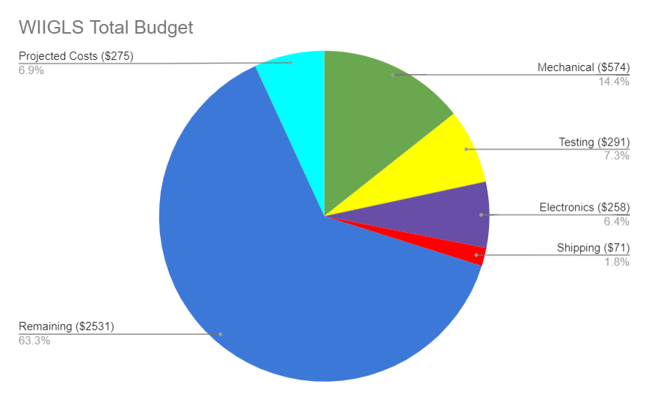
Cost Plan
Budget Breakdown:
Mechanical:
Raw Materials
Hardware
Electronics:
Sensors/Battery
Microprocessor
Projected:
Additional raw materials
Additional Electronics
Remaining: $2531
Overview
Test Readiness
Schedule
Appendix
Budget

Slide 46
Acknowledgements
Team WIIGLS would like to thank Dr. Erik Knudsen, Dr. Francisco López Jiménez, Yasara Dharmadasa, Professor Trudy Schwartz, Dr. Wingate, Nate Coyle, Matt Rhode, and the TFs for their guidance, mentoring, and contributions to this presentation.
THANK YOU!

Slide 47
Thank you
Any Questions?

Slide 48
Appendix & Supporting Materials

Slide 49
Administrative

Slide 50
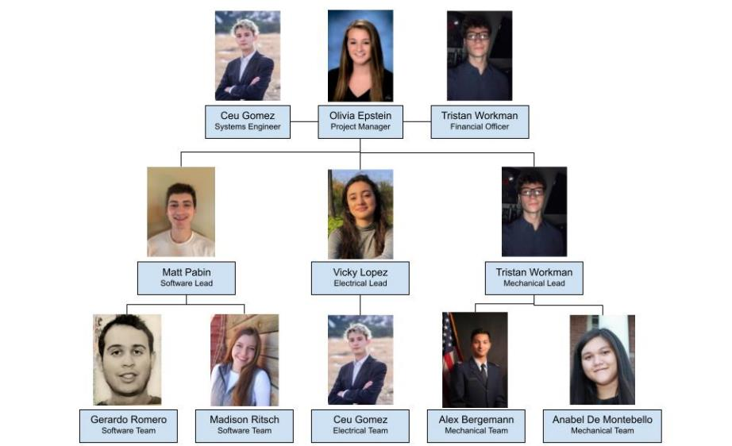
Team Organization
Overview
Test Readiness
Schedule
Appendix
Budget

Slide 51
Key Functional Requirements
Requirement ID | Title | Description
FR1 | Mission | System shall accurately record deployment motion of attached panel structure.
FR2 | Integration | System shall fit into the provided panel structure without obstructing deployment or changing the dynamics of the system.
FR3 | Budget | System shall cost less than $750 per unit.
FR4 | Mobility | System shall be quickly removable/replaceable from panel to be tested.
FR5 | Power | System shall be able to record data for up to an hour, with an additional hour of standby.
Overview
Test Readiness
Schedule
Appendix
Budget

Slide 52
Testing

Slide 53
Testing Descriptions – Component Level
Test | Description
1G Sampling | Verify sensors measure 1G when recording data while lying flat and still.
Link Budget | Verify data transfer occurring at predicted speeds.
Software Compile | Ensure all software created successfully compiles, records, and stores data.
Battery Life | Ensure battery can survive 2 hours of active data recording.
Sensor Saturation | Ensure sensors can record data at the maximum speed. Stationary test.
Center of Gravity | Verify CAD calculated center of gravity.
Overview
Test Readiness
Schedule
Appendix
Budget

Slide 54
Testing Descriptions – Subsystem Level
Test | Description
Electronics System | Ensure entire electronics system successfully records and stores data.
Clock Sync | Verify accelerometer and IMU clocks are synced and recording data together.
Impact Test | Verify suite survives and measures high G shock.
Vibe Test | Verify suite survives and measures high frequency sweep.
Mock Deployment | Verify suite survives and measures predictable mock deployment.
Epoxy Application | Verify epoxy application method and ability to hold sensors in sensor tray via a drop test.
Overview
Test Readiness
Schedule
Appendix
Budget

Slide 55
Testing Descriptions – System Level
Test | Description
Integrated Deployment | Ensure suite records carbon fiber dynamics within 5% of truth data.
Insertion/Removal | Ensure suite can be inserted and removed from carbon fiber panel in less than 5 minutes without causing damage.
Overview
Test Readiness
Schedule
Appendix
Budget

Slide 56
Spin Test
DR 3.1: Sensors shall be mounted to sensor tray securely
DR 3.1.2: Sensors shall record accelerations to within 10% of measured input
Deadline: March 24
Not Started
What:
Electronics suite survives low frequency and high G mode
Sensor suite and integration epoxy is not damaged in testing
Sensors accurately measure modes
Sensors measure low frequencies as expected
Sensors measure the high Gs as expected at deployment
All data is recorded (no clipping)
Why:
Prove the ability to record low frequencies within 10% accuracy of inputted motion (CPE2)
Prove the ability to record the high G the panel experiences at the snapping motion at the beginning of deployment (CPE1)
Ensure that the electronics suite will not suffer from the high Gs expected from deployment – success level 2 from testing objective
Test Equipment:
Lathe
Lathe Chuck
Plates and ¼-20 bolts to secure electronics
Electronics suite
Test Facility:
AERO 155 – Machine Shop
Pre-requisite Tests:
Power & Thermal
Accelerometer/IMU calibration test
Sampling Rate Quantification
Software DAQ test
Overview
Test Readiness
Schedule
Appendix
Budget

Slide 57
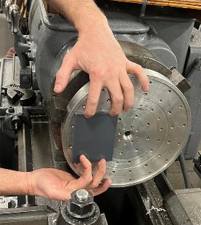
Spin Test
DR 3.1: Sensors shall be mounted to sensor tray securely
DR 3.1.2: Sensors shall record accelerations to within 10% of measured input
Deadline: March 24
Not Started
Test Fixture Design
Sensor Selection and Calibration:
ADXL375 - accelerometer, up to 200G
LM6DSOX – IMU, up to 16G
DAQ plans
IMU & accelerometer will record data
Data will be verified against the kinematics model
Lathe
Chuck
Electronics suite
Pre-tapped holes to secure suite
Overview
Test Readiness
Schedule
Appendix
Budget

Slide 58
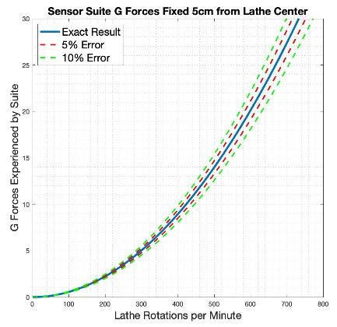
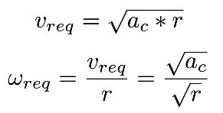
Spin Test
DR 3.1: Sensors shall be mounted to sensor tray securely
DR 3.1.2: Sensors shall record accelerations to within 10% of measured input
DR 3.1: First Level DR(s) here
DR 3.1.1: Second level DR(s) here
Deadline: March 24
Not Started
Test Model
Target Region:
12 - 16G
Desired G Force Experienced: 16G
Distance to sensor CG: 5cm
Required Lathe RPM: 535.03 RPM
*Spin rate of lathe will be verified using a digital tachometer
Overview
Test Readiness
Schedule
Appendix
Budget

Slide 59
Spin Test
DR 3.1: Sensors shall be mounted to sensor tray securely
DR 3.1.2: Sensors shall record accelerations to within 10% of measured input
DR 3.1: First Level DR(s) here
DR 3.1.1: Second level DR(s) here
Deadline: March 24
Not Started
Test Procedure:
Turn on the sensor tray
Attach the sensor tray to the lathe
Run software to begin data gathering
Set the lathe to desired RPM and turn it on for 15 seconds
Turn lathe off and retrieve the sensor tray
Retrieve data from the SD placed on sensor tray
Analyze data against model
Safety Procedure:
Perform RPM sweep
Ensure suite stays secure at lower RPMs
Ensure suite stays secure through lathe acceleration and deceleration periods
Other Notes:
All testing will be supervised by Matt Rhode
Sandbags will be on standby in case of battery fire
All participants will be wearing safety glasses
Overview
Test Readiness
Schedule
Appendix
Budget

Slide 60
Spin Test
DR 3.1: Sensors shall be mounted to sensor tray securely
DR 3.1.2: Sensors shall record accelerations to within 10% of measured input
Deadline: March 24
Not Started
Risk Reduction:
Structural failure under load risk
Test for short time periods
Build up to required speed
Battery puncture
Battery encased in sensor tray
Safety equipment close by
Model Validation:
G forces measured should match expected model results within 10%
Any discrepancy likely to come from inaccuracies in lathe RPM selection
Fail Criteria
Measured frequencies do not match the truth data with 10% accuracy
Sensor tray and electronics are damaged or displaced
Measured accelerations do not match the truth data with 10% accuracy
Pass Criteria
Measured frequencies match the truth data with 10% accuracy
Sensor tray and electronics are not damaged or displaced
Measured accelerations match the truth data with 10% accuracy
Expected Result
PASS
Overview
Test Readiness
Schedule
Appendix
Budget

Slide 61
High G – Vibe Table
DR 3.1: Sensors shall be mounted to sensor tray securely
DR 3.1.2: Sensors shall record accelerations to within 10% of measured input
Deadline: March 24
Not Started
What:
Electronics suite survives low frequency and high G mode
Sensor suite and integration epoxy is not damaged in testing
Sensors accurately measure modes
Sensors measure low frequencies as expected
Sensors measure the high Gs as expected at deployment
All data is recorded (no clipping)
Why:
Prove the ability to record low frequencies within 10% accuracy of inputted motion (CPE2)
Prove the ability to record the high G the panel experiences at the snapping motion at the beginning of deployment (CPE1)
Ensure that the electronics suite will not suffer from the high Gs expected from deployment – success level 2 from testing objective
Test Equipment:
Test Facility:
AERO 155 – Machine Shop
Pre-requisite Tests:
Power & Thermal
Accelerometer/IMU calibration test
Sampling Rate Quantification
Software DAQ test
Overview
Test Readiness
Schedule
Appendix
Budget

Slide 62
Manufacturing

Slide 63
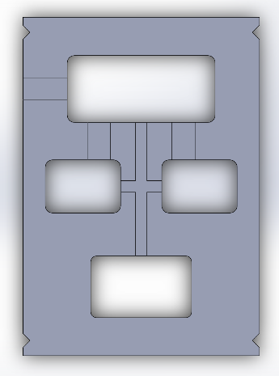
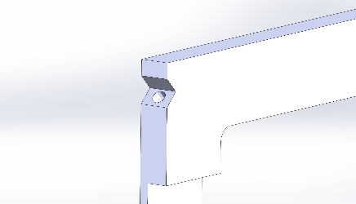
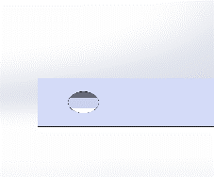
Changes to Design
More precise wire routing
Ensures completed threads
Overview
Test Readiness
Schedule
Appendix
Budget

Slide 64
Delrin, Fastners, Heli-coil
Delrin specifications
Density: 1.54 g/cm3
Youngs Modulus: 3 GPa
DuPont Engineering
Fastners
Tensile strength: 2-56 Black Oxide
170,000 psi
Helicoils
Tensile strength: 200,000 psi
All specifications from McMaster
Overview
Test Readiness
Schedule
Appendix
Budget
Notes:
https://www.mcmaster.com/8573K15/
https://www.mcmaster.com/91251A079/
https://www.mcmaster.com/91732A202/

Slide 65
Size & Mass
Electronics
Structure
 | LSM6DSOX (IMU) | ADXL375 (Accelerometer) | Microprocessor (Adafruit Featherlogger M0) | Battery
Dimensions [mm] | 25.6x17.8x2 | 25.6x17.8x2 | 51x23x3 | 69x45x2
Mass [g] | 1.7 | 1.7 | 4.7 | 9
 | Sensor Suite Tray | Guide Rails | Hardware (HeliCoils + Fasteners)
Dimensions [mm] | 117.8 x 81.8 x 5 | 117.8 x 5 x 5 | n/a
Mass [g] | 31.86 | 15.04 | 2.6
Overview
Test Readiness
Schedule
Appendix
Budget
Notes:
Well below 150 g for level 1 success

Slide 66
SW Center of Mass and MOI
Center Of Mass | X Coordinate | Y Coordinate | Z Coordinate
Dimensions [mm] | -0.094 | -0.241 | 0.376
Overview
Test Readiness
Schedule
Appendix
Budget
Notes:
Well below 150 g for level 1 success

Slide 67
Fastener Failures
Safety factors of 67 – 640
Axial tear out
Shear on head
Shear on body
Overview
Test Readiness
Schedule
Appendix
Budget

Slide 68
Fastener Preload and Torque
Preload
Required Torque
Overview
Test Readiness
Schedule
Appendix
Budget

Slide 69
Edge Tear out
Fastener Hole in Aluminum 6061
Worst Case Scenario
206 MPa 6061 Shear Strength (Mechanics of Materials)
276 MPa 6061 Yield Strength (Materials Science and Engineering)
2.08 Factor of Safety for worst case
Overview
Test Readiness
Schedule
Appendix
Budget

Slide 70
Thermal Expansion
Parallel
Normal
Overview
Test Readiness
Schedule
Appendix
Budget

Slide 71
Electronics

Slide 72
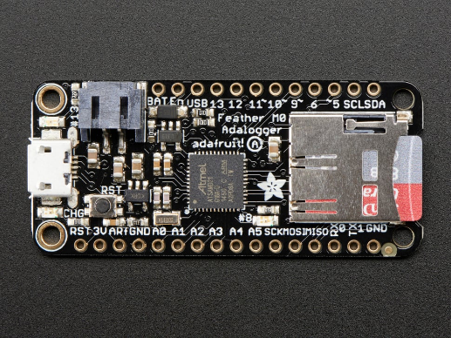
Data Collection – Microprocessor Feather M0 Adalogger
Parameter | Specification
Clock | 48 MHz (maximum)
I/O | USB, I2C, SPI
DAC | 10-bit
Power Consumption | 6.3 mA @ 3.6V
Memory | 256KB Onboard Flash + I2C SD Expansion 32KB RAM
Power Supply | 500mA 3.3V Regulator 100mA LiPo Charger
Overview
Test Readiness
Schedule
Appendix
Budget

Slide 73
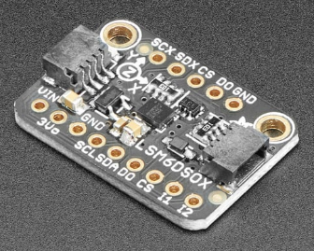
Data Collection – High Bandwidth IMU
LSM6DSOX
Parameter | Specification
DOF | 6
Range | ±2/4/8/16 G
Sensitivity | 61/122/244/488 µG/LSB
Output Data Rate - sampling rate | 1.6 - 6664 Hz (linear acc. ODR) 12.5-6664 Hz (angular rate ODR)
Current Draw | 0.55 mA (high-performance) @ 3.3V
Bandwidth | 4.2-1441.8 Hz
Overview
Test Readiness
Schedule
Appendix
Budget

Slide 74
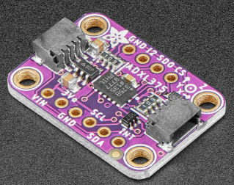
Data Collection – High Range Accelerometer
ADXL375
Parameter | Specification
DOF | 3
Range | ± 200 G
Sensitivity | 49 mG/LSB
ODR | 800 Hz
Current Draw | 0.14 mA (maximum) @ 3.3V
Bandwidth | Up to 1 kHz
Overview
Test Readiness
Schedule
Appendix
Budget

Slide 75
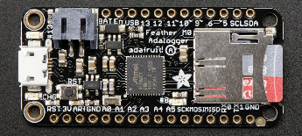
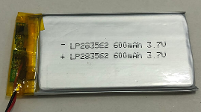
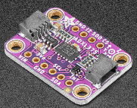
Sensing Component for Purchase & Vendors
Adafruit Featherlogger M0
Vendor / Link | Adafruit - Amazon link
Lead time | 3- business days
Cost | $26.45
Battery
Vendor / Link | Lipol Battery
Lead time | 1 week
Cost | $10.99
Sensors
 | LM6DSOX IMU | ADXL375 Accel
Vendor / Link | Adafruit IMU | Adafruit ADXL375
Lead time | 3-5 business days | 3-5 business days
Cost | $11.95 | $24.95
Memory Card – 32 GB
Vendor / Link | Amazon Micro-SD
Lead Time | 3 business days
20-gauge Wires
Vendor / Link | Amazon Wires
Lead Time | 3 business days
Overview
Test Readiness
Schedule
Appendix
Budget
Notes:
The customer wanted us to get angular velocities, so the IMU has 6 DOF that it can measure

Slide 76
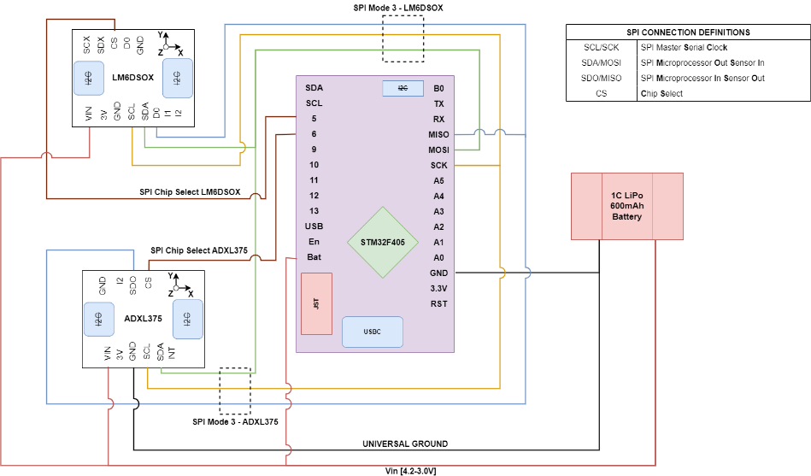
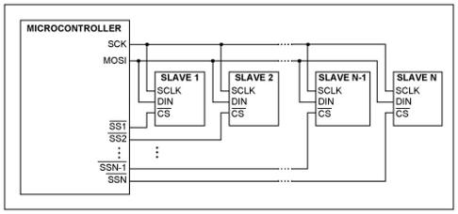
Wiring Diagram
Overview
Test Readiness
Schedule
Appendix
Budget

Slide 77
Power Budget
FR5 – Power & Thermal
21.25 hours Idealized Battery Life
DR5.1 - 2 hours of power
Overview
Test Readiness
Schedule
Appendix
Budget

Slide 78
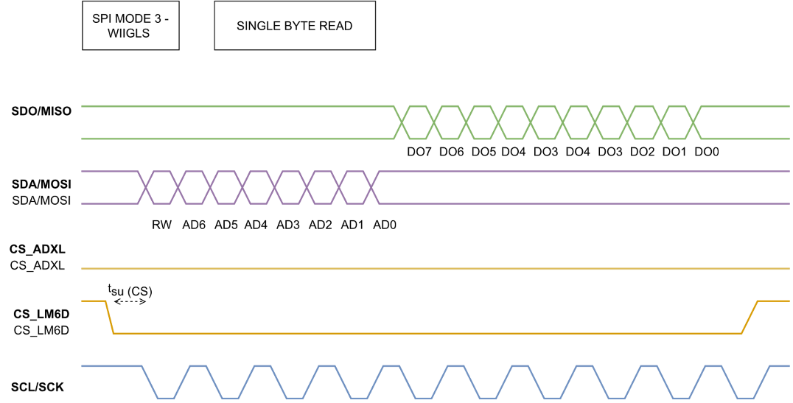
Link Budget & Communications
Overview
Test Readiness
Schedule
Appendix
Budget

Slide 79
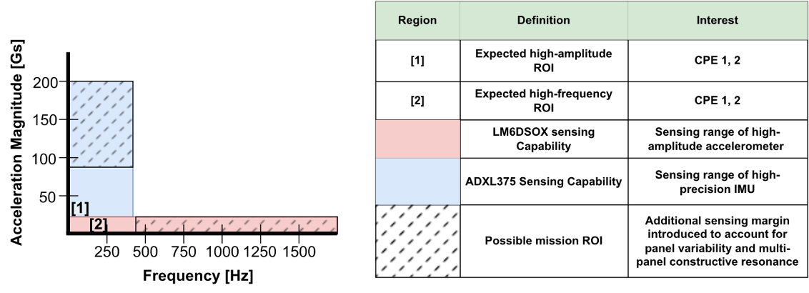
Sensing – Design Space
DR1.1 - 10% accuracy
DR1.2 - 2x Nyquist Frequency
Overview
Test Readiness
Schedule
Appendix
Budget

Slide 80
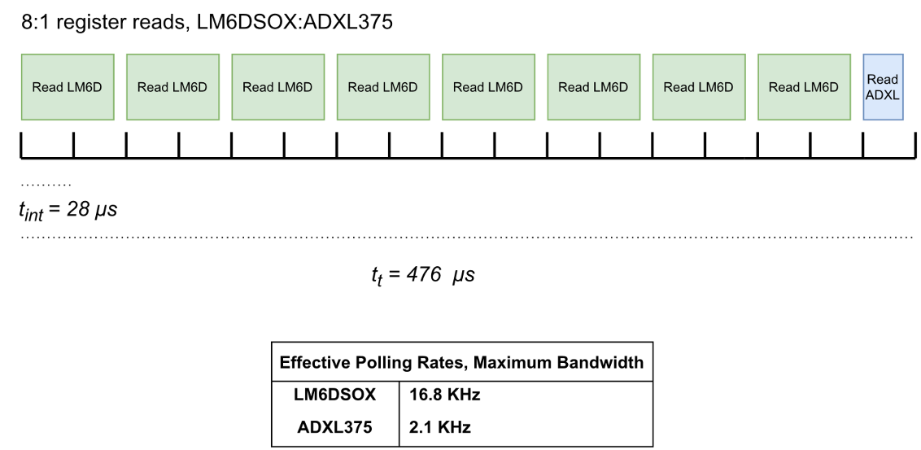
Link Budget & Communications
Overview
Test Readiness
Schedule
Appendix
Budget

Slide 81
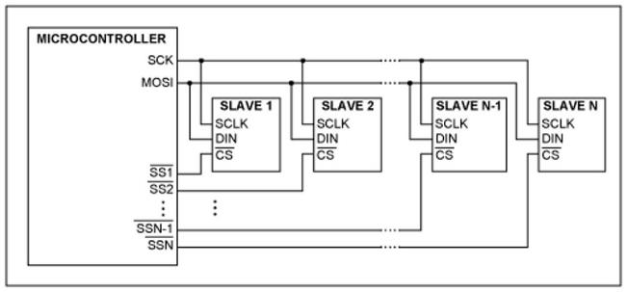
Sensor Communication Interface
SPI Clock | 2 MHz
SPI Mode | 3 [Read Rising, Push Falling]
SPI Parallel Communications Layout
Overview
Test Readiness
Schedule
Appendix
Budget

Slide 82
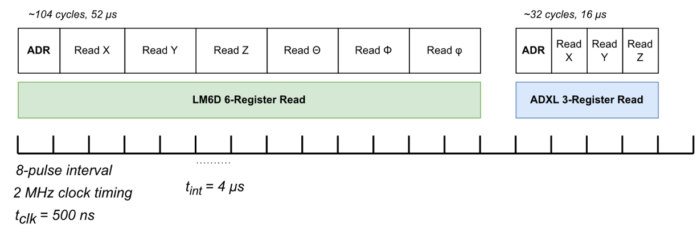
Link Budget & Communications
Overview
Test Readiness
Schedule
Appendix
Budget

Slide 83
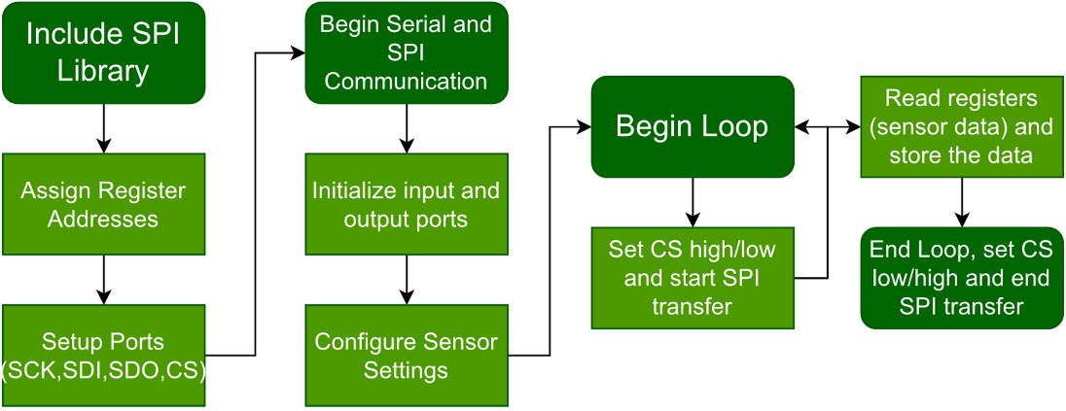
Software Functional Block Diagram
Overview
Test Readiness
Schedule
Appendix
Budget
Notes:
This is Arduino coding/Arduino IDE
- Because of this we include the SPI library
Put draw IO file in teams

Slide 84
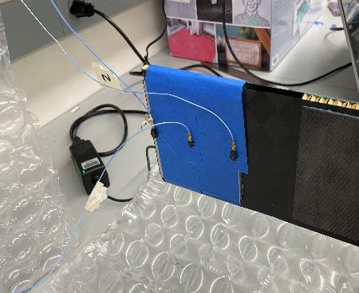
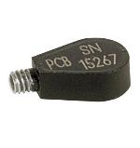
Teardrop Accelerometers
Record accelerations over the panel
Predict experienced forces and frequencies
Max G-load: 19 G
Model# 352C22
9.55 mV/g
±500 g pk
1-10,000 Hz
4 tests conducted:
Unmodified panel
Panel + 60 grams
Panel + 120 grams
Panel + 180 grams
Overview
Test Readiness
Schedule
Appendix
Budget
Notes:
-Needed to test panel before defining DRs
-Used an industry standard accelerometer to measure a deployment
-Mounted with beeswax
- Found raw g force over time

Slide 85
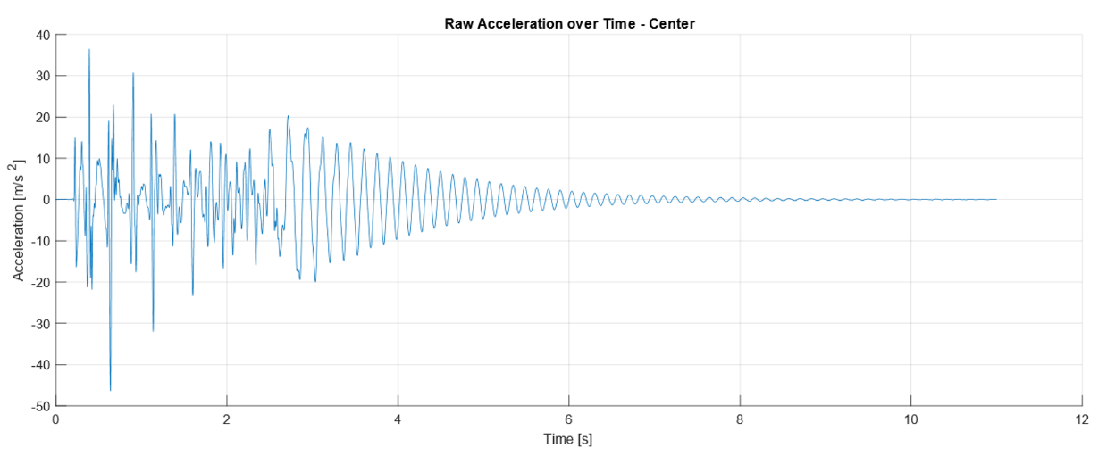
Teardrop Accelerometer Testing – Rise
Accelerometer Sampling Rate: 2557.5 Hz
Maximum Loading: 19G
Overview
Test Readiness
Schedule
Appendix
Budget
Notes:
- Here are the results from the teardrop test
-2 distinct regions – resonance region and the initial deployment
-Max loading occurred at the hinge section
-We think when panel is not snapping it can be modeled as 1D spring mass system, to do this we can look at the initial deployment region
-

Slide 86
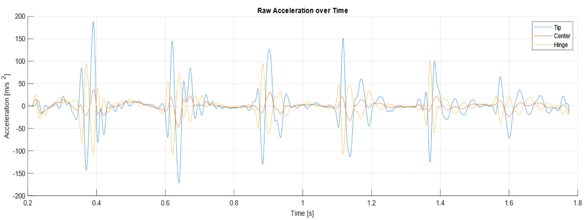
Teardrop Accelerometer Testing
Overview
Test Readiness
Schedule
Appendix
Budget
Notes:
-This is our region of interest for model development, using the tip

Slide 87
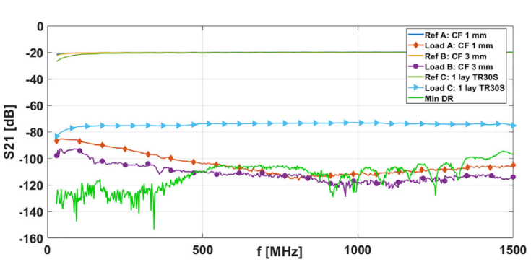
EMF Noise Mitigation
DR1.1 - 10% accuracy
[1]
[1]
[1] Munalli, D., Dimitrakis, G., Chronopoulos, D., Greedy, S., & Long, A. (2019). Electromagnetic shielding effectiveness of carbon fibre reinforced composites. Composites Part B: Engineering, 173, 6–10. https://doi.org/10.1016/j.compositesb.2019.106906
Overview
Test Readiness
Schedule
Appendix
Budget

Slide 88
Other tests

Slide 89
Power Test
Power the sensor suite for two hours of active recording data, while also getting temperature measurements from the micro-processor:
1 test with the sensor suite by itself
1 test of the sensor suite inside the panel
Compare the temperature data to ensure the electronics have enough ventilation to work properly
Ensure that the battery is outputting 3.4V for the two hours it will power the electronics:
This will be measured by the micro-processor which has a power regulator
Overview
Test Readiness
Schedule
Appendix
Budget

