Slide 1
MARCo PoLo
Mobile Astronautic Ranging Computer for Positioning and Localization
Test Readiness Review
Presenters:
Kintan Surghani, Brian Byrne,
Austin Coleman, Justin Pedersen,
Matt Davis, Tyler Candler,
Jackson DePenning
Company Sponsor:
Lockheed Martin -
Taylor Maurer and
Josh Nelson
Full Group:
Kevin Cook,
Ray Stine, Tyler Sterrett,
Ben Arnold, Nadia Abuharus,
Faculty Advisor:
Alexandra Le Moine

Slide 2
Presentation Agenda
1.0 Project Overview
2.0 Schedule
3.0 Test Readiness
4.0 Budget
5.0 Questions
Notes:
KIN
Darken slide number

Slide 3
Acronyms/Terminology
Term | Definition
ASPEN Lab | Autonomous Systems Programming, Evaluating, and Network Laboratory
DITL | Day in the Life
I.C.P. | Iterative Closest Point
SOSC | Space Operation Simulation Center
Marco | The “mock cubesat” that will house the sensor, processor, and mount to the larger robot at the SOSC. This will be moving at a rate of ~1 cm/s.
Polo | A “mock satellite” that houses nothing and will be mounted to the smaller robot at the SOSC. This object is what will be “sensed” by our sensor suite. This will be stationary.
Notes:
KIN
Darken slide number

Slide 4
Project Description
Project Overview
Notes:
Clear what the project is about and what it must accomplish to be successful. Describe all major elements of the project and how the baseline design works. (9-10 pts)
Brief top level overview of your project purpose and specific, quantitative objectives (levels of success), including a brief overview of the project CONOPS and FBD.
Brief review of the baseline design with respect to CDR. Describe major changes to the design.
Review of the critical project elements, along with any updates on critical issues from CDR, FFR, IDR, etc.

Slide 5
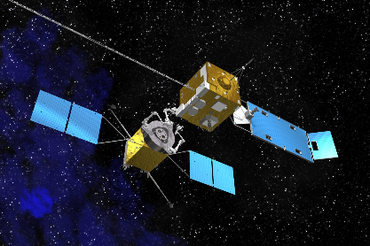
Motivation: On-Orbit Servicing is the Future!
Primary Mission: Extend the design life of on-orbit spacecrafts
Goal: Dock with malfunctioning satellite to perform the needed maintenance or upgrades
Solution: Low-cost CubeSats equipped to perform satellite servicing
Project Description: To design, build, and test a prototype capable of the relative navigation processing system
1.0 Project Overview
2.0 Schedule
3.0 Test Readiness
4.0 Budget
5.0 Questions
Notes:
JACKSON

Slide 6
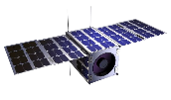
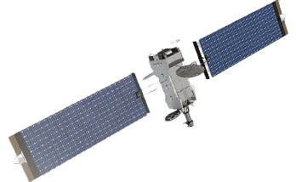
High Level Mission CONOPs
Maintenance request received
2.) Marco placed on orbit
3.) Short range sensing begins
3.) Short range sensing continues
!! This is the MARCo PoLo Focus !!
4.) Docking
and Servicing
1 - 30 meters
Notes:
JACKSON
During Presentation: Talk about the space environment/what orbit this generally will function at (i.e. GEO and LEO)
During Presentation: Potentially add future applications/orbits (i.e. MEO, HEO, and CisLunar)

Slide 7
2.) Activate Marco
Mount Marco and Polo to respective stands
3.) Collect, Process, and Store Necessary Data
During Marco’s Trajectory
5.) Compare Results with Truth Data
4.) Deactivate Marco
Marco
10 | 10 | ✅
0.5 | 0.5 | ✅
12.2 | 12.2 | ✅
3 | 3 | ✅
Polo
Notes:
JACKSON
Animation Slide
Add slide number

Slide 8
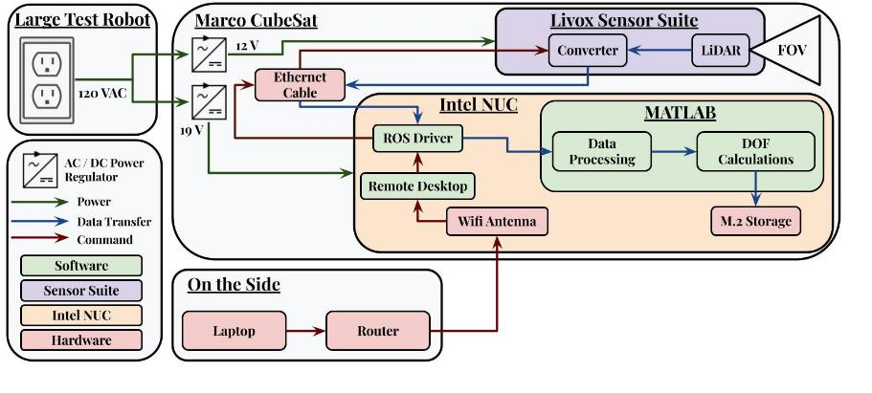
Functional Block Diagram
1.0 Project Overview
2.0 Schedule
3.0 Test Readiness
4.0 Budget
5.0 Questions
Notes:
BRIAN

Slide 9
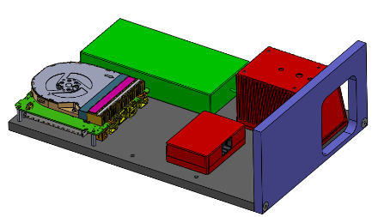
Baseline Design at CDR
Processor Regulator
Livox Mid-70 Lidar
Software:
ROS
Sensor node (pub)
Driver node (pub)
Filter node (sub)
ICP node (sub)
Initiation Method:
Option #1: Physical switch
Option #2: Upon powering system, bash script commands start/stop the system
30 cm
20 cm
Processor NUC Board
Livox Converter 2.0
1.0 Project Overview
2.0 Schedule
3.0 Test Readiness
4.0 Budget
5.0 Questions
Notes:
BRIAN
Recap baseline design
Slide number

Slide 10
Baseline Design: What’s Changed?
Software:
Switch ROS -> MATLAB for computations
Object Detection
Point Cloud Filtering
ICP Algorithm
6 DOF Measurements
Initiation Method:
Created a WiFi Antenna + Router Setup for initiation and live communication
1.0 Project Overview
2.0 Schedule
3.0 Test Readiness
4.0 Budget
5.0 Questions
Notes:
BRIAN
Recap baseline design

Slide 11
Critical Project Elements and Critical Issues
CI | Critical Issues
CI.2.1 | Data Frequency
CI.2.2 | Dimensions of Test Object Shall be Unknown
CI.4.1 | Equipment Safety During DITL Testing
CPE | Critical Project Element
CPE.1 | Sensors
CPE.2 | Software
CPE.3 | Processor
CPE.4 | SOSC Testing
MP | Mitigation Plan
MP.2.1 | Optimize Code and/or Parallel Processing
MP.2.2 | Utilizing ASPIN Docking Port and Implementing Bounding Boxes
MP.4.1 | Extensive Test Planning
1.0 Project Overview
2.0 Schedule
3.0 Test Readiness
4.0 Budget
5.0 Questions
Notes:
BRIAN
Redundancies

Slide 12
Project Description
Schedule
Notes:
A comprehensive project schedule was presented for the spring semester that describes all major tasks especially with respect to Test Readiness, milestones and relates the critical path. Tasks potentially needing to use margin were described. (17-20 pts)
Provide a chart of ALL tests that have or will be performed. Indicate which ones have been completed.
Review the whole project schedule in the form of the Gantt chart, showing overall progress toward goals. In this case, the status should be described with an emphasis on testing. Highlight any major changes in the project schedule since CDR, and indicate shifts in critical path or margins.

Slide 13
Testing Chart: Component Level
Component Level | Completion Date
Sensor Power | Dec 12
Sensor Range (30m) | Jan 25
Sensor FOV at 1 m | Jan 25
Sensor FOV at 30 m | Jan 25
Sensor + Reflectivity Material | Feb 1
Sensor + Lighting | Feb 1
Processor Power | Feb 1
Data Storage (30 mins/3 hr) | Feb 1
Filter Proof of Concept (MATLAB) | Feb 9
ICP Proof of Concept (MATLAB) | Feb 9
Sensor Accuracy (1m) | Feb 6 - Feb 15
Sensor Accuracy (30m) | Feb 6 - Feb 15
KEY
To Do
In Progress
Done
1.0 Project Overview
2.0 Schedule
3.0 Test Readiness
4.0 Budget
5.0 Questions
Notes:
KIN
Maybe{
Due dates column
Descriptions cloumn}

Slide 14
Testing Chart: Subsystem Level
Subsystem Level | Completion Date
MARCo Electronics (Power Reg) | Feb 1
Processor in the Loop | Feb 6
Polo Detection at 1 m | Feb 13 - Mar 6
Polo Detection at 30 m | Feb 13 - Mar 6
Software in the Loop | Feb 22
Initiation Method | Feb 22
Data Frequency (MATLAB) | Feb 22 - Mar 22
KEY
To Do
In Progress
Done
1.0 Project Overview
2.0 Schedule
3.0 Test Readiness
4.0 Budget
5.0 Questions
Notes:
KIN
Due dates column
Descriptions cloumn

Slide 15
Testing Chart: System Level
System Level | Completion Date
Learn Vicon Suite Day | Feb 22 - Mar 1
ASPEN Lab 1 | Mar 6
ASPEN Lab 2 | Mar 8
ASPEN Lab 3 | Mar 13
ASPEN Lab 4 | Mar 15
ASPEN Lab 5 | Mar 17
ASPEN Lab 6 | Mar 22
SOSC Test Day | Apr 12
KEY
To Do
In Progress
Done
1.0 Project Overview
2.0 Schedule
3.0 Test Readiness
4.0 Budget
5.0 Questions
Notes:
KIN
Due dates column
Descriptions cloumn

Slide 16
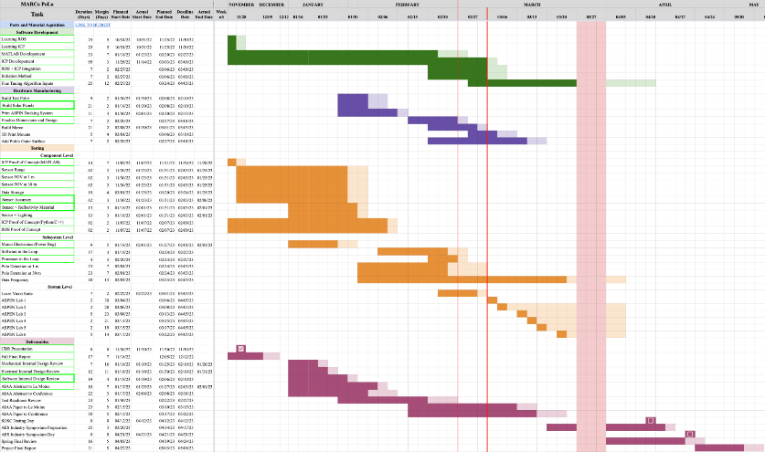
Gantt Chart
Component Testing
Subsystem Testing
System Testing
SOSC Test
16
Notes:
KIN
Writing bigger for testing if not big enough for N240
Add color legend or describe for headings
Describe Crit Path
Check in N240 before slide submission

Slide 17
Project Description
Test Readiness
Notes:
(52-60 pts) Clearly presented two to three critical tests with necessary engineering detail to convey:
- Tests will utilize correct hardware, software, data acquisition plans, and facilities
- Presented pre-requisite test plans/data which indicate this test can be successful
- Tests selected will either verify critical requirements or validate mission objectives. Measurements of design performance can be successful, pass/fail criteria are directly tied to requirements and/or mission objectives
- Tests reduce key risks to design operation
- At least one test will allow for validation of key models presented at CDR
What is being tested and why: your rationale for performing the test in terms of requirements to be verified or mission objectives to be validated.
Highlight critical pre-requisite tests planned/completed that will or do demonstrate this test will be successful. (For example, the components are operating within datasheet ranges, signals could be sent and received, etc) This should not be a deep dive, but rather a quick summary that can be completed in 1 to 2 minutes.
Describe the scope of the testing tasks in the project specifically:
- the design of the test fixtures, selection and calibration of sensors, data acquisition plans o test equipment and/or facilities are needed
- an overview of the test and safety procedures
Describe how the test(s) will reduce risk to meeting requirements, expected results, and how models will be validated. Include clear pass/fail criteria ALONG with expected performance measurements.

Slide 18
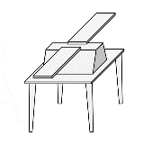
Polo Detection
Objective: Optimize software for detecting and tracking to lessen reliance on shape of Polo
Expected Results: Distinguish Polo at varying ranges
Test Date: 02/13 - 03/06
Deadline: 03/06/23
1.5m cube
Status: In Progress
1m cube
LM 400
30m
1m
30m
1m
Driving Requirement(s):
DR.2 (1m position accuracy)
DR.3 (15° attitude accuracy)
DR.4 (Subsystem Interface)
DR.5 (Filtering)
DR.6 (Relative Measurements)
DR.11 (Non-fiducial test object)
1.0 Project Overview
2.0 Schedule
3.0 Test Readiness
4.0 Budget
5.0 Questions
Leave this ->
Notes:
JUSTIN
Check rubric!!!
Need test equipment/facilities
Need safety mitigation procedures
Model Validation?
Expected Results?
Preprocessing to look at only 1-30 m distance
Cluster detention – identify objects
Bounding box on each potential object
ASPIN Docking port to recognize polo

Slide 19
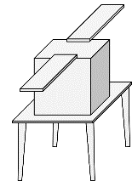
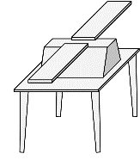
Polo Detection
Facility: Hallways/Project Space
Test Equipment:
LiDAR + NUC Set Up
Tripod/Polo Stand
Tape
Safety Mitigation:
Lidar on tripod
Test in Progress Sign
Tape cords
Prerequisite Tests:
Processor in the Loop
Software in the Loop
Initiation Method
Validation: Ability to detect test objects of different shapes and sizes
1.0 Project Overview
2.0 Schedule
3.0 Test Readiness
4.0 Budget
5.0 Questions
Notes:
JUSTIN
Check rubric!!!
Need test equipment/facilities
Need safety mitigation procedures
Model Validation?
Expected Results?
Outcomes
Through ROS we can get local X,Y,Z positions and orientation from Vicon Suite
Use this as truth data to verify system performs as intended.

Slide 20
Polo Detection - Software Procedure
Group Objects by Point Clusters
Apply Bounding Box to Objects
Identify Polo
Iterative Closest Point
6 DOF State Vector
1.0 Project Overview
2.0 Schedule
3.0 Test Readiness
4.0 Budget
5.0 Questions
Notes:
JUSTIN
Title “Polo Detection Procedure” or something
Preprocessing to look at only 1-30 m distance
Cluster detention – identify objects
Bounding box on each potential object
ASPIN Docking port to recognize polo

Slide 21
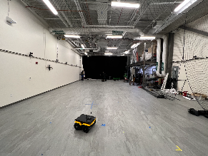
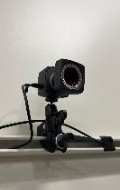
ASPEN Lab Day in the Life (DiTL)
Objective: Imitate SOSC testing day and acquire accurate truth data for comparison
Expected Results: Relative measurement state vector errors within 1 meter and 15°
Test Date: 03/06 - 03/22
Deadline: 04/05
Status: Upcoming
Driving Requirement(s):
DR.2 (1m position accuracy)
DR.3 (15° attitude accuracy)
DR.4 (Subsystem Interface)
DR.6 (Relative Measurements)
DR.7 (1 Hz data rate)
DR.8 (Data Storage)
DR.11 (Non-fiducial test object)
1.0 Project Overview
2.0 Schedule
3.0 Test Readiness
4.0 Budget
5.0 Questions
Notes:
MATT
Check rubric!!!
Need test equipment/facilities
Need safety mitigation procedures
Model Validation?
Expected Results?
Outcomes
Through ROS we can get local X,Y,Z positions and orientation from Vicon Suite
Use this as truth data to verify system performs as intended.

Slide 22
ASPEN Lab Day in the Life (DiTL)
Facility: ASPEN Lab (Aerospace Building)
Test Equipment:
Marco Sensor Suite (Lidar, NUC)
Assembled Polo variations
Tripod/Cart
Vicon Camera Suite
Tape
Outputs:
Trust Data: Vicon Suite
RX, RY, RZ: Euler Angles in Radians
TX, TY, TZ: Global Position in mm
Conversion to local relative measurements
Experimental Data: Marco Sensor Suite:
Relative 6 DOF measurements between Marco and Polo
Safety Mitigation:
Safety meeting with Bobby for ASPEN lab
Test equipment trade study
Preset trajectory
Prerequisite Tests:
Polo Detection
Data Frequency
Initiation Method
Validation:
Comparison between Truth Data and Experimental Data
1.0 Project Overview
2.0 Schedule
3.0 Test Readiness
4.0 Budget
5.0 Questions
Notes:
MATT
Check rubric!!!
Need test equipment/facilities
Need safety mitigation procedures
Model Validation?
Expected Results?
Outcomes
Through ROS we can get local X,Y,Z positions and orientation from Vicon Suite
Use this as truth data to verify system performs as intended.

Slide 23
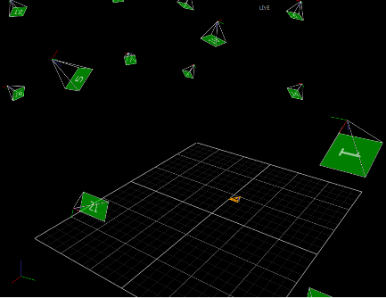
ASPEN Lab DiTL
Vicon Cameras
Vicon Suite Tracking area ~6.1 m x 12.2 m
Moving Object
Place markers on system(s)
Algorithms localize the position of each marker relative to a predefined origin
Tracker determines local position and orientation of object
1.0 Project Overview
2.0 Schedule
3.0 Test Readiness
4.0 Budget
5.0 Questions
Notes:
MATT
Check text size w N240
Explain the 3 week test window and what are the objectives. What is considered a pass. This will need to be very thorough. Can be spread across multiple slides.
Backup options

Slide 24
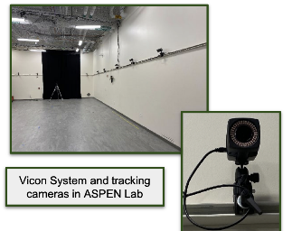
ASPEN Lab DiTL
Vicon Suite
Viewer shows camera orientations and object being tracked
1.0 Project Overview
2.0 Schedule
3.0 Test Readiness
4.0 Budget
5.0 Questions
Notes:
MATT

Slide 25
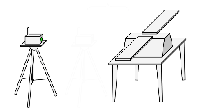
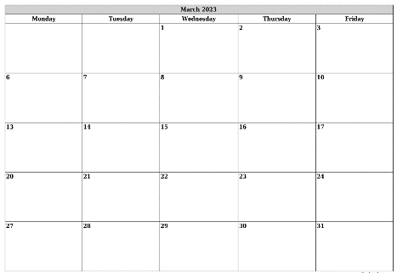
ASPEN Lab DiTL
X
X
X
Objectives
March 1 -> Learn Vicon Suite and Familiarize with Software
March 6 -> X-Axis - Roll
March 8 -> Z-Axis - Pitch
March 13 -> Y-Axis - Yaw
March 15 -> All 3 Axes
March 17 -> BLANK
March 22 -> BLANK
X
X
X
X
1.0 Project Overview
2.0 Schedule
3.0 Test Readiness
4.0 Budget
5.0 Questions
Notes:
MATT
MATLAB Integration (Week 1)
(10 minute test using MATLAB algorithm)
(Individual degrees of freedom)
(Week 2)
(10 minute test using algorithm)
(Individual degrees of freedom)
Full System Integration (Week 3)
(Full 30 minute test using chosen algorithm)
(All degrees of freedom)
Explain the 3 week test window and what are the objectives. What is considered a pass. This will need to be very thorough. Can be spread across multiple slides.
State vector accuracy
Point cloud duration test (paired with sensor accuracy)
Bounding box test (is it applying bounding box through time?)
Full software test
Backup options
Outcomes:
Which mock satellite to use
Which material to use

Slide 26
ASPEN Lab DiTL - Movement
Test 1: x-axis
Test 2: z-axis
Test 3: y-axis
10m
1m
1.0 Project Overview
2.0 Schedule
3.0 Test Readiness
4.0 Budget
5.0 Questions
Leave this here ->
Notes:
MATT
Explain the 3 week test window and what are the objectives. What is considered a pass. This will need to be very thorough. Can be spread across multiple slides.
Backup options

Slide 27
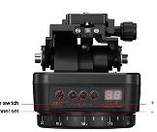
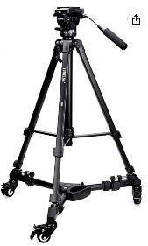
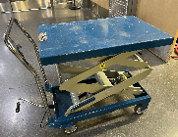
ASPEN Lab DiTL - Moving Marco
Tripod with Wheels
Cart + Rotary Table or Camera Gimbal
Pros
Smooth Yaw/Pitch Control
Electronic Rotation
Less Equipment Risk
Cons
Human Powered
Expensive
Only mount sensor
to gimbal
Pros
Pitch/Yaw Control
Greater Z-Axis Range
Cheaper
Easy Implementation
Cons
Human Powered
Higher safety risk for Marco
1.0 Project Overview
2.0 Schedule
3.0 Test Readiness
4.0 Budget
5.0 Questions
Notes:
MATT
Backup options
Highlight that we will have a set path/”dance” to follow to mitigate risks of tripping, falling, etc.
No more hand-held + strap option. Instead, cart + camera gimbal option.
Marco will have handles anyways for ease of transportation and handling

Slide 28
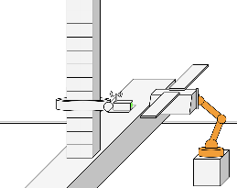
SOSC Testing
Objective: Showcase sensor suite capabilities at a large scale
Expected Result: Relative measurements from Marco sensor suite and truth data provided by Lockheed
Test Date: 04/12
Deadline: 04/12
Procedure:
Pre-test prior to travelling to SOSC to ensure system is operational
Package sensor suite in safety travelling case
Drive to SOSC facility and enter
Build Polo and attach mount
Mount Marco to large test robot and plug in
Set up software
Begin recording on Lockheed approved cameras
Activate Marco system
Watch Large Test Robot approach Polo via docking trajectory (30 min)
Terminate Marco system
Reset Large Test Robot to starting position
Repeat steps 7-11 for the 3 hour window
Thank Lockheed for the opportunity to test at SOSC
Status: Upcoming
1.0 Project Overview
2.0 Schedule
3.0 Test Readiness
4.0 Budget
5.0 Questions
Notes:
AUSTIN
Don’t just read step by step, only highlight important info

Slide 29
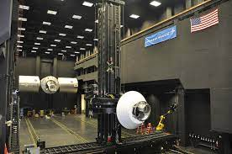
SOSC Testing
Facility: SOSC Lockheed Facility
Test Equipment:
Marco + Mount
Polos + Fasteners + Mount
Personal Computer
Prerequisite Tests:
ASPEN DiTL Testing
Data Frequency
Safety Mitigation:
Initial SOSC visit in the Fall
On-site SOSC staff
Taylor and Josh present
Validation: Meet mission objectives
1.0 Project Overview
2.0 Schedule
3.0 Test Readiness
4.0 Budget
5.0 Questions
Notes:
AUSTIN
Don’t just read step by step, only highlight important info

Slide 30
SOSC Testing - Key Risks
 | 5
 | 4 |  | R.5 |  |  | R.1
 | 3 |  |  | R.4 |  | R.2 R.3
 | 2
 | 1
 |  | 1 | 2 | 3 | 4 | 5
 | CONSEQUENCES
R | Risk Description
R.1 | Damage to sensor suite and test objects
R.2 | Malfunctioning hardware
R.3 | Malfunctioning software
R.4 | Incompatible mounting
R.5 | Limited testing time
LIKELIHOOD
R.5
R.2
R.3
R.4
R.1
1.0 Project Overview
2.0 Schedule
3.0 Test Readiness
4.0 Budget
5.0 Questions
Notes:
AUSTIN

Slide 31
SOSC - Key Risk Analysis
R | Risk Description | Mitigation Plan
R.1 | Damage to sensor suite and test objects | Soft travelling box for Marco and Polo assembly on-site
R.2 | Malfunctioning hardware | Multiple Polos, tool box and extra fasteners on hand
R.3 | Malfunctioning software | Extensive pre-testing so code is mature and as many unforeseen issues/bugs worked out as possible
R.4 | Incompatible mounting | Pre-tested the mounting system at SOSC
R.5 | Limited testing time | Multiple 30 minute tests in the span of 3 hours
1.0 Project Overview
2.0 Schedule
3.0 Test Readiness
4.0 Budget
5.0 Questions
Notes:
AUSTIN
Mention we have five 30 minute tests

Slide 32
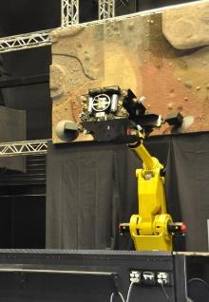
SOSC Testing
1.0 Project Overview
2.0 Schedule
3.0 Test Readiness
4.0 Budget
5.0 Questions

Slide 33
Project Description
Budget
Notes:
The team presented an update on status of all expenses including parts received, pending and planned with emphasis on long-lead and most important parts to project success. An updated Cost Plan (CP) was presented, in the form of a financial budget, for all major items in the project, highlighting uncertainties and corresponding budget margins. (9-10 pts)
• Provide an update on all project expenses including status of parts/materials procurement and the financial budget.

Slide 34
Cost Plan: Parts Received & Pending
Procured
All critical subsystem components
Electrical Components and Sensors
Intel NUC
Livox Mid-70
Mechanical Components
Sensor suite enclosure
SOSC mounting equipment
Test Objects
Baseline Testing Equipment
Remaining Purchases
Testing equipment
ASPEN Lab
SOSC Facility
1.0 Project Overview
2.0 Schedule
3.0 Test Readiness
4.0 Budget
5.0 Questions
Notes:
TYLER

Slide 35
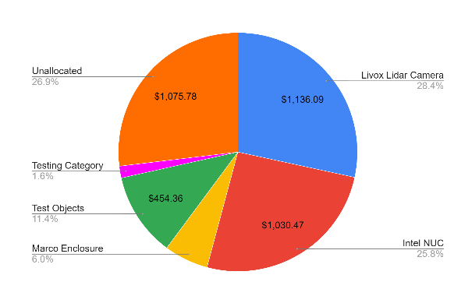
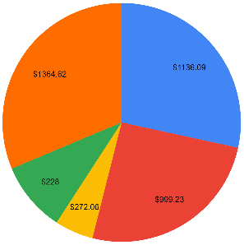
Cost Plan: Financial Budget & Margins
CDR
TRR
1.0 Project Overview
2.0 Schedule
3.0 Test Readiness
4.0 Budget
5.0 Questions
Notes:
TYLER

Slide 36
Project Description
Questions

Slide 37
Backup Slides
Notes:
HYPERLINKED TABLE OF CONTENTS

Slide 38
Table of Contents
Acknowledgements
Administrative
Testing
Mechanical
Software

Slide 39
Acknowledgements

Slide 40
Acknowledgements
Taylor Mauer (LM)
Josh Nelson (LM)
Jeffrey Thayer
Alexandra Le Moine
Bobby Hodgkinson
Trudy Schwartz
Kathryn Wingate
Scott Palo
Jasmin Chadha
Andreas Brecl
Chris Muldrow
Matt Rhodes
Samia Juras
Shakeeb Ahmad
Sean Humbert

Slide 41
Administrative

Slide 42
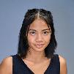
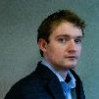
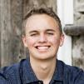
Organization Chart
Kintan Surghani
Project Manager
Brian Byrne
Systems Engineer
Nadia Abuharus
Mechanical Lead
Ben Arnold
Electrical Lead
Austin Coleman
Software Lead
Tyler Candler
CFO
Kevin Cook
Mechanical
Tyler Candler
Mechanical
Justin Pedersen
Electrical / Test
Matt Davis
Electrical / Test Lead
Ray Stine
Software
Jackson DePenning
Software
Tyler Sterrett
Software

Slide 43
Requirements
Design Requirements
Requirements (LVL 0)
Requirements (LVL 1)
Requirements (LVL 2)
Requirements (LVL 3)

Slide 44
Design Requirements
DR |  | Design Requirement
DR.1 |  | The sensor shall have a detection range from 1 to 30 meters
DR.2 |  | The system shall have a position measurement accuracy of at least 1 meter
DR.3 |  | The system shall have an attitude measurement accuracy of at least 15 degrees
DR.4 |  | The onboard computer shall provide an interface between the sensor and algorithm for data analysis
DR.5 |  | A software pipeline shall be implemented to produce a filtered data set from raw sensor data
DR.6 |  | An algorithm shall be implemented to produce relative measurements from sensor data
DR.7 |  | The system shall output processed data at a rate of 1 Hz
DR. 8 |  | The system shall store 3 hours worth of processed data
DR.9 |  | The system shall operate with a fixed 120 VAC power supply
DR.10 |  | The system shall interface with the SOSC test environment
DR.11 |  | The test object shall be non-fiducial

Slide 45
Requirements (LVL 0)
# | Requirement | Parent | Verification Method
O | Mission Objectives
O.1 | Prototype sensor suite to gather data of surrounding objects to determine relative position/orientation | - | A
O.2 | Develop algorithm to refine sensor data into relative position measurements (6 DOF) | - | A
O.3 | Develop processor to run algorithm | - | A
O.4 | Maximize in-situ performance | - | A
SC | Mission Success Criteria
SC.1 | Shall be capable of measuring objects up to 30 meters away | O.1 | T
SC.2 | Shall be capable of measuring objects modeled after the LM400 Series | O.1 | T/A
SC.3 | Shall transform raw translational data to target relative measurements | O.2-3 | T
SC.4 | Shall transform raw rotational data to target relative measurements | O.2-3 | T
SC.5 | Shall be capable of sampling/storing at least 3 hours worth of data | O.3 | T
SC.6 | Shall record relative position measurements at a minimum rate of 1 Hz | O.3 | T
SC.7 | Shall be autonomous with the exception of start and stop | O.4 | T/A
SC.8 | Shall be compatible with SOSC testing facilities | O.4 | T
SC.9 | Shall be functionally validated prior to SOSC test day | O.1-4 | T/A
C | Constraints
C.1 | Shall not exceed $4000 in total expenses | - | A
C.2 | Shall not exceed TBD size | - | I
C.3 | Shall accept a 120 V AC power supply | - | A
C.4 | Shall not exceed 450 kg | - | A

Slide 46
Requirements (LVL 1)
# | Requirement | Parent | Verification Method
1.1 | Mission Design
1.1.1 | Shall be capable of locating unknown object of TBD size up to 30 meters away | O.1, SC.2-3 | T/A
1.1.2 | Shall transform raw translational data to target relative measurements at an accuracy of 1 meter | O.2-3, SC.3 | T/A
1.1.3 | Shall transform raw rotational data to target relative measurements at an accuracy of 15 degrees | O.2-3, SC.4 | T/A
1.1.4 | Shall record relative position measurements at a minimum rate of 1 Hz | SC.5,6 | T
1.1.5 | Shall be compatible with SOSC testing facility | O.4, SC.8 | A
1.1.6 | Shall survive travel to SOSC | O.4, SC.8 | A
1.2 | Prototype System
1.2.1 | Shall house sensor(s) | O.1 | I
1.2.2 | Shall house the processor | O.3 | I
1.2.3 | Shall be electronically compatible with testing stand | SC.8 | A
1.2.4 | Shall be mechanically compatible with testing stand | SC.8 | A
1.2.5 | Shall be autonomous except for activation and termination | O.4, SC.7,9 | A
1.2.6 | Shall meet functionality and accuracy requirements prior to SOSC test day | O.1-4, SC.5-9 | D/A
1.3 | Testing Facility
1.3.1 | Shall test at Lockheed Martin Space Operations Simulation Center (SOSC) | O.4, SC.8 | I
1.3.2 | Shall be capable of 3 hours of autonomous testing | O.4, SC.5 | T
Notes:
DO NOT USE! GET UPDATED SPREADSHEET!!

Slide 47
Requirements (LVL 2)
# | Requirement | Parent | Verification Method
2.1 | Software
2.1.1 | Shall collect raw target object data | 1.1.2-3 | T
2.1.2 | Shall be capable of autonomous computation | 1.2.6, 1.3.2 | T/A
2.1.3 | Shall determine object state at a rate of 1 Hz | 1.1.2-3, 1.2.3 | T/A
2.1.4 | Shall determine target object's position relative to sensor with an accuracy of 1m | 1.1.2 | T/A
2.1.5 | Shall determine target object's attitude relative to the sensor with an accuracy of 15 degrees | 1.1.3 | T/A
2.1.6 | Shall validate relative measurement accuracies | 1.2.6 | D/A
2.2 | Electronics
2.2.1 | Shall be capable of autonomous data transfer | 1.2.5, 1.3.2 | T/A
2.2.2 | Shall be capable of storing data at a minimum rate of 1 Hz | 1.1.4 | T/A
2.2.3 | Shall interface sensor suite critical components together Sensor, Processor, and Data Storage are critical components | 1.2.3,6 | T/A
2.2.4 | Shall regulate and control electrical power for sensor suite components | 1.2.3-4 | T/A
2.3 | Mechanical
2.3.1 | Shall securely house all components | 1.2.1-2 | I
2.3.2 | Shall interface with SOSC test stand | 1.1.5-6, 1.2.3,6 | I/A
2.3.3 | Shall withstand testing duration and movement | 1.1.5,1.2.4,1.3.2 | T/A
2.3.4 | Shall model heritage satellite as test object | 1.1.1,1.3.1 | I/A

Slide 48
Requirements (LVL 3)
# | Requirement | Parent | Verification Method
3.1 | Sensor
3.1.1 | Shall sample at a minimum rate of 1 Hz | 2.1.1 | T/A
3.1.2 | Sensors shall collect raw target object data in TBD form | 2.1.1 | T/A
3.1.3 | Shall be capable of measuring objects at a resolution of TBD | 2.1.1,4-5 | A
3.2 | Chassis
3.2.1 | Shall house a processor, sensors, storage device, and all connecting wires | 2.3.1 | I
3.2.2 | Shall be designed to be compatible with the SOSC mounting system (TBD) | 2.3.2 | A
3.2.3 | Shall be designed to withstand test duration | 2.3.3 | A
3.3 | Test Object
3.3.1 | Shall be designed to be compatible with SOSC mounting system (TBD) | 2.3.2 | A
3.3.2 | Shall be designed to withstand test duration | 2.3.3 | A
3.3.3 | Shall be modeled after a Lockheed satellite | 2.3.4 | I/A
3.4 | Processing System
3.3.1 | Shall be electronically compatible with sensor suite | 2.2.3-4 | T/A
3.3.2 | Shall implement algorithms to transform raw sensor data to translational and rotational relative measurements | 2.1.2,4-5 | T/A
3.3.3 | Shall store relative measurement data at a minimum rate of TBD Hz | 2.1.3,2.2.2 | A
3.5 | Algorithms
3.5.1 | Shall convert raw data into a TBD format | 2.1.1-6 | A
3.5.2 | Shall be developed in TBD language(s) | 2.1.1-6 | A
3.5.3 | Shall convert raw data into position data | 2.1.4 | A
3.5.4 | Shall convert raw data into attitude data | 2.1.5 | A
3.6 | Data Storage
3.6.1 | Shall be capable of storing TBD (amount of) processed data Determined by processor, TBD data type, and test duration | 2.2.2 | T/A
3.6.2 | Shall be stored in TBD format | 2.2.2 | A

Slide 49
Testing
Testing Logistics
Sensor Power
Sensor Range
Sensor FOV
Sensor Accuracy
Reflectivity + Lighting
Initiation Method
Processor in the Loop
Software in the Loop
Data Storage
Marco Electronics
How to use LiDAR
System Communication
ASPEN DiTL
SOSC Day

Slide 50
Link to Testing Logistics

Slide 51
Sensor Power
Objective: Ensure the AC/DC power regulator supplies the correct voltage to the Livox Mid-70 LiDAR and secure it to the Livox power cable.
Procedure:
Cut and strip the power regulator to expose wire ends
Plug the power regulator into a 120 VAC power outlet
Connect voltmeter to wire ends and check voltage
If step 3 reads optimal voltage, then continue to step 4.
Power down power regulator by connecting it to a capacitor
Using voltmeter, occasionally check voltage in power regulator. Wait till voltage reaches zero.
Solder wire ends of power regulator to wire ends of Livox power supply
Wrap solder point with electrical tape.
Test Date: 12/13/22
Deadline: 01/31/23
Status: Complete
Driving Requirement(s):
DR.9
DR.10
Notes:
NAME(S):
TIME:
DATE:
LOCATION:
LINK TO PHOTO FOLDER:

Slide 52
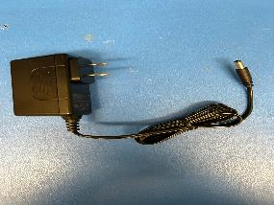
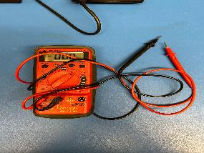
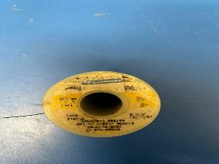
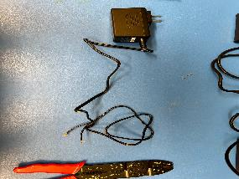
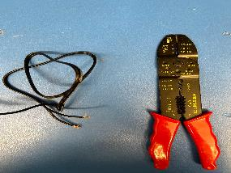
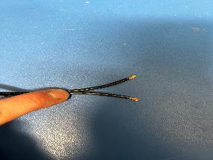
Sensor Power

Slide 53
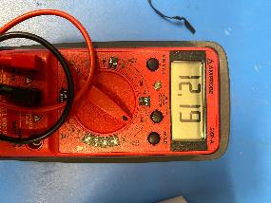
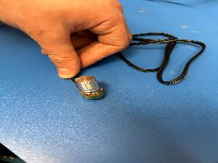
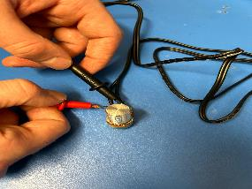
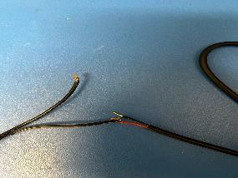
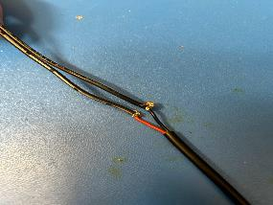
Sensor Power

Slide 54
Sensor Range
Objective: Ensure that the Livox Mid-70 LiDAR has a detection range of 30 m.
Procedure:
Set up Livox Mid-70 LiDAR in courtyard
Run Mid-70 LiDAR
In LVS, change the scale from Reflectivity to Distance
Observe what colors appear
30 m ~ Light Blue
In LVS, select the Measure Distance tool
Start from the origin and extend outwards
Ensure that the Mid-70 LiDAR is generating points from 1 m - 30 m
Test Date: 01/25/23
Deadline: 01/31/23
Status: Complete
Driving Requirement(s):
DR.1

Slide 55
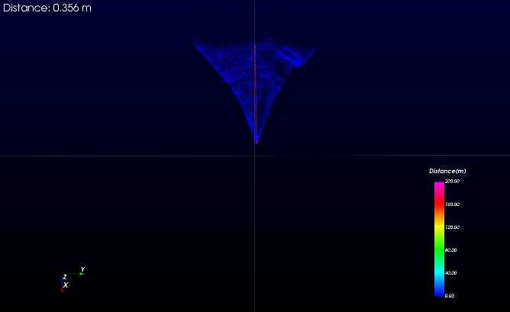
Sensor Range

Slide 56
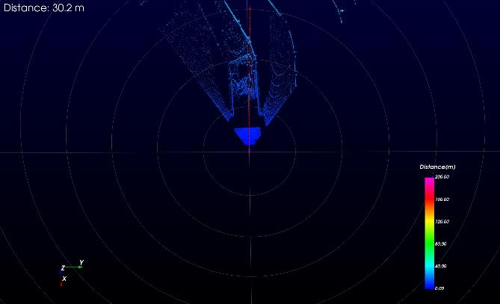
Sensor Range

Slide 57
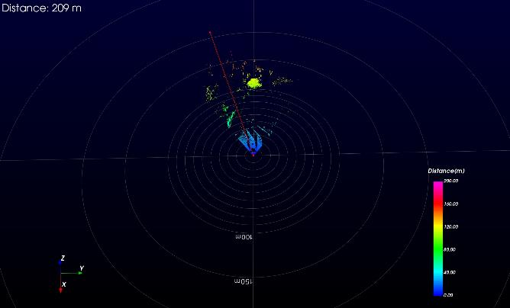
Sensor Range

Slide 58
Sensor FOV
Objective: Ensure the Livox Mid-70 LiDAR has the same FOV as stated on it’s spec-sheet.
Procedure:
Set up Livox Mid-70 LiDAR in courtyard
Run Mid-70 LiDAR
In LVS, select the Measure Distance tool
Start from the origin and extend outwards
Using trig, obtain necessary measurements
Calculate FOV based off of trig measurements
Ensure that the Mid-70 LiDAR has an FOV of 70⁰
Test Date: 01/25/23
Deadline: 01/31/23
Status: Complete
Status: Complete
Driving Requirement(s):
DR.1
Hypotenuse = 10.3 m Opposite = 11.8 m / 2 = 5.9 m FOV = Theta = ?
Theta = sin(Opposite/Hypotenuse) = sin(5.9 m / 10.3 m) = 34.95 deg
FOV = Theta x 2 = 34.95 deg x 2 = 70 deg

Slide 59
Sensor FOV

Slide 60
Sensor FOV

Slide 61
Sensor Accuracy (3 DOF)
Objective: Determine sensor accuracy at 1-30m
Procedure:
Connect Livox sensor (on tripod) to NUC in AERO hallway
Use laser pointer to point sensor at center of Polo face.
Setup Polo face at 1m
Open MATLAB on NUC
Run script to capture point cloud data
Save data in appropriate folder
Repeat steps 2-5 for 30m test
Test Date: 02/06-02/15
Deadline: 01/31/23
Status: Complete
Status: In Progress
Driving Requirement(s):
DR.1

Slide 62
Reflectivity Material + Lighting
Objective: Determine the amount of reflectivity produced by varying materials when exposed to the SOSC lighting, and how well the Lidar can detect these materials.
Procedure:
Set up Livox Mid-70 LiDAR in room with minimal lighting conditions.
Run Mid-70 LiDAR
In LVS, pause the live point cloud data and open Data Viewer tab
Select range of data points and save file
Repeat steps 3-4 for each material at each lighting condition
Obtain reflectivity data and average over selected range to determine best option for material to be used with Polo.
Test Date: 02/01
Deadline: 01/31/23
Status: Complete
Driving Requirement(s):
DR.1

Slide 63
Reflectivity Material + Lighting
Lumens | Aluminum Tape Reflectivity | White Paint Reflectivity | White Paper Reflectivity | Black Paint Reflectivity | Foam Reflectivity | Cardboard Reflectivity
0.12 | 153.31 | 136.42 | 140.21 | 5.69 | 42.26 | 112.09
4.0 | 150.34 | 130.14 | 137.99 | 8.60 | 23.28 | 107.13
100 | 156.45 | 131.42 | 137.82 | 1.66 | 34.45 | 102.36
300 | 156.49 | 135.24 | 129.47 | 6.93 | 22.76 | 93.27
600 | 156.92 | 130.21 | 137.87 | 8.53 | 35.67 | 98.25
Average | 154.90 | 132.09 | 136.67 | 6.28 | 31.68 | 102.62
Notes:
Averages from data taken from Livox-Viewer in Reflectivity/lighting test done on 02/01

Slide 64
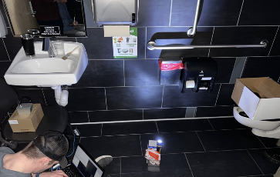
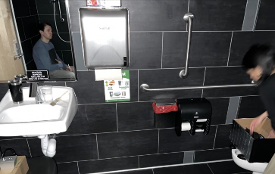
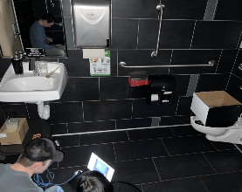
Reflectivity Material + Lighting
Notes:
Pictures

Slide 65
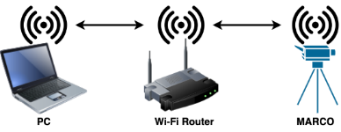
Initiation Method
Pre-defined startup procedure
Terminal commands to to initiate each component
Livox Camera
MATLAB
PRIMARY
Remote desktop, all actions through GUI
Command line in NUC desktop
Test progress visible
BACKUP:
Secure Socket Shell (SSH)
Command line communication only
Connection Option A
Connection Option B

Slide 66
Processor in the Loop
Objective: Ensure that the software and LiDAR are compatible with the NUC
Procedure:
Set up a testing environment where LiDAR can safely gather data
Connect NUC and LiDAR via Livox Converter ethernet port
Plug in both power cords to supply system with power
Initiate system via remote desktop and ensure functionality and proper outputs
Test Date: 02/24/23
Deadline: 02/27/23
Status: Complete
Driving Requirement(s):
LiDAR gathering data and NUC processing data
Notes:
NAME(S):
TIME:
DATE:
LOCATION:
LINK TO PHOTO FOLDER:

Slide 67
Software in the Loop
Objective: Verify operation of software using captured lidar data
Procedure:
Capture 20 second scene of test object with measured changes to lidar position and angle
Run through data frame by frame to allow measurement of processing time
Apply filtering algorithms to data to verify functionality
Apply ICP algorithm to data to verify functionality
Extract state vector from ICP output
Compare state vector to known reference data and check processing time
Load data at set rate to simulate live data acquisition and repeat steps 3-6
Test Date: 02/22/23
Deadline: 02/27/23
Status: Complete
Driving Requirement(s):
DR.5 DR.6 DR.7
Notes:
NAME(S):
TIME:
DATE:
LOCATION:
LINK TO PHOTO FOLDER:

Slide 68
Data Storage
Objective: Ensure that data storage amount on the NUC Mini Computer will have enough space to store all necessary data.
Procedure:
Set up Livox Mid-70 LiDAR
Run Mid-70 LiDAR
Wait 3 hours
Save Data
Click the record button in LVS
Save data file to laptop
Check file size and compare to NUC data storage amount
Test Date: 1/27/23
Deadline: 01/31/23
Status: Complete
Driving Requirement(s):
DR.8
Notes:
NAME(S):
TIME:
DATE:
LOCATION:
LINK TO PHOTO FOLDER:

Slide 69
Data Storage
Notes:
NAME(S):
TIME:
DATE:
LOCATION:
LINK TO PHOTO FOLDER:

Slide 70
Marco Electronics Regulation
Objective: Ensure that power regulation is supplying the correct DC Voltage to the LiDAR and NUC
Procedure:
Plug in LiDAR power converter
Measure the output voltage with a digital multimeter and ensure that it is 12V before connecting to LiDAR
Plug in NUC power converter
Measure the output voltage with a digital multimeter and ensure that it is 19V before connecting to NUC
Test Date: 02/01/23
Deadline: 01/31/23
Status: Complete
Driving Requirement(s):
LiDAR gathering data and NUC processing data
Notes:
NAME(S):
TIME:
DATE:
LOCATION:
LINK TO PHOTO FOLDER:

Slide 71
How to Use the LiDAR
Objective: Setting up the Livox Mid-70 LiDAR for testing
Procedure: (0. Download Livox Viewer Software)
Set up Livox Mid-70 LiDAR
Plug Mid-70 power supply into a 120 VAC wall outlet
Connect power supply to Livox Converter 2.0
Connect Mid-70 to Livox Converter 2.0
Connect Livox Converter 2.o to a laptop via ethernet cable
On laptop, set up necessary IP address
IP: 192.168.1.2
Subnet: 192.168.1.1
Gateway: 255.255.0.0 or 255.255.255.0
DNS: 1.1.1.1 or 8.8.8.8
On laptop, launch the Livox Viewer Software
Initiate Livox Viewer Software
In LVS, select Mid-70 LiDAR tab and connect
Click the play button in LVS
Observe screen and ensure real-time point cloud is being generated
Run Mid-70 LiDAR
Click the record button in LVS
Notes:
NAME(S):
TIME:
DATE:
LOCATION:
LINK TO PHOTO FOLDER:
0334

Slide 72
How to Get Systems Talking
Objective: Inter-Link Sensor Package with External Computer for Command & Control
Procedure Option 1 (WIFI)
Assemble sensor package and power on
Connect NUC PC to Livox camera via ethernet cable using dedicated ethernet port on NUC PC
Power on external computer
Power on pre-programmed WiFi router
External Computer connect to broadcasted WiFi signal MAXWELL
Verify External Computer is set for DHCP on WiFi interface
Start Remote Desktop
Connect to IP: 172.16.1.50
Login using Intel NUC profile
User: marco
Password: ‘single space’
Procedure Option 2 (Direct Connect)
Assemble sensor package and power on
Connect NUC PC to Livox camera via ethernet cable using dedicated ethernet port on NUC PC
Power on external computer
Attach USBC-ethernet adapter to NUC PC
Connect ethernet cable from External Computer to USBC-ethernet adapter
Assign the following parameters to External Computer ethernet adapter interface
IP: 10.0.0.1
Gateway: 255.255.0.0
Start Remote Desktop
Connect to IP: 10.0.0.100
Login using Intel NUC Profile
User: marco
Password: ‘single space’

Slide 73
Link to ASPEN DiTL Procedure

Slide 74
Link to SOSC Procedure

Slide 75
Mechanical
Marco
Polo (Cube)
Polo (LM400)
ASPIN Docking Port
Mounting Bracket
Hardware Integration

Slide 76
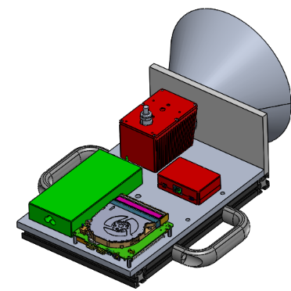
Marco
Frontplate
Livox
FOV
Processor Regulator
Livox Converter
Mount + Handles
NUC Processor

Slide 77
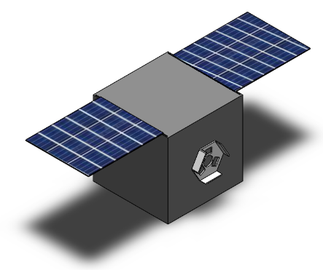
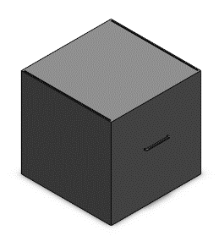
Polo (Cube)
Slots and handles to accommodate add-ons
Solar Panels (Foam)
Satellite Bus (Foam)
2.56 m / 2.06 m
1.5 m / 1 m
1.5 m / 1 m
ASPIN Docking Port (3D printed)
1.0 Purpose and Objectives
2.0 Design Solution
3.0 CPEs and Risk
4.0 Requirements and Satisfaction
5.0 Verification and Validation
6.0 Project Planning

Slide 78
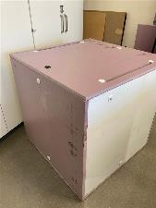
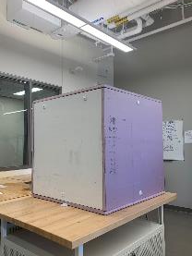
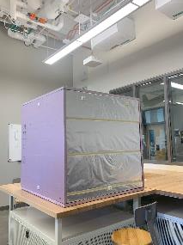
Polo (Cube)
Big Polo
Small Polo
1.0 Purpose and Objectives
2.0 Design Solution
3.0 CPEs and Risk
4.0 Requirements and Satisfaction
5.0 Verification and Validation
6.0 Project Planning

Slide 79
Polo (LM400)
Slots and handles to accommodate add-ons
Solar Panels (Foam)
Satellite Bus (Foam)
2.4 m
1.34 m
0.67 m
ASPIN Docking Port (3D printed)
1.0 Purpose and Objectives
2.0 Design Solution
3.0 CPEs and Risk
4.0 Requirements and Satisfaction
5.0 Verification and Validation
6.0 Project Planning

Slide 80
Polo (LM400)
1.0 Purpose and Objectives
2.0 Design Solution
3.0 CPEs and Risk
4.0 Requirements and Satisfaction
5.0 Verification and Validation
6.0 Project Planning

Slide 81
ASPIN Docking Port
1.0 Purpose and Objectives
2.0 Design Solution
3.0 CPEs and Risk
4.0 Requirements and Satisfaction
5.0 Verification and Validation
6.0 Project Planning

Slide 82
Mounting Bracket
Corner Brackets
T-Nuts
Attached to Marco using T-Nuts (slide into rails)
80-20 construction rails attached together with corner brackets
Mount is attached to optical breadboard using clamps and ¼”-20 fasteners
80-20 Rails
Clamps
1.0 Purpose and Objectives
2.0 Design Solution
3.0 CPEs and Risk
4.0 Requirements and Satisfaction
5.0 Verification and Validation
6.0 Project Planning
Notes:
NADIA
During Presentation: Explain that it fulfills the D.R. of being compatible with the SOSC and that we've already done testing on it during the tour, but due to us not being able to take pictures, we are unable to show it works visually.

Slide 83
Mounting Bracket
1.0 Purpose and Objectives
2.0 Design Solution
3.0 CPEs and Risk
4.0 Requirements and Satisfaction
5.0 Verification and Validation
6.0 Project Planning

Slide 84
Hardware Integration
Sensor
Sensor + PC
Sensor + NUC + Monitor Setup
Sensor + NUC + Remote Desktop
Sensor + NUC + WIFI
Housing + Components (Marco)
Housing + Components + Mount
1.0 Project Overview
2.0 Schedule
3.0 Test Readiness
4.0 Budget
5.0 Questions

Slide 85
Software
MATLAB Flowchart
ComputRel(Pos) Flowchart

Slide 86
MATLAB Flowchart
1.0 Project Overview
2.0 Schedule
3.0 Test Readiness
4.0 Budget
5.0 Questions
Notes:
BRIAN
legend

Slide 87
ComputRelPos() Flowchart
1.0 Project Overview
2.0 Schedule
3.0 Test Readiness
4.0 Budget
5.0 Questions
Notes:
BRIAN

