Slide 1
MARCo PoLo
Mobile Astronautic Ranging Computer for Positioning and Localization
Critical Design Review
Presenters:
Kintan Surghani, Brian Byrne,
Nadia Abuharus, Ben Arnold,
Tyler Sterrett, Tyler Candler,
Jackson DePenning
Company Sponsor:
Lockheed Martin -
Taylor Maurer and
Josh Nelson
Full Group:
Justin Pedersen,
Austin Coleman, Matt Davis,
Ray Stine, Kevin Cook
Faculty Advisor:
Alexandra Le Moine

Slide 2
Presentation Agenda
1.0 Purpose and Objectives
2.0 Design Solution
3.0 CPEs and Risk
4.0 Requirements and Satisfaction
5.0 Verification and Validation
6.0 Project Planning
Notes:
KIN

Slide 3
Acronyms/Terminology
Term | Definition
SOSC | Space Operation Simulation Center
Marco | The “mock cubesat” that will house the sensor, processor, and mount to the larger robot at the SOSC. This will be moving at a rate of ~1 cm/s.
Polo | A “mock satellite” that houses nothing and will be mounted to the smaller robot at the SOSC. This object is what will be “sensed” by our sensor suite. This will be stationary.
Relative Position | A point defined with reference to another position, either fixed or moving
R.O.S. | Robot Operating System
I.C.P. | Iterative Closest Point
Notes:
KIN

Slide 4
Project Description
Purpose and Objectives
Notes:
Recap the project descriptions that appeared in the PDD, CDD, and PDR.
It should be a concise overview that assumes the review board has not just reviewed these earlier documents.
That is, the CDR should stand alone as a description of the project from concept through design solution.
Typically, this overview will include a CONOPS, updated to help explain the project purpose and specific objectives as quickly and clearly as possible.

Slide 5
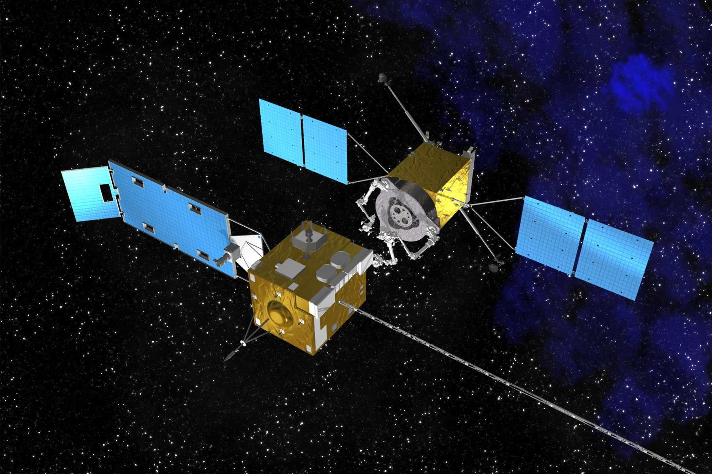
Motivation: On-Orbit Servicing is the Future!
Primary Mission: Extend the design life of on-orbit spacecrafts
Goal: Dock with malfunctioning satellite to perform the needed maintenance or upgrades
Solution: Low-cost CubeSats equipped to perform satellite servicing
Project Description: To design, build, and test a prototype capable of the relative navigation processing system
1.0 Purpose and Objectives
2.0 Design Solution
3.0 CPEs and Risk
4.0 Requirements and Satisfaction
5.0 Verification and Validation
6.0 Project Planning
Notes:
KIN

Slide 6
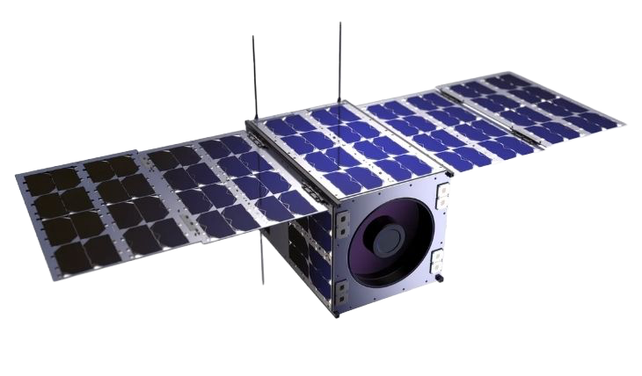
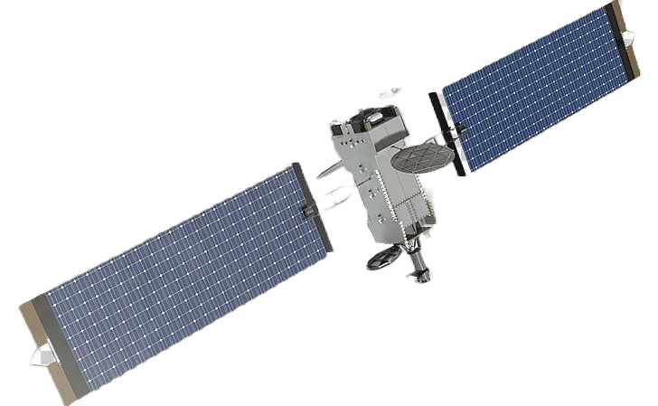
High Level Mission CONOPs
Maintenance request received
2.) Marco placed on orbit
3.) Short range sensing begins
3.) Short range sensing continues
!! This is the MARCo PoLo Focus !!
4.) Docking
and Servicing
1 - 30 meters
Notes:
KIN
During Presentation: Talk about the space environment/what orbit this generally will function at (i.e. GEO and LEO)
During Presentation: Potentially add future applications/orbits (i.e. MEO, HEO, and CisLunar)

Slide 7
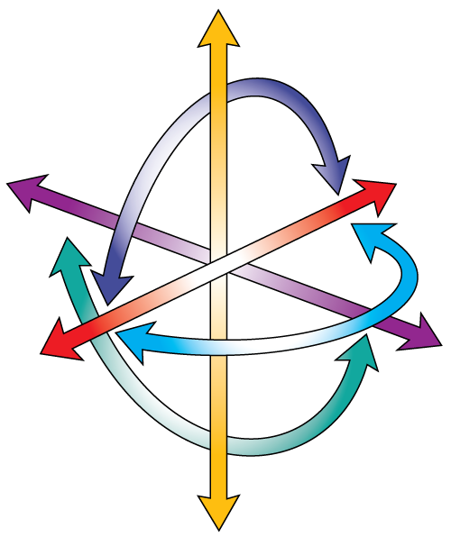
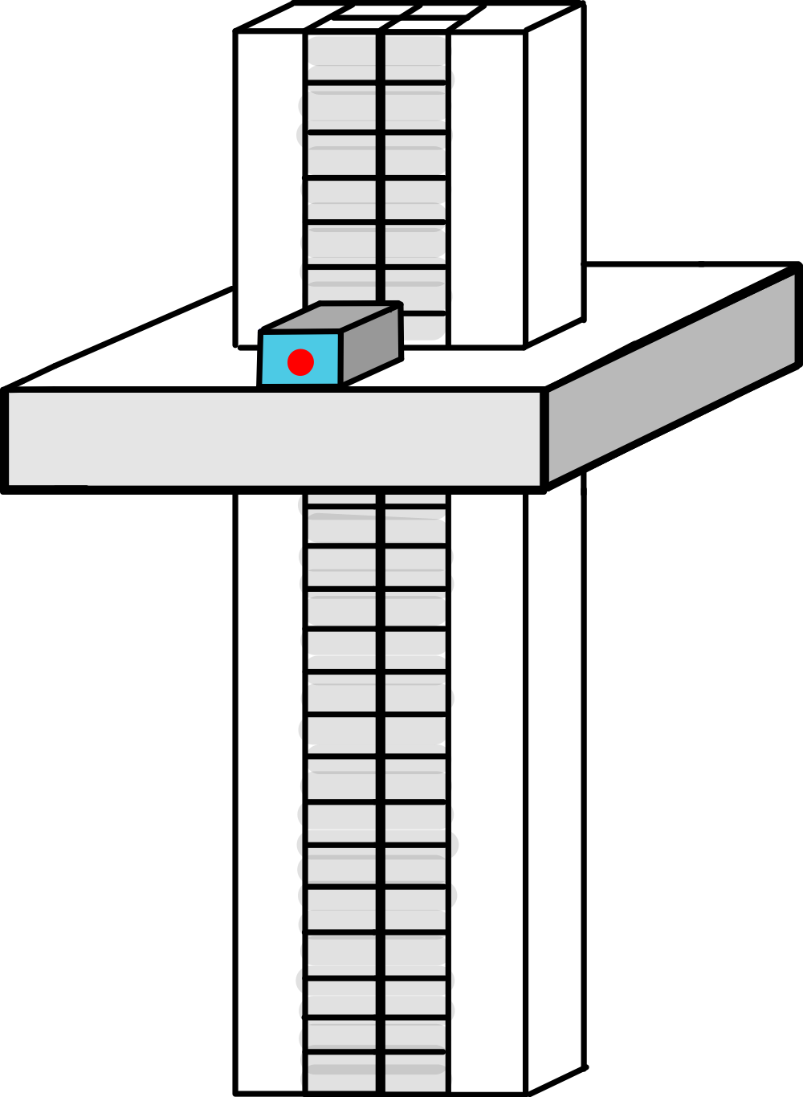
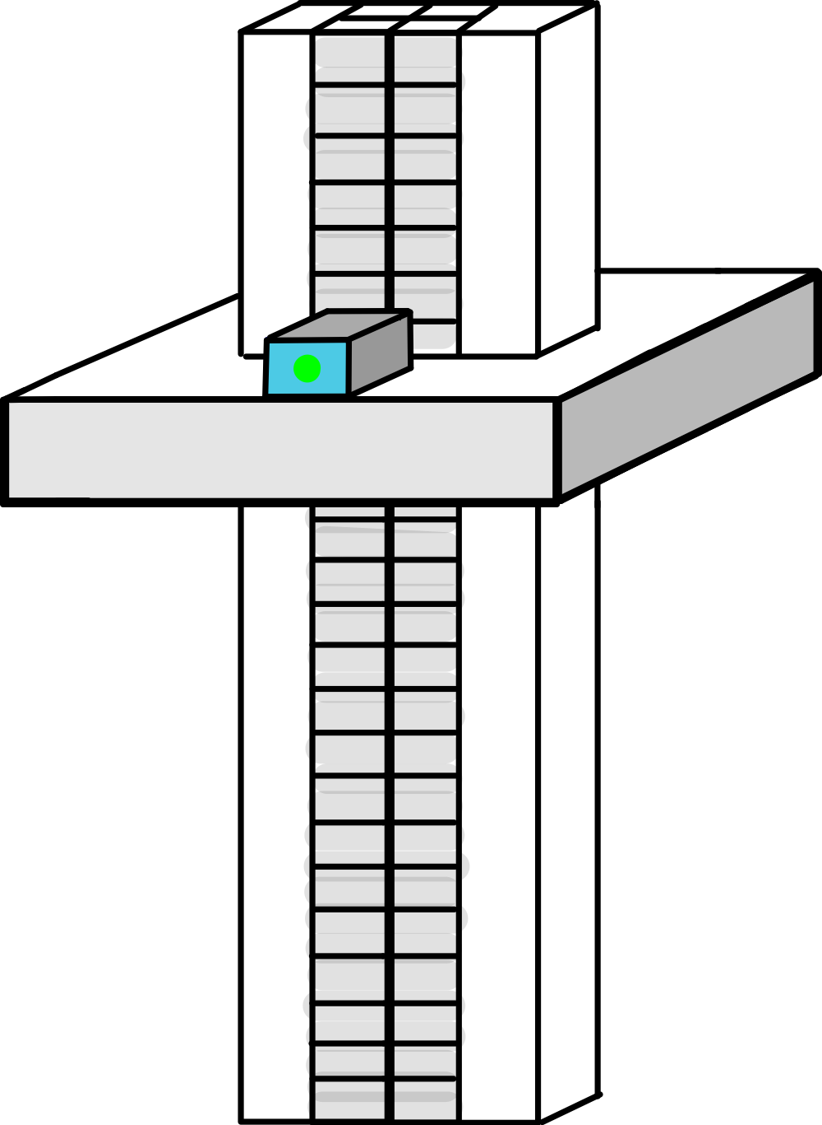
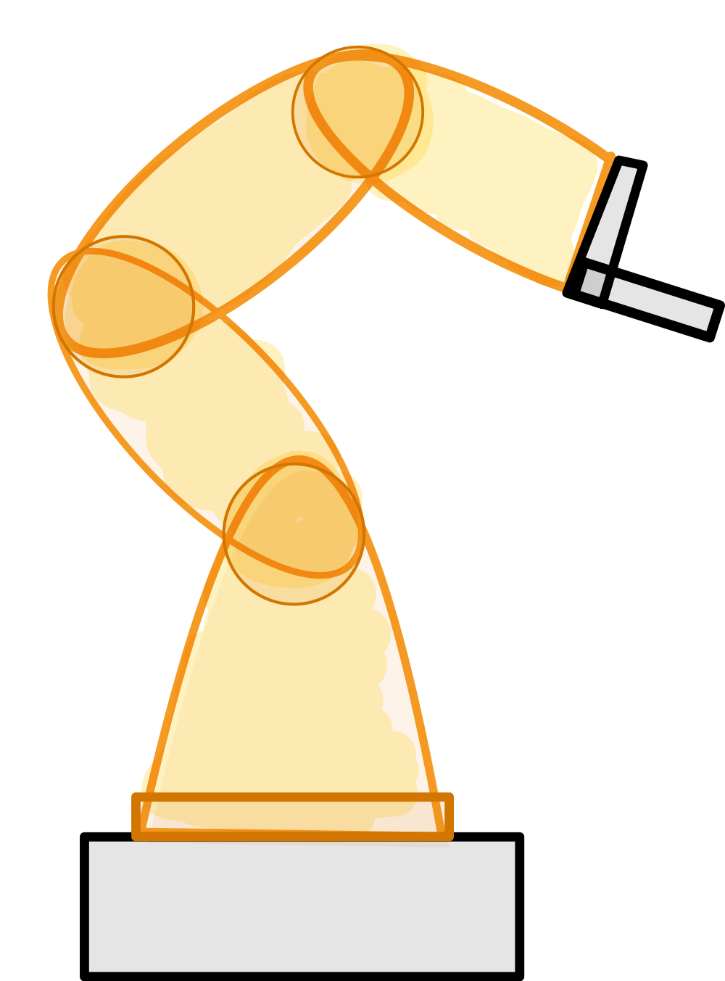
1
Mount Marco and Polo to respective stands
2
Activate Marco
3
Collect, Process, and Store Necessary Data
During Marco’s Trajectory
5
Compare Results with Truth Data
4
Deactivate Marco
1 - 30 m
10 | 10 | ✅
0.5 | 0.5 | ✅
12.2 | 12.2 | ✅
3 | 3 | ✅
Notes:
KIN

Slide 8
Project Description
Design Solution
Notes:
This is a top level description of the overall outcome of your design efforts.
It should show what the whole system looks like, its key parameters (dimensions, mass, data rates, etc.), what the major elements or subsystems are, and most importantly, how it works.
Include a functional block diagram.
This provides the context and terminology for more detailed descriptions later in the presentation.

Slide 9
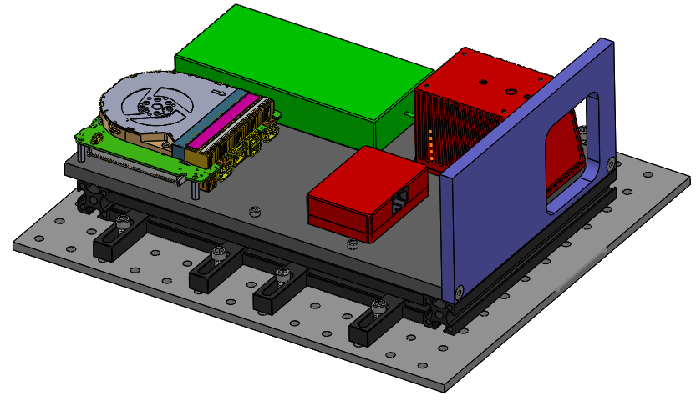
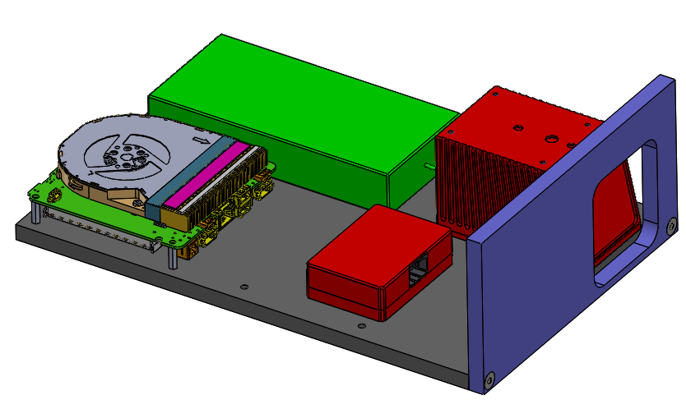
Top Level Design: Marco
Frontplate (3D print)
Processor Regulator
Livox Mid-70 Lidar
30 cm
20 cm
Mount
Baseplate (Aluminum)
Processor NUC Board
Livox Converter 2.0
1.0 Purpose and Objectives
2.0 Design Solution
3.0 CPEs and Risk
4.0 Requirements and Satisfaction
5.0 Verification and Validation
6.0 Project Planning
Notes:
NADIA
Will go over mount in more detail in a later slide
Each of the components have mounting holes on the bottom
Fits a 12U cubesat (20cm x 20cm x 34.05cm)

Slide 10
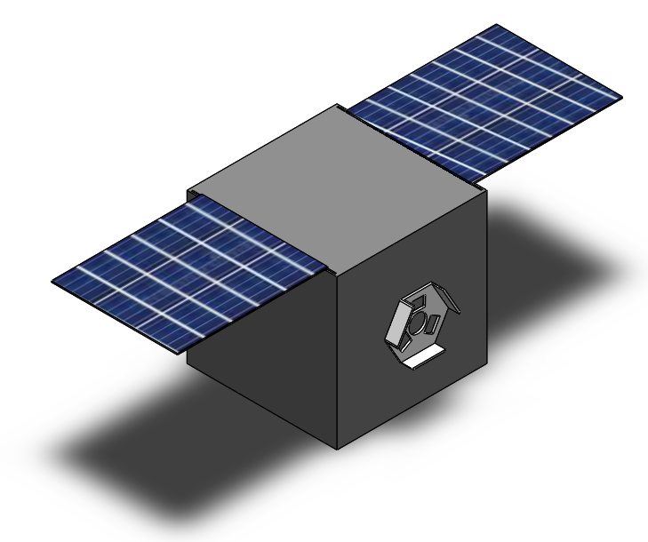
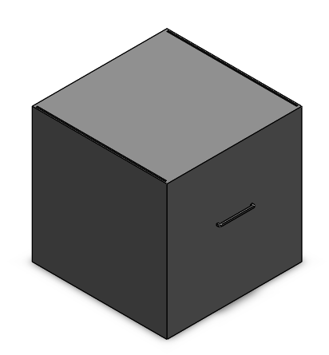
Top Level Design: Polo (Cube)
Slots and handles to accommodate add-ons
Solar Panels (Foam)
Satellite Bus (Foam)
2.56 m / 2.06 m
1.5 m / 1 m
1.5 m / 1 m
ASPIN Docking Port (3D printed)
1.0 Purpose and Objectives
2.0 Design Solution
3.0 CPEs and Risk
4.0 Requirements and Satisfaction
5.0 Verification and Validation
6.0 Project Planning
Notes:
NADIA
(Solar panels add 1.06 m to the length)
The larger cube is larger than the FOV at 1m and the smaller one fits right into the FOV at 1 m
This cube design will be made in 2 sizes (larger size/smaller size)
Both the solar panels and the docking port are removable, and attach by hooks/slots
The docking port is a mock up of the LM ASPIN docking system

Slide 11
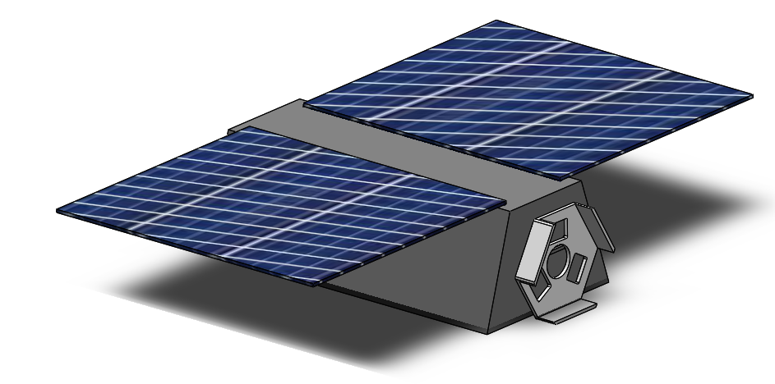
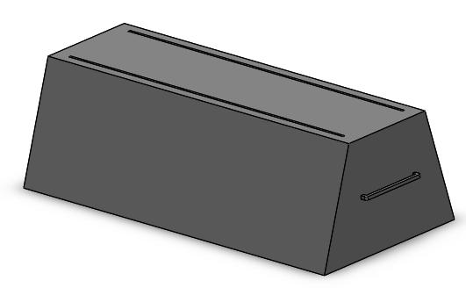
Top Level Design: Polo (LM400)
Slots and handles to accommodate add-ons
Solar Panels (Foam)
Satellite Bus (Foam)
2.4 m
1.34 m
0.67 m
ASPIN Docking Port (3D printed)
1.0 Purpose and Objectives
2.0 Design Solution
3.0 CPEs and Risk
4.0 Requirements and Satisfaction
5.0 Verification and Validation
6.0 Project Planning
Notes:
NADIA
We are planning on making 3 Polos: small cube and large cube (previous slide), and a polo that resembles an LM400 sat.
We will test the sensor suite with all three of these designs to better understand the effect of size relative to FOV on the performance, as well as to test different shapes (cube vs more complex,non-symmetrical shape)

Slide 12
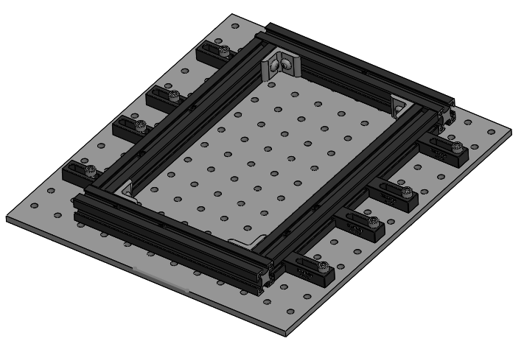
Major Hardware Element: Mounting Bracket
Corner Brackets
T-Nuts
Attached to Marco using T-Nuts (slide into rails)
80-20 construction rails attached together with corner brackets
Mount is attached to optical breadboard using clamps and ¼”-20 fasteners
80-20 Rails
Clamps
1.0 Purpose and Objectives
2.0 Design Solution
3.0 CPEs and Risk
4.0 Requirements and Satisfaction
5.0 Verification and Validation
6.0 Project Planning
Notes:
NADIA
During Presentation: Explain that it fulfills the D.R. of being compatible with the SOSC and that we've already done testing on it during the tour, but due to us not being able to take pictures, we are unable to show it works visually.

Slide 13
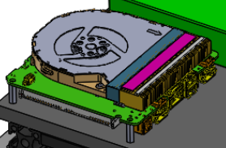
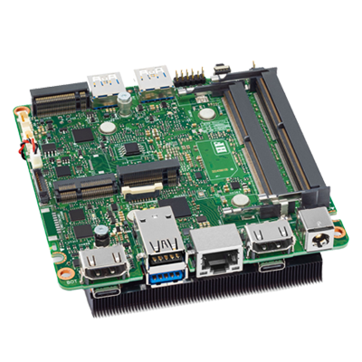
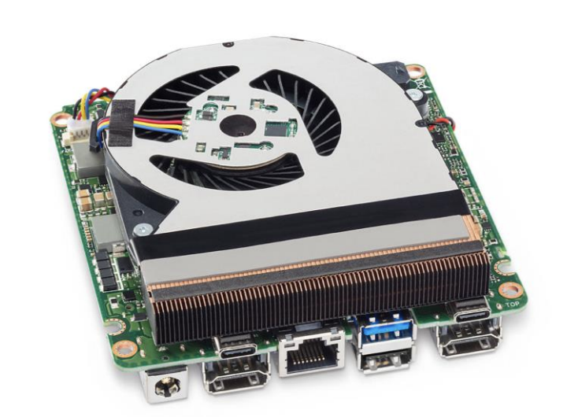
Major Hardware Element: Processor
Intel® NUC Board with 11th Generation Intel® Core™ Processors
Key Specifications
CPU | i7-1185G7 vPro processor
Clock Speed | 3.0GHz@28W, up to 4.8GHz
RAM | 64GB (2x32) DDR4
Storage | 512GB M.2 SSD
Power | TDP 28W, 120W converter
1.0 Purpose and Objectives
2.0 Design Solution
3.0 CPEs and Risk
4.0 Requirements and Satisfaction
5.0 Verification and Validation
6.0 Project Planning
Notes:
JACKSON

Slide 14
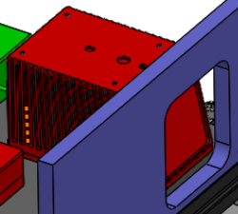
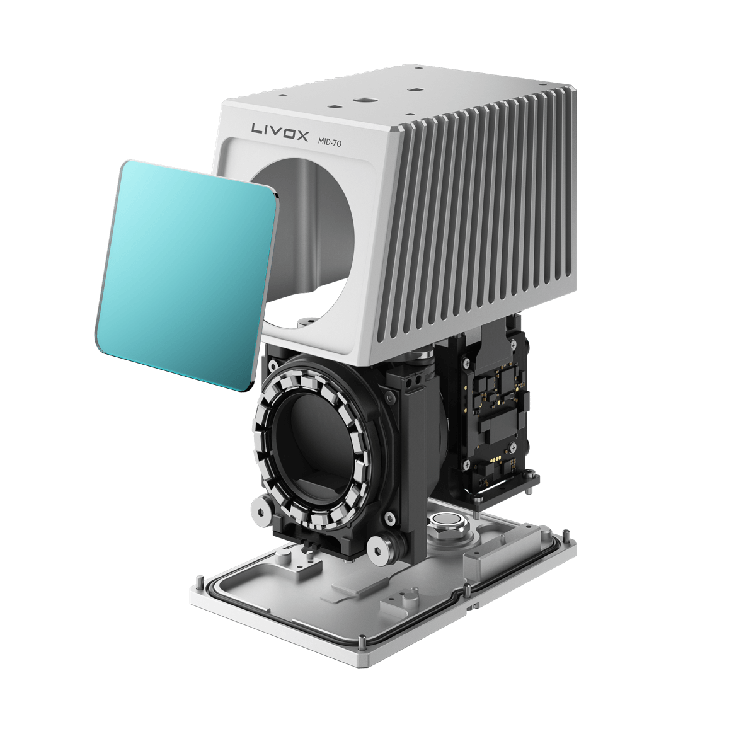
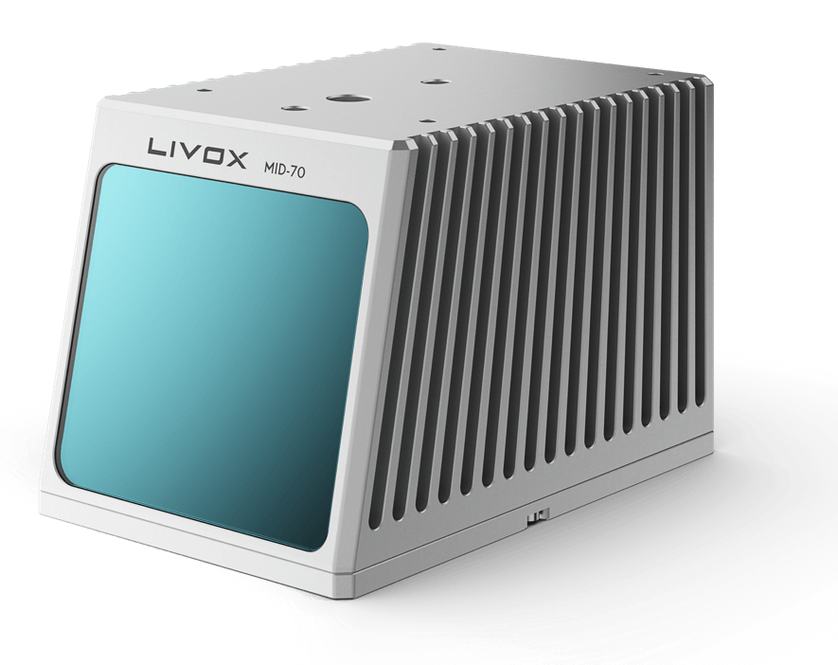
Major Hardware Element: Sensor (LiDAR)
Livox Mid-70
Key Specifications
Detection Range | 90 m @ 10% reflectivity 130 m @ 20% reflectivity 260 m @ 80% reflectivity
Range Precision | 1σ (@ 20m) ≤ 2 cm 1σ (@ 0.2~1m) ≤ 3 cm
FOV | 70.4° (Circular)
Point Rate | 100,000 points/s
Power | 8 W (Average)
1.0 Purpose and Objectives
2.0 Design Solution
3.0 CPEs and Risk
4.0 Requirements and Satisfaction
5.0 Verification and Validation
6.0 Project Planning
Notes:
JACKSON

Slide 15
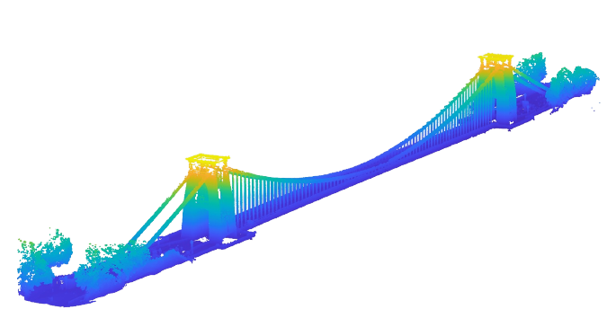
What is LiDAR?
What is a Point Cloud?
LiDAR operates by sending a laser at a target and measuring the time it takes for the reflection of light to return
Exceptional flight heritage
Capable of developing high resolution 3D point cloud maps
Point clouds are 3D sets of data points that when combined represent an object
Highly detailed
Require hundreds of thousands of points for accurate models
1.0 Purpose and Objectives
2.0 Design Solution
3.0 CPEs and Risk
4.0 Requirements and Satisfaction
5.0 Verification and Validation
6.0 Project Planning
Notes:
JACKSON
Include coloration of the point cloud data
LiDAR, which stands for Light Detection and Ranging, is a range detection method commonly employed by spacecraft. LiDAR operates by sending a laser at a target object and measuring the time it takes for that light to reflect back to the equipment. LiDAR is reliable and has a long flight heritage on spacecraft. For our project, it will be used to develop high resolution 3D point cloud maps of our target object. Point clouds are 3D sets of data points that when combined represent an object. They can be highly detailed and represent even minute details on an object, which is useful for identifying specific parts of a spacecraft. This detail comes at a significant computational cost that we have accounted for, in order to model a 3D object with point clouds hundreds of thousands of individual points are often necessary.

Slide 16
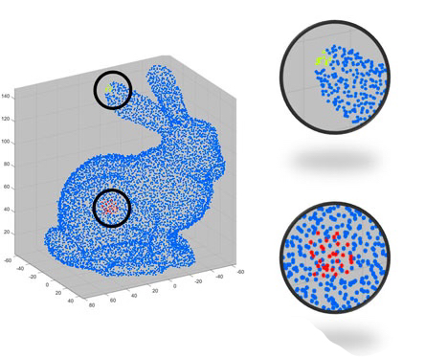
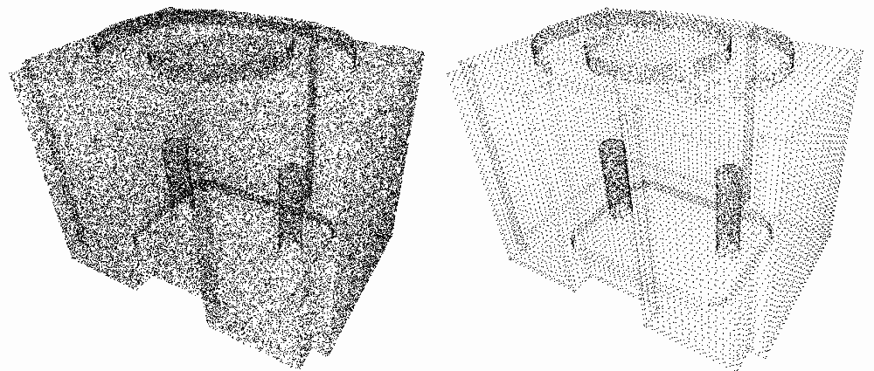
Major Software Element: Point Cloud Filtering
Downsample Filter
Reduces the density of the point cloud in a regular fashion
Used at close ranges, where Polo takes up most of the FOV
Radial Filter
Only keeps points in point cloud within dictated radius of a specified point
Used with object detection at long ranges to reduce point cloud size (FOV shaving)
Goal: Reduce point cloud size to decrease computational load
1.0 Purpose and Objectives
2.0 Design Solution
3.0 CPEs and Risk
4.0 Requirements and Satisfaction
5.0 Verification and Validation
6.0 Project Planning
Notes:
TYLER S

Slide 17
Major Software Element: I.C.P. Algorithm
An Iterative Closest Point algorithm finds the transformation necessary to best align two data sets
Efficient when movements in data sets are small
Output will be the transformation matrix between inputted point cloud states
1.0 Purpose and Objectives
2.0 Design Solution
3.0 CPEs and Risk
4.0 Requirements and Satisfaction
5.0 Verification and Validation
6.0 Project Planning
Notes:
TYLER S
I.C.P. minimizes the sum of the squared error as a function of rotation (R) and translation (t) for corresponding data sets (x and p), each with N data points
This is the main means of converting LIDAR data to useful coordinate frame information
Make sure to mention the equation
Don’t say DCM Matrix
We expect our object to move at 1 cm/s which is ideal for ICP
https://cs.gmu.edu/~kosecka/cs685/cs685-icp.pdf

Slide 18
Software Progression
1. Familiar with Language
3. I.C.P. Algorithm
2. Point Cloud Filtering
4. Optimize Code
MatLab
ROS
Future
1.0 Purpose and Objectives
2.0 Design Solution
3.0 CPEs and Risk
4.0 Requirements and Satisfaction
5.0 Verification and Validation
6.0 Project Planning
Notes:
BRIAN

Slide 19
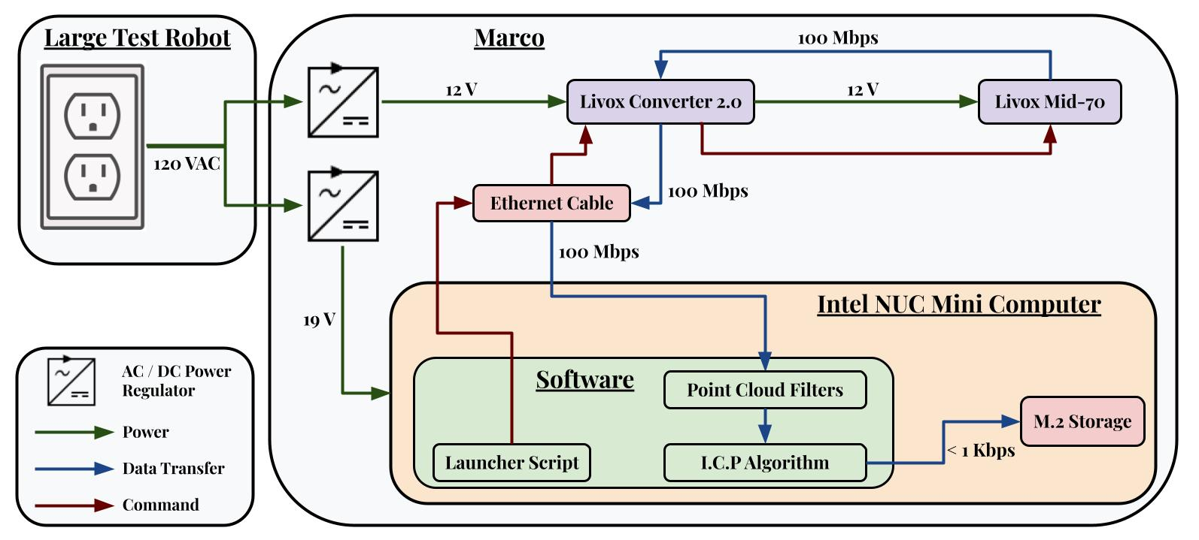
Functional Block Diagram
1.0 Purpose and Objectives
2.0 Design Solution
3.0 CPEs and Risk
4.0 Requirements and Satisfaction
5.0 Verification and Validation
6.0 Project Planning
Notes:
BRIAN

Slide 20
Project Description
Critical Project
Elements and Risks
Notes:
This is a description of what is most important to success of the project, and why these elements were chosen to focus on in this presentation. This discussion should convey your understanding of how the system works and what design features, attributes, or characteristics are most important to that functionality. Provide a risk matrix, showing identified risks and an assessment of their likelihood and severity of consequences to the success of the project. These risks must be credible and specific to your project. An cogent discussion of risks is one of the ways that your understanding of the project and how it works is conveyed to the review board.

Slide 21
CPEs
DR |  | Design Requirement
DR.1 |  | The sensor shall have a detection range from 1 to 30 meters
DR.2 |  | The system shall have a position measurement accuracy of at least 1 meter
DR.3 |  | The system shall have an attitude measurement accuracy of at least 15 degrees
DR.4 |  | The onboard computer shall provide an interface between the sensor and algorithm for data analysis
DR.5 |  | A software pipeline shall be implemented to produce a filtered data set from raw sensor data
DR.6 |  | An algorithm shall be implemented to produce relative measurements from sensor data
DR.7 |  | The system shall output processed data at a rate of 1 Hz
DR. 8 |  | The system shall store 3 hours worth of processed data
DR.9 |  | The system shall operate with a fixed 120 VAC power supply
DR.10 |  | The system shall interface with the SOSC test environment
DR.11 |  | The test object shall be non-fiducial
DR |  | Design Requirement
DR.1 |  | The sensor shall have a detection range from 1 to 30 meters
DR.2 |  | The system shall have a position measurement accuracy of at least 1 meter
DR.3 |  | The system shall have an attitude measurement accuracy of at least 15 degrees
DR.4 |  | The onboard computer shall provide an interface between the sensor and algorithm for data analysis
DR.5 |  | A software pipeline shall be implemented to produce a filtered data set from raw sensor data
DR.6 |  | An algorithm shall be implemented to produce relative measurements from sensor data
DR.7 |  | The system shall output processed data at a rate of 1 Hz
DR. 8 |  | The system shall store 3 hours worth of processed data
DR.9 |  | The system shall operate with a fixed 120 VAC power supply
DR.10 |  | The system shall interface with the SOSC test environment
DR.11 |  | The test object shall be non-fiducial
CPE | Critical Project Element
CPE.1 | Sensors
CPE.2 | Software
CPE.3 | Processor
CPE.4 | SOSC Testing / Prototype
1.0 Purpose and Objectives
2.0 Design Solution
3.0 CPEs and Risk
4.0 Requirements and Satisfaction
5.0 Verification and Validation
6.0 Project Planning
Notes:
BEN
Dont read through all of these. Highlight the important ones that we are modeling
These are the critical project elements and design requirements of our project. In order, the chosen sensor must operate at a maximum range of 30 meters and a minimum range of 1 meter. The system as a whole must maintain acceptable accuracy within 1 meter and 15 degrees. The onboard computer must provide an interface between the sensor and algorithm for data analysis. Software must be able to produce a filtered data set from raw data, and an algorithm will be able to produce relative measurements from that data. The system has be able to process data at at least 1 Hz, and be able to store 3 hours worth of processed data. Finally, the system will operate with a 120 VAC power supply and overall be capable of interfacing with the SOSC test environment.

Slide 22
Key Risk Matrix
R | Risk Description
R.1 | Unable to capture target object within desired range
R.2 | Algorithm crashes or data corruption occurs
R.3 | Central processing system is overloaded
R.4 | Mounting system malfunctions (does not mount properly to test stand or demounts during testing)
R.5 | Parts delayed
 | 5
 | 4 |  |  |  | R.3
 | 3 |  | R.5 | R.1 |  | R.2
 | 2 |  |  |  |  | R.4
 | 1
 |  | 1 | 2 | 3 | 4 | 5
 | CONSEQUENCES
LIKELIHOOD
R.5
R.3
R.1
R.2, R.4
1.0 Purpose and Objectives
2.0 Design Solution
3.0 CPEs and Risk
4.0 Requirements and Satisfaction
5.0 Verification and Validation
6.0 Project Planning
Notes:
BEN
Revisit the movement into Likelihood. Optimistic vs. Reality

Slide 23
Key Risk Analysis
R | Risk Description | Mitigation Plan
R.1 | Unable to capture target object within desired range | Preliminary tests
R.2 | Algorithm crashes or data corruption occurs | Test using sample data for complete SOSC test duration | Backup Algorithm
R.3 | Central processing system is overloaded | Preliminary test to check proper processing power and data storage
R.4 | Mounting system malfunctions (does not mount properly to test stand or demounts during testing) | Confirm system is to exact LM specs and test system before SOSC full system test day
R.5 | Parts delayed | Order parts before spring semester
1.0 Purpose and Objectives
2.0 Design Solution
3.0 CPEs and Risk
4.0 Requirements and Satisfaction
5.0 Verification and Validation
6.0 Project Planning
Notes:
BEN
Also don’t read all of these, R2 and 3 are important

Slide 24
Project Description
Design Requirements
and Satisfaction
Notes:
Building off your CPEs, explain the key requirements which are driving the design, and how the current design satisfies them. Note at this point detailed requirements should have discrete values. You must present two to three engineering predictive models that demonstrate the system will work to satisfy the functional and detailed requirements. Your team may utilize drawings, diagrams, schematics, flow charts, etc. that come from research, analyses, simulations, prototyping, and precursor experiments. A good overview of the design (2.2) and a good discussion of critical elements (2.3) will enable you to focus on a few most important design issues here with your limited presentation time.

Slide 25
Driving Design Requirements
DR |  | Design Requirement
DR.1 |  | The sensor shall have a detection range from 1 to 30 meters
DR.2 |  | The system shall have a position measurement accuracy of at least 1 meter
DR.3 |  | The system shall have an attitude measurement accuracy of at least 15 degrees
DR.5 |  | A software pipeline shall be implemented to produce a filtered data set from raw sensor data
DR.6 |  | An algorithm shall be implemented to produce relative measurements from sensor data
DR.11 |  | The test object shall be non-fiducial
1.0 Purpose and Objectives
2.0 Design Solution
3.0 CPEs and Risk
4.0 Requirements and Satisfaction
4.0 Requirements and Satisfaction
5.0 Verification and Validation
6.0 Project Planning
Notes:
BRIAN

Slide 26
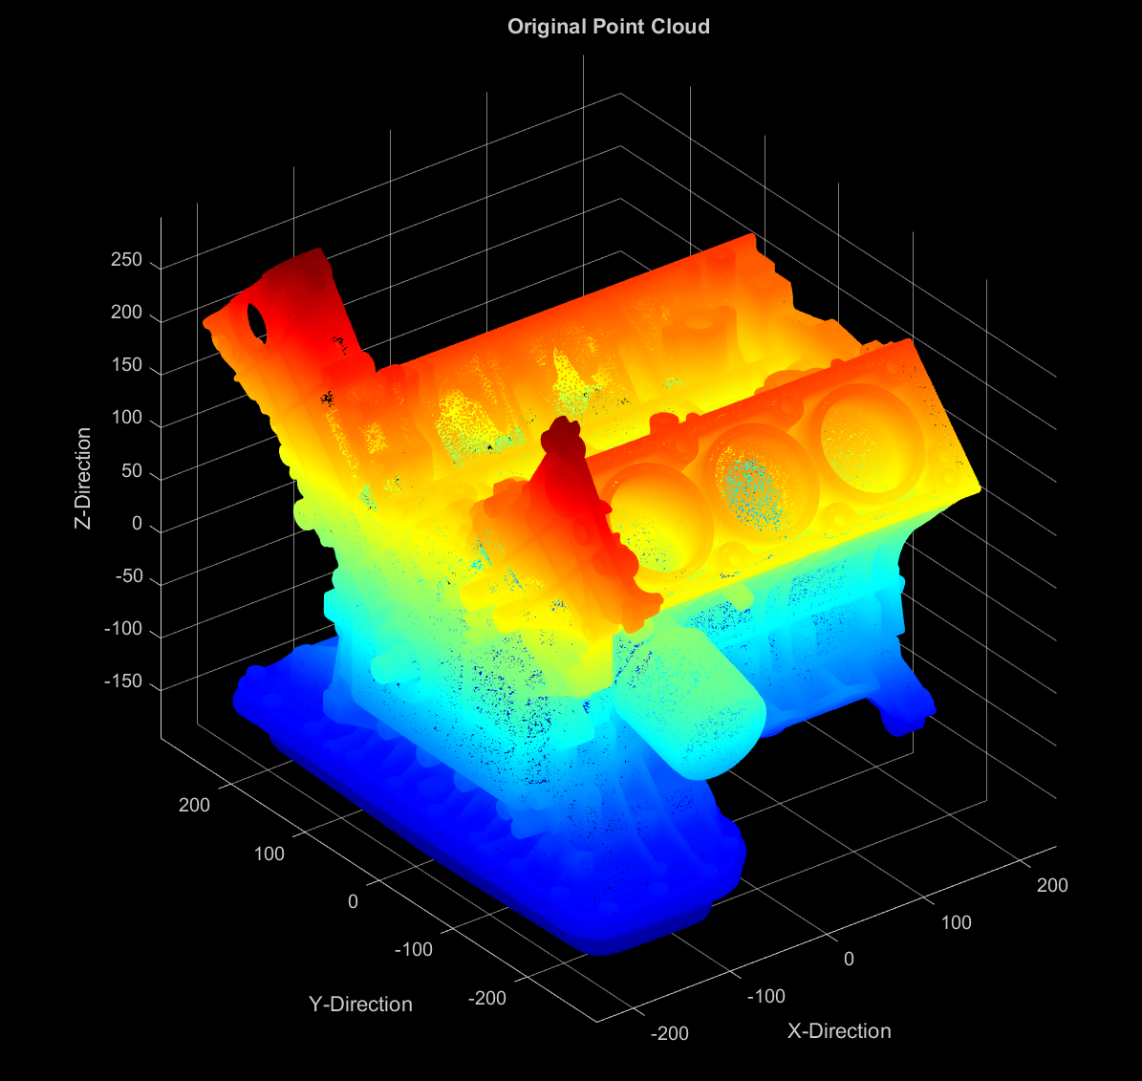
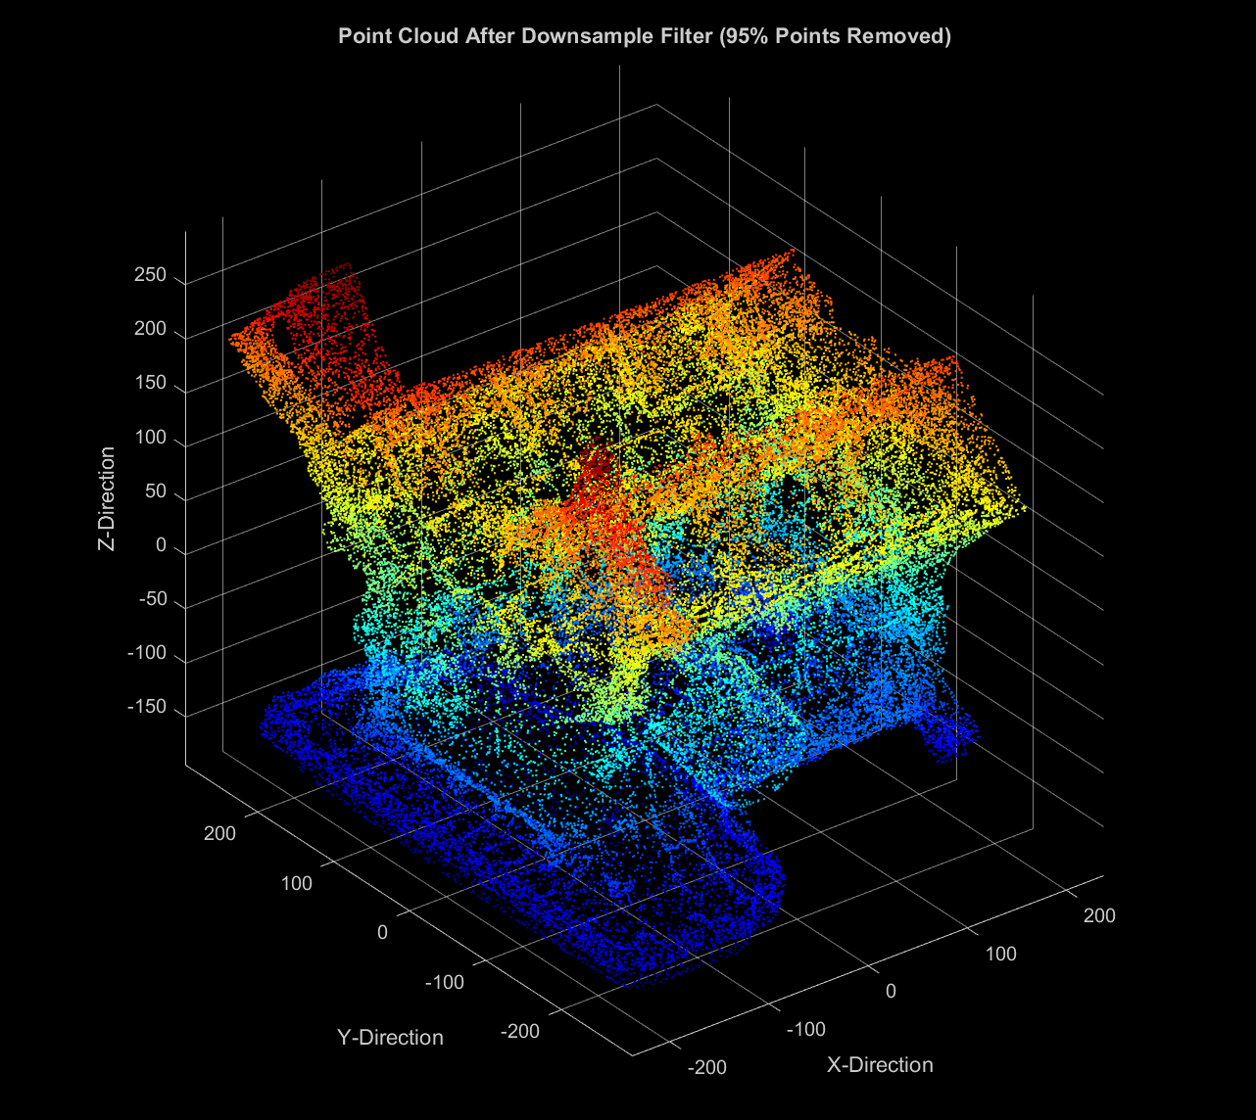
Software Model: Point Cloud Downsample Filter
Design Requirement | Satisfaction
DR. 5 (Filtered Data Set) | YES ✅
1.0 Purpose and Objectives
2.0 Design Solution
3.0 CPEs and Risk
4.0 Requirements and Satisfaction
5.0 Verification and Validation
6.0 Project Planning
Notes:
BRIAN

Slide 27
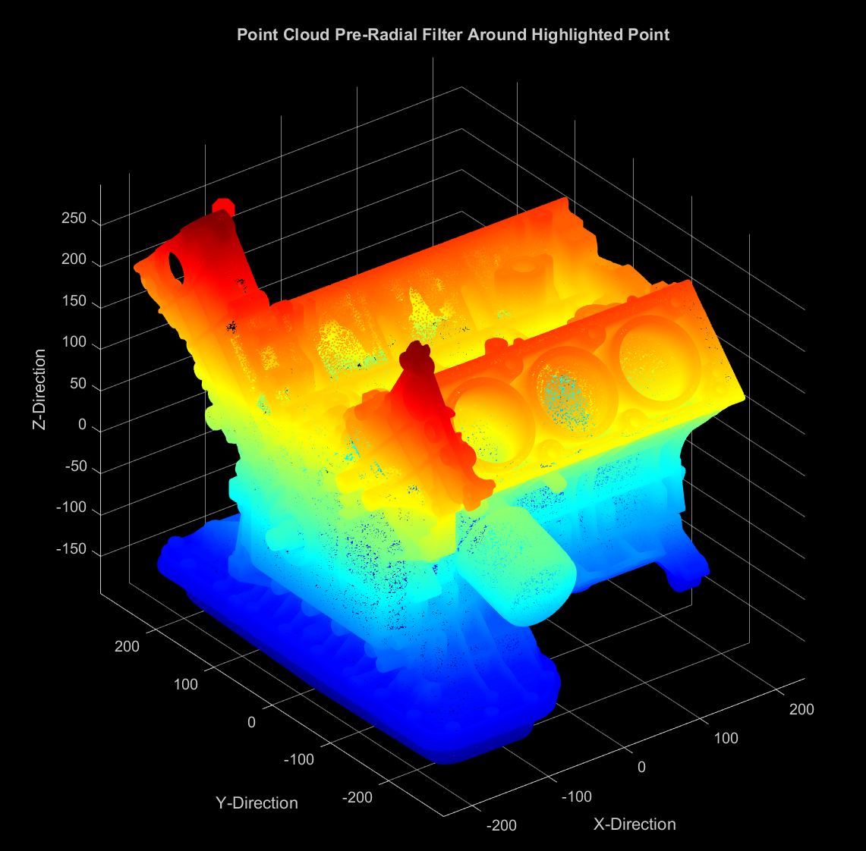
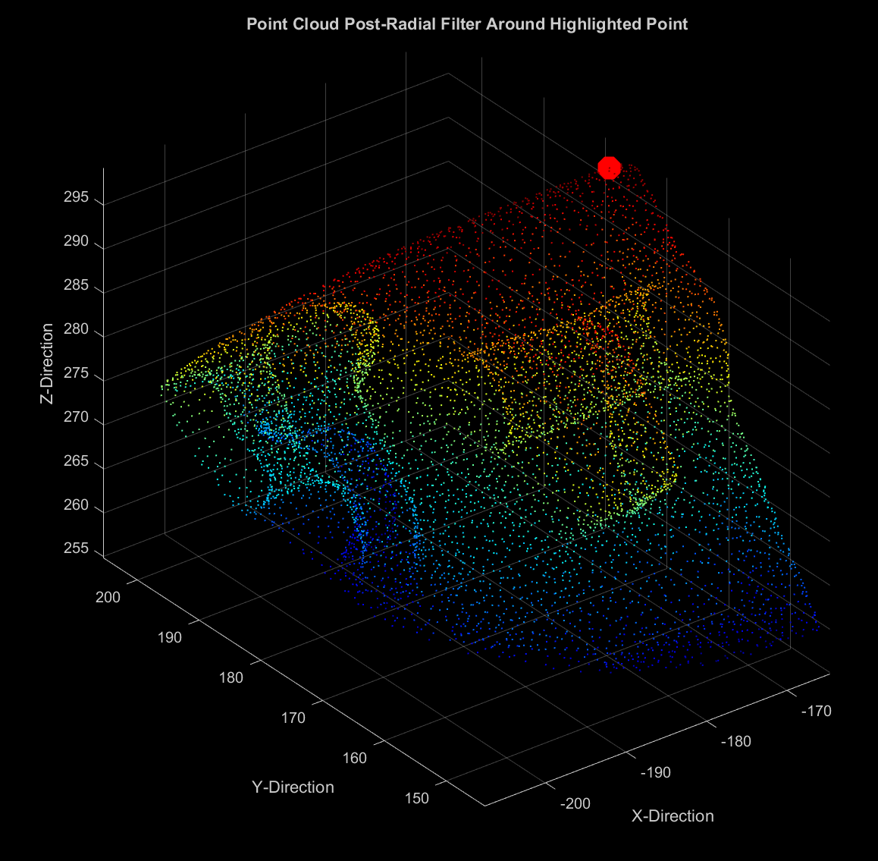
Software Model: Point Cloud Radial Filter
Design Requirement | Satisfaction
DR. 5 (Filtered Data Set) | YES ✅
1.0 Purpose and Objectives
2.0 Design Solution
3.0 CPEs and Risk
4.0 Requirements and Satisfaction
5.0 Verification and Validation
6.0 Project Planning
Notes:
BRIAN

Slide 28
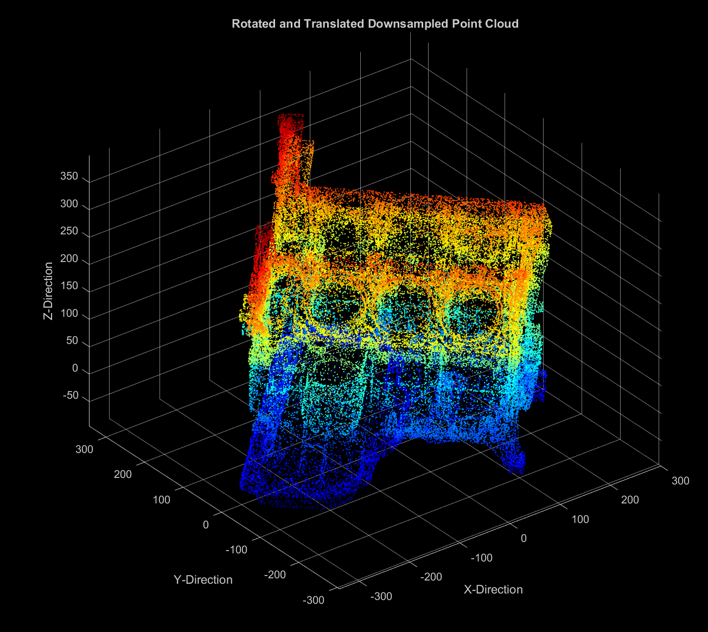
Software Model: I.C.P. Algorithm
1.0 Purpose and Objectives
2.0 Design Solution
3.0 CPEs and Risk
4.0 Requirements and Satisfaction
5.0 Verification and Validation
6.0 Project Planning
Notes:
BRIAN
Use blender to show the change of

Slide 29
Software Model: I.C.P. Algorithm
DOF | Truth Data | I.C.P. Algorithm
x | 0 | 0
y | 0 | 0
z | 100 | 100
α | 0⁰ | 0⁰
β | 0⁰ | 0⁰
γ | 45⁰ | 45⁰
Design Requirement | Satisfaction
DR. 2 (1 m Accuracy) DR.3 (15⁰ Accuracy) DR. 6 (I.C.P. Algorithm) | YES ✅ YES ✅ YES ✅
1.0 Purpose and Objectives
2.0 Design Solution
3.0 CPEs and Risk
4.0 Requirements and Satisfaction
5.0 Verification and Validation
6.0 Project Planning
Notes:
BRIAN
Use blender to show the change of

Slide 30
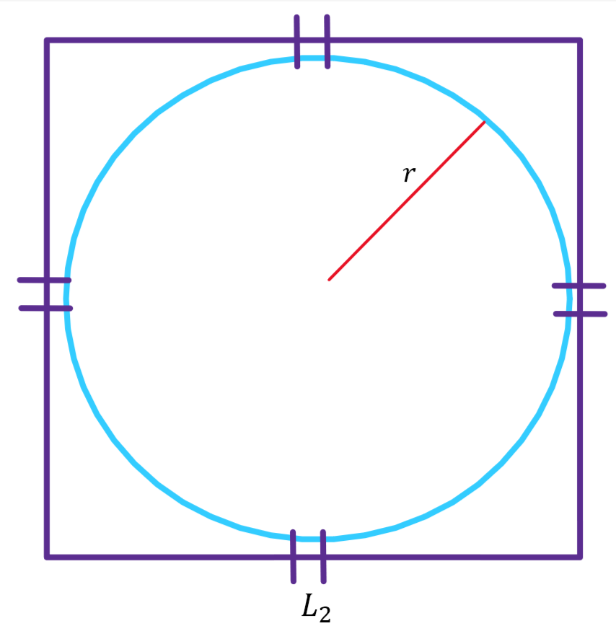
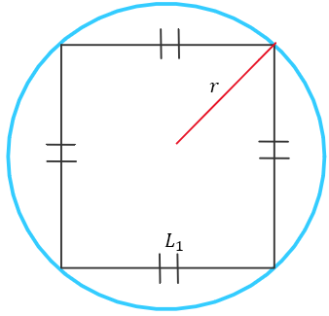
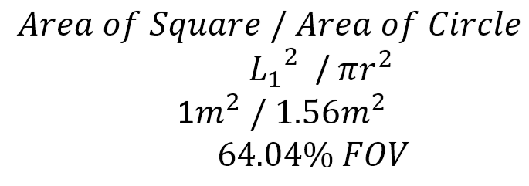
Hardware Model: Polo Detection at 1 meter
Point of View of Camera at 1m
Small Test Object
Large Test Object
Design Requirement | Satisfaction
DR.1 (1 m range) | YES ✅
DR.11 (Non-Fiducial Test Object) | YES ✅
1.0 Purpose and Objectives
2.0 Design Solution
3.0 CPEs and Risk
4.0 Requirements and Satisfaction
5.0 Verification and Validation
6.0 Project Planning
Notes:
TYLER C
Combine with slide after
FoV: Have notes on Worst case scenario (close up, we can’t get a full view of the craft), model in progress
ADD rotated close range FOV
ADD the longest range distance case as well

Slide 31
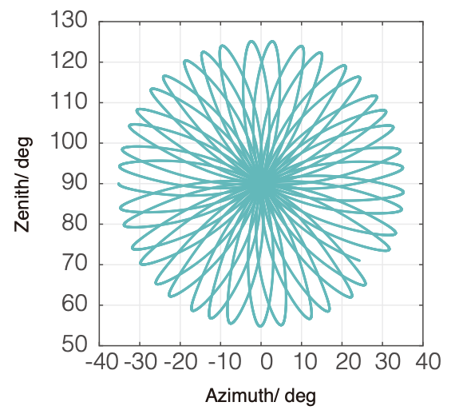
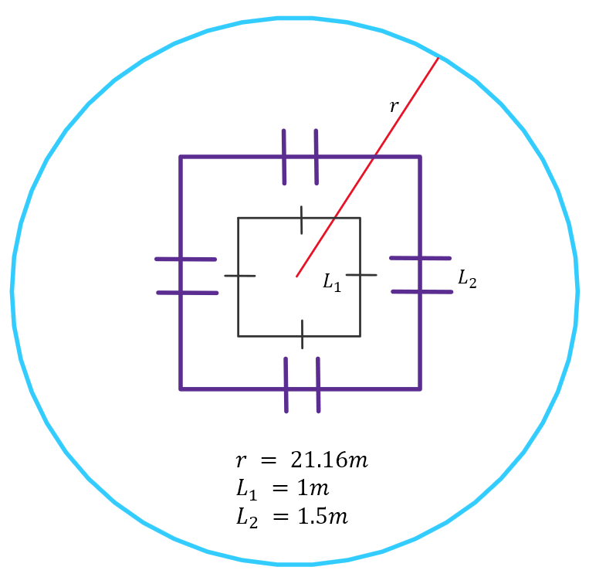
Hardware Model: Polo Detection at 30 meters
Point of View of Camera at 30m
Small Test Object
Large Test Object
Design Requirement | Satisfaction
DR.1 (30 m range) | YES ✅
DR.11 (Non-Fiducial Test Object) | YES ✅
1.0 Purpose and Objectives
2.0 Design Solution
3.0 CPEs and Risk
4.0 Requirements and Satisfaction
5.0 Verification and Validation
6.0 Project Planning
Notes:
TYLER C
Combine with slide after
FoV: Have notes on Worst case scenario (close up, we can’t get a full view of the craft), model in progress

Slide 32
Project Description
Verification and Validation
Notes:
Describe how the design will be validated against functional requirements and overall project success criteria.
Give two or more examples of how the design will be verified against predictive models through characterization testing.
Use diagrams to convey the test set up,The facilities and equipment needed, and how the test works.
Describe the measurements to be made, and key measurement issues (resolution, sampling rate, etc.)
Show how the selected sensors, instruments, data acquisition, test fixtures, etc. provide the required capabilities.
Identify if any testing may result in safety risks.

Slide 33
Polo Detection
Objective:
Verify identifiability of various Polo designs at varying distances
Validation Plan:
Test Polo distinguishability at a 1 m distance
Test Polo distinguishability at a 30 m distance
Repeat with varying Polo designs
Driving Requirements:
DR.1 (1->30 m Range)
DR.2 (1 m Accuracy)
DR.3 (15⁰ Accuracy)
DR.10 (SOSC)
P
P
M
1 meter
30 meters
1.0 Purpose and Objectives
2.0 Design Solution
3.0 CPEs and Risk
4.0 Requirements and Satisfaction
5.0 Verification and Validation
6.0 Project Planning
Notes:
TYLER C
Essentially checking to see if algorithm can pick up on key features of Polo at distance limits with different Polo sizes
Check LiDAR image at a measured 1 meter from the center
Check LiDAR image at a measured 30 meters from the center
Perform these tests with the larger and smaller Polo

Slide 34
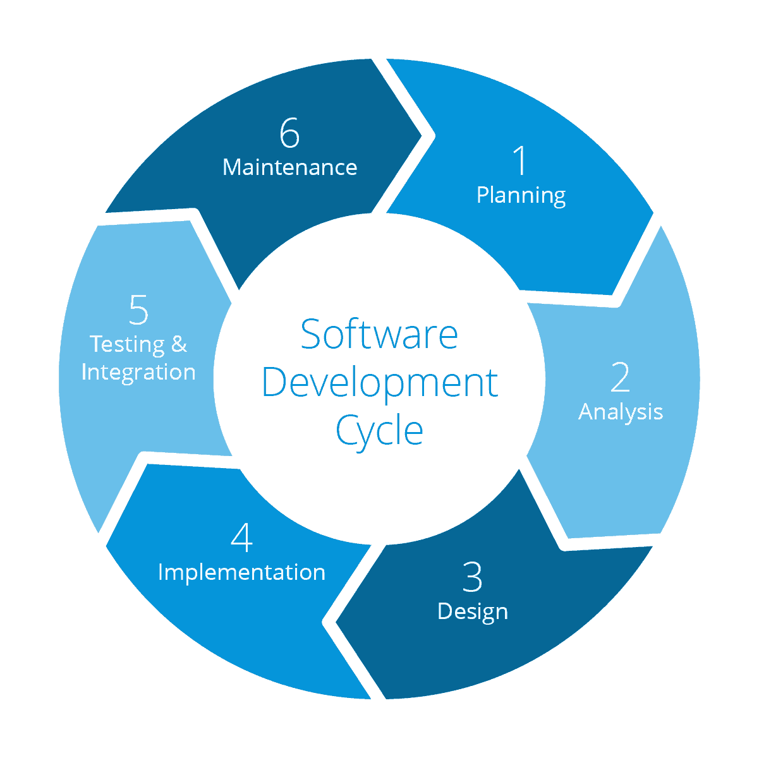
Software in the Loop
Objective:
Verify software produces relative position and attitude measurements with optimal accuracy and frequency
Validation Plan:
Refine algorithm input standards via pre-processing
FOV shaving
Point cloud sizing/density
Refine I.C.P. algorithm
Driving Requirements:
DR.2 (1 m Accuracy)
DR.3 (15⁰ Accuracy)
DR.4 (Software Interface)
DR. 5 (Filtered Data Set)
DR.6 (I.C.P. Algorithm)
1.0 Purpose and Objectives
2.0 Design Solution
3.0 CPEs and Risk
4.0 Requirements and Satisfaction
5.0 Verification and Validation
6.0 Project Planning
Notes:
TYLER S
Add Image?
Less wordy
Find optimal LiDAR data points/s, find best algorithm, etc.

Slide 35
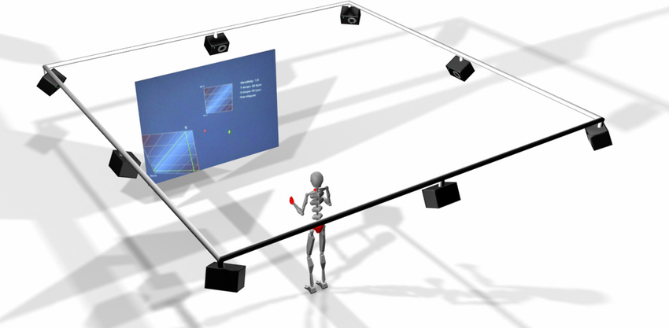
System Accuracy
Objective:
Verify system resolves relative position measurements to within 1 meter, and relative attitude measurements to within 15 degrees
Validation Plan:
Test system accuracy via comparison against Truth Data
ASPEN Lab Vicon Suite -> Michael Rhodes
IMU
Predetermined Stopping Points
Driving Requirements:
DR.2 (1 m Accuracy)
DR.3 (15⁰ Accuracy)
Vicon Motion Camera Tracking Suite
1.0 Purpose and Objectives
2.0 Design Solution
3.0 CPEs and Risk
4.0 Requirements and Satisfaction
5.0 Verification and Validation
6.0 Project Planning
Notes:
TYLER S
Add Image?
Less wordy
Find optimal LiDAR data points/s, find best algorithm, etc.

Slide 36
System Accuracy Testing Plans
Test Type | Truth Data | Location | Duration | Purpose
Movement | ASPEN Lab Vicon Suite | ASPEN Lab | 30 minutes | Examine system accuracy while moving
 | IMU | N200 | 15 seconds | Examine system accuracy while moving
Limit Case | Predetermined locations at constant 1 m radius | ASPEN Lab / N200 | 30 minutes | Examine system accuracy at closest possible distance
 | Predetermined locations at constant 30 m radius | Parking Lot | 30 minutes | Examine system accuracy at furthest possible distance
1.0 Purpose and Objectives
2.0 Design Solution
3.0 CPEs and Risk
4.0 Requirements and Satisfaction
5.0 Verification and Validation
6.0 Project Planning
Notes:
TYLER S.
Reach out to ASPEN Lab Vicon Suite
Test output state accuracies over a 30 minute test window with Marco moving around at a constant distance of 30 meters from Polo (possible worst case scenario)
Test output state accuracies over a 30 minute test window with Marco moving around at a constant distance of 1 meter from Polo (possible worst case scenario)
Test output state accuracies over a short 20 second test with Marco’s movement being measured by an IMU for comparison
Test output state accuracies over a 30 minute test window with Marco moving around at variable distances from 1 to 30 meters from Polo

Slide 37
Project Description
Project Planning

Slide 38
Major Tests
Component Level
ROS
ICP
Sensor
Material Reflectivity
Subsystem Level
Polo Detection
Software in the Loop
Data Frequency
System Level
System Accuracy
ASPEN DiTL
1.0 Purpose and Objectives
2.0 Design Solution
3.0 CPEs and Risk
4.0 Requirements and Satisfaction
5.0 Verification and Validation
6.0 Project Planning
Notes:
KIN
Major component, subsystem, and system level
TESTS
Software: Throw largest (200,000 points per second) and smallest (100,000 points per second) file sizes and see the extremes and how it functions. Full 30 minute run test. Unit level tests, for software are we able to take in data and have in function, can we modify data rate, are our Hz requirements. Maybe have a backup slide for less significant tests

Slide 39
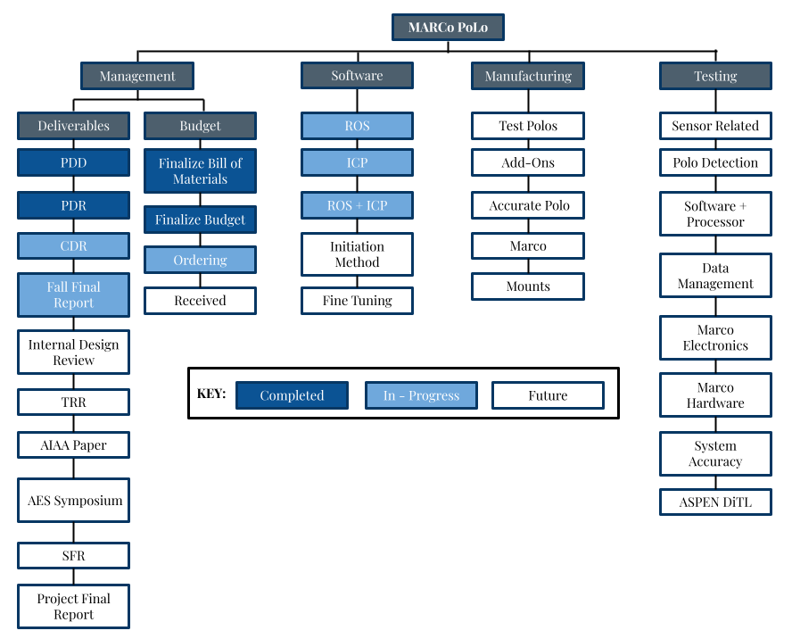
WBS
1.0 Purpose and Objectives
2.0 Design Solution
3.0 CPEs and Risk
4.0 Requirements and Satisfaction
5.0 Verification and Validation
6.0 Project Planning
Notes:
KIN

Slide 40
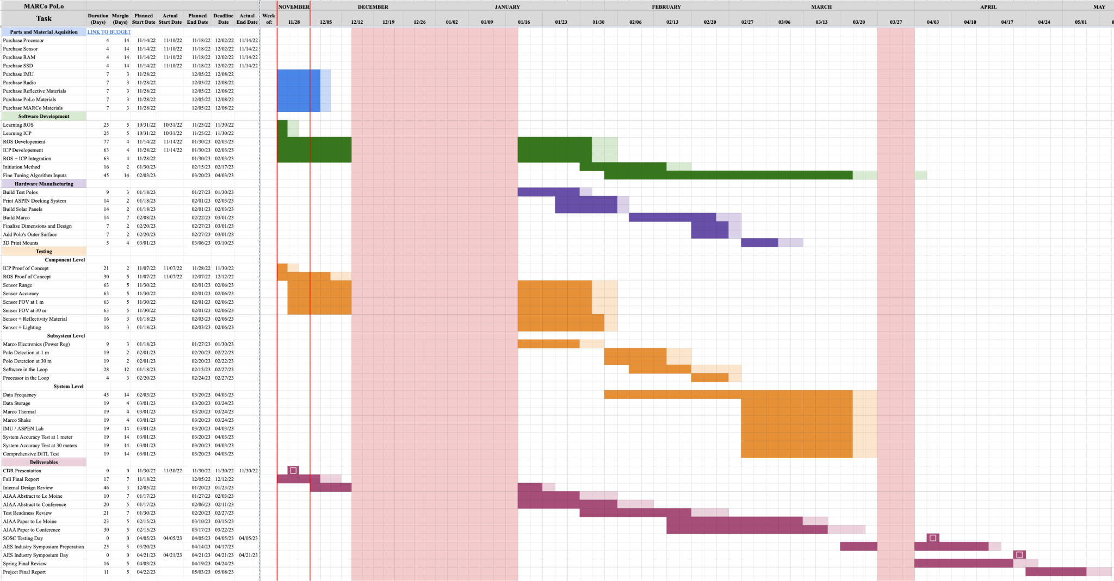
Work Plan
Component Testing
Subsystem Testing
System Testing
SOSC Test
Notes:
KIN
Milestones, critical path, margin, parallel or series

Slide 41
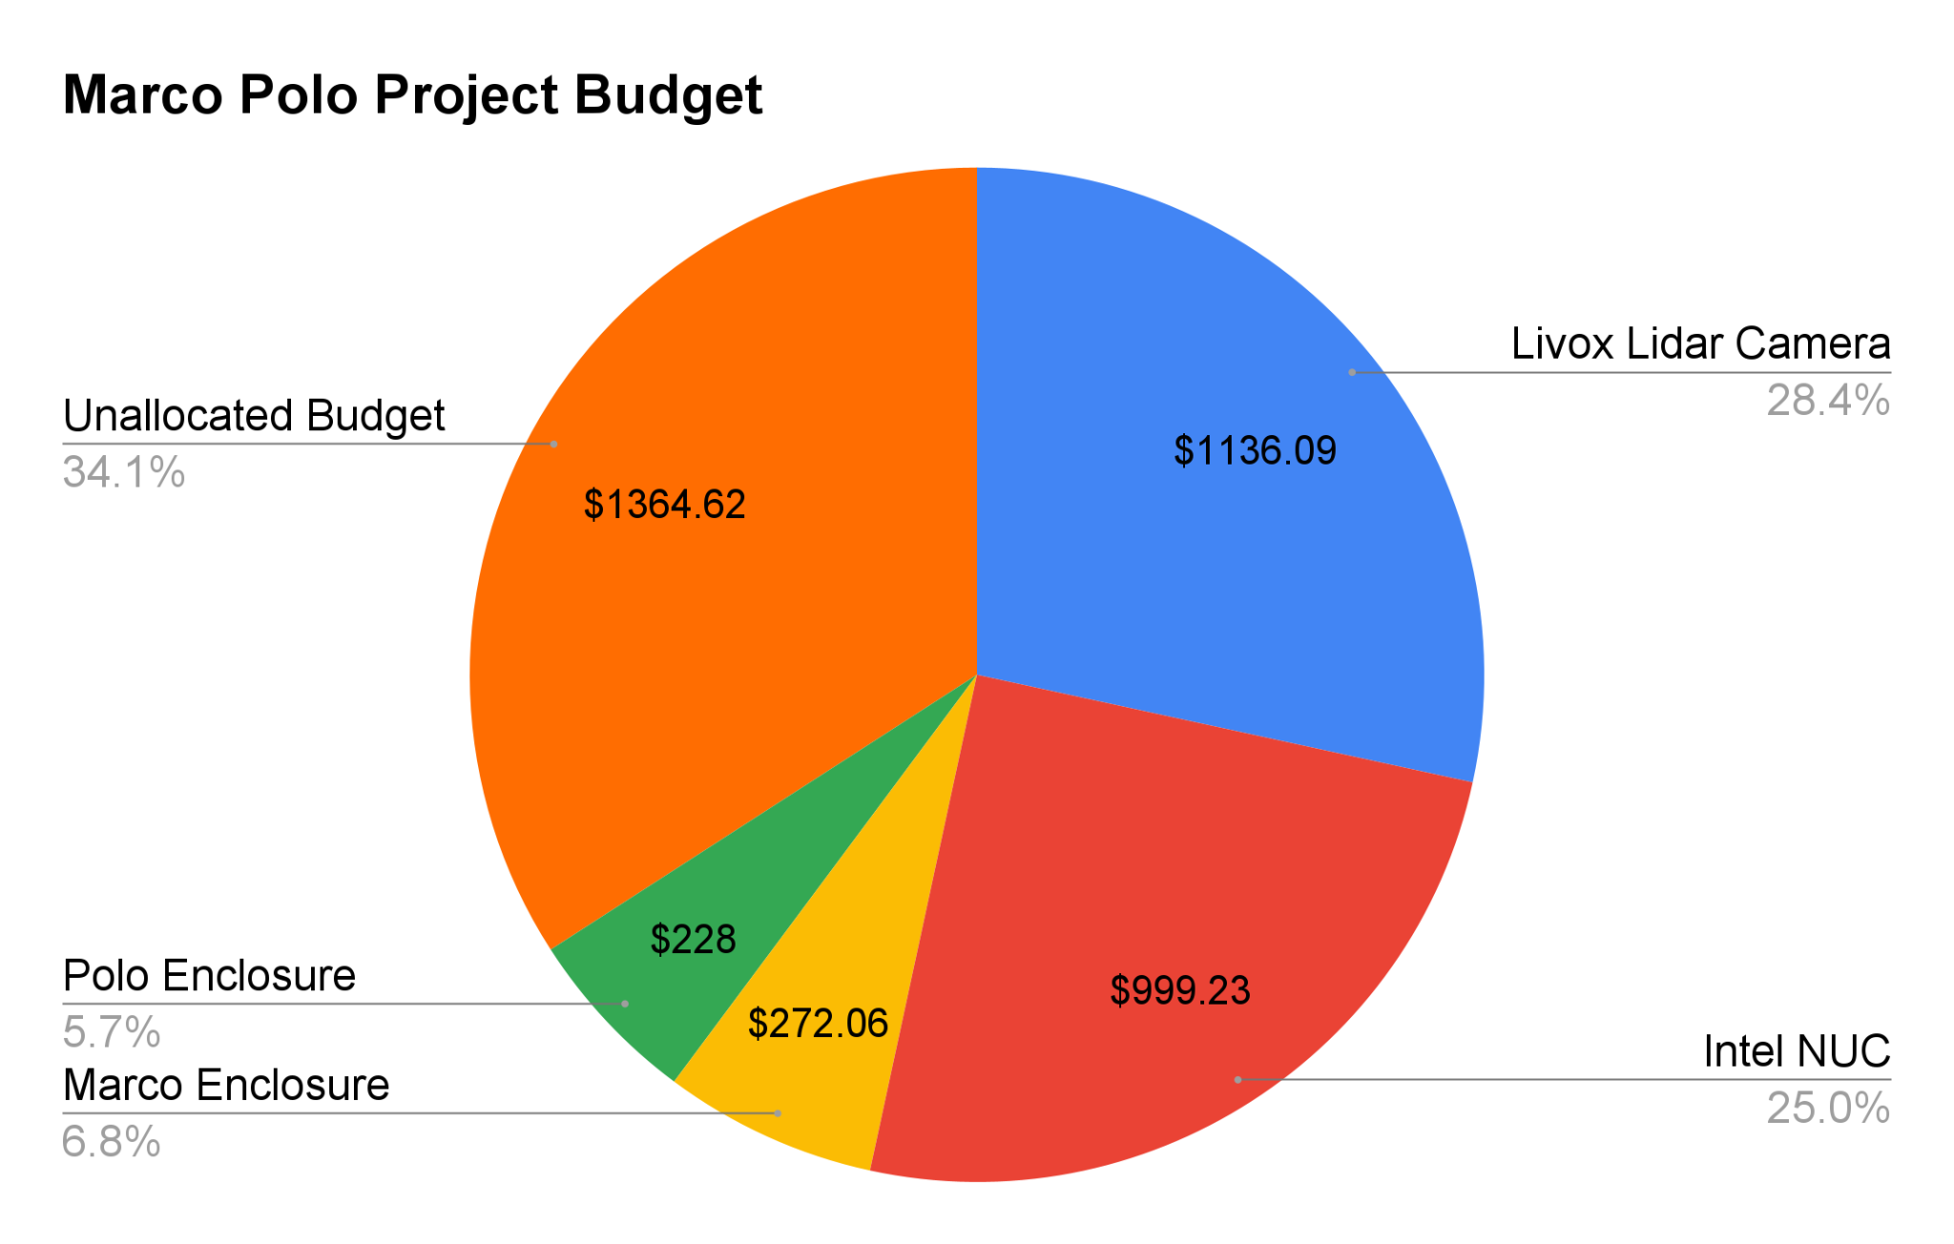
Cost Plan
Components Remaining:
Mechanical Components for Marco
Enclosure materials for Polo
Testing apparatus and IMU
1.0 Purpose and Objectives
2.0 Design Solution
3.0 CPEs and Risk
4.0 Requirements and Satisfaction
5.0 Verification and Validation
6.0 Project Planning
Notes:
TYLER C.
Talk about the what if the lidar camera breaks
Talk about budget margins (could we still succeed if camera broke)
Pie Chart

Slide 42
Project Description
Questions

Slide 43
Backup Slides
Notes:
HYPERLINKED TABLE OF CONTENTS

Slide 44
Table of Contents
Acknowledgements/References
Administrative
Models / Verification & Validation
Trade Studies

Slide 45
Acknowledgements/
References

Slide 46
Acknowledgements
Taylor Mauer (LM)
Josh Nelson (LM)
Jeffrey Thayer
Alexandra Le Moine
Bobby Hodgkinson
Trudy Schwartz
Kathryn Wingate
Scott Palo
Jasmin Chadha
Andreas Brecl
Chris Muldrow
Matt Rhodes
Samia Juras
Shakeeb Ahmad
Sean Humbert

Slide 47
References
Jung, S., Park, S.-Y., Park, H.-E., Park, C.-D., Kim, S.-W., and Jang, Y.-S., “Real-time determination of relative position between satellites using Laser Ranging,” Journal of Astronomy and Space Sciences, vol. 29, 2012, pp. 351–362.
Langer, D., “An Integrated MMW Radar System for Outdoor Navigation,” Proceedings of IEEE International Conference on Robotics and Automation, Jan. 1997.
Opromolla, R., and Nocerino, A., “Uncooperative spacecraft relative navigation with lidar-based unscented Kalman filter,” IEEE Access, vol. 7, 2019, pp. 180012–180026.
Roos, F., Kellner, D., Klappstein, J., Dickmann, J., Dietmayer, K., Muller-Glaser, K. D., and Waldschmidt, C., “Estimation of the orientation of vehicles in high-resolution radar images,” 2015 IEEE MTT-S International Conference on Microwaves for Intelligent Mobility (ICMIM), 2015.
Sherer, T. P., Martin, S. M., and Bevly, D. M., “Keynote: Radar Probabilistic Data Association filter with GPS aiding for target selection and relative position determination,” ION Pacific PNT, 2017.
Zhang, Y., Han, Y., Yu, R., Yang, Z., Wang, Z., and Zhang, J., “Pose measurement and motion estimation of space on-orbit CubeSats based on micro-doppler effect using laser coherent radar,” Applied Sciences, vol. 12, 2022, p. 4021.

Slide 48
References
Wa̧sik Alicja, Ventura, R., Pereira, J. N., Lima, P. U., and Martinoli, A., “Lidar-based relative position estimation and tracking for Multi-robot systems,” Advances in Intelligent Systems and Computing, 2015, pp. 3–16.
Lotti, A., Modenini, D., Tortora, P., Saponara, M., and Perino, M. A., “Deep Learning for Real Time Satellite Pose Estimation on Low Power Edge TPU,” arXiv.
Kisantal, M., Sharma, S., Park, T. H., Izzo, D., Martens, M., and D'Amico, S., “Satellite Pose Estimation Challenge: Dataset, Competition Design, and results,” IEEE Transactions on Aerospace and Electronic Systems, vol. 56, 2020, pp. 4083–4098.
Montella, C., “The Kalman filter and related algorithms: A literature review” Available: https://www.researchgate.net/publication/236897001_The_Kalman_Filter_and_Related_Algorithms_A_Literature_Review.
“Satellite Solutions,” Lockheed Martin Available: https://www.lockheedmartin.com/en-us/products/satellite.html.

Slide 49
References
Zhao, G., 2018. LiDAR-Based Non-Cooperative Tumbling Spacecraft Pose Tracking by Fusing Depth Maps and Point Clouds. MDPI, [online] Available: https://o365coloradoedu.sharepoint.com/:b:/r/sites/AEROENGR-MARCoPoLo/Shared%20Documents/Software/LiDAR%20Research%20Papers%20%26%20Resources/Zhao%20et%20al.%20Pose%20using%20LiDAR%20Point%20Clouds.pdf?csf=1&web=1&e=vvaAPG
Galante, J. et. al, n. d. Pose Measurement Performance of the Argon Relative Navigation Sensor Suite in Simulated Flight Conditions. [online] Available at: https://scholar.google.com/scholar_url?url=https://ntrs.nasa.gov/api/citations/20120013578/downloads/20120013578.pdf&hl=en&sa=X&ei=RU0vY-ODGe2KywTYs7iICQ&scisig=AAGBfm01u0YB6vqBNuYvUHORj9_wGF5TiA&oi=scholarr.
Petrick, D. et. al, n.d. Adapting the Reconfigurable SpaceCube Processing System for Multiple Mission Applications. [online] Zenodo.org. Available at: https://zenodo.org/record/1263941/files/article.pdf
Lidar, “Lidar technology explained at the electronics level,” In the Scan Available: https://blog.lidarnews.com/lidar-technology-explained-at-the-electronics-level/

Slide 50
References
“Neuvition's high-resolution solid-state lidar boosts surveillance applications - neuvition: Solid-state lidar,LIDAR sensor suppliers, Lidar Technology, Lidar Sensor,” Neuvition Available: https://www.neuvition.com/industries/survellience/neuvitions-high-resolution-solid-state-lidar-boosts-surveillance-applications.html.

Slide 51
Administrative

Slide 52
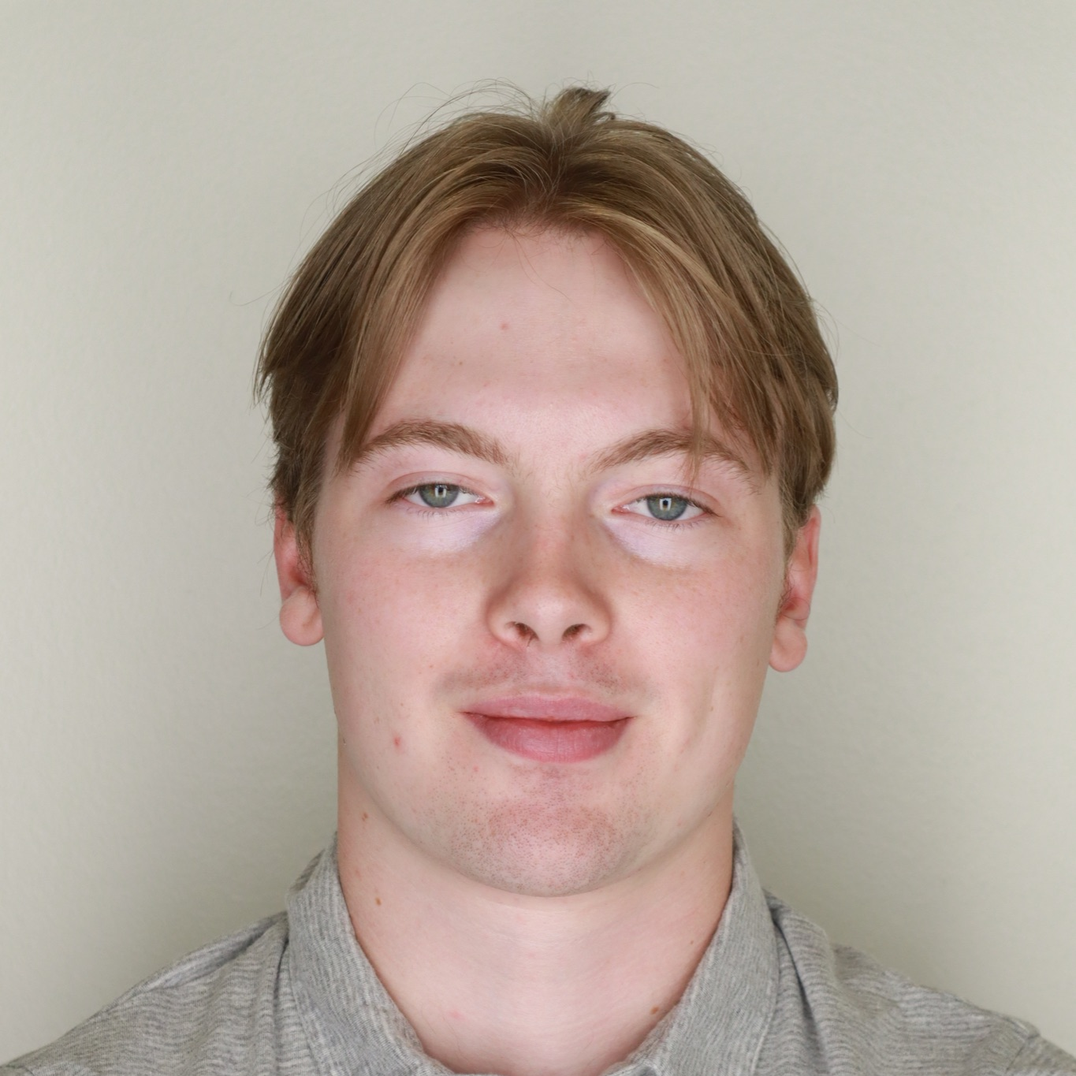
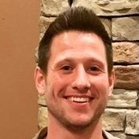
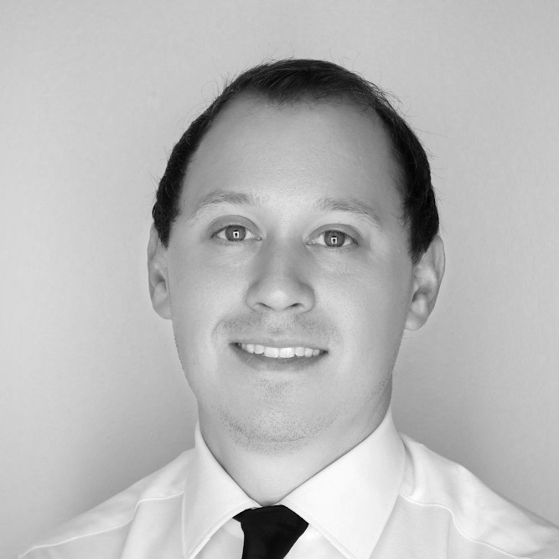
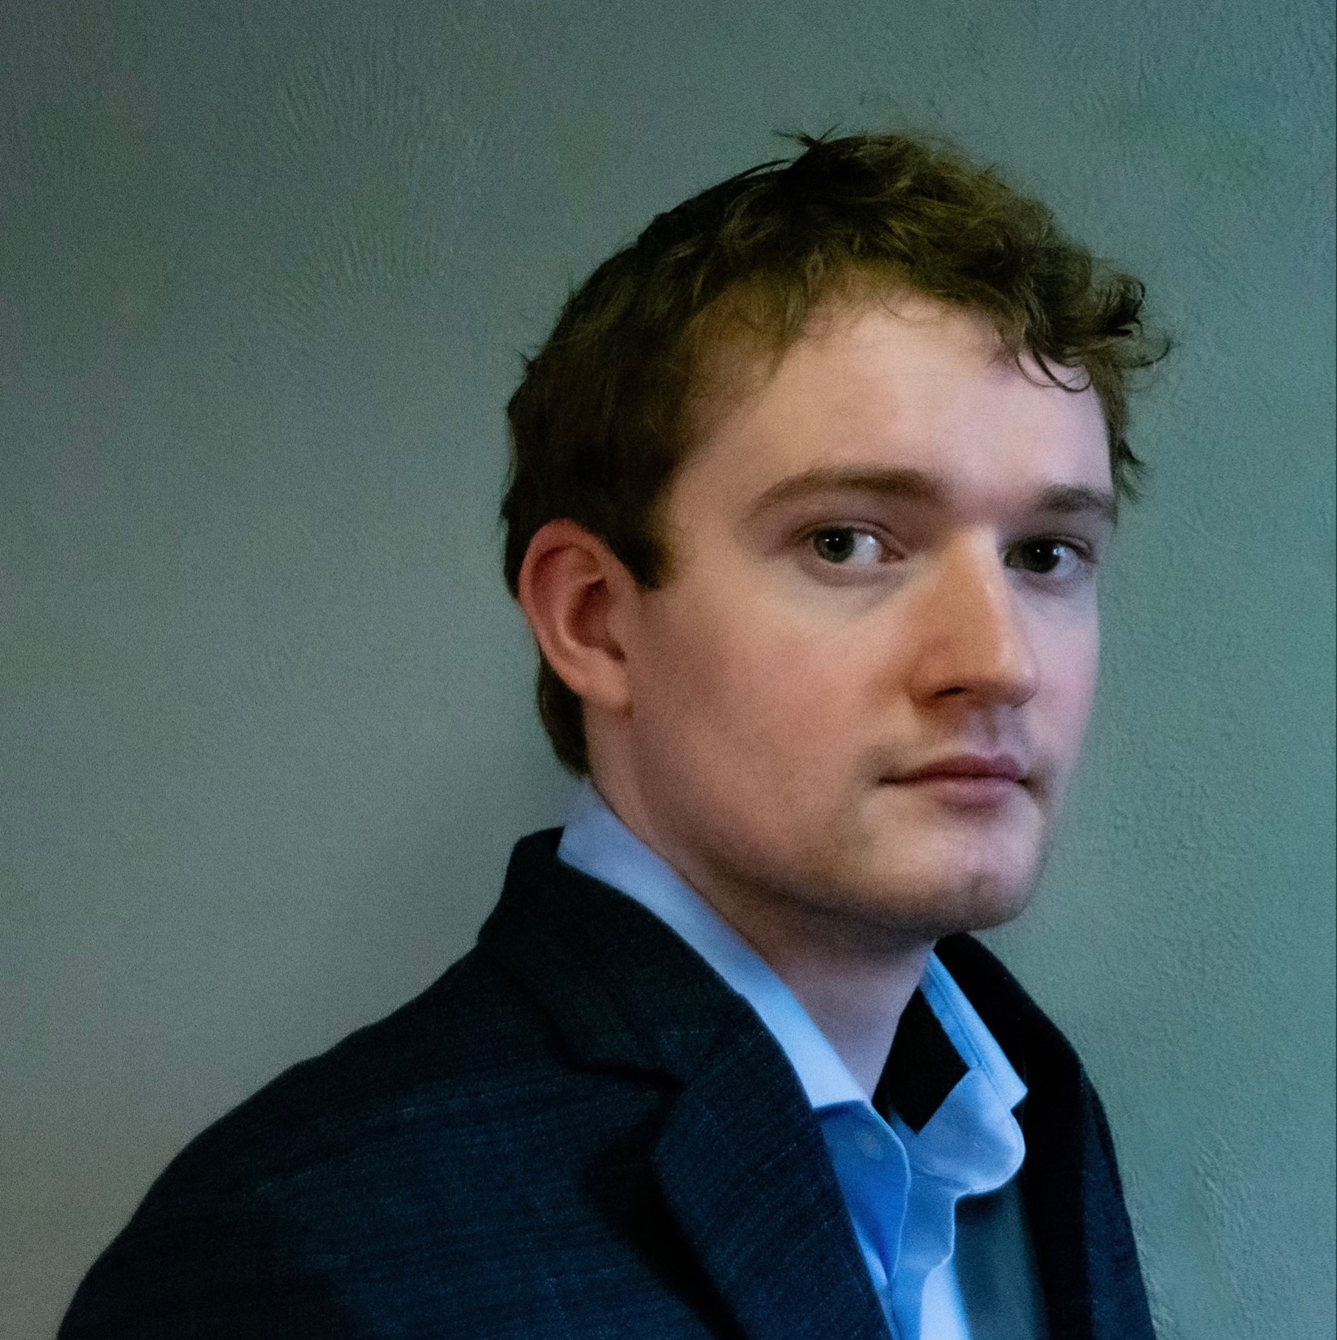
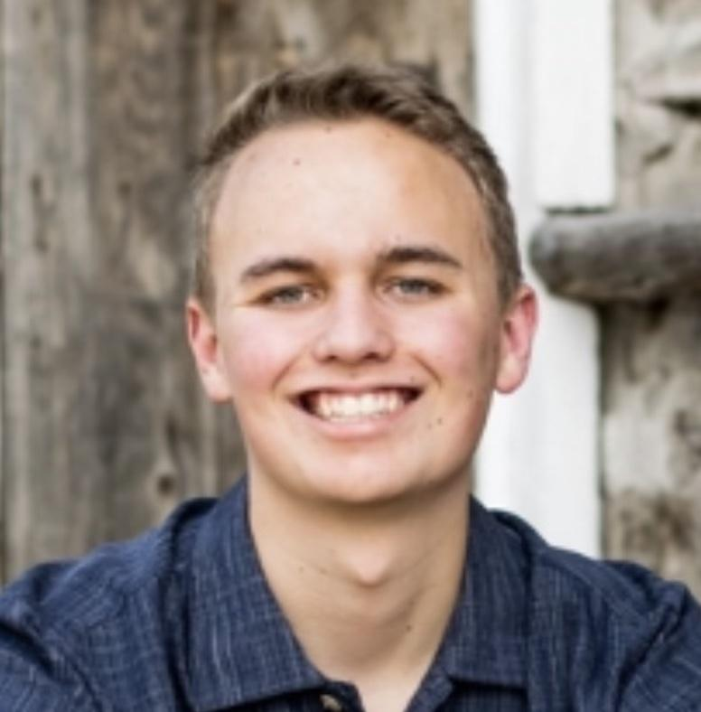
Organization Chart
Kintan Surghani
Project Manager
Brian Byrne
Systems Engineer
Nadia Abuharus
Mechanical Lead
Ben Arnold
Electrical Lead
Austin Coleman
Software Lead
Tyler Candler
CFO
Kevin Cook
Mechanical
Tyler Candler
Mechanical
Justin Pedersen
Electrical
Matt Davis
Electrical
Ray Stine
Software
Jackson DePenning
Software
Tyler Sterrett
Software

Slide 53
Requirements
Requirements (LVL 0)
Requirements (LVL 1)
Requirements (LVL 2)
Requirements (LVL 3)
Notes:
HYPERLINKED TABLE OF CONTENTS

Slide 54
Requirements (LVL 0)
# | Requirement | Parent | Verification Method
O | Mission Objectives
O.1 | Prototype sensor suite to gather data of surrounding objects to determine relative position/orientation | - | A
O.2 | Develop algorithm to refine sensor data into relative position measurements (6 DOF) | - | A
O.3 | Develop processor to run algorithm | - | A
O.4 | Maximize in-situ performance | - | A
SC | Mission Success Criteria
SC.1 | Shall be capable of measuring objects up to 30 meters away | O.1 | T
SC.2 | Shall be capable of measuring objects modeled after the LM400 Series | O.1 | T/A
SC.3 | Shall transform raw translational data to target relative measurements | O.2-3 | T
SC.4 | Shall transform raw rotational data to target relative measurements | O.2-3 | T
SC.5 | Shall be capable of sampling/storing at least 3 hours worth of data | O.3 | T
SC.6 | Shall record relative position measurements at a minimum rate of 1 Hz | O.3 | T
SC.7 | Shall be autonomous with the exception of start and stop | O.4 | T/A
SC.8 | Shall be compatible with SOSC testing facilities | O.4 | T
SC.9 | Shall be functionally validated prior to SOSC test day | O.1-4 | T/A
C | Constraints
C.1 | Shall not exceed $4000 in total expenses | - | A
C.2 | Shall not exceed TBD size | - | I
C.3 | Shall accept a 120 V AC power supply | - | A
C.4 | Shall not exceed 450 kg | - | A

Slide 55
Requirements (LVL 1)
# | Requirement | Parent | Verification Method
1.1 | Mission Design
1.1.1 | Shall be capable of locating unknown object of TBD size up to 30 meters away | O.1, SC.2-3 | T/A
1.1.2 | Shall transform raw translational data to target relative measurements at an accuracy of 1 meter | O.2-3, SC.3 | T/A
1.1.3 | Shall transform raw rotational data to target relative measurements at an accuracy of 15 degrees | O.2-3, SC.4 | T/A
1.1.4 | Shall record relative position measurements at a minimum rate of 1 Hz | SC.5,6 | T
1.1.5 | Shall be compatible with SOSC testing facility | O.4, SC.8 | A
1.1.6 | Shall survive travel to SOSC | O.4, SC.8 | A
1.2 | Prototype System
1.2.1 | Shall house sensor(s) | O.1 | I
1.2.2 | Shall house the processor | O.3 | I
1.2.3 | Shall be electronically compatible with testing stand | SC.8 | A
1.2.4 | Shall be mechanically compatible with testing stand | SC.8 | A
1.2.5 | Shall be autonomous except for activation and termination | O.4, SC.7,9 | A
1.2.6 | Shall meet functionality and accuracy requirements prior to SOSC test day | O.1-4, SC.5-9 | D/A
1.3 | Testing Facility
1.3.1 | Shall test at Lockheed Martin Space Operations Simulation Center (SOSC) | O.4, SC.8 | I
1.3.2 | Shall be capable of 3 hours of autonomous testing | O.4, SC.5 | T
Notes:
DO NOT USE! GET UPDATED SPREADSHEET!!

Slide 56
Requirements (LVL 2)
# | Requirement | Parent | Verification Method
2.1 | Software
2.1.1 | Shall collect raw target object data | 1.1.2-3 | T
2.1.2 | Shall be capable of autonomous computation | 1.2.6, 1.3.2 | T/A
2.1.3 | Shall determine object state at a rate of 1 Hz | 1.1.2-3, 1.2.3 | T/A
2.1.4 | Shall determine target object's position relative to sensor with an accuracy of 1m | 1.1.2 | T/A
2.1.5 | Shall determine target object's attitude relative to the sensor with an accuracy of 15 degrees | 1.1.3 | T/A
2.1.6 | Shall validate relative measurement accuracies | 1.2.6 | D/A
2.2 | Electronics
2.2.1 | Shall be capable of autonomous data transfer | 1.2.5, 1.3.2 | T/A
2.2.2 | Shall be capable of storing data at a minimum rate of 1 Hz | 1.1.4 | T/A
2.2.3 | Shall interface sensor suite critical components together Sensor, Processor, and Data Storage are critical components | 1.2.3,6 | T/A
2.2.4 | Shall regulate and control electrical power for sensor suite components | 1.2.3-4 | T/A
2.3 | Mechanical
2.3.1 | Shall securely house all components | 1.2.1-2 | I
2.3.2 | Shall interface with SOSC test stand | 1.1.5-6, 1.2.3,6 | I/A
2.3.3 | Shall withstand testing duration and movement | 1.1.5,1.2.4,1.3.2 | T/A
2.3.4 | Shall model heritage satellite as test object | 1.1.1,1.3.1 | I/A

Slide 57
Requirements (LVL 3)
# | Requirement | Parent | Verification Method
3.1 | Sensor
3.1.1 | Shall sample at a minimum rate of 1 Hz | 2.1.1 | T/A
3.1.2 | Sensors shall collect raw target object data in TBD form | 2.1.1 | T/A
3.1.3 | Shall be capable of measuring objects at a resolution of TBD | 2.1.1,4-5 | A
3.2 | Chassis
3.2.1 | Shall house a processor, sensors, storage device, and all connecting wires | 2.3.1 | I
3.2.2 | Shall be designed to be compatible with the SOSC mounting system (TBD) | 2.3.2 | A
3.2.3 | Shall be designed to withstand test duration | 2.3.3 | A
3.3 | Test Object
3.3.1 | Shall be designed to be compatible with SOSC mounting system (TBD) | 2.3.2 | A
3.3.2 | Shall be designed to withstand test duration | 2.3.3 | A
3.3.3 | Shall be modeled after a Lockheed satellite | 2.3.4 | I/A
3.4 | Processing System
3.3.1 | Shall be electronically compatible with sensor suite | 2.2.3-4 | T/A
3.3.2 | Shall implement algorithms to transform raw sensor data to translational and rotational relative measurements | 2.1.2,4-5 | T/A
3.3.3 | Shall store relative measurement data at a minimum rate of TBD Hz | 2.1.3,2.2.2 | A
3.5 | Algorithms
3.5.1 | Shall convert raw data into a TBD format | 2.1.1-6 | A
3.5.2 | Shall be developed in TBD language(s) | 2.1.1-6 | A
3.5.3 | Shall convert raw data into position data | 2.1.4 | A
3.5.4 | Shall convert raw data into attitude data | 2.1.5 | A
3.6 | Data Storage
3.6.1 | Shall be capable of storing TBD (amount of) processed data Determined by processor, TBD data type, and test duration | 2.2.2 | T/A
3.6.2 | Shall be stored in TBD format | 2.2.2 | A

Slide 58
Models / Verification & Validation
FOV
Sensor Accuracy
Sensor Range
CPU in the Loop
ROS
ICP
Power Regulation
Data Storage
Data Frequency
Initiation Method
Material Reflectivity
Thermal
Lighting
Random Vibration
Notes:
HYPERLINKED TABLE OF CONTENTS

Slide 59
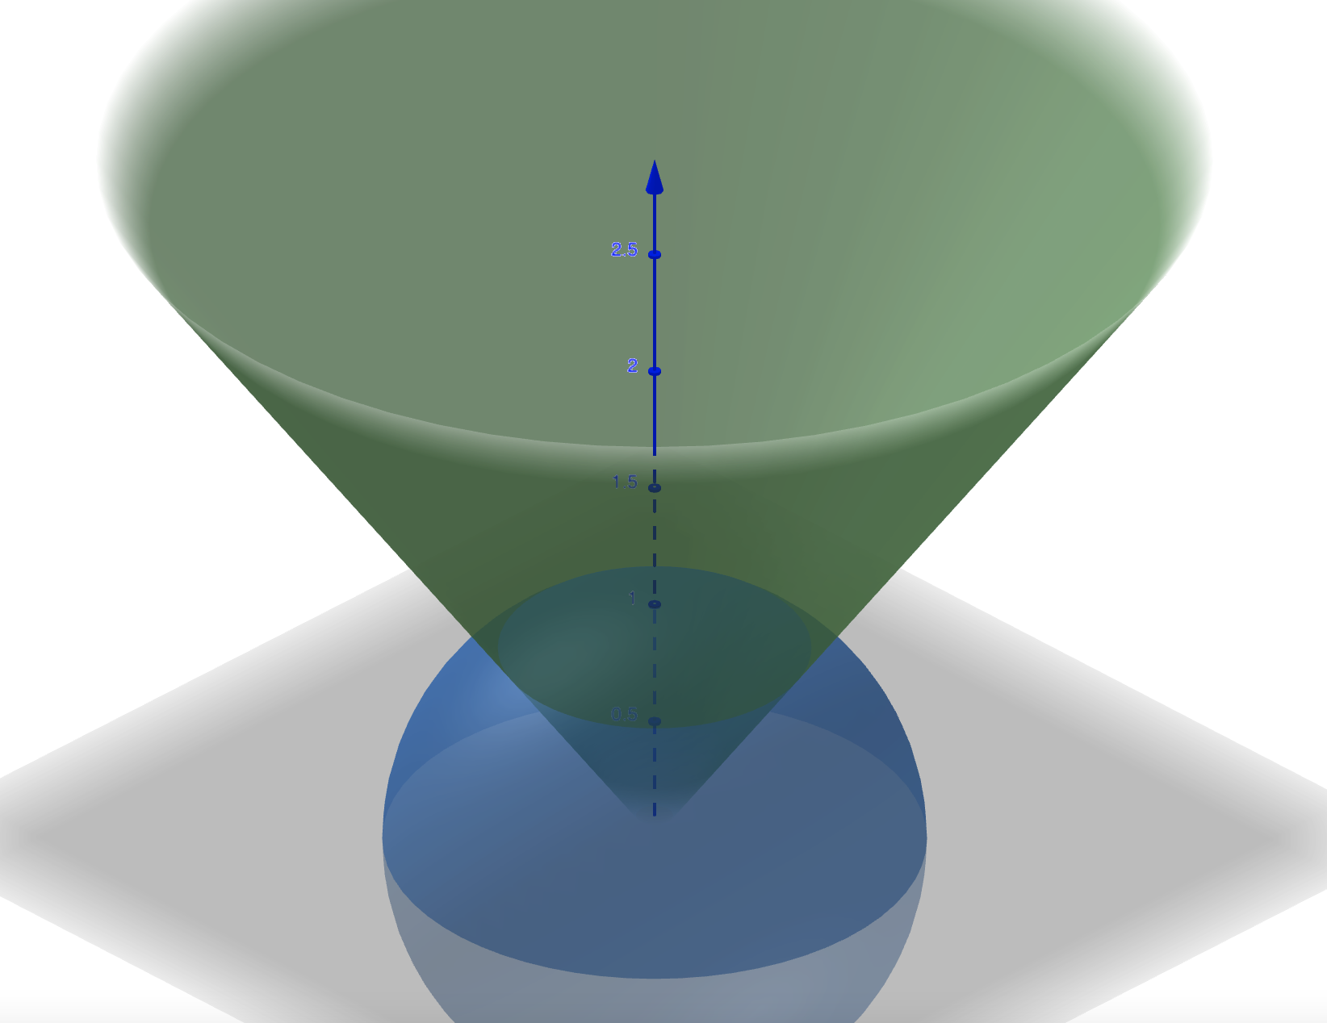
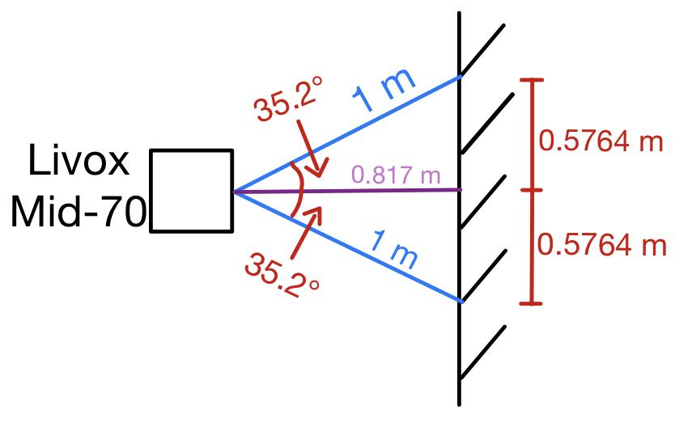
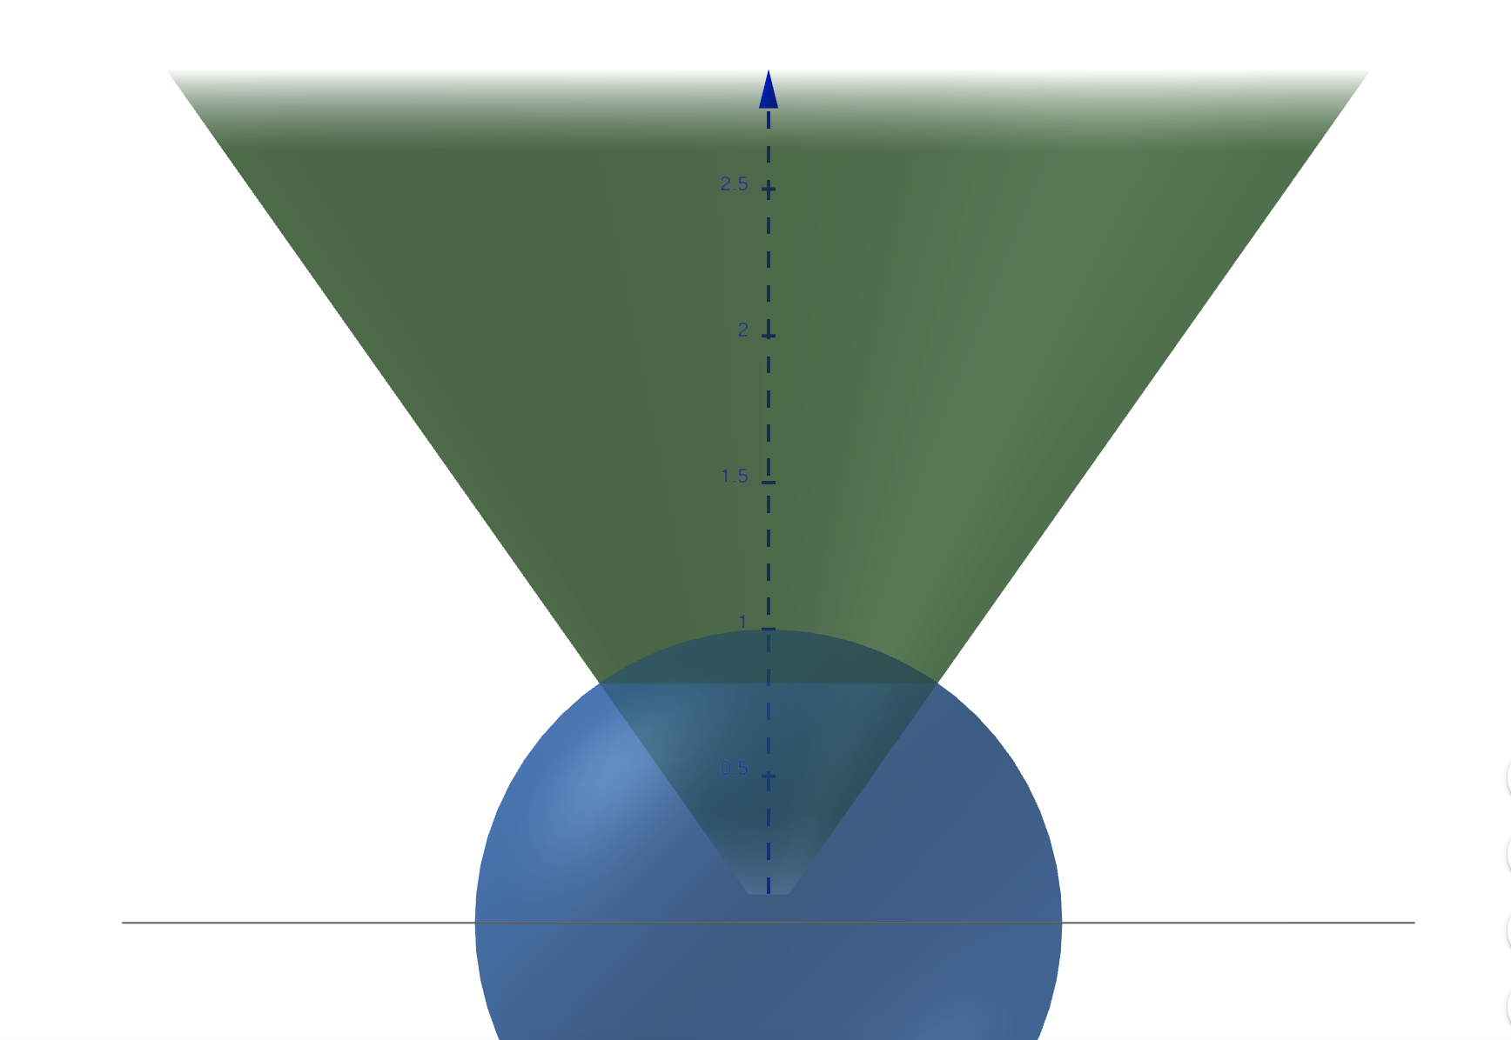
Model: FOV at 1 meter
Notes:
FoV: Have notes on Worst case scenario (close up, we can’t get a full view of the craft), model in progress
ADD rotated close range FOV
ADD the longest range distance case as well

Slide 60
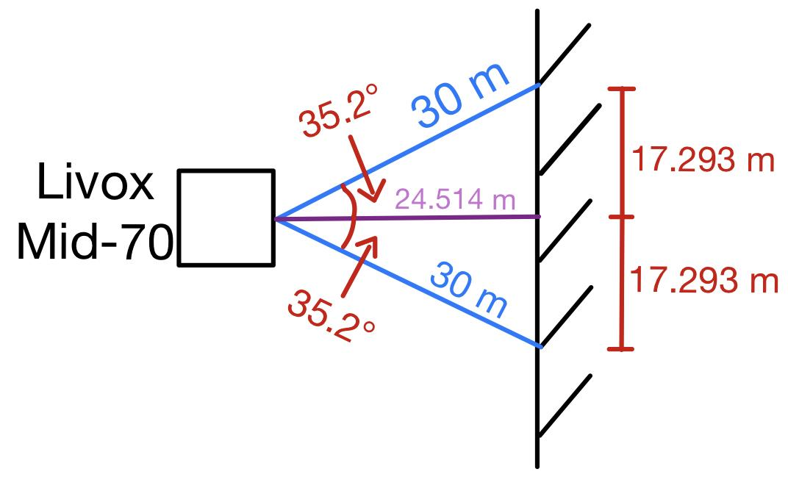
Model: FOV at 30 meters
Notes:
FoV: Have notes on Worst case scenario (close up, we can’t get a full view of the craft), model in progress
ADD rotated close range FOV
ADD the longest range distance case as well

Slide 61
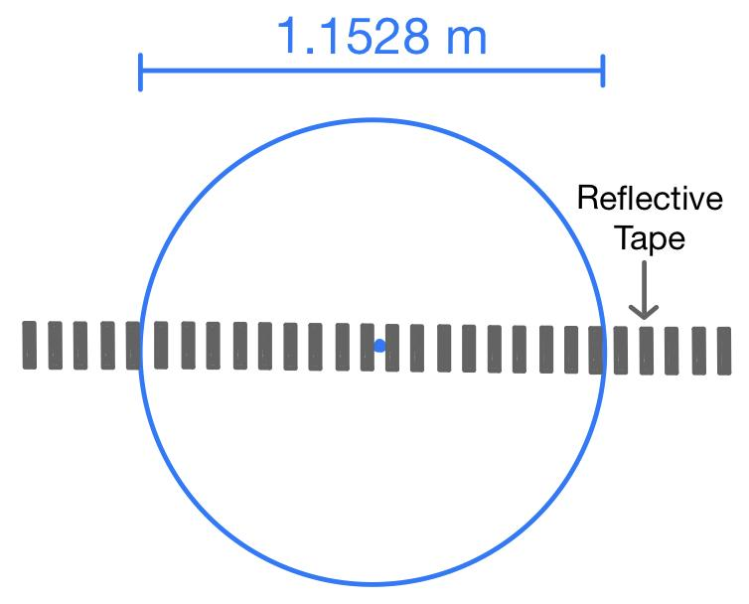
Verification Plan: Sensor FOV at 1 meter
Objective
Verify the provided field of view is accurate at the closest possible distance of 1 meter
Testing Plan
Mark expected FOV area on a wall 1 meter from stationary LiDAR sensor
Space 1 cm strips of reflective tape across the diameter of the expected FOV
Capture LiDAR picture of reflective tape on wall and measure the FOV diameter using reflective tape
Compare measured FOV diameter to expected FOV diameter
Driving Requirement(s)
DR.2: The system shall have a range measurement accuracy of at least 1 meter
DR.3: The system shall have an attitude measurement accuracy of at least 15 degrees

Slide 62
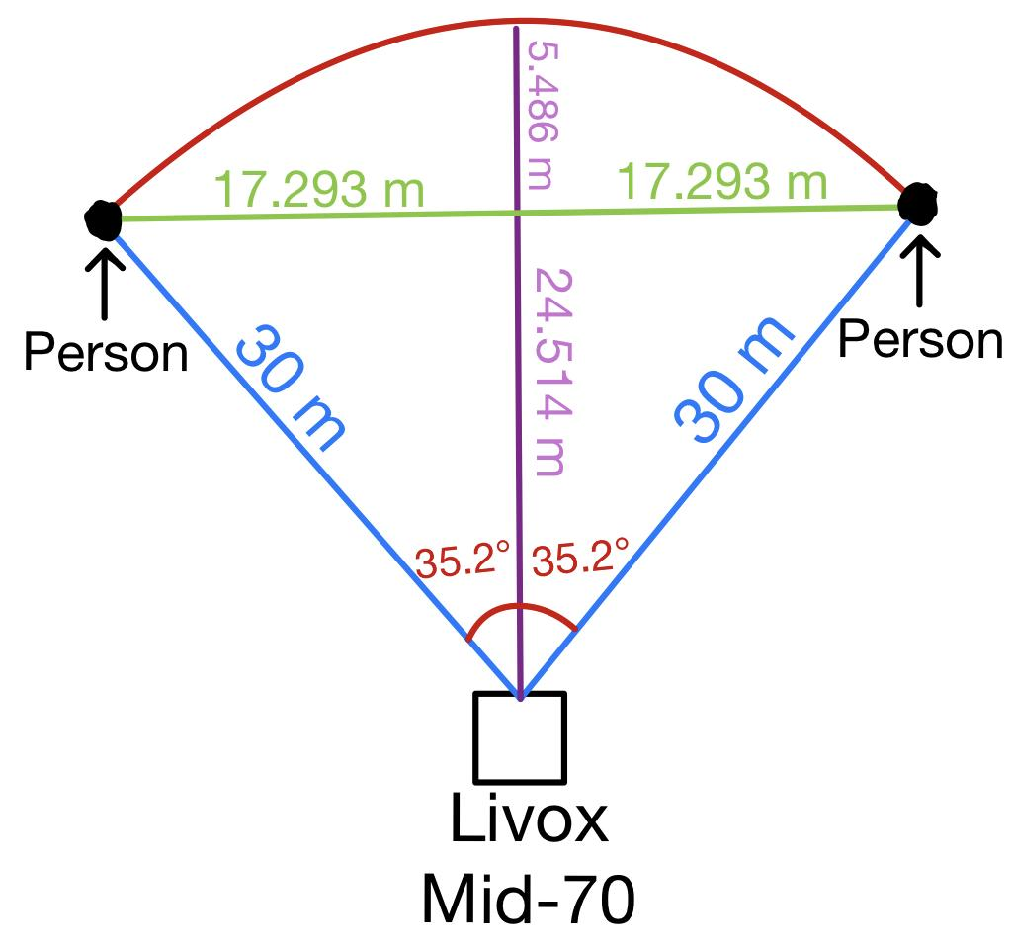
Verification Plan: Sensor FOV at 30 meters
Objective
Verify the provided field of view is accurate at the furthest possible distance of 30 meters
Testing Plan
Measure the expected FOV a distance of 30 meters from the sensor (2D arc, no FOV height)
Place a person on each edge of the FOV a distance of 30 meters from the sensor
Capture a LiDAR image of the actual FOV
Ensure both people are on the very outside edges of the produced image
Driving Requirement(s)
DR.2: The system shall have a range measurement accuracy of at least 1 meter
DR.3: The system shall have an attitude measurement accuracy of at least 15 degrees

Slide 63
Validation Plan: Sensor Accuracy
Objective
Verify LiDAR sensor resolves relative position measurements to within 1 meter, and at a maximum distance of 30 meters
Testing Plan
Verify output data matches object position at a distance of 30 meters
Verify output data matches object position at a distance of 1 meter
Driving Requirement(s)
DR.2: The sensor shall have a range measurement accuracy of at least 1 meter
Notes:
Translational accuracy specs. The main objective of this validation test is to verify that the LiDAR sensor operates within acceptable parameters at the minimum/maximum ranges of 1 meter and 30 meters. This can be achieved fairly simply by measuring distance from LiDAR to an object and verifying that it is reliably able to detect the object at that range.

Slide 64
Verification Plan: Sensor Range
Objective
Verify that our LiDAR is able to measure objects in our required range
Testing Plan
While measuring with our LiDAR and a rangefinder or reference, have a group member holding a Polo-sized object walk away starting from 1 m to over 30 m
Verify that point cloud shows person/test object at least up to 30 m
Driving Requirement(s)
DR.1: The sensor shall have a measurement range from 1 to 30 meters

Slide 65
Verification Plan: CPU in the Loop
Objective
Verify that processor system can run our code
Testing Plan
Install code on the NUC and run with mock data to ensure our program works on embedded device
Iterate as needed to fix/improve code for NUC system
Driving Requirement(s)
DR.4: The onboard computer shall provide an interface between the sensor and algorithm for data analysis
Notes:
With processor. NO sensor data just fake data

Slide 66
Software - R.O.S.
Data distribution service
Nodes (devices and executables)
Language agnostic
Plug and Play Libraries
Our Project:
ROS master node
Sensor node (pub)
Driver node (pub)
Filter node (sub)
ICP node (sub)
Notes:
BEN
Our NUC computer will be running linux, with the OS extension ROS (Robotic Operating System). ROS is an open source program developed for robotic applications made for robotics developers to be able to share the solutions they come up with for various coding problems, such that engineers can avoid reinventing the wheel and instead focus on applications. It is by far the favorite program for driving and processing the data from LiDARs, and our sensor has a ROS driver linked on the manufacturer’s website. ROS works by distributing data to and from various nodes in a language agnostic way; the nodes can be sensors or executables. A huge thing that comes along with using ROS is a vast catalog of plug and play libraries, from which we will pull algorithms for filtering and subsequently processing our data. We can find solutions for each of the individual coding problems in whatever programming language we want, and allow ROS to connect these “nodes” without having to worry about compatibility. For our project we will have the ROS master node which handles everything under the hood when it comes to connecting the separate nodes, as well as our driver node which will publish instructions to the sensor node, which then publishes its data. The filter node will subscribe to this point cloud data message and output a filtered point cloud, to which our ICP node will subscribe and turn this point cloud into the 6DOF coordinates, our final output. Now for a look at the key component, ICP:

Slide 67
Top Level Design: ROS (Software)
Notes:
BRIAN

Slide 68
ICP Results - Translational Results
Translation Results
Imposed X-Translation | Imposed Y-Translation | Imposed Z-Translation
0 | 0 | 100
Computed X-Translation | Computed Y-Translation | Computed Z-Translation
0.00 | -0.00 | 100.00
Note: 1) No units were given with point cloud file being used.
2) Negative value in computed y-translation was output by MATLAB

Slide 69
ICP Results - Rotational Results
cos(θ) | -sin(θ) | 0
sin(θ) | cos(θ) | 0
0 | 0 | 1
0.7071 | -0.7071 | 0
0.7071 | 0.7071 | 0
0 | 0 | 1
0.7071 | -0.7071 | 0.00
0.7071 | 0.7071 | 0.00
-0.00 | -0.00 | 1.00
θ = 45°
Imposed 3x3 Rotation Matrix On Point Cloud
A 45 degree rotation was imposed about the z-axis of the point cloud file, resulting in the above 3x3 rotation matrix
Computed 3x3 Rotation Matrix From ICP Algorithm
Negative values were output by MATLAB

Slide 70
Model: Power Regulation

Slide 71
Model: Power Regulation
Livox Converter Diagram

Slide 72
Model: Power Regulation

Slide 74
Verification Plan: Power Regulation
Objective
Verify power converters are capable of supplying correct voltage/power, confirm thermal output
Testing Plan
Connect 12V converter to programmable load and simulate maximum startup power
Connect 19V converter to programmable load and simulate 1.5 TDP
Driving Requirement(s)
DR.9: The system shall operate with a fixed 120 VAC power supply

Slide 75
Model: Data Storage
Initial conversations about LiDAR positioning and localization systems suggest that point cloud data will be stored in RAM not SSD.
Drive only has to store the 6DOF output for 3 hours of data.
We created a mock 6DOF 10,800 by 6 .csv file, with 4 significant figure precision floats.
File size is 646 KB, insignificant compared to the size of our ROS program and the operating system.
Off ramp: if data storage proves to be a problem we can upgrade our storage up to multiple terabytes for a reasonable price.

Slide 76
Verification Plan: Data Storage
Objective
Verify that our solid state drive is capable of storing necessary data output as well as code and OS
Testing Plan
Once operating system is installed, and preliminary code is developed (accuracy unimportant) run a 30 minute test creating our own data and verify we have enough storage to do this 6 times with a factor of safety
Driving Requirement(s)
DR.8: The system shall store 3 hours worth of processed data
Notes:
Given the low cost of memory, we have purchased a 512GB drive for $40 which given our initial modeling is significantly more storage than we need.

Slide 77
Model: Data Frequency
Complexity O(n log(n)) - O(n²)
n=200,000 -> 10⁷-10¹⁰ computations per second
CPU base speed 3*10⁹ TDP with 4 cores
Off ramp:
More filtering
Parallel processing
Post processing
Optimizing CPU for budget restrictions to maximize capability

Slide 78
Verification Plan: Data Frequency
Objective
Verify that our system is able to output 6DOF data at 1Hz
Testing Plan
Pre-integration: test our software on a laptop with mock data and measure number of outputs per minute
Post-integration: test our software on our NUC while taking data and measure number of outputs per minute
Driving Requirement(s)
DR.7 The system shall output processed data at a rate of 1 Hz

Slide 79
Verification Plan: Initiation Method
Objective
Verify electrical systems are operational and algorithms automatically collect and store data for entire duration of test
Testing Plan
Option #1: Physical switch designed into electrical system to power on components, begin test, and end test - components will have an LED indicator to verify functionality
Option #2: Upon powering system, algorithm will automatically start/stop test and provide commands indicating successful operation of components
Driving Requirement(s)
DR4: The onboard computer shall provide an interface between the sensor and algorithm for data analysis
DR8: The system shall store 3 hours worth of processed data

Slide 80
Validation Plan: Material Reflectivity
Objective
Determine the amount of reflectivity produced by varying materials when exposed to the SOSC lighting, and whether the Lidar can detect these materials
Testing Plan
Collect samples of the following materials: aluminum, ___
Expose the materials to ___ lumens
Setup the Lidar in front of the material and determine whether the materials can be sufficiently detected by the sensor
Driving Requirement(s)
DR.10: The system shall interface with the SOSC test environment
DR.11: The test object shall be non-fiducial
Notes:
SC.2: Shall be capable of measuring arbitrary and unknown objects modeled after the LM400 Series
SC.8: Shall be compatible with SOSC testing facilities
Need to add more materials and determine lighting

Slide 81
Model: Thermal
Notes:
Done on Solidworks
In this model the baseplate is made of 3D printed PLA
This is a worst case scenario, this is the hottest the processor can get but it is not anticipated this is the actual heat the model will experience during testing
Typically PLA melting point is from 180-200 C, the hottest the PLA can get according to this model is 79 C
Dark blue areas indicate room temperature

Slide 82
Validation Plan: Thermal
Objective
Verify that the heat given off by each electrical component is not too hot for the material selected (3D printed PLA)
Testing Plan
Start a thermal study on Solidworks of MARCo
Apply the corresponding heat power to each component in the CAD, this information is found from each component’s user manual/specifications
Mesh the model
Run the simulation, and analyze the temperature results
Attach thermopiles to components of concern
Run algorithm for full 30 minute test
Driving Requirement(s)
DR.10: The system shall interface with the SOSC test environment
Notes:
2.3.1: Shall securely house all components

Slide 83
Validation Plans: Lighting Scenarios
Objective
Verify lighting specified at SOSC will be sufficient for materials used and algorithm data processing
Testing Plan
Test sensor suite in multiple lighting conditions using applications to measure light intensity illuminances
Driving Requirement(s)
DR10: The system shall interface with the SOSC test environment
P

Slide 84
Validation Plan: Random Vibration
Objective
Ensure MARCo will withstand the movement induced by the large SOSC robot
Testing Plan
Secure MARCo to a vibration table
Apply vibrations of 1 Hz
Observe MARCo during and after vibration, specifically checking fasteners and standoffs
Driving Requirement(s)
DR.10: The system shall interface with the SOSC test environment
Notes:
2.3.3: Shall withstand testing duration and movement
2.3.1: Shall securely house all components
Vibrate at a low hertz because we don’t anticipate too much movement, this test is to just ensure everything is secure

Slide 85
Trade Studies
Sensor
Algorithm
Validation System
Circuit Building
Power Regulation
Initiation Sequence
Chassis (Marco)
Test Subject (Polo)
Notes:
HYPERLINKED TABLE OF CONTENTS

Slide 86
Trade Study: Final LiDAR Selection
Metric | Weight | 3 | Scores 2 | 1
Angular Precision/ Accuracy | 0.2 | < 0.05 | < 0.1 | < 0.15
Minimum Field of View | 0.45 | 70° and above | 40° to 70° | 25° to 40°
Power Consumption | 0.1 | 8 W | 10 W | 12 W
Cost | 0.25 | < $600 | < $1100 | < $1600
Notes:
DON’T PRESENT
availability metric

Slide 87
Trade Study: Algorithm
Metric | Description | Weight | Scores
 |  |  | 3 | 2 | 1
Computational Expense | Computational expense of algorithm -In order to meet SC.7, raw sensor data must be converted into meaningful relative position and attitude (pose) measurements at a minimum rate of 1 Hz. | 0.3 | Algorithm is able to output pose measurements at a rate greater than 2 Hz, giving 2x margin on FR.2 and FR.3 time rates | Algorithm is able to output pose measurements at a rate greater than 1 Hz, giving 1x margin on FR.2 and FR.3 time rates | Algorithm is unable to output pose measurements at a rate equal to 1 Hz, fails FR.2 and FR.3
Complexity/Time Consumption | Estimated workload of implementing algorithms within project timeline, including verification and validation | 0.3 | Algorithm of moderate complexity structurally and mathematically that it can be implemented within the given timeframe with little instruction | Algorithm of high enough complexity that moderate amount of instruction from technical experts/faculty advisor likely to be able to implement within the given timeframe. | Algorithm either too complex in general to implement or would require unsatisfactory level of guidance and instruction.
Data Dependence | Dependence on quality, cadence and throughput of input sensor data, increase in required data input drives higher algorithm complexity and computational expense | 0.1 | Algorithm that is capable of producing results to the level of accuracy desired by the mission with low quality data. | Algorithm that can realistically achieve results outlined by mission requirements but imposes some constraints on sensor quality. | Algorithm that will require data to level of fidelity that the mission won't be able to provide due to financial constraints on sensor choice.
Pose Resolvability | Demonstrated ability of algorithms to resolve pose of objects in prior use cases | 0.3 | Algorithm is able to resolve objects to less than 0.5 m of accuracy and 8 degrees of rotational accuracy, 2x pose margin on FR.2 and FR.3 | Algorithm is able to resolve objects to less than 1 m of accuracy and 15 degrees of rotational accuracy, 1x pose margin on FR.2 and FR.3 | Algorithm is able to resolve objects to greater than 1 m of accuracy and 15 degrees of rotational accuracy, fails FR.2 and FR.3
Notes:
DON’T PRESENT
availability metric answered by complexity/ time consumption (clarification needed?)
OPEN SOURCE ?
Stick with serial code ! (metric for processor?)
Stray away from any parallelization

Slide 88
Trade Study: Algorithm
Metric | Weight | Kalman Filter | Iterative Closest Point | Pose Estimation | VSLAM
Computational Expense | 0.3 | 1 | 1 | 2 | 2
Complexity/Time Consumption | 0.3 | 2 | 2 | 3 | 2
Data Dependence | 0.1 | 2 | 3 | 2 | 3
Pose Resolvability | 0.3 | 3 | 3 | 3 | 3
Score | 1 | 2 | 2.1 | 2.6 | 2.4
Notes:
DON’T PRESENT
availability metric

Slide 89
Trade Study: Validation System
Metric | Description | Weight | Scores
 |  |  | 3 | 2 | 1
Translational Movement Measurement Accuracy | Ability to determine movement of target object in the X Y Z positional axis within acceptable accuracy parameters. | 0.35 | Reliably provides measurements at an accuracy less than 1 meter | Reliably provides measurements at an accuracy approximately 1 meter | Reliably provides measurements at an accuracy greater than 1 meter
Rotational Movement Measurement Accuracy | Ability to determine movement of target object in the Φ θ Ψ rotational axis within acceptable accuracy parameters | 0.35 | Reliably provides measurements at accuracy of less than 15 degrees | Reliably provides measurements at accuracy of approximately 15 degrees | Reliably provides measurements at accuracy of greater than 15 degrees
Cost | The monetary cost of validation systems. The project has a maximum budget of $4000 dollars and validation is not as high priority as other components from a cost perspective. | 0.1 | Less than $75 | $75 - $125 | More than $125
Power Consumption/Implementation | Amount of power necessary for validation system measured in volts. Accounts for both consumption while in use and for implementation of power system. | 0.1 | Less than 6 V | 6 V - 10 V | More than 10 V
Computational Complexity | The complexity of the validation computing system, measured by difficulty to implement and ability to operate in real time. | 0.1 | Real-time processing with little implementation complexity | Real-time processing with appreciable complexity to implement | Either post-processing only or complex enough that it becomes unreliable as a validation system
Notes:
DON’T PRESENT
availability metric answered by complexity/ time consumption (clarification needed?)
OPEN SOURCE ?
Stick with serial code ! (metric for processor?)
Stray away from any parallelization

Slide 90
Trade Study: Sensor(s)
Metric | Description | Weight | Scores
 |  |  | 3 | 2 | 1
Computational Expense | Computational expense of associated algorithms - In order to meet SC.6, raw sensor data must be converted into meaningful relative position and attitude (pose) measurements at a minimum rate of 1 Hz | 0.3 | Real time processing (>=1 Hz) | Slow real time processing (<1 Hz) | Post processing only
Cost | Cost of sensor(s) - The project has a maximum budget of $4000. While the sensor suite is an important component of the system design, its cost is a key consideration in selecting a sensor type. | 0.15 | Less than $1000 | $1000-$2000 | More than $2000
Range | Sensor measurement range - In order to meet SC.1, the sensor suite must be capable of providing sufficiently accurate data up to 30 m away. | 0.2 | More than 50 m | 30-50 m | Less than 30 m
Accuracy | Sensor measurement accuracy (resolution) - In order to meet 1.1.2 and 1.1.3, sufficient sensor resolution data is required to ensure position measurements will be accurate to within 1 m, and attitude measurements will be accurate to within 15 degrees. | 0.25 | Meets accuracy requirement over 30 m | Meets accuracy requirement in range 20-30 m | Meets accuracy requirement under 20 m
Risk | Risk level of sensor - The sensor suite will be required to obtain relative location information of the test object in the SOSC testing facility. This information is vital to the project objectives, so any risks associated with specific sensor types must be accounted for. | 0.1 | Low risk - a relatively simple system overall that has heritage demonstrating reliability of performance in similar applications. | Medium - a system either more complex and difficult to integrate into overall system, or a system that has limited heritage that proves performance in similar applications. | High - a system of high complexity that is unrealistic to successfully implement into overall system, or has no heritage proving it can be utilized in applications comparable to the mission.
Notes:
AUSTIN
Less text, too much info and hard to read
Could think about splitting this table up
Are these too lengthy and detailed? Should we split it up? I can make the risk one shorter. Is that mainly what you were thinking?
Yeah I can make it shorter. Do you want me to leave the others as is?
IDK I just thought that maybe its just text heavy and doesn’t look presentable…but thats something we can ask Jasmin
Yeah I can make it shorter. Do you want me to leave the others as is?
Just leave them where they are at for now. We’ll ask Jasmin tmrw morning. Actually, yes maybe condense risks and leave the others

Slide 91
Trade Study: Validation System
Metric | Weight | IMU | Gyro + Accelerometer | Range Finder + Rotating Jig
Translational Movement Measurement Accuracy | 0.35 | 3 | 3 | 3
Rotational Movement Measurement Accuracy | 0.35 | 3 | 3 | 3
Cost | 0.1 | 3 | 2 | 1
Power Consumption/Implementation | 0.1 | 3 | 2 | 3
Computational Complexity | 0.1 | 3 | 3 | 1
Score | 1 | 2.7 | 2.6 | 2.3
Notes:
DON’T PRESENT
availability metric

Slide 92
Trade Study: Circuit Building
Build PCB
Building a PCB would be the most size efficient option and once built makes electronics integration much easier
This would increase manufacturing complexity and cost, and presents risk of having to do multiple revisions on a project without ample time
Splice Wires Point-to-Point
This is a less elegant solution but is probably sufficient for the complexity of our circuit design
More risk of shorting or making wiring mistakes
Cheaper and allows for making changes in design much more easily especially far along in the process
Notes:
Ask Jasmin if we need to format this better
Can say we might not have to do this at all, it might literally just be a converter to take the data in whatever form the sensor outputs it and give it to the processor
Are these dependent each other?
Can this be transformed into a tree to better visualize? Refer to Lecture 8 slide 12

Slide 93
Trade Study: Chassis Material
Metric | Description | Weight | Scores
 |  |  | 3 | 2 | 1
Mass | While C.4 gives the team an upper limit of 450kg, mass should be minimized for ease of transportation, as well as mounting | 0.05 | Material Density below 2 g/cc. | Material density between 2 and 3 g/cc. | Material density greater than 3 g/cc.
Strength | In order to fulfill 1.1.5, 1.1.6, 1.2.1, and 1.2.2 the enclosure needs to be sufficiently strong to avoid mounted components from coming loose during testing as well as during transportation | 0.15 | Tensile strength greater than 150 MPa. | Tensile strength between 50-150 MPa. | Tensile strength less than 50 MPa.
Cost | The Team has a budget of $4000 dollars. It is anticipated that a good portion of the teams budget will be taken up by sensor selection, so minimizing the cost of materials for manufacturing is key to fulfilling C.1 | 0.25 | Less than $250. | $250-$500 | Greater than $500.
Manufacturability | The team has a strict timeline to fulfill 1.3.1, with a testing date on April 6th at the SOSC. If assembly components need to be remanufactured close to the testing date, slow manufacturing time Size?? | 0.4 | Less than a week to manufacture. Materials available off the shelf | Between 1 - 4 weeks to manufacture. Materials readily available to purchase | Longer than 1 month to manufacture. Materials not readily available/require special order.
Thermal | The material selected must be able to sustain the heat produced by each electrical component. This is tested by running a thermal simulation of the MARCo model and comparing each material. | 0.15 | Exceeds MPT by >31C | Exceeds MPT by 11-30C | Meets or exceeds melting point temperature by 10C
Notes:
Mass is not a concern because the robots are capable of holding hundreds of pounds, well above the weight we expect
Strength and thermal are not as important because the material will not be experiencing any forces, and the only heat anticipated is from the components and these heats are not high enough to cause concern
Cost is the second important weight because we are limited on budget, but given the smaller size of the components we plan to build, and given the cost of 3D printing and aluminum (fairly low), we don’t anticipate we will spend more money than we are allotted
Manufacturability was made the highest weight because if a material is difficult to manufacture it will take a long time, it is ideal to select the most feasible material to work with.

Slide 94
Trade Study: Power Regulation
Use regulator that comes with hardware
This is the preferred option as it simplifies our manufacturing process and guarantees hardware compliance
This plan relies on receiving a power chord with linear regulation with each piece of electrical hardware (interdependent on sensor and processor decisions)
The reason that we would choose not to use the default regulator is if a custom built one would be preferable for meeting the size requirements (this is an interdependency with mechanical design)
Build linear regulator
Non-switching
Reliable and low ripple
Switching
Smaller, but with higher complexity and higher ripple
Notes:
Can this be transformed into a tree to better visualize? Refer to Lecture 8 slide 12

Slide 95
Trade Study: Initiation Sequence
Initiate on receiving power
Simpler hardware
Possibly easier to integrate into full CubeSat
Initiate with start button/switch
Could make startup errors less likely?
Possibly more elegant for the scope of our project even if it would work differently when fully integrated

Slide 96
Trade Study: Chassis Material
Metric | Weight | Aluminum | Acrylic | PLA
Mass Density [g/cc] | 0.05 | 2 | 3 | 3
Strength [MPa] | 0.15 | 3 | 2 | 1
Cost [$] | 0.25 | 2 | 3 | 3
Manufacturability | 0.25 | 2 | 2 | 1
Thermal | 0.3 | 3 | 3 | 3
Score | 1 | 1.55 | 1.7 | 1.3

Slide 97
Chassis References
MARCo PoLo is being developed for use on the LINUSS (Lockheed Martin In-space Upgrade Satellite System) CubeSat
2 LM 50TM 12U vehicles in geosynchronous orbit
“LINUSS’ mission is to validate essential maneuvering capabilities for Lockheed Martin’s future space upgrade and servicing missions, as well as to showcase miniaturized Space Domain Awareness capabilities.”
Notes:
https://news.lockheedmartin.com/linuss-small-sats-mission

Slide 98
Test Subject References
Weight: ~2-330 lbs / 1-150 kg
Power: 2-250 W
Size: 1U to half ESPA
Mission life: Three months to five years
Weight: 400-800 kg
Power: 1.3-16.0 kW
Size: ~1.1 x 1.7 m footprint / 1.5-3.0 m tall
Weight: 606-4,850 lbs / 275-2,200 kg
Power: 1.5-10 kW
Size: ~6 ft / ~1.8 m tall hexagon
Weight: 5,070-14,330 lbs / 2,300-6,500 kg
Power: 20 kW
Size: ~12x6 ft / ~3.7x1.8 m rectangle
Notes:
https://www.lockheedmartin.com/en-us/products/satellite.html

Slide 99
Mounting Specifications
Large Robot Mounting:
Can accommodate any hardware or equipment that would mount on a horizontal optical breadboard (1/4-20 fasteners on a 1” x 1” pattern).
Small Robot Mounting:
Mounting to the robot’s flange is a possibility but awkward for visitors due to the large hardware and tight tolerances. There are interface plates that can be adapted to 80/20 framework, etc. LM can provide some custom fabrication to adapt to the SOSC. Any object that can allow fastening to an 11”x 11” plate can be accommodated.
Notes:
KEVIN
I want to add this in, but IDK which section it should go in

Slide 100
Mid-70 Specs
Laser Wavelength | 905 nm | Data Port | 100 Mbps Ethernet
Laser Safety | Class 1 (Eye Safety) | Data synchornizatin | PTPv2, PPS, GPS (PPS+UTC)
Detection Range (@ 100 klx) | 90 m @ 10% reflectivity 130 m @ 20% reflectivity 260 m @ 80% reflectivity | False Alarm Rate (@ 100 klx) | < 0.01%
FOV | 70.4° (Circular) | Operating Temperature | -20 C to 65 C
Range Precision (1σ @ 20m) | 1σ ( @ 20m) ≤ 2 cm 1σ ( @ 0.2~1m) ≤ 3 cm | Power | 8 W (average)
Angular Precision（1σ ） | < 0.1 | Power Supply Voltage Range | 10 ~ 15 V DC（with Converter 2.0: 9~30V DC ）
Beam Divergence | 0.28° (Vertical) × 0.03° (Horizontal) | IP Rating | IP67
Point Rate | 100,000 points/s (first or strongest return) 200,000 points/s (dual return) | Dimensions | 97×64×62.7 mm
Data Port | ≤ 2 ms | Weight | 580 g

Slide 101
SOSC Test Setup
Polo - Test Object
Marco - Sensor Suite

Slide 102
Link to Budget
Notes:
HYPERLINKED TABLE OF CONTENTS

