Slide 1

GUST
GUST
GUST
Guided UAS Supplemented by Timing
Preliminary Design Review
Project Sponsors:
Professor Penina Axelrad,
Steve Borenstein
Faculty Advisor:
Professor Dennis Akos
Presenters:
Anand Trehan, Billy Weigl, Chris Krebs, Jake Miles-Colthup, Luke Engelken, Nic Mayhan
Additional Group Members:
Adam Buencamino, Alex Kenyon, Eric Cervantes
Notes:
Anandx

Slide 2
Presentation Breakdown:
Project Overview
Baseline Design
Feasibility Analysis
Status & Summary
Future Work
1
2
3
4
5
Notes:
Anand

Slide 3

Project Overview
Background:
IRISS research team needs a method to control a UAV/UAS in both the time and space domain for precise communications.
UAV/UAS systems frequently utilize autopilot software to navigate to XYZ coordinates in a predetermined sequence
Current UAV/UAS autopilots control does not have the capability to enable precise timing of motion
Project Overview
Baseline
Design
Feasibility Analysis
Status and Summary
Future Work
Notes:
Anand
Our project is sponsored by the IRISS team
They have a desire to control a UAV in both the time and space domain for a certain use case and potentially many other cases as well
Many current UAV/UAS systems use an autopilot software that can navigate the drone to predetermined way points in a set sequence
While these systems are well developed to deliver a UAV at the correct XYZ geographical location, they lack the ability to deliver a UAV to that location at a predetermined time.

Slide 4
CONOPS
Notes:
Akos presentation:

Slide 5


1. Mission Planning:
Flight path interpolated from user-defined XYZT coordinates
2. Simulate Path
Software judges feasibility and outputs expected performance
3. Upload:
Mission waypoints and schedule are communicated to vehicle
6. Post Processing:
Vehicle performance is validated
5. Mission Termination:
Vehicle completes mission on time
4. Mission Execution:
Vehicle flies path on schedule and autonomously

Slide 6
1. Mission Planning:
Flight path interpolated from user-defined XYZT coordinates
2. Simulate Path
Software judges feasibility and outputs expected performance

Slide 7
2. Simulate Path
Software judges feasibility and outputs expected performance
3. Upload:
Mission waypoints and schedule are communicated to vehicle

Slide 8
3. Upload:
Mission waypoints and schedule are communicated to vehicle
4. Mission Execution:
Vehicle flies path on schedule and autonomously

Slide 9

5. Mission Termination:
Vehicle completes mission on time
4. Mission Execution:
Vehicle flies path on schedule and autonomously

Slide 10
6. Post Processing:
Vehicle performance is validated
5. Mission Termination:
Vehicle completes mission on time

Slide 11
1. Mission Planning:
Flight path interpolated from user-defined XYZT coordinates
2. Simulate Path
Software judges feasibility and outputs expected performance
3. Upload:
Mission waypoints and schedule are communicated to vehicle
6. Post Processing:
Vehicle performance is validated
5. Mission Termination:
Vehicle completes mission on time
4. Mission Execution:
Vehicle flies path on schedule and autonomously

Slide 12
Project Overview
Motivation:
Previous approaches:
Knowing predetermined time deltas, solve for velocity to travel between points
Continuous telemetry link with required velocity to next waypoint
IRISS use case: Mirroring LEO satellite pass for communication relay
Project Overview
Baseline
Design
Feasibility Analysis
Status and Summary
Future Work
Image here of 3 subplots - time vs lat, time vs lon, time vs alt. 3 lines per subplot - commanded path, time delta velocity truth, continuous telemetry truth
Notes:
Anand
The current IRISS use case for our project is to be able to mirror the path that a LEO satellite takes during a pass albeit at a much lower altitude for communication relay
The IRISS team has attempted to complete this objective in two different manners
The first is by utilizing the fact that if the time deltas between two different waypoints are known as well as the distance, it is simple to compute the velocity that must be flown between the two waypoints and input this to mission planner
However this does not take into account error accumulation. If there is a disturbance such as wind that causes a delay in the vehicle reaching a waypoint, there is no way to recognize or feed this error back for recalculation and thus the trajectory begins to differ significantly in the time domain from the desired (reference graph)
The second method was by using a continuous telemetry link. In this method, one waypoint at a time is uploaded to the drone and the velocity calculations are done waypoint by waypoint. As is seen in the graph, this removes the error accumulation and you end up with a very good following in the time domain
However it is not reasonable to assume a constant telemetry link and this is where our project comes in. We need somewhat of a blend of the two approaches where error is taken into account when determining the path being taken and adjustments can be made and we need to happen all on-board without a constant telemetry link or companion computer (loss of link)

Slide 13


Project Overview
Mission Statement:
The GUST team will work to modify existing autopilot software in order to implement a timing system which will enable UAVs to travel and transmit signals along a specified path in space and time
Project Overview
Baseline
Design
Feasibility Analysis
Status and Summary
Future Work
Notes:
Anand
In short, this is our mission: to modify an existing autopilot system in order to add the parameter of time, with the end goal of flying our own drone to various set waypoints in a given time frame.

Slide 14
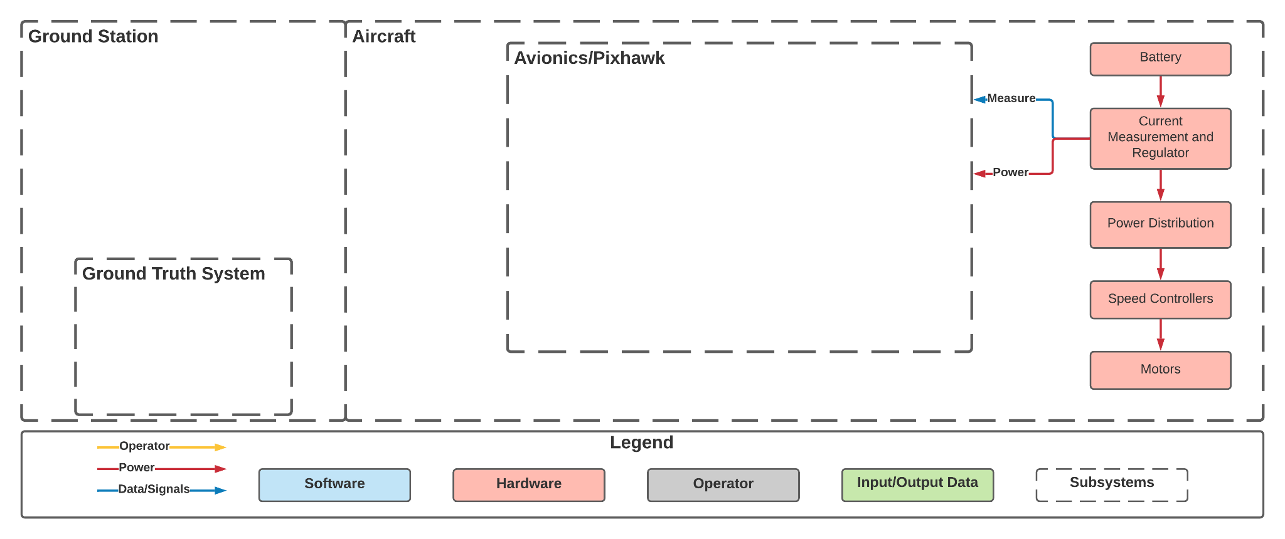
Functional Block Diagram
Project Overview
Baseline
Design
Feasibility Analysis
Status and Summary
Future Work
Notes:
Jake
FBD is complex and shows interactions between many subsystems
Look at each subsystem at a time
Aircraft subsystem
Shows the power flow down through hardware components to power the motors and achieve motion

Slide 15
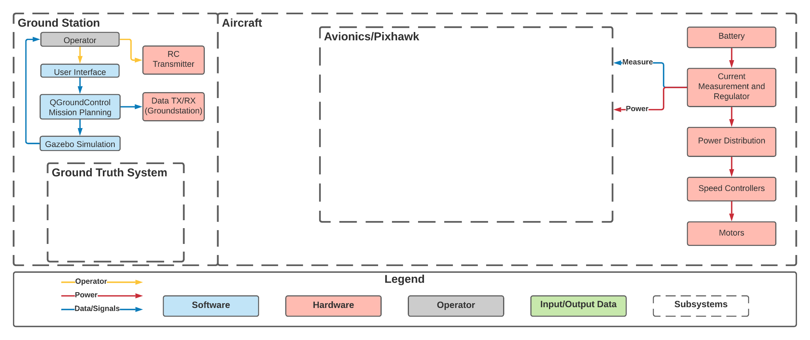
Functional Block Diagram
Project Overview
Baseline
Design
Feasibility Analysis
Status and Summary
Future Work
Notes:
Jake
Ground station subsystem
Flow of information from the operator through mission planning and simulation for feasibility
Transmission from ground station to vehicle

Slide 16
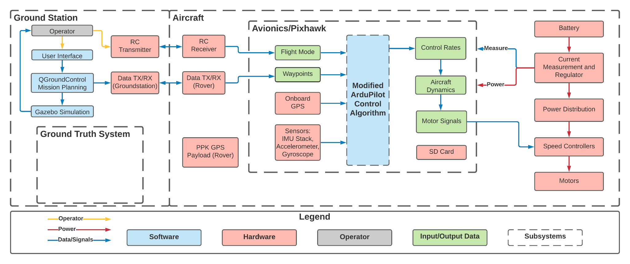
Functional Block Diagram
Project Overview
Baseline
Design
Feasibility Analysis
Status and Summary
Future Work
Notes:
Jake
Avionics subsystem
Flow of data through the avionics after upload
Sensor, GPS, waypoints are input into modified ardupilot control algorithm
Control algorithm outputs control rates and motor signals which feed into the speed controllers

Slide 17
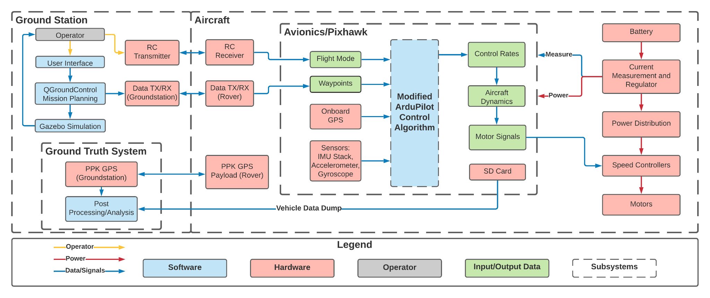
Functional Block Diagram
Project Overview
Baseline
Design
Feasibility Analysis
Status and Summary
Future Work
Notes:
Jake
Ground truth system
Data from onboard RTK GPS module is transmitted
SD card data dump of all tracked data on aircraft
Post processing to evaluate success

Slide 18
Functional Requirements
Functional Requirement: | Description:
FR1 | The control algorithm shall be able to command the multirotor to XYZT coordinates within 1 second.
FR2 | The control algorithm shall be integrated with an existing autopilot software.
FR3 | The UAS and its testing shall adhere to FAA and CU Boulder Guidelines.
FR4 | The modified mission planning software shall support integration of the control algorithm through a user interface that allows input XYZT coordinates.
FR5 | The simulation software shall be capable of simulating desired trajectory and determining its feasibility.
FR6 | Test vehicle shall have sufficient flight capabilities for use in demonstrating and evaluating control algorithm performance.
FR7 | Ground Truth System must be able to detect and record the flight trajectory of the test vehicle to 10cm and evaluate performance of control algorithm.
Project Overview
Baseline
Design
Feasibility Analysis
Status and Summary
Future Work
Notes:
Anand
Our functional requirements are as follows:
First, the developed control algorithm shall be able to command the multirotor to predetermined XYZT coordinates within 1 second of accuracy
Second, the control algorithm shall be an augmentation of an existing autopilot software
Next, the UAS and its flight will adhere to all FAA and CU guidelines
The developed software shall support the control algorithm allowing for a user to input XYZT coordinates
A simulations Software will determine the feasibility of any desired trajectory
The test vehicle itself must be sufficiently capable to demonstrate and evaluate the control algorithm performance
A GTS must be able to detect and record the flight trajectory of the test vehicle within half a meter (??)

Slide 19
Critical Project Elements
CPE | Name | Description
E1 | Guidance | The multirotor mission planning software shall accept XYZT waypoints, and a feasible flight trajectory shall be passed to the control algorithm.
E2 | Control | The XYZT control algorithm shall be integrated into an already existing autopilot to adjust its flight velocity while maintaining XYZ accuracy to reach each waypoint within 1 second of the desired time.
E3 | Airframe | The UAS must be able to be controlled via an autopilot system containing the XYZT control system.
E4 | Simulation | The simulation software must be able to accurately determine whether the selected UAS is capable of completing the mission that is desired.
E5 | Ground Truth System | The Ground Truth System must be capable of accurately determining the position of the UAS with respect to space and time and evaluating control algorithm performance.
E6 | Operations & Testing | The XYZT control system must be able to be implemented on a UAS.
Project Overview
Baseline
Design
Feasibility Analysis
Status and Summary
Future Work
Notes:
Anand
In order to properly define feasibility for our project, we first turn to the Critical Project Elements outlined in this table, summarized as follows:

Slide 20
Baseline Design
Notes:
Akos presentation: 5:30

Slide 21
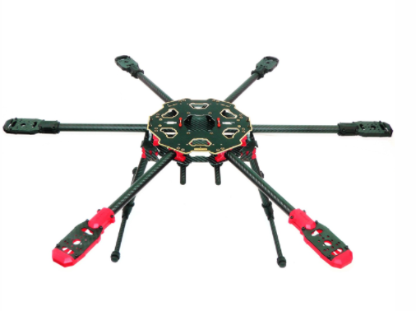
UAS Selection: Hex-Copter
Key attributes:
Redundancy measures
Relatively affordable
Stability and power
Maneuverability and speed
Tarot 680 Pro Frame
Project Overview
Baseline
Design
Feasibility Analysis
Status and Summary
Future Work
Notes:
Chris
Didn’t just choose quad because hexacopter offers more mission flexibility with higher performance. Also has additional motor redundancy in the case of motor failure which is key, especially budget considered. UAS selection trade study with metrics and weighting can be found in the additional slides.

Slide 22
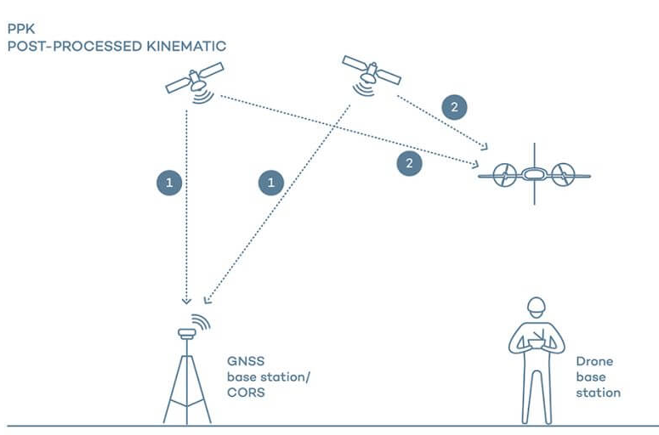
Ground Truth System Selection: PPK GPS
Key attributes:
Ease of use and implementation
Budget
Accuracy
Onboard Space Requirement
Project Overview
Baseline
Design
Feasibility Analysis
Status and Summary
Future Work
Notes:
Luke
Speaker notes:
Talk about 4 options considered: Use onboard GPS to store position data, Laser Tracking, RF Triangulation, Optical tracking
Chose GPS because: we can use GPS module used in flight controller, cost of implementation is the SD card only, to get as
accurate as GPS, other methods would require significant amount of time for research and development

Slide 23


Autopilot Selections: Ardupilot and PixHawk 4
ArduPilot Key Attributes:
PixHawk 4 Key Attributes:
Ease of modification
Support and documentation
Robustness
Hardware compatibility
Software support
Flexible hardware peripheral
32-bit MCU
U-blox M8N GPS
Reliable
Project Overview
Baseline
Design
Feasibility Analysis
Status and Summary
Future Work
Notes:
Jake
Baseline design will include ArduPilot as the autopilot software and PixHawk 4 as the flight controller board
Important aspects of ArduPilot
Very detailed tutorials on modifying code - adding new flight mode
Similarly, very thorough documentation and support from the community in case of issues
Been around for 10+ years and is very popular and reliable. Also capable of supporting many vehicles including multirotor
Capable of interfacing with the chosen flight controller board
On that note, important aspects of PixHawk 4
Many input-output channels for additional hardware that is needed or desired
High processing capability and speed
Effective accelerometer, gyros, magnetometer, barometer
Most popular board in use, lots of support, documentation, and tutorials

Slide 24
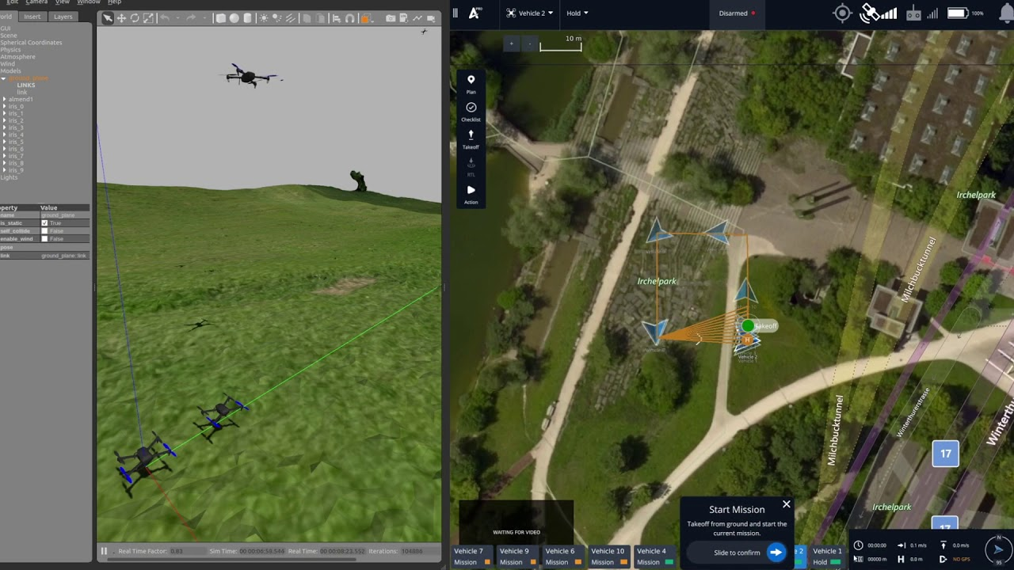
Simulation Selection: Gazebo
Key attributes:
Ease of modification
Documentation
Robustness
User interface
Project Overview
Baseline
Design
Feasibility Analysis
Status and Summary
Future Work
Notes:
The selected simulation software which GUST will implement is Gazebo
The purpose of our simulation software is to determine of the desired mission is feasible given vehicle restraints such as speed, battery, conditions or others
Also, the simulation serves as a place where the actual ardupilot firmware that will be flying on the drone can actually be tested and examined prior to experimentation on real hardware
This allows the team to accurately test the designed control algorithm in preliminary tests
Gazebo is an excellent simulator for these purposes because of its physics simulation and modification capabilities
Gazebo is built on open source code which is well documented easing the teams learning process with the simulator
The simulator can be easily modified to simulate various flight conditions and is commonly used and trusted for various robotics and aerodynamic simulations
Gazebo also has a robust physics model to ensure that simulation conducted by the team are accurate

Slide 25
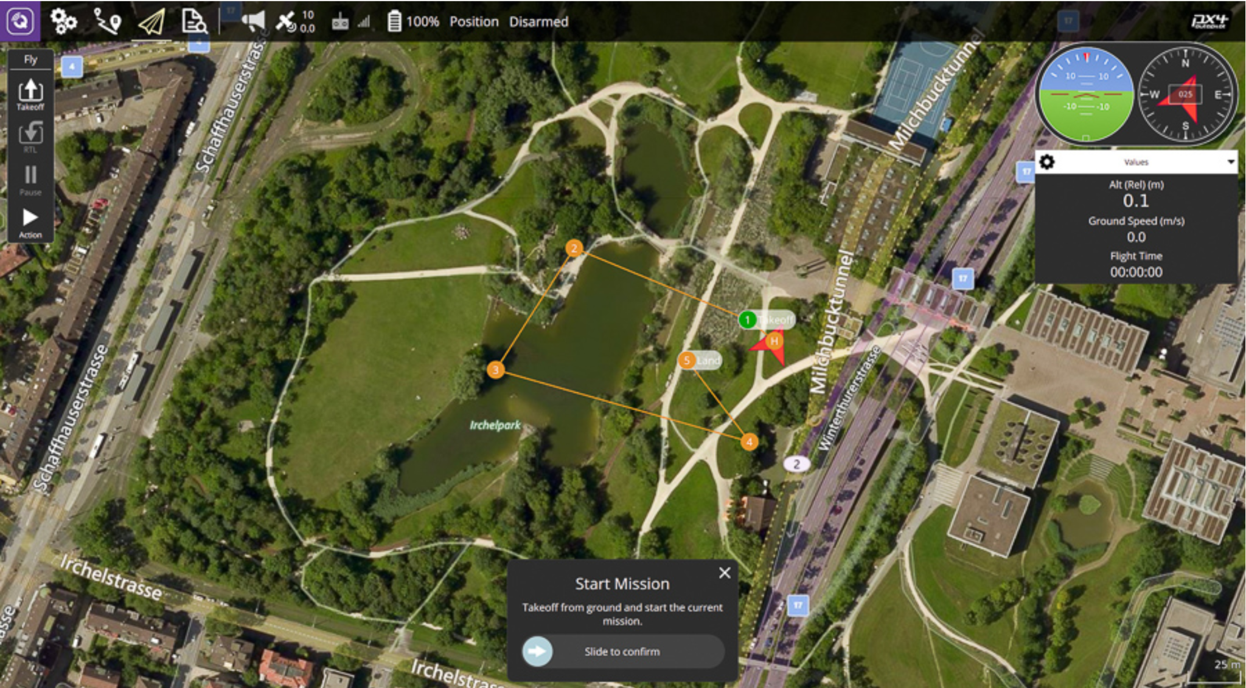
Mission Planner Selection: QGroundControl
Key attributes:
Ease of modification
Support and documentation
User interface simplicity
Project Overview
Baseline
Design
Feasibility Analysis
Status and Summary
Future Work
Notes:
Billy
The mission planning software is where the user inputs waypoints in XYZT coordinates, the coordinates are then passed on to the simulator for flight feasibility and finally uploaded to the flight controller for mission execution
Trade study of mission planning software packages - metrics
QGroundControl, Mission Planner, APM Planner 2
QGC is the selected mission planning software to plan flight path for GUST
Easy to modify due to open source code and extensive documentation including a developer guide
simple and intuitive user interface that is designed for tables (preferred by our customer) but compatible with phones and computers

Slide 26
Feasibility Analysis
Notes:
Akos presentation:

Slide 27
Feasibility Analyses Conducted
Name | Statement | CPEs | FRs | Feasible
UAS | The chosen UAS kit is capable of sustaining a 20 min hover time while holding a position within 0.5 m in XYZ directions and carrying an operational payload. | E3, E6 | FR6
Ground Truth System | The GTS is capable of determining vehicle location to within 10cm post mission and evaluating the performance of the control algorithm. | E5 | FR7
Autopilot Hardware | The autopilot hardware is capable of controlling the chosen vehicle and interfacing with chosen software packages. | E6 | FR6
Autopilot Software | The autopilot software and control theory can be understood, modified, and compiled by the team to create XYZT control to within 1 second time accuracy. | E1, E2 | FR1, FR2
Simulation | Simulation software can generate aircraft dynamics for chosen airframe, reveal mission feasibility, test control algorithm development, and be compiled by the team. | E4 | FR5
Mission Planner | Mission planner software is modifiable to accept XYZT coordinates from the user and pass the waypoints to the control algorithm, and the code can be compiled by the team and used on various platforms. | E1 | FR4
Project Overview
Project Overview
Baseline
Design
Baseline
Design
Feasibility Analysis
Feasibility Analysis
Status and Summary
Status and Summary
Future Work
Future Work
Notes:
Anand
From the critical project elements, we are able to define different metrics of feasibility for the important areas of our project.
These analyses as well as the critical project elements and functional requirements that drive them are shown in this table.

Slide 28
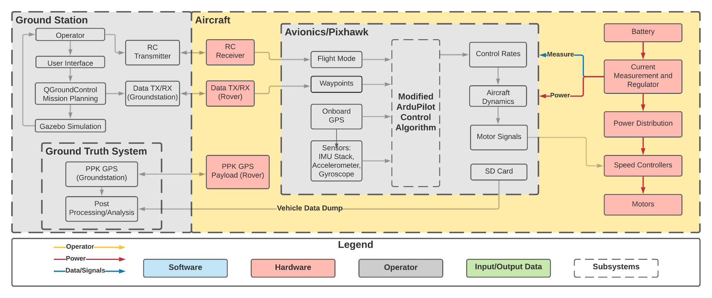
Feasibility Analysis: UAS
Feasibility Statement: The chosen UAS kit is capable of sustaining a 20 min hover time while holding a position within 0.5 m in XYZ directions and carrying an operational payload.
Project Overview
Project Overview
Baseline
Design
Baseline
Design
Feasibility Analysis
Feasibility Analysis
Status and Summary
Status and Summary
Future Work
Future Work
Notes:
Let’s talk more about the feasibility statement used here. -Ak

Slide 29
Feasibility Analysis: UAS
Flight-time Feasibility Methodology
Vehicle Mass
Lift Power
Lift Force Required Per Motor
Efficiencies
Momentum Theory
Flight Time Calculation
Project Overview
Project Overview
Baseline
Design
Baseline
Design
Feasibility Analysis
Feasibility Analysis
Status and Summary
Status and Summary
Future Work
Future Work
Notes:
Chris
As previously mentioned, flight time in a hover position is the primary indication of feasibility for a selected airframe configuration.
and here is the outline in which we will follow to determine the flight time.
The vehicle mass involves creating a mass-budget for each airframe and associated manufacturer-recommended components(including speed controllers, motors, propellors, etc).
Assuming each motor produces equal thrust in order to lift the entire airframe configuration, momentum theory is then used to calculate the power required for each motor’s thrust.
Next, we will look into the efficiencies of the primary components to determine the power required of the battery. This leads to the flight time calculation
Note: detailed mass and power budgets for the given configurations are given in the additional slides as well as the full derivations for the calculations.

Slide 30
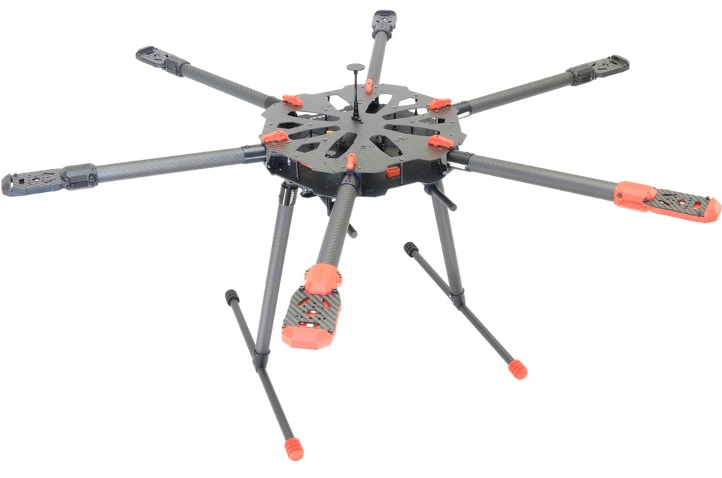
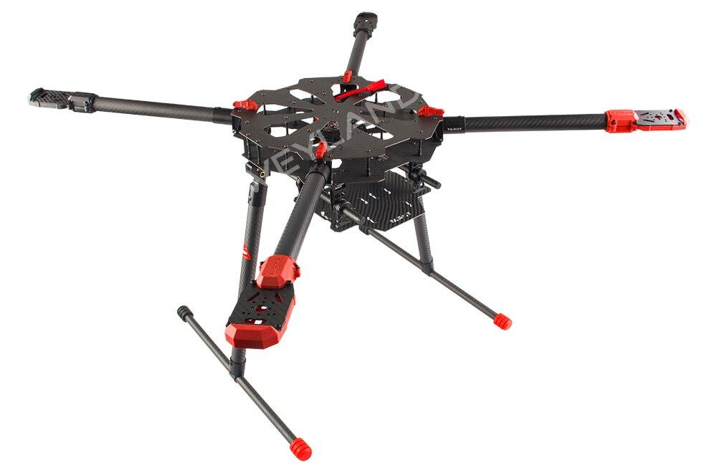
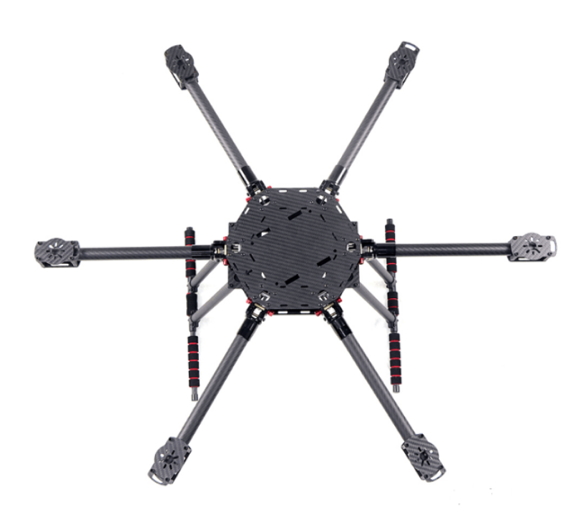
Feasibility Analysis: UAS Cont.
UAS Kit Options Overview
Tarot 680 Pro
LJI ZD700 Pro
Tarot X6
Tarot X4
Project Overview
Project Overview
Baseline
Design
Baseline
Design
Feasibility Analysis
Feasibility Analysis
Status and Summary
Status and Summary
Future Work
Future Work
Notes:
Chris
Here are 4 main airframe options in which we considered along with recommended components for these frames.
As can be seen, there are 3 hexacopter options, and we also considered the Tarot X4 - the quadrotor variant of the X6. These were selected based on a variety of factors, including team member operational experience and especially ease of manufacturing and implementation of required components

Slide 31
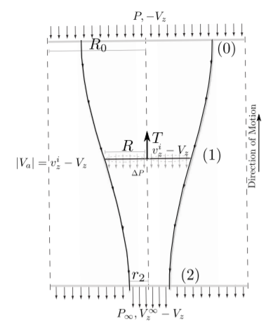
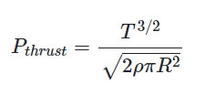
Feasibility Analysis: UAS Cont.
Momentum Theory for Static-Thrust Calculation
1. Apply Conservation of momentum
2. Apply conservation of energy
3. Solve for lift power relation
Assume:
V_{Z} = 0 for hover condition
Each rotor produces equal thrust to lift UAS configuration
Project Overview
Project Overview
Baseline
Design
Baseline
Design
Feasibility Analysis
Feasibility Analysis
Status and Summary
Status and Summary
Future Work
Future Work
Notes:
Used to determine the power required for each motor to achieve its required thrust.
On the left is a diagram which gives the airflow through a propellor modeled as a streamtube and used in the full derivation, which is given in the additional slides.
Essentially, these steps are followed:
We will assume velocity of the air in the Z direction is zero for hover condition, each rotor will produce equal thrust to lift the UAS configuration (hexacopter, each rotor’s thrust is ⅙ of the total weight)

Slide 32

Feasibility Analysis: UAS Cont.
Component Efficiency Model
Battery
Efficiency Values Used:
Prop efficiency = 0.65
Reasonable estimate for fixed 2-blade prop with ~80N/m^2 disk loading.
ESC Efficiency = 0.75
Varies slightly with throttle input &
switching frequency
Reasonable for brushless ESC’s
Motor Efficiency = 0.8
Varies with load on motor
Reasonable for hovering throttle position
𝜂_{ESC}
Electronic Speed Control (ESC)
𝜂_{motor}
Motor
𝜂_{P}
Propellor
(per motor)
Project Overview
Project Overview
Baseline
Design
Baseline
Design
Feasibility Analysis
Feasibility Analysis
Status and Summary
Status and Summary
Future Work
Future Work
Notes:
Once the thrust power of each motor is determined, we work backwards to determine the total power required by the battery given the efficiencies of these components

Slide 33
Feasibility Analysis: UAS Cont.
Obtain Battery Mass
Component Efficiencies
Update Mass Budget
Estimated Power Consumption
Momentum Theory
Compute Current Draw - Components Included
Lifting Power
Estimated Flight Time
Project Overview
Project Overview
Baseline
Design
Baseline
Design
Feasibility Analysis
Feasibility Analysis
Status and Summary
Status and Summary
Future Work
Future Work
Notes:
Given a methodology that relates vehicle mass and the power requirements, we can obtain a flight time estimation for varying battery capacities.
The battery mass is obtained from the battery’s rated capacity and power density, and the result is then added to the mass budget for the configuration.
For preliminary calculations, we make the assumption that the battery is capable of supplying a nominal voltage for the majority of the rated capacity
(low 3-6C load on battery during hovering makes this reasonable for preliminary calculations)
Dividing the estimated power consumption by the batteries nominal voltage gives us an estimate of the the total current draw from the battery for hovering flight.
Finally, from the batteries capacity and projected current draw, the flight time can be estimated.

Slide 34
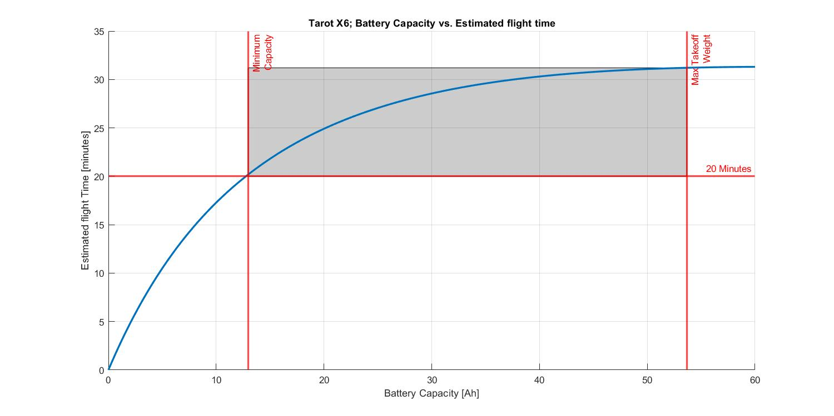
Feasibility Analysis: UAS Cont.
Project Overview
Project Overview
Baseline
Design
Baseline
Design
Feasibility Analysis
Feasibility Analysis
Status and Summary
Status and Summary
Future Work
Future Work
Notes:
Most Important parameter in determining flight time was battery capacity.
Plot shows Battery capacity in Amp-Hours along X & Estimated flight time in minutes along Y
Design space shown in gray, bounded by 20 minute minimum flight time, Minimum capacity to reach 20 minutes, and Max takeoff weight as specified per manufacturer.

Slide 35
Feasibility Analysis: UAS
Name | Statement | CPEs | FRs | Feasible
UAS | The chosen UAS kit is capable of sustaining a 20 min hover time while holding a position within 0.5 m in XYZ directions and carrying an operational payload. | E3, E6 | FR6 | Yes
Project Overview
Project Overview
Baseline
Design
Baseline
Design
Feasibility Analysis
Feasibility Analysis
Status and Summary
Status and Summary
Future Work
Future Work

Slide 36
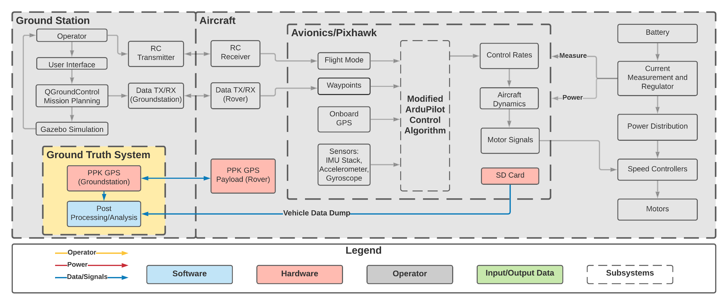
Feasibility Analysis: Ground Truth System
Feasibility Statement: The GTS is capable of determining vehicle position to within 10cm post mission and evaluating the performance of the control algorithm.
Project Overview
Project Overview
Baseline
Design
Baseline
Design
Feasibility Analysis
Feasibility Analysis
Status and Summary
Status and Summary
Future Work
Future Work
Notes:
Speaker notes:
In order to show feasibility, GTS needs to:
Be capable of measuring and storing the position (to 10cm) and timing of a test flight
Be capable of evaluating the performance of the flight algorithm using position and timing error
Describe position in FBD: Physical components include RTK GPS ground station receiver, onboard receiver, and sd card to log the data

Slide 37
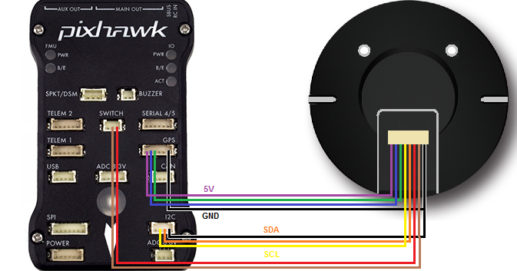
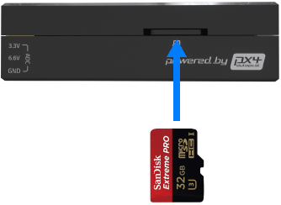
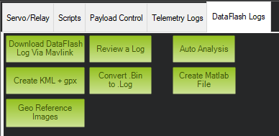
Feasibility Analysis: Ground Truth System
Objective 1: Measure and store position during flight with +/-10cm accuracy
Use onboard GPS receiver to take Lat Lon Alt measurements during flight
PPK Ground station receiver factors in measurements to improve accuracy
Store processed data in micro SD card
Convert to MATLAB file using Mission Planner software
GPS Module | Position Accuracy
Here3 | +/- 0.025m
CUAV C-RTK 9P | +/- 0.01m
Holybro H-RTK F9P | +/- 0.01m
Error Estimation Code
Project Overview
Project Overview
Baseline
Design
Baseline
Design
Feasibility Analysis
Feasibility Analysis
Status and Summary
Status and Summary
Future Work
Future Work
Notes:
Speaker notes:
State 1st objective of GTS (listed in slide)
To make sure the aircraft is capable of this, we first need a GPS sensor able to measure position
within the desired 10cm. Table shows 3 modules we’re looking at compatible with the PixHawk
that meets this requirement
Next we need to make sure it’s possible to store these measurement from flight
As it turns out, the pixhawk flight controller board we’re using can hold an SD card and is
capable of recording flight data including GPS measurements
Explain process of measuring and storing data (pictures):
Onboard GPS receiver connected to the PixHawk board takes GPS measurements in latitude,
longitude and altitude units and logs them in the SD card
We can then
NEED TO ADDRESS EXTRA SOFTWARE TO OBTAIN ACCURATE SOLUTIONS
References:
Here3, CUAV, Holybro

Slide 38
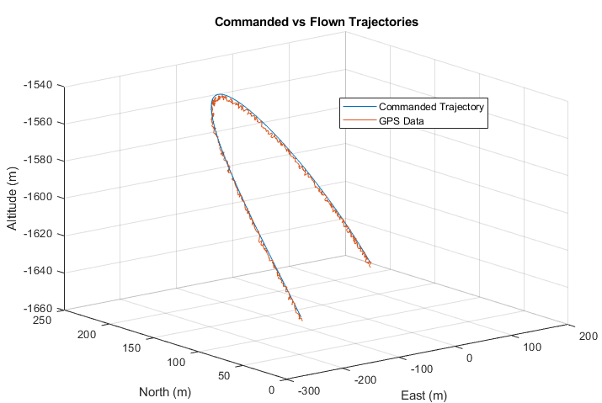


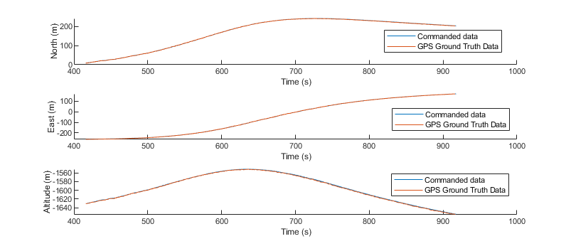
Feasibility Analysis: Ground Truth System
Objective 2: Use flight trajectory data to evaluate control algorithm
Using similar hardware, IRISS team was able to record position/time data using SD card for both trajectories
Ground truth trajectory data from GPS allows for error estimation compared to commanded trajectory
Position RMS Error | Timing RMS Error
Project Overview
Project Overview
Baseline
Design
Baseline
Design
Feasibility Analysis
Feasibility Analysis
Status and Summary
Status and Summary
Future Work
Future Work
Notes:
Speaker notes:
List second objective (in slide)
The method of evaluation we’re going to use will be to find the RMS error between the commanded and
flown trajectories with respect to position and time
To show we can calculate the associated error, we looked at flight trajectory data from IRISS’s previous missions in the same form
of logged GPS data on an SD card that we’re expecting. The data was stored in a compressed binary file which we were able to
convert to a MATLAB file using Mission planner and then export the GPS measurements.
The plot on the left shows a simulated commanded and flown trajectory which was used to test error calculations Using the position and time
data for the commanded and flown trajectories, we were able to calculate the RMS error of both position and time across the
full trajectory
EXTRA: IRISS’s Solution
Idea was to specify velocity for drone to fly at from pt A to pt B as distance and Δt were known. Basic solution made possible by
Mission planner allowing user to set drone speed. RESULT: accurate for first few waypoints, susceptible to wind and couldn’t correct itself.
Next solution was to add feedback from drift. If drone is late/early to waypoint, velocity gets updated to account for these errors
and commands are sent using telemetry from ground station to aircraft during flight
Explain how we were given flight data taken from the SD card of several trajectories and we calculated TBD error in position and time
across trajectories.
Once we’re able to estimate the error of a trajectory using sample flight data, we can quantify and compare how our control algorithm
performs during testing

Slide 39
Feasibility Analysis: Ground Truth System
Name | Statement | CPEs | FRs | Feasible
Ground Truth System | The GTS is capable of determining vehicle position to within 10cm post mission and evaluating the performance of the control algorithm. | E5 | FR7 | Yes
Project Overview
Project Overview
Baseline
Design
Baseline
Design
Feasibility Analysis
Feasibility Analysis
Status and Summary
Status and Summary
Future Work
Future Work
Notes:
Speaker notes:
Based on the fact that we are able to measure and store the aircraft’s position to within 10cm
and calculate a metric that let’s us evaluate the control algorithm, our ground truth system is
feasible

Slide 40
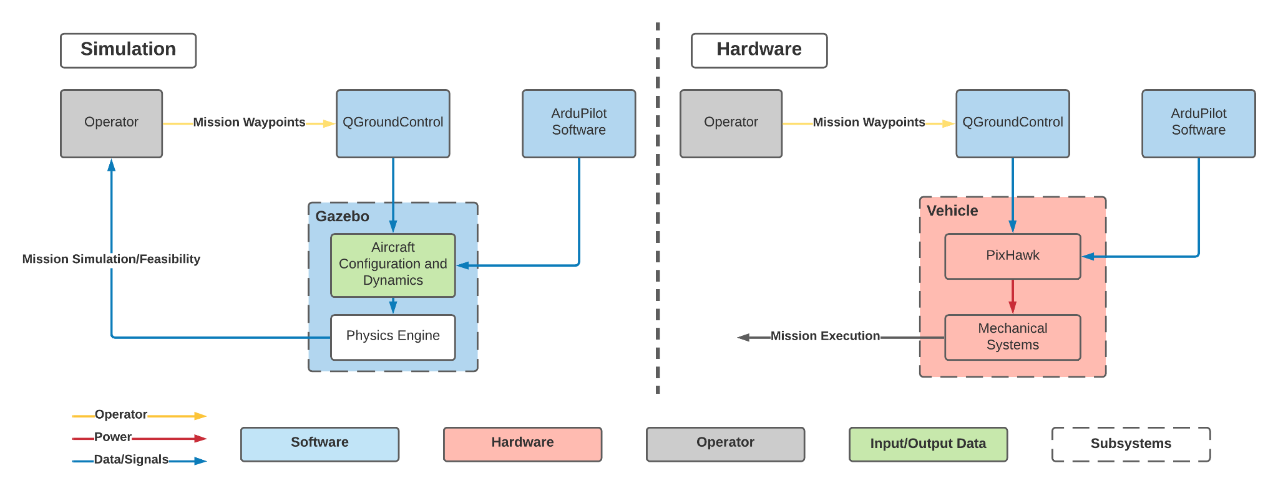
Feasibility Analysis: High Level Interface FBD
Project Overview
Project Overview
Baseline
Design
Baseline
Design
Feasibility Analysis
Feasibility Analysis
Status and Summary
Status and Summary
Future Work
Future Work
Notes:
FBD shows how the hardware implementation of our project is a manifestation of the simulation implementation
Simulation side on the left
All the chosen software properly interfaces with each other
Operator inputs waypoints which are formatted in QGroundControl
Gazebo pulls the compiled ardupilot code and uses aircraft dynamics and a physics engine to simulate the projected mission
Returns simulation results and feasibility to the operator
Physical Hardware on the right
Chosen hardware interfaces properly with the chosen software
Operator inputs waypoints to QGroundControl which are uploaded to the pixhawk
Ardupilot code is compiled on the pixhawk board
Pixhawk controls the mechanical systems
Mission execution

Slide 41
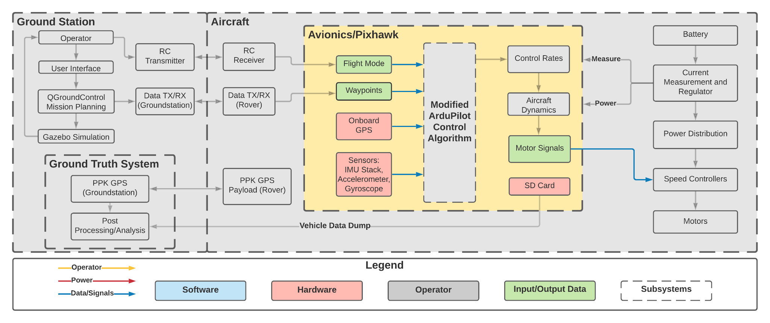
Feasibility Analysis: Autopilot Hardware
Feasibility Statement: The autopilot hardware is capable of controlling the chosen vehicle and interfacing with chosen software packages.
Project Overview
Project Overview
Baseline
Design
Baseline
Design
Feasibility Analysis
Feasibility Analysis
Status and Summary
Status and Summary
Future Work
Future Work

Slide 42
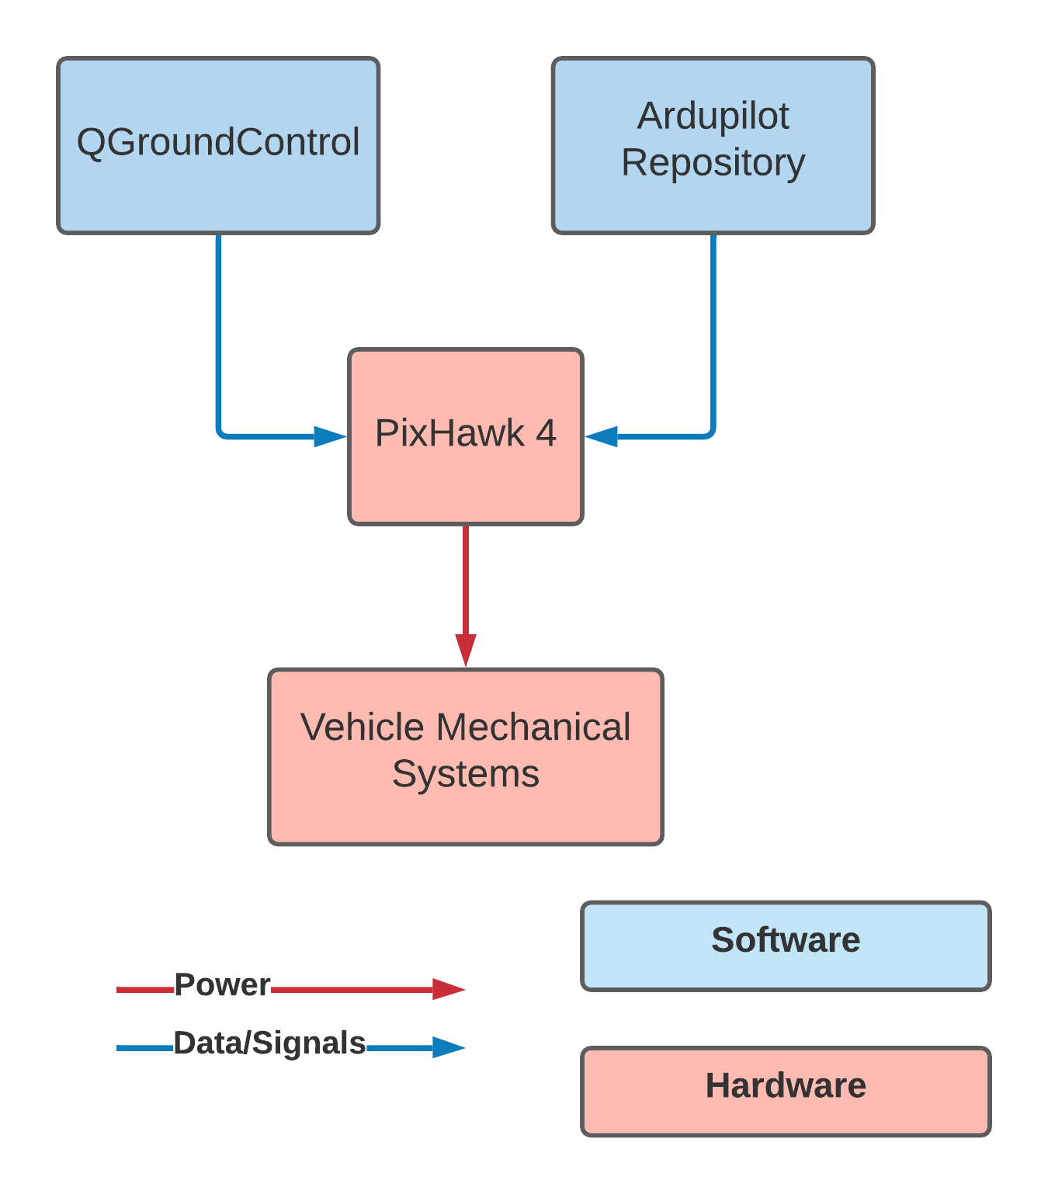
Feasibility Analysis: Autopilot Hardware
PixHawk 4 and QGroundControl
QGroundControl gives option for ArduPilot Firmware
Compiles and builds code onto PixHawk 4 board
PixHawk 4 and ArduPilot
The PixHawk 4 Board is supported by the ArduPilot firmware
Documentation on setup is provided
PixHawk 4 and Test Vehicle
PixHawk 4 is capable of controlling Ardupilot supported vehicles including multirotors
Many input/output pins for additional desired hardware
Project Overview
Project Overview
Baseline
Design
Baseline
Design
Feasibility Analysis
Feasibility Analysis
Status and Summary
Status and Summary
Future Work
Future Work
Notes:
What is feasibility
Chosen flight controller can run the flight software stack and is capable of controlling the chosen vehicle
PixHawk and QGC
QGC gives option to build ArduPilot Code and flash it to PixHawk 4 board
PixHawk and ArduPilot
PixHawk 4 board is supported by ArduPilot
Capable of building code for this specific board
PIxHawk and vehicle
Pixhawk 4 board can control multirotors - encompasses design space
Input output channels for any additional hardware that is needed or desired in the future

Slide 43
Feasibility Analysis: Autopilot Hardware
Name | Statement | CPEs | FRs | Feasible
Autopilot Hardware | The autopilot hardware is capable of controlling the chosen vehicle and interfacing with chosen software packages. | E6 | FR6 | Yes
Project Overview
Project Overview
Baseline
Design
Baseline
Design
Feasibility Analysis
Feasibility Analysis
Status and Summary
Status and Summary
Future Work
Future Work
Notes:
Following flow down from FRs and CPEs, the PixHawk 4 board satisfies the AutoPilot Hardware feasibility statement

Slide 44
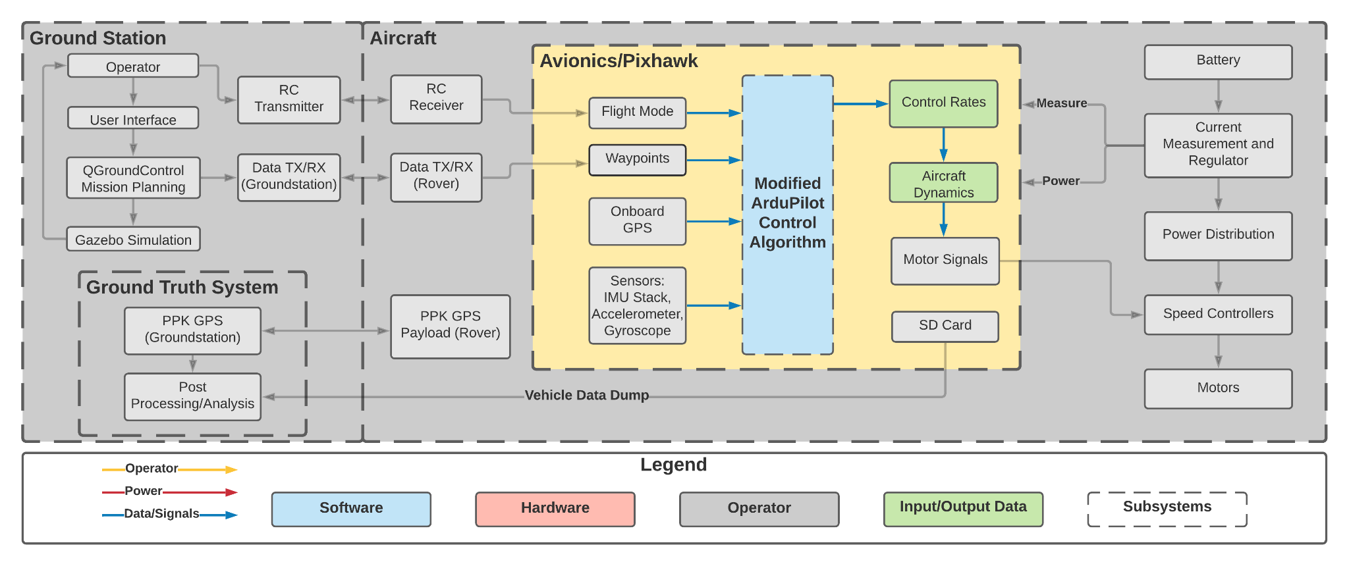
Feasibility Analysis: Autopilot Software
Feasibility Statement: The autopilot software and control theory can be understood, modified, and compiled by the team to create XYZT control to within 1 second time accuracy.
Project Overview
Project Overview
Baseline
Design
Baseline
Design
Feasibility Analysis
Feasibility Analysis
Status and Summary
Status and Summary
Future Work
Future Work

Slide 45
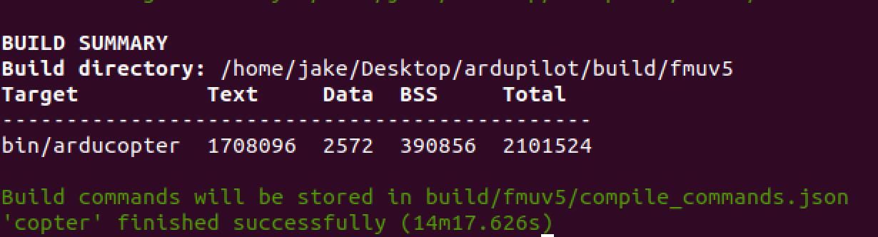
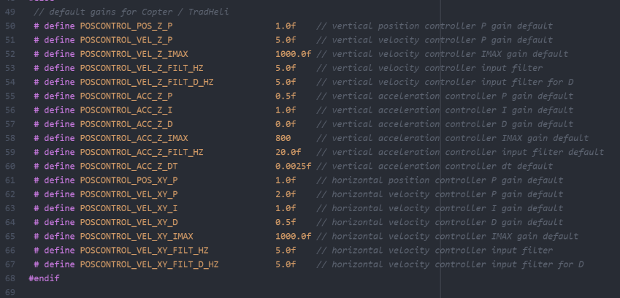
Feasibility Analysis: Autopilot Software
Compiling the Code
Using virtual linux machines
Configure code to run on specific boards
Build code, upload code to board
Modifying the Code
Removed the PID velocity control gain
Exaggerated the positional proportional control gain
Compilation with modified code
Waypoints were established with QGC
QGC communicated the waypoints to Ardupilot SITL
SITL simulated trajectory with input control algorithm
Project Overview
Project Overview
Baseline
Design
Baseline
Design
Feasibility Analysis
Feasibility Analysis
Status and Summary
Status and Summary
Future Work
Future Work
Notes:
What is Feasibility
Software can be compiled by the team
Team understands how and where to modify the software
Software can be modified by the team
Compiling the code
ArduPilot is primarily linux based with support for both mac and windows OS
Team used virtual linux machines so everyone was on same OS and since main ArduPIlot support
Team built the code configured for the chosen PixHawk 4 board
Screenshot on the right shows compilation success
Modifying the code
Team removed PID velocity control gain and exaggerated proportional position control gain
Recompiled the code base
Simulated code through QGroundControl and native SITL functionality
Observed expected effect of significant overshoot of waypoint position
To demonstrate the feasibility of our chosen autopilot software - ArduPilot for the completion of this project we tested the following areas
Firstly, we needed to make sure that the team was able to build the codebase. To this end, the team has utilized virtual linux machines, configured the codebase for the chosen board, and built the code. Without the hardware available, it is not certain that the code will successfully be uploaded to the board however there is no reason to doubt this as the code is successfully built to a file that just needs to be flashed to the PixHawk in a well documented process.
Next, the team verified that the simulation was functioning correctly with the built code utilizing both the native SITL simulation as well as the gazebo simulation. The code was successfully compiled and run by the simulator.
Finally, the team modified the code files by NULL and recompiled and simulated the code to verify that the modifications yielded the expected results in the simulation.

Slide 46
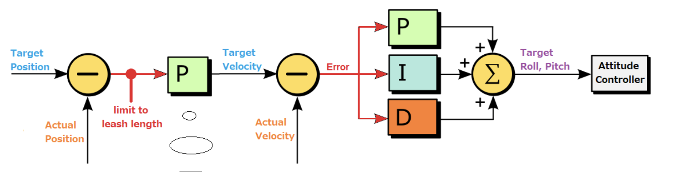
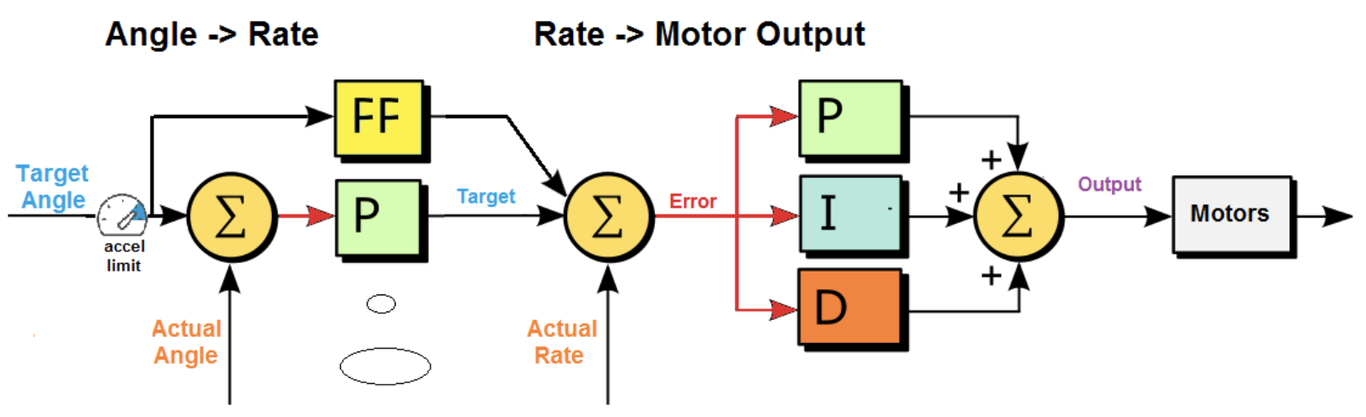
Feasibility Analysis: Autopilot Software Cont.
Current Ardupilot ArduCopter Control Law
Position controller used in conjunction with an Attitude controller
Both controllers utilize layered PID control laws and a square-root controller
Reside in AC_PosControl and AC_AttitudeControl libraries
Position Controller
Attitude Controller
Project Overview
Project Overview
Baseline
Design
Baseline
Design
Feasibility Analysis
Feasibility Analysis
Status and Summary
Status and Summary
Future Work
Future Work
Notes:
Knowledge of where to modify the code
Team identified the libraries which contain the position and attitude control libraries
Both controllers use layered PID control laws and a square root controller
Control block diagrams for each are shown her at the bottom of this slide
Team knows that this is likely where the code will need to be modified to solve our project
With knowledge of the code architecture and how to modify it, the next step is the bulk of the team’s software challenge in this project. That is to implement a control law which includes time as an input that results in variable velocity along a specified flight path for accurate arrival time at the next waypoint.
To accomplish this the team first looked at the control laws currently implemented in ArduPilot
This is an control block diagram (left image) of the control law implemented in the attitude and position controllers
Ardupilot Control Law
ArduCopter build uses a position controller in conjunction with an attitude controller
These controllers use layered PID control laws
These controllers reside within AC_PosControl and AC_AttitudeControl libraries
After determining where the controller code resides and understanding how it is implemented, the next step to prove feasibility is demonstrating previous work involving Time Feedback Control laws similar to what could be implemented in the GUST modifications of Ardupilot

Slide 47
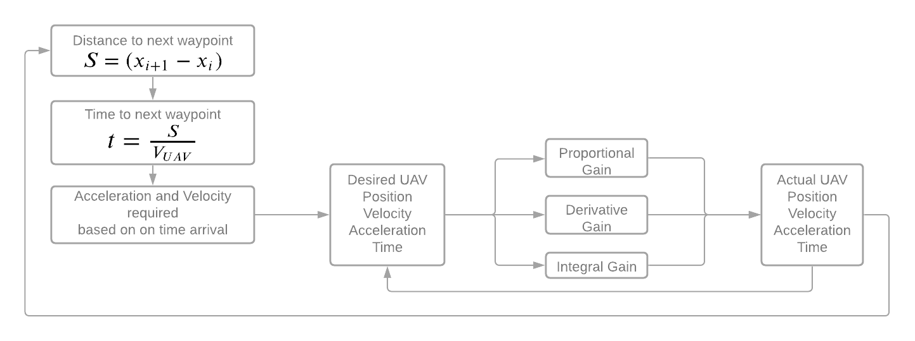
Feasibility Analysis: Control Algorithm
Real-time optimization of short-term flight profiles to control time of arrival
Gu, Tang, et al. ‘Aerospace Science and Technology’, Vol 84, 2019
Able to control time of arrival to within reasonable error
Simple concept based on need to accelerate or decelerate
Aircraft flight trajectory vs UAV flight trajectory
Project Overview
Project Overview
Baseline
Design
Baseline
Design
Feasibility Analysis
Feasibility Analysis
Status and Summary
Status and Summary
Future Work
Future Work
Notes:
What feasibility means
Is there a method to control a UAS in the time domain to arrive at a waypoint with specific time accuracy
Analyzed a research paper that worked to control the time of arrival for passenger aircraft
They were able to control time of arrival to within 4 seconds (arbitrarily determined)
Using a simple method of accelerate or decelerate to meet a schedule
Aircraft flight is far more complex than UAV flight due to density, fuel, linked dynamics
Should make our use case simpler to implement
Proposed Control loop
Nested feedback loop
Outer loop calculates necessary velocity and acceleration
Inner loop brings UAV to that desired state
Need to define desired states - existing control law for position and velocity already functional

Slide 48
Feasibility Analysis: Autopilot Software
Name | Statement | CPEs | FRs | Feasible
Autopilot Software | The autopilot software and control theory can be understood, modified, and compiled by the team to create XYZT control to within 1 second time accuracy. | E1, E2 | FR1, FR2 | Yes
Project Overview
Project Overview
Baseline
Design
Baseline
Design
Feasibility Analysis
Feasibility Analysis
Status and Summary
Status and Summary
Future Work
Future Work
Notes:
Following the flow down from the relevant FRs and CPEs, the team has determined that the ArduPilot code repository satisfies the feasibility statement for Autopilot software

Slide 49
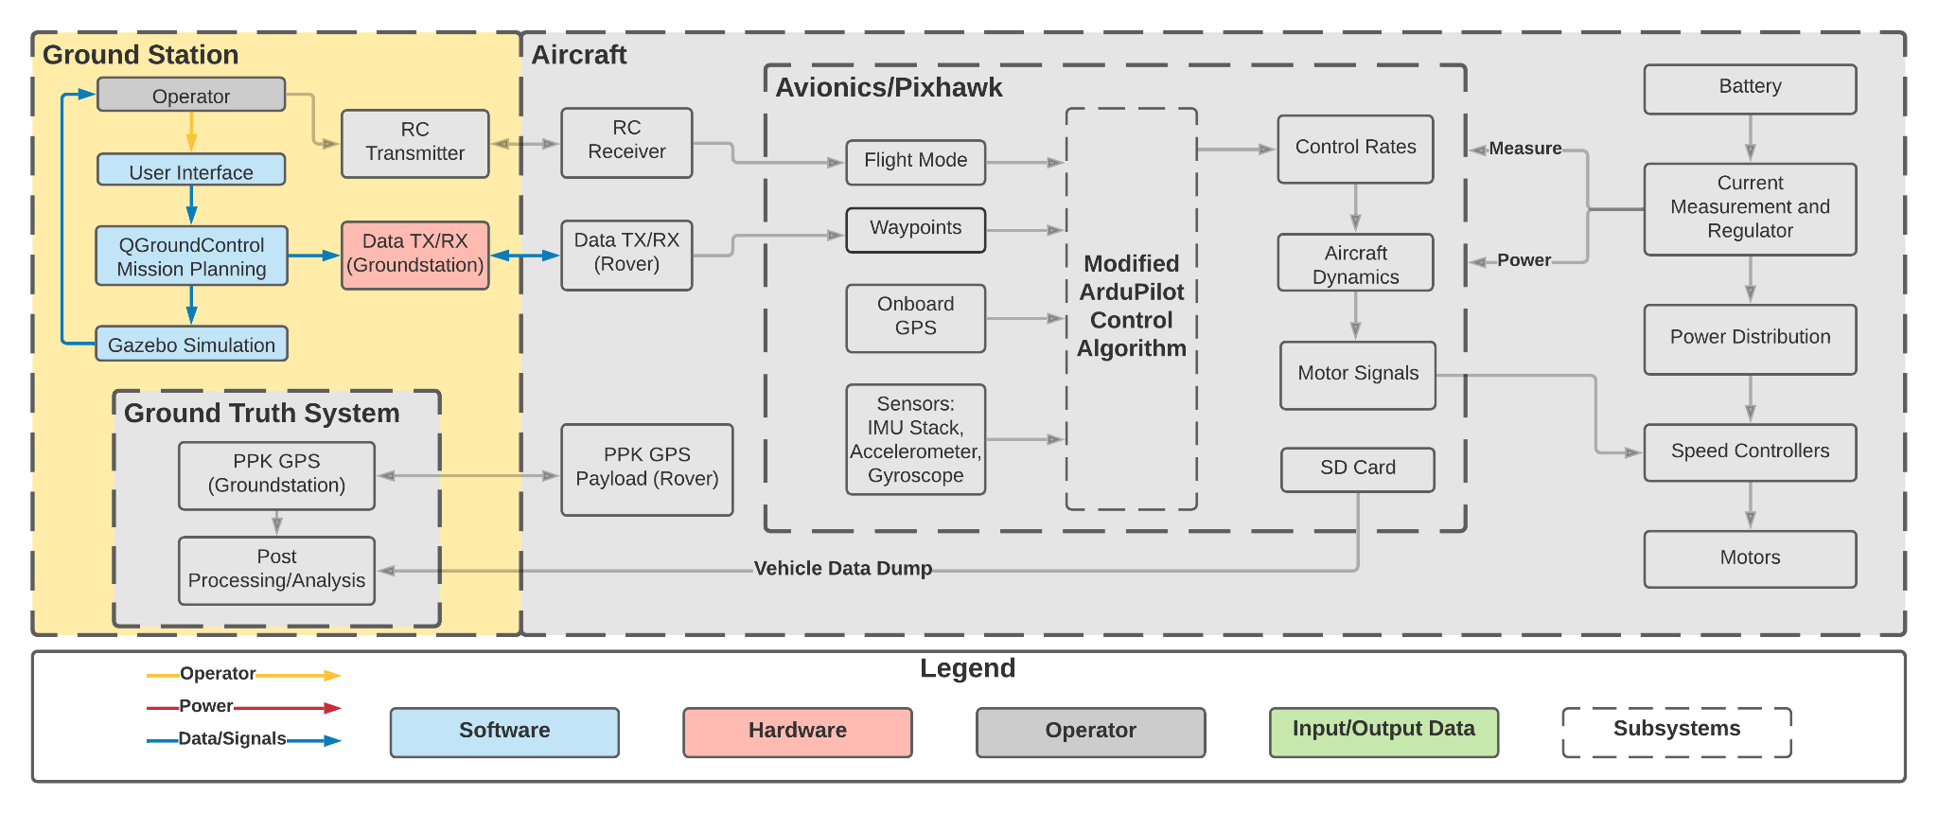
Feasibility Analysis: Simulation
Feasibility Statement: Simulation software can generate aircraft dynamics for chosen airframe, reveal mission feasibility, test control algorithm development, and be compiled by the team.
Project Overview
Project Overview
Baseline
Design
Baseline
Design
Feasibility Analysis
Feasibility Analysis
Status and Summary
Status and Summary
Future Work
Future Work

Slide 50
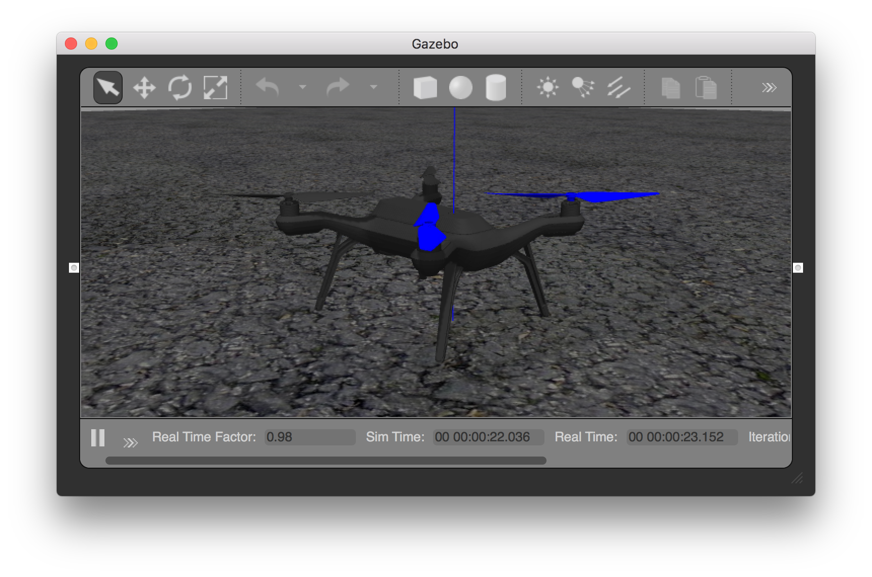
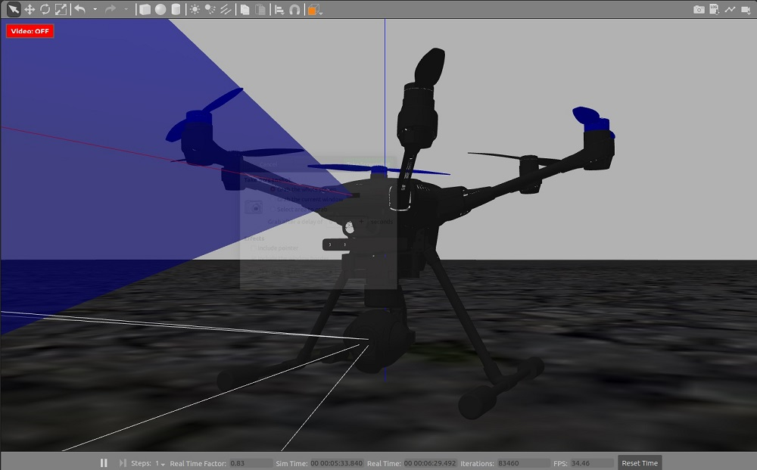
Feasibility Analysis: Simulation
Gazebo Physics Engine
Gazebo accurately models thrust, drag, lift and disturbance forces
Gazebo able to interface with Ardupilot & QGroundControl
Gazebo has been run on team’s machines and baseline flights have been conducted
Gazebo easily models quadcopter or hex-copter drone frames
Project Overview
Project Overview
Baseline
Design
Baseline
Design
Feasibility Analysis
Feasibility Analysis
Status and Summary
Status and Summary
Future Work
Future Work
Notes:
Before diving into how Gazebo is feasible we have to establish what feasibility means for the simulation
The simulator must be capable of interfacing with our other software systems
The simulator must accurately determining if the mission is feasible and show an accurate depiction of the flight which is primarily dependent on the physics capabilities of the simulator
Gazebos Feasibility Analysis - They key aspects of Gazebo that show feasibility are shown here on the left side of this slide
Gazebo’s documentation shows how it models the dynamics of the drone taking into account important factors such as the forces that will act on it during flight. Some of these forces include thrust, drag, lift, and disturbance forces such as wind
Gazebo can easily interface with ardupilot and QGroundControl and Gazebo has been installed on the teams own machines test this
The team has run simple baseline simulations and shown that we can send comments to a drone and control it inside of the Gazebo simulation
Also, there are various tutorials that exists ease the learning curve of the simulator and will be useful in creating and designing further simulations

Slide 51
Feasibility Analysis: Simulation
Name | Statement | CPEs | FRs | Feasible
Simulation | Simulation software can generate aircraft dynamics for chosen airframe, reveal mission feasibility, test control algorithm development, and be compiled by the team. | E4 | FR5 | Yes
Project Overview
Project Overview
Baseline
Design
Baseline
Design
Feasibility Analysis
Feasibility Analysis
Status and Summary
Status and Summary
Future Work
Future Work
Notes:
Gazebo is capable of accurately simulating the desired trajectory of the vehicle because of its robust physics engine.
Gazebo is also capable of interfacing with our other software systems ardupilot and QGroundControl so utilizing Gazebo for our project is feasible.

Slide 52
Feasibility Analysis: Mission Planner
Feasibility Statement: Mission planner software is modifiable to accept XYZT coordinates from the user and pass the waypoints to the control algorithm, and the code can be compiled by the team and used on various platforms.
Project Overview
Project Overview
Baseline
Design
Baseline
Design
Feasibility Analysis
Feasibility Analysis
Status and Summary
Status and Summary
Future Work
Future Work
Notes:
Feasibility analysis modifiable, pass, code can be compiled and used to fly the drone by the team

Slide 53
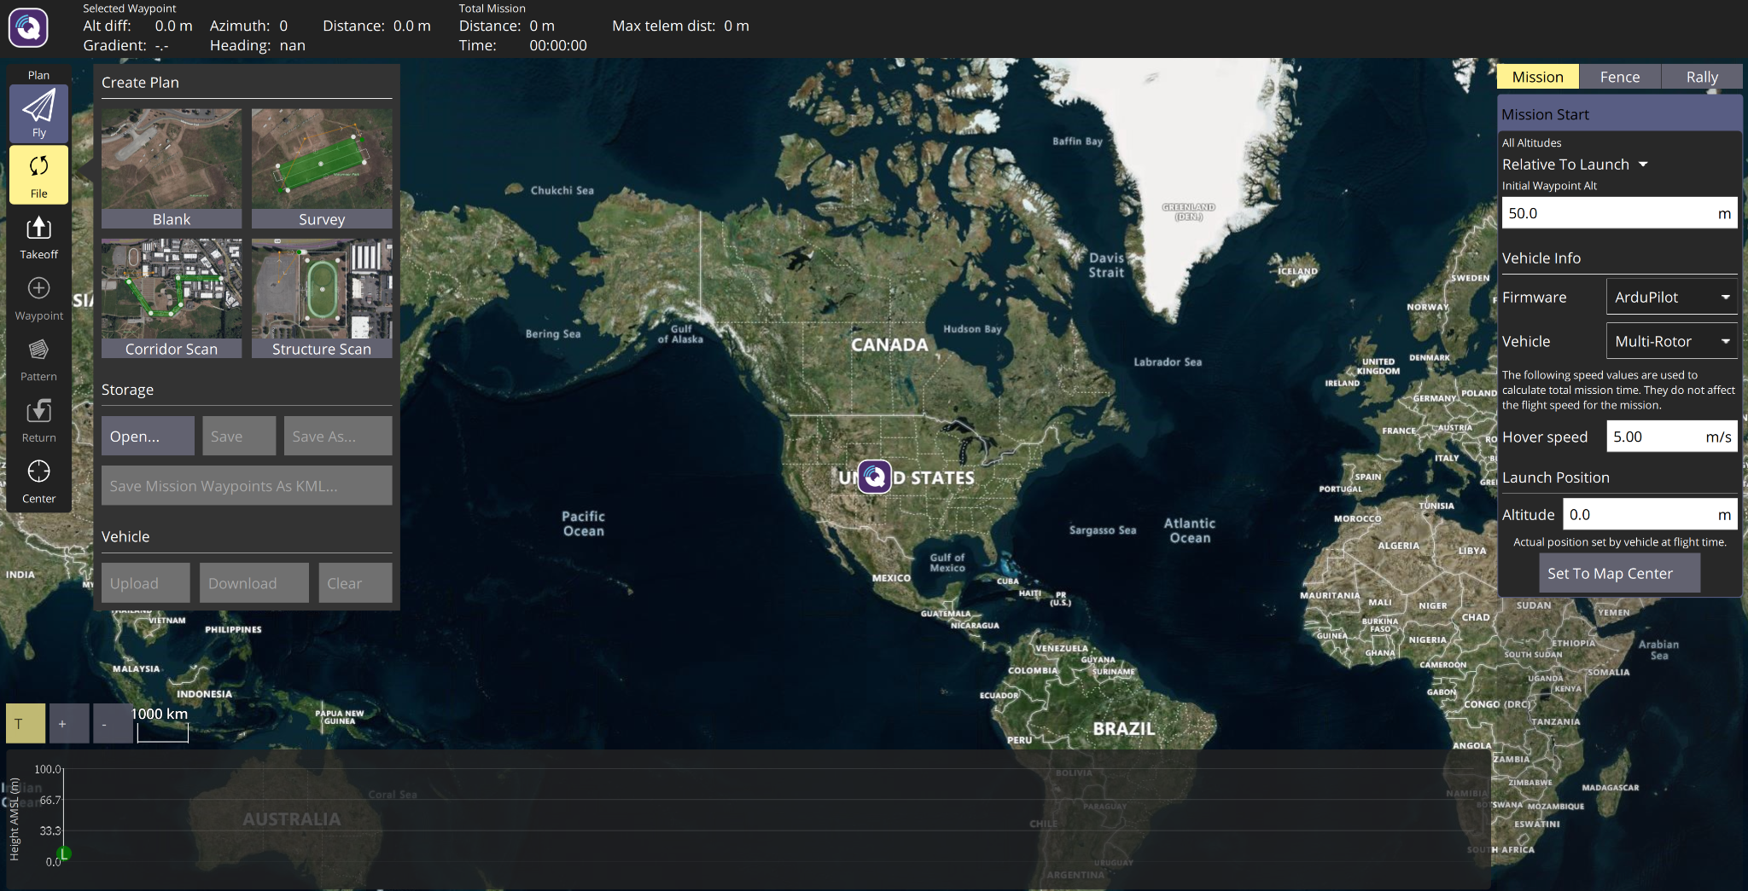
Feasibility Analysis: Mission Planner
QGroundControl
Base QGroundControl is already ready for vehicle configuration and mission planning on team’s machines
QGroundControl’s GUI needs to accept XYZT waypoints
QGroundControl’s source code must pass XYZT waypoints to the simulator and autopilot
Source code has been built on team’s machines
Interface modification will occur in the MissonCommandTree class
Project Overview
Project Overview
Baseline
Design
Baseline
Design
Feasibility Analysis
Feasibility Analysis
Status and Summary
Status and Summary
Future Work
Future Work
Notes:
To help prove we can use the software easily - The base QGC is already installed ready for use on team’s machines both windows and Macs
Reason for modification is that currently QGroundControl only supports position waypoints and flight paths. We need to add the time component
To determine the feasibility of modifying QGC, the source code has already been built which lets us know how we can make edits to the source code
Identified a location of modification. The MissionCommandTree class creates the user interface, its properties and methods will need to be changed to accept time waypoints
Modifications deemed feasible since we know how to make changes to the code and where the main modifications must occur
Notes:
COMPATIBLE WITH OTHER SOFTWARE
In the future: find other projects that have interfaced QGC with ardu? For proof of compatibility with ardupilot
Source code is open source and modifiable
Detailed documentation available to help the team
Proof of built code: TODO
Uses Qt QML to enhance UI features - will this make it more complicated to modify? TODO
Uses QML layout features to reflow a set of QML UI code to fit different form factors (screen sizes)
This means that coding a new feature takes less time (HUGE) since the UI coding only needs to be done once, and the layout reflow is easy to use once you get used to it
TODO ASAP: identify files/parts of the source code to modify. Will help prove feasibility of modification
Global QGroundControl object
Mission Controller (C++) provides the view with the mission item data and methods
The UI for editing a specific mission item command is dynamically created from a hierarchy of json metadata that is called the Mission Command Tree. This tree is the MissionCommandTree class
Delete the 2nd and 3rd bullets???

Slide 54
Feasibility Analysis: Mission Planner
Name | Statement | CPEs | FRs | Feasible
Mission Planner | Mission planner software is modifiable to accept XYZT coordinates from the user and pass the waypoints to the control algorithm, and the code can be compiled by the team and used on various platforms. | E1 | FR4 | Yes
Project Overview
Project Overview
Baseline
Design
Baseline
Design
Feasibility Analysis
Feasibility Analysis
Status and Summary
Status and Summary
Future Work
Future Work
Notes:
State the feasibility statement

Slide 55
Status and Summary

Slide 56
Feasibility Analysis Summary
Name | Statement | CPEs | FRs | Feasible
UAS Hex-Copter | The chosen UAS kit is capable of sustaining a 20 min hover time while holding a position within 0.5 m in XYZ directions and carrying an operational payload. | E3, E6 | FR6 | Yes
Ground Truth System PPK GPS Module | The GTS is capable of determining vehicle location to within 10cm post mission and evaluating the performance of the control algorithm. | E5 | FR7 | Yes
Autopilot Hardware PixHawk 4 | The autopilot hardware is capable of controlling the chosen vehicle and interfacing with chosen software packages. | E6 | FR6 | Yes
Autopilot Software ArduPilot | The autopilot hardware is capable of controlling the chosen vehicle and interfacing with chosen software packages. | E1, E2 | FR1, FR2 | Yes
Simulation Gazebo | Simulation software can generate aircraft dynamics for chosen airframe, reveal mission feasibility, test control algorithm development, and be compiled by the team. | E4 | FR5 | Yes
Mission Planner QGroundControl | Feasibility Statement: Mission planner software is modifiable to accept XYZT coordinates from the user and pass the waypoints to the control algorithm, and the code can be compiled by the team and used on various platforms. | E1 | FR4 | Yes
Project Overview
Project Overview
Baseline
Design
Baseline
Design
Feasibility Analysis
Feasibility Analysis
Status and Summary
Status and Summary
Future Work
Future Work
Notes:
After conducting feasibility analyses, all aspects of our baseline design including…. are feasible to meet our requirements within resources and time constraints in this course

Slide 57
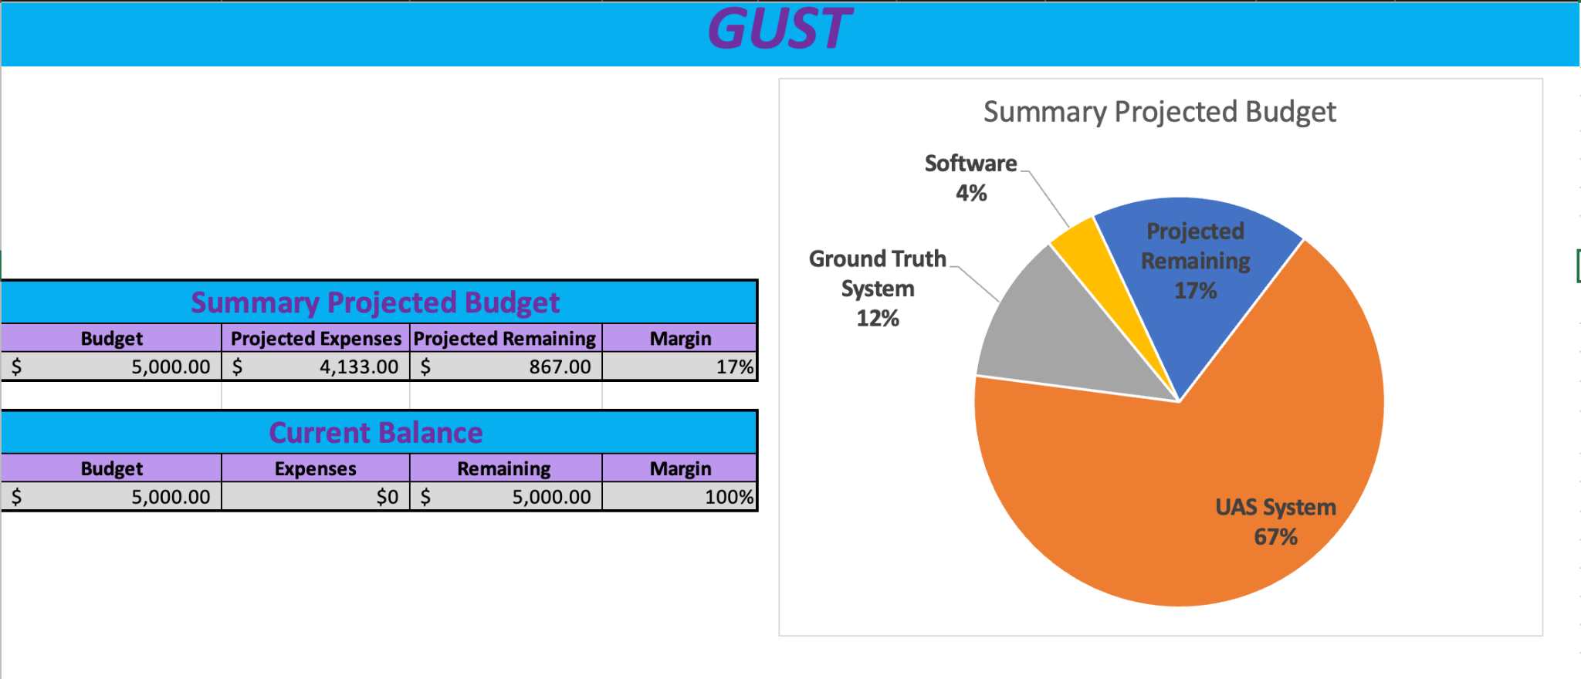
Budget Overview
Project Overview
Project Overview
Baseline
Design
Baseline
Design
Feasibility Analysis
Feasibility Analysis
Status and Summary
Status and Summary
Future Work
Future Work
Notes:
Here is a high level overview of our budget breakdown for our project
It is split up into our three primary systems UAS, Ground Truth, and Software
The majority of our budget is spent in the UAS hardware, which includes excess margin for spare UAS parts in the case of a failure or certain components
Ground truth will include the GPS sensor the team decided on and the software is potential expenses that are planned for but may be unnecessary
Even with an overestimation of cost in each system the team is still left with over 800 dollars left as a cushion in the case of unforeseen expenses

Slide 58
Future Work

Slide 59
Future Work
Hardware
  Refine flight time model further
  Perform sensitivity analysis on flight time model parameters
  Look at vehicle max performance figures as they relate to LEO emulation trajectories and power use.
  Final airframe downselection
  Final parts selection
Project
Overview
Baseline
Design
Feasibility Analysis
Status and Summary
Future Work
Notes:
Hardware
Refine flight time model further, specifically around individual component efficiencies.
Perform sensitivity analysis on flight time model parameters.
Look at vehicle max performance figures as they relate to LEO emulation trajectories and power use.
Final airframe downselection
Final parts selection

Slide 60
Future Work
Autopilot
  Further research into time optimal guidance algorithms, control laws, and integration with position and attitude controls
  Investigate lower level functions of the ardupilot repository and how these functions interweave with the output control algorithm
Mission Planner
  Modify the user interface and output flowdown, then test modifications for successful mission configuration and upload
Simulation
  Conduct further simulations with more advanced flight modes to export and analyze data
  Test new iterations of developed XYZT control law
Project
Overview
Baseline
Design
Feasibility Analysis
Status and Summary
Future Work

Slide 61
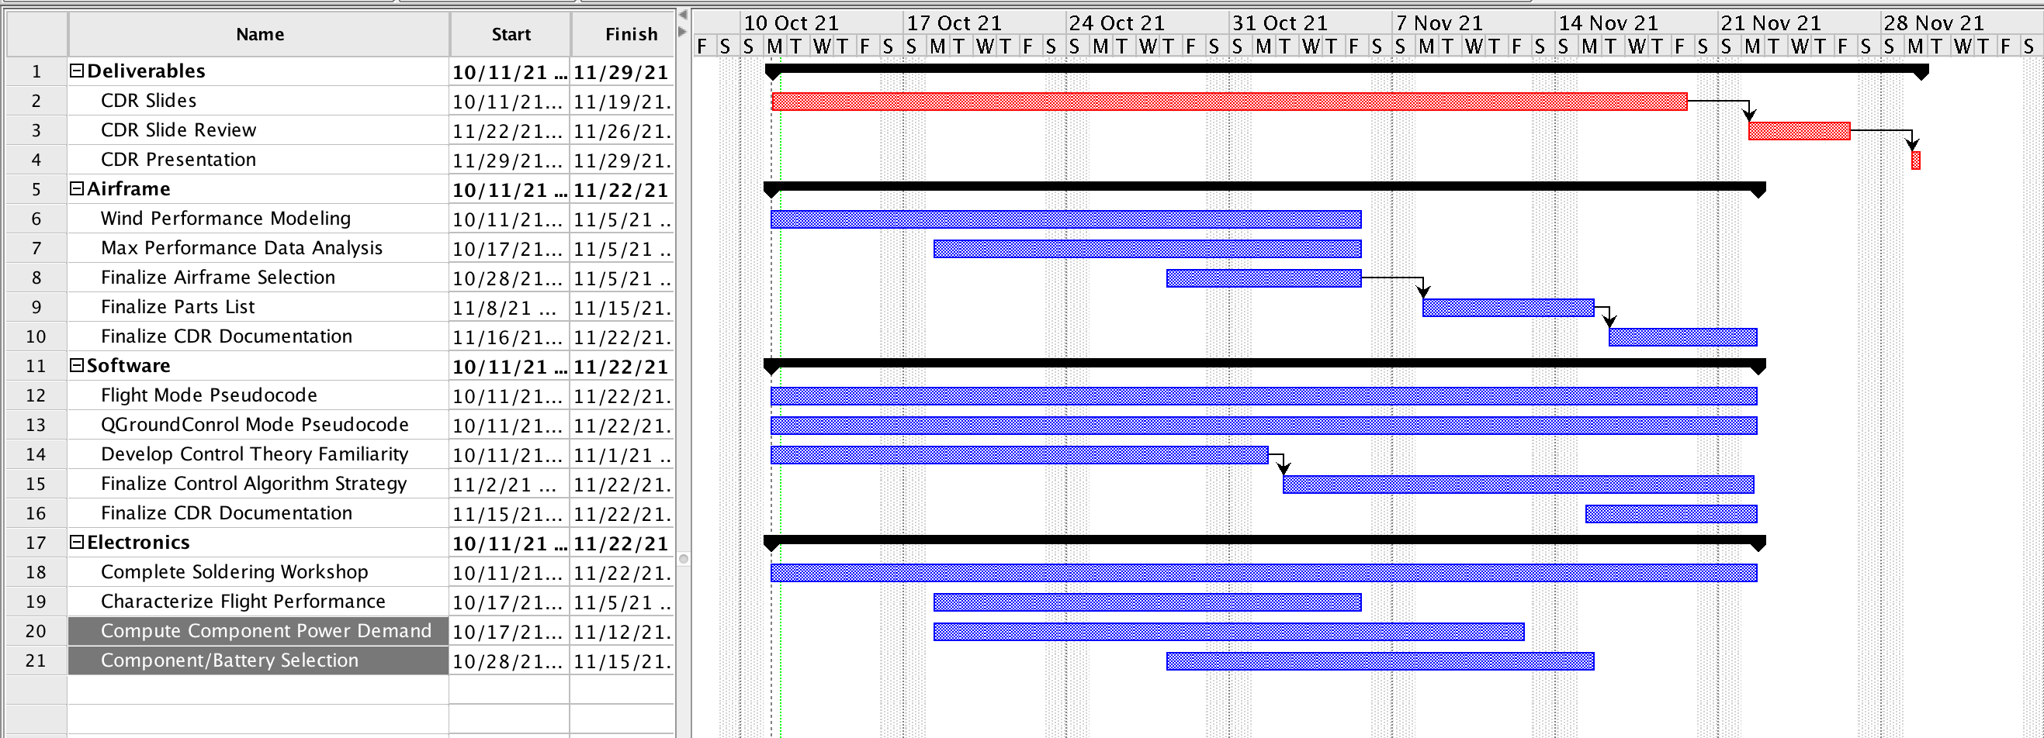
GANTT
Project
Overview
Baseline
Design
Feasibility Analysis
Status and Summary
Future Work

Slide 62
Thank you!

Slide 63
Supporting Materials

Slide 64
Supporting Materials Quick Links
Administrative
Trade Studies
Hardware
Controls
Software

Slide 65
Administrative
Return to Supporting Materials Quick Links

Slide 66
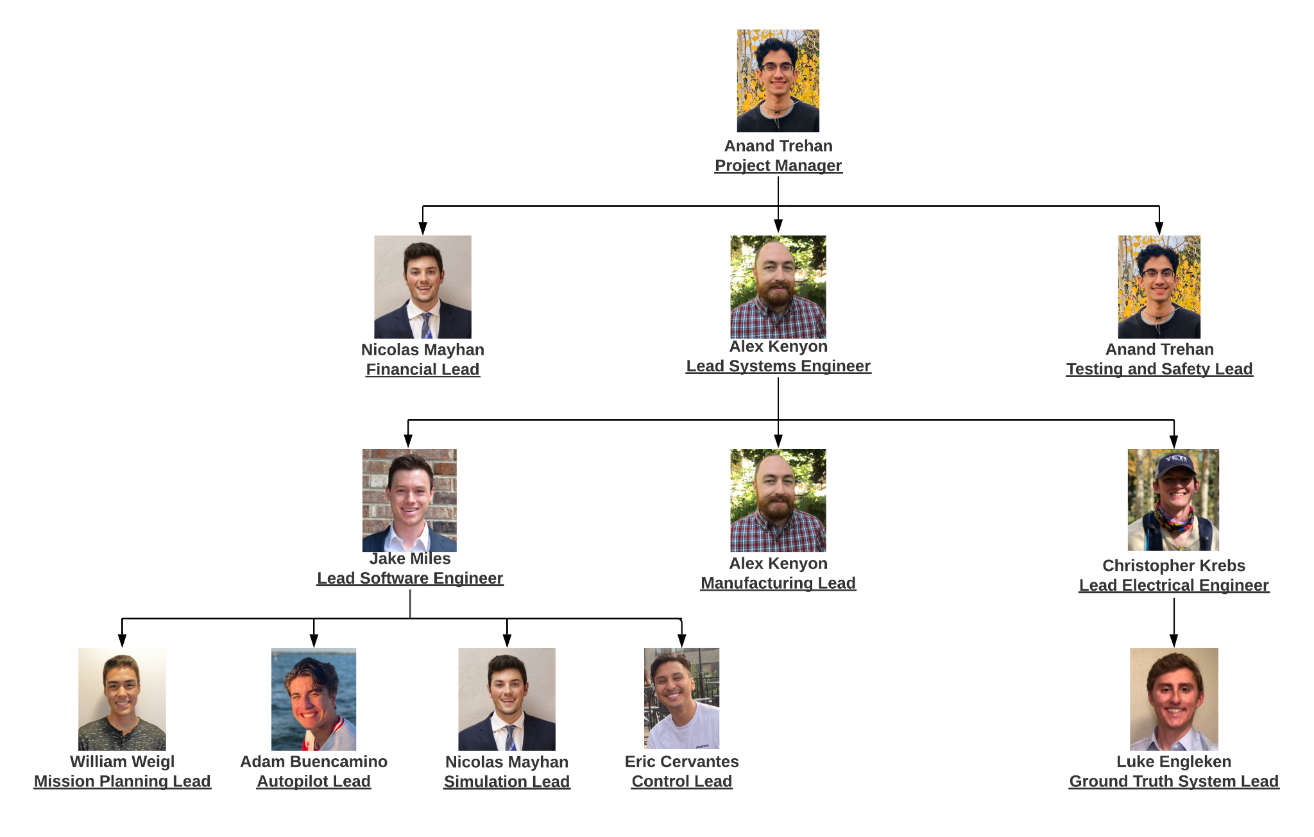
Organization Chart

Slide 67
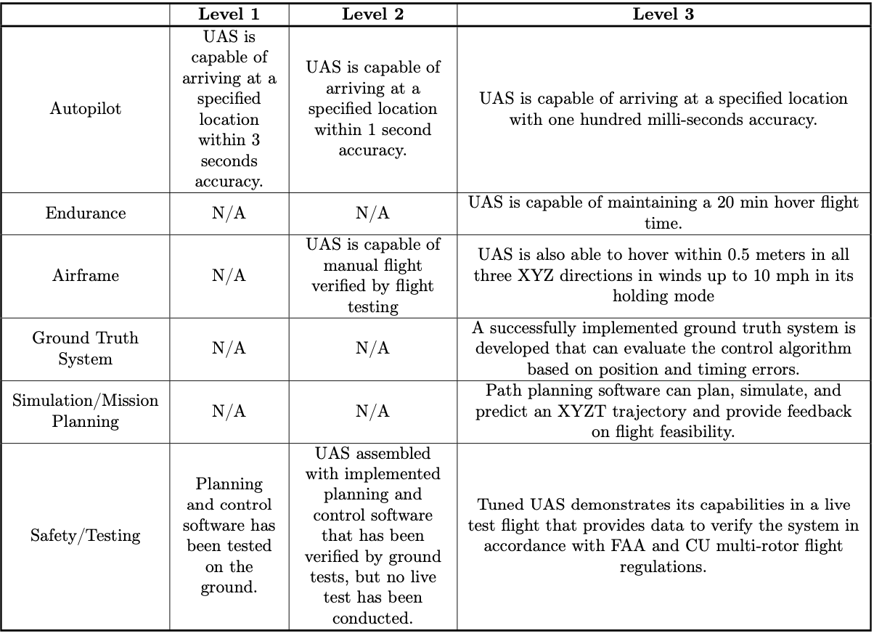
Specific Objectives

Slide 68
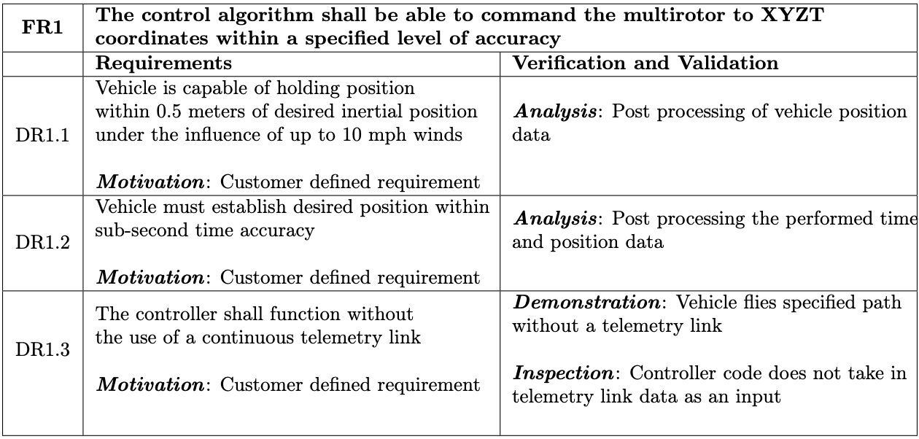
Design Requirements: FR 1

Slide 69
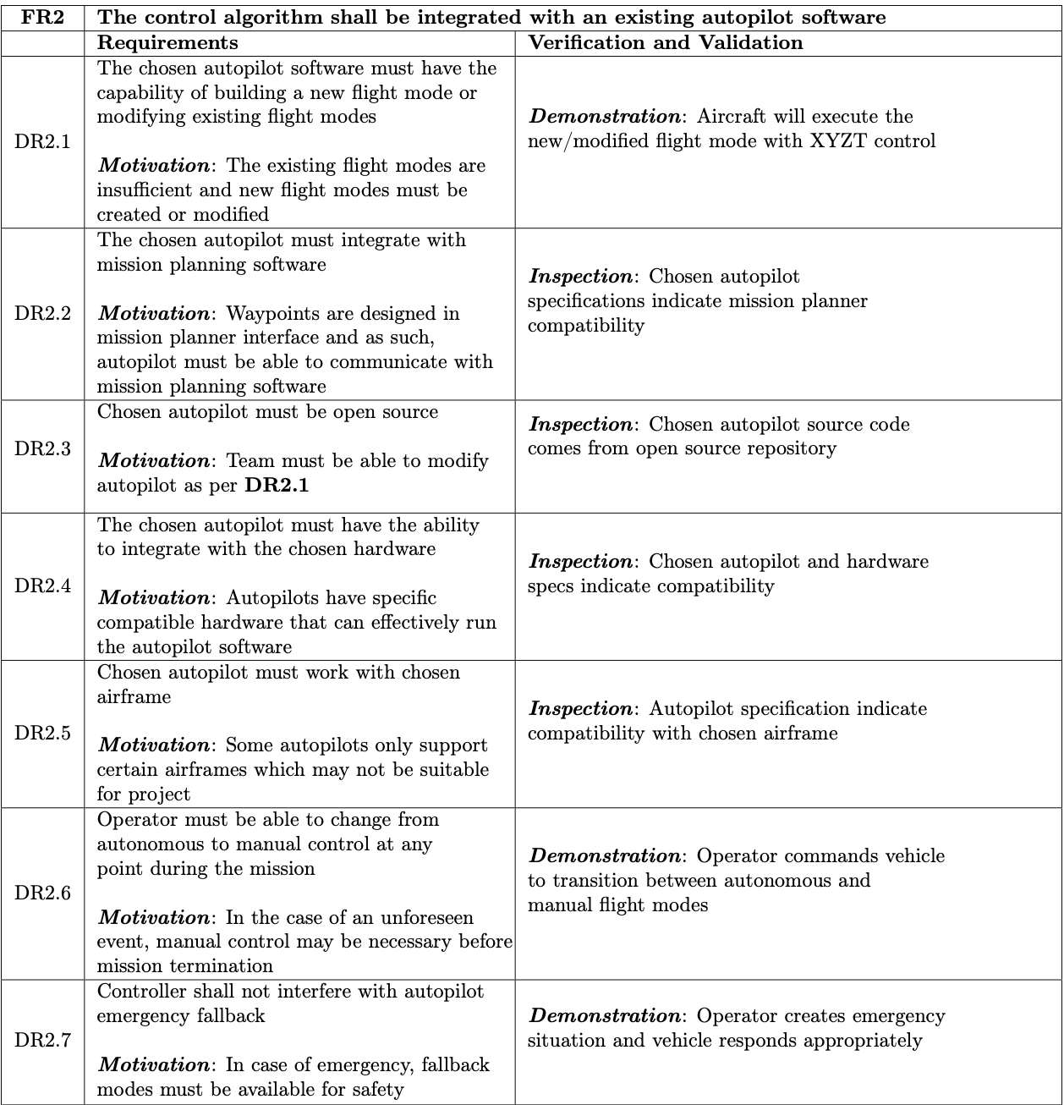
Design Requirements: FR 2

Slide 70
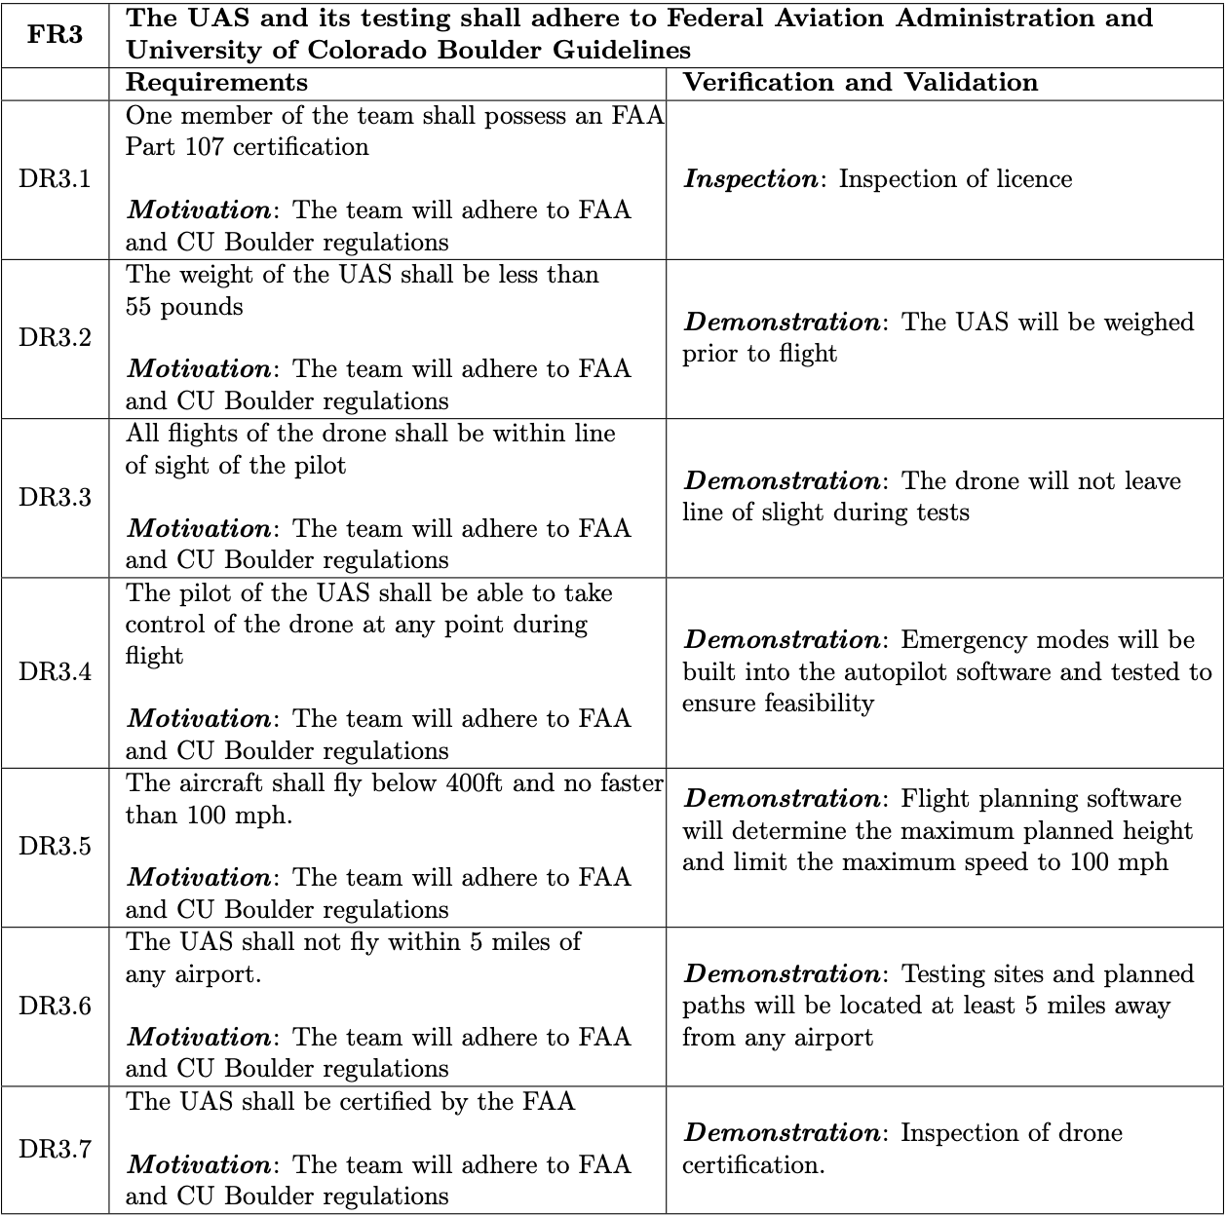
Design Requirements: FR 3

Slide 71
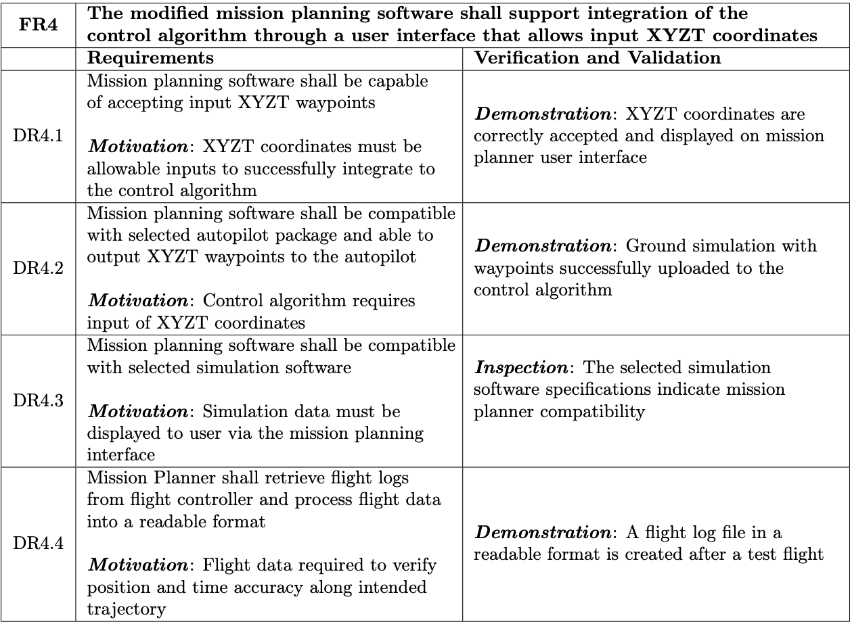
Design Requirements: FR 4

Slide 72
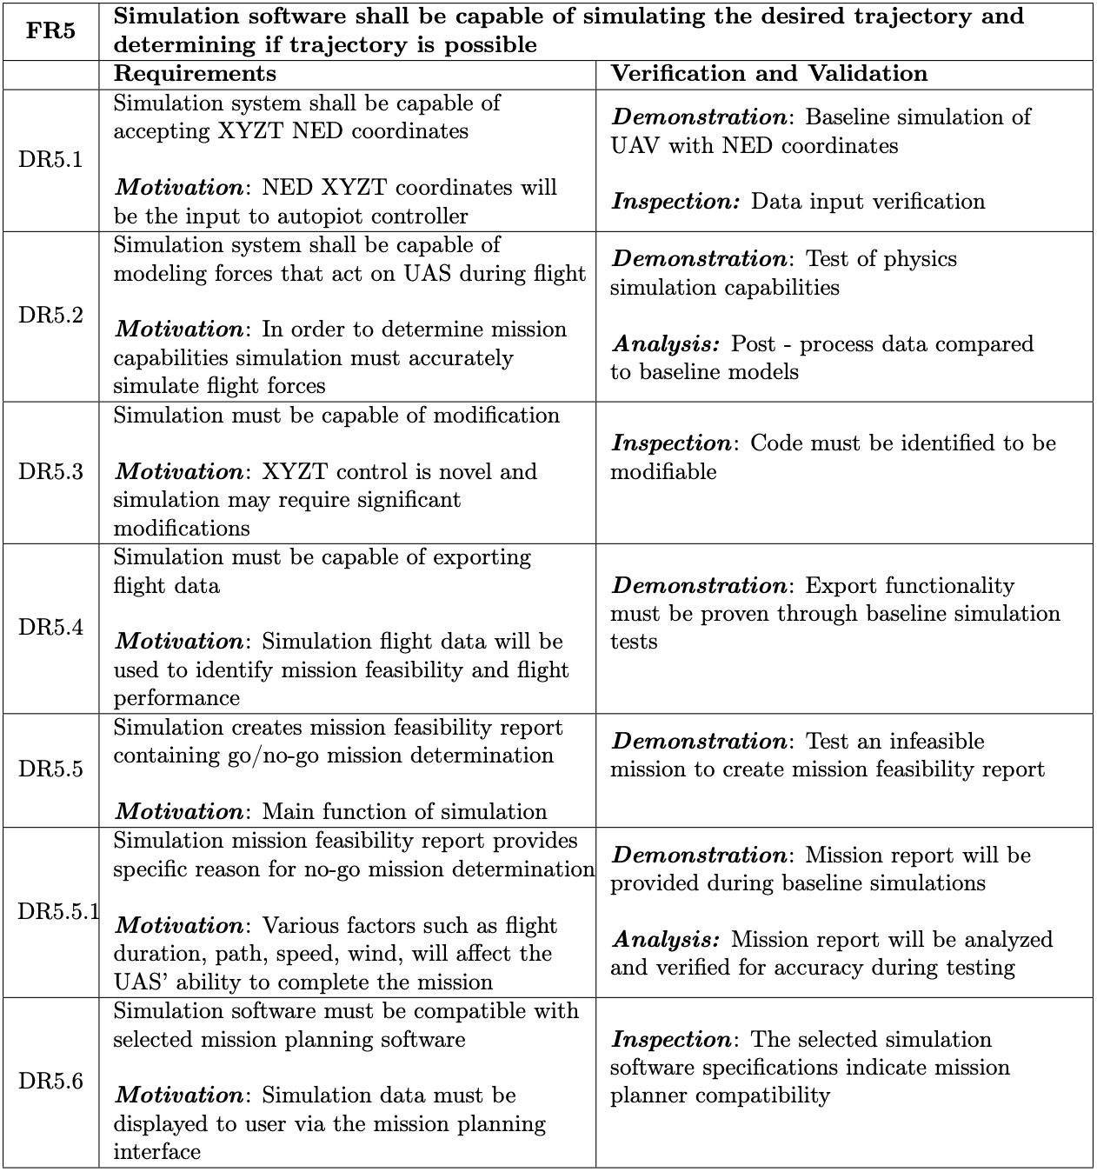
Design Requirements: FR 5

Slide 73
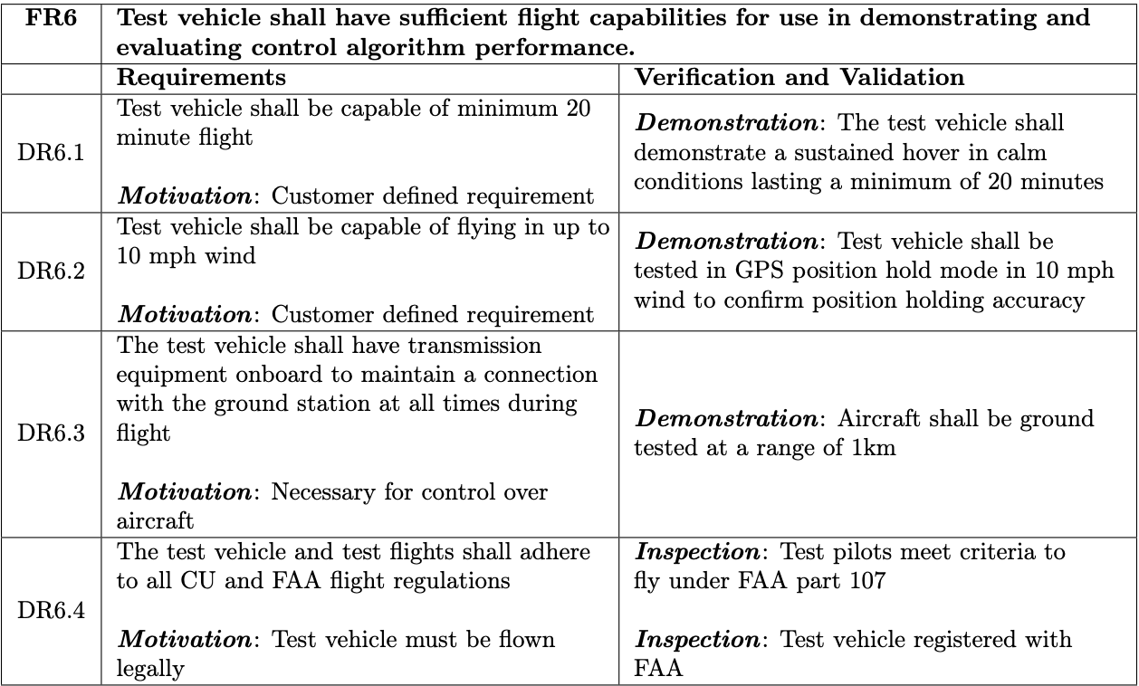
Design Requirements: FR 6

Slide 74
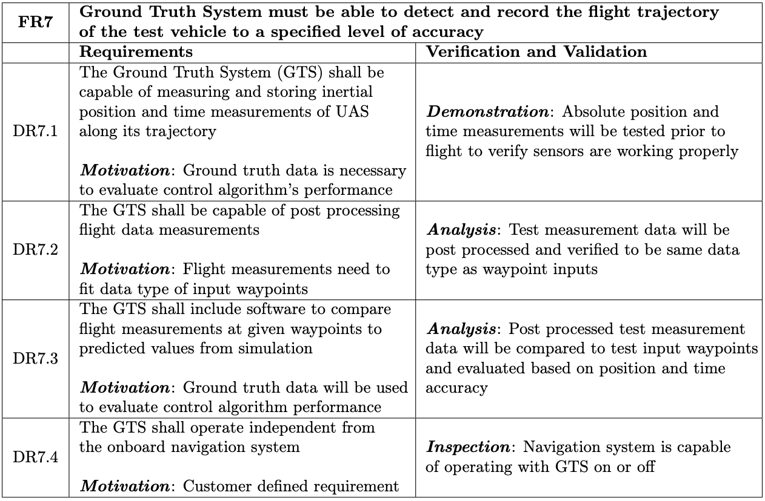
Design Requirements: FR 7

Slide 75
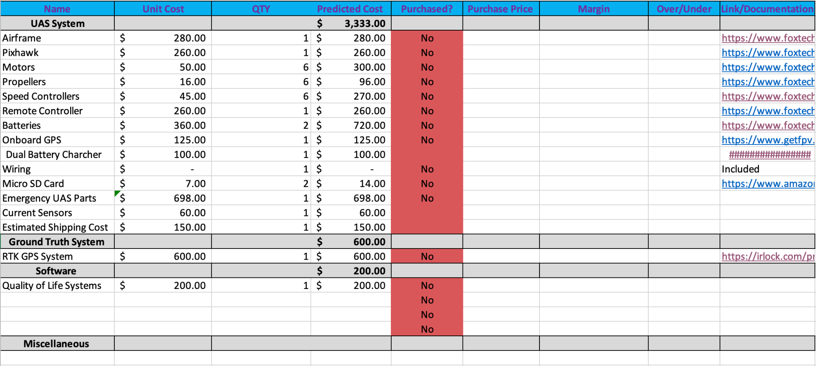
Budget Detailed Breakdown

Slide 76
Trade Studies
Return to Supporting Materials Quick Links

Slide 77
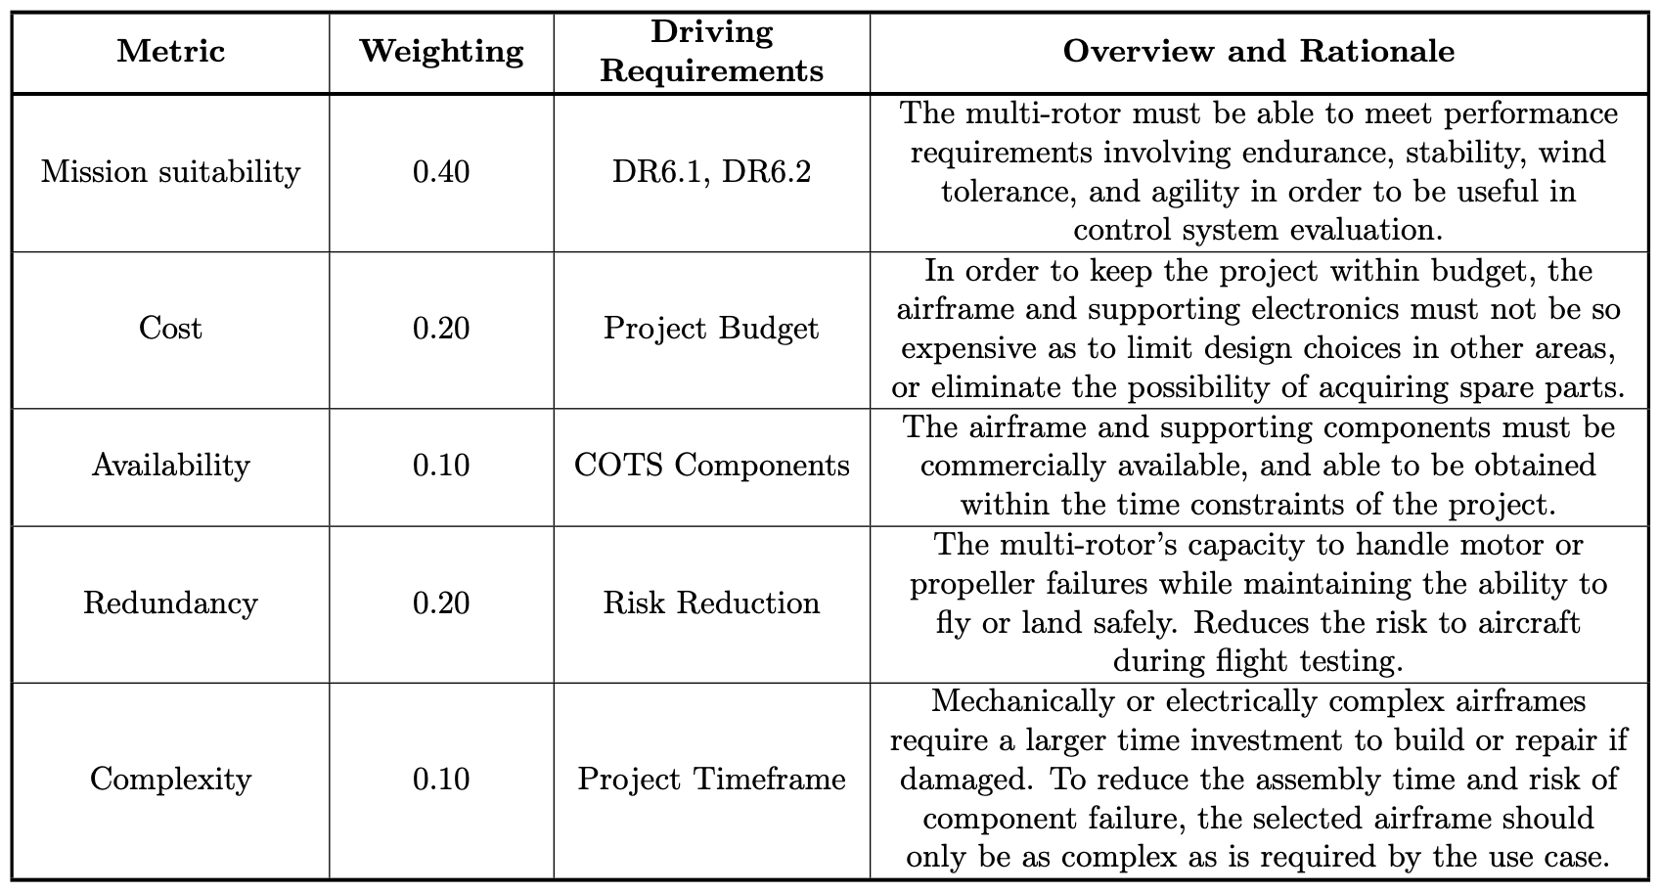
Trade Study: UAS
Notes:
Metric table for UAS trade study

Slide 78
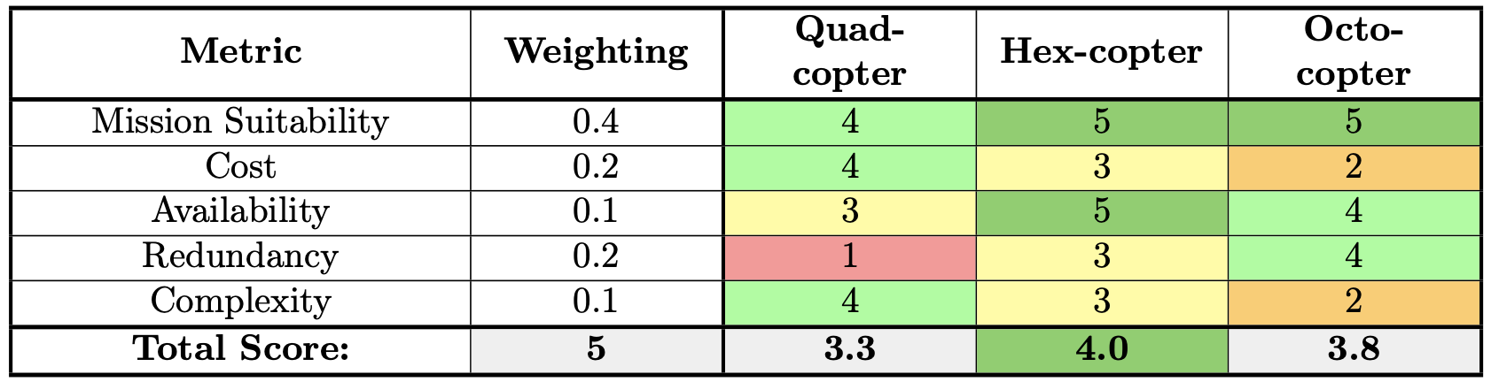
Trade Study: UAS
Notes:
Trade matrix for UAS Trade Study

Slide 79
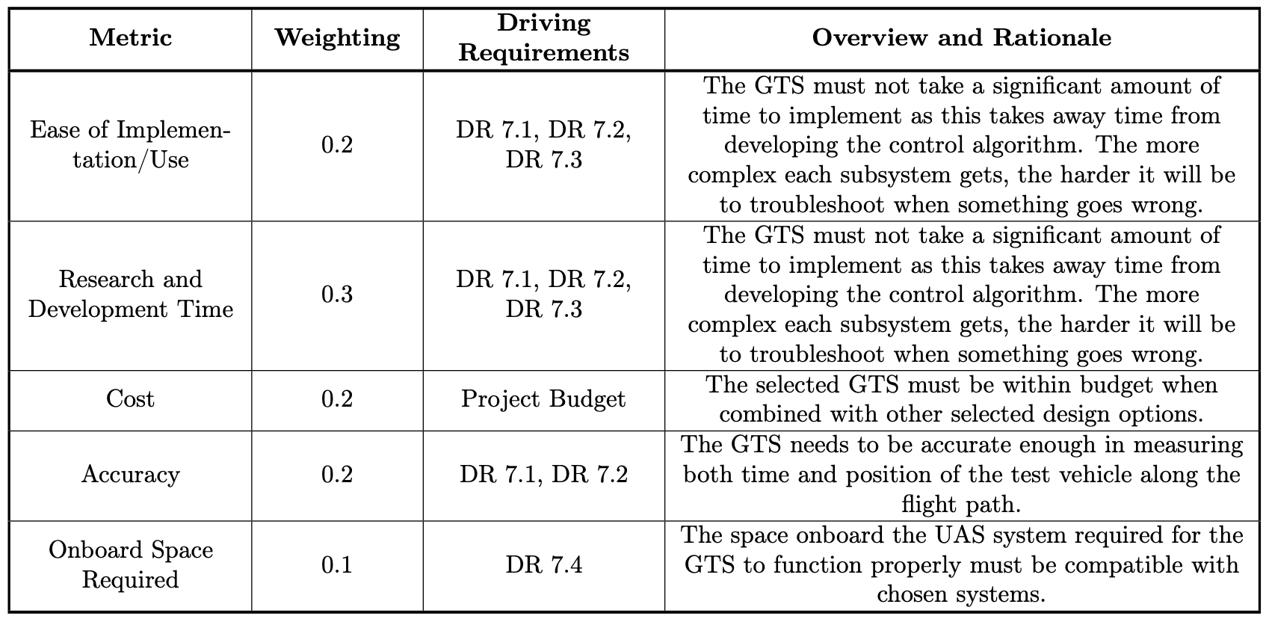
Trade Study: Ground Truth System
Notes:
Metric table for GTS trade study

Slide 80
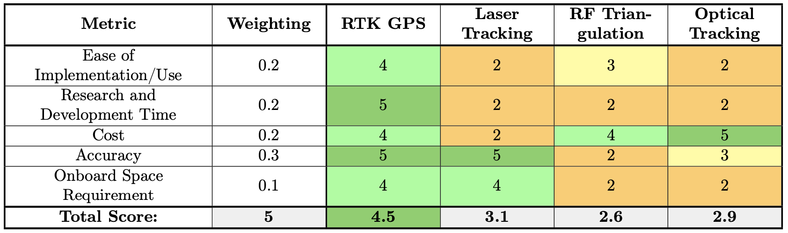
Trade Study: Ground Truth System
Notes:
Trade matrix for GTS Trade Study

Slide 81

Trade Study: Autopilot Software
Notes:
Metric table for Autopilot Software trade study

Slide 82

Trade Study: Autopilot Software
Notes:
Trade matrix for Autopilot Software Trade Study

Slide 83

Trade Study: Simulation
Notes:
Metric table for Simulation trade study

Slide 84

Trade Study: Simulation
Notes:
Trade matrix for Simulation Trade Study

Slide 85

Trade Study: Mission Planner
Notes:
Metric table for Mission Planner trade study

Slide 86

Trade Study: Mission Planner
Notes:
Trade matrix for Mission Planner Trade Study

Slide 87
Hardware
Return to Supporting Materials Quick Links

Slide 88


PixHawk Flight Controller
Notes:
PixHawk 4 Technical, Electrical, and Mechanical Specifications

Slide 89


PixHawk Flight Controller
Notes:
PixHawk 4 Input/Output interfaces

Slide 90

PixHawk GPS Module
Notes:
Onboard ublox M8N GPS receiver
2.5 m accuracy

Slide 91
Feasibility Analysis: UAS
UAS Kit Options Overview
Tarot X6 | Tarot X4 | Tarot 680 Pro | LJI ZD700 Pro
Imbedded power distribution system Largest airframe Most stable | Quadrotor Lower cost with less components Imbedded power distribution system | Smallest frame, lower weight Higher flight time due to lower thrust requirement | Lower cost Smaller frame, lower weight Stable takeoff and landing platform Higher build time
Notes:
Chris

Slide 92
Feasibility Analysis: UAS Cont.
Flight-time Feasibility Assumptions
Steady Hover
  Total motor lift = vehicle weight
Clean Air
  Vehicle is out of ground effect
Stationary w/ no wind
  No control forces or moments that would affect power consumption
Symmetrical power units
  All motor, ESC, prop assemblies have identical power consumption.
Colorado Air Density
  ρ = 1.0476 kg/m^3
Reasonable values for powertrain efficiency
Battery is capable of providing a nominal voltage for the majority of its rated capacity
Notes:
Chris
Assumptions:
Steady Hover → Total motor lift = vehicle weight
Clean Air → Vehicle is out of ground effect
Stationary w/ no wind → no control forces or moments that would affect power consumption
Symmetrical power units → All motor, ESC, prop assemblies have identical power consumption.
Colorado Air Density → ρ = 1.0476 kg/m^3
Reasonable values for powertrain efficiency
Ideal battery (20% reserve) → simplifies battery model and accounts for voltage dropoff

Slide 93




Feasibility Analysis: UAS Cont.
Momentum Theory for Static-Thrust Calculation
1. Apply Conservation of momentum
2. Apply conservation of energy
3. Solve for lift power relation
(Assume V_{Z} = 0 for hover condition)
https://arxiv.org/pdf/1601.00733;Aerodynamics

Slide 94




Feasibility Analysis: UAS Cont.
Momentum Theory for Static-Thrust Calculation Full Derivation
Conservation of Momentum:
Substitute T from (1) into (2), compare to (3):
(1)
(2)
Implies:
Kinetic power imparted into the air across the streamtube:
Mass flow rate defined:
(4)
(3)
(5)
Use (4) and (5) with assumption of zero z-Velocity (hover):
Notes:
(similar to how EMU did it on slide 19, but stopping at third Eq.)

Slide 95

Feasibility Analysis: UAS Cont.
Battery model
For lithium-Polymer, most voltage drop-off occurs at in last 10-20% of battery pack.
Treat battery as providing a nominal voltage for first 80-90% of pack.
Under hovering power conditions, 13Ah battery is under 3-6C discharge. Voltage drop under load is expected to be reasonably low for packs rate 20C or above.
Battery data as used in calculations:
Chemistry = Lithium Polymer (LiPo)
Nominal pack voltage = 22.2 Volts (6S)
Power Density = 7 mAh/gram (low estimate)
Figure; Example of typical LiPo discharge curve (1S)
Notes:
this method is commonly used for “back of napkin” calculations and should be enough to prove feasibility. -Ak

Slide 96
Feasibility Analysis: UAS Cont.
Flight Time Calculation Steps
Tarot X6:
Max flight time: 31.2 min
Minimum Capacity: 12.96Ah
Obtain battery mass using given capacity
Include battery mass in total vehicle mass budget
Combine mass budget, Momentum theory, and efficiency values to calculate estimated power consumption (see slides 23-26)
Divide by battery nominal voltage to get current draw and add 500mAh for avionics (see slide 102)
Flight time = (capacity[Ah]/Current[A])
Model:
Predicted a required 7 g/W total efficiency at hover
Manufacturers data:
Predicted 10g/W efficiency for same configuration at hover.
Notes:
Multiply by capacity to get battery mass
Add battery mass to Vehicle mass w/o battery
Combine mass budget, Momentum theory, efficiency values to get estimated power consumption.
Divide by battery nominal voltage to get current draw + add 500mAh for avionics.
Flight time = (capacity[Ah]/Current[A])*60

Slide 97
UAS Mechanical Systems
X6 Mass Budget
Part | Count | Mass (each) | Mass (per line)
Tarot X6 Airframe | 1 | 2000g | 2000g
5008/340Kv Brushless motor | 6 | 168g | 1008g
TMotor 40A ESC | 6 | 26g | 156g
18’ x 5.5” CF Propeller | 6 | 31g | 186g
Pixhawk Autopilot & avionics | 1 | 100g | 100g
Wiring | 1 | 500g | 500g
+10% margin | 1 | 395g | 395g
Total | - | - | 4345g (Before battery)

Slide 98
UAS Mechanical Systems

Slide 99
UAS Mechanical Systems
X4 Mass Budget
Part | Count | Mass (each) | Mass (per line)
Tarot X4 Airframe | 1 | 1600g | 1600g
6115/320Kv Motor | 4 | 312g | 1248g
TMotor 60A ESC | 4 | 60g | 240g
22” x 5.5” CF Prop | 4 | 62g | 248g
Pixhawk Autopilot & avionics | 1 | 100g | 100g
Wiring | 1 | 300g | 300g
+10% margin | 1 | 375g | 375g
Total | - | - | 4110g (Before battery)

Slide 100

UAS Mechanical Systems

Slide 101
UAS Mechanical Systems
Tarot 680 PRO Mass Budget
Part | Count | Mass (each) | Mass (per line)
Tarot 680 PRO Airframe | 1 | 810g | 810g
4108/380Kv Brushless motor | 6 | 93g | 558g
TMotor 40A ESC | 6 | 26g | 156g
Tarot 1355 CF Propeller | 6 | 14g | 84g
Pixhawk Autopilot & avionics | 1 | 100g | 100g
Wiring | 1 | 500g | 500g
+10% margin | 1 | 223g | 221g
Total | - | - | 2429g (Before battery)
Notes:
6S combo to stay consistent with Tarot X6 options
Website noted Hobbywing XRotor 40A-OPTO for ESC recommendation, kept 40A TMotor option in instead (same mass anyways)
Add power distribution board? Or just assume we would manually sol

Slide 102

UAS Mechanical Systems

Slide 103
UAS Mechanical Systems
LJI ZD700 Pro Hexacopter
Part | Count | Mass (each) | Mass (per line)
LJI ZD700 Pro Airframe | 1 | 1060g | 1060g
4010/380Kv Brushless motor | 6 | 82.5g | 495g
Arris 30A ESC | 6 | 25g | 150g
Tarot 1355 CF Propeller | 6 | 14g | 84g
Pixhawk Autopilot & avionics | 1 | 100g | 100g
Wiring | 1 | 500g | 500g
+10% margin | 1 | 223g | 223g
Total | - | - | 2612g (Before battery)

Slide 104

UAS Mechanical Systems

Slide 105

Feasibility Analysis: UAS Cont.
Airframe Power System Feasibility (Tarot X6)
Hovering Power Consumption
Pixhawk/Avionics; 2.5W
Power Assemblies; 845W - 2,280W
(Battery configuration dependant)
Full-throttle Power consumption
Pixhawk/Avionics; 2.5W
Power Assemblies; 2837W
(Motor maximum output)
Battery Power Capabilities
12,960mAh capacity can provide 7192 W
(minimum capacity 6S LiPo at 25C discharge rate)
Minimum capacity battery is capable of meeting the X6 airframes total power requirements during both hover and full throttle conditions.
Vehicle power consumption is feasible for chosen battery chemistry and capacity.
Notes:
Move to main presentation if time permits?

Slide 106
Feasibility Analysis: UAS Cont.
Empirical Total Efficiency Calculation
Tarot 5008/340 KV Brushless Motor (recommended for use on the Tarot X6)
https://www.foxtechfpv.com/5008340kv-brushless-motorblack-p-1149.html
The following steps were followed to obtain an estimation of the total efficiency of the power system used on the Tarot X6. These follow a static test performed by the manufacturer to determine a variety of parameters.
For a given amount of thrust, compute the ideal P_{thrust} required using momentum theory.
Using the manufacturer’s power data, compute the total power (P_{total} = V*I) drawn from the battery when power system is producing the desired amount of thrust.
Compute the total efficiency from the motor configuration. 𝞰_{total}=P_{thrust}/P_{total}
  Note, this test includes the use of a speed controller (ESC) and propeller.
Notes:
Given both the battery used during the manufacturer’s test and measured current draw, compute the total power (P_{total} = V*I) drawn from the battery at 40% throttle (hover).

Slide 107

Feasibility Analysis: UAS Cont.
Empirical Total Efficiency Calculation
Tarot 5008/340 KV Brushless Motor Manufacturer Test Results
For a reference thrust of 1.0kg:
  P_{thrust}= 48.4 W
1.0kg thrust produced at 35% throttle:
  P_{total}= 87.5 W
𝞰_{total} = 0.55
https://www.foxtechfpv.com/5008340kv-brushless-motorblack-p-1149.html
Notes:
18” diameter propellor used, 168g weight of motor configuration (see Foxtech website)
P_{thrust}=73.91 W
At 40% throttle:
1.3 kg of thrust produced
P_{total}=135 W
𝞰_{total} = 0.52

Slide 108
Feasibility Analysis: Ground Truth System GPS Modules
GPS Module | Position Accuracy (with PPK) | Data Output Rate | Onboard Volume | Cost (rover only)
Here3 | +/-0.025m | Max 8Hz | 7.6cm x 7.6cm x 1.7cm | $125
CUAV C-RTK 9P | +/-0.01m | Max 20Hz | 3.15cm x 4.8cm x 1.2cm | $600
Holybro H-RTK F9P | +/-0.01m | Max 8Hz | 7.6cm x 7.6 cm x 2.0cm | $400
Notes:
Move to main presentation if time permits?

Slide 109
Controls
Return to Supporting Materials Quick Links

Slide 110

Ardupilot General FBD
Notes:
First block is entering the ArduCopter(multi-rotor) directory
Second block sets the mode and update the flight modes to its most recent state
Third block instantiates the stabilization(hover) mode as the initial mode. This is the default mode
Fourth block is the bulk of the control algorithm code. Estimates attitude with the onboard sensors and calculates error between the desired attitude and current error. Takes error and sends a motor request to fix the error. The next slide has a lower level FBD of this block
Fifth block changes the motor request into individual motor inputs
Sixth and Seventh block pushes the outputs to the onboard electronic speed controller

Slide 111

Ardupilot Attitude Control FBD
Notes:
Angle —> Rate: Takes in the desired attitude parameters and converts to a quaternion and angular velocity using the functions stated in the box
Rate —> Motor: Up until this point the control has been independent of vehicle type and now using the overlying AC_PID library, higher level motor commands and sets general motor commands to be put into the specific motor matrix for the desired vehicle. In our case a hexacopter.

Slide 112

Modifying Control Law Feasibility
Native SITL Simulation of Default Control Algorithm
Takes off to 50 m
Travels to specified waypoint
Travels back to takeoff position
Lands at original position
Gain | Value
Pos P | 1.0
Vel P | 2.0
Vel I | 1.0
Vel D | 0.5
Notes:
Pos P: The horizontal proportional position gain
Vel P: The horizontal proportional velocity gain
Vel I: The horizontal integral velocity gain
Vel D: The horizontal derivative velocity gain
This test used the defaults gain values and the mission arrived at the waypoint and returned very effectively with minimal visual error.

Slide 113

Modifying Control Law Feasibility
Native SITL Simulation of Control Algorithm without velocity control and exaggerated position proportional control
Same exact mission planned from the previous slide
Gain | Value
Pos P | 2.0 (Max)
Vel P | 0.1 (Min)
Vel I | 0.02 (Min)
Vel D | 0.0 (Min)
Notes:
Pos P: The horizontal proportional position gain
Vel P: The horizontal proportional velocity gain
Vel I: The horizontal integral velocity gain
Vel D: The horizontal derivative velocity gain
This test took away all velocity control leaving only proportional control in the XY plane. Visually, this test did not complete the mission as intended as the simulated copter overshot the waypoint and the return to home waypoint by a rather large margin.

Slide 114
Extended Kalman Filter
Theory
IMU angular rates are integrated to calculate the angular position
IMU accelerations are converted to earth NED axes and corrected for gravity
Accelerations are integrated to calculate the velocity
Velocity is integrated to calculate the position
Estimated gyro and accelerometer noise (EKF_GYRO_NOISE and EKF_ACC_NOISE) are used to estimate the growth in error in the angles, velocities and position calculated using IMU data.
Difference between predicted position and GPS position
State correction from using calculations from 5) and 6)
Calculate uncertainty reduction return to step 1

Slide 115
Software
Return to Supporting Materials Quick Links

Slide 116
Gazebo Physics Engine and First Principles
1st Principles Quadrotor Dynamics
Assume Symmetrical Quadrotor
Assume point mass
F = f_grav + f_aero + f_cntrl
m = m_aero + m_cntrl
No lift force
  Lift force is treated as thrust not an aerodynamic force
Drag is the only aerodynamic force
  Drag acts exactly opposite of air-relative velocity
Approximates relative wetted area for drag
Idealizes rotors/mechanical systems
Would require rederivation of equations of motion if rotor configuration would change
Linearlized: Small Disturbance Theory
  Defines variables wrt hover state
  Does not accurately model each variable response to a disturbance
Gazebo UAS Dynamics
Extracts rotor configuration from ardupilot
Forces & moments are modeled directly from rotors and across the UAS
Lift and drag are treated as aerodynamic forces separate from motor forces
Drag is calculated from drone configuration as the UAS moves throughout simulated world
Able to adapt to various configurations/disturbances

Slide 117


Gazebo Physics Engine and First Principles Cont.
1st Principles EOM
Quadrotor Response to Disturbances Example

Slide 118
Gazebo Physics Engine and First Principles Cont.
Gazebo ODE Architecture
Uses a Physics SDK Engine to perform dynamics (rigid-body, flexible-body, fluid, particle) simulation
Simulation of Equations of Motion
  Lagrange Multiplier - state space model which accounts for accounts for all body degrees of freedom and models forces explicitly
  Reduced Coordinate - system of tracking bodies without tracking every variable of the body
  Implements a hybrid system to take advantage of variables Lagrange tracks and the speed with the reduced coordinate system has
Integration of EOM
  Solves the EOM over time using implicit integration
    Acceleration as a function of future forces. Causes numerical dampling = more stable
Constraint Based Modeling
  1st principles uses constraint force modeling - user calculated forces applied to bodies
    Lots of parameters to tune, harder to achieve/model desired effects
  Gazebo uses constraint based modeling - velocity/acceleration constraints for EOM
    More versatile system that more accurately models the behavior of complex systems
Notes:
Physics SDK Presentation overview : http://ode.org/slides/parc/dynamics.pdf

Slide 119
ArduPilot Flight Modes
Basic Flight Modes Advanced Flight Modes
Stabilize
Self leveling roll and pitch axis
Alt Hold
Hold Altitude and self level roll and pitch
Loiter
Hold altitude and position, use GPS for movement
Return to launch
Return to take off location
Auto
Follow predetermined waypoints
Guided
Navigate to single points commanded by GCS
Auto tune
Automated pitch and bank maneuvers to improve control loops
Follow
Follows another vehicle
Land
Reduces altitude to ground level, goes straight down

