Slide 1
S P E C T E R
Test Readiness Review
February 16th, 2022
ASEN-011 Team 9
Presenters
Hanna Galimanis, Noah Avery, Vivien Blumofe, Mary Hanson, Sam Alvis, Andrew Komitor, Gabriel Feldman
Company Customer
L3Harris
Faculty Advisor
Professor John Mah
Additional Team Members
Josef Michelsen, Nick Spens, Zach Harris, Ajay Dhindsa

Slide 2
Table of Contents
Project Overview
Project Updates
Schedule
Test Readiness
Budget

Slide 3
Project Overview
Project Overview
Project Updates
Schedule
Test Readiness
Budget

Slide 4
Purpose & Mission Statement
Purpose: collect data on satellites in GEO and determine if a significant event has occurred or is imminent
Maneuvers
Close encounters between two or more satellites (including docking and collisions)
Breakups
The Satellite Position Estimation Collision Tracking & Event Recognition (SPECTER) mission will monitor satellite movements in geostationary orbit to provide space domain awareness.
Project Overview
Project Updates
Schedule
Test Readiness
Budget

Slide 5
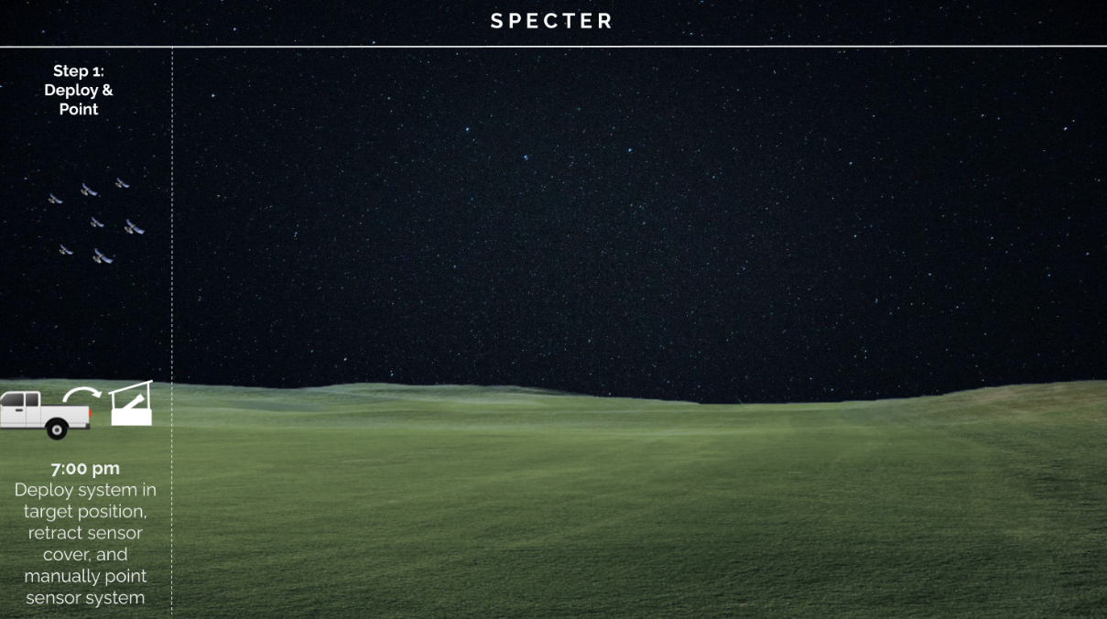
Concept of Operations
Project Overview
Project Updates
Schedule
Test Readiness
Budget

Slide 6
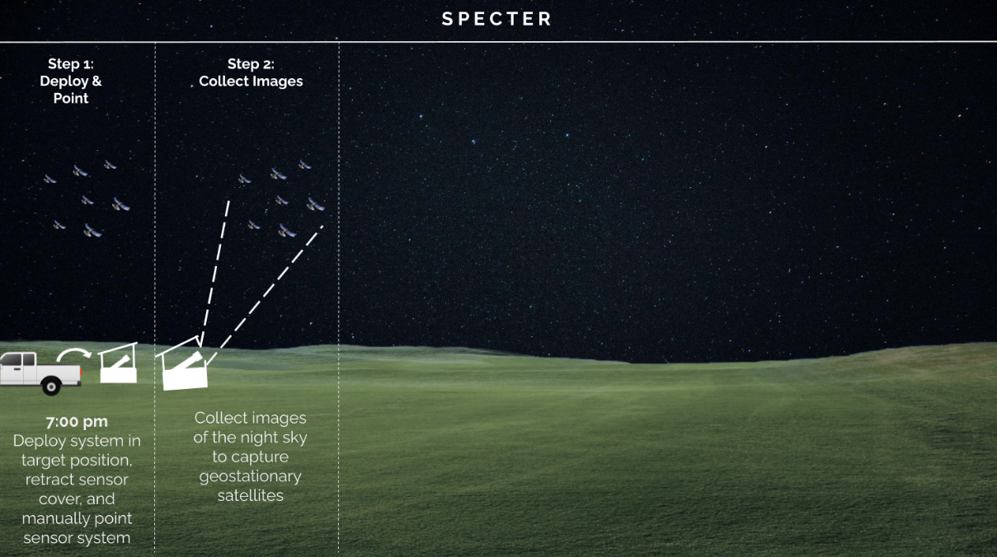
Concept of Operations
Project Overview
Project Updates
Schedule
Test Readiness
Budget

Slide 7
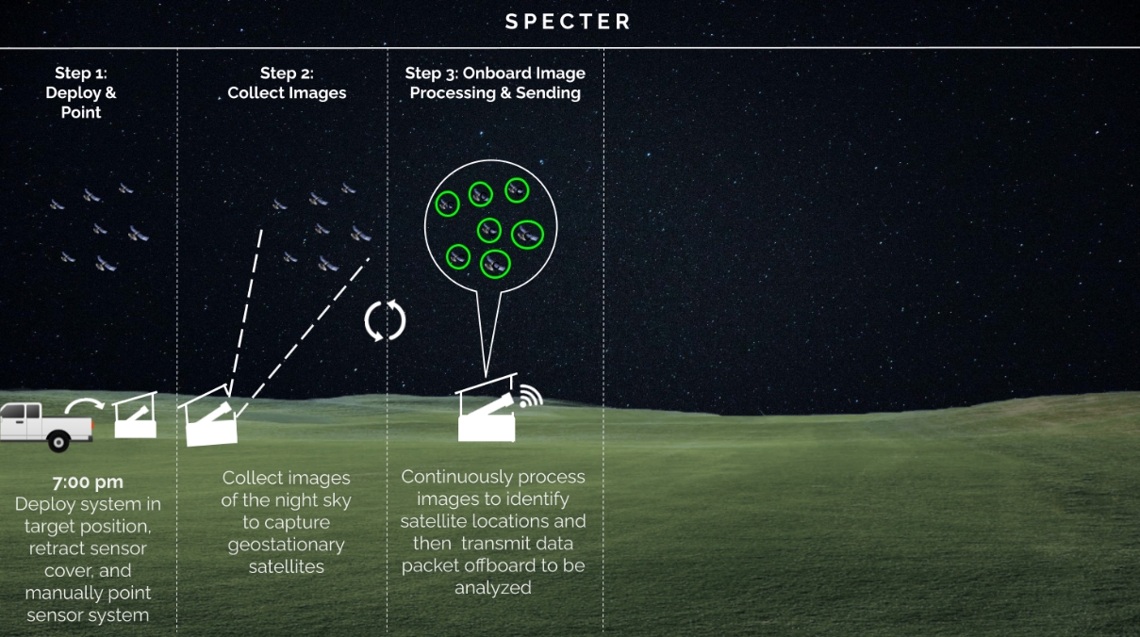
Concept of Operations
Project Overview
Project Updates
Schedule
Test Readiness
Budget

Slide 8
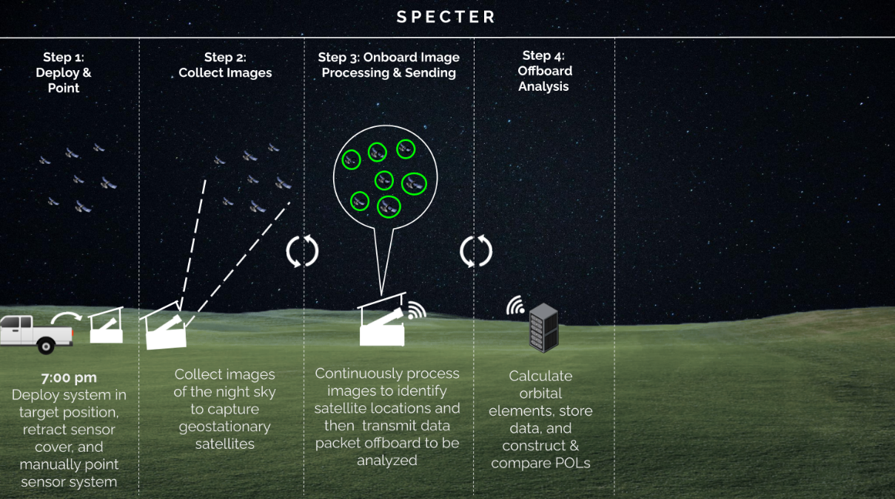
Concept of Operations
Project Overview
Project Updates
Schedule
Test Readiness
Budget

Slide 9
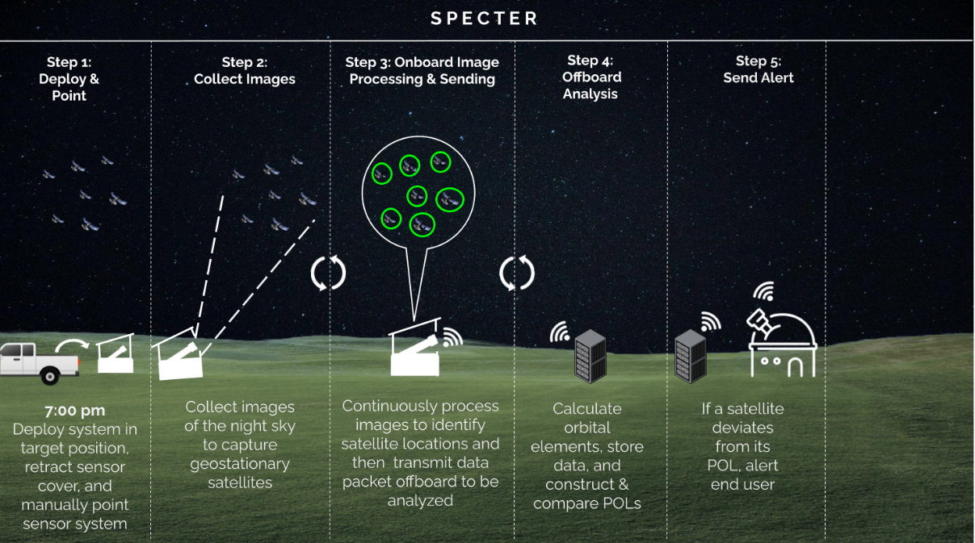
Concept of Operations
Project Overview
Project Updates
Schedule
Test Readiness
Budget

Slide 10
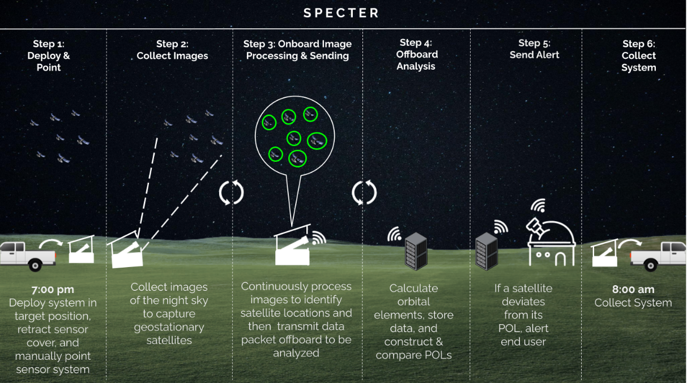
Concept of Operations
Project Overview
Project Updates
Schedule
Test Readiness
Budget

Slide 11
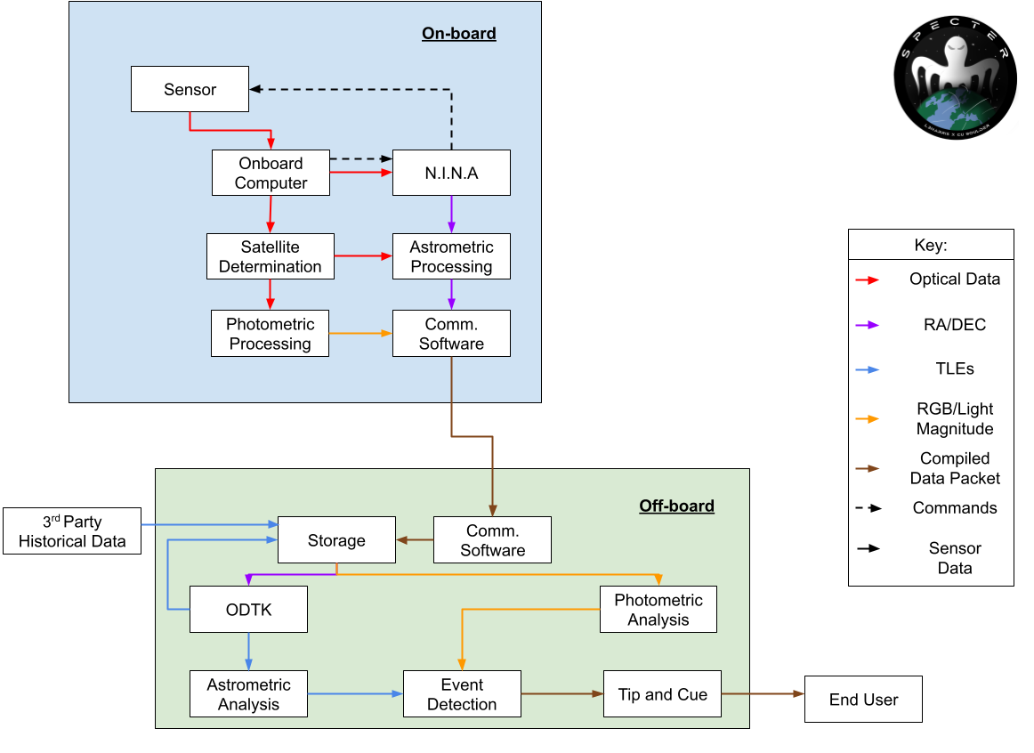
Image Software CONOPS
Project Overview
Project Updates
Schedule
Test Readiness
Budget

Slide 12
Objectives
Subsystem | Capability | Level 3 Success
Software - Algorithm | Detect Pattern of Life (POL) | Autonomously compare observed orbital behaviors against historical POLs, distinguish changes, and characterize events
Software - Data | Camera Data Transfer and Storage | Camera subsystem sends data to server to be analyzed autonomously
Communication and Software | Tip and Cue | Autonomously send alerts based on recognized events
Mechanical - Enclosure | Enclosure for System | Enclosure autonomously responds to weather conditions
Electronics | Collection and Processing | Collect and Process image data autonomously
Project Overview
Project Updates
Schedule
Test Readiness
Budget

Slide 13
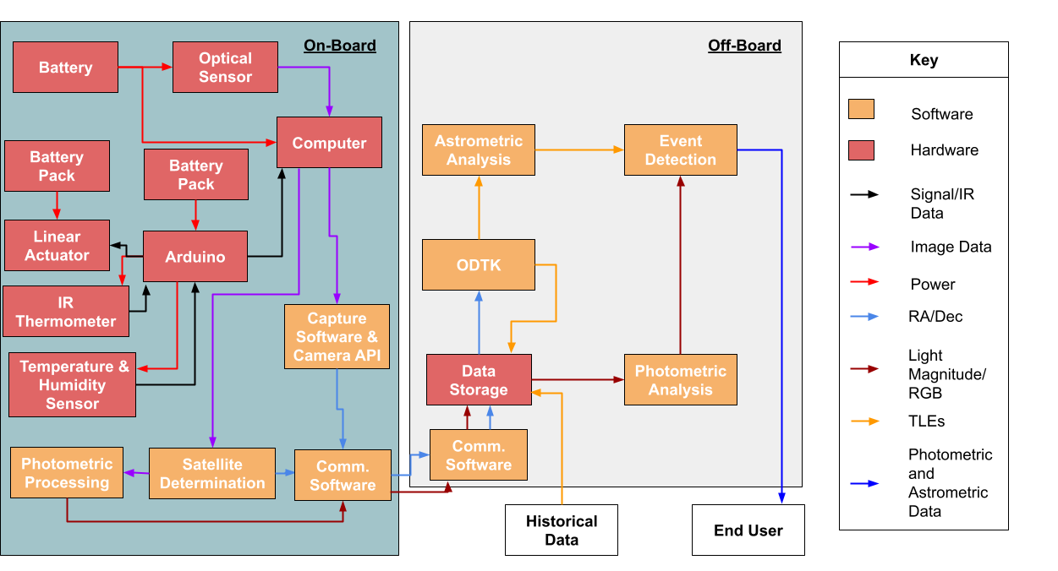
Functional Block Diagram
Project Overview
Project Updates
Schedule
Test Readiness
Budget

Slide 14
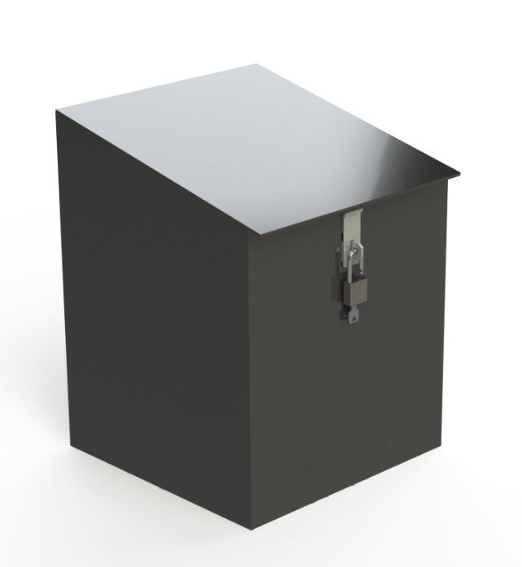
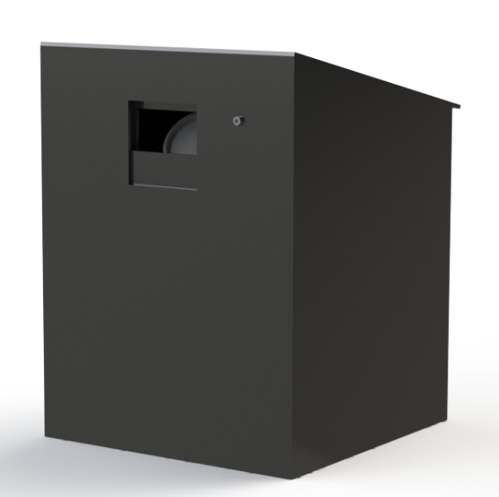
Enclosure Design - Exterior
24 in
20 in
IR Thermometer
Sparkfun MLX90614
Padlock
18 in
18 in
Project Overview
Project Updates
Schedule
Test Readiness
Budget

Slide 15
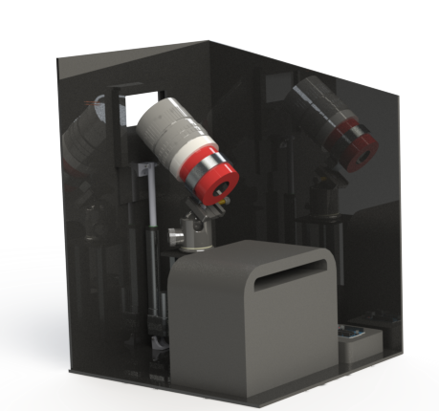
Enclosure Design - Cutaway
IR Thermometer
Sparkfun MLX90614
Lens
Canon 135mm lens
Camera Mounting System
ZWO Holder Ring + Neewer Professional Panoramic Ball Head
Sensor
ZWO ASI 2600 MC Pro
Battery
EcoFlow RIVER Battery
Linear Actuator
Eco Worthy 6 inch Linear Actuator
Arduino Uno
Computer
Beelink Mini PC
Project Overview
Project Updates
Schedule
Test Readiness
Budget

Slide 16
Critical Project Elements
CPE | Importance
1. GEO Observation | SPECTER must be capable to observe satellites to facilitate data collection
2. Data Collection | Data collection is required for future POL comparison
3. POL Determination | POL’s are necessary to monitor for deviations from expectations
4. Event Detection | The system must be able to use the astrometric and photometric data output from the image processing subsystem to compare to historical data. To alert end users of a POL deviation, the SPECTER system must have the capability to detect the event.
Project Overview
Project Updates
Schedule
Test Readiness
Budget

Slide 17
Project Updates
Project Overview
Project Updates
Schedule
Test Readiness
Budget

Slide 18
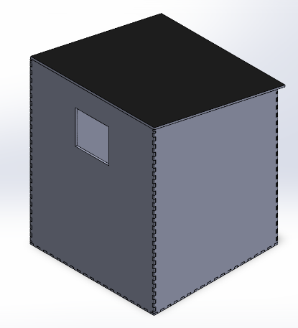
Updates
New POC Dr. Thomas Gemmer
Sr. Specialist, Astrodynamics Systems Development - Space Domain Awareness (SDA) Division
Acrylic enclosure finger joints for increased rigidity
Onboard processor delayed
CAD close-up of finger joints
CAD of structure with finger joints
Project Overview
Project Updates
Schedule
Test Readiness
Budget

Slide 19
Schedule
Project Overview
Project Updates
Schedule
Test Readiness
Budget

Slide 20
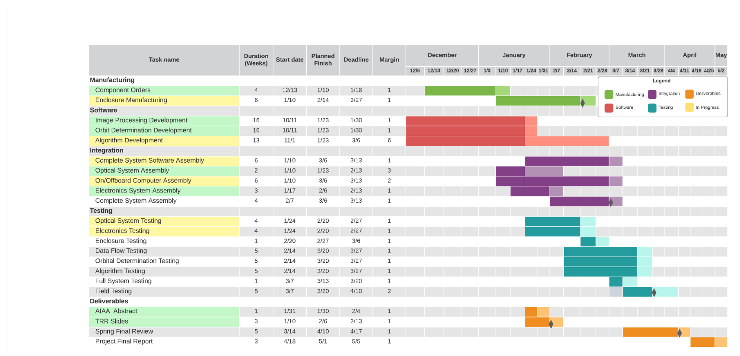
Gantt Chart
Project Overview
Project Updates
Schedule
Test Readiness
Budget

Slide 21
Test Readiness
Project Overview
Project Updates
Schedule
Test Readiness
Budget

Slide 22
Major Tests to be Conducted
Type | Test Name | CPE and FR | Completion Date | Status
Subsystem - Optics | OPT.7: LSM | CPE 1 FR 1 | 2/20/22 | Ready to Test
Subsystem - Data Flow | DAT.2: Integrated Communications | CPE 2 FR 3 | 3/20/22 | Not Started
Subsystem - Orbit Determination | ORB.1: Semi-Major Axis Determination | CPE 3 FR 4 | 3/20/22 | Not Started
Subsystem - Algorithm | ALG.2: Semi-Major Axis POL ALG.7: Maneuver Event Detection | CPE 2 FR 3 | 3/20/22 | Not Started
System - Structure & Optics | STR.3: Stability Test | CPE 1 FR 1 | 2/20/22 | Manufacturing
System | SYS.5: Full System Day in the Life (Field Testing) | CPE All FR All | 4/10/22 | Not Started
Project Overview
Project Updates
Schedule
Test Readiness
Budget

Slide 23
Testing Phase 1: Component Testing
Component | Test Name | Completion Date | Status
Lens | OPT.2: Optical Alignment | 2/7/22 | Completed
Lens | OPT.3: Sharpness | 2/7/22 | Completed
Lens | OPT.4: Focus Accuracy | 2/7/22 | Completed
Lens | OPT.5: Distance Focus | 2/7/22 | In Progress
Linear Actuator | STR.1: Force | 2/7/22 | In Progress
IR Sensor | ELE.1: IR Sensor | 2/13/22 | Completed
Temp Sensor | ELE.2: Temp Sensor | 2/13/22 | Completed
Humidity Sensor | ELE.3: Humidity Sensor | 2/13/22 | Completed
Image Processing | DAT.2: Image Processing | 2/16/22 | In Progress
Project Overview
Project Updates
Schedule
Test Readiness
Budget

Slide 24
Completed Component Tests Summary
OPT.2: Optical Alignment (Completed 2/9/22)
PASS: By visual inspection - the center circle is in focus and has no warping
OPT.3: Sharpness (Completed 2/3/22)
PASS: By visual inspection - lockers in aero workshop are clear and in focus
OPT.4: Focus Accuracy (Completed 2/3/22)
PASS: By visual inspection - the number “10” is in focus
Pass
Fail
Project Overview
Project Updates
Schedule
Test Readiness
Budget

Slide 25
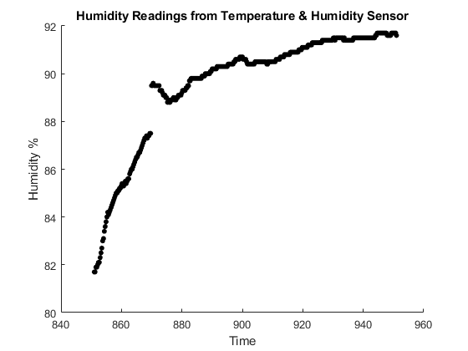
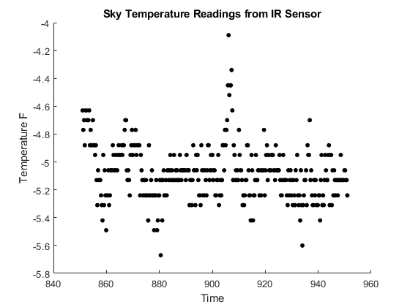
Completed Component Tests Summary
ELE.1: IR Sensor (Initial Test 2/12/22)
ELE.2: Temp Sensor (Initial Test 2/12/22)
ELE.3: Humidity Sensor (Initial Test 2/12/22)
Testing in Progress: Sensors work but accuracy cannot yet be confirmed
Project Overview
Project Updates
Schedule
Test Readiness
Budget

Slide 26
Testing Phase 2: Subsystem Testing
Subsystem | Test(s) Name | Completion Date | Status
Optics | OPT.1: Basic Functionality OPT.6: Pointing OPT.7: LSM* | 2/20/22 | Completed - Appendix Not Started - On Track In Progress - Presented
Structures | STR.2: Thermal Model* STR.4: Water Protection | 2/20/22 | Not Started - On Track Not Started - On Track
Orbit Determination | ORB.1-7: All Keplerian Element Tests ORB.8: Close Approach Event Prediction | 3/20/22 | In Progress - Presented Not Started - On Track
Electronics | ELE.4: Power Interface ELE.5: Power Failure ELE.6: Communication/Data Interface | 2/20/22 | Not Started - On Track Not Started - On Track Not Started - On Track
Data Flow | DAT.1: Communications DAT.3: Alert Timing* | 3/20/22 | In Progress - Presented In Progress
Algorithm | ALG.1-6: POLs ALG.7-10: Events | 3/20/22 | In Progress - Presented In Progress - Presented
Project Overview
Project Updates
Schedule
Test Readiness
Budget

Slide 27
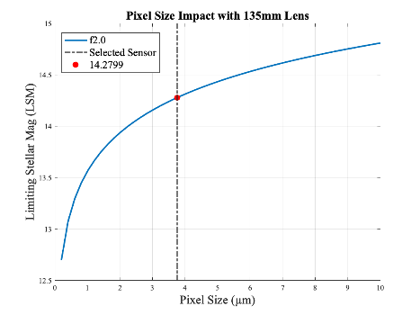
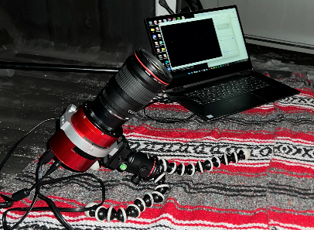
OPT.7: Limited Stellar Magnitude
Test By Date: 2/20/22 Status: Ready to test
CPE 1 GEO Observation
FR 1 The system shall observe satellites in geostationary orbit
Objective: Validate that the LSM model correctly predicts the LSM of the system
Setup, Facilities, and Equipment
Outside aerospace building at night, lens, sensor, computer, tripod
Procedure
Setup the lens, sensor, computer system
Use live feed to adjust the settings (focus, gain, exposure)
Point the system 40˚ elevation south and collect 10 images
Run collected image through ASTAP to obtain name of objects in the image
Success Criteria
Confirm an object with a LSM ≥ 13
Laptop/ Capture API
Lens
Sensor
Tripod
12v Power & USB
Project Overview
Project Updates
Schedule
Test Readiness
Budget

Slide 28
Optics Status
Risk Description | Mitigation | Pre-mit. | Post-mit.
System does not achieve required LSM of 13, 13-15 ideal | Test OPT.7 Success: Validates the system can observe an LSM in the required range | 12 | 3
Tasks Completed:
Sensor takes clear images w/ ASICAP
Sensor successfully integrated with NINA
Tasks To Do:
Capture clear images with the optic system at night
Project Overview
Project Updates
Schedule
Test Readiness
Budget

Slide 29
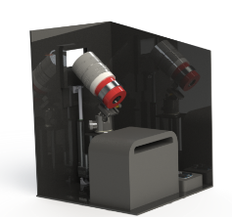
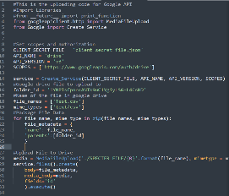
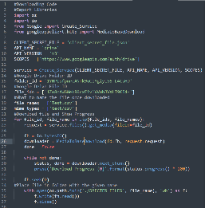
DAT.2: Integrated Communication Test
Test By Date: 3/20/22 Status: Not Started
CPE 2 Data Collection
FR 3 Collected astrometric and photometric data shall be stored
Objective Confirm communication functionality between the onboard (where data is collected) and offboard computer (where data is processed)
Setup, Facilities, and Equipment
Senior projects room, onboard and offboard computer, 4G hotspot and coverage
Procedure
Connect onboard computer to 4G hotspot
On onboard computer assign Test.csv for upload
Run Google API upload on the onboard system
Run Google API download on offboard system
Success Criteria
Download script matches uploaded script
Whole process is under a minute
Google Drive API
Project Overview
Project Updates
Schedule
Test Readiness
Budget

Slide 30
DAT.2 Integrated Communications Status
Risk Description | Mitigation | Pre-mit | Post-mit
Data is corrupted or the wrong file is transferred | Test DAT.2 Success: Validates the system can transmit correct data without corruption | 15 | 5
Tasks Completed:
Upload functionality
Download functionality
Test .CSV file created
Tasks To Do:
Receive 4G hotspot
Automated File ID Recovery
Project Overview
Project Updates
Schedule
Test Readiness
Budget

Slide 31
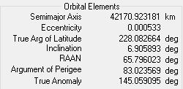
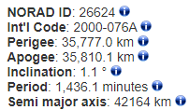
ORB.1: Semi-Major Axis Determination
Test By Date: 3/20/22 Status: In Progress
CPE 3 POL Determination
FR 4 Use astrometric data from the image processing subsystem to compare to historical data
Objective: Verify the semi-major axis of a satellite can be determined
Setup, Facilities, and Equipment
Senior projects room, computer, L3 data set, historical data, Python, ODTK
Procedure
Obtain Right Ascension / Declination (𝛼, 𝛿) angle pair measurements from the provided L3 data set
Perform orbit determination with ODTK
Compare the calculated semi-major axis to spacetrack historical database to determine difference
Success Criteria
Calculated semi-major axis is within 100 km of historical semi-major axis
ODTK Data
L3 Data Set
ODTK API
ID: 26624
Historical Data
Results
Error
Historical Data Set
Project Overview
Project Updates
Schedule
Test Readiness
Budget

Slide 32
Orbit Determination Status
Risk Description | Mitigation | Pre-mit | Post-mit
Accurate orbital determination methods are needed to perform event detection | ORB.1 Success: Validates the orbital determination can predict within a tolerable error, giving confidence in further event classification | 16 | 3
Tasks Completed:
Tested ODTK Program Functionality
Performed manual orbit determination with ODTK
Tasks To Do:
Complete API in Python for automation
Complete integration with other software / hardware
Project Overview
Project Updates
Schedule
Test Readiness
Budget

Slide 33
ALG.2: Semi-Major Axis POL
Test By Date: 3/20/22 Status: Not Started
CPE 3 POL Determination
FR 2 Software shall determine the POL of satellites in geostationary orbit from historical data
Objective Verify the system has the ability to create Semi-Major Axis (a) POL deviations
Setup, Facilities, and Equipment
Senior projects room, computer, test data, historical data from Space-Track.org
Procedure
Create semi-major axis POL for 50 different satellites using historical truth data
Run test data through the algorithm to find deviations in POL
Success Criteria
By visual inspection and error analysis, confirm the numerical deviations are consistent with what is expected.
Ensure that type-I and type-II error rates are both below 10% for success
Historical Data Set
POL Script
Results
L3Harris Data
Error
Project Overview
Project Updates
Schedule
Test Readiness
Budget

Slide 34
ALG.7: Maneuver Event Detection
Test By Date: 3/20/22 Status: Not Started
CPE 4 Comparison of Collected Data to Historical Data
FR 6 The software subsystem shall have the capability to detect an event
Objective Verify the system has the ability to detect a maneuver.
Setup, Facilities, and Equipment
Senior projects room, computer, test data, historical data from Space-Track.org
Procedure
Identify 50 historical data sets - 25 w/ known maneuver, 25 w/ known lack of maneuver
Input each test data set into the algorithm
Document whether the system alerts or not
Success Criteria
Algorithm should detect the 25 maneuvers
Ensure that type-I and type-II error rates are both below 10% for success
Historical Data Set
Analysis
Event Detection
Alert and Confidence
Project Overview
Project Updates
Schedule
Test Readiness
Budget

Slide 35
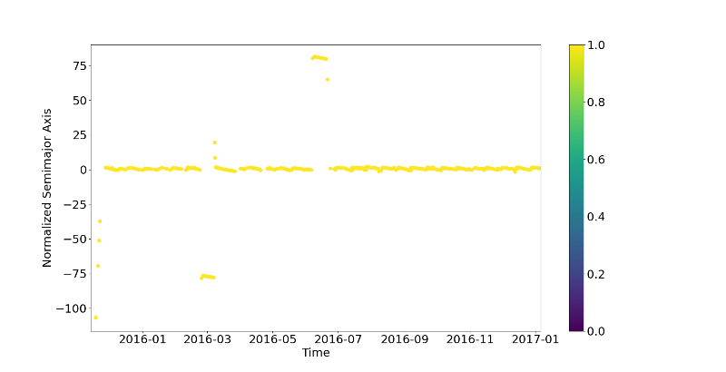
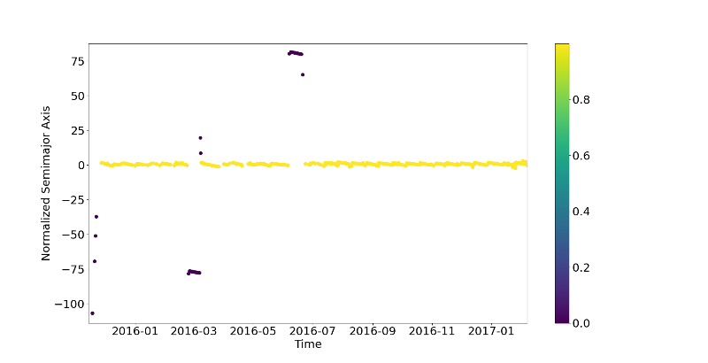
ALG.7: Maneuver Event Detection
Test By Date: 3/20/22 Status: Not Started
CPE 4 Comparison of Collected Data to Historical Data
FR 6 The software subsystem shall have the capability to detect an event
Before Prediction
After Prediction (99.6% accuracy)
Classification
Classification
Project Overview
Project Updates
Schedule
Test Readiness
Budget

Slide 36
Algorithm Risk
Risk Description | Mitigation | Pre-mit. | Post-mit.
The algorithm can’t create a POL | ALG. 2 Success: Validates the system can detect deviations in semi-major axis POL with minimal false positives and negatives | 20 | 8
Deviation detection is necessary to alert end user and satisfy mission objective | ALG. 7 Success: Validates the system can detect maneuvers with minimal false positives and negatives | 20 | 8
Project Overview
Project Updates
Schedule
Test Readiness
Budget

Slide 37
Algorithm Status
Tasks Completed:
Thresholding Algorithm
Machine Learning Thresholding Analogue
Recurrent Neural Network Initial Model
Tasks to Complete:
Recurrent Neural Network Refined Model
Bootstrapping Algorithm (for RGB values)
Error Analysis
Project Overview
Project Updates
Schedule
Test Readiness
Budget

Slide 38
Testing Phase 3: System Testing
Test Name | Completion Date | Status
STR.3: Stability | 2/20/22 | Manufacturing - Presented Here
Full System Software Test | 3/6/22 | Not Started - On Track
Structure View Test | 3/6/22 | Not Started - On Track
Full System Test | 3/6/22 | Not Started - On Track
Full System Day in the Life (Field Testing) | 4/10/22 | Not Started - Presented Here
Project Overview
Project Updates
Schedule
Test Readiness
Budget

Slide 39
STR.3: Stability Test Plan
Test By Date: 2/20/22 Status: Manufacturing
CPE 1 GEO Observation
FR 1 The system shall observe satellites in geostationary orbit
Objective: Verify that during standard operations the sensor is stable and image collection is not disturbed
Setup, Facilities, and Equipment
Outside the aerospace building, structure, all components
Procedure
Place the structure with all internal components outside
Point the structure at a wall or building with a geometric pattern
Run the system for three hours and collect 180 images
Success Criteria
No images taken during the test are blurred or distorted
Project Overview
Project Updates
Schedule
Test Readiness
Budget

Slide 40
Structure Stability Risk
Risk Description | Mitigation | Pre-mit. | Post-mit.
If On-Board Electronics cause internal vibrations/movement the captured images could be distorted | STR. 3 Success: Test proves onboard electronics do not cause detectable internal vibrations/movements | 20 | 4
Project Overview
Project Updates
Schedule
Test Readiness
Budget

Slide 41
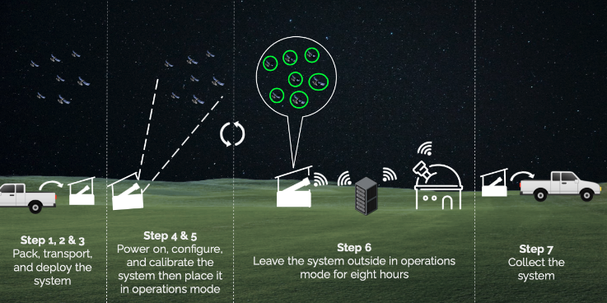
SYS.5: Field Testing
Test By Date: 4/10/22 Status: Not Started
CPE All CPE’s
FR All Functional Requirements
Objective Confirm that the full system functions as expected during operations for eight hours overnight
Setup, Facilities, and Equipment
Exterior location, full system, back up computer
Procedure
Follow packing procedure and transport the system to test location
Deployment procedure to secure the components
Power-on procedure to power-on and calibrate
Operations procedure to place the system in an operations mode
Leave the system outside and running for eight hours
Collect the system using packing procedure
Offboard
Computer
Project Overview
Project Updates
Schedule
Test Readiness
Budget

Slide 42
SYS.5: Field Testing
Test By Date: 4/10/22 Status: Not Started
CPE All CPE’s
FR All Functional Requirements
Success Criteria
System continuously takes clear images for 8 hours
Electronics collects and stores temperature and humidity data
RA and Dec are calculated for all images taken
Onboard computer uploaded data and offboard computer downloads data within 1 minute of image capture
Orbit determination method calculates all Keplerian orbital elements
Algorithm event detection has type-I and type-II errors less than 10%
Project Overview
Project Updates
Schedule
Test Readiness
Budget

Slide 43
Risk Mitigation - Tests Summary
System Risk | Test
Optics | OPT. 7 LSM Test
Enclosure | STR. 3 Stability Test
Data Comm. | DAT.2 Integrated Communications Test
OD | ORB. 1 Semi-Major Axis Test
Algorithm | ALG. 2 Semi-Major Axis POL ALG. 7 Maneuver Event Detection
Severity
 |  | Negligible 1 | Minor 2 | Moderate 3 | Major 4 | Severe 5
 | Very Likely 5 |  |  |  | Enclosure
 | Likely 4 |  |  |  | OD | Alg
 | Possible 3 |  |  |  | Optics | Data Comm.
 | Not Likely 2 |  | Enclosure |  | Alg
 | Rare 1 |  |  | OD Optics |  | Data Comm.
Likelihood Level
Project Overview
Project Updates
Schedule
Test Readiness
Budget

Slide 44
Major Tests to be Conducted
Type | Test Name | CPE and FR | Completion Date | Status
Subsystem - Optics | OPT.7: LSM | CPE 1 FR 1 | 2/20/22 | Ready to Test
Subsystem - Data Flow | DAT.2: Integrated Communications | CPE 2 FR 3 | 3/20/22 | Not Started
Subsystem - Orbit Determination | ORB.1: Semi-Major Axis Determination | CPE 3 FR 4 | 3/20/22 | Not Started
Subsystem - Algorithm | ALG.2: Semi-Major Axis POL ALG.7: Maneuver Event Detection | CPE 2 FR 3 | 3/20/22 | Not Started
System - Structure & Optics | STR.3: Stability Test | CPE 1 FR 1 | 2/20/22 | Manufacturing
System | SYS.5: Full System Day in the Life (Field Testing) | CPE All FR All | 4/10/22 | Not Started
Project Overview
Project Updates
Schedule
Test Readiness
Budget

Slide 45
Budget
Project Overview
Project Updates
Schedule
Test Readiness
Budget

Slide 46
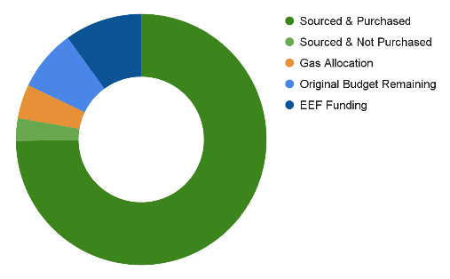
Budget Updates Procurement Updates
$1017.21 in margin
$439 of that due to EEF
Also $250 set aside for gas (conservative)
All sections under budget (structure, electronics, optics, other)
Enough margin to cover any single part failure - except the sensor!
Sensor is most critical part!
All parts sourced, almost all procured!
Processor (Critical - Electronics)
Beelink PC through Amazon
Miscommunication w/ Aero Finance
Linear Actuator (Critical - Structures)
6” ECO-WORTHY Linear Actuator
Accidentally ordered 2” Actuator due to link
Miscommunication w/ Aero Finance
Other Parts Arriving Soon
Wires (Amazon as well)
Mobile Hotspot (Originally not need until field test, now to be ordered this week)
Future Purchases
Lens Warmer (Not needed until field test)
Hotspot Data Plan (Not needed until field test)
Project Overview
Project Updates
Schedule
Test Readiness
Budget

Slide 47
Questions?

Slide 48
Appendix

Slide 49
Risk Description
System Risk | Risk Description | Test
Optics | An LSM of 13 is required for the optical system, with 13 - 15 ideal | OPT. 7 LSM Test
Enclosure | The enclosure must be stable in order for the optical system to capture sharp images | STR. 3 Stability Test
Data Communication | Data is corrupted or the wrong file is transferred. | DAT.2 Integrated Communications Test
OD | Accurate orbital determination methods are needed to predict event detection | ORB. 1 Semi-Major Axis Test
Algorithm | The algorithm must be able to create a POL and detect a deviation from created POLs | ALG. 2 Semi-Major Axis POL ALG. 7 Maneuver Event Detection

Slide 50
Optics

Slide 51
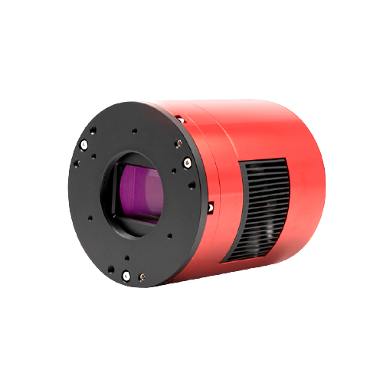
Dedicated Astrophotography Sensor Parameters
ZWO ASI2600MC Pro (color)
Mirrorless
Full frame
26.1 Megapixels
RGB
Pixel size: 3.76µm square
6248×4176 @ 3.51fps
Exposure Range: 32μs-2000s
Read Noise: 1.0-3.3e
QE peak: over 80%
Dimensions: 90mm Diameter
Weight: 700g

Slide 52
Limiting Stellar Magnitude (LSM)
Majority of GEO Satellites in range m = 11-14
Customer requires 13, 14-15 ideal
Aperture diameter (D) most important for urban areas
Assumptions:
Optical System is in ‘stare’ mode thus relative velocity is (⍵) = velocity of Satellite
GEO Satellites have circular orbits
Satellites treated as spheres
GEO Satellites
Sun
Full Moon
Naked
Eye Limit
-30
-25
-20
-15
-10
-5
0
5
10
15
20
25
Apparent Magnitude ( m_{v} )
13 <
[3] Coder, Holzinger, 2016)
Notes:
Better explain, use < to highlight values versus goal. Greater than
Equation too dense?

Slide 53
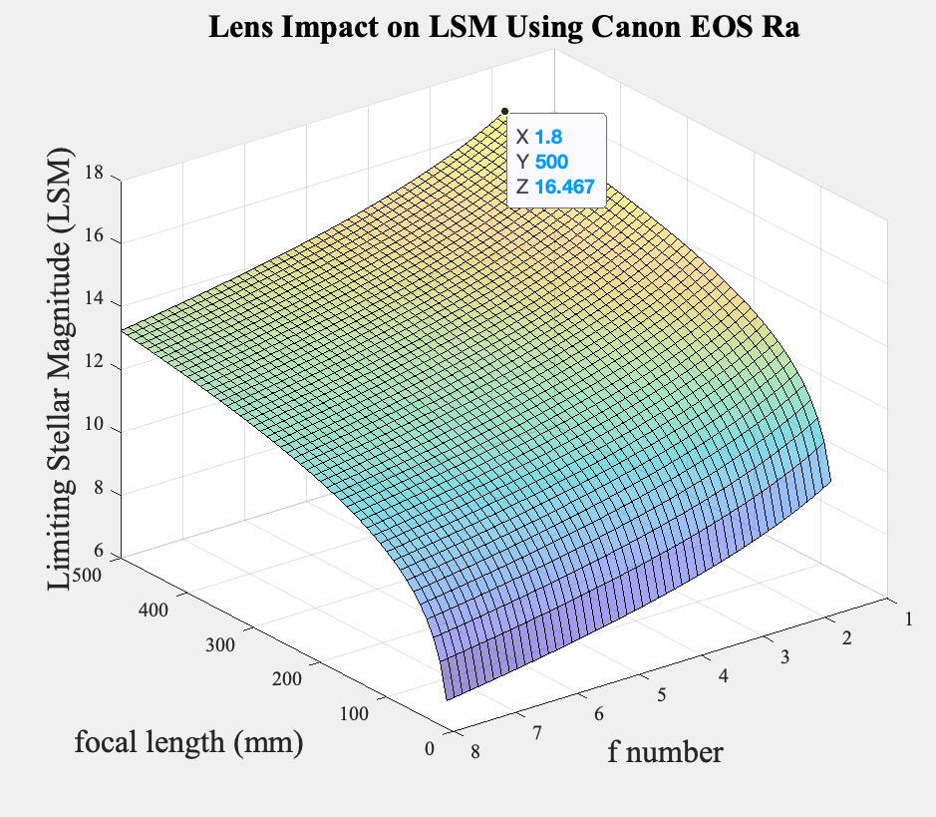
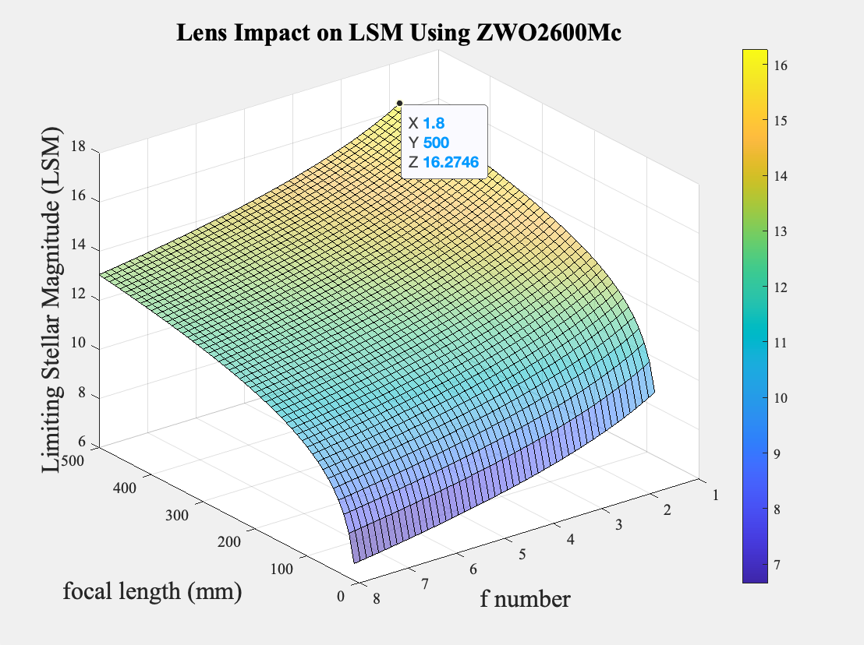
Optic Options in Consideration

Slide 54
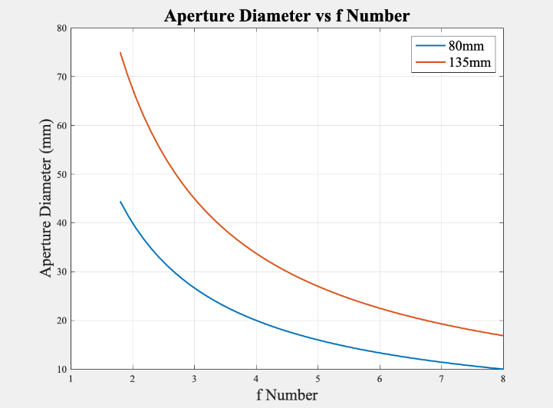
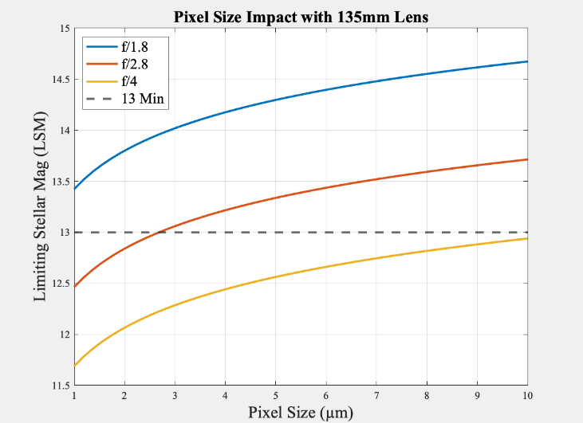
Lens & Sensor Selection
Notes:
Not enough info to stand alone
Line at 13, shade the good section
Add in 13 minimum (or maximum?) requirement

Slide 55
Control Variables
(Coder, Holzinger, 2016)
Design Variables
F-number (N)
aperture diameter (D)
pixel size (p)
f
_ µm
P
D
1080
1920
N = f/D
Notes:
Box N, D, p in equation (or terms they impact)

Slide 56
Optical System Nomenclature
Symbol | Value [units] | Description
SNR_{alg} | 6 | Signal to Noise Ratio
m_{i} | 40 (pixels) | Initial # of pixels occupied by space object (SO) image
𝜱_{alg} | 5.6*E10 (photons/s/m²) | Photon Flux Density
q_{p,sky} | 120 (e−/s/pixel) | Photon Flux per pixel from background radiant intensity
q_{p,dark} | 0.00391 (e−/s/pixel) | Photon flux of CCD (Charge Coupled-Device) dark current
𝛕_{atm} | 0.69 | Transmittance of optics atmosphere
𝛕_{opt} | 0.9 | Transmittance of optics assembly
QE | 0.66 | Quantum Efficiency

Slide 57
Electronics

Slide 58
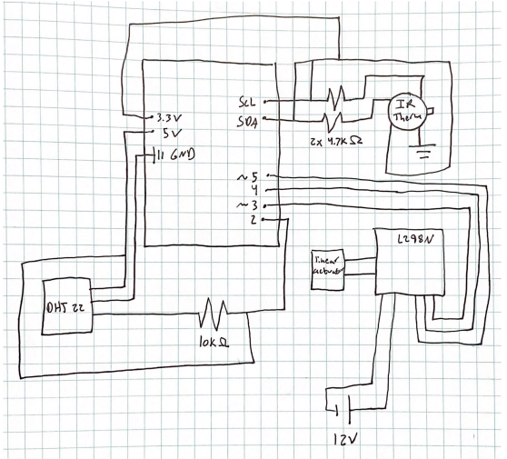
Schematic

Slide 59
Sampling Rate, Resolution, and Accuracy
 | Resolution | Accuracy | Sampling Rate
IR Thermometer | 0.02 C | 0.5 C | 5 min
Temp Sensor | 0.1 C | 0.5 C | 5 min
Humidity Sensor | 0.1% | 2% | 5 min
Astrophotography Sensor | 6248×4176 pixel | NA | 3.51fps

Slide 60
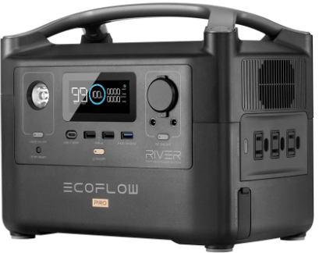
Power Source
Ports
3 x AC Output 120Vac (50Hz/60Hz)
2 x USB-A Output 5Vdc, 2.4A
1 x USB-A Fast Charge 5V/2.4A, 9V/2A, 12V/1.5A
1 x USB-C Output 5Vdc, 9Vdc, 12Vdc, 20Vdc , 5A
1 x Car Power Output 13.6Vdc 10A
2 x DC5521 Output 13.6Vdc, 3A
Specs
Discharge Temperature -20 to 45 C
720Wh capacity
Lithium-ion cell chemistry
Performance begins to degrade below 0 C

Slide 61
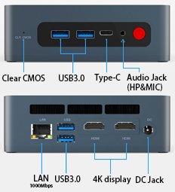
Processor
Specs
CPU - i5-8279U 2.4GHz, Turbo 4.1GHz
CPU Core - 4 Cores 8 Threads
Operating System - Windows 10 Pro
Storage - 512GB
RAM - 16G
Ports
4 x USB 3.0
1 x DC Jack ()
1 x RJ45
1 x Type-C
1 x Clear CMOS
1 x Audio Jack
2 x HDMI

Slide 62
Proof of Processor Capability
Actual Processor - Intel Core i5-8279U - 2.4 GHz with 4.1 GHz max
Test Processor 1 - Intel Core i7-4500U - 1.8 GHz with 2.4 GHz max
ASTAP = 32% max of test processor 1 CPU usage , 1.1 second run time
NINA = 13.5% max of test processor 1 CPU usage , 3.3 second run time (plate solving)
Test Processor 2 - i5-1135G7 -- 2.4 GHz with 4.2 GHz max
Satellite Identification = 40% max of test processor 2 CPU usage , 11 second run time

Slide 63
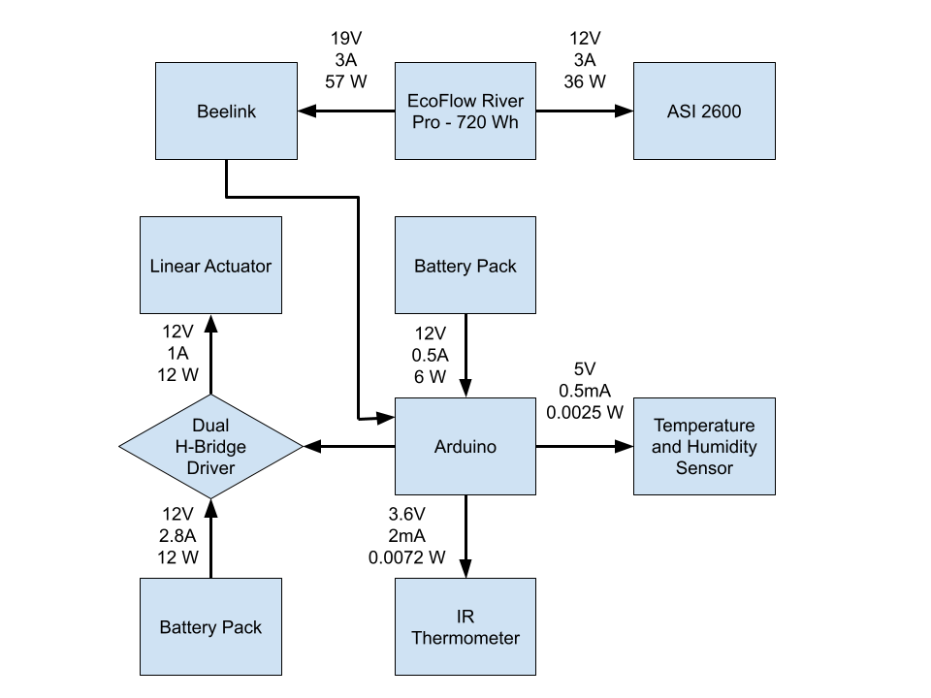
Power Analysis
Maximum Power Draw = 93W
Run Time with Maximum Power Draw = 7.74 Hours
Reasonable Assumptions:
CPU (28W Thermal Design Power, TDP)will never be maxed out with our low computation requirements
GPU (15W TDP) will never be maxed out with no need for graphics processing

Slide 64
Temperature considerations
Operating Temperatures
Linear Actuator: -26 to +65 C
Power Source: -20 to +45 C
Onboard Computer: -10 to +45 C (30-90% Humidity)
Sensor: -5 C to +50 C
Average Environmental Temp: (March)
Nederlands: 6 / -9 ˚C
Lyons: 13 / 2˚C
Brainard Lake: 3/-10˚C
Clear Lake (Cabin):
Will need to analyze weather data to determine optimal testing days
Days with no precipitation
Clear Days (little to no clouds)
Wind Speeds less than 35 mph

Slide 65
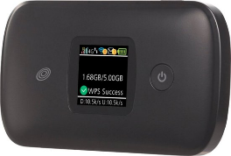
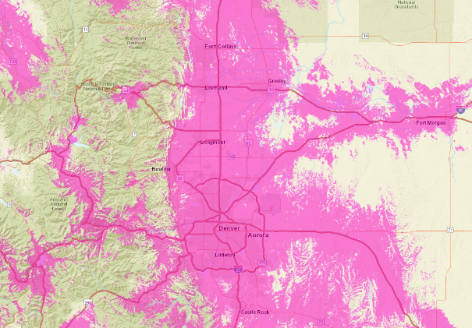
Communication
Location Requirements:
Expecting to transmit below 1 kbs
Low light pollution (need coverage in suburban to rural areas)
Using a Moxee 4G Mobile Hotspot as well as a Simple Mobile / T-Mobile Plan
FCC map of T-Mobile coverage confirms at least 1-5 Mbps coverage in many locations around Boulder
Notes:
FCC provides data on regions with at least 1-5 Mbps coverage
Light pollution maps based on

Slide 66
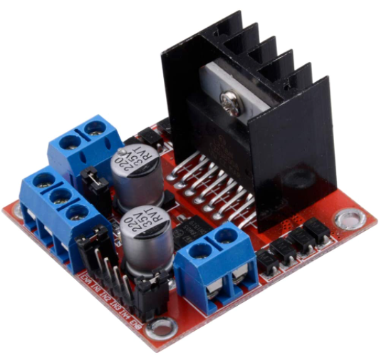
Linear Actuator Control
L298N
Dual channel H-Bridge driver
Accepts external power supply
Controls polarity of output to motor using any two regular digital high-low arduino pins
Controls speed using PWM pin
Usable as a 5V power supply when given 7V or more

Slide 67
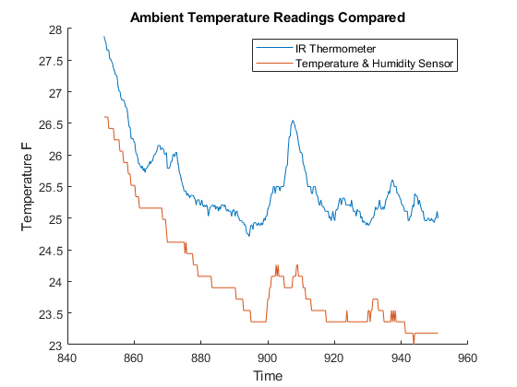
Temperature Comparison between Sensors

Slide 68
Software

Slide 69
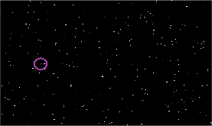
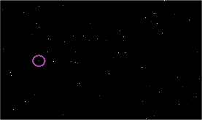
Software CONOPS
Historical Keplerian elements
RGB
Brightness
Image Processing
Image at t_{n-1}
Right Ascension
Declination
Timing
ML Algorithm
Tip and Cue
Statistical
Thresholding
Image at t_{n}
Download from Drive
Upload to Drive
Keplerian Elements
(a, e, i, 𝜃, Ω, ω)
ODTK
Orange = Data to be processed
Green = Data ready for algorithm
Blue = Process / Function
Project Overview
Project Updates
Schedule
Test Readiness
Budget
Notes:
vivien? I can do this but i'm not sure what goes in the last bubble

Slide 70
Machine Learning Justification
Time dependence of data
Pattern recognition
Regression
Project Overview
Baseline Design
Requirement Satisfaction
Risk
V&V
Project Planning

Slide 71
DAT.1 Communications Software Test
Objective:
This test will confirm the communication functionality of the Google API Software.
Setup, Facilities, and Equipment:
Senior Project Room, 2 laptops, Google API Code
Procedure:
Assign Test.csv to be uploaded
Run Google API upload script
Time the runtime of script to time of successful upload
Check drive for file
On another laptop run Google API download script
Time the runtime to time of download
Compare downloaded script to uploaded script
Success Criteria:
The correct file is uploaded on one laptop and downloaded on another without corruption.

Slide 72
DAT.3 Image Processing Production Test
Objective:
This test will determine if the image processing system on the onboard computer works as expected.
Setup, Facilities, and Equipment:
Senior Projects Room, Optical Sensor, and Onboard Computer
Procedure:
Run sample images through standalone image processing script
Verify that the correct pixels are identified as satellites
Run sample images through ASTAP
Manually convert pixel coordinates to RA and Dec values
Turn on on-board computer
Start process timer
Pass sample images through embedded script sequence
Verify that the RA and Dec output is correct by comparison to earlier values
Record process time
Success Criteria:
Images are processed in under 20 seconds
RA/Dec of all known satellites are recorded and packaged for sending.

Slide 73
DAT.4 Alert Timing Test
Objective:
This test ensures that an event can be detected and an alert sent within 90 minutes of the event occurring
Setup, Facilities, and Equipment:
Senior Projects room, field team in location with 4G Cellular Coverage and the onboard and offboard systems
Procedure:
Travel to location with 4G cellular service
Begin the onboard script
Time the processing
Time Uploading
Have the offboard system back in boulder begin their onboard script
Time the download
Compare the data sent and received
Resume the onboard script
Time the analysis
Time till email is received (Tip and Cue)
Compare the data packaged with that analyzed
Success Criteria:
Alert email is sent within 90 minutes with requisite data

Slide 74
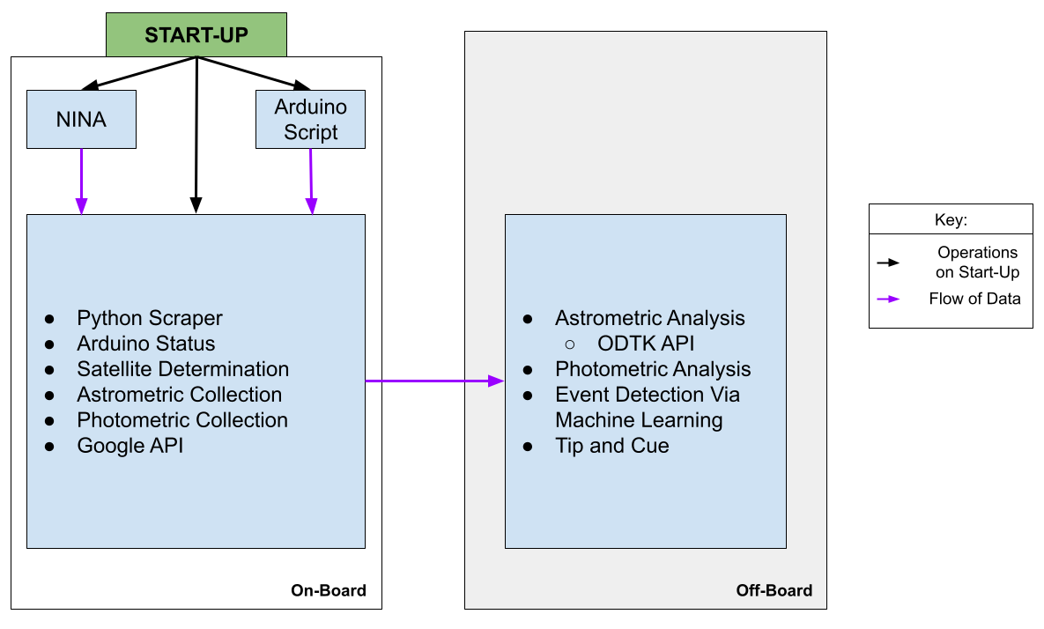
Software Overview

Slide 75
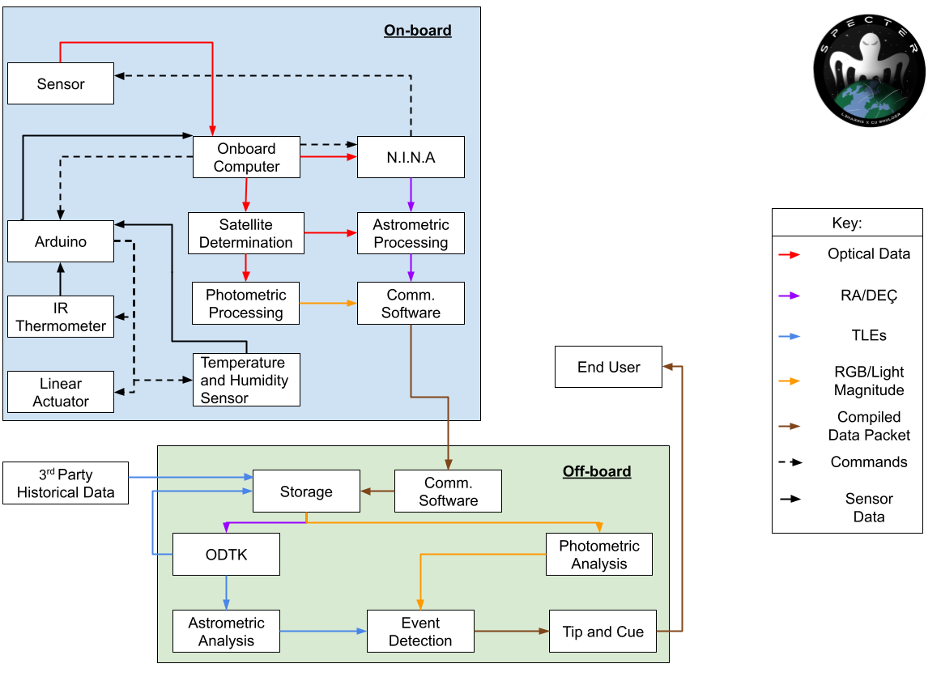
Data Inputs/Outputs

Slide 76
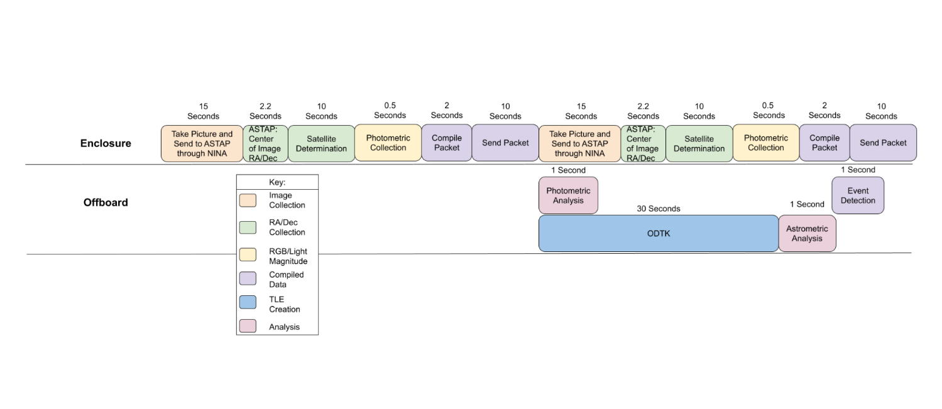
Computation Resources - Time Constraints
5 Minute Time constraint for analysis of each image
Need time taken to compute and proof/graphs of worst/best case computation time scenarios.
1 hour to send alert to L3

Slide 77
Computation Resources-Completed Models
Tip and Cue Model
Plate Solving Model
Photometric Collection Model
Astrometric Collection Model
Photometric Analysis Model
Astrometric Analysis Model
Arduino Model

Slide 78
Computation Resources-To Be Completed Tests
Full Software Test
Day-In-The-Life
Communication Model with Google API
Satellite Determination
ODTK API
NINA Scraper

Slide 79
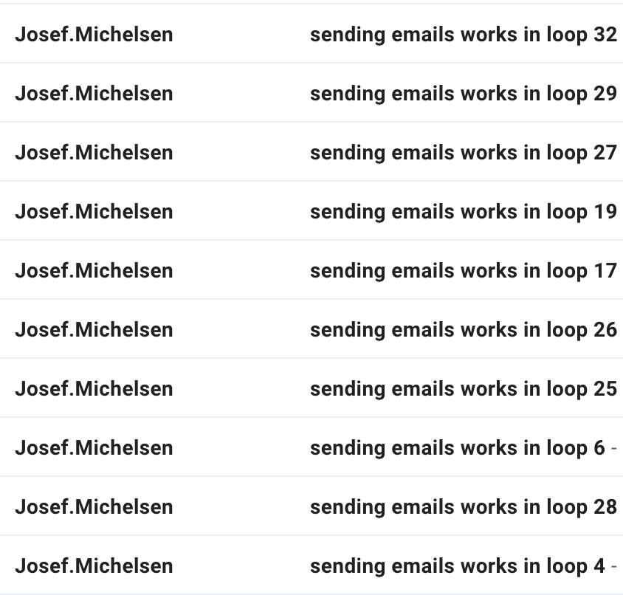
Tip and Cue Model Output

Slide 80
Plate Solving Model Results
File Size | 4.6 GB
Blind Solve Test Speed | 3.1 seconds
Reliability | 100% (When compared to Astrometry.net)

Slide 81
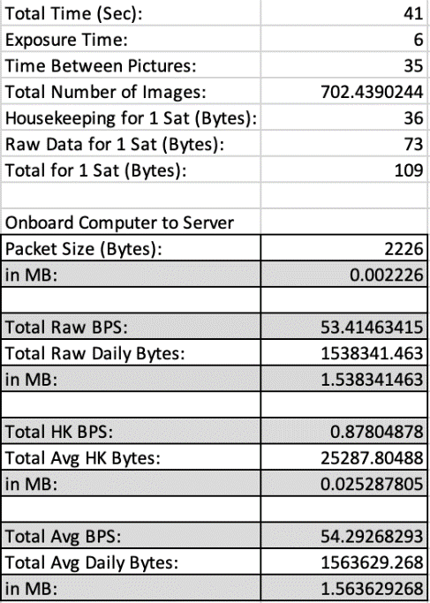
Data Budget

Slide 82
Example Packet

Slide 83
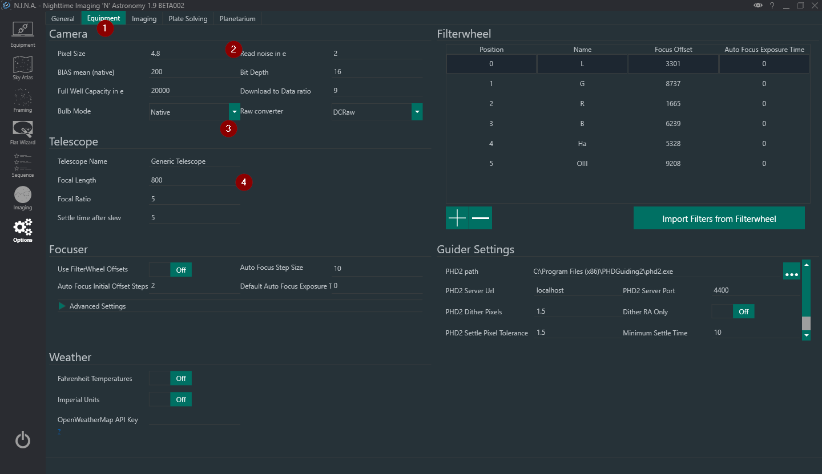
NINA Camera API

Slide 84
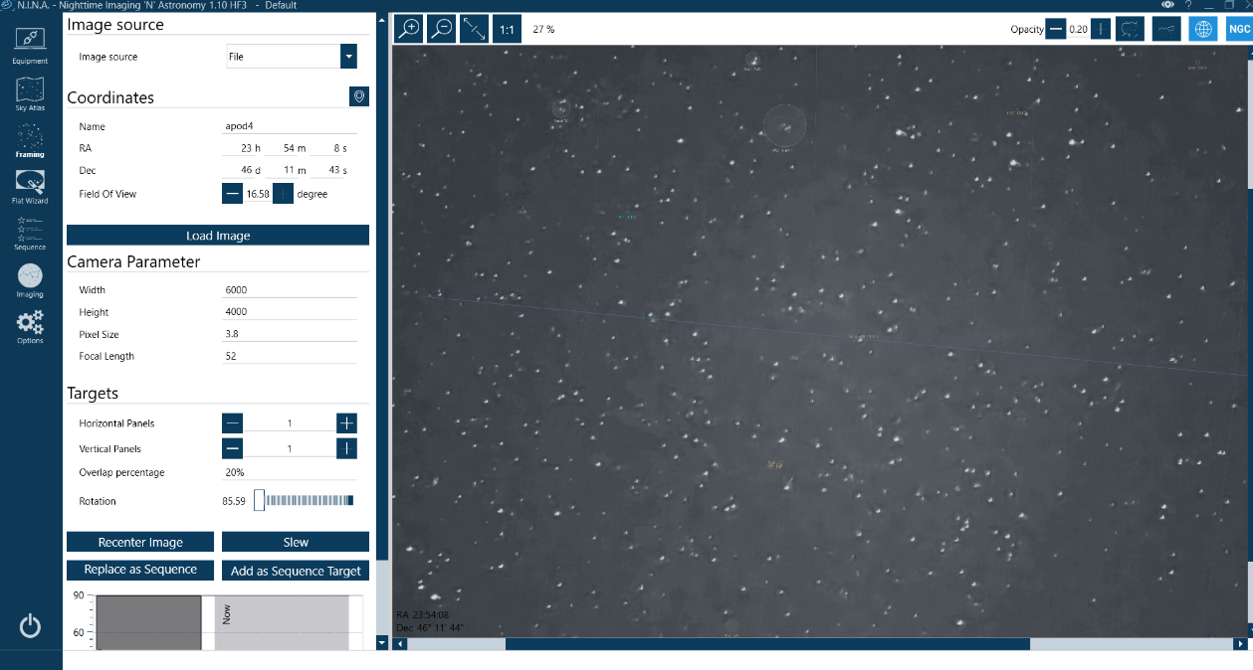
NINA/ASTAP Plate Solver

Slide 85
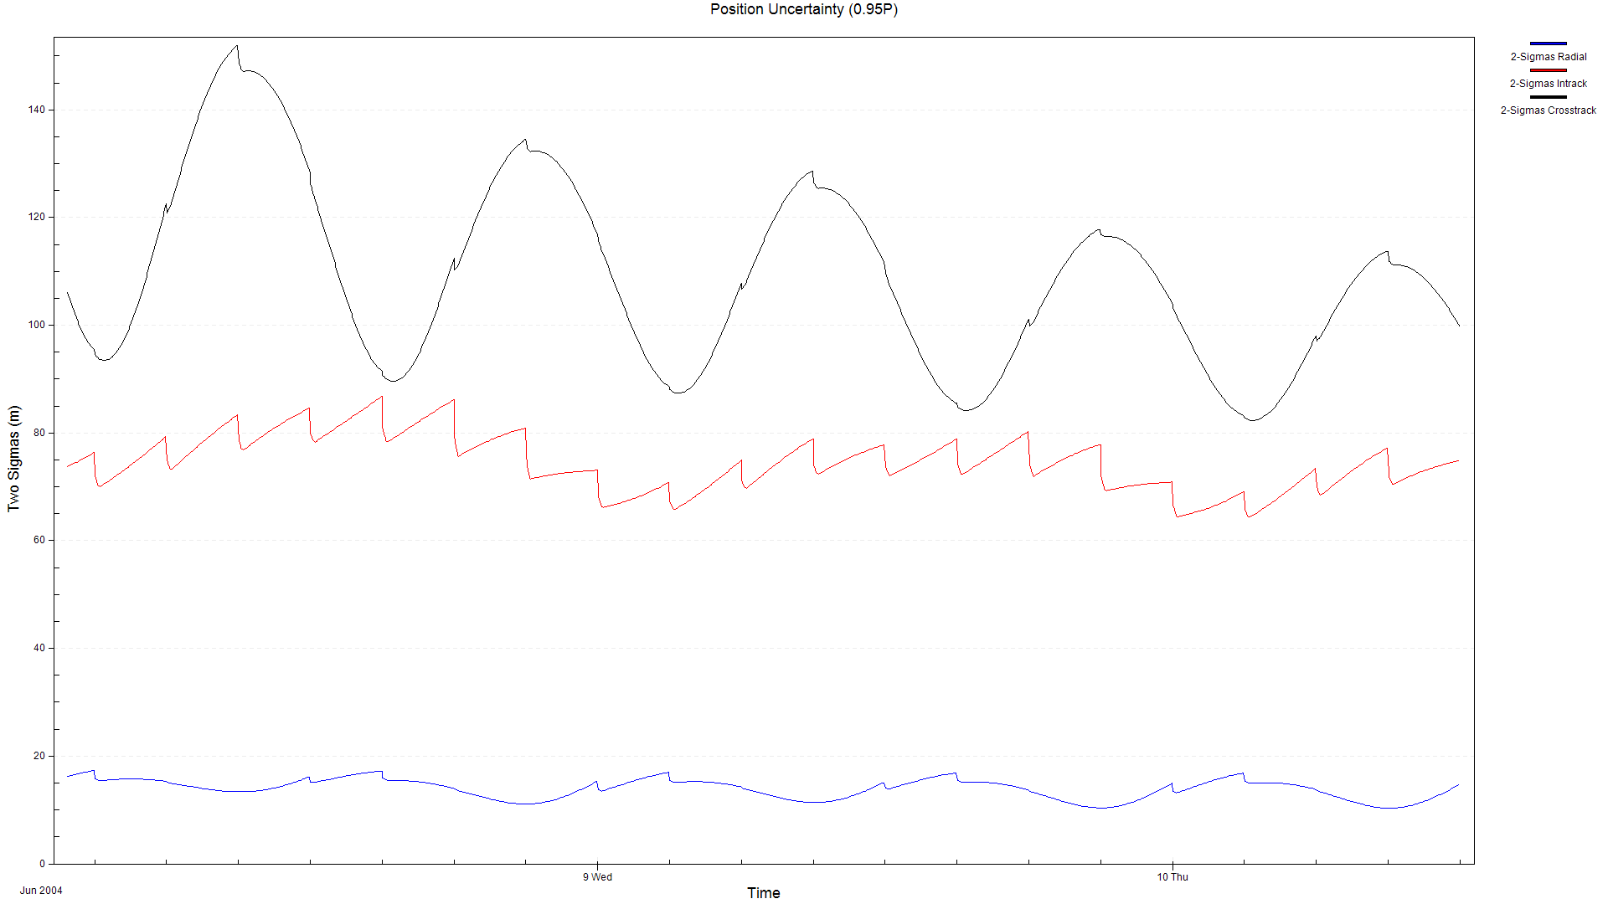
ODTK Reports - Position Uncertainty

Slide 86
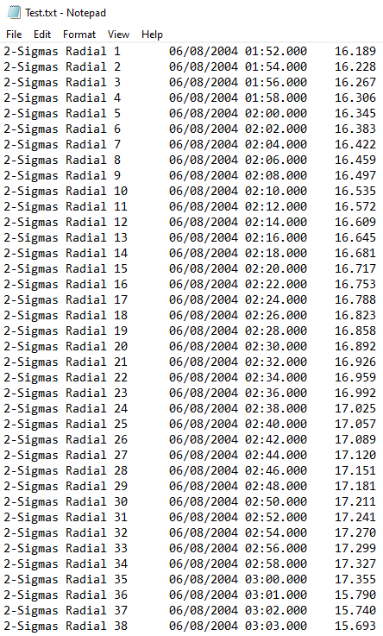
ODTK Reports - Position Uncertainty Report

Slide 87
Testing Appendix

Slide 88
Functional Requirements
FR 1 | The system shall observe satellites in geostationary orbit
FR 2 | The software subsystem shall determine the POL of satellites in geostationary orbit from historical data
FR 3 | Collected astrometric and photometric data shall be stored
FR 4 | The system shall be able to use the astrometric data output from the image processing subsystem to compare to historical data
FR 5 | The system shall be able to use the photometric data output from the image processing subsystem to compare to historical data.
FR 6 | The software subsystem shall have the capability to detect an event
FR 7 | An alert shall be sent with enough time to allow for an actionable response if there is a deviation from any POL
FR 8 | An enclosure shall protect the camera and its associated electronic equipment

Slide 89
Functional Requirements and Motivation
FR 1: Observe satellites in geostationary orbit | In order to collect data on satellites the system must have the capability to observe them in orbit.
FR 2: Determine the POL from historical data | The ability for the system to detect a deviation from a satellite’s expected movements requires a previously established POL for new data to be compared to.
FR 3: Collect & store astrometric & photometric data | Customer defined design requirement. The data must be stored in order to continue the creation of a baseline POL.
FR 4: Use the astrometric data | A successful system will be able to detect a deviation from the astrometric POL. A deviation will be detectable by comparing the astrometric POL to recently collected astrometric data.
FR 5: Use the photometric data | A successful system will be able to detect a deviation from photometric POL. A deviation will be detectable by comparing the POL to recently collected photometric data.
FR 6: Detect an event | Customer defined. For SPECTER to be successful, the system must be able to detect satellite events.
FR 7: Alert for deviation from any POL | The system needs to have the ability to communicate alerts to the end user to inform them of an anomaly within a timely manner.
FR 8: Protect the camera and associated electronics | The sensor and associated electronic equipment need to be protected from damage by weather and incident solar radiation.
Notes:
Blue on sheet

Slide 90
Critical Project Elements
CPE | Importance
1. GEO Observation | SPECTER must be capable to observe satellites to facilitate data collection
2. Data Collection | Data collection is required for future POL comparison
3. POL Determination | POL’s are necessary to monitor for deviations from expectations
4. Comparison of Collected Data to Historical Data | The system must be able to use the astrometric and photometric data output from the image processing subsystem to compare to historical data.
5. Event Detection | To alert end users of a POL deviation, the SPECTER system must have the capability to detect the event.
Notes:
Zach

Slide 91
V&V Overview
… = Component Test
… = Subsystem Test
… = System Test
… = Model Validation
Project Overview
Baseline Design
Requirement Satisfaction
Risk
V&V
Project Planning
Notes:
Hanna Galimanis

Slide 92
Testing Phase 1: Component Testing
Component | Test Name | Completion Date | Status
Lens | OPT.2: Optical Alignment | 2/7/22 | Completed - Appendix
Lens | OPT.3: Sharpness | 2/7/22 | Completed - Appendix
Lens | OPT.4: Focus Accuracy | 2/7/22 | Completed - Appendix
Lens | OPT.5: Distance Focus | 2/7/22 | In Progress
Linear Actuator | STR.1: Force | 2/7/22 | In Progress
IR Sensor | ELE.1: IR Sensor | 2/7/22 | Completed - Appendix
Temp Sensor | ELE.2: Temp Sensor | 2/7/22 | Completed - Appendix
Humidity Sensor | ELE.3: Humidity Sensor | 2/7/22 | Completed - Appendix
Image Processing | DAT.2: Image Processing | 2/16/22 | In Progress
Notes:
Blue on sheet

Slide 93
Testing Phase 2: Subsystem Testing
Subsystem | Test(s) Name | Completion Date | Status
Optics | OPT.1: Basic Functionality OPT.6: Pointing OPT.7: LSM* | 2/20/22 | Completed - Appendix Not Started In Progress - Presented
Structures | STR.2: Thermal Model* STR.4: Water Protection | 2/20/22 | Not Started Not Started
Orbit Determination | ORB.1-7: All Keplerian Element Tests ORB.8: Close Approach Event Prediction | 3/20/22 | In Progress - Presented Not Started
Electronics | ELE.4: Power Interface ELE.5: Power Failure ELE.6: Communication/Data Interface | 2/20/22 | Not Started Not Started Not Started
Data Flow | DAT.1: Communications DAT.3: Alert Timing* | 3/20/22 | In Progress - Presented In Progress
Algorithm | ALG.1-6: POLs ALG.7-10: Events | 3/20/22 | In Progress - Presented In Progress - Presented
Notes:
Yellow on sheet

Slide 94
Testing Phase 3: System Testing
Test Name | Completion Date | Status
STR.3: Stability
Full System Software Test | 3/6/22 | Not Started
Structure View Test | 3/6/22 | Not Started
Full System Test | 3/6/22 | Not Started
Full System Day in the Life (Field Testing) | 4/10/22 | Not Started - Presented Here
Notes:
Red on sheet

Slide 95
Optics (OPT) V&V Overview
Test Number | Test Name | Completion Date
OPT.1 | Basic Optics Functionality Test | 2/20/22
OPT.2 | Optical Alignment Test | 2/7/22
OPT.3 | Sharpness Test | 2/7/22
OPT.4 | Focus Accuracy Test | 2/7/22
OPT.5 | Distance Focus | 2/7/22
OPT.6 | Pointing | 2/20/22
OPT.7 | LSM | 2/20/22
OPT.8 | Optics Day in the Life | 2/20/22

Slide 96
Procedures and Checklists to be Completed
Packing Procedure and Checklist
Deployment Procedure and Checklist
Power-on Procedure and Checklist
Operations Procedure and Checklist

Slide 103
Structure (STR) V&V Overview
Test Number | Test Name | Completion Date
STR.1 | Force | 2/7/22
STR.2 | Thermal | 2/20/22
STR.3 | Stability | 2/20/22
STR.4 | Water | 2/20/22
STR.5 | Transport | N/A

Slide 108
Orbit Determination (ORB) V&V Overview
Test Number | Test Name | Completion Date
ORB.1 | Semi-Major Axis Determination | 3/20/22
ORB.2 | Eccentricity Determination | 3/20/22
ORB.3 | Inclination Determination | 3/20/22
ORB.4 | True Anomaly Determination | 3/20/22
ORB.5 | RAAN Determination | 3/20/22
ORB.6 | Argument of Periapsis Determination | 3/20/22
ORB.7 | Fully Keplerian Orbital Element Calculation | 3/20/22
ORB.8 | Event Prediction - Close Approach | 3/20/22

Slide 109
500 km

Slide 110
Electronics (ELE) V&V Overview
Test Number | Test Name | Completion Date
ELE.1 | IR Sensor | 2/7/22
ELE.2 | Temperature Sensor | 2/7/22
ELE.3 | Humidity Sensor | 2/7/22
ELE.4 | Power Interface Check | 2/20/22
ELE.5 | Power Failure | 2/20/22
ELE.6 | Communications and Data Interface Check | 2/20/22

Slide 116
Data (DAT) V&V Overview
Test Number | Test Name | Completion Date
DAT.1 | Communications | 3/20/22
DAT.2 | Image Processing Products | 2/7/22
DAT.3 | Alert Timing | 3/20/22

Slide 121
Algorithm (ALG) V&V Overview
Test Number | Test Name | Completion Date
ALG.1 | Inclination POL | 3/20/22
ALG.2 | Semi-Major Axis POL | 3/20/22
ALG.3 | Direction of Burn POL | 3/20/22
ALG.4 | Frequency of Burn POL | 3/20/22
ALG.5 | Brightness POL | 3/20/22
ALG.6 | RGB POL | 3/20/22
ALG.7 | Maneuver Event Detection | 3/20/22
ALG.8 | Close Approach Event Detection | 3/20/22
ALG.9 | Docking Event Detection | 3/20/22
ALG.10 | Breakup Event Detection | 3/20/22

Slide 122
ALG.1: Inclination POL
Req | CPE | Test Description | Measurements | Setup | Facilities | Equipment
FR 2 | POL Determination | This test will confirm that the inclination POL can be created using historical data. | By visual inspection and error analysis, confirm the created POL matches an L3 Harris provided POL for the same satellite over the same period of time. | Create POL for five different satellites using historical data. Plot the POL. Compare the plotted POL to a L3 Harris provided POL and determine the error between the two. | Senior Projects Room | N/A

Slide 123
ALG.2: Semi-Major Axis POL
Req | CPE | Test Description | Measurements | Setup | Facilities | Equipment
FR 2 | POL Determination | This test will confirm that the semi-major axis POL can be created using historical data. | By visual inspection and error analysis, confirm the created POL matches an L3 Harris provided POL for the same satellite over the same period of time. | Create POL for five different satellites using historical data. Plot the POL. Compare the plotted POL to a L3 Harris provided POL and determine the error between the two. | Senior Projects Room | N/A

Slide 124
ALG.3: Direction of Burn POL
Req | CPE | Test Description | Measurements | Setup | Facilities | Equipment
FR 2 | POL Determination | This test will confirm that the direction of burn POL can be created using historical data. | By visual inspection and error analysis, confirm the created POL matches an L3 Harris provided POL for the same satellite over the same period of time. | Create POL for five different satellites using historical data. Plot the POL. Compare the plotted POL to a L3 Harris provided POL and determine the error between the two. | Senior Projects Room | N/A

Slide 125
ALG.4: Frequency of Burn POL
Req | CPE | Test Description | Measurements | Setup | Facilities | Equipment
FR 2 | POL Determination | This test will confirm that the frequency of burn POL can be created using historical data. | By visual inspection and error analysis, confirm the created POL matches an L3 Harris provided POL for the same satellite over the same period of time. | Create POL for five different satellites using historical data. Plot the POL. Compare the plotted POL to a L3 Harris provided POL and determine the error between the two. | Senior Projects Room | N/A

Slide 126
ALG.5: Brightness POL
Req | CPE | Test Description | Measurements | Setup | Facilities | Equipment
FR 2 | POL Determination | This test will confirm that the brightness POL can be created using historical data. | By visual inspection and error analysis, confirm the created POL matches an L3 Harris provided POL for the same satellite over the same period of time. | Create POL for five different satellites using historical data. Plot the POL. Compare the plotted POL to a L3 Harris provided POL and determine the error between the two. | Senior Projects Room | N/A

Slide 127
ALG.6: RGB POL
Req | CPE | Test Description | Measurements | Setup | Facilities | Equipment
FR 2 | POL Determination | This test will confirm that the RGB POL can be created using historical data. | By visual inspection and error analysis, confirm the created POL matches an L3 Harris provided POL for the same satellite over the same period of time. | Create POL for five different satellites using historical data. Plot the POL. Compare the plotted POL to a L3 Harris provided POL and determine the error between the two. | Senior Projects Room | N/A

Slide 128
ALG.7: Maneuver Event Detection
Req | CPE | Test Description | Measurements | Setup | Facilities | Equipment
FR 6 | Event Detection | This test will confirm that a satellite maneuver can be detected. | For the five datasets where there was a maneuver - the algorithm should detect it. For the five datasets where there was not a maneuver - the algorithm should not detect it. The confidence level for each data set should also be captured. | Identify ten historical data sets. Five where there is a known maneuver and five where there is no known maneuver. Input each data set into the algorithm one at a time. Capture whether the system alert the system alerts or not, and the confidence level of that prediction. | Senior Projects Room | N/A

Slide 129
ALG.8: Close Approach Event Detection
Req | CPE | Test Description | Measurements | Setup | Facilities | Equipment
FR 6 | Event Detection | This test will confirm that a close approach between two satellites can be detected. | For the five datasets where there was a close approach - the algorithm should detect it. For the five datasets where there was not a close approach - the algorithm should not detect it. The confidence level for each data set should also be captured. | Identify ten historical data sets. Five where there is a known close approach between two satellites and five where there is no known close approach between two satellites. Input each data set into the algorithm one at a time. Capture whether the system alert the system alerts or not, and the confidence level of that prediction. | Senior Projects Room | N/A

Slide 130
ALG.9: Docking Event Detection
Req | CPE | Test Description | Measurements | Setup | Facilities | Equipment
FR 6 | Event Detection | This test will confirm that a docking between two satellites could be detected. | For the two datasets where there was a docking - the algorithm should detect it. For the two datasets where there was not a docking - the algorithm should not detect it. The confidence level for each data set should also be captured. | Identify four historical data sets. Two where there is a known docking between two satellites and two where there is no known close approach between two satellites. Input each data set into the algorithm one at a time. Capture whether the system alert the system alerts or not, and the confidence level of that prediction. | Senior Projects Room | N/A

Slide 131
ALG.10: Breakup Event Detection
Req | CPE | Test Description | Measurements | Setup | Facilities | Equipment
FR 6 | Event Detection | This test will confirm that a satellite breakup could be detected. | For the two datasets where there was a breakup - the algorithm should detect it. For the two datasets where there was not a breakup - the algorithm should not detect it. The confidence level for each data set should also be captured. | Identify four historical data sets. Two where there is a known breakup and two where there is no known breakup. Input each data set into the algorithm one at a time. Capture whether the system alert the system alerts or not, and the confidence level of that prediction. | Senior Projects Room | N/A

Slide 132
ALG.11: POL Deviation
Req | CPE | Test Description | Measurements | Setup | Facilities | Equipment
FR 6 | Event Detection | This test will confirm that the system has the ability to detect deviations in POL. This will be done from the inclination, semi-=major axis, direction of burn, frequency of burn, brightness and RBG value. | For five data sets where there is no deviation in POL - the algorithm does not label a deviation and does not find the time. For the five data sets where there is a deviation in POL - the algorithm correctly labels that there is one and identifies the time. | Identify ten historical data sets for each type of POL. Five where there is a known deviation and five where there is no known deviation. Input each data set into the algorithm one at a time. Capture whether the system alerts the system alerts or not, the time of the alert, and the confidence level of that prediction. | Senior Projects Room | N/A

Slide 133
System (SYS) V&V Overview
Test Number | Test Name | Completion Date
SYS.1 | Full System Software Test | 3/6/22
SYS.2 | Structure View Test | 3/6/22
SYS.4 | Full Systems Test | 3/6/22
SYS.5 | Full System Day in the Life (Field Testing) | 4/10/22

Slide 134
SYS.1: Full System Software Test
Req | CPE | Test Description | Measurements | Setup | Facilities | Equipment
ALL | ALL | This test will confirm all the integrated software works as expected on the electronics. | By visual inspection, confirm the software performs as expected. | Connect and power all the necessary electronics. Input an image into the software system. Have the image go through all the required software. Confirm the expected output is received. | N/A | All structures components All electronics components Onboard and offboard computer Power

Slide 135
SYS.2: Structure View Test
Req | CPE | Test Description | Measurements | Setup | Facilities | Equipment
ALL | ALL | This test will confirm the optical system has the required FOV for image processing and POL/event detection. | By visual inspection, confirm the image had the expected FOV and the algorithm was able to function as expected. | Set up the whole system outside at night. Take three images, five seconds apart. Send the three images through the data processing and algorithms. | N/A | All structures components All electronics components Onboard and offboard computer Power

Slide 136
SYS.3: Full System Test
Req | CPE | Test Description | Measurements | Setup | Facilities | Equipment
ALL | ALL | This test will confirm that for 24 images, the full system functions as expected. | Store all the images taken, all the data out of the image processing system, all the decisions weather to alert or not, temperature, humidity, and IR data all on the onboard computer. On the offboard computer, store if the system alerts. After the test, analyze the all data together and confirm the system performed as expected. | Set up the whole system outside at night. Take 24 images. Send the 24 images through the entire data processing and algorithms systems. Store all noted data on the onboard and offboard computer. | N/A | All structures components All electronics components Onboard and offboard computer Power

Slide 137
SYS.4: Full System Day in the Life (Field Testing)
Req | CPE | Test Description | Measurements | Setup | Facilities | Equipment
ALL | ALL | This test will confirm that for eight hours overnight, the full system functions as expected. | Store all the images taken, all the data out of the image processing system, all the decisions weather to alert or not, temperature, humidity, and IR data all on the onboard computer. On the offboard computer, store if the system alerts. After the test, analyze the all data together and confirm the system performed as expected. | Set up the whole system outside at night for eight hours. Send the images through the entire data processing and algorithms systems. Store all noted data on the onboard and offboard computer. | N/A | All structures components All electronics components Onboard and offboard computer Power

Slide 138
Off-Site Test Plans
Follow the packing procedure to pack all the components for transportation
Transport the system to the testing location
Follow the deployment procedure to set up the structure, electronics, optics system, and software (in order to get a full eight hours of testing this will need to happen between 8pm - 12am)
Follow the power-on procedure to configure and calibrate the system into a mode that is ready for operations
Follow the operations procedure to place the system in an operations mode
Leave the system outside and running for eight hours
Collect the system and follow the packing procedure to pack all the components for transportation

Slide 139
Safety Appendix

Slide 140
Battery Overview
EF ECOFLOW River battery
Charging: Wall outlet
Outputs: Onboard computer, Sensor
8-cell AA battery holder
Charging: N/A
Outputs: Backup for the Arduino, Linear Actuator

Slide 141
Battery Test Plans
Power Interface Check - by 2/20/22, senior projects room
Power Failure Check - by 2/20/22, senior projects room
Full System Test - by 3/6/22, outside aerospace building
Full system day in the life (field testing) - by 4/10/22, remote

Slide 142
Battery Checklist
Charging Procedure
Plug into wall outlet and monitor until fully charged
1.6 hours to fully charged
Power On Procedure
Confirm battery is charged and powered off
Plug the onboard computer into the first AC Port
Plug sensor into the second AC Port
Power on the battery

Slide 143
Off-Site Test Overview
Location: Someone's known property in Lyons (final location to be determined)
Personal: 4-5 people (one person from each subteam, rotating)
Equipment: Entire SPECTER System
Transportation: Personal vehicle
Dates: Five or six days between 3/1/22 - 3/20/22 (depending on weather)

Slide 144
Off-Site Test Plans
Follow the packing procedure to pack all the components for transportation
Transport the system to the testing location
Follow the deployment procedure to set up the structure, electronics, optics system, and software (in order to get a full eight hours of testing this will need to happen between 8pm - 12am)
Follow the power-on procedure to configure and calibrate the system into a mode that is ready for operations
Follow the operations procedure to place the system in an operations mode
Leave the system outside and running for eight hours
Collect the system and follow the packing procedure to pack all the components for transportation

Slide 145
Off-Site Checklist (In Progress)
Packing Procedure and Checklist
Deployment Procedure and Checklist
Power-on Procedure and Checklist
Operations Procedure and Checklist

Slide 146
Off-Site Testing CONOPS

Slide 147
Budget Appendix
Notes:
Sam A

Slide 148
Notes:
Sam A
Red highlight margins
Orange Highlight criticals
Mention wires, warmer, hotspot (not highlighted)
ALL OTHER PARTS ORDERED AND RECEIVED! HIGHLIGHT THAT!
Put whole slide into backup
Just need to make clear of what items we are waiting on and what we actually need to spend more money on etc.

