Slide 1
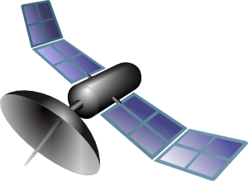
S P E C T E R
Preliminary Design Review
October 14th, 2021
ASEN-011 Team 9
Presenters
Gabriel Feldman, Sam Alvis, Vivien Blumofe, Zach Harris, Andrew Komitor, Ajay Dhindsa
Company Customer
L3Harris
Faculty Advisor
Professor John Mah
Additional Team Members
Hanna Galimanis, Nick Spens, Mary Hanson, Josef Michelson, Noah Avery

Slide 2
Table of Contents
Project Overview
Baseline Design
Enclosure Feasibility
Electronics Feasibility
Optics Feasibility
Image Processing Feasibility
Orbit Determination Feasibility
Algorithm Feasibility
Status Summary and Strategy
Appendix

Slide 3
Project Overview
Project Overview
Baseline Design
Feasibility of Design
Summary and Strategy

Slide 4
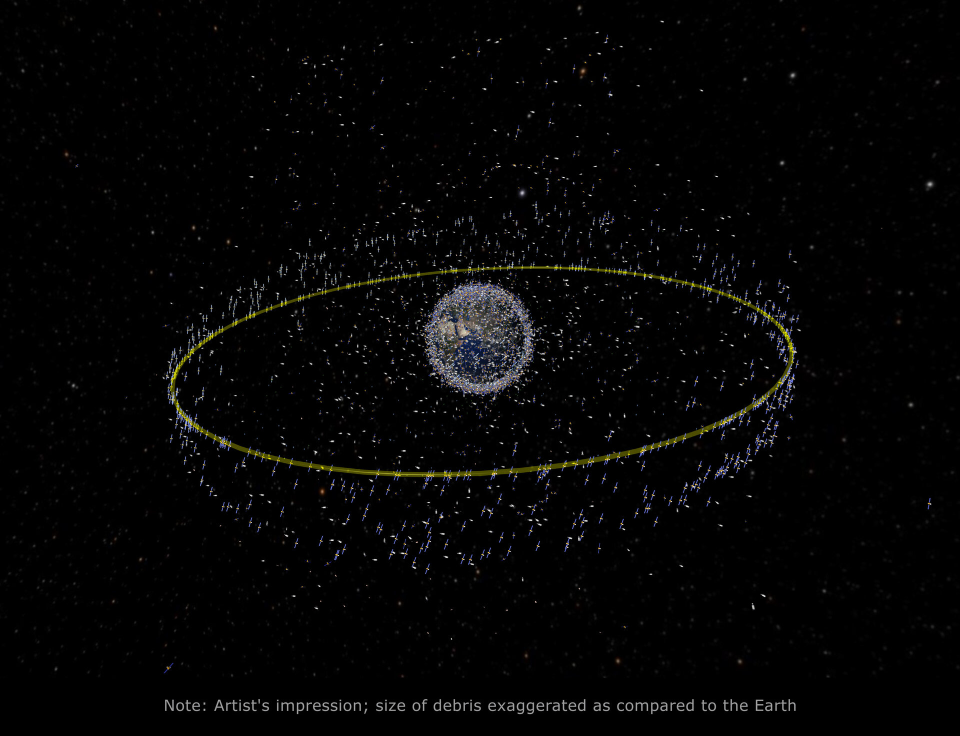
Motivation
Space situational awareness (SSA)
January 1st, 2021: Over 18,000 human made objects in Earth Orbit
Approximately 500 are in GEO
Geosynchronous Earth Orbit (GEO) holds critical satellites for communication, weather, and military purposes
Orbits with semi-major axis of roughly 42,000 km
Orbital Period of 1 day
Many unknown/unidentified satellites
GEO Visualization from esa.int
Project Overview
Motivation
Mission Statement
Key Terms
Objectives
CONOPS
FBD
Notes:
Riebeek, H.
“Catalog of earth satellite orbits”.
NASA.
https://earthobservatory.nasa.gov/features/OrbitsCatalog

Slide 5
Purpose & Mission Statement
Purpose: collect data on satellites in GEO and determine if a significant event has occurred or is imminent
Maneuvers
Close encounters between two or more satellites (including docking and collisions)
Breakups
The Satellite Position Estimation Collision Tracking & Event Recognition (SPECTER) mission will monitor satellite movements in geosynchronous orbit to provide space domain awareness.
Project Overview
Motivation
Mission Statement
Key Terms
Objectives
CONOPS
FBD

Slide 6
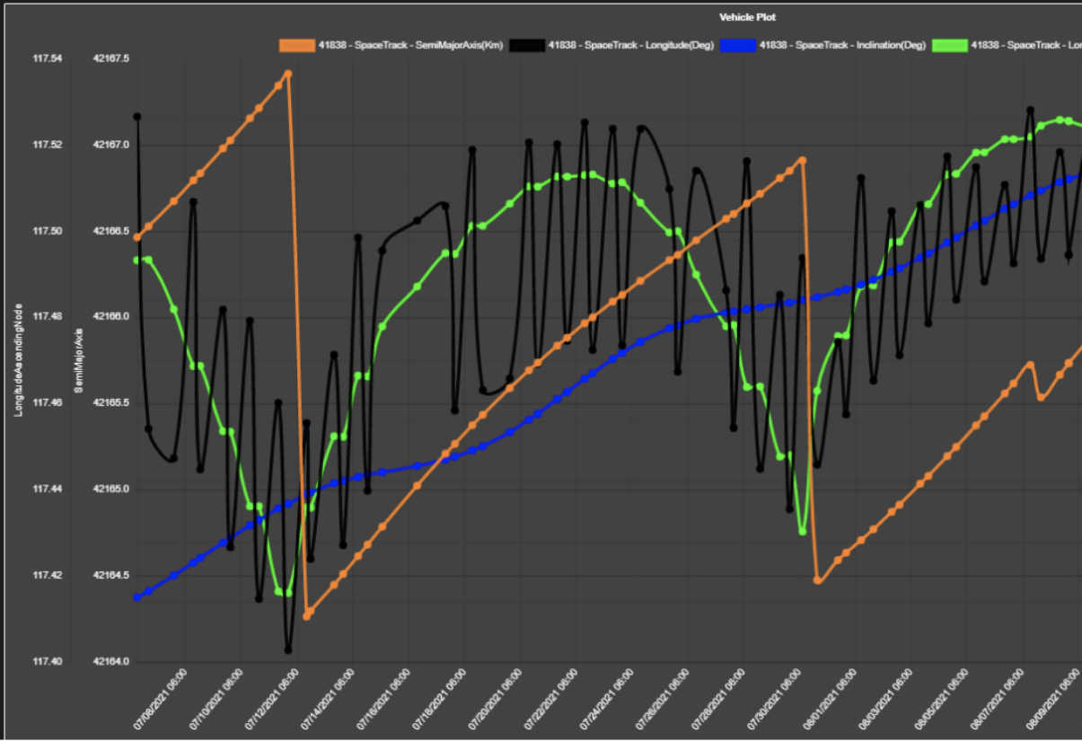
Key Terms
TLE: Two-Line (Orbital) Element Set
POL: Pattern of Life
Includes a satellite's position, velocity, light curve intensity and color data over time. Created from historical data categorizing satellite behavior.
L3Harris POL Plot Example
Time scale: ~1 month (07/08/2021 - 08/09/2021)
… = Semi-major axis [km]
… = Longitude [deg]
… = Inclination [deg]
… = Longitude Ascending Node [deg]
L3Harris, Project Introduction Presentation
Project Overview
Motivation
Mission Statement
Key Terms
Objectives
CONOPS
FBD

Slide 7
Objectives
Subsystem | Capability | Level 3 Success
Software - Algorithm | Detect Pattern of Life (POL) | Autonomously compare observed orbital behaviors against historical POLs, distinguish changes, and characterize events
Software - Data | Camera Data Collection and Storage | Camera subsystem sends data to cloud to be analyzed autonomously
Communication and Software | Tip and Cue | Autonomously send alerts based on recognized events
Mechanical - Enclosure | Enclosure for System | Enclosure autonomously responds to weather conditions
Electronics | Power | Power on camera subsystem autonomously
Project Overview
Motivation
Mission Statement
Key Terms
Objectives
CONOPS
FBD

Slide 8
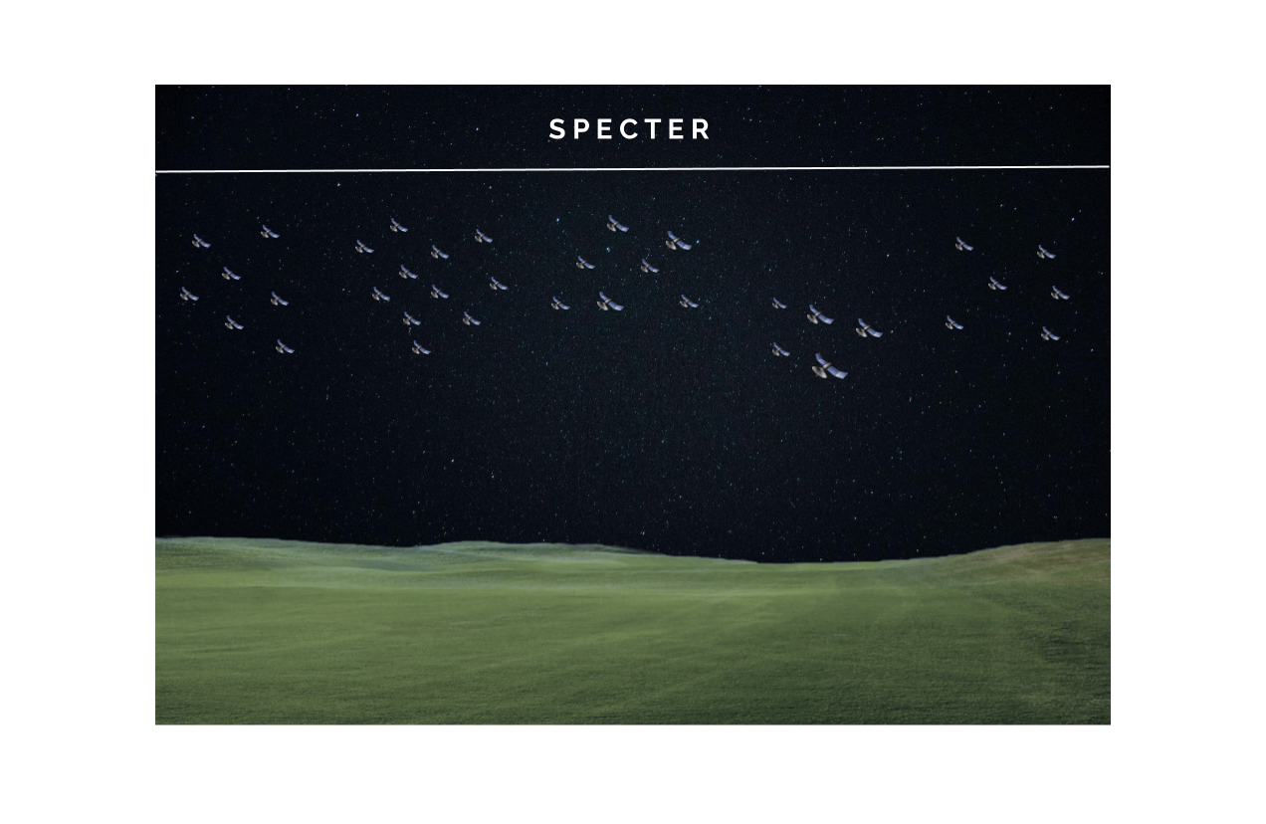
Concept of Operations
Project Overview
Motivation
Mission Statement
Key Terms
Objectives
CONOPS
FBD

Slide 9
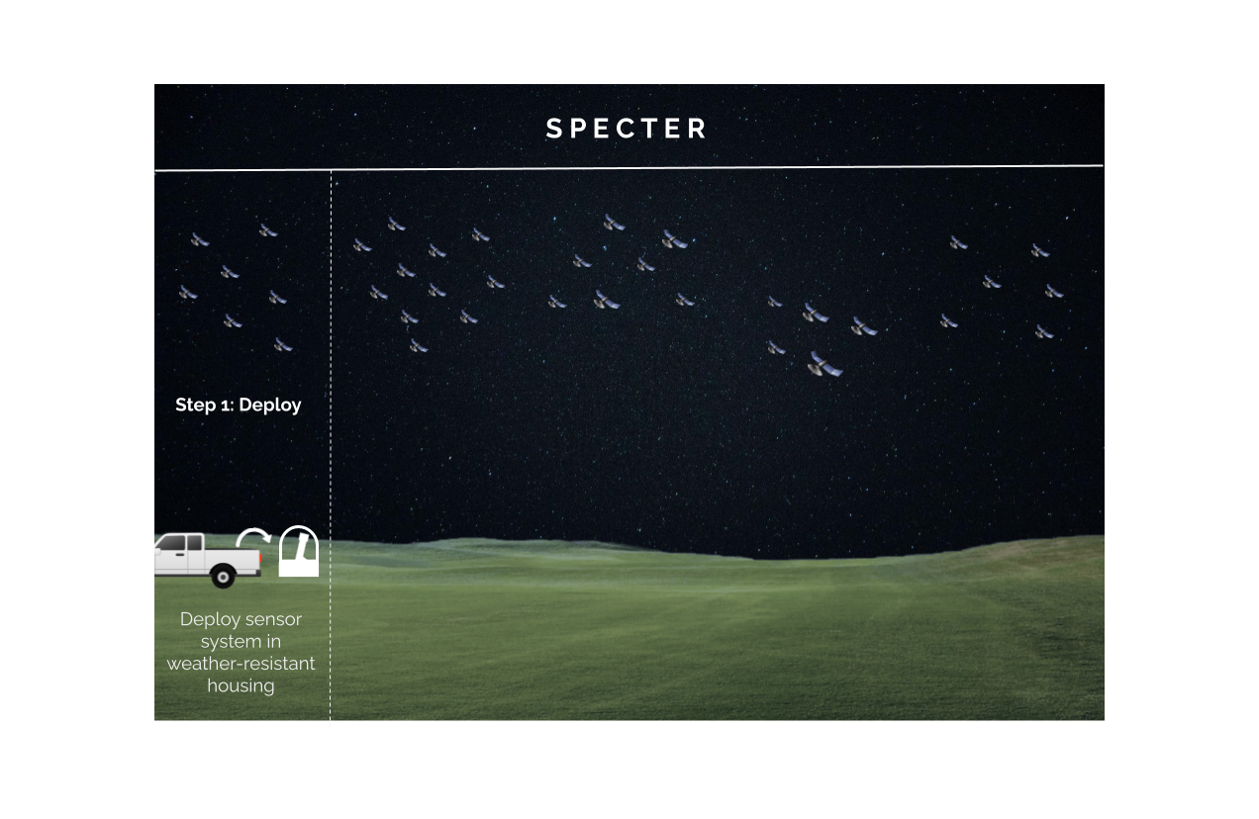
Concept of Operations - Step 1
Project Overview
Motivation
Mission Statement
Key Terms
Objectives
CONOPS
FBD

Slide 10
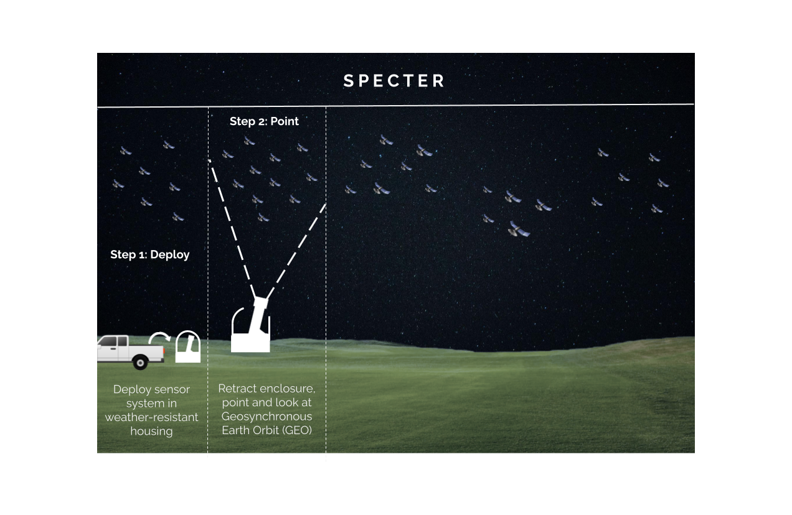
Concept of Operations - Step 2
Project Overview
Motivation
Mission Statement
Key Terms
Objectives
CONOPS
FBD

Slide 11
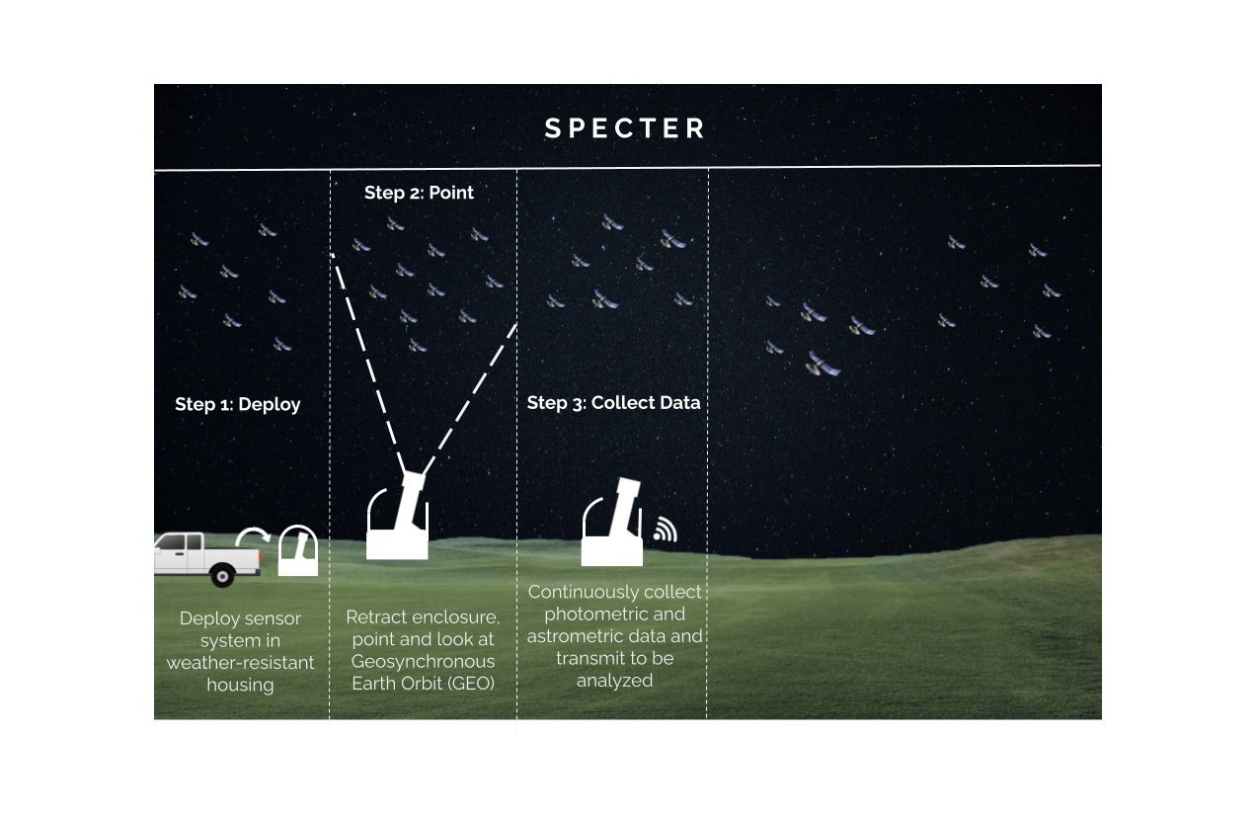
Concept of Operations - Step 3
Project Overview
Motivation
Mission Statement
Key Terms
Objectives
CONOPS
FBD

Slide 12
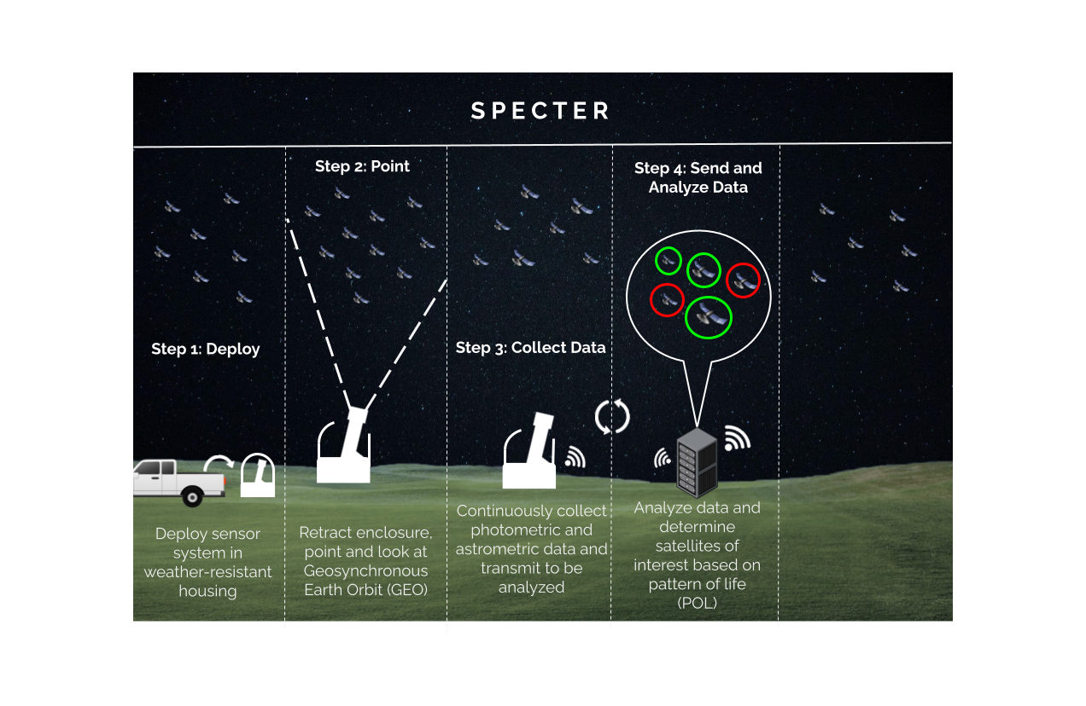
Concept of Operations - Step 4
Project Overview
Motivation
Mission Statement
Key Terms
Objectives
CONOPS
FBD

Slide 13
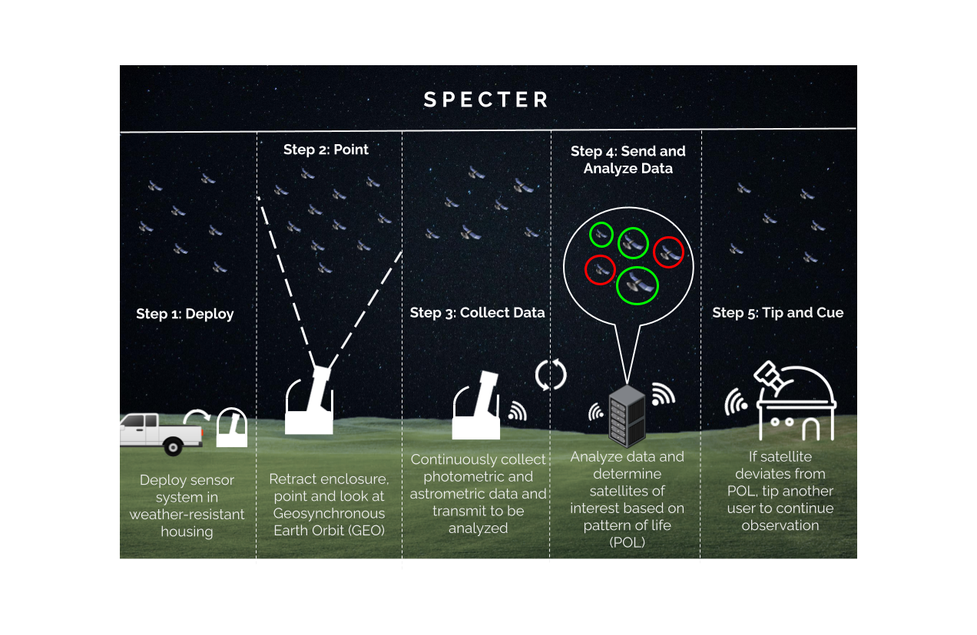
Concept of Operations - Step 5
Project Overview
Motivation
Mission Statement
Key Terms
Objectives
CONOPS
FBD

Slide 14
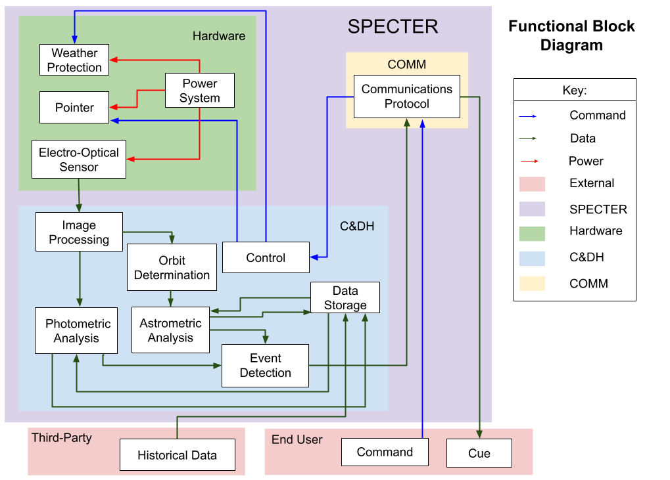
Functional Block Diagram
Project Overview
Motivation
Mission Statement
Key Terms
Objectives
CONOPS
FBD
Notes:
Also may want to remove pointer, if it’s not a part anymore
TRACE A PATH: (Command, Comm, Control, Weather Protection; Sensor, Processing, Orbit, AStro, ED, Comm, Cue

Slide 15
Baseline Design
Project Overview
Baseline Design
Feasibility of Design
Summary and Strategy

Slide 16
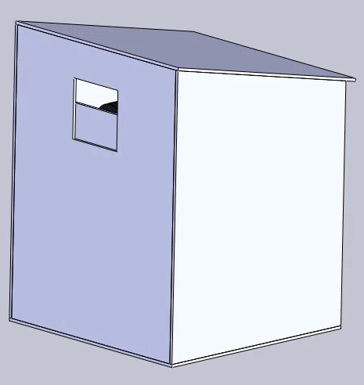
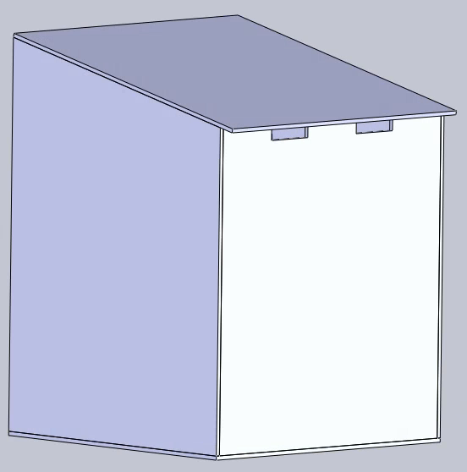
Baseline Design - Outside
Colored Opaque Acrylic
Vent Holes
24 inches
20 in.
Side View
18 inches
18 inches
Front View
Side View
Back View
Baseline Design
Data Flow Diagram
Critical Project Elements
Notes:
Flesh out, combine with project breakdown

Slide 17
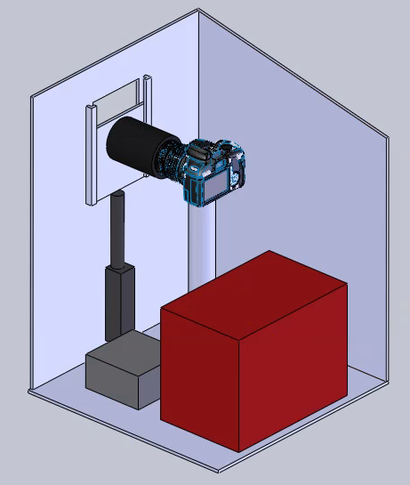
Baseline Design - Components
Lens
Brackets
Sensor/Camera
Sensor Mount
Linear Actuator
Sensor + lens approximate dimensions:
Length: 10.2 inches
Diameter: 3.6 inches
Battery
Electronics
Inside of Enclosure
Baseline Design
Data Flow Diagram
Critical Project Elements
Notes:
Flesh out, combine with project breakdown

Slide 18
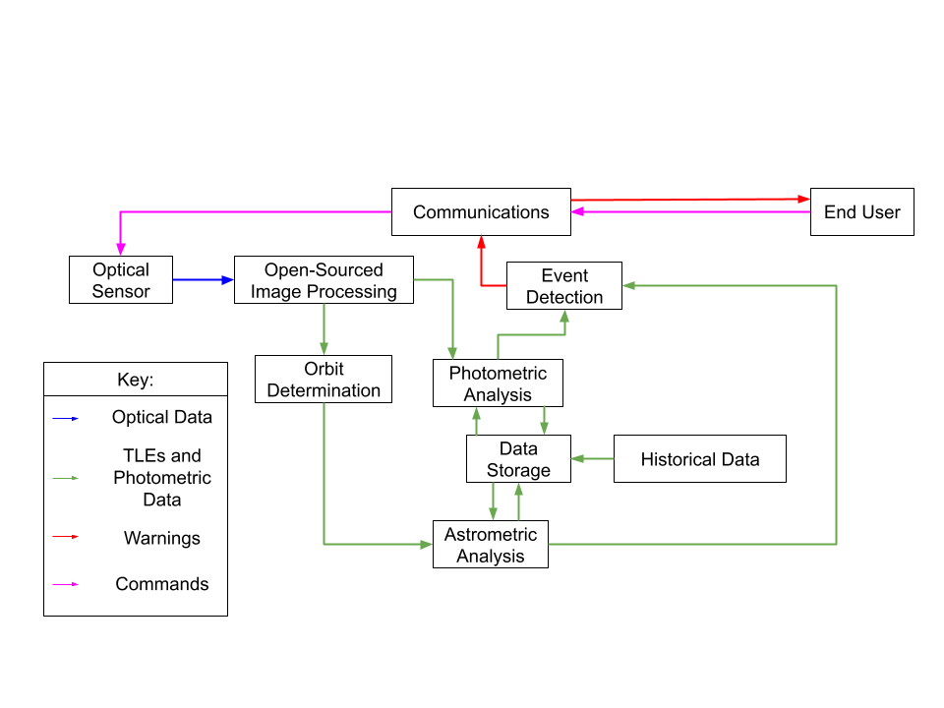
Data Flow Block Diagram
Baseline Design
Data Flow Diagram
Critical Project Elements

Slide 19
Critical Project Elements
CPE | Importance
1. Weather Protection | An enclosure is needed to protect the internal subsystems (optical and electronics) from IPX-1 elements
2. GEO Observation | SPECTER must be capable to observe satellites to facilitate data collection
3. Data Collection | Data collection is required for future POL comparison
4. POL Determination | POL’s are necessary to monitor for deviations from expectations
5. Comparison of Collected Data to Historical Data | The system must be able to use the astrometric and photometric data output from the image processing subsystem to compare to historical data.
6. Event Detection | To alert end users of a POL deviation, the SPECTER system must have the capability to detect the event.
7. Tip and Cue | The SPECTER system must be able to alert end users of POL deviations
Baseline Design
Data Flow Diagram
Critical Project Elements
Notes:
More description of elements, as well as the motivations listed here

Slide 20
Feasibility of Baseline Design
Project Overview
Baseline Design
Feasibility of Design
Summary and Strategy

Slide 21
Feasibility Overview
Feasibility Studied | CPE | Feasibility
Enclosure (weather protection) | 1 | ??
Electronics | 2-6 | ??
Image Processing | 3,4,5 | ??
Orbit Determination | 4,5 | ??
Optical Assembly | 2,3 | ??
Algorithm | 4,5,6 | ??
Notes:
Transfer green, yellow, red chart to here in initial unfilled out form

Slide 22
Enclosure Feasibility
Project Overview
Baseline Design
Feasibility of Design
Summary and Strategy

Slide 23
Enclosure Driving Requirements
FR 8 | An enclosure shall protect the camera and its associated electronic equipment.
DR 8.1 | The enclosure shall maintain a moisture level below IPX-1, where IPX-1 is defined as water resistance against drops of water falling vertically.
DR 8.2 | The enclosure shall provide solar protection during the day.
Driving Requirements
Enclosure Characteristics
Door Actuation

Slide 24
Enclosure Characteristics
Material
Colored Acrylic (waterproof)
Weather and Sun Protection
Passive
Slanted roof to prevent water pooling
IPX-1 protection is from vertical dripping water, so enclosure does not need to be fully watertight
Colored acrylic to shield from sunlight
Autonomous
Connection to weather app for sunrise/sunset times, rain
If rain is predicted, the enclosure will not open
If clear skies are predicted, cloud cover will be measured before the enclosure opens
IR thermometer to determine cloud cover
Cloudy skies are around 10°C warmer than clear skies
Cover
Linear actuator to slide cover behind window
Enclosure exterior
Driving Requirements
Enclosure Characteristics
Door Actuation

Slide 25
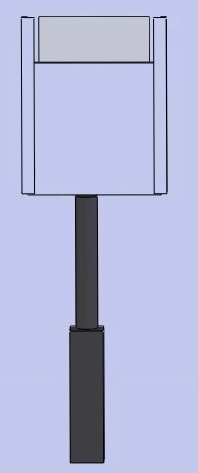
Door Actuation
Coefficient of Friction of Acrylic: 0.4-0.5
Weight of hole cover: 0.4 lbs
6x6 inch piece of acrylic with density of 0.043lb/cu. in
Force due to friction:
0.4*0.5 = 0.2 lbs needed
Linear actuator found can move up to 330 lbs
330 lbs > 0.6 lbs ✅
Linear actuator and door cover
Driving Requirements
Door Actuation
Driving Requirements
Enclosure Characteristics
Enclosure Characteristics

Slide 26
Electronics Feasibility
Project Overview
Baseline Design
Feasibility of Design
Summary and Strategy

Slide 27
Electronics Driving Requirements
FR 3 | Collected astrometric and photometric data shall be stored.
DR 3.1 | The system shall support storage of imported historical data and collected data.
FR 4 | The system shall be able to use the astrometric data output from the image processing subsystem to compare to historical data.
DR 4.5 | Collected astrometric data shall be processed by a processor within 5 minutes.
DR 5.3 | Collected photometric data shall be processed by a processor within 5 minutes.
Requirements
Location & Communication Analysis
Power Feasibility

Slide 28
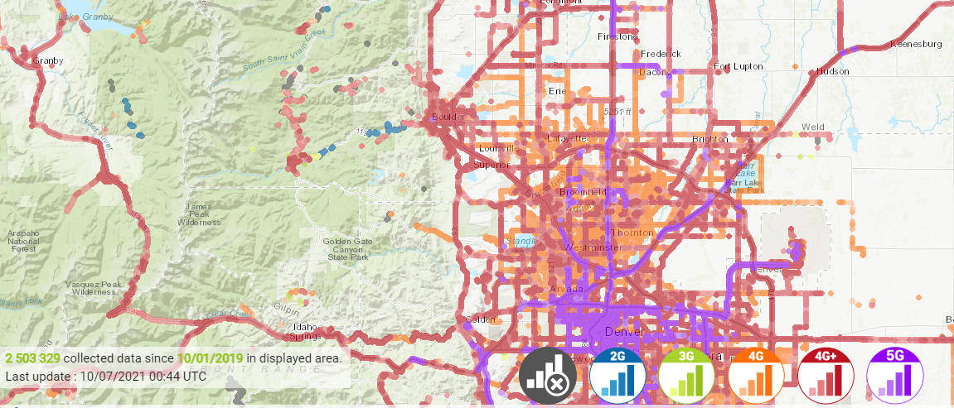
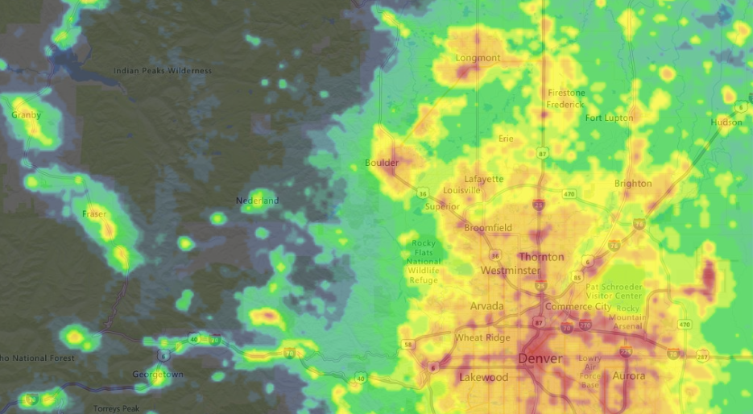
Location and Communication Analysis
Will need to upload data on order of kB
4G or 5G will meet these requirements
Data Coverage:
3G & Below - not widely available
4G - broad range, far outside of cities
5G - only in cities/densely populated areas
Light Pollution:
Naked Eye Limiting Magnitude (NELM)^{[7]}
NELM ~ 7
In suburban sky, NELM ~ 5
Telescope limit of ~ 14 (see optics feasibility)
In suburban sky, limit would be reduced to ~12
Too low for GEO satellite observations!
Verizon Coverage around Boulder [10]
Light Pollution Map [11]
Requirements
Location & Communication Analysis
Power Feasibility
Notes:
Need to explain why this requirement is here, first! (4g, 5 Mbit, light pollution)
Must list

Slide 29
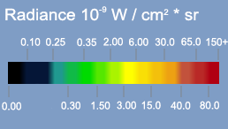
Location and Communication Analysis
Denver
Boulder
Boulder
Denver
Denver
Needs 4G coverage, low light pollution
Also proximity to Boulder
Candidate Spots: Lyons, Nederland
Nederland
Lyons
Requirements
Location & Communication Analysis
Power Feasibility
Notes:
Need to explain why this requirement is here, first! (4g, 5 Mbit, light pollution)
Must list

Slide 30
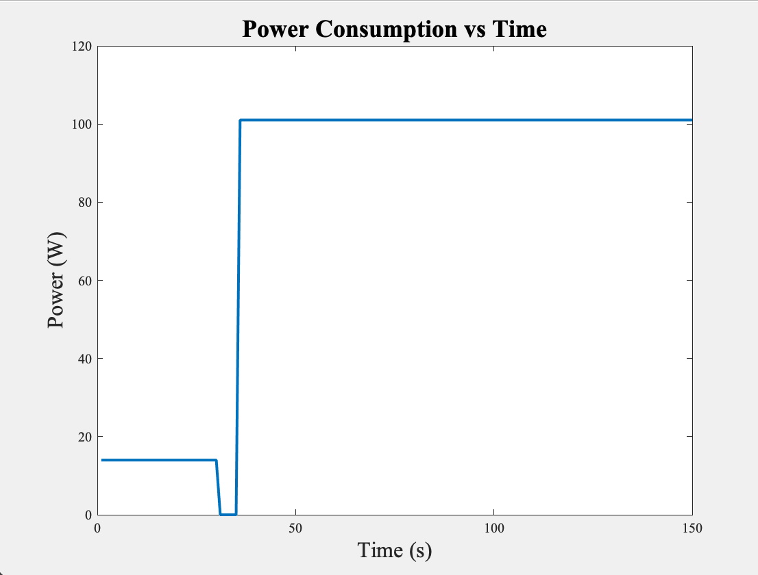
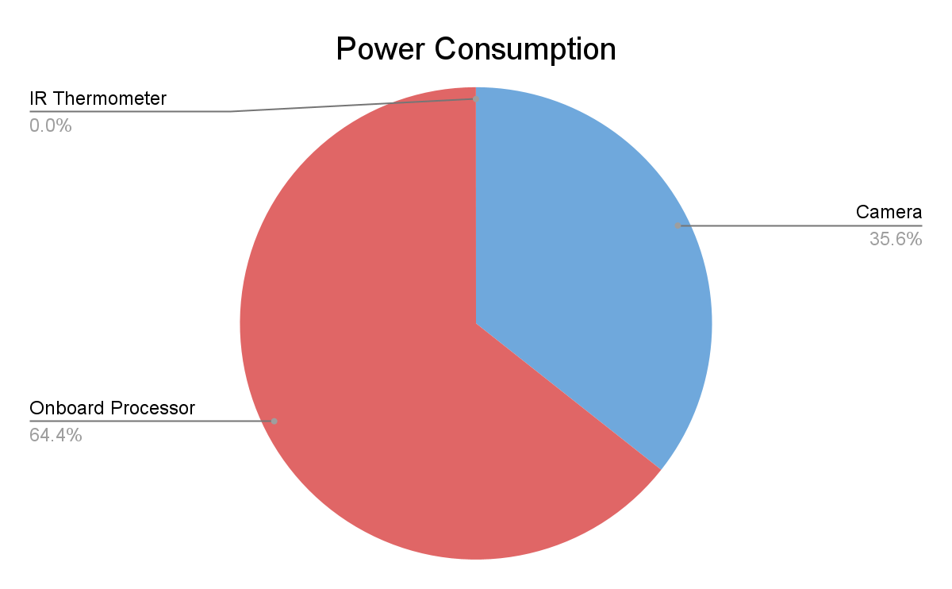
Power Feasibility
Opening Cover
Linear actuator
36 W max
Normal Operations
Onboard computer, camera, and IR thermometer
101.0075 W max
Battery
720 Wh
7.13 h (Worst Case)
Opening Cover
(Worst Case)
Normal Operations
(Worst Case)
Requirements
Location & Communication Analysis
Power Feasibility

Slide 31
Optics Feasibility
Project Overview
Baseline Design
Feasibility of Design
Summary and Strategy

Slide 32
Optics Driving Requirements
FR 1 | The system shall observe satellites in geosynchronous orbit
DR 1.1 | The camera subsystem shall point the camera with an accuracy that ensures the target satellite will be in the field of view
FR 3 | Collected astrometric and photometric data shall be stored
Driving Req.
LSM
Design Options
Optics
Lens
Summary

Slide 33
Limiting Stellar Magnitude (LSM)
Majority of GEO Satellites in range m = 11-14
Customer requires 13, 14-15 ideal
Aperture diameter (D) most important for urban areas
Assumptions:
Optical System is in ‘stare’ mode thus relative velocity is (⍵) = velocity of Satellite
GEO Satellites have circular orbits
Satellites treated as spheres
GEO Satellites
Sun
Full Moon
Naked
Eye Limit
-30
-25
-20
-15
-10
-5
0
5
10
15
20
25
Apparent Magnitude ( m_{v} )
13 <
[3] Coder, Holzinger, 2016)
Driving Req.
LSM
Design Options
Optics
Lens
Summary
Notes:
Better explain, use < to highlight values versus goal. Greater than
Equation too dense?

Slide 34
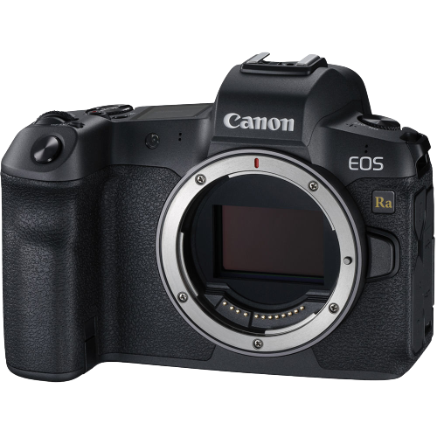
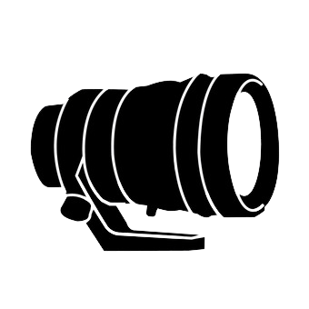
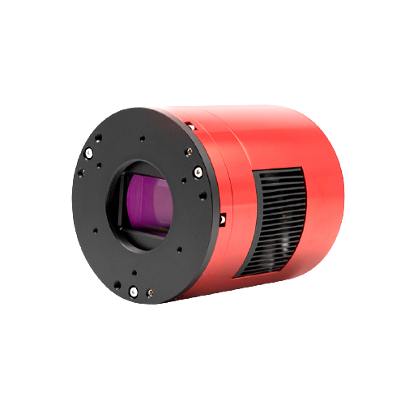
Design Options
Canon EOS Ra + TBDmm f/TBD = TBD LSM
ZWO ASI2600Mc + TBD mm f/TBD = TBD LSM
?
+
=
Canon, EOS Ra
?
+
=
ZWO, ASI2600MC Pro (color)
Driving Req.
LSM
Design Options
Optics
Lens
Summary

Slide 35
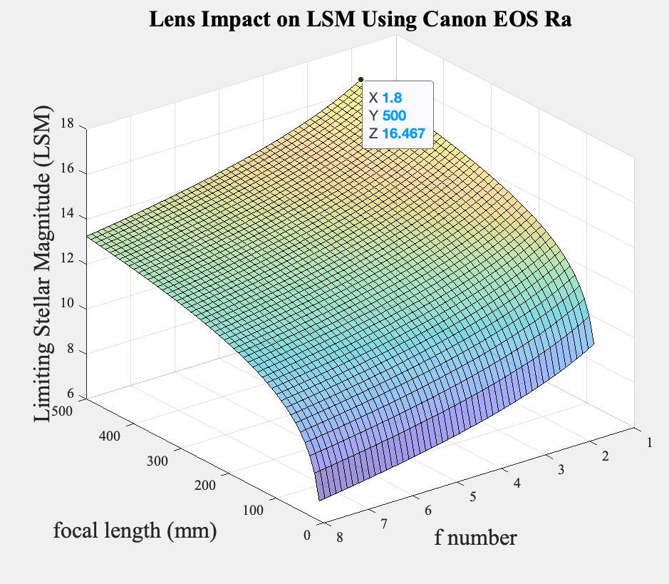
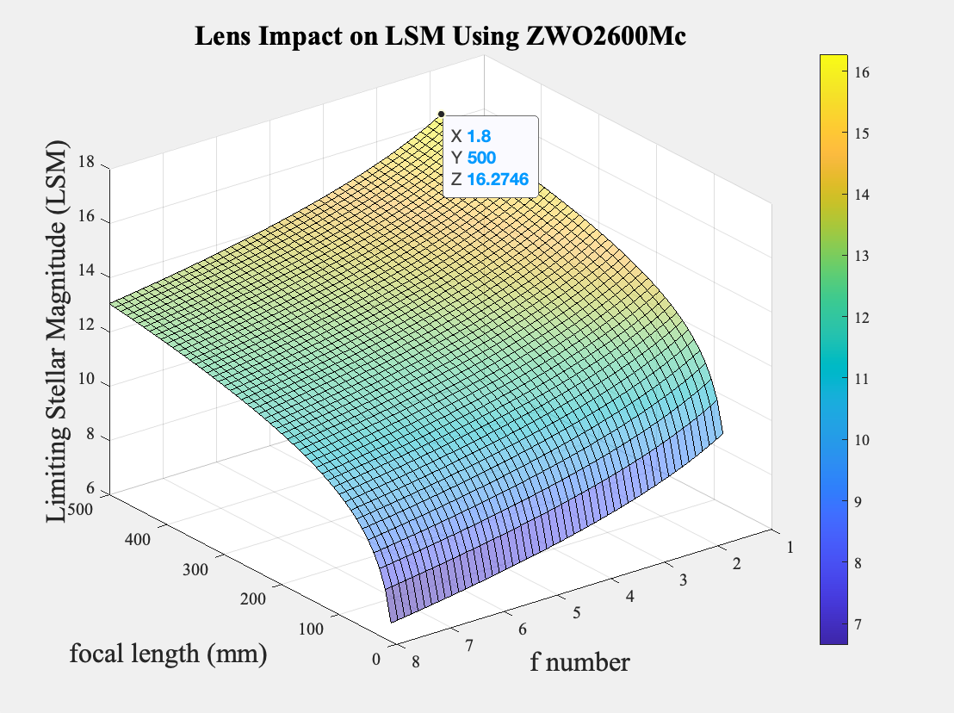
Optic Options in Consideration
Driving Req.
LSM
Design Options
Optics
Lens
Summary

Slide 36
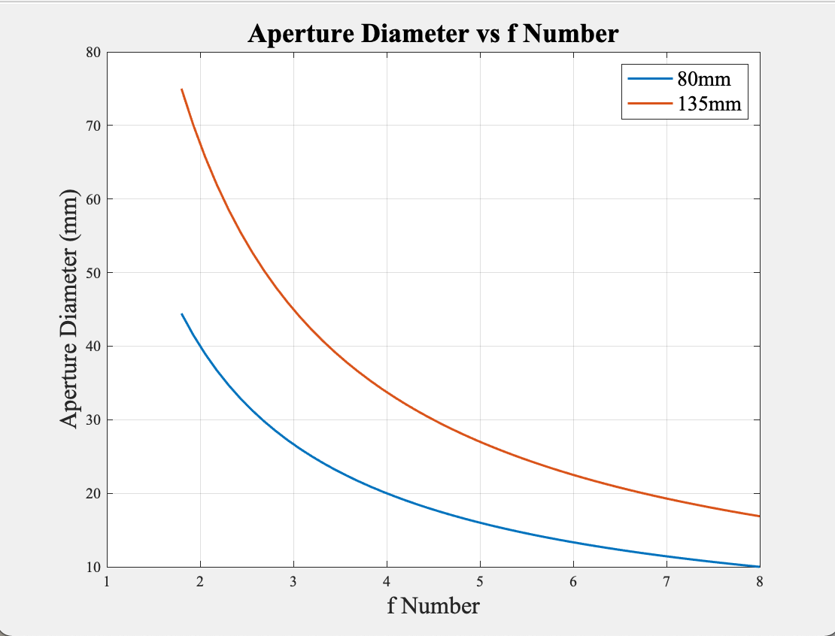
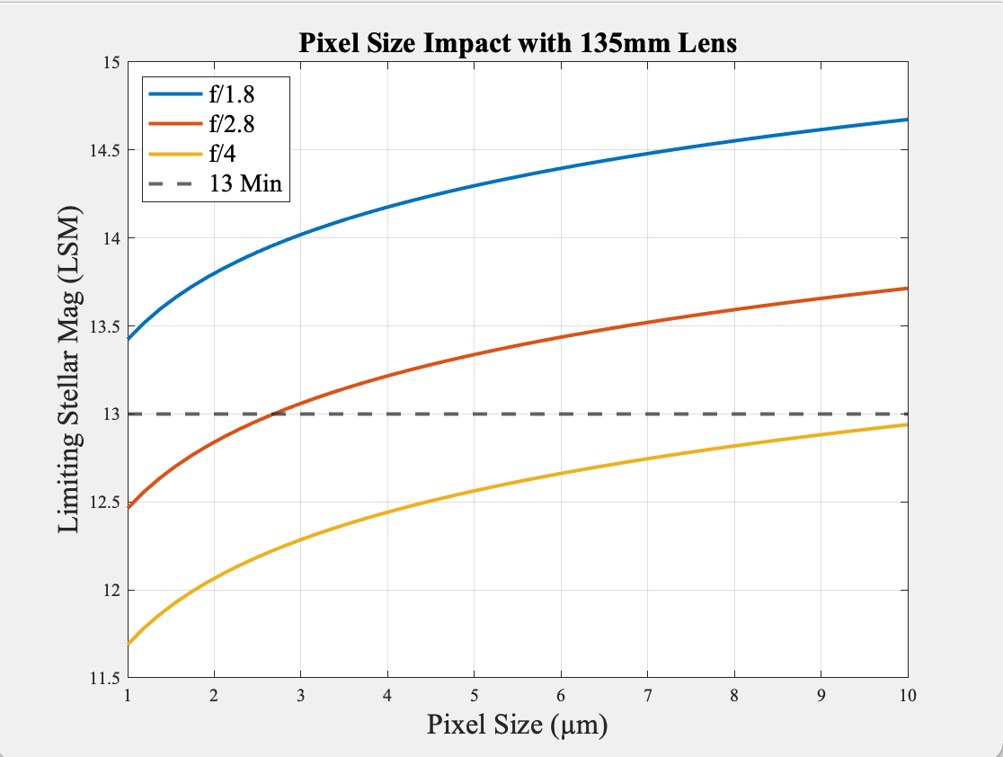
Lens & Sensor Selection
Driving Req.
LSM
Design Options
Optics
Lens
Summary
Notes:
Not enough info to stand alone
Line at 13, shade the good section
Add in 13 minimum (or maximum?) requirement

Slide 37
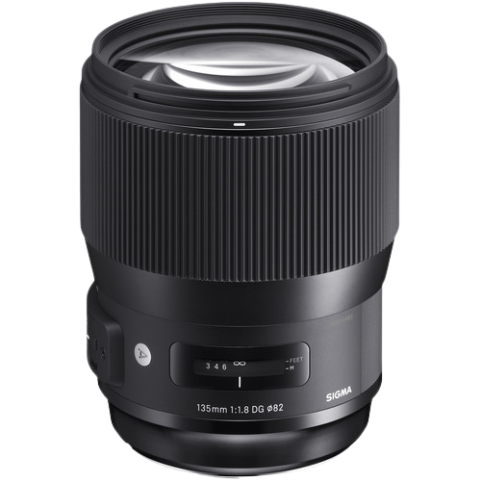
Summary: Optical Feasibility
Canon EOS Ra + Sigma 135mm f/1.8 = 14.335 LSM
ZWO ASI2600Mc + Sigma 135mm f/1.8 = 14.142 LSM
Both systems feasible for detecting GEO satellites
✅
+
=
Canon, EOS Ra
BH Photo Video, Sigma 135mm f/1.8 DG HSM Art Lens
✅
+
=
ZWO, ASI2600MC Pro (color)
BH Photo Video, Sigma 135mm f/1.8 DG HSM Art Lens
Driving Req.
LSM
Design Options
Optics
Lens
Summary

Slide 38
Image Processing Feasibility
Project Overview
Baseline Design
Feasibility of Design
Summary and Strategy

Slide 39
Image Processing Driving Requirements
FR 4 | The system shall be able to use the astrometric data output from the image processing subsystem to compare to historical data.
FR 5 | The system shall be able to use the photometric data output from the image processing subsystem to compare to historical data.
DR 5.3, DR 4.5 | Collected data shall be processed by a processor within 5 minutes.
Requirements
IPF 1
IPF 2
IPF 3
Astrometry.net Output

Slide 40
Image Processing Feasibility
t_{n-1}
Sensor Image
Astrometry.net
RA_{n-1}/Dec_{n-1}
+
t_{n}
Sensor Image
Astrometry.net
RA_{n}/Dec_{n}
=
GEO Satellites
Requirements
IPF 1
IPF 2
IPF 3
Astrometry.net Output
Notes:
Too fast! combine!

Slide 41
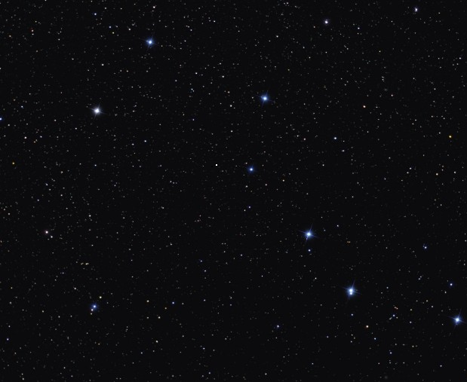
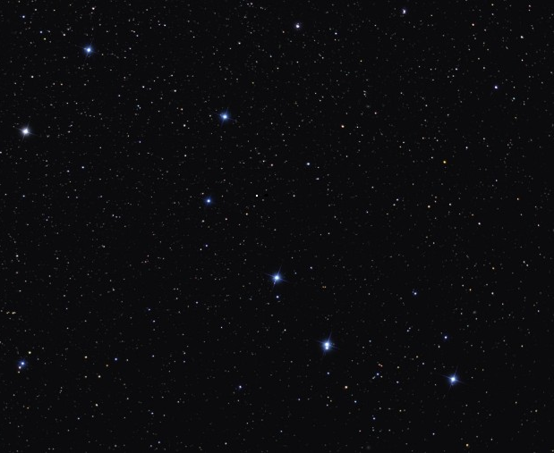
Image Processing Feasibility
Image at t_{n-1}
Image at t_{n}
Requirements
IPF 1
IPF 2
IPF 3
Astrometry.net Output

Slide 42
Image Processing Feasibility
Image at t_{n-1}
Image at t_{n}
Requirements
IPF 1
IPF 2
IPF 3
Astrometry.net Output
Notes:
What’s going on here?

Slide 43
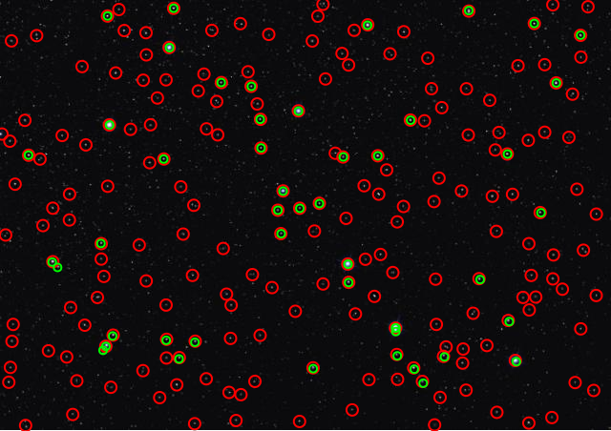
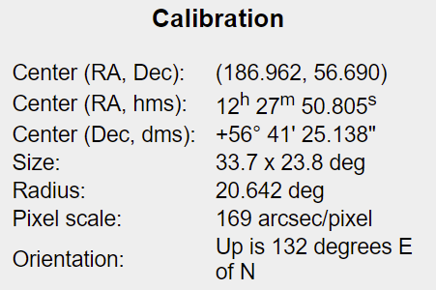
Astrometry.net Output
: Star
: Star with location known
(nova.astrometry.net)
Requirements
IPF 1
IPF 2
IPF 3
Astrometry.net Output
Notes:
Mention astrometry.net gives location data but not satellite data without extra processing done by us.

Slide 44
Orbit Determination Feasibility
Project Overview
Baseline Design
Feasibility of Design
Summary and Strategy

Slide 45
Orbit Determination Driving Requirements
FR 6 | The software subsystem shall have the capability to detect an event.
DR 6.1 | The software subsystem shall have the capability to predict a close approach between two satellites.
DR 6.1.1 | Once a potential satellite close approach is identified the system will extrapolate how long it will take until the two objects are at their closest point.
DR 6.1.2 | The satellite close approach shall be detected when satellites are within a 25 km range.
DR 6.1.3 | The time prediction for a satellite close approach shall be detected within a 5 km margin of error.
Requirements
ODTK Use Cases
Angle Estimation
Gooding Method

Slide 46
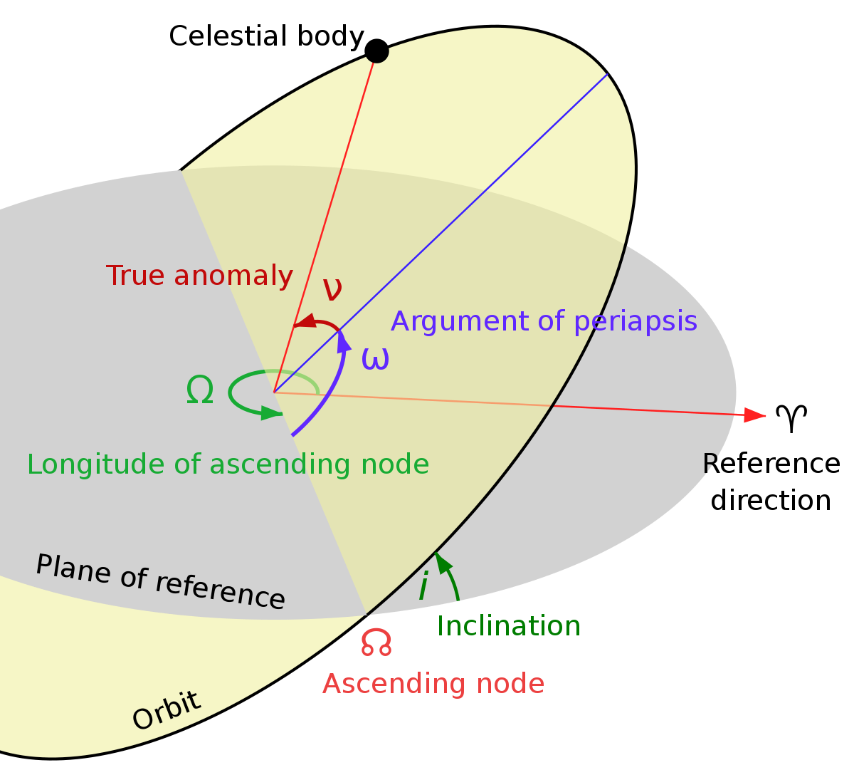
Orbit Determination Feasibility - ODTK Use Cases
Determine TLE (Two Line Element) of satellite given angle measurements
Inputs: Angle measurements from Imaging System
Outputs: TLE (Two Line Element)
a - Semi-Major Axis e - Eccentricity 𝜈 - True Anomaly i - Inclination Ω - Right Ascension of Ascending Node 𝜔 - Argument of Periapsis
Predict close approach between two satellites
Inputs: Two Satellites NORAD-ID’s
Outputs: Prediction of two objects being within 25km of each other
How long until the two objects are at the closest point
5km error margin on distance prediction
Illustration Via Wikipedia
Requirements
ODTK Use Cases
Angle Estimation
Gooding Method
Notes:
Bold ideal parameters
Point out ideal ones on chart?

Slide 47
Astrometry.net Angle Estimation
Method of Angle Determination from Ground Station
Given:
Center of Image (RA, Dec)
Pixel Scale (169 arcsec/pixel)
Use algorithm to convert pixel coordinates to RA/Dec angle pairs of satellites.
Requirements
ODTK Use Cases
Angle Estimation
Gooding Method

Slide 48
ODTK Equations and Assumptions: Gooding Method
Assumption: Two-Body Problem
Inputs:
Requires 3 distinct pairs of 2-angle measurements.
Right Ascension & Declination (𝛼_{j} , 𝛿_{j})
Azimuth & Elevation (𝜍_{j}, 𝜂_{j})
Time between each measurement
Location of site where the measurements were taken
Outputs:
Position Vector of Satellite, r₂
Velocity Vector of Satellite, v₂
ODTK Function: GoodingIOD
Input (𝛼₁ , 𝛿₁) (𝛼₂ , 𝛿₂) (𝛼₃ , 𝛿₃)
Output [r₂ ] [v₂]
Requirements
Gooding Method
Requirements
ODTK Use Cases
Angle Estimation
Notes:
Equations? Just input to output feels weird

Slide 49
Algorithm Feasibility
Project Overview
Baseline Design
Feasibility of Design
Summary and Strategy

Slide 50
Algorithms Driving Requirements
FR 2 | The software subsystem shall determine the POL of satellites in geosynchronous orbit from historical data.
FR 4 | The system shall be able to use the astrometric data output from the image processing subsystem to compare to historical data.
FR 5 | The system shall be able to use the photometric data output from the image processing subsystem to compare to historical data.
FR 6 | The software subsystem shall have the capability to detect an event.
Requirements
Algorithms Flow Chart
Algorithms Machine Learning

Slide 51
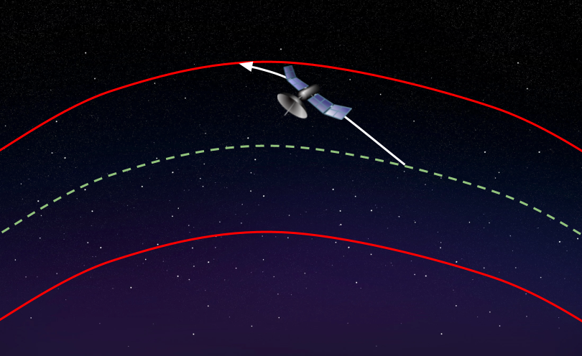
Algorithms Flowchart
Image Processing Output
Maximum &
Minimum Allowable Values
Pattern Recognition,
Object Classification, Convolutional Techniques
Thresholding
POL Estimation
Machine Learning
Statistical Analysis
Nominal Position, Velocity,
Light Intensity, Color Data
Mean, Variance
Deviation
Yes
Send Alert
No
Store Data
Requirements
Algorithms Flow Chart
Algorithms Machine Learning
Notes:
We will take two images
How confidence??? Metric?
Visualize threshold?
P(detected) = P(detected | occured) + P(detected | !occured)
^? ^tied to confidence ^false positive

Slide 52
Algorithms Machine Learning
Model Visualization
Nominal State
Astrometric Input Data
Close Approach
Two-Line Elements
Photometric Input Data
Classification
Maneuver
Visual Magnitude/Color Data
Additional Input Data
Docking
Raw Image Data
Collision
Input Layer
Hidden Layer(s)
Output Layer
Requirements
Algorithms Flow Chart
Algorithms Machine Learning
Notes:
Say this: 70% of data will be training, 30% of data will be testing in terms of historical data
TensorFlow: intuitive high-level API, lets developers easily build and deploy ML powered applications.

Slide 53
Status Summary and Strategy
Project Overview
Baseline Design
Feasibility of Design
Summary and Strategy

Slide 54
Feasibility Summary
Feasibility Studied | CPE | Status
Weather Protection | 1 | Feasibility Confirmed
Power | 2-6 | Feasibility Confirmed (Pending Battery Life)
Optical System | 3,4,5 | Feasibility Confirmed
Orbit Determination | 4,5 | Feasibility Confirmed
Image Processing | 2,3 | Feasibility Confirmed
Algorithm | 4,5,6 | Feasibility Confirmed
Feasibility Summary
Budget & Finance
Future Work
Acknowledgements

Slide 55
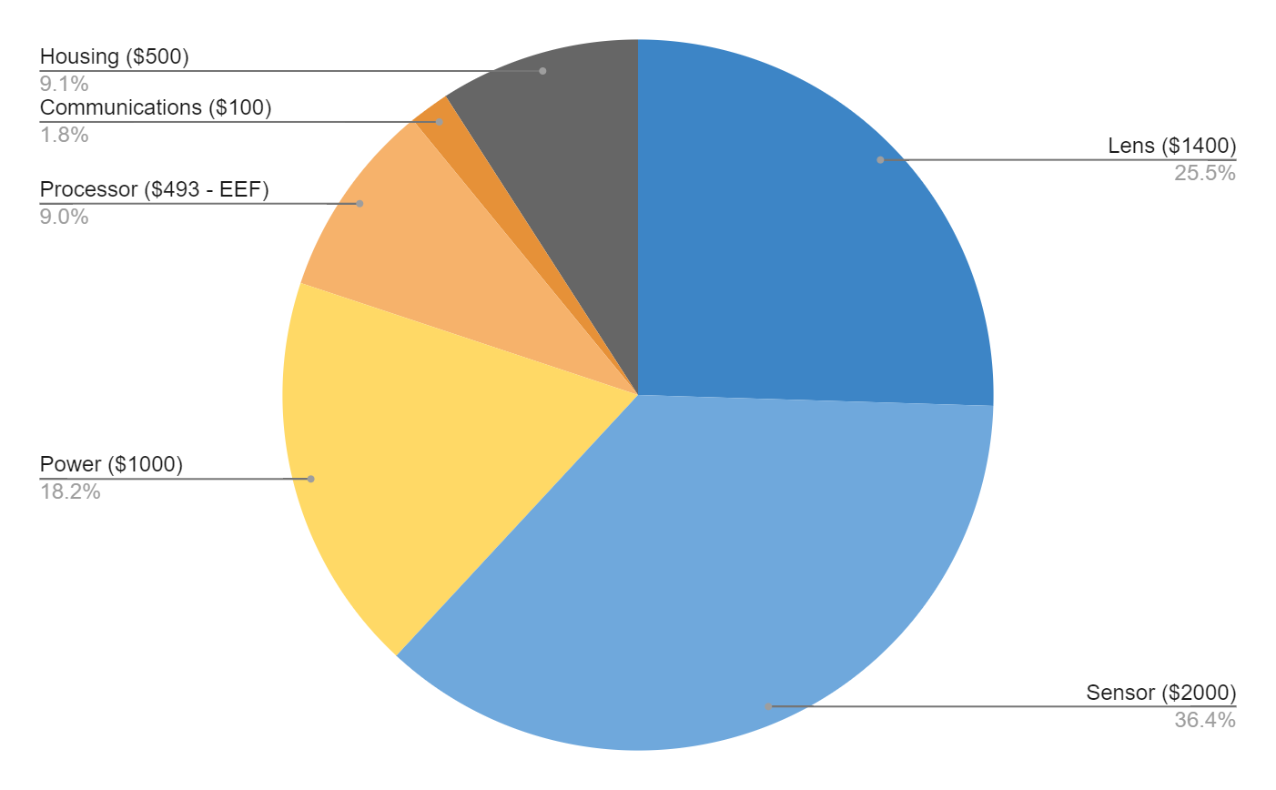
Budget & Finance
$5000 from Aerospace Department
Covers optics, supporting electronics, housing.
$493 from EEF
Covers processor
Lens and Sensor are large (and unavoidable) money sinks
Power is costly due to needed battery life
Processor needed for image processing
Reduces data transmission to just astrometric and photometric data
Sending whole images would be too slow
Feasibility Summary
Budget & Finance
Future Work
Acknowledgements
Notes:
Pie chart budget, overview by subsystem
Send to backup (not if funding is close, or EEF is key!)

Slide 56
Timeline/Future Work
Hardware
Enclosure
Thermodynamic considerations
Finalize Design - Before CDR
Optical
Select Sensor
Select Lens Brand
Determine adapter requirements
Software
Processing
Develop a working local Astrometry.net code
Orbit Determination
Develop accurate method of angle estimation
Automate usage of ODTK
Implement Kalman Filter
Analysis
Develop thresholding and statistical analysis software
Write/train the machine learning event detection system
Feasibility Summary
Budget & Finance
Future Work
Acknowledgements

Slide 57
Acknowledgements
L3Harris
Edward T. Brown
Advisors
Professor Mah
Dr. Jelliffe Jackson
Dr. Kathryn Wingate
Dr. Holzinger
Dr. Coder
Teaching Assistants
Emma Markovich
Colin Claytor
Feasibility Summary
Budget & Finance
Future Work
Acknowledgements

Slide 58
Questions?

Slide 59
Appendix

Slide 60
Appendix Table of Contents
Organization
Electronics
Optics
Orbital Determination
Enclosure
Mount
Algorithm

Slide 61
Organization

Slide 62
References
[1] Astrometry.net: https://iopscience.iop.org/article/10.1088/0004-6256/139/5/1782
[2] Lockheed Martin Probabilistic Assessment of Space Threats (PAST): https://amostech.com/TechnicalPapers/2019/Machine-Learning-for-SSA-Applications/DiBona.pdf
[3] Coder, R. D. & Holzinger, M. J. (2016), “ Multi-objective design of optical systems for space situational awareness,” Acta Astronautica, 128, 669–684. https://doi.org/10.1016/j.actaastro.2016.07.008
[4] MLX90614 IR Thermometer Datasheet. https://www.sparkfun.com/datasheets/Sensors/Temperature/SEN-09570-datasheet-3901090614M005.pdf
[5] Night Radiative Cooling. https://asterism.org/wp-content/uploads/2019/03/tut37-Radiative-Cooling.pdf
[6] Clouds Energy Budget https://mynasadata.larc.nasa.gov/mini-lessonactivity/analyzing-cloud-effects-earths-energy-budget-student-activity
[7] Wikipedia: https://en.wikipedia.org/wiki/Bortle_scale
[8]Astrometry.net: http://nova.astrometry.net/
[9] Linear actuator: https://www.amazon.com/ECO-WORTHY-Actuator-Maximum-Mounting-Brackets/dp/B00NM8H5VO/ref=sr_1_4?_encoding=UTF8&c=ts&dchild=1&keywords=Linear+Motion+Actuators&qid=1633542200&s=industrial&sr=1-4&ts_id=350654011
[10] Verizon Coverage around Boulder: https://www.nperf.com/en/map/US/5574991.Boulder/3255.Verizon-Wireless/signal/
[11] Light Pollution Map: https://www.lightpollutionmap.info/#zoom=7.67&lat=40.1837&lon=-105.1400&layers=B0FFFFFFTFFFFFFFFFF
[12] Geostationary Ring: https://www.esa.int/ESA_Multimedia/Images/2008/03/The_geostationary_ring
[13] Orbital Elements: https://en.wikipedia.org/wiki/Argument_of_periapsis#/media/File:Orbit1.svg
[14] Gooding’s Method: https://link.springer.com/content/pdf/10.1007/BF00049379.pdf
[15] Comparison of Method: https://conference.sdo.esoc.esa.int/proceedings/sdc8/paper/129/SDC8-paper129.pdf
[16] Modified Gooding: https://www.researchgate.net/publication/254199485_Modifications_to_the_Gooding_Algorithm_for_Angles-Only_Initial_OrbitDetermination
[17] Batch Filtering: https://www.sciencedirect.com/science/article/pii/S0898122113004471
[18] Kalman Filtering: https://vtechworks.lib.vt.edu/bitstream/handle/10919/49102/Keil_EM_T_2014.pdf?sequence=1
[19] Kalman Filtering: https://arxiv.org/ftp/arxiv/papers/1609/1609.05225.pdf
[20] AGI: https://help.agi.com/odtk/LinkedDocuments/GoodingAnglesOnly.pdf
[21] AGI: https://help.agi.com/stk/11.0.1/Content/stk/importfiles-11.htm
[22] Pixel Coordinate Transformation: https://www.aanda.org/articles/aa/pdf/2002/45/aah3860.pdf

Slide 63
Objectives
Subsystem | Capability | Level 1 | Level 2 | Level 3
Software - Algorithm | Detect Pattern of Life (POL) | Compare observed orbital behavior against historical POLs - inclination, semi-major axis, direction of burn, frequency of burn, brightness, and RGB value | Autonomously Distinguish POL change | Autonomously Characterize Events
Software - Data | Camera Data Collection and Storage | Camera subsystem stores data on hard drive to be physically collected and analyzed manually | Camera subsystem sends data to cloud to be downloaded and manually inputted to algorithm and analyzed | Camera subsystem sends data to cloud to be analyzed autonomously
Communication and Software | Tip and Cue | Manually send alerts to the end user based on POL deviations | The same as level 1 | Autonomously send alerts based on recognized events
Mechanical - Enclosure | Enclosure for System | Cover for the camera and lens | Enclosure with weather and sun resistance | Enclosure autonomously responds to weather conditions
Electronics | Power | Manually power on camera subsystem | Power on camera subsystem remotely | Power on camera subsystem autonomously

Slide 64
Team Structure
Gabriel Feldman
Project Manager
Noah Avery
Systems Lead
Sam Alvis
Finance Lead
Hanna Galimanis
Zach Harris
Gabriel Feldman
Gabriel Feldman
Mary Hanson
Design Lead
Josef Michelsen
Electronics Lead
Vivien Blumofe
Manufacturing Lead
Hanna Galimanis
Testing Lead
Sam Alvis
Vivien Blumofe
Sam Alvis
Nick Spens
Zach Harris
Noah Avery
Andrew Komitor
Mary Hanson
Sam Alvis
Vivien Blumofe
Mary Hanson
Nick Spens
Controls Lead
Andrew Komitor
Algorithms Lead
Ajay Dhindsa
Astrodynamics Lead
Zach Harris
Data Flow Lead
Zach Harris
Ajay Dhindsa
Andrew Komitor
Vivien Blumofe
Nick Spens
Josef Michelsen
Gabriel Feldman
Vivien Blumofe
Hanna Galimanis
Nick Spens
Josef Michelsen
Andrew Komitor
Ajay Dhindsa
Noah Avery

Slide 65
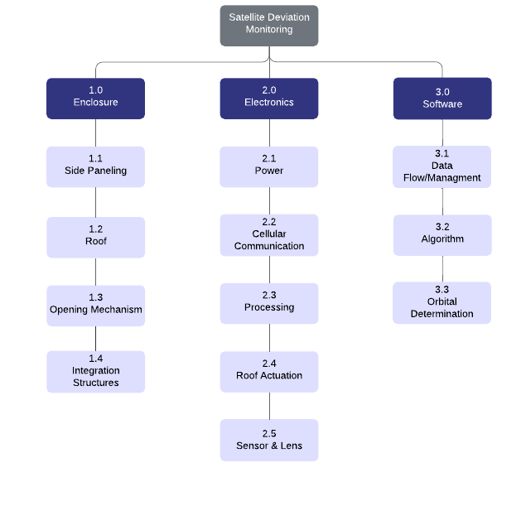
Project Breakdown Structure
Notes:
Combine with 13 and 14

Slide 66
Electronics

Slide 67
Power Feasibility
Power Usage | Voltage Difference (VDC) | Average Power Required (W) | Maximum Required Power (W)
Linear Actuator | 12 | 9.6 | 36
Onboard Computer | 19 | Variable | 65
Camera | 12 | 5.75 | 36
IR Thermometer | 5 | 0.0075 | 0.0075
Total | 36 | Variable | 101.0075 < Max Available Power
Power Source | Voltage Difference (VDC) | Voltage Difference (VAC) | Power (Wh) | Worst Case Total Run Time (h)
Ecoflow River | 20,13.6, 2x5 | 3x120 | 720 | 7.13
Notes:
Table, not list
Power, voltage, name, etc.
State W < W_max
Fix graph, label levels, make the lower voltage time more visible (Also should be W not V??)

Slide 68
Processor Feasibility
Requirement | Description | Feasibility
Data storage | 64 Gb of storage >~50 Gb required | Feasible
Processing Power | Wraith and Ghost tested on a 2.9 Ghz processor with processing times of ~10 seconds<Our 3.6 Ghz processor | Feasible

Slide 69
Temperature considerations
Operating Temperatures
Linear Actuator: -26 to +65 C
Power Source: -20 to 45 C
Onboard Computer: 0 to +50 C
Sensor: - 5 C to 50 C
Average Environmental Temp: (March)
Nederlands: 6 / -9 ˚C
Lyons: 13 / 2˚C
Will need to analyze weather data to determine optimal testing days
Days with no precipitation
Clear Days (little to no clouds)

Slide 70
Optics

Slide 71
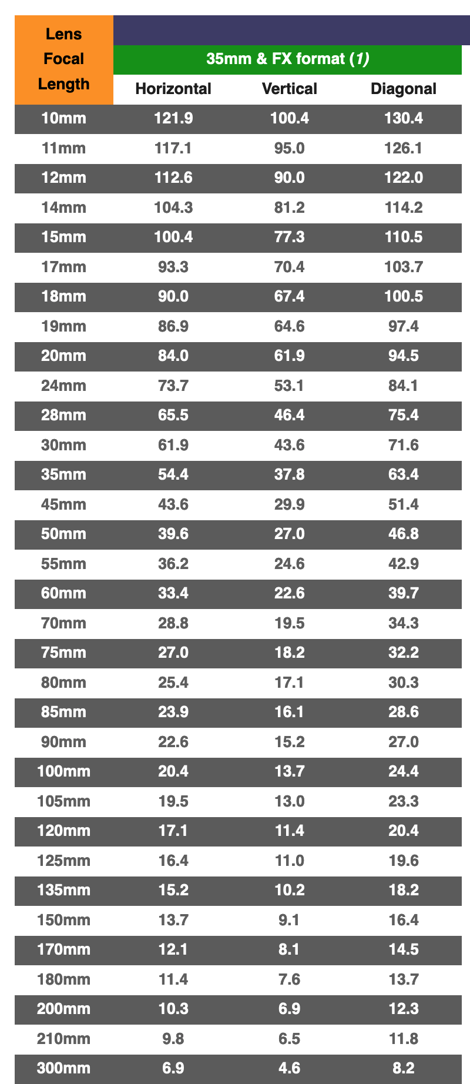
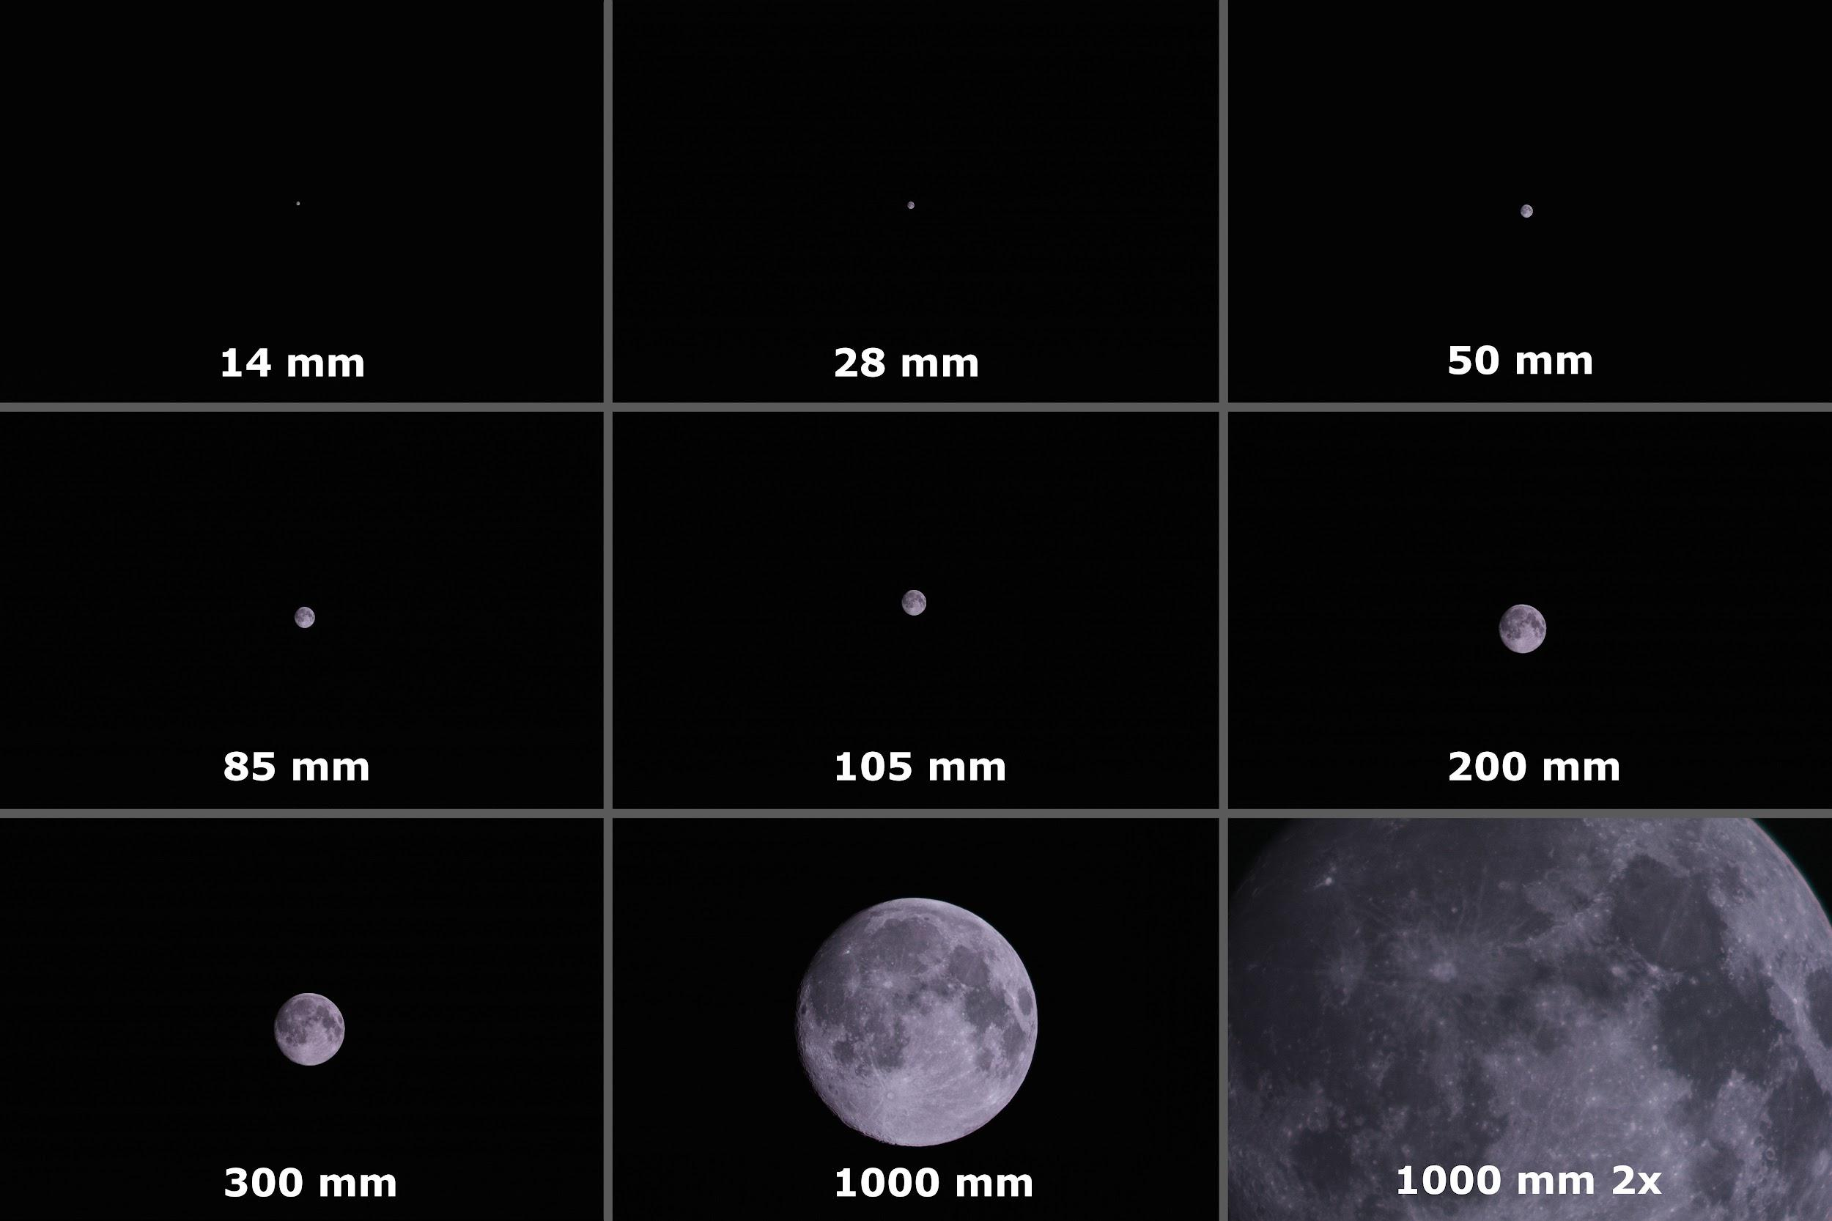
Chart Depicting Focal Length FOV Capability
https://www.nikonians.org/reviews/fov-tables
Provided By : User

Slide 72
Dedicated Astrophotography Sensor Parameters
Mirrorless
Full frame
26.1 Megapixels
RGB
Pixel size: 3.76µm square

Slide 73
Hobbyist Sensor Parameters
Mirrorless
Full frame
30.3 Megapixels
RGB
Pixel size: 5.36µm square

Slide 74
Control Variables
(Coder, Holzinger, 2016)
Design Variables
F-number (N)
aperture diameter (D)
pixel size (p)
f
_ µm
P
D
1080
1920
N = f/D
Notes:
Box N, D, p in equation (or terms they impact)

Slide 75
Optical System Nomenclature
Symbol | Value [units] | Description
SNR_{alg} | 6 | Signal to Noise Ratio
m_{i} | 40 (pixels) | Initial # of pixels occupied by space object (SO) image
𝜱_{alg} | 5.6*E10 (photons/s/m²) | Photon Flux Density
q_{p,sky} | 120 (e−/s/pixel) | Photon Flux per pixel from background radiant intensity
q_{p,dark} | 0.00391 (e−/s/pixel) | Photon flux of CCD (Charge Coupled-Device) dark current
𝛕_{atm} | 0.69 | Transmittance of optics atmosphere
𝛕_{opt} | 0.9 | Transmittance of optics assembly
QE | 0.66 | Quantum Efficiency

Slide 76
Orbital Determination

Slide 77
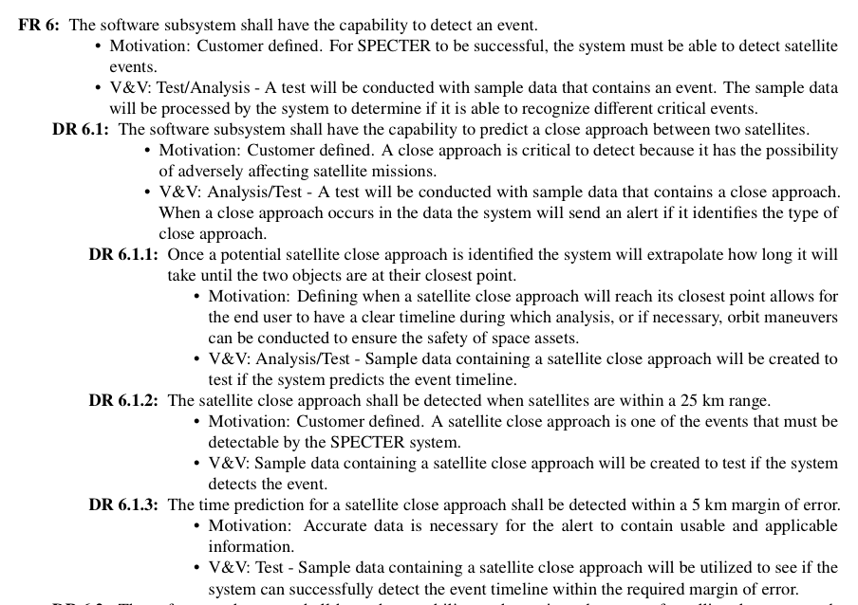
Orbit Determination Full Requirements Breakdown

Slide 78
ODTK Equations and Assumptions: Gooding Method Derivation
General Methodology
Using three pairs of angles, determine unit vectors ȓ₁ and ȓ₃
Find position vector r_{j} of the groundstation.
Assume value for range, 𝜌₁ and 𝜌₃ . Use range and unit vectors to determine position vectors R₁ and R₃ of satellite
𝜌_{j}ȓ₁ = R_{j} - s_{j}
Where s_{j} is the position vector of the groundstation.
Notes:
Equations? Just input to output feels weird

Slide 79
ODTK Equations and Assumptions: Gooding Method Derivation
General Methodology
Begin Iteration
Generate Estimated Orbit by solving Lambert’s Problem
From Lambert’s Problem, will receive estimate of v₁ of satellite
Now have complete orbit made from R₁ and v₁
Propagate R₁ and v₁ to obtain estimates for R₂ and v₂
Calculate 𝜌₂ as an estimate of the true range vector 𝜌₂
Iterate 𝜌₁ and 𝜌₃ via Newton-Raphson Method to obtain better estimate of 𝜌₂
End
Notes:
Equations? Just input to output feels weird

Slide 80
Orbit Determination - GoodingIOD
Angle pair option 1:
αj = right ascension (ground or space based)
δj = declination (ground or space based)
tj = time tag
sj = platform position
Angle pair option 2:
ςj = azimuth (ground based)
ηj = elevation (ground based)
tj = time tag
sj = platform position
Note: j = 1,2,3 and t1 < t2 < t3 and must be “sufficiently large”
Notes:
Reference: https://help.agi.com/odtk/LinkedDocuments/GoodingAnglesOnly.pdf

Slide 81
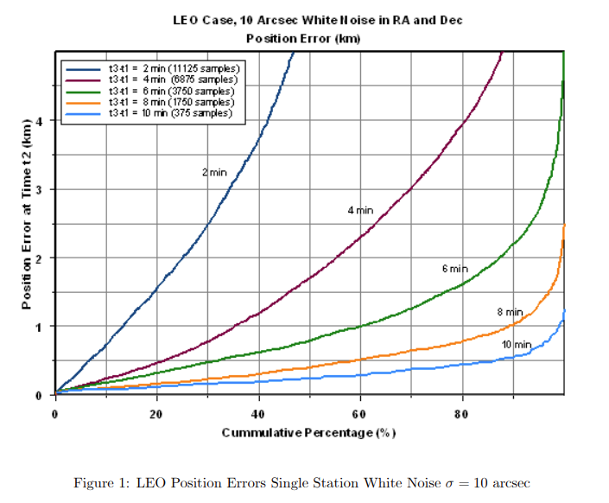
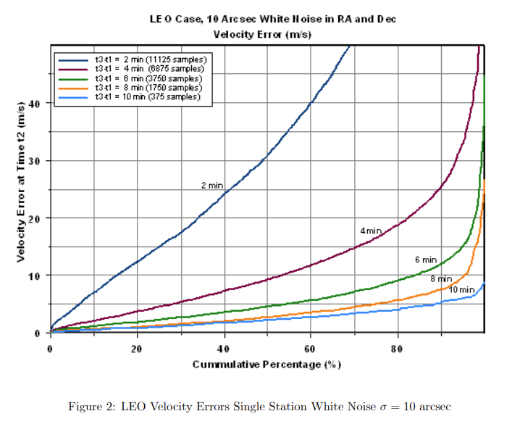
Orbit Determination: GoodingIOD Time Delay Error
Reference: AGI
Notes:
Reference: https://help.agi.com/odtk/LinkedDocuments/GoodingAnglesOnly.pdf

Slide 82
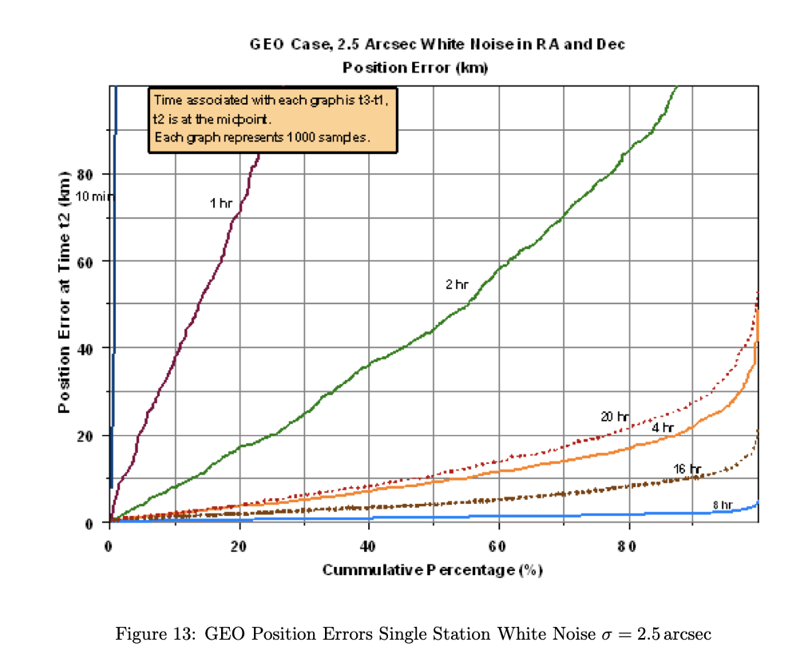
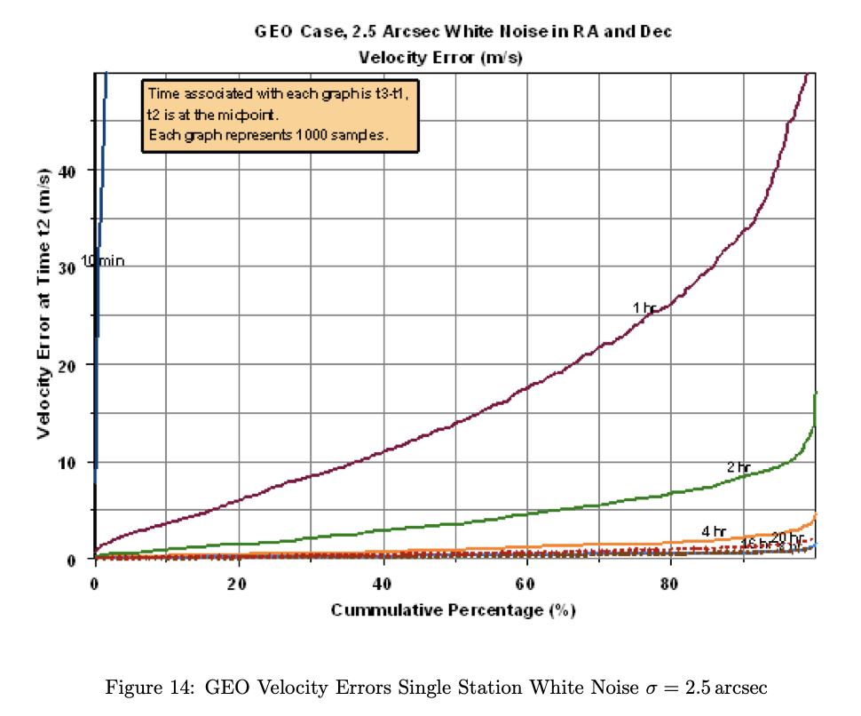
Orbit Determination: GoodingIOD Error σ = 2.5 arcsec
Reference: AGI
Notes:
Reference: https://help.agi.com/odtk/LinkedDocuments/GoodingAnglesOnly.pdf

Slide 83
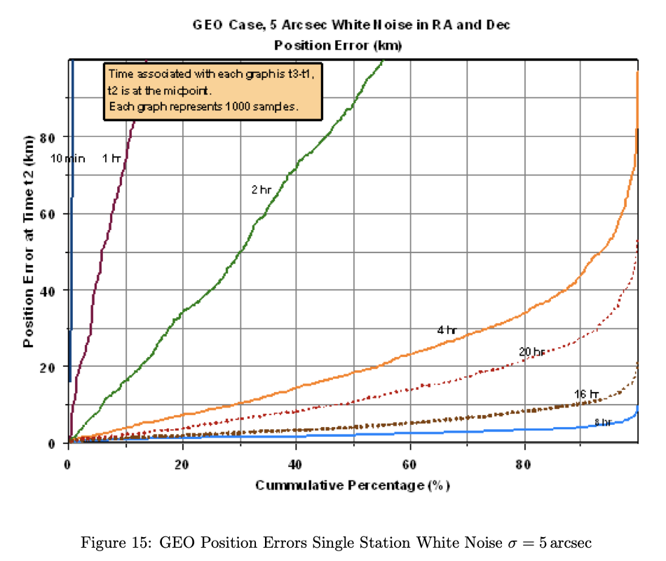
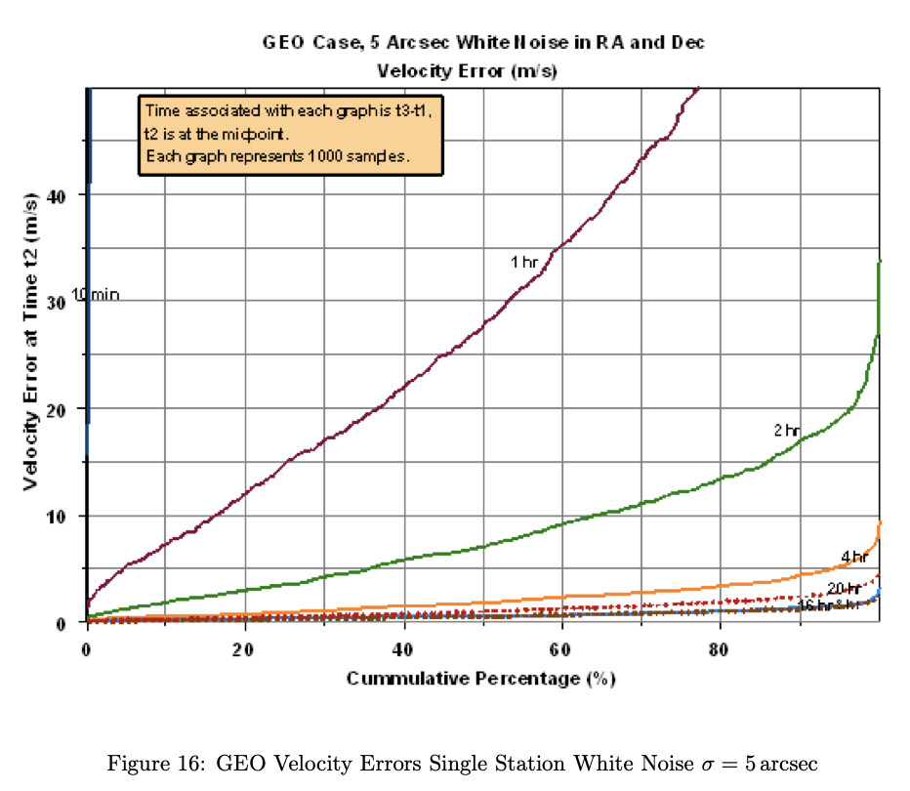
Orbit Determination: GoodingIOD Error σ = 5 arcsec
Reference: AGI
Notes:
Reference: https://help.agi.com/odtk/LinkedDocuments/GoodingAnglesOnly.pdf

Slide 84
Enclosure

Slide 85
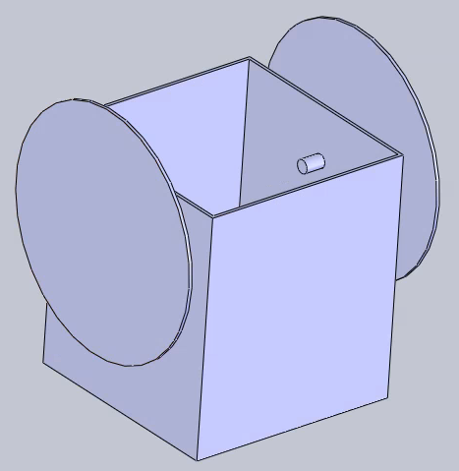
Alternative Enclosure Design
Enclosure roof is made of a tarp attached to two motor-driven wheels. The enclosure design was changed due to:
More moving parts means more changes of failure
Don’t need to move camera so don’t need to have full view of sky, only where camera is pointing

Slide 86
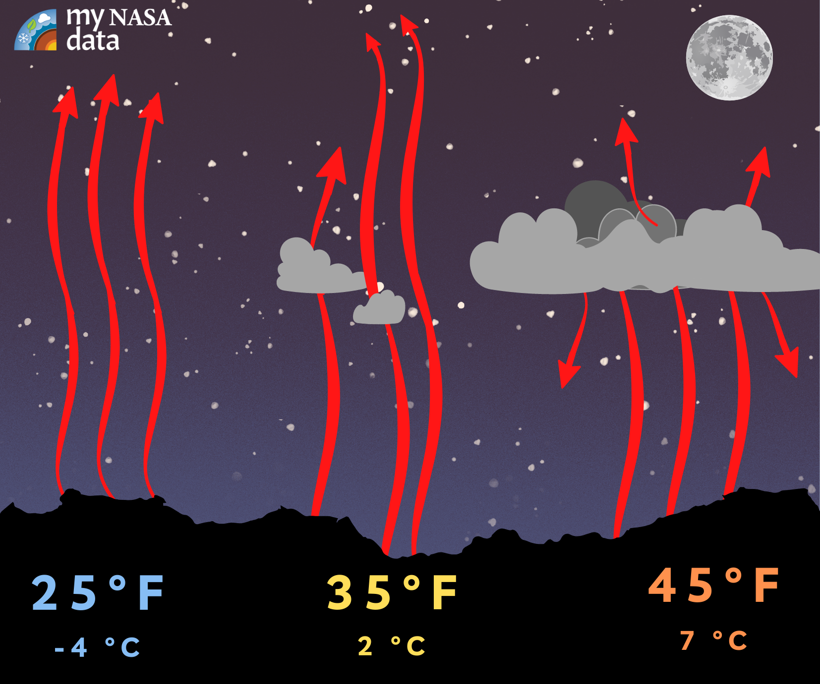
Infrared Thermometer
An IR thermometer pointed along the camera's line of sight will remotely determine the temperature of the sky
A cloudy sky reflects heat back to Earth, while a clear sky does not:
Cloudy skies are around 10°C warmer than clear skies
If skies are cloudy, observations will not be taken
Image from My NASA Data
Driving Requirements
Enclosure Characteristics
IR Thermometer
Door Actuation
Notes:
visuals

Slide 87
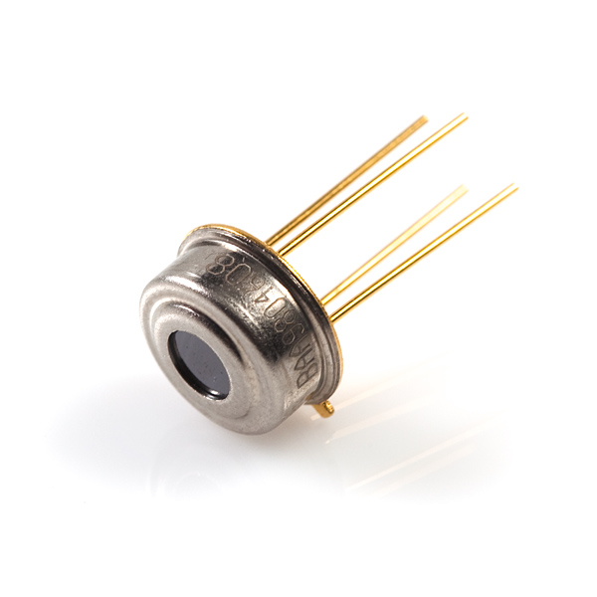
Infrared Thermometer Characteristics
MLX90614 Infrared Thermometer:
5V DC
0.02 °C resolution
Sensor temperature range -40 to +125 °C
Observation range -70 to +380 °C
Image from Sparkfun
Notes:
visuals

Slide 88
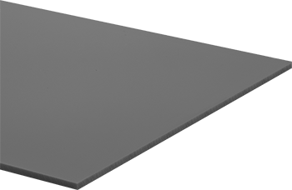
Acrylic Characteristics
Density: 0.043 lb/in^3
Temperature range: -40° to 170° F
Tensile Strength: 10,500 psi
Image from McMaster-Carr

Slide 89
Mount

Slide 90
Mount Driving Requirements
FR 9 | The system shall have the capability to move the electro-optical subsystem.
DR 9.1 | The electro-optical subsystem shall be able to change azimuth angles to collect data on geosynchronous satellites.
DR 9.2 | The electro-optical subsystem shall observe the elevation angles needed to collect data on geosynchronous satellites.
Driving Req.
Feasibility Summary

Slide 91
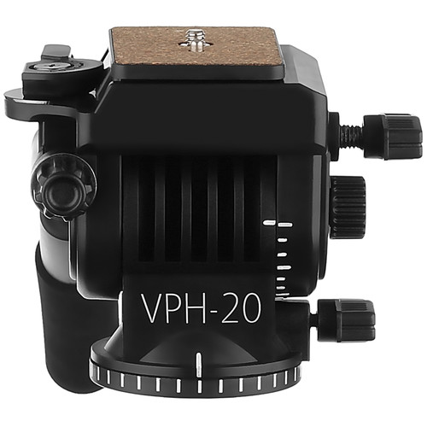
Mount Feasibility
Magnus VPH-20 Video Pan & Tilt Fluid Head
Functionality checks
Pan (azimuth angle) capabilities - manual
360°
Tilt (elevation angles) capabilities - manual
180°
Load checks
Supports 11 lbs loads
Individual pan-and-tilt tension control and locks
Locking pins
Interface checks
3/18” -16 tripod mount thread
1/4" -20 camera screw
✅
✅
✅
Baseline Design Mount
Driving Req.
Feasibility Summary

Slide 92
Mount Full Requirement Breakdown

Slide 93
Pervious Mount Choice (Not in Consideration)
Bescor MP-101 Motorized Pan & Tilt Head
Connection interfaces
Supports 6 lbs
¼”-20 camera mount screw
¼”-20 tripod mount screw
Remote for control
Power
4 AA batteries (what will be used)
PS-260 AC power supply (will not be used)
Pan (azimuth angle) capabilities
+/- 170°
Tilt (elevation angles) capabilities
+/- 15°
Baseline Design Mount

Slide 94
Algorithm

Slide 95
Image Processing Feasibility
Image at t_{n-1}
Image at t_{n}
Notes:
What’s going on here?

Slide 96
Budget

Slide 97
Budget
Part | Part Description | Cost | Budget | Margin
Optics |  | $3,398.00 | $3,400.00 | $2.00
Lens | 135 f/1.8 lens | $1,399.00 | $1,400.00 | $1.00
Sensor | ZWO ASI 2600 MC Pro | $1,999.00 | $2,000.00 | $1.00
Electronics |  | $493.00 | $1,593.00 | $1,100.00
Processor | Udoo | $493.00 | $493.00 | $0.00
Communications |  |  | $100.00 | $100.00
Power |  |  | $1,000.00 | $1,000.00
Housing |  | $0.00 | $500.00 | $500.00
Acrylic |  |  | $100.00 | $100.00
Mount |  |  | $100.00 | $100.00
Motor |  |  | $100.00 | $100.00
Other |  |  | $200.00 | $200.00
Other |  | $0.00 | $0.00 | $0.00
Astrodynamics Software | ODTK, for Astrodynamic analysis | $0.00
TOTAL |  | $3,891.00 | $5,493.00 | $1,602.00
Notes:
Pie chart budget, overview by subsystem
Send to backup (not if funding is close, or EEF is key!)

