Slide 1
S P E C T E R
Critical Design Review
December 1st, 2021
ASEN4018-011 Team 9
Presenters
Gabriel Feldman, Hanna Galimanis, Nick Spens, Mary Hanson, Josef Michelsen, Noah Avery, Andrew Komitor
Company Customer
L3Harris
Faculty Advisor
Professor John Mah
Additional Team Members
Sam Alvis, Vivien Blumofe, Zach Harris,
Ajay Dhindsa
Notes:
Gabriel Feldman

Slide 2
Table of Contents
Project Overview
Baseline Design
Design Requirements & Satisfaction
Risk
Verification and Validation
Project Planning
Appendix
Notes:
Gabriel Feldman

Slide 3
Project Overview
Project Overview
Baseline Design
Requirement Satisfaction
Risk
V&V
Project Planning
Notes:
Gabriel Feldman

Slide 4
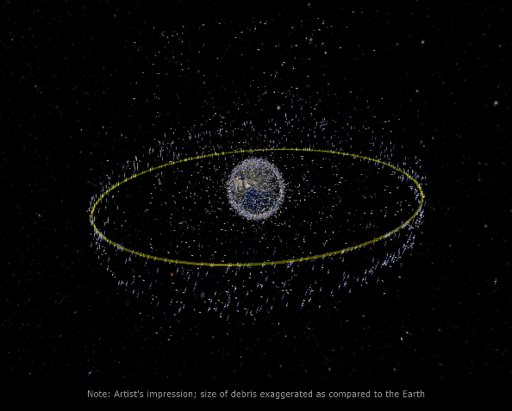
Motivation
Space situational awareness (SSA)
January 1st, 2021: 500 human made objects in Geosynchronous Earth Orbit (GEO)
Importance of GEO
Holds critical satellites for communication, weather, and military purposes
Orbits with semi-major axis of roughly 42,000 km
Orbital Period of 1 sidereal day
Many unknown/unidentified satellites
GEO Visualization from esa.int
Project Overview
Baseline Design
Requirement Satisfaction
Risk
V&V
Project Planning
Notes:
Josef

Slide 5
Purpose & Mission Statement
Purpose: collect data on satellites in GEO and determine if a significant event has occurred or is imminent
Maneuvers
Close encounters between two or more satellites (including docking and collisions)
Breakups
The Satellite Position Estimation Collision Tracking & Event Recognition (SPECTER) mission will monitor satellite movements in geostationary orbit to provide space domain awareness.
Project Overview
Baseline Design
Requirement Satisfaction
Risk
V&V
Project Planning
Notes:
Josef
Change to geostationary

Slide 6
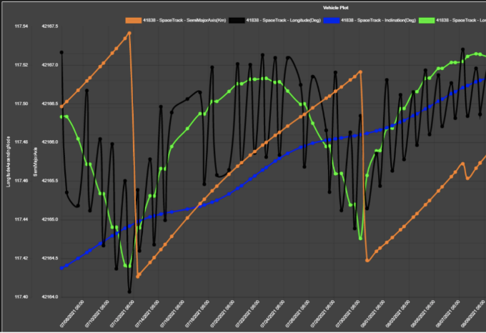
Key Terms: POL
POL: Pattern of Life
Includes a satellite's position, velocity, light curve intensity and color data over time. Created from historical data categorizing satellite behavior.
L3Harris POL Plot Example
Time scale: ~1 month (07/08/2021 - 08/09/2021)
… = Semi-major axis [km]
… = Longitude [deg]
… = Inclination [deg]
… = Longitude Ascending Node [deg]
L3Harris, Project Introduction Presentation
Project Overview
Baseline Design
Requirement Satisfaction
Risk
V&V
Project Planning
Notes:
Josef

Slide 7
Key Terms
Astrometric Data: Position and motion data sets
Photometric Data: Light intensity and RGB data sets
GEO: Geostationary orbit
Software:
ASTAP: Astrometric Stacking Program
Uses plate solving to determine right ascension and declination
NINA: Nighttime Imaging 'N' Astronomy
Astrophotography capture software and camera API
ODTK- Orbit Determination Tool Kit
Orbital Elements:
6 Keplerian orbital elements: Semi-Major Axis (a), Eccentricity (e), Inclination (i), True Anomaly (𝜃), Right Ascension of Ascending Node (Ω), Argument of Perigee (ω)
Project Overview
Baseline Design
Requirement Satisfaction
Risk
V&V
Project Planning
Notes:
Josef

Slide 8
Objectives
Subsystem | Capability | Level 3 Success
Software - Algorithm | Detect Pattern of Life (POL) | Autonomously compare observed orbital behaviors against historical POLs, distinguish changes, and characterize events
Software - Data | Camera Data Transfer and Storage | Camera subsystem sends data to server to be analyzed autonomously
Communication and Software | Tip and Cue | Autonomously send alerts based on recognized events
Mechanical - Enclosure | Enclosure for System | Enclosure autonomously responds to weather conditions
Electronics | Collection and Processing | Collect and Process image data autonomously
Project Overview
Baseline Design
Requirement Satisfaction
Risk
V&V
Project Planning
Notes:
Andrew

Slide 9
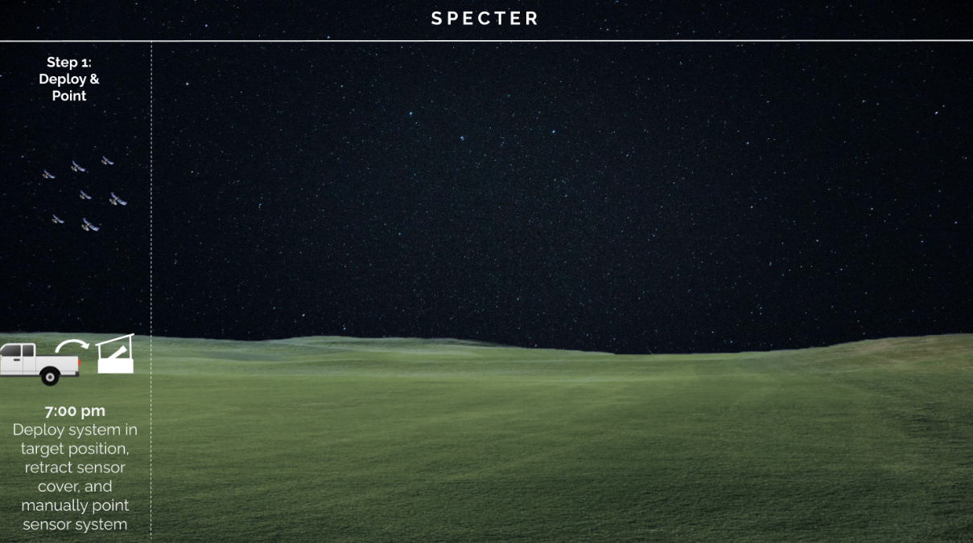
Concept of Operations
Project Overview
Baseline Design
Requirement Satisfaction
Risk
V&V
Project Planning
Notes:
Mary

Slide 10
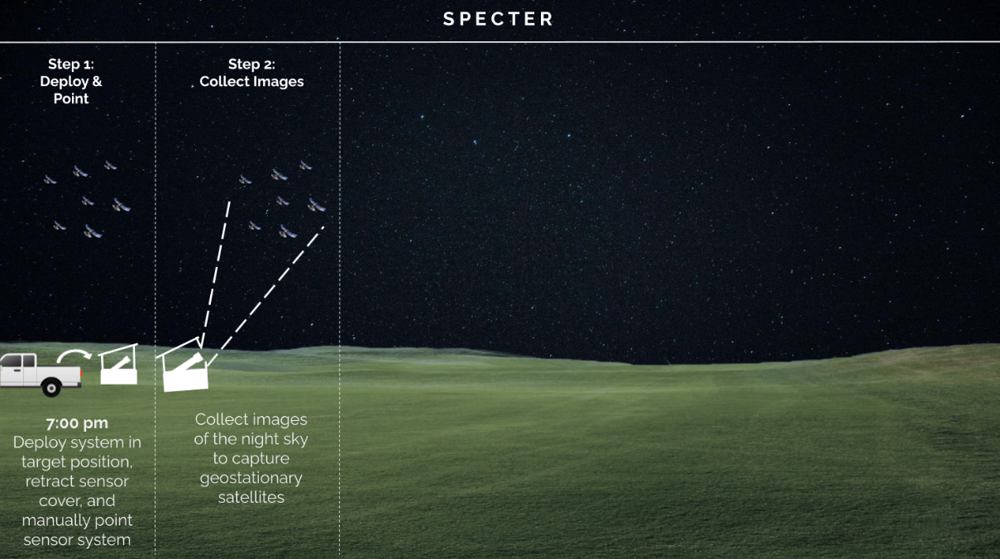
Concept of Operations
Project Overview
Baseline Design
Requirement Satisfaction
Risk
V&V
Project Planning
Notes:
Mary

Slide 11
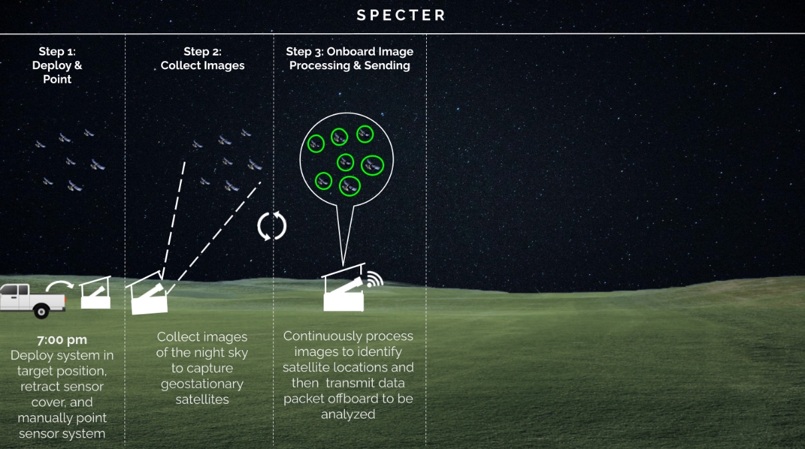
Concept of Operations
Project Overview
Baseline Design
Requirement Satisfaction
Risk
V&V
Project Planning
Notes:
Mary

Slide 12
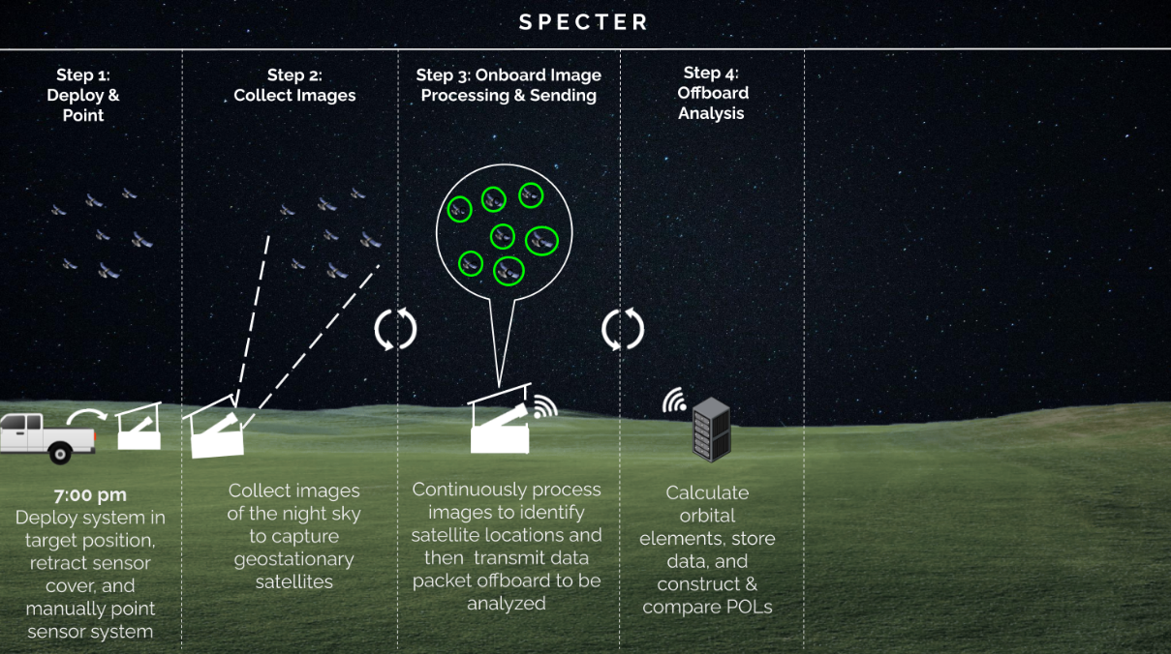
Concept of Operations
Project Overview
Baseline Design
Requirement Satisfaction
Risk
V&V
Project Planning
Notes:
Mary

Slide 13
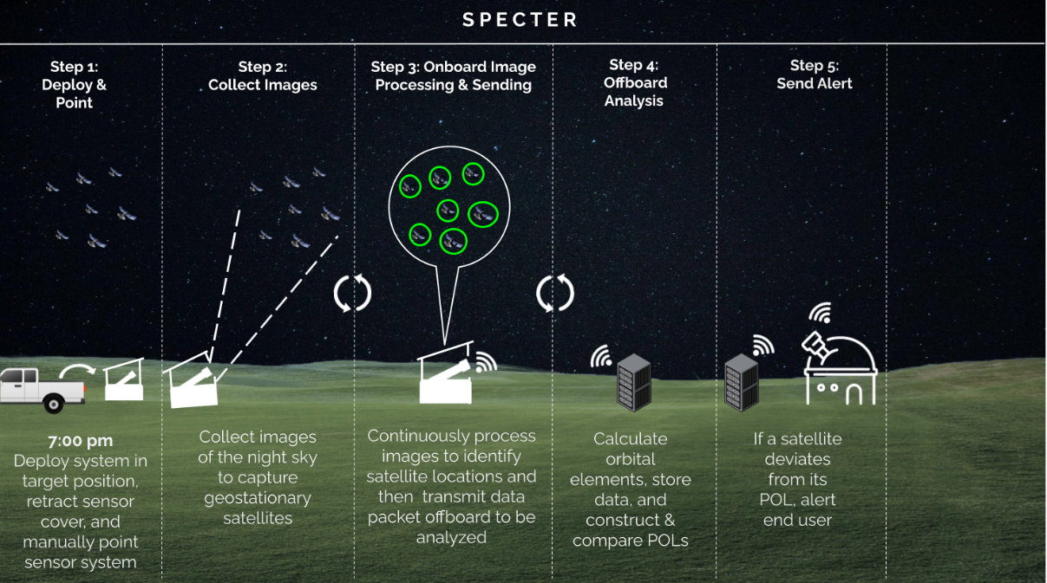
Concept of Operations
Project Overview
Baseline Design
Requirement Satisfaction
Risk
V&V
Project Planning
Notes:
Mary

Slide 14
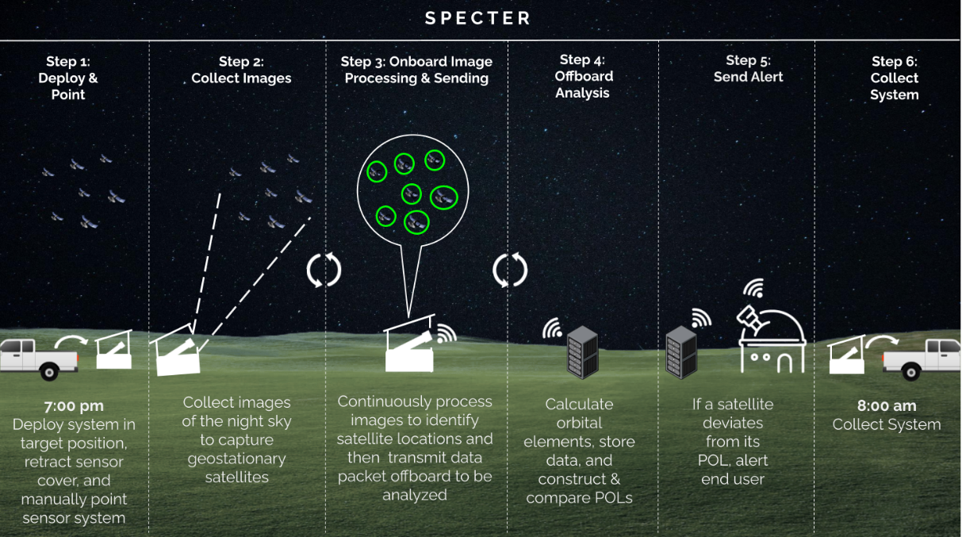
Concept of Operations
Project Overview
Baseline Design
Requirement Satisfaction
Risk
V&V
Project Planning
Notes:
Mary

Slide 15
Baseline Design
Project Overview
Baseline Design
Requirement Satisfaction
Risk
V&V
Project Planning

Slide 16
Critical Project Elements
CPE | Importance
1. GEO Observation | SPECTER must be capable to observe satellites to facilitate data collection
2. Data Collection | Data collection is required for future POL comparison
3. POL Determination | POL’s are necessary to monitor for deviations from expectations
4. Event Detection | The system must be able to use the astrometric and photometric data output from the image processing subsystem to compare to historical data. To alert end users of a POL deviation, the SPECTER system must have the capability to detect the event.
Project Overview
Baseline Design
Requirement Satisfaction
Risk
V&V
Project Planning
Notes:
Mary

Slide 17
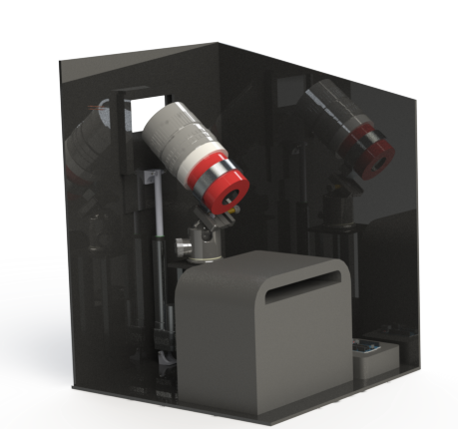
Enclosure Design - Interior
IR Thermometer
Sparkfun MLX90614
Lens
Canon 135mm lens
Camera Mounting System
ZWO Holder Ring + Neewer Professional Panoramic Ball Head
Sensor
ZWO ASI 2600 MC Pro
Battery
EcoFlow RIVER Battery
Linear Actuator
Eco Worthy 6 inch Linear Actuator
Arduino Uno
Computer
Beelink Mini PC
Project Overview
Baseline Design
Requirement Satisfaction
Risk
V&V
Project Planning
Notes:
Mary

Slide 18
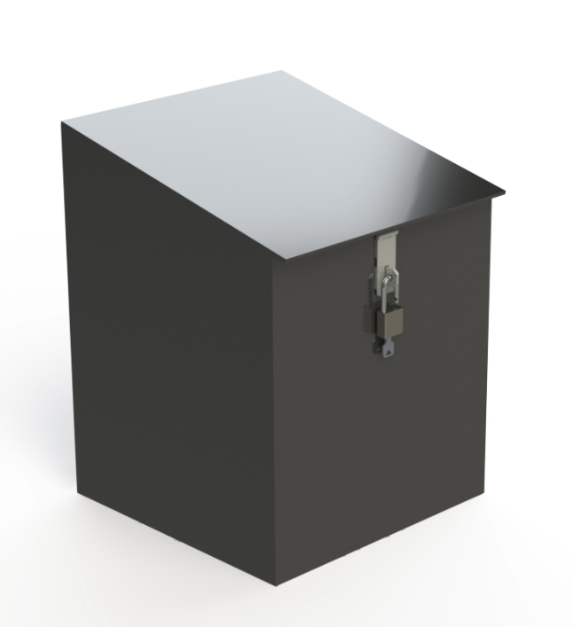
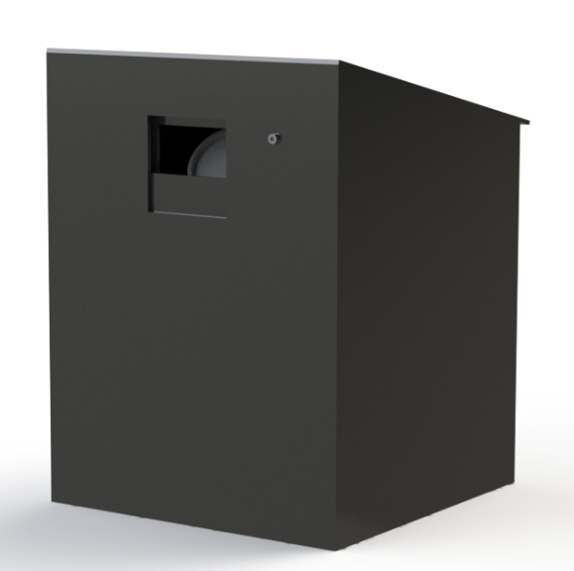
Enclosure Design - Exterior
24 in
20 in
IR Thermometer
Sparkfun MLX90614
Padlock
18 in
18 in
Project Overview
Baseline Design
Requirement Satisfaction
Risk
V&V
Project Planning
Notes:
Mary

Slide 19
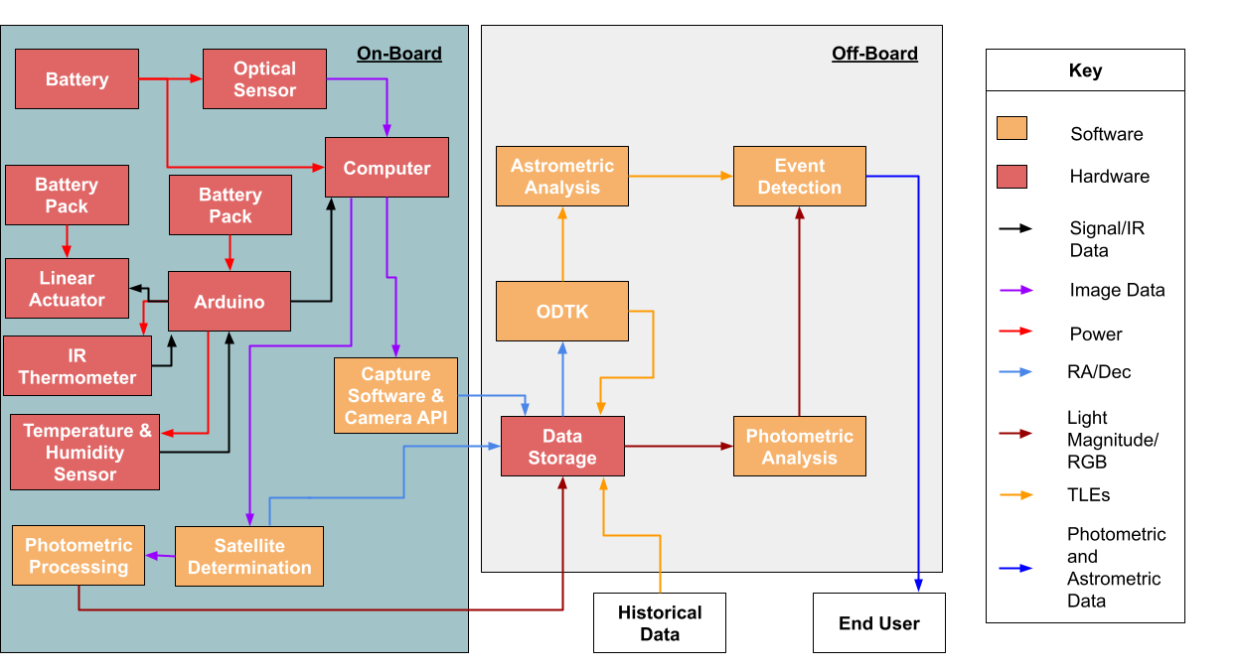
Functional Block Diagram
Project Overview
Baseline Design
Requirement Satisfaction
Risk
V&V
Project Planning

Slide 20
Design Requirements and Satisfaction
Project Overview
Baseline Design
Requirement Satisfaction
Risk
V&V
Project Planning

Slide 21
CPE 1: GEO Observation
Project Overview
Baseline Design
Requirement Satisfaction
Risk
V&V
Project Planning

Slide 22
Driving Requirements
FR 1 | The system shall observe satellites in geostationary orbit
Project Overview
Baseline Design
Requirement Satisfaction
Risk
V&V
Project Planning

Slide 23
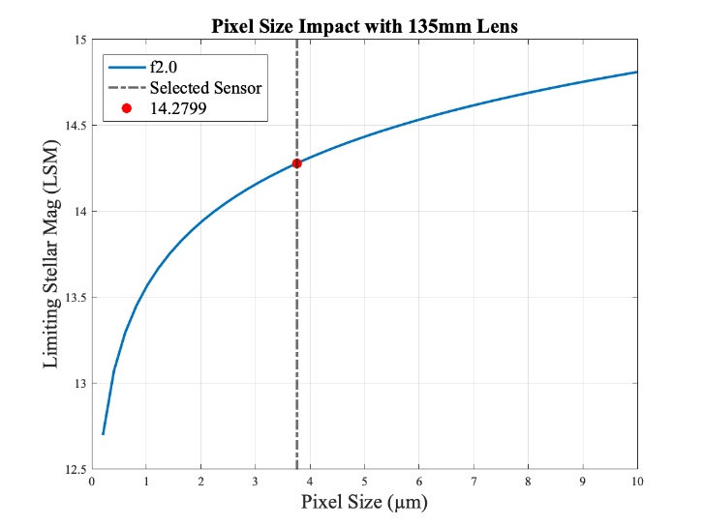
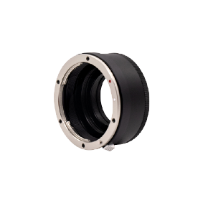
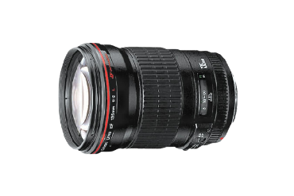
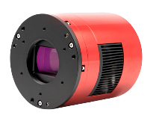
Requirement Satisfaction
Majority of GEO Satellites LSM of 11 - 14
Customer requires 13
Ideal: 14 - 15
Light pollution can decrease LSM
Conservative estimate: 14.28
+
+
Canon EF 135mm f/2L
ZWO EOS-T2 Adapter
ZWO ASI2600MC Pro
FR. 1: Verified ✔
Project Overview
Baseline Design
Requirement Satisfaction
Risk
V&V
Project Planning

Slide 24
CPE 2: Data Collection
Project Overview
Baseline Design
Requirement Satisfaction
Risk
V&V
Project Planning

Slide 25
Processing Driving Requirements
FR 4 | The system shall be able to use the astrometric data output from the image processing subsystem to compare to historical data.
FR 5 | The system shall be able to use the photometric data output from the image processing subsystem to compare to historical data.
DR 5.3, DR 4.5 | Collected data shall be processed by a processor within 5 minutes.
Project Overview
Baseline Design
Requirement Satisfaction
Risk
V&V
Project Planning
Notes:
Sam Alvis

Slide 26
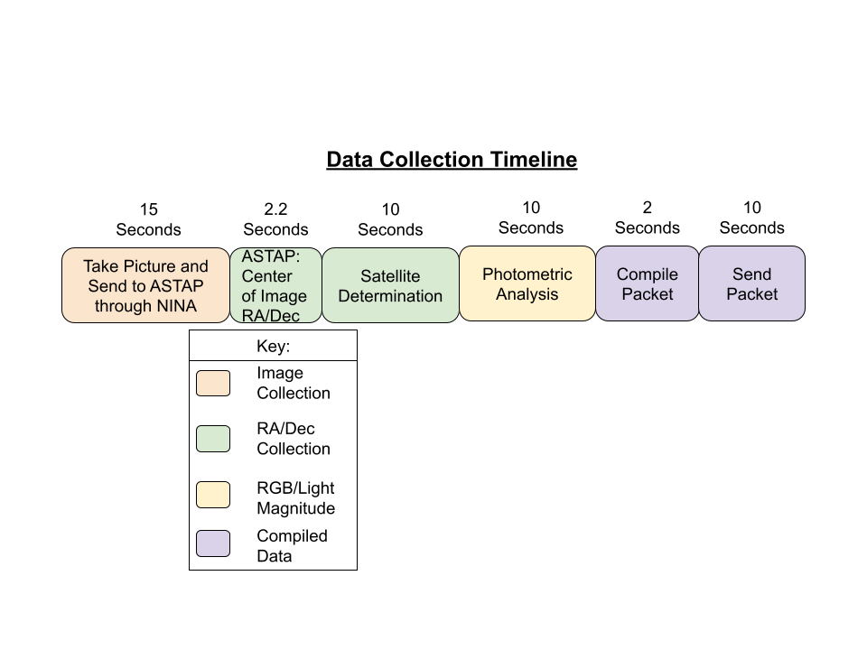
Time Breakdown
Max Time: 49.2s
DR 5.3, DR 4.5: Verified ✔
Project Overview
Baseline Design
Requirement Satisfaction
Risk
V&V
Project Planning

Slide 27
Pointing Determination
Plate Solving:
Identifies the RA and Dec of a reference pixel to minimize error between points in the image and a stored database of stars
Also provides all information necessary to calculate the RA and Dec of any other pixel relative to the reference
Project Overview
Baseline Design
Requirement Satisfaction
Risk
V&V
Project Planning

Slide 28
Satellite Identification
Image converted to binary array
Project Overview
Baseline Design
Requirement Satisfaction
Risk
V&V
Project Planning

Slide 29
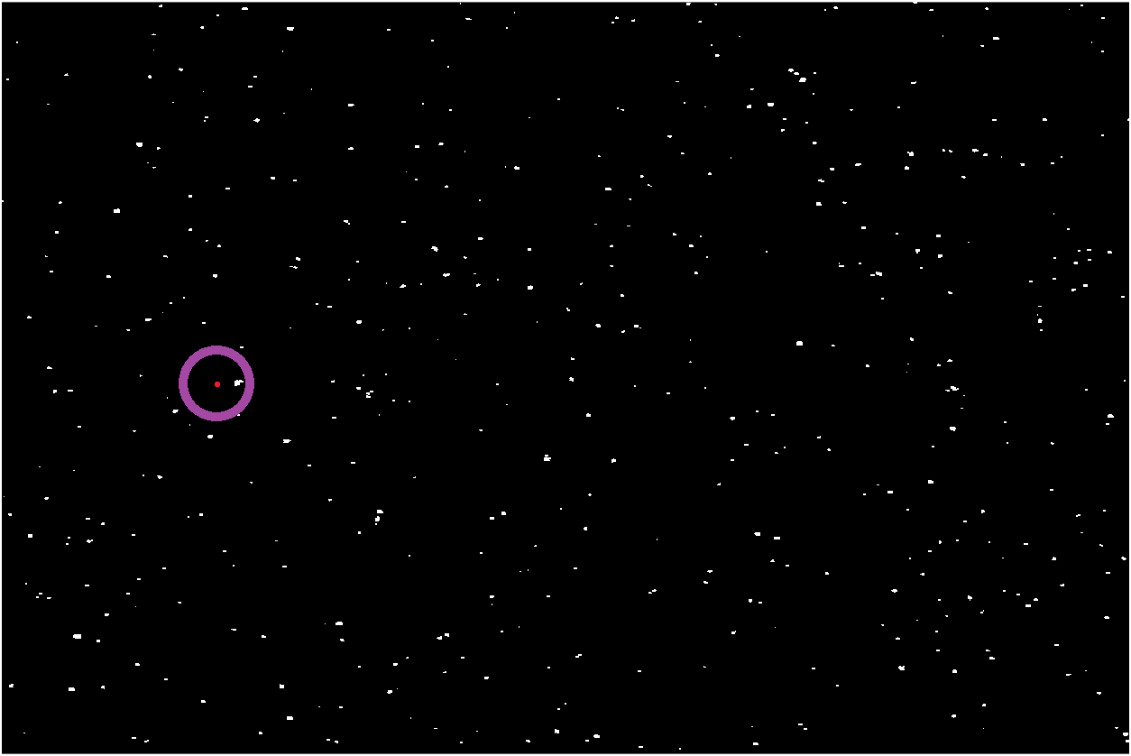
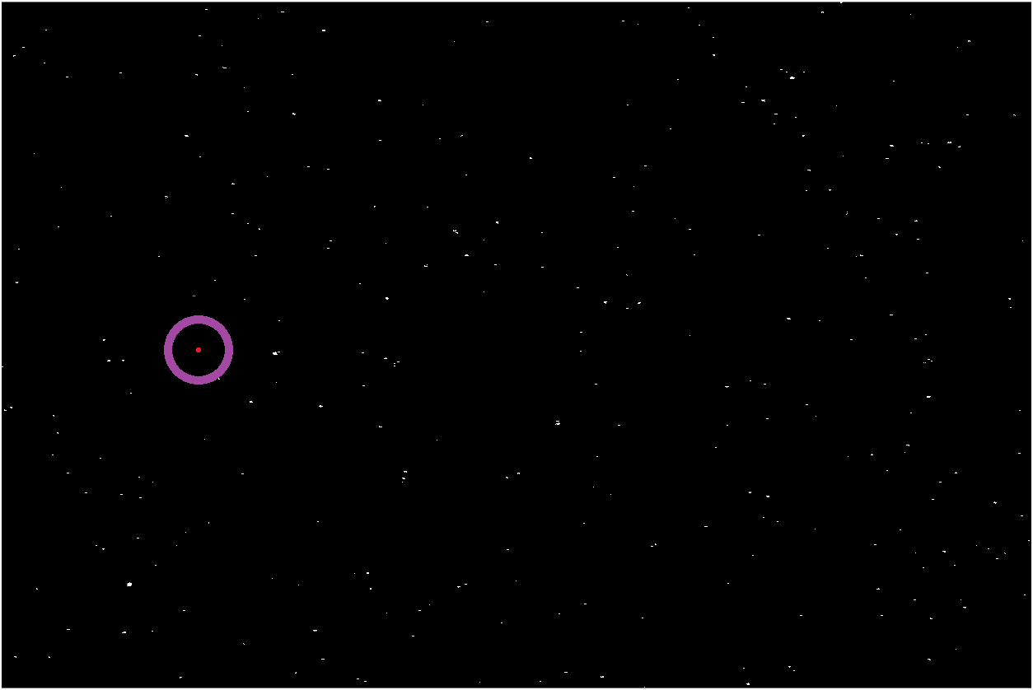
Satellite Identification
Image at t_{n-1}
Image at t_{n}
Project Overview
Baseline Design
Requirement Satisfaction
Risk
V&V
Project Planning
Notes:
Crop and zoom in

Slide 30
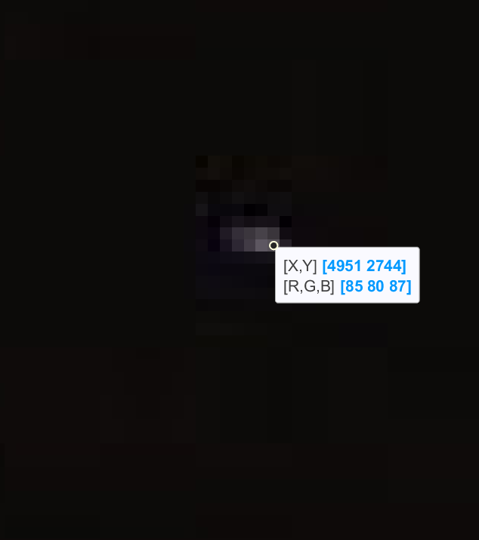
Parameter Collection
Overlapping pixels found by the satellite identification algorithm will be stored with position and color data
The transformation from the plate solver will be applied to produce RA and Dec values
The final packet will contain time, RA, Dec, R, G, and B values for each pixel identified as a satellite in the image
FR 4, FR 5: Verified ✔
Project Overview
Baseline Design
Requirement Satisfaction
Risk
V&V
Project Planning

Slide 31
CPE 3: POL Determination
CPE 4: Event Detection
Project Overview
Baseline Design
Requirement Satisfaction
Risk
V&V
Project Planning
Notes:
Hanna Galimanis

Slide 32
Driving Requirements
FR 2 | The software subsystem shall determine the POL of satellites in geostationary orbit from historical data.
FR 4 | The system shall be able to use the astrometric data output from the image processing subsystem to compare to historical data.
FR 5 | The system shall be able to use the photometric data output from the image processing subsystem to compare to historical data.
FR 6 | The software subsystem shall have the capability to detect an event.
DR 6.1 | The software subsystem shall have the capability to predict a close approach between two satellites.
Project Overview
Baseline Design
Requirement Satisfaction
Risk
V&V
Project Planning
Notes:
Hanna Galimanis

Slide 33
Requirement Satisfaction
Semi-Major Axis Determination
Orbital element set determined from historical data set provided by project sponsor.
Resulted in error of semi-major axis of 0.0202 %
NORAD ID 35496 | Semi-Major Axis (km)
Calculated | 42,174.361
Look Up | 42,165.85
Difference | 8.511
FR 2, DR 6.1: Verified ✔
Project Overview
Baseline Design
Requirement Satisfaction
Risk
V&V
Project Planning
Notes:
Hanna Galimanis
RA and DEC from L3Harris data - choose 2 angle pairs long enough time apart

Slide 34
Requirement Satisfaction
Orbital Elements Determination
Keplerian Orbital Elements determined for satellite found from sample images taken.
Results are typical of satellite at GEO
NORAD ID: Unknown | Keplerian Elements
a (km) | 40,622.79
e | 0.038
i (deg) | 13.366
𝜃 (deg) | 179.622
Ω (deg) | 67.945
ω (deg) | 91.712
FR 4, DR 6.1: Verified ✔
Project Overview
Baseline Design
Requirement Satisfaction
Risk
V&V
Project Planning
Notes:
Hanna Galimanis
Image, unknown sat, matches GEO expectation (low e, i within 15 deg equator, expected a)

Slide 35
Requirement Satisfaction
Thresholding:
Thresholding is a simple approach to detect deviations from an expected value
Bounds determined manually by analyzing numerous historical satellites over large periods of time.
Project Overview
Baseline Design
Requirement Satisfaction
Risk
V&V
Project Planning
Notes:
Increase plot label size

Slide 36
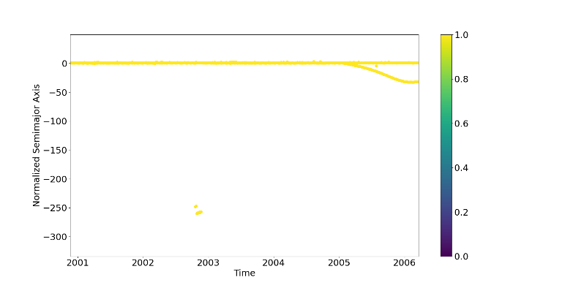
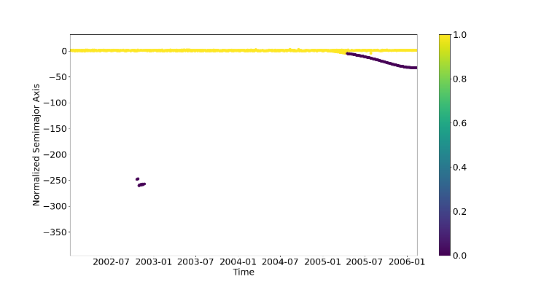
Requirement Satisfaction
Thresholding:
Before Thresholding
After Thresholding
Classification
Classification
Dummy threshold of ±5 km used in order to demonstrate any deviation from nominal maneuvers
FRs 2, 4, 5: Verified ✔
Project Overview
Baseline Design
Requirement Satisfaction
Risk
V&V
Project Planning
Notes:
Increase plot label size

Slide 37
Requirement Satisfaction
Statistical Analysis:
Butterworth Low-Pass Filter used to attenuate noisy data to aid in understanding
Bootstrapping used to make conclusions from limited historical sources
Project Overview
Baseline Design
Requirement Satisfaction
Risk
V&V
Project Planning

Slide 38
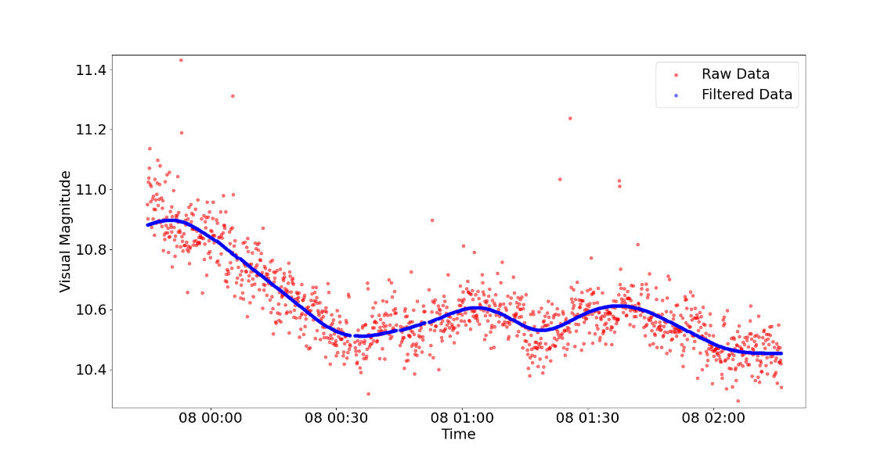
Requirement Satisfaction
Statistical Analysis:
Butterworth Low-Pass Filter (4th order, 𝜔_{n} = 0.01)
FRs 4, 5, 6: Verified ✔
Project Overview
Baseline Design
Requirement Satisfaction
Risk
V&V
Project Planning

Slide 39
Requirement Satisfaction
Machine Learning:
Technical Demonstration: classify if semi-major axis measurement is within POL
No necessity to manually or algorithmically determine the threshold boundaries
In the future:
A recurrent neural network will be used in order to explore the time dependence of data
Manual labeling of data will allow better conclusions to be gained
Project Overview
Baseline Design
Requirement Satisfaction
Risk
V&V
Project Planning

Slide 40
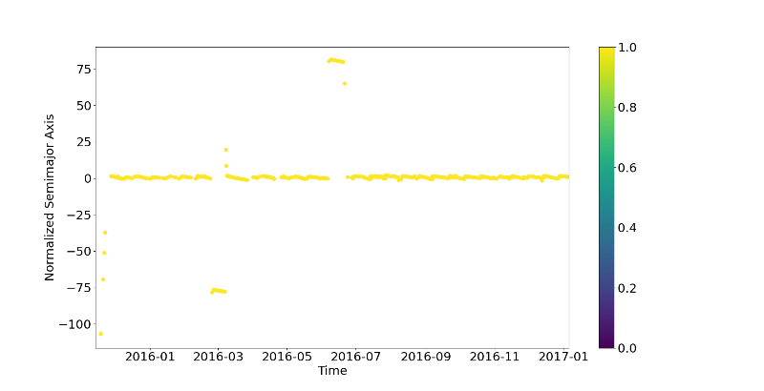
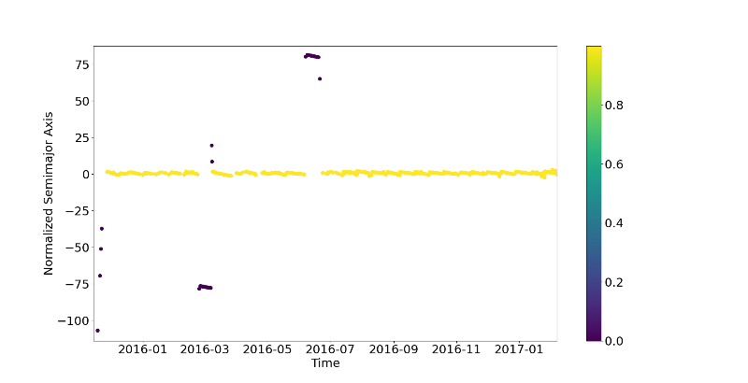
Requirement Satisfaction
Machine Learning:
Before Prediction
After Prediction (99.6% accuracy)
Classification
Classification
Wealth of training data obtained from Space-Track.org
7 data sets (27312 data points) for training and testing
Labeled using previous thresholded data
FRs 4, 6: Verified ✔
Project Overview
Baseline Design
Requirement Satisfaction
Risk
V&V
Project Planning
Notes:
CPE 4: Algorithm - Analysis Methods Proof
More in depth step by step
Show completed butterworth and compare to the image L3Harris provided?
CPE 4: Algorithm - Machine Learning Proof
CLEARLY explain why and for what reason/what it will do for the project
Show where training data is coming from and is it enough
Show what has been done and EXACTLY how we will expand it

Slide 41
Risk
Project Overview
Baseline Design
Requirement Satisfaction
Risk
V&V
Project Planning
Notes:
Andrew

Slide 42
Risks
System Risk | Description | Effect
Optics I | The ability to capture noise-minimized images and transmit data packets are reliant on light pollution and cell service respectively | Issues with satellite visibility, increased difficulty to process the images, and data packets will be sent slower/not at all.
Optics II | The ability to gather data is reliant on the weather of the field test | Inability to test and collect data
Enclosure | Temperature and humidity levels of components must remain within system components operational thresholds | Potential electrical component damage
Image Proc. | Images may have error in RA/Dec measurements | Error propagation in POL creation and detection of close approaches
OD | Could have large error in orbital elements if pictures are not taken sufficiently apart | Error propagation in POL creation and potential for false alerts
Project Overview
Baseline Design
Requirement Satisfaction
Risk
V&V
Project Planning

Slide 43
Pre-Mitigation Matrix
System Risk | Description
Optics I | The ability to capture noise-minimized images and transmit data packets are reliant on light pollution and cell service respectively
Optics II | The ability to gather data is reliant on the weather of the field test
Enclosure | Temperature and humidity levels of components must remain within system components operational thresholds
Image Proc. | Images may have error in RA/Dec measurements
OD | Could have large error in orbital elements info if pictures are not taken sufficiently apart
Severity
 |  | Negligible 1 | Minor 2 | Moderate 3 | Major 4 | Severe 5
 | Very Likely 5 |  |  |  | Enclosure
 | Likely 4 |  |  |  | OD | Optics II
 | Possible 3 |  |  |  |  | Optics I Image Processing
 | Not Likely 2
 | Rare 1
Likelihood Level
Project Overview
Baseline Design
Requirement Satisfaction
Risk
V&V
Project Planning

Slide 44
Mitigation - Optics
System Risk | Mitigation
Optics I | Location selection for light pollution mitigation and 4g data strength
Optics II | Frequent testing schedule to account for days lost to inclement weather
Severity
 |  | Negligible 1 | Minor 2 | Moderate 3 | Major 4 | Severe 5
 | Very Likely 5
 | Likely 4 |  |  |  |  | Optics II
 | Possible 3 |  |  |  |  | Optics I
 | Not Likely 2 |  |  |  |  | Optics II
 | Rare 1 |  |  |  | Optics I
Likelihood Level
Project Overview
Baseline Design
Requirement Satisfaction
Risk
V&V
Project Planning

Slide 45
Mitigation - Enclosure
System Risk | Mitigation
Enclosure | Power off fail safe system using interior thermometer and humidity sensor Frequent testing schedule to account for days lost to inclement weather
Severity
 |  | Negligible 1 | Minor 2 | Moderate 3 | Major 4 | Severe 5
 | Very Likely 5 |  |  |  | Enclosure
 | Likely 4
 | Possible 3
 | Not Likely 2 |  | Enclosure
 | Rare 1
Likelihood Level
Project Overview
Baseline Design
Requirement Satisfaction
Risk
V&V
Project Planning

Slide 46
Mitigation - Image Proc.
System Risk | Mitigation
Image Proc. | Utilizes both light pollution mitigation and redundant RA/Dec measurements to ensure accurate pointing and satellite position determination
Severity
 |  | Negligible 1 | Minor 2 | Moderate 3 | Major 4 | Severe 5
 | Very Likely 5
 | Likely 4
 | Possible 3 |  |  |  |  | Image Processing
 | Not Likely 2
 | Rare 1 |  |  | Image Processing
Likelihood Level
Project Overview
Baseline Design
Requirement Satisfaction
Risk
V&V
Project Planning

Slide 47
Mitigation - OD
System Risk | Mitigation
OD | Correction by checking against orbital elements generated from 3 images each with a 10 minute interval apart
Severity
 |  | Negligible 1 | Minor 2 | Moderate 3 | Major 4 | Severe 5
 | Very Likely 5
 | Likely 4 |  |  |  | OD
 | Possible 3 | OD
 | Not Likely 2
 | Rare 1
Likelihood Level
Project Overview
Baseline Design
Requirement Satisfaction
Risk
V&V
Project Planning

Slide 48
Post-Mitigation Matrix
Severity
 |  | Negligible 1 | Minor 2 | Moderate 3 | Major 4 | Severe 5
 | Very Likely 5 |  |  |  | Enclosure
 | Likely 4 |  |  |  | OD | Optics II
 | Possible 3 | OD |  |  |  | Image Processing Optics I
 | Not Likely 2 |  | Enclosure |  |  | Optics II
 | Rare 1 |  |  | Image Processing | Optics I
Likelihood Level
Project Overview
Baseline Design
Requirement Satisfaction
Risk
V&V
Project Planning

Slide 49
Verification and Validation
Project Overview
Baseline Design
Requirement Satisfaction
Risk
V&V
Project Planning
Notes:
Hanna Galimanis

Slide 50
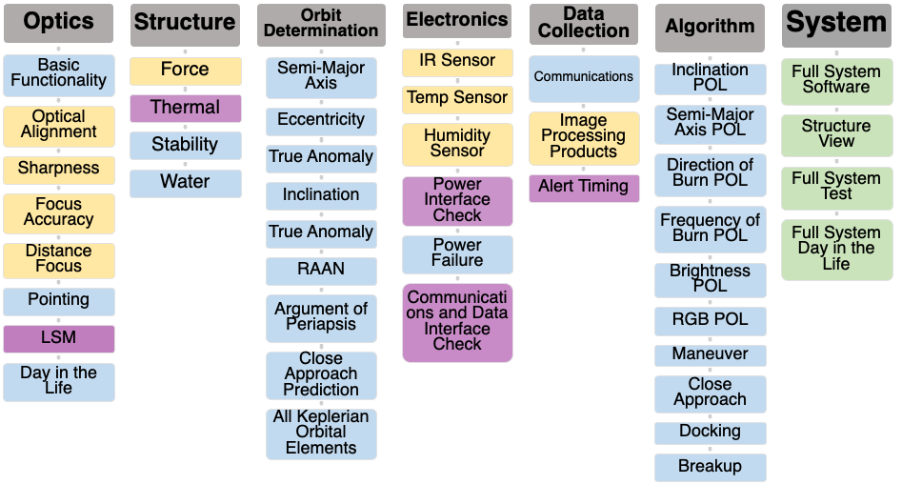
FR V&V Description
… = Component Test
… = Subsystem Test
… = System Test
… = Model Validation
Project Overview
Baseline Design
Requirement Satisfaction
Risk
V&V
Project Planning
Notes:
Hanna Galimanis

Slide 51
Models for Verification Overview
Structure Thermal Model - STR.2 (Enclosure backup - Temperature)
Electronics Power Model - ELE.4 (Electronics backup - Power Analysis)
Communication Data Rate Model - ELE.6 (Processing backup - Data Budget)
Alert Time Model - DAT.3 (Organization backup - Software Time Breakdown)
Limiting Stellar Magnitude Model - OPT.7 (Presented in CPE 1 Req Satisfaction)

Slide 52
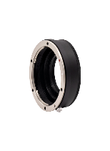
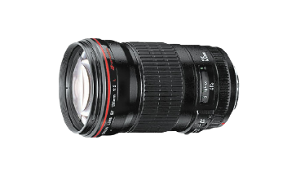
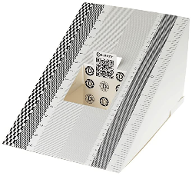
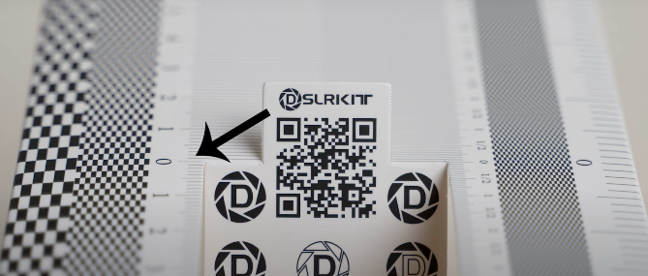
V&V: Optics Focus Accuracy
FR1: Observe GEO
Objective: Determine if the optics system is forward, back, or center focused.
Setup
Connect sensor, adaptor, lens, turn off corrections, set to widest aperture, focus lens on the logo, use a timer to take a photo of the test unit
Facilities: Senior Projects Room
Equipment: Test Unit, Tripod
Key Measurements
Photo taken from the sensor
Success Criteria
By visual inspection, confirm if the zero is the most in-focus and sharpest point
Sensor, Adaptor, Lens
Test Unit
Mount
Project Overview
Baseline Design
Requirement Satisfaction
Risk
V&V
Project Planning
Notes:
Hanna Galimanis
Reference: https://www.youtube.com/watch?v=L7i4WDU65lU

Slide 53
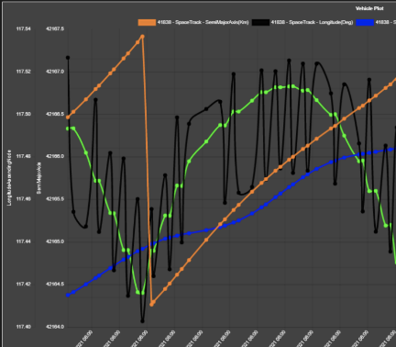
V&V: Algorithm Semi-Major Axis POL
FR 2: Determine POL
Objective: Verify the system has the ability to detect Semi-Major Axis (a) POL deviation.
Setup
Import semi-major axis data from 10 satellites
Five where POL deviates
Five where POL does not deviate
Run the data through the algorithm
Facilities: N/A
Equipment: Test data
Inputs
Semi-Major Axis data over a year
Outputs
Binary Label (whether POL deviated)
Time stamp of deviation
Success Criteria
Algorithm correctly labels if the POL deviates and finds the time when POL deviated
Historical Semi-Major Axis Data
Algorithm
Label and Timestamp
Orange line shows the what an expected Semi-Major Axis POL Plot looks like (image from L3Harris)
Project Overview
Baseline Design
Requirement Satisfaction
Risk
V&V
Project Planning
Notes:
Hanna Galimanis

Slide 54
V&V: Structure Thermal Model
FR 8: Protect System
Objective: Validate the thermal model of the structure.
Setup
Put four thermocouples inside the structure, two outside, place the structure outside when it is between -5 ˚C and 45 ˚C, turn on all electronics, collect temperature data
Facilities: Outside the aero building at night
Equipment: Structure, all internal system components, four thermocouples
Key Measurements
Temperature (˚C) at four points inside the structure and two points outside the structure
Success Criteria
Confirm that interior temperature matches the predicted temperature (ambient)
X indicates location of thermocouple
... = Internal wall
... = External wall
... = Sensor
... = Battery
... = Ambient
Diagram of thermal model test setup
Project Overview
Baseline Design
Requirement Satisfaction
Risk
V&V
Project Planning
Notes:
Hanna Galimanis

Slide 55
CPE V&V Plan
CPE (abbreviated) | V&V Test Numbers | V&V Plan
1: GEO Observation | OPT.1-8, STR.1, STR.3, STR.2, STR.4, ELE.1-3, ELE.5, SYS.1-5 | ✔
2: Data Collection | DAT.1, DAT.2, SYS.1-5 | ✔
3: POL Determination | ALG.1-6, SYS.1-5 | ✔
4: Event Detection | ORB.1-8, ELE.4, ELE.6, ELE.4, ELE.6, DAT.2,SYS.1-5 | ✔
Project Overview
Baseline Design
Requirement Satisfaction
Risk
V&V
Project Planning
Notes:
Hanna Galimanis

Slide 56
FR V&V Plan
Functional Requirement (abbreviated) | Test Numbers | V&V Plan
FR 1: Observe satellites in geostationary orbit | OPT.1-8, STR.1, STR.3, SYS.1-5 | ✔
FR 2: Determine the POL from historical data | ALG.1-6, SYS.1-5 | ✔
FR 3: Collect & store astrometric & photometric data | DAT.1, DAT.2, SYS.1-5 | ✔
FR 4: Use the astrometric data | ORB.1-8, ELE.4, ELE.6, SYS.1-5 | ✔
FR 5: Use the photometric data | ELE.4, ELE.6, DAT.2, SYS.1-5 | ✔
FR 6: Detect an event | ALG.7-10, SYS.1-5 | ✔
FR 7: Alert for deviation from any POL | DAT.3, SYS.1-5 | ✔
FR 8: Protect the camera and associated electronics | STR.2, STR.4, ELE.1-3, ELE.5, SYS.1-5 | ✔

Slide 57
Project Planning
Project Overview
Baseline Design
Requirement Satisfaction
Risk
V&V
Project Planning

Slide 58
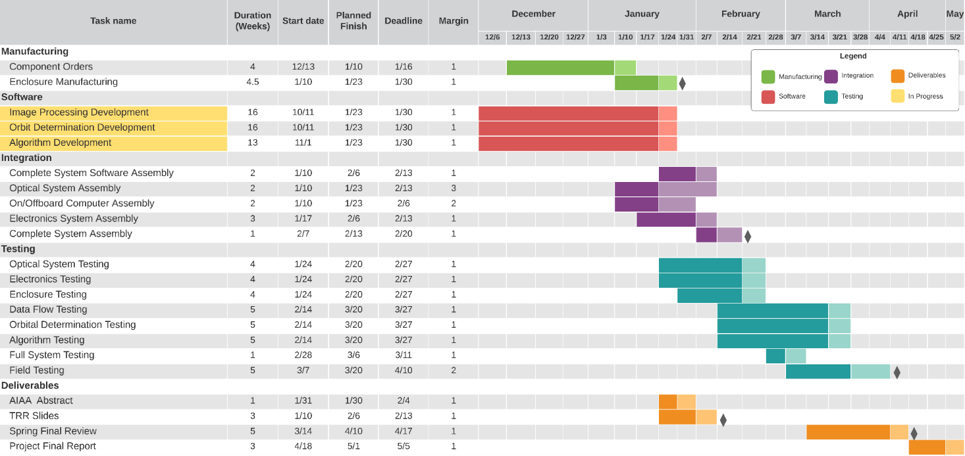
Work Plan
Project Overview
Baseline Design
Requirement Satisfaction
Risk
V&V
Project Planning

Slide 59
Cost Plan
$5,439 budget
$5,000 from Aerospace Department
$439 EEF grant possible
Margin without EEF is still $1,178.93 > $439.00
Due to L3Harris donation of lens
Section | Budget | Cost | Margin
Optics | $3,400.00 | $2,117.00 | $1,283.00
Electronics | $1,539.00 | ~$1,325.72 | ~$213.28
Structures | $500.00 | $378.35 | $121.65
Total | $5,439.00 | $3,821.07 | ~$1,617.93
Project Overview
Baseline Design
Requirement Satisfaction
Risk
V&V
Project Planning

Slide 60
Major Tests to be Conducted
Type | Test Name | Completion Date | Facility - Equipment
Component - Lens | OPT.2: Optical Alignment | 2/7/22 | Project Room - Lens, sensor, test paper
Subsystem - Algorithm | ALG.1-6: POLs | 3/20/22 | Projects Room - N/A
Subsystem - Orbit Determination | ORB.8: Close Approach Event Prediction | 3/20/22 | Projects Room - N/A
Subsystem - Data Flow | DAT.3: Alert Timing | 3/20/22 | Projects Room - N/A
System | SYS.5: Full System Day in the Life (Field Testing) | 4/10/22 | None - Full System
Project Overview
Baseline Design
Requirement Satisfaction
Risk
V&V
Project Planning
Notes:
Hanna Galimanis

Slide 61
Acknowledgements
L3Harris
Edward T. Brown
Advisors
Professor Mah
Dr. Jelliffe Jackson
Dr. Kathryn Wingate
Dr. Holzinger
Dr. Coder
Teaching Assistants
Emma Markovich
Colin Claytor
Project Overview
Baseline Design
Requirement Satisfaction
Risk
V&V
Project Planning

Slide 62
Questions?

Slide 63
Appendix

Slide 64
Appendix Table of Contents
Organization
Enclosure
Electronics
Optics
Orbital Determination
Mount
Processing
V&V
Algorithm
Additional Risks
Budget

Slide 65
References
[1] Astrometry.net: https://iopscience.iop.org/article/10.1088/0004-6256/139/5/1782
[2] Lockheed Martin Probabilistic Assessment of Space Threats (PAST): https://amostech.com/TechnicalPapers/2019/Machine-Learning-for-SSA-Applications/DiBona.pdf
[3] Coder, R. D. & Holzinger, M. J. (2016), “ Multi-objective design of optical systems for space situational awareness,” Acta Astronautica, 128, 669–684. https://doi.org/10.1016/j.actaastro.2016.07.008
[4] MLX90614 IR Thermometer Datasheet. https://www.sparkfun.com/datasheets/Sensors/Temperature/SEN-09570-datasheet-3901090614M005.pdf
[5] Night Radiative Cooling. https://asterism.org/wp-content/uploads/2019/03/tut37-Radiative-Cooling.pdf
[6] Clouds Energy Budget https://mynasadata.larc.nasa.gov/mini-lessonactivity/analyzing-cloud-effects-earths-energy-budget-student-activity
[7] Wikipedia: https://en.wikipedia.org/wiki/Bortle_scale
[8]Astrometry.net: http://nova.astrometry.net/
[9] Linear actuator: https://www.amazon.com/ECO-WORTHY-Actuator-Maximum-Mounting-Brackets/dp/B00NM8H5VO/ref=sr_1_4?_encoding=UTF8&c=ts&dchild=1&keywords=Linear+Motion+Actuators&qid=1633542200&s=industrial&sr=1-4&ts_id=350654011
[10] Verizon Coverage around Boulder: https://www.nperf.com/en/map/US/5574991.Boulder/3255.Verizon-Wireless/signal/
[11] Light Pollution Map: https://www.lightpollutionmap.info/#zoom=7.67&lat=40.1837&lon=-105.1400&layers=B0FFFFFFTFFFFFFFFFF
[12] Geostationary Ring: https://www.esa.int/ESA_Multimedia/Images/2008/03/The_geostationary_ring
[13] Orbital Elements: https://en.wikipedia.org/wiki/Argument_of_periapsis#/media/File:Orbit1.svg
[14] Gooding’s Method: https://link.springer.com/content/pdf/10.1007/BF00049379.pdf
[15] Comparison of Method: https://conference.sdo.esoc.esa.int/proceedings/sdc8/paper/129/SDC8-paper129.pdf
[16] Modified Gooding: https://www.researchgate.net/publication/254199485_Modifications_to_the_Gooding_Algorithm_for_Angles-Only_Initial_OrbitDetermination
[17] Batch Filtering: https://www.sciencedirect.com/science/article/pii/S0898122113004471
[18] Kalman Filtering: https://vtechworks.lib.vt.edu/bitstream/handle/10919/49102/Keil_EM_T_2014.pdf?sequence=1
[19] Kalman Filtering: https://arxiv.org/ftp/arxiv/papers/1609/1609.05225.pdf
[20] AGI: https://help.agi.com/odtk/LinkedDocuments/GoodingAnglesOnly.pdf
[21] AGI: https://help.agi.com/stk/11.0.1/Content/stk/importfiles-11.htm
[22] Pixel Coordinate Transformation: https://www.aanda.org/articles/aa/pdf/2002/45/aah3860.pdf

Slide 66
Organization

Slide 67
Functional Requirements
FR 1 | The system shall observe satellites in geostationary orbit
FR 2 | The software subsystem shall determine the POL of satellites in geostationary orbit from historical data
FR 3 | Collected astrometric and photometric data shall be stored
FR 4 | The system shall be able to use the astrometric data output from the image processing subsystem to compare to historical data
FR 5 | The system shall be able to use the photometric data output from the image processing subsystem to compare to historical data.
FR 6 | The software subsystem shall have the capability to detect an event
FR 7 | An alert shall be sent with enough time to allow for an actionable response if there is a deviation from any POL
FR 8 | An enclosure shall protect the camera and its associated electronic equipment

Slide 68
Functional Requirements and Motivation
FR 1: Observe satellites in geostationary orbit | In order to collect data on satellites the system must have the capability to observe them in orbit.
FR 2: Determine the POL from historical data | The ability for the system to detect a deviation from a satellite’s expected movements requires a previously established POL for new data to be compared to.
FR 3: Collect & store astrometric & photometric data | Customer defined design requirement. The data must be stored in order to continue the creation of a baseline POL.
FR 4: Use the astrometric data | A successful system will be able to detect a deviation from the astrometric POL. A deviation will be detectable by comparing the astrometric POL to recently collected astrometric data.
FR 5: Use the photometric data | A successful system will be able to detect a deviation from photometric POL. A deviation will be detectable by comparing the POL to recently collected photometric data.
FR 6: Detect an event | Customer defined. For SPECTER to be successful, the system must be able to detect satellite events.
FR 7: Alert for deviation from any POL | The system needs to have the ability to communicate alerts to the end user to inform them of an anomaly within a timely manner.
FR 8: Protect the camera and associated electronics | The sensor and associated electronic equipment need to be protected from damage by weather and incident solar radiation.
Notes:
Blue on sheet

Slide 69
Critical Project Elements
CPE | Importance
1. GEO Observation | SPECTER must be capable to observe satellites to facilitate data collection
2. Data Collection | Data collection is required for future POL comparison
3. POL Determination | POL’s are necessary to monitor for deviations from expectations
4. Comparison of Collected Data to Historical Data | The system must be able to use the astrometric and photometric data output from the image processing subsystem to compare to historical data.
5. Event Detection | To alert end users of a POL deviation, the SPECTER system must have the capability to detect the event.
Notes:
Zach

Slide 70
Objectives
Subsystem | Capability | Level 1 | Level 2 | Level 3
Software - Algorithm | Detect Pattern of Life (POL) | Compare observed orbital behavior against historical POLs - inclination, semi-major axis, direction of burn, frequency of burn, brightness, and RGB value | Autonomously Distinguish POL change | Autonomously Characterize Events
Software - Data | Camera Data Collection and Storage | Camera subsystem stores data on hard drive to be physically collected and analyzed manually | Camera subsystem sends data to cloud to be downloaded and manually inputted to algorithm and analyzed | Camera subsystem sends data to cloud to be analyzed autonomously
Communication and Software | Tip and Cue | Manually send alerts to the end user based on POL deviations | The same as level 1 | Autonomously send alerts based on recognized events
Mechanical - Enclosure | Enclosure for System | Cover the camera and lens | Enclosure with weather and sun resistance | Enclosure autonomously responds to weather conditions
Electronics | Power | Manually power on camera subsystem | Power on camera subsystem remotely | Power on camera subsystem autonomously

Slide 71
Team Structure
Gabriel Feldman
Project Manager
Noah Avery
Systems Lead
Sam Alvis
Finance Lead
Hanna Galimanis
Zach Harris
Gabriel Feldman
Gabriel Feldman
Mary Hanson
Design Lead
Josef Michelsen
Electronics Lead
Vivien Blumofe
Manufacturing Lead
Hanna Galimanis
Testing Lead
Sam Alvis
Vivien Blumofe
Sam Alvis
Nick Spens
Zach Harris
Noah Avery
Andrew Komitor
Mary Hanson
Sam Alvis
Vivien Blumofe
Mary Hanson
Nick Spens
Controls Lead
Andrew Komitor
Algorithms Lead
Ajay Dhindsa
Astrodynamics Lead
Zach Harris
Data Flow Lead
Zach Harris
Ajay Dhindsa
Andrew Komitor
Vivien Blumofe
Nick Spens
Josef Michelsen
Gabriel Feldman
Vivien Blumofe
Hanna Galimanis
Nick Spens
Josef Michelsen
Andrew Komitor
Ajay Dhindsa
Noah Avery

Slide 72
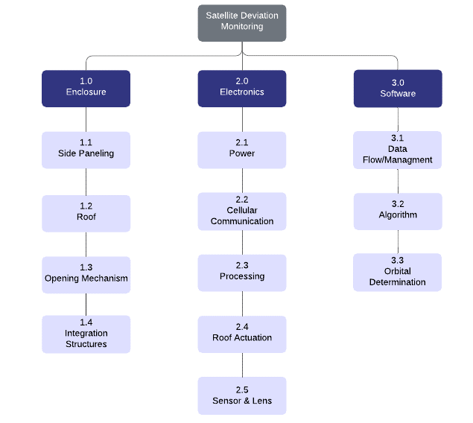
Project Breakdown Structure
Notes:
Combine with 13 and 14

Slide 73
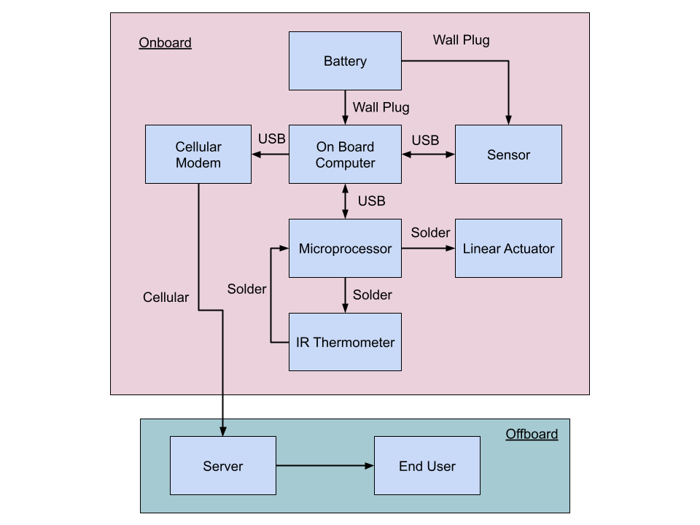
Electronics Flow Block Diagram

Slide 74
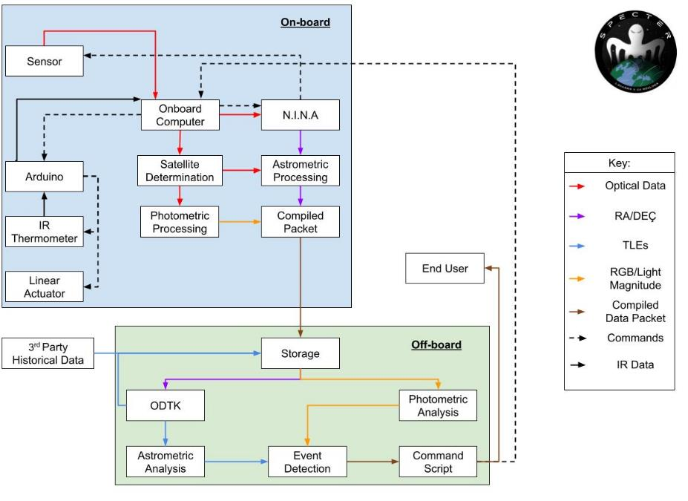
Data Flow Block Diagram

Slide 75
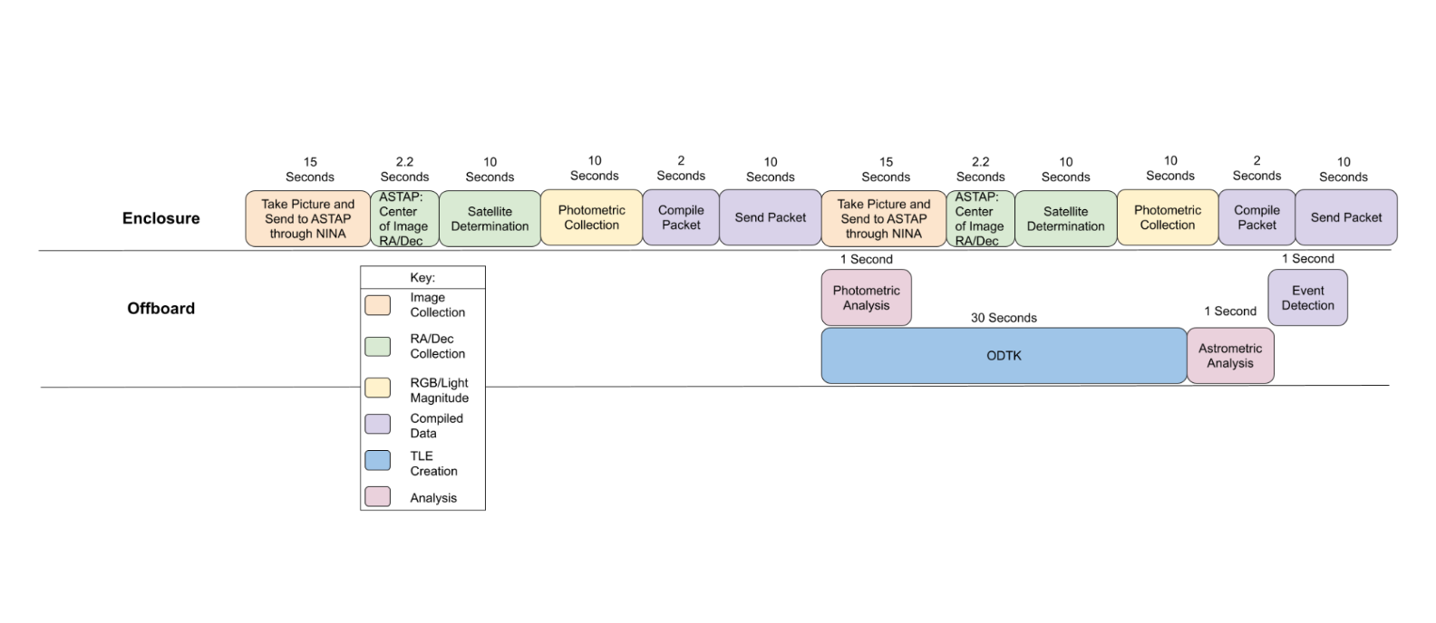
Software Time Breakdown

Slide 76
Enclosure

Slide 77
Material Selection
Colored acrylic was chosen for the enclosure due to its low mass and cost per square foot, its inherent water resistance, and the ease with which it can be manufactured.
Other materials considered include Aluminum 6061, wood, and PLA
Aluminum 6061 determined to be too massive and too expensive compared to acrylic
Wood determined to be too difficult to weatherproof
PLA determined to be too expensive and too difficult to manufacture due to the enclosure size

Slide 78
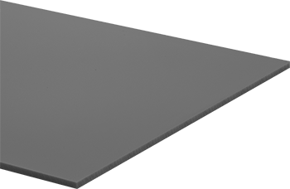
Acrylic Characteristics
Density: 0.043 lb/in^3
Temperature range: -40° to 170° F
Tensile Strength: 10,500 psi
Image from McMaster-Carr

Slide 79
Weather Deployment Process
Before deployment, weather predictions will be taken from the AccuWeather API.
If predicted temperatures are outside than the component operating temperatures, the system will not be deployed
If the forecast does not predict clear skies, the system will not be deployed.
If clear skies are predicted, the system will be deployed with the IR thermometer taking data
If at any point the IR thermometer detects cloud cover, the enclosure window will close to protect the camera, lens, and electronics

Slide 80
Weather Precautions
There will be a temperature/humidity sensor inside the enclosure
If temperature or humidity readings are outside operating ranges, the enclosure window will close, and the power will turn off to protect the components
There will be removable insulation on the enclosure interior
This will help retain the heat produced by the electronics in cold temperatures
In warmer temperatures, the insulation is not needed
To seal the door a weather strip will be used to prevent moisture from entering the enclosure while the door is closed

Slide 81
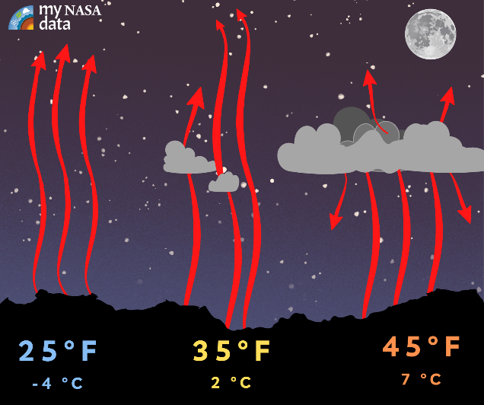
Infrared Thermometer
An IR thermometer pointed along the camera's line of sight will remotely determine the temperature of the sky
A cloudy sky reflects heat back to Earth, while a clear sky does not:
Cloudy skies are around 10°C warmer than clear skies
If skies are cloudy, observations will not be taken
Image from My NASA Data
Notes:
visuals

Slide 82
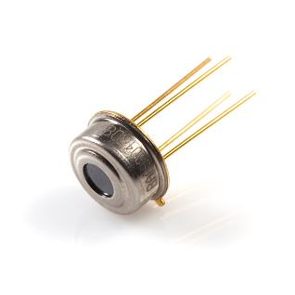
Infrared Thermometer Characteristics
MLX90614 Infrared Thermometer:
5V DC
0.02 °C resolution
Sensor temperature range -40 to +125 °C
Observation range -70 to +380 °C
Image from Sparkfun
Notes:
visuals

Slide 83
Humidity
A temperature and humidity sensor inside the enclosure will take continuous to ensure that weather conditions are within operating ranges for the equipment.
When relative humidity is high and the temperature of the components is lower than the temperature of the air, there is a chance that water in the air may condense
A conformal coating will be applied to the electronics to prevent condensation from damaging the components.

Slide 84
Temperature
Operating Temperatures
Linear Actuator: -26 to +65 C
Power Source: -20 to +45 C
Onboard Computer: -10 to +45 C (30-90% Humidity)
Sensor: -5 C to +50 C
Average Environmental Temp: (March)
Nederlands: 6 / -9 ˚C
Lyons: 13 / 2˚C
Our thermal model shows that the amount of heat the electronics put out will not greatly increase the temperature inside of the box, so the internal temperature is expected to match the ambient temperature.
If the temperature is expected to be less than -5C we will not put the box out. If the internal temperature sensor detects temperatures of less than -5C the window will close and all electronics will be put off.

Slide 85
Linear Actuator
The selected linear actuator is the ECO-WORTHY 12V 6 inch linear actuator
This actuator is rated for up to 330 lbs
This is far more than will be needed for this project, but it is the most cost-effective option
The Aerospace Electronics Center does not have any appropriate actuators for loan
Prof. Schwartz says most linear actuators cost upwards of $100
When power is removed, it will stay in its position
This is important because it would otherwise have to be constantly powered to stay closed

Slide 86
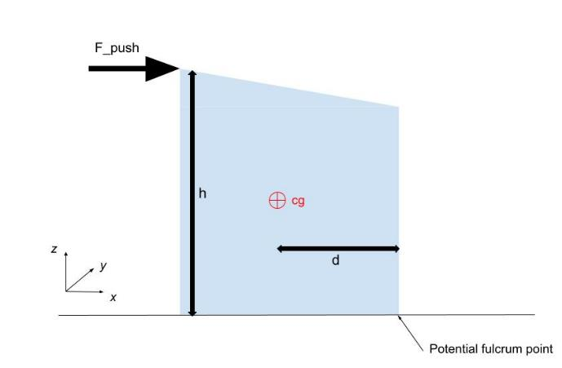
Stability and Security
BOTE Tipping Force Calculation
For the enclosure to tip over, Fh > mgd, which rearranges to give F_tip = mgd/h
approximate cg at (8.7, 9, 11) in.
h_max = 24 in.
mg = 25 lbs.
d = 9.3 in
F_tip = (25 lbs)(9.3 in)/(24 in) = 9.7 lbs
With no additional stability precautions, the enclosure will tip if there is a lateral force greater than 9.7 lbs.
To prevent the components from being accessed without permission, the lid will have a lock

Slide 87
Stability cont.
BOTE Wind Force Calculation
Wind Force = ½*rho*v^2*A
A = 3 ft^2 on largest side (0.278 m^2)
rho ~ 1.14 kg/m^3
F = 9.7 lbs = 43.15 N
V_wind = root((2*43.15)/(1.14*0.278))
With no additional stability precautions, the enclosure will tip if there is a wind velocity greater than 16 meters per second or 35 mph.
Average wind speed in the spring is 10.1 mph in Nederland and 9.2 mph in Lyons

Slide 88
Assembly
Acrylic:
1: 36x48 inch board
3: 24x24 inch boards
Assemble with L-Brackets and bolts on edges
Seal with silicone
Hinges on lid

Slide 89
Electronics

Slide 90
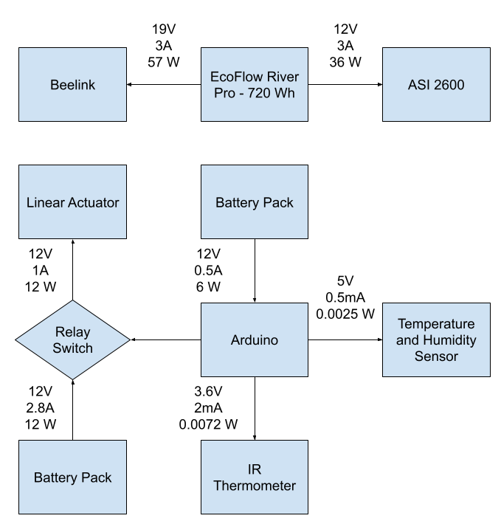
Power Analysis
Maximum Power Draw = 93W
Run Time with Maximum Power Draw = 7.74 Hours
Reasonable Assumptions:
Between 0⁰ C and 15⁰ C the ASI 2600 only requires up to 10% of available TEC & FAN power draw
CPU (28W Thermal Design Power, TDP)will never be maxed out with our low computation requirements
GPU (15W TDP) will never be maxed out with no need for graphics processing

Slide 91
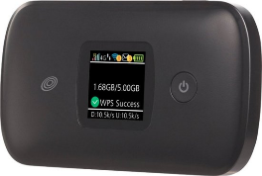
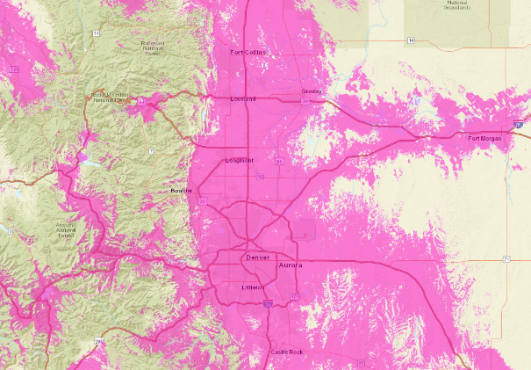
Communication
Location Requirements:
Expecting to transmit below 1 kbs
Low light pollution (need coverage in suburban to rural areas)
Using a Moxee 4G Mobile Hotspot as well as a Simple Mobile / T-Mobile Plan
FCC map of T-Mobile coverage confirms at least 1-5 Mbps coverage in many locations around Boulder
Notes:
FCC provides data on regions with at least 1-5 Mbps coverage
Light pollution maps based on

Slide 92
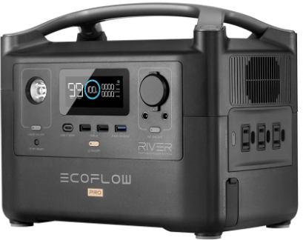
Power Source
Ports
3 x AC Output 120Vac (50Hz/60Hz)
2 x USB-A Output 5Vdc, 2.4A
1 x USB-A Fast Charge 5V/2.4A, 9V/2A, 12V/1.5A
1 x USB-C Output 5Vdc, 9Vdc, 12Vdc, 20Vdc , 5A
1 x Car Power Output 13.6Vdc 10A
2 x DC5521 Output 13.6Vdc, 3A
Specs
Discharge Temperature -20 to 45 C
720Wh capacity
Lithium-ion cell chemistry
Performance begins to degrade below 0 C

Slide 93
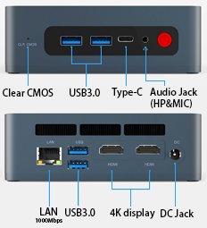
Processor
Specs
CPU - i5-8279U 2.4GHz, Turbo 4.1GHz
CPU Core - 4 Cores 8 Threads
Operating System - Windows 10 Pro
Storage - 256GB/512GB
RAM - 8G/16G
Ports
4 x USB 3.0
1 x DC Jack ()
1 x RJ45
1 x Type-C
1 x Clear CMOS
1 x Audio Jack
2 x HDMI

Slide 94
Proof of Processor Capability
Actual Processor - Intel Core i5-8279U - 2.4 GHz with 4.1 GHz max
Test Processor 1 - Intel Core i7-4500U - 1.8 GHz with 2.4 GHz max
ASTAP = 32% max of test processor 1 CPU usage , 1.1 second run time
NINA = 13.5% max of test processor 1 CPU usage , 3.3 second run time (plate solving)
Test Processor 2 - i5-1135G7 -- 2.4 GHz with 4.2 GHz max
Satellite Identification = 40% max of test processor 2 CPU usage , 11 second run time

Slide 95
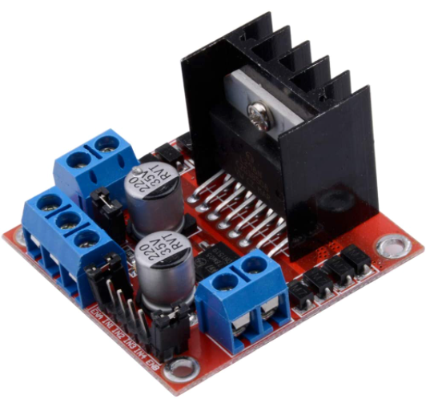
Linear Actuator Control
L298N
Dual channel H-Bridge driver
Accepts external power supply
Controls polarity of output to motor using any two regular digital high-low arduino pins
12V 2A max
Usable as a 5V power supply when given 7V or more

Slide 96
Temperature considerations
Operating Temperatures
Linear Actuator: -26 to +65 C
Power Source: -20 to +45 C
Onboard Computer: -10 to +45 C (30-90% Humidity)
Sensor: -5 C to +50 C
Average Environmental Temp: (March)
Nederlands: 6 / -9 ˚C
Lyons: 13 / 2˚C
Will need to analyze weather data to determine optimal testing days
Days with no precipitation
Clear Days (little to no clouds)
Wind Speeds less than 35 mph

Slide 97
Electronics Components
Power Source
EcoFlow River Pro Portable Power Station
Processor
SEi8 Beelink Mini PC
4G Adapter
Linear Actuator and H-Bridge
IR Thermometer
Temperature and Humidity Sensor
Arduino Uno
Arduino Shield
Arduino Wires
12V Battery Holder
12V Battery Adapter
AA Batteries

Slide 98
Optics

Slide 99
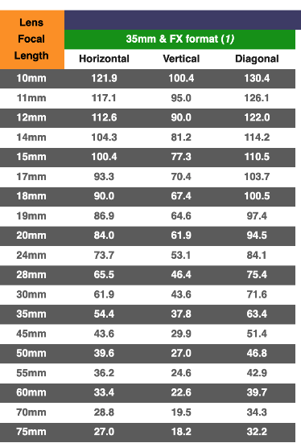
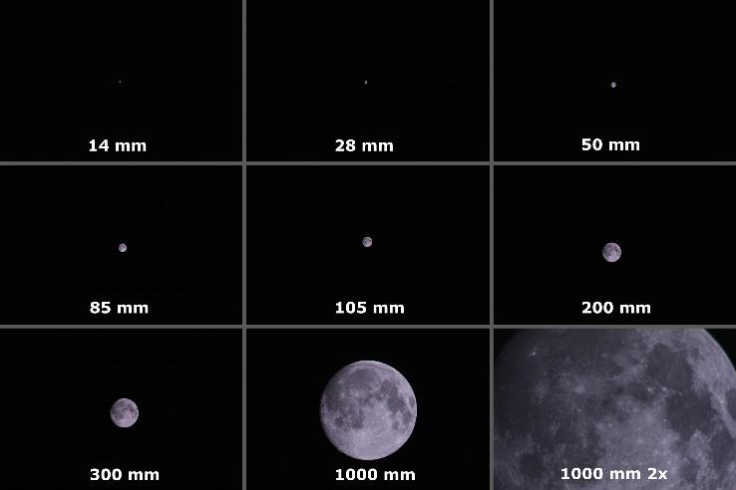
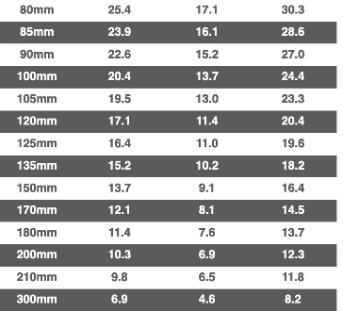
Chart Depicting Focal Length FOV Capability
https://www.nikonians.org/reviews/fov-tables
Provided By : User

Slide 100
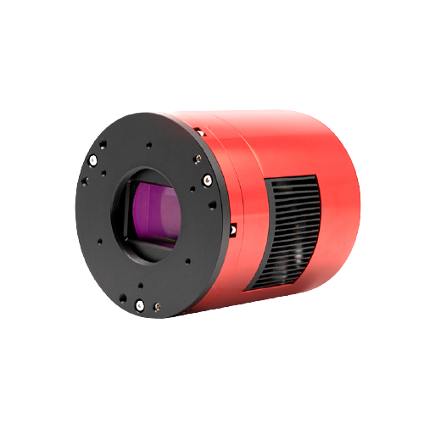
Dedicated Astrophotography Sensor Parameters
ZWO ASI2600MC Pro (color)
Mirrorless
Full frame
26.1 Megapixels
RGB
Pixel size: 3.76µm square
6248×4176 @ 3.51fps
Exposure Range: 32μs-2000s
Read Noise: 1.0-3.3e
QE peak: over 80%
Dimensions: 90mm Diameter
Weight: 700g

Slide 101
Limiting Stellar Magnitude (LSM)
Majority of GEO Satellites in range m = 11-14
Customer requires 13, 14-15 ideal
Aperture diameter (D) most important for urban areas
Assumptions:
Optical System is in ‘stare’ mode thus relative velocity is (⍵) = velocity of Satellite
GEO Satellites have circular orbits
Satellites treated as spheres
GEO Satellites
Sun
Full Moon
Naked
Eye Limit
-30
-25
-20
-15
-10
-5
0
5
10
15
20
25
Apparent Magnitude ( m_{v} )
13 <
[3] Coder, Holzinger, 2016)
Notes:
Better explain, use < to highlight values versus goal. Greater than
Equation too dense?

Slide 102
Optic Options in Consideration

Slide 103
Lens & Sensor Selection
Notes:
Not enough info to stand alone
Line at 13, shade the good section
Add in 13 minimum (or maximum?) requirement

Slide 104
Control Variables
(Coder, Holzinger, 2016)
Design Variables
F-number (N)
aperture diameter (D)
pixel size (p)
f
_ µm
P
D
1080
1920
N = f/D
Notes:
Box N, D, p in equation (or terms they impact)

Slide 105
Optical System Nomenclature
Symbol | Value [units] | Description
SNR_{alg} | 6 | Signal to Noise Ratio
m_{i} | 40 (pixels) | Initial # of pixels occupied by space object (SO) image
𝜱_{alg} | 5.6*E10 (photons/s/m²) | Photon Flux Density
q_{p,sky} | 120 (e−/s/pixel) | Photon Flux per pixel from background radiant intensity
q_{p,dark} | 0.00391 (e−/s/pixel) | Photon flux of CCD (Charge Coupled-Device) dark current
𝛕_{atm} | 0.69 | Transmittance of optics atmosphere
𝛕_{opt} | 0.9 | Transmittance of optics assembly
QE | 0.66 | Quantum Efficiency

Slide 106
Orbital Determination

Slide 107
Orbit Determination Full Requirements Breakdown

Slide 108
ODTK Equations and Assumptions: Gooding Method Derivation
General Methodology
Using three pairs of angles, determine unit vectors ȓ₁ and ȓ₃
Find position vector r_{j} of the groundstation.
Assume value for range, 𝜌₁ and 𝜌₃ . Use range and unit vectors to determine position vectors R₁ and R₃ of satellite
𝜌_{j}ȓ₁ = R_{j} - s_{j}
Where s_{j} is the position vector of the groundstation.
Notes:
Equations? Just input to output feels weird

Slide 109
ODTK Equations and Assumptions: Gooding Method Derivation
General Methodology
Begin Iteration
Generate Estimated Orbit by solving Lambert’s Problem
From Lambert’s Problem, will receive estimate of v₁ and v₂ of satellite
Now have complete orbit made from R₁ and v₁
Propagate R₁ and v₁ to obtain estimates for R₂ and v₂
Calculate 𝜌₂ as an estimate of the true range vector 𝜌₂
Iterate 𝜌₁ and 𝜌₃ via Newton-Raphson Method to obtain better estimate of 𝜌₂
End
Notes:
Equations? Just input to output feels weird

Slide 110
Orbit Determination - Angle Conversion
Constructing Position Vector of Ground Station:
Find unit vector of position of ground station by calculating Vector L via method shown.
Determine position vector of ground station by finding altitude at location of ground station and multiplying by unit vector L to find position vector of ground station
𝛼 = Right Ascension (degrees)
δ = Declination (degrees)
Notes:
Reference: https://help.agi.com/odtk/LinkedDocuments/GoodingAnglesOnly.pdf

Slide 111
Orbit Determination - Angle Conversion
Constructing Position Vector of Satellites:
Find unit vector of position of satellite by calculating Vector L via method shown.
Determine initial guess of position vector of satellite by multiplying unit vector L with estimated distance of satellite of 42000 km to obtain initial guess for position vector of satellite.
𝛼 = Right Ascension (degrees)
δ = Declination (degrees)
Notes:
Reference: https://help.agi.com/odtk/LinkedDocuments/GoodingAnglesOnly.pdf

Slide 112
Orbit Determination - Lambert’s Problem
General Methodology:
Given two position vectors, it is possible to determine the velocity vectors of the beginning and end of a transfer arc connecting these two points in space.
Need to find orbital elements, a and e, of transfer conic connecting the two position vectors within some given flight time.
Using discovered a and e, calculate the velocity vectors at each location which would complete the maneuver along the arc.
Notes:
Reference: https://help.agi.com/odtk/LinkedDocuments/GoodingAnglesOnly.pdf

Slide 113
Orbit Determination - Lambert’s Problem
There are several conics which could satisfy the conditions of the Lambert arc, so the correct arc must be chosen.
In this case, as the two positions will be close together over a short period of time, the minimum semi-major axis required to complete the arc can be chosen from the minimum energy required to complete the transfer along the arc.
Notes:
Reference: https://help.agi.com/odtk/LinkedDocuments/GoodingAnglesOnly.pdf

Slide 114
Orbit Determination - Lambert’s Problem
Lambert Problem Solution - Determining Semi-Major Axis
Step 1: Find the transfer angle between the two points.
Step 2: Determine the chord length, c, and semi-parameter, s, of the transfer arc.
Notes:
Reference: https://help.agi.com/odtk/LinkedDocuments/GoodingAnglesOnly.pdf

Slide 115
Orbit Determination - Lambert’s Problem
Lambert Problem Solution - Determining Semi-Major Axis
Step 3: Determine minimum Time of Flight (TOF) of transfer conic.
𝜇 in this case is the 𝜇 of Earth.
Notes:
Reference: https://help.agi.com/odtk/LinkedDocuments/GoodingAnglesOnly.pdf

Slide 116
Orbit Determination - Lambert’s Problem
Lambert Problem Solution - Determining Semi-Major Axis / Velocity
Step 4: Numerically iterate TOF calculation to determine Semi-Major Axis, a.
After solving the minimum TOF using initial values of 𝛼, 𝛽, and a, we can iteratively solve the TOF until the calculated TOF minus the measured TOF is less than the error tolerance chosen. This will result in the final value of a.
Step 5: Find eccentricity, e.
where
Notes:
Reference: https://help.agi.com/odtk/LinkedDocuments/GoodingAnglesOnly.pdf

Slide 117
Orbit Determination - Lambert’s Problem
Lambert Problem Solution - Determining Velocity
Step 6: Determine the velocity vectors at the beginning and end of the transfer.
The velocity vectors at the beginning and end of the transfer can be found using f and g function which are defined below.
These f and g functions help relate position and velocity at general locations along an orbit within the two-body problem at a specific time.
Notes:
Reference: https://help.agi.com/odtk/LinkedDocuments/GoodingAnglesOnly.pdf

Slide 118
Driving Requirements
DR 6.1 | The software subsystem shall have the capability to predict a close approach between two satellites.
DR 6.1.1 | Once a potential satellite close approach is identified the system will extrapolate how long it will take until the two objects are at their closest point.
DR 6.1.2 | The satellite close approach shall be detected when satellites are within a 25 km range.
Notes:
Ajay

Slide 119
Orbit Determination - Error Resolution
Close Approach - DR 6.1.2
Using an error bound of less than 0.1% would give a max range bound of 42 km on the semi-major axis measurement. It is realistic to have positioning data that is bounded this tightly; however, it is entirely dependent on the resolution and accuracy of the images being taken.
We have done tests with ODTK and our imaging capabilities and have found that it is possible to obtain accuracy of less than 10 km as seen in 2.5 arcsec error graph.

Slide 120
Orbit Determination: GoodingIOD Time Delay Error
Reference: AGI
Notes:
Reference: https://help.agi.com/odtk/LinkedDocuments/GoodingAnglesOnly.pdf

Slide 121
Orbit Determination: GoodingIOD Error σ = 2.5 arcsec
Reference: AGI
Notes:
Reference: https://help.agi.com/odtk/LinkedDocuments/GoodingAnglesOnly.pdf

Slide 122
Orbit Determination: GoodingIOD Error σ = 5 arcsec
Reference: AGI
Notes:
Reference: https://help.agi.com/odtk/LinkedDocuments/GoodingAnglesOnly.pdf

Slide 123
Mount

Slide 124
Sensor to Mount
ZWO Holder Ring
“ZWO Holder Ring is designed to keep your ASI6200 Pro or ASI2600 camera steady, with a 90 mm diameter”
Notes:
Reference:
https://optcorp.com/products/zwo-holder-ring-asi6200-pro-cameras?gclid=Cj0KCQjw_fiLBhDOARIsAF4khR10zKVtbczTUwQvjziUZ7BXtCXuMxTI7CbFX6WBdL-xDrJ7oyhZOy4aAuvLEALw_wcB

Slide 125
Mount to Tripod
Neewer 360 Degree Rotating Ball Head
Max Load: 17.6 lbs.
1/4" quick shoe plate
3/8'' Bottom Screw Thread
Horizontal and vertical bubble level
Notes:
Reference: https://www.amazon.com/Neewer-Professional-Panoramic-17-6pounds-8kilograms/dp/B01M4LQ8P6/ref=asc_df_B01M4LQ8P6/?tag=hyprod-20&linkCode=df0&hvadid=309836137809&hvpos=&hvnetw=g&hvrand=7348227515418024315&hvpone=&hvptwo=&hvqmt=&hvdev=c&hvdvcmdl=&hvlocint=&hvlocphy=9028818&hvtargid=pla-402506087649&psc=1

Slide 126
Processing

Slide 127
NINA

Slide 128
Astrometry.net VS ASTAP
Astrometry.net
ASTAP
File Size | ~10 GB
Blind Solve Test Speed | 28 seconds
Reliability | 100% (When compared to ASTAP)
File Size | 4.6 GB
Blind Solve Test Speed | 3.1 seconds
Reliability | 100% (When compared to Astrometry.net)

Slide 129
Data Budget

Slide 130
Example Packet

Slide 132
Algorithm

Slide 133
Machine Learning Model
Sequential Model
128 Node Dense Layer
ReLU Activation
Dropout Layer
0.5 Probability
1 Node Output Layer
Sigmoid Activation
Loss Function: Binary Cross-Entropy
Optimizer: Adam
Training Epochs: 5
Notes:
CPE 4: Algorithm - Analysis Methods Proof
More in depth step by step
Show completed butterworth and compare to the image L3Harris provided?
CPE 4: Algorithm - Machine Learning Proof
CLEARLY explain why and for what reason/what it will do for the project
Show where training data is coming from and is it enough
Show what has been done and EXACTLY how we will expand it

Slide 134
Other Risks

Slide 135
Risks Mitigation
Risk | Description | Mitigation | Pre (LxS) | Post (LxS)
Enclosure II | System could be stolen | Bike Lock to grounded structure, padlock on lid, placing box on property of people we know | 3x5=15 | 1x5=5
Enclosure III | Something could shift the enclosure (ex. Wind, animals) | Using stakes to secure system and reduce structure wobbling, | 1x4= 4 | 1x2 = 2
Enclosure IV | Damaging system in transportation to testing location | Transportation protocol stipulates sensor and lens transported in delivered boxes separate from system, system strapped down | 2x3 = 6 | 1x1 = 1
Enclosure V | Precipitation | Box is waterproof and is slanted to move water away from the window. All seams are sealed with silicone or weatherstrip. This has already been mitigated. | 1x5=5 | 1x5=5
Image Processing II | Program freeze (NINA, Image Processing) onboard computer | Python backup, if no data is being collected and or if the data packet is empty force restart the programs onboard | 2x4= 8 | 1x2 = 2
Notes:
SNR Ratio to High

Slide 136
Risks Mitigation
Risk | Description | Mitigation | Pre | Post
Optics II | Focus problems from sensor suit assembly | Spacers to add back focus, additional parts, and ZWO system calibration | 3x4 = 12 | 2x3 = 6
Optics III | Exposure time requirement is unknown | Background research on exposure time recommendations based upon light pollution. Testing various exposures upon deploying system. | 3x4 = 12 | 2x2 = 4
Optics IV | Lens fogging due to pressure and temperature fluctuations | Frequent testing schedule to allow for testing in more favorable conditions and a lens warmer | 3x4 = 12 | 2x2 = 4
Finance I | Exceeding Budget | Using a color sensor instead of a monochrome sensor system | 4x4 = 16 | 1x2 = 2

Slide 137
Risks Mitigation
Risk | Description | Mitigation | Pre | Post
Electronics II | Error associated with Temp. Sensor, Humidity Sensor,and IR Thermometer | System will execute emergency shut off before even reaching system threshold levels | 2x4 = 8 | 1x3 = 3
Electronics III | Condensation on Arduino leading to sensor failure | Add silicone conformal coating to the protoboard | 3x4 = 12 | 1x4 = 4
Electronics IV | Power Failure that leaves electronics vulnerable to out of spec temp and humidity | Power Arduino and linear actuator with a battery pack so if EcoFlow fails it can still operate | 1x5 = 5 | 1x1 = 1
Electronics V | Loss of connection | Store recent data collected locally and then once connection is established send local packets and delete | 1x2 = 2 | 1x1 = 1

Slide 138
V&V Backup Slides

Slide 139
V&V Backup Overview
Phase 1, 2, and 3
Optics V&V
Structures V&V
Orbit Determination V&V
Electronics V&V
Data Collection V&V
Algorithm V&V
System V&V

Slide 140
Test Abbreviation Key
OPT - Optics
STR - Structures
ORB - Orbital
ELE - Electronics
DAT - Data
ALG - Algorithm
SYS - System

Slide 141
Testing Phase 1: Component Testing
Component | Test Name | Completion Date | Facility - Equipment
Lens | OPT.2: Optical Alignment | 2/7/22 | Project Room - Lens, sensor, test paper
Lens | OPT.3: Sharpness | 2/7/22 | Project Room - Lens, sensor, test unit
Lens | OPT.4: Focus Accuracy | 2/7/22 | Project Room - Lens, sensor, test unit
Lens | OPT.5: Distance Focus | 2/7/22 | Outside at night - Lens, sensor
Linear Actuator | STR.1: Force | 2/7/22 | Project Space - Linear actuator, power
IR Sensor | ELE.1: IR Sensor | 2/7/22 | Outside at night - IR, Arduino, power
Temp Sensor | ELE.2: Temp Sensor | 2/7/22 | Outside at night - Temp, Arduino, power, ice
Humidity Sensor | ELE.3: Humidity Sensor | 2/7/22 | Outside at night - Humidity, Arduino, power
Image Processing | DAT.2: Image Processing | 2/7/22 | Project Space - None
Notes:
Blue on sheet

Slide 142
Testing Phase 2: Subsystem Testing
Subsystem | Test(s) Name | Completion Date | Facility - Equipment
Optics | OPT.1: Basic Functionality OPT.6: Pointing OPT.7: LSM* OPT.8: Optics Day in the Life | 2/20/22 | Projects Room - Lens, sensor, test paper
Structures | STR.2: Thermal Model* STR.3: Stability STR.4: Water Protection | 2/20/22 | Outside aero - full structure, water, water can, thermocouples
Orbit Determination | ORB.1-7: All Keplerian Element Tests ORB.8: Close Approach Event Prediction | 3/20/22 | Projects Room - N/A
Electronics | ELE.4: Power Interface ELE.5: Power Failure ELE.6: Communication/Data Interface | 2/20/22 | Projects Room - All electronics, linear actuator
Data Flow | DAT.1: Communications DAT.3: Alert Timing* | 3/20/22 | Projects Room - N/A
Algorithm | ALG.1-6: POLs ALG.7-10: Events | 3/20/22 | Projects Room - N/A
Notes:
Yellow on sheet

Slide 143
Testing Phase 3: System Testing
Test Name | Completion Date | Facility - Equipment
Full System Software Test | 3/6/22 | None - Full System
Structure View Test | 3/6/22 | None - Full System
Full System Test | 3/6/22 | None - Full System
Full System Day in the Life (Field Testing) | 4/10/22 | None - Full System
Notes:
Red on sheet

Slide 144
Optics (OPT) V&V Overview
Test Number | Test Name | Completion Date
OPT.1 | Basic Optics Functionality Test | 2/20/22
OPT.2 | Optical Alignment Test | 2/7/22
OPT.3 | Sharpness Test | 2/7/22
OPT.4 | Focus Accuracy Test | 2/7/22
OPT.5 | Distance Focus | 2/7/22
OPT.6 | Pointing | 2/20/22
OPT.7 | LSM | 2/20/22
OPT.8 | Optics Day in the Life | 2/20/22

Slide 145
OPT.1: Basic Optics Functionality
Req | CPE | Test Description | Measurements | Setup | Facilities | Equipment
FR 1 | GEO Observation | Take a photo of the lockers in the senior projects room and review the photos to confirm the lens functioned as expected. | Inspect the image to confirm there is no obvious warping, uneven brightness, uneven focus, or spots. | Clean the lens, place the lens on a known functional camera body, mount to a tripod, take a photo, and review the photo. | Senior Projects Room | Provided lens for project Known functional camera body Lens cleaner Tripod SD Card

Slide 146
OPT.2: Optical Alignment Test
Req | CPE | Test Description | Measurements | Setup | Facilities | Equipment
FR 1 | GEO Observation | Tape the optics test paper to the wall and align the camera such that the center circle fills the screen. Start recording the camera. Adjust the focus to cover all ranges three times over approximately 30 seconds. Review the recorded video. | Review the video and by visual inspection confirm the center of the circle does not move and that the whole image goes in focus and out of focus at the same time. | Clean the lens, place the lens on a known functional camera body, tape the optics test paper to the wall, adjust the distance between the lens and wall to ensure the whole wheel is in focus, conduct the test | Senior Projects Room | Provided lens for project Known functional camera body Lens cleaner Tape Tripod SD Card Optics test paper printed

Slide 147
OPT.3: Sharpness Test
Req | CPE | Test Description | Measurements | Setup | Facilities | Equipment
FR 1 | GEO Observation | Tape the optics test paper to the wall and align the camera so that the paper fills the screen, do not move the camera or the test paper for the duration of the test. Start at the largest aperture, take a photo, decrease the aperture 1 stop, take a photo, repeat until the aperture is at a minimum. | Review the photos and by visual inspection confirm the sharpness stays the same across the optics test paper for all apertures. | Clean the lens, place the lens on a known functional camera body, tape the optics test paper to the wall, adjust the distance between the lens and wall to ensure the optics test paper is in frame, do not move the setup for the duration of the test | Senior Projects Room | Provided lens for project Known functional camera body Lens cleaner Tape Tripod SD Card Optics test paper printed

Slide 148
OPT.4: Focus Accuracy Test
Req | CPE | Test Description | Measurements | Setup | Facilities | Equipment
FR 1 | GEO Observation | Place the focus accuracy test unit on the table, attach the camera the tripod, focus the camera on the middle and take a photo, review the photo to confirm if the camera is forward or back focusing. Repeat for a known functioning camera body and for the chosen project sensor. | Review the photos and by visual inspection confirm if the zero is the most in-focus and sharpest point | Clean the lens, place the lens on a known functional camera body, turn off camera corrections, center auto focus, set to wides aperture, use a timer | Senior Projects Room | Provided lens for project Known functional camera body Sensor for the project Lens cleaner Test Unit Tripod SD Card
Notes:
Reference: https://www.youtube.com/watch?v=L7i4WDU65lU

Slide 149
OPT.6: Pointing
Req | CPE | Test Description | Measurements | Setup | Facilities | Equipment
FR 1 | GEO Observation | Determine azimuth and elevation angle of the Moon and use those angles to position the optics system to point at the Moon. Take a photo and confirm the Moon is in the center of the image. | Review the photos and by visual inspection confirm that the Moon is in the center of the image (focusing does not matter). Use a grid system to confirm the position of the Moon in the frame. | Place optics system on the mount and place the mount on a tripod, adjust the azimuth and elevation angle, take a photo . | Outside the Aerospace Building at Night | Provided lens for project Sensor for the project Tripod

Slide 150
OPT.5: Distance Focus
Req | CPE | Test Description | Measurements | Setup | Facilities | Equipment
FR 1 | GEO Observation | Point the optics system at the Moon, focus the camera, take a photo, and confirm the Moon is in focus. | Review the photos and by visual inspection confirm that the Moon is in focus. | Place optics system on the mount and place the mount on a tripod, point the system, take a photo | Outside the Aerospace Building at Night | Provided lens for project Sensor for the project Tripod

Slide 151
OPT.7: LSM (Limited Stellar Magnitude)
Req | CPE | Test Description | Measurements | Setup | Facilities | Equipment
FR 1 | GEO Observation | This test will validate the LSM model by determining the lowest LSM object that the system can see. | Review the photos and by visual inspection confirm the object can be seen. | Place optics system on the mount and place the mount on a tripod, adjust the settings, point the system. Take a photo of the sky on three different clear nights, one with a new Moon, half Moon, and full Moon. Set the aperture, focus, and all other settings to accordingly. Run photo through image processing and identify the object that has the lowest LSM. Confirm the object matches the predicted model. | Outside the Aerospace Building at Night | Provided lens for project Sensor for the project Tripod

Slide 152
OPT.8: Optics Day in the Life
Req | CPE | Test Description | Measurements | Setup | Facilities | Equipment
FR 1 | GEO Observation | Tape the optics test paper to the wall and align the camera such that the paper fills the field of view. Leave the camera on and taking photos and storing photos for seven hours at one photo every five seconds, store the photos. | Review the photos and confirm all the expected photos were taken during the test. By visual inspection, confirm the photos are in focus and there are no obvious errors in the images that were taken. | Clean the lens, place the lens on the sensor, mount to a tripod, provide power that will last seven hours, adjust sensor settings to take one photo every five seconds, start the system and leave it running for seven hours. | Senior Projects Room | Provided lens for project Sensor for project Timer Lens Cleaner Tape Tripod Optics test paper printed

Slide 153
Structure (STR) V&V Overview
Test Number | Test Name | Completion Date
STR.1 | Force | 2/7/22
STR.2 | Thermal | 2/20/22
STR.3 | Stability | 2/20/22
STR.4 | Water | 2/20/22
STR.5 | Transport | N/A

Slide 154
STR.1: Force
Req | CPE | Test Description | Measurements | Setup | Facilities | Equipment
FR 1 | GEO Observation | This test will confirm that the linear actuator has the required force to open the window and allow for the sky to be visible to the optics system. | A mass sim will be used to test the linear actuator and confirm it has enough force to raise and lower the window. | Place a mass sim on the top of the linear actuator, power the linear actuator, and confirm it can raise and lower with the mass sim. | Senior Projects Room | Linear actuator Power source Mass sim

Slide 155
STR.2: Thermal
Req | CPE | Test Description | Measurements | Setup | Facilities | Equipment
FR 8 | Weather Protection | This test will verify the structures thermal model. | Place the box with all components powered on and running outside with a four thermometers at four points inside the box and on thermometer at one point outside the box, and one thermometer 10 feet away from the box (to monitor ambient temperature). Take readings from the thermometer for the duration of the test and compare against the thermal model. | Place the box outside for 7 hours overnight when the temperature is between 10 - 35C (this is the average temperature of where the final box deployment will be). Set up the thermometers and power on all the equipment. Take data on the temperature of the box for the duration of the test and confirm the system is still operational every 30 minutes. | Outside the aerospace building at night. | Structure Fully Optics System Fully Electronics Thermocouples

Slide 156
STR.3: Stability
Req | CPE | Test Description | Measurements | Setup | Facilities | Equipment
FR 1 | GEO Observation | This test will confirm when the system is operating the structure does not move, because any movement will impact the data collection. | By inspection of the images, confirm the structure remained stable for the duration of the test. | Place the structure, will all components on and running, outside during the day. Point and focus the camera at the optics focus accuracy test unit. Leave the system running for four hours. Review the photos by inspection to confirm the focus stays constant for the duration of the test. Note, the image processing system will not be able to understand the photos being taken, but still run the images through the system and upload dummy data to the server. Store the raw images on the onboard computer. | Outside the aerospace building during the day. | Structure Fully Optics System Fully Electronics

Slide 157
STR.4: Water
Req | CPE | Test Description | Measurements | Setup | Facilities | Equipment
FR 8 | Weather Protection | Expose empty structure to water associated with IPX1 and confirm that no water gets inside. | By inspection of the structure after the test, confirm there is no water inside the box and that there are no harmful effects to the structure due to the test. | Place the empty enclosure outside. Drip 1 mm of vertical water per minute on the box for 10 minutes. | Outside the aerospace building during the day. | Structure Water Watering Can

Slide 158
STR.5: Transport
Req | CPE | Test Description | Measurements | Setup | Facilities | Equipment
NONE | NONE | This test will confirm that the system can be transported for remote setup. This is NOT driven by any requirement. it is simply a test for the team to either confirm it can be transported in one peice or not. | The weight of the box will be measured to ensure it is reasonable for two people to lift it (under TBD lbs). The mobility will also be tested by having two people try to carry the box 100 feet across the aerospace building. This will not perfectly match the environment it will be deployed in, but it will provide the information needed for the team. | First, weigh the box (without any equipment inside) to confirm it should be liftable by two people (TBD lbs). Next, have two people lift the box and move it TBD feet. | Senior Projects Room | Structure 2 people

Slide 159
Orbit Determination (ORB) V&V Overview
Test Number | Test Name | Completion Date
ORB.1 | Semi-Major Axis Determination | 3/20/22
ORB.2 | Eccentricity Determination | 3/20/22
ORB.3 | Inclination Determination | 3/20/22
ORB.4 | True Anomaly Determination | 3/20/22
ORB.5 | RAAN Determination | 3/20/22
ORB.6 | Argument of Periapsis Determination | 3/20/22
ORB.7 | Fully Keplerian Orbital Element Calculation | 3/20/22
ORB.8 | Event Prediction - Close Approach | 3/20/22

Slide 160
ORB.1: Semi-Major Axis Determination
Req | CPE | Test Description | Measurements | Setup | Facilities | Equipment
FR 4 | POL Determination | This test will confirm that the semi-major axis can determined within 1% error. | Error between the calculated and true semi-major axis. | Using the right ascension, declination, and location of data collection, use the provided L3 Harris data, calculate the semi-major axis of a satellite with a known NORAD-ID. Compare the calculated to the true value for that satellite. Calculate the error between the two values. | Senior Projects Room | Computer with Data, MatLab, and ODTK

Slide 161
ORB.2: Eccentricity Determination
Req | CPE | Test Description | Measurements | Setup | Facilities | Equipment
FR 4 | POL Determination | This test will confirm that the eccentricity can determined within 2% error. | Error between the calculated and true eccentricity. | Using the right ascension, declination, and location of data collection, use the provided L3 Harris data, calculate the eccentricity of a satellite with a known NORAD-ID. Compare the calculated to the true value for that satellite. Calculate the error between the two values. | Senior Projects Room | Computer with Data, MatLab, and ODTK

Slide 162
ORB.3: Inclination Determination
Req | CPE | Test Description | Measurements | Setup | Facilities | Equipment
FR 4 | POL Determination | This test will confirm that the inclination can determined within 1% error. | Error between the calculated and true inclination. | Using the right ascension, declination, and location of data collection, use the provided L3 Harris data, calculate the inclination of a satellite with a known NORAD-ID. Compare the calculated to the true value for that satellite. Calculate the error between the two values. | Senior Projects Room | Computer with Data, MatLab, and ODTK

Slide 163
ORB.4: True Anomaly Determination
Req | CPE | Test Description | Measurements | Setup | Facilities | Equipment
FR 4 | POL Determination | This test will confirm that the true anomaly can determined within 1% error. | Error between the calculated and true true anomaly. | Using the right ascension, declination, and location of data collection, use the provided L3 Harris data, calculate the true anomaly of a satellite with a known NORAD-ID. Compare the calculated to the true value for that satellite. Calculate the error between the two values. | Senior Projects Room | Computer with Data, MatLab, and ODTK

Slide 164
ORB.5: RAAN Determination
Req | CPE | Test Description | Measurements | Setup | Facilities | Equipment
FR 4 | POL Determination | This test will confirm that the right ascension of the ascending node can determined within 1% error. | Error between the calculated and true right ascension of the ascending node. | Using the right ascension, declination, and location of data collection, use the provided L3 Harris data, calculate the right ascension of the ascending node of a satellite with a known NORAD-ID. Compare the calculated to the true value for that satellite. Calculate the error between the two values. | Senior Projects Room | Computer with Data, MatLab, and ODTK

Slide 165
ORB.6: Argument of Periapsis Determination
Req | CPE | Test Description | Measurements | Setup | Facilities | Equipment
FR 4 | POL Determination | This test will confirm that the argument of periapsis can determined within 1% error. | Error between the calculated and true argument of periapsis. | Using the right ascension, declination, and location of data collection, use the provided L3 Harris data, calculate the argument of periapsis of a satellite with a known NORAD-ID. Compare the calculated to the true value for that satellite. Calculate the error between the two values. | Senior Projects Room | Computer with Data, MatLab, and ODTK

Slide 166
ORB.7: Full Keplerian Orbital Element Determination
Req | CPE | Test Description | Measurements | Setup | Facilities | Equipment
FR 4 | POL Determination | This test will confirm that when the right ascension and declination are inputted, all six orbital elements are returned within the acceptable error. | Error between the calculated and true value for all six orbital elements. | Using the right ascension, declination, and location of data collection, use the provided L3 Harris data, calculate the six orbital elements for a satellite with a known NORAD-ID. Compare the calculated to the true value for that satellite. Calculate the error between the two values. | Senior Projects Room | Computer with Data, MatLab, and ODTK

Slide 167
ORB.8: Event Prediction - Close Approach
Req | CPE | Test Description | Measurements | Setup | Facilities | Equipment
FR 4 | POL Determination | This test will confirm the system can predict a close approach between two satellites using satellite data from two satellites where there is a close approach and using satellite data from two satellites where there snot a close approach. Confirm the close approach is predicted within 1% error. | Distance between the two satellites throughout the orbit, error on the position of each satellite. | Use two sets of two satellite data where there is no close approach. Use two sets of two satellite data where there is a close approach. Test with all four of these data sets (before the close approach would occur). Propagate the data in ODTK and confirm the system predicts a close approach with the data there is one and confirm the system does not predict a close approach with the data that there isn't. Confirm the position of each satellite and the error of each satellite is expected. | Senior Projects Room | Computer with Data, MatLab, and ODTK

Slide 168
Electronics (ELE) V&V Overview
Test Number | Test Name | Completion Date
ELE.1 | IR Sensor | 2/7/22
ELE.2 | Temperature Sensor | 2/7/22
ELE.3 | Humidity Sensor | 2/7/22
ELE.4 | Power Interface Check | 2/20/22
ELE.5 | Power Failure | 2/20/22
ELE.6 | Communications and Data Interface Check | 2/20/22

Slide 169
ELE.1: IR Sensor
Req | CPE | Test Description | Measurements | Setup | Facilities | Equipment
FR 8 | Weather Protection | This test will determine if the IR sensor works as intended and correctly notifies if there are clouds above the system. | The IR sensor will be placed outside for one hour at night taking data and alerting if there is a cloud. Do this on four different nights, once when there is no clouds, one night were there are some clouds, one night where there is full cloud cover, and one night when it is raining. The sensor results will be confirmed by visual inspection. Someone will sit outside with the sensor and document if there are clouds above every 5 minutes as well as anytime the sensor alerts. Also, weather data from the National Weather Service will be used to verify the visual inspection was correct. | Upload the necessary code to the Arduino, calibrate the system, place the sensor outside on a clear night for five hours, confirm it does not alert. Place the sensor outside on a cloudy day and confirm it does alert when there is a cloud above. During the test, a person will also be outside with the sensor documenting if there are any clouds above every 5 minutes. | Outside the aerospace building at night. | IR sensor Battery Arduino Computer for data collection Associated wires and connectors

Slide 170
ELE.2: Temperature Sensor
Req | CPE | Test Description | Measurements | Setup | Facilities | Equipment
FR 8 | Weather Protection | This test will confirm the temperature sensor works as expected and alerts when the temperature is outside of a defined range. | The temperature sensor will be placed outside for three hours (on a night predicted to be within the defined range) to collect temperature data every second, confirm the sensor does not alert. Compare the data to the National Weather Service data, calculate the error and confirm it matches the data sheet. At the end of that test, expose the temperature sensor to a temperature above the allowable range, confirm it alerts. Then expose the temperature sensor to a temp be below the allowable range, confirm it alerts. | Upload the necessary code to the Arduino, calibrate the system, place the sensor outside on a night where the temperature is predicted to be within the range for three hours, confirm it does not alert. Place a finger on the temperature sensor to increase the temperature. Place an ice pack on the temperature sensor to decrease the temperature. | Outside the aerospace building at night. | Temperature sensor Battery Arduino Ice Computer for data collection Associated wires and connectors

Slide 171
ELE.3: Humidity Sensor
Req | CPE | Test Description | Measurements | Setup | Facilities | Equipment
FR 8 | Weather Protection | This test will confirm the humidity sensor works as expected and alerts when the humidity is outside of a defined range. | The humidity sensor will be placed outside for three hours to collect humidity data every second. The data will the be compared against humidity data from the National Weather Service. At the end of the test, expose the humidity sensor to a humidity above the defined range, confirm it alerts. | Upload the necessary code to the Arduino, calibrate the system, place the sensor outside on a night where the humidity is predicted to be below the defined range for three hours, confirm it does not alert. Breath on the humidity sensor to increase it above the defined range, confirm it alerts. | Outside the aerospace building at night. | Humidity sensor Battery Arduino Computer for data collection Associated wires and connectors

Slide 172
ELE.4: Power Interface Check
Req | CPE | Test Description | Measurements | Setup | Facilities | Equipment
FR4, FR 5 | Data Collection | This test will confirm all the power interfaces work as designed. Therefore confirming the system has power. | For components that the power can be measured with a voltmeter, measure the voltage and confirm it matches the model. For components that power can not be measured with a voltmeter, confirm (yes or no) if the component has enough power. | For each component that requires a power interface: Battery to beelink Battery to sensor Beelink to Arduino Arduino to IR Thermometer Arduino to linear actuator through converter | Senior Projects Room | Battery Arduino Linear Actuator IR Thermometer Beelink Sensor Associated cables and wires

Slide 173
ELE.5: Power Failure
Req | CPE | Test Description | Measurements | Setup | Facilities | Equipment
FR 8 | Weather Protection | This test will determine if the system fails closed, ensuring the protection of the equipment, regardless of the power status. | Remove power from the linear actuator while in an open position, confirm when the power is turned off, the system goes to a closed position. Remove power from the linear actuator while in an closed position and then confirm when the power is turned off the system stays in a closed position. | Place a mass sim on the linear actuator. Power the linear actuator to the "open" position. Remove power and confirm the system goes to a "closed" position. Then power the system to a "closed" position. Remove power and confirm the system remains in a "closed" position. | Outside the aerospace building at night. | Linear actuator Power source Mass sim

Slide 174
ELE.6: Communications and Data Interface Check
Req | CPE | Test Description | Measurements | Setup | Facilities | Equipment
FR4, FR 5 | Data Collection | This test will confirm all the communications and data interfaces work as designed. Therefore confirming the system will be able to collect the intended data. | Each of the communication interfaces listed in the test setup will be testing using the data file types and sizes that are estimated for each interface. The test of each will be verified as a pass or fail. The test will pass if the communication / data interface works as intended. The test will fail if not. | For each component that has a communications and/or data interface, make the connection one component at a time and confirm the interface is functional: Beelink to server using 4G Sensor to beelink NINA on Beelink IR to Arduino Arduino to Beelink Arduino to linear actuator Server to offboard computer Offboard computer to and from ODTK ODTK to algorithm Algorithm to .csv | Senior Projects Room | Battery All associated electronics components

Slide 175
Data (DAT) V&V Overview
Test Number | Test Name | Completion Date
DAT.1 | Communications | 3/20/22
DAT.2 | Image Processing Products | 2/7/22
DAT.3 | Alert Timing | 3/20/22

Slide 176
DAT.1: Communications
Req | CPE | Test Description | Measurements | Setup | Facilities | Equipment
FR 3 | Data Collection | This test will confirm the communication functionality between the onboard and offboard computer via a server. | By inspection, confirm the txt file that was uploaded has the same format, size and has the same content as the txt file that was downloaded | Upload a txt file to the server from the onboard computer and download the txt file from the server from the offboard computer. | Senior Projects Room | Onboard computer Offboard computer Set-up server

Slide 177
DAT.2: Image Processing Products
Req | CPE | Test Description | Measurements | Setup | Facilities | Equipment
FR 3, FR4, FR 5 | Data Collection | This test will determine if the image processing system on the onboard computer works as expected. | By inspection, confirm the onboard processing output image matches expected processed photo. | Upload a pre-processed photo to the onboard computer, have the computer process the data, and analyze the post-processed photo to confirm the expected processing occurred. | Senior Projects Room | Onboard computer Offboard computer Set-up server

Slide 178
DAT.3: Alert Timing
Req | CPE | Test Description | Measurements | Setup | Facilities | Equipment
FR 7 | Data Collection | This test will determine validate the alert timing model, including the image processing, uploading the data, and downloading the data.. | By analysis, quantify how long each step of the data flow process takes, including a time for how long the image processing takes, how long upload takes, how long download takes. | This test will be run three different times to fully define the image processing time of the system. First, note the upload and download speed of the offboard and onboard computer at the time of the test. Once the speed is noted, Upload a pre-processed photo (one each of TBD size, TBD size, and TBD size) to the onboard computer, and then time how long it takes to process on the onboard computer, send to a server, and download on the onboard computer. | Senior Projects Room | Onboard computer Offboard computer Set-up server

Slide 179
Algorithm (ALG) V&V Overview
Test Number | Test Name | Completion Date
ALG.1 | Inclination POL | 3/20/22
ALG.2 | Semi-Major Axis POL | 3/20/22
ALG.3 | Direction of Burn POL | 3/20/22
ALG.4 | Frequency of Burn POL | 3/20/22
ALG.5 | Brightness POL | 3/20/22
ALG.6 | RGB POL | 3/20/22
ALG.7 | Maneuver Event Detection | 3/20/22
ALG.8 | Close Approach Event Detection | 3/20/22
ALG.9 | Docking Event Detection | 3/20/22
ALG.10 | Breakup Event Detection | 3/20/22

Slide 180
ALG.1: Inclination POL
Req | CPE | Test Description | Measurements | Setup | Facilities | Equipment
FR 2 | POL Determination | This test will confirm that the inclination POL can be created using historical data. | By visual inspection and error analysis, confirm the created POL matches an L3 Harris provided POL for the same satellite over the same period of time. | Create POL for five different satellites using historical data. Plot the POL. Compare the plotted POL to a L3 Harris provided POL and determine the error between the two. | Senior Projects Room | N/A

Slide 181
ALG.2: Semi-Major Axis POL
Req | CPE | Test Description | Measurements | Setup | Facilities | Equipment
FR 2 | POL Determination | This test will confirm that the semi-major axis POL can be created using historical data. | By visual inspection and error analysis, confirm the created POL matches an L3 Harris provided POL for the same satellite over the same period of time. | Create POL for five different satellites using historical data. Plot the POL. Compare the plotted POL to a L3 Harris provided POL and determine the error between the two. | Senior Projects Room | N/A

Slide 182
ALG.3: Direction of Burn POL
Req | CPE | Test Description | Measurements | Setup | Facilities | Equipment
FR 2 | POL Determination | This test will confirm that the direction of burn POL can be created using historical data. | By visual inspection and error analysis, confirm the created POL matches an L3 Harris provided POL for the same satellite over the same period of time. | Create POL for five different satellites using historical data. Plot the POL. Compare the plotted POL to a L3 Harris provided POL and determine the error between the two. | Senior Projects Room | N/A

Slide 183
ALG.4: Frequency of Burn POL
Req | CPE | Test Description | Measurements | Setup | Facilities | Equipment
FR 2 | POL Determination | This test will confirm that the frequency of burn POL can be created using historical data. | By visual inspection and error analysis, confirm the created POL matches an L3 Harris provided POL for the same satellite over the same period of time. | Create POL for five different satellites using historical data. Plot the POL. Compare the plotted POL to a L3 Harris provided POL and determine the error between the two. | Senior Projects Room | N/A

Slide 184
ALG.5: Brightness POL
Req | CPE | Test Description | Measurements | Setup | Facilities | Equipment
FR 2 | POL Determination | This test will confirm that the brightness POL can be created using historical data. | By visual inspection and error analysis, confirm the created POL matches an L3 Harris provided POL for the same satellite over the same period of time. | Create POL for five different satellites using historical data. Plot the POL. Compare the plotted POL to a L3 Harris provided POL and determine the error between the two. | Senior Projects Room | N/A

Slide 185
ALG.6: RGB POL
Req | CPE | Test Description | Measurements | Setup | Facilities | Equipment
FR 2 | POL Determination | This test will confirm that the RGB POL can be created using historical data. | By visual inspection and error analysis, confirm the created POL matches an L3 Harris provided POL for the same satellite over the same period of time. | Create POL for five different satellites using historical data. Plot the POL. Compare the plotted POL to a L3 Harris provided POL and determine the error between the two. | Senior Projects Room | N/A

Slide 186
ALG.7: Maneuver Event Detection
Req | CPE | Test Description | Measurements | Setup | Facilities | Equipment
FR 6 | Event Detection | This test will confirm that a satellite maneuver can be detected. | For the five datasets where there was a maneuver - the algorithm should detect it. For the five datasets where there was not a maneuver - the algorithm should not detect it. The confidence level for each data set should also be captured. | Identify ten historical data sets. Five where there is a known maneuver and five where there is no known maneuver. Input each data set into the algorithm one at a time. Capture whether the system alert the system alerts or not, and the confidence level of that prediction. | Senior Projects Room | N/A

Slide 187
ALG.8: Close Approach Event Detection
Req | CPE | Test Description | Measurements | Setup | Facilities | Equipment
FR 6 | Event Detection | This test will confirm that a close approach between two satellites can be detected. | For the five datasets where there was a close approach - the algorithm should detect it. For the five datasets where there was not a close approach - the algorithm should not detect it. The confidence level for each data set should also be captured. | Identify ten historical data sets. Five where there is a known close approach between two satellites and five where there is no known close approach between two satellites. Input each data set into the algorithm one at a time. Capture whether the system alert the system alerts or not, and the confidence level of that prediction. | Senior Projects Room | N/A

Slide 188
ALG.9: Docking Event Detection
Req | CPE | Test Description | Measurements | Setup | Facilities | Equipment
FR 6 | Event Detection | This test will confirm that a docking between two satellites could be detected. | For the two datasets where there was a docking - the algorithm should detect it. For the two datasets where there was not a docking - the algorithm should not detect it. The confidence level for each data set should also be captured. | Identify four historical data sets. Two where there is a known docking between two satellites and two where there is no known close approach between two satellites. Input each data set into the algorithm one at a time. Capture whether the system alert the system alerts or not, and the confidence level of that prediction. | Senior Projects Room | N/A

Slide 189
ALG.10: Breakup Event Detection
Req | CPE | Test Description | Measurements | Setup | Facilities | Equipment
FR 6 | Event Detection | This test will confirm that a satellite breakup could be detected. | For the two datasets where there was a breakup - the algorithm should detect it. For the two datasets where there was not a breakup - the algorithm should not detect it. The confidence level for each data set should also be captured. | Identify four historical data sets. Two where there is a known breakup and two where there is no known breakup. Input each data set into the algorithm one at a time. Capture whether the system alert the system alerts or not, and the confidence level of that prediction. | Senior Projects Room | N/A

Slide 190
System (SYS) V&V Overview
Test Number | Test Name | Completion Date
SYS.1 | Full System Software Test | 3/6/22
SYS.2 | Structure View Test | 3/6/22
SYS.4 | Full Systems Test | 3/6/22
SYS.5 | Full System Day in the Life (Field Testing) | 4/10/22

Slide 191
SYS.1: Full System Software Test
Req | CPE | Test Description | Measurements | Setup | Facilities | Equipment
ALL | ALL | This test will confirm all the integrated software works as expected on the electronics. | By visual inspection, confirm the software performs as expected. | Connect and power all the necessary electronics. Input an image into the software system. Have the image go through all the required software. Confirm the expected output is received. | N/A | All structures components All electronics components Onboard and offboard computer Power

Slide 192
SYS.2: Structure View Test
Req | CPE | Test Description | Measurements | Setup | Facilities | Equipment
ALL | ALL | This test will confirm the optical system has the required FOV for image processing and POL/event detection. | By visual inspection, confirm the image had the expected FOV and the algorithm was able to function as expected. | Set up the whole system outside at night. Take three images, five seconds apart. Send the three images through the data processing and algorithms. | N/A | All structures components All electronics components Onboard and offboard computer Power

Slide 193
SYS.3: Full System Test
Req | CPE | Test Description | Measurements | Setup | Facilities | Equipment
ALL | ALL | This test will confirm that for 24 images, the full system functions as expected. | Store all the images taken, all the data out of the image processing system, all the decisions weather to alert or not, temperature, humidity, and IR data all on the onboard computer. On the offboard computer, store if the system alerts. After the test, analyze the all data together and confirm the system performed as expected. | Set up the whole system outside at night. Take 24 images. Send the 24 images through the entire data processing and algorithms systems. Store all noted data on the onboard and offboard computer. | N/A | All structures components All electronics components Onboard and offboard computer Power

Slide 194
SYS.4: Full System Day in the Life (Field Testing)
Req | CPE | Test Description | Measurements | Setup | Facilities | Equipment
ALL | ALL | This test will confirm that for eight hours overnight, the full system functions as expected. | Store all the images taken, all the data out of the image processing system, all the decisions weather to alert or not, temperature, humidity, and IR data all on the onboard computer. On the offboard computer, store if the system alerts. After the test, analyze the all data together and confirm the system performed as expected. | Set up the whole system outside at night for eight hours. Send the images through the entire data processing and algorithms systems. Store all noted data on the onboard and offboard computer. | N/A | All structures components All electronics components Onboard and offboard computer Power

Slide 195
Full Test Description
SPECTER V&V Sheet

Slide 196
Budget

Slide 197
Budget Breakdown
Still need data plan
Location dependant due to coverage
Still need some fine details for electronics section
All parts are fairly inexpensive
Expect some unknown costs in all sections
Main components thoroughly researched
Only expect small unknown costs
Margin of 1,100 to 1,600 dollars
EEF dependant
Either way, very safe margin

