Slide 1



Specialized Propulsion Engine Control System
Test Readiness Review
Advisors: Professor John Mah
Customer: Air Force Research Laboratory
POC: 1st Lt. Carol Bryant
Team:
Greg Frank
Sam Piper
Yuzhang Chen
Preston FitzRandolph
Cedric Camacho
Matt Knickerbocker
Madison Junker
Daniel Castillo Oropeza
John Cutler
Markus Fuernkranz
Dan Harthan
Notes:
-Sam

Slide 2
Problem Statement
Increase Thrust-to-Weight (T/W) Ratio of the JetCat P90-RXi Engine
The engine must run for an ‘extended period of time’ as defined by CONOPS
Motivation
The United States Air Force (USAF) would like to implement a T/W increasing modification into their fleet of Unmanned Aerial Vehicles (UAV)
Ideal solution would be low cost and easy to implement with minimal modification to existing engine
Notes:
-Sam

Slide 3
Overview
Overview
Schedule
Testing
Budget

Slide 4
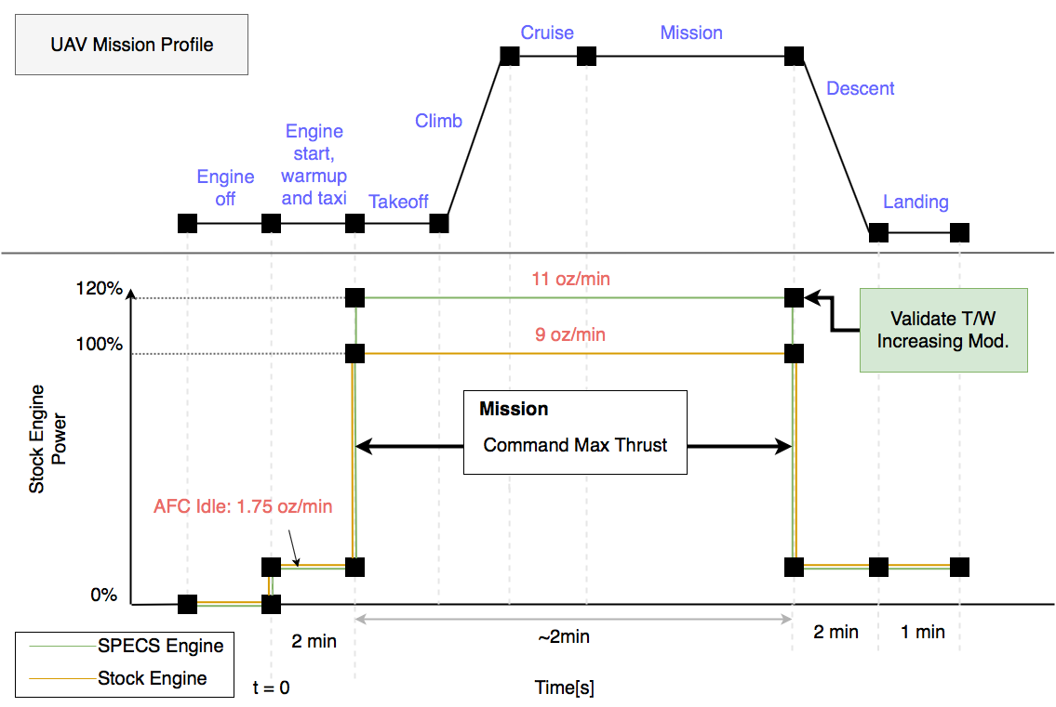
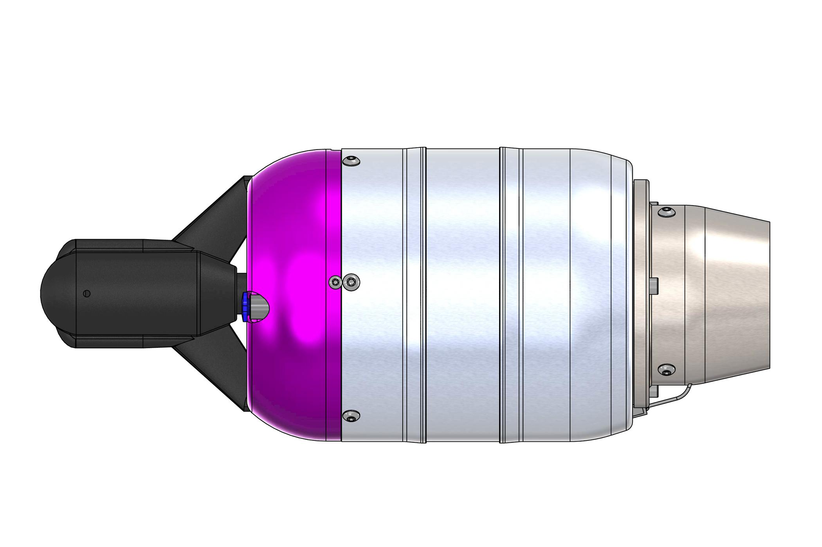
Concept of Operations (Mission Profile)
Notes:
-Sam
Shame or Glory

Slide 5
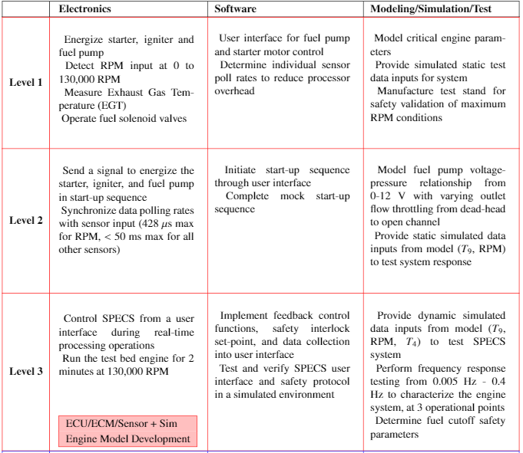

Levels of Success
Notes:
Just explain where we are currently at: I would say this is what you’ve seen from all of last semester to our MSR Demo

Slide 6
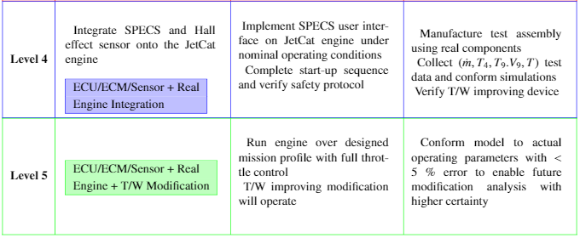
Levels of Success
Notes:
-Sam

Slide 7
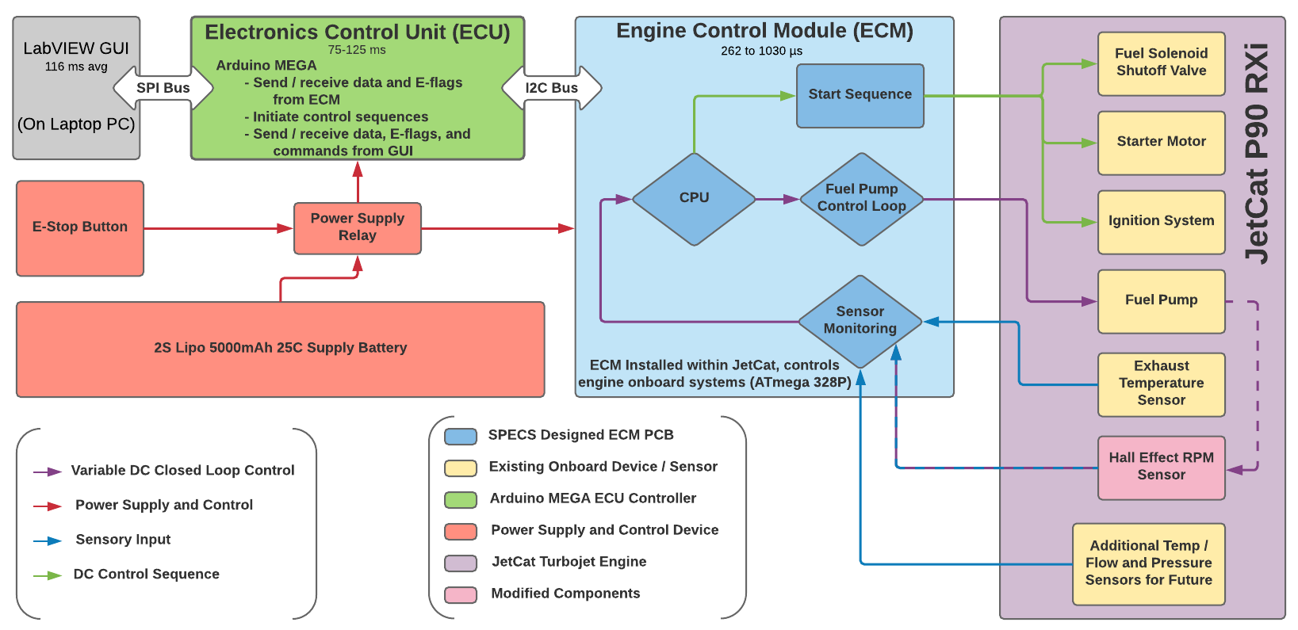
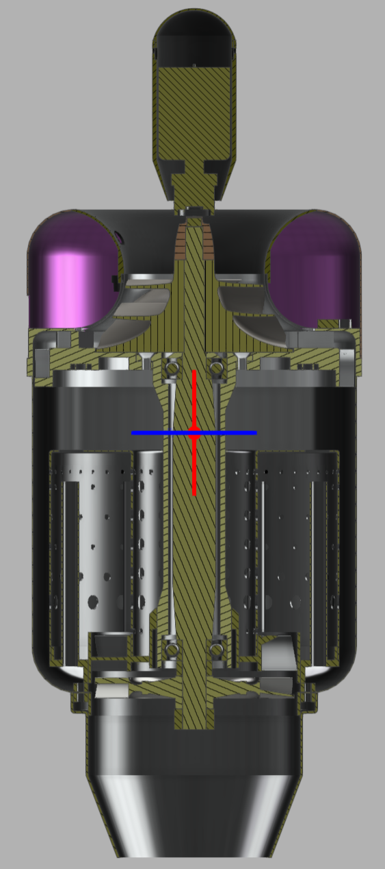

Functional Block Diagram
+
7
Notes:
Whole system overview, talk about these major elements and their overall purpose. Make sure we say out loud what we are building and changing
-Aerospike for design verification

Slide 8
Critical Project Elements
Designation | CPE | Critical Characteristics
CPE-2.1 | Engine Control Loop (ECM) | Control algorithms are inherently complex and require additional validation prior to implementation. Certification through the use of an engine analog is necessary.
CPE-2.2 | Engine Sensors (ECM) | Coordination of engine sensor data acquisition with its utilization by the processor is critical. Without accurate sensor data, the engine cannot safely operate.
CPE-3 | Communication from User to Engine (ECU) | During initial testing and product development user oversight will verify safe operation and monitor for anomalies.
Notes:
-test bed and controls testing in simulation
-drives need for engine sensors
-drives need for electronics design

Slide 9
Scheduling
Overview
Schedule
Testing
Budget

Slide 10
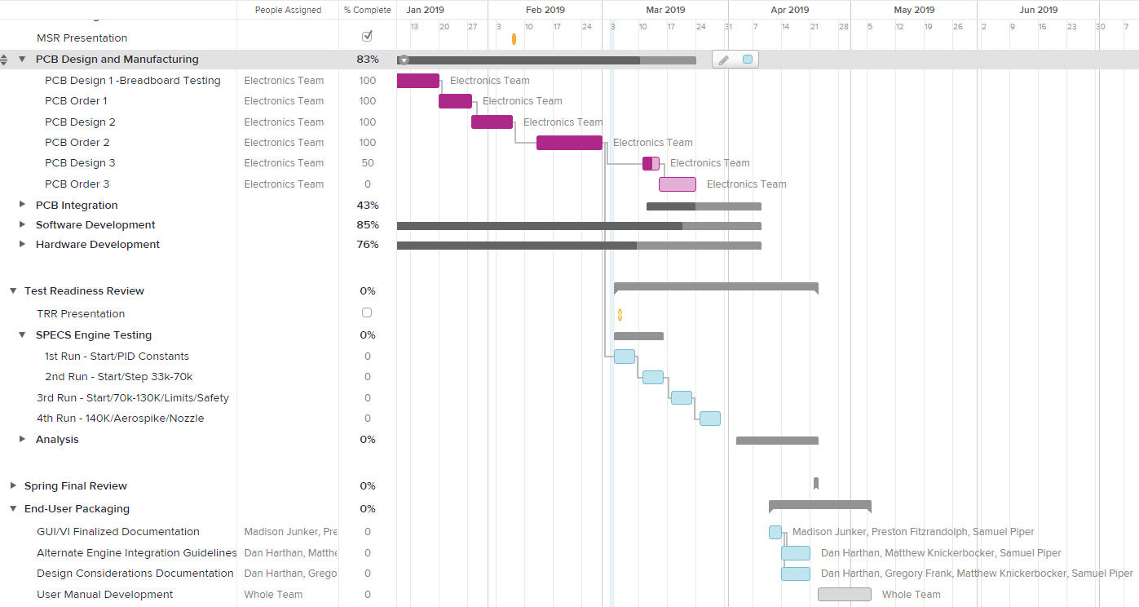
Project Planning
PCB Final Design
TRR
Engine Testing with V2.0 SPECS Electronics
SPECS V3.0 Engine Test
SFR
End User Packaging & Documentation

Slide 11
Testing
Overview
Schedule
Testing
Budget

Slide 12
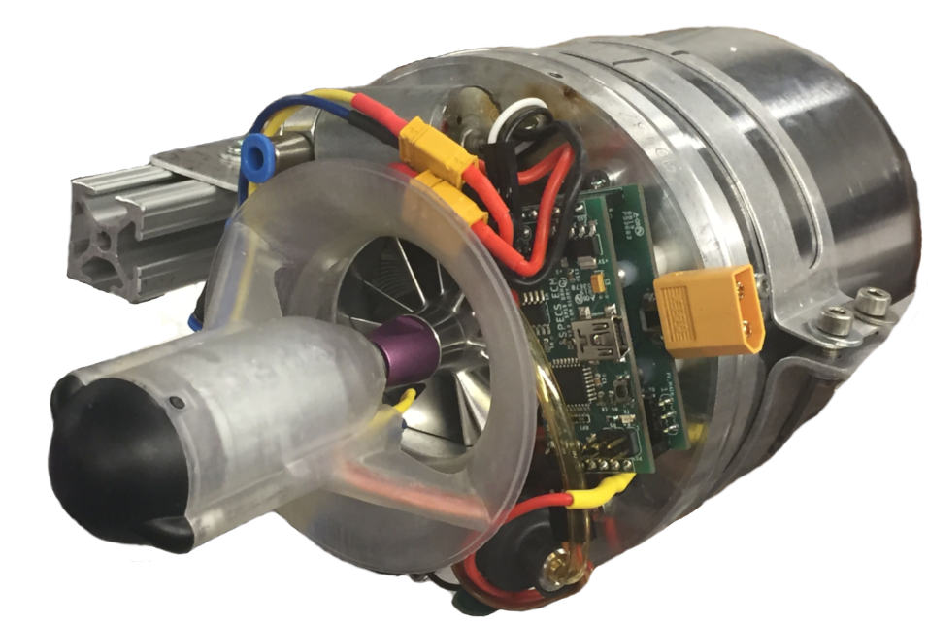
Electronics Testing Flowchart
PCB Production
Microscope Inspection
Power On
FLIR
Program
FLIR
Calibration
Sensors
Power
FLIR
Verification
Simulation
Test-Bed
FLIR
Model Verification
Data Acquisition
Engine Run
FLIR

Slide 13
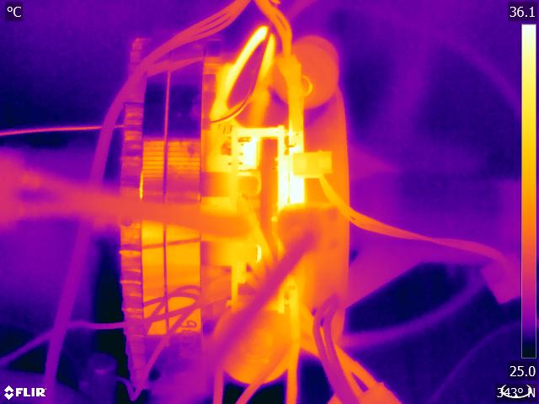
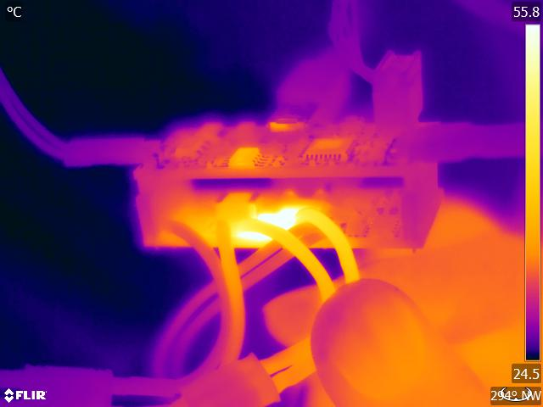
Electronics Testing Thermal Results
V1.0
Corrections: Higher current 5V linear regulator, moved battery measure circuit to ECM, TVS diode for MOSFETS, larger flyback diodes, larger
gauge wire for motors and ignition system.
V2.0
Corrections: Larger flyback diodes again, signal resistors need space, locate programming header toward centerline, USB pinout correction on ECU, heatsinks for controller components.

Slide 14
Electronics & Simulation Testing
SCOPE
  Install SPECS ECU and ECM. Command from GUI and simulation. Measure the simulation response. Develop initial controller setpoints for first engine start.
  Connect fuel pump ECM output to input DAQ and RPM and EGT inputs on ECM to simulator output DAQ. Run all system commands from GUI to simulate engine run parameters. Verify ECM output.
PURPOSE
  Determine conservative operation expectations for first engine start.
  Verify safety functions and estimated max EGT and RPM.
STATUS
  Electronics testing complete, simulation requires verification. PWM maximum of 13.7% duty cycle controller output maximum to prevent the engine from receiving enough fuel to exceed 100,000 RPM, allowing for transient values.
  Selected a maximum RPM command value of 70,000 for first test, predicted steady state EGT of 638℃.
SAFETY
  Triplicate limits: commanded fuel pump PWM, commanded RPM, sensed RPM.

Slide 15
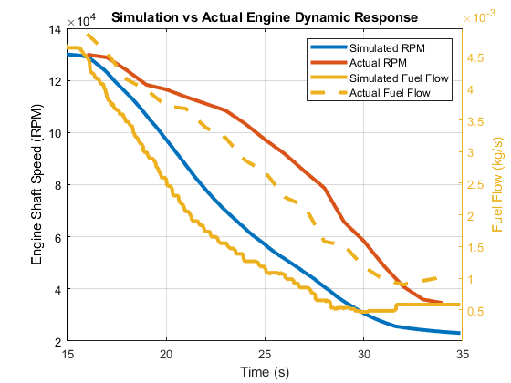
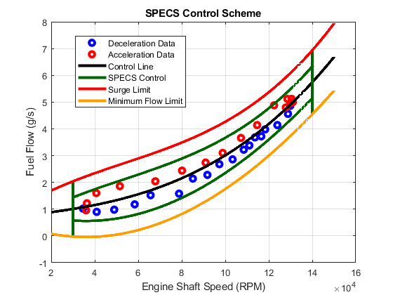
Simulation Testing Results
Simulation dynamic response closely mimics that of the actual engine.
Limited data requires further analysis of data obtained after incorporating SPECS system.
Dynamic engine response data from previous years defines SPECS engine acceleration limits.
Result: SPECS acceleration limits set to not exceed what was observed by stock engine performance.

Slide 16
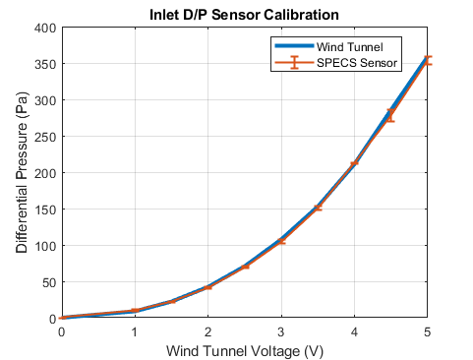
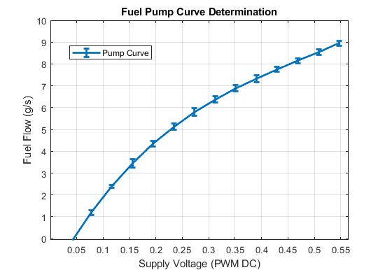
Error Propagation
Inlet mass flow used to validate thermodynamic model.
Sensor calibrated using ITLL Wind tunnel.
  Max Error: 2.8%
  Typical Error: 2% - Consistent with Mfr.
Fuel flow to ECM PWM relationship used to ensure engine control limits are not exceeded and provide initial estimates for RPM/EGT.
Fuel flow determined using the same methodology as the original fuel flow to pump voltage relationship.
  Max Error: 2.2%
  Typical Error: 1.4%
    Resultant Max Engine RPM Error: 2375 RPM.

Slide 17
Integrated Engine Run
SCOPE
  Install SPECS system on JetCat P90 RXi.
  Using controller limits previously determined: command start sequence, tune to achieve stable starting sequence.
  Performed on site at EDEP utility plant.
PURPOSE
  Initial programmed start sequence can be varied to achieve stable conditions for combustion. Determine fixed start sequence tuning variables and timing.
  Validate starting sequence and combustion parameters for starting engine.
STATUS
  First test scheduled for Monday, March 4th, followed by weekly tests
  Engine operation limits gradually increased as control scheme is refined.
SAFETY
  Set low controller outputs initially, engine operation limited to achieve start RPM. Verified functional E-Stop button and controller.
Notes:
SCOPE
What is the test?
Test setup, equipment, facilities
Procedures overview
PURPOSE
How does it reduce risk?
What is the expected result?
What requirements/models will be validated?
STATUS
Is the test complete?
If not when is it/what needs to be done to get there
SAFETY
What have you done to minimize risk?

Slide 18
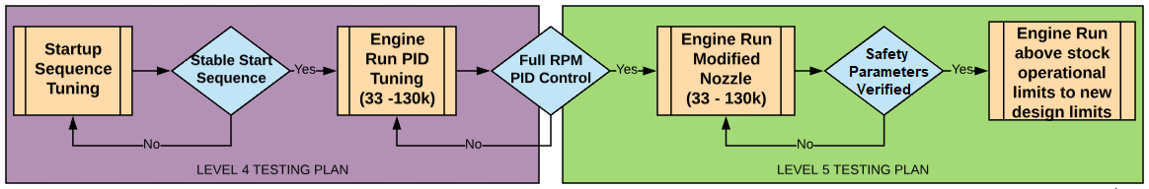
Upcoming Engine Test Sequence
March 4th March 11th March 18th March 25th
Engine Run Limited
(33K-70K)
Limit and Safety Testing
Overview: Determine start sequence using SPECS Electronics & verify simulation
Overview:
Perform step response testing from 33k to 70k RPM for control constants.
Overview: Continue step response testing from 70k-130k RPM. Test E-Stop, Test OP limits and safety.
Overview:
Increase to 140K RPM, Implement Aerospike, Integrate SPECS Nozzle
Notes:
Start and shutdown sequence (in Progress)
Focus on timing for reliable startup and shutdown only.
Stable transfer from startup to PID control
Determine controller stable PID values for stable running with small transients
PID tuning and controller performance testing
Detailed controller classification and design to fine tune PID values
Engine implementation with modified nozzle
Apply thrust to weight improving nozzle with final exit area
PID tuning with modified engine
Re-perform detailed controller classification to fine tune PID values
Performance testing to improve thrust output
Push engine to upper limits determined to be safe for operation

Slide 19
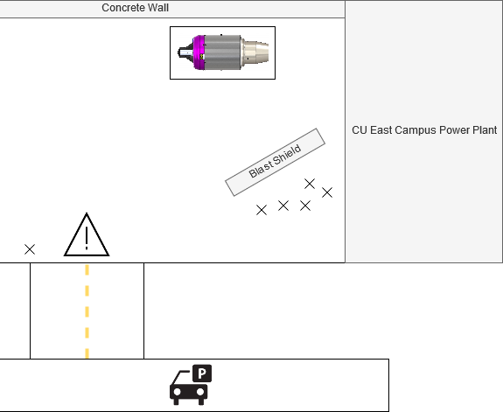




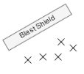
Engine Run Safety
Electronics Safeties
  Software limits/stops, emergency shut-offs
Fire Safety
  Fire department & CUPD notified
  Class B fire extinguisher + trained users
Physical Safety
  PPE, test procedures, blast shield, barriers, distance, limited personnel
Chemical Safety
  PPE, absorbent materials, drip tray
10 ft
10 ft
20 ft
CU East District Powerplant
Danger Zone
N

Slide 20
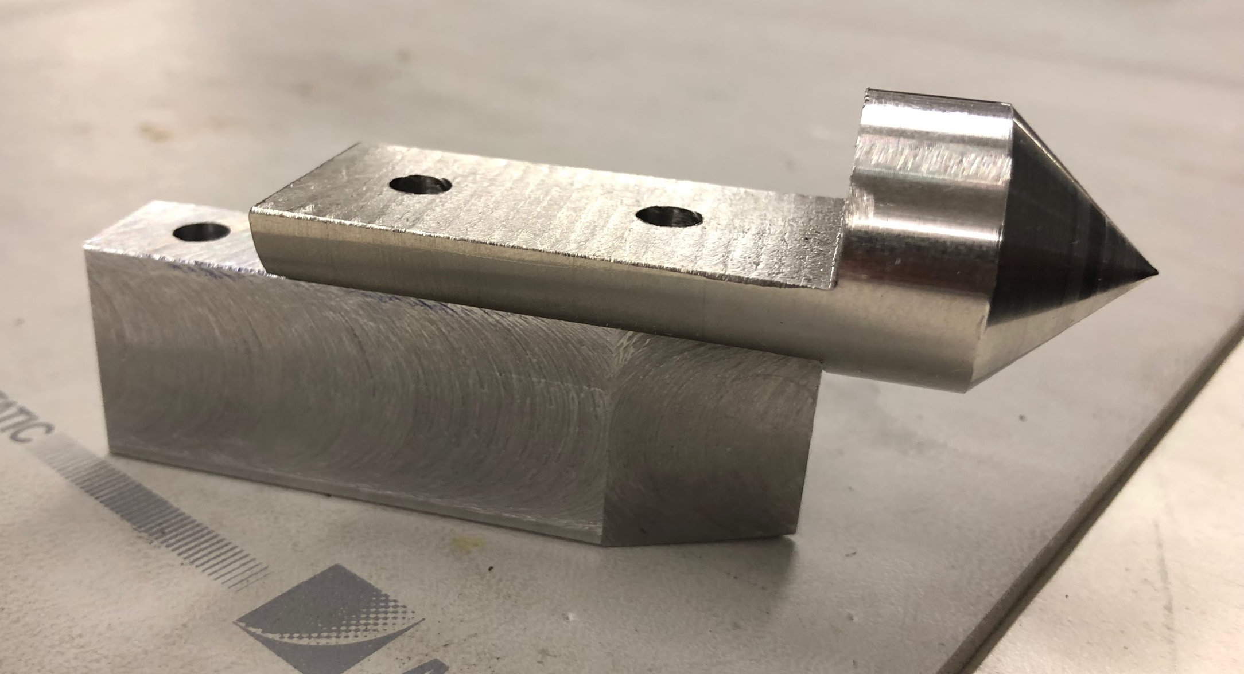
Aerospike & Nozzle Testing
SCOPE
  Inserting aerospike into the nozzle flow to alter exit area and static pressure
  Test stand (with engine), actuator, spike, and mount
  Procedures: Take thrust and pressure data at different effective exit areas at 140K RPM
PURPOSE
  Allows for dynamic tuning of nozzle, removes requirement of fabrication of multiple nozzles.
  See an increase in thrust from load cell, and exhaust static pressure ambient.
  Validates exit area of nozzle for higher thrust.
STATUS
  Need to complete actuator calibration (in progress)
  Need a fully functional running engine, start-up sequence needed first
SAFETY
  Heat gun and pressure force testing, FLIR monitoring

Slide 21
Budget
Overview
Schedule
Testing
Budget

Slide 22
Budget Status
Purchased/Received/Manufactured:
Electronics:
  PCBs: V1.0-V2.0
  PCB Components
  E-Stop
  Arduino
  Battery & Charger
Mechanical/Test Stand
  Nozzle (Being Manufactured)
  Aerospike
  x2 JetCat P90 Engines
  Fire Extinguisher
  Fuel System
  First Aid Kit
  Blast Shield
2%
Pending Purchases:
ECU & ECM V3.0 (5 Day Lead) $250
AIAA registration ($50/person) $100
New engine P-100 (2-4 Weeks) $2500
Presentation Poster $100
Total Remaining Cost: $2950
27.1%
Notes:
We have purchased all of the big purchases overall. There are still miscellaneous items that need to be purchased as they are needed. We are keeping a large margin in case we need to purchase a new engine which would deplete the rest of the budget.

Slide 23
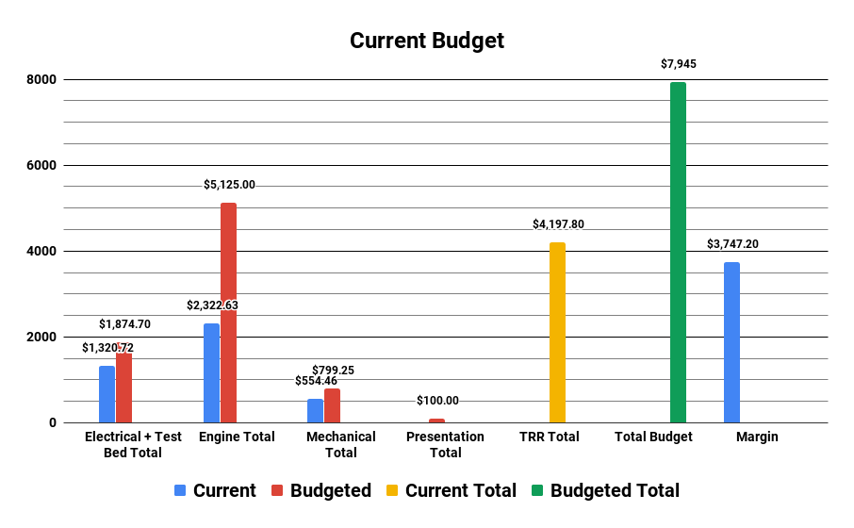
Budget Status (Visual)
Notes:
-Sam

Slide 24
Questions?

Slide 25
References
[1] Alex Bertman, Jake Harrell, Tristan Isaacs, Alex Johnson, Matthew McKernan, T.R. Mitchell, Nicholas Moore, James Nguyen, Matthew Robak, Lucas Sorensen, Nicholas Taylor, “Air-breathing Cold Engine Start Manufacturing Status Review”, 2017, Retrieved Jan 25, 2019.
[2] Andrew Sanchez, Tucker Emmett, Corrina Briggs, Jared Cuteri, Grant Vincent, Alexander Muller, “SABRE Manufacturing Status Review’’, 2016. Retrieved Jan 25, 2019.
[3] “Turbine Data Sheet.” JetCat. JetCat, July 14 2015. Web. September 4, 2018, from
https://www.chiefaircraft.com/pdf/jetcat-data.pdf
[4] “JetCat RX Turbines with V10 ECU.” JetCat. JetCat, n.d. Web. September 4, 2018, from
https://studylib.net/doc/18303934/jetcat-rx-turbines-with-v10-ecu
[5] “ATmega 328/P Datasheet.” Atmel. Atmel, November 2016. Web. September 4, 2018, from
http://ww1.microchip.com/downloads/en/devicedoc/atmel-42735-8-bit-avr-microcontroller-atmega328-328p_datasheet.pdf
[6] “ATmega 640/1280/1281/2560/2561 Datasheet.” Atmel. Atmel, February 2014. Web September 4, 2018, from
http://ww1.microchip.com/downloads/en/devicedoc/atmel-2549-8-bit-avr-microcontroller-atmega640-1280-1281-2560-2561_datasheet.pdf
[7] Daniel Alonzo, Alex Crocker, Eric James, John Kingston III, “Design and Manufacturing of a Miniature Turbojet Engine”, Worchester Polytechnic Institute, March 23, 2018, retrieved 20 October 201

Slide 26
Backup Slides

Slide 27
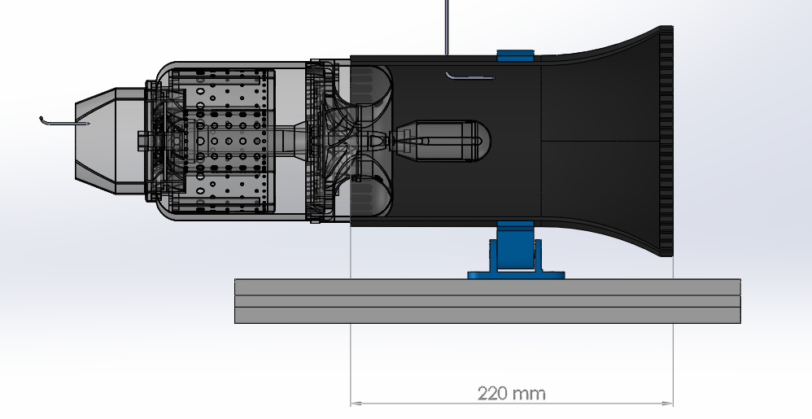
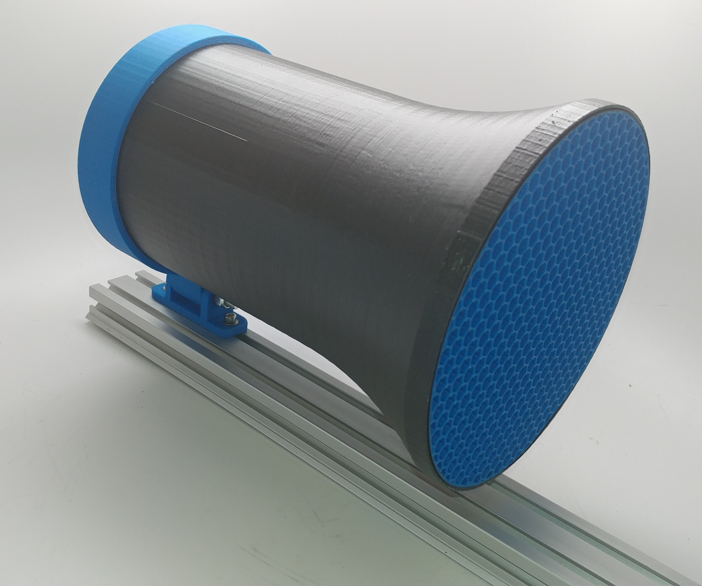
Mass Flow Inlet
Pitot Tube
New Nozzle
Mass Flow Inlet Design
27
Notes:
-Ray

Slide 28
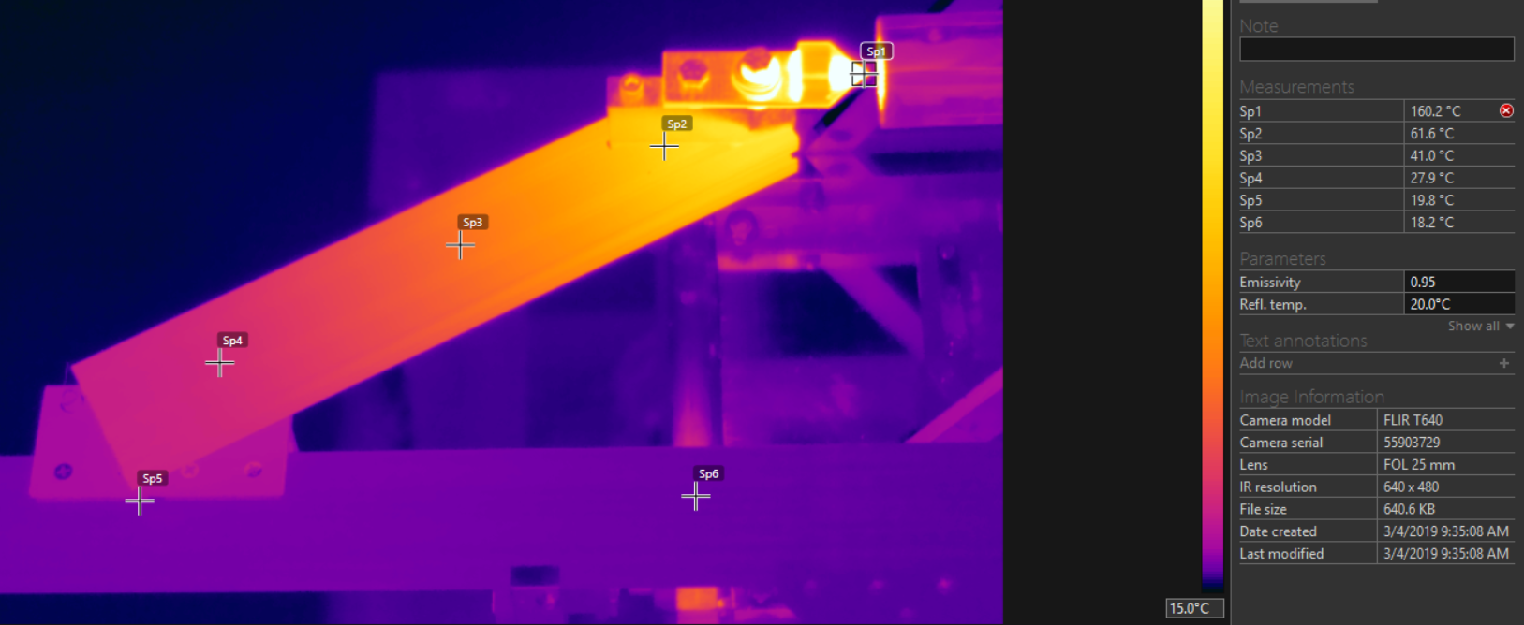
Aerospike Thermal Testing
28
Notes:
-Ray

Slide 29
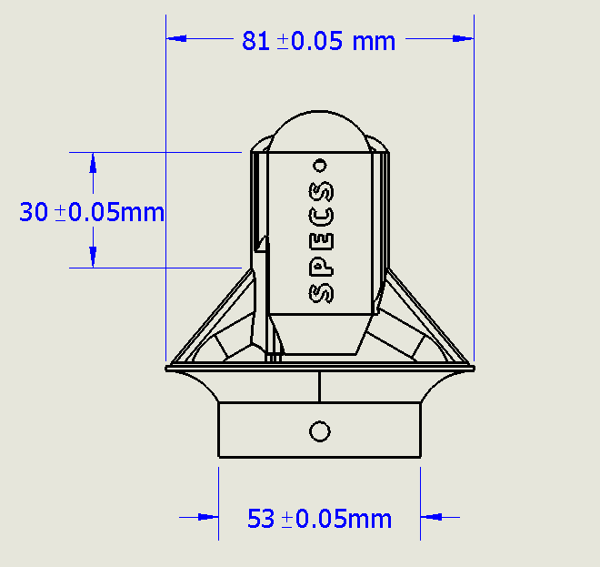
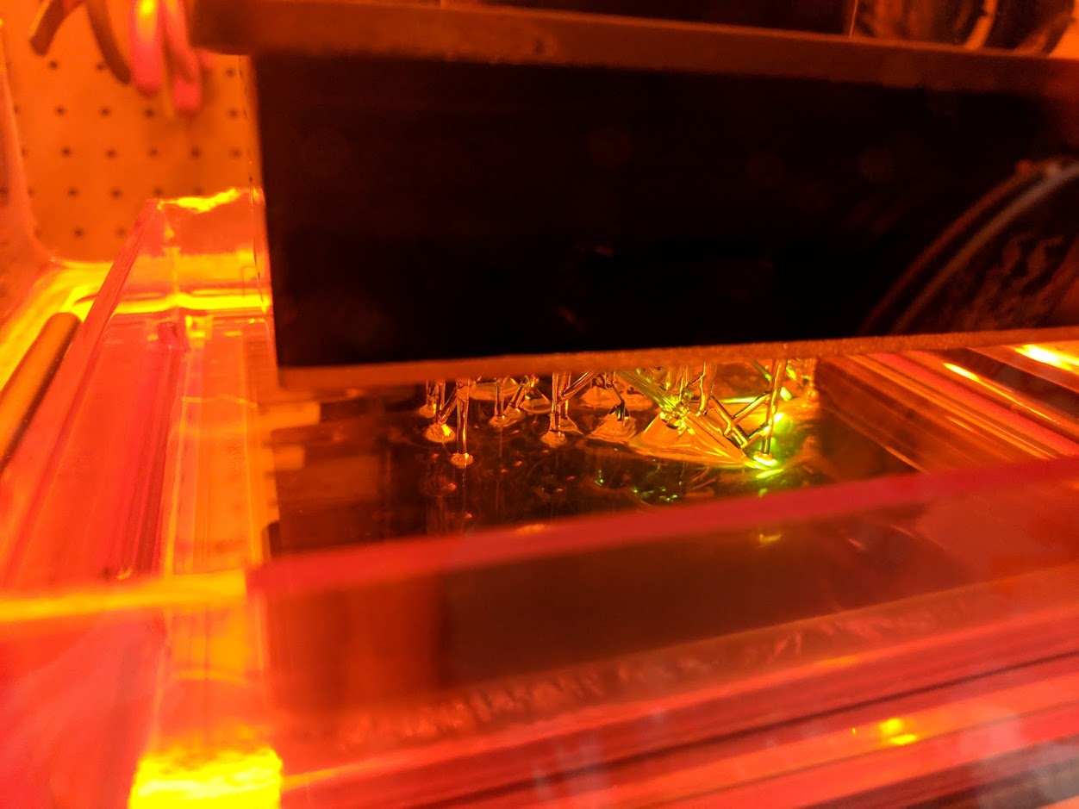
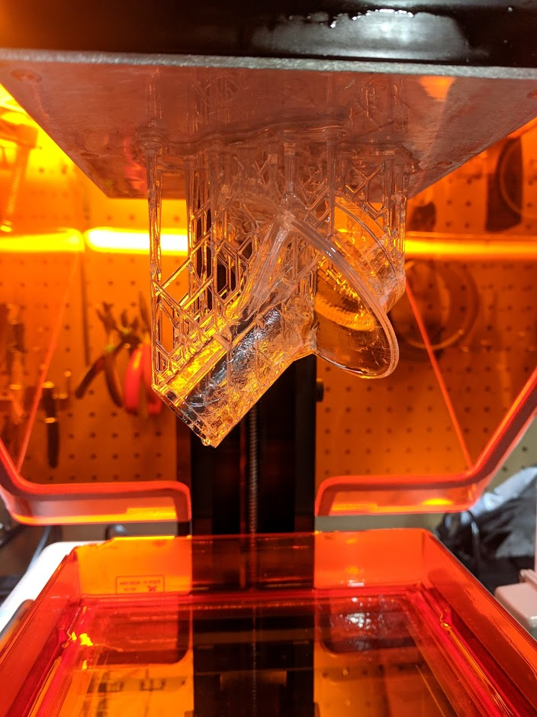

Starter Inlet
Status
-Design complete and starter inlet printed with Formlabs class printer using high strength FLGPCLR02 Resin
Concerns
-Stall torque of starter motor
-Potential flow disturbance
Mitigation Strategies
-Structural analysis
-Testing
29
Notes:
-Marcus

Slide 30
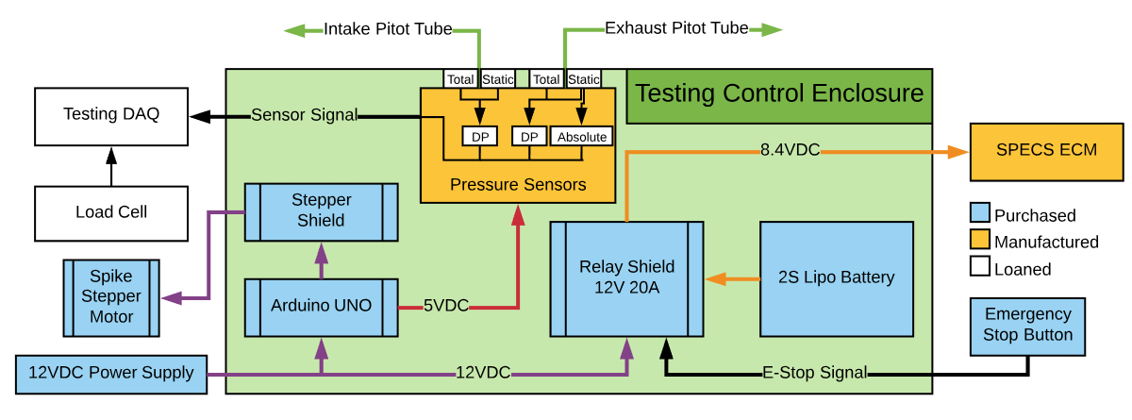
Test Stand Component Layout
All sensors and DAQs have been acquired.
Requires calibration certification
New Nozzle
30
Notes:
-Ray

Slide 31
Software Manufacturing Overview
: In working condition
: In development

