Slide 1



Specialized Propulsion Engine Control System
Manufacturing Status Review
Advisors: Professor John Mah
Customer: Air Force Research Laboratory
POC: 1st Lt. Carol Bryant
Team:
Greg Frank
Sam Piper
Yuzhang Chen
Preston FitzRandolph
Cedric Camacho
Matt Knickerbocker
Madison Junker
Daniel Castillo Oropeza
John Cutler
Markus Fuernkranz
Dan Harthan
Notes:
-Sam

Slide 2
Problem Statement
Increase Thrust-to-Weight (T/W) Ratio of the JetCat P90-RXi Engine
The engine must run for an ‘extended period of time’ as defined by CONOPS
Motivation
The United States Air Force (USAF) would like to implement a T/W increasing modification into their fleet of Unmanned Aerial Vehicles (UAV)
Ideal solution would be low cost and easy to implement with minimal modification to existing engine
Notes:
-Sam

Slide 3
Overview
Overview
Schedule
Manufacturing
Budget

Slide 4
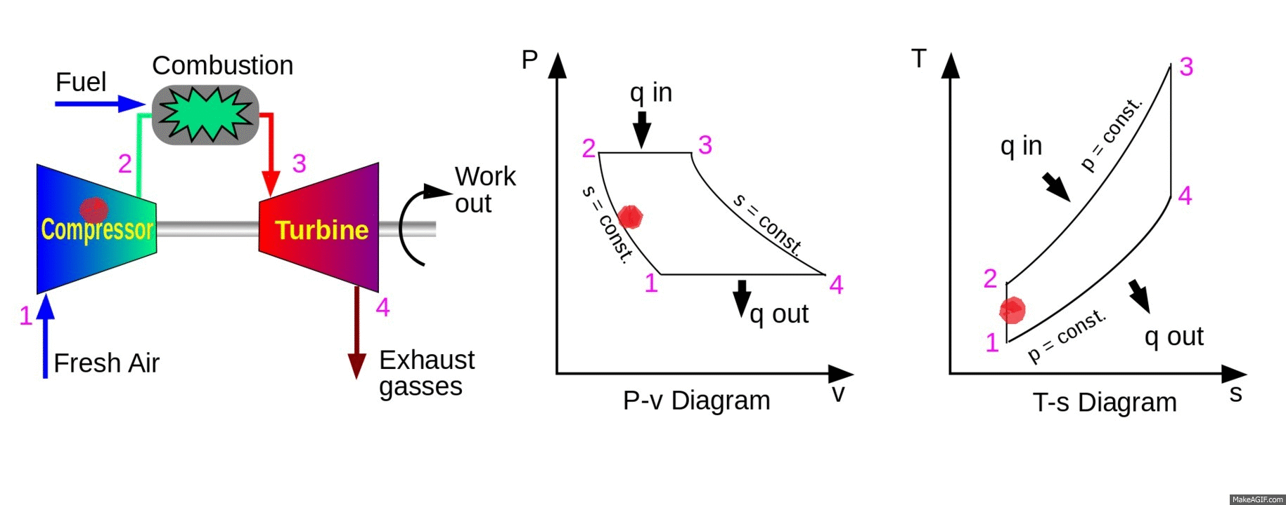
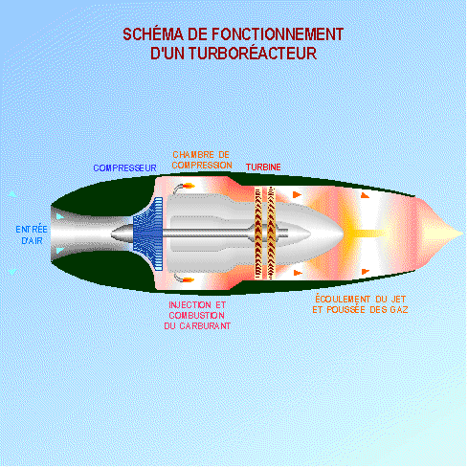
Basic Jet Engine Operation Refresher
Brayton Cycle for Jet Engine
Notes:
-Sam
http://www.solidswiki.com/index.php?title=File:Turbo-jet-animation.gif
https://i.makeagif.com/media/8-25-2015/WjCD4y.gif

Slide 5
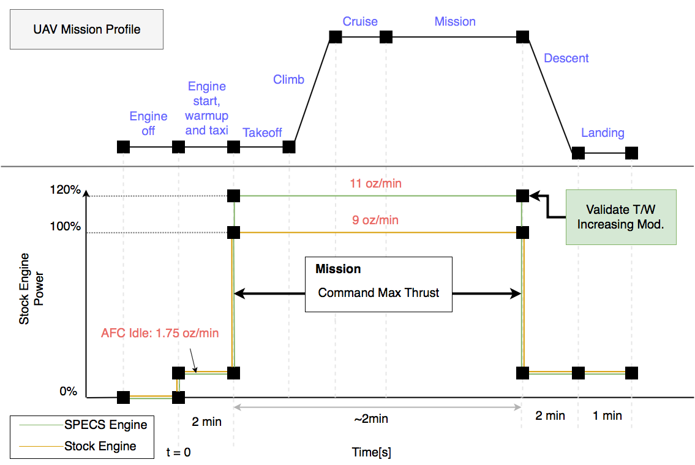
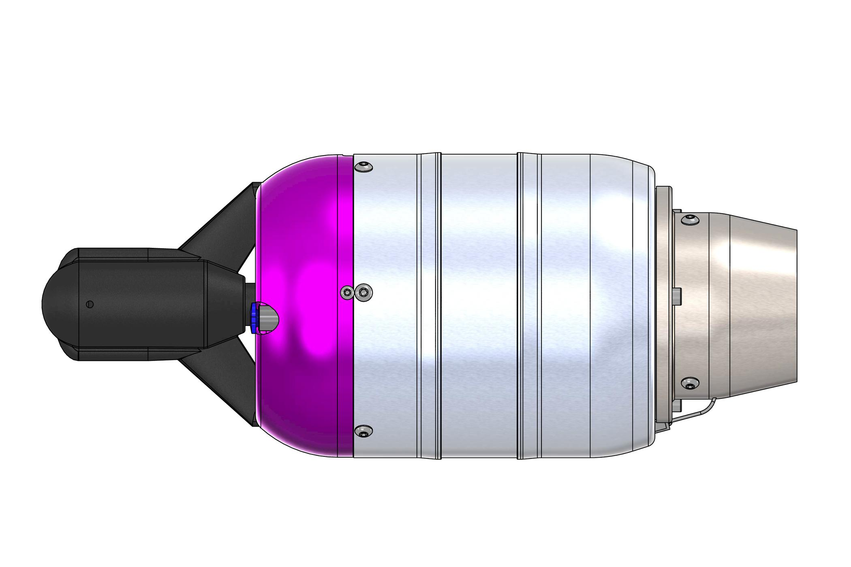
Concept of Operations (Mission Profile)
Notes:
-Sam
Shame or Glory

Slide 6
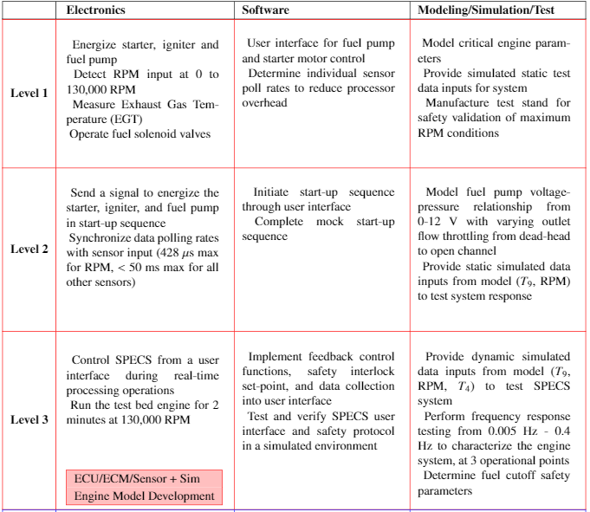
Levels of Success
Notes:
-Sam

Slide 7
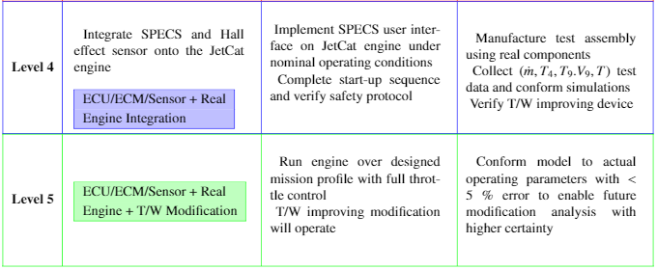
Levels of Success
Notes:
-Sam

Slide 8
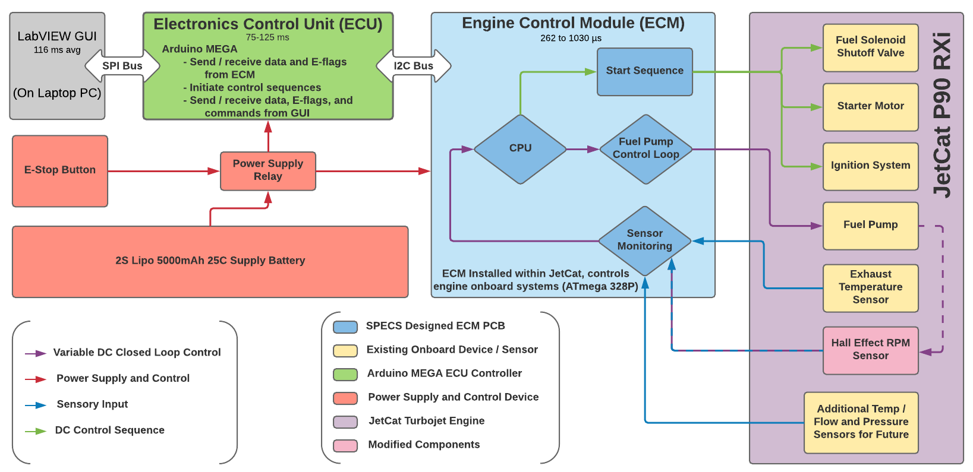
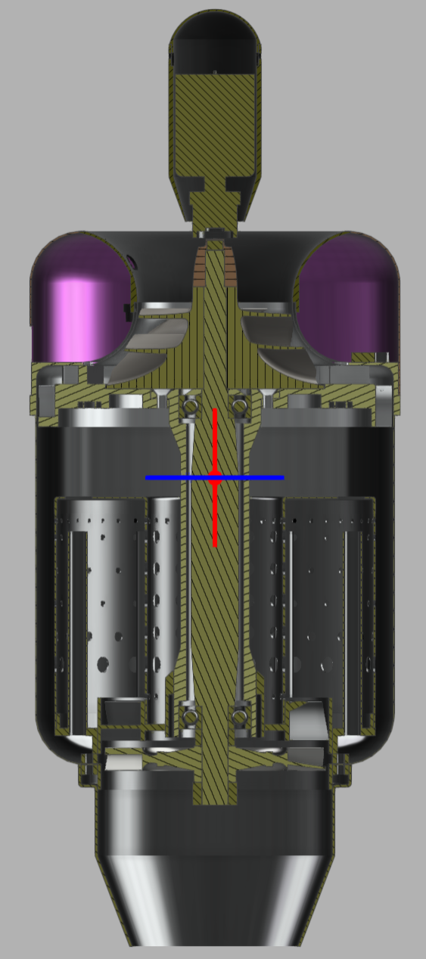
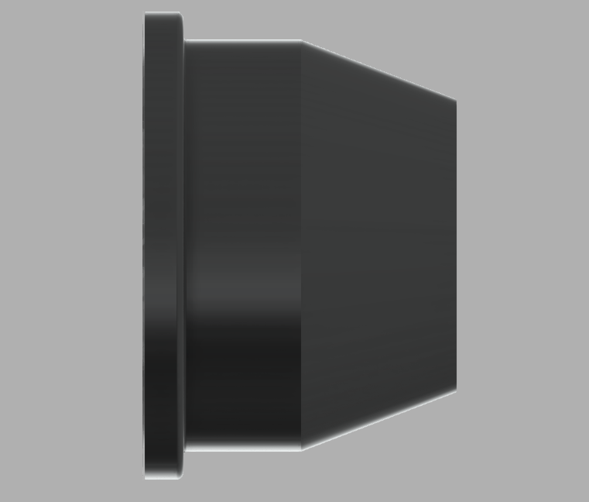
Functional Block Diagram
+
‹#›
Notes:
-Sam
Whole system overview, talk about these major elements and their overall purpose. Make sure we say out loud what we are building and changing

Slide 9
Critical Project Elements
Designation | CPE | Critical Characteristics
CPE-2.1 | Engine Control Loop (ECM) | Control algorithms are inherently complex and require additional validation prior to implementation. Certification through the use of an engine analog is necessary.
CPE-2.2 | Engine Sensors (ECM) | Coordination of engine sensor data acquisition with its utilization by the processor is critical. Without accurate sensor data, the engine cannot safely operate.
CPE-3 | Communication from User to Engine (ECU) | During initial testing and product development user oversight will verify safe operation and monitor for anomalies.
Notes:
-Marcus

Slide 10
Scheduling
Overview
Schedule
Manufacturing
Budget

Slide 11
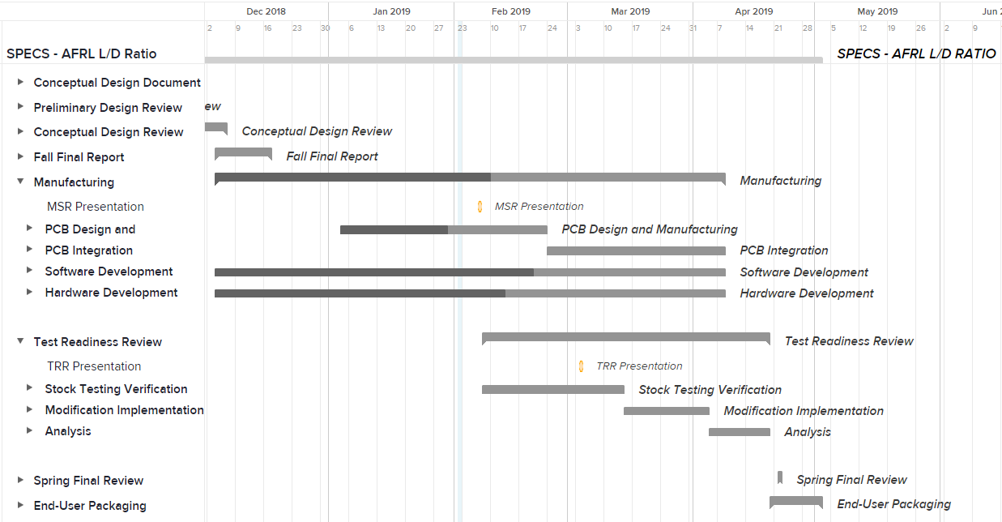
Project Planning
MSR
TTR
TESTING/Analysis
Final Packaging

Slide 12
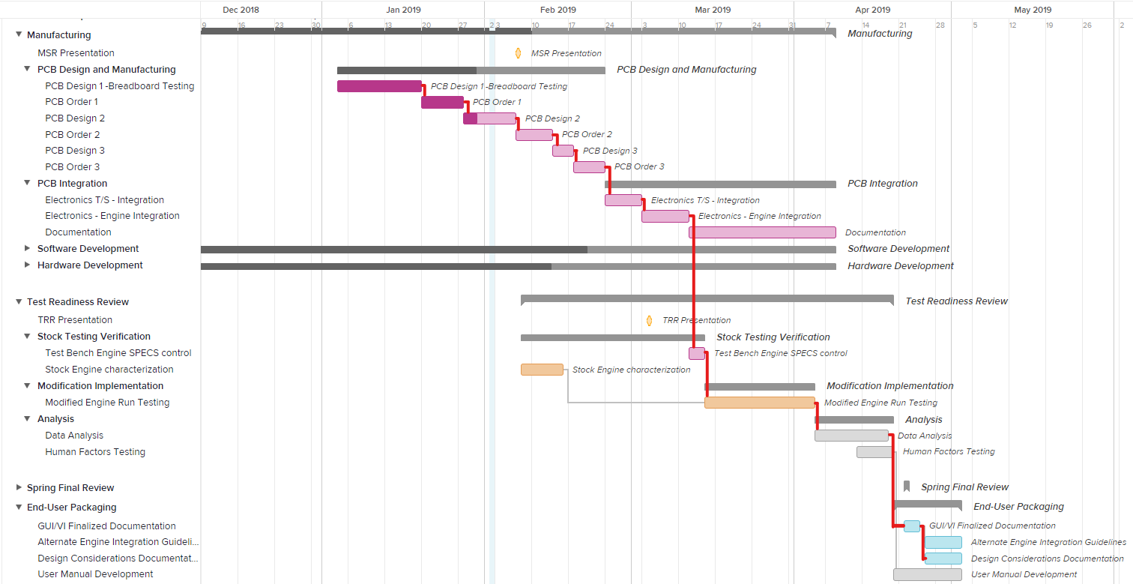
Project Planning
Thermo
Mechanical
Electronics
Critical Path
Critical Events
Electronic Manufacturing/Design/Test/Redesign
Electronic T/S
Electronics Integration
Electronic T/S
Electronics Integration/Test
Modified Engine Run
Data Analysis/Presentation
End-User Packaging

Slide 13
Manufacturing
Overview
Schedule
Manufacturing
Budget

Slide 14
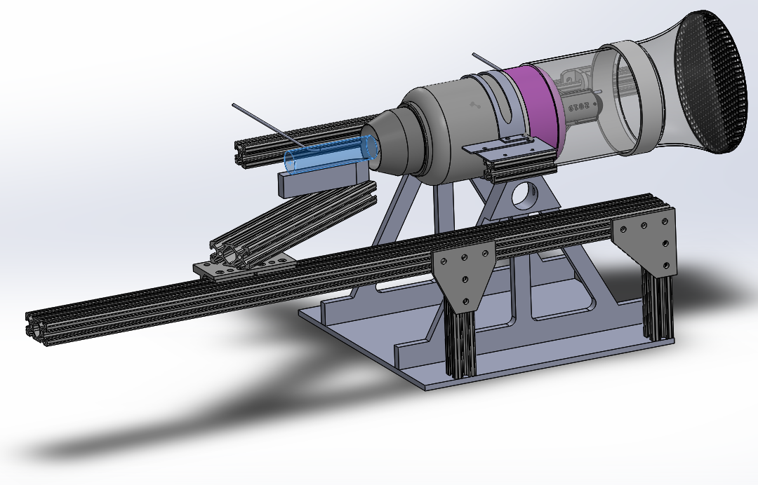
Mechanical Manufacturing Overview
Mass Flow Pitot-Static
Exhaust Pitot-Static Probe
New Nozzle
Aerospike Concept
Mass Flow Inlet
Starter Inlet
Purchased: Lead ACME screw stepper motor, T-Slot + Mounting, linear bearing, hardware
Manufactured: Inlet control volume, extrusion mounting system, aerospike, nozzle
Need: Aerospike mount machining
New Nozzle
‹#›

Slide 15
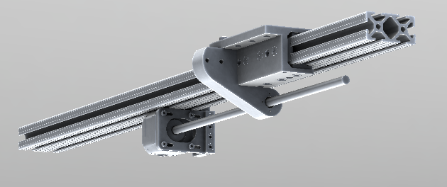
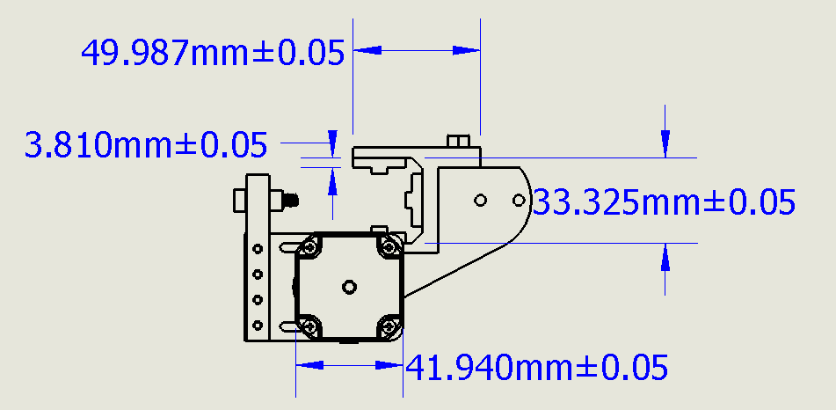
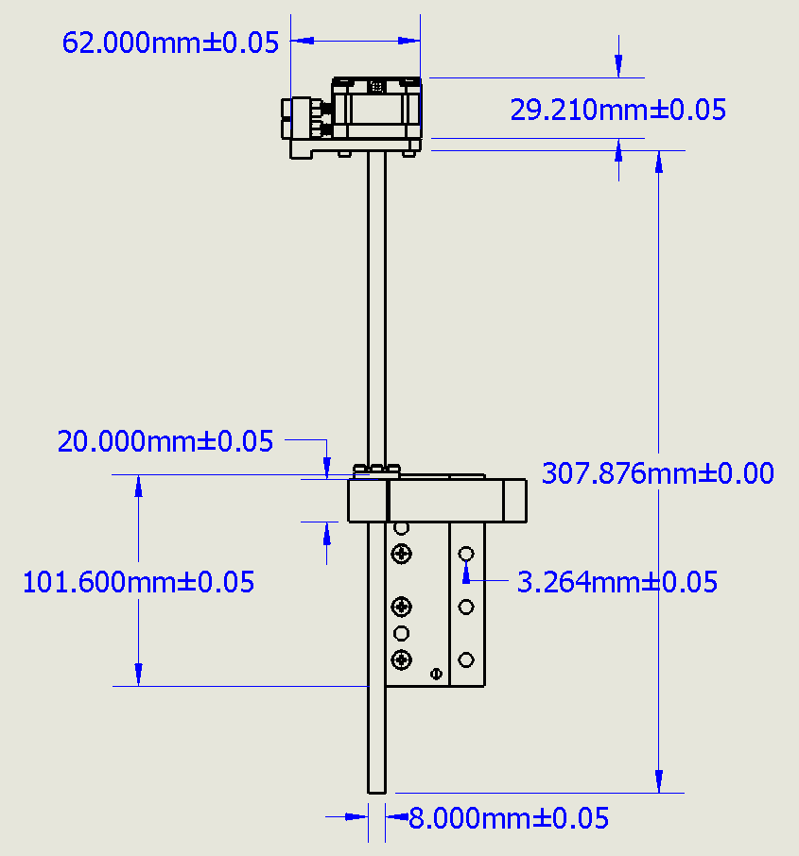
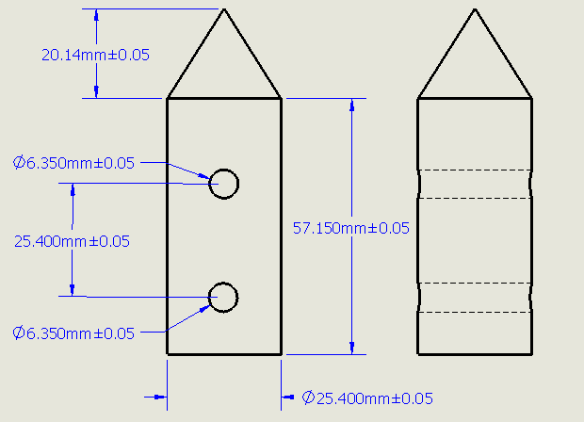
Aerospike Manufacturing
Status
-In design and analysis phase
-Initial prototype in development
-Aerospike mount needs machining
Concerns
-Flow/thrust disturbance
-Damage to components/test stand due to high heat transfer
-Accuracy & Vibration
Mitigation Strategies
-Thermal/structural analysis
-Exhaust deflector, insulating shims
-Minimal mount points
-Fine-tunable lead screw actuator
-Non-critical, replaceable hardware
New Nozzle
‹#›
Notes:
-Ray

Slide 16
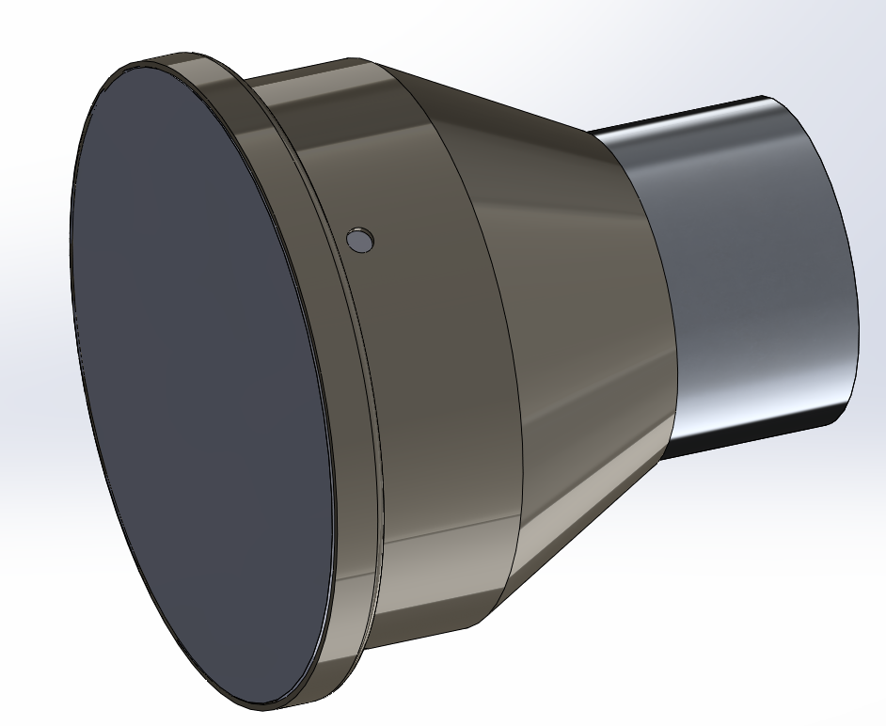
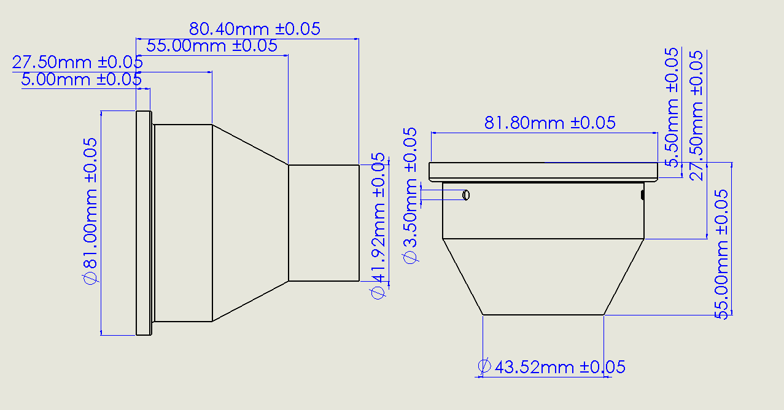
Nozzle Manufacturing
Assembly
Status
-Design complete, need aerospike test before
machining
-Titanium round ordered
Concerns
-Wall thickness too thin
-Manufacturing Time
Mitigation Strategies
-Mandrel to support thin walls during manufacturing
-Budget for two spare nozzles
-Increase Wall Thickness
-Manufacture extended version
Mandrel(Left)+Nozzle(Right)
Wall Thickness(0.8 mm)
‹#›
Notes:
-Ray

Slide 17
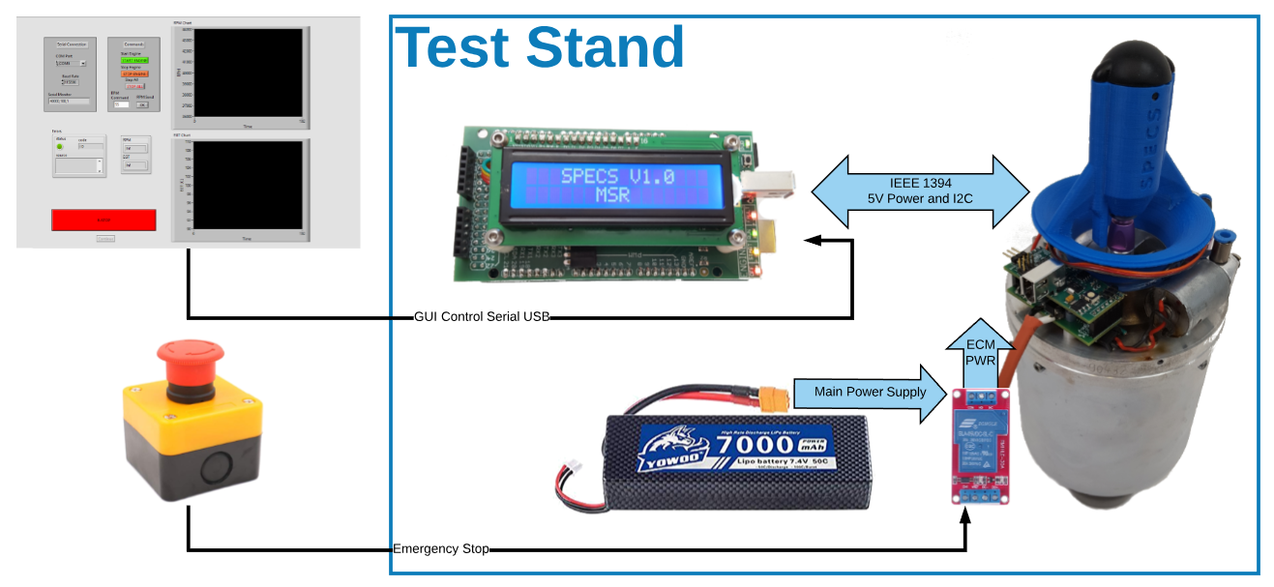
Electronics Manufacturing Overview
Purchased: Battery, Battery Charger, E-Stop Switch, Power Relay
Manufactured: All PCB V1.0 Complete, GUI in progress is functional
Need: Connectors, Wiring for E-Stop assembly
New Nozzle
‹#›
Notes:
-Ray

Slide 18
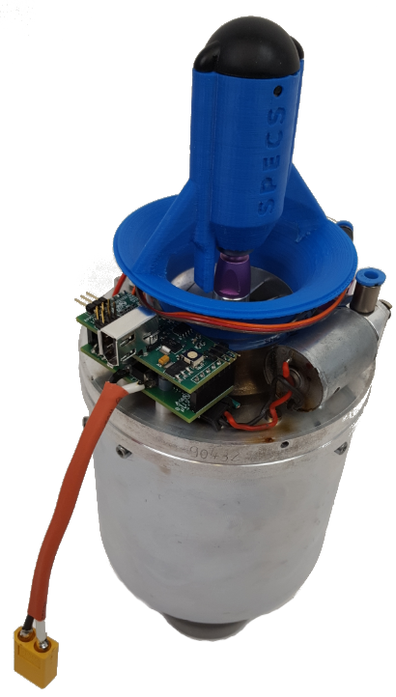
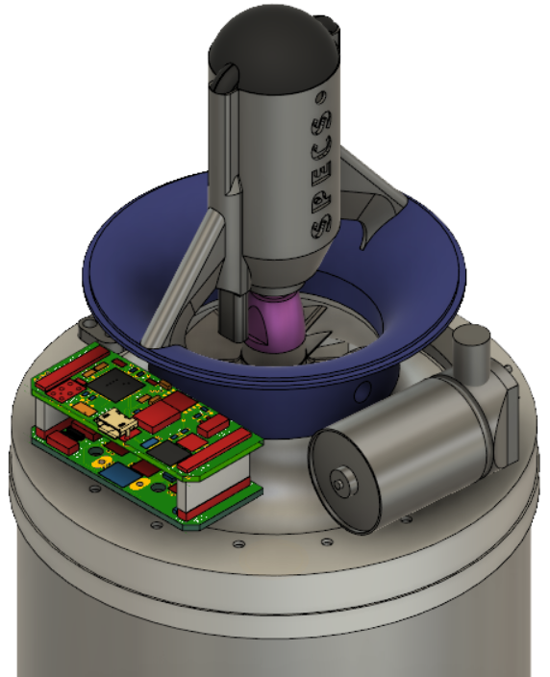
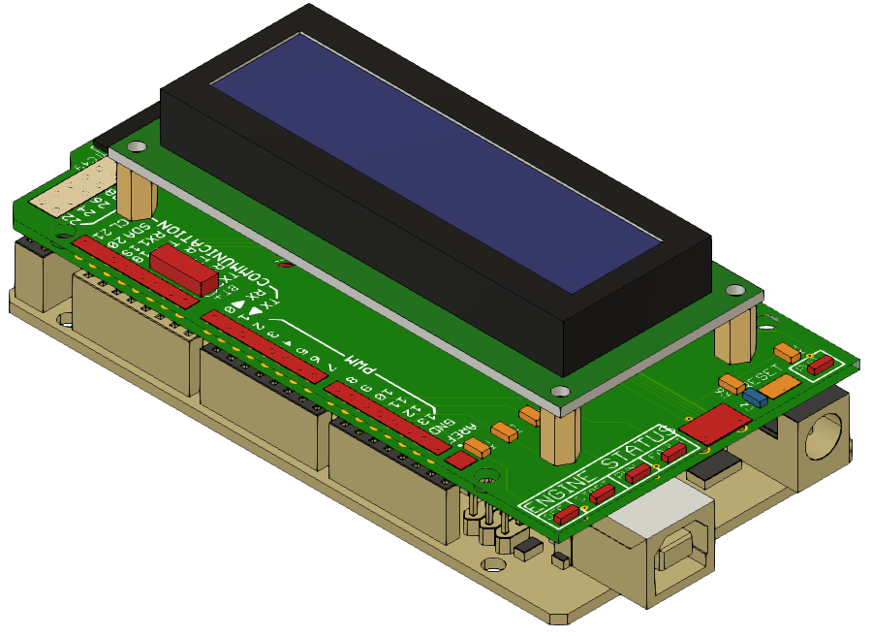
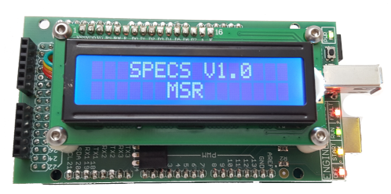
Engine Electronics Assembly
Electronics Control Unit (ECU)
Status: Assembled, Fully Functional
Concerns: Physical Damage / Pin Shorting Against Test Stand.
Mitigation Strategy: Build Protective Enclosure
Engine Control Module (ECM)
Status: Assembled, Power and Programming Testing in Progress
Concerns: Thermal, Fuel Line Routing
Mitigation Strategy: Thermal Imaging Camera, Fuel Line Protective Sheath, Mount Off-board

Slide 19
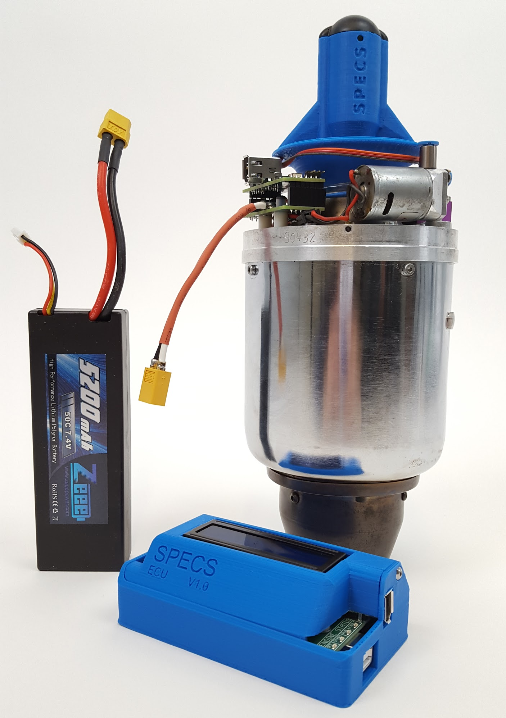
Electronics V1.0 Assembly Overview
ECU V1.0: All testing complete. Fully functional with ECU software from last semester.
ECM V1.0: Power Testing Complete, ATmega328P programming successful. Testing on hold until XT30 connectors arrive for motors.
Next Steps:
  Install on Test Rig perform start sequence.
  Using IR camera, verify PCB thermal integrity for high current devices.
  Apply parameters from stock engine run.
New Nozzle
‹#›
Notes:
-Ray

Slide 20
Software Manufacturing Overview
Control GUI allowing user commands to engine
SPECS Interface to combine control GUI data with sensor collector VI data

Slide 21
Software Manufacturing Overview
Control GUI allowing user commands to engine
SPECS Interface to combine control GUI data with sensor collector VI data

Slide 22
Software
Status
  Control GUI
    Test bed state, needs additional parameters for full engine tests
  Collector VIs
    Load cell and pressure sensor developed and tested
  SPECS Interface
    Initial development
  SPECS Simulation
    S/W complete, but must be tested on H/W
Concerns | Mitigation Strategies
Speed of writing data to files | -Speed up writing data to files using .tdms files -Reduce DAQ overhead by using DAQmx low-level functions instead of DAQ assistant
Signal/Noise ratio from DAQ output signal | -Upgrade NI DAQ 6009 output to NI DAQ 9263
Speed of simulation I/O update and engine status calculation | -Use regenerative signal output with a 10% over-sample based on design process time -‘Wait’ function to standardize timestep (3 ms) for engine simulation and discrete output format
New Nozzle
‹#›
Notes:
-Ray

Slide 23
Budget
Overview
Schedule
Manufacturing
Budget

Slide 24
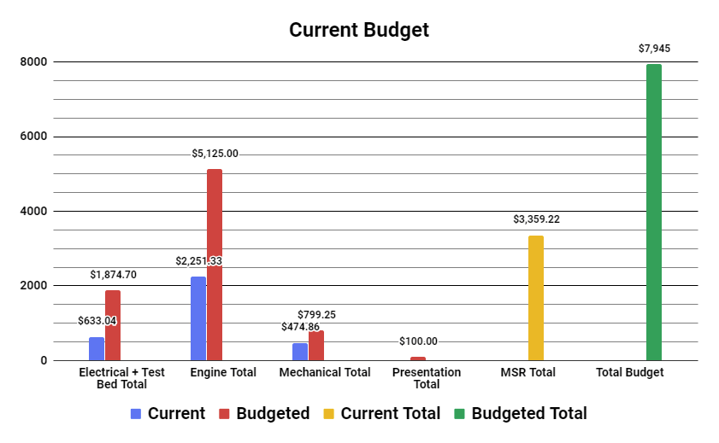
Budget Status
2%
16.8%
All major parts ordered
Misc. small components
PCBs versions accounted for
Current Margin = $4585.78
JetCat P100 = $2500
JetCat P90 = $1400
Titanium Round Bar = $373.14
27.1%
18.6%
31.2%
Notes:
-Sam

Slide 25
Questions?

Slide 26
References
[1] Alex Bertman, Jake Harrell, Tristan Isaacs, Alex Johnson, Matthew McKernan, T.R. Mitchell, Nicholas Moore, James Nguyen, Matthew Robak, Lucas Sorensen, Nicholas Taylor, “Air-breathing Cold Engine Start Manufacturing Status Review”, 2017, Retrieved Jan 25, 2019.
[2] Andrew Sanchez, Tucker Emmett, Corrina Briggs, Jared Cuteri, Grant Vincent, Alexander Muller, “SABRE Manufacturing Status Review’’, 2016. Retrieved Jan 25, 2019.
[3] “Turbine Data Sheet.” JetCat. JetCat, July 14 2015. Web. September 4, 2018, from
https://www.chiefaircraft.com/pdf/jetcat-data.pdf
[4] “JetCat RX Turbines with V10 ECU.” JetCat. JetCat, n.d. Web. September 4, 2018, from
https://studylib.net/doc/18303934/jetcat-rx-turbines-with-v10-ecu
[5] “ATmega 328/P Datasheet.” Atmel. Atmel, November 2016. Web. September 4, 2018, from
http://ww1.microchip.com/downloads/en/devicedoc/atmel-42735-8-bit-avr-microcontroller-atmega328-328p_datasheet.pdf
[6] “ATmega 640/1280/1281/2560/2561 Datasheet.” Atmel. Atmel, February 2014. Web September 4, 2018, from
http://ww1.microchip.com/downloads/en/devicedoc/atmel-2549-8-bit-avr-microcontroller-atmega640-1280-1281-2560-2561_datasheet.pdf
[7] Daniel Alonzo, Alex Crocker, Eric James, John Kingston III, “Design and Manufacturing of a Miniature Turbojet Engine”, Worchester Polytechnic Institute, March 23, 2018, retrieved 20 October 201

Slide 27
Backup Slides

Slide 28
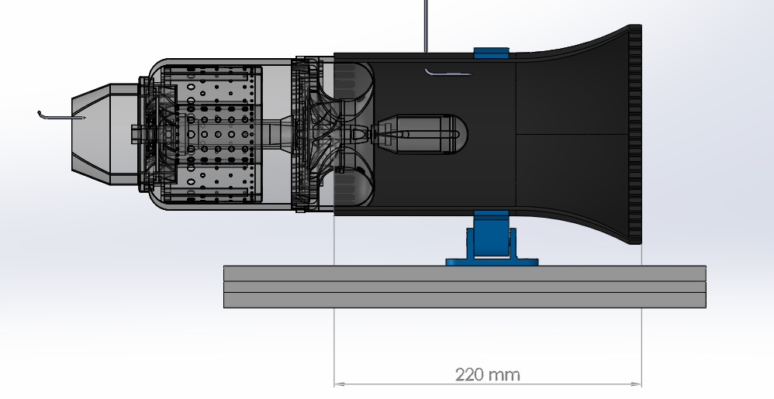
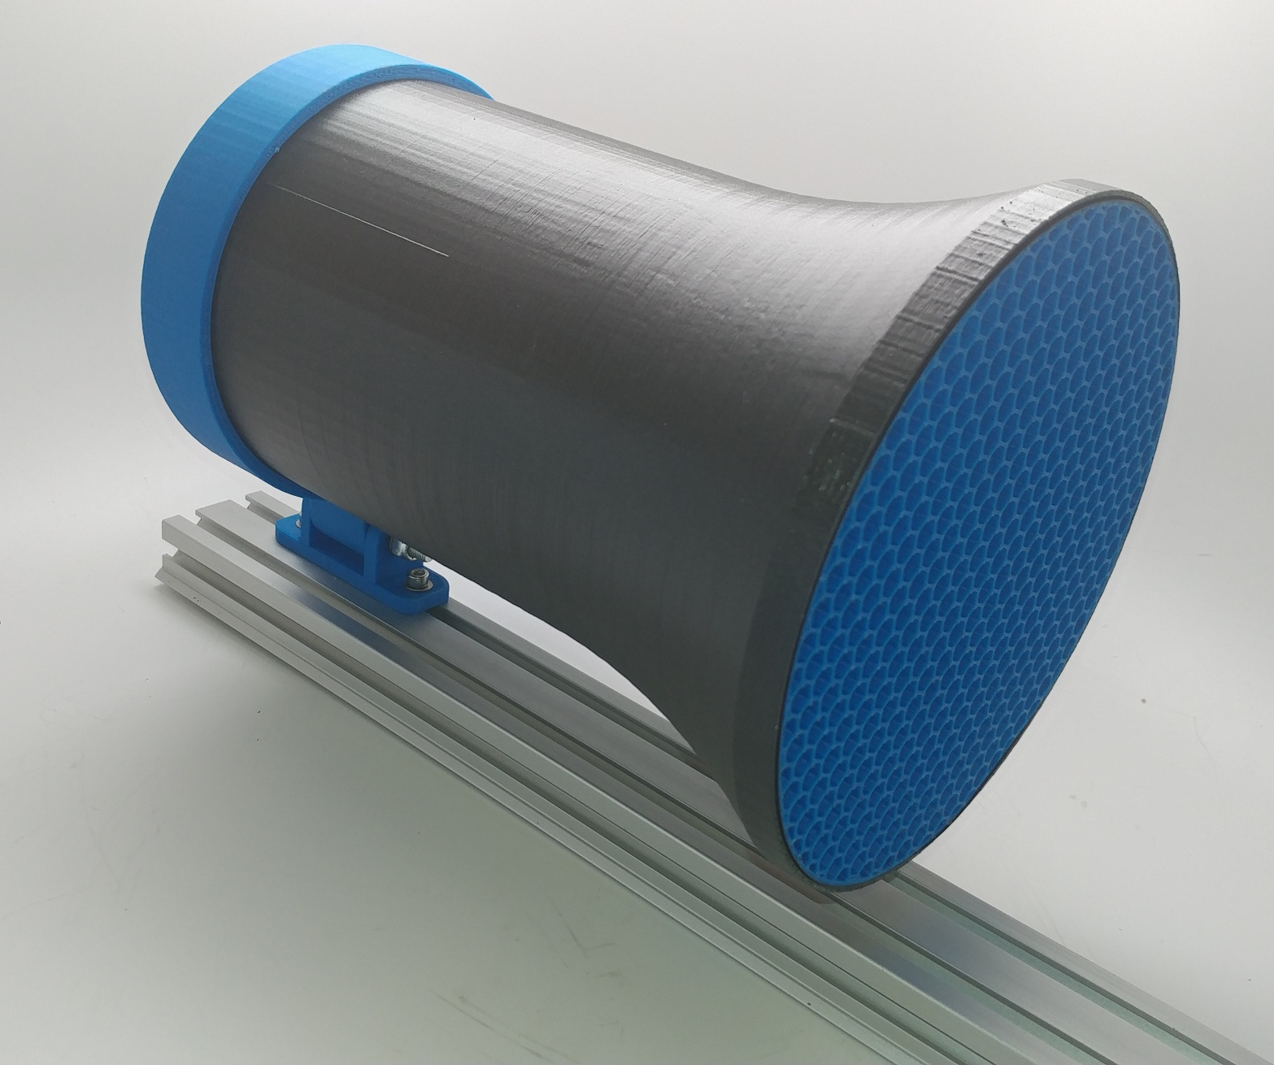
Mass Flow Inlet
Pitot Tube
New Nozzle
Mass Flow Inlet Design
‹#›
Notes:
-Ray

Slide 29
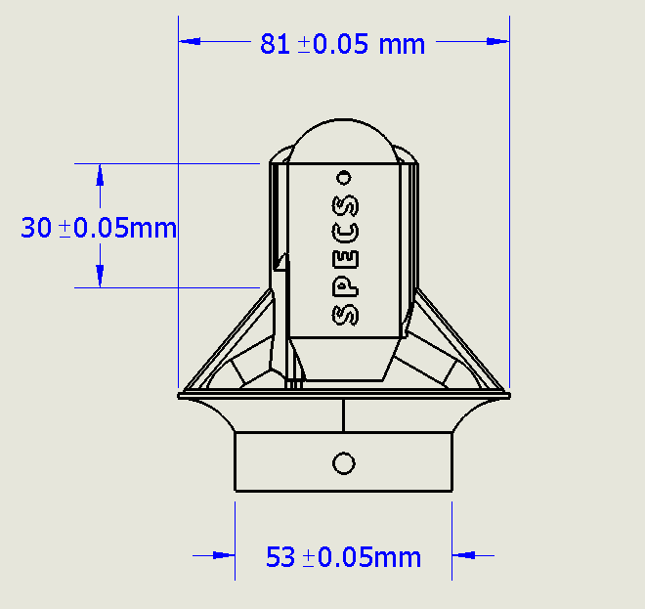
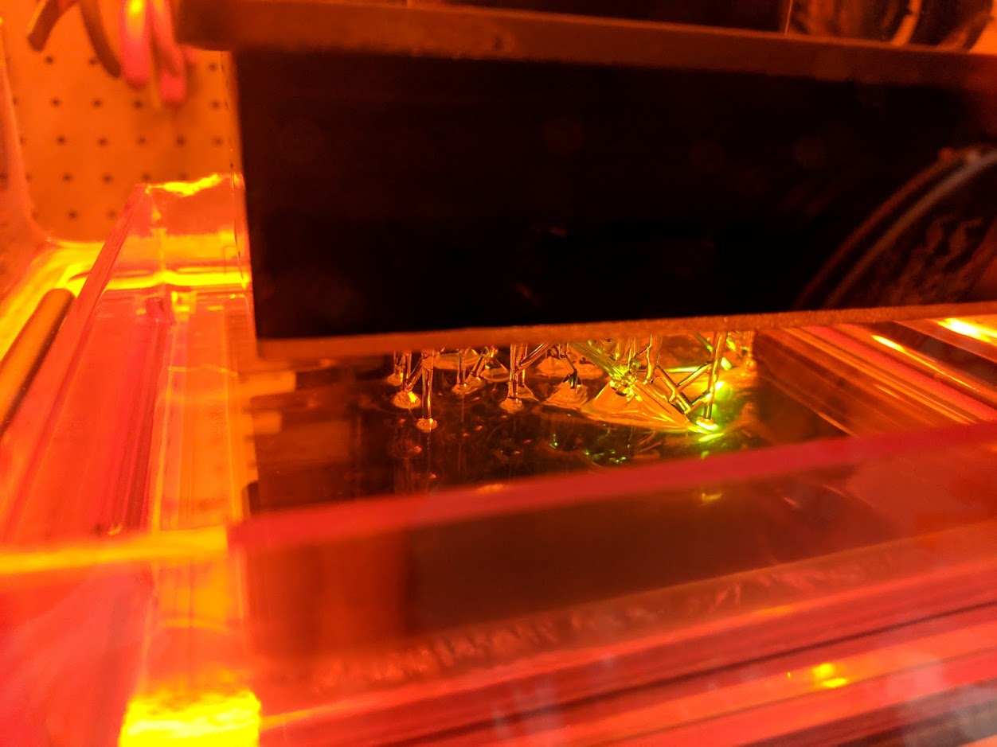
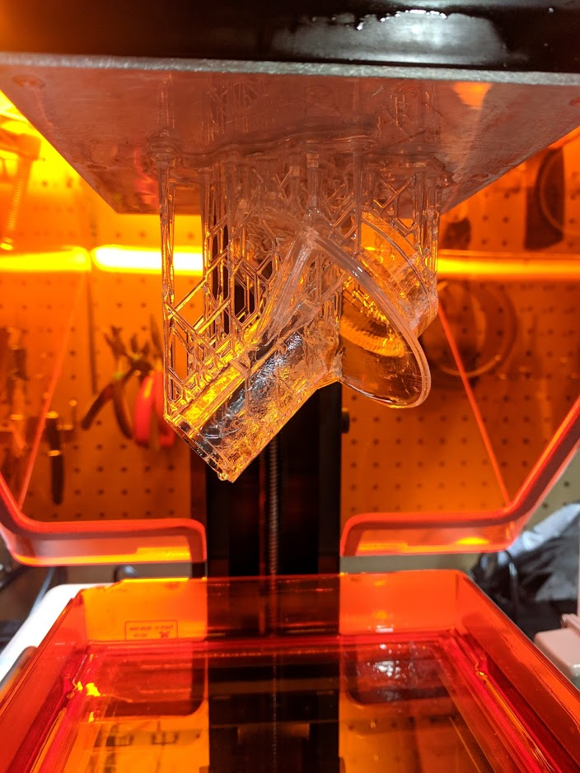

Starter Inlet
Status
-Design complete and starter inlet printed with Formlabs class printer using high strength FLGPCLR02 Resin
Concerns
-Stall torque of starter motor
-Potential flow disturbance
Mitigation Strategies
-Structural analysis
-Testing
‹#›
Notes:
-Marcus

Slide 30
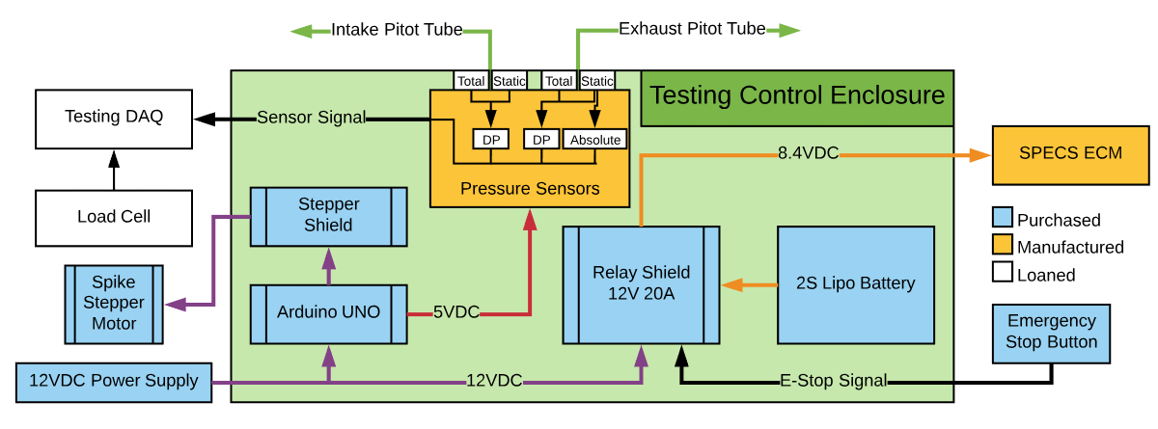
Test Stand Component Layout
All sensors and DAQs have been acquired.
Requires calibration certification
New Nozzle
‹#›
Notes:
-Ray

Slide 31
Software Manufacturing Overview
: In working condition
: In development

