Slide 1
SP4CE
Critical Design Review
Presenters:
Jasmin Chadha, Ryan Charles, Cesario Garcia, Vicki Hurd,
Jack Lana, Sarah Leary
Additional Team Members:
Aneesh Balla, Jesse Bartlett,
Gio Borrani, Zach Fields
Company Sponsor:
Blue Origin
Faculty Advisor:
Dr. Yu Takahashi
December 6, 2021
ASEN 4018-011 Team 1

Slide 2
Presentation Outline
Project Overview
Design Solution
Design Requirements & Satisfaction
Project Risks
Verification & Validation
Project Planning
Project Overview
Design Solution
Design Requirements & Satisfaction
Project Risks
Verification & Validation
Project Planning

Slide 3
Project Overview
Cesario Garcia
Project Overview
Design Solution
Design Requirements & Satisfaction
Project Risks
Verification & Validation
Project Planning

Slide 4
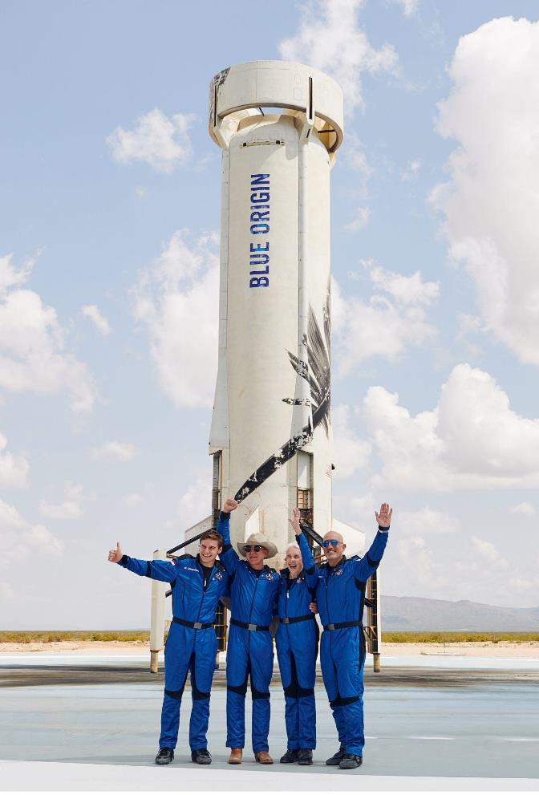
SP4CE Motivation
Background: Blue Origin needs an autonomous camera module that ejects from the New Shepard Booster at Booster/Crew Capsule separation, safely takes images/videos of astronauts in the Crew Capsule with Earth’s horizon in the background, and survives reentry with the intent to be reusable.
Project Overview
Design Solution
Design Requirements & Satisfaction
Project Risks
Verification & Validation
Project Planning
Notes:
Brief project definition using Objectives, CONOPS, and FBD from PDD
paint a picture of why this is needed motivation tie to six flags and link to why photographic evidence is the best kind of story
when

Slide 5
Mission Statement
The Suborbital Photography For Crew Experience (SP4CE) module will provide Blue Origin with both a Camera Ejection Device (CED), intended to be mounted inside of the Booster, and an autonomous Crew Capsule Experience Camera (CCEC) that will be ejected from the Booster, take pictures of the astronauts inside the Crew Capsule, and survive reentry with the intent of being reused.
Project Overview
Design Solution
Design Requirements & Satisfaction
Project Risks
Verification & Validation
Project Planning

Slide 6
Project Overview
Design Solution
Design Requirements & Satisfaction
Project Risks
Verification & Validation
Project Planning
Notes:
Should each of these slides have the “Concept of Operations” title above it, or do we want to use the extra space to make the image bigger for viewing? I vote for bigger

Slide 7
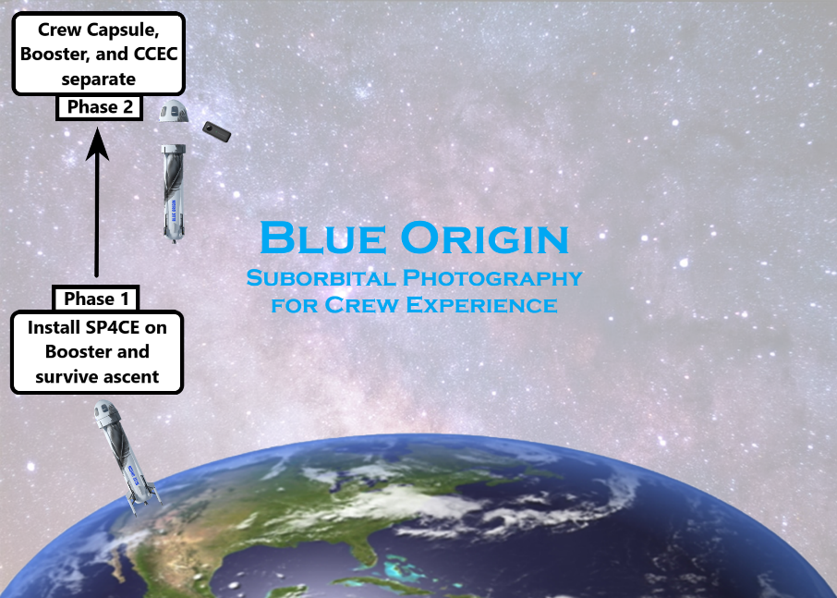
Project Overview
Design Solution
Design Requirements & Satisfaction
Project Risks
Verification & Validation
Project Planning

Slide 8
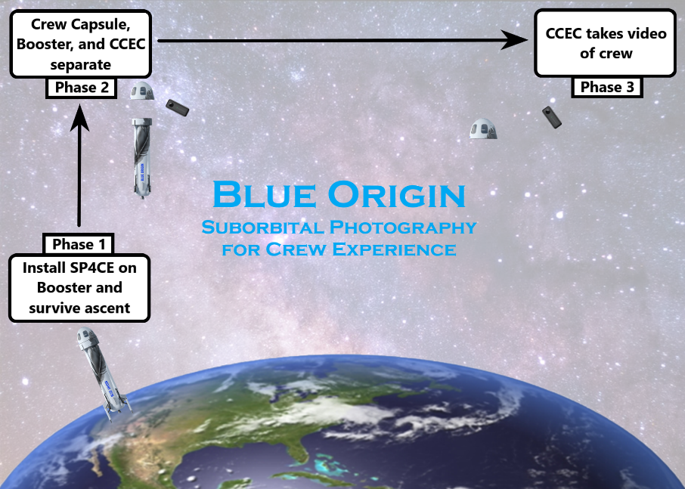
Project Overview
Design Solution
Design Requirements & Satisfaction
Project Risks
Verification & Validation
Project Planning

Slide 9
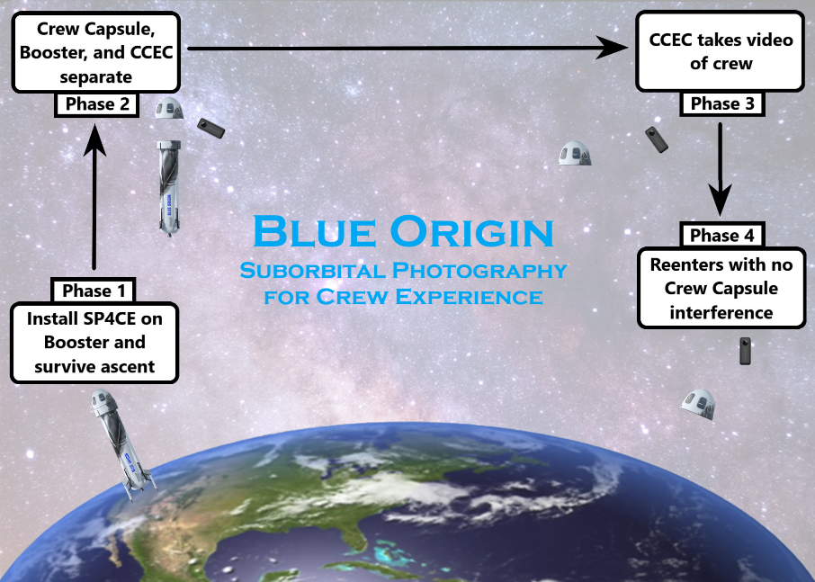
Project Overview
Design Solution
Design Requirements & Satisfaction
Project Risks
Verification & Validation
Project Planning

Slide 10
Project Overview
Design Solution
Design Requirements & Satisfaction
Project Risks
Verification & Validation
Project Planning
Notes:
Phase 1 applicable numbers: temp range 30F-100F
Phase 2 applicable numbers: separates at x time, vids start at x time, angle 68-72, force for springs x
Phase 3 applicable numbers: TBD distance, fov 360, resolution 5760x2880@30FPS
Phase 4 applicable numbers: separation rate x, ballistic coeff x, thermal x
Phase 5 applicable numbers: distance radius x, time to find x, impact x

Slide 11
Design Solution
Cesario Garcia
Project Overview
Design Solution
Design Requirements & Satisfaction
Project Risks
Verification & Validation
Project Planning

Slide 12
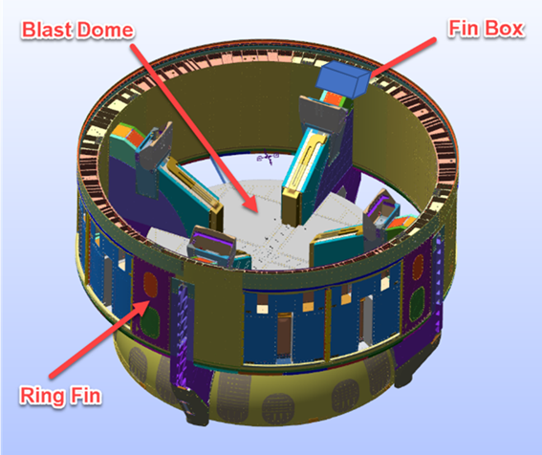
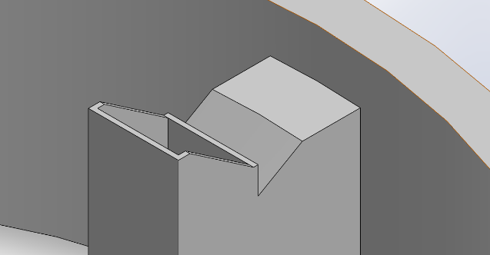
Design Solution:
Location & Volumetric Reference
6’’
10’’
4’’
Magnified Fin Box
Project Overview
Design Solution
Design Requirements & Satisfaction
Project Risks
Verification & Validation
Project Planning
Notes:
Volume constraints

Slide 13
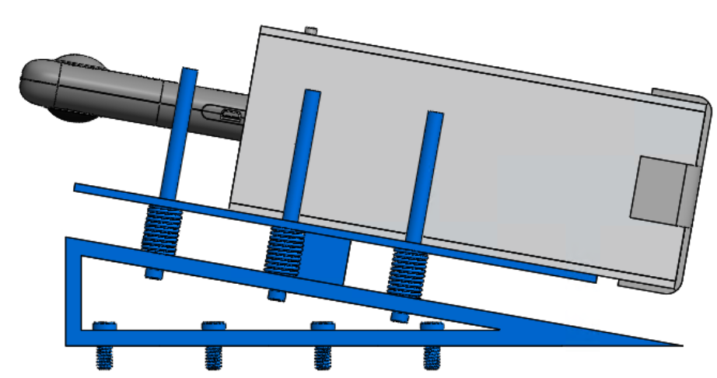
SP4CE Module
Crew Capsule Experience Camera (CCEC)
Camera Ejection Device (CED)
Project Overview
Design Solution
Design Requirements & Satisfaction
Project Risks
Verification & Validation
Project Planning
Notes:
I know this isn’t the up-to-date CAD model, but we can replace the image later. This is just a Sarah thought.

Slide 14
Design Solution:
Ejection
Project Overview
Design Solution
Design Requirements & Satisfaction
Project Risks
Verification & Validation
Project Planning
Notes:
Trigger for Ejection:
LaserPING Rangefinder
Camera Ejection Device (CED)
Ejection Springs
Lock for Ejection

Slide 15
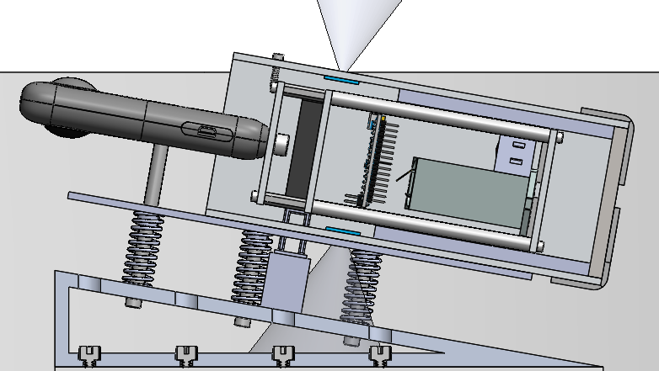
Design Solution:
Ejection
Rangefinders (f_{s} = 45 ms)
Ejection Lock
Guided Springs
(k = 38 lbf/ft)
Project Overview
Design Solution
Design Requirements & Satisfaction
Project Risks
Verification & Validation
Project Planning
Notes:
Trigger for Ejection:
LaserPING Rangefinder
Camera Ejection Device (CED)
Ejection Springs
Lock for Ejection

Slide 16
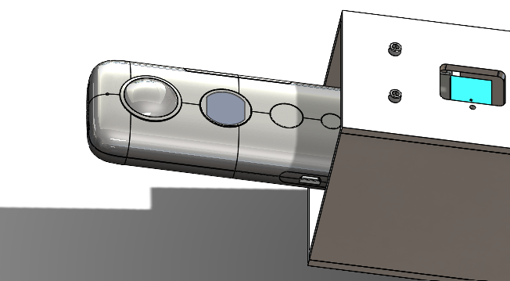
Design Solution:
Media Capture
Insta360 OneX
No enclosure
Dual Lenses
(200° AOV,
5.7K Resolution)
Project Overview
Design Solution
Design Requirements & Satisfaction
Project Risks
Verification & Validation
Project Planning
Notes:
Camera Specs need to be added

Slide 17
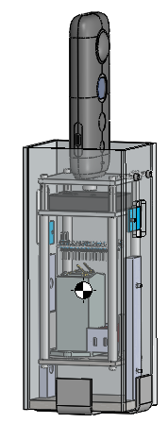
Design Solution:
Reentry
No TPS:
Aluminum Structure
(T_{melt} = 1220°F)
CM
(Ballast weight allows for automatic reorientation upon reentry)
Project Overview
Design Solution
Design Requirements & Satisfaction
Project Risks
Verification & Validation
Project Planning
Notes:
Helps with thermally protecting camera from reentry temperatures

Slide 18
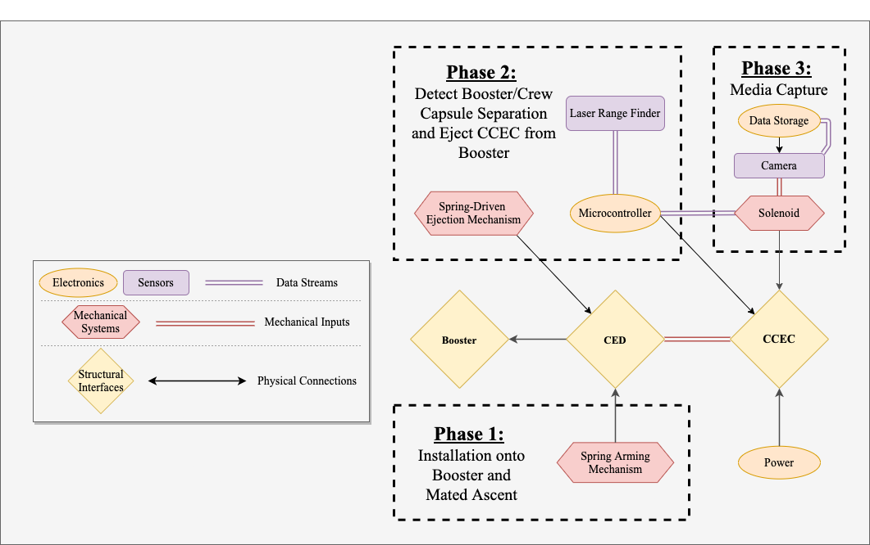
Functional Block Diagram

Slide 19
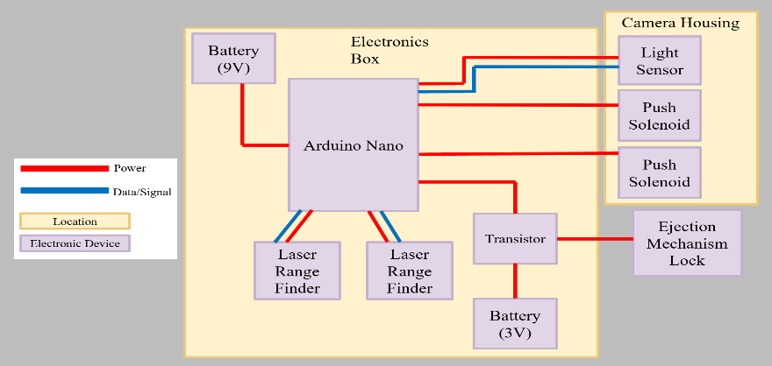
Electronic Functional Block Diagram
Project Overview
Design Solution
Design Requirements & Satisfaction
Project Risks
Verification & Validation
Project Planning
Notes:
Update

Slide 20
Critical Project Elements
Critical Element | Constraint Rationale | FR
E1: Survival | The SP4CE module must be easily integrated to the Booster and survive ascent, ejection, the space environment, and reentry. | FR. 5 FR. 6 FR. 7
E2: Safety | The SP4CE module must not endanger astronaut health and safety or the integrity of the Crew Capsule. | FR. 2 FR. 3 FR. 5
E3: Ejection | The Camera Ejection Device (CED) must eject the CCEC within 10s of Booster/Crew Capsule separation to ensure moments in microgravity are captured. | FR. 2 FR. 3
E4: Media Capture | The CCEC camera must have the proper Field of View (FOV) and resolution to capture desired features. | FR. 1 FR. 4
Project Overview
Design Solution
Design Requirements & Satisfaction
Project Risks
Verification & Validation
Project Planning

Slide 21
Functional Requirements
FR 1 | The CCEC shall capture video of the entire Crew Capsule with the Earth’s horizon in the background including features (e.g. clouds) and astronauts’ faces in windows during the period of Crew Capsule microgravity.
FR 2 | The CCEC shall be ejected from the Booster by the CED at or after Booster/Crew Capsule separation.
FR 3 | The CCEC shall maintain a neutral or positive separation rate from the Crew Capsule following ejection through Crew Capsule apogee.
FR 4 | The CCEC shall take videos of the CC starting no later than 10 seconds following Booster/CC separation with video taken for at least the next 180 seconds.
FR 5 | The CCEC shall have a ballistic coefficient less than the Crew Capsule (0.5 lbm/in²) to ensure no in-flight contact during reentry.
FR 6 | The CCEC shall survive reentry.
FR 7 | The SP4CE module should have a loaded weight of less than 50 lbm.
Project Overview
Design Solution
Design Requirements & Satisfaction
Project Risks
Verification & Validation
Project Planning

Slide 22
Design Requirements & Satisfaction
Victoria Hurd, Ryan Charles, Sarah Leary
Project Overview
Design Solution
Design Requirements & Satisfaction
Project Risks
Verification & Validation
Project Planning

Slide 23
Driving Requirements
Requirement | Requirement Summary | CPE | Satisfaction
FR. 7 | Integration | E1
FR. 2, FR. 3 | Ejection | E3, E2
FR. 1, FR. 4 | Media Capture | E4
FR. 5, FR. 6 | Reentry | E1
Project Overview
Design Solution
Design Requirements & Satisfaction
Project Risks
Verification & Validation
Project Planning

Slide 24
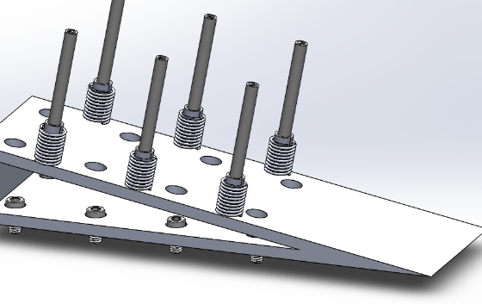
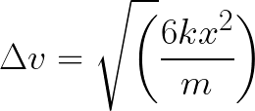
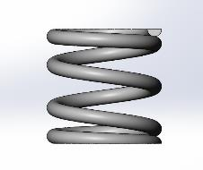
Ejection (FR. 2)
DR. 2.3: CED shall impart a delta-v of 9 ± 1 ft/s on the CCEC at ejection.
DR. 2.3.1: CED springs shall impart a force 37.7 lbf ± 20% on CCEC at ejection.
Conservation of Energy & Hooke’s Law
6-spring system
k = 38 lbf/ft
𝚫v = 9 ft/s
F_{spring} = 6.3 lbf
F_{total} = 37.7 lbf
Project Overview
Design Solution
Design Requirements & Satisfaction
Project Risks
Verification & Validation
Project Planning
Notes:
Include equations from spring analyses.
Where did the k = spring geometric and material properties equation come from?

Slide 25
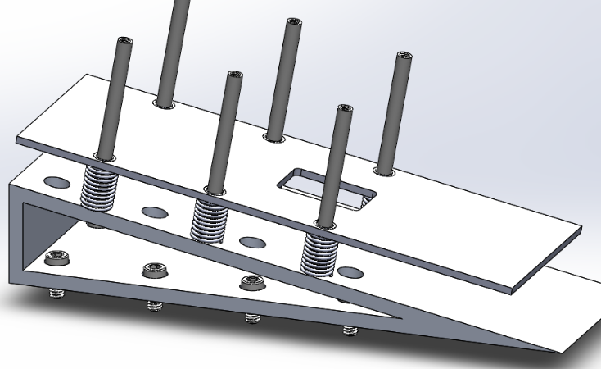
Ejection (FR. 2)
DR. 2.2: CED shall eject the CCEC at an angle of 80 ± 3°.
Spring guide rails
Mitigates spring buckling
Plate covering springs
Mitigates unbalanced ejection forces
Ejection Lock
Ensures plate ejects correctly
Ejection direction
80°
Project Overview
Design Solution
Design Requirements & Satisfaction
Project Risks
Verification & Validation
Project Planning
Notes:
Include CAD model showing angle of ejection.
Include location of CCEC relative to CC based on different angles of ejection.
Error ellipses at end of media capture
change CED acronym

Slide 26
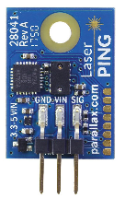
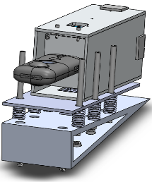
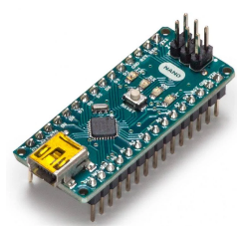
Ejection (FR. 2)
DR. 2.1: CED shall eject the CCEC 2 ± 1 seconds after Booster/CC separation.
t = 0
0 < t < 2
t = 2
t > 2
LaserPING Rangefinder 1 detects Booster/Crew Capsule separation.
Arduino NANO waits 2 seconds.
Cabinet locks unlock, springs release, CCEC ejects.
LaserPING Rangefinder 2 verifies CCEC ejection.
Project Overview
Design Solution
Design Requirements & Satisfaction
Project Risks
Verification & Validation
Project Planning
Notes:
Explain how laser range finder (with plume laser) will make this happen.
Include diagram of laser range finder plume (FOV) looking at the CC to ensure the laser range finder will see the CC separate. Include distance the CC will be at when range finder detects it.
Include error ellipses to show how the laserPING Rangefinder can still capture CC/Booster separation for different ejection time/angles.
May go in backup slides.
Work w/ Cesario and Vicki.

Slide 27
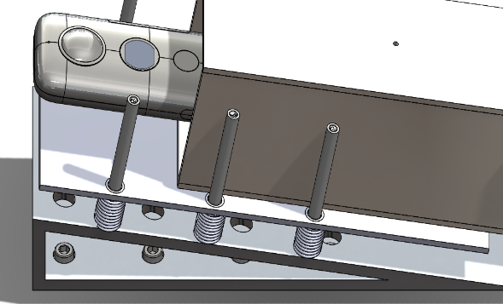
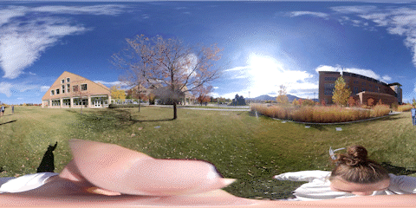
Media Capture (FR. 1)
DR. 1.3: CCEC camera shall capture video under rotation rates of at least 10 rad/s.
360° camera without encasing
Plate covering springs
~1.6 rev/s = 10.4 rad/s ✅
Project Overview
Design Solution
Design Requirements & Satisfaction
Project Risks
Verification & Validation
Project Planning
Notes:
Rotational dynamics model baby!
Work w/ Zach on this one for rotational dynamics. Work with Jack & Gio for CAD design.
Include the CCEC CAD model showing the camera.
Include the CCEC CAD model showing the flat plate that mitigates potential rotations.

Slide 28
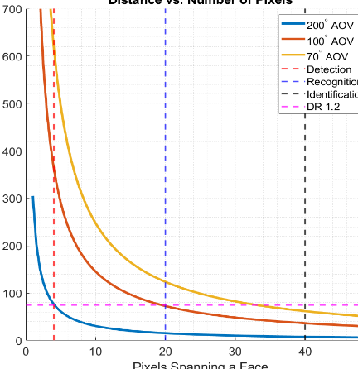
Media Capture (FR. 1)
DR. 1.2: CCEC camera shall capture video with astronaut faces visible up to a distance of 75 feet.
Insta360 OneX
Resolution = 5760 x 2880
2 lenses
AOV = 200°
Within budgetary constraints
Ideal camera
Resolution = 5760 x 2880
AOV = 70-100°
4-6 lenses
Project Overview
Design Solution
Design Requirements & Satisfaction
Project Risks
Verification & Validation
Project Planning
Notes:
We will have to explain that our customer wanted us to design the “optimal” camera, though the camera we have in our possession may not be that camera. We do not have the funds $$$ to purchase the perfect camera.
Work w/ Sarah.
Add the pixel figure from PDR that takahashi liked. Make changes that Akos said about it

Slide 29
Media Capture (FR. 4)
DR. 4.2.1: CCEC camera battery shall maintain a temperature between -4 and 104°F while operating.
ANSYS Transient Thermal Radiation
Initial temp: 100 °F
Plastic
Emissivity ~ 0.9 [3]
Fine mesh
Project Overview
Design Solution
Design Requirements & Satisfaction
Project Risks
Verification & Validation
Project Planning
Notes:
Temperature of surface contacting camera was modeled in ANSYS. Assumed initial surface temp of battery = initial surface temp of camera = ambient temp in fin box.
Battery will produce some heat that will warm it up (about 4 deg F)
Work w/ Aneesh, Jesse, Sarah, and Gio.

Slide 30
Reentry (FR. 5)
FR. 5: CCEC shall have a ballistic coefficient less than the Crew Capsule (0.5 lbm/in²) to ensure no in-flight contact during reentry.
Ballistic coefficient
C_{d} = 1.7 [1]
A_{c} = 3 in ⨉ 2.5 in
m < 6.375 lbm
BC = 0.1991 lbm/in²
m = 2.5 lbm
Project Overview
Design Solution
Design Requirements & Satisfaction
Project Risks
Verification & Validation
Project Planning
Notes:
Include a lil bit of a mass breakdown here? That may not be too bad.

Slide 31
Reentry (FR. 6)
DR. 6.1: The CCEC camera shall not exceed a temperature of 185°F to ensure survival of the SD card.
Ballast weight
Orient CCEC such that camera is “far” from location of max temperatures
Off-center Center of Mass (CM) will cause CCEC to automatically orient in favored configuration
CM
Location of maximum temperature
Project Overview
Design Solution
Design Requirements & Satisfaction
Project Risks
Verification & Validation
Project Planning
Notes:
Insert CAD model with (approximate or exact) CG. It should show the impact of the ballast weight (i.e. an off-center CG).
Explain how the ballast weight ensures the camera is far away from aerodynamic heating.

Slide 32
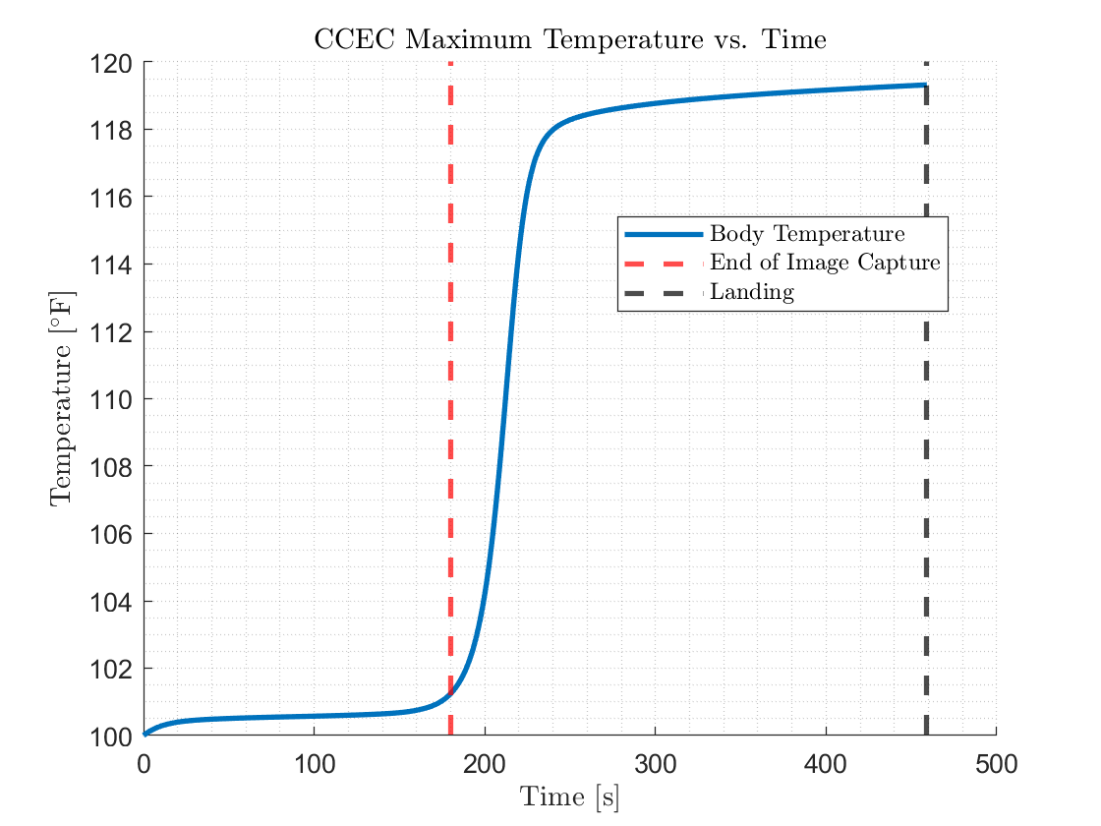
Reentry (FR. 6)
DR. 6.1: The CCEC camera shall not exceed a temperature of 185°F to ensure survival of the SD card.
Aluminum structure
Melting point = 1220°F
High melting point accounts for model inaccuracies
Project Overview
Design Solution
Design Requirements & Satisfaction
Project Risks
Verification & Validation
Project Planning

Slide 33
Driving Requirements
Requirement | Requirement Summary | CPE | Satisfaction
FR. 7 | Integration | E1 | ✅
FR. 2, FR. 3 | Ejection | E3, E2 | ✅
FR. 1, FR. 4 | Media Capture | E4 | ✅
FR. 5, FR. 6 | Reentry | E1 | ✅
Project Overview
Design Solution
Design Requirements & Satisfaction
Project Risks
Verification & Validation
Project Planning
Notes:
Let’s highlight the requirements we will actually go over and grey out the ones we include in the backup slides!

Slide 34
Project Risks
Jasmin Chadha
Project Overview
Design Solution
Design Requirements & Satisfaction
Project Risks
Verification & Validation
Project Planning

Slide 35
Risk Measurement
Severity
Rank | Level | Description
1 | Negligible | No impact on success of the project.
2 | Low | Little impact on success of the project.
3 | Medium | Negatively impacts success of the project, but does not cause failure.
4 | High | Negatively impacts success of the project and causes failure.
Likelihood
Rank | Level | Description
1 | Very unlikely | No probability of occurring during the project.
2 | Unlikely | Low probability of occuring during the project.
3 | Likely | Medium probability of occurring during the project.
4 | Very likely | High probability of occurring during the project.
Project Overview
Design Solution
Design Requirements & Satisfaction
Project Risks
Verification & Validation
Project Planning
Notes:
add colors for these

Slide 36
Critical Project Risk 1
Risk Description | Ejection system malfunctions (prematurely activates or does not activate in time).
Mitigation Strategy | Second rangefinder used to check proper ejection and communicate with microcontroller.
Related Phase | Ejection
CPE | E2: Safety, E3: Ejection
Project Overview
Design Solution
Design Requirements & Satisfaction
Project Risks
Verification & Validation
Project Planning
Notes:
MEMORIZE WHAT EACH CPE IS
Mitigation Strategy: “Second rangefinder verifies CC separation data and decreases uncertainty associated with ejection time.”

Slide 37
Risk 1 Placement
Severity Likelihood | Negligible | Low | Medium | High
Very likely
Likely |  |  |  | 1
Unlikely
Very unlikely |  |  | 1
Project Overview
Design Solution
Design Requirements & Satisfaction
Project Risks
Verification & Validation
Project Planning
Notes:
limitations on hardware → certain things we can’t fully test should have higher risk
error with trajectory
Severity/Impact: Major
Probability: Likely→ Unlikely
For this risk we could further decrease the probability to be “Rare” given that we can easily test our range finders and ejection trigger as much as needed

Slide 38
Critical Project Risk 2
Risk Description | Imbalance in spring release causes a spin or moment affecting rotational dynamics.
Mitigation Strategy | Plates and rails used to guide springs during decompression.
Related Phase | Ejection, Media Capture
CPE | E2: Safety, E3: Ejection, E4: Media Capture
Project Overview
Design Solution
Design Requirements & Satisfaction
Project Risks
Verification & Validation
Project Planning
Notes:
do risk explanation verbally

Slide 39
Risk 2 Placement
Severity Likelihood | Negligible | Low | Medium | High
Very likely |  |  | 2
Likely
Unlikely |  | 2
Very unlikely
Project Overview
Design Solution
Design Requirements & Satisfaction
Project Risks
Verification & Validation
Project Planning
Notes:
limitations on hardware → certain things we can’t fully test should have higher risk
error with trajectory
Severity/Impact: Minor (Stitching functionality of 360 camera makes rotational dynamics negligible within certain bounds)
Probability: Certain → Unlikely
It will be hard for us to decrease the probability associated with this risk given the fact we will never be able to test ejection/trajectory in micro-gravity

Slide 40
Critical Project Risk 3
Risk Description | Camera does not turn on in time for media capture.
Mitigation Strategy | Light sensor used to detect if camera screen turns on.
Related Phase | Media Capture
CPE | E4: Media Capture
Project Overview
Design Solution
Design Requirements & Satisfaction
Project Risks
Verification & Validation
Project Planning
Notes:
do risk explanation verbally
Mitigation strategy should include a strategy for turning the camera on in the case that its off. I know we talked about designing something to either press the power button or try to turn in on electronically using the micro usb.
feed back light detection values → if not turned on, resend signal → cone

Slide 41
Risk 3 Placement
Severity Likelihood | Negligible | Low | Medium | High
Very likely
Likely |  |  |  | 3
Unlikely |  |  | 3
Very unlikely
Project Overview
Design Solution
Design Requirements & Satisfaction
Project Risks
Verification & Validation
Project Planning
Notes:
limitations on hardware → certain things we can’t fully test should have higher risk
error with trajectory
Severity: Major
Probability: Likely
I don’t think this mitigation has a major affect on the risk associated with it yet. There will be additional risks associated with the design solution we come up with to turn the camera on, and we need to test some solutions before quantifying the probability it will fail.

Slide 42
Critical Project Risk 4
Risk Description | SP4CE or CCEC module hits the Crew Capsule or Booster.
Mitigation Strategy | Plates and rails used to guide springs during decompression.
Related Phase | Ejection, Reentry
CPE | E2: Safety
Project Overview
Design Solution
Design Requirements & Satisfaction
Project Risks
Verification & Validation
Project Planning
Notes:
do risk explanation verbally
Mitigation Strategy: 1 is good. 2? The CCEC’s Ballistic coefficient ensures a positive rate of separation during reentry

Slide 43
Risk 4 Placement
Severity Likelihood | Negligible | Low | Medium | High
Very likely
Likely |  |  |  | 4
Unlikely
Very unlikely |  |  | 4
Project Overview
Design Solution
Design Requirements & Satisfaction
Project Risks
Verification & Validation
Project Planning
Notes:
limitations on hardware → certain things we can’t fully test should have higher risk
error with trajectory
Severity: Catastrophic/Critical
Probability: Unlikely

Slide 44
Critical Project Risk 5
Risk Description | CCEC burns in Earth’s atmosphere upon reentry.
Mitigation Strategy | Reentry temperature testing conducted in thermal chamber.
Related Phase | Reentry
CPE | E1: Survival
Project Overview
Design Solution
Design Requirements & Satisfaction
Project Risks
Verification & Validation
Project Planning
Notes:
do risk explanation verbally
Risk Description: “CCEC suffers catastrophic thermal damage upon reentry”
Mitigation Strategy: good

Slide 45
Risk 5 Placement
Severity Likelihood | Negligible | Low | Medium | High
Very likely
Likely
Unlikely |  |  |  | 5
Very unlikely |  |  | 5
Project Overview
Design Solution
Design Requirements & Satisfaction
Project Risks
Verification & Validation
Project Planning
Notes:
limitations on hardware → certain things we can’t fully test should have higher risk
error with trajectory
Severity: Major
Probability: Likely → Unlikely

Slide 46
Critical Project Risk 6
Risk Description | Camera lens damaged due to the space environment.
Mitigation Strategy | Cold temperature testing conducted with dry ice in cooler.
Related Phase | Media Capture
CPE | E1: Survival, E4: Media Capture
Project Overview
Design Solution
Design Requirements & Satisfaction
Project Risks
Verification & Validation
Project Planning

Slide 47
Risk 6 Placement
Severity Likelihood | Negligible | Low | Medium | High
Very likely
Likely |  | 6
Unlikely |  | 6
Very unlikely
Project Overview
Design Solution
Design Requirements & Satisfaction
Project Risks
Verification & Validation
Project Planning
Notes:
limitations on hardware → certain things we can’t fully test should have higher risk
error with trajectory
Severity: Minor
Probability: Likely → Unlikely

Slide 48
Risk Matrix
Severity Likelihood | Negligible | Low | Medium | High
Very likely |  |  | 2
Likely |  | 6 |  | 3, 1, 4
Unlikely |  | 6, 2 | 3 | 5
Very unlikely |  |  | 1, 4, 5
Risk Number | Risk Description
1 | Ejection system malfunctions (prematurely activates or does not activate in time).
2 | Imbalance in spring release causes a spin or moment affecting rotational dynamics.
3 | Camera does not turn on in time for media capture.
4 | SP4CE or CCEC module hits the Crew Capsule or Booster.
5 | CCEC burns in Earth’s atmosphere upon reentry.
6 | Camera lens damaged due to the space environment.
Project Overview
Design Solution
Design Requirements & Satisfaction
Project Risks
Verification & Validation
Project Planning
Notes:
limitations on hardware → certain things we can’t fully test should have higher risk
error with trajectory
always within 3sigma ellipse so we’ll be close to the crew capsule

Slide 49
Verification & Validation
Jack Lana
Project Overview
Design Solution
Design Requirements & Satisfaction
Project Risks
Verification & Validation
Project Planning

Slide 50
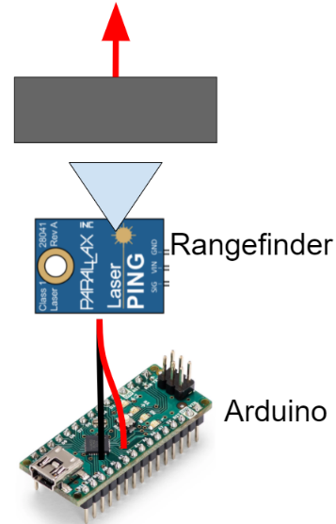
Ejection Verification:
Trigger
Purpose
Prove capability of electronic triggering system
Verify accuracy of triggering system
Plan
Move object away from rangefinder
Monitor rangefinder output via Arduino
Verify Arduino outputs ejection trigger signal
Driving Requirements/Passing Criteria
DR. 2.1: Arduino outputs trigger signal 2 ± 1 seconds after object is moved
Project Overview
Design Solution
Design Requirements & Satisfaction
Project Risks
Verification & Validation
Project Planning

Slide 51
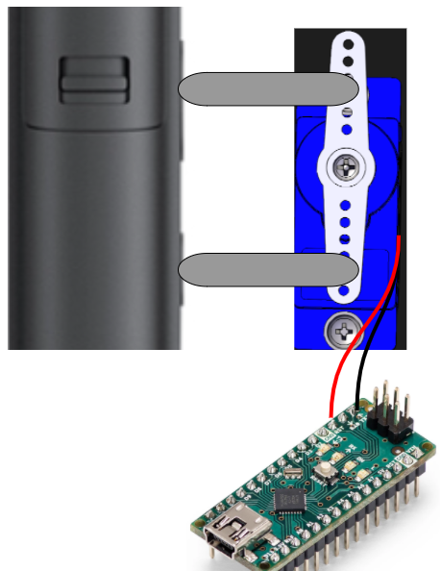
Media Capture Verification:
Camera Activation
Purpose
Prove capability of camera activation via Solenoid
Plan
Mount Solenoid in flight similar configuration
Trigger Solenoid using Arduino
Ensure proper camera activation
Driving Requirements/Passing Criteria
DR. 4.1: CCEC camera shall turn on no later than 1 second after ejection.
Solenoids
Camera
Arduino

Slide 52
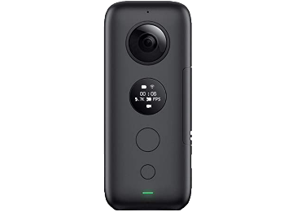
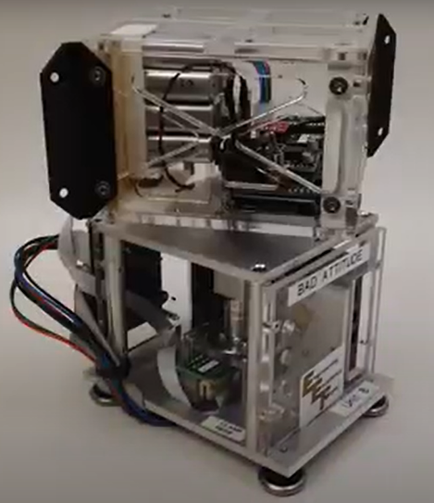
Media Capture Verification:
Rotation Capability
Purpose
Prove stitching capability of rotating camera
Plan
Place camera on spin module
Rotate at a known rate
Repeat for several different axis
Monitor recording for stitching breakdowns
Driving Requirements/Passing Criteria
DR. 1.3: Video stitching continues at 10 rad/s
Project Overview
Design Solution
Design Requirements & Satisfaction
Project Risks
Verification & Validation
Project Planning
Notes:
wotation wate

Slide 53
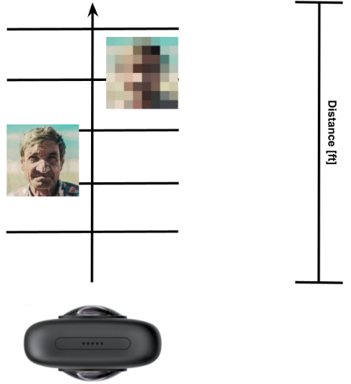
Media Capture Verification:
Resolution Capability
Purpose
Prove camera resolution capabilities
Plan
Place camera on secure mount
Record video with subjects at increasing distances
Monitor recording for facial recognition and detection distances
Driving Requirements/Passing Criteria
DR. 1.2: Subject faces are visible up to a 75 foot distance
Project Overview
Design Solution
Design Requirements & Satisfaction
Project Risks
Verification & Validation
Project Planning

Slide 54
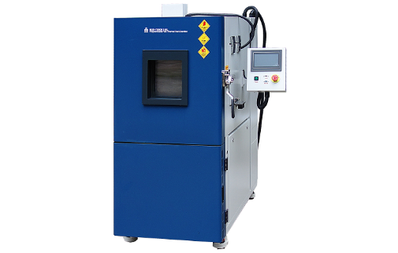
Reentry Verification: Maximum Temperature
Purpose
Prove enclosure prevents camera from surpassing 185°F during reentry
Plan
Place enclosure in thermal chamber with reentry conditions
Monitor temperature of camera
Driving Requirements/Passing Criteria
DR. 6.1: Camera does not surpass 185°F under reentry heating conditions
Project Overview
Design Solution
Design Requirements & Satisfaction
Project Risks
Verification & Validation
Project Planning
Notes:
why is F in times new roman
insulation verification
purpose:

Slide 55
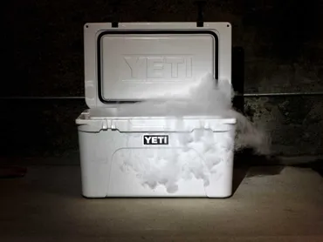
Thermal Verification: Minimum Temperature
Purpose
Prove camera battery does not reach a temperature below -4°F when exposed to a cooling chamber
Plan
Move camera from room temperature to dry ice cooler for duration of media capture
Monitor temperature and performance of camera battery
Driving Requirements/Passing Criteria
DR 4.2.1
Project Overview
Design Solution
Design Requirements & Satisfaction
Project Risks
Verification & Validation
Project Planning
Notes:
why is F in times new roman
insulation verification
purpose:

Slide 56
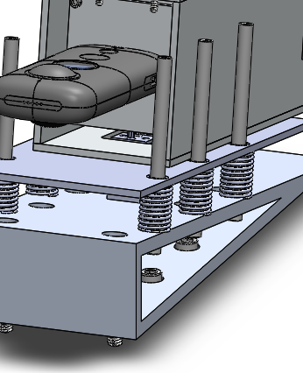
Ejection Subsystem Validation
Purpose
Prove capability of full ejection system
Plan
Load CCEC onto spring platform
Move object away from rangefinder to trigger release
Film release trajectory using slow motion camera
Driving Requirements/Passing Criteria
FR. 2: Ejection delay, ejection angle, ejection velocity
Project Overview
Design Solution
Design Requirements & Satisfaction
Project Risks
Verification & Validation
Project Planning
Notes:
validation is more of a full system thing that can meet all requirements → this looks like more of a verification?
verifying individual requirements, validating full system functionality
put validation at the end → V&V flow has verification for each subsystem first

Slide 57
Project Planning
Jasmin Chadha, Ryan Charles
Project Overview
Design Solution
Design Requirements & Satisfaction
Project Risks
Verification & Validation
Project Planning

Slide 58
Major Tests
Test | Output | Anticipated Date | Location | Point
Ejection Trigger | Delay time | January 2022 | AERO 140 | DR. 2.1 // E2, E3
Camera Resolution | Distance to object, clarity of video | January 2022 | AERO Back Patio | DR. 1.1, 1.2 // E4
Camera Activation | Turns on (yes/no) | February 2022 | AERO 140 | DR. 4.1, 4.2 // E4
Camera Rotation | Rotation rates, clarity of video | February 2022 | Pilot Lab | DR. 1.3 // E4
Reentry Heating | Temperature profile | February 2022 | TBD | DR. 6.1 // E1
Cold Temperature | Temperature profile | February 2022 | AERO 140 | DR. 6.1 // E1
Project Overview
Design Solution
Design Requirements & Satisfaction
Project Risks
Project Risks
Verification & Validation
Verification & Validation
Project Planning
Project Planning
Notes:
5x5
note restricted access to equipment → VERBALLY

Slide 59
Major Tests
Test | Output | Anticipated Date | Location | Point
Spring Loading | Mechanically feasible (yes/no) | March 2022 | AERO 140 | FR. 2 // E1, E2
Ejection Validation | Delta-V, ejection angle | March 2022 | AERO 140 | DR 2.2, 2.3 // E1, E2, E3
Launch Vibration | Structural loads, failure modes | April 2022 | Pilot Lab | E1, E2
Project Overview
Design Solution
Design Requirements & Satisfaction
Project Risks
Project Risks
Verification & Validation
Verification & Validation
Project Planning
Project Planning
Notes:
5x5
note restricted access to equipment → VERBALLY

Slide 60
Finance Budget
Project Overview
Design Solution
Design Requirements & Satisfaction
Project Risks
Verification & Validation
Project Planning
Notes:
if yall want both or just one u can pick and choose

Slide 61
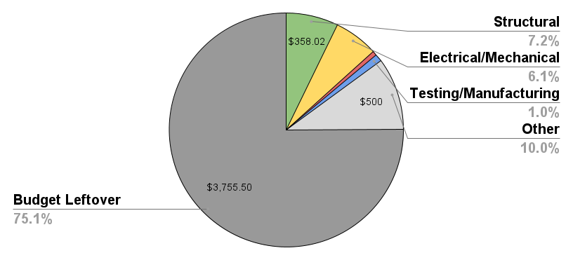
Finance Budget
Project Overview
Design Solution
Design Requirements & Satisfaction
Project Risks
Verification & Validation
Project Planning
Notes:
if yall want both or just one u can pick and choose

Slide 62
Work Plan
Project Overview
Design Solution
Design Requirements & Satisfaction
Project Risks
Project Risks
Verification & Validation
Verification & Validation
Project Planning
Project Planning
Notes:
5x5
show entire gantt, line showing where we’re at
→ selected subset of immediate work next (2 weeks?)
→ put same line there to show where it is

Slide 63
Questions?

Slide 64
Backup Slides

Slide 65
Supporting Materials
Acknowledgement & References
Administrative
Design Requirements & Satisfaction

Slide 66
Acknowledgements & References

Slide 67
Acknowledgements
Blue Origin POCs: Dean Misterek, Gary Lai
Faculty Advisor: Dr. Yu Takahashi
Teaching Fellows: Emma Markovich, Colin Claytor
ASEN 4018 Professors: Dr. Kathryn Wingate, Dr. Jelliffe Jackson
Additional Professors: Dr. Ross Chaudhry, Dr. Francisco López Jiménez, Alexandra Le Moine, Dr. Nicholas Rainville, Trudy Schwartz
CDR Reviewers: GRASS and CubIST

Slide 68
References
http://ftp.demec.ufpr.br/disciplinas/TM240/Marchi/Bibliografia/Hoerner.pdf
https://tfaws.nasa.gov/TFAWS12/Proceedings/Aerothermodynamics%20Course.pdf
https://www.engineeringtoolbox.com/emissivity-coefficients-d_447.html
ASEN 5519 Formula Sheet
https://cdn-learn.adafruit.com/downloads/pdf/adafruit-bh1750-ambient-light-sensor.pdf
https://store.arduino.cc/products/arduino-nano
https://www.duracell.com/wp-content/uploads/2021/06/CR123_US.pdf
https://www.tme.eu/Document/44e2b5a5a277fb97063ce3897cb3bea2/BAT-6F22-UL.pdf
https://www.aliexpress.com/item/1005001357276043.html?src=google&memo1=freelisting&src=google&albch=shopping&acnt=708-803-3821&slnk=&plac=&mtctp=&albbt=Google_7_shopping&albagn=888888&isSmbAutoCall=false&needSmbHouyi=false&albcp=9760820159&albag=99451607003&trgt=894486321753&crea=en1005001357276043&netw=u&device=c&albpg=894486321753&albpd=en1005001357276043&gclid=CjwKCAjwzt6LBhBeEiwAbPGOgQlB3yTSYyhuS7I3_1KaCbrGx-YWHqhw5NVik_u9_vqDXQi7Dc6JvxoCYfcQAvD_BwE&gclsrc=aw.ds&aff_fcid=96adcd39af8e4f9e84b27b0a32b6a68c-1635313496072-03660-UneMJZVf&aff_fsk=UneMJZVf&aff_platform=aaf&sk=UneMJZVf&aff_trace_key=96adcd39af8e4f9e84b27b0a32b6a68c-1635313496072-03660-UneMJZVf&terminal_id=e02d5d7b2b184b5d91529cc7f0993480

Slide 69
Administrative
Gantt Chart, Org Chart, Functional Requirements, Acronyms, Notable Term Definitions

Slide 70
Fall Organizational Chart
Systems Engineer
Sarah Leary
Jack Lana
Jasmin Chadha
Vicki Hurd
Project Manager
Jasmin Chadha
Financial Officer
Ryan Charles
Electrical Engineer
Cesario Garcia
Aneesh Balla
Gio Borrani
Jasmin Chadha
Manufacturing Engineer
Jesse Bartlett
Mechanical Engineer
Gio Borrani
Cesario Garcia
Jack Lana
Vicki Hurd
Software Engineer
Vicki Hurd
Cesario Garcia
Sarah Leary
Zach Fields
Structures Engineer
Zach Fields
Aneesh Balla
Jesse Bartlett
Ryan Charles
Testing & Safety Engineer
Jack Lana
Jasmin Chadha
Ryan Charles
Zach Fields
Thermal Engineer
Aneesh Balla
Gio Borrani
Jesse Bartlett
Sarah Leary

Slide 71
Spring Organizational Chart
Systems Engineer
Sarah Leary
Project Manager
Jasmin Chadha
Financial Officer
Ryan Charles
Electrical Engineer
Cesario Garcia
Aneesh Balla Jesse Bartlett
Gio Borrani
Jasmin Chadha
Manufacturing Engineer
Jesse Bartlett
Gio Borrani
Jasmin Chadha
Zach Fields
Cesario Garcia
Vicki Hurd
Sarah Leary
Mechanical Engineer
Gio Borrani
Cesario Garcia
Jack Lana
Vicki Hurd
Software Engineer
Vicki Hurd
Structures Engineer
Zach Fields
Testing & Safety Engineer
Jack Lana
Aneesh Balla
Jasmin Chadha
Ryan Charles
Zach Fields
Sarah Leary
Thermal Engineer
Aneesh Balla

Slide 72
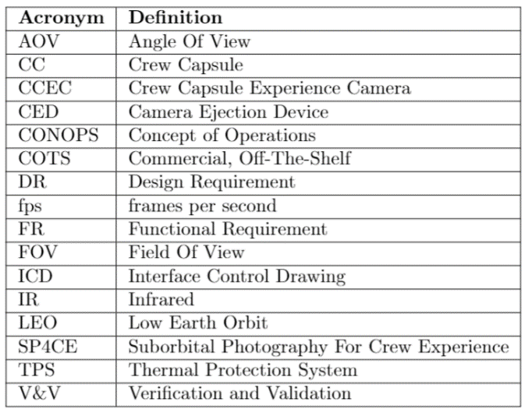
Acronyms
Notes:
nice

Slide 73
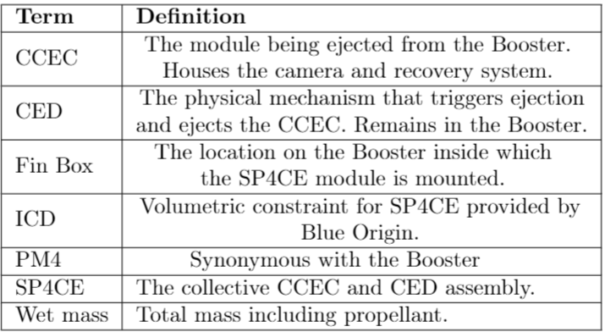
Notable Term Definitions
Notes:
nice

Slide 74
Design Requirements & Satisfaction

Slide 75
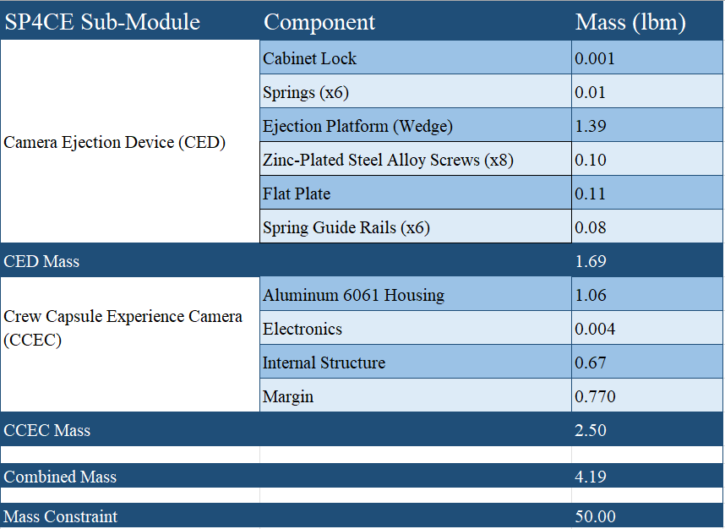
Integration (FR. 7)
FR. 7: SP4CE module should have a loaded weight of less than 50 lbm.
Project Overview
Design Solution
Design Requirements & Satisfaction
Project Risks
Verification & Validation
Project Planning
Notes:
Backup slide.
Insert mass budget here.

Slide 76
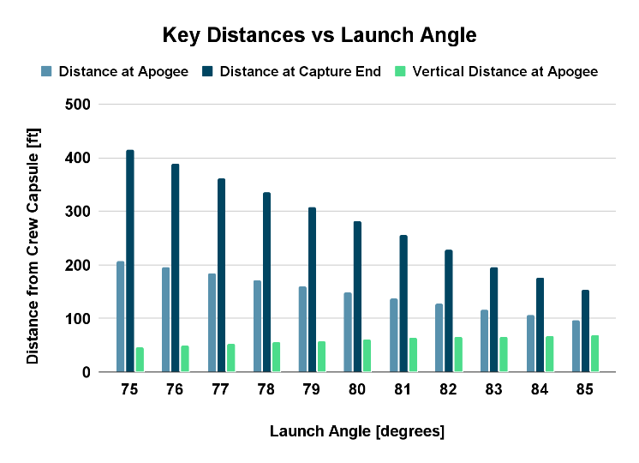
Ejection (FR. 2)
Project Overview
Design Solution
Design Requirements & Satisfaction
Project Risks
Verification & Validation
Project Planning
Notes:
making of delay times and vertical distance and end distance

Slide 77
Ejection (FR. 2)
Delay Times | Vertical Distance at Apogee | Total Distance at Apogee | Total Distance at Capture End
1 second | 69.5 ft | 154.1 ft | 284.6 ft
2 seconds | 60.7 ft | 148.8 ft | 281.5 ft
3 seconds | 50.6 ft | 144.032 ft | 283.9 ft
4 seconds | 41.2 ft | 139.596 ft | 284.5 ft
5 seconds | 29.3 ft | 135.613 ft | 286.1 ft
Project Overview
Design Solution
Design Requirements & Satisfaction
Project Risks
Verification & Validation
Project Planning
Notes:
making of delay times and vertical distance and end distance

Slide 78
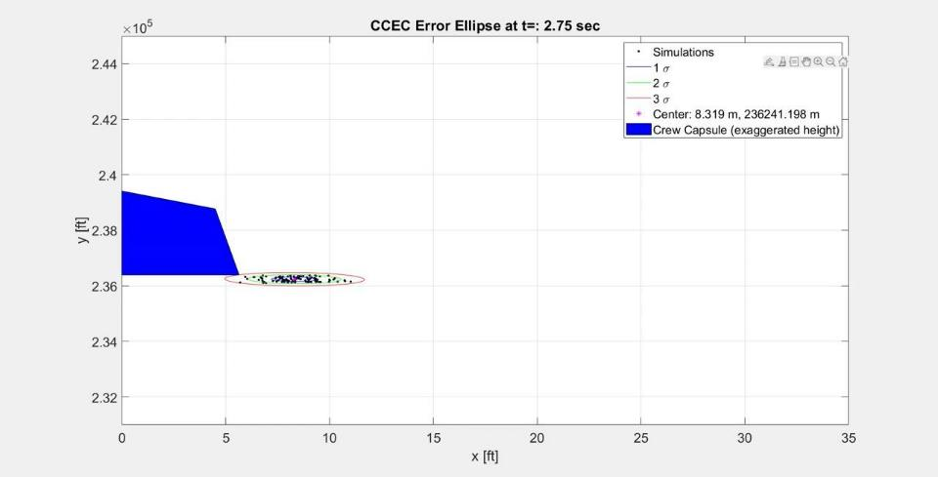
Ejection (FR. 2): Error Ellipses
Parameter | Variation
Ejection Angle | 80 +/- 5°
Spring Force | 37.7 +/- 20% lbf
Ejection Delay Time | 2 +/- 1 sec
Coefficient of Drag | 1.7 +/- 0.5

Slide 79
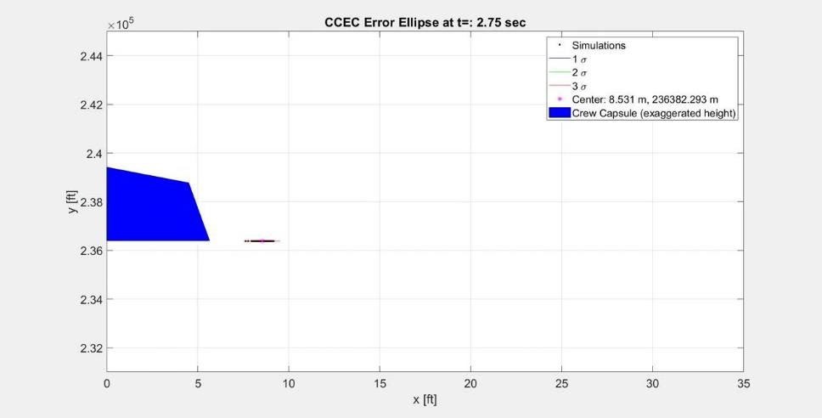
Ejection: Error Ellipses
Parameter | Variation
Ejection Angle | 80 +/- 5°
Spring Force | 37.7 +/- 20% lbf
Ejection Delay Time | 2 +/- 1 sec
Coefficient of Drag | 1.7 +/- 0.5

Slide 80
Ejection: Error Ellipses
Parameter | Variation
Ejection Angle | 80 +/- 5°
Spring Force | 37.7 +/- 20% lbf
Ejection Delay Time | 2 +/- 1 sec
Coefficient of Drag | 1.7 +/- 0.5

Slide 81
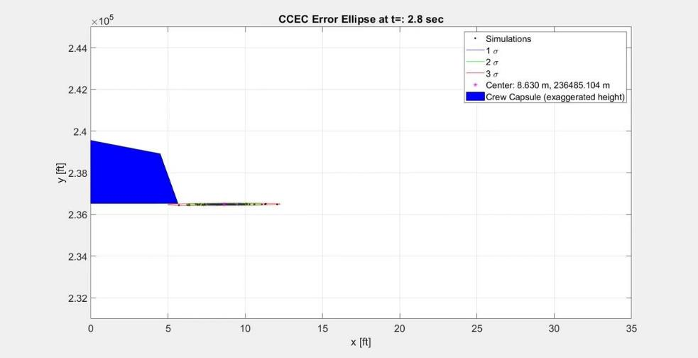
Ejection: Error Ellipses
Parameter | Variation
Ejection Angle | 80 +/- 5°
Spring Force | 37.7 +/- 20% lbf
Ejection Delay Time | 2 +/- 1 sec
Coefficient of Drag | 1.7 +/- 0.5

Slide 82
Ejection: Error Ellipses
Parameter | Variation
Ejection Angle | 80 +/- 3°
Spring Force | 37.7 +/- 20% lbf
Ejection Delay Time | 2 +/- 1 sec
Coefficient of Drag | 1.7 +/- 0.5

Slide 83
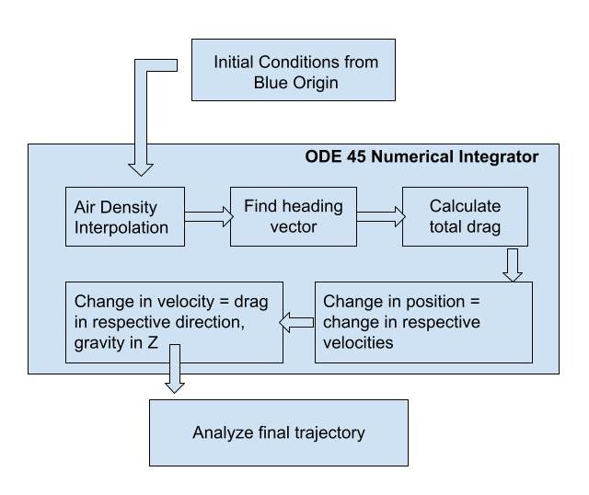
Ejection Trajectory: Assumptions & Methods
Assumptions:
One-dimensional problem
Instantaneous delta-v
Ejection delay of 2 seconds
No wind throughout flight
Notes:
Trajectory modeling, angle of ejection
expected delta-V from springs, size and spring constant
volume estimate from Jack’s CAD model of the ejection setup
Ejection time from booster
Initiating camera recording
Mention that mockup CCEC isnt final desigm
Assumptions are 1D problem for CC, no lateral displacements, cd for rectangular prism. A = xx in by xx in, compression distance of 0.25 ft by volumetric constraints, instantaneous dV, instantaneous chute deployment, ejecting at booster separation (negligible delay for ejection),
Methods:
Incorporate initial CCEC state from Blue Origin
Feed into numerical integrator ODE45
Interpolate air density from atmospheric data
Varying gravity force over time
Apply drag from parachute its deployment time
Analyze final state versus time

Slide 84
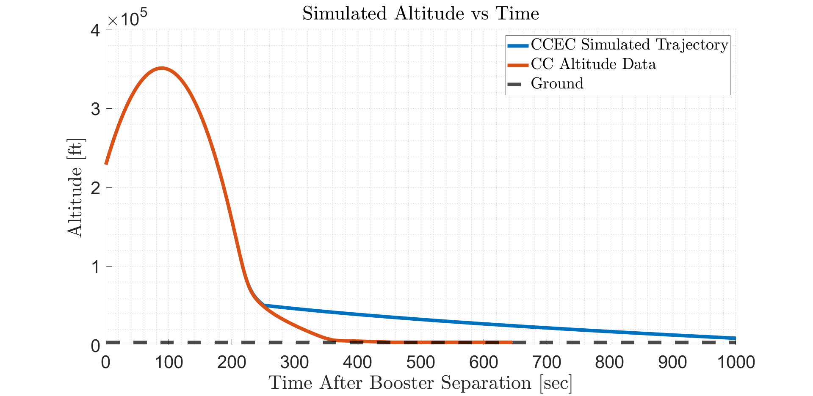
Ejection Trajectory: Delta-V & CC Altitude
Notes:
assuming 80 deg launch angle due to volumetric constraints. If we want 185 ft away at apogee, dv must be 12 ft/s
if spring system is used, assume compression distance of 0.25 ft. Using cons of energy for spring system, k = 115200 slugs/s^2 (this is for single spring system!)
Talk about where this trajectory came from, blue origins given trajectory stuff
I’ll make a methods slide. I’ll put info about ODE45, changing gravity, changing air desnity, launch angle decision (non-neglible width vs trying to launch as vertically as possible to be above CC with lowest necessary dv)
From here, do dv and altitude slide, then distance during media capture, then rate of separation.

Slide 85
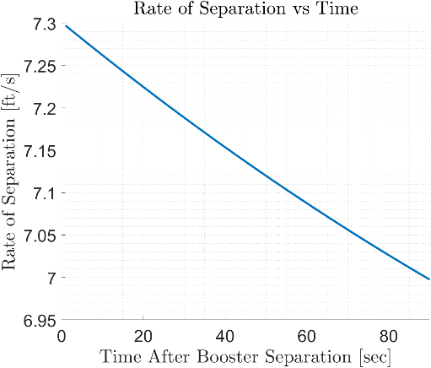
Ejection (FR. 3)
FR. 3: CCEC shall maintain a neutral or positive separation rate from the Crew Capsule following ejection through Crew Capsule apogee.
Trajectory model
Initial Conditions given
ODE45
Crew Capsule apogee: 90 sec
Separation rate achievable
Average: 7.14 ft/s
Standard deviation: 0.09 ft/s
Project Overview
Design Solution
Design Requirements & Satisfaction
Project Risks
Verification & Validation
Project Planning
Notes:
Probably back-up slide.
Insert plot of separation rate between CC and CCEC over time. State: so long as the springs function within error bounds, the separation rate will be positive.

Slide 86
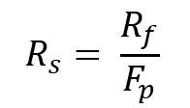
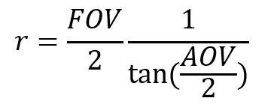
Media Capture: Model Development
R_{f} | Feature resolution (smallest feature that must be reliably resolved) in physical units [in]
F_{p} | Number of desired pixels that will span a feature of minimum size [pixels]
R_{s} | Spatial resolution [in/pixel]
R_{i} | Camera resolution [pixels]
FOV | Field of View [ft]
AOV | Angle of View [°]
r | Distance from CC to CCEC [ft]

Slide 87
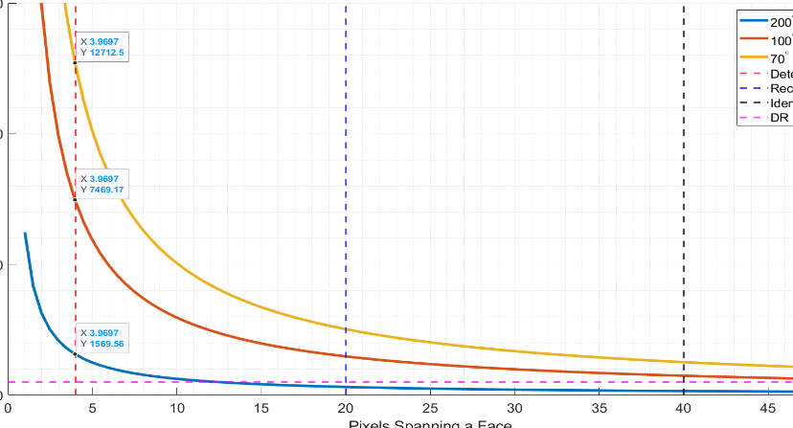
Media Capture (FR. 1)
DR. 1.1: CCEC camera shall capture video with the Crew Capsule visible up to a distance of 500 feet.
Project Overview
Design Solution
Design Requirements & Satisfaction
Project Risks
Verification & Validation
Project Planning
Notes:
We will have to explain that our customer wanted us to design the “optimal” camera, though the camera we have in our possession may not be that camera. We do not have the funds $$$ to purchase the perfect camera.
Work w/ Sarah.
Add the pixel figure from PDR that takahashi liked. Make changes that Akos said about it

Slide 88
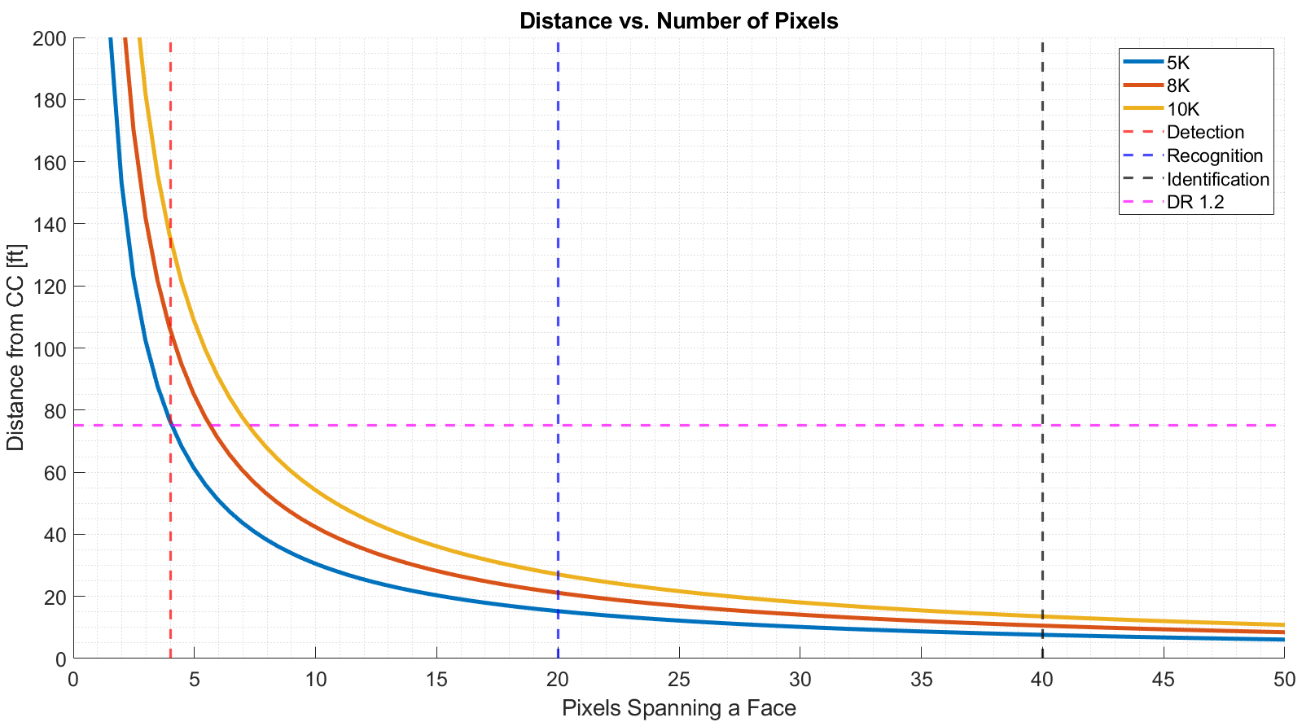
Media Capture (FR. 1)
How Resolution affects allowable distance between CC and CCEC
Assuming AOV = 200°
Project Overview
Design Solution
Design Requirements & Satisfaction
Project Risks
Verification & Validation
Project Planning
Notes:
We will have to explain that our customer wanted us to design the “optimal” camera, though the camera we have in our possession may not be that camera. We do not have the funds $$$ to purchase the perfect camera.
Work w/ Sarah.
Add the pixel figure from PDR that takahashi liked. Make changes that Akos said about it

Slide 89
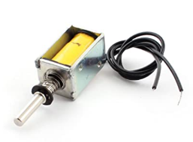
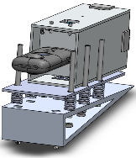
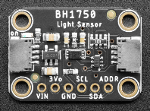
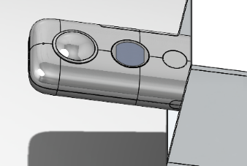
Media Capture (FR. 4)
DR. 4.1: CCEC camera shall turn on no later than 1 second after ejection.
DR. 4.2: CCEC camera shall capture video for at least 180 seconds.
t = 0 → t = 2
2 < t < 3
t = 3
3 < t < 183
Booster/CC Separate at t = 0. CCEC ejects at t = 2.
Solenoid turns CCEC camera on.
Light sensor verifies CCEC camera is on.
CCEC camera captures video footage of astronauts and CC in microgravity environment.
INSERT SERVO HERE
Project Overview
Design Solution
Design Requirements & Satisfaction
Project Risks
Verification & Validation
Project Planning
Project Overview
Design Solution
Design Requirements & Satisfaction
Project Risks
Verification & Validation
Project Planning

Slide 90
Media Capture (FR. 4)
DR. 4.2.1: CCEC camera battery shall maintain a temperature between -4 and 104°F while operating.
Project Overview
Design Solution
Design Requirements & Satisfaction
Project Risks
Verification & Validation
Project Planning
Notes:
Temperature of surface contacting camera was modeled in ANSYS. Assumed initial surface temp of battery = initial surface temp of camera = ambient temp in fin box.
Battery will produce some heat that will warm it up (about 4 deg)
Work w/ Aneesh, Jesse, Sarah, and Gio.

Slide 91
Media Capture: Camera Heat Loss
ANSYS Transient Thermal Radiation
Initial temp: 30 °F
Plastic
Emissivity ~ 0.9 [3]
Fine mesh
Notes:
ANSYS transient thermal analysis
Radiation heat transfer out from body to surroundings
Initial temperature of 30 deg F
Plastic material with emissivity of about 0.9
Used a fine mesh in ANSYS with high resolution

Slide 92
Reentry (FR. 6)
DR. 6.1: The CCEC camera shall not exceed a temperature of 185°F to ensure survival of the SD card.
Time integration
Mass m
Cross-sectional area A_{c}
Body temperature T_{b}
Specific heat capacity c_{p}
Convective heat transfer (Sutton-Graves [2])
Constant k = 1.7415⨉10⁻⁴
Air density 𝝆
Nose/edge radius R_{n} = 1.5 in
Velocity V
1.5 in
2.5 in
3 in
Face normal to freestream
Project Overview
Design Solution
Design Requirements & Satisfaction
Project Risks
Verification & Validation
Project Planning
Notes:
Explain model blah blah blah
Also factored in radiation felt by aluminum but it basically added no further effect

Slide 93
Reentry: Stagnation/Air Temperature
Stagnation Temperature vs. Time
Stagnation Temperature vs. Altitude
Notes:
stagnation temperature during reentry

Slide 94
Reentry: No Enclosure
CCEC is a blunt body
When supersonic, a bow shock forms
Most kinetic energy is transferred to blunt body wake, rather than convected to surface
Maximum temperatures (60 - 130°F) occur on face normal to freestream velocity
Location of max temperature
Bow shock
Notes:
Backup slide.
Definitely need to include some type of thermal analysis to prove the acrylic casing will not melt.

Slide 95
Reentry: Deceleration
Deceleration of CCEC
Velocity V (ft/s)
Flight path angle 𝛾₀ = -90°
Acceleration of gravity g = 32.2 ft/s²
Constant e ~ 2.7183
Scaling factor ᾶ ~ 4.199⨉10⁻⁵/ft
[4]
Notes:
g-forces of CCEC as it is reentering

Slide 96
Reentry: Heating Rate
Heating of CCEC vs. Time
Heating of CCEC vs. Altitude
Notes:
heating rate of CCEC as it is reentering

Slide 97
Reentry: Velocity/Mach Number
CCEC Velocity vs. Time
CCEC Mach Number vs. Time
Notes:
velocity/Mach number of CCEC as it is reentering

Slide 98
Landing
No longer within the scope of the project.
Guide rails
Ensures reusability of camera
Leaving room for a crushable structure and/or parachute/streamers/deployable drag device
Project Overview
Design Solution
Design Requirements & Satisfaction
Project Risks
Verification & Validation
Project Planning
Notes:
Definitely backup slide.
Include CAD model showing guide rails with room for parachute and crushable structure.

Slide 99
Electronic Components
Arduino Nano
Transistor MOSFET
LaserPING RangeFinder (x2)
Battery 9V
Battery 3V
Push Solenoids (x2)
Light Sensor
Project Overview
Design Solution
Design Requirements & Satisfaction
Project Risks
Verification & Validation
Project Planning

Slide 100
Electronic Component Specs
Arduino Nano
Vin = 7-12 V
Operating Voltage = 5V
Flash Memory = 32KB
SRAM = 2 KB
Mass = 7g
6 PWM pins
LaserPing Rangefinder
Vin = 3.3-5 V DC
Amps = 25 mA
Range = 2-200cm
Resolution = 1mm
Sampling Rate = 45ms

Slide 101
Electronic Component Specs
BH1750 Light Sensor
Adafruit
Vin = 3-5 V
Range = 0-65K Lux
Resolution = 0.01 Lux
No Power reqs given
Mini Push Pull Solenoid
Vin = 4.5 V
Current Draw ≈ 600 mA
Force = 0.056 lbs/in
Notes:
Pushy fixy

Slide 102
Electronic Component Specs
UltraLife 9V
Vout = 9V
1200 mAh
Duracell 123 3 V
Vout = 3V
Max Discharge = 1470 mAh

Slide 103
Electronic Component Specs
SARY Cabinet Lock
Vin = 1.5 V - 12 V
Current Draw = 1A
Max Hook Force 110 lbs

Slide 104
Power Consumption
UltraLife 9V
Laser on Until Separation: 42 mA
Servo Use to Turn On: 19mA + 600 mA
Verify Camera On: Unknown
Unlocking Locks: 40 mA
Verify Ejection: 42 mA
Servo Use to Record: 19mA + 600 mA
Duracell 123 3 V
Unlocking Lock: 1 A

