Slide 1
SBMS
Stored Battery Monitoring System
Test Readiness Review
February 14th, 2022
ASEN 4018-012 Team 6
Customer:
EnerSys ABSL
Presenters:
Ian Adler, Ben Gavin, Devin Geegan, Jamie Henault, Evan Meany, Nathan Zhao
Additional Team Members:
Richard Folsom, Joseph Harrell, Shreeyash Nadella

Slide 2
Presentation Outline
Overview
Schedule
Test Readiness
Voltage/PCB Stress Testing
Power System Testing
Communication Signal Testing
Day-in-the-Life Testing at EnerSys
Budget
Overview Schedule Test Readiness Budget References Backup

Slide 3
Overview

Slide 4
Project Motivation
EnerSys ABSL batteries
Storage
Health Deterioration
Quality checks
Bagging Process
Time-consuming
Mission Statement:
SBMS shall measure the voltage of an 8S3P battery and the temperature of the 8S3P’s environment and wirelessly send this data to an on-site system
Overview Schedule Test Readiness Budget References Backup

Slide 5
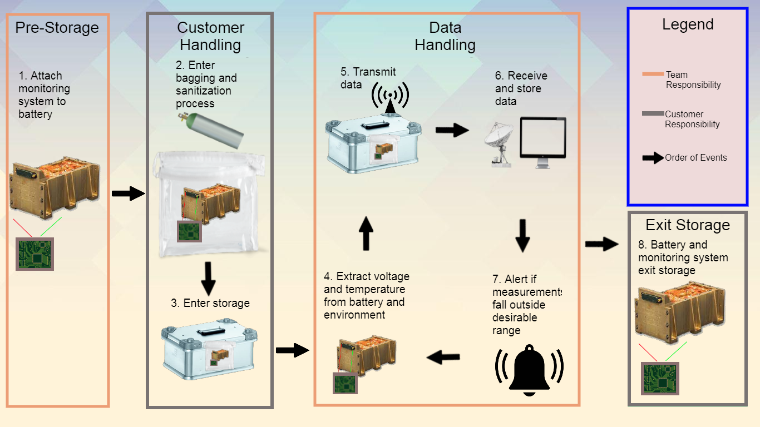
Concept of Operations (CONOPs)
Overview Schedule Test Readiness Budget References Backup

Slide 6
Key Levels of Success
Level 1 | Level 2 | Level 3
Wireless communication through air | Wireless communication through one aluminum box | Wireless communication through two aluminum boxes
Sense temperatures from 0-20^{O}C | Sense temperatures with accuracy of 0.15^{O}C
Sense voltages from 20-33.6V | Sense voltages with accuracy of 0.1V
Powered by an external battery | Battery life lasts for a year
Send raw sensor data to receiver | Send specific voltage and temperature values to receiver hourly | Transmission frequency is configurable
Overview Schedule Test Readiness Budget References Backup

Slide 7
System Critical Project Elements
CPE | Description | FR
CPE1 | System shall measure temperature and voltage. | FR1, FR2
CPE2 | System shall have the necessary hardware for wireless communication. | FR5
CPE3 | System shall have the necessary software for wireless communication. | FR3, FR5, FR7
CPE4 | All parts of system shall integrate with one another. | All FRs
CPE5 | System shall be battery-powered. | FR6
CPE6 | System shall be validated for functionality. | All FRs
Overview Schedule Test Readiness Budget References Backup

Slide 8
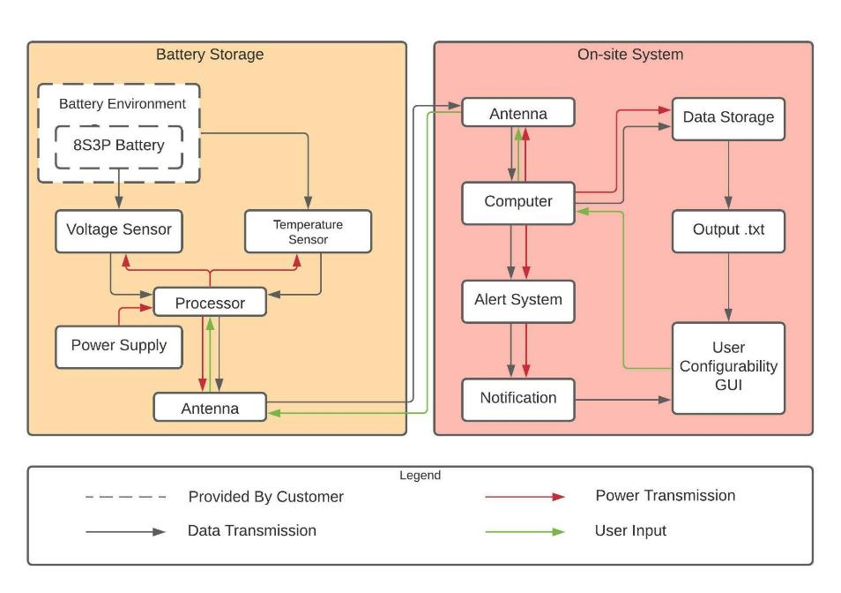
Functional Block Diagram (FBD)
Overview Schedule Test Readiness Budget References Backup

Slide 9
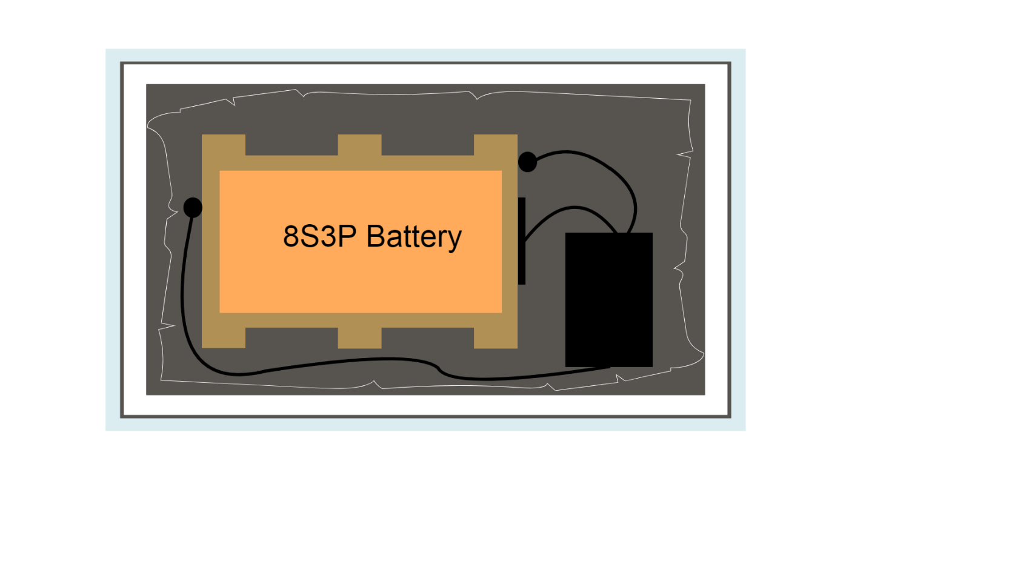
Baseline Design (Storage)
K470 Zarges Box
176 mm
96 mm
SMT172
25-pin D-sub connector
SMT172
Styrofoam Layer
Monitoring System
Heat/Vacuum Sealed Bag
Overview Schedule Test Readiness Budget References Backup

Slide 10
Baseline Design (Monitoring System)
Top-Down View
Bluetooth Low Energy
PCB with built-in voltage sensor and connections to 8S3P & SMT172 temp sensors
nrf52840
nrf52840
Side View
MiniBoost 5V
Custom
PCB
MakerFocus 10000 mAh Lithium Polymer Battery
MakerFocus 10000 mAh Lithium Polymer Battery
Overview Schedule Test Readiness Budget References Backup

Slide 11
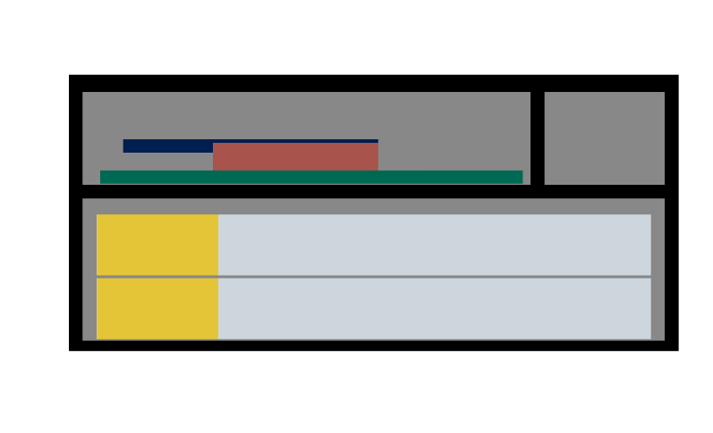
Baseline Design (Monitoring System)
Top-Down View
50.8 mm
46.04 mm
Side View
16.8 mm
110 mm
21.9 mm
50 mm
76.2 mm
15.24 mm
100 mm
11 mm
60 mm
110 mm
70 mm
Overview Schedule Test Readiness Budget References Backup

Slide 12
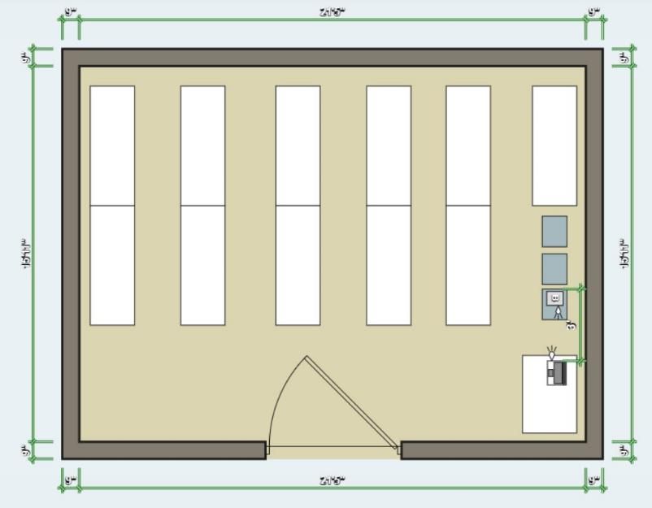
EnerSys Storage Schematic
On-site computer is 3-15 ft from the stored battery
Temperature conditions are ~58°F (15°C)
Secondary Nordic dongle plugged into customer computer
Overview Schedule Test Readiness Budget References Backup

Slide 13
Schedule

Slide 14
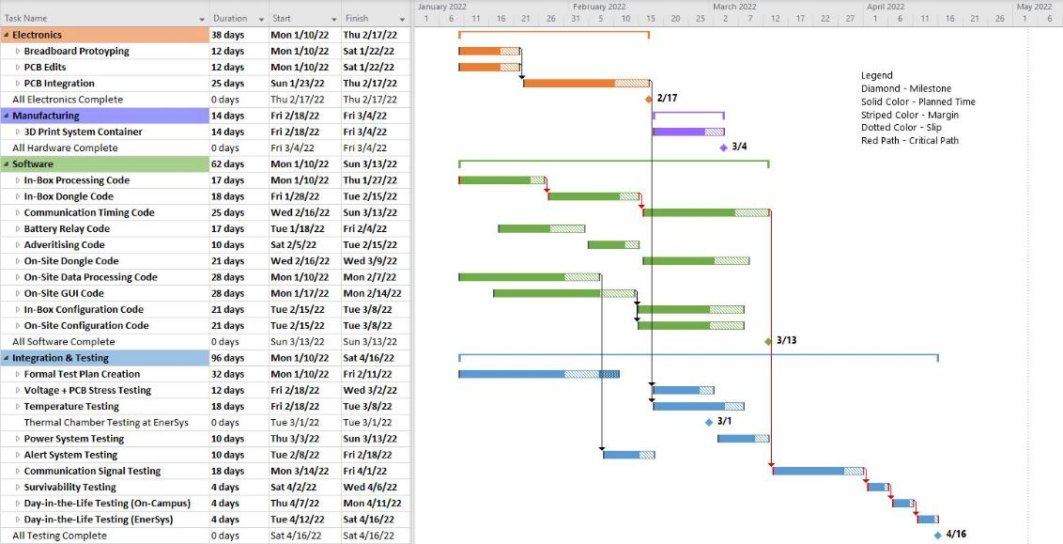
SBMS Spring Schedule
Overview Schedule Test Readiness Budget References Backup

Slide 15
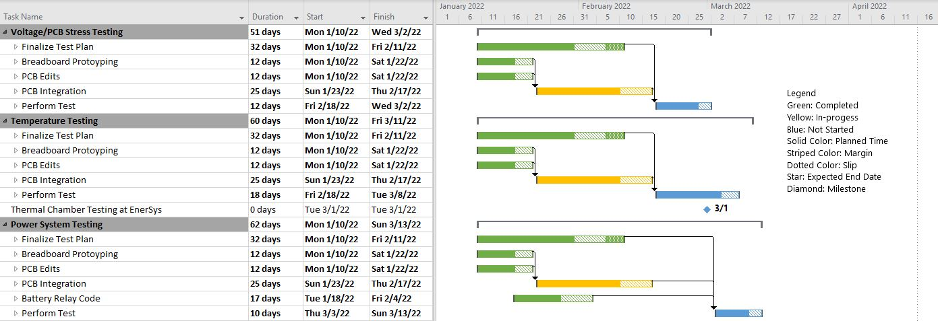
Electronics Test Schedule
3/2
3/4
3/10
Overview Schedule Test Readiness Budget References Backup

Slide 16
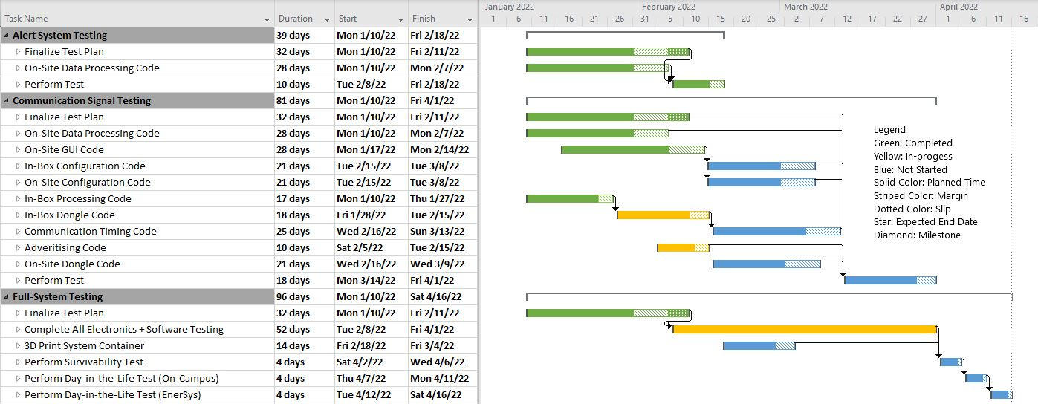
Software and Full-System Test Schedule
2/9
4/1
Overview Schedule Test Readiness Budget References Backup

Slide 17
Test Readiness

Slide 18
Project Testing Tasks
Test | Test Purpose | Related FRs | Status
Voltage/PCB Stress | Ensure that SBMS can measure voltage accurately and survive being turned on/off repeatedly | 1 | In-Progress
Temperature | Ensure that SBMS can measure temperature | 2 | In-Progress
Alert System | Ensure that SBMS can generate alerts when temperature and/or voltage reach an undesirable state | 3,7 | Complete
Survivability | Ensure that SBMS can survive the customer’s bagging process | 4 | In-Progress
Communication Signal | Ensure that system can wirelessly transmit + receive data, as well as change the frequency at which data is sent | 5,7 | In-Progress
Power System | Ensure the SBMS can operate on its external battery | 6 | In-Progress
Day-in-the-Life (CU) | Ensure that all subsystems can function as a cohesive unit | 1,2,3,4,5,6,7 | In-Progress
Day-in-the-Life (EnerSys) | Ensure that full system works as expected in the design environment | 1,2,3,4,5,6,7 | In-Progress
Overview Schedule Test Readiness Budget References Backup

Slide 19
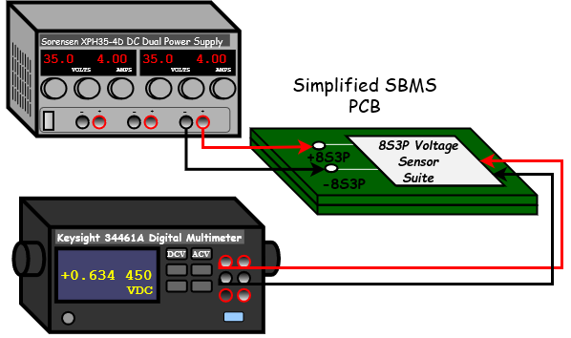
Voltage/PCB Stress Testing
In-Progress
Deadline: 3/2
DR 1.1: Voltage sensor shall have a range of at least 20-33.6V
DR 1.2: Voltage sensor shall have a sensitivity of at least 0.1V
CPE 1: System shall measure temperature and voltage
Test Rationale
Verify that voltage sensor measures in required range with required accuracy
Perform highly accelerated life test to demonstrate reliability of PCB and expose design weaknesses
Necessary Equipment and Facilities
Aerospace Electronics Lab
Sorensen XPH35-4D DC Dual Power Supply
Keysight 34461A Digital Multimeter
Test Fixture Design
Overview Schedule Test Readiness Budget References Backup

Slide 20
Voltage/PCB Stress Testing Continued
In-Progress
Deadline: 3/2
FR 1: System shall measure voltage
DR 1.1: Voltage sensor shall have a range of at least 20-33.6V
DR 1.2: Voltage sensor shall have a sensitivity of at least 0.1V
CPE 1: System shall measure temperature and voltage
Test Procedure Overview
Voltage Testing
Use power supply to simulate 8S3P voltage
Measure sensor voltage with desktop multimeter
Save voltage measured by the SBMS
Compare measurements over desired range
PCB Stress Testing (Highly Accelerated Life Test)^{[2,3]}
Cycle power to board 18000x
Each power cycle, test functionality of all peripherals
Failure indicated by peripherals becoming unresponsive, unexpected sensor readings, and overheating
Overview Schedule Test Readiness Budget References Backup

Slide 21
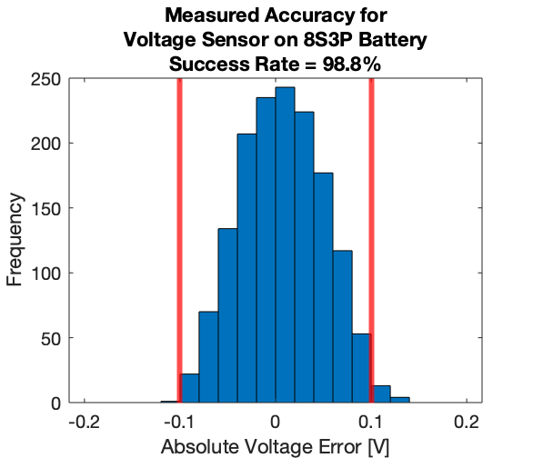
Voltage/PCB Stress Testing Continued
In-Progress
Deadline: 3/2
DR 1.1: Voltage sensor shall have a range of at least 20-33.6V
DR 1.2: Voltage sensor shall have a sensitivity of at least 0.1V
CPE 1: System shall measure temperature and voltage
Expected Results and Model Validation
System expected to measure voltage accurately, with breakdown at higher voltages
Will validate the 98.8% success rate predicted by the Monte Carlo simulation
Risk Reduction
Proves voltage sensor can meet DRs 1.1 & 1.2
Proves PCB can handle stress of mission duration
Eliminates risk that PCB will break or measure inaccurate voltages
Overview Schedule Test Readiness Budget References Backup

Slide 22
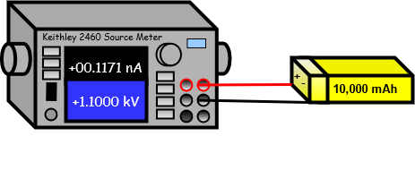
Power System Testing
In-Progress
Deadline: 3/13
DR 6.1: External battery shall operate for one year without charging
CPE 5: System shall be battery-powered
Test Rationale
Show battery capacity is as expected
Show current draw is as expected
Necessary Equipment and Facilities
Aerospace Electronics Lab
Ammeter - Keysight 34461A
1uA range, 1pA resolution^{[8]}
Sourcemeter - Keithley 2460
Current Draw:
Battery Capacity:
Test Fixture Designs
Overview Schedule Test Readiness Budget References Backup

Slide 23
Power System Testing Continued
In-Progress
Deadline: 3/13
DR 6.1: External battery shall operate for one year without charging
CPE 5: System shall be battery-powered
Test Procedure Overview
PCB Current Draw Testing
Connect ammeter between power supply and PCB
Run wake and sleep modes
Record current draws
Battery Capacity Testing
Connect battery to sourcemeter
Set current draw < C-rating
Allow to discharge
Extract CSV data from sourcemeter
Overview Schedule Test Readiness Budget References Backup

Slide 24
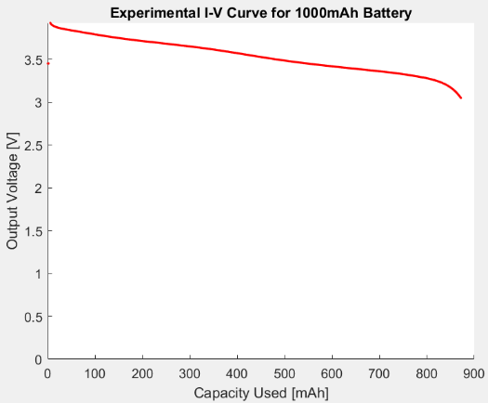
Power System Testing Continued
In-Progress
Deadline: 3/13
DR 6.1: External battery shall operate for one year without charging
CPE 5: System shall be battery-powered
Expected Results and Model Validation
6.5 mA wake
33 uA sleep
No DC/DC converter
= 1,240 mAh / year
8,000mAh before dropping below 3.0V
Data recorded by Sourcemeter
Risk Reduction
Device won’t turn off before mission complete
Capacity Used = Current Draw [mA] * Duration [hrs]
Overview Schedule Test Readiness Budget References Backup

Slide 25
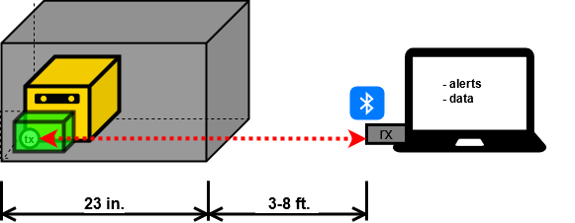
Communication Signal Testing
In-Progress
Deadline: 4/1
DR 5.4: System shall send signals through a K470 Universal Aluminum Box
DR 5.5: Data shall be transmitted over a distance of at least three feet
DR 7.2.1: System shall have a configurable transmission frequency option
CPE 2: System shall have the necessary hardware for wireless communication
CPE 3: System shall have the necessary software for wireless communication
Test Rationale: Verify that system can transceive given the required parameters
Zarges K470 Box
EnerSys 8S3P Battery
Controller
Controller
In-Box System
On-Site System
Overview Schedule Test Readiness Budget References Backup

Slide 26
Communication Signal Testing Continued
In-Progress
Deadline: 4/1
DR 5.4: System shall send signals through a K470 Universal Aluminum Box
DR 5.5: Data shall be transmitted over a distance of at least three feet
DR 7.2.1: System shall have a configurable transmission frequency option
CPE 2: System shall have the necessary hardware for wireless communication
CPE 3: System shall have the necessary software for wireless communication
Test Procedure Overview
Setup both systems and verify with LEDs
Send preset voltage and temperature values from In-Box to to On-Site system
Verify voltage/temperature values
Change frequency configuration and repeat steps above (verify that configuration change is correct)
Overview Schedule Test Readiness Budget References Backup

Slide 27
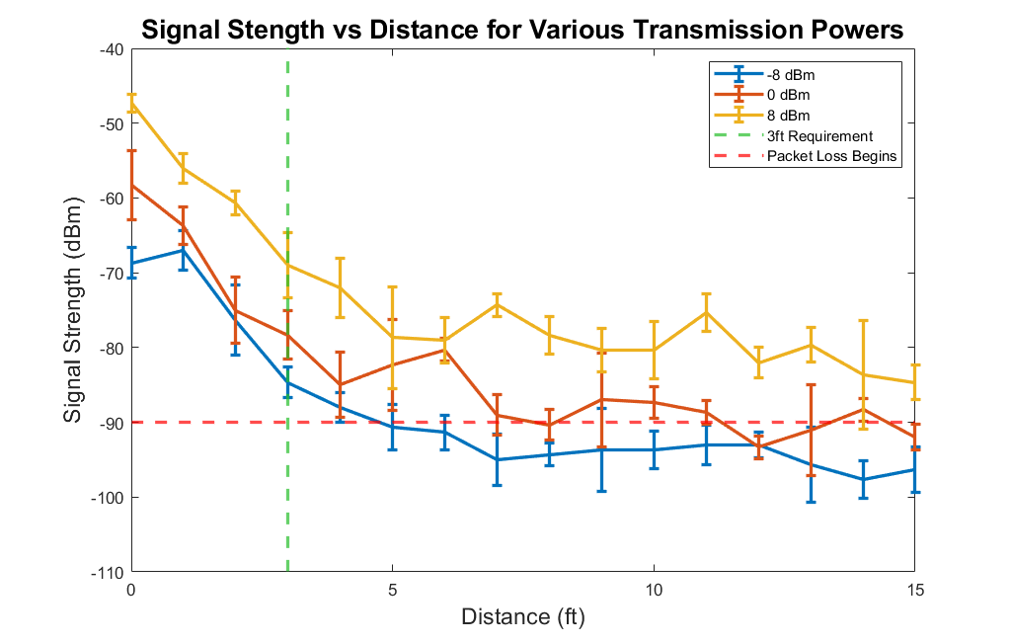
Communication Signal Testing Continued
In-Progress
Deadline: 4/1
DR 5.4: System shall send signals through a K470 Universal Aluminum Box
DR 5.5: Data shall be transmitted over a distance of at least three feet
DR 7.2.1: System shall have a configurable transmission frequency option
CPE 2: System shall have the necessary hardware for wireless communication
CPE 3: System shall have the necessary software for wireless communication
Expected Results/ Model Validation
System will wirelessly transmit and receive data correctly
System will correctly be configurable
Risk Reduction
Proves that system can send/receive communications through K470 Box
BLE functions with other peripherals running
Both systems can both send and receive
Overview Schedule Test Readiness Budget References Backup

Slide 28
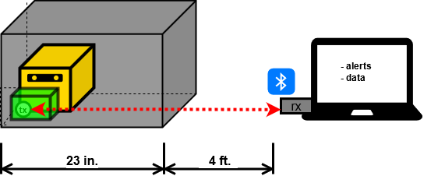
Day-in-the-Life at EnerSys
In-Progress
Deadline: 4/16
All FRs
All CPEs
Test Rationale
Validate that all system components are fulfilling customer requirements
Necessary Equipment and Facilities
EnerSys Cold Storage
8S3P battery
Zarges K470 box
Computer
Risk Reduction
System is autonomous
Expected Results
.txt file of data
Experimental Test Design
Overview Schedule Test Readiness Budget References Backup

Slide 29
Day-in-the-Life at EnerSys Continued
In-Progress
Deadline: 4/16
All FRs
All CPEs
Test Procedure Overview
Put in-box system and battery through a physical integrity test
Insert bagged system and battery into Zarges K470 box inside of foam casing
Leave system alone for 24 hours while it takes temperature and voltage measurements
System will send voltage and temperature measurements to on-site system in a .txt file
Overview Schedule Test Readiness Budget References Backup

Slide 30
Budget

Slide 31
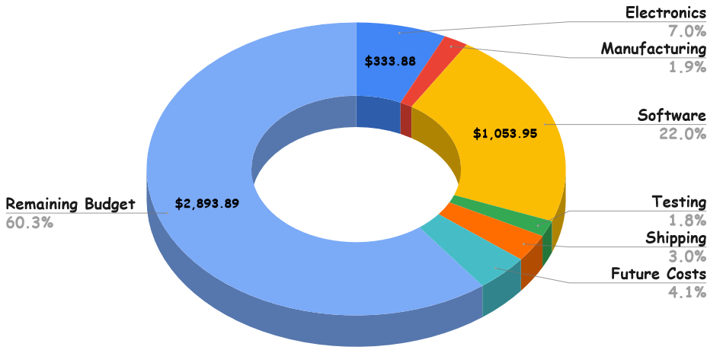
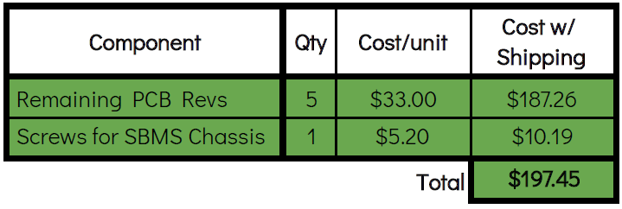
Cost Plan
 | CDR Estimate | Actual | Updated Estimate
Total Spent | $3,933.14 | $1908.66 | $2,106.11
Remainder | $1,066.86 | $3,091.34 | $2,893.89
$84.48
Future Expenses
$145.39
$197.45
Overview Schedule Test Readiness Budget References Backup

Slide 32
Acknowledgements
EnerSys ABSL Team
Jacqueline Maldonado, Brice Lucero, Travis Mault, Ryan Pritchard
Team Advisor
Dr. Jean Koster
Projects Advisory Board
Dr. Jelliffe Jackson, Dr. Jade Morton, Dr. Christopher Roseman,
Dr. Jean Koster, Dr. Melvin Rafi, Professor Matt Rhode
Additional Support
Professor Trudy Schwartz, Professor Bobby Hodgkinson,
Emma Markovich, Colin Claytor
Overview Schedule Test Readiness Budget References Backup

Slide 33
References
“SMT172 Datasheet,” Smartec, Last Updated March 20, 2017. Available: https://www.smartec-sensors.com/cms/media/Datasheets/Temperature/SMT172-datasheet.pdf
Peterson, Z. “Overview of Electrical Stress Test Methods for PCBAs,” Altium, Last Updated January 6 2022. Available: https://resources.altium.com/p/overview-electrical-stress-test-methods-pcbas
“HALT Testing: Highly Accelerated Life Testing,” Delserro Engineering Solutions. Available: https://www.desolutions.com/testing-services/reliability-tests/highly-accelerated-life-testing-halt/
“ERA3AEB113V,” Newark. Available: https://www.newark.com/panasonic-electronic-components/era3aeb113v/surface-mount-thin-film-resistor/dp/62W8736
“ERA-3AEB302V,” Mouser. Available: https://www.mouser.com/ProductDetail/Panasonic/ERA-3AEB302V?qs=%2Fha2pyFaduhb05ESoU1Edd%252B%252BYQj5NEVJ4yV8H3JHdTrOH%252BIkW8jYRA%3D%3D
“MCS0402MD1004BE000,” Digikey. Available: https://www.digikey.bg/en/products/detail/vishay-dale/MCS0402MD1004BE000/14324215
“RP73PF1E118KBTD,” Digikey. Available: https://www.digikey.com/en/products/detail/te-connectivity-passive-product/RP73PF1E118KBTD/8261060
“Digital Multimeters 34460A, 34461A, 34465A, 34470A,” Keysight. Available: https://www.keysight.com/zz/en/assets/7018-03846/data-sheets/5991-1983.pdf
“How do I calculate the accuracy of a multimeter?,” Keysight. Available: https://edadocs.software.keysight.com/kkbopen/how-do-i-calculate-the-accuracy-of-a-multimeter-577940567.html
“Sorensen XPH Series,” SignalTestInc. Available: http://www.signaltestinc.com/v/vspfiles/assets/datasheet/Sorensen_XPH_Datasheet.pdf
“Keithley 2460 - SMU Source Meter (100V, 7A, 100W),” Tequipment. Available: https://www.tequipment.net/Keithley/2460/Source-Measure-Unit/SMU/?gclid=Cj0KCQiAr5iQBhCsARIsAPcwROMDU8VrN-KGo1gyjo0cOUJ-vs6973bQGY2TBfrGFfXZKLKNpRh4ugEaAr94EALw_wcB
“LTC2063” Analog Devices. Available: https://www.analog.com/en/products/ltc2063.html#product-overview
“onsemi FDV303N,” LCSC Electronics. Available: https://lcsc.com/product-detail/MOSFETs_onsemi-FDV303N_C80498.html
“nRF52840,” Nordic Semiconductors. Available: https://www.nordicsemi.com/-/media/Software-and-other-downloads/Product-Briefs/old-versions/nRF52840PBv20.pdf?la=en&hash=516968A8D06D7F41C8B14B6639DD9E14099E2853
Overview Schedule Test Readiness Budget References Backup

Slide 34
Thank You!
Questions?

Slide 35
Backup Slides

Slide 36
Contents
Overview
Organizational Chart
Work Breakdown Structure
Requirements
Levels of Success
Test Readiness
Temperature Testing
Alert System Testing
Survivability Testing
Day-in-the-Life Testing (CU Boulder)
Voltage Sensor Testing
Error Model Background
PCB Layout and Test Sites
Test Equipment
Test Failure Approaches
Test Readiness (Continued)
Power Testing
Current Draw Model Background
Battery Capacity Experimental Model Background
COTS Battery Choice
Test Equipment
Test Failure Approach
Communication Signal Testing
Experimental Model Background
Test Failure Approach
Budget
Detailed Plan
Overview Schedule Test Readiness Budget References Backup

Slide 37
SBMS Organizational Chart
Advisor
Dr. Jean Koster
Project Manager
Jamie Henault
Finance Lead
Richard Folsom
Customer
EnerSys ABSL
Systems Engineer Lead
Nathan Zhao
Power Lead
Ian Adler
Data Processing Lead
Joseph Harrell
Communications Lead
Evan Meany
Testing Lead
Devin Geegan
Electronics + Hardware Lead
Ben Gavin
Commands Lead
Shreeyash Nadella
Subteam
Nathan Zhao
Ben Gavin
Richard Folsom
Joseph Harrell
Subteam
Nathan Zhao
Ben Gavin
Devin Geegan
Evan Meany
Subteam
Nathan Zhao
Shreeyash Nadella
Joseph Harrell
Subteam
Jamie Henault
Richard Folsom
Subteam
Ian Adler
Jamie Henault
Richard Folsom
Shreeyash Nadella
Subteam
Nathan Zhao
Ian Adler
Joseph Harrell
Evan Meany
Back
Overview Schedule Test Readiness Budget References Backup

Slide 38
Work Breakdown Structure (WBS)
SBMS
Project Management
Software
Electronics & Hardware
Testing
Fall Final Report
In-Box Processing
Custom PCB+Attachments
Voltage
Test Readiness Review
In-Box Dongle
In-Box System Container
Temperature
AIAA Conference Paper
In-Box Configuration
On-Site Dongle
Power
Spring Final Review
On-Site Data Processing
Alerts
Project Final Report
On-Site Dongle
Communication Signal
On-Site Configuration
Survivability
On-Site GUI
Day-in-the-life (On-Campus)
Communication Timing
Day-in-the-life (EnerSys)
Advertising
Battery Relay
Back
Overview Schedule Test Readiness Budget References Backup

Slide 39
Requirements
Back
FR | DR | Requirement
1 |  | System shall measure voltage
 | 1.1 | Voltage sensor shall have a range of at least 20-33.6V
 | 1.2 | Voltage sensor shall have a sensitivity of 0.1V
 | 1.3 | Voltage sensor shall connect to the customer’s 8S3P battery
 | 1.4 | Voltage sensor shall measure DC voltage
2 |  | System shall measure temperature
 | 2.1 | Temperature sensor shall have a range of at least 0-20ºC
 | 2.2 | Temperature sensor shall have a sensitivity of 0.15ºC
 | 2.3 | Temperature sensor shall measure the temperature of the battery environment
Overview Schedule Test Readiness Budget References Backup

Slide 40
Requirements Continued
Back
FR | DR | Requirement
3 |  | System shall communicate when voltage and temperature reach an undesirable state
 | 3.1 | Alert shall be generated when voltage exceeds 33.6V
 | 3.2 | Alert shall be generated when voltage drops below 20V
 | 3.3 | Alert shall be generated when temperature exceeds 20ºC
 | 3.4 | Alert shall be generated when temperature drops below 0ºC
4 |  | System shall continue operation after sanitization & bagging process performed by customer
 | 4.1 | System shall survive dry nitrogen purging at room temperature and a pressure of 2psi
 | 4.2 | System shall remain intact during vacuum and heat sealing process
5 |  | System shall transmit and receive data wirelessly
Overview Schedule Test Readiness Budget References Backup

Slide 41
Requirements Continued
Back
FR | DR | Requirement
 | 5.1 | Data communication process shall be autonomous
 | 5.2 | System shall send/receive voltage measurements to on-site system wirelessly
 | 5.3 | System shall send/receive temperature measurements to on-site system wirelessly
 | 5.4 | System shall send signals through the K470 Universal Aluminum Box (provided by the customer) that the battery is stored in
 | 5.4.1 | System shall send signals through a secondary K470 Universal Aluminum Box next to the one it is being stored in
 | 5.5 | Data shall be transmitted over a distance of at least three feet
6 |  | System shall be battery-powered
 | 6.1 | External battery shall operate for one year without charging
Overview Schedule Test Readiness Budget References Backup

Slide 42
Back
Requirements Continued
FR | DR | Requirement
 | 6.2 | External battery shall draw negligible charge from stored battery
7 |  | System shall save received data with a timestamp
 | 7.1 | System shall save raw data
 | 7.1.1 | System shall save specific voltage and temperature values, so long as requirement 7.1 is met
 | 7.2 | Data shall be sent once an hour by default configuration
 | 7.2.1 | System shall have a configurable transmission frequency option
 | 7.2.1.1 | A user interface shall be made to input configuration changes
 | 7.3 | Data shall be presented in a .txt file
Overview Schedule Test Readiness Budget References Backup

Slide 43
Detailed Levels of Success
Back
Level 1 | Level 2 | Level 3
Wireless communication through air | Wireless communication through one aluminum box | Wireless communication through two aluminum boxes
Sense temperatures from 0-20^{O}C | Sense temperatures with accuracy of 0.15^{O}C
Sense voltages from 20-33.6V | Sense voltages with accuracy of 0.1V
Powered by an external battery | Battery life lasts for a year
System interfaces with customer battery
Send raw sensor data to receiver | Send specific voltage and temperature values to receiver hourly | Transmission frequency is configurable
Data is saved to a .txt file with a timestamp |  | Data is presented in a GUI
Alert generated to indicate poor battery health | Alerts autonomously emailed to customer
Overview Schedule Test Readiness Budget References Backup

Slide 44
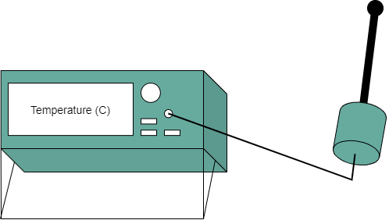
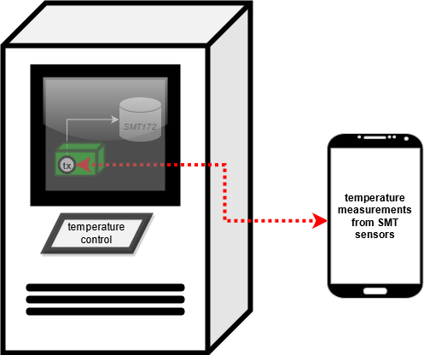
Test Readiness: Temperature Testing
In-Progress
Deadline: 3/8
DR 2.1: Temperature sensor shall have a range of at least 0-20ºC
DR 2.2: Temperature sensor shall have a sensitivity of 0.15ºC
CPE 1: System shall measure temperature and voltage
Test Rationale
Verify that temperature sensor can measure in required range with required accuracy
Necessary Equipment & Facilities:
Sensor integrated into harness
PCB populated with temp sensing peripherals
Processor w/ headers
F150 Precision Thermometer
EnerSys ABSL Thermal Chamber
Back
Overview Schedule Test Readiness Budget References Backup

Slide 45
Test Readiness: Temperature Testing Continued
Test Readiness: Temperature Testing
In-Progress
Deadline: 3/8
DR 2.1: Temperature sensor shall have a range of at least 0-20ºC
DR 2.2: Temperature sensor shall have a sensitivity of 0.15ºC
CPE 1: System shall measure temperature and voltage
Test Procedure Overview (Range)
Configure dongle to continuously measure and transmit temperature before placing SBMS in temperature chamber
Increase chamber temperature from 0-20°C by 1°C every 5 minutes
Record temperature throughout test to ensure that SBMS can measure within the required range
Test Procedure Overview (Accuracy)
Record the temperature of the electronics lab with the F150 Precision Thermometer
Transmit and save the temperature measured by the processor attached to the team temperature sensor
Record this value and ensure that it is within 0.15ºC of the first measurement
Repeat this process two more times in the senior projects room and the PILOT lab to ensure that when the temperature changes, the system can still give the necessary accuracy
Back
Overview Schedule Test Readiness Budget References Backup

Slide 46
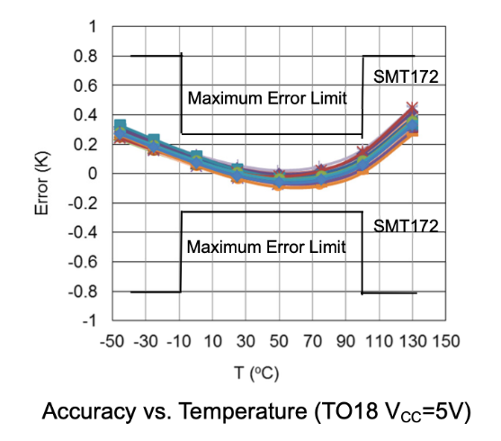
Test Readiness: Temperature Testing Continued
In-Progress
Deadline: 3/8
DR 2.1: Temperature sensor shall have a range of at least 0-20ºC
DR 2.2: Temperature sensor shall have a sensitivity of 0.15ºC
CPE 1: System shall measure temperature and voltage
Expected Results and Model Validation
Both sensors report temperature within 0.15°C of each other after reaching steady state in each environment
Sensor performance guaranteed by manufacturer
Risk Reduction
To satisfy FR2, temperature sensing range & accuracy must be characterized - test will reduce risk associated with satisfying FR2 by assessing both metrics
Temperature Error Chart From Manufacturer^{[1]}:
Back
Overview Schedule Test Readiness Budget References Backup

Slide 47
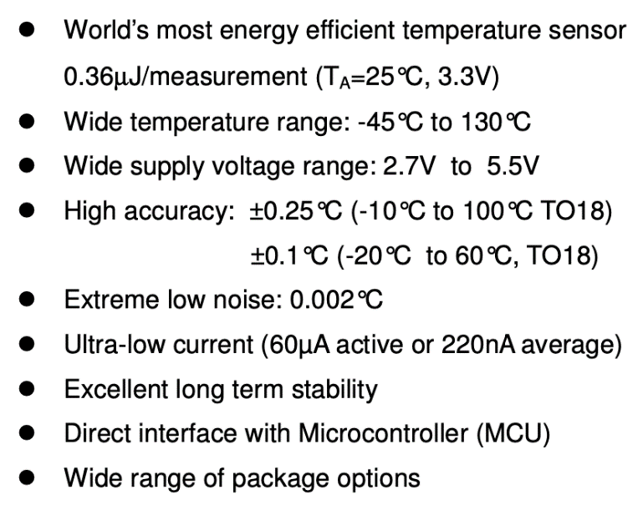
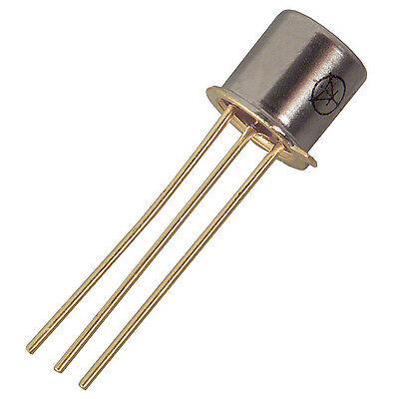
Test Readiness: Smartec SMT172^{[1]} - Chosen Temperature Sensor
Back
Overview Schedule Test Readiness Budget References Backup

Slide 48
Test Readiness: Temperature Sensor Configuration
SMT172
V
GND
DATA
Heat Shrink Tubing
200 mm
S
MOSFET
D
G
VDD
GPIO
GND
GPIO
Processor
Circuit Board
Back
Overview Schedule Test Readiness Budget References Backup

Slide 49
Test Readiness: Approach to a Failed Temperature Sensor Test
Bias in sensor readings will be calibrated for with adjustments to the conversion equation provided by the manufacturer.
Non-linearities over the desired range will be smoothed out with adjustments to the equation mentioned above.
Undesirable noise will be eliminated by increasing the number of signal periods from which a single value is averaged.
Back
Overview Schedule Test Readiness Budget References Backup

Slide 50
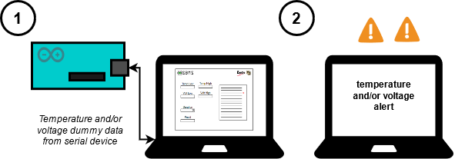
Test Readiness: Alert System and Data Logging
Complete
Deadline: 2/18
FR 3: System shall communicate when voltage and/or temperature reach an undesirable state
FR 7: System shall save received data with a timestamp
CPE 3: System shall have the necessary software for wireless communication
Test Rationale
Verify that alerts shall be generated when temperature (DR 3.1,3.2) and voltage (DR 3.3,3.4) fall out of acceptable range
Verify that data shall be saved in a text file format (DR 7.1,7.1.1,7.3)
Test Equipment
Computer
Arduino Uno
Back
Overview Schedule Test Readiness Budget References Backup

Slide 51
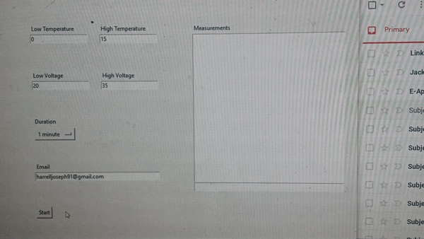
Test Readiness: Alert System and Data Logging
Complete
Deadline: 2/18
FR 3: System shall communicate when voltage and/or temperature reach an undesirable state
FR 7: System shall save received data with a timestamp
CPE 3: System shall have the necessary software for wireless communication
Test Procedure
Program arduino to communicate selected data
Input email address that will receive alert
Input lower/upper bounds for both values
First where data is within bounds to ensure no alert is generated
Second where data is not within bounds
Verify that designated email address has received the alert
Verify that data is saved
Back
Overview Schedule Test Readiness Budget References Backup

Slide 52
Test Readiness: Alert System and Data Logging
Complete
Deadline: 2/18
FR 3: System shall communicate when voltage and/or temperature reach an undesirable state
FR 7: System shall save received data with a timestamp
CPE 3: System shall have the necessary software for wireless communication
Expected Results and Model Validation
The SBMS will be able to generate alerts for both an undesired temperature and voltage state
Undesired states will be input through the SBMS GUI system
Data will be saved
GUI layout will match design presented at CDR
Risk Reduction
Proves alert system will satisfy FR 3 and its associated DRs
Ensure SBMS’ email address privacy has optimal settings
Data is not lost
Temp Low
Temp High
Volt Low
Volt High
Duration
Email
Back
Overview Schedule Test Readiness Budget References Backup

Slide 53
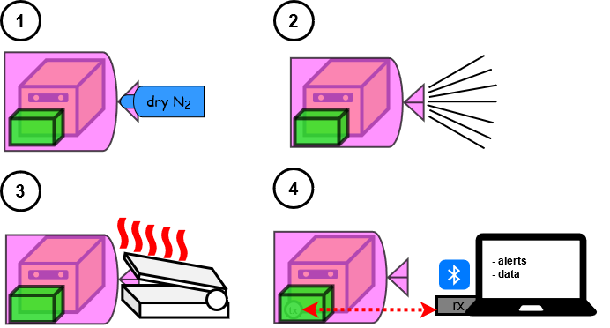
Test Readiness: Survivability Testing
In-Progress
Deadline: 4/6
FR 4: System shall continue operation after sanitization and bagging process performed by the customer
CPE 6: System shall be validated for functionality
Test Rationale
System will undergo sanitization and bagging process during its mission
Must ensure functionality remains after dry nitrogen purging and heat seal
Necessary Equipment and Facilities
ESD compliant plastic bag
Vacuum/heat sealer
Dry nitrogen canister
Test Fixture Design
Back
Overview Schedule Test Readiness Budget References Backup

Slide 54
Test Readiness: Survivability Testing Continued
In-Progress
Deadline: 4/6
FR 4: System shall continue operation after sanitization and bagging process performed by the customer
CPE 6: System shall be validated for functionality
Test Procedure Overview
Ensure functionality prior to test
Capable of sensing data
Capable of wirelessly sending data
Place monitoring system attached to a battery inside plastic bag
Purge system with dry nitrogen to remove moisture
Vacuum seal the bag to remove excess air and dust
Heat seal the bag shut to keep the environment secluded
Monitor computer to ensure data is still being transmitted
Back
Overview Schedule Test Readiness Budget References Backup

Slide 55
Test Readiness: Survivability Testing Continued
In-Progress
Deadline: 4/6
FR 4: System shall continue operation after sanitization and bagging process performed by the customer
CPE 6: System shall be validated for functionality
Expected Results and Model Validation
System will continue operation
Risk Reduction
Ensures system will be able to survive in the expected environment
Reduces concern of manufacturing failure
Back
Overview Schedule Test Readiness Budget References Backup

Slide 56
Test Readiness: Approach to a Failed Survivability Test
Structural Failure
If the housing unit cannot withstand the vacuum sealing pressure, the team will revisit the CAD model to thicken the width of the unit
If the housing unit cannot withstand the heat sealing process, an alternative material will be used
Functionality Failure
If the electronics do not maintain functionality, the team can look into an extra insulation layer underneath the housing unit
Back
Overview Schedule Test Readiness Budget References Backup

Slide 57
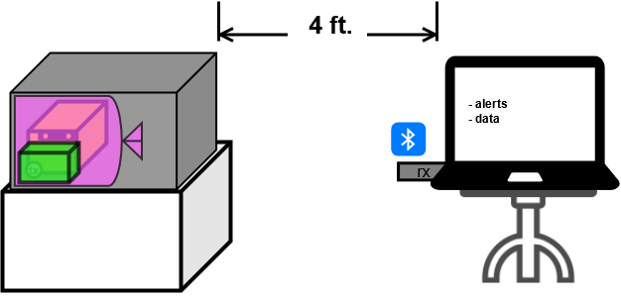
Test Readiness: Day-in-the-Life Testing at CU Boulder
In-Progress
Deadline: 4/11
All FRs
All CPEs
Same test setup and procedure as Day-in-the-Life at EnerSys, except not in cold storage
System will also be monitored every 3 hours during testing
Expected Results
.txt file containing data
Test Rationale
System will operate autonomously
Monitoring will allow the team to find any issues when running for an extended period
Back
Overview Schedule Test Readiness Budget References Backup

Slide 58
Test Readiness: Approach to a Failed Day-in-the-Life Test
This is for both the CU and EnerSys located tests
Functionality Failure
If the in-box system is not able to establish communication with the on-site system
Zarges K470 box will be removed
In-box system will still undergo bagging process but will be placed in the foam casing with no Zarges K470 box around it
This will eliminate the interference caused by the metal lining on the Zarges K470 box
With significantly less interference, the in-box system should be able to establish communication with the on-site system
Back
Overview Schedule Test Readiness Budget References Backup

Slide 59
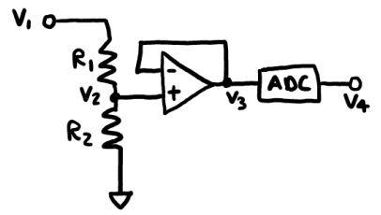
Test Readiness: Voltage Sensor Error Model Setup
DR 2.1 | Voltage sensor shall have a sensitivity of 0.1V
8S3P^{[6][7]}
R₁ = 1MΩ
R₂ = 118kΩ
V_{max(1)} = 50V
V_{max(2)} = 200V
P_{max(1,2)} = 0.1W
External Battery^{[4][5]}
R₁ = 11kΩ
R₂ = 3kΩ
V_{max(1,2)} = 75V
P_{max(1,2)} = 0.1W
Back
Overview Schedule Test Readiness Budget References Backup

Slide 60
Test Readiness: Voltage Sensor Error Model Calculations
Actual Voltage (V₁)
Random value from 20 to 33.6V
Expected Resistances
R_{1,exp}= 1MΩ
R_{2,exp}= 118kΩ
Expected Intermediate Voltage (V_{2,exp})
V_{2,exp} = (R_{2,exp}*V₁) / (R_{1,exp} + R_{2,exp})
Resistor Tolerances (R_{1,tol}, R_{2,tol})
Random values from -1% to +1%
Actual Resistances (R_{1,act}, R_{2,act})
R_{1,act} = R_{1,exp} + R_{1,exp} * R_{1,tol}
R_{2,act} = R_{2,exp} + R_{2,exp} * R_{2,tol}
Actual Intermediate Voltage (V_{2,act})
V_{2,act} = (R_{2,act}*V₁) / (R_{1,act} + R_{2,act})
Op-amp Error (V_{op,err})
Random value from -5μV to +5μV
Actual Intermediate Voltage (V_{3,act})
V_{3,act} = V_{2,act} + V_{op,err}
Back
Overview Schedule Test Readiness Budget References Backup

Slide 61
Test Readiness: Voltage Sensor Error Model Calculations Continued
ADC Differential Nonlinearity Error (E_{D})
Random Value from -0.95 to +1.3
ADC Integral Nonlinearity Error (E_{I})
Random Value from -10 to +10
ADC Gain Error (E_{G})
Random Value from -0.03 to +0.03
ADC Total Error (E_{ADC})
E_{ADC} = (E_{D} + E_{I} + E_{G} + 1)*V_{3,act} / 2¹²
Actual Final Voltage (V_{4,act})
V_{4,act} = V_{3,act} + E_{ADC}
Absolute Voltage Error (V_{E})
V_{E} = V_{4,act} - V_{2,exp}
Absolute Voltage Error Scaled Back up to Input Voltage Range (V_{E,scaled})
V_{E,scaled} = (R_{1,exp} + R_{2,exp})*(V_{E} / R_{2,exp})
Back
Overview Schedule Test Readiness Budget References Backup

Slide 62
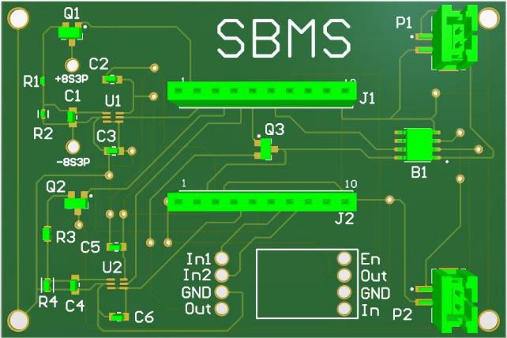
Test Readiness: PCB Layout
Dongle Connector
Battery Switch
8S3P Customer Battery Voltage Sensor
External Battery Connectors
External Battery Voltage Sensor
Temperature Processing
Power Converter
Back
Overview Schedule Test Readiness Budget References Backup

Slide 63
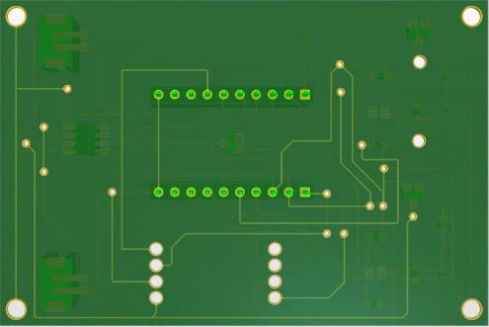
Test Readiness: PCB Voltage and Stress Test Attachments
To (+) input on power supply
To (+) input on multimeter
To (-) input on power supply
To (-) input on multimeter
Back
Overview Schedule Test Readiness Budget References Backup

Slide 64
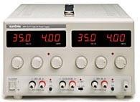
Test Readiness: Sorensen XPH35-4D DC Dual Power Supply^{[10]}
Back
Overview Schedule Test Readiness Budget References Backup

Slide 65
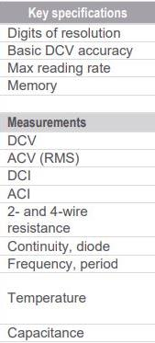
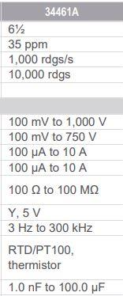
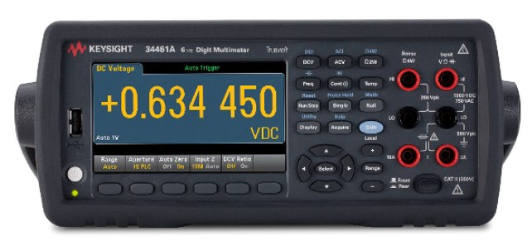
Test Readiness: Keysight 34461A Digital Multimeter^{[8,9]}
Voltage Accuracy Note
35ppm of 20V is 20*35*(1/1,000,000) = 0.0007V
35ppm of 33.6V is 33.6*35*(1/1,000,000) =0.001176V
Expected accuracy of multimeter in SBMS’ voltage range is 0.001176 - 0.0007V which is << 0.1V, so the multimeter reading can be taken as the “true” value
Back
Overview Schedule Test Readiness Budget References Backup

Slide 66
Test Readiness: Approach to a Failed Voltage Test
Accuracy Failure
Small failure (~0.2V achieved instead of 0.1)
Talk with the customer about changing the requirement. Couldn’t reach temperature accuracy of 0.1ºC due to resolution, and the customer was happy to let us change this to 0.15ºC, so we would aim for this same small change in voltage
Large failure (>0.2V achieved)
Do some circuit debugging to see where accuracy issues are coming from (i.e. op-amp, voltage divider, etc.) and possibly change these components / associated trace length on PCB for increased accuracy
Range Failure
High-side failure
Look into components that can handle higher voltages/power to avoid component breakdown
Low-side failure
Look into components that can handle a smaller resolution
Back
Overview Schedule Test Readiness Budget References Backup

Slide 67
Test Readiness: Approach to a Failed PCB Stress Test
PCB Stress Failure
If shorts, burns, or component failures are seen, our team may increase the width of traces or add a ground plane to ensure that there isn’t too much resistance in any line or heat generation along the board
May need to add more capacitors to help manage the power being repeatedly applied to the board
Back
Overview Schedule Test Readiness Budget References Backup

Slide 68
Test Readiness: Power System Current Draw Model
Back
 | Current [mA] | Sources or Justification
Voltage Sensor + Peripherals | 0.010 (on) 0.003 (off) | LTC2063^{[12]} & FDV303N^{[13]} Datasheets
Temp. Sensor + Peripherals | 0.120 (on) 0.002 (off) | SMT172 Datasheet Active Draw^{[1]}
Board - Wake | 6.400 | Nordic Semiconductors Datasheet, pg 62
Board - Sleep | 0.00084 | Nordic Semiconductors Datasheet, pg 59
Total - Wake | 6.530 | Calculated
Total - Sleep | 0.123 | Calculated
Required Yearly Supply | 1,240 mAh | Calculated:
Overview Schedule Test Readiness Budget References Backup

Slide 69
Test Readiness: Power System Current Draw Model Continued
Back
 | Loss | Multiplier | Battery Size Required [mAh] | Sources or Justification
Required Supply | - | - | 1,240 | Prev. Slide
Low-Temp | 0% | 1 | 1,240 | Storage temp (58ºF) is not cold enough to affect capacity
Temporal | 60% | 2.5 | 3,100 | ~5% loss in capacity per month
Discharge | 20% | 1.25 | 3,875 | ~80% of rated capacity is usable; Experimental validation
Converter | 20% | 1.25 | 4,844 | Boost 3.7V -> 5V Buck 5V -> 3.3V
FOS | - | 2 | 9,688 | -
Desired Size: | - | - | 10,000 mAh | -
Selected Battery: MakerFocus 10,000 mAh Lithium Polymer Battery
Overview Schedule Test Readiness Budget References Backup

Slide 70
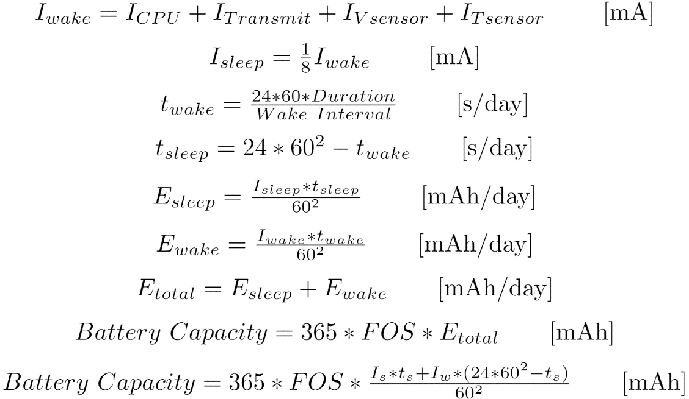
Test Readiness: Power System Current Draw Model (Derivation)
Back
Overview Schedule Test Readiness Budget References Backup

Slide 71
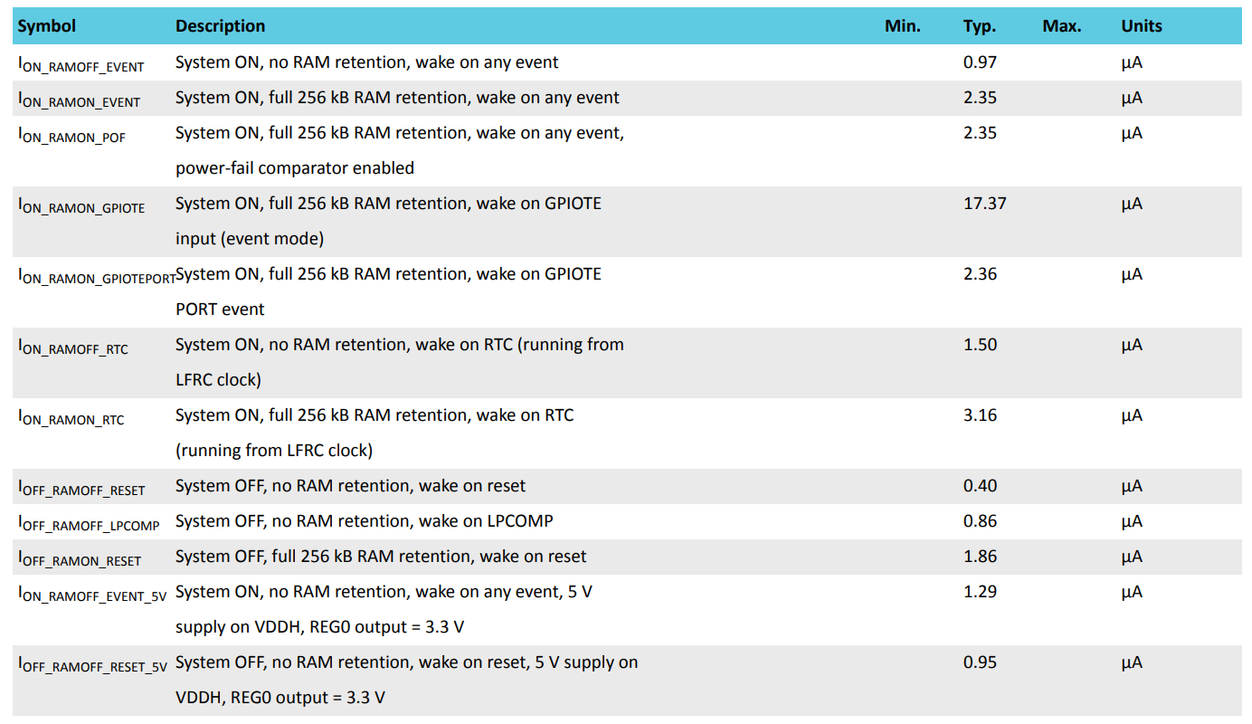
Test Readiness: Power System Current Draw Model (Detailed Current Draw Estimates)
Back
Overview Schedule Test Readiness Budget References Backup

Slide 72
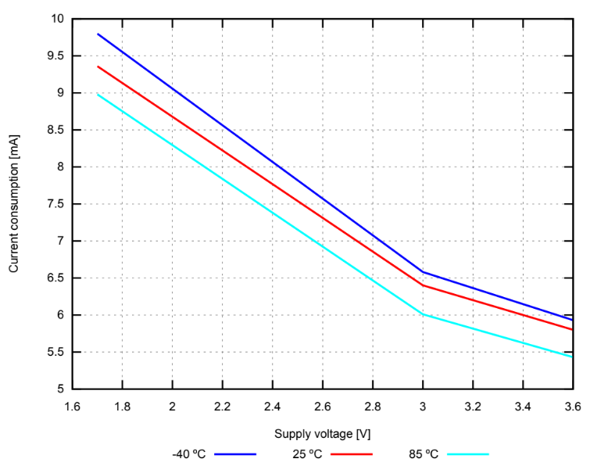
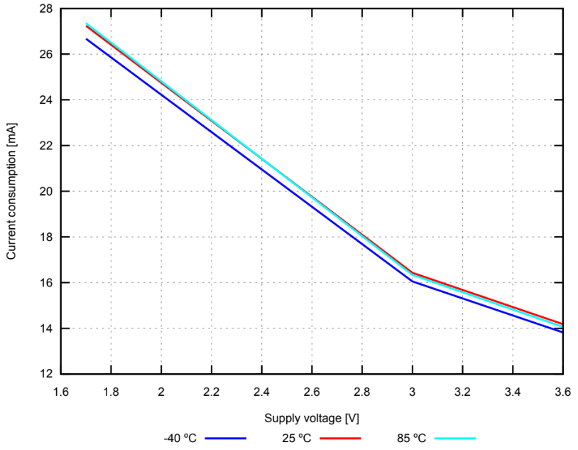
Test Readiness: Power System Current Draw Model (Detailed Current Draw Estimates)
Back
Overview Schedule Test Readiness Budget References Backup

Slide 73
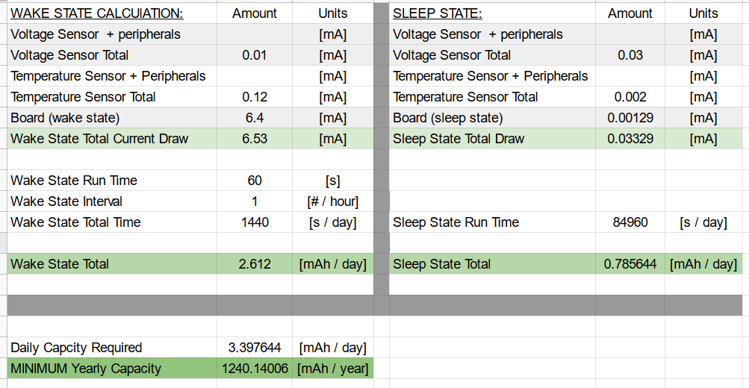
Test Readiness: Power System Current Draw Model (Detailed Current Draw Estimates)
Back
Overview Schedule Test Readiness Budget References Backup

Slide 74
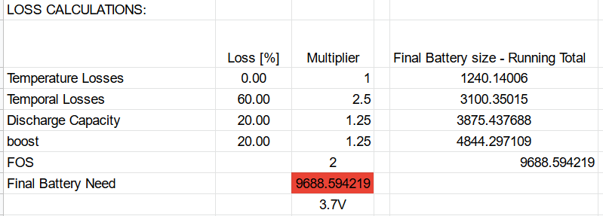
Test Readiness: Power System Current Draw Model (Detailed Current Loss Estimates)
Back
Overview Schedule Test Readiness Budget References Backup

Slide 75
Test Readiness: Power System Current Draw Model (COTS Battery Choice)
Back
 | Battery #1 (LiPo) | Battery #2 (LiPo) | Battery #3 (Li-ion) | Battery #4 (Li-ion)
Cell Capacity [mAh] | 3,700mAh | 10,000mAh | 2000mAh | 3000mAh
Dimensions [in] | 1.3 x 3.8 x 0.4 | 4.4 x 2.6 x 0.3 | 1.34 x 0.63d | 2.8 x 0.7d
Energy [mAh / in³] Density | 1,872 | 2,900 | 1,188 | 728
Meets Requirements (Temp, Size, C rate) | ✔️ | ✔️ | ✔️ | ✔️
Available From | Amazon | Makerfocus, Amazon | Amazon | Amazon
Cost per unit | $61 / (4 pc) | $30 / (1 pc) | $30 / (4 pc) | $34 / (2 pc)
Total Purchase Cost (1 full system) | $122 | $60 | $60 | $136
Overview Schedule Test Readiness Budget References Backup

Slide 76
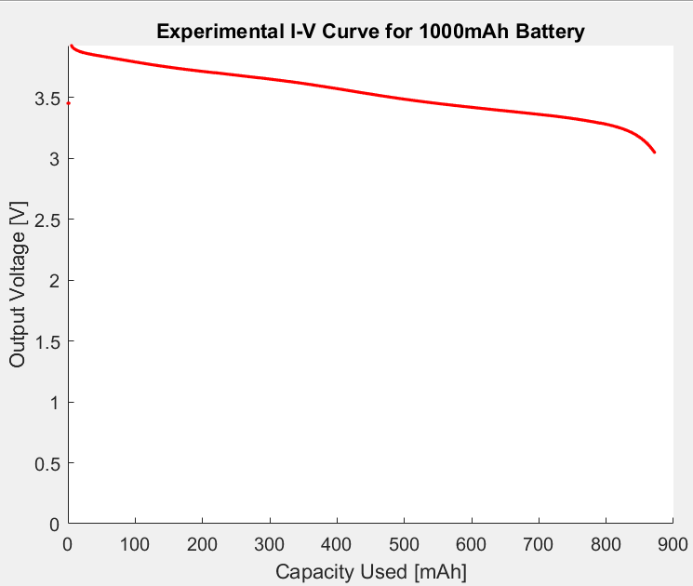
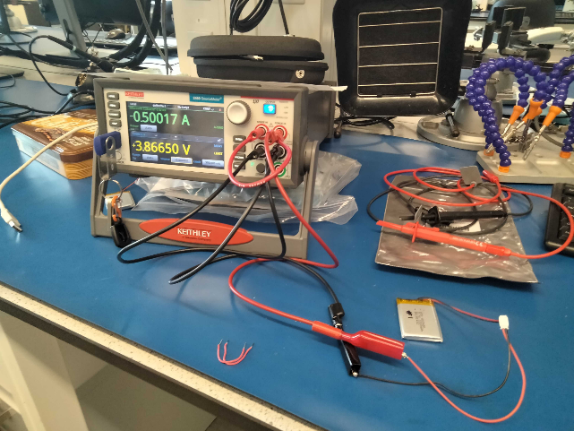
Test Readiness: Power System Battery Capacity Experimental Model
Keithley 2460 Sourcemeter
1000mAh Battery
Back
Overview Schedule Test Readiness Budget References Backup

Slide 77
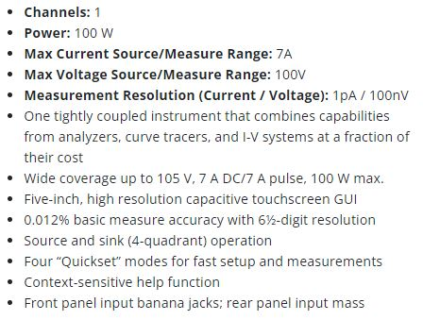
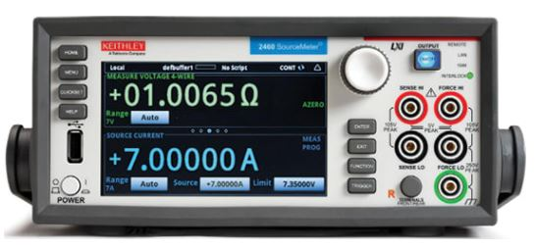
Test Readiness: Keithley 2460 SMU Sourcemeter^{[11]}
Back
Overview Schedule Test Readiness Budget References Backup

Slide 78
Test Readiness: Approach to a Failed Power System Test
Battery Failure
If battery capacity is less than desired, our team can connect batteries in parallel to increase capacity to acceptable values
If battery is defective, our team will test the other batteries in the batch, and if necessary purchase a different brand of battery
Current Draw Failure
If current draw is higher than expected, there are at least two options:
Diagnose the electrical issue and make appropriate changes
Connect more batteries in parallel, increasing capacity to meet the need
Back
Overview Schedule Test Readiness Budget References Backup

Slide 79
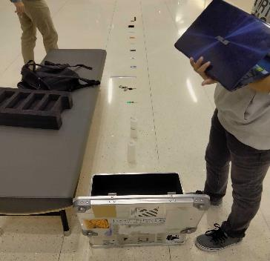
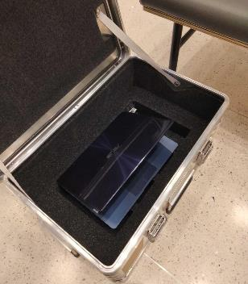
Test Readiness: Communication Signal Experimental Model
Flashed code to advertise out of ZARGES case
Tested the signal strength at different distances and transmission strengths
Back
Overview Schedule Test Readiness Budget References Backup

Slide 80
Test Readiness: Approach to a Failed Communication Signal Test
Signal Strength Failure
If signal is not strong enough to go through the Zarges case, our team will increase the transmission power until it is able to do so - we will revisit battery capacity if this issue occurs
Back
Overview Schedule Test Readiness Budget References Backup

Slide 81
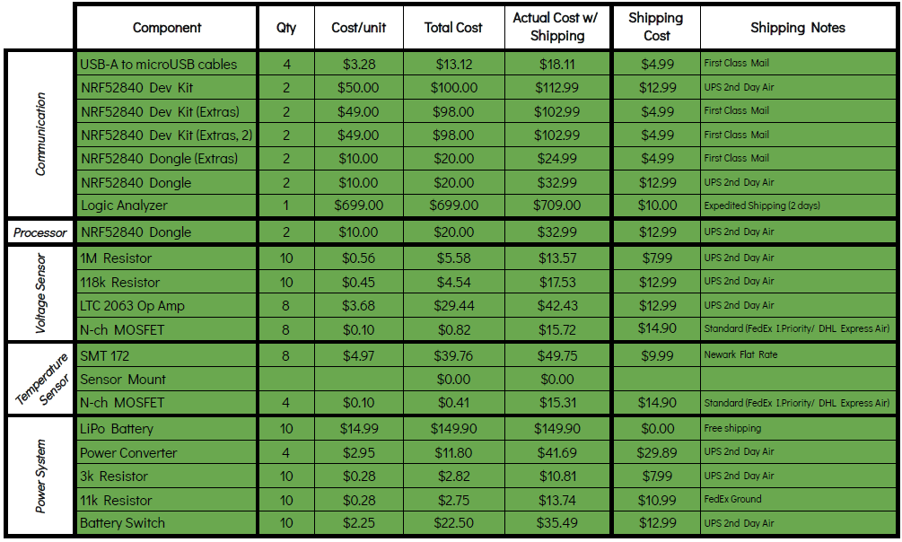
Detailed Cost Plan
Back
Overview Schedule Test Readiness Budget References Backup

Slide 82
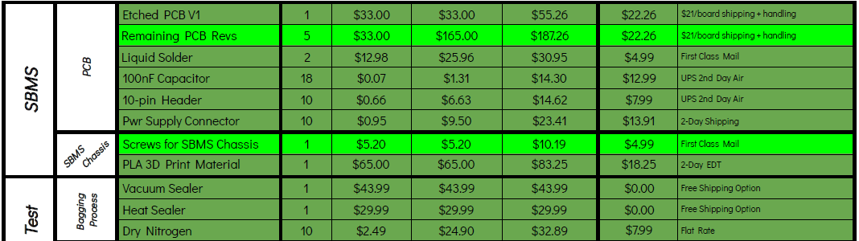
Detailed Cost Plan Continued
*Black arrow indicates items that were not included at CDR
*Dark green indicates items that have been received
*Light green indicates items to be purchased in the future
Back
Overview Schedule Test Readiness Budget References Backup

