Slide 1
SBMS
Stored Battery Monitoring System
Critical Design Review
December 1st, 2021
ASEN 4018-012 Team 6
Customer:
EnerSys ABSL
Presenters:
Ian Adler, Ben Gavin, Devin Geegan, Jamie Henault, Evan Meany, Nathan Zhao
Additional Team Members:
Richard Folsom, Joseph Harrell, Shreeyash Nadella

Slide 2
Presentation Outline
Project Purpose and Objectives
Design Solution
Critical Project Elements
Design Requirements Satisfaction
Wireless Communication & Software Design
Sensors & Electrical Design
External Power Source
Project Risks
Verification and Validation
Project Planning
Overview Design Solution CPEs Requirements Satisfaction Risks Verification & Validation Project Planning References Backup

Slide 3
Project Purpose and Objectives

Slide 4
Project Motivation
EnerSys ABSL batteries
Storage
Health Deterioration
Quality checks
Bagging Process
Time-consuming
Mission Statement:
SBMS shall measure the voltage of an 8S3P battery and the temperature of the 8S3P’s environment and wirelessly send this data to an on-site system
Overview Design Solution CPEs Requirements Satisfaction Risks Verification & Validation Project Planning References Backup

Slide 5
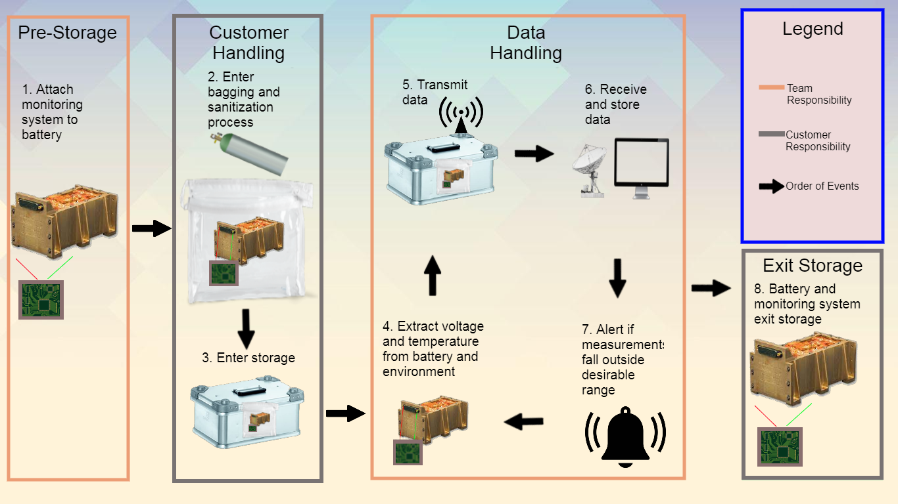
Concept of Operations (CONOPS)
Overview Design Solution CPEs Requirements Satisfaction Risks Verification & Validation Project Planning References Backup

Slide 6
Design Solution

Slide 7
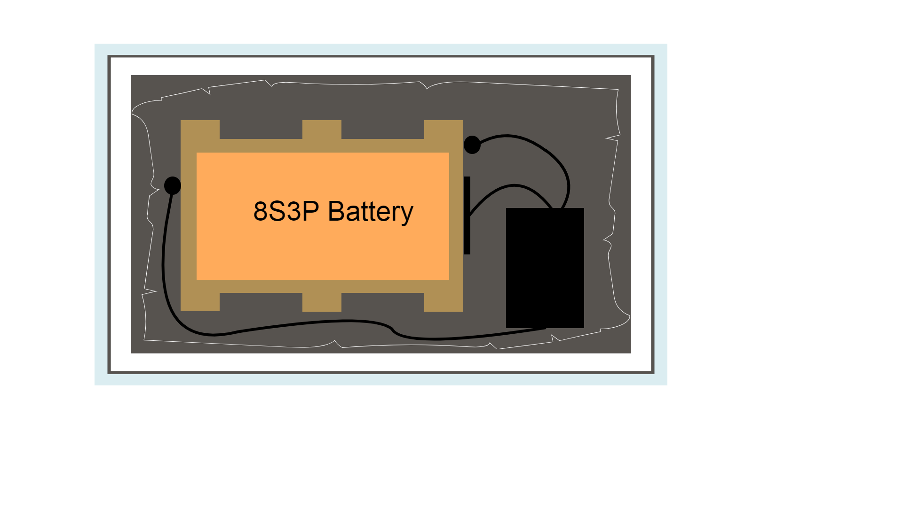
Baseline Design (Storage)
K470 Zarges Box
SMT172
25-pin dsub connector
SMT172
Styrofoam Layer
Monitoring System
Heat/Vacuum Sealed Bag
Overview Design Solution CPEs Requirements Satisfaction Risks Verification & Validation Project Planning References Backup

Slide 8
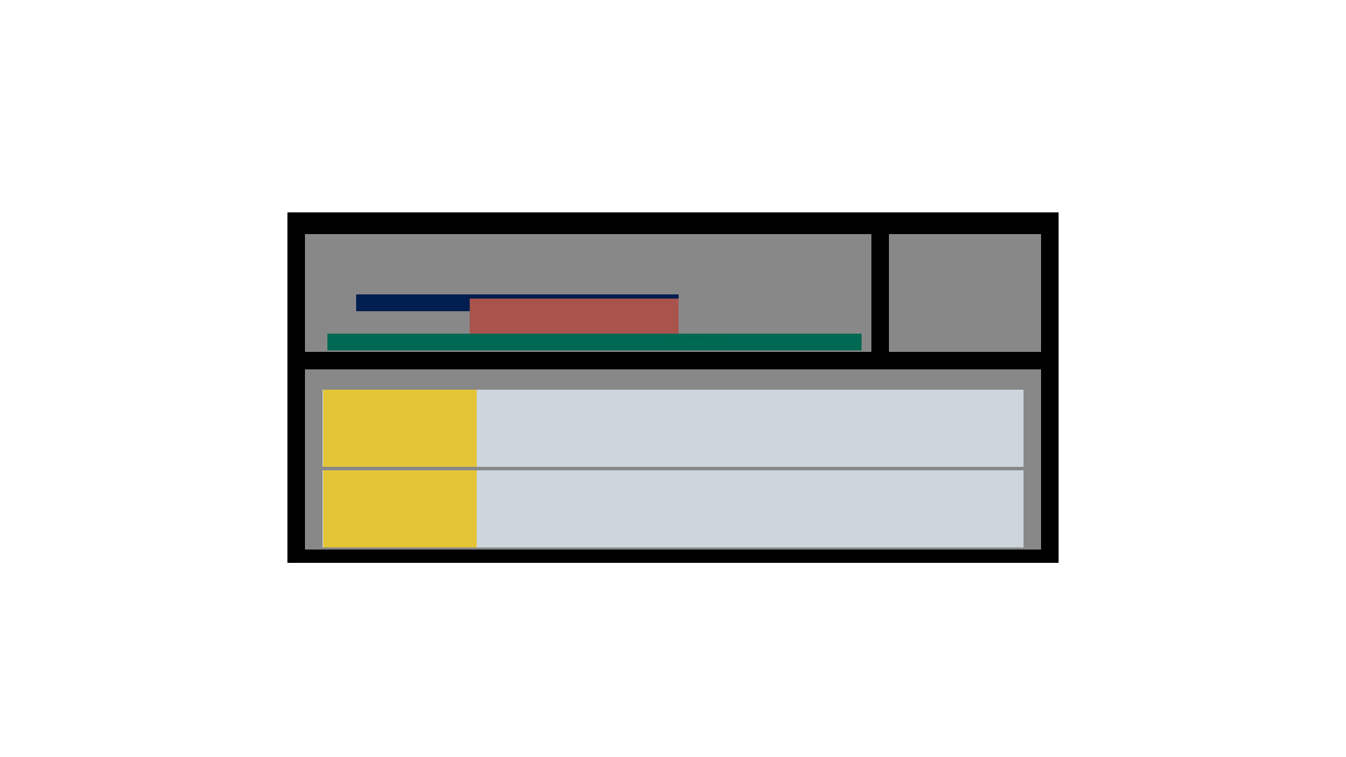
Baseline Design (Monitoring System)
Top-Down View
Bluetooth Low Energy
PCB with built-in voltage sensor and connections to 8S3P & SMT172 temp sensors
nrf52840
nrf52840
Side View
MiniBoost 5V
Custom
PCB
MakerFocus 10000 mAh Lithium Polymer Battery
MakerFocus 10000 mAh Lithium Polymer Battery
Overview Design Solution CPEs Requirements Satisfaction Risks Verification & Validation Project Planning References Backup

Slide 9
Baseline Design (Monitoring System)
Top-Down View
50.8 mm
46.04 mm
Side View
16.8 mm
21.9 mm
110 mm
50 mm
76.2 mm
15.24 mm
100 mm
11 mm
110 mm
60 mm
70 mm
Overview Design Solution CPEs Requirements Satisfaction Risks Verification & Validation Project Planning References Backup

Slide 10
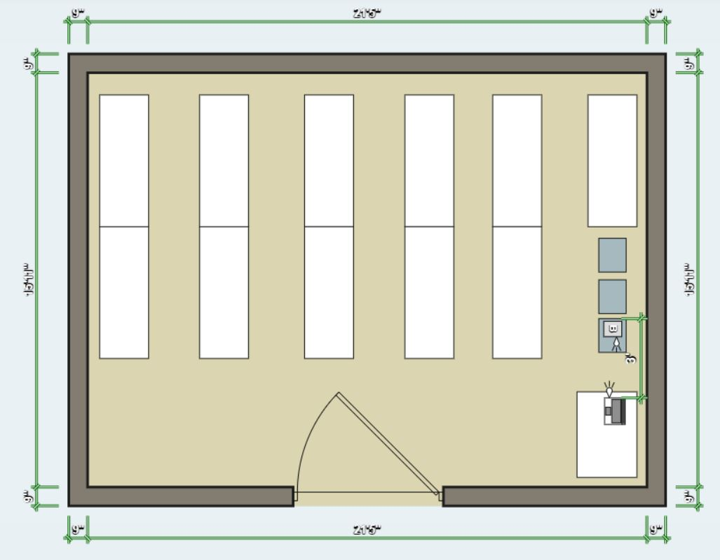
EnerSys Storage Schematic
On-site computer is 3-15 ft from the stored battery
Temperature conditions are ~58°F (15°C)
Secondary Nordic dongle plugged into customer computer
Overview Design Solution CPEs Requirements Satisfaction Risks Verification & Validation Project Planning References Backup

Slide 11
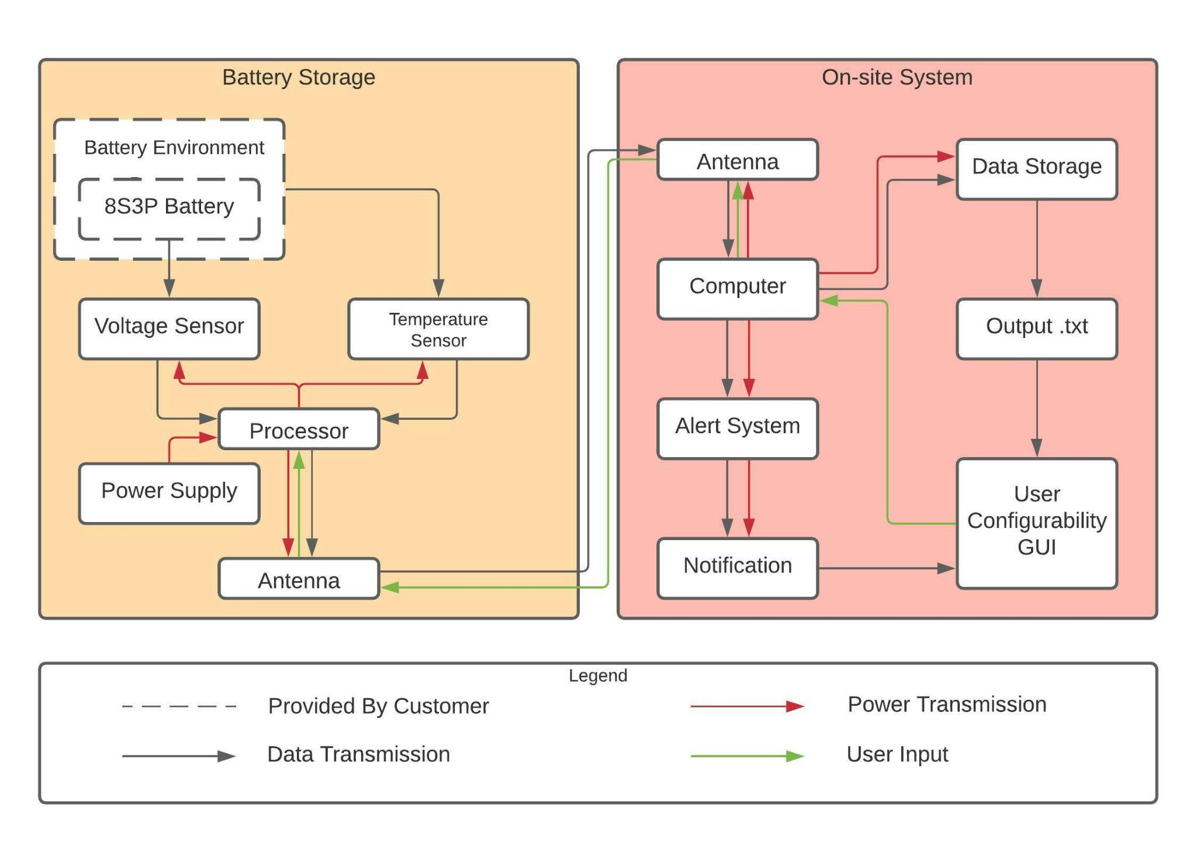
Functional Block Diagram (FBD)
Overview Design Solution CPEs Requirements Satisfaction Risks Verification & Validation Project Planning References Backup

Slide 12
Critical Project Elements

Slide 13
System Critical Project Elements
CPE | Description | FR
CPE1 | System shall measure temperature and voltage. | FR1, FR2
CPE2 | System shall have the necessary hardware for wireless communication. | FR5
CPE3 | System shall have the necessary software for wireless communication. | FR3, FR5, FR7
CPE4 | All parts of system shall integrate with one another. | All FRs
CPE5 | System shall be battery-powered. | FR6
CPE6 | System shall be validated for functionality. | All FRs
Overview Design Solution CPEs Requirements Satisfaction Risks Verification & Validation Project Planning References Backup

Slide 14
Design Requirements Satisfaction

Slide 15
Driving Requirements
FR | Description | Satisfied?
1 | System shall measure voltage
2 | System shall measure temperature
5 | System shall transmit and receive data wirelessly
6 | System shall be battery-powered
7 | System shall save received data with a timestamp
Overview Design Solution CPEs Requirements Satisfaction Risks Verification & Validation Project Planning References Backup

Slide 16
Wireless Communication Critical Experiments/Analyses
FR | Description | Satisfaction Strategy
5 | Wireless Communication | Simulate the design environment to ensure sufficient signal strength and analyze the feasibility of data rate/packet size
7 | Data Saving | Demonstrate scope of the code
Overview Design Solution CPEs Requirements Satisfaction Risks Verification & Validation Project Planning References Backup

Slide 17
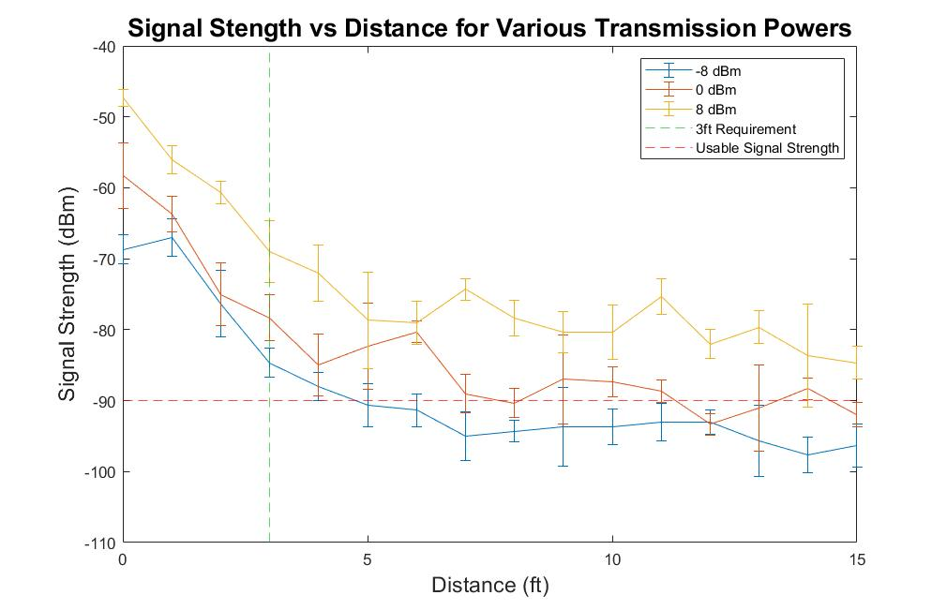
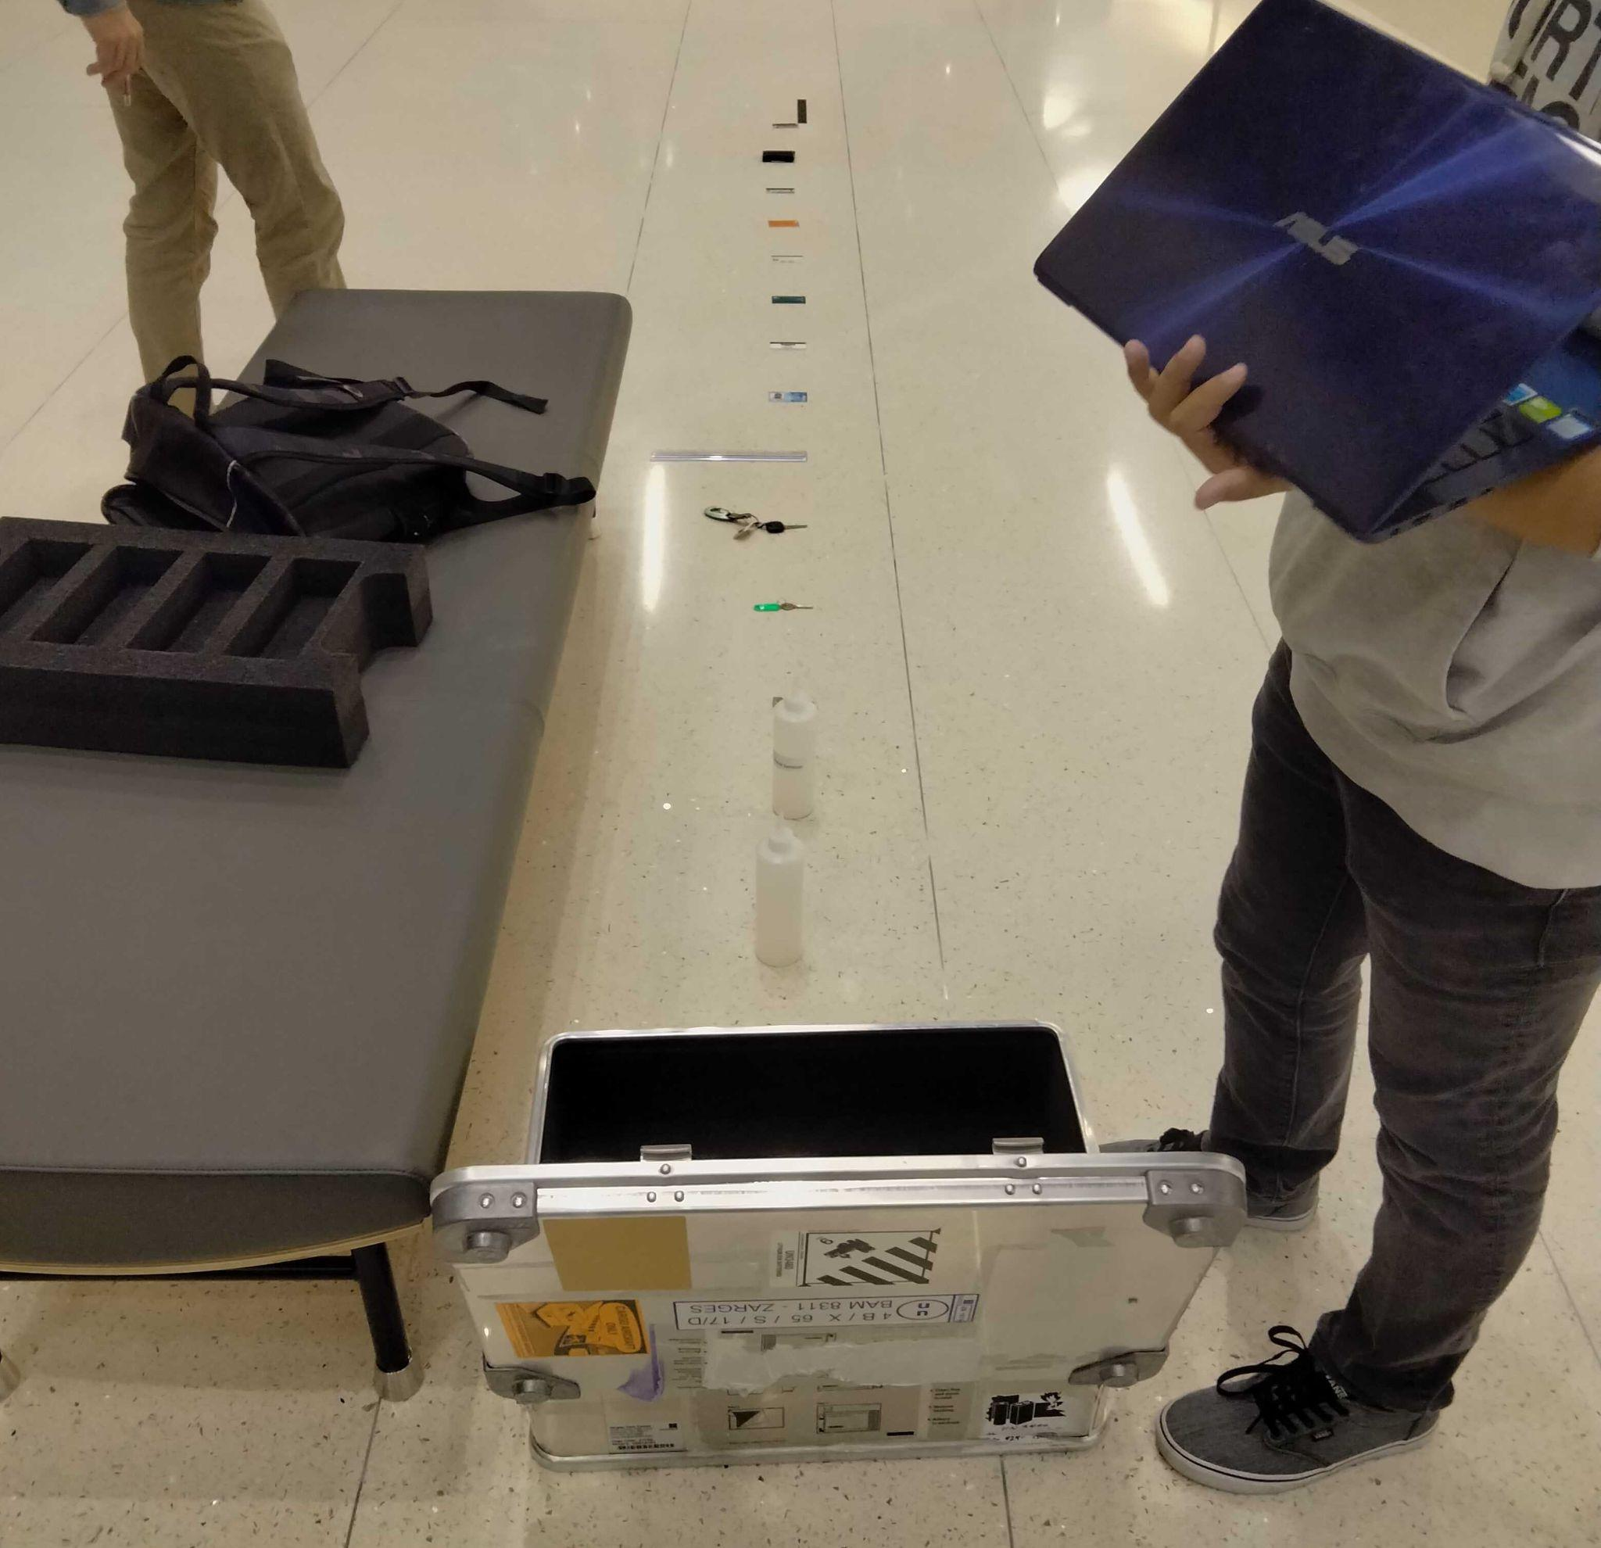
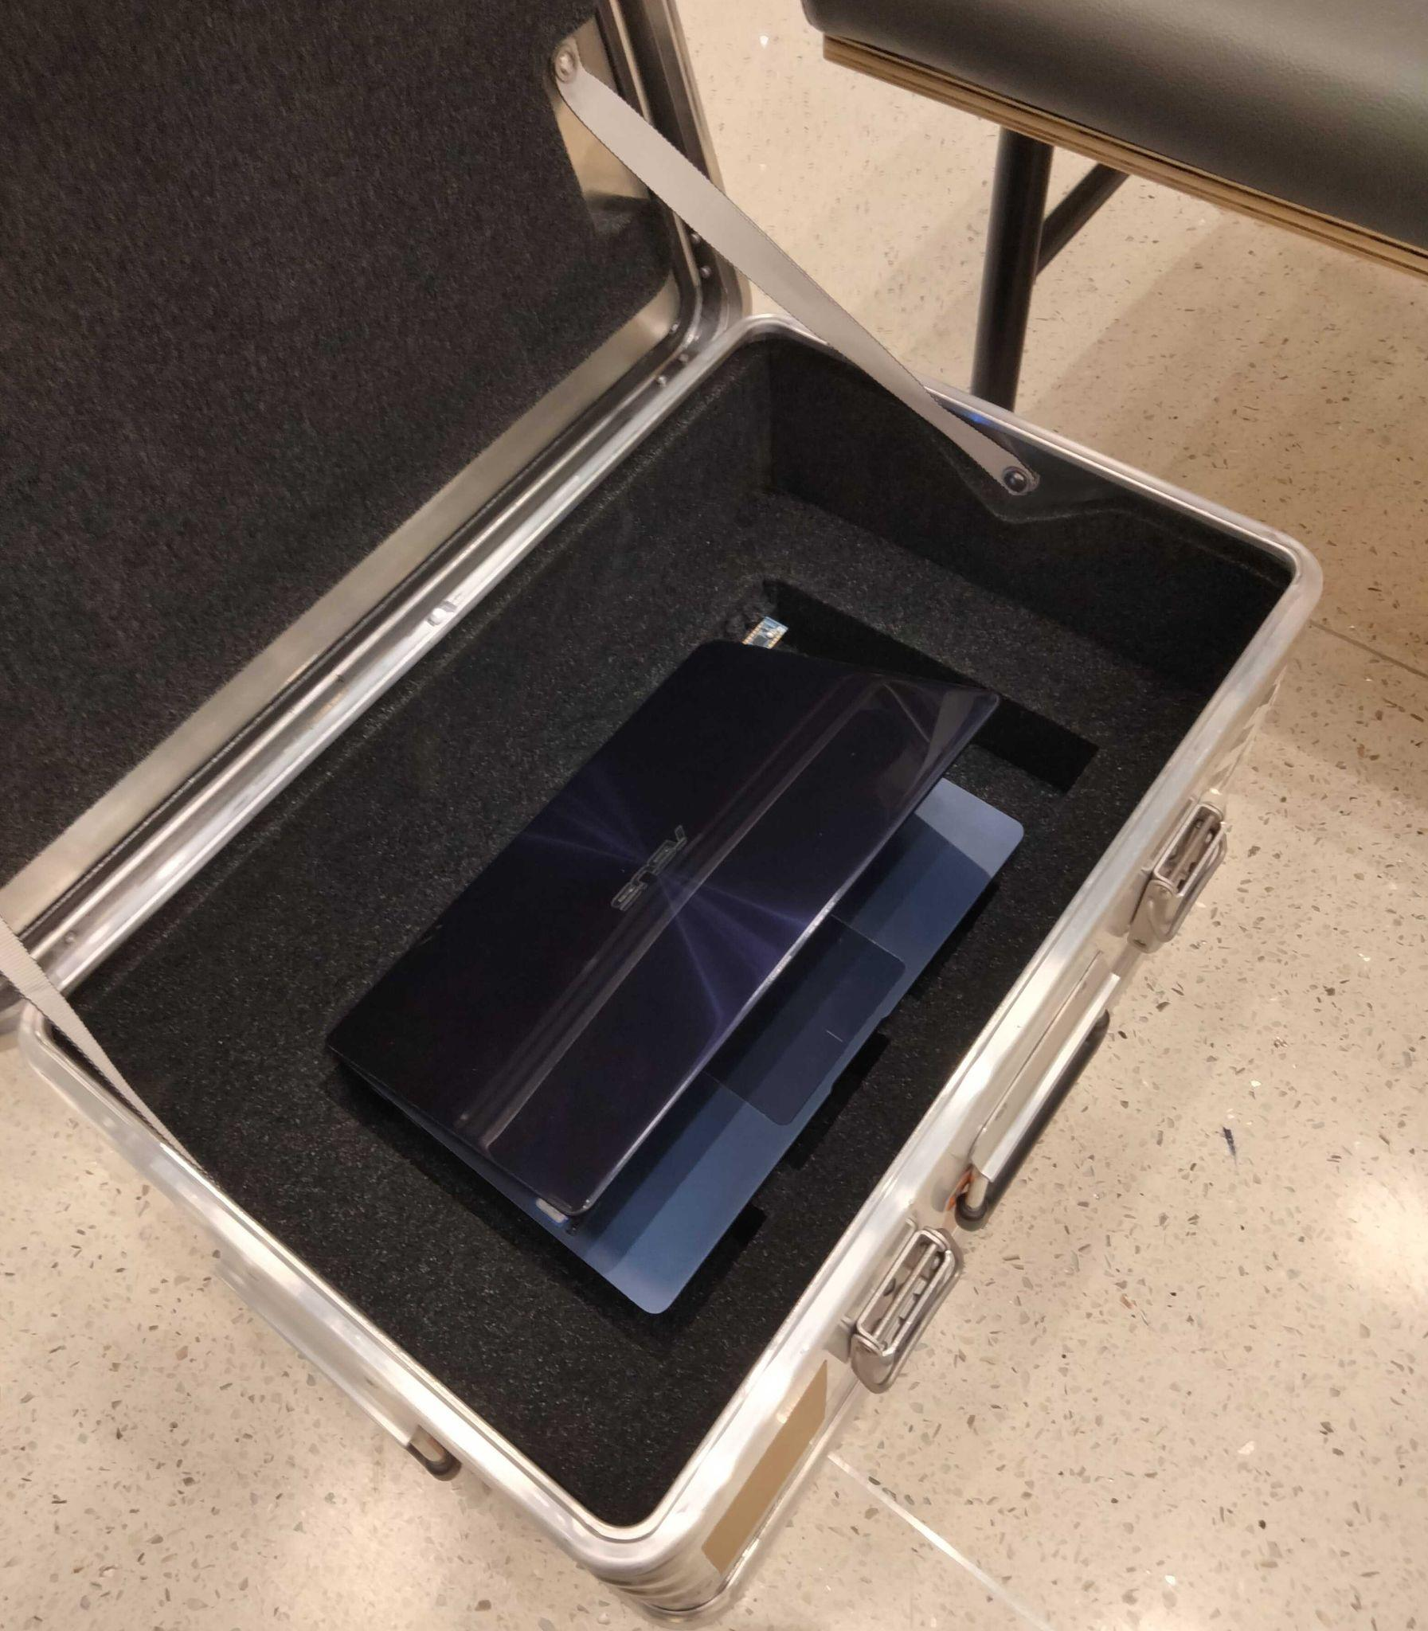
DR 5.4 & 5.5 Satisfaction [Communications Experiment]
DR 5.4: System shall send signals through the K470 Universal Aluminum Box
DR 5.5: Data shall be transmitted over a distance of at least three feet
Flashed code to advertise out of ZARGES case
Tested the signal strength at different distances and transmission strengths
Overview Design Solution CPEs Requirements Satisfaction Risks Verification & Validation Project Planning References Backup

Slide 18
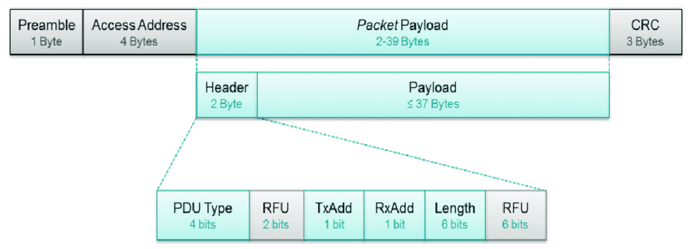
DR 5.2 & 5.3 Satisfaction [BLE Data Packet Format]
DR 5.2: System shall send/receive voltage measurements to on-site system wirelessly
DR 5.3: System shall send/receive temperature measurements to on-site system wirelessly
1B Preamble
4B Access Address
Protocol Data Unit
2B Header
4B MIC
1B OP
16B UUID
2B Length, Type
4B Volt/Temp Data
3B CRC
~37B Total
250 kbps Data Rate
BLE Packet Format^{[22]}
Overview Design Solution CPEs Requirements Satisfaction Risks Verification & Validation Project Planning References Backup

Slide 19
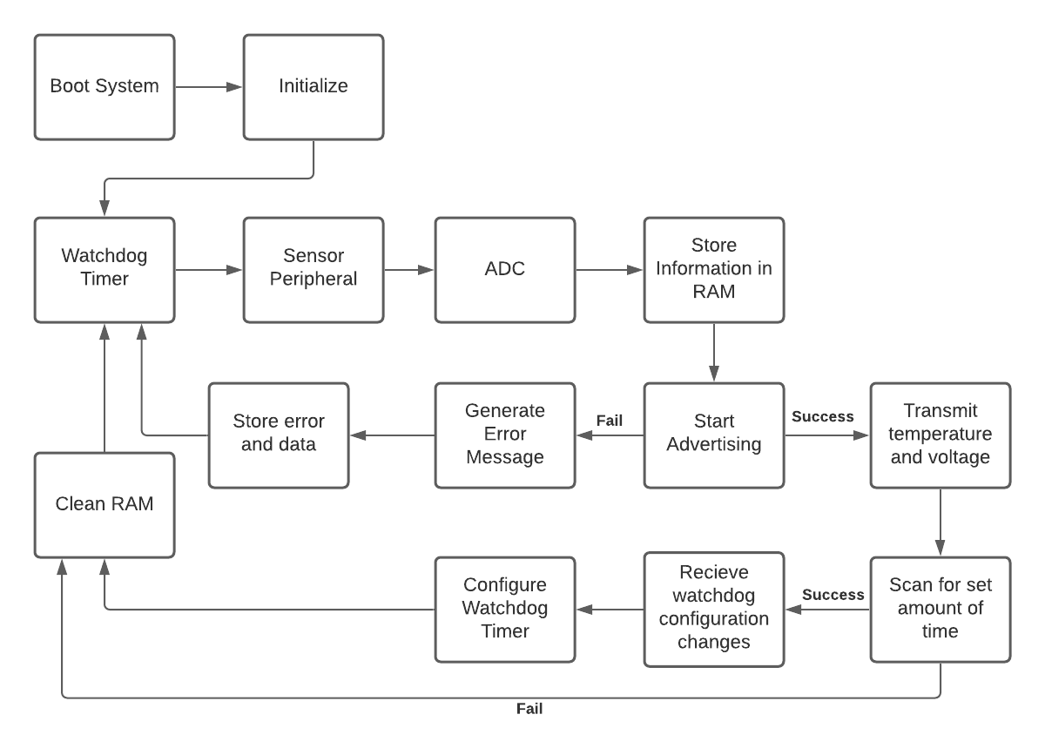
DR 5.1, 7.1, & 7.2 Satisfaction [In-Box Code Flow]
DR 5.1: Data communication process shall be autonomous
DR 7.1: System shall save raw data
DR 7.2: Data shall be sent once an hour by default configuration
Overview Design Solution CPEs Requirements Satisfaction Risks Verification & Validation Project Planning References Backup

Slide 20
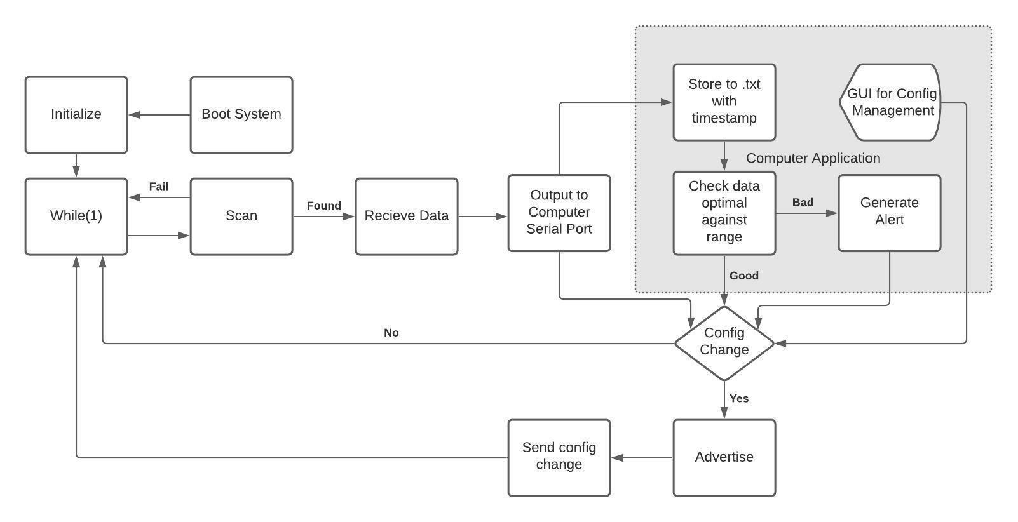
DR 5.1, 7.1, & 7.2 Satisfaction [On-Site Code Flow]
DR 5.1: Data communication process shall be autonomous
DR 7.1: System shall save raw data
DR 7.2: Data shall be sent once an hour by default configuration
Overview Design Solution CPEs Requirements Satisfaction Risks Verification & Validation Project Planning References Backup

Slide 21
Communication Requirement Satisfaction Summary
DR | Description | Satisfied?
5.1 | Autonomous Communication | Code flowchart achieves autonomy
5.2/5.3 | Send/Receive Voltage and Temperature | System will be able to send usable values through the ADC and the size of this data fits within the BLE framework
5.4 | Transmit Through K470 Box | Communications experiment showed signal could transmit through ZARGES case
5.5 | Transmit 3 Feet | Communications experiment showed that the signal strength was usable for all strengths at 3ft
7.1 | Save Raw Data | Code flowchart shows that on-site device will communicate with computer through serial ports
7.2 | Data Sent Every Hour | Handled by watchdog timer within code flowchart
Overview Design Solution CPEs Requirements Satisfaction Risks Verification & Validation Project Planning References Backup

Slide 22
Electronics and Power Source Critical Analyses
FR | Description | Satisfaction Strategy
1 | Voltage Sensor | Measurement accuracy analyzed using error model
2 | Temperature Sensor | Measurement range and accuracy guaranteed by manufacturer
6 | Power Circuit | Current draw from customer battery analyzed using MOSFET datasheet and circuit calculations
Overview Design Solution CPEs Requirements Satisfaction Risks Verification & Validation Project Planning References Backup

Slide 23
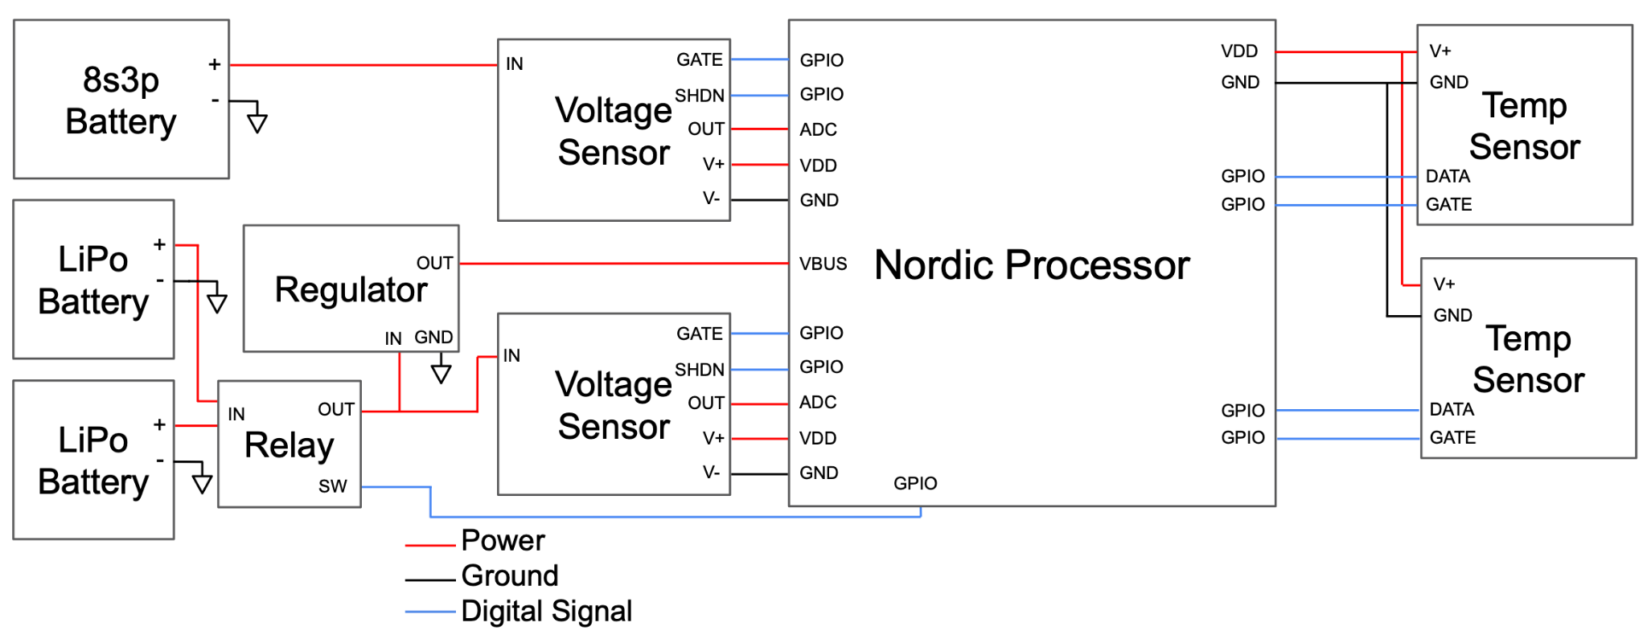
Electrical Wiring Diagram
Overview Design Solution CPEs Requirements Satisfaction Risks Verification & Validation Project Planning References Backup

Slide 24
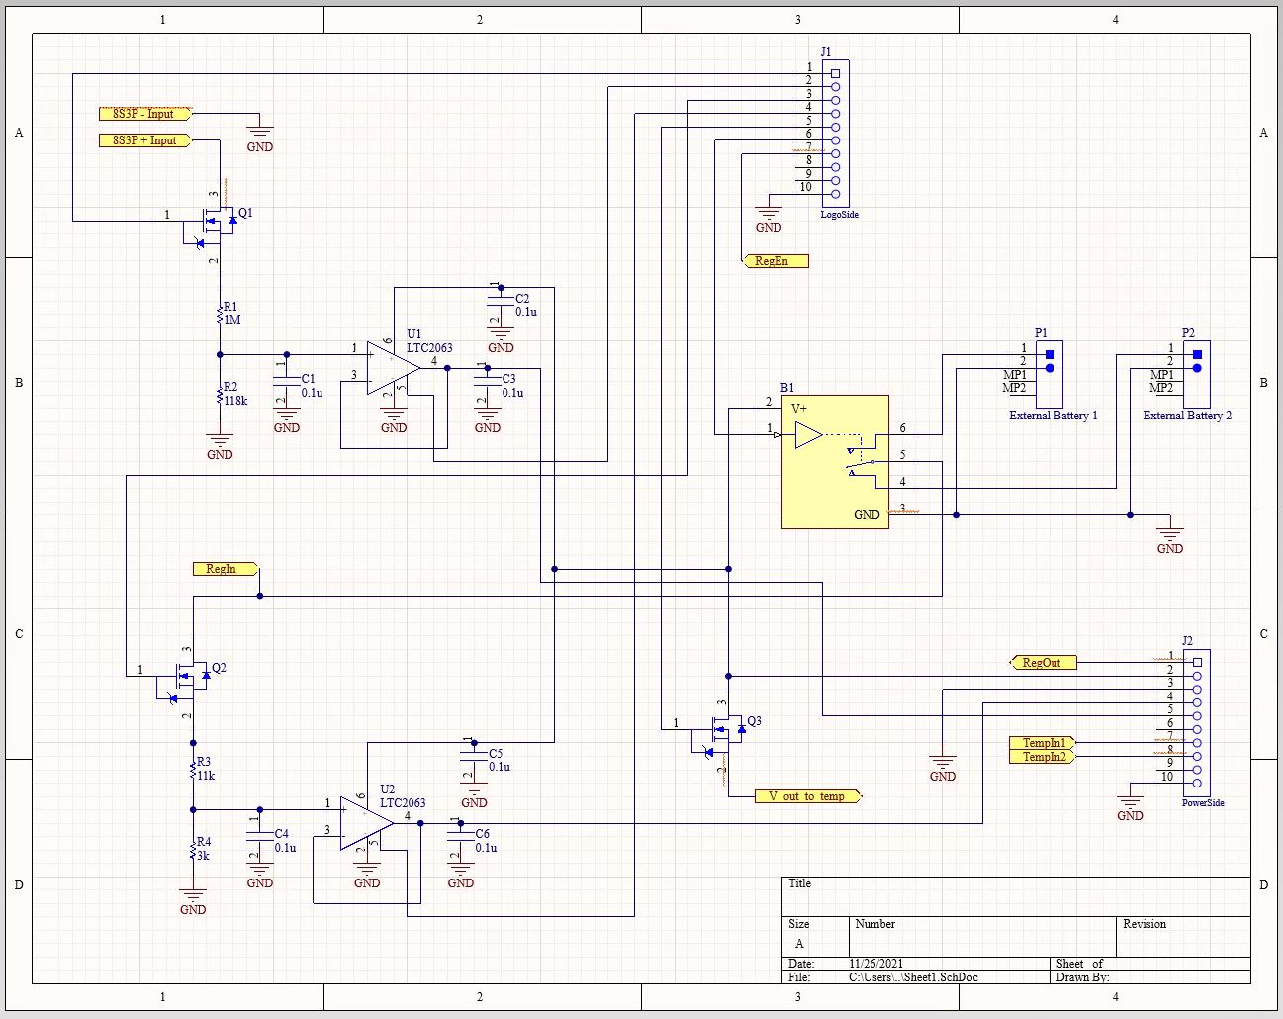
Circuit Schematic
Overview Design Solution CPEs Requirements Satisfaction Risks Verification & Validation Project Planning References Backup

Slide 25
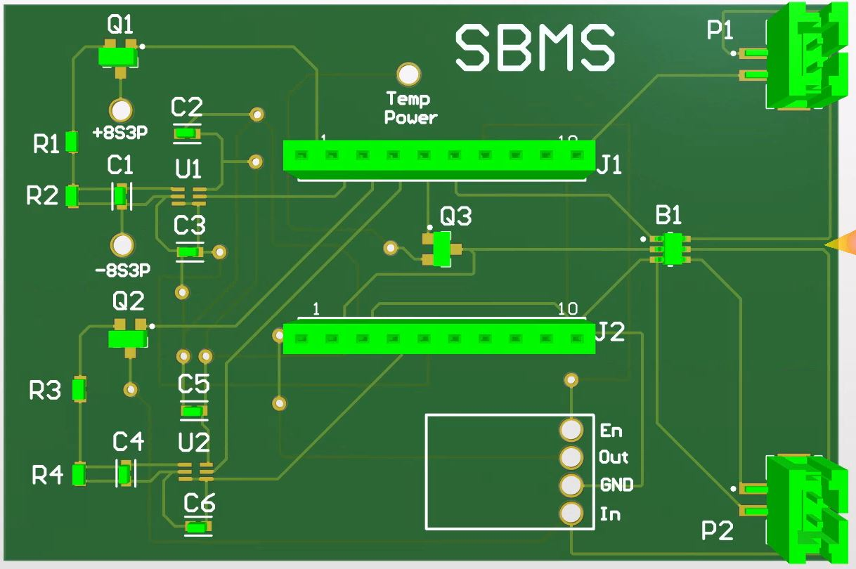
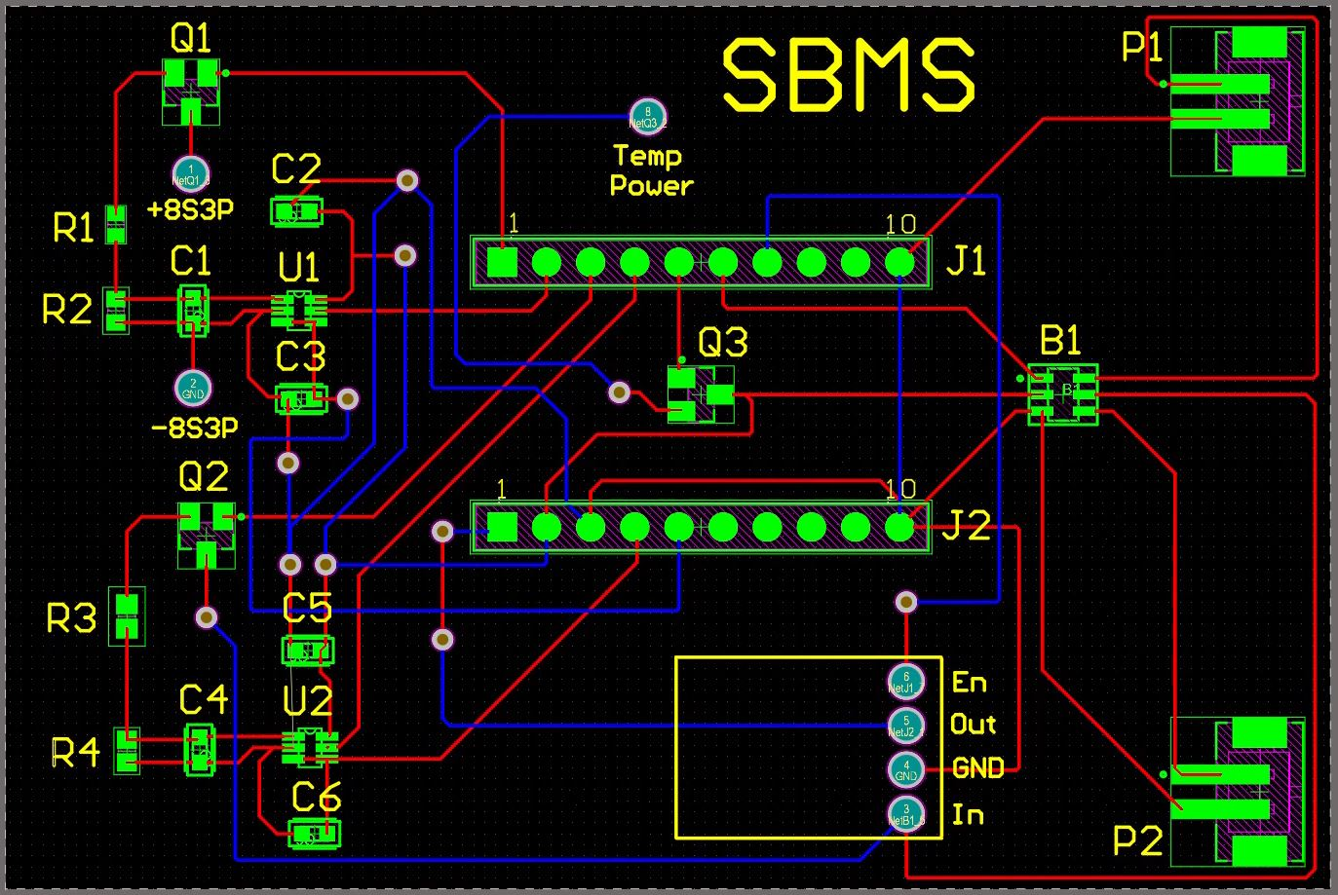
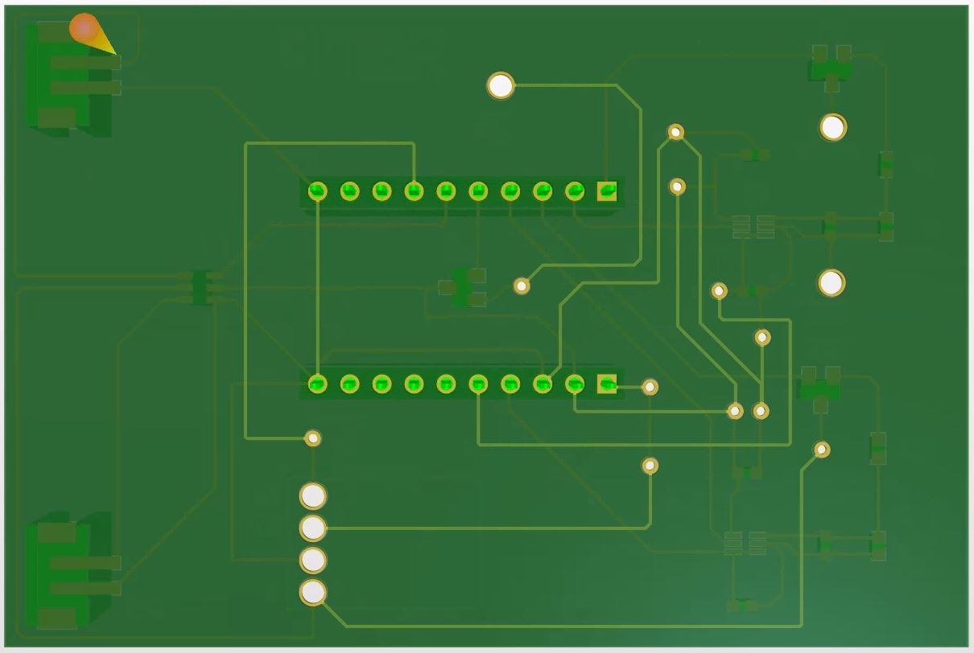
PCB Design
Overview Design Solution CPEs Requirements Satisfaction Risks Verification & Validation Project Planning References Backup

Slide 26
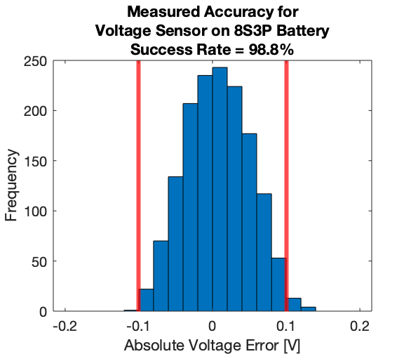
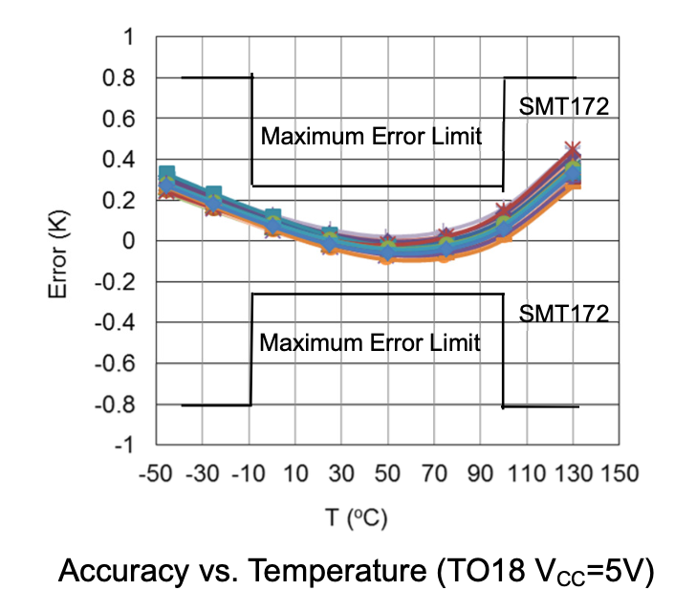
DR 1.1, 1.2, 2.1 & 2.2 Satisfaction [Sensor Range & Accuracy]
DR 1.1: Voltage sensor shall have a range of at least 20-33.6V
DR 1.2: Voltage sensor shall have a sensitivity of 0.1V
DR 2.1: Temperature sensor shall have a range of at least 0-20ºC
DR 2.2: Temperature sensor shall have a sensitivity of 0.1ºC
Voltage Sensor Error Model Results:
Temperature Error Chart From Manufacturer^{[4]}:
Overview Design Solution CPEs Requirements Satisfaction Risks Verification & Validation Project Planning References Backup

Slide 27
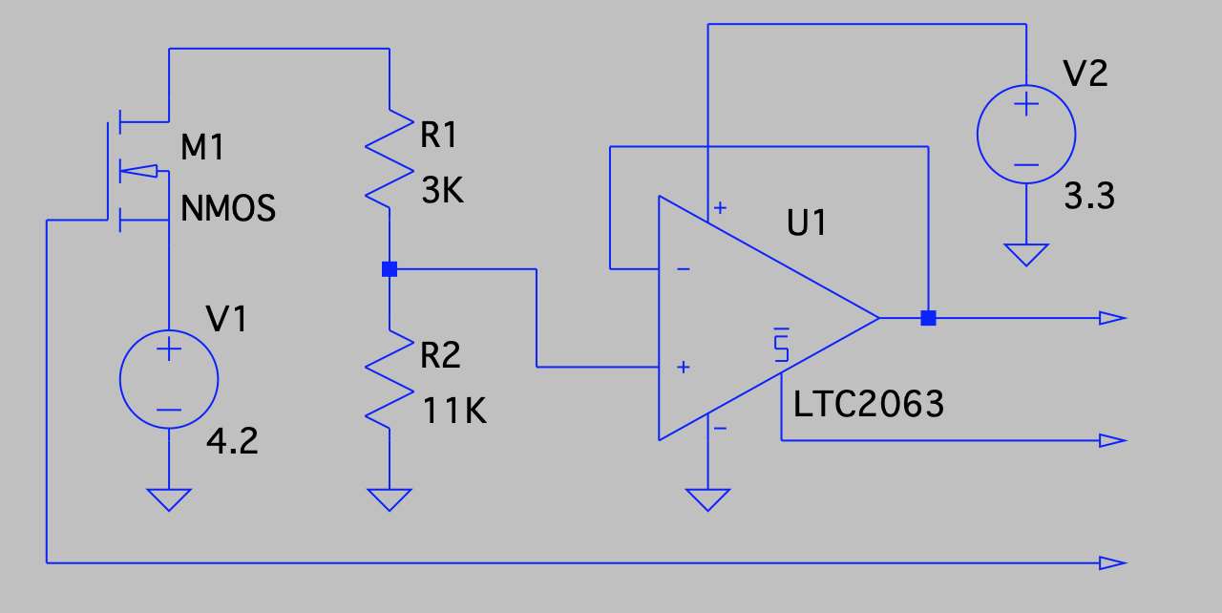
DR 6.1 Satisfaction [Power Supply Lifetime]
DR 6.1: External battery shall operate for one year without charging
System will have a backup battery selected with a digitally controlled SPDT IC switch
Switch output will be fed into a voltage sensor so the processor can monitor its power source
The MAX4544 chip is ideal with its nanoamp supply and leakage currents^{[16]}
Overview Design Solution CPEs Requirements Satisfaction Risks Verification & Validation Project Planning References Backup

Slide 28
DR 6.1 Satisfaction [Power Supply Lifetime] (cont.)
DR 6.1: External battery shall operate for one year without charging
To limit power consumption during sleep, a MOSFET will cut off power to the temperature sensors
The MOSFET in the power source voltage sensor will only be on for the duration required to make a measurement
The buffers in the voltage sensors can be shut down so the sensor circuits draw reduced power when not measuring
Overview Design Solution CPEs Requirements Satisfaction Risks Verification & Validation Project Planning References Backup

Slide 29
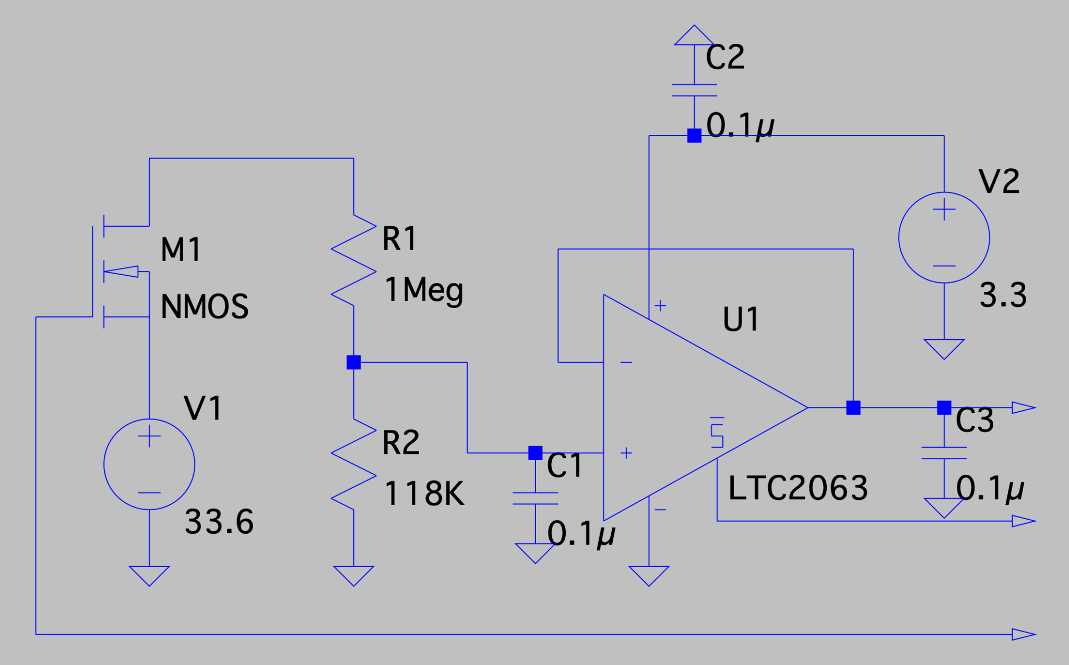
DR 6.2 Satisfaction [Negligible Draw from Stored Battery]
DR 6.2: External battery shall draw negligible charge from stored battery
Assume MOSFET always leaking:
MOSFET ZGVD current <= 1uA^{[15]}
1uA * 24hr/day * 365 day/yr = 8.8mAh/yr
Assume voltage sensor on 1 min/hr:
24V / 1.118MΩ = 21uA
21uA * 24hr/day * 365 day/yr / 60 = 3.1mAh/yr
Max allowable current draw = 23mAh/yr
8.8mAh/yr + 3.1mAh/yr = 11.9mAh/yr
Overview Design Solution CPEs Requirements Satisfaction Risks Verification & Validation Project Planning References Backup

Slide 30
Sensor/Circuitry Requirement Satisfaction Summary
DR | Description | Satisfied?
1.1 | 20 to 33.6V Range | Resistors bring this range into the acceptable ADC input range
1.2 | 100mV Accuracy | Voltage error model
1.3 | System - Battery Connection | Connector provided by customer will be wired to SBMS
1.4 | DC Voltage Measurements | Voltage sensor converts DC input to DC signal for ADC
2.1 | 0 to 20°C Range | Guaranteed by manufacturer
2.2 | 0.1°C Accuracy | Guaranteed by manufacturer over desired range
2.3 | Measures Battery Environment | Sensors will be taped against battery chassis at multiple points
6.1 | Power Supply Lifetime | Sensors shut down during sleep cycles / backup battery
6.2 | Low Draw from Stored Battery | Power draw calculations
Overview Design Solution CPEs Requirements Satisfaction Risks Verification & Validation Project Planning References Backup

Slide 31
Power System Analysis/Experiment
FR | Description | Satisfaction Strategy
6 | Power Supply Lifetime | Power Modeling, Experimental Validation, Redundancy
Overview Design Solution CPEs Requirements Satisfaction Risks Verification & Validation Project Planning References Backup

Slide 32
DR 6.1 Satisfaction [Power Supply Lifetime] - Current Draws
DR 6.1 External battery shall operate for one year without charging
 | Current [mA] | Sources or Justification
Voltage Sensor + Peripherals | 0.010 (on) 0.003 (off) | LTC2063^{[14]} & FDV303N^{[24]} Datasheets
Temp. Sensor + Peripherals | 0.120 (on) 0.002 (off) | SMT172 Datasheet Active Draw^{[4]}
Board - Wake | 6.400 | Nordic Semiconductors Datasheet, pg 62
Board - Sleep | 0.00084 | Nordic Semiconductors Datasheet, pg 59
Total - Wake | 6.530 | Calculated
Total - Sleep | 0.123 | Calculated
Required Yearly Supply | 1,240 mAh | Calculated:
Overview Design Solution CPEs Requirements Satisfaction Risks Verification & Validation Project Planning References Backup

Slide 33
DR 6.1 Satisfaction [Power Supply Lifetime] - Current Draws
DR 6.1 External battery shall operate for one year without charging
 | Loss | Multiplier | Battery Size Required [mAh] | Sources or Justification
Required Supply | - | - | 1,240 | Prev. Slide
Low-Temp | 0% | 1 | 1,240 | Storage temp (58ºF) is not cold enough to affect capacity
Temporal | 60% | 2.5 | 3,100 | ~5% loss in capacity per month
Discharge | 20% | 1.25 | 3,875 | ~80% of rated capacity is usable; Experimental validation
Converter | 20% | 1.25 | 4,844 | Boost 3.7V -> 5V Buck 5V -> 3.3V
FOS | - | 2 | 9,688 | -
Desired Size: | - | - | 10,000 mAh | -
Selected Battery: MakerFocus 10,000 mAh Lithium Polymer Battery
Overview Design Solution CPEs Requirements Satisfaction Risks Verification & Validation Project Planning References Backup

Slide 34
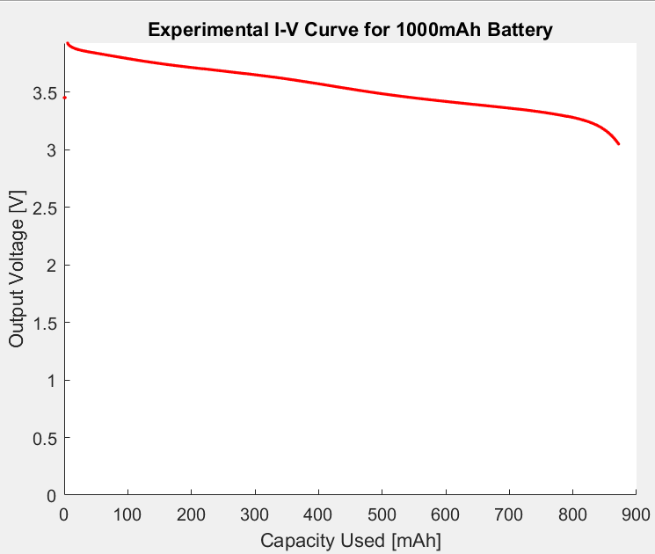
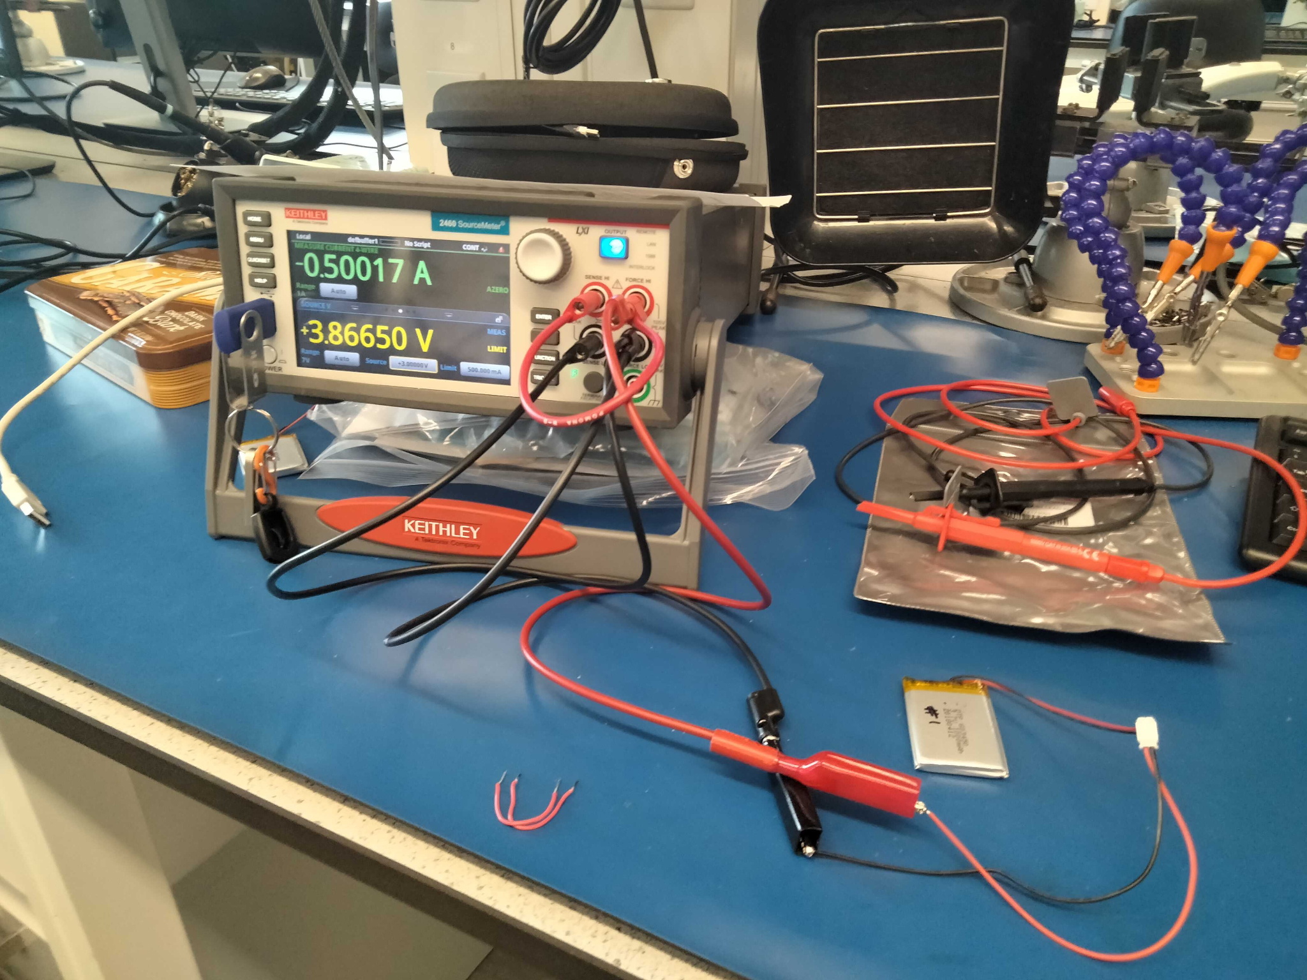
DR 6.1 Satisfaction [Power Supply Lifetime] - Battery Capacity
DR 6.1 External battery shall operate for one year without charging
Keithley 2460 Sourcemeter
1000mAh Battery
Overview Design Solution CPEs Requirements Satisfaction Risks Verification & Validation Project Planning References Backup

Slide 35
Power System Requirement Satisfaction
DR | Name | Satisfied?
6.1 | Power Supply Lifetime | Battery with required size chosen based on power model and expected capacity proved by experimental modeling
Overview Design Solution CPEs Requirements Satisfaction Risks Verification & Validation Project Planning References Backup

Slide 36
Driving Requirements Satisfaction
FR | Description | Satisfied?
FR1 | System shall measure voltage | Yes
FR2 | System shall measure temperature | Yes
FR5 | System shall transmit and receive data wirelessly | Yes
FR6 | System shall be battery-powered | Yes
FR7 | System shall save received data with a timestamp | Yes
Overview Design Solution CPEs Requirements Satisfaction Risks Verification & Validation Project Planning References Backup

Slide 37
Project Risks

Slide 38
Risk Scoring
Likelihood Level
Extremely Improbable (1)
Low Likelihood (2)
Likely (3)
Highly Likely (4)
Almost Certain (5)
Severity Level | Definition
Minimal (1) | DRs & FRs Met
Minor (2) | 1 DR Failed
Major (3) | Multiple DRs Failed Under One FR
Serious (4) | Multiple DRs Failed Under Multiple FRs
Catastrophic (5) | FR(s) Failed
Numerical Value | Risk Level
1-3 | Acceptable Risk
4-6 | Requires Monitoring
8-12 | Requires Constant Mitigation
15-25 | Unacceptable Risk
x
=
Overview Design Solution CPEs Requirements Satisfaction Risks Verification & Validation Project Planning References Backup

Slide 39
Risk Table
Risk ID | Risk Description | Effect | Likelihood | Severity
1 | NRF development board backordered | Will be difficult to debug code, which could lead to various design requirement failures | 2 | 4
2 | Temperature chamber at EnerSys cannot be used | Temperature range requirement cannot be verified | 4 | 2
3 | Wireless communication with on-site system fails due to an obstruction | Data cannot be received by on-site system for processing | 2 | 5
4 | External battery has lower capacity than stated by manufacturer/system draws more power than expected | Battery will be drained sooner than expected, causing the whole system to die | 3 | 5
5 | Unable to interface with customer computer due to computer state | Data will be received, but it cannot be saved to on-site system and sent to customer | 4 | 5
6 | Temperature sensor backordered | Unable to measure temperature of the system | 3 | 5
Overview Design Solution CPEs Requirements Satisfaction Risks Verification & Validation Project Planning References Backup

Slide 40
Risk Matrix (Pre-Mitigation)
Almost Certain
Highly Likely |  | 2 |  |  | 5
Likely |  |  |  |  | 4, 6
Low Likelihood |  |  |  | 1 | 3
Extremely Improbable
 | Minimal | Minor | Major | Serious | Catastrophic
Key
NRF development board backordered
EnerSys temp chamber unusable
Wireless communication failure
External battery failure
Computer interface failure
Temp sensor backordered
Likelihood
Severity
Overview Design Solution CPEs Requirements Satisfaction Risks Verification & Validation Project Planning References Backup

Slide 41
Risk Matrix for Risk ID 1 (Post-Mitigation)
Almost Certain
Highly Likely
Likely
Low Likelihood | 1 |  |  | 1
Extremely Improbable
 | Minimal | Minor | Major | Serious | Catastrophic
Risk: NRF development board backordered
Mitigation Strategy: Order ASAP and use existing hardware owned by team members
Outcome: Debugging can be done early on with existing hardware, allowing the system to be tested before additional boards arrive, so design requirements can be met with confidence
Likelihood
Severity
Overview Design Solution CPEs Requirements Satisfaction Risks Verification & Validation Project Planning References Backup

Slide 42
Risk Matrix for Risk ID 2 (Post-Mitigation)
Almost Certain
Highly Likely | 2 | 2
Likely
Low Likelihood
Extremely Improbable
 | Minimal | Minor | Major | Serious | Catastrophic
Risk: Temperature chamber at EnerSys cannot be used
Mitigation Strategy: Rent temperature chamber from Espec for nearly $1,000
Outcome: Major increase in project budget, but temperature range can be verified
Likelihood
Severity
Overview Design Solution CPEs Requirements Satisfaction Risks Verification & Validation Project Planning References Backup

Slide 43
Risk Matrix for Risk ID 3 (Post-Mitigation)
Almost Certain
Highly Likely
Likely
Low Likelihood | 3 |  |  |  | 3
Extremely Improbable
 | Minimal | Minor | Major | Serious | Catastrophic
Risk: Wireless communication failure
Mitigation Strategy: Store data to flash memory of in-box controller until communication is possible; increase signal power to blast through obstruction
Outcome: Sensor measurements still accounted for and will be received once communication with on-site system is reestablished
Likelihood
Severity
Overview Design Solution CPEs Requirements Satisfaction Risks Verification & Validation Project Planning References Backup

Slide 44
Risk Matrix for Risk ID 4 (Post-Mitigation)
Almost Certain
Highly Likely
Likely |  |  |  |  | 4
Low Likelihood
Extremely Improbable | 4
 | Minimal | Minor | Major | Serious | Catastrophic
Risk: External battery failure
Mitigation Strategy: Test battery prior to integration to ensure that discharge curve is as expected Include safety factor of 2 Include a backup battery
Outcome: Reduced likelihood as battery is truly larger than needed, and reduced severity as there is a backup
Likelihood
Severity
Overview Design Solution CPEs Requirements Satisfaction Risks Verification & Validation Project Planning References Backup

Slide 45
Risk Matrix for Risk ID 5 (Post-Mitigation)
Almost Certain
Highly Likely |  |  |  |  | 5
Likely
Low Likelihood
Extremely Improbable |  |  |  |  | 5
 | Minimal | Minor | Major | Serious | Catastrophic
Risk: Computer interface failure
Mitigation Strategy: Ensure computer is constantly plugged in/charging and that sleep mode has been disabled
Outcome: Customer computer will not be able to enter power saving sleep mode, but will successfully receive data
Likelihood
Severity
Overview Design Solution CPEs Requirements Satisfaction Risks Verification & Validation Project Planning References Backup

Slide 46
Risk Matrix for Risk ID 6 (Post-Mitigation)
Almost Certain
Highly Likely
Likely | 6 |  |  |  | 6
Low Likelihood
Extremely Improbable
 | Minimal | Minor | Major | Serious | Catastrophic
Risk: Temperature sensor backordered
Mitigation Strategy: Have a backup chip (TMP117)
Outcome: System will be able to measure temperature, but our team will have to port an arduino library to the NRF hardware which will require additional coding
Likelihood
Severity
Overview Design Solution CPEs Requirements Satisfaction Risks Verification & Validation Project Planning References Backup

Slide 47
Risk Matrix (Post-Mitigation) Summary
Almost Certain
Highly Likely | 2
Likely | 6
Low Likelihood | 1, 3
Extremely Improbable | 4 |  |  |  | 5
 | Minimal | Minor | Major | Serious | Catastrophic
Key
NRF development board backordered
EnerSys temp chamber unusable
Wireless communication failure
External battery failure
Computer interface failure
Temp sensor backordered
Likelihood
Severity
Overview Design Solution CPEs Requirements Satisfaction Risks Verification & Validation Project Planning References Backup

Slide 48
Verification and Validation

Slide 49
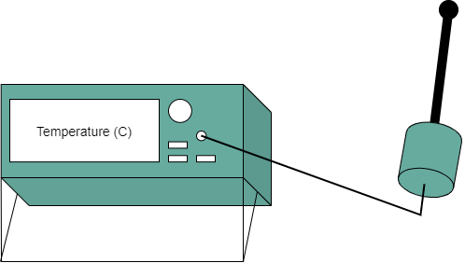
Subsystem Verification - Sensors
DR 1.2: Voltage sensor shall have a sensitivity of 0.1V
DR 2.2: Temperature sensor shall have a sensitivity of 0.1ºC
Objective
Calibrate software to sensors
Confirm both sensors work within accuracy tolerance
Compare with error models
Plan
Input power supply voltage into sensor then measure output with multimeter then check that measurements are within ±0.1V of one another
Record temperature measured by sensor and by F150 precision thermometer, then check that measurements are within ±0.1ºC of one another
Measurements
Voltage of power supply at 20V, 25V & 33.6V
Temperature of room and controlled chamber
Pass Criteria
Both sensor measurements are within sensitivity tolerance
Overview Design Solution CPEs Requirements Satisfaction Risks Verification & Validation Project Planning References Backup

Slide 50
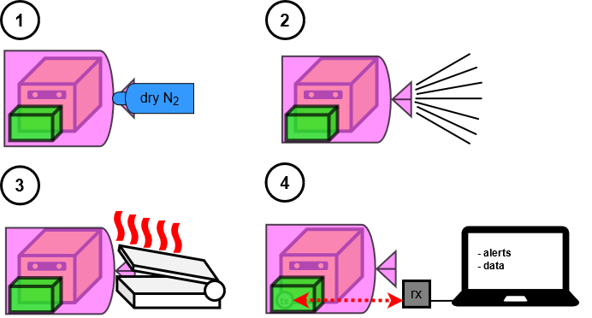
Subsystem Verification - Physical Integrity
DR 4.1: System shall survive dry nitrogen purging at room temperature and a pressure of 2psi
DR 4.2: System shall remain intact during vacuum and heat sealing process
Objective
Maintain system functionality after passing through a cleaning environment
Plan
Attach system to battery and insert into a bag
Remove air from bag and then seal bag shut by applying heat
Measurements
Voltage and temperature measurements of system in bag
Pass Criteria
Measurements are taken while inside vacuum and heat sealed environment
Overview Design Solution CPEs Requirements Satisfaction Risks Verification & Validation Project Planning References Backup

Slide 51
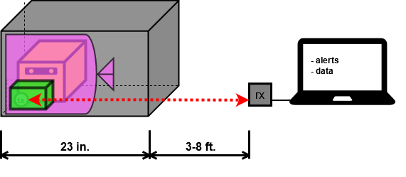
Subsystem Verification - Communication Signal
DR 5.4: System shall send signals through the K470 Universal Aluminum Box (provided by the customer) that the battery is stored in
Objective
Establish and maintain communication with receiver outside of K470 box
Compare with experiment
Plan
Attach system to battery and insert into K470 box
Take measurements with system then send measurements through K470 using BLE
Measurements
Voltage and temperature measurements of system inside box
Pass Criteria
Measurements taken inside K470 box are transmitted via BLE to receiver outside of K470 box
Overview Design Solution CPEs Requirements Satisfaction Risks Verification & Validation Project Planning References Backup

Slide 52
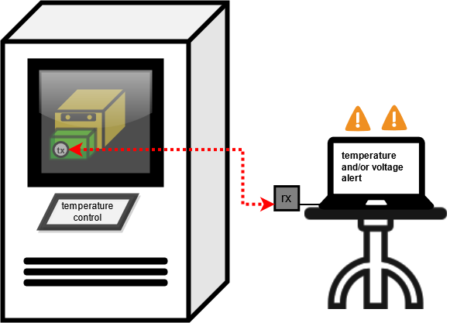
Subsystem Verification - Alert System
FR 3: System shall communicate when voltage and/or temperature reach an undesirable state
Objective
Communicate with customer when an undesired state is reached
Plan
Attach system to placeholder battery and insert into a temperature chamber to reach undesirable temperature levels
Attach system to a voltage supply to reach undesirable voltage levels
Measurements
Voltage and temperature measurements of system
Pass Criteria
Measurements taken while inside an undesirable state will issue a warning to the customer
Overview Design Solution CPEs Requirements Satisfaction Risks Verification & Validation Project Planning References Backup

Slide 53
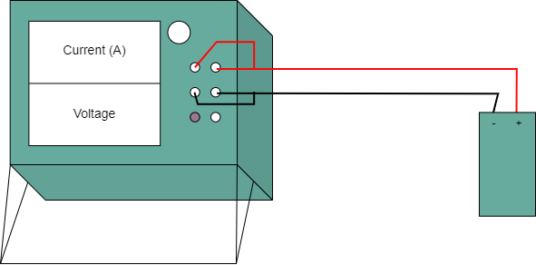
Subsystem Verification - Power Supply
DR 6.1: External battery shall operate for one year without charging
Objective
Maintain system functionality for one year of use without charging/changing power supply
Compare with power model
Plan
Attach battery to Keithley 2460 SourceMeter and apply resistance for discharge over a chosen time
Measurements
Discharge curve in volts vs mAh
Pass Criteria
Battery is shown to provide power for chosen fraction of one year when enduring scaled amount of the estimated total load
Overview Design Solution CPEs Requirements Satisfaction Risks Verification & Validation Project Planning References Backup

Slide 54
System Validation - Day In The Life
Objective
Simulate a 24 hour period that the system would undergo in typical use
Plan
Attach system to battery and insert into K470 box
Take measurements with system then send measurements through K470 using BLE
Continue for 24 hours with no human intervention
Measurements
Voltage and temperature measurements of system inside box
Pass Criteria
Measurements taken inside K470 box are transmitted via BLE to receiver outside of K470 box over entire period
Overview Design Solution CPEs Requirements Satisfaction Risks Verification & Validation Project Planning References Backup

Slide 55
Project Planning

Slide 56
Work Breakdown Structure (WBS)
SBMS
Project Management
Software
Electronics & Hardware
Testing
Fall Final Report
In-Box Processing
Ordering
Voltage
Test Readiness Review
In-Box Dongle
Breadboard Prototyping
Temperature
AIAA Conference Paper
In-Box Configuration
PCB Integration
Power
Spring Final Review
On-Site Data Processing
System Container Printing
Alerts
Project Final Report
On-Site Dongle
Configurability
On-Site Configuration
Communication Signal
On-Site GUI
Survivability
Communication Timing
Day-in-the-life (On-Campus)
Advertising
Day-in-the-life (EnerSys)
Battery Relay
Overview Design Solution CPEs Requirements Satisfaction Risks Verification & Validation Project Planning References Backup

Slide 57
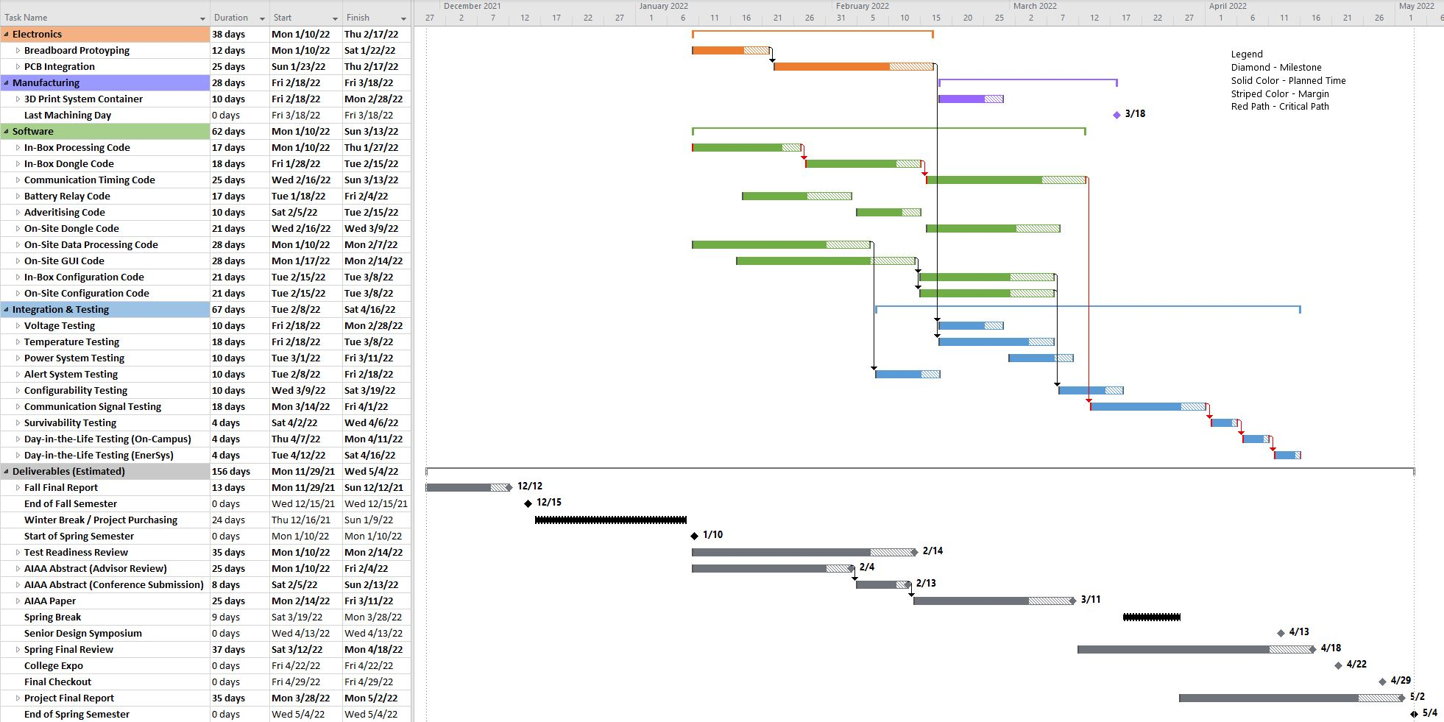
Spring Semester Work Plan
Overview Design Solution CPEs Requirements Satisfaction Risks Verification & Validation Project Planning References Backup

Slide 58
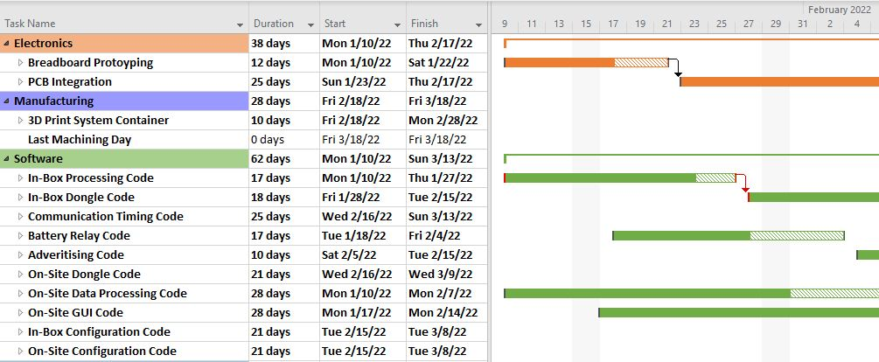
Spring Semester Work Plan: First Month
Overview Design Solution CPEs Requirements Satisfaction Risks Verification & Validation Project Planning References Backup

Slide 59
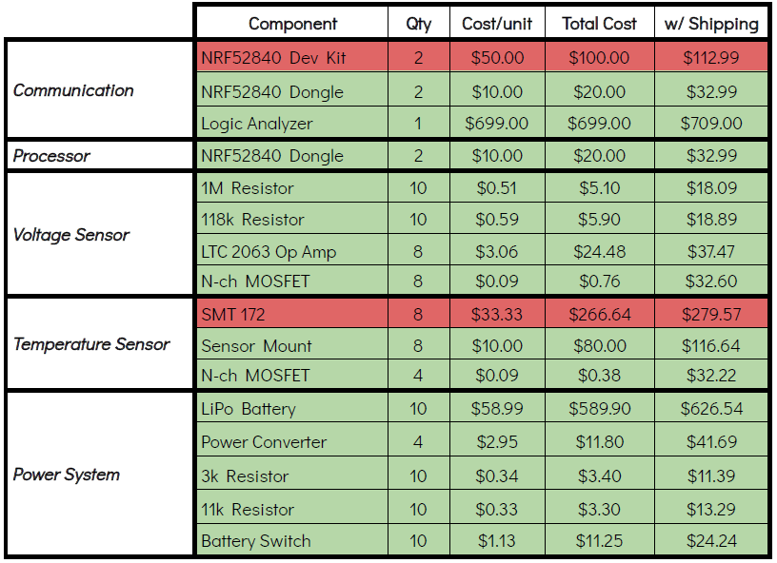
Cost Plan
Overview Design Solution CPEs Requirements Satisfaction Risks Verification & Validation Project Planning References Backup

Slide 60
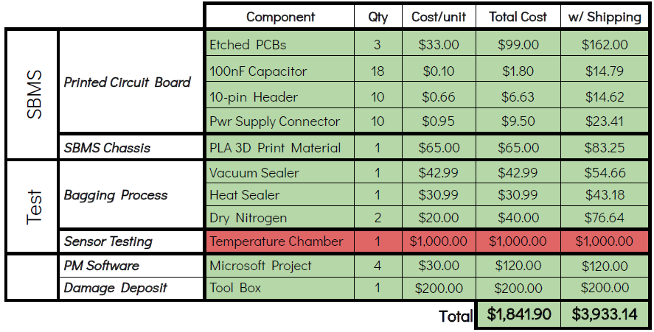
Cost Plan
(mls)
(mls)
Overview Design Solution CPEs Requirements Satisfaction Risks Verification & Validation Project Planning References Backup

Slide 61
Test Plan
Test Name | CPE Addressed
Sensor Functionality | 1
Survivability | 4
Communication Signal | 2,3
Alert System | 1,2,3
Power Supply | 5
Scheduling
Location | Anticipated Date | Hazards or Challenges
Electronics Lab | February 2022 | Calibrating measurement system
Pilot Lab | April 2022 | Achieving a perfect vacuum seal
Pilot Lab | March 2022 | N/A
Pilot Lab | February 2022 | N/A
Electronics Lab | March 2022 | N/A
Overview Design Solution CPEs Requirements Satisfaction Risks Verification & Validation Project Planning References Backup

Slide 62
Test Plan
Test Name | CPE Addressed
Full System Test | All
Day In The Life | All
Handover | All
Scheduling
Location | Anticipated Date | Hazards or Challenges
Electronics Lab | April 2022 | N/A
Electronics Lab | April 2022 | Maintaining test environment overnight
EnerSys Facilities | April 2022 | Transmitting through several K470 boxes if needed
Overview Design Solution CPEs Requirements Satisfaction Risks Verification & Validation Project Planning References Backup

Slide 63
Acknowledgements
EnerSys ABSL Team
Jacqueline Maldonado, Brice Lucero, Travis Mault, Ryan Pritchard
Team Advisor
Dr. Jean Koster
Projects Advisory Board
Dr. Jelliffe Jackson, Dr. Jade Morton, Dr. Christopher Roseman,
Dr. Jean Koster, Dr. Melvin Rafi, Professor Matt Rhode
Additional Support
Professor Trudy Schwartz, Professor Bobby Hodgkinson,
Emma Markovich, Colin Claytor
Overview Design Solution CPEs Requirements Satisfaction Risks Verification & Validation Project Planning References Backup

Slide 64
References
“ERA3AEB113V,” Newark. Available: https://www.newark.com/panasonic-electronic-components/era3aeb113v/surface-mount-thin-film-resistor/dp/62W8736
“ERA-3AEB302V,” Mouser. Available: https://www.mouser.com/ProductDetail/Panasonic/ERA-3AEB302V?qs=%2Fha2pyFaduhb05ESoU1Edd%252B%252BYQj5NEVJ4yV8H3JHdTrOH%252BIkW8jYRA%3D%3D
“TMP117 Datasheet,” Texas Instruments, Revised April 2021. Available: https://www.ti.com/product/TMP117
“SMT172 Datasheet,” Smartec, Last Updated March 20, 2017. Available: https://www.smartec-sensors.com/cms/media/Datasheets/Temperature/SMT172-datasheet.pdf
“nRF52840,” Nordic Semiconductors. Available: https://www.nordicsemi.com/-/media/Software-and-other-downloads/Product-Briefs/old-versions/nRF52840PBv20.pdf?la=en&hash=516968A8D06D7F41C8B14B6639DD9E14099E2853
“Air - Thermal Conductivity vs. Temperature and Pressure.” Engineering ToolBox. Available: https://www.engineeringtoolbox.com/air-properties-viscosity-conductivity-heat-capacity-d_1509.html
“Thermal Conductivity of Metals, Metallic Elements and Alloys.” Engineering ToolBox. Available: https://www.engineeringtoolbox.com/thermal-conductivity-metals-d_858.html
“Properties of Silicon and Silicon Wafers.” El,Available: https://www.el-cat.com/silicon-properties.htm
“The Thermal Conductivity of Unfilled Plastics – C-Therm Technologies Ltd..” C, 10 Dec. 2020/ Available: https://ctherm.com/resources/newsroom/blog/the-thermal-conductivity-of-unfilled-plastics/
Measurement of the Effective Radial Thermal ... - NASA. Available: https://tfaws.nasa.gov/wp-content/uploads/TFAWS18-IN-08_Paper.pdf
Townsend, Kevin. “Introduction to Bluetooth Low Energy.” Adafruit Learning System. Available: https://learn.adafruit.com/introduction-to-bluetooth-low-energy/gatt
“RF Wireless World.” BLE Advertising Packet Format | BLE Data Packet Format, Available: https://www.rfwireless-world.com/Terminology/BLE-Advertising-and-Data-Packet-Format.html
Overview Design Solution CPEs Requirements Satisfaction Risks Verification & Validation Project Planning References Backup

Slide 65
References (cont.)
13. “MCS0402MD1004BE000,” Digikey. Available: https://www.digikey.bg/en/products/detail/vishay-dale/MCS0402MD1004BE000/14324215
14. “LTC2063” Analog Devices. Available: https://www.analog.com/en/products/ltc2063.html#product-overview
15. “FDV303N - Digital FET” ON Semiconductor. Available: https://www.onsemi.com/pdf/datasheet/fdv303n-d.pdf
16. “MAX4544” Maxim Integrated. Available: https://www.maximintegrated.com/en/products/analog/analog-switches-multiplexers/MAX4544.html
17. “RP73PF1E118KBTD,” Digikey. Available: https://www.digikey.com/en/products/detail/te-connectivity-passive-product/RP73PF1E118KBTD/8261060
18. “10,000 mAh Battery”, Makerfocus. Available: https://www.makerfocus.com/products/makerfocus-3-7v-lipo-battery-10000mah-lithium-rechargeable-battery-9065115-with-micro-ph2-0-plug-for-raspberry-pi-ups-board?_pos=1&_sid=6a377f236&_ss=r
19. “CGA3E2X7R1H104K080AA,” Digikey. Available: https://www.digikey.com/en/products/detail/tdk-corporation/CGA3E2X7R1H104K080AA/2443144
20. “61301011821,” Mouser. Available: https://www.mouser.com/ProductDetail/Wurth-Elektronik/61301011821?qs=W%252B2sBeLta1ZhlLR0YCzonQ%3D%3D
21. “Adafruit MiniBoost 5V @ 100mA Charge Pump - AP3602A,” Adafruit. Available: https://www.adafruit.com/product/3661?gclid=Cj0KCQiA7oyNBhDiARIsADtGRZZnpuExyqBrbn59R64kl9sqkQ00pMlgd3CpbBy_UVoWxRPjFBfqlyYaAh3SEALw_wcB
22. Lindh, J., “Bluetooth low energy Beacons,” Texas Instruments. Available:
https://www.ti.com/lit/an/swra475a/swra475a.pdf?ts=1638134655301&ref_url=https%253A%252F%252Fwww.google.com%252F
23. “JST Right-Angle Connector - Through-Hole 2-Pin,” Sparkfun. Available: https://www.sparkfun.com/products/9749
24. “onsemi FDV303N,” LCSC Electronics. Available: https://lcsc.com/product-detail/MOSFETs_onsemi-FDV303N_C80498.html
25. “Student PCB Sponsorship & Discounts,” Advanced Circuits. Available: https://www.4pcb.com/pcb-student-discount.html
26. “PLA,” MakerBot. Available: https://store.makerbot.com/3d-printers-materials/method-spools/pla-material
Overview Design Solution CPEs Requirements Satisfaction Risks Verification & Validation Project Planning References Backup

Slide 66
References (cont.)
27. “8 inch 200mm Impulse Bag Sealer, Manual Bag Sealer Heat Seal Closer, Adjustable Timer Electric Heat Seal Closer Packaging Sealer with 2 Free Replacement Kit, Blue,” Amazon. Available: https://www.amazon.com/Impulse-Sealer-Adjustable-Electric-Replacement/dp/B08GCBNN9W/
28. “GERYON Vacuum Sealer, Automatic Food Sealer Machine for Food Savers w/Starter Kit|Led Indicator Lights|Easy to Clean|Dry & Moist Food Modes| Compact Design (Black),” Amazon. Available: https://www.amazon.com/GERYON-Automatic-Machine-Starter-Indicator/dp/B07B4X61Z4/ref=sr_1_5?keywords=vacuum%2Bsealer&qid=1638161536&sr=8-5&th=1
29. “Saleae Logic Pro 8,” Saleae. Available: https://usd.saleae.com/products/saleae-logic-pro-8?variant=7076781686844
30. ”Nordic Semiconductor USB CDC ACM” Nordic Infocenter. https://infocenter.nordicsemi.com/index.jsp?topic=%2Fcom.nordic.infocenter.sdk5.v15.2.0%2Fusbd_cdc_acm_example.html
31. “PySerial” Python. https://pyserial.readthedocs.io/en/latest/
32. “Simple Mail Transfer Protocol” Python. https://docs.python.org/3/library/smtplib.html
Overview Design Solution CPEs Requirements Satisfaction Risks Verification & Validation Project Planning References Backup

Slide 67
Thank You!
Questions?

Slide 68
Backup Slides

Slide 69
SBMS Organizational Chart
Advisor
Dr. Jean Koster
Project Manager
Jamie Henault
Finance Lead
Richard Folsom
Customer
EnerSys ABSL
Systems Engineer Lead
Nathan Zhao
Power Lead
Ian Adler
Data Processing Lead
Joseph Harrell
Communications Lead
Evan Meany
Testing/Validation Lead
Devin Geegan
Sensor + Hardware Lead
Ben Gavin
Commands Lead
Shreeyash Nadella
Subteam
Nathan Zhao
Ben Gavin
Richard Folsom
Joseph Harrell
Subteam
Nathan Zhao
Ben Gavin
Devin Geegan
Evan Meany
Subteam
Nathan Zhao
Shreeyash Nadella
Joseph Harrell
Subteam
Jamie Henault
Richard Folsom
Subteam
Ian Adler
Jamie Henault
Richard Folsom
Shreeyash Nadella
Subteam
Nathan Zhao
Ian Adler
Joseph Harrell
Evan Meany
Overview Design Solution CPEs Requirements Satisfaction Risks Verification & Validation Project Planning References Backup

Slide 70
Requirements
FR | DR | Requirement
1 |  | System shall measure voltage
 | 1.1 | Voltage sensor shall have a range of at least 20-33.6V
 | 1.2 | Voltage sensor shall have a sensitivity of 0.1V
 | 1.3 | Voltage sensor shall connect to the customer’s 8S3P battery
 | 1.4 | Voltage sensor shall measure DC voltage
2 |  | System shall measure temperature
 | 2.1 | Temperature sensor shall have a range of at least 0-20ºC
 | 2.2 | Temperature sensor shall have a sensitivity of 0.1ºC
 | 2.3 | Temperature sensor shall measure the temperature of the battery environment
Overview Design Solution CPEs Requirements Satisfaction Risks Verification & Validation Project Planning References Backup

Slide 71
Requirements Continued
FR | DR | Requirement
3 |  | System shall communicate when voltage and temperature reach an undesirable state
 | 3.1 | Alert shall be generated when voltage exceeds 33.6V
 | 3.2 | Alert shall be generated when voltage drops below 20V
 | 3.3 | Alert shall be generated when temperature exceeds 20ºC
 | 3.4 | Alert shall be generated when temperature drops below 0ºC
4 |  | System shall continue operation after sanitization & bagging process performed by customer
 | 4.1 | System shall survive dry nitrogen purging at room temperature and a pressure of 2psi
 | 4.2 | System shall remain intact during vacuum and heat sealing process
5 |  | System shall transmit and receive data wirelessly
Overview Design Solution CPEs Requirements Satisfaction Risks Verification & Validation Project Planning References Backup

Slide 72
Requirements Continued
FR | DR | Requirement
 | 5.1 | Data communication process shall be autonomous
 | 5.2 | System shall send/receive voltage measurements to on-site system wirelessly
 | 5.3 | System shall send/receive temperature measurements to on-site system wirelessly
 | 5.4 | System shall send signals through the K470 Universal Aluminum Box (provided by the customer) that the battery is stored in
 | 5.4.1 | System shall send signals through a secondary K470 Universal Aluminum Box next to the one it is being stored in
 | 5.5 | Data shall be transmitted over a distance of at least three feet
6 |  | System shall be battery-powered
 | 6.1 | External battery shall operate for one year without charging
Overview Design Solution CPEs Requirements Satisfaction Risks Verification & Validation Project Planning References Backup

Slide 73
Requirements Continued
FR | DR | Requirement
 | 6.2 | External battery shall draw negligible charge from stored battery
7 |  | System shall save received data with a timestamp
 | 7.1 | System shall save raw data
 | 7.1.1 | System shall save specific voltage and temperature values, so long as requirement 7.1 is met
 | 7.2 | Data shall be sent once an hour by default configuration
 | 7.2.1 | System shall have a configurable transmission frequency option
 | 7.2.1.1 | A user interface shall be made to input configuration changes
 | 7.3 | Data shall be presented in a .txt file
Overview Design Solution CPEs Requirements Satisfaction Risks Verification & Validation Project Planning References Backup

Slide 74
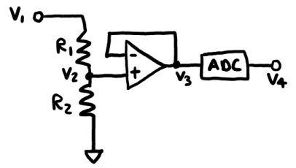
Voltage Sensor Error Setup & Requirements
DR 2.1 | Voltage sensor shall have a sensitivity of 0.1V
8S3P^{[13][17]}
R₁ = 1MΩ
R₂ = 118kΩ
V_{max(1)} = 50V
V_{max(2)} = 200V
P_{max(1,2)} = 0.1W
External Battery^{[1][2]}
R₁ = 11kΩ
R₂ = 3kΩ
V_{max(1,2)} = 75V
P_{max(1,2)} = 0.1W
Overview Design Solution CPEs Requirements Satisfaction Risks Verification & Validation Project Planning References Backup

Slide 75
Voltage Sensor Error Calculations
Actual Voltage (V₁)
Random value from 20 to 33.6V
Expected Resistances
R_{1,exp}= 1MΩ
R_{2,exp}= 118kΩ
Expected Intermediate Voltage (V_{2,exp})
V_{2,exp} = (R_{2,exp}*V₁) / (R_{1,exp} + R_{2,exp})
Resistor Tolerances (R_{1,tol}, R_{2,tol})
Random values from -1% to +1%
Actual Resistances (R_{1,act}, R_{2,act})
R_{1,act} = R_{1,exp} + R_{1,exp} * R_{1,tol}
R_{2,act} = R_{2,exp} + R_{2,exp} * R_{2,tol}
Actual Intermediate Voltage (V_{2,act})
V_{2,act} = (R_{2,act}*V₁) / (R_{1,act} + R_{2,act})
Op-amp Error (V_{op,err})
Random value from -5μV to +5μV
Actual Intermediate Voltage (V_{3,act})
V_{3,act} = V_{2,act} + V_{op,err}
Overview Design Solution CPEs Requirements Satisfaction Risks Verification & Validation Project Planning References Backup

Slide 76
Voltage Sensor Error Calculations (cont.)
ADC Differential Nonlinearity Error (E_{D})
Random Value from -0.95 to +1.3
ADC Integral Nonlinearity Error (E_{I})
Random Value from -10 to +10
ADC Gain Error (E_{G})
Random Value from -0.03 to +0.03
ADC Total Error (E_{ADC})
E_{ADC} = (E_{D} + E_{I} + E_{G} + 1)*V_{3,act} / 2¹²
Actual Final Voltage (V_{4,act})
V_{4,act} = V_{3,act} + E_{ADC}
Absolute Voltage Error (V_{E})
V_{E} = V_{4,act} - V_{2,exp}
Absolute Voltage Error Scaled Back up to Input Voltage Range (V_{E,scaled})
V_{E,scaled} = (R_{1,exp} + R_{2,exp})*(V_{E} / R_{2,exp})
Overview Design Solution CPEs Requirements Satisfaction Risks Verification & Validation Project Planning References Backup

Slide 77
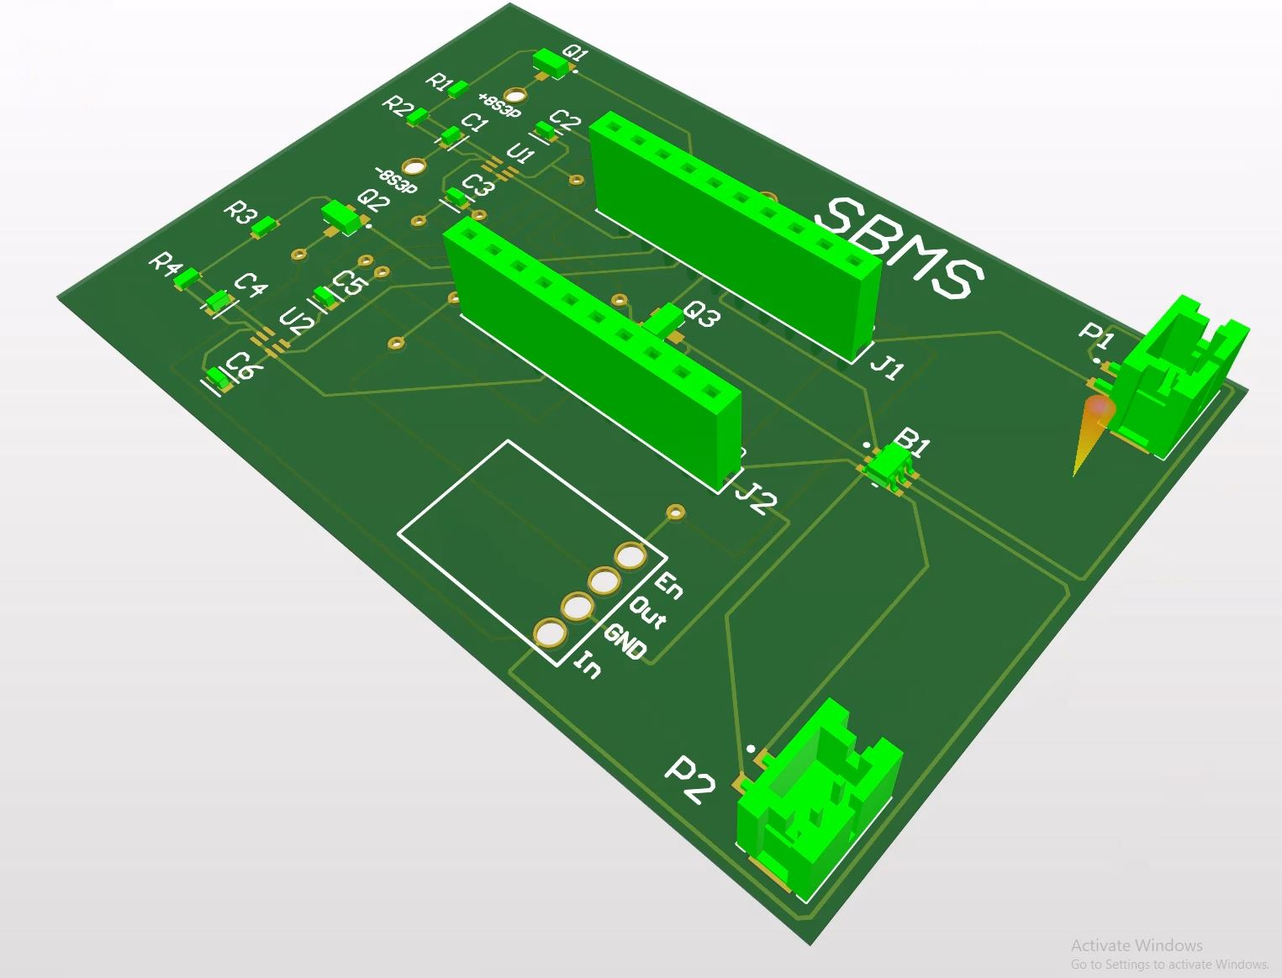
PCB Isometric View & Voltage Sensor Location
8S3P Customer Battery Voltage Sensor
External Battery Voltage Sensor
Overview Design Solution CPEs Requirements Satisfaction Risks Verification & Validation Project Planning References Backup

Slide 78
Electronics/Hardware Bill of Materials
Component | Product | Source | Price/Unit [$]
Op Amp^{[14]} | LTC2063 | Mouser | 2.92
N-ch MOSFET^{[15]} | FDV303N | LCSC | 0.43
Temp Sensor^{[4]} | SMT172 | Newark/Ebay | 3.79
1M Resistor^{[13]} | MCS0402MD1004BE000 | Digikey | 0.51
118k Resistor^{[17]} | RP73PF1E118KBTD | Digikey | 0.59
3k Resistor^{[1]} | ERA-3AEB302V | Mouser | 0.34
11k Resistor^{[2]} | ERA3AEB113V | Newark | 0.33
Power Converter^{[21]} | MiniBoost 5v | Adafruit | 2.95
Battery Switch^{[16]} | MAX4544 | Digikey | 2.89
Battery Connector | 25-pin Dsub | ABSL | N/A
100nF Capacitor^{[19]} | CGA3E2X7R1H104K080AA | Digikey | 0.10
10-pin Header^{[20]} | 61301011821 | Mouser | 0.68
Power Supply Connector^{[23]} | JST PH2 | Sparkfun | 0.95
Overview Design Solution CPEs Requirements Satisfaction Risks Verification & Validation Project Planning References Backup

Slide 79
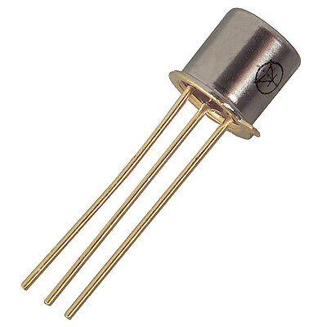
Temp Sensor Configuration
SMT172
V
GND
DATA
Heat Shrink Tubing
200 mm
S
MOSFET
D
G
VDD
GPIO
GND
GPIO
Processor
Circuit Board
Overview Design Solution CPEs Requirements Satisfaction Risks Verification & Validation Project Planning References Backup

Slide 80
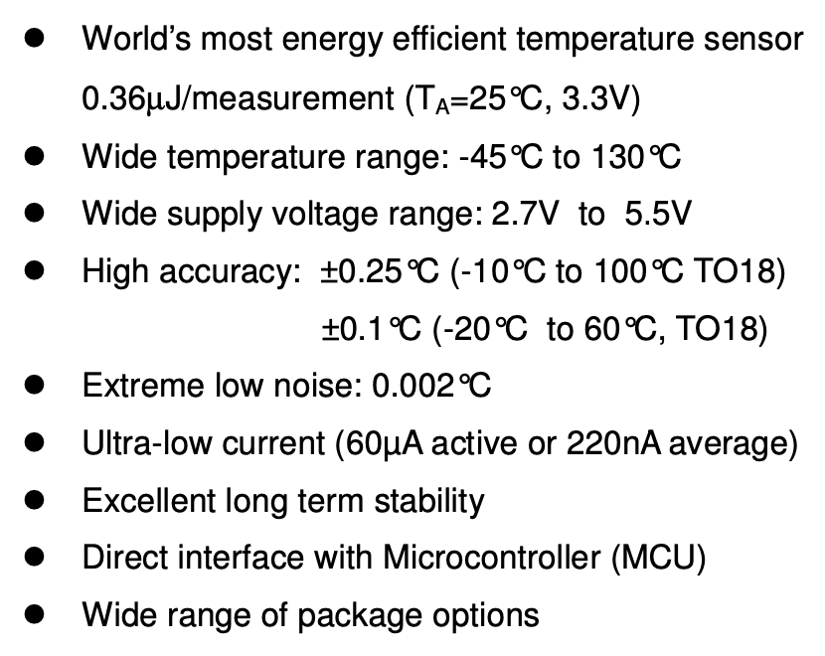
Smartec SMT172^{[4]} - Chosen Temperature Sensor
Overview Design Solution CPEs Requirements Satisfaction Risks Verification & Validation Project Planning References Backup

Slide 81
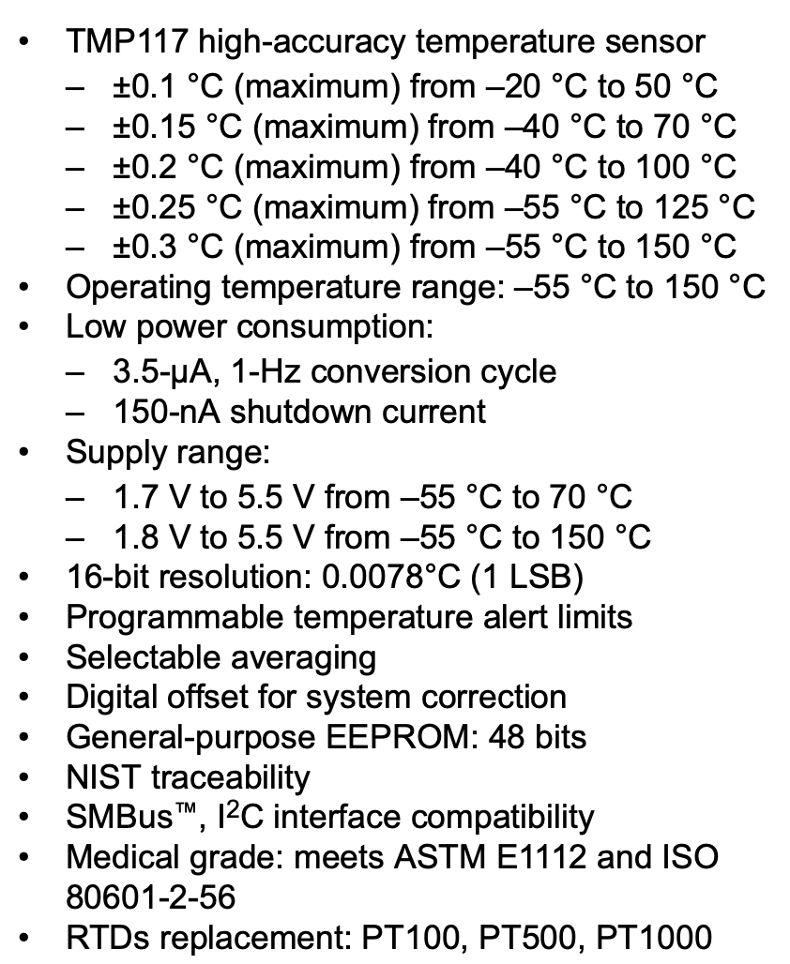
Texas Instruments TMP117^{[3]} - Backup Temperature Sensor
Overview Design Solution CPEs Requirements Satisfaction Risks Verification & Validation Project Planning References Backup

Slide 82
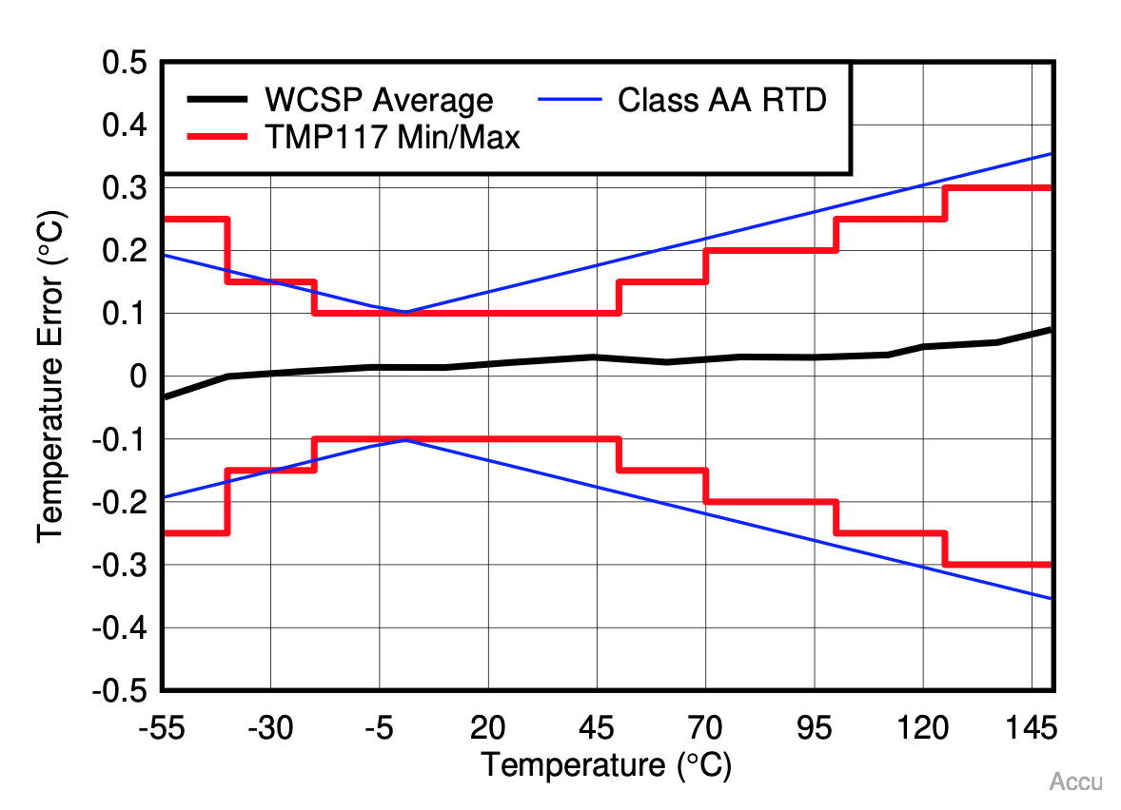
Temperature Sensor Accuracy Comparison
Sensor | Range (°C) | Accuracy (°C) | Compatibility
TI TMP117^{[3]} | -55 to 150 | 0.1 from -20 to 50 | 1.8 to 5.5V, Digital I2C-SMB Signal
Smartec SMT172^{[4]} | -45 to 130 | 0.1 from -20 to 60 | 2.7 to 5.5V, Digital PWM Signal
TMP117 Accuracy^{[3]}
SMT172 Accuracy^{[4]}
Overview Design Solution CPEs Requirements Satisfaction Risks Verification & Validation Project Planning References Backup

Slide 83
CAD Housing Unit
Overview Design Solution CPEs Requirements Satisfaction Risks Verification & Validation Project Planning References Backup

Slide 84
CAD Electronics Compartment
Overview Design Solution CPEs Requirements Satisfaction Risks Verification & Validation Project Planning References Backup

Slide 85
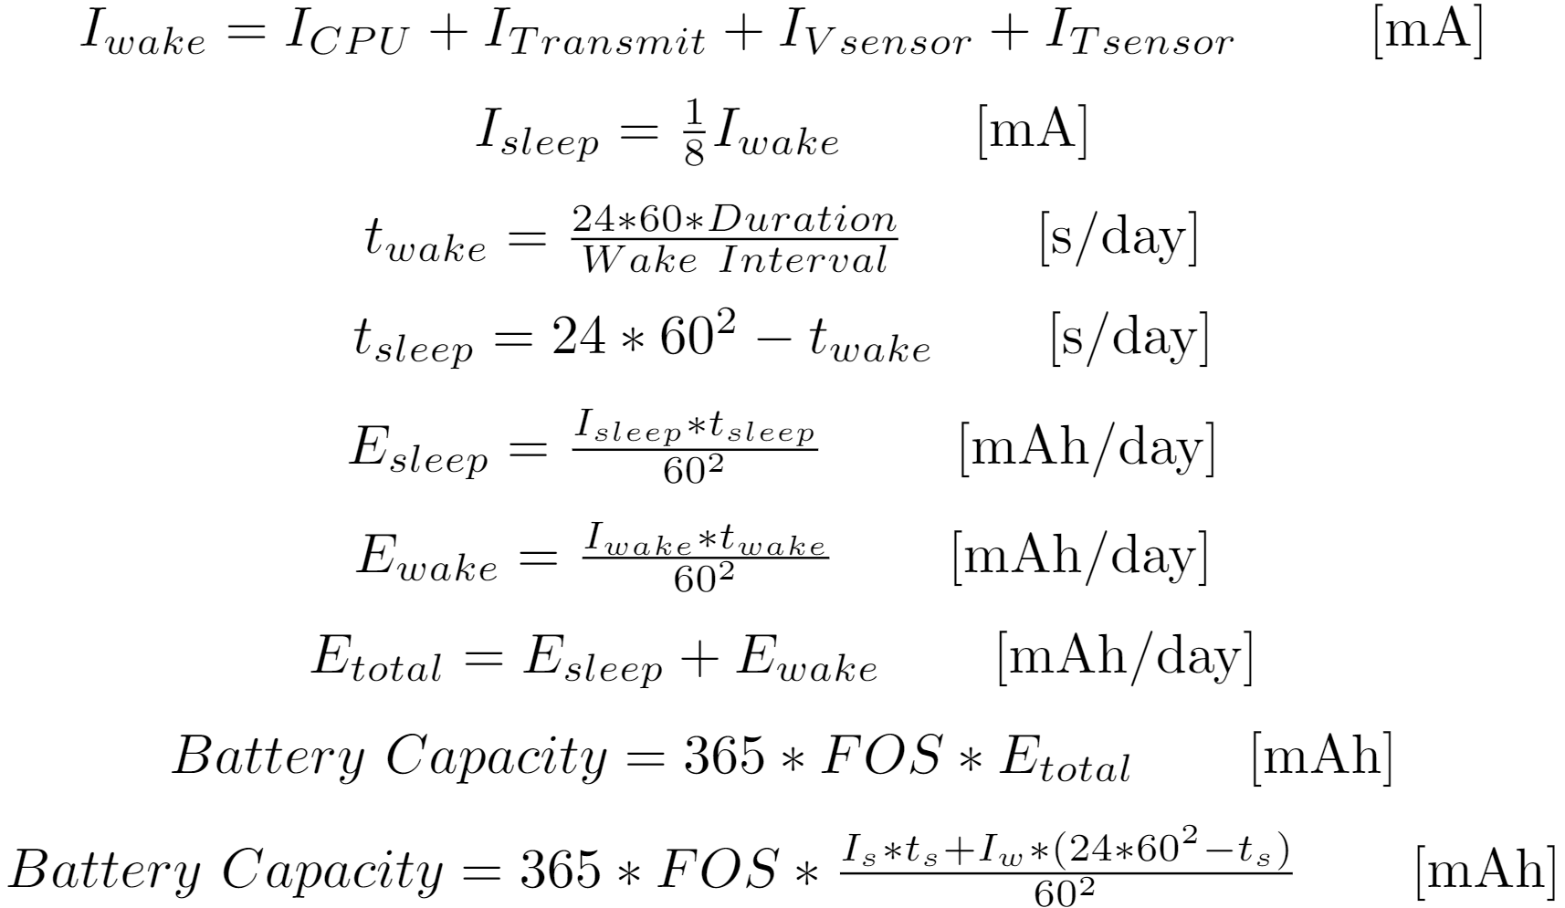
DR 6.1 Satisfaction - Current Draw Derivation
Overview Design Solution CPEs Requirements Satisfaction Risks Verification & Validation Project Planning References Backup

Slide 86
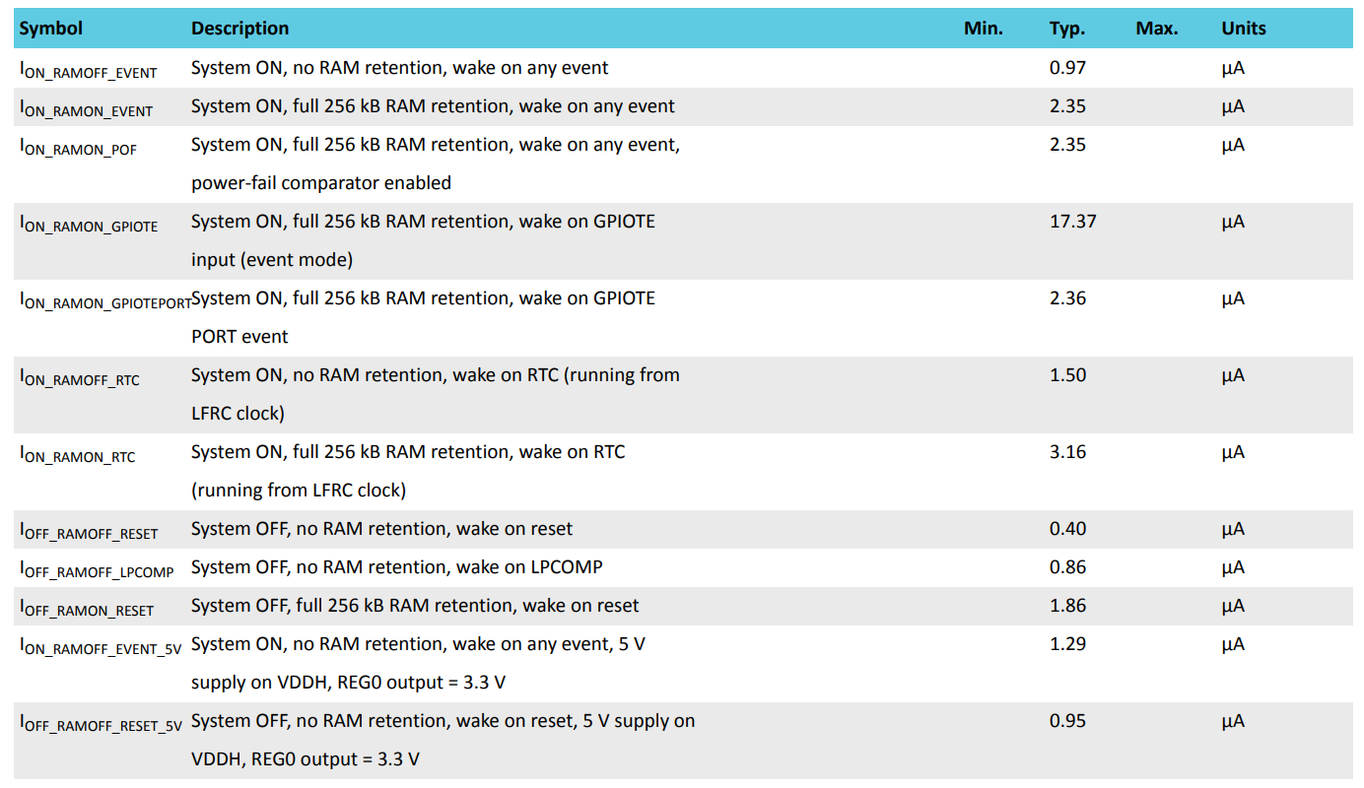
DR 6.1 Satisfaction - Detailed Current Estimates
Overview Design Solution CPEs Requirements Satisfaction Risks Verification & Validation Project Planning References Backup

Slide 87
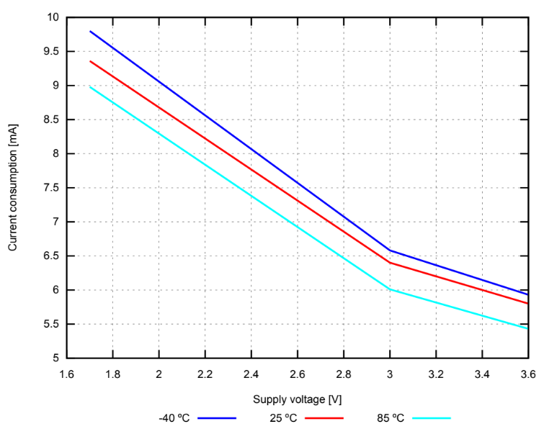
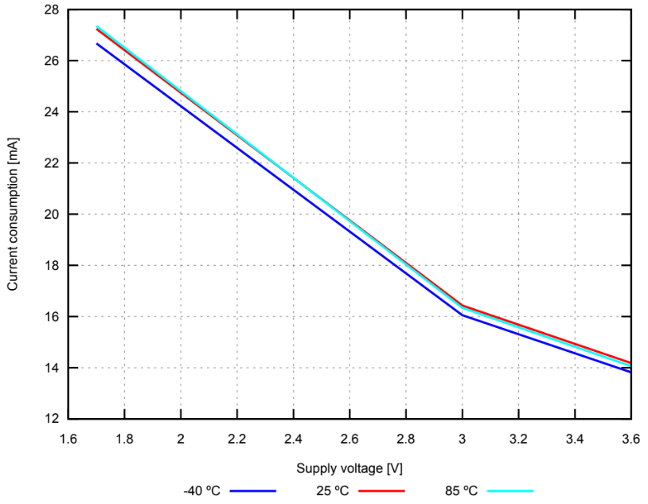
DR 6.1 Satisfaction - Detailed Current Estimates
Overview Design Solution CPEs Requirements Satisfaction Risks Verification & Validation Project Planning References Backup

Slide 88
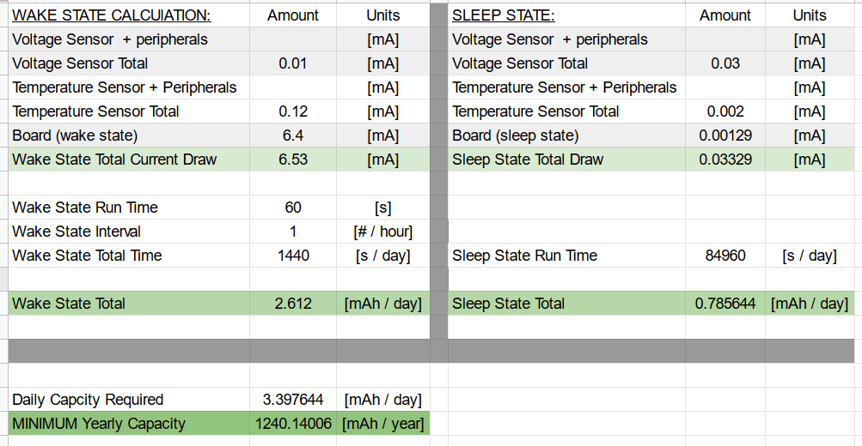
DR 6.1 Satisfaction - Detailed Current Draw Estimates
Overview Design Solution CPEs Requirements Satisfaction Risks Verification & Validation Project Planning References Backup

Slide 89
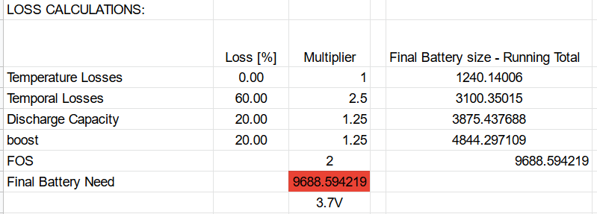
DR 6.1 Satisfaction - Detailed Current Loss Estimates
Overview Design Solution CPEs Requirements Satisfaction Risks Verification & Validation Project Planning References Backup

Slide 90
DR 6.1 Satisfaction - Reconsidering Options - NiMH, Li-ion
NiMH
large ‘memory effect’, limited reusability
Li-ion
Marginally Safer, Higher Capacity Per Volume
NiMH will not be considered
Li-ion will be considered alongside Lipo
Overview Design Solution CPEs Requirements Satisfaction Risks Verification & Validation Project Planning References Backup
Overview Design Solution CPEs Requirements Satisfaction Risks Verification & Validation Project Planning References Backup

Slide 91
DR 6.1 Satisfaction - COTS Choice
 | Battery #1 (LiPo) | Battery #2 (LiPo) | Battery #3 (Li-ion) | Battery #4 (Li-ion)
Cell Capacity [mAh] | 3,700mAh | 10,000mAh | 2000mAh | 3000mAh
Dimensions [in] | 1.3 x 3.8 x 0.4 | 4.4 x 2.6 x 0.3 | 1.34 x 0.63d | 2.8 x 0.7d
Energy [mAh / in³] Density | 1,872 | 2,900 | 1,188 | 728
Meets Requirements (Temp, Size, C rate) | ✔️ | ✔️ | ✔️ | ✔️
Available From | Amazon | Makerfocus, Amazon | Amazon | Amazon
Cost per unit | $61 / (4 pc) | $30 / (1 pc) | $30 / (4 pc) | $34 / (2 pc)
Total Purchase Cost (1 full system) | $122 | $60 | $60 | $136
Overview Design Solution CPEs Requirements Satisfaction Risks Verification & Validation Project Planning References Backup

Slide 92
Thermal Analysis Requirements
DR 2.1 | Temperature sensor shall have a range of at least 0-20ºC
DR 2.3 | Temperature sensor shall measure the temperature of the battery environment
DR 3.3 | Alert shall be generated when temperature exceeds 20ºC
With our system operating in the environment of the battery, it cannot generate enough heat to send the system outside of its measurable range. So, the heat generated by SBMS must have a small effect on the temperature of the battery environment to satisfy the three design requirements above.
Overview Design Solution CPEs Requirements Satisfaction Risks Verification & Validation Project Planning References Backup

Slide 93
Thermal Circuit
Temperature Sensor (8)
Temperature Sensor (8)
Air
(5)
Air
(7)
Wall
(1)
Nordic
(2)
Wall
(1)
Wall
(1)
Connector
(3)
PCB
(4)
Battery
(6)
Battery
(6)
Overview Design Solution CPEs Requirements Satisfaction Risks Verification & Validation Project Planning References Backup

Slide 94
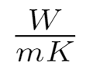
Thermal Analysis Setup
Part | Thermal Conductivity [ ] | Area [mm²] | Length [mm]
Wall (1) | k_{ABS} = 0.2^{[9]} | 6667.5 | 5
Nordic Dongle (2) | k_{CU} = 386^{[7]} | 771.843 | 2.388
Connector (3) | k_{CU} = 386^{[7]} | 30.03 | 5
PCB (4) | k_{CU} = 386^{[7]} | 2510.64 | 2.30
Air Cavity (5) | k_{Air} = 0.025^{[6]} | 6667.5 | 16.8
Battery (6) | k_{LiPo} = 0.43^{[10]} | 6000 | 11
Air Cavity (7) | k_{Air} = 0.025^{[6]} | 6667.5 | 25.6
Temperature Sensor (8) | k_{Si} = 148^{[8]} | 3.927 | 5
Overview Design Solution CPEs Requirements Satisfaction Risks Verification & Validation Project Planning References Backup

Slide 95
Thermal Analysis Calculations & Results
Individual Resistances:
Total Resistance:
R_{tot} = 0.004299
Temperature Increase = ~0.142℃
R₁ | R₂ | R₃ | R₄ | R₅ | R₆ | R₇ | R₈
3.745 | 0.00799 | 0.431 | 0.00246 | 100.787 | 47.636 | 153.581 | 0.00860
Overview Design Solution CPEs Requirements Satisfaction Risks Verification & Validation Project Planning References Backup

Slide 96
Signal Interference Requirements
DR 5.2 | System shall send/receive voltage measurements to on-site system wirelessly
DR 5.3 | System shall send/receive temperature measurements to on-site system wirelessly
With multiple systems operating in one room, the signals sent from each system must be differentiable to satisfy the two design requirements above.
Overview Design Solution CPEs Requirements Satisfaction Risks Verification & Validation Project Planning References Backup

Slide 97
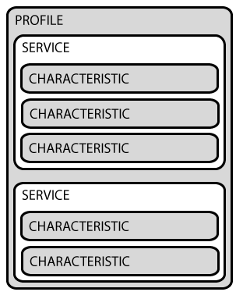
Signal Interference UUID Code
Data Packet Format
GATT^{[11]}
Service
Characteristic ***
UUID Pseudorandom Code
Unique
Value
Overview Design Solution CPEs Requirements Satisfaction Risks Verification & Validation Project Planning References Backup

Slide 98
Reading Sensor Input and Transmitting it
DR 1.4 | System shall measure DC voltage
DR 5.2 | System shall send/receive voltage measurements to on-site system wirelessly
Process
Used AnalogDiscovery2 to generate a square wave
Used the GPIO pin on NRF52840 to take in the analog signal
Used the onboard SAADC (successive approximation analog to digital converter) peripheral to convert the analog signal to a digital signal
The discrete digital values were written to a characteristic
The characteristic was subscribed to using the NRF connect app, and the values were compared with the expected values of the analog signal
Process Satisfies requisite Design Requirements
Overview Design Solution CPEs Requirements Satisfaction Risks Verification & Validation Project Planning References Backup

Slide 99
Saving Data
DR 7.1 | System shall save raw data
DR 7.1.1 | System shall save specific voltage and temperature values, so long as requirement 7.1 is met
DR 7.3 | Data shall be presented in a .txt file
Process
nRF52840 USB CDC ACM^{[30]} module capable of outputting data to the customer PC serial port
Python pySerial^{[31]} module capable of receiving serial port output as data
Python capable of generating timestamp and writing text file
Process Satisfies requisite Design Requirements
Overview Design Solution CPEs Requirements Satisfaction Risks Verification & Validation Project Planning References Backup

Slide 100
Generating Alerts
DR 3.1 | Alert shall be generated when voltage exceeds 33.6V
DR 3.2 | Alert shall be generated when voltage drops below 20V
DR 3.3 | Alert shall be generated when temperature exceeds 20ºC
DR 3.4 | Alert shall be generated when temperature drops below 0ºC
Process
Conditional Statement to determine if alert needs to be generated
Python has Simple Mail Transfer Protocol (SMTP)^{[32]} functionality
Capable of sending alert email to designated recipients
Process satisfies requisite Design Requirements
Overview Design Solution CPEs Requirements Satisfaction Risks Verification & Validation Project Planning References Backup

Slide 101
GUI Requirements
DR 7.2 | Data shall be sent once an hour by default configuration
DR 7.2.1 | System shall have a configurable transmission frequency option
DR 7.2.1.1 | A user interface shall be made to input configuration changes
Our team will create a GUI for the customer to input transmission frequencies into to satisfy the three design requirements above.
Overview Design Solution CPEs Requirements Satisfaction Risks Verification & Validation Project Planning References Backup

Slide 102
GUI Creation and Layout
HTML
Simple graphics
Implementation of alert system
Live feed of measurements
Temp Low
Temp High
Volt Low
Volt High
Duration
Email
Overview Design Solution CPEs Requirements Satisfaction Risks Verification & Validation Project Planning References Backup

Slide 103
Battery Selection
DR 4.1 | System shall survive dry nitrogen purging at room temperature and a pressure of 2psi
DR 4.2 | System shall remain intact during vacuum and heat sealing process
DR 6.1 | External battery shall operate for one year without charging
Selected Battery: 10Ah makerfocus lipo battery
Battery has required capacity for one year of continuous operation
Battery is durable which makes it more likely to survive the sealing/bagging process
Overview Design Solution CPEs Requirements Satisfaction Risks Verification & Validation Project Planning References Backup

Slide 104
Processor Selection
Chosen Processor | Idle Power Consumption | Cost | RAM | BLE Compatible?
nRF52840^{[5]} | 1.5 μA | $10-13 | 256 KB | Yes
Overview Design Solution CPEs Requirements Satisfaction Risks Verification & Validation Project Planning References Backup

Slide 105
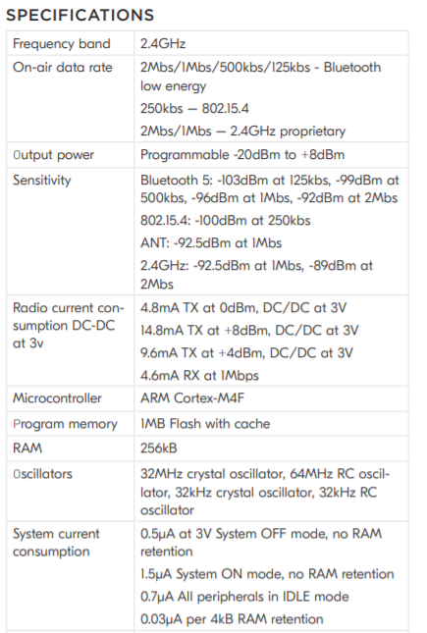
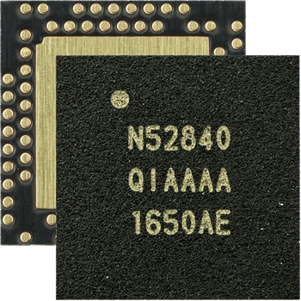
nRF52840^{[5]}
Link to datasheet
Overview Design Solution CPEs Requirements Satisfaction Risks Verification & Validation Project Planning References Backup

Slide 106
Risk Mitigation Table
Risk ID | Risk | Mitigation Strategy | Outcome
1 | NRF development board backordered | Order ASAP and use existing hardware owned by team members | Debugging can be done early on with existing hardware, allowing the system to be tested before additional boards arrive, so design requirements can be met with confidence
2 | EnerSys Temperature chamber cannot be used | Rent temperature chamber from Espec for nearly $1,000 | Major increase in project budget, but temperature range can be verified
3 | Wireless communication with on-site system fails due to an obstruction | Store data to flash memory of in-box controller until communication is possible; increase signal power to blast through obstruction | The voltage and temperature measurements are still accounted for and will be received once communication with on-site system is reestablished
4 | External battery has lower capacity than stated by manufacturer/system raws more power than expected | Test battery before integration to ensure that discharge curve is as expected, include safety factor of 2, include a backup battery | Battery will only be implemented if it has expected capacity, large safety factor ensures that there is more power than needed if it is lower than expected, second battery ensures backup if one fails
5 | Unable to interface with customer computer due to computer state | Ensure computer is constantly plugged in/charging and that sleep mode has been disabled | Customer computer will not be able to enter power saving sleep mode, but will successfully receive data
6 | Temperature sensor backordered | Have a backup chip (TMP117) | System will be able to measure temperature, but our team will have to port an arduino library to the nrf hardware which will require additional coding
Overview Design Solution CPEs Requirements Satisfaction Risks Verification & Validation Project Planning References Backup

Slide 107
Risk Matrix Mitigation Summary
Almost Certain
Highly Likely | 2 | 2 |  |  | 5
Likely | 6 |  |  |  | 6 4
Low Likelihood | 1 3 |  |  | 1 | 3
Extremely Improbable | 4 |  |  |  | 5
 | Minimal | Minor | Major | Serious | Catastrophic
Key
NRF development board backordered
EnerSys temp chamber unusable
Wireless communication failure
External battery failure
Computer interface failure
Temp sensor backordered
Likelihood
Severity
Overview Design Solution CPEs Requirements Satisfaction Risks Verification & Validation Project Planning References Backup

