Slide 1


SBMS
Stored Battery Monitoring System
Preliminary Design Review
October 18th, 2021
ASEN 4018-012 Team 6
Customer:
EnerSys ABSL
Presenters:
Richard Folsom, Ben Gavin, Joseph Harrell, Jamie Henault, Shreeyash Nadella, Nathan Zhao
Additional Team Members:
Ian Adler, Devin Geegan, Evan Meany

Slide 2
Presentation Outline
Project Description (Nathan)
Evidence of Baseline Feasibility
  Communication Signal & Processor Feasibility (Shreeyash)
  Power Source Feasibility (Joseph)
  Voltage Sensor Feasibility (Jamie)
  Temperature Sensor Feasibility (Ben)
  Financial Feasibility (Richard)
Status Summary & Remaining Studies (Richard)
Presentation Outline Project Description Feasibility Analysis Status Summary & Remaining Studies References & Backup

Slide 3
Project Description

Slide 4
Project Motivation
EnerSys ABSL batteries
  Storage
  Health Deterioration
Quality checks
  Bagging Process
  Time-consuming
Task: SBMS
  Wireless Monitoring System
  Report on battery and environment health
Presentation Outline Project Description Feasibility Analysis Status Summary & Remaining Studies References & Backup

Slide 5
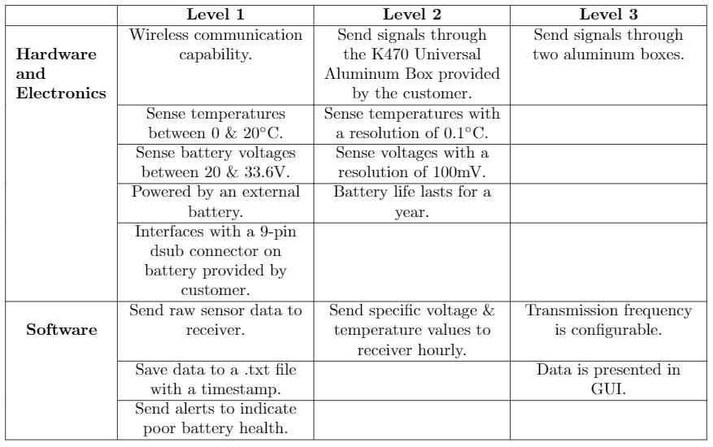
Project Objectives
Presentation Outline Project Description Feasibility Analysis Status Summary & Remaining Studies References & Backup

Slide 6
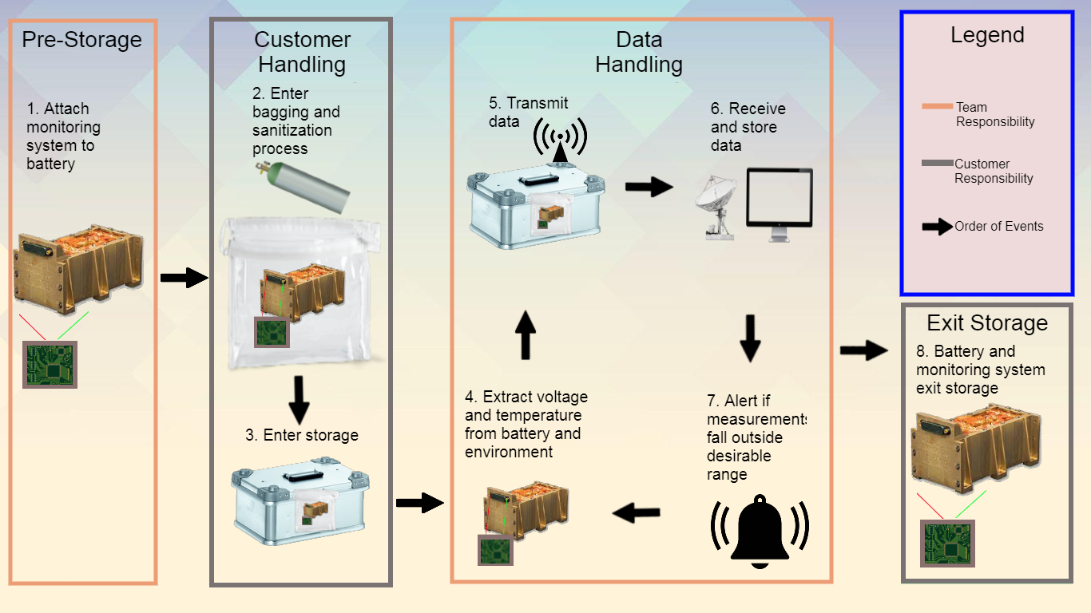
Concept of Operations (CONOPS)
Presentation Outline Project Description Feasibility Analysis Status Summary & Remaining Studies References & Backup

Slide 7
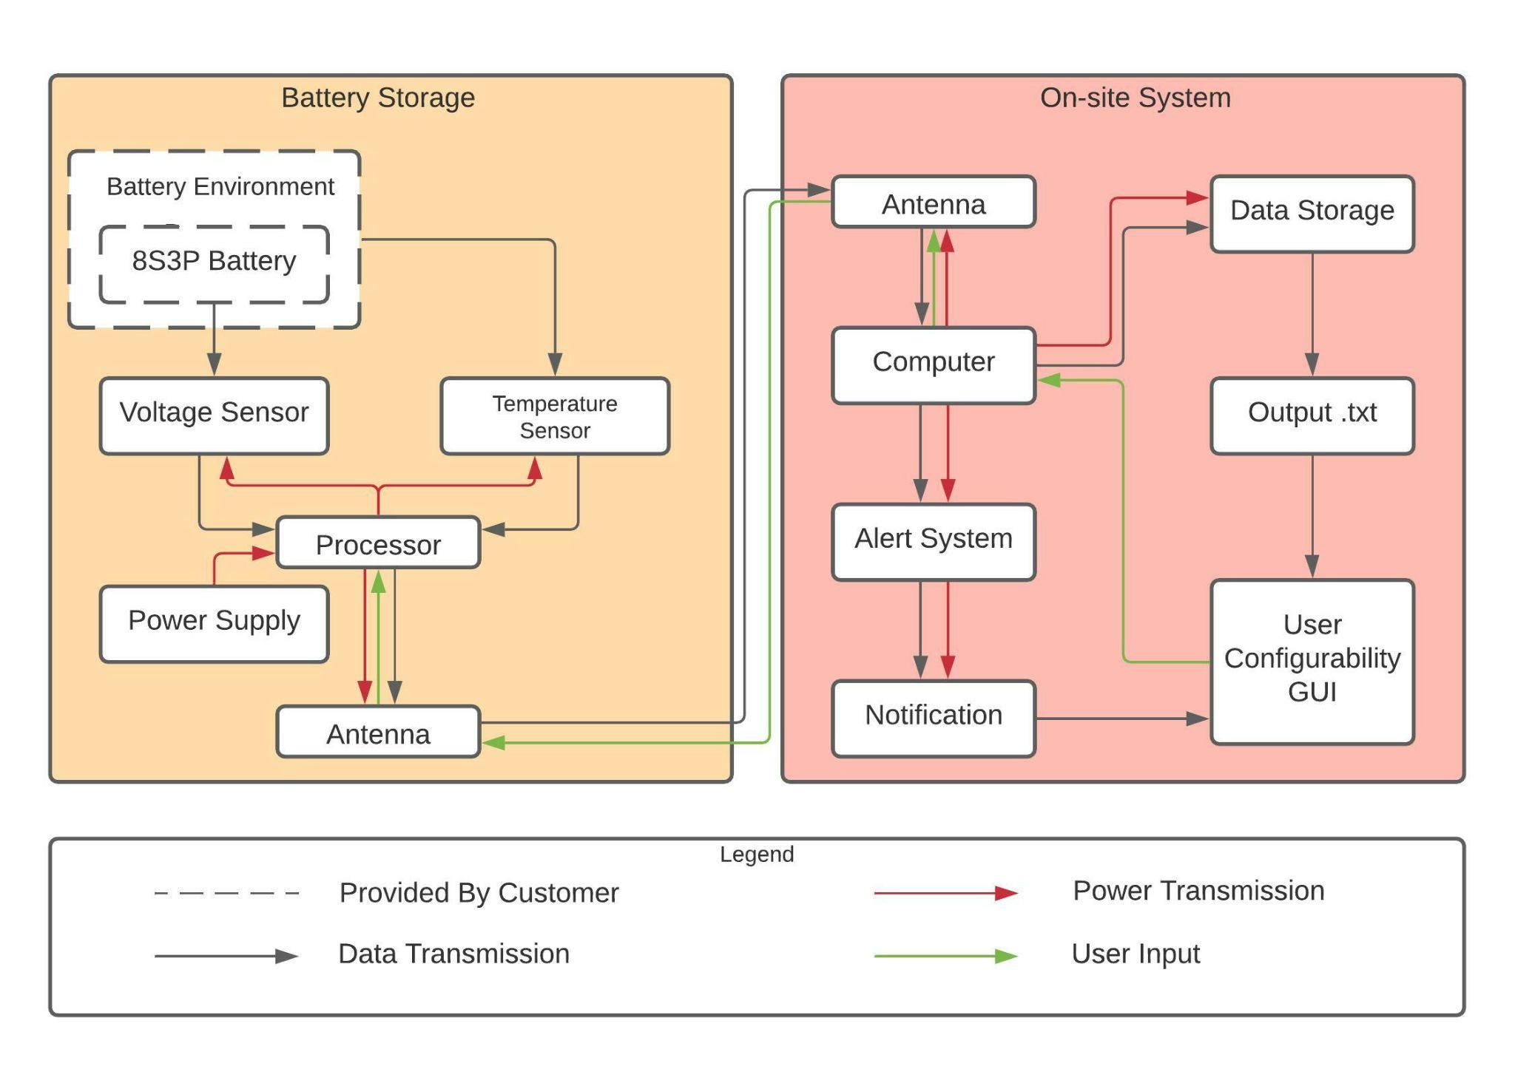
Functional Block Diagram (FBD)
Presentation Outline Project Description Feasibility Analysis Status Summary & Remaining Studies References & Backup

Slide 8
System Critical Project Elements
CPE1
Sensing Hardware
Temperature and voltage sensors
Means to transmit data wirelessly
CPE2
Wireless Communication Hardware
Software to command data transfer
CPE3
Wireless Communication Software
Interface correctly between components and customer’s
battery
CPE4
System Integration
Operate off an external power source
CPE5
Power Source
Tested/validated to ensure function
CPE6
Testing and Validation
Presentation Outline Project Description Feasibility Analysis Status Summary & Remaining Studies References & Backup

Slide 9
System Functional Requirements
Measure voltage
FR1
Voltage Sensing
Measure temperature
FR2
Temperature Sensing
Communicate when voltage and/or temperature
reach an undesirable state
FR3
Alerts
Continue operation after sanitization and
bagging process performed by customer
FR4
Sustainability
Transmit and receive data wirelessly
FR5
Wireless Capability
Be battery-powered
FR6
Operations
Receive data with a timestamp
FR7
Tracking
Presentation Outline Project Description Feasibility Analysis Status Summary & Remaining Studies References & Backup

Slide 10
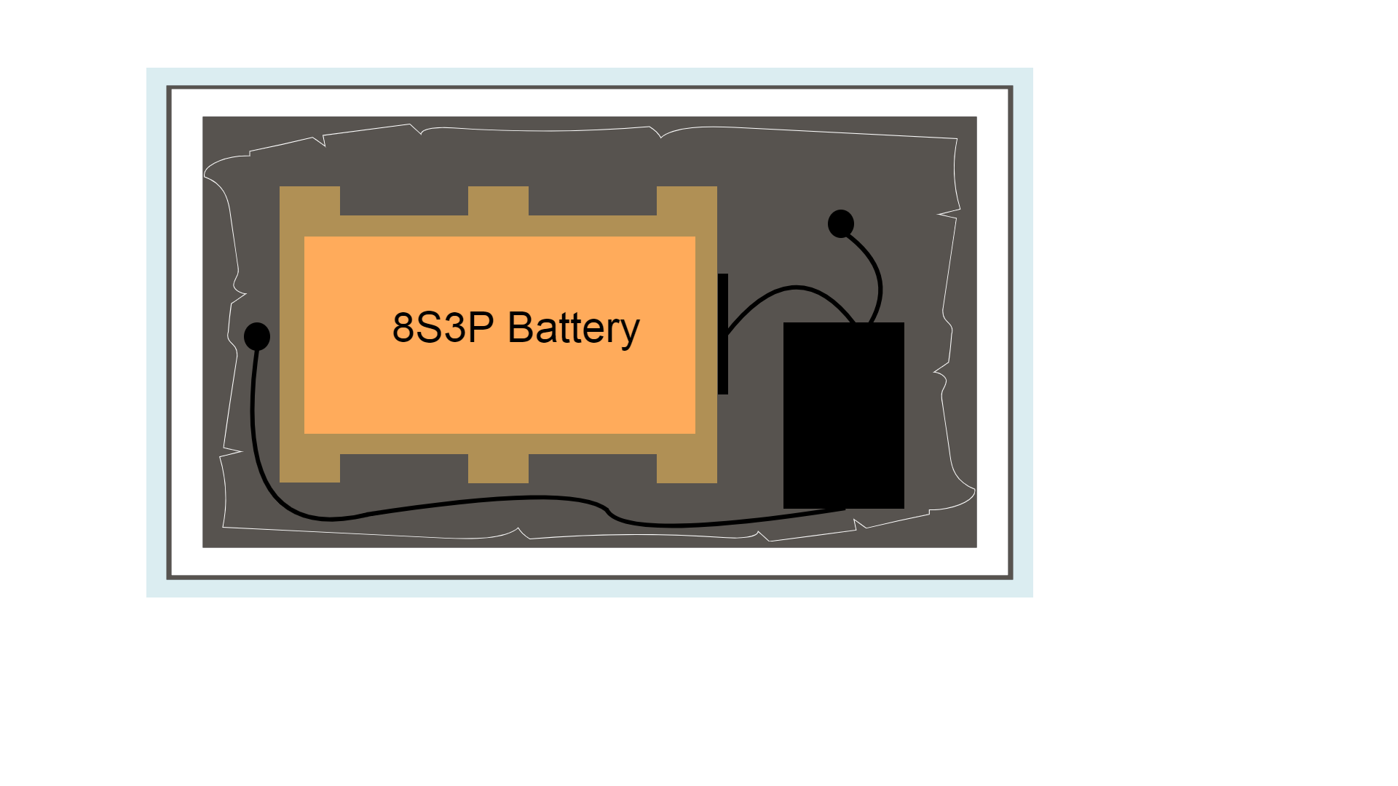
Baseline Design (Storage)
K470 Zarges Box
Silicon IC Temperature Sensor
Silicon IC Temperature Sensor
Styrofoam Layer
Monitoring System
Heat/Vacuum Sealed Bag
Presentation Outline Project Description Feasibility Analysis Status Summary & Remaining Studies References & Backup

Slide 11
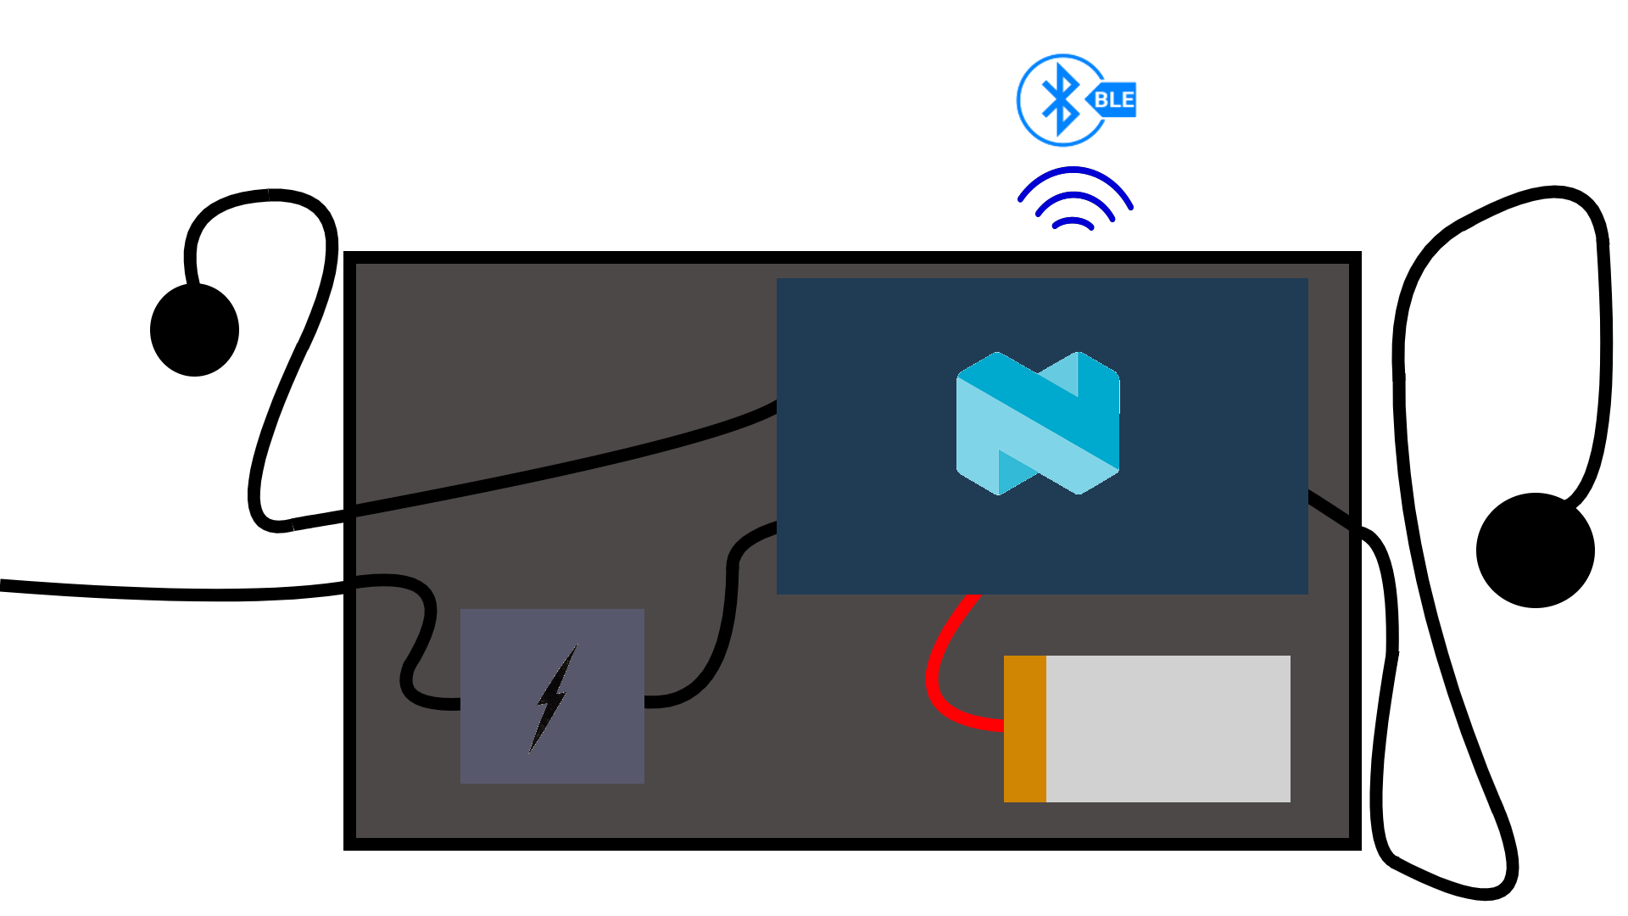
Baseline Design (Monitoring System)
Nordic Semiconductor Processor
Bluetooth Low Energy
Silicon IC Temperature Sensor
Voltage from Battery
Active Voltage Sensor
Silicon IC Temperature Sensor
Lithium Polymer Battery
Presentation Outline Project Description Feasibility Analysis Status Summary & Remaining Studies References & Backup

Slide 12
Feasibility:
Communication Signal
& Processor

Slide 13
Communication: Reasoning & Approach
Required by customer → Communication Signal must be analysed for feasibility
Feasibility assessed by chip’s range and ability to send information
Low power consumption
Metric | Description | CPE | Requirement
Signal Strength | The wireless signal shall be received at least 3 ft outside of an aluminum box. | 2,3 | 5.4, 5.5
Data Transfer Accuracy | Temperature and voltage data shall be transmitted wirelessly. | 2,3 | 5.2, 5.3
Power Consumption | The SBMS shall operate for one year. | 3 | 6.1
Presentation Outline Project Description Feasibility Analysis Status Summary & Remaining Studies References & Backup

Slide 14
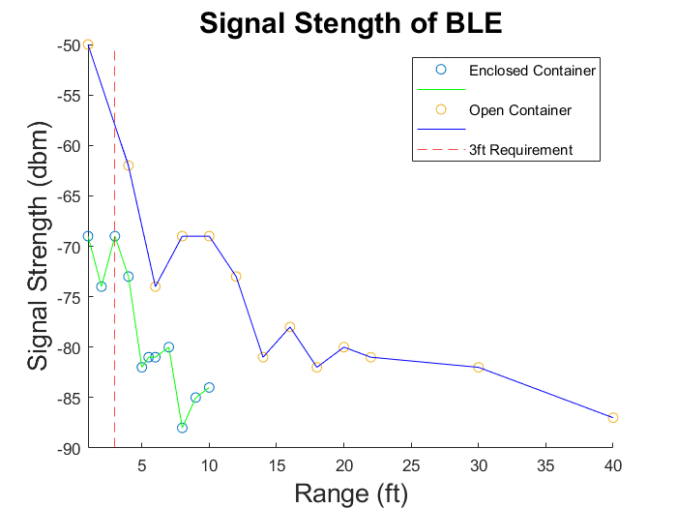
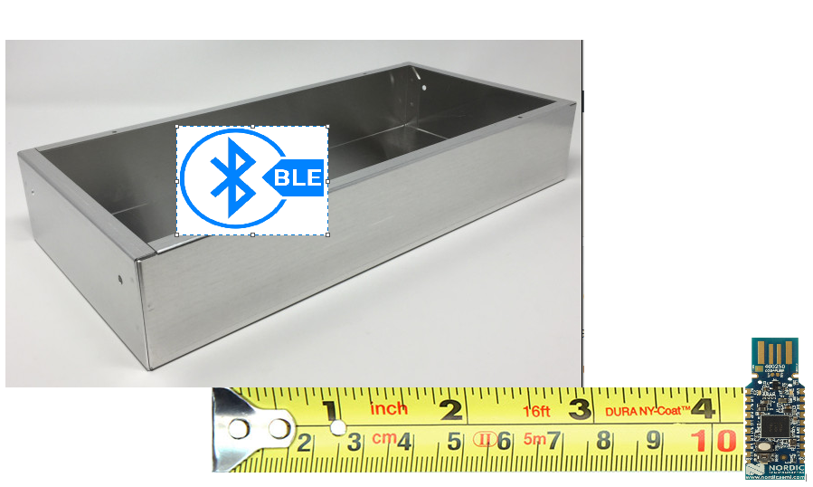
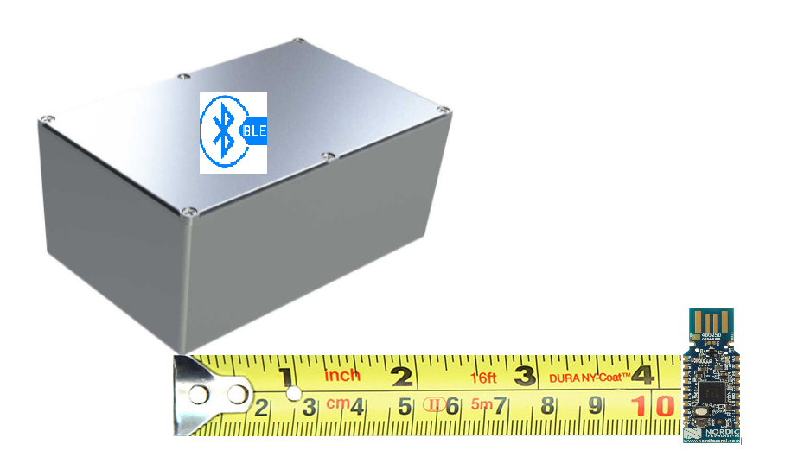
BLE Signal Strength Experiment
Nordic Semiconductor BLE scanned BLE beacon:
  Inside enclosed metal container
  Inside open metal container
Experimental Setup with open metal container and enclosed metal container ^{[15][17][18][19]}
Presentation Outline Project Description Feasibility Analysis Status Summary & Remaining Studies References & Backup

Slide 15
Candidate Processors
Processor | Idle Power Consumption | Cost | RAM | BLE Compatible?
nRF52840^{[15]} | 1.5 uA | $10-13 | 256 KB | Yes
nRF5340^{[14]} | 1.7 uA | $7-10 | 512 KB | Yes
nRF52805^{[16]} | 1.1 uA | $2-4 | 24 KB | Yes
Presentation Outline Project Description Feasibility Analysis Status Summary & Remaining Studies References & Backup

Slide 16
Main Takeaways
BLE is feasible within range requirements
The processors are feasible within cost, power, and BLE constraints
Presentation Outline Project Description Feasibility Analysis Status Summary & Remaining Studies References & Backup

Slide 17
Feasibility:
External Power Source

Slide 18
Design Requirements: External Power Source
Battery must satisfy DR 6.1
Feasibility proven by estimating required battery capacity
Metric | Description | CPE | Requirement
Battery Capacity | External battery shall operate for one year without charging | 5 | 6.1
Presentation Outline Project Description Feasibility Analysis Status Summary & Remaining Studies References & Backup

Slide 19
Estimated Required Battery Capacity
Processor Wake (I_{P}) | Processor Sleep (I_{s}) | Communications (I_{C} ) | Voltage Sensors (I_{V}) | Temperature Sensors (I_{T}) | Wake Time (t_{w}) | Factor of Safety
541 μA^{[6]} | 67.7 μA | Included in I_{P} | 400 μA^{[2],[5],[11]} | 20 μA^{[10]} | 60 s | 2
Required Battery Capacity | 2.36 Ah
Presentation Outline Project Description Feasibility Analysis Status Summary & Remaining Studies References & Backup

Slide 20
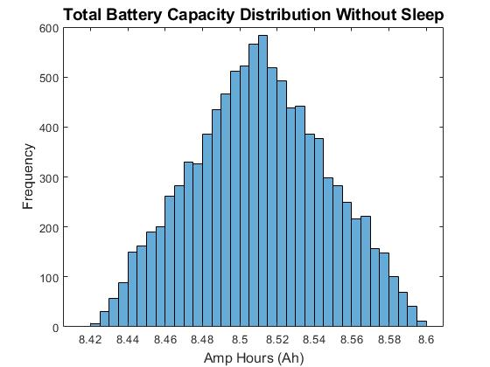
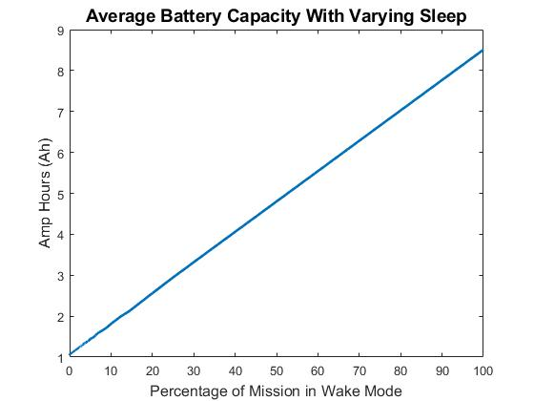
Power Draw Simulation
Monte Carlo of extreme scenario
Sizing ratio for wake to sleep mode
Presentation Outline Project Description Feasibility Analysis Status Summary & Remaining Studies References & Backup

Slide 21
Feasibility: External Power Source
External Power Source is feasible
  COTS LiPo batteries exist that satisfy this requirement
  Power systems are ~$60
Battery Examples | Battery Capacity | Dimensions
Zeee 8000mAh 11.1V 100C 3S RC^{[7]} | 8 Ah | 5.43 x 1.85 x 1.41 in
Youme Lipo 4S Battery^{[8]} | 3 Ah | 5.35 x 1.77 x 1.26 in
Ryobi 18-Volt ONE+^{[9]} | 1.5 Ah | 5.32 x 3.12 x 3.42 in
Presentation Outline Project Description Feasibility Analysis Status Summary & Remaining Studies References & Backup

Slide 22
Feasibility:
Voltage Sensor

Slide 23
Voltage Sensor: Reasoning & Approach
Voltage measurement critical in understanding the health of the battery
Feasibility assessed by sensor’s ability to accurately measure a specific range of DC input voltages
Metric | Description | CPE | Requirement
Range | Voltage sensor shall have a range of at least 20-33.6V. | 1 | 1.1
Accuracy | Voltage sensor shall have a sensitivity of at least 0.1V. | 1 | 1.2
Compatibility | Voltage sensor shall measure DC voltage. | 1, 4 | 1.4
Presentation Outline Project Description Feasibility Analysis Status Summary & Remaining Studies References & Backup

Slide 24
Possible Sensors
Sensor | Voltage Relative Error | Voltage Range
Adafruit INA260 Voltage Sensor^{[1]} | ±1% | 0 to 36V
DFRobot Gravity: I2C Digital Wattmeter^{[2]} | ±0.2% | 0 to 26V
Team Concept Design RK73G2ATTD2002C Resistor (R1)^{[3]} RK73G2ATTD4701C Resistor (R2)^{[4]} OPA2205 Buffer^{[5]} | ±0.25% tolerance ±0.25% tolerance ±15μV (max) input offset voltage | V_{max} = 50V V_{max} = 24.24V V_{s,min}= 4.5V, V_{s,max}= 36V, -7 to 7V recommended
Presentation Outline Project Description Feasibility Analysis Status Summary & Remaining Studies References & Backup

Slide 25

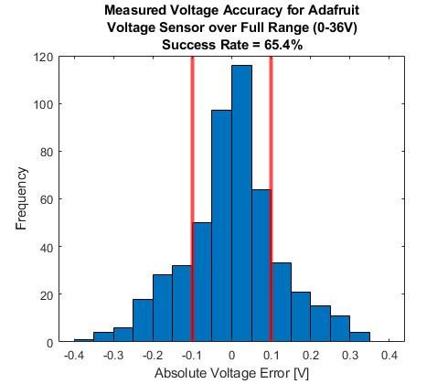
Measured Voltage Accuracy for Adafruit
Monte Carlo Simulation
Actual Voltage (V_{A})
  Random value from 0 to 36V
Percent Error (E)
  Random value from -1% to +1%
Absolute Voltage Error (V_{E})
  V_{E} = V_{A}*E
Presentation Outline Project Description Feasibility Analysis Status Summary & Remaining Studies References & Backup

Slide 26
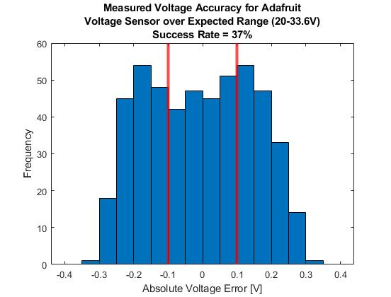
Measured Voltage Accuracy for Adafruit Continued
Updated Monte Carlo Simulation
Actual Voltage (V_{A})
  Random value from 20 to 33.6V
Absolute voltage error increases with increasing voltage
Presentation Outline Project Description Feasibility Analysis Status Summary & Remaining Studies References & Backup

Slide 27
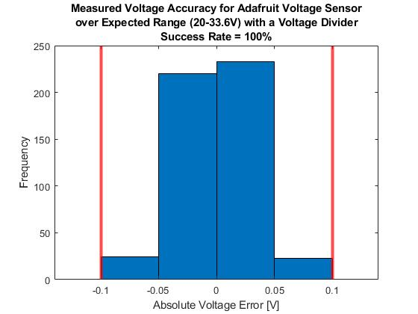
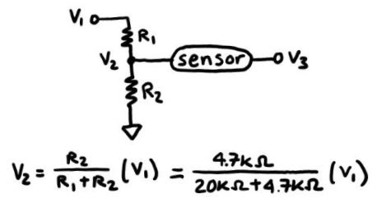
Measured Voltage Accuracy for Adafruit Continued
Updated Monte Carlo Simulation
Voltage Divider Addition
  Brings sensor input voltage down from 20-33.6V to about 3.8-6.4V
Presentation Outline Project Description Feasibility Analysis Status Summary & Remaining Studies References & Backup

Slide 28
Main Takeaways
Performed same analysis for remaining sensors
All three sensors are feasible options
  Adafruit Voltage Sensor
    Measures DC voltage
    Needs voltage divider to meet accuracy requirement
  DFRobot Voltage Sensor
    Measures DC voltage
    Needs voltage divider to meet range requirement
  Team Concept Design
    Measures DC voltage
    High precision components allow for all requirements to be met
Presentation Outline Project Description Feasibility Analysis Status Summary & Remaining Studies References & Backup

Slide 29
Feasibility:
Temperature Sensor

Slide 30
Temperature Sensor Reasoning & Approach
Required by customer → Sensor must be analyzed for feasibility
Feasibility assessed by range, accuracy & ability to send data to a processor
Metric | Description | CPE | Requirement
Range | Sensor must be accurate within 0-20°C range. | 1 | 2.1
Accuracy | Sensor must have an accuracy of 0.1°C. | 1 | 2.2
Compatibility | Sensor must interface with processor. | 1, 4 | 2.3
Presentation Outline Project Description Feasibility Analysis Status Summary & Remaining Studies References & Backup

Slide 31
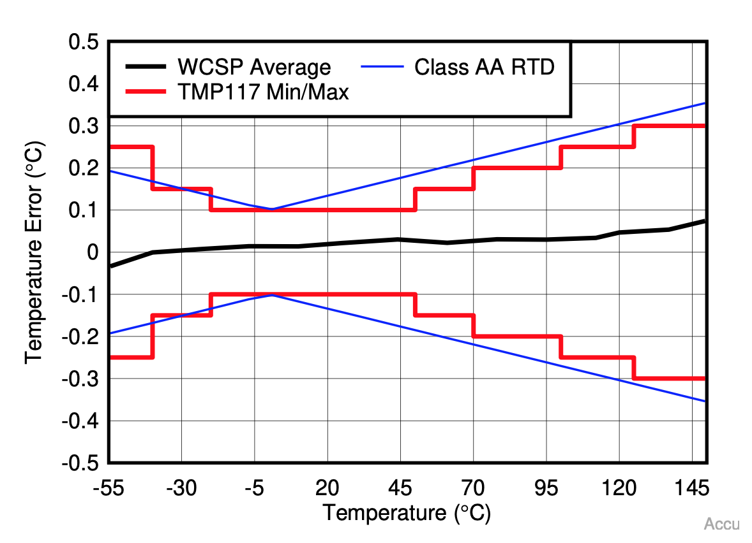
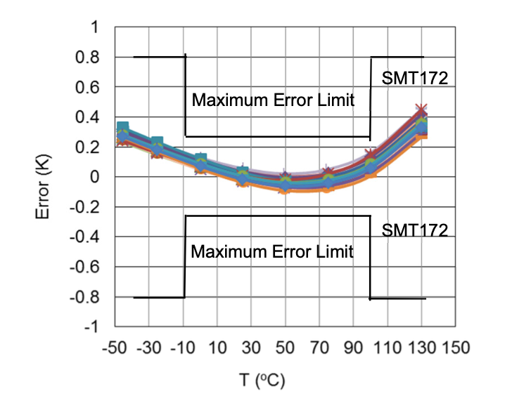
Possible Temperature Sensors
Sensor | Range (°C) | Accuracy (°C) | Compatibility
TI TMP117^{[12]} | -55 to 150 | 0.1 from -20 to 50 | 1.8 to 5.5V, Digital I2C-SMB Signal
Smartec SMT172^{[13]} | -45 to 130 | 0.1 from -20 to 60 | 2.7 to 5.5V, Digital PWM Signal
TMP117 Accuracy^{[12]}
SMT172 Accuracy^{[13]}
Presentation Outline Project Description Feasibility Analysis Status Summary & Remaining Studies References & Backup

Slide 32
Main Takeaways
Feasible within course duration & team skills.
Feasible within facilities.
Feasible within project budget.
COTS sensors meet design requirements & easily interface with a microcontroller.
Presentation Outline Project Description Feasibility Analysis Status Summary & Remaining Studies References & Backup

Slide 33
Feasibility:
Financial

Slide 34
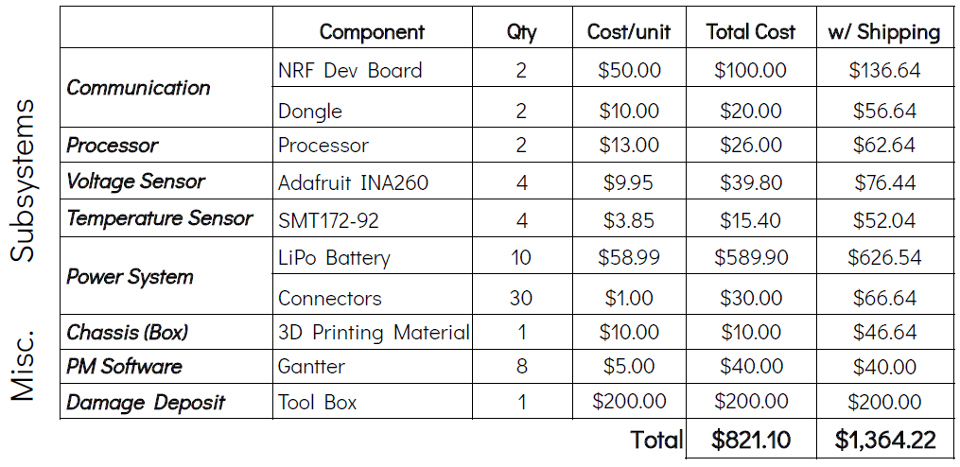

Budget Estimates for Financial Feasibility
[15]
[15]
[15]
[1]
[13]
[8]
[8]
[20]
Presentation Outline Project Description Feasibility Analysis Status Summary & Remaining Studies References & Backup

Slide 35
Status Summary &
Remaining Work

Slide 36
Status Summary
 | Feasibility Proven?
Communication Signal | 🗸
Processor | 🗸
Power System | 🗸
Voltage Sensor | 🗸
Temperature Sensor | 🗸
Financial | 🗸
Presentation Outline Project Description Feasibility Analysis Status Summary & Remaining Studies References & Backup

Slide 37
Remaining Work
Trade studies
  Processor
  LiPo Battery
  Voltage Sensor
  Temperature Sensor
Processor Research
  No built-in sleep mode
  Need to research implementation
Integration Considerations
  Full circuit design w/ sensors
  Wireless transmission of the data
Prototyping
  Chassis Box
  Voltage sensor
  Processor Software
Presentation Outline Project Description Feasibility Analysis Status Summary & Remaining Studies References & Backup

Slide 38
Acknowledgements
EnerSys ABSL Team
Jacqueline Maldonado, Brice Lucero, Travis Mault, Ryan Pritchard
Team Advisor
Dr. Jean Koster
Projects Advisory Board
Dr. Jelliffe Jackson, Dr. Jade Morton, Christopher Roseman,
Dr. Jean Koster, Dr. Melvin Rafi, Professor Matt Rhode
Additional Support
Professor Trudy Schwartz, Professor Bobby Hodgkinson,
Emma Markovich, Colin Claytor
Presentation Outline Project Description Feasibility Analysis Status Summary & Remaining Studies References & Backup

Slide 39
Thank You!
Questions?

Slide 40
References
Siepert, B., “Adafruit INA260 Current + Voltage + Power Sensor Breakout,” Adafruit Learning System. Available: https://cdn-learn.adafruit.com/downloads/pdf/adafruit-ina260-current-voltage-power-sensor-breakout.pdf
“Gravity: I2C Digital Wattmeter,” DFRobot. Available: https://media.digikey.com/pdf/Data%20Sheets/DFRobot%20PDFs/SEN0291_Web.pdf
“RK73G2ATTD2002C,” Digikey Electronics. Available: https://www.digikey.com/en/products/detail/koa-speer-electronics-inc/RK73G2ATTD2002C/13577087
“RK73G2ATTD4701C,” Digikey Electronics. Available: https://www.digikey.com/en/products/detail/koa-speer-electronics-inc/RK73G2ATTD4701C/13576067
“OPA2205 2-µV, 0.04-µV/°C, Low-Power, Super Beta, Bipolar, e-trim™ Op Amp,” Texas Instruments. Available: https://www.ti.com/lit/ds/symlink/opa2205.pdf?HQS=dis-mous-null-mousermode-dsf-pf-null-wwe&ts=1633294801543&ref_url=https%253A%252F%252Fwww.mouser.com%252F
“Online Power Profiler for Bluetooth Le.” Online Power Profiler for Bluetooth LE - Opp - Online Power Profiler - Nordic DevZone. Available: https://devzone.nordicsemi.com/nordic/power/w/opp/2/online-power-profiler-for-bluetooth-le
“Zeee 8000mAh 11.1V 100C 3s RC Lipo Battery” . Available: https://www.amazon.com/Zeee-8000mAh-Battery-Traxxas-Associated/dp/B07K1B79P3
“Youme 11.1V RC Lipo Battery Pack, 3S Lipo Battery 6500mah 60C with TRX Plug for Traxxas Slash X-Maxx RC Buggy Truggy Crawler Monster Car ，Helicopter，Airplane (2packs) Ship from USA, Battery Packs - Amazon Canada.” Youme 11.1V RC Lipo Battery Pack, 3S Lipo Battery 6500mAh 60C with TRX Plug for Traxxas Slash X-Maxx RC Buggy Truggy Crawler Monster Car ，Helicopter，Airplane (2Packs) Ship from USA, Battery Packs - Amazon Canada. Available: https://www.amazon.ca/Youme-Battery-6500mAh-Traxxas-%EF%BC%8CHelicopter%EF%BC%8CAirplane/dp/B07ZM8K3NM
Presentation Outline Project Description Feasibility Analysis Status Summary & Remaining Studies References & Backup

Slide 41
References Continued
9.“Ryobi 18-Volt One+ Lithium-Ion Compact Battery Pack 1.3AH” Available: https://www.amazon.com/Ryobi-18-Volt-Lithium-Ion-Compact-Battery/dp/B07G7D9JVN
10. “Temperature Sensors.” STMicroelectronics Available: https://www.st.com/en/mems-and-sensors/temperature-sensors.html#:~:text=The%20digital%20temperature%20sensors%20feature,55%20to%20%2B125%20%C2%B0C
11. “INA260,” Texas Instruments. Available: https://www.ti.com/product/INA260#description
12. “TMP117 Datasheet,” Texas Instruments, Revised April 2021. Available: https://www.ti.com/product/TMP117
13. “SMT172 Datasheet,” Smartec, Last Updated March 20, 2017. Available: https://www.smartec-sensors.com/cms/media/Datasheets/Temperature/SMT172-datasheet.pdf
14. “nRF5340,” Nordic Semiconductors. Available: https://www.nordicsemi.com/-/media/Software-and-other-downloads/Product-Briefs/nRF5340-SoC-PB.pdf?la=en&hash=3A89851C4F094917E874D092CF68DB27E51A5E4A
15. “nRF52840,” Nordic Semiconductors. Available: https://www.nordicsemi.com/-/media/Software-and-other-downloads/Product-Briefs/old-versions/nRF52840PBv20.pdf?la=en&hash=516968A8D06D7F41C8B14B6639DD9E14099E2853
16. “nRF52805,” Nordic Semiconductors. Available: https://www.nordicsemi.com/-/media/Software-and-other-downloads/Product-Briefs/nRF52805-SoC-PB.pdf?la=en&hash=747490E125E4A9D0B79B47B7C03FD9D6ED4150C1https://www.nordicsemi.com/-/media/Software-and-other-downloads/Product-Briefs/nRF52805-SoC-PB.pdf?la=en&hash=747490E125E4A9D0B79B47B7C03FD9D6ED4150C1
17. “BLE,” Special Interest Group. Available: https://www.bluetooth.com/
18. “Measuring Tape,” The Tape Store. Available: https://www.thetapestore.co.uk/knowledgebase/How/How_to_Read_a_Tape_Measure.html
19. “Metal Box,” Amazon. Available: https://www.amazon.com/metal-box/s?k=metal+box
20. “Gantter | Project Planning & Task Management Software”. Ganter. Available: https://www.gantter.com/pricing/
Presentation Outline Project Description Feasibility Analysis Status Summary & Remaining Studies References & Backup

Slide 42
Backup Slides

Slide 43
Requirements
FR | DR | Requirement
1 |  | System shall measure voltage
 | 1.1 | Voltage sensor shall have a range of at least 20-33.6V
 | 1.2 | Voltage sensor shall have a sensitivity of 0.1V
 | 1.3 | Voltage sensor shall connect to the customer’s 8S3P battery
 | 1.4 | Voltage sensor shall measure DC voltage
2 |  | System shall measure temperature
 | 2.1 | Temperature sensor shall have a range of at least 0-20ºC
 | 2.2 | Temperature sensor shall have a sensitivity of 0.1ºC
 | 2.3 | Temperature sensor shall measure the temperature of the battery environment
Presentation Outline Project Description Feasibility Analysis Status Summary & Remaining Studies References & Backup

Slide 44
Requirements Continued
FR | DR | Requirement
3 |  | System shall communicate when voltage and temperature reach an undesirable state
 | 3.1 | Alert shall be generated when voltage exceeds 33.6V
 | 3.2 | Alert shall be generated when voltage drops below 20V
 | 3.3 | Alert shall be generated when temperature exceeds 20ºC
 | 3.4 | Alert shall be generated when temperature drops below 0ºC
4 |  | System shall continue operation after sanitization & bagging process performed by customer
 | 4.1 | System shall survive dry nitrogen purging at room temperature and a pressure of 2psi
 | 4.2 | System shall remain intact during vacuum and heat sealing process
5 |  | System shall transmit and receive data wirelessly
Presentation Outline Project Description Feasibility Analysis Status Summary & Remaining Studies References & Backup

Slide 45
Requirements Continued
FR | DR | Requirement
 | 5.1 | Data communication process shall be autonomous
 | 5.2 | System shall send/receive voltage measurements to on-site system wirelessly
 | 5.3 | System shall send/receive temperature measurements to on-site system wirelessly
 | 5.4 | System shall send signals through the K470 Universal Aluminum Box (provided by the customer) that the battery is stored in
 | 5.4.1 | System shall send signals through a secondary K470 Universal Aluminum Box next to the one it is being stored in
 | 5.5 | Data shall be transmitted over a distance of at least three feet
6 |  | System shall be battery-powered
 | 6.1 | External battery shall operate for one year without charging
Presentation Outline Project Description Feasibility Analysis Status Summary & Remaining Studies References & Backup

Slide 46
Requirements Continued
FR | DR | Requirement
 | 6.2 | External battery shall draw negligible charge from stored battery
7 |  | System shall save received data with a timestamp
 | 7.1 | System shall save raw data
 | 7.1.1 | System shall save specific voltage and temperature values, so long as requirement 7.1 is met
 | 7.2 | Data shall be sent once an hour by default configuration
 | 7.2.1 | System shall have a configurable transmission frequency option
 | 7.2.1.1 | A user interface shall be made to input configuration changes
 | 7.3 | Data shall be presented in a .txt file
Presentation Outline Project Description Feasibility Analysis Status Summary & Remaining Studies References & Backup

Slide 47
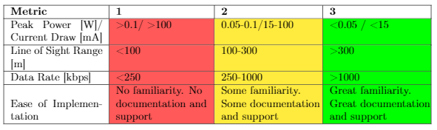
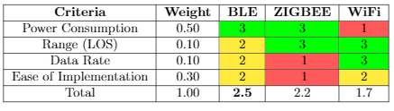
Communication Signal Trade Study
Presentation Outline Project Description Feasibility Analysis Status Summary & Remaining Studies References & Backup

Slide 48
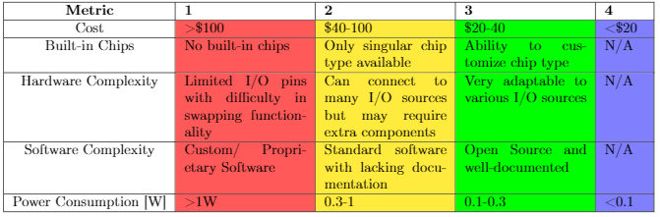
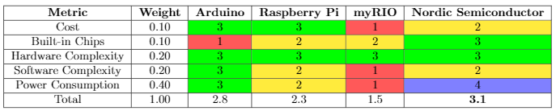
Processor Trade Study
Presentation Outline Project Description Feasibility Analysis Status Summary & Remaining Studies References & Backup

Slide 49
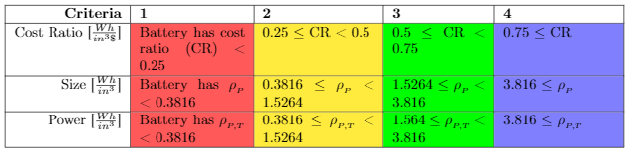
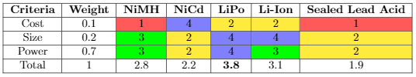
Power Source Trade Study
Presentation Outline Project Description Feasibility Analysis Status Summary & Remaining Studies References & Backup

Slide 50
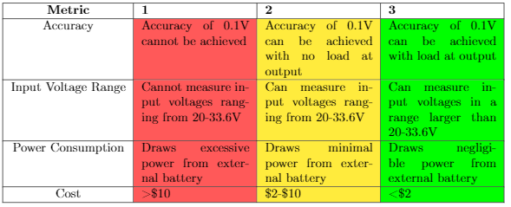
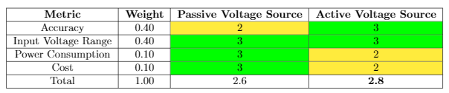
Voltage Sensor Trade Study
Presentation Outline Project Description Feasibility Analysis Status Summary & Remaining Studies References & Backup

Slide 51
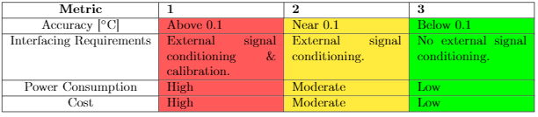
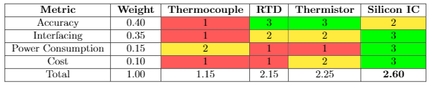
Temperature Sensor Trade Study
Presentation Outline Project Description Feasibility Analysis Status Summary & Remaining Studies References & Backup

Slide 52
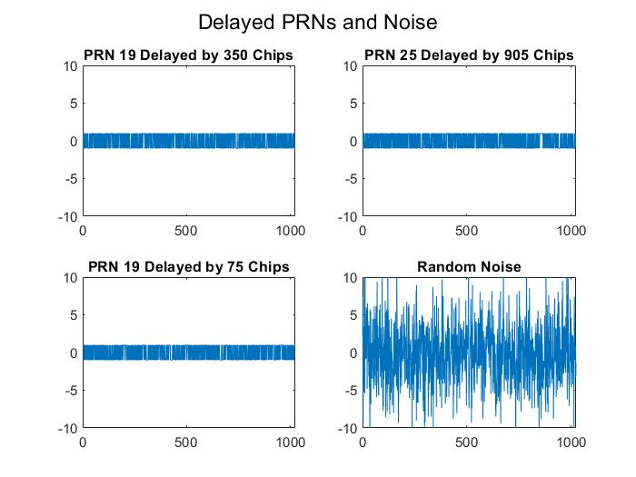
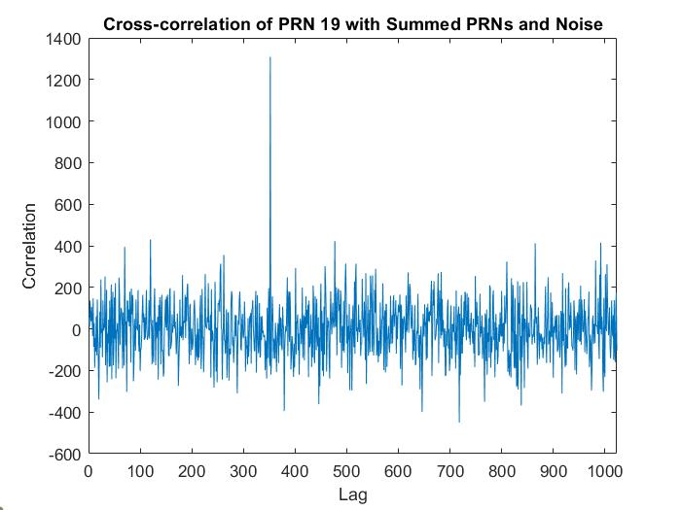
Noise Avoidance
Presentation Outline Project Description Feasibility Analysis Status Summary & Remaining Studies References & Backup

Slide 53
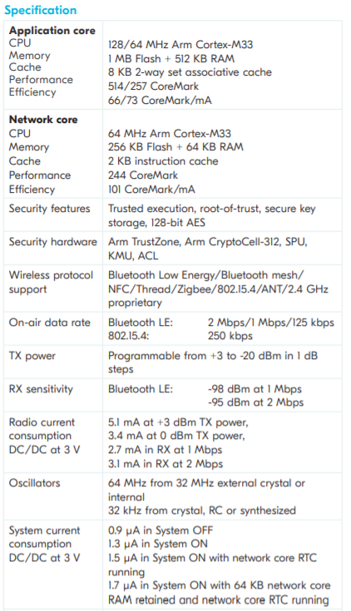
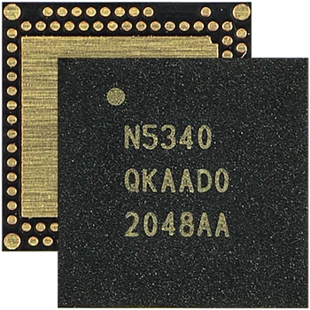
nRF5340^{[14]}
Link to datasheet
Presentation Outline Project Description Feasibility Analysis Status Summary & Remaining Studies References & Backup

Slide 54
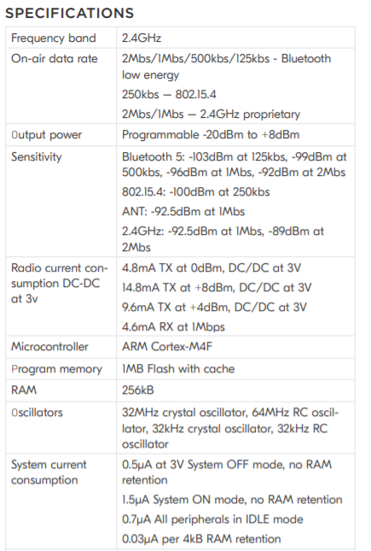
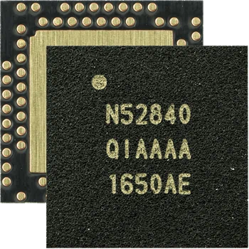
nRF52840^{[15]}
Link to datasheet
Presentation Outline Project Description Feasibility Analysis Status Summary & Remaining Studies References & Backup

Slide 55
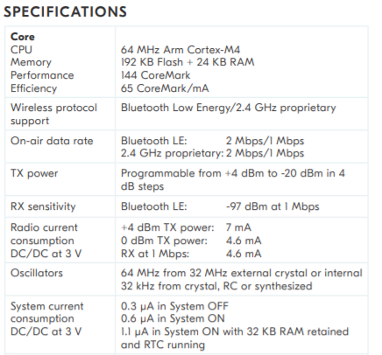
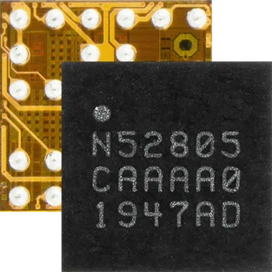
nRF52805^{[16]}
Link to datasheet
Presentation Outline Project Description Feasibility Analysis Status Summary & Remaining Studies References & Backup

Slide 56
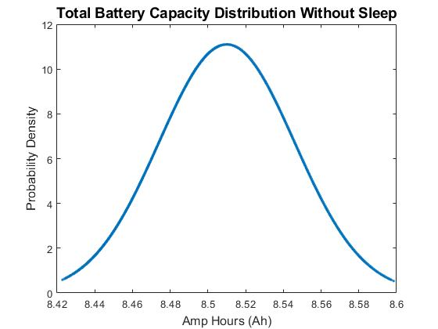
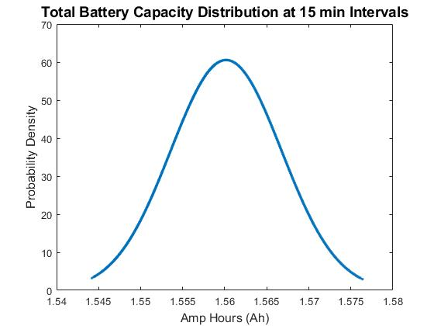
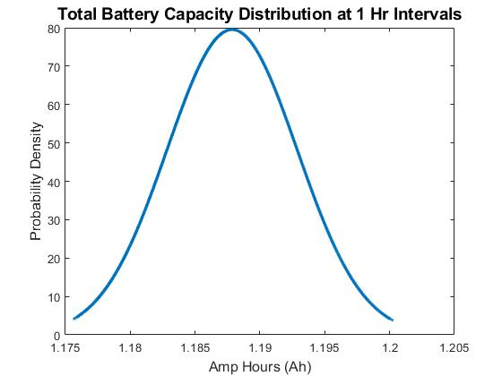
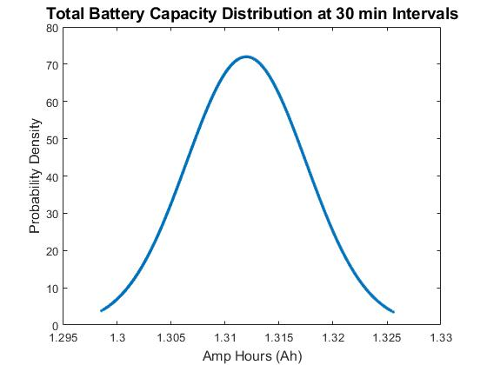
Additional Power Draw Simulations
Presentation Outline Project Description Feasibility Analysis Status Summary & Remaining Studies References & Backup

Slide 57
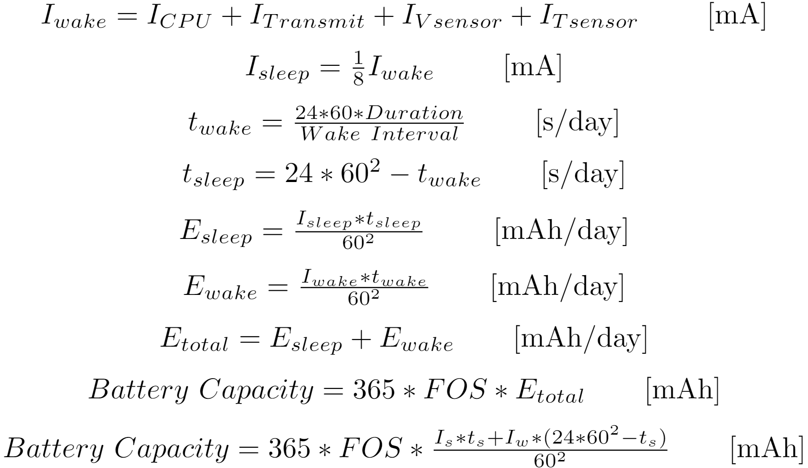
Current Draw Derivation
Presentation Outline Project Description Feasibility Analysis Status Summary & Remaining Studies References & Backup

Slide 58
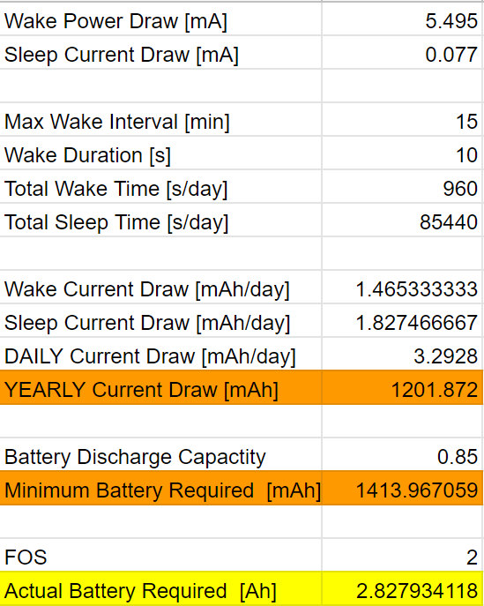
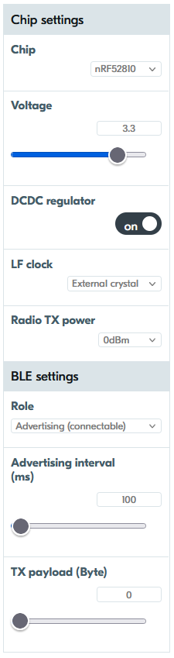
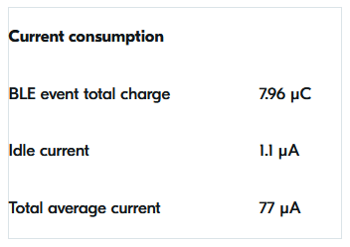
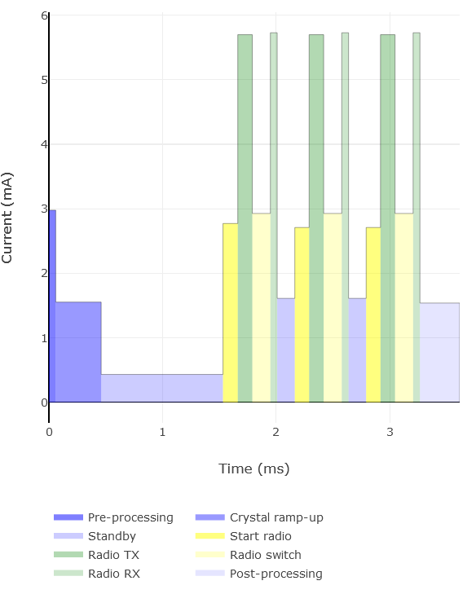
Detailed Current Estimates
77uA
Wake time current draw source: https://devzone.nordicsemi.conordic/power/w/opp/2/online-power-profiler-for-ble
Presentation Outline Project Description Feasibility Analysis Status Summary & Remaining Studies References & Backup

Slide 59
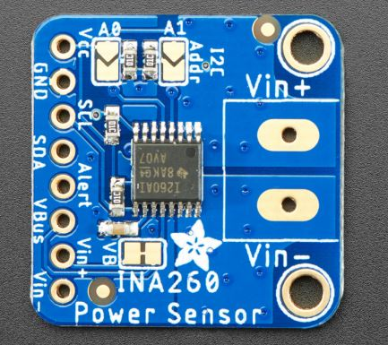
Adafruit^{[1],[11]}
Specification
Compatible with 3V and 5V logic
Can measure DC current up to +15A
Can measure DC voltages up to +36V
  Not for use with AC voltages
Measurements taken with better than 1% accuracy
Uses an INA260 chip
  Operates from a 2.7 to 5.5V supply
  Draws 310μA (typical) of supply current
Voltage across an integrated 2mΩ, 0.1% shunt resistor is measured by the internal 16-bit ADC
Presentation Outline Project Description Feasibility Analysis Status Summary & Remaining Studies References & Backup

Slide 60
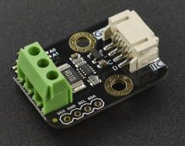
DFRobot^{[2]}
Specification
Input Voltage (VCC) : 3.3V~5.5V
  Voltage Range (IN+ or IN- relative to GND): 0 ~ 26 V
  Voltage Resolution: 4 mV
  Voltage Relative Error: <±0.2% (Typical)
  Current Range: 0 ~ ±8A (Bidirectional current)
  Current Resolution: 1mA
  Current Relative Error: <±0.2% (Typical, manual calibration required)
  Power Range: 0 ~ 206 W
  Power Resolution: 20 mW (Hardware) / 4 mW (Software)
  Quiescent Current: 0.7 mA
  Interface: Gravity I2C (logic level: 0-VCC)
  I2C Address: Four options 0x40, 0x41, 0x44, 0x45
Dimension: 30.0mm*22.0mm
Weight: 4g
Presentation Outline Project Description Feasibility Analysis Status Summary & Remaining Studies References & Backup

Slide 61
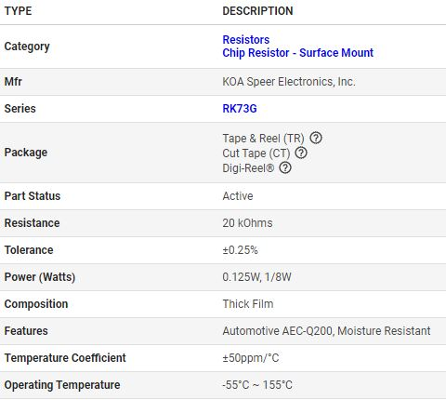
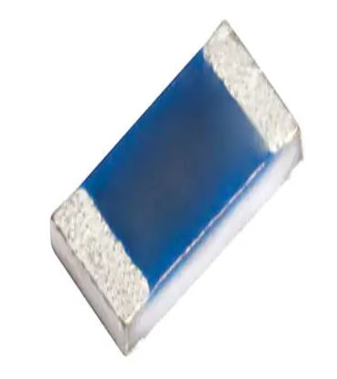
Team Design - Resistors^{[3],[4]}
or 4.7 kOhms
Presentation Outline Project Description Feasibility Analysis Status Summary & Remaining Studies References & Backup

Slide 62
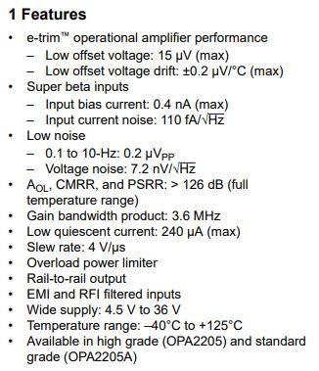
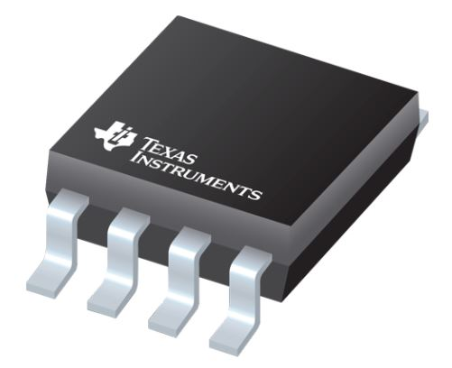
Team Design - Buffer^{[5]}
Presentation Outline Project Description Feasibility Analysis Status Summary & Remaining Studies References & Backup

Slide 63

Voltage Divider Transfer Function and Power Calculations
Power
  P = 0.125W = V²/R so V = (PR)^{0.5}
  R₁ = 20kΩ so V_{max} = (0.125*20000)^{0.5} = 50V
  R₂ = 4.7kΩ so V_{max} = (0.125*4700)^{0.5} = 24.24V
Circuity
  Voltage divider with R₁ = 20kΩ and R₂ = 4.7kΩ
  So V_{int}=((R₂)/(R₁+R₂))*V_{in}
  Same voltage divider used for all three sensor circuits
Presentation Outline Project Description Feasibility Analysis Status Summary & Remaining Studies References & Backup

Slide 64
Accuracy Calculations with Added Voltage Divider
Actual Voltage (V₁)
  Random value from 20 to 33.6V
Expected Resistances
  R_{1,exp}= 20kΩ
  R_{2,exp}= 4.7kΩ
Expected Intermediate Voltage (V_{2,exp})
  V_{2,exp} = (R_{2,exp}*V₁) / (R_{1,exp} + R_{2,exp})
Resistor Tolerances (R_{1,tol}, R_{2,tol})
  Random values from -0.25% to +0.25%
Actual Resistances (R_{1,act}, R_{2,act})
  R_{1,act} = R_{1,exp} + R_{1,exp} * R_{1,tol}
  R_{2,act} = R_{2,exp} + R_{2,exp} * R_{2,tol}
Actual Intermediate Voltage (V_{2,act})
  V_{2,act} = (R_{2,act}*V₁) / (R_{1,act} + R_{2,act})
Sensor Percent Error (E)
  Random value from -1% to +1%
Intermediate Voltage Error (V_{I})
  V_{I} = V_{2,act}*E
Measured Voltage (V₃)
  V₃ = V_{2,act} + V_{I}
Absolute Voltage Error (V_{E})
  V_{E} = V₃ - V_{2,exp}
**See Slide 27 for Schematic
Presentation Outline Project Description Feasibility Analysis Status Summary & Remaining Studies References & Backup

Slide 65



Measured Voltage Accuracy for DFRobot
Presentation Outline Project Description Feasibility Analysis Status Summary & Remaining Studies References & Backup

Slide 66


Measured Voltage Accuracy for Team Designed Voltage Sensor
Presentation Outline Project Description Feasibility Analysis Status Summary & Remaining Studies References & Backup

Slide 67


Texas Instruments TMP117^{[12]}
Presentation Outline Project Description Feasibility Analysis Status Summary & Remaining Studies References & Backup

Slide 68


Smartec SMT172^{[13]}
Presentation Outline Project Description Feasibility Analysis Status Summary & Remaining Studies References & Backup

