Slide 1

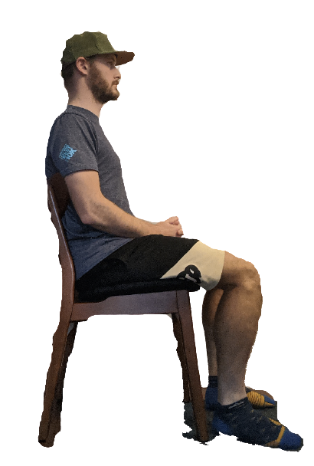
CHAIR
Critical Design Review
Cueing via Haptics And Inner-ear Responses
Wednesday, November 25 2020
** Torin not included
Notes:
<3 <3 <3

Slide 2

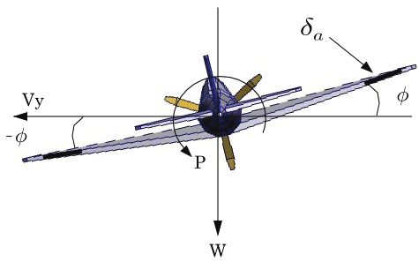
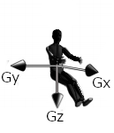
Project Overview
Creating an attitude cueing system for remote pilots
Used as a tool to validate this idea as a proof of concept
Cueing via Galvanic Vestibular Stimulation (GVS) and Tactile Cueing System (TCS)
We will cue pure roll, for the test subject (about the Gx axis)

Slide 3
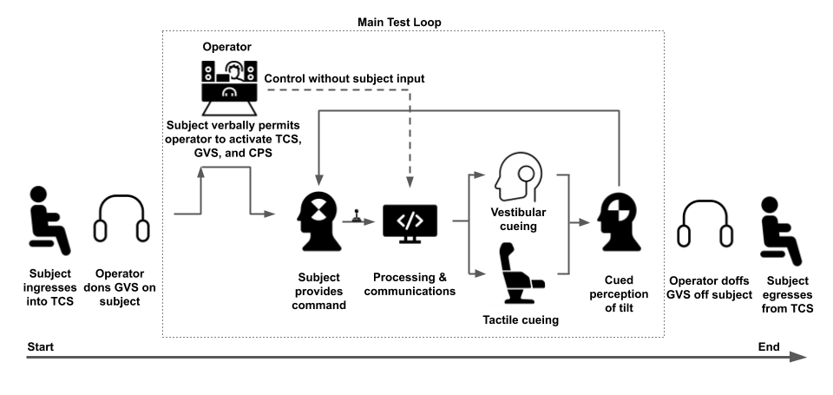
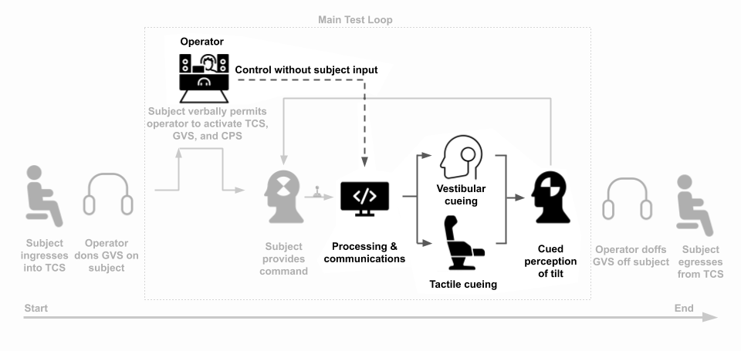
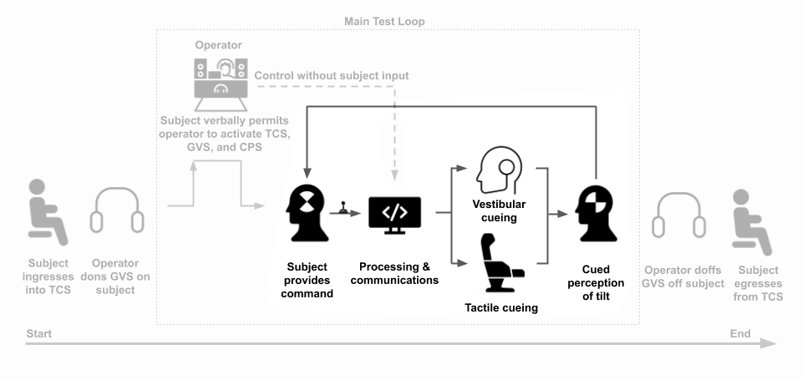
ConOps

Slide 4
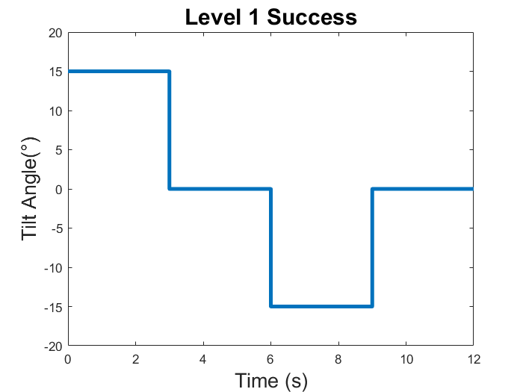
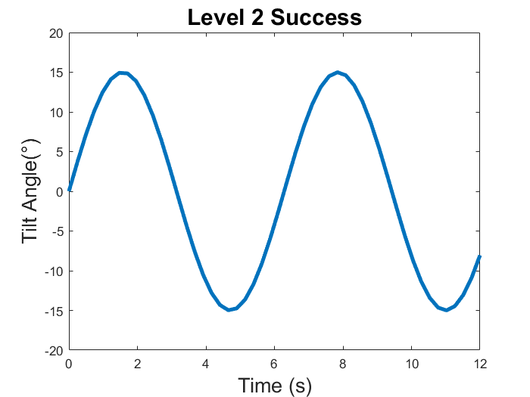
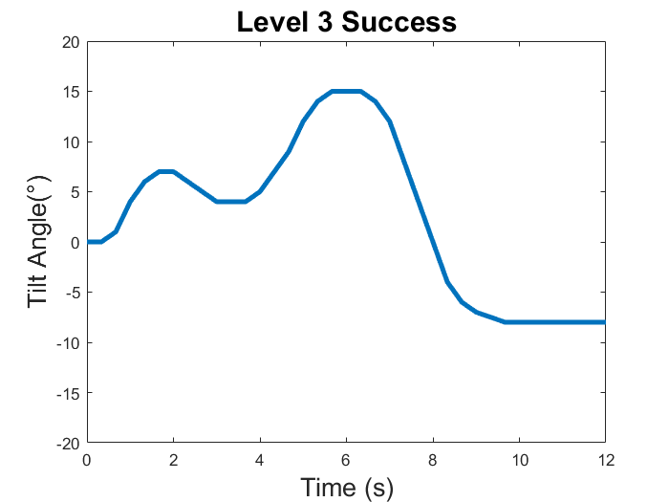
Objectives
Level 1 - Binary (Discrete)
  Allow the test subject to initiate binary tilts of +/- 15° in either direction
  Implementation of joystick control from the first level
Level 2 - Sinusoidal (Continuous)
  Cue sinusoidal tilt profiles with maximum amplitude of 15°
Level 3 - Variable Profile
  Allow the test subject to command tilt profiles up to +/- 15° in either direction

Slide 5
Design Solution
Requirements
Satisfaction
Verification & Validation
Project Planning
Design Solution
Risk Analysis

Slide 6
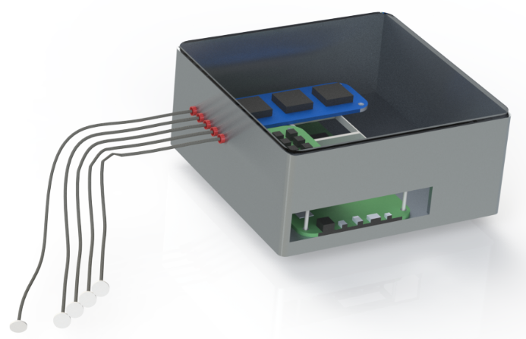
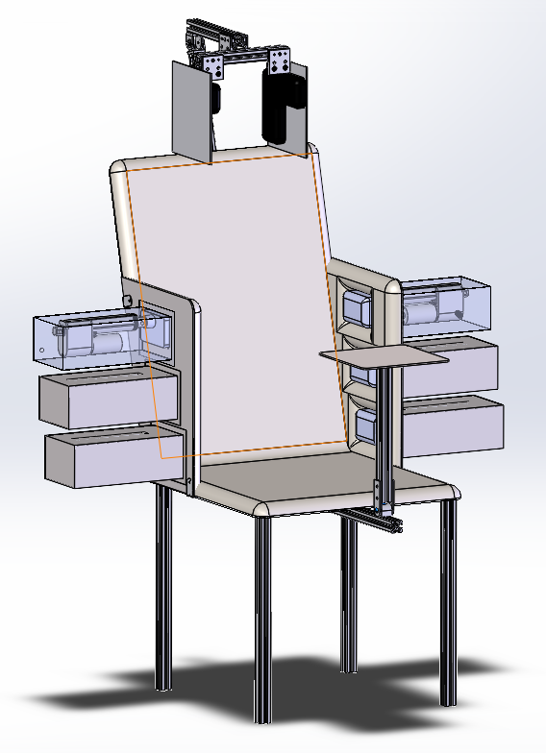





CHAIR Preliminary Design & Critical Project Elements
GVS (Galvanic Vestibular Stimulator)
  Multi-Electrode Setup
  Skin-Electrode Interface
  Current Control
TCS (Tactile Cueing System)
  3 pressure plates on each side
  Actuators, Circuits and Hardware
  Extension of pressure pads integrated with sensor feedback
C++ base GUI
Pressure Plate Tactical cueing
Dual Electrode
cueing
CPS (Central Processing System)
  Control Flow
  Interfacing with the TCS, GVS or GUI
Design Solution
Requirements
Risk Analysis
Verification & Validation
Project Planning

Slide 7
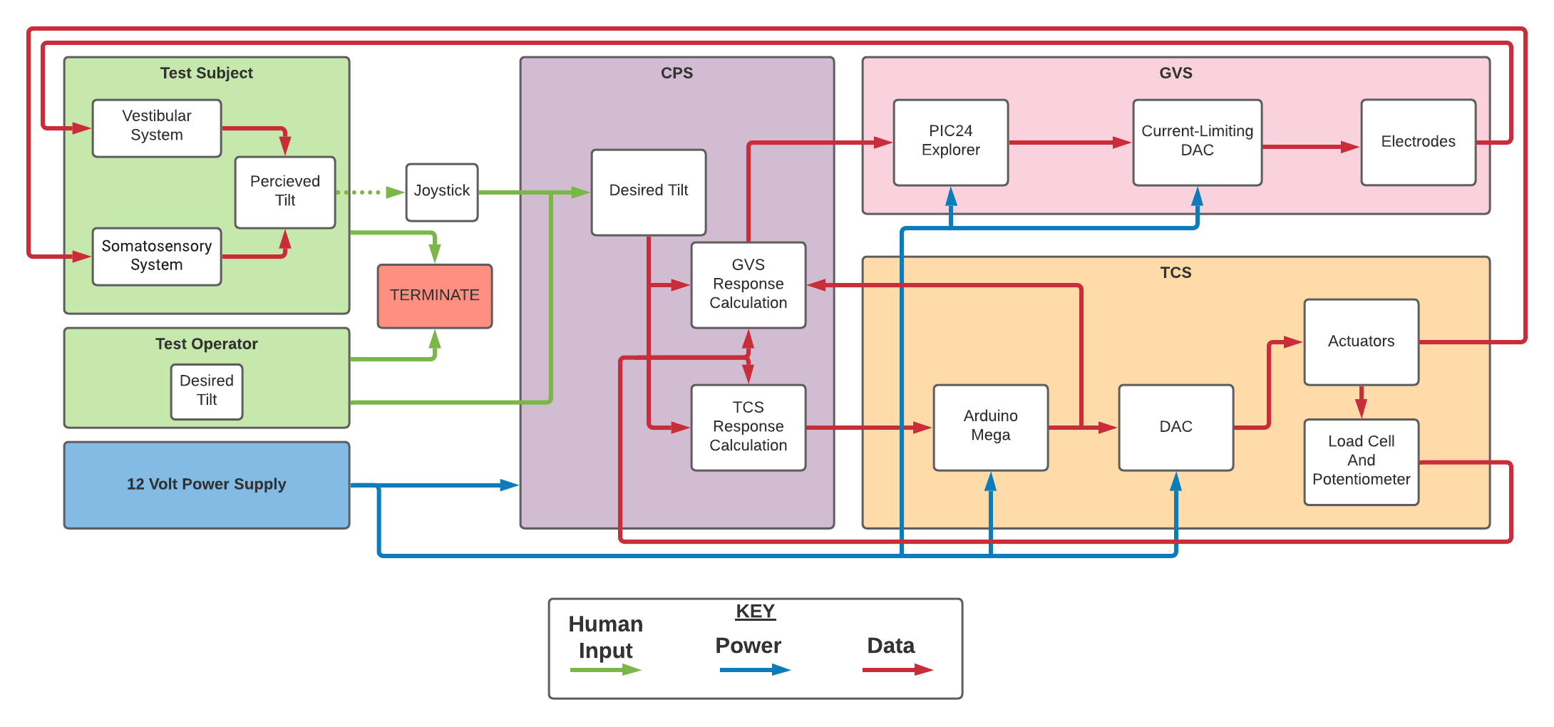
Functional Block Diagram
Max pressure = 3.63 psi
Max amperage = 4 mA
Max lag = 200 ms
Max incongruence = 100 ms
Design Solution
Requirements
Risk Analysis
Verification & Validation
Project Planning

Slide 8
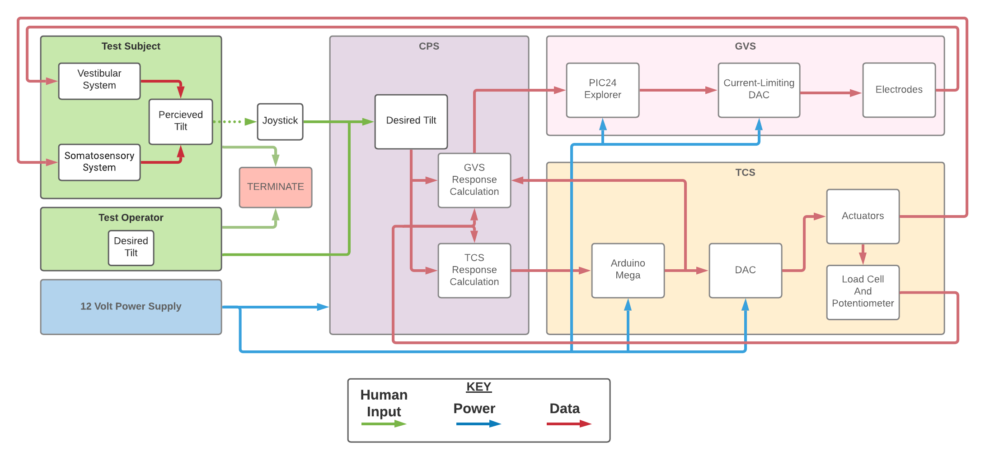
Functional Block Diagram
Max pressure = 3.63 psi
Max amperage = 4 mA
Max lag = 200 ms
Max incongruence = 100 ms
Design Solution
Requirements
Risk Analysis
Verification & Validation
Project Planning

Slide 9
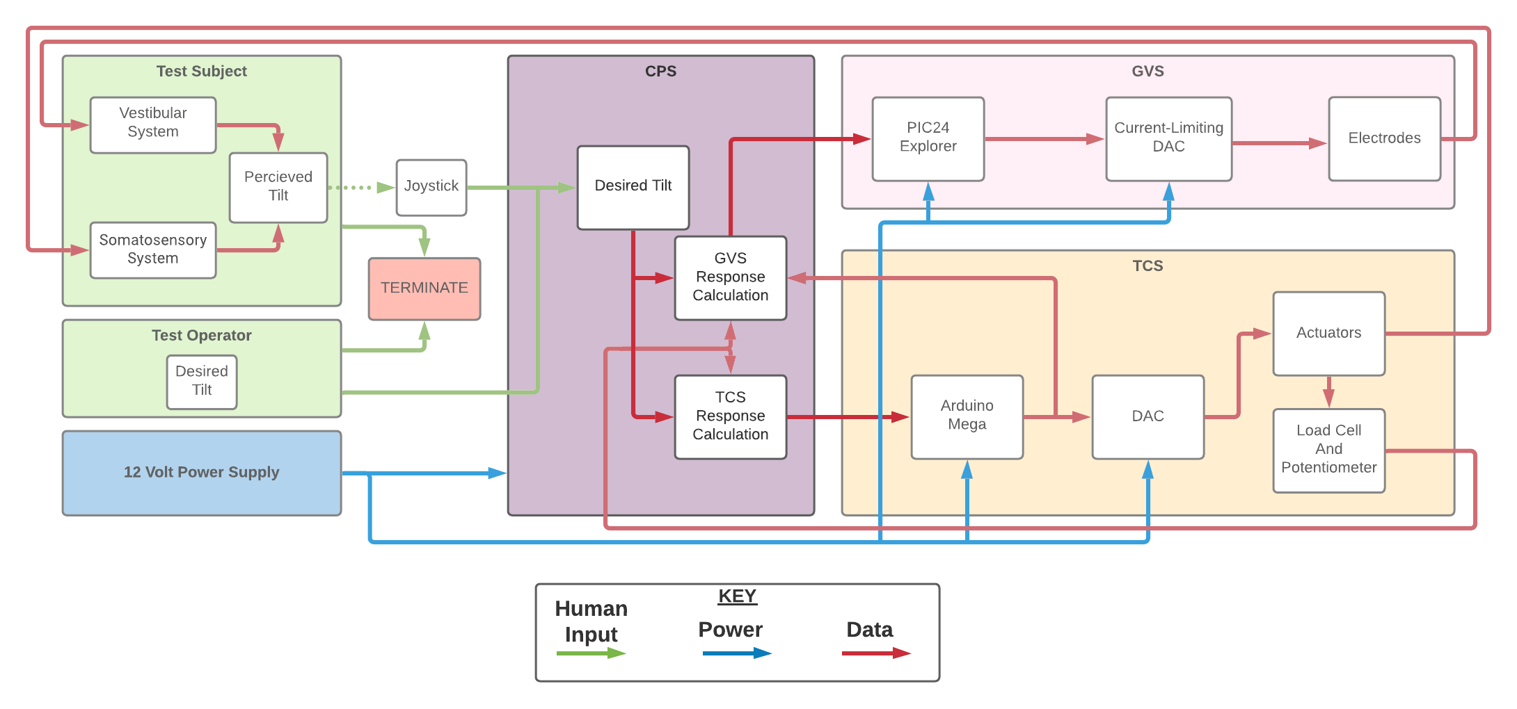
Functional Block Diagram
Max pressure = 3.63 psi
Max amperage = 4 mA
Max lag = 200 ms
Max incongruence = 100 ms
Design Solution
Requirements
Risk Analysis
Verification & Validation
Project Planning

Slide 10
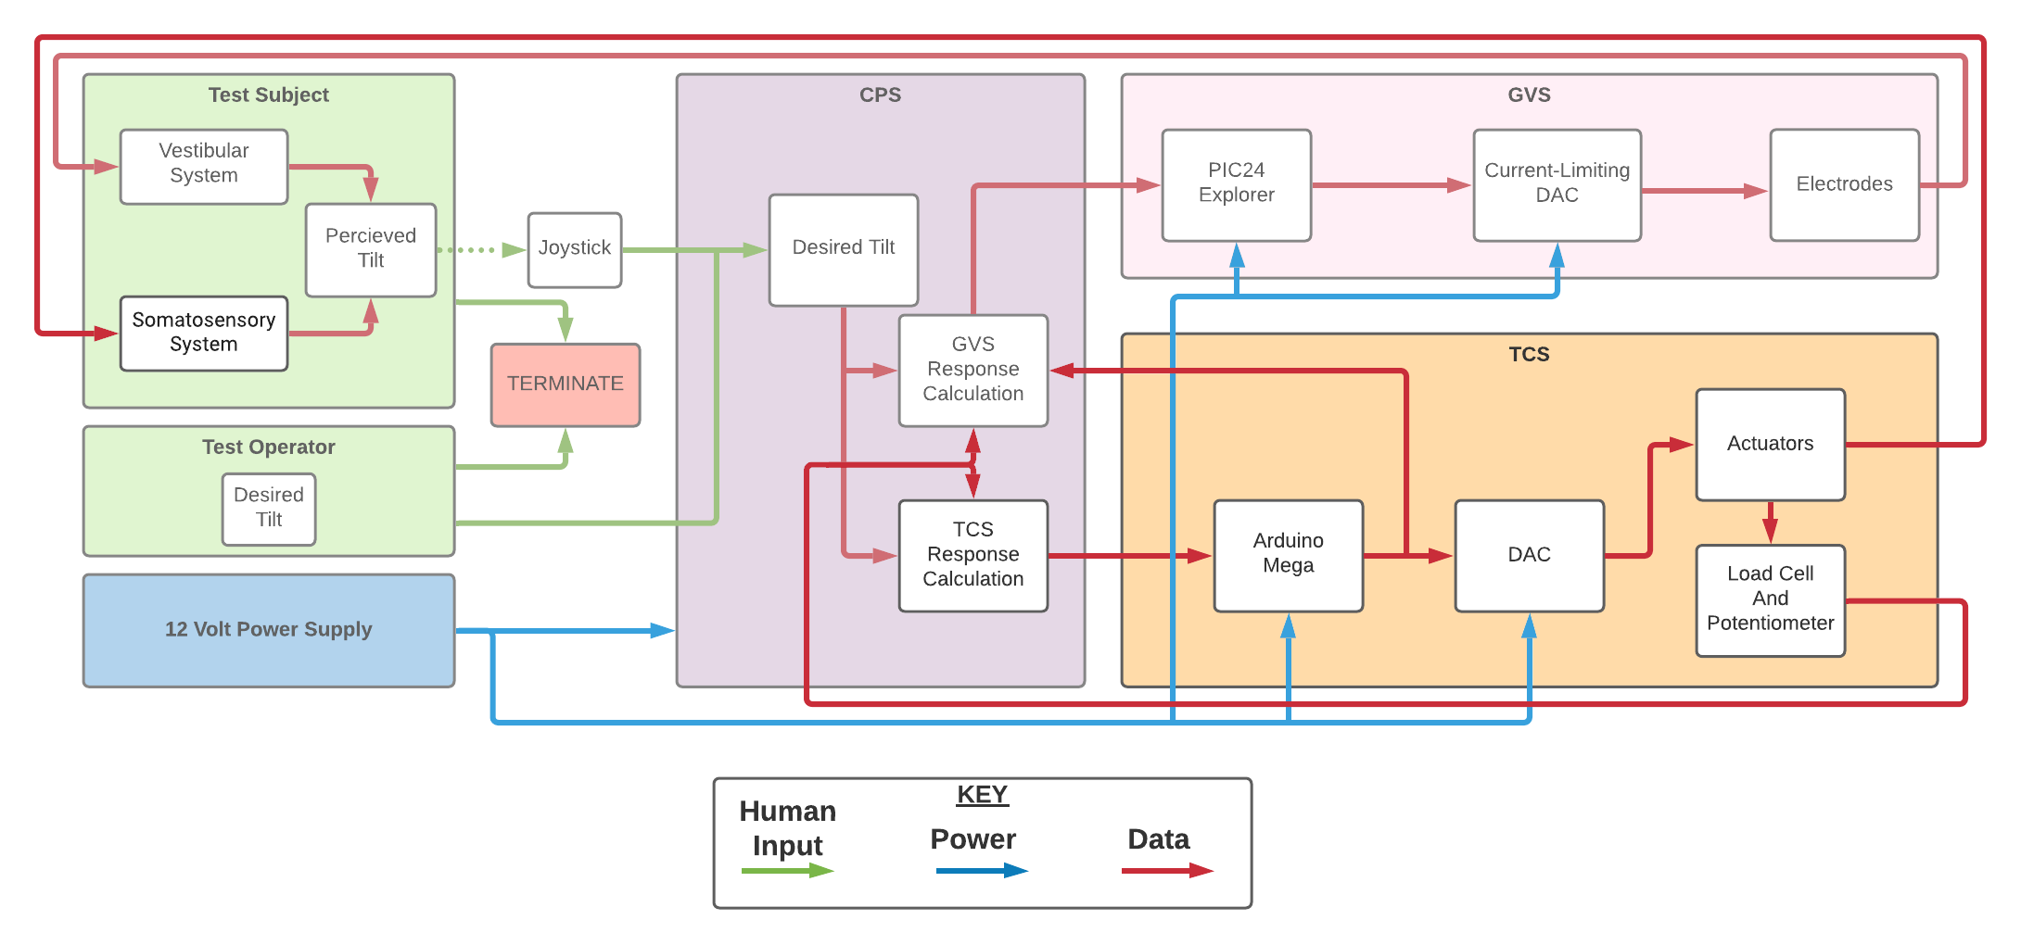
Functional Block Diagram
Max pressure = 3.63 psi
Max amperage = 4 mA
Max lag = 200 ms
Max incongruence = 100 ms
Design Solution
Requirements
Risk Analysis
Verification & Validation
Project Planning

Slide 11
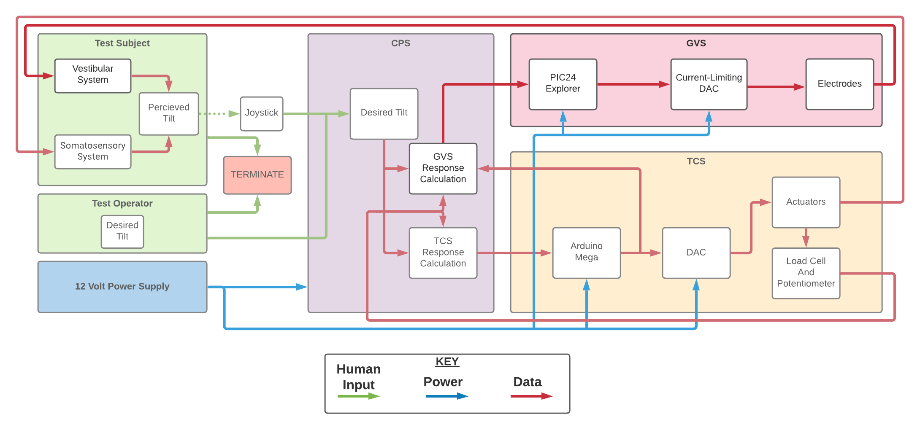
Functional Block Diagram
Max pressure = 3.63 psi
Max amperage = 4 mA
Max lag = 200 ms
Max incongruence = 100 ms
Design Solution
Requirements
Risk Analysis
Verification & Validation
Project Planning

Slide 12
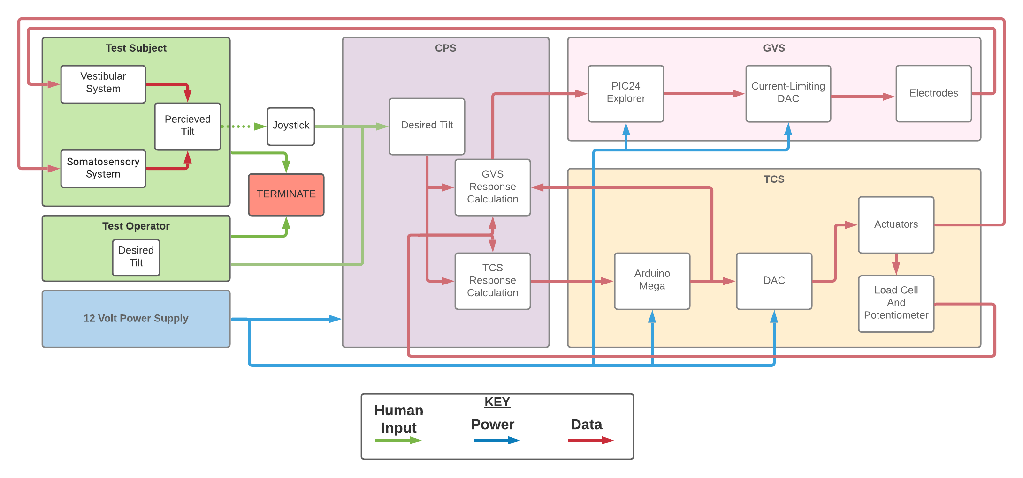
Functional Block Diagram
Max pressure = 3.63 psi
Max amperage = 4 mA
Max lag = 200 ms
Max incongruence = 100 ms
Design Solution
Requirements
Risk Analysis
Verification & Validation
Project Planning

Slide 13
Requirements Satisfaction
Requirements
Satisfaction
Verification & Validation
Project Planning
Design Solution
Risk Analysis

Slide 14

Functional Requirements
Requirement Designation | Description | Satisfied?
FR1 | The test subject will receive vestibular and tactile cueing to convey representative flight orientation.
FR2 | The test subject will not experience any pain caused by the operation of the system.
FR3 | The GVS and TCS will be integrated to respond to test controller input as well as joystick input.
FR4 | The CHAIR system will be operable within common conditions of a lab.
Design Solution
Requirements
Risk Analysis
Verification & Validation
Project Planning

Slide 15
Critical Project Element: Galvanic Vestibular Stimulator
Design Solution
Requirements
Risk Analysis
Verification & Validation
Project Planning
Notes:
Put CAD model here

Slide 16
GVS Design Requirements
Requirement Designation | Description | Satisfied?
DR 1.2 | The GVS shall provide electrical currents from -4mA to 4mA through electrodes placed on the mastoids.
DR 2.3 | The GVS current output shall not exceed 4mA.
DR 4.4 | The GVS system shall be able to operate repeatedly without losing functionality.
Design Solution
Requirements
Risk Analysis
Verification & Validation
Project Planning

Slide 17
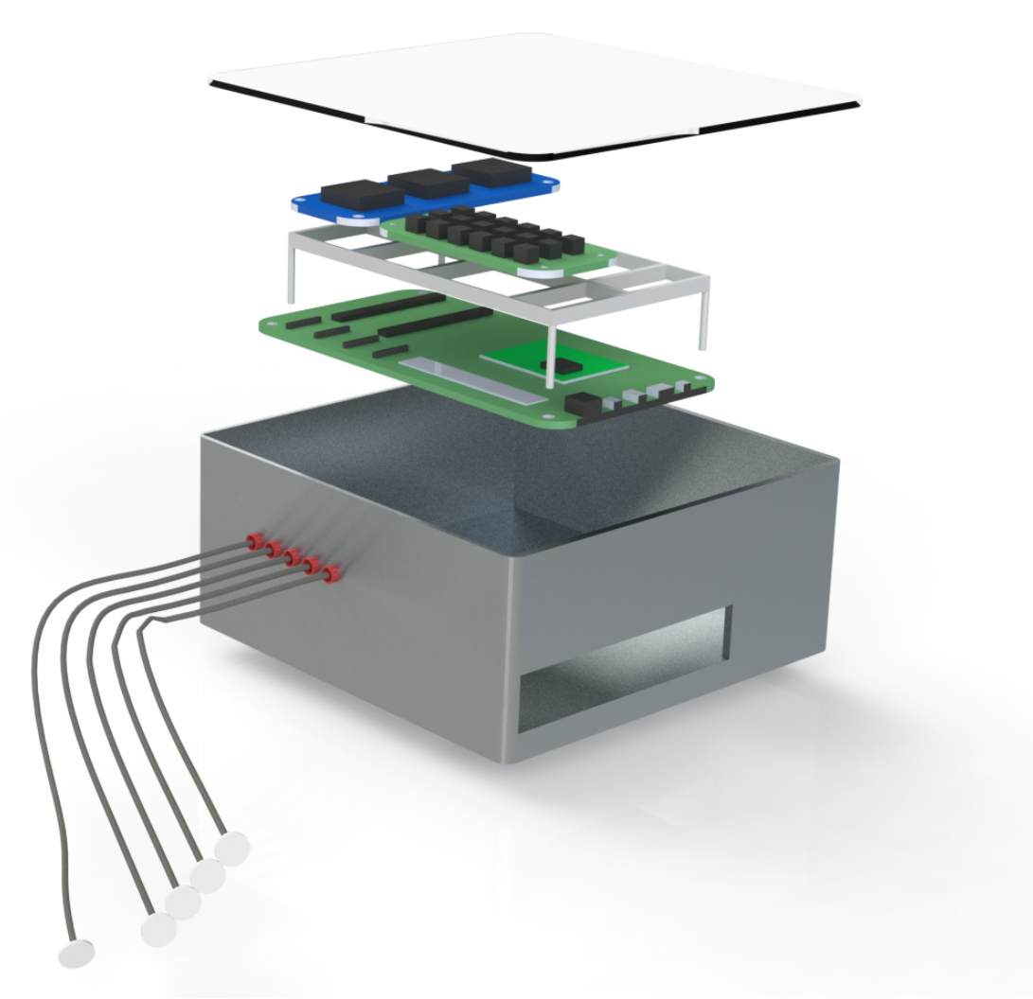
GVS Overview
Power Circuit
DAC
Microcontroller
Electrodes (5)
Design Solution
Requirements
Risk Analysis
Verification & Validation
Project Planning

Slide 18
GVS Overview
Customer Request:
Multi-axial cueing via multiple electrodes is the cutting edge of GVS research
We determined this reach goal is feasible, though will not be needed for any CHAIR-specific deliverables
System must be able to explicitly define sign and magnitude for each electrode’s current
I_{E}
I_{A}
HEAD
I_{D}
I_{B}
I_{C}
I_{A}+ I_{B}+ I_{C}+ I_{D}+ I_{E} = 0
Design Solution
Requirements
Risk Analysis
Verification & Validation
Project Planning

Slide 19
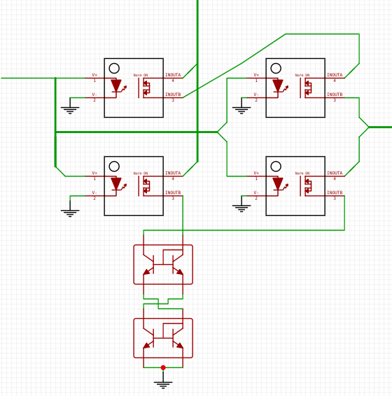
GVS Power Circuit Design
DAC 0
DAC 1
Pin Low
Pin Low
HEAD
Design Solution
Requirements
Risk Analysis
Verification & Validation
Project Planning

Slide 20
GVS Power Circuit Design
DAC 0
DAC 1
Pin High
Pin Low
HEAD
Design Solution
Requirements
Risk Analysis
Verification & Validation
Project Planning

Slide 21
GVS Power Circuit Design
DAC 0
DAC 1
Pin High
Pin Low
HEAD
Design Solution
Requirements
Risk Analysis
Verification & Validation
Project Planning

Slide 22
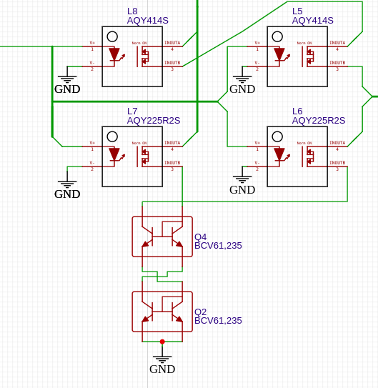
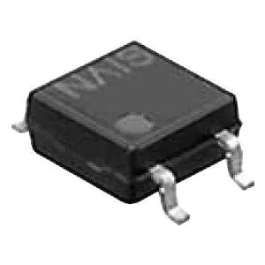
GVS Power Circuitry Design
Solid-State SPST Relays
Controllable with TTL logic levels for both high-side and low-side (source and sink) switching
Switching between sinking and sourcing an electrode will require dropping DAC output to zero for 0.5ms-1ms
DR4.4
Durability
Design Solution
Requirements
Risk Analysis
Verification & Validation
Project Planning

Slide 23
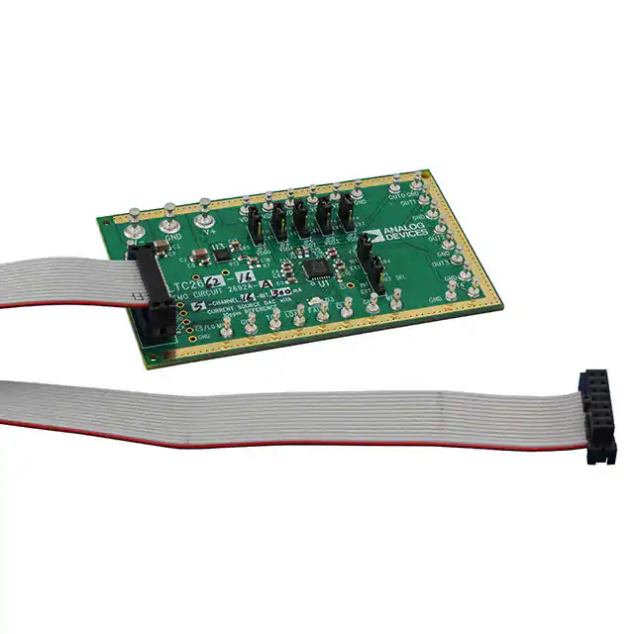
GVS DAC Selection
LTC2662
16-bit I_{OUT} 5-channel DAC
Up to 33V external supply
Programmable FSR: We will use 6.25mA mode, limit to 4mA in software
Internal, self-regulated V_{REF}
DR1.2
Current control
Design Solution
Requirements
Risk Analysis
Verification & Validation
Project Planning

Slide 24
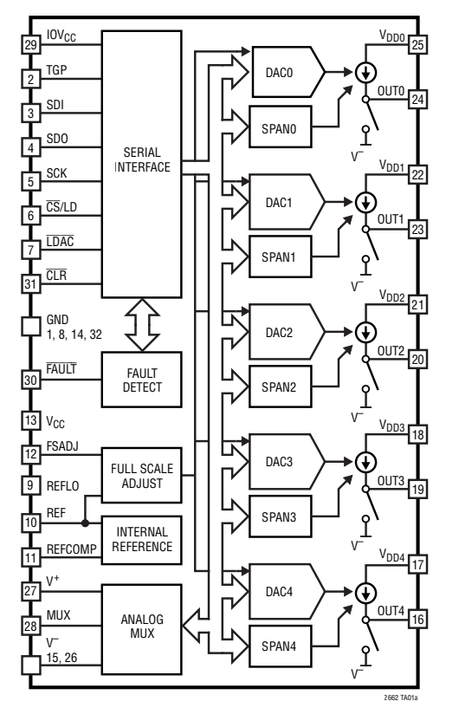
GVS DAC Selection
LTC2662
Fault detect register and mux pins to read actual currents once integrated
Double-buffered inputs gives 180pA-s of mid-scale glitch
CLR pin resets output on microcontroller POR
DR2.3
Current Limiting
Design Solution
Requirements
Risk Analysis
Verification & Validation
Project Planning

Slide 25
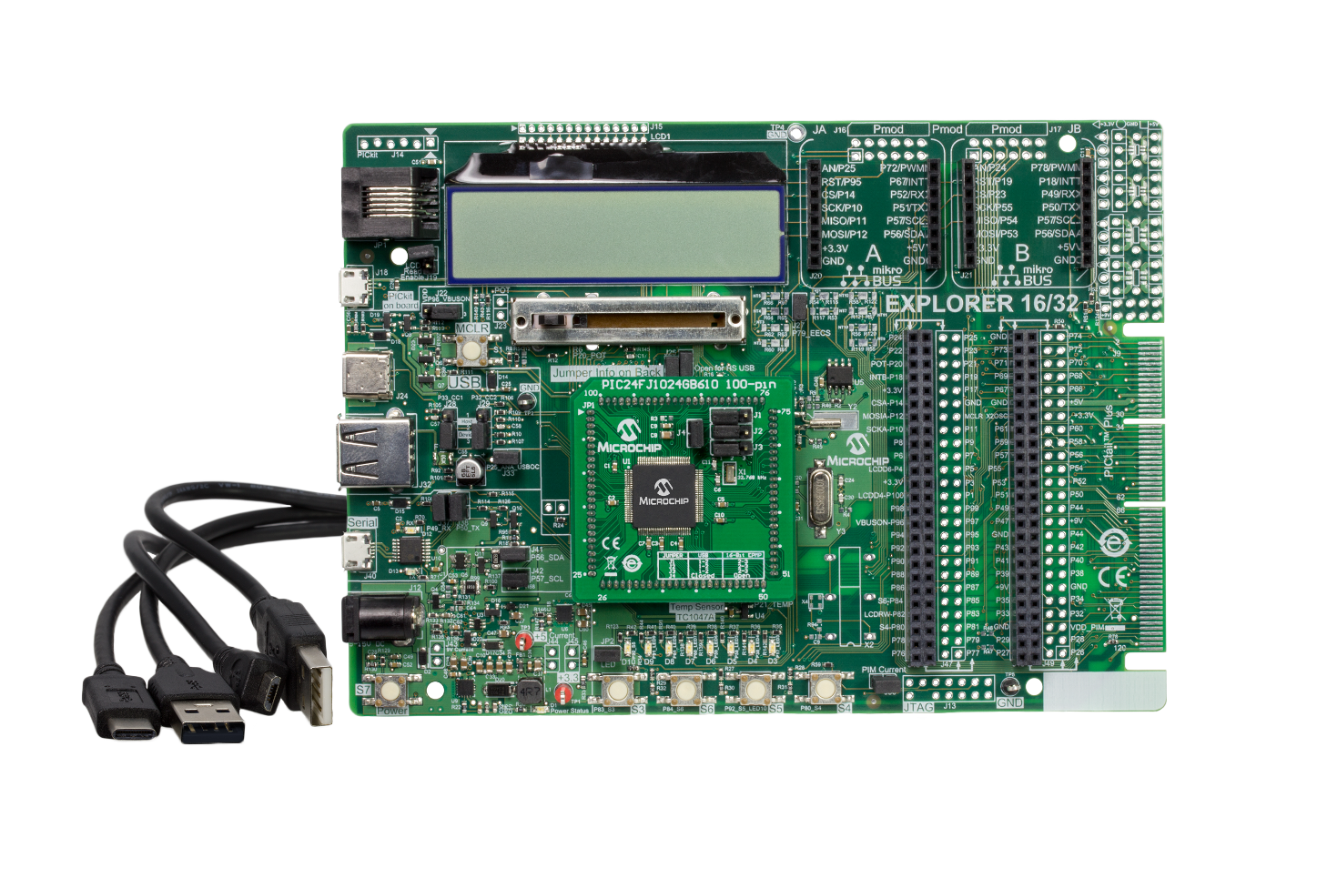
GVS Microcontroller Selection
PIC Explorer 16 with PIC24FJ1024GB610 PIM
16-bit, 8MHz microcontroller - 12𝜇s to update the DAC currents
Two team members familiar with PIC programming
UART and SPI modules
Design Solution
Requirements
Risk Analysis
Verification & Validation
Project Planning

Slide 26
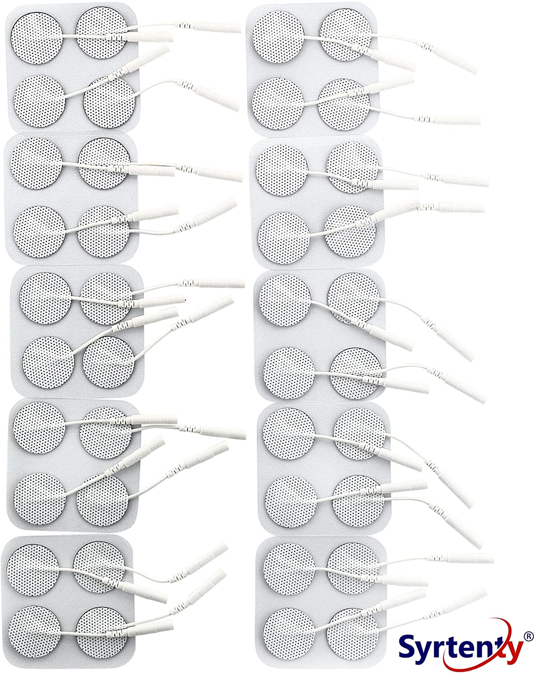
GVS Electrode Selection
Syrtenty 1” TENS Electrode
Designed for electrical stimulation across skin-electrode interface
Self-adhesive electrodes can be arranged in any configuration
Measured resistance ~2.5kΩ
Need 10V to drive 4mA. 12V should drive >99% of resistances (t-distribution)
DR1.2
Cueing through mastoids
Design Solution
Requirements
Risk Analysis
Verification & Validation
Project Planning

Slide 27
GVS Design Requirements
Requirement Designation | Description | Satisfied?
DR 1.2 | The GVS shall provide vestibular cueing in the form of electrical currents from -4mA to 4mA through electrodes placed on the mastoids.
DR 2.3 | The GVS current output shall not exceed 4mA.
DR 4.4 | The GVS system shall be able to operate repeatedly without losing functionality.
Design Solution
Requirements
Risk Analysis
Verification & Validation
Project Planning

Slide 28
Critical Project Element: Tactile Cueing System & Actuators
Design Solution
Requirements
Risk Analysis
Verification & Validation
Project Planning
Notes:
Put CAD model here

Slide 29
TCS Design Requirements
Requirement Designation | Description | Satisfied?
DR2.1 | The TCS shall provide no more than 3.63 psi on the test subject
DR4.2 | The TCS shall accommodate a male body of 50th percentile height and 50th percentile weight
Design Solution
Requirements
Risk Analysis
Verification & Validation
Project Planning

Slide 30
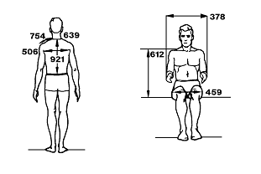
Structural Considerations
Stress calculations conducted to determine possible points of failure in structure
  Lowest calculated factor of safety is 14
Headrest included to stabilize the head
Joystick placed within a comfortable reaching distance for the test subject
Anthropometric Dimension Diagram
NASA STD 3000 Anthropometry and Biomechanics
Design Solution
Requirements
Risk Analysis
Verification & Validation
Project Planning

Slide 31
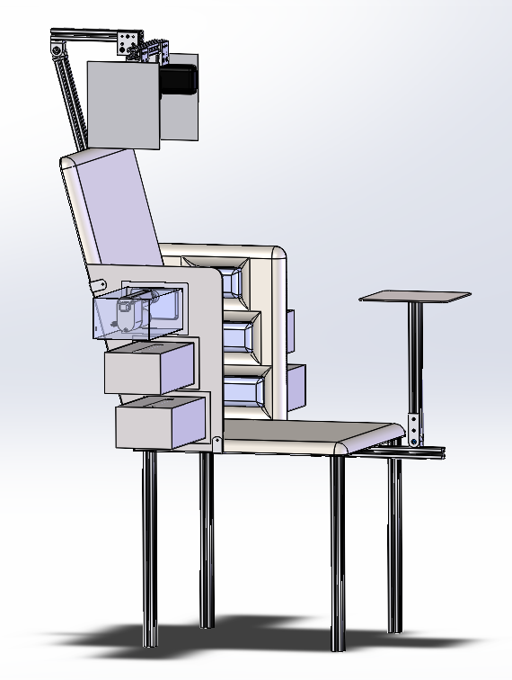
TCS- Final Design
DR4.2
Accommodation
Weight: 1st - 71st percentiles males and 1st - 87th percentile females
Hip Breadth: 3rd to 78th percentile males and 1st to 47th percentile females
Anthropometric Data of US Personnel
Design Solution
Requirements
Risk Analysis
Verification & Validation
Project Planning
Notes:
Put final TCS cad model here

Slide 32
Actuator Design Space:
Max test subject weight: 215 lb max side force applied = 55 lb
55 lbf / 3 actuators = 19 lbf per actuator
Roll angle: ~2° - 15°
Force: 2.5 lb - 19 lb
Pressure: 0.38 psi (minimum for human sensation) - 3.63 psi (human pain threshold)
Area (for 19 lbf maximum): 5.23 in² (max pressure) - 50 in² (min pressure)
DR2.1
Max pressure
To produce large enough area to be comfortable, but not larger than the side of the test subject, the team chose 10 in² pressure modules, which produce 1.9 psi at 19 lbf maximum
Note: We are no longer including bottom cueing due to lack of fidelity at such small roll angles
Design Solution
Requirements
Risk Analysis
Verification & Validation
Project Planning

Slide 33
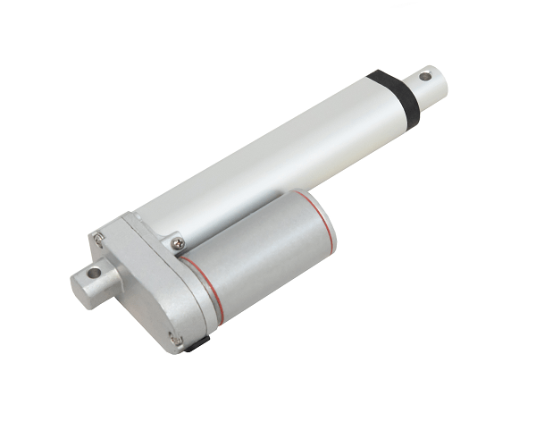
Actuator Selection
Can accommodate up to 50 lbf of static force (unpowered)
  Will not statically load while powered for more than 10 seconds
Equipped with feedback potentiometer for real-time extension position feedback
Can accommodate up to 50 lbf of static force (unpowered)
  Will not statically load while powered for more than 10 seconds
3” extension can accommodate large array of test subjects while not being too big
  Hip Breadth: 3rd to 78th percentile males and 1st to 47th percentile females
Progressive Automations 50 lbf Feedback Actuator
Design Solution
Requirements
Risk Analysis
Verification & Validation
Project Planning

Slide 34
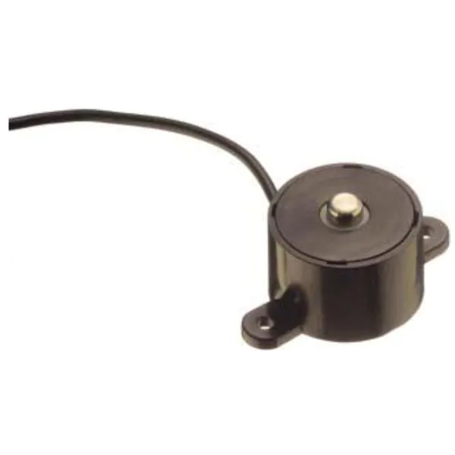
Load Cell Selection
DR2.1
Max pressure
Handles up to 25 lbf
Force resolution: 0.0039 V/bit / 0.16 V/lb = 0.024 lb/bit
  < 1% of minimum load
Error (nonlinearity, hysteresis, repeatability): ±0.04 V
Response time: ~50 ms
Sparkfun 25 lb Compression Load Cell
Design Solution
Requirements
Risk Analysis
Verification & Validation
Project Planning

Slide 35
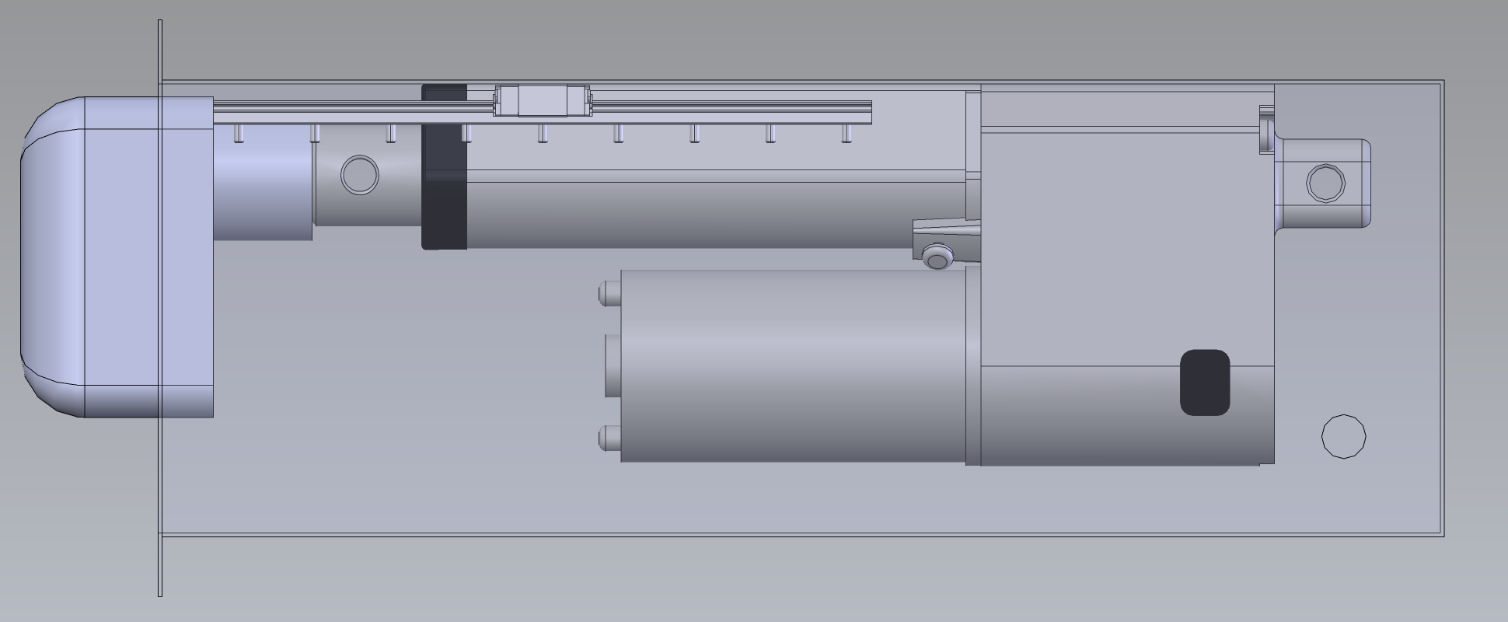
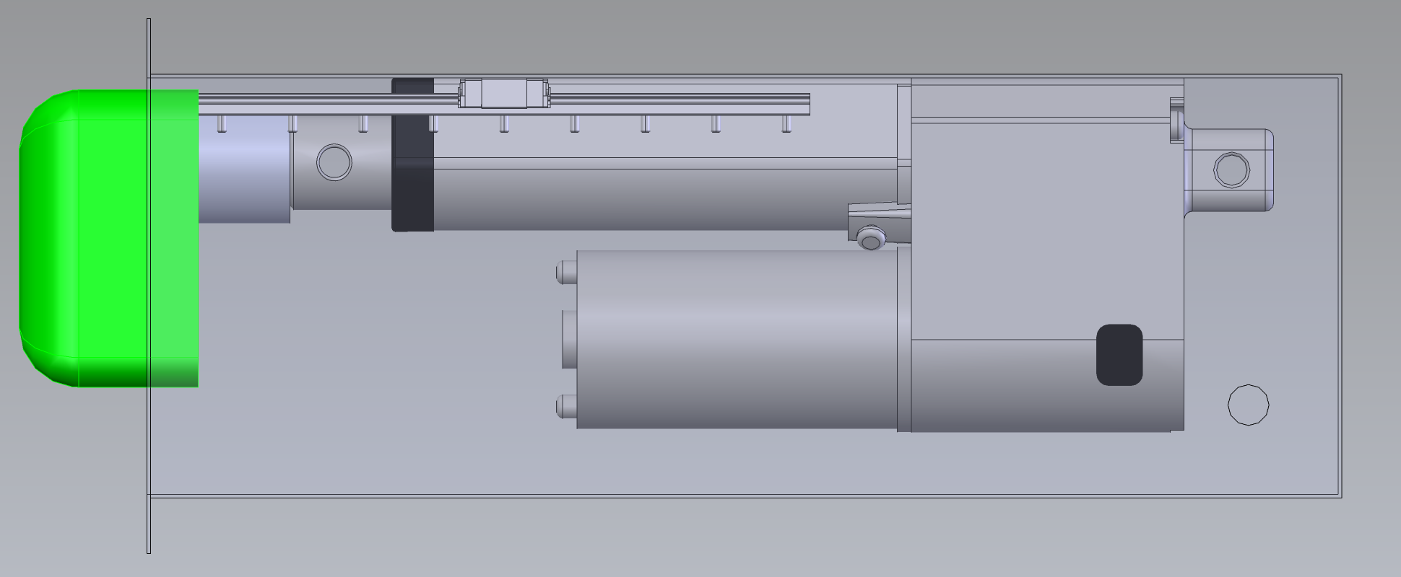
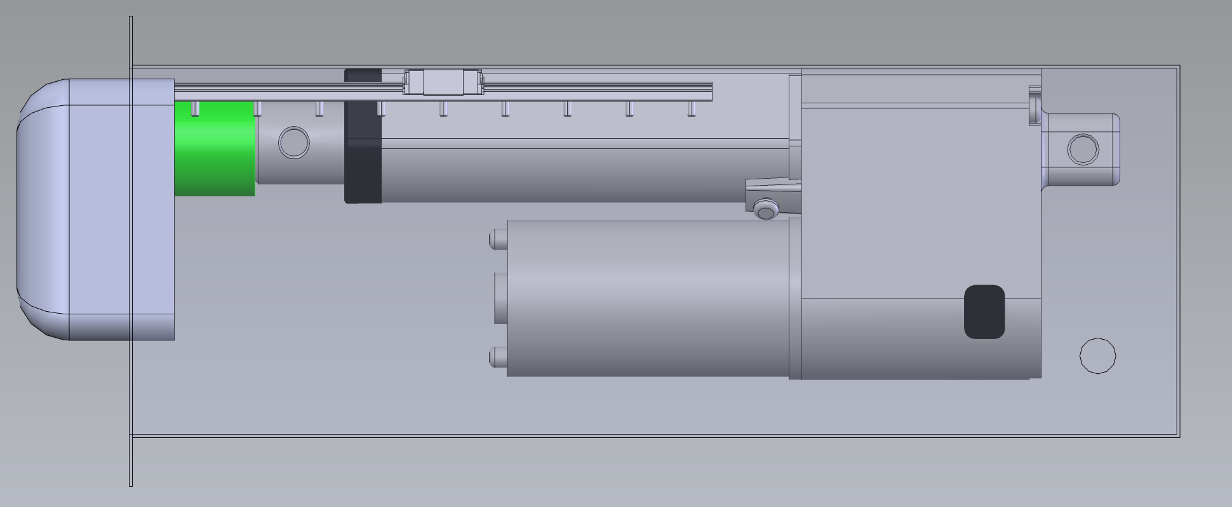
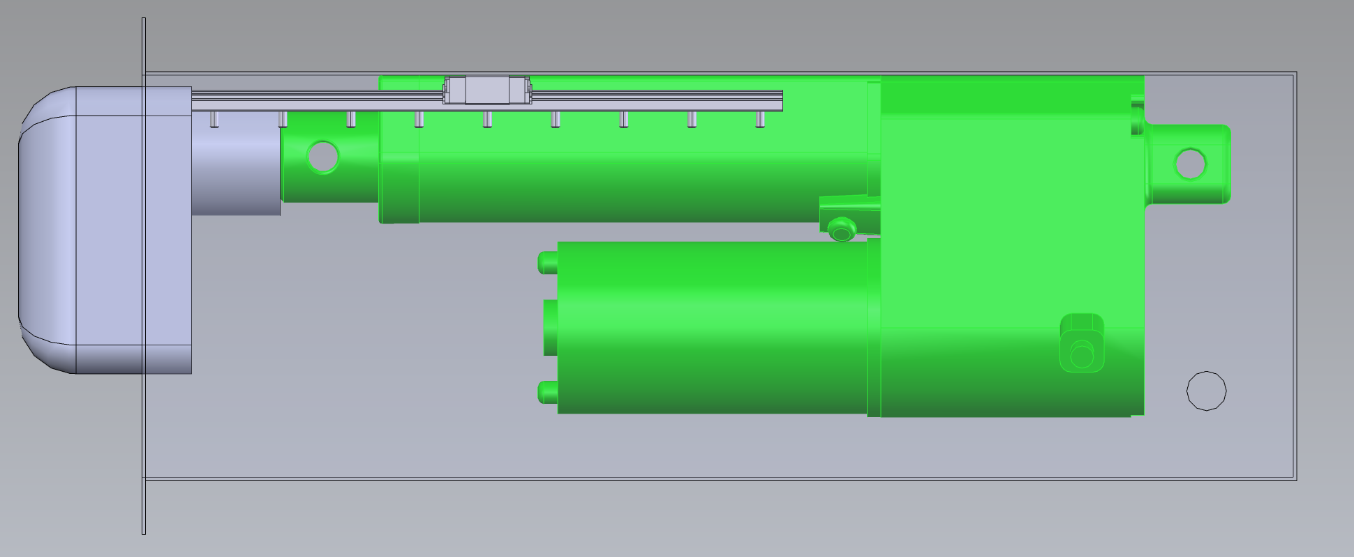
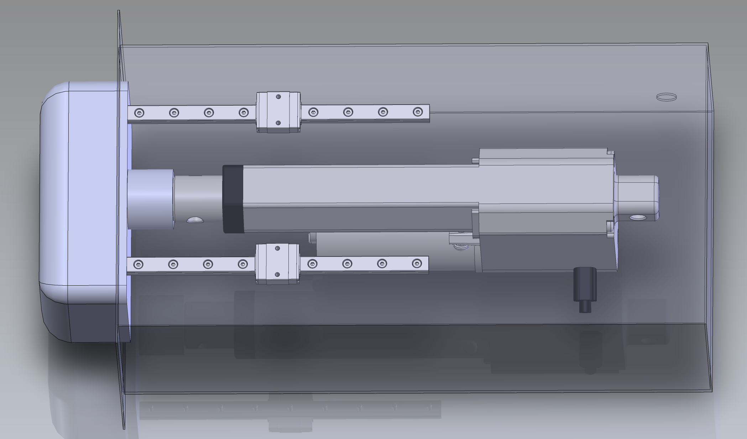
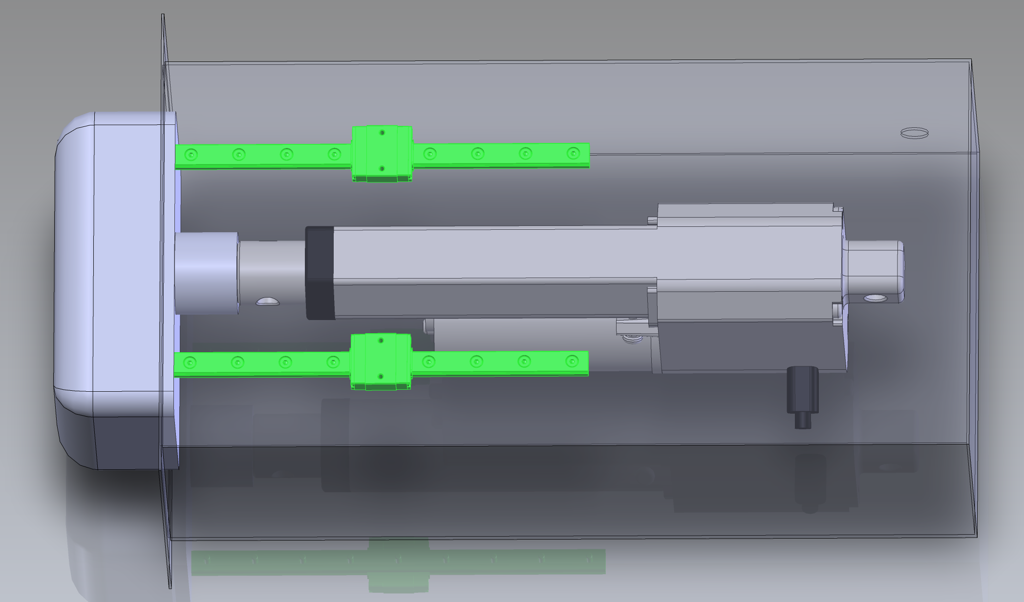
TCS Mechanisms Housing Final Design
Notes:
Put pressure module cad model here

Slide 36
TCS Design Requirements
Requirement Designation | Description | Satisfied?
DR2.1 | The TCS shall provide no more than 3.63 psi on the test subject
DR4.2 | The TCS shall accommodate a male body of 50th percentile height and 50th percentile weight
Design Solution
Requirements
Risk Analysis
Verification & Validation
Project Planning

Slide 37
Critical Project Element: Central Processing System
Design Solution
Requirements
Risk Analysis
Verification & Validation
Project Planning
Notes:
Put CAD model here

Slide 38
CPS Design Requirements
Designation | Requirement Description | Satisfied?
DR2.4 | The CPS will not instruct the TCS or the GVS to exceed maximum allowed outputs described in requirements 2.1 (55lbf maximum) and 2.3 (4mA maximum)
DR2.5 | The CPS will be equipped with an emergency stop switch that will enable all functions to be terminated immediately
DR3.2 | The CPS shall coordinate the TCS and GVS responses, such that the time delay between the TCS and GVS cues as experienced by the test subject is less than 100 ms
DR3.3 | The CPS shall coordinate the hardware response such that the time delay from the joystick signal commanded by the test subject to the TCS and GVS cueing is within 200ms
DR3.4 | The CPS shall incorporate a user interface allowing the controller to choose magnitude and direction of roll rate cued by the GVS and TCS systems.
Design Solution
Requirements
Risk Analysis
Verification & Validation
Project Planning

Slide 39
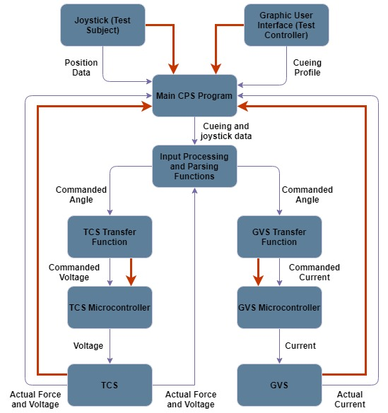
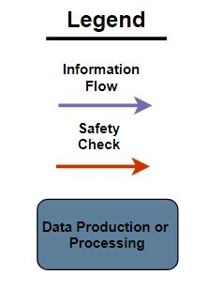
Software Requirements
DR2.4
Amperage and force limits
DR2.5
Emergency stop
Design Solution
Requirements
Risk Analysis
Verification & Validation
Project Planning
Notes:
The CPS will perform safety checks at three separate points
The test controller will have the option to terminate the test at any time
A visualization of GVS and TCS outputs will be provided to the test controller, along with a warning system when values are approaching the unsafe region
Potentially unsafe commands will not be sent to the GVS and TCS by software
Outputs from GVS and TCS will be periodically sampled, and unsafe outputs will trigger an automatic test abort

Slide 40
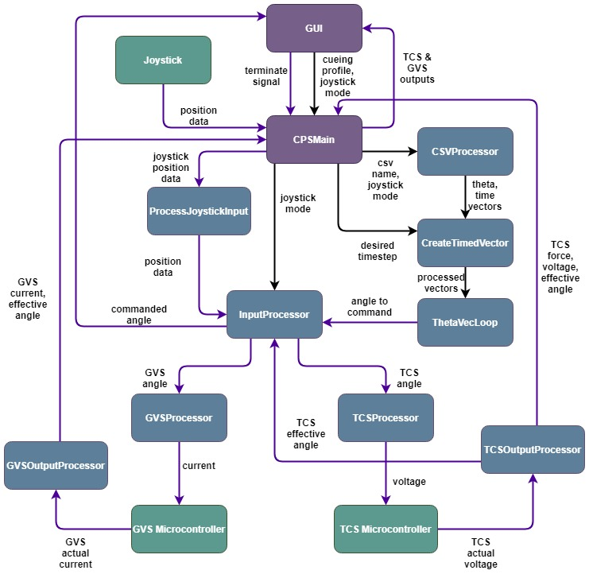
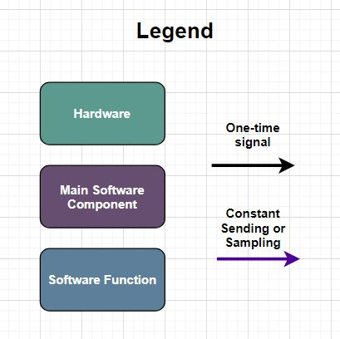
Software Requirements
DR3.2
Time Delay, Communication (TCS-GVS)
DR3.3
Time Delay, Communication (Joystick-TCS&GVS)
Design Solution
Requirements
Risk Analysis
Verification & Validation
Project Planning
Notes:
CPS is the driving factor for integration of subsystems
CPS will communicate between GUI, joystick, and microcontrollers using C++ code
System takes input from GUI (csv) and joystick (position data), converts inputs to values usable by GVS and TCS
Multithreading can be used to limit lag time, but expectations are that lag will be minimal
GUI and CPS protype already in development
Communication with GUI made simple through MATLAB .mex files or C++ qt5 library

Slide 41
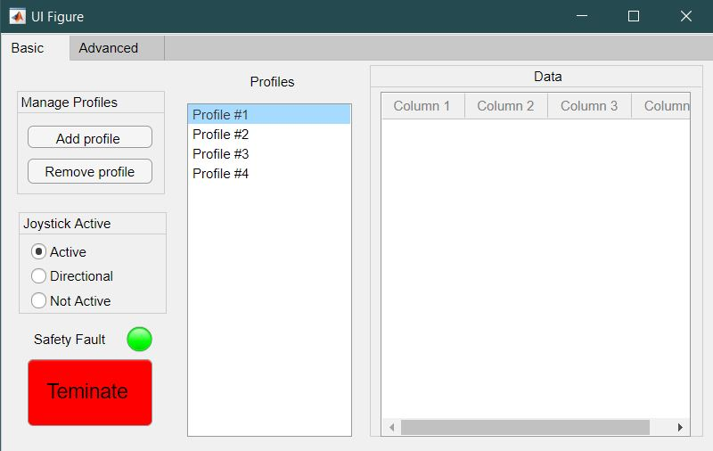
Graphical User Interface
Used by the test controller to communicate with CPS
Allows for control over input profile, joystick mode
Displays test outputs in real time
Allows for saving of data, cueing profiles
DR2.5
DR3.4
Emergency Stop
User Interface
Design Solution
Requirements
Risk Analysis
Verification & Validation
Project Planning

Slide 42
CPS Design Requirements
Designation | Requirement Description | Satisfied?
DR2.4 | The CPS will not instruct the TCS or the GVS to exceed maximum allowed outputs described in requirements 2.1 (55lbf maximum) and 2.3 (4mA maximum)
DR2.5 | The CPS will be equipped with an emergency stop switch that will enable all functions to be terminated immediately
DR3.2 | The CPS shall coordinate the TCS and GVS responses, such that the time delay between the TCS and GVS cues as experienced by the test subject is less than 100 ms
DR3.3 | The CPS shall coordinate the hardware response such that the time delay from the joystick signal commanded by the test subject to the TCS and GVS cueing is within 200ms
DR3.4 | The CPS shall incorporate a user interface allowing the controller to choose magnitude and direction of roll rate cued by the GVS and TCS systems.
Design Solution
Requirements
Risk Analysis
Verification & Validation
Project Planning

Slide 43
Risk Analysis
Requirements
Satisfaction
Verification & Validation
Project Planning
Design Solution
Risk Analysis

Slide 44
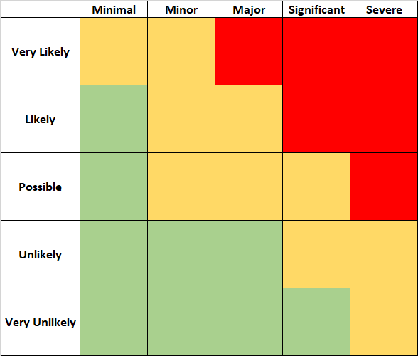
Hardware Risk Assessment
Designation | Risk
SAT | Actuator saturation
LCF | Load cell feedback failure
PSF | Primary or secondary structural failure
TSF | Tertiary structural failure
DAC | DAC evaluation board
SAT
TSF
PSF
DAC
LCF
Design Solution
Requirements
Risk Analysis
Verification & Validation
Project Planning

Slide 45
Hardware Risk Mitigation
Risk | Mitigation
SAT | The CPS will not command sustained current from the actuators
LCF | Current limiter in actuator prevents excess force
PSF | Structural analysis
TSF | Structural analysis
DAC | Can be constructed ourselves if supplier is unavailable
SAT
TSF
TSF
PSF
LCF
DAC
DAC
LCF
SAT
PSF
Design Solution
Requirements
Risk Analysis
Verification & Validation
Project Planning

Slide 46
Software Risk Assessment
Risk | Designation
High lag times | LAG
Unsafe exports to GVS, TCS | SAF
Inability to communicate with hardware, GUI | COM
Over-use of memory, memory leaks | MEM
Lack of portability | PORT
PORT
SAF
COM
LAG
MEM
Design Solution
Requirements
Risk Analysis
Verification & Validation
Project Planning

Slide 47
Software Risk Mitigation
Risk | Mitigation
LAG | C++ as software language, peer review system to check for code efficiency
SAF | Multiple safety checks, automatic abort system, terminate button
COM | Use of microcontrollers, built in C++ libraries
MEM | Peer review system, extensive testing
PORT | Test and develop on both Mac and Windows OS. Develop for Windows if portability is impossible
PORT
SAF
PORT
COM
LAG
COM
MEM
LAG
MEM
SAF
Design Solution
Requirements
Risk Analysis
Verification & Validation
Project Planning

Slide 48
Verification and Validation
Requirements
Satisfaction
Verification & Validation
Project Planning
Design Solution
Risk Analysis

Slide 49
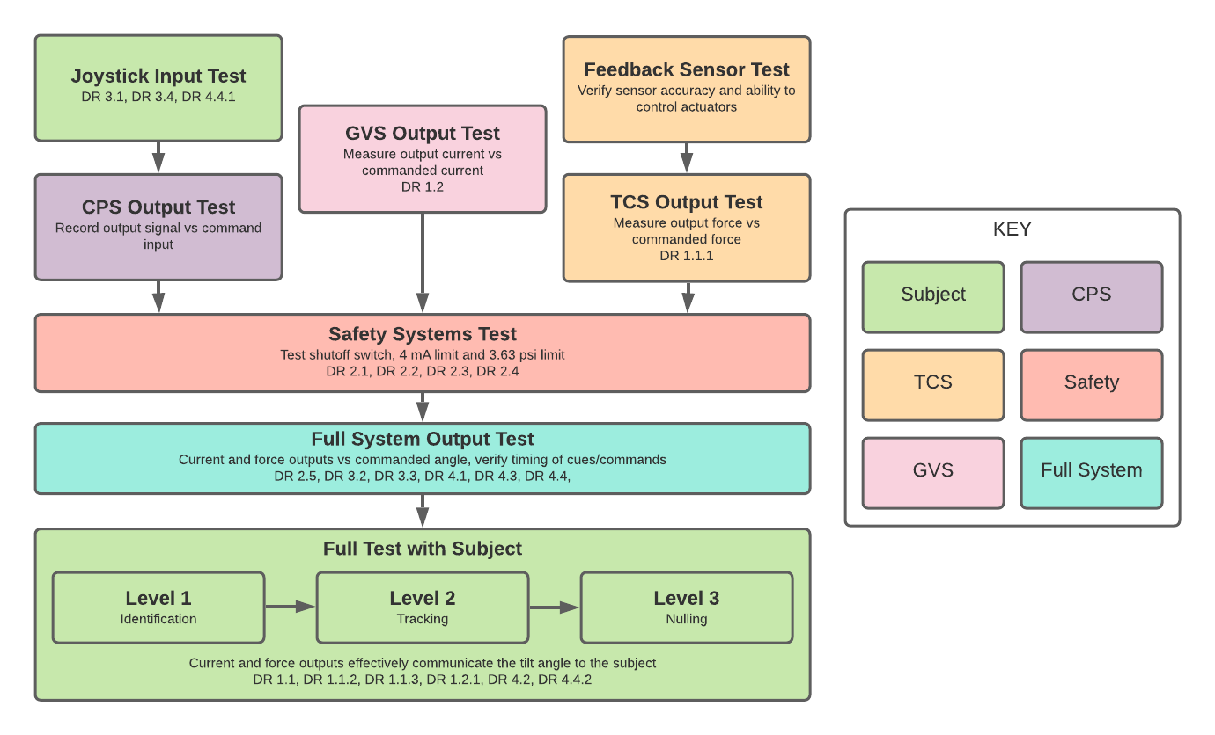
Verification Testing Overview

Slide 50
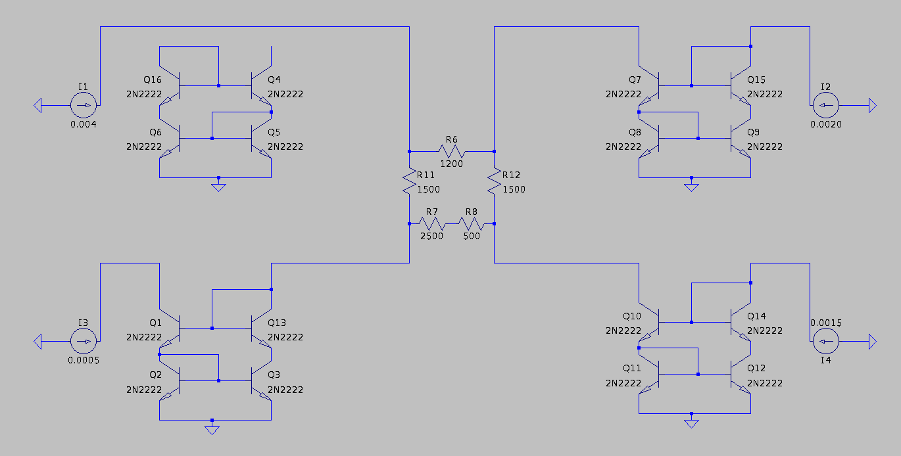
GVS Model Results
Simulated multiple electrodes in LTSpice
Verifies controllable magnitude and direction of current through any given electrode
SOURCE
SINK 2
SINK 1
SINK 3
Electrode | % Error
Sink 1 | 0.0011%
Sink 2 | 0.0062%
Sink 3 | -0.0073%

Slide 51
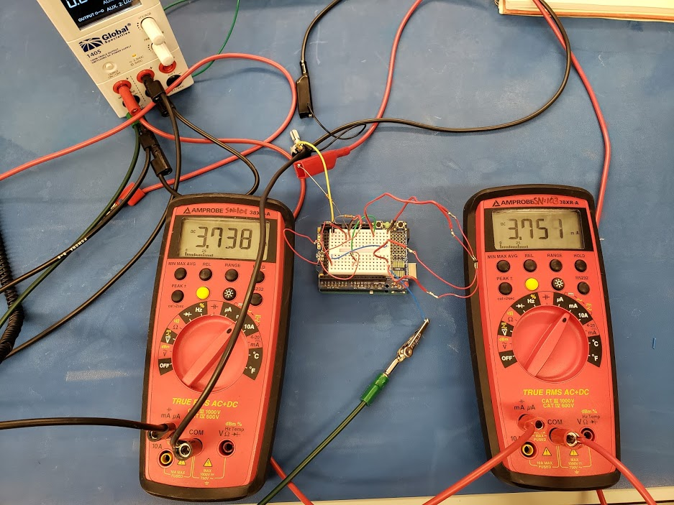
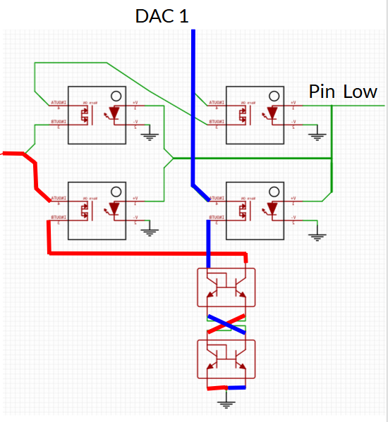
GVS Model Verification

Slide 52
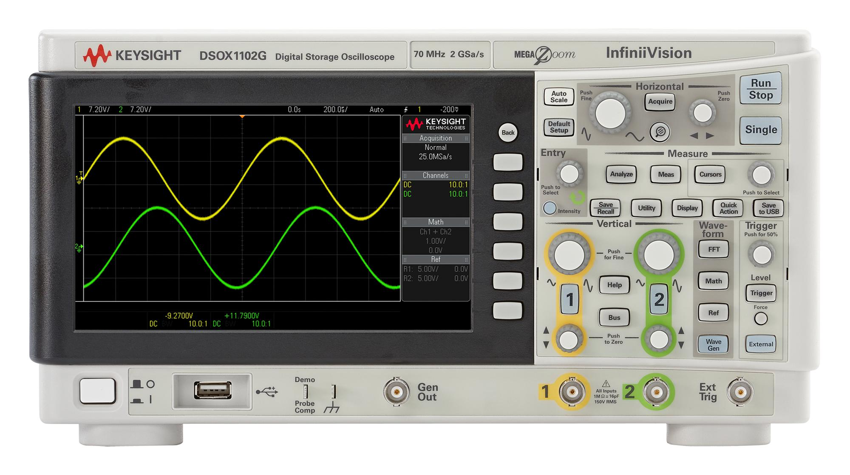
GVS Model Verification (Integration Test)
Testing Setup
  Use oscilloscope to monitor multiple electrodes simultaneously
  Test performance across a potentiometer before applying currents across our advisor
  Write current commands to microcontroller and observe output
Verification Goals
  Verify time delay between commanded currents and output currents
  Verify current accuracy
  Verify toggling sink/source modes

Slide 53
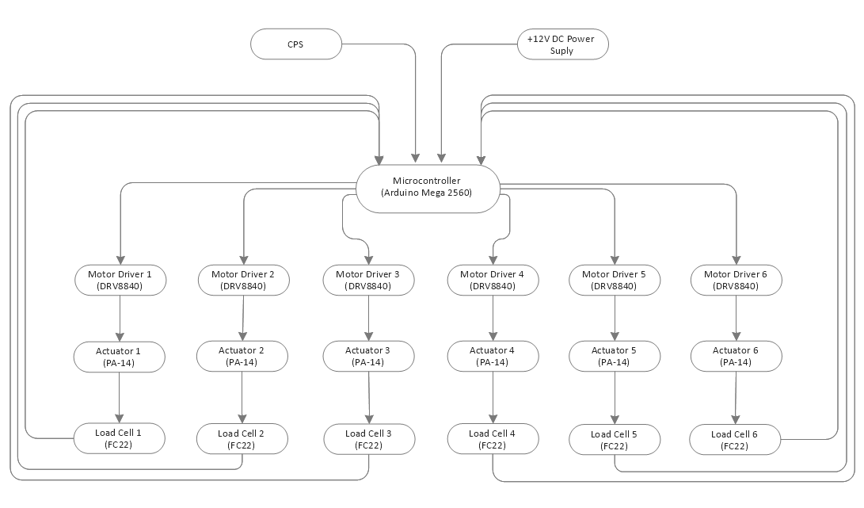
TCS Circuit Model Verification (Circuit Flow Chart)
Microcontroller distributes voltage to six motor drivers
Motor drivers will regulate current through the actuators which directly relates to the output force from the actuator
Load cells will sense output force and provide feedback to microcontroller for closed-loop control
Design Solution
Requirements
Risk Analysis
Verification & Validation
Project Planning

Slide 54
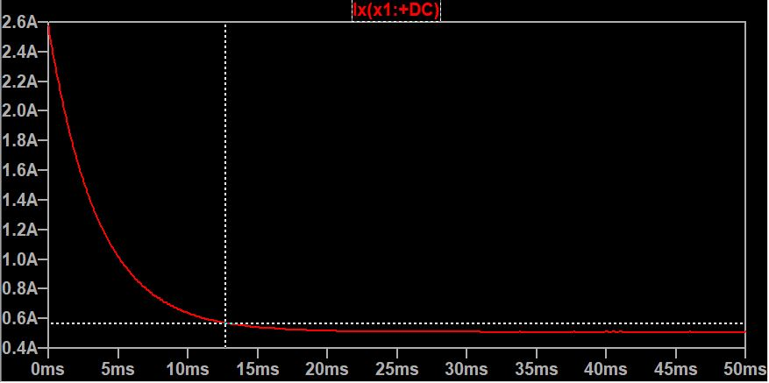
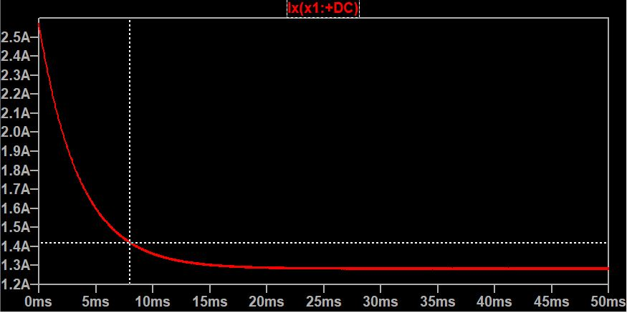
TCS Circuit Model Verification (Model Results)
20% Duty Cycle
Verifies that current will respond predictably within our response time tolerance
Current output falls within 10% of desired output within 12.66 ms.
Current Response
12.66 ms
50% Duty Cycle
Verifies that current will respond predictably within our response time tolerance
Current output falls within 10% of desired output within 7.92 ms.
Current Response
7.92 ms
Time (ms)
Design Solution
Requirements
Risk Analysis
Verification & Validation
Project Planning
Notes:
3.3 The CPS shall coordinate the hardware response such that the time delay from the joystick signal commanded by the test subject to the TCS and GVS cueing is within 200ms

Slide 55
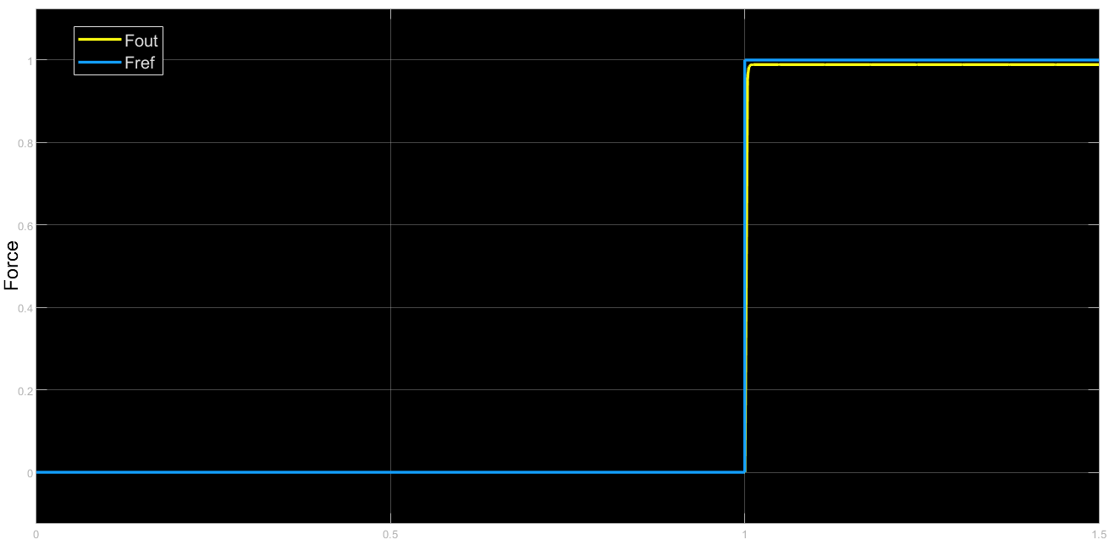

Force Simulation Verification
1.12% error on steady state force output
12.9 ms rise time
  Actual times will vary when we measure motor properties
Current seeks to hover at 1A for 0LB cueing
Force Response
Property | k_{p} | k_{d} | k_{i}
Current | 100 | 0.01 | 0
Force | 100 | 0.01 | 1
Current Response
Time Step
Design Solution
Requirements
Risk Analysis
Verification & Validation
Project Planning
Notes:
Requirement 2.1 The TCS shall provide no more than 25 kPa on the test subject. Can control the force on the test subject

Slide 56

TCS Model Validation (Feedback Sensor Test)
Testing Setup
  Breadboard
  Single Force Actuator
  Microcontroller
  IC Motor Driver
  Power Supply/Oscilloscope (Used with
  permission through CU Aerospace Facilities)
Verification Goals
  Verify predicted current through actuator
  Verify TCS safety measures in place (current limiters and shutoffs)
  Verify force feedback control loop response and adjust gain values as necessary
Design Solution
Requirements
Risk Analysis
Verification & Validation
Project Planning

Slide 57
System Validation
System will be validated according to level of success
CPS will record joystick input and commanded angle
Perceived Direction
Perceived Magnitude
Design Solution
Requirements
Risk Analysis
Verification & Validation
Project Planning

Slide 58
System Validation
System will be validated according to level of success
CPS will record joystick input and commanded angle
Level 1 (Binary): Identifying
  Subject will use joystick to identify their perceived tilt direction
  Provides data only for perceived direction
Perceived Direction
Perceived Magnitude
Design Solution
Requirements
Risk Analysis
Verification & Validation
Project Planning

Slide 59
System Validation
System will be validated according to level of success
CPS will record joystick input and commanded angle
Level 1 (Binary): Identifying
  Subject will use joystick to identify their perceived tilt direction
  Provides data only for perceived direction
Level 2 (Sinusoidal): Tracking
  Subject will use joystick to track the sinusoidal tilt profile
  Provides both magnitude and direction data
Perceived Direction
Perceived Magnitude
Design Solution
Requirements
Risk Analysis
Verification & Validation
Project Planning

Slide 60
System Validation
System will be validated according to level of success
CPS will record joystick input and commanded angle
Level 1 (Binary): Identifying
  Subject will use joystick to identify their perceived tilt direction
  Provides data only for perceived direction
Level 2 (Sinusoidal): Tracking
  Subject will use joystick to track the sinusoidal tilt profile
  Provides both magnitude and direction data
Level 3 (Variable Profile): Nulling
  Subject will use joystick to cancel out an unknown tilt profile
  Provides more accurate data due to subject receiving feedback
Perceived Direction
Perceived Magnitude
Design Solution
Requirements
Risk Analysis
Verification & Validation
Project Planning
Notes:
Contingency plan of changing gain values to drive perception of magnitude if test subjects fails magnitude perception tests.

Slide 61
Project Planning
Requirements
Satisfaction
Verification & Validation
Project Planning
Design Solution
Risk Analysis

Slide 62

Team Organization

Slide 63


Work Breakdown Structure
Design Solution
Requirements
Risk Analysis
Verification & Validation
Project Planning

Slide 64


Gantt Chart Critical Path
Full Gantt Located on Slide 121
IC Trade Studies & Circuit Designs
Design Solution
Requirements
Risk Analysis
Verification & Validation
Project Planning
Notes:
Contingency times will be altered to fit Manufacturing Readiness Review, Test Readiness Review, and Final Report. ALso used to keep time available for unforseen circumstances & issues.

Slide 65
Gantt Chart Critical Path
Full Gantt Located on Slide 121
Electronics Schematics Made
Design Solution
Requirements
Risk Analysis
Verification & Validation
Project Planning
Notes:
Contingency times will be altered to fit Manufacturing Readiness Review, Test Readiness Review, and Final Report. ALso used to keep time available for unforseen circumstances & issues.

Slide 66
Gantt Chart Critical Path
Full Gantt Located on Slide 121
CDR & Fall Final Report
Design Solution
Requirements
Risk Analysis
Verification & Validation
Project Planning
Notes:
Contingency times will be altered to fit Manufacturing Readiness Review, Test Readiness Review, and Final Report. ALso used to keep time available for unforseen circumstances & issues.

Slide 67


Gantt Chart Example
Full Gantt Located on Slide 121
1
Design Solution
Requirements
Risk Analysis
Verification & Validation
Project Planning
Notes:
Contingency times will be altered to fit Manufacturing Readiness Review, Test Readiness Review, and Final Report. ALso used to keep time available for unforseen circumstances & issues.

Slide 68
Gantt Chart Example
Full Gantt Located on Slide 121
2
Design Solution
Requirements
Risk Analysis
Verification & Validation
Project Planning
Notes:
Contingency times will be altered to fit Manufacturing Readiness Review, Test Readiness Review, and Final Report. ALso used to keep time available for unforseen circumstances & issues.

Slide 69
Gantt Chart Example
Full Gantt Located on Slide 121
3
Design Solution
Requirements
Risk Analysis
Verification & Validation
Project Planning
Notes:
Contingency times will be altered to fit Manufacturing Readiness Review, Test Readiness Review, and Final Report. ALso used to keep time available for unforseen circumstances & issues.

Slide 70
Gantt Chart Example
Full Gantt Located on Slide 121
4
Design Solution
Requirements
Risk Analysis
Verification & Validation
Project Planning
Notes:
Contingency times will be altered to fit Manufacturing Readiness Review, Test Readiness Review, and Final Report. ALso used to keep time available for unforseen circumstances & issues.

Slide 71
Gantt Chart Example
Full Gantt Located on Slide 121
5
Design Solution
Requirements
Risk Analysis
Verification & Validation
Project Planning
Notes:
Contingency times will be altered to fit Manufacturing Readiness Review, Test Readiness Review, and Final Report. ALso used to keep time available for unforseen circumstances & issues.

Slide 72
Gantt Chart Example
Full Gantt Located on Slide 121
6
Design Solution
Requirements
Risk Analysis
Verification & Validation
Project Planning
Notes:
Contingency times will be altered to fit Manufacturing Readiness Review, Test Readiness Review, and Final Report. ALso used to keep time available for unforseen circumstances & issues.

Slide 73

Testing Arrangements
Design Solution
Requirements
Risk Analysis
Verification & Validation
Project Planning
Notes:
Change this to a table, include specific tests, primary testing locations, contingency locations

Slide 74

CHAIR Expenses Breakdown
Allocated Budgets
CPS | GVS | TCS | MISC | Total
$600 | $600 | $2,500 | $500 | $4,200
TCS is the most expensive Sub-System
No allocated budgets are exceeded
$800 still remains unallocated
Design Solution
Requirements
Risk Analysis
Verification & Validation
Project Planning

Slide 75
The End
Thank you!
Are there any questions from the PAB?

Slide 76
Sources
Alzoubi, M. F., Al-Hallaj, S., & Abu-Ayyad, M. M. (2014). Modeling of compression curves of flexible polyurethane foam with variable density, chemical formulations and strain rates. Journal of Solid Mechanics, 6.
American Roller Bearing Company. (2016). Bearing Friction and Frequency Factors. American Roller Bearings. https://www.amroll.com/friction-frequency-factors.html
ANSUR II Anthropometric Data Explorer II
FoamOrder Foam Supplier
Fryar CD, Gu Q, Ogden CL. Anthropometric reference data for children and adults: United States, 2007–2010. National Center for Health Statistics. Vital Health Stat 11(252). 2012.

Slide 77
Backup Slides

Slide 78
Backup Slides Index
GVS
CPS
TCS Structural
TCS Electronics
Safety
Risk
Verification and Validation
Project Planning

Slide 79

GVS Power Circuitry Design
Current Mirrors
NPN matched transistors in an IC package
Two combined for Full Wilson configuration
30V, 100mA max
Design Solution
Requirements
Risk Analysis
Verification & Validation
Project Planning

Slide 80

GVS Housing Unit
3D-Printed Housing
Keep electrical components safe from touching
External plastic shell with clear acrylic on top to view LED/LCD
3D-printed truss will support LTC2662 and power circuitry as a stack on top of microcontroller
Design Solution
Requirements
Risk Analysis
Verification & Validation
Project Planning

Slide 81

GVS Power Circuitry Design
Design Solution
Requirements
Risk Analysis
Verification & Validation
Project Planning

Slide 82

GVS Power Circuitry Design

Slide 83



GVS Power Circuitry Design
LTC2662
New code is written to holding registers, then all 5 channels update simultaneously
12𝜇s update time for dual-electrode (CHAIR) mode, 24𝜇s to update all 5 electrodes.
Design Solution
Requirements
Risk Analysis
Verification & Validation
Project Planning

Slide 84

GVS Model Verification

Slide 85

GVS Model Verification

Slide 86


GVS & TCS MCUs

Slide 87
Detailed CPS Logic: GUI Functionality
GUI Functional Requirements
Read in a .csv with a cueing profile consisting of times and angles
Provide this file to the main CPS
Output a stream of visual data to the test controller as the test is run
Allow the test controller to load and view data from a set of .csv files with CPS commands and GVS and TCS outputs upon test completion
Include a terminate button that immediately ends the test upon activation
Advanced tab for more complex data inputs or analysis

Slide 88


Detailed CPS Logic: Communicating with the GVS

Slide 89


Detailed CPS Logic: Communicating with the TCS

Slide 90


Required Force Derivation
Max test subject weight: 215 lb
Max side force applied:
= 55 lb
Side actuators must apply a total of 55 lb to mimic horizontal gravitational force during 15° roll angle
*representative

Slide 91
Foam Selection
Assumption: Human body and pressure plate module are rigid bodies
Customer hip breadth: 16”
  Add ½” margin on each side to allow ingression/regression max width is 17”
1”
1”
Test Subject
Test Subject
15””

Slide 92
Foam Selection
Assumption: Human body and pressure plate module are rigid bodies
Customer hip breadth: 16”
  Add 1” margin on each side to allow ingression/regression max width is 17”
  Using 3” actuators, initial width range becomes 12” - 17”
13”
Test Subject
17”

Slide 93
Foam Selection
Assumption: Human body and pressure plate module are rigid bodies
Customer hip breadth: 15”
  Add 1” margin on each side to allow ingression/regression -> max width is 17”
  Using 3” actuators, initial width range becomes 12” - 17”
Using ½” foam, this reduces range to 11”-16” at a minimum (no compression) or 12”-17” at maximum (full compression)
16”
12”
17”
13”
Test Subject
Test Subject
Test Subject
Test Subject
No foam compression
Full foam compression

Slide 94

Foam Selection
EverFlex V44 Foam Properties:
Density: 2.8 lb/ cubic ft
Firm
Penn State HR Foam Properties:
Density: 3.4 lb/ cubic ft
Extra Firm
Figure 1: Penn State Experimental Results
Pressure module compression stress: 1.9 psi = 0.0131 MPa
From Figure 1, at 0.0131 MPa, compression strain = ~0.66 or 66%
  Thus, max foam compression is ~66% or 0.33”
Hip breadth range narrows to: 11.66” - 16.34”
  *Team will obtain a more accurate range through materials testing
Can accommodate 3rd to 78th percentile males and 1st to 47th percentile females in hip breadth

Slide 95


Linear Bearing Selection
Frictional Coefficient: .006
Loading (weight of pressure module wood + foam): ~.216 lb
Frictional Force: ~1.1 lbf
  5% of maximum loading
Maximum Allowable Static Loading: 285 lbf in all directions
Preload: Clearanced (lower friction)
Misumi Short Block Mini Linear Guide

Slide 96




Seat Bottom Analysis
304-2b Stainless Steel
Shear Strength (ksi) | 75
Tensile Yield strength (ksi) | 312
Modeled as a beam
Max shear force occurs at the ends of the beam
Max bending stress occurs in the middle of the beam
Dimensions | Value [in]
Width | 17
Depth | 18
Thickness | 1/8
 | Max predicted stress (ksi) | FOS
Shear | 0.04 | 1762
Bending | 8.17 | 38

Slide 97




Seat Back Analysis
304-2b Stainless Steel
Shear Strength (ksi) | 75
Tensile Yield strength (ksi) | 312
Modeled as a beam
Max bending stress occurs at the back seat and bottom seat connection
Dimensions | Value
Width [in] | 16
Height [in] | 25
Thickness [in] | 1/8
Angle [deg] | 15
 | Max predicted stress (ksi) | FOS
Bending | 22.2 | 14

Slide 98


Headrest Design
GVS stimulation can induce head tilt
A headrest is implemented to stabilize the head
Fully adjustable design
  A pivot allows the headrest to be raised and lowered
  I linear bearing allows the headrest to slide forward and backward
  Bearings allow the side plates to be adjusted from side to side

Slide 99
TCS IC Selection
DR3.1
CPS Comm
Selection | Purpose | Key Functionality | Quantity
Arduino Mega 2560 | Microcontroller | Control logic, feedback loops, and communication with CPS | 1
TI DRV8840 | Brushed DC Motor Controller | Manage current direction and control of actuators | 6
TI INA240 | Low-side Current Sense Amplifier | Read and amplify current through actuators for feedback | 6
VAC-12VDC Converter | Wall power to DC power converter | Provide main power source for actuators, arduino and motor drivers | 1
TI LMR50401 | DCDC Buck Converter | Convert 12VDC to 5VDC to power current sense amplifiers and load cells | 1
Design Solution
Requirements
Risk Analysis
Verification & Validation
Project Planning

Slide 100

TCS Electronics Circuit Model
DR3.1
CPS Comm
Circuit model ensures that the actuators will respond as expected within the designed time-delay margin
Simulates various PWM signals to control the motor in forward and reverse directions
Different duty cycles of the PWM signal will control current output which will regulate the force output of the actuator
Notes:
Internal inductance and resistance of motor are currently unknown. System will be further tuned upon testing.
Design Solution
Requirements
Risk Analysis
Verification & Validation
Project Planning

Slide 101


DC Motor Controller Simulink Model
Apply nested control loops
Inner loop tracks current
Outer loop tracks Force
Saturate current and voltage
0 A< I_{out} < 2.6 A
0 V < V_{out} < 12 V
Notes:
L and R of DC motor in actuators are currently unknown
  Placeholders used in model
Gains will be re-tuned once measurements performed
Design Solution
Requirements
Risk Analysis
Verification & Validation
Project Planning

Slide 102

DC Motor Controls Derivation
Requirements
Satisfaction
Requirements
Satisfaction
Verification & Validation
Verification & Validation
Project Planning
Design Solution
Project Planning
Design Solution
Risk Analysis
Risk Analysis

Slide 103

TCS IC Selection/Schematics - Arduino Mega 2560
IC Specifications:
15 ADC Pins for reading signals
16 Analog inputs and 52 Digital I/O
  Need 12 Analog In and 51 digital IO
1024 bin analog read abilities
  ~2mA resolution for current sensing
  ~0.025lb resolution for load cells

Slide 104

TCS IC Schematics/Justification - DRV8840
IC Specifications:
8.2 - 45V operating range
  Actuators run at 12VDC
Built in Variable Current Limiting
5A max current driving
  Actuators require ~2.6 max for our use
Built in overcurrent/over temp protection and reporting
Low cost (~$1.80 each)

Slide 105

TCS IC Schematics/Justification - DRV8840
Design Points:
VREF limits maximum current draw to 2.6A
Passive components instructed by datasheet
Rsense connected to low side current sense amplifier

Slide 106


TCS IC Schematics/Justification - INA240
IC Specifications:
PWM rejection
  Filters out transient current spikes caused by PWM control
20V/V Gain
Low cost, ~$1.30 each

Slide 107

TCS IC Schematics/Justification - INA240
Design Points
G = 20V/V
R35 converts current into voltage
  At max current 2.6 A, R = 0.09 Ohm
    V = IR = 0.234 V
  Scales to 5V operating range of arduino
    V*G = 4.68 V
      Wiggle room in case of overcurrent
Arduino Read Resolution:
1024 bins in arduino, 5V operating range
Maps to 2.71mA/bin resolution

Slide 108

TCS IC Schematics/Justification - LMR5401
Schematic and Component selection via TI Webench Power Designer
Converts 12VDC power supply to 5VDC to power load cells and current sense amplifiers
93.569 % steady state efficiency

Slide 109

Tactile Cueing System Circuit Schematic
Notes:
Each driver is equipped with current limiters as well as individual fault pins which will disable the entire system if an error is detected. Motor drivers will be able to function in forward and reverse directions. They will also be able to hold and maintain their position depending on the current phase input that is commanded by the microcontroller. Through the microcontroller, the TCS system will be grounded and also will have direct communication with the microcontroller, thus satisfying design requirement 2.2 which requires the TCS to be grounded and it also satisfies design requirement 3.1 because we are able to maintain direct communication with the CPS through the microcontroller.
Nreset, Active Low disables H bridge
Nsleep, Logic high
NFault- diagnose each actuator directly
The TCS and test subject shall be electrically grounded Requirement 2.2
The TCS shall be provided with a method of communication to the Central Processing System (CPS) 3.1

Slide 110


Chair Grounding/CPS Communication
Chair will be connected to grounding pin on PCB that is connected to the ground power supply
MEGA USB port can be used to communicate with CPS via serial
Design Solution
Requirements
Risk Analysis
Verification & Validation
Project Planning

Slide 111


Reverse Direction Simulation Results
20% Duty Cycle
Maximum IC driving current of 3.3A used
Current output falls within 10% of desired output within 18.8 ms.
50% Duty Cycle
Maximum IC driving current of 3.3A used
Current output falls within 10% of desired output within 16.9 ms.
Note: Only 2.6A needed for maximum force output
Design Solution
Requirements
Risk Analysis
Verification & Validation
Project Planning
Notes:
3.3 The CPS shall coordinate the hardware response such that the time delay from the joystick signal commanded by the test subject to the TCS and GVS cueing is within 200ms

Slide 112


Safety
Everyone's a Safety!
NASA and OSHA standards used.
Redundant safety checks along each cue path.
Hardware and Software safety checks.
Safety ICD and SER’s generated to guide test/verification.

Slide 113
Risk Scale
Level | Risk Likelihood | Risk Severity
5 | Very Likely: We can expect this issue to occur | Severe: This risk could cause complete project failure or unsafe conditions for the test subject
4 | Likely: There is a significant likelihood of this issue occurring | Significant: This risk would cause significant delays or damage to project functionality
3 | Possible: There is about a 50% chance of encountering this issue | Major: This issue could cause a delay of several days or impact higher-level project success
2 | Unlikely: This issue will most likely not occur | Minor: This issue could cause small delays up to one day
1 | Very Unlikely: We do not expect this issue to actually occur | Minimal: This issue would cause inconveniences but could be fixed in a matter of hours
Design Solution
Requirements
Risk Analysis
Verification & Validation
Project Planning

Slide 114
Production Risk Assessment
Risk | Designation | Mitigation
Insufficient Funds | INFD | Designed with sufficient margin
COVID-19 Gathering Size | GTH | Tests and assembly will be planned to use few team members
COVID-19 Closure | CLS | None
Delay of Materials | MTL | All materials will be ordered as soon as possible
Design Solution
Requirements
Risk Analysis
Verification & Validation
Project Planning

Slide 115
Production Risk Matrix
Unmitigated
Mitigated
GTH
GTH
CLS
MTL
CLS
INSF
MTL
INSF
Design Solution
Requirements
Risk Analysis
Verification & Validation
Project Planning

Slide 116
Software Verification and Validation: Safety Tests
Test functionality and lag time of test controller “Terminate” button
Does it stop inputs to the GVS and TCS within a reasonable amount of time from the button being pressed?
Create a cueing profile that exceeds maximum limits of GVS and TCS (separately) and run this (no joystick)
Does the CPS stop these commands from going through and notify the test controller?
Input a cueing profile that does not exceed maximum limits, but joystick commands are unsafe
Does the CPS stop these commands from going through and notify the test controller notified?
Create unsafe readings from GVS and TCS (separately) and read these to the CPS
Does the test abort automatically?
Intentionally cause the software system to crash (ex. intentional severe memory leak)
Do commands to the GVS and TCS stop?
All Test Cases: Is all data still saved and available to the test controller?
Design Solution
Requirements
Risk Analysis
Verification & Validation
Project Planning

Slide 117
Independent Software Validation: Functional Tests
Multiple test-cases for reading and processing of GUI inputs
  Different file types
  Different file formats
  Multiple cueing profiles for each level of success
Sampling and processing of joystick output stream
  Is joystick output stream readable?
  Can we reliably process the joystick data into desired formats for all three levels of success?
Evaluate lag time between parser, GUI, main CPS, and microcontrollers
Send data to microcontrollers
  Check that outputs are as expected
  Check that microcontroller can keep up with CPS data rates
Design Solution
Requirements
Risk Analysis
Verification & Validation
Project Planning

Slide 118
End-to-End Verification and Validation
Receive and process commands from GUI and joystick together
  Is the data as expected for all three levels of success?
  Can we receive data?
  Are we able to successfully process data?
Send commands to the GVS and TCS
  Do the GVS and TCS subsystems respond to the given commands?
  Do the output readings from the GVS and TCS reflect the commanded profiles?
Design Solution
Requirements
Risk Analysis
Verification & Validation
Project Planning

Slide 119

TCS Hardware Validation (Feedback Sensor Test)
Testing Setup
  Breadboard
  TCS Microcontroller (Arduino Mega 2560)
  IC Motor Driver (DRV8840)
  Feedback Sensor
  Multimeter/Scope (requires use of CU Aerospace Building Lab Equipment)
Test Goals
  Tune Gains in order to achieve desired current/force output
  Verify that current will be limited to 2.6A
  Verify motor will run in forward and reverse directions in addition to braking
Note: will update the test setup diagram to show proper force sensor and IC
Design Solution
Requirements
Risk Analysis
Verification & Validation
Project Planning
Notes:
Use

Slide 120
Subsystem Verification Methods
Galvanic Vestibular Stimulator
  Angle to current model developed by customer
  Output will be verified using current measurements between electrodes
  Measured with µA resolution and 100 Hz sampling frequency
Tactile Cueing System
  Angle to force model developed from free body diagram
  Output will be verified using feedback load cells
  Load cells will be verified using known weights
  Measured with mV resolution and 100 Hz sampling frequency
Central Processing System
  Different file types/formats
  Sampling and processing of joystick output stream
  Lag time evaluation
  Verify that signal received by microcontroller is as expected
Design Solution
Requirements
Risk Analysis
Verification & Validation
Project Planning

Slide 121

Overall Gantt
Design Solution
Requirements
Risk Analysis
Verification & Validation
Project Planning
Notes:
Focus on Final report

Slide 122

Financial Table

