Slide 1
Spacial HEO Autonomous Detector & Evaluator
Critical Design Review
Sponsor
The Aerospace Corporation
Advisor
Dr. Zachary Sunberg
SHADE
Team
Robert Redfern, Quinton Dombrowski, Benjamin Vidaurre, Elliott Tung, Katherine Nyland, Marlin Jacobson, Jacob Weiner, Davis Peirce, John Hugo & Vinay Simlot

Slide 2
Project Description

Slide 3
The Need
Higher risks now posed by Earth-orbiting objects
Attributed to cheaper launches and limited space junk removal
Large Space Situational Awareness Systems
Highly capable, very expensive, currently overwhelmed
Need to reduce ‘trivial’ tracking requests
Producing inexpensive smaller systems will free up operational bandwidth for more capable systems
Courtesy: NASA Goddard Space Flight Center
Timeline Project Description Design Solution Requirement Satisfaction Risks Validation Planning Summary

Slide 4
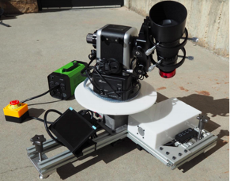
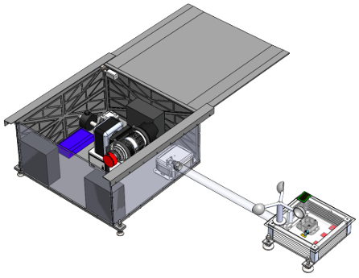
Project History
GHOST (2018/19)
WRAITH (2019/20)
Ground-Based Hardware for Orbital Space Testing
Created to track circular LEO and MEO objects
Key elements: Autonomous imaging and processing for orbit determination, scheduling limited observation windows
Weather Resistant Autonomous Imaging for Tracking HEOs
Added HEO tracking capabilities to GHOST
Modified to function autonomously for 12 hour observations
Project cut short in March 2020 due to COVID-19 pandemic
Key elements: Active and passive weather protection, dynamic scheduler to reschedule missed observations in a single night
Timeline Project Description Design Solution Requirement Satisfaction Risks Validation Planning Summary

Slide 5
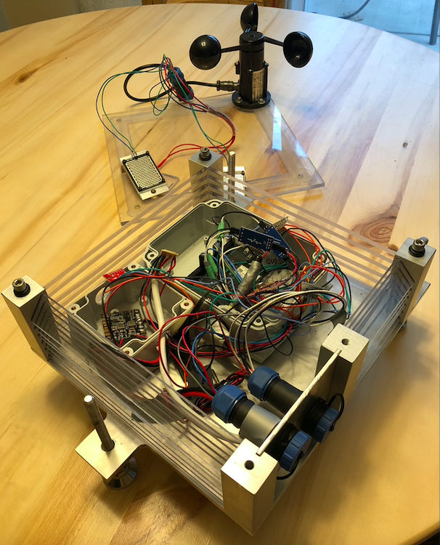
Legacy Status
Some aspects of legacy systems are undocumented or exhibit limited capability.
These systems require additional development and significant integration work to be used as intended.
SHADE’s manufacturing, integration, and testing will work to improve existing systems as well as implement the new design features.
After Initial Legacy Testing
15% working as intended
30% in progress
55% broken/undeveloped
Initial state of WRAITH Environmental Suite
Timeline Project Description Design Solution Requirement Satisfaction Risks Validation Planning Summary
Notes:
Put picture of WRAITH in here to show how bad it is
Put percentages (we can estimate) about status of things - % working, % in progress, % broken, etc.

Slide 6
Spacial HEO Autonomous Detector & Evaluator 2020/21
Mission Statement
To provide an easily accessible, multi-night orbit tracker, specializing in the evaluation of highly elliptical orbits. SHADE will be a low-cost capable tracking system, able to withstand adverse weather conditions.
Timeline Project Description Design Solution Requirement Satisfaction Risks Validation Planning Summary
Notes:
Reduce number of words, (bold stuff)

Slide 7
SHADE Functional Requirements
1) SHADE shall predict locations and visibility windows for objects in LEO, MEO, GEO, and HEO.
2) SHADE shall function autonomously in standard operating conditions for at least two nights.
3) SHADE shall autonomously enter and exit a safe mode to protect itself from adverse weather.
4) SHADE shall autonomously track objects in LEO, MEO, GEO, and HEO.
5) SHADE shall image objects with apparent magnitude of less than 10.
6) SHADE shall create and save orbit estimates for each object within 5 mins of the end of the associated visibility window.
New to SHADE
7) SHADE shall be deployed & recoverable in 30 minutes by a single operator.
8) SHADE shall be capable of making observations on multiple nights during a single deployment.
Timeline Project Description Design Solution Requirement Satisfaction Risks Validation Planning Summary
Notes:
Associated requirements to FR 1-6 have been modified to account for multi day deployment

Slide 8
CONOPS

Slide 9
5
Notes:
Animation Dialogue
Single operator arrives in vehicle with in 100 feet of deployment site (click)
Operator transports system modules to deployment site by foot, making a total of three separate trips (click)
Operate assembles the system modules, uploads the TLE List and deploys SHADE (click)
The system beginnings imaging (click)
However if the weather detection unit is triggered due to bad weather, the system will enter safe mode. (click)
Otherwise, the imaging process is initiated (click)
If an object is present at the predicted location, SHADE will analyze its location and predict its orbit (click)
This imaging cycle continues for the duration of the night. (click)
If an object is not present at its predicted location, Shade will search the nearby sky for the missing object. (click)
If the missing object is found the cycle will continue, otherwise SHADE will move on to the next object. (click)
This cycle occurs for each night of deployment. (click)
At the end of deployment, the single operator returns to deployment site and recovers and disassembles the system.

Slide 10
Design Solution

Slide 11
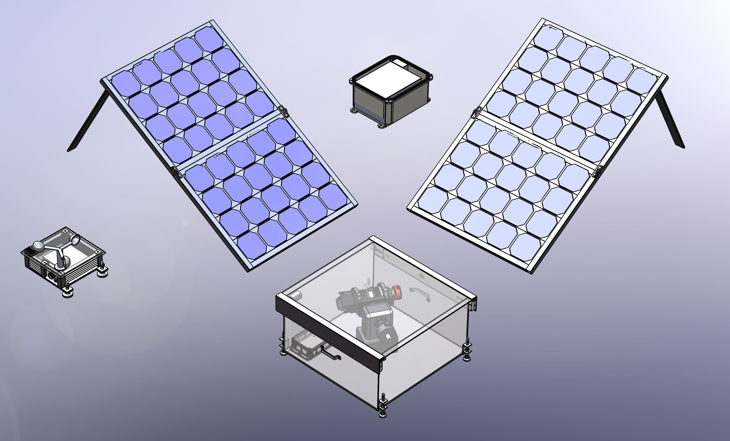
Introducing

Slide 12
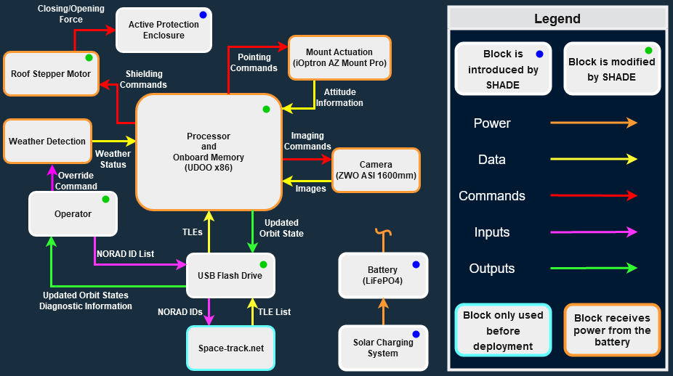
Overall Functional Block Diagram
Timeline Project Description Design Solution Requirement Satisfaction Risks Validation Planning Summary
Notes:
Use laser pointer

Slide 13
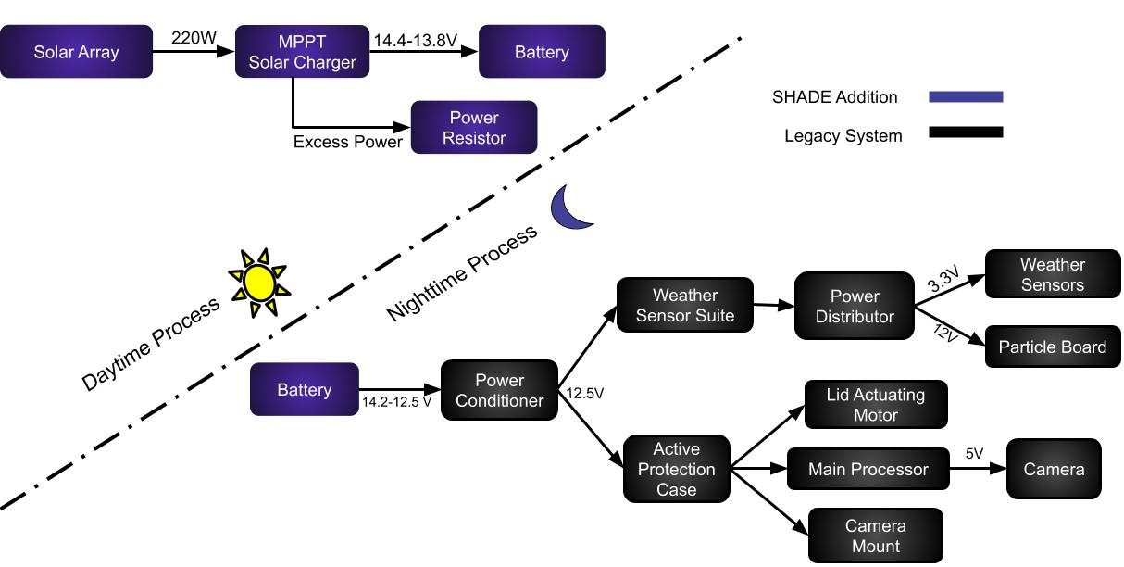
Power System FBD
Timeline Project Description Design Solution Requirement Satisfaction Risks Validation Planning Summary
Notes:
Maybe box each set by itself
Put sun and moon vertically in-line with each other
Place sun and moon in the same order they appear in the legend (Sun over moon in the legend)
Take away wordy stuff

Slide 14
Critical Project Elements Review
Power System
Weather Detection
Modularity
Passive Protection
Active Protection
Software
Timeline Project Description Design Solution Requirement Satisfaction Risks Validation Planning Summary
Notes:
Animate
Maybe make each component of modularity smaller font and make the polygon thing for each a different shade of purple

Slide 15
Requirement Satisfaction

Slide 16
THANKS
Power System
Does anyone have any questions?
Follow the project updates
addyouremail@freepik.com
+91 620 421 838
yourcompany.com
Requirement Satisfaction Power Modularity Software
Notes:
The purpose of SHADEs weather detection suite is to protect the system from adverse weather conditions that it may encounter during multiple night deployment, functional requirement 3.

Slide 17
Power System Functional Requirements
Functional
Requirement 2
The system shall function autonomously in standard operating conditions with no human intervention for at least two nights.
Functional
Requirement 7
The system shall be deployed and recovered within 30 minutes by one operator.
Functional
Requirement 8
The system shall be capable of making observations on multiple nights during a single deployment.
Requirement Satisfaction Power Modularity Software

Slide 18
Power System Design Requirements
Req. | Description
DR 2.2 | The system shall contain a battery capable of supplying operational power levels for 12 hours without recharging. [Met by WRAITH design, integration untested]
DR 8.1 | SHADE shall be resilient to diurnal temperature fluctuations over the range of temperatures described by the Standard Operating Conditions.
DR 8.1.1 | During charging, the magnitude of the thermal coefficient for the solar panels shall not exceed -0.5% per °C.
DR 8.2 | The solar charging system shall be capable of providing a constant 12.5V input voltage to the SHADE system during adequate solar conditions.
 | Battery & Charger
 | Solar Array
 | Thermal Regulation
Requirement Satisfaction Power Modularity Software
Notes:
Prove DR 8.1.2 in backup slides

Slide 19
Core Power System Components
Battery & Charger
(FR 2,7,8 - Modification)
Easier to transport, reduces weight from 40 to 20.5 lbs
Life cycle increased by 10x
Charges faster than SLA
Solar Array
(FR 2,7,8 - Novel)
Each solar panel weighs less than 50 lbs
Extends deployment time to multiple nights without operator intervention
Thermal Regulation
(FR 2,8 - Novel)
Heat sinks lower panel temperature from 1-10 ºF on hot days
Lower temperatures increase panel efficiency
 | Modification
 | Novel
Requirement Satisfaction Power Modularity Software

Slide 20
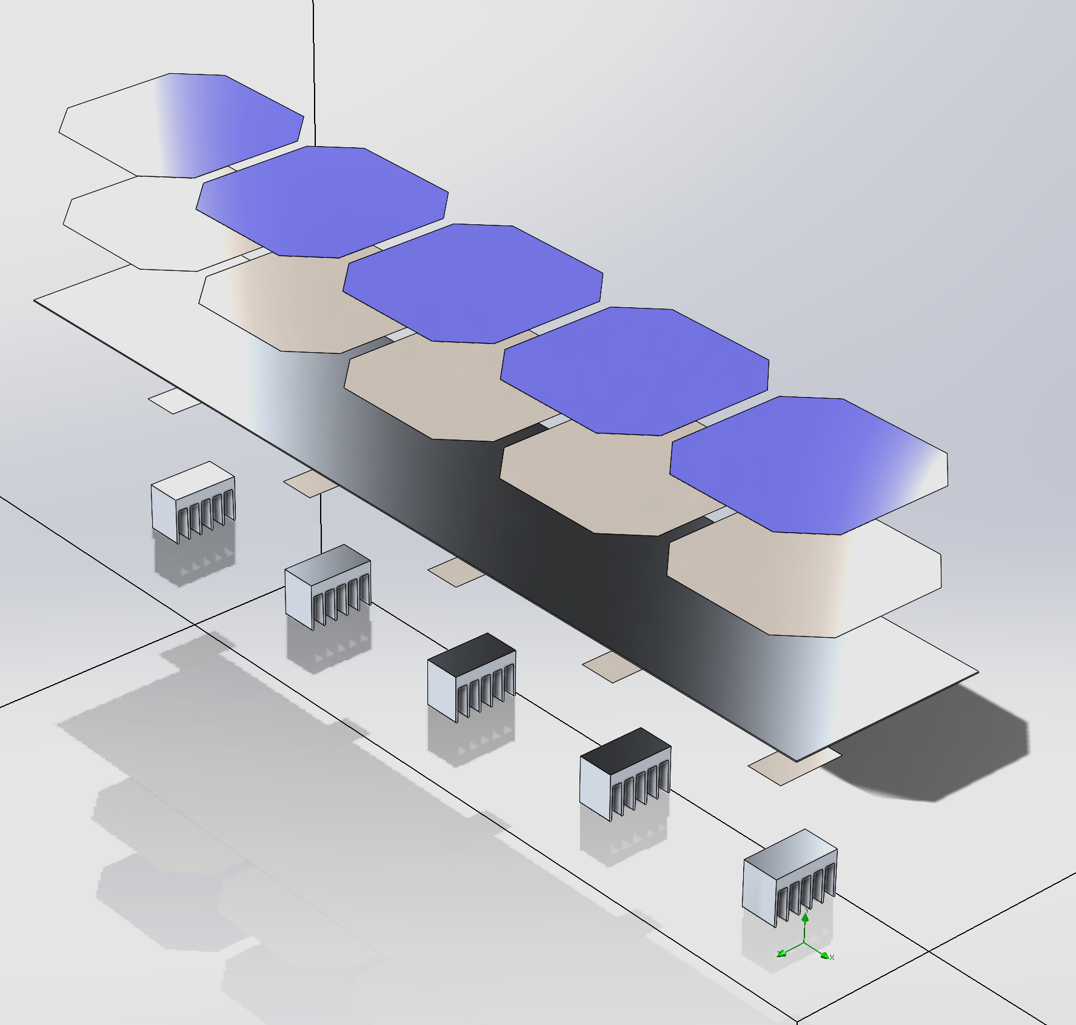
Solar Panel
Solar Cells
Aluminum Back Plate
Thermal
Epoxy
Heat Sink
Solderable “Dogbone”
Requirement Satisfaction Power Modularity Software
Notes:
63.5% increase in surface are per solar cell w/ heat sink

Slide 21
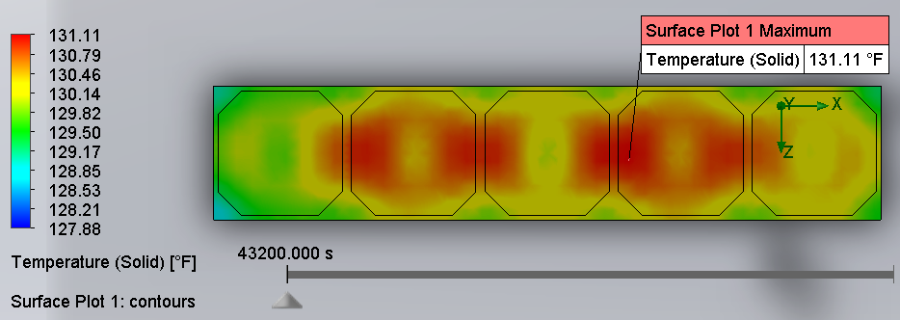
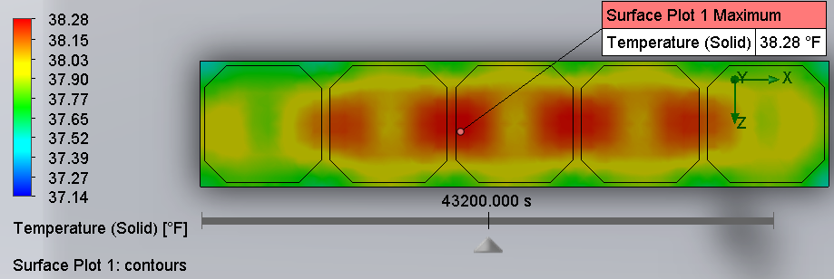
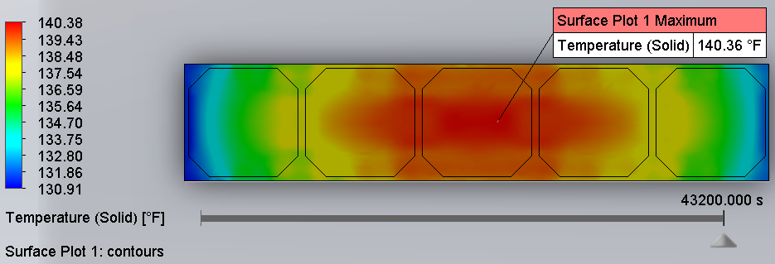
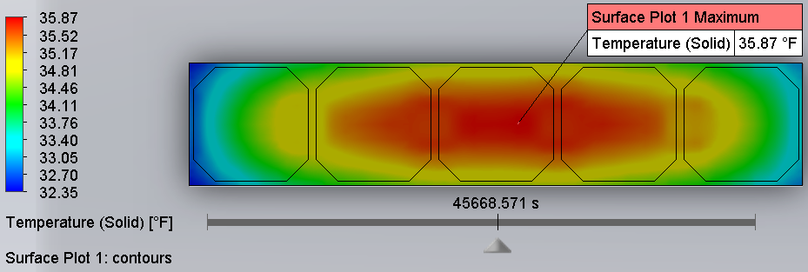
Thermal Regulation
Hot Case (June 28, 2018)
Cold Case (December 28, 2018)
With Heat Sinks
Without Heat Sinks
Requirement Satisfaction Power Modularity Software

Slide 22
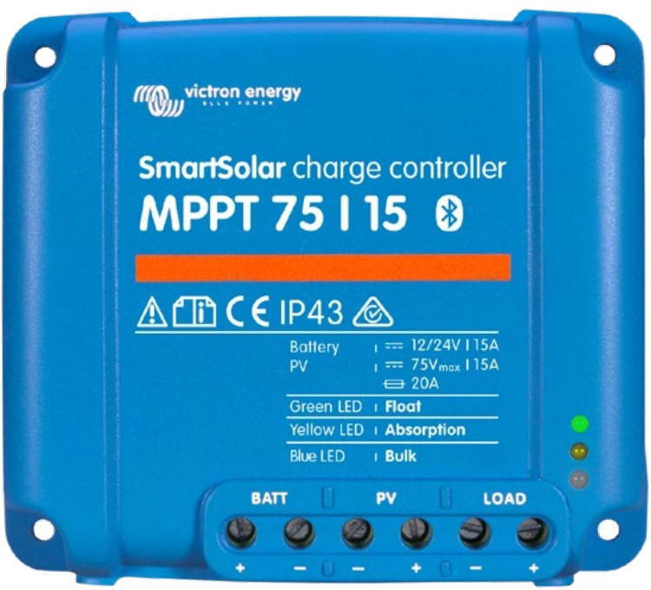
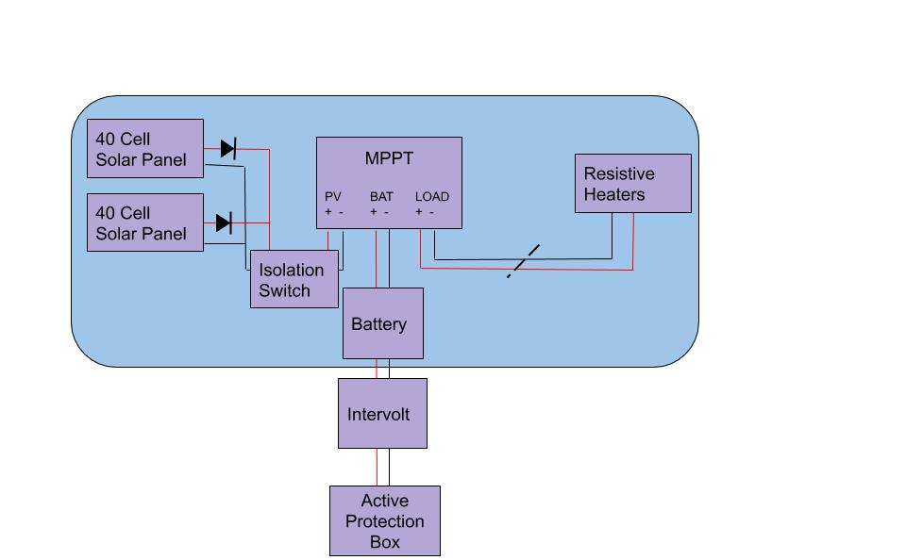
Revised Charging System
Switch from BlueSolar to SmartSolar
System can be programmed to divert extra power
Eliminated need for external power diverter
Power Module
Requirement Satisfaction Power Modularity Software
Notes:
SmartSolar - is programmable via smartphone to dump excess power to a dummy load. Helpful when battery is charging above 90% or trickle charing
MPPT adjusts the load on the PV array to operate in the arrays maximum power point.
The diodes prevent back current
Isolation switch is for safe removal of PV array
CHANGE SHADE TO ACTIVE PROTECTION BOX

Slide 23
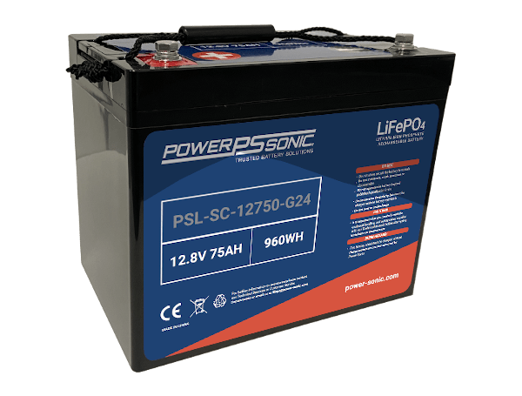
Battery
Deep Cycle LiFePO4 Battery
12.8V 75AH
960WH
2000 Cycles
Dimensions: 10.24” x 6.53” x 8.58”
PSL-SC-12750-G24 Battery
Requirement Satisfaction Power Modularity Software

Slide 24
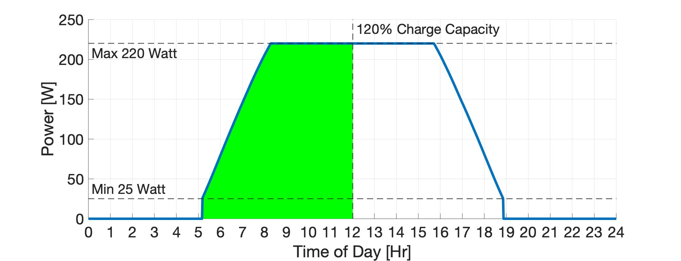
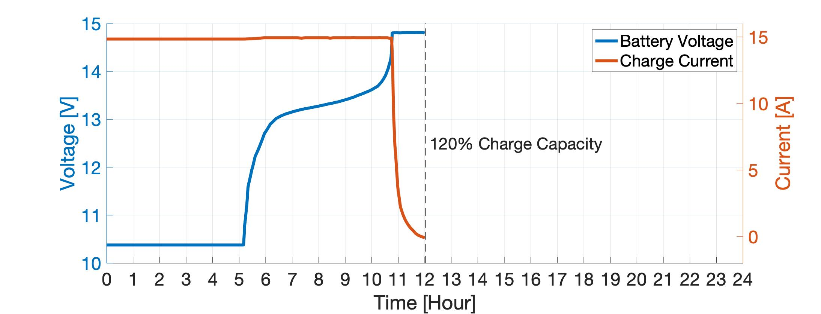
Battery Charging Simulations - Hot Day
Power Generated From Solar Panel
Full Day: 2.3 kWh
Sunrise: 5:35 AM
Sunset: 8:34 PM
120% Charge By 12 PM
Battery Charge Profile
Requirement Satisfaction Power Modularity Software
Notes:
Explicitly state that green = charging
Make axes bigger
State the reason for these simulations was to show typical envelope for charging

Slide 25
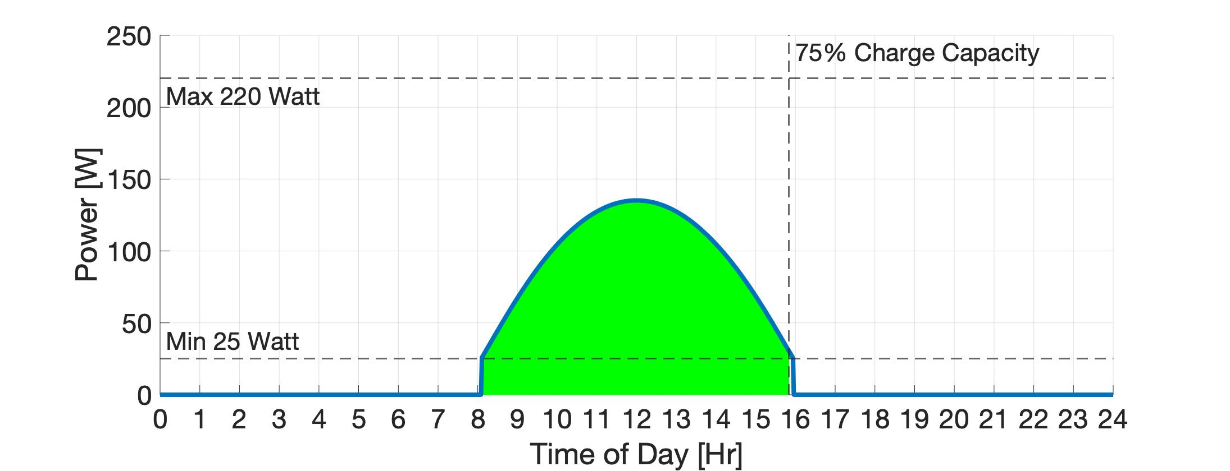
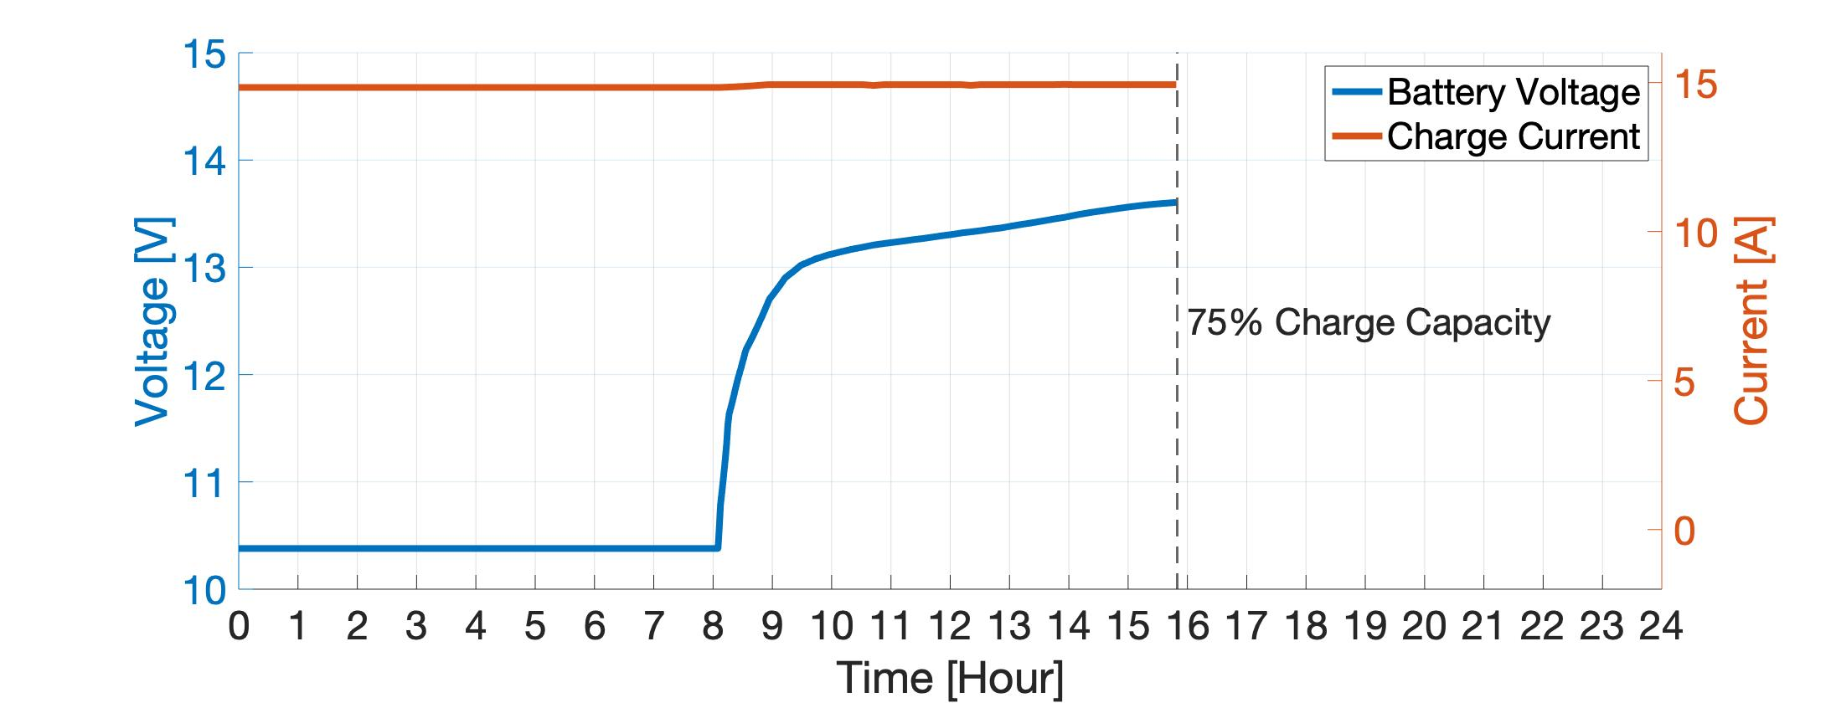
Battery Charging Simulations - Cold Day
Power Generated From Solar Panel
Full Day: 723 Wh
Sunrise: 7:22 AM
Sunset: 4:43 PM
75% Charge By Sunset
Battery Charge Profile
Requirement Satisfaction Power Modularity Software
Notes:
Explicitly state that green = charging
Make axes bigger
State the reason for these simulations was to show typical envelope for charging

Slide 26
THANKS
Modularity
Does anyone have any questions?
Follow the project updates
addyouremail@freepik.com
+91 620 421 838
yourcompany.com
Requirement Satisfaction Power Modularity Software
Notes:
The purpose of SHADEs weather detection suite is to protect the system from adverse weather conditions that it may encounter during multiple night deployment, functional requirement 3.

Slide 27
Modularity Functional Requirements
Functional
Requirement 2
The system shall function autonomously in standard operating conditions with no human intervention for at least two nights.
Functional
Requirement 3
The system shall autonomously enter and exit a safe mode to protect itself from adverse weather, as defined by conditions worse than the Standard Operating Conditions.
Functional
Requirement 7
The system shall be deployed and recovered within 30 minutes by one operator.
Functional
Requirement 8
The system shall be capable of making observations on multiple nights during a single deployment.
Requirement Satisfaction Power Modularity Software
Notes:
(Many of these are addressed by legacy design components)

Slide 28
Modularity Design Requirements
Req. | Description
DR 7.1 | The individual system modules shall weigh less than 22.68 kilograms (50 lbs).
DR 7.2 | SHADE shall be set up and taken down in accordance to the process document titled: SHADE System Operation Manual.
DR 8.1 | SHADE shall be resilient to diurnal temperature fluctuations over the range of temperatures described by the Standard Operating Conditions.
 | Modularization
 | Active Protection Module
Requirement Satisfaction Power Modularity Software
Notes:
***Put Standard Operating in Backup slides

Slide 29
Core Modularity Components
Modularization
(FR 7 - Novel)
Enabling single operator transport, all modules < 50 lbs
4 modules, enabling single operator transport & assembly in under 30 minutes
Active Protection Module
(FR 7 - Modification)
Active Protection module material will be changed to Polycarbonate, reducing weight & making for easier transport
Active Protection dimensions reduced, minimizing volume
Requirement Satisfaction Power Modularity Software

Slide 30
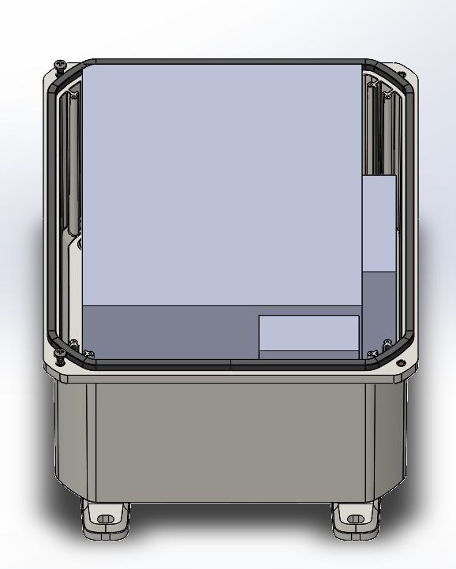
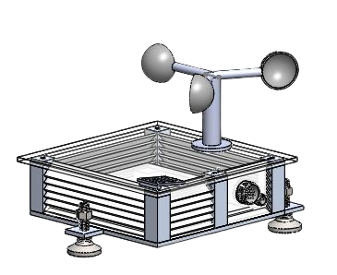
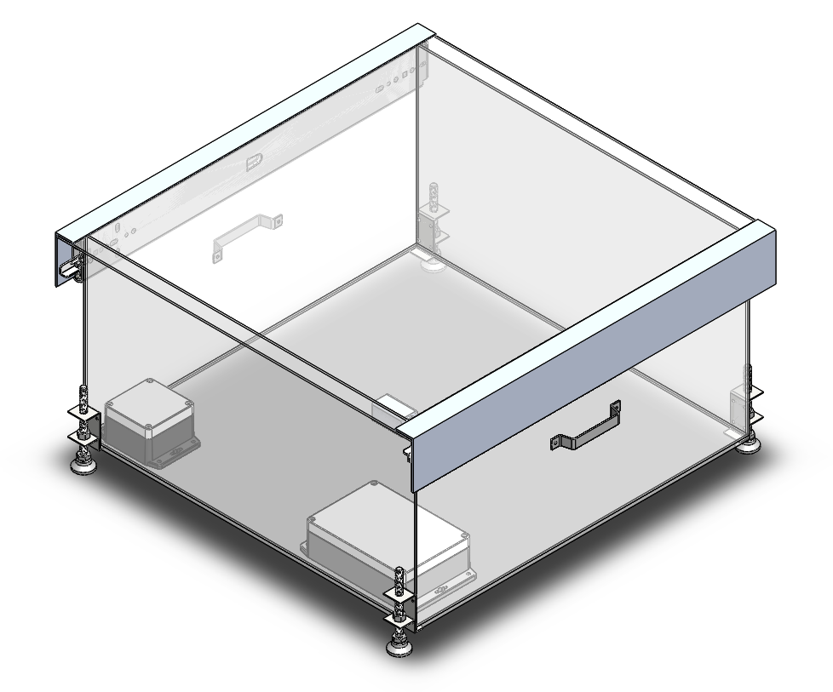
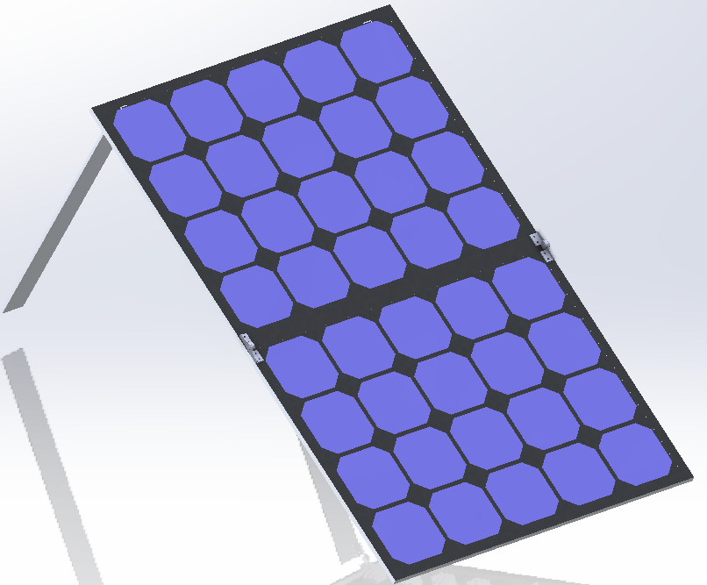
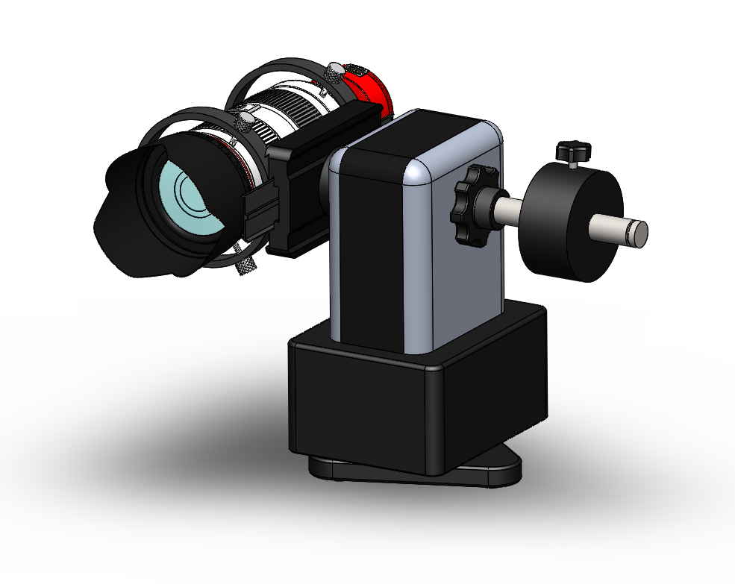
Transport Modules
Trip #1:
Trip #2:
Active Protection Enclosure:
Weight: 15 lb
Environmental Suite & Power Module:
Weight:
Suite: 5 lb
Power Mod: 25.55 lb
Trip #3:
Trip #4/5:
Actuation Mount & Telephoto Lens/Camera:
Weight: 18 lb
2 Solar Panels:
Weight: 27.34 lb (each)
Requirement Satisfaction Power Modularity Software

Slide 31
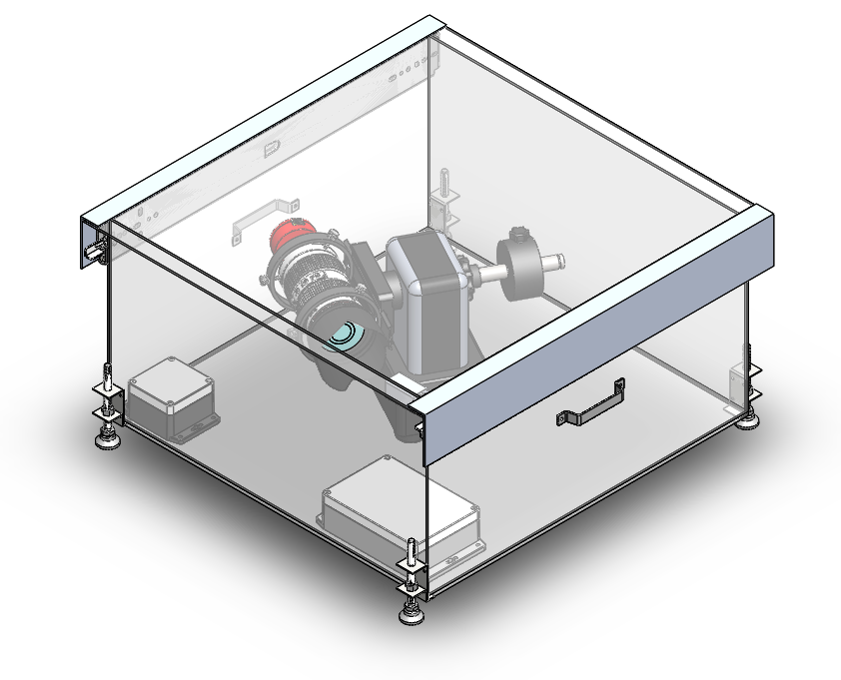
Active Protection Module - Overview
Camera and Mount
Polycarbonate Structure with White Cool-Coat Paint
Aluminum Roof Sliders
Aluminum Rail Guards
Steel Leveling Feet
Power Distributor Housed in Polycase
Aluminum Handles
Processor Housed in Polycase
Requirement Satisfaction Power Modularity Software

Slide 32
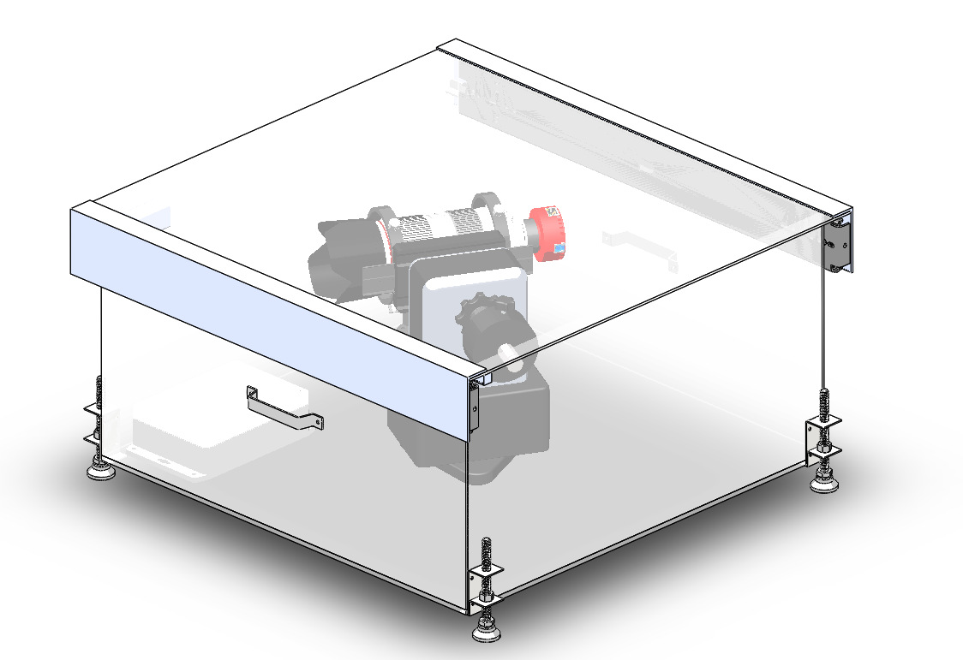
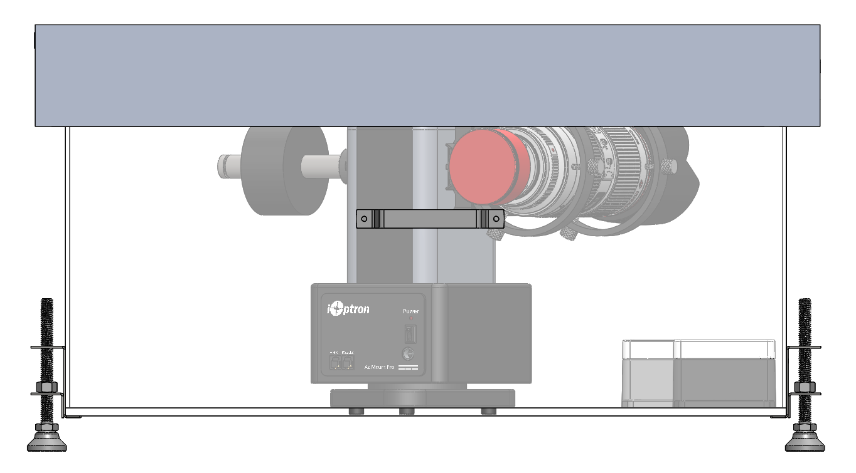
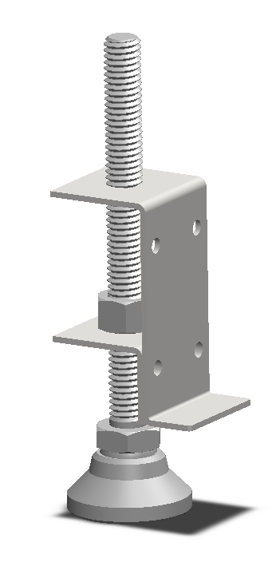
Active Protection Module - Geometry
Floor dimensions and wall height allow camera to rotate and have appropriate FOV.
Roof slope of -0.25 in/ft prevents liquid from pooling.
Box leveled with adjustable feet.
Rain/Snow
12 in
23 in
23 in
Requirement Satisfaction Power Modularity Software

Slide 33
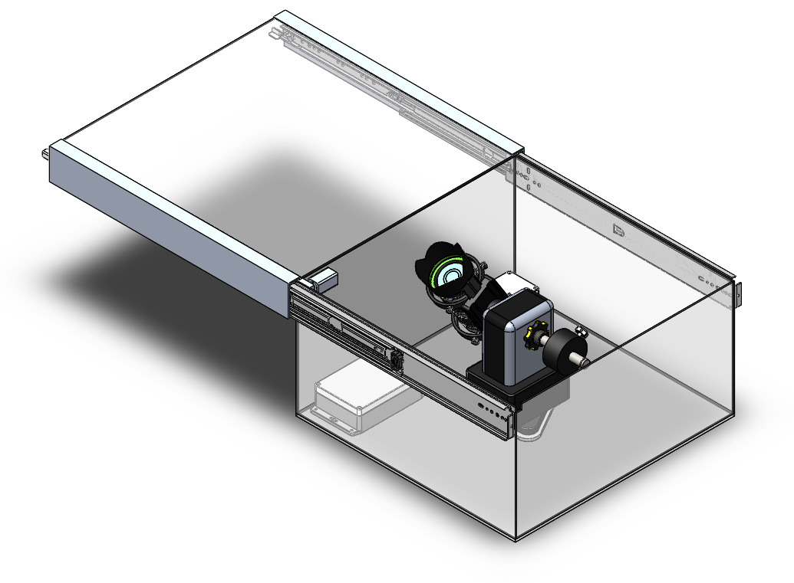
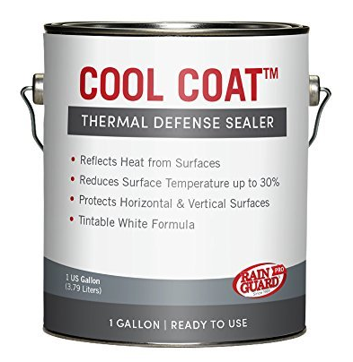
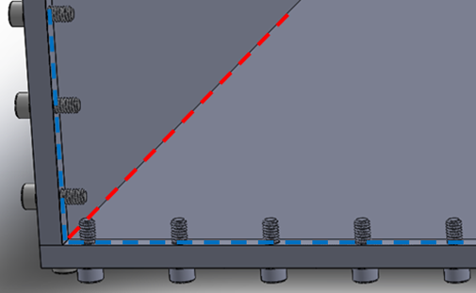
Active Protection Module - Passive Protection
Cool Coat white paint applied on exterior components to enable minimal solar heating and hide interior components.
High emissivity and low solar absorptivity prevents system from overheating.
Gap Sealer under Roof:
Weatherstrip
Edge Sealant:
Loctite Liquid Gasket
Interior Sealant: Silicone Caulk
Requirement Satisfaction Power Modularity Software

Slide 34
Active Protection Module - Verification
Thermal analysis setup:
Greatest solar flux day of the year.
Solar flux applied to external surfaces except bottom.
95°F ambient air.
90°F initial structure temperature.
Natural convection.
Internal and external radiation.
ΔTime = 3 hrs
Tamb = 95 F
Temperatures do not exceed material limits.
Internal hardware is safe from heating.
Tinitial = 90 F
Tmax = 166 F
Requirement Satisfaction Power Modularity Software

Slide 35
THANKS
Software
Does anyone have any questions?
Follow the project updates
addyouremail@freepik.com
+91 620 421 838
yourcompany.com
Requirement Satisfaction Power Modularity Software
Notes:
The purpose of SHADEs weather detection suite is to protect the system from adverse weather conditions that it may encounter during multiple night deployment, functional requirement 3.

Slide 36
Software Functional Requirements
The system shall be deployed and recovered within 30 minutes by one operator.
Functional
Requirement 7
Functional
Requirement 8
The system shall be capable of making observations on multiple nights during a single deployment.
Requirement Satisfaction Power Modularity Software

Slide 37
Software Design Requirements
Req. | Description
DR 7.3 | SHADE shall be able to startup and perform all tasks with no user input beyond supplying a target list file via external USB drive.
DR 7.4 | During routine operation, SHADE shall execute an automatic attitude determination procedure.
DR 8.3 | The scheduler shall predict location of an object at an arbitrary time up to five nights in the future.
DR 8.4 | When creating the initial schedule, the scheduler shall be able to consider the total mission duration when prioritizing observation windows.
 | Startup Procedure
 | Automatic Calibration
 | Scheduler
Requirement Satisfaction Power Modularity Software
Notes:
Be sure to explain the DR 7.4 has been modified in its essence due to the modification of the image processor.

Slide 38
Core Software Components
Startup Procedure
(FR 7 - Novel)
Minimizes necessary operator expertise
Fewer tasks for operator to perform
Faster setup time
Generally improved interface
Automatic Calibration
(FR 7&8 - Modification)
Part of automatic setup
Allows for recalibration (a necessity of long deployments)
Scheduler
(FR 8 - Modification)
Multi-day deployments demand changes to observation priority
Potential for prediction quality to decay
GPS (Never implemented)
Incomplete
Incomplete
Prototyped
Requirement Satisfaction Power Modularity Software

Slide 39
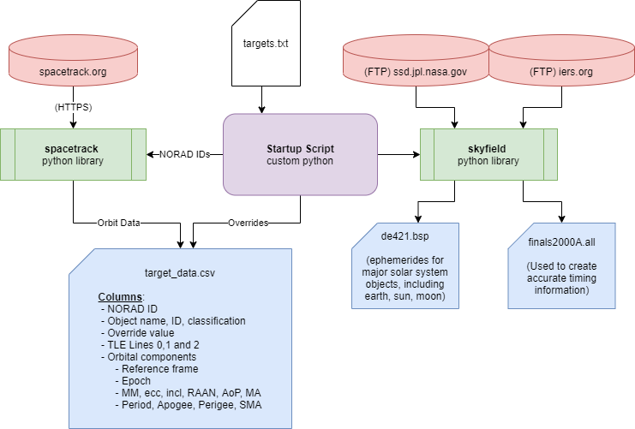
Startup Procedure
Before Deployment: Setup Script (left)
Python
Fetch from online databases (red)
Save collected data to USB (blue)
At Deployment: System Startup
Bash, Python
Operating system tasks
Login
Mount USB filesystem
Run self-check
Existence of input data
Basic hardware operability
Requirement Satisfaction Power Modularity Software

Slide 40
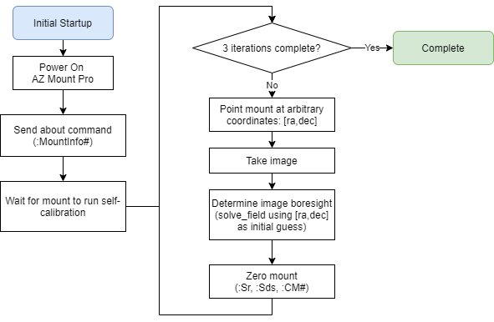
Automatic Calibration
Initial Calibration
Allow AZ Mount to achieve GPS lock and find magnetic south
Runs astrometry on images of arbitrary coordinates to determine boresight
Feeds back to AZ Mount to correct it’s calibration
IMU Check Removed
Adds additional integration complexity
Benefit no longer necessary with improvements to image processing
Each imaging sequence preceded by calibration image and alignment correction
Requirement Satisfaction Power Modularity Software

Slide 41
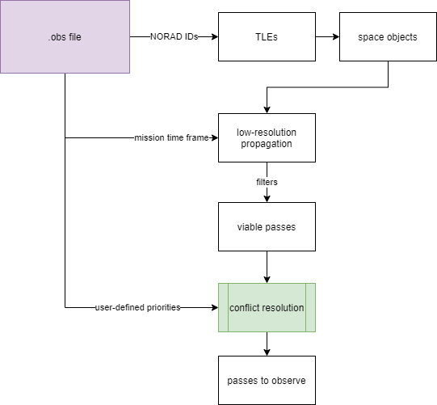
Scheduler
High-priority modifications
Remove internet dependence
TLEs
Time information
Planetary ephemerides
Run before each night instead of once
Dynamic time frame
De-prioritize objects observed on previous nights
Low-priority modifications
Remove serialization
Results in unwanted dependencies
Replace TLE format
TLE will be irrelevant in few years
Limited resolution of orbit estimates
Requirement Satisfaction Power Modularity Software

Slide 42
Scheduler - Orbit Propagation
Variable | m | b | Mean | Standard Deviation
Time | 0.1707 | 0.1676 | 2221 | 3620
Eccentricity | 0.0207 | 0.1074 | 0.0804 | 0.0006
Mean motion | -0.0197 | 0.0802 | 0.0495 | 2.903
Semi-major axis | 0.0198 | 0.0802 | 13031 | 3.919
Requirement Satisfaction Power Modularity Software
Notes:
During PDR, we presented a graph showing that we would need to modify the scheduler due to high amounts of error in the orbit predictions. An error was found in those calculations and the results have been revised. Here we have linear approximations for an error in degrees derived from years of data and several satellites (NOAA-6, NOAA-17, DMSP-F16, GOES-4, AO-10, and AO-13). For each error value and each desired variable, all other values were found where the other variables were constant within 2%. A line of best fit was calculated and averaged, yielding the following. M and B correspond to a scaled linear fit, and the mean and standard deviation are how the independent variable was scaled. To use the linear fit, the input must be scaled as seen in the equation on screen. The scheduler will now be able to predict the error of a TLE based on orbit parameters and modify the observation window to avoid errors that would place the object outside the field of view of the camera.

Slide 43
Additional Software
Motor Controller Software
(FR 3 - Modification)
Existing motor control software untested
Multiple flaws identified that need to be addressed
Relatively simple, but needs to be reworked from scratch
New Image Processor
(FR 4,5,6 - Novel)
Addresses multiple flaws identified with GHOST imaging
Improves reliability and accuracy of orbit determination
Reduced imaging requirements
Not Started
Awaiting Integration
Requirement Satisfaction Power Modularity Software

Slide 44
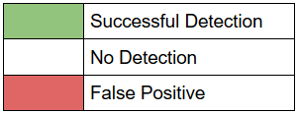
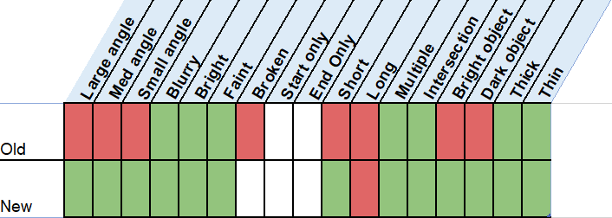
New Imaging System (Streak Detection)
Old System: Matched Filter
(Find where template matches image)
Requires a “blank” image
Can only detect single point
Prone to false positives
New System: Hough Transform
(Detect features, i.e. lines, in image)
Only one image required
Can detect both endpoints
Independent of orbit estimate
Requirement Satisfaction Power Modularity Software

Slide 45
Software Integration Components
Signals/Protocols
RS-232
Arduino
AZ Mount Pro
GPS
USB
Operator data flash drive
Camera
PWM
Motor controller
HTTPS
Spacetrack
Time information
Operating System
Filesystem management
User environment
Privileges
Login
Sleep/Wake
Program coordination
C/C++, Python, Bash
Memory/CPU resource limits and priority
Python Environment
Package structure
3rd party packages
Image manipulation
Propagation
Astrometry
Astronomy
Package Compatibility
Has already posed problems
Requirement Satisfaction Power Modularity Software

Slide 46
Risks

Slide 47
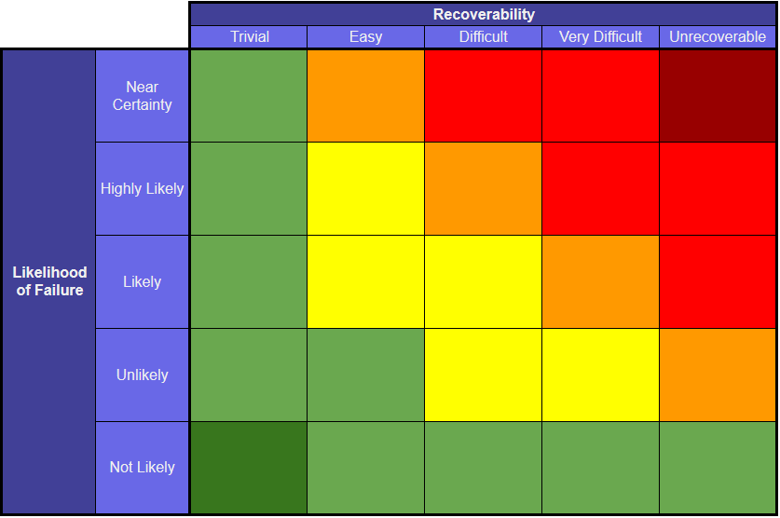
Highlighted Risks & Mitigation Strategies
Legacy Component Functionality
Legacy System Integration
Expanded Mission Envelope
Single Point of Failure
D
A
C
B
Timeline Project Description Design Solution Requirement Satisfaction Risks Validation Planning Summary
Notes:
This has relatively generic risks for initial digestibility, more comprehensive list in backups.
Subtract 4 slides from total. This presents like a single slide

Slide 48
Highlighted Risks & Mitigation Strategies
Legacy Component Functionality
Testing
Legacy System Integration
Expanded Mission Envelope
Single Point of Failure
D
A
C
B
A
Timeline Project Description Design Solution Requirement Satisfaction Risks Validation Planning Summary

Slide 49
Highlighted Risks & Mitigation Strategies
Legacy Component Functionality
Testing
Legacy System Integration
Testing
Dynamic integration
Expanded Mission Envelope
Single Point of Failure
D
A
C
B
B
A
Timeline Project Description Design Solution Requirement Satisfaction Risks Validation Planning Summary

Slide 50
Highlighted Risks & Mitigation Strategies
Legacy Component Functionality
Testing
Legacy System Integration
Testing
Dynamic integration
Expanded Mission Envelope
Thermal regulation
Automatic calibration
Orbit propagation
Single Point of Failure
D
A
C
B
B
C
A
Timeline Project Description Design Solution Requirement Satisfaction Risks Validation Planning Summary

Slide 51
Highlighted Risks & Mitigation Strategies
Legacy Component Functionality
Testing
Legacy System Integration
Testing
Dynamic integration
Expanded Mission Envelope
Thermal regulation
Automatic calibration
Orbit propagation
Single Point of Failure
Defined operator procedure
New software developments
Image processor
Orbit propagation
Automatic calibration
D
A
C
B
B
D
C
A
Timeline Project Description Design Solution Requirement Satisfaction Risks Validation Planning Summary

Slide 52
Validation

Slide 53
Planned Verification & Functional Tests
Full System Tests
Single Night Deployment (Aero Building Roof)
Multi-Night Deployment (Aero Building Roof)
30 min Deployment
Power Tests
Battery Duration
Low-Power Shutdown
Solar Panel Charging
Active Protection Tests
Thermal (Hot and Cold Cases)
Structural
Lid Actuation
Weather Detection Tests
Sensor Safe Mode Shutdown
Software Tests
Orbit Propagation
Week-Long Dynamic Scheduling
Image Processing
Timed Software Setup
Timeline Project Description Design Solution Requirement Satisfaction Risks Validation Planning Summary

Slide 54
Deployment Time Budget Testing (FR 7)
Parameters:
30 minutes
Single Operator
Vehicle within 100 ft of deployment site
Operator carries no more than 50 lbs at a time
5 trips to deployment site
WRAITH Team Sensor Equilibrium testing - RH Sensor equalized in 250s
Timeline Project Description Design Solution Requirement Satisfaction Risks Validation Planning Summary
Notes:
Delete upload TLE list
2 min per trip - 5 modules
List parameters
The main thing to note here is the transport time and the sensor equilibrium time…
FR 7 - SHADE shall be deployed & recoverable in 30 minutes by a single operator.

Slide 55
Planning

Slide 56
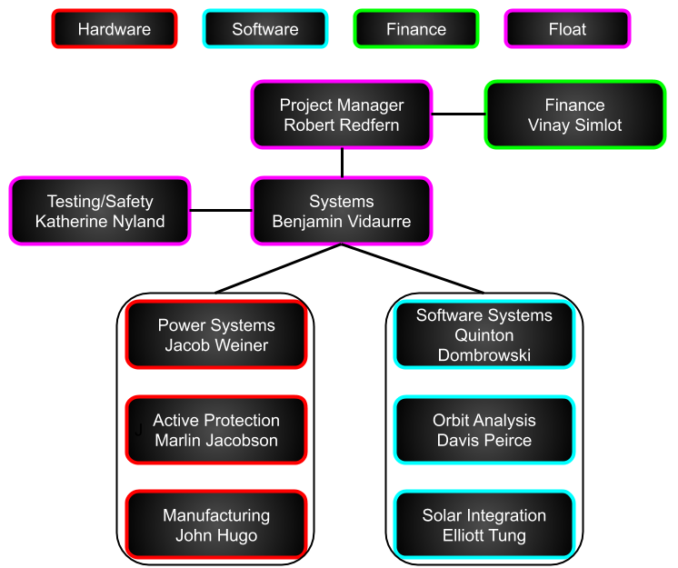
Organizational Chart
Timeline Project Description Design Solution Requirement Satisfaction Risks Validation Planning Summary
Notes:
Define float

Slide 57
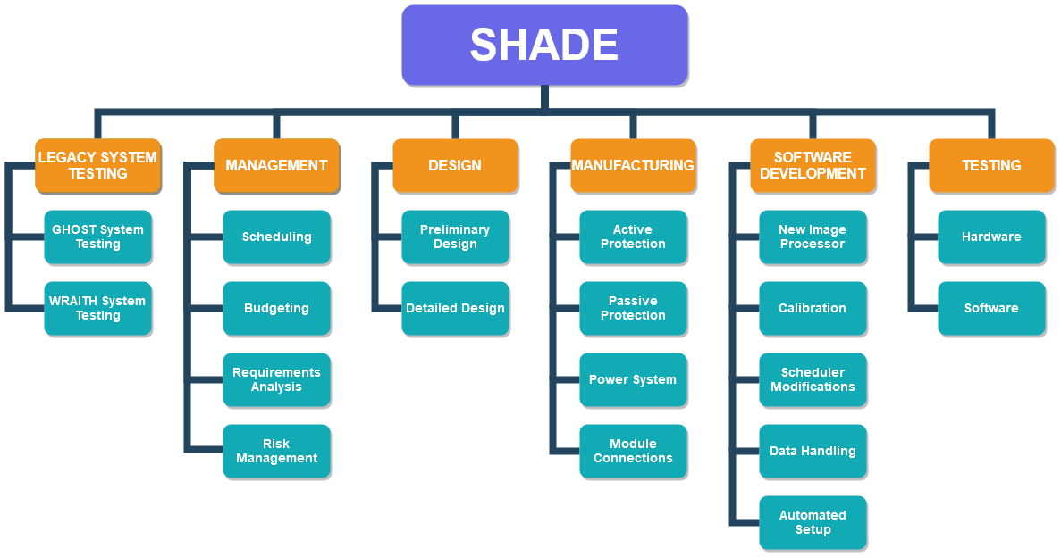
Work Breakdown Structure
Timeline Project Description Design Solution Requirement Satisfaction Risks Validation Planning Summary
Notes:
This WBS mirrors the construction of the actual WBS developed for SHADE. Not as illustrative of design and development undertaken as the ‘Highlights’ version

Slide 58
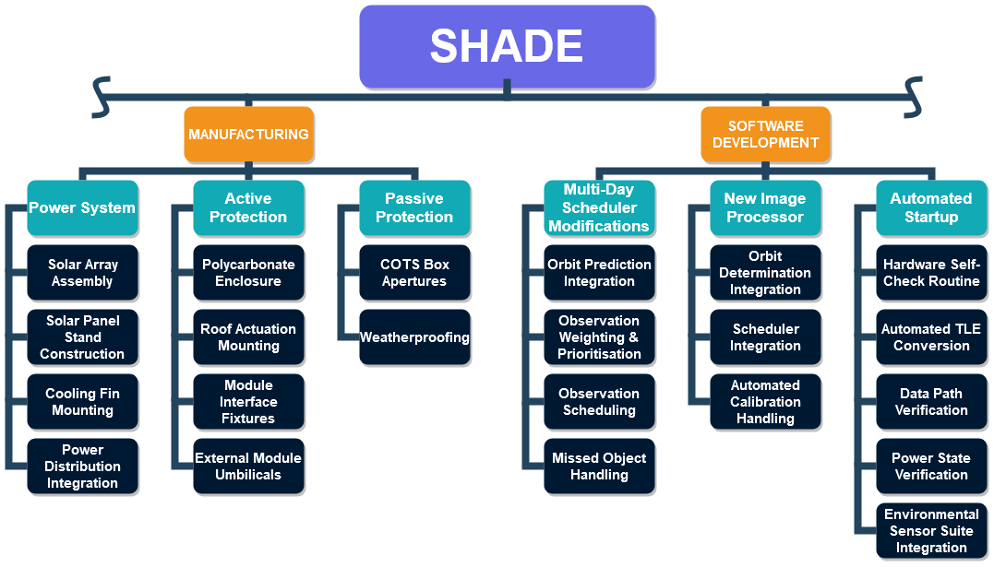
Work Breakdown Structure
Timeline Project Description Design Solution Requirement Satisfaction Risks Validation Planning Summary
Notes:
This WBS is the ‘Highlights’ version meant to illustrate the novel work undertaken by SHADE. Does not directly follow the actual WBS and has some organizational inconsistencies.
Present the slide as a product oriented version of the WBS rather than as a organizational version.

Slide 59
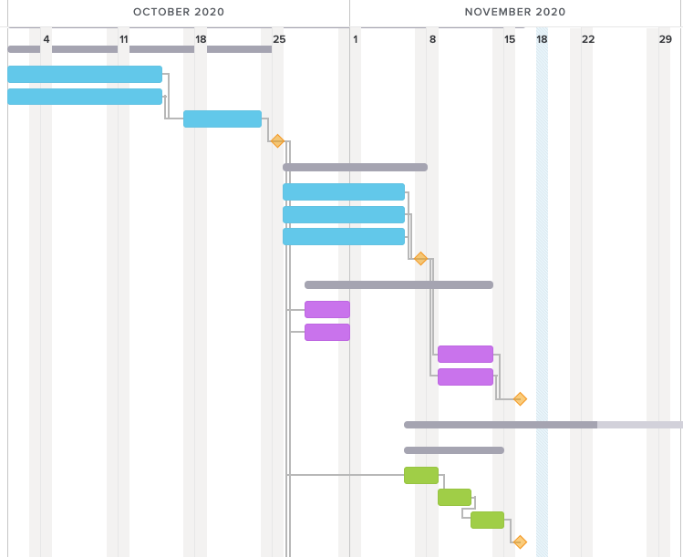
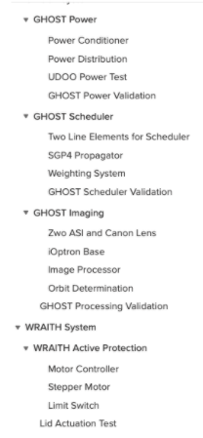
Completed Legacy Testing
Working as Intended
Requires Additional Development
Timeline Project Description Design Solution Requirement Satisfaction Risks Validation Planning Summary
Notes:
Talk about tests completed through Oct-Nov and why these were done first

Slide 60
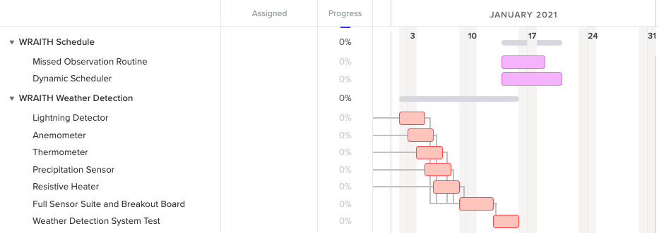
Remaining Legacy Testing
Dependent on arrival of new Particle board
Timeline Project Description Design Solution Requirement Satisfaction Risks Validation Planning Summary
Notes:
Remaining testing depends on components that need to be ordered with P-cards, will have to take place over break and in January

Slide 61
Spring Testing/Work Plan
Power System
Component/System Tests
Development/Manufacturing Tasks
Timeline Project Description Design Solution Requirement Satisfaction Risks Validation Planning Summary

Slide 62
Spring Testing/Work Plan
Active Protection
Integration with legacy components expected to be the most time consuming
Software
Timeline Project Description Design Solution Requirement Satisfaction Risks Validation Planning Summary
Notes:
Talk about software integration taking longer compared to development
Active Protection Wiring will incorporate all modules

Slide 63
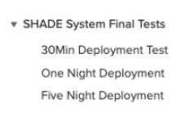
Spring Testing/Work Plan
Multiple testing windows budgeted to allow for inclement weather
Timeline Project Description Design Solution Requirement Satisfaction Risks Validation Planning Summary
Notes:
Talk about software integration taking longer compared to development
Active Protection Wiring will incorporate all modules

Slide 64
Cost Plan
Subsystem | Estimated Cost | Budget | Margin
Active Protection | $412.35 | $490.00 | 16%
Power | $1,998.62 | $2,250.00 | 11%
Software | $313.98 | $350.00 | 10%
Legacy Replacements | $85.00 | $345.00 | 75%
Deposit | $200.00 | $200.00 | 0%
Total | $2,929.96 | $3,540.00 | 17%
Timeline Project Description Design Solution Requirement Satisfaction Risks Validation Planning Summary

Slide 65
Summary

Slide 66
Mission Statement
To provide an easily accessible, multi-night orbit tracker, specializing in the evaluation of highly elliptical orbits. SHADE will be a low-cost capable tracking system, able to withstand adverse weather conditions.
Introducing
Timeline Project Description Design Solution Requirement Satisfaction Risks Validation Planning Summary

Slide 67
Questions?

Slide 68
THANKS
Backup
Slides
Does anyone have any questions?
Follow the project updates
addyouremail@freepik.com
+91 620 421 838
yourcompany.com
Notes:
The purpose of SHADEs weather detection suite is to protect the system from adverse weather conditions that it may encounter during multiple night deployment, functional requirement 3.

Slide 69
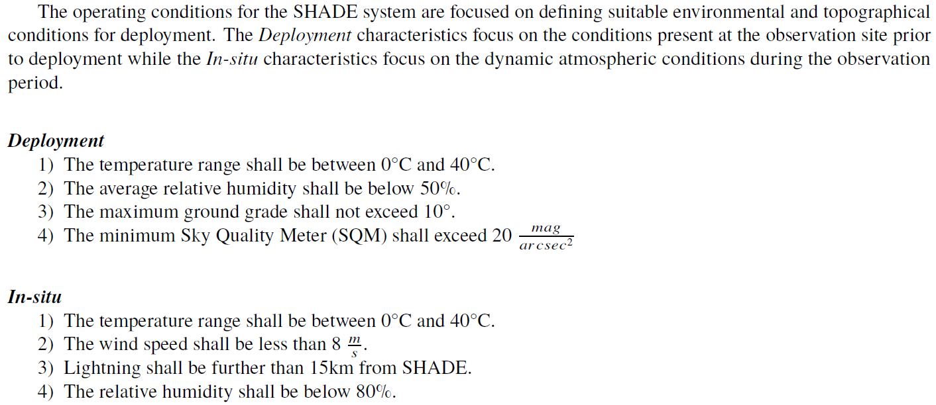
Standard Operating Conditions

Slide 70
Time Budget Validation

Slide 71
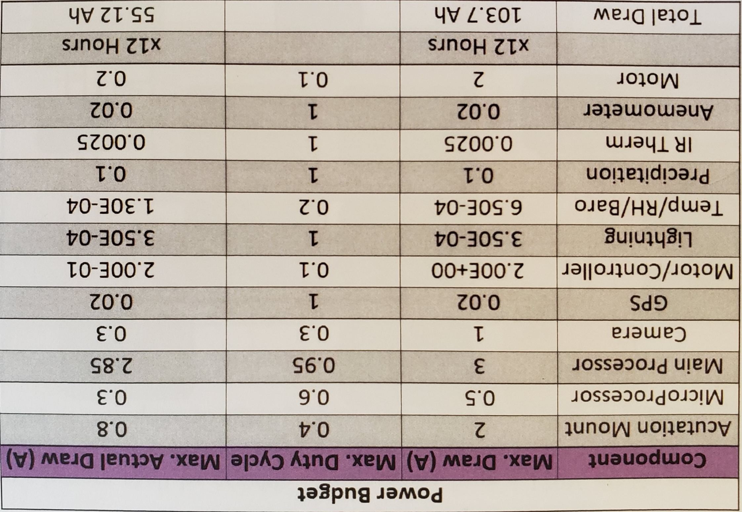
Power Budget

Slide 72
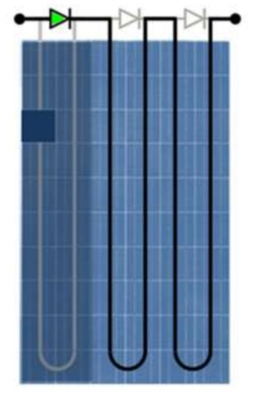
Substring Diodes
“SunPower cells operate in reverse bias with uniform breakdown across the cell, resulting in much lower temperatures, so bypass diodes are not required to ensure long term reliability.”
“SunPower includes diodes only to increase the production of the system in the case that several cells in the same substring go into reverse bias. In this case, the diodes limit the total amount of power that can be dissipated by reverse-biased cells.”
https://energyhub.org/wp-content/uploads/2018/05/SunPower-Module-Degredation-PDF.pdf

Slide 73
Solar Errors
Assumptions
CAD Thermal Simulation is accurate
Manufacturer specifications are accurate
Safe Guards
Designing for a worst case scenario
Validation
Test finished components
Record solar data, ambient temperature, PV power
Compare to analytical model

Slide 74
Solar Charger
Internal temperature sensor - compensates absorption and float charge voltage for temperature
Programmable charge algorithm
Configurable load output

Slide 75
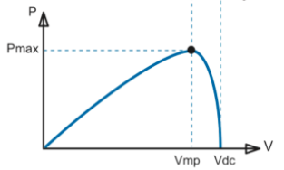
Maximum Power Point Tracking (MPPT)

Slide 76
SHADE Temperature Constraints
Power System Components
Battery: 32 - 104F while charging, -4 - 140F while discharging
Intervolt: -13 - 113F operation
Victron: -22 - 140F operation
Active Protection Components
Polycarbonate: 212F mold temperature
Processor: 32 - 140F operating
iOptron Mount: 14 - 104F operation
Camera: -4 - 140F storage, 23 - 113F operation
Roof Motor: max 140F operation

Slide 77
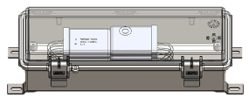
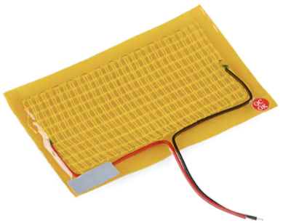
Cold Case Risk
UDOO Minimum Operating Temperature: 32℉ (0℃)
Minimum Temperature With Heater on Polycase: 17.87℉ (-7.85℃)
iOptron Minimum Operating Temperature: 14℉ (-10℃)
ZWO Camera Minimum Operating Temperature: 22℉ (-5℃)
Feasibility Check: Current Operating Temps Are Within SOC (FR 2)
Notes:
The iOptron Mount and ZWO camera will be able to operate within the current Standard Operating Conditions. However, the UDOO processor will not be able to operate in temperatures below freezing and a heating pad will be used to reduce the UDOO’s operating temperature from 32 degrees to 18 degrees Fahrenheit. And with this addition all components will be able to operate within the proper temperature ranges

Slide 78
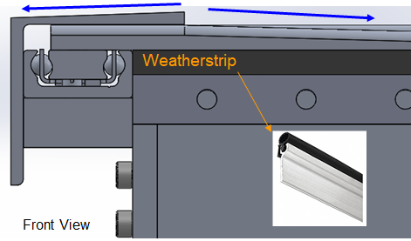
Actuating Roof Design
Ensure water moves away from sliders
Utilize weatherstripping/thresholds where appropriate
Timeline
Project Description
Baseline Design
Power System
Modularity
Software
Testing Status
Summary
Notes:
The roof will be designed in a manner that weather elements will not damage the interior components. While the roof will be weatherproof, rainwater would pool on top of the box if not designed properly. Thus the roof will include slopes that will direct rain water away from the sliders, either from the edges or towards the middle of the roof. Weatherstripping or thresholds will be applied for additional protection when appropriate

Slide 79
Actuating Roof Design
Maintain tight tolerances (Gaps < 0.050’’)
Utilize weatherstripping/thresholds where appropriate
Timeline
Project Description
Baseline Design
Power System
Modularity
Software
Testing Status
Summary
Notes:
The sliding lid will be designed with tight tolerances and feature weatherstripping or thresholds when appropriate to further waterproof the roof as seen in these images.

Slide 80
Hardware Tipping Prevention Model
The active protection system will not tip over due to the weight of the lid or small animals.
Timeline
Project Description
Baseline Design
Power System
Modularity
Software
Testing Status
Summary
Notes:
In order to ensure the stability of the system during deployment with the moonroof opened, a worst case load was modeled at the tip of the roof.
Overall, the weigt of the opened roof itself will not cause the system to tip over, and the opened roof can withstand up to an additional 13 lbs at the tip before tipping over

Slide 81
Hardware Failure Prevention Model
The slider tracks will not break due to the weight of the lid.
If weight is applied to the lid, the system will tip over before breaking.
Timeline
Project Description
Baseline Design
Power System
Modularity
Software
Testing Status
Summary
Notes:
Next, to ensure that our moonroof tracking system will not break, a similar analysis was performed. Overall, the track of the lid will not break due to the weight of the roof, and the system will fall over before breaking if a load greater than 13 lbs is applied to the end of the open roof.

Slide 82
Old Image System FBD

Slide 83
New Image System FBD

Slide 84
Risk Analysis Methodology

Slide 85
Comprehensive Risk Accounting

Slide 86
Comprehensive Risk Accounting

Slide 87
Full WBS - First Half

Slide 88
Full WBS - Second Half

Slide 89
SHADE Full Gantt Chart

Slide 90
SHADE Full Gantt Chart

Slide 92
Revised Orbit Example - NOAA-6
Notes:
Backup slide: fixed results for the NOAA-6 satellite

Slide 93
Detailed Budget Breakdown - Power
Item | Estimated Cost/unit | Number | Budgeted amount | Total Estimated Cost | Margin
MAXEON Solar Cells | $3.21 | 80 | $300.00 | $256.80 | 14%
Thermal Adhesive | $250.00 | 1 | $300.00 | $250.00 | 17%
Aluminum for framing | $12.60 | 6 | $100.00 | $75.60 | 24%
Aluminum Sheet 18x18x0.025 | $40.12 | 4 | $200.00 | $160.48 | 20%
1.813" Wide Extruded Aluminum Heatsink - 1 in | $0.78 | 80 | $80.00 | $62.40 | 22%
LifePo4 Smart Lithium Battery | $747.95 | 1 | $800.00 | $747.95 | 7%
ZQ-121006 Outdoor Electrical Enclosure | $63.24 | 1 | $80.00 | $63.24 | 21%
Junction Box | $100.00 | 1 | $100.00 | $100.00 | 0%
SmartSolar MPPT 75 I 15 charge controller | $118.15 | 1 | $120.00 | $118.15 | 2%
Friction Hinge | $20.50 | 8 | $170.00 | $164.00 | 4%

Slide 94
Detailed Budget Breakdown - Active Protection
Item | Estimated Cost/unit | Number | Budgeted amount | Total Estimated Cost | Margin
Rain Guard Water Sealers SP-2001 | $43.78 | 1 | $50.00 | $43.78 | 12%
Polycarbonate sheets | $274.98 | 1 | $300.00 | $274.98 | 8%
Corner Guards | $36.80 | 2 | $100.00 | $73.60 | 26%
Leveling Feet | $19.99 | 1 | $20.00 | $19.99 | 0%
screws |  |  | $20.00 | $ - | 100%

Slide 95
Detailed Budget Breakdown - WRAITH Recovery
Item | Estimated Cost/unit | Number | Budgeted amount | Total Estimated Cost | Margin
New Umbilical Cord | $20.00 | 1 | $20.00 | $20.00 | 0%
Replacement Sensors |  |  | $200.00
LTE Board | $5.00 | 1 | $50.00 | $5.00 | 90%
Particle Board | $60.00 | 1 | $75.00 | $60.00 | 20%

Slide 96
Detailed Budget Breakdown - Software
Item | Estimated Cost/unit | Number | Budgeted amount | Total Estimated Cost | Margin
64 GB SD Card | $17.99 | 1 | $20.00 | $17.99 | 10%
1 TB USB Drive | $19.99 | 1 | $30.00 | $19.99 | 33%
UDOO x86 2.0 | $276.00 | 1 | $300.00 | $276.00 | 8%

