Slide 1
Test Readiness Review
Presenters: Greg Clements, Logan Thompson, Austin Abraham, Tyler Faye
Additional Team Members: Nicholas Carvo, Thad Gleason, Everett Hale, Zachary Donovan, Anna Tiberi, Jeremiah Lane, and Aubrey McKelvy
Customer: Lockheed Martin
Advisor: Dr. Dennis Akos

Slide 2
Overview
Overview
Schedule
Updates
Test Readiness
Budget
Update

Slide 3
Overview
Schedule
Updates
Test Readiness
Budget
Update

Slide 4
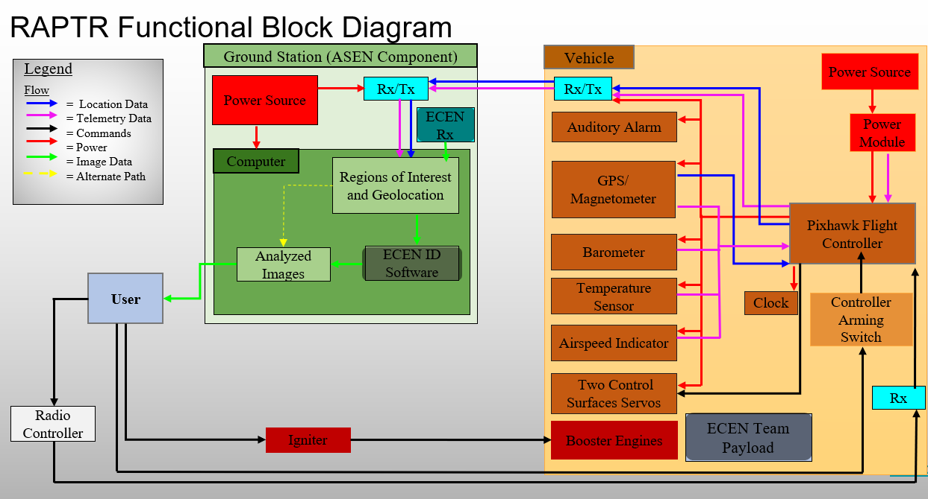
Overview
Schedule
Updates
Test Readiness
Budget
Update

Slide 5
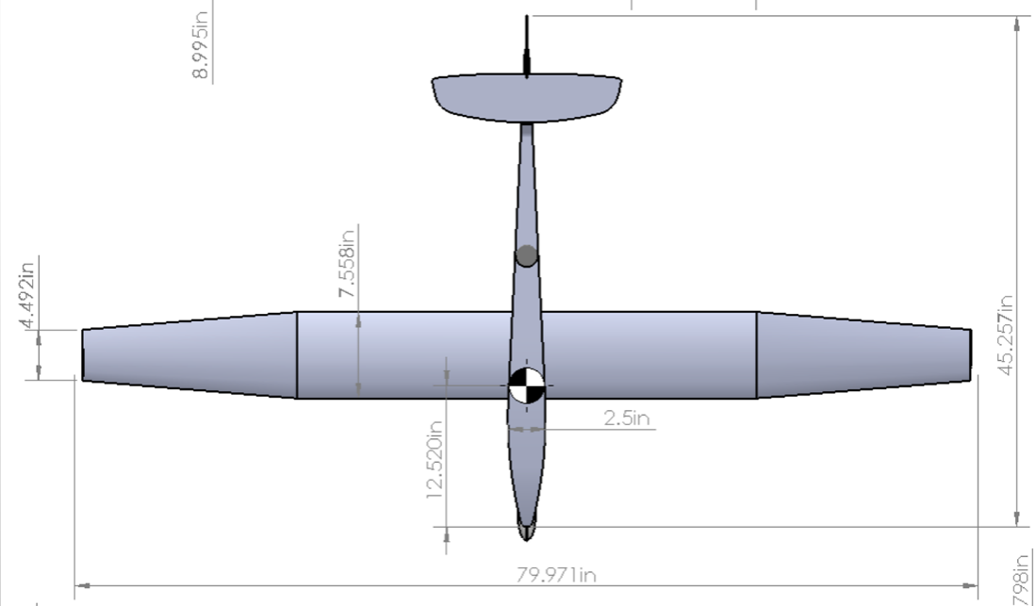
Overview
Schedule
Updates
Test Readiness
Budget
Update
Baseline Design Overview
Index
Changes from MSR
Total Payload Redesign
Ascent Profile Modifications
Modified Hyperflight AndREaS
Pixhawk GNC
H42 Rocket Motor
Item(s)​ | Mass [lb]​
Airframe​ | 1.14​
Motor and Mount​ | 1.2​
Electronics​ | 0.48​
Payload​ | 1.10​
Total​ | 3.92​

Slide 6
CPE Review
Overview
Schedule
Updates
Manufacturing
Status
Budget
Update
Structural Integrity
Index
Level 1 | Level 2 | Level 3
Survive Component Testing | Survive Flight | Be capable of Re-Flight
Aerial Vehicle Design
Vehicle and Payload Integration
Vehicle Electronics
Transmission and Reception
FAA compliance
Target Recognition/GeoLocation Software
Propulsion System
Control
IMU and GPS Functionality Verification
Level 1 | Level 2 | Level 3
GPS maps vehicle route | Pixhawk IMU within target accuracy | N/A
Motor Thermal Effects
Level 1 | Level 2 | Level 3
Airframe does not Ignite | Internal Temperatures remain under threshold | Motor Ditches and Vehicle Functionality Preserved
Trimmability and Control
Level 1 | Level 2 | Level 3
Vehicle is Trimmable on Launch | PID gains determined | Capable of Autonomous Flight of Designed Path

Slide 7
Schedule Update
Overview
Schedule
Updates
Test Readiness
Budget
Update
5

Slide 8
Spring Gannt
Overview
Schedule
Updates
Test Readiness
Budget
Update
Index
Testing
Manufacturing
Analysis

Slide 9
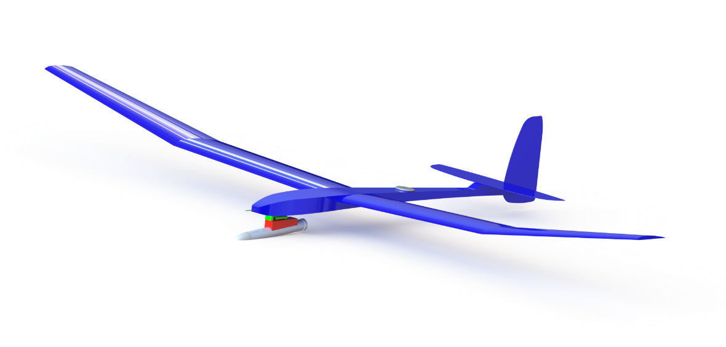
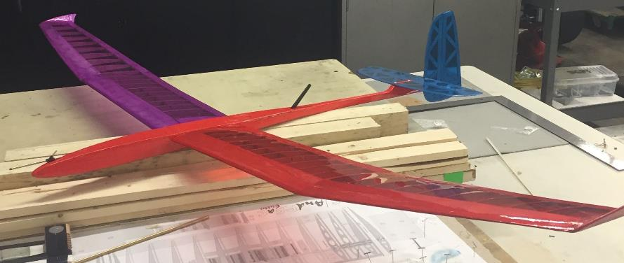
Test Readiness
Overview
Schedule
Updates
Test Readiness
Budget
Update

Slide 11
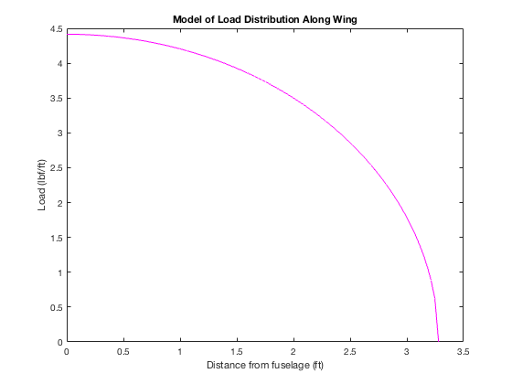
Structural Testing
Overview
Schedule
Updates
Test Readiness
Budget
Update
Status: In Progress
Index
Rationale – Modified glider must be capable of withstanding forces from rocket motor
Model
Related Risks
Risk | Before Test | Predicted After Test
2. Wing Integrity on Launch
5. Motor Ditching
Success Criteria
Motor mount can hold force = max thrust (22lbs) with no visible damage
Motor ejects successfully at predicted spring compression
Safety Measures
Predicted Max Lift: 32.6 lbs with 16.3 lbs/wing
Experimental Max Lift: 27.1 lbs with 13.55 lbs/wing
Safety goggles
Testing area cleared of bystanders
Notes:
Add comparison between stock and modified fuselages

Slide 12
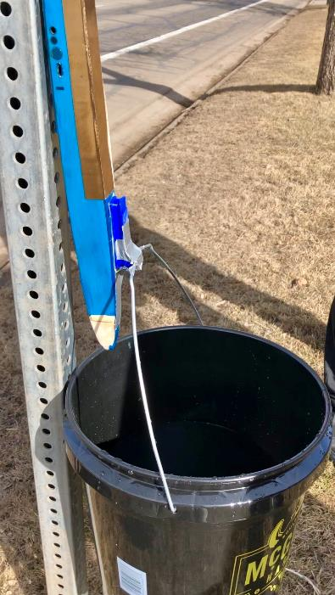
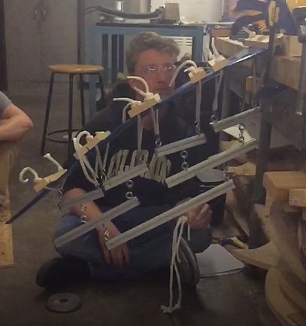
Structural Testing
Overview
Schedule
Updates
Test Readiness
Budget
Update
Index
Test | Measurements | Equipment
Motor Mount Test | Weight of bucket | Motor mount
 |  | Fuselage
 |  | Bucket
 |  | Water
Wing Bending Test | Location of whiffle tree bars | Whiffle tree kit
 | Total weight of tree upon failure | Wing
 | Failure point along wing | Wood block and Clamps
 |  | Calipers
Motor Ejection Spring | Force applied to spring | Calipers
 | Displacement of spring | Strain Gauge
Notes:
Add comparison between stock and modified fuselages

Slide 13
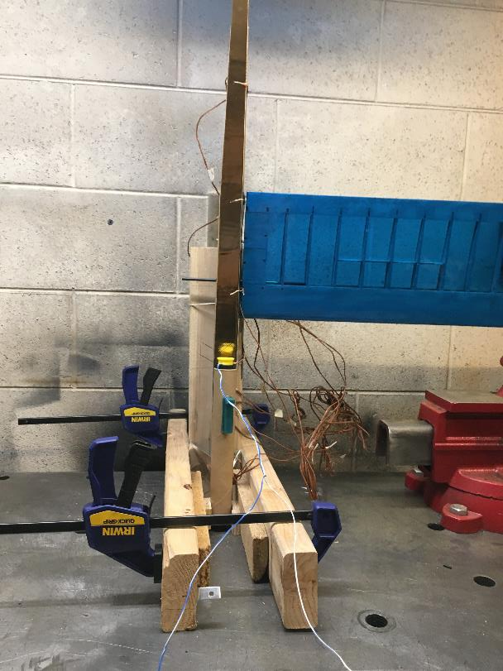
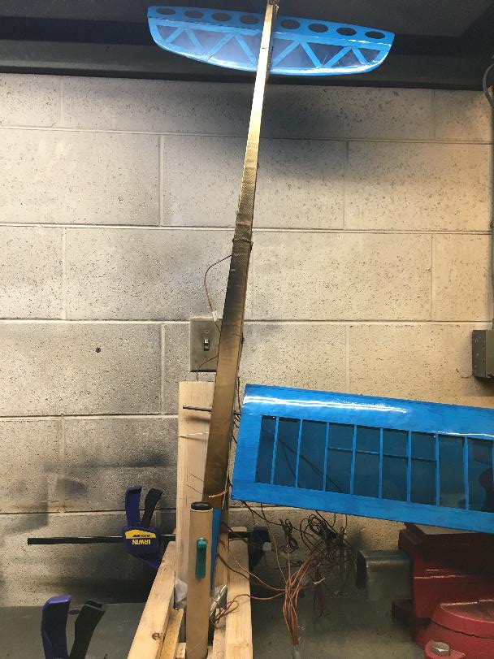
Thermal Test
Overview
Schedule
Updates
Test Readiness
Budget
Update
Status: In Progress
Index
Rationale – The glider and electronics must survive the thrust phase.
Related Risks
Risk | Before Test | After Test
11. Rocket Thermal Effects
Model/Success Criteria
Glider must not sustain significant damage.
Wings and tail must remain intact.
Internal temperatures may not exceed 158F (70C)
Safety Measures
Motor secured off campus
Lab cleared and motor placed under fume hood
Notes:
Add comparison between stock and modified fuselages

Slide 14
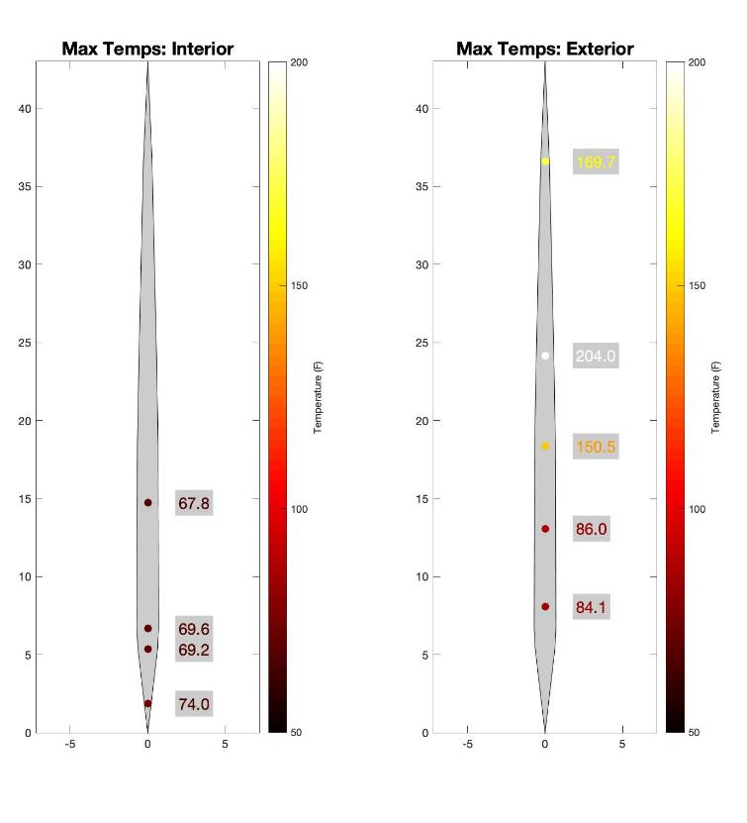
Thermal Test
Overview
Schedule
Updates
Test Readiness
Budget
Update
Index
Measurements | Equipment/Facilities | Procedure
Fuselage Internal Temperature (5 points) | 11x K-type thermocouple | 1. Apply thermal tape to bottom of fuselage and tail
Fuselage External Temperature (5 points) | 16 channel DAQ | 2. Clamp and secure fuselage
External Motor Casing Temperature | Test Fuselage | 3. Clamp motor to fuselage at 5-degree angle
Motor Angle w.r.t Fuselage | Gold Heat Shielding Tape | 4. Tape thermocouples on assembly
Motor Distance to fuselage | H42 motor with casing | 5. Initiate data recording
 | Clamps and wood | 6. Fire motor
 | Location: Aero Welding Shop | 7. Analyze Data
Measurements
Equipment/Facilities
Procedure
Initial Results
Internal temperature of fuselage at five different points
External temperature at five different points
External temperature of motor casing
Angle of motor
Distance of motor to fuselage
K-type thermocouple x11
16 channel DAQ
Fuselage
Gold Heat Shielding Tape
H42 motor w/ casing
Clamps and Wood
Location: Aerospace Welding Shop
Apply thermal tape to bottom of fuselage and tail
Clamp fuselage in place
Clamp motor in place angled 5 degrees towards fuselage
Tape thermocouples in place
Start recording data
Ignite motor
Notes:
Add comparison between stock and modified fuselages

Slide 16
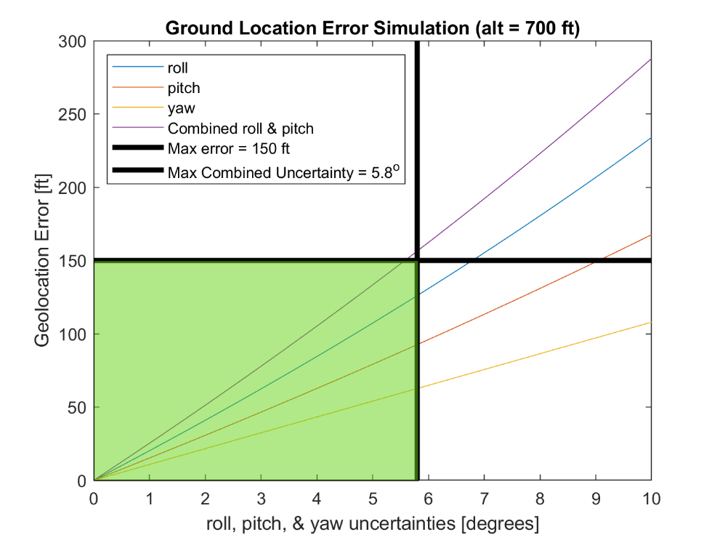
IMU/GPS Verification Test
Overview
Schedule
Updates
Test Readiness
Budget
Update
Status: Complete
Index
Rationale – Demonstrate IMU/GPS Fidelity
Related Risks
Risk | Before Test | After Test
4. Autopilot Adaptation
8. Comm Interference
12. Data Transmission Rate
Success Criteria
Pixhawk IMU accuracy is within the target capture design area
GPS signal properly maps the vehicle route
All attitude/position sensors function cohesively together
Max Roll/Pitch Uncertainty | 5.8°
Notes:
Add comparison between stock and modified fuselages

Slide 17
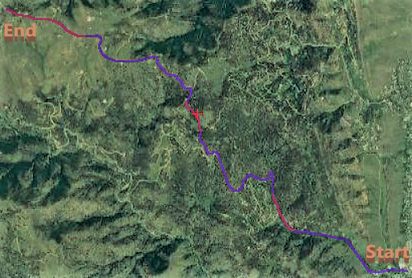
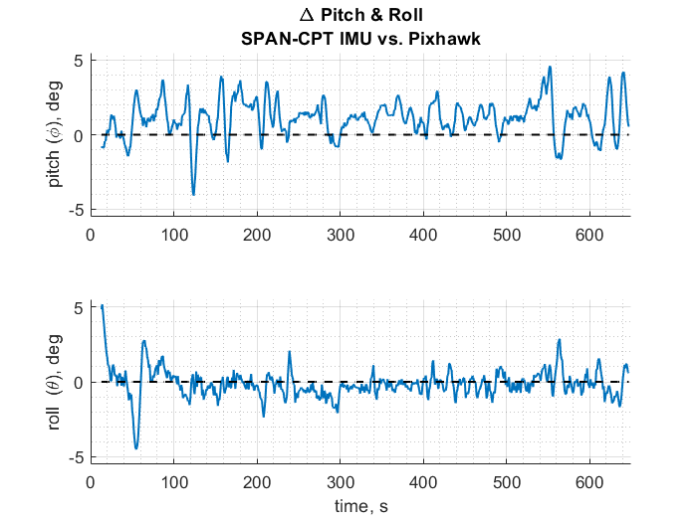
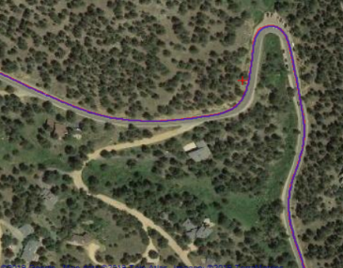
IMU/GPS Verification Test
Overview
Schedule
Updates
Test Readiness
Budget
Update
Index
Measurements
Procedure
Results
Roll and Pitch
GPS lat/long
Altitude and Heading
Equipment
Pixhawk 4 IMU and GPS
SPAN-CPT Single Enclosure GNSS/INS Receiver
 | Mean | Error
Pitch | 1.13° | ± 3.24°
Roll | -0.13° | ± 1.90°
Roll/Pitch | -0.51 | ± 2.65°
Notes:
Add comparison between stock and modified fuselages

Slide 18
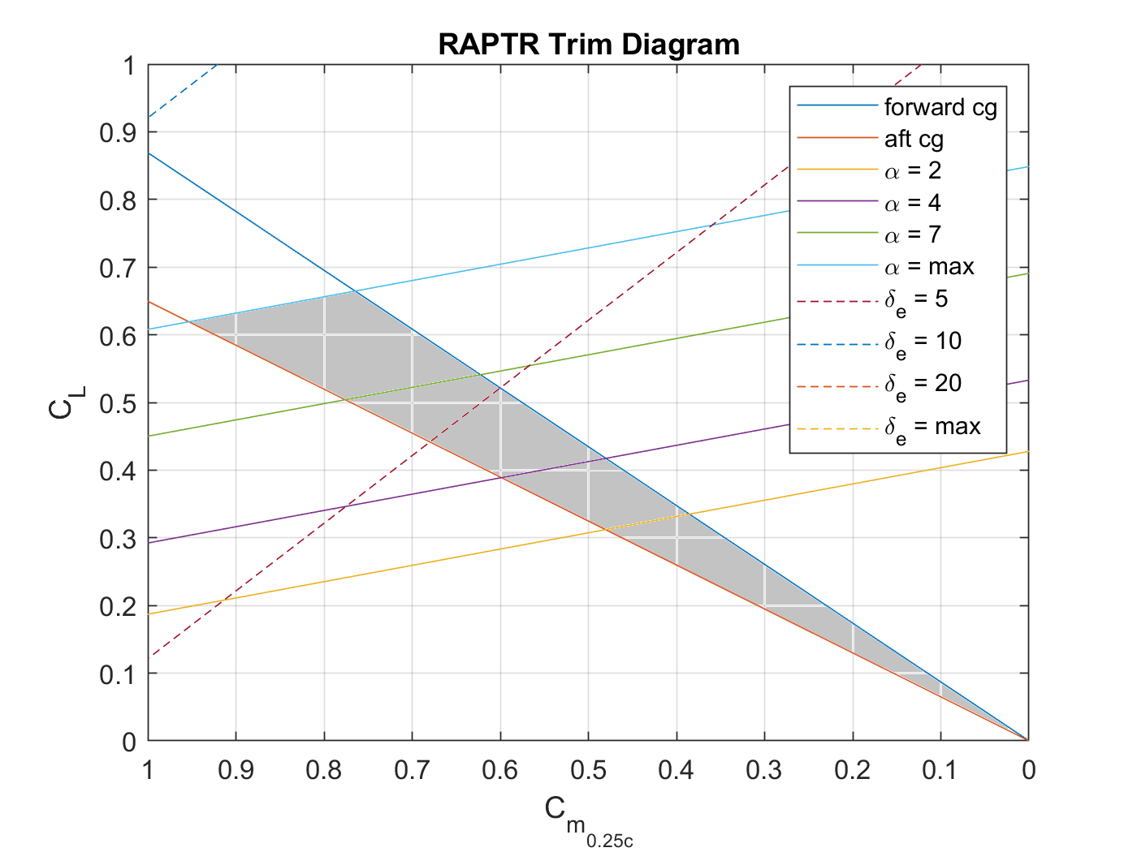
Controls Testing
Overview
Schedule
Updates
Test Readiness
Budget
Update
Status: In Progress
Index
Rationale – Vehicle must be capable of manually/autonomous navigation
Models
Related Risks
AJ's Trim Calculations
Risk | Before Test | Predicted After Test
3. Control Authority
Success Criteria
Controllability of RAPTR before and after rocket disposal
PID Gains
Safety Measures
Manual override capable at all times
Testing personnel will be out of glider flight path
Notes:
Add comparison between stock and modified fuselages

Slide 19
Controls Testing
Overview
Schedule
Updates
Test Readiness
Budget
Update
Index
Test | Measurements | Equipment
Level Glide Test *Neutral Control Surfaces* | RAPTR Glide Slope | RAPTR
 | RAPTR Aerodynamic Moments | Video Recorder
 | Full Telemetry Recovery of Attitude and Position | Interface Laptop
 |  | RC Controller
 |  | Location: Scott Carpenter Park
Short Controlled Glide Test | Control Effects on Roll/Pitch/Yaw | See "Level Glide Test Equipment"
 | Demonstrate Controllability of RAPTR before Tuning Test
 | Full Telemetry Recovery of Attitude and Position
Bungee Launch Glide Test *Gain Tuning* | Control Effects on Roll/Pitch/Yaw | See "Level Glide Test Equipment"
 | Experimental PID Tuning Gains | Bungee launch System
 |  | Location: North Boulder Park
Initial Schedule
2 Mar – 3 Mar
Postponed Schedule
5 Mar – 6 Mar
Schedule
7 Mar
Notes:
Add comparison between stock and modified fuselages

Slide 21
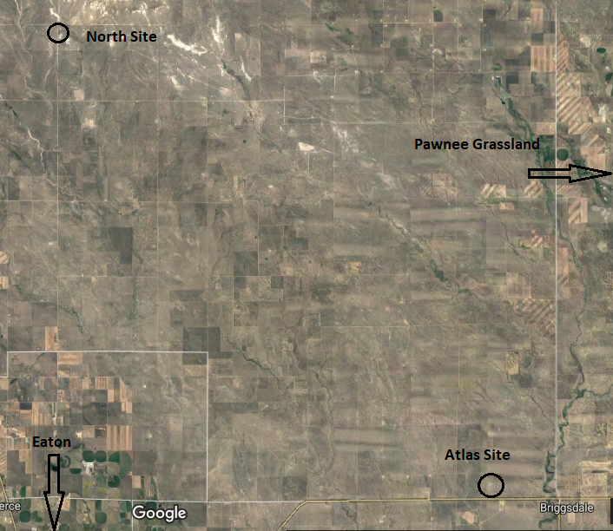
Vehicle Flight Testing (March 09 – April 14)
Overview
Schedule
Updates
Test Readiness
Budget
Update
Index
Rationale – Verify and Validate Vehicle Performance Requirements
Model/Success Criteria
Related Risks
Verify Performance and Stability Models for all flight phases via telemetry (Propulsive and Aerodynamic Models)
Verify ability to navigate designed flight path
Exhibit capability to carry payload mass simulator
Risk | Before Test | Predicted After Test
2. Wing Integrity on Launch
3. Control Authority
5. Motor Ditch
Safety Measures
Launching away from populated areas
Observing all NAR regulations and fire advisories
Notes:
Add comparison between stock and modified fuselages

Slide 22
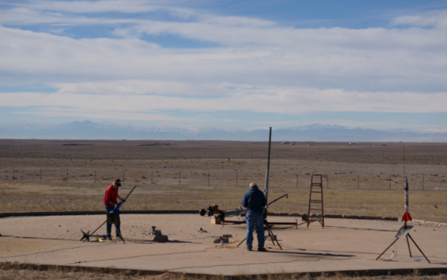
Vehicle Flight Testing (March 09 – April 14)
Overview
Schedule
Updates
Test Readiness
Budget
Update
Index
Measurements | Equipment | Procedure
Vehicle attitude and position data | RAPTR vehicle and payload (simulator) | 1. Setup Launch Stand and Ground Station
Vehicle internal health data | Launch Rail | 2. Upload Flight Plan, calibrate GPS
Vehicle speed and aerodynamic loading data | Interface Laptop and Telemetry Radio | 3. Attach Motor and place Vehicle on Launch Rail
Full downlink of all telemetry data | RC Controller | 4. RSO Approval: install ignitor
Geolocation of target w.r.t. the user | Motor Ignitor | 5. RSO Approval: Ignite motor
Operations performed in required time window | Location: NAR Launch Site | 6. RSO Approval: Recover Vehicle/Motor
Launch Windows
Sat. Mar 9 | Atlas Launch Site
Sat. Mar 30 | Atlas Launch Site
Sat. April 13 | North Launch Site
Sun. April 14 | North Launch Site
Notes:
Add comparison between stock and modified fuselages

Slide 23
Budget Update
Overview
Schedule
Updates
Test Readiness
Budget
Update

Slide 24
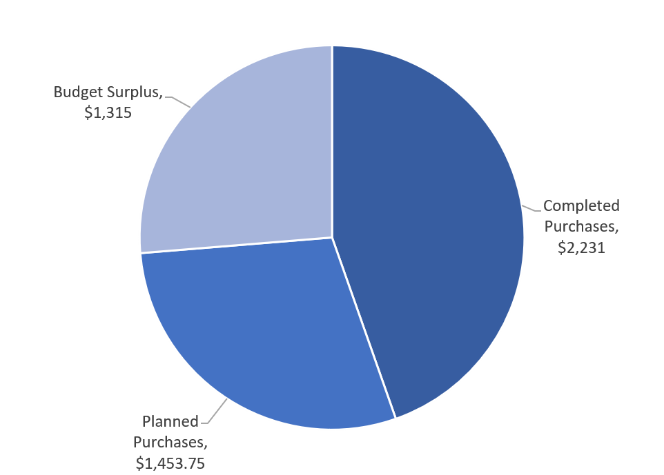
Budget Update
Overview
Schedule
Updates
Test Readiness
Budget
Update
Index
All parts procured for first launch
Budget accounts for 3 launches
Cost of additional launch: ~$1032
Completed Purchases
Planned Purchases
Item | Price
Pixhawk 4 (x2) | $468.82
AndREaS Glider (x3) | $813.88
Manufacturing Supplies | $274.98
Electronics for One Glider | $379.24
RC Controller | $245
Thermal Tape | $48.90
Total: | $2230.82
Item | Price
Pixhawk 4 (x1) | $211
AndREaS Glider (x1) | $241.99
Electronics for Two Gliders | $758.48
Rocket Motors and Supplies for 3 Launches | $242.28
Total: | $1453.75

Slide 25
Backup Slides
Overview
Schedule
Updates
Test Readiness
Budget
Update
General Testing
Overview
Structural Testing
Structure/Thermal
Thermal Testing
GPS/Controls
Electronics and Controls Testing
Full
Software Testing
Aerodynamics

Slide 26
General Testing Backup Slides
Overview
Schedule
Updates
Test Readiness
Budget
Update
Index

Slide 27
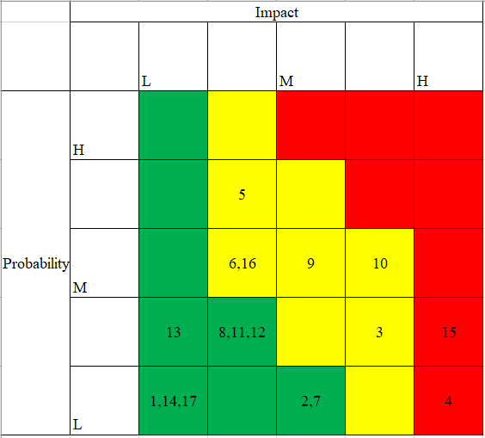
Risk Matrix
Overview
Schedule
Updates
Test Readiness
Budget
Update
Risks
1. Uneven Rocket Moment | 15. Image Processing Time
2. Wing Launch Integrity | 16. Transmission at Range
3. Control Authority | 17. Software Integration
4. Autopilot Adaptation | 18. CNN Training Time
5. Motor Ditching
6. Poor L/D in Glide
7. Testing Permission
8. Comm Interference
9. Payload Weight
10. Payload Volume
11. Physical Integration
12. Thermal Effects
13. Transmission Rate
14. Data Synch
Index
Notes:
Add comparison between stock and modified fuselages

Slide 28
Software Testing (In Progress)
Overview
Schedule
Updates
Test Readiness
Budget
Update
Index
Completed Tasks | In Progress
Captured drone images of scaled down targets | Capture images of targets with camera gimballed
Geo-referenced image pixels using drone GPS coordinates | Test failure/success rates of detection software
Detect and output targets' GPS location | Integrate detection software with E.E classification software
Notes:
Add comparison between stock and modified fuselages

Slide 29
Testing Schedule
Overview
Schedule
Updates
Test Readiness
Budget
Update
RAPTR Test Schedule
Test Name | Date(s) | Description | Requirements
Test Imaging (Software) | 11/19/18 02/17/19 | Capture images of dummy target with drone for software development/testing | FR 4: The system shall identify a distinctly colored target and determine the unique target shape and relay the target's latitude and longitude.
Structural Testing | 02/01/19 | Stress test motor mount and wings using weights to verify structural integrity | DR 1.4: The vehicle structures shall withstand the forces of the launch and glide phases.
Thermal Test | 02/08/19 03/01/19 | Static fire of motor positioned near glider fuselage to verify effectiveness of heat shield | DR 5.2.2.1: The fuselage shall maintain an internal temperature less than 80C and sustain no fire damage during the launch phase
IMU/GPS Verification Test | 02/17/18 | Verify accuracy of PixHawk IMU/GPS modules at high speeds | DR 4.2.1: The vehicle/payload shall utilize a sensor suite to quantify its location and attitude
Electronics Integration Test | 02/24/18 | Verify functionality of fully integrated electronics system including servos, receivers and transmitters | DR 1.1.5: The vehicle shall be capable of receiving manual user control inputs
Communications Integration Test | 03/03/19 - 03/08/19 (Exact Date TBD) | Controls and image data will be simultaneously transmitted on the ground to verify no channel interference | DR 3.2: The electronics system shall transmit image and telemetry data at least 4,000 ft to the ground station in real time
Controls testing/tuning | 03/01/19 03/02/19 | Improve tuning parameters of PixHawk flight controller and verify controllability of vehicle both manually and with autopilot | DR 1.1.6: The vehicle shall be capable of maneuvering control surfaces to achieve both autonomous and manual control
Vehicle Systems Testing | 03/09/19 03/30/19 | Launch vehicle with a weight simulating the payload to verify trajectory/flight path | FR 1: The system shall survey a 2,000 foot long and at least 400 foot wide corridor beginning 2,000 feet from the user and aligned with a user defined heading.
Full Systems Testing | 04/06/19 04/13/19 05/03/19 | Full systems launch with payload to determine/verify overall project success | FR 1,2,3,4,5,6
Index
Notes:
Add comparison between stock and modified fuselages

Slide 30
Full System Testing
Overview
Schedule
Updates
Test Readiness
Budget
Update
Index
Rationale – Full CONOPS test to verify and validate all project requirements
Model/Success Criteria
Related Risks
Carry Payload through Designed Flight Path
Receive Images and Telemetry
Identify and Geo-Locate Targets
Complete Mission in 3 minutes from Launch
Risk | Before Test | Predicted After Test
10. Vehicle/Payload Integration
Notes:
Add comparison between stock and modified fuselages

Slide 31
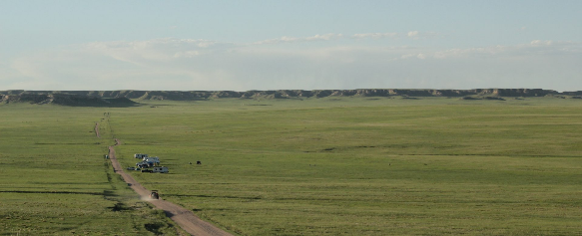
Full System Testing (March 09 – April 14)
Overview
Schedule
Updates
Test Readiness
Budget
Update
Index
Measurements
Equipment/Facilities
Procedure
Time
Pitch, Yaw, Bank
Elevation, Azimuth, Roll
Position, Velocity
Internal Temperature
Payload Images
Vehicle with Functioning Payload (including motor)
5'x5' Targets
Launch Rail
Ground Station Computer and Antennas
RC controller
Motor Ignitor
NAR Launch Site (Atlas Site or North Site)
Set up Launch Rail and G.S.
Upload Flight Plan, calibrate GPS, and Activate Payload
Attach Motor and place Vehicle on Launch Rail
RSO Approval: install ignitor
RSO Approval: Ignite motor
RSO Approval: Recover Vehicle/Motor
Launch Windows
Sat. Mar 9 | Atlas Launch Site
Sat. Mar 30 | Atlas Launch Site
Sat. April 13 | North Launch Site
Sun. April 14 | North Launch Site
Notes:
Add comparison between stock and modified fuselages

Slide 32
Structures Backup Slides
Overview
Schedule
Updates
Test Readiness
Budget
Update
Index

Slide 33
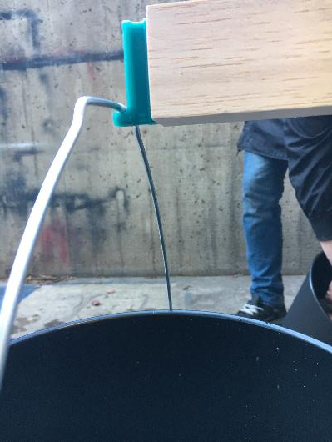
Structural Testing (Completed)
Overview
Schedule
Updates
Test Readiness
Budget
Update
Index
Test | Purpose | Result
Motor Mount Testing | Verify motor mount will withstand launch forces | Motor mount and vehicle was able to sustain 22 lbs with no damage
Wing Loading | Determine maximum loading wings can sustain before failure | Wing failure occurred at 13.55lb at the end of the wing spar
Motor Mount Spring Test | Verify spring mechanism will eject motor at burnout
Notes:
Add comparison between stock and modified fuselages

Slide 34
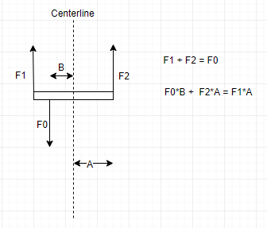
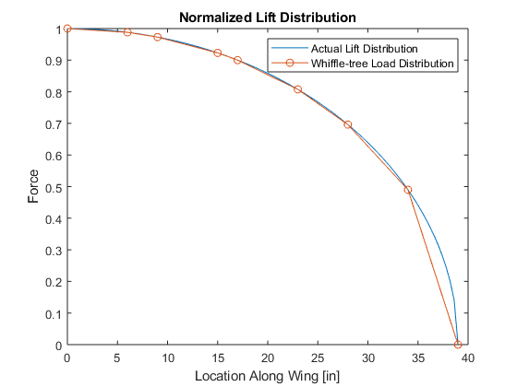
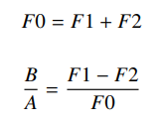
Structural Testing-Whiffletree Test
Overview
Schedule
Updates
Test Readiness
Budget
Update
Index
Notes:
Add comparison between stock and modified fuselages

Slide 35
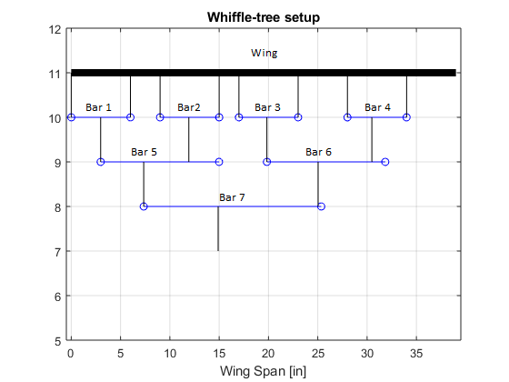
Structural Testing-Whiffletree Test
Overview
Schedule
Updates
Test Readiness
Budget
Update
Index
Notes:
Add comparison between stock and modified fuselages

Slide 36
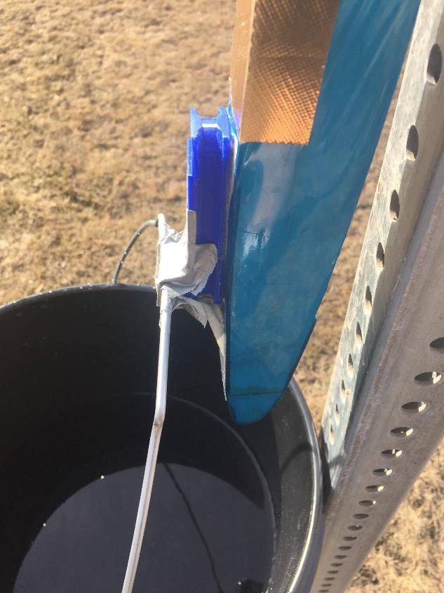
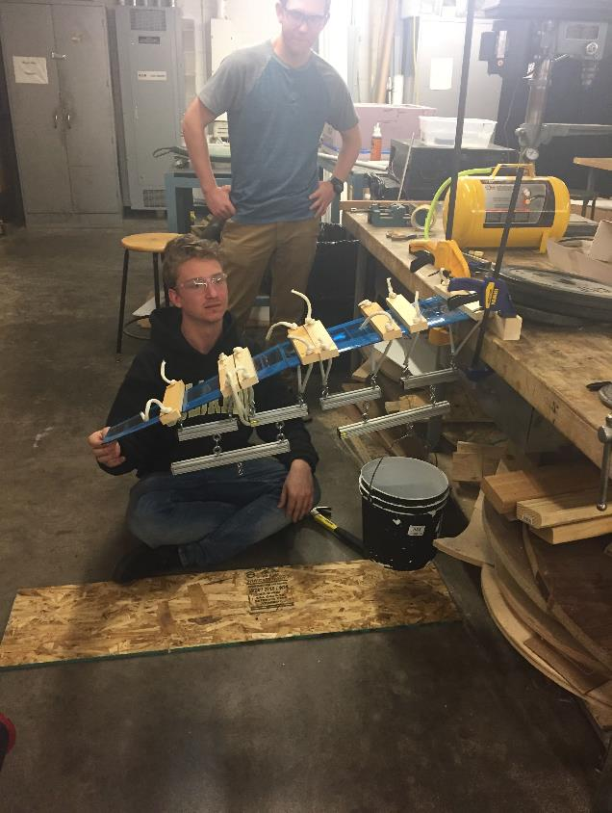
Structural Testing Pictures
Overview
Schedule
Updates
Test Readiness
Budget
Update
Index
Notes:
Add comparison between stock and modified fuselages

Slide 37
Thermal Backup Slides
Overview
Schedule
Updates
Test Readiness
Budget
Update
Index

Slide 38
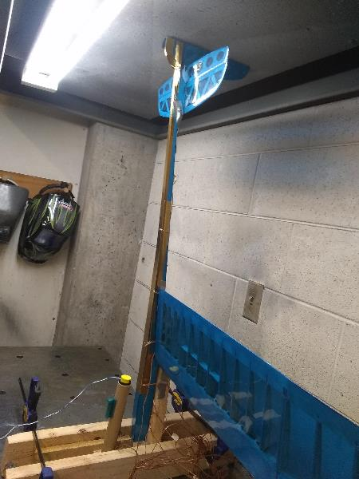
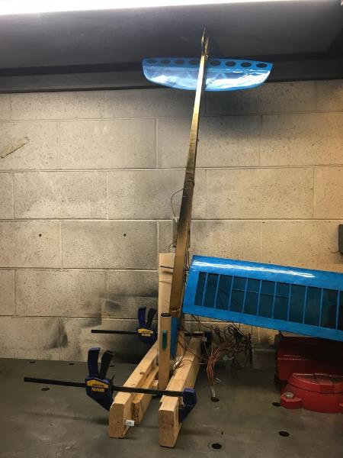
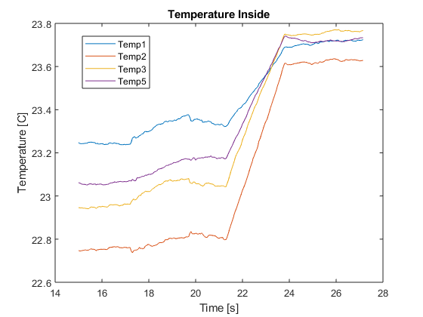
Thermal/Motor Testing (Completed)
Overview
Schedule
Updates
Test Readiness
Budget
Update
Index
Purpose | Materials | Result
Verify no fire damage is sustained during launch Verify internal temperature stays below 80C | Gold Heat Shield Tape | No damage to glider. Internal temperatures remained low.
 | K-type thermocouple x11
 | 16 Channel DAQ
 | Glider
 | H-42 Motor
Notes:
Add comparison between stock and modified fuselages

Slide 39
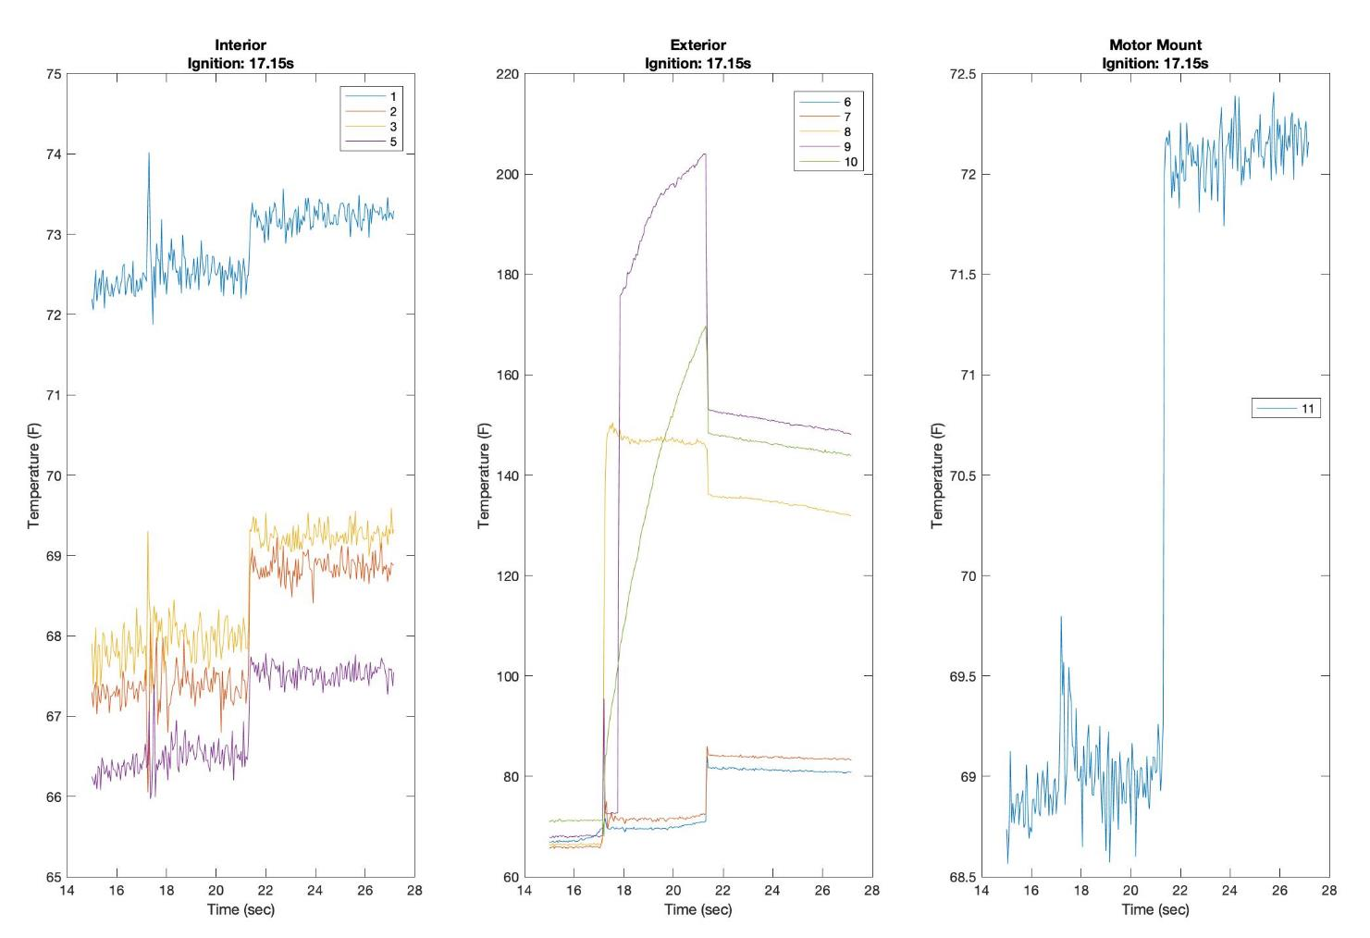
Overview
Schedule
Updates
Test Readiness
Budget
Update
Index

Slide 40
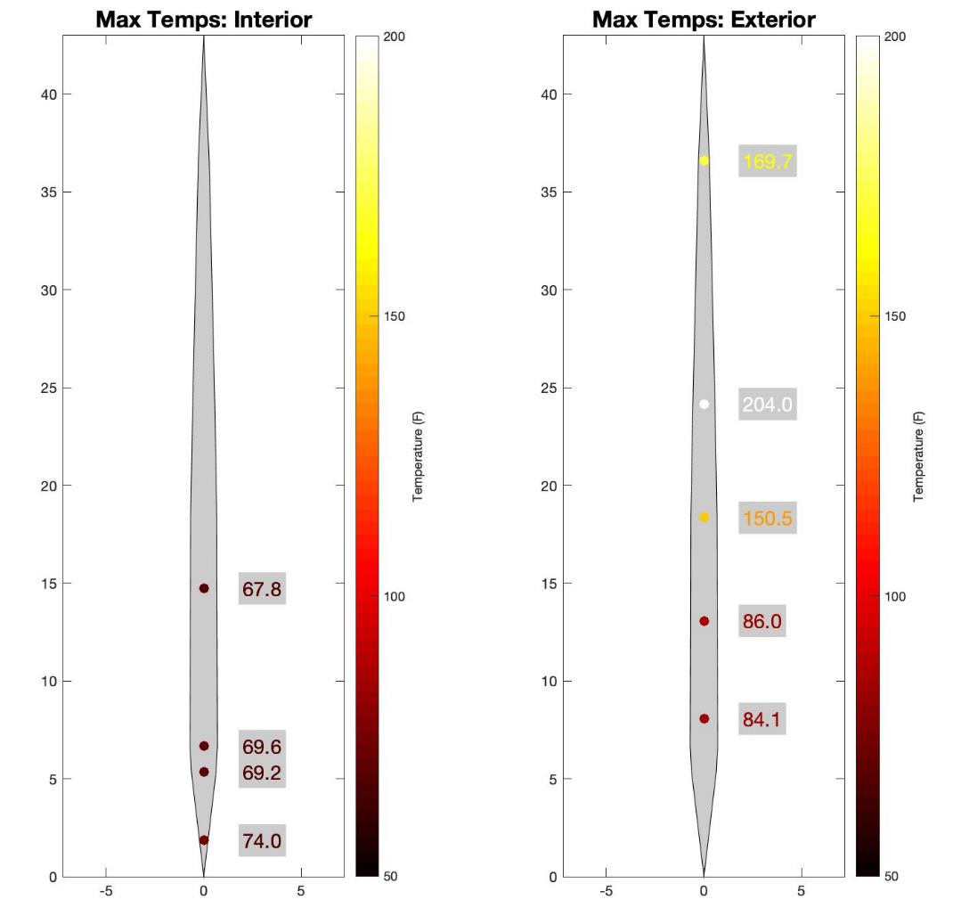
Overview
Schedule
Updates
Test Readiness
Budget
Update
Index

Slide 41
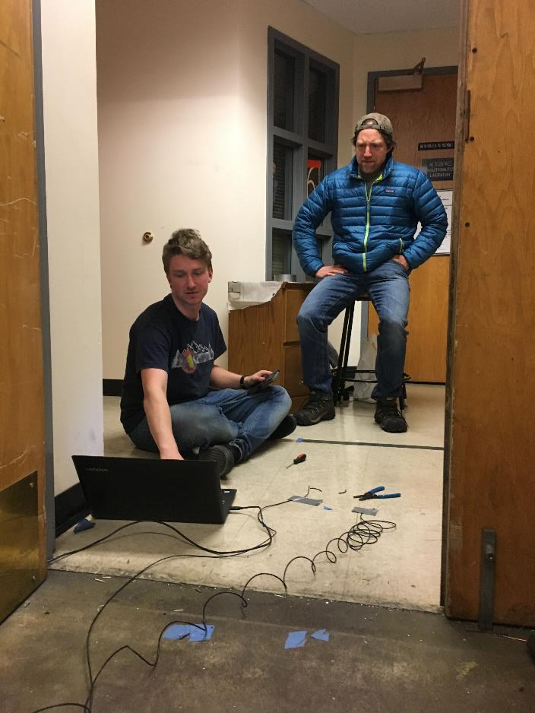
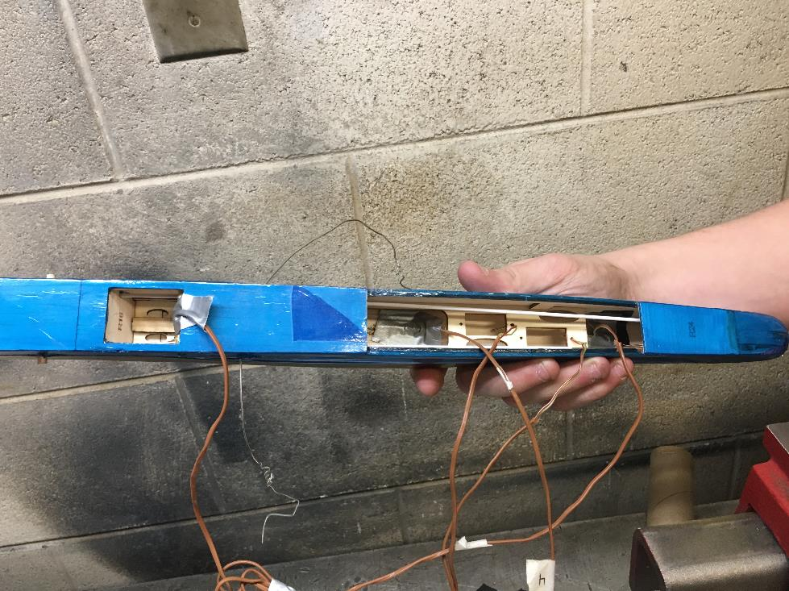
Overview
Schedule
Updates
Test Readiness
Budget
Update
Index
Test Setup: Internal Thermocouple Placement
Test Setup: Computer and Wiring with Greg and Dr. Akos

Slide 42
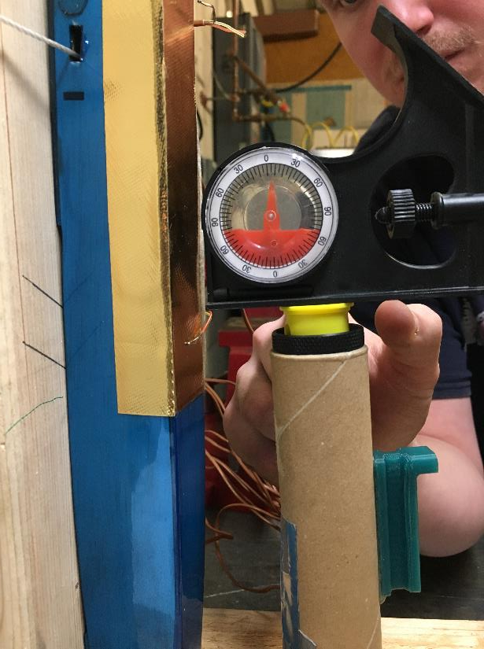
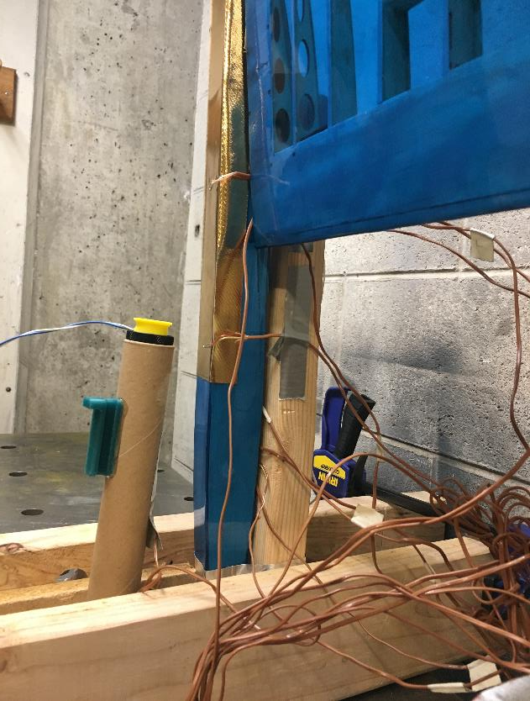
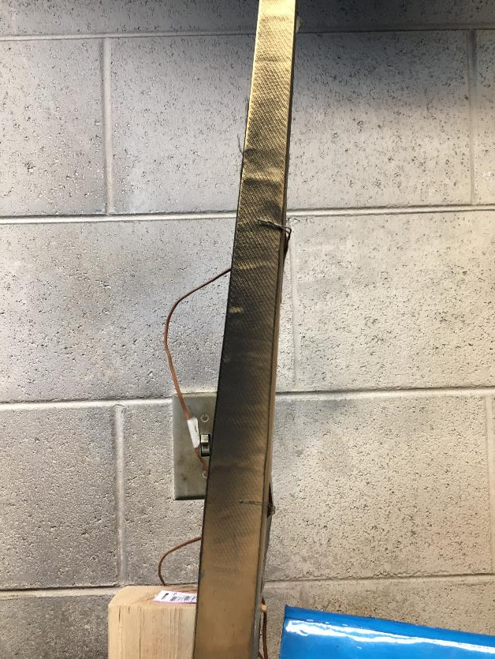
Overview
Schedule
Updates
Test Readiness
Budget
Update
Index
Test Setup: Motor Cant
Test Setup: Side View
Post Test: Fuselage External Closeup

Slide 43
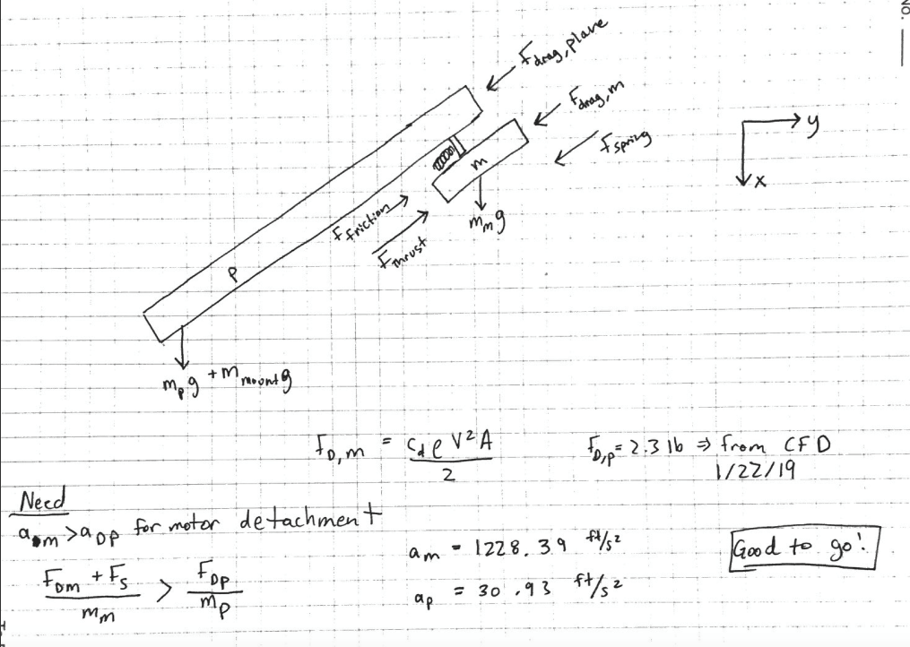
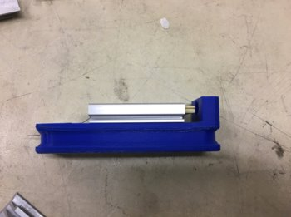
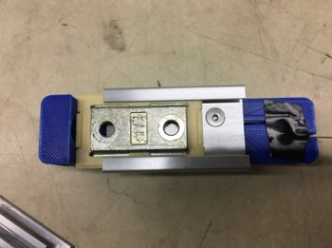
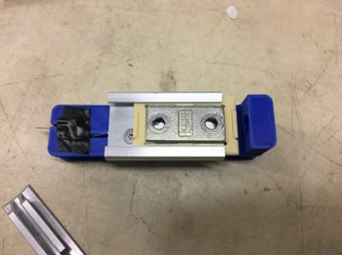
Motor Ditching
Overview
Schedule
Updates
Test Readiness
Budget
Update
Index
664.07
K_theo = 18.41
K_exp = 16.763
% Error = 8.9%
A_m_theo = 728.28 ft/s^2
A_m_exp = 664.07 ft/s^2

Slide 44
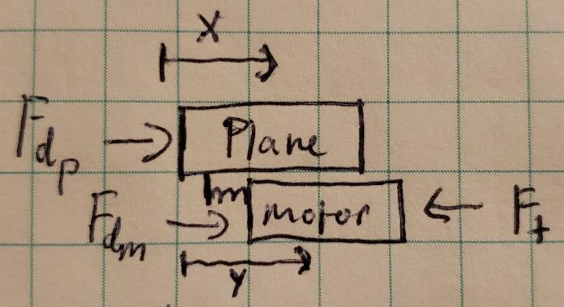
Overview
Schedule
Updates
Test Readiness
Budget
Update
Motor Ditching MATLAB Model
Index

Slide 45
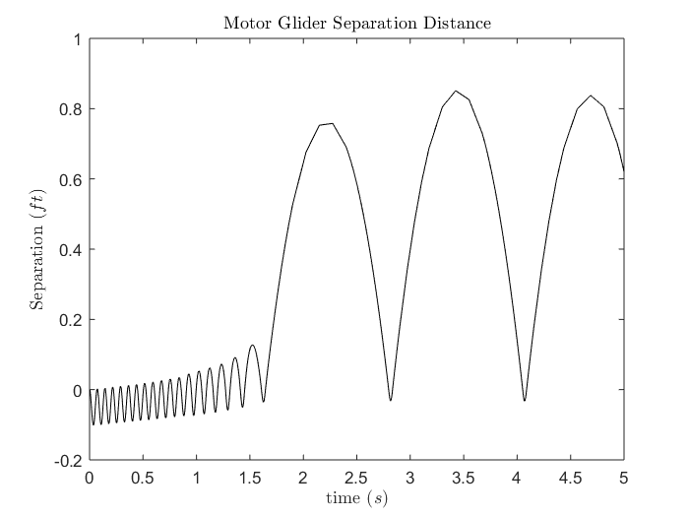
Overview
Schedule
Updates
Test Readiness
Budget
Update
Motor Ditching MATLAB Model - Results
Index

Slide 46
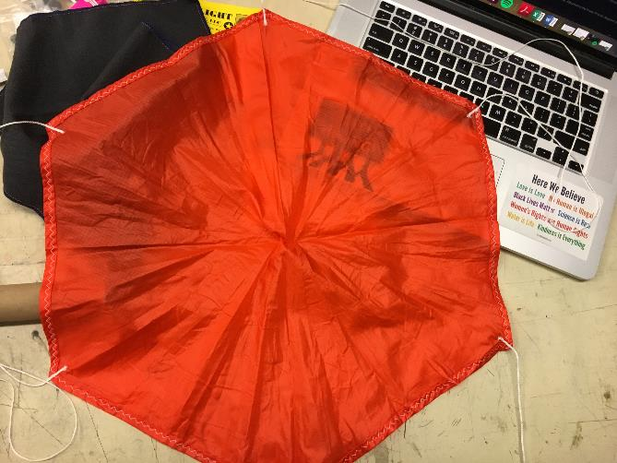
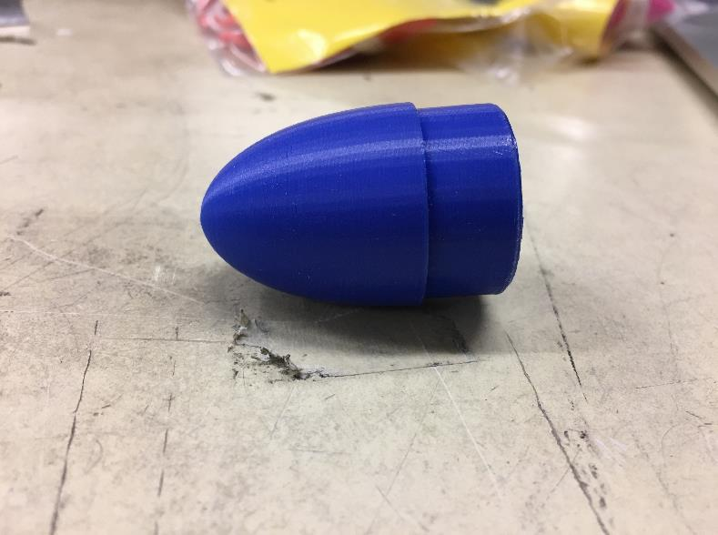
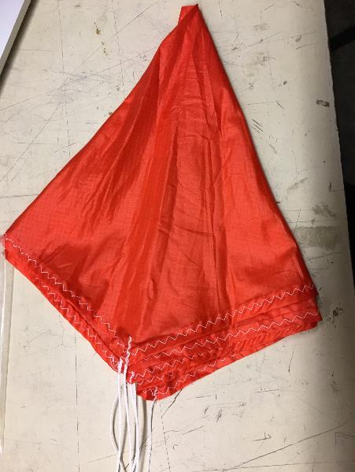
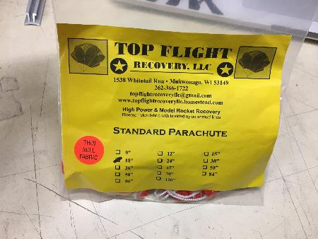
Parachute and Nose Cone
Overview
Schedule
Updates
Test Readiness
Budget
Update
Index

Slide 47
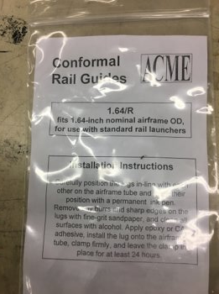
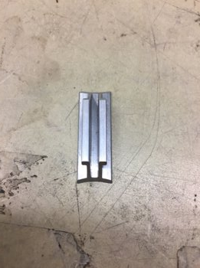
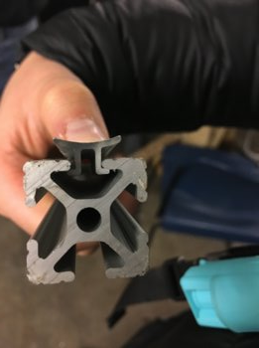
Launch Rail and Lug
Overview
Schedule
Updates
Test Readiness
Budget
Update
Index

Slide 48
Electronics and Controls Backup Slides
Overview
Schedule
Updates
Test Readiness
Budget
Update
Index

Slide 49
Overview
Schedule
Updates
Test Readiness
Budget
Update
IMU Setup
Index

Slide 50
Overview
Schedule
Updates
Test Readiness
Budget
Update
Full Pitch and Roll IMU Data
Index

Slide 51
Overview
Schedule
Updates
Test Readiness
Budget
Update
Augmented Full Pitch and Roll IMU Data
Index

Slide 52
Overview
Schedule
Updates
Test Readiness
Budget
Update
Combined Pitch and Roll IMU Data
Index
Roll and Pitch: | -0.51 ± 2.65°

Slide 53
Overview
Schedule
Updates
Test Readiness
Budget
Update
Altitude Data
Index

Slide 54
Electronics Integration Test
Overview
Schedule
Updates
Test Readiness
Budget
Update
Status: Complete
Index
Rationale – Demonstrate Electronics Fit and Function
Model
Related Risks
Risk | Before Test | After Test
3. Control Authority
10. Physical Integration
Success Criteria
All electronics fit within fuselage with ample room for each component
Ie. Servo actuators posses full range of motion
GPS, telemetry radio, and RC radio can communicate to the user and satellites
2
Notes:
Add comparison between stock and modified fuselages

Slide 55
Electronics Integration Test
Overview
Schedule
Updates
Test Readiness
Budget
Update
Index
Measurements
Equipment/Facilities
Procedure
Electronics are enclosed by the fuselage
Electronics function cohesively together
Control surfaces are actuated by the servos
Full electronics systems
Pixhawk 4
Stock power board
Supplemental power board
Turnigy LiPo Battery
Telemetry Radio
Control Radio
GPS/Compass Unit
Airspeed Sensor
RAPTR Vehicle
Laptop
Ardupilot
Telemetry radio
RC Controller
Assemble and secure electronics within vehicle
Power vehicle from battery
Establish wireless connection to vehicle
Send control commands using Ardupilot and RC controller
Ensure control surfaces behave appropriately
2
Notes:
Add comparison between stock and modified fuselages

Slide 56
Comms Integration Test
Overview
Schedule
Updates
Test Readiness
Budget
Update
Status: In Progress
Index
Rationale – Ensure Effective Wireless Communications
Related Risks
Risk | Before Test | After Test
7. Comm System Interference
12. Data Transmission Rate
15. Transmission at Range
Success Criteria
RC controller can successfully control RAPTR from all stages of flight
Telemetry Radio can downlink telemetry during all stages of flight
2
Notes:
Add comparison between stock and modified fuselages

Slide 57
Comms Integration Test
Overview
Schedule
Updates
Test Readiness
Budget
Update
Index
Measurements
Equipment/Facilities
Procedure
Signal strength
Signal integrity
Signal range
Full Electronics Systems
Pixhawk 4
Stock power board
Supplemental power board
Turnigy LiPo Battery
Telemetry Radio
Control Radio
GPS/Compass Unit
Airspeed Sensor
RAPTR Vehicle
Laptop
Ardupilot
Telemetry Radio
RC Controller
Power RAPTR vehicle from battery
Establish wireless connection to vehicle
Measure signal strength and integrity
Separate laptop/RC controller and vehicle to measure connection range
2
Notes:
Add comparison between stock and modified fuselages

Slide 58
Software Backup Slides
Overview
Schedule
Updates
Test Readiness
Budget
Update
Index

Slide 59
Software Testing
Overview
Schedule
Updates
Test Readiness
Budget
Update
Index
Measurements
Equipment/Facilities
Procedure
GPS coordinates of targets
Altitude of drone
Location of drone
Size of targets
Drone heading
DGI Phantom Standard
Brightly colored carboard cutout
Cell-phone GPS
Location: Boulder North Park
Place targets in center of field
Measure GPS location of each target
Capture images of targets with drone at varying altitudes
Download images
Input images into software
Safety Measures
Images gathered with quadcopter
10
Notes:
Add comparison between stock and modified fuselages

Slide 60
Software Testing
Overview
Schedule
Updates
Test Readiness
Budget
Update
Status: In Progress
Index
Rationale – Ground station software must detect targets and provide GPS coordinates
Model
Related Risks
The software must be capable of calculating a target's GPS coordinates within 150ft of the truth data (requirement given by customer) as well as be able to detect regions of interest
This test was designed to mimic the conditions expected in the full system test to verify that the software is functioning properly
Success Criteria:
Software can calculate GPS coordinates of each target with 150ft accuracy
Software can detect targets in the images and display a bounding box over them
Risk | Before Test | Predicted After Test
14. Image Processing Time
9
Notes:
Add comparison between stock and modified fuselages

Slide 61
Overview
Schedule
Updates
Test Readiness
Budget
Update
Equations Used in Software Testing Model
Index

Slide 62
Overview
Schedule
Updates
Test Readiness
Budget
Update
Determining Test Target Size
Index

Slide 63
Overview
Schedule
Updates
Test Readiness
Budget
Update
Altitude with 3.75'x3.75' Target
Index

Slide 64
Aerodynamics Backup Slides
Overview
Schedule
Updates
Test Readiness
Budget
Update
Index

Slide 65
Overview
Schedule
Updates
Test Readiness
Budget
Update
V-n Diagrams
Index

Slide 66
Overview
Schedule
Updates
Test Readiness
Budget
Update
Trim Diagram
Index

