Slide 1
RALPHIE
Testing Readiness Review
February 23, 2022
ASEN 4028-012
Company Customer:
Ann & H.J. Smead Department of Aerospace Engineering Sciences (John Mah)
Faculty Advisor:
Dr. Melvin Rafi
Presenters:
Andreas Brecl, Lorenzo Madera, Sean Newman, Sunny Sarkar, Gina Staimer, Andrew Thompson
Additional Team Members:
Sam Garza, Cooper Dale, Kidd Deng, Carson Leppla, Quinn Lewis, Dawei Zhao

Slide 2
Agenda
Project Overview Andreas Brecl
Schedule Sunny Sarkar
Test Readiness Andrew Thompson, Sean Newman, Lorenzo Madera
Budget Gina Staimer

Slide 3
Project Overview
Notes:
Expected: 3:30
Time Taken During Practice: 3:22
3.1.1 Brief project definition, using Objectives, CONOPS and FBD from PDD
3.1.2 Baseline design from CDD. Include diagrams and explanation sufficient to understand
the baseline design without having to read the CDD.

Slide 4
Mission Statement
Rapid Autonomous Loiter Program for Highly Increased Endurance (RALPHIE) will provide the Ann & H.J. Smead Department of Aerospace Engineering Sciences Department with an autonomous flight controller that can improve upon the endurance of existing small Unmanned Aerial System (UAS).
Project Description
Notes:
Talk about Background here - introduce project. This should cover PDD, CDD, and PDR

Slide 5
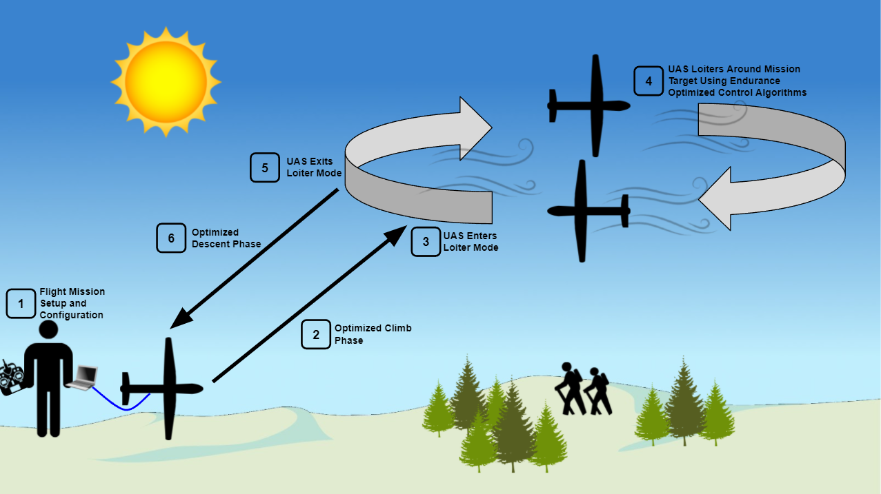
Overview CONOPS
Project Description
Notes:
Bulk of work for lottery phase

Slide 6
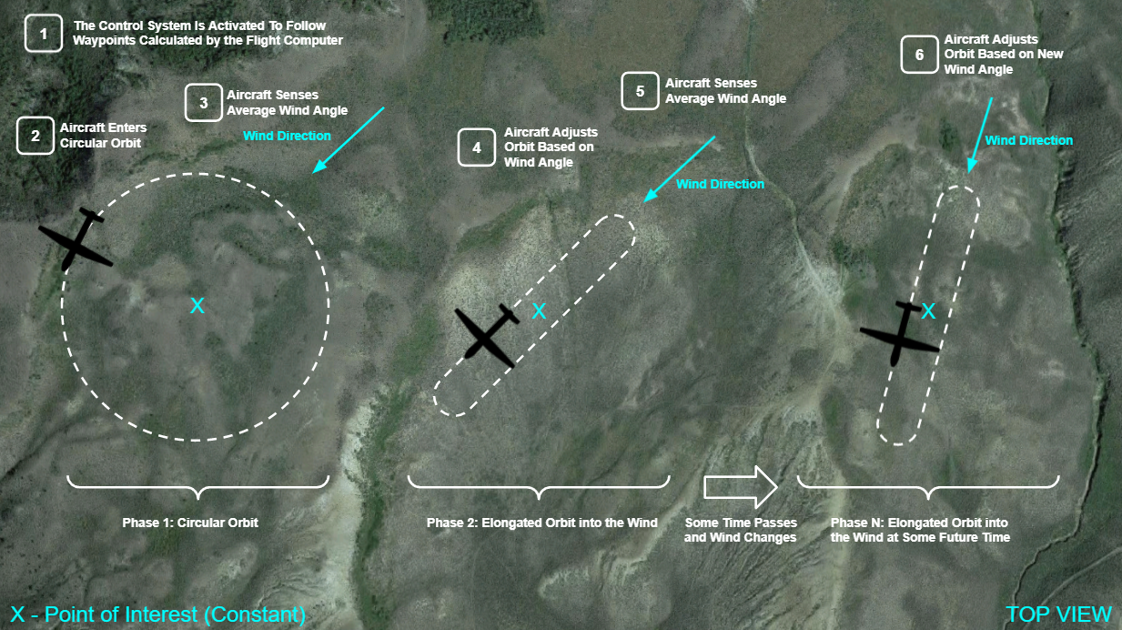
Main Mission CONOPS
Project Description
Notes:
dont say optimal
LQT hasn’t been formally introduced should we just call it our control system instead?
Maybe define LQT or remove? or mention we will talk about it later
How to change race tracks and flight paths, related to previous slide

Slide 7
Design Solution
Notes:
Expected: 4 min
Time Taken During Practice: 4:40

Slide 8
Critical Project Elements
CPE | Description | Function Requirement (FR)
CPE-1 | The aircraft must meet all FAA requirements including being flown by a FAA certified pilot 14 CFR Part 107, SMALL UNMANNED AIRCRAFT SYSTEMS | FR-03 FR-07
CPE-2 | A single operator with minimal training must be able to input mission parameters and load the flight software | FR-04 FR-05 FR-06 FR-07
CPE-3 | The UAS will use a autonomous flight controller that will determine a path for improved endurance in order to observe a target | FR-02
CPE-4 | Board must be capable of running entirety of flight software. Board must contain same interfaces to a range of peripherals and sensors. | FR-05
CPE-5 | The UAS must be able to determine its state and position to feed to the control system in order for the flight path to be improved | FR-02
CPE-6 | The cost of the flight controller and avionics system combined with the cost of the air frame must not exceed $5000. | FR-01
Design Solution
Notes:
Do we need to run CPE updates past mah?
Switch out “optimal” for improved

Slide 9
Levels of Success
Area of Success | Level 1 | Level 2 | Level 3
Endurance | Flight controller inputs environmental & energy factors. | Flight controller accounts for environmental & energy factors. | 5% increase in endurance from an off the shelf autonomous flight controller.
Autonomy | Operator controls the aircraft to mission phase and then fully autonomous in mission phase. Create simulation to test software and controls. | Autonomous climb and descent. | -
Integrated Energy and Mission Management | Stay in the mission area while maximizing power distribution to critical systems only. | Use on-board sensors to detect environmental factors in order to improve energy usage and endurance. | -
Design Solution

Slide 10
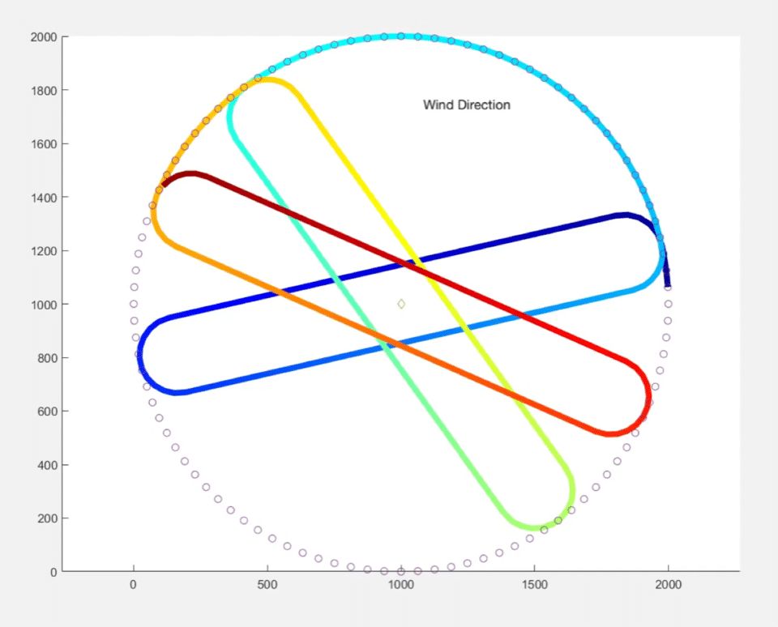
Trajectory Planning - WARIO
How do we choose an efficient path?
To minimize energy use and maximize endurance, we need to give the aircraft a trajectory which requires minimum correction
Driving Requirements:
Maintain mission area
Minimizing amount of control required for turns
Aircraft State Variables Involved:
Inertial Position: [x, y, z]
WARIO - Wind Averaging Recursive Intra-squircular Orbits
Design Solution
Notes:
Rename this slide - talk about WARIO algorithm name

Slide 11
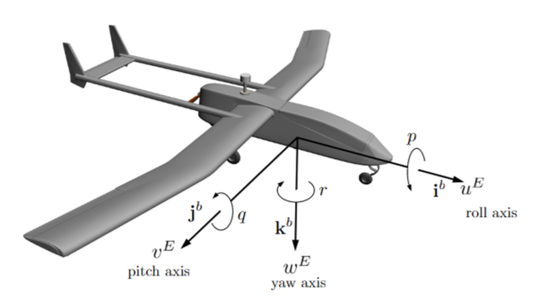
Control System - LQT
How do we maintain a path efficiently?
Linear Quadratic Tracker
Minimizes use of throttle while minimizing error between actual and desired state
Allows for weighting of control surfaces and state vector
Weights determine what will be more costly or important to the system
Design Solution
Notes:
LQT balances how well the path is followed, and how much throttle is used
Weighting throttle to be minimized
Weighting ‘u’ to fly at trim
When flying straight, weighted variables are x, y, T, u
When Turning, weighted variables are roll, yaw, T, u
State weights will determine how closely the path is followed,
The more the controls are weighted, the less they are used
mention that the desire state is that “most efficient path” like the highway

Slide 12
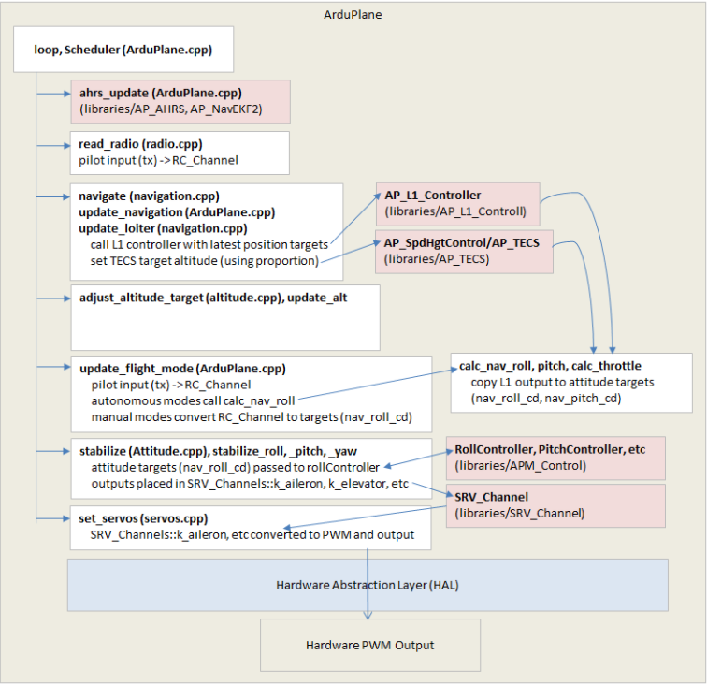
Software Integration
ArduPilot Flight Software Architecture
Uses multithreaded scheduler
Attitude, heading, and reference system (AHRS)
Construct full aircraft states
“Navigate” and “Stabilize” tasks will be replaced
Design Solution
Notes:
think about good answer to why we are removing things. for the PABs

Slide 13
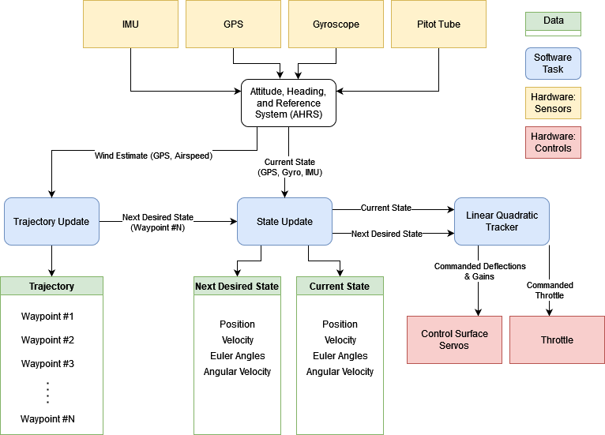
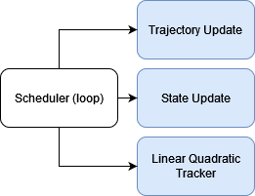
Software/Hardware Functional Block Diagram
(Motor)
Design Solution

Slide 14
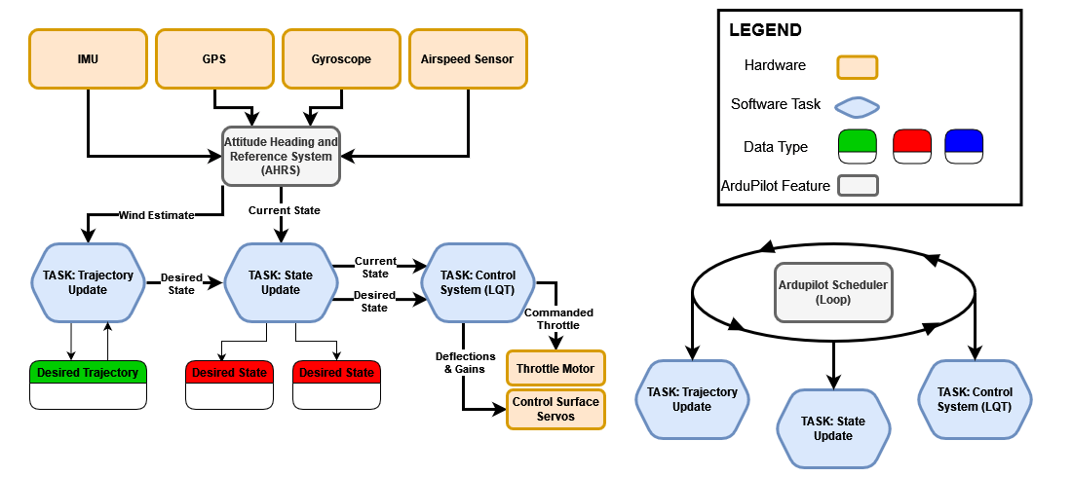
Software/Hardware Functional Block Diagram
(Motor)
Design Solution

Slide 15
Schedule
Notes:
Expected: 3:30
Time Taken During Practice: 3:22
3.1.1 Brief project definition, using Objectives, CONOPS and FBD from PDD
3.1.2 Baseline design from CDD. Include diagrams and explanation sufficient to understand
the baseline design without having to read the CDD.

Slide 16
Work Breakdown Structure - Development
UNIT TESTING CONCURRENT
UNIT TESTING CONCURRENT
SOME DELAYS WITH ORDERING
Schedule
Notes:
Colin: have this view to show overall tasks to be done, then on another slide show a “2 week forecast” gantt of the immediate next steps you will do. This one cannot be read, but the next one will actually facilitate the PAB being able to read the next few tasks you have to execute. Also the title should probably be “Gantt Chart” and not “Work Breakdown Structure”

Slide 17
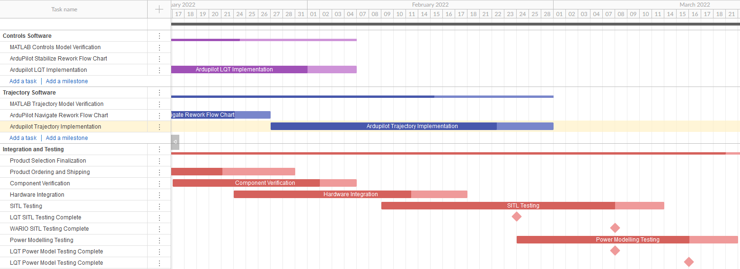
Work Breakdown Structure - Transition
LQT TESTING
WARIO TESTING
LQT TESTING
WARIO TESTING
Schedule

Slide 18
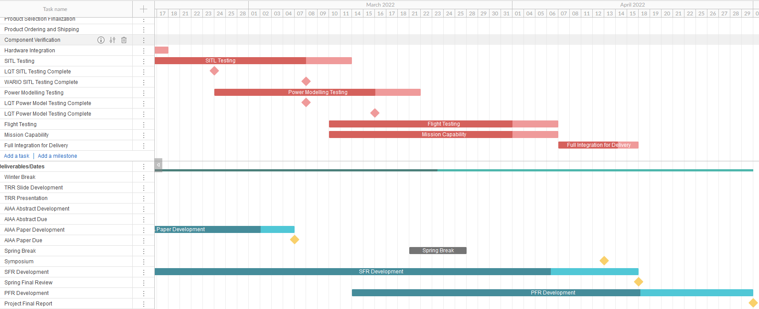
Work Breakdown Structure - Validation
WEATHER DEPENDENT
Schedule

Slide 19
Test Plan
Test | Date | Progress | Prerequisite
Matlab/Simulink Control Testing | Nov 29th | Complete | None
Component Testing | Jan 17th | In Progress | Hardware acquired
SITL Testing | Feb 8th | In Progress | Matlab/Simulink Testing Complete Software Implementation Working
Power Model Testing | March 7th | Future Work | SITL Testing Majority Complete Component Testing Complete
Flight Test | March 11th | Future Work | Can be concurrent with Power Model Testing
Schedule
Notes:
Update to match test overview
Call out which tests are verification and validation

Slide 20
Test Readiness
Notes:
Expected: 3:30
Time Taken During Practice: 3:22
3.1.1 Brief project definition, using Objectives, CONOPS and FBD from PDD
3.1.2 Baseline design from CDD. Include diagrams and explanation sufficient to understand
the baseline design without having to read the CDD.
Describe the scope of the testing tasks in the project: what tests are being planned, specifically:
what is being tested for (your rationale for performing the test),
the design of the test fixtures,
what test equipment and facilities are needed, and
an overview of the test procedures.
Describe how the test(s) will reduce risk to your project, what results do you expect, and what
models will be validated.
Describe the status of the testing tasks, showing engineering details as needed to convey a solid
understanding of the design (and the ability to reduce risk), requirements to be verified or validated,
and what V&V is most important for project success.

Slide 21
Functional Requirements
FR-01 | The total flyaway cost for flight controller hardware, flight controller software, and a ground station shall be based on current day consumer level UAS flight hardware costs to enable ease of purchase and replacement by smaller organizations.
FR-02 | The UAS software shall optimize flight trajectory for improved endurance and energy use.
FR-03 | The UAS shall adhere to FAA guidelines outlined in 14 CFR Part 107, SMALL UNMANNED AIRCRAFT SYSTEMS.
FR-04 | The flight control system shall be adaptable to a variety of fixed wing air vehicles.
FR-05 | The UAS shall be capable of sustaining an 80% Full Mission Capable rate (RMC) under Instrument Meteorological Conditions (IMC). be capable of maintaining a continual 100% standby posture.
FR-06 | The UAS shall be operable by a single operator for the entire duration of the mission.
FR-07 | The UAS software shall be capable of a recovery and return mode to maintain the safety of the aircraft.
Test Readiness

Slide 22
Test Overview
 | Test | Functional Requirement | Status
Component | Component Checks | FR-05 | Complete
 | Controls | FR-02 | In Progress
Sub-System | Unit Testing | FR-06, FR-07 | In Progress
 | Software in the Loop | FR-02, FR-04, FR-07 | In Progress
 | Hardware Integration | FR-06 | In Progress
System | Power Modeling | FR-02 | Planned 3/7
 | Flight Test - LQT, WARIO, Full | FR-02, FR-06, FR-07 | Planned 3/11
 | Mission Capability | FR-05,FR-06 | Planned 3/11
Test Readiness

Slide 23
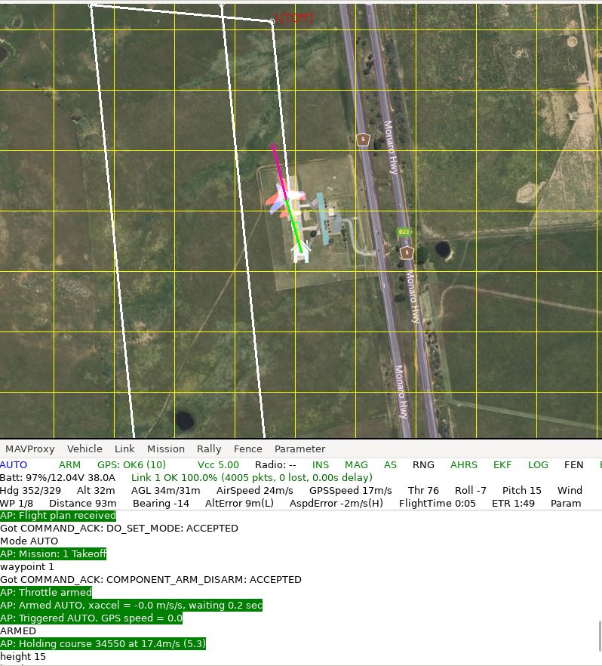
Verification: Software In The Loop Testing (SITL)
Rationale: Integrated flight software to be tested in isolation from hardware, assess performance of integrated software components
Test Fixture: Ardupilot SITL driver with aircraft dynamics model
Equipment Needed: Linux Operating System
Procedure:
Configure flight software for desired test scenario. Enable/Disable major project components:
LQT Control System
WARIO Trajectory Algorithm
Set simulation parameters
Wind
Dynamics Model
Execute Simulation
Risk Reduction: Identify integration incompatibilities between major software components.
Test Readiness

Slide 24
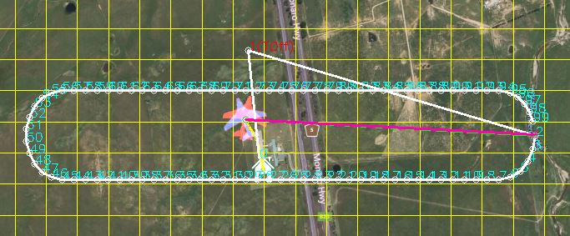
Verification: Software In The Loop Testing (SITL)
Expected/Desired Results:
WARIO algorithm adjusts trajectory upon 15º deviation of simulated wind direction within 90 seconds (FR-02)
Demonstration of LQT ability to control multiple aircraft dynamics models (FR-04)
Verify flight software initiates return to launch upon 30% battery charge (FR-07)
Requirement | Description
FR-02 | UAS software shall optimize trajectory for improved endurance and energy.
FR-04 | The flight control system shall be adaptable to a variety of fixed wing air vehicles.
FR-07 | The UAS software shall be capable of a recovery and return mode to maintain the safety of the aircraft.
Original Wind Direction Updated Wind Direction
In Progress
Test Readiness
Notes:
Manufacturer Recommended battery charge

Slide 25
Validation: Power Modeling
Rationale:
Used to predict the power usage of the aircraft from SITL results
Validate flight tests and predict how other airframes will perform
Reduces risk of aircraft power capabilities during flight
Test Fixture:
Ardupilot SITL and Matlab
Equipment Needed:
Multimeter
Assembled airframe
Requirement | Description
FR-02 | UAS software shall optimize trajectory for improved endurance and energy.
Planned for 3/7
Test Readiness
Notes:
Lorenzo
Can be used to validate flight tests, and predict how other airframes will perform
Using actual hardware based on control surface and thruster usage
Recording power and current draw of control surfaces at different deflections
Can integrate current draw to obtain voltage and perform regression analysis

Slide 26
Validation: Power Modeling
Procedure:
Measure voltage and current draw at a series of control surface deflection angles.
Measure voltage and current draw at a series of motor thrust levels.
Perform regression analysis to develop a power usage model based on control surface deflections and propellor usage.
Run SITL simulation and use output data to model power usage.
Risk Reduction:
Allows for the prediction and characterization of power usage to validate flight tests.
Expected/Desired Results:
5% increase in endurance
Requirement | Description
FR-02 | UAS software shall optimize trajectory for improved endurance and energy.
Planned for 3/7
Test Readiness
Notes:
Lorenzo
5% increase in endurance from an off the shelf autonomous flight controller.
Can be used to validate flight tests, and predict how other airframes will perform
Using actual hardware based on control surface and thruster usage
Recording power and current draw of control surfaces at different deflections
Can integrate current draw to obtain voltage and perform regression analysis

Slide 27
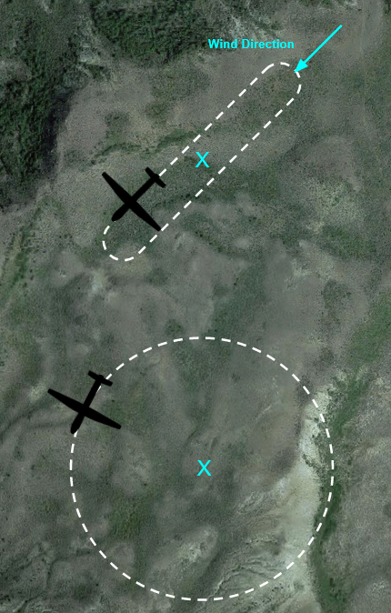
Verification: Flight Testing - WARIO
Rationale: Integrated flight software to be tested on hardware in real world conditions. Assess the performance of WARIO separate from the LQT compared to base ardupilot.
Test Fixture: Flight Test Facility
Equipment Needed:
Pixhawk with WARIO implementation
Pixhawk with default Ardupilot
2 Flight Units
Procedure:
Load WARIO algorithm onto RALPHIE flight unit.
Launch RALPHIE flight unit and Control Flight Unit for simultaneous flight.
Initiate Return mode for landing.
Download Flight Data from both flight units and compare power usage
Risk Reduction: Ensures that the WARIO trajectory algorithm is operating correctly before the full integration flight test.
Status: Planned
Test Readiness
Notes:
Make sure to describe software in the loop WAHHHHHHHHHHHHHHHHHHHHHHHHHHHHHHHHHHHHH

Slide 28
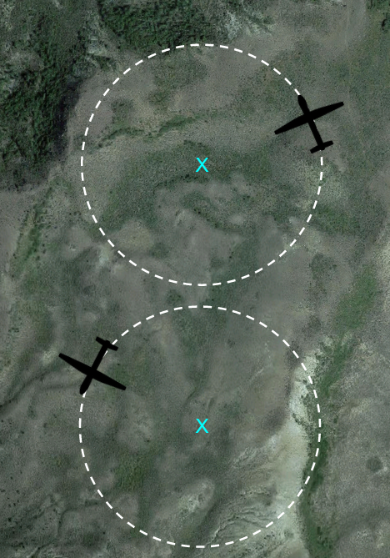
Verification: Flight Testing - LQT
Rationale: Integrated flight software to be tested on hardware in real world conditions. Assess the performance of the LQT separate from WARIO compared to base ardupilot.
Test Fixture: Test Facility
Equipment Needed:
Pixhawk with LQT implementation
Pixhawk with default Ardupilot
2 Flight Units
Procedure:
Load LQT algorithm onto RALPHIE flight unit.
Launch RALPHIE flight unit and Control Flight Unit for simultaneous flight.
Initiate Return mode for landing.
Download Flight Data from both flight units and compare power usage
Risk Reduction: Ensures that the LQT algorithm is operating correctly before the full integration flight test.
Status: Planned
Test Readiness
Notes:
Make sure to describe software in the loop

Slide 29
Verification: Flight Testing - Full Integration
Rationale: Integrated flight software to be tested on hardware in real world conditions. Assess the performance of RALPHIE flight software compared to base ardupilot.
Test Fixture: Flight Test Facility
Equipment Needed:
Pixhawk with full RALPHIE flight software
Pixhawk with default Ardupilot
2 Flight Units
Procedure:
Load RALPHIE FSW onto RALPHIE flight unit.
Launch RALPHIE flight unit and Control Flight Unit for simultaneous flight.
Initiate Return mode for landing.
Download Flight Data from both flight units and compare power usage
Risk Reduction: FAA Part 107
Status: Planned
Test Readiness
Notes:
Make sure to describe software in the loop

Slide 30
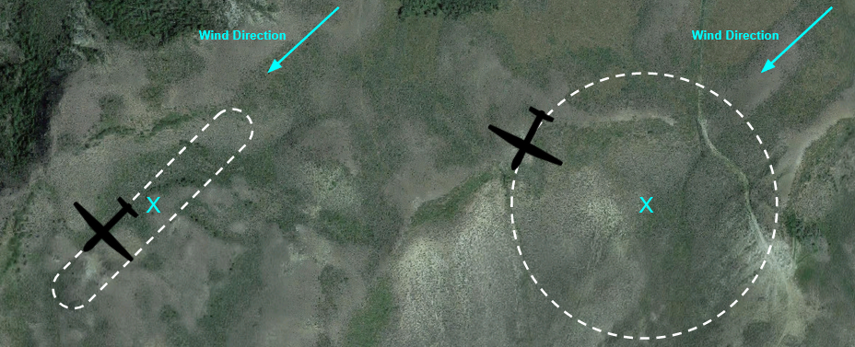
Verification: Flight Testing Full Integration
Expected/Desired Results:
The Ralphie FSW reduces the power usage for the flight unit by 5% when compared to the default Ardupilot FSW.
A Single operator undertakes the mission, from building the RALPHIE flight software to landing
The return mode is utilized to return the aircraft to the operator
Requirement | Description
FR-02 | UAS software shall optimize trajectory for improved endurance and energy.
FR-06 | The UAS shall be operable by a single operator for the entire duration of the mission.
FR-07 | The UAS software shall be capable of a recovery and return mode to maintain the safety of the aircraft.
Planned for 3/11
Test Readiness
Notes:
Manufacturer Recommended battery charge

Slide 31
Flight Test Facility Access and Safety
Facility Options
NOAA Table Mountain Test Facility
CU Smead Aerospace/ CU Boulder South
Boulder Aeromodler Fields
Follow FAA part 107 Guidelines
107.39 Operation over human beings:
107.49 Preflight familiarization, inspection, and actions for aircraft operation.
107.51 Operating limitations for small unmanned aircraft.
107.12 Requirement for a remote pilot certificate with a small UAS rating.
Test Readiness

Slide 32
Verification: Mission Capability
Rationale: Ensure that RALPHIE FSW is capable of being launched at a moments notice once built to achieve mission success.
Equipment Needed:
Pixhawk with full RALPHIE flight software
1 Flight Unit
Ground Station
Procedure:
Build software
Prime aircraft for launch
Launch Aircraft (Concurrent with Flight Testing)
Assess mission success
Risk Reduction: Reduce risk for general purpose use of flight software
Expected/Desired Results:
The RALPHIE FSW remains ready for launch and communicating with the ground station after being built and mission parameters are input 100% of the time.
The RALPHIE FSW completes mission objectives without error 80% of the time
A single operator builds the RALPHIE FSW and input mission parameters
Requirement | Description
FR-05 | The UAS shall be capable of sustaining an 80% Full Mission Capable rate (RMC) under Instrument Meteorological Conditions (IMC). be capable of maintaining a continual 100% standby posture.
FR-06 | The UAS shall be operable by a single operator for the entire duration of the mission.
Planned for 3/11
Test Readiness
Notes:
Manufacturer Recommended battery charge

Slide 33
Budget
Notes:
Expected: 3:30
Time Taken During Practice: 3:22
3.1.1 Brief project definition, using Objectives, CONOPS and FBD from PDD
3.1.2 Baseline design from CDD. Include diagrams and explanation sufficient to understand
the baseline design without having to read the CDD.

Slide 34
Cost Plan
System |  | Projected Cost
Unit Cost |  | $1,564
x2 | Flight Controller Package | $233
x2 | Air Speed Sensor | $49
x1 | GPS-RTK Board Ground + Rover | $310
x2 | GPS-RTK Board Rover | $200
x2 | Battery | $25
x1 | Ground Controller | $160
x2 | Telemetry System | $40
Testing |  | $1,424
x4 | Airframe | $306
x1 | FAA License | $200
Miscellaneous/Shipping |  | $1,500
Excess |  | $512
Total Used |  | $4,488
Budget
Notes:
Need to Update

Slide 35
Updated Budget
Supplier | Order Number | Parts | Purchase Amount | Customs Fees | Total | Status
Holybro
 | 22010811402639 |  | $1,355.54 | $353.75 | $1,709.29 | Delivered
 | 22011207575323 |  | $140.03 | $0.00 | $140.03 | Delivered
Hobby King
 | 102731726 | Airframe (x3) | $500.15 | $0.00 | $500.15 | Delivered
 | 102731732 | Airframe (x1) | $178.89 | $0.00 | $178.89 | Delivered
Amazon
 | #114-2944513-7365004 | RC Controller | $158.99 | $0.00 | $158.99 | Delivered
 | #114-1282445-6371423 |  | $58.19 | $0.00 | $58.19 | Delivered
 | N/a | R12DS RadioLink Receiver | $26.99 | $0.00 | $26.99 | Still Processing
 | #112-9936523-7121842 | XT60 Male to Female Extension Adapter | $17.96 | $0.00 | $17.96 | Delivered
 | #112-7654317-9709843 | AA Batteries | $16.27 | $0.00 | $16.27 | Delivered
 | N/a | SD Card | $16.96 | $0.00 | $16.96 | Still Processing
 | N/a | RC Controller | $158.99 | $0.00 | $158.99 | Still Processing
FAA Certifications
FAA Licenses |  |  | $350 |  |  | In Progress
 |  |  | Budget Spent |  | $3,332.71
 |  |  | Remaining Budget: |  | $1,667.29
Budget
Notes:
Need to Update with final order for telemetry radio

Slide 36
Acknowledgements
The team would like to acknowledge:
Professor Melvin Rafi
Professor John Mah
Professor Kathryn Wingate
Professor Jelliffe Jackson
Professor Eric Frew
The PAB and TAs
All listed provided lots of support during the senior design process. Their input and feedback has helped guide us to our current design
Closing Slides

Slide 37
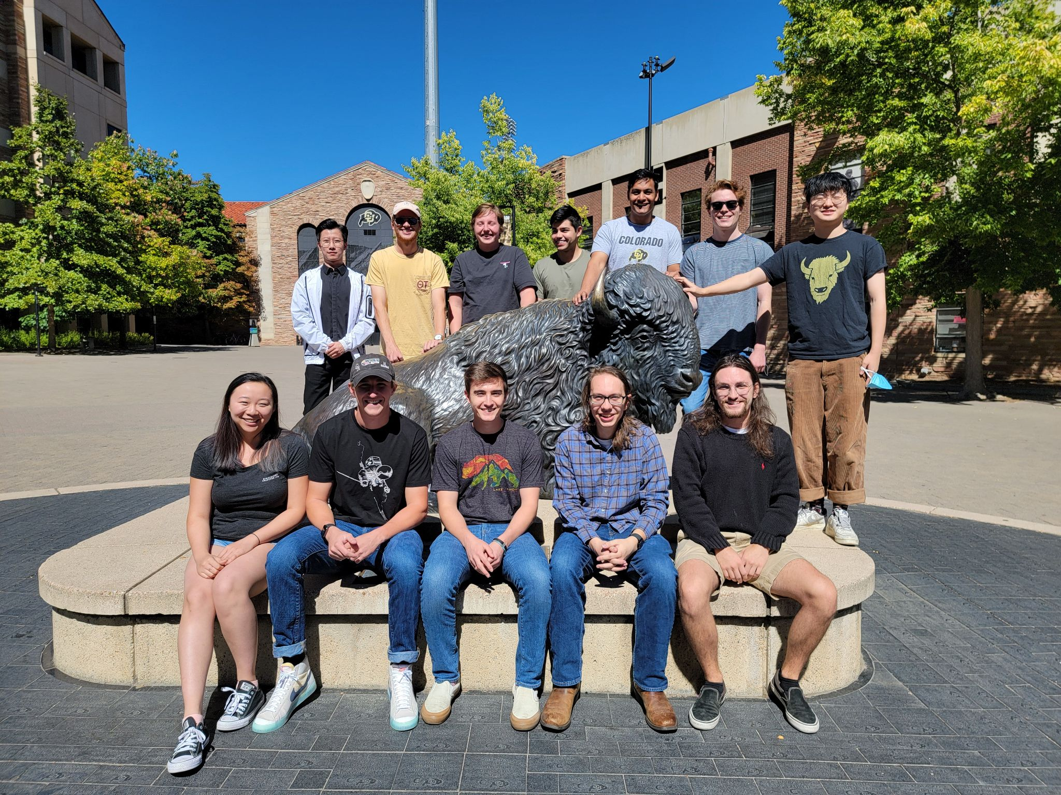
Questions?
Closing Slides

Slide 38
Backup Slides
Notes:
Expected: 3:30
Time Taken During Practice: 3:22
3.1.1 Brief project definition, using Objectives, CONOPS and FBD from PDD
3.1.2 Baseline design from CDD. Include diagrams and explanation sufficient to understand
the baseline design without having to read the CDD.

Slide 39
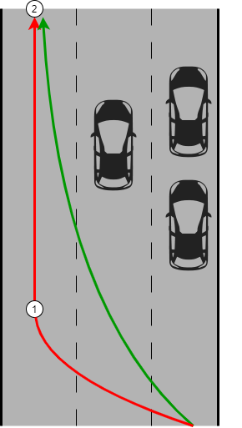
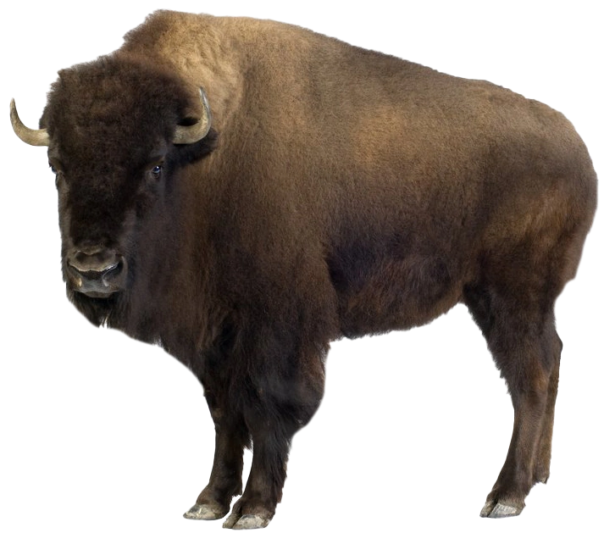
Highway Analogy
How would you increase fuel efficiency while driving a car on a highway?
How do we choose a lane on the highway?
(Trajectory Planning)
Which will be the fastest?
Most cars?
How do we get in the lane efficiently?
(Control System)
How sharp do we want the turns?
How fast should we drive while making these turns?
Backup Slide
Notes:
pose these all as questions. add another car that adds you. keep at higher level. just say what lanes we want to go in. talk about how we want to switch lanes (fast or slow).
figure out a way to more directly tie this together early in this section. Just to ensure that people do not forget.

Slide 40
Levels of Success
Area of Success | Level 1 | Level 2 | Level 3
Safety | Aircraft meets all FAA requirements outlined in 14 CFR Part 107, SMALL UNMANNED AIRCRAFT SYSTEMS. Aircraft has manually override of autonomous control and can be manually controlled. | - | -
Cost | Flyaway cost for a single UAS’s electrical system and software shall not exceed $1000. | Flyaway cost for a single UAS’s electrical system and software shall not exceed $950 | Flyaway cost for a single UAS’s electrical system and software shall not exceed $900
Endurance | Flight controller inputs environmental & energy factors. | Flight controller accounts for environmental & energy factors. | 10% increase in endurance from an off the shelf autonomous flight controller.
Software Initialization/Startup | The software boot time should not exceed 14 minutes and can be used by a single operator. Software obtains GPS lock and performs pre-flight sensor and controls checks. | The software boot time should not exceed 12 minutes and can be used by a single operator. | The software boot time should not exceed 10 minutes and can be used by a single operator.
Autonomy | Operator controls the aircraft to mission phase and then fully autonomous in mission phase. Create simulation to test software and controls. | Autonomous climb and descent. | -
Integrated Energy and Mission Management | Stay in the mission area while maximizing power distribution to critical systems only. | Use on-board sensors to detect environmental factors in order to optimize energy usage and endurance. | -
Backup Slide

Slide 41
Nomenclature
Inertial Position
x: inertial x position (North)
y: inertial y position (East)
z: inertial z position (Down)
Euler Angles
φ: roll angle
θ: pitch angle
𝜓: yaw angle
Inertial Velocity
u: inertial velocity component along i
v: inertial velocity component along j
w: inertial velocity component along k
Angular Velocity
p: roll rate
q: pitch rate
r: yaw rate
Full State Vector:
Backup Slide
Notes:
mention what the colors represent. change colors potentially for easier different to see. Change colors in state vector
Don’t talk down to audience. Preface by saying for the benefit of non-aircraft experts

Slide 42
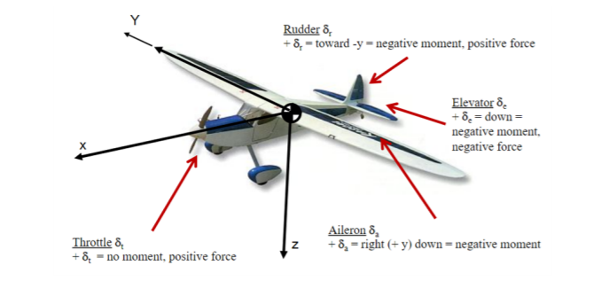
Nomenclature
Elevator - 𝛿_{e}
Deflect up and down and causes rotation along the y axis
Rudder - 𝛿_{r}
Deflect left and right and cause rotation on the z axis
Aileron - 𝛿_{a}
Deflect both up and down and cause rotation along the x axis of the aircraft
Throttle - 𝛿_{t}
Along x axis of aircraft
Full Input Vector:
Backup Slide

Slide 43
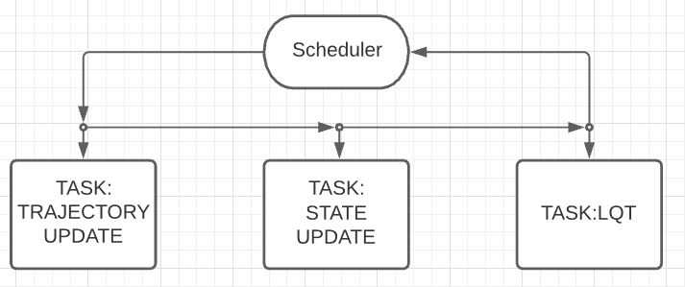
Software Integration
Perform wind averaging
Maintain and store desired trajectory
Update trajectory based on conditions
Interface with AHRS to construct current state vector
Retrieve the next desired state vector
Use current/desired state to compute control surface inputs
Backup Slide

Slide 44
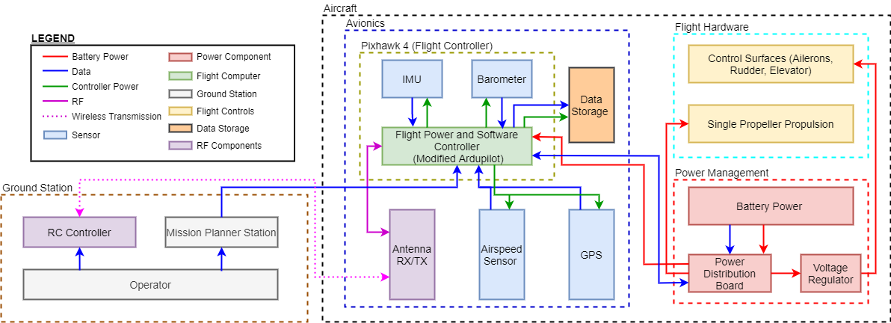
Functional Block Diagram
Backup Slide
Notes:
Add a spatial component
Focus more on sensor specifics
Mention V&V

Slide 45
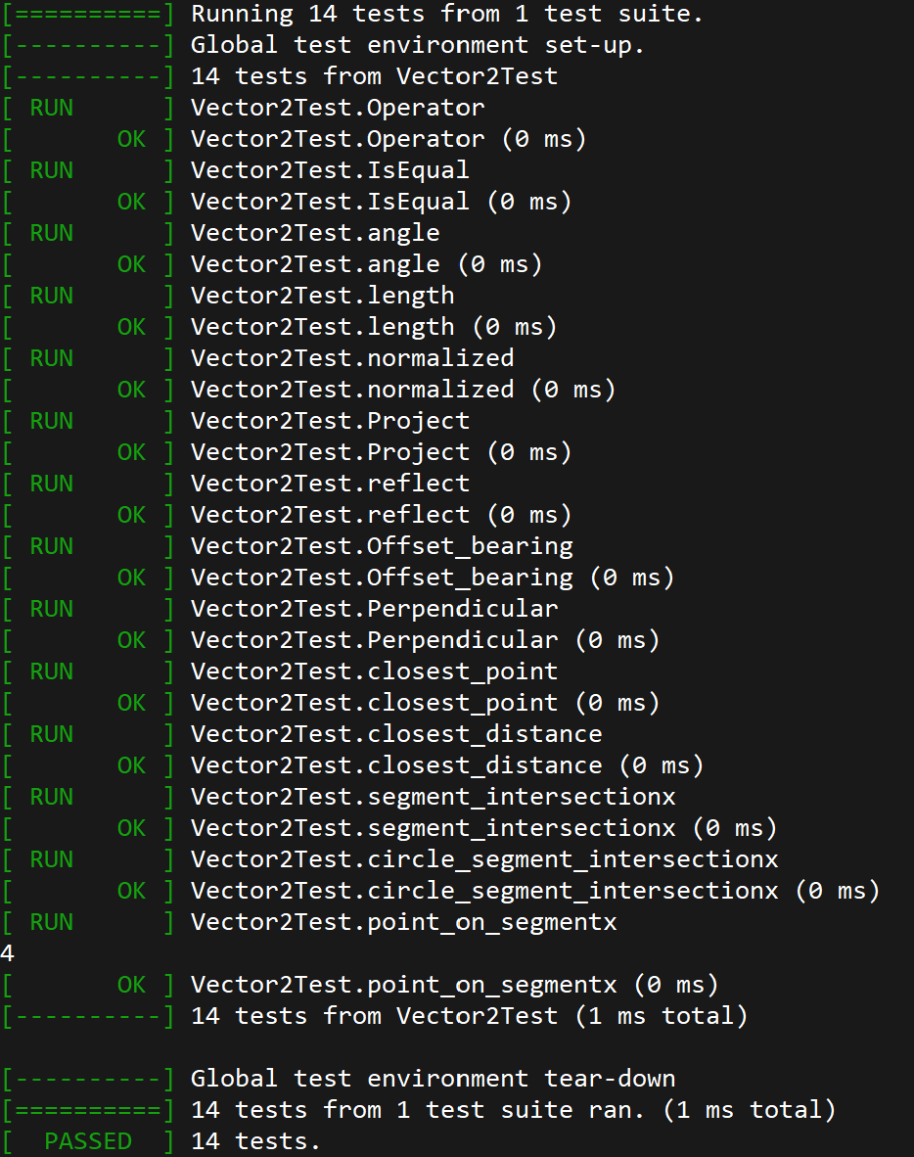
Unit Testing
Rationale: Individual modules and functions must be validated before integration
Test Fixture: Google Test Suit (GMock)
Equipment Needed: Linux Operating System
Procedure:
Create realistic scenario to test
Generate expected result
Compare expected results with actual results
Risk Reduction: Reduce likelihood of undiscovered low-level software bugs during flight
Status: In progress
Backup Slide
Notes:
sean is an angry test engineer

Slide 46
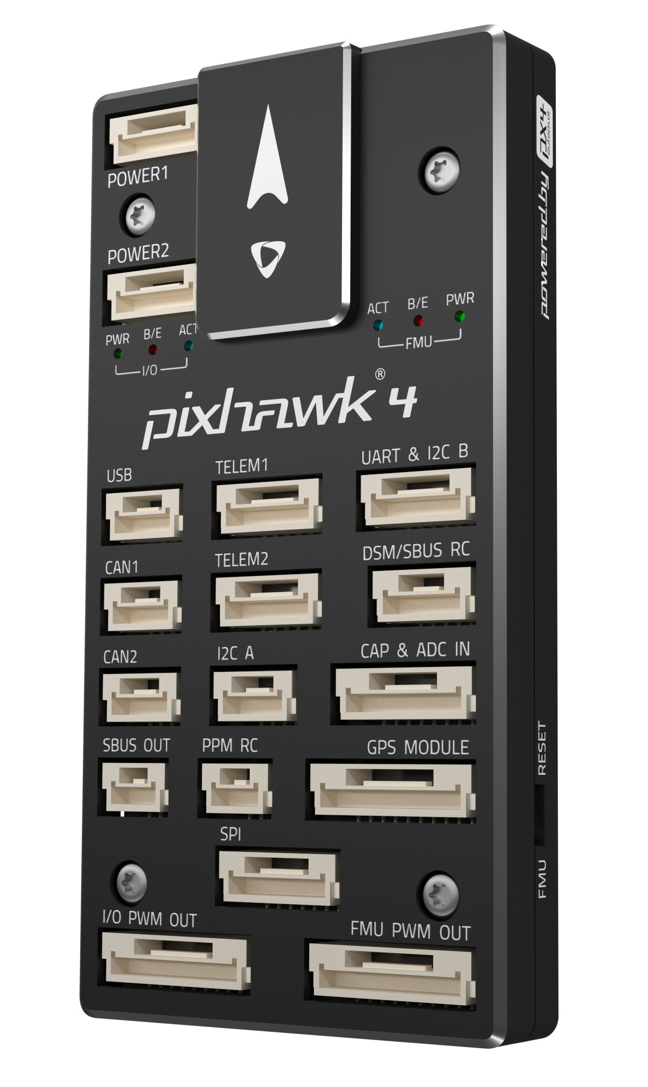
Avionics- Pixhawk 4 (Hardware)
Sufficient RAM available
60 KB of RAM dedicated to LQT (worst case)
Easily able to account for general software
Verified via comparison to other FSW
Hardware
44mm
 | Processor Speed (MHz) | RAM (KB) | Operational Temperature Range (°C)
Main Processor STM32F765 | 216 | 512 | -40 to 85
Total Weight: 33.3 g
84mm
12mm
Backup Slide
Notes:
2x the amount of RAM as the pixhawk3 that ran essentially the same flight software --- should be plentyyyy of RAM

Slide 47
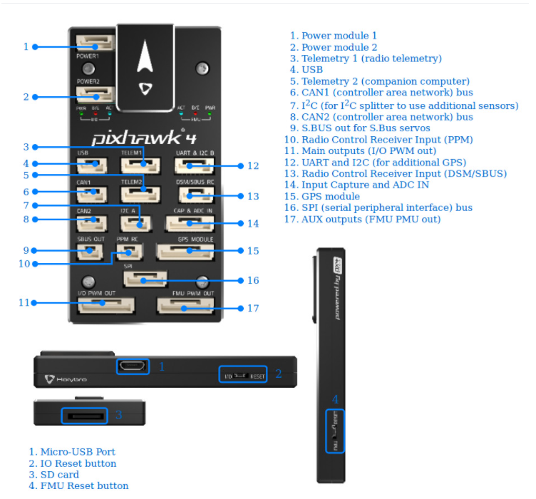
Avionics- Pixhawk 4 (Integration)
Port and Sensor Capability
Important Interfaces
GPS Receiver Module
Digital Airspeed Sensor (I²C)
RC Receiver
SD Card Insert
USB
Power Module
I/O Outputs
Integrated Sensors
2 Inertial Measurement Units (IMUs)
Barometer
Magnetometer
Backup Slide
Notes:
Sufficient ports for GPS and wind sensor integration
Sufficient included sensors for altitude and inertial sensing

Slide 48
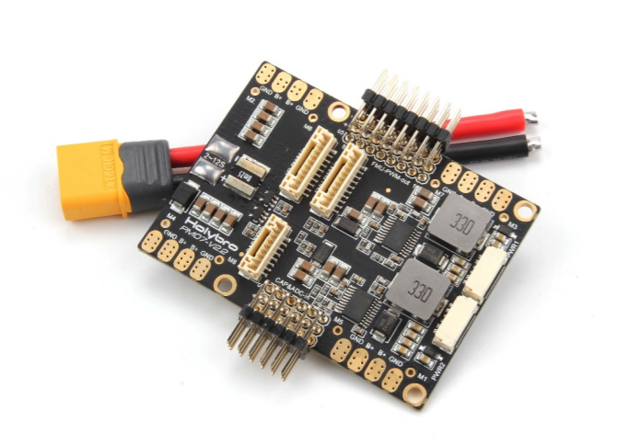
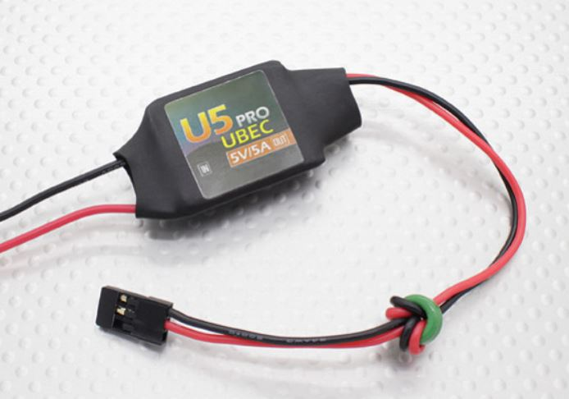
Avionics- Power Integration
PM07 Power Management Board (PMB)
Recommended to be used with the Pixhawk4
Connects the ESC and propulsion system, flight controller
Sends information about battery voltage and current consumption
UBEC Power Regulator
5V/5A
Powers servos
Must ensure maximum current draw from servos do not exceed 5A
Backup Slide

Slide 49
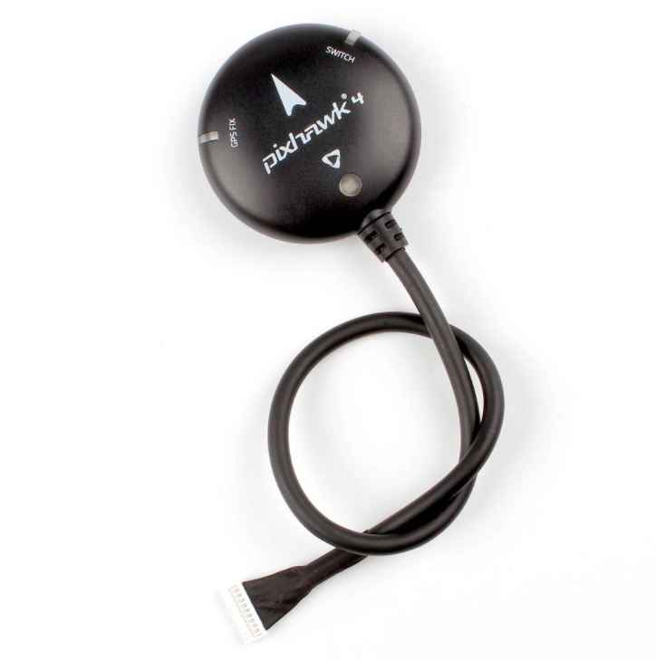
Sensors - GPS Receiver
Selected Design: Holybro M8N GPS Module
Features:
Built in compass
Accuracy up to a few meters
18 Hz update rate
Protective case
Plug and play with Pixhawk
Backup Slide

Slide 50
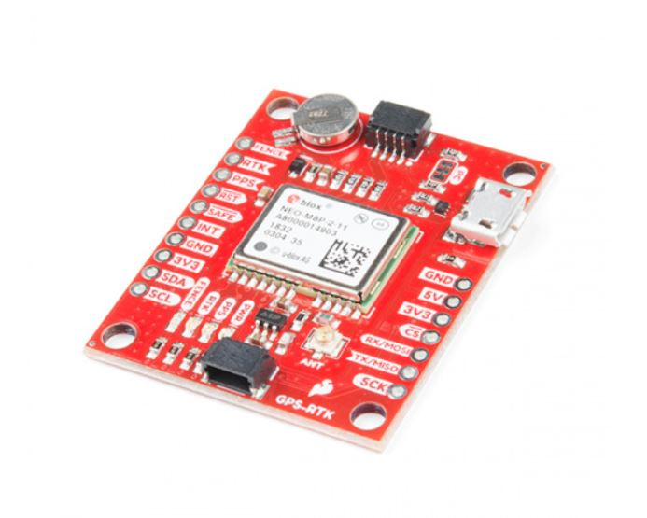
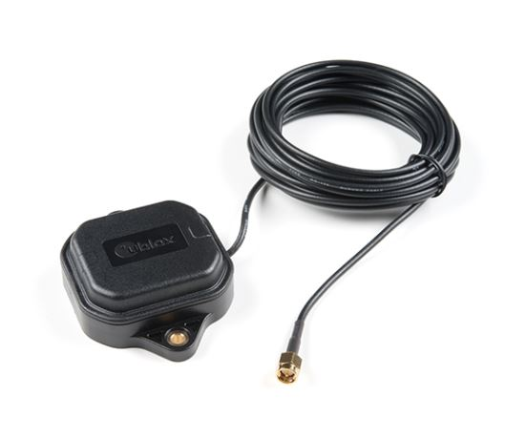
Sensors - RTK - GPS
Selected Design
Sparkfun GPS-RTK Board - NEO-M8P - 2
Features
Real Time Kinematics upgrade
Positioning accuracy of 1 centimeter
Used as a base station to provide correction data
Backup Slide

Slide 51
Feasibility Analysis: Avionics - Battery (Turnigy)
Battery Specifications
Features
Lightweight
Large capacity
Medium discharge rate to ensure motor and system as a whole powering capabilities
Capacity | 5000mAh
Discharge Rate | 20C
Size | 143 x 51 x 23mm
Weight | 360g
Turnigy LiPo Pack
Backup Slide

Slide 52
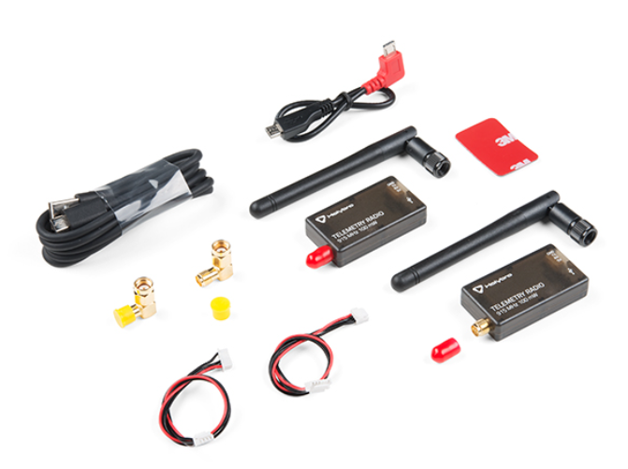
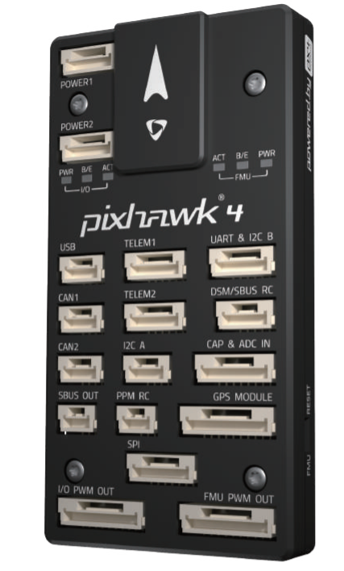
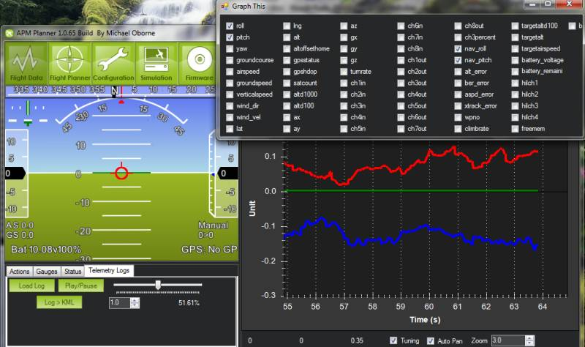
Coms - Telemetry and Data Communication
Wireless
Pixhawk 4 has a built in telemetry port that can be used to data transmission during flight
SiK Radio($50) can be used to send telemetry data to Mission Planner during flight
Wired
Pixhawk 4 has a built in SD card(Free) that can store telemetry data, this data can then be loaded and into Mission Planner for analysis
Both of these options cost no more than $50 and Ardupilot has created extensive walkthroughs for implementation of both
Backup Slide

Slide 53
Control System
How do we maintain a path efficiently?
Linear Quadratic Tracker
Minimizes use of throttle while minimizing error between actual and desired state
Allows for weighting of control surfaces and state vector
Weights determine what will be more costly or important to the system
Backup Slide
Notes:
LQT balances how well the path is followed, and how much throttle is used
Weighting throttle to be minimized
Weighting ‘u’ to fly at trim
When flying straight, weighted variables are x, y, T, u
When Turning, weighted variables are roll, yaw, T, u
State weights will determine how closely the path is followed,
The more the controls are weighted, the less they are used
mention that the desire state is that “most efficient path” like the highway

Slide 54
ACRONYMS
RALPHIE - Rapid Autonomous Loiter Program for Highly Increased Endurance
UAS - Unmanned Aerial System
AHRS - Attitude, Heading, and Reference System
LQT - Linear Quadratic Tracker
IMU - Inertial Measuring Unit
GPS - Global Positioning System
CPE - Critical Project Element
FR - Functional Requirement
SLUF - Steady Level Unaccelerated Flight
SITL - Software in the Loop
PID - Proportional, Integral, and Derivative
HITL - Hardware in the Loop
Backup Slide

Slide 55
Test Readiness
Notes:
Expected: 3:30
Time Taken During Practice: 3:22
3.1.1 Brief project definition, using Objectives, CONOPS and FBD from PDD
3.1.2 Baseline design from CDD. Include diagrams and explanation sufficient to understand
the baseline design without having to read the CDD.

Slide 56
Component Test
Rationale: Individual component testing to insure components work correctly before full aircraft integration
Test Fixture: N/A
Equipment Needed: Power Supply, MultiMeter, Mission Planner
Procedure:
Isolate Component
Connect singular component to Pixhawk 4 flight controller
Receive Data via mission Planner
Verify received data
Risk Reduction: Reduce likelihood hardware malfunction
Status: Next Slide
Notes:
Lorenzo
Describe Test done for each component
Same test for multiple components

Slide 57
Component’s Progress
Component | Progress | Details
Pixhawk 4 | Functional | Controller integrating correctly, connecting to mission planner
Servos | Functional | Actuating and connecting, need’s final calibration
Telemetry | Functional | Ground station communicating correctly
GPS | Functional | GPS verified via mission planner
Air-Speed Sensor | In Progress | Needs tested and calibrated
Essential Control Surfaces (ESC)/Motor | Close to Functional | working, but needs to be connected
IMU’s and Sensors | Close to Functional | need calibration
Notes:
Lorenzo
Servos need to be re-centered

Slide 58
Telemetry?

Slide 59
Controls
Rationale: Control model must be tested before aircraft integration to ensure successful flight.
Test Fixture: MATLAB, Athena Vortex Lattice (AVL)
Equipment Needed: Laptop
Procedure:
Model aircraft in AVL
Update stability derivatives in linear dynamics model
Re-tune LQT for new aircraft
Run test cases for squircular trajectories
Risk Reduction: Ensure control surface deflections don’t exceed maximum limits and that control reactions are reasonable
Status: In progress
Notes:
Lorenzo

Slide 60
Hardware Integration Testing
Rationale: Must be able to integrate the modified ardupilot software with the avionics to assess performance
Test Fixture: Pixhawk 4 Upload
Equipment Needed: Pixhawk 4, Mission Planner, COTS Airframe
Procedure:
Complete ardupilot edits
Compile ardupilot on local machine
Upload this version of ardupilot onto Pixhawk through Mission Planner
Run simulated flight on Mission Planner and monitor reactions of COTS Aircraft
Risk Reduction: Reduce the likelihood of the software failing or sending a misinput in flight to avoid risk of crashing.
Status: Planned for XX
Notes:
Lorenzo
Kidd finding CG in order to find where to put components.

Slide 61
Test Facility Access
NOAA Table Mountain Test Facility:
Requires FAA Part 107 Certification
CU Smead Aerospace/ CU Boulder South:
Requires FAA Part 107 Certification
Boulder Aeromodler Fields:
Does not require FAA Part 107 Certification
Test Readiness

Slide 62
Test Facility Safety
Follow FAA part 107 Guidelines
107.39 Operation over human beings: No person may operate a small unmanned aircraft over a human being unless -
(a) That human being is directly participating in the operation of the small unmanned aircraft;
(b) That human being is located under a covered structure or inside a stationary vehicle that can provide reasonable protection from a falling small unmanned aircraft
107.49 Preflight familiarization, inspection, and actions for aircraft operation.
107.51 Operating limitations for small unmanned aircraft.
(a) The groundspeed of the small unmanned aircraft may not exceed 87 knots (100 miles per hour).
(b) The altitude of the small unmanned aircraft cannot be higher than 400 feet above ground level
107.12 Requirement for a remote pilot certificate with a small UAS rating.
No person may manipulate the flight controls of a small unmanned aircraft system unless:
(1) That person has a remote pilot certificate with a small UAS rating or
(2) That person is under the direct supervision of a remote pilot in command and the remote pilot in command has the ability to immediately take direct control of the flight of the small unmanned aircraft.
Test Readiness

