Slide 1
RALPHIE
Critical Design Review
December 6, 2021
ASEN 4018-012
Company Customer:
Ann & H.J. Smead Department of Aerospace Engineering Sciences (John Mah)
Faculty Advisor:
Dr. Melvin Rafi
Presenters:
Andreas Brecl, Andrew Thompson, Carson Leppla, Gina Staimer, Quinn Lewis, Kidd Deng, Sunny Sarkar
Additional Team Members:
Sean Newman, Cooper Dale, Sam Garza, Dawei Zhao, Lorenzo Madera

Slide 2
Agenda
Project Purpose and Objectives - Andreas Brecl
Design Solution - Andrew Thompson
Critical Project Elements - Gina Staimer
Design Requirements and Satisfaction - Kidd Deng & Quinn Lewis
Project Risks - Gina Staimer
Verification & Validation - Carson Leppla
Project Planning - Sunny Sarkar

Slide 3
Project Purpose and Objectives
Notes:
3.1.1 Brief project definition, using Objectives, CONOPS and FBD from PDD
3.1.2 Baseline design from CDD. Include diagrams and explanation sufficient to understand
the baseline design without having to read the CDD.

Slide 4
Mission Statement
Rapid Autonomous Loiter Program for Highly Increased Endurance (RALPHIE) will provide the Ann & H.J. Smead Department of Aerospace Engineering Sciences Department with an autonomous flight controller that can improve upon the endurance of existing small Unmanned Aerial System (UAS).
Project Description
Notes:
Talk about Background here - introduce project. This should cover PDD, CDD, and PDR

Slide 5
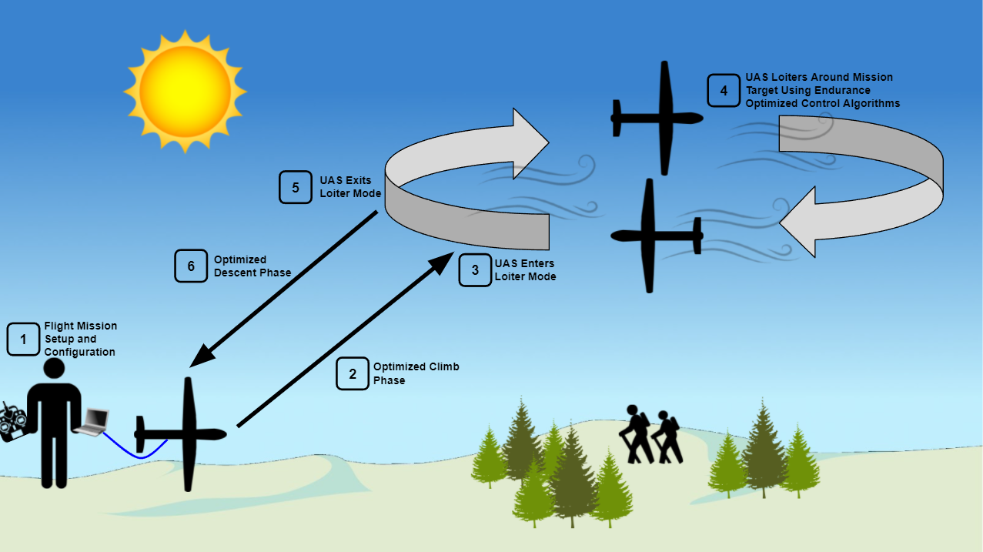
Overview CONOPS
Project Description
Notes:
not best way to phrase significance. reword how it is present it

Slide 6
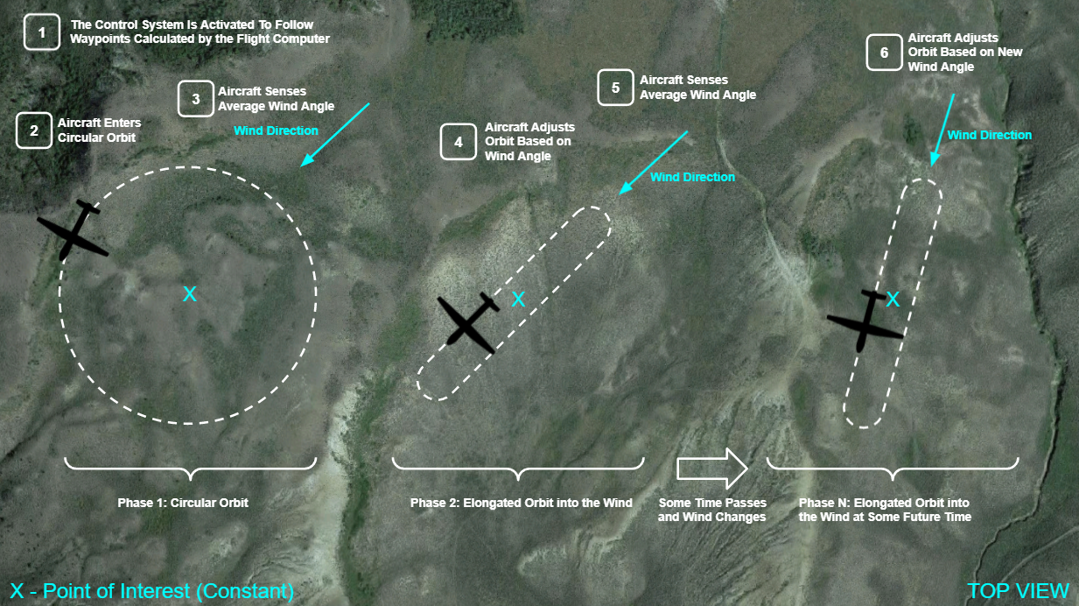
Main Mission CONOPS
Project Description
Notes:
dont say optimal
LQT hasn’t been formally introduced should we just call it our control system instead?
Maybe define LQT or remove? or mention we will talk about it later

Slide 7
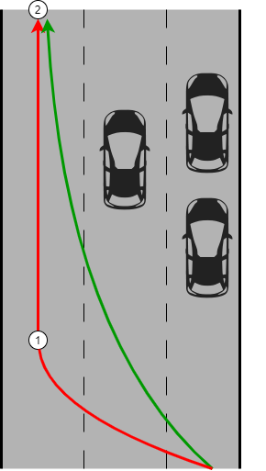
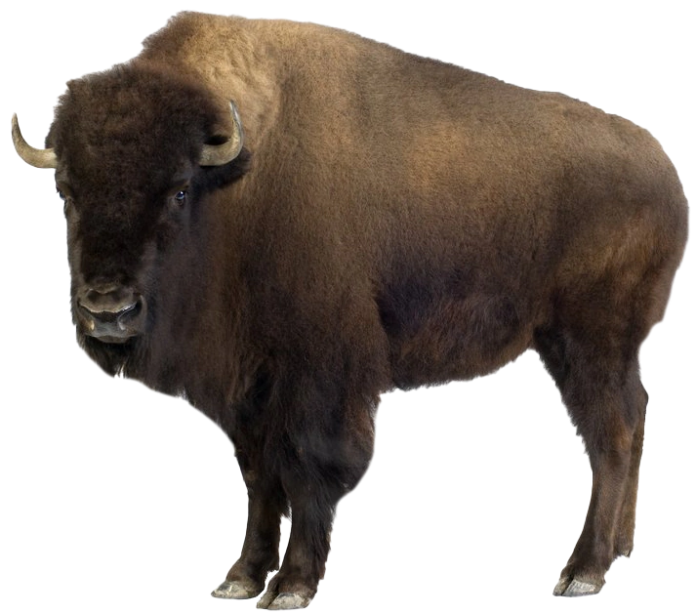
Highway Analogy
How would you increase fuel efficiency while driving a car on a highway?
How do we choose a lane on the highway? (Trajectory Planning)
Which will be the fastest?
Most cars?
How do we get in the lane efficiently? (Control System)
How sharp do we want the turns?
How fast should we drive while making these turns?
Project Description
Notes:
pose these all as questions. add another car that adds you. keep at higher level. just say what lanes we want to go in. talk about how we want to switch lanes (fast or slow).
figure out a way to more directly tie this together early in this section. Just to ensure that people do not forget.

Slide 8
Design Solution

Slide 9
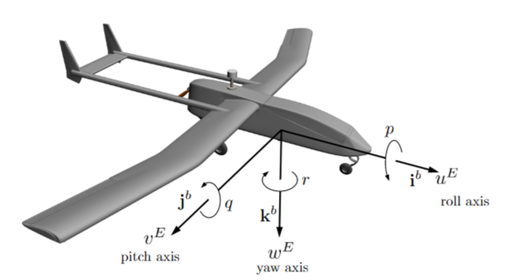
Nomenclature
Inertial Position
x: inertial x position (North)
y: inertial y position (East)
z: inertial z position (Down)
Euler Angles
φ: roll angle
θ: pitch angle
𝜓: yaw angle
Inertial Velocity
u: inertial velocity component along i
v: inertial velocity component along j
w: inertial velocity component along k
Angular Velocity
p: roll rate
q: pitch rate
r: yaw rate
Full State Vector:
Design Solution
Notes:
mention what the colors represent. change colors potentially for easier different to see. Change colors in state vector

Slide 10
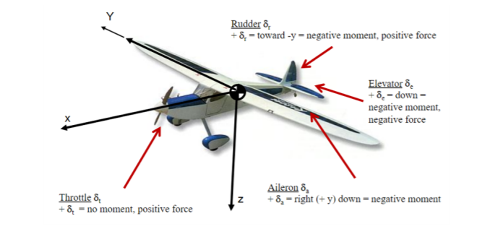
Nomenclature
Elevator - 𝛿_{e}
Deflect up and down and causes rotation along the y axis
Rudder - 𝛿_{r}
Deflect left and right and cause rotation on the z axis
Aileron - 𝛿_{a}
Deflect both up and down and cause rotation along the x axis of the aircraft
Throttle - 𝛿_{t}
Along x axis of aircraft
Full Input Vector:
Design Solution

Slide 11
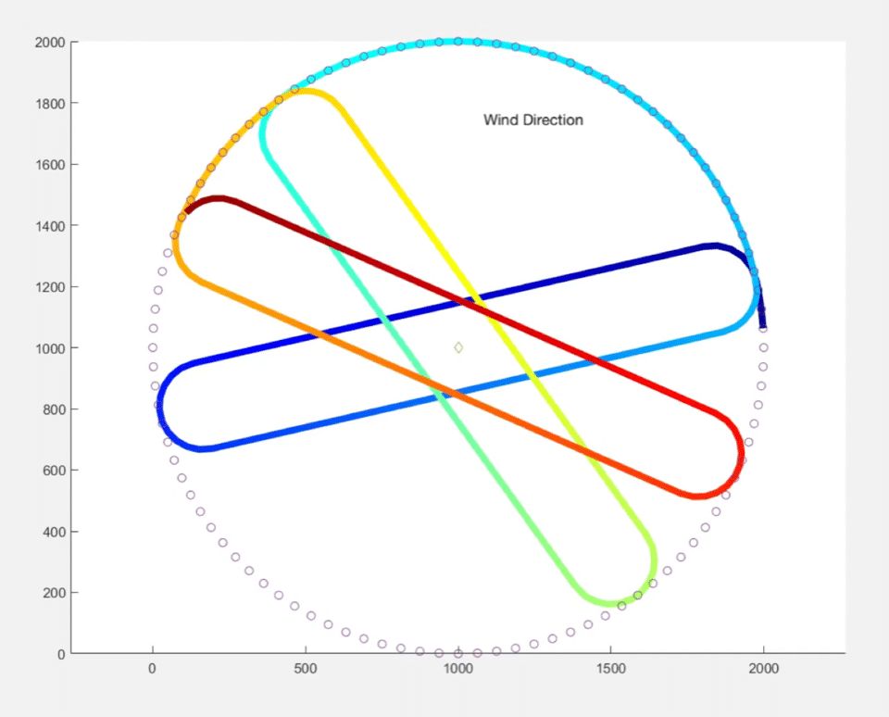
Trajectory Planning
How do we choose an efficient path?
To minimize energy use and maximize endurance, we need to give the aircraft a trajectory which requires minimum correction
Driving Requirements:
Maintain mission area
Minimizing amount of control required for turns
Aircraft State Variables Involved:
Inertial Position: [x, y, z]
Design Solution
Notes:
mark starting point and ending place. add the animated trajectory.

Slide 12
Control System
How do we maintain a path efficiently?
Linear Quadratic Tracker
Minimizes use of throttle while minimizing error between actual and desired state
Allows for weighting of control surfaces and state vector
Weights determine what will be more costly or important to the system
Design Solution
Notes:
LQT balances how well the path is followed, and how much throttle is used
Weighting throttle to be minimized
Weighting ‘u’ to fly at trim
When flying straight, weighted variables are x, y, T, u
When Turning, weighted variables are roll, yaw, T, u
State weights will determine how closely the path is followed,
The more the controls are weighted, the less they are used
mention that the desire state is that “most efficient path” like the highway

Slide 13
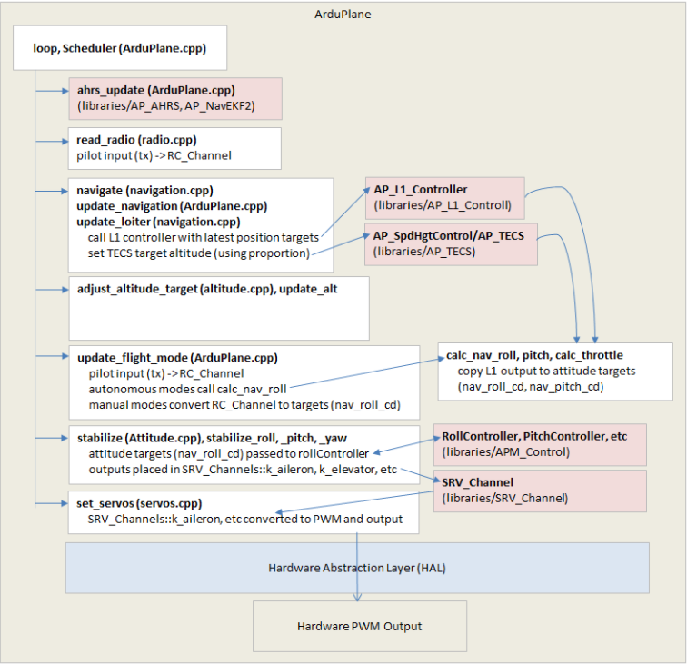
Software Integration
ArduPilot Flight Software Architecture
Uses multithreaded scheduler
Attitude, heading, and reference system (AHRS)
Construct full aircraft states
“Navigate” and “Stabilize” tasks will be replaced
Design Solution
Notes:
think about good answer to why we are removing things. for the PABs

Slide 14
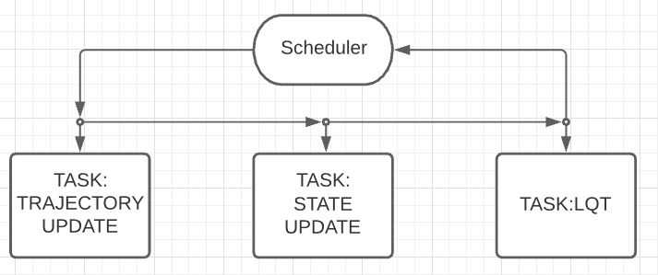
Software Integration
Perform wind averaging
Maintain and store desired trajectory
Update trajectory based on conditions
Interface with AHRS to construct current state vector
Retrieve the next desired state vector
Use current/desired state to compute control surface inputs
Design Solution

Slide 15
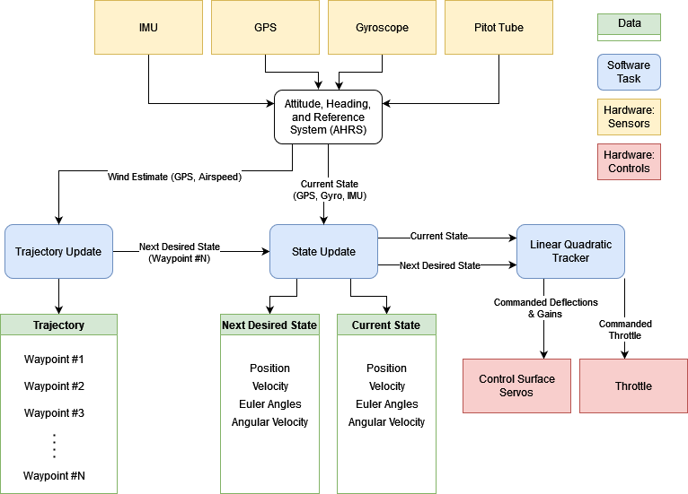
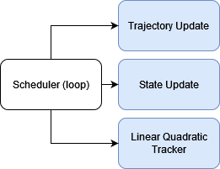
Software/Hardware Functional Block Diagram
(Motor)
Design Solution

Slide 16
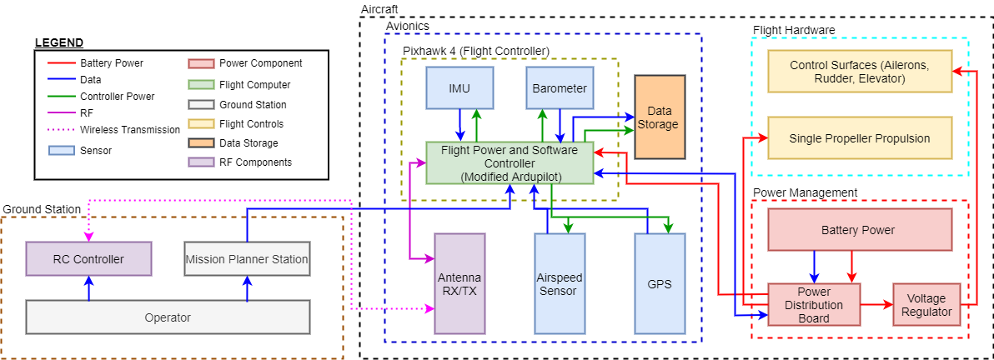
Functional Block Diagram
Design Solution
Notes:
Add a spatial component
Focus more on sensor specifics

Slide 17
Critical Project Elements

Slide 18
Critical Project Elements
CPE | Description | Function Requirement (FR)
CPE-1 | The aircraft must meet all FAA requirements including being flown by a FAA certified pilot 14 CFR Part 107, SMALL UNMANNED AIRCRAFT SYSTEMS | FR-03 FR-07
CPE-2 | A single operator with minimal training must be able to input mission parameters and load the flight software | FR-04 FR-05 FR-06 FR-07
CPE-3 | The UAS will use a autonomous flight controller that will determine the optimal path for efficiency and endurance in order to observe a target | FR-02
CPE-4 | Board must be capable of running entirety of flight software. Board must contain same interfaces to a range of peripherals and sensors. | FR-05
CPE-5 | The UAS must be able to determine its state and position to feed to the control system in order for the flight path to be optimized | FR-02
CPE-6 | The cost of the flight controller and avionics system combined with the cost of the air frame must not exceed $5000. | FR-01
Critical Project Elements
Notes:
Address CPE’s and what makes them important -> tie back in to functional requirements and relevance to mission
Focus on CPE-5 and CPE-3 - why are these most important.
Majority of design space and technical challenge is in meeting these requirements so the next section will address DR pertaining to these topics

Slide 19
Design Requirements and Satisfaction

Slide 20
Functional Requirements
Functional Requirement Number | Description | CPE | Satisfied?
FR-2 | The UAS software shall optimize flight trajectory for optimal endurance and energy use. | CPE-3, CPE-5
FR-4 | The flight control system shall be adaptable to a variety of fixed wing air vehicles. | CPE-2
Design Requirements and Satisfaction

Slide 21
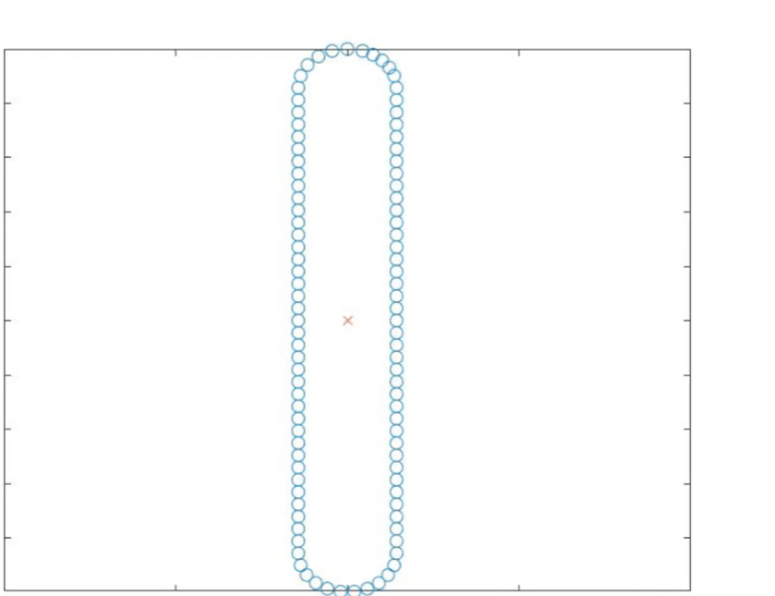
Trajectory Determination (FR-02)
DR-2.3: The UAS software shall optimize the loitering flight trajectory to maximize endurance and minimize energy use.
DR-2.10: The UAS software shall account for 2D wind to maximize endurance
Initial circular orbit to sense wind direction using Pixhawk IMU and GPS
Transition orbit to the start of the squircle path
Squircle path with axis along aligned with the wind direction
Wind direction averaged over time for path update
Y - Position
X - Position
IMU - Inertial Measuring Unit
Design Requirements and Satisfaction
Notes:
the path templates are plotted before taking off
the main path rotates about observing point based on wind direction
the main paths are connected by transition path

Slide 22
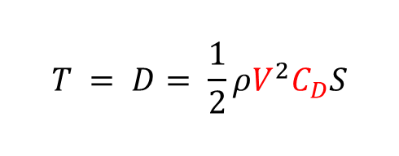
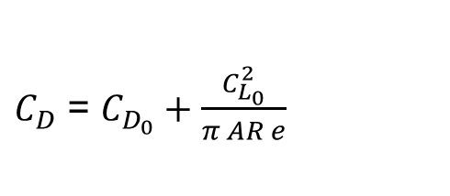
Reducing Power - Flight Path
Minimizing Throttle Usage
Limit coefficient of drag (C_{D}) through control surface usage
Fly at max endurance velocity (V)
Fly at Steady Level Unaccelerated Flight (SLUF)
T - Thrust
D - Drag
𝜌 - Air Density
V - Velocity
S - Planform Area
C_{D} - Coefficient of Drag
C_{D,0} - Coefficient of Parasite Drag
C_{L,0} - Coefficient of Lift
AR - Aspect Ratio
e - Oswald Efficiency Ratio
Design Requirements and Satisfaction
Notes:
carson? and andreas
Relationship between control surface and drag: talking point
https://skybrary.aero/articles/differential-ailerons

Slide 23
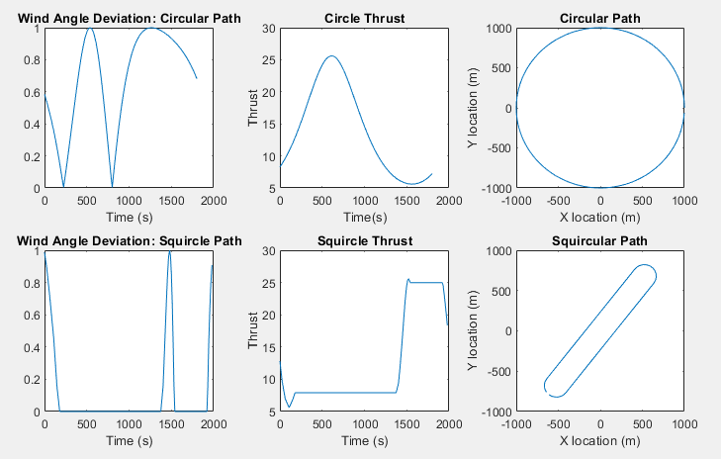
Trajectory Throttle Usage
Aircraft airspeed: 10 m/s
Wind speed: 5 m/s
Throttle decrease from circle to squircle: 10.9%
Design Requirements and Satisfaction
Notes:
talk more at a higher level on how these values mean what is physically happening instead of exact energy levels. numbers may be confusing.
look more into a thrust model.
a simple model could be an aircraft with a drag coefficient, and in order to reach a speed we need some thrust,. as p position along the path changes the relative wind speed changes. this adds or negates the amount of thrust we need. add just control surface reasoning too (more logical reasoning instead of numbers if the model is not done).
*need to figure out how to weight items (time/distance or what we chose best fit). Show maybe for example over 15 minutes flying in a path that this happens.
may be able to optimize thickness based on thrust model (look at turning radius of aircraft)
-using ardupilot simulation of circle vs squircle trajectory to demonstrate throttle/control surface usage

Slide 24
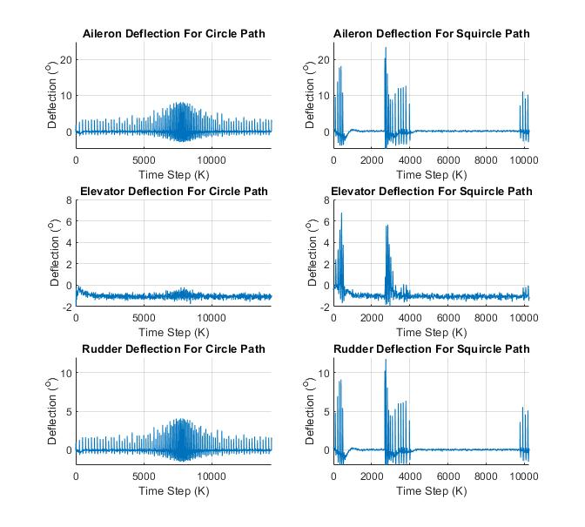
Control Surface Deflection
Software in the Loop (SITL) Proportional, Integral, and Derivative (PID) controller simulation with wind
Squircle has larger sections of lower control surface deflection
Circle path is always using some amount of control surface deflections
Design Requirements and Satisfaction
Notes:
Circle path uses a intermediate amount of deflection.
Squircle path uses small amounts of large deflection angles and large amounts of small deflections.
https://www.researchgate.net/publication/280887290_Experimental_results_analysis_for_UiTM_BWB_baseline-I_and_baseline-II_UAV_running_at_01_mach_number#pf6

Slide 25
The Controller - Linear Quadratic Tracker
DR-02.3: The UAS software shall optimize the loitering flight trajectory to maximize endurance and minimize energy use.
DR-04.1: The UAS software shall be reprogrammable to accept different flight dynamics models.
Control Method | Pros | Cons
Linear Quadratic Tracker (LQT) | Decreased energy consumption through cost matrices More accurate tracking Control gains already contain trajectory info | Each timestep of the desired trajectory requires separate control gain calculations
Design Requirements and Satisfaction
Notes:
FR 2
We had multiple options to choose from for our Controller.
PID is the most common, and is easy to implement but, it is difficult to tune the portional gains for an unstable system
Because we are making this controller for other aircraft and not just a single one, this option will not be the best choice for us
The LQR is a robust and computationally efficient controller than finds the proportional gains for our system for us.
This means we don't need re-tune gains for different aircraft.
The downside is that it uses one set of gains for the entire simulation, this will bring up an issue when we transition from a straight line to a curved turn.
The LQT uses the LQR to calculate the needed gains values for each time step defined by our trajectory.
Define what is meant by “more accurate tracking” when speaking
Talk more about how LQT decreases energy consumption -> cost matrices

Slide 26
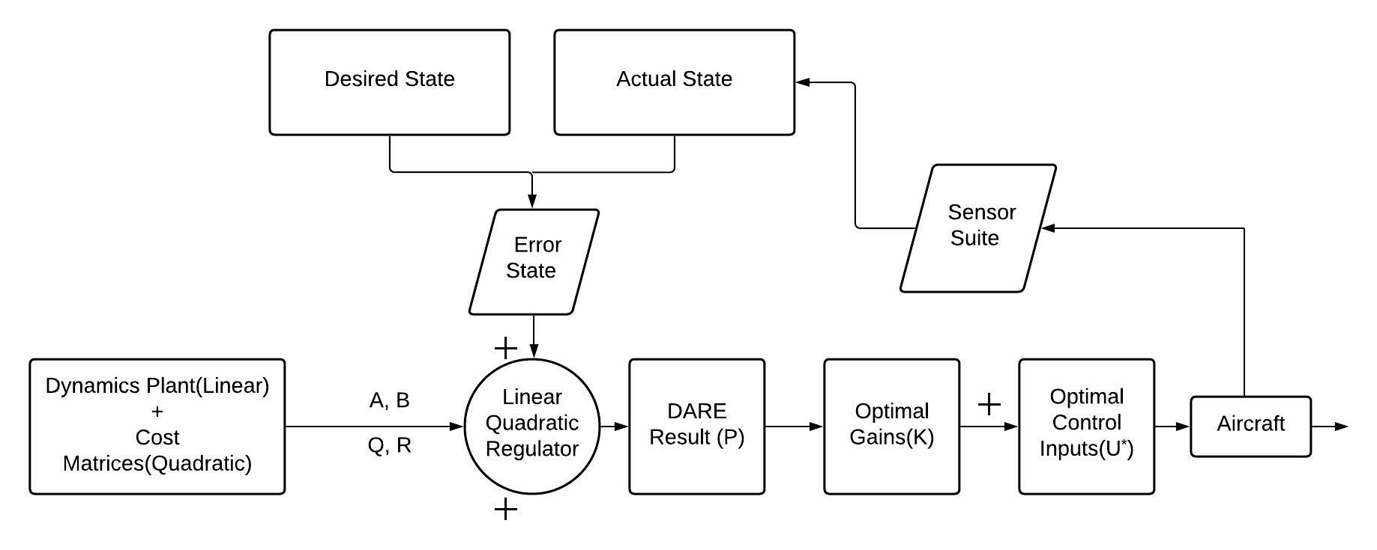
The Linear Quadratic Tracker
Design Requirements and Satisfaction
Notes:
Dynamics Plant
A and B describe the linear dynamics of the system
Can change the stability derivatives of the system for individual aircraft
Cost Matrices
Q and R
Simulation testing will give us our weights
Actual State
From onboard aircraft sensors
Desired State
From flight path trajectory planning
Change u to capital u_star, use laser pointer when talking about blocks
Arrow from error state to LQR needs to be black

Slide 27
Cost Matrices - Q & R
Q =
[x, 0, 0, 0, 0, 0, 0, 0, 0, 0, 0, 0;
0, y, 0, 0, 0, 0, 0, 0, 0, 0, 0, 0;
0, 0, z, 0, 0, 0, 0, 0, 0, 0, 0, 0;
0, 0, 0, 𝞅, 0, 0, 0, 0, 0, 0, 0, 0;
0, 0, 0, 0, θ, 0, 0, 0, 0, 0, 0, 0;
0, 0, 0, 0, 0, ψ, 0, 0, 0, 0, 0, 0;
0, 0, 0, 0, 0, 0, u, 0, 0, 0, 0, 0;
0, 0, 0, 0, 0, 0, 0, v, 0, 0, 0, 0;
0, 0, 0, 0, 0, 0, 0, 0, w, 0, 0, 0;
0, 0, 0, 0, 0, 0, 0, 0, 0, p, 0, 0;
0, 0, 0, 0, 0, 0, 0, 0, 0, 0, q, 0;
0, 0, 0, 0, 0, 0, 0, 0, 0, 0, 0, r]
R =
[𝛿a, 0, 0, 0;
0, 𝛿r, 0, 0;
0, 0, 𝛿e, 0;
0, 0, 0, 𝛿t]
Weighing these values heavier will force the LQT to track those values better
Weighing these values heavier will force the LQT to use those control surfaces less
Design Requirements and Satisfaction
Notes:
work in progress
Both Q and R are symmetrical square matrices
Q is a 12x12 matrix that represents our state cost matrix
The values in this matrix control how closely we want to follow specific variables in a our state matrix
R is a 4x4 matrix that represents our input cost matrix
The values in these matrices are what determine how costly each input in our system is, higher weighted values result in them being used less
CHange coloring of zeros so they blend in with the background more
Explicity talk about how the weights effect the flight paths and the LQT in general

Slide 28
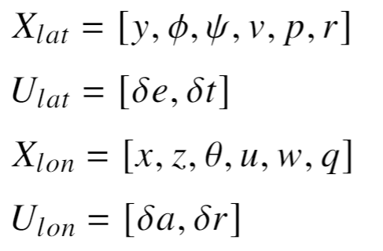
Our Simulation
Split into the lateral and longitudinal frames of the aircraft
Lateral
Longitudinal
Design Requirements and Satisfaction
Notes:
Lateral - defines the side to side direction of the aircraft
Longitudinal - defines the up and down direction of the aircraft
Move to back up slides

Slide 29
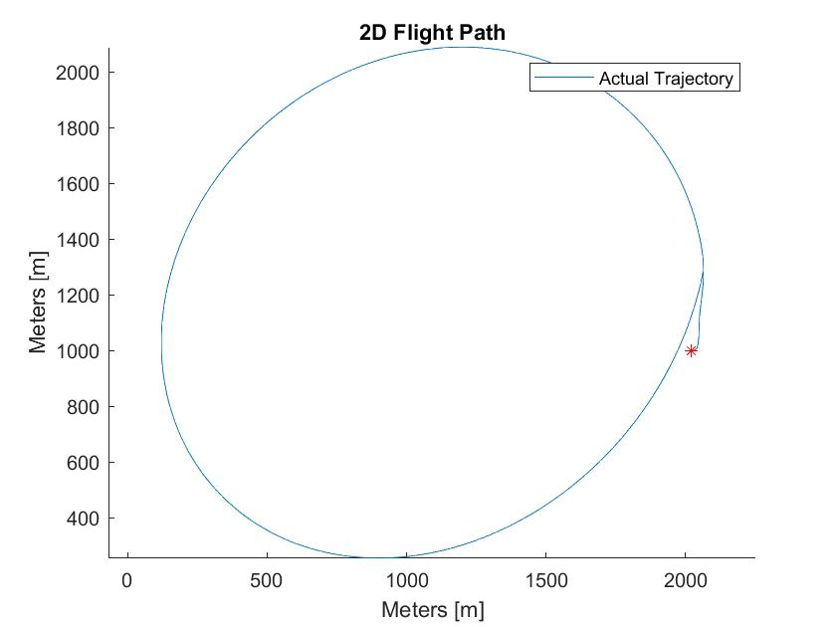
Circular Weights
Weighing for a circular pattern, not position
p - roll rate of aircraft
r - yaw rate of aircraft
𝝍 - yaw angle of aircraft
𝛿e - elevator deflection
𝛿t - thrust usage
Given desired trajectory for a coordinated turn
Curved portion of squircle
Design Requirements and Satisfaction
Notes:
GET RID OF THE CIRCLE, instead prove that weighing the q and r matrices cause a change in flight path
Add bar at top for meeting FR’s

Slide 30
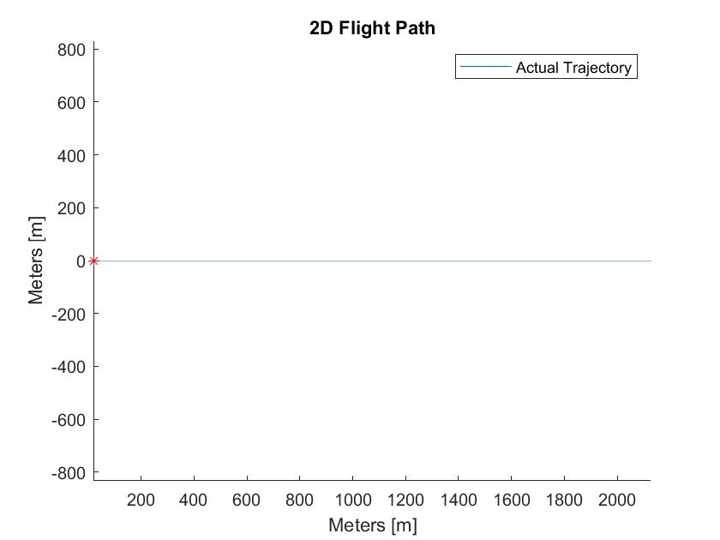
Position Weights
Weighing for a straight line segment of flight
x - inertial position
y - inertial position
z - inertial position
𝛿e - elevator deflection
𝛿t - thrust usage
Given a desired trajectory of steady, level, unaccelerated, flight
Straight line portion of squircle
Design Requirements and Satisfaction
Notes:
GET RID OF THE CIRCLE, instead prove that weighing the q and r matrices cause a change in flight path
straight line results in similar performance of PID controller

Slide 31
Functional Requirements
Functional Requirement Number | Description | CPE | Satisfied?
FR-2 | The UAS software shall optimize flight trajectory for optimal endurance and energy use. | CPE-3, CPE-5 | YES
FR-4 | The flight control system shall be adaptable to a variety of fixed wing air vehicles. | CPE-2 | Further Analysis Required
Design Requirements and Satisfaction
Notes:
Colin: Instead of “Maybe?” put “further analysis required” to demonstrated that you are addressing FR-4
For FR-4 mention that we will also be inputting 747 data for LQT controller validation, all that is needed for adapting to a different aircraft would be changing the linear dynamics and tuning gains a little

Slide 32
Project Risks
Notes:
Colin: More could be done to reduce severity of risks, Point out redundancy in sensors
Present the risk matrix first
For each individual risk
Talk about the first risk and the mitigation strategy
Show the movement of the risk in the matrix after mitigation

Slide 33
Risk Criteria
Severity
Value | Level | Description
1 | Low | No DR failure
2 | Tolerable | 1 DR failure
3 | Medium | Multiple DR failure
4 | High | CPE or FR failure
Likelihood
Value | Level | Description
1 | Low | Not Likely
2 | Medium | Likely
3 | High | Highly Likely
Project Risk
Notes:
Step through each risk individually,
Start w/ matrix to define risk
Step through each risk individually, show updated risk matrix with each time

Slide 34
Risk Table
Risk Number | Description | Effect | Likelihood | Severity
1 | Unable to get hardware. | Inability to do flight testing Inability to do Hardware in the Loop (HITL) testing | Medium | High
 |  | Mitigation | New Likelihood | New Severity
 |  | Ordering early Having Backup Sources Redundancy in data sources | Low | Medium
 | Likelihood
Severity |  | Low | Medium | High
 | High |  | 1
 | Medium | 1
 | Tolerable
 | Low
Project Risk

Slide 35
Risk Table
Risk Number | Description | Effect | Likelihood | Severity
2 | Exceed budget ($1000) | FR-01 Failure CPE-6 Failure | Low | High
 |  | Mitigation | New Likelihood | New Severity
 |  | Ordering early Redundancy in data sources | Low | Medium
 | Likelihood
Severity |  | Low | Medium | High
 | High | 2
 | Medium | 2
 | Tolerable
 | Low
Project Risk
Notes:
Descope some sensors if necessary

Slide 36
Risk Table
Risk Number | Description | Effect | Likelihood | Severity
3 | Sensor Failure | Results in inaccurate readings or no readings sent to the LQT algorithm | Medium | High
 |  | Mitigation | New Likelihood | New Severity
 |  | Ground testing Redundant Sensors Flying in Line Of Sight (LOS) so operator can take manual control if a problem arises | Low | Medium
 | Likelihood
Severity |  | Low | Medium | High
 | High |  | 3
 | Medium | 3
 | Tolerable
 | Low
Project Risk

Slide 37
Risk Table
Risk Number | Description | Effect | Likelihood | Severity
4 | The system is too complex to set up for a single operator with minimal experience | FR-06 Failure CPE-2 Failure | Medium | High
 |  | Mitigation | New Likelihood | New Severity
 |  | Evaluate all changes to documentation for the system and have it evaluated by someone unfamiliar with it. Provide an easy and user friendly way to adjust the software for different vehicles | Low | High
 | Likelihood
Severity |  | Low | Medium | High
 | High | 4 | 4
 | Medium
 | Tolerable
 | Low
Project Risk

Slide 38
Risk Table
Risk Number | Description | Effect | Likelihood | Severity
5 | Hardware Failure | Inability to do flight testing Inability to do HITL testing | Low | Medium
 |  | Mitigation | New Likelihood | New Severity
 |  | Test all hardware before using for flight Run-Preflight checks to ensure hardware is working as intended | Low | Tolerable
 | Likelihood
Severity |  | Low | Medium | High
 | High
 | Medium | 5
 | Tolerable | 5
 | Low
Project Risk

Slide 39
Risk Table
Risk Number | Description | Effect | Likelihood | Severity
6 | Software Failure | Inability to flight testing Crashing airframe/breaking hardware | Medium | High
 |  | Mitigation | New Likelihood | New Severity
 |  | Utilize defensive programming techniques Emphasize modular programming Lean heavily on existing ardupilot features | Low | Medium
 | Likelihood
Severity |  | Low | Medium | High
 | High |  | 6
 | Medium | 6
 | Tolerable
 | Low
Project Risk

Slide 40
Post Mitigation Risk Matrix
 | Likelihood
Severity |  | Low | Medium | High
 | High | 1,2,4
 | Medium | 3,6
 | Tolerable | 5
 | Low
Project Risk

Slide 41
Verification and Validation
Notes:
put V&V into tables
Colin: Verification tests look solid, include diagrams if possible. Go through some validation tests: full system and customer demo are some examples of validation

Slide 42
Subsystem Verification - Control Law and Trajectory Algorithm
Test Description | Run a Matlab simulation of the LQT and trajectory algorithm
Objective | Show that the control algorithm adjusts flight path to follow the cost matrix and incorporates the trajectory algorithm.
Comparison Model | A Matlab simulation of control algorithm vs. default circular path
Key Measurements and Pass Criteria | Simulated Aircraft correctly follows the state trajectories dictated by the cost matrix. Simulated Aircraft adjusts interior flight path based on inputs from the trajectory algorithm.
Requirement(s) Verified | FR-2
Verification and Validation
Notes:
Comparison vs circular path and squirticular path

Slide 43
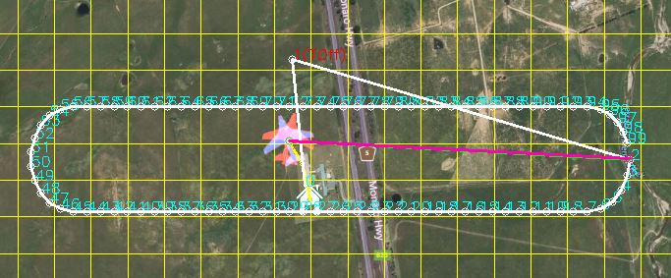
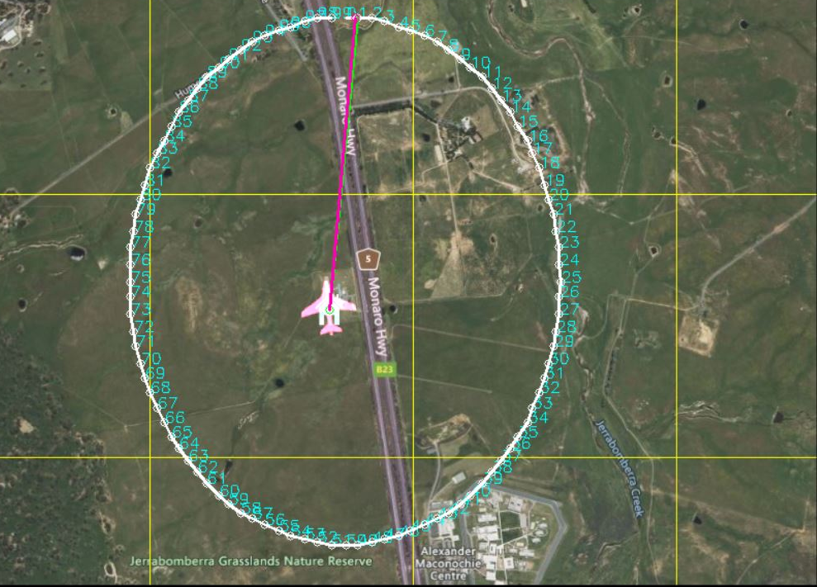
Subsystem Verification - Ardupilot Control Algorithm
Test Description | Run a SITL of the LQT and trajectory algorithm
Objective | Prove LQT control law and trajectory algorithm has been correctly implemented in the Ardupilot code
Comparison Model | A SITL simulation of the default Ardupilot control system
Key Measurements and Pass Criteria | Simulated Aircraft correctly follows the state trajectories dictated by the cost matrix. Simulated Aircraft adjusts interior flight path based on inputs from the trajectory algorithm.
Requirement(s) Verified | FR-2, FR-4
Verification and Validation

Slide 44
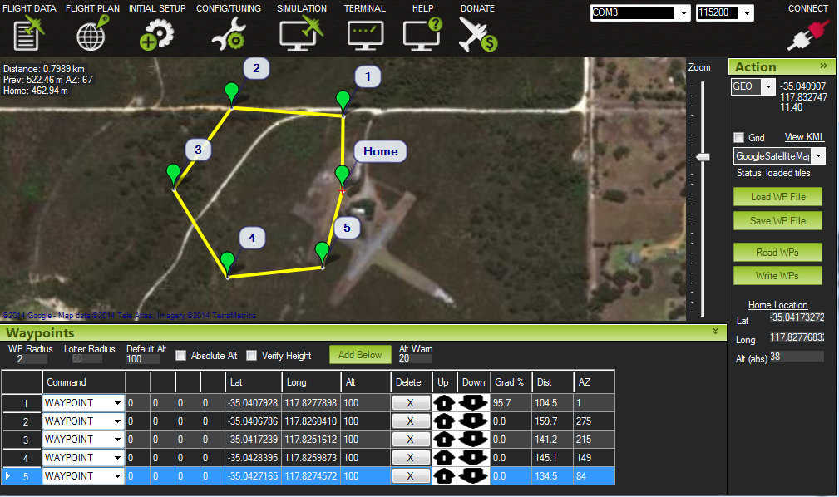
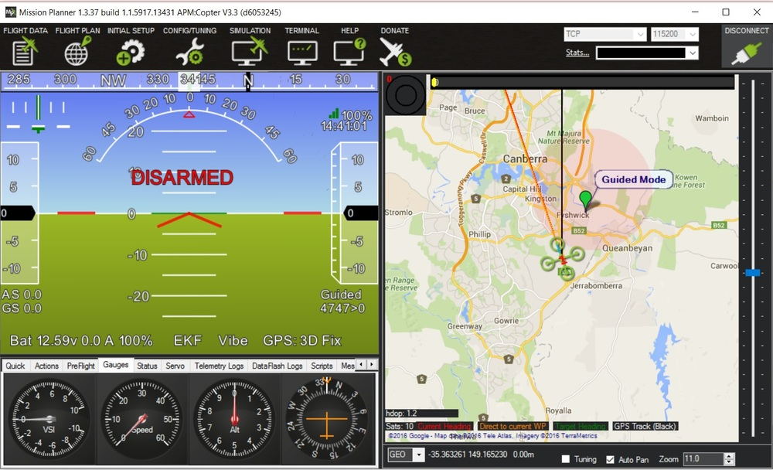
Subsystem Verification - Hardware In The Loop (HITL)
Test Description | Run a hardware in the loop (HITL) of the LQT and trajectory algorithm and standard Ardupilot software
Objective | Measure power usage of LQT and trajectory algorithm compared to the standard ardupilot controller
Comparison Model | A HITL simulation of the default Ardupilot control system
Key Measurements and Pass Criteria | LQT and trajectory algorithm reduce power usage by 5% compared to the default Ardupilot controller
Requirement(s) Verified | FR-2, FR-4
Verification and Validation
Notes:
https://developer.x-plane.com/article/custom-wind-weather-in-x-plane-10/

Slide 45
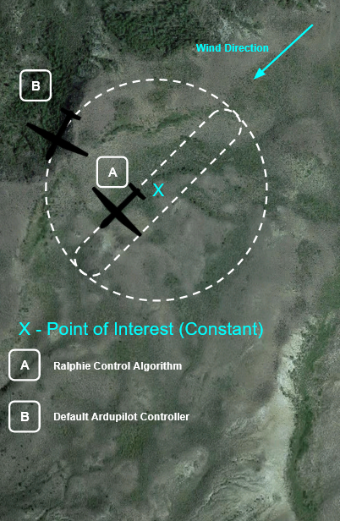
Subsystem Verification - Flight Testing
Test Description | Perform two simultaneous flights with the LQT and standard Ardupilot controller.
Objective | Prove that a single operator can launch, fly, and recover the UAS and measure the LQT endurance compared to the standard Ardupilot controller.
Comparison Model | Flight unit with default Ardupilot controller
Key Measurements and Pass Criteria | LQT and trajectory algorithm reduce power usage by 5% compared to the default Ardupilot controller Single operator is able to undertake each mission
Requirement(s) Verified | FR-02, FR-06
Verification and Validation

Slide 46
Project Planning
Notes:
Colin: Don’t forget to put your budget in this section!

Slide 47
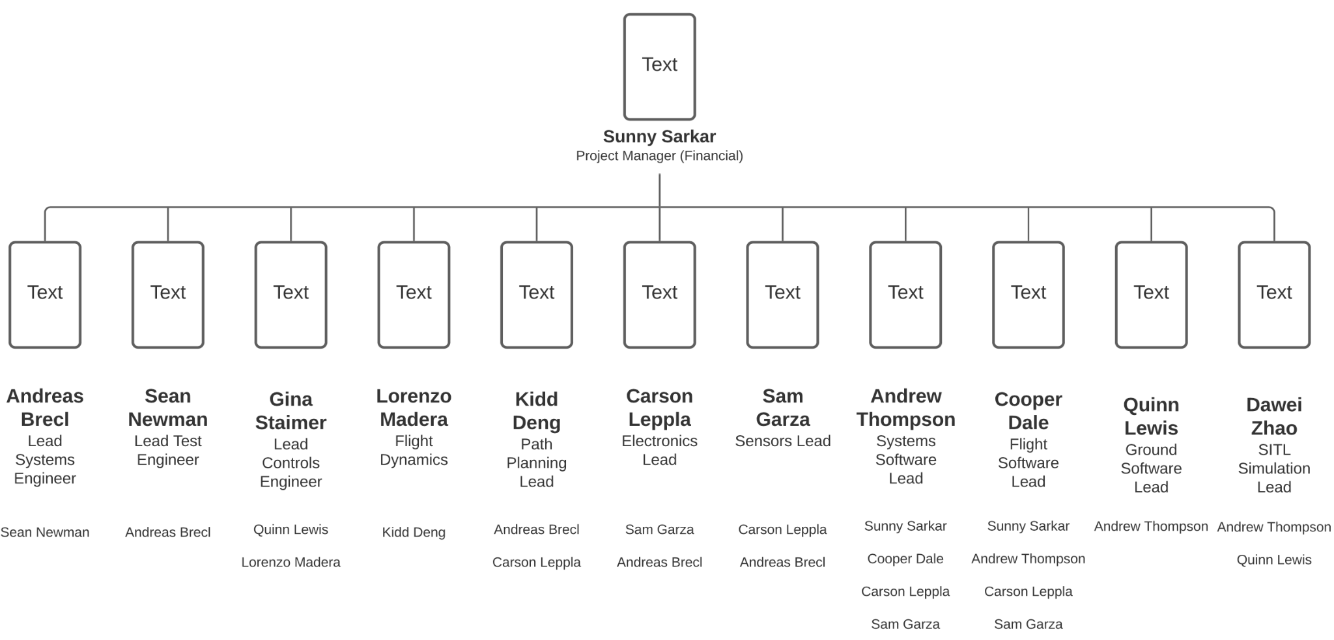
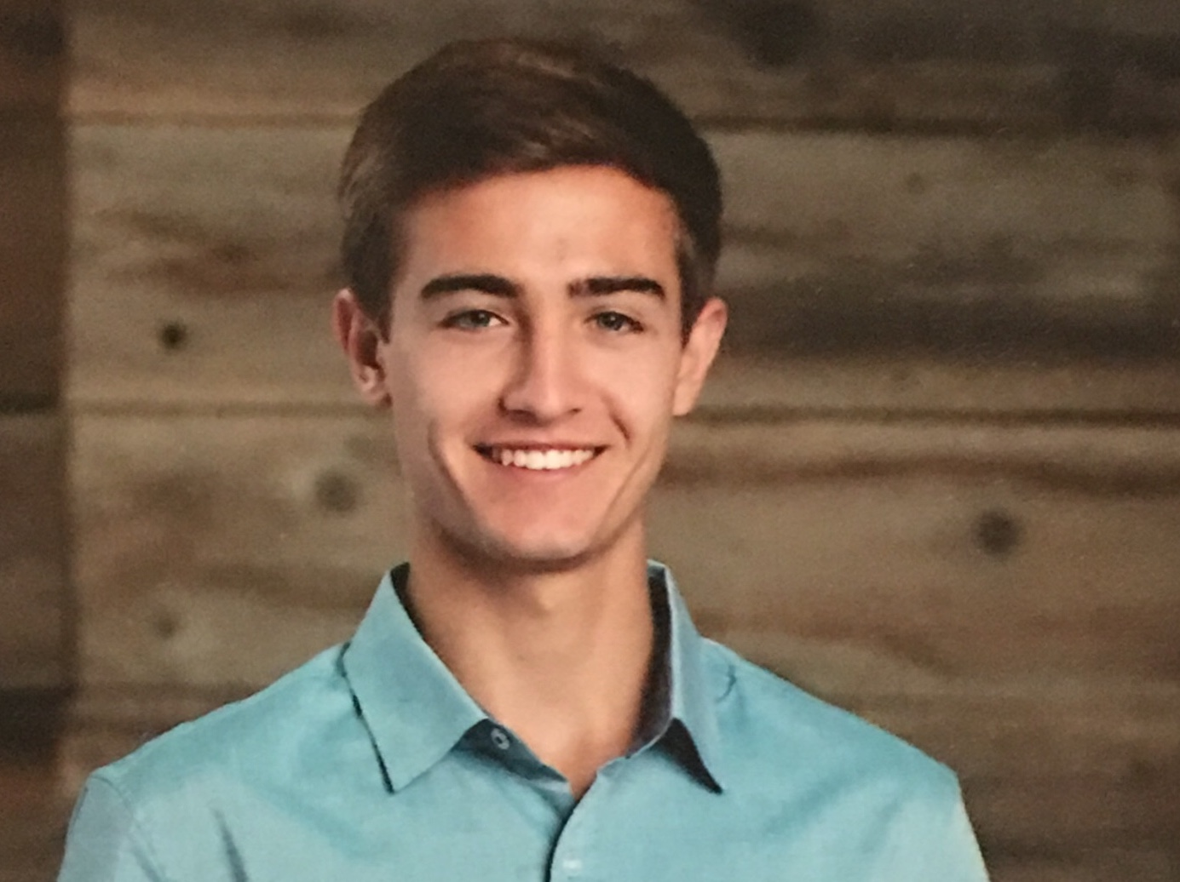
Organizational Chart
Project Planning
Notes:
Colin: Increase font size

Slide 48
Work Breakdown Structure
Project Planning
Notes:
Colin: have this view to show overall tasks to be done, then on another slide show a “2 week forecast” gantt of the immediate next steps you will do. This one cannot be read, but the next one will actually facilitate the PAB being able to read the next few tasks you have to execute. Also the title should probably be “Gantt Chart” and not “Work Breakdown Structure”

Slide 49
Work Breakdown Structure - Development
Project Planning
Notes:
Colin: have this view to show overall tasks to be done, then on another slide show a “2 week forecast” gantt of the immediate next steps you will do. This one cannot be read, but the next one will actually facilitate the PAB being able to read the next few tasks you have to execute. Also the title should probably be “Gantt Chart” and not “Work Breakdown Structure”

Slide 50
Work Breakdown Structure - Testing
Project Planning
Notes:
Colin: have this view to show overall tasks to be done, then on another slide show a “2 week forecast” gantt of the immediate next steps you will do. This one cannot be read, but the next one will actually facilitate the PAB being able to read the next few tasks you have to execute. Also the title should probably be “Gantt Chart” and not “Work Breakdown Structure”

Slide 51
Work Breakdown Structure - Short Term Forecast
Project Planning

Slide 52
Test Plan
Test | Date | Progress | Prerequisite
Matlab/Simulink Control Testing | Nov 29th | In Progress | None
SITL Testing | Feb 14th | Future Work | Matlab/Simulink Testing Complete Software Implementation Working
Component Testing | Jan 24th | Future Work | Hardware acquired
HITL Testing | April 10th | Future Work | SITL Testing Majority Complete Component Testing Complete
Flight Test | April 30th | Future Work | HITL Testing Complete
Project Planning
Notes:
sean is an angry test engineer

Slide 53
Cost Plan
System |  | Cost
Unit Cost |  | $1,564
x2 | Flight Controller Package | $233
x2 | Air Speed Sensor | $49
x1 | GPS-RTK Board Ground + Rover | $310
x2 | GPS-RTK Board Rover | $200
x2 | Battery | $25
x1 | Ground Controller | $160
x2 | Telemetry System | $40
Testing |  | $1,424
x4 | Airframe | $306
x1 | FAA License | $200
Miscellaneous/Shipping |  | $1,500
Excess |  | $512
Total Used |  | $4,488
Project Planning

Slide 54
Acknowledgements
The team would like to acknowledge:
Professor Melvin Rafi
Professor John Mah
Professor Kathryn Wingate
Professor Jelliffe Jackson
Professor Eric Frew
The PAB and TAs
All listed provided lots of support during the senior design process. Their input and feedback has helped guide us to our current design
Project Planning

Slide 55
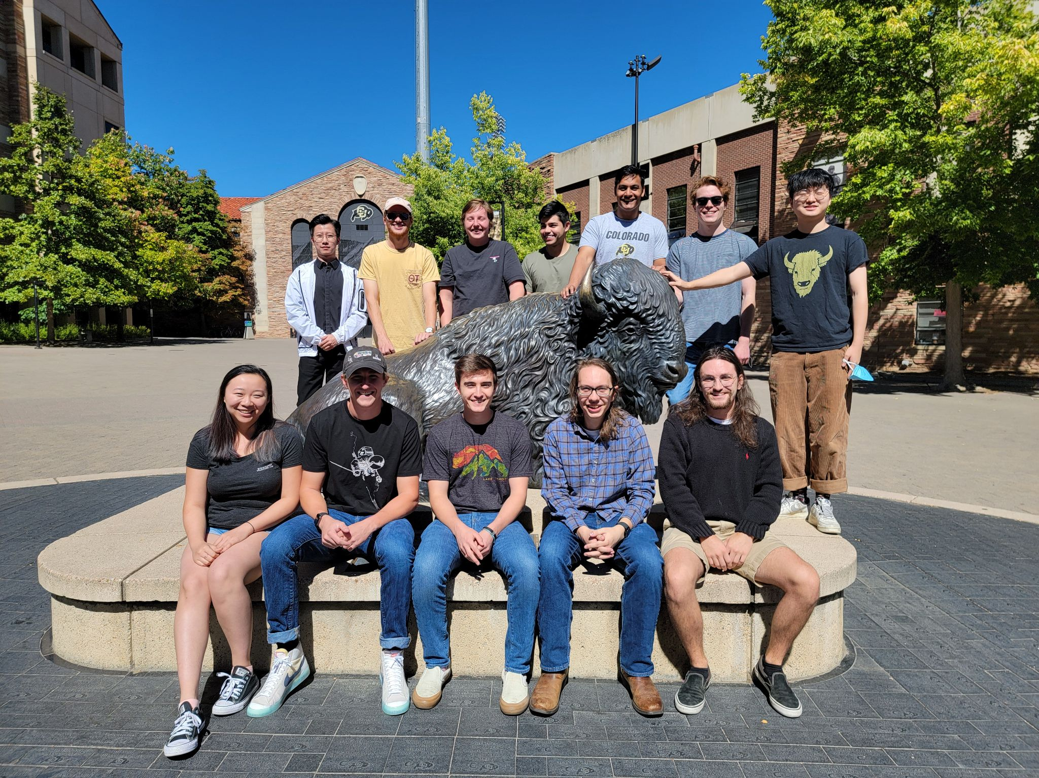
Questions?
Project Planning

Slide 56
Backup Slides

Slide 57
Design Requirements and Satisfaction
Backup Slides

Slide 58
Functional Requirements
Functional Requirement Number | Description | CPE
FR-01 | The total flyaway cost for flight controller hardware, flight controller software, and a ground station shall be based on current day consumer level UAS flight hardware costs to enable ease of purchase and replacement by smaller organizations | CPE-6
FR-03 | The UAS shall adhere to FAA guidelines outlined in 14 CFR Part 107, SMALL UNMANNED AIRCRAFT SYSTEMS. | CPE-1
FR-05 | The UAS shall be capable of sustaining an 80% Full Mission Capable rate (RMC) under Instrument Meteorological Conditions (IMC). be capable of maintaining a continual 100% standby posture. | CPE-2,CPE-4
FR-06 | The UAS shall be operable by a single operator for the entire duration of the mission. | CPE-2
FR-07 | The UAS software shall be capable of a recovery and return mode to maintain the safety of the aircraft. | CPE-2
Backup Slides

Slide 59
Verification and Validation
Backup Slides

Slide 60
Subsystem Verification - Hardware Interface
Test Description | Test that Pixhawk 4 can control the avionics package autonomously Test the RC controller can control the avionics package
Objective | Prove the avionics package works and runs properly
Comparison Model | N/A
Key Measurements and Pass Criteria | Avionics autonomously works via inspection RC controller controls avionics package via inspection
Requirement(s) Verified | FR-03, FR-04
Backup Slides

Slide 61
Subsystem Verification - Telemetry Verification
Test Description | Test RTK and RC signal within line of sight
Objective | Verify packet loss is less than 50% within line of sight (2 miles)
Comparison Model | Perform a ground test to Compare amount of data sent and received from a shorter know distance to a distance of 2 miles
Key Measurements and Pass Criteria | Packet Loss [%] is less than 50% at a distance of 2 miles
Requirement(s) Verified | FR-02
Backup Slides

Slide 62
Verification and Validation Feasibility
Functional Requirement | Test 1 | Test 2
FR-01: Cost | Inspection: Finance officer will verify the cost does not exceed $1000 USD for the package
FR-02: Software | Demonstration: The mission parameters will be inputted into the Flight Software and the test team will verify that the UAS software optimizes flight trajectory. | Test/Analysis: The UAS will undertake the same mission profile being flown manually and autonomously. The flight time and battery usage will be monitored and compared between the two flights.
FR-03: FAA Guidelines | Inspection: The UAS will be weighed to show that it is less than 55 lbs as per FAA guidelines.
FR-04: Adaptability | Demonstration: The UAS will undergo static and non-static testing on the standard aircraft picked in the trade studies and HERD-CU Phase 1a’s aircraft to demonstrate that the software can be used on different systems. | Analysis: The control algorithms used will have software scripts created to show that the control laws in the software will correctly respond to inputs and output signals that would control the control surfaces and propulsion system.
FR-05: Mission Capability | Test: The UAS shall be left on standby mode aircraft and then be operated after 4 hours to show that the mission capability is maintained.
FR-06: Ease of Operation | Demonstration: A single operator will operate the UAS through a full mission profile from loading the parameters to recovering the UAS.
FR-07: Recovery & Return | Demonstration: Verify that the UAS autonomously returns to a recoverable state when switched into the recovery software mode.
Backup Slide

Slide 63
Avionics/Hardware
Backup Slides

Slide 64
Flight Unit
Controller Hardware
Pixhawk 4
Features
Pre-installed sensor suite
Compatible with a variety of fixed wing aircraft and control surfaces (FR-04)
Compatible with Ardupilot
Vibration Isolated IMU
Capable of On Board Storage
Industry Standard
Controller Firmware
Ardupilot
Features
Open Source
Simulation Capability
Adaptable to a Variety of Vehicle Configurations (FR-04)
Well Documented
Supports Autonomous Flight
Modifiable
Airframe
Volantex Phoenix 2400
Features
Launchable by a Single User (FR-06)
Light
Standard Control surfaces
Integrates with Flight Controller
Large Capacity
Backup Slides

Slide 65
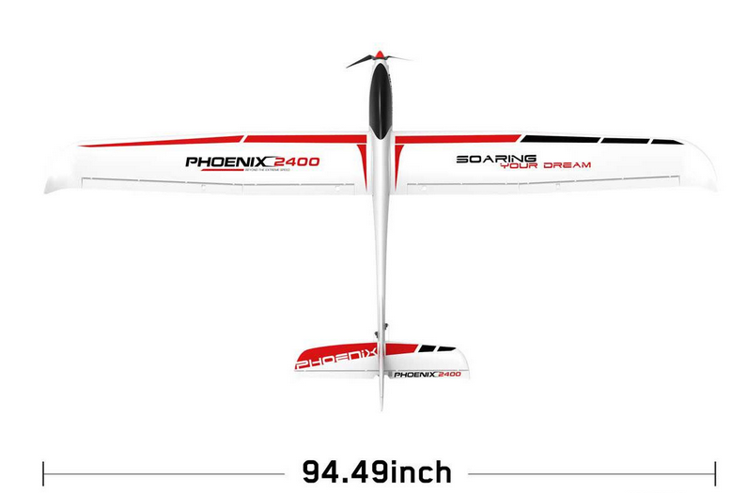
Airframe
Selected Design
Volantex 759-3 Phoenix 24
Features
Launchable by a Single User (FR-06)
Light
Standard Control surfaces
Integrates with Flight Controller
Large Capacity
Backup Slide

Slide 66
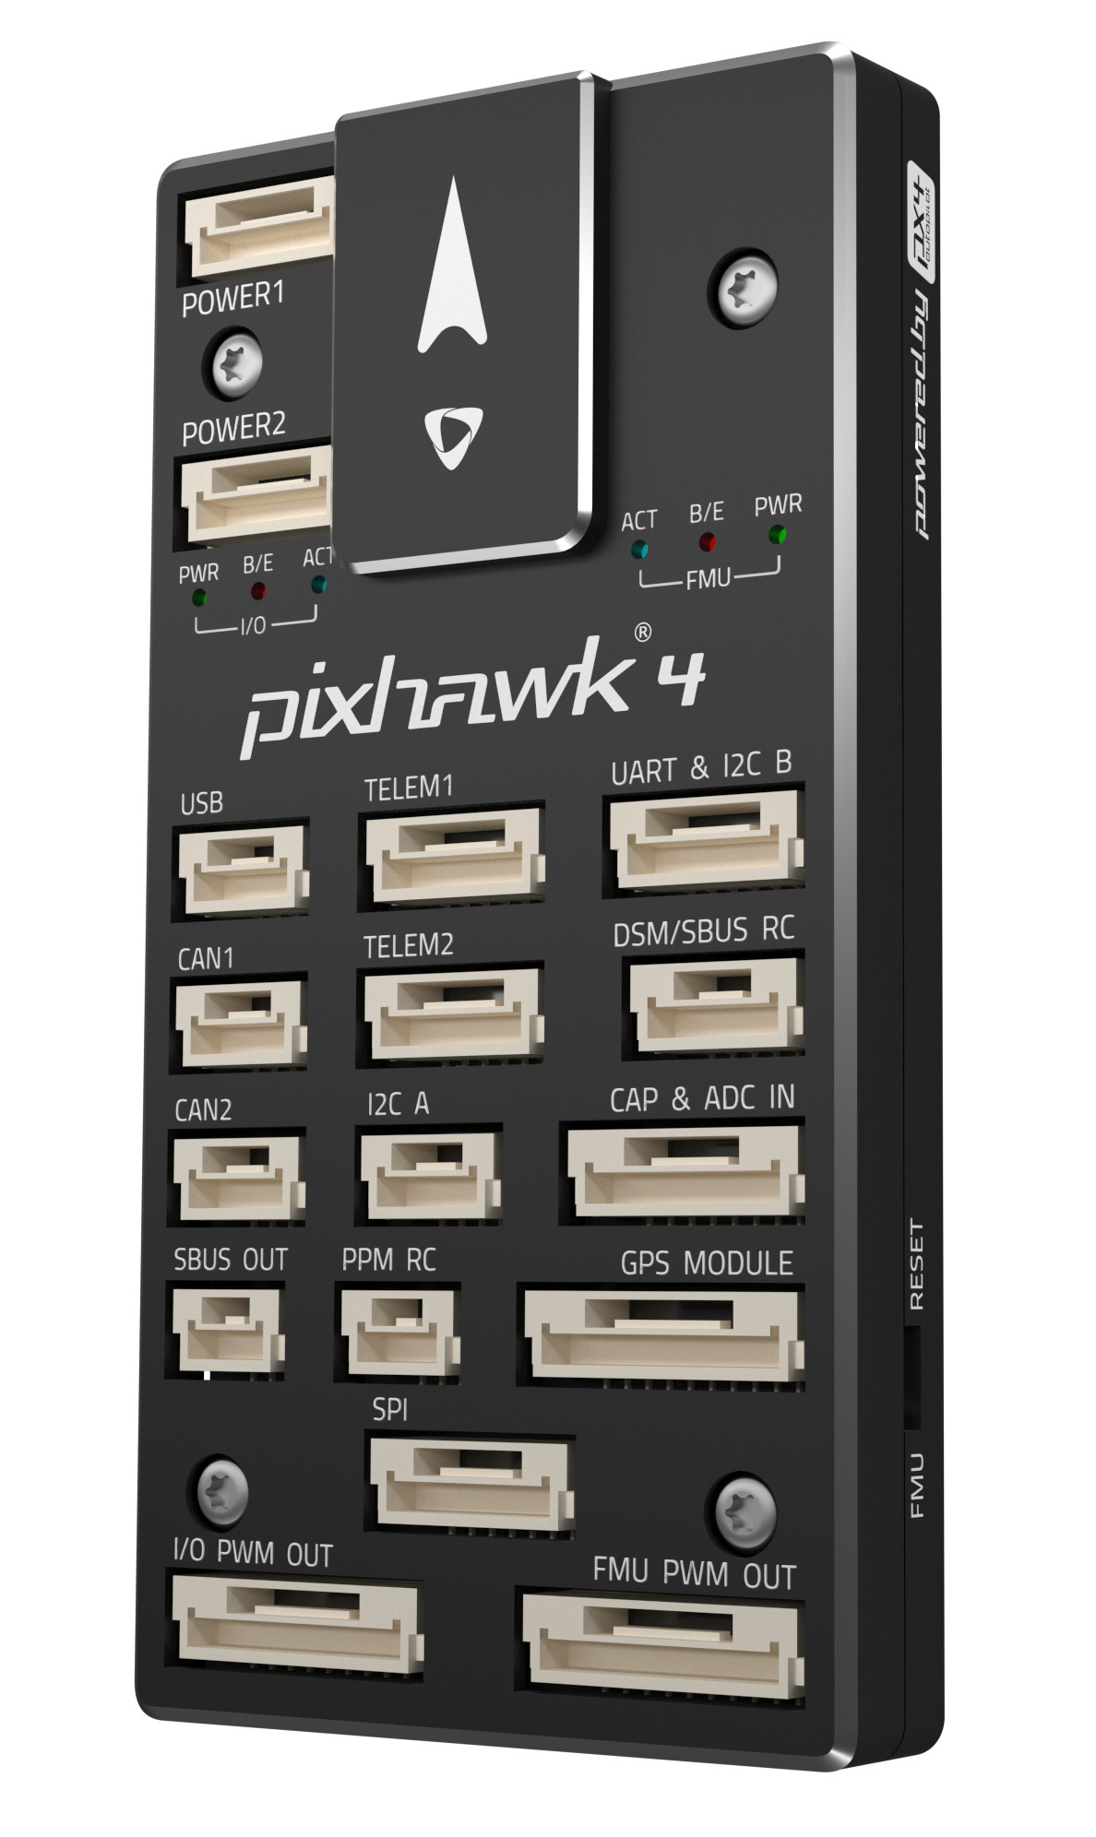
Avionics- Pixhawk 4 (Hardware)
Sufficient RAM available
60 KB of RAM dedicated to LQT (worst case)
Easily able to account for general software
Verified via comparison to other FSW
Hardware
44mm
 | Processor Speed (MHz) | RAM (KB) | Operational Temperature Range (°C)
Main Processor STM32F765 | 216 | 512 | -40 to 85
Total Weight: 33.3 g
84mm
12mm
Feasibility Analysis
Notes:
2x the amount of RAM as the pixhawk3 that ran essentially the same flight software --- should be plentyyyy of RAM

Slide 67
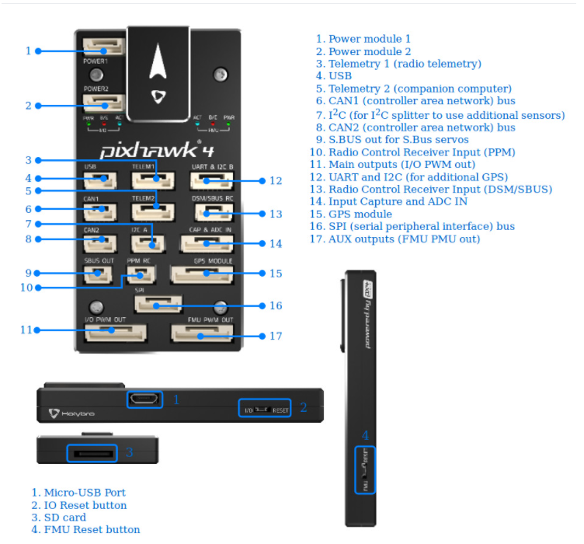
Avionics- Pixhawk 4 (Integration)
Port and Sensor Capability
Important Interfaces
GPS Receiver Module
Digital Airspeed Sensor (I²C)
RC Receiver
SD Card Insert
USB
Power Module
I/O Outputs
Integrated Sensors
2 Inertial Measurement Units (IMUs)
Barometer
Magnetometer
Feasibility Analysis
Notes:
Sufficient ports for GPS and wind sensor integration
Sufficient included sensors for altitude and inertial sensing

Slide 68
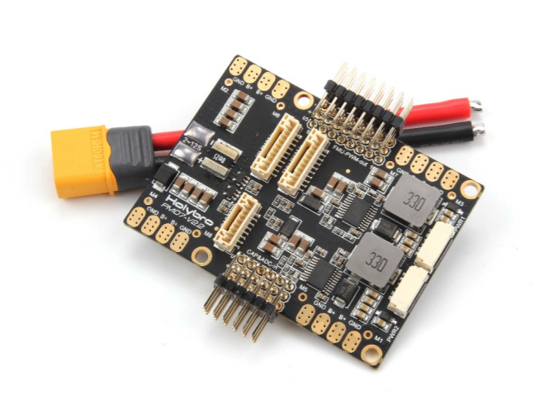
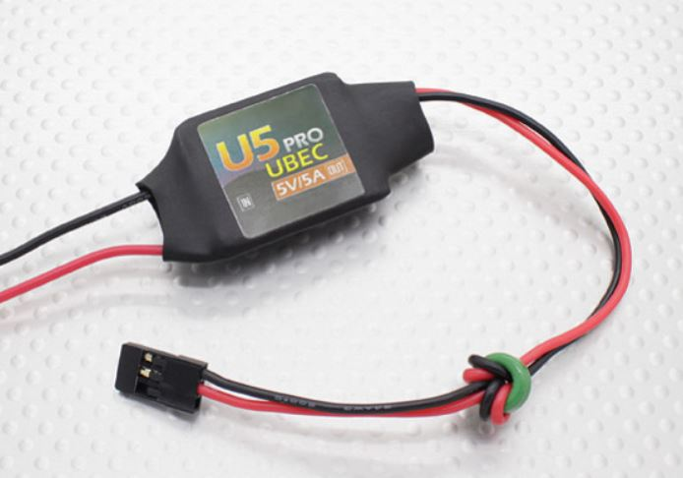
Avionics- Power Integration
PM07 Power Management Board (PMB)
Recommended to be used with the Pixhawk4
Connects the ESC and propulsion system, flight controller
Sends information about battery voltage and current consumption
UBEC Power Regulator
5V/5A
Powers servos
Must ensure maximum current draw from servos do not exceed 5A

Slide 69
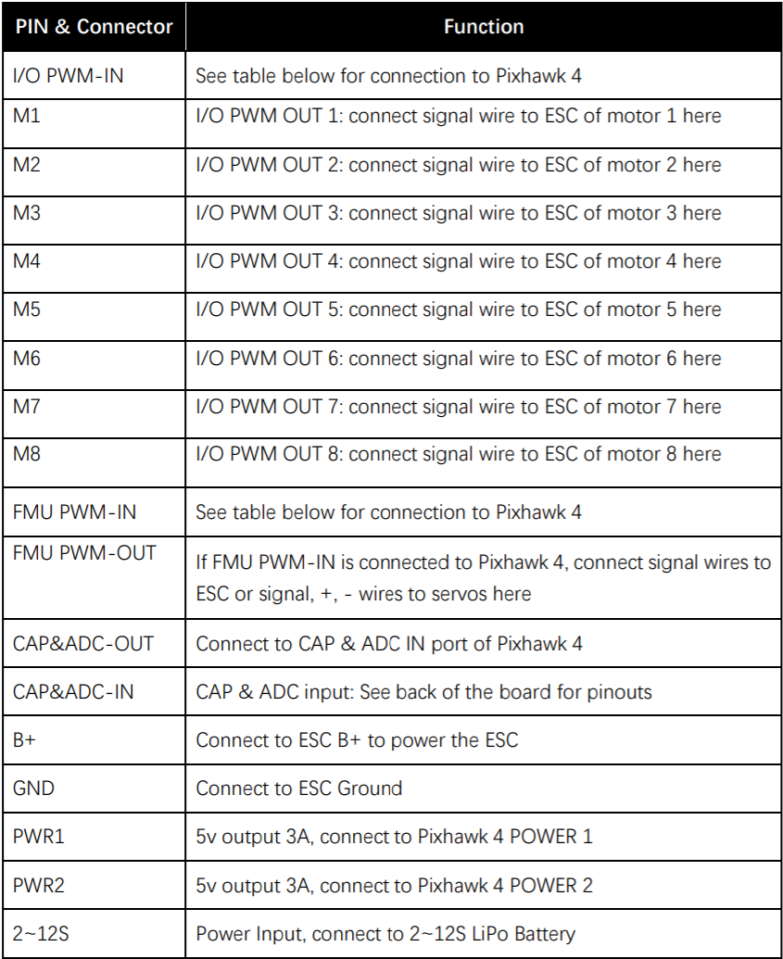
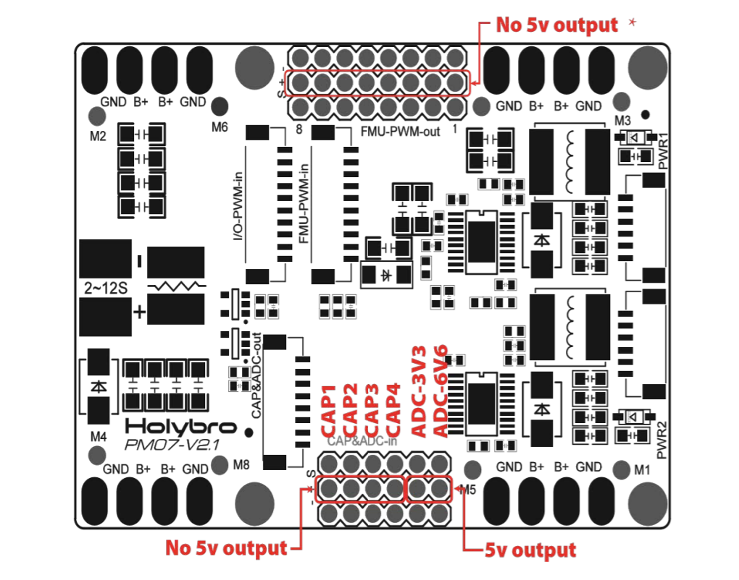
Avionics- PMB integration
Feasibility Analysis

Slide 70
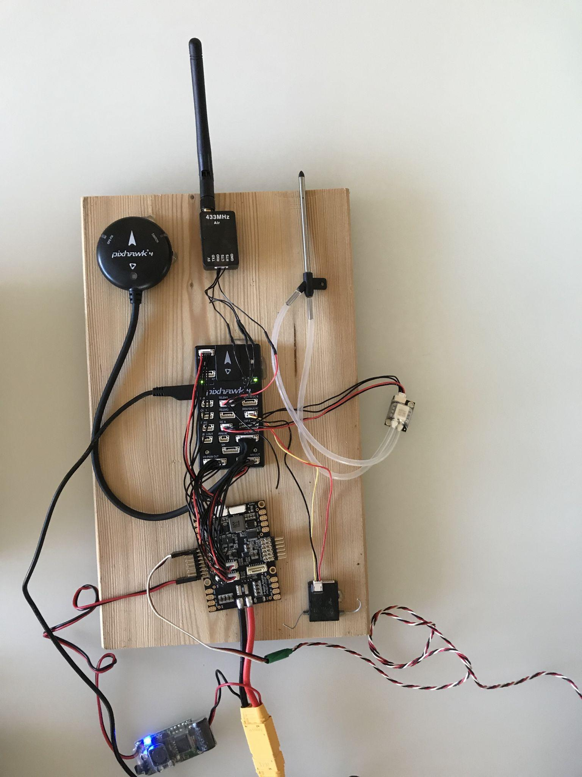
Full Avionics Setup
Important Components
GPS Receiver Module
Digital Airspeed Sensor (I²C) and Pitot Tube
RC Receiver
Power Management Board (PMB)
UBEC Voltage Regulator
Servo Connection
Battery Connection
Feasibility Analysis

Slide 71
Feasibility Analysis: Avionics - Battery (Turnigy)
Battery Specifications
Features
Lightweight
Large capacity
Medium discharge rate to ensure motor and system as a whole powering capabilities
Capacity | 5000mAh
Discharge Rate | 20C
Size | 143 x 51 x 23mm
Weight | 360g
Turnigy LiPo Pack
Backup Slide

Slide 72
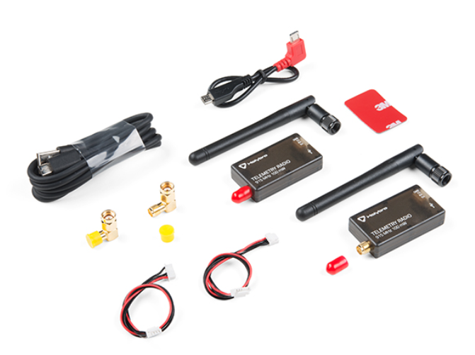
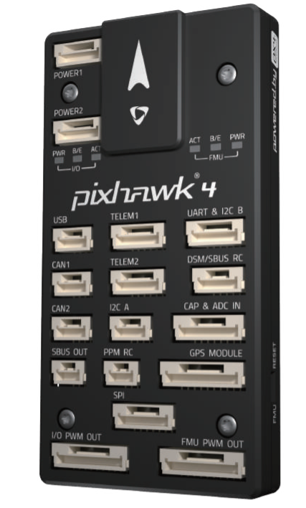
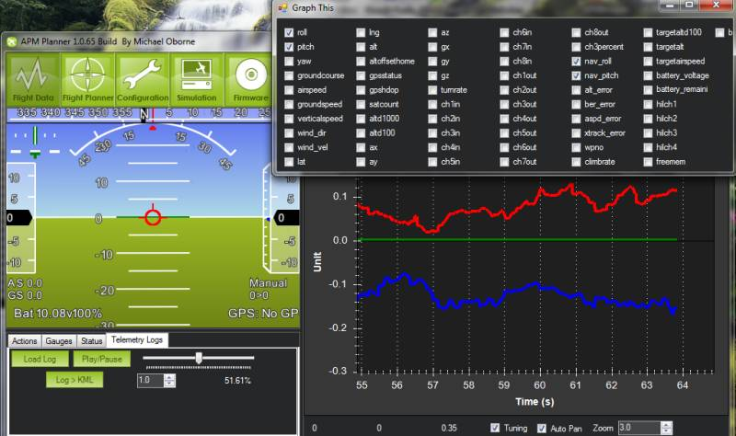
Coms - Telemetry and Data Communication
Wireless
Pixhawk 4 has a built in telemetry port that can be used to data transmission during flight
SiK Radio($50) can be used to send telemetry data to Mission Planner during flight
Wired
Pixhawk 4 has a built in SD card(Free) that can store telemetry data, this data can then be loaded and into Mission Planner for analysis
Both of these options cost no more than $50 and Ardupilot has created extensive walkthroughs for implementation of both
Backup Slide

Slide 73
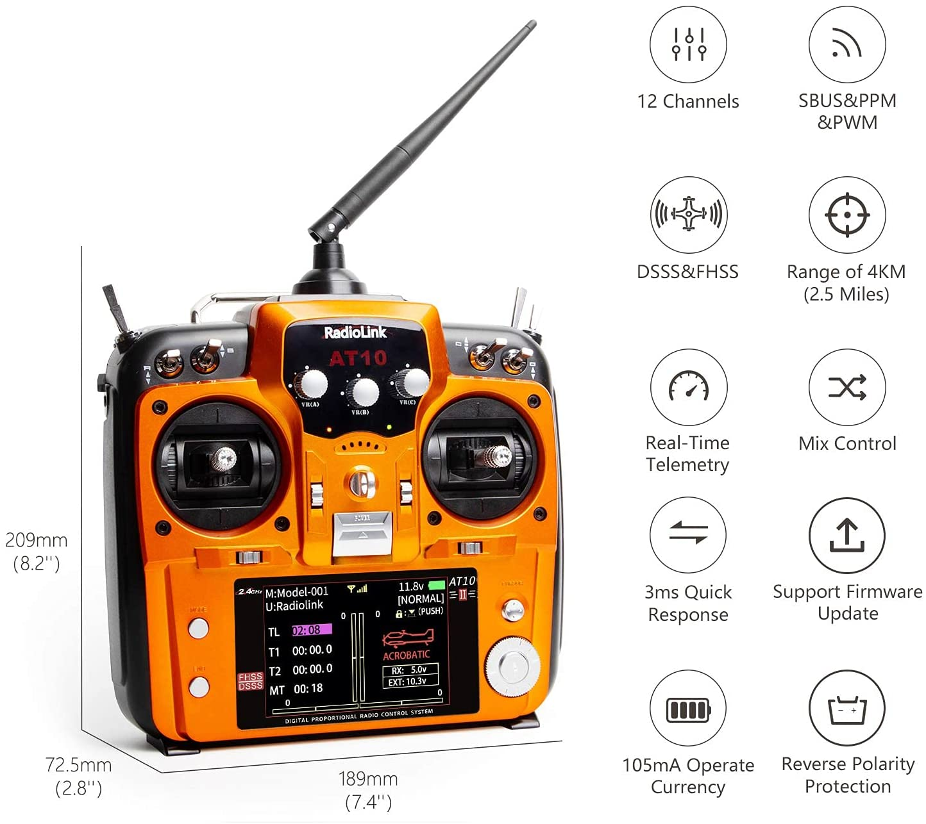
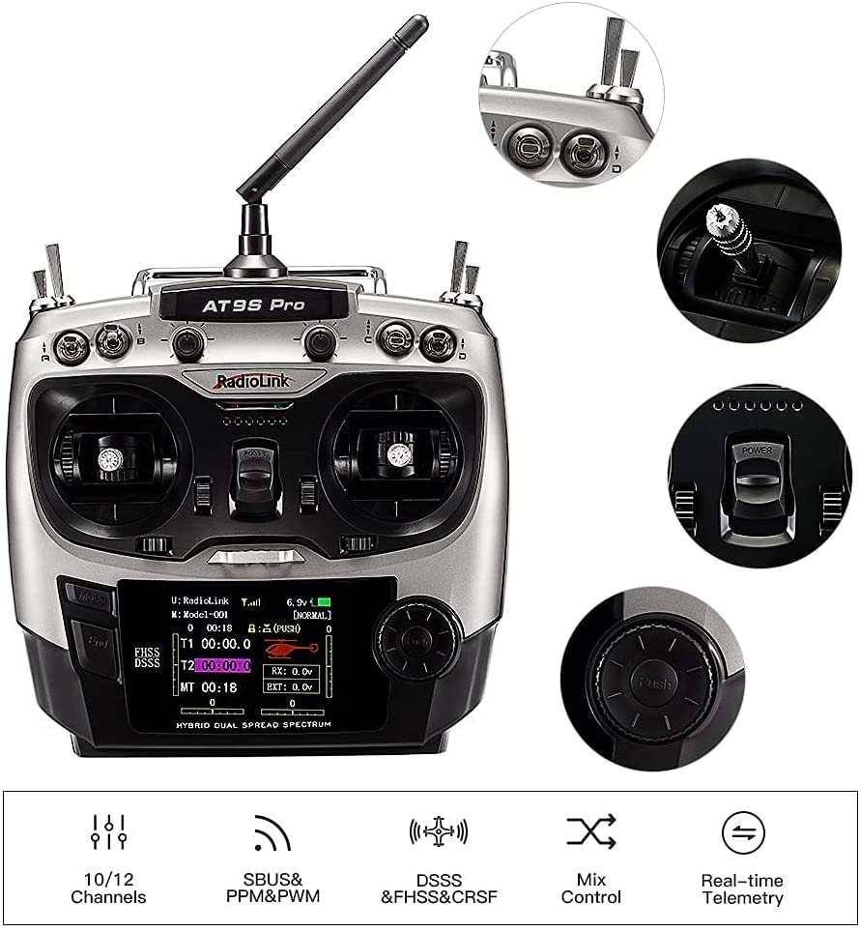
Coms - Manual Control & User Input
Pixhawk 4 has a built in DSM/SBUS RC port that can be used to input manual control
Components that are needed: Controller and RC Receiver
AT10II or AT9S from RadioLink, both of which come with RC Receivers to be used with Pixhawk 4
All initial use parameters can be entered through Mission Planner using the parameter tree feature
ArduPilot has extensive information and walkthroughs for RC Controller setup and parameter input to make these processes easy
Backup Slide

Slide 74
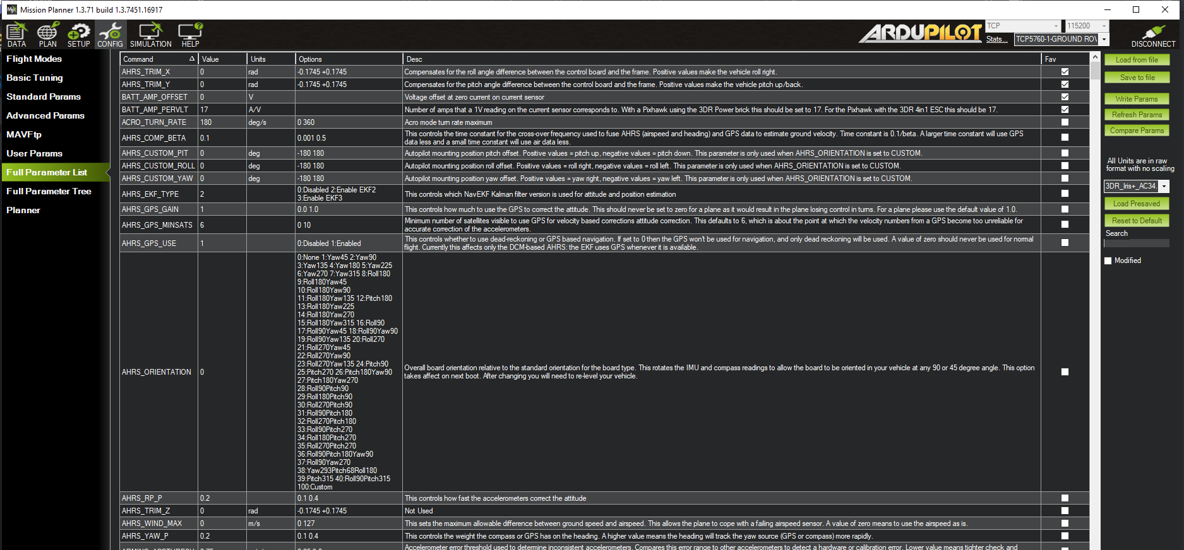
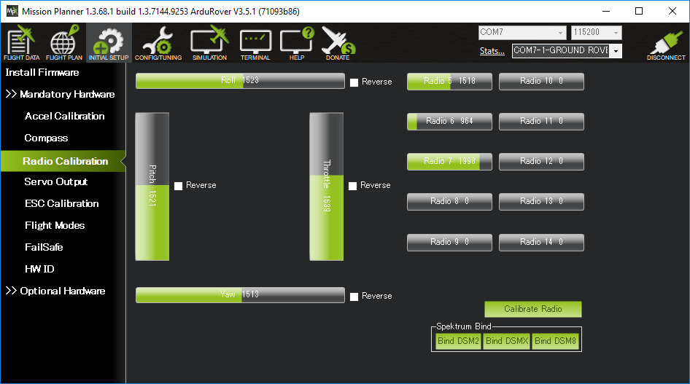
Coms - Manual Control & User Input
Backup Slide

Slide 75
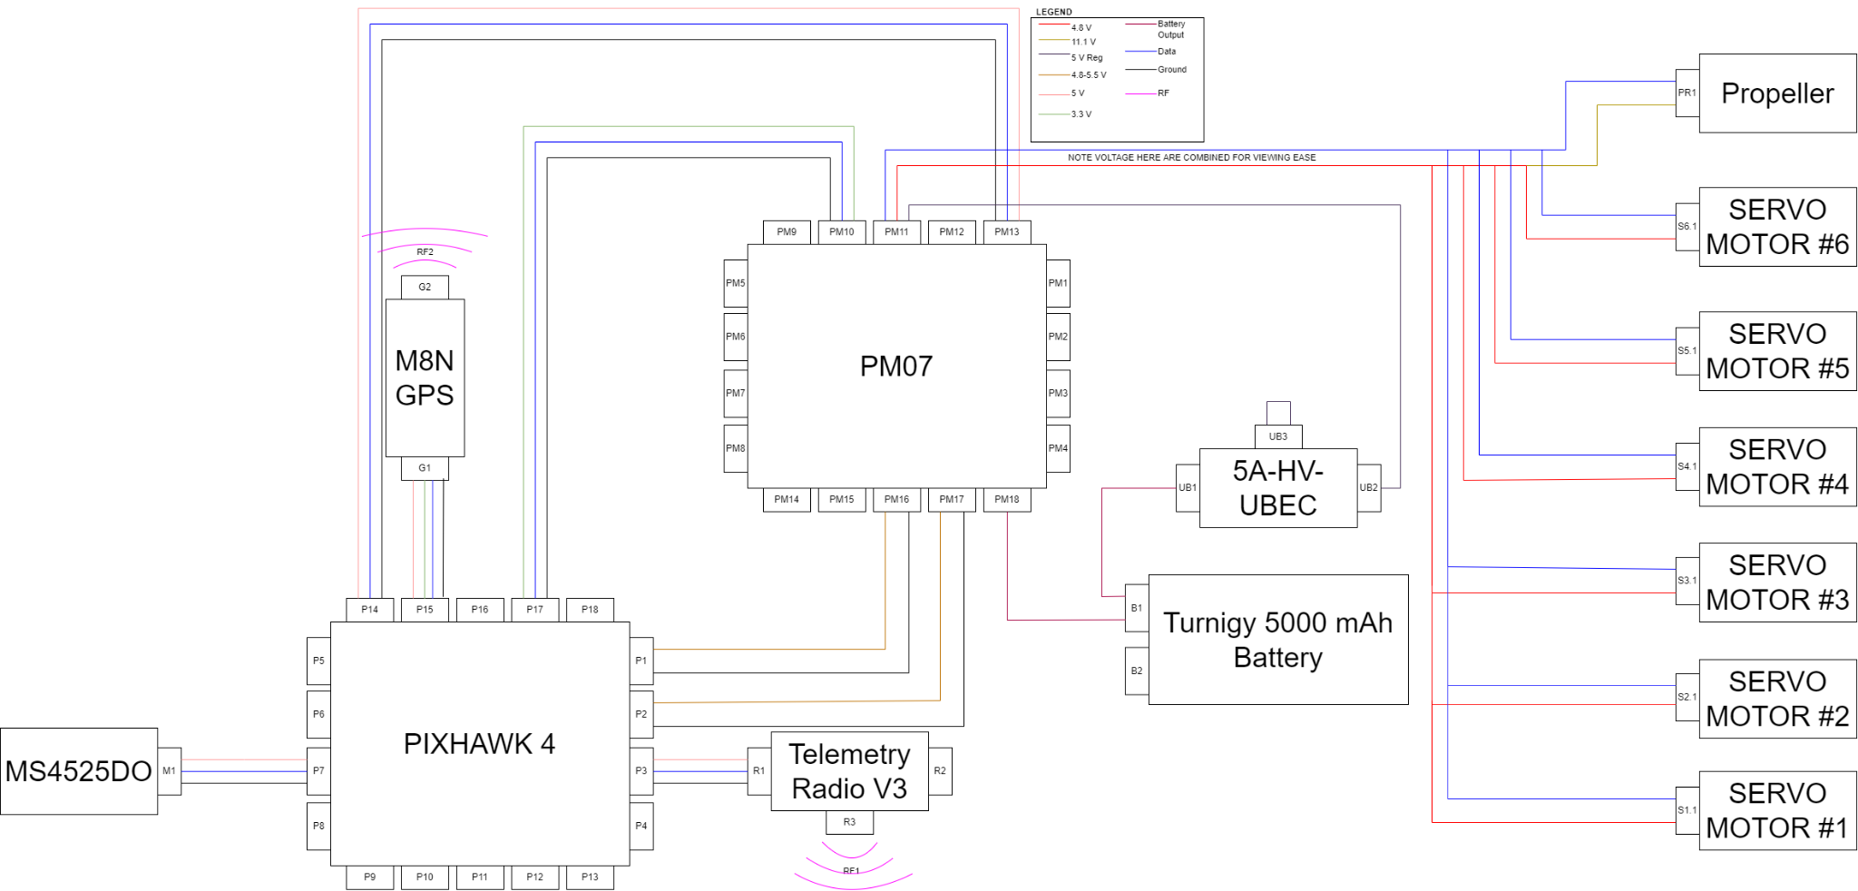
Wiring Diagram
Backup Slides

Slide 76
Feasibility Analysis: Power Management
Component | Current Draw(mA)
Pixhawk 4 | 175
Servos/Propeller | ~2000(based off of a 70 W/lb. requirement)
Sensors | 110
Total Current Draw(mA): | 2285
Battery Capacity(mAh): | 5000
Battery Life(hours): | ~2.2
Backup Slide

Slide 77
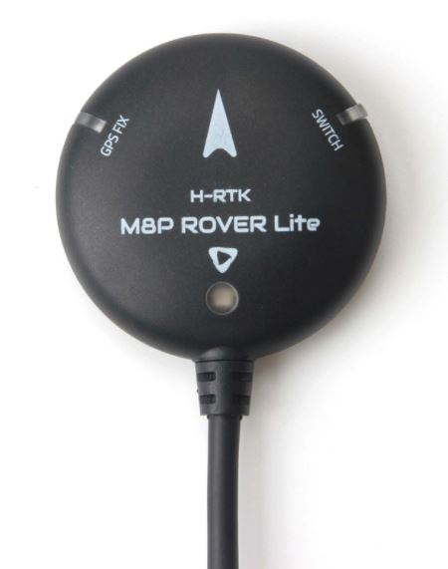
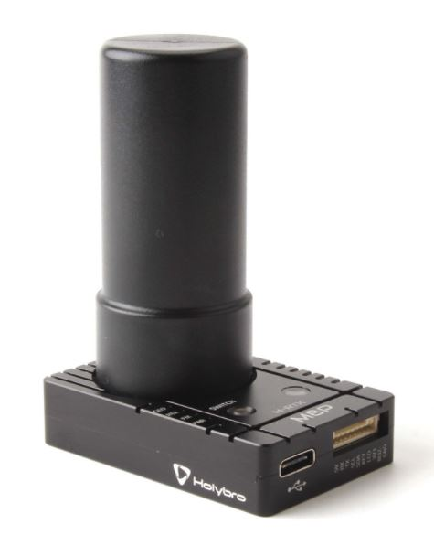
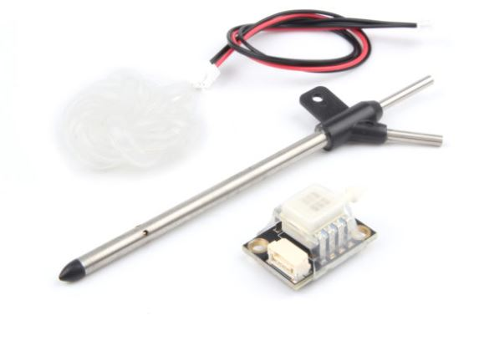
Sensors
GPS Sensor System
H-RTK M8P - Rover and Base Station
Airspeed Sensor
Physical pitot tube w/ Extended Kalman Filter
Features
Real Time Kinematics upgrade
Positioning accuracy of 1 centimeter
Used as a base station to provide correction data
Features
Physical pitot tube - pressure transducer
Ardupilot has a base EKF included in the software
Tuning the EKF will allow us to optimize the endurance of the UAS
Backup Slides
Backup Slides

Slide 78
FR-03 Satisfaction
Functional Requirement Number | Description | CPE | Satisfied?
FR-03 | The UAS shall adhere to FAA guidelines outlined in 14 CFR Part 107, SMALL UNMANNED AIRCRAFT SYSTEMS. | CPE-1 | YES
Small unmanned aircraft means an unmanned aircraft weighing less than 55 pounds on takeoff, including everything that is on board or otherwise attached to the aircraft.
The UAS should not exceed 55 pounds at takeoff
Backup Slides

Slide 79
Software
Backup Slides

Slide 80
FR-05 Satisfaction
Functional Requirement Number | Description | CPE | Satisfied?
FR-05 | The UAS shall be capable of sustaining an 80% Full Mission Capable rate (RMC) under Instrument Meteorological Conditions (IMC). be capable of maintaining a continual 100% standby posture. | CPE-2 CPE-5 | PARTIAL
FR-05/A Satisfaction:
Possible mission failure scenarios include sensor & power failure, loss of packets, etc.
FR-05/B Satisfaction:
All ground and flight software is compiled
After configuring the aircraft parameters, mission parameters, and compiling the software, the resulting executable is static, and will be ready to run via a sequence of commands indefinitely
Backup Slides

Slide 81
FR-06 Satisfaction
Functional Requirement Number | Description | CPE | Satisfied?
FR-06 | The UAS shall be operable by a single operator for the entire duration of the mission. | CPE-2 | YES
FR-06 Satisfaction:
If the ground and flight software is configured with mission and aircraft parameters, the aircraft only requires a single operator to initiate the launch.
This process only requires a single operator, but is complex and requires specific technical knowledge.
Because the flight software is completely autonomous, no operator action is required during a nominal mission scenario.
As long as the operator maintains line of sight with the aircraft, a single operator is capable of taking control of the aircraft.
Backup Slides

Slide 82
FR-07 Satisfaction
Functional Requirement Number | Description | CPE | Satisfied?
FR-07 | The UAS software shall be capable of a recovery and return mode to maintain the safety of the aircraft. | CPE-1 CPE-2 | YES
FR-07/A Satisfaction:
Ardupilot provides failure monitoring for the ground control system, and battery
If a failure is detected, the response to different failure types is programmable.
Aircraft can be switched into return to launch (RTL) mode, in which the autopilot software generates the necessary trajectory and controls to return to the launch area.
Ardupilot also provides manual override capability
The autopilot is capable of manual control upon reception of the signal from the ground controller.
Backup Slides

Slide 83
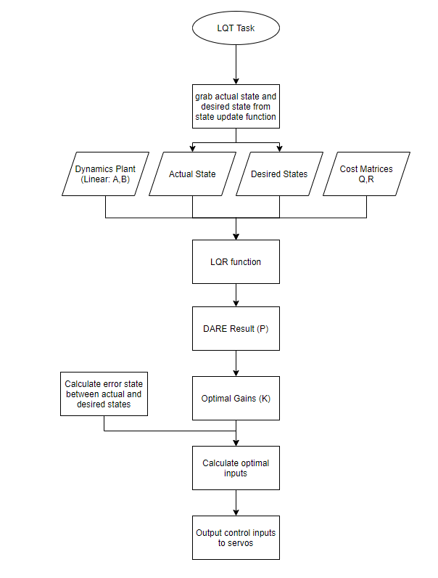
FSW LQT Task
Backup Slides

Slide 84
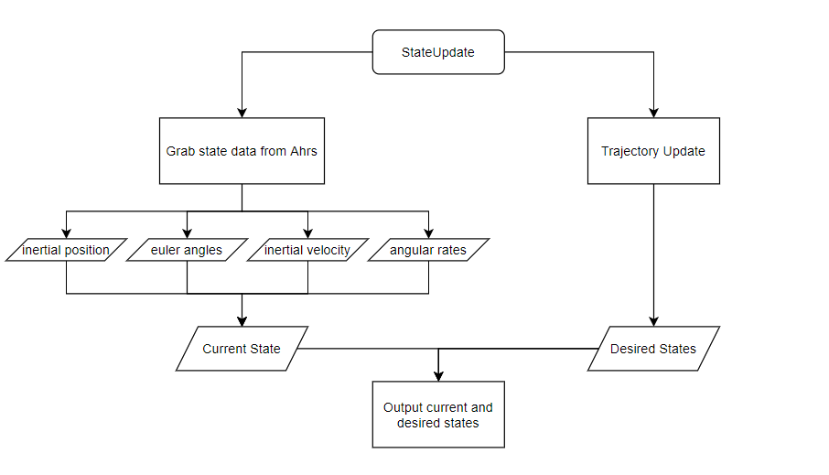
FSW Gather State Task
Backup Slides

Slide 85
FSW Trajectory Task
Called once upon system initialization
Called repeatedly during flight*
* Execution frequency TBD
Backup Slides

Slide 86
SITL Visualization
Backup Slides

Slide 87
FR-03 Satisfaction
Functional Requirement Number | Description | CPE | Satisfied?
FR-03 | The UAS shall adhere to FAA guidelines outlined in 14 CFR Part 107, SMALL UNMANNED AIRCRAFT SYSTEMS. | CPE-1 | YES
FR-06 Satisfaction:
Total weight of the aircraft and electrical components is 2.87 lbs
The aircraft will fly in line of sight (LOS) so it will not exceed the 3 mile FAA guidelines
The aircraft will not fly outside of the 400 feet limit during testing unless a waiver is given by the FAA
Part | Weight (g) | Number Used | Total Weight (g)
Telemetry Radio V3 | 14 | 1 | 14
Volantex RC Phoenix 2400 | 1160 | 1 | 1160
PM07 | 47.5 | 1 | 47.5
Pixhawk 4 | 15.8 | 1 | 15.8
5A-HV-UBEC | 30 | 1 | 30
MicroSD Card | 0.25 | 1 | 0.25
MS4525DO | 3 | 1 | 3
M8N GPS | 32 | 1 | 32
Backup Slides

Slide 88
Athena Vortex Lattice (AVL)
Calculates aerodynamic properties for the specific aircraft being used given a input geometry file
Aerodynamics outputs:
Stability derivatives
Direct forces and moments
Spanwise lift distribution
Backup Slides
Notes:
Has dummy airfoil data --- just proof of concept

Slide 89
Trajectory
Backup Slides

Slide 90
Width of Main Path
Template Data
C_{L} = 0.71
C_{D} = 0.044
Wing Area = 2.2 m²
Mass = 13.6 kg
Backup Slides
Notes:
BACKUP

Slide 91
Trajectory Algorithm
Backup Slides
Notes:
slide needs to be clarified/updated
potentially can be put in backup

Slide 92
Controls
Backup Slides

Slide 93
Controller Options(PID)
Control Method | Pros | Cons
Proportional Integral Derivative Controller (PID) | Improved Stability Simple to implement Reduces steady-state error | Performance of controller will vary in non-linear systems High noise in derivative portion Low robustness Difficult to tune parameters for unstable systems
Backup Slides
Notes:
FR 2
We had multiple options to choose from for our Controller.
PID is the most common, and is easy to implement but, it is difficult to tune the portional gains for an unstable system
Because we are making this controller for other aircraft and not just a single one, this option will not be the best choice for us
The LQR is a robust and computationally efficient controller than finds the proportional gains for our system for us.
This means we don't need re-tune gains for different aircraft.
The downside is that it uses one set of gains for the entire simulation, this will bring up an issue when we transition from a straight line to a curved turn.
The LQT uses the LQR to calculate the needed gains values for each time step defined by our trajectory.

Slide 94
Controller Options(LQR)
Control Method | Pros | Cons
Linear Quadratic Regulator (LQR) | Computationally efficient Robust Fixed control gain can be used for each trajectory | Not as useful for non-linear systems Requires knowledge about the state of the object which is not always possible Increased energy consumption
Backup Slides
Notes:
FR 2
We had multiple options to choose from for our Controller.
PID is the most common, and is easy to implement but, it is difficult to tune the portional gains for an unstable system
Because we are making this controller for other aircraft and not just a single one, this option will not be the best choice for us
The LQR is a robust and computationally efficient controller than finds the proportional gains for our system for us.
This means we don't need re-tune gains for different aircraft.
The downside is that it uses one set of gains for the entire simulation, this will bring up an issue when we transition from a straight line to a curved turn.
The LQT uses the LQR to calculate the needed gains values for each time step defined by our trajectory.

Slide 95
LQT - Matrix Math
Below are the steps for calculating the optimal gains using the LQT
A and B are state transition matrices that are made from the linearized dynamics of the aircraft
Q and R are the state cost matrices as seen on previous slides
Backup Slides

Slide 96
LQT Control Surfaces - Coordinated Turn, Lateral
Backup Slides
Notes:
Convert to rads instead of degrees

Slide 97
LQT Control Surfaces - Coordinated Turn, Longitudinal
Backup Slides
Notes:
Convert to rads instead of degrees

Slide 98
LQT Control Surfaces - Straight Line, Lateral
Backup Slides
Notes:
Convert to rads instead of degrees

Slide 99
LQT Control Surfaces - Straight Line, Longitudinal
Backup Slides
Notes:
Convert to rads instead of degrees

Slide 100
ACRONYMS
RALPHIE - Rapid Autonomous Loiter Program for Highly Increased Endurance
UAS - Unmanned Aerial System
AHRS - Attitude, Heading, and Reference System
LQT - Linear Quadratic Tracker
IMU - Inertial Measuring Unit
GPS - Global Positioning System
CPE - Critical Project Element
FR - Functional Requirement
SLUF - Steady Level Unaccelerated Flight
SITL - Software in the Loop
PID - Proportional, Integral, and Derivative
HITL - Hardware in the Loop

Slide 101
ACRONYMS
LOS - Line of Sight
FAA - Federal Aviation Administration
RMC - Mission Capable Rate
IMC - Instrument Meteorological Conditions
RC - Remote Controller

Slide 102
References
Coms:
Radiolink.com. AT10II 12 channels transmitter for racing drone, fixed wing, helicopter, glider, cars and boats. [online] Available at: <https://www.radiolink.com/at10ii> [Accessed 11 October 2021].
Ardupilot.org. 2021. Mission Planner Features/Screens — Mission Planner documentation. [online] Available at: <https://ardupilot.org/planner/docs/mission-planner-features.html> [Accessed 11 October 2021].
Serial Telemetry Radio Kit - 915MHz, 1., 2021. Serial Telemetry Radio Kit - 915MHz, 100mW - WRL-15007 - SparkFun Electronics. [online] Sparkfun.com. Available at: <https://www.sparkfun.com/products/15007> [Accessed 11 October 2021].
Avionics:
Hobbyking. Turnigy 5000mAh 3S 20C LiPo Pack w/XT-60. [online] Available at: <https://hobbyking.com/en_us/turnigy-5000mah-3s-20c-lipo-pack-xt-90.html> [Accessed 11 October 2021].
diydrones. 2021. Pixhawk (and APM) Power Consumption. [online] Available at: <https://diydrones.com/profiles/blogs/pixhawk-and-apm-power-consumption> [Accessed 11 October 2021].
theParkPilot.org. Brushless Motor Basics. [online] Available at: <https://www.theparkpilot.org/brushless-motor-basics> [Accessed 11 October 2021].
Holybro.com. [online] Available at: <http://www.holybro.com/manual/PM07-Quick-Start-Guide.pdf> [Accessed 11 October 2021].
Controls:
Automaticaddison.com. Linear Quadratic Regulator (LQR) With Python Code Example – Automatic Addison. [online] Available at: <https://automaticaddison.com/linear-quadratic-regulator-lqr-with-python-code-example/> [Accessed 11 October 2021].
Etd.lib.metu.edu.tr. 2021. [online] Available at: <https://etd.lib.metu.edu.tr/upload/12617592/index.pdf> [Accessed 11 October 2021].
Stanford.edu. 2021. [online] Available at: <https://stanford.edu/class/ee363/lectures/dlqr.pdf> [Accessed 11 October 2021].
Software:
ardupilot.org/dev ArduPilot Development Site [online] Available at: <https://ardupilot.org/dev/index.html> [Accessed 21 November 2021]
Sensors:
Learn.sparkfun.com. Setting up a Rover Base RTK System - learn.sparkfun.com. [online] Available at: <https://learn.sparkfun.com/tutorials/setting-up-a-rover-base-rtk-system/all> [Accessed 11 October 2021].
Ardupilot.org. Using an Airspeed Sensor — Plane documentation. [online] Available at: <https://ardupilot.org/plane/docs/airspeed.html#arspd-sensor-list> [Accessed 11 October 2021].
Miscellaneous:
Backup Slides
Notes:
plz drop links here!!!

