Slide 1
RALPHIE
Preliminary Design Review
October 11, 2021
ASEN 4018-012
Company Customer:
Ann & H.J. Smead Department of Aerospace Engineering Sciences (John Mah)
Faculty Advisor:
Dr. Melvin Rafi
Presenters:
Sunny Sarkar, Sean Newman, Cooper Dale, Sam Garza, Dawei Zhao, Lorenzo Madera
Additional Team Members:
Andreas Brecl, Andrew Thompson, Carson Leppla, Gina Staimer, Quinn Lewis, Kidd Deng

Slide 2
Agenda
Project Description - Sunny Sarkar
Feasibility: Controls - Lorenzo Madera
Baseline Design - Sean Newman
Feasibility: Avionics - Sam Garza
Feasibility: Software - Cooper Dale
Summary - Dawei Zhao

Slide 3
Project Description
Notes:
3.1.1 Brief project definition, using Objectives, CONOPS and FBD from PDD
3.1.2 Baseline design from CDD. Include diagrams and explanation sufficient to understand
the baseline design without having to read the CDD.

Slide 4
Mission Statement
Rapid Autonomous Loiter Program for Highly Increased Endurance (RALPHIE) will provide the Ann & H.J. Smead Department of Aerospace Engineering Sciences Department with an autonomous flight controller that can improve upon the endurance of existing small UAS.
Project Description

Slide 5
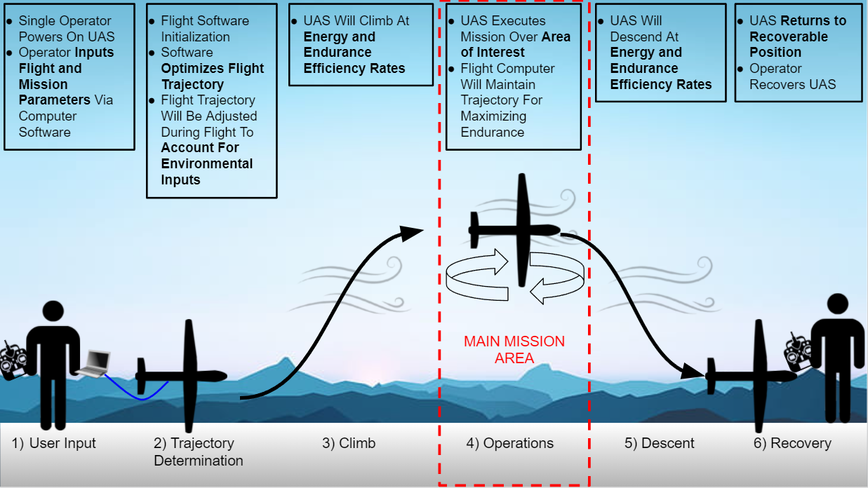
Verification CONOPS
Project Description

Slide 6
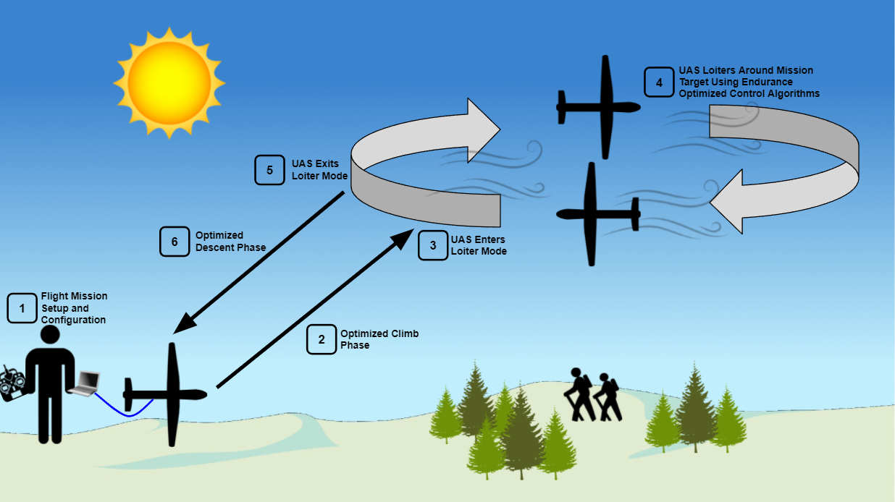
Use Case CONOPS
Project Description

Slide 7
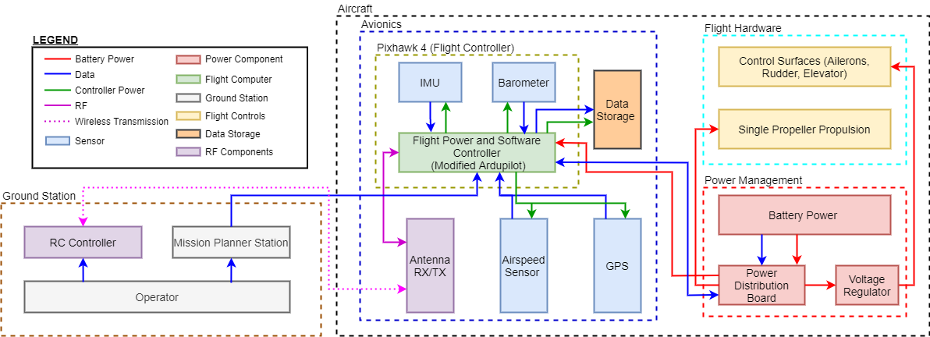
Functional Block Diagram
Project Description

Slide 8
Functional Requirements
FR-01 | The total flyaway cost for flight controller hardware, flight controller software, and a ground station shall be based on current day consumer level UAS flight hardware costs to enable ease of purchase and replacement by smaller organizations.
FR-02 | The UAS software shall optimize flight trajectory for optimal endurance and energy use.
FR-03 | The UAS shall adhere to FAA guidelines outlined in 14 CFR Part 107, SMALL UNMANNED AIRCRAFT SYSTEMS.
FR-04 | The flight control system shall be adaptable to a variety of fixed wing air vehicles.
FR-05 | The UAS shall be capable of sustaining an 80% Full Mission Capable rate (RMC) under Instrument Meteorological Conditions (IMC). be capable of maintaining a continual 100% standby posture.
FR-06 | The UAS shall be operable by a single operator for the entire duration of the mission.
FR-07 | The UAS software shall be capable of a recovery and return mode to maintain the safety of the aircraft.
Project Description

Slide 9
Baseline Design
Notes:
3.2.1 Identification of critical project feasibility elements, choice of key elements to present
3.2.2 First-level feasibility analyses of all key critical project feasibility elements.
3.2.3 Other evidence (comparisons, simulations, experiments) as needed to show feasibility
Have 2 slides, 1 for Hardware and 1 for software (at least combine the slides to more effectively use space)

Slide 10
Flight Unit
Controller Hardware
Pixhawk 4
Features
Pre-installed sensor suite
Compatible with a variety of fixed wing aircraft and control surfaces (FR-04)
Compatible with Ardupilot
Vibration Isolated IMU
Capable of On Board Storage
Industry Standard
Controller Firmware
Ardupilot
Features
Open Source
Simulation Capability
Adaptable to a Variety of Vehicle Configurations (FR-04)
Well Documented
Supports Autonomous Flight
Modifiable
Airframe
Volantex Phoenix 2400
Features
Launchable by a Single User (FR-06)
Light
Standard Control surfaces
Integrates with Flight Controller
Large Capacity
Baseline Design

Slide 11
Sensors
GPS Sensor
Sparkfun GPS-RTK Board - NEO-M8P-2
Airspeed Sensor
Tuned Extended Kalman Filter (EKF) with physical pitot tube.
Features
Real Time Kinematics upgrade
Positioning accuracy of 1 centimeter
Used as a base station to provide correction data
Features
Physical pitot tube - pressure transducer
Ardupilot has a base EKF included in the software
Tuning the EKF will allow us to optimize the endurance of the UAS
Baseline Design

Slide 12
Control Laws
Selected Design
Linear Quadratic Tracker (LQT)
Features
Allows for optimization of throttle and control inputs to maximize endurance (FR-02)
Provides better optimization capabilities than a standard PID controller
Can be implemented via the pixhawk and ardupilot
Sensor Data
Linear Quadratic Tracker
Control Surfaces and Propeller
Baseline Design
Notes:
Needs input from Gina/Lorenzo
Lqr/LQT solves some cost function for a desired output.
Input state is sensors input or state data, outputs an error state. Solving a DT riccoti equation , this happens recursively, which allows us to solve for out ks/gain matrix. Using the K matrix we can solve for “optimal controls”
* Maybe mention filtering of sensor data from included PixHawk capabilities? -> not sure we will use it though, maybe just see if we get any questions about it

Slide 13
Feasibility Analysis
Notes:
Recap baseline design with aspects shown to be feasible vs. studies still needed

Slide 14
Summary of Feasibility Analyses
System | Feasible | Reasoning
Controls | ? | Implementation of control laws will increase endurance and minimize energy usage while also maintaining aircraft stability during flight.
Avionics Package | ? | Ability to interface with sensors, controls, and battery
Software | ? | Interfaces with avionics package to provide autonomous flight modes for standard plane configuration - Implement LQT control laws - Environment compatibility
Budget | ? | All controller packages and avionics should not exceed $1000. There should be redundancy in purchased items for products damaged during testing.
Communication | ? | Communication between the user on the ground and the UAS during flight is necessary to ensure the safety of the vehicle and bystanders in case the controller fails.
Feasibility Analysis

Slide 15
Feasibility Analysis: Controls
Required Functionalities:
1 | Accept input of a specified trajectory defining a mission area. | ?
2 | Optimizes system controls for endurance. | ?
3 | Ability to implement for full aircraft state. | ?

Slide 16
Feasibility Analysis: Controls
Linear Quadratic Tracker (LQT)
Determines optimal control by minimizing the cost function of the dynamics model
Gains are tuned per system for weighting optimal control
Dynamics Model
Linear
Linear Quadratic Tracker (LQT)
Cost Function
Quadratic
Feasibility Analysis
Notes:
Need to reword this slide or shorten it depending on what Sean is saying in baseline design
LQT determines the optimal input (actuators/control surfaces) to achieve the desired state while minimizing the cost of the maneuver. (In the case of our project we want to minimize parameters like throttle, and
vertical acceleration”

Slide 17
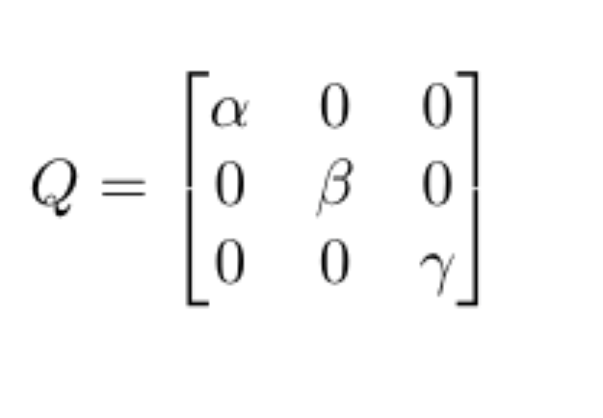
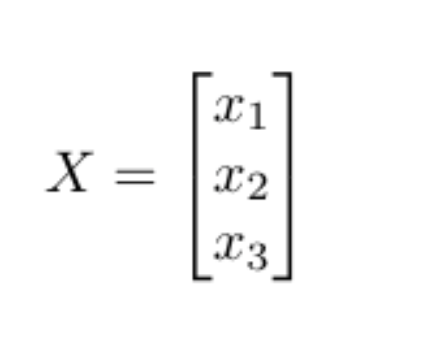
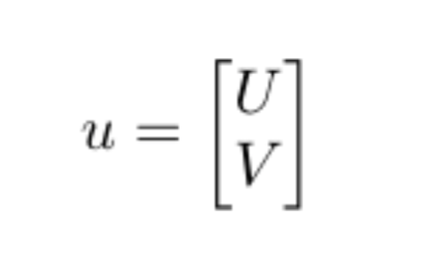
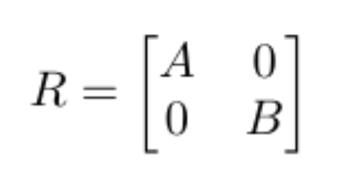
Feasibility Analysis: Controls
Inputs: current state, desired state, Q, R, A, B, dt
A, B = State transition matrices
Q = State cost matrix
R = Input cost matrix
1 | Accept input of specified area
Feasibility Analysis
Notes:
The LQT uses the inputs listed here:
The currents state and desired state are used to calculate an “error state” to use
A and B are the state transition matrices which define the dynamics of the system.
dt is the time step between each observation.
Q is the state cost matrix and R is the input cost matrix
both matrices are diagonal with coefficients corresponding to the “cost” we want to assign to each state component
Example using dummy variables to show how error state would be reduced for some variables more than others and how the inputs can be minimized.

Slide 18
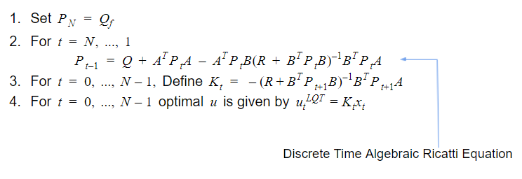
Feasibility Analysis: Controls
Outputs: Optimal control inputs (u*)
2 | Optimizes system controls
References: https://automaticaddison.com/linear-quadratic-regulator-lqr-with-python-code-example/
Feasibility Analysis

Slide 19
Feasibility Analysis: Controls
Full Aircraft State Problem
3 | Implement for full aircraft state
Feasibility Analysis
Notes:
X is the full aircraft state
A_12x12 is the discretized linear dynamics matrix for the aircraft
B = input matrix
u* is the optimized input for throttle, aileron, rudder, and elevator deflection
Variables underlined in red are the ones we will design Q and R to put a high cost on - talk about why
We want to track XY for a relatively accurate trajectory
Z is only important to stay w/in altitude block so the cost can be lower - we will set it in the middle(ish) of our altitude block and thus the error on either side should still keep it in the block
u,v,w will help us maximize endurance for ideal glide rate <- state that this is velocity components
T is throttle and we want to minimize its use when possible to save on power.

Slide 20
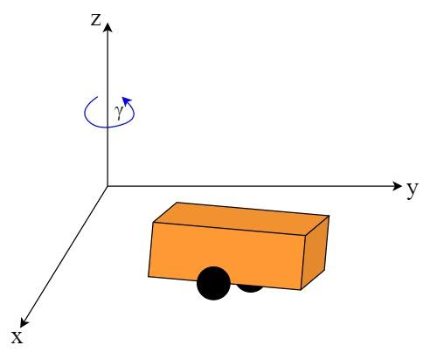
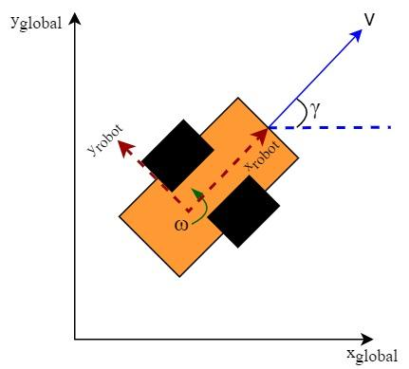
Feasibility Analysis: Controls
Baseline Simulation
Controlling a small robot that can rotate and move laterally
LQT generates velocity commands that minimize error between current and desired positions
Robot 3D Diagram
Robot Bird’s Eye View
Feasibility Analysis
Notes:
Since further work needs to be done to define the aircraft state space system dynamics model, we implemented an LQT on a much simpler scenario. With this “baseline simulation” simulation we wrote up the “LQT function” that will solve for the ideal input for any state space systems and desired state which can be used in our FSW with the full a/c state. This “smaller” sim proved that our team can implement the algorithms needed to use LQT on a larger scale and that we understand how the coefficients on the Q and R matrices affects the end trajectories.
In this baseline sim we modeled a small robot that can rotate and move laterally. This LQT for this generates velocity inputs v,w to help the robot track to the desired trajectory.
*Figures shown for clarity

Slide 21
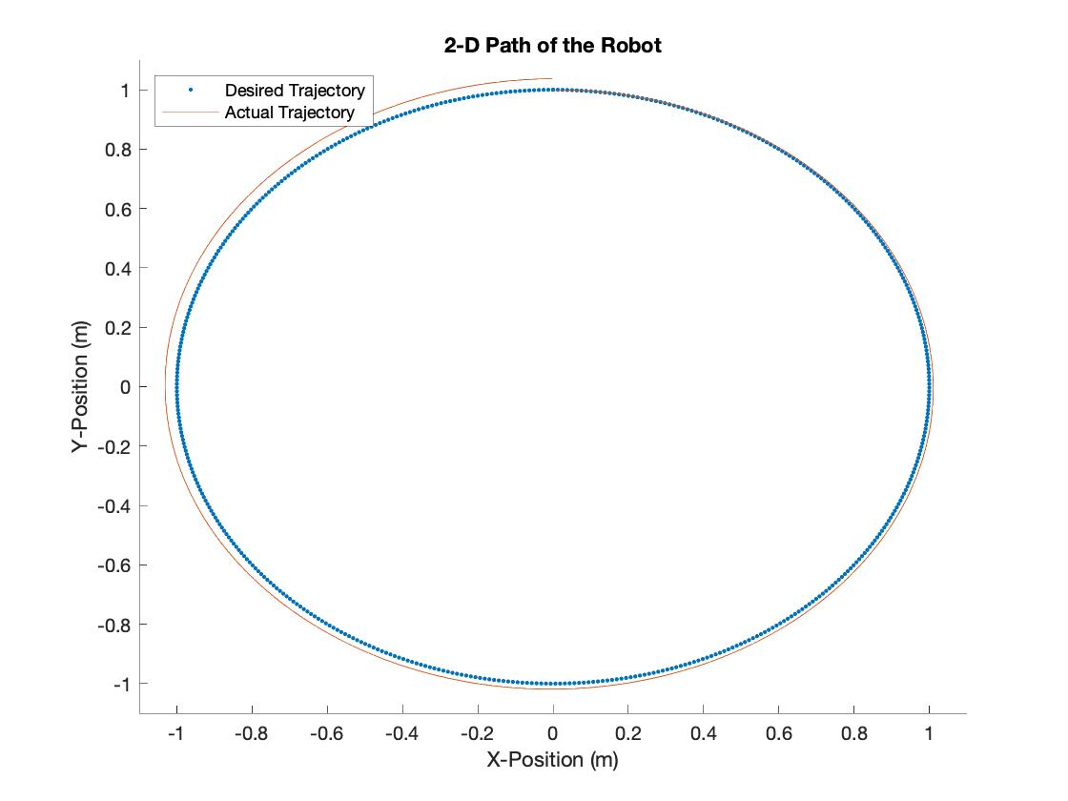
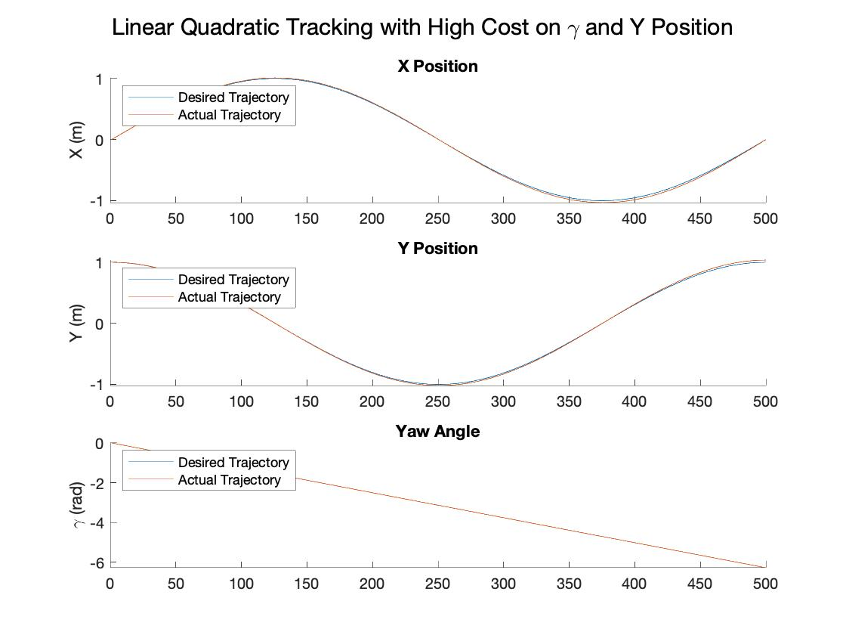
Feasibility Analysis: Controls
Simulation Results
Summary
Notes:
These are the results of one simulation where we put a high cost on the angle gamma and the Y position. As you can see in the figure to the right it doesn’t track perfectly because it is optimizing between the x,y, and omega trajectories we gave it.
This simulation doesn’t have a high cost on actuator inputs but we do have a backup slide that shows the effects.
The baseline sim allowed us to explore the impacts of varying the Q and R coefficients on the accuracy of the trajectory and the overall behavior of the system. For example, the way this system is set up, the angle is tied to the Y value of the robot - thus varying one of their coefficient can sometimes have an impact on the other variable. Additionally we found that there is different accuracy levels of tracking depending on the number of sample points along the trajectory. These are both valuable lessons that will help us as we develop the full LQT sim for the UAS.
*I will put in more simulation results into the back up slides in case anyone asks about them

Slide 22
Feasibility Analysis: Software
Required Functionalities:
1 | Environment Compatibility and ability to compile. | ?
2 | Software interfaces with avionics package. | ?
3 | Autonomous flight modes for mission profile, control implementation. | ?

Slide 23
Feasibility Analysis: Software
ArduPilot Development Logistics:
Source/Versions control setup in Git by forking repository
Development environment: Windows Subsystem for Linux, Ubuntu
Waf build system already setup - Can compile project specific code
Extensive community forums and tutorials for setup, learning, testing, and debugging.
1 | Environment Compatibility and ability to compile
Feasibility Analysis

Slide 24
Feasibility Analysis: Software
Compatibility Needed | Header File Including Compatibility | Description of Contents
Airspeed Sensor | AP_Airspeed.h | Airspeed calculation, uses Kalman filtering
IMU | AP_InertialSensor.h | Interfaces to inertial sensors
Barometer | AP_Baro.h | Barometer interface, data averaging
Accelerometer | AP_AccelCal.h | Accelerometer interface, calibration
GPS Receiver | AP_GPS.h | GPS interface
Ground Controller | GCS_MAVLink.h | Ground controller interface, communication between controller and ground
2 | Interfaces with avionics package
Feasibility Analysis

Slide 25
Feasibility Analysis: Software
Flight Mode | Location within ArduPlane folder | Description
Takeoff | Takeoff.cpp | File supporting autonomous takeoff and climb. Check for GPS lock and initiate launch.
Loiter | mode_loiter.cpp | File implementing aircraft loiter with specified radius.
Circle | mode_circle.cpp | File implementing autonomous circular flight around a target point with specific radius.
Fence | fence.cpp | Ability to set geographical fence around target area.
Descent and Landing | AP_Landing.h | Written for automated landing and descent angle control.
Control Implementation:
Control laws developed will be implemented into APM_Control.h library which includes library for roll, pitch, yaw, and steer controllers.
3 | Autonomous flight modes for mission profile, control implementation
Feasibility Analysis

Slide 26
Feasibility Analysis: Avionics Package
Required Functionalities
1 | Pixhawk has enough processing power for LQT and general flight software. | ?
2 | Ability to integrate with GPS and airspeed sensor. | ?
3 | Ability to integrate with Essential Control Surfaces (ECS) and propulsion system. | ?
4 | Ability to retrieve battery information and send it to the flight controller software. | ?
5 | Compatibility with COTS airframe. | ?
Feasibility Analysis

Slide 27
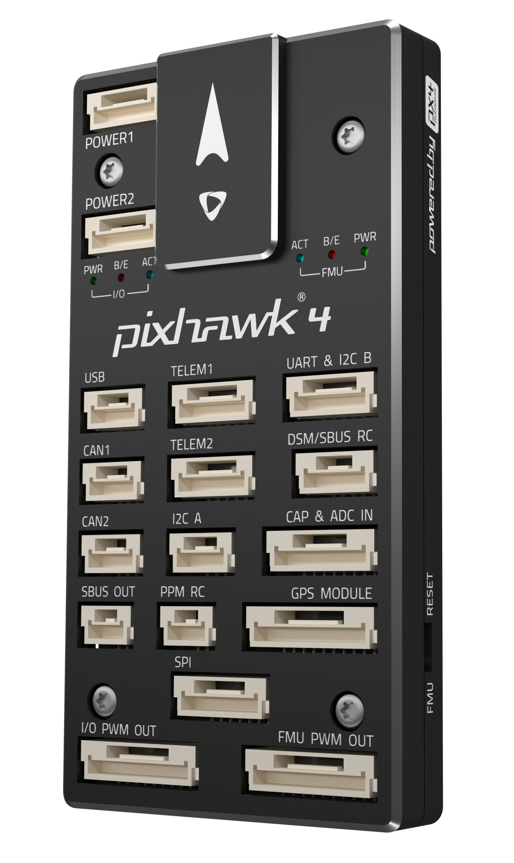
Feasibility Analysis: Avionics- Pixhawk 4 (Hardware)
Sufficient RAM available
60 KB of RAM dedicated to LQT (worst case)
Easily able to account for general software
Verified via comparison to other FSW
Hardware
44mm
 | Processor Speed (MHz) | RAM (KB) | Operational Temperature Range (°C)
Main Processor STM32F765 | 216 | 512 | -40 to 85
Total Weight: 33.3 g
84mm
1 | Enough processing power for LQT and general flight software
12mm
Feasibility Analysis
Notes:
2x the amount of RAM as the pixhawk3 that ran essentially the same flight software --- should be plentyyyy of RAM

Slide 28
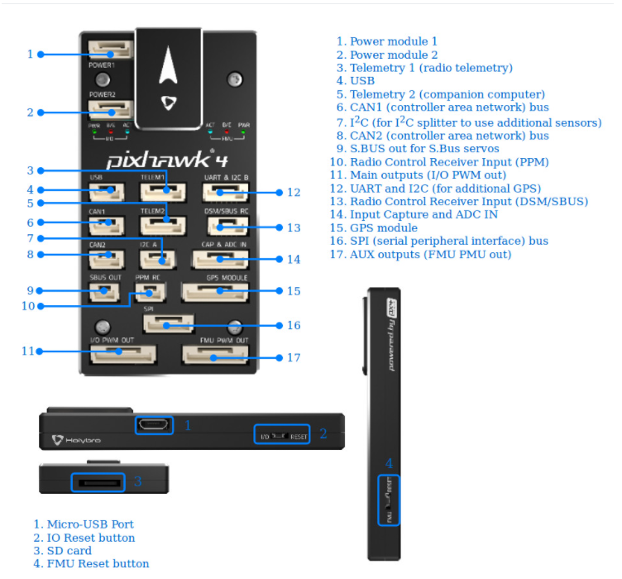
Feasibility Analysis: Avionics- Pixhawk 4 (Integration)
Port and Sensor Capability
Important Interfaces
GPS Receiver Module
Digital Airspeed Sensor (I²C)
RC Receiver
SD Card Insert
USB
Power Module
I/O Outputs
Integrated Sensors
2 Inertial Measurement Units (IMUs)
Barometer
Magnetometer
2 | Ability to integrate with GPS and airspeed sensor
Feasibility Analysis
Notes:
Sufficient ports for GPS and wind sensor integration
Sufficient included sensors for altitude and inertial sensing

Slide 29
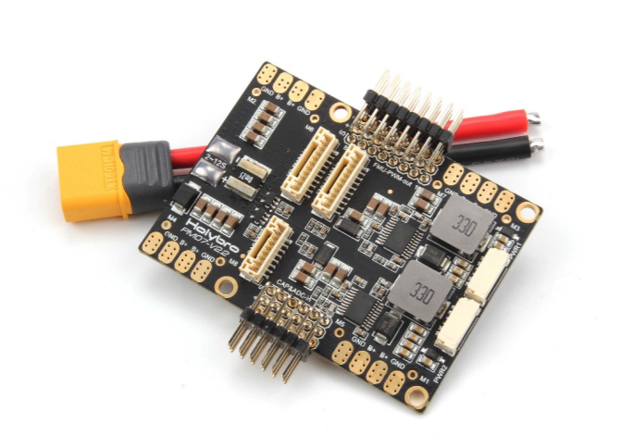
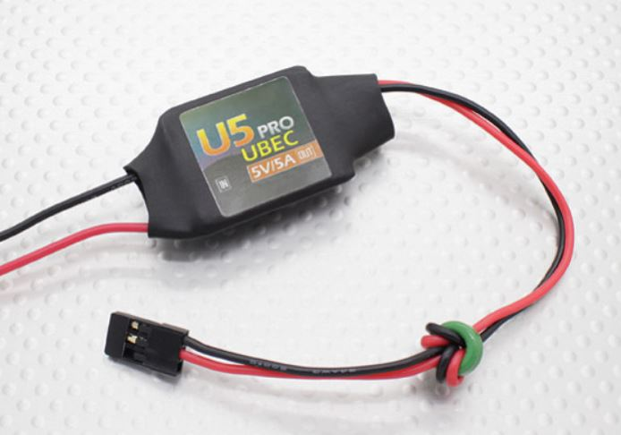
Feasibility Analysis: Avionics- Power Integration
PM07 Power Management Board (PMB)
Recommended to be used with the Pixhawk4
Connects the ESC and propulsion system, flight controller
Sends information about battery voltage and current consumption
UBEC Power Regulator
5V/5A
Powers servos
Must ensure maximum current draw from servos do not exceed 5A
3 | Ability to integrate with Essential Control Surfaces (ECS) and propulsion system
4 | Ability to retrieve battery information and send it to the flight controller software

Slide 30
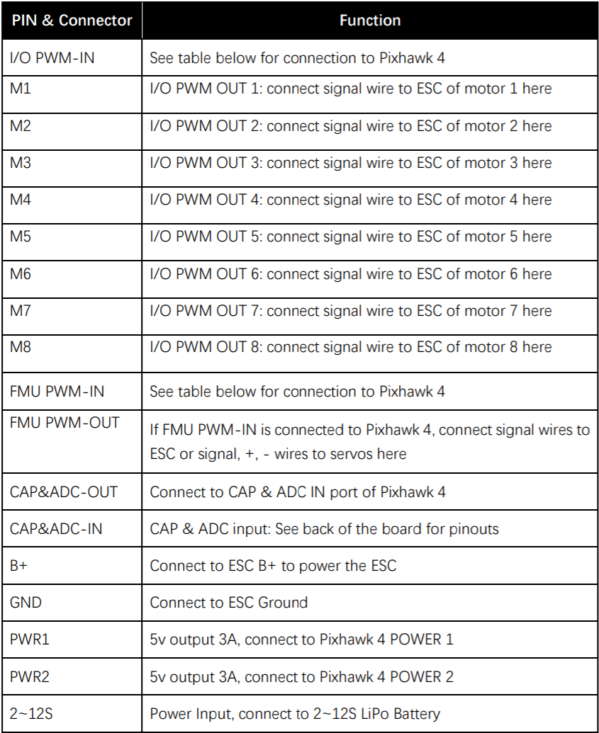
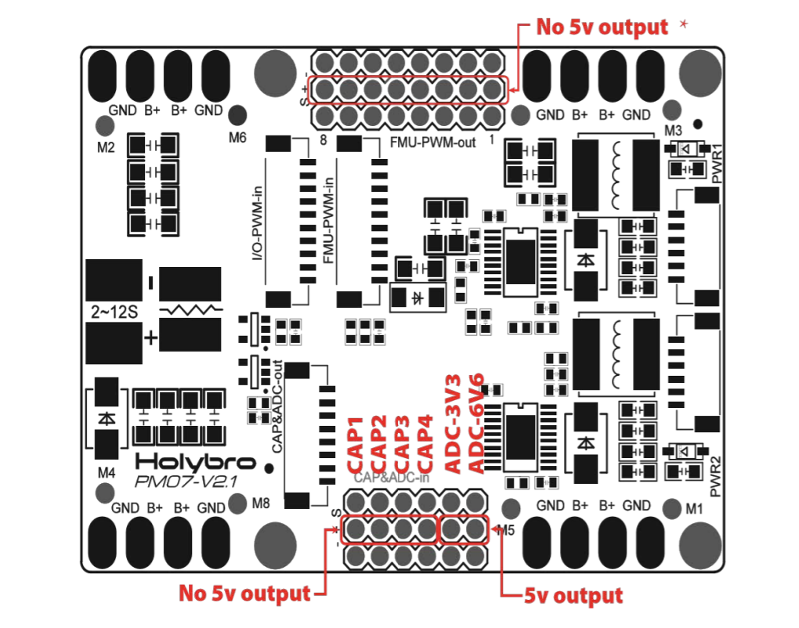
Feasibility Analysis: Avionics- PMB integration
Feasibility Analysis

Slide 31
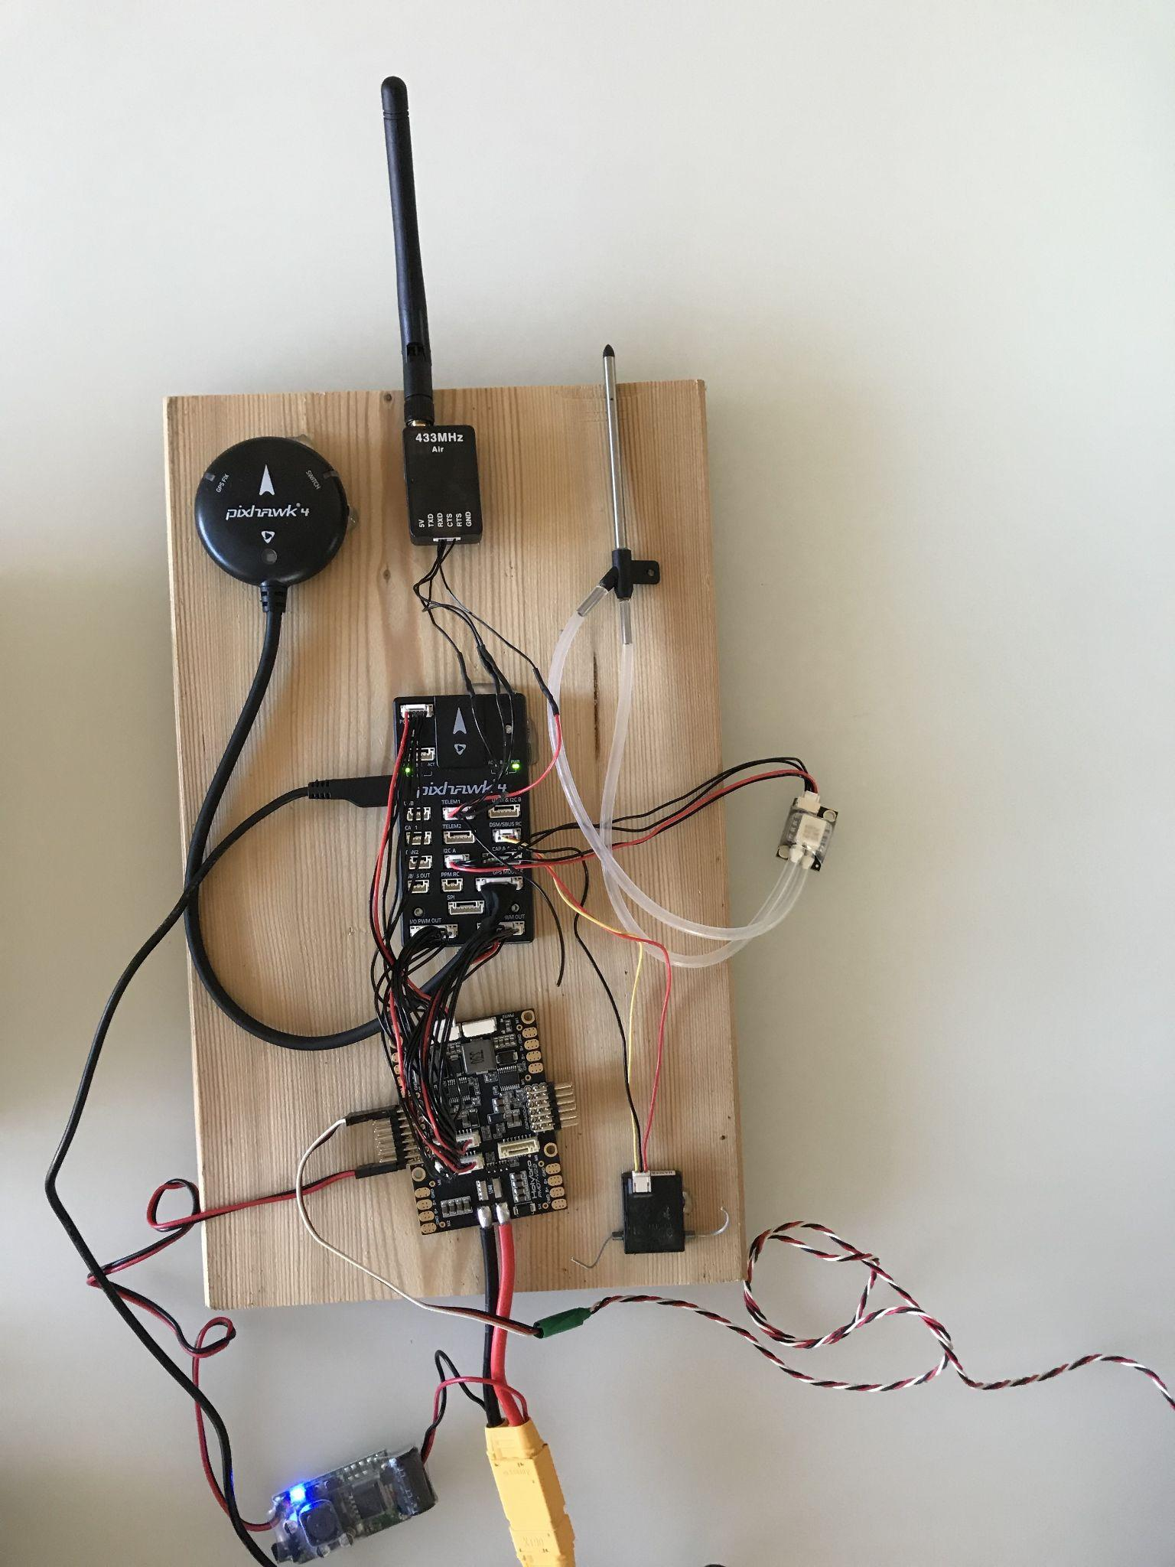
Full Avionics Setup
Important Components
GPS Receiver Module
Digital Airspeed Sensor (I²C) and Pitot Tube
RC Receiver
Power Management Board (PMB)
UBEC Voltage Regulator
Servo Connection
Battery Connection
5 | Capability with COTS airframe
Feasibility Analysis

Slide 32
Summary
Notes:
Recap baseline design with aspects shown to be feasible vs. studies still needed
summary table(delete reasons)/highlight/gantt chart/future work/cost

Slide 33
Summary of Feasibility Analyses
System | Feasible
Controls
Avionics Package
Software
Budget
Communication
Feasibility Analysis

Slide 34
Baseline design summary
Control System: LQT
Firmware: Ardupilot
Control Board: Pixhawk-4
Sensors: Sparkfun GPS-RTK board & physical airspeed sensor
GUI: Mission Planner
Airframe: Volantex Phoenix 2400
Power: Turnigy LiPo Pack + PM07 PMB
Summary
Notes:
will be completed later

Slide 35
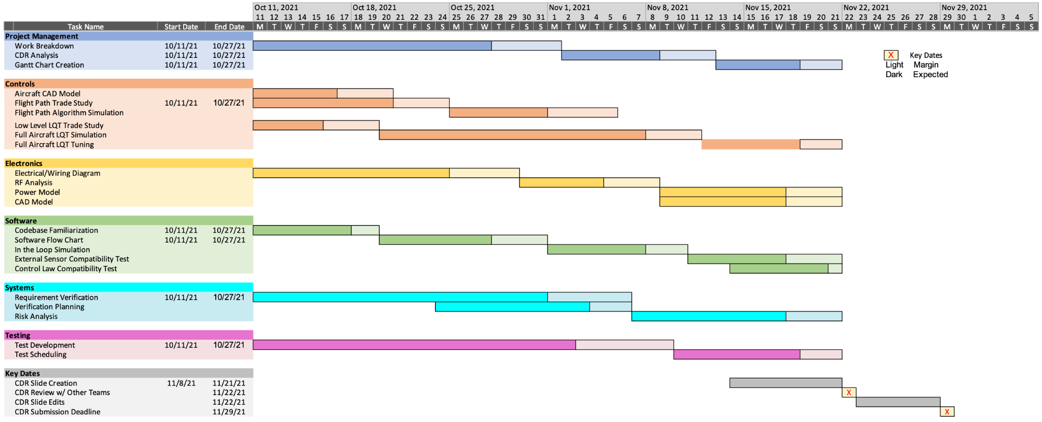
Gantt Chart
Summary

Slide 36
Future work
Summary
Controls
Expanding baseline simulation to full aircraft state
Tuning cost matrices based on simulation results
Further analysis to determine optimal trajectories and velocities for endurance
Software
Familiarity with code
Create code flow chart
Code modification
SITL simulation
Sensors/Control law test
Electronics & Avionics
Draw the overall electrical diagram
RF analysis
Simulation
CFD data for chosen airframe
Summary

Slide 37
Acknowledgements
We would like to thank to Dr. Rafi and the other PABs for advising us on our design project process.
We would also like to thank our TFs Emma and Colin for their support in advising our project.
Finally we would like to thank our customer Professor Mah.
Summary

Slide 38
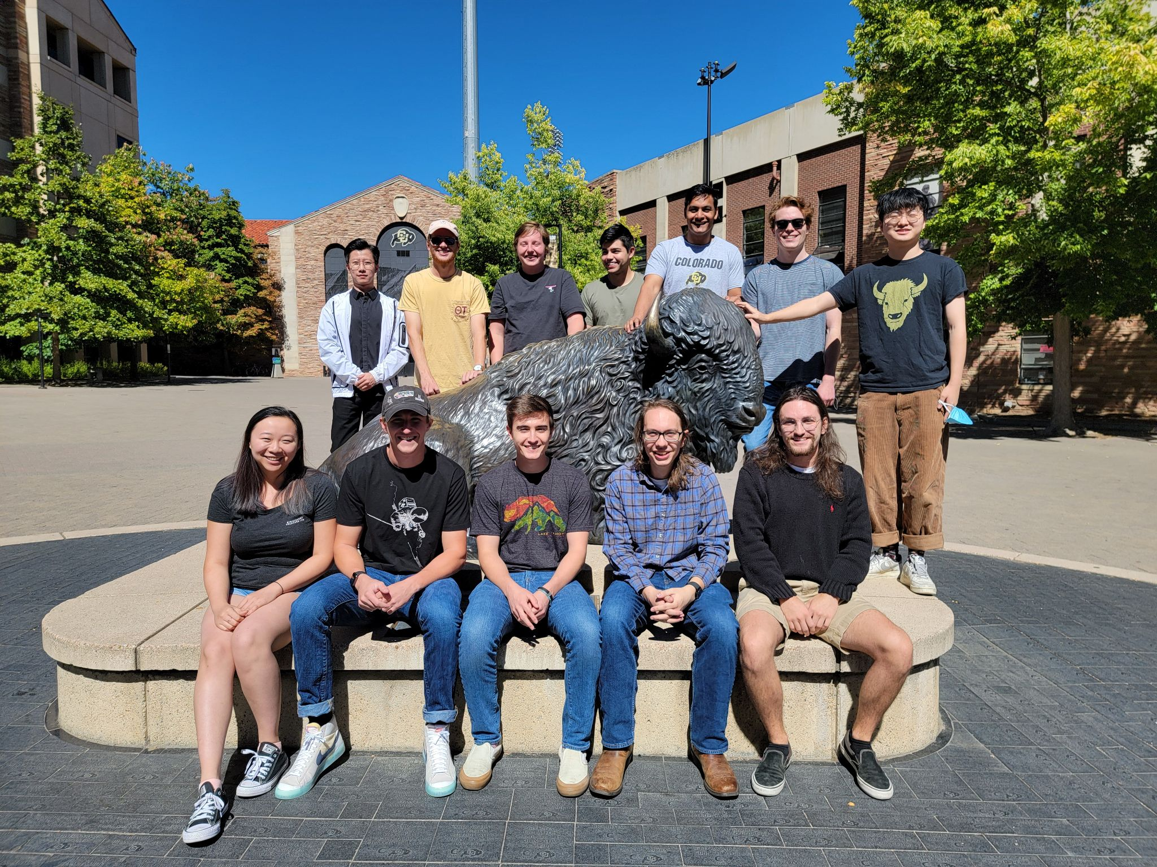
Questions?

Slide 39
Backup Slides
Notes:
Recap baseline design with aspects shown to be feasible vs. studies still needed

Slide 40
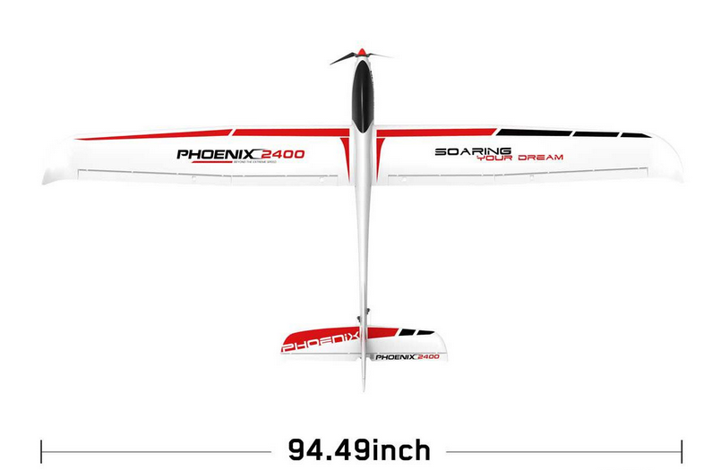
Airframe
Selected Design
Volantex 759-3 Phoenix 24
Features
Launchable by a Single User (FR-06)
Light
Standard Control surfaces
Integrates with Flight Controller
Large Capacity
Backup Slide

Slide 41
Flight Controller Firmware
Selected Design
Ardupilot
Features
Open Source
Simulation Capability
Adaptable to a Variety of Vehicle Configurations (FR-04)
Well Documented
Supports Autonomous Flight
Modifiable
Backup Slide

Slide 42
Flight Control Board
Selected Design
Pixhawk 4
Features
Pre-installed sensor suite
Compatible with a variety of fixed wing aircraft and control surfaces (FR-04)
Compatible with Ardupilot
Vibration Isolated IMU
Capable of On Board Storage
Industry Standard
Backup Slide

Slide 43
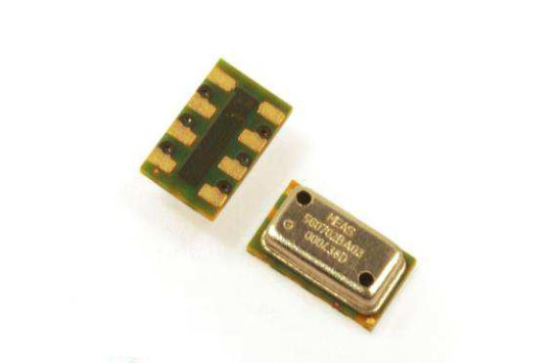
Sensors - Altitude Sensor
Selected Design: On-Board Barometer
Features:
Provides altitude sensing to stay within the mission altitude block.
Precise enough to fulfil mission requirements.
Pre-included in the Pixhawk, no added weight or price.
Backup Slide

Slide 44
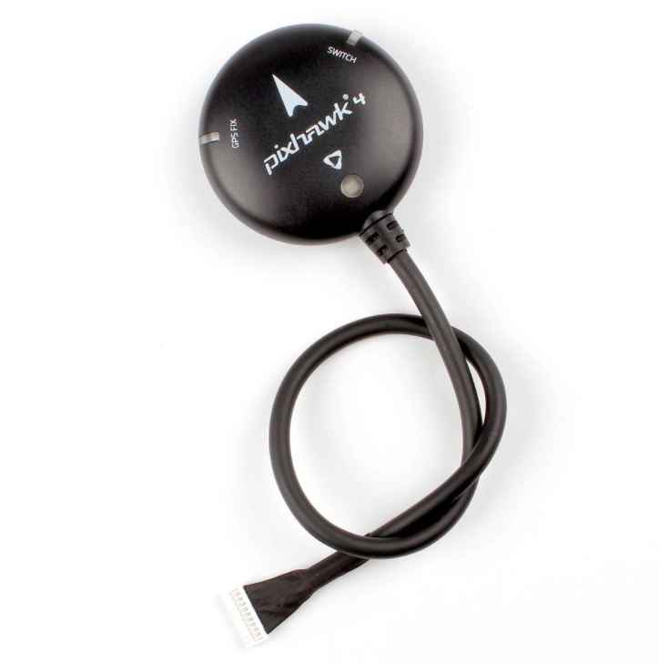
Sensors - GPS Receiver
Selected Design: Holybro M8N GPS Module
Features:
Built in compass
Accuracy up to a few meters
18 Hz update rate
Protective case
Plug and play with Pixhawk
Backup Slide

Slide 45
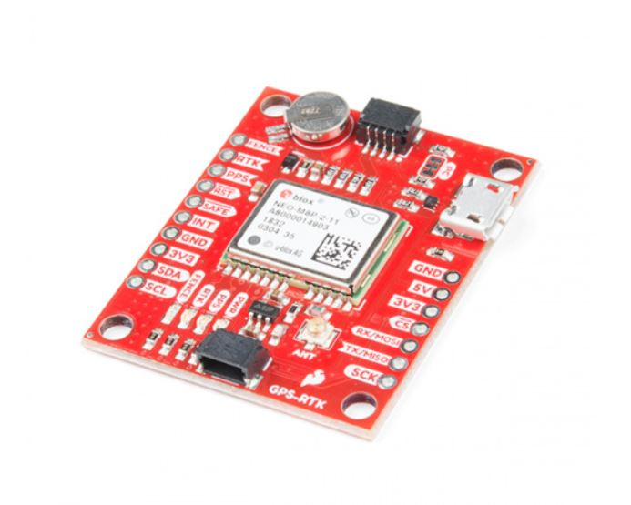
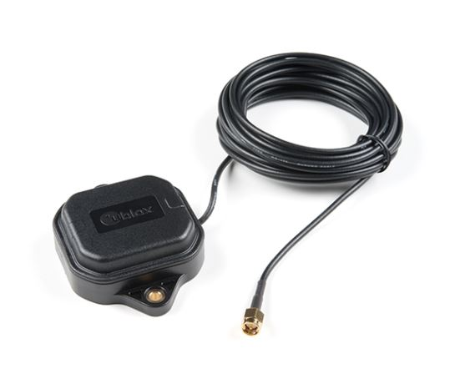
Sensors - RTK - GPS
Selected Design
Sparkfun GPS-RTK Board - NEO-M8P - 2
Features
Real Time Kinematics upgrade
Positioning accuracy of 1 centimeter
Used as a base station to provide correction data
Backup Slide

Slide 46
Sensors - Airspeed Sensor
Selected Design
Tuned Extended Kalman Filter (EKF) with physical airspeed sensor
Features
Physical pitot tube - pressure transducer
Ardupilot has a base extended Kalman filter included in the software
Tuning the EKF will allow us to optimize the endurance of the UAS
Backup Slide

Slide 47
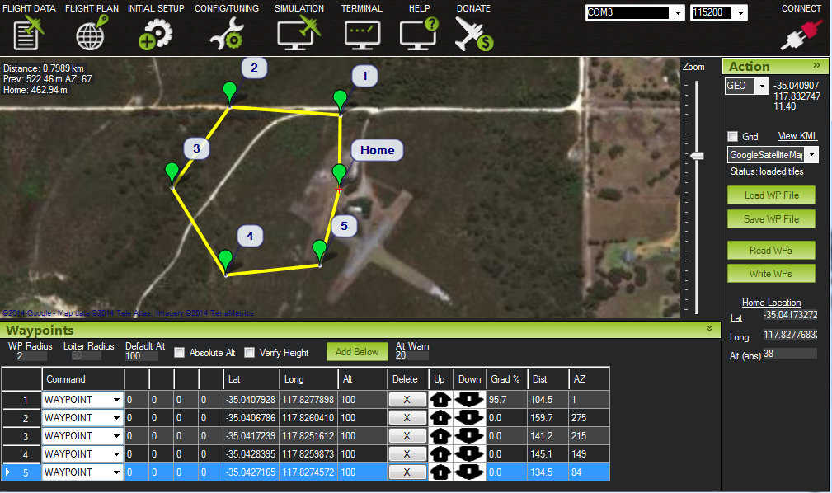
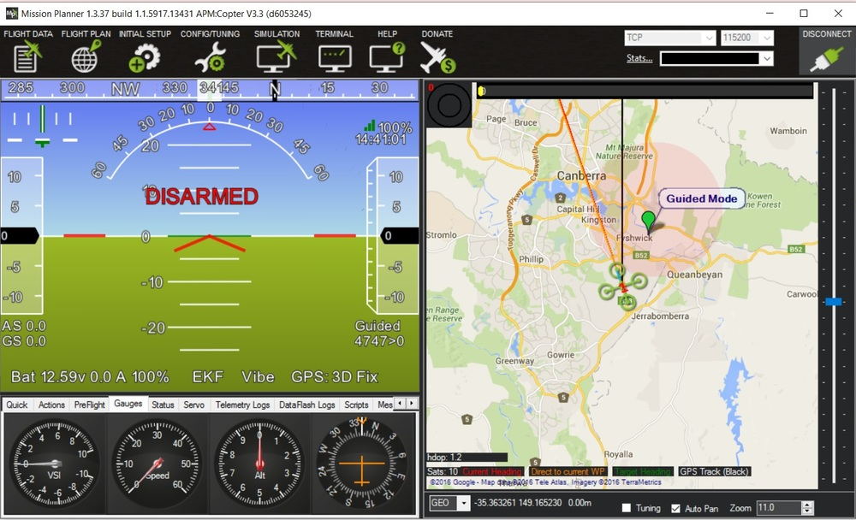
Ground Controller and UI
Selected Design
Mission Planner
Features
Open Source
Compatible with Ardupilot
Endorsed by Ardupilot
Customizable
Well Documented
Backup Slide

Slide 48
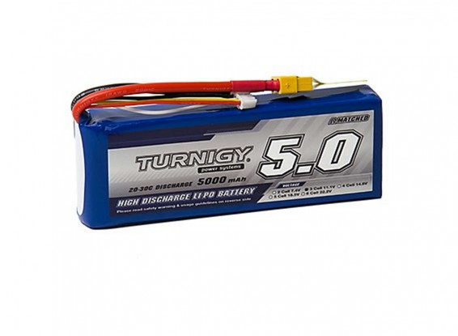
Feasibility Analysis: Avionics - Battery (Turnigy)
Battery Specifications
Features
Lightweight
Large capacity
Medium discharge rate to ensure motor and system as a whole powering capabilities
Capacity | 5000mAh
Discharge Rate | 20C
Size | 143 x 51 x 23mm
Weight | 360g
Turnigy LiPo Pack
Backup Slide

Slide 49
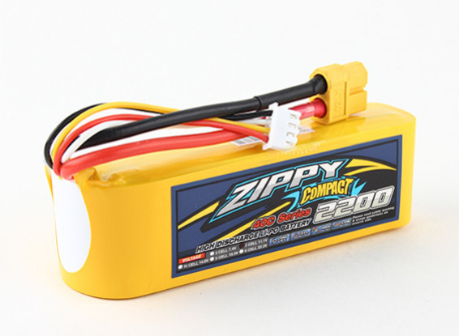
Feasibility Analysis: Avionics - Battery (Turnigy)
Battery Specifications
Features
Lightweight
Medium capacity
High discharge rate to ensure motor and system as a whole powering capabilities
Capacity | 2200mAh
Discharge Rate | 40C
Size | 109 x 34 x 27mm
Weight | 196g
ZIPPY Compact
Backup Slide

Slide 50
Feasibility Analysis: Power Management
Using the Turnigy LiPo 5000 mAh battery pack and researching the average power draw for our aircraft and the pixhawk, the following results were found:
Component | Current Draw(mA)
Pixhawk 4 | 175
Servos/Propeller | ~2000(based off of a 70 W/lb. requirement)
Sensors | 110
Total Current Draw(mA): | 2285
Battery Capacity(mAh): | 5000
Battery Life(hours): | ~2.2
Backup Slide

Slide 51
Feasibility Analysis: Avionics - Power Management Board
Electrical Specifications of Pixhawk 4:
Specifications:
Power module output: 4.8-5.5V
Max input voltage: 6V
Max current sensing: 120A
USB power input: 4.75-5.25V
Servo Rail Input: 0-36V
Electrical Specifications of PM07 Power Management Board(PMB):
Specifications:
PCB Current: 120A max output
UBEC 5v output current :3A
UBEC input voltage : 7~51v (2~12s LiPo)
Backup Slide
Notes:
ADD UCEB

Slide 52
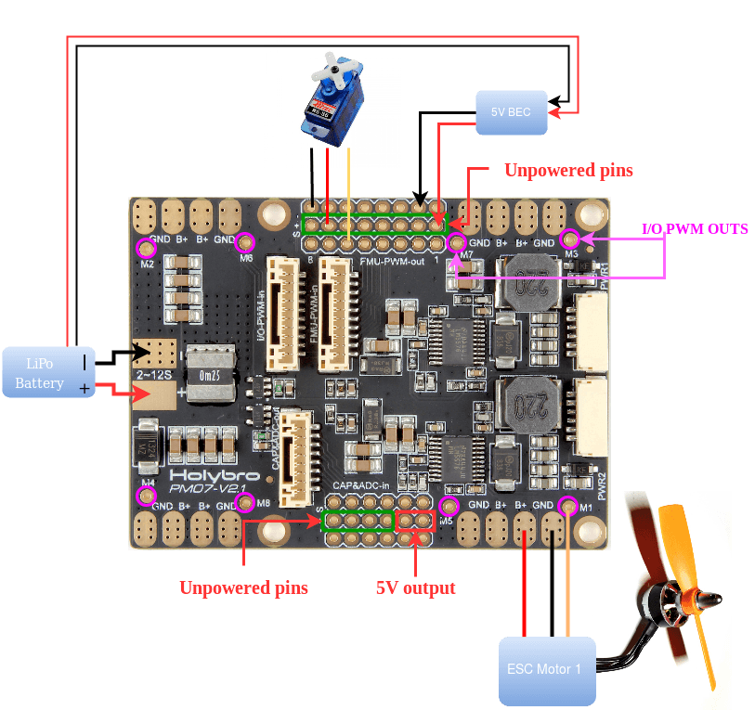
PM07 Wiring Diagram
Backup Slide

Slide 53
Pixhawk 4: Previous Work
Industry standard
Used in past senior projects
Votrex, EMU, NESSIE, BUBO BUBO
Other projects
S500 V2 - holybro
X500 - holybro
IRSS
DeltaQuad
Backup Slide

Slide 54
Coms
Considerations
Receiving input from manual control at ground station
This includes controlling the aircraft using a manual controller from the ground, also includes initial configuration of system to allow for user input
Telemetry logging, either streaming data live or saving to onboard flash memory
Backup Slide

Slide 55
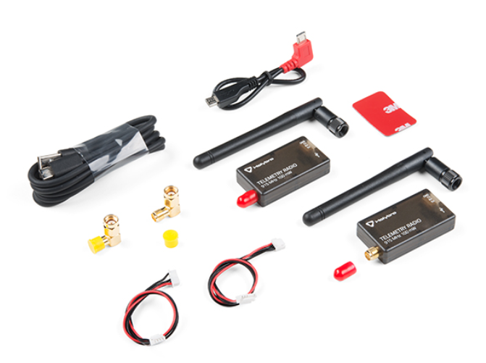
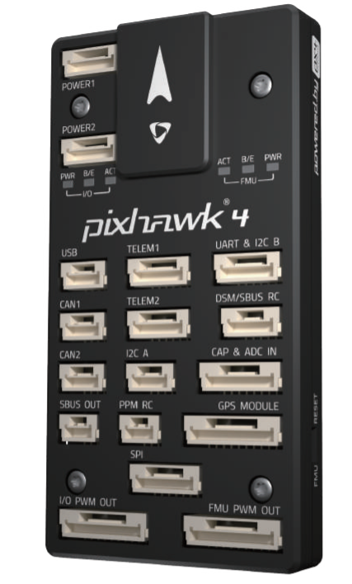
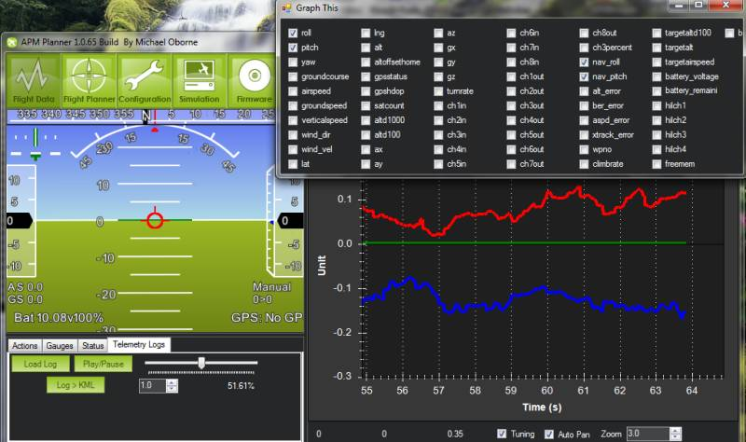
Coms - Telemetry and Data Communication
Wireless
Pixhawk 4 has a built in telemetry port that can be used to data transmission during flight
SiK Radio($50) can be used to send telemetry data to Mission Planner during flight
Wired
Pixhawk 4 has a built in SD card(Free) that can store telemetry data, this data can then be loaded and into Mission Planner for analysis
Both of these options cost no more than $50 and Ardupilot has created extensive walkthroughs for implementation of both
Backup Slide

Slide 56
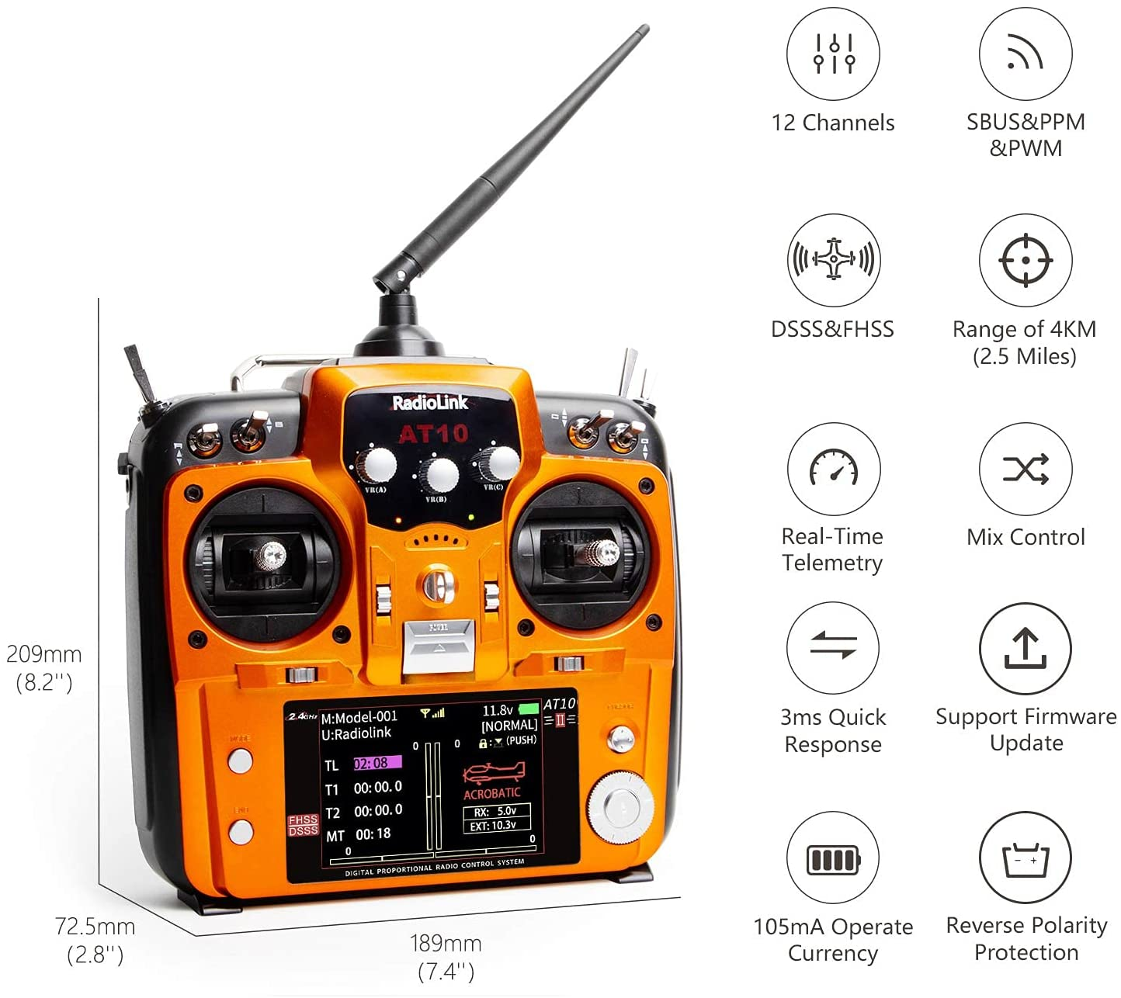
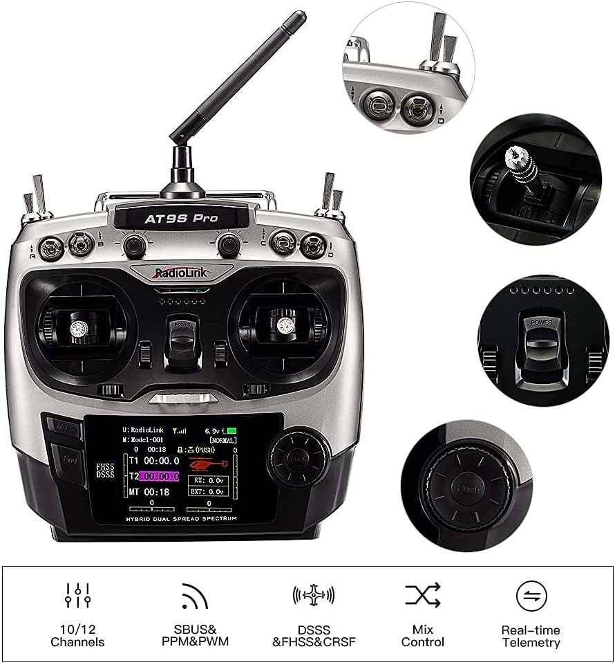
Coms - Manual Control & User Input
Pixhawk 4 has a built in DSM/SBUS RC port that can be used to input manual control
Components that are needed: Controller and RC Receiver
AT10II or AT9S from RadioLink, both of which come with RC Receivers to be used with Pixhawk 4
All initial use parameters can be entered through Mission Planner using the parameter tree feature
ArduPilot has extensive information and walkthroughs for RC Controller setup and parameter input to make these processes easy
Backup Slide

Slide 57
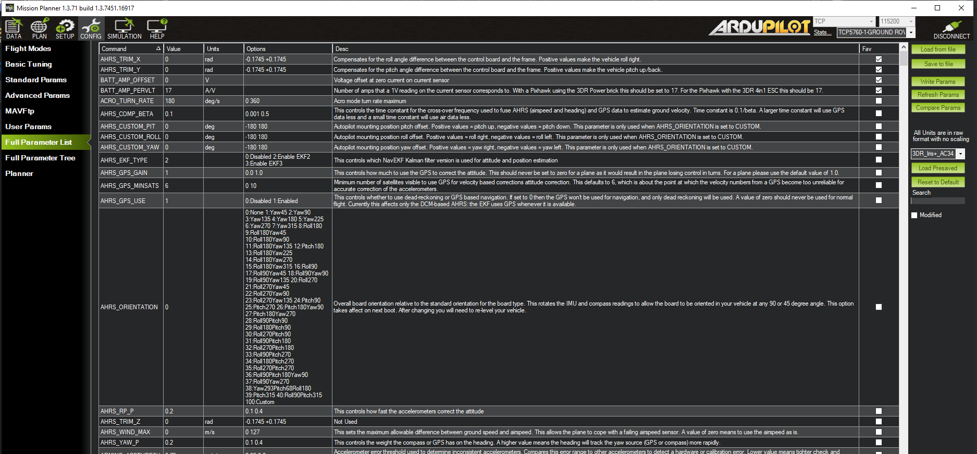
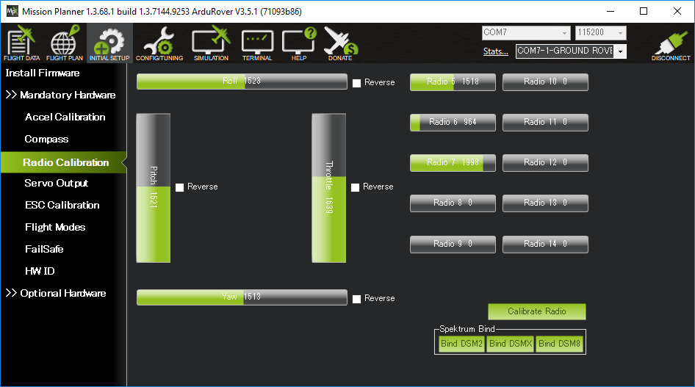
Coms - Manual Control & User Input
Backup Slide

Slide 58
Controls - Control Laws Comparison
 | Pros | Cons
PID | Improved Stability Simple to implement Reduces steady-state error | Performance of controller will vary in non-linear systems High noise in derivative portion Low robustness Difficult to tune parameters for unstable systems
LQR | Computationally efficient Robust Fixed control gain can be used for each trajectory | Not as useful for non-linear systems Requires knowledge about the state of the object which is not always possible Increased energy consumption
LQT | Decreased energy consumption More accurate tracking Control gains already contain trajectory info | Each trajectory requires separate control gain calculations
Backup Slide

Slide 59
Controls - Cost Function
The above is the discrete time finite horizon cost function
Q, R set relative weights of state deviation and input usage
Minimized to find u* the ideal input using the algorithm described in feasibility analysis.
Notes:
We solve the DT riccati eqn in the feasibility analysis slides that uses J to solve for U*.
Q is positive semi-definite
R is positive definite

Slide 60
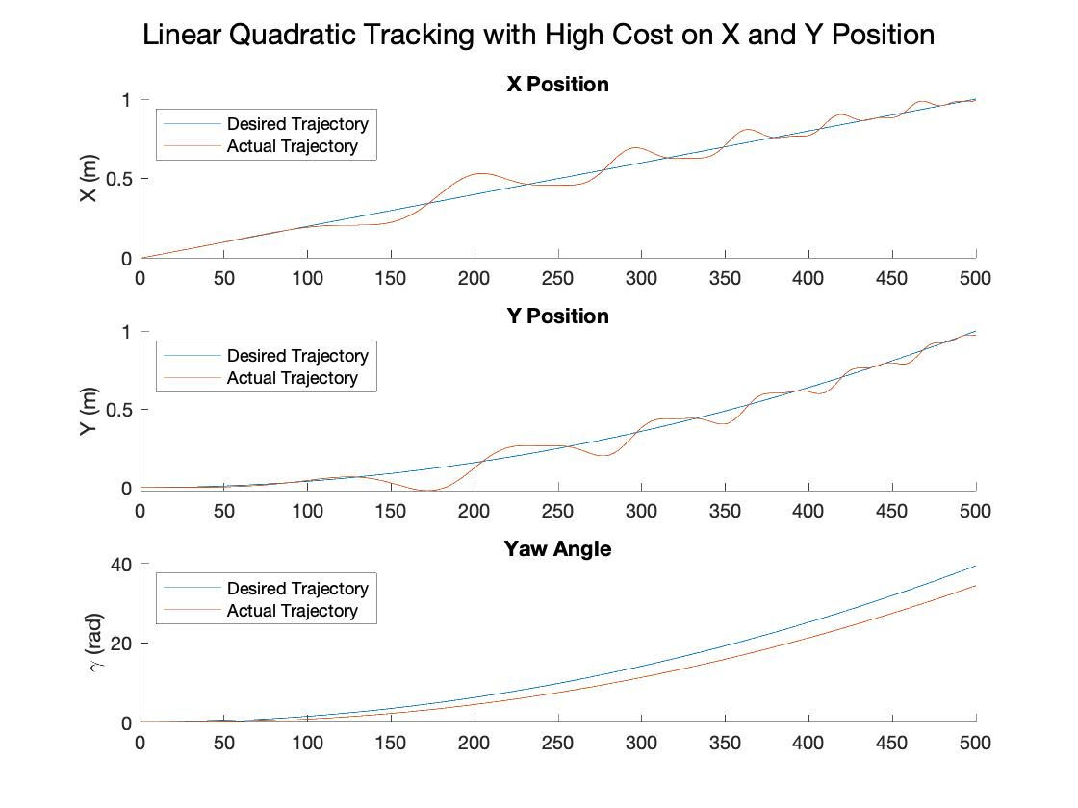
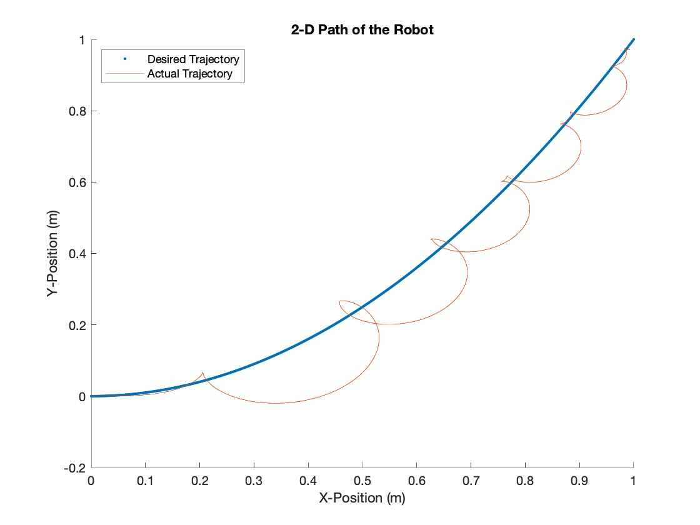
Controls - Additional Simulation Results
Notes:
Interesting example of how the algorithm will track a trajectory given conflicting physical constraints. Also how the X and Y look relatively accurate over the left plot but considerably worse over the right.

Slide 61
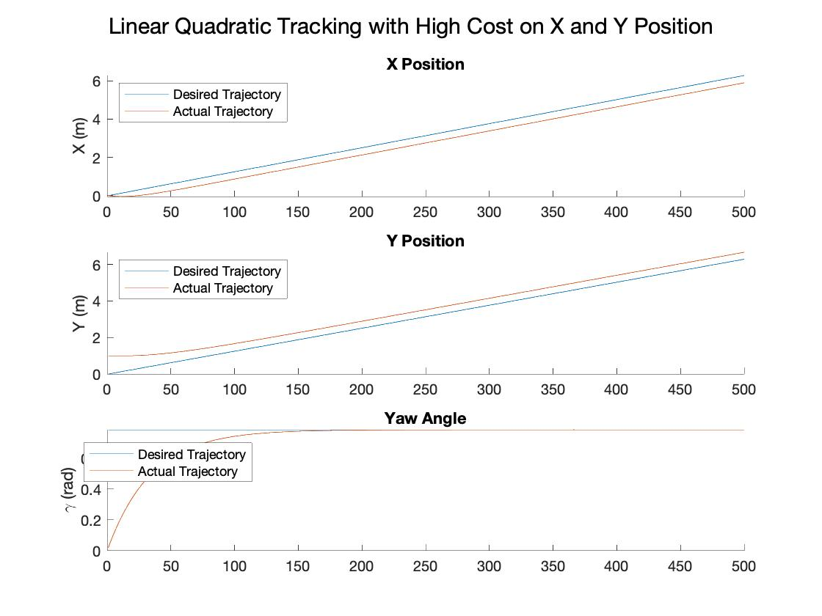
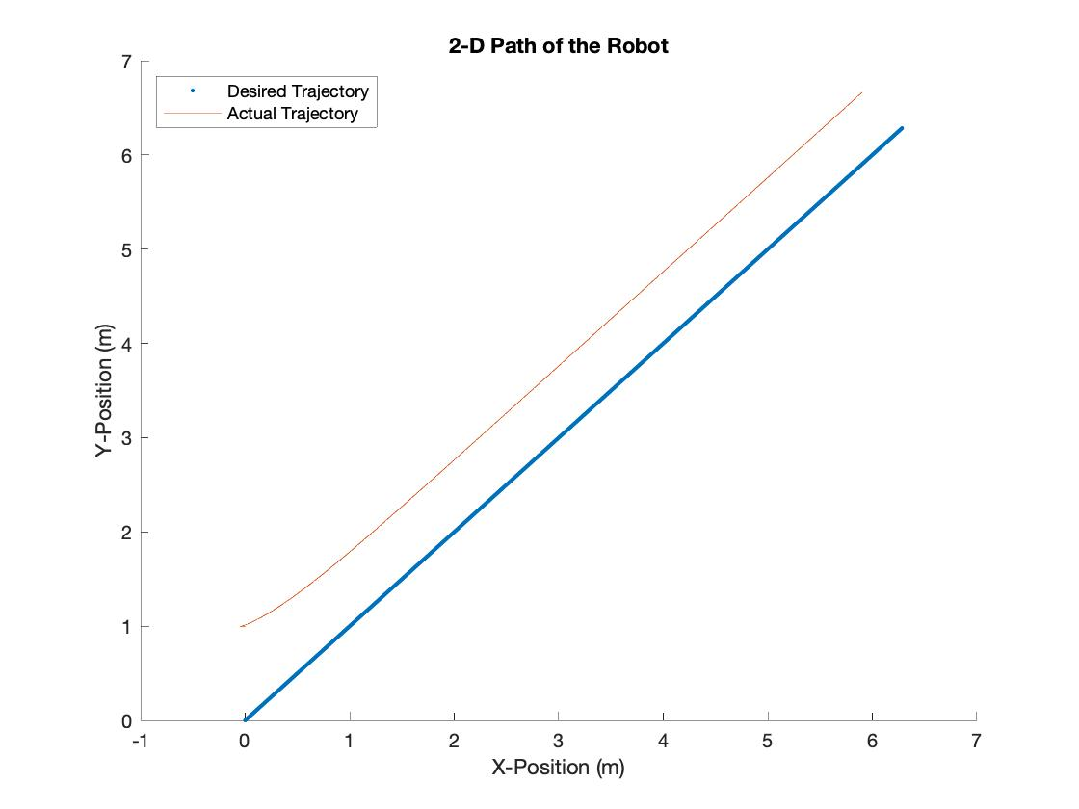
Controls - Additional Simulation Results
Notes:
Example of how the tracker will correct to a SS error based on the dynamics and input matrix B for this system

Slide 62
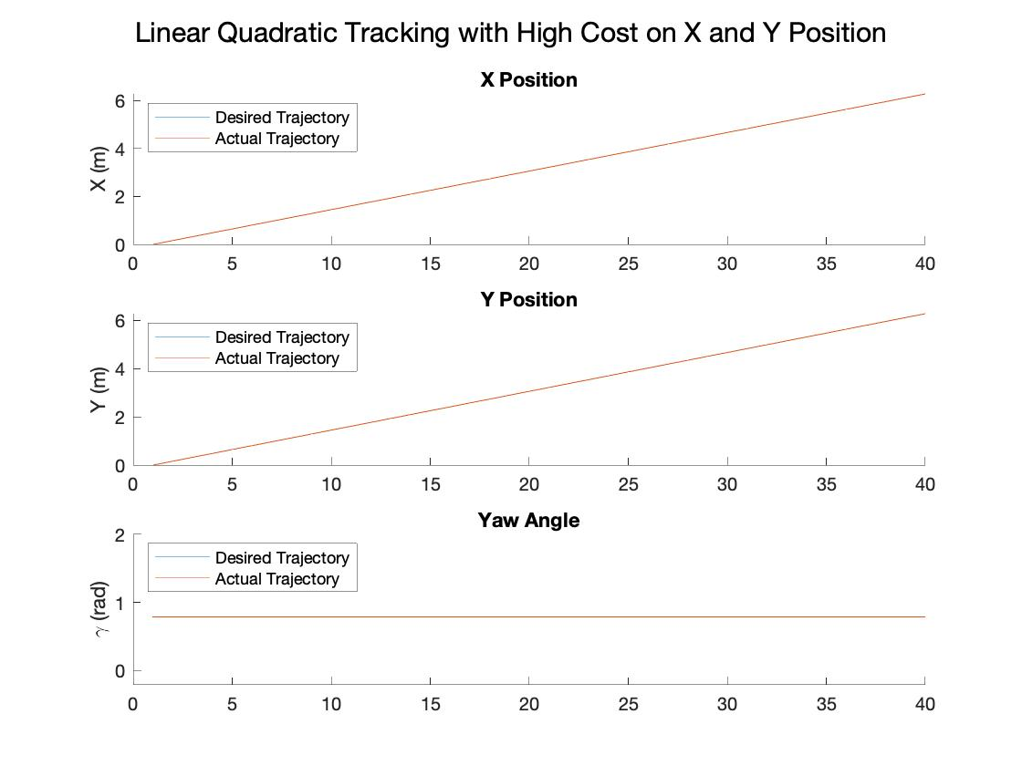
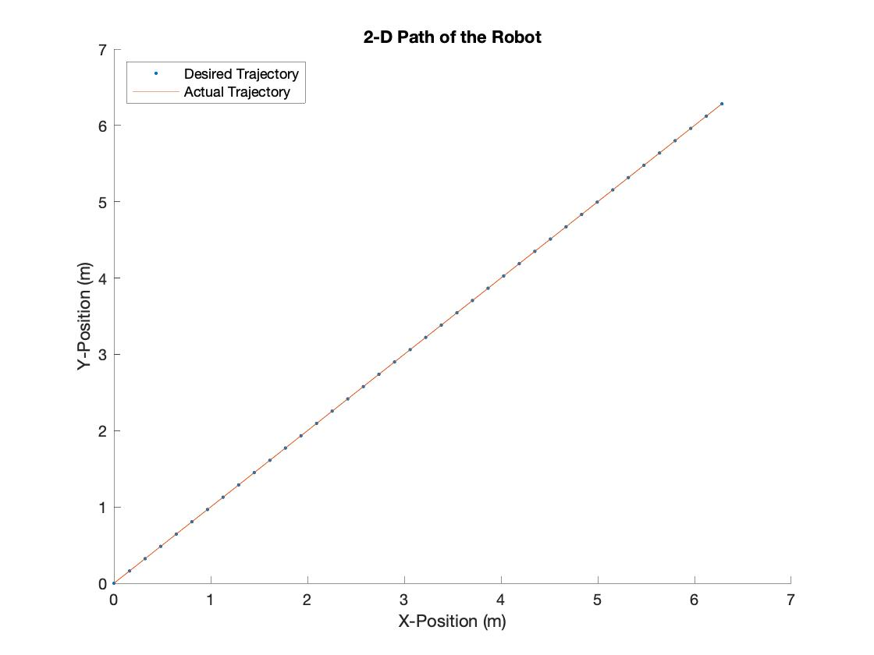
Controls - Additional Simulation Results
Notes:
Perfect Linear tracking - was reliant on good initial state
Shows that some of the behavior you get it just choosing a good trajectory based on the physical limitations of the system
The error will be drive smaller if we give it more than one iteration to get to the next trajectory point though

Slide 63
Verification and Validation Feasibility
Functional Requirement | Test 1 | Test 2
FR-01: Cost | Inspection: Finance officer will verify the cost does not exceed $1000 USD for the package
FR-02: Software | Demonstration: The mission parameters will be inputted into the Flight Software and the test team will verify that the UAS software optimizes flight trajectory. | Test/Analysis: The UAS will undertake the same mission profile being flown manually and autonomously. The flight time and battery usage will be monitored and compared between the two flights.
FR-03: FAA Guidelines | Inspection: The UAS will be weighed to show that it is less than 55 lbs as per FAA guidelines.
FR-04: Adaptability | Demonstration: The UAS will undergo static and non-static testing on the standard aircraft picked in the trade studies and HERD-CU Phase 1a’s aircraft to demonstrate that the software can be used on different systems. | Analysis: The control algorithms used will have software scripts created to show that the control laws in the software will correctly respond to inputs and output signals that would control the control surfaces and propulsion system.
FR-05: Mission Capability | Test: The UAS shall be left on standby mode aircraft and then be operated after 4 hours to show that the mission capability is maintained.
FR-06: Ease of Operation | Demonstration: A single operator will operate the UAS through a full mission profile from loading the parameters to recovering the UAS.
FR-07: Recovery & Return | Demonstration: Verify that the UAS autonomously returns to a recoverable state when switched into the recovery software mode.
Backup Slide

Slide 64
Financials
System |  | Cost
Unit Cost (x2) |  | $1,806
 | Flight Controller Package | $280
 | Air Speed Sensor | $49
 | GPS-RTK Board Ground | $224
 | Battery | $25
 | Ground Controller | $160
 | Telemetry System | $40
 | Misc/Shipping | $125
Testing |  | $506
 | Airframe (x2) | $306
 | FAA License | $200
Miscellaneous |  | $1,000
Total |  | $3,312
Excess |  | $1,688
Backup Slide

Slide 65
Functional Block Diagram - With Flow Labeled
Backup Slide

Slide 66
Acronyms Part 1
RALPHIE - Rapid Autonomous Loiter Program for Highly Increased Endurance
UAS - Unmanned Aerial System
RMC - Full Mission Capable Rate
IMC - Instrument Meteorological Conditions
LQT - Linear Quadratic Tracker
EKF - Extended Kalman Filter
PMB - Power Management Board
RC - Radio Control
IMU - Inertial Measurement Unit
RAM - Random Access Memory
GPS - Global Positioning System
Backup Slide

Slide 67
Acronyms Part 2
RTK - Real Time Kinematics
FAA - Federal Aviation Administration
GUI - Graphical User Interface
PWM - Pulse Width Modulation
DSM - Digital Spectrum Modulation
COTS - Commercial Off-The-Shelf
ECS - Essential Control Surfaces
I/O - Input/Output
UBEC - universal battery eliminator circuit
PCB - Printed Circuit Board
LiPo - Lithium Polymer
Backup Slide

Slide 68
Acronyms Part 3
LQR - Linear Quadratic Regulator
PID - Proportional Integral Derivative
FSW - Flight Software
Backup Slide

Slide 69
References
Coms:
Radiolink.com. AT10II 12 channels transmitter for racing drone, fixed wing, helicopter, glider, cars and boats. [online] Available at: <https://www.radiolink.com/at10ii> [Accessed 11 October 2021].
Ardupilot.org. 2021. Mission Planner Features/Screens — Mission Planner documentation. [online] Available at: <https://ardupilot.org/planner/docs/mission-planner-features.html> [Accessed 11 October 2021].
Serial Telemetry Radio Kit - 915MHz, 1., 2021. Serial Telemetry Radio Kit - 915MHz, 100mW - WRL-15007 - SparkFun Electronics. [online] Sparkfun.com. Available at: <https://www.sparkfun.com/products/15007> [Accessed 11 October 2021].
Avionics:
Hobbyking. Turnigy 5000mAh 3S 20C LiPo Pack w/XT-60. [online] Available at: <https://hobbyking.com/en_us/turnigy-5000mah-3s-20c-lipo-pack-xt-90.html> [Accessed 11 October 2021].
diydrones. 2021. Pixhawk (and APM) Power Consumption. [online] Available at: <https://diydrones.com/profiles/blogs/pixhawk-and-apm-power-consumption> [Accessed 11 October 2021].
theParkPilot.org. Brushless Motor Basics. [online] Available at: <https://www.theparkpilot.org/brushless-motor-basics> [Accessed 11 October 2021].
Holybro.com. [online] Available at: <http://www.holybro.com/manual/PM07-Quick-Start-Guide.pdf> [Accessed 11 October 2021].
Controls:
Automaticaddison.com. Linear Quadratic Regulator (LQR) With Python Code Example – Automatic Addison. [online] Available at: <https://automaticaddison.com/linear-quadratic-regulator-lqr-with-python-code-example/> [Accessed 11 October 2021].
Etd.lib.metu.edu.tr. 2021. [online] Available at: <https://etd.lib.metu.edu.tr/upload/12617592/index.pdf> [Accessed 11 October 2021].
Stanford.edu. 2021. [online] Available at: <https://stanford.edu/class/ee363/lectures/dlqr.pdf> [Accessed 11 October 2021].
Software:
Sensors:
Learn.sparkfun.com. Setting up a Rover Base RTK System - learn.sparkfun.com. [online] Available at: <https://learn.sparkfun.com/tutorials/setting-up-a-rover-base-rtk-system/all> [Accessed 11 October 2021].
Ardupilot.org. Using an Airspeed Sensor — Plane documentation. [online] Available at: <https://ardupilot.org/plane/docs/airspeed.html#arspd-sensor-list> [Accessed 11 October 2021].
Miscellaneous:
Backup Slide
Notes:
plz drop links here!!!

Slide 70
Project Feasibility
Mission Statement /Use case conops/verification conops(Andreas) /FBD/functional requirements - Sunny
Baseline design - go through CDD Sean
Feasibility Analysis
Controls - Kidd Gina Lorenzo
Power Usage/Avionics/Computational Power, Sam Carson
Software - Andrew Cooper
Summary Dawei
Backup slides - environmental, spec sheets in backup
budget/time/Gantt chart, Carson Sunny
testing, Andreas Sean
Coms - Quinn Dawei
Backup Slide

