Slide 1
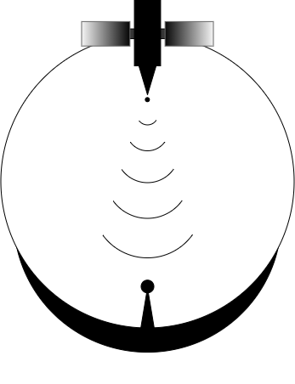
PROS8
Test Readiness Review
Point of Contact:
Sam Gagnard
Team Advisor:
Zoltan Sternovsky
Passive Radio Frequency Observation System 8
Quinton Nietfeld, Kieran O’Day, Colton Ord, Ryan Cameron, Yang Lee, Zaki Laouar, Zachary Arbogast, Mamdooh Alkalbani

Slide 2
Specific Objective
PROS8 is a satellite observation scoring and scheduling software that uses a passive radio frequency (RF) ground-station to determine and compare satellite observation opportunities. ​​

Slide 3
Key Terms
Two Line Element (TLE) Data – a data format encoding a list of orbital elements for Earth orbiting satellites​
Doppler Shift - change in frequency of a wave in relation to an observer who is moving relative to the wave source​
Radio Frequency (RF) – Electromagnetic waves with frequency ranging from 20kHz to 300 GHz. ​
L1 Band – Subset of Radio Frequency with a range of 1 – 2 GHz
Image Credit: NASA

Slide 4
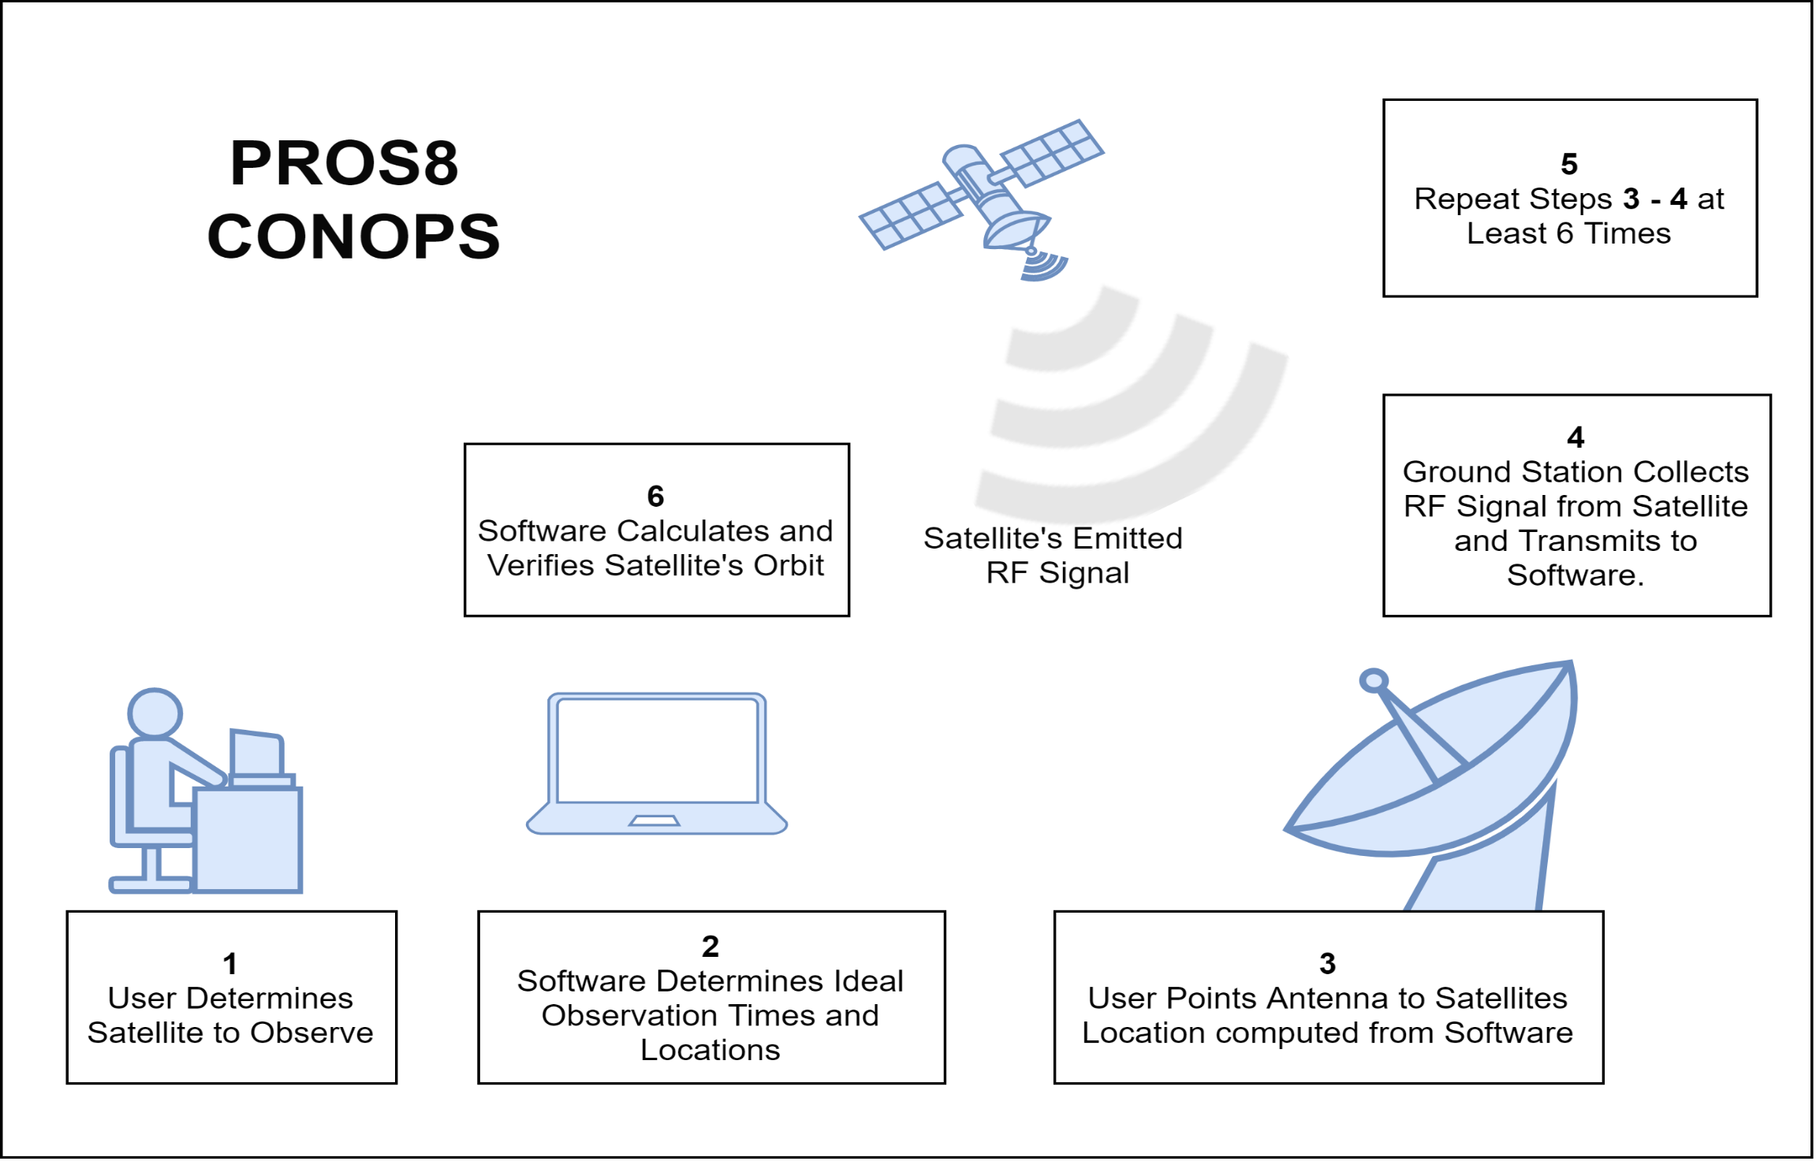

Slide 5
Functional Block Diagram

Slide 6
Critical Project Elements

Slide 7
Ground Station Design
Signal Reception – CPE1
Antenna Feed
Antenna Dish
Lowpass Filter
Low Noise Amplifier
Pointing Controls – CPE2​
Rotor
Controller
Signal Processing – CPE3
Software Defined Radio
GPS Disciplined Clock

Slide 8
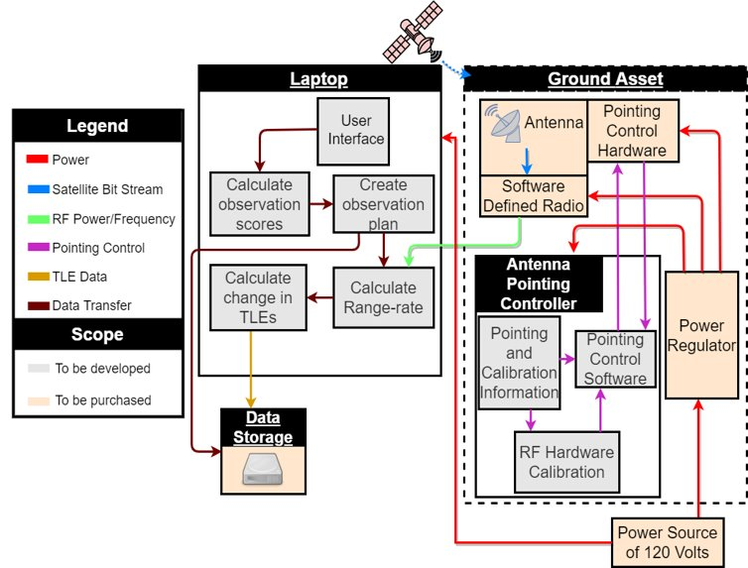
Software Design
Four main areas​
Scoring Software – CPE4​
Scheduling Software – CPE5​
Graphical User Interface​
Orbit Determination​
​
All are currently being developed or completed ​
All will integrate together to make a final software package​

Slide 9
Schedule

Slide 10
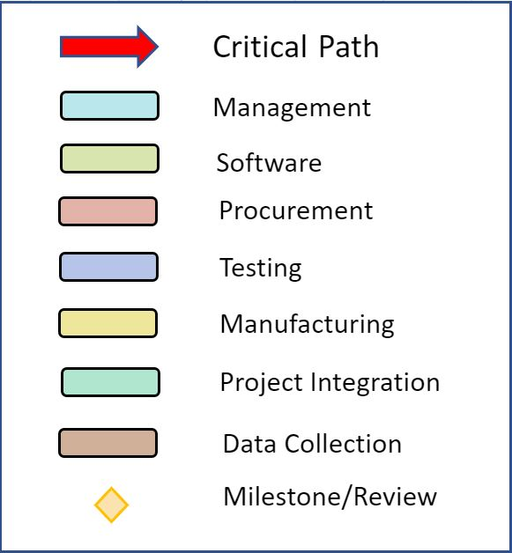
Gantt Chart
TRR
Testing
Manufacturing
Integration
Data Collection Begins
Data Collection
SFR
Expo
Project Close

Slide 11
Test Readiness

Slide 12
Functional Requirement 3
FR 3.0 | Convert L1 band analog RF signal into a digital signal

Slide 13
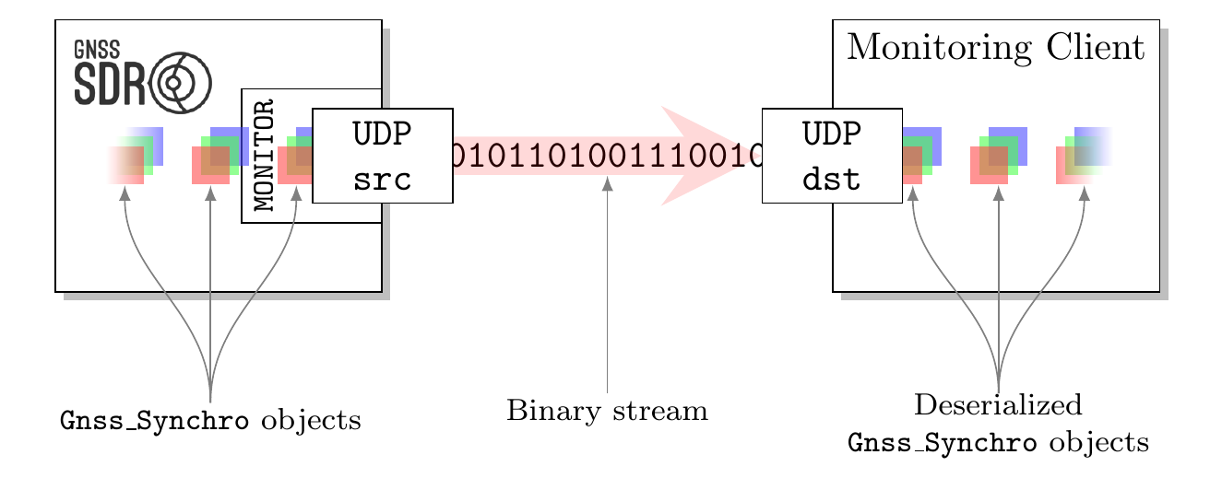
Monitoring the internal status of the software receiver
Objective/Rationale: Receive Doppler frequency shift of a given GPS satellite
Design:

Slide 14
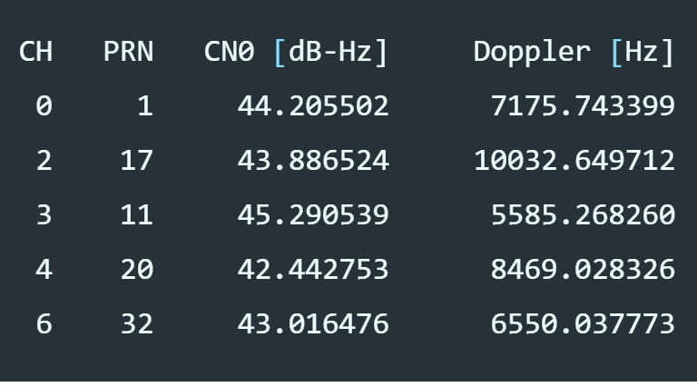
Facilities Needed: None
Expected Results: Print and update the PRN, CN0 and Doppler frequency shift for each channel on a terminal window while the receiver is running with the Monitor block activated
Risk Reduction: This test can confirm functionality of the software GPS receiver before full scale signal reception/processing is carried out

Slide 15
Functional Requirement 4
FR 4.0 | The scoring software shall provide scores for each planned observation and update orbit estimates after observation

Slide 16
Propagation Functional Test (Completed)
Retrieve TLE Data from www.space-track.org
Propagate TLE Data into a complete orbit using SGP4 algorithm (Simplified General Perturbation)
Compare propagated satellite position (azimuth, elevation, range) and the data available on online satellite tracking websites
Success: data matches up
Fail: else

Slide 17
Scoring Functional Test (In Progress)
Set up conditions where scores = 0 in software
No Line-of-Sight, below minimum elevation, weak signal ...etc.
Score should return 0
Other regular conditions
Each data point should return a score less than max score (100)
Expected results:
0 or number less than 100 for every data point

Slide 18
Scheduling Functional Test (In Progress)
Input a list of three satellites for initial testing
Set observation time frame
Set priority
Begin scheduling
Test cases
Completely unable to observe (no passes)
Prioritize satellite with highest priority (when observation time overlap)
Test Gantt Chart Generation
Should have a list of satellites to be observed and the time for observation
Expected Results:
Populated Gantt Chart for Choosen Satellites

Slide 19
Observation Schedule

Slide 20
Orbit Determination Functional Test (Completed)
Method
Use propogation algorithm to generate test data (6 frequencies)
Put generated data through an orbit determination algorithm
Output position and velocity vectors at nominal
Convert vectors to orbit elements
Expected Result
A complete set of orbital elements resembling test data input

Slide 21
Orbit Simulation Example (GPS BIIR 8)​
​ | Rx (km)​ | Ry (km)​ | Rz (km)​ | Vx (m/s)​ | Vy (m/s)​ | Vz (m/s)​
Truth​ Position &Velocity​ | 8192.2​ | 12225.3​ | 21925.6​ | -2554.96​ | 2940.54​ | -80.33​
PropagatedPosition &Velocity​ | 8192.2​ ​ | 12225.3​ ​ | 21925.6​ ​ | -2554.96​ ​ | 2940.54​ ​ | -91.54​
Percent Error (%)​ | 0​ | 0​ | 0​ | 0​ | 0 ​ | 13.96 ​
​ | i (deg)​ | e(dim less)​ | ω (deg)​ | Ω (deg)​ | Θ (deg)​ | a(km)​
Truth OrbitElements​ | 57.16​ | 0.129​ | 3.92​ | 310.22​ | 94.88​ | 26558.3​
PropagatedOrbit ​ Elements​ ​ | 57.18​ | 0.127​ | 4.23​ | 310.11​ | 94.64​ | 26561.7​
Percent Error (%)​ | 0.0242​ | 1.852​ | 7.69​ | 0.034​ | 0.28​ | 0.013​

Slide 22
Software Integration Test (In Progress)
Once all the individual components are tested and integrated
Test the entire software as a singular package
Perform all aforementioned functions
Not all functions produce outputs
Need to purposely modify for testing purposes
Reduce Project Risks by
Identifying potential bugs
Eliminate bugs
Improve functionality/effectiveness if deemed necessary

Slide 25
Functional Requirement 1
FR 1.0 | Receive RF signals from satellites in various conditions, with various orbital geometries

Slide 26
Electrical Continuity
Objective/Rationale: Confirm that all ordered parts transfer electrical signals as expected.
Design: For all "wire" portions, confirm that they output signals that are given as input. For all "PSU" portions, confirm the output voltages. For LNA confirm its gain. For external clock confirm output of 10 Mhz.
Facilities Needed: Aero electrical room next to pilot room, (multimeter, oscilloscope)
Expected Results: All components will function as listed in their data sheets (PSU will output correct voltages, clock will output 10Mhz, LNA will have ~14dB gain, wires transmit input signals)
Risk Reduction: This will narrow our debugging efforts when looking into our software bugs

Slide 27
Electrical Continuity (Completion)
"Wire" portions - Complete
"PSU" portions – Complete
LNA – Incomplete (March 6th Projected)
External Clock – Incomplete (March 26th Projected)

Slide 28
FEKO simulation
Objective/Rationale: To explore the sensitivity of our antenna pickup location
Design: FEKO is a CAD based software that uses meshes and solves Maxwell's equations iteratively. We will build our antenna within the program and vary our antenna pickup location according to the possible mounting locations on the given clamp.
Facilities Needed: FEKO simulation software
Expected Results: Sensitivity will allow for mounting with the provided focus point mount
Risk Reduction: This will reduce the risk that we obtain have lower gain values than we expect due to either a change in the offset angle of our dish or a reduction in its overall gain.

Slide 29
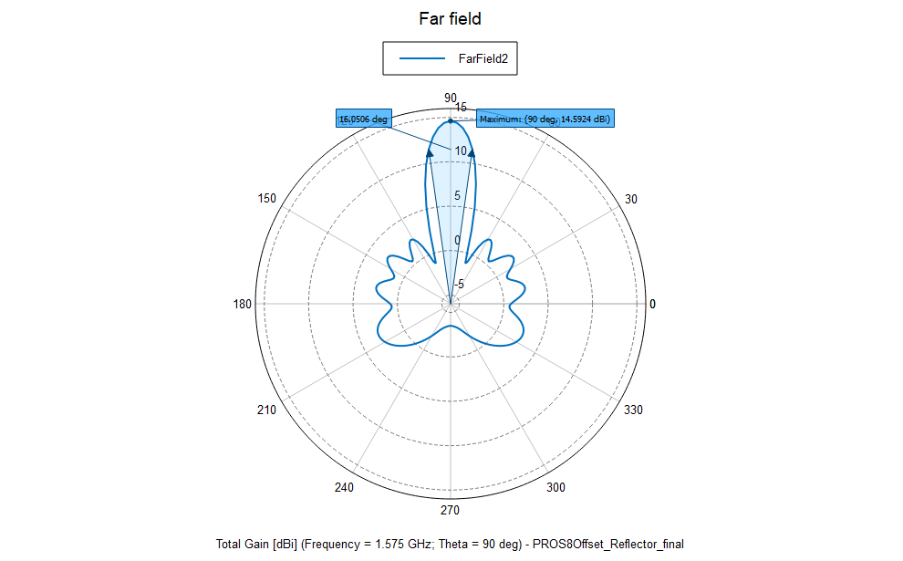
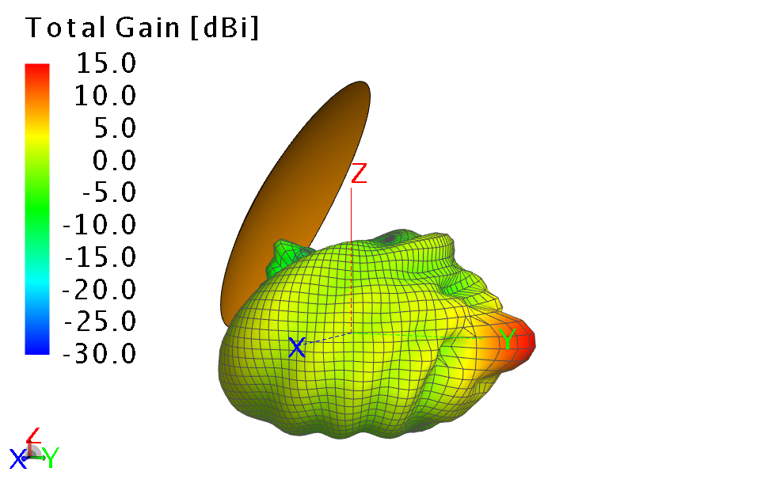
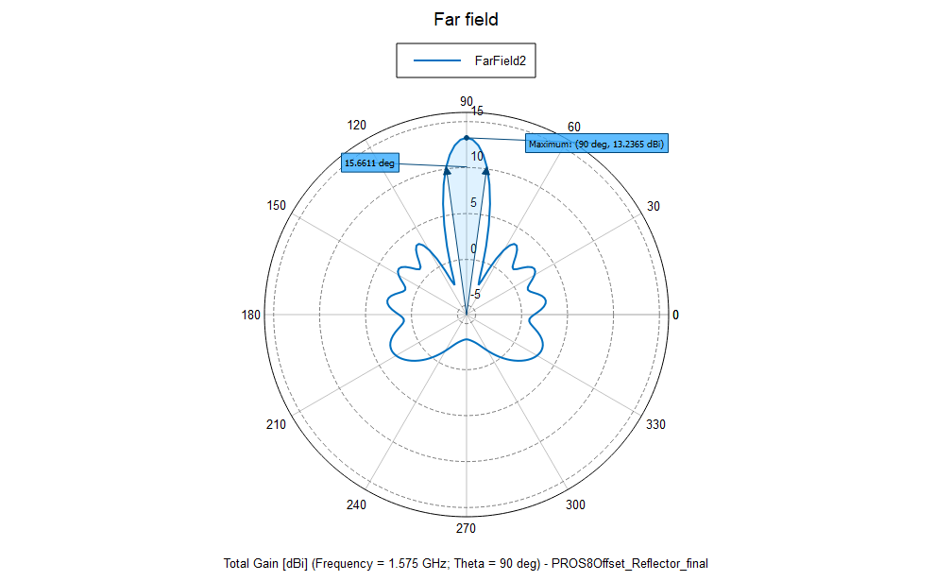
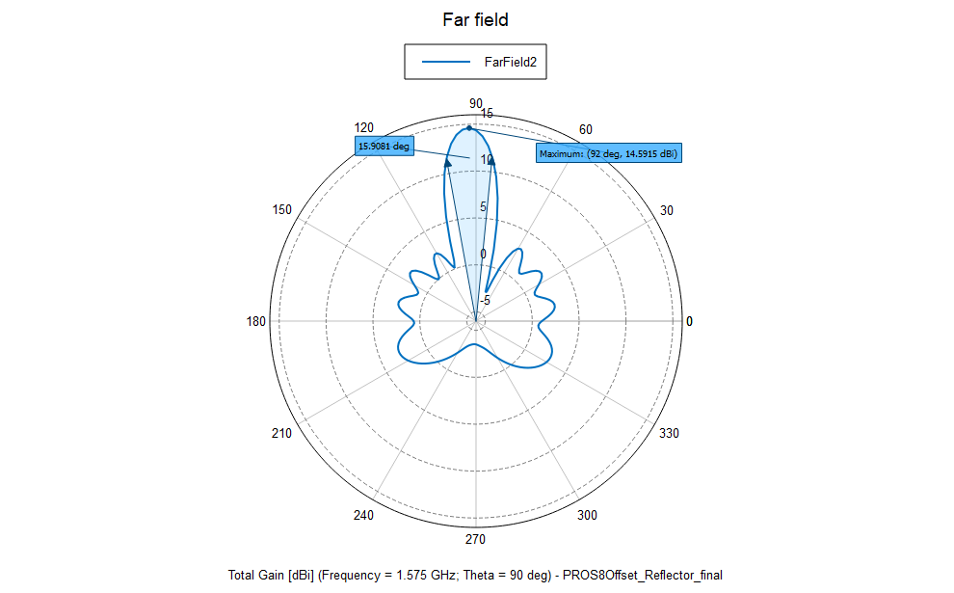
Complete
NOTES: All three changes showed less than a dB of gain affected/lost and next to no change in beamwidth
(+-) Z (+-) Y (+-) X

Slide 30
Gain
Objective/Rationale: To verify the gain of our antenna
Design: We will assemble the antenna and plug its output into our laptop. We will then manually point it at a GPS satellite using a protractor, compass. We will fine tune pointing by hand to discover the maximum gain our antenna is capable of. We will need a live FFT of the GPS signal viewable on our laptop in order to fine tune our pointing
Facilities Needed: Area with clear view of sky and hard ground, at least two people
Expected Results: Total gain of our antenna will be >15dBi
Risk Reduction: This will guarantee that our view of GPS satellites won't be limited by our antenna's gain

Slide 31
Beamwidth
Objective/Rationale: To verify the beamwidth of our antenna
Design: From the gain test, we will have two pieces of scrap wood to mark elevation and azimuth of the maximum gain. We then change its azimuth and elevation until finding the -3dB point respectively, marking each on the wood. We will then use a protractor to conclude what our horizontal and vertical beamwidths are.
Facilities Needed: Area with clear view of sky and hard ground, at least two people
Expected Results: beamwidth of our antenna will be 3<theta<20 degrees
Risk Reduction: This will validate our conditions for viewability in our scheduling software

Slide 32
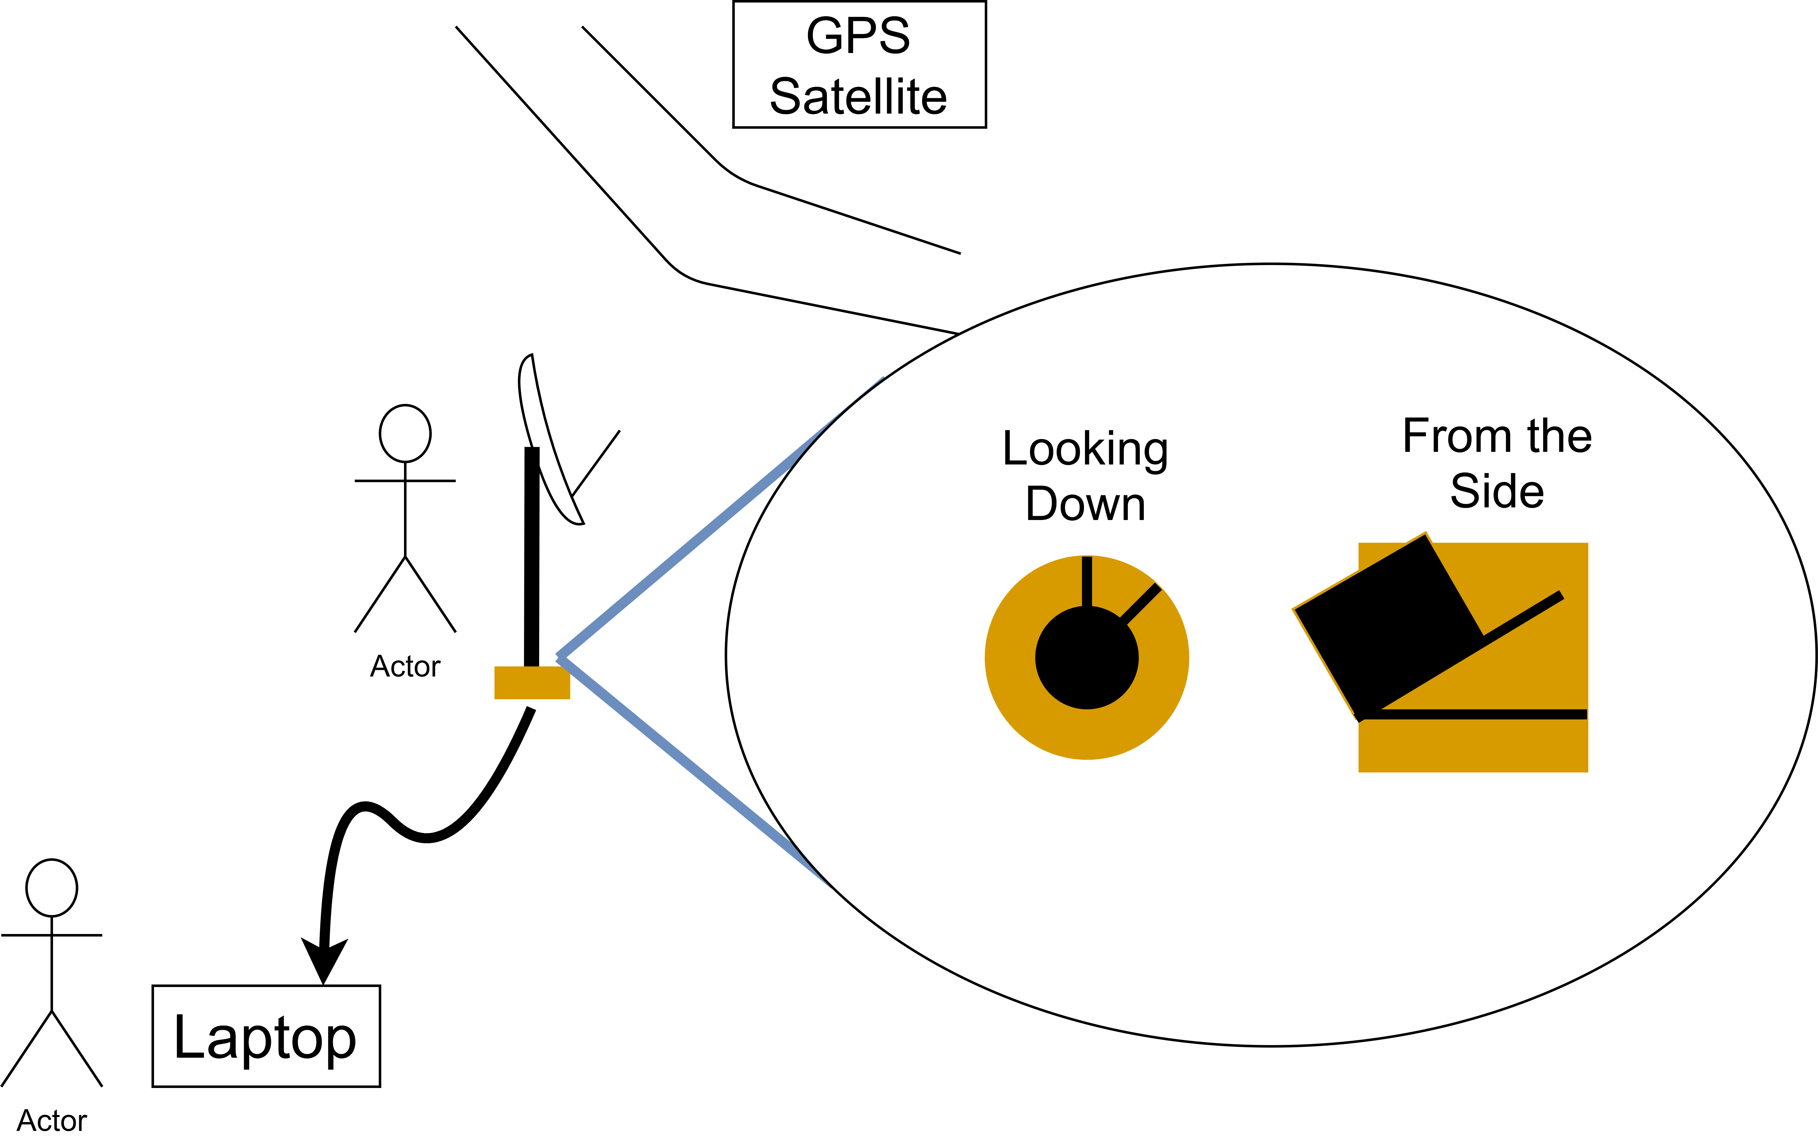
Status
Incomplete (March 14th Projected)

Slide 33
Functional Requirement 2
FR 2.0 | Point system along orbit path from manual input within a few degrees pointing accuracy

Slide 34
Pointing Controls Sub-System Test (In progress)
Objective: Ensure the pointing control system responds to commands and accurately points the antenna dish & receiver to a point in the sky (within a few degrees).
Design: The controller and rotor will be connected and powered via wall outlet. The dish will be mounted to the rotor to simulate true testing conditions. Manual inputs of corner cases of elevation and azimuth (true north, straight up, 180 degrees azimuth).
Facilities Needed: Power Supply (Wall outlet), senior projects room
Expected Results: Manual input into the pointing controls causes the dish and receiver to point to a specified point in the sky to be able to collect the RF signal.
Risk Reduction: This test will ensure that we will be able to have our dish and receiver “see” the RF signal to allow for confident signal acquisition.

Slide 35
Fit Testing/Assembly Plan
Objective: Ensure that everything can connect and assemble as expected.
Facilities: Projects room, workbench, wall outlet.
Procedures overview: Test all integration steps.
Connect controller cables to rotor
Connect rotor to tripod
Connect rotor to antenna dish
Connect pickup to antenna dish
Connect all power cables (rotor, controller, antenna)

Slide 36
Fit Testing/Assembly Plan
Risk Reduction: This reduces the risk of Mech-2, which had to do with integration of parts taking too long.
Will verify the CAD model based off specs given to us during conversations directly with the supplier.

Slide 37
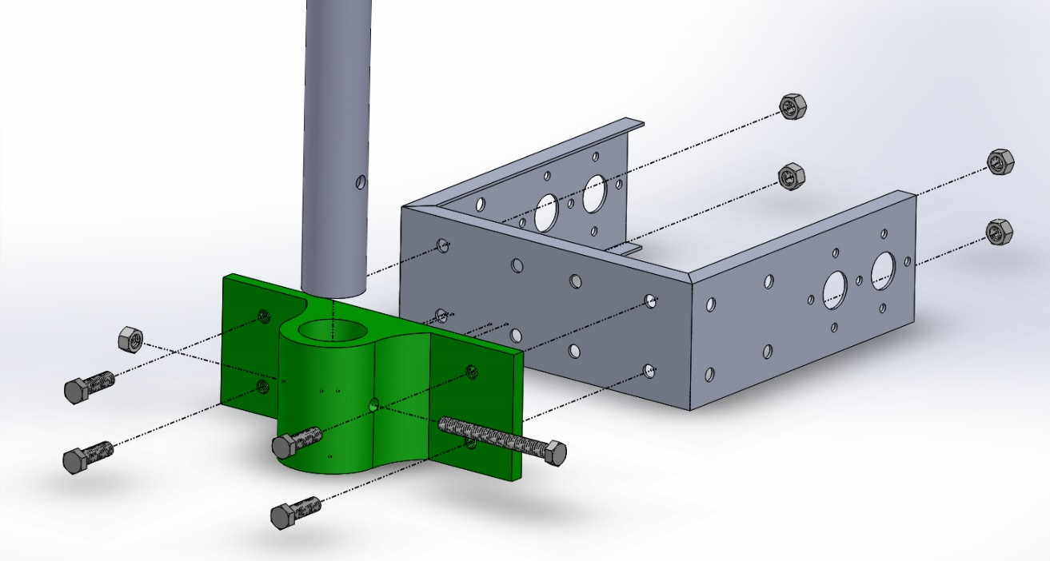
Fit Testing/Assembly Plan Status
All mechanical parts have been received.
Necessary cables have come in to connect power and data (Rot2Prog)
Aluminum block has come
Need to machine the Rotor to Antenna mount.

Slide 38
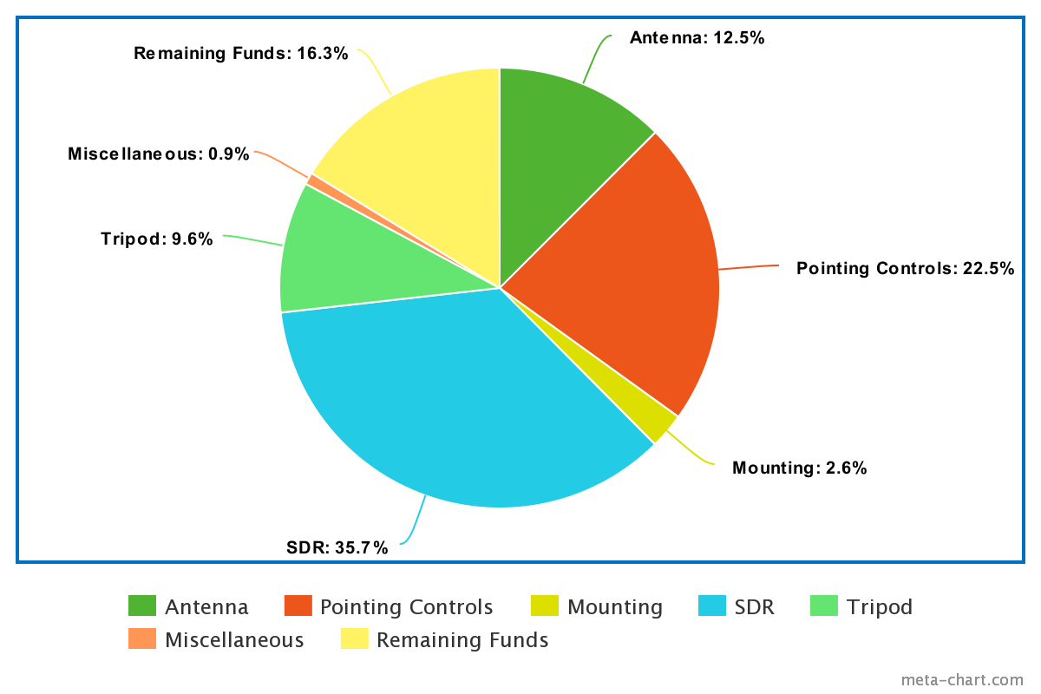
Budget
Group​ | Previous Cost | Current Cost*
Antenna​ | $463.61​ | $625.01
Pointing Controls​ | $937.22​ | $1122.58
Mounting​ | $125.08​ | $130.32
SDR​ | $1734.03​ | $1782.90
Tripod​ | $419.80​ | $481.59
Misc.​ | $42​ | $44.28
Total​ | $3771.74​ | $4186.67
Note when doing shipping and such, if needed just divide the total by number of items and add
Current Budget Margin: 16.27%​
Shipping and Fees Cost: ​$340.59
*The cost now includes all charges (credit card fees, shipping, etc.)

Slide 39
Status of Items
Vendors | Status of Order | Item Type
Satellite Shop | Received | Antenna
RF Hamdesign | Received | Pointing Controls/Tripod
Amazon | Received | Antenna/SDR/Misc.
Ettus | Shipped | SDR
Taoglas | Received | Antenna
Pasternack | Received | SDR
MetalsDepot | Received | Mounting
Minicircuts | Received | Antenna
Novus | Shipped | SDR

Slide 40
Major Items
Item | Group | Status of Order
Log Antenna | Antenna | Received
Offset (Dish) | Antenna | Received
Controls | Pointing Controls | Received
Controls Power Supply | Pointing Controls | Received
Aluminum Metal | Mounting | Received
SDR | SDR | Expect Delivery: March 6th
Tripod | Tripod | Received

Slide 41
Backup Slides

Slide 42
Full Spring Schedule

Slide 44
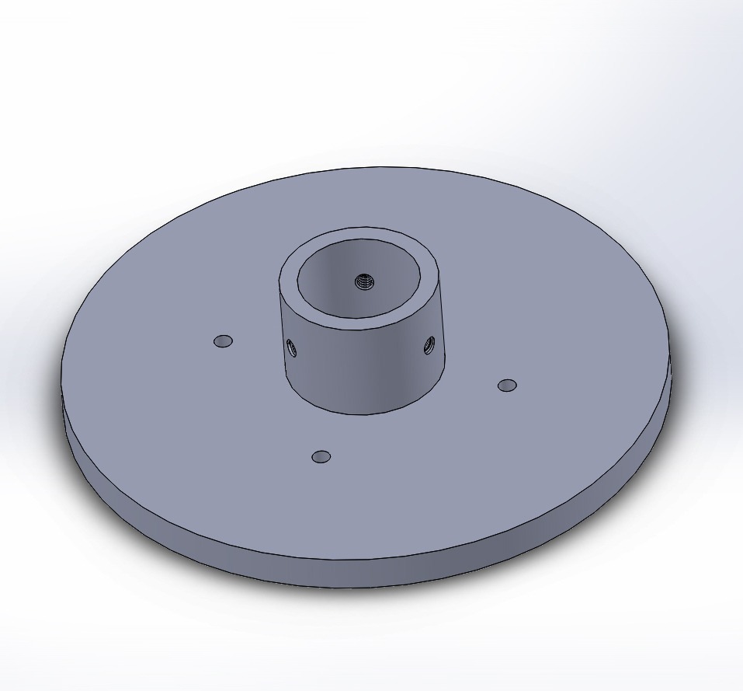
Rotor to Tripod
Plan A: Buy additional parts from RF Ham Design to attach the rotor to the tripod that they provided as well.
Risk of long lead time
Risk of budget restrictions
Plan B: Machine an extra part to attach the rotor to the antenna. Part is shown to the right.

Slide 45
Rotor to Antenna Plan
Place top left ¼”-20 bolt through the top left (front facing) hole of the mounting plate and through the rotor bracket.
Thread the nut onto bolt 1 from the back.
Repeat steps 1 and 2 for the other 3 corner bolts.
Place the Antenna Pipe through the center hole.
Align the hole in the side of the pipe with the ¼”-20 size hole through the center hole.
Place the long ¼”-20 bolt through the through-hole.
Thread the nut from the other side.
Tighten.
Place the Post Clamp onto the Antenna Rod.
Tighten using the provided ¼” bolt and hex nut (4 & 9)
Attach the Post Clamp to the Elevation Bracket using bolt 6.
Insert adjustable elevation bolt (1) and nut and washer (4 & 8).
Attach the Elevation Bracket to the Antenna Dish using 4 ¼” bolt and nuts (1&4).

Slide 46
Pickup to Antenna
Place pickup into donut shim
Place donut shim into the LNBF clamp.
Tighten using two provided M4*16mm nuts and bolts.
Attach the coax cable to the back of the pickup.
Place tape around the pickup, taping to the donut shim.
Lightly pull the coax cable to ensure pickup remains stationary in the clamp.

