Slide 1
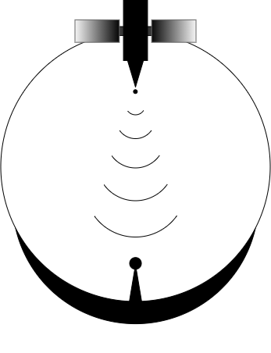
PROS8
Final Oral Review
Point of Contact:
Sam Gagnard
Team Advisor:
Zoltan Sternovsky
Passive Radio Frequency Observation System 8
Quinton Nietfeld, Kieran O’Day, Colton Ord, Ryan Cameron, Yang Lee, Zaki Laouar, Zachary Arbogast, Mamdooh Alkalbani

Slide 2
Key Terms
Two Line Element (TLE) Data – a data format encoding a list of orbital elements for Earth orbiting satellites​
GPS Ephemeris Data – data set of positions of GPS satellites
Doppler Shift - change in frequency of a wave in relation to an observer who is moving relative to the wave source​
Radio Frequency (RF) – Electromagnetic waves with frequency
ranging from 20kHz to 300 GHz. ​
L1 Band – Subset of Radio Frequency with a range of 1 – 2 GHz
Image Credit: NASA

Slide 3
Project Motivation
Background
Orbit Logic specializes in scheduling satellite observations and utilizes their software Heimdall
Heimdall schedules observations of know and uncharacterized space objects observed by ground stations
Heimdall currently utilizes ground stations with optical and RADAR sensors when scheduling observations

Slide 4
Project Motivation
Problem
Heimdall software does not support passive RF observations
Best practices for observing and characterizing satellites using passive RF sensors are unknown

Slide 5
Specific Objective
PROS8 developed a satellite observation scoring and scheduling software that uses a passive radio frequency (RF) ground-station to determine and compare satellite observation opportunities. ​​
This will allow customers to communicate with satellites via RF efficiently.

Slide 6
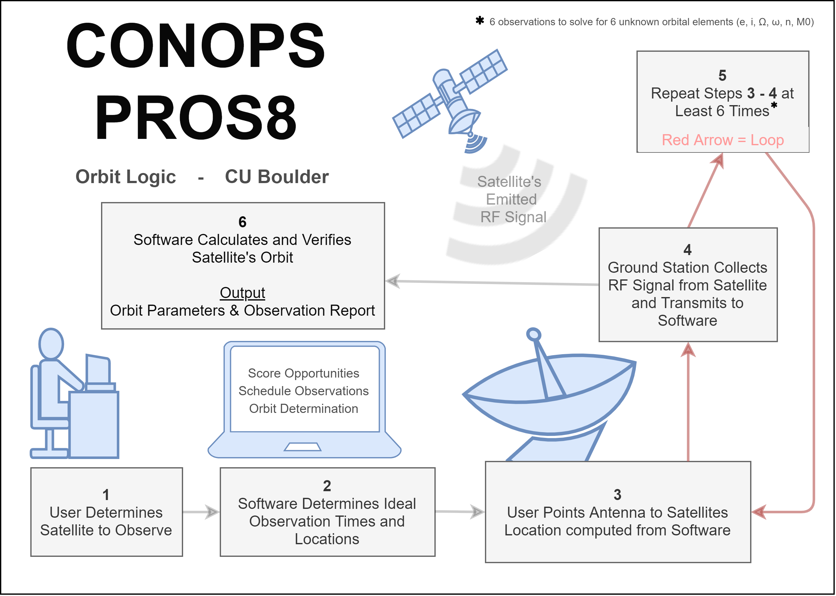

Slide 7
Levels of Success
Level | Signal Reception | Signal Processing | Scoring Software* | Scheduling Software* | Pointing Controls
1 | Receive 6 RF signals from a satellite | Isolate signal of a desired frequency | Determine variables that influence ability to observe satellite RF signals | Schedule feasible observations within time frame for one satellite | Point Antenna center at fixed locations
2 | Receive RF signals from satellites in multiple orbit geometries | Calculate the doppler shift | Develop formula to score satellite observation opportunities | Schedule observations taking into account scores | Point system along given orbit path
3 | Receive RF signals from a satellite in various conditions |  | Determine relative error between estimated orbit and TLE data | Schedule observations of multiple satellites by score
4 | Receive RF signals from multiple satellite in various conditions
* Satellite observation scoring & scheduling software

Slide 8
Critical Project Elements
Designation​ | CPE​ | ​Critical Characteristics
CPE-1​ | Signal Reception​ | ​Receive radio frequency signals from satellite
CPE-2​ | Pointing Control​ | ​Point antenna at the location of the satellite
CPE-3​ | Signal Processing​ | Process the received analog signal to a digital signal
CPE-4​ | Scoring Software​ | Score the quality of a given observation
CPE-5​ | Scheduling Software​ | ​Schedule a plan for several observations

Slide 9
Critical Project Elements Reasoning
Designation​ | CPE​ | Reasoning
CPE-1​ | Signal Reception​ | Must receive an RF signal to observe the satellite
CPE-2​ | Pointing Control​ | Must have antenna pointed at the location of the satellite to receive the RF signal
CPE-3​ | Signal Processing​ | Must have a digital signal for the software to utilize
CPE-4​ | Scoring Software​ | Must score satellite observations to identify high-success signal reception observations
CPE-5​ | Scheduling Software​ | ​Must create a schedule from the scored observations for the user to execute

Slide 10
Ground Station Design
Signal Reception – CPE1
Antenna Feed (L1 Band pickup)
Antenna Dish
Lowpass Filter
Low Noise Amplifier
Pointing Controls – CPE2​
Rotor (azimuth & elevation)
Controller
Signal Processing – CPE3
Software Defined Radio
GPS Disciplined Clock

Slide 11
Software Design
Scoring Software Design
Scores satellite passive RF observations based from inputs to determine high chance of success observations for scheduling.
Inputs: satellite's TLE data and ground station location
Outputs: Satellite RF observations with a respective score
Scheduling Software Design
Schedules an observation plan for the user based from the scoring software outputs
Inputs: Observation time window, observation scores, satellite priorities, and desire scheduling method
Outputs: Observation Schedule Plan and Gantt Chart
Four main areas​
Scoring Software – CPE4​
Scheduling Software – CPE5​
Graphical User Interface​
Orbit Determination​
All will integrate to make a final software package​

Slide 12
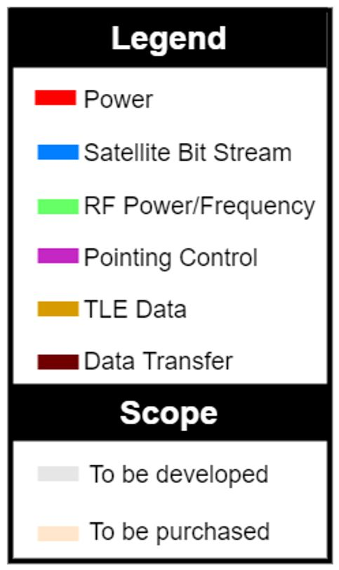
Functional Block Diagram

Slide 13
Scoring Software Sub-system
FR 4.0 | The scoring software shall provide scores for each planned observation and update orbit estimates after observation

Slide 14
Software Integration Testing
Objective:
Ensure full software package works properly
Debug unforeseen issues within the code
Design:
Input the test cases design for functional testing and check the output
Actively operate the software, checking for bugs within the UI
Operate the entirety of the software package as intended, checking for outputs
Facilities:
Anywhere that has access to the software package and a computer
Importance:
High
Plan to be fielded after testing is complete

Slide 15
Propagation Functional Test
Retrieve TLE Data from www.space-track.org
Propagate TLE Data into a complete orbit
Use TLE Data to construct an orbit in Matlab
Compare propagated satellite position and the data available on online satellite tracking websites
Success: data matches up
Fail: else

Slide 16
Scoring Functional Test
Set up conditions where scores = 0 in software
No Line-of-Sight, below minimum elevation, weak signal ...etc.
Score should return 0
Other regular conditions
Each data point should return a score less than max score (100)
Expected results:
0 or number less than 100 for every data point

Slide 17
Orbit Determination Functional Test
Method
Use propagation algorithm to generate test data (at least 6 measurements)
Put generated data through an orbit determination algorithm
Output deviations in position and velocity vectors
Update position and velocity vectors with deviations
Repeat steps above until solution converges
Convert vectors to orbit elements to verify against TLE
Expected Result
A complete set of orbital elements resembling test data input

Slide 18
Scheduling Software Sub-system
FR 4.0 | The scoring software shall provide scores for each planned observation and update orbit estimates after observation

Slide 19
Scheduling Functional Test
Ensuring the scheduling software can take a list of satellites and output when to observe each of the possible satellite
Checking that higher priorities are put into the observation plan
Make sure the Gantt Chart is readable
Test cases
Completely unable to observe (no passes)
Prioritize satellite with highest priority (when observation time overlap)
Expected Results:
Populated Gantt Chart for Satellites

Slide 20
Signal Processing Sub-system
FR 3.0 | Convert L1 band analog RF signal into a digital signal

Slide 21
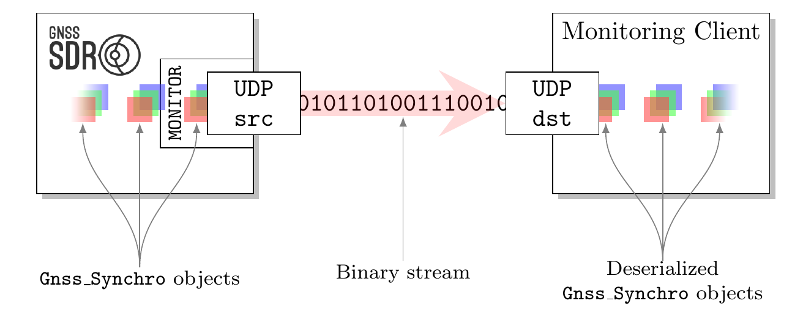
Monitoring the internal status of the software receiver
Objective: Receive Doppler frequency shift of a given GPS satellite
Design:
Facilities Needed: Laptop with Linux OS
Importance: High

Slide 22
Signal Reception Subsystem
FR 1.0 | Receive RF signals from satellites in various conditions, with various orbital geometries

Slide 23
FEKO simulation
Objective: To explore the sensitivity of our antenna pickup location
Design: FEKO is a CAD based software that uses meshes to solve Maxwell's equations iteratively. We will build our antenna within the program and vary our antenna pickup location according to the possible mounting locations on the given clamp.
Facilities: FEKO simulation software
Importance: Moderate

Slide 24
Signal Reception
Objective: To verify that our antenna receives L1 Band GPS Signals
Design: We will assemble the antenna and plug its output into our laptop. We will then manually point it at a GPS satellite using a protractor and compass.
Facilities: Area with clear view of sky and hard ground, at least two people
Importance: High

Slide 25
Pointing Controls Sub-system
FR 2.0 | Point system along orbit path from manual input within a few degrees pointing accuracy

Slide 26
Pointing Controls Sub-System Test
Objective: Ensure the pointing control system responds to commands and accurately points the antenna dish & receiver to a point in the sky (within a few degrees).
Design: The controller and rotor will be connected and powered via wall outlet. The dish will be mounted to the rotor to simulate true testing conditions. Manual inputs of corner cases of elevation and azimuth (true north, straight up, 180 degrees azimuth).
Facilities Needed: Power Supply (Wall outlet), senior projects room
Importance: Need to be able to point the antenna at a satellite to get a signal. Although bandwidth is large, still need it to get in there.

Slide 27
Full System

Slide 28
Electrical Continuity
Objective: Confirm that all ordered parts transfer electrical signals as expected.
Design: For all "wire" portions, confirm that they output signals that are given as input. For all "PSU" portions, confirm the output voltages. For LNA confirm its gain. For external clock confirm output of 10 Mhz.
Facilities: Aero electrical room next to pilot room, (multimeter, oscilloscope)
Importance: Moderate

Slide 29
Fit Testing
PICKUP
ANTENNA DISH
Objective: Ensure that all the mechanical parts fit together so that the ground station can be assembled as a whole.
Facilities Needed: Projects room, toolbox.
Importance: Needed to make sure the ground station will be able to assemble and disassemble.
ROTOR MOUNT
ROTOR
CONTROLLER
TRIPOD MOUNT
TRIPOD

Slide 30
Full System Test
Objective: To confirm software can…
Schedule observation times with appropriate azimuth and elevation directions
Determine the Orbit of a GPS satellite using Doppler Shift observations
Determine this Orbit more accurately using the scheduled observation times as opposed to random observation times.

Slide 31
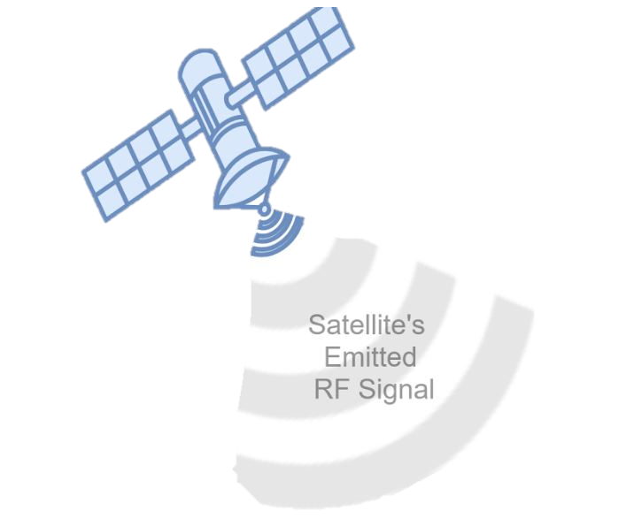
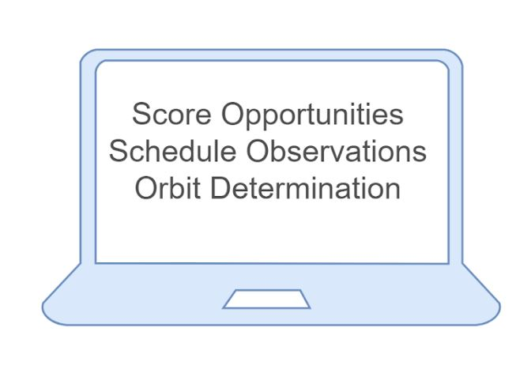
Full System Test Design
Software Implementation
User
Input 10 satellites to observe within 1, 2, and 3 days into GUI software
Scheduling Software
Determine 60 observation times within the inputted timeframes
User
Perform scheduled observations
60 Observation Times

Slide 32
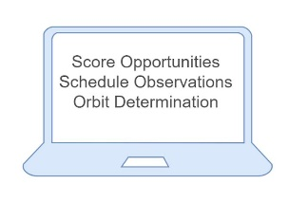
Full System Test Design
Software Implementation
Ground Station
Receive signal & convert signal & input into software
(for each observation)
OD Software
Calculate Doppler shift in received signal
(for each observation)
OD Software
Determine satellite’s orbit using Doppler Shift
(for each satellite)
Doppler Shift
Calculation
Orbit Determination (OD)
SDR

Slide 33
Full System Test Design
NO Software Implementation
Ground Station & Software
Same automated process as before after observation.
1. receive signal
2. convert signal to digital
3. input converted signal
4. calculate Doppler shift
5. determine orbit
1–4 : All 60 observations
5 : All 10 Satellites
User
Same 10 satellites to observe within 1, 2, and 3 days
User
Perform 60 observations randomly throughout the time frames

Slide 34
Full System Test Design
Final Comparison
Orbit Determination of 10 different satellites
WITHOUT
PROS8 Software
WITH
PROS8 Software
GPS Ephemeris Data
(actual)

Slide 35
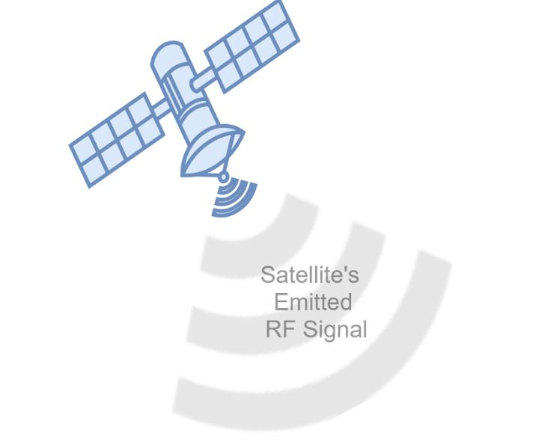
Full System Test
Facilities:
South Boulder Campus
Assembled Ground Station
3 People
Importance: High, this ensures that our system works as designed

Slide 36
Data Collection Testing
Objective: Update software and understanding of observing satellites using passive RF signals.
Design: Take data from numerous satellite observations utilizing the ground station over the course of one month. Ensure data collection during various orbit geometries and surrounding conditions.
Facilities: CU Boulder South Campus
Importance: Moderate, this test will allow for experimental research to improve our understanding of the system and RF observations.

Slide 37
Scoring Software Sub-system
FR 4.0 | The scoring software shall provide scores for each planned observation and update orbit estimates after observation

Slide 38
Software Integration Test
Expected Result :
Each component of the software functions as intended without bugs
Choose satellites
Propagate orbit
Score
Schedule
Orbit Determination using Frequency Measurements
Validation:
No bugs
Output matches with expected result from individual function tests

Slide 39
Software Integration Testing

Slide 40
Propagation Functional Test
Expected Result :
Software takes in TLE data and propagates the data to an orbit
Validation:
Output orbit matches with available online data

Slide 41
Propagation Simulation Results
Results:
Very slight deviation
Causes:
Error in Numerical Integration (ODE45)
Inaccuracies in TLE Data
Conclusion:
Propagation is Acceptable

Slide 42
Scoring Functional Test
Expected Result : The scores that the software package computes should be equal to the predetermined score. These scores will have been predetermined and are between 0 (no observation opportunity) and 100 (perfect observation opportunity)
Validation:
ensures that the scoring algorithm is considers all the variables that can affect an observation
Output scores for scheduling purposes

Slide 43
Preliminary Scoring Model
Scoring Algorithm Plot
0 if no observation opportunities
Below minimum elevation, low SNR, etc
Max score of 100
Score is used for scheduling

Slide 44
Orbit Determination Functional Test
Expected Result : The software shall be able to take a set of 6 frequency data (a simulated observation set) and compute the satellite’s orbit, this should match the simulated orbit predetermined.
Validation: This test will ensure that the collected frequency data is adequately used to construct an orbit.

Slide 45
Orbit Simulation Example (GPS BIIR 8)​
​ | Rx (km)​ | Ry (km)​ | Rz (km)​ | Vx (m/s)​ | Vy (m/s)​ | Vz (m/s)​
Truth​ Position &Velocity​ | 8192.2​ | 12225.3​ | 21925.6​ | -2554.96​ | 2940.54​ | -80.33​
PropagatedPosition &Velocity​ | 8192.2​ ​ | 12225.3​ ​ | 21925.6​ ​ | -2554.96​ ​ | 2940.54​ ​ | -91.54​
Percent Error (%)​ | 0​ | 0​ | 0​ | 0​ | 0 ​ | 13.96 ​
​ | i (deg)​ | e(dim less)​ | ω (deg)​ | Ω (deg)​ | Θ (deg)​ | a(km)​
Truth OrbitElements​ | 57.16​ | 0.129​ | 3.92​ | 310.22​ | 94.88​ | 26558.3​
PropagatedOrbit ​ Elements​ ​ | 57.18​ | 0.127​ | 4.23​ | 310.11​ | 94.64​ | 26561.7​
Percent Error (%)​ | 0.0242​ | 1.852​ | 7.69​ | 0.034​ | 0.28​ | 0.013​

Slide 46
Scheduling Software Sub-system
FR 4.0 | The scoring software shall provide scores for each planned observation and update orbit estimates after observation

Slide 47
Scheduling Functional Test
Expected Result : Scheduling function properly sorts through the scored observations, and creates a realistic schedule, in the form of a Gantt chart, of observation opportunities.
Validation: This will ensure that the software will not return a unusable schedule of observations and that the high priority observations are being executed.

Slide 48
Scheduling User Interface

Slide 49
Observation Schedule
Satellite
Time

Slide 50
Signal Processing Sub-system
FR 3.0 | Convert L1 band analog RF signal into a digital signal

Slide 51
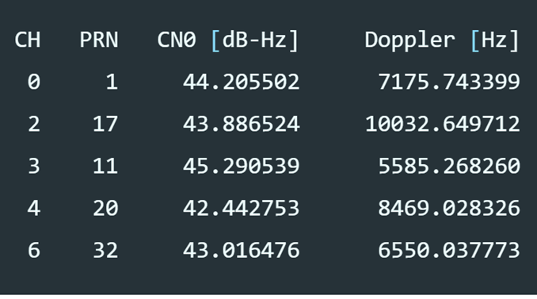
Expected Results: Print and update the PRN, CN0 and Doppler frequency shift for each channel on a terminal window while the receiver is running with the Monitor block activated
Validation: This test can confirm functionality of the software GPS receiver in that it is able to process an analog GPS signal and calculate a doppler shift

Slide 52
Signal Reception Subsystem
FR 1.0 | Receive RF signals from satellites in various conditions, with various orbital geometries

Slide 53
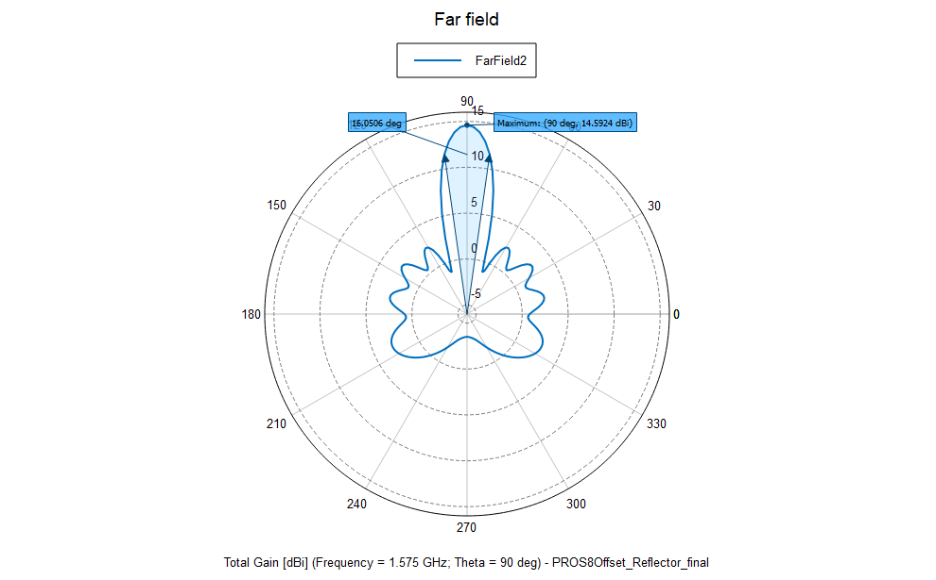
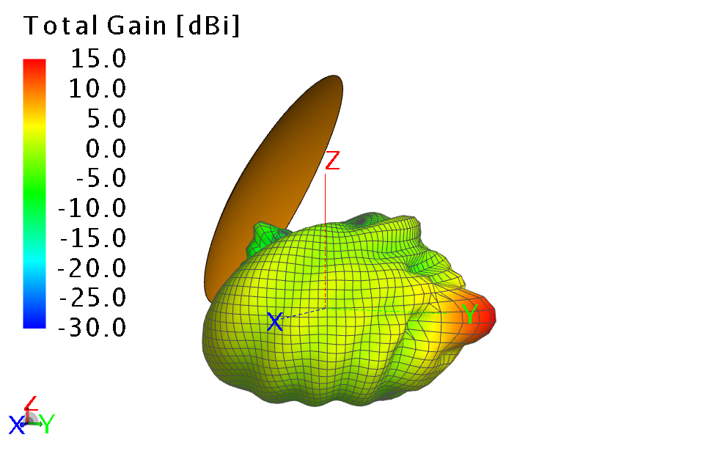
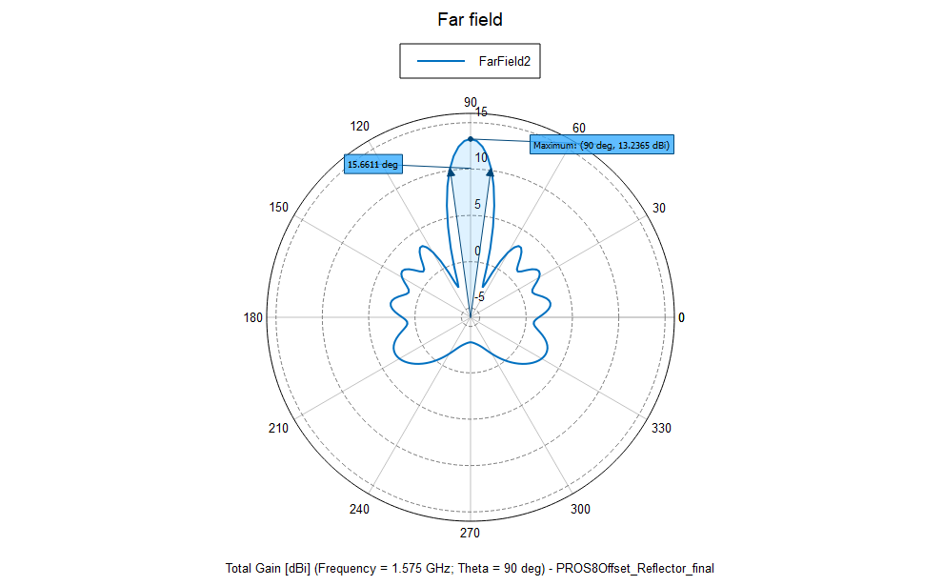
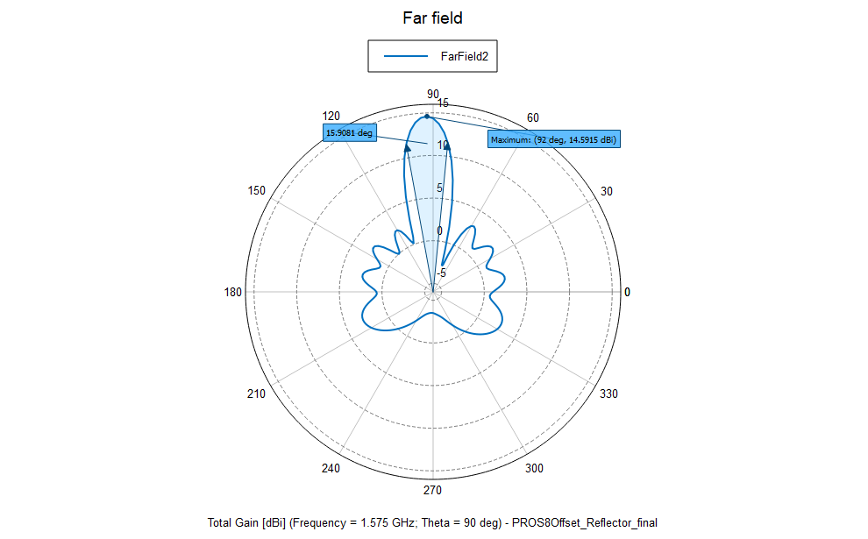
FEKO Simulation
Validation: All three changes showed less than a dB of gain affected/lost and next to no change in beamwidth which validates our original mounting decisions for the pickup
(+-3cm) Z (+-3cm) Y (+-3cm) X

Slide 54
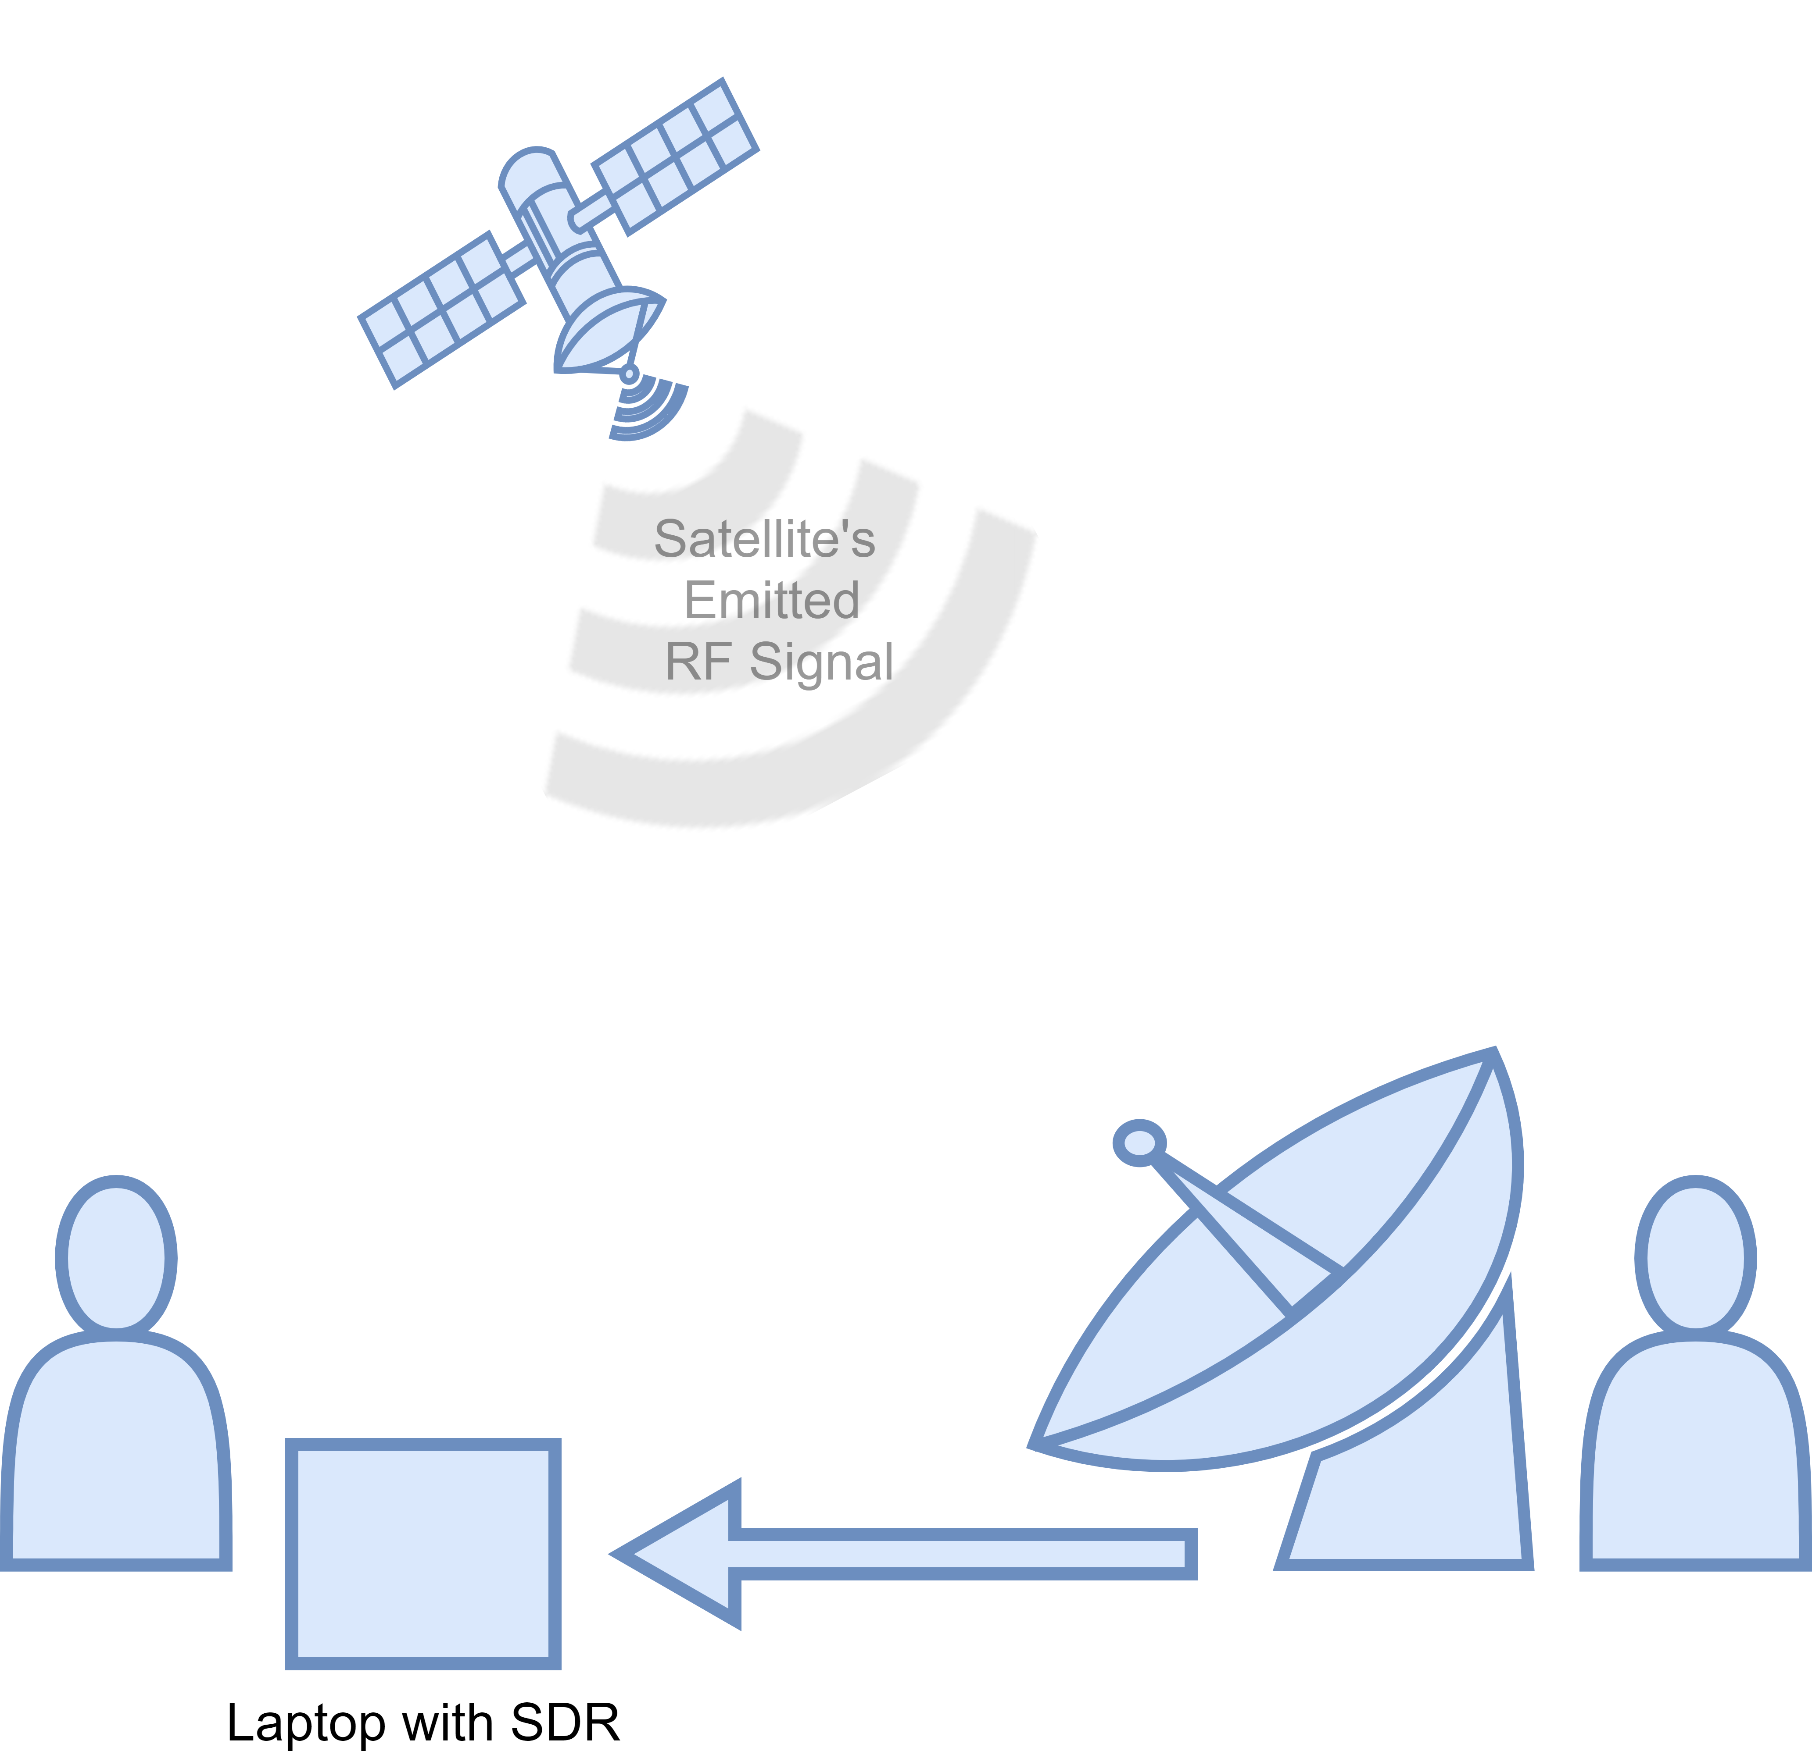
Signal Reception
Expected Results: Observe signals centered about 1575 +- 14 MHz
Validation: This validates our design requirement 1.3: "The receiver will be able to receiver frequency within the L bandwidth."

Slide 55
Pointing Controls Sub-system
FR 2.0 | Point system along orbit path from manual input within a few degrees pointing accuracy

Slide 56
Pointing Controls Sub-System Test
Expected Results: Expected around 1 degree of accuracy. Manufacturer specified 0.5 but with fit differences, we expect a little more. Still well inside beamwidth though.
Validation: This test ensures that the antenna is pointed at the satellite we want. Part of the project was to be able to point at multiple satellites. So, there is a need to point at a specific satellite to ensure the station is not only receiving data, but the correct data.

Slide 57
Full System

Slide 58
Electrical Continuity
Expected Results: We expect the following of each component
Pointing Controls PSU outputs 15 +- 2 V and a maximum of 19 +- 1A
Coax cables, connectors, and LPF transmit signals with losses under 0.5dBi
LNA transmits signal with 14 +- 1dBi gain
Antenna pickups 60 Hz in a lab setting
Validation: These tests validate that the components we ordered will function as expected, and that assembly of the ground station will present no issues

Slide 59
Fit Test
Expected Results: All Mechanical connections are present and working.
Validation: Validating that the ground station can operate.
PICKUP
ANTENNA DISH
ROTOR MOUNT
ROTOR
CONTROLLER
TRIPOD MOUNT
TRIPOD

Slide 60
Full System Test
Expected Results: Full system is able to…
Communicate with user
Score and schedule observations (with proven efficiency)
Receive and process a GPS L1 RF signal emitted from satellite
Calculate doppler shift and satellite’s orbit
Compare with TLE/GPS ephemeris data
Validation: Ensure full system performs as designed

Slide 61
Data Collection Test
Expected Results: Data collection in multiple satellite orbit geometries and various surrounding conditions. Many hours of experience taking data with developed software and ground station.
Validation: Update and improve software and understanding on taking passive RF observations of satellites.

Slide 62
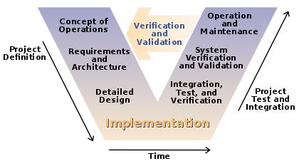
Systems Engineering
High level approach – follow the systems engineering 'V' structure

Slide 63
Systems Engineering
High level approach – follow the systems engineering 'V' structure
CONOPS – Describe the characteristics & basic operation of the system we want to create
Functional Requirements – What does the system need to do to achieve our goals for the customer?
Design Requirements – What characteristics of each sub-system are required to succeed with our functional requirements?
Iterate and improve requirements through PDR & CDR
Design sub-systems to meet design requirements
Test and integrate sub-systems
Perform full system test and document results as they relate to functional requirements

Slide 64
Requirements Flown Down
Signal Reception
FR 1 - Receive RF signals from satellites in various conditions, with various orbit geometries
DR 1.1 - HPBW of the receiver 3° < THETA < 20°
DR 1.2 - The receiver will have a gain of > 0 dB
DR 1.3 - The receiver will be designed to receive GPS frequencies in the L1 band
Pointing Control
FR 2 - Point system along orbit path from manual input with 1° pointing accuracy
DR 2.1 - Pointing hardware provides enough torque to rotate the antenna
DR 2.2 - Able to run on 120V, 60Hz, 15A power supply
Signal Processing
FR 3 - Convert L1 band analog RF signal into a digital signal to calculate Doppler shift
DR 3.1 - Scoring Software models attenuation due to various causes
DR 3.2 - Scoring Software models noise from the Sun (with respect to degrees from Sun)
DR 3.3 - The software model shall grab data for its attenuation model locally and remotely
Scoring Software
FR 4 - The scoring software shall provide orbit estimates and scores for each planned observation
DR 4.1 - The software shall take frequency measurements as its input and calculate Doppler shift
DR 4.2 - The software shall calculate orbit estimates based on Doppler shift
DR 4.3 - The software shall output scores for pre-planned scoring opportunities
Scheduling Software
FR 5 - The scheduling software shall develop an observation scheduling plan for a given satellite
DR 5.1 - The software shall give the orbit of a satellite within a given timeframe the time between each observation to be made
DR 5.2 - The software shall calculate the time between each observation to be made
DR 5.3 - The software shall determine if an observation can be made

Slide 65
Risk Assessment
Broke down risk assessment by sub-systems and assessed likelihood and severity with sub-system leads
Identified most severe risks to project success
Created detailed risk mitigation plans for each risk with a focus on the top 3 risks

Slide 66
Risk Assessment – Mitigation Summary

Slide 67
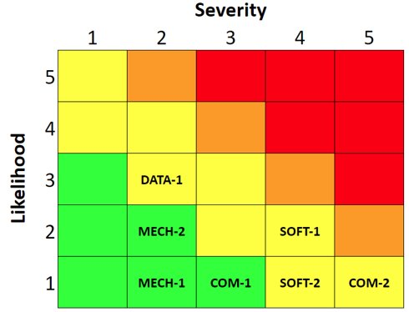
Risk Assessment – Mitigation Summary

Slide 68
Systems Engineering Lessons Learned
Communication is key – keep everyone on the same page with respect to sub-system progress and the high-level project overview.
Take extra time to understand the customer's needs and work hard to develop a thorough project scope from the start.
Make sure each subsystem has multiple team members who have a deep understanding in case of personnel changes.
Planning is important but prepare for changes in the work to be done and timeframes.
Consider inputs and outputs of each sub-system and how they change over time to make the full-system integration easier.

Slide 69
Management Approach
Communication
Bi-weekly full team meeting - Design Phase - Fall Semester
Weekly full team meeting - Production Phase - Spring Semester
Independent sub-system meetings
Online communication via Slack, Zoom, and Google Drive
Weekly Status Reports to Customer
Each sub-system has individual lead
With 1 to 3 extra individuals (depending on the sub-system)
Ensures all aspects of project are meeting requirements
Changes went through entire team
Gantt Chart Schedule to follow project progression

Slide 70
Management Lessons Learned
Successes
Team communication remained strong throughout project
Defining requirements of sub-systems
Changes facilitated effectively and efficiently
Challenges
Team conflicts
Focusing in on a defined scope at the beginning of the design phase
Ensuring procurement and work arrive on schedule
Lessons Learned
Ensure margins are large enough to accommodate delays
Team conflicts need to be addressed immediately and resolved ASAP
All work must be backed by multiple team members to eliminate single points of failure

Slide 71
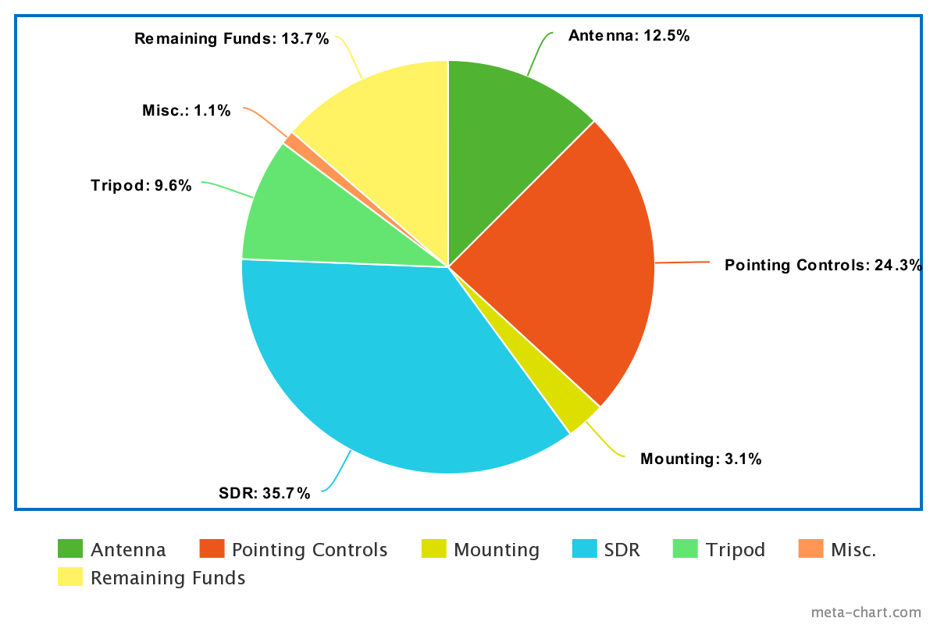
Budget Planned
Group​ | CDR Cost | FOR Theoretical Cost
Antenna​ | $917.55 | $625.01
Pointing Controls​ | $855.05 | $1215.63
Mounting​ | $202.84 | $155.39
SDR​ | $919 | $1782.90
Tripod​ | $419.80 | $481.59
Misc.​ | $260.88 | $54.27
Total​ | $4186.67 | $4314.79
CDR Budget Margin: 16.27%​
Current Budget Margin: 13.7%​

Slide 72
Budget Changes
Group | FOR ​ Actual Cost​
Antenna | $625.01​
Pointing Controls | $1215.63​
Mounting | $155.39​
SDR | $892.90
Tripod | $481.59​
Misc. | $54.27​
Total | $3424.79
Pointing Controls: Required power supply from vendor to work properly
SDR: Required GPS disciplined clock to receive the signal accurately
The GPS disciplined order was cancelled due to virus
Lower SDR cost by approximately $1000

Slide 73
Theoretical Cost for PROS8
Description | Cost (if finished) | Cost (as is)
Labor | $101,562.50 (3200 hrs*) | $93,750.00 (3000 hrs*)
Materials | $4,314.79 | $3,424.79
Overhead (200%) | $203,125.00 | $187,500.00
Total | $309,002.29 | $284,674.79
Entry-level Aerospace Engineer Salary of $65,000 for 2080 hours of work
31.25 dollars per hour of work
Estimated 3200 work hours (based off timesheets, and estimation for project close)
Overhead rate of 200%
Average of 11.7 hours per week per individual
* Estimated hours
Notes:
2331.5 hours calculated
Round up to 2500 hours for winter break and unaccounted hours
$65,000 per 2080 hours = 31.25 per hour
2500 hours * 31.25 $/hour = $78,125.00 as estimated total labor cost

Slide 74
Backup Slides

Slide 75
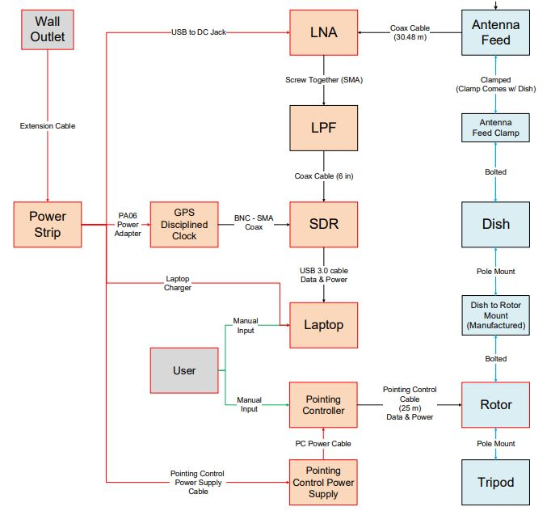
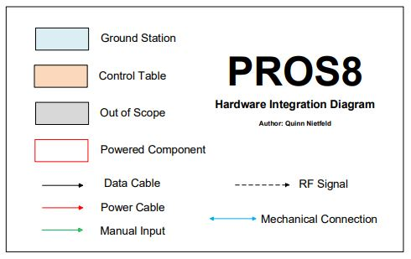
Hardware Integration

