Slide 1



SNOW DEPTH INFORMATION AND MITIGATION BEFORE AVALANCHES
Presenters
Max Fidler, Adam Gourmous, Brett Papenfuss, Stephen Peng, Devon Ricken, Saad Syed, Jordan Walters, Kevin Yevak, Sean Yoo
Customer
Copper Mountain Resorts: Hagen Lyle
Advisor
Professor Zachary Sunberg
Additional Team Members
Lucas Dickinson, Travis Griffin, Aidan Sesnic
SPONSORS:
Notes:
Brett

Slide 2

Purpose and Objectives
Purpose
Design
CPE’s
Reqts
Risks
Verify
Planning
Backups
Notes:
Brett

Slide 3

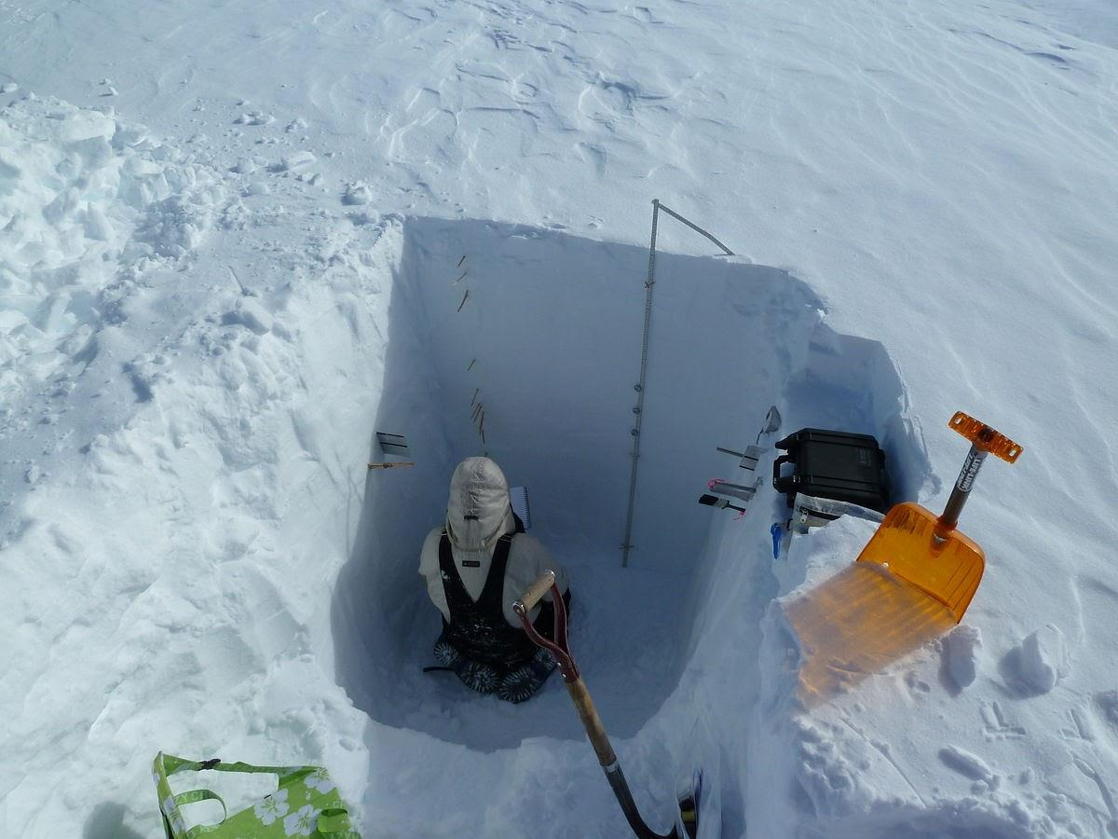
Motivation
Motivation:
Locations of snow pit is variable
Time consuming (3-4 hours per pit)
Multiple pits for accurate representation
Safety Risks
Provide information for explosives planning, boot packing, and ski cutting
Help decide safer snow pit dig sites
Photo Courtesy of commons.wikimedia.org
Purpose
Design
CPE’s
Reqts
Risks
Verify
Planning
Backups
Notes:
Brett
Current methods involve digging snow pits on the sides of avalanche prone areas

Slide 4
Purpose
Mission Statement:
The SIMBA team will design a land based sensor package to remotely sense snow depth to within ± 10 cm accuracy in avalanche prone areas of Copper Mountain Ski Resort.
Purpose
Design
CPE’s
Reqts
Risks
Verify
Planning
Backups
Notes:
Brett

Slide 5
Objectives
Main Objectives:
Snow depth accurately measured to within ±10 cm at 400 m with 1 m spatial resolution
Produce heat map displaying snow depth
Operate at minimum temperature of -20°C
Purpose
Design
CPE’s
Reqts
Risks
Verify
Planning
Backups
Notes:
Brett

Slide 6
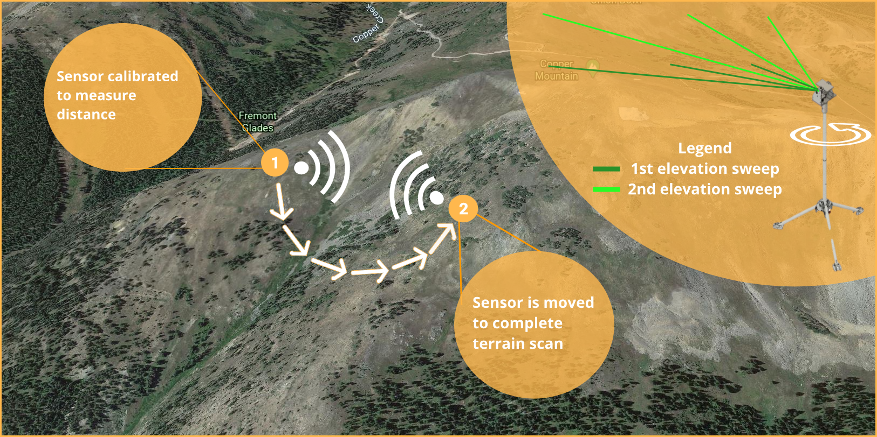
CONOPS
Purpose
Design
CPE’s
Reqts
Risks
Verify
Planning
Backups
Notes:
Sean

Slide 7
Design Solutions
Purpose
Design
CPE’s
Reqts
Risks
Verify
Planning
Backups
Notes:
Stephen

Slide 8
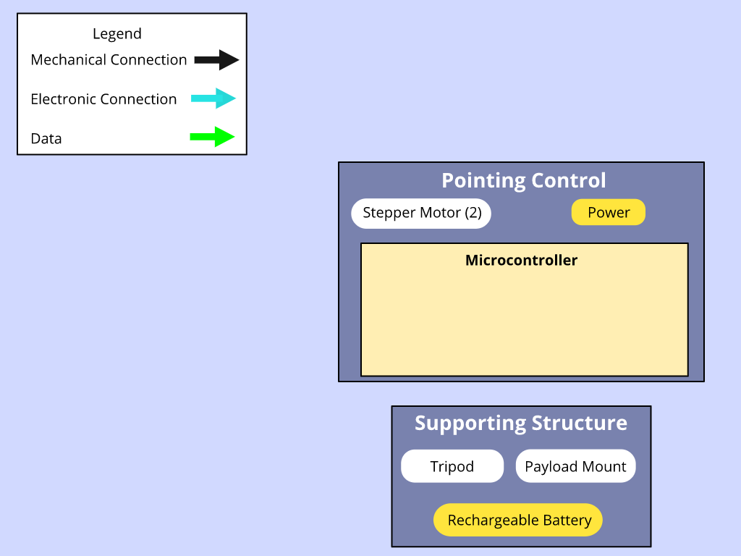
Design Solution: Functional Block Diagram
Purpose
Design
CPE’s
Reqts
Risks
Verify
Planning
Backups
Notes:
Sean

Slide 9
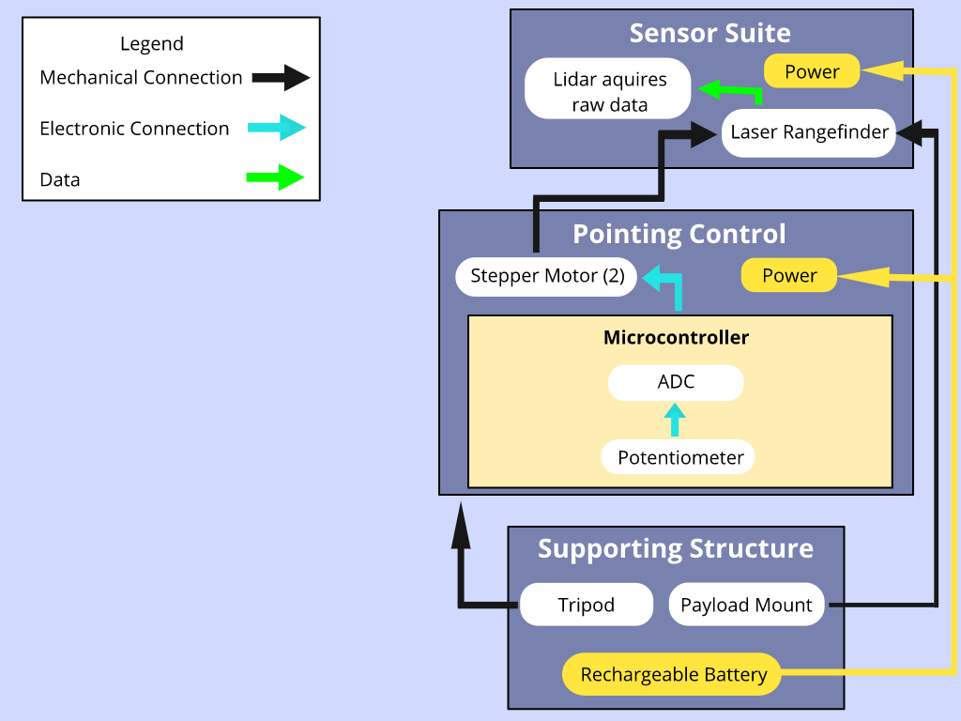
Design Solution: Functional Block Diagram
Purpose
Design
CPE’s
Reqts
Risks
Verify
Planning
Backups
Notes:
Sean

Slide 10
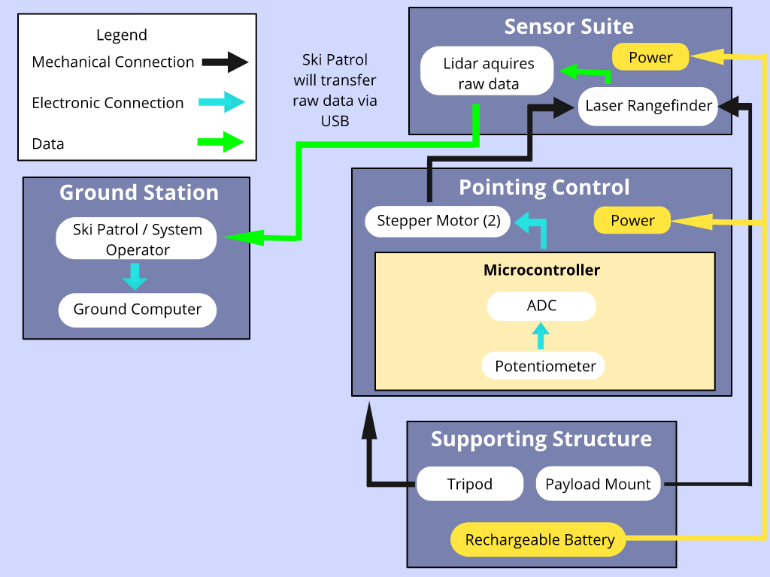
Design Solution: Functional Block Diagram
Purpose
Design
CPE’s
Reqts
Risks
Verify
Planning
Backups
Notes:
Sean

Slide 11
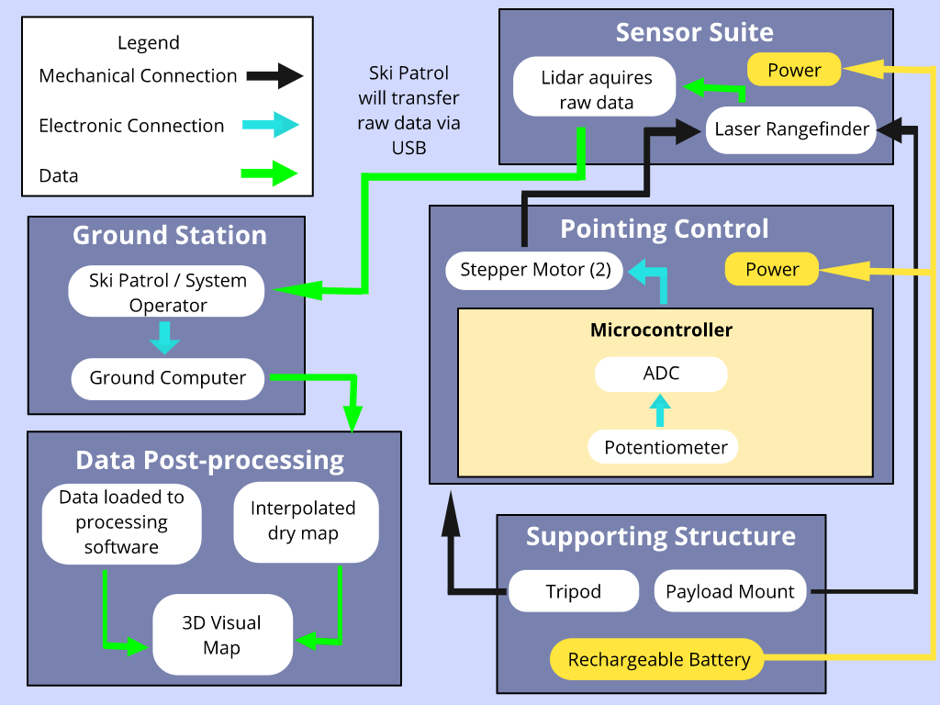
Design Solution: Functional Block Diagram
Purpose
Design
CPE’s
Reqts
Risks
Verify
Planning
Backups
Notes:
Sean

Slide 12
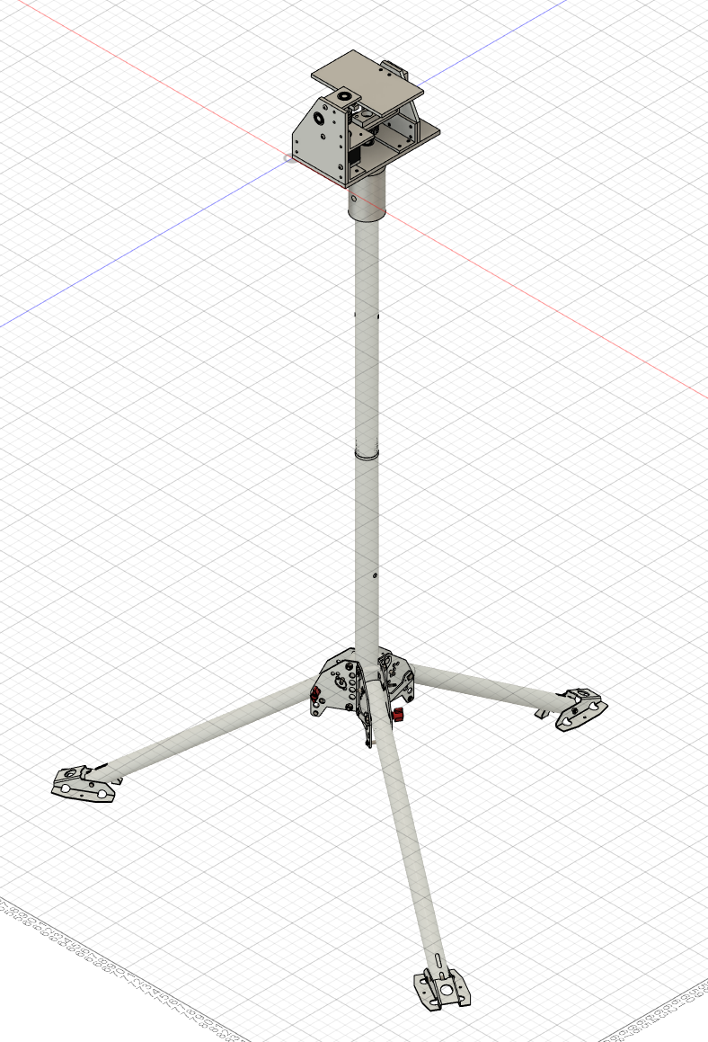
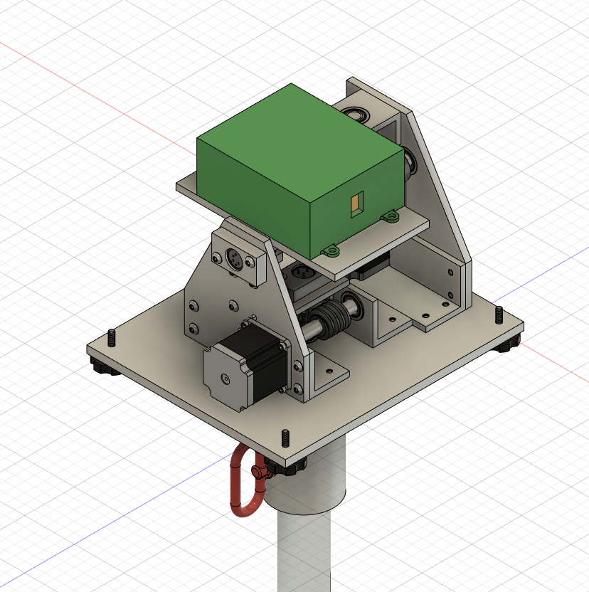
Design Solution: Overall Design Solution
Sensor Package
Range Finder & Raspberry Pi
Tripod
Pitch Stepper Motor
Azimuth Potentiometer
Pitch Potentiometer
Quick Release Pin
Azimuth Stepper Motor
Purpose
Design
CPE’s
Reqts
Risks
Verify
Planning
Backups
Notes:
Jordan
Starting from the bottom of the image, the tripod, which serves as the foundation of the system will be bolted to the ground for the entire measuring season. Guy wires can be used to stabilize the top of the tripod in windy conditions. The angular pointing direction of the rangefinder is controlled by two stepper motors: one in pitch and one in azimuth. The brain of the system which controls the distance finder, stepper motors, and records pointing direction is a raspberry pi located to the rear to the top top. Potentiometers are connected to each axle to record the angular position of each axis. A range finder is laser used to measure the distance between the sensor’s know location and the terrain of interest. This laser is the heart of the project.

Slide 13
Design Solution: Internal Enclosure
Controls angular pointing of the laser
0.11 degree resolution
3141 steps per revolution
Placement
Range finder
Potentiometers
Stepper motors
Raspberry Pi and hat stack
Rigidity
Keep rotational flexing between potentiometer and true distance finder positioning to less the 0.001 degrees.
Purpose
Design
CPE’s
Reqts
Risks
Verify
Planning
Backups
Notes:
Jordan
The internal enclosure is responsible for controlling the angular pointing direction of the laser, having internal space within the enclosure for all subsystems and maintaining rigidity within the system to control pointing error. The angular pointing is controlled by the actuator system made up of stepper motors and worm gears. The actuator system must be able to have a resolution of 0.11 degrees or 4,141 steps per revolution. The placement of the range finder, potentiometers, stepper motors and the microcontroller stack must be housed such that no collisions are possible for any configuration the the mechanical system can be moved into. The internal enclosure must also be rigid such that the potentiometer is able to accurately measure to pointing direction of the rangefinder. This rigidity should be stiffer than 0.001 degrees. This will be hard to achieve on the azimuth axis even with a high level of assembly competence.

Slide 14
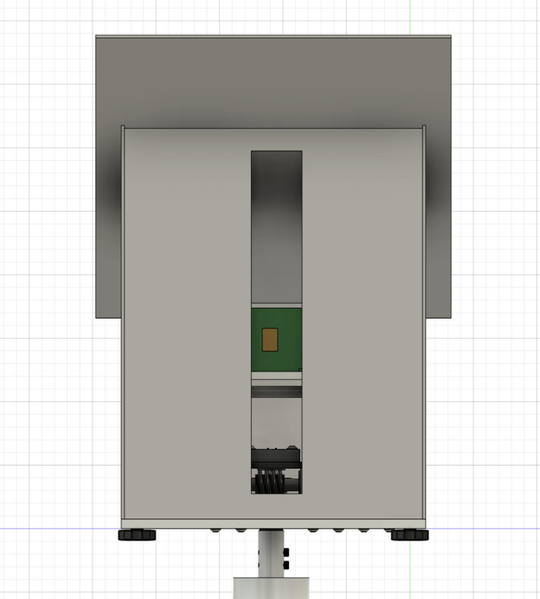
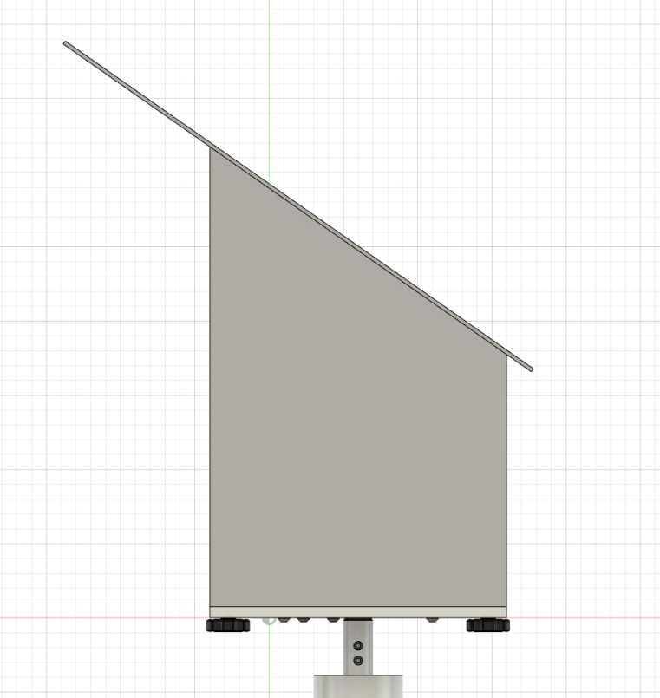
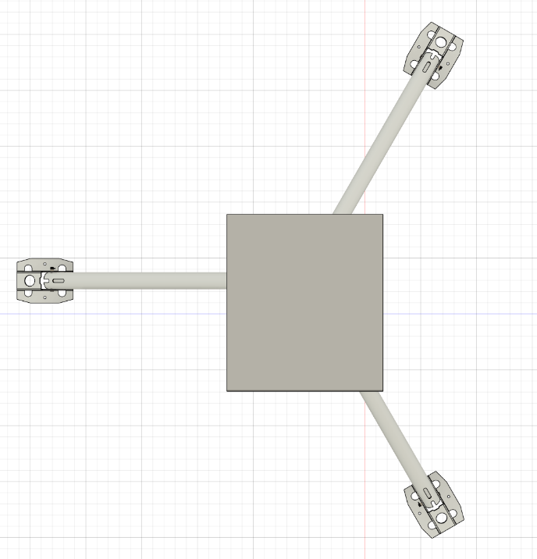
Design Solution: Sensor Housing
Front View Side View Top View
Purpose
Design
CPE’s
Reqts
Risks
Verify
Planning
Backups
Notes:
Saad
Roof overhangs 6 inches in direction of laser pointing
Snow & Wind Expected
Slit for laser
Slit is worst case and
Modular sealing
Electronics sealed with glass side
Weather sealant [caulk?]

Slide 15
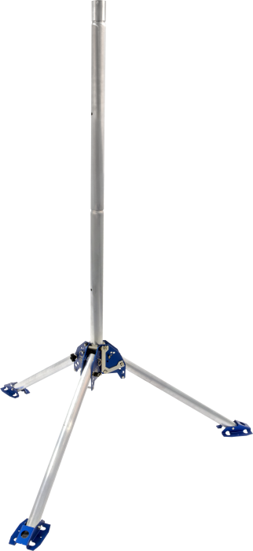
Design Solution: Sensor Platform
Campbell Scientific QST6 Tripod
Purpose: Firmly hold sensor package in adverse weather conditions to prevent errors in data.
This tripod is being used by Copper Mountain Staff; familiarity with setup of tripod
Purpose
Design
CPE’s
Reqts
Risks
Verify
Planning
Backups
Notes:
Stephen

Slide 16
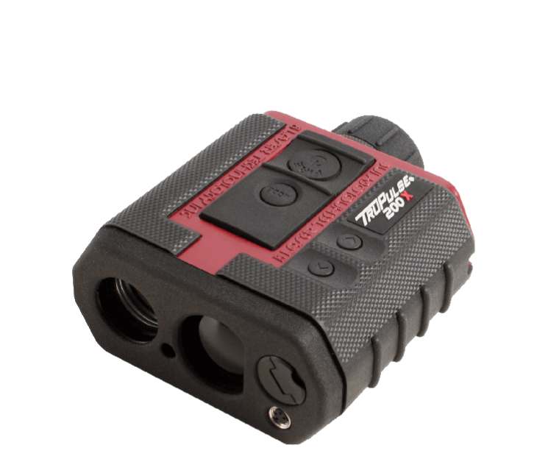
Design Solution: Laser Rangefinder
TruPulse 200X Laser Rangefinder
Purpose: provide accurate range measurements
Accurate to ±4 cm @ 400m range
Provides target quality flags
“TruTargeting”
Purpose
Design
CPE’s
Reqts
Risks
Verify
Planning
Backups
Notes:
Max

Slide 17
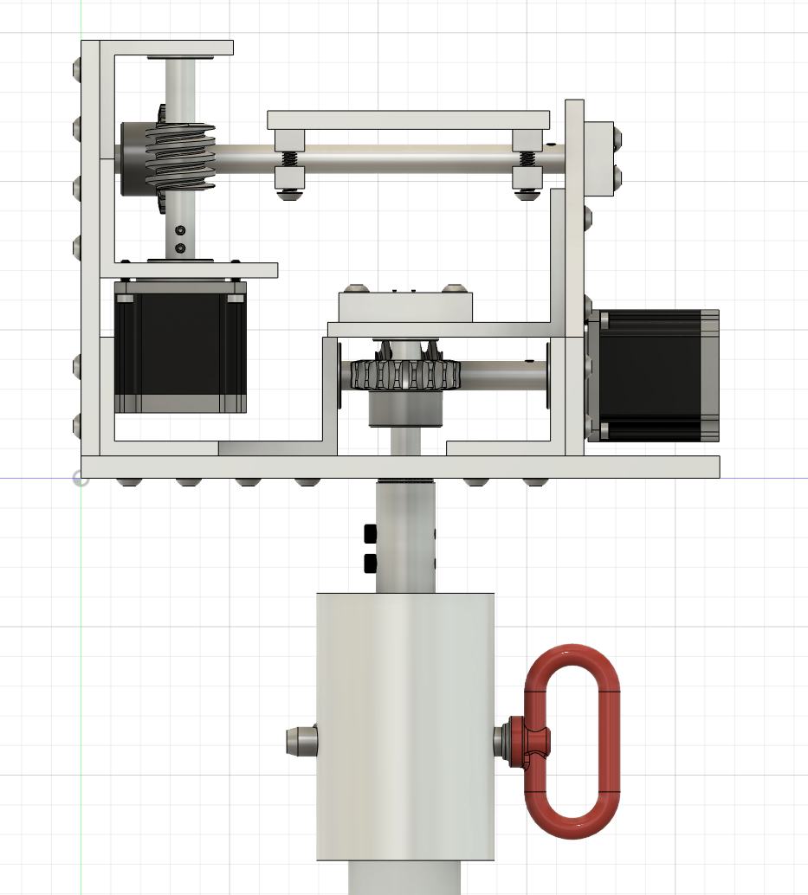
Design Solution: Potentiometer
Single turn, full 360° rotation, 10,000 ohm range: 6187R10KL1.0LF
Smallest degree turn that can be read
360/10,000 ohm = 0.036 °/ohm
Small error in value, 1% independent linearity
0.036 * 0.01 = 3.6x10⁻⁴ °/ohm
Power rating 1.0 Watt at 70°C, derating to 0 at 125°C
Works for measuring elevation and azimuth
Inclinometer no longer needed
Purpose
Design
CPE’s
Reqts
Risks
Verify
Planning
Backups
Notes:
Adam

Slide 18
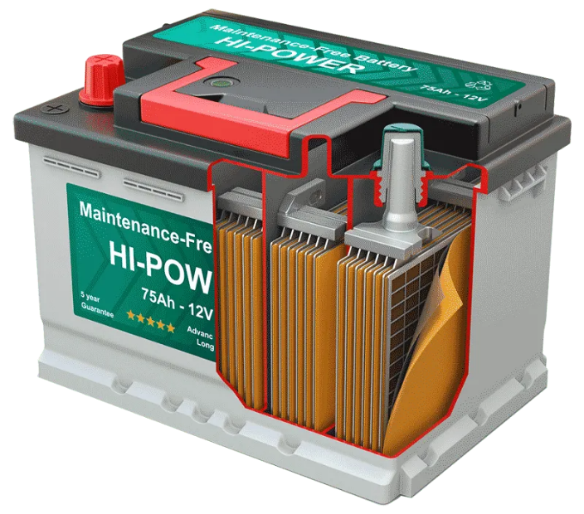
Design Solution: Batteries
Minimum Operating Voltage from Power Budget
12 Volts
Total Current Draw from Power Budget
3.9 - 4 Amps
Operate at 32°C Maximum for Dry scan
Scan time is 27 hours
Operate at -20°C Minimum for Wet scan
Scan time is 70 minutes
Purpose
Design
CPE’s
Reqts
Risks
Verify
Planning
Backups
Notes:
Devon
Saying what the battery has to perform

Slide 19
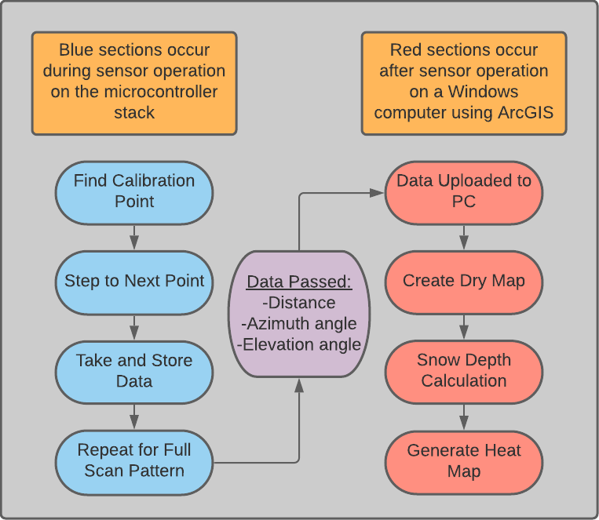


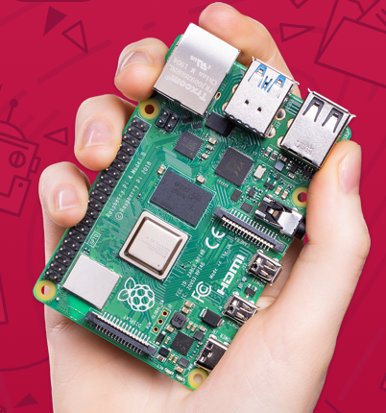

Design Solution: Software Overview
Post-Processing Computer: Windows PC
Microcontroller: Raspberry Pi 4
Purpose
Design
CPE’s
Reqts
Risks
Verify
Planning
Backups
Notes:
Brett

Slide 20
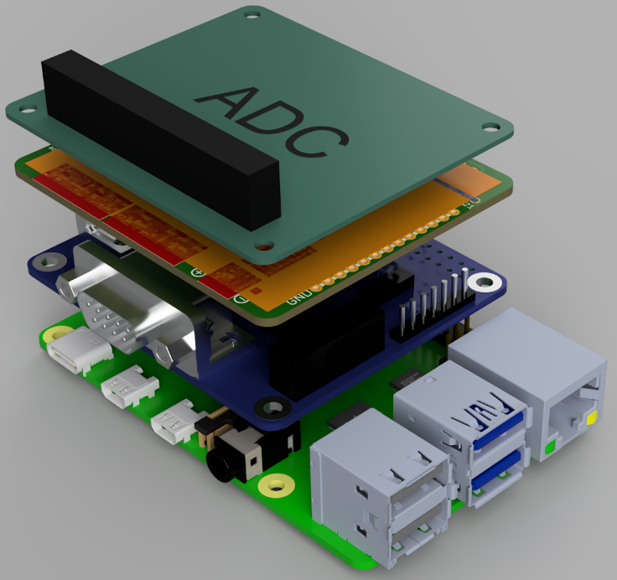
Design Solution: Microcontroller
System to control and communicate with sensors
Sensor pointing
Sensors all have different ways of communicating
Store collected data for retrieval after scan
One scan about 15 MB
Operate in cold conditions
24 Bit ADC
Stepper motor
controller
RS232 Hat
Raspberry Pi 4
Purpose
Design
CPE’s
Reqts
Risks
Verify
Planning
Backups
Notes:
Brett
Raspberry Pi isn’t technically a microcontroller, but thats essentially what we are using it as

Slide 21
Critical Project Elements
Purpose
Design
CPE’s
Reqts
Risks
Verify
Planning
Backups
Notes:
Adam

Slide 22
Critical Project Elements
Battery
Sensor Package (Collecting Snow Depth Data)
Laser Rangefinder
Pointing Accuracy
Sensor Environment
Control System
Software
(Sensor Communication)
Data Visualization
Georeferencing
Microcontroller
Purpose
Design
CPE’s
Reqts
Risks
Verify
Planning
Backups
Notes:
Adam

Slide 23
Design Requirements and their Satisfactions
Purpose
Design
CPE’s
Reqts
Risks
Verify
Planning
Backups
Notes:
Adam

Slide 24
Functional Requirements
Depth Detection: The system shall implement a snow depth detection system to assist Copper Mountain ski patrol in avalanche mitigation
Data Collection: The system shall be able to collect data for a region in one measuring cycle
Operation Conditions: The system shall be able to operate in the typical weather conditions found on the top of Copper Mountain
Data Storage: Data must be stored onboard for the scan duration and transferred to an existing computer system after the scan is complete
Data Processing: The system shall process the data collected and present snow depth data to Copper Mountain ski patrol in the software found at their facilities
System Control: The system shall collect pointing data accurately and then use that data to control the sensor’s pointing
Purpose
Design
CPE’s
Reqts
Reqts
Risks
Verify
Planning
Backups
Notes:
Adam

Slide 25
Laser Rangefinder
TruPulse 200X Laser Rangefinder
Detection Accuracy of ± 4 cm @ 400m
Satisfies DR 1.1
Operational Temperature down to -20ºC
Satisfies DR 3.1
 | Driving Design Requirement
DR 1.1 | The snow depth measurements shall be accurate to plus/minus 10cm.
DR 3.1 | The system shall be able to operate and collect data in temperature as low as -20°C.
Purpose
Design
CPE’s
Reqts
Reqts
Risks
Verify
Planning
Backups
Notes:
Max

Slide 26
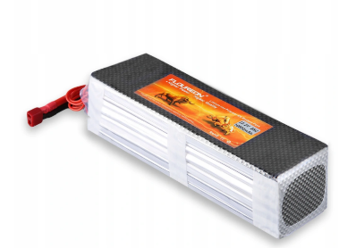
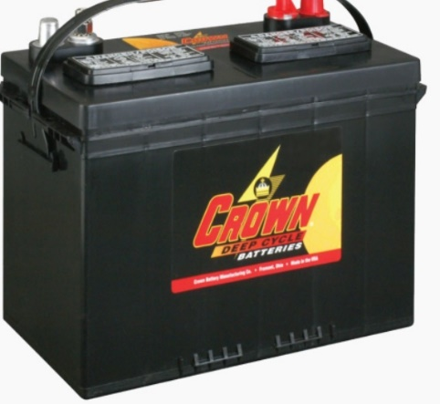
Battery
GRP9563159-25C-22.2V
22.2 Volts: Satisfies Voltage Requirement
10,000 mAh: Satisfies Wet scan time Requirement
Rated for extreme cold Temperatures: Satisfies Environment Requirement DR 2.4
27DC105 27 Deep-Cycle Crown Battery
12 Volts: Satisfies Voltage Requirement
105 Ah: Satisfies Dry scan time Requirement
Purpose
Design
CPE’s
Reqts
Risks
Verify
Planning
Backups
Notes:
Devon
Lipo battery specifically rated for cold weather

Slide 27
Sensor Housing & Weatherproofing
CPE | Laser Rangefinder | Stepper Motors | Raspberry Pi | Potentiometer
Temp Rating (°C) | -20° to 60° | -20° to 50° | -30° to 50° (unofficial) | 0° +
DR 3.1 Operational at -20°C
DR 3.3 IP 34 Rating
Purpose
Design
CPE’s
Reqts
Risks
Verify
Planning
Backups
Notes:
Saad
IP34
Solid objects larger than 0.1’
Diagonal sprays of w 5 mins

Slide 28
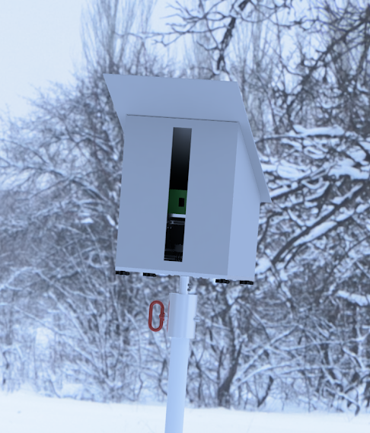
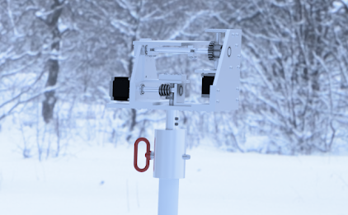
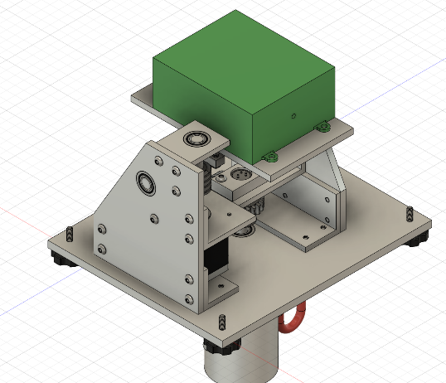
Sensor Housing & Weatherproofing
HDPE Housing Case (Designed and Built by SIMBA/CU)
High Density PolyEthylene is low cost & easy to manufacture
Edges sealed using caulk
Modular insulation for components
UV coating on exterior
Narrower slit for laser
Purpose
Design
CPE’s
Reqts
Risks
Verify
Planning
Backups
Notes:
Saad
Slit sized for (33 ft @ 300 ft)

Slide 29
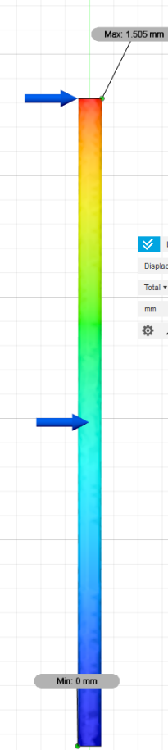
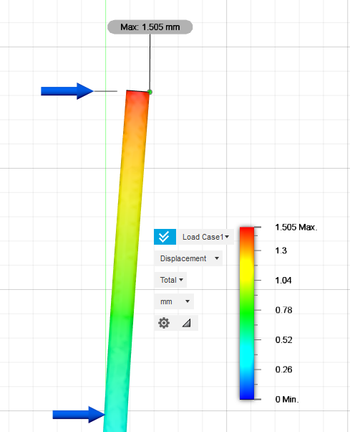
Sensor Platform
Campbell Scientific QST6 Tripod
Max. Tip Deflection: 0.0015 m
Max. Deflection Angle: 0.065°
Satisfies DR 3.2
 | Driving Design Requirement
DR 3.2 | The system shall be able to endure 40 mph wind gusts with no significant impact on data spatial resolution
Purpose
Design
CPE’s
Reqts
Risks
Verify
Planning
Backups
Notes:
Stephen

Slide 30
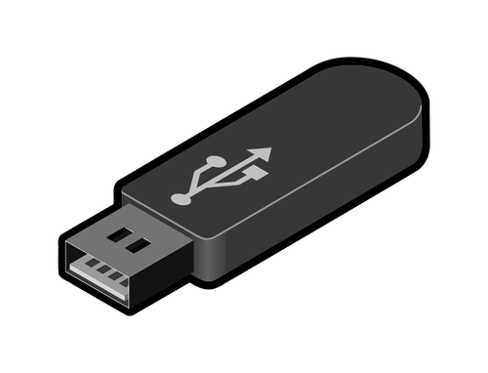
Data Storage
 | Driving Design Requirement
DR 4.1 | Store at least one scan
DR 4.2 | Easily transferable
1 scan = approximately 15 MB
32GB/15MB = 2133 scans
Raspberry Pi 4 with USB flash drive
32 GB USB stick
Can store roughly 2000 scans: Satisfies DR 4.1
USB ports on Raspberry Pi and PC
USB very common and easy to use: Satisfies DR 4.2
Purpose
Design
CPE’s
Reqts
Risks
Verify
Planning
Backups
Notes:
Brett
Can easily get a larger USB if needed

Slide 31
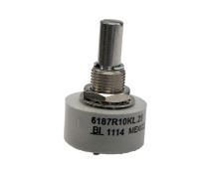
Potentiometer
The smallest value the potentiometer can read is 0.034° with a 3.4x10⁻⁴ certainty. If error is not accounted for:
Does not satisfy DR 6.1, 6.2
Can be used in control system
Control system is needed to satisfy DR 6.1, 6.2
 | Driving Design Requirement
DR 6.1 | Locate itself accurately to 0.005º in elevation direction
DR 6.2 | Locate itself accurately to 0.005º in azimuth direction
Purpose
Design
CPE’s
Reqts
Risks
Verify
Planning
Backups
Notes:
Adam

Slide 32

Control System
*Note, this displays the loop for the azimuth angle (ɣ) but can also be used for elevation angle (ɸ)
* See “Calculating Stepping Size” slide for more detail
= ɣ_{pot}(t) - ɣ_{pot}(t-1)
ƒ(d_{p},Δs) = Δɣ_{calc}
ɣ_{targ}
Δɣ_{pot}
Angle motor turns to
Satisfies DR 6.1
Satisfies DR 6.2
* Summation carried to next step
Purpose
Design
CPE’s
Reqts
Risks
Verify
Planning
Backups
Notes:
Adam

Slide 33
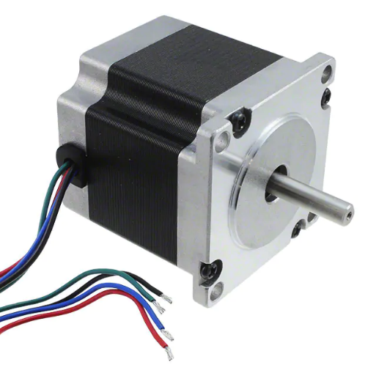
Stepper Motors
QSH5718-56-28-126
1600 steps per revolution with microstepping
Satisfies DR 1.4
1.26 Nm holding torque
Satisfies DR 2.2
Operational Temperature down to -20ºC
Satisfies DR 3.1
 | Design Driving Requirement
DR 1.4 | Can measure 1x1 meter plots at 500m
DR 2.2 | Torque to measure area quickly
DR 3.1 | Operate in Copper winter conditions
Purpose
Design
CPE’s
Reqts
Risks
Verify
Planning
Backups
Notes:
Jordan
The stepper motor will need to drive the laser such that it can scan 1x1 meter plots 500 meters away. The motors must also be able to move the laser rapidly to reduces scanning time and be able to operate in winter conditions. Therefore, we will be using the 126 model from QSH5718 stepper motor family. With 8 substep microstepping, the motor alone will have a pointing resolution of 1600 steps which is 31% of the ending resolution. With microstepping, the holding torque is 0.157Nm which is 76% of the minimum hold torque needed to drive the system. The motor is also rated down to -20 degrees C.

Slide 34

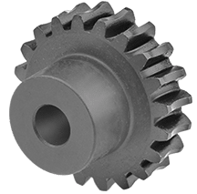
Gearing System
20:1 Worm Gear
20:1 gearing reduction
Satisfies DR 1.4
3.15 resulting torque
Satisfies DR 2.2
 | Design Driving Requirement
DR 1.4 | Can measure 1x1 meter plots at 500m
DR 2.2 | Torque to measure area quickly
Purpose
Design
CPE’s
Reqts
Risks
Verify
Planning
Backups
Notes:
Jordan
Again, the entire actuator system must have a pointing resolution of 3141 steps and must also be able to rapidly reposition the laser from rapid scanning. Therefore, a 20:1 worm gear was chosen to be included on the step motor drive train. Combined with microstepping, the total system resolution will be 32,000 steps per revolution. This results in ten times the baseline pointing resolution needed. Holding torque is also improved. Even with a 50% efficiency loss, the output torque with microstepping losses is 1.575 Nm, or 13 times greater then minimum required driving torque.

Slide 35
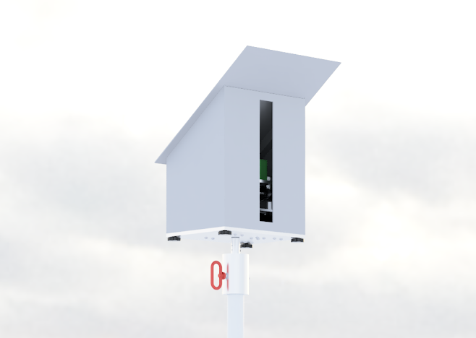
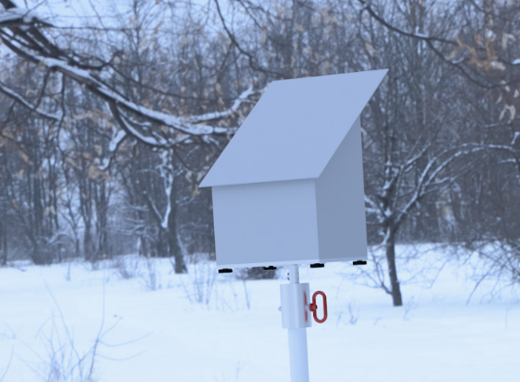
Total Enclosure
Thermal Protection
Sensor operational at -20 ^{O}C
Insulated HDPE Enclosure
Waste heat from electronics
Satisfies DR 3.1
Environmental Protection
Protected from debris & precipitation
Water-Resistant
Modular Component Enclosures
Satisfies DR 3.3
Purpose
Design
CPE’s
Reqts
Risks
Verify
Planning
Backups
Notes:
Saad
DR3.1 -20
DR 3.3 IP34

Slide 36

Microcontroller
24 Bit ADC
Raspberry Pi communicates with... | Communication Method
Laser Rangefinder | RS-232 and Waveshare serial hat
Potentiometers | Seeed Technology ADC
Windows PC | USB stick
Stepper Motors | Adafruit stepper motor hat
Stepper motor
controller
RS232 Hat
Raspberry Pi 4
Purpose
Design
CPE’s
Reqts
Risks
Verify
Planning
Backups
Notes:
Brett

Slide 37
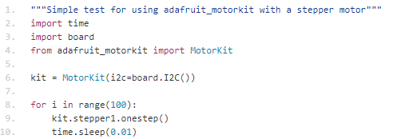
Microcontroller Continued
 | Driving Design Requirement
DR6.3 | Use control system to control sensor pointing
Raspberry Pi 4 used as microcontroller (plus attachments)
Python library for controlling stepper motors
Use measurements from potentiometers for feedback control: Satisfies DR 6.3
From learn.adafruit.com
Purpose
Design
CPE’s
Reqts
Risks
Verify
Planning
Backups
Notes:
Brett

Slide 38
ArcGIS
 | Driving Design Requirement
DR 5.1 | Interpolate dry map from summer scan
Data Passed on from scan:
Distance
Azimuth angle
Elevation angle
Data initialized (text file)
convert values into latitude, longitude, and altitude
Insert values into ArcGIS to create a layer of x and y coordinates,
Satisfies DR 5.1
Purpose
Design
CPE’s
Reqts
Risks
Verify
Planning
Backups
Notes:
Adam

Slide 39
ArcGIS
 | Driving Design Requirement
DR 5.3 | Calculate Snow Depth
DR 5.4 | Display data using ArcGIS
Data Passed on from scan:
Distance
Azimuth angle
Elevation angle
Data initialized (text file)
convert values into latitude, longitude, and altitude
Calculate snow depth using dry map
Satisfies DR5.3
Stack dry map layer and wet map layer. Wet map layer shows estimated snow depths
Satisfies DR 5.4
Purpose
Design
CPE’s
Reqts
Risks
Verify
Planning
Backups
Notes:
Adam

Slide 40
Risks
Purpose
Design
CPE’s
Reqts
Risks
Verify
Planning
Backups
Notes:
Stephen

Slide 41
Risk Evaluation Methods
Severity Level | Severity of Risk
1: Negligible | No effect to project success
2: Minor | Not critical to project success
3: Moderate | Risk will impede project success
4: Significant | Failure to meet one element of project success
5: Severe | Failure to meet multiple elements of project success
Likelihood Level | Likelihood of Risk
1: Very Unlikely | We do not expect risk to occur
2: Unlikely
3: Possible | Risk is realistic and previously documented
4: Likely
5: Very Likely | We expect risk to occur
Purpose
Design
CPE’s
Reqts
Risks
Verify
Planning
Backups
Notes:
Kevin

Slide 42
Overall Risk Matrix
R1 | Thermal Drift in Potentiometer
R2 | Water Damage
R3 | Fogging of sensor
R4 | Raspberry Pi causes software crash due to bugs
R5 | Tripod deflection
R6 | Error in sensor due to reflectivity of snow/ direct sunlight to sensor
R7 | Potentiometer backlash
Severity
 | 1 | 2 | 3 | 4 | 5
5 |  |  |  | R7
4 |  |  | R5 | R2 | R4
3 |  |  | R6 | R3
2
1 |  | R1
Likelihood
Purpose
Design
CPE’s
Reqts
Risks
Verify
Planning
Backups
Notes:
Kevin

Slide 43
Risk Mitigations
R1 | Thermal Drift in Potentiometers
Mitigation | Sensors enclosed in an insulated enclosure
R2 | Water Damage
Mitigation | Sensor Package Enclosure
Severity
Severity
 | 1 | 2 | 3 | 4 | 5
5
4
3
2
1 | R1 | R1
 | 1 | 2 | 3 | 4 | 5
5
4 |  |  |  | R2
3 |  | R2
2
1
Likelihood
Likelihood
Purpose
Design
CPE’s
Reqts
Risks
Verify
Planning
Backups
Notes:
Kevin

Slide 44
Risk Mitigations
R3 | Fogging of sensor
Mitigation | Consistent transport temp. & letting temp. settle before data collection
R4 | Raspberry Pi causes software crash due to bugs
Mitigation | Testing and validating different scenarios to account for different bugs.
Severity
Severity
 | 1 | 2 | 3 | 4 | 5
5
4
3 |  |  |  | R3
2
1 |  |  |  | R3
 | 1 | 2 | 3 | 4 | 5
5
4 |  |  |  |  | R4
3
2 |  |  | R4
1
Likelihood
Likelihood
Purpose
Design
CPE’s
Reqts
Risks
Verify
Planning
Backups
Notes:
Kevin

Slide 45
Risk Mitigations
R5 | Tripod Deflection
Mitigation | Add guy wires to support structure
R6 | Error in sensor due to reflectivity of snow/ direct sunlight to sensor
Mitigation | “TruTargeting” provides quality flag point of read & time of day, uses 4 measurements
Severity
Severity
 | 1 | 2 | 3 | 4 | 5
5
4 | R5 |  | R5
3
2
1
 | 1 | 2 | 3 | 4 | 5
5
4
3 | R6 |  | R6
2
1
Likelihood
Likelihood
Purpose
Design
CPE’s
Reqts
Risks
Verify
Planning
Backups
Notes:
Kevin
R6 TruTargeting- already on the laser range finder. Tells the user if the data point is being interfered by sunlight.

Slide 46
Risk Mitigations
R7 | Potentiometer Backlash
Mitigation | Realign voltage every change of elevation in scan. Still will be present, but will have minimal effect.
Severity
 | 1 | 2 | 3 | 4 | 5
5 | R7 |  |  | R7
4
3
2
1
Likelihood
Purpose
Design
CPE’s
Reqts
Risks
Verify
Planning
Backups
Notes:
Kevin

Slide 47
Verification and Validation
Purpose
Design
CPE’s
Reqts
Risks
Verify
Planning
Backups
Notes:
Stephen

Slide 48
Verification and Validation Overview
Test | Component Being Tested
Range Test | Laser Range Finder
Incident Angle Test | Laser Range Finder
Reflectivity Test | Laser Range Finder
Actuator System Test | Stepper Motors
Potentiometer Test | Potentiometer
Data Visualization Test | ArcGIS
Whole System Test | Whole System
Purpose
Design
CPE’s
Reqts
Risks
Verify
Planning
Backups
Notes:
Max

Slide 49
Test Process: Sensor
Range Test:
FR 2
Use the sensor to measure an object at a given distance
Confirm range measurement using a 100 ft measuring tape along straight line
Incident Angle Test:
FR 6
Measure a range distance of piece of plywood at a known distance
Change the angle of the plywood to see impact on accuracy
Find the incidence angles the sensor can measure
Purpose
Design
CPE’s
Reqts
Risks
Verify
Planning
Backups
Notes:
Max

Slide 50
Test Process: Sensor
Reflectivity Test:
FR 6
Repeat the Incident Angle Test with a reflective surface covering the plywood
Snow or white spray paint
Do measurements with sun glare on snow
Do measurements with sunlight directly at sensor
Do measurements at night
Determine the effects of different lighting scenarios and reflectivity on sensor accuracy
Position 1
2
3
θ
Purpose
Design
CPE’s
Reqts
Risks
Verify
Planning
Backups
Notes:
Max

Slide 51
Test Process: Actuator System
Range
FR6
Test pitching and azimuth range
Pointing Resolution
FR6
Determine to minimum stepping angle of actuator system
Power Draw
FR6
Determine power draw for holding torque and moving the system
Purpose
Design
CPE’s
Reqts
Risks
Verify
Planning
Backups
Notes:
Jordan
There are three tests to verify the actuator system meets the design requirements. The first test is making sure the pitching system has a field of view of 60 degrees and the azimuth system has a field of view of 135 degrees. This is tested by commanding the azimuth motor to move 75 steps and the pitching motor to move 34 steps. The total angular distance traveled by the output of the gear shaft is measured and compared to the required range. The second test explores the actuator system resolution. A laser is attached to the output of the gearing system and the smallest used microstep is commanded to the stepper motor. The distance the laser point travels on the pointing surface is used to back out the output resolution of the actuator system. The next slide shows a visual of this test nicely. The last test is to quantify the power draw of the motors by applying a holding torque of 0.25 Nm, drive the motor 0.1 degrees per second and the 6.7 degrees per second.

Slide 52
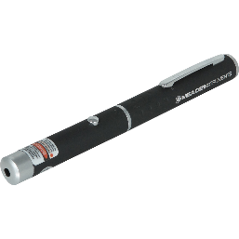
Test Process: Potentiometer
1 cm graph paper
Potentiometer accuracy needs to be tested to 0.001 degrees
FR 6
Attach laser pointer to potentiometer and shine at graph paper
If 1 cm graph paper is 0.175 meters away, one square represents 0.001 degrees
0.175 m
Laser pointer attached to potentiometer
Purpose
Design
CPE’s
Reqts
Risks
Verify
Planning
Backups
Notes:
Adam
0.175 m is minimum distance to get 0.001 degree accuracy

Slide 53
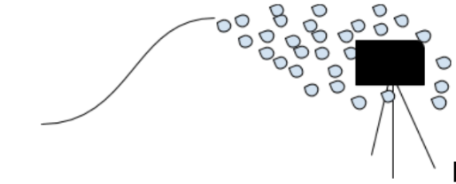
Test Process: Whole System
Test accuracy of whole system
Measure before and after snowfall of a Boulder hill with known snow depths
Test durability of whole system
FR3 Elements/Weather Protection
Test in cold weather/cold chamber for function
Operation while spraying water and small debris to verify IP24 Rating
Strength
Push system over to verify sensor package can withstand falls from operating height
Purpose
Design
CPE’s
Reqts
Risks
Verify
Planning
Backups
Notes:
Devon

Slide 54
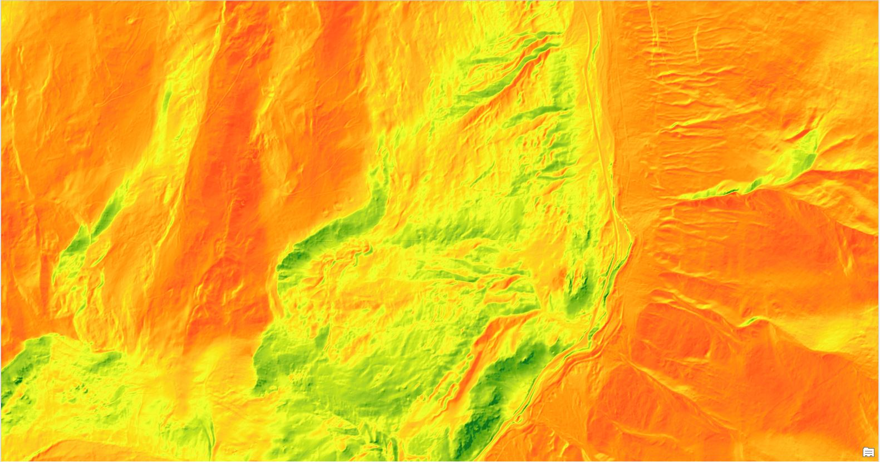
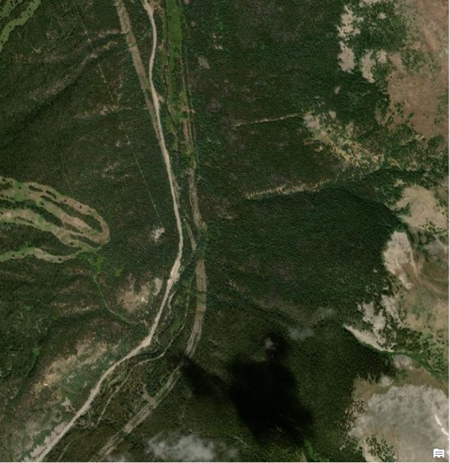
Test Process: Data Visualization
Test ability of program to plot data from whole system test
FR 5
Test ability of program to process and calculate data accurately
Test codes robustabillity
Add some “NaN” values to the dataset
* Note, 1m x 1m elevation maps are available for testing data usability. However, these maps are accurate to 4m so it can not function as the formative depth map.
Purpose
Design
CPE’s
Reqts
Risks
Verify
Planning
Backups
Notes:
Adam

Slide 55
Project Planning
Purpose
Design
CPE’s
Reqts
Risks
Verify
Planning
Backups
Notes:
Stephen

Slide 56
Organizational Chart
Customer
Hagen Lyle
Advisor
Zachary Sunberg
Project Manager
Stephen Peng
Systems Engineer
Saad Syed
Financial Lead
Adam Gourmos
Manufacturing Lead
Sean Yoo
Safety Lead
Max Fidler
Enclosure Lead
Jordan Walters
SW Systems Engineer
Brett Papenfuss
Modeling Lead
Aidan Sesnic
Thermal Lead
Kevin Yevak
Sensor Lead
Luke Dickinson
Battery Lead
Devon Ricken
ADCS Lead
Travis Griffin
Purpose
Design
CPE’s
Reqts
Risks
Verify
Planning
Backups
Notes:
Sean

Slide 57
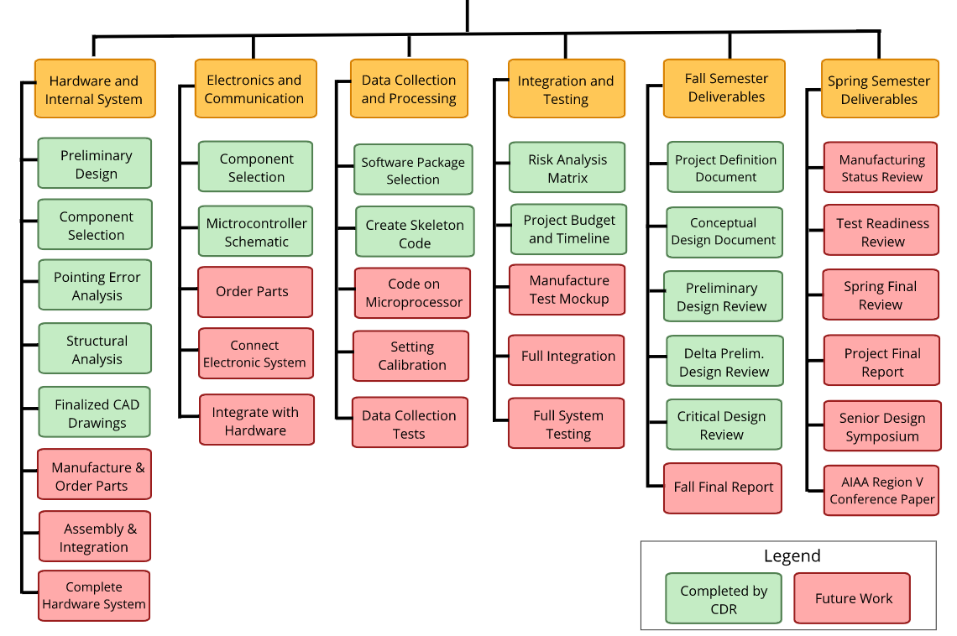
Work Breakdown Structure
Team SIMBA
Purpose
Design
CPE’s
Reqts
Risks
Verify
Planning
Backups
Notes:
sean

Slide 58
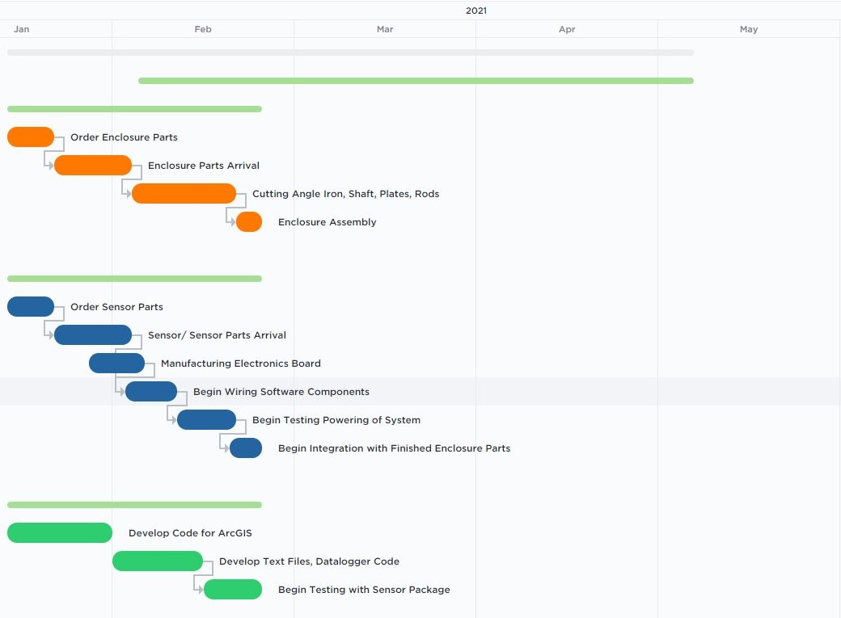
Work Plan
Manufacturing Team
Sensor Team
Software Team
Purpose
Design
CPE’s
Reqts
Risks
Verify
Planning
Backups
Notes:
Stephen

Slide 59
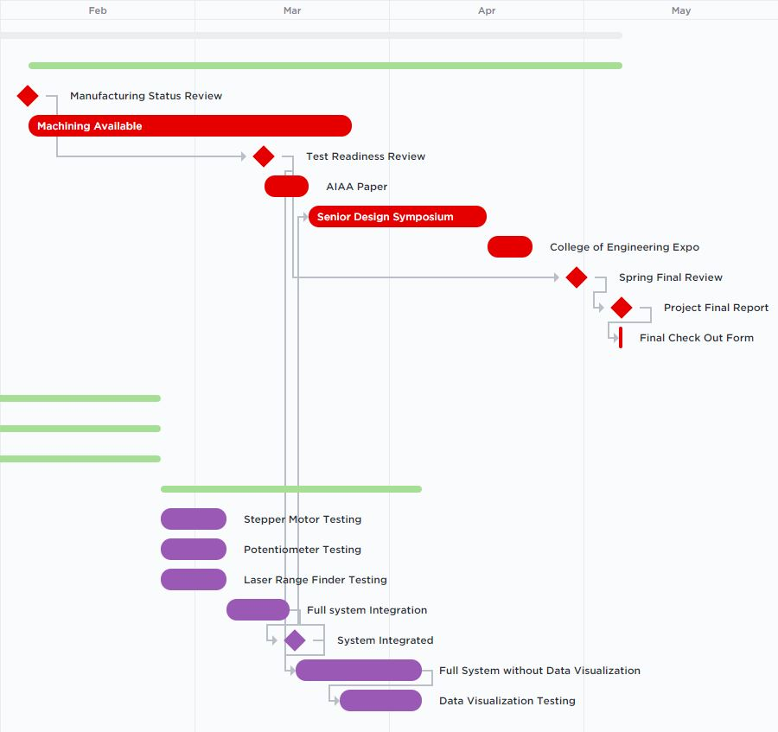
Testing Plan
Administrative Plan
Integration & Testing
Purpose
Design
CPE’s
Reqts
Risks
Verify
Planning
Backups
Notes:
Stephen

Slide 60
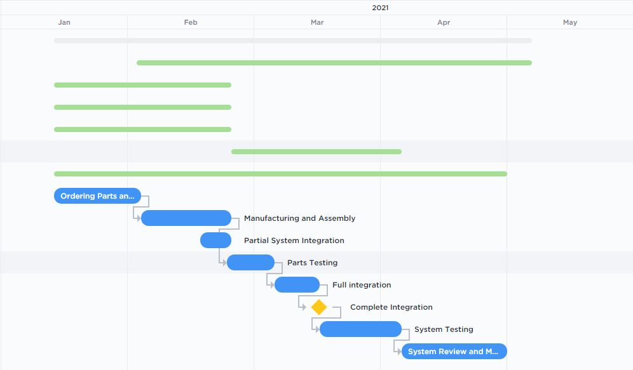
Critical Project Path
Purpose
Design
CPE’s
Reqts
Risks
Verify
Planning
Backups
Notes:
Adam

Slide 61
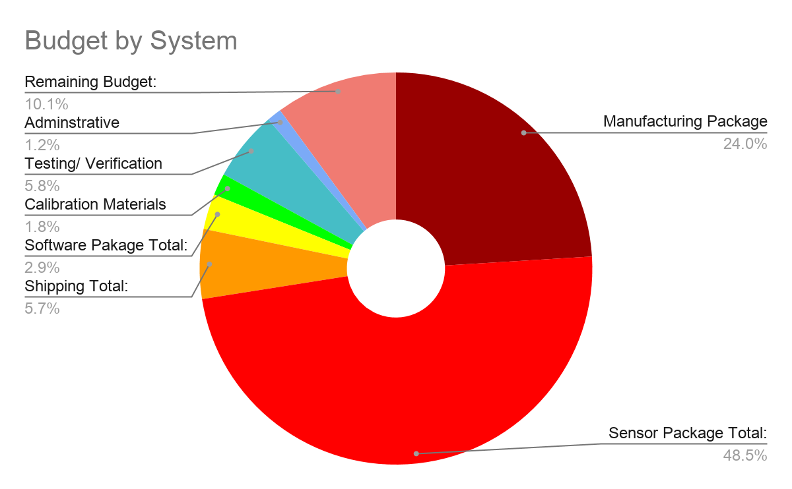
Cost Plan
Manufacturing Package Total: | $1,201.25
Sensor Package Total: | $2,423.94
Shipping Total: | $286.73
Software Pakage Total: | $145.66
Calibration Materials | $90.83
Testing/ Verification Equipment | $288.74
Adminstrative | $60
Total w/ Margin: | $4,497.14
Remaining Budget: | $502.86
* 5% Margin applied to total to account for any costs not considered
* More in depth chart given on “Comprehensive Financial Plan” slide
Purpose
Design
CPE’s
Reqts
Risks
Verify
Planning
Backups
Notes:
Adam

Slide 62
Acknowledgements
Thank you to Professor Sunberg for his guidance through this project
Thank you to Collin for feedback on how to improve our presentation
Thank you to the PAB for helping us get our project back on track
Purpose
Design
CPE’s
Reqts
Risks
Verify
Planning
Backups
Notes:
Stephen

Slide 63
Backup Slides: Design
Purpose
Design
CPE’s
Reqts
Risks
Verify
Planning
Backups
Notes:
Stephen

Slide 64
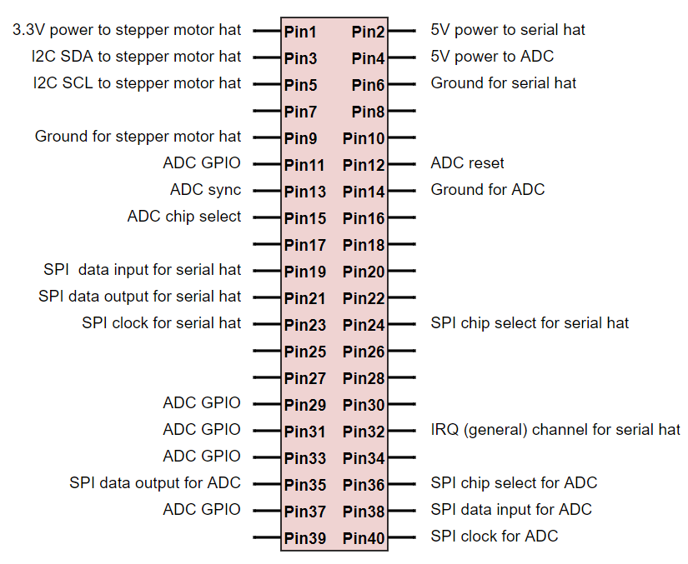
Raspberry Pi Pinout
Purpose
Design
CPE’s
Reqts
Risks
Verify
Planning
Backups

Slide 65
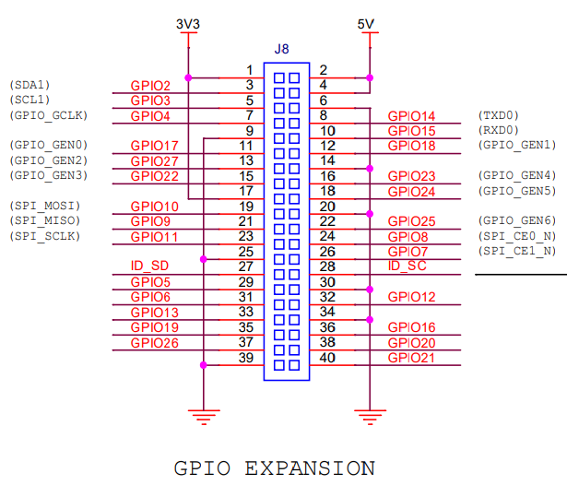
Raspberry Pi Schematic
Raspberry Pi 4 Model B
Schematic of GPIO pinouts to the right
Full schematics: https://www.raspberrypi.org/app/uploads/2012/04/Raspberry-Pi-Schematics-R1.0.pdf
Purpose
Design
CPE’s
Reqts
Risks
Verify
Planning
Backups

Slide 66
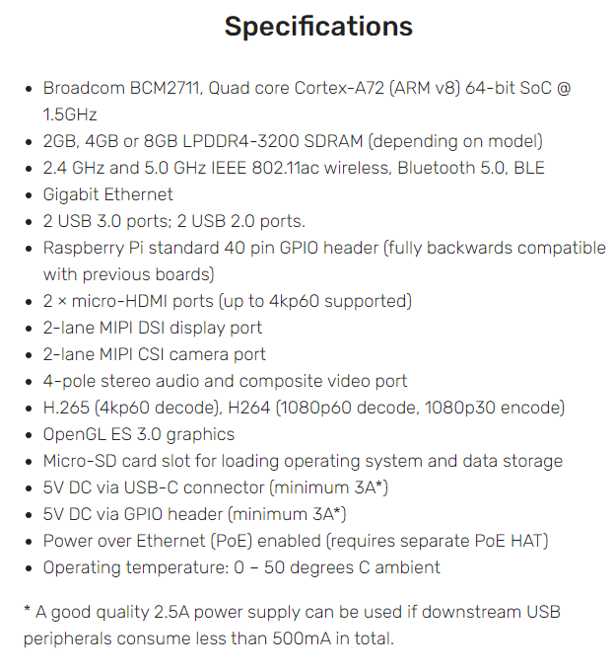
Raspberry Pi Specs
Raspberry Pi 4 has up to 8GiB of RAM, 64-bit ARM Cortex microprocessor: plenty of hardware resources to meet computation demands
Several USB ports to allow for writing of data to USB flash drives
Very low cost
Hardware-level floating point support (expect this to be helpful given required pointing precision)
Wide variety of add-on boards to support interfacing with RS-232, stepper motors, etc.
Extensive libraries, code made by other users available
*Specs from : https://www.raspberrypi.org/products/raspberry-pi-4-model-b/specifications/?resellerType=home
Purpose
Design
CPE’s
Reqts
Risks
Verify
Planning
Backups

Slide 67
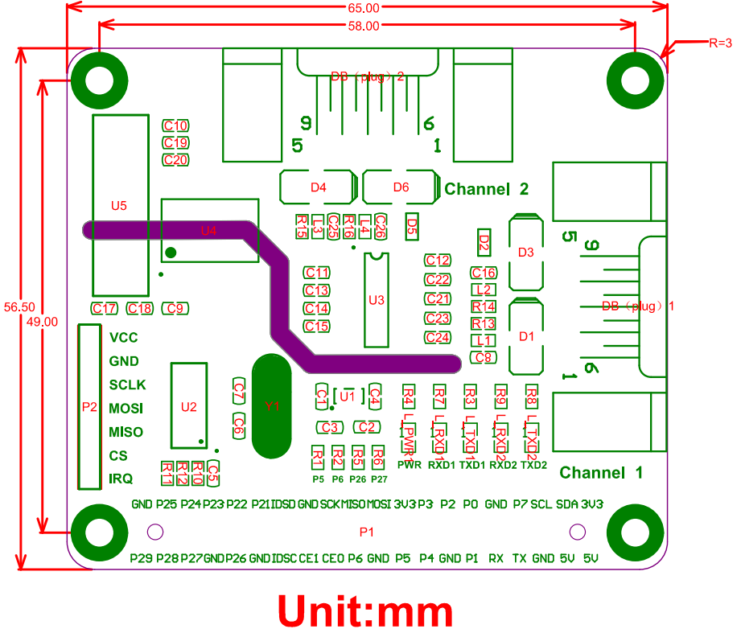
Serial Hat Schematic
Waveshare 2-CH RS232 HAT
Full pinouts: https://www.waveshare.com/w/upload/5/5a/2-CH_RS232_HAT_SchDoc.pdf
Purpose
Design
CPE’s
Reqts
Risks
Verify
Planning
Backups

Slide 68
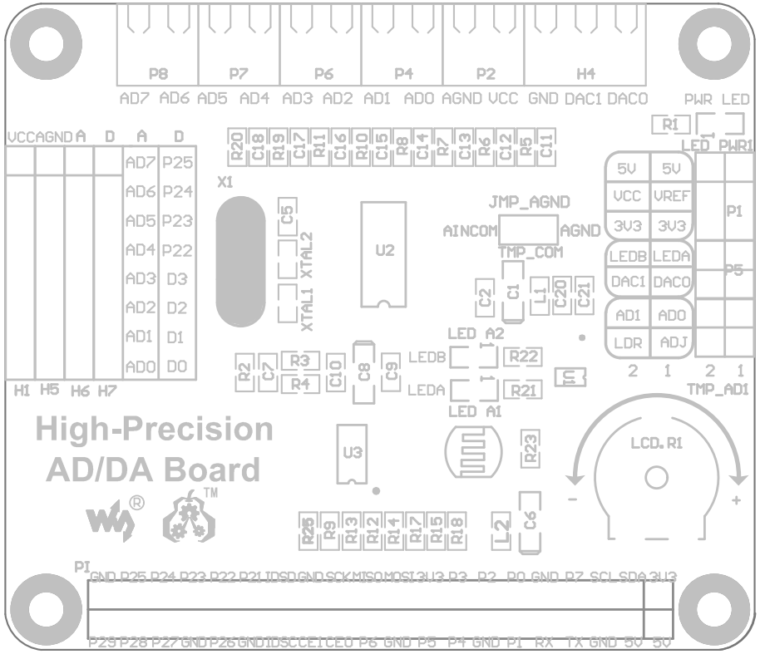
ADC Schematic
Seeed Technology Raspberry Pi High-Precision AD/D
Full pinouts: https://www.waveshare.com/w/upload/2/29/High-Precision-AD-DA-board.pdf
Purpose
Design
CPE’s
Reqts
Risks
Verify
Planning
Backups

Slide 69
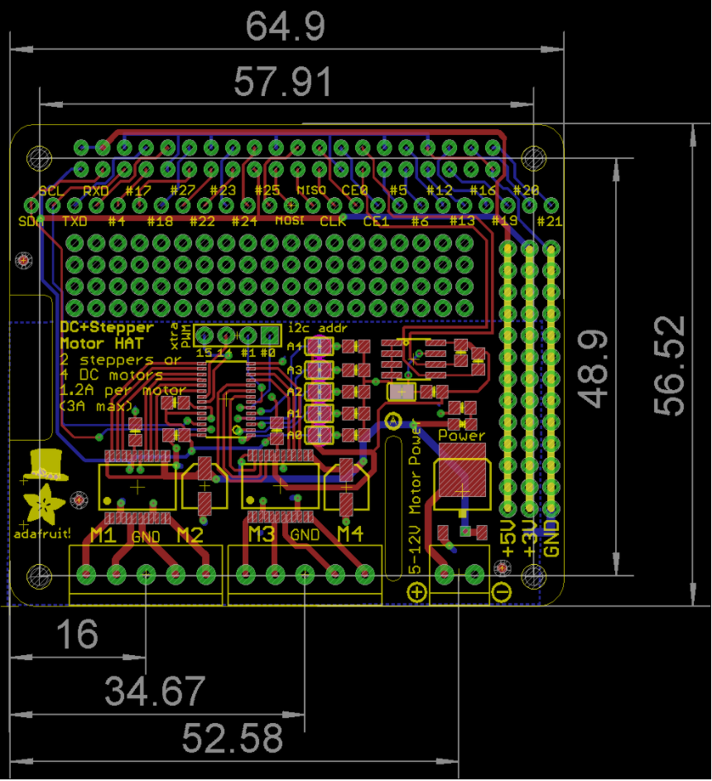
Stepper Motor Hat Schematic
Adafruit DC and Stepper Motor HAT for Raspberry Pi
Full pinouts: https://learn.adafruit.com/adafruit-dc-and-stepper-motor-hat-for-raspberry-pi/downloads
Purpose
Design
CPE’s
Reqts
Risks
Verify
Planning
Backups

Slide 70
Sampling Rates and Data Size
- Sampling rate (dry): 1-2 Hz
- Data size (dry): 15 MB
- Sampling rate (wet): 1-2 Hz
- Sampling size (wet): <1 MB
-Total Storage: 32 GB
Purpose
Design
CPE’s
Reqts
Risks
Verify
Planning
Backups

Slide 71
Microcontroller Power Cost
Raspberry Pi 4 Model B
Voltage: 5.1V
Active current draw with no hats: ~600mA
Max active current draw of hats: 1.2 A
Recommended max current capacity: 3 A
Raspberry Pi power input is USB-C, the other boards draw power through Raspberry Pi’s GPIO pins
Purpose
Design
CPE’s
Reqts
Risks
Verify
Planning
Backups

Slide 72
Enabling I2C for Raspberry Pi
Some of the serial hats utilise I2C communication, which needs to be enabled on the Pi
Run sudo apt-get install -y python-smbus and sudo apt-get install -y i2c-tools
Run sudo raspi-config once the install is complete
Go to interface options, then I2C and click enable
Test using sudo i2cdetect -y 1
https://learn.adafruit.com/adafruits-raspberry-pi-lesson-4-gpio-setup/configuring-i2c
Purpose
Design
CPE’s
Reqts
Risks
Verify
Planning
Backups

Slide 73
Calculating Stepping Angle
Law of Cosines
a² = b² + c² - 2bc cos(A) *b=c
1 = 2d_{p}² - 2d_{p}² cos(ɣ)
ɣ = cos⁻¹[1- (1/2d_{p}²)]
elbow
assumed
Δs = 1m
d_{p}
d_{p}
ɣ
Pros
Maintains spatial resolution
Will never see an “elbow” when measuring elevation angle
Cons
Poor reading for “elbows” on surface
Adds more time to scanning
Purpose
Design
CPE’s
Reqts
Risks
Verify
Planning
Backups

Slide 74
Geolocation Assignment
Laser
North
*d_{p}= sin(90-Φ)*d
z
z
ɣ
Φ
y
Bare Surface
x
d_{p}
d
Z_{o}
*Top View
d_{p}
Z_{c}
Key
Φ = Elevation angle
ɣ = Azimuth angle
d = Distance measured by laser
d_{p}= Projected Distance for “Great Circle” Equation
*Side View
Purpose
Design
CPE’s
Reqts
Risks
Verify
Planning
Backups

Slide 75
Geolocation Assignment
Great Circle Equations
Given the initial base location, azimuth angle, and distance to a location we can find its latitude:
L_{d} = sin⁻¹[sin(L_{o})cos(d_{p}/R) + cos(L_{o})sin(d_{p}/R)cos(ɣ)]
Given the initial base location, azimuth angle, distance, and calculated latitude at a location, we can find its longitude:
Δ_{d} = Δ_{o} + atan2[sin(ɣ)sin(d_{p}/R)cos(L_{o}) , cos(d_{p}/R)-sin(L_{o})sin(L_{d})]
North
*d_{p}= sin(90-Φ)*d
z
ɣ
x
d_{p}
* (L_{d},Δ_{d},z_{d})
*Top View
Key
Φ = Elevation angle
θ = Azimuth angle
d = Distance measured by laser
d_{p}= Projected Distance for “Great Circle” Equation
Purpose
Design
CPE’s
Reqts
Risks
Verify
Planning
Backups

Slide 76
Sensor Pointing Math
Equations:
(x+dx) tan(Φ) = y+dy
AE cos(Φ + dΦ) = AB + x+ dx
AE sin(Φ + dΦ) = y + dy
Law of Sines:
AD = AE sin(Ө- Φ - dΦ)/ sin(180 - Φ - Ө)
Solve 1,2,3,4 for dy in terms of only AE
Vertical error equation due to vertical deviations:
dy = AE ( sin(Φ + dΦ) -
((sin(Φ)*sin(Ө- Φ - dΦ)/ sin(180 - Ө+Φ)))
Ө is slope angle
Φ is vertical pointing angle
dΦ is pointing error angle
AE is measurement returned by sensor
AD is intended pointing direction
C
E
dy
dΦ
D
Ө
y
dx
A
Φ
B
Ө
x
Note: Similar analysis is done for azimuth pointing error to solve for vertical error then added in quadrature
Purpose
Design
CPE’s
Reqts
Risks
Verify
Planning
Backups

Slide 77
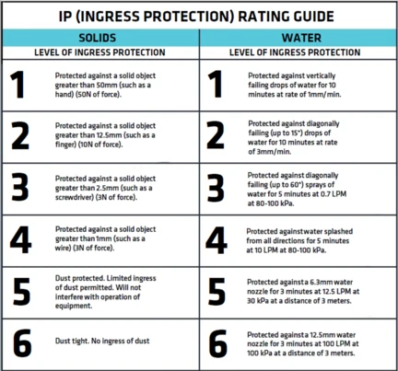
Ingress Protection
Purpose
Design
CPE’s
Reqts
Risks
Verify
Planning
Backups

Slide 78
Backup Slides: CPEs
Purpose
Design
CPE’s
Reqts
Risks
Verify
Planning
Backups
Notes:
Stephen

Slide 79
Levels of Success
 | Sensor Package | Software | Pointing Accuracy and Control | Output
1 | Snow depth accurately measured within ±50 cm at 1 location at 400 m | Data of one distance measurement by sensor is saved | Laser pointing is able to be determined to 0.01 degrees. No feedback present. Motors ±1º of desired position | Compile data to form a plane to serve as origin for height measurements
2 |  | Distance and attitude of each measurement is recorded for attitude control | Feedback is present allowing the motors to readjust as needed | Display snow depth calculated for one location
3 | Snow depth accurately measured within ±15 cm at 400m | Distance, attitude, time & temperature of each measurement is recorded | Motor initial move ±0.1º of desired position. Feedback allows for ±0.01º | Produce map displaying snow depth
4 | Snow depth accurately measured within ±10 cm at 400 m with 1 m spatial resolution |  | Motor initial move ±0.01º of desired position. Feedback allows for ±0.001º | Produce topographical snow depth map to within ±10 cm
Purpose
Design
CPE’s
Reqts
Risks
Verify
Planning
Backups

Slide 80
Backup Slides: Reqts
Purpose
Design
CPE’s
Reqts
Risks
Verify
Planning
Backups
Notes:
Stephen

Slide 81
FR1: Snow Depth Sensing Detection
 | Design Requirement | Technical Performance Measure
DR 1.1 | The snow depth measurements shall be accurate to plus/minus 10cm. | Snow Depth
DR 1.2 | The snow depth data shall have a spatial resolution of at least 6m by 6m | Spatial Resolution
DR 1.3 | The system shall be able to meet requirements in areas clear of foliage. | Snow Depth/Spatial Resolution
Purpose
Design
CPE’s
Reqts
Risks
Verify
Planning
Backups
Notes:
Stephen
Current methods involve digging snow pits on the sides of avalanche prone areas

Slide 82
FR2: Acceptable Endurance
 | Design Requirement | Technical Performance Measure
DR2.1 | Scan area of 0.15 km² | Surface Area of Digital Elevation Model (DEM), Measurement Distance (Min/Max)
DR2.2 | Less than 1.5? | Duration of scan of 0.15 km² in standard conditions
DR2.3 | Capable of one (dry) scan in summer. | Maximum Autonomous Operational Time:?? (Summer)
DR2.4 | Capable of one (wet) scan in winter | Autonomous Operational Time: 90min (Winter)
Purpose
Design
CPE’s
Reqts
Risks
Verify
Planning
Backups

Slide 83
FR3: Operational in Adverse Weather
 | Design Requirement | Technical Performance Measure
DR3.1 | Operational at -20 ºC | Internal Temperature, Environment Temperature
DR3.2 | Endure 40 mph wind gusts | Wind Speed, Force, Sensor Deflection
DR3.3 | IP55 water resistant | Ingress Protection Rating
Purpose
Design
CPE’s
Reqts
Risks
Verify
Planning
Backups
Notes:
Stephen
Current methods involve digging snow pits on the sides of avalanche prone areas

Slide 84
FR4: Data Storage
 | Design Requirement | Technical Performance Measure
DR4.1 | Capable of storing 15 MB of data | Storage Capacity, Available Storage Capacity
DR4.2 | Data transferrable for post-processing | Repeatability of Data Transfer, Typical Duration of Data Transfer
Purpose
Design
CPE’s
Reqts
Risks
Verify
Planning
Backups
Notes:
Brett

Slide 85
FR5: Present Snow Depth Data
 | Design Requirement | Verification
DR5.1 | Interpolate dry map from summer scan | Accuracy of Digital Elevation Model (Dry), Surface Area of Digital Elevation Model
DR5.2 | Process sensor data from USB | USB Compatibility, File Compatibility
DR5.3 | Calculate Snow Depth | Accuracy of Digital Elevation Model (Snow Depth)
DR5.4 | Display data using ArcGIS | Display digital elevation model on customer’s device
Purpose
Design
CPE’s
Reqts
Risks
Verify
Planning
Backups

Slide 86
FR6: Collect & Use Pointing Data
 | Design Requirement | Technical Performance Measure
DR6.1 | Locate itself accurately to 0.005º in elevation direction | Measured Angular Accuracy (Elevation)
DR6.2 | Locate itself accurately to 0.005º in azimuth direction | Measured Angular Accuracy (Azimuth)
DR6.3 | Use feedback system to control sensor pointing | Control Accuracy
Purpose
Design
CPE’s
Reqts
Risks
Verify
Planning
Backups
Notes:
Stephen
Current methods involve digging snow pits on the sides of avalanche prone areas

Slide 87
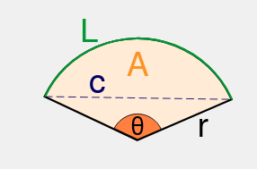
Sensor Platform
Campbell Scientific QST6 Tripod
Max. Tip Deflection: 0.0015 m
Max. Deflection Angle: 0.065°
R = 400 m
Chord Length(c): 0.45 m
Less than spatial resolution requirement of 1 m
Purpose
Design
CPE’s
Reqts
Risks
Verify
Planning
Backups
Notes:
Stephen

Slide 88
ArcGIS
 | Driving Design Requirement
DR 5.2 | Process sensor data from USB
Data from USB will be formatted in a comma-delimited, Hex ASCII text file.
Data will then be processed in an python scripting tool within ArcGIS
Satisfies DR 5.2
Purpose
Design
CPE’s
Reqts
Risks
Verify
Planning
Backups
Notes:
Adam

Slide 89
Backup Slides: Risks
Purpose
Design
CPE’s
Reqts
Risks
Verify
Planning
Backups
Notes:
Stephen

Slide 90
Risk Summary
 | Risk | What’s at Risk
R1 | Thermal Drift in Potentiometer | Accuracy
R2 | Water Damage | Hardware
R3 | Fogging of sensor | Sensor/Accuracy
R4 | Raspberry Pi causes software crash due to bugs | Hardware Control
R5 | Tripod deflection | Accuracy
R6 | Error in sensor due to reflectivity of snow/ direct sunlight to sensor | Accuracy
R7 | Potentiometer Backlash | Attitude Control
Purpose
Design
CPE’s
Reqts
Risks
Verify
Planning
Backups
Notes:
Kevin
Current methods involve digging snow pits on the sides of avalanche prone areas

Slide 91

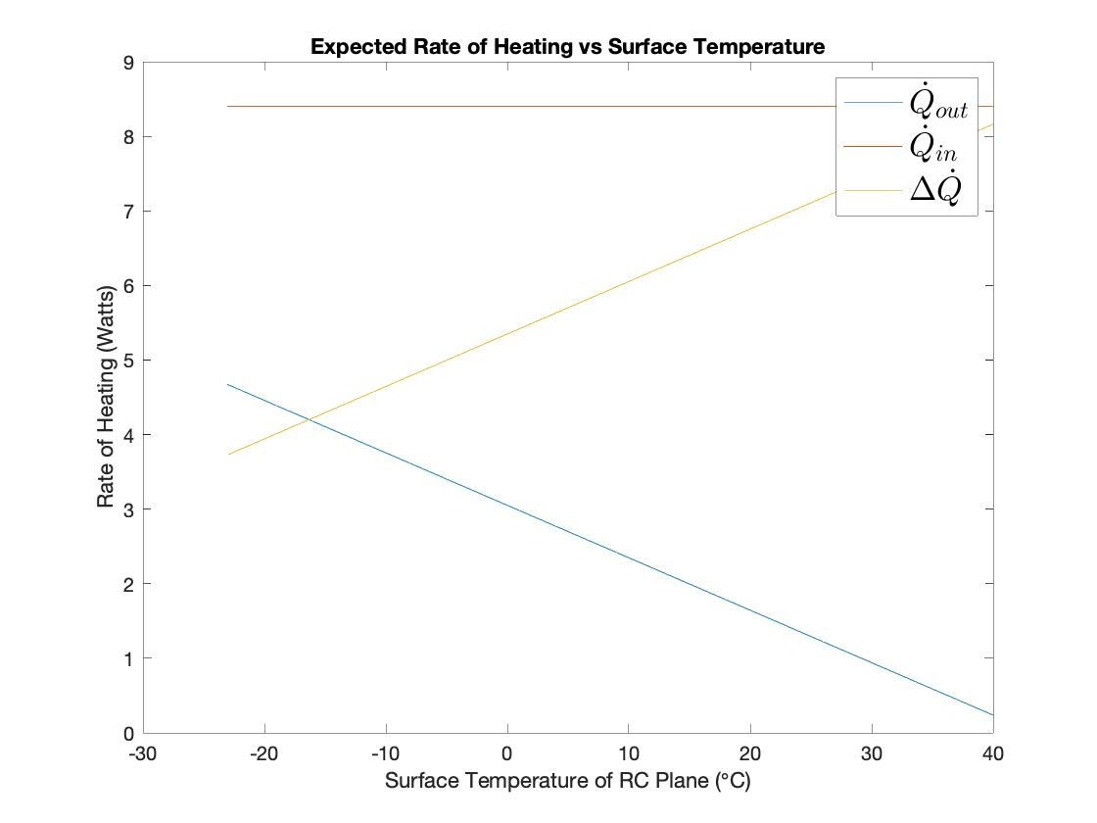

Batteries in the Cold
Purpose
Design
CPE’s
Reqts
Risks
Verify
Planning
Backups
Notes:
Stephen
Current methods involve digging snow pits on the sides of avalanche prone areas

Slide 92

Temperature Sensor (if needed)
Adafruit DS18B20 Digital temperature sensor
Knowing the temperature allows for better error correction
Usable temperature range: -55 to 125°C (-67°F to +257°F)
9 to 12 bit selectable resolution
Uses 1-Wire interface- requires only one digital pin for communication
Unique 64 bit ID burned into chip
Multiple sensors can share one pin
±0.5°C Accuracy from -10°C to +85°C
Temperature-limit alarm system
Query time is less than 750ms
Usable with 3.0V to 5.5V power/data
Purpose
Design
CPE’s
Reqts
Risks
Verify
Planning
Backups
Notes:
Stephen
Current methods involve digging snow pits on the sides of avalanche prone areas

Slide 93

Mitigating Backlash
Backlash
Δe
Backlash: Potentiometer continues to read even when gears don’t engage.
To fix:
After scanning a row (when changing elevation value), find point where ɣ_{pot} = ɣ_{o}
At this point, take difference in output voltage
Apply voltage difference (Δe) to motor to account for in next step
Output Voltage from Shaft (e)
e₁
e_{o}
ɣ_{o}
ɣ₂
ɣ₁
Azimuth Turn Angle (ɣ)
Purpose
Design
CPE’s
Reqts
Risks
Verify
Planning
Backups

Slide 94
Risk Summary
Risk ID | What’s at Risk | Description | Original Severity | Original Likelihood | Mitigation
R1 | Accuracy | Thermal Drift in Potentiometer | Minor | Unlikely | Sensors will be housed in a insulated enclosure
R2 | Hardware | Water Damage | Significant | Likely | Sensor package enclosure
R3 | Sensor/ Accuracy | Fogging of sensor | Significant | Possible | Consistent transport temp & let temp settle before data collection
R4 | Hardware Control | Raspberry Pi causes software crash due to bugs | Moderate | Unlikely | Testing and validating different scenarios to account for different bugs.
R5 | Accuracy | Tripod deflection | Moderate | Very Likely | Add guy wires to support structure
R6 | Accuracy | Error in sensor due to reflectivity of snow/ direct sunlight to sensor | Moderate | Possible | “TruTargeting” provides quality flag of point read & time of day
Purpose
Design
CPE’s
Reqts
Risks
Verify
Planning
Backups
Notes:
Kevin
Current methods involve digging snow pits on the sides of avalanche prone areas

Slide 95
Backup Slides: Verify
Purpose
Design
CPE’s
Reqts
Risks
Verify
Planning
Backups
Notes:
Stephen

Slide 96
Potentiometer testing
At 0.175 m, one square of 1 cm graph paper = 0.001 degrees of rotation for the potentiometer
1 cm
0.001 deg
x = ?
arctan(0.001 deg) =0.01 m/x
x = 0.01/arctan(0.001)
x = 0.175 m
Purpose
Design
CPE’s
Reqts
Risks
Verify
Planning
Backups

Slide 97


Facilities
Hillside somewhere near Boulder (need to investigate a location)
Need snowless and snowy hill measurements
Possibly cold chamber if weather is not permitting
Yard behind aerospace building
Purpose
Design
CPE’s
Reqts
Risks
Verify
Planning
Backups
Notes:
Sean Yoo

Slide 98



Equipment for Testing
Completed System
Snow probe
Tape Measure
Windows Computer with ArcGIS
Plywood sheet
1 cm graph paper
Laser pointer
Purpose
Design
CPE’s
Reqts
Risks
Verify
Planning
Backups
Notes:
Sean

Slide 99
Backup Slides: Planning
Purpose
Design
CPE’s
Reqts
Risks
Verify
Planning
Backups
Notes:
Stephen

Slide 100
User Manual
Plan to create users manual and deliver to customer
Software user manual
Hardware user manual with maintenance guide
We would also like to do an in-person training session running through a full setup, scan, and processing of the data, but this is entirely dependent on the Covid situation near the end of next semester.
Purpose
Design
CPE’s
Reqts
Risks
Verify
Planning
Backups
Notes:
Stephen
Current methods involve digging snow pits on the sides of avalanche prone areas

Slide 101

Comprehensive Financial Plan
Purpose
Design
CPE’s
Reqts
Risks
Verify
Planning
Backups
Notes:
Stephen
Current methods involve digging snow pits on the sides of avalanche prone areas

Slide 102
USB Drive Prices
Size | Price
16 GB | $7
32 GB | $9 (only $2 more to double storage)
64 GB | $13
256 GB | $43
Sandisk Cruzer Glide 3.0 model
Purpose
Design
CPE’s
Reqts
Risks
Verify
Planning
Backups

