Slide 1
Testing Readiness Review
Optical Thermal Regulation System
Justin Alvey Ryan Bennett Emma Cooper
Sean Ellingson Pierre Guillaud Nash Jekot
Jacob Killelea Micah Svenson Kendall Worden
Customer: General Atomics Advisor: Dr. Kathryn Wingate

Slide 2
Project Overview

Slide 3
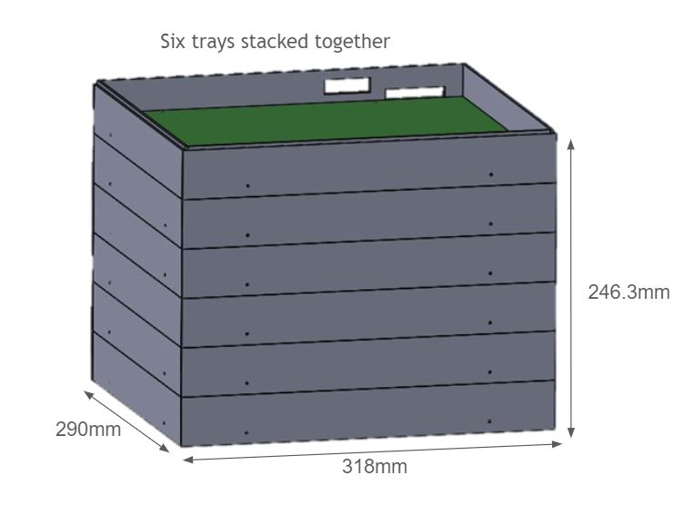
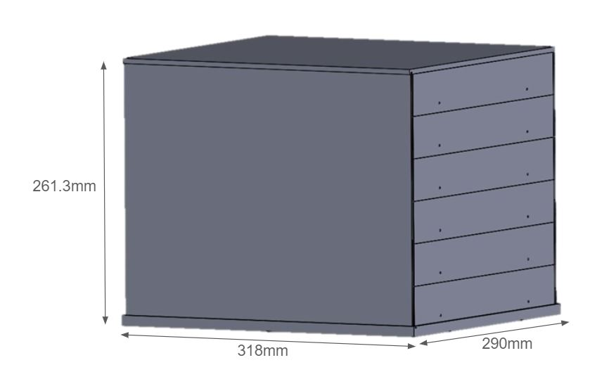
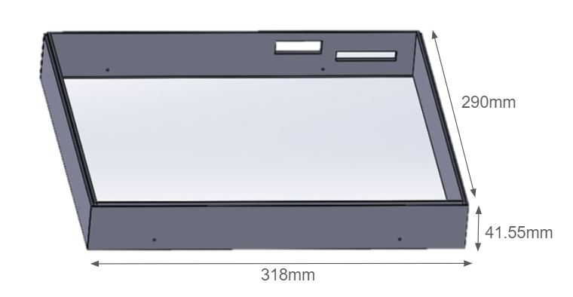
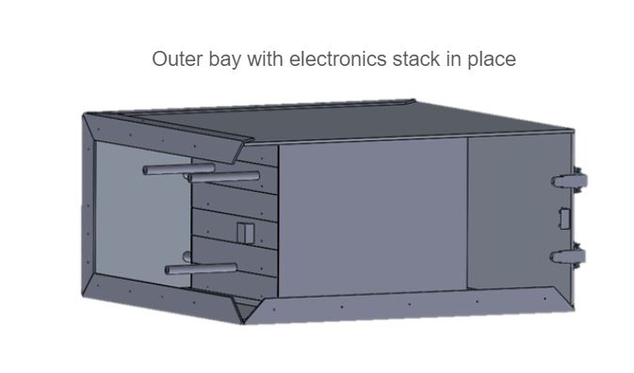
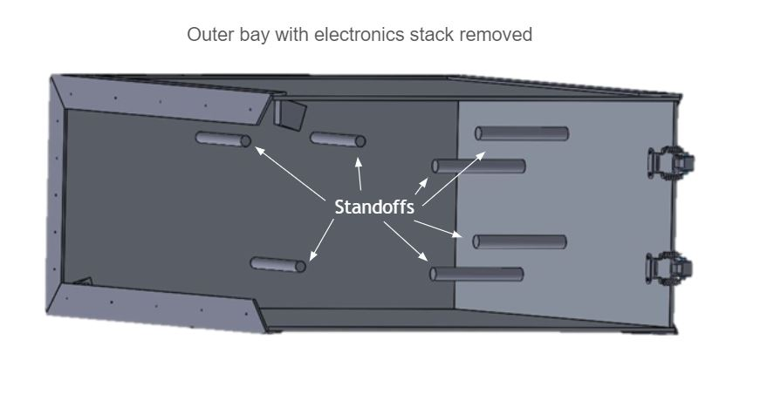
Baseline Design
Single Tray
6 Trays Form the Electronics Stack
Stack With Removable Imaging Wall
OTheRS System
IR Cameras
Thermal Ctrl
Simulated Electronics System
Create Thermal Profile
Reference Data System
Full TestBed (Bay + Stack)
V&V of Thermal Camera Data

Slide 4
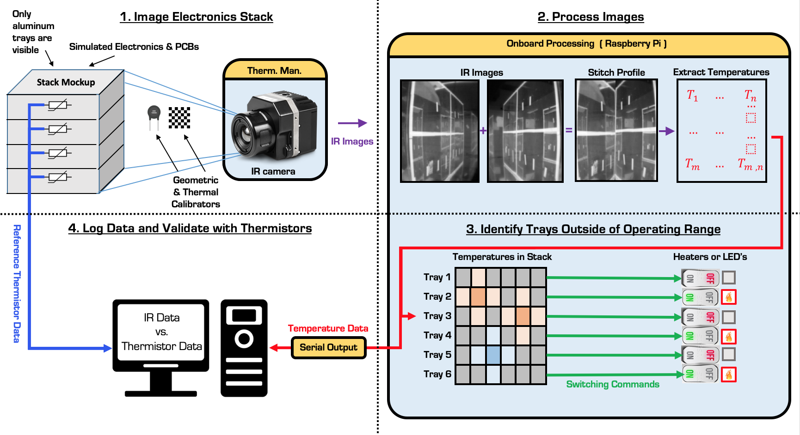
CONOPS
Notes:
thermal cameras will be mounted to the ceiling and floor of the bay, and image a single side of the rectangular electronics stack. Data will also be simulataneously taken from an array of thermistors mounted on the opposite side of the stack face. You can also see the camera has its own thermal managment system.
After the cameras captures an image, it is processed by stitching the images together, correcting for skew and extracting temperature infromation.
This information is then sent through a controller, which will send regulatory commands to LED’s as representative indicators of control ouput.
Data will also be sent to through a serial output, which will then be validated by comparing against the previously mentioned thermistor array.

Slide 5
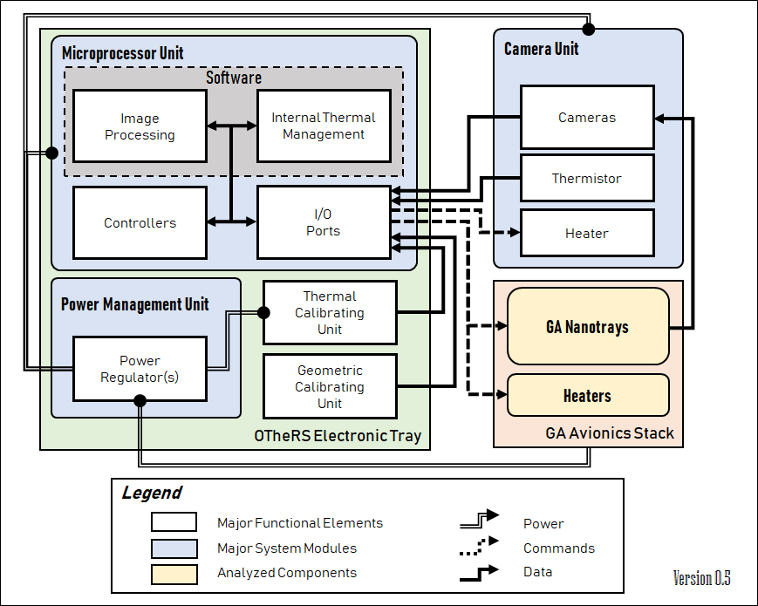
Functional Block Diagram

Slide 6
Critical Project Elements
Critical Project Elements | Explanation
Image Capture and Processing System | Image capture allows for the system to read the thermal behavior while the processing allows for functions like stitching and hotspot identification.
Test Bed Structure | Structure allows the system to see a representation of the customer’s satellite bay.
Thermal Control of Camera | Ensure the camera will survive in final thermal chamber testing at the low range (-30°C).
Full-Stack Regulation | Customer desired functionality and shows response of the image processing abilities.

Slide 7
Critical Project Elements - Updates
Critical Project Elements | Concerns/Updates Since MSR
Image Capture and Processing System | Image Stitching has been resolved. Temperature accuracy is now the main concern.
Test Bed Structure | Camera mounting modified to reduce geometric skew
Thermal Control of Camera | PCB are being manufactured
Full-Stack Regulation | PCB are manufactured, troubleshooting/integration in progress

Slide 8
Levels of Success
Criteria | Camera | Image Processing | Elec/Comm/Ctrl | Test Bed
Level 1 | Camera system will sense temperatures between -30°C and 60°C and will fit within the interior of the given satellite | Software can differentiate between module trays in the stack being monitored while recording their temperature. Software can also facilitate spacial and thermal calibration of the OTheRS system | The control system will command representative indicators based on thermal data from the image processing system and will handle 2.5A.The entire system will also be able to operate on 28V of unregulated power | The test bed will have two different heated objects, whose temperature is read by both the thermal camera and thermistors in an ambient air, room temperature environment. This is a minimum to help ensure the camera can differentiate and monitor multiple components
Level 2 | Camera system will survive below a temperature of-30°C |  |  | System operates successfully when tested in thermal chamber between -30°C and 60°C
Level 3 |  | Software can determine temperature of components inside of the Avionics Bay |  | A range of coatings will be tested to determine effect on temperature readings

Slide 9
Project Schedule

Slide 10
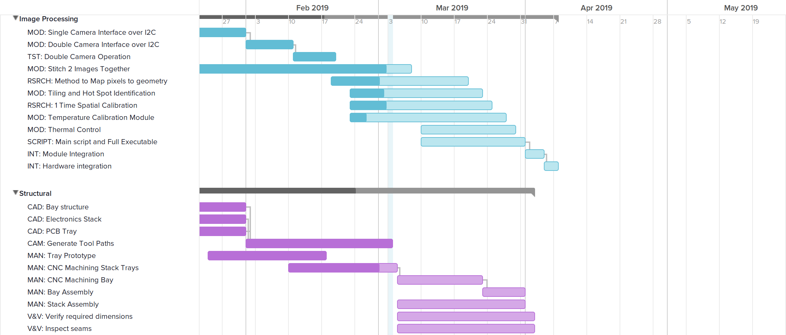
Image Processing and Manufacturing
Hardware Testing
Image Stitching
Critical Path
Map Pixels
Margin:
5 days for Modules, longer for those in concurrent development
Hot Spot Identification
Temperature & Reflection calibration
Module Integration
MSR
TRR
SFR
PFR
CAD Models
Machining Stack and Bay
*No Machining after March 22nd
1 Day Margin for machining tasks with a cutoff at 3/22
1 Week Margin for assembly tasks
Assembly

Slide 11
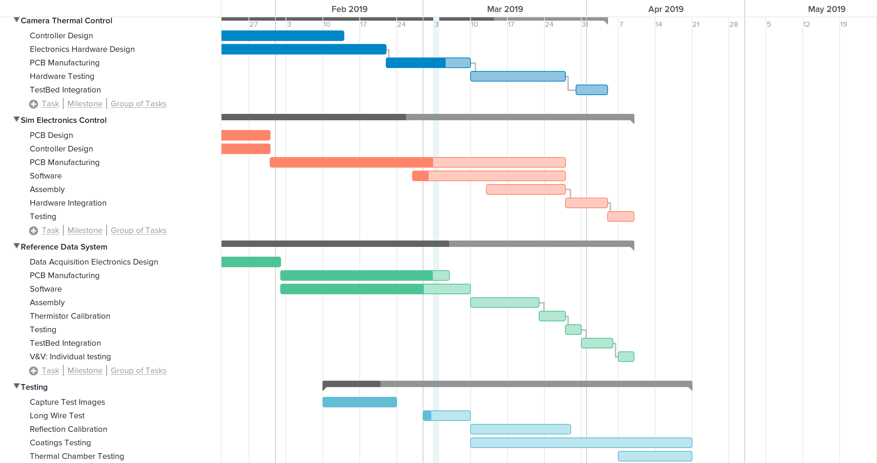
Other Project Elements
Camera Thermal Regulation
Critical Path
Simulation Electronics
MSR
TRR
SFR
PFR
Reference Data System
Critical Tests

Slide 12
Test Progress

Slide 13
Requirements

Slide 14
Requirement Matrix
Test Category | Associated Requirements | Testing Overview
Datasheet Inspection | IMAG 1, THER 2, COM 2, TEST 2, TEST 4 | Verify materials and components meet requirements
Dimension Verification | IMAG 3, TEST 1, TEST 1.1, TEST 1.1.1 | Measure manufactured parts and setup to check physical replication of the bay
IP Output Check | IMAG 2, IMAG 3.1, PROC 1, PROC 1.1, PROC 2, PROC 4, PROC 4.1 | Verify algorithms are functioning as written and with designed test setup
Control and Communication | PROC 3, CONT 1, CONT 2, COM 1, COM 1.1, COM 2* | Use test cases and directly observe responses for components
Pre Acceptance Instrumentation | POW 2, THER 1, TEST 3 | Final system check prior to acceptance testing in a thermal chamber

Slide 15
Test Flowchart
Datasheet Inspection
IP Unit Testing
Hardware Software Testing
Manufacture Parts
Test Controls (Test Cases)
Test Comms (Observe/Test Case)
Software Automation & Integration
Long Wire Testing
Assembly
Lepton Thermal Management Verif.
IP Output Check
Software Performance
Dimension Verif.
Control and Comm
Reflection Calibration
Legend
Pre-Acceptance Instrumentation
Major Testing
Test Bed Integration
Acceptance Testing
Requirement Retirement

Slide 16
Completed Testing

Slide 17
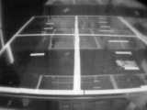
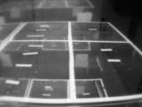
Image Stitching
Requirements:
FR 6: The thermal imaging device(s) shall image critical stack electronics on at least a single side of the stack.
Purpose:
Capture one side of the stack in a single grid
Software must facilitate spatial calibration of the OTheRS system
Experimental Variables:
Camera positioning
Emissivity sticker layouts
Concerns:
Data for the near-corners of stack are missing
Risk Mitigated:
Inability to softcode a geometric stitch or repurpose software
Left Image
Right Image
Stitched Image

Slide 18
Model Validation

Slide 19
Thermal Model Overview
Purpose
Predict temperature profiles for scenarios that require thermal chamber testing
Understand impact of heat transport modes on the system
Concerns:
Complexity and time cost
Loss of model fidelity to simplifications required to produce reasonable meshing
Difficult to test in no-convection ambient
Experimental Variables:
Temperature (component, ambient, bulk)
Thermal resistance, emissivity, convection coefficients
Risk Mitigated:
Source of information to verify camera data
Visual representation of thermal changes expected to be seen during a test
Notes:
MAKE SURE TO INCLUDE REQUIREMENTS AND RISK MITIGATED if necessary - *No requirements on this - Ryan*

Slide 20
Assumptions to Testing
Model Assumption | Map to Test Setup
Negligible heat transfer across PCB | Error in this assumption measured by truth data taken across board surface
Ambient air temperature constant | To be measured at constant intervals through all ambient testing
Top tray will be hottest | Test will use a single tray from the final test setup
Reference data system accurate enough to quantify model error | Discrete measurement points can be compared between the model and test bed
Notes:
negligable a key word.
2. Convection repeatability, assume at least 5% error (@65F, plus or minus 2.85)
SUPER DIFFICULT TO MODEL DUE TO CONVECTION IN THE ROOM, SO WE MIGHT AS WELL SAY IT DOESNT EXIST
3. Top tray will be the hottest due to convection in ambient, and thus the most susceptible to failing temperature boundary requirements
4
5. Reference data system will also provide the team with thermal contact resistance data!

Slide 21
Thermal Model Setup
Equipment / Setup
Single tray w/ 2 heaters, wiring, and 6 equally spaced thermistors
Prototype test bed “box”
Computer/Arduino/ADCs to collect thermistor data
Procedure:
Construct single tray using low-resistance thermal epoxy and PCB for structural rigidity
Measure and fix thermistors into place against tray wall with low-resistance thermal epoxy
Quantify thermal resistance of epoxy application for model refinement
Isolate the system and use thermistor data to ensure bulk thermal equilibrium
Turn heaters on until steady state is reached

Slide 22
Thermal Model Results
Quantitative temperature data at predetermined discrete points
Provide transient temperature profile
1x6 matrix as a function of time
Expect to see impact of convection when ΔT sufficiently large
Provide final steady state temperature profile
Technical experience required to construct and instrument full stack
Validity of model assumptions / boundary conditions

Slide 23
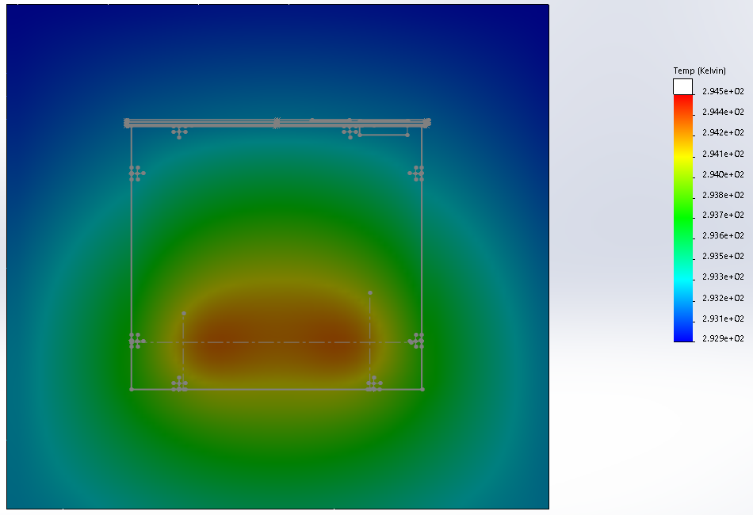
Thermal Model Results (Steady State)
33 minutes to compute view factors and run
Heater location 50mm from each wall

Slide 24
Planned Testing

Slide 25
Long Wire Test Overview
Purpose:
Customer concerned with signal integrity from cameras over long distances
Long wires are needed connect cameras to processing hardware outside of thermal chamber
Experimental Variables:
Wire length
Concerns:
Need to ensure that wires are long enough to reach out of thermal chamber.
Attenuation / Ringing / Propagation Delays affect signal integrity.
Propagation delay can cause signals to become misaligned.
Risk Mitigated:
Verify data is usable from the camera with longer wires
Quantify how long wires can be before data unusable

Slide 26
Long Wire Test Setup
Equipment / Setup
Raspberry Pi, FLIR Lepton.
Copper wire, wire cutters and strippers, pin sockets, maybe a soldering iron.
High speed oscilloscope.
Procedure:
Attach Lepton(s) over 3m of copper wire. Examine signal waveform, throughput, maximum achievable bus speed.
Shorten wires (0.5 - 0.25m per test) until satisfactory throughput and bus speed achieved.
Results:
Relationship between wire length and maximum clock speed.
Qualitative examination of signal waveform.
Quantitative understanding of SPI bus slave and propagation delays.

Slide 27
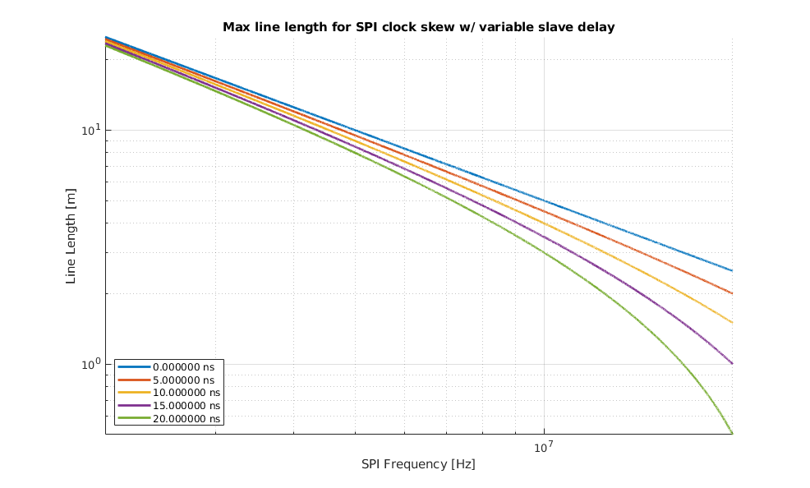
Prediction of Propagation Delay Limit

Slide 28
Software Performance Testing
Requirements:
DR IMAG-2: Images of the stack shall be taken at no more than 90 second intervals.
DR PROC-4.1: Automated image processing shall be completed between image captures as defined in DR-IMAG 2.
Purpose:
Image processing must occur between image captures and in under 90 seconds
Quantify how well we meet the requirements
Experimental Variables:
Algorithm complexity for each image processing step
Concerns:
Delays in processing could lead to a data backlog.
Speed of data transmission over long wires could significantly impact necessary processing speed.
Risk Mitigated:
Ensures that images can be processed and transmitted within the required time period.

Slide 29
Software Performance Setup
Equipment/Setup:
Raspberry Pi, FLIR Lepton(s), Laptop computer
1 GB Ethernet-USB adapter
Procedure:
Performance of the software will be tested through the Python timing library
Unit tests of the software modules will be completed to develop a timing profile
Results:
Quantitative timing analysis of the image processing software.
Compare predicted run times to test results.
Determine the most labor-intensive software modules and identify software bottlenecks
Implement optimization strategies where necessary

Slide 30
Reflection Error Overview
Requirements:
DR-PROC 4: Temperature data shall be extracted from the thermal image
Purpose
Calibrate temperature data from Lepton cameras
Understand reflection impact on error
Concerns:
Radiometry data is inaccurate due to reflection
Correcting reflection error may require empirical characterization throughout the full temperature range.
May require black body calibrator
Experimental Variables:
TestBed temperature
Reflectivity of surroundings
Risk Mitigated:
Inaccurate temperatures measurements due to reflective environment

Slide 31
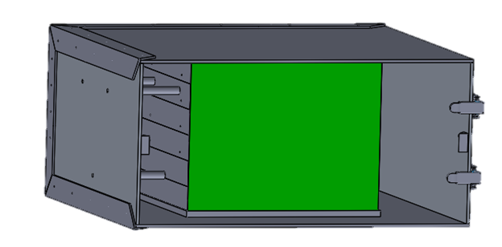
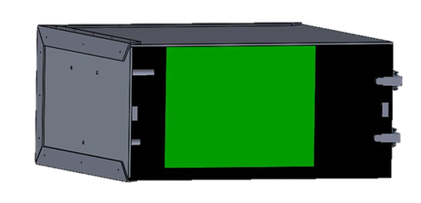
Reflection Error Setup
Equipment
Surface preparations
Anti-Reflective preparations to all TestBed surfaces except imaged stack face
Both initial and final testbed
Procedure:
Capture images in non reflective environment
Capture images in final environment
Introduce correction factor to reduce effects of reflected radiation
Face to be imaged

Slide 32
Coatings Performance Overview
Requirements:
DR-PROC 4: Temperature data shall be extracted from the thermal image
Purpose:
Quantify how well reflections are being mitigated on face under test
Experimental Variables:
Surface Roughness
Reflectivity (Absorptivity)
Concerns:
Coatings may not have desirable or intended effects
Budget may not support much continued testing
Risk Mitigated:
Camera data accuracy can be improved
Better information for picking coatings on final test bed

Slide 33
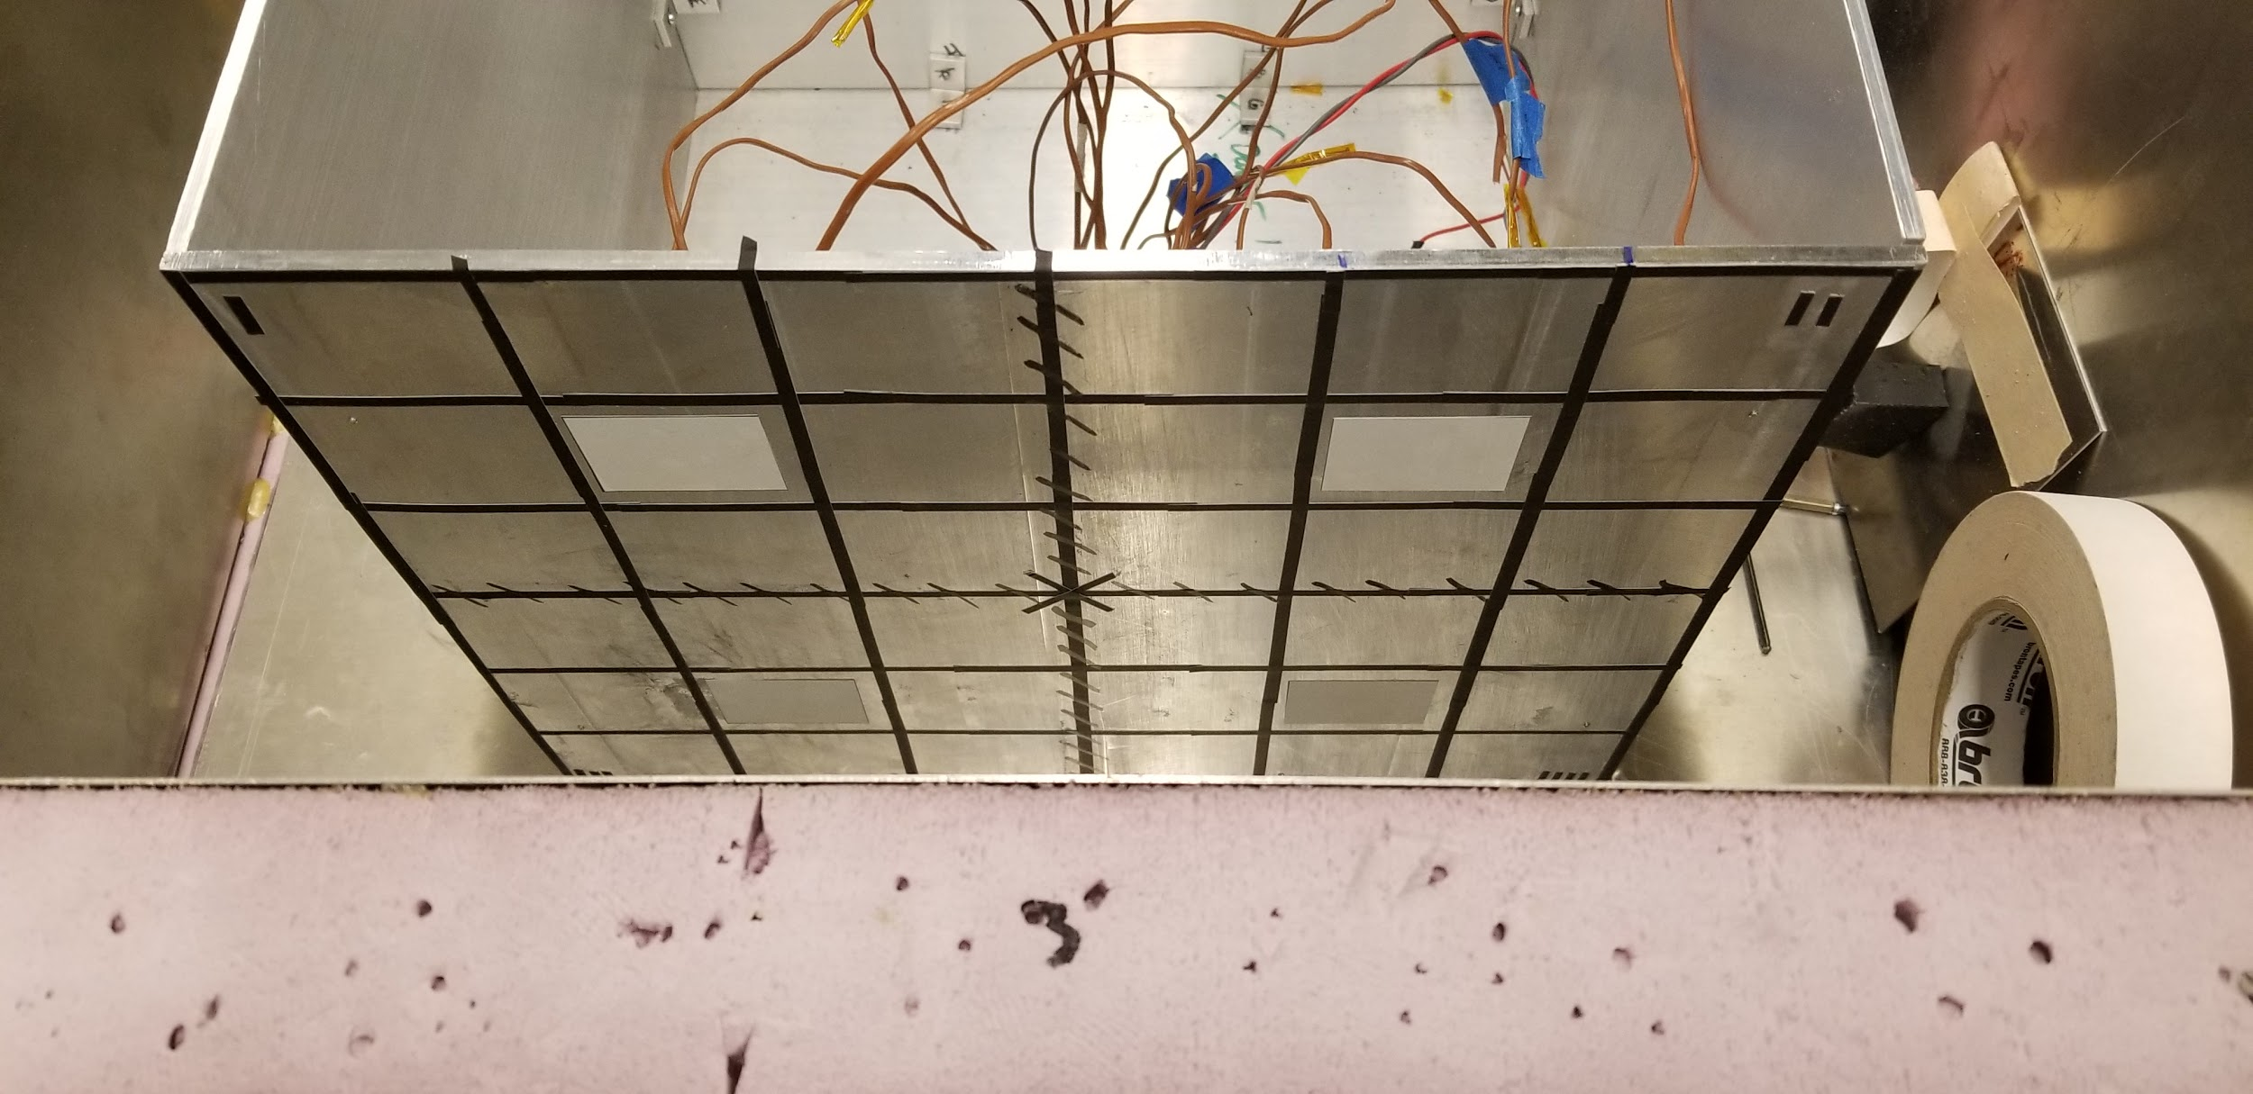
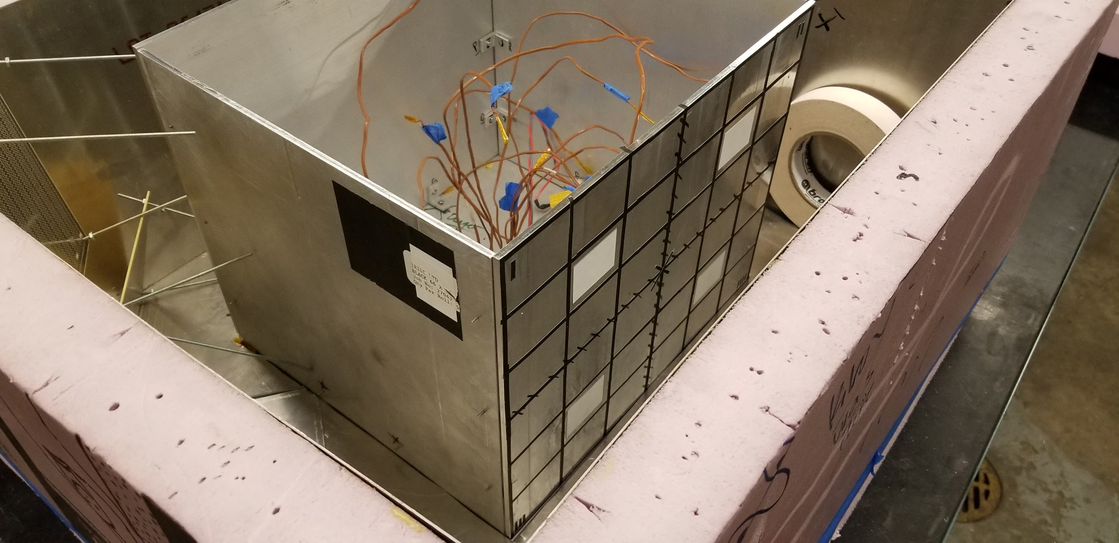
Coatings Performance Setup
Equipment
Surface preparations
Initial test bed - Sticky notes, adhesives, colored paper, sand paper
Procedure:
Power on OTheRS and begin taking data at nominal condition
Nominal condition is heaters off at ambient temperature
Turn heaters ON and take data
Test until reference data system notes a 15°C change from nominal condition on bare surface

Slide 34
Coatings Performance Results
Metrics to score coatings
Is reflection mitigated (accuracy increased)?
Temperature of thermal imaging device compared with bare Aluminum test camera data
Is the thermal behavior captured by the thermal imaging device?
Temperature of reference data system compared with thermal imaging device
Are material properties changing?
Temperature of reference data system compared with bare Aluminum test reference results
Data required
Matrix of reference data system results over the course of the test
Camera data during the course of the test
Historical data from previous tests
Score the data relative to base condition
Score the data relative to other surface preparations

Slide 35
Acceptance Testing

Slide 36
Thermal Chamber Overview
Requirements:
FR 1: OTheRS shall return a thermal data map for multiple components between -30°C and 60°C.
FR 2: OTheRS shall provide regulatory commands when components are outside -20°C to 50°C.
Purpose:
Test system functionality at required temperature range
Experimental Variables:
Chamber Temperature
Dwell Time
Concerns:
Customer has not updated team on chamber status
Wiring pass throughs
Scheduling conflicts

Slide 37
Thermal Chamber Setup
Equipment / Setup
Final test bed
Customer’s thermal chamber
Procedure
Hot Test
Dry gas purge the chamber
Power on OTheRS system
Plan to run at 0.5A with 25 Ohm resistors (6.25W)
Set thermal chamber to 50°C
Check system output for commands
Check thermal response on reference data system
Set chamber to 60°C
Observe command response over thermal change
Verify system is functional at 60C
Cold Test
Similar test but has following differences
Initial chamber set at -20°C
Final chamber set at -30°C
Notes:
Looks good to me ryan - sean

Slide 38
Thermal Chamber Results
Primary Metric
Temperature of reference data system compared with thermal imaging device
Look at both mean and max changes as a function of time
Required Data
Reference Data System
Grid (matrix) of thermistors measurements over the duration of the test
Image Processing
Matrix of thermal data for the entire face under test
Expected Results
Expect error between reference data and Lepton
Both should follow these trends with varying accuracy:
Horizontal trend when heaters are not powered
As heaters are powered, expect a minimal linear trend
Linear trend expected as the chamber temperature changes

Slide 39
Required Testing Facilities

Slide 40
Facility Matrix
Test Plan Section | Test Plan Name | Required Facilities
Model Validation | Thermal Model | Top tray (Final Test bed) Initial Test bed Outer Bay Structure
Planned Testing | Long Wire | High speed oscilloscope (≥ 150 MHz) Soldering iron or wire stripper
 | Software Performance | Raspberry Pi with IP modules loaded
 | Reflection Error | Initial Testbed, Final Testbed, anti-reflective paper, Thermal Chamber
 | Coatings Performance | Initial testbed (Preliminary Tests) Final testbed (Continued Tests)
Acceptance Testing | Thermal Chamber | Final Test bed Customer’s Thermal Chamber

Slide 41
Safety

Slide 42
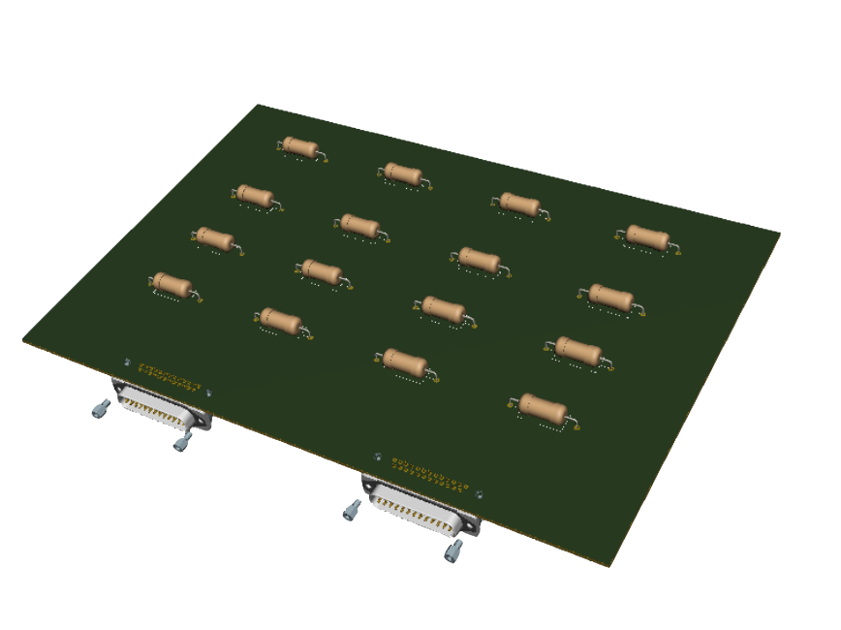
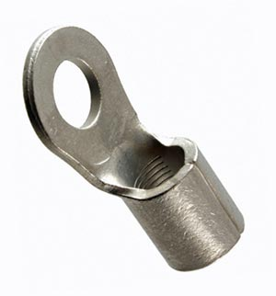
Safety
Temperature and Burn:
2. Grounding the testbed
Heater PCB
Solderless crimp Terminal
Monitor the temperature via the reference data periodically
Only run two of the 96 power resistors at a time.
Have an LED that indicates when the stack walls are over 38°C, and therefore, should not be touched
The Test bed will be grounded through the utilization of solderless crimp terminals.
These will connect to the aluminum surface and then to a grounding terminal.

Slide 43
Budget

Slide 44
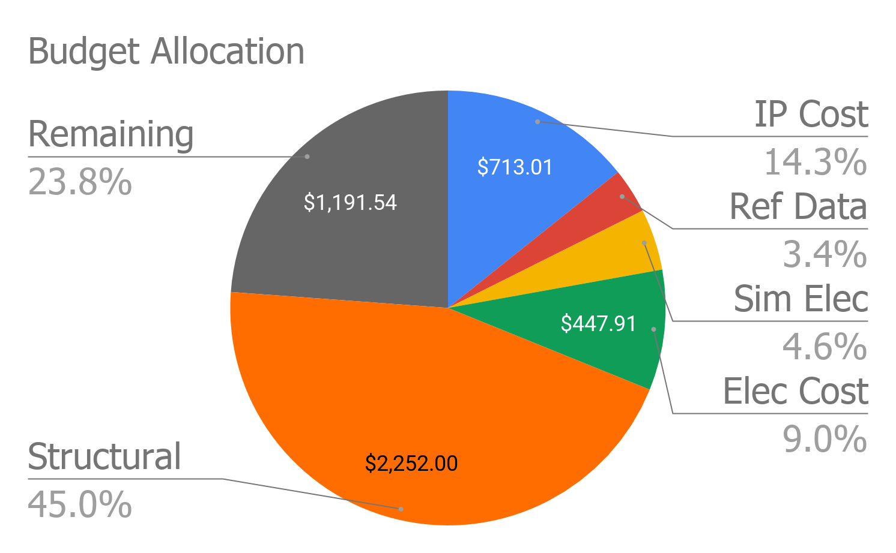
Cost Breakdown as of TRR
IP Cost | $713.01
Ref Data Cost | $167.54
Sim Elec Cost | $228.00
Elec Cost | $447.91
Structural | $2,252.00
Remaining | $1,191.54

Slide 45
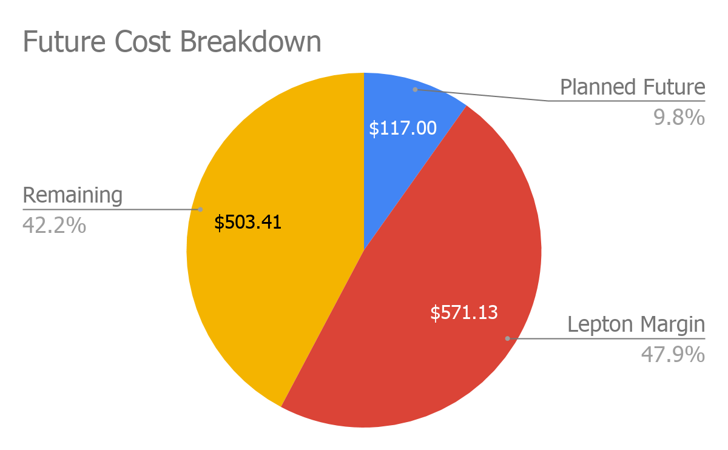
Future Cost Planning
Future Costs
Thermal Paste
Lepton Margin
$571.13 To cover replacing both Leptons in case of failure
Coatings
Remaining budget after future costs ($503.41) will be used for research coatings

Slide 46
Questions?

Slide 47
BackUp Slide Deck

Slide 48
Mechanical Structure

Slide 49
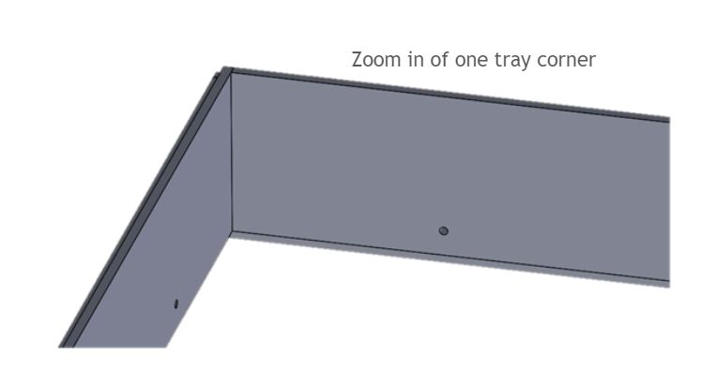
TestBed - Tray

Slide 50
TestBed - Tray

Slide 51
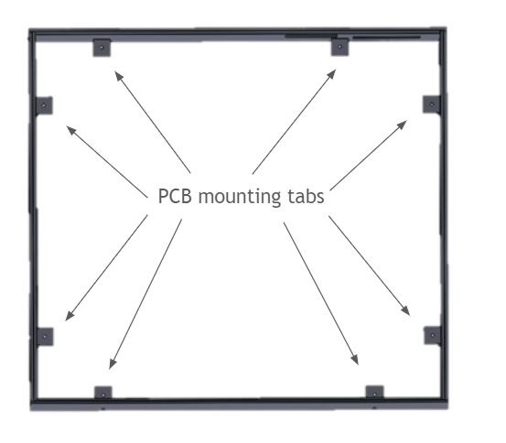
TestBed - Tray

Slide 52
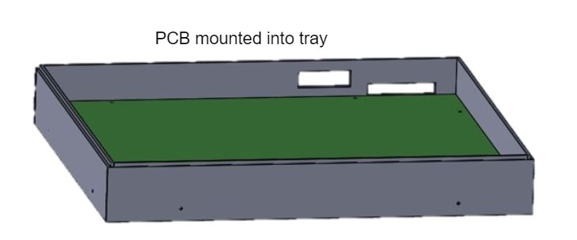
TestBed - Tray

Slide 53
TestBed - Stack

Slide 54
TestBed - Stack

Slide 55
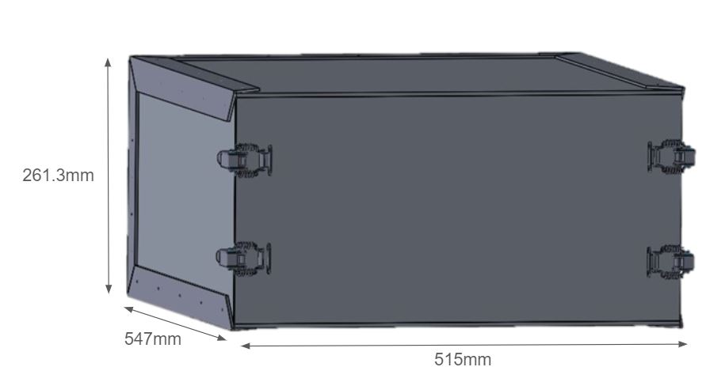
TestBed - Outer Bay

Slide 56
TestBed

Slide 57
TestBed - Entire Configuration

Slide 58
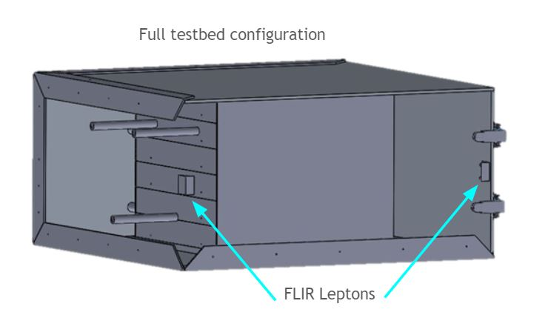
TestBed - Entire Configuration

Slide 59
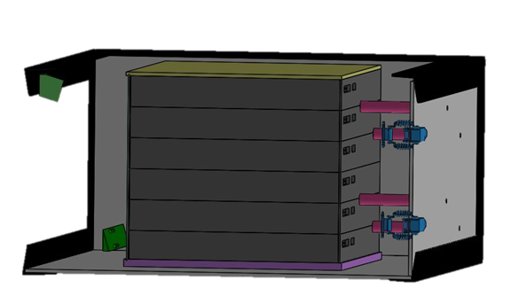
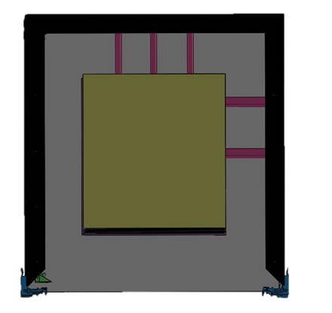
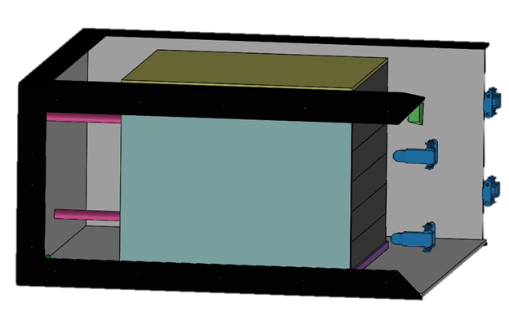
Design of Testbed

Slide 60
Tolerances
± 0.01 inch = 0.254 mm
16.538° ± 3° (vertical angle, camera mount)
52° ± 7° (horizontal angle, camera mount)
Most important components to minimize tolerance:
Stack walls - want to keep heat isolated to inside the stack
Bay walls - want to keep system isolated, don’t want outside light entering testbed
Camera mount - want to be able to image entire side of stack

Slide 61
Thermal Model

Slide 62
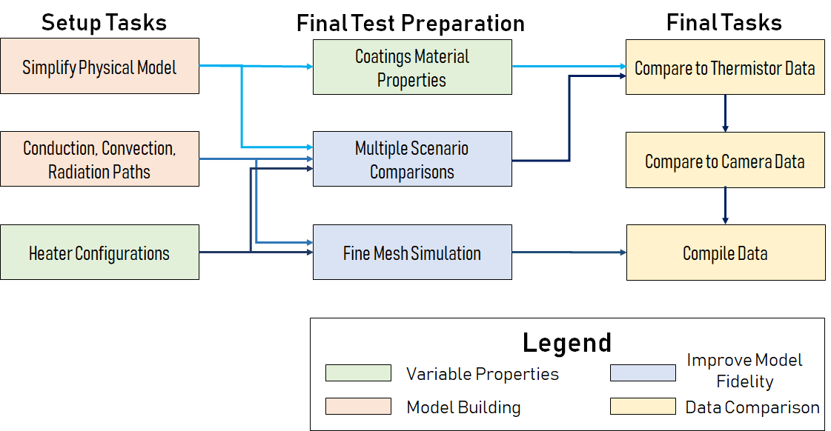
Thermal Model
Wiring and Realistic Heater Performance

Slide 63
Thermal Model - Steady State
Assumptions Made:
Convection coefficient constant @ 10 W/(m² K)
ε_{Al} = .1 (assuming unoxidized Al 6061-T6)
ε_{Heater} = .92 (ceramic porcelain)
PCB and tray holes can be neglected for meshing simplification
Important Values
55,609 nodes (using node to surface contact, Jacobian 4-point)
Ambient temperature set to 65F (291K)
Global mesh size 12mm with .6mm tolerance

Slide 64
Thermal Model Assumptions
No conduction across PCB
Increases model complexity for heat paths
Impact can be quantified using temperature measurements across board
Air temperature is constant at the building’s set temperature(18C/65F)
Will give repeatability for convection
Must be measured at time of test (Account for 5% error on this assumption)
Likely through nominal (initial) period in the test
Top tray is being verified in test
Primary heat transport is via convection
Allows for more heat transport to and away from surfaces
Significantly increases model complexity compared to space environment
Test can be performed in ambient environment
Reference data system can be used to quantify error
Discrete measurement points can be compared between the model and test bed
Notes:
Edits have been made

Slide 65
Thermal Model Overview
Purpose
Predict temperature profiles for scenarios that require thermal chamber testing
Understand impact of heat transport modes on the system
Concerns:
Complexity and time cost
Loss of model fidelity to simplifications required to produce reasonable meshing
Experimental Variables:
Temperature (component, ambient, bulk)
Thermal resistance, emissivity, convection coefficients
Risk Mitigated:
Source of information to verify camera data
Visual representation of thermal changes expected to be seen during a test
Notes:
MAKE SURE TO INCLUDE REQUIREMENTS AND RISK MITIGATED if necessary - *No requirements on this - Ryan*

Slide 66
Thermal Model Validation
Isolate tray from ambient environment and heat sources
Preliminary test bed used to insulate/remove sources
Can modify model parameters to remove convection/radiation to ambient environment
Heat using same power and resistors as the model for the same time period
Measure test using reference data system
Thermistors in final test bed
Quantify error in model as a function of time and temperature
Can look at entire time length of test or as a function of the temperature during the test
Does it change with internal heat or time during test?
Quantify error of initial assumption of constant temperature
Quantify error of initial assumption of constant convection coefficient

Slide 67
Thermal Model Setup
Equipment / Setup
Computer w/ SolidWorks Simulation Package
Procedure:
Simplify model by removing screw holes, wire pass throughs, square internal corner cuts
Make assumptions and determine boundary conditions
Specify component material and base properties
Set up thermal paths
Power resistor to stack/air
Stack to stack/air/bay
Bay to bay/stack/air/ambient
Define steady state or transient simulation condition
Define mesh parameters, including mesh tolerance and FEM matrix size
Results:
Visual and quantitative temperature data
To be compared with thermistor data at known surface points

Slide 68
Thermal Model Setup
As is:
Steady state
Single tray and bay wall @ tray height
Unoxidized Al 6061-T6, ceramic porcelain, and PCB substrate
ε_{Al} = .1, ε_{Heater} = .92, ε_{PCB} = 0
U = 10 W/(m² K)
Global mesh size 12mm with .6mm tolerance
55,609 nodes (using node to surface contact, Jacobian 4-point)
Ambient and bulk temperature set to 65F/18C (291K)
Heaters set to 6.25W heat power each
PCB conduction, convection, radiation ignored
PCB mounting tabs also ignored
In Progress:
Transient single tray
Steady state full stack w/ bay
To Do:
Transient full stack w/ bay

Slide 69
Full Stack Regulation System

Slide 70
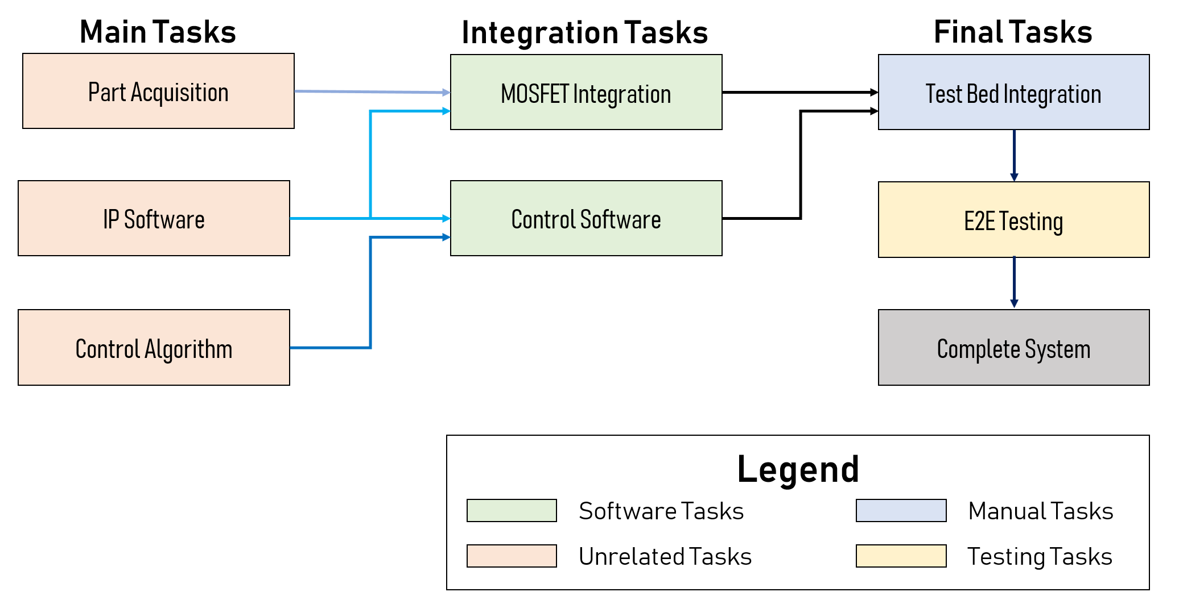
Integration Plan

Slide 71
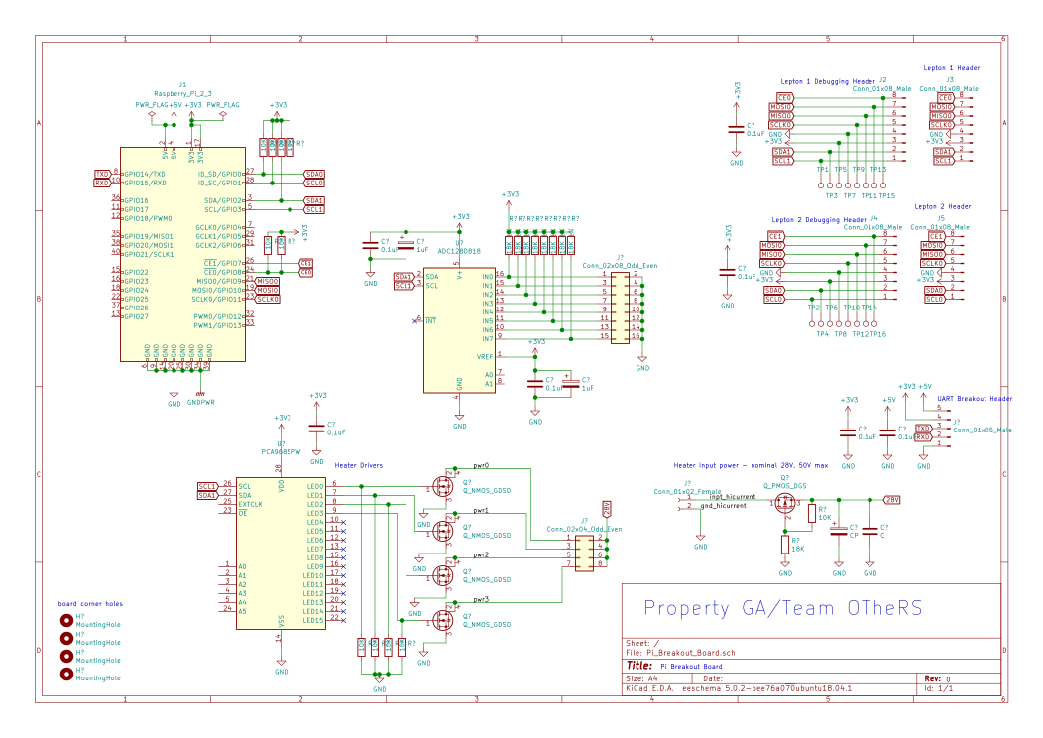
Full Stack Regulation System Schematic

Slide 72
Propagation Delay Limitations: 2-20 MHz
Notes:
Akin’s 6th law of spacecraft design (Mar’s Law): Everything is linear if plotted log-log with a fat magic marker

Slide 73
Reference Data System

Slide 74
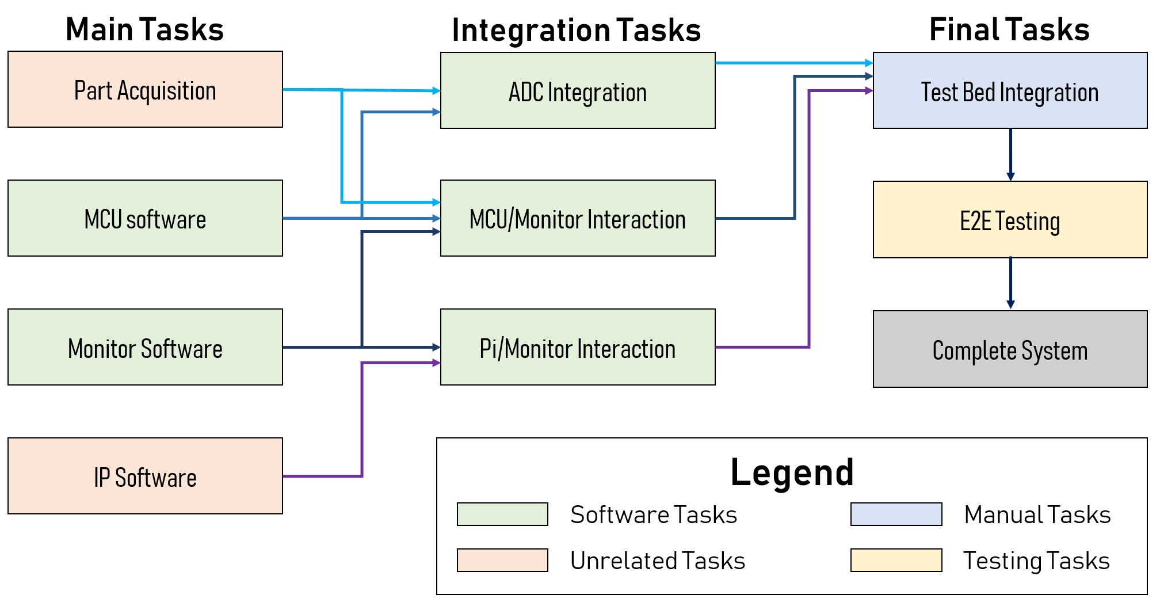
Integration Plan

Slide 75
Budget

Slide 76
Purchases Made Up Until MSR |  |  |  |  | Purchases Made Up Until MSR
Sub-System | Part | Unit Price | Qty | Total | Sub-System | Part | Unit Price | Qty | Total
IP/Camera | FLIR Lepton 3.5 | $301.01 | 2 | $610.02 | Ref Data | Sparkfun RedBoard | $19.95 | 1 | $24.95
IP/Camera | Lepton 3.5 Breakout | $0.00 | 2 | $0.00 | Ref Data | Resistors - CRGCQ0402F18K | $0.10 | 80 | $8.00
IP/Camera | High Emmisivity Stickers | $53.00 | 1 | $62.99 | Ref Data | Custom PCB | $10.00 | 3 | $30.00
IP/Camera | Raspberry Pi 3b | $40.00 | 1 | $40.00 | Sim Elec | Custom PCB | $8.00 | 10 | $85.00
Structural | Aluminum 6061-T6 Plates .04"x2'x4' in (Bay) | $59.90 | 10 | $639.00 | Sim Elec | Power Resistor - 71-RS01025R00FE73 | $1.19 | 100 | $119.00
Structural | Toggle Clamps | $19.99 | 4 | $87.96 | Sim Elec | Power Driver Board | $8.00 | 3 | $24.00
Structural | Aluminum 6061-T6 Plates (1/16") - 25.5"x24" | $69.50 | 3 | $248.50 | Sim Elec | D-Type Connectors | $0.00 | 0 | $0.00
Structural | Aluminum 6061-T6 Plates (1/16")13.5"x25" | $69.50 | 3 | $208.50 | Electronics | Buck Converter | $6.99 | 2 | $13.98
Structural | Aluminum 6061-T6 Plates (1/16") 24"x13.5" | $49.50 | 3 | $148.50 | Electronics | Wiring - 12 Gauge | $15.95 | 2 | $36.90
Structural | Foam Insulation | $32.60 | 1 | $32.60 | Electronics | D-type Connector | $1.57 | 0 | $0.00
Structural | AL 6061 Plate | $59.90 | 2 | $119.80 | Electronics | AC Adapter | $19.99 | 1 | $19.99
Structural | AL 6061 Sheet Metal | $101.75 | 3 | $305.25 | Electronics | USB for Arduino | $34.99 | 1 | $34.99
Structural | M2 Tap Starting | $16.53 | 2 | $33.06 | Electronics | MOSFET 60V | $0.71 | 10 | $15.05
Structural | M2 Tap Closed | $16.53 | 2 | $33.06 | Electronics | IC LED DRIVER | $2.33 | 3 | $6.99
Structural | 18-8 Stainless Steel Slotted Flat Head Screws | $7.79 | 1 | $7.79 | Electronics | MOSFET 55V | $1.08 | 3 | $3.24
Structural | Paper Tape | $9.89 | 1 | $9.89 | Electronics | CAP ALUM 47UF 20% 63V RADIAL | $0.33 | 4 | $1.32
Structural | Threaded Rod 40x6 H44815E | $1.08 | 10 | $10.80 | Electronics | TE Connectivity Amp Connectors | $1.04 | 3 | $3.12
Structural | Nut Hex H140009E | $0.08 | 20 | $1.62 | Electronics | CONN HEADER R/A | $3.70 | 6 | $22.20
Structural | MS Metric Phil Pan M2X12 H4307E | $0.30 | 32 | $9.50 | Electronics | 25W Chassis Resistors | $3.08 | 2 | $6.16
Structural | MS Metric Phil Pan M2X8 H4306E | $0.24 | 19 | $4.62 | Electronics | Thermocouple BreakOuts | $12.76 | 2 | $25.52
Ref Data | Thermistors - Vishay NTCLE413 | $1.39 | 45 | $70.55 | Electronics | Power Resistor Kit | $4.76 | 1 | $4.76
Ref Data | Screw Terminals | $0.80 | 10 | $10.00 | Electronics | MOSFET Transistors | $2.03 | 10 | $20.30
Ref Data | ADC - ADC128D818 | $4.68 | 3 | $19.04 | Electronics | Arduino Uno | $23.38 | 1 | $23.38

Slide 77
Test Backup
Testing Backup

Slide 78
Planned Testing

Slide 79
Adhesive Testing
Purpose:
Find amount of adhesive used to fix thermistors to stack surface
Procedure:
Fix thermistors to sheet of aluminum using variable amount of adhesive
Heat plate to constant temperature
Use no adhesive as baseline
Find thickness cutoff that gives values within 5% of actual value
Facilities Needed:
Constant heat source
Ovens or hot plates can be used
Concerns:
Thermal paste could corrupt temperature measurements
Risk Mitigated:
Know thermistor readings are within 5% of accurate

Slide 80
Planned Testing - IP

Slide 81
Software Test - Identify Thermal Hotspots
Purpose:
Test that the software can recognize thermal hotspots within the thermal image
Identify thermal hotspots to make LED control decisions
Temperature data shall be extracted from the image
Procedure:
Load thermal images to the software
Break apart the data in smaller chunks, find local temp max and mins
Select data that is representative of the stack face
Export resulting decisions over RS232 serial communication
Concerns:
The software not being able detect thermal hotspots is a major concern
Risk Mitigated:
The OTheRS system must be thermally regulated!

Slide 82
Automated Software Testing
Purpose:
Test completed software module timing requirements on the RasPi
Image processing will be completed between image captures
Procedure:
Load completed software modules to the Raspi
Determine the timing requirement of the cohesive software
Facilities Needed:
Initial Test Bed
2 operational Lepton Cameras
1 raspberry pi + software
Concerns:
The software not being able to successfully complete within 90 sec
Risk Mitigated:
Software that takes too long will fail requirements

Slide 83
Unit Testing
Purpose:
Test software modules on the Raspberry Pi
Image stitching (multiple images) to find a (quality) representative image of the stack
Verify that the
Problem:
Corners of the stack are not seeable on the near camera
Procedure:
To create a seperate profile for the corners from the far camera
Facilities Needed:
2 FLIR Lepton 3.5
Test bed
Raspberry pi
Concerns:
Horizontal skew causes bad data because corners are only seen from the far camera
Risk Mitigated:
OTheRS system needs to capture a representative image of the stack

Slide 84
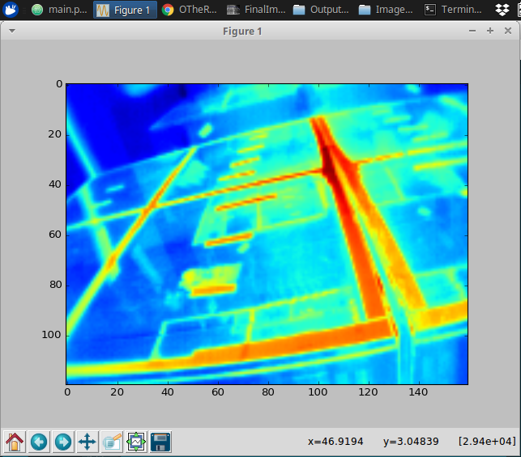
Reflection Error Results
Heat testing:
Resulting radiometry images and resulting temp data
Local Minimum: 20.9 C
Local Maximum: 50.9 C
Significant reflection still compromises temperature data
The error in degrees due to reflection has yet to be determined

Slide 85
Acceptance Testing

Slide 86
Thermal Chamber Testing
Talk through thermal chamber testing at GA
Big concern:
We don’t have specific information on the customer’s chamber
data/power run throughs (system integration with chamber)
availability
We were told we can use this whenever but have not heard a response from the customer
Allows for system to test most important customer given requirements
2 seperate plans (one high, one low)
High test (60 C)
Set chamber at 45C, run heaters until 60C is measured on the reference data system
Between 50 and 60C, the regulatory commands should be sent
Low test (-30 C)
Set chamber to -35C, run heaters until at least -20C is measured on the reference data system
Between -30 and -20C, the regulatory commands should be sent
Running at 0.5A with 25 Ohm resistors
Will get time for 15C change from initial testing on test bed with thermocouples

Slide 87
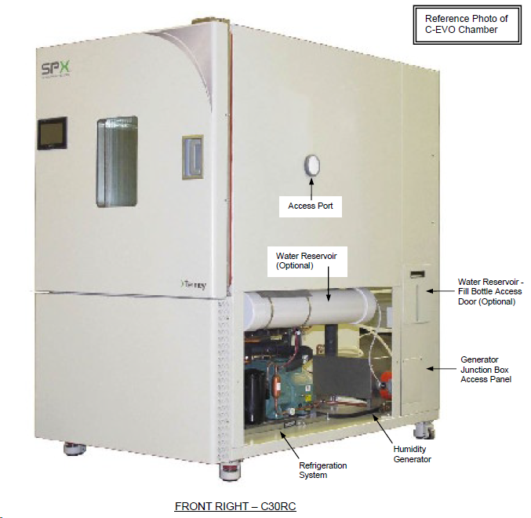
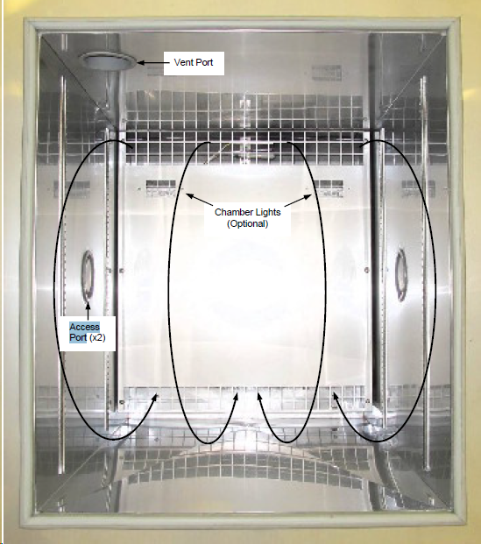
Thermal Chamber

Slide 88
Coatings

Slide 89
Preliminary Coatings Testing
4 types of coating families selected for testing on prototype test bed
Bare Aluminum
Baseline case
Sticky Notes
Replicate Customer case
Tape
Increase conduction from sticky note test
Sanded Face
Find dependency on surface roughness
Metrics established to score coatings
Are material properties changing?
Temperature of reference data system compared with bare Aluminum test
Is accuracy increased or reflection mitigated?
Temperature of thermal imaging device compared with bare Aluminum test
Is the thermal behavior captured by the thermal imaging device
Temperature of reference data system compared with thermal imaging device

Slide 90
Continued Coatings Testing
Testing on the final testbed will have dependencies on findings from preliminary testing
Testing will be completed on the final test bed design
Coatings to be tested
Slide in sheet of Aluminum 6061
Quantify effect of thermal contact resistance
Material variation
Vary material attached to face being imaged
Surface coatings
Time and budget constraints
Intention to test coatings with similar space grade variants
Aids the customer for their application

