Slide 1
Manufacturing Status Review
Optical Thermal Regulation System
Justin Alvey Ryan Bennett Emma Cooper
Sean Ellingson Pierre Guillaud Nash Jekot
Jacob Killelea Micah Svenson Kendall Worden
Customer: General Atomics Advisor: Dr. Kathryn Wingate

Slide 2
Project Overview

Slide 3
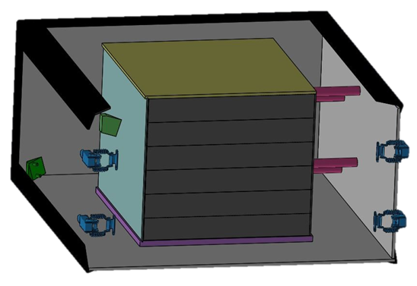
Baseline Design
Goal: Replace traditional temp sensors with IR camera
System uses 2 cameras mounted on bay ceiling/floor (shown in green)
Image centrally located electronics stack and return surface temperature data
Turn representative indicators on/off based on localized temperature hot spots
TestBed replicates materials and dimensions of the stack with modifications to allow changing of some parameters.
Material of imaged stack face can be swapped
OTheRS System
IR Cameras
Thermal Ctrl
Simulated Electronics System
Create Thermal Profile
Reference Data System
V&V of Thermal Camera Data

Slide 4
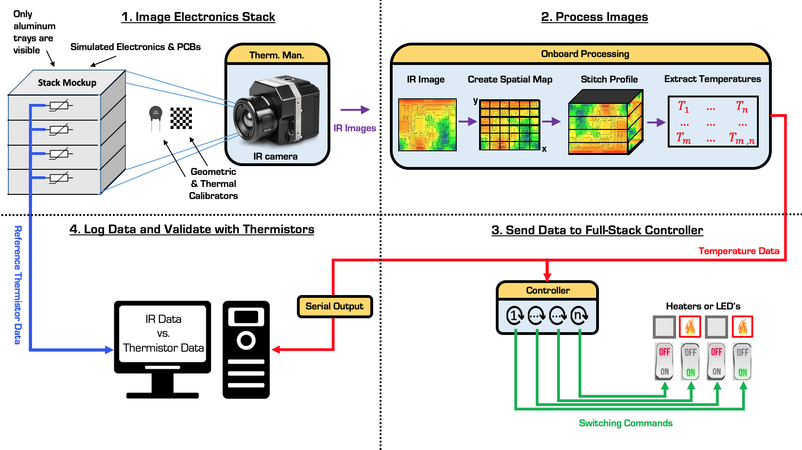
CONOPS
Notes:
thermal cameras will be mounted to the ceiling and floor of the bay, and image a single side of the rectangular electronics stack. Data will also be simulataneously taken from an array of thermistors mounted on the opposite side of the stack face. You can also see the camera has its own thermal managment system.
After the cameras captures an image, it is processed by stitching the images together, correcting for skew and extracting temperature infromation.
This information is then sent through a controller, which will send regulatory commands to LED’s as representative indicators of control ouput.
Data will also be sent to through a serial output, which will then be validated by comparing against the previously mentioned thermistor array.

Slide 5
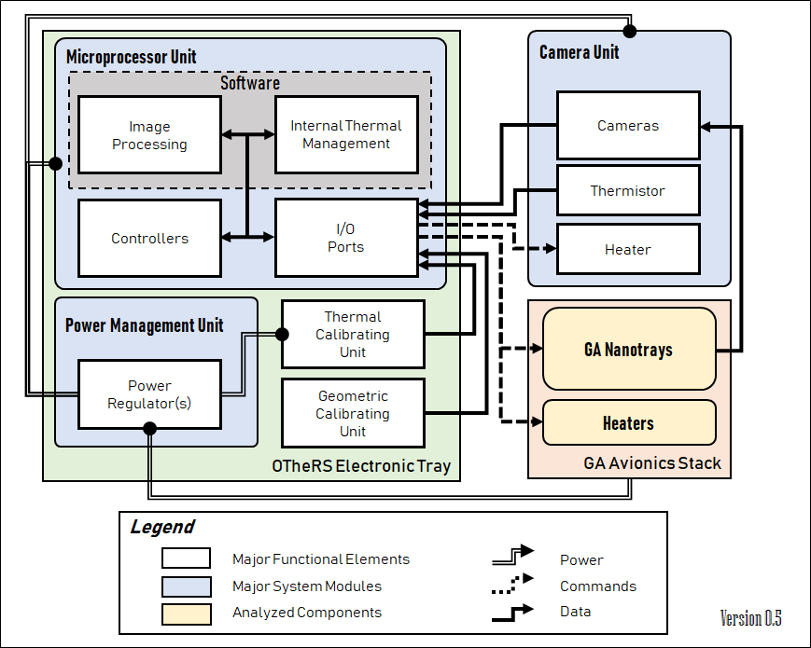
Functional Block Diagram

Slide 6
Critical Project Elements
Critical Project Elements | Concerns/Updates Since CDR
Image Capture and Processing System | Image Processing is farther behind than expected. Image Stitching is now using hardcoded geometry
Test Bed Structure | Stack tray was redesigned, prototype in progress.
Thermal Control of Camera | Resistors being used as heaters PCB design under work
Full-Stack Regulation | Basic On/Off Control, integrated into IP software

Slide 7
Project Schedule

Slide 8
Image Processing and Manufacturing
2 camera interface with Raspberry Pi
Image Stitching
Critical Path
Identify Hotspots
Temp. Accuracy Calibration
TestBed Integration & Test
MSR
TRR
SFR
PFR
CAD Models
Tool Paths and
Tray Prototype
Machining and Assembly

Slide 9
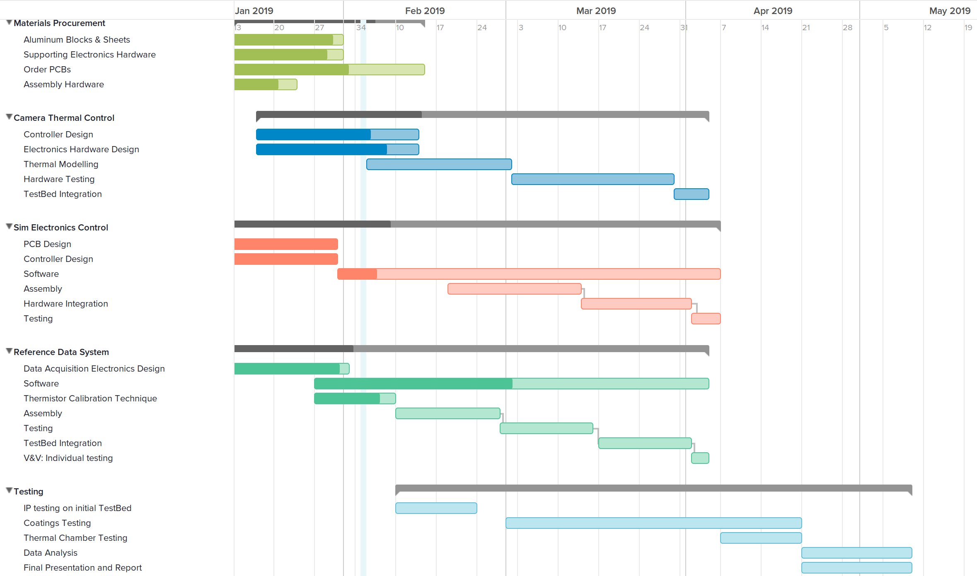
Other Project Elements
Procurement
Critical Path
Camera Thermal Regulation
Simulation Electronics
MSR
TRR
SFR
PFR
Reference Data System
Testing and Final Report

Slide 10
Manufacturing Progress

Slide 11
Mechanical

Slide 12
Status of TestBed
P
D
M
Bay Aluminum Angles
P
D
M
Stack Lid
P
D
M
Standoffs
P
D
M
Camera Mounts
P
D
M
Stack Trays
P
D
M
Wall Clamps
P
D
M
Bay Walls
P
D
M
Removable stack face
P
D
M
Offset Plate
Needed
In progress
Acquired
P
= procurement
D
= design
M
= manufacturing

Slide 13
Integration Plan
Main Tasks
Integration Tasks
Final Tasks
Manufacture Parts
Test Bed Integration
Assemble Stack
Measure Parts
E2E Testing
Assemble Outer Bay
Test Part Fitment
Complete System
Test Camera Mount
Legend
Hardware Tasks
Manual Tasks
Unrelated Tasks
Testing Tasks

Slide 14
Electrical

Slide 15
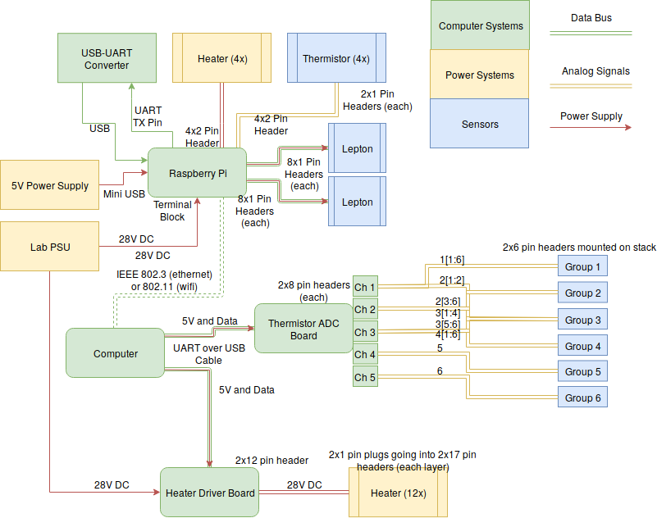
Wiring Diagram
Notes:
This will have to be updated w/ the serial data comm hardware. Include RS232 to UART converter that connects to the Pi. 4 pins (GND is shared) used. Connects to the RasPi- Justin 2/1

Slide 16
Full-Stack Regulation System

Slide 17
Integration with project
Notes:
This will have to be updated w/ the serial data comm hardware. Include RS232 to UART converter that connects to the Pi. 4 pins (GND is shared) used. Connects to the RasPi- Justin 2/1

Slide 18
Tasks
Resources Involved:
PCB Design
Receive PCBs
Assemble board
Test Bed integration
Component Selection
Receive components
Control software
Needed
In progress
Complete
Control software:
Python
Runs on embedded Raspberry Pi
Heater Driver PCB:
Order from: JLCPCB (China), Digikey
Design software used: KiCad
Production + Shipping time: 2+ weeks

Slide 19
Reference Data System

Slide 20
Integration with project
Notes:
This will have to be updated w/ the serial data comm hardware. Include RS232 to UART converter that connects to the Pi. 4 pins (GND is shared) used. Connects to the RasPi- Justin 2/1

Slide 21
Tasks
Resources Involved:
PCB Design
Receive PCBs
Component Selection
Assemble board
Test Bed Integration
Receive Components
Write Monitor GUI software
Write ADC controller software
Integrate with GUI
Needed
In progress
Acquired
MCU Software:
C++
Able to run on Arduino Uno
ADC PCB:
Order from: JLCPCB (China), Digikey
Design software used: KiCad
Production + Shipping time: 2+ weeks
Monitor Software:
Python 3.7
Packages used: numpy, Tkinter, os, Matplotlib, pySerial, datetime, time
Able to run on Linux, Windows

Slide 22
Heater Driver Board

Slide 23
Integration with project
Notes:
This will have to be updated w/ the serial data comm hardware. Include RS232 to UART converter that connects to the Pi. 4 pins (GND is shared) used. Connects to the RasPi- Justin 2/1

Slide 24
Tasks
Resources Involved:
PCB Design
Receive PCBs
Component Selection
Assemble boards
Test Bed Integration
Receive Components
Write Monitor GUI software
Write Heater driver software
Integrate with GUI
Needed
In progress
Acquired
Embedded Software:
C++
Able to run on Arduino Uno
Other:
High density components may require reflow station in ITLL (TSSOP-16 and -28 packages)
Requires separate power supply for heater current
Driver PCB:
Order from: JLCPCB (China), Digikey
Design software used: KiCad
Production + Shipping time: 2+ weeks

Slide 25
Image Processing
Software

Slide 26
Integration with project
Notes:
This will have to be updated w/ the serial data comm hardware. Include RS232 to UART converter that connects to the Pi. 4 pins (GND is shared) used. Connects to the RasPi- Justin 2/1

Slide 27
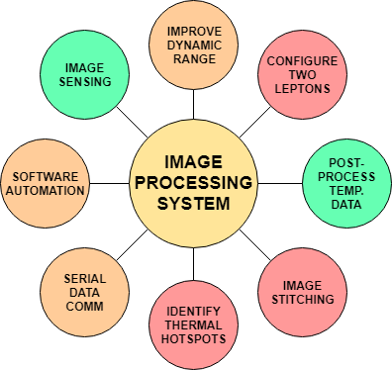
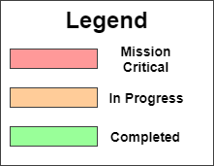
Software Task Progress

Slide 28
Integration Plan
Main Tasks
Integration Tasks
Final Tasks
Image Capture
Unit Testing
Test Bed Integration
Image Stitch
Software Automation
E2E Testing
Data Extraction
Data Calibration
Embed Software
Complete System
Identify Hot Spots
Legend
Data Export
Software Tasks
Manual Tasks
Unrelated Tasks
Testing Tasks

Slide 29
Budget

Slide 30
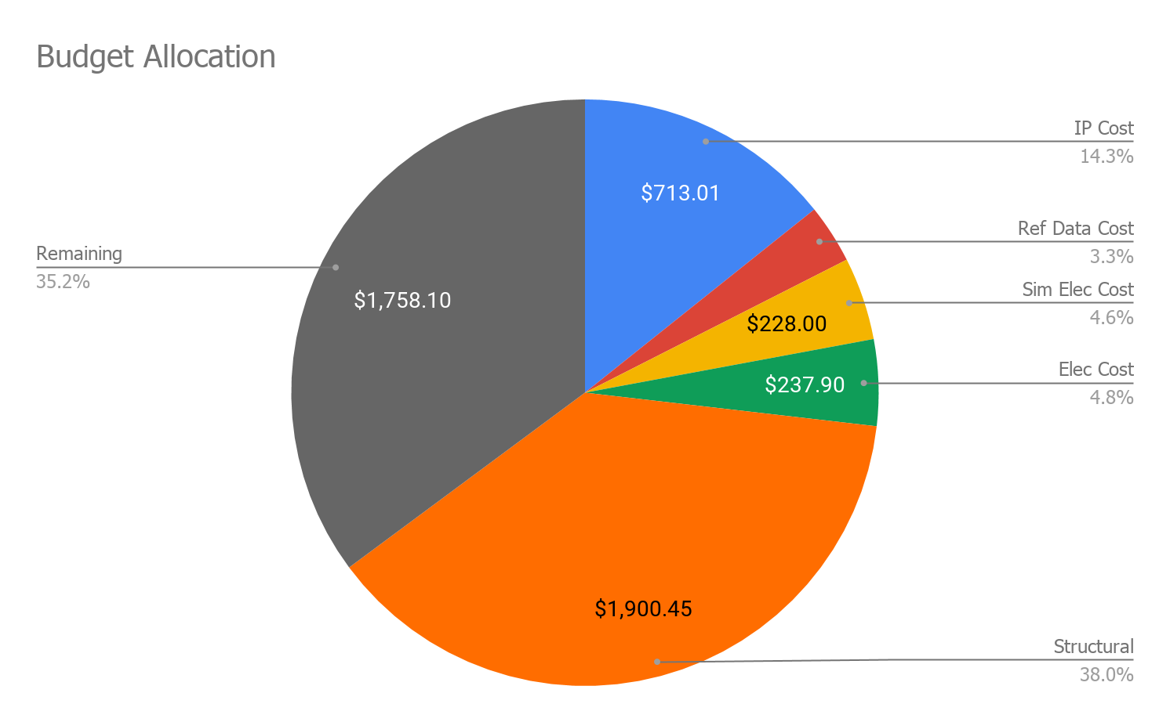
Cost Breakdown As of MSR
IP Cost | $713.01
Ref Data Cost | $162.54
Sim Elec Cost | $228.00
Elec Cost | $237.90
Structural | $1,900.45
Grand Total | $3,241.90
Remaining | $1,758.10

Slide 31
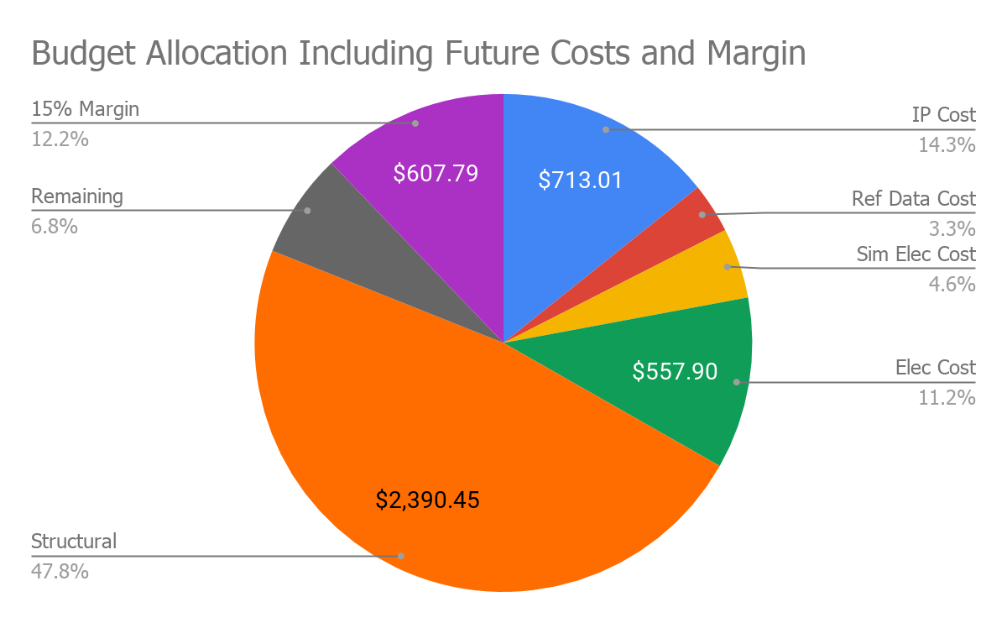
Future Cost Planning
Structural
Lid ($124)
Standoffs ($7)
Removable Plates ($60 per plate)
Offset Plate ($120)
Electronics
PCB for the Heaters ($80 per PCB)
Coatings
Remaining budget will be used to research coatings

Slide 32
Questions?

Slide 33
Back Up Slide Deck

Slide 34
References
https://www.unitedaluminum.com/chemical-composition-and-properties-of-aluminum-alloys/
https://www.makeitfrom.com/compare/2014-T6-Aluminum/6061-T6-Aluminum
https://www.monolithicpower.com/pub/media/document/MP1584_r1.0.pdf
https://www.digikey.com/catalog/en/partgroup/lepton-breakout-board/55730?utm_adgroup=Programmers%20Dev&slid=&gclid=EAIaIQobChMIkf6j54WE3wIVFx6tBh1j3gDuEAAYAiAAEgIv9PD_BwE
https://www.midstateinstruments.com/iriss-small-shaped-high-emissivity-target-labels-4-x-500/
https://www.instructables.com/id/Read-and-write-from-serial-port-with-Raspberry-Pi/

Slide 35
Baseline Design

Slide 36
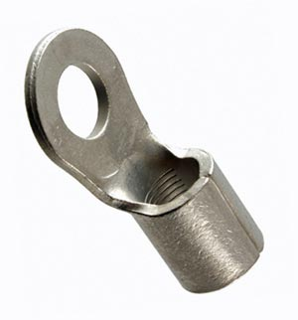
Grounding The Testbed
The Test bed will be grounded through the utilization of solderless crimp terminals.
These will connect to the aluminum surface and then to a grounding terminal.
Figure: Solderless crimp Terminal

Slide 37
Mechanical Structure Status

Slide 38
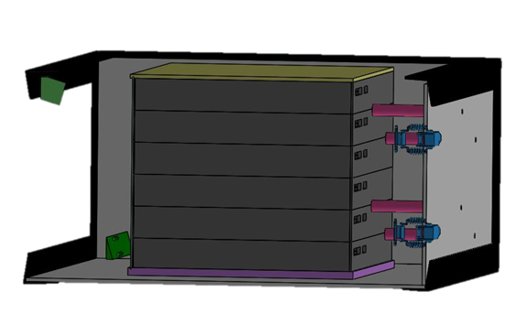
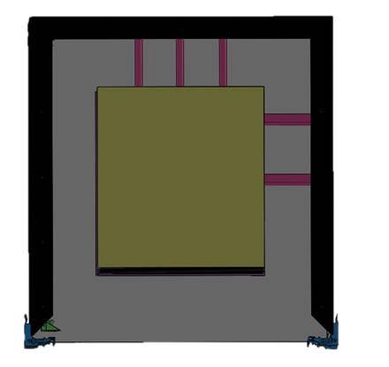
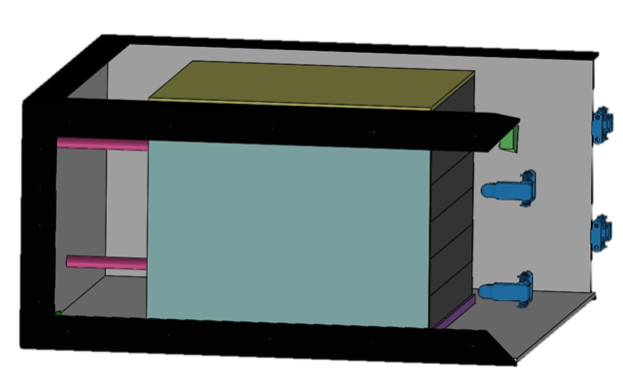
Design of Testbed

Slide 39
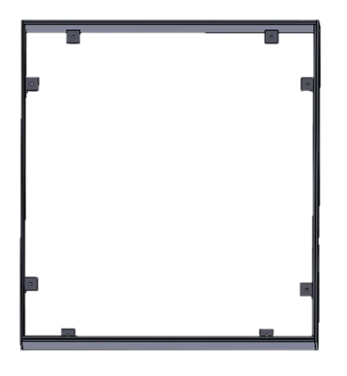
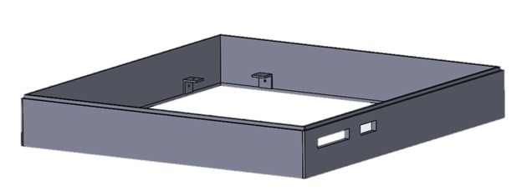
Tray Design

Slide 40
Tolerances
± 0.01 inch = 0.254 mm
16.538° ± 3° (vertical angle, camera mount)
52° ± 7° (horizontal angle, camera mount)
Most important components to minimize tolerance:
Stack walls - want to keep heat isolated to inside the stack
Bay walls - want to keep system isolated, don’t want outside light entering testbed
Camera mount - want to be able to image entire side of stack

Slide 41
Thermal Model Status

Slide 42
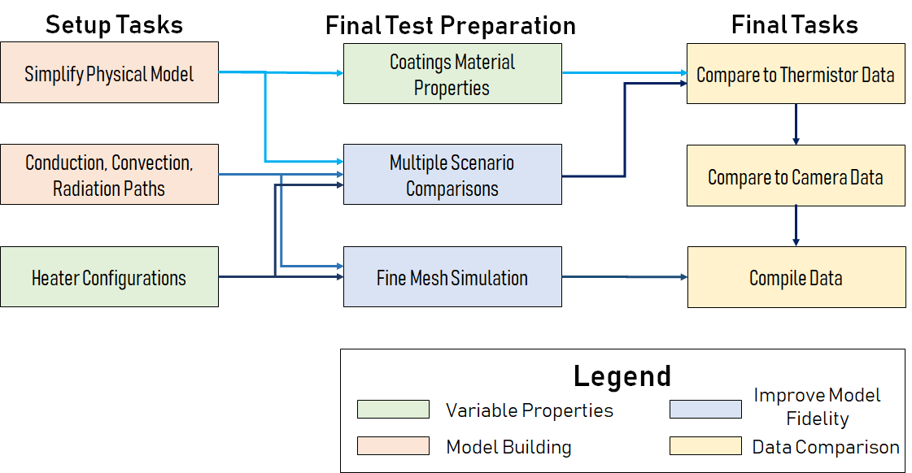
Thermal Model
Wiring and Realistic Heater Performance

Slide 43
Software Development

Slide 44
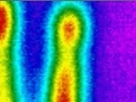
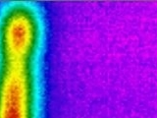
Current Challenges - Image Stitching
Test 4: 160X120 pixels
Image stitching will resolve two thermal images into one.
The current Stitch API does not create a stitch for small images (160x120)
Custom solution script currently in development taking advantage of pre-determined coordinates
Testing will resume Feb. 7th
Fig. 1,2: Input Thermal Images
1
2
Fig. 3: Results
Not enough matches found!
Test Results:
Significant Matches Found? - Success
Comprehensive Stitch - Fail
Notes:
Main change since CDR is depth of testing. The current software does not provide a stitch for images so small. Solution script is currently in development.
Notes: Based on current research, the current industry-preferred method for stitching does not perform well with low-resolution images. The image processing for this project is a case-study on if this can be done. This software module is top priority. - Justin

Slide 45
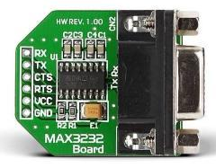
Current Challenges - Serial Data Comm.
Serial data communication protocol will be RS232, as specified by the customer.
Code has been written, preliminary testing
Currently, the RasPi can write to the RS232 to UART converter but not read
Testing will resume Feb. 5th
Test 1: Serial Communication
Fig. 1: RS232 to UART converter
Potential Hardware Issue
Testing Results:
RasPi Code Write - Success
RasPi Code Read - Fail
Send serial data to host - Fail
Notes:
As defined by our customer, system will need to communicate via serial comm protocal RS232. In the current test setup, RPi sends data to the laptop. Temperature data is sent along these lines of communication.

Slide 46
Software Development Timeline
Image Sensing:
Find workable Image Capture Module
Configure FLIR Lepton w/ RasPi
Useful images test (initial testbed)
Thermal Image Capture
Enable radiometry feature via Lepton SDK
Radiometric image testing
Temperature data post-processing
Improve dynamic range (8bits -> 14 bits per channel)
Verify temperature data
Configure 2x FLIR Lepton w/ RasPi
Test image capture w/ both cameras
Infant Stages
In progress
Complete
Since CDR

Slide 47
Software Development Timeline
Image Stitching:
Find workable Image Stitching Module
Research stitching methods
Research Stitching API (ORB Stitching)
Timing analysis for OpenCV stitching methods
Testing stitching module
Test stitching module with high-resolution images
Test stitching module with high-resolution thermal image
Test stitching module with low-resolution thermal image
Test stitching module with low-resolution low-quality thermal image
Researching additional image stitching methods
Brainstorming custom software options
Locate keypoint matches between the two images (hard-code)
Develop comprehensive stitch, preserving data
Infant Stages
In progress
Complete
Since CDR

Slide 48
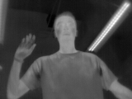
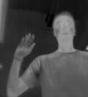
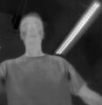
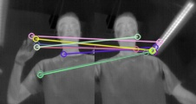
Other Stitching Tests
Raw Match Data
Captured Image
Image A to Stitch
Stitch test with FLIR 3.5
Result: Failure, Not enough accurate matches were found to complete the stitch

Slide 49
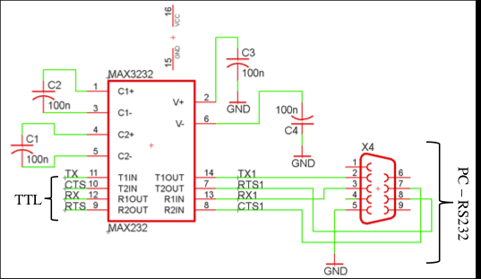
Rs232 to UART Converter

Slide 50
IP Hardware Interfacing
RS232 to UART converter
FLIR Lepton Cameras
Notes:
Current use of pins on the RasPi. External hardware involved: RS232 to UART converter and 2 FLIR Lepton cameras.

Slide 51
Full Stack Regulation System

Slide 52
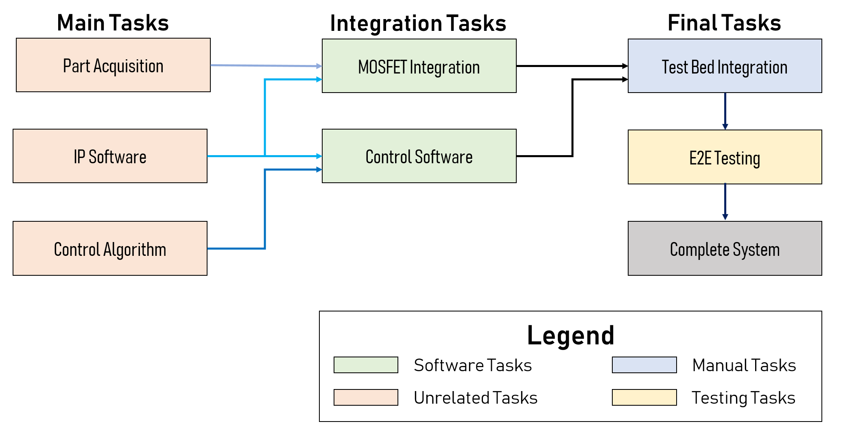
Integration Plan

Slide 53
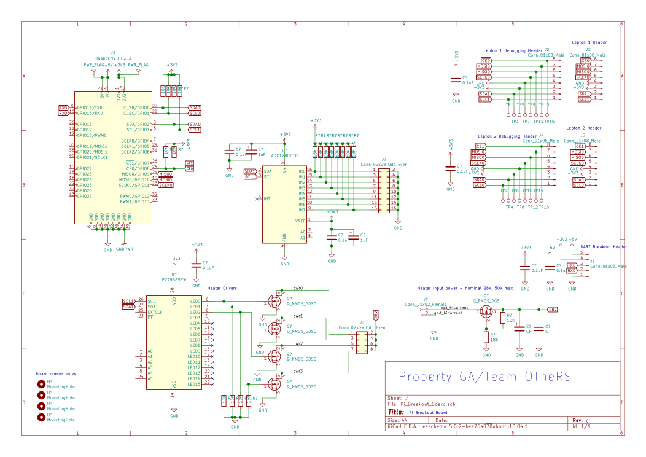
Full Stack Regulation System Schematic

Slide 54
Heater Driver System

Slide 55
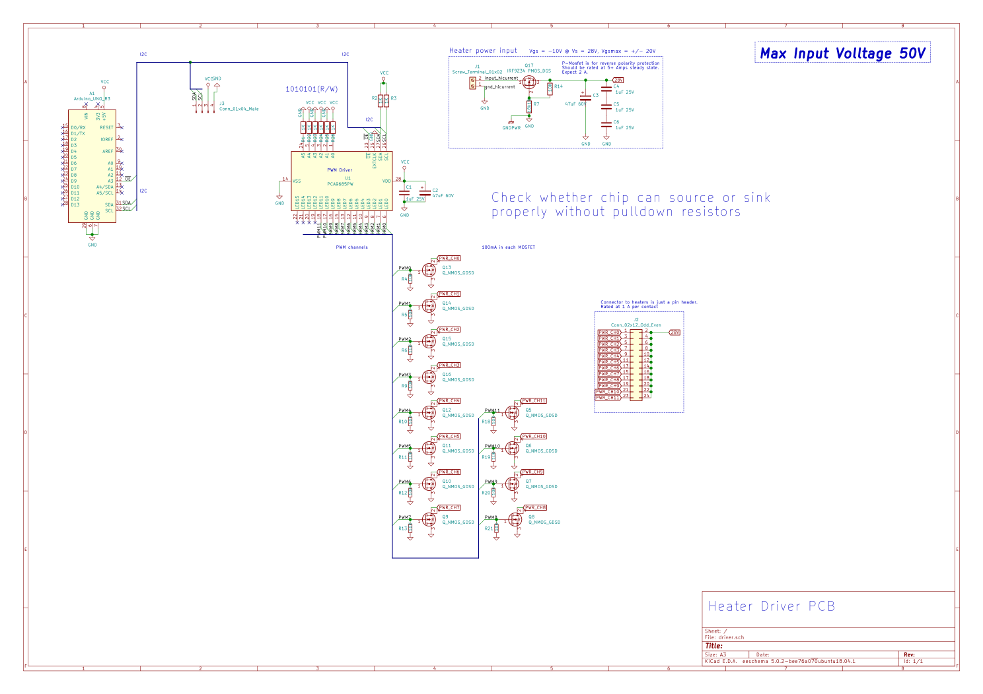
Heater Driver Schematic

Slide 56
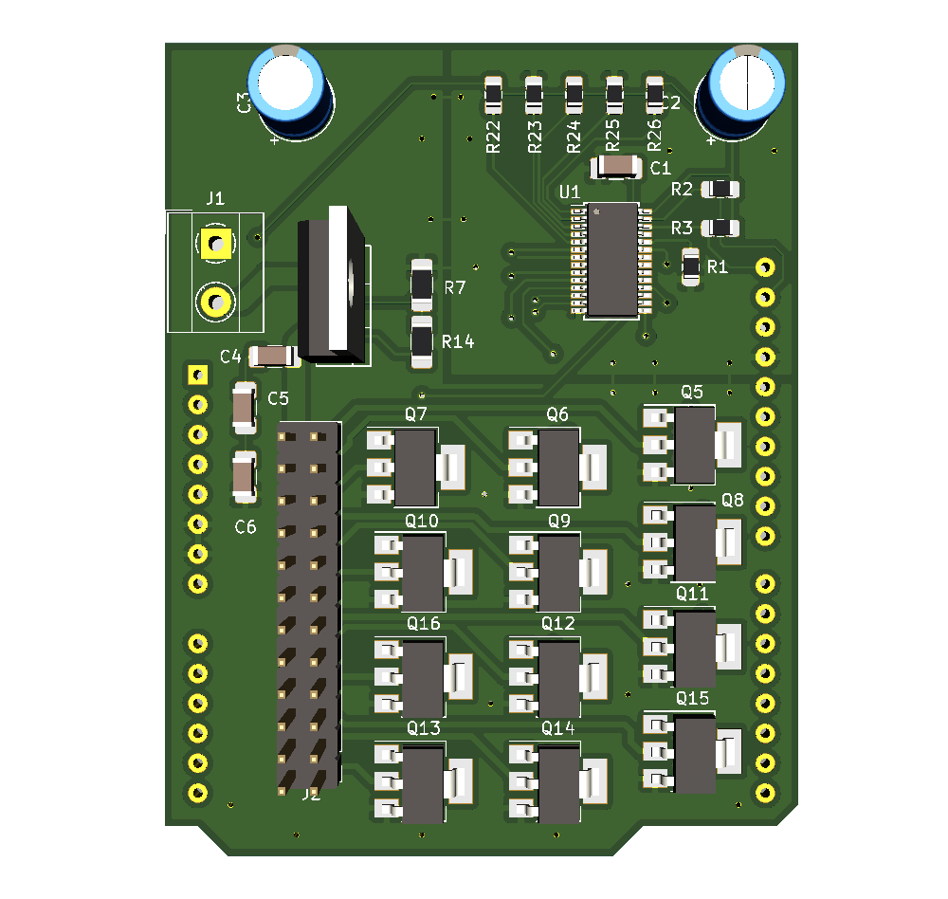
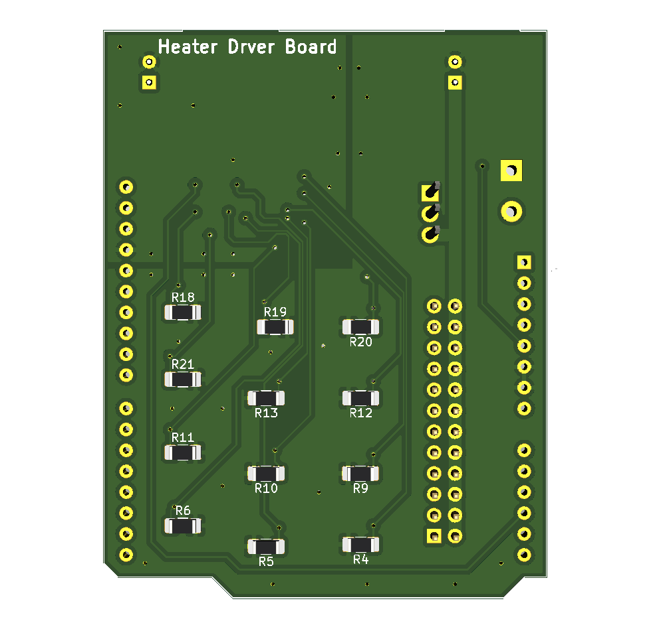
Heater Driver PCB

Slide 57
Reference Data System

Slide 58
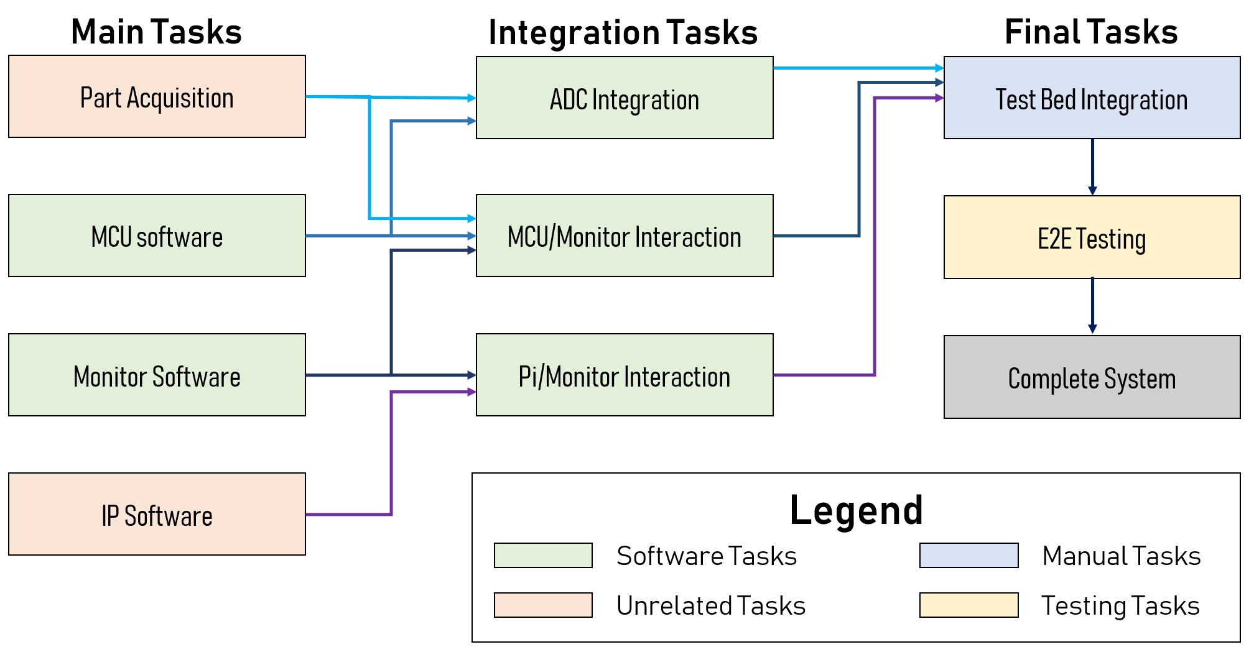
Integration Plan

Slide 59
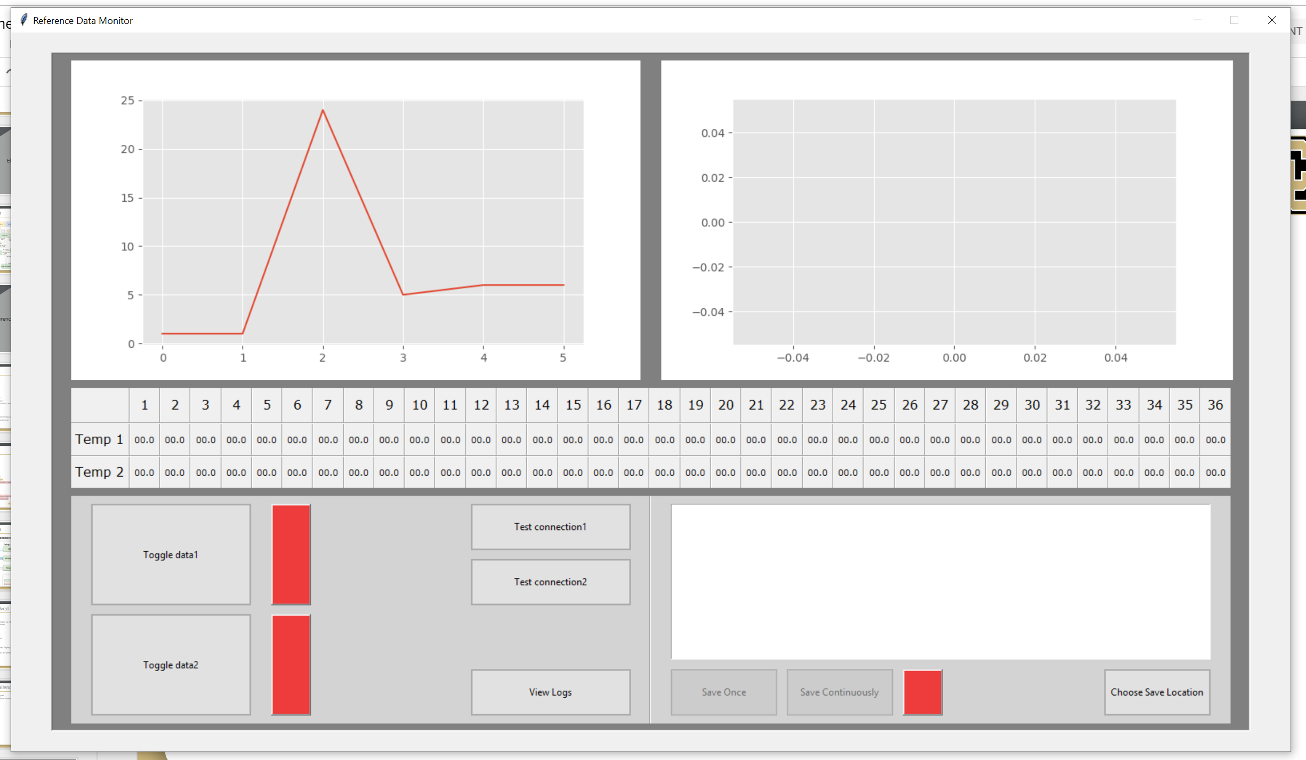
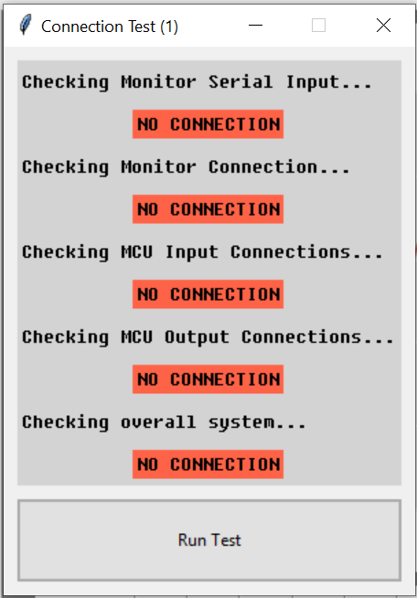
Monitor GUI

Slide 60
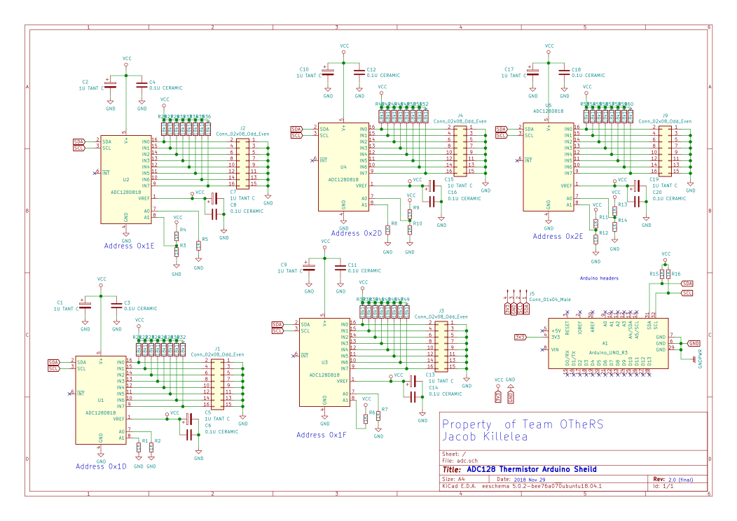
Reference Data System Schematic

Slide 61
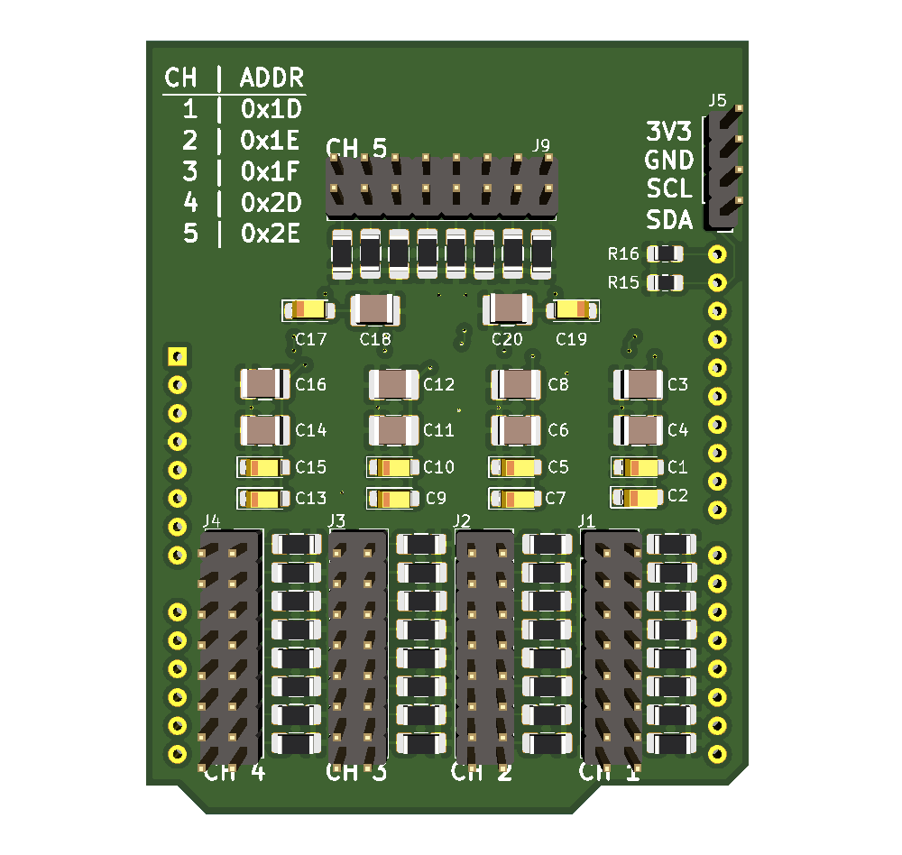
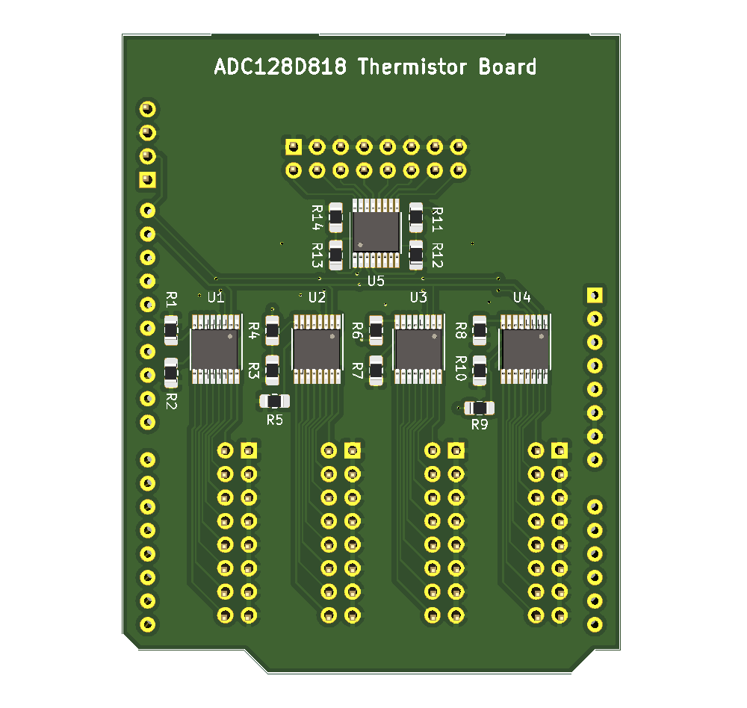
Reference Data System PCB

Slide 62
Coatings

Slide 63
Preliminary Coatings Testing
4 types of coating families selected for testing on prototype test bed
Bare Aluminum
Baseline case
Sticky Notes
Replicate Customer case
Tape
Increase conduction from sticky note test
Sanded Face
Find dependency on surface roughness
Metrics established to score coatings
Are material properties changing?
Temperature of reference data system compared with bare Aluminum test
Is accuracy increased or reflection mitigated?
Temperature of thermal imaging device compared with bare Aluminum test
Is the thermal behavior captured by the thermal imaging device?
Temperature of reference data system compared with thermal imaging device

Slide 64
Continued Coatings Testing
Testing on the final testbed will have dependencies on findings from preliminary testing
Testing will be completed on the final test bed design
Coatings to be tested
Slide in sheet of Aluminum 6061
Quantify effect of thermal contact resistance
Material variation
Vary material attached to face being imaged
Surface coatings
Time and budget constraints
Intention to test coatings with similar space grade variants
Aids the customer for their application

Slide 65
Budget

Slide 66
Purchases Made Up Until MSR
Sub-System | Part | Unit Price | Qty | Total | Sub-System | Part | Unit Price | Qty | Total
IP/Camera | FLIR Lepton 3.5 | $301.01 | 2 | $610.02 | Ref Data | Sparkfun RedBoard | $19.95 | 1 | $24.95
IP/Camera | Lepton 3.5 Breakout | $0.00 | 2 | $0.00 | Ref Data | Resistors - CRGCQ0402F18K | $0.10 | 80 | $8.00
IP/Camera | High Emmisivity Stickers | $53.00 | 1 | $62.99 | Ref Data | Custom PCB | $10.00 | 3 | $30.00
IP/Camera | Raspberry Pi 3b | $40.00 | 1 | $40.00 | Sim Elec | Custom PCB | $8.00 | 10 | $85.00
Structural | Aluminum 6061-T6 Plates .04"x2'x4' in (Bay) | $59.90 | 10 | $639.00 | Sim Elec | Power Resistor - 71-RS01025R00FE73 | $1.19 | 100 | $119.00
Structural | Toggle Clamps | $19.99 | 4 | $87.96 | Sim Elec | Power Driver Board | $8.00 | 3 | $24.00
Structural | Aluminum 6061-T6 Plates (1/16") - 25.5"x24" | $69.50 | 3 | $248.50 | Sim Elec | D-Type Connectors | $0.00 | 0 | $0.00
Structural | Aluminum 6061-T6 Plates (1/16")13.5"x25" | $69.50 | 3 | $208.50 | Electronics | Buck Converter | $6.99 | 2 | $13.98
Structural | Aluminum 6061-T6 Plates (1/16") 24"x13.5" | $49.50 | 3 | $148.50 | Electronics | Wiring - 12 Gauge | $15.95 | 2 | $36.90
Structural | Foam Insulation | $32.60 | 1 | $32.60 | Electronics | D-type Connector | $1.57 | 0 | $0.00
Structural | AL 6061 Plate | $59.90 | 2 | $119.80 | Electronics | AC Adapter | $19.99 | 1 | $19.99
Structural | AL 6061 Sheet Metal | $101.75 | 3 | $305.25 | Electronics | USB for Arduino | $34.99 | 1 | $34.99
Structural | M2 Tap Starting | $16.53 | 2 | $33.06 | Electronics | MOSFET 60V | $0.71 | 10 | $15.05
Structural | M2 Tap Closed | $16.53 | 2 | $33.06 | Electronics | IC LED DRIVER | $2.33 | 3 | $6.99
Structural | 18-8 Stainless Steel Slotted Flat Head Screws | $7.79 | 1 | $7.79 | Electronics | MOSFET 55V | $1.08 | 3 | $3.24
Structural | Paper Tape | $9.89 | 1 | $9.89 | Electronics | CAP ALUM 47UF 20% 63V RADIAL | $0.33 | 4 | $1.32
Structural | Threaded Rod 40x6 H44815E | $1.08 | 10 | $10.80 | Electronics | TE Connectivity Amp Connectors | $1.04 | 3 | $3.12
Structural | Nut Hex H140009E | $0.08 | 20 | $1.62 | Electronics | CONN HEADER R/A | $3.70 | 6 | $22.20
Structural | MS Metric Phil Pan M2X12 H4307E | $0.30 | 32 | $9.50 | Electronics | 25W Chassis Resistors | $3.08 | 2 | $6.16
Structural | MS Metric Phil Pan M2X8 H4306E | $0.24 | 19 | $4.62 | Electronics | Thermocouple BreakOuts | $12.76 | 2 | $25.52
Ref Data | Thermistors - Vishay NTCLE413 | $1.39 | 45 | $70.55 | Electronics | Power Resistor Kit | $4.76 | 1 | $4.76
Ref Data | Screw Terminals | $0.80 | 10 | $10.00 | Electronics | MOSFET Transistors | $2.03 | 10 | $20.30
Ref Data | ADC - ADC128D818 | $4.68 | 3 | $19.04 | Electronics | Arduino Uno | $23.38 | 1 | $23.38

