Slide 1
NESSIE
NIGHTTIME ELEVATED SYSTEM FOR SATELLITE IMAGING AND EVALUATION

Slide 2
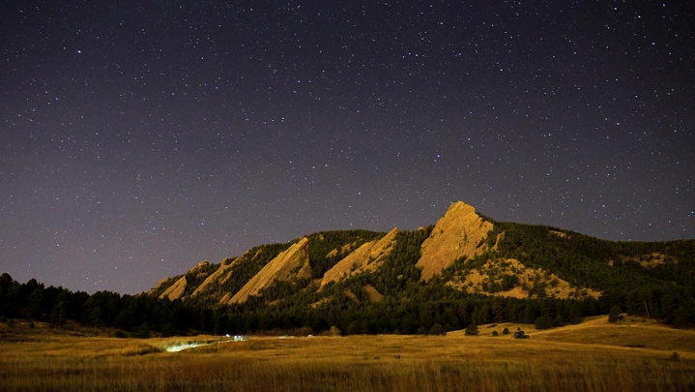
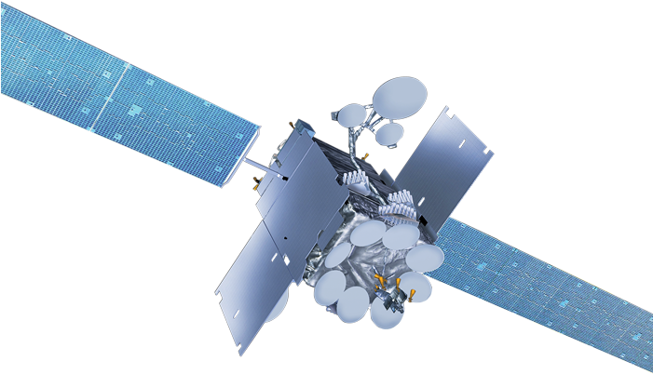
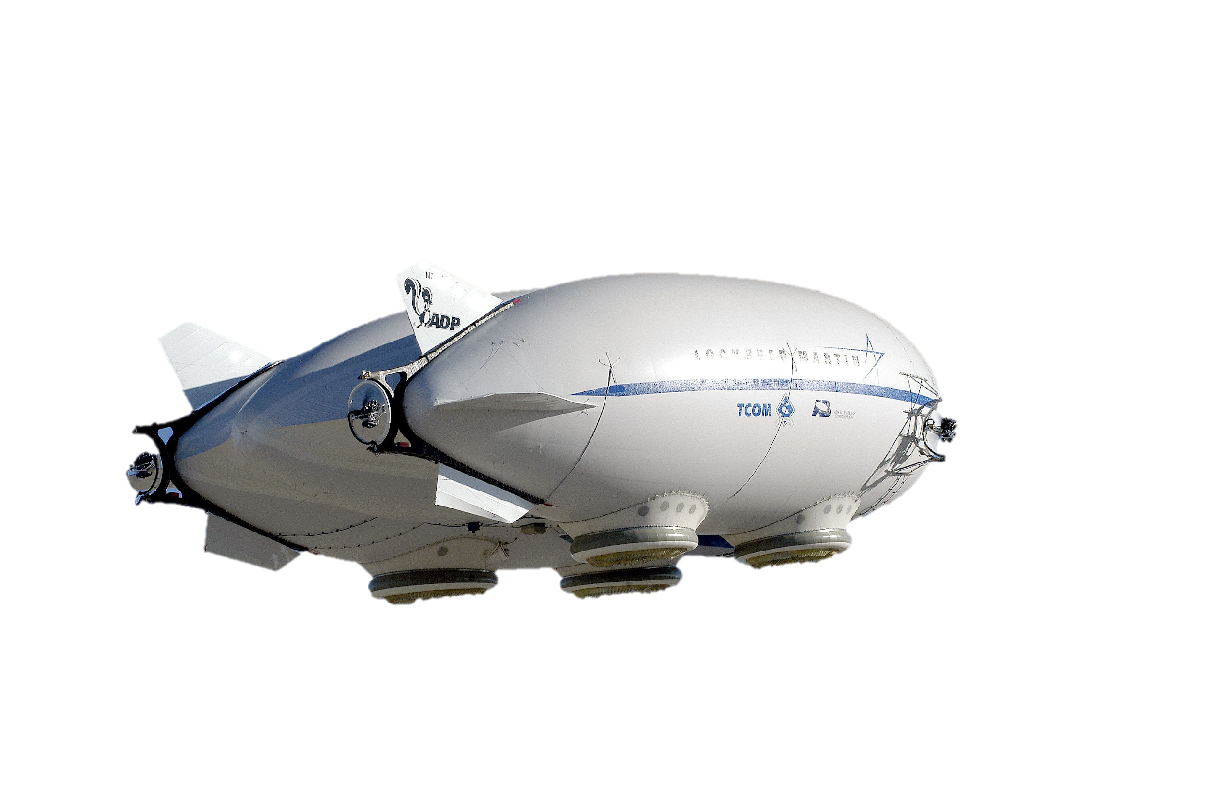
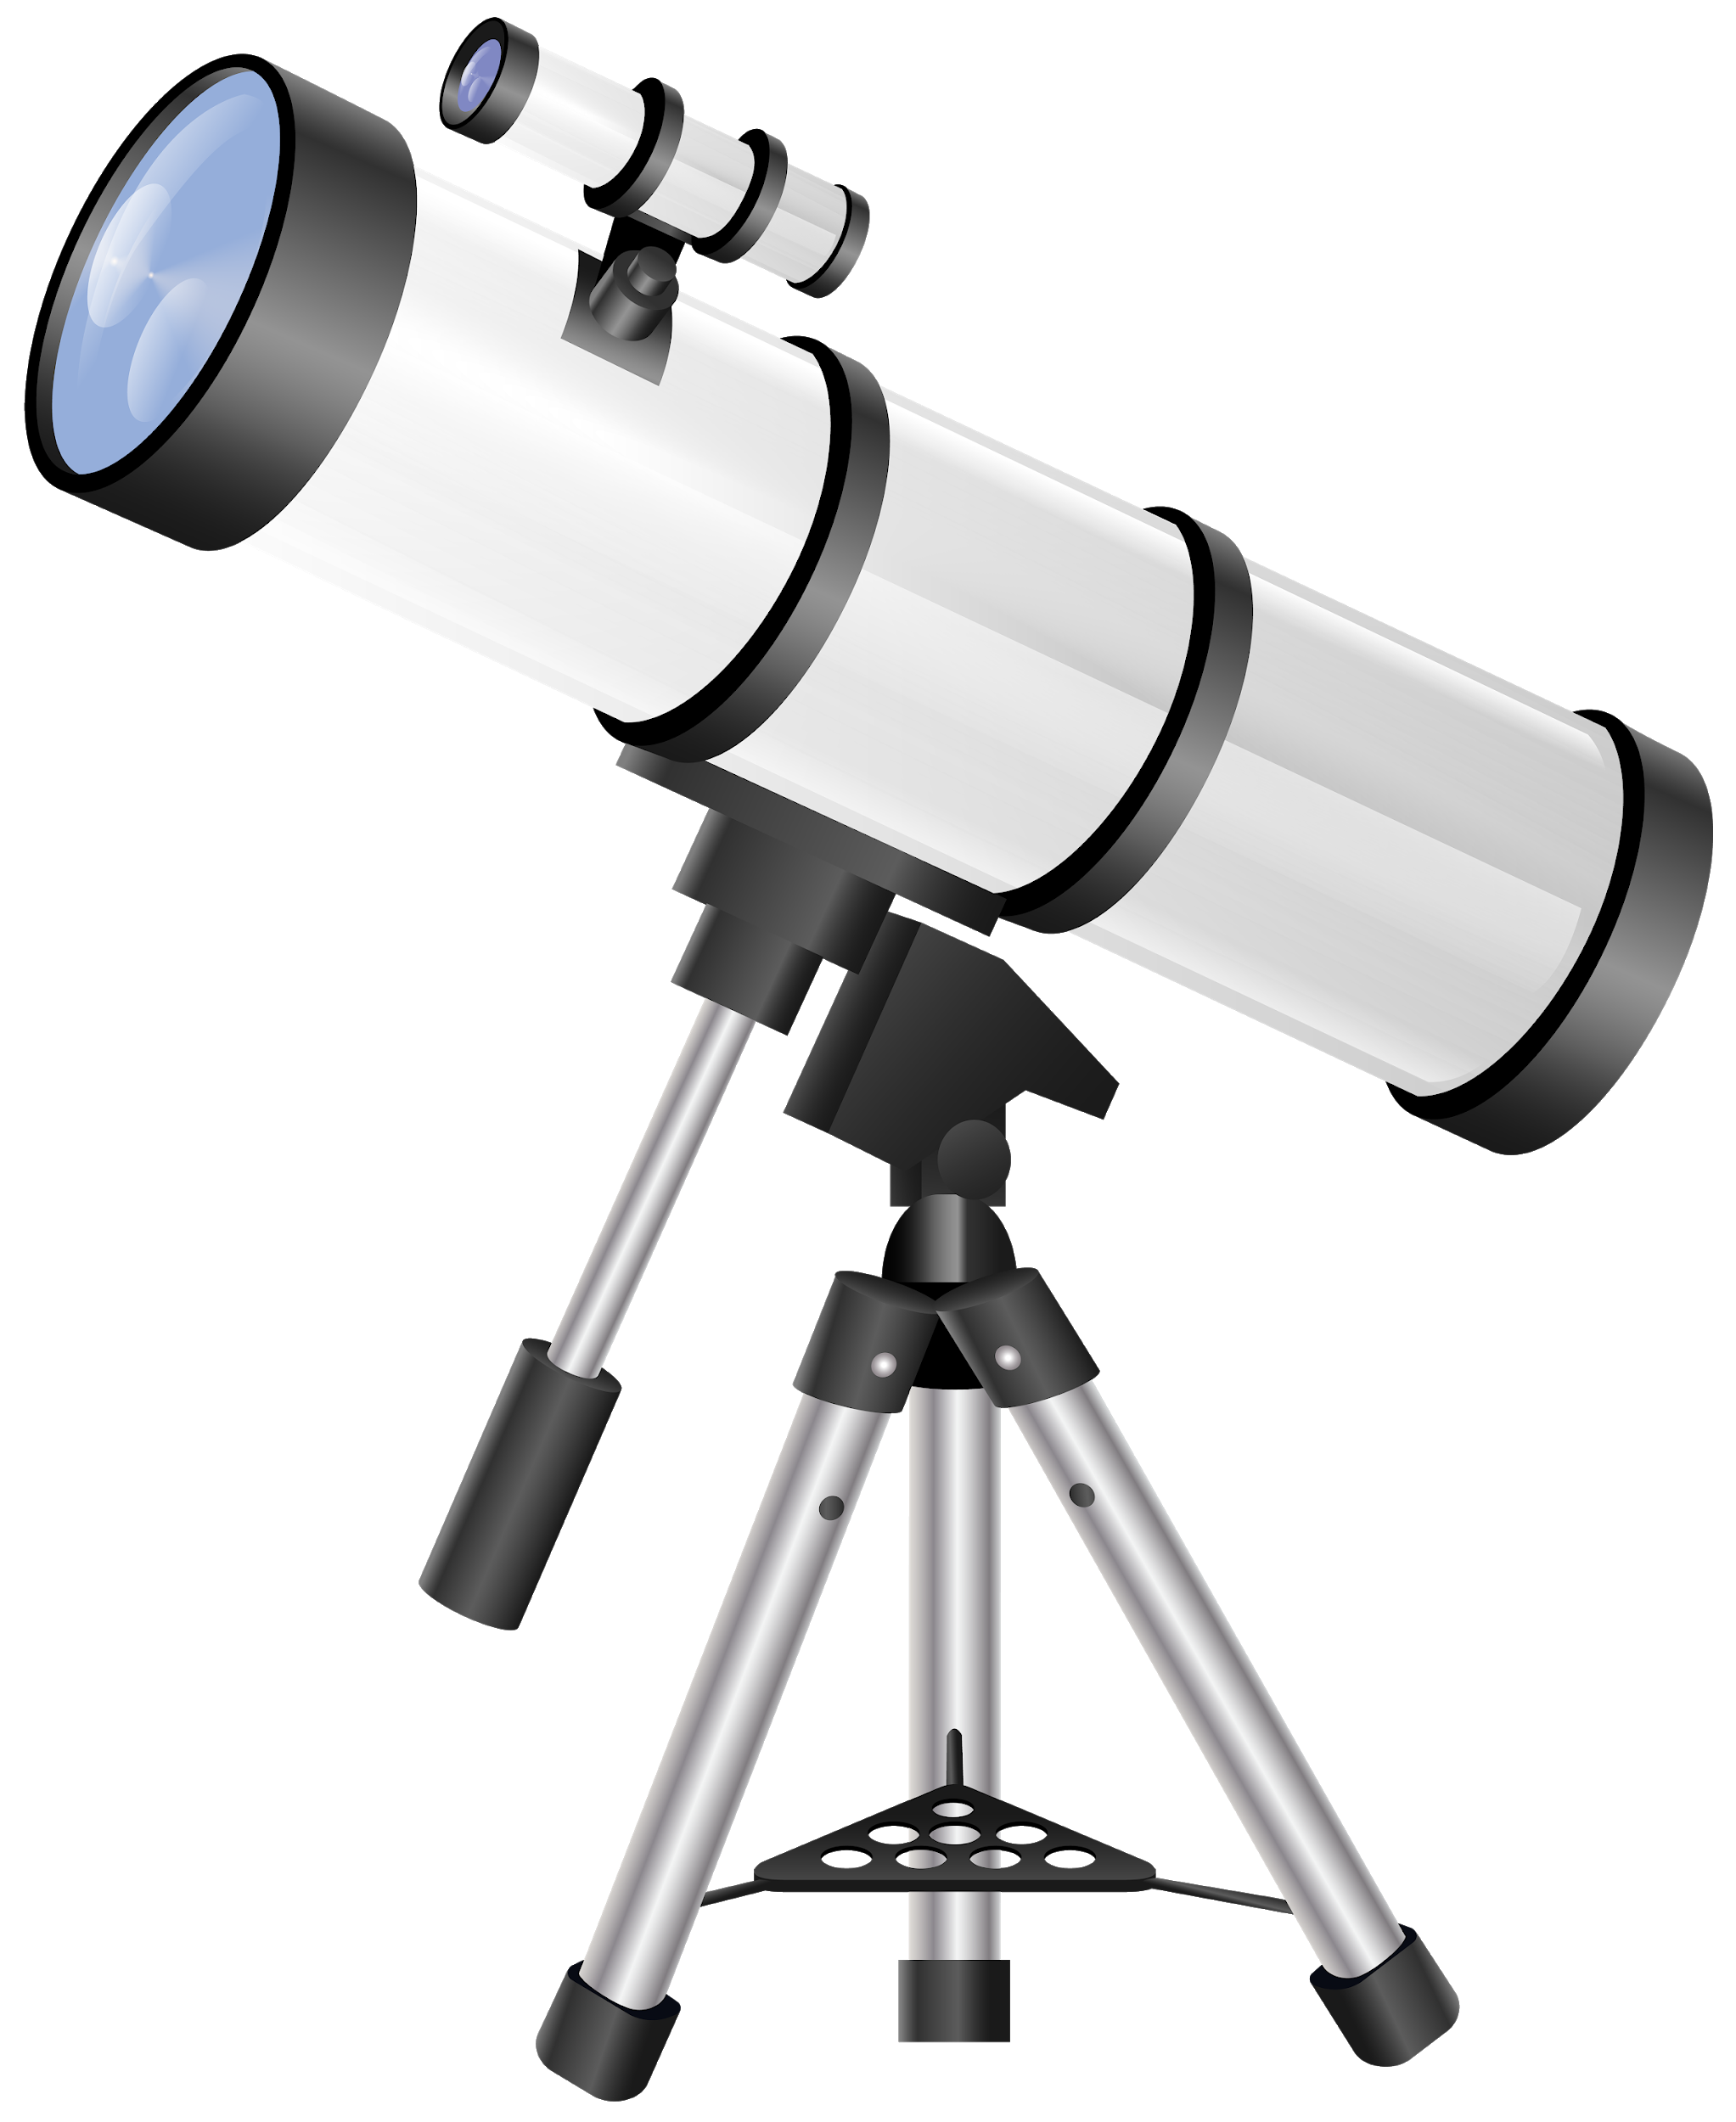
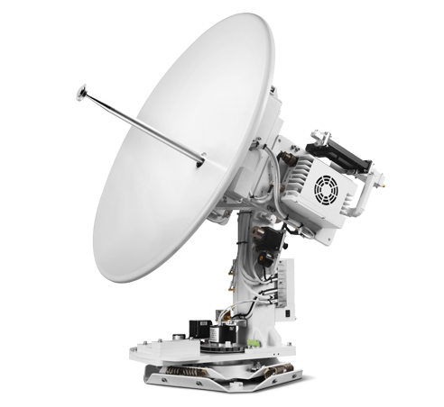
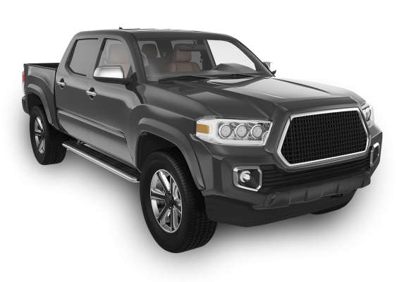
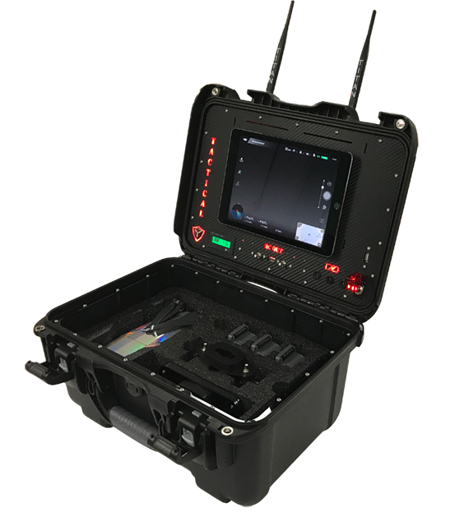
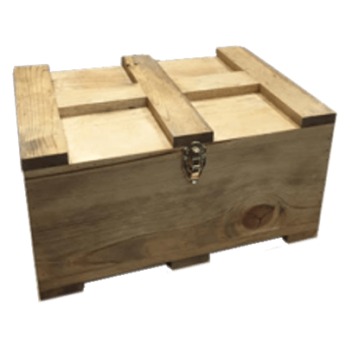
Stay on a 65,600 ft to 164,000 ft distance from takeoff spot
Legend:
🡪 Requirements
🡪 Operations flow
10 arcseconds object centroid identification accuracy, 3 sigma precision
5. Point optical system, capture image, measure time and position
Dimness ≥ 13 apparent magnitude
4. Pointing and stabilization check, autonomous flight
6. Store image and data
7. Start autonomous descent to Ground Station when battery is low.
Max altitude 18,000 ft
Loop
3. Manual ascent above clouds, uplink from ground station
Constantly downlink position and status data to ground station
8. Manual landing, uplink from ground station
1. System transportation
2. Unload/ Assembly/ Prep.
Ground Station
End of mission 14 hours after first ascent
Land 300 ft (100 yards) from takeoff spot
Notes:
This Figure illustrates the full mission scope where a team would go out to a location deploy the NESSIE system, collect SSA data for a time period and descend. So Where our team comes in this

Slide 3
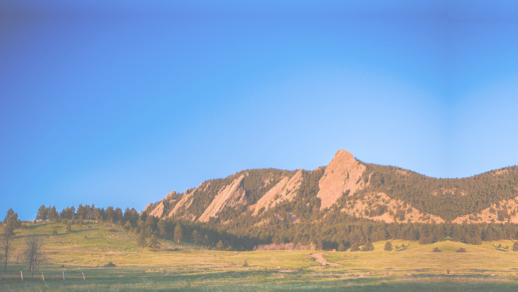
Stay within 400 ft of takeoff spot
Legend:
🡪 Requirements
🡪 Operations flow
4. Systems check, Manual flight
5. Continuously collect acceleration data from onboard IMUs
Provide power and data connectivity to payload
6. Start manual descent to Ground Station when battery is low.
Max altitude 80 ft
Downlink position and status data to ground station
7. Manual landing, uplink from ground station
3. Manual ascent, uplink from ground station
1. System transportation
End of mission when battery reaches ~20%
2. Unload/ Assembly/ Prep.
Ground Station
Land 300 ft (100 yards) from takeoff spot
Notes:
This Figure represents the CONPOPS of our Sr. Project team.
Will drive out to a field
prep our A/c
Ascend it to 400ft
Conduct a comm check
Collect data for XXX mins
Descend and land saftley

Slide 4
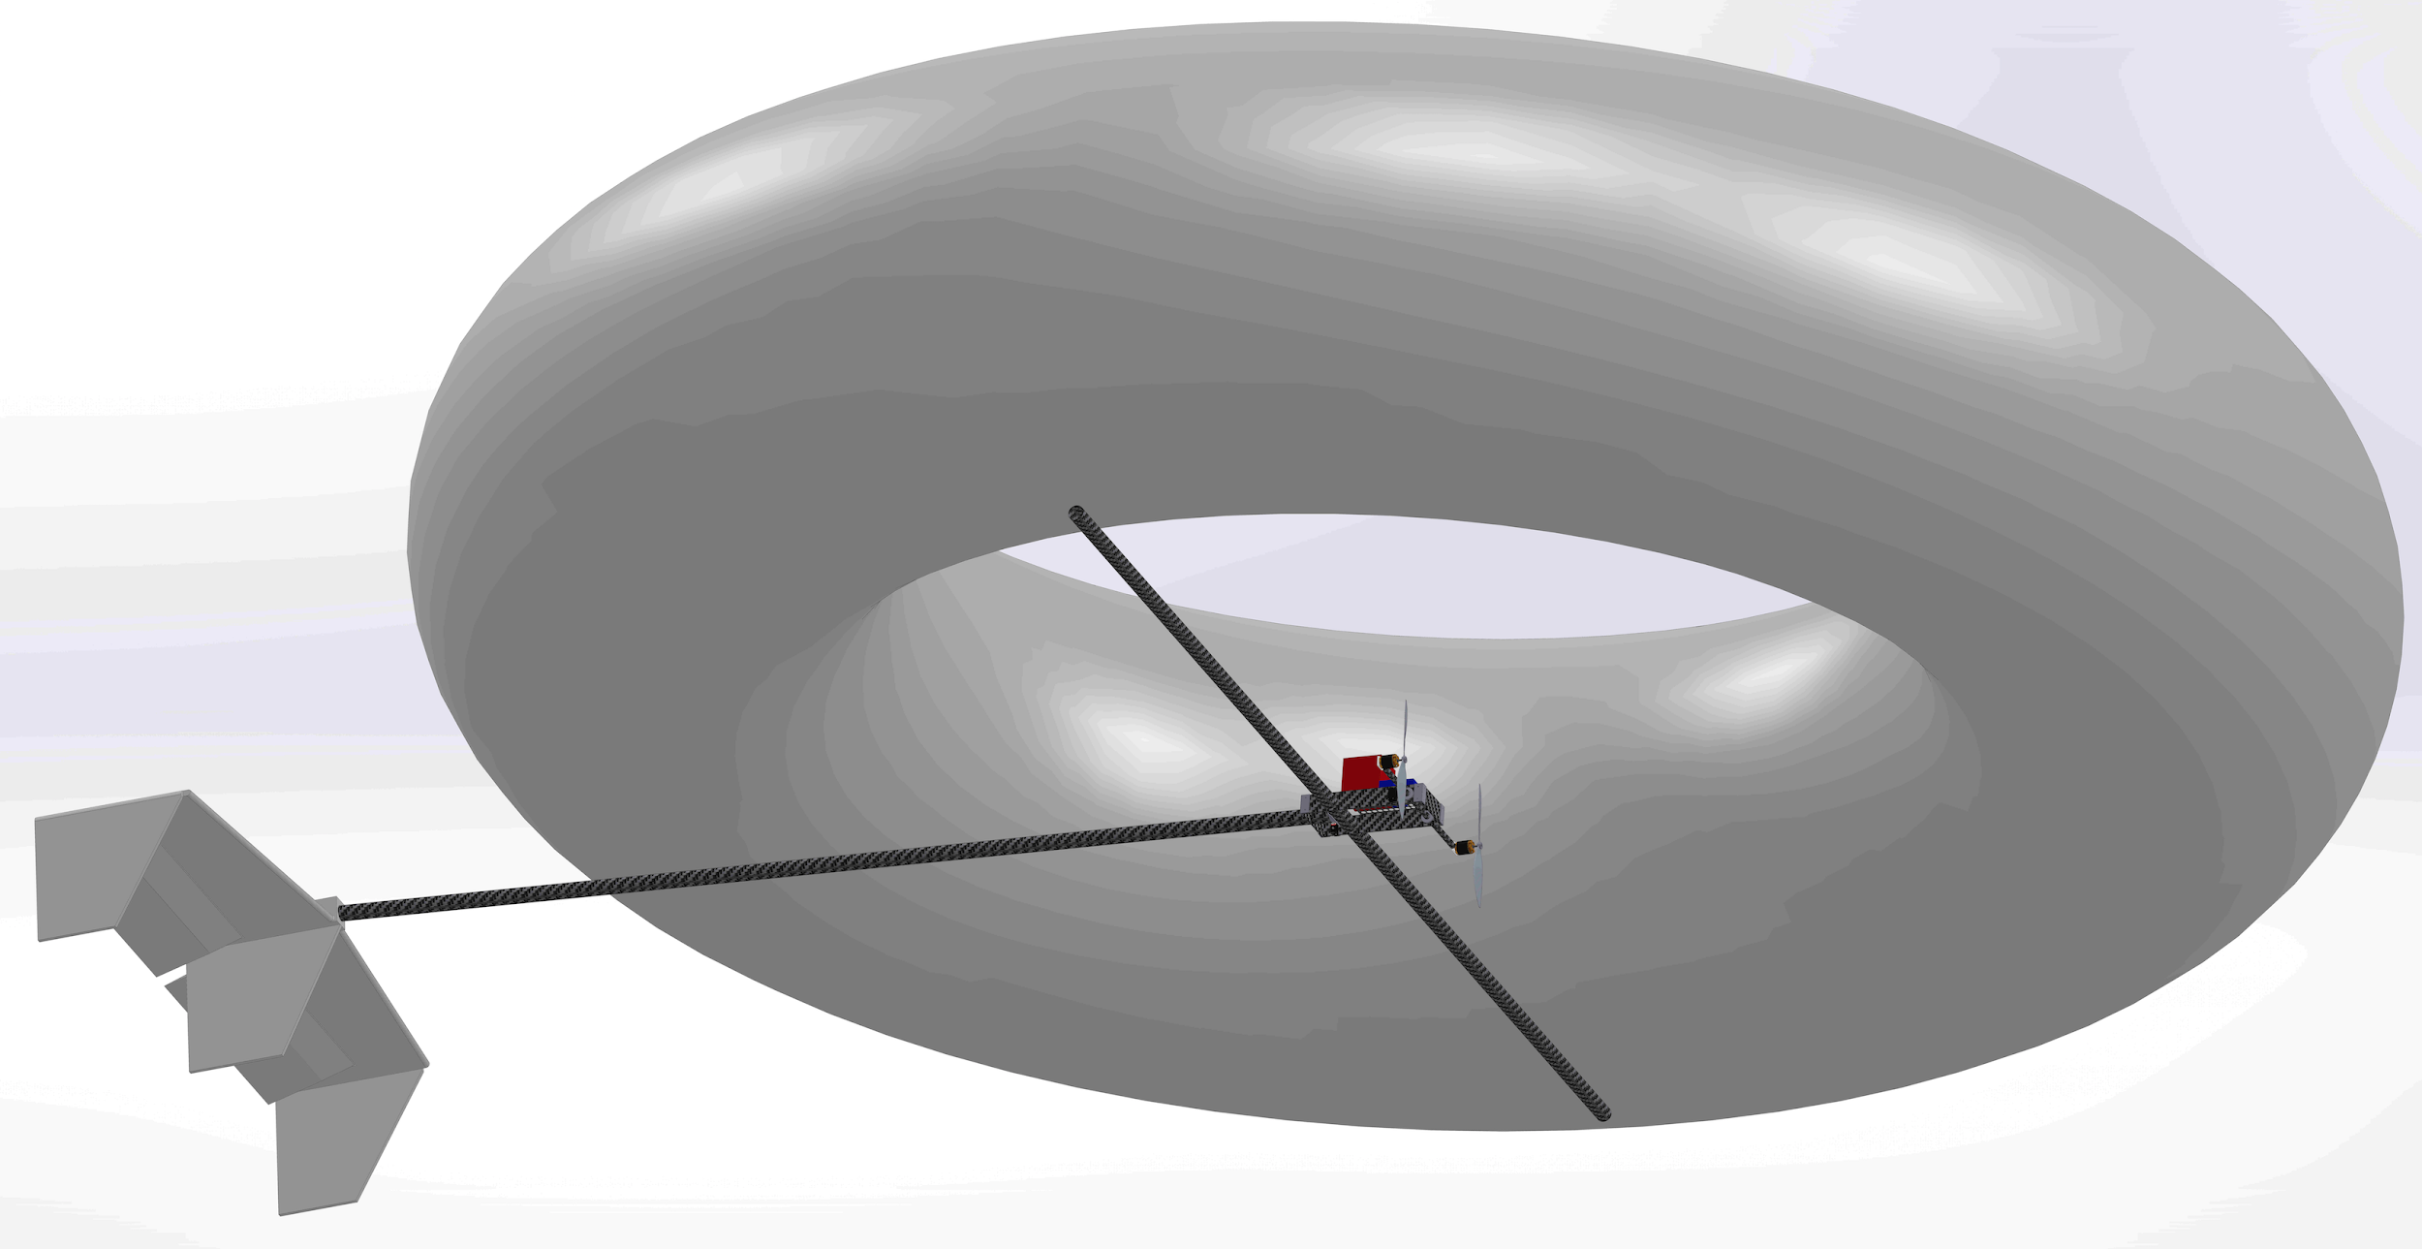
Overview - Baseline Design
15 ft
13 ft

Slide 5
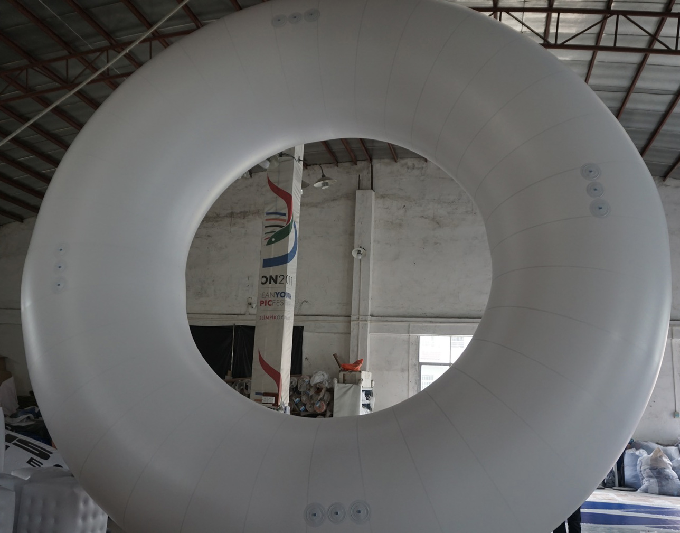
Overview - Baseline Design
20 ft
10 ft
Legs
Notes:
Call out attachment points
zoomed in image?
dimensions

Slide 6
Levels of Success For Final Flight Test
Level of Test success | Collect Payload Data | Establish Flight Capabilities of NESSIE | Recover NESSIE
1 | Backup SD card of IMU data is retrieved from NESSIE | NESSIE is landed in non-contingency manner | All components of NESSIE are recovered
2 | Data is successfully down-linked to computer during flight | NESSIE is shown to be controllable in all DOF NESSIE does not exceed the altitude limit | No components are damaged
3 |  | NESSIE reaches the target altitude +/-20 ft NESSIE is landed within the 300 ft requirement

Slide 7
Schedule - Overview (MSR)

Slide 8
Schedule - Overview (Current)

Slide 9
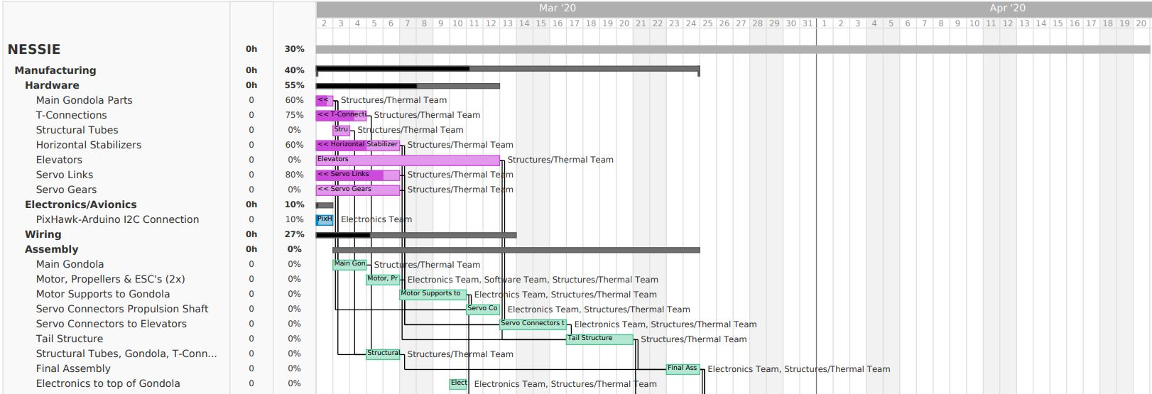
Schedule - In Depth Review: Manufacturing Schedule
Critical Path

Slide 10
Schedule - In Depth Review: Testing Schedule
Fully integrated test date Apr. 6th with 2 contingency dates
Critical Path
Notes:
call out info about testing schedule specifically

Slide 11
Design Changes:
NESSIE will use hydrogen gas as its lifting gas
Approved by Dr. Argrow and Matt Rhode
All related information is detailed in NESSIE’s Hydrogen Safety Proposal
Notes:
call out info about testing schedule specifically

Slide 12
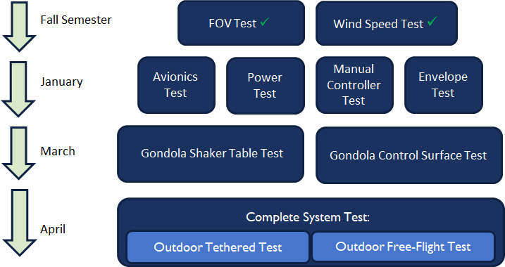
Overall Testing Schedule
March

Slide 13
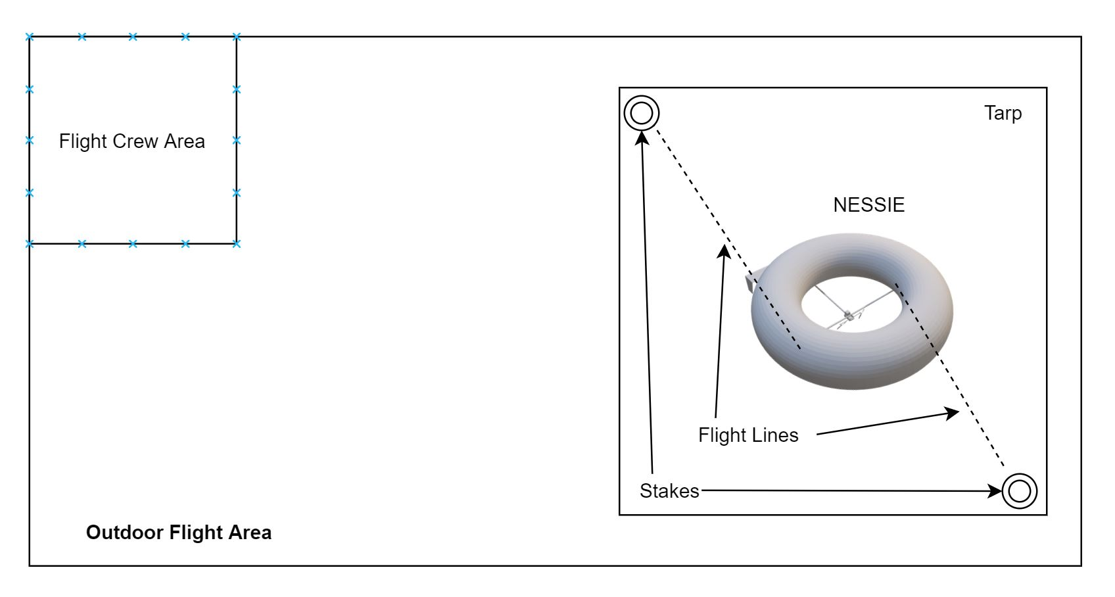
Flight Tests
Rationale: To prove the feasibility of the entire project, the vehicle must be flown in a fully integrated test.
Equipment:
NESSIE
Gondola
Horizontal tubes and tail boom
Tail
RC controller
Hydrogen gas
Facilities:
CU South Boulder
Table Mountain flight space is backup
Flight windows: 4/6, 4/8, 4/13 10:30am-2:30pm
Maps can be seen in backup slide here
Flight test setup:

Slide 14
Flight Test Cont.
Test Procedure
Transportation to flight area
Ensure travel time is factored in to allow for prompt 10:30 am start time
Test area set up
Emplant mooring stakes
Place ground tarp
Assemble NESSIE structure
Fill NESSIE with hydrogen gas
Matt Rhode will do this
Fill Procedure in backup slide here
Once rigid, NESSIE’s gondola will be affixed to gas envelope.
NESSIE flight
See next slide for this procedure
Nessie landing and recovery
See next slide for this procedure
Gas venting/recapture
Hydrogen from NESSIE will be vented
Data recovery
In-flight IMU data
GPS and any available flight controller data
Pilot qualitative comments on vehicle performance will be recorded

Slide 15
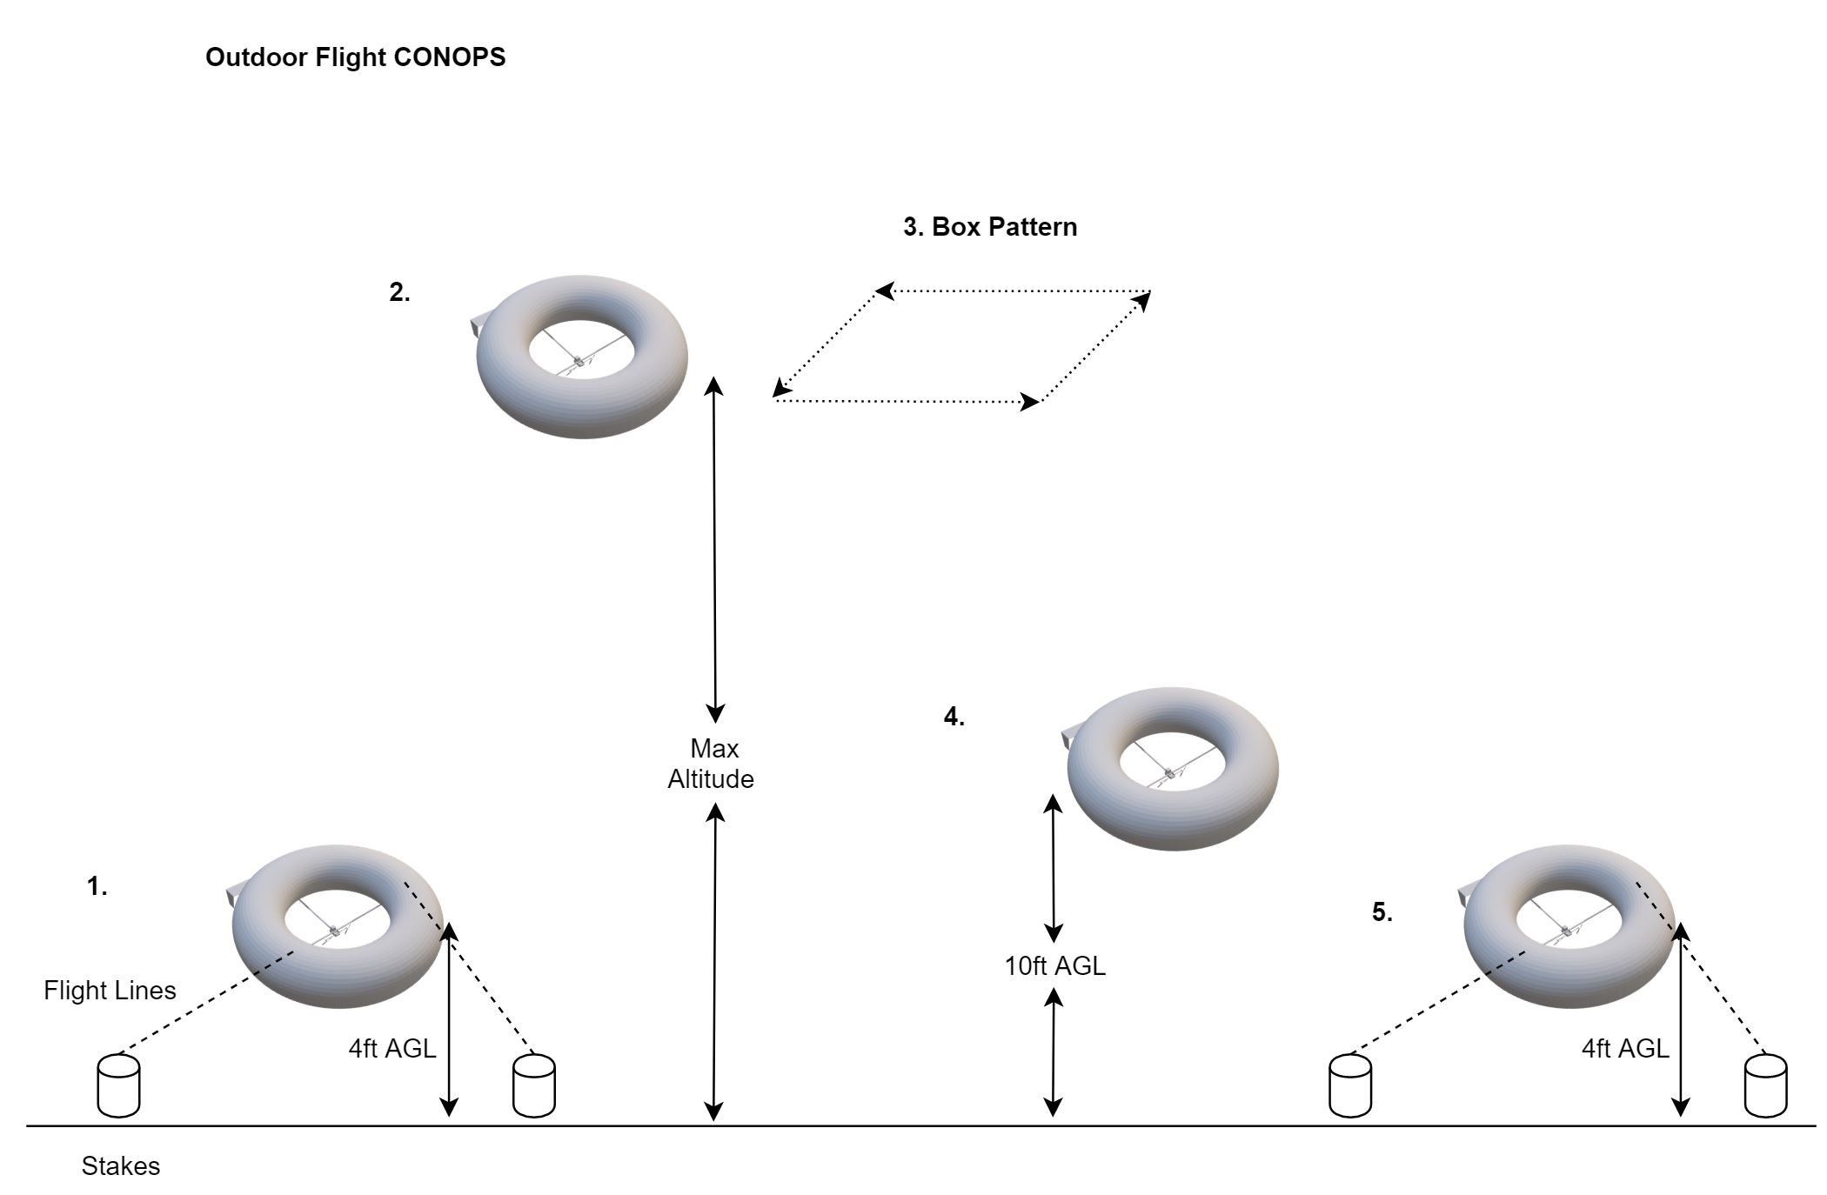
Flight Test Cont.
Flight Procedure:
Tethered Flight
NESSIE will fly tethered at 4ft AGL to establish controllability.
Untethered Flight
NESSIE will fly to 80 ft AGL
Box Pattern
NESSIE will fly in a box pattern to establish control
NESSIE is taking data for FR1 here
Reduce Altitude
NESSIE will use its motors to descend to 10ft AGL
Recapture
NESSIE will be recaptured and staked via its tethers.
At any time, if control is lost, emergency solenoid and burn wire can be used in this test.

Slide 16
Flight Test Cont.
Reduce Risk:
Clearly designated and marked viewer, flight crew, and flight areas.
Matt Rhode will be filling NESSIE with hydrogen
Utilize grounding stake to eliminate risk of ESD while near ground.
Reduced inclement weather risk with three flight windows
Fire department will be on standby
Police will be contacted in case of erroneous police calls (flight will be visible from highway 36)
Be prepared to call FAA if test goes awry
Expected Results:
Performance capabilities
Vibrational data for customer
Requirements being satisfied: THis test will satisfy the following requirements
FR1: System shall be capable of supporting a scaled payload that can collect the necessary image data to
allow for initial orbit determination.
All DR1.X
DR2.2: System shall be capable of surviving gusts up to 5 mph.
FR3: The system shall provide sufficient net lifting force to attain desired altitudes.
DR 3.3 The aircraft shall be controllable by manual RC controller
FR4: System shall be able to communicate
All DR4.X
Status of Test:
6 April 2020 + 2 Contingency dates

Slide 17
Camera Shaker Table Test
Rationale:
NESSIE’s purpose is to provide a platform for an optical system.
Must account for noise to creep into images from vibrations. (disturbances discussed in CDR)
Necessary to prove blurred images are recoverable from anticipated noise.
Facility:
CU Boulder Aerospace Building (Shaker Table)
Equipment:
Raspberry Pi
Raspberry Pi Cam
Monitor for camera
Gondola (Camera test bed)
“space object” (the image to be taken of)
Shaker Table
Test Personnel (Rich, Flora, Paul, Katie Rae)

Slide 18
Camera Shaker Table Test Cont.
Test Procedure:
Power on and configure camera. Set for 1s exposure time.
Place camera inside test bed and place onto shaker table and orient toward “space object”
Take image of “space object” - No Vibration (Base Image)
Reconfigure camera as in step 1
Run shaker table at set frequency and retake image.
Note:
Process will repeat for all intended frequency ranges discussed in CDR, FFR.
Blurred images will be recovered using a deconvolution algorithm (MATLAB)
Recovered images will be compared to base images to measure recoverability.

Slide 19
Camera Shaker Table Test Cont.
Reducing Risk:
The recovered images prove NESSIE is capable of establishing a platform suitable for orbit determination.
Expected Results:
Recovered images to have a 95% match or better with base images.
**A 95% match with no stability measures is deemed
highly conservative based on research**
Satisfied Requirement(s):
FR1
Status of Test:
Test is on schedule for the second week of March. ( 10 March 2020 )

Slide 20
Budget
Parts Received:
Parts Pending:
Electronics
IMU
Servos
PixHawk
Batteries
Hardware/Materials
Carbon fiber
Propellers
Propellor attachments
Aluminum fittings
Bearings
Polyester foam
Burn wire
Hardware/Materials
Envelope
Notes:
Specifically mention that there are no more planned purchases

Slide 21
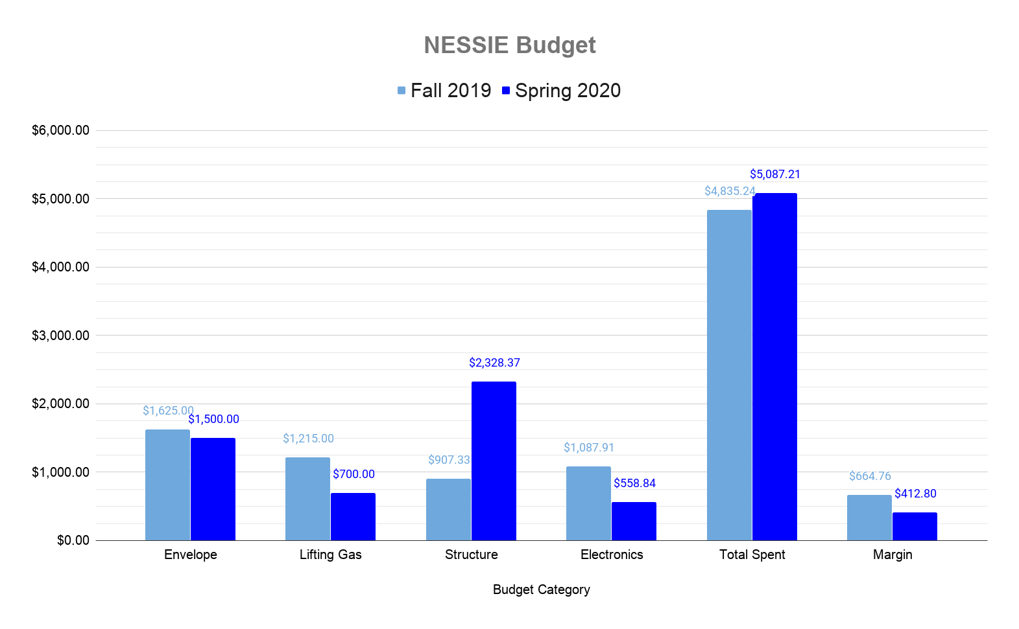
Budget
Total Budget: $5,500
Notes:
Lifting gas: helium vs hydrogen
hydrogen cost accounts for 2 fills

Slide 22
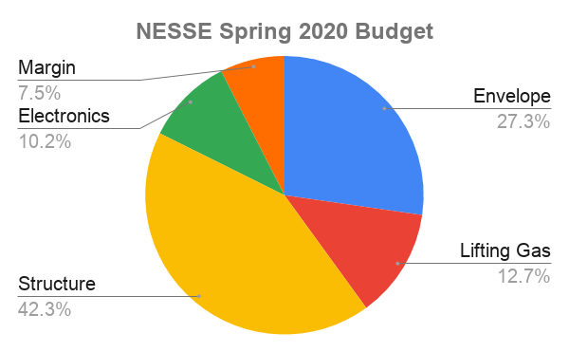
Budget

Slide 23
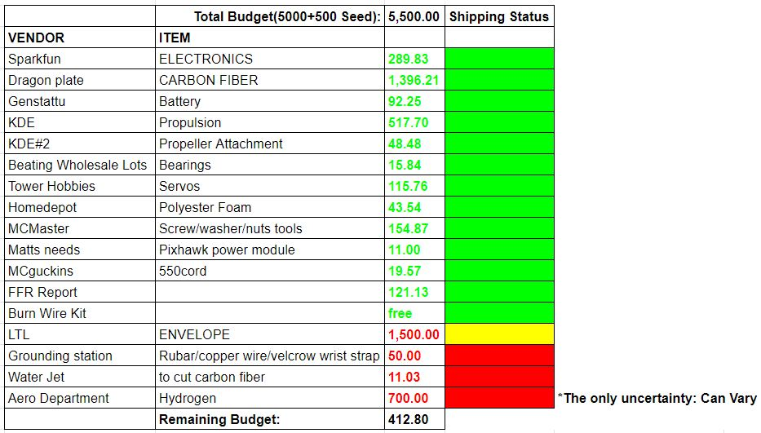

Slide 24
Acknowledgements
Special thanks to:
Katie Rae assisting with all shaker table testing
Matt Rhode leading the fight for hydrogen
Prof. Argrow guidance on safety and logistics

Slide 25
Backup Slides

Slide 26
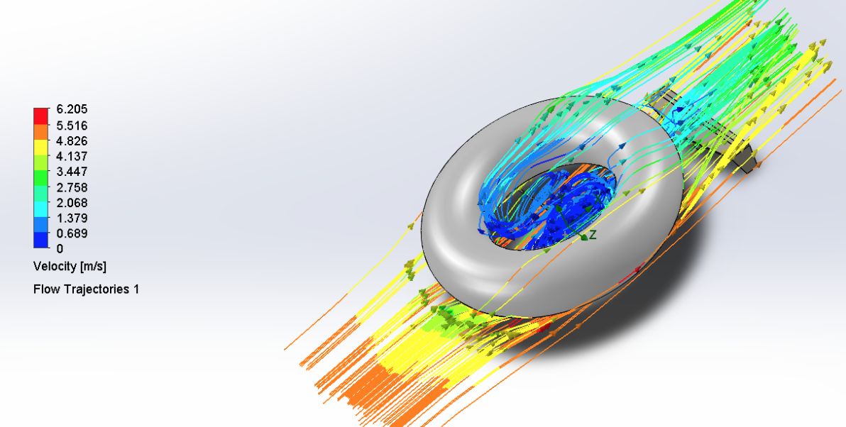
Wind Speed Test
Rationale:
Wind speeds at 400ft AGL are assumed to be approximately 5 mph.
It is necessary to to ensure NESSIE has the stability to withstand the forces in this environment.
Equipment:
SolidWorks (CFD Simulation)
3D CAD model of NESSIE
Facilities:
Pilot or personal laptop with SolidWorks software

Slide 27
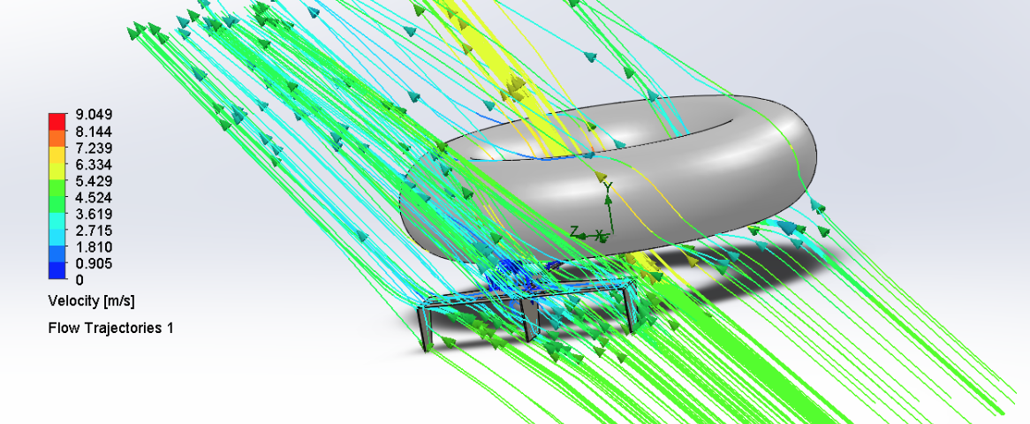
Wind Speed Test Cont.
Test Procedure:
Start up SolidWorks
Initiate CFD Wizard portal
Configure environmental and scenario settings
Set required calculations: Cd, Cl, Fx, Fy, Fz, etc
Run Simulation
Record Results and Images

Slide 28
Wind Speed Test Cont.
Reducing Risk:
This test provides the NESSIE team an idea of torques and other forces likely found in a realistic flight environment.
The force calculations are needed to help substantiate NESSIE’s stability.
Expected Results:
Results provided he NESSIE team with quantified force values to implement into the stability analysis.
Requirements being satisfied:
Supplement to satisfying FR2.
Status of Test:
This test was completed in the Fall semester and discussed in the CDR and FFR.

Slide 29
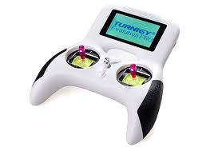
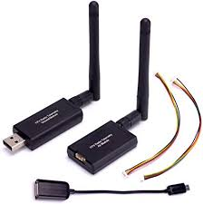
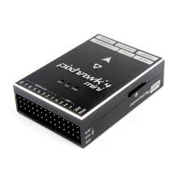
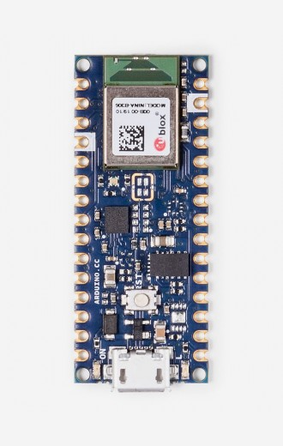
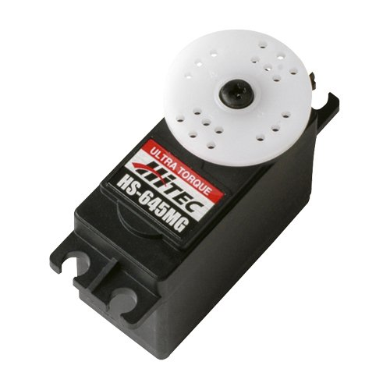
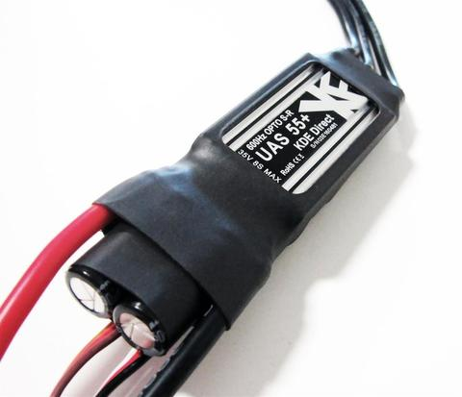
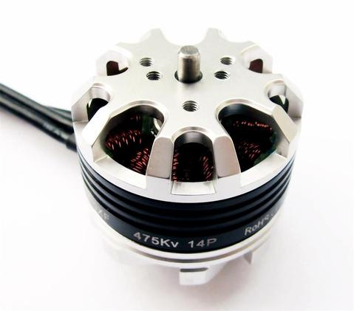
Avionics Test
a.
Rationale: All electronic flight components must be verified to be functional together before flight
Equipment:
Facilities:
CU Boulder Aerospace Building: Electronics Lab
d.
b.
Test Equipment Multimeter Oscilloscope Breadboard Arduino Raspberry Pi | Components Turnigy Evolution Radio Arduino Nano 33 BLE (IMU) Pixhawk Mini 4 Pixhawk Radio Telemetry Kit HiTec Servos KDE 55+ ESCs KDE 475kV Motors
c.
f.
g.
e.

Slide 30
Avionics Test Cont.
Test Procedure:
Connect each individual component to vendor specified power (externally)
Ensure individual functionality (each component test can be found in backup slides here)
Test inter-component connectivity and functionality
IMU to Pixhawk
Radio to Handheld RC
Radio to Pixhawk
Pixhawk to Servos
Pixhawk to ESCs to Motors
Test all components in integrated flight configuration off battery power and ensure all function as expected.

Slide 31
Avionics Test Cont.
Reduce Risk:
Propeller Blades will not be attached during any testing of the ESCs
Propellers will be added to the final craft only during the final flight tests
Expected Results:
All electronics can be controlled by RC controller
All vehicle electronics can be powered by battery
Motors spin, servos deflect
Payload IMU data is transmitted to groundstation
Requirements being satisfied: This test verifies the following requirements:
DR 3.3: The aircraft shall be controllable by manual RC controller
FR 4: System shall provide a data link during flight
DR 4.1: The system shall maintain a link margin of 0 dB or greater throughout the duration of its flight.
DR 4.2: The ground station shall have the ability to transmit to the aircraft.
DR 4.3: The aircraft shall have the ability to transmit to the ground station
Status of Test: Tests are ongoing. Fully integrated test scheduled for 3/20

Slide 32
Power Test
Rationale:
NESSIE must provide sufficient power to the components and payload for sustained flight.
Equipment:
NESSIE’s electrical components
Oscilloscope (measuring Voltage/Current)
Breadboard
Additional wires (with alligator clamps)
Testers (Matt, Kody, Jeffrey, Bobby Hodgkinson…?)
Facilities:
CU Boulder Aerospace Building (Pilot Lab)

Slide 33
Power Test Cont.
Test Procedure (Components):
Connect all electrical components
Connect oscilloscope between the battery and the power distribution board
Simulate partial mission profile of electrical system
Measure voltage and current at current testing location
Repeat steps 2-4 for all electrical connections to verify power is distributed properly throughout system.
(General flow should be from battery connections “outwards” testing voltage and current to each component)
Test Procedure(System Endurance):
Connect all electrical components
Connect oscilloscope between the battery and the power distribution board
Simulate full mission profile of electrical system
Measure voltage and current of battery throughout test to quantify endurance of system.
(Test will monitor battery voltage/current under simulated flight use for endurance)

Slide 34
Power Test Cont.
Reduce Risk:
ESD wristbands will be used to reduce the risk of static shock damaging components.
Although servos and motors will be utilized, they will not be attached to their respective control surfaces or propellers
Expected Results:
Each component will receive power within the expected range
Battery will last more than 40 minutes during simulated mission profile
Requirements being satisfied: This test verifies DR 3.5.1 in which the system should last 40 minutes or more under constant use.This test also verifies DR 1.3: System shall provide 5.57 W to the payload.
Status of Test: Test is on schedule for the second week of March. ( 10 March 2020 )

Slide 35
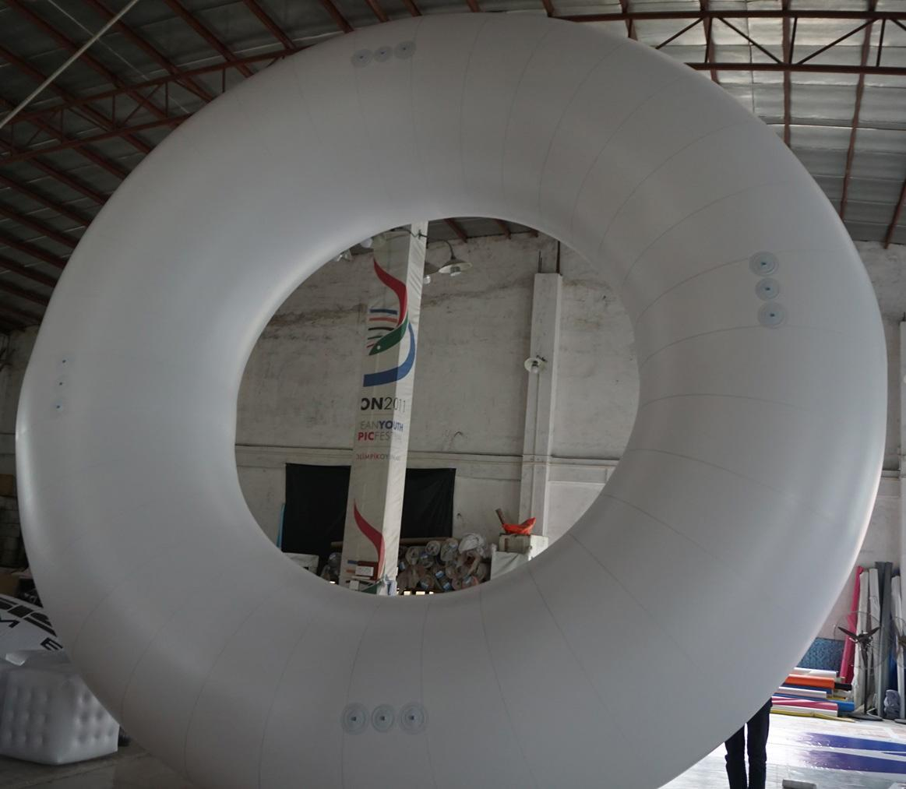
Envelope Test
Rationale:
Quantify any envelope leaking in preparation for final flight test
Compare leakage data against model
Equipment:
Larger Than Life Inflatables envelope
Shipped from CA, expected arrival 3/2
Compressed Air Source
Pressure transducer
LabView
Facilities:
CU Boulder Aerospace Building (Main Lobby/High Bay)
Pending approval

Slide 36
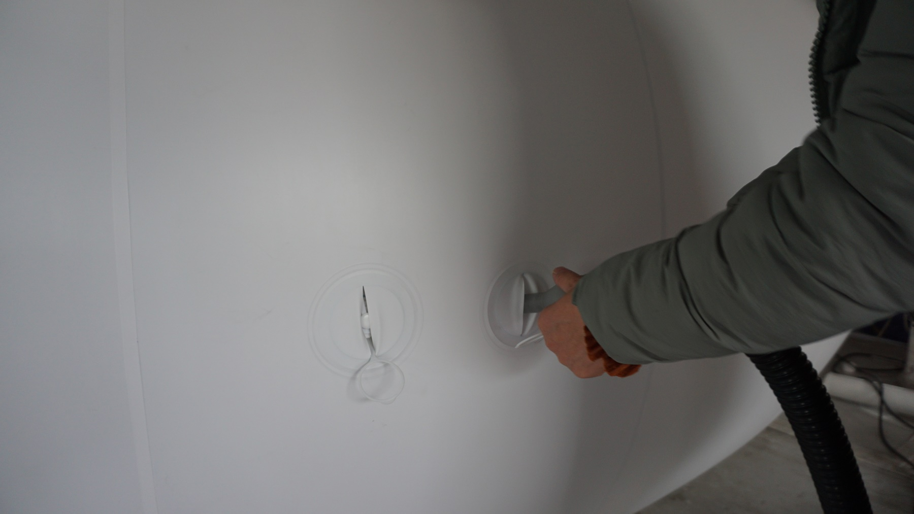
Envelope Test Cont.
Test Procedure:
Compressed air will be used
Fill to no more than 1 PSI
See backup slide for fill procedure here
Use bleed valve to achieve nominal internal pressure of 1/15 PSI
Hold pressure for 1 hour, monitor pressure to verify a lack of leaks
Success is determined when no leaks are found

Slide 37
Envelope Test Cont.
Reduce Risk:
Limit personnel for filling the envelope
Section off total area that will be used for testing
Clear test zone of personnel and other potential hazards
Expected Results:
Positive pressure is maintained throughout test duration
Requirements being satisfied: This test verifies the following requirements:
FR 2: System shall be capable of operating at 400ft AGL
FR 3: System shall be capable of attaining a specified altitude and station keeping at that altitude
DR 3.1: The system shall provide sufficient net lifting force to attain desired altitudes
Status of Test:
Envelope is en route
Estimated delivery on 3/2/2020
Envelope test scheduled for 3/5/2020

Slide 38
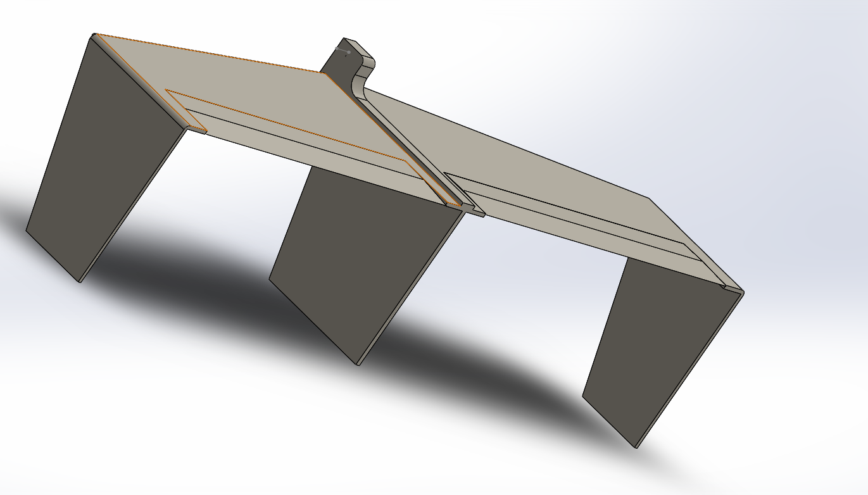
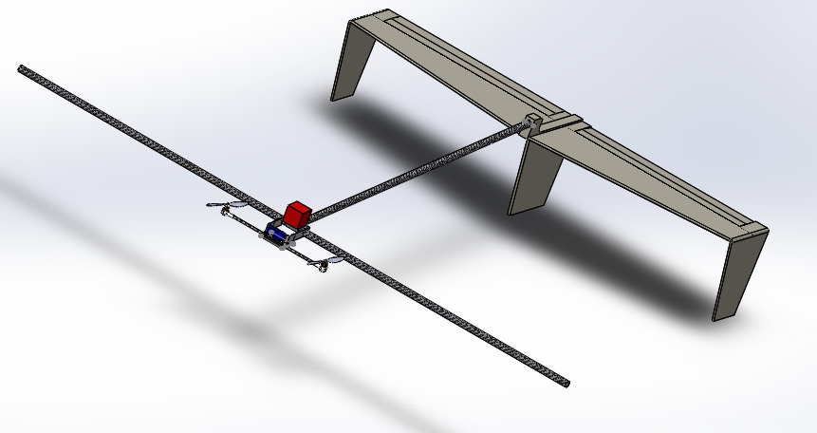
Gondola Control Surface Test
Rationale: Ensure the servo is capable of moving the control surface from +45 degree to -45 degree, and hold this position when a moment is applied on the control surfaces.
Equipment:
Servo, cables, linkage mechanism and tail assembly.
Facilities:
CU Boulder Aerospace Building (Shaker Table)
Elevator test

Slide 39
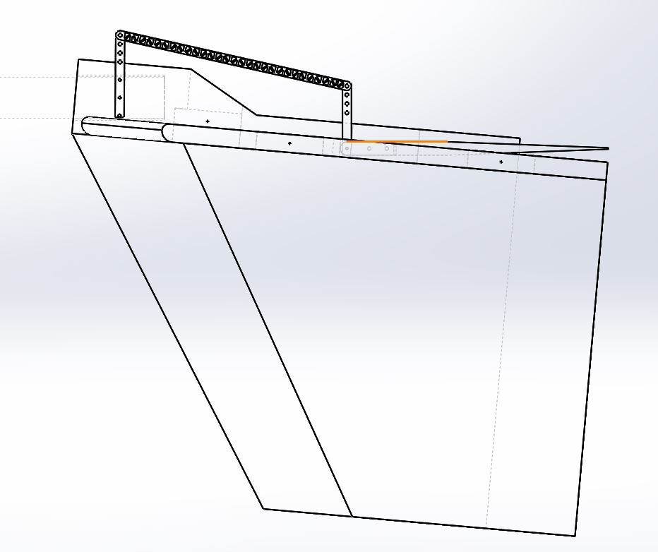
Gondola Control Surface Test Cont.
Test Procedure:
Move the horizontal stabilizer to +45 degrees to -45 degree continuously.
Hold the horizontal stabilizer at +5 degree. Attach a 200 grams weight on the end of the control surface to apply a 0.56N-m moment on the control surface pivot.
Measure the angle of the horizontal control surface.
Cables
Weight
Notes:
The 0.56N-m torque was calculated from a 5mph gust over a plate at 45 degree angle. This create an overestimate of the highest load on the control surface.
Contact Jose if any questions regarding this test. Mobile: 512-993-9751

Slide 40
Gondola Control Surface Test Cont.
Reduce Risk: Ensure the control-ability of the blimp during flight.
Expected Results: The servo corrects the angle with an accuracy of 2 degree to the desired angle when the moment is applied.
Requirements being satisfied: This test verifies FR.4. System shall be capable of attaining a specified altitude and station keeping at that altitude
Status of Test: Test is on schedule for the second week of March.

Slide 41
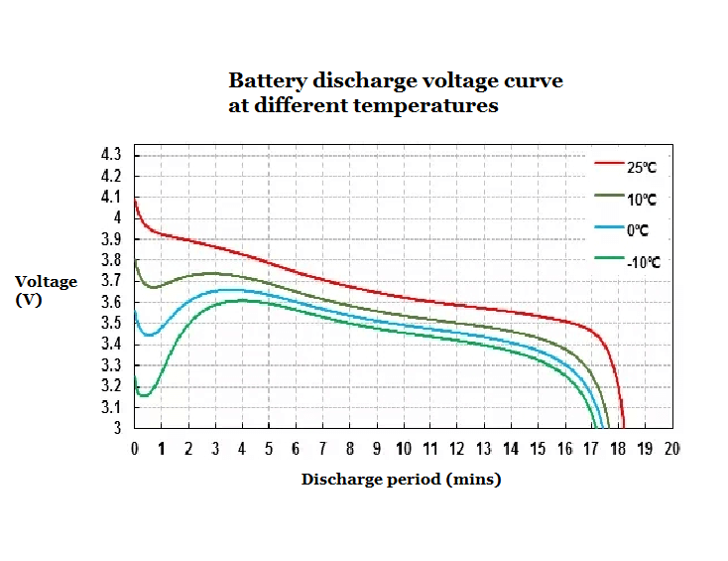
Electronics - Battery Testing
Electronics - Battery Testing
Discharge
Charge Battery to 16.5V (92%)
During charging process every 5 minutes record voltage
Safety
Ensure the leads on the battery terminal are not shorted, this destroys the battery
Do not over charge the battery, always use the assigned charge management board
When the battery voltage warning is sounded by any system remove the current battery and return to at least storage charge level at first chance.
Expected discharge curve from manufacturer
(GensTattu)
Notes:
Add requirements to all tests
BACKUP SLIDE THIS

Slide 42
Electronics - Servos
Electronics - Servos
Safety
Servos will not be attached to any components during testing for
Testing
Using supplemental Arduino Mega, set upper and lower bounds on each servo
The two extreme states will be flipped between repeatedly
Validation:
Flip between two states and compare measured angle vs theoretical angle using a hanging protractor
Notes:
Tests
Control
Telemetry
Progress/ontrack

Slide 43
Electronics - Electronic Flight Controllers (ESCs)
Electronics – Electronic Speed Controllers (ESCs)
Safety
Blades will not be attached during any testing of the ESCs. Propellers will be added to the final craft only during the final flight tests
No more than 6V will be used to directly power the ESCs during testing
Testing
s
Validation:
Verify vendor 3 phase output with oscilloscope
GET A PLOT
Notes:
Tests
Control
Telemetry
Progress/ontrack

Slide 44
Electronics - Solenoid
Electronics - Solenoid
Safety
Servos will not be attached to any components during testing
Testing
Using supplemental Arduino ___, set upper and lower bounds on each servo
The two extreme states will be flipped between repeatedly
Validation:
Flip between two states and compare measured angle vs theoretical angle using a hanging protractor
‹#›
Notes:
still in process of picking solenoid
here is the likely procedure

Slide 45
Electronics - Communications
Control (incremental testing)
Establish radio connection ✓
Establish servo control at all positions
Establish motor control
Establish control surface and tilt rotor axle control
Telemetry
Ensure that data is being collected to arduino SD card.
Ensure that data is being downlinked via radio connection.
Notes:
Tests
Control
Telemetry
Progress/ontrack

Slide 46
Structures
Weight
Verify total mass of structure is under 55lb. max FAA weight limit
Measure mass of each individual component and add all component masses together
Vibrational Test
Camera to measure vibration against model from CDR
Verify Gondola structure and components don’t disassemble during flight
Worst case scenario of shaker test with gondola only
Integrated system will be dampened and be less than worse case scenario
Accelerometer node placed in gondola bay and node placed on motor mount
Notes:
Tests
Weight
Vibrational
Safety
Progress/ontrack

Slide 47
Emergency Landing Systems Testing
Burn Wire Test
Use compressed air stream to increase pressure on sensor via dynamic pressure
Ensure that circuit trips at equivalent pressure to 80 ft AGL Boulder
Solenoid Test
Repeat Fill test to 1/15 PSI,
Trigger Solenoid release valve using remote transmitter

Slide 48
Hydrogen Safety Back up Slide

Slide 49
Nessie Vs Manta Overview
Design Scaling
Dimension 2.466:1
Mass 15:1
Volume 15:1
Flight Time 1.570:1
Testing Scaling
Vibrations 0.637:1
Material strength
Cost (maybe remove)
Lifting Gas \propto gas volume (above)
Materials \propto structure mass (above)

Slide 50
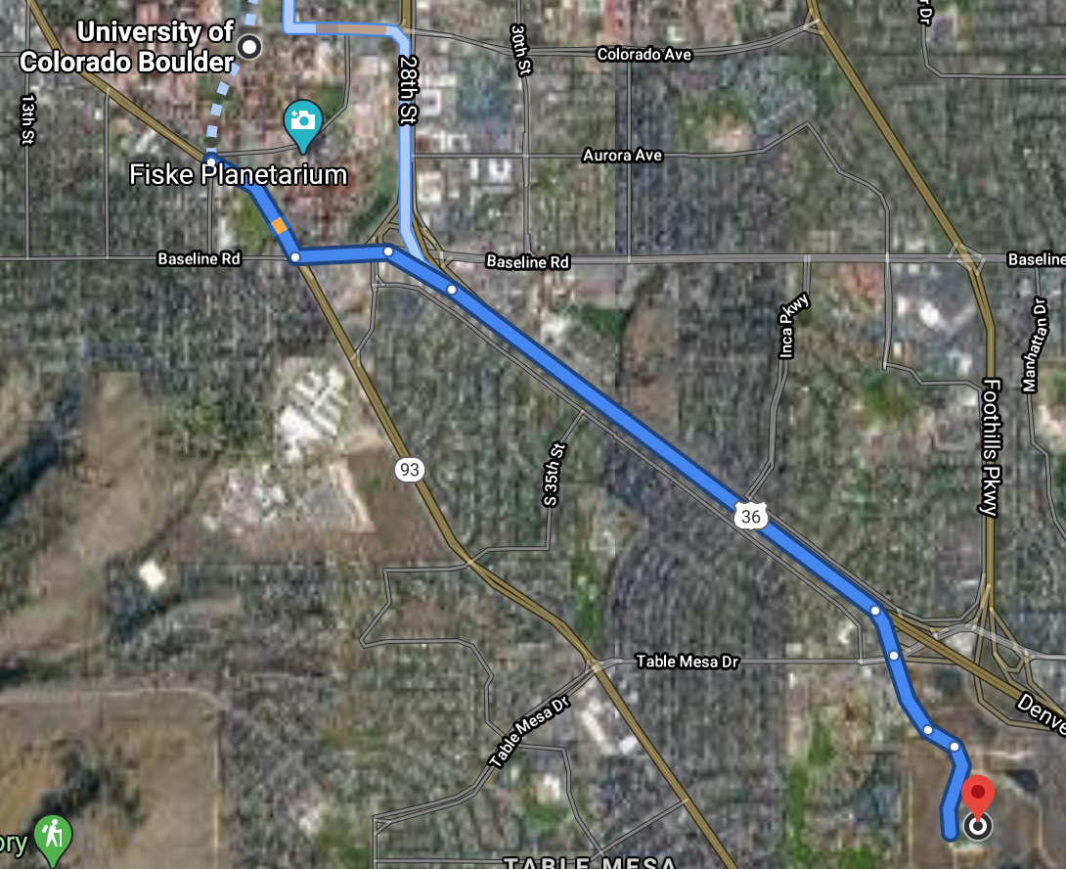
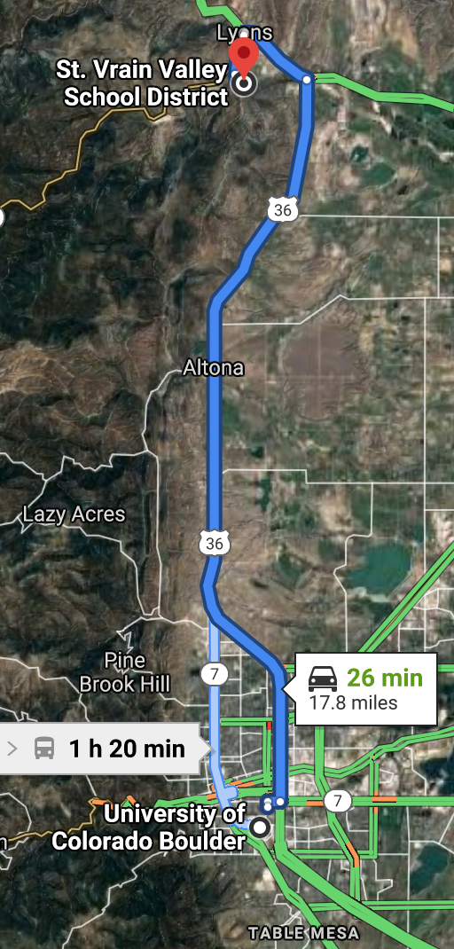
Maps to Test Flight Locations
Table Mountain Flight Space
CU South Boulder

Slide 51
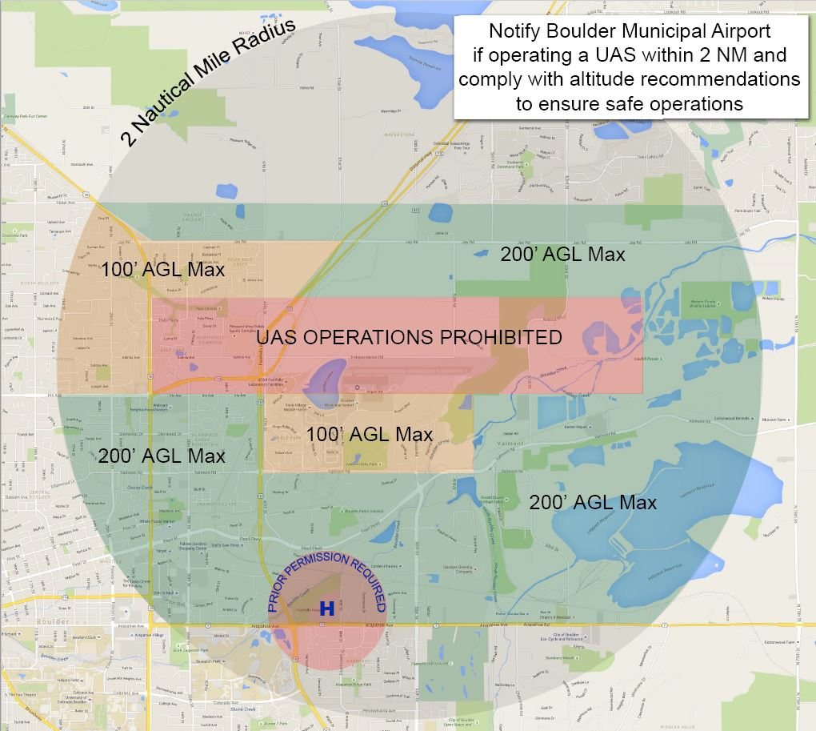
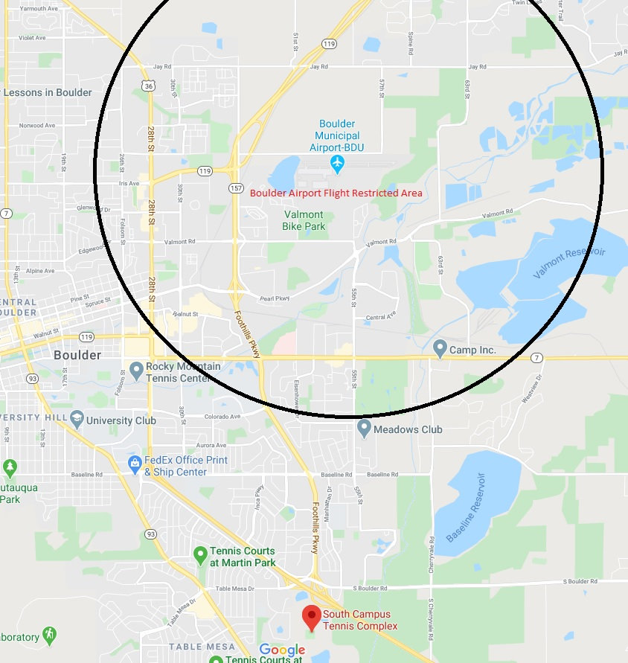
Restricted Airspace Maps
https://www-static.bouldercolorado.gov/docs/UASMap-1-201610181644.pdf

Slide 52
Path Forward
Exceptions Special Authority for Certain Unmanned Aircraft Systems (Section 44807) Exception to fly an unmanned aircraft that weighs 55 lbs or more Separate “full” COA to fly above 400 ft COA application must have exemption and registration numbers | Timeline Must allow at least 120 days for review of Section 44807 petition Expected response to COA application within 60 days of application submission At least 180 days of wait time
Funding MANTA team will be responsible for securing their own funding | Regulations Potential to lobby the FAA for updated/new regulations regarding drone airships Work with Dr. German to determine: Most effective way to lobby the FAA How long it would take for changes to go into effect MANTA will be subjected to FAA and CU regulations if team is affiliated with the university

Slide 53
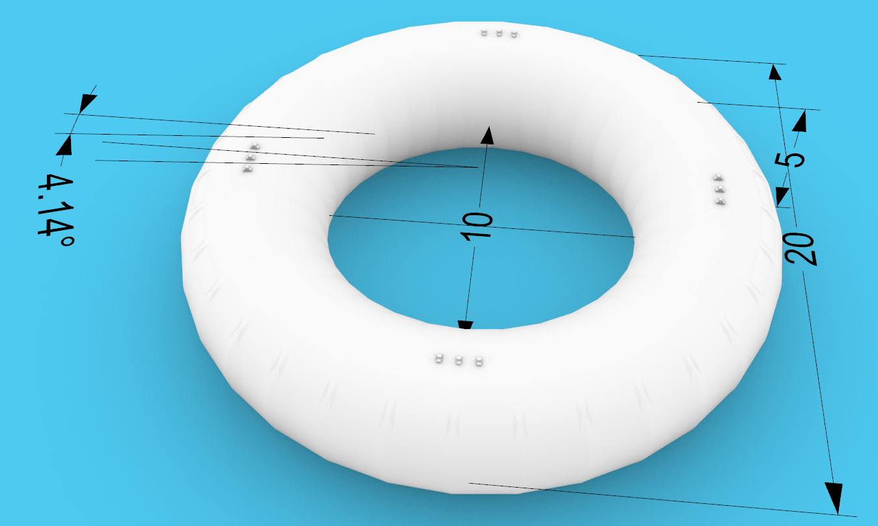
FOV Test
Rationale: In order to meet DR 1.5, the balloon geometry must allow for 100° FOV to the payload.
Equipment:
Vendor and designed dimensions
Facilities:
None
*Dimensioned in ft.
Notes:
Hi paul

Slide 54
FOV Test Cont.
Test Procedure:
Verify using geometry that at least 100° is available at the bottom of the torus. If this is met, the test is successful
✓

Slide 55
FOV Test Cont.
Reduce Risk: As this test is analytical and must be finished to before the balloon design is finalized, the risk is low
Expected Results: The design meets the expected parameter of 100° or greater.
Requirements being satisfied:
FR 1: System shall be capable of supporting a scaled payload that can collect the necessary image data to allow for initial orbit determination.
DR 1.5: Payload space shall provide a housing location where an optical system would have a field of view (FOV) over 100 degrees.
Status of Test: Test is complete and was successful

Slide 56
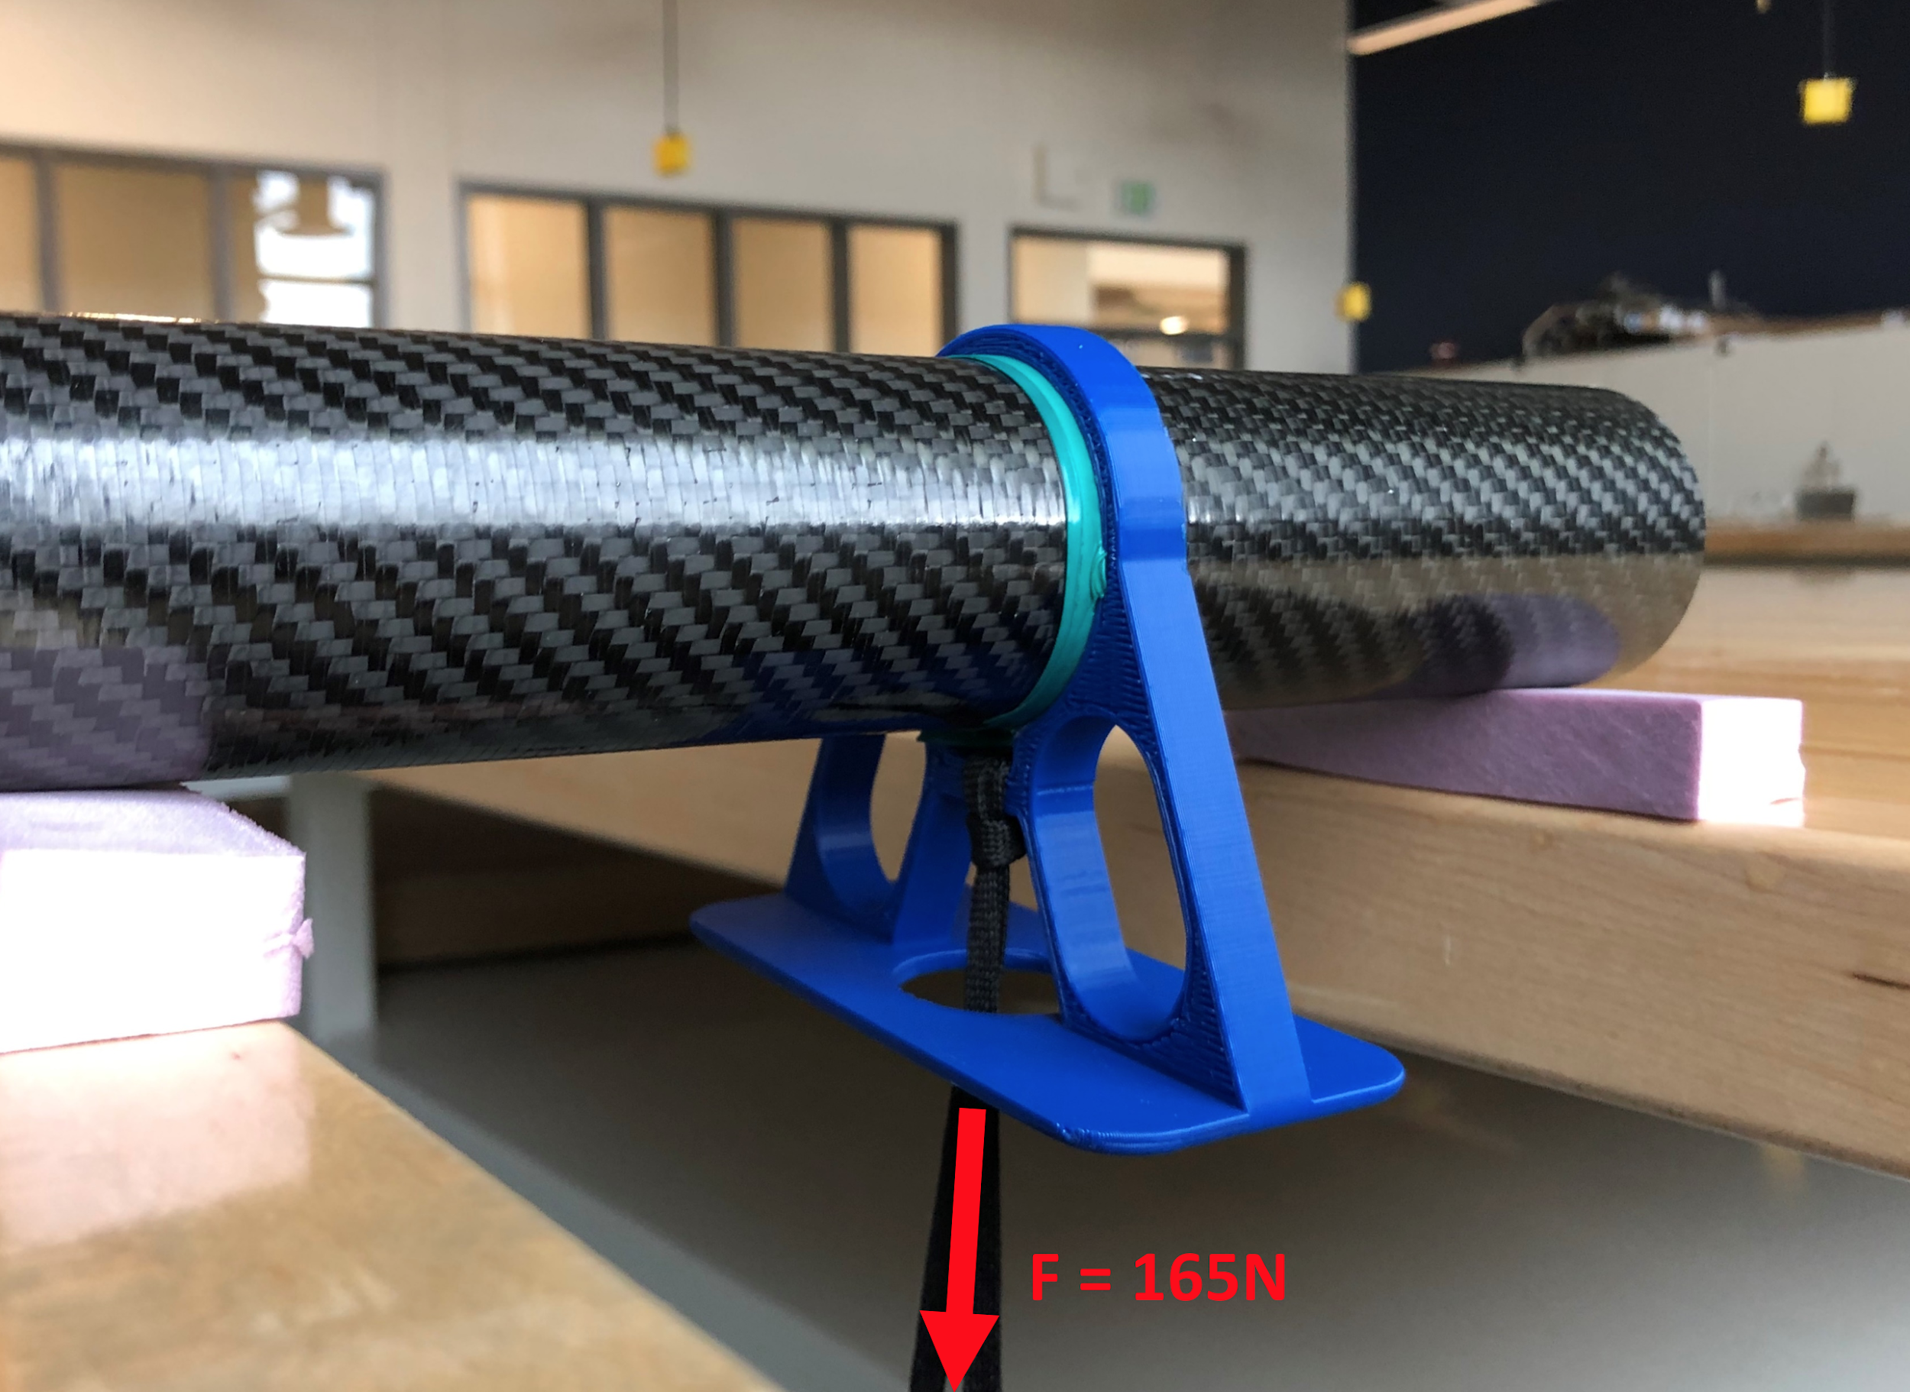
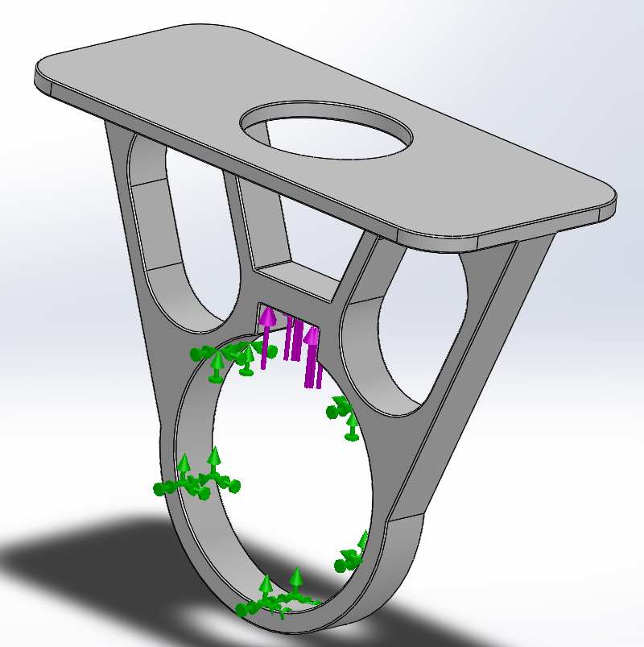
Edge connectors - Stress test 1
Rationale: Verify the factor of safety for the edge connectors for worst case loadings.
Status of Test: Test will be completed following week
Equipment: Spring scale, clamps, zip ties, edge connectors, carbon fiber tube.
Procedure: Using a spring scale and weights to apply force on edge connectors. Part will be fixed to a tube and the tube clamped.
Expected Results from structural analysis: FOS= 10, Maximum Von Mises Stress = 4.9 MPa compared to the yield strength of PLA of 50 MPa.

Slide 57
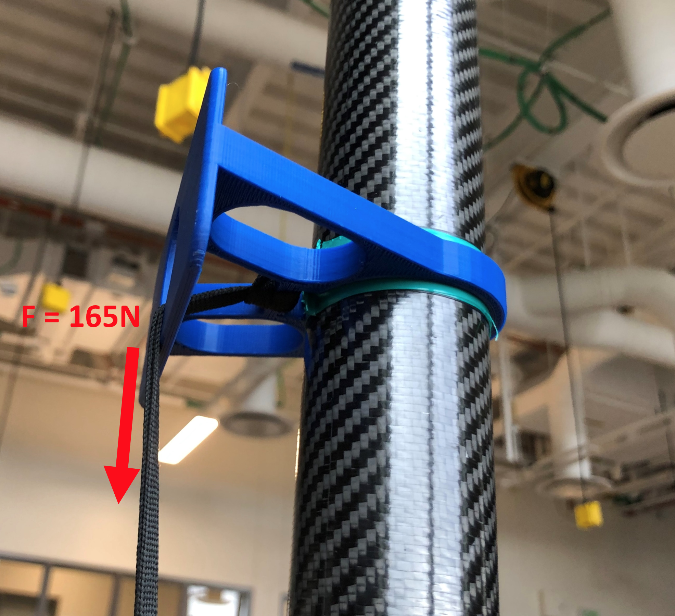
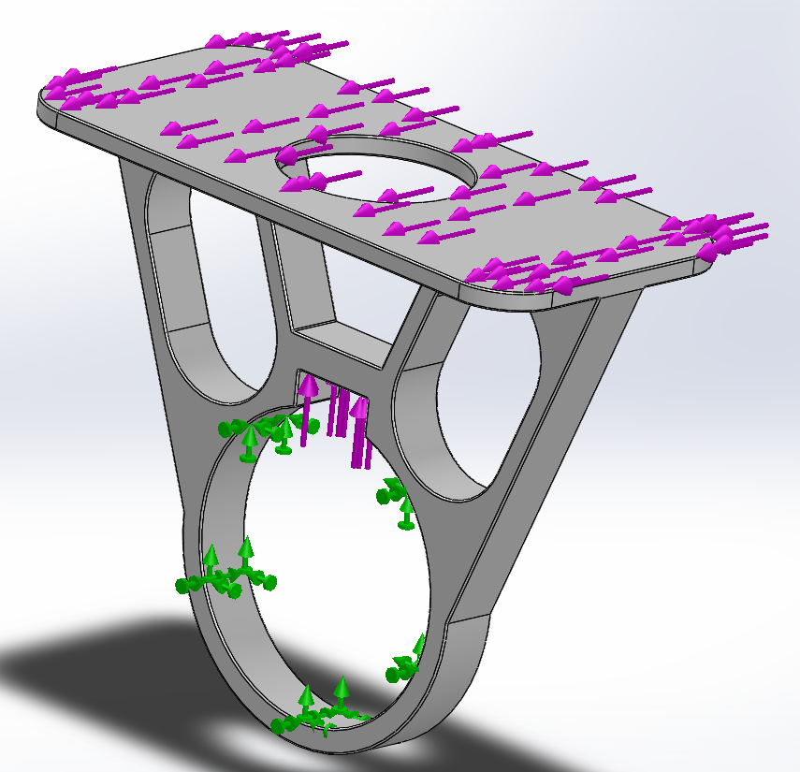
Edge connectors - Stress test 2
Rationale: Verify the factor of safety for the edge connectors for worst case loading.
Status of Test: Test will be completed following week
Equipment: Spring scale, clamps, zip ties, edge connectors, carbon fiber tube.
Procedure: Using a spring scale and weights to apply force on edge connectors. Part will be fixed to a tube and the tube clamped.
Expected Results from structural analysis: FOS= 4.5, Maximum Von Mises Stress = 11 MPa compared to the yield strength of PLA of 50 MPa.

Slide 58
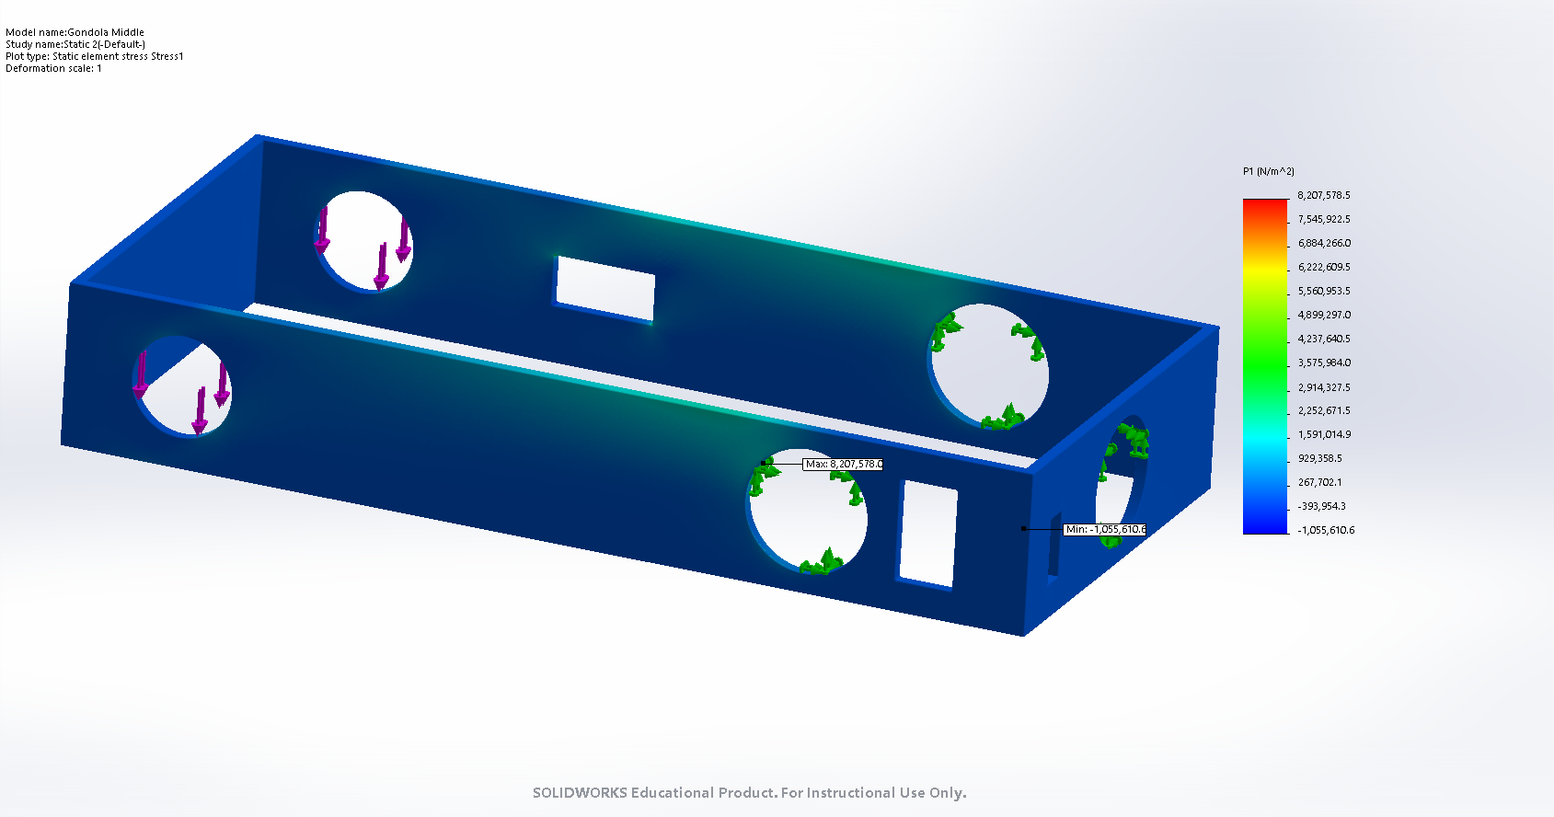
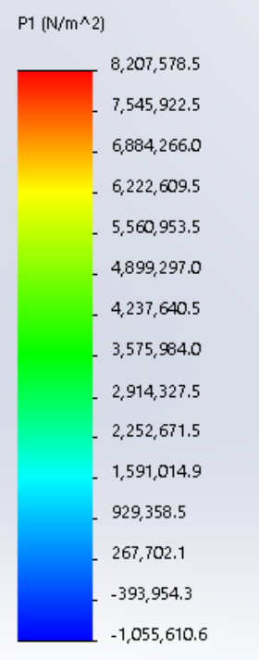
Main Gondola - FEM Analysis 1
Software: SolidWorks static simulation
Loading scenario: Maximum thrust = 66N on bearing connections (purple)
Fixture: Fixed geometry on large diameter tube contacts (green)
Mesh settings: Curvature based mesh, jacobian points at nodes, 2e6 total nodes, 1.3e6 total elements.
Result: In the worst loading orientation carbon fiber has a yield strength of 100 MPa, therefore we have a FOS = 12

Slide 59
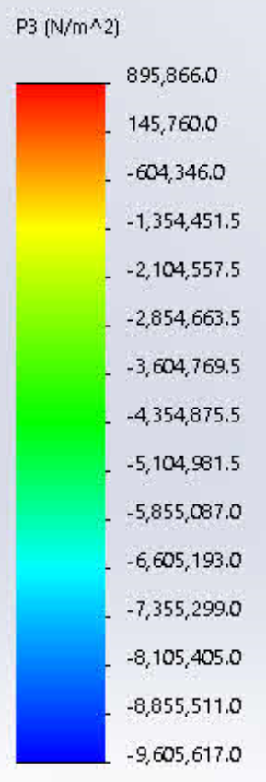
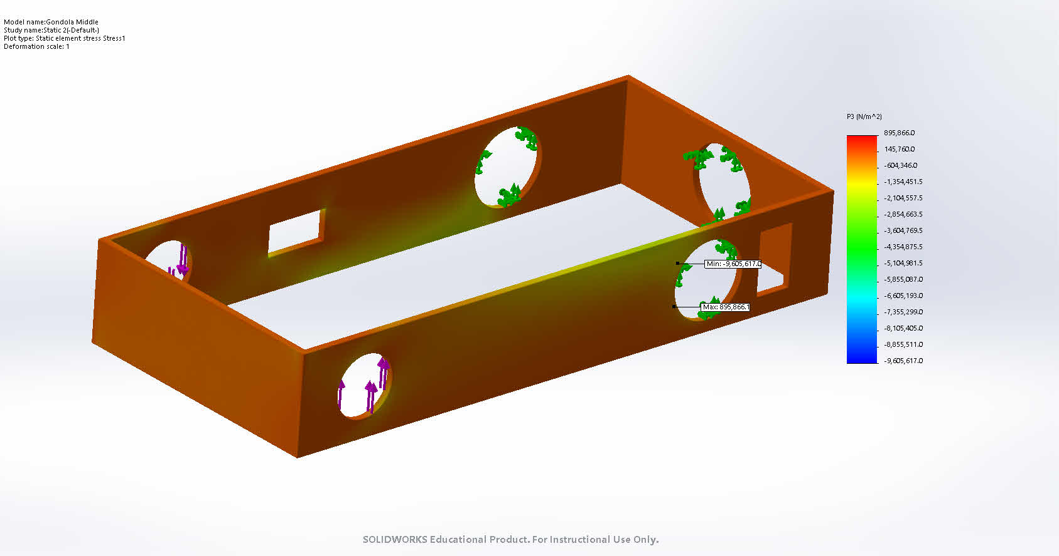
Main Gondola - FEM Analysis - Torsion
Software: SolidWorks static simulation
Loading scenario: Maximum thrust at opposite directions, 33N on each side (purple)
Fixture: Fixed geometry on large diameter tube contacts (green)
Mesh settings: Curvature based mesh, jacobian points at nodes, 2e6 total nodes, 1.3e6 total elements.
Result: In the worst loading orientation carbon fiber has a yield strength of 100 MPa, therefore we have a FOS = 10

Slide 60
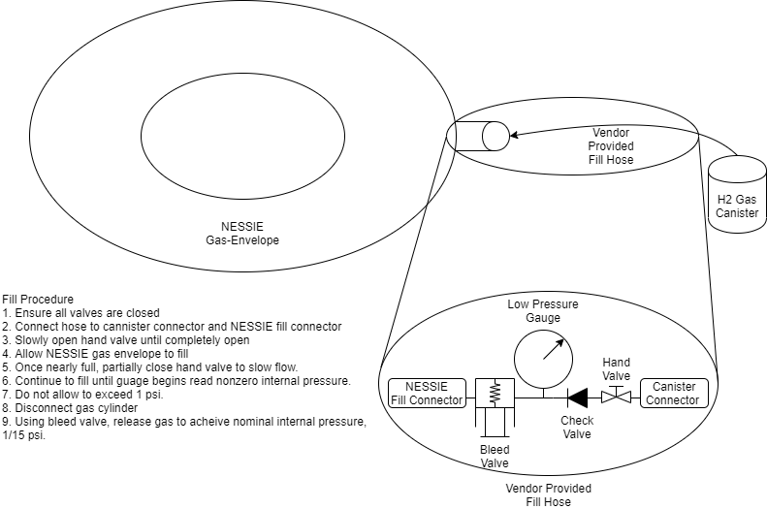
Balloon Fill Procedure
Used for both compressed air and hydrogen gas.
Notes:
Tests
Fill
Solenoid release
Connection Points
Progress/ontrack
Safety
Hydrogen Basic Safety
Handling to avoid damage

Slide 61
Balloon Handling and Safety Procedures
Basic Safety
All personnel must be grounded when handling hydrogen tank
Rebar grounding stakes
Copper wire for grounding personnel to rebar
Limit tank’s exposure to heat and direct sunlight
Remove/mitigate ignition sources
open flames, sparking electronics, static electricity
Filling personnel to wear Personal Protective Equipment (PPE’s)
TBD if provided by BFD or purchased separtely
Handling
Make sure workspace/testing location is cleared of potential hazards
Vendor-provided patch kit for emergencies
Do not place on surfaces with many sharp objects such as sticks

